Slide 1
VIDEO Session 22 of simple

Slide 3
Welcome to simple session 22 structural dissociation theory and the treatment of the traumatic spectrum disorders

Slide 9
Warning about meditation
Feel free to skip it. Followed by a moment of silence

Slide 13
Homework from before the march break
Submit
Submit questions or comments to itssimple2023@gmail.com
Read
Simple manual session 22.
Continue
Continue reviewing and practicing your crisis plans, diary cards, chain analysis, rational mind remediations and goals diary cards.
Continue
Continue tracking all the skills you’ve learned using the skills lists. Practice them.

Slide 14
Homework for April 9
Submit
Submit questions or comments to itssimple2023@gmail.com
Read
Read skills training workbook p. 207-227.
Read
Simple manual session 23 introducing wise mind remediation, the last tool.
Continue
Continue reviewing and practicing your crisis plans, diary cards, chain analysis and rational mind remediations.
Finish
Finish your wellness assessment tool have 1-3 goals in your goals diary card and continue tracking them.
Continue
Continue tracking all the skills you’ve learned using the skills lists. Practice them.

Slide 15
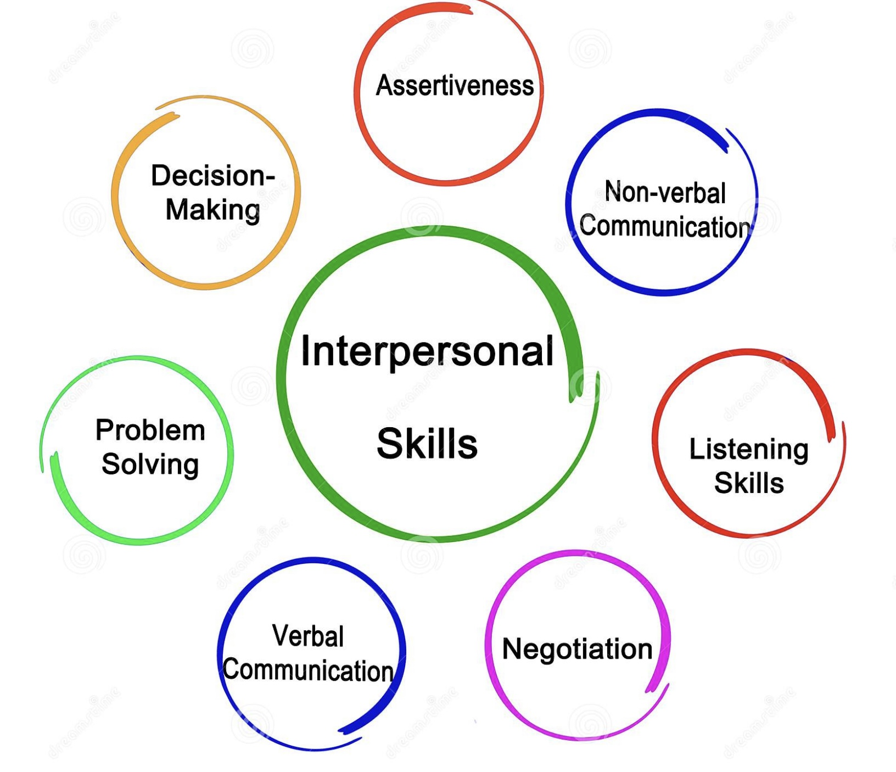
Skills training workbook p. 207-227 basic interpersonal skills part I
This section of the workbook covers seven topics
1. Mindful attention
2. Compassion for others
3. Passive vs. aggressive behavior
4. I want-they want ratio
5. I want-I should ratio
6. Key interpersonal skills
7. Blocks to using interpersonal skills

Slide 16
No simple or boing sessions next week.
We will not have Wednesday sessions on March 19, 26 and April 2nd. We’re back April 9th.
We will not have Monday sessions on March 17,24, or 31st. We’re back April 7th.
Session 23, on April 7th will introduce the last tool wise mind remediation. Session 24, the following week will introduce my favourite psychotherapeutic approach internal family systems
Searching for meaning is on-line and was sent to you. Your feedback would be very appreciated.
WEEKLY ANNOUNCEMENTS

Slide 17
E-mailed questions, comments, feedback

Slide 18
what if life gets so busy you don’t have time to use the tools ?
I have a rational mind and a wise mind response to this very important and common question.
The rational mind has to do with the back-end vs. the front-end time commitment.
Using the skills tools and strategies would be a good goal in that it can help with physiological, safety, psychological and spiritual needs. Every goal you set will require that you use skills and tools. If you are struggling to find goals start with setting time aside to use skills and tools every week. Even 15 minutes twice weekly will make big difference. The important thing is being accountable.
Doing something inefficiently (or if you keep falling into holes) takes so much more time than doing it efficiently.
The wise mind response has to do with our unconscious resists change. How much time do we spend on social media or watching TV each day? It takes wise mind to do the hard thing when the hard thing is the right thing to do.
We live in an attention economy, and our attention is drawn to certain things and not to others. It is drawn to things that providing us immediate gratification and high emotional intensity.
People are also drawn to chaos as its familiar its repetition compulsion, it distracts us from our pain, and it validates our view of the world.
Our parts resist change.

Slide 19
“Talking about your trauma doesn’t make you a victim. Making your trauma your identity does.”
IN OUR EXPLORATION OF TRAUMA, WE HAVE SO FAR DISCUSSED :
Stress and the stress response
Adult, developmental, and attachment trauma
How to assess trauma
The consequences of trauma
The Adverse Childhood Events studies
Trauma as a disorder of implicit memory
How understanding the states of autonomic activation is key to understanding the trauma related disorders
Psychiatry's blind spot for trauma
Trauma informed care

Slide 20
What we will do today
We will review the material covered in session 22 of the simple manual; dissociation and the structural dissociation theory.
After the brake will discuss the treatment of the traumatic spectrum disorders

Slide 21
today
What is dissociation?
Structural dissociation theory
How dissociation arises from trauma
Primary structural dissociation
Types of flashbacks
Features of PTSD
Secondary structural dissociation
Tertiary structural dissociation
Controversies in the diagnosis of dissociative identity disorder
Treatment of the trauma spectrum disorders
How simple addresses the three stages of trauma therapy
Special considerations in the treatment of trauma

Slide 22
today
What is dissociation?
Structural dissociation theory
How dissociation arises from trauma
Primary structural dissociation
Types of flashbacks
Features of PTSD
Secondary structural dissociation
Tertiary structural dissociation
Controversies in the diagnosis of dissociative identity disorder
Treatment of the trauma spectrum disorders
How simple addresses the three stages of trauma therapy
Special considerations in the treatment of trauma

Slide 23
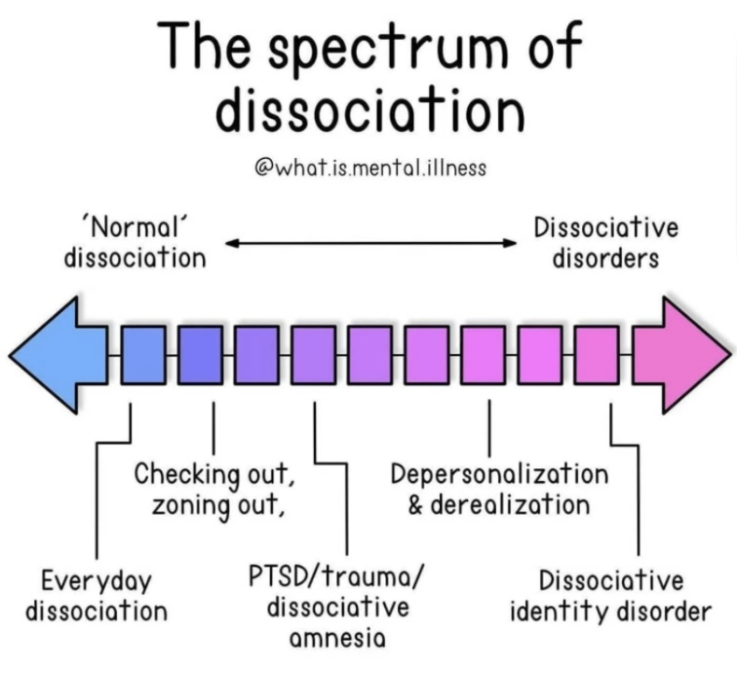
WHAT IS DISSOCIATION?
Definition: in its common usage the term “dissociation” refers to a disconnection between things usually associated with each other.
In psychology, dissociation refers to a wide array of psychological experiences, ranging from a mild emotional detachment from our immediate surroundings, such as happens when we’re driving long distances, to a more severe disconnection from our physical and emotional experiences.
Spectrum: Individual instances of dissociation are best understood as lying on a spectrum. In mild cases, dissociation can, in the presence of stress, be a healthy coping mechanism or defense. Daydreaming is a benign example of mild dissociation. Towards the pathological end of the dissociative spectrum are the DSM dissociative disorders.
Metaphor: Trees adapt to the stress of wind by bending. Every tree has a breaking point (traumatic stress) at which rather than bending branches will break.
After a windstorm, a few or many, small or large tree branches may break.(spectrum of dissociative disorders)
The degree of damage a tree sustains depends on the severity of the wind, the resilience of the tree and other resources or protective factors such as other trees sheltering each other from the wind.

Slide 24
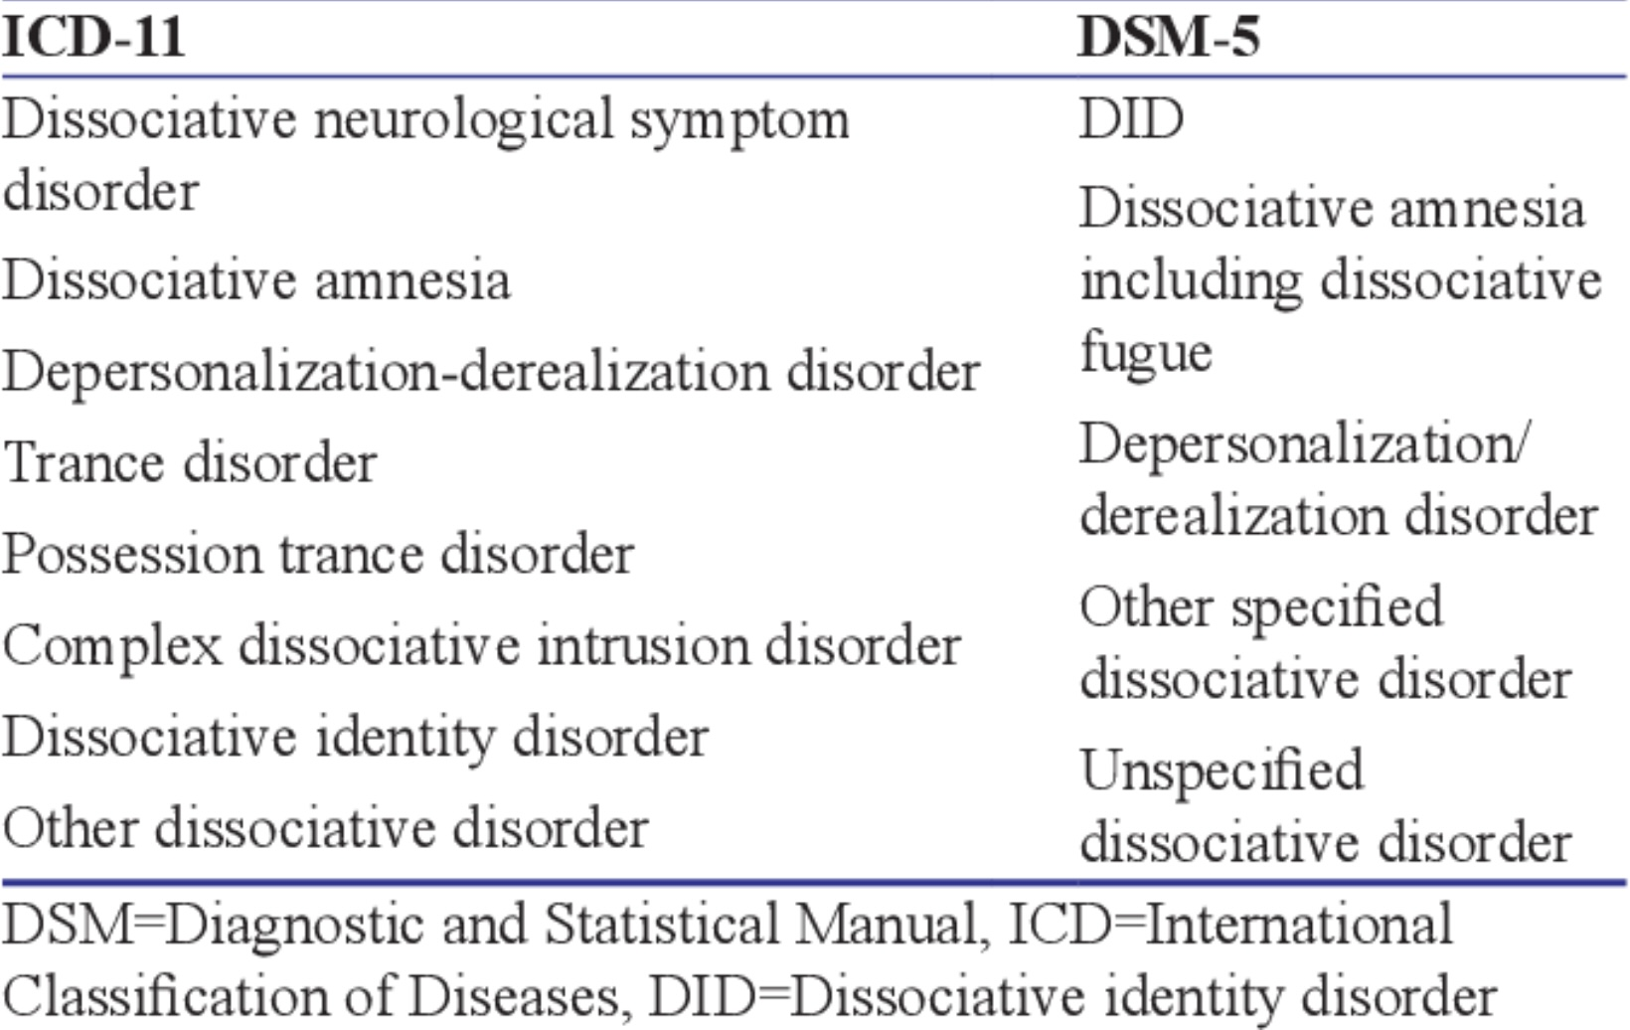
DISSOCIATION diagnosis
The major characteristic of all dissociative phenomena is a detachment from reality, rather than a loss of reality as is the case in psychosis
The DSM 5 lists five dissociative disorders: 1. dissociative identity disorder, 2. dissociative amnesia including dissociative fugue 3. depersonalization derealization disorder. 4. other specified dissociative disorder and 5. unspecified dissociative disorder. The DSM doesn’t make an explicit link between dissociation and the trauma spectrum disorders.
ICD-10, the International classification of disease 11th edition, also lists, in addition to the five DSM’s dissociative disorders described above: 6. dissociative neurological symptom disorder which includes psychogenic paralysis, unexplained pain and other sensations, and pseudo seizures. 7. trance disorder 8. possession trance disorder and 9. complex dissociative intrusion disorder
As we will see when we consider dissociative identity disorder, dissociative experiences are sometimes not integrated into the usual sense of self resulting, for people experiencing them, in discontinuities of conscious awareness and memory.

Slide 25
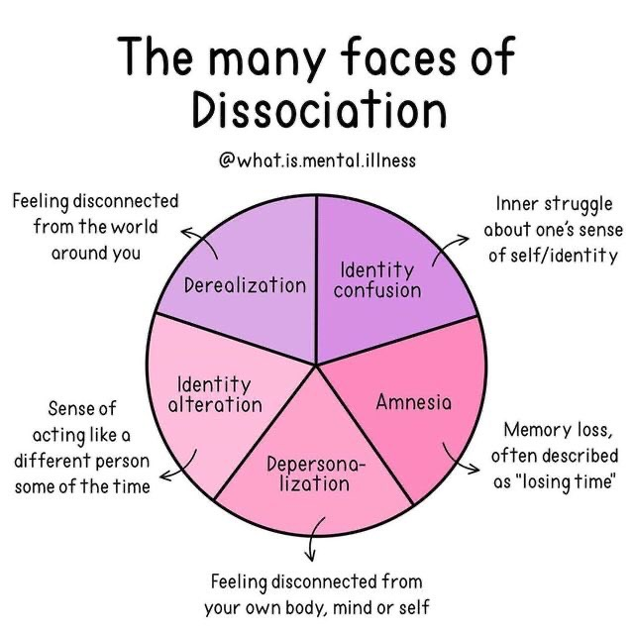
THE 5 CORE FEATURES OF DISSOCIATION
Derealization is an alteration in the perception of the external world, causing those with the condition to perceive it as unreal, distant, distorted or falsified. Other symptoms include feeling as if one's environment is lacking in spontaneity, emotional coloring, and depth.
Depersonalization can consist of a detachment within the self, regarding one's mind or body or being a detached observer of oneself. It can be described as feeling like one is on "autopilot" and that the person's sense of individuality or selfhood has been hindered or suppressed
Identity confusion is a pronounced difficulty achieving a cohesive sense of self. Someone with identity confusion may constantly wrestle with separate often adversarial identities that are engaged in a battle for control of the person's mind and body.
Dissociative amnesia is characterized by retrospectively reported memory gaps. These gaps involve an inability to recall personal information, usually of a traumatic or stressful nature.
Identity alteration involves pronounced changes in behavior, memory and thinking over periods of time.
Notes:
Psychological dissociation refers to the disintegration of functions of the nervous system that are normally integrated. In psychologically healthy people the emotional, rational, and self observing brains communicate and cooperate optimally. Each of these brains however can separate itself from the others. The classical type of dissociation seen in hypo freeze is when the self observing, rational, and higher levels of the emotional brain shut down, and the reptilian brain which preserves basic life functions takes over.
There are other forms of dissociation however, for instance being hyper rational may be a form of dissociation in which the emotional brain shuts down as does the self observing brain. This type of dissociation is commonly used by avoidantly attached people.
Dissociation presents in many different ways. This includes identity confusion which is an inner struggle about one sense of self/identity. Amnesia which presents as memory loss that is often described as "losing time"…

Slide 26
today
What is dissociation?
Structural dissociation theory
How dissociation arises from trauma
Primary structural dissociation
Types of flashbacks
Features of PTSD
Secondary structural dissociation
Tertiary structural dissociation
Controversies in the diagnosis of dissociative identity disorder
Treatment of the trauma spectrum disorders
How simple addresses the three stages of trauma therapy
Special considerations in the treatment of trauma

Slide 27
What is structural dissociation theory ?

Slide 28
THE ORIGIN OF structural dissociation theory
Pierre Marie Felix Janet was a pioneering French psychologist, physician, philosopher and psychotherapist who coined the term dissociation and tried to explain its importance in mental health by postulating his “structural dissociation theory”.
Pierre Janet was 3 years younger than Freud.
He studied under Jean-Martin Charcot at the Parisian Hospital La Salpetriere where in 1885 Freud also spent 3 months learning about “hysteria”.
Janet was one of the first psychologists to draw a clear connection between a person’s past trauma and symptoms presenting later in life. Unlike Freud he never renounced this idea.
Freud acknowledged his debt to Janet. Janet doesn’t have as high a profile in modern psychology as Freud possibly because unlike the later he was humble and avoided the spotlight .
In the late 1980’s Ellert, Nijenhuis, Onno van der Hart, and Kathy Steele built on Janet’s work and expanded structural dissociation theory into its present-day form
Pierre Janet 1859-1947
Notes:
Structural dissociation theory is a psychodynamic theory that's over 100 years old. It is one of the theories about dissociation that makes the most sense.French physician and philosopher Pierre Janet proposed this theory.

Slide 29
WHAT IS Structural dissociation theory?
Structural dissociation theory describes three types of psychopathological dissociation:
According to structural dissociation theory, 1. posttraumatic stress disorder, 2. complex posttraumatic stress disorder, and 3. dissociative identity disorder, (formally known as multiple personality disorder), are all related dissociative disorders.
Structural dissociation theory proposes that people with these trauma related disorders experience a dissociation of their personality into separate parts, each having its own psychobiological characteristics.
The theory describes three types of dissociation. There is no clear demarcation between these three types as they are thought to be on a continuum or spectrum of severity. They are:
1. Primary structural dissociation = PTSD
2. Secondary structural dissociation = Complex PTSD
3. Tertiary structural dissociation = dissociative identity disorder
A person with a trauma related disorder can experience a combination of symptoms from any of these three. Ex. Someone with predominantly PTSD can present with some DID symptoms.
The type of dissociation a person develops depends on the balance between the duration and severity of the trauma and the person’s coping resources.

Slide 30
What we will do today
What is dissociation?
Structural dissociation theory
How dissociation arises from trauma
Primary structural dissociation
Types of flashbacks
Features of PTSD
Secondary structural dissociation
Tertiary structural dissociation
Controversies in the diagnosis of dissociative identity disorder
Treatment of the trauma spectrum disorders
How simple addresses the three stages of trauma therapy
Special considerations in the treatment of trauma

Slide 31
Can we review how dissociation arises from trauma?

Slide 32
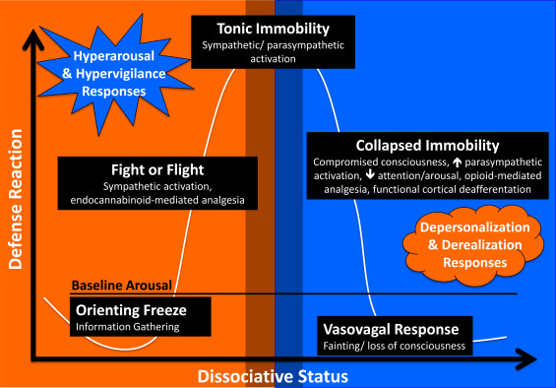
THE ORIGINS OF DISSOCIATION
1)When faced with a life-threatening danger, an organism first goes into a fight or flight state of activation.
2) When the organism perceives that life-threatening danger as physically inescapable, it leaves or psychologically dissociates from the situation by going into a freeze state of activation. (Tonic to collapsed immobility is when the branch of the metaphorical tree breaks.)
REALM OF DISSOCIATIVE EXPERIENCES
Notes:
Recall the arousal curve in which we have the window of tolerable emotions. Outside that window is hyper activation of which hyper freeze or the orienting response and fight or flight are both features. Also outside the window of tolerance is hypo activation which is depression or depersonalization. Hypo activation is when the handbrake's of the dorsal parasympathetic nervous system go on and the organism goes into feigned death in which the heart slows down as those respiration and virtually every other bodily function. It is here in this dorsal parasympathetic activation that the organism goes into reptilian brain mode. That's classical dissociation.

Slide 33
Activation curves
Traumatic stress not resulting in PTSD
Inescapable traumatic stress resulting in PTSD
X
No escape (Tonic immobility)
hyperfreeze
(Collapsed immobility)
activated
calm
← Dissociated unprocessed
emotional memory
hypofreeze
3) The unprocessed dissociated memory of the traumatic situation is then encoded in its original form with accompanying activation states, physical sensations, emotions, and visual images in the somatic, emotional, and rational memory systems. To use a computer metaphor, a traumatic dissociated experience is like a document or file that is saved into the computer memory and no longer present as an open window. Triggers however reopen the document or file.
Notes:
When a person faces a traumatic stress the first responses to fight back or flee. That's fight or flight. When the traumatic stress appears to be physically inescapable by fighting back or fleeing, then all that's left is escaping mentally into the reptilian brain. That escape leaves behind and unprocessed emotional memory of the trauma which is stored in a "file" in the emotional brain.

Slide 34
What we will do today
What is dissociation?
Structural dissociation theory
How dissociation arises from trauma
Primary structural dissociation
Types of flashbacks
Features of PTSD
Secondary structural dissociation
Tertiary structural dissociation
Controversies in the diagnosis of dissociative identity disorder
Treatment of the trauma spectrum disorders
How simple addresses the three stages of trauma therapy
Special considerations in the treatment of trauma

Slide 35
What is primary structural dissociation?

Slide 36
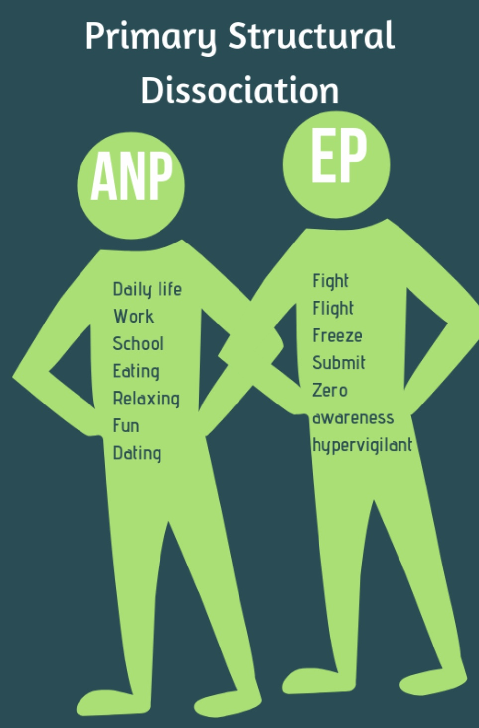
Structural dissociation theory considers that humans have a rational and an emotional mind/brain which function in an integrated fashion.(recall DMM’s three information centers and the triune brain)
It then postulates that in PTSD or primary structural dissociation the mind dis-integrates or splits into two parts:
1. An apparently normal part or ANP (façade) that tries to carry on with the usual business of life… and
2. A dissociated emotional part or EP, whose primary concern is defence and survival. This part carries the unprocessed dissociated traumatic memories that occasionally resurface and manifest as flashbacks, dysregulated emotions, and the physiological arousal states of fight, flight, freeze, and fawn.
At times, the person with PTSD functions mostly in their apparently normal part ANP, while at other times the traumatized dissociated emotional part EP is triggered and takes over.
1. 2.
A.K.A. PTSD
Notes:
Let's start with primary structural dissociation which is another term for posttraumatic stress disorder.
Structural dissociation theory recognizes that there is an emotional and a rational brain. It theorizes that trauma splits or dissociates personality into two components: the emotional part and the apparently normal part…

Slide 37
What do the apparently normal part or ANP and the emotional part or EP do?

Slide 38
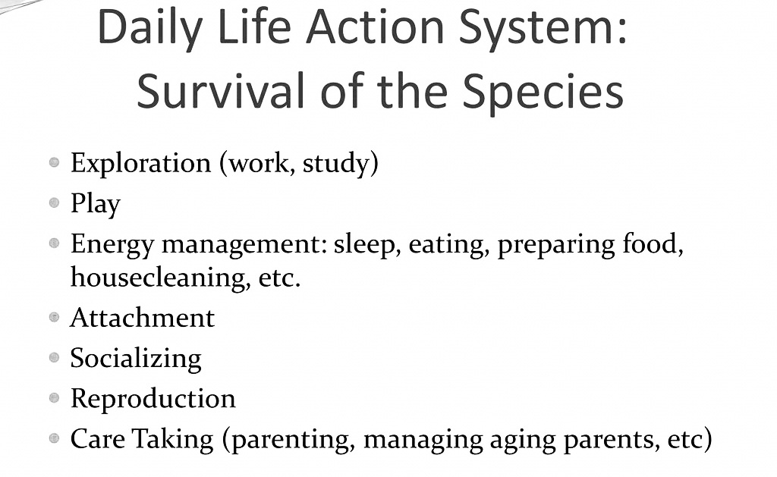
Functions of the ANP and ep in ptsd
APPARENTLY NORMAL PART
EMOTIONAL PART
Structural dissociation theory’s emotional part is the “computer file or document" that's created by the trauma and stored in the somatic and emotional memory systems. It occasionally, and sometimes unpredictably, resurfaces into the computer “window” of everyday life as a flashback
Notes:
According to structural dissociation theory the apparently normal part belongs to the daily life action system, the emotional part belongs to the defensive action system. These systems have different functions…

Slide 39
What we will do today
What is dissociation?
Structural dissociation theory
How dissociation arises from trauma
Primary structural dissociation
Types of flashbacks
Features of PTSD
Secondary structural dissociation
Tertiary structural dissociation
Controversies in the diagnosis of dissociative identity disorder
Treatment of the trauma spectrum disorders
How simple addresses the three stages of trauma therapy
Special considerations in the treatment of trauma

Slide 40
Is a PTSD flashback the surfacing of an emotional part ?

Slide 41
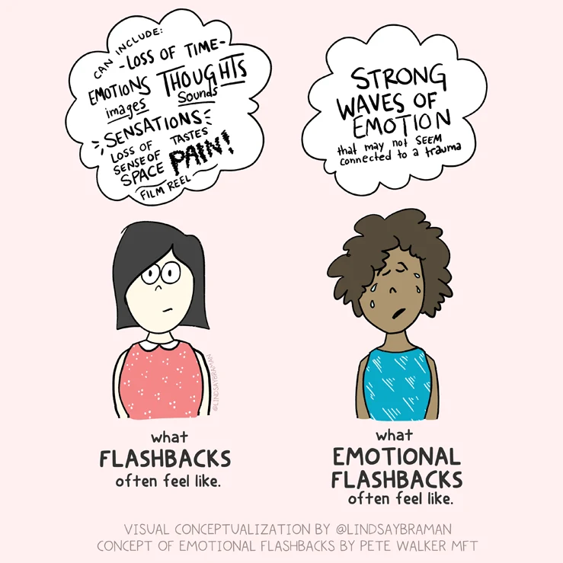
The common understanding of a flashback is that it is the reexperiencing of the trauma as a visual image with an auditory component. These images and sounds are however only the conscious or rational mind memory of the trauma.
Flashbacks are a common experience in people with trauma related disorders and can be thought of as the surfacing of the EP
There are however at least three distinct types of flashbacks each associated with one of the three information processing centers:
1) cognitive flashbacks in which the traumatic memory is reexperienced as a visual or auditory experience
2) emotional flashbacks in which the intense emotions felt during the trauma are reexperienced and
3) somatic flashbacks in which the pain and bodily sensations felt during the trauma are reexperienced
While people with trauma related disorders readily associate their visual and auditory flashbacks with their trauma, they may not as readily associate somatic or emotional flashbacks with the trauma.
People are often at a loss as to how to explain somatic and emotional flashbacks when they occur independent of cognitive memories of the trauma. They may attribute the somatic sensations and emotional reactions to something happening in the present rather than to their trauma.
YES!
TYPES OF FLASHBACKS
Notes:
Yes, and that file poping into the screen is called a "flashback"…

Slide 42
What we will do today
What is dissociation?
Structural dissociation theory
How dissociation arises from trauma
Primary structural dissociation
Types of flashbacks
Features of PTSD
Secondary structural dissociation
Tertiary structural dissociation
Controversies in the diagnosis of dissociative identity disorder
Treatment of the trauma spectrum disorders
How simple addresses the three stages of trauma therapy
Special considerations in the treatment of trauma

Slide 43
I know we already covered this on our session on trauma, but can we quickly review what people with primary structural dissociation or PTSD experience?

Slide 44
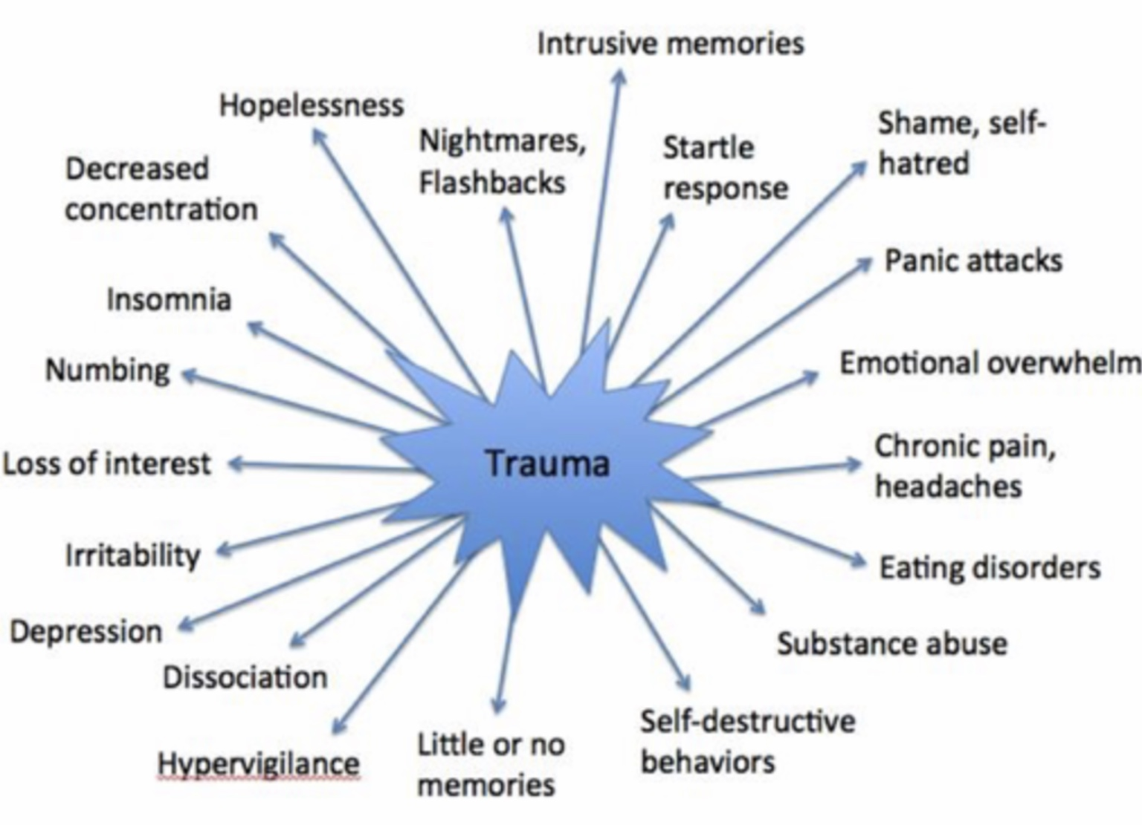
REVIEW OF SYMPTOMS IN PTSD
Notes:
This unprocessed dissociated traumatic memory pops up in the screen of the mind when triggered by something that resembles the original trauma event. The presence of these dissociated traumatic memories gives rise to the trauma spectrum symptoms which include…

Slide 45
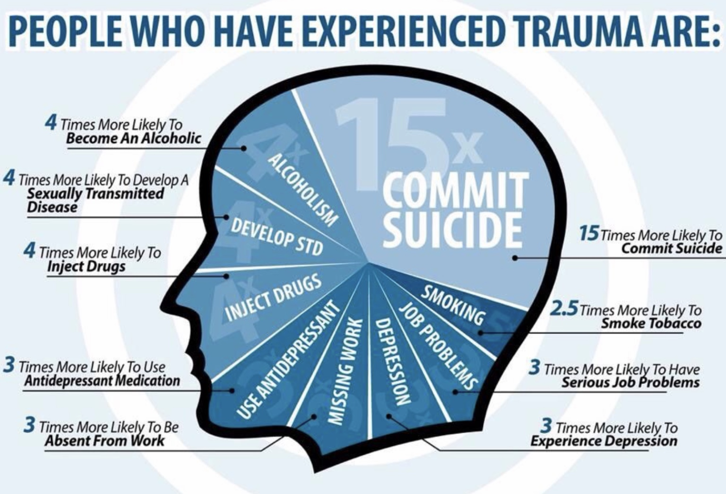
SOME FEATURES OF PTSD
A REVIEW
People who have experienced trauma are at a much greater risk for other issues such as substance abuse, suicide, depression, sexually transmitted diseases, and unemployment.
In some ways PTSD presents differently in men and women.
10% of all women develop diagnosable PTSD compared to only 4% of all men.
Women are at a much greater risk of sexual assault or abuse, child abuse, and domestic violence.
Risk factors for developing PTSD include genetic predispositions, lack of social support, neurological impairments, previous trauma, pre-existing mental health conditions, and significant life stressors.
The posttraumatic stress disorders are often misdiagnosed as mood, anxiety and personality disorders.
There is a significant overlap between symptoms of the posttraumatic stress disorders and of ADHD. Both can present with easy distractibility, difficulty listening, disorganization, hyperactivity, restlessness and difficulty sleeping.

Slide 46
ptsd: avoidance, depression, and vulnerability
For people suffering from trauma related disorders, reminders of the trauma can trigger the EP to surface, consequently they try to avoid triggers.
Eventually the person avoids more and more things and becomes more agoraphobic to the point that many people with trauma related disorders become housebound
As their life becomes more restricted, they become more disconnected from others, a meaningful occupation, engagement with the world, nature, and a meaningful cosmic story. This is in part why people with PTSD are also often depressed.
The avoidance of potential triggers and memories perpetuates PTSD since the processing of the traumatic memories requires some degree of controlled exposure to triggers . By not facing their fears people with PTSD remain victims of the trauma rather than becoming survivors.
The more avoidance there is, the less the ANP is able to maintain a semblance of apparent normality
How trauma impacts people depends on their resources : at one end of the resource's spectrum are people with secure attachment, who had normal psychosocial development prior to a single event trauma. They have more resources and are less likely to develop PTSD. If they do, their prognosis is better.
At the other of the resource's spectrum are people with insecure forms of attachment, and developmental trauma who likely have psychosocial developmental issues. They often have fewer resources and are more likely to be retraumatized and to experience the more severe types of the post traumatic disorders.

Slide 47
Can you also review how the type of parenting a person receives plays a role in their predisposition to developing PTSD?

Slide 48
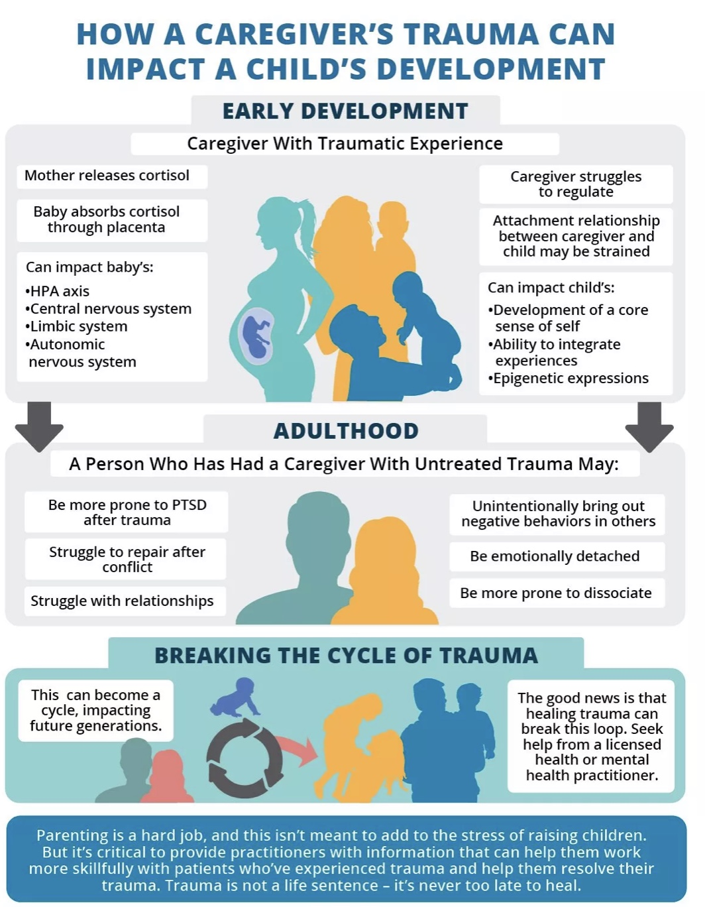
MULTIGENERATIONAL TRAUMA
There are several ways in which trauma can be passed from one generation to another
Epigenetically – trauma alters the expression of the parents' genes, and this is passed on to the child
Intra-uterine environment – a mother who has experienced trauma releases much larger quantities of stress hormones which cross the placenta and impact the fetus's development
Attachment issues – trauma corelates with insecure attachment and attachment styles tend to be passed on from generation to generation
Caregiver difficulties with emotional regulation – emotional regulation is learned via modelling. Parents who struggle with emotional regulation may have difficulty teaching their children to emotionally regulate
Lack of psychosocial resources – Trauma corelates with poverty and fewer social supports. A child growing up in such an environment will also have fewer psychosocial resources and be more vulnerable to trauma.
People who have trauma spectrum disorders often feel guilty that they may pass these on to their children. They often ask what can I do to help my children? The consensus answer seems to be "do what you can to heal yourself that healing will also be passed on to your children."
Notes:
There are three main ways by which a parent/caregiver's trauma can impact a child's development.
1) epi genetically. We have already discussed this and won't repeat that here.
2) the mother's hormones especially cortisone affect the baby's development in the womb.
3) PTSD and its accompanying emotional dysregulation impact attachment style.
A person who has a caregiver with untreated trauma may therefore be more prone to PTSD after trauma, struggled to repair after interpersonal conflict, struggle with relationships, and be more prone to emotional dysregulation.

Slide 49
What we will do today
What is dissociation?
Structural dissociation theory
How dissociation arises from trauma
Primary structural dissociation
Types of flashbacks
Features of PTSD
Secondary structural dissociation
Tertiary structural dissociation
Controversies in the diagnosis of dissociative identity disorder
Treatment of the trauma spectrum disorders
How simple addresses the three stages of trauma therapy
Special considerations in the treatment of trauma

Slide 50
How is secondary structural dissociation or complex PTSD different from primary structural dissociation or PTSD?

Slide 51
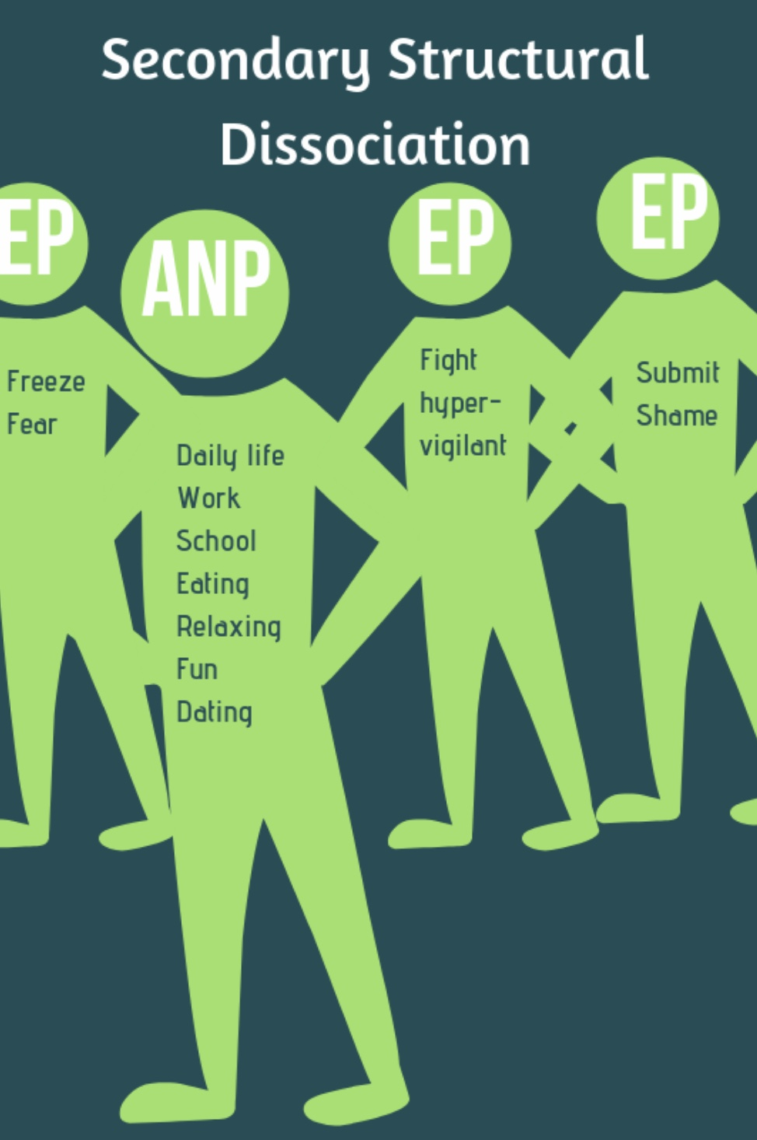
Secondary structural dissociation is a more severe type of dissociation often associated with disorganized attachment, and attachment and developmental trauma.
Children and adults with insecure attachment are more vulnerable to trauma and more likely to experience multiple traumatic events
As with primary structural dissociation/PTSD, in secondary structural dissociation, after traumatic experiences, an apparently normal part (ANP) tries to carry on with normal everyday life.
But, in secondary structural dissociation, because there may have been multiple traumas and/or an increased vulnerability, there are multiple split off emotional parts, (EP’s) each arising from a different trauma and each carrying different implicit memories.
These traumas may have happened at different ages and stages of development, and the trauma that gave rise to them may not be a discreet one-time event but ongoing over a significant period. (as in ongoing child or partner abuse)
As we will see when we talk about internal family systems, it’s useful to think of these EP’s as having distinct personalities, ages, ways of thinking, feeling, behaving, and distinct states of activation (fight, flight, freeze, or fawn)
In secondary Structural dissociation, while consciously the person experiences themselves as a single individual emotionally, they feel they are different people.
2
4
3
1
A.K.A. COMPLEX PTSD
Notes:
Secondary structural dissociation is also known as complex PTSD. On the spectrum of dissociative disorders, it is more severe than primary structural dissociation or PTSD

Slide 52
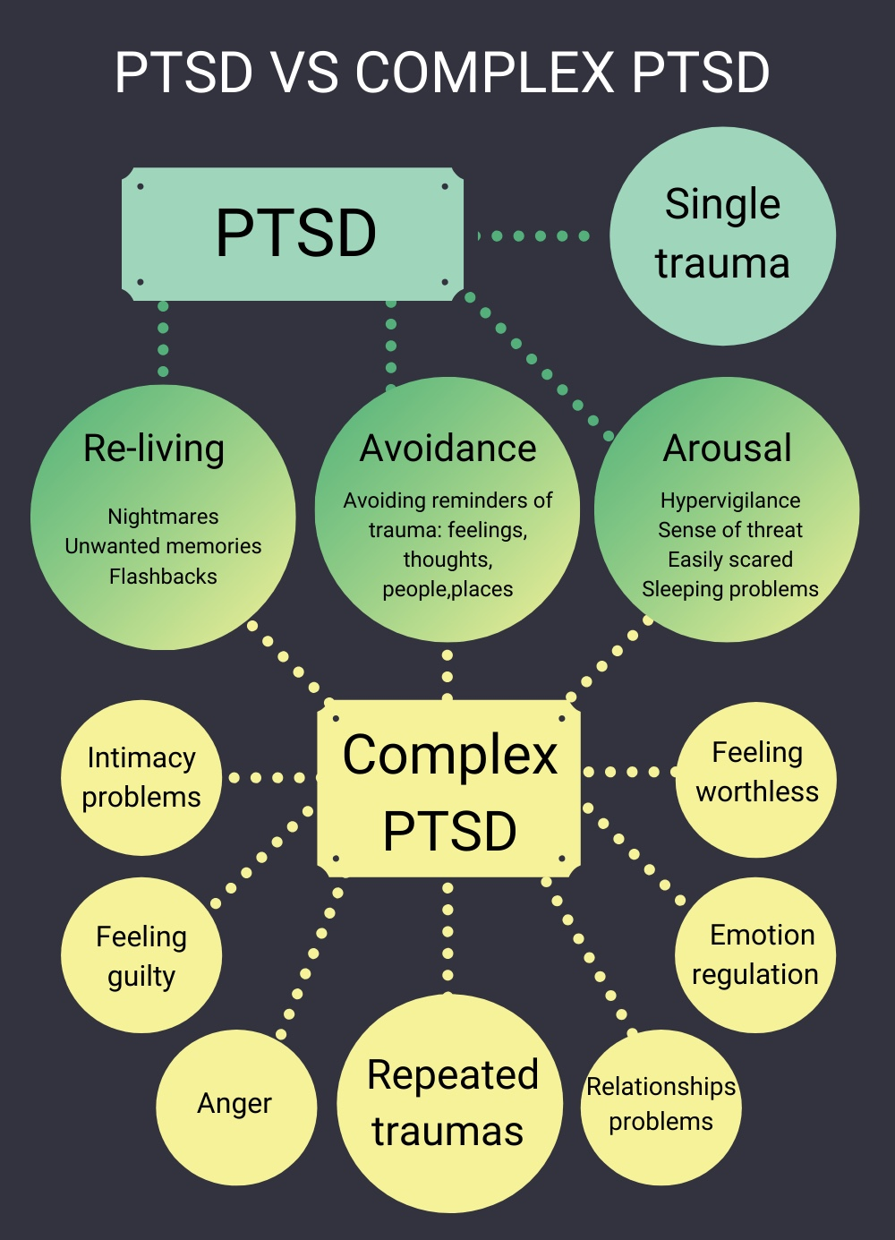
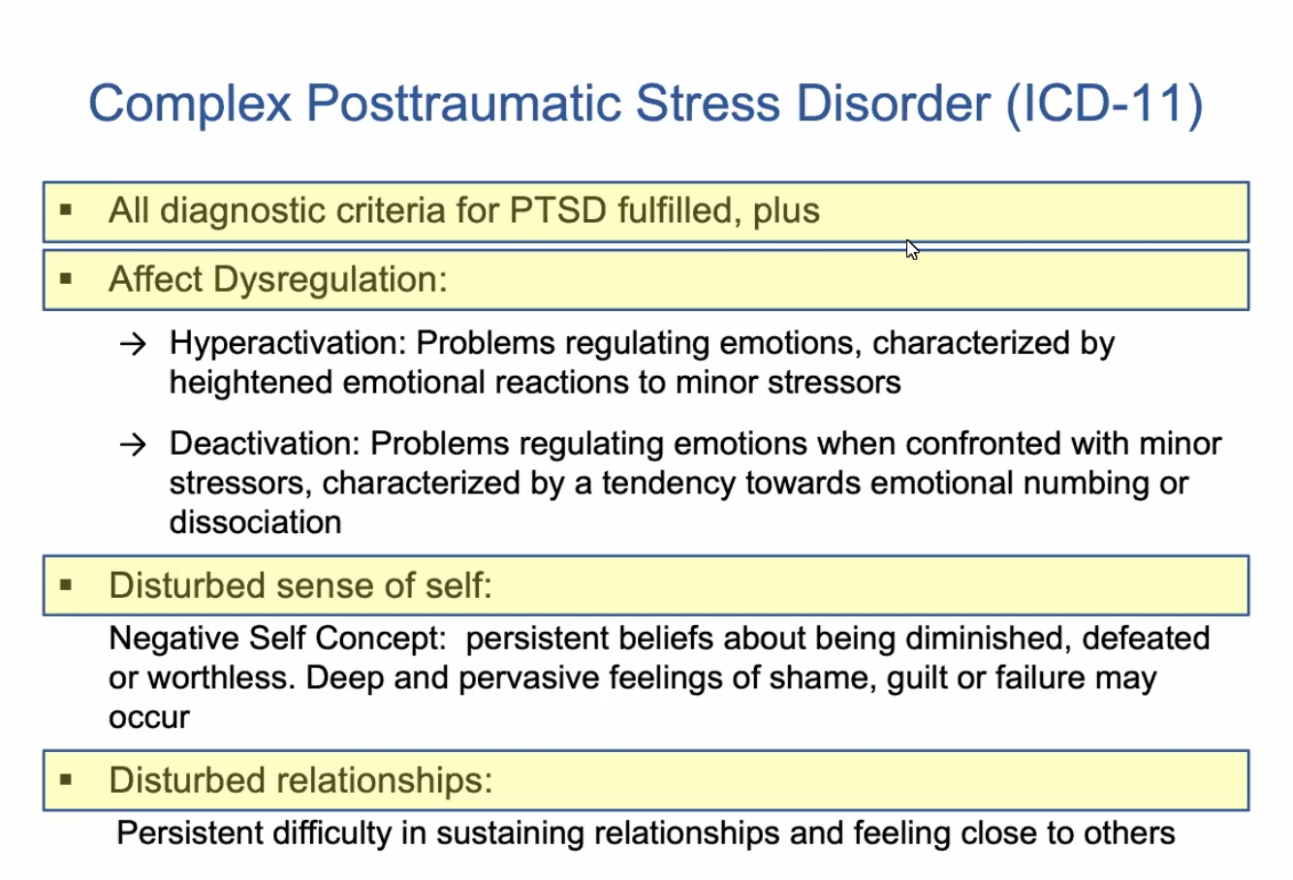
WHAT IS COMPLEX PTSD AND HOW DOES IT MANIFEST ?
Complex PTSD often results from exposure to severe stressors that are 1) repetitive or prolonged 2) in children involve harm or abandonment by caregivers or other ostensibly responsible adults and 3) occur at developmentally vulnerable times in the victim's life.
Like PTSD, people with complex PTSD feel 1) a sense of threat, 2) reexperience the trauma in the form of flashbacks, and 3) avoid potential triggers.
In addition, people with complex PTSD also experience 4) affect dysregulation, 5) negative self-concept, and 6) interpersonal disturbances all of which are often not present in PTSD.
Complex PTSD is included in the ICD – 11 diagnostic system but not in DSM V. This omission was explained in that supposedly there's not enough evidence to differentiate PTSD from complex PTSD. Many trauma experts disagree with this decision.
Complex PTSD does significantly overlap with two DSM-V childhood (must be made before age 5) diagnosis: reactive attachment disorder and disinhibited social engagement disorder.

Slide 53
Remember that these are general categories arrived at by consensus of select experts. Each person's experience is unique. Don't get bogged down self diagnosing
While they are distinct concepts, posttraumatic stress disorder, complex posttraumatic stress disorder and borderline personality disorder overlap
PTSD and c PTSD share flashbacks/nightmares, numbing/dissociation and hypervigilance/startle
c PTSD and BPD share self-harm, an unstable sense of self, emotional regulation difficulties, interpersonal problems, and a negative self-concept
BPD Overlaps significantly with disorganized attachment style and features suicidal behavior, frantic efforts to avoid abandonment, and shifting self-identity
SYMPTOM OVERLAP BETWEEN PTSD, C-PTSD, AND Borderline PD
Notes:
Complex PTSD overlaps both with PTSD and borderline personality disorder. Most people with borderline personality disorder have complex PTSD and/or a disorganized attachment style

Slide 54
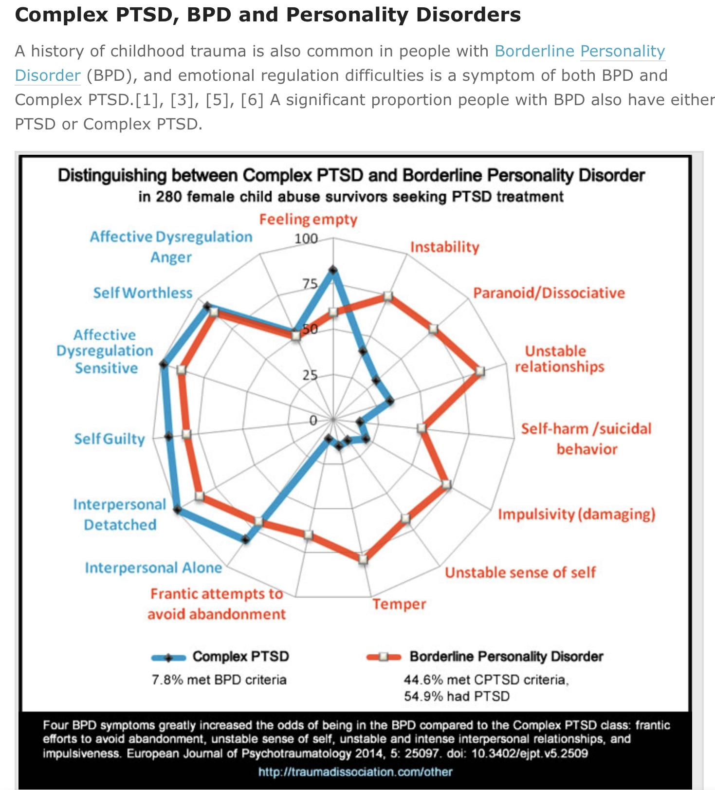
C-PTSD, AND BPD
A history of childhood trauma is common but not always present in people diagnosed with BPD.
A history of trauma is always present in people diagnosed with c PTSD.
A person can be diagnosed with both BPD and PTSD or c PTSD. 8% of people diagnosed with c PTSD also met criteria for BPD. 45% of people with BPD met c PTSD criteria. 55% of people diagnosed with BPD also met criteria for PTSD
Most people diagnosed with BPD have a disorganized attachment style
BPD and c PTSD overlap in 1) low self-worth 2) feelings of guilt 3) feeling detached and alone 4) sensitivity to slights 5) feels of anger
The symptoms that are found more frequently in BPD than in c PTSD are: 1) frantic efforts to avoid abandonment 2) unstable sense of self 3) unstable and intense interpersonal relationships and 4) impulsiveness
In my opinion psychiatry is doing a terrible job in trying to classify emotional dysregulation. Take all these labels with a huge grain of salt
While there is a lot of interest in these distinctions keep in mind that humans are complex and that psychiatric labels are imperfect, limited, political, evolving ways of trying to understand this complexity

Slide 55
What we will do today
What is dissociation?
Structural dissociation theory
How dissociation arises from trauma
Primary structural dissociation
Types of flashbacks
Features of PTSD
Secondary structural dissociation
Tertiary structural dissociation
Controversies in the diagnosis of dissociative identity disorder
Treatment of the trauma spectrum disorders
How simple addresses the three stages of trauma therapy
Special considerations in the treatment of trauma

Slide 56
What is tertiary structural dissociation?

Slide 57
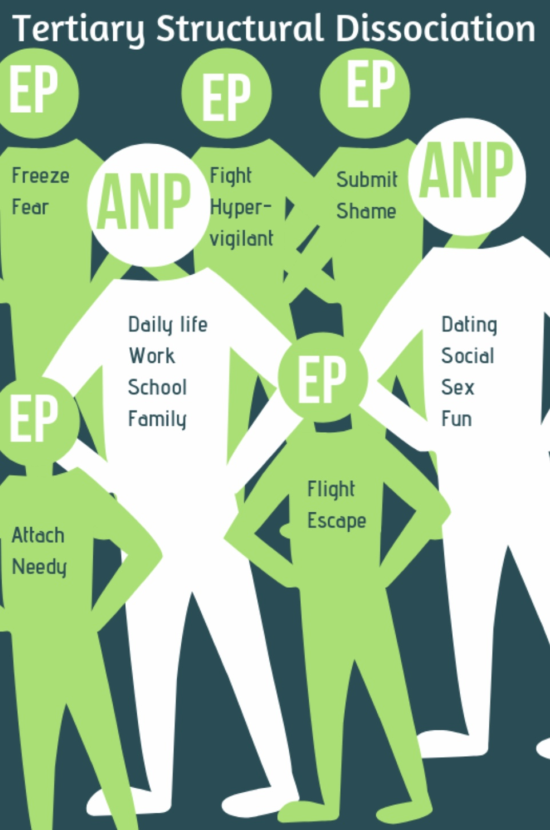
Dissociative identity disorder or tertiary structural dissociation used to be called “multiple personality disorder”. It is the most severe form of dissociation.
According to structural dissociation theory, in tertiary structural dissociation, there is such an imbalance between the severity and duration of the trauma and the person’s coping resources, that the emotional mind’s dissociative coping mechanisms are insufficient to protect the self from the trauma and the apparently normal and conscious self also splits or fragments. This creates two or more conscious mind parts or alters that have distinct personalities and states of activation.
Each “alter” of the apparently normal part ANP ( I and II) may have a function in the overall personality system. Ex. One goes to work, another socializes, others protect the person…
1
3
2
II
I
5
4
A.K.A. Dissociative identity disorder
Notes:
Tertiary structural dissociation is dissociative identity disorder.

Slide 58
In only 5% of people experiencing DID is there blatant switching of parts, making it easy to misdiagnose since behavior changes can be subtle.
Dissociative identity disorder is at the frontier of our understanding of the trauma related disorders, and perhaps because of that, is a subject around which there much debate and controversy.
Imaging studies have compared DID individuals to actors and studied alters who are blind while the main personality is not.
While some experts consider all parts present in primary, secondary, and tertiary structural dissociation as being on a dissociative spectrum, others differentiate “ego states” in which parts retain a shared sense of belonging to a person as a whole and are less distinct, autonomous, and amnesic and “dissociative states” in which each part has its own sense of identity with discreet self-representations, autobiographical memory and personal experiences or a sense of I, me, and mine.
1
3
2
II
I
5
4
A.K.A. Dissociative identity disorder
Notes:
Tertiary structural dissociation is dissociative identity disorder.

Slide 59
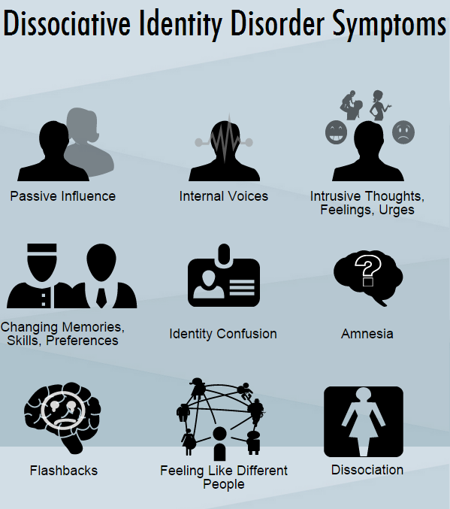
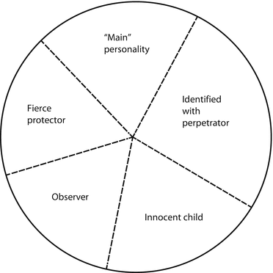
COMMON DID SYMPTOMS
COMMON DID ALTERS
Common types of alters in dissociative identity disorder include: the host, child alters, internal self-helper, opposite sex alters, persecutor, protector, sexual alters, suicidal altar, teen alter.
Less common alters include animal alter, baby and infant, caretaker, demonic, military or political, non- human, robot or machinelike, and supernatural alters
Notes:
In dissociative identity disorder/tertiary structural dissociation the emotional parts become "alters". Just as there are common emotional parts, there are common alters.
People with dissociative identity disorder present with a number of characteristic symptoms.

Slide 60
Overt and covert DID refer to different manifestations of DID.
Overt DID is when the presence of different identities is clearly visible. Individuals with overt DID may experience noticeable switches between identities, which can result in changes in behavior, voice, or demeanor that others can observe. People around them might notice these sudden changes, making overt DID more recognizable.
Covert DID, on the other hand, is less apparent to others. The identity switches may be more subtle, and individuals might not outwardly show distinct changes when transitioning between identities. Instead, they might feel these shifts internally, experiencing changes in thoughts, emotions, or attitudes. Because of these intricacies, covert DID can be more challenging to diagnose and may often remain hidden from those around the individual.
OVERT AND COVERT DID

Slide 61
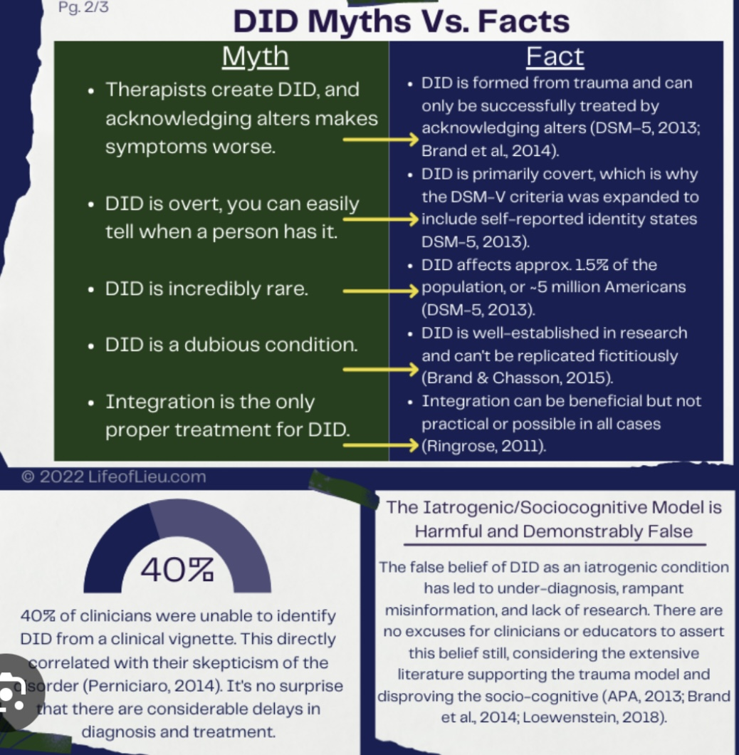
OVERT AND COVERT DID
Covert Dissociative Identity Disorder (DID) can sometimes be misdiagnosed as other mental health conditions. Because the symptoms of covert DID are less apparent and more subtle than overt DID, it can lead clinicians to consider other diagnoses. Common misdiagnoses for covert DID include:
Major Depressive Disorder: Due to mood fluctuations and feelings of hopelessness that can accompany DID.
Bipolar Disorder: Because of the shifts in mood and behavior, which might resemble the manic and depressive episodes in bipolar disorder.
Schizophrenia: Some individuals with DID may report hearing voices (from their alternate identities), which can be confused with the auditory hallucinations seen in schizophrenia.
Borderline Personality Disorder: Overlaps can occur with emotional instability and identity confusion, common in both conditions.
Post-Traumatic Stress Disorder (PTSD): Since DID often develops as a response to severe trauma, the two conditions can share symptoms like flashbacks and dissociation.

Slide 62
What we will do today
What is dissociation?
Structural dissociation theory
How dissociation arises from trauma
Primary structural dissociation
Types of flashbacks
Features of PTSD
Secondary structural dissociation
Tertiary structural dissociation
Controversies in the diagnosis of dissociative identity disorder
Treatment of the trauma spectrum disorders
How simple addresses the three stages of trauma therapy
Special considerations in the treatment of trauma

Slide 63
Is there some controversy regarding the diagnosis of dissociative identity disorder ?

Slide 64
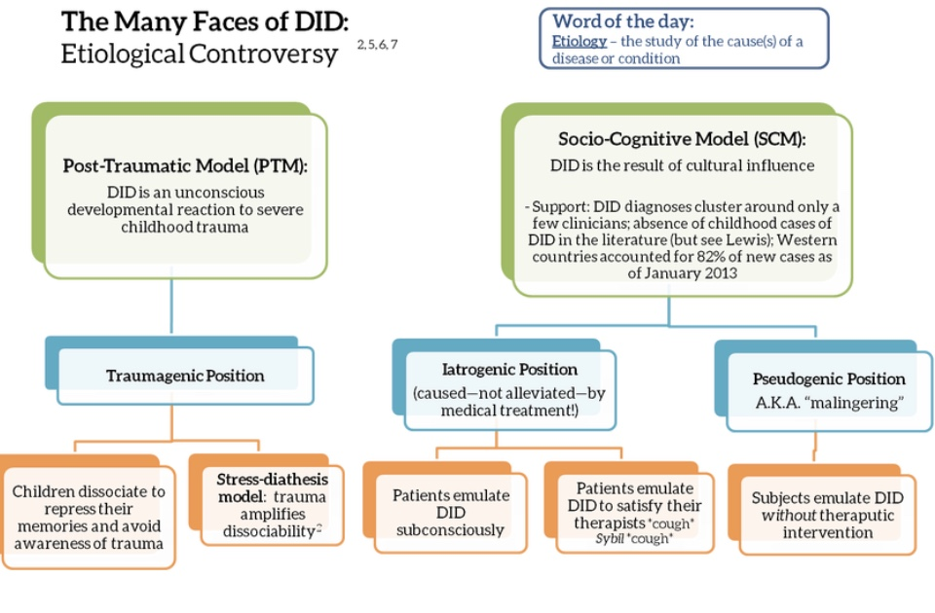
There has been significant controversy surrounding DID and its causes. In the simple course we follow and have presented the 1) post-traumatic model of DID. There is however also the…
2) Socio-cognitive model which proposes two alternative explanations for DID A) the iatrogenic- which suggests that DID is in part induced by therapy, and B) the pseudogenic position which suggests that some individuals feign DID for secondary gain. Many experts in the field now hold that these models are compatible. Click link which explores this controversy
Notes:
Yes there is. In this course we support the posttraumatic model described on the left hand of the slide.
The socio-cognitive model is however supported by many authorities in the field. It suggests to other possible explanations for dissociative identity disorder: iatrogenesis and pseudo-genesis.

Slide 65
session 22 of SIMPLE MID SESSION 10 MINUTE break

Slide 66
session 22 of SIMPLE welcome back from the break

Slide 67
What we will do today
What is dissociation?
Structural dissociation theory
How dissociation arises from trauma
Primary structural dissociation
Types of flashbacks
Features of PTSD
Secondary structural dissociation
Tertiary structural dissociation
Controversies in the diagnosis of dissociative identity disorder
Treatment of the trauma spectrum disorders
How simple addresses the three stages of trauma therapy
Special considerations in the treatment of trauma

Slide 68
If PTSD, complex PTSD, and DID or primary, secondary and tertiary dissociation are all on the dissociative spectrum is their treatment similar?

Slide 69
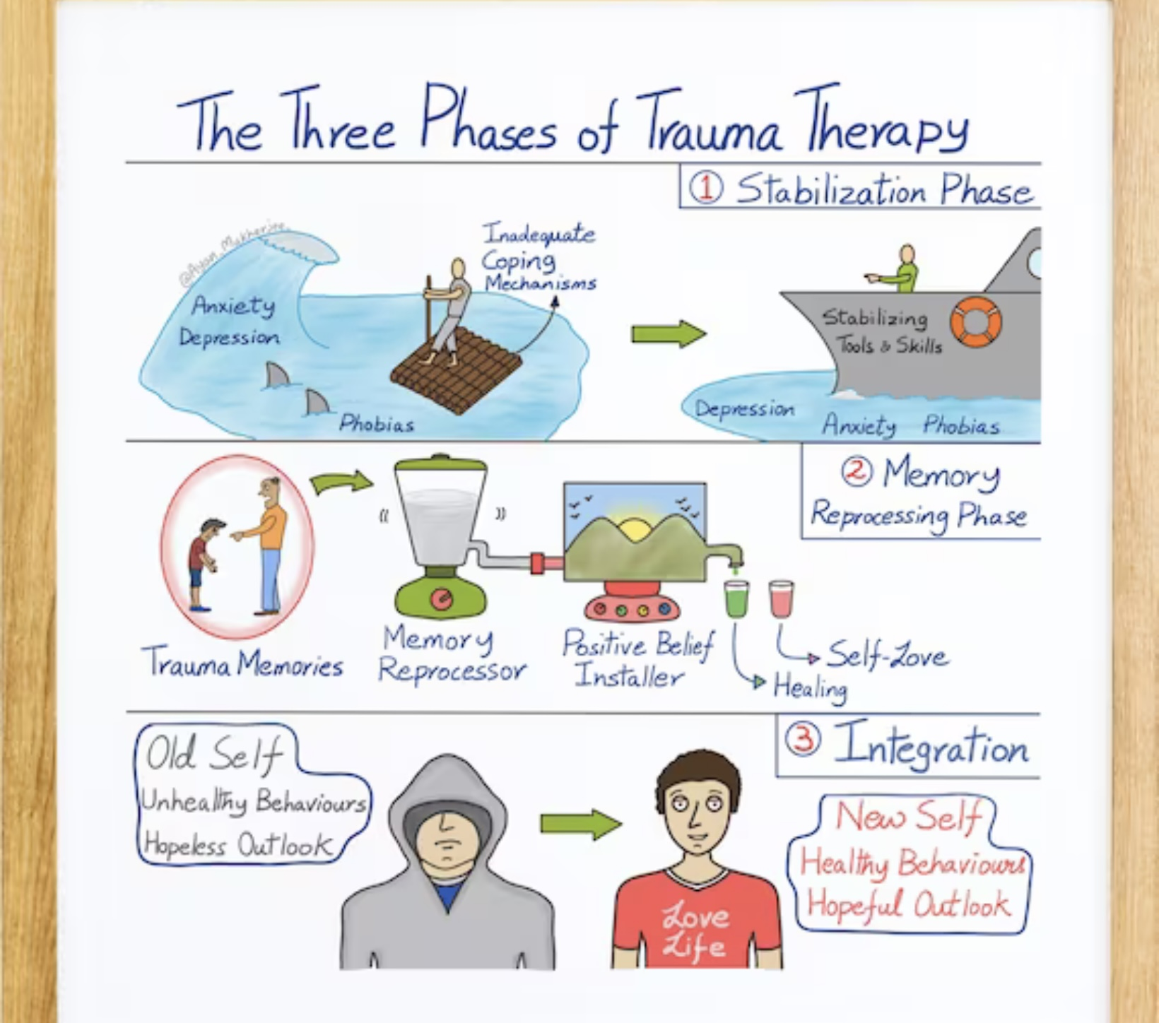
Treatment of TRAUMA spectrum disorders
Today there is more scientific knowledge, public awareness, and peer initiatives in the fields of trauma and its treatment than there’s ever been, but there is also a great lack of well-trained trauma treatment providers, programs and resources.
We are in a situation akin to that which the treatment of acute lymphocytic leukemia, the most common type of childhood cancer, was in in the 1970’s when it had a 90% mortality rate. Today the mortality rate of ALL has dropped to 10%. This is not because we have any new treatments. We are still using all the same ones as we did 50 years ago. What has changed is that we’re much better at using those treatments in a uniform systematic way.
Similarly with dissociative/trauma spectrum disorders, if we were better at using the treatments we’ve known about for 100 years effectively, we’d have much better treatment outcomes.

Slide 70
Treatment of TRAUMA spectrum disorders
In this segment of today’s session, we will explore the three phases of treatment for dissociative trauma spectrum disorders which are the common denominator of all trauma treatment approaches. Keep in mind that treatment needs, of course, to be individualized for each person. For instance, people with single event PTSD who have good resources may not need to spend a lot of time in phase I of treatment and may be able to proceed directly to phase II.
On the other hand, people who have fewer “resources” may need to spend considerable time in phase I stabilization whereas those with significant psychosocial developmental issues may need to spend considerable time in phase III
We will also explore how specific treatment issues arise in each of the three types of structural dissociation. For example, shame is an important consideration in secondary structural dissociation/complex PTSD. We’ll explore why.
In the next two sessions we will discuss Wise mind remediation and Internal family systems which are both phase II trauma processing approaches.

Slide 71
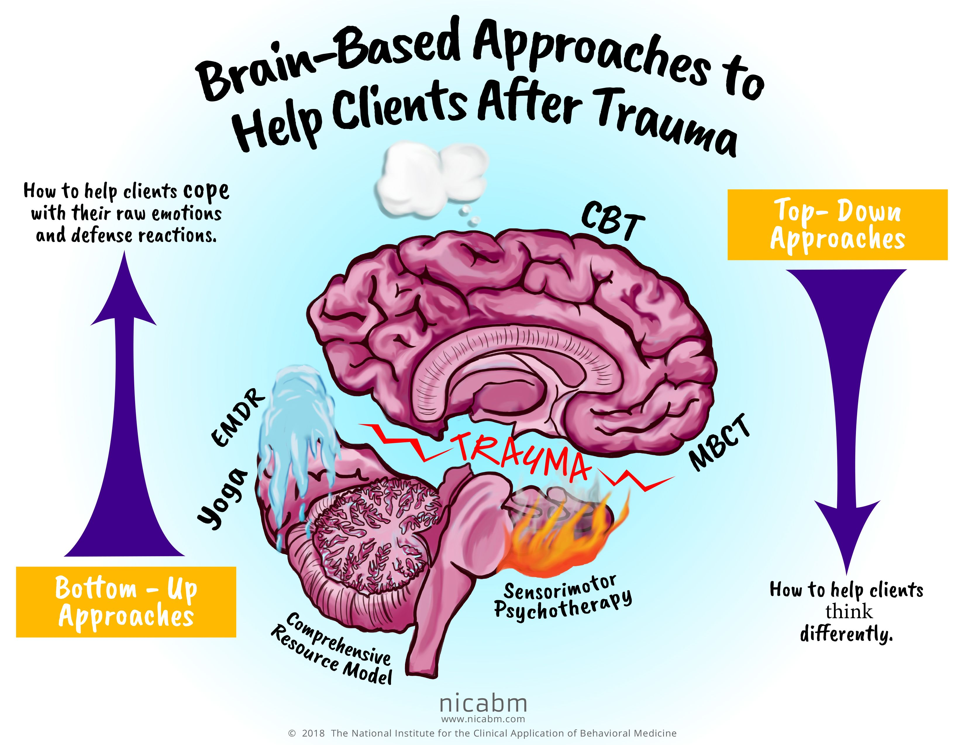
BOTTOM UP VS. TOP-DOWN APPROACHES
Trauma treatment approaches are commonly grouped into “top down” or “bottom up” categories. “Top” refers to the rational brain, thinking, or cognition, “bottom” to the body or somatic information center. Trauma affects all three information processing centers, but specific treatment approaches tend to target primarily the body or thinking.
Top-down approaches help people think differently, bottom-up help people cope with their sensations, emotions, and action urges.
For example, CBT and MBCT are top-down approaches, Yoga, EMDR, and the sensorimotor therapies bottom up.
Notes:
The treatment approaches to, have been divided into bottom-up, those approaches that target the body and secondarily affect thinking. And top-down, those approaches that target thinking and secondarily affect the body. The ideal trauma treatment incorporates elements of both.
Bessel van der Kolk has written the classic text on the trauma spectrum disorders and their treatment.

Slide 72
General Principles of Therapy of dissociative and trauma spectrum disorders
The foundations underlying the treatment approaches for the dissociative and trauma spectrum disorders have not changed much since the time of Pierre Janet.
There are three phases (or stages) to the active stage treatment of trauma spectrum dissociative disorders be they primary, secondary, or tertiary dissociation.
Phase 1 deals with the person’s safety and aims to stabilize them
phase 2 deals with remembrance and mourning of past trauma and
phase 3 reconnection with the world of other people, nature, the universe and a meaningful occupation.
If people are pre-contemplative, they may not understand that their symptoms and distress are in part the effects of their past trauma on their present. They may believe the problem is only with the world, others, social systems, or health care providers and not also with them. If people are pre-contemplative psychoeducation is critical.
Re-enacting traumatic issues with health care providers who are not trauma informed is not helpful for the person
DBT , and CBT are mostly phase I therapies.
SIMPLE uses DBT and CBT phase I strategies
Simple’s Internal family systems, Wise mind remediation, and editing, splicing, and pasting are phase II strategies
The goals diary card procedure is a phase III strategy

Slide 73
THE GOALS OF EACH OF THE STAGES OF TREATMENT
Notes:
Each of the stages of treatment has a different goal.

Slide 74
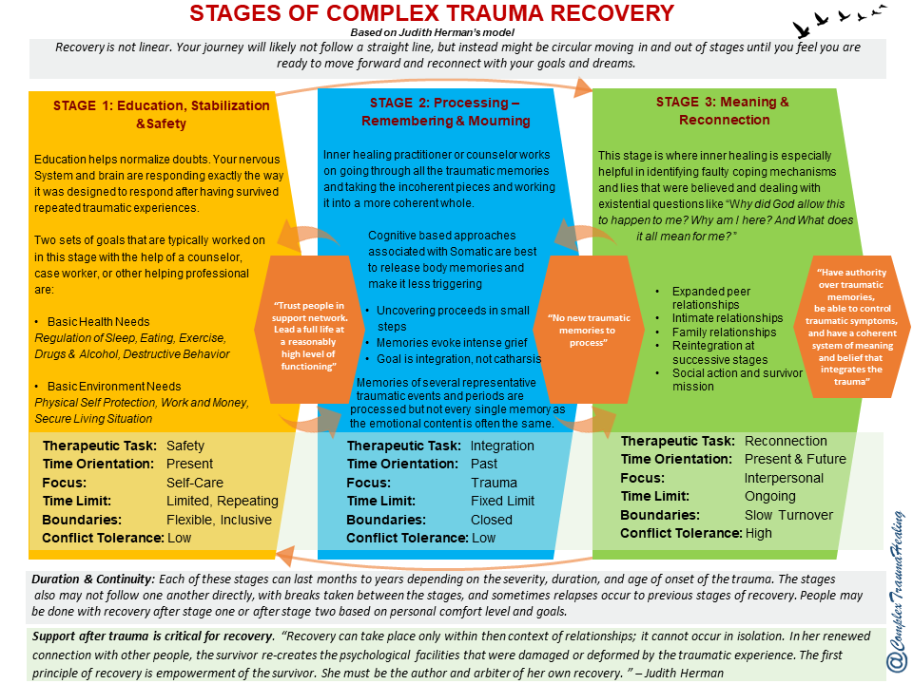
Notes:
This slide describes in greater detail the work to be done at each of the stages of trauma recovery. In the following slides we will consider each of the stages.

Slide 75
Stage I in the healing of trauma spectrum disorders involves:
1) developing a personal roadmap for the healing process.
2) developing realistic and attainable goals and setting up a plan of action for achieving those goals in a practical timeframe
3) establishing a sense of stability and safety in interpersonal relationships, one's own body, and all other areas of life
4) learning how to regulate emotions, and how to manage psychological and behavioral symptoms that may contribute to a sense of instability and overall personal suffering
5) beginning to recognize and tap into resources and inner strength.
6) developing crucial coping mechanisms and life skills, geared towards effectively managing painful experiences and regulating emotional, mental, and physical responses.

Slide 76
Practically, Stage I stabilization goals include reduction and elimination of drug and alcohol abuse, promotion of good health, safe housing, adequate income, adequate transportation and setting and keeping a healthy schedule.
The main goals of stage I are developing a sense of personal safety, cultivating a healthy self-care routine and learning to regulate emotions and behaviors appropriately.
Once these necessary skills become fully integrated into our lives, we will be able to do the stage II working through painful memories with far less mental and emotional repercussions. It is, however, not always necessary for everyone to do the stage II work of processing traumatic memories.

Slide 77
Phase I treatment (stabilization) can be lengthy in people who have prominent dissociative features.
When people start working on phase II or processing trauma, which can trigger dysregulation, they need phase I stabilization skills to pendulate back to the window of tolerance.
Stabilization skills include:
1) learning to observe somatic sensations. This is a somatic experiencing technique
2) developing and installing “resources”. This is done in approaches such as EMDR through resourcing which refers to identifying and instilling coping resources that help us to deal with difficult situations. It is also part of DBT skills.
3) developing spiritual resources
4) building social supports
5) engaging in pleasant activities
6) healing the brain using neurofeedback
Empirically supported stage I treatments include DBT, mindfulness-based stress reduction, cognitive behavioral therapy, imagery rehearsal therapy, and motivational interviewing.

Slide 78
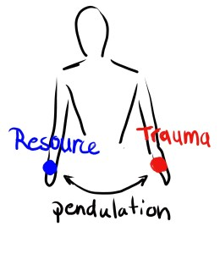
The importance of stage I “resources” FOR STAGE II work
In trauma therapy a "resource" is anything that helps the therapeutic process. Resources can be supportive friends, therapists, therapy animals, learnt skills etc. Resources help bring people back to the window of tolerance.
When processing trauma, it is critical that the person stay in the window of tolerance
All trauma processing strategies involve some kind of imaginal, real life, or virtual exposure to implicit and/or explicit traumatic memories with pendulation to resources when the person is leaving the therapeutic window. Thus, pendulation between trauma and resources.
“Dual focus”, or the shifting of focus between trauma and resources, is the common factor of many phase 2 approaches including EMDR.
This is why phase I work which fosters resources is so important before embarking on processing trauma
If you try to do phase II work but don’t have resources to help bring you back to the window of tolerance, exploration of dissociated traumatic memories will only further traumatize you.

Slide 79
Stage II of trauma recovery is frequently referred to as "remembrance and mourning". Once an individual has developed a strong and functional set of coping skills and feels reasonably safe and secure in their surroundings, it becomes possible to address long buried memories.
The main work the second stage of trauma recovery involves:
1)discussing and evaluating painful and traumatic memories with the intention of restructuring the role they play in people’s lives.
2) Working through trauma -related grief brought about by unwanted or abusive experiences, and the impact they had and continue to have on people's lives.
3) mourning the loss of good experiences that have not yet occurred, or did not have the chance to occur, because of persistent, trauma -related symptoms.

Slide 80
4) discussing painful memories is not always necessary to achieve the personal goals established in the first stage of trauma recovery. Remember stages will vary depending on personal history and personality. Some people may find that memories that were once perceived as too painful to examine are no longer causing any grief or inner turmoil.
5) if memories are still disruptive and have been found to continuously pose a threat to long-term recovery from related issues, there are several "memory processing" methods that can be employed during this stage of recovery such as EMDR or sensorimotor therapies.

Slide 81
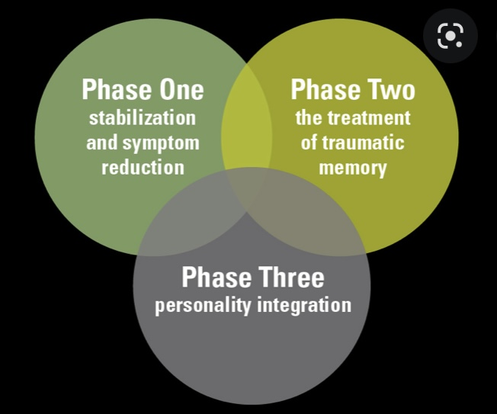
STAGE III WORK
Stage III the third and final stage of trauma recovery focuses largely on reconnecting with people, personally meaningful activities, and all other aspects of a meaningful, fulfilling and healthy life.
In this stage, we need to develop a new sense of self. Traumatic experiences will no longer play a defining role in our lives, and we will be mentally and emotionally set free from the painful and limiting chains of the past. Steps toward self-actualization and empowerment will be taken, and the human spirit, in all its awe-inspiring resilience, will begin truly and thoroughly recovering from the devastating effects of traumatic experiences.

Slide 82
STAGE III WORK
It is important to keep in mind that recovery is a highly individualized process, and it will look quite different for every individual. It is common for those who have suffered trauma to want to feel better as quickly as possible. However, recovering from trauma is a process that requires consistency, commitment, and self compassion.
Recovering from trauma does not mean we will be completely free of intrusive thoughts or feelings, rather, we will reclaim our life, love, and authentic self.

Slide 83
The previous slides described the general type of work to be done at each of the stages of treatment. Can you tell us more about the specific therapeutic modalities that are offered by therapists ?

Slide 84
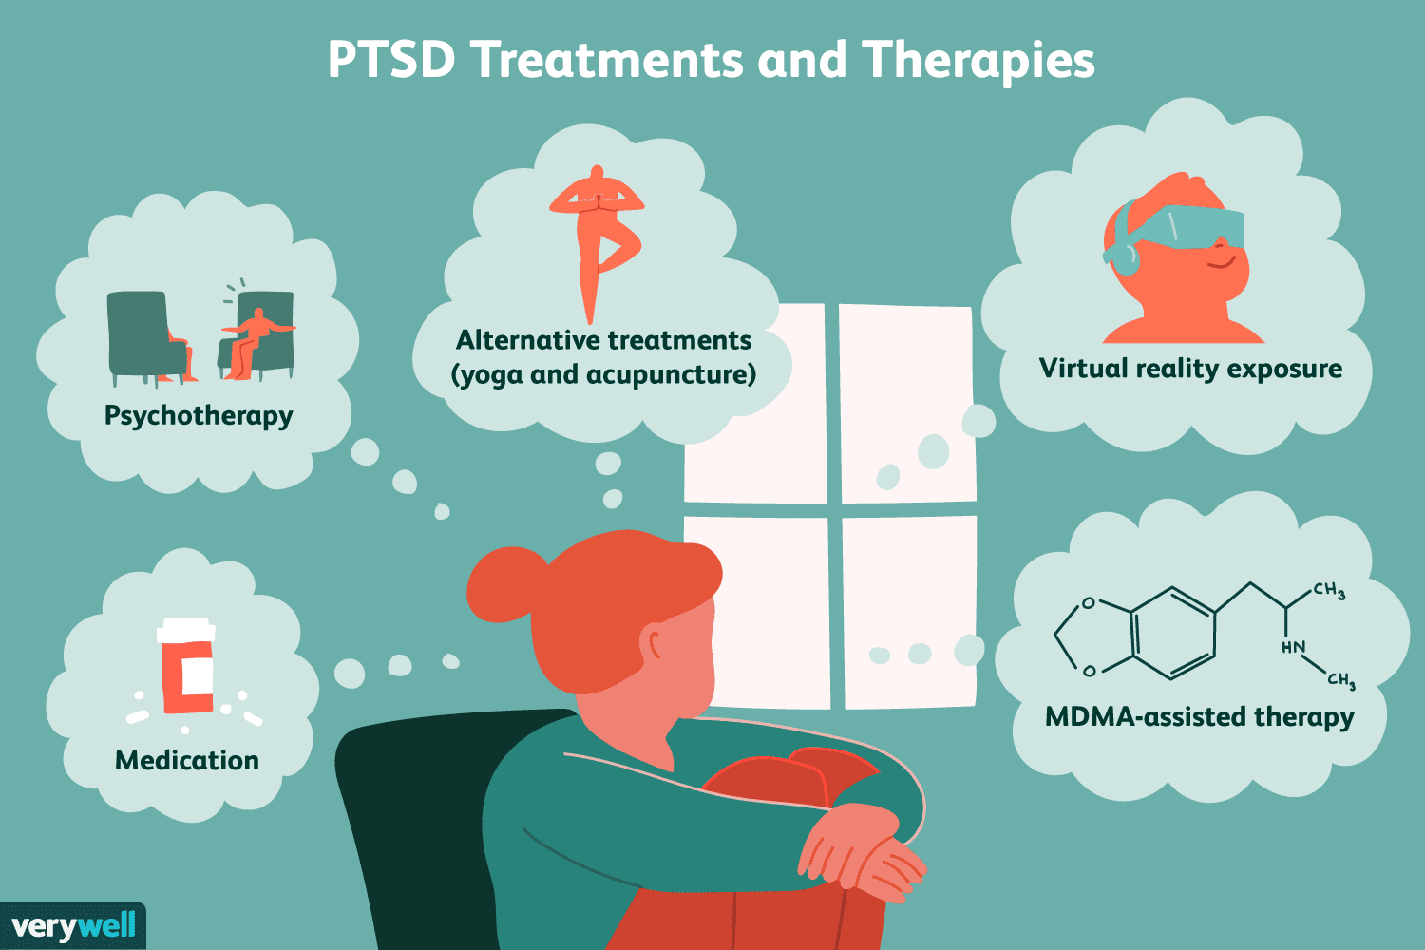
SPECIFIC TRAUMATIC SPECTRUM TREATMENTS
Notes:
Several different approaches have been used to treat trauma spectrum disorders

Slide 85
Notes:
The higher the bar on this graph the more effective the treatment.

Slide 86
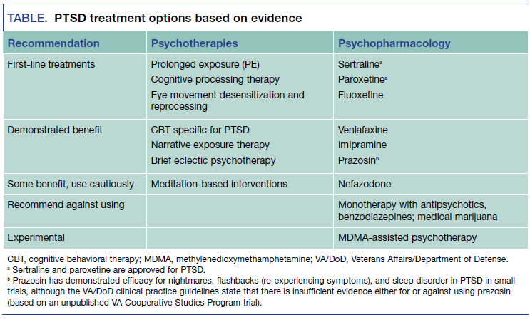
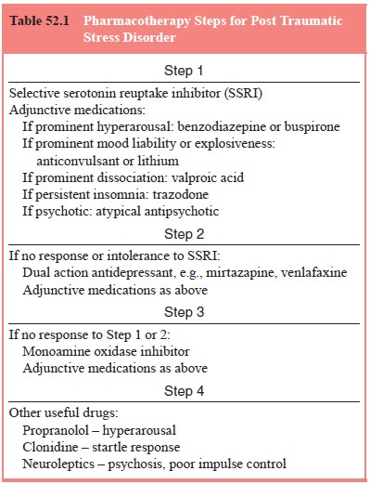
Rx OF PTSD
Notes:
This slide lists psychotherapies and psychopharmacology that has been found helpful in the treatment of ptsd.

Slide 87
Notes:
This slide lists the models for which there is evidence in the treatment of the traumatic spectrum disorders. The slides following this one describe each model in slightly greater length.

Slide 92
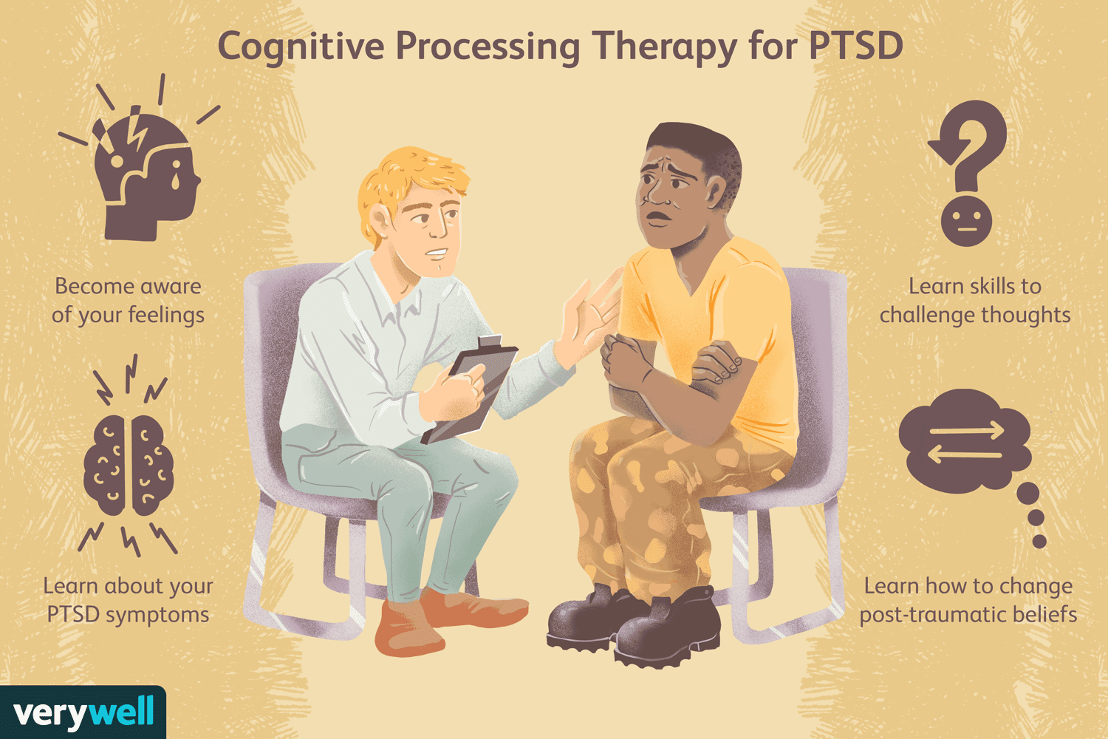

Slide 93
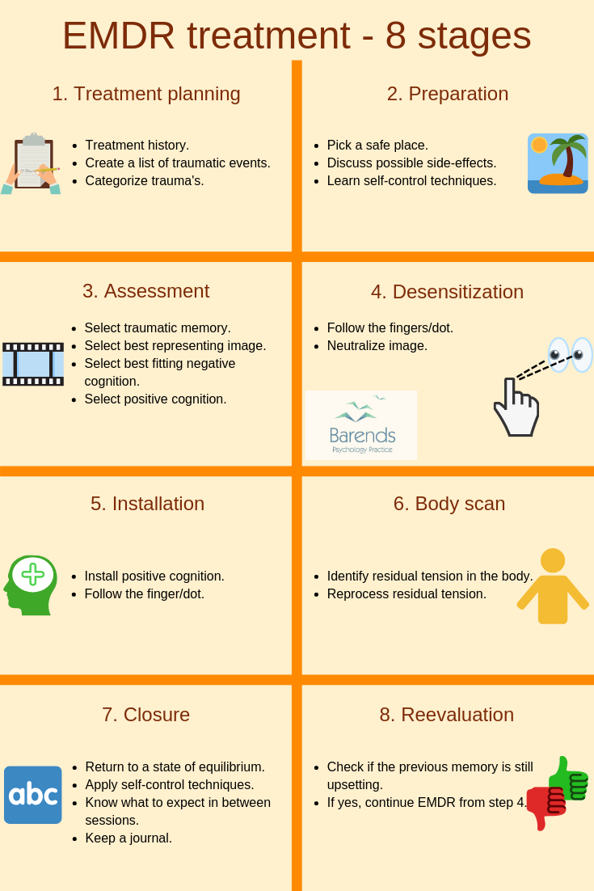
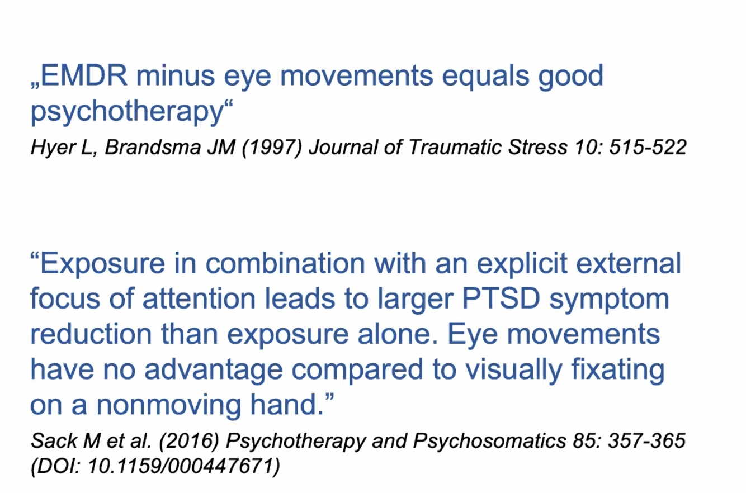

Slide 94
EXPOSURE : IMAGINATION, REAL LIFE, VIRTUAL

Slide 95
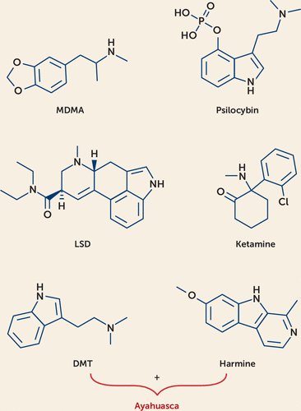
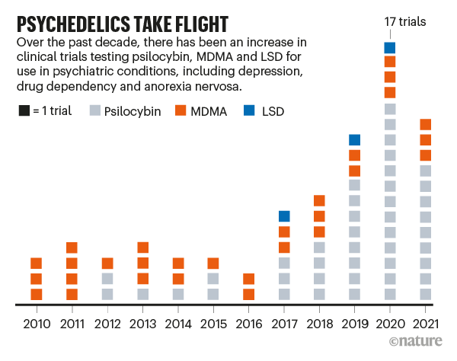
AGENTS USED IN PSYCHEDELIC ASSISTED PSYCHOTHERAPY
mescaline

Slide 96
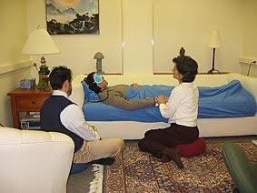
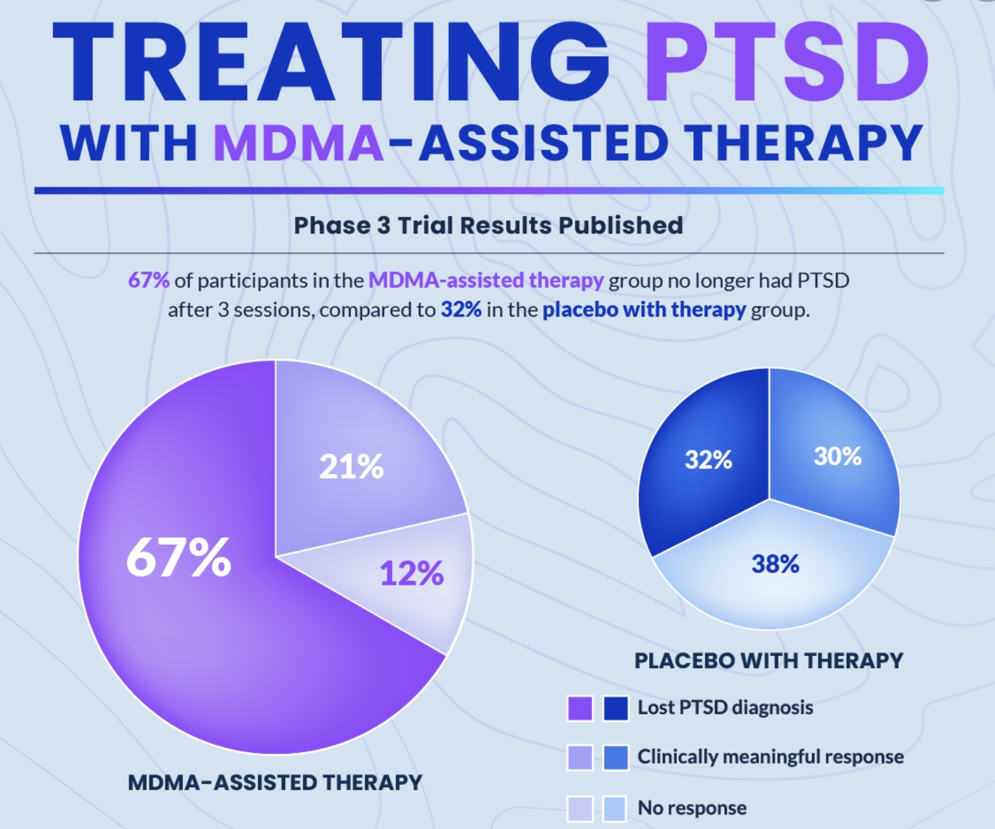
Psychedelic assisted psychotherapy

Slide 97
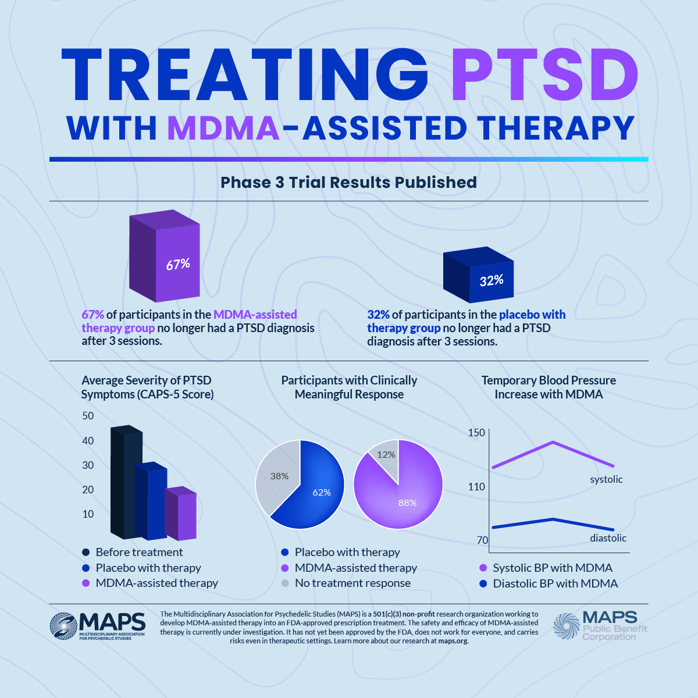

Slide 98
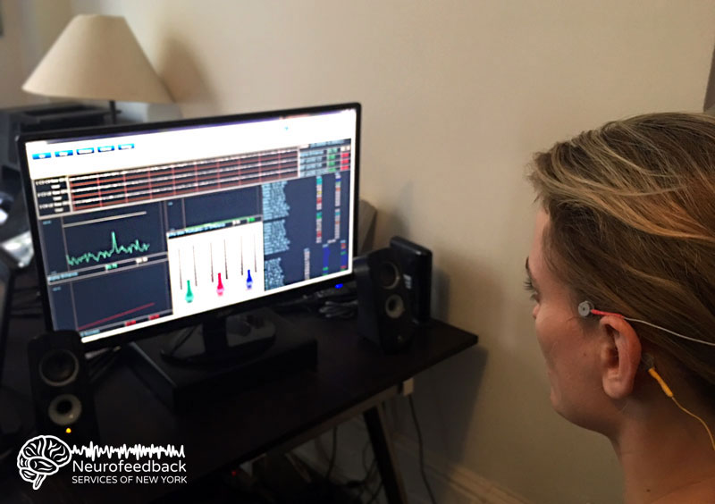

Slide 99
Therapeutic alliance
Stabilization
Psychoeducation
Emotional regulation
Exposure
Finding meaning
Processing memories
Mobilizing resources
Notes:
Although there are many different approaches to the treatment of trauma, many of these approaches share common elements.

Slide 101
Notes:
Because it is the most severe form of structural dissociation, the treatment of dissociative identity disorder is the most challenging. Experts agree that there are three main goals in the treatment of the ID: 1) cooperative arrangement between altar/parts 2) partial integration 3) final fusion.
Because there are so few people who specialize in the treatment of DID, it is extremely difficult to access expert effective treatment.

Slide 102
What we will do today
What is dissociation?
Structural dissociation theory
How dissociation arises from trauma
Primary structural dissociation
Types of flashbacks
Features of PTSD
Secondary structural dissociation
Tertiary structural dissociation
Controversies in the diagnosis of dissociative identity disorder
Treatment of the trauma spectrum disorders
How simple addresses the three stages of trauma therapy
Special considerations in the treatment of trauma

Slide 103
Is simple a stage I, II, or III therapy ?

Slide 104
Simple addresses all three stages of trauma therapy
Stage I and II work focus on the bottom half of Maslow’s pyramid : meeting physiological and safety needs and staying safely in the window of tolerance. In simple we spend a lot of time discussing emotional regulation and building resources.
Stage III work focuses on top half of pyramid : Developing connections, self-esteem and a sense of meaning.
The goals diary card procedure outlines our various needs, helps us assess which are and aren’t met, and sets out a systematic approach to pursuing our need for connection.
Stage three work pursues establishing a meaningful life through connections. It focuses on the upper half of Maslow’s pyramid or love and belonging, self-esteem, and self-actualization
Stage three fosters psychosocial growth through Erikson’s stages of achieving a healthy identity, the capacity for true intimacy, the desire to give back to the world, and to find meaning in life.
This requires stages I and II work first.

Slide 105
What we will do today
What is dissociation?
Structural dissociation theory
How dissociation arises from trauma
Primary structural dissociation
Types of flashbacks
Features of PTSD
Secondary structural dissociation
Tertiary structural dissociation
Controversies in the diagnosis of dissociative identity disorder
Treatment of the trauma spectrum disorders
How simple addresses the three stages of trauma therapy
Special considerations in the treatment of trauma

Slide 106
Clearly the treatment of the trauma related disorders is complex. Is there anything else we might have left out that you think is important for us to know?

Slide 107
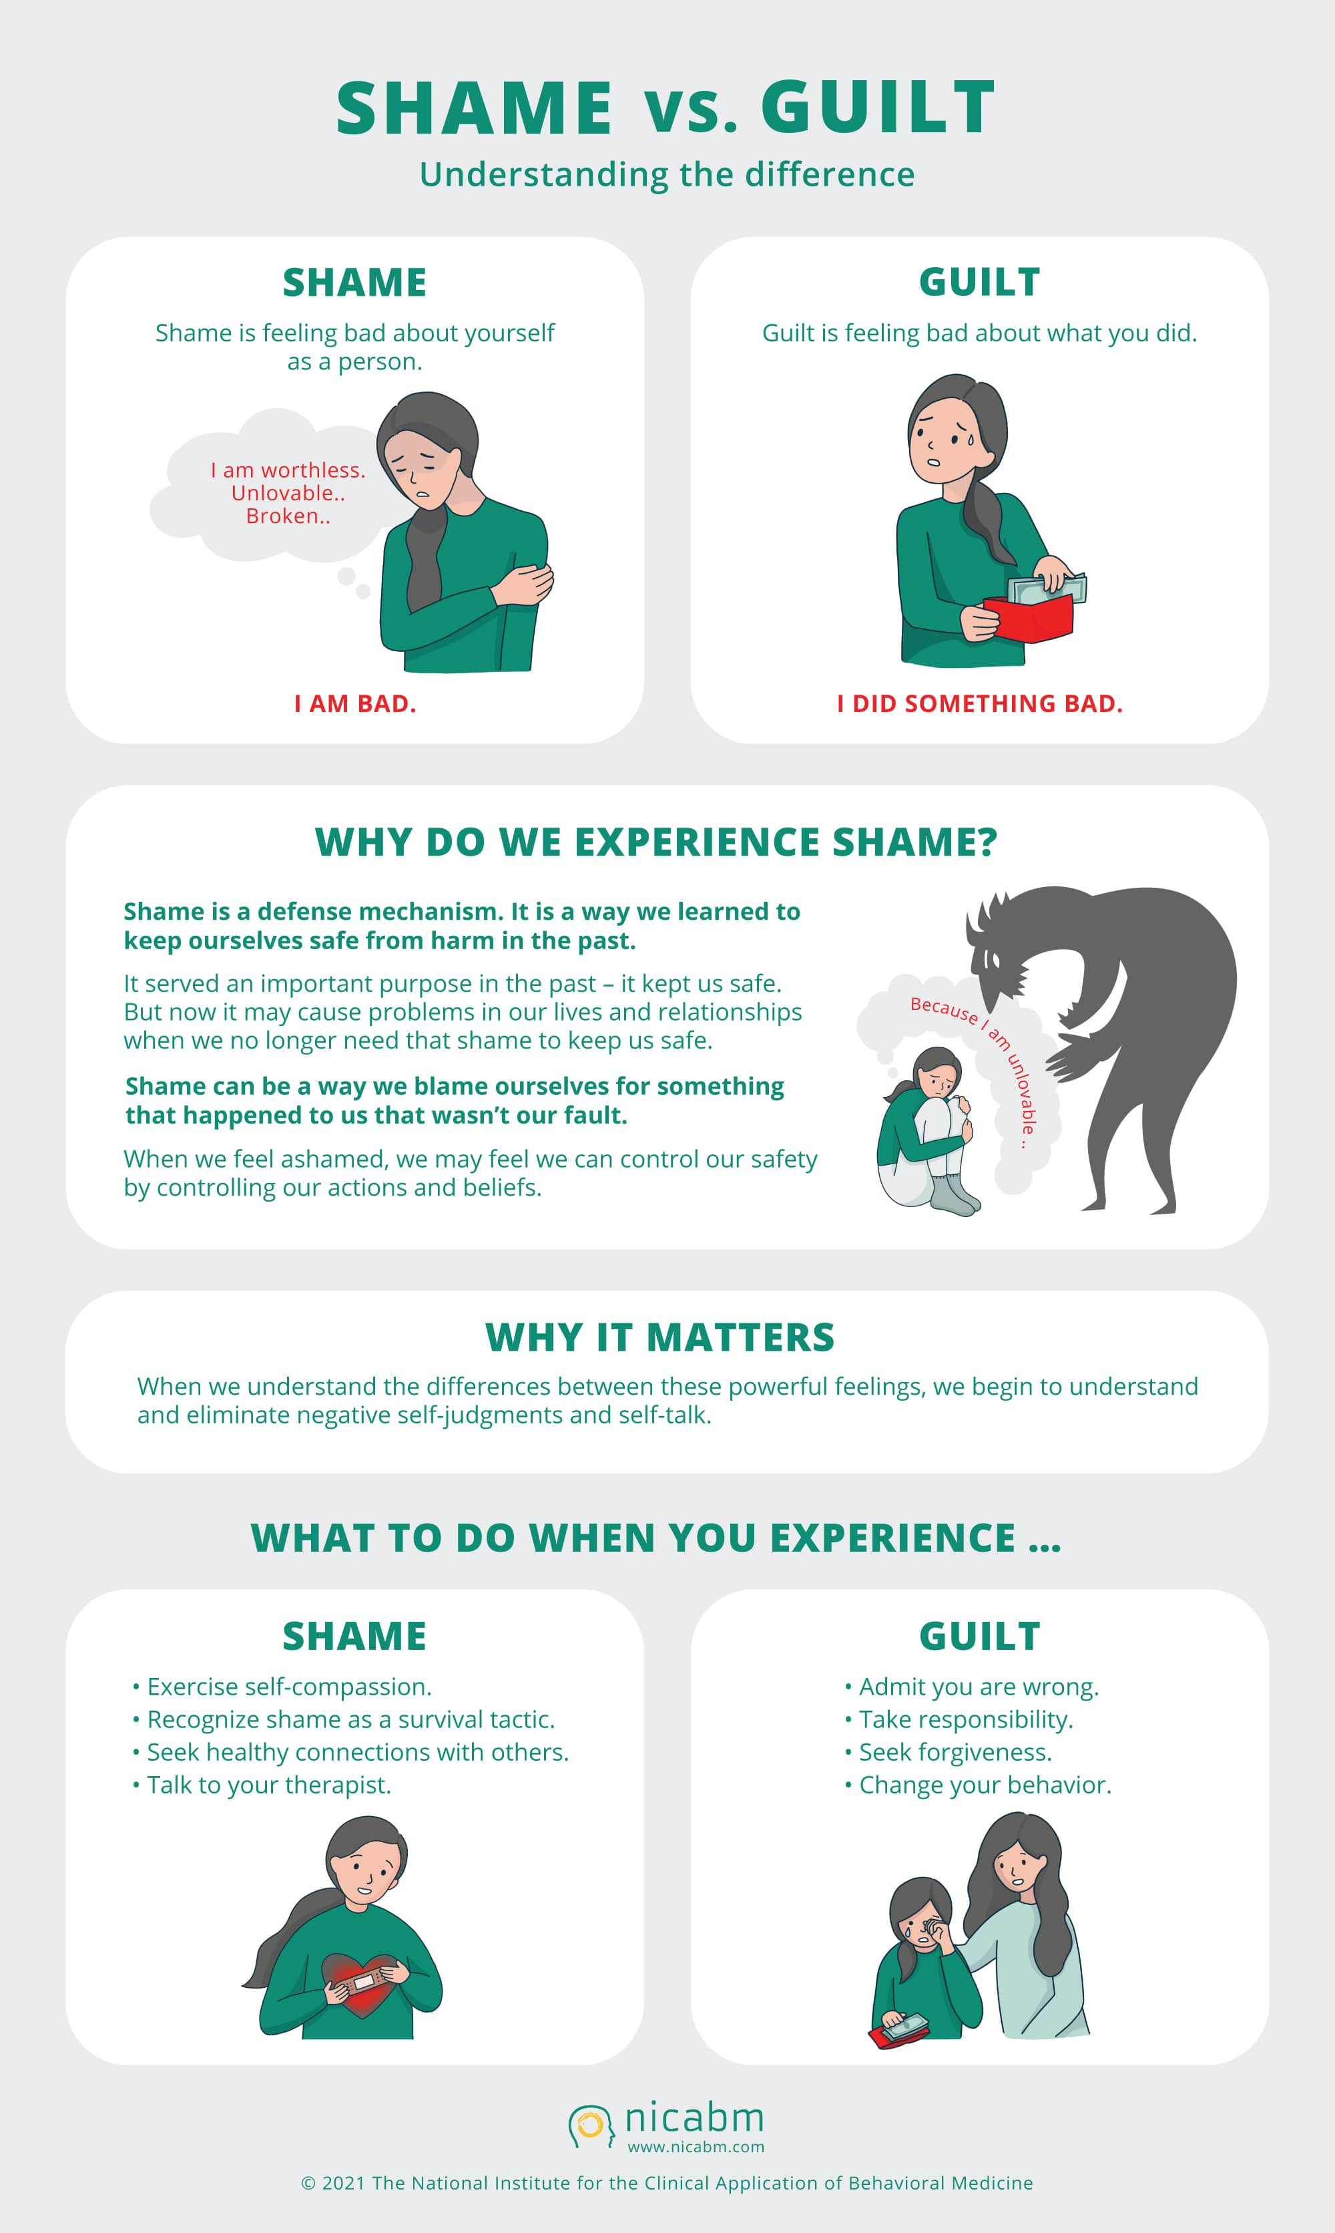
Guilt is the feeling that we have done something wrong
Shame, in contrast, is the feeling we have when we evaluate our actions, feelings, and behaviors and conclude that we are inadequate or deficient. Shame encompasses the whole of ourselves; it generates a wish to hide, to disappear or even to die. Shame is the feeling of inferiority.
Shame is the belief in one's inferior status or the feeling that one does not conform to social norms and expectations.
Shame is frequently associated with complex PTSD. Enduring prolonged abuse, whether it be by a caregiver, partner, relative, or coworker, leaves the person with a false internalized belief that they are innately bad, defective, and not good enough.
Shame is associated with trust issues, being a people pleaser, self sabotage, feeling undeserving of love, never feeling safe, feeling as if you must be perfect, constantly feeling like you've done something wrong, and a chronic sense of worthlessness and not being good enough.
People experience external shame in the form of thoughts and feelings about how they exist in the mind of others and internal shame or self-directed evaluations, thoughts and feelings about inadequacies and flaws.
SHAME AND GUILT

Slide 108
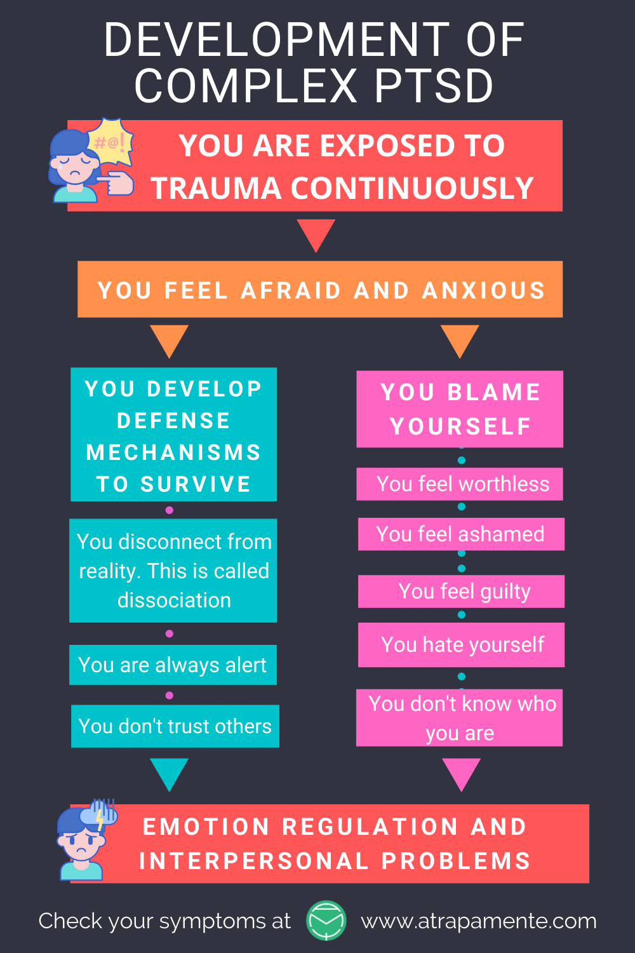
SHAME: A FEATURE OF ATTACHMENT ISSUES AND CAREGIVER TRAUMA
When most of us think of an abused child, we rationally know the child does not deserve the abuse. We consider the abuser to be entirely at fault for the abuse.
If, however, as adults, we are in an abusive relationship, over time, we often come to believe that the problem is with us.(gaslighting-Stockholm syndrome.)
That is because we come to feel the situation from emotional mind and emotional mind dominates rational mind.
The emotional mind is fully developed at birth, the rational mind isn’t, it starts to develop at age 3-4 and is only fully developed by our mid 20’s.
The abused child doesn’t have the capacity to think rationally about their situation. They can only “feel” the situation. The model that forms in their mind is that of 1) an all-knowing, all-powerful adult who is angry at them and repeatedly holds them at fault, and 2) their frightened, or despairing/abandoned selves .
Shame, the feeling that there is something fundamentally wrong, evil, unlovable, not good enough, or different and that I will be abandoned, in danger, unhappy and that it is my fault is born in this caregiver child dynamic. This deep-rooted feeling is resistant to change by rational mind re-framing.
This kind of shame is extremely common in people with attachment and developmental trauma issues.

Slide 109
Shame often result in people stopping or never engaging in treatment.
Shame impedes social connection and cuts the individual off from the support and soothing that may come from others including therapists.
The power imbalance between patient and therapist, and the unilateral exposure of the patients most intimate thoughts and feelings can further contribute to a feeling of shame in therapy.
The lack of trust present in complex PTSD starts with early attachment issues and the failure to negotiate Erickson's stage of trust versus mistrust.
The development of a trusting and secure relationship whether it be with a mentor, friend, partner, or therapist is key in the repair of shame.
SHAME IN THERAPY

Slide 110
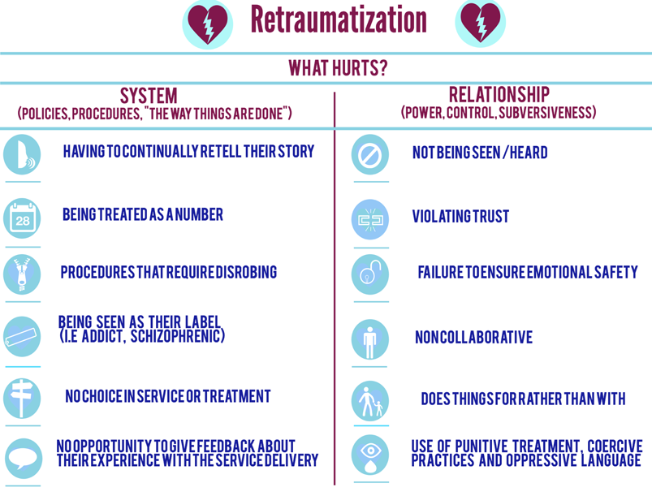
RE-TRAUMATIZATION
Re-traumatization happens when a person suffering from a trauma related disorder is exposed to people, incidents, or environments that cause them to relive the previous trauma, almost as if it were occurring again.
Because we are drawn not to relationships that are good for us but to those that are familiar, re-traumatization is common.
In a therapeutic setting transference and countertransference can result in re-traumatization.
Re-traumatization often affects vulnerable people in contact with healthcare settings.
Re-traumatization can be prevented through trauma informed care.
Notes:
The last but perhaps most important subject will touch on in the session is re-traumatization. Re-traumatization can occur both through the system, as well as in individual relationships with care providers.

Slide 111
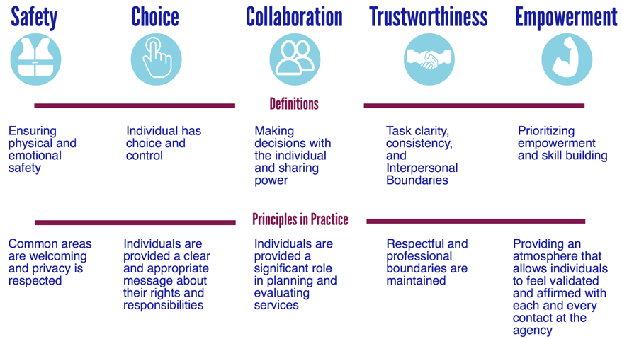
TRAUMA INFORMED CARE: WHAT HELPS
Notes:
The answer to re-traumatization is trauma informed care. Trauma informed care is contingent on a number of factors…

Slide 112
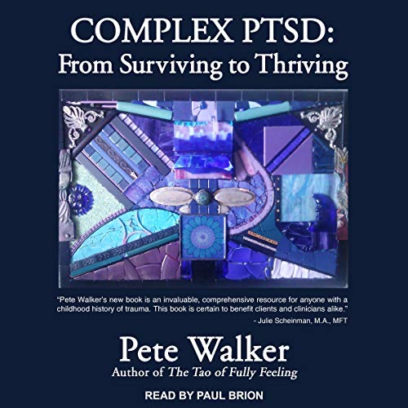
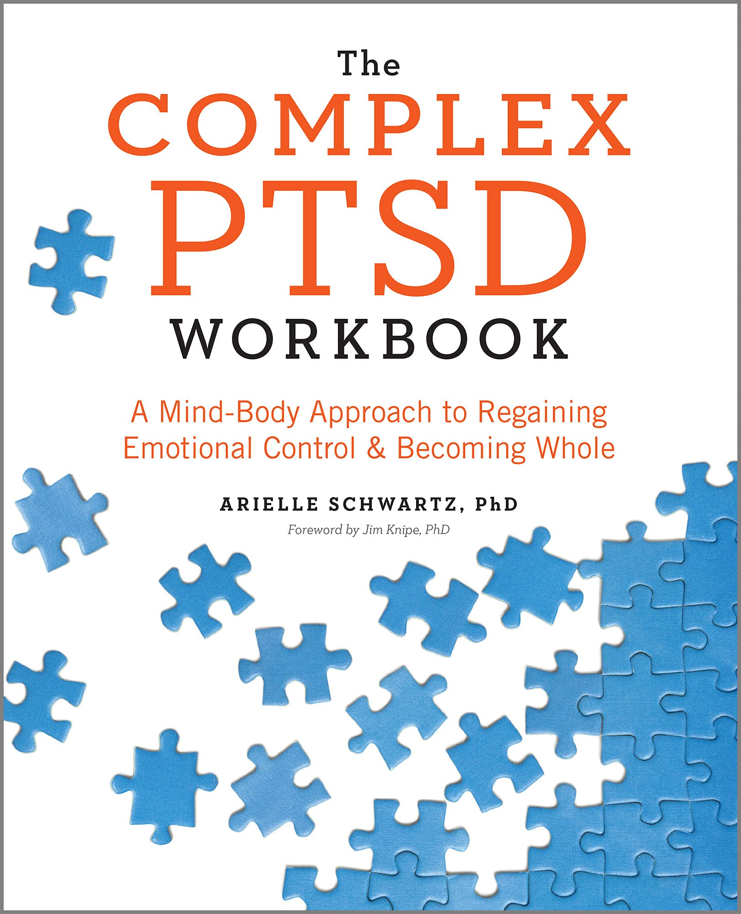
Notes:
Finally here are three books that might help you to better understand the traumatic spectrum disorders.

Slide 114
See you next session

Slide 115
(1)Structural dissociation theory is a psychological theory that was developed by Onno van der Hart, Ellert Nijenhuis, and Kathy Steele. It is based on the idea that the mind is structured into different parts or self-states, each with its own thoughts, feelings, and memories. According to this theory, dissociation is a normal and adaptive response to trauma, where the mind separates different parts of the self in order to cope with overwhelming experiences. In structural dissociation theory, there are two main parts of the self: the apparently normal part (ANP) and the emotional part (EP). The ANP is responsible for day-to-day functioning and is often unaware of traumatic memories, while the EP holds the emotional and traumatic memories. When a person experiences trauma, these parts of the self can become fragmented and disconnected, leading to symptoms of dissociation and other psychological disorders. Therapy based on structural dissociation theory aims to help individuals integrate these different parts of the self, so that they can process and heal from traumatic experiences. By understanding and working with these different self-states, individuals can develop a more cohesive sense of self and reduce symptoms of dissociation.

Slide 116
(2)Flashbacks are a common symptom of post-traumatic stress disorder (PTSD) and can be distressing experiences where a person feels as though they are reliving a traumatic event. There are several different types of flashbacks that individuals may experience: 1. Visual flashbacks: These involve vivid images or scenes from the traumatic event that play out in the person's mind as if they are happening in the present moment. 2. Emotional flashbacks: These involve intense emotions or feelings related to the traumatic event, such as fear, sadness, or anger, that can be triggered by certain stimuli or reminders. 3. Sensory flashbacks: These involve sensations or physical feelings associated with the traumatic event, such as pain, smells, sounds, or tastes, that can be triggered by sensory cues in the environment. 4. Dissociative flashbacks: These involve a sense of detachment or disconnection from reality, where the person may feel like they are outside of their body or watching themselves from a distance. It's important to note that flashbacks can vary in intensity and duration, and may be triggered by specific cues or reminders of the traumatic event. It's also important for individuals experiencing flashbacks to seek support from mental health professionals to learn coping strategies and techniques to manage and reduce the impact of these distressing experiences.

