Slide 1
Welcome to the 2025-26 simple course
“ Human beings are driven by forces of which they are not aware” Jeffrey Kripal
“Healing is the touching with love of that which has been touched with fear, anger, and despair” Anonymous.
“Health is not the absence of disease, it is the state of physical, psychological, social, and spiritual wellbeing.” WHO
“Be kind for everyone you meet is fighting a great battle” Anonymous
Notes:
Pre slide one
Cars, bicycles, cameras, computers, almost anything these days comes with an owner's manual. Unfortunately, people don’t
An owners' manual can help you operate a product and trouble shoot if something goes wrong with it
One of the Simple course goals is to try to provide you with an owner's manual to your mind. If you’re happy with your life, you don’t need to do this course, but if you struggle with feelings, thoughts, or behaviors you will find it useful.
Many aspects of the human mind remain a great mystery but increasingly we have glimpses into how it functions. Knowing how it functions can, if we struggle emotionally, help ease our pain.
It's a privilege to be with you, hopefully for all the 29 simple sessions, in which together we will explore the mind and how to heal it. Welcome to the simple journey

Slide 2
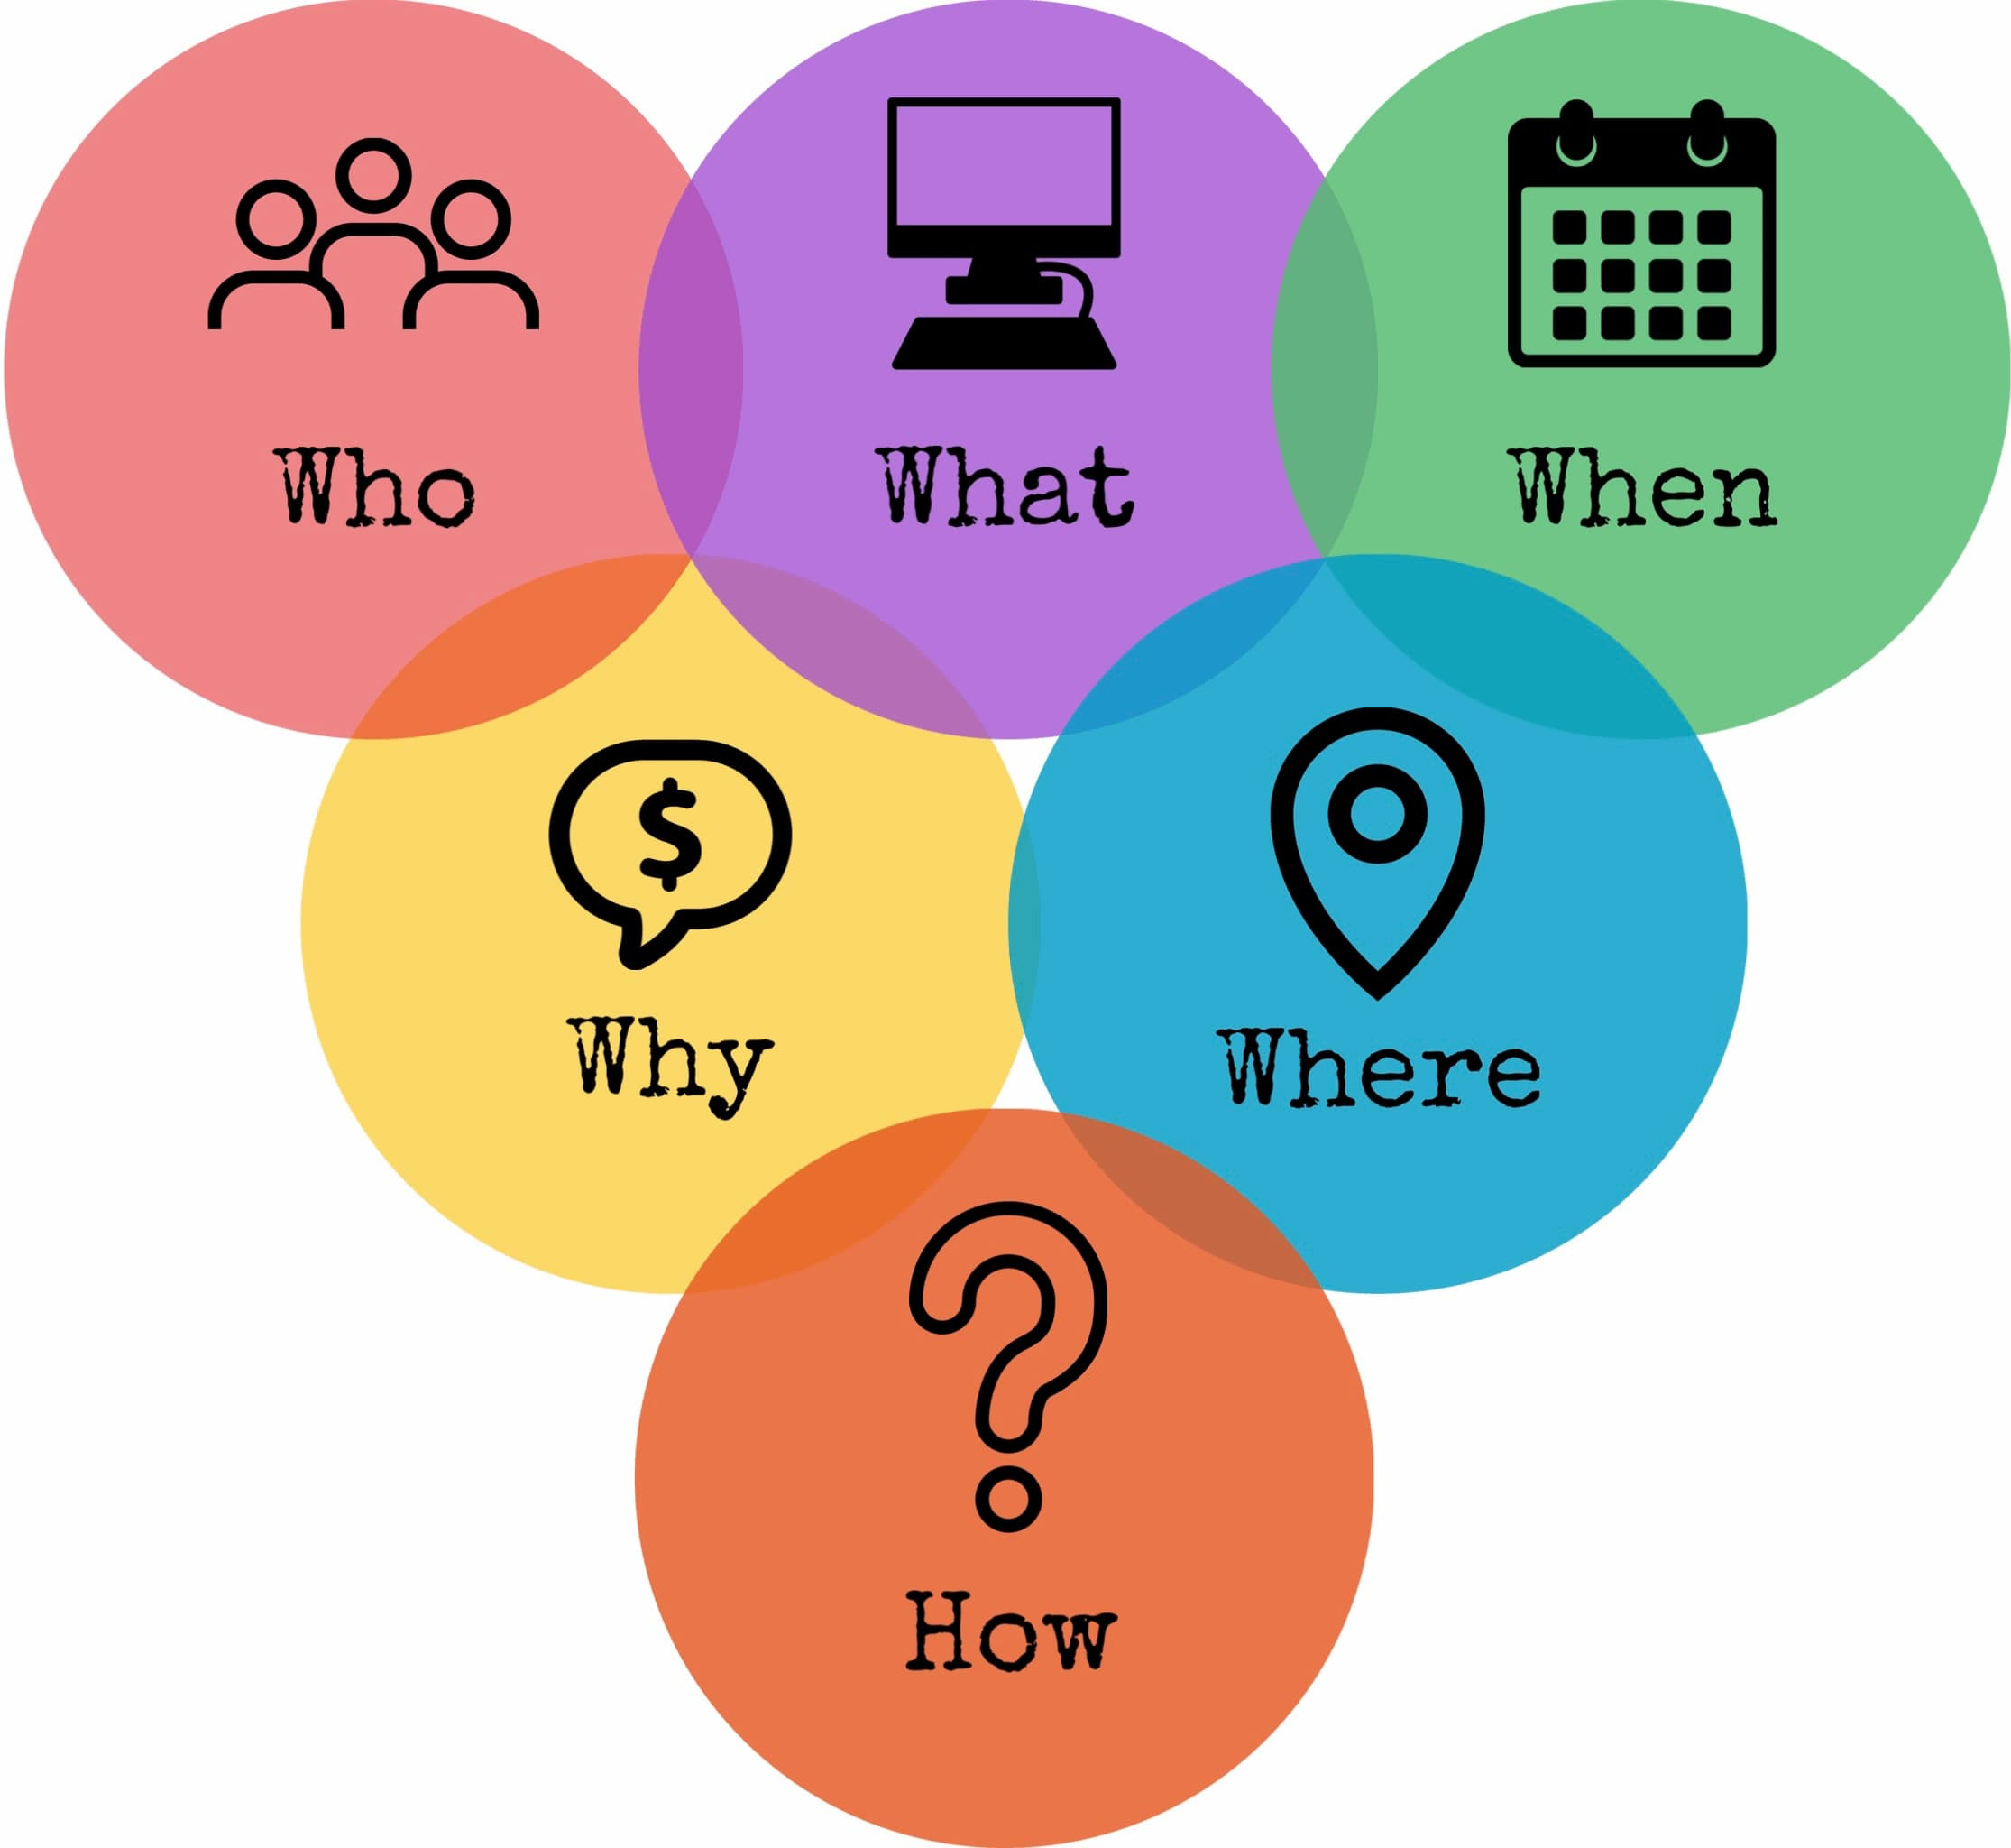
week 1 of SIMPLE orientation and introduction
WELCOME

Slide 3
week 1- orientation and overview- sessions 1 and 2 of simple manual. week 2- introducing distress tolerance-p. 1-13 of dbt workbook and crisis plans-session 3 of the manual. week 3- the theoretical foundations of the simple course. session 4, 6, and 8 of the manual. week 4- distress tolerance p. 14-32 of dbt workbook. suicide prevention session 5 of the manual. our first practice- crisis plans. week 5- distress tolerance p. 33-46 of dbt workbook. introducing holes diary cards- session 7 of manual. week 6- distress tolerance p. 47-68 of dbt workbook. finding your diary card targets- session 9 of manual. our second practice- holes diary cards. week 7- introducing personality- session 10 of manual. week 8- distress tolerance p. 69-90 of dbt workbook. introducing chain analysis-session 11 of manual. week 9- what shapes personality-session 12 of manual. week 10-introducing mindfulness skills p.90-109 of dbt workbook. advanced chain analysis- session 13 of manual. our third practice-chain analysis. week 11- attachment theory- session 14 of manual. week 12- mindfulness skills p. 110-131 of dbt workbook. introducing rational mind remediation-session 15 of manual. week 13- the dynamic-maturational model of attachment and adaptation- session 16 of manual. week 14-mindfulness skills p. 131-147 of dbt workbook. reviewing all the tools-session 17 of manual. our fourth practice-rational mind remediation. week 15-stress-session 18 of manual. week 16-introducing emotion regulation skills p.148-182 of dbt workbook. introducing the goals diary card procedure-session 19 of manual.

Slide 4

My name is…
My role as a co leader is…
My hope for the time we spend together is…
Luis Cleto
“Sargent simple”
May I live graciously and joyfully nurturing the flame and being of service to the universe

Slide 5

In an effort to make the course more easily available, this year we are recording the Wednesday sessions.
We will post the videos on our YouTube channel @itssimpleonyoutube1123.
We are very concerned about respecting the privacy of the participants. Our goal is that neither the in person nor the zoom participants will be visible or audible on the videos unless they want to be.
To this effect we will have two periods for participant questions or comments. The first will be before the midsession break and the second before the end of the session. We will stop recording during these periods.
We also encourage you to save any lengthier or more personal comments or questions for the Monday “boing” group which will not be recorded. (more on this group later) The boing group starts Monday October 27th (1-2:30pm).
RECORDING SESSIONS

Slide 6

YOUR QUESTIONS AND COMMENTS
We truly appreciate your active participation in the course and welcome your questions and comments. They are important in making the content of the course clearer and helping us to do a better job.
Over the years we’ve experimented with different question and comment formats. Last year participants could ask questions at any point in the session.
From the feedback we got most participants thought that interrupted the flow of the session and was distracting.
In response to this feedback, we are going back to having two designated periods of up to 15 minutes each for questions and comments.
These will be before or right after the half-way break and before the end of the session. Outside these times we will not be using the raised hand function.
You can send us your questions or make comments in the chat box or ask them in person.
If you have questions between sessions, you can email us, and we will try to address them. If they are lengthier or more personal questions or comments, we encourage you to save them for the Monday boing group.

Slide 7
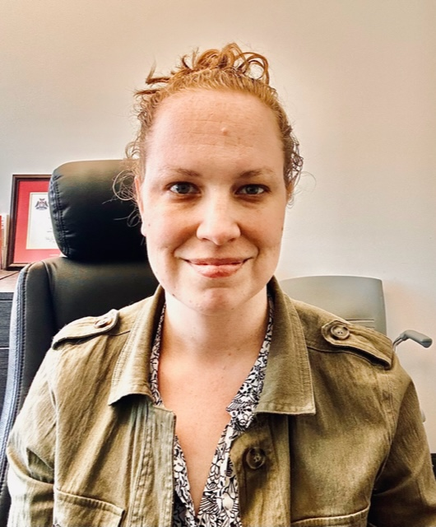
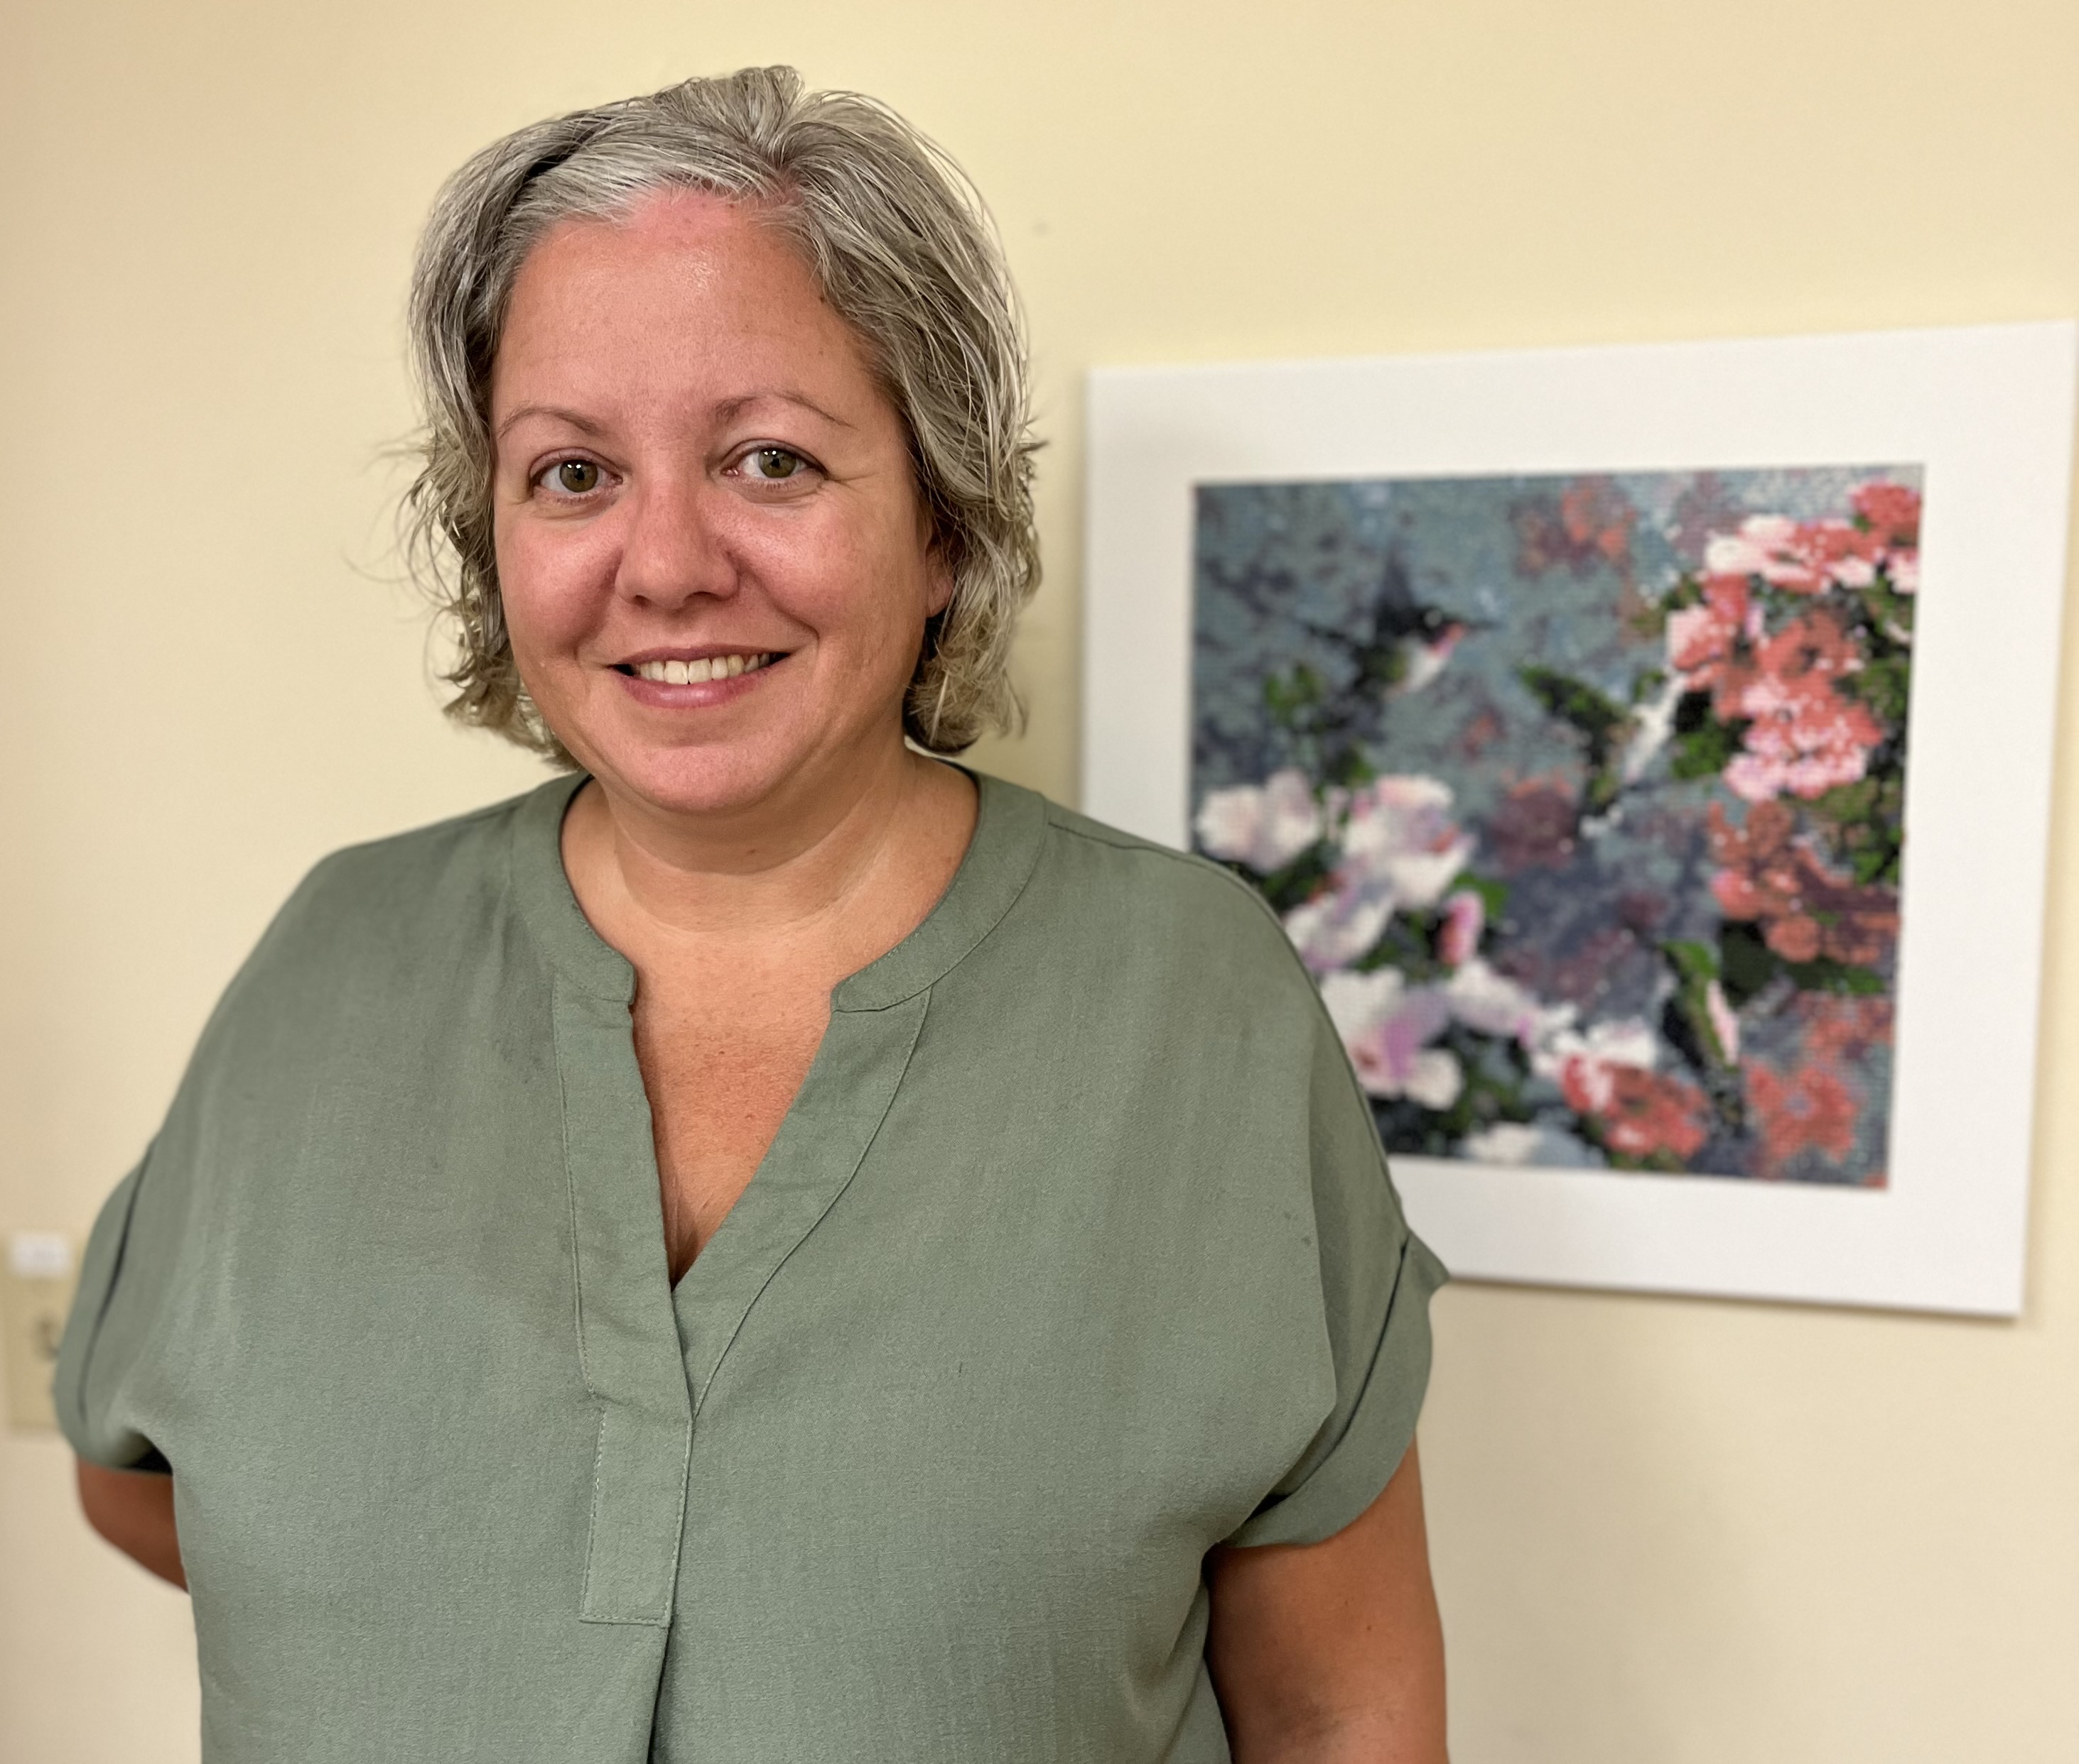


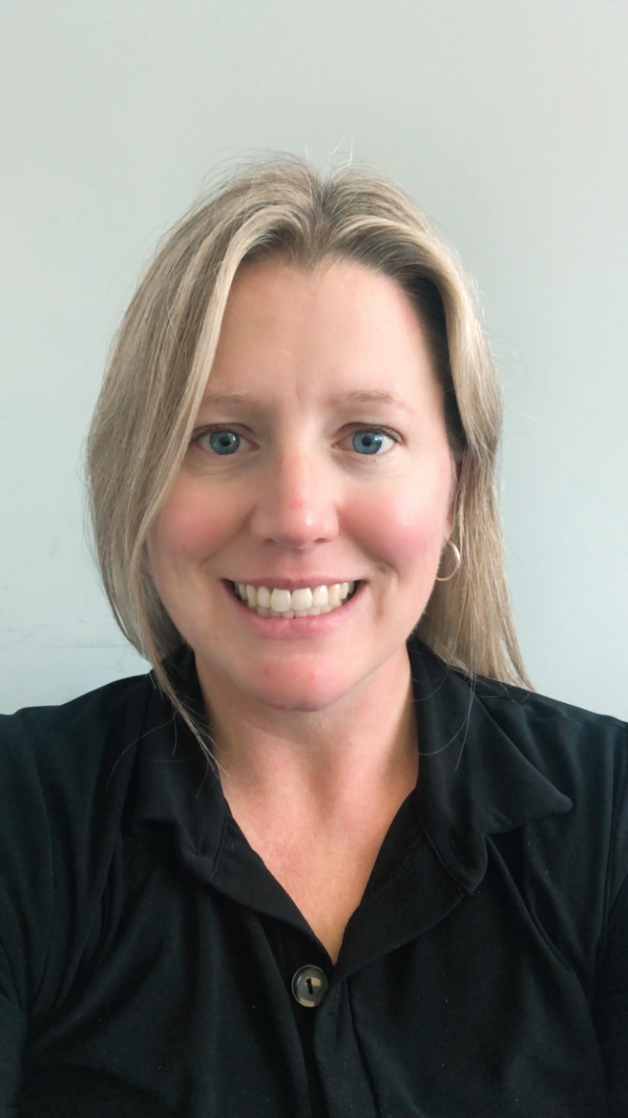


2025-26 SIMPLE COURSE CO-LEADERS
Lauren Gienow
Eyes in the sky .
Peg Huettlin
Peg Huettlin
Zoom in room
Betsy Austin Olsen
Stealthy supporter
luis cleto
Sargent simple
Formerly corporal cleto
Nicole Rogerson
Skills and thrills 2
Kate Smidts
Highlights and insights
Joan Flanagan
Skills and thrills 1
The 2024-25 Simple course is offered in collaboration with:
The Stratford and Star family health teams
Notes:
I, Luis cleto, have offered the simple course every year for the last 25 years. Over that time, I've had the privilege to co-lead the course with several different clinicians. In 2022 – 23 these were the coleaders of the in person and virtual live simple course.

Slide 8


TODAY IS DIVIDED INTO 2 PARTS
2. OVERVIEW: THE WHAT OF THE SIMPLE COURSE
An overview of the Simple “trip” or material we will cover over the next 8 months.
1. ORIENTATION: THE WHO, HOW, WHY WHERE, AND WHEN OR NUTS AND BOLTS OF THE SIMPLE COURSE
An introduction to the Simple “bus”

Slide 9

WHAT WE WILL DO TODAY
Poll about you
Mindfulness
Your intentions for the course
Why is this course called Simple and who might benefit from it
What do you need to have to do the Simple course ?
Simple course resources and schedule
Participant agreements for the in person and zoom attendees.
health, illness, disease, sickness, disorder, pain and suffering
"there is a hole in my sidewalk" by Portia Nelson
What we will be covering in the course
Challenges often encountered by people doing Simple
Stuff to keep in mind when sharing in the group or if you’re triggered
Homework for the coming week
Notes:
In our session today we will cover several subjects these include:

Slide 10
Nicole Rogerson
Skills and thrills 2
My name is…
My role as a co leader is…
My hope for the course is…

Slide 11
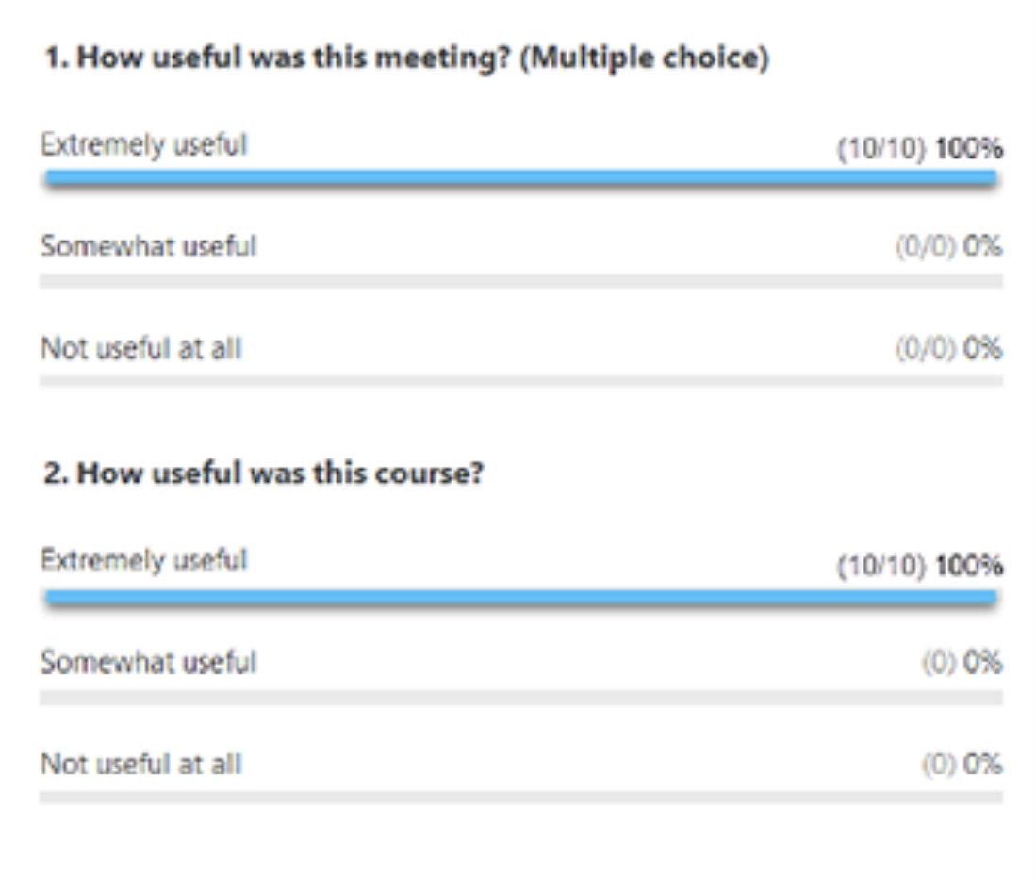
ZOOM POLLS
Throughout the year we will be doing polls to better understand some of your thoughts, feelings and needs from the course.
We’ll look at the answers of zoom participants immediately after we do the polls.
We’ll share the answers of in person participants at the beginning of the session the week after the poll.
Answers are anonymous
Session 1 poll… some information about you

Slide 12
ORIENTATION TO SIMPLE:
WHAT WE WILL DO TODAY
Introductions
Mindfulness
Your intentions for the course
Why is this course called Simple and who might benefit from it
What do you need to have to do the Simple course ?
Simple course resources and schedule
Participant agreements for the in person and zoom attendees.
health, illness, disease, sickness, disorder, pain and suffering
"there is a hole in my sidewalk" by Portia Nelson
What we will be covering in the course
Challenges often encountered by people doing Simple
Stuff to keep in mind when sharing in the group or if you’re triggered
Homework for the coming week
Notes:
In our session today we will cover several subjects these include:

Slide 13
My name is…
My role as a co leader is…
My hope for the course is…
Joan Flanagan
Skills and thrills 1
Mindfulness is paying attention in the present moment without judgement. Mindfulness is a core concept in the course

Slide 14
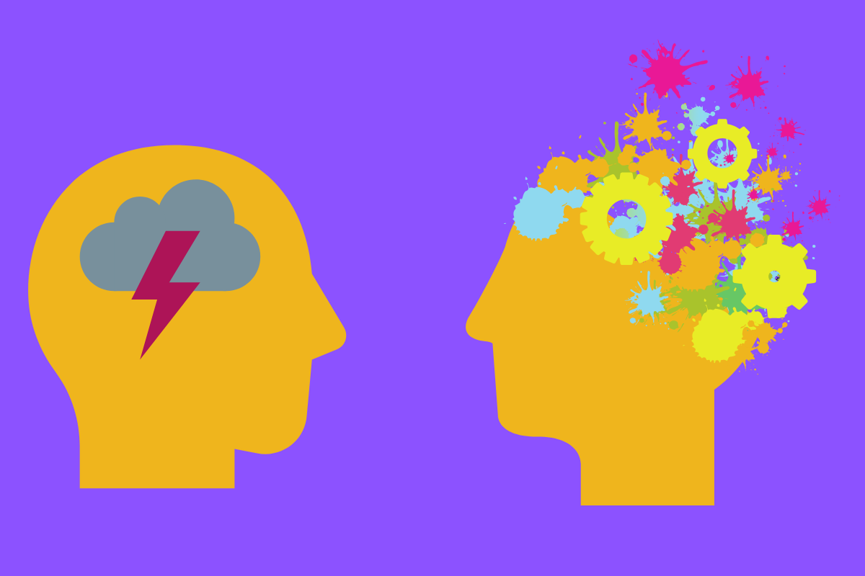
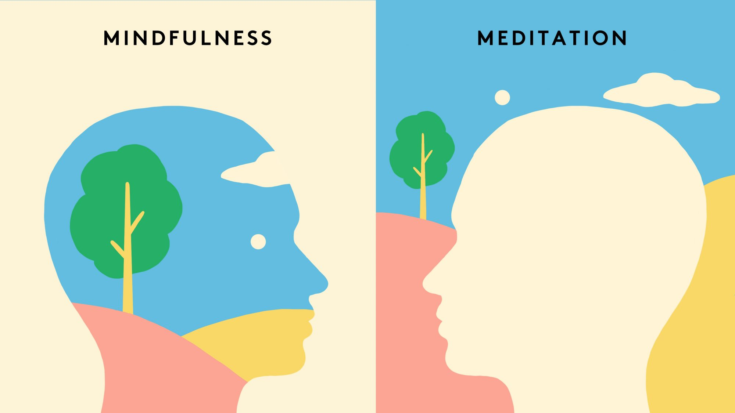
WHAT IS MINDFULNESS ?
Distressing thoughts and feelings
Mindfulness and meditation
Negative thoughts
Racing thoughts
In our day-to-day life, when we are not focused on a concrete task, our thoughts tend to roam, flitting from one subject to another in a stream of associations. Sometimes our thoughts go to happy or neutral places but many people experience a disproportionate amount of negative painful thoughts and feelings.
Mindfulness is learning the difficult skill of influencing the contents of our thoughts and feelings.
In mindfulness, we fill our mind with something that we choose to fill it with, for example being present with a friend, the forest around us, or a sunset. In mindfulness the mind stays present with that one thing and does not roam to other subjects.
Mindfulness, is about learning to live in the present moment rather than “time travelling” and ruminating about the past or catastrophizing about the future.
Meditation is a mindfulness practice that helps us learn to focus our attention by keeping it focused on one single object of perception such as the breath, a mantra, or our bodily sensations.
Notes:
Pre slide
Often, when we’re distressed, we have negative, racing, intrusive or unwanted thoughts, and feelings
mindfulness Is the practice of focusing the mind on an object of one’s choice . That object might for example be our breath.
Meditation on the other hand is the activity of emptying the mind as much as possible. That may also be done by focusing on our breath, and then noticing when it wonders and gently bringing it back to focus.

Slide 15
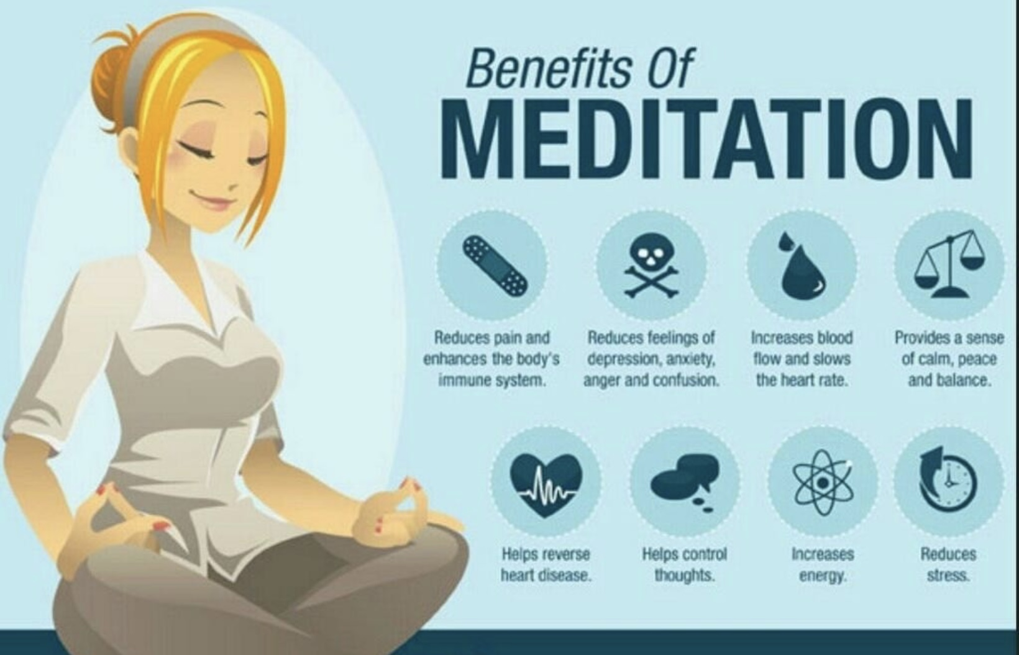
BENEFITS AND RISKS OF MEDITATION
Thousands of studies have concluded that meditation benefits mental, physical, emotional, and spiritual health.
Meditation is also known to potentially have some negative effects.
The most common negative effects of meditation are increased anxiety, panic, confusion and disorientation, depression, and feeling spaced out.
People with significant past trauma and those who frequently have ruminative negative thoughts are the most likely to experience these negative effects.
A busy life can serve to distract us from painful thoughts and feelings. Sometimes when we slow our minds down the negative thoughts and feelings fill the empty space we created.
This is also why some people are more distressed at nighttime or in the morning when it’s quieter.

Slide 16
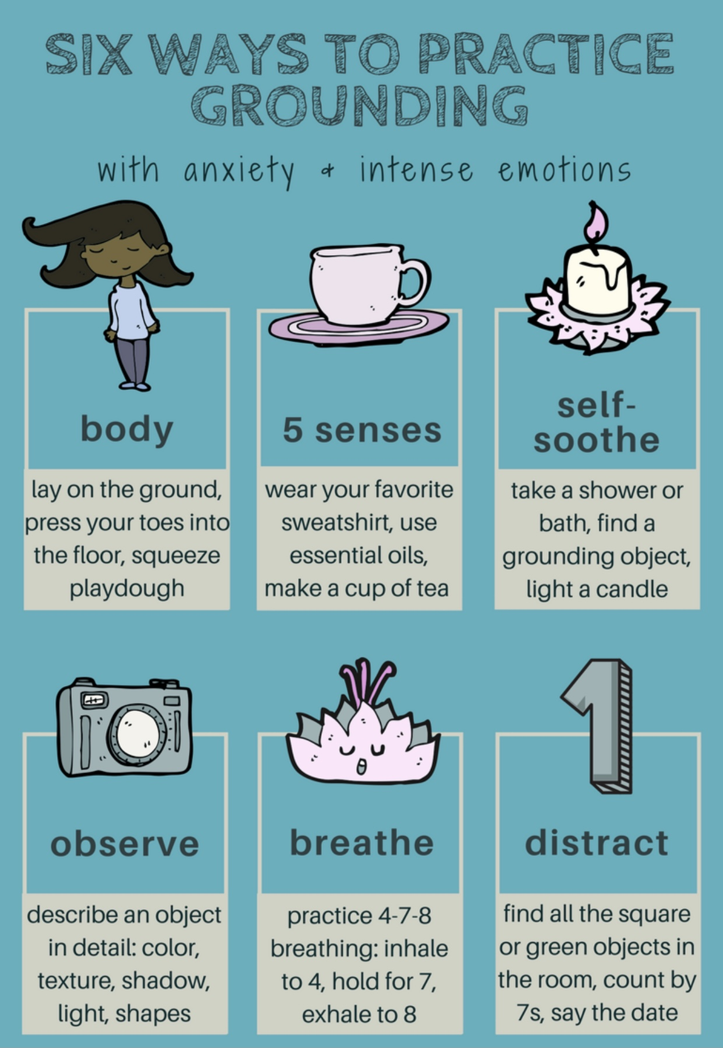
WHAT IS GROUNDING?
Grounding techniques, also known as grounding exercises or grounding skills, can distract, reframe, or otherwise soothe distressing feelings. They shift your focus from past or future thinking into the present moment. You may already engage in some of these techniques without formally realizing it.
Grounding exercises are especially helpful if you are experiencing anxiety disorders, self-harm urges, substance use disorders, eating disorders, PTSD or complex PTSD symptoms, dissociation, childhood trauma, panic attacks or persistent feelings of being overwhelmed, and chronic pain.
Grounding exercises are practices that can help you to manage your trauma symptoms when they occur. Grounding exercises help you to focus on the here and now. This can help you to distract from what is preoccupying your mind.
Grounding exercises are mindfulness but not meditation exercises.
The self soothing toolkit and the mindful eating exercise which we will do together in future sessions are both grounding exercises. They should both be safe for most people
If mindfulness exercise cause you distress feel free to skip them, you may want to use that time to do a grounding practice

Slide 17
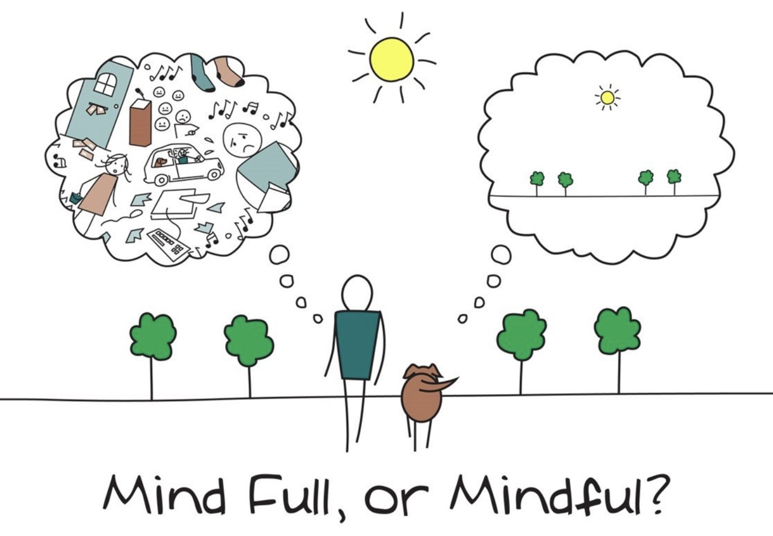
OUR FIRST 5 MINUTE MINDFULNESS EXERCISE

Slide 18

mindfulness practice
feel free to skip it if you feel distressed
Notes:
Pre slide
Today we will do what is perhaps the most iconic DBT mindfulness practice: the raisin exercise.
It is a mindfulness exercise in which your mind will be full of the different aspects of the raisin: what it looks like, what it smells like, what it feels like, even what it sounds like and finally what it tastes like.
Mindfulness exercises such as this one and the sensory toolkit are also grounding exercises. Grounding exercises generally avoid the side effects of meditation, and you may choose to focus on them as you begin a meditation practice.
The six different types of grounding exercises which are the most popular and were previously discussed in the distress tolerance module are 1) focusing on bodily sensations 2) grounding with the five senses 3) self soothing 4) describing an object in great detail 5) counting breaths 6) distracting with a mind activity.

Slide 19
WELCOME
Let’s begin by finding a comfortable position—seated or lying down—whatever feels safe and grounded to you.
If you feel comfortable, you can gently close your eyes. If not, simply lower your gaze or soften your focus.
Take a moment to arrive.
Notice that you are here, in this space, with this group.
You don’t need to do anything right now. There’s nothing to fix or figure out. Just be.
Let your attention rest on your breath—noticing the in-breath… and the out-breath.
You don’t have to breathe in any special way.
Just notice the natural rhythm.
Feel the breath as it enters through your nose or mouth…
and gently leaves your body.
Now bring awareness to your body.
Can you feel the support beneath you—your chair, the floor?
Allow yourself to settle into that support, trusting that you are held.
If it feels okay, gently scan your body from head to toe.
Noticing any areas of tension, ease, or simply neutral sensation.
There’s no need to judge or change what you find.
Just notice. Just allow.
And now, gently notice whatever emotions are here.
You might feel calm, nervous, curious, or something unnamed.
Whatever is present is welcome.
You don’t need to push anything away.
Just for this moment, give yourself permission to be exactly as you are.
Breathing in, I am here.
Breathing out, I allow myself to be here.
Let’s take a final moment of quiet together.
[10–15 seconds of silence]
When you’re ready, gently wiggle your fingers and toes.
You can open your eyes if they were closed, and come back to the room.
Welcome to the group. You belong here. We’re glad you’re here.

Slide 20
ORIENTATION TO SIMPLE:
WHAT WE WILL DO TODAY
Introductions
Mindfulness
Your intentions for the course
Why is this course called Simple and who might benefit from it
What do you need to have to do the Simple course ?
Simple course resources and schedule
Participant agreements for the in person and zoom attendees.
health, illness, disease, sickness, disorder, pain and suffering
"there is a hole in my sidewalk" by Portia Nelson
What we will be covering in the course
Challenges often encountered by people doing Simple
Stuff to keep in mind when sharing in the group or if you’re triggered
Homework for the coming week
Notes:
In our session today we will cover several subjects these include:

Slide 21
My name is…
My role as a co leader is…
My hope for the course is…
Betsy Austin Olsen
Stealthy supporter

Slide 22
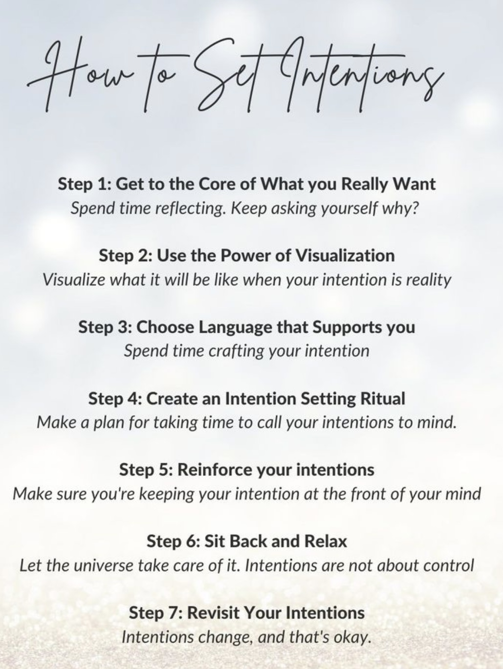
Setting an intention involves consciously deciding what you want to focus on or achieve in a particular area of your life. It’s about clarifying your goals, desires, or feelings and aligning your actions and mindset with those aspirations. This practice can be done in various ways, such as through meditation, journaling, or simply taking a moment to reflect.
When you set an intention, you’re not just wishing for something to happen; you’re actively committing to a mindset or a course of action that can help you manifest your goals. It can be as specific as wanting to improve your health or as broad as seeking more joy in your daily life. The key is to be clear and positive about what you want to invite into your life!
Take a moment now to think about and set your intention for the next 32 sessions which we’ll spend together. Write it down. Remind yourself of your intentions every time you do the course. If you would like, you can share your intentions with us during the question period.
YOUR INTENTIONS FOR THE COURSE

Slide 23
ORIENTATION TO SIMPLE:
WHAT WE WILL DO TODAY
Introductions
Mindfulness
Your intentions for the course
Why is this course called Simple and who might benefit from it
What do you need to have to do the Simple course ?
Simple course resources and schedule
Participant agreements for the in person and zoom attendees.
health, illness, disease, sickness, disorder, pain and suffering
"there is a hole in my sidewalk" by Portia Nelson
What we will be covering in the course
Challenges often encountered by people doing Simple
Stuff to keep in mind when sharing in the group or if you’re triggered
Homework for the coming week
Notes:
In our session today we will cover several subjects these include:

Slide 24




it's simple
Structured
Integrative, integral, idealist, IFS inspired
Mindful
Psychotherapy that is Learned
Easily
SIMPLE
Neurobiology
DBT
Psychodynamic attachment and trauma theory
Integral theory
Simple is a bio psycho socio spiritual course/group that is geared towards anyone who experiences emotional dysregulation.
It strives to synthesize knowledge from a variety of disciplines into a single framework
Notes:
Thank you for your time I truly appreciate it. Over the next 30 minutes I’d like to share with you a project which I think, if taken to the next phase, could address some gaps in mental health care .
Simple is an acronym for… Integral is a nod to philosopher Ken Wilber whose work permeates the course while idealist refers to philosophical idealism which is becoming more accepted in academic philosophical circles particularly as articulated by philosophers such as Bernardo Kastrup. Mindful I don’t have to explain.

Slide 25
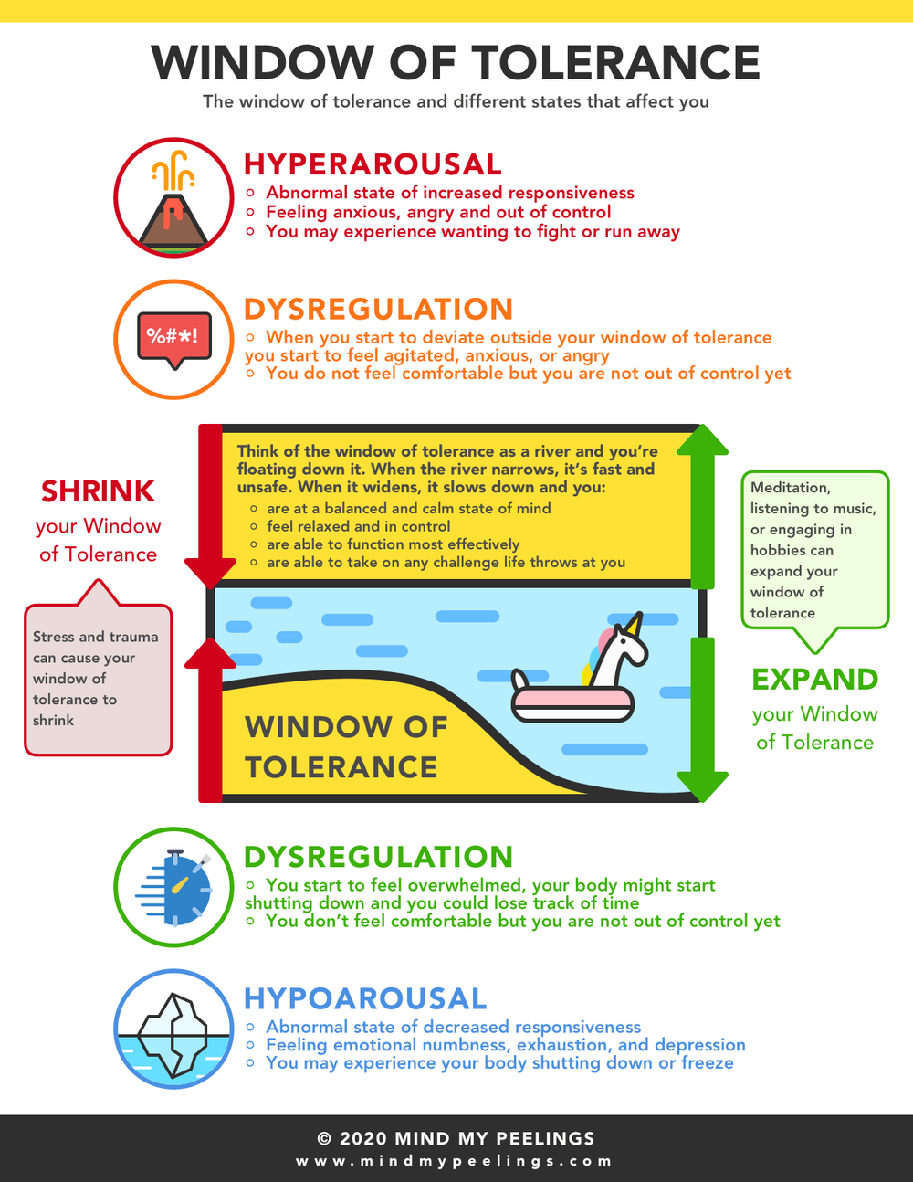
WHO SIMPLE IS FOR
Anyone who experiences emotional dysregulation.
Being calm or alert is a state of physiological activation referred to as the ‘window of emotional tolerance’. Outside that window lie the hyperarousal of fight/flight and the hypoarousal of freeze/dissociation.
What is emotional dysregulation?
It is a disproportionate emotional reaction to present day events or intense emotions arising apparently from nowhere.
Dysregulated emotions are often seen as the core problem which then give rise to dysregulated thoughts and behaviors.
Many people who experience depression, anxiety, high levels of shame and anger, self-harm, excessive substance use, high risk behaviors, perfectionism, conflictual interpersonal relationships, issues with eating, suicidal thoughts, etc.. do so because of emotional dysregulation
Dysregulated emotions are not just average responses to present day events, they often are triggered by present-day events but may owe to unconscious factors such as a person’s temperamental predispositions, and their past experiences, including the type of parenting they had and/or previous traumatic circumstances they may have encountered in the course o their lives.
The main goals of this course are 1. to help people who experience emotional dysregulation become aware of, understand, and better regulate their dysregulated emotions , thoughts, and behaviors and 2. to heal the traumas that underlie emotional dysregulation

Slide 26
ORIENTATION TO SIMPLE:
WHAT WE WILL DO TODAY
Introductions
Mindfulness
Your intentions for the course
Why is this course called Simple and who might benefit from it
What do you need to have to do the Simple course ?
Simple course resources and schedule
Participant agreements for the in person and zoom attendees.
health, illness, disease, sickness, disorder, pain and suffering
"there is a hole in my sidewalk" by Portia Nelson
What we will be covering in the course
Challenges often encountered by people doing Simple
Stuff to keep in mind when sharing in the group or if you’re triggered
Homework for the coming week
Notes:
In our session today we will cover several subjects these include:

Slide 27
What do you need to do the Simple course?

Slide 28
WHAT YOU NEED TO DO THE SIMPLE COURSE
1. a)The Simple manual $13 b)the skills training and c)IFS workbooks each around $30
2. A 3-ring binder
3. Access to the Simple website- Itssimple2021.com
5. Your active participation
4. Access to the It’s Simple on YouTube (Luis Cleto it’s simple on YouTube sessions) or the “live” course.
Notes:
You need five things to do the simple course

Slide 29

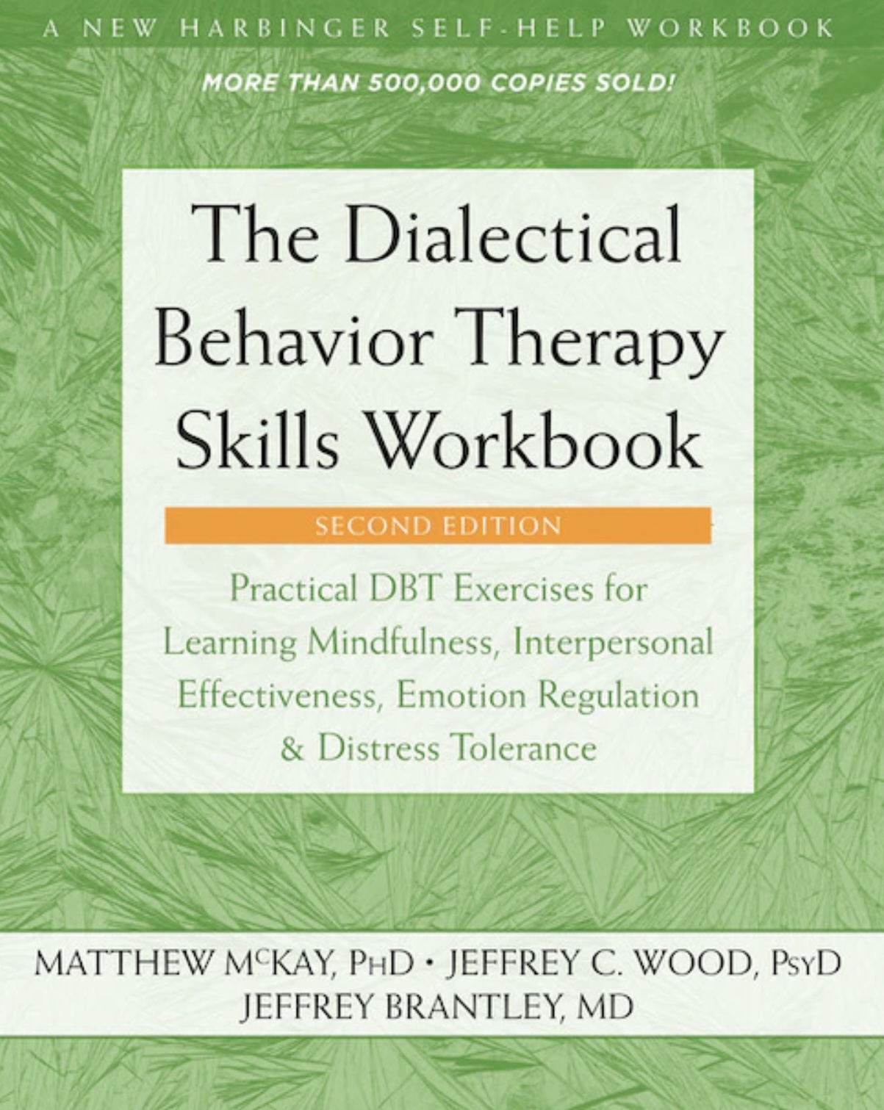

THE BOOKS WE USE IN THE SIMPLE COURSE
only need it in February 2026
Notes:
Both books are available on Amazon in e-book or paperback format.

Slide 30

THREE RING BINDER
Preferably with 30 separation tabs- one for each session
Have it with you at each session
You can use it to keep your weekly homework: crisis plans, diary cards, chain analysis, jot down notes, etc.

Slide 31

MOST IMPORTANTLY
Across all different therapy models, the most important predictor of positive change is the client’s emotional engagement with the work
Meaning you’ll get the most out the course if you actively emotionally engage in it. This includes:
Doing the homework: reading about the skills, tools, strategies, theory, and optionally reviewing the PowerPoint presentations and YouTube videos ahead of the sessions
Intentionally and mindfully applying the tools and skills you are learning in the course in your day-to-day life.
The benefits you’ll get from the course are proportional to the effort you put in.
Do the homework, stay organized and…
Practice, practice, practice

Slide 32
ORIENTATION TO SIMPLE:
WHAT WE WILL DO TODAY
Introductions
Mindfulness
Your intentions for the course
Why is this course called Simple and who might benefit from it
What do you need to have to do the Simple course ?
Simple course resources and schedule
Participant agreements for the in person and zoom attendees.
health, illness, disease, sickness, disorder, pain and suffering
"there is a hole in my sidewalk" by Portia Nelson
What we will be covering in the course
Challenges often encountered by people doing Simple
Stuff to keep in mind when sharing in the group or if you’re triggered
Homework for the coming week
Notes:
In our session today we will cover several subjects these include:

Slide 33
What learning resources does the course offer ? What does our schedule for the year look like? And what do we do in case of unexpected events such as the internet being down?

Slide 34

SIMPLE COURSE RESOURCES: email
E-mail: Our email is itssimple2023@gmail.com .
On Wednesday mornings before the group, we will review and answer questions, comments, and feedback e-mailed to us during the week.
When appropriate we may address these questions, comments and feedback “live” at the beginning of a session.
Unfortunately, at other times In-between sessions, we cannot guarantee that we will always answer your e-mails
You can also email us if you want to volunteer for a in-class practice. We will work with you individually to prepare for the session in which we will use the tools and skills in front of the group.( more on this later)
Notes:
We have already talked about the books we use in simple and the website. A third resource that "live" course participants have access to his our email. If you are doing the YouTube course facilitated by mental health professional having a course website might be an option.

Slide 35
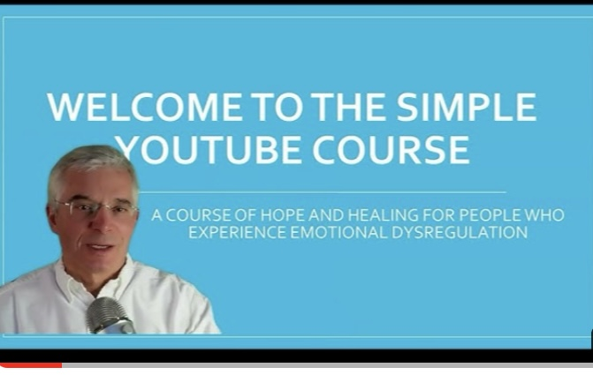
Simple YouTube channel
Search YouTube for: @itssimpleonyoutube1123.
We go into each topic in more depth than in class
May help you understand the material
May be useful to you if you miss one or more sessions.
Allows people to do the course on their own.
Starting this year we’ll all post recordings of all the sessions on this channel.
SIMPLE COURSE
RESOURCES: YouTube

Slide 36
SIMPLE COURSE SCHEDULE 2025-26
Week 1- October 1
Week 2- October 8
Week 3- October 15
Week 4- October 22
Week 5- October 29
Week 6- November 5
Week 7- November 12
Week 8- November 19
Week 9- November 26
Week 10- December 3
Week 11- December 10
Week 12- December 17
December 24 and 31 no course
Week 13- January 7
Week 14- January 14
Week 15- January 21
Week 16- January 28
Week 17- February 4
Week 18- February 11
Week 19- February 18
Week 20- February 25
Week 21- March 4
March 11 and 18 no course
Week 22- March 25
Week 23- April 1
Week 24- April 8
Week 25- April 15
Week 26- April 22
Week 27- April 29
Week 28- May 6
Week 29- May 13
Week 30- May 20
Week 31- May 27
Week 32- June 3

Slide 37
week 1- orientation and overview- sessions 1 and 2 of simple manual. week 2- introducing distress tolerance-p. 1-13 of dbt workbook and crisis plans-session 3 of the manual. week 3- the theoretical foundations of the simple course. session 4, 6, and 8 of the manual. week 4- distress tolerance p. 14-32 of dbt workbook. suicide prevention session 5 of the manual. our first practice- crisis plans. week 5- distress tolerance p. 33-46 of dbt workbook. introducing holes diary cards- session 7 of manual. week 6- distress tolerance p. 47-68 of dbt workbook. finding your diary card targets- session 9 of manual. our second practice- holes diary cards. week 7- introducing personality- session 10 of manual. week 8- distress tolerance p. 69-90 of dbt workbook. introducing chain analysis-session 11 of manual. week 9- what shapes personality-session 12 of manual. week 10-introducing mindfulness skills p.90-109 of dbt workbook. advanced chain analysis- session 13 of manual. our third practice-chain analysis. week 11- attachment theory- session 14 of manual. week 12- mindfulness skills p. 110-131 of dbt workbook. introducing rational mind remediation-session 15 of manual. week 13- the dynamic-maturational model of attachment and adaptation- session 16 of manual. week 14-mindfulness skills p. 131-147 of dbt workbook. practicing all the tools-session 17 of manual. our fourth practice-rational mind remediation. week 15-stress-session 18 of manual. week 16-introducing emotion regulation skills p.148-182 of dbt workbook. introducing the goals diary card procedure-session 19 of manual.

Slide 38
week 17- the stress and trauma related disorders-session 20 of manual.
week 18- emotional regulation skills p.183-206 of dbt workbook. our fifth practice session-the goals diary card procedure- session 21 of manual
week 19- structural dissociation theory and the treatment of the traumatic spectrum disorders- session 22 of manual.
week 20- introducing interpersonal skills p.207-241 of dbt workbook. Review of all the skills
week 21-introducing internal family systems (ifs)-session 24 of manual. introducing the ifs workbook and ifs workbook guided ai assisted self therapy
week 22- Spirituality, religion, and health- session 26 of manual.
week 23-interpersonal skills and putting it all together p.242-265 of dbt workbook. states of activation as essential trailheads and the four pillars of recovery from trauma-session 27 of manual.

Slide 39
week 24 -ifs workbook guided ai assisted self therapy. Workbook p. 1-63 (slides from beginning to end of part 1- getting to know your Self and parts.)
week 25 -6th practice-ifs. ifs workbook guided ai assisted self therapy. Workbook p. 64-100 (slides part 2- appreciating your overworked managers)
Week 26 - 7th practice-ifs. ifs workbook guided ai assisted self therapy. Workbook p.104-137 (slides part 3- befriending your activated firefighters)
Week 27 -8th practice-ifs. Ifs workbook guided ai assisted self-therapy. Workbook p. 142-175 (slides part 4 embracing your burdened exiles. )
Week 28 -9th practice-ifs. Ifs workbook guided ai assisted self-therapy. Workbook p.179-215 (slides part 5 accessing your unlimited self leadership)
Week 29 - introducing wise mind remediation and using it to heal and grow-Session 23 of manual. Workbook slides Section II Using IFS every day to heal and grow.
Week 30 -relationship and their repair-session 28 of manual.
week 31 - Searching for meaning circle
week 32- 10th practice. Wrap up, evaluation, brunch

Slide 40

Every year we ask for volunteers to help us demonstrate how the tools and skills are used. These “practices” are done live in front of the group and have been very appreciated both by the volunteers and course participants.
To prepare for these practices, volunteers meet with dr. Cleto for about 90 minutes the Wednesday prior to the practice (at 1:30 PM).
There will be 10 practices throughout the year, one for each of the 6 tools we discuss in Simple and 4 devoted to internal family systems.
The last five practice sessions will work on internal family systems and the Wise mind remediation procedure. To volunteer for these sessions, you should be willing to work with us through the internal family systems workbook. These last 5 practices involve stage 2 trauma work. If you volunteer for these It's important that you’ve learned and can use the emotional regulation skills discussed in the remainder of the course and have some access to Wise mind.
If you’d like to volunteer, let us know by Email (itssimple2023@gmail.com.) We take volunteers on a first email first volunteer basis. If we receive an email from you, about this we will get back to discuss.

Slide 41
PRACTICE SESSIONS SCHEDULE
preparation
1. Week 5 October 29 October 22, 1:30 Crisis Plans
2. Week 6 November 5 October 29, 1:30 Holes diary cards
3. Week 10 December 3 November 26, 1:30 Chain analysis
4. Week 14 January 14 January 7, 1:30 Rational mind remediation
5. Week 18 February 11 February 4, 1:30 goals diary card
6. Week 25 April 15 April 8, 1:30 IFS workbook 1
7. Week 26 April 22 April 15 IFS workbook 2
8.Week 27 April 29 April 22 IFS workbook 3
9. Week 28 May 6 April 29 IFS workbook 4
10.Week 31 May 27 May 20 1:30 PM Wise mind remediation

Slide 42
VOLUNTEER FOR OCTOBER 22ND
We will practice the first tool; making your own crisis plan October 29. If you’d like to do this, you’ll meet with Dr. Cleto to prepare on October 22th at 1:30 at 444 Douro St. second floor. That meeting usually takes 90 minutes. If you’d like to volunteer do the first practice in front of the group, please email us ASAP at itssimple2023@gmail.com. To be fair we’ll work with the first volunteer that contacts us.

Slide 43

BOING GROUP
Boing stands for break out informal and graduate group.
It’s open to all simple course participants present and past (graduates)
It will run Monday’s 1 t0 2:30 PM starting October 27th.
It’s held on zoom (same link as the Wednesday group) and in person (in the board room of the Stratford family health team 444 Douro St. 2nd floor.)
We don’t introduce any new material but help participants understand and practice what we talk about on Wednesdays.
It’s drop-in so you can come sometimes and stay only part of the time.

Slide 44


UNEXPECTED EVENTS
There may be unexpected events that interfere with the normal running of the simple course.
These may include internet issues, power outages, or bad weather.
Some suggestions:
If the internet cuts out, check if the problem is at your end. If it’s at our end, we will keep trying to reconnect. Often it’s short lived.
If for some reason we can’t do the course virtually, (power outage, long internet disruption.) we will still do it in person.
If it’s bad weather:
If the church is open, we will be here.
If the church is closed, we will still do the course virtually. If you’re doing the course in person and need a zoom link, please email us. ( meeting 85101122900 password 322517 )
How will we know if the church is closed?
We will post updates on unexpected events on the website

Slide 45
ORIENTATION TO SIMPLE:
WHAT WE WILL DO TODAY
Introductions
Mindfulness
Your intentions for the course
Why is this course called Simple and who might benefit from it
What do you need to have to do the Simple course ?
Simple course resources and schedule
Participant agreements for the in person and zoom attendees.
health, illness, disease, sickness, disorder, pain and suffering
"there is a hole in my sidewalk" by Portia Nelson
What we will be covering in the course
Challenges often encountered by people doing Simple
Stuff to keep in mind when sharing in the group or if you’re triggered
Homework for the coming week
Notes:
In our session today we will cover several subjects these include:

Slide 46
My name is…
My role as a co leader is…
My hope for the course is…
Kate Smidts
Highlights and insights

Slide 47

PARTICIPANT AGREEMENTS

Slide 48
SIMPLE COURSE CODE OF CONDUCT AGREEMENT (all participants)
Everyone in the course will strive to interact with others in a kind and respectful manner. We will strive to validate, avoid judgments and assume the best about each other.
Personal information, including names, should not be discussed with anyone outside of the course. What happens in simple stays in simple.
Participants are encouraged to arrive on time and stay until the end of the session.
Participants are encouraged to do the assigned homework between sessions.
If you are doing the course in person and become ill with a potentially transmissible condition, please do the course virtually until you are well. (If you need the zoom link, please email us)
Active participation is encouraged but not necessary. (you don’t ever have to say anything)
During discussions participants may provide examples from their own experiences. Please keep in mind, however, that discussing some subjects such as traumatic relationships, self-harm, suicide, substance abuse etc. may trigger others. (save this for boing)
If in person course participants needs to leave the room to take a reregulation break, please let the facilitators know .
In person course participants will strive to avoid side conversations when another individual is speaking.
Course participants are encouraged to not engage in dysregulated behaviors with other participants outside of the course.
Course participants are encouraged to avoid forming new romantic relationships with other participants for the duration of the course.
Course participants are strongly discouraged to attend sessions under the influence of drugs or alcohol.
If you are doing the course in-person, please legibly write your first and last name on the attendance sheet as you come into the room. If you are doing it virtually, please enter your first name and the initial of your last name on the screen.
Notes:
The Simple course etiquette agreement has evolved organically over the years. It is a code of conduct which participants in coleaders agree to abide by.

Slide 49
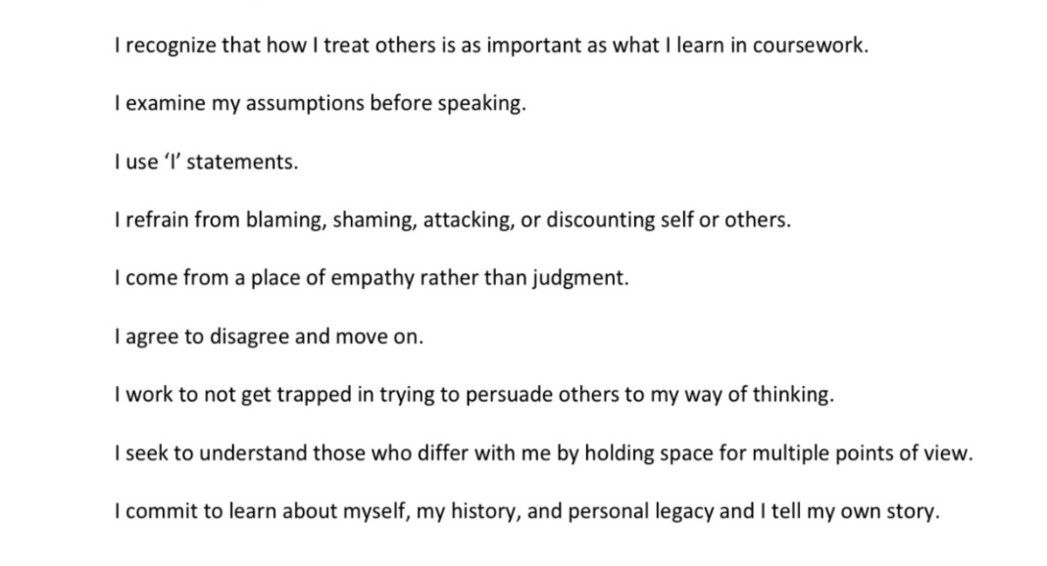
ALTERNATIVE PARTICIPANT AGREEMENT

Slide 50
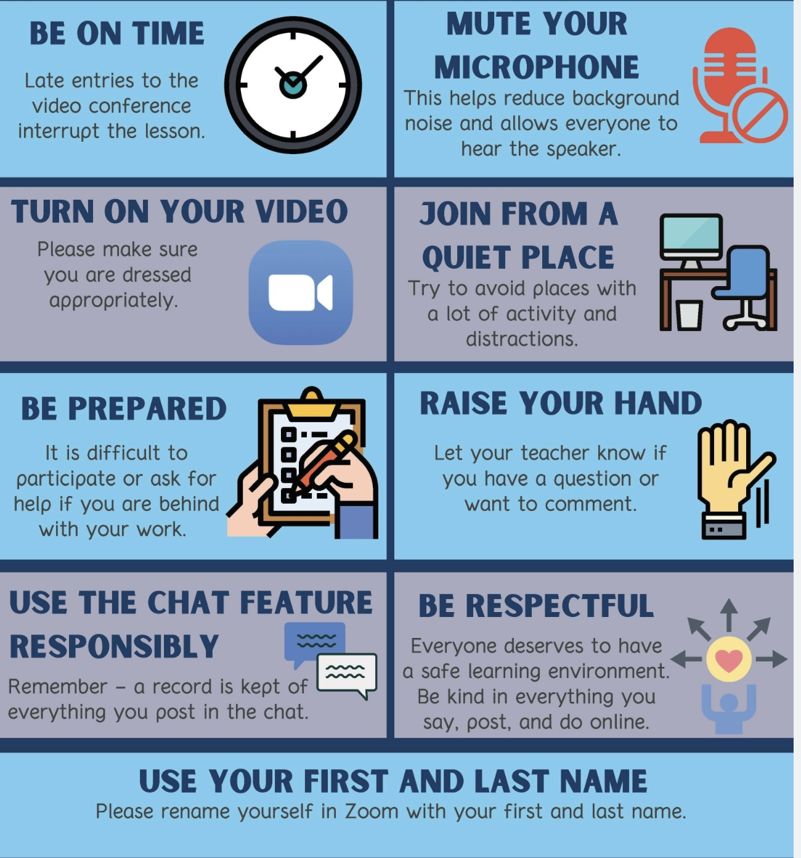
ZOOM PARTICIPANT AGREEMENT
Please mute your microphone when not using it
Please have your camera on at the beginning of the session and during question period . You may turn it off during PowerPoint slide presentations or if you need to step out of the group. It’s important that we see each other so that we can establish trust and ensure confidentiality.
Please make sure no one at your end who is not taking part in the course can see or overhear other group participants .
When you have questions, comments, feedback please chat them to the co-leaders or save them for the question periods when you can raise your hand icon and wait until one of the co leaders gets to you.

Slide 51




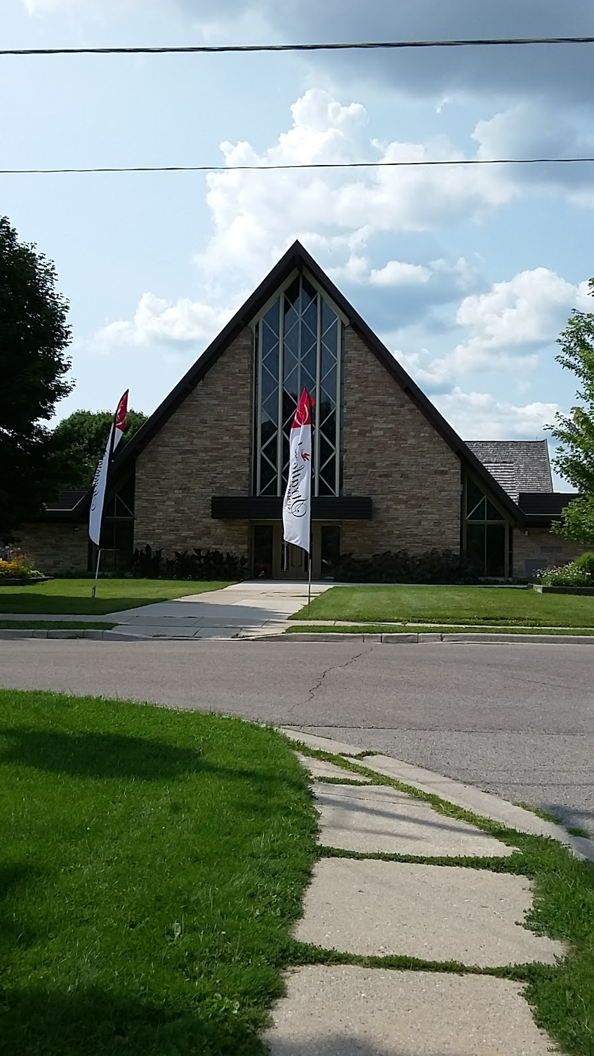
Please no scents. If it’s wet or snowy please bring indoor footwear.
Please legibly write down your first and last names on the attendance sheet when you come in.
AVONDALE UNITED CHURCH
Our hosts: Yvonne - front desk. Roger - custodian
Rev. Keith Reynolds – minister
feel free to bring a drink and/or a snack but please clean up after yourself.
If you’re ill with a cold or have been in contact with someone who is, we strongly encourage you to attend the course on zoom or if you have to do it in person to use a mask and hand sanitizer.
please write down the zoom meeting number and password in case you lose the link.
No smoking is allowed on church grounds.(not just 12 feet)
Please if it’s wet or snowy outside bring a pair of dry shoes to change into.
The Avondale church is a scent free environment
You can bring something to eat or drink but please keep your area neat.
ZOOM meeting
Meeting id: 851 0112 2900
Passcode: 322517

Slide 52

REMINDER SLIDE POSTED at each session
If you have questions, comments, or feedback, raise your real/virtual hand. We’ll take note and get to you at an appropriate time.
Keep comments, questions, and feedback relatively brief so everyone has a chance to participate. One breath sharing on Wednesdays.
Please avoid side conversations
If you’re on zoom, make sure no one can overhear what is being said
For reasons that will become clear later in the course please avoid giving advice to other participants about what they should or should not do. Validation, encouragement , and understanding are however very much appreciated.

Slide 53
ORIENTATION TO SIMPLE:
WHAT WE WILL DO TODAY
Introductions
Mindfulness
Your intentions for the course
Why is this course called Simple and who might benefit from it
What do you need to have to do the Simple course ?
Simple course resources and schedule
Participant agreements for the in person and zoom attendees.
health, illness, disease, sickness, disorder, pain and suffering
"there is a hole in my sidewalk" by Portia Nelson
What we will be covering in the course
Challenges often encountered by people doing Simple
Stuff to keep in mind when sharing in the group or if you’re triggered
Homework for the coming week
Notes:
In our session today we will cover several subjects these include:

Slide 54

DEFINITIONS
As we begin our journey of healing and growing, it may be helpful to explore the meaning of the terms health, pain, suffering, Illness, disease, sickness and disorders or conditions.
According to the world health organization, health is “a state of complete physical, mental, social and spiritual wellbeing and not merely the absence of disease and infirmity.”
Pain is a physical sensation or emotional experience that signals harm or distress. It can be acute (short-term) or chronic (long-lasting) and is typically a direct response to injury, illness, or other physical conditions. Pain is a biological signal that something is wrong, prompting individuals to take action to protect themselves.
Suffering, on the other hand, is a broader emotional and psychological experience that encompasses the feelings of distress, anguish, or hardship that can arise from pain, but also from other sources such as loss, disappointment, or existential concerns. Suffering can occur even in the absence of physical pain, and it often involves a deeper, more complex response to life's challenges. Pain and suffering are often intertwined but represent different experiences.
Illness is a feeling or experience of unwellness which is entirely personal, and interior to the person of the patient. Often it accompanies disease, but the disease may be as yet undiagnosed, as in the early stages of cancer, tuberculosis, or diabetes. Sometimes illness exists where no disease can be found.
Disease is a physical pathological process or deviation from a biological norm. There is an objectivity about disease which doctors are able to see, touch, measure, or smell. Diseases are valued as essential facts in the medical model. Traditional medicine is not very good at understanding or caring for illness in the absence of disease unbearable to the clinician.

Slide 55

Sickness is a social role, a status, a negotiated position in the world, a bargain struck between the person henceforward called "sick", and a society which is prepared to recognize and sustain him.
Sickness based on illness alone is of the most uncertain status. But even the possession of disease does not guarantee equity in sickness. Those with chronic disease are much less secure than those with an acute one; those with a psychiatric disease than those with a surgical one… Best is an acute physical disease in a young man quickly determined by recovery or death, either will do, both are equally regarded.
Psychiatric, psychological or mental disorders/conditions are characterized by a clinically significant disturbance in an individual’s thinking, emotional regulation, or behavior. They are usually associated with distress or impairment in important areas of functioning.
Biological psychiatry follows a disease model, in which mental disorders are seen as being “chemical”, physiological, or biological diseases.
We will argue in this course that by embracing the disease model, psychiatry neglects the social, psychological, and spiritual aspects of illness without which we cannot fully understand most people’s experiences.
DEFINITIONS
Rheumatic pain II by Remedios Varo

Slide 56
ORIENTATION TO SIMPLE:
WHAT WE WILL DO TODAY
Introductions
Mindfulness
Your intentions for the course
Why is this course called Simple and who might benefit from it
What do you need to have to do the Simple course ?
Simple course resources and schedule
Participant agreements for the in person and zoom attendees.
health, illness, disease, sickness, disorder, pain and suffering
"there is a hole in my sidewalk" by Portia Nelson
What we will be covering in the course
Challenges often encountered by people doing Simple
Stuff to keep in mind when sharing in the group or if you’re triggered
Homework for the coming week
Notes:
In our session today we will cover several subjects these include:

Slide 57
My name is…
My role as a co leader is…
My hope is…
Peg Huettlin
Zoom in room

Slide 58
THERE’S A HOLE IN MY SIDEWALK
A central metaphor in the course
I walk down the street.
There is a deep hole in the sidewalk.
I fall in.
I am lost… I am helpless.
It isn’t my fault.
It takes forever to find a way out.
I walk down the same Street.
There is a deep hole in the sidewalk.
I pretend I don’t see it.
I fall in again.
I can’t believe I am in the same place.
But it isn’t my fault.
It still takes me a long time to get out.
I walk down the same Street.
There is a deep hole in the sidewalk.
I see it is there.
I still fall in. It’s a habit.
My eyes are open.
I know where I am.
It is my fault. I get out immediately.
I walk down the same Street.
There is a deep hole in the sidewalk.
I walk around it.
I walk down another Street.”
Portia Nelson (2)

Slide 59

There’s a hole in my sidewalk
Portia Nelson’s poem There’s a hole in my sidewalk is a powerful reflection on self-awareness, personal growth, and the journey of life. The poem describes a process of encountering the same challenges repeatedly, illustrating how we often fall into familiar patterns of behavior, thought or emotions.
In simple we use the hole in the sidewalk metaphor to represent the maladaptive patterns of thinking, emotions and behaviors that people may repeatedly encounter in their lives and that can cause great distress.
In the course we will start by helping you identify some “holes in the sidewalk”(holes for short) you repeatedly fall into.
We will then encourage you to become familiar with these holes, what might cause you to fall into them and how to get out.
We will see how when we are in these holes we are typically in “emotional mind”.
We will learn how to use our rational and wise minds to get out of and eventually to avoid them.
Notes:
People who experience emotional dysregulation often relate to Sisyphus and to the character in Nelson's poem.

Slide 60
ORIENTATION TO SIMPLE:
WHAT WE WILL DO TODAY
Introductions
Mindfulness
Your intentions for the course
Why is this course called Simple and who might benefit from it
What do you need to have to do the Simple course ?
Simple course resources and schedule
Participant agreements for the in person and zoom attendees.
health, illness, disease, sickness, disorder, pain and suffering
"there is a hole in my sidewalk" by Portia Nelson
What we will be covering in the course
Challenges often encountered by people doing Simple
Stuff to keep in mind when sharing in the group or if you’re triggered
Homework for the coming week
Notes:
In our session today we will cover several subjects these include:

Slide 61
WHY DO OUR LIVES UNFOLD THE WAY THEY DO?
Our lives unfold as they do through the interplay of innumerable factors: the circumstances we are born into, the random events that alter our course, and the influence of our relationships, social systems, cultural moment, biological makeup, and spiritual or existential orientation. All these combine in unique ways to shape each person’s personality and life path. Much of life happens to us and is out of our control.
Personality which can be defined as the long-term patterns of how we react emotionally, and of how we think and behave develops in the interaction of who we are at birth, that is our temperament and neurodivergences and what happens to us.
How we respond to what happens to us which is determined by our personality, also greatly affects the trajectories that our lives and can mean the difference between weather we flourish, survive or fail to thrive.
Metaphorically personality can be thought of as an “armor” that protects us from the “slings and arrows” that life constantly throws at us. Each person’s armor varies in how effective it is at protecting them.
Personality, what shapes it and how we can change certain aspects of it is a central theme in this course. Over the next 8 months we will explore how personality develops and is affected by biological, psychological, social, and spiritual factors. We will consider how temperament and neurodivergences, attachment patterns and trauma, social forces such as inequities, economic pressures, and the impact of new technologies, from smartphones to social media impact our lives and affect our personality.
Understanding ourselves and the many forces affecting the course of our lives, is in contrast to a deficit and symptom based medical model a patient centered model that can help us shift from automatically reacting to what happens to us to reflecting on it and acting wisely which can mean the difference between failing to thrive and flourishing.
We’re starting a 32-week, 144-hour journey together. It is one that may give us new perspectives, skills, tools, strategies, and possibilities that will allow us to live with greater awareness, intention and peace.

Slide 62
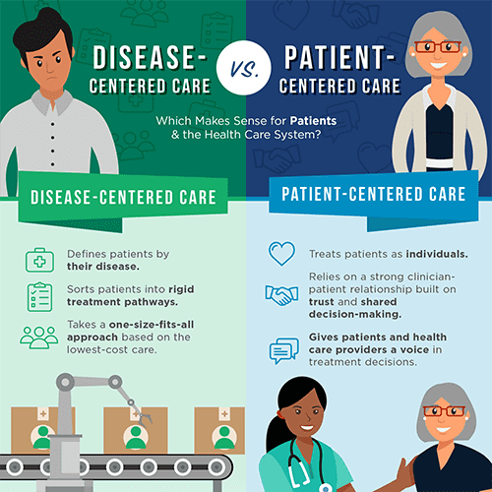
MEDICAL VS. PATIENT-CENTERED MODEL
In the medical model, an issue such as substance abuse if diagnosed can be seen as one of the main causes of a person’s problems. For example, someone drinks heavily, then loses their job, damages relationships, and suffers health consequences. The focus is on the substance itself as the driver of the ills in their life. Treatment in this model usually aims at removing the substance, stopping the drinking or drug use, because the assumption is that this will solve most of the problems. The medical model asks “what is wrong with the person?”
The patient-centered model takes a wider lens. Instead of seeing substance use as the single cause, it sees it as one piece of a much bigger picture. Substance use is often a symptom or correlate of deeper struggles, not the original cause. What leads someone to use substances may include their temperament (for example, being more sensitive or impulsive), the quality of their early attachments, their family culture, their social environment, the stresses and inequities they face, the availability of support programs, and many protective or aggravating forces during their formative years.
From a patient-centered perspective, the substance use is not the starting point, it’s one outcome of a complex web of influences. If we only focus on the substance, we risk missing the person. The patient-centered model asks “what happened in this person’s life that made substances serve a purpose for them?” This approach doesn’t ignore the harm of substance use, but it recognizes that healing requires us to understand and address the whole person and the whole context of their life.

Slide 63
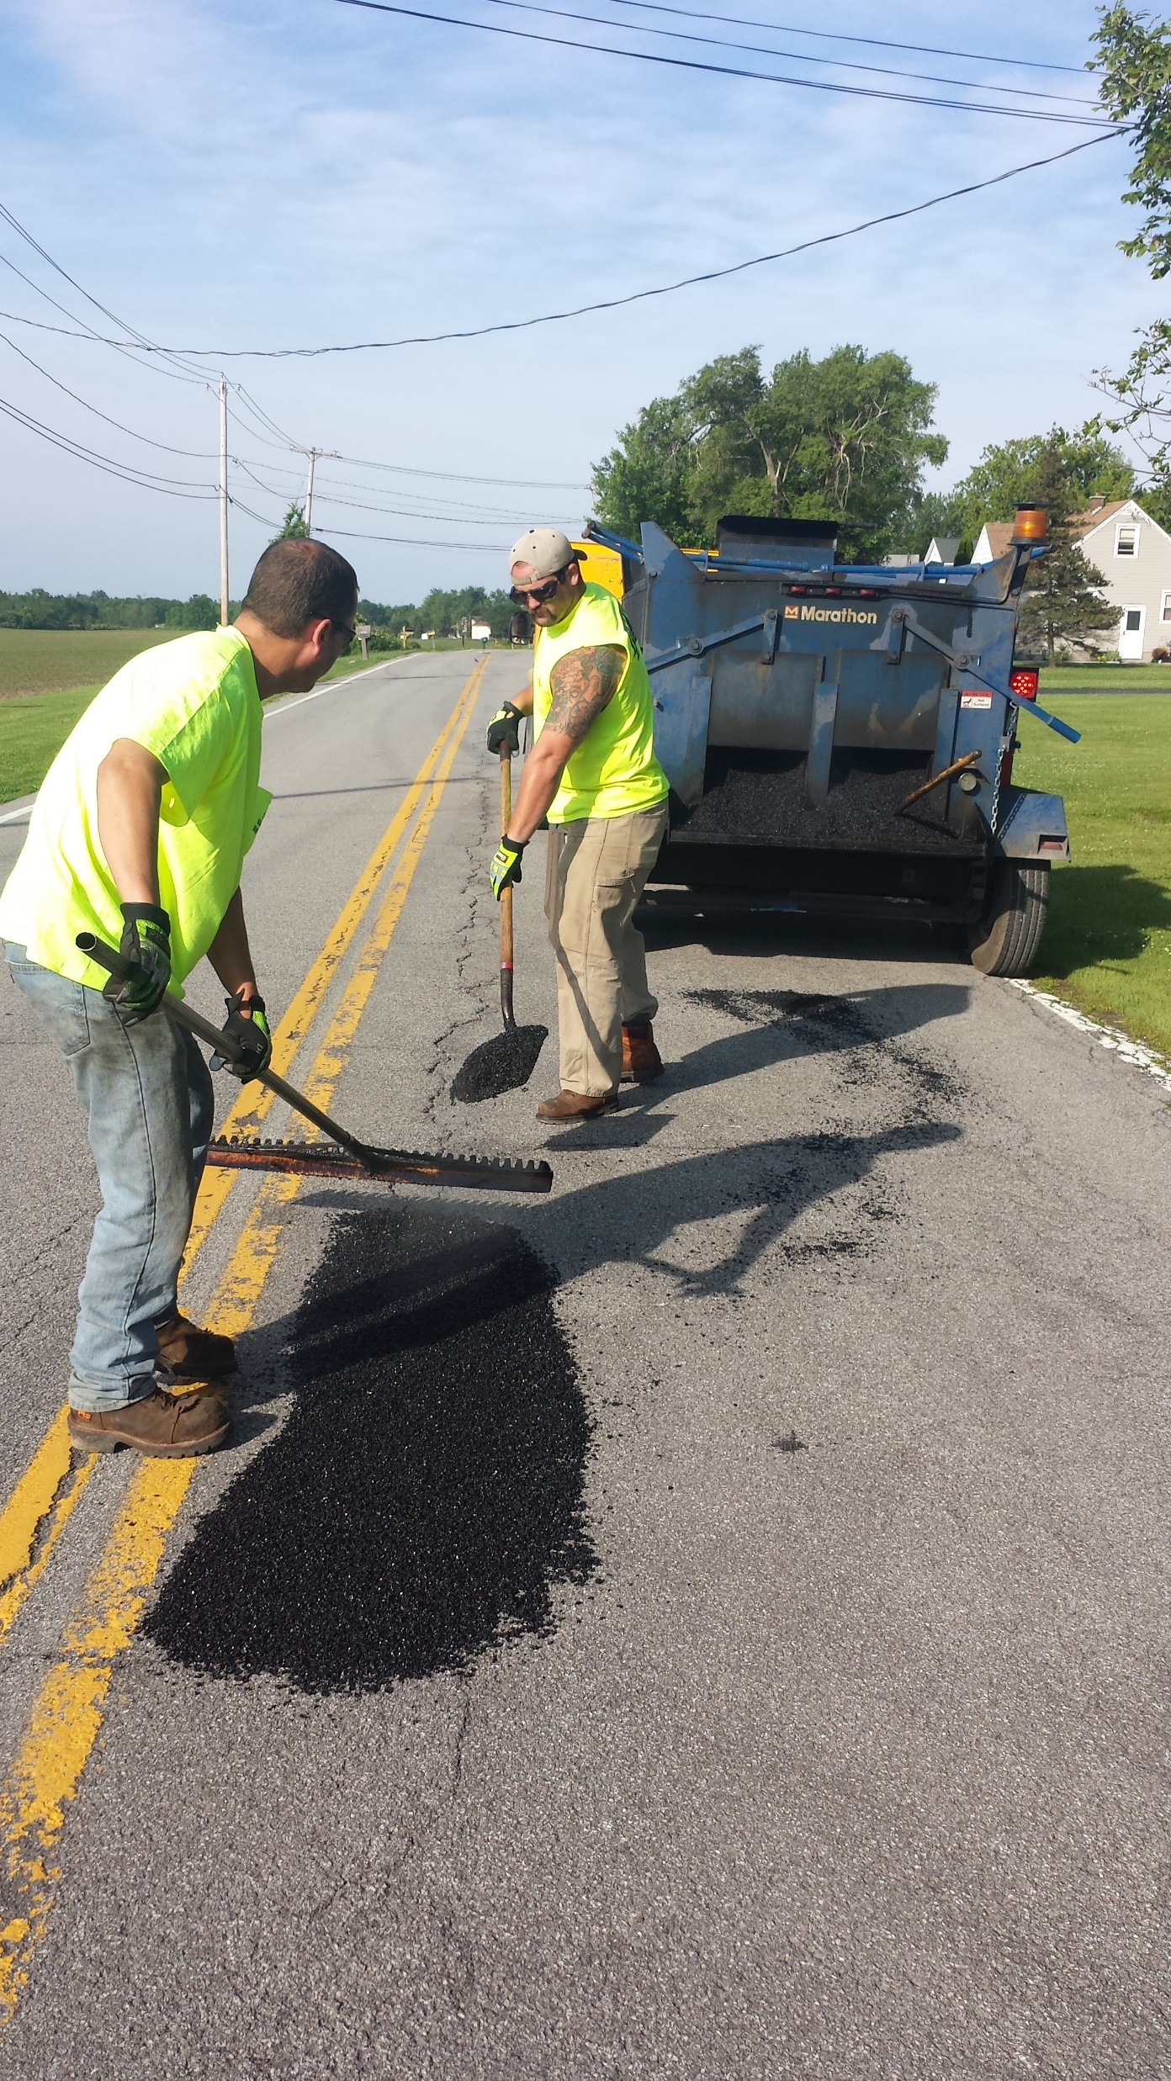
A BRIEF OVERVIEW OF THE SIMPLE COURSE
The Simple course aims to help us identify, become more aware of, get out of, avoid, and repair some of the “holes in the sidewalk” we keep falling into.
It aims to help us
1) expand our window of emotional tolerance
2) heal our trauma
3) live a full life
Don’t be overwhelmed by the quantity of material we’re previewing today. We will spend a lot of time together exploring it in detail.

Slide 64

SIMPLE Course overview
The Simple course can be divided into 6 parts:
Part 1: Psychological theory- understanding our mind
Part 2: learning DBT skills
Part 3: learning the 6 tools
Part 4: learning the techniques and strategies needed for using the tools and skills
Part 5: Practicing applying skills, tools, and strategies in everyday life
Part 6: Using IFS to heal trauma

Slide 65
SIMPLE Course overview
Part 1: Psychological theory- understanding our mind
Part 2: Learning DBT skills
Part 3: learning the 6 tools
Part 4: learning the techniques and strategies needed for using the tools and skills
Part 5: Practicing applying skills, tools, and strategies in everyday life
Part 6: Using IFS to heal trauma

Slide 66

1. Psychological Theory: What’s covered:
Foundations of the simple course: The evolution of emotional, rational mind and wise minds
Introduction to personality
Temperament and character
Introduction to attachment theory
The dynamic maturational model of attachment
Stress, distress, and the post-traumatic stress spectrum
Traumatic stress in children and adults
Dissociation and the structural dissociation theory
Internal family systems
Dominant states of activation of part selves
Interpersonal conflicts and their repair
Spirituality and health
Searching for meaning
a biopsychosociospiritual
model for understanding the mind

Slide 67
SIMPLE Course overview
Part 1: Psychological theory- understanding our mind
Part 2: Learning DBT skills
Part 3: learning the 6 tools
Part 4: learning the techniques and strategies needed for using the tools and skills
Part 5: Practicing applying skills, tools, and strategies in everyday life
Part 6: Using IFS to heal trauma

Slide 68

Skills- The DBT skills workbook
The DBT workbook covers the four traditional DBT modules:
1 Distress tolerance – how to deal with crisis.
2 Mindfulness – how to become more aware of your thoughts, feelings, sensations, and behaviors.
3 Emotional regulation – how to widen and increasingly be able to stay in the window of emotional tolerance
4 Interpersonal effectiveness – how to have healthier relationships by being assertive rather than passive or aggressive.
We will, as part of the course’s suggested homework, assign readings from the DBT skills training workbook. We strongly encourage you to do these readings because when in the sessions we cover them you will already be familiar with what we are talking about. At the sessions we’ll also be happy to explore anything you might not have understood from your reading.
Notes:
The skills training component of DBT is typically done in a group setting. There are several different workbooks that cover the traditional four modules of DBT skills.

Slide 69

The DBT workbook suggests using the DBT diary card (found on p. 262-265 of the 2nd edition of the workbook) to keep track of all the skills you are learning.
Simple recommends using the skill list that we’ll provide each time we discuss new skills. (see below)
Review whichever way you choose to keep track of the skills regularly. Quiz yourself to see if you can remember and describe each of the skills.
While its ideal to be familiar with all the skills presented in the workbook, everyone has their favourite ones which they use more often.
TRACKING THE SKILLS AS WE LEARN THEM
Notes:
Pre slide
In each of the four modules many different skills are discussed.
You will not use all of them. As we go through all the skills choose a few that you understand and think you can use.
Getting good at using any one skill takes practice. Don't get discouraged if the first time you try a skill you are not very good at it. That's completely normal and expected. Persistence is key.
The DBT diary card which can be found at the back of the second edition of the skills training workbook can help you keep track of the skills that you are learning.

Slide 70
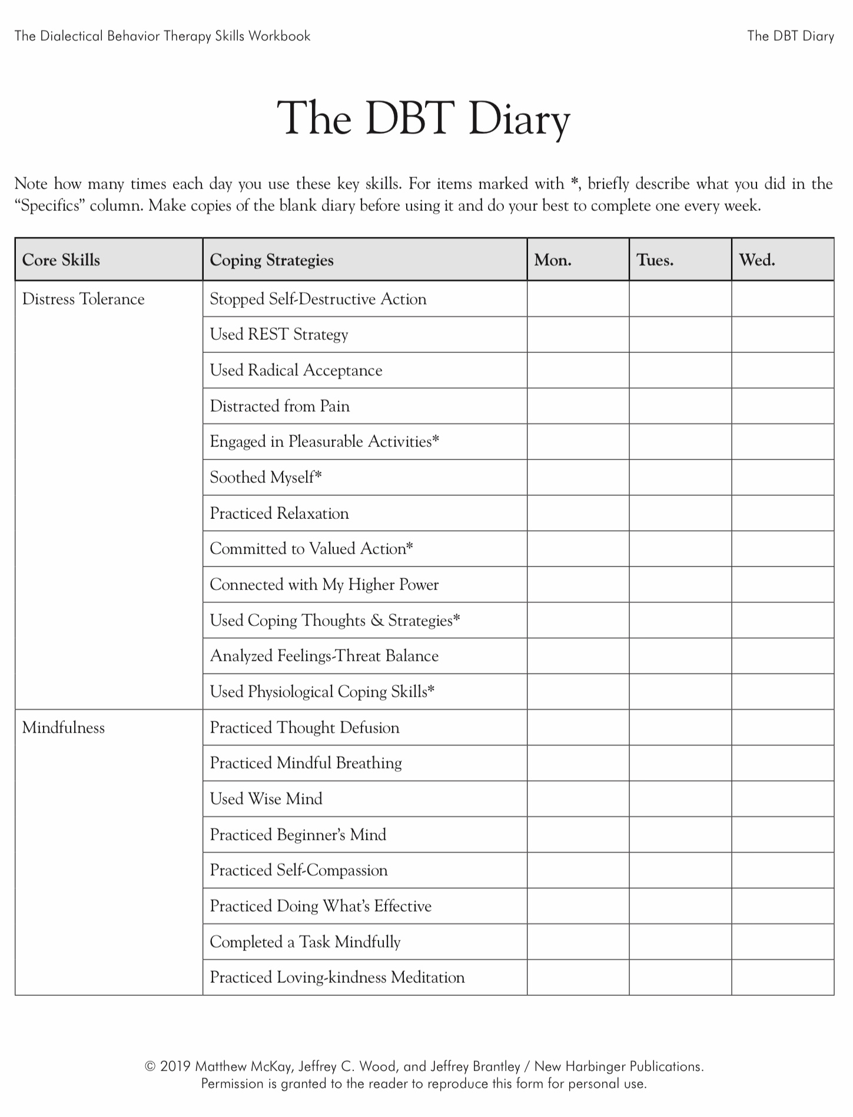

Slide 71
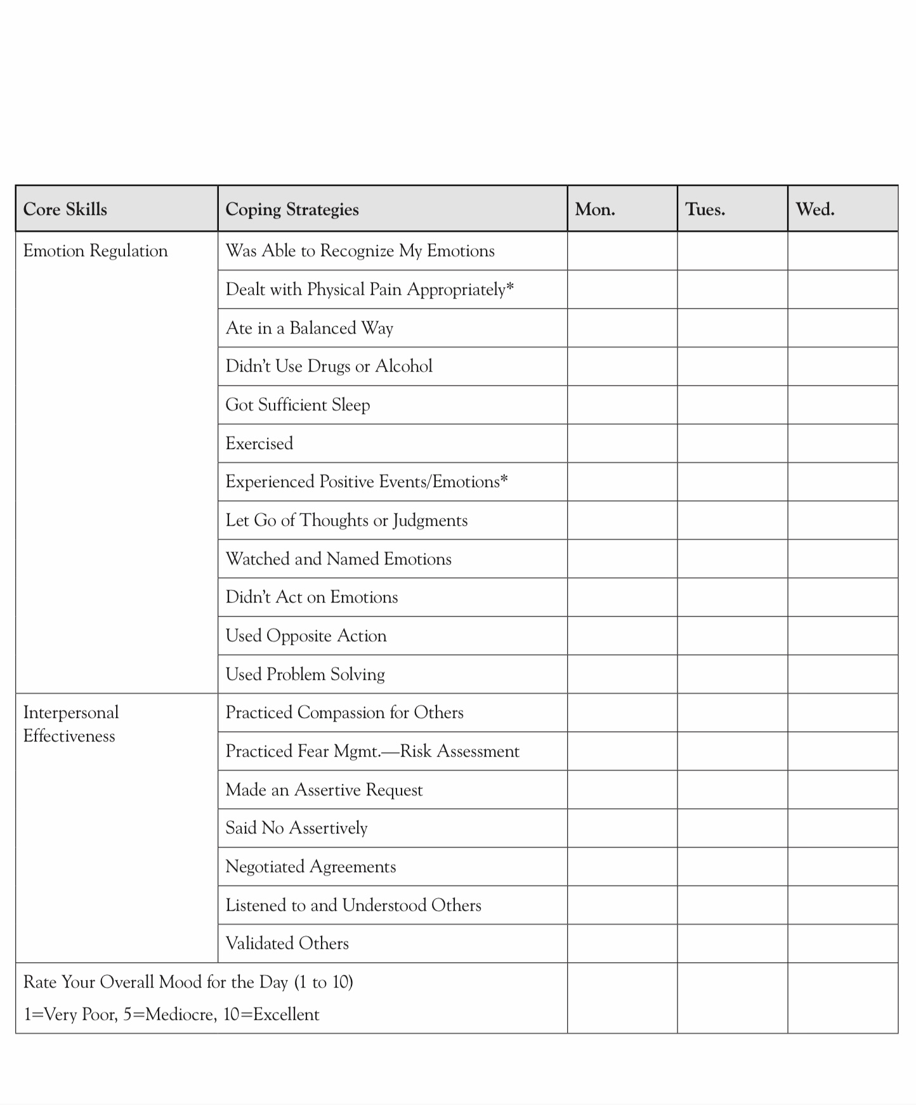

Slide 72
UPDATED PERSONAL SKILLS LIST
Distress tolerance skills
Grounding skills- Set a daily intention
“ - Sensory soothing toolkit
“ -The 5,4,3,2,1 method
“ -The emotional freedom technique
REST (or PEST) Pause
Radical acceptance statements (please specify)
Distraction plan “
Self-soothing plan
Safe place visualization
Cue controlled relaxation
Rediscovering your values (please specify)
Rehearse values-based behavior or edit/splice/paste
Connect with your higher power “
14. Live in the present moment
15. Use self-encouraging coping thoughts
16. Radical acceptance
17. Use self-affirming statements
18. Balance feelings and threat
19. Create new coping strategies
20. Create an emergency coping plan
21. Box breathing
22. Cold temperatures
23. High intensity exercise
24. Progressive muscular relaxation
25. Paced breathing
26. Side to side eye movement.

Slide 73
UPDATED PERSONAL SKILLS LIST
Mindfulness skills
1. Focus on a single minute
2. Focus on a single object
3. Band of light
4. Inner-Outer Experience
5. Record Three Minutes of Thoughts
6. Thought Diffusion
7. Describe Your Emotion
8. Focus Shifting
9. Mindful Breathing
10. Mindful Awareness of Emotion
11. Wise mind
12.how to make Wise mind decisions
13. Radical acceptance
14. Judgements and labels
15. Self compassion
16. Mindful communication
17. Being mindful in our daily life
18. How to do tasks mindfully
19. How to be mindful of our activities
20. Resistances and hindrances to mindfulness practice
21. Exploring mindfulness further
22. Mindfulness and meditation
23. Using kindness and compassion
24. Paying attention to spaciousness and stillness

Slide 74
UPDATED PERSONAL SKILLS LIST
Emotional regulation skills
How do emotions work?
Recognizing emotions
Overcoming barriers to healthy emotions
Reducing physical vulnerability
Reducing cognitive vulnerability
5. Increasing Positive Emotions
6. Being mindful of your emotions without judgement
Emotion exposure.
Doing the opposite of your emotions
9. Problem Solving

Slide 75
TODAY-UPDATED PERSONAL SKILLS LIST
Interpersonal effectiveness skills
1.Mindful attention
2. Compassion for others
3. Passive vs. aggressive behavior
4. I want-they want ratio
5. I want-I should ratio
6. Key interpersonal skills
7. Blocks to using interpersonal skills
8. Knowing what you want
9. Modulating the intensity of a request
10. Making a simple request
11. Designing basic assertiveness scripts and
12. Assertive listening

Slide 76
SIMPLE Course overview
Part 1: Psychological theory- understanding your mind
Part 2: Learning DBT skills
Part 3: learning the 6 tools
Part 4: learning the techniques and strategies needed for using the tools and skills
Part 5: Practicing applying skills, tools, and strategies in everyday life
Part 6: Using IFS to heal trauma

Slide 77

3. THE Six TOOLS-Simple manual
1 Crisis plans
2 Holes diary cards
3 Chain analysis
4 Rational mind remediation
5 Goals diary cards
6 Wise mind remediation
The tools build on one another. To use the second tool, you need to know how to use the first one and so on.
To benefit the most from the course you must use the tools with the skills.
Wise mind remediation is complex, compatible with IFS and can be used long after you’ve finished the course.

Slide 78
SIMPLE Course overview
Part 1: Psychological theory- understanding your mind
Part 2: Learning DBT skills
Part 3: learning the 6 tools
Part 4: learning the techniques and strategies needed for using the tools and skills
Part 5: Practicing applying skills, tools, and strategies in everyday life
Part 6: Using IFS to heal trauma

Slide 79

4. the Techniques and strategies needed to use the simple tools
1. Use good problem-solving strategies when using the tools by following the steps in the algorithms and templates.
2. Be mindful of your “dashboard”:
a) Monitor your energy balance.
b) Be mindful of your crisis risk level.
c) Stay in the window of emotional tolerance
3. Stay in the window of tolerance by pendulating.
4. Use editing, splicing and pasting with problematic thoughts, feelings or behaviors to practice new ones.

Slide 80
SIMPLE Course overview
Part 1: Psychological theory- understanding your mind
Part 2: Learning DBT skills
Part 3: learning the 6 tools
Part 4: learning the techniques and strategies needed for using the tools and skills
Part 5: Practicing applying skills, tools, and strategies in everyday life
Part 6: Using IFS to heal trauma

Slide 81

5. Practice applying skills tools and strategies in everyday life.
During the year, after introducing a new tool and as we go through the IFS workbook, we schedule in-session practices with volunteers
The goal of practices is to help the volunteers, and the other participants, understand how to use the skills, tools and strategies in their own lives and in real life situations.
If you would like to volunteer for a practice, please let us know using email.
Volunteers meet with Dr. Cleto individually in person the Wednesday before the practice after the group at 1:30 pm to go over how to apply the tools, skills and strategies to their situation.
The following Wednesday we will do this “live” in the group. Volunteers decide if they want to leave it in the recording or take it out.
We can also practice using the tools skills and strategies in your situations in the Boing group.
Wednesday practices

Slide 82
SIMPLE Course overview
Part 1: Psychological theory- understanding your mind
Part 2: Learning DBT skills
Part 3: learning the 6 tools
Part 4: learning the techniques and strategies needed for using the tools and skills
Part 5: Practicing applying skills, tools, and strategies in everyday life
Part 6: Using IFS to heal trauma

Slide 83
IFS MANUAL GUIDED AI ASSISTED SELF THERAPY
There’s 3 stages in trauma therapy:
1 emotional regulation,
2 processing trauma and
3 reclaiming a full life
DBT deals mostly with stage 1.
Internal family systems is the therapeutic approach we use in this course for stage 2 trauma work
This year for the first time we’ll devote 7 weeks to IFS and processing trauma.
Stage 2 trauma work can go on for years, but our intent is to launch you on a sustainable long-term practice.
We’ll use the IFS workbook and AI assistance (you can use only the workbook if you prefer.)

Slide 84
NEW IN 2025-26
In response to feedback from last years participants and suggestions from the co-leaders, we’ve made some significant changes to this year’s course:
One orientation and introduction session rather than two.
One foundations of the simple course session rather than three.
10 practice sessions rather than 6.
Fewer slides presented at each session.
Simpler language used on the slides.
Email us your questions and what you’d like to see discussed prior to the boing Monday sessions.
A totally different format for the circle of meaning session.
Much more emphasis on trauma processing with the internal family systems part of the course expanded from two to seven sessions.
Sessions will be recorded.
We will go back to the old format of having two interaction periods per sessions rather than having interactions at any point in the session.
We’re using a different room at the Avondale Church.
Kate’s role has expanded.
Keep giving us feedback so the course will become more user friendly.

Slide 85
ORIENTATION TO SIMPLE:
WHAT WE WILL DO TODAY
Introductions
Mindfulness
Your intentions for the course
Why is this course called Simple and who might benefit from it
What do you need to have to do the Simple course ?
Simple course resources and schedule
Participant agreements for the in person and zoom attendees.
health, illness, disease, sickness, disorder, pain and suffering
"there is a hole in my sidewalk" by Portia Nelson
What we will be covering in the course
Challenges often encountered by people doing Simple
Stuff to keep in mind when sharing in the group or if you’re triggered
Homework for the coming week
Notes:
In our session today we will cover several subjects these include:

Slide 86
Lauren Gienow
Eyes in the sky
My name is…
My role as a co leader is…
My hope for the course is…

Slide 87

Accessing and benefitting from mental health care
Getting out of, learning to avoid, and repairing holes or developing and implementing solutions to our problems can be challenging.
Challenges can arise around:
1. Realizing there is a problem.
2. Having a good understanding of the problem.
3. Deciding on which approach is best suited to working on your problems and
4. Accessing mental health professionals to help implement the approach.
Obstacles to developing and implementing solutions to problems may have to do:
1. mostly with the person seeking to change
2. mostly with accessing the right resources.
Understanding and dealing with these obstacles is essential in benefiting from mental health care resources.
Notes:
Pre slide
The world presents everyone with stressful challenges and difficulties.
When we are struggling, we may feel that others and the world are to blame for these struggles.
The world is full of holes, and some people do indeed encounter more holes than others. It’s however difficult to change the world and make it friendlier , sometimes it's more realistic to learn to cope by getting out of, or avoid holes.
Sometimes our responses to difficult circumstances are well-regulated, meaning anybody in the same circumstances would've fallen into that hole. Sometimes our responses to circumstances are dysregulated, falling into the hole has to do with our personalities or who we are. Our well-regulated distress is normal what we want to learn about and deal with is our dysregulated distress.
Mental health resources hold out the prospect of helping people cope better but there is a long road to travel on the road from the prospect of help to actual positive change. There can be many obstacles on that road.
Let’s now look at what these obstacles may be. Perhaps knowing them can help us avoid them

Slide 88

personal and systemic Obstacles to change
For a more detailed consideration of these obstacles please see slides from 2024-25 which you’ll find below.
1. Am I the problem, or is the world the problem? Internal vs. external locus of control, the stages model of change and motivational interviewing
2. Understanding the problem: diagnosis vs. formulations
3. What will help and who can I trust.
4. Coping with limited resources
5. Dealing with competing priorities
6. Believing one can change: Self-efficacy, learned helplessness, and locus of control

Slide 89
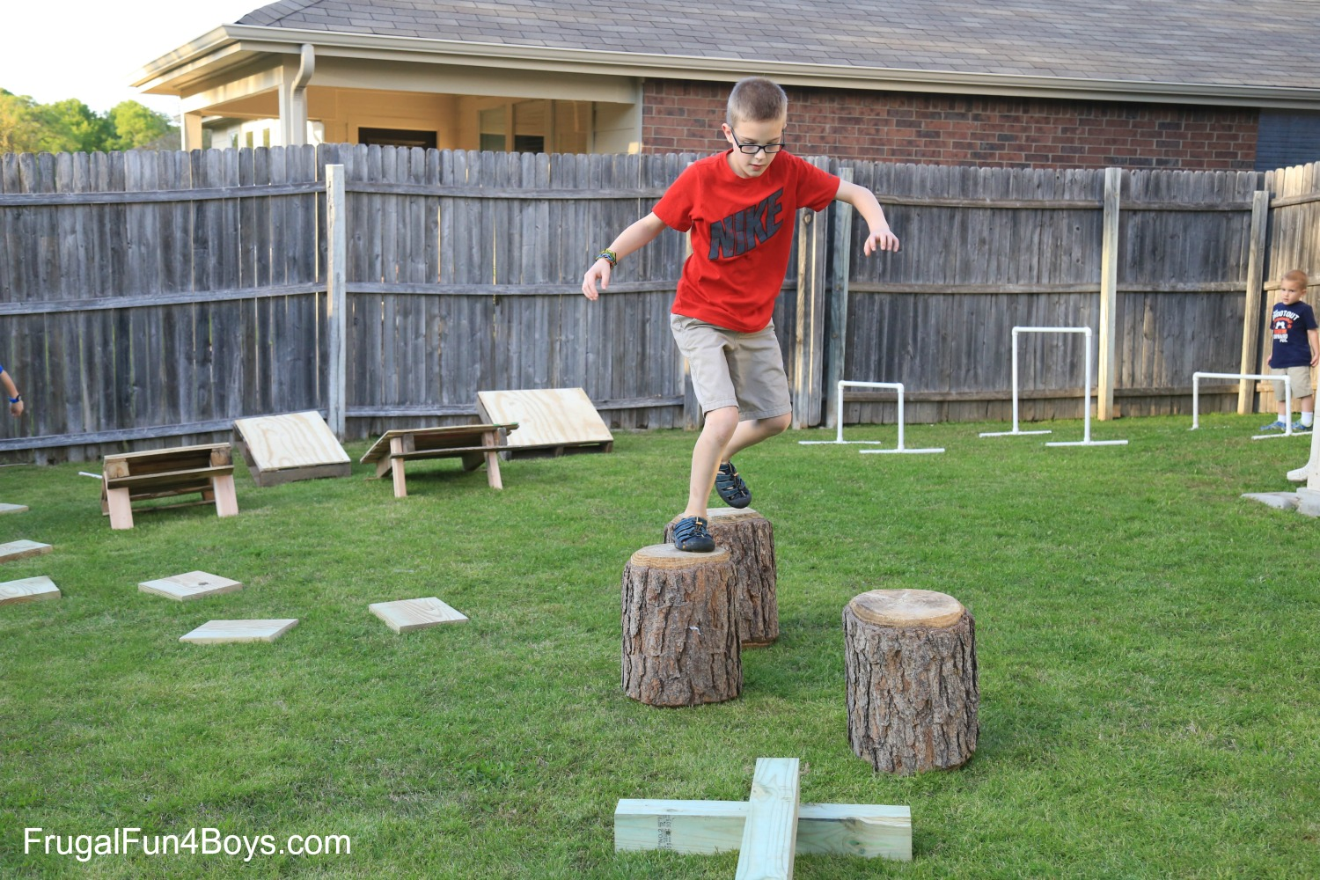
Obstacles participants often encounter in the simple course
One out of every three people who attends at least one session of the Simple course stops coming. Some of the reasons people have shared:
They feel better and don’t need the course anymore, or feel worse and can’t find the motivation, hope, or interest needed for participating.
They may feel their problems are too big for a course like this or that what they really need is individual therapy.
Simple is not a good fit for their issues, their attention span, or learning style.
There are changes in their schedules, new commitments, or changes in circumstances.
They experience general discouragement: “if I have to do all of this to change, change is impossible” or “What we’ve talked about so far is not working and nothing will ever work”
Notes:
Pre slide
Over the years of doing the simple course we've talked with participants about what they found to be the main obstacles to doing the course, the homework, and applying the tools skills and strategies in their everyday lives.
This is what they told us:

Slide 90
Obstacles participants often encounter in the simple course
Three hours (or 4.5 hours if you attend boing) a week is a big commitment other things get in the way. People miss one or two session and feel they are too far behind. People can’t be in a room or in front of a screen for 3 hours.
The material covered is too difficult to understand.
The format the material is presented in, is challenging when people have trouble with attention, concentration, or have atypical learning styles. The co-leaders are boring.
Participating in the course, the material, what the co-leaders say or how they say it, and other participants trigger strong emotions that people want to avoid such as hurt, anxiety, anger, grief, sadness, hopelessness.
Combinations of several of the above.
OBSTACLES PARTICIPANTS OFTEN ENCOUNTER IN THE SIMPLE COURSE

Slide 91
ORIENTATION TO SIMPLE:
WHAT WE WILL DO TODAY
Introductions
Mindfulness
Your intentions for the course
Why is this course called Simple and who might benefit from it
What do you need to have to do the Simple course ?
Simple course resources and schedule
10-minute Break
Participant agreements for the in person and zoom attendees.
health, illness, disease, sickness, disorder, pain and suffering
"there is a hole in my sidewalk" by Portia Nelson
What we will be covering in the course
Challenges often encountered by people doing Simple
Stuff to keep in mind when sharing in the group or if you’re triggered
Homework for the coming week
Notes:
In our session today we will cover several subjects these include:

Slide 92
Stuff to keep in mind when sharing in the group or if you’re triggered
Kate Smidts

Slide 93
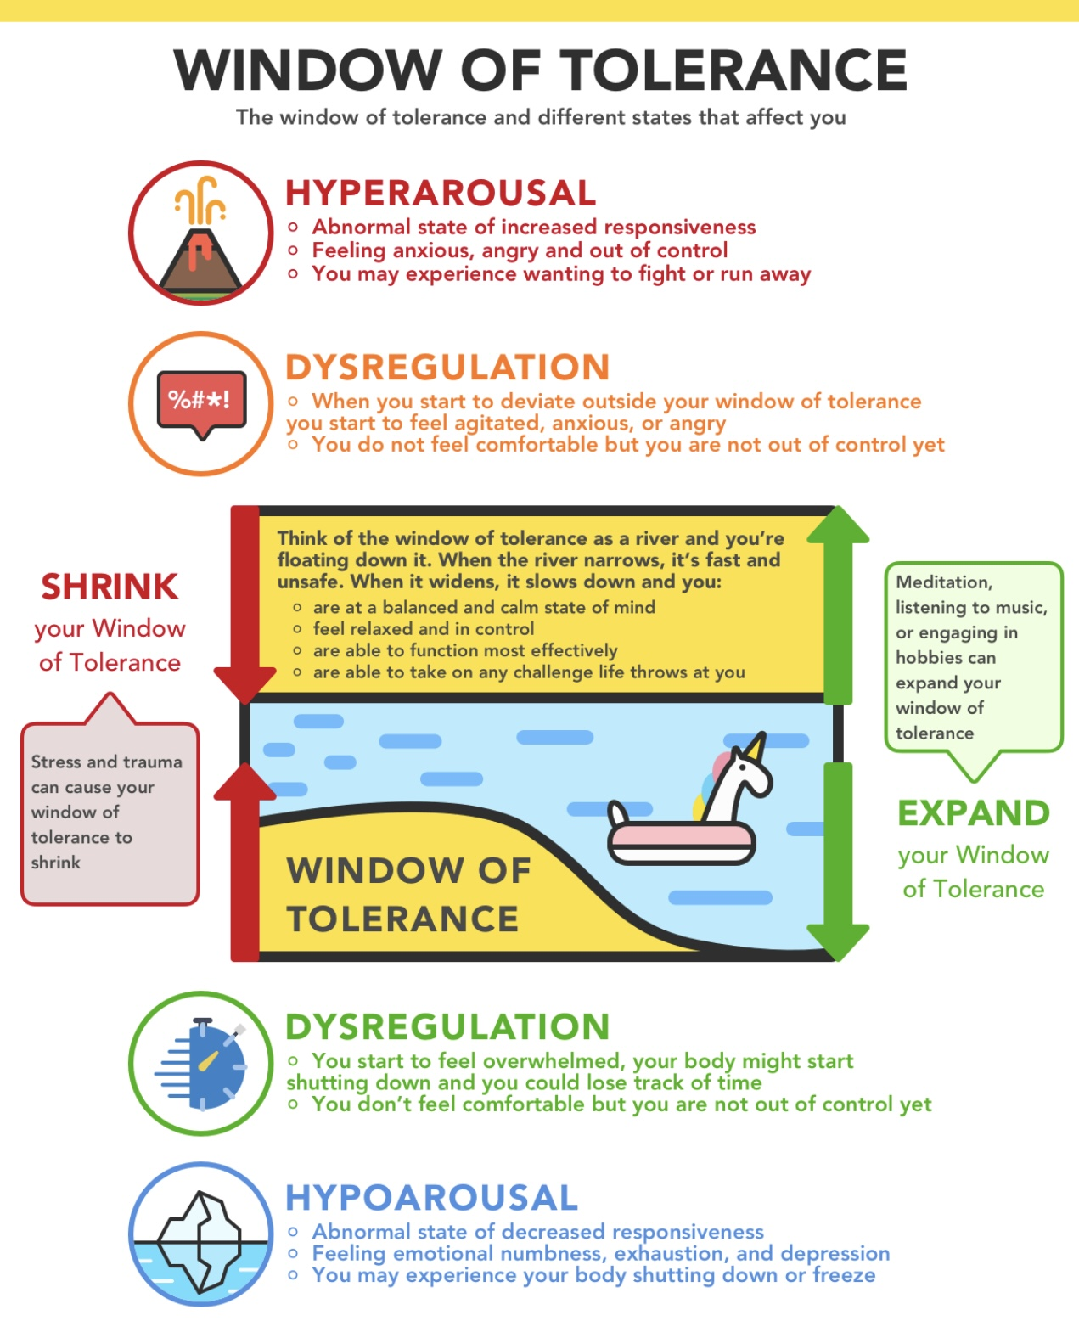
IF YOU’RE TRIGGERED
At some point during the course, you will be triggered. This may even happen frequently. Being triggered is an unpleasant experience that we all want to avoid.
Emotional triggers are experiences such as memories, situations, certain objects or words, people etc. that spark intense negative emotions.
These emotions can arise abruptly.
People with emotional dysregulation frequently have narrow windows of tolerance and frequently experience intense emotions.
Our minds tend to blame the triggering events for causing these intense emotions. This ignores the fact that being triggered has less to do with the triggering event and more to do with our psychological struggles that the triggering event reveals.

Slide 94
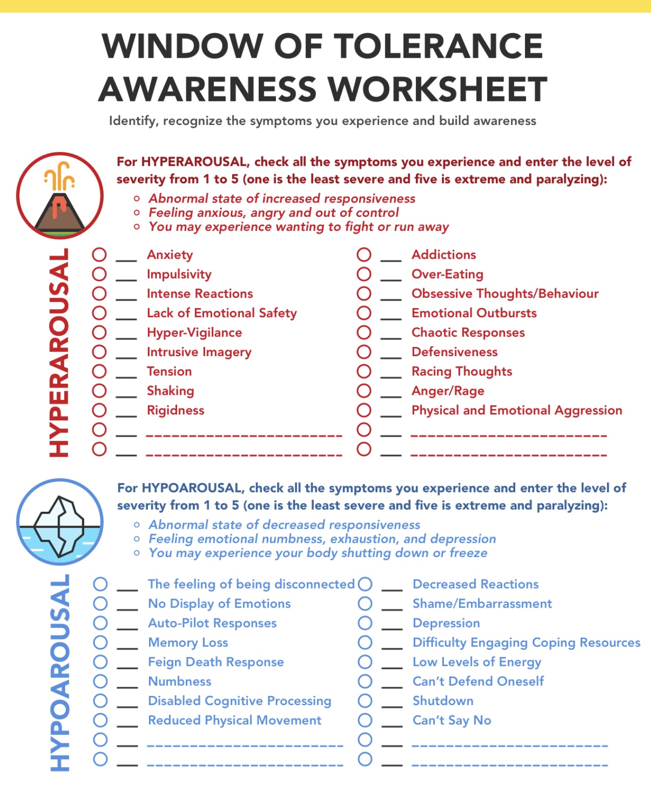
IF YOU’RE TRIGGERED
The automatic reactions to being triggered include withdrawing (anxiety), attacking (anger), or numbing out (dissociation).
Rather than withdrawing, attacking, or numbing out, which is often the repeat of the previous experiences you've encountered, we encourage you to observe and reflect on your emotional reactions.
This is more likely to help you widen your window of tolerance and heal.

Slide 95

when SHARING in the group
Course participants can share their feelings and thoughts in the sessions during the designated periods. Participant contributions are generally considered, by most participants, to be one of the most valuable aspects of the course.
You will notice that the co-leaders strive to time manage during the course so that all the different components of each session are adequately covered.
Last year we encouraged participants to jump in with questions or comments at any point during the session. At the end of the year the feedback was that many people didn’t like this as the flow of the session was sometimes disrupted.
This year we’ll ask you to save your questions and comments to the two designated periods.
At these times, please put your hand up and the co-leaders will keep track of the order in which you did so. When you share, please try to follow the “one breath sharing rule”
Remember that the Monday boing group is an opportunity to express yourself more fully. Come to that group.

Slide 96

when SHARING in the group
We schedule 10 practice session throughout the year in which we set aside a much longer period of time for one of the co-leaders and a volunteer to work together using personal examples to put into practice the material we’re learning. If you’d like to volunteer for a practice, please email us. We’ll take volunteers on first email first practice basis.
Any sharing of emotional material can have a significant effect on other course participants. Many course participants have had traumatic experiences in their lives and emotions associated with these experiences may be triggered when hearing other people who have had similar experiences talking about their traumas.
Take this into account and use the tools, skills, and strategies that you will learn, to recognize and try to regulate your feelings when you are sharing or listening to someone who is. We will help you stay emotionally regulated.
When you feel triggered by something in the course and go into fight, flight, or freeze, rather than acting on these emotions and thoughts take this as an opportunity to try to understand what happen and practice regulating yourself. The co-leaders will be happy to help you do this.

Slide 97

In this course we strive to create an effective learning environment.
This involves paying attention to factors such as safety and comfort, engagement, inclusivity, clear expectations, supportive relationships, feedback and assessment, flexibility, encouragement of critical thinking, and positive reinforcement.
Your contributions to creating such an environment are essential. We encourage you to:
1) view challenges as opportunities for growth. Perseverance will lead to improvement, and mistakes are a natural part of the learning process.
2) Understand the real-world applications of what you are learning.
3) Help us create a safe and inclusive atmosphere where everyone feels comfortable and safe. Collaborate and respect your peers.
4) Recognize and celebrate yours and other people’s achievements, both big and small. Positive feedback can boost confidence and motivation.
5) Approach the course with a sense of wonder and curiosity.
6) Set achievable goals for yourself. You don’t have to understand everything to benefit from the course.
LEARNING
CHALLENGES

Slide 98
ORIENTATION TO SIMPLE:
WHAT WE WILL DO TODAY
Introductions
Mindfulness
Your intentions for the course
Why is this course called Simple and who might benefit from it
What do you need to have to do the Simple course ?
Simple course resources and schedule
Participant agreements for the in person and zoom attendees.
health, illness, disease, sickness, disorder, pain and suffering
"there is a hole in my sidewalk" by Portia Nelson
What we will be covering in the course
Challenges often encountered by people doing Simple
Stuff to keep in mind when sharing in the group or if you’re triggered
Homework for the coming week
Notes:
In our session today we will cover several subjects these include:

Slide 99

Homework for the coming week
Please read p. 1-13 of the DBT skills training workbook 2nd edition. Joan and Nicole will cover these pages next week.
Read Simple manual Session 3
Submit questions, comments and feedback to or if you’d like to volunteer for a practice to itssimple2023@gmail.com

Slide 100

What we will do NEXT WEEK
Part I We’ll review the Skills training workbook p. 1-13 – which covers 5 topics:
1. DBT an overview of the treatment, who the DBT skills training workbook book is for?
2. Basic distress tolerance skills, what are they?
3. About this chapter
4. How to use this chapter
5. Take a rest.
Part II We’ll introduce the 4 Simple strategies. Covered in the Simple manual
Part III We’ll introduce the first tool: crisis plans also covered in the Simple manual session 3

Slide 101



Slide 102

OPEN DISCUSSION

Slide 103

See you next session

Slide 104
My name is…
But let me tell you about my nickname…This summer at one of the co-leaders meetings Lauren suggested all the co-leaders should have nicknames. I already had one corporal cleto. One of the first movies I ever watched was the ww ii movie the great escape. The movie’s climax is a scene in which the main character played by Steve McQueen escapes from a German pow camp by jumping with a motorcycle over a tall and wide barbed wire fence. The other prisoners watching this feat give him a long salute as he rides off into the sunset. The movie made quite an impression on me so that shortly after when in my second-grade class the teacher was taking attendance and called my name I got up and saluted her. All the kids thought that was hilarious. The teacher didn’t and sent me to the principles office. After that whenever I met my classmates, they would salute me and call me corporal cleto. Lauren said that after all this time I should have a higher rank and suggested sergeant simple. That evening at home I mentioned this to my wife and she said I’m happy you’ve been promoted. If I had been at the meeting I would have suggested an even higher rank. I think “Major pain” would have been even more fitting.

Slide 105
My role as a co leader is…
Even thought over the next 8 months you’ll see a lot of me up here, I didn’t create this course. Over the 25 years that I’ve been involved with it simple has organically grown from the contribution of the many people who have participated in it, the dozens of co-leaders, and the thoughts of those who proposed the perspectives, theories and approaches that we’ll discuss.
The course is now something with a life of its own. My role as a co-leader is to be one of the caretakers of the course.
If you imagine the course as a garden then the garden only exists because of innumerable contributions: those of the current group of gardeners that look after it, the visitors without whom there would be no garden, natural evolution that produced all the plants and flowers, the geological forces that shaped the land and soil, and the workers and suppliers of the Garden Centre that supplied us with soil, seeds, fertilizer and tools.
This garden exists so that we may heal and grow together. What you and I bring to the garden this year will undoutdly make it more complex and beautiful.

Slide 106
My hope for the time we spend together is…
That this becomes for you a safe place where you feel understood and learn to better understand yourself. Where you relate securely to the co-leaders and other group members while at the same time having different beliefs and opinions about many things. My hope is that the time we spend together helps us all grow and heal as we strive to be compassionate, curious, clear, creative, calm, confident, courageous, and connected with each other.

Slide 107
Portia Nelson's poem "There's a Hole in My Sidewalk" is a powerful reflection on self-awareness, personal growth, and the journey of life. The poem describes a process of encountering the same challenges repeatedly, illustrating how we often fall into familiar patterns of behavior.
The speaker initially falls into a hole, representing a lack of awareness or understanding of their circumstances. This highlights the importance of recognizing our problems.
As the poem progresses, the speaker begins to take responsibility for their actions and choices. This shift indicates growth and a willingness to change.
Eventually, the speaker learns to navigate around the hole, symbolizing personal development and the ability to overcome obstacles. This suggests that with awareness and effort, we can change our responses to life's challenges.
The poem emphasizes the importance of accepting our experiences, including pain and mistakes, as part of the human journey.
Nelson’s poem encourages readers to reflect on their own lives, recognize patterns, and take steps toward personal growth and self-improvement. It’s a reminder that while we may encounter the same issues repeatedly, we have the power to change our approach and ultimately find a way forward.

Slide 108
Creating an effective learning environment involves several important factors:
Safety and Comfort: A physically and emotionally safe space encourages students to take risks and express themselves without fear of judgment.
Engagement: Incorporating interactive and hands-on activities helps maintain student interest and motivation. Varied teaching methods can cater to different learning styles.
Inclusivity: Recognizing and respecting diverse backgrounds, abilities, and perspectives fosters a sense of belonging and encourages participation from all students.
Clear Expectations: Establishing clear rules, goals, and outcomes helps students understand what is expected of them and how they can succeed.
Supportive Relationships: Building strong relationships between teachers and students, as well as among peers, promotes collaboration and a sense of community.
Access to Resources: Providing access to a variety of learning materials and technologies can enhance the educational experience and support different learning needs.
Feedback and Assessment: Regular, constructive feedback helps students understand their progress and areas for improvement, while formative assessments can guide instruction.
Flexibility: Adapting the learning environment to meet the changing needs of students can enhance engagement and effectiveness.
Encouragement of Critical Thinking: Creating opportunities for students to analyze, evaluate, and create fosters deeper understanding and skills that are essential for lifelong learning.
Positive Reinforcement: Recognizing and celebrating achievements, both big and small, can boost motivation and self-esteem.
By considering these factors, educators can create a dynamic and effective learning environment that supports student growth and success.

Slide 109
Intellectual learning involves acquiring knowledge and understanding concepts through cognitive processes such as reading, studying, and analyzing information. It focuses on developing critical thinking skills and expanding one's intellectual capacity.
Experiential learning, on the other hand, is a hands-on approach to learning that involves learning through experience, reflection, and experimentation. It emphasizes learning by doing, and often involves real-world applications of knowledge and skills.
Effective learning refers to the ability to retain and apply what has been learned in a meaningful way. It involves understanding how to learn efficiently, setting goals, managing time effectively, and utilizing various learning strategies to maximize learning outcomes.
In summary, intellectual learning focuses on acquiring knowledge and understanding concepts, experiential learning emphasizes learning through hands-on experience, and effective learning involves retaining and applying knowledge in a meaningful way. Each approach has its unique benefits and can be combined to create a comprehensive learning experience

Slide 110

videos
Introduction to the simple course
Session 1 of simple
Session 2

Slide 111
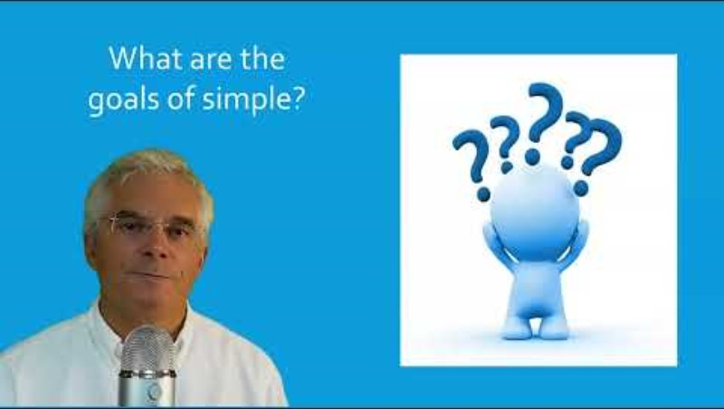

Slide 112
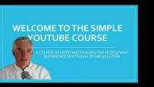

Slide 113


Slide 114


Slide 115
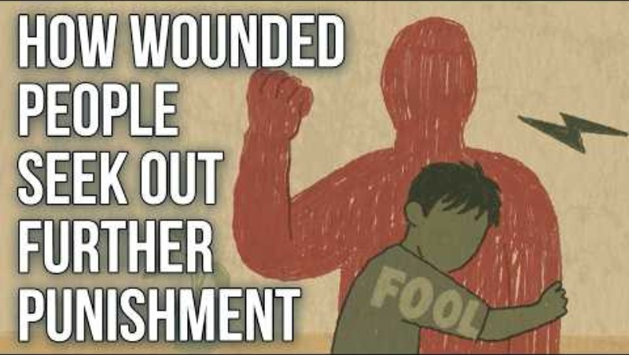

Slide 116


Slide 117


Slide 118
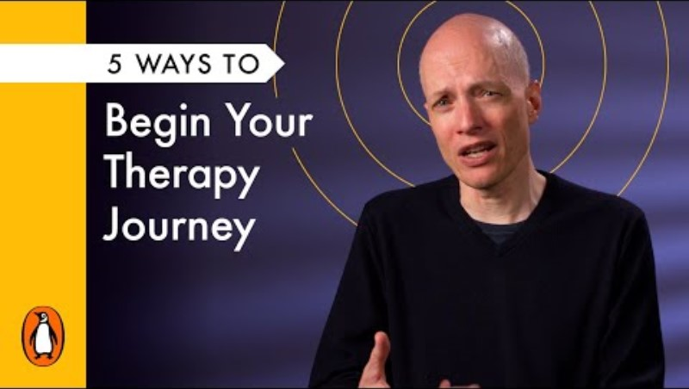

Slide 119


Slide 120
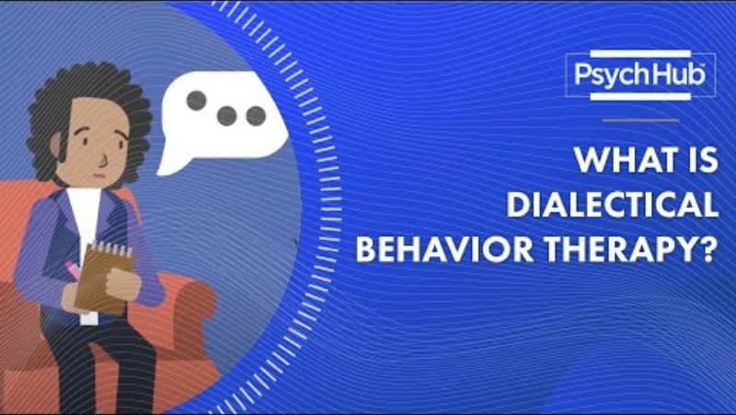

Slide 121
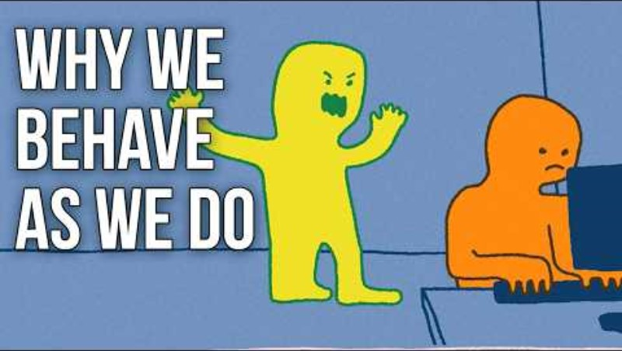

Slide 122


Slide 123


Slide 124

Notes:
Pre slide
People who experience emotional dysregulation often can relate both to Sisyphus and to the narrator in Nelson's poem there’s a hole in my sidewalk. Let’s start with the myth of Sisyphus

Slide 125


Slide 126
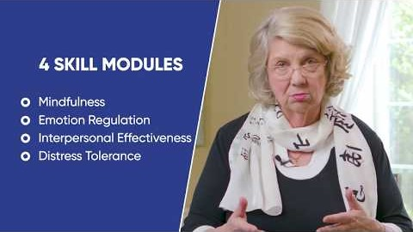

Slide 127
2024-25 sessions 1 and 2

Slide 128
Welcome to the 2024-25 simple course
“Healing is the touching with love of that which has been touched with fear, anger, and despair” Anonymous.
Health is not the absence of disease it is physical, psychological, social, and spiritual wellbeing.
Notes:
Pre slide one
Cars, bicycles, cameras, computers, almost anything these days comes with an owner's manual. Unfortunately, people don’t
An owners' manual can help you operate a product and trouble shoot if something goes wrong with it
One of the Simple course goals is to try to provide you with an owner's manual to your mind. If you’re happy with your life, you don’t need to do this course, but if you struggle with feelings, thoughts, or behaviors you will find it useful.
Many aspects of the human mind remain a great mystery but increasingly we have glimpses into how it functions. Knowing how it functions can, if we struggle emotionally, help ease our pain.
It's a privilege to be with you, hopefully for all the 29 simple sessions, in which together we will explore the mind and how to heal it. Welcome to the simple journey

Slide 129

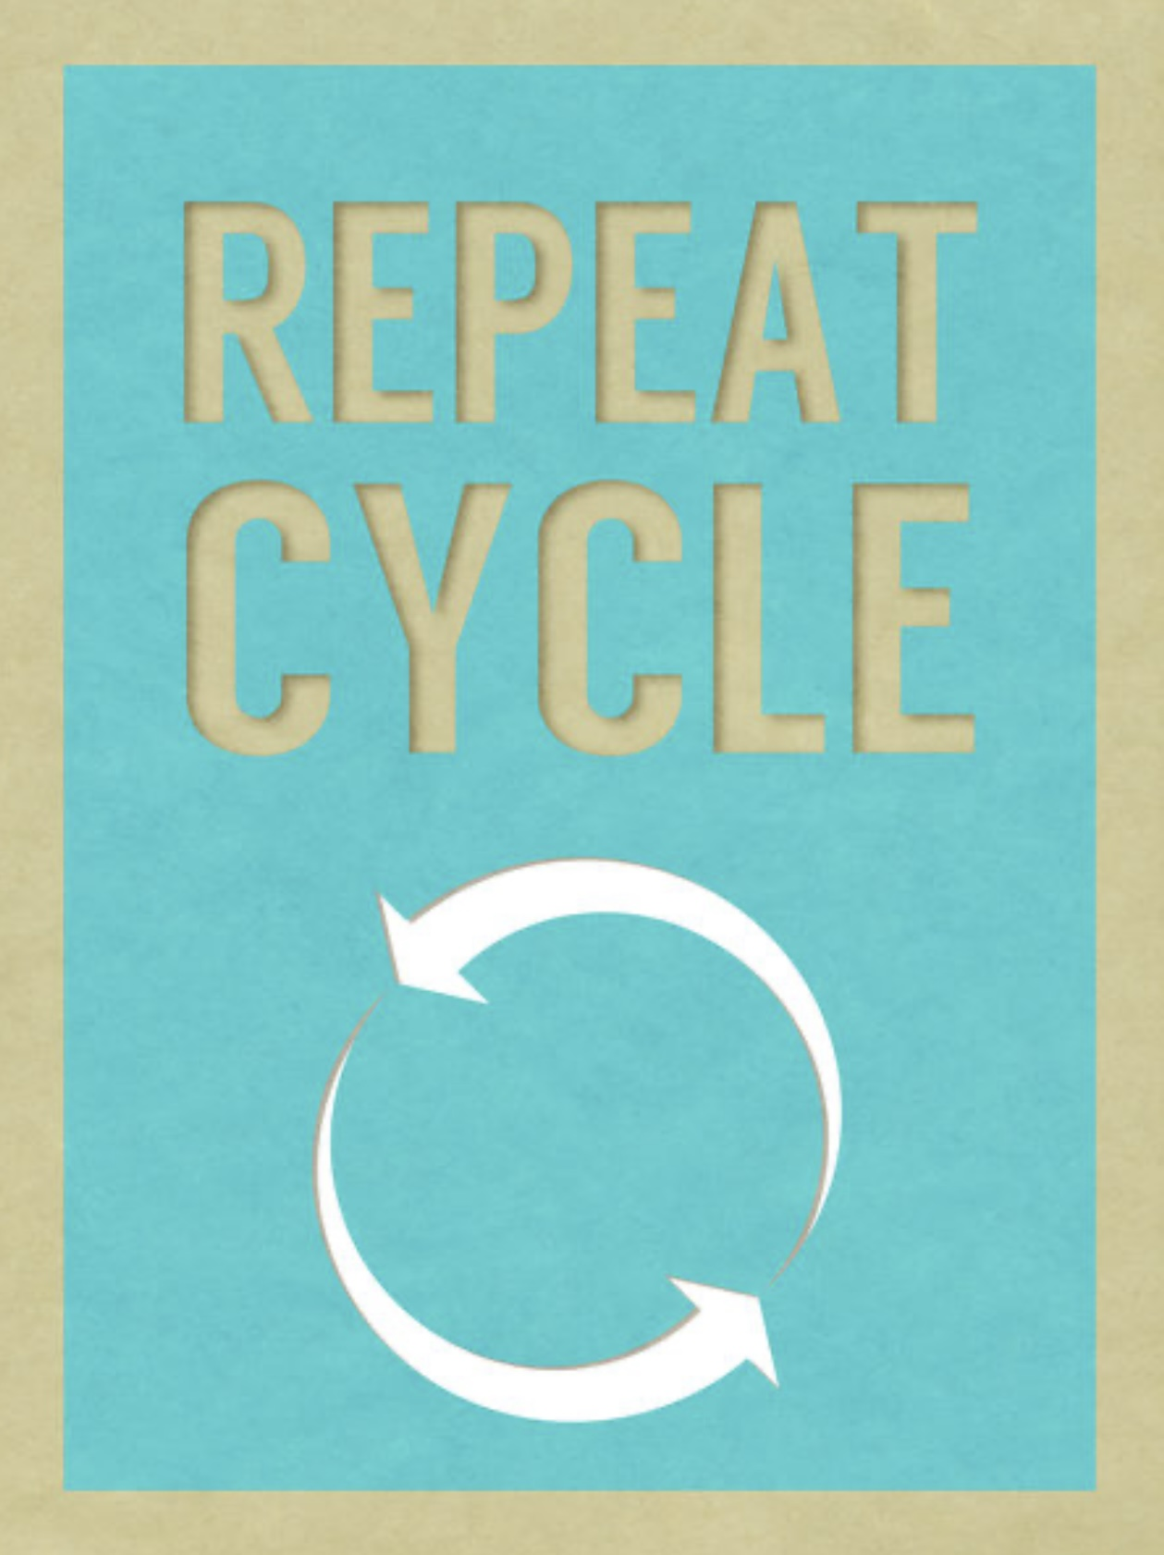

My name is…
My role as a co leader is…
My intention for the time we spend together is…
My hope for the course is…
Luis Cleto
Health is not the absence of disease it is physical, psychological, social, and spiritual wellbeing.
May the time we spend together help us grow and heal as we strive to stay compassionate, curious, clear, creative, calm, confident, courageous, and connected.
May I live graciously and joyfully nurturing the flame and being of service to the universe

Slide 130

session 1 of SIMPLE orientation

Slide 131

2024-25 SIMPLE COURSE CO-LEADERS
Lauren Ginow .
Peg Huettlin
Peg Huettlin
Betsy Austin Olson
luis cleto
Nicole Rogerson
Kate Smidts
Joan Flanagan
The 2024-25 Simple course is offered in collaboration with:
The Stratford and Star family health teams
Notes:
I, Luis cleto, have offered the simple course every year for the last 25 years. Over that time, I've had the privilege to co-lead the course with several different clinicians. In 2022 – 23 these were the coleaders of the in person and virtual live simple course.

Slide 132
videos
Introduction to the simple course
Session 1 of simple

Slide 135
SESSION 2 OVERVIEW: THE WHAT
OF THE SIMPLE COURSE
An overview of the Simple “trip” or material we will cover
SESSION 1 ORIENTATION: THE WHO, HOW, WHY WHERE, AND WHEN OF THE SIMPLE COURSE
An introduction to the Simple “bus”

Slide 136
My name is…
My role as a co leader is…
My intention for the time we spend together is…
My hope for the course is…
Peg Huettlin

Slide 137

LAND AKNOWLEGMENT
We acknowledge that we are standing on the traditional territory of the Haudenosaunee, Anishinaabe and Neutral peoples. As we gather let us remember that we are standing on treaty land that is steeped in rich indigenous history and home to many First Nations, Metis, and Inuit peoples. We are grateful to have the opportunity to live, work, and play on this land.

Slide 142
ORIENTATION TO SIMPLE:
WHAT WE WILL DO TODAY
Poll: some information about you
Mindfulness
Your intentions for the course
Why is this course called Simple and who might benefit from it
A brief history of Simple .
Individual vs. group psychotherapy
What do you need to have to do the Simple course ?
Types of learning and how we try to make learning easier
Simple course resources and schedule
10-minute Break
Conversation with Kate
Stuff to keep in mind when sharing in the group or if you’re triggered
Participant agreements for the in person and zoom attendees.
Homework for the coming week
Notes:
In our session today we will cover several subjects these include:

Slide 143
Nicole Rogerson
My name is…
My role as a co leader is…
My intention for the time we spend together is…
My hope for the course is…

Slide 144
ZOOM POLL
This year we will do polls only on weeks that we’re also reviewing new DBT skills.(every second week- when Joan and Nicole are with us.)
We’ll look at the answers of zoom participants immediately after we do the polls.
We’ll share the answers of in person participants at the beginning of the session the week after the poll.
Answers are anonymous

Slide 145
ORIENTATION TO SIMPLE:
WHAT WE WILL DO TODAY
Poll: some information about you
Mindfulness
Your intentions for the course
Why is this course called Simple and who might benefit from it
A brief history of Simple .
Individual vs. group psychotherapy
What do you need to have to do the Simple course ?
Types of learning and how we try to make learning easier
Simple course resources and schedule
10-minute Break
Conversation with Kate
Stuff to keep in mind when sharing in the group or if you’re triggered
Participant agreements for the in person and zoom attendees.
Homework for the coming week
Notes:
In our session today we will cover several subjects these include:

Slide 146
My name is…
My role as a co leader is…
My intention for the time we spend together is…
My hope for the course is…
Joan Flanagan

Slide 147
OUR FIRST MINDFULNESS EXERCISE

Slide 148
MINDFULNESS AND MEDITATION
Distressing thoughts and feelings
Mindfulness and meditation
Negative thoughts
Racing thoughts
In everyday life, when our minds are not focused on a concrete task, our thoughts roam free, flitting from one subject to another in a stream of associations. At these times a brain network called the default mode network is active. Our thoughts, which are linked to our feelings, may become obsessively stuck in negative ruts. This happens, for example, in anxiety and depression.
Mindfulness is about having some measure of influence over the contents of our mind. Mindfulness deactivates the default mode network. Mindfulness is a translation of the Hindu word sati, which means awareness, attention, and remembering.
In mindfulness, the mind is full of what we choose to fill it with, for example being present with a friend, the forest around us, or a sunset. In mindfulness the mind stays present and does not roam to other subjects. Through mindfulness, a person learns how to live in the present moment in an enjoyable way rather than worrying about the past or being concerned for the future.
Whereas mindfulness involves focusing the mind on the present moment, meditation is the practice of learning to empty the mind as much as possible by keeping it focused on one single object of perception such as the breath, a mantra, or bodily sensations. Meditation commonly involves a quiet environment, a comfortable relaxed position, and a point of mental focus.
Notes:
Pre slide
Often, when we’re distressed, we have negative, racing, intrusive or unwanted thoughts, and feelings
mindfulness Is the practice of focusing the mind on an object of one’s choice . That object might for example be our breath.
Meditation on the other hand is the activity of emptying the mind as much as possible. That may also be done by focusing on our breath, and then noticing when it wonders and gently bringing it back to focus.

Slide 149

COMMON TYPES OF MEDITATION
Concentration on a word, thought,
sensation, or image: ex. transcendental meditation, relaxation response, breath focused meditation, mantra repetition, meditation on a prayer, mandala, or other image.
2. Movement based meditation: ex. yoga, tai chi, Qi gong, Sufi dancing
3. Cultivating positive emotions such as compassion, forgiveness, gratitude, or loving kindness: ex. Buddhist Metta or tonglen practices, Institute of heart math training.
4. Emptying the self: centering prayer, waiting on the inner voice or inner light
Notes:
There are many different types of meditation practice. Meditation has been well documented to have mental, physical, emotional and spiritual benefits.

Slide 150
Thousands of studies have concluded that meditation benefits mental, physical, emotional, and spiritual health.
Mental health benefits – meditation increases awareness, clarity, compassion and a sense of calm. One study showed that meditating for four weeks increased focus by 14%. Another study reported that eight weeks of meditation led to participants reporting a 46% reduction in depression and 31% reduction in anxiety. Meditation can rewire the brain towards more positive thoughts and emotions.
Physical health benefits – meditation reduces stress hormones such as cortisol. In one University of California study people who meditated for 10 days had a 12% decrease in stress hormones and those meditated for 30 days saw their stress hormone level decrease by more than 30%
BENEFITS OF MEDITATION

Slide 151
POSSIBLE NEGATIVE EFFECTS OF MEDITATION
While meditation has been found to have very significant physical and mental health benefits it is also known to potentially occasionally have some negative effects.
The most common negative effects of meditation are increased anxiety, panic, confusion and disorientation, depression, and feeling spaced out. In other words, meditation can occasionally trigger emotional dysregulation causing the meditator to leave the window of emotional tolerance.
People with significant past trauma and those who frequently have ruminative negative thoughts are the most likely to experience these negative effects. People with trauma and ruminative thoughts, are often distracted by the busyness of everyday life. When they try to slow their minds down in meditation, their default mode network trauma is activated, and their traumatic memories and negative thoughts tend to fill the empty mind space created.
This reduction in distracting stimuli is why people with these issues also tend to have more difficulties at bedtime and with falling asleep when all is quiet.
Notes:
While the benefits of meditation far outweigh its possible negative effects, it is important for us to discuss these possible negative effects…

Slide 152
GROUNDING
Grounding techniques also known as grounding exercises or grounding skills, can distract, reframe, or otherwise soothe distressing feelings. They shift your focus from past or future thinking into the present moment. You may already engage in some of these techniques without formally realizing it.
Grounding exercises are especially helpful if you are experiencing anxiety disorders, self-harm urges, substance use disorders, eating disorders, PTSD or complex PTSD symptoms, dissociation, childhood trauma, panic attacks or persistent feelings of being overwhelmed, and chronic pain.
Grounding exercises are practices that can help you to manage your trauma symptoms when they occur. Grounding exercises help you to focus on the here and now. This can help you to distract from what is preoccupying your mind.
Grounding exercises are mindfulness but not meditation exercises.
Feel free to skip our guided meditation exercises if you become significantly dysregulated by them.
The self soothing toolkit and the mindful eating exercise which we will do together in future sessions are both grounding exercises. They should both be safe for most people
If mindfulness exercise cause you distress feel free to skip them, you may want to use that time to do a grounding practice

Slide 153
Warning about mindfulness practice
feel free to skip it. followed by a moment of silence
Notes:
Pre slide
Today we will do what is perhaps the most iconic DBT mindfulness practice: the raisin exercise.
It is a mindfulness exercise in which your mind will be full of the different aspects of the raisin: what it looks like, what it smells like, what it feels like, even what it sounds like and finally what it tastes like.
Mindfulness exercises such as this one and the sensory toolkit are also grounding exercises. Grounding exercises generally avoid the side effects of meditation, and you may choose to focus on them as you begin a meditation practice.
The six different types of grounding exercises which are the most popular and were previously discussed in the distress tolerance module are 1) focusing on bodily sensations 2) grounding with the five senses 3) self soothing 4) describing an object in great detail 5) counting breaths 6) distracting with a mind activity.

Slide 155

SPIRITUAL PRACTICES
In "Science and Spiritual Practices," Rupert Sheldrake explores various spiritual practices and their potential benefits, drawing connections between these practices and scientific insights. Some of the spiritual practices he discusses include:
Meditation: Sheldrake highlights meditation as a practice that can lead to increased mindfulness, reduced stress, and improved emotional well-being. He suggests that it can enhance one's connection to the present moment and foster a sense of inner peace.
Mindfulness and Presence: He advocates for practices that encourage being present and aware, which can improve mental clarity and emotional regulation.
Prayer: He examines the role of prayer in various religious traditions, arguing that it can promote a sense of connection to something greater than oneself and provide comfort and support during challenging times.
Rituals: Sheldrake discusses the importance of rituals in creating a sense of community and shared purpose. He suggests that rituals can help individuals feel anchored in their cultural and spiritual identities.
Nature Connection: He emphasizes the benefits of spending time in nature, which can lead to a greater sense of awe and connection to the natural world, fostering feelings of well-being and interconnectedness.
Gratitude Practices: Sheldrake points out that cultivating gratitude can enhance overall happiness and life satisfaction, as it shifts focus from what is lacking to appreciating what one has.
Sheldrake argues that these practices not only have psychological and emotional benefits but also resonate with scientific principles, such as the interconnectedness of all life and the influence of consciousness on the material world. He suggests that integrating these spiritual practices into daily life can enhance well-being and foster a deeper understanding of the nature of reality.

Slide 156
ORIENTATION TO SIMPLE:
WHAT WE WILL DO TODAY
Poll: some information about you
Mindfulness
Your intentions for the course
Why is this course called Simple and who might benefit from it
A brief history of Simple .
Individual vs. group psychotherapy
What do you need to have to do the Simple course ?
Types of learning and how we try to make learning easier
Simple course resources and schedule
10-minute Break
Conversation with Kate
Stuff to keep in mind when sharing in the group or if you’re triggered
Participant agreements for the in person and zoom attendees.
Homework for the coming week
Notes:
In our session today we will cover several subjects these include:

Slide 157
My name is…
My role as a co leader is…
My intention for the time we spend together is…
My hope for the course is…
Betsy Austin Olson

Slide 158
YOUR INTENSIONS FOR THE COURSE
Setting an intention involves consciously deciding what you want to focus on or achieve in a particular area of your life. It’s about clarifying your goals, desires, or feelings and aligning your actions and mindset with those aspirations. This practice can be done in various ways, such as through meditation, journaling, or simply taking a moment to reflect.
When you set an intention, you’re not just wishing for something to happen; you’re actively committing to a mindset or a course of action that can help you manifest your goals. It can be as specific as wanting to improve your health or as broad as seeking more joy in your daily life. The key is to be clear and positive about what you want to invite into your life!

Slide 159
THE BENEFITS OF SETTING INTENTIONS
Setting an intention can have several benefits, particularly in the context of personal growth, learning, and achieving goals.
Setting an intention helps clarify what you want to achieve, making it easier to focus your efforts and resources
Intentions can serve as a source of motivation, providing a reason to take action and stay committed to your goals.
The process of setting an intention encourages mindfulness, helping you to be present and aware of your thoughts and actions.
Intentions often promote a positive outlook, encouraging you to view challenges as opportunities for growth rather than obstacles.
Setting intentions allows you to align your actions with your core values and beliefs, leading to a more fulfilling and authentic life.
Intentions can enhance your focus by directing your attention toward specific outcomes, reducing distractions and increasing productivity.
When faced with setbacks, having a clear intention can help you stay resilient and committed to your goals, reminding you of your purpose.
Intentions can guide your decision-making process, making it easier to choose actions that align with your desired outcomes.
Sharing your intentions with others can create a sense of accountability, encouraging you to follow through on your commitments.
Setting intentions fosters a growth mindset, encouraging you to embrace challenges, learn from experiences, and continuously improve.
By incorporating intention-setting into your daily routine, you can create a more purposeful and fulfilling approach to learning and personal development.

Slide 160
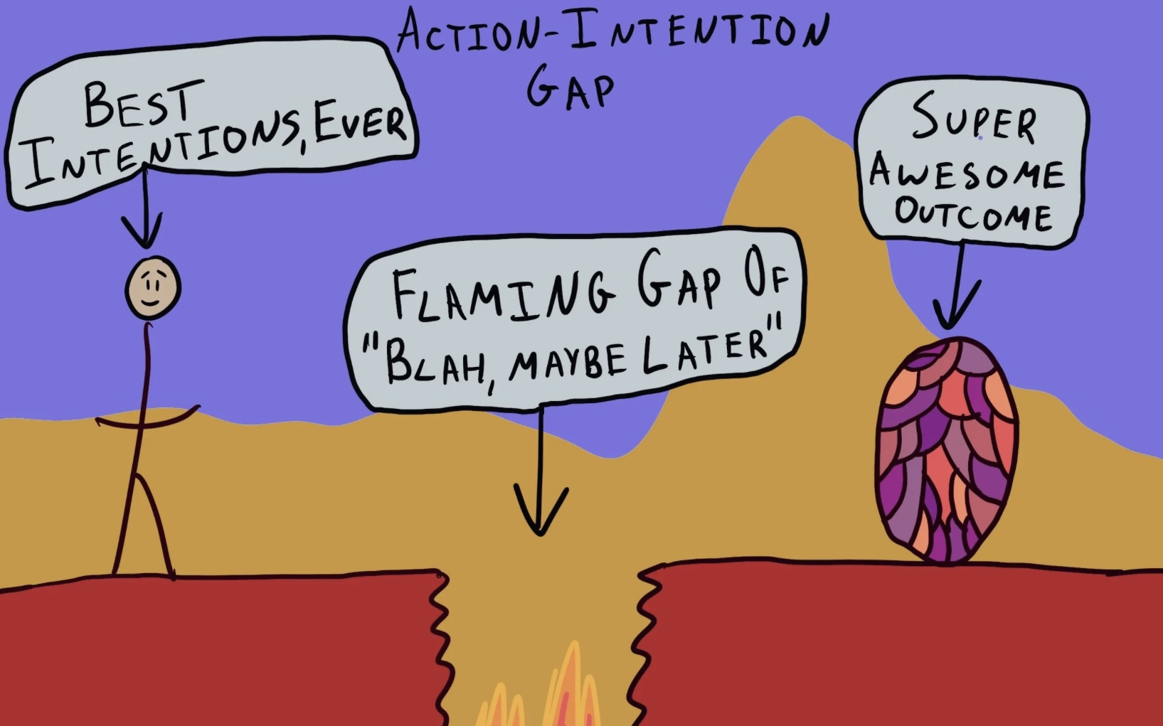
YOUR INTENSIONS FOR THE COURSE
If you’d like, please share your intentions for the course with us now…
Or chat/email them to us.

Slide 161
ORIENTATION TO SIMPLE:
WHAT WE WILL DO TODAY
Poll: some information about you
Mindfulness
Your intentions for the course
Why is this course called Simple and who might benefit from it
A brief history of Simple .
Individual vs. group psychotherapy
What do you need to have to do the Simple course ?
Types of learning and how we try to make learning easier
Simple course resources and schedule
10-minute Break
Conversation with Kate
Stuff to keep in mind when sharing in the group or if you’re triggered
Participant agreements for the in person and zoom attendees.
Homework for the coming week
Notes:
In our session today we will cover several subjects these include:

Slide 162
it's simple
Structured
Integrative, integral, idealist
Mindful
Psychotherapy that is Learned
Easily
SIMPLE
Neurobiology
DBT
Psychodynamic attachment and trauma theory
Integral theory
Simple is a bio psycho socio spiritual course/group that is geared towards anyone who experiences emotional dysregulation.
It strives to synthesize knowledge from a variety of disciplines into a single framework
Notes:
Thank you for your time I truly appreciate it. Over the next 30 minutes I’d like to share with you a project which I think, if taken to the next phase, could address some gaps in mental health care .
Simple is an acronym for… Integral is a nod to philosopher Ken Wilber whose work permeates the course while idealist refers to philosophical idealism which is becoming more accepted in academic philosophical circles particularly as articulated by philosophers such as Bernardo Kastrup. Mindful I don’t have to explain.

Slide 163
WHO SIMPLE IS FOR
Anyone who experiences emotional dysregulation or a narrow window of tolerable emotions.
Being calm or alert is a state of physiological activation referred to as the ‘window of emotional tolerance’. Outside that is fight/flight hyperarousal and hypoarousal freeze/dissociation.
What is emotional dysregulation?
A disproportionate emotional reaction to present day events or intense emotions arising apparently from nowhere.
Dysregulated emotions can be seen as the core problem which can then give rise to dysregulated thoughts and behaviors.
Signs of dysregulated emotions include depression, anxiety, high levels of shame and anger, self-harm, excessive substance use, high risk behaviors, perfectionism, conflictual interpersonal relationships, issues with eating, suicidal thoughts, etc..
Dysregulated emotions are not just average responses to present day events, they often are triggered by present-day events but may owe to unconscious factors such as a person’s temperamental predispositions, and their past experiences, including the type of parenting they had and/or previous traumatic circumstances they may have encountered in the course o their lives.
The main goals of this course are 1. to help people who experience emotional dysregulation become aware of, understand, and better regulate their dysregulated emotions , thoughts, and behaviors and 2. to heal the traumas that underlie emotional dysregulation
Being emotionally well-regulated means having the capacity to bring yourself to a calm or alert state from states of fight or flight, depression or dissociation.

Slide 164
ORIENTATION TO SIMPLE:
WHAT WE WILL DO TODAY
Poll: some information about you
Mindfulness
Your intentions for the course
Why is this course called Simple and who might benefit from it
A brief history of Simple .
Individual vs. group psychotherapy
What do you need to have to do the Simple course ?
Types of learning and how we try to make learning easier
Simple course resources and schedule
10-minute Break
Conversation with Kate
Stuff to keep in mind when sharing in the group or if you’re triggered
Participant agreements for the in person and zoom attendees.
Homework for the coming week
Notes:
In our session today we will cover several subjects these include:

Slide 165

A BRIEF HISTORY OF THE SIMPLE COURSE
Some of the significant moments of the Simple course include:
1993 – Marsha Linehan publishes “cognitive behavioral treatment of borderline personality disorder” DBT is born.
1997- first DBT group offered at Stratford General Hospital
1997- present- Why DBT evolved into Simple.
2020- Simple 1st offered virtually
2023-Simple on YouTube
2024-25- 27 th anniversary of the course
Notes:
The history of the simple course goes back to around 1997. After finishing my psychiatry residency in 1989, I practiced Hospital psychiatry in a suburb of Montréal called Longueil for seven years. Shortly after Marshall Linehan published her 1993 book "cognitive behavioral treatment of borderline personality disorder“ I came across her work, and it changed my practice. In 1996 I moved to Stratford and introduced DBT at the Stratford General Hospital. In 1997 mental health nurse Maureen Pratley and I started the first DBT group in Stratford. I also worked part time for 5 years at regional mental health care London helping to develop a DBT program. From 1997 to 2022 DBT evolved into simple for two main reasons

Slide 166
ORIENTATION TO SIMPLE:
WHAT WE WILL DO TODAY
Poll: some information about you
Mindfulness
Your intentions for the course
Why is this course called Simple and who might benefit from it
A brief history of Simple .
Individual vs. group psychotherapy
What do you need to have to do the Simple course ?
Types of learning and how we try to make learning easier
Simple course resources and schedule
10-minute Break
Conversation with Kate
Stuff to keep in mind when sharing in the group or if you’re triggered
Participant agreements for the in person and zoom attendees.
Homework for the coming week
Notes:
In our session today we will cover several subjects these include:

Slide 167

INDIVIDUAL OR GROUP THERAPY
Research shows that both individual and group therapy are equally as effective at addressing many psychological issues. Each modality, however, has something to offer:
1) group therapy – Assures individuals that they are not alone. Connects them to others in similar situations.
Provides them with a different perspective on their issues.
Allows them to receive and give support.
Helps them develop communication and socialization skills.
2)individual therapy – Occurs in a more intimate setting, which provides an increased level of confidentiality.
Allows the therapist to fully focus on the individual.
Encourages sharing without fear of judgement.
Allows people to dig down deeper into their own issues.
Allows for more flexible schedule.
3) why I prefer group
.

Slide 168
ORIENTATION TO SIMPLE:
WHAT WE WILL DO TODAY
Poll: some information about you
Mindfulness
Your intentions for the course
Why is this course called Simple and who might benefit from it
A brief history of Simple .
Individual vs. group psychotherapy
What do you need to have to do the Simple course ?
Types of learning and how we try to make learning easier
Simple course resources and schedule
10-minute Break
Conversation with Kate
Stuff to keep in mind when sharing in the group or if you’re triggered
Participant agreements for the in person and zoom attendees.
Homework for the coming week
Notes:
In our session today we will cover several subjects these include:

Slide 169
What you need to do the Simple course?

Slide 170
WHAT YOU NEED TO DO THE SIMPLE COURSE
1. The Simple manual $13 and the skills training workbook $29
2. A 3-ring binder
3. Access to the Simple website- Itssimple2021.com
5. Your active participation
4. Access to the It’s Simple on YouTube (Luis Cleto it’s simple on YouTube sessions) or the “live” course.
Notes:
You need five things to do the simple course

Slide 171
THREE RING BINDER
Preferably with 30 separation tabs- one for each session
Have it with you at each session
You can use it to keep your weekly homework: crisis plans, diary cards, chain analysis, jot down notes, etc.

Slide 172
THE BOOKS WE USE IN THE SIMPLE COURSE
Notes:
Both books are available on Amazon in e-book or paperback format.

Slide 173
MOST IMPORTANTLY
Across all different therapy models, the most important predictor of positive change is the client’s emotional engagement with the work
Meaning you’ll get the most out the course if you actively emotionally engage in it. This includes:
Doing the homework: reading about the skills, tools, strategies, theory, and optionally reviewing the PowerPoint presentations and YouTube videos ahead of the sessions
Intentionally and mindfully applying what you are learning in the course in your day-to-day life.
The benefits you’ll get from the course are proportional to the effort you put in.
Do the homework, stay organized and…
Practice, practice, practice.

Slide 174
ORIENTATION TO SIMPLE:
WHAT WE WILL DO TODAY
Poll: some information about you
Mindfulness
Your intentions for the course
Why is this course called Simple and who might benefit from it
A brief history of Simple .
Individual vs. group psychotherapy
What do you need to have to do the Simple course ?
Types of learning and how we try to make learning easier
Simple course resources and schedule
10-minute Break
Conversation with Kate
Stuff to keep in mind when sharing in the group or if you’re triggered
Participant agreements for the in person and zoom attendees.
Homework for the coming week
Notes:
In our session today we will cover several subjects these include:

Slide 175
LEARNING
In this course we strive to create an effective learning environment.
This involves paying attention to factors such as safety and comfort, engagement, inclusivity, clear expectations, supportive relationships, feedback and assessment, flexibility, encouragement of critical thinking, and positive reinforcement.
Your contributions to creating such an environment are essential. We encourage you to:
1) view challenges as opportunities for growth. Perseverance will lead to improvement, and mistakes are a natural part of the learning process.
2) Understand the real-world applications of what you are learning.
3) Help us create a safe and inclusive atmosphere where everyone feels comfortable and safe. Collaborate and respect your peers.
4) Recognize and celebrate yours and other people’s achievements, both big and small. Positive feedback can boost confidence and motivation.
5) Approach the course with a sense of wonder and curiosity.
6) Set achievable goals for yourself. You don’t have to understand everything to benefit from the course.
(1)

Slide 176
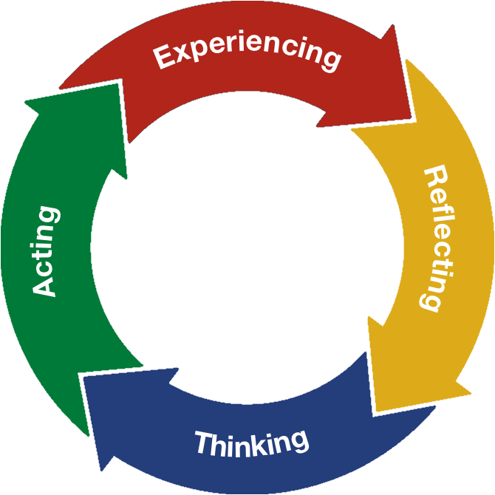
TYPES OF LEARNING: INTELLECTUAL, EXPERIENTIAL, AND EFFECTIVE
Intellectual learning- is learning about ideas, concepts, and practices in your mind. It involves reflecting and thinking.(music theory)
Experiential or practical learning – is learning to apply the ideas, concepts, and practices learned in everyday life. It involves acting and experiencing. It is where the rubber hits the road.(practicing your instrument)
Effective learning- is learning that produces the desired or intended results. Effective learning requires both intellectual and experiential learning.(applying theory while you are playing the music)
Each week, in the 3 hours of the Simple course, we will do intellectual learning, along with some experiential learning.
At home, practicing and applying the tools, strategies and skills assigned in the homework, you will hopefully do a lot of experiential or practical learning
Both of these types of learning are necessary for you to learn effectively and get the most out of the course.
(2)
EFFECTIVE LEARNING

Slide 177

TO make learning easier
To make the material easier to learn and keep you interested:
In each session we follow a format that incorporates a variety of activities including:
1. videos related to the course material,
2. weekly reminders for the participants,
3. a mindfulness exercises,
4. descriptions of what we will do in the session,
5. a review of previous weeks and assignment of next week’s homework,
6. on alternating weeks, we present psychological theory, tools, skills, strategies, and do group practice
7. 10-minute break at midway point
8. On alternating weeks, we do participant polls
9. Questions, comments and feedback from participants at any point in the session but limited to 3 minutes. (we have the option on continuing our discussion on the Monday boing group)
Be patient and remember that we go over important material many times
Everyone has different learning styles and something that works for one person may not for another.

Slide 178

COURSE
RENOVATIONS
In an effort to improve the course, we are constantly updating it making both big and small renovations.
Many of these renovations are aesthetic, others are major involving knocking down some walls. If you did the course last year you will notice a number of changes:
1) To replace the breakout rooms, we created the boing group
2) The leaders will strive to "read the slides" less and "tell a story" more.
3) The foundations of the simple course sessions: 4, 6, and 8, have undergone major renovations
4) Participants will now be able to ask questions, make comments or give us feedback at any point during the session. We will however limit these to a maximum of three minutes with the option of coming back to these discussions at greater length in the following boing group.
5) This year for the first time we used AI when researching certain subjects.

Slide 179
ORIENTATION TO SIMPLE:
WHAT WE WILL DO TODAY
Poll: some information about you
Mindfulness
Your intentions for the course
Why is this course called Simple and who might benefit from it
A brief history of Simple .
Individual vs. group psychotherapy
What do you need to have to do the Simple course ?
Types of learning and how we try to make learning easier
Simple course resources and schedule
10-minute Break
Conversation with Kate
Stuff to keep in mind when sharing in the group or if you’re triggered
Participant agreements for the in person and zoom attendees.
Homework for the coming week
Notes:
In our session today we will cover several subjects these include:

Slide 180
What learning resources does the course offer ? What does our schedule for the year look like? And what do we do in case of unexpected events such as the internet being down?

Slide 181
SIMPLE COURSE RESOURCES
E-mail: Our email is itssimple2023@gmail.com .
On Wednesday mornings before the group, we will review and answer questions, comments, and feedback e-mailed to us during the week.
When appropriate we may address these questions, comments and feedback “live” at the beginning of a session.
Unfortunately, at other times In-between sessions, we cannot guarantee that we will always answer your e-mails
You can also email us if you want to volunteer for a in-class practice. We will work with you individually to prepare for the session in which we will use the tools and skills in front of the group.
Notes:
We have already talked about the books we use in simple and the website. A third resource that "live" course participants have access to his our email. If you are doing the YouTube course facilitated by mental health professional having a course website might be an option.

Slide 182
3) Simple YouTube channel
Search YouTube for: “Luis Cleto it’s simple on youtube sessions”. Then click the red “I” icon.
We go into each topic in more depth than in class
May help you understand the material
May be useful to you if you miss one or more sessions.
Allows people to do the course on their own.
SIMPLE COURSE RESOURCES

Slide 183
DATE | SIMPLE SESSION
OCTOBER 2 | 1
9 | 2
16 | 3
23 | 4
30 | 5
NOVEMBER 6 | 6
13 | 7
20 | 8
27 | 9
DECEMBER 4 | 10
11 | 11
18 | 12
25 | Christmas break
JANUARY 1 | Christmas break
8 | 13
15 | 14
22 | 15

Slide 184
DATE | SIMPLE SESSION
JANUARY 29 | 16
FEBRUARY 5 | 17
12 | 18
19 | 19
26 | 20
MARCH 5 | 21
12 | 22
19 | March break
26 | “
APRIL 2 | “
9 | 23
16 | 24
23 | 25
30 | 26
MAY 7 | 27
14 | 28
21, 28, June 4 | 29, 30, final review

Slide 185
UNEXPECTED EVENTS
There may be unexpected events that interfere with the normal running of the simple course.
These may include internet issues, power outages, or bad weather.
Some suggestions:
If the internet cuts out, check if the problem is at your end. If it’s at our end, we will keep trying to reconnect.
If for some reason we can’t do the course virtually, (power outage, long internet disruption.) we will still do it in person.
If it’s bad weather:
If the church is open we will be here.
If the church is closed, we will still do the course virtually. If you’re doing the course in person and need a zoom link, please email us
How will we know if the church is closed?
We will post updates on unexpected events on the website

Slide 186
ORIENTATION TO SIMPLE:
WHAT WE WILL DO TODAY
Poll: some information about you
Mindfulness
Your intentions for the course
Why is this course called Simple and who might benefit from it
A brief history of Simple .
Individual vs. group psychotherapy
What do you need to have to do the Simple course ?
Types of learning and how we try to make learning easier
Simple course resources and schedule
10-minute Break
Conversation with Kate
Stuff to keep in mind when sharing in the group or if you’re triggered
Participant agreements for the in person and zoom attendees.
Homework for the coming week
Notes:
In our session today we will cover several subjects these include:

Slide 187
session 1 of SIMPLE
10-minute break

Slide 188


Slide 189
session 1 of SIMPLE welcome back from the break

Slide 190
ORIENTATION TO SIMPLE:
WHAT WE WILL DO TODAY
Poll: some information about you
Mindfulness
Your intentions for the course
Why is this course called Simple and who might benefit from it
A brief history of Simple .
Individual vs. group psychotherapy
What do you need to have to do the Simple course ?
Types of learning and how we try to make learning easier
Simple course resources and schedule
10-minute Break
Conversation with Kate
Stuff to keep in mind when sharing in the group or if you’re triggered
Participant agreements for the in person and zoom attendees.
Homework for the coming week
Notes:
In our session today we will cover several subjects these include:

Slide 191
We thought it would be useful, especially for people doing the course for the first time, to be able to have access to the perspective of a participant who has previously done the course.
All the people who are repeating the course have very valuable insights.
Over the last couple of years, we’ve asked that one participant join the coleader group during our summer planning time to give us their perspective on how to continue to improve the course
Kate kindly agreed to take on this role, and her contribution at our meetings this summer was greatly appreciated.
Today we’ll start our “conversations with Kate” segment of the session in which Kate and Jody who is doing the course for the first time (more or less) will have a conversation.
In the future if anyone, especially people doing the course for the first time has questions they think would be better answered by Kate than by other co leaders please let us know.
You can also email or chat us your questions for Kate now or any time in the future.

Slide 192
ORIENTATION TO SIMPLE:
WHAT WE WILL DO TODAY
Poll: some information about you
Mindfulness
Your intentions for the course
Why is this course called Simple and who might benefit from it
A brief history of Simple .
Individual vs. group psychotherapy
What do you need to have to do the Simple course ?
Types of learning and how we try to make learning easier
Simple course resources and schedule
10-minute Break
Conversation with Kate
Stuff to keep in mind if you’re triggered in the group
Participant agreements for the in person and zoom attendees.
Homework for the coming week
Notes:
In our session today we will cover several subjects these include:

Slide 193
IF YOU’RE TRIGGERED
My name is…
My role as a co leader is…
My intention for the time we spend together is…
My goal for the course is…
Kate Smidts

Slide 194
SOME THINGS TO KEEP in mind when SHARING in the group
Course participants are encouraged to share their feelings and thoughts in the sessions. Participant contributions are generally considered by most participants to be the most valuable aspect of the course.
You will notice that the co-leaders strive to time manage during the course so that all the different components of each session are adequately covered.
At any time during a session, you may make comments, give us feedback or ask us questions. In order to cover all the course material and stay on track during sessions, we will not go very deeply into any issue and will try to limit any interaction to about 3 minutes. We have the option of coming back to these conversations during the boing group.
We schedule 6 or 7 practice session throughout the year in which we set aside a much longer period of time for one of the co-leaders and a volunteer to work together using personal examples to put into practice the material we’re learning.
Any sharing of emotional material can have a significant effect on course participants. Many course participants have had traumatic experiences in their lives and emotions associated with these experiences may be triggered when hearing other people who have had similar experiences talking about their traumas.
Take this into account and use the tools, skills, and strategies that you will learn, to recognize and try to regulate your feelings when you are sharing or listening to someone who is. We will help you stay emotionally regulated.
When you feel triggered by something in the course and go into fight, flight, or freeze, rather than acting on these emotions and thoughts take this as an opportunity to try to understand what happen and practice regulating yourself. The co-leaders will be happy to help you do this.

Slide 195
WHAT TO DO WHEN YOU FIND YOURSELF TRIGGERED DURING THE GROUP
At some point during the course, you will be triggered. This may even happen frequently. Being triggered is an unpleasant experience that we all want to avoid.
Emotional triggers are experiences such as memories, situations, certain objects or words, people etc. that spark intense negative emotions.
These emotions can arise abruptly.
People with emotional dysregulation frequently have narrow windows of tolerance and frequently experience intense emotions.
Our minds tend to blame the triggering events for causing these intense emotions. This ignores the fact that being triggered has less to do with the triggering event and more to do with our psychological struggles that the triggering event reveals.
The automatic reactions to being triggered include withdrawing (anxiety), attacking (anger), or numbing out (dissociation).
Rather than withdrawing, attacking, or numbing out which is often the repeat of the previous experiences you've encountered, we encourage you to observe and reflect on your emotional reactions. This is more likely to help you widen your window of tolerance and heal.

Slide 196
ORIENTATION TO SIMPLE:
WHAT WE WILL DO TODAY
Poll: some information about you
Mindfulness
Your intentions for the course
Why is this course called Simple and who might benefit from it
A brief history of Simple .
Individual vs. group psychotherapy
What do you need to have to do the Simple course ?
Types of learning and how we try to make learning easier
Simple course resources and schedule
10-minute Break
Conversation with Kate
Stuff to keep in mind when sharing in the group or if you’re triggered
Participant agreements for the in person and zoom attendees.
Homework for the coming week
Notes:
In our session today we will cover several subjects these include:

Slide 197
Lauren Ginow
My name is…
My role as a co leader is…
My intention for the time we spend together is…
My goal for the course is…

Slide 198
PARTICIPANT AGREEMENTS

Slide 199
SIMPLE COURSE CODE OF CONDUCT AGREEMENT (all participants)
Everyone in the course will strive to interact with others in a kind and respectful manner. We will strive to validate, avoid judgments and assume the best about each other.
Personal information, including names, should not be discussed with anyone outside of the course. What happens in simple stays in simple.
Participants are encouraged to arrive on time and stay until the end of the session.
Participants are encouraged to do the assigned homework between sessions.
If you are doing the course in person and become ill with a potentially transmissible condition, please do the course virtually until you are well. (If you need the zoom link, please email us)
Actively participating by talking is encouraged but not necessary.
During discussions participants may provide examples from their own experiences. Please keep in mind, however, that discussing some subjects such as traumatic relationships, self-harm, suicide, substance abuse etc. may trigger others.
If in person course participants need to leave the room to take a reregulation break, please let the facilitators know .
In person course participants will strive to avoid side conversations when another individual is speaking. Virtual live participants will be mindful about overusing the “chat box”
Course participants are encouraged to not engage in dysregulated behaviors with other participants outside of the course.
Course participants are encouraged to avoid forming new romantic relationships with other participants for the duration of the course.
Course participants will not attend sessions under the influence of drugs or alcohol.
Please avoid sharing in-depth personal stories outside of specific session times provided for this.
If you are doing the course in-person, please legibly write your first and last name on the attendance sheet as you come into the room. If you are doing it virtually, please enter your first name and the initial of your last name on the screen.
Notes:
The Simple course etiquette agreement has evolved organically over the years. It is a code of conduct which participants in coleaders agree to abide by.

Slide 200
ZOOM PARTICIPANT AGREEMENT
Please mute your microphone when not using it
Please keep your camera on . You may turn it off during PowerPoint slide presentations or if you need to step out of the group. It’s important that we see each other so that we can establish trust and ensure confidentiality.
Please make sure no one at your end who is not taking part in the course can see or overhear other group participants .
When you have questions, comments, feedback please raise your hand icon and wait until one of the co leaders gets to you.
Please avoid overusing the chat box. Please do not use it to make critical comments.

Slide 201
ALTERNATIVE PARTICIPANT AGREEMENT

Slide 202
Please no scents. If it’s wet or snowy please bring indoor footwear.
Please legibly write down your first and last names on the attendance sheet when you come in.
AVONDALE UNITED CHURCH
Our hosts: Yvonne - front desk
Roger - custodian
Rev. Keith Reynolds – minister
feel free to bring a drink and/or a snack but please clean up after yourself.
we encourage the use of masks and hand sanitizer especially if you’ve been in contact with someone who is ill.
if you think you are contagious, even if it’s just a cold, please do the course virtually until you’re well.
please write down the zoom meeting number and password in case you lose the link.
ZOOM meeting
Meeting id: 851 0112 2900
Passcode: 322517

Slide 203
REMINDER SLIDE POSTED at each session
If you have questions, comments, or feedback, raise your real/virtual hand. We’ll take note and get to you at an appropriate time.
Keep comments, questions, and feedback relatively brief so everyone has a chance to participate.
Please avoid side conversations
Please do not overuse zoom’s chat function.
If you’re on zoom, make sure no one can overhear what is being said
For reasons that will become clear later in the course please avoid giving advice to other participants about what they should or should not do. Validation, encouragement , and understanding are however very much appreciated.

Slide 204
ORIENTATION TO SIMPLE:
WHAT WE WILL DO TODAY
Poll: some information about you
Mindfulness
Your intentions for the course
Why is this course called Simple and who might benefit from it
A brief history of Simple .
Individual vs. group psychotherapy
What do you need to have to do the Simple course ?
Types of learning and how we try to make learning easier
Simple course resources and schedule
10-minute Break
Conversation with Kate
Stuff to keep in mind when sharing in the group or if you’re triggered
Participant agreements for the in person and zoom attendees.
Homework for the coming week
Notes:
In our session today we will cover several subjects these include:

Slide 205
HOMEWORK FOR THE COMING WEEK
Please read Simple manual Sessions 1 and 2
Please write the above down so you remember. Or…
You can view this and all the PowerPoint slides, on our website: itssimple2021.com
Virtual participants please have a handful of raisins or similar dried fruit ready for next week’s mindfulness exercise.
Optional: Please watch YouTube simple sessions 1 and 2 which you can find by searching on YouTube for It’s simple on YouTube sessions 1-30.

Slide 206
OPEN DISCUSSION

Slide 207

FOOTNOTES

Slide 208
(1) Creating an effective learning environment involves several important factors:
Safety and Comfort: A physically and emotionally safe space encourages students to take risks and express themselves without fear of judgment.
Engagement: Incorporating interactive and hands-on activities helps maintain student interest and motivation. Varied teaching methods can cater to different learning styles.
Inclusivity: Recognizing and respecting diverse backgrounds, abilities, and perspectives fosters a sense of belonging and encourages participation from all students.
Clear Expectations: Establishing clear rules, goals, and outcomes helps students understand what is expected of them and how they can succeed.
Supportive Relationships: Building strong relationships between teachers and students, as well as among peers, promotes collaboration and a sense of community.
Access to Resources: Providing access to a variety of learning materials and technologies can enhance the educational experience and support different learning needs.
Feedback and Assessment: Regular, constructive feedback helps students understand their progress and areas for improvement, while formative assessments can guide instruction.
Flexibility: Adapting the learning environment to meet the changing needs of students can enhance engagement and effectiveness.
Encouragement of Critical Thinking: Creating opportunities for students to analyze, evaluate, and create fosters deeper understanding and skills that are essential for lifelong learning.
Positive Reinforcement: Recognizing and celebrating achievements, both big and small, can boost motivation and self-esteem.
By considering these factors, educators can create a dynamic and effective learning environment that supports student growth and success.

Slide 209
(2) Intellectual learning involves acquiring knowledge and understanding concepts through cognitive processes such as reading, studying, and analyzing information. It focuses on developing critical thinking skills and expanding one's intellectual capacity.
Experiential learning, on the other hand, is a hands-on approach to learning that involves learning through experience, reflection, and experimentation. It emphasizes learning by doing, and often involves real-world applications of knowledge and skills.
Effective learning refers to the ability to retain and apply what has been learned in a meaningful way. It involves understanding how to learn efficiently, setting goals, managing time effectively, and utilizing various learning strategies to maximize learning outcomes.
In summary, intellectual learning focuses on acquiring knowledge and understanding concepts, experiential learning emphasizes learning through hands-on experience, and effective learning involves retaining and applying knowledge in a meaningful way. Each approach has its unique benefits and can be combined to create a comprehensive learning experience

Slide 210
See you next session

Slide 211
video
Session 2 of simple

Slide 213

Welcome to session 2 introduction to the simple course
Notes:
Pre slide
Welcome to session 2 of the simple course. Today we review the material we will cover in the next 27 sessions of the simple course and the obstacles you may face as you try to access the mental health resources and improve your mental health
Welcome to session two of the simple course

Slide 214
Today Session 2 OVERVIEW: THE WHAT
An overview of the “trip” or material we will discuss
Last week Session 1 ORIENTATION: THE WHO, HOW, WHY, WHERE, AND WHEN OF THE SIMPLE COURSE
An introduction to the “bus”
Notes:
Last week we began our overview of the course with an orientation… This week we introduce the theory, skills, tools, and strategies and techniques that we will be discussing in the next 28 sessions. We will also talk about the most common obstacles that might interfere with people benefiting from the course.

Slide 215

Overview Of today’s session
Reminders
Mindfulness: Sensory soothing toolkit
health, illness, disease, sickness, disorder, pain and suffering
Why are the myth of Sisyphus and the poem "there is a hole in my sidewalk" by Portia Nelson important metaphors in the course?
Simple vs. DBT
What we will be covering in the course
10-minute Break 10:30-10:40 (give or take 10 minutes)
Challenges often encountered by people doing Simple
Notes:
In our session today we will cover several subjects these include:

Slide 219
Overview Of today’s session
Reminders
Mindfulness: Sensory soothing toolkit
health, illness, disease, sickness, disorder, pain and suffering
Why are the myth of Sisyphus and the poem "there is a hole in my sidewalk" by Portia Nelson important metaphors in the course?
Simple vs. DBT
What we will be covering in the course
10-minute Break 10:30-10:40 (give or take 10 minutes)
Challenges often encountered by people doing Simple
Notes:
In our session today we will cover several subjects these include:

Slide 220

Notes:
These general reminders are intended for participants doing the life course or those doing it on YouTube and then meeting in a group.

Slide 221
Homework for the past week
Please read Simple manual Sessions 1 and 2

Slide 222
Homework for the coming week
Please read p. 1-13 of the DBT skills training workbook 2nd edition. Joan and Nicole will cover these pages next week.
Read Simple manual Session 3
Try making and using your own “sensory soothing kit”. To guide you, view the mindfulness video on the PowerPoint slides for session 2 or search “trauma coping toolkit-sooth intense emotions with the 5 senses.” on YouTube.
Submit questions, comments and feedback to itssimple2023@gmail.com

Slide 223
REMINDER PARTICIPANT AGREEMENTS
If you have questions, comments, or feedback, raise your real/virtual hand. We’ll take note and get to you at an appropriate time.
Keep comments, questions, and feedback relatively brief so everyone has a chance to participate.
Please avoid side conversations
Please do not overuse zoom’s chat function.
If you’re on zoom, make sure no one can overhear what is being said
For reasons that will become clear later in the course please avoid giving advice to other participants about what they should or should not do. Validation, encouragement , and understanding are however very much appreciated.

Slide 224

E-mailed questions, comments, feedback
AND “housekeeping”

Slide 225

WEEKLY ANNOUNCEMENTS
For medico-legal reasons we are required to take attendance.
Attendance numbers also allow us to justify, with the organizations that support us, continuing to offer this course. So…
If you’re on zoom, please sign in with your first name and the initial of your last name.
If you’re in person, please write your name legibly
THANK YOU

Slide 226
IN PERSON POLL RESULTS FROM LAST WEEK
1. I am doing the simple course…
A) for the first time – 62%
B) I've done it before – 38%
2. The time I have to devote to the course...
A) is limited because of other things going on in my life – 15%
B) is adequate – 85%
3. I tend towards...
A) Introversion – 62%
B) extraversion – 8%
C) worrying a lot – 100%
D) not worrying much – 0%
E) being easy-going – 23%
F) being uptight – 38%
G) getting along with others – 77%
H) having difficulty in relationships – 62%
I) being open to new experiences – 23%
J) preferring the familiar – 77%
4. I think that
A)The simple course will likely help me- 92%
B)The course may or may not help me- 0%
C)I’m not sure anything can help me- 8%

Slide 227
Overview Of today’s session
Reminders
Mindfulness: Sensory soothing toolkit
health, illness, disease, sickness, disorder, pain and suffering
Why are the myth of Sisyphus and the poem "there is a hole in my sidewalk" by Portia Nelson important metaphors in the course?
Simple vs. DBT
What we will be covering in the course
10-minute Break 10:30-10:40 (give or take 10 minutes)
Challenges often encountered by people doing Simple
Notes:
In our session today we will cover several subjects these include:

Slide 228

MINDFULNESS
Next week we’ll be mindfully eating a raisin.
Zoom participants please have some raisins available at the beginning of the class
We will bring the raisins for those who come in-person.

Slide 229
Warning about mindfulness practice
feel free to skip it. followed by a moment of silence
Notes:
Pre slide
Today we will do what is perhaps the most iconic DBT mindfulness practice: the raisin exercise.
It is a mindfulness exercise in which your mind will be full of the different aspects of the raisin: what it looks like, what it smells like, what it feels like, even what it sounds like and finally what it tastes like.
Mindfulness exercises such as this one and the sensory toolkit are also grounding exercises. Grounding exercises generally avoid the side effects of meditation, and you may choose to focus on them as you begin a meditation practice.
The six different types of grounding exercises which are the most popular and were previously discussed in the distress tolerance module are 1) focusing on bodily sensations 2) grounding with the five senses 3) self soothing 4) describing an object in great detail 5) counting breaths 6) distracting with a mind activity.

Slide 230


Slide 231
Overview Of today’s session
Reminders
Mindfulness: Sensory soothing toolkit
health, illness, disease, sickness, disorder, pain and suffering
Why are the myth of Sisyphus and the poem "there is a hole in my sidewalk" by Portia Nelson important metaphors in the course?
Simple vs. DBT
What we will be covering in the course
10-minute Break 10:30-10:40 (give or take 10 minutes)
Challenges often encountered by people doing Simple
Notes:
In our session today we will cover several subjects these include:

Slide 232
DEFINITIONS
As we begin our journey of healing and growing, it may be helpful to explore the meaning of the terms health, pain, suffering, Illness, disease, sickness and disorders or conditions.
According to the world health organization, health is “a state of complete physical, mental, social and spiritual wellbeing and not merely the absence of disease and infirmity.”
Pain is a physical sensation or emotional experience that signals harm or distress. It can be acute (short-term) or chronic (long-lasting) and is typically a direct response to injury, illness, or other physical conditions. Pain is a biological signal that something is wrong, prompting individuals to take action to protect themselves.
Suffering, on the other hand, is a broader emotional and psychological experience that encompasses the feelings of distress, anguish, or hardship that can arise from pain, but also from other sources such as loss, disappointment, or existential concerns. Suffering can occur even in the absence of physical pain, and it often involves a deeper, more complex response to life's challenges. Pain and suffering are often intertwined but represent different experiences.
Illness, To quote Marshall Marinker, is “a feeling or experience of unhealth which is entirely personal, and interior to the person of the patient. Often it accompanies disease, but the disease may be as yet undiagnosed, as in the early stages of cancer, tuberculosis, or diabetes. Sometimes illness exists where no disease can be found. Traditional medical education has made the deafening silence of illness in the absence of disease unbearable to the clinician.”
Disease is a “pathological process, most often physical as in throat infection, or cancer... The quality which identifies disease is some deviation from a biological norm. There is an objectivity about disease which doctors are able to see, touch, measure, or smell. Diseases are valued as essential facts in the medical model.”

Slide 233
Sickness is “the external and public mode of unhealth. Sickness is a social role, a status, a negotiated position in the world, a bargain struck between the person henceforward called "sick", and a society which is prepared to recognize and sustain him. The security of this role depends on a number of factors, not least of which is the possession of that much treasured gift, the disease. Sickness based on illness alone is of the most uncertain status. But even the possession of disease does not guarantee equity in sickness. Those with chronic disease are much less secure than those with an acute one; those with a psychiatric disease than those with a surgical one… Best is an acute physical disease in a young man quickly determined by recovery or death, either will do, both are equally regarded.”
Psychiatric, psychological or mental disorders/conditions are characterized by a clinically significant disturbance in an individual’s thinking, emotional regulation, or behavior. They are usually associated with distress or impairment in important areas of functioning.
Biological psychiatry follows a disease model, in which mental disorders are seen as being “chemical”, physiological, or biological diseases.
We will argue in this course that by embracing the disease model, psychiatry neglects the social, psychological, and spiritual aspects of illness without which we cannot fully understand most people’s experiences.
DEFINITIONS
Rheumatic pain II by Remedios Varo

Slide 234
Overview Of today’s session
Reminders
Mindfulness: Sensory soothing toolkit
health, illness, disease, sickness, disorder, pain and suffering
Why are the myth of Sisyphus and the poem "there is a hole in my sidewalk" by Portia Nelson important metaphors in the course?
Simple vs. DBT
What we will be covering in the course
10-minute Break 10:30-10:40 (give or take 10 minutes)
Challenges often encountered by people doing Simple
Notes:
In our session today we will cover several subjects these include:

Slide 235
Notes:
Pre slide
People who experience emotional dysregulation often can relate both to Sisyphus and to the narrator in Nelson's poem there’s a hole in my sidewalk. Let’s start with the myth of Sisyphus

Slide 236

PAIN AND
SUFFERING
The myth of Sisyphus is an ancient Greek myth on which the Algerian/French Nobel prize winning existentialist philosopher and writer Albert Camus based a famous essay. (1)
The myth of Sisyphus is a metaphor for the human condition, especially for people experiencing chronic physical, psychological, social or spiritual distress
Sisyphus eternal punishment of rolling a boulder up a hill only for it to roll back down depicts meaningless pain and represents the absurdity of life and the struggle inherent in human experience.
The key aspect of the myth is Sisyphus's acceptance of his pain. This acceptance is a powerful commentary on the human experience, suggesting that while pain is inevitable, how we respond to it can define our existence.
Camus saw Sisyphus as a hero because instead of being crushed and defeated by the pain of his punishment, Sisyphus’s passion, yearning for freedom, defiance, and hope made him stronger. He refused to be a victim and defined himself a survivor instead. (1)
These same themes are articulated in Victor Frankel’s book “man's search for meaning”: "The one thing you can’t take away from me is the way I choose to respond to what you do to me. The last of one's freedoms is to choose one's attitudes in any given circumstance. Happiness cannot be pursued it must ensue. Life is never made unbearable by circumstances but only by a lack of meaning and purpose. Between stimulus and response there is a space. In that space is our power to choose our response. In our response lies our growth and our freedom.“
Even amidst great pain there can be meaning, repair, and growth.
Portia Nelson’s poem There’s a hole in my sidewalk is a powerful reflection on self-awareness, personal growth, and the journey of life. The poem, like the myth of Sisyphus, describes a process of encountering the same challenges repeatedly, illustrating how we often fall into familiar patterns of behavior.
Notes:
People who experience emotional dysregulation often relate to Sisyphus and to the character in Nelson's poem.

Slide 238
THERE’S A HOLE IN MY SIDEWALK
I walk down the street.
There is a deep hole in the sidewalk.
I fall in.
I am lost… I am helpless.
It isn’t my fault.
It takes forever to find a way out.
I walk down the same Street.
There is a deep hole in the sidewalk.
I pretend I don’t see it.
I fall in again.
I can’t believe I am in the same place.
But it isn’t my fault.
It still takes me a long time to get out.
I walk down the same Street.
There is a deep hole in the sidewalk.
I see it is there.
I still fall in. It’s a habit.
My eyes are open.
I know where I am.
It is my fault. I get out immediately.
I walk down the same Street.
There is a deep hole in the sidewalk.
I walk around it.
I walk down another Street.”
Portia Nelson (2)

Slide 239
Overview Of today’s session
Reminders
Mindfulness: Sensory soothing toolkit
health, illness, disease, sickness, disorder, pain and suffering
Why are the myth of Sisyphus and the poem "there is a hole in my sidewalk" by Portia Nelson important metaphors in the course?
Simple vs. DBT
What we will be covering in the course
10-minute Break 10:30-10:40 (give or take 10 minutes)
Challenges often encountered by people doing Simple
Notes:
In our session today we will cover several subjects these include:

Slide 240

Before starting our overview of the course can you explain what the difference is between DBT and simple ?

Slide 241
DBT Simple
HOW DBT AND SIMPLE DIFFER ?
Theory- cognitive behavioral, Buddhist philosophy
Skills- DBT skills
Tools- not named as such but uses 2 or 3 CBT tools.
Accessibility-Pure model consists of group, individual, crisis coaching, and therapist consultation which makes pure DBT expensive and difficult to access. Adaptations are more widely available and are typically called DBT.
Theory-Psychodynamic trauma and attachment theory, CBT, DBT, structural dissociation, internal family systems, etc.
Skills-DBT skills
Tools-uses 6 tools borrowed from a variety of therapeutic modalities
Also uses 4 Strategies and techniques to help with using the skills and tools.
Accessibility-Can be done as a live course, on your own, or with the assistance of an individual mental health professional. This makes Simple more accessible.
Notes:
Pre slide
DBT Is a core part of the simple course but simple is more than just DBT
There are several differences between simple and DBT
In terms of a theoretical framework DBT uses cognitive behavioral theory whereas Simple uses psychodynamic trauma and attachment theory, cognitive behavioural and dialectical behavioural theories, the structural dissociation model, internal family systems, and integral philosophy..
The skills presented in DBT and simple are roughly the same
DBT does not name "tools" but does use two or three cognitive behavioural therapy tools. Simple uses six tools borrowed from a variety of therapeutic modalities.
Simple also names and uses five strategies and techniques
. In terms of accessibility, the pure DBT model because it involves four elements: group, individual therapy, crisis coaching, and therapist support meetings is expensive and difficult to access. Simple on the other hand can be done in a group, individually, or with the help of an individual mental health professional. It is therefore accessible and inexpensive

Slide 242
the workbook and the manual
DBT workbook
Simple manual
Covers the traditional DBT skills
How to use skills is covered in the workbook’s exercises, worksheets, and logs.
The workbook focuses on phase I of trauma therapy, stabilization or self-regulation
Does not cover DBT skills
How to use skills is covered by the 6 tools, and 5 strategies.
The manual covers phases I, II, and III of trauma therapy.
It’s easy to get confused because how to use the DBT skills is presented in a different way in the workbook and in the manual. We encourage you to try both but if you’re confused or have limited time 1) learn the skills from the skills training workbook and skip the exercises, worksheets and logs. Focus instead on the tools and strategies presented in the manual.

Slide 243
Overview Of today’s session
Reminders
Mindfulness: Sensory soothing toolkit
health, illness, disease, sickness, disorder, pain and suffering
Why are the myth of Sisyphus and the poem "there is a hole in my sidewalk" by Portia Nelson important metaphors in the course?
Simple vs. DBT
What we will be covering in the course
10-minute Break 10:30-10:40 (give or take 10 minutes)
Challenges often encountered by people doing Simple
Notes:
In our session today we will cover several subjects these include:

Slide 244
Can you give us an overview of the material we will be covering in the simple course?

Slide 245
A BRIEF OVERVIEW OF THE SIMPLE COURSE
The Simple course aims to help you identify, become more aware of, get out of, avoid, and repair some of the “holes in the sidewalk” you keep falling into.
Today, we will start by giving you a brief overview of the material we will cover in the course.
We will then spend the rest of the Simple course exploring this material in much greater detail.
Please try not to be overwhelmed by the quantity of material discussed today. We will spend a lot of time together exploring it in detail.

Slide 246
SIMPLE Course overview
The Simple course can be divided into 5 parts:
Part 1: Psychological theory- understanding your mind
Part 2: learning DBT skills
Part 3: learning the 6 tools
Part 4: learning the techniques and strategies needed for using the tools and skills
Part 5: Practicing applying skills, tools, and strategies in everyday life

Slide 247
SIMPLE Course overview
Part 1: Psychological theory- understanding your mind
Part 2: learning DBT skills
Part 3: learning the 6 tools
Part 4: learning the techniques and strategies needed for using the tools and skills
Part 5: Practicing applying skills, tools, and strategies in everyday life

Slide 248
1. Psychological Theory
Foundations I : The evolution of instincts/emotional mind
Managing suicidal thoughts
Foundations II: The evolution of cognition/ rational mind
Foundations III : The evolution of modern day thinking/wise mind
Personality
Temperament and character
Attachment
The dynamic maturational model of attachment
Stress, distress, and the post-traumatic stress spectrum
Traumatic stress in children and adults
Structural dissociation theory
Internal family systems
Dominant states of activation of part selves
Interpersonal conflicts and their repair
Spirituality and health
Tying it all together :“My", "Ours”, and “The” stories – My personal religious myth
a biopsychosociospiritual
model for understanding the mind

Slide 249
SIMPLE Course overview
Part 1: Psychological theory- understanding your mind
Part 2: learning DBT skills
Part 3: learning the 6 tools
Part 4: learning the techniques and strategies needed for using the tools and skills
Part 5: Practicing applying skills, tools, and strategies in everyday life

Slide 250
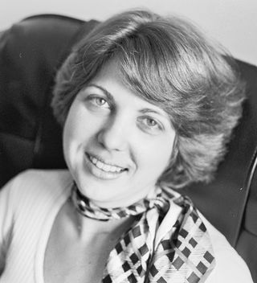
2. The 4 components of THE PURE DBT MODEL
1. Group sessions- taught skills
2. Individual work- taught how to apply skills to the individual persons circumstances
3. Crisis line – help with using skills in a crisis
4. Therapist consultation- help for the therapists.
The “Pure DBT model” was shown to be effective in reducing self-harm but was resource intensive
Because it was so resource intensive, the “pure model” led to many adaptations which could be more easily provided but whose efficacy not studied
Simple is one of those adaptations, but it is also more than DBT.

Slide 251
Skills- The Dialectical Behavioral therapy skills workbook
The DBT workbook covers the four traditional modules:
1 Distress tolerance – how to deal with crisis.
2 Mindfulness – how to become more aware of your thoughts, feelings, sensations, and behaviors.
3 Emotional regulation – how to widen and increasingly be able to stay in the window of emotional tolerance
4 Interpersonal effectiveness – how to have healthier relationships by being assertive rather than passive or aggressive.
Every second week will, as part of the course suggested homework, assign readings from the DBT skills training workbook. We strongly encourage you to do these readings because when in the session we cover them you will already be familiar with what we are talking about. We’ll also be happy to discuss anything you might not quite understand.
Notes:
The skills training component of DBT is typically done in a group setting. There are several different workbooks that cover the traditional four modules of DBT skills.

Slide 252
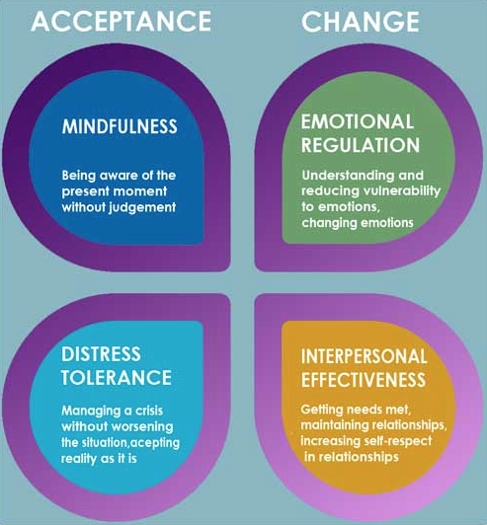
The four DBT modules promote both acceptance of life as it is, and the need to change so as to make life better.
Linehan says DBT recognizes and accepts that each person is doing their best while at the same time encouraging them to change for the better.
The mindfulness and distress tolerance modules emphasize acceptance while the emotional regulation and interpersonal effectiveness modules emphasize change.

Slide 254
TRACKING THE SKILLS AS WE LEARN THEM
The DBT diary card (found on p. 262-265 of the 2nd edition of the workbook) helps you keep track of all the skills you are learning.
Review the diary card regularly. Quiz yourself to see if you can remember and describe each of the skills.
While its ideal to be familiar with all the skills, everyone has their favourite ones which they use more often.
Notes:
Pre slide
In each of the four modules many different skills are discussed.
You will not use all of them. As we go through all the skills choose a few that you understand and think you can use.
Getting good at using any one skill takes practice. Don't get discouraged if the first time you try a skill you are not very good at it. That's completely normal and expected. Persistence is key.
The DBT diary card which can be found at the back of the second edition of the skills training workbook can help you keep track of the skills that you are learning.

Slide 257

Since its inception, DBT has evolved, and some practitioners have expanded on the 4 original modules by incorporating additional skills or techniques. These have been grouped into 3 additional modules:
Walking the Middle Path: A module focused on balancing acceptance and change, particularly useful for families and adolescents.
Self-Compassion and Self-Care Skills: Emphasizing the importance of self-kindness and self-care practices.
Cultural Competence: Incorporating an understanding of cultural factors and their impact on therapy and skills application.
We will not be covering these in our course.
DBT ADAPTATIONS

Slide 258
SIMPLE Course overview
Part 1: Psychological theory- understanding your mind
Part 2: learning DBT skills
Part 3: learning the 6 tools
Part 4: learning the techniques and strategies needed for using the tools and skills
Part 5: Practicing applying skills, tools, and strategies in everyday life

Slide 259
3. THE Six TOOLS-
Simple manual
1 Crisis plans
2 Holes diary cards
3 Chain analysis
4 Rational mind remediation
5 Goals diary cards
6 Wise mind remediation
The tools build on one another. To use the second tool, you need to know how to use the first one and so on.
To benefit the most from the course you must use the tools.

Slide 260
Assessment tools remediation tools
TWO TYPES OF SIMPLE TOOLS
Help you identify and understand your issues or the holes you fall into:
Holes diary cards
Chain analysis
Goals diary cards
Help you develop and implement approaches to changing your problems or get out of and avoid holes :
Crisis plans
Rational mind remediation
Goals diary cards
Wise mind remediation
Notes:
Pre slide
The six simple tools can be divided into two categories 1)assessment tools and 2)remediation tools. (Read slide)
(After reading slide) note how the goals diary card has elements of both an assessment and or remediation tool

Slide 261
SIMPLE Course overview
Part 1: Psychological theory- understanding your mind
Part 2: learning DBT skills
Part 3: learning the 6 tools
Part 4: learning the techniques and strategies needed for using the tools and skills
Part 5: Practicing applying skills, tools, and strategies in everyday life

Slide 262
4. the Techniques and strategies needed to use the simple tools
1. Use good problem-solving strategies when using the tools by following the steps in the algorithms and templates.
2. Be mindful of your “dashboard”:
a) Monitor your energy balance.
b) Be mindful of your crisis risk level.
c) Stay in the window of emotional tolerance
d) Be aware of your emotional footprint and that of those around you.
e) track your expansion
3. Stay in the window of tolerance by pendulating.
4. Use editing, splicing and pasting with problematic thoughts, feelings or behaviors to practice new ones.

Slide 263
SIMPLE Course overview
Part 1: Psychological theory- understanding your mind
Part 2: learning DBT skills
Part 3: learning the 6 tools
Part 4: learning the techniques and strategies needed for using the tools and skills
Part 5: Practicing applying skills, tools, and strategies in everyday life

Slide 264
5. Practice applying skills tools and strategies in everyday life.
6 or 7 times during the year, after introducing a new tool we schedule time to practice it, in a session, with a volunteer . The goal is to help the volunteer, and the other participants, understand how to use the skills, tools and strategies in their own lives and in real life situations.
If you would like to volunteer for a practice, please let us know using email.
If you decide to volunteer you will meet with Dr. Cleto individually on zoom or in person to practice applying the tools, skills and strategies to your situation before doing it “live” in the Wednesday session.(you will have to have time for this, it usually takes 1.5-2 hours)
We will be asking for volunteers throughout the year. If you would like to volunteer for a practice, please let us know using the itssimple2023@gmail.com email.
We may not be able to do a practice with everyone who volunteers. We will go by first email first practice volunteer basis.
We may also some of this in the Boing group.
Wednesday practices

Slide 265
Overview Of today’s session
Reminders
Mindfulness: Sensory soothing toolkit
health, illness, disease, sickness, disorder, pain and suffering
Why are the myth of Sisyphus and the poem "there is a hole in my sidewalk" by Portia Nelson important metaphors in the course?
Simple vs. DBT
What we will be covering in the course
10-minute Break 10:30-10:40 (give or take 10 minutes)
Challenges often encountered by people doing Simple
Notes:
In our session today we will cover several subjects these include:

Slide 266
session 2 of SIMPLE
10-minute break

Slide 268
session 2 of SIMPLE welcome back from the break

Slide 269
Overview Of today’s session
Reminders
Mindfulness: Sensory soothing toolkit
health, illness, disease, sickness, disorder, pain and suffering
Why are the myth of Sisyphus and the poem "there is a hole in my sidewalk" by Portia Nelson important metaphors in the course?
Simple vs. DBT
What we will be covering in the course
10-minute Break 10:30-10:40 (give or take 10 minutes)
Challenges often encountered by people doing the Simple course
Notes:
In our session today we will cover several subjects these include:

Slide 270
The course covers a lot of material. Are there common problems that people run into doing the course? If so, how can we deal with these problems?

Slide 271
Accessing and benefitting from mental health care
Getting out of, learning to avoid, and repairing holes or developing and implementing solutions to our problems can be challenging.
Challenges can arise around:
1. Realizing there is a problem.
2. Having a good understanding of the problem.
3. Deciding on which approach is best suited to working on your problems and
4. accessing mental health professionals to help implement the approach.
Obstacles to developing and implementing solutions to problems may have to do:
1. mostly with the person seeking to change
2. mostly with accessing the right resources.
Understanding and dealing with these obstacles is essential in benefiting from mental health care resources.
Let’s consider some of these challenges.
Notes:
Pre slide
The world presents everyone with stressful challenges and difficulties.
When we are struggling, we may feel that others and the world are to blame for these struggles.
The world is full of holes, and some people do indeed encounter more holes than others. It’s however difficult to change the world and make it friendlier , sometimes it's more realistic to learn to cope by getting out of, or avoid holes.
Sometimes our responses to difficult circumstances are well-regulated, meaning anybody in the same circumstances would've fallen into that hole. Sometimes our responses to circumstances are dysregulated, falling into the hole has to do with our personalities or who we are. Our well-regulated distress is normal what we want to learn about and deal with is our dysregulated distress.
Mental health resources hold out the prospect of helping people cope better but there is a long road to travel on the road from the prospect of help to actual positive change. There can be many obstacles on that road.
Let’s now look at what these obstacles may be. Perhaps knowing them can help us avoid them

Slide 272
personal and systemic Obstacles to change
1. Am I the problem, or is the world the problem? Internal vs. external locus of control, the stages model of change and motivational interviewing
2. Understanding the problem: diagnosis vs. formulations
3. What will help and who can I trust.
4. Coping with limited resources
5. Dealing with competing priorities
6. Believing one can change: Self-efficacy, learned helplessness, and locus of control
7. Obstacles frequently encountered by Simple course participants

Slide 273
personal and systemic Obstacles to change
1. Am I the problem, or is the world the problem? Internal vs. external locus of control, the stages model of change and motivational interviewing (3)
2. Understanding the problem: diagnosis vs. formulations
3. What will help and who can I trust.
4. Coping with limited resources
5. Dealing with competing priorities
6. Believing one can change: Self-efficacy, learned helplessness, and locus of control
7. Obstacles frequently encountered by Simple course participants

Slide 274
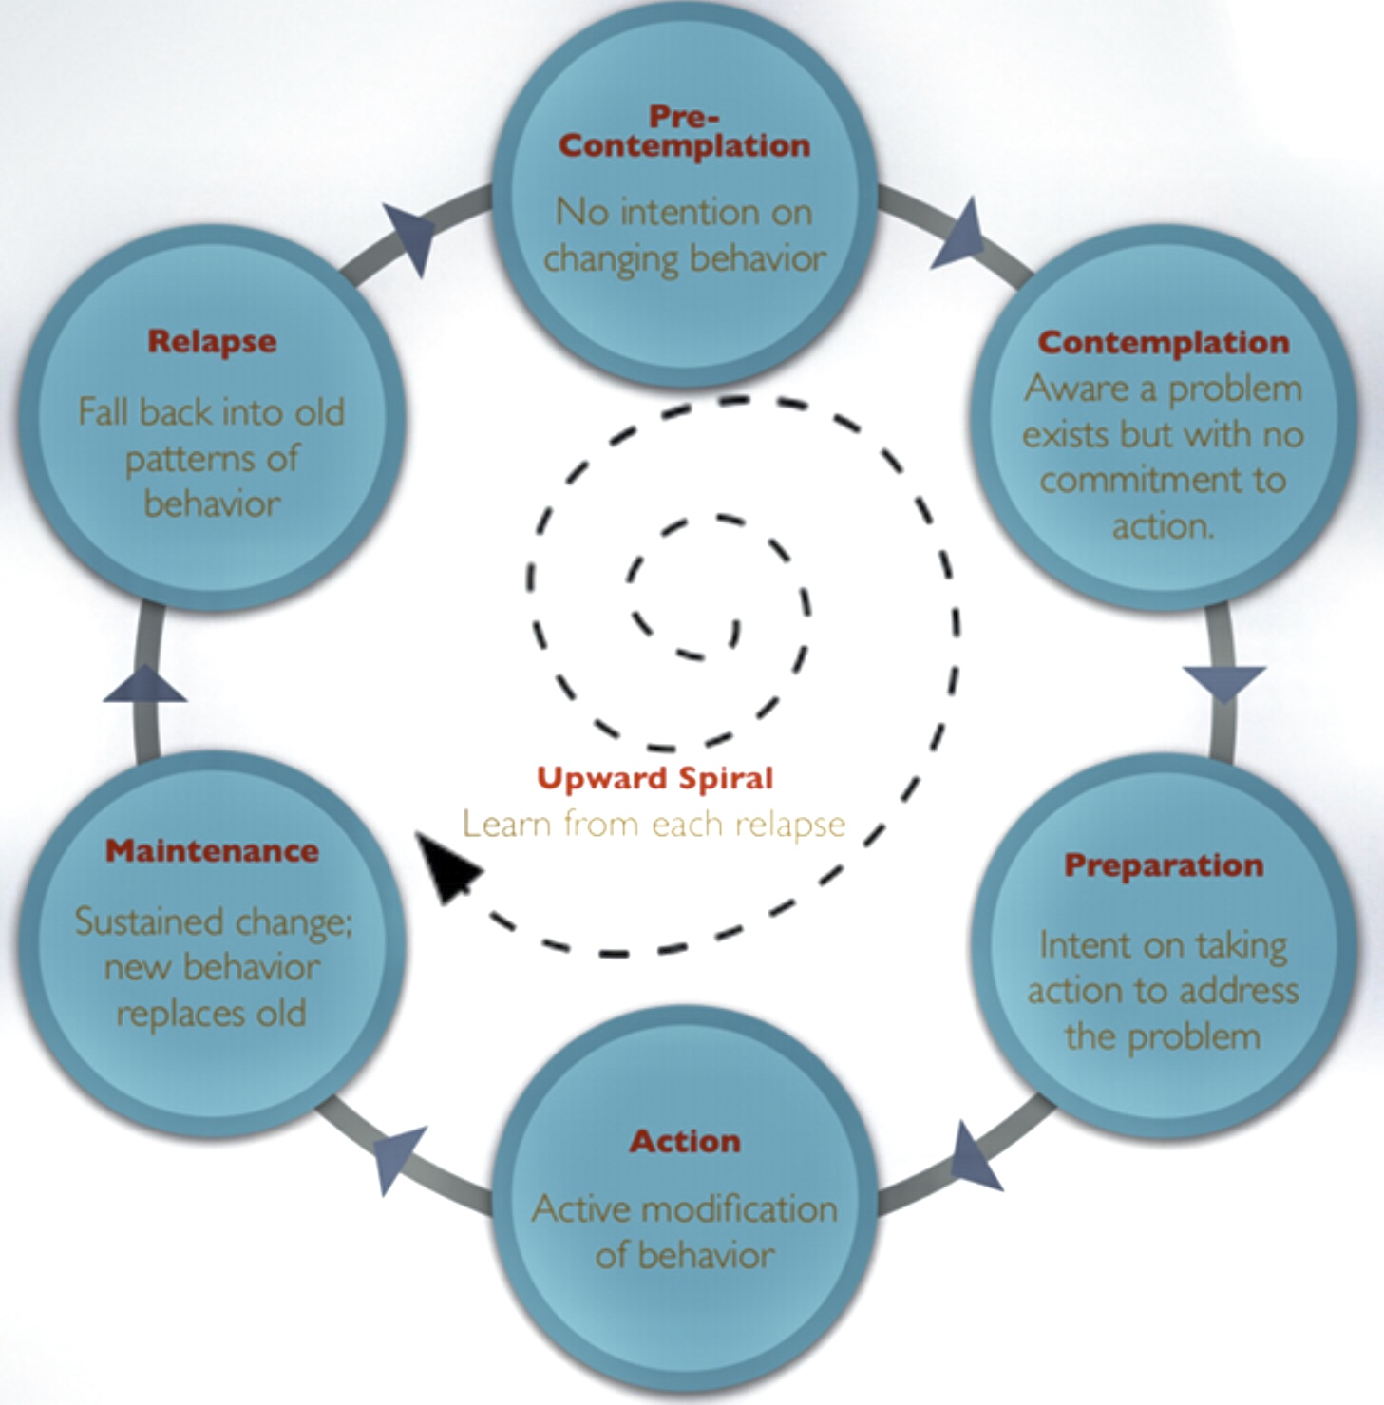
1. The stages model of change
The stages model of change deals with the question of where an individual is at in the process of realizing that they have a problem, that it is their responsibility to deal with this problem and that to do so they have to learn and apply new ways of thinking and behaving.
Take for example Bill, whose family and friends think drinks too much. He has missed work because of hangovers, and has a fatty liver…
Bill may not think he has a drinking problem. He may think that the problem is that his wife worries too much and is always nagging him… Eventually, he may realize he does have a problem, take responsibility for it and learn and implement ways of managing it.
Owning and realizing your responsibility for dysregulated feelings, thoughts, or behaviors, or “holes” you want to work on is an essential first step in dealing with these issues. While it is not your fault your emotions are dysregulated, growing and healing is your responsibility.
Motivational interviewing is a therapeutic approach laying out the most effective techniques to help people progress through the process of change: precontemplation, contemplation, preparation, action, maintenance and relapse.
The principles of motivational interviewing are captured in the distinction between “calling out” and “calling in”. Calling out is remarkably ineffective in helping people change, calling in is much more effective.(4)

Slide 275
Motivational interviewing stages and interventions
Stage I – precontemplation. The person doesn't think they have a problem, the problem is with others or the world. The therapist uses empathy and understanding to establish a working relationship. The therapist makes it clear that their role is not to tell the client what to do.
Stage II – contemplation. The person is starting to realize that the problem is with them, but they don't yet know how to change it. The therapist explores the problem and amplifies the person's ambivalence. The therapist elicits the patient's reasons for change. When done successfully, the patient will be voicing the arguments for change
Stage III – preparation. The person starts to learn what they need to make the changes they desire. The therapist helps the person to clarify the focus to work on and sets goals. The focus is on the patient's most pressing concerns.
Stage IV – action. The person starts using the tools and skills they have learned to work on their problem. The therapist supports the person in this endeavor. This phase is marked by the shift from the “why” of change to the when and how. The therapist guides the patient to come up with the best options for change.
Stage VI – maintenance. The person becomes more and more familiar with the tools and skills and continues to use them to make changes. The therapist helps the person to monitor for relapse triggers
Stage VII – relapse. The person falls into the hole again but now can get out much faster. The therapist helps the person to go with it, reassess and revise.(5)
Notes:
Motivational interviewing describes interventions that are the most effective at each of the stages of change. The techniques used in the early stages of the work differ from those used later on.

Slide 276
personal and systemic Obstacles to change
1. Am I the problem, or is the world the problem? Internal vs. external locus of control, the stages model of change and motivational interviewing
2. Understanding the problem: diagnosis vs. formulations
3. What will help and who can I trust.
4. Coping with limited resources
5. Dealing with competing priorities
6. Believing one can change: Self-efficacy, learned helplessness, and locus of control
7. Obstacles frequently encountered by Simple course participants

Slide 277
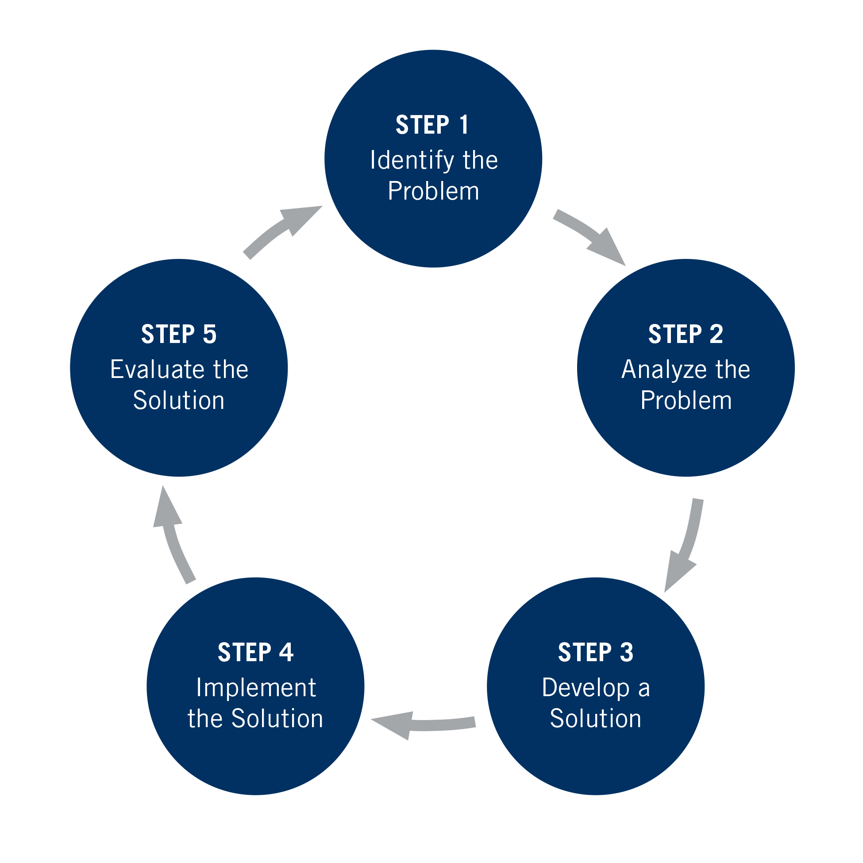
Principles of good mental health care
If a person is at the contemplative stage of change owning that it’s up to them to get out of/avoid their hole in the sidewalk , they are ready to problem-solve which relies on certain principles.
Often, when people seek help, they sense something is wrong, but they don’t know quite what it is
Steps 1 and 2 of good health care involves transforming the patient’s sense that something is wrong into defined workable problems.
A feeling that something is wrong doesn’t lead to an approach to addressing it whereas identifying specific problems does.
Diagnoses and formulations help transform feelings of being unwell (Illness) into workable problems.

Slide 278
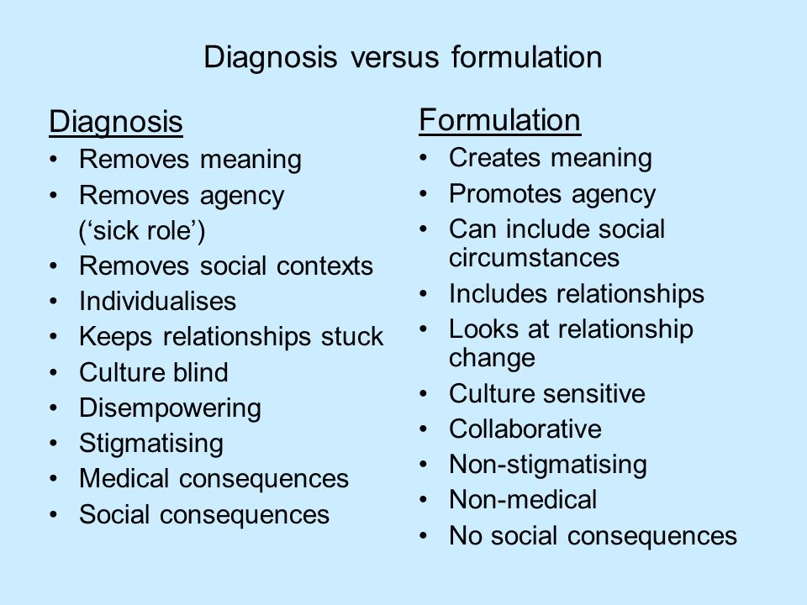
diagnosis AND formulations
Steps 1 and 2 of good problem solving involve identifying and understanding the holes we fall into. This typically involves diagnosis and formulations
A diagnosis such as major depression, generalized anxiety disorder, or borderline personality disorder is a label that captures an agreed-upon constellation of symptoms. In psychiatry the symptoms needed to meet the criteria for these diagnostic categories are found in the diagnostic and statistical manual of mental disorders or DSM. A diagnosis is a descriptive label, it is theory neutral, predicts the course of illness, and identifies treatment.
A formulation, on the other hand, is an explanation, based on theory, of the symptoms the person is presenting with. We may for example formulate that someone has an attachment disorder or developmental trauma which underlies their diagnosis of depression, generalized anxiety disorder, or borderline personality disorder. Some diagnoses such as posttraumatic stress disorder are at the same time formulations. A formulation is an explanatory summary. It is unique to an individual, is informed by theory and informs treatment.
Notes:
Pre slide
It's important for us to consider the differences between a diagnosis and a formulation.(read slide)

Slide 279
personal and systemic Obstacles to change
1. Am I the problem, or is the world the problem? Internal vs. external locus of control, the stages model of change and motivational interviewing
2. Understanding the problem: diagnosis vs. formulations
3. What will help and who can I trust.
4. Coping with limited resources
5. Dealing with competing priorities
6. Believing one can change: Self-efficacy, learned helplessness, and locus of control
7. Obstacles frequently encountered by Simple course participants

Slide 280


WE ARE BIO psycho socio spiritual beings
Humans are simultaneously biological, psychological, social and spiritual beings.
Finding, becoming aware of, getting out of, and repairing our “holes” involves understanding all these aspects of our nature.
Much of modern psychiatry looks at people as biological beings. This perspective underlies the biological and medical model it mostly uses.
Modern psychology takes a psychological approach to understanding people .
Sociology and social psychology consider how people are affected by their social environment to be of great importance.
Religious and spiritual approaches consider the spiritual dimension of being human as primary.
In this course we strive to consider all these perspectives as equally important.
Notes:
Pre slide
The main perspectives from which mental health professionals consider their clients issues are the biological, psychological, social, or spiritual one.

Slide 281
Simple takes a bio-psycho-socio-spiritual perspective
Our bodies are biological
Our minds are psychological
Our bodies and minds are influenced by Social, economic, and political factors.
Ultimately, some of the wisest people believe that we are spiritual beings having a human experience
To begin to understand ourselves we need to consider all these mutually interacting facets of what it is to be human

Slide 282
Principles of good mental health care
Steps 3 and 4 of good health care involve developing and implementing solutions to address the problem. That often involves working with health professionals. This leads to the question of who to go to for help, and how do you know if you can you trust them
If you have a problem with your car and you go to several different mechanics, you may get a number of different opinions as to what the problem is and how to fix it. Some opinions, such as “your engine isn’t working” may not be very helpful. This may be the equivalent of a mental health care professional telling you “you’re depressed or anxious”.
Who do you trust to help you figure out what the problem is?
Is there a good fit between you and the person helping you?
And what is the right therapeutic approach for your problem?...

Slide 283

What is the difference between psychiatrists, psychologists, psychotherapists, and counsellors ?
Psychiatrists have medical degrees. After graduating from medical school, they do five years of specialty training in psychiatry. Most psychiatrists consider their patients from a biological perspective and prescribe medication.
Psychologists have a degree in psychology and do talk therapy.
Psychotherapists may have different backgrounds such as psychology, psychiatry or social work. The commonality is that they use talk therapy to help people. Psychotherapists often try to understand the role the patient's past plays in their current problems.
Counsellors are more action and behavior focused that psychotherapists and deal with the person’s current problems without necessarily exploring the past.
WHO TO GO TO FOR MENTAL HEALTH ISSUES?

Slide 284
THE MEDICAL vs. PATIENT CENTERED MODELS(10)
Medical model
the patient's role is passive
the patient is the recipient of treatment
the physician dominates the conversation
care is disease centred
the physician does most of the talking
the patient may or may not adhere to the treatment plan
Patient centred model
the patient's role is active
the patient is a partner in the treatment plan
the physician collaborates with the patient
care is quality of life centred
the physician listens more and talks less
the patient is more likely to adhere to the treatment plan
Simple is patient centred
Notes:
Pre slide
The relationship between a patient and a healthcare professionals falls somewhere on the spectrum from a medical to a patient centred model.
In fields such as surgery the medical model is often the most appropriate, in others such as mental health care a patient centred model may work better
Each patient and healthcare professional tend to prefer some point on the spectrum. The adequacy of the fit between them depends in part on Whether they prefer a medical model or a patient centred model.
Let's compare the medical to the patient centred model (read slide)

Slide 285
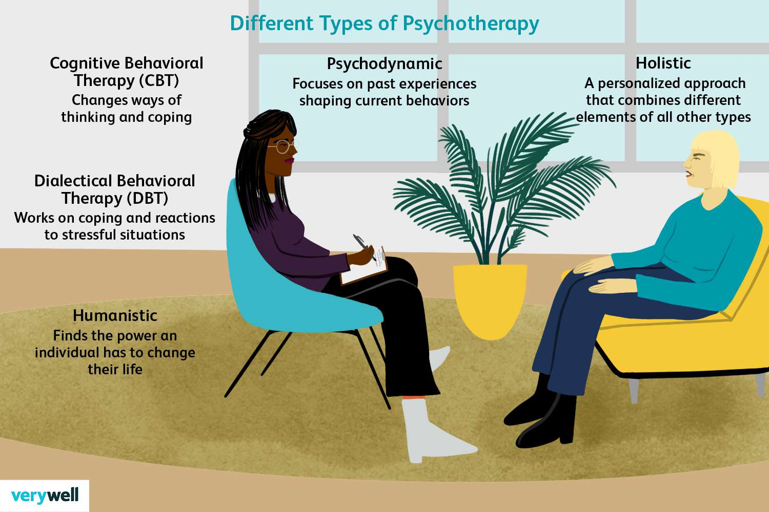
What is psychotherapy?
Psychotherapy is the use of psychological methods to help a person change their thoughts, behaviors, and feelings and work on their problems.
There are a multitude of psychotherapeutic approaches purporting to help with our mental health issues. These include cognitive behavioural therapy, dialectical behavioural therapy, humanistic approaches, psychodynamic psychotherapy, and perhaps the most common, generic non- specific psychotherapy
What’s most likely to help us? And how do we choose an approach?
To make matters more complicated the type of approach used is only one of many factors that contribute to the efficacy of therapy.

Slide 286
FACTORS THAT CONTRIBUTE TO THE EFFICACY OF THERAPY
In addition to the type of approach used in psychotherapy other factors play a role in whether people benefit from psychotherapy:
Therapeutic Alliance: A strong, trusting relationship between the therapist and the client is crucial. This includes empathy, warmth, and mutual respect.
Client Factors: The client's own characteristics, such as motivation, openness to change, and resilience, play a significant role in the effectiveness of therapy.
Therapist Factors: The therapist's skills, experience, and personal qualities can greatly impact the therapeutic process. Their ability to adapt to the client's needs is also important.
Client Engagement: Active participation by the client in the therapeutic process, including homework assignments and practicing skills outside of sessions, contributes to better outcomes.
Cultural Competence: Understanding and respecting the client's cultural background can improve the therapeutic relationship and effectiveness.
Setting Goals: Collaboratively setting clear, achievable goals can help clients stay focused and measure progress.
Feedback and Adaptation: Regularly seeking feedback from clients and being willing to adapt the approach based on their responses can lead to better outcomes.
Support Systems: Involvement of family or social support systems can enhance the therapeutic process and provide additional resources for the client.
Duration and Frequency of Sessions: The length of therapy and how often sessions occur can also influence effectiveness, with more frequent sessions often leading to better outcomes.

Slide 287

What IS the ROLE OF A psychotherapist ?
John Bowlby, the father of attachment theory, which we will explore in detail later in the course, stated that the psychotherapist has five main tasks:
1) to provide the client with a secure base or "holding environment" in which to explore his or her pain.
2) to help clients consider how their manner of engaging in relationships actually shapes the situations that cause them pain.
3) to help clients examine the relationship with the therapist as a microcosm of their engagement style with others.
4) to explore the origins of this style in a clients past and the "frightening, alien and/or unacceptable" emotions that are primed in this process and…
5) to help clients to reflect on how past experience constrains their perception of the world and so governs how they think, feel, and act in the present and to then help them find better alternatives.
These goals closely align with those of the simple course.

Slide 288
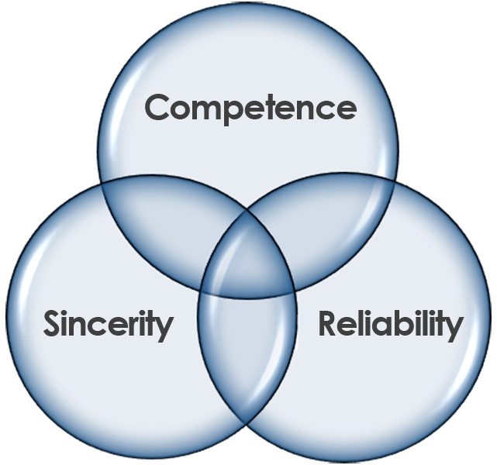
What fosters a patients trust in a health professional?
We tend to trust people who are of 1)good character and 2)competent.
Good character
caring – concerned with the well-being of the patient
transparent – is clear about the motivations behind the treatment suggestions
open – is receptive of the patient's ideas
honest – is truthful
fair – acts without biases, discrimination, or injustice
authentic – is consistent and sincere in thinking, words and actions
Competence
skillful – can accomplish professional tasks with ease, speed and proficiency
knowledgeable – is very familiar with the current knowledge in the field
experience has accumulated practical knowledge
reputable – is held in high esteem by others
credible – consistently articulates ideas in a convincing and believable way
performs – discharges personal responsibilities competently.
WHAT HELPS US TRUST?
Notes:
Pre slide
Research reveals that the presence of three attributes in a professional fosters trust in clients: 1)competence, 2)reliability, and 3)sincerity
Reliability and sincerity are features of a professional's character as are their honesty, caring, transparency, fairness, openness, and authenticity
Competence can be broken down into 1) capability which involves skills, knowledge, and experience, and 2) results which involves reputation, credibility, and performance.

Slide 289
personal and systemic Obstacles to change
1. Am I the problem, or is the world the problem? Internal vs. external locus of control, the stages model of change and motivational interviewing
2. Understanding the problem: diagnosis vs. formulations
3. What will help and who can I trust.
4. Coping with limited resources
5. Dealing with competing priorities
6. Believing one can change: Self-efficacy, learned helplessness, and locus of control
7. Obstacles frequently encountered by Simple course participants

Slide 290
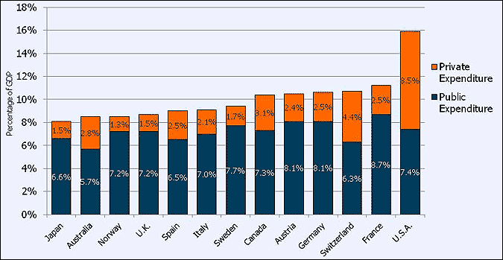
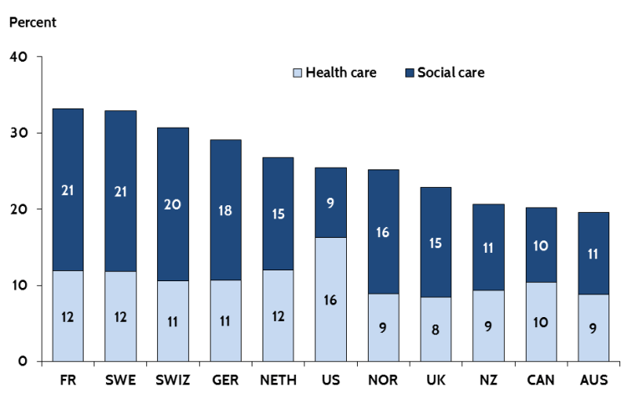
Contributors to OUR health care crisis (10)
Many factors contribute to our current health care crisis including:
Capped budgets for health care
Among industrialized countries ,Canada has among the lowest budgets for social spending. Social spending include social assistance payments, housing subsidies, and child welfare. All of these drive social determinants of health.
Worsening social conditions for a significant number of people giving rise to toxic social stress and “deaths of despair” (suicide, drug overdoses, alcoholism).
Aging demographics consume a disproportionate amount of healthcare money
Number of hospital beds calculated for normal times not crisis, no excess capacity.
Uneven distribution of resources

Slide 291
Contributors to OUR health care crisis
Poor integration of health records
Elderly needing long term care that is not available or affordable for families and spending more time in acute care hospitals.
Many more expensive interventions available. (cardiac surgery, joint replacements…)
Lack of emphasis on prevention and public health
Increased proportion of healthcare administrators compared to front line staff
COVID
Demoralization of health care providers

Slide 292

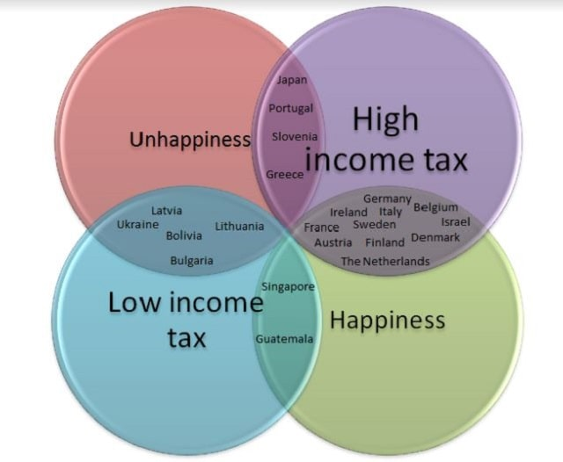
taxes AND SOCIAL WELLBEING?
Our priorities affect our well-being. Almost everyone is concerned about high taxes, only a small percentage of people at any one time are concerned about the state of health care and even less about the lack of social spending
Notes:
At election time, many people assume that lower taxes will make them happy.
Among developed countries Canada's tax rates as a percentage of gross domestic product is quite low.
The slide on the right depicts the overlap between happiness and unhappiness and high and low taxation rates.
A couple of countries have both low taxes and happiness.
More countries have high taxes and unhappiness.
Even more countries have low taxes and unhappiness.
By far most countries that have high taxes also have high levels of happiness.

Slide 293
personal and systemic Obstacles to change
1. Am I the problem, or is the world the problem? Internal vs. external locus of control, the stages model of change and motivational interviewing
2. Understanding the problem: diagnosis vs. formulations
3. What will help and who can I trust.
4. Coping with limited resources
5. Dealing with competing priorities
6. Believing one can change: Self-efficacy, learned helplessness, and locus of control
7. Obstacles frequently encountered by Simple course participants

Slide 294

Dealing with Competing priorities
Learning to get out of “holes” and eventually to avoid them takes time and effort
Most people have little spare time and energy and are already overburdened by the stresses and demands of everyday life.
But continuing to regularly fall into holes consumes a lot of time, energy, and produces enormous suffering. It ca be an enormous handicap.
Those people who would most benefit from psychotherapy have the least access, energy, and time, for it.
Investing the time now can, however, save much time, energy and suffering in the future.

Slide 295
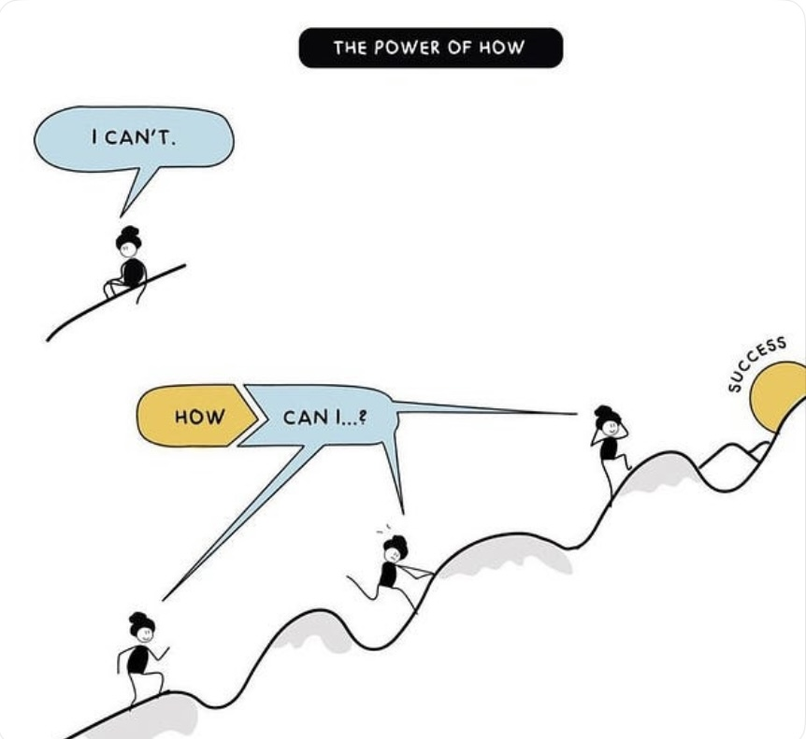
personal and systemic Obstacles to change
1. Am I the problem, or is the world the problem? Internal vs. external locus of control, the stages model of change and motivational interviewing
2. Understanding the problem: diagnosis vs. formulations
3. What will help and who can I trust.
4. Coping with limited resources
5. Dealing with competing priorities
6. Believing one can change: Self-efficacy, learned helplessness, and locus of control
7. Obstacles frequently encountered by Simple course participants

Slide 296
LIMITING FACTORS AND BELIEFS
Limiting factors and beliefs are concepts that have been much studied in psychology.
Limiting factors are external conditions or constraints that hinder progress or performance. These can be tangible or intangible and can affect individuals or groups. Examples include: 1) Resource availability such as lack of time, money, or materials.2) Environmental Conditions: Physical or social environments that restrict opportunities. 3)Skills and Knowledge: Gaps in education or experience that prevent effective action. 4) Regulatory Constraints: Laws or policies that limit certain actions or behaviors.
Limiting beliefs are internal convictions or assumptions that negatively affect an individual's mindset and behavior. These beliefs often stem from past experiences, societal norms, or negative self-talk. Examples include: 1)Self-Doubt: Believing one is not capable of achieving certain goals.2)Fear of Failure: Assuming that failure is inevitable, which can prevent taking risks. 3)Negative Self-Image: Thinking one is unworthy or incapable of success. 4)Fixed Mindset: Believing that abilities and intelligence are static and cannot be developed.
Both limiting factors and limiting beliefs can significantly impact a person's ability to reach their goals, but while limiting factors are often external, limiting beliefs are internal and can often be challenged and changed through personal development practices.
There are hard and soft limiting factors and beliefs. Hard limits can’t reasonably be overcome. I will never run a 4-minute mile or become prime minister of Canada. Soft limits can be overcome but the person holding them is convinced they can’t: in high school I was convinced I could never get into University. Soft limits are frequently based on distorted core beliefs about the self and the world. (as above)
Distinguishing between hard and soft limiting factors and beliefs requires wisdom as described in the serenity prayer: “God grant me the courage to change the things I can change, the serenity to accept those I can’t and the wisdom to know the difference.
A number of concepts explore the psychology of soft and hard limiting factors and beliefs.

Slide 297
Self-efficacy and learning theory(8)
Albert Bandura introduced the concept of self-efficacy: our belief of whether we’ll succeed or fail at something affects how hard we try, or even if we try at all.
Self-efficacy is determined by
1. observing what others do.
2. listening to what others say about us.
3. personal successes and failures.
4. our baseline state of activation.
Notes:
Pre slide
Self-efficacy, learned helplessness, and locus of control are three interrelated concepts which determine how each person faces challenges and obstacles in their lives.
Essentially a person who habitually gives up easily is less likely to succeed in life than one who persists when faced with difficulties.
Let’s start with self efficacy
Self-efficacy refers to an individual's belief in his or her capacity to execute behaviors necessary to achieve certain goals. Psychologist Albert Bandura was the first to write about this concept.

Slide 298

INTERNAL VS. EXTERNAL LOCUS OF CONTROL(7)
Who and what, do I believe, controls my life and future?
Do I believe that for the most part I control my life or that it is mostly controlled by external forces.
What we each believe about where control over our life lies is somewhere a spectrum from one extreme to the other.
We learn this from our models, parenting, and life experiences.
Locus of control is a self-fulfilling prophesy, if we believe we have control over our lives we’re more likely to have control over our lives. The opposite also applies.
Simple aspires to increase people’s internal locus of control by presenting effective ways of changing aspects of your life.
The ideal balance between accepting what cannot realistically be changed and trying to change what with hard work might be was articulated by theologian Reinhold Niebuhr and popularized by AA as the serenity prayer: “God, grant me the serenity to accept the things I cannot change, courage to change the things I can, and wisdom to know the difference”.
Notes:
Pre slide
Locus means place. Locus of control is a psychological term used to refer to where a particular person perceives the control over what happens in their lives to lie. This perceived control can lie inside or outside the individual. This is referred to respectively as inner or outer locus of control.

Slide 299
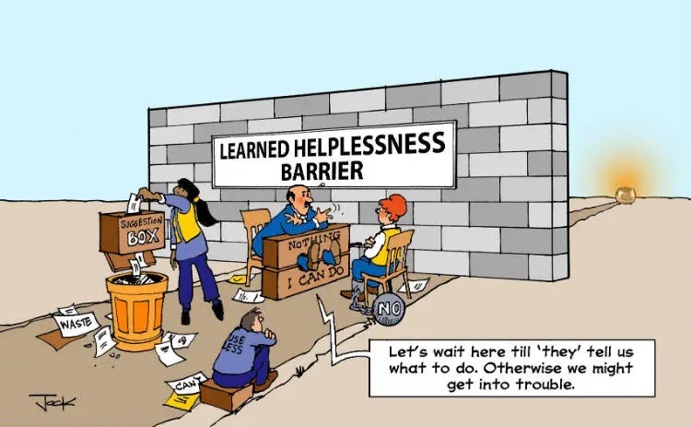
learned helplessness (6)
Learned helplessness is a lack of belief in self-efficacy, a sense that we have no control over our lives.
People who learn helplessness have an external locus of control. They stop trying.
The concept of learned helplessness was developed by psychologist Martin Seligman.
Learned helplessness is associated with inappropriate early childhood expectations, modelling, and feedback.
It can be pervasive or a part of personality or short term such as when it’s experimentally induced by an unsolvable puzzle situation. Short term is more easily reversed.
We have learned from animal models of depression/learned helplessness.
Learned helplessness is linked to Erickson’s industry vs inferiority developmental stage and hence to psychosocial development.
Notes:
Post slide
Many factors are known to affect a person's locus of control. For example, farmers who grow crops such as wheat depend to a significant extent on the weather for the success of their crops. Because their success depends on external factors, these farmers tend to develop more of an outer locus of control.
In contrast rice farming is a very labour-intensive and depends less on external conditions than on the farmers attention to the crop. These farmers tend to develop more of an inner locus of control, their success depends on their own efforts.
East Asian cultures, perhaps because of their dependence on rice farming, tend to have an inner locus of control. Asian children are more likely to believe that their success in school depends on hard work. In western cultures on the other hand, many children are taught that success depends on factors such as talent which you either have or you don't. Talent is something that nature gives you, in this way it is an external factor. Western students generally believe that it is their talent or lack of it, rather than hard work, that will lead to their success. They have more of an external locus of control.
Locus of control is learned through the experience of success. Parents who are good at fostering an internal locus of control in their children give them age-appropriate challenges and let them work it out. This fosters in children the sense they can succeed at something. If children aren't challenge that all or if their given challenges that are beyond their ability to solve they don't develop a sense of self-efficacy and tend to have an outer locus of control

Slide 300
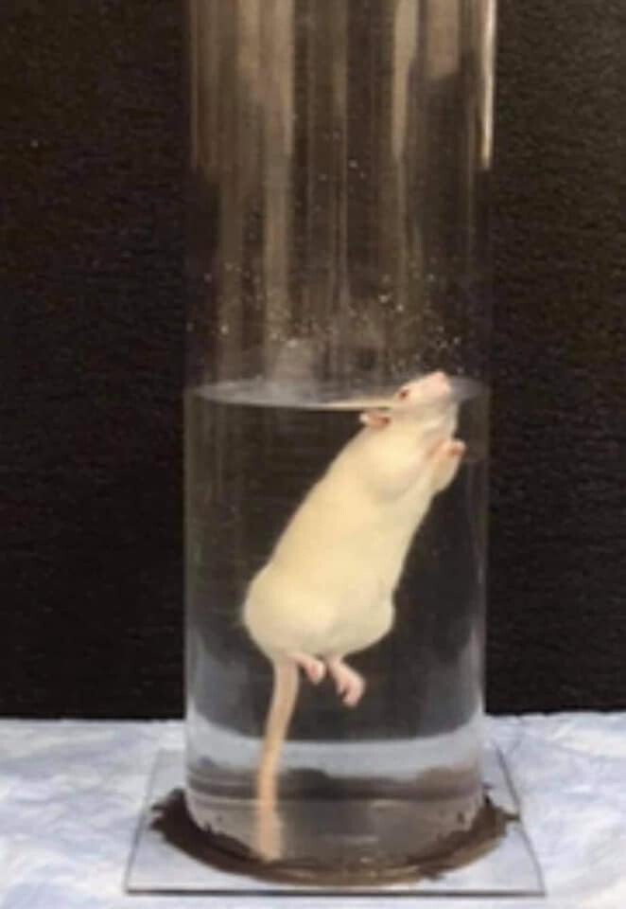
The importance of hope AND A sense of control in change
Locus of control is related to self-efficacy.
High self-efficacy is associated with an internal locus of control
Low self-efficacy and learned helplessness are associated with with an external locus of control
A belief one has some control over their lives, or a sense of self-efficacy, is necessary for change.
If you don’t have hope you can change, you won’t work at it and you won’t change.
We move towards an internal locus of control, self-efficacy and hope through small incremental experiences of success and change. This reverses learned helplessness
Notes:
Pre slide
In a brutal animal experiment performed in the 50’s that has come to be known as the hope experiment, Psychologist Curt Richter placed rats in a pool of water to test how long they could thread water. On average they give up and sank after 15 minutes. But what happens if right before they gave up due to exhaustion, the researchers plucked the rats out of the water, dried them out, let them rest for a few minutes, and put them back in the water for a second round?
Researchers were amazed to discover that on the second round the rats could tread water for up to 60 hours. The conclusion drawn was that since the rats believed they would eventually be rescued, they could push their body's way past what they previously thought possible.

Slide 301

The word "apathy" originates from the Greek word "apatheia," which means "lack of feeling" or "indifference." It is composed of the prefix "a-" meaning "without" and "pathos," which means "feeling" or "emotion." The term has evolved over time to describe a state of indifference or a lack of interest, enthusiasm, or concern regarding various aspects of life such as personal relationships, work, or hobbies. It can manifest as emotional numbness, a lack of motivation, or a disconnection from one's surroundings and experiences.
Several factors can contribute to apathy, including:
Mental Health Conditions: Disorders such as depression, and anxiety can lead to feelings of apathy. Depression, in particular, often involves a loss of interest in activities that once brought joy.
Chronic Stress: Prolonged exposure to stress can lead to burnout, which may result in apathy as individuals become overwhelmed and disengaged.
Substance Abuse: Alcohol and drug use can alter brain chemistry, leading to apathy.
Lack of Stimulation: A monotonous routine or an environment lacking in challenges can lead to feelings of boredom and disengagement.
Physical Health Issues: Chronic illnesses or fatigue can sap energy and interest, contributing to apathy.
Life Changes or Transitions: Major life events, such as the loss of a loved one, job loss, or significant changes in personal circumstances, can trigger feelings of apathy.
APATHY

Slide 302
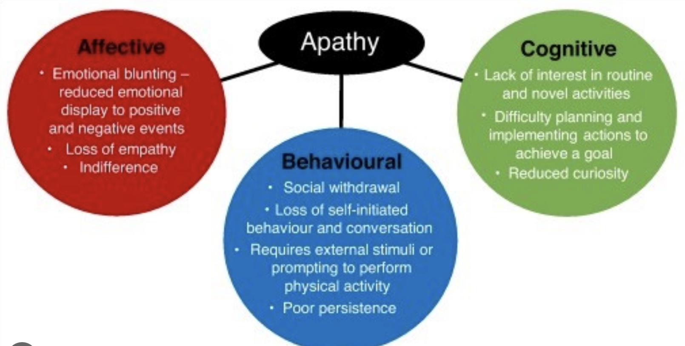
DEALING WITH APATHY
Dealing with apathy often involves addressing its underlying causes.
Breaking tasks into smaller, manageable steps can help create a sense of accomplishment and motivation.
Even if you don’t feel like it, participating in hobbies or social activities can help rekindle interest and connection.
Creating a daily schedule can provide structure and help combat feelings of aimlessness.
Techniques such as meditation, yoga, or deep breathing can help increase awareness and engagement with the present moment.
Reaching out to friends or family can provide support and reduce feelings of isolation.
Regular exercise can boost mood and energy levels, helping to combat apathy.
Eating well, getting enough sleep, and avoiding excessive alcohol or drugs can positively impact overall well-being.

Slide 303
personal and systemic Obstacles to change
1. Am I the problem, or is the world the problem? Internal vs. external locus of control, the stages model of change and motivational interviewing
2. Understanding the problem: diagnosis vs. formulations
3. What will help and who can I trust.
4. Coping with limited resources
5. Dealing with competing priorities
6. Believing one can change: Self-efficacy, learned helplessness, and locus of control
7. Obstacles past Simple course participants have encountered

Slide 304
Obstacles participants often encounter in the simple course
Kate

Slide 305
Obstacles participants often encounter in the simple course
One out of every three people who attends at least one session of the Simple course stops coming. Some of the reasons people have shared:
They feel better and don’t need the course anymore, or feel worse and can’t find the motivation, hope, or interest needed for participating.
They may feel their problems are too big for a course like this or that what they really need is individual therapy.
Simple is not a good fit for their issues, their attention span, or learning style.
There are changes in their schedules, new commitments, or changes in circumstances.
They experience general discouragement: “if I have to do all of this to change, change is impossible” or “What we’ve talked about so far is not working and nothing will ever work”
Notes:
Pre slide
Over the years of doing the simple course we've talked with participants about what they found to be the main obstacles to doing the course, the homework, and applying the tools skills and strategies in their everyday lives.
This is what they told us:

Slide 306
Obstacles participants often encounter in the simple course
Three hours a week is a big commitment other things get in the way. People miss one or two session and feel they are too far behind. People can’t be in a room or in front of a screen for 3 hours.
The material covered is too difficult to understand.
The format the material is presented in, is challenging when people have trouble with attention, concentration, or have atypical learning styles. The co-leaders are boring.
Participating in the course, the material, what the co-leaders say or how they say it, and other participants trigger strong emotions that people want to avoid such as hurt, anxiety, anger, grief, sadness, hopelessness.
Combinations of several of the above.
OBSTACLES PARTICIPANTS OFTEN ENCOUNTER IN THE SIMPLE COURSE

Slide 307
What can we do to decrease the number of people who stop attending simple?
What are our limiting beliefs and how do we deal with them?

Slide 308
Sensory soothing toolkit
health, illness, disease, sickness, disorder, pain and suffering
Why are the myth of Sisyphus and the poem "there is a hole in my sidewalk" by Portia Nelson important metaphors in the course?
Simple vs. DBT
What we will be covering in the course
Challenges often encountered by people doing Simple

Slide 309
Overview Of today’s session
Reminders
Mindfulness: Sensory soothing toolkit
health, illness, disease, sickness, disorder, pain and suffering
Why are the myth of Sisyphus and the poem "there is a hole in my sidewalk" by Portia Nelson important metaphors in the course?
Simple vs. DBT
What we will be covering in the course
10-minute Break 10:30-10:40 (give or take 10 minutes)
Challenges often encountered by people doing Simple
Notes:
In our session today we will cover several subjects these include:

Slide 310
OPEN DISCUSSION

Slide 311
See you next session

Slide 312
(1) Sisyphus, a figure from Greek mythology, is often interpreted through the lens of existential philosophy, particularly in Albert Camus's essay "The Myth of Sisyphus." In this context, Sisyphus's eternal punishment of rolling a boulder up a hill only for it to roll back down represents the absurdity of life and the struggle inherent in human existence.
Acceptance of Pain: Sisyphus must accept his pain because it is an inescapable part of his fate. By acknowledging his situation, he confronts the absurdity of his existence rather than denying it. This acceptance can lead to a sense of freedom, as it allows him to find meaning in his struggle, despite its futility.
Embracing the Struggle: Camus argues that one must imagine Sisyphus happy. The act of pushing the boulder becomes a metaphor for human resilience. By embracing his task and finding joy in the struggle itself, Sisyphus transforms his punishment into a form of personal triumph.
Finding Meaning: Accepting his pain allows Sisyphus to create his own meaning in a seemingly meaningless existence. This reflects the human condition, where individuals often face challenges and hardships, yet can choose to find purpose in their efforts.
Sisyphus's acceptance of his pain is a powerful commentary on the human experience, suggesting that while suffering is inevitable, how we respond to it can define our existence.

Slide 313
(2) Portia Nelson's poem "There's a Hole in My Sidewalk" is a powerful reflection on self-awareness, personal growth, and the journey of life. The poem describes a process of encountering the same challenges repeatedly, illustrating how we often fall into familiar patterns of behavior.
The speaker initially falls into a hole, representing a lack of awareness or understanding of their circumstances. This highlights the importance of recognizing our problems.
As the poem progresses, the speaker begins to take responsibility for their actions and choices. This shift indicates growth and a willingness to change.
Eventually, the speaker learns to navigate around the hole, symbolizing personal development and the ability to overcome obstacles. This suggests that with awareness and effort, we can change our responses to life's challenges.
The poem emphasizes the importance of accepting our experiences, including pain and mistakes, as part of the human journey.
Nelson’s poem encourages readers to reflect on their own lives, recognize patterns, and take steps toward personal growth and self-improvement. It’s a reminder that while we may encounter the same issues repeatedly, we have the power to change our approach and ultimately find a way forward.

Slide 314
(3) The stages model of change, also known as the Transtheoretical Model, was developed by Prochaska and DiClemente in the 1980s. It describes the process individuals go through when making a change in their behavior. The model consists of six stages: precontemplation, contemplation, preparation, action, maintenance, and termination. In each stage, individuals have different attitudes and behaviors towards change, and understanding these stages can help in developing effective strategies to support behavior change:
1. Precontemplation: In this stage, individuals are not yet considering making a change. They may be unaware of the need for change or resistant to the idea.
2. Contemplation: In this stage, individuals are aware that a change is needed and are considering the pros and cons of making that change. They may be ambivalent and not yet committed to taking action
3. Preparation: In this stage, individuals have made the decision to change and are preparing to take action. They may start gathering information, setting goals, and making plans for change.
4. Action: In this stage, individuals actively modify their behavior, environment, or situation to make the desired change. This stage requires effort, commitment, and perseverance.
5. Maintenance: In this stage, individuals work to sustain the changes they have made and prevent relapse. They continue to practice new behaviors and strategies to maintain their progress.
6. Termination: In this final stage, individuals have successfully integrated the change into their lives, and it has become a permanent part of their behavior. They no longer feel tempted to revert to their old habits.
These stages are not always linear, and individuals may move back and forth between them before successfully making a lasting change

Slide 315
(4)"Calling in" and "calling out" are terms often used in discussions about social justice, accountability, and interpersonal relationships, and they have distinct meanings:
Calling Out: This typically involves publicly confronting someone about their behavior or statements that are perceived as harmful, offensive, or problematic. It often aims to hold individuals accountable for their actions in a more direct and sometimes confrontational manner. For example, someone might call out a public figure for making a racist comment on social media.
Calling I: In contrast, calling in is a more private and compassionate approach. It involves addressing someone's problematic behavior or comments in a way that encourages dialogue and understanding rather than shame or defensiveness. The goal is often to foster growth and learning, allowing the person to reflect on their actions without feeling attacked. For instance, someone might call in a friend by having a private conversation about why a certain joke was hurtful.

Slide 316
(5) Motivational interviewing is a counseling approach that helps individuals explore and resolve ambivalence about behavior change. Developed by psychologists William R. Miller and Stephen Rollnick, motivational interviewing is a collaborative, goal-oriented method of communication that strengthens a person's motivation and commitment to change.
In motivational interviewing, the counselor or therapist uses a non-confrontational, empathetic, and non-judgmental approach to help individuals identify their own reasons for change and work towards setting and achieving their goals. The key principles of motivational interviewing include expressing empathy, developing discrepancy, rolling with resistance, and supporting self-efficacy.
Motivational interviewing is often used in healthcare settings, addiction treatment, weight management, and other areas where behavior change is necessary. It has been shown to be effective in helping individuals overcome ambivalence, increase motivation for change, and ultimately achieve their goals.
Motivational interviewing can be effectively applied to the stages model of change to help individuals progress through the stages and make lasting behavior changes. Different motivational interviewing strategies are used in each stage of the stages model:
1. Precontemplation: In this stage, motivational interviewing can help individuals explore their ambivalence about change and increase their awareness of the need for change. By expressing empathy and understanding, the counselor can help individuals consider the pros and cons of their current behavior and start to see the benefits of making a change.
2. Contemplation: In this stage, motivational interviewing can help individuals resolve their ambivalence and strengthen their motivation for change. By exploring their values, goals, and concerns, the counselor can help individuals clarify their reasons for change and build confidence in their ability to make a change.
3. Preparation: In this stage, motivational interviewing can help individuals set specific goals, develop a plan for change, and build self-efficacy. The counselor can help individuals identify potential barriers to change and develop strategies to overcome them, increasing their readiness for action.

Slide 317
4. Action: In this stage, motivational interviewing can help individuals stay motivated, overcome challenges, and maintain their commitment to change. The counselor can provide support, encouragement, and feedback to help individuals stay on track and make progress towards their goals.
5. Maintenance: In this stage, motivational interviewing can help individuals sustain their behavior changes and prevent relapse. By exploring potential triggers and developing coping strategies, the counselor can help individuals build resilience and maintain their progress over time.
By integrating motivational interviewing techniques into each stage of the stages model of change, counselors can effectively support individuals in making lasting behavior changes and achieving their goals

Slide 318
(6) Learned helplessness is a psychological phenomenon where an individual learns to feel helpless and unable to control or change a situation, even when opportunities for change are present. This can occur when someone repeatedly experiences negative events or failures that are perceived as uncontrollable, leading them to believe that their actions will not make a difference. Over time, this can result in a sense of resignation and passivity, even in situations where they could potentially make a positive change
Learned helplessness typically develops through a series of experiences where an individual faces repeated failures or negative outcomes that they perceive as beyond their control. These experiences can lead to the belief that their actions do not matter and that they are powerless to change their circumstances. Over time, this belief becomes ingrained, and the individual may stop trying to improve their situation, even when opportunities for change exist. Factors such as past trauma, chronic stress, lack of social support, and low self-esteem can also contribute to the development of learned helplessness

Slide 319
(7) Internal locus of control and external locus of control are concepts in psychology that refer to individuals' beliefs about the extent to which they can control events in their lives.
- Internal locus of control: Individuals with an internal locus of control believe that they have control over their own actions and the outcomes they experience. They tend to attribute success or failure to their own abilities, efforts, and decisions. People with an internal locus of control are more likely to take responsibility for their actions and feel empowered to make changes in their lives.
- External locus of control: In contrast, individuals with an external locus of control believe that external factors, such as luck, fate, or other people, determine the outcomes they experience. They may feel that they have little control over their lives and that their actions do not significantly influence their circumstances. People with an external locus of control may be more likely to feel helpless or resigned in the face of challenges.
These beliefs about control can influence how individuals approach goals, cope with stress, and navigate life's challenges.
The following examples illustrate the differences between internal and external loci of control:
Internal locus of control:
1. Example 1: A student who believes that their academic success is primarily determined by their hard work, study habits, and perseverance has an internal locus of control.
2. Example 2: An employee who attributes their job promotion to their skills, performance, and dedication to their work demonstrates an internal locus of control.
3. Example 3: A person who takes responsibility for their health by exercising regularly, eating well, and managing stress believes in their ability to influence their well-being.
External locus of control:
1. Example 1: A job applicant who believes that getting hired is purely based on luck and external circumstances has an external locus of control.
2. Example 2: A person who attributes their financial difficulties solely to the economy and external factors rather than their spending habits or financial decisions exhibits an external locus of control.

Slide 320
3. Example 3: Someone who feels that their relationships always fail because of other people's actions and not their own behavior may have an external locus of control.
These examples demonstrate how individuals with internal and external loci of control perceive the causes of events in their lives and how these beliefs can influence their attitudes and behaviors

Slide 321
(8) Self-efficacy is the belief in one's ability to achieve goals, handle tasks, and overcome challenges. It is a key component of motivation and plays a significant role in determining how people approach and accomplish tasks. High self-efficacy is associated with increased persistence, effort, and resilience in the face of obstacles, while low self-efficacy can lead to feelings of helplessness and a lack of motivation

Slide 322
(9) Patient-centered care and the medical model represent two different approaches to healthcare.
The medical model, also known as the biomedical model, is a traditional approach to healthcare that focuses on diagnosing and treating diseases and medical conditions. It is often centered around the expertise of healthcare providers, with an emphasis on identifying and addressing physical symptoms and using medical interventions to cure or manage illnesses.
On the other hand, patient-centered care is a more holistic approach that places the patient at the center of the healthcare experience. It emphasizes building a partnership between healthcare providers and patients, taking into account the patient's preferences, values, and goals when making healthcare decisions. Patient-centered care also considers the social, emotional, and psychological aspects of health, in addition to the physical aspects

Slide 323
(10) Some major challenges facing the Canadian health care system include long wait times for medical procedures, an aging population leading to increased demand for healthcare services, rising healthcare costs, and disparities in access to care across different regions of the country. Additionally, there are ongoing debates about how to best fund and deliver healthcare services in a way that is sustainable and meets the needs of all Canadians. Wait times for medical procedures: Patients often have to wait weeks or even months to see specialists or undergo surgeries, which can lead to delays in treatment and potentially worsen health outcomes.
The aging population in Canada: as the proportion of seniors in the population is increasing. This demographic shift is putting pressure on the healthcare system to provide more services for chronic conditions and age-related illnesses, leading to increased demand for healthcare resources.
Rising healthcare costs are also a significant challenge for the Canadian system, as expenses for medications, technology, and personnel continue to increase. This puts strain on government budgets and can lead to difficult decisions about resource allocation and funding priorities.
Disparities in access to care across different regions of Canada: pose a challenge to the healthcare system. Rural and remote areas may have limited access to healthcare services, leading to inequities in health outcomes between urban and rural populations.

