Slide 1
"It is hard to fight with what one's heart desires. Whatever it wishes to get, it purchases at the cost of soul."
Heraclitus (circa 535-475 BCE)
"I do not understand what I do. For what I want to do I do not do, but what I hate I do.“
Romans 7:15 (New Testament)

Slide 2

Week 3 of SIMPLE
THE FOUNDATIONS: mind AND CONSCIOUSNESS

Slide 3
week 1- orientation and overview- sessions 1 and 2 of simple manual. week 2- introducing distress tolerance-p. 1-13 of dbt workbook and crisis plans-session 3 of the manual. week 3- the theoretical foundations of the simple course. sessions 4, 6, and 8 of the manual. week 4- distress tolerance p. 14-32 of dbt workbook. suicide prevention session 5 of the manual. week 5- distress tolerance p. 33-46 of dbt workbook. introducing holes diary cards- session 7 of manual. Our first practice crisis plans. week 6- distress tolerance p. 47-68 of dbt workbook. finding your diary card targets- session 9 of manual. our second practice- holes diary cards. week 7- introducing personality- session 10 of manual. week 8- distress tolerance p. 69-90 of dbt workbook. introducing chain analysis-session 11 of manual. week 9- what shapes personality-session 12 of manual. week 10-introducing mindfulness skills p.90-109 of dbt workbook. advanced chain analysis- session 13 of manual. our third practice-chain analysis. week 11- attachment theory- session 14 of manual. week 12- mindfulness skills p. 110-131 of dbt workbook. introducing rational mind remediation-session 15 of manual. week 13- the dynamic-maturational model of attachment and adaptation- session 16 of manual. week 14-mindfulness skills p. 131-147 of dbt workbook. reviewing all the tools-session 17 of manual. our fourth practice-rational mind remediation. week 15-stress-session 18 of manual. week 16-introducing emotion regulation skills p.148-182 of dbt workbook. introducing the goals diary card procedure-session 19 of manual.

Slide 4
PRACTICE SESSIONS SCHEDULE
preparation
1. Week 5 October 29 October 22, 1:30 Crisis Plans Chris G.
2. Week 6 November 5 October 29, 1:30 Holes diary cards Barb H.
3. Week 10 December 3 November 26, 1:30 Chain analysis Ashley S.
4. Week 14 January 14 January 7, 1:30 Rational mind remediation Helga H.
5. Week 18 February 11 February 4, 1:30 goals diary card
6. Week 25 April 15 April 8, 1:30 IFS workbook 1 Elaine S.
7. Week 26 April 22 April 15 IFS workbook 2
8.Week 27 April 29 April 22 IFS workbook 3
9. Week 28 May 6 April 29 IFS workbook 4
10.Week 32 June 3 May 27 1:30 PM Wise mind remediation

Slide 5
Tool practice- crisis plans
In two weeks, (week 5) we will practice developing a crisis plan with Chris .
Think about volunteering, we still have spots for this year.

Slide 6
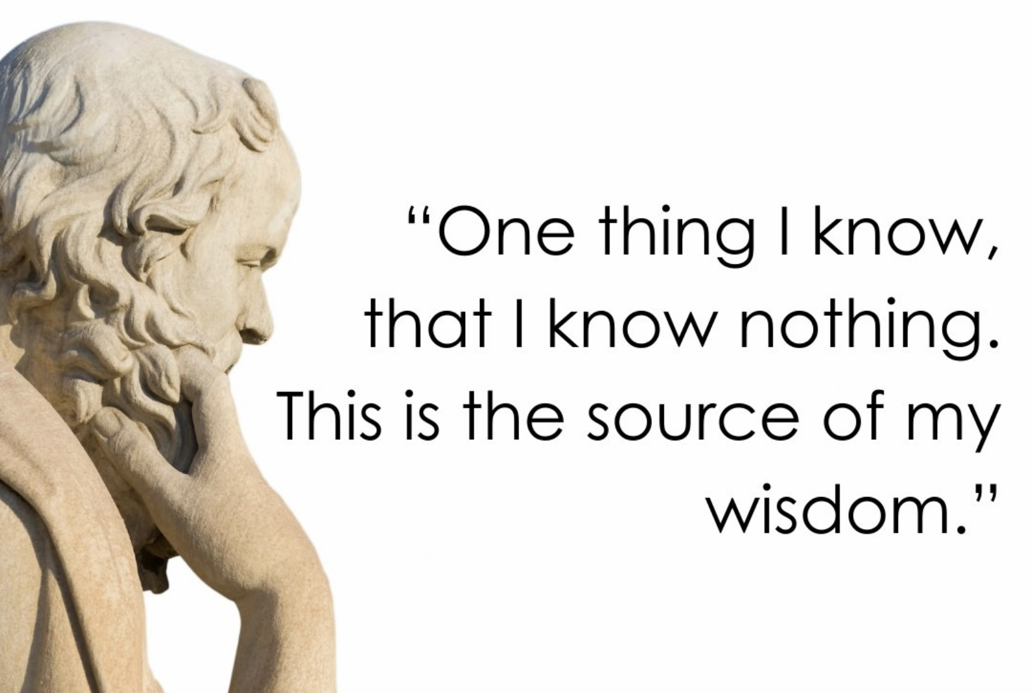
To heal and grow we must understand ourselves.
Understanding ourselves is easier if we see the mind as being made up of a number of parts: the somatic (body), emotional, rational and self-observing/wise minds.
In the course we will repeatedly refer to these four aspects of mind.
The common-sense view is that we perceive the world accurately and then act rationally upon this information.
The beginning of wisdom is the realization that neither of these views are true and that “We are lived by powers we pretend to understand.” Powers that control us.
In an effort to understand the powers that control us, today we’ll go back 3.7 billion years to the beginning of life on earth as we explore the different parts of our mind and how they influence our thoughts, feelings and behaviors.
OVERVIEW
“We are lived by powers we pretend to understand.”
W H Auden

Slide 7

Notes:
These general reminders are intended for participants doing the life course or those doing it on YouTube and then meeting in a group.

Slide 8

PLEASE HAVE YOUR RAISIN READY

Slide 9

Homework from last week
Start tracking the skills you are learning using the DBT diary card.
Submit questions or comments to itssimple2023@gmail.com
Read Simple manual sessions 4, 6 and 8
Start working on a crisis plan.
Craft your own personal dashboard

Slide 10

Homework for the coming week
Read skills training workbook p. 14-32
Read Simple manual session 5
Continue working on a crisis plans. Memorize it and practice it in your imagination using the editing splicing and pasting technique.
Continue tracking skills you are learning using DBT diary card or the skills list. Practice them.
Submit questions or comments to itssimple2023@gmail.com

Slide 11


REMINDER PARTICIPANT AGREEMENTS
If you have questions, comments, or feedback, please save them for the two question periods. You can put them in the chat box or raise your real/virtual hand.
Feedback from last week from several people: Keep comments, questions, and feedback relatively brief so everyone has a chance to participate.(one breath sharing) If you have more to share come to boing starting October 27th.
If you’re on zoom, make sure no one can overhear what is being said
For reasons that will become clear later in the course please avoid giving advice to other participants about what they should or should not do. Validation, encouragement , and understanding are however very much appreciated.

Slide 12

WEEKLY ANNOUNCEMENTS
Boing starts October 27. It is both in-person and on zoom (same link as on Wednesdays). The in-person session is held the board room of the Stratford family health team at 444 Douro St. Stratford on the second floor.
In the first boing group, we can have Joan and Nicole guide us in crafting a personal dashboard, creating a personal sensory soothing kit or we can work on crisis plans. We’ll do a poll on this today.
While, during the presentations, we’re sharing the PowerPoint slides anyone can edit them by drawing or writing on them if you do this it will show up on everyone’s slides so, please be careful. Thank you.

Slide 13
RESULTS ON IN PERSON POLL FROM LAST WEEK
1. Which of the following “holes” do you sometimes or often fall into(multiple choice
Substance use or other addictive behaviors ​​41%
Destructive impulsive behavior ​​​​27%
Patterns of dysfunctional interpersonal interactions​ 45%
Negative self-talk ​​​​​​​91%
Being overly critical of others ​​​​​50%
Dysregulated anger, anxiety, despair, or numbing out ​86%
Problems with boundaries-such as being unable to say no​ 73%
Any repeated behaviors' you later regret ​​​​45%
Withdrawing or running away​​​​​​ 77%
Thinking of and actually hurting yourself​​​​ 23%
Suicidal thoughts ​​​​​​​​36%
2. With respect to your thought holes, which thought do you most often have about yourself? (multiple choice)
I’m incompetent ​​​​​​​50%
I’m an imposter​​​​​​​ 14%
I’m defective ​​​​​​​64%
I’m unworthy ​​​​​​​59%
I’m shameful​​​​​​​ 23%
I’m guilty ​​​​​​​​41%
I’m unsafe​​​​​​​​ 18%
I’m vulnerable​​​​​​​ 27%
I’m out of control​​​​​​​ 27%

Slide 14
3. I’m in crisis…(single choice)
All the time ​​​​​​​​0%
Very often​​​​​​​​ 36%
Often ​​​​​​​​​41%
Sometimes ​​​​​​​​23%
Rarely ​​​​​​​​0%
4. When I’m in crisis I feel…(multiple choice)
Angry​​​​​​​​​ 36%
Anxious ​​​​​​​​91%
In despair ​​​​​​​​77%
Confused or lost​​​​​​​ 41%
Numb​​​​​​​​ 45%
Like I’m in a bottomless hole​​​​​ 50%
5. My crisis typically lasts…(multiple choice)
Minutes​​​​​​​​ 32%
b. Hours ​​​​​​​​45%
c. Days ​​​​​​​​​59%
d) Weeks​​​​​​​​ 9%
e) Months ​​​​​​​​5%
f) They never stop​​​​​​​ 14%

Slide 15
6. In a crisis I tend to think that …(multiple choice)
I’m worthless ​​​​​​​55%
I’m shameful ​​​​​​​50%
I’m unlovable ​​​​​​​50%
I don’t belong ​​​​​​​59%
I’m bad ​​​​​​​​27%
I’m irreparably flawed​​​​​​ 55%
7. In a crisis…
I tend to keep it all inside​​​​​ 77%
I tend to let it out​​​​​​​ 45%

Slide 16

Kate’s summary of the last session:

Slide 17


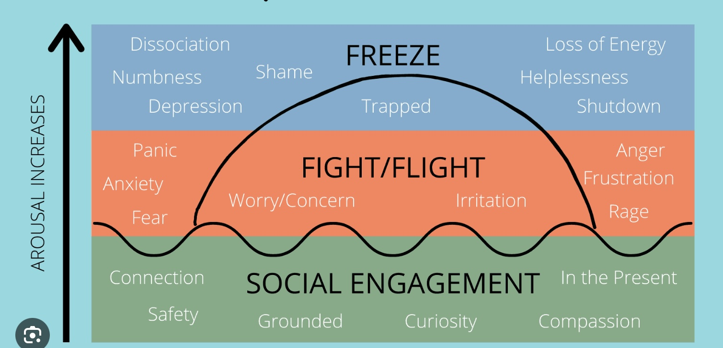

Check in regularly with your Personal dashboard
Spend a few moments checking in with yourself by asking:
1)What is the current risk that I’ll experience a state of crisis ?
Low b) Moderate c) high d) very high e) extreme
2) Am I in the window of tolerance?
a) Yes b) I’m a little outside c) very outside
3) What state of activation am I mostly in at the moment?
a) Calm b) Fight c) Flight d) Dissociated e) Depressed?
4) Where is my energy tank right now?
a) Full b) ¾ c) ½ d) near empty
CRISIS RISK
WINDOW OF TOLERANCE
STATE OF ACTIVATION
ENERGY RESERVES

Slide 18

Warning about meditation
feel free to skip it
followed by a moment of silence
Notes:
To watch the video please go to the website now

Slide 19
MINDFUL RAISIN EATING MEDITATION SCRIPT
(invite participants to hold a single raisin in their hand.)
Let’s begin by taking a moment to arrive here, together.
Sit comfortably, with your spine gently upright.
Feel your feet on the floor… your body supported.
Let your hands rest in your lap, one of them holding a single raisin.
We’re going to explore this tiny object with full attention, as if encountering it for the first time.
1. Seeing
Gently lift the raisin into your line of sight.
Take a moment to look at it, really look.
Notice its shape…
Is it round, oval, irregular?
Notice its colors—
shades of brown, amber, purple, perhaps even gold when it catches the light.
Trace the folds, the wrinkles, the shadows. Imagine you’ve never seen a raisin before.

Slide 20
There is no need to judge or analyze—
Just observe, with curiosity and presence.
2. Touching
Now bring the raisin into your fingertips.
Roll it gently between your fingers.
Feel its texture—
Is it sticky? Smooth? Rough?
Does it have weight?
Is it soft or firm?
Let your fingers take their time.
This isn’t about eating yet. It’s about being with.
3. Smelling
Bring the raisin slowly toward your nose.
Take a breath in through your nose and notice its scent.
Is it sweet? Earthy? Sour? Or perhaps faint and hard to detect?

Slide 21
Notice what memories or feelings arise as you inhale its fragrance.
Just witness whatever comes.
4. Hearing (optional)
If you move it between your fingers or gently drop it into your palm,
does it make a sound?
Can you hear the whisper of contact?
Let your ears be curious, too.
5. Placing in the Mouth (but not chewing)
Now, gently place the raisin in your mouth—
but don’t chew it yet.
Let it rest on your tongue.
Notice how your mouth responds…
Are there sensations of salivation, movement, anticipation?
Explore it with your tongue.
Notice the texture, the temperature.

Slide 22
Simply be with it, fully.
6. Chewing Slowly
When you’re ready, begin to chew.
Slowly.
Let each bite be deliberate.
Notice the flavor as it emerges, unfolds, maybe even changes.
Notice the sound of chewing, the feel of your jaw moving,
the way the raisin softens or sticks to your teeth.
Let the experience unfold in its own time.
7. Swallowing and Following the Sensation
When the time comes, swallow with awareness.
Follow the path of the swallow—down your throat, into your body.
Then pause.

Slide 23
Take a breath.
Notice any thoughts, emotions, or bodily sensations that are present now.
(Closing Reflection)
This tiny raisin has offered you a doorway into deeper presence.
Imagine what other everyday moments might hold this kind of richness,
if only we give them our full attention.
You’ve just practiced mindfulness.
Not by emptying your mind,
but by filling your attention.
Take a final breath together.
And gently return.

Slide 24


Slide 25

E-mailed questions, comments, feedback
AND “housekeeping”

Slide 26
OVERVIEW
Where we summarize what we will cover today and give a timeline of major, and not so major, events in the existence of the universe.

Slide 27
THE PLAN FOR TODAY
To understand ourselves and our struggles it helps to consider what mind and consciousness are and how they evolved. Today we’ll explore four aspects of our minds and their interplay.
In part 1 we’ll explore the somatic intelligence of our cells, organs and bodies which is as old as life on earth and the instinctual intelligence of emotional mind which flourished after the Cambrian explosion 541 million years ago.
In part 2 we’ll consider the rational conscious mind which is concerned with thinking and reasoning and which, in its human form, dates to the first Hominins 6 million years ago.
In part 3 we’ll reflect on the self-observing or wise mind which helps Humans understand themselves and their place in the world and which has flourished since the beginning of history 5000 years ago.
In part 4 we’ll explore how, because our brains are built on the nervous system wiring inherited from earlier species, we each carry within us evolutionary layers of mind. Across time, life on earth has progressed from reacting, to acting with intention, to thinking with reason, and finally to contemplating with awareness and wisdom. Yet at any given moment whether as individuals or as whole societies, our “center of gravity” can rest on any one of these stages. What stage of this progression we find ourselves at, depends greatly on whether we feel safe enough to explore or threatened enough to defend.
In 2025 we are in a global polycrisis. Western culture is being pulled back from more contemplative and thoughtful states of mind into more reactive and survival-driven ones.
Finally in part 5 we’ll look at how the four aspects of mind we discussed relate to each other.
Before doing all this however, we’ll start with a time line of events in the life of the universe and some definitions.

Slide 28
MAJOR EVENTS IN THE LIFE OF THE UNIVERSE
Number of years ago
13.8 billion The Big Bang, the beginning of space-time. Matter and energy appear
4.5 billion formation of the earth
3.8 billion first organisms appear on earth
6 million last ancestor common to humans and chimpanzees
2.5 million first human species (Homo) evolve in Africa. Start using stone tools
2 million human species spread from Africa to Eurasia, evolution of different human species
300,000 human species learn to use fire
200,000 Homo sapiens our genera of Homo emerges as a distinct species in Africa
100,000 Humans quickly climb from insignificance to the top of the ecological chain
70,000 cognitive revolution. Emergence of storytelling. Beginning of history. Homo sapiens ---------- leave Africa
30,000 extinction of Neanderthals leaving sapiens as the only remaining human species
16,000 sapiens settle America
12,000 the agricultural revolution. Domestication of plants and animals
first kingdoms, script and money, polytheistic religions
first Empire – the Arcadian Empire of Sargon
the scientific revolution, Europeans conquer America
the Industrial Revolution
Now the digital revolution

Slide 29
MIND AND CONSCIOUSNESS:
A FEW DEFINITIONS
Where we define some terms which we’ll come across as we discuss mind and consciousness in this course. Some of these terms imply an idealist rather than a physicalist metaphysics so we will also also briefly discuss alternative views of ultimate reality.

Slide 30
DEFINITIONS
In the course we will be discussing mind and consciousness. There will be terms we will use frequently. Let’s define some of them. Beware however that definitions vary, with for example, philosophers and biologists defining “consciousness” differently.
Mind is the totality of mental phenomena including thoughts, feelings, perceptions, memories, intentions, and awareness whether conscious or not. (I like the idea that the body and the mind are one seen from two perspectives. The body is the mind seen from the outside and the mind the body felt from inside)
Intelligence is the capacity to achieve goals through adaptive behavior, reasoning, learning, and problem-solving. It can be general or domain-specific and does not require self-awareness. (as for example in cells and bacteria)
Cognition is the set of processes by which a system acquires, stores, transforms, and uses information including perception, memory, attention, reasoning, and decision-making.
Consciousness is the state or process of having subjective experience “what it is like” to be a system. It includes both the contents of awareness and the fact of being aware.
Sentience is the capacity to have subjective experiences that include feelings, sensations, and emotions especially the ability to feel pleasure or pain. It is often considered a subset of consciousness focused on experiential valence.
Ego is what you think you are. Ego is also called small s self.
Superego is the part of your mind that carries the social rules you learned.
Id is the instinctual, pleasure seeking, emotionally driven part of your mind that doesn’t care for rules
Persona is how you like to be perceived.

Slide 31
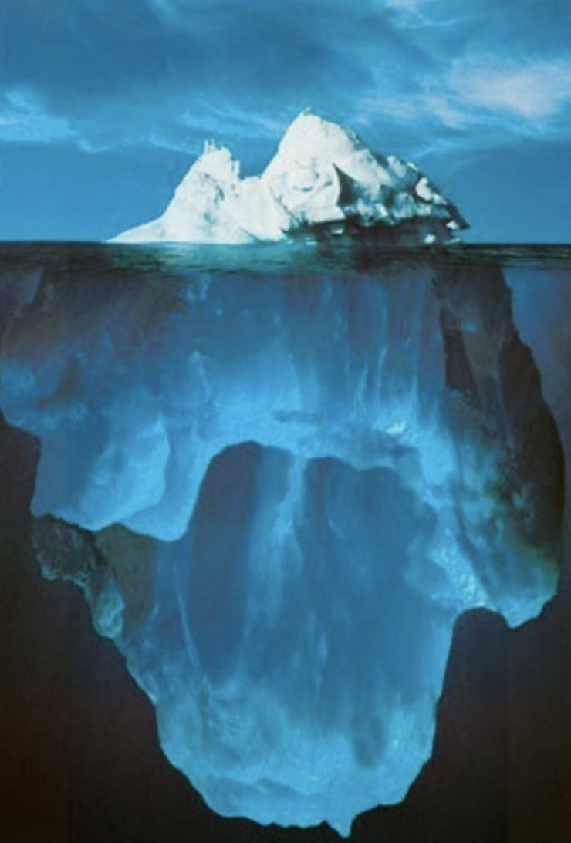
LEVELS OF CONSCIOUSNESS
Humans simultaneously experience different levels of consciousness.
Conscious refers to the state of being aware of one’s surroundings, thoughts, feelings, and actions in the present moment. An example is noticing you feel hungry or hearing a bird sing.
Unconscious refers to deep mental processes and contents inaccessible to awareness under normal circumstances, often shaping behavior indirectly (e.g., repressed memories, Freudian drives, autonomic regulation).
Subconscious refers to the mental processes that operate outside of conscious awareness but can influence thoughts, feelings, and behavior (e.g., implicit biases, habits).
Preconscious refers to mental content not currently in conscious awareness but accessible through attention or recall (e.g., a phone number you can remember when prompted).
Metaconscious refers to awareness of your awareness or the ability to reflect on, monitor, or think about your own conscious experience. An example of metaconsciousness is realizing “I’m aware that I feel hungry” or “I notice that I’m distracted instead of focusing on the bird’s song.” Put simply: Consciousness = experiencing. Metaconsciousness = observing yourself experiencing = mindfulness.

Slide 32
TERMS REFERING TO MIND
The terms rational, thinking, conscious, mature, metacognitive, self-observing and self-reflecting minds are often misunderstood, but they point to overlapping but distinct aspects of the human mind.
Rational mind is The part of the mind that uses logic, evidence, and reason to solve problems and make decisions. It is analytical, objective, and rule-following. For example, If you’re trying to decide which college to go to by comparing costs, programs, and locations, you’re using your rational mind. Rational mind sometimes ignores emotions or deeper needs, and it can justify unhealthy behaviors if they’re “logical.”
Thinking Mind consists of the general mental activity that involves processing information, reflecting, imagining, planning, and problem-solving. It’s always active and includes both rational and irrational thoughts. It’s not always helpful some thoughts can be repetitive, anxious, or untrue. Think of the thinking mind as the full orchestra of your thoughts. The rational mind is the violin section playing logical tunes.
Conscious Mind is the part of your mind that you’re aware of right now your present thoughts, feelings, and perceptions. It is aware, intentional, able to reflect and choose. It’s just the tip of the iceberg most of what affects us lies below the surface (in the unconscious).
Metacognitive mind is aware of and regulates one’s own cognitive processes, it thinks about thinking, monitors one’s reasoning, and adjusts strategies. Two terms are closely related to metacognitive mind: the self-Observing mind has the capacity to notice one’s own thoughts, emotions, and actions from a detached perspective, often without judgment while the self-Reflecting mind carries on the active process of evaluating and interpreting one’s own mental states, experiences, and values often with the aim of understanding motives, meaning, or identity. These three terms are closely related to Wise mind and mindfulness.
Executive functions refers to the mind’s ability to manage thoughts and emotions and actions in order to reach a goal. It include skills like planning, focusing, attention, remembering instructions and regulating impulses. Executive functions are associated with metacognition and the prefrontal cortex

Slide 33
FUNDAMENTAL REALITY
Today, science and culture are dominated by a philosophical view called Physicalism, which holds that physical matter and its laws are the only fundamental reality. In this view, consciousness and mental states arise entirely from and can in principle be reduced to physical processes in the brain and body. Minds are thus byproducts of complex arrangements of matter.
I hold another view called philosophical idealism. In the “searching for meaning session” towards the end of the course I explain why in 700 PowerPoint slides.
Idealism holds that mind or consciousness is the fundamental reality, and the physical world is either dependent on it or is a manifestation of it. In this view, “matter” is not the basic constituent of the universe, “matter” is a pattern in experience or mental processes.
If we try to explain the spectrum from basal cognition to metacognition within physicalism, we have to posit a very sharp explanatory leap: subjective experience “emerges” from purely physical, non-experiential matter at some threshold of complexity. This creates the so-called hard problem of consciousness.
Under idealism, all levels of mind, from the simplest to the most complex, are already mental in nature. Basal cognition is simply a minimal, low-dimensional expression of mind, and metacognition is a richer, more self-reflective one. We don’t have to explain how “mindless matter” suddenly becomes aware, instead we just describe changes in the organization, scope, and integration of pre-existing consciousness. The gradations in consciousness and mind then look like continuous modulations of the same fundamental stuff, not abrupt ontological jumps.
I mention these two philosophical positions because they are implicit in the description and definitions of mind and consciousness that I offer next.

Slide 34
SUMMARY: FUNDAMENTAL REALITY
The dominant modern worldview, physicalism, sees matter and forces and its laws as the only fundamental reality, with mind and consciousness as byproducts of complex physical processes.
In contrast, philosophical idealism holds that mind or consciousness is primary, and the physical world depends on or manifests from it.
I introduce these two positions to frame the definitions of mind and consciousness that follow.

Slide 35
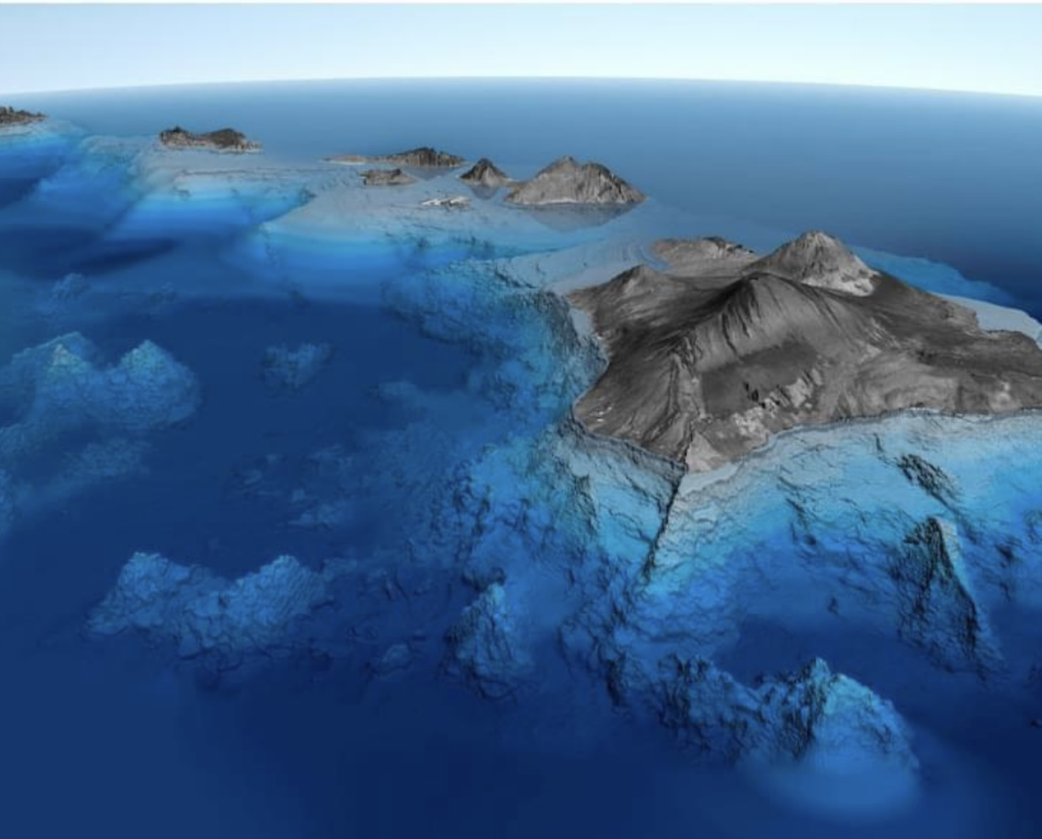
EVEN MORE DEFINITIONS
Personal unconscious is the layer of the psyche just beneath conscious awareness, unique to each person. It is related to forgotten memories, repressed experiences, subliminal perceptions, and complexes (emotionally charged clusters of ideas/feelings). It is formed from one’s individual life history.
Collective Unconscious (as described by Carl Jung) is a deeper, universal layer of the unconscious that all humans share. It is related to archetypes which are innate, universal patterns and motifs (e.g., Mother, Hero, Shadow, Wise Old Man, Self). It is the shared psychic inheritance of the species. Jung described the collective unconscious as stratified, with deeper layers reaching further back in evolutionary history. These layers can be seen as: 1. Cultural Layer: Shared myths, symbols, and motifs specific to a civilization or cultural group. 2. Archetypal Layer: Universal human patterns and primordial images, the classic Jungian archetypes. 3. Phylogenetic / Biological Layer: Psychic structures reflecting our evolutionary inheritance as animals, rooted in instinctual patterns (e.g., mating, survival, fear). 4. Primal Layer (Pre-human/Transpersonal): The deepest stratum, connecting to the origins of life itself, what Jung sometimes hinted might border on the “psychoid” level, where psyche and matter are not yet differentiated.
Jung was a philosophical idealist and a mystic. In contrast to Freud’s iceberg model of mind he saw it as an archipelago of islands that while seemingly separate at the surface are in depths really one.

Slide 36
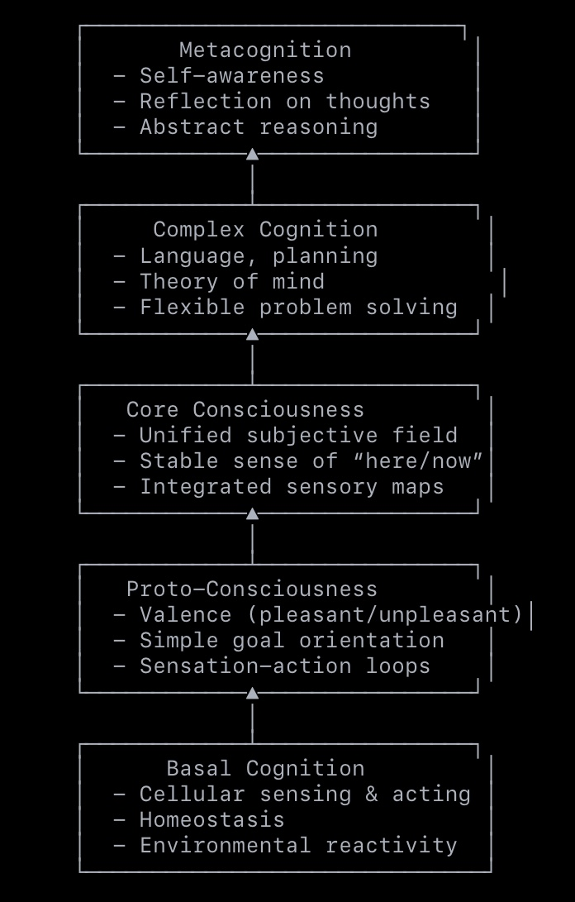
SPECTRUM OF COGNITION
The idealist continuum of mind, describes different levels of consciousness moving from the simplest forms toward the richest expressions of awareness. In this framework, all levels are modes of mind, differing only in complexity, integration, and self-referential depth not in whether consciousness exists at all. Mind is one substance and all layers are mind, expressed at different levels of complexity. There’s a smooth deepening and integration of consciousness and evolution and development are processes of complexifying mind, not producing it from scratch.
There is a spectrum of cognition with its simplest forms being unconscious while its more complex forms are conscious and metaconscious.
Basal Cognition is the simplest form of mental functioning, the capacity of even very simple life forms (and possibly some non-living systems in panpsychist interpretations) to sense and respond to environmental conditions in a goal-directed way. Key Features: Homeostasis (self-maintenance). Basic stimulus-response behavior. No integration across multiple sensory channels. Examples: A bacterium moving toward nutrients (chemotaxis). Single-celled slime mold solving a maze to reach food
Protocognition is a primitive integration of perception and action, early forms of valence (pleasant/unpleasant) and proto-experience. The organism does not merely react; it can modulate its responses based on past interactions or rudimentary “expectations.” Key Features: Simple sensory integration. Memory traces influencing behavior. Goal orientation with minimal flexibility. Examples: A worm adjusting movement patterns to avoid previously encountered noxious stimuli or plants altering leaf orientation based on previous light exposure patterns

Slide 37
SPECTRUM OF COGNITION
Core Consciousness is a stable, here-and-now subjective field, the ability to integrate sensory input into a unified moment-to-moment experience and distinguish “self” from “not-self.” Key Features: Present-focused awareness. Multimodal sensory integration. Embodied sense of self-location. Examples: A dog recognizing itself as the perceiver of a scene. A bird navigating in real time while integrating vision, balance, and proprioception
Complex Cognition is the ability to manipulate mental representations, plan, simulate possible futures, and infer others’ perspectives (“theory of mind”). Key Features: Abstract thinking and symbolic reasoning. Temporal depth, thinking about past and future. Social cognition and cooperative strategies. Examples: A chimpanzee using tools and anticipating how others might react. A human child engaging in pretend play and perspective-taking
Metacognition is the awareness of one’s own mental processes the ability to monitor, evaluate, and modify thoughts, strategies, and behaviors. Key Features: “Thinking about thinking”. Self-evaluation and error correction. Reflection on beliefs, values, and motives. Examples: A human realizing they are forgetting something and using a mnemonic. A meditator noticing their mind has wandered and returning focus to the breath.

Slide 38
SUMMARY OF THE SPECTRUM OF COGNITION
Philosophical idealism sees mind as the fundamental of the universe and views consciousness as a single substance expressed at different levels of complexity. Evolution and development don’t create mind from nothing, as philosophical materialists or physicalists maintain, but instead deepen and integrate it.
Idealism describes a spectrum of cognition, from unconscious to conscious and metaconscious forms: (remember that cognition is the set of processes by which a system acquires, stores, transforms, and uses information including perception, memory, attention, reasoning, and decision-making.)
1. Basal Cognition – Simple stimulus–response and self-maintenance. Present in cells, bacteria, and slime mold.
2. Protocognition – Early integration, primitive memory, and goal-modulated responses. Present in worms, and plants.
3. Core Cognition – Present-moment awareness, multimodal integration, sense of self vs. world. Present in dogs and birds.
4. Complex Cognition – Abstract thought, planning, perspective-taking, social strategies. Present in chimps and human children.
4. Metacognition – Reflection on one’s own mental processes, beliefs, and values. Present in humans monitoring their thought, for example meditators noticing mind-wandering.
In an idealist view, consciousness runs continuously from the simplest forms to the richest awareness, differing only in depth and integration.

Slide 39
HIGHER-ORDER CONSCIOUSNESS
Philosopher Bernardo Kastrup defines Universal consciousness (also called mind-at-large or universal mind) as the sole fundamental reality. It is not in space and time rather, space, time, and matter arise within it as contents of experience. It is subjective in nature meaning, its essence is “what it is like to be” it. It is not a person, deity, or mind with human-like thoughts. It is an all-encompassing field of experience whose patterns give rise to everything we call the physical world. It is aware, but not reflexively self-aware in the human sense. It has experiences, but does not narrate, “I am having this experience” There is only one universal consciousness. What we think of as “many minds” are dissociated parts (alters) of this single field, comparable to dream characters within a dreamer’s mind. Each individual mind, yours, mine, a dog’s, is a partition in universal consciousness, somewhat insulated from the rest. This dissociation allows localized perspectives to emerge. The “physical” is how the contents of universal consciousness look when observed from across the dissociative boundary i.e., from the outside. From the “inside,” these same events are experiences.
In Kastrup’s analytic idealism, the “observer” you experience is not separate from universal consciousness. The Raw Awareness of the observer Comes from Universal Consciousness. Universal consciousness is the only subject of experience it is that which knows. When you feel “I am aware,” the source of that awareness is universal consciousness itself, flowing through your localized perspective. This means the “light” of awareness in you is the same light everywhere it’s just passing through the filter of your individuality. Your Mind Shapes the Observation. As an alter (dissociated part) of universal consciousness, you have a nervous system and cognitive architecture that: Shapes what you can experience. Produces a self-model the idea of “me” as a separate observer. The awareness is universal; the self-awareness is local. Universal consciousness itself is aware but not reflexively self-aware. The “observer” you feel is universal consciousness + your brain’s capacity for meta-cognition (thinking about thinking).

Slide 40
ALTERED STATES OF CONSCIOUSNESS
An altered state of consciousness is any condition in which the normal waking patterns of awareness, perception, and thought are significantly changed. These changes can affect sensory experience, sense of time, self-awareness, emotions, and cognitive processing. Altered states may occur naturally, be self-induced (through practices like meditation), or be induced by external agents (like drugs or brain stimulation).
Natural Biological States occur as part of the body’s normal cycles. Sleep stages: REM sleep → vivid dreaming with emotional intensity. Deep non-REM sleep → minimal awareness, restorative. Daydreaming → drifting attention away from the present task into internal imagery or thought.
Meditative & Contemplative States arise through trained mental focus, relaxation, or absorption. Mindfulness meditation → heightened present-moment awareness, reduced rumination. Transcendental meditation → feelings of unity, timelessness, reduced self-boundaries. Prayer or mystical absorption → sense of merging with the divine.
Flow States are highly focused, optimal performance states where self-consciousness drops away. Examples include a musician completely absorbed in improvisation, losing track of time or an athlete “in the zone” during a game.
Hypnagogic & Hypnopompic States are borderline states between wakefulness and sleep. Hypnagogic (falling asleep) → dreamlike imagery, floating sensations. Hypnopompic (waking up) → lingering dream impressions, vivid mental images.
Drug-Induced States alter perception, mood, and cognition. Psychedelics (LSD, psilocybin) → intensified colors, altered sense of time, ego dissolution. Stimulants (amphetamines, cocaine) → heightened alertness, sometimes hyperfocus. Depressants (alcohol, benzodiazepines) → sedation, impaired judgment.
Hypnosis is an induced state of focused attention and increased suggestibility.
Trauma-Related & Extreme States triggered by intense physical or emotional experiences. Dissociation → feeling detached from body or surroundings. Near-death experiences → sense of leaving the body, moving through a tunnel, meeting beings of light.

Slide 41
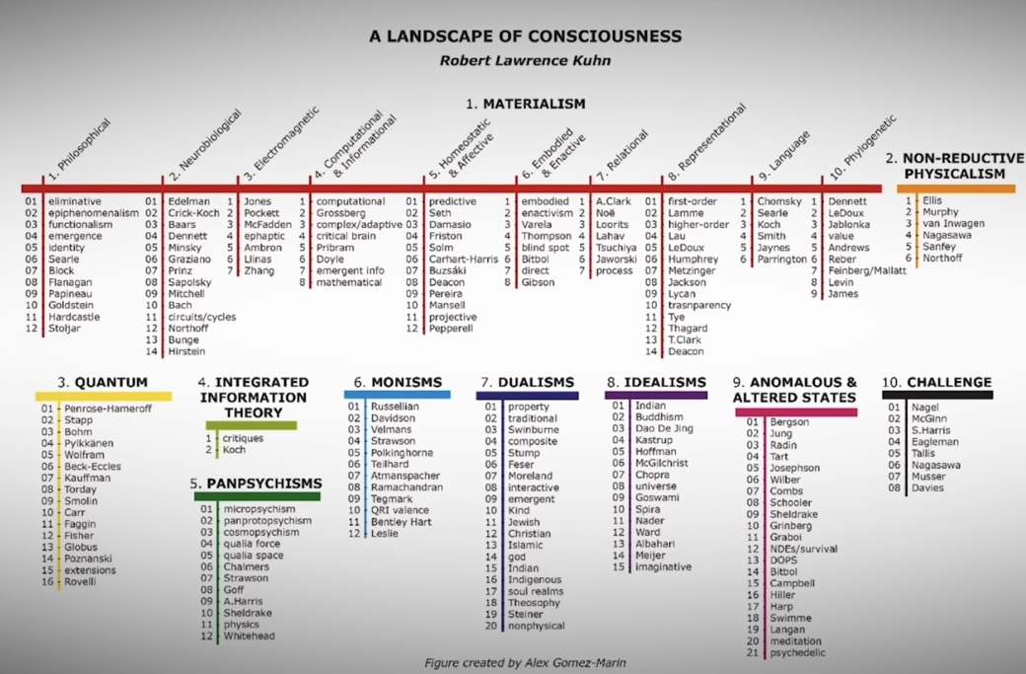
325 THEORIES OF CONSCIOUSNESS
“Humans are divided in their understanding of the most fundamental aspects of existence. The questions of whether there is a God, life after death, meaning, free will and what are personal identity, purpose and value all depend on what one’s theory of consciousness is”

Slide 42
4 SCIENTIFIC THEORIES OF CONSCIOUSNESS
Of these 325 theories only 4 are considered scientific because 1.They are expressed in precise, testable models rather than broad speculation 2. Each maps onto measurable brain processes 3. Each generates falsifiable predictions about brain activity and 4. each has large research groups actively testing them with neuroimaging, stimulation, lesion studies, and computational modeling.
Integrated Information Theory (IIT) – Giulio Tononi. Proposes that consciousness corresponds to how much integrated information a system generates. A conscious experience is unified and irreducible, quantified by a value called Φ (phi). The more integrated and differentiated the system’s information, the more conscious it is.
Global Workspace Theory (GWT) – Bernard Baars, Stanislas Dehaene. Consciousness arises when information is broadcast globally across the brain’s “workspace.” Unconscious processes are local and specialized; conscious ones are integrated and accessible to multiple brain systems (e.g., memory, decision-making, language).
Higher-Order Thought (HOT) Theories – David Rosenthal, Hakwan Lau. A mental state becomes conscious when you have a thought about that thought. For example: a first-order perception of red is unconscious, but when you form a higher-order representation “I see red,” it becomes conscious. Emphasizes meta-cognition as the key to consciousness.
Recurrent Processing Theory (RPT) – Victor Lamme. Consciousness depends on recurrent (feedback) activity in sensory areas of the brain. Early feedforward processing (like a snapshot) is unconscious. When neural signals loop back and integrate locally within sensory cortices, the experience becomes conscious, even before global broadcasting.

Slide 43
THE HUMAN EVOLUTIONARY LINEAGE
Where we consider how we’re the descendants of a long lineage of lifeforms going all the way back to the first single celled organisms that existed on earth 3.7 billion years ago and why this is important in understanding ourselves.
“From the paramecium to the human race, all life forms are meticulously organized, sophisticated aggregates of evolving microbial life. Far from leaving microorganisms behind on an evolutionary ‘ladder,’ we are both surrounded by them and composed of them.”
Lynn Margulis

Slide 44
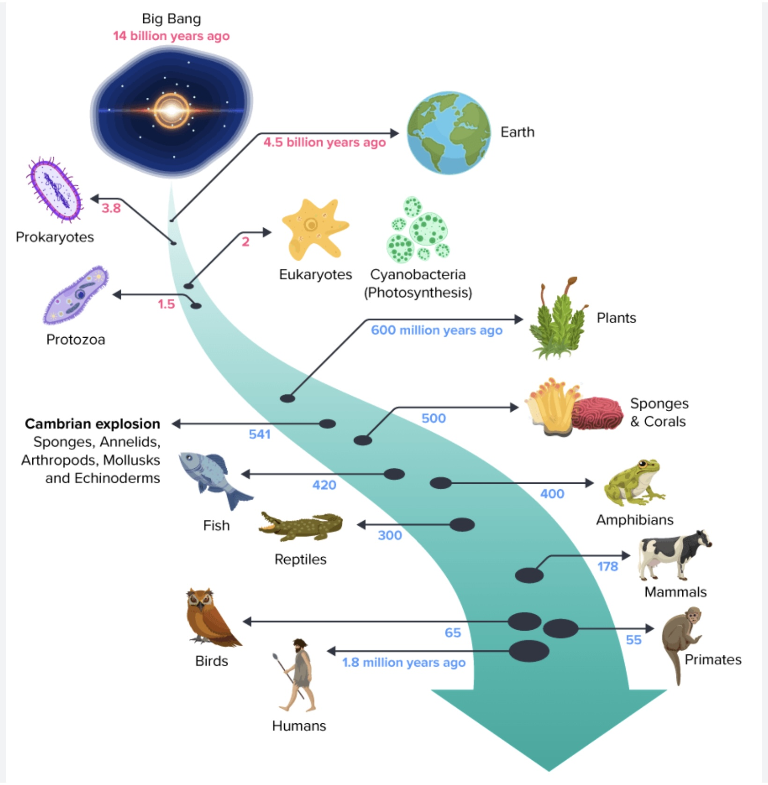
HUMANS LONG EVOLUTIONARY LINEAGE
Life on earth began in the oceans around 3.7 billion years ago and consisted of single simple “prokaryotic” cells. These cells had a membrane to keep things in and out, DNA and RNA to store information, and the ability to obtain and convert energy from the environment. All life on earth today descends from these cells and retains their basic blueprint.
Over time, some cells started living together in colonies. Eventually one cell swallowed another and instead of digesting it, began working symbiotically with it, creating more complex “eukaryotic” cells. (cells with a nucleus).
Around 600 million years ago, some cells living in colonies learned to specialize in doing specific tasks for the colony. This specialization is replayed when the single fertilized egg we all begin as, develops into many different types of cells in our bodies: skin, heart, kidney, liver, muscle etc.
One of the specialized cells that evolved was the neuron which in jellyfish formed primitive types of brains called “nerve nets” which sensed and responded to the world. Over hundreds of millions of years, these nerve nets evolved into Human brains.

Slide 45
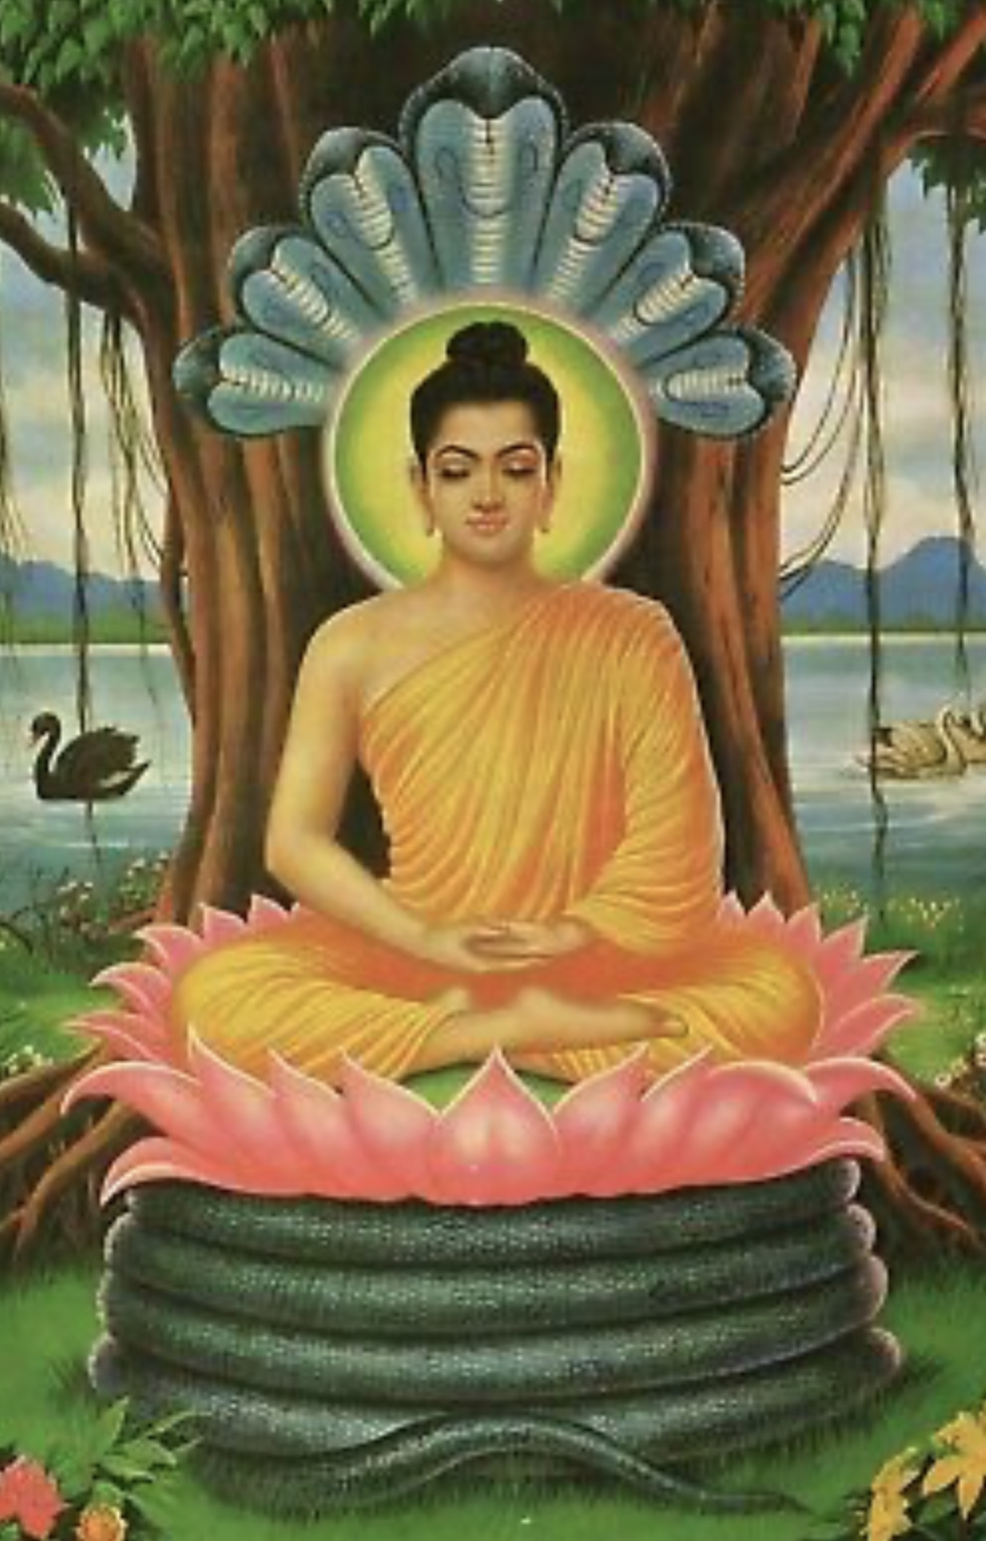

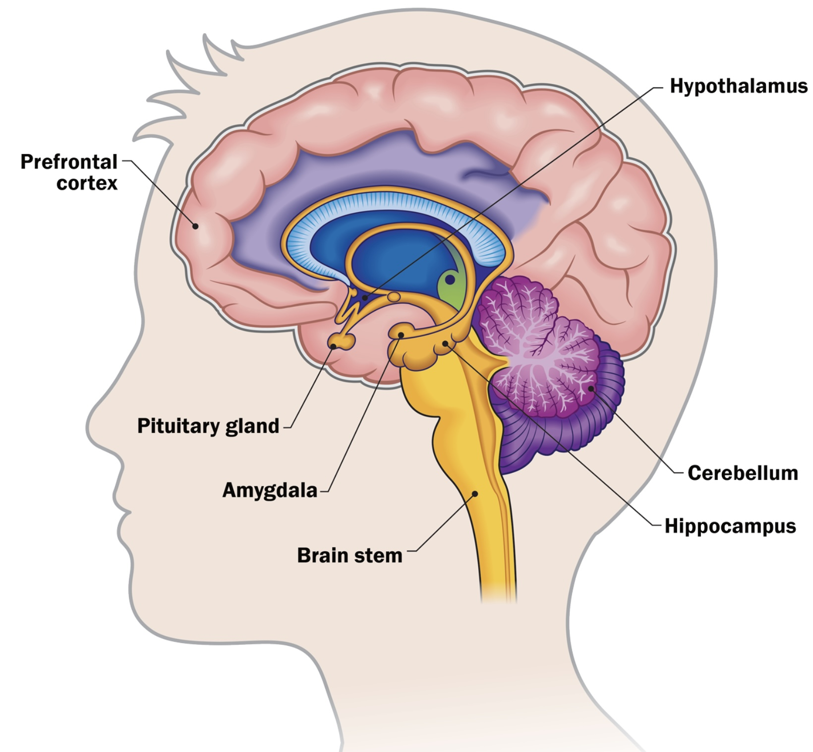



The Human nervous system inherited components from all the organisms who were our evolutionary ancestors: Our spinal chord with its reflexes is similar to a 1) mollusk’s nervous system. The Human brainstem, involved in basic survival functions, is very similar a 2) reptile’s brain. Our limbic system, involved in emotions, is very similar to the brain of mammals such as 3) dogs, while parts of our cortex, involved in problem solving are similar to the 4) ape brain.
About 6 to 7 million years ago, the evolutionary tree split with one branch leading to chimps and the other to Hominins. Over time, Hominins developed larger brains, language, tools, and eventually the complex cultures we live in today. Humans have the unique ability to 5) self-reflect a function of the pre-frontal cortex.
cortex
5)
4)
2)
3)
1)

Slide 46
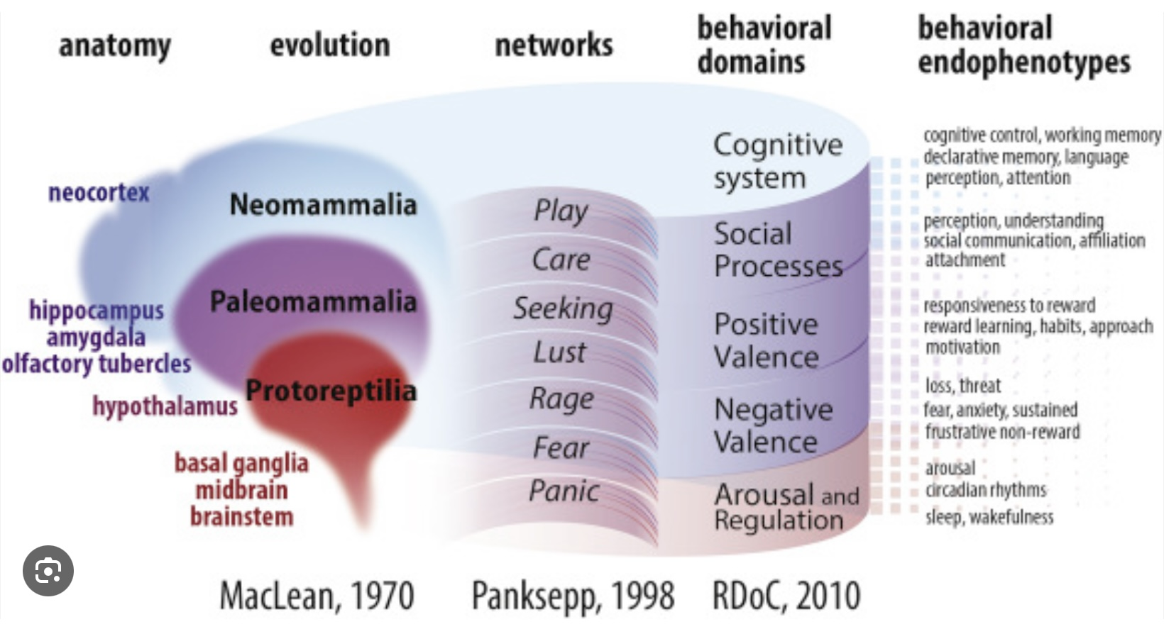
The triune brain theory, proposed by neuroscientist Paul MacLean in the 1960s, suggests that the human brain is structured in three distinct layers that correspond to different aspects of our evolutionary development.
The reptilian Brain is the most primitive part of the brain, responsible for basic survival functions such as heart rate, breathing, and instinctual behaviors. It governs aggression, dominance, territoriality, and basic survival instincts.
The Limbic System is associated with emotions, social behaviors, and memory. It includes structures such as the amygdala and hippocampus and is responsible for processing emotions and forming emotional memories.
The Neocortex or rational Brain is the most evolved part of the brain, responsible for higher-order functions such as reasoning, problem-solving, language, and abstract thinking. It allows for complex thought processes and is involved in planning and decision-making.
The reptilian brain and limbic system are instinctual while the neocortex is rational. The prefrontal cortex, the most recently evolved part of the cortex corresponds to the self-observing/wise mind.
THE TRIUNE BRAIN

Slide 47
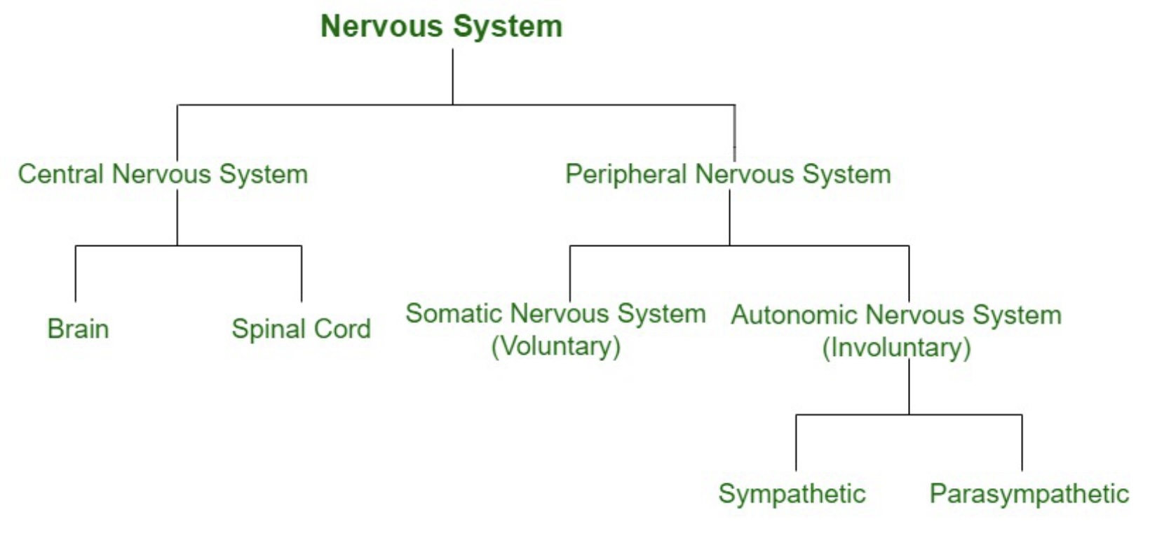
THE NERVOUS SYSTEM’S LINEAGE
Charles Darwin made a very strong case that Humans were not made whole cloth on the 6th day of creation. Instead, he argued we evolved step by step from single celled organisms.
To understand ourselves, we need to appreciate how evolution shaped our brains and minds. In this course we will focus on four parts of the Human nervous system, “brains” or minds. These co-exist within us. They are the 1) somatic (body or peripheral nervous system), and 2) the central nervous system’s a-emotional, b-rational, and c-self-observing brains. We will explore their history, how each processes information, responds differently to the challenges we face and why understanding that we have not one but several brains is so important in understanding mental health.
We have evolutionarily older simpler brains as well as younger more complex ones within us. In certain situations, for example when we’re startled, our older reptilian brain reacts before our newer thinking brain does. Emotions such as anxiety, anger or sadness are associated with our older emotional brain and sometimes control us. Other times we can rationally self-talk or sooth ourselves into feeling better or calming down by using more recently developed parts of our mind. Our mind is not just one thing; it’s a dialogue between different parts of our nervous system.
2
1

Slide 48
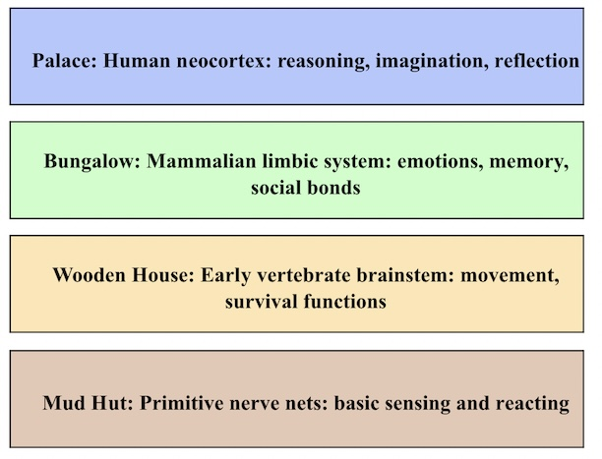
Imagine the brain’s evolution as a series of architectural add-ons to a building, where nothing old ever gets torn down, only built upon.
At the very beginning, life built a simple mud hut, just walls and a roof, no rooms, no second floor. This was like the first nerve nets: a basic way of sensing the world and responding, with no central control.
Over time, instead of demolishing the mud hut, a sturdier wooden house was constructed around it. This gave more structure and organization, just like early vertebrate brains, which added a spinal cord and simple brainstem to coordinate movement and survival functions. The old mud hut (the nerve net) was still there, buried inside, still doing its job.
Later, evolution further expanded the structure, putting a comfortable bungalow on top of the old structures. This bungalow had rooms for memory, emotion, and social living; the limbic system. You could now have a “family life” of feelings, relationships, and basic learning, layered right on top of the simpler survival wiring.
Finally, the palace arose, a grand construction with towers and libraries, able to look out on the world, reflect, and plan. This is the neocortex, especially developed in humans: capable of reasoning, imagination, art, and philosophy. Yet beneath this palace lie the bungalow, the wooden house, and even the old mud hut. They were never demolished; they remain foundational, influencing the grand palace above.
AN ARCHITECTURAL METAPHOR

Slide 49
NERVOUS SYSTEMS FROM REACTING TO REFLECTING
One simple way to understand what each of these brains/minds does is through the concepts of reacting, acting, thinking and reflecting.
Reacting-Somatic nervous system- reacting is an immediate, automatic response. It’s fast, instinctive, and driven by bodily states or emotions (e.g., flinching when startled, snapping back when hurt). Reacting is rooted in the body’s survival system (fight/flight/freeze). It corresponds to the raw, physiological responses, muscle tension, visceral sensations.
Acting-Emotional brain- Acting is a step beyond reacting. It is the carrying out of a purposeful behavior, guided by habits or learned patterns, but is not always deeply thought through (e.g., going to work, cooking dinner, following a routine). Acting is fueled by feelings such as love, anger, fear, longing, that move us toward or away from others. Acting aligns with the emotional brain which is involved with attachment needs, affective expression, and relational protest.
Thinking-Rational brain- Thinking involves slower, more deliberate processing. This is where reasoning, problem-solving, and planning come in (e.g., weighing options before making a decision, strategizing).Thinking involves cognitive processing, meaning-making, planning, the rational brain, words, logic, and analysis to interpret and guide experience.
Reflecting-Self-reflecting brain- Reflecting involves standing back and observing one’s own mind, with its thoughts, feelings, behaviors and sensations. This is self-awareness, perspective-taking, and meaning-making (e.g., asking, “Why did I react that way?” or “What really matters to me in this situation?”). Reflecting goes beyond thought into meta-awareness; the capacity to observe self and parts compassionately. It aligns with the self-reflecting pre-frontal cortex: holding together somatic, emotional, and rational in an integrated observing consciousness.

Slide 50
FROM REACTING TO REFLECTING
As life evolved on earth there was an increase in consciousness as organisms shifted from reacting to acting to thinking to reflecting.
Early single-celled organisms survive by reacting to immediate conditions: moving toward nutrients, away from toxins, adjusting to light or temperature. This is reactivity without a long-term plan; just rapid responses wired into physiology. These cells were conscious in the sense that they felt like something.
With nervous systems and mobility, animals begin acting, not just reacting. A predator hunts rather than waits for food; a bird builds a nest in anticipation of eggs. Here, organisms exert agency and modify their environment. Acting marks the rise of intentional behavior: goal-directedness without needing conceptual thought.
With more complex brains, primates began thinking: using concepts, memory, and imagination to shape action. Instead of relying only on instinct, primates and especially humans created tools, language, and culture. Thinking allows planning, problem-solving, and cooperation across time and space. Life is no longer just about survival; it becomes about creating possibilities.
Around 70,000 years ago, humans begin reflecting not only on the world but on themselves. Reflecting means asking: What am I doing? Why am I doing it? What does it mean? This gives rise to philosophy, religion, art, science, and culture but also to anxiety, moral responsibility, and awareness of mortality. Reflection allows us to step back from thought itself, which is why it feels like a uniquely human leap.
It’s important to see this evolution not as rigid stages left behind, but as layers: Humans still react. We still act . We still think but now we are also capable of reflection. Each new stage enfolds from the earlier ones, widening the horizon of what “mind” and consciousness means.

Slide 51
NERVOUS SYSTEMS JOURNEY FROM MUD HUT TO PALACE
Mud Hut → Reacting
• Brain level: Nerve nets / brainstem functions.
• Mode: Immediate, automatic survival responses.
• Example: Pulling your hand from a hot stove, jumping at a loud sound.
Wooden House → Acting
• Brain level: Early vertebrate brainstem + basal ganglia.
• Mode: Purposeful behaviors guided by routines, instincts, or habits.
• Example: Hunting for food, migrating, performing daily routines without deep thought.
Bungalow → Thinking
• Brain level: Mammalian limbic system + expanding cortex.
• Mode: Problem-solving, reasoning, planning.
• Example: Remembering where food is stored, planning a journey, strategizing a response.
Palace → Reflecting
• Brain level: Human neocortex (especially prefrontal cortex).
• Mode: Self-awareness, meaning-making, perspective-taking.
• Example: Asking “Why did I do that?”, considering long-term purpose, creating philosophy or art.

Slide 52
HEALING DYSREGULATED MINDS
Healing involves learning to balance the relationship between different parts of our minds that we’ve inherited through evolution.
When life feels unsafe our brainstem and reptilian circuits dominate our minds. We experience fight, flight and freeze. Healing our dysregulated reptilian brain involves soothing and regulating these primal responses through safety, grounding, breath, movement, and co-regulation with other people.
The mammalian brain or limbic system governs emotions, attachment, and motivation. Once survival isn’t the immediate issue, our attention turns to acting out of emotional needs; seeking connection, expressing feelings, engaging relationships. Healing our dysregulated mammalian brain focuses on repairing attachment wounds and reclaiming, through practice the feeling that we can control some things in our lives.
The neocortex, especially expanded in primates, supports abstract thought, planning, and language. With safety and emotional grounding, the neocortex can come online fully. People can reflect on past experiences, understand patterns, and choose deliberate strategies. Healing our dysregulated Hominid thinking brain involves insight, re-storying trauma, and making meaning.
Einstein said “We cannot solve a problem with the same mind that created it”. Healing dysregulated feelings, thoughts and behaviors, requires the reflecting prefrontal cortex, which is capable of self-awareness, empathy, moral reasoning, and integration of emotion with thought.
True reflection and healing emerges when the prefrontal cortex can see and hold with compassion the dysregulated reptilian, mammalian and Hominid brains. With self-awareness or mindfulness instead of being trapped in survival reflexes or rigid narratives, we can observe our own inner life, befriend all our parts, and live with greater freedom.

Slide 53
HEALING AS A JOURNEY FROM REACTING TO REFLECTING
Healing recapitulates evolution: we first calm the animal within us, then reclaim our mammalian need for love and belonging, then use our primate intelligence to make meaning, and finally grow into the uniquely human gift of reflective consciousness.
In the early stages of distress or trauma, people often live primarily in reactive patterns; automatic fight, flight, freeze, or fawn responses. Life feels dominated by triggers, with little sense of choice. Healing begins by noticing these patterns and gently creating safety so reactivity doesn’t rule everything.
With more stability, a person begins to act intentionally, choosing new behaviors instead of being swept away by old reactions. This might look like practicing grounding skills, setting boundaries, or taking steps toward healthier routines. Agency and empowerment grow as we realize: “I can do something different.”
Later, there is room for thinking, making sense of one’s experiences, linking past and present, and seeing patterns. This includes insight into family dynamics, cultural influences, and personal narratives. Thinking provides coherence and allows us to plan for a different future.
At the deepest level comes reflection: the ability to observe one’s own mind with compassion. Reflection opens the door to self-acceptance, forgiveness, and even spiritual or existential insight. Here, a person is not only choosing new behaviors or making sense of life, they are beholding themselves in a way that is both tender and transformative.
Healing, then, isn’t just about fixing symptoms. It’s about moving up this ladder of mind, from being lived by our reactions, to becoming agents of our choices, to making meaning, and finally to cultivating reflective wisdom.

Slide 54
FROM THE BEGINNING OF THE UNIVERSE
TO THE FIRST LIFE ON EARTH
Where, ludicrously briefly, in one slide covering 10 billion years, we describe the evolution of the universe from the big bang to the beginning of life on earth
“The evolution of the world can be compared to a display of fireworks that has just ended: some few red wisps, ashes and smoke. Standing on a well-chilled cinder, we see the slow fading of the suns, and we try to recall the vanished brilliance of the origin of worlds.”
Georges Lemaître

Slide 55
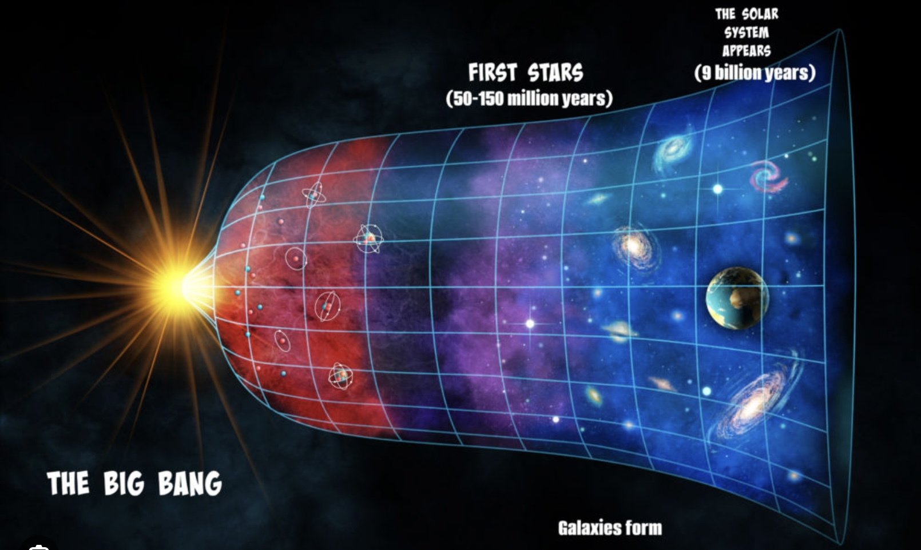
THE UNIVERSE FROM THE BIG BANG TO THE BEGINNING OF LIFE ON EARTH
The most accepted model of how the universe evolved tells us that about 13.8 billion years ago, there was the Big Bang, (term coined by Fred Hoyle in 1949) a silent massive “explosion” of space, time, and energy.
At first, the universe was just super-hot energy, but as it cooled, “particles” like protons, neutrons, and electrons formed. These came together to make the first hydrogen and helium atoms.
Over time, gravity pulled these atoms into giant clouds that formed stars. Inside those stars, heavier elements like carbon and oxygen were created through nuclear fusion. When big stars exploded in supernovas, they scattered those elements across space.
Some of that stardust came together, about 4.6 billion years ago, to form our solar system. The sun formed at the center, and the leftover material spun around it, clumping together into planets, including Earth.

Slide 56
PART 1:THE BODY’s intelligence AND the EMOTIONAL MIND
Where we describe the somatic intelligence of our cells, organs and bodies which is as old as life on earth and the instinctual intelligence of emotional mind which flourished after the Cambrian explosion 541 million years ago. ( this period spans from 3.7 billion years ago-5 million years ago)
“Instinct is reason in a lower form” Charles Darwin

Slide 57
A MAP OF THE MIND
Self-aware/observing mind
We assume that the part of our mind of which we are conscious, or can “see” in our minds eye, is in control of our lives.
This is far from the truth. Today and over the next 8 months we will explore some of the obscured or unconscious parts of our mind, those parts we have difficulty seeing, but enormously influence our lives and how we feel, think and behave.
Today we’ll start to try to understand those powerful forces by mapping out different aspects of mind and consciousness.
In the remainder of the course, we will then focus on a part of that territory: the somatic, emotional, rational and self-aware/observing/wise minds.
Rational mind
conscious
unconscious
Emotional mind
Embodied (somatic) mind
Organ Intelligence
Basal or Cellular Intelligence

Slide 58
Self-aware/observing mind
A MAP OF THE MIND: SOMATIC OR EMBODIED MIND
Rational mind
conscious
unconscious
Emotional mind
basal or cellular and organ intelligence
The body’s memory.
Embodied (somatic) mind
Organ Intelligence
Basal or Cellular Intelligence

Slide 59
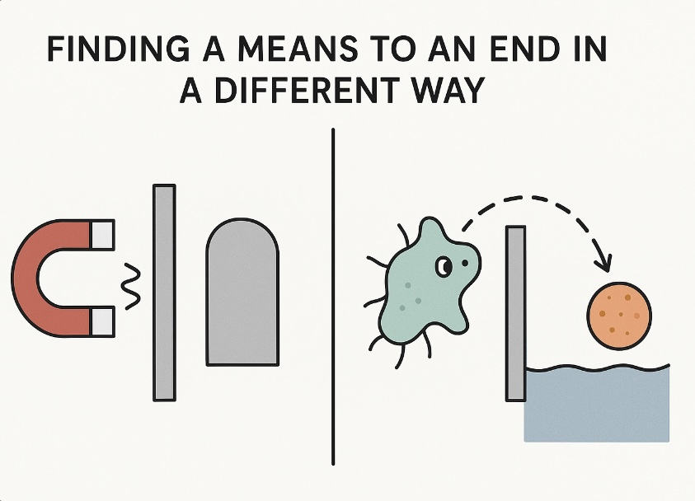
Intelligence is a specific function or capacity of the mind. The mind is the broader concept encompassing all mental processes, while intelligence refers to the ability to reason, solve problems, and learn. In simpler terms, the mind is the "screen" where thoughts and possibilities arise, and intelligence is the "eye" that evaluates and acts on those possibilities.
Intelligence isn’t confined to brains; it pervades every level of life. Individual such as bacteria and cells in living organisms such as humans exhibit problem-solving abilities. They are not passive executors of genetic blueprints, they are adaptive, intelligent units, capable of interpreting and responding to challenges.
Intelligence doesn’t just manifest at the cellular level. Organs like the liver show signs of a form of intelligence: A 2023 article by biologist Michael Levin introduced the concept of the “hepatostat,” where the liver maintains its size and function through internal feedback mechanisms akin to homeostatic intelligence . If we apply the same criteria, we use to attribute consciousness or intelligence to others (behavior, problem-solving, evolutionary basis), organs such as the liver can meet them too. The liver and other organs operate not by executing a code, but by monitoring, adjusting, and maintaining balance demonstrating a kind of embodied “thinking” or cognition.
A liver cell accomplishes many tasks demonstrating intelligence including monitoring and adjusting blood glucose, detoxifying substances, producing vital proteins, sensing when the liver is too large or small, proliferating or pruning cells to restore optimal function, and regenerating tissue after damage. These behaviors reflect a kind of distributed, goal-oriented system, an intelligent architecture where each cell contributes to a larger, dynamic purpose.
THE CONSCIOUSNESS OF OUR CELLS

Slide 60
THE INTELLIGENCE OF THE BODY
Embodied intelligence is the idea that intelligence doesn’t reside solely in the brain or in abstract reasoning, it emerges from the entire body’s interaction with the environment. This idea is rooted in the view that thinking, perceiving, and problem-solving are shaped by the body’s physical form, its structure, senses, and movement capabilities, its continuous feedback with the world, how it acts in and is acted upon by its surroundings and how processes in muscles, sensory organs, and even cellular and visceral systems contribute to adaptive behavior.
When we think about ‘mind,’ we tend to think of the brain. But the story of the mind begins when life first started on earth 3.5 billion years ago much before the first structures we recognize as brains developed about 550 million years ago.
The first single-celled bacteria already showed intelligence by William James’s definition: finding a means to an end in a different way when circumstances change.
The work of biologist Michael Levin’s shows that even without neurons, cells make decisions. They process information electrically and chemically, communicate with neighbors, and take actions that serve long-term goals repairing damage, growing toward nutrients, and avoiding harm.
This is intelligence embodied in chemistry and structure, not in thought. Over evolutionary time, multicellular cooperation, nervous systems, and eventually complex brains grew from these ancient problem-solving roots.
Our cellular, organ and somatic “mind” is this ancient intelligence, still active today fast, adaptive, and below conscious awareness.
Every moment of every day, our bodies are engaged in prodigious feat of intelligence and decision-making: regulating blood pressure, adjusting muscle tone, healing injuries, changing balance and movement in response to the environment without us thinking about it.
These capacities are not just ‘automatic’; they are refined problem-solving strategies inherited from life’s earliest forms. They form the foundation on which our emotional and rational minds operate. When we ‘listen to the body whether it’s a gut feeling, a sudden posture shift, or a subtle muscle tightening we’re tapping into billions of years of evolutionary wisdom. This is the most resilient, time-tested intelligence we have.

Slide 61
Summary
The “mind” encompasses all mental processes while intelligence is the specific ability to reason, solve problems, and learn.
Intelligence isn’t limited to brains; it exists at many levels of life. Even bacteria, cells, and organs like the liver act intelligently by adapting, solving problems, and maintaining balance. The liver for example “thinks” in its own way, regulating blood sugar, detoxifying, repairing itself, and keeping its size stable. This shows that intelligence is not just in the brain or central nervous system but spread throughout the body. This idea, called embodied intelligence, means our whole body, its cells, organs, senses, and movements, participates in thinking and problem-solving.
All these thinking processes that keep our bodies going are automatic and unconscious. If we had to think about doing all the things our bodies do automatically or unconsciously, we’d be overwhelmed.

Slide 62
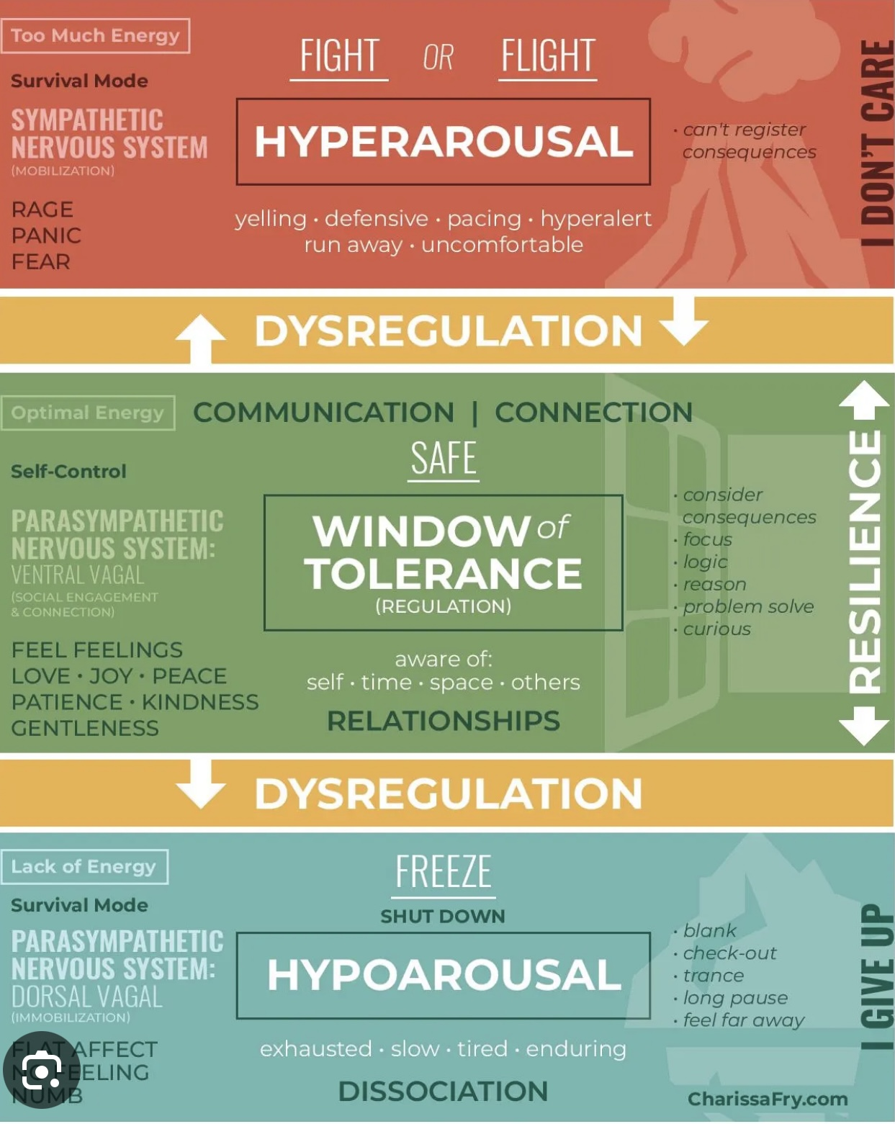
Physiological-level “states” such as calm, fear, irritability, dissociation and depression are stored in the body as memory, with the autonomic nervous system (ANS) playing a central role.
A physiological state here refers to a pattern of body-wide activation involving heart rate and rhythm, breathing patterns , muscle tone and posture, hormonal release, immune readiness, and blood flow distribution.
Shifts in physiological states are orchestrated mainly by the sympathetic and parasympathetic branches of the ANS.
When a significant emotional event occurs, these physiological states become encoded in the body as brain and body act together to create a highly specific physiological configuration and memory
ANS set-points are recalibrated e.g., a person with repeated threat exposure may have a chronically elevated sympathetic baseline. Hormone receptors are up- or down-regulated. There are chronic changes in muscle tone and posture readying the person to re-engage. Immune memory is shifted toward inflammatory readiness as the body “expects” ongoing threats.
People with trauma spectrum disorders experience not just visual flashbacks but have full-body, often chronic replay of trauma. The body “remembers” by always being or rapidly returning with even minor triggers to the physiological state originally associated with the traumatic events.
Trauma therapy works by gently re-patterning autonomic set-points allowing new physiological patterns to overwrite old ones.
THE BODY’S MEMORY

Slide 63
Self-aware/observing mind
A MAP OF THE MIND:
EMOTIONAL MIND
Rational mind
conscious
unconscious
Instincts
Instincts and emotions
Emotional mind
Embodied (somatic) mind
Organ Intelligence
Basal or Cellular Intelligence

Slide 64
MILESTONES IN THE EVOLUTION OF LIFE
Instincts have been evolving since life on earth began.
Origin of Life (approximately 3.5 to 4 billion years ago)- The earliest life forms, simple single-celled organisms, exhibited basic instinctual behaviors such as movement toward nutrients and away from harmful substances.
Multicellularity (approximately 600 million years ago)- The evolution of multicellular organisms led to more complex behaviors, including coordinated movements and responses to environmental stimuli.
Development of nervous systems (approximately 500 million years ago)- The emergence of simple nervous systems (nerve nets) in early animals, such as jellyfish, allowed for more sophisticated responses to stimuli, including reflexes.
Development of the Brain (approximately 400 million years ago)- The evolution of more complex brains in vertebrates enabled advanced instinctual behaviors, such as predator avoidance and social interactions.

Slide 65
MILESTONES IN THE EVOLUTION OF LIFE
Parental Care in Vertebrates (approximately 200 million years ago)- The evolution of parental care behaviors in reptiles, birds, and mammals enhanced offspring survival, driven by instinctual motivations to protect and nurture young.
Social Structures in Mammals (approximately 100 million years ago)- Evolution of social instincts in mammals led to the development of complex social structures, communication, and cooperative behaviors, particularly in species like wolves, elephants, and primates.
Tool Use in Primates (approximately 2.5 million years ago)- Early hominins, such as Australopithecus, began to use tools in the service of instinctual behaviors enhancing their ability to gather food and adapt to their environment.
Cultural Evolution and Learning (ongoing)- While instincts remain foundational to the behavior of modern humans, culture increasingly shapes Human responses to the environment.

Slide 66
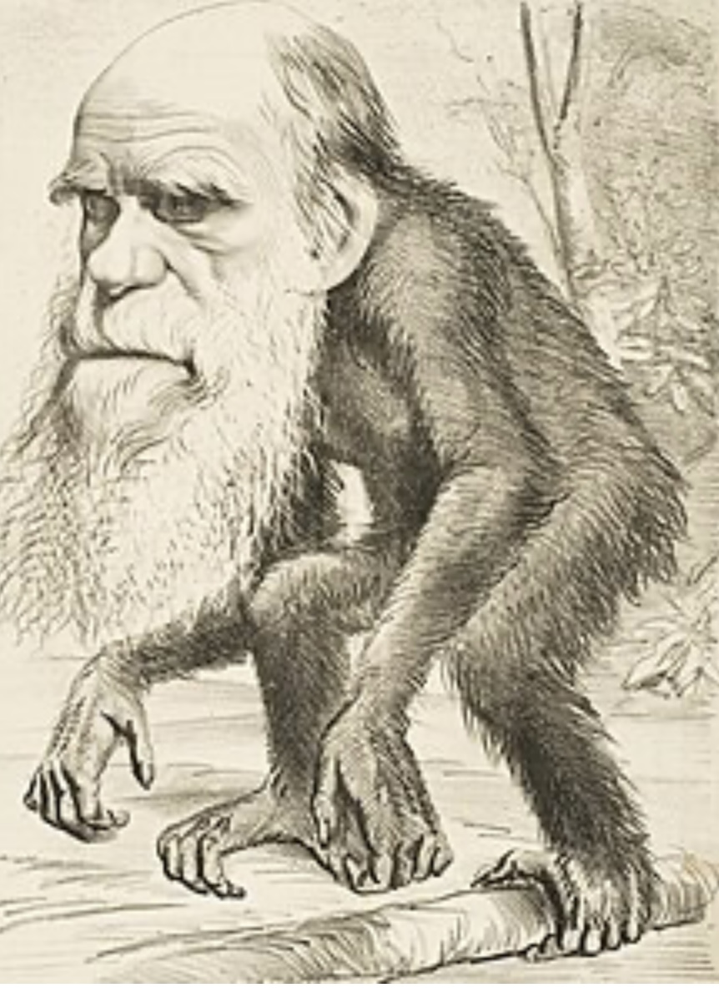
WHAT ARE
INSTINCTS?
Instincts are innate, hardwired, biologically-based responses that are characteristic of a species.
Instincts produce automatic and involuntary actions that occur in response to specific stimuli and play a crucial role in survival and reproduction.
Instincts are either present from birth or develop at certain stages of life. Instincts are distinct from learned behaviors, which are acquired through experience and interaction with the environment. While instincts are innate, they can be influenced by environmental factors.
Different species exhibit different instincts that are adapted to their environments and lifestyles.
Understanding instincts is critical if we want to understand the behavior of both animals and humans.

Slide 67
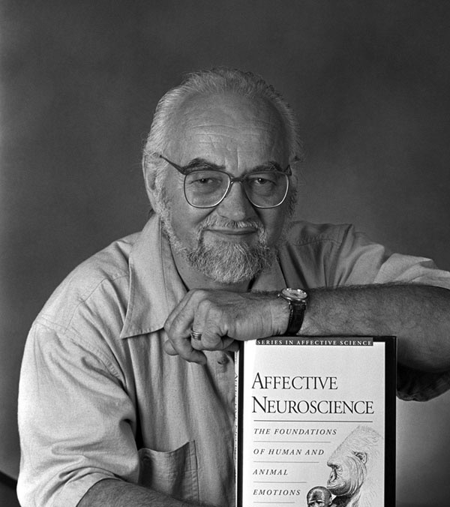
Jaak Panksepp 1943-2017
We owe much of our current understanding of instincts to neuroscientist Jaak Panksepp’s who defined instincts as “brain systems that promote survival.”
Panksepp identified five core emotional systems that he believed are universal across mammals:
- Seeking: The drive to explore and find resources which is crucial for survival.
- Fear and rage: which are both responses to threats.
- Lust: which is related to reproductive behaviors.
- Care: which is related to nurturing and protecting offspring.
- and Play: which facilitates social bonding and learning through playful interactions.
Panksepp's research has implications for understanding mental health. Disruptions produced in instincts by the environment and experiences (such as attachment issues, adverse experiences and trauma) can lead to psychological disorders.

Slide 68

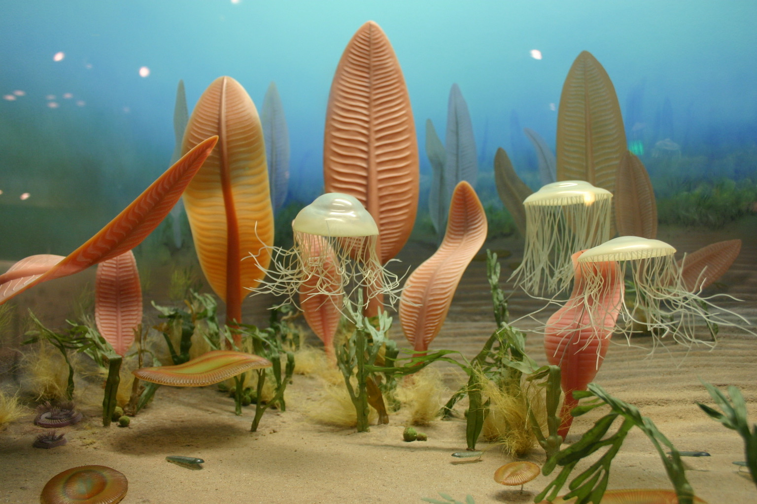
PRE-CAMBRIAN INSTINCTS
The term "Cambrian" comes from "Cambria," the classical Latin name for Wales. British geologist Adam Sedgwick named the Cambrian geological period after the rocks he studied in North Wales in the 1830s.
The pre-Cambrian era spans from 3.7 billion to 450 million years ago.
During the pre-Cambrian era there were only unicellular and simple multicellular life forms which interacted little with each other and got their energy from the sun or from organic molecules around them. These organisms had developed three instincts:
1. Seeking good conditions for survival: heat, nutrition, right composition of surrounding environment.
2. Avoidance of bad conditions for survival. Both seeking and avoidance present from beginning of life on earth.
3. The earliest form of sexual reproduction occurred 2 Billion years ago in the prokaryote exchange of genetic material

Slide 69
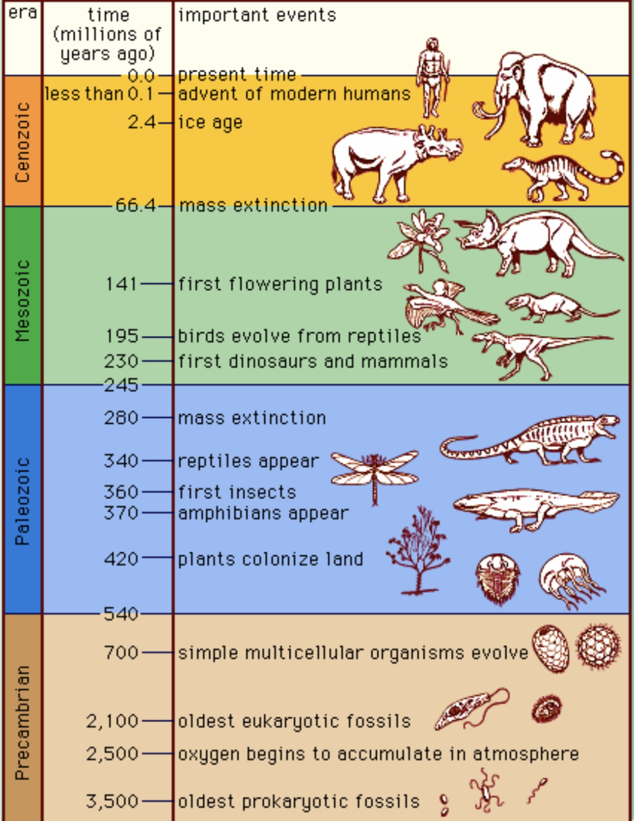
POST Cambrian INSTINCTS
The Cambrian explosion refers to a period 540 million years ago, that lasted approximately 20 million years.
The Cambrian explosion was a biological “arms race” which for the first time saw organisms preying on each other as sources of energy. As a result of this “arms race” the diversity and complexity of life suddenly “exploded”
This preying and fleeing predators gave rise to the fight or flight instinct.
Around 200 million years ago as organisms became more complex; they started to be born immature and needed a period of parental caring in order to survive. This gave rise to attachment and loss of attachment/grief instincts.
As organisms became even more complex so did their behaviors. Becoming proficient at complex behaviors such as social interactions and hunting requires practice. This is the role of play which is the most recently evolved instinct.

Slide 70
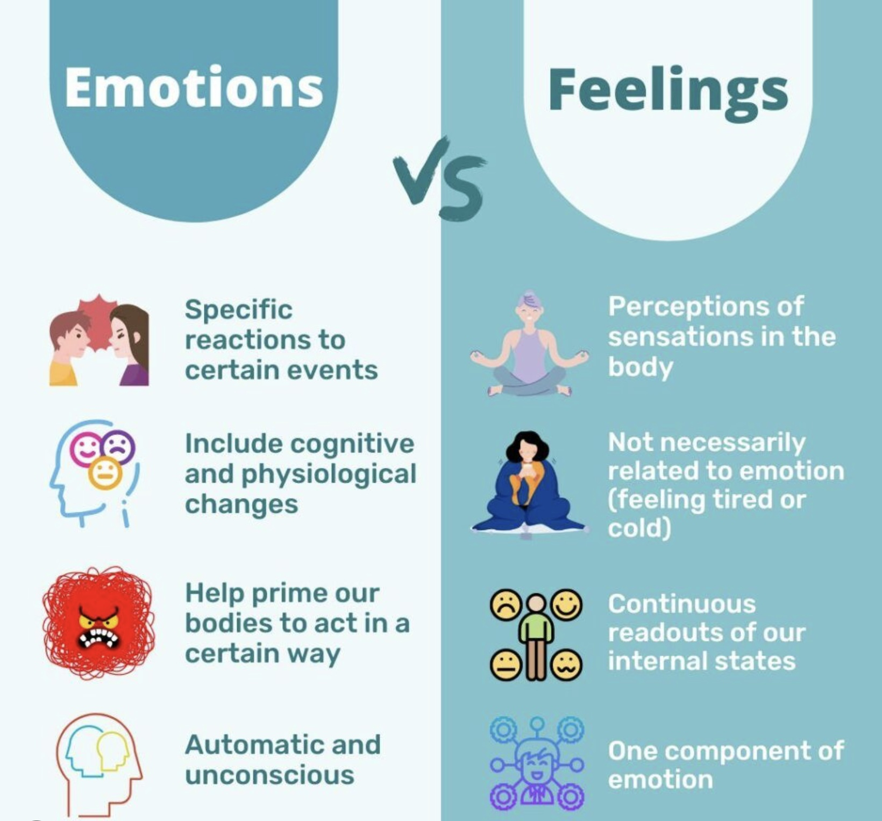
INSTINCTS EMOTIONS
AND FEELINGS
Instincts, emotions, and feelings are all parts of human experience.
We already defined instincts as innate, biological drives that are often hardwired into our brains and bodies.
Emotions are complex instinctual reactions to environmental stimuli that manifest as 1. body physiological responses, 2. subjective experiences, and 3. behavioral or expressive responses.
Feelings are one of the three components of emotions, the consciously felt part of emotions.

Slide 71

Week 3 POLL
Throughout the year we will be doing polls to better understand some of your thoughts, feelings and needs.
We’ll look at the answers of zoom participants immediately after we do the polls.
We’ll share the answers of in person participants at the beginning of the session the week after the poll.
Answers are anonymous
Week 3 poll…

Slide 72
Rational MIND
Where we describe the rapid evolution of the rational mind in the last 5 million years after the hominin line split from that of chimps . We consider major events contributing to that evolution. (spans from 5 million years to 5000 years ago when writing was invented.)
“Reason is, and ought only to be, the slave of passions”
David Hume

Slide 73
Self-aware/observing mind
A MAP OF THE MIND:
RATIONAL MIND
Rational mind
conscious
unconscious
Cognition and thinking
Hominids
The cognitive revolution
Human dominance
The agricultural revolution
Emotional mind
Embodied (somatic) mind
Organ Intelligence
Basal or Cellular Intelligence

Slide 74
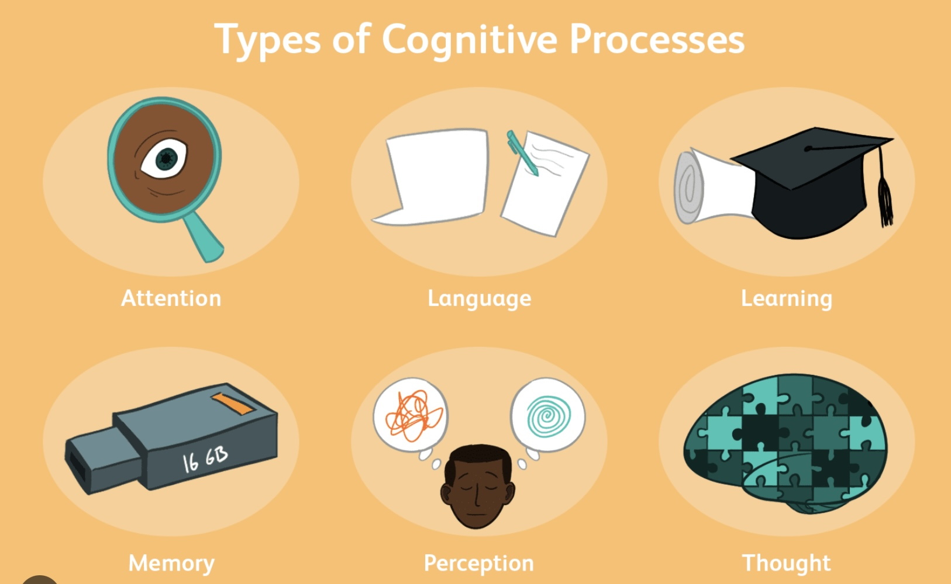
WHAT ARE COGNITION
AND THINKING?
Cognition is the big picture, it includes everything our brain does to understand and interact with the world: noticing things, remembering, learning, solving problems, paying attention, and even daydreaming.
Thinking is just one part of cognition, it’s when we’re actively using our mind to reason through something, like solving a math problem or making a decision.
In short:
All thinking is cognition, but not all cognition is thinking.
Cognition is the whole toolbox. Thinking is just one tool inside it.

Slide 75
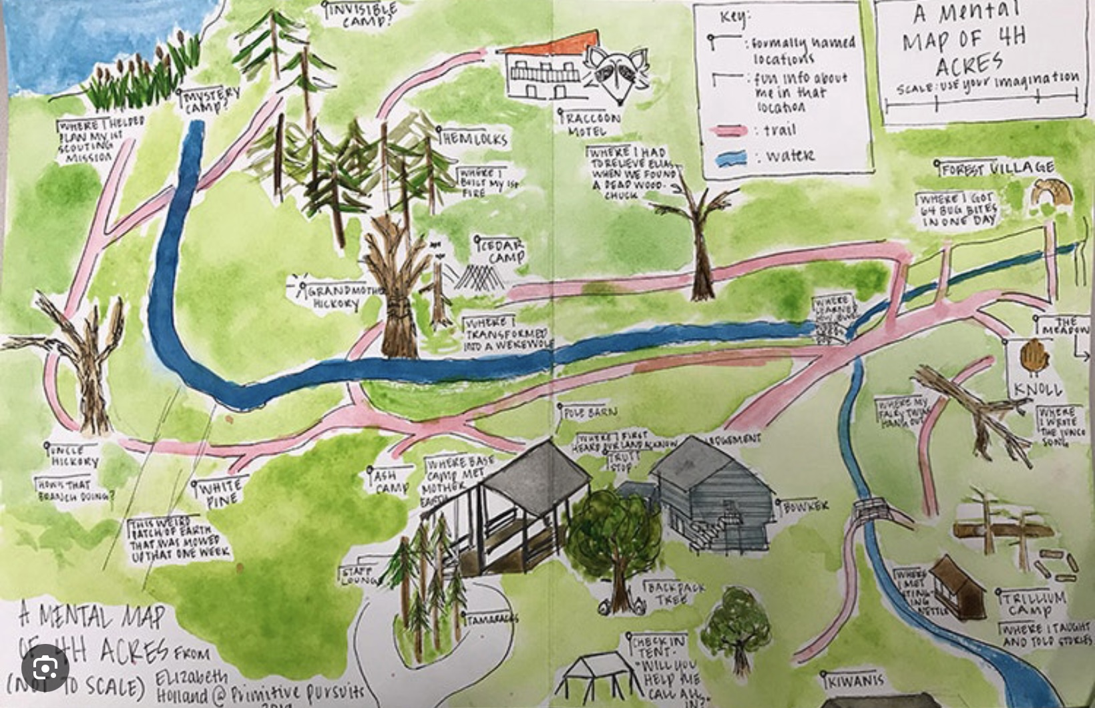

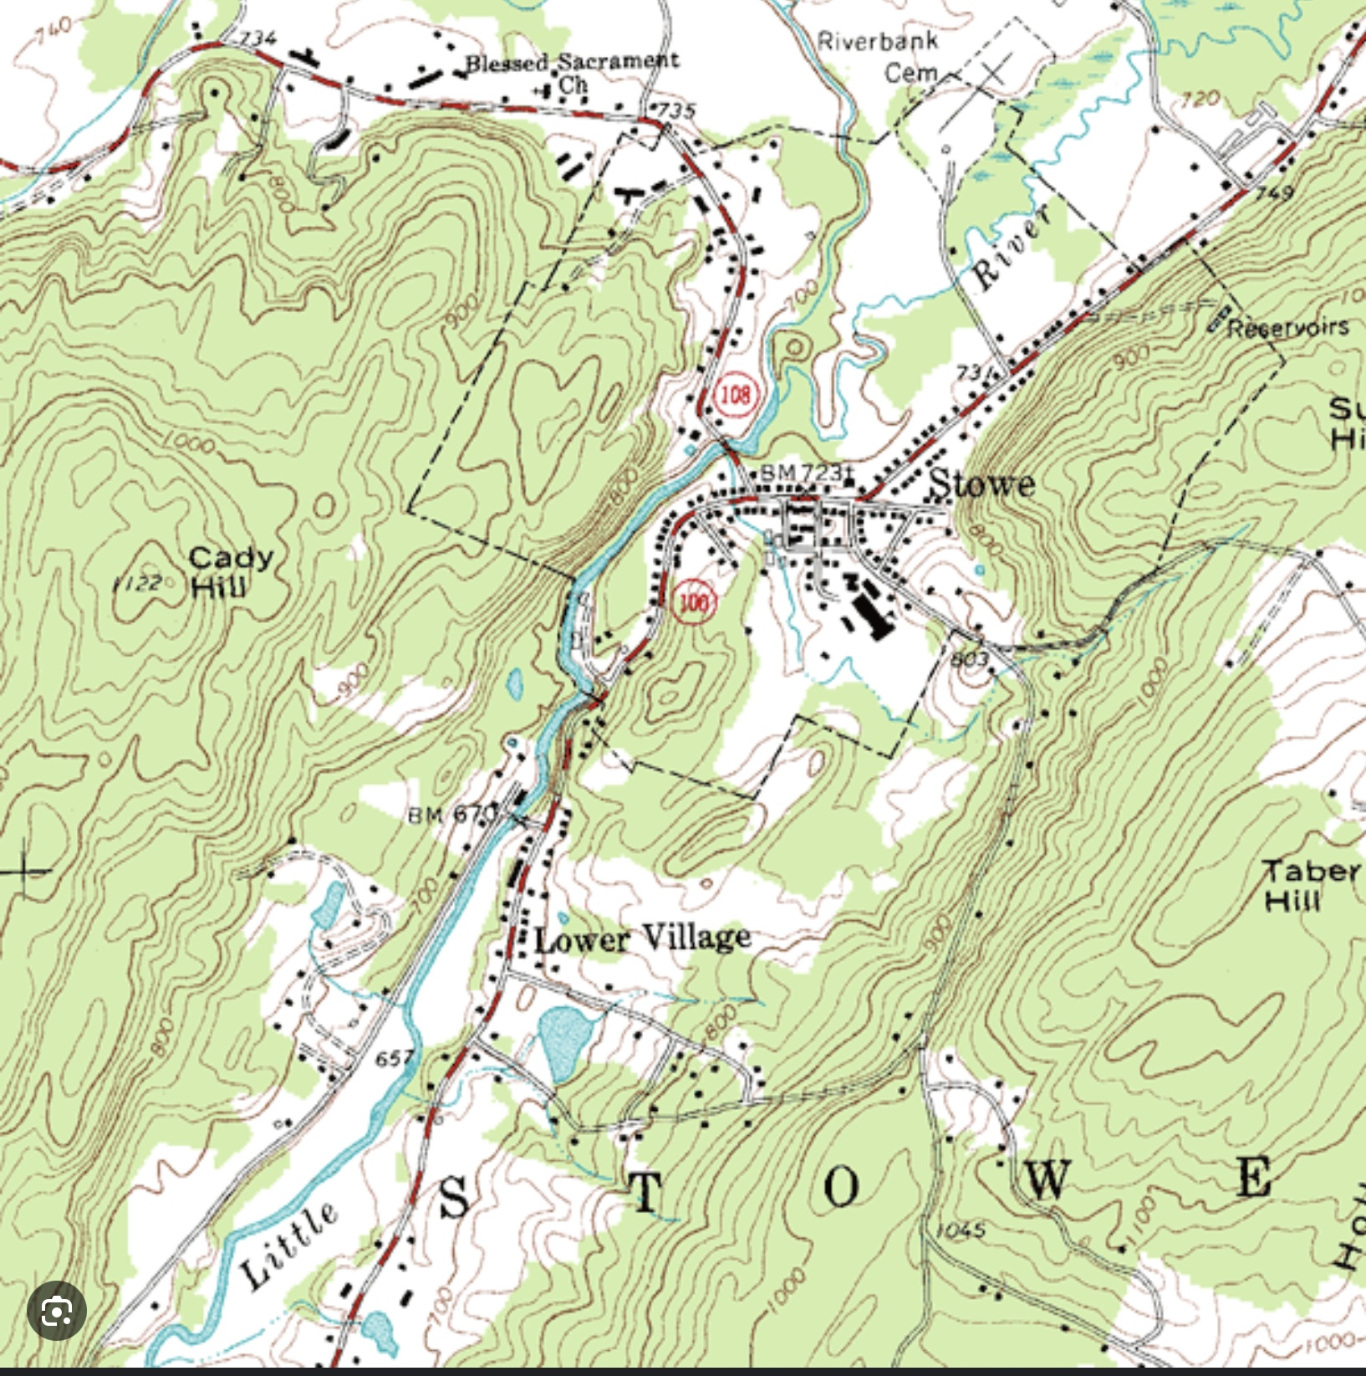
THINKING AS A MAP OF REALITY
Ideas and the “maps” they produce have to do with how we perceive the world using our senses.
Our perceptions are however limited by our cognitive ability and the limitations of our senses.
As such, our perceptions do not capture an objective reality as we often believe they do. Realizing this is the beginning of wisdom.
If the universe is the territory. The ideas humans think up about the universe are maps of that territory.
Maps are not the territory they are models of the territory.
The territory is infinitely more complex than any map or thought we might come up with to model it.
We build maps to help us better navigate the world.
Thought maps more or less accurately represent the world
The physical and social sciences, the humanities, religion and culture give us useful maps but when we mistake these maps for reality or “the territory”, we start to believe absurdities such as all there is in the world is matter and other nonmaterial realms are illusions.

Slide 76
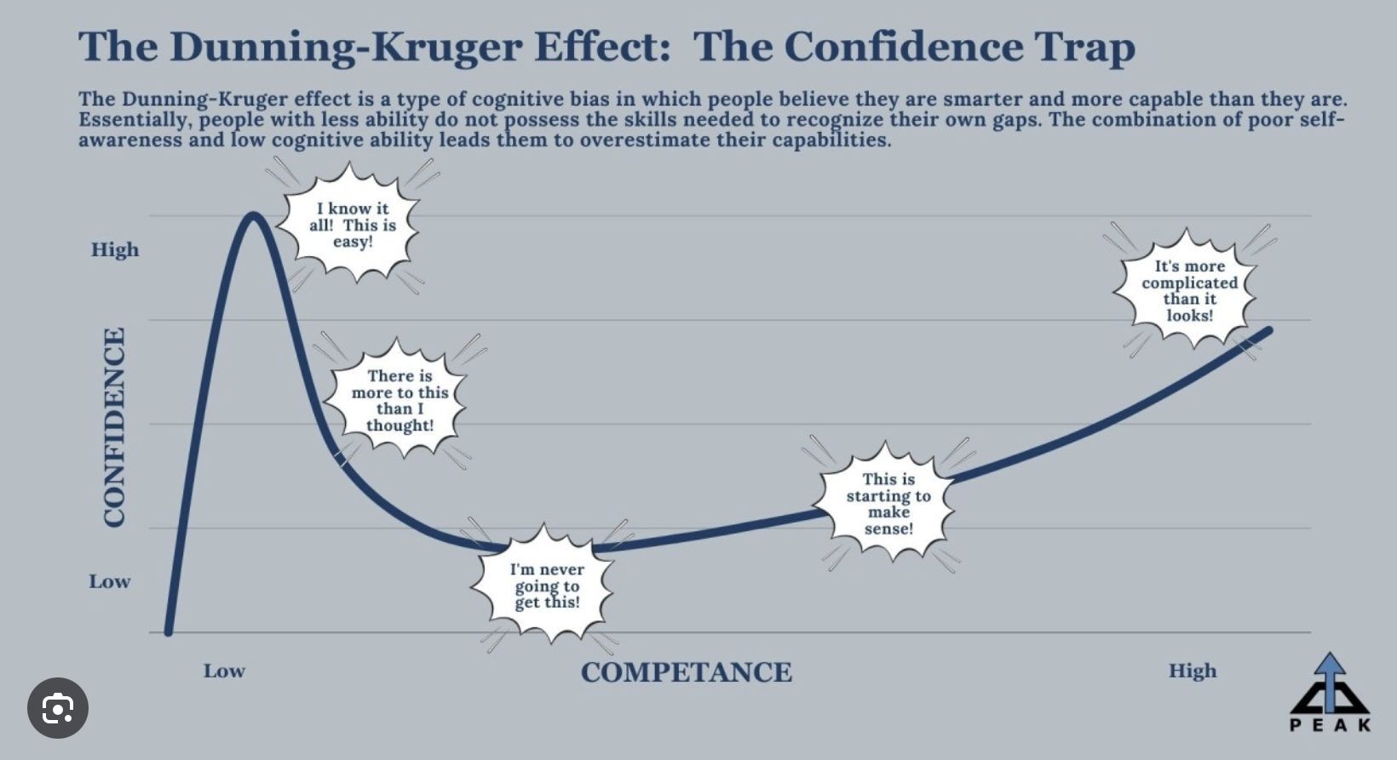

Slide 77
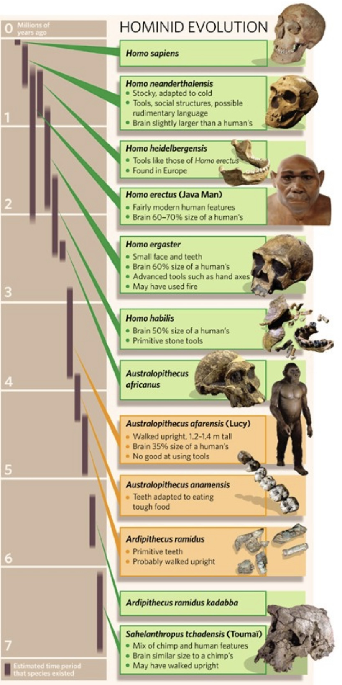
WHAT ARE HOMININS?
Hominins are a family of primates that includes not only modern humans, but also other of our now extinct close relatives.
All Hominids walked upright on two legs and to used tools.
The major Hominin groups include:
Australopithecines: A group of early hominids that lived in Africa between 4 and 2 million years ago.
Neanderthals (Homo neanderthalensis): An extinct species closely related to modern humans, known to have lived in Europe and parts of Asia until about 40,000 years ago.
Modern Humans (Homo sapiens): The only surviving species of the genus Homo.
Other Extinct Hominids species like Homo habilis, Homo erectus, and various other relatives that contributed to the evolutionary lineage leading to modern humans.

Slide 78
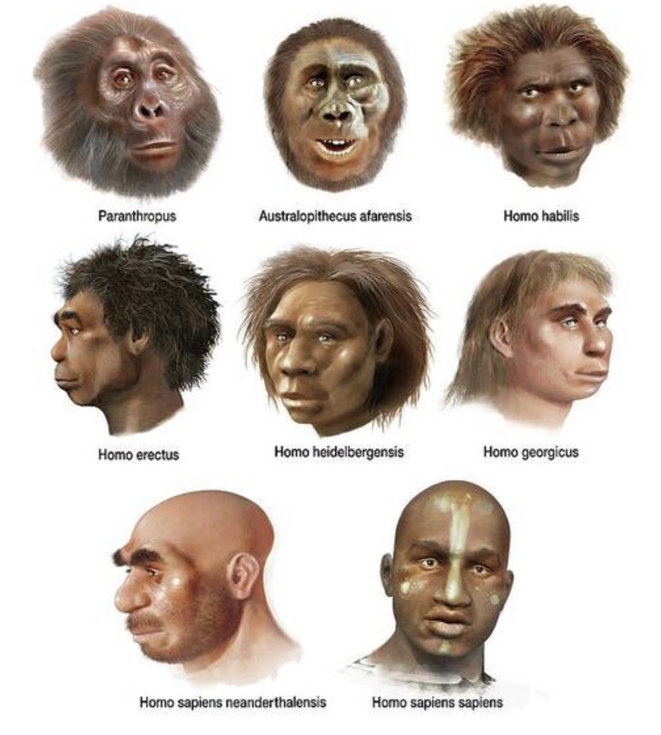
MILESTONES IN THE DEVELOPMENT
OF HOMININS
Some of the major milestones in the development of hominins include:
6-7 million years ago: Early hominins begin to walk on two legs, marking a significant adaptation that differentiates hominins from other primates.
2.5 million years ago: The development of simple stone tools by early hominins, such as Homo habilis, marks the beginning of the Lower Paleolithic era.
1.8 million years ago. Homo erectus emerges, exhibiting more advanced tool-making skills and the ability to control fire. This species shows evidence of increased brain size and social organization.
200,000 - 300,000 years ago. Homo sapiens appear in Africa, characterized by a more developed brain and advanced cognitive abilities.
70,000 - 30,000 years ago. A significant leap in Homo sapiens cognitive capabilities, known as the cognitive revolution, occurs, allowing for complex language, abstract thinking, and the creation of art and culture. This period is marked by the development of symbolic thought and greater social cooperation.
10,000 BCE. The transition from nomadic hunter-gatherer societies to settled agricultural communities begins, leading to the growth of populations and the establishment of complex societies.

Slide 79
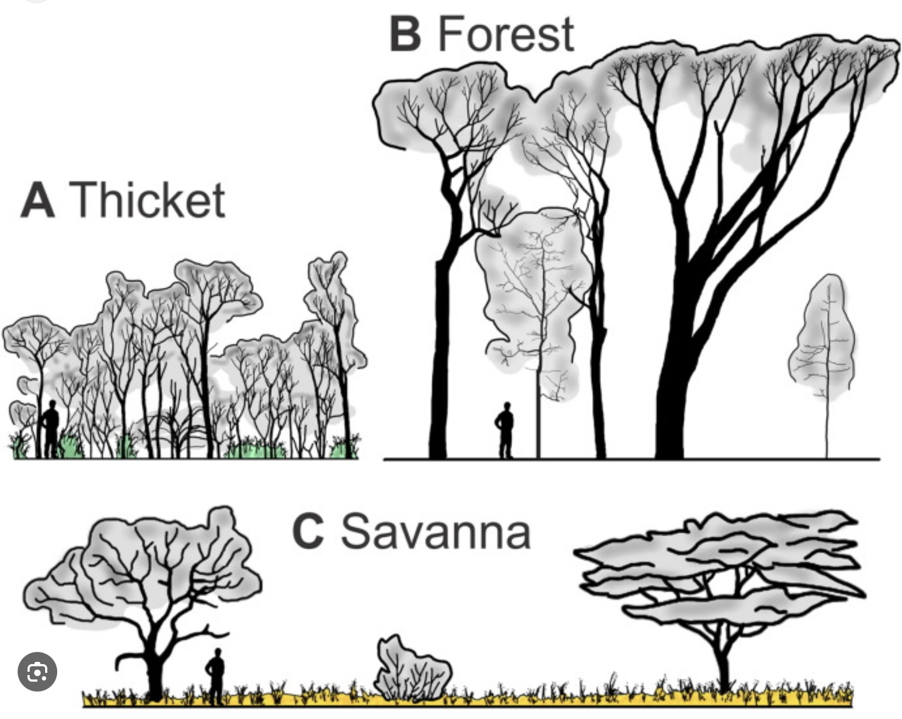
CLIMATE CHANGE AND
HOMININ EVOLUTION
Climate change has shaped hominin evolution by forcing our ancestors to adapt to changing environments. As climates shifted, like forests turning into grasslands, humans had to walk longer distances, hunt in new ways, and develop tools and cooperation to survive.
These challenges helped us evolve key traits like:
• Walking on two legs
• Bigger brains for problem-solving
• Social skills for working together
Climate change pushed our ancestors to adapt, and that pressure helped shape the humans we are today.

Slide 80
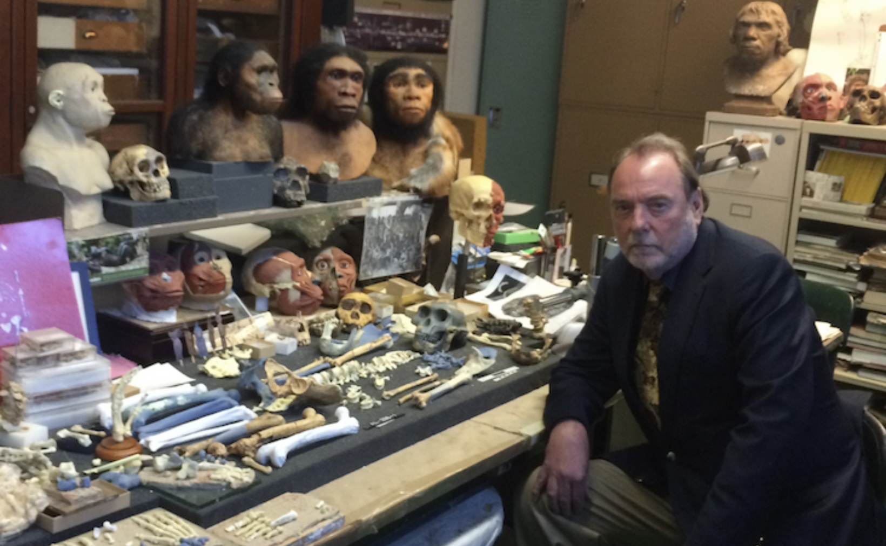
Anthropologist Ian Tattersall argues that even though our human ancestors and other Homo species such as Neanderthals had brains as big as that of homo sapiens, something suddenly changed about 70,000 years ago: Our Homo sapiens ancestors started thinking in new, creative ways, using symbols, making art, inventing language, and imagining things that didn’t exist.
He calls this sudden leap the cognitive revolution, a mental breakthrough that allowed modern humans to think symbolically, tell stories, and build culture.
Our brains didn’t just grow, they started working differently, giving us imagination, creativity, and complex language. That’s what made us truly human.
THE COGNITIVE REVOLUTION

Slide 81
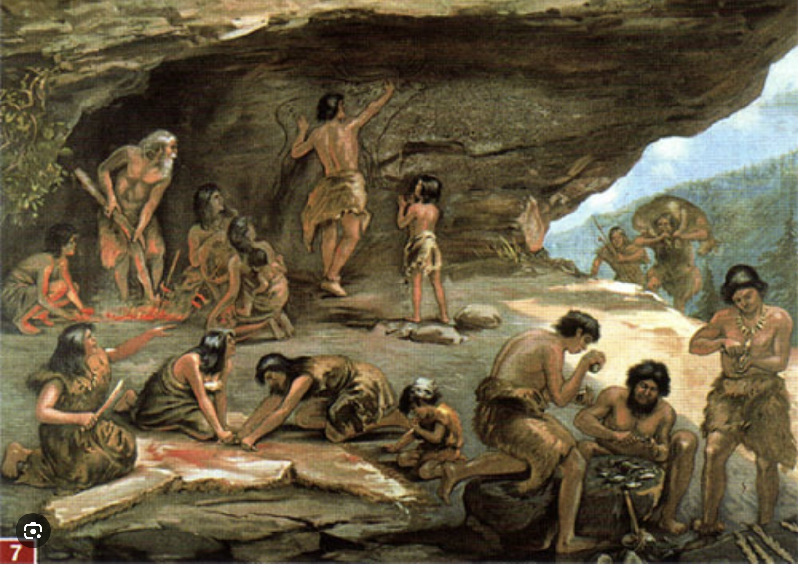
The modern-day experience that people have of being separate individuals is a relatively recent development.
Our prehistoric ancestors felt less like individuals and more like a part of their social group and natural world.
Prehistoric societies were organized in small, close-knit groups or bands. These groups fostered strong social bonds and a sense of belonging. Individuals identified closely with their family and community rather than as isolated individuals.
Prehistoric hunter-gatherers lived in direct relationship with each other and with the natural world they knew the land, the animals, the weather, and the seasons deeply, because their survival depended on it.
They didn’t have screens, clocks, or cities. Life was slower, more communal, and based on the present moment. They paid close attention to sights, sounds, smells, their senses were more attuned. Knowledge was passed down through stories and experience.
HOW PRE-HISTORIC PEOPLE
EXPERIENCED THE WORLD

Slide 82
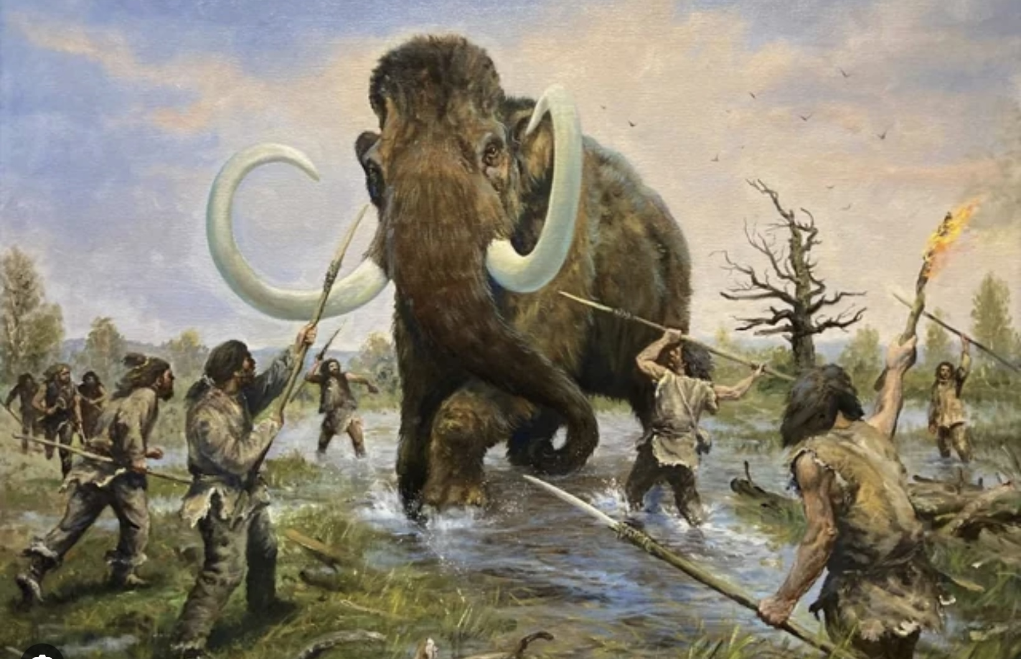
The cognitive revolution gave humans powerful new mental abilities like language, imagination, and complex planning.
We could share ideas, work in large groups, and imagine things that don’t exist (like laws, money, or nations).
These abilities helped us cooperate in flexible ways, build tools and cultures, and adapt to almost any environment better than any other species.
The cognitive revolution gave us the power to think, imagine, and cooperate like never before and that’s what made humans the most dominant species on Earth.
WHY HUMANS BECAME
THE DOMINANT SPECIES

Slide 83

THE AGRICULTURAL REVOLUTION
The Agricultural Revolution happened about 10,000 years ago, when humans began farming instead of only hunting and gathering. We learned to grow crops and raise animals, which meant we could stay in one place and produce more food.
This changed everything:
• People built villages, then cities.
• Populations grew fast.
• Jobs and social classes appeared.
• We got governments, writing, and money.
But it wasn’t all good, farming also brought harder work, disease, and inequality.
The Agricultural Revolution turned humans from roaming bands into settled societies it built civilization but also brought new problems.

Slide 84
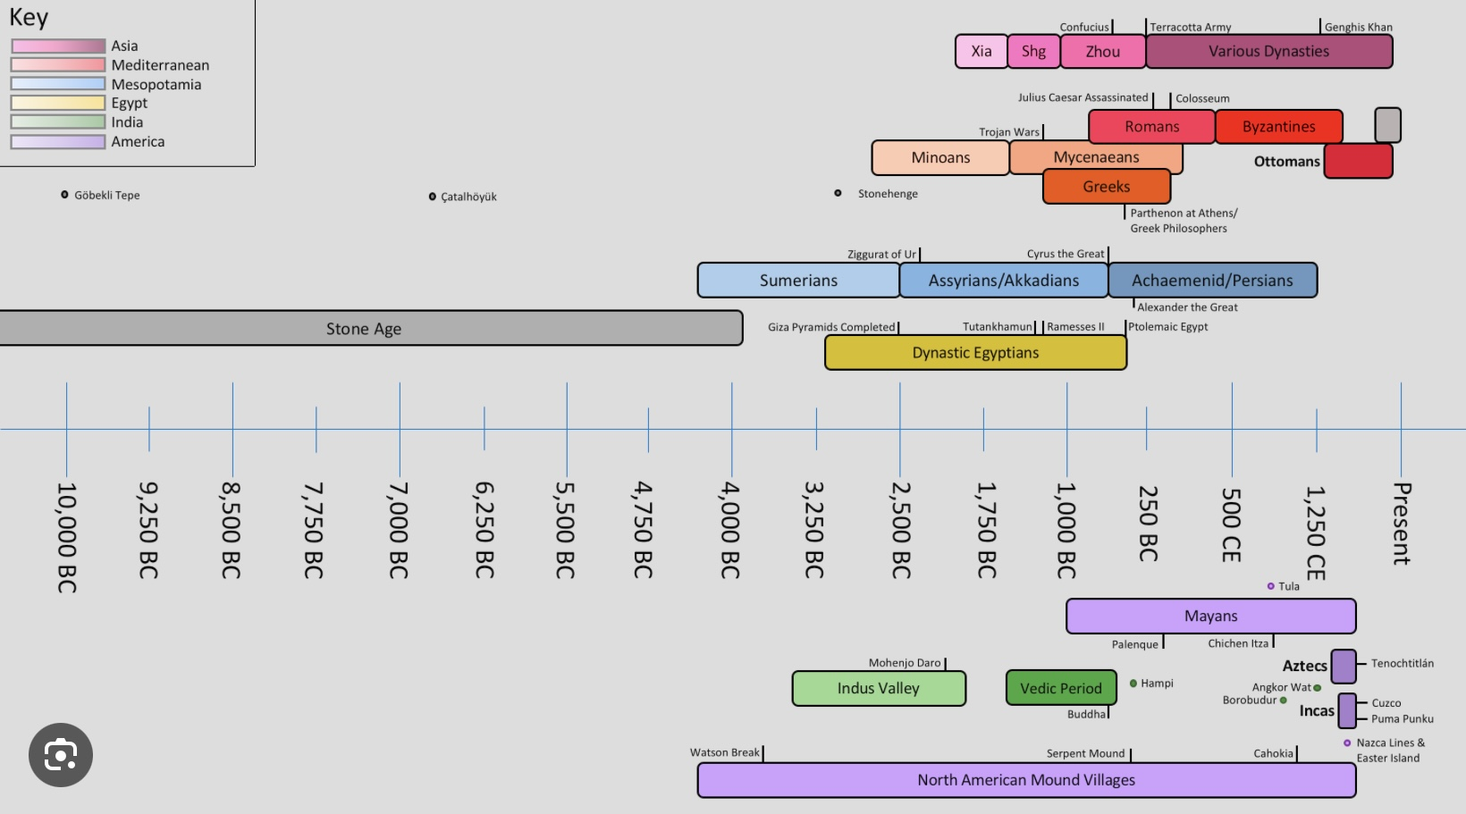
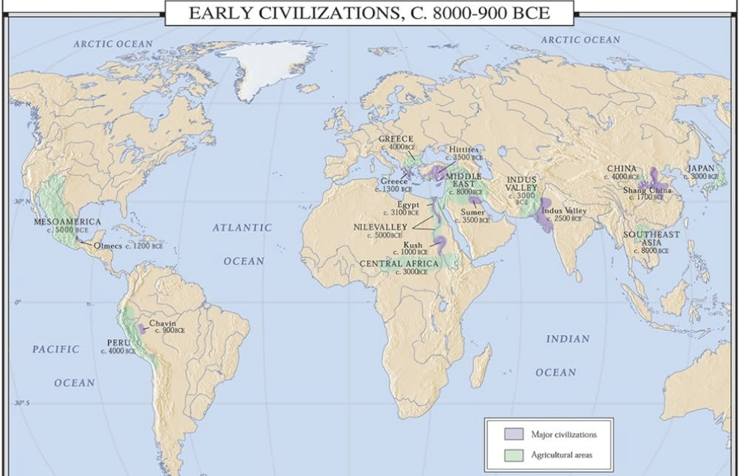
THE RISE OF
CIVILIZATIONS
A civilization is a complex human society that has developed cities, organized government, social classes, religion, writing, art, and technology. Civilizations usually form when people start farming and settling in one place, rather than hunting and gathering.
Some ancient civilizations include
1. Mesopotamia (modern-day Iraq): Known as the “cradle of civilization.” Invented the first system of writing (cuneiform), built large cities like Ur and Babylon, and developed the first legal code (Hammurabi’s Code).
2. Ancient Egypt (Northeast Africa):Famous for the pyramids, hieroglyphic writing, and pharaohs. Developed advanced mathematics, medicine, and irrigation systems along the Nile River.
3. Indus Valley (modern-day Pakistan and India): Built well-planned cities like Mohenjo-Daro and Harappa with advanced drainage systems. Had a writing system and traded with Mesopotamia.
4. Ancient China (along the Yellow River): Created early dynasties like the Shang and Zhou. Invented paper, silk, and the compass, and built the foundations of Chinese philosophy.
5. Ancient Mesoamerica (e.g., Olmec, Maya): Built cities and pyramids in Central America. Developed complex calendars, astronomy, and writing systems.

Slide 85
THE RISE OF WISE MIND
Where we consider how the invention of writing permitted disciplines like history, philosophy, religion, science, psychology and the humanities to arise. These fields all help humans self-reflect on themselves and their world. This self-reflection is the essence of wise mind and can help us live better lives. We describe some of the influences that have shaped modern western self-knowledge.
“The real problem of Humanity is that we have ape-like brains, medieval institutions and God-like technologies.” E. O. Wilson

Slide 86
Self-aware/observing mind
A MAP OF THE MIND: SELF-AWARE/OBSERVING MIND
Rational mind
conscious
unconscious
History.
Philosophy
Religion
Science
Emotional mind
Embodied (somatic) mind
Organ Intelligence
Basal or Cellular Intelligence

Slide 87
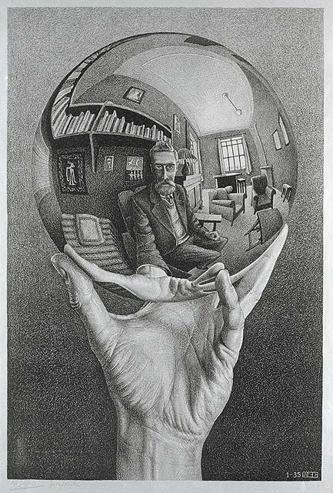
WISE MIND IS reflecting MIND
Of all the species on earth, humans have the greatest capacity to reflect not only on the world but on ourselves.
Reflection means asking: What am I doing? Why? What does it mean? What is this world I live in? What did my ancestors do?
These reflective questions gave rise to history, philosophy, religion, medicine, psychology, art, science, and culture.
Reflection also led to awareness of our circumstances, our mortality, our vulnerability and moral responsibility.
Reflection allows us to think about our thoughts, feelings and behaviors and those of our fellow humans and is the uniquely human superpower.

Slide 88
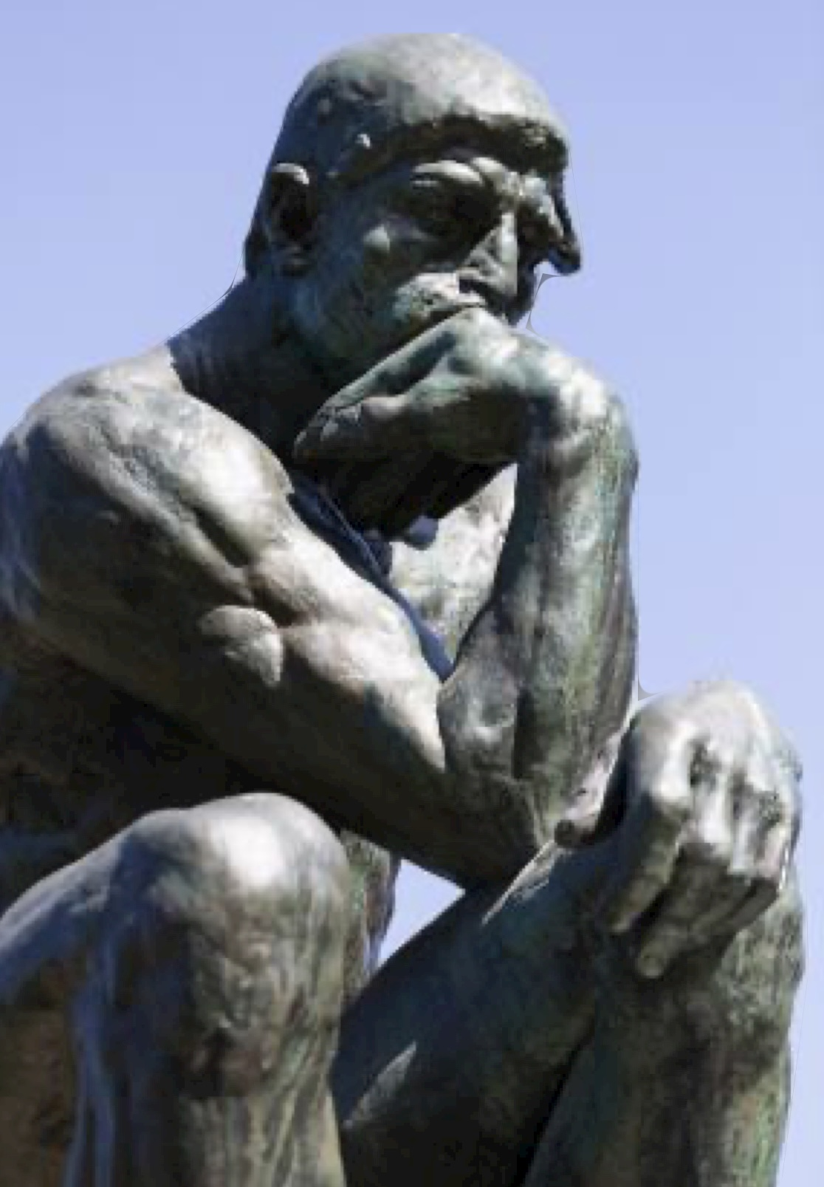
HISTORY
AS WISE MIND
History as a time period encompasses the time since writing was invented.
History as a discipline was made possible by the invention of writing which allowed historians to have a better idea about what happened in the past.
History, the discipline, encourages us to reflect on our lives in the context of the broader human experience and can thus promote both self-awareness and personal growth.
By studying history, individuals can gain a deeper understanding of themselves and the cultural, social, and political contexts that have shaped human behavior and societies over time. This awareness can lead to a better understanding of our place in the world and the factors that influence personal and collective identities.
History provides countless examples of successes and failures, allowing individuals to learn from past experiences. This can inspire self-improvement by encouraging people to adopt successful strategies and avoid repeating past mistakes.
Engaging with historical narratives and sources develops critical thinking skills. This process encourages individuals to question assumptions, analyze evidence, and consider multiple perspectives, fostering a more reflective and self-aware mindset.
“ History doesn’t repeat itself, but it often rhymes”
Mark Twain

Slide 89
HISTORICAL PERIODS
The field of History is often divided into periods that help us organize and understand the development of civilization.
Prehistory refers to the time before written records.
Ancient History includes the rise of early civilizations (like Mesopotamia, Ancient Egypt, the Indus Valley, and Ancient China) and lasts until the fall of the Western Roman Empire around 476 AD.
The Classical Period is often considered part of ancient history, this period is marked by the dominance of empires such as Greece and Rome, and it includes significant developments in art, philosophy, and governance. It generally spans from around 500 BC to 500 AD.
The Post-Classical Period, Middle Ages, or Medieval period follows the classical era and lasts from about 500 AD to 1500 AD. It starts with the fall of the Western Roman Empire in 476 AD and includes the rise of Islam, the Byzantine Empire, and the development of various kingdoms and empires around the world.
The Renaissance begins in the 14th century and lasts into the 17th century, this period is marked by a revival of art, culture, and intellectual pursuits inspired by classical antiquity.
The Early Modern Period follows the Renaissance and extends from the late 15th century to the late 18th century. It is characterized by the rise of nation-states, exploratory voyages, and the beginnings of the Industrial Revolution.
Modern History starting in the late 18th century this period includes significant events like the Industrial Revolution, the two World Wars, the Cold War, and the rise of globalization.
Contemporary History focuses on events from the late 20th century to the present.

Slide 90
MILESTONES IN THE EVOLUTION OF WESTERN THOUGHT
As we explore history, we’ll touch on some important milestones which greatly influenced modern Western thought:
3000 BCE- The rise of organized polytheistic religions with multiple gods, such as those in ancient Mesopotamia, Egypt, and Greece. These belief systems include various deities representing natural forces and human experiences
1200 BCE - 500 CE- The development of monotheistic religions, notably Judaism, which emphasizes the belief in one God. This idea evolves into Christianity and Islam, shaping Western and Middle Eastern thought.
800 BCE - 200 BCE-A period of profound philosophical and religious development known as the Axial age occurs across various regions. This period saw the emergence of Confucianism, Buddhism, Zoroastrianism, and the philosophical inquiries of ancient Greece
400 BCE. - Plato introduces the popularizes philosophical idealism, positing that the material world reflects a higher reality of forms or ideas.
14th - 17th centuries - A cultural movement known as the Renaissance emphasizes human potential and achievements, leading to a revival of classical learning and the arts. Thinkers like Erasmus and Machiavelli challenge traditional religious views.

Slide 91
MILESTONES IN THE EVOLUTION OF WESTERN THOUGHT
16th - 18th centuries - A period of profound change in scientific thought known as The Scientific Revolution challenges traditional views of the universe and lays the groundwork for modern science.
17th - 19th centuries- An intellectual movement known as the Enlightenment emphasizes reason, individualism, and skepticism of authority. Thinkers like Voltaire, Rousseau, and Kant contribute to ideas about democracy, human rights, and ethics.
1724 – 1804- Immanuel Kant explores the relationship between human experience and knowledge, arguing that our understanding of the world is shaped by both sensory experience and innate concepts.
20th century - The development of quantum mechanics challenges classical physics, introducing the concepts of uncertainty and the interconnectedness of particles.

Slide 92
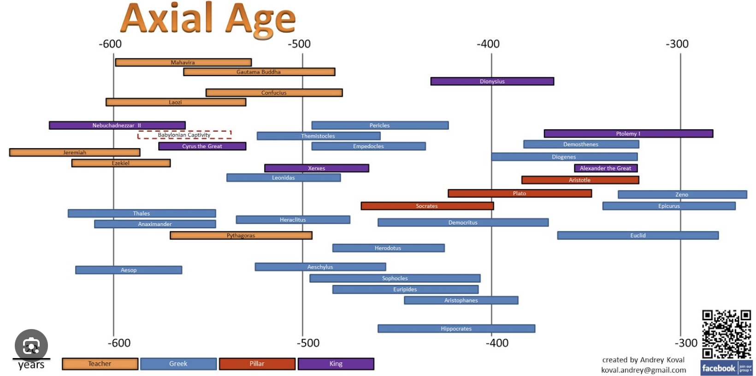
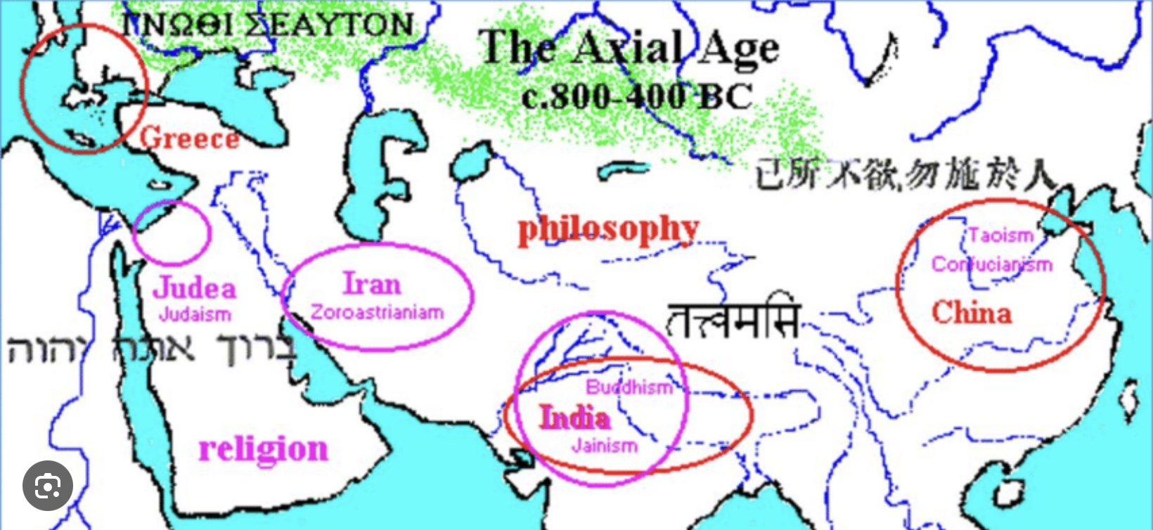
THE AXIAL AGE
The term “Axial age” describes a pivotal period in human history, spanning from roughly 800 BCE to 200 BCE, during which significant philosophical, religious, and cultural developments occurred in close temporal proximity across various regions of the world. The Axial Age laid the foundation for many of the world's major religious and philosophical systems, influencing subsequent thought and culture for centuries to come.
The period saw the emergence of many influential thinkers and traditions, including Confucianism and Daoism in China, Buddhism in India, Zoroastrianism in Persia, and the philosophical inquiries of figures like Socrates, and Plato in Greece.

Slide 93
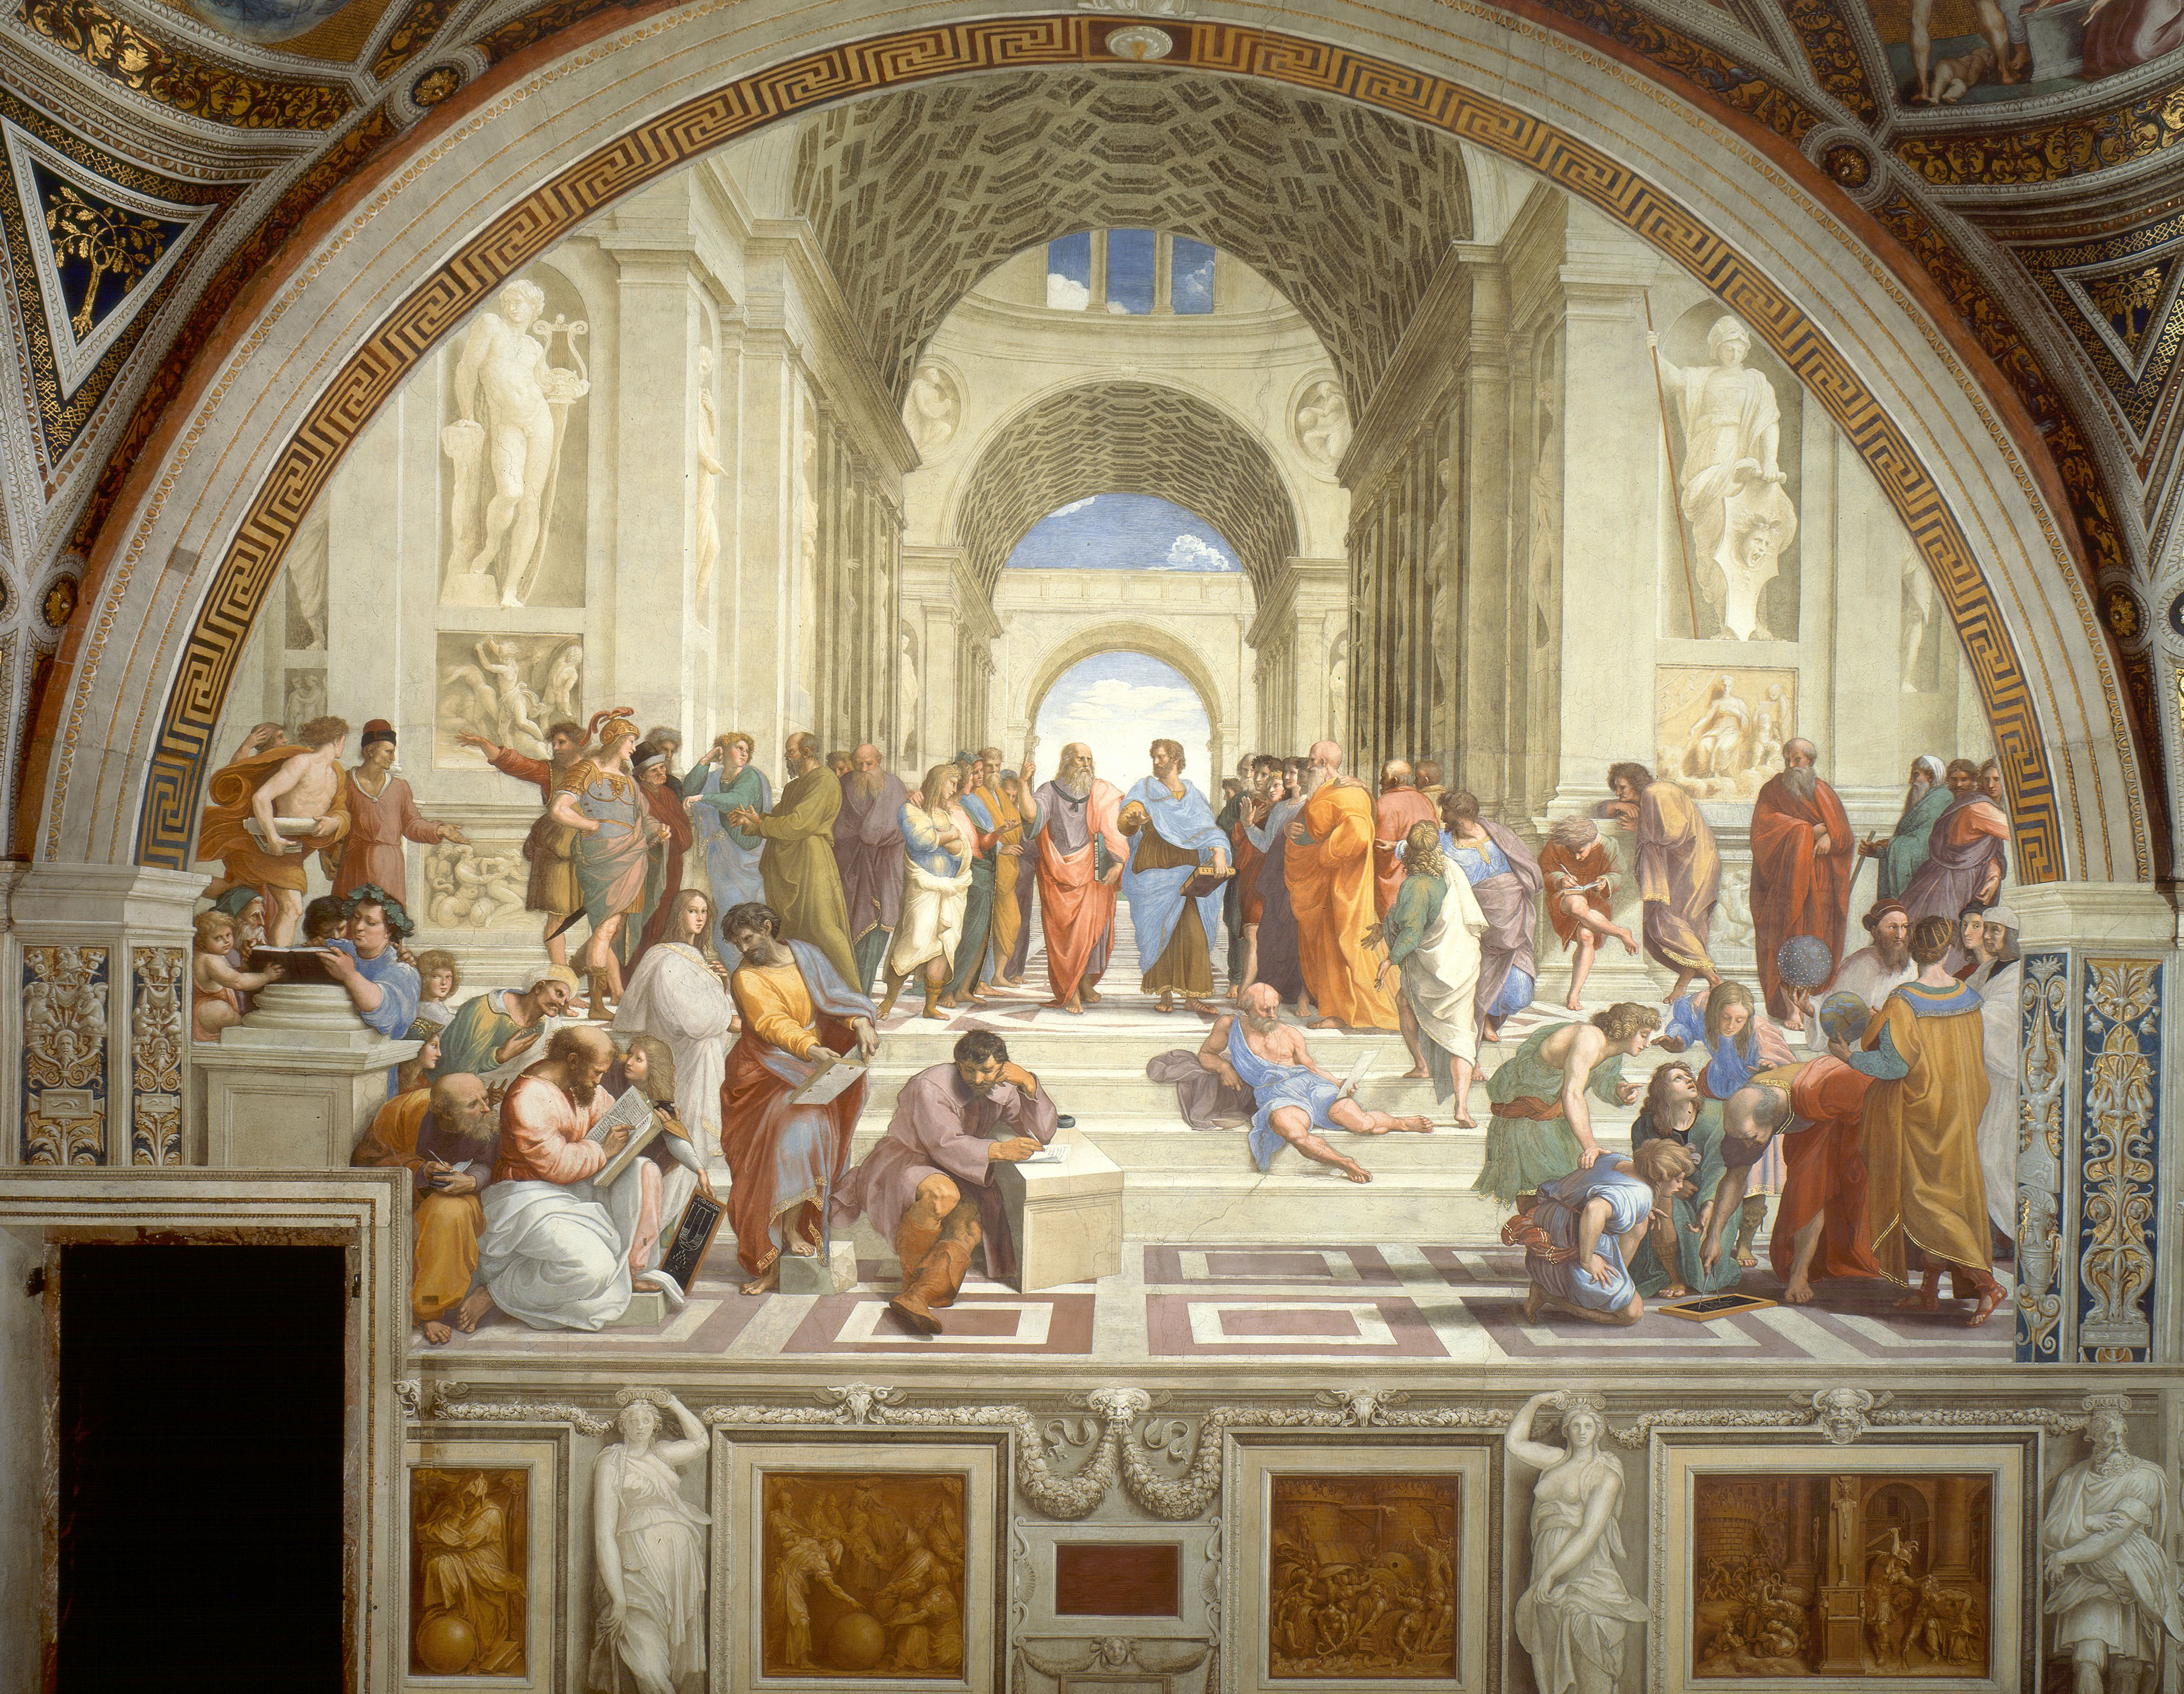
The roots of Western philosophy can be traced back to thinkers in ancient Greece, such as Thales, Anaximander, and Heraclitus
Philosophy, meaning the “love of knowledge”, arose out of the Human desire to understand ourselves, our world, and our place in it .
Philosophy asks questions such as what is real? what is of value? What is beauty? how should societies be governed? and how can we think clearly about these and other questions?
Philosophers have given us timeless insights such as “Know thyself”, “I know one thing that is that I know nothing” and “we see the world not as it is, but as we are” .
Philosophy points out the limitations and ever-changing nature of our beliefs, reminding us not to assume that everything we think, and feel is true and urging us to look deeper into what reality is.
Philosophy also tells us that not all beliefs are equally valid. While we may not have access to “ultimate truth” we can avoid flawed thinking and unsubstantiated beliefs.
Plato (427 to 347 BCE) is one of philosophy’s most influential figures.
PHILOSOPHY
THINKING ABOUT THINKING
RAPHAEL’S THE SCHOOL OF ATHENS

Slide 94
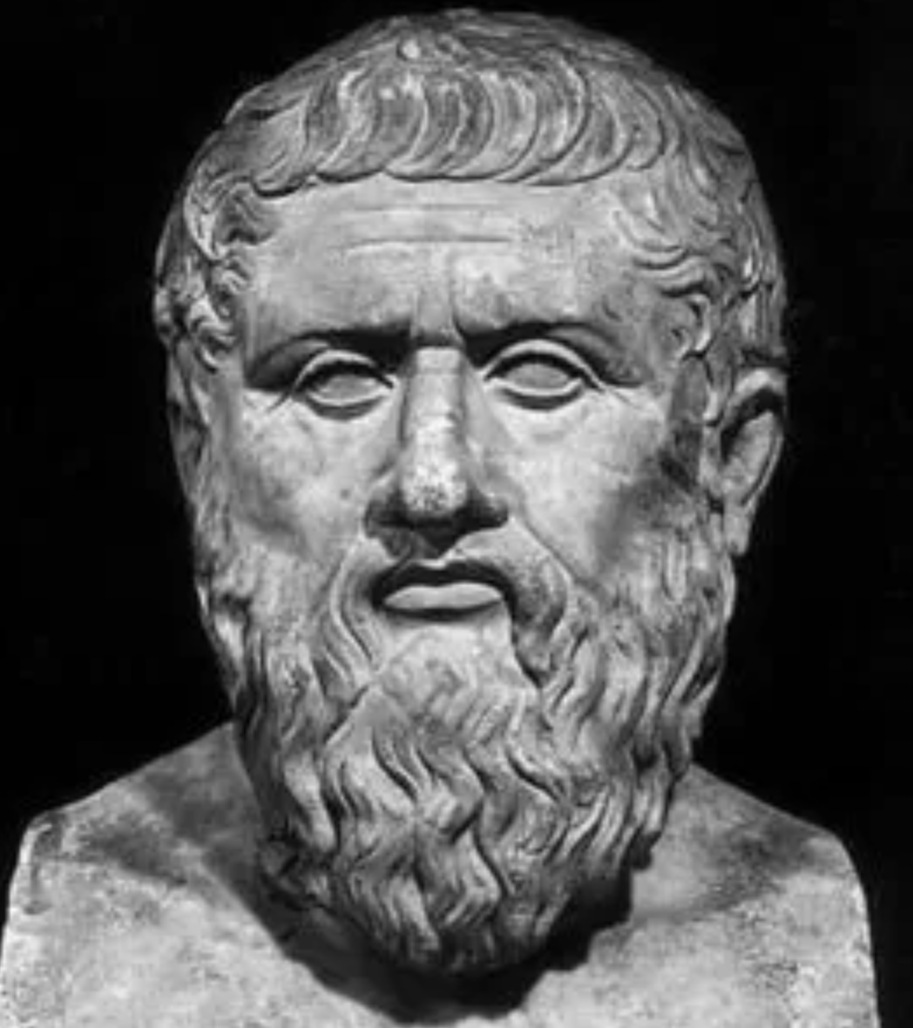
The ancient Greek philosopher Plato was a student of Socrates, and Aristotle’s teacher. He is known for his contributions to various fields of philosophy, including ethics, politics, metaphysics, epistemology, and aesthetics.
Plato was born into an aristocratic family in Athens. He lived during a time of great political and social upheaval, which influenced his philosophical views. After the execution of Socrates, whom he greatly admired, Plato became disillusioned with Athenian democracy and sought to explore alternative forms of governance and ethics.
In 387 BCE Plato founded the Academy in Athens, one of the earliest institutions of higher learning in the Western world. The Academy attracted many students and became a center for philosophical inquiry.
Plato wrote dialogues, many of which feature Socrates discussing various philosophical topics and displaying his method of Socratic questioning.
Plato laid the groundwork for much of Western philosophy, influencing countless thinkers and schools of thought. Plato's method of dialogue and dialectic encouraged critical thinking and the pursuit of deeper understanding, which continues to be a hallmark of philosophical inquiry today.
PLATO

Slide 95
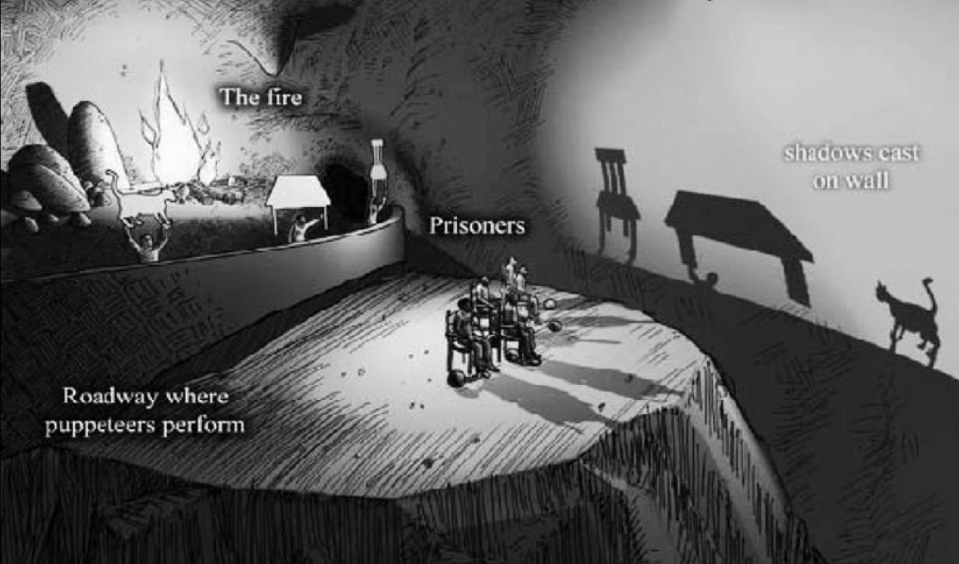
PLATO’S ALLEGORY OF THE CAVE
Imagine a group of people who have been trapped in a dark cave their whole lives. They’re chained so they can’t turn their heads. All they can see is a blank wall in front of them. Behind them is a fire, and between the fire and the prisoners are people holding up objects. The light from the fire casts shadows of the objects onto the wall.
Since the prisoners can’t see anything else, they believe the shadows are the only real things in the world.
Now imagine one prisoner is freed. At first, he’s confused and blinded by the firelight. But eventually, he turns around and sees the real objects causing the shadows. Then he climbs out of the cave into the sunlight and he sees the real world for the first time: the sky, trees, animals, and people. It’s overwhelming, but amazing.
If he goes back into the cave to tell the others, they won’t believe him. They’ll think the shadows are still the only reality and might even get angry at him.

Slide 96
PLATO’S ALLEGORY OF THE CAVE
What it means:
Plato is using this story to say that most people live in ignorance, only seeing “shadows” of the truth. The real truth, the deeper understanding of life and reality, takes effort to discover, like leaving the cave and adjusting to the light. Education and philosophy help us “leave the cave” and see the truth more clearly.
The cave = ignorance
The shadows = illusions or false beliefs
The sunlight = truth and knowledge
The journey out = the struggle to gain wisdom
It’s a powerful way to think about growing up, learning, and seeing the world more clearly.

Slide 97
METAPHYSICS: WHAT IS THE NATURE OF REALITY?
1. Idealism: Basic idea: Mind or consciousness is the basis of reality. What appears as the physical world is really consciousness. Think of a dream. In a dream, everything feels real but it’s all happening inside your mind. Idealists believe that something like this is true for the whole universe: what we call the “physical world” depends on consciousness or mind to exist. “Reality is mental. The world is more like a thought than a rock.”
2. Materialism: (also called Physicalism): Basic idea: The physical stuff like atoms, energy, and matter is all that really exists. The mind comes from the brain, which is just a complex arrangement of physical things.
This is the view behind most modern science. It says thoughts, feelings, and consciousness are the result of physical processes in your brain. “Reality is made of matter. The mind is what the brain does.”
3. Panpsychism: Basic idea: Everything in the universe has some form of consciousness even tiny things like atoms. Panpsychists don’t think a rock has a mind like a human, but they believe that even the smallest bits of matter might have a tiny “spark” of awareness. When lots of these bits come together in a complex way (like in your brain), you get a rich, full consciousness. “Consciousness is everywhere, just in different amounts.”

Slide 98
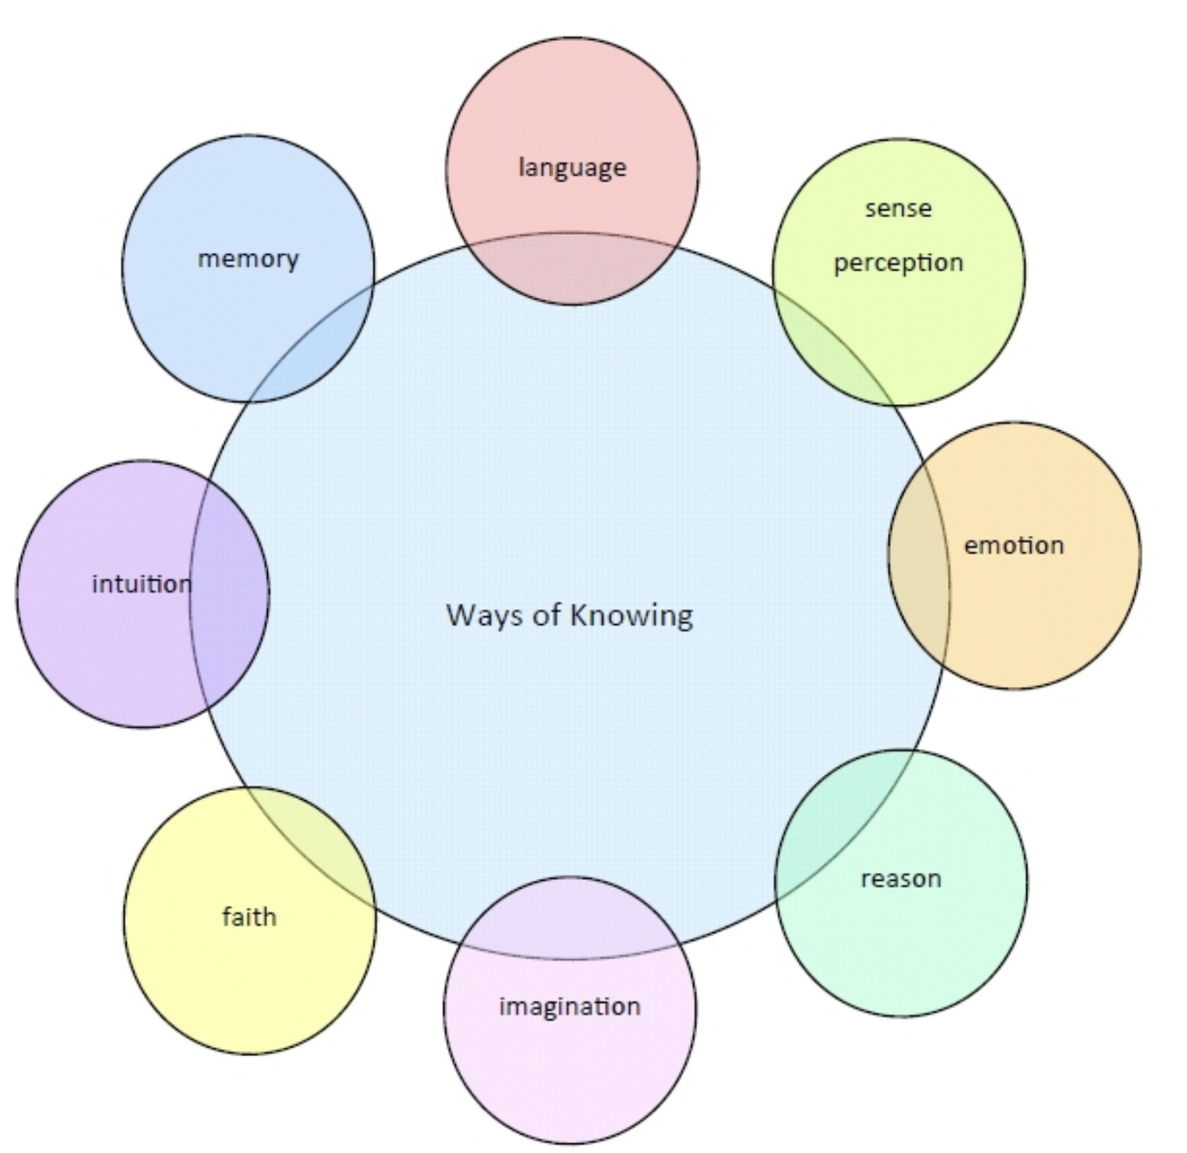
In addition to asking questions about reality, morality, beauty, politics and nature, philosophy also explores what distinguishes sound from poor thinking. This is the subject matter of two branches of philosophy logic and epistemology.
Logic is the study of reasoning and argumentation. It focuses on the principles of valid inference and correct reasoning. Logic helps us understand how to construct arguments, identify fallacies, and determine the validity of statements.
Epistemology, on the other hand, is the study of knowledge and belief. It explores questions such as what is knowledge? How do we acquire it? and What justifies our beliefs?
Epistemology examines the nature, sources, limits, and validity of knowledge, and addresses issues related to skepticism, certainty, and the distinction between justified belief and opinion.
Together, logic and epistemology provide a framework for understanding how we think, reason, and come to know things about the world.
EPISTEMOLOGY: HOW DO WE KNOW WHAT WE KNOW?

Slide 99
HOW DO WE KNOW
WHAT WE KNOW?
How individuals acquire knowledge and understanding is an important Epistemological question. There are a variety of forms of knowledge:
Empirical Knowledge is acquired through observation and experience. This includes scientific methods where knowledge is acquired through experimentation and data collection.
Rational Knowledge is derived from logical reasoning and critical thinking and involves using deduction and induction to arrive at conclusions based on premises or evidence.
Intuitive Knowledge comes from instinct or a gut feeling. It often involves immediate understanding without the need for conscious reasoning.
Emotional Knowledge is gained through feelings and emotions. It can include empathy and emotional intelligence, allowing individuals to relate to others' experiences.
Aesthetic Knowledge is acquired through the appreciation of beauty and art. This involves understanding through sensory experiences and personal interpretations of artistic expressions.

Slide 100
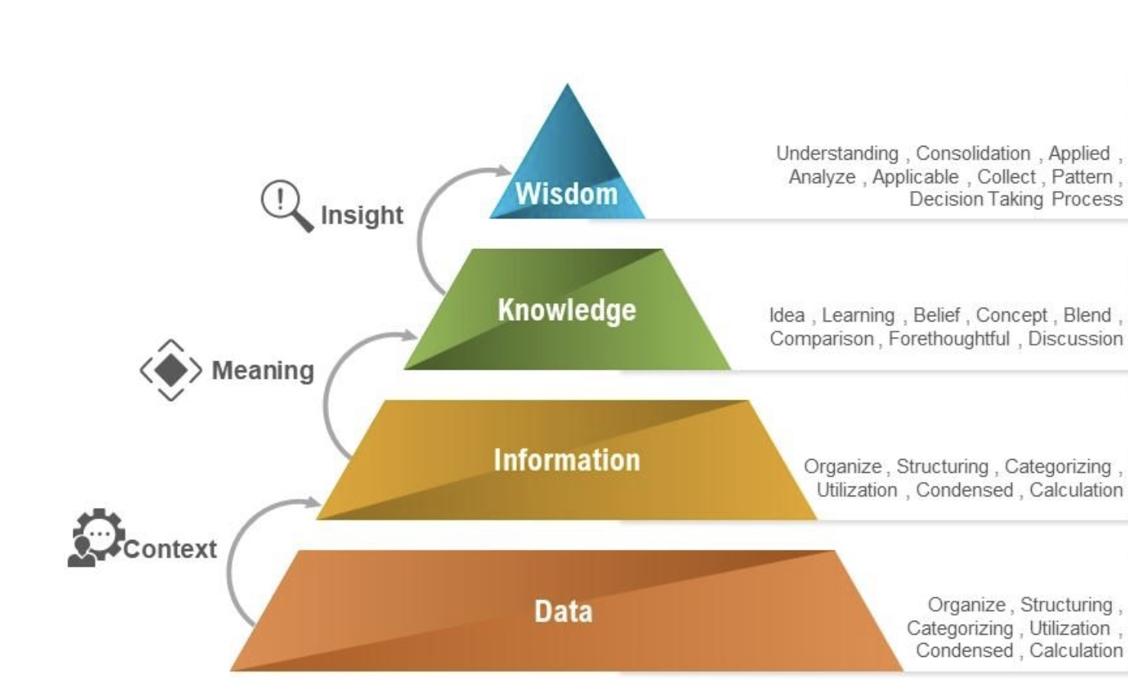
HOW DO WE KNOW
WHAT WE KNOW?
Cultural Knowledge encompasses the beliefs, values, practices, and norms shared by a group or society. Cultural knowledge is often transmitted through traditions, rituals, and socialization and can shape an individual's worldview.
Religious or Spiritual Knowledge is based on faith, spiritual experiences, and religious teachings. It often addresses existential questions and provides a framework for understanding morality, purpose, and the nature of existence.
Pragmatic Knowledge is knowledge gained through practical experience and application. It emphasizes the usefulness and effectiveness of knowledge in real-world situations, often valuing results over theoretical considerations.
Each of these ways of knowing contributes to a comprehensive understanding of the world and human experience. The different ways of knowing can complement each other and drawing on multiple ways of knowing can help us form a well-rounded view of the world.
Some individuals and cultures place higher value on some ways of knowing than on others and this can lead to fields like science being given more credibility than fields like religion (The inverse can also happen).

Slide 101
HOW DO WE KNOW
WHAT WE KNOW?
When we consider the scientific revolution, we will see how, during that revolution, the ways of knowing that were given the greatest importance changed and we’ll consider the consequences that change had for culture as the world became “disenchanted”.
Sound reasoning is particularly critical today as digital technology provides us with endless amounts of information evoking a famous line from T.S. Elliot’s poem The Rock: “Where is the wisdom we have lost in knowledge? Where is the knowledge we have lost in information?
To quote historian Yuval Harari: “ Information is not truth. Truth is a costly kind of information. Truth requires research. Fiction and conspiracy theories do not. Truth is complicated, fiction and conspiracy theories can be as simple as we want them to be, and many people prefer simplicity. Truth can be painful as it requires questioning your beliefs and confronting hard truths about yourself and your society. Fiction and conspiracy theories can be as pleasant, painless and complementary to you as you want them to be.”

Slide 102
SUMMARY: PHILOSOPHY AND SOUND THINKING
Beyond questions of reality, morality, beauty, and politics, philosophy also examines how we think. Two central branches of this study are 1) logic, the study of valid reasoning and argumentation or how to build sound arguments, spot fallacies, and test validity and 2) epistemology, the study of knowledge and belief, what counts as knowledge, how we acquire it, and what justifies belief.
Epistemology explores different forms of knowledge, each contributing to how humans understand the world:
Empirical knowledge: gained through observation and experience (science, experiments).
Rational knowledge: derived from logical reasoning (deduction, induction).
Intuitive knowledge: immediate “gut” understanding.
Emotional knowledge: through feelings, empathy, and emotional intelligence.
Aesthetic knowledge: appreciation of beauty, art, and sensory experiences.
Cultural knowledge: values, norms, and traditions shared within societies.
Religious/Spiritual knowledge: faith, teachings, and existential insights.
Pragmatic knowledge: practical, experience-based knowledge focused on usefulness.
Different individuals and cultures emphasize certain forms of knowing over others (e.g., science vs. religion).
During the Scientific Revolution, empirical and rational knowledge gained dominance, shifting culture toward a more “disenchanted” view of the world. This highlights how valuing one way of knowing over others shapes societies.
In our digital age, where information is abundant, the need for sound reasoning is urgent. As T.S. Eliot wrote: “Where is the wisdom we have lost in knowledge? Where is the knowledge we have lost in information?”
Yuval Harari warns that truth is difficult and costly, it requires research and challenges our beliefs, while fiction and conspiracy theories are simple, comfortable, and appealing.

Slide 103
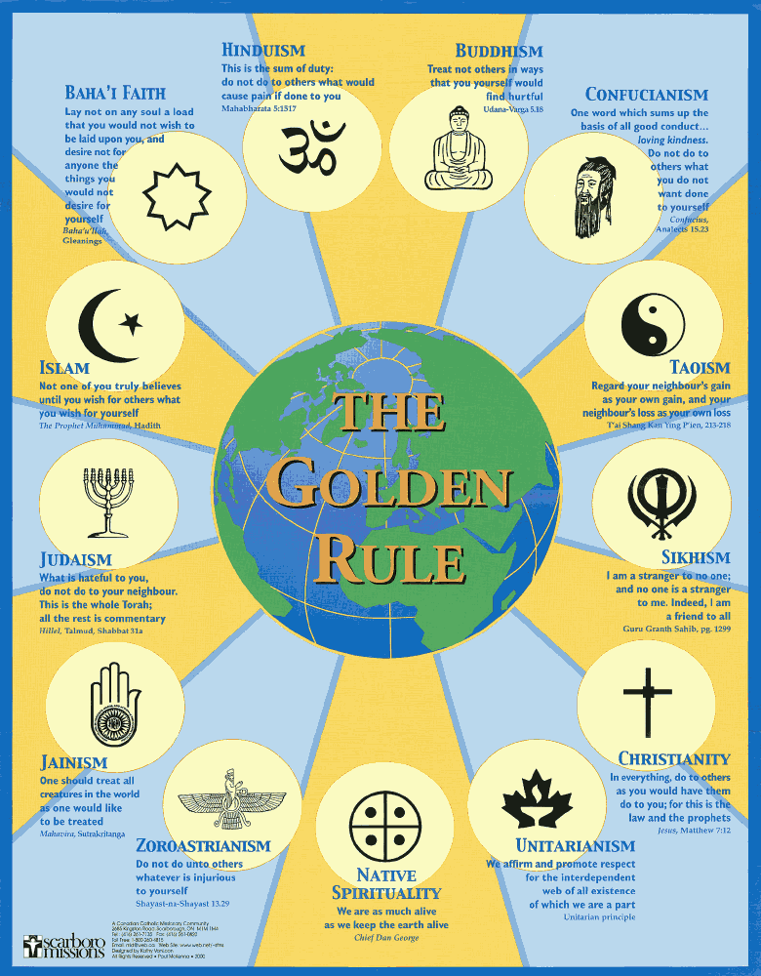
RELIGION
AS WISE MIND
Religion and spirituality encourage us to explore a sacred or spiritual realm that while not clearly visible in our everyday mundane lives in its manifestations, suggests a greater reality that gives many of us meaning.
Religion and spirituality foster self-awareness and self-improvement through spiritual practices, ethical teachings, and community involvement.
For example, Buddhism emphasizes mindfulness and meditation, which cultivate self-awareness and personal growth.
Christianity encourages self-examination as a paths to spiritual growth and moral improvement.
Islam promotes self-discipline and reflection through practices like prayer and fasting, fostering self-awareness and personal development.

Slide 104
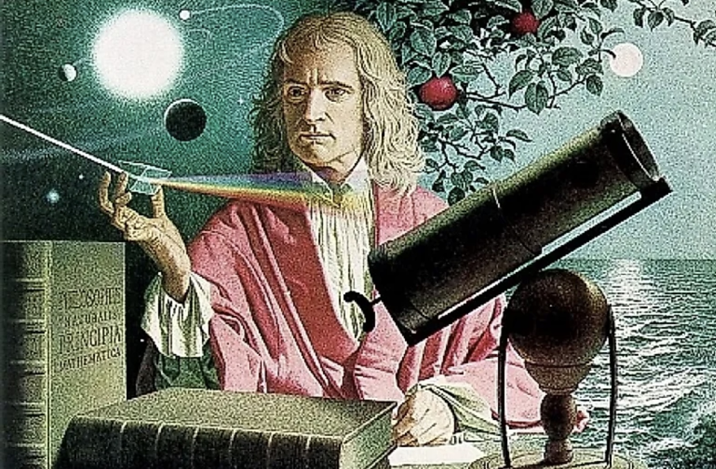
The Scientific Revolution was a transformative period in history, roughly spanning from the late 16th century to the 18th century, during which significant advancements were made in scientific thought and practice.
This era marked a departure from medieval and ancient explanations of the natural world, emphasizing observation, experimentation, and the application of reason. The scientific revolution transformed human thought.
The Scientific Revolution challenged the prevailing Aristotelian and Ptolemaic views of the universe, which placed Earth at the center of the cosmos and were part of Christian doctrine. The new heliocentric model proposed by Nicolaus Copernicus, which positioned the Sun at the center of the solar system, was a pivotal moment in this shift.
THE SCIENTIFIC REVOLUTION

Slide 105
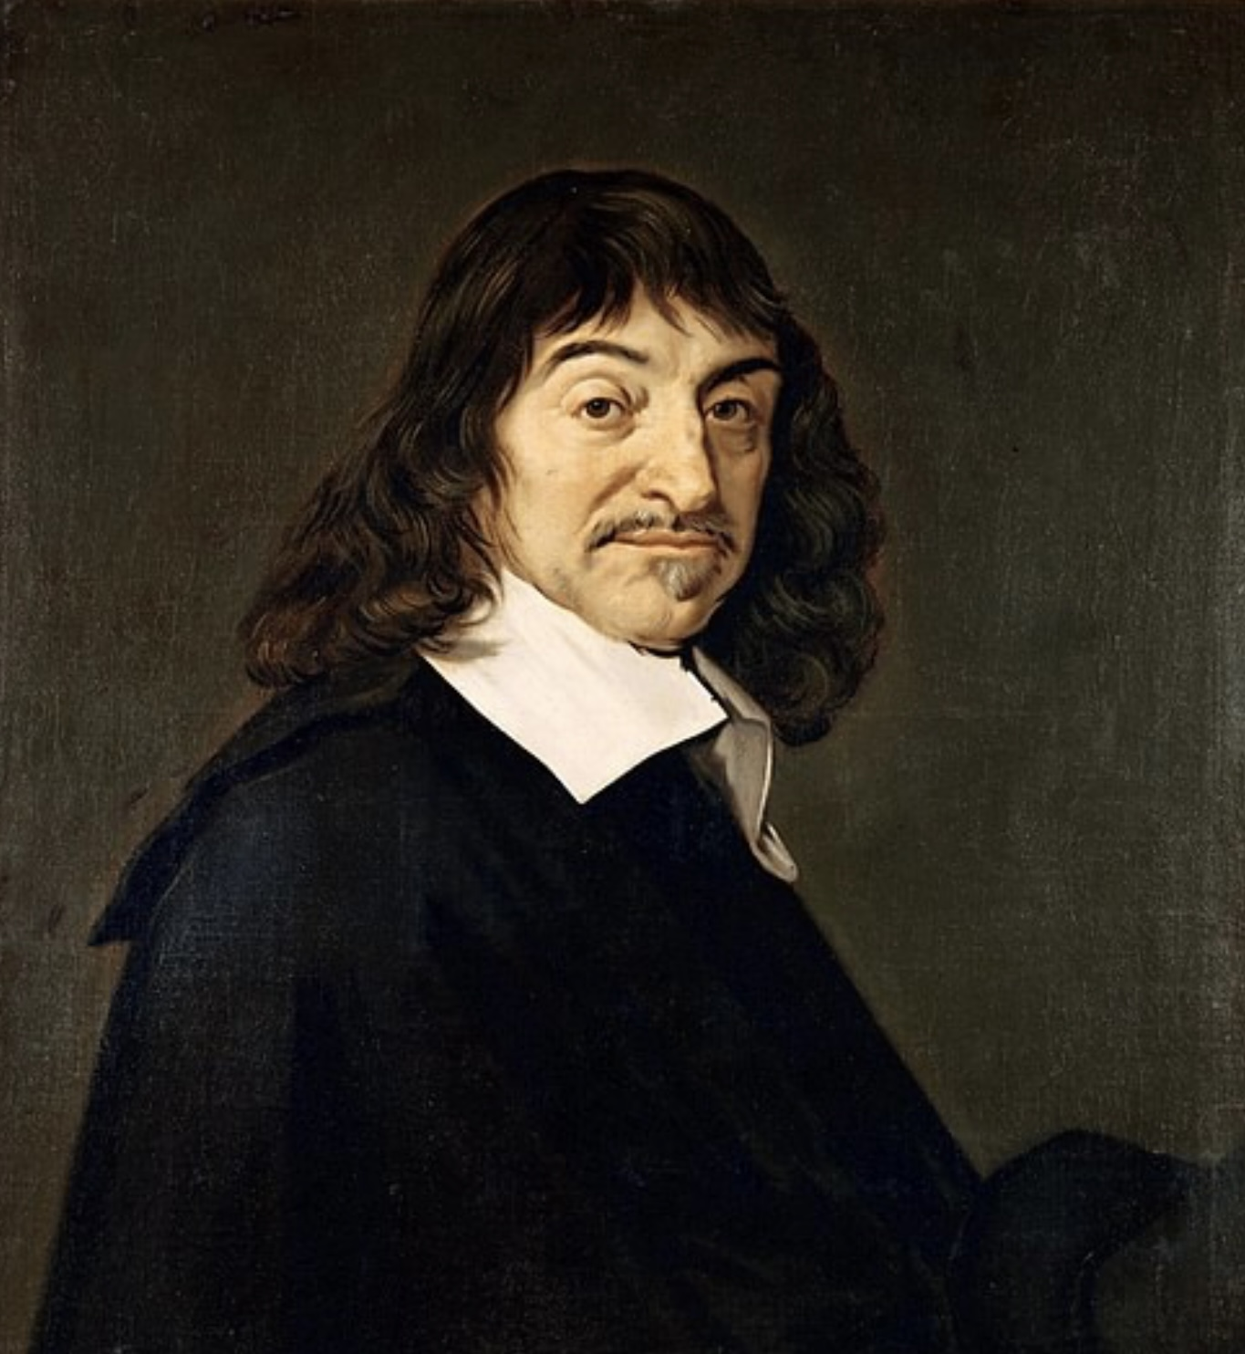
René Descartes, a 17th-century French philosopher and mathematician, significantly changed the Western world’s views of nature through his philosophical ideas and scientific contributions. His work laid the groundwork for modern philosophy and science, leading to a shift in how individuals understood the natural world.
Descartes proposed a reductionistic and mechanistic view of the universe, likening it to a machine. He argued that natural phenomena could be explained in terms of matter and motion, governed by physical laws. This contrasted with the more organic views of nature that were prevalent before him, which often included a spiritual or purpose-driven explanations for natural events.
Descartes was a proponent of philosophical dualism, distinguishing between the mind, or soul, and the body a physical substance. He argued that the mind is a non-material substance that interacts with the physical body. This separation influenced how people thought about consciousness, identity, and the nature of living beings.
Descartes' ideas influenced later scientific thinkers, such as Isaac Newton, who further developed the mechanistic worldview.
Eventually the success of the scientific method in explaining natural phenomena reinforced the notion that the world was a rational, ordered system, leading to a decline in mystical or enchanted interpretations of nature.
Descartes’s greatly contributed to the rise of science and to what is called the “disenchantment” of the world.
SCIENCE
AS WISE MIND
RENE DESCARTES
1596-1650

Slide 106
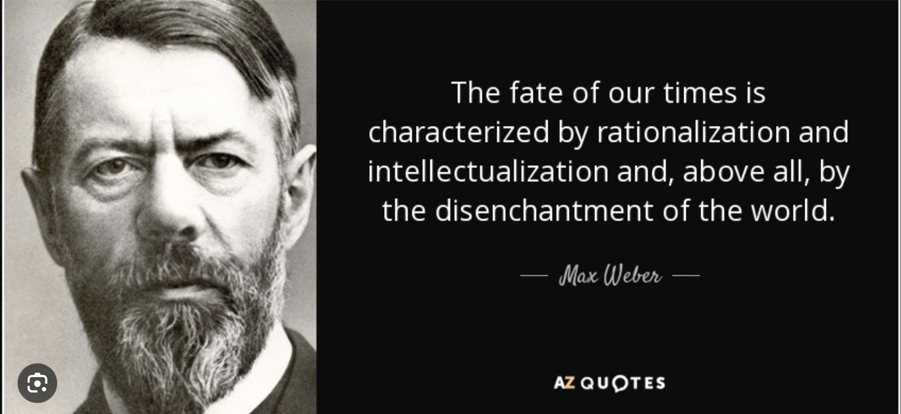
"disenchantment of the world" is a process described by sociologist Max Weber, which denotes the decline of mystical and religious explanations of the world in favor of rational, scientific understanding.
This concept suggests that as societies modernize, they move away from supernatural interpretations of reality, adopting more secular worldviews.
“Disenchantment" also implies a loss of wonder and meaning that was often associated with pre-modern belief systems. Instead, the focus shifts to empirical evidence and rational thought, which while leading to a more systematic and predictable understanding of the universe may also result in feelings of alienation or a lack of purpose for individuals and whole cultures.
This disenchantment is at the root of the meaning crisis that much of western culture is currently struggling with.
THE DISENCHANTMENT OF THE WORLD

Slide 107
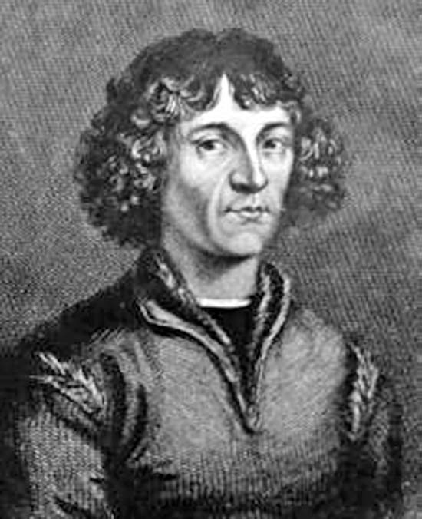
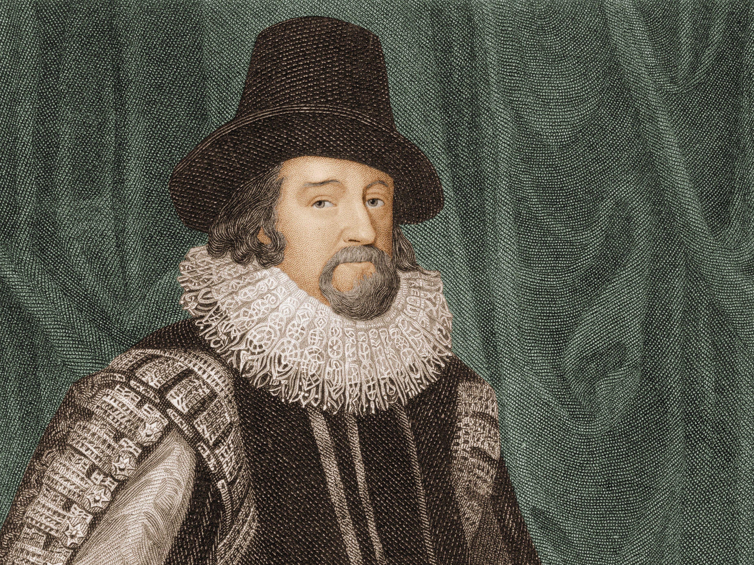
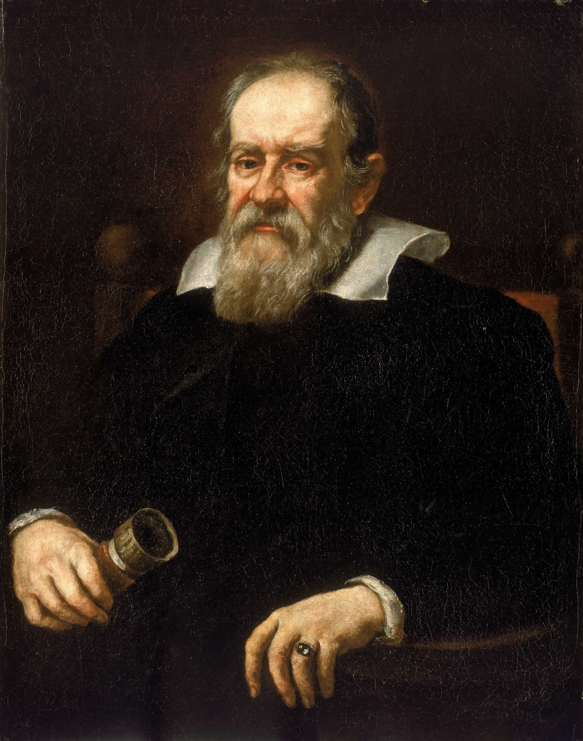
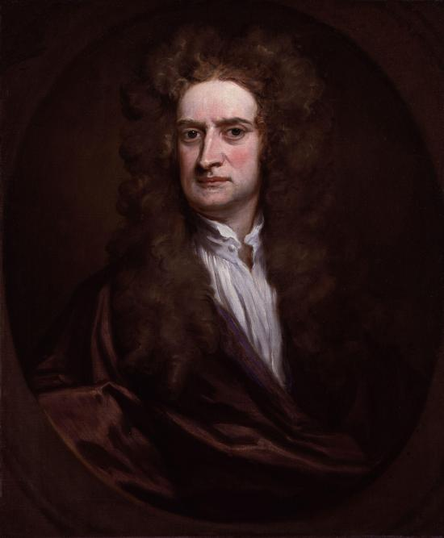
KEY FIGURES OF THE SCIENTIFIC REVOLUTION
The Scientific Revolution was marked by the contributions of several key figures who made significant advancements in various fields of science. Some of the most influential scientists and thinkers from this period include:
1. Nicholas Copernicus (1473 – 1543) – Copernicus was a mathematician and astronomer who formulated a heliocentric model of the universe which eventually replaced the Ptolemaic geocentric model. His book “On the revolutions of the heavenly spheres" was published posthumously.
2. Francis Bacon(1561-1626-) Bacon criticized scholars for relying too heavily on Aristotle and other ancient thinkers. He emphasized empiricism or doing experiments from which conclusions could then be drawn. This is the basis of the scientific method.
3. Galileo Galilei (1564 – 1642) – Galileo was a philosopher, astronomer, and mathematician who made fundamental contributions to the sciences of motion, astronomy, and to the development of the scientific method. He was the first to use a telescope to make celestial observations. Famously, church official Cesare Cremonini, refused to look through Galileo’s telescope
4. Isaac Newton (1642 – 1726) – Newton is one of the greatest scientists of all time. His work laid the foundations for classical mechanics, he made seminal contributions to optics. With Leibniz he shares credit for the development of calculus.

Slide 108
Other notable figures of the scientific revolution include:
Andreas Vesalius (1514–1564) was a Flemish physician and anatomist, Vesalius is considered the founder of modern human anatomy. His work, On the Fabric of the Human Body, provided detailed descriptions and illustrations of human anatomy based on dissections, challenging many of the misconceptions held since antiquity.
Johannes Kepler (1571–1630) was a German mathematician and astronomer, Kepler is best known for formulating the laws of planetary motion. His three laws described the elliptical orbits of planets and provided a mathematical framework for understanding celestial mechanics.
William Harvey (1578–1657) was an English physician, Harvey is best known for his discovery of the circulation of blood in the human body. His work, On the Motion of the Heart, provided a groundbreaking understanding of the cardiovascular system.
Robert Boyle (1627–1691) was an Anglo-Irish chemist and physicist, Boyle is often referred to as the "father of modern chemistry." He is known for Boyle's Law, which describes the relationship between the pressure and volume of a gas. His work emphasized the importance of experimentation and the scientific method in chemistry.
Gottfried Wilhelm Leibniz (1646–1716) was German mathematician and philosopher, Leibniz contributed to calculus (independently of Newton) and made significant advances in mathematics and philosophy. His work laid the groundwork for later developments in both fields.
These figures, among others, played pivotal roles in shaping the scientific landscape during the Scientific Revolution, contributing to the development of new ideas, methodologies, and technologies that continue to influence modern science today.
The Scientific Revolution had profound philosophical implications, leading to the development of empiricism and rationalism. It encouraged thinkers to question traditional authority and seek knowledge through observation and reason, paving the way for the Enlightenment.
The ideas and discoveries of the Scientific Revolution contributed to a broader cultural shift, promoting secularism and challenging the dominance of religious explanations for natural phenomena. This shift laid the groundwork for modern science and significantly influenced Western thought, politics, and society.

Slide 109
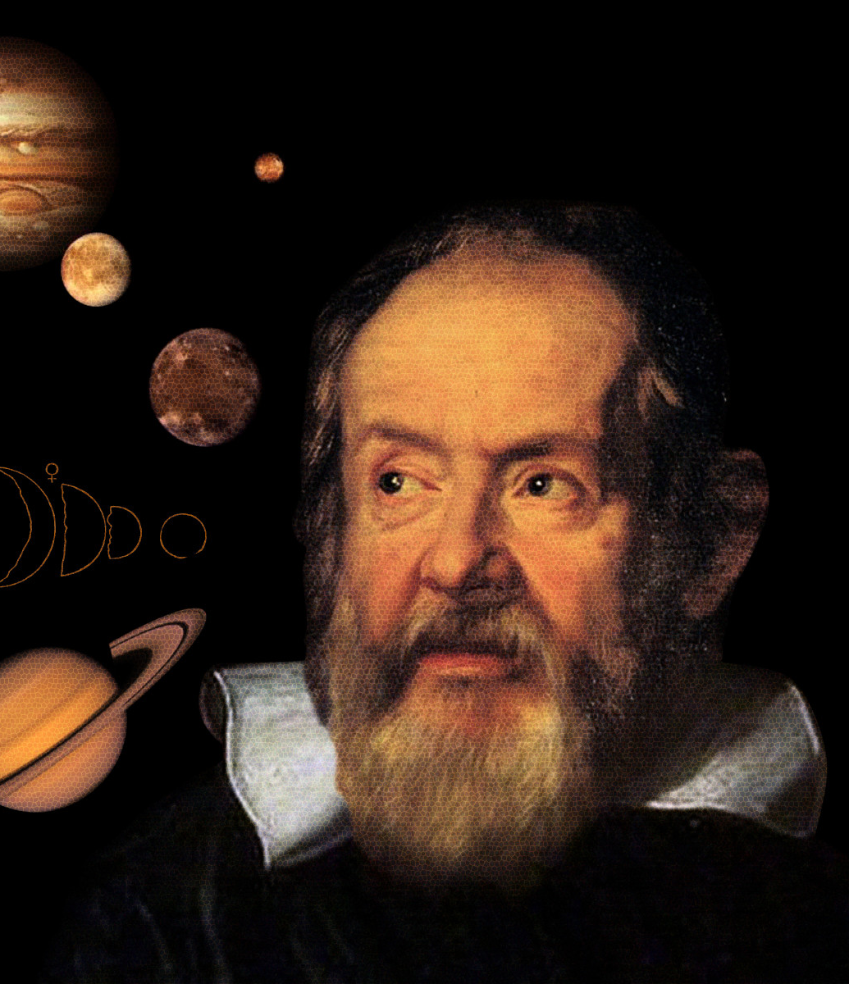
THE RISE OF SCIENCE AND
DECLINE OF RELIGION
Science and religion are two distinct ways of understanding the world and rely on different methods and approaches to knowledge.
Science uses the scientific method and relies on empirical evidence, experimentation, and observation to draw conclusions.
Religion, on the other hand, relies on faith, personal spiritual experiences, divine revelations, sacred texts, rituals and teachings as sources of knowledge and understanding.
The relationship between science and religion is complex and has evolved over centuries.
Until the last 100 years most humans accepted the religious over the scientific view of the world and took as a given that there were 2 realms of existence: 1. The visible, this worldly, material, mundane realm and 2. the invisible, other worldly, immaterial, sacred realm. Of the two the sacred realm was the more important one.
The belief in a sacred realm began to be seriously challanged in the 19th century when the advancements in technology and understanding of the natural world started to lead to a more secular worldview. As people began to rely more on scientific explanations for everyday life, the authority of religious institutions diminished in many areas.

Slide 110

The Enlightenment, scientific and Industrial revolutions emphasized reason, science, and empirical evidence over faith and religion. As scientific understanding and technology evolved, many people began to question religious explanations for natural phenomena.
Seeing that the moral frameworks provided by the previously dominant religion were being challenged, Friedrich Nietzsche foresaw that this would lead to a crisis of values. Nietzsche’s 1882 pronouncement "God is dead" is a commentary on the decline of traditional religious and metaphysical beliefs that began in the late 19th century.
Nietzsche's statement was not a literal claim about the existence of God but rather a metaphorical expression of the cultural and philosophical changes of his time. He believed that the "death" of traditional beliefs could lead to both challenges and opportunities for humanity to redefine itself.
Nietzsche saw the rise of secularism and the questioning of religious institutions as a necessary but painful transition, in which humanity would have to create its own values and meanings in a world without apparent divine oversight. Nietzsche was a forerunner of existentialism the philosophical movement that emphasizes individual freedom, choice and responsibility in world without inherent meaning.
THE DEATH OF GOD

Slide 111

The quantum revolution was a major shift in science that happened in the early 1900s when scientists discovered that the tiniest parts of the universe like atoms and subatomic particles don’t follow the same rules as bigger objects. This was a revolution because it completely changed how we understand reality.
Key Ideas of Quantum Physics:
1. Particles act like waves- elementary particles can behave like waves of energy, not just solid objects.
2. Uncertainty is built-in- You can’t know both the position and speed of a particle exactly at the same time (Heisenberg’s Uncertainty Principle). Nature has a kind of fuzziness at the smallest level.
3. Observation changes things- In some experiments, just observing a particle affects how it behaves. It’s like reality isn’t fully decided until it’s measured.
4. Particles can be connected across space- This is called entanglement when two particles are connected so that changing one instantly affects the other, even across long distances.
The quantum revolution led to amazing technology, like lasers, computers, and MRI machines. It challenged how we think about reality, time, and space. It showed that the universe is stranger and more mysterious than anyone expected.
THE QUANTUM AND
RELATIVITY REVOLUTIONS

Slide 112

Scientism is the belief that science is the only way to understand everything that matters.
People who believe in scientism think that if something can’t be measured, tested, or proven through science, then it’s not real or not important. They might reject philosophy, art, religion, or personal experience as ways of gaining real knowledge.
Scientism is not the same as science. Science is a powerful tool for understanding the natural world like how diseases work, what stars are made of, or how gravity works. It’s based on observation, experiments, and evidence. Scientism goes further than science. It says: “Only science can tell us the truth. If science can’t study it, it doesn’t matter.”
People Disagree with Scientism because feelings, beauty, morality, and meaning are hard to measure, but they’re still important parts of life. Some truths might be found through philosophy, poetry, religion, or personal reflection, not just experiments. Even science relies on assumptions (like logic or cause and effect) that can’t be proven by science itself.
Science is a method. Scientism is a belief that science is the only method that counts. Many scientists themselves warn against scientism because it can shut down curiosity about the things science can’t fully explain like love, purpose, or consciousness.
SCIENTISM

Slide 113

Scientific progress made possible technologies that led to the industrial revolution. The Industrial Revolution has been a period of significant economic, technological, and social change that began in the late 18th century and continues to the present.
The Industrial Revolution has been divided into four phases, each marked by significant technological, economic, and social changes. Each of these revolutions has profoundly affected how we live and think.
The first Industrial Revolution (late 18th to early 19th century Approximately 1760 to 1840.) began in Britain and was characterized by the transition from hand production methods to machines. Key innovations included the steam engine, the spinning jenny, and the power loom. The first industrial revolution led to the rise of factories, urbanization, and significant changes in labor systems.
The second Industrial Revolution (late 19th to early 20th century Approximately 1870 to 1914.) saw advancements in steel production, electricity, and chemical processes. Innovations like the internal combustion engine, the telegraph, and the telephone emerged. The second industrial revolution was also marked the expansion of railroads and the rise of mass production techniques, particularly in industries such as automotive and consumer goods.
THE INDUSTRIAL REVOLUTIONS

Slide 114
The third Industrial Revolution (late 20th century Approximately 1960s to the 1990s) is often referred to as the first Digital Revolution, this phase was characterized by the rise of electronics, telecommunications, and computers. The development of the internet and information technology transformed industries and created new ways of communication and commerce.
The fourth Industrial Revolution (21st century. Approximately 2010 to present.) has been characterized by the fusion of advanced technologies such as artificial intelligence, robotics, the Internet of Things (IoT), biotechnology, and quantum computing. It emphasizes automation, smart manufacturing, and the integration of digital and physical systems. This phase is also marked by discussions about the ethical implications and societal impacts of these technologies.
THE INDUSTRIAL REVOLUTIONS

Slide 115
THE POLYCRISIS AND THE NEW dark age
where we consider that just as societies and individuals can progress from reacting to acting to thinking and contemplating as we saw in the renaissance and the enlightenment, we can also regress from contemplating to reacting as is happening now in the western world and as did most notably during during the dark ages.
“ Those who do not remember the past are condemned to repeat it”
George Santayana

Slide 116
Self-aware/observing mind
A MAP OF THE MIND: A RETURN TO EMOTIONAL MIND
Rational mind
conscious
unconscious
Emotional mind
are we entering a new “dark age“?
Embodied (somatic) mind
Organ Intelligence
Basal or Cellular Intelligence

Slide 117

The term "Dark Ages" traditionally refers to the early medieval period of Western European history, roughly from the fall of the Western Roman Empire in the 5th century to the beginning of the High Middle Ages around the 10th century.
This period is often characterized by a perceived cultural and economic decline, a lack of scientific and literary output, and general societal regression.
The term dark ages suggests a period of darkness, ignorance, and barbarism, especially when compared to the preceding Greek and Roman Empires and the later Renaissance.
Some people call the present-day decline in cultural and intellectual progress caused by various factors like political instability, environmental and ecological challenges, and societal upheaval “the new dark age”.
ARE WE ENTERING A “NEW DARK AGE“?

Slide 118

The 3rd and 4th phases of the industrial revolution are also known as the Digital Revolution. This period which began in the late 20th century and continues to the present saw a shift from mechanical and analog technology to digital technology. The digital revolution encompasses the transition from traditional forms of media and communication to digital formats, significantly impacting various aspects of society, the economy, and culture.
The development of computers in the mid-20th century laid the groundwork for the Digital Revolution. Early computers were large, expensive, and primarily used by governments and large corporations. The introduction of personal computers in the 1970s and 1980s made computing accessible to the public. Companies like Apple and IBM played significant roles in this phase, leading to widespread adoption of PCs.
The creation and commercialization of the Internet in the 1990s transformed communication and information sharing. It enabled the rise of email, websites, and eventually social media platforms, fundamentally changing how people connect and access information.
The transition from analog to digital media, including music, video, and photography, occurred with the advent of technologies like MP3s, DVDs, and digital cameras. This shift changed how content is produced, distributed, and consumed.
THE NEW DARK AGE

Slide 119

The proliferation of smartphones and mobile devices in the 2000s further accelerated the Digital Revolution, allowing people to access information and communicate on the go. This phase also saw the rise of mobile applications and services.
Platforms like Facebook, Twitter, and Instagram transformed social interactions, enabling users to share content and connect globally.
The Digital revolution has had profound effects on culture, politics, and personal relationships. The ability to collect, analyze, and utilize vast amounts of data has led to advancements in AI and machine learning, influencing industries from healthcare to finance.
The rise of the internet and mobile technology has transformed how people communicate. Social media platforms, instant messaging, and video calls have made it easier to connect with others across the globe.
THE NEW DARK AGE

Slide 120

Algorithms are complex programs that power artificial intelligence and determine what content users receive on their feeds. Algorithms analyze various factors, such as user behavior, engagement patterns, and content characteristics, to curate personalized experiences.
Social media platforms collect vast amounts of data on user interactions, including likes, shares, comments, and time spent on different posts and sites. Based on this data, profiles are created and constantly updated identifying user preferences, interests, and behaviors.
When new content is posted, algorithms rank it based on relevance to the user.
The algorithm then delivers a tailored feed that aims to maximize user engagement, keeping users on the platform longer. Algorithms are designed to draw and retain people’s attention as a way of maximizing profits, not to deliver quality information
To retain attention, algorithms have learned to prioritize emotional, sensational, divisive and misleading content which generates more engagement than cool and rational content.
Algorithms also reinforce a users already existing beliefs by showing them content similar to what they have previously engaged with, creating echo chambers, spreading misinformation, and manipulating public opinion by prioritizing sensational or misleading content. Algorithms have greatly contributed to societal polarization as each individual is only exposed to a few perspectives.
ALGORITHMS AND THE NEW DARK AGE

Slide 121

The digital revolution has had a marked negative effects on our mental health.
Excessive engagement with screens and social media use has significantly contributed to the epidemic of anxiety, depression, and feelings of inadequacy that is especially prevalent in GenZ.
Mental health trends among Generation Z (those born approximately between 1997 and 2012) have garnered significant attention in recent years. Studies have shown that Gen Z experiences higher levels of anxiety and depression. Factors contributing to this include academic pressure, and global issues such as climate change and political instability but what seems the most significant is that this was the first generation to grow up with smart phones.
Social media can contribute to feelings of inadequacy, cyberbullying, and social comparison, which can negatively impact mental health. Many Gen Z individuals also report feeling pressure to maintain a perfect online person.
Digital technology and social media algorithms, which have become ubiquitous, pose significant risks that can impact individual well-being and societal discourse.
It's essential for users to be aware of these risks and for platforms to consider the ethical implications of their technologies. Ensuring that technology serves the public good while minimizing negative impacts requires a multifaceted approach, including regulation, education, and ethical considerations in technology development and deployment.
Because in our society profits trump mental health very little is being done to regulate these platforms.
THE DIGITAL REVOLUTION’S EFFECTS ON MENTAL HEALTH

Slide 122

Currently there is, among the public, a high level of distrust of government, its agencies, institutions such as universities, and of experts. Many factors have contributed to this.
One important reason for this distrust is the rise of neoliberalism, promoted since the 1980s by politicians such as (Brian Mulroney, Steven Harper in Canada) Margaret Thatcher and Ronald Reagan who famously said, "the most frightening words in the English language are: I'm from the government and I'm here to help." .
Neoliberalism is an economic and political ideology that emphasizes the importance of free-market capitalism as a primary driver of economic growth and societal well-being. It advocates for reduced government intervention in the economy, deregulation of industries, privatization of state-owned enterprises, and a focus on individual entrepreneurship and consumer choice.
Starting in the 1980s neoliberal governments across the globe began dismantling previous existing oversights and regulations that constrained corporations and the top 0.1% of income earners. As a result, contrary to what was promised, a vast amount of wealth trickled up from the poorer to the wealthier and inequality rose to all time highs.
Neoliberal policies starved government of resources and resulted in an increase in fraud and corruption, deterioration of public safety, environmental degradation, economic inequality, consumer harm, financial instability and erosion of public trust.
THE DEATH OF
REASON

Slide 123
The erosion of public trust became a feedback loop. Government and institutions inevitably, in some ways, let people down. This can motivate people to either invest in fixing these institutions or to stop supporting them. Neoliberals who dominated politics ran for government on negative messages advocating small government as essential to “liberty”. They cut the budgets of regulating agencies, stripping the government of the capacity to solve people’s problems. People seeing the mounting failures of government such as crumbling infrastructure and widening inequality became even more distrustful, perceiving the government and institutions as ineffective in solving their problems. This led to a vicious cycle of distrust, disinvestment in government and institutions and eventually of segments of the population wanting to destroy the system.
Those who felt the most distrustful of government, institutions and experts flocked to support like minded angry influencers and charismatic leaders who offered simplistic solutions to complex problems and who promised to fix everything often with little understanding of anything.
THE DEATH OF
REASON

Slide 124

Digital media greatly compounded the problems created by neoliberalism.
Making vast amounts of information of mediocre quality readily available, lead to a situation where anyone can access information on almost any topic. This can create the illusion that expertise is less necessary and that everyone is equally well informed.
The abundance of online information available has led to confusion and difficulty in discerning credible sources. This has made it challenging for individuals to identify trustworthy experts, contributing to skepticism. The idea that all beliefs and practices are equally valid has led to a dismissal of expert knowledge, especially if it conflicts with personal or cultural beliefs. This has resulted in a preference for alternative viewpoints that align more closely with individual experiences or ideologies.
The rise of social media and online communities has created echo chambers where individuals are exposed primarily to viewpoints that reinforce their own. In such environments, expert opinions that contradict these views are be dismissed or ridiculed, further eroding trust.
The prevalence of false online information exacerbates distrust in institutions and experts. When people encounter conflicting information, they tend to become skeptical of established authorities and experts.
THE DEATH OF TRUTH

Slide 125

There has been a rise in populist movements that challenge traditional institutions and expertise. This led to a cultural shift where expertise is viewed with suspicion or as elitist.
Platforms like Twitter and Facebook amplify voices without credentials, allowing non-experts to gain large followings. This leads to a preference for popular opinion over expert consensus.
Many contemporary issues (like climate change, public health, etc.) are complex and multifaceted. This complexity leads to confusion and frustration, making it easier for people to dismiss expert opinions.
There is a growing trend towards valuing personal experience and anecdotal evidence over academic or professional expertise. This leads to a more subjective understanding of truth.
These factors combined contribute to a climate where institutions and expertise are undervalued and questioned, impacting how society approaches knowledge and decision-making.
THE DEATH OF TRUTH

Slide 126

THE DEATH OF SELF-REFLECTION
Academia refers to the world of education, including the community of teachers, schools and the academic environment of colleges and universities. While society at large is seeing these major changes, academia, thanks to postmodernism, has itself become increasingly critical of expertise and the idea of truth.
Postmodernism is a philosophical stance that emerged in the mid 20th century that challenges the notions of objective truth and universal values suggesting that knowledge, truth, and meaning are not absolute but are instead constructed through social, cultural, and historical contexts. This perspective argues that what we consider "truth" is influenced by various factors, including language, power dynamics, and individual experiences.
Postmodern relativism has contributed to a lack of trust in experts. It fosters a skepticism that can lead individuals to question the validity of expert opinions, as they may view them as just another perspective rather than a definitive answer.
Postmodern thought often emphasizes personal narratives and experiences over established facts. This can lead people to prioritize individual stories over expert analysis, fostering distrust in experts who rely on data and scientific methods.
Postmodernism encourages the deconstruction of traditional authority figures, including experts. This can result in a general distrust of those in positions of knowledge, as individuals may see experts as part of a larger system that they believe is flawed or biased.
Postmodern relativism has fostered an environment where questioning authority and expertise is common, leading to a more fragmented understanding of knowledge and a decline in trust in experts.

Slide 127

Along with increasing distrust in government, institutions and experts, there has been growing conflict and polarization in society. This has been attributed to several interrelated factors.
The increasing divide between political parties has led to a more adversarial political climate. Partisan media and social media echo chambers reinforce these divisions, making compromise more difficult.
Social media algorithms on platforms like Facebook and Twitter often prioritize sensational or emotionally charged content, which can exacerbate conflicts and polarize opinions. This creates environments where extreme views are amplified.
Issues related to race, gender, and sexuality have become central to political and social discourse. While these discussions are important, they can also lead to divisions as groups rally around their identities and experiences.
Growing economic inequality has fueled resentment and division. Many feel left behind by globalization and technological changes, leading to a sense of disenfranchisement that can manifest as conflict.
Rapid changes in societal norms and values, such as those related to LGBTQ+ rights, immigration, and multiculturalism, can lead to backlash from those who feel their traditional values are being threatened.
The spread of false information can create confusion and mistrust among different groups. This can lead to heightened tensions and an inability to find common ground.
Many people feel anxious about the future due to factors like climate change, economic instability, and political unrest. This fear can lead to a desire to cling to familiar identities and ideologies, further entrenching divisions.
These factors, among others, contribute to the complex landscape of conflict and polarization in contemporary culture. Addressing these issues requires open dialogue, empathy, and a willingness to engage with differing perspectives.
Polarization and conflict has also led to the increased popularity of autocratic leaders who offer simplistic answers to complex problems.
SOCIATAL POLARIZATION

Slide 128

Historically, when authoritarian leaders take over in countries, some patterns follow.
Authoritarian leaders typically undermine or dismantle democratic institutions, such as independent judiciaries, free press, and electoral systems. This erosion limits checks and balances on their power.
Authoritarian regimes suppress political opposition and dissent through censorship, intimidation, imprisonment, or violence against activists and opposition leaders.
Authoritarian governments engage in systematic human rights abuses, including torture, extrajudicial killings, and the curtailment of freedoms of speech, assembly, and religion.
Power tends to become highly centralized, with leaders consolidating authority and often ruling through decrees rather than through legislative processes.
Authoritarian regimes use propaganda to maintain control over public perception, manipulating media narratives and restricting access to independent news sources.
While some authoritarian regimes may initially achieve economic growth, many face long-term economic challenges due to corruption, mismanagement, and lack of innovation, leading to inequality and social unrest.
Authoritarianism exacerbates social divisions, as leaders exploit ethnic, religious, or cultural differences to consolidate power and distract from governance failures.
Over time, repression leads to widespread discontent, resulting in protests, uprisings, or revolutions as citizens seek to reclaim democratic rights and freedoms.
Authoritarian regimes can contribute to regional instability, as their actions may provoke conflicts, refugee crises, or spillover effects in neighboring countries.
Authoritarian leaders may pursue aggressive foreign policies or engage in human rights abuses that can lead to international sanctions, isolation, or conflict.
THE RISE OF AUTHORITARIANISM

Slide 129
SUMMARY: THE NEW DARK AGE, THE DEATH OF REASON
TRUTH AND COMTEMPLATION
The Digital Revolution (late 20th century–today) marked a shift from mechanical and analog technologies to digital ones. It began with the spread of personal computers in the 1970s–80s, accelerated by the Internet in the 1990s, and expanded with smartphones and social media in the 2000s. This transformed communication, media, culture, and the global economy.
The digital revolution had some positive impacts such as instant access to information and global communication, new forms of media, entertainment, economic opportunity, growth in AI, machine learning, and data-driven industries.
It’s also had catastrophic negative impacts: Social media algorithms, designed to maximize profit, prioritize sensational, emotional, and divisive content. This creates echo chambers, spreads misinformation, and polarizes society. Overuse of screens and social media contributes to anxiety, depression, and feelings of inadequacy, especially among Generation Z, the first to grow up with smartphones.
Alongside digital change, neoliberal policies (since the 1980s) weakened government regulation, increased inequality, and eroded trust in institutions. Combined with digital media, this fueled distrust of experts, spread misinformation, and created a “death of truth” culture where personal opinion often outweighs expertise. Postmodern relativism in academia also questioned the idea of objective truth, further undermining authority and expertise.
As a result society has become more polarized, with partisan media and social media reinforcing divisions.
Distrust and division have made people more vulnerable to authoritarian leaders, who promise simple solutions to complex problems while undermining democratic institutions. The overall result is a cycle of conflict, weakened trust in institutions, and growing risks to democracy and mental health.

Slide 130

Humans are in discover mode when they feel safe and defend mode when they feel threatened. In discovery mode we are open, curious, playful. We explore, learn, and connect. Discovery leans on the rational mind guided by emotion but not ruled by fear.
Defend mode is closed, vigilant, protective. We react to threat, real or perceived. This is dominated by the emotional mind overriding reason.
Authoritarian governments deliberately stoke fear of outsiders, chaos, economic collapse, and disloyal neighbors. Fear activates the defend mode, keeping people anxious and focused on safety. In this state rational, reflective thinking gets narrowed or shut down and emotional reactivity (anger, suspicion, tribal loyalty) takes over. People become less open to new ideas and more willing to trade freedom for the promise of security.
When many people in a society are in defend mode, we see
1) polarization and scapegoating as people seek safety in in-groups and demonize out-groups
2) conformity and obedience with less tolerance for dissent, and more following of authority
3) suppressed creativity and progress as discovery mode (innovation, art, science, dialogue) is weakened and
4) chronic stress as health and mental well-being suffer under constant vigilance.
DISCOVER AND DEFEND

Slide 131
THE RELATIONSHIP BETWEEN EMOTIONAL, RATIONAL AND WISE MIND
Where we briefly consider from the perspective of a number of different theories the relationship between emotional, rational and wise minds. (much more on this is week 7 when we discuss personality)
“The emotional mind is the horse, the rational mind the rider, and the self-observing mind the one who watches them both and learns when to loosen the reins.”
Daniel Goleman

Slide 132
Self-aware/observing mind
A MAP OF THE MIND: THE INTEGRATION OF EMOTIONAL, RATIONAL AND SELF OBSERVING MINDS
Rational mind
conscious
unconscious
Emotional mind
Embodied (somatic) mind
Organ Intelligence
Basal or Cellular Intelligence

Slide 133

Freud didn’t use the modern terms emotional mind, rational mind, and self-observing mind but his concepts of id, ego and superego map onto these terms.
Emotional mind is Freud’s Id, the part of us driven by instinct, desire, and raw feeling. It wants immediate satisfaction, without concern for consequences or logic.
Rational mind is Freud’s Ego. The ego is the part of us that deals with reality, making plans, weighing risks, and using reason to navigate the world.
Self-observing mind comes closest to Freud’s Superego thought there are significant differences between these two concepts. The superego is our internalized conscience, values, ideals, and sense of right and wrong.
When Freud’s ego manages to balance the id’s impulses with the superego’s moral demands, you could say that’s something close to self-observing mind, a harmonized state where instincts, reason, and values are working together.
Freud also described the mind like an iceberg, with most of it hidden beneath the water: Conscious (tip above water) are the thoughts we’re aware of. Subconscious (just below waterline) are the memories and knowledge we can bring into awareness. While the Unconscious, deep under water, are instincts, fears, hidden wishes, and trauma, things that strongly shape us but we aren’t directly aware of.
The id is entirely unconscious, deep underwater, the ego is partly conscious and partly unconscious, it bridges above and below the waterline. The superego also spans both conscious and unconscious, some values we’re aware of, others are buried.
FREUD

Slide 134

Daniel Kahneman, a psychologist and Nobel laureate, introduced the concepts of System 1 and System 2.
System 1 is the fast, automatic, intuitive part of our mind. It operates quickly and effortlessly, relying on heuristics and gut feelings. This system is responsible for our immediate reactions and judgments, often without us being fully aware of it.
System 2 is the slower, more deliberate, and analytical part of our mind. It requires effort and attention, and it's used for complex problem-solving and decision-making. This system is activated when we encounter situations that require more thought, such as solving a math problem or making a difficult choice.
System 1 corresponds to the emotional mind and System 2 to the rational mind.
Kahneman argues that understanding these systems can help us make better decisions and improve our critical thinking.
There are some noteworthy differences between systems one and two:
System 1, the emotional mind, runs on autopilot, it's fast, effortless, difficult to control or modify, has no self-awareness, is evolutionarily old, shared with animals, nonverbal, and independent of general intelligence.
System 2 in contrast is slow, effortful, logical and sceptical, deliberately controlled, has self-awareness, is evolutionarily recent, uniquely human, linked to language, sequential, heritable, and linked to general intelligence.
KAHNEMAN’S
DUAL PROCESS

Slide 135

System 1 has been compared to a car’s accelerator and system 2 to the car’s breaks
Factors affecting the accelerator/brake balance in each person at any one point in time include their:
Temperament
Character
Circumstances
Stress level
energy balance
Illness
substance use
etc.
Dual process theory

Slide 136

Evolutionary mismatch happens when the way our bodies and brains evolved in the past doesn’t fit well with the modern world we live in today. That is when our emotional mind wants something and our rational mind wants something else. When this happens, self-observing mind, if we have access to it, might mediate between the two.
Example: Our ancestors lived in small groups, hunted and gathered food, and had to stay alert for danger like wild animals. So, humans evolved to crave sugar and fat, because these foods were rare and gave us a lot of energy, react strongly to stress, to survive threats and be constantly moving and active.
Today, however, we’re surrounded by junk food, but don’t need to chase it down. We face school stress or social media anxiety, not lions but our bodies react the same. We sit at desks, in cars, and on couches most of the day.
Our evolved instincts don’t always match our modern environment which can lead to health problems like obesity, anxiety, or depression.
Knowing about evolutionary mismatch helps us understand why we sometimes feel or act in ways that don’t seem logical.
DARWIN AND LORENZ’S EVOLUTIONARY MISMATCH

Slide 137



Slide 138

OPEN DISCUSSION

Slide 139

videoS
Week 3 of simple (sessions 4,6 and 8)

Slide 140


Slide 141


Slide 142


Slide 143


Slide 144


Slide 145


Slide 146


Slide 147


Slide 148


Slide 149


Slide 150


Slide 151


Slide 152


Slide 153


Slide 154


Slide 155


Slide 156


Slide 157


Slide 158


Slide 159


Slide 160


Slide 161


Slide 162


Slide 163


Slide 164


Slide 165


Slide 166
video
Session 4 of simple

Slide 168
ORPHAN Slides AND VIDEOS from previous years

Slide 169

Deep History is an interdisciplinary approach to understanding the history of the universe, from the Big Bang to the present day. It combines insights from various fields such as astronomy, geology, biology, anthropology, and history to create a comprehensive narrative that spans 13.8 billion years.
Deep history emphasizes the connections between different events and processes across time scales, highlighting how cosmic, geological, biological, and human histories are interlinked. It explores themes such as complexity, the emergence of life, the development of civilizations, and the impact of human activity on the planet.
By looking at history from such a broad perspective, Deep History encourages us to think about our place in the universe and the long-term implications of our actions. It can also foster a sense of shared humanity and responsibility toward the planet and future generations.
Deep History helps us contextualize current events and challenges within a larger framework. This can lead to a better understanding of issues like climate change, resource depletion, and social dynamics.
Deep history fosters a sense of shared identity and responsibility among people by emphasizing our common origins and the collective challenges we face as a species. This fosters global cooperation and empathy.
WHAT IS DEEP HISTORY?

Slide 170

We’re exploring deep history with the goal of understanding the mind but before we talk about the mind let’s briefly consider the relationship between mind and brain.
The brain is a physical organ located in the skull, composed of neurons and glial cells. The brain operates through biological and chemical processes, and its structure can be studied using various techniques like MRI and EEG.
The mind, on the other hand refers to the set of cognitive faculties that encompass consciousness, perception, thinking, emotions, and subjective experiences. It is often associated with mental processes such as reasoning, memory, and imagination. The mind is typically seen as non-physical.
The productive theory is the most widely held theory among conventional neuroscientists and the public. It posits that the mind is entirely produced by the brain's functions. In this view, cognitive processes, emotions, and consciousness arise directly from the brain's physical and biochemical activities. The brain is a factory, and the mind is its product, suggesting that understanding the brain's structure and function is key to understanding the mind.
There are however two other theories about the relationship between mind and brain:
The permissive theory suggests that the brain provides the necessary conditions for the mind to exist but does not directly produce mental states. In this view, the brain acts as a facilitator, allowing for the emergence of consciousness and mental processes, but the mind is seen as something that can exist independently of the brain's specific physical structure or processes.
The brain permits the emergence of consciousness rather than solely producing it. The brain is like a garden, and the mind is like the flowers that grow in it, the garden provides the right conditions for the flowers to bloom, but the flowers themselves are not made of soil or water; they are distinct entities that flourish due to the garden's environment.
HOW ARE BRAIN
AND MIND RELATED?

Slide 171

HOW ARE BRAIN AND MIND RELATED?
The third theory describing the relationship between brain and mind is the transmissive theory.
According to the transmissive theory the brain, much like a TV receives mental states or consciousness from an external source or realm that is separate from the physical brain. The brain serves as a conduit or medium through which mental states are expressed or experienced, rather than being the origin of those states.
Proponents of the transmissive theory argue that consciousness is fundamental and that the brain acts as a filter or interface for this consciousness. The brain does not create consciousness but rather transmits it, suggesting a deeper reality where consciousness is primary.
These three theories reflect different philosophical stances on the mind-body problem and highlight the complexity of understanding the mind.

Slide 172

Why do we start the course with a deep history of the universe, and the evolution of human instincts, cognition and western thought?

Slide 177

To put the time that it has taken for modern humans to evolve into perspective consider the following…
The big bang happened 13.7 billion years ago.
Earth is 4.5 billion years old. Life first appeared on earth 3.7 billion years ago
Imagine that the whole history of life on earth spans just one year instead of 3.7 billion, then…
From January 1 until the end of October there were only bacteria.
In November multicellular life forms started to proliferate in the Cambrian explosion.
Humans arose on December 31 at approximately 11 PM, we then spent an hour roaming around as hunter gatherers.
Farming was invented at 11:58 PM December 31st.
Everything we call history happened in the 60 seconds before midnight December 31st.
4.5 BILLION YEARS OF EARTH'S HISTORY
CONDENSED INTO ONE YEAR.

Slide 178
video
Session 6 of simple

Slide 180

What does the Dunning-Kruger effect tell us about overconfident ignorance, knowledge and wisdom?
The concepts of information, knowledge, and wisdom are interconnected but distinct, each representing a different level of understanding and insight.
Information consists of raw data and facts. It is the basic building block that provides context or details about a particular topic or event. Information is often unprocessed and can be quantitative or qualitative. It answers basic questions like who, what, where, and when. Information can be true or false.
Ex. It’s raining outside right now.
Knowledge is the organization and interpretation of information. It involves understanding patterns, relationships, and principles derived from information. Knowledge is contextual and often gained through experience, education, or practice. It answers questions like how and why.
Ex. A meteorologist.
Wisdom is the ability to make sound judgments and decisions based on knowledge and experience. It involves applying knowledge in practical, ethical, or meaningful ways. Wisdom is often associated with insight, foresight, and the ability to see the bigger picture. It involves understanding the long-term implications and ethical considerations of actions.
Ex. A meteorologist who has a deep historical, sociological, political and ethical understanding of the factors that influence climate and who realizes that the “territory” of climate is incredibly complex and her knowledge is limited.
overconfident ignorance
wisdom
knowledge

Slide 188

Climate changes have had a major effect on the evolution of Hominids and rational mind.
Geological “Epochs” are long periods of the earth’s history during which similar geological or climatic conditions prevailed.
2.58 Million Years Ago: Pleistocene Epoch Begins. It is characterized by repeated glacial cycles. Since then, the Earth has experienced a series of ice ages and interglacial periods.
200,000 Years Ago: Homo sapiens emerges during a period of fluctuating climate, adapting to various environments.
120,000 Years Ago: Interglacial warm period (between ice ages period) period begins. Temperatures were warmer than today, and sea levels were higher, leading to significant ecological changes. Lasted about 5000 years.
115,000-11,700 Years Ago: last Ice age.
70,000 - 60,000 Years Ago: The last ice age was affected by the Toba Super volcano Eruption. This massive eruption in Indonesia may have caused a volcanic winter, leading to a further dramatic drop in global temperatures.
20,000 Years Ago: Last Glacial Maximum: The peak of the most recent glacial period, during which ice sheets covered large parts of North America, Europe, and Asia, leading to significantly lower global sea levels.
15,000 - 10,000 Years Ago: End of the Last Ice Age. Rapid warming occurs, leading to the retreat of ice sheets and the rise of sea levels. This period marks the transition to the Holocene epoch.
Holocene Epoch (last 11,700 years): Current stable Climate Period. The climate stabilizes, allowing human civilizations to develop agriculture and settle in various regions.
Little Ice Age (1300 - 1850): Cooling Period. A period of cooler temperatures in the Northern Hemisphere, affecting agriculture and leading to societal changes in Europe and North America.
TIMELINE OF CLIMATE CHANGE EVENTS IN THE LAST MILLION YEARS

Slide 189
Climate has been a driving force in the evolution of hominins and their, biology, cognition, behavior, and culture.
Fluctuations in climate have led to changes in habitats, which influenced where early humans could live and how they adapted. For example, climate change caused areas in Africa that were tropical forests to become open savannahs. This pressured early hominins to leave their tree habitat and become bipedal as this allowed to see over the tall grasses. The also had to develop new foraging strategies.
Changes in climate affected the availability of food resources. As climates shifted, early humans had to adapt their diets, which may have led to the development of tools for hunting and gathering, as well as the eventual domestication of plants and animals.
Climate change has historically driven human migration. For example, during ice ages, lower sea levels and colder temperatures forced populations to move to more hospitable areas, this facilitated the spread of cultures.
As groups adapted to new environments, social structures likely evolved in response to the challenges posed by climate. Cooperation in hunting, gathering, and later agriculture became essential for survival in changing climates.
The need to adapt to diverse and changing environments spurred cognitive evolution, leading to increased problem-solving abilities, social cooperation, and the development of language.
Climate has also influenced cultural practices, including shelter construction, clothing, and the development of technologies to cope with environmental challenges, such as fire for warmth and cooking.
CLIMATE CHANGE AND
HUMAN EVOLUTION

Slide 190

THE LAST GLACIAL MAXIMUM
The last Ice Age peaked approximately 26,500 years ago. It was part of the Pleistocene Epoch, which lasted from about 2.6 million years ago to around 11,700 years ago. The last ice age saw large parts of the Earth covered in ice sheets, particularly in the Northern Hemisphere.
Estimates suggest that the global population of Homo sapiens, modern humans, who had migrated out of Africa 50 to 60,000 years ago may have dropped to as low as several thousand individuals because of these harsh conditions. This decline was influenced by factors such as reduced food availability, habitat changes, and increased competition for resources. However, as the climate warmed and the ice sheets retreated, human populations began to recover and expand.
The global climate began to warm around 20,000 years ago, leading to the gradual retreat of the ice sheets and the transition into the current Holocene epoch.
The transition from hunter-gatherer societies to agriculture was influenced by climate changes that made certain areas of the world more hospitable for farming.
The Medieval Warm Period (approximately 950-1250 AD) allowed for population growth in Europe, but the subsequent Little Ice Age (roughly 1300-1850 AD) brought colder temperatures, leading to crop failures, famine, and a decline in population.

Slide 191

Migration has been continuously occurring in Hominis who originated in Africa where they evolved over millions of years. The migration of hominids out of Africa occurred in several waves, with different species leaving the African continent at various times.
The earliest hominis, such as Australopithecus, lived in Africa around 4 to 2 million years ago. Evidence suggests that some of these early hominids may have begun to disperse from Africa into other regions, but these migrations were limited and did not lead to widespread settlement.
One of the first hominin species known to have migrated out of Africa is Homo erectus. This species is believed to have left Africa around 1.9 million years ago and spread into parts of Asia and Europe. Homo erectus was more adaptable and capable of surviving in diverse environments compared to earlier hominids.
Following the migration of Homo erectus, other hominis, such as Neanderthals and Denisovans, emerged. Neanderthals are believed to have evolved from a common ancestor with modern humans in Europe and Asia, while Denisovans are known from fossil evidence found in Siberia. These groups lived alongside early modern humans (Homo sapiens) and interacted with them.
The most significant migration of Homo sapiens out of Africa is believed to have taken place around 60,000 to 70,000 years ago. This migration marked the beginning of the spread of anatomically modern humans to various parts of the world, including Europe, Asia, Australia, and eventually about 15,000 years ago the Americas.
HOMININ MIGRATION

Slide 192


Evolutionary pressure refers to environmental factors that influence the survival and reproduction of individuals within a population. Over generations these pressures can lead to changes in the traits of organisms.
For example, if a particular trait enhances an organism's ability to survive and reproduce in its environment, individuals with that trait are more likely to pass it on to their offspring. This process is a key mechanism of natural selection, driving the evolution of species over time. Evolutionary pressures can come from various sources, including predation, competition for resources, environmental changes, and social interactions.
The hominin lineage, of which humans are the last surviving species, descended from chimpanzees 5 million years ago. Humans and chimpanzees share 99% of their DNA. In addition to climate changes there were other evolutionary pressures that affected Human evolution.
Robin Dunbar a British anthropologist and evolutionary psychologist has described some of these evolutionary pressures. Dunbar is best known for his work on social networks and the concept known as "Dunbar's number."
The Dunbar number is a theoretical cognitive limit to the number of stable relationships that a primate can maintain, for Humans this number is estimated to be around 150.
Dunbar’s number is derived from his research on the relation between primate brain sizes and social group sizes. This research suggests that the size of the neocortex limits the number of meaningful social relationships an individual can manage.
This limit in number occurs because having a meaningful social relationship involves remembering what other member of the group are like so that an individual can successfully manage their social interactions. This “remembering” requires significant cognitive resources that require a larger cerebral cortex.
Dunbar's theory suggests that the neocortex is responsible for managing social relationships and understanding social dynamics. As the neocortex size increases, it allows for more complex social interactions and relationships. However, there is a limit to how many meaningful relationships one can maintain due to cognitive constraints. Essentially, the larger the neocortex, the more social connections one can handle, but there is still a finite limit.
HOMININ EVOLUTIONARY PRESSURES

Slide 193
The cognitive revolution describes a period that saw a significant shift in human thought and behavior that is believed to have occurred around 70,000 years ago. It led to the emergence of more complex language, abstract thinking, and advanced social structures among Homo sapiens. The cognitive revolution marked a pivotal moment in human history, which allowed for the development of modern societies.
Anthropologist Ian Tattersall believes that the core change that occurred during the cognitive revolution was the emergence of symbolic thought. He writes “With symbolic thought humans dissect our interior and exterior worlds into a vocabulary of mental symbols and then we rearrange those symbols according to rules to imagine alternate versions of the reality we’re living in. As far as we know no other organism treats information in this way.”
The capacity for symbolic thinking that arose during the cognitive revolution is evident in the sudden development, during this period, of art, music, rituals and sophisticated tools.
With their newly emergent capacity for symbolic thought, our human ancestors began to think abstractly. This allowed for the creation of concepts such as religion, mythology, and art. The ability to imagine things that do not exist in the physical world enabled the development of convenient fictions, which became a fundamental aspect of culture.
According to historian Yuval Harari "convenient fictions" are shared beliefs or narratives that exist in human societies. These fictions are not necessarily true in a factual sense, but they serve important social functions. Examples include concepts like money, nations, corporations, and laws. These convenient fictions allow large groups of people to cooperate and coordinate their actions, creating a framework for social order and collaboration. Shared beliefs in convenient fictions enable complex societies to function, even though they are based on collective imagination rather than objective reality.
Enhanced cognitive skills and convenient fictions fostered more complex social structures. Humans gradually become better able to form larger groups and cooperate on a scale that was not possible for earlier hominids. This cooperation was essential for hunting, gathering, and sharing resources, and lead to the establishment of social norms and cultural practices.
THE COGNITIVE REVOLUTION

Slide 194

THE COGNITIVE REVOLUTION
The cognitive revolution is thought to have been caused by several interrelated factors. Some researchers suggest that changes in the brain, possibly due to genetic mutations, may have led to the enhancement of Human cognitive abilities.
The ability to communicate using complex language also played a crucial role in the cognitive revolution as it enabled humans to share ideas, collaborate, and build social bonds, all of which are essential for survival and community building.
As humans began to form larger and more complex social groups, cultural practices, convenient fictions, and shared beliefs became more prevalent. These helped to create a sense of belonging and cohesion within groups, fostering the development of cultural identities. As cognitive abilities continued to advance, humans began to develop moral and ethical frameworks that guided their behavior.
Cultural evolution was later facilitated by the development of writing systems and other communication technologies which enhanced the transmission of knowledge and skills across generations. The development of writing also demarcated pre-History from “History”.

Slide 195
PRE-HISTORIC PERIODS
Prehistory refers to the period of human history before the invention of the writing systems which allowed for the recording of historical events. The pre-historic era encompasses the vast majority of human existence and is typically divided into several key periods called eras that are based on archaeological and anthropological findings. The main periods or eras of prehistory include:
Paleolithic Era (Old Stone Age): This is the earliest and longest period of prehistory, lasting from approximately 2.5 million years ago to around 10,000 BCE. It is characterized by the use of simple stone tools, the development of early human societies, and the emergence of art and culture, including cave paintings and carvings.
Mesolithic Era (Middle Stone Age): The Mesolithic period is generally considered to have occurred from around 10,000 BCE to about 5,000 BCE (dates can vary by region). It marks a transitional phase between the Paleolithic and Neolithic eras. It is characterized by the development of more advanced tools, the beginnings of settled communities, and changes in subsistence strategies, including fishing and foraging.
Neolithic Era (New Stone Age): The Neolithic period began around 10,000 BCE (in some regions) and lasted until the advent of metalworking, which varies by location but is often placed around 3,000 BCE. This era is marked by the development of agriculture, the domestication of animals, and the establishment of permanent settlements. It also saw significant advancements in pottery, weaving, and social organization.
Chalcolithic Era (Copper Age): The Chalcolithic period, which overlaps with the late Neolithic, typically spans from around 4,500 BCE to 3,000 BCE. It is characterized by the use of copper tools alongside stone tools and the emergence of early urban societies.
Prehistory ends with the invention of writing, which marks the beginning of recorded history. The timing of this transition varies by region; for example, writing systems emerged around 3,200 BCE in Mesopotamia (Sumer) and around 3,100 BCE in ancient Egypt.

Slide 196
The modern-day experience that people have of being separate individuals is a relatively recent development.
Our prehistoric ancestors felt less like individuals and more like a part of their social group and natural world. This conclusion is drawn from archaeological evidence, anthropological studies, and insights from comparative studies with modern hunter-gatherer societies
Prehistoric societies, particularly during the Paleolithic era, were organized in small, close-knit groups or bands. These groups fostered strong social bonds and a sense of belonging. Individuals identified closely with their family and community rather than as isolated individuals.
Prehistoric humans were deeply connected to their environment, relying on it for sustenance, shelter, and materials for tools. This reliance fostered a sense of interconnectedness with the natural world.
Ancient spirituality contributed to a sense of connection to the world beyond the immediate physical environment. Many prehistoric cultures held animist spiritual views. Animism is considered one of the earliest forms of religion and has influenced many other religious traditions.
Animism attributes spiritual essence or consciousness to non-human entities, including animals, plants, rocks, and even natural phenomena like rivers and mountains. Animism is characterized by the idea that these entities possess a life force or spirit, which can influence the world and human experiences.
The animistic worldview inherently includes the notion of a sacred realm, where these spirits interact with humans and influence their lives. Animism emphasizes the interconnectedness of all living and non-living things. It suggests that humans are part of a larger ecological and spiritual web.
Many animistic cultures hold a deep respect for nature, viewing it as sacred. This often leads to practices that promote environmental stewardship and sustainability.
PRE-HISTORIC PEOPLE’S
EXPERIENCE OF THE WORLD

Slide 197
In a one-on-one confrontation, a human without a weapon, doesn’t stand a chance with an apex predator such as a lion, bear or shark. But humans, while physically unimpressive, have, thanks to their cognitive abilities developed cultures and technologies that have made them the indisputable dominant species on earth. A lion, a bear or a shark does not stand a chance against a person armed with a powerful rifle.
Human cognition enabled the transmission of cultures and technologies across generations and played a crucial role in allowing humans to become the dominant species on Earth. The Human capacity for creative thinking led to the invention of tools and technologies that improved survival and efficiency. This innovation cycle has allowed humans to manipulate their environment in unprecedented ways.
Humans developed the ability to analyze complex situations, foresee potential outcomes, and devise solutions. This enabled early humans to adapt to various environments and challenges, such as hunting, gathering, and later, agriculture.
The development of complex language allowed humans to share knowledge, collaborate, and build social structures. This facilitated the transmission of ideas and skills across generations, leading to cultural advancements.
Cognition enabled humans to form larger social groups and cooperate in ways that other species could not. This social cohesion was essential for hunting, gathering, and defense against predators.
Human societies, using convenient fictions, developed complex cultures, including art, religion, and governance, which further strengthened social bonds and facilitated cooperation on a larger scale.
All these cognitive abilities combined to give humans a significant advantage over other species, allowing for adaptability, innovation, and complex social structures that contributed to our dominance on the planet.
WHY HUMANS BECOME
THE DOMINANT SPECIES

Slide 198
The Agricultural Revolution, which began around 10,000 years ago, was significantly influenced by climate change, particularly the transition from the last Ice Age to a warmer, more stable climate.
As the planet warmed, regions that were previously too cold for agriculture became more hospitable. This allowed for the growth of wild grains and other edible plants, which provided a reliable food source.
The warming climate also led to an increase in plant and animal diversity, providing early humans with a wider range of resources. This abundance made it easier for communities to experiment with domestication of plants and animals.
Climatic stability encouraged sedentary lifestyles, as people could rely on consistent harvests. Human societies began to transition from nomadic lifestyles to settled farming communities.
The need to manage resources, coordinate agricultural production, and maintain order in growing communities led to the establishment of political structures and governance systems. Leaders emerged to organize labor, defend against threats, and regulate trade.
The Agricultural Revolution contributed to the emergence of social hierarchies and class structures. As resources became more abundant, wealth accumulation became possible, leading to distinctions between different social classes based on land ownership, occupation, and power.
With a stable food supply, not everyone needed to focus on agriculture. This allowed for the specialization of labor, where individuals could pursue different roles such as artisans, traders, priests, and leaders, fostering innovation and cultural development.
THE AGRICULTURAL REVOLUTION

Slide 199


Certain regions, such as the Fertile Crescent, Mesoamerica, and the Indus Valley, had natural advantages for agriculture, including fertile soil, abundant water sources, and a favorable climate.
These geographic conditions made it easier for agriculture to take root.

Slide 200
A civilization is generally defined as a complex society characterized by the development of urban centers, social stratification, centralized governance, economic systems, written language, and cultural achievements. Civilizations typically have advanced forms of political organization, trade networks, and artistic and scientific contributions. The Earliest Civilizations were:
c. 3500–3000 BCE: Sumer (Mesopotamia), located where modern-day Iraq is today. Mesopotamia developed city-states (e.g., Ur, Uruk), cuneiform writing, advanced agriculture, and monumental architecture (ziggurats).
c. 3100 BCE: Ancient Egypt, located in Northeastern Africa, along the Nile River. Ancient Egypt formed a centralized state under the pharaohs, hieroglyphic writing, monumental structures (pyramids), and a complex religious system.
c. 2500 BCE: Indus Valley Civilization, located in present-day Pakistan and northwest India. This civilization developed urban planning (cities like Harappa and Mohenjo-Daro), advanced drainage systems, trade networks, and a script that remains undeciphered.
c. 1600 BCE: Shang Dynasty, located in the Yellow River Valley of China. The Shang Dynasty developed writing (oracle bones), bronze metallurgy, a complex social hierarchy, and ancestor worship.
c. 1200 BCE: Olmec Civilization, located in modern-day Mexico. The Olmecs are known for their colossal stone heads, early writing, and influence on later Mesoamerican cultures.
c. 800 BCE: Phoenician Civilization, located in the Eastern Mediterranean, modern-day Lebanon and parts of Syria and Israel. The Phoenicians developed maritime trade, the alphabet, and established city-states (e.g., Tyre, Sidon).
c. 600 BCE: Achaemenid Empire, located in modern-day Iran and surrounding regions. This Empire developed a centralized administration, extensive road networks, and a diverse empire that included various cultures and languages.
These early civilizations laid the groundwork for later complex societies, influencing culture, politics, and economics in their regions and beyond. Their innovations in technology, governance, and culture, continue to shape human history today.
THE RISE OF
CIVILIZATIONS

Slide 201

As pre-historic animist bands became more complex, shamanistic practices emerged, where individuals (shamans) acted as intermediaries between the human world and the spirit world. Ancestor worship also became prominent, as communities honored their deceased relatives, believing that they could influence the living. These practices laid the groundwork for more structured religious beliefs.
With the rise of civilizations, the animism of hunter gatherers evolved first into polytheism and then into monotheism. As societies grew and became more stratified, certain spirits began to be personified and elevated to the status of deities. This transition often involved the attribution of specific powers or domains, such as agriculture, war, or the weather to these deities. Polytheism thus emerged as a more organized belief system that recognized multiple gods, each with distinct roles, attributes, and responsibilities.
This development allowed for a more complex understanding of the divine, as different aspects of life could be addressed through various deities. Polytheistic religions often included elaborate myths, rituals, and temples dedicated to their gods, and reflecting the values and concerns of the society.
As cultures interacted through trade, conquest, and migration, ideas about the divine were exchanged and blended. This often led to the incorporation of new deities and practices into existing belief systems, further enriching polytheistic traditions.
In some cultures, philosophical thought began to influence religious beliefs, leading to more abstract concepts of divinity. While polytheism remained prevalent, some societies began to explore ideas of a single, overarching deity or a hierarchy of gods, which would later contribute to the development of monotheistic religions.
As societies became even more complex there was often a need for a unifying belief system. Monotheism provided a single, overarching framework that could help unify diverse groups under one religious and moral code.
THE RISE OF
MODERN RELIGION

Slide 202
video
Session 8 of simple

Slide 210
OVERCONFIDENT IGNORANCE, KNOWLEDGE AND WISDOM
We previously defined information, knowledge, and wisdom as interconnected but distinct concepts.
Information consists of raw data and facts. It is the basic building block that provides context or details about a particular topic or event. Ex. It’s raining outside right now.
Knowledge is the organization and interpretation of information. It involves understanding patterns, relationships, and principles derived from information. Ex. A meteorologist.
Wisdom is the ability to make sound judgments and decisions based on knowledge and experience. It involves applying knowledge in practical, ethical, or meaningful ways. Wisdom is often associated with insight, foresight, and the ability to see the bigger picture. Ex. A meteorologist who has a deep historical, sociological, political and ethical understanding of the factors that influence climate and who realizes that the “territory” of climate is incredibly complex and that her knowledge is limited.
Over the last 5000 years through endeavors such as the study of History, Philosophy, Spirituality/religion and science humans have sought to know themselves and their world.
When we’ve been wise, we’ve understood that each of these endeavors is but a map of a vastly complex territory.
As we will see however, we’ve often been unwise and assumed that our maps are the territory.
This lack of wisdom has had terrible consequences for us and is largely responsible for the polycrisis Humanity finds itself in today.
overconfident ignorance
wisdom
knowledge

Slide 211
HISTORY
AND WISE MIND
History is both a time period and a discipline. “History” as a time period encompasses the time since writing was invented. Writing allows historians to learn about the past.
History, the discipline, encourages us to reflect on our lives in the context of the broader human experience and can thus promote both self-awareness and personal growth.
By studying history, individuals can gain a deeper understanding of the cultural, social, and political contexts that have shaped human behavior and societies over time. This awareness can lead to a better understanding of our place in the world and the factors that influence personal and collective identities.
History provides countless examples of successes and failures, allowing individuals to learn from past experiences. This can inspire self-improvement by encouraging people to adopt successful strategies and avoid repeating past mistakes.
Engaging with historical narratives and sources develops critical thinking skills. This process encourages individuals to question assumptions, analyze evidence, and consider multiple perspectives, fostering a more reflective and self-aware mindset.
History exposes individuals to diverse cultures, beliefs, and experiences, promoting empathy and understanding. This broadened perspective can lead to personal growth and a more compassionate approach to others.
Exploring one's own history and heritage can enhance self-awareness by connecting individuals to their roots and helping them understand how their personal and cultural identities have been shaped over time.
Historical figures and movements often serve as sources of inspiration, motivating individuals to strive for self-improvement and to contribute positively to society.
“Those who do not know history are doomed to repeat it.”
George Santayana
“ History doesn’t repeat itself, but it often rhymes”
Mark Twain

Slide 212
HISTORICAL PERIODS
The field of History is often divided into periods that help us organize and understand the development of civilization.
Prehistory refers to the time before written records.
Ancient History includes the rise of early civilizations (like Mesopotamia, Ancient Egypt, the Indus Valley, and Ancient China) and lasts until the fall of the Western Roman Empire around 476 AD.
The Classical Period is often considered part of ancient history, this period is marked by the dominance of empires such as Greece and Rome, and it includes significant developments in art, philosophy, and governance. It generally spans from around 500 BC to 500 AD.
The Post-Classical Period, Middle Ages, or Medieval period follows the classical era and lasts from about 500 AD to 1500 AD. It starts with the fall of the Western Roman Empire in 476 AD and includes the rise of Islam, the Byzantine Empire, and the development of various kingdoms and empires around the world.
The Renaissance begins in the 14th century and lasts into the 17th century, this period is marked by a revival of art, culture, and intellectual pursuits inspired by classical antiquity.
The Early Modern Period follows the Renaissance and extends from the late 15th century to the late 18th century. It is characterized by the rise of nation-states, exploratory voyages, and the beginnings of the Industrial Revolution.
Modern History starting in the late 18th century this period includes significant events like the Industrial Revolution, the two World Wars, the Cold War, and the rise of globalization.
Contemporary History focuses on events from the late 20th century to the present.

Slide 213
MILESTONES IN THE EVOLUTION OF WESTERN THOUGHT
As we explore history, we’ll touch on some important milestones which greatly influenced modern Western thought:
3000 BCE- The rise of organized polytheistic religions with multiple gods, such as those in ancient Mesopotamia, Egypt, and Greece. These belief systems include various deities representing natural forces and human experiences
1200 BCE - 500 CE- The development of monotheistic religions, notably Judaism, which emphasizes the belief in one God. This idea evolves into Christianity and Islam, shaping Western and Middle Eastern thought.
800 BCE - 200 BCE-A period of profound philosophical and religious development known as the Axial age occurs across various regions. This period saw the emergence of Confucianism, Buddhism, Zoroastrianism, and the philosophical inquiries of ancient Greece
400 BCE. - Plato introduces the popularizes philosophical idealism, positing that the material world reflects a higher reality of forms or ideas.
14th - 17th centuries - A cultural movement known as the Renaissance emphasizes human potential and achievements, leading to a revival of classical learning and the arts. Thinkers like Erasmus and Machiavelli challenge traditional religious views.
16th - 18th centuries - A period of profound change in scientific thought known as The Scientific Revolution challenges traditional views of the universe and lays the groundwork for modern science.
17th - 19th centuries- An intellectual movement known as the Enlightenment emphasizes reason, individualism, and skepticism of authority. Thinkers like Voltaire, Rousseau, and Kant contribute to ideas about democracy, human rights, and ethics.
1724 – 1804- Immanuel Kant explores the relationship between human experience and knowledge, arguing that our understanding of the world is shaped by both sensory experience and innate concepts.
20th century - The development of quantum mechanics challenges classical physics, introducing the concepts of uncertainty and the interconnectedness of particles.

Slide 214
THE AXIAL AGE
The term “Axial age” describes a pivotal period in human history, spanning from roughly 800 to 200 BCE, during which significant philosophical, religious, and cultural developments occurred in close temporal proximity across various regions of the world. The Axial Age laid the foundation for many of the world's major religious and philosophical systems, influencing subsequent thought and culture for centuries to come.
The period saw the emergence of many influential thinkers and traditions, including Confucianism and Daoism in China, Buddhism in India, Zoroastrianism in Persia, and the philosophical inquiries of figures like Socrates, and Plato in Greece.
The Axial Age was the result of a combination of social, economic, political, and intellectual factors.
As societies grew more complex, with larger populations and diverse social structures, there was a need for new ways of thinking about ethics, governance, and human relationships. This complexity often led to the questioning of traditional norms and the exploration of new ideas.
The rise of cities created environments where people from different backgrounds could interact. Urban settings facilitated the exchange of ideas and fostered intellectual discourse.
Increased trade and economic activity during this period allowed for greater cultural exchange.
The formation of new states and empires often brought about instability and conflict. In response, thinkers sought to address questions of justice, governance, and morality, leading to the development of new political philosophies.
Many societies faced crises, such as wars, social upheaval, and moral decline. These challenges prompted individuals to seek deeper meaning and understanding, leading to the emergence of new spiritual and philosophical movements.
There was a growing interest in exploring fundamental questions about existence, the nature of the universe, and the human condition. Thinkers began to engage in critical inquiry and philosophical debate, moving beyond mythological explanations.

Slide 215

PHILOSOPHY
THINKING ABOUT THINKING
The roots of Western philosophy can be traced back to thinkers in ancient Greece, such as Thales, Anaximander, and Heraclitus
Philosophy, meaning the “love of knowledge”, arose out of the Human desire to understand ourselves, our world, and our place in it .
Philosophy asks questions such as what is real? what is of value? What is beauty? how should societies be governed? and how can we think clearly about these and other questions?
Philosophers have given us timeless insights such as “Know thyself”, “I know one thing that is that I know nothing” and “we see the world not as it is, but as we are” .
Philosophy points out the limitations and ever-changing nature of our beliefs, reminding us not to assume that everything we think, and feel is true and urging us to look deeper into reality. These are all goals for this course.
Philosophy also tells us that not all beliefs are equally valid. While we may not have access to “ultimate truth” we can avoid flawed thinking and unsubstantiated beliefs.
Plato (427 to 347 BCE) is one of philosophy’s most influential figures.
RAPHAEL’S THE SCHOOL OF ATHENS

Slide 216
PLATO
The ancient Greek philosopher Plato was a student of Socrates, and Aristotle’s teacher. He is known for his contributions to various fields of philosophy, including ethics, politics, metaphysics, epistemology, and aesthetics.
Plato was born into an aristocratic family in Athens. He lived during a time of great political and social upheaval, which influenced his philosophical views. After the execution of Socrates, whom he greatly admired, Plato became disillusioned with Athenian democracy and sought to explore alternative forms of governance and ethics.
In 387 BCE Plato founded the Academy in Athens, one of the earliest institutions of higher learning in the Western world. The Academy attracted many students and became a center for philosophical inquiry.
Plato wrote dialogues, many of which feature Socrates discussing various philosophical topics and displaying his method of Socratic questioning.
Plato laid the groundwork for much of Western philosophy, influencing countless thinkers and schools of thought. Plato's method of dialogue and dialectic encouraged critical thinking and the pursuit of deeper understanding, which continues to be a hallmark of philosophical inquiry today.

Slide 217

THE THEORY OF FORMS
One of Plato's most significant contributions to philosophy is his Theory of Forms or Ideas. He posited that beyond the physical world, there exists a realm of abstract, perfect Forms that represent the true essence of things. The theory of Forms is one of the most influential formulations of philosophical idealism. It distinguishes between the sacred realm of Forms and the mundane realm of sensible objects that is the ordinary everyday physical world.
The realm of Forms or Ideas is a higher, non-material realm that contains the perfect, unchanging, and eternal Forms or Ideas. These Forms are the true essence of all things, they do not change and are not subject to decay.
The realm of Sensible Objects, or Physical World is the lower realm that consists of the physical, material world we experience through our senses. It includes all tangible objects, living beings, and phenomena.
Plato viewed the physical world as imperfect, transient, and constantly changing. The objects in this realm are mere shadows or reflections of the true Forms.
Plato's allegory of the cave, found in "The Republic," illustrates the distinction between these realms.

Slide 218

THE ALLEGORY OF THE CAVE
Plato's Allegory of the Cave serves as a profound commentary on the nature of reality, knowledge, and the philosopher's role in society. It emphasizes the importance of philosophical inquiry, the pursuit of truth, and the transformative journey from ignorance to Wisdom.
Imagine a group of prisoners who have been chained inside a dark cave for their entire lives. They are positioned in such a way that they can only see the wall in front of them. Far behind them, there is light, and between the light and the prisoners is a walkway where puppeteers can move about holding objects whose shadows are cast on the wall and seen by the prisoners.
Because the prisoners can see only the shadows of objects that are being projected onto the wall by the light, they take these shadows to be the entirety of reality. The shadows represents the Realm of Sensible Objects, or the physical world where people perceive only the imperfect, changing, and illusory aspects of the world.
Imagine that one day, a prisoner breaks free from his chains and exits the cave. Initially, he is blinded by the sunlight and struggles to adjust to the brightness. As his eyes acclimate, he begins to see the world outside the cave. This prisoner’s journey represents the philosopher's ascent to knowledge and understanding.
Upon leaving the cave, the freed prisoner sees the sun, which symbolizes ultimate truth. In this realm, he encounters the true essence of things, the Forms, which are unchanging and perfect and where true knowledge exists beyond mere appearances.
The freed prisoner, now enlightened, returns to the cave to share his discoveries. However, the prisoners who never left the cave, resist his insights and cling to their familiar view of the world based on the shadows they see.
This illustrates the difficulty of changing people’s ideas and their resistance to deeper truths. The cave represents the physical world, where individuals are limited to sensory experiences and the shadows of reality. This realm is characterized by illusion, ignorance, and the belief that what is seen is all there is.
The world outside the cave symbolizes the Realm of Forms, where true knowledge and understanding reside. Here, the liberated prisoner gains insight into the eternal and unchanging truths that underpin the physical world. The sun represents the Form of the Good, the highest truth that illuminates all other Forms.

Slide 219


NEOPLATONISM
Neoplatonism emerged in the 3rd century CE, primarily through the work of the philosopher Plotinus.
Neoplatonism integrates Plato’s ideas with those of esoteric spiritual and mystical traditions.
Neoplatonism emphasizes the existence of a single, transcendent source of all reality, often referred to as the One or the Good.
The One is beyond all attributes and cannot be fully comprehended by human thought. From the One emanates a hierarchy of realities, including the Intellect, which contains the Forms (the perfect, abstract ideals), and the World Soul, which connects the material world to the higher realms.
Neoplatonism explored the relationship between the material and spiritual worlds, advocating for the soul's ascent towards the divine through intellectual and mystical practices.
Neoplatonism had a significant influence on later philosophical and theological thought, particularly in Christianity and Islam.
The mystical branches of Christianity which were inspired by Neoplatonism were then systematically suppressed by Church authorities. Despite this suppression mystical Christianity survives to the present especially in figures such as Richard Rohr, Cynthia Bourgeault, Thomas Keating and James Finley.
PLOTINUS 204-270 CE

Slide 220

PHILOSOPHICAL IDEALISM AND MATERIALISM
Plato’s beliefs about the fundamental nature of reality were a form of philosophical Idealism.
Dating back to prehistoric animism, the vast majority of human beliefs about the basic nature of reality have been philosophically idealist, making the philosophical materialism that is prevalent in modern day is a historical anomaly.
Philosophical idealism is a broad and complex school of thought encompassing a range of views that prioritize the role of the mind and ideas in understanding reality. Idealism challenges the notion that the physical world is the sole basis of existence.
There are many different versions of idealism, such as the ones held by Plato, the Neoplatonists, and Christian theologians. More recent forms of idealism include objective Idealism which is associated with philosophers like Hegel, that posits that while reality is shaped by the mind, there exists an absolute or universal mind that encompasses all individual consciousness.
In contemporary philosophy, idealism continues to be discussed and developed, often in relation to topics such as consciousness, perception, and the nature of reality in fields like metaphysics and philosophy of mind.
Towards the end of the course, we’ll explore Bernardo Kastrup’s analytic idealism which is informed by the findings of quantum physics.
Idealist views of the world are ancient. All major religions including animism have idealist elements assuming a mental, immaterial or spiritual realm beyond the material one which is readily apparent to humans.

Slide 221

Philosophical materialism which holds that the physical world is the basis of all reality has been, in the history of human thought, a much less common view than idealism.
Democritus is often credited with formulating one of the earliest versions of a materialist metaphysics, the atomic theory.
Democritus (c. 460 – c. 370 BCE) was an ancient Greek philosopher, born 30 years before Plato. He proposed that everything in the universe is composed of small, indivisible particles called "atoms" (from the Greek word "atomos," meaning "indivisible"). He believed that these atoms are eternal, unchangeable, and vary in shape and size, which accounts for the diversity of matter.
Democritus is considered a materialist because he emphasized that the physical world is the basis of all reality. He rejected the idea that non-material entities, such as the Forms or ideas that Plato proposed, could exist independently of the material world. For him, everything, including thoughts and emotions, could be explained in terms of the interactions of atoms.
His philosophy presented a mechanistic view of nature, suggesting that natural phenomena could be explained by the movement and interaction of atoms in a void (empty space). This perspective laid the groundwork for later scientific developments.
Unlike most other philosophical materialists, Democritus acknowledged the existence of gods, his view of them however differed significantly from traditional religious beliefs. He considered the gods to be distant and uninvolved in human affairs believing the universe operates according to natural laws rather than divine intervention.
As we will see, as we continue to trace the development of Western thought, philosophical idealism recognizes a sacred realm of existence that helps give our lives meaning while philosophical materialism does not. Our modern materialist view of the world have significantly contributed to the present-day crisis of meaning which has had profound implications for our mental health.
This crisis of meaning is a widespread sense of disconnection, confusion and uncertainty that many people experience today and is related to the loss of traditional values and structures, rapid social change, and the rise of individualism that have accompanied the modern materialist view of the world.
PHILOSOPHICAL IDEALISM AND MATERIALISM
Democritus (c. 460 – c. 370 BCE)

Slide 222
In addition to asking questions about reality, morality, beauty, politics and nature, philosophy also explores what distinguishes sound from poor thinking. This is the subject matter of two branches of philosophy logic and epistemology.
Logic is the study of reasoning and argumentation. It focuses on the principles of valid inference and correct reasoning. Logic helps us understand how to construct arguments, identify fallacies, and determine the validity of statements.
Epistemology, on the other hand, is the study of knowledge and belief. It explores questions such as what is knowledge? How do we acquire it? and What justifies our beliefs?
Epistemology examines the nature, sources, limits, and validity of knowledge, and addresses issues related to skepticism, certainty, and the distinction between justified belief and opinion.
Together, logic and epistemology provide a framework for understanding how we think, reason, and come to know things about the world.
How individuals acquire knowledge and understanding is an important Epistemological question. There are a variety of forms of knowledge:
Empirical Knowledge is acquired through observation and experience. This includes scientific methods where knowledge is acquired through experimentation and data collection.
Rational Knowledge is derived from logical reasoning and critical thinking and involves using deduction and induction to arrive at conclusions based on premises or evidence.
Intuitive Knowledge comes from instinct or a gut feeling. It often involves immediate understanding without the need for conscious reasoning.
Emotional Knowledge is gained through feelings and emotions. It can include empathy and emotional intelligence, allowing individuals to relate to others' experiences.
Aesthetic Knowledge is acquired through the appreciation of beauty and art. This involves understanding through sensory experiences and personal interpretations of artistic expressions.
HOW DO WE KNOW
WHAT WE KNOW?

Slide 223
Cultural Knowledge encompasses the beliefs, values, practices, and norms shared by a group or society. Cultural knowledge is often transmitted through traditions, rituals, and socialization and can shape an individual's worldview.
Religious or Spiritual Knowledge is based on faith, spiritual experiences, and religious teachings. It often addresses existential questions and provides a framework for understanding morality, purpose, and the nature of existence.
Pragmatic Knowledge is knowledge gained through practical experience and application. It emphasizes the usefulness and effectiveness of knowledge in real-world situations, often valuing results over theoretical considerations.
Each of these ways of knowing contributes to a comprehensive understanding of the world and human experience. The different ways of knowing can complement each other and drawing on multiple ways of knowing can help us form a well-rounded view of the world.
Some individuals and cultures place higher value on some ways of knowing than on others and this can lead to fields like science being given more credibility than fields like religion (The inverse can also happen).
When we consider the scientific revolution, we will see how, during that revolution, the ways of knowing that were given the greatest importance changed and we’ll consider the consequences that change had for culture as the world became “disenchanted”.
Sound reasoning is particularly critical today as digital technology provides us with endless amounts of information evoking a famous line from T.S. Elliot’s poem The Rock: “Where is the wisdom we have lost in knowledge? Where is the knowledge we have lost in information?
To quote historian Yuval Harari: “ Information is not truth. Truth is a costly kind of information. Truth requires research. Fiction and conspiracy theories do not. Truth is complicated, fiction and conspiracy theories can be as simple as we want them to be, and many people prefer simplicity. Truth can be painful as it requires questioning your beliefs and confronting hard truths about yourself and your society. Fiction and conspiracy theories can be as pleasant, painless and complementary to you as you want them to be.”
HOW DO WE KNOW
WHAT WE KNOW?

Slide 224
PHILOSOPHY
AND WISE MIND
Philosophy provides various frameworks and tools for individuals to reflect on their lives, understand themselves better, and strive for self-improvement. Consider the following examples:
Socrates, famously said, "The unexamined life is not worth living," highlighting the importance of self-awareness. His “Socratic method” also encourages individuals to question their beliefs and assumptions, which can lead to greater self-understanding and to personal growth.
Stoicism, another school of philosophy, teaches the importance of understanding one's own thoughts and emotions to live a virtuous life. Stoics like Marcus Aurelius and Epictetus emphasized self-discipline and rationality as paths to self-improvement.
Eastern Philosophies cultivate self-awareness through practices like meditation, which helps individuals understand the nature of their mind. Similarly, in Hinduism, self-awareness is a key component of self-realization and spiritual growth.
Philosophers like Jean-Paul Sartre and Søren Kierkegaard explored the idea of self-awareness in the context of personal freedom and responsibility. They argued that individuals must become aware of their own existence and choices to live authentically and improve themselves.
Humanism emphasizes the potential for self-improvement through reason, ethics, and justice. Humanists believe in the capacity of individuals to shape their own lives and better themselves and society.
These are just a few examples of how Philosophy’s encourages us to reflect on ourselves and our world thus promoting wise mind.

Slide 225

THE INFLUENCE OF JUDAISM
AND CHRISTIANITY
Judaism and Christianity have had a profound influence on modern Western culture. Their teachings have shaped the moral and ethical foundations of Western societies. Concepts such as the inherent dignity of the individual, the importance of compassion and charity, and the idea of justice have Judeo-Christian roots.
Many Western legal systems are influenced by Christian principles. Ideas about human rights, the sanctity of life, and the importance of community welfare can be traced back to Christian teachings.
The evolution of Judaism into Christianity is a complex historical process that took place over several centuries. After the Babylonian Exile (516 BCE to 70 CE) many Jews held expectations of a coming Messiah, a figure who would restore Israel and bring about divine justice. These expectations were influenced by the political turmoil and foreign domination experienced by the Jewish people.
Jesus, a Jewish preacher and religious leader, emerged in this context. His teachings emphasized love, compassion, and a personal relationship with God. He also challenged certain religious practices and interpretations of the Torah. Jesus attracted both followers and opposition and was crucified around 30-33 CE. His followers believed that he then rose from the dead. His resurrection became a central tenet of faith for his followers and was seen as a validation of his teachings and messianic claims.
After Jesus' death, his apostles and early followers began to spread his teachings. They initially preached to Jewish audiences, emphasizing that Jesus was the promised Messiah and the fulfillment of Jewish prophecy.
As this movement grew, it began to attract non-Jewish followers. The Apostle Paul played a crucial role in this expansion, advocating for the inclusion of Gentiles without requiring full adherence to Jewish law. This shift broadened the appeal of the movement. Over time, distinct theological beliefs began to develop, including the concepts of the Trinity, the nature of Christ, and salvation through faith in Jesus. These beliefs diverged from traditional Jewish teachings.

Slide 226


ARISTOTLE
Early Christians began to produce their own texts, including the letters of Paul and the Gospels of Matthew, Mark, Luke, and John. These writings were eventually compiled into the New Testament, which became central to Christian faith.
As the number of non-Jewish Christians grew, tensions between Jewish and Christian communities increased, leading to a gradual separation. By the end of the first century, Christianity was increasingly viewed as a distinct religion.
In the early 4th century, Roman Emperor Constantine converted to Christianity and issued the Edict of Milan (313 CE) legalizing Christianity in the Roman Empire. This led to the establishment of Christianity as a major world religion and further distanced it from its Jewish roots.
A deep connection between Aristotle’s ideas and Christianity evolved during the Middle Ages when the Greek philosopher’s works were rediscovered and integrated into Christian thought.
Aristotle's philosophy, particularly his ideas on ethics, metaphysics, and natural philosophy, had a profound impact on Christian theologians. His emphasis on reason and empirical observation provided a framework that many early Christian thinkers found valuable for understanding the world and human existence.
The Christian church adopted the ideas of other Greek philosophers including those of Claudius Ptolemy. Ptolemy was a Greco-Egyptian mathematician, astronomer, geographer, and astrologer who lived during the 2nd century CE. He is best known for his work in astronomy, which posited that the Earth was at the center of the universe and that all other celestial bodies, including the sun and stars, orbited around it. This geocentric model became part of Christian doctrine and was widely accepted in the Western world until the Copernican revolution in the 16th century.
PTOLEMY

Slide 227
RELIGION
AND WISE MIND
Religion and spirituality encourage us to explore a sacred or spiritual realm that while not clearly visible in our everyday mundane lives in its manifestations suggest a greater reality that gives many of us meaning.
Religion and spirituality foster self-awareness and self-improvement through spiritual practices, ethical teachings, and community involvement.
For example, Buddhism emphasizes mindfulness and meditation, which cultivate self-awareness and personal growth.
Christianity encourages self-examination as a paths to spiritual growth and moral improvement.
Islam promotes self-discipline and reflection through practices like prayer and fasting, fostering self-awareness and personal development.

Slide 228
René Descartes, a 17th-century French philosopher and mathematician, significantly changed the Western world’s views of nature through his philosophical ideas and scientific contributions. His work laid the groundwork for modern philosophy and science, leading to a shift in how individuals understood the natural world.
Descartes proposed a reductionistic and mechanistic view of the universe, likening it to a machine. He argued that natural phenomena could be explained in terms of matter and motion, governed by physical laws. This contrasted with the more organic views of nature that were prevalent before him, which often included a spiritual or purpose-driven explanations for natural events.
Descartes introduced the concept of dualism, distinguishing between the mind, or soul, and the body a physical substance. He argued that the mind is a non-material substance that interacts with the physical body. This separation influenced how people thought about consciousness, identity, and the nature of living beings.
Descartes emphasized the importance of reason and rational thought in understanding nature. His famous statement "I think, therefore I am" underscored the role of doubt and critical thinking as foundational to knowledge. This shift encouraged individuals to rely on reason and empirical evidence rather than tradition or authority when exploring natural phenomena.
Descartes advocated for the use of mathematics as a tool for understanding the natural world. He believed that mathematical principles could explain physical phenomena. This emphasis on quantification and mathematical modeling became a cornerstone of the scientific method.
Descartes questioned the reliability of sensory perception, arguing that our senses could be deceived. This skepticism prompted a more rigorous approach to observation and experimentation, as scientists began to seek objective evidence rather than relying solely on subjective experience.
Descartes' ideas influenced later scientific thinkers, such as Isaac Newton, who further developed the mechanistic worldview.
Eventually the success of the scientific method in explaining natural phenomena reinforced the notion that the world was a rational, ordered system, leading to a decline in mystical or enchanted interpretations of nature.
Descartes’s greatly contributed to the rise of science and to what is called the “disenchantment” of the world.
DESCARTES’S
DISENCHANTMENT
RENE DESCARTES
1596-1650

Slide 229
The expression "disenchantment of the world" refers to a process described by sociologist Max Weber, which denotes the decline of mystical and religious explanations of the world in favor of rational, scientific understanding.
This concept suggests that as societies modernize, they move away from supernatural interpretations of reality, leading to more secular worldviews.
“Disenchantment" also implies a loss of wonder and meaning that was often associated with pre-modern belief systems. Instead, the focus shifts to empirical evidence and rational thought, which while leading to a more systematic and predictable understanding of the universe may also result in feelings of alienation or a lack of purpose for individuals and whole cultures.
This disenchantment is at the root of the meaning crisis that much of western culture is currently struggling with.
THE DISENCHANTMENT OF THE WORLD

Slide 230
The Scientific Revolution was a transformative period in history, roughly spanning the late 16th century to the 18th century, during which significant advancements were made in scientific thought and practice. This era marked a departure from medieval and ancient explanations of the natural world, emphasizing observation, experimentation, and the application of reason. The scientific revolution transformed human thought.
The Scientific Revolution challenged the prevailing Aristotelian and Ptolemaic views of the universe, which placed Earth at the center of the cosmos and were part of Christian doctrine. The new heliocentric model proposed by Nicolaus Copernicus, which positioned the Sun at the center of the solar system, was a pivotal moment in this shift.
Many factors contributed to the Scientific revolution including the Renaissance’s revival of classical learning, innovations such as the printing press, improvements in instruments like the telescope and microscope, the increasing importance of mathematics as a tool for understanding nature, and the questioning of traditional authorities, including the Church and ancient philosophers like Aristotle.
The Age of Exploration expanded knowledge of the world and introduced new phenomena that required explanation. The study of new plants, animals, and cultures also encouraged a more empirical approach to science.
The establishment of scientific societies and institutions, such as the Royal Society in England, provided a platform for collaboration, communication, and validation of new ideas.
All these factors created an environment ripe for scientific inquiry and innovation, leading to groundbreaking discoveries and the establishment of modern scientific principles.
THE SCIENTIFIC REVOLUTION

Slide 231
KEY FIGURES OF THE SCIENTIFIC REVOLUTION
The Scientific Revolution was marked by the contributions of several key figures who made significant advancements in various fields of science. Some of the most influential scientists and thinkers from this period include:
1. Nicholas Copernicus (1473 – 1543) – Copernicus was a mathematician and astronomer who formulated a heliocentric model of the universe which eventually replaced the Ptolemaic geocentric model. His book “On the revolutions of the heavenly spheres" was published posthumously.
2. Francis Bacon(1561-1626-) Bacon criticized scholars for relying too heavily on Aristotle and other ancient thinkers. He emphasized empiricism or doing experiments from which conclusions could then be drawn. This is the basis of the scientific method.
3. Galileo Galilei (1564 – 1642) – Galileo was a philosopher, astronomer, and mathematician who made fundamental contributions to the sciences of motion, astronomy, and to the development of the scientific method. He was the first to use a telescope to make celestial observations. Famously, church official Cesare Cremonini, refused to look through Galileo’s telescope
4. Isaac Newton (1642 – 1726) – Newton is one of the greatest scientists of all time. His work laid the foundations for classical mechanics, he made seminal contributions to optics. With Leibniz he shares credit for the development of calculus.

Slide 232
Other notable figures of the scientific revolution include:
Andreas Vesalius (1514–1564) was a Flemish physician and anatomist, Vesalius is considered the founder of modern human anatomy. His work, On the Fabric of the Human Body, provided detailed descriptions and illustrations of human anatomy based on dissections, challenging many of the misconceptions held since antiquity.
Johannes Kepler (1571–1630) was a German mathematician and astronomer, Kepler is best known for formulating the laws of planetary motion. His three laws described the elliptical orbits of planets and provided a mathematical framework for understanding celestial mechanics.
William Harvey (1578–1657) was an English physician, Harvey is best known for his discovery of the circulation of blood in the human body. His work, On the Motion of the Heart, provided a groundbreaking understanding of the cardiovascular system.
Robert Boyle (1627–1691) was an Anglo-Irish chemist and physicist, Boyle is often referred to as the "father of modern chemistry." He is known for Boyle's Law, which describes the relationship between the pressure and volume of a gas. His work emphasized the importance of experimentation and the scientific method in chemistry.
Gottfried Wilhelm Leibniz (1646–1716) was German mathematician and philosopher, Leibniz contributed to calculus (independently of Newton) and made significant advances in mathematics and philosophy. His work laid the groundwork for later developments in both fields.
These figures, among others, played pivotal roles in shaping the scientific landscape during the Scientific Revolution, contributing to the development of new ideas, methodologies, and technologies that continue to influence modern science today.
The Scientific Revolution had profound philosophical implications, leading to the development of empiricism and rationalism. It encouraged thinkers to question traditional authority and seek knowledge through observation and reason, paving the way for the Enlightenment.
The ideas and discoveries of the Scientific Revolution contributed to a broader cultural shift, promoting secularism and challenging the dominance of religious explanations for natural phenomena. This shift laid the groundwork for modern science and significantly influenced Western thought, politics, and society.

Slide 233

A method of inquiry developed during the scientific revolution and still used today is known as the scientific method. It is a systematic approach to inquiry used to investigate phenomena, acquire new knowledge, or correct and integrate previous knowledge. It is characterized by a series of steps that help ensure that its findings are reliable and valid. While the exact steps can vary, the scientific method generally includes several components.
The scientific method includes several steps:
1) Observing the world… (for example the planets and stars and their movements)
2) Based on these observations a specific question is formulated and…( what is the structure of the Universe?)
3) A hypothesis is proposed as a tentative explanation for the observed phenomenon... (Geocentric, Heliocentric universes)
4) Experiments are designed and conducted to test the hypothesis… 5) Data is then collected and analyzed to determine whether it supports or refutes the hypothesis…
6) Based on an analysis of the data, a conclusion is drawn…
7) The results of the research are shared with the scientific community through publications, presentations, and discussions… 8)This allows other scientists to review, replicate, refute and build upon the findings.
Scientific inquiry is ongoing. New questions may arise from previous conclusions, leading to further investigation and refinement of knowledge.

Slide 234
Science and spirituality/religion are two distinct ways of understanding the world and rely on different methods and approaches to knowledge.
Science uses the scientific method and relies on empirical evidence, experimentation, and observation to draw conclusions.
Religion, on the other hand, relies on faith, personal spiritual experiences, divine revelations, sacred texts, rituals and teachings as sources of knowledge and understanding.
The relationship between science and religion is complex and has evolved over centuries.
The shift from the geocentric to the heliocentric model proposed by Copernicus and later supported by Galileo challenged the Church's teachings, which were based on biblical texts that adopted a geocentric Ptolemaic view of the Universe. This challenge to the established dogma led to a suppression of the scientific approach by the church.
Famously Giordano Bruno was burned at the stake for questioning this dogma.
To allow science to liberate itself from the religiously sanctioned Ptolemaic worldview, Galileo, a devout catholic who was being prosecuted by the church offered church authorities a compromise: Science would limit itself to the study of what was then considered the less important physical or material world, which could be understood using mathematics. Meanwhile, the realms of the mind, Soul, and Spirit, which were generally recognized as the far more important realms but not amenable to mathematical analysis, were to remain the domain of the church and the theologians.
This compromise which separated the study of the mundane from that of the sacred worked well at first with science and religion peacefully co-existing.
Until the last 100-200 years most humans were absolutely convinced of the existence of these two realms: 1. The visible, this worldly, material, mundane realm and 2. the invisible, other worldly, immaterial, sacred realm. They also knew the sacred was more important.
This order of importance of the realms was upended in the 19th century when the advancements in technology and understanding of the natural world started to lead to a more secular worldview. As people began to rely more on scientific explanations for everyday life, the authority of religious institutions diminished in many areas.
THE RISE OF SCIENCE AND
DECLINE OF RELIGION

Slide 235
PSYCHOLOGICAL SCIENCE
AND WISE MIND
Wise mind’s goal is to understand itself/ourselves and the universe more deeply.
The scientific method helps us understand certain aspects of the world and ourselves. Wise mind also knows that the knowledge we acquire through the scientific method only provides us with useful maps or theories, that is aspects of the territory.
For example, Psychology, one of the branches of science, gives us useful maps for understanding ourselves and others and offers practical methods for personal development and well-being. Psychology helps individuals understand their thoughts, emotions, and behaviors and gain insights into their personality and motivations. This self-awareness is crucial for personal growth and healing.
Psychology focuses on helping individuals change unhelpful patterns provides tools, skills and strategies for setting goals, overcoming obstacles, and developing healthier habits.
The field of positive Psychology specifically focuses on developing the resources that contribute to a fulfilling life.
Psychological practices often incorporate mindfulness and self-reflection, which enhance self-awareness. These practices help individuals become more attuned to their present experiences and foster a deeper understanding of themselves.

Slide 236
Scientism is the belief that the scientific method and empirical science are the most authoritative and valuable means of understanding the world and that they can be applied to all areas of inquiry, including those traditionally considered outside the realm of science, such as religious beliefs, philosophical reasoning, intuition, ethics, and the arts.
Proponents of scientism often argue that scientific knowledge is superior to other forms of knowledge and that only scientific claims should be considered valid.
The idea that the ways of knowing in science are superior to those in religion stems from several factors related to the nature of knowledge, evidence, and the goals of each of these two domain.
Science specifically addresses questions about the natural world and physical phenomena, making it a powerful tool for understanding and manipulating the environment. Science is grounded in empirical observation and experimentation. This reliance on evidence makes scientific knowledge more adaptable and self-correcting over time. Scientific knowledge evolves as new discoveries are made, allowing for continual refinement and improvement. This adaptability is often seen as a strength, as it reflects a commitment to understanding the world more accurately over time.
Religion, while addressing moral, ethical, and existential questions, often deals with matters that are not scientifically testable.
The modern-day perceived superiority of scientific ways of knowing does not inherently diminish the value of religious knowledge. Many individuals find that religion provides meaning, community, and ethical guidance that science does not address.
While science is a powerful tool for understanding the natural world and has led to significant advancements, critics argue that scientism is a distortion of the scientific method. Scientism can lead to a form of philosophical materialism, where only physical phenomena are considered real, potentially neglecting subjective experiences, moral values, and existential questions.
By reducing complex human experiences, emotions, and cultural phenomena to mere biological or chemical processes, scientism can strip away the richness of human experience and leave individuals feeling disconnected from the world and unable to find deeper meaning in life. Scientism is scientific knowledge without the wisdom that scientific “maps” are not the territory.
Scientism is at the root of the disenchantment of the world we previously discussed.
SCIENTISM

Slide 237

In its overreliance on certain ways of knowing and its neglect of others, scientism is very similar to religious fundamentalism.
Many of life's big questions such as the purpose of existence, the nature of love, and the concept of morality are not easily answered by scientific inquiry alone. A strict adherence to scientism can leave these questions unaddressed.
A comprehensive and wise understanding of complex human experiences and societal issues often requires insights from multiple disciplines, including philosophy, religion, ethics, and the arts. Balancing scientific understanding with other forms of knowledge and experience is crucial for a more holistic understanding of life.
Both the scientific and religious ways of knowing can offer valuable insights, but they operate within different domains and address different kinds of questions about existence, meaning, and the nature of reality. Science and religion can coexist and serve different purposes in people's lives. Each has its own strengths and limitations
While science has challenged many religious beliefs, it's important to note that increasingly people are finding ways to reconcile spiritual with scientific understanding.
If we want a more comprehensive wise understanding of the world and human experience it’s essential that we look at the world through both the scientific and the spiritual lenses.
COMPLEX HUMAN EXPERIENCE

Slide 238
Scientific progress made possible technologies that led to the industrial revolution. The Industrial Revolution has been a period of significant economic, technological, and social change that began in the late 18th century and continues to the present.
The Industrial Revolution has been divided into four phases, each marked by significant technological, economic, and social changes. Each of these revolutions has profoundly affected how we live and think.
The first Industrial Revolution (late 18th to early 19th century Approximately 1760 to 1840.) began in Britain and was characterized by the transition from hand production methods to machines. Key innovations included the steam engine, the spinning jenny, and the power loom. The first industrial revolution led to the rise of factories, urbanization, and significant changes in labor systems.
The second Industrial Revolution (late 19th to early 20th century Approximately 1870 to 1914.) saw advancements in steel production, electricity, and chemical processes. Innovations like the internal combustion engine, the telegraph, and the telephone emerged. The second industrial revolution was also marked the expansion of railroads and the rise of mass production techniques, particularly in industries such as automotive and consumer goods.
The third Industrial Revolution (late 20th century Approximately 1960s to the 1990s) is often referred to as the first Digital Revolution, this phase was characterized by the rise of electronics, telecommunications, and computers. The development of the internet and information technology transformed industries and created new ways of communication and commerce.
The fourth Industrial Revolution (21st century. Approximately 2010 to present.) has been characterized by the fusion of advanced technologies such as artificial intelligence, robotics, the Internet of Things (IoT), biotechnology, and quantum computing. It emphasizes automation, smart manufacturing, and the integration of digital and physical systems. This phase is also marked by discussions about the ethical implications and societal impacts of these technologies.
THE INDUSTRIAL REVOLUTION

Slide 239

The first two phases of the industrial revolution saw the transition from agrarian economies, which were largely based on manual labor and handicrafts, to industrialized and mechanized systems of production.
Machinery and new technologies, such as the steam engine, spinning jenny, and power loom, were introduced that revolutionized production processes. This led to increased efficiency and the ability to produce goods on a larger scale.
As factories were established, people moved from rural areas to urban centers in search of work. This shift contributed to the growth of cities and significant changes in living conditions.
These changes facilitated the rise of capitalism, with an emphasis on factory mass production of goods, and the development of new markets. It also led to the emergence of a working class and changes in labor practices.
The first two phases of the revolution had profound social implications, including changes in class structures, family dynamics, and gender roles. While they created new job opportunities, they also led to horrible working conditions, child labor, and social inequality.
Innovations in transportation, such as the expansion of railways and steamships, improved the movement of goods and people. Advances in communication, like the telegraph, also played a critical role in connecting markets and facilitating trade.
The first two phases of the Industrial Revolution were a pivotal moment in history that laid the groundwork for the modern world, influencing economic practices, social structures, and technological advancements that continue to shape society today.
We will come back to the second and third phases of the industrial revolution later in this session when we discuss the digital revolution.
THE 1st AND 2nd INDUSTRIAL REVOLUTIONS

Slide 240
The Enlightenment, scientific and Industrial revolutions emphasized reason, science, and empirical evidence over faith and religion. As scientific understanding and technology evolved, many people began to question religious explanations for natural phenomena.
The rapid changes brought about by the Industrial Revolution transformed societies, leading to urbanization and a shift in values. This often resulted in a more secular worldview, as people became more focused on material and practical concerns.
Seeing that the moral frameworks provided by the previously dominant religion were being challenged by these forces, Friedrich Nietzsche foresaw that this would lead to a crisis of values. Nietzsche’s 1882 pronouncement "God is dead" is often interpreted as a commentary on the decline of traditional religious and metaphysical beliefs that began in the late 19th century.
Nietzsche's statement was not a literal claim about the existence of God but rather a metaphorical expression of the cultural and philosophical changes of his time. He believed that the "death" of traditional beliefs could lead to both challenges and opportunities for humanity to redefine itself.
Nietzsche saw the rise of secularism and the questioning of religious institutions as a necessary but painful transition, in which humanity would have to create its own values and meanings in a world without apparent divine oversight.
This difficult period of transition continues to the present day.
THE DEATH OF GOD

Slide 241
The quantum and relativity revolutions were two significant shifts in scientific understanding that further transformed our view of the physical universe in the early 20th century.
The quantum revolution refers to the development of quantum mechanics, a branch of physics that emerged in the early 1900s. The quantum revolution revealed that matter is not constituted of particles but is something else that we are still struggling to understand. The quantum revolution fundamentally changed our understanding of atomic and subatomic processes, leading to advancements in technology, such as semiconductors and quantum computing.
The quantum revolution had profound implications for the debate between philosophical materialists and idealists. Quantum mechanics challenged the classical materialist view that the physical world is entirely deterministic and can be fully understood through classical physics. The probabilistic nature of quantum events, such as the behavior of particles, suggests that at a fundamental level, reality may not be as straightforward as materialism posits.
The observer effect, where the act of measurement affects the system being observed, raises questions about the role of consciousness and observation in defining reality. This challenges the materialist notion that the physical world exists independently of our observation and understanding.
Phenomena such as quantum entanglement suggest that particles can be instantaneously connected across vast distances, defying classical notions of locality. This challenges the materialist view of separateness and independence of physical entities.
Quantum theory has been interpreted by some as indicating that consciousness plays a fundamental role in shaping reality. This aligns with certain idealist perspectives, which posit that consciousness or mind is primary, and the material world is secondary or dependent on mental processes.
Several key figures in the early development of quantum mechanics expressed views that can be interpreted as idealist or mystical including Niels Bohr , Werner Heisenberg, David Bohm’s and Wolfgang Pauli.
The relativity revolution was centered around Albert Einstein's theories of special relativity (1905) and general relativity (1915). It challenged classical physics' notions of space, and time leading to a deeper understanding of the universe's structure and behavior. The quantum and relativity revolutions paved the way for modern physics and have had profound implications for cosmology, particle physics, and our understanding of the fundamental forces of nature.
THE QUANTUM AND
RELATIVITY REVOLUTIONS

Slide 242
The 3rd and 4th phases of the industrial revolution are also known as the Digital Revolution. This period which began in the late 20th century and continues to the present saw a shift from mechanical and analog technology to digital technology. The digital revolution encompasses the transition from traditional forms of media and communication to digital formats, significantly impacting various aspects of society, the economy, and culture.
The development of computers in the mid-20th century laid the groundwork for the Digital Revolution. Early computers were large, expensive, and primarily used by governments and large corporations. The introduction of personal computers in the 1970s and 1980s made computing accessible to the public. Companies like Apple and IBM played significant roles in this phase, leading to widespread adoption of PCs.
The creation and commercialization of the Internet in the 1990s transformed communication and information sharing. It enabled the rise of email, websites, and eventually social media platforms, fundamentally changing how people connect and access information.
The transition from analog to digital media, including music, video, and photography, occurred with the advent of technologies like MP3s, DVDs, and digital cameras. This shift changed how content is produced, distributed, and consumed.
The proliferation of smartphones and mobile devices in the 2000s further accelerated the Digital Revolution, allowing people to access information and communicate on the go. This phase also saw the rise of mobile applications and services.
Platforms like Facebook, Twitter, and Instagram transformed social interactions, enabling users to share content and connect globally.
The Digital revolution has had profound effects on culture, politics, and personal relationships. The ability to collect, analyze, and utilize vast amounts of data has led to advancements in AI and machine learning, influencing industries from healthcare to finance.
The rise of the internet and mobile technology has transformed how people communicate. Social media platforms, instant messaging, and video calls have made it easier to connect with others across the globe.
THE DIGITAL
REVOLUTION

Slide 243

We have derived many benefits from the digital revolution.
Early on, the digital revolution held the promise of democratizing access to information: with a few clicks, people would find vast amounts of data, educational resources, and news, empowering them to learn and make informed decisions.
The nature of work also changed significantly. New job opportunities were created and remote flexible work became more common.
Online communities and social network redefined social interactions offering new ways to connect.
E-commerce transformed how people shop. Consumers started having access to a global marketplace, making it easier to compare prices and find products.
The digital landscape influenced culture, from how art and music are created and distributed to the rise of new forms of entertainment, such as streaming services and online gaming.
While, when used wisely, digital technology brought users many benefits, it has also became quite clear that it has also caused significant harm to individuals and to society .
Much of this harm is associated with algorithms.
THE BENEFITS OF THE
DIGITAL REVOLUTION

Slide 244
The term "Dark Ages" traditionally refers to the early medieval period of Western European history, roughly from the fall of the Western Roman Empire in the 5th century to the beginning of the High Middle Ages around the 10th century.
This period is often characterized by a perceived cultural and economic decline, a lack of scientific and literary output, and general societal regression.
The term suggests a period of darkness, ignorance, and barbarism, especially when compared to the preceding Roman Empire and the later Renaissance.
Some people use the term referring to the present-day decline in cultural and intellectual progress caused by various factors like political instability, environmental and ecological challenges, and societal upheaval.
ARE WE ENTERING A NEW “DARK AGE“?

Slide 245
Algorithms are complex programs that power artificial intelligence and determine what content users receive on their feeds. Algorithms analyze various factors, such as user behavior, engagement patterns, and content characteristics, to curate personalized experiences.
Social media platforms collect vast amounts of data on user interactions, including likes, shares, comments, and time spent on different posts and sites. Based on this data, profiles are created and constantly updated identifying user preferences, interests, and behaviors.
When new content is posted, algorithms rank it based on relevance to the user.
The algorithm then delivers a tailored feed that aims to maximize user engagement, keeping users on the platform longer. Algorithms are designed to draw and retain people’s attention as a way of maximizing profits, not to deliver quality information
To retain attention, algorithms have learned to prioritize emotional, sensational, divisive and misleading content which generates more engagement than cool and rational content.
Algorithms also reinforce a users already existing beliefs by showing them content similar to what they have previously engaged with, creating echo chambers, spreading misinformation, and manipulating public opinion by prioritizing sensational or misleading content. Algorithms have greatly contributed to societal polarization as each individual is only exposed to a few perspectives.
ALGORITHMS AND THE DARK AGE

Slide 246
The digital revolution has had a marked negative effects on our mental health.
Excessive engagement with screens and social media use has significantly contributed to the epidemic of anxiety, depression, and feelings of inadequacy that is especially prevalent in GenZ.
Mental health trends among Generation Z (those born approximately between 1997 and 2012) have garnered significant attention in recent years. Studies have shown that Gen Z experiences higher levels of anxiety and depression. Factors contributing to this include academic pressure, and global issues such as climate change and political instability but what seems the most significant is that this was the first generation to grow up with smart phones.
Social media can contribute to feelings of inadequacy, cyberbullying, and social comparison, which can negatively impact mental health. Many Gen Z individuals also report feeling pressure to maintain a perfect online person.
Digital technology and social media algorithms, which have become ubiquitous, pose significant risks that can impact individual well-being and societal discourse.
It's essential for users to be aware of these risks and for platforms to consider the ethical implications of their technologies. Ensuring that technology serves the public good while minimizing negative impacts requires a multifaceted approach, including regulation, education, and ethical considerations in technology development and deployment.
Because in our society profits trump mental health very little is being done to regulate these platforms.
THE DIGITAL REVOLUTION’S EFFECTS ON MENTAL HEALTH

Slide 247
THE MEDIUM IS THE MESSAGE
Marshall McLuhan, a pioneering Canadian media theorist, famously stated that "the medium is the message," suggesting that the way information is delivered is just as important, if not more so, as the content itself. When a new technology, like the printing press or digital media, is introduced, McLuhan argued that it fundamentally alters human perception, social organization, and communication. For example, the printing press democratized knowledge by making books more accessible, which contributed to significant societal changes like the Renaissance and the Reformation. Similarly, digital media has transformed how we communicate, access information, and interact with one another.
McLuhan believed that each new medium reshapes our experiences and influences our thoughts and behaviors in profound ways, often in ways we may not immediately recognize. He emphasized the importance of understanding these effects to grasp the broader implications of technological advancements on culture and society.
Several writers have made predictions about the long-term effects of the digital revolution on society.
Sherry Turkle warns that the decline in face-to-face interactions may affect empathy and all interpersonal relationships.
Nicholas Carr in his book "The Shallows." expresses concern that the internet and digital media will continue to decrease our ability to concentrate and think deeply.
The historian and author of “Nexus“ Yuval Noah Harari predicts that advancements in technology, particularly AI and biotechnology, could lead to significant changes in human identity, work, and social structures.
Jaron Lanier a prominent computer scientist and virtual reality pioneer, in his book “Ten arguments for deleting your social media accounts right now” cautions us about the economic and social implications of digital monopolies and the loss of individual agency in the digital age.
Johann Hari in his book "Stolen Focus: Why You Can't Pay Attention." explores the reasons behind the modern-day crisis of attention and focus. He argues that our ability to concentrate is being eroded by various factors, including technology, social media, and the fast-paced nature of contemporary life. Hari examines how these elements impact our cognitive functions and offers insights into how we might reclaim our attention and lead more fulfilling lives.

Slide 248
FOOTNOTE
Recommended documentaries about the digital revolution:
The Social Dilemma (2020) which features tech experts discussing the dangerous human impact of social networking, including addiction, misinformation, and the erosion of privacy is one of many insightful documentaries exploring the impact of social media on society, culture, and individual behavior that have come out in the last few years. Others include:
Great Hack (2019) which delves into the Cambridge Analytica scandal and examines how data is used to influence elections and shape public opinion through social media.
Screened Out (2020) which explores the effects of screen time and social media on mental health, relationships, and society, raising questions about the impact of technology on our lives.
Social Media: The New Addiction (2019) which looks at the psychological effects of social media and how it can lead to addiction, particularly among young people.
The Cleaners (2018) which investigates the shadowy world of content moderation on social media platforms, revealing the challenges and ethical dilemmas faced by those who decide what content is acceptable.
Like (2018) which explores the impact of social media on our lives, particularly among younger generations, and discusses the importance of digital literacy and responsible usage. And
In the Age of AI (2019) which while not solely focused on social media, examines the broader implications of artificial intelligence, including its integration with social media platforms and the ethical concerns that arise.

Slide 249
Currently there is, among the public, a high level of distrust of government, its agencies, institutions such as universities, and of experts. Many factors have contributed to this.
One important reason for this distrust is the rise of neoliberalism, promoted since the 1980s by politicians such as (Brian Mulroney, Steven Harper in Canada) Margaret Thatcher and Ronald Reagan who famously said, "the most frightening words in the English language are: I'm from the government and I'm here to help." .
Neoliberalism is an economic and political ideology that emphasizes the importance of free-market capitalism as a primary driver of economic growth and societal well-being. It advocates for reduced government intervention in the economy, deregulation of industries, privatization of state-owned enterprises, and a focus on individual entrepreneurship and consumer choice.
Starting in the 1980s neoliberal governments across the globe began dismantling previous existing oversights and regulations that constrained corporations and the top 0.1% of income earners. As a result, contrary to what was promised, a vast amount of wealth trickled up from the poorer to the wealthier and inequality rose to all time highs.
Neoliberal policies starved government of resources and resulted in an increase in fraud and corruption, deterioration of public safety, environmental degradation, economic inequality, consumer harm, financial instability and erosion of public trust.
The erosion of public trust became a feedback loop. Government and institutions inevitably, in some ways, let people down. This can motivate people to either invest in fixing these institutions or to stop supporting them. Neoliberals who dominated politics ran for government on negative messages advocating small government as essential to “liberty”. They cut the budgets of regulating agencies, stripping the government of the capacity to solve people’s problems. People seeing the mounting failures of government such as crumbling infrastructure and widening inequality became even more distrustful, perceiving the government and institutions as ineffective in solving their problems. This led to a vicious cycle of distrust, disinvestment in government and institutions and eventually of segments of the population wanting to destroy the system.
Those who felt the most distrustful of government, institutions and experts flocked to support like minded angry influencers and charismatic leaders who offered simplistic solutions to complex problems and who promised to fix everything often with little understanding of anything.
THE DEATH OF
EXPERTISE

Slide 250
Digital media greatly compounded the problems created by neoliberalism.
Making vast amounts of information of mediocre quality readily available, lead to a situation where anyone can access information on almost any topic. This can create the illusion that expertise is less necessary and that everyone is equally well informed.
The abundance of online information available has led to confusion and difficulty in discerning credible sources. This has made it challenging for individuals to identify trustworthy experts, contributing to skepticism. The idea that all beliefs and practices are equally valid has led to a dismissal of expert knowledge, especially if it conflicts with personal or cultural beliefs. This has resulted in a preference for alternative viewpoints that align more closely with individual experiences or ideologies.
The rise of social media and online communities has created echo chambers where individuals are exposed primarily to viewpoints that reinforce their own. In such environments, expert opinions that contradict these views are be dismissed or ridiculed, further eroding trust.
The prevalence of false online information exacerbates distrust in institutions and experts. When people encounter conflicting information, they tend to become skeptical of established authorities and experts.
There has been a rise in populist movements that challenge traditional institutions and expertise. This led to a cultural shift where expertise is viewed with suspicion or as elitist.
Platforms like Twitter and Facebook amplify voices without credentials, allowing non-experts to gain large followings. This leads to a preference for popular opinion over expert consensus.
Many contemporary issues (like climate change, public health, etc.) are complex and multifaceted. This complexity leads to confusion and frustration, making it easier for people to dismiss expert opinions.
There is a growing trend towards valuing personal experience and anecdotal evidence over academic or professional expertise. This leads to a more subjective understanding of truth.
These factors combined contribute to a climate where institutions and expertise are undervalued and questioned, impacting how society approaches knowledge and decision-making.
THE DEATH OF TRUTH

Slide 251
Academia refers to the world of education, including the community of teachers, schools and the academic environment of colleges and universities. While society at large is seeing these major changes, academia, thanks to postmodernism, has itself become increasingly critical of expertise and the idea of truth.
Postmodernism is a philosophical stance that emerged in the mid 20th century that challenges the notions of objective truth and universal values suggesting that knowledge, truth, and meaning are not absolute but are instead constructed through social, cultural, and historical contexts. This perspective argues that what we consider "truth" is influenced by various factors, including language, power dynamics, and individual experiences.
Postmodern relativism has contributed to a lack of trust in experts. It fosters a skepticism that can lead individuals to question the validity of expert opinions, as they may view them as just another perspective rather than a definitive answer.
Postmodern thought often emphasizes personal narratives and experiences over established facts. This can lead people to prioritize individual stories over expert analysis, fostering distrust in experts who rely on data and scientific methods.
Postmodernism encourages the deconstruction of traditional authority figures, including experts. This can result in a general distrust of those in positions of knowledge, as individuals may see experts as part of a larger system that they believe is flawed or biased.
Postmodern relativism has fostered an environment where questioning authority and expertise is common, leading to a more fragmented understanding of knowledge and a decline in trust in experts.
THE DEATH OF ACADEMIA

Slide 252

THE DEATH OF THINKING AND EXPERTISE

Slide 253
Along with increasing distrust in government, institutions and experts, there has been growing conflict and polarization in society. This has been attributed to several interrelated factors.
The increasing divide between political parties has led to a more adversarial political climate. Partisan media and social media echo chambers reinforce these divisions, making compromise more difficult.
Social media algorithms on platforms like Facebook and Twitter often prioritize sensational or emotionally charged content, which can exacerbate conflicts and polarize opinions. This creates environments where extreme views are amplified.
Issues related to race, gender, and sexuality have become central to political and social discourse. While these discussions are important, they can also lead to divisions as groups rally around their identities and experiences.
Growing economic inequality has fueled resentment and division. Many feel left behind by globalization and technological changes, leading to a sense of disenfranchisement that can manifest as conflict.
Rapid changes in societal norms and values, such as those related to LGBTQ+ rights, immigration, and multiculturalism, can lead to backlash from those who feel their traditional values are being threatened.
The spread of false information can create confusion and mistrust among different groups. This can lead to heightened tensions and an inability to find common ground.
Many people feel anxious about the future due to factors like climate change, economic instability, and political unrest. This fear can lead to a desire to cling to familiar identities and ideologies, further entrenching divisions.
These factors, among others, contribute to the complex landscape of conflict and polarization in contemporary culture. Addressing these issues requires open dialogue, empathy, and a willingness to engage with differing perspectives.
Polarization and conflict has also led to the increased popularity of autocratic leaders who offer simplistic answers to complex problems.
SOCIATAL POLARIZATION

Slide 254
Historically, when authoritarian leaders take over in countries, some patterns follow.
Authoritarian leaders typically undermine or dismantle democratic institutions, such as independent judiciaries, free press, and electoral systems. This erosion limits checks and balances on their power.
Authoritarian regimes suppress political opposition and dissent through censorship, intimidation, imprisonment, or violence against activists and opposition leaders.
Authoritarian governments engage in systematic human rights abuses, including torture, extrajudicial killings, and the curtailment of freedoms of speech, assembly, and religion.
Power tends to become highly centralized, with leaders consolidating authority and often ruling through decrees rather than through legislative processes.
Authoritarian regimes use propaganda to maintain control over public perception, manipulating media narratives and restricting access to independent news sources.
While some authoritarian regimes may initially achieve economic growth, many face long-term economic challenges due to corruption, mismanagement, and lack of innovation, leading to inequality and social unrest.
Authoritarianism exacerbates social divisions, as leaders exploit ethnic, religious, or cultural differences to consolidate power and distract from governance failures.
Over time, repression leads to widespread discontent, resulting in protests, uprisings, or revolutions as citizens seek to reclaim democratic rights and freedoms.
Authoritarian regimes can contribute to regional instability, as their actions may provoke conflicts, refugee crises, or spillover effects in neighboring countries.
Authoritarian leaders may pursue aggressive foreign policies or engage in human rights abuses that can lead to international sanctions, isolation, or conflict.
THE RISE OF AUTHORITARIANISM

Slide 255

As a reaction to philosophical materialism, scientism, the death of God, and the loss of faith in government, institutions, and expertise, a new interest in and pursuit of spirituality is taking place. Spirituality can offer comfort, resilience, and a sense of community during times of uncertainty. In a fast-paced, often chaotic world, many individuals are seeking deeper meaning and purpose in their lives.
Wise Spirituality can be an antidote to nihilism. It can give life meaning and serve as a platform for fighting for justice and social change.
Several trends point to this renewed interest in spirituality.
There has been a growing emphasis on holistic health, which integrates physical, mental, and spiritual well-being. Practices like yoga, meditation, and mindfulness have gained popularity, often blending ancient spiritual traditions with modern wellness practices.
The internet and social media have allowed for the rapid sharing of spiritual ideas and practices across cultures. Online communities and platforms have made it easier for individuals to explore diverse spiritualities, connect with like-minded people, and share personal experiences.
There is a trend toward individualized spirituality, where people curate their own beliefs and practices from various traditions. This can include elements from Buddhism, New Age philosophies, indigenous practices, and more, allowing for a more personal and flexible approach to spirituality.
The incorporation of mindfulness practices into mental health care has highlighted the spiritual dimensions of well-being. Techniques that promote present-moment awareness and self-compassion are increasingly recognized for their psychological benefits.
A growing awareness of environmental issues has also led to a spiritual awakening for many, as people seek to connect with nature and recognize the interconnectedness of all life. This has fostered a sense of stewardship and reverence for the planet.
Global challenges, such as pandemics, climate change, and social upheaval, have prompted many to reevaluate their values and beliefs.
CAN A NEW SPIRITUALITY BE THE ANTIDOTE TO THE CRISIS OF MEANING?

Slide 256
THE RELATIONSHIP BETWEEN EMOTIONAL, RATIONAL AND WISE MINDS
We began the foundations of the simple course sessions by quoting Khalil Gibran "Your soul is oftentimes a battlefield, upon which your reason and your judgment wage war against your passions and your desires.”
Then using an approach called “deep history” we explored three aspects of the human mind that are part of this conflict.
1. the instinctual emotional mind which is concerned with survival and slowly evolved since life first arose on earth 3.7 billion years ago
2. the thinking rational mind, which in its human form we traced to the first Hominins 5 million years ago. And
3. the self-observing or wise mind which allows us to try to understand ourselves and our place in the world and which has been developing primarily since the beginning of history 5,000 years ago.
We defined personality as our habitual patterns of thinking, feeling and behaving. We said personality is the battleground for the conflict between the three aspects of the mind and this conflict is why we fall into “holes in the sidewalk”.
We will now very briefly consider how a number of theories understand the interaction between these three aspects of the mind and how conflict between them can lead to great distress.
Over the coming year we will spend a great deal of time exploring these and other theories and learning how to integrate our minds and live in greater harmony.

Slide 257

Thinkers were theorizing about the conflicts in the mind long before Freud. Plato, for instance proposed a tripartite theory of mind.
The Logos or Reason, he thought, is the rational, thinking part of the mind. It's associated with wisdom, logic, and decision-making. In an ideal personality, logos should guide and regulate the other parts. People with a strong logos tend to be analytical, contemplative, and seek knowledge.
The Thumos or Spirit represents the passionate or spirited part of the mind. It's linked to emotions like anger, courage, and the sense of honor. Thumos can be a source of noble ambition and righteous indignation. Individuals with a dominant thumos might be assertive, competitive, and driven by a sense of justice.
The Epithymia or Appetite is the desiring part of the mind, associated with basic needs and wants. It includes physical desires like hunger and thirst, as well as the desire for material possessions. A person with a strong epithymia might be more focused on physical pleasures or material gain.
According to Plato, the ideal personality has these three aspects in balance, with reason guiding and moderating the spirited thumos and appetitive epithymia parts. This balance leads to a just and virtuous individual.
Freud’s structural theory, also known as the structural model of the psyche, is a foundational concept in psychoanalysis that describes how Freud thought the human mind was organized.
Like Plato, Freud proposed that the mind is divided into three distinct but interacting parts: the id, the ego, and the superego. Each of these components playing a crucial role in shaping human behavior and personality.
PLATO (427 to 347 BCE)
SIGMUND FREUD
1856-1939

Slide 258
The instinctual id is the most primitive part of the psyche and operates on the pleasure principle. It is present from birth and encompasses all basic instincts and drives, such as hunger, thirst, and sexual desire. The id seeks immediate gratification and is impulsive, demanding instant satisfaction without considering consequences or social norms. It is often associated with our unconscious desires and urges. The id corresponds to emotional mind.
The rational mind superego represents internalized societal norms, values, and moral standards. It develops during childhood as a result of parental guidance and socialization. The superego acts as a moral compass. It can induce feelings of guilt or shame when one acts contrary to its standards, and it often conflicts with the id's desires.
The self observing/wise mind ego develops as a person matures and learns to live in the world. It operates on the reality principle, meaning it seeks to satisfy the id's desires in realistic and socially appropriate ways. The ego mediates between the id's demands and the constraints of reality, helping to make decisions and solve problems. It is responsible for rational thinking, planning, and self-control.
The interaction between the id, superego, and ego or emotional, rational and wise minds creates a dynamic system that influences behavior. For example, when the id desires something immediately (like food), the ego must find a way to satisfy that desire within the constraints of reality and the moral guidelines set by the superego.
Conflicts among these three components can lead to anxiety, depression and other forms of psychological distress.
Freud's structural theory provides a framework for understanding the complexities of human behavior and personality. It emphasizes the internal conflicts that can arise from competing desires and moral standards, laying the groundwork for many concepts in psychology and psychotherapy.
While some aspects of Freud's theories have been criticized or revised over time, his structural model remains influential in the fields of psychology, psychiatry, and psychoanalysis.
We will return to Freud’s structural theory and the concepts of the conscious, subconscious and unconscious when we discuss personality.
THE ID, EGO, AND SUPEREGO

Slide 259
THE TRIUNE BRAIN
The triune brain theory, proposed by neuroscientist Paul MacLean in the 1960s, suggests that the human brain is structured in three distinct layers that correspond to different aspects of our evolutionary development.
The reptilian Brain is the most primitive part of the brain, responsible for basic survival functions such as heart rate, breathing, and instinctual behaviors. It governs aggression, dominance, territoriality, and basic survival instincts.
The Limbic System is associated with emotions, social behaviors, and memory. It includes structures such as the amygdala and hippocampus and is responsible for processing emotions and forming emotional memories.
The Neocortex or rational Brain is the most evolved part of the brain, responsible for higher-order functions such as reasoning, problem-solving, language, and abstract thinking. It allows for complex thought processes and is involved in planning and decision-making.
The reptilian brain and limbic system are instinctual while the neocortex is rational. The prefrontal cortex, the most recently evolved part of the cortex corresponds to the self-observing/wise mind.

Slide 260
FEATURES OF
SYSTEMS 1 AND 2
Daniel Kahneman, a psychologist and Nobel laureate, introduced the concepts of System 1 and System 2.
System 1 is the fast, automatic, intuitive part of our mind. It operates quickly and effortlessly, relying on heuristics and gut feelings. This system is responsible for our immediate reactions and judgments, often without us being fully aware of it.
System 2 is the slower, more deliberate, and analytical part of our mind. It requires effort and attention, and it's used for complex problem-solving and decision-making. This system is activated when we encounter situations that require more thought, such as solving a math problem or making a difficult choice.
System 1 corresponds to the emotional mind and System 2 to the rational mind.
Kahneman discusses how these two systems interact and how their interaction can lead to cognitive biases and errors in judgment. System 1 can sometimes lead us astray with its quick conclusions, while System 2 can help us correct those mistakes, but it’s often lazy and may not engage unless necessary. Kahneman concludes that understanding these systems can help us make better decisions and improve our critical thinking.
There are some noteworthy differences between systems one and two:
System 1, the emotional mind, runs on autopilot, it's fast, effortless, difficult to control or modify, has no self-awareness, is evolutionarily old, shared with animals, nonverbal, and independent of general intelligence.
System 2 in contrast is slow, effortful, logical and sceptical, deliberately controlled, has self-awareness, is evolutionarily recent, uniquely human, linked to language, sequential, heritable, and linked to general intelligence.

Slide 261
Dual process theory
System 1 has been compared to a car’s accelerator and system 2 to the car’s breaks
Factors affecting the accelerator/brake balance in each person at any one point in time include their:
Temperament
Character
Circumstances
Stress level
energy balance
Illness
substance use
etc.

Slide 262

Marsha Linehan, the creator of Dialectical Behavior Therapy, describes three states of mind: the Emotional , Rational Mind, and the Wise Minds. In DBT the concepts of emotional mind, rational mind, and wise mind are essential for understanding how individuals can navigate their lives.
Emotional Mind is dominated by feelings and emotions. When in Emotional Mind, a person may react impulsively based on their feelings, often leading to decisions that are not well thought out. Dysregulated emotions can cloud judgment, making it difficult to think clearly.
In Rational Mind a person relies on logic, facts, and analysis. The Rational Mind is focused on objective reasoning and problem-solving, often disregarding emotions. While this state can be beneficial for decision-making, it can also lead to a lack of empathy or connection with one's feelings and the feelings of others.
In DBT, Wise Mind represents a balance between the Emotional Mind and the Rational Mind. It incorporates emotions and logic, allowing for a more holistic approach to decision-making. The Wise Mind recognizes feelings but also considers rational thought, leading to more thoughtful and balanced choices.
Linehan emphasizes that cultivating the Wise Mind is essential for emotional regulation and effective decision-making. By integrating the strengths of both the Emotional and Rational Minds, individuals can navigate challenges more effectively and respond to situations in a balanced way.
The goal of DBT is to help individuals recognize when they are in each of these states and to cultivate their wise mind, allowing for healthier coping strategies and more effective interpersonal relationships.
DBT’S EMOTIONAL, RATIONAL AND WISE MINDS

Slide 263

Internal Family Systems (IFS) is a therapeutic model developed by Richard Schwartz that views the mind as made up of different "parts," each with its own perspectives, memories, and roles. These parts can be thought of as subpersonalities that have their own thoughts, feelings, and behaviors which influence us. Parts correspond to emotional mind.
In IFS, the concept of the "Self" is central. The Self is considered the core of a person, embodying qualities such as compassion, curiosity, and calmness. It is the true essence of an individual, capable of leading and harmonizing the various parts. The self in IFS corresponds to wise mind.
The relationship between the Self and the parts is one of leadership and healing. The Self is seen as the wise and compassionate leader that can help the parts work together in a more harmonious way. Each part has its own role, often developed in response to past experiences.
In IFS therapy, the goal is to help individuals access their Self and foster a compassionate relationship between it and their parts. This allows for healing, integration, and a more balanced internal system. The Self can help the parts feel understood and valued, leading to a more cohesive and functional internal family.
IFS emphasizes the importance of recognizing and nurturing the Self while understanding and working with the various parts to create harmony within the individual.
We will return to internal family systems later in the course
INTERNAL FAMILY SYSTEM’S
emotional exiles and protectors, rational
self like part, and wise Self

Slide 264
Evolutionary mismatch refers to a phenomenon where the instinct based traits or behaviors that evolved in a species are no longer well-suited to the current environment in which that species exists.
This concept is often discussed in the context of human evolution, where our instinct based biological and psychological traits, shaped by billions of years of evolution, may not align with the modern world we inhabit today.
Humans and their ancestors evolved in environments that were vastly different from today's urban, technologically advanced societies. Our ancestors faced challenges related to survival, such as finding food, avoiding predators, and forming social bonds that we don’t today.
Many aspects of modern life such as processed foods, sedentary lifestyles, and constant digital stimulation can create mismatches with our evolved biology. For example, our bodies are wired to crave high-calorie foods for energy. These foods were scarse in the environments in which we evolved. This wiring can lead to obesity in an environment where such foods are abundant and easily accessible.
Mismatches can contribute to various health issues, including obesity, anxiety, depression, and other lifestyle-related diseases. For instance, our stress response systems evolved to deal with immediate threats, but in today's world, chronic stress from work or social pressures can lead to negative health outcomes.
Beyond physical health, evolutionary mismatch can also affect behavior. For example, our innate social instincts may struggle to adapt to the complexities of modern social media and virtual interactions, leading to feelings of isolation or anxiety.
Recognizing evolutionary mismatches can help individuals and societies make better choices. By understanding our evolutionary heritage, we can create environments and lifestyles that align more closely with our biological needs, promoting better health and well-being.
Evolutionary mismatch highlights the importance of considering our evolutionary past when addressing contemporary challenges, emphasizing the need for a deeper understanding of how our biology interacts with modern life.

Slide 265

Ignatian discernment of spirits is a spiritual practice rooted in the teachings of St. Ignatius of Loyola (1491-1556), the founder of the Jesuits. This practice is designed to help individuals “interpret the movements of their hearts and spirits”, that is understand their minds, by distinguishing between mature and immature thoughts and feelings or between thoughts and feelings that come from God (the “mature spirits“ or thoughts and feelings) and those that come from the enemy or evil forces (the “immature spirits“ or thoughts and feelings).
According to Ignatius, we experience various inner movements or "spirits" that influence our thoughts, emotions, and actions. These can make us experience peace, joy, and consolation (good spirits) or anxiety, fear, and desolation (bad spirits).
Ignatius outlined specific rules to help individuals discern the origin of these movements: Consolation refers to feelings of closeness to God, peace, and spiritual joy. It's a sign that one is moving towards God. Desolation involves feelings of darkness, discomfort, and spiritual darkness, often indicating a movement away from God.
The practice of discernment of spirits involves regular self-examination, often through the “Examen”, a daily reflective prayer where one reviews their day to recognize moments of consolation and desolation. This helps in making decisions aligned with God's will.
In the “daily examen” a person reviews their day and tries to discover where God’s perspective could have been of help to them, and how they would have responded from God’s perspective. By this reflection, the person hopes to discern whether their desires and choices are motivated by the Holy Spirit or a base or evil spirit. Coming to understand our motivations helps us to choose what is good rather than destructive, holy rather than evil.
Ignatian discernment is particularly useful in decision-making processes. By paying attention to the inner movements of consolation and desolation, individuals can discern God’s guidance in their choices.
Often, this discernment is done with the guidance of a spiritual director who can provide an outside perspective and help interpret the movements of the spirit.
Discernment corresponds to wise mind which allows us to choose if we listen to more mature rational spirits or more immature emotionally dysregulated ones.
IGNATIAN SPIRITUALITY

Slide 266

SIMPLE
In the coming sessions of the simple course, we will explore in greater detail all the theories about the structure of the mind that we have just mentioned.
This will help us understand ourselves, why we fall into “holes in the sidewalk” and what will help us heal and grow.
It may seem odd to include Ignatian spirituality among psychological theories describing the structure of the mind but in the last session of the course I hope to show you that it is a simple and intuitive model that is in line with the other theories presented as well as with an idealist metaphysics that contemporary physics and the study of consciousness seems to be pointing at.

