Slide 1

Welcome to week 4 of simple
1.distress tolerance SKILLS part II
2. suicide AND SELF-HARM
Notes:
Having suicidal thoughts is an extreme form of distress. Crisis planning is about learning to deal with or tolerate distress. Because of its importance in mental health today we spend part of the session exploring suicidality.

Slide 2
week 1- orientation and overview- sessions 1 and 2 of simple manual. week 2- introducing distress tolerance-p. 1-13 of dbt workbook and crisis plans-session 3 of the manual. week 3- the theoretical foundations of the simple course. session 4, 6, and 8 of the manual. week 4- distress tolerance p. 14-32 of dbt workbook. Suicide and self-harm session 5 of the manual. week 5- distress tolerance p. 33-46 of dbt workbook. introducing holes diary cards- session 7 of manual. Our first practice crisis plan week 6- distress tolerance p. 47-68 of dbt workbook. finding your diary card targets- session 9 of manual. our second practice- holes diary cards. week 7- introducing personality- session 10 of manual. week 8- distress tolerance p. 69-90 of dbt workbook. introducing chain analysis-session 11 of manual. week 9- what shapes personality-session 12 of manual. week 10-introducing mindfulness skills p.90-109 of dbt workbook. advanced chain analysis- session 13 of manual. our third practice-chain analysis. week 11- attachment theory- session 14 of manual. week 12- mindfulness skills p. 110-131 of dbt workbook. introducing rational mind remediation-session 15 of manual. week 13- the dynamic-maturational model of attachment and adaptation- session 16 of manual. week 14-mindfulness skills p. 131-147 of dbt workbook. reviewing all the tools-session 17 of manual. our fourth practice-rational mind remediation. week 15-stress-session 18 of manual. week 16-introducing emotion regulation skills p.148-182 of dbt workbook. introducing the goals diary card procedure-session 19 of manual.

Slide 3
PRACTICE SESSIONS SCHEDULE
preparation
1. Week 5 October 29 October 22, 1:30 Crisis Plans Chris G.
2. Week 6 November 5 October 29, 1:30 Holes diary cards Barb H.
3. Week 10 December 3 November 26, 1:30 Chain analysis Ashley S.
4. Week 14 January 14 January 7, 1:30 Rational mind remediation Helga H.
5. Week 18 February 11 February 4, 1:30 goals diary card
6. Week 25 April 15 April 8, 1:30 IFS workbook 1 Elaine S.
7. Week 26 April 22 April 15 IFS workbook 2
8.Week 27 April 29 April 22 IFS workbook 3
9. Week 28 May 6 April 29 IFS workbook 4
10.Week 32 June 3 May 27 1:30 PM Wise mind remediation

Slide 4


Slide 5

Homework from last week
Read Skills training workbook book p. 14-32
Read Simple manual session 5
Continue working on your crisis plans. Memorize them and practice them in your imagination.
Continue tracking skills you are learning using DBT diary card. Practice them.
Submit questions or comments to itssimple2023@gmail.com

Slide 6

Homework for the coming week
Submit questions or comments to itssimple2023@gmail.com
Read Simple manual session 6.
Create both a “distraction plan.” and “relaxation plan.” (pages 26 and 31 of workbook) . Both the distraction and relaxation plans can be a very useful part of your crisis plan.
Keep in mind that the skills we’ve covered so far are only a few of the many skills we’ll discuss so start thinking about your “preferred skills” or those you plan to use from among all that are presented
Continue tracking and practicing the skills you are learning. Use the DBT diary card. Better yet use the skills list which we provide at each session.
Continue working on your crisis plans. Practice it in your imagination. Use your distraction and relaxation plan in your crisis plan. Use the edit, splice and paste technique.

Slide 7
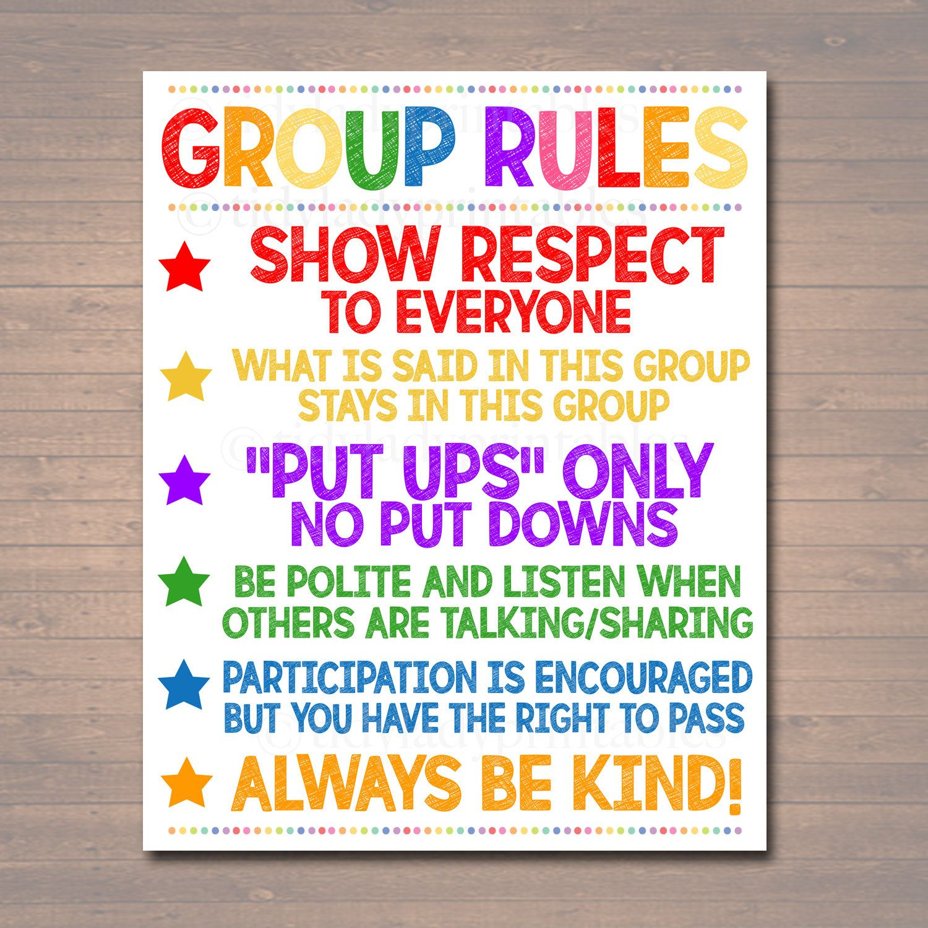
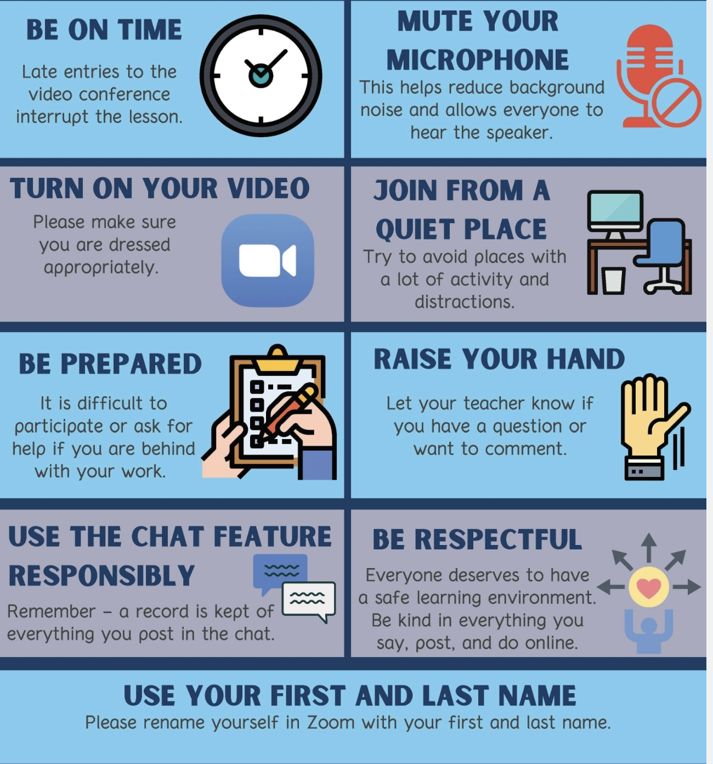
REMINDER PARTICIPANT AGREEMENTS
If you have questions, comments, or feedback, please save them for the two question periods. You can put them in the chat box or raise your real/virtual hand.
Keep comments, questions, and feedback relatively brief so everyone has a chance to participate.(one breath sharing)
If you’re on zoom, make sure no one can overhear what is being said
For reasons that will become clear later in the course please avoid giving advice to other participants about what they should or should not do. Validation, encouragement , and understanding are however very much appreciated.

Slide 8
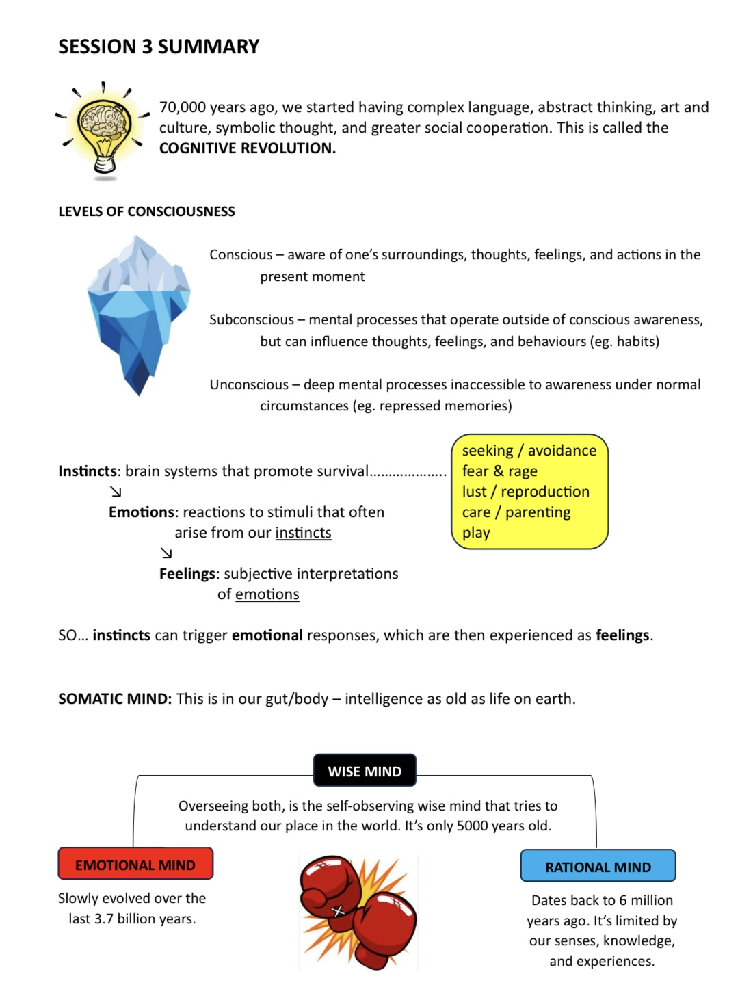
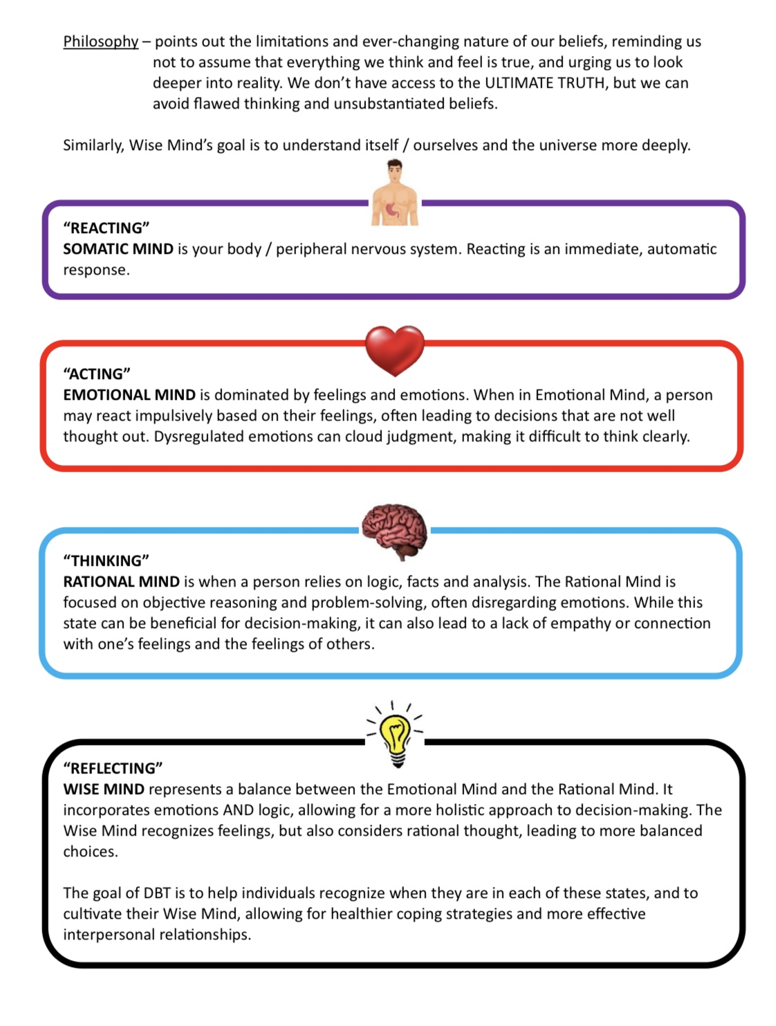
By Kate

Slide 9
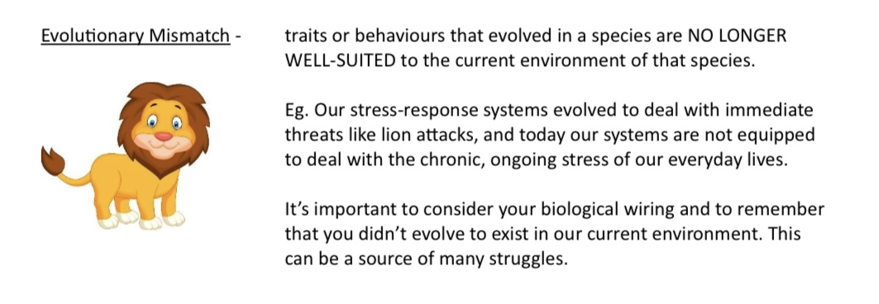

Slide 10

Sorry about last week.
This coming Monday October 27 at 1:00 will be our first boing group. We did a poll last week and 80% of those who responded wanted to use that time to practice a crisis plan.
Next week we’ll practice crisis plans both Monday and Wednesday. Carolyn volunteered for Monday and Chris for Wednesday.
The exercises in the DBT workbook can be downloaded from the publisher’s website (Harbinger)
Best line from last week’s session: we quoted Nietzsche “God is dead” to which, according to Elaine, God responded “Nietzsche is dead”.
WEEKLY ANNOUNCEMENTS

Slide 11
ITS SIMPLE-WEEK 3 POLL
1. How engaged did you feel in the course sessions so far?
a) Very engaged 50%
b) Somewhat engaged 33%
c) Neutral 4%
d) Somewhat disengaged 13%
e) Not engaged 0%
2. How clear in their presentation of the material have the presenters been so far?
a) Very clear 30%
b) Mostly clear 58%
c) Somewhat unclear 8%
d) Confusing 4%
3. Emotionally, for me, so far, the sessions have been…
a) OK 59%
b) Challenging 33%
c) Very challenging 8%
d) Almost intolerable 0%

Slide 12
4. I plan to attend the first boing group on Oct. 27 th 1-2:30pm (444 Douro St.2 nd floor) either in person or on zoom. My preference for what the group should focus on…(single choice)
a) Crafting a personal dashboard 10%
b) Putting together a sensory tool kit 5%
c) Preparing a crisis plan 80%
*any of the above 5%

Slide 13
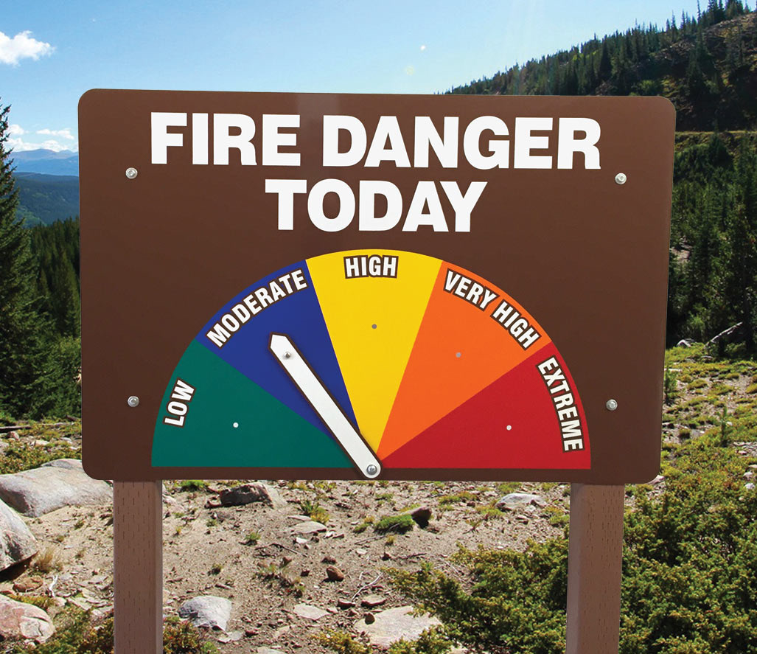

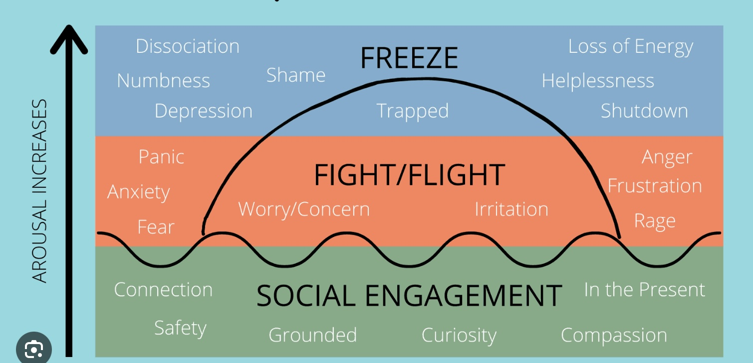

Check in regularly with your Personal dashboard
Spend a few moments checking in with yourself by asking:
1)What is the current risk that I’ll experience a state of crisis ?
Low b) Moderate c) high d) very high e) extreme
2) Am I in the window of tolerance?
a) Yes b) I’m a little outside c) very outside
3) What state of activation am I mostly in at the moment?
a) Calm b) Fight c) Flight d) Dissociated e) Depressed?
4) Where is my energy tank right now?
a) Full b) ¾ c) ½ d) near empty
CRISIS RISK
WINDOW OF TOLERANCE
STATE OF ACTIVATION
ENERGY RESERVES

Slide 14

Warning about meditation
Feel free to skip it
Followed by a moment of silence

Slide 15


Slide 16

E-mailed, questions, comments, feedback
HOUSEKEEPING
What is dissociation ? Are there different kinds of dissociation? I having a sensory soothing tool kit and I try to use it but I stay dissociated. What am I doing wrong?

Slide 17

What we will do today
We’ll start by reviewing the skills training workbook p. 14-32
We’ll discuss suicide and self-harm, and how to prevent them.
We’ll do a poll
We’ll pause for a brake
Kate will do the summary

Slide 18
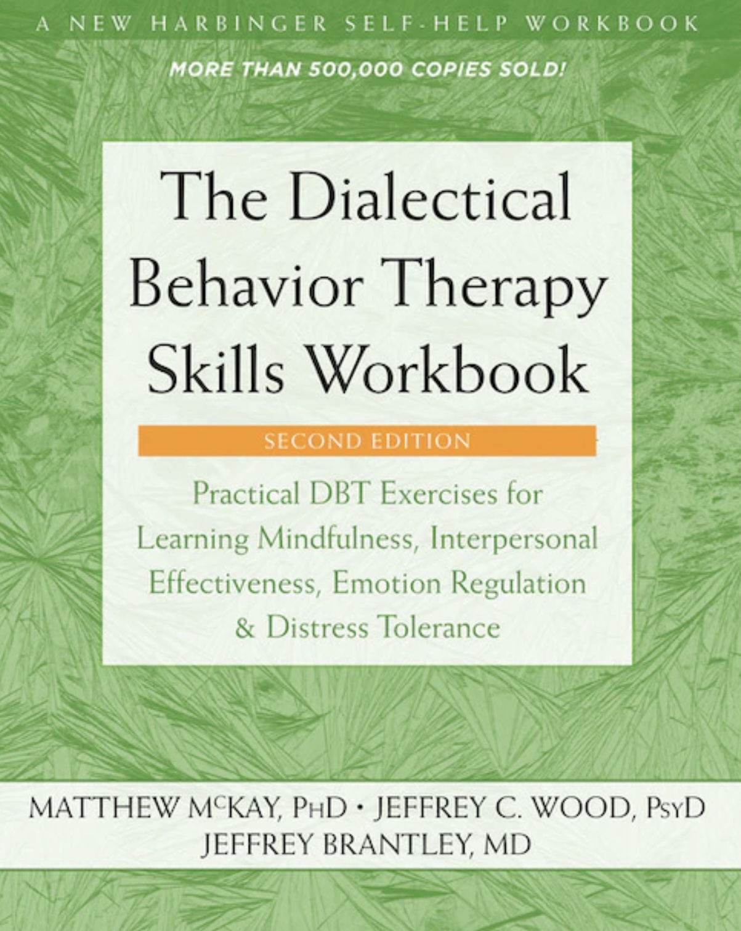


JOAN
NICOLE

Slide 19

Distress tolerance skills PART 2
DBT SKILLS TRAINING WORKBOOK p. 14-32

Slide 20
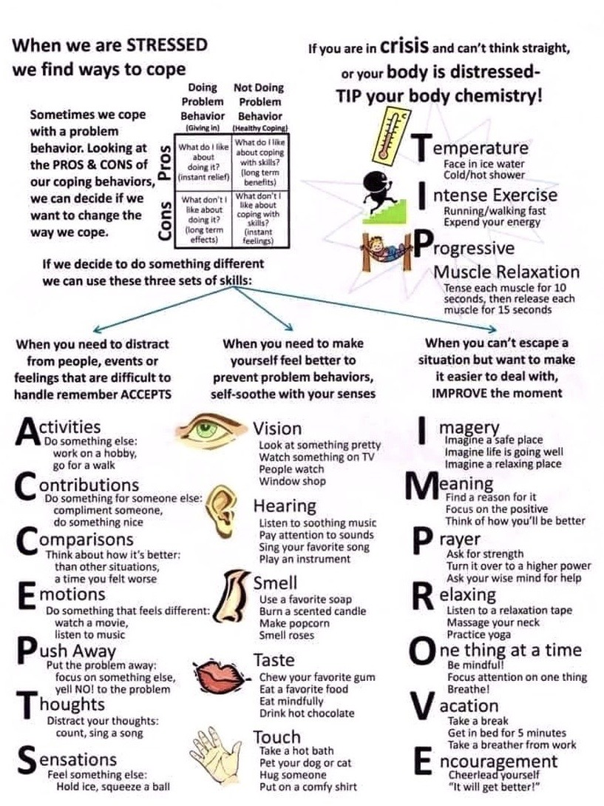
Skills training workbook p. 14-32, distress tolerance week 2
Today we’ll cover 3 subjects:
1. Calm mind ACCEPTS (distracts from emotional mind with Activities, Contributions, Comparisons, Emotions, Pushing away, Thoughts, and Sensations)
2. Sooth yourself with the 5 senses
3. Create distraction and self-soothing plans (choose skills to use in your crisis plan)
In 2 weeks, we’ll discuss:
Advanced distress tolerance skills-IMPROVE the moment (with imagery, meaning, prayer, relaxation, one thing at a time, vacation and encouragement)
In 4 weeks, we’ll go over:
Physiological hacks to calm yourself – TIP (Temperature, Intense exercise, Progressive muscle relaxation)

Slide 21
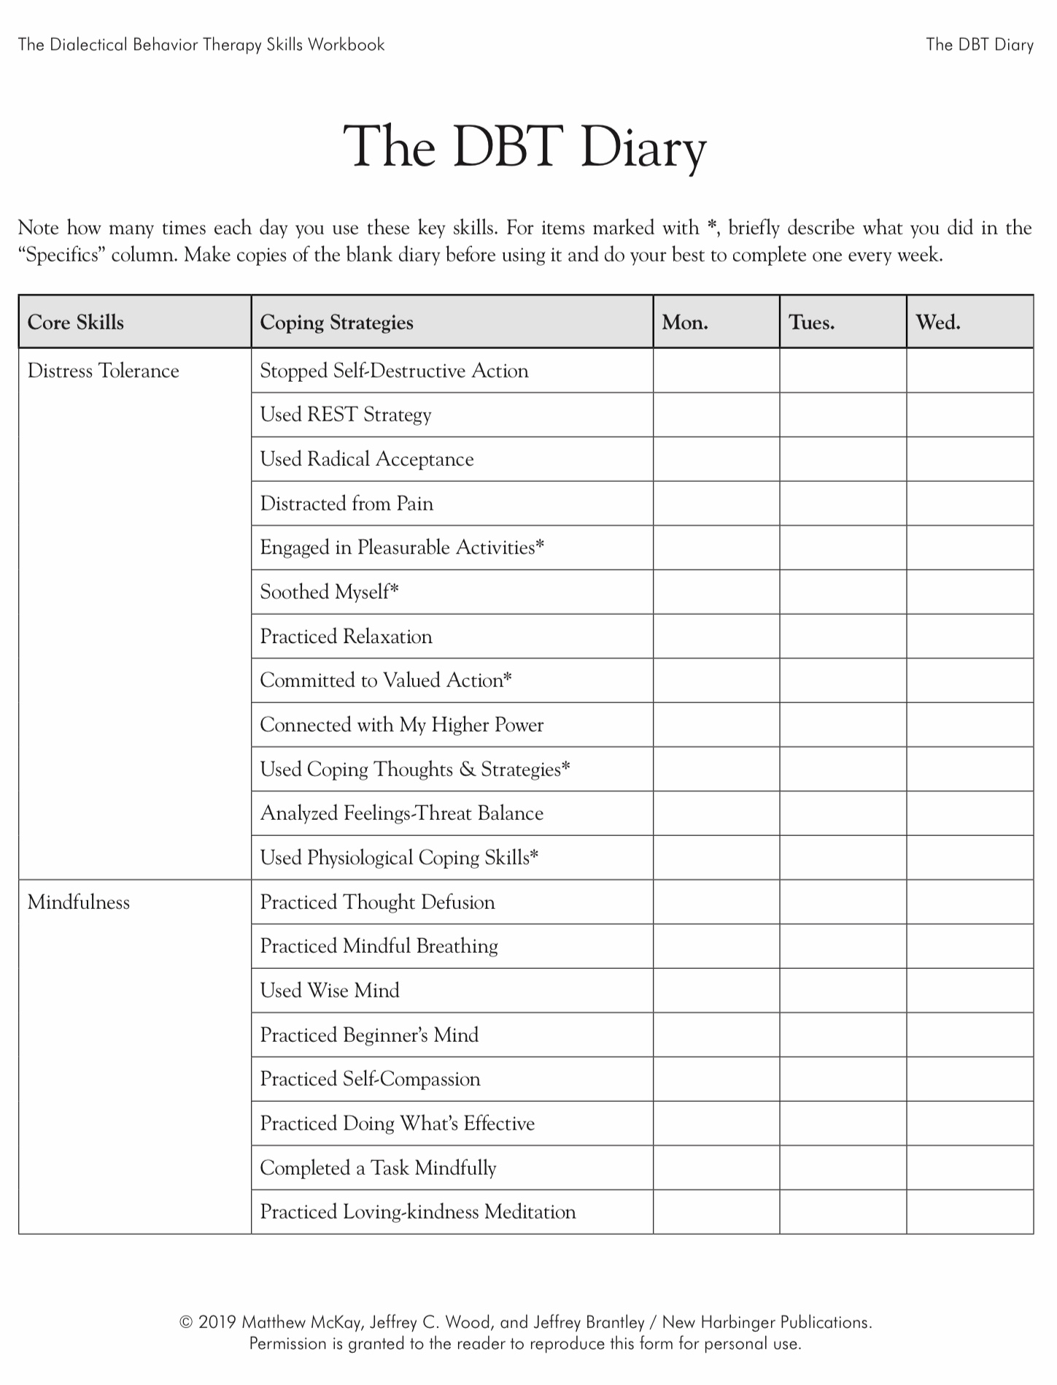
2 weeks ago
2 weeks ago
Today
Today
Today
Today
Today

Slide 22
KEEP A PERSONAL SKILLS LIST INSTEAD OF USING THE DBT DIARY CARD
Many people are confused by or don’t find the skills diary card helpful. People have for example mentioned that it doesn’t list skills you already know or that we talk about in the course but are not in the workbook such as for example the sensory soothing kit, the 5,4,3,2,1 method, or the emotional freedom technique.
Instead of using the skills diary card, consider keeping your own list of the skills you are learning or already know and write these down on a page in your binder.
You might even *(star) your favorite skills on this list.
You could include for example grounding skills such as the self-soothing toolkit, a breathing exercise, REST, and after today’s session radical acceptance statements, and your distraction and self-soothing plan.
Such a list might be more flexible, and more useful than sticking to the more rigid skills diary card provided in the workbook.
You can update this list as you learn new skills.
PERSONAL SKILLS LIST
Grounding skills- Set a daily intention
“ - Sensory soothing toolkit
“ -The 5,4,3,2,1 method
“ -The emotional freedom technique
REST (or PEST) Pause
Radical acceptance statements
Distraction plan
Self-soothing plan
…

Slide 23
PERSONAL SKILLS LIST UP TO THE PRESENT
DISTRESS TOLERANCE SKILLS
Grounding skills- Set a daily intention
“ - Sensory soothing toolkit
“ -The 5,4,3,2,1 method
“ -The emotional freedom technique
REST (or PEST) Pause
Today
6. Radical acceptance statements (please specify)
7. Distraction plan “
8. Self-soothing plan “

Slide 24
Distress tolerance part2
1. Radical acceptance
2. Distraction
skills
4. Relax and Self Soothe skills
5. Create a relaxation Plan
3.Create a distraction plan

Slide 25
Distress tolerance 2
1. Radical acceptance
2. Distraction
4. Relax and Self Soothe
5. Create a relaxation Plan
3.Create a distraction plan

Slide 26
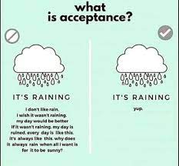
1. Radical Acceptance
Radical acceptance helps us better tolerate pain and distress by changing how we react to it.
When we are in physical or psychological pain, we often judge it and react with blame, anger, anxiety, and general non-acceptance of the pain. These judgements are a form of resistance to the pain. (the second arrow)
Resisting pain often makes it worse. Not only are we experiencing pain or distress but we’re also experiencing the resistance or rejection of it which is also painful. Pain and distress are made worse by this rejection and resistance.
Resistance and non-acceptance of pain may also keep us from doing what is under our control to deal effectively with the cause of the pain and distress.
Radical acceptance asks us to accept pain and distress without adding resistance, rejection or judgement.
Accepting the pain and distress does not mean that these are good things. Instead, it helps us focus on what we can do to alleviate these states rather than spending our energy futilely fighting, resisting and judging them .

Slide 27
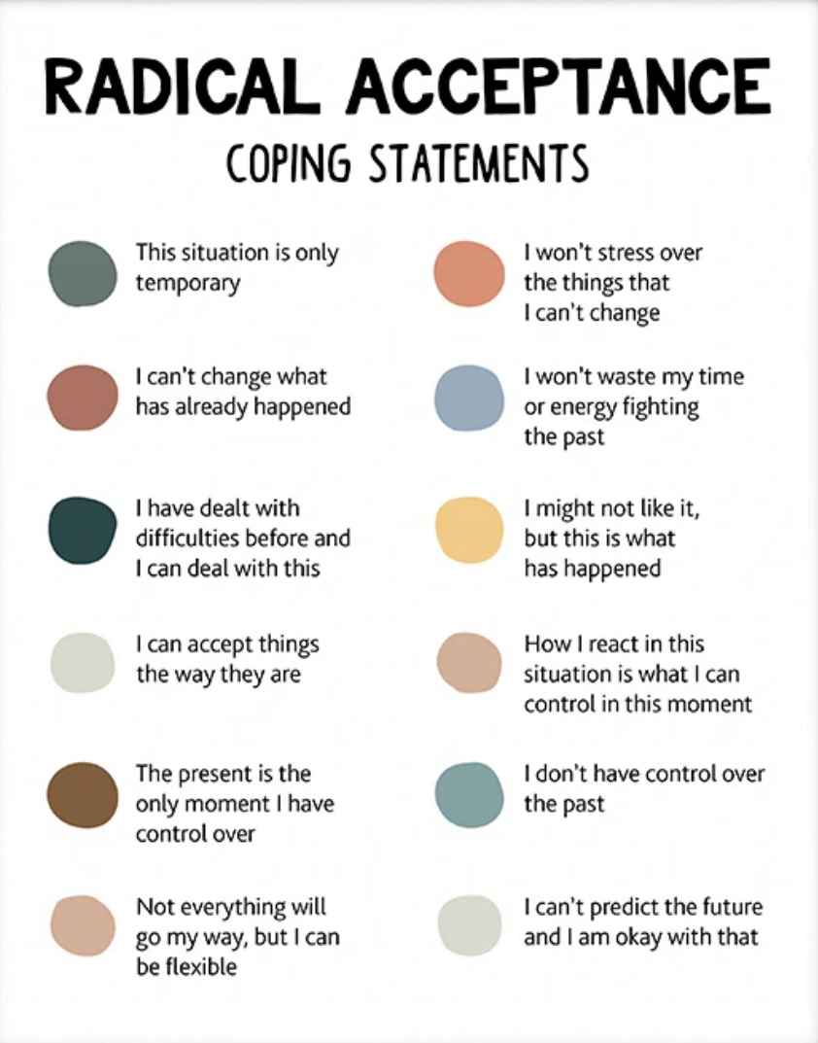
Radical acceptance coping statements
On the left are some examples of radical acceptance coping statements.
Choose one or more statements from this list for your own use. Add this to your list.
Or come up with your own statements
Think of them as your distress “mantra”
The key is to use these when you’re in pain or distress and find yourself resisting them.
Make radical acceptance coping statements part of your crisis plan.
Practice this for videos of past crisis using editing splicing and pasting

Slide 28

PRACTICE USING RADICAL acceptance
To get better at radically accepting pain and distress without judgement, rejection or resistance:
The key is to start with small things
For example, practice radical acceptance when 1. you’re caught in traffic, or 2. in a long line up at the grocery store, or 3. somebody is late to meet you or 4. talking to Rogers.
Can you think of other circumstances in which you might practice radical acceptance?
Decide ahead of time which radical acceptance “mantra” statements you will use.
Come up with your videos of when you experienced emotional pain. Use the editing splicing and pasting technique along with radical acceptance coping statements.
After practicing with small things try it with more serious things like watching the blue jays or maple leafs lose.

Slide 29
Distress tolerance 2
1. Radical acceptance
2. Distraction
4. Relax and Self Soothe
5. Create a relaxation Plan
3.Create a distraction plan

Slide 30

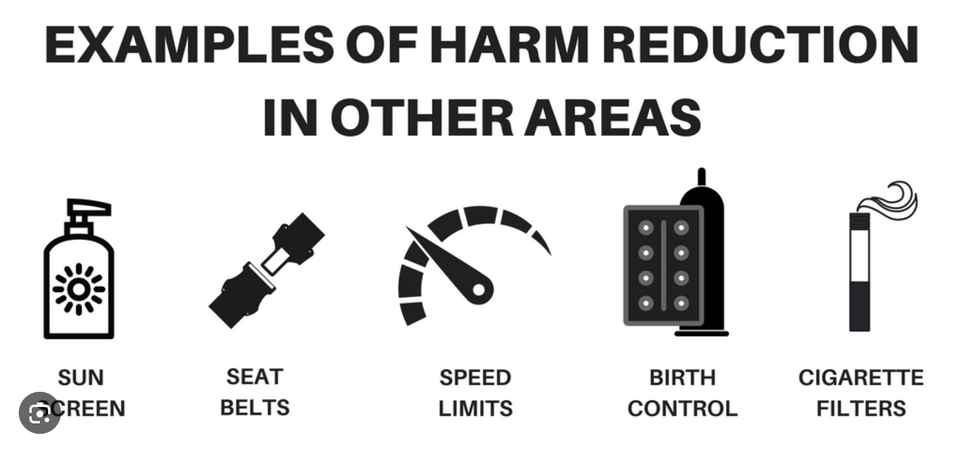
2. DISTRACT AND HARM REDUCE FROM SELF-DESTRUCTIVE BEHAVIORS
We sometimes use maladaptive or self-destructive strategies to try to sooth pain and distress but over the long term this makes them worse.
Maladaptive and self destructive strategies can sooth us over the short term but cause more damage over the long term.
We can use distraction to try to not engage in maladaptive and self-destructive behaviors.
We can also try harm reduction which is doing something that resembles the self-destructive strategy and therefor sooths us but is less harmful over the long run.
Ex. Hold an ice cube in your hand as long as you can. Snap a rubber band on your wrist , pop balloons with faces you’ve drawn.
You can incorporate distraction and harm reduction into your crisis plan. Then edit, splice and paste it into our “videos” of a crisis.

Slide 31
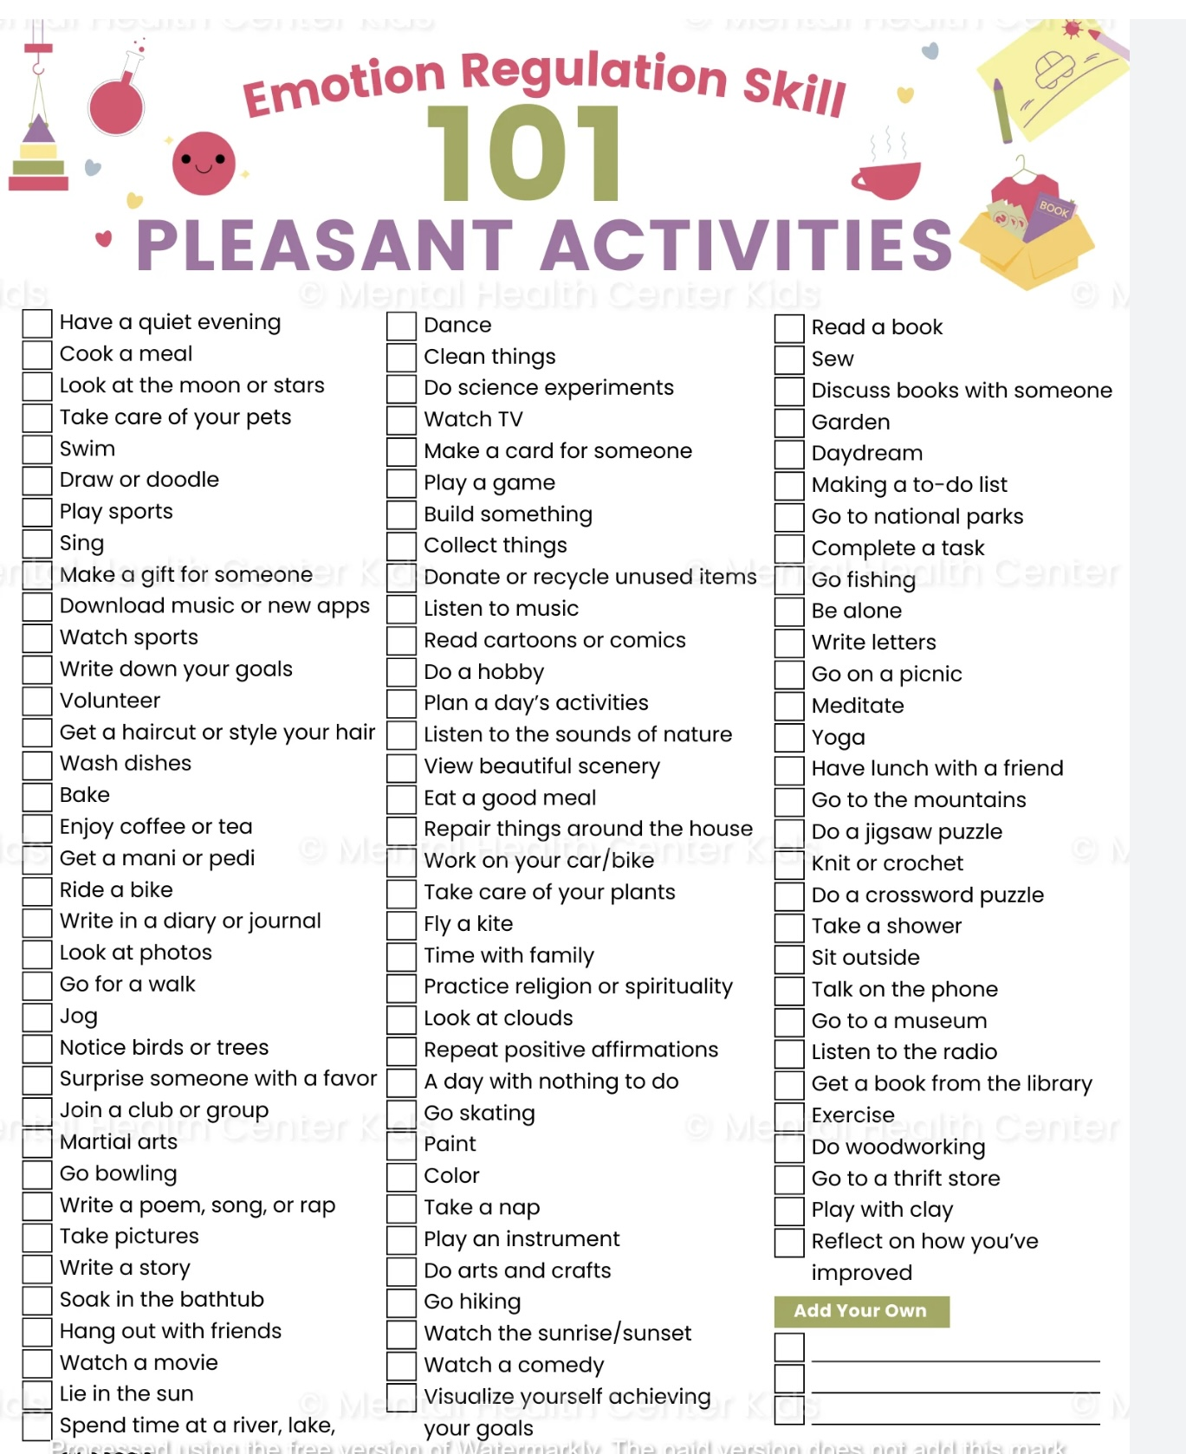
2. DISTRACT WITH PLEASURABLE ACTIVITIES
Review the list of pleasurable activities on pages 18-20 of the workbook
Check off the activities you are likely to use
Engage in these activities as often as you can, don’t wait until you’re in crisis. Come back to the check list when using the 5th tool the goals diary card procedure
Sometimes doing something that makes you feel good is the best way to distract yourself from distressing and painful emotions
Remember to use these in your distraction plan

Slide 32

Other ways to distract yourself

Slide 33
2. Focus on someone else
Pay attention to someone else
Do something for someone else
Take your attention off yourself
Think of someone you care about
3. With thoughts
Distract your thoughts
Remember past pleasant events
Observe nature
Imagine your wildest fantasy coming true. What would it be?
4. By leaving
Distract yourself by leaving
Sometimes it’s helpful to just leave and create some distance between you and the problem
5. With tasks/Chores
Distract yourself with tasks/chores
Take care of yourself or your environment
1. By counting
Distract by counting breaths, subtracting numbers
OTHER WAYS OF DISTRACTING YOURSELF

Slide 34
Distress tolerance 2
1. Radical acceptance
2. Distraction
4. Relax and Self Soothe
5. Create a relaxation Plan
3.Create a distraction plan

Slide 35

3. Create your OWN Distraction plan and use it in your crisis plan

Slide 36
Distress tolerance 2
1. Radical acceptance
2. Distraction
4. Relax and Self Soothe
5. Create a relaxation Plan
3.Create a distraction plan

Slide 37

4. Relax and Self Soothe
When we are in the window of emotional tolerance, that is calm or alert, we think more clearly and make better choices
Relaxation and self-soothing strategies can bring us back into the window of tolerance
We can relax and self-sooth using any of our 5 senses.
Use these in your sensory soothing kit.

Slide 38

SMELL
Light a candle, use incense
smell perfume, essential oils, or freshly baked bread/cookies
Go to a place with a comforting smell
Go to a forest or a farm

Slide 39

vision
Make a collage
Find a picture of or go to a place that’s visually soothing
Carry a photo of someone you admire or love

Slide 40

sound
Listen to…
music
Audio books/ podcast
Nature sounds
White noise machine
Guided meditations

Slide 41

Taste
Prepare and eat favorite meal
Or comfort food
Drink cold or hot drinks
Try gum, mints, candy
Chew on ice cubes
Prepare and drink fresh juicy fruit

Slide 42

touch
Use your self-soothing kit
Carry something soft and comforting in your pocket
Try a using prayer bead
Take warm or cold showers
Get a massage
Play with a pet
Wear comfortable clothes

Slide 43
Distress tolerance 2
1. Radical acceptance
2. Distraction
4. Relax and Self Soothe
5. Create a relaxation Plan
3.Create a distraction plan

Slide 44

PUTTING IT TOGETHER: select your:
1) radical acceptance statement
2) distraction strategy
3) relaxation and self soothing method and use these IN your crisis plan

Slide 45
Don’t forget to add radical acceptance statements and a distraction and self-soothing plan to your DBT diary card or personal skills list.
This is super important because if you don’t keep a list, you won’t remember the skills you’ve learned when you need them.
PERSONAL SKILLS LIST
Grounding skills- Set a daily intention
“ - Sensory soothing toolkit
“ -The 5,4,3,2,1 method
“ -The emotional freedom technique
REST (or PEST) Pause
Radical acceptance statements
Distraction plan
Self-soothing plan
…

Slide 46
PERSONAL SKILLS LIST UP TO THE PRESENT
DISTRESS TOLERANCE SKILLS
Grounding skills- Set a daily intention
“ - Sensory soothing toolkit
“ -The 5,4,3,2,1 method
“ -The emotional freedom technique
REST (or PEST) Pause
6. Radical acceptance statements (please specify)
7. Distraction plan “
8. Self-soothing plan “

Slide 47
Suicide AND SELF-HARM
“The thought of suicide is a great consolation: by means of it one gets through many a dark night.”
— Friedrich Nietzsche
“So many people are hanging on by the thinnest of threads. Treat people with kindness you don’t think they deserve. You never know how much someone is struggling.”
— Nanea Hoffman
“Suicide doesn’t end the chances of life getting worse, it eliminates the possibility of it ever getting better.”
— Unknown
Myths and reality

Slide 48
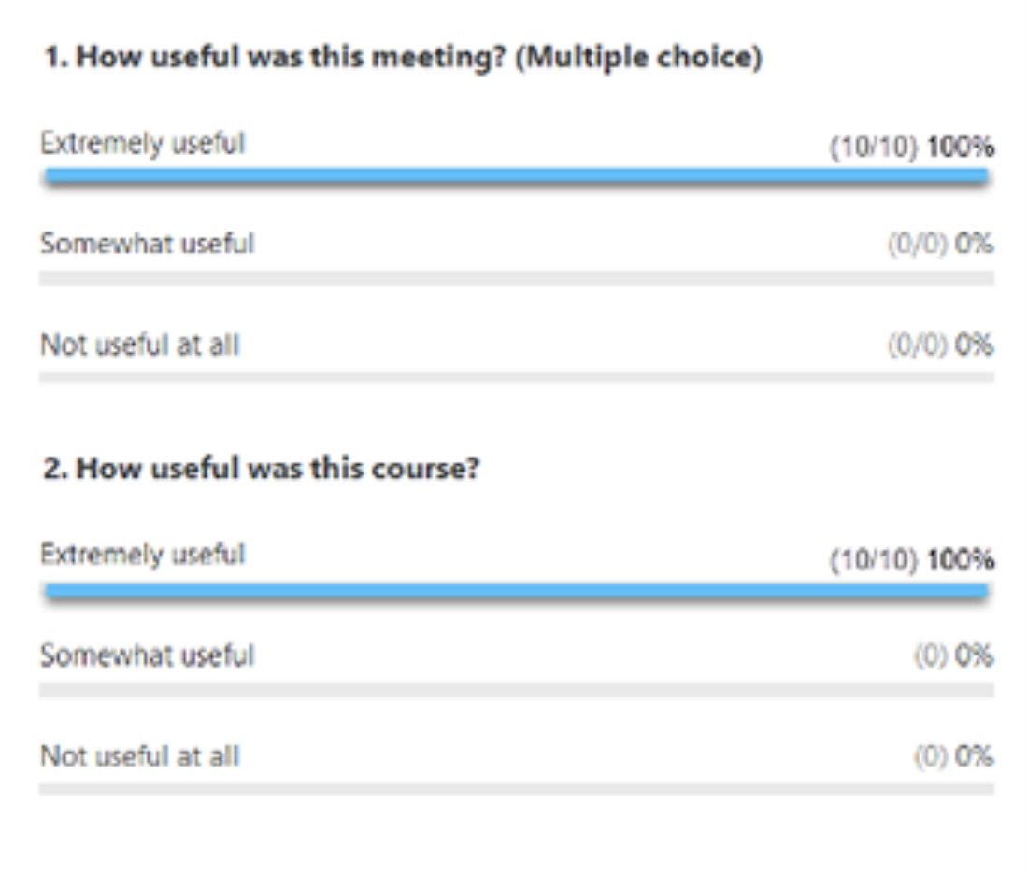
ZOOM POLL
Please answer the following question
Answers are anonymous
In person participants please answer the page that was handed out.

Slide 49

Today we’re going to talk about suicide. Is there a risk some people might be triggered by this discussion?
Notes:
That's a good point. Discussing suicidality could bring back personal experiences that people have had. It's very important in every every session but especially in this one that people keep monitoring their personal dashboard. If their crisis risk increases or they are very outside the window of tolerance, they should pause and use some distress tolerance skills. Although there is some risk of triggering people, this is an important discussion to have, and provided people are careful I think the benefits outweigh the risks.?

Slide 50

WE NEED TO TALK ABOUT…
While some people attending the course may never have had suicidal thoughts, it’s estimated that at least 10% of Canada’s population will experience suicidal ideation at some point in their lives.( 5% will make an attempt and 4% a suicide plan)
Suicidal ideation is a common and very important "hole" that many people, especially those with mental health issues, encounter.
Because it can be so consequential, we devote part of this distress tolerance and crisis planning session to it.
Many people who struggle with mental health issues have either, occasional, frequent, or constant suicidal ideation.
Thoughts of suicide or self-harm, including feelings of despair and hopelessness, suicidal thoughts, and suicidal behaviors are, for anyone who experiences them, a critical “hole” for which crisis plans and distress tolerance skills can be lifesaving. Having a crisis plan is a must for anyone who experiences these thoughts.
Although this discussion may trigger some people, it is an important one to have at this point in the course. There is very good evidence that talking about suicide or self-harm does not make it worse (except for cases of “contagion” which we’ll discuss below)
As we proceed today, pay attention to your personal internal dashboard and take care of yourself the best you know how. Take a break if you need to.

Slide 51
Many different terms are used when talking about suicide and self-harm. These terms can be somewhat confusing. Could we define some of them?

Slide 52
frequently used terms
6. Suicide plan – how and the means by which the person intends to carry out suicide
7. Suicidal intent – refers to the main goal or objective of the suicidal behavior. Is it seeking relief? Sending a message? A cry for help? An expression of anger?
8. Suicide related communication – conveying suicidal ideation to others
9. Suicidal threats – an interpersonal communication that a reasonable person would interpret as communicating or suggesting that suicidal behavior might occur in the near future
10. Suicidal gesture – suicide-related behaviors that are carried out without suicidal intent. (is a term that can be misused to convey an intent to manipulate)
1. Suicidal behavior – any behavior resulting in an attempt or preparation for an attempt; this may include practicing or rehearsing for the attempt.
2. Suicide attempt – nonfatal self-directed potentially injurious behavior with any intent to die as a result of the behavior. A suicide attempt may or may not result in injury.
3. Non suicidal self injury (also known as self-harm) – deliberate self-directed destruction or alteration of body tissues without a conscious suicidal intent.
4. Postvension – interventions to address the care of bereaved survivors, caregivers, and healthcare providers. These are meant to destigmatize the tragedy of suicide and assist with the recovery process and serve as a secondary prevention effort to minimize the risk of subsequent suicides due to complicated grief, contagion, or unresolved trauma.
5. Suicide contagion – the phenomenon by which suicide and suicidal behavior is increased for some who are exposed to the suicide of others. This is especially common among younger people.
Notes:
This is a partial list of some of the commonly used terms in discussions about suicidality.

Slide 53
NON-SUICIDAL SELF-INJURY
Non-suicidal self-injury (NSSI) or non-suicidal self-harm (NSSH) can be defined in both a narrow and a broader sense, depending on context (clinical research vs. public health or psychosocial discussion).
Narrow Definition (Clinical / Research). In the DSM-5 and most clinical studies non-suicidal self-injury (NSSI) refers specifically to direct, deliberate, and self-inflicted damage to body tissue without suicidal intent and for purposes not socially sanctioned. Examples are cutting, burning, scratching, or hitting oneself. From this narrow definition are excluded behaviors such as substance misuse, disordered eating, or reckless driving. The emphasis is on direct tissue damage, absence of suicidal intent and a repetitive pattern.
This definition is used to distinguish NSSI from both suicidal behavior and broader self-destructive coping. strategies.
Broader Definition (Public Health / Psychosocial). In broader contexts, such as community mental-health research, or sociology, “self-harm” or “non-suicidal self-harm” may include any intentional act of self-injury or self-poisoning regardless of motive or degree of suicidal intent. Indirect forms of self-harm, such as binge drinking, starvation, or other risky behaviors, can be included under a “continuum of self-injury.” Under this broader definition the focus is on psychological distress, emotion regulation, and risk factors, rather than precise diagnostic boundaries.

Slide 54
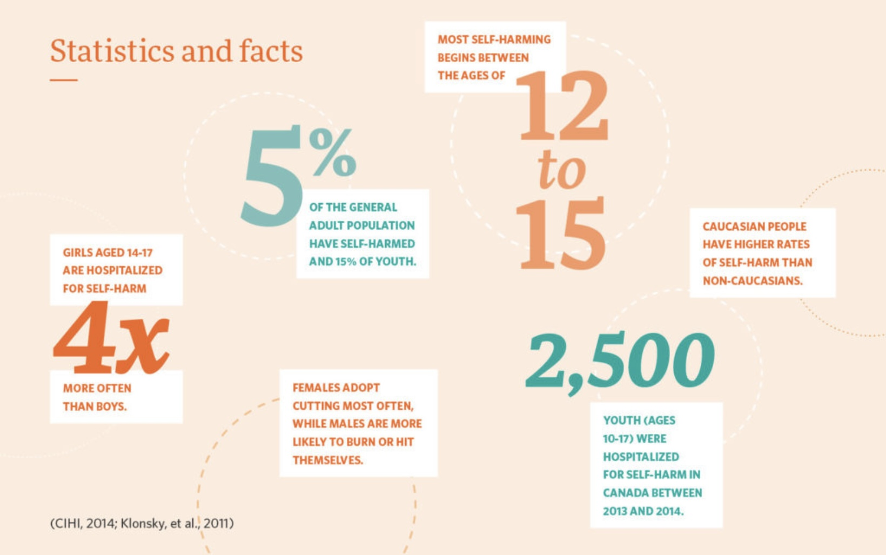
NON-SUICIDAL SELF-INJURY
Examples of non-suicidal self-injury (NSSI), that is, deliberate self-inflicted harm done without intent to die include:
1. Cutting or scratching: Using sharp objects (e.g., razor blades, knives, glass, safety pins) to make shallow cuts on arms, legs, or other body parts. Scratching the skin with fingernails or objects until it bleeds.
2. Burning: Pressing lit cigarettes, lighters, or heated metal against the skin. Pouring hot water or other hot substances on oneself.
3. Hitting or punching: Punching walls or hard objects. Hitting oneself (e.g., in the face or thighs). Banging one’s head against a wall or surface.
4. Interfering with wound healing: Picking at scabs or reopening old wounds to prolong healing or to feel pain again.
5. Hair-pulling: Pulling out hair from the scalp, eyelashes, eyebrows, or other body areas.
6. Severe skin-picking: Repeatedly picking at pimples, scabs, or healthy skin until it bleeds or scars.
7. Ingesting non-lethal or harmful substances: Swallowing small amounts of toxic or inedible materials (soap, chemicals, etc.) without suicidal intent. Taking medications in small overdoses, not to die but to feel pain or loss of control.
8. Extreme forms of physical restraint or deprivation: Starving oneself or excessive exercising (especially when primarily to punish oneself rather than for body image). Exposing oneself to extreme cold or heat intentionally.

Slide 55
Can you compare and contrast suicide and self-harm ?

Slide 56
SELF HARM VS. SUICIDE ATTEMPTS
It is important to distinguish self-harm from suicide attempts.
Self-harm is also referred to as “non-suicidal self-injury.”
Self-harm is defined as the deliberately hurting of the body such as by cutting, headbanging, hitting, or burning.
Self-harm is a harmful and maladaptive way of trying to cope with emotional pain such as sadness frustration or anger.
There are several important differences between self-harm and suicide attempts in terms of frequency, methods, severity, and purpose.
self-harm suicide attempts
Is very frequent and on the rise in the young happen less frequently
Often involve cutting burning and self hitting most frequent method is overdosing
is less life endangering are more life endangering sometimes fatal
Is often done to cope with painful emotions are done with an intent to die

Slide 57
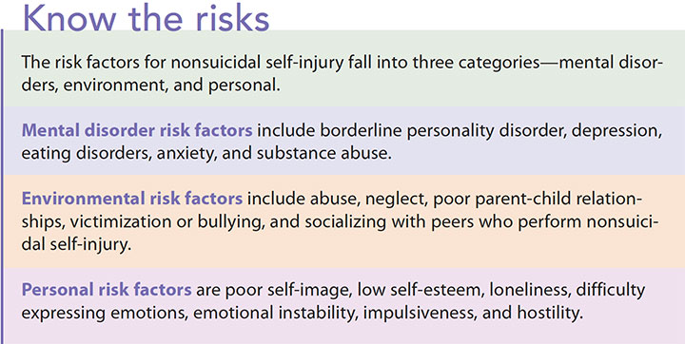
WHY PEOPLE
SELF-HARM
Self-harm is often not about wanting to die, but about coping with overwhelming inner experiences.
Self-harm may be used to:
Regulate intense emotions (release, relief, or to feel something when numb)
Gain a sense of control when life feels chaotic
Express inner pain that feels hard to put into words
Distract or ground from overwhelming thoughts or memories
Relieve tension through physical sensation
Punish oneself out of guilt, shame, or anger
Communicate distress or signal need for care
Feel real or embodied when dissociated or disconnected…

Slide 58
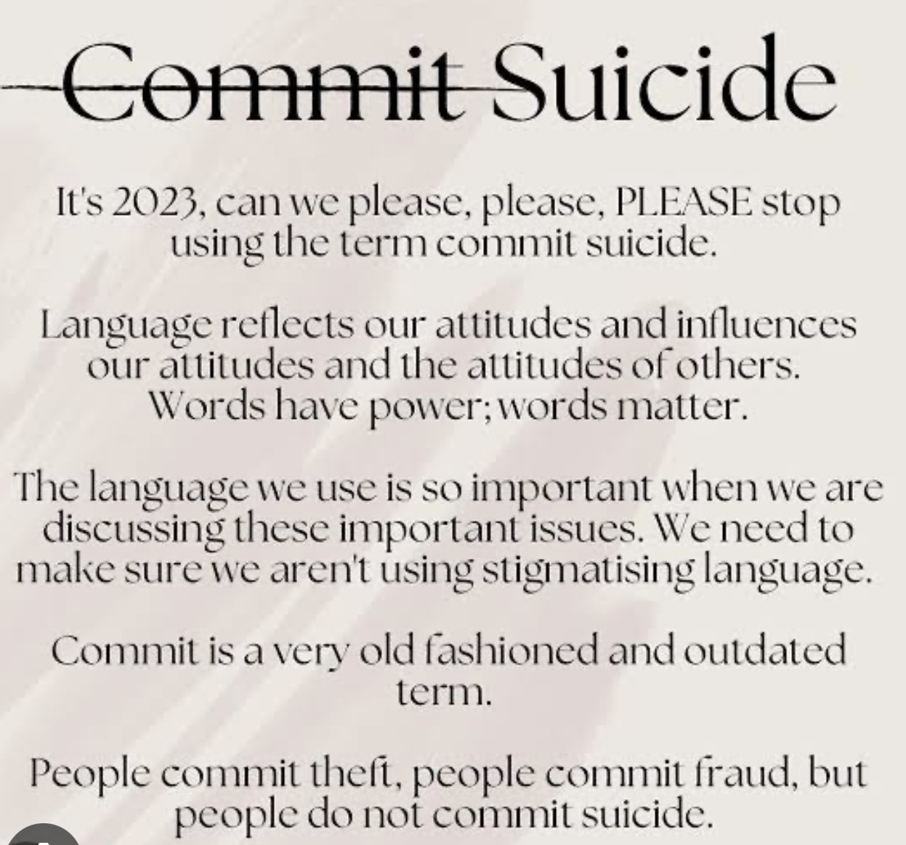
WHY PEOPLE MIGHT CONSIDER SUICIDE
“Commit” is a word generally reserved for acts viewed as sinful or immoral. “Completed” is usually a good thing.
Instead of these words suicide awareness advocates encourage the use of words like contemplate, think of, died by, took her own life.
“Contemplating” suicide is often not due to one cause, but overlapping human experiences of pain, distress, loss, and disconnection including:
Unbearable emotional pain ("psych ache") and hopelessness
Mental health conditions (depression, anxiety, bipolar, PTSD)
Relationship loss, rejection, or conflict
Histories of trauma, abuse, or bullying
Profound loneliness and social isolation
Financial, work, or academic stress
Chronic illness or ongoing physical pain
Substance use lowering control and intensifying distress
Feeling like a burden to others
Impulsivity during an acute crisis or sudden stressor

Slide 59
How common are suicide and self-harm ?

Slide 60
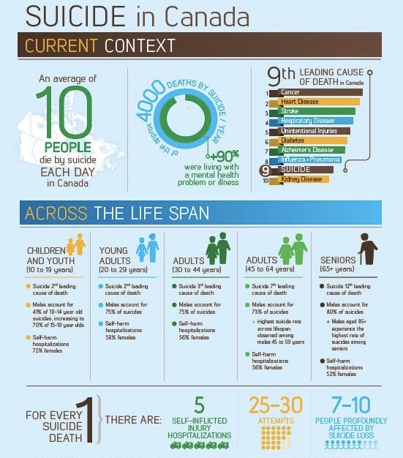
CANADIAN STATISTICS
In Canada there are approximately 120,000 suicide attempts every year, or 10-11 people per 100,000. (That’s over 300 suicide attempts in Canada every day of the year.)
In Canada approximately 4000 people die from suicide per year. That’s an average of more than 10 every day.
Every persons suicide profoundly affects an average of 10 people.
More than 90% of people who attempt, or die by suicide have diagnosable mental health issues.
More than 50% of people who die by suicide have never received any kind of mental health care
Males account for 75% of deaths by suicide
Females account for most suicide attempts and self-harm.
Overall, suicide is the 9th leading cause of death in Canada.
However:
For people aged 15 to 34 it is the 2nd leading cause of death.
Suicide rates among adolescents has gone up 40% in the last 10 years
Indigenous communities experience significantly higher rates of attempts and deaths by suicide. Suicide rates are higher in Northern and isolated communities

Slide 61

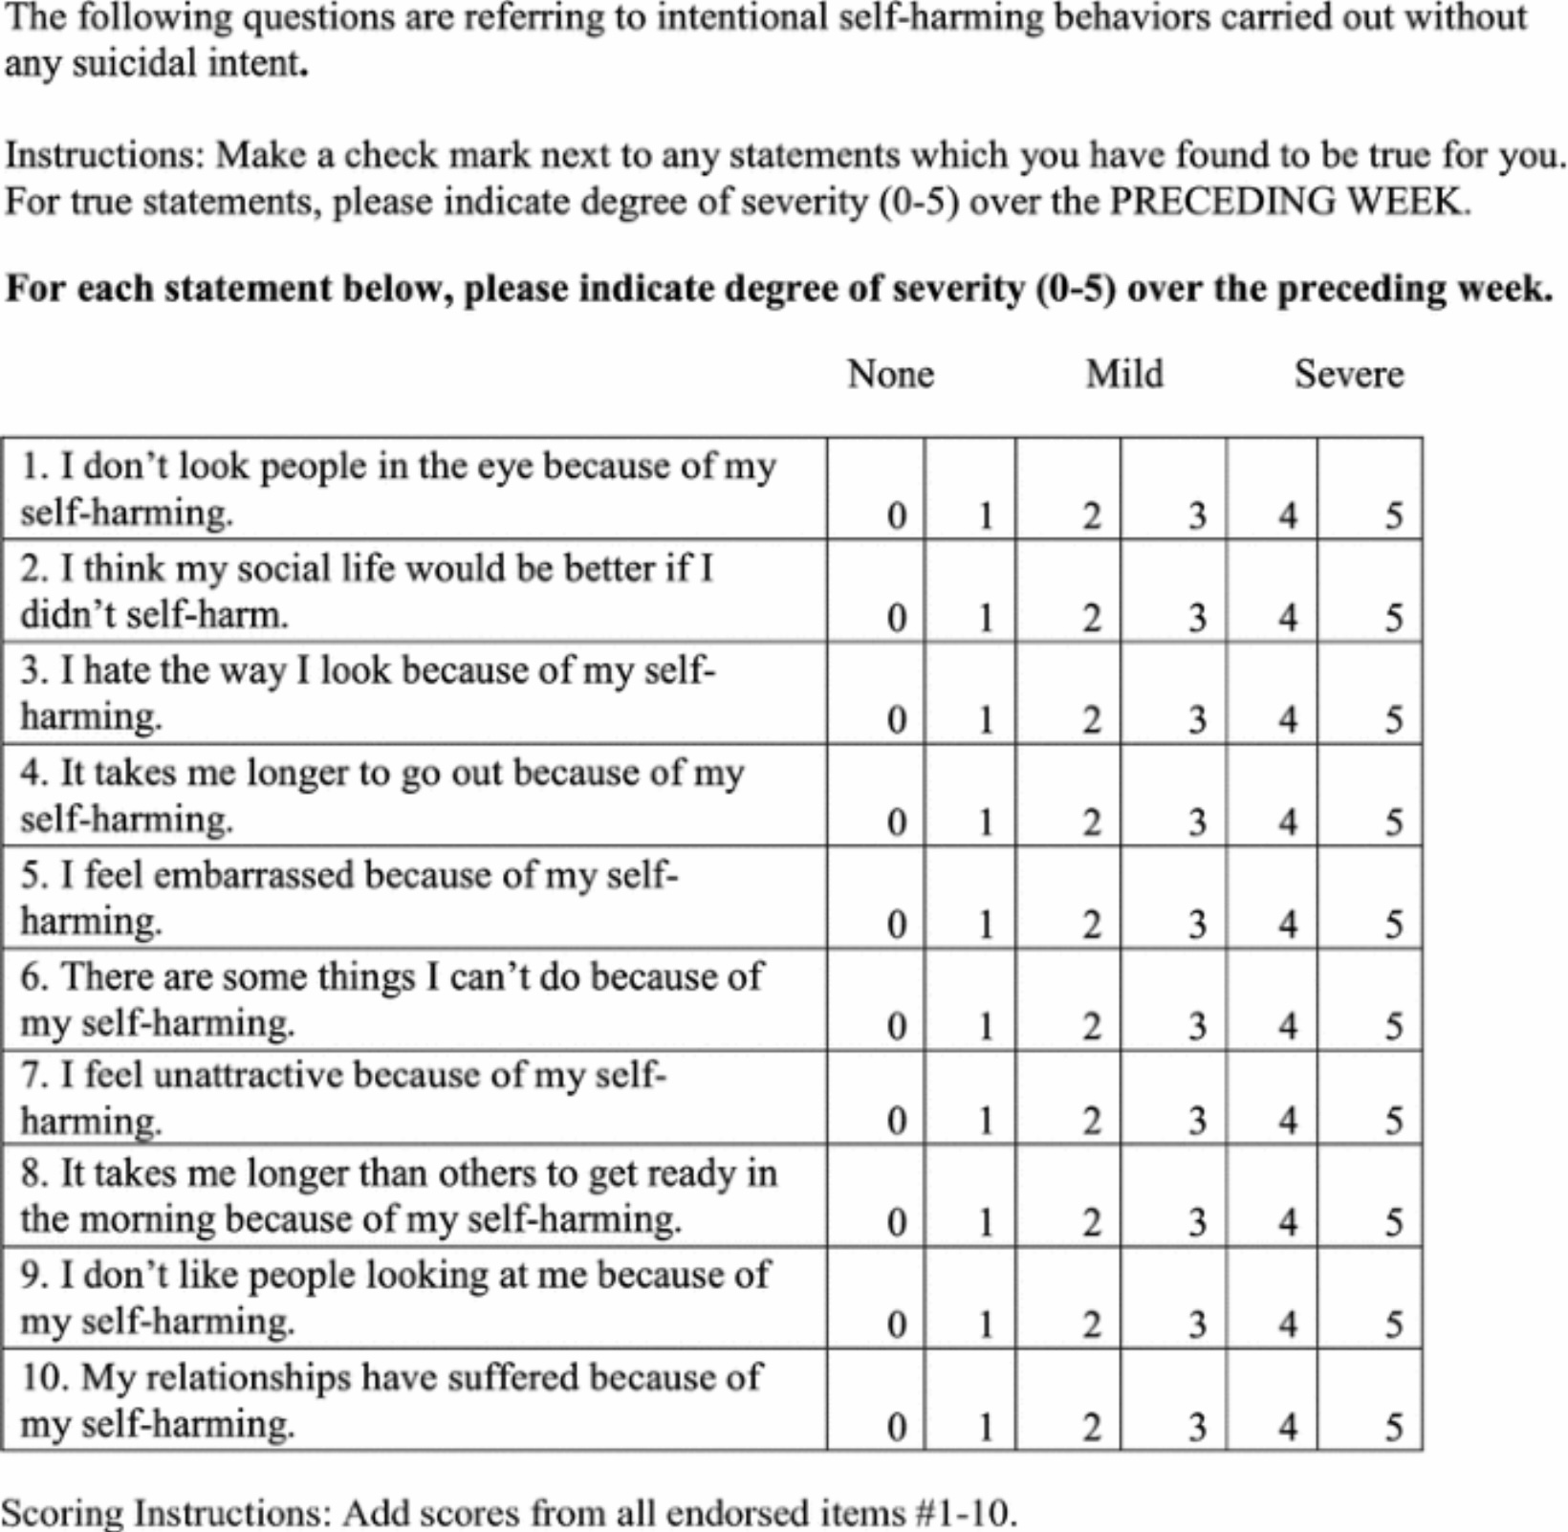
NON-SUICIDAL SELF-INJURY
Among adolescents, the lifetime prevalence of non-suicidal self-injury (NSSI) is estimated to be around 16 % (with girls typically higher than boys) in many studies.
A recent meta-analysis found an aggregate lifetime prevalence of NSSI in youth at 22 % and a past-12-month prevalence of 19.5 % .
In Canada, self-harm leads to about 20,000 hospitalizations annually.
Globally, there are an estimated 14 million incidents of self-harm per year.
These figures include non-suicidal self-harm (i.e. behaviors without intent to die) as well as deliberate self-harm / suicidal attempts in some studies, so definitions and numbers vary.
Rates tend to be higher during adolescence and young adulthood than in other life stages.
Females generally report higher rates of non-suicidal self-injury than males in community samples.
Many incidents of self-harm are not captured in available data (because people may not seek medical help or may treat wounds themselves), so these numbers likely underestimate the true prevalence.

Slide 62
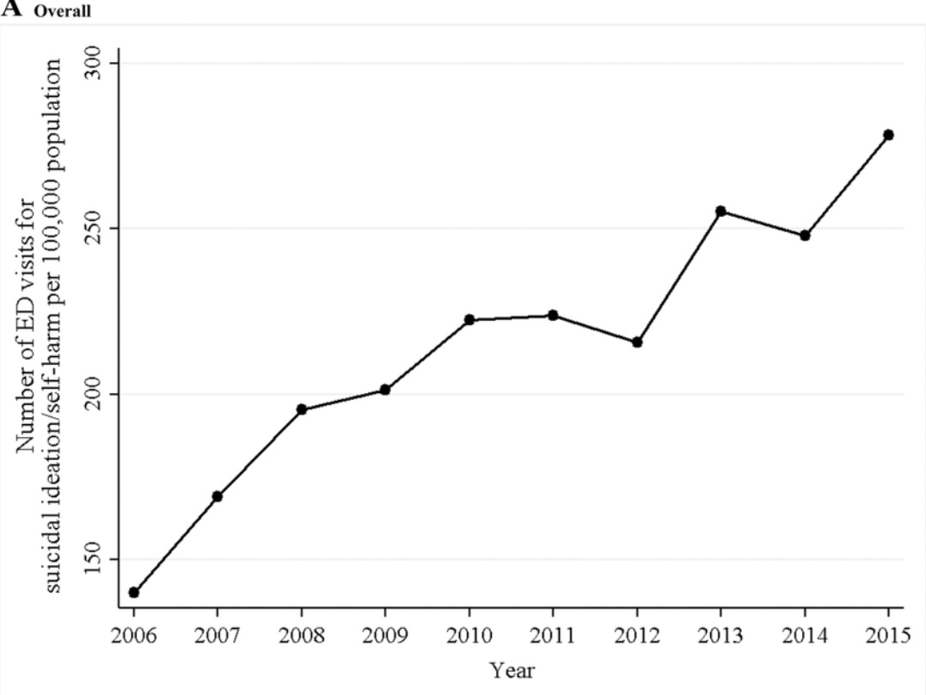

Slide 63
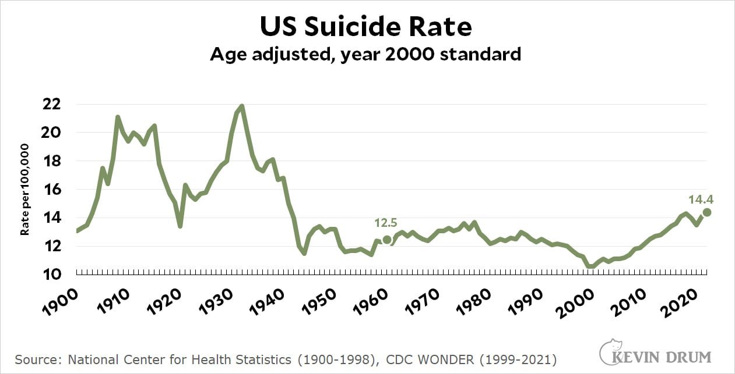

Slide 65
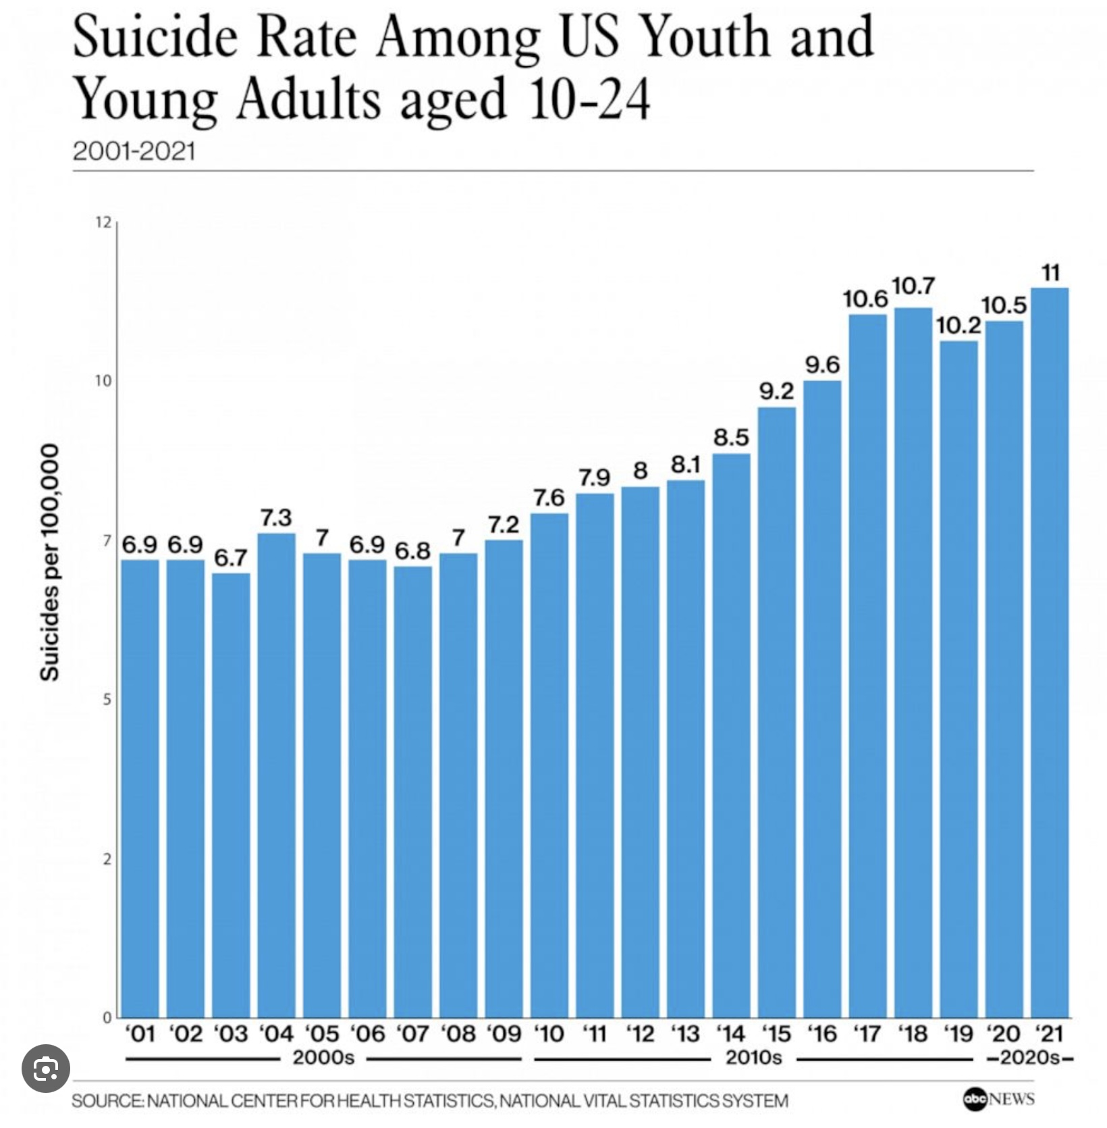
TRENDS
Although trends can vary by region, and demographic group, suicide rates in North America have overall increased over the last decade.
Several factors are thought to have contributed to this rise:
There has been an increase in mental health disorders such as depression and anxiety.
Despite growing awareness, access to mental health care can still be limited for many people.
Despite progress, there is still stigma surrounding mental health issues, which can prevent individuals from seeking help.
The opioid crisis and increased use of other substances have been linked to higher suicide rates. Substance abuse can exacerbate mental health issues and increase impulsivity.
Economic instability, unemployment, and financial stress can contribute to feelings of hopelessness and despair, leading to higher suicide rates.
Changes in social structures and increased social isolation, especially during events like the COVID-19 pandemic, have been associated with increased mental health challenges.
Easy access to means of suicide, such as firearms, can increase suicide rates. Efforts to restrict access have been shown to help reduce rates.

Slide 66


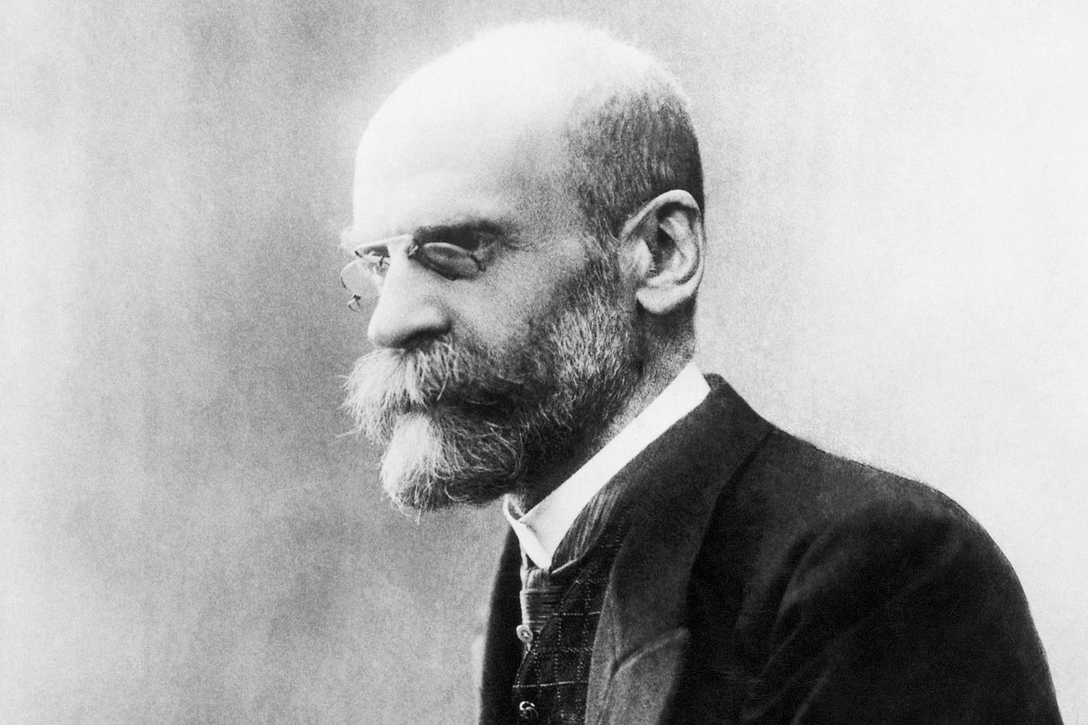
The sociological study of suicide begins with Émile Durkheim, one of the founding figures of sociology. His groundbreaking1897 work “Le Suicide” was the first major sociological study to treat suicide not just as an individual psychological phenomenon, but as a social fact, shaped by forces larger than any one person.
Durkheim’s core insight was that suicide is not simply an individual act driven by mental illness or personal despair, it is deeply influenced by the structure of society, particularly the degree of integration and social regulation a person experiences.
Durkheim identified four types of suicide, each arising from imbalances in these two social forces:
Egoistic Suicide- Occurs when social integration is too low. The person feels isolated, not meaningfully part of any group. It is common in societies with weak communal bonds. Example: A person with no family or religious ties who feels existentially adrift. “Egoism is the state where the individual ego asserts itself to excess in the face of the social ego and at its expense.”
Altruistic Suicide- Occurs when social integration is too high. The self is so absorbed into the group that one sacrifices themselves for it. Seen in highly collectivist cultures or military situations. Example: Kamikaze pilots, or suicide bombers. The individual “no longer perceives the limits of the self” and dissolves into the group identity.
THE SOCIOLOGY OF SUICIDE

Slide 67
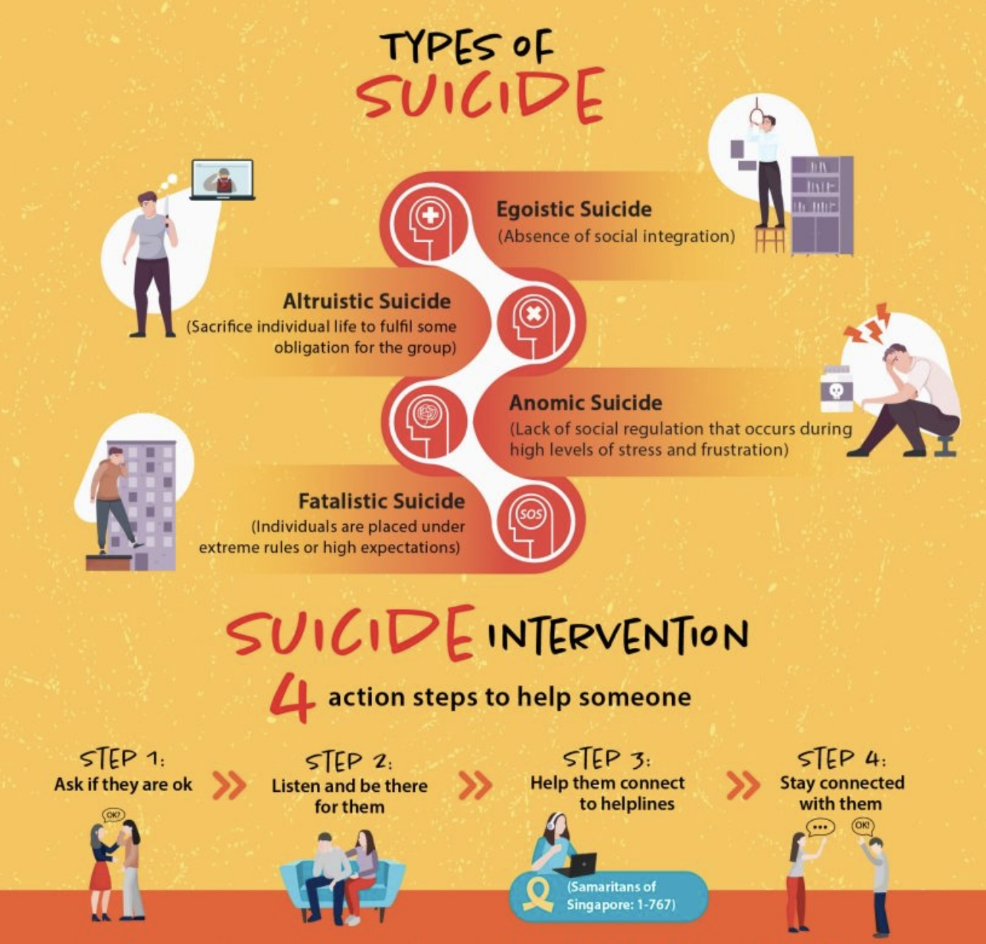
Anomic Suicide- Occurs when social regulation is too low, especially during times of economic upheaval or rapid social change. Norms are disrupted; people feel unanchored. Example: Suicide rates rising after a financial crisis or divorce. Anomie is a state of “normlessness”, a disconnection from shared rules, expectations, and meaning.
Fatalistic Suicide - Occurs when social regulation is too high. Lives are overcontrolled and oppressive; there is no hope of change. Example: Suicides among prisoners or people in abusive institutions.
In his study of suicide, Durkheim shifted the lens from asking “What’s wrong with this person?” to “What does this person’s despair say about their relationship to society?”
It was a revolutionary move toward seeing mental health, despair, and even suicide as socially patterned phenomena, not just as private tragedies.
Durkheim’s theory remains relevant in modern research:
The suicide epidemic among men (especially middle-aged men) has been linked to egoistic or anomic factors.
Indigenous youth suicide involves disconnection (egoistic) and cultural suppression (fatalistic).
Workplace burnout or suicide in high-pressure professions overlaps with fatalistic and anomic types.
THE SOCIOLOGY OF SUICIDE

Slide 68
INEQUALITY AND SUICIDE RATES
There’s a well-documented and striking relationship between income inequality (measured by the Gini coefficient) and suicide rates, observed across many countries and over time.
Higher Gini coefficients (greater income inequality) are consistently associated with higher suicide rates, both across countries and within nations over time. “It’s not just poverty that predicts suicide, it’s inequality.” People’s sense of relative disadvantage, social exclusion, and lack of belonging appear more predictive than absolute economic hardship.
A 2021 World Psychiatry meta-analysis found that a 0.1 increase in a country’s Gini coefficient was associated with roughly a 5–8 % higher suicide rate, depending on age group.
OECD data show that countries with lower inequality (e.g. Norway, Denmark, Netherlands) tend to have lower suicide rates than similarly wealthy but more unequal nations (e.g. U.S., South Korea).
Within the U.S., counties with the highest inequality have suicide rates up to 30 % higher than those with the lowest inequality, even after adjusting for poverty and unemployment.
Different possible reasons have been offered for this. 1) Relative deprivation: When the gap between rich and poor widens, people experience more social comparison, shame, and feelings of failure.2) Erosion of social trust and cohesion: Inequality weakens community bonds, known protective factors against suicide.3) Reduced access to resources and mental-health supports for those at lower socioeconomic levels.4) Cultural emphasis on individual achievement in unequal societies can amplify despair in those who struggle economically.
The link is strongest for men, working-age adults, and younger people in highly individualistic societies.
In societies with strong social safety nets, inequality has a weaker effect, suggesting policy and culture can buffer the harm.
Rise in inequality seems to increase suicide risk, not only through material deprivation but by corroding the social fabric that gives people belonging, dignity, and hope

Slide 69

DEATHS OF DESPAIR
"Deaths of despair" is a term that has been used to describe deaths resulting from suicide, drug overdose, and alcohol-related conditions. The term was popularized by economists Anne Case and Angus Deaton, who highlighted the increasing rates of these deaths, particularly among middle-aged white Americans of lower socioeconomic status.
The term “despair” reflects the idea that these deaths are often linked to a sense of hopelessness , driven by factors such as economic hardship, social isolation, and lack of access to healthcare and mental health services.
The rise in deaths of despair has been attributed to several interconnected factors, including:
Declining job opportunities, particularly in industries like manufacturing and mining, which have led to economic instability and reduced social mobility for many individuals and families.
Changes in community structures, family dynamics, and social networks which have led to increased feelings of loneliness and isolation.
The opioid crisis, along with increased use of other drugs and alcohol, has contributed significantly to these types of deaths.
Shifts in cultural and societal norms may also play a role, influencing how individuals cope with stress and adversity.
Although the term was only recently popularized, historically many underprivileged communities, such as native North Americans, have also experienced deaths of despair.

Slide 70
Can you summarize the biological, physical, psychological, psychological, social and spiritual factors that have been linked to suicide?

Slide 71
BIOLOGICAL FACTORS IMPACTING SUICIDE
1. Neurotransmitter Imbalance-Low serotonin → Impulsivity, aggression, depression. Dopamine dysfunction → Anhedonia, hopelessness. Norepinephrine dysregulation → Emotional instability
2. Brain Structure & Function-Prefrontal cortex: ↓ impulse control, decision-making. Amygdala: ↑ emotional reactivity, fear
Anterior cingulate cortex: ↑ emotional pain, social rejection sensitivity
3. Genetic & Epigenetic Risk-Family history of suicide → inherited traits (e.g., impulsivity, mood disorders). Epigenetic changes from trauma or stress → altered brain chemistry
4. Hormonal & Stress Systems-HPA axis overactivation → chronic stress, cortisol imbalance. ↑ Risk in thyroid dysfunction, low testosterone, estrogen fluctuations
5. Physical Illness & Neurological Conditions-Chronic pain, traumatic brain injury (TBI). Epilepsy, stroke, Parkinson’s, multiple sclerosis. Terminal illness or cancer
Biological factors don’t cause suicide alone but lower the threshold, especially when combined with trauma, mental illness, or social stress.

Slide 72
PHYSICAL FACTORS IMPACTING SUICIDE
1. Chronic Pain-Linked to hopelessness, depression, and desire to escape suffering. Higher suicide risk with opioid dependence
2. Neurological Conditions-Traumatic brain injury (TBI), epilepsy, stroke, Parkinson’s, multiple sclerosis. Impact emotional regulation and cognitive function
3. Terminal and Life-Limiting Illnesses-Cancer, ALS, advanced heart/lung disease. Associated with loss of autonomy, existential distress
4. Disability and Functional Impairment-Loss of mobility, sensory deficits, or independence. Increased risk of isolation, depression, and suicidal ideation
5. Endocrine and Hormonal Disorders-Thyroid dysfunction, low testosterone, menopause. Can affect mood, energy, and mental health
6. Sleep Disorders-Chronic insomnia, sleep apnea. Strongly linked to depression and suicidality
Physical health conditions, especially when combined with pain, loss, or isolation, can significantly elevate suicide risk integrated care is essential.

Slide 73
PSYCHOLOGICAL FACTORS IMPACTING SUICIDE
1. Depression & Mood Disorders-Hopelessness, worthlessness, emotional pain. High suicide risk in major depressive episodes and bipolar disorder
2. Anxiety Disorders & PTSD-Severe anxiety and trauma-related flashbacks increase risk. Often co-occurs with depression and substance use
3. Personality Disorders-Especially borderline personality disorder (BPD). Emotional dysregulation, impulsivity, chronic emptiness
4. Substance Use Disorders-Lowered inhibition and increased impulsivity. Exacerbates depression and hopelessness
5. Cognitive Distortions-All-or-nothing thinking, catastrophizing, tunnel vision. Belief that things will never improve
6. History of Trauma or Abuse-Childhood adversity, neglect, or sexual abuse increase lifetime risk. Linked to shame, dissociation, and identity disturbance
Suicidality often stems from intense emotional pain + distorted thinking. Psychological support can restore hope, connection, and coping capacity.

Slide 74
SPIRITUAL FACTORS IMPACTING SUICIDE
Spiritual crisis or “dark night of the soul” -A person may feel that God is absent, that prayer is not answered, or that their spiritual life is void, leading to deep despair or alienation. This is often tied to psychological distress (e.g. depression) rather than purely spiritual causes.
Loss of religious belief / religious disaffiliation- For someone raised in a religious tradition, losing faith or feeling betrayed by traditions can produce existential emptiness, guilt, or crisis of meaning.
Spiritual guilt or shame- If a person believes that suicide is a sin (or that suicidal thoughts are sinful), they may suppress or hide distress, feel additional shame, or believe they have no “right” to seek help. This can inhibit them from talking openly about suicidal ideation or accessing mental health supports.
Fear of eternal consequences / damnation- In a strongly religious mindset, the person might fear spiritual punishment after death, yet feel trapped by suffering in life, leading to inner conflict, despair, or impulsive acts. The tension between doctrinal belief and lived suffering can become unbearable for some.
Spiritual isolation / loss of community- Religion often offers social support, shared rituals, and a sense of belonging. When people lose these connections, they may lose coping frameworks and support systems. The weakening of church-based social networks or disconnection from religious community may reduce protective buffers.
Cultural-religious expectation of “holding on”- In some religious or cultural narratives, persevering through suffering is valorized. Some may feel guilt or failure if they can’t “hold on,” deepening their distress. This can make people feel even more isolated or “weak” for having suicidal thoughts.
Meaninglessness / loss of purpose- When traditional religious narratives or spiritual meanings weaken, some people might struggle to find meaning, contributing to existential despair.
Spiritual or religious conflict -For example, internal conflict between personal desires / identity and religious teachings (e.g. sexuality, gender identity, moral struggles) can produce intense inner turmoil and guilt. Especially in places or communities where religious conservatism is strong, this tension may become acute.

Slide 75

RELIGIOUS/SPIRITUAL FACTORS IMPACTING SUICIDE
Sense of meaning & sacredness Protective
Community and belonging Protective
Positive coping & prayer Protective
Moral/religious prohibitions Protective
Spiritual struggle/guilt Risk-enhancing
Non-affirming religious environments Risk-enhancing

Slide 76
What is the mental health system’s approach to working with people experiencing suicidal thoughts?

Slide 77
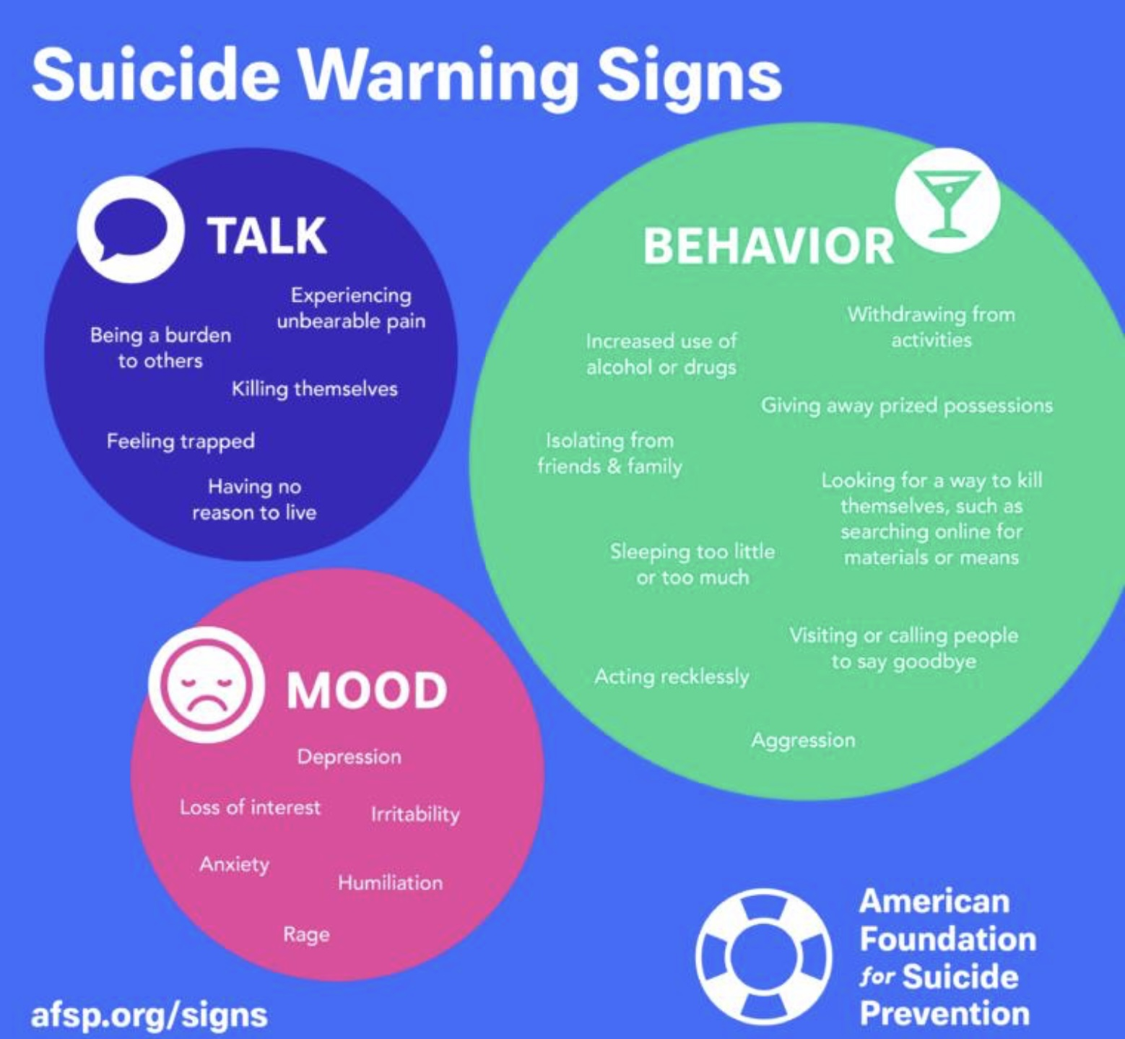
WORKING WITH PEOPLE EXPERIENCING SUICIDAL THOUGHTS
1. Assessment: screening, evaluation, and triage, risk factors, lethality and chronicity
2. Interventions
3. Prevention
4. Building resiliency
5. DBT’s approach to suicidality
6. How to effectively seek professional help

Slide 78
WORKING WITH PEOPLE EXPERIENCING SUICIDAL THOUGHTS
1. Assessment: screening, evaluation, and triage, risk factors, lethality and chronicity
2. Interventions
3. Prevention
4. Building resiliency
5. DBT’s approach to suicidality
6. How to effectively seek professional help

Slide 79
SCREENING VS. EVALUATION
Suicide Screening is a brief, standardized process used to identify individuals who may be at risk for suicide. Its purpose is to flag potential risk quickly so that further evaluation can be done. It can be done by anyone in a healthcare, educational, or community setting, including non-specialists (e.g., nurses, teachers, crisis line workers, ER staff).
Tools used: PHQ-9 (especially item 9), Columbia-Suicide Severity Rating Scale (C-SSRS) screener version. Ask Suicide-Screening Questions (ASQ)
Screening doesn’t diagnose or determine actual level of risk and has high false positive/negative rates if used alone.
Suicide Evaluation (AKA Risk Assessment) is a comprehensive, clinical process to assess the severity, immediacy, and context of suicide risk. Its purpose is to determine the level of danger, understand underlying factors, and inform treatment and safety planning. It is conducted by trained mental health professionals (e.g., psychiatrists, psychologists, social workers). It includes: Assessment of current ideation (frequency, intensity, duration). Presence of a plan and means. Past attempts. Mental health history. Substance use. Protective factors (e.g., relationships, reasons for living). Risk factors (e.g., trauma, psychiatric illness, loss)
The goal is to classify risk (low, moderate, high, imminent) and guide next steps: hospitalization, safety/crisis plan, outpatient care, etc.

Slide 80
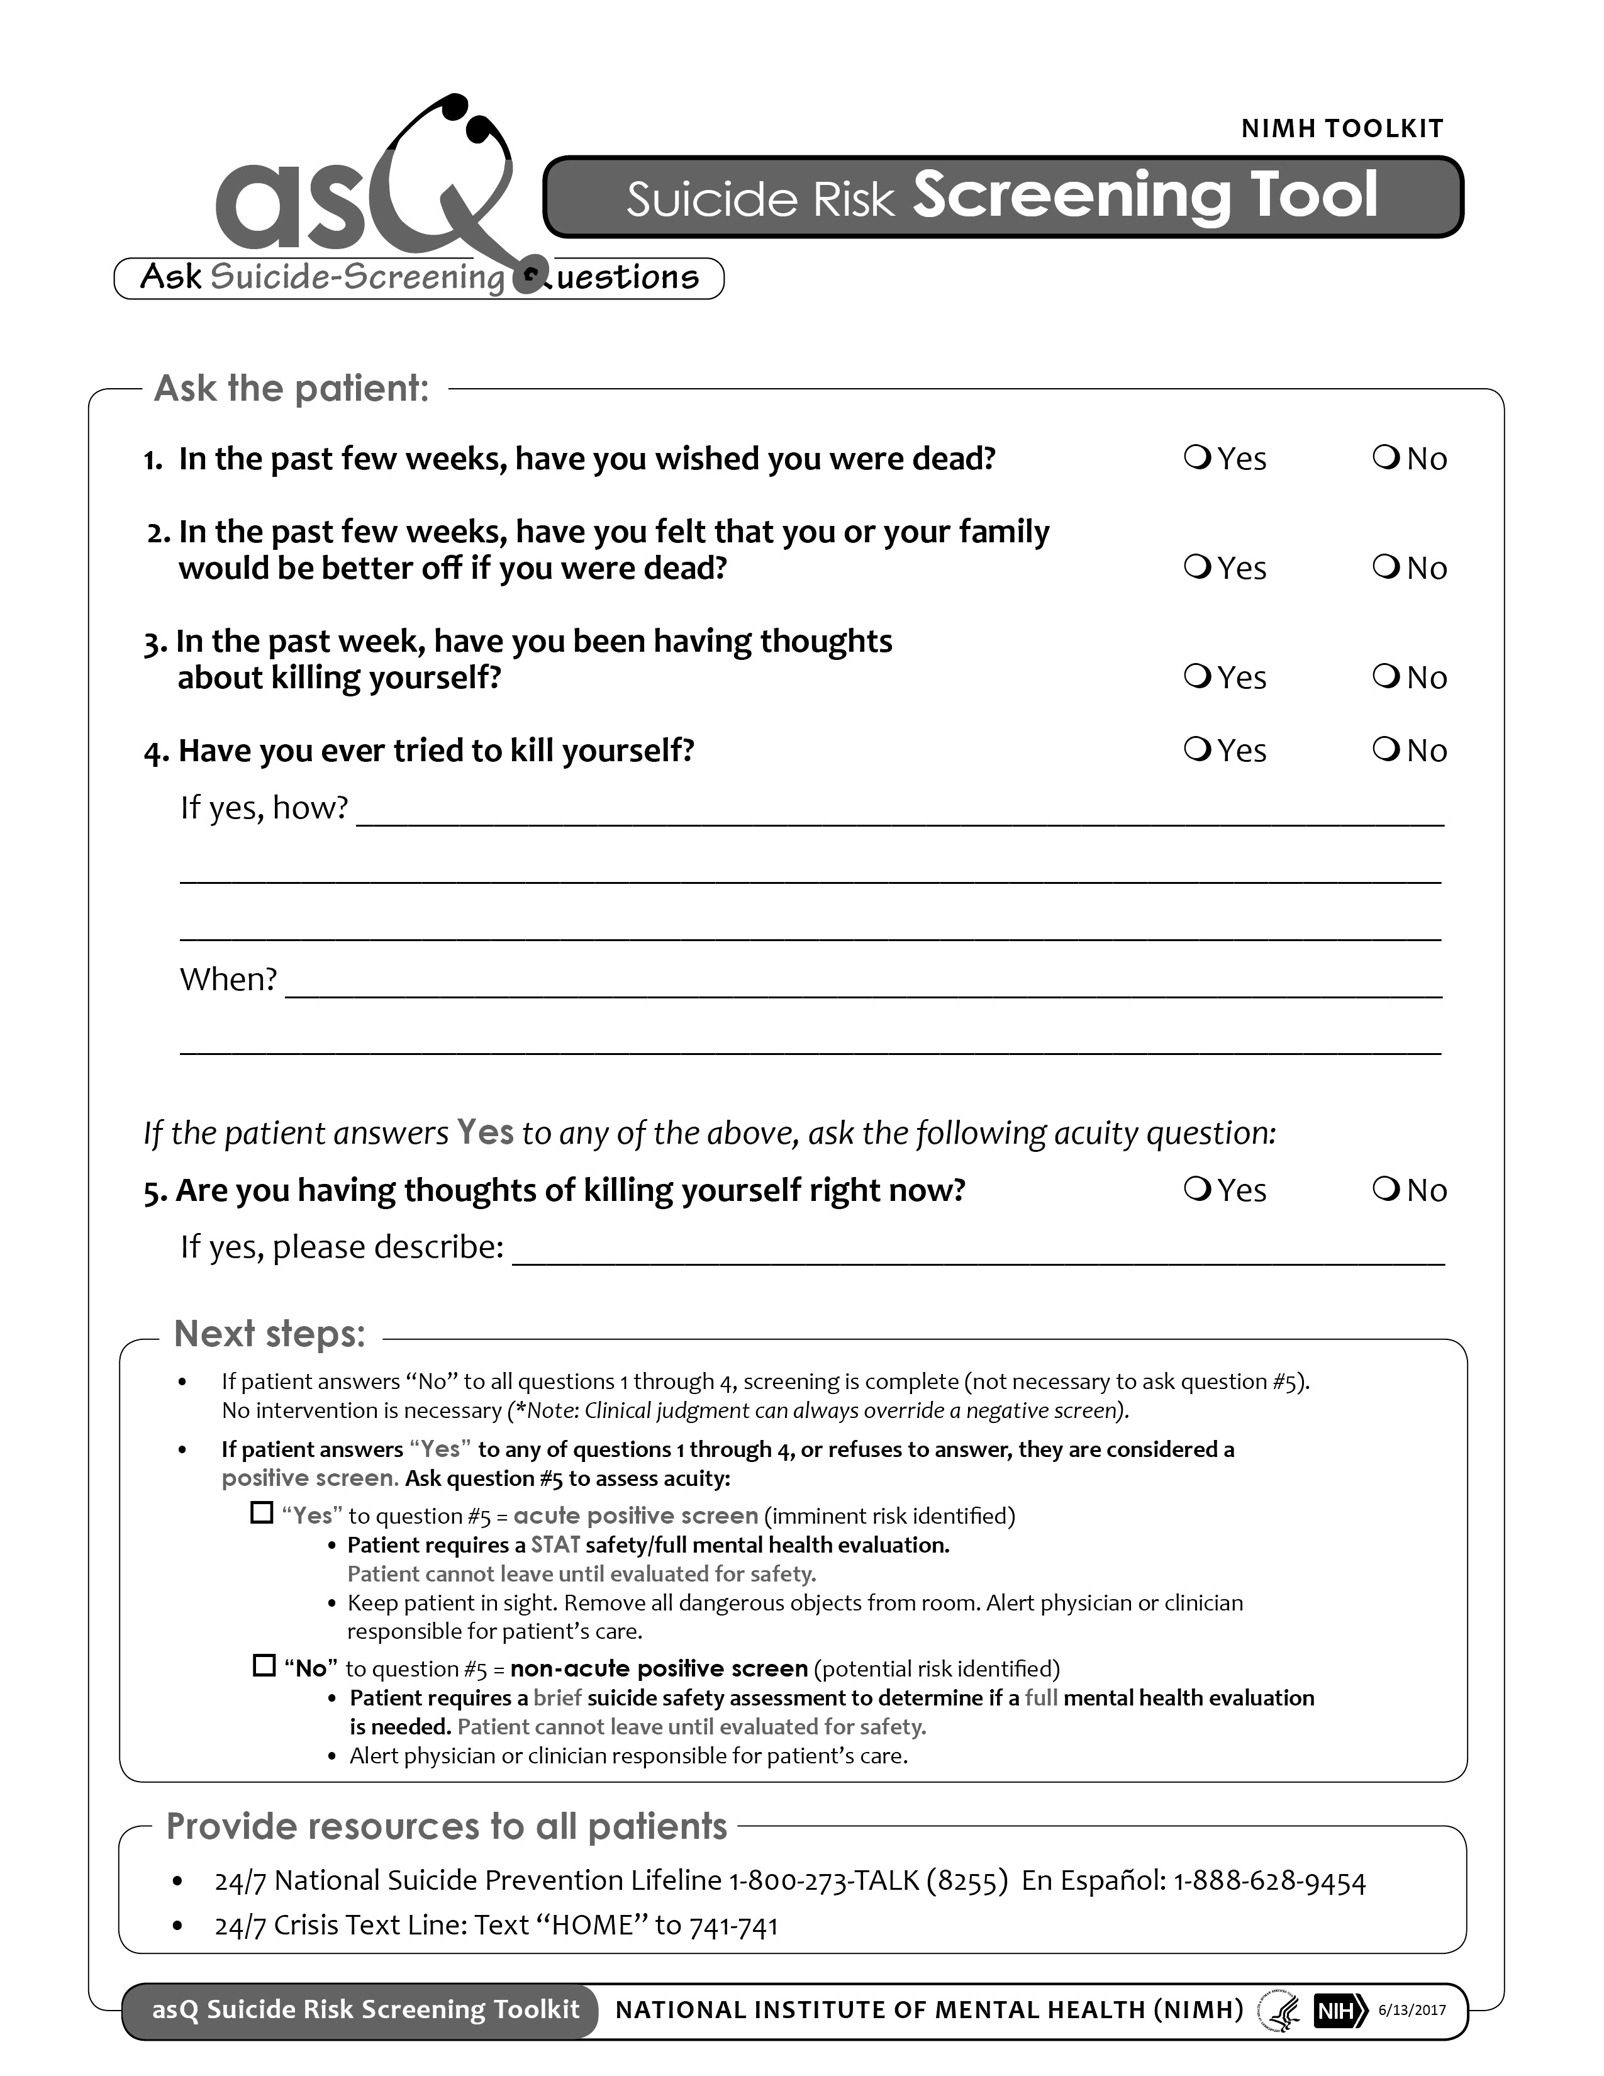
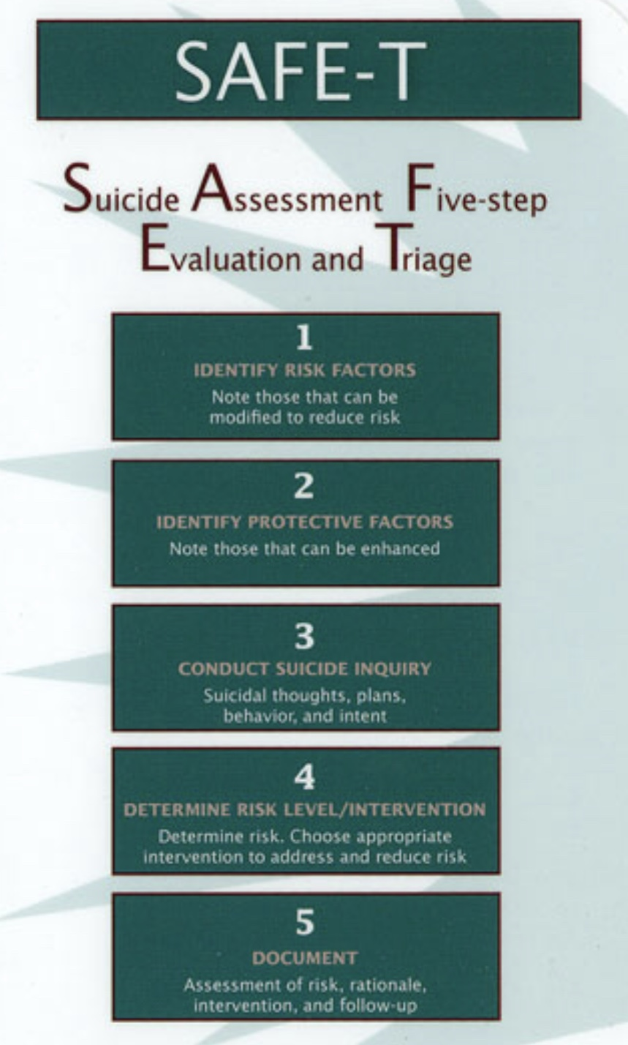
1. SCREENING AND ASSESSING PEOPLE WITH SUICIDAL IDEATION.
.
Notes:
A good assessment of suicidal individuals should consider several factors. Screening is something that happens before a more in-depth assessment. Screening determines whether that in-depth assessment needs to be done. The assessment itself is often divided into five steps

Slide 81
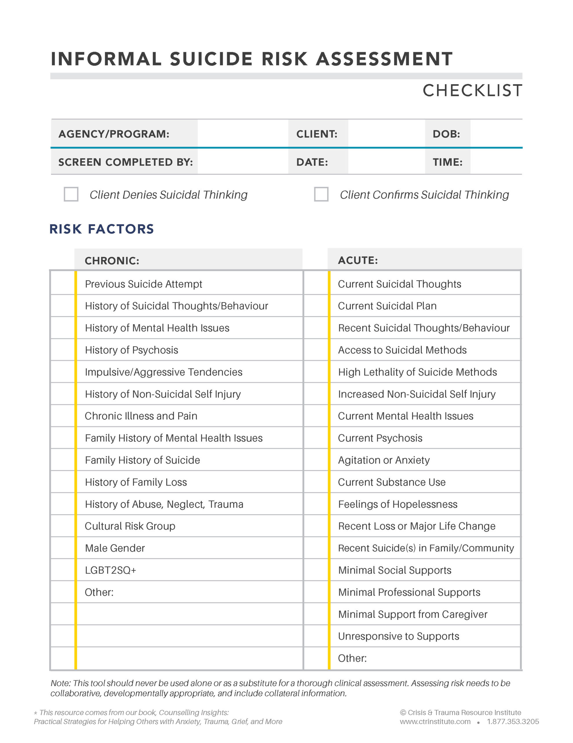
ACUTE VS CHRONIC RISK FACTORS
Risk factors are variables that are associated with an increased risk of a disease or negative health outcome
Suicide risk factors help professionals assess the likelihood that a person will die by suicide and are an important part of a suicide assessment.
There are chronic or longstanding and acute or short-term risk factors that predict death by suicide.
People with acute high risk (right hand column) are those who are most often admitted to hospital.
People with chronic high-risk factors (left hand column) are most often treated in outpatient settings and often not hospitalized.
Notes:
In epidemiology, a risk factor is a variable associated with an increased risk of a disease or negative health outcomes.

Slide 82
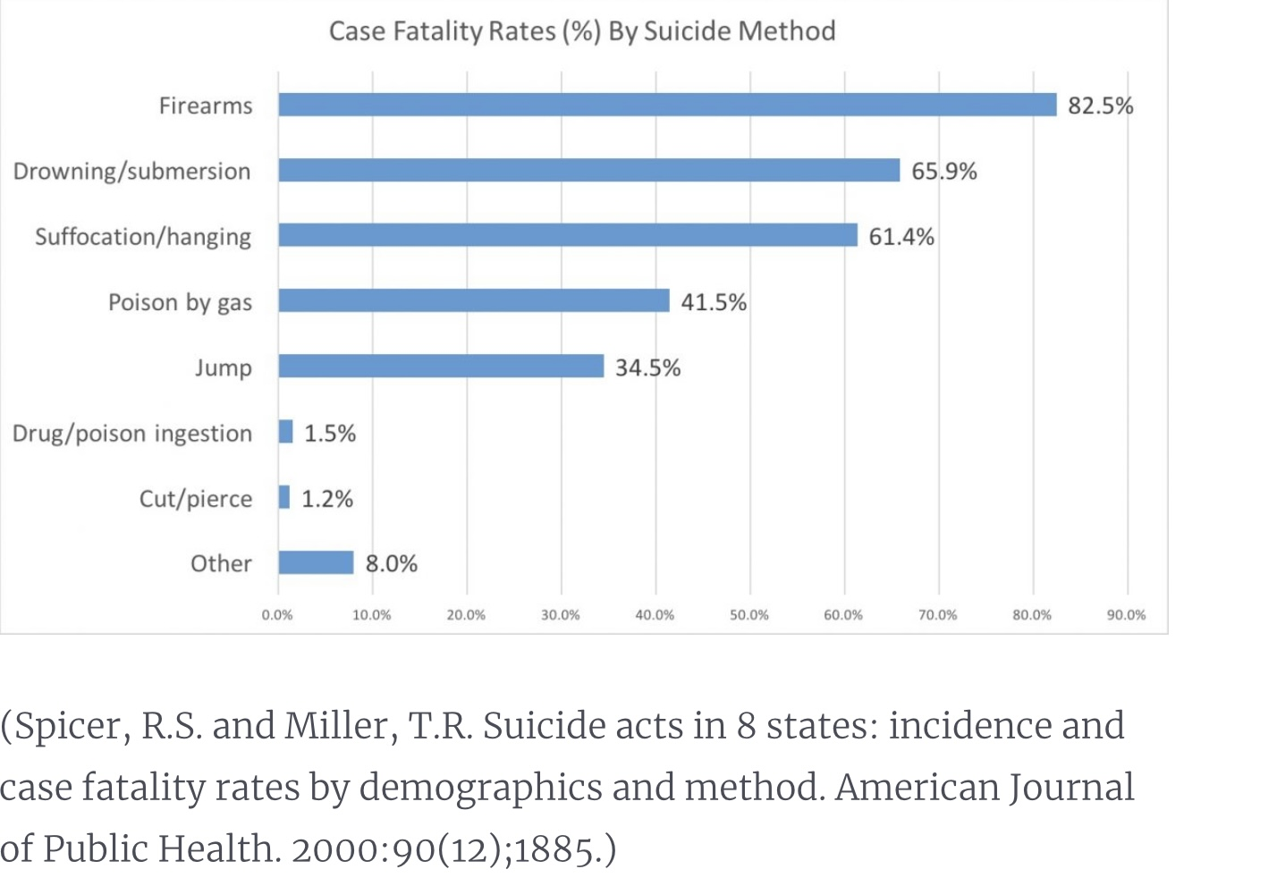
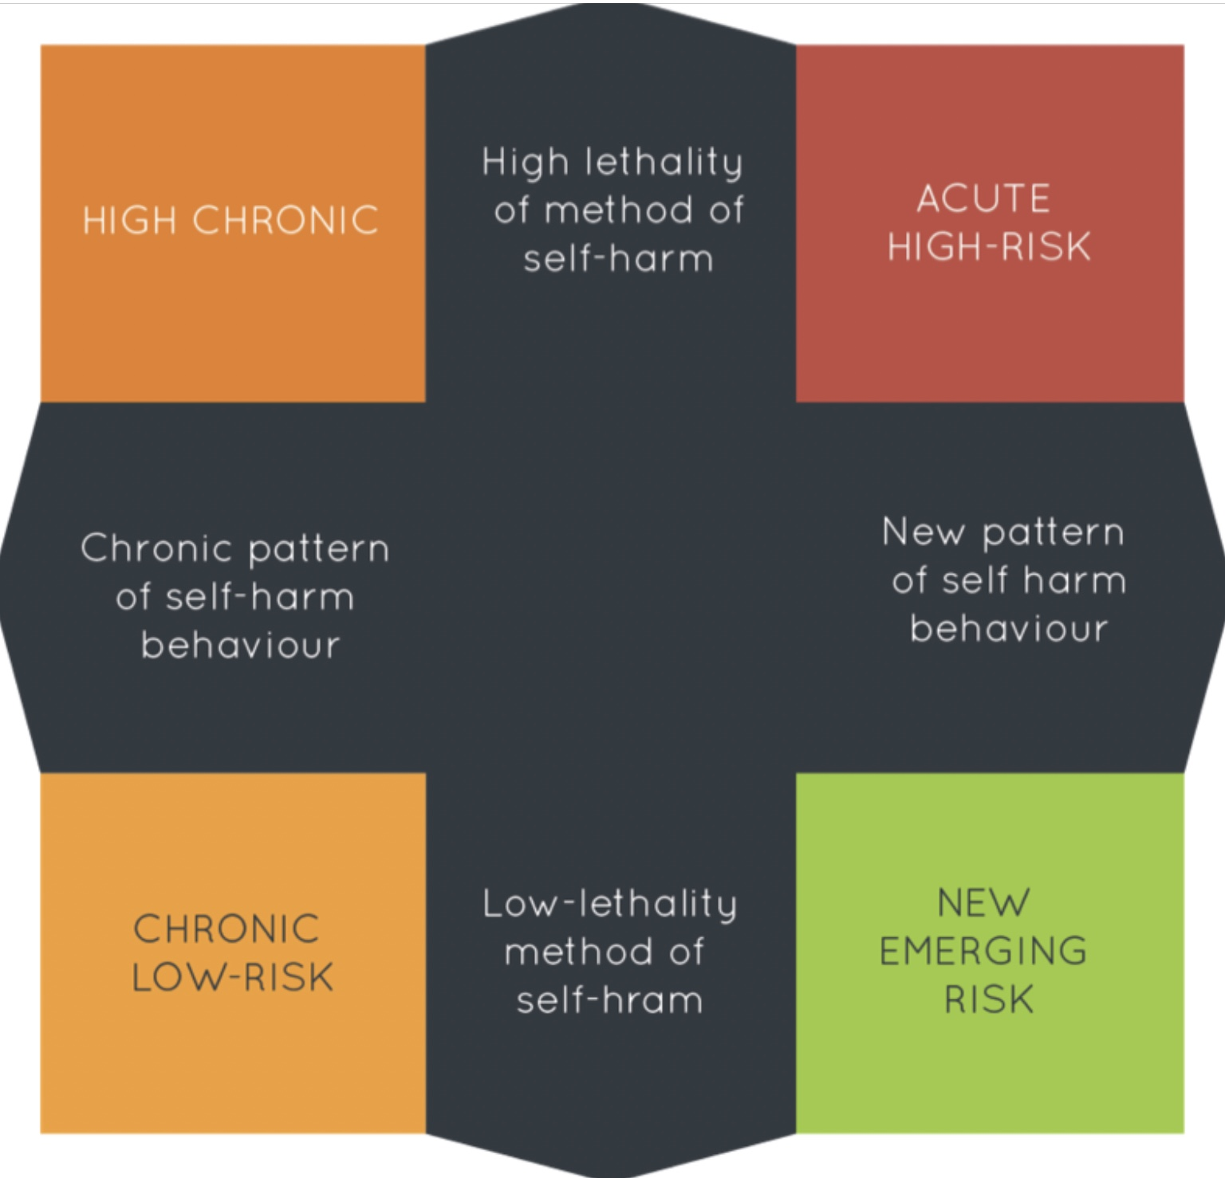
LETHALITY AND CHRONICITY
Suicide risk assessment involves assessing the lethality of a person’s chosen method for suicide and the duration of the suicidal ideation.
Lethality of method refers to the % of people who die in suicide attempts with different methods of suicide. For example, using firearms is much more lethal than ingesting harmful substances
Acuity/chronicity of suicidality refers to how long or frequently the person has thought of suicide.
Individuals who experience suicidal ideas can roughly be grouped into four categories.
1)Those with a highly lethal method and a chronic pattern of suicidal ideation
2)Those with highly lethal method in whom suicidal ideation is a new or acute phenomenon.
3)Those with low lethality and a chronic pattern
4)Those with low lethality in whom suicidal ideation is new
Treatment approaches vary depending on which of these categories people fall into.
Notes:
Another factor in assessing suicidal risk is considering lethality of the method.

Slide 83
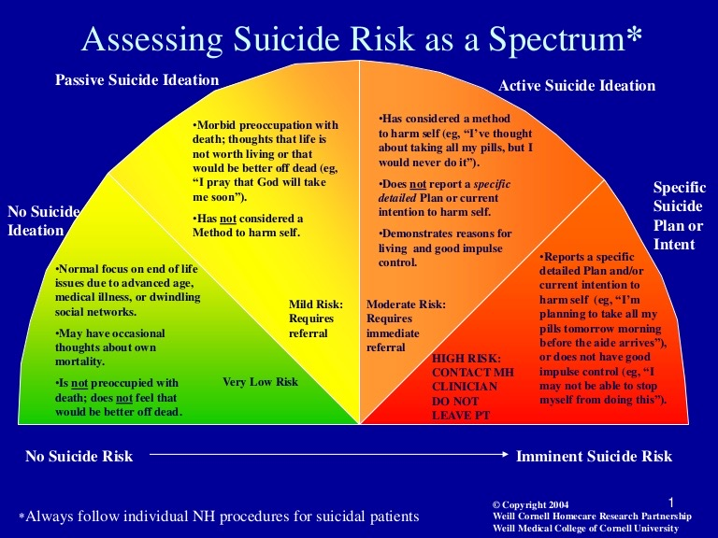
THE SUICIDE RISK SPECTRUM
A careful assessment helps clinicians to determine each person’s suicide risk
Suicide risk, or the likelihood that a person will complete suicide, is a spectrum ranging from no risk to imminent risk of suicide completion.
Intent means the determination to do something.
Increasing degrees of risk are described as 1) suicidal thoughts without suicidal intent 2) suicidal thoughts with passive intent 3) suicidal thoughts with active intent and 4) suicidal thoughts with a specific plan.
There are suggested guidelines for working with each of these different degrees of risk
In real life, the fewer resources there are, the more mental health professionals develop a tolerance for suicide risk.
Compared to when I started in psychiatry in 1985, there much fewer resources today and an increased tolerance for suicide risk.
What does this say about our society?
Notes:
The risk of suicide of an individual is rated on a spectrum.

Slide 84
What approaches does mental health care use in working with people experiencing suicidal ideation ?

Slide 85
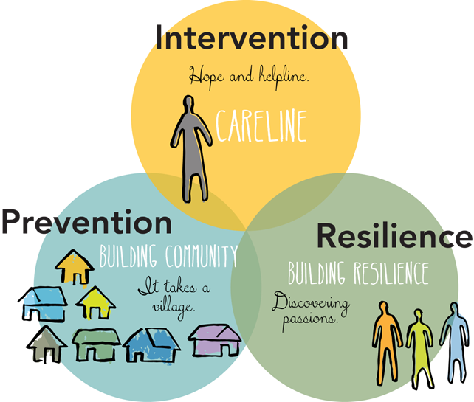
Approaches to WORKING WITH people EXPERIENCING Suicidal ideation
There are three types of approaches to working with people experiencing suicidal ideation:
1. Suicide interventions- describes the recommended immediate steps to take with someone who has active suicidal ideation.
2. Suicide prevention- is the collection of efforts to reduce the long-term risk of suicide of individuals, and in communities, and societies.
3. Building resiliency- involves helping vulnerable people develop ways of adapting in the face of adversity and distress.
The distress tolerance skills, and the crisis plan, are both intervention and prevention strategies
The overall goal of the Simple course is to help people build resilience

Slide 86
WORKING WITH PEOPLE EXPERIENCING SUICIDAL THOUGHTS
1. Assessment: screening, evaluation, and triage, risk factors, lethality and chronicity
2. Interventions
3. Prevention
4. Building resiliency
5. DBT’s approach to suicidality
6. How to effectively seek professional help

Slide 87
Suicide intervention refers to the collection of efforts to reduce the short-term or immediate risk of suicide in at-risk individuals.

Slide 88
CRISIS PLANS IN SUICIDE PREVENTION
Preparing individualized crisis plans is a critical intervention in suicide prevention. Crisis plans serve as a proactive strategy to help individuals manage their feelings and behaviors during times of crisis. Completing a crisis plan involves the active collaboration of the individual.
A crisis plan is tailored to the individual's specific needs and triggers. It includes personalized coping strategies and resources that can help them navigate difficult moments. Creating a crisis plan can empower individuals by giving them a sense of control over their situation. It encourages proactive thinking about how to manage crises.
The plan provides clear steps to take when experiencing suicidal thoughts or feelings.
Crisis plans involve identifying personal warning signs that indicate a crisis is approaching. Recognizing these signs can empower individuals to take action before reaching a critical point.
A crisis plan typically includes a list of supportive people in the individual's life who can be contacted during a crisis. Knowing who to reach out to can make a significant difference in times of distress.
Having a plan in place can reduce anxiety and uncertainty during a crisis. It provides a sense of control and preparedness, which can be comforting. Knowing there is a plan in place can help individuals feel less alone and more supported, which is vital in times of crisis.
Crisis plans also encourage individuals to seek professional help, whether through therapy or counseling. This can lead to ongoing support and resources for managing mental health.
By developing and utilizing a crisis plan, individuals can build resilience and coping skills over time, which can help them handle future challenges more effectively.

Slide 89
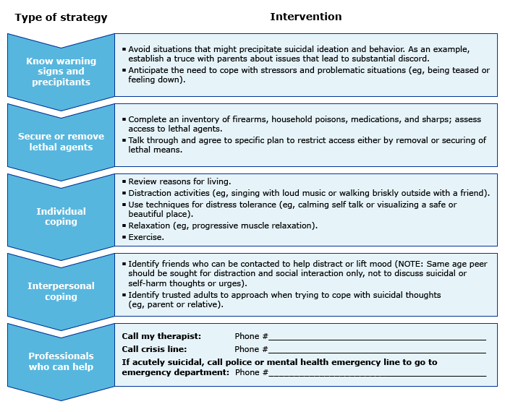
2. SUICIDE INTERVENTION AND PREVENTION: A CRISIS PLAN SPECIFICALLY FOR SUICIDAL IDEATION
A suicide intervention plan is a crisis plan adapted for a suicidal ideation “hole”. Notice the similarities between this template and simple’s crisis plan template
1.
2.
3.
4.
5.
Notes:
Suicide intervention is what is done in an acute situation when an individual has suicidal thoughts and is at risk of carrying them through. This five point crisis plan is general, the individual crisis plans that we work on in the simple course are personalized to each individual.

Slide 90
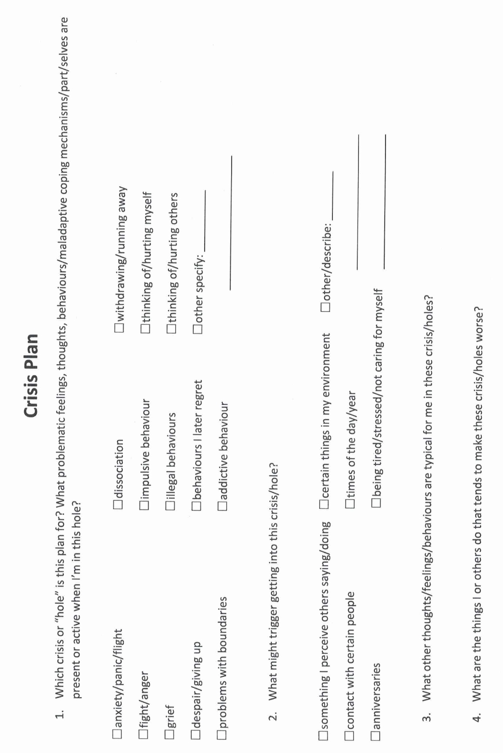

Slide 91
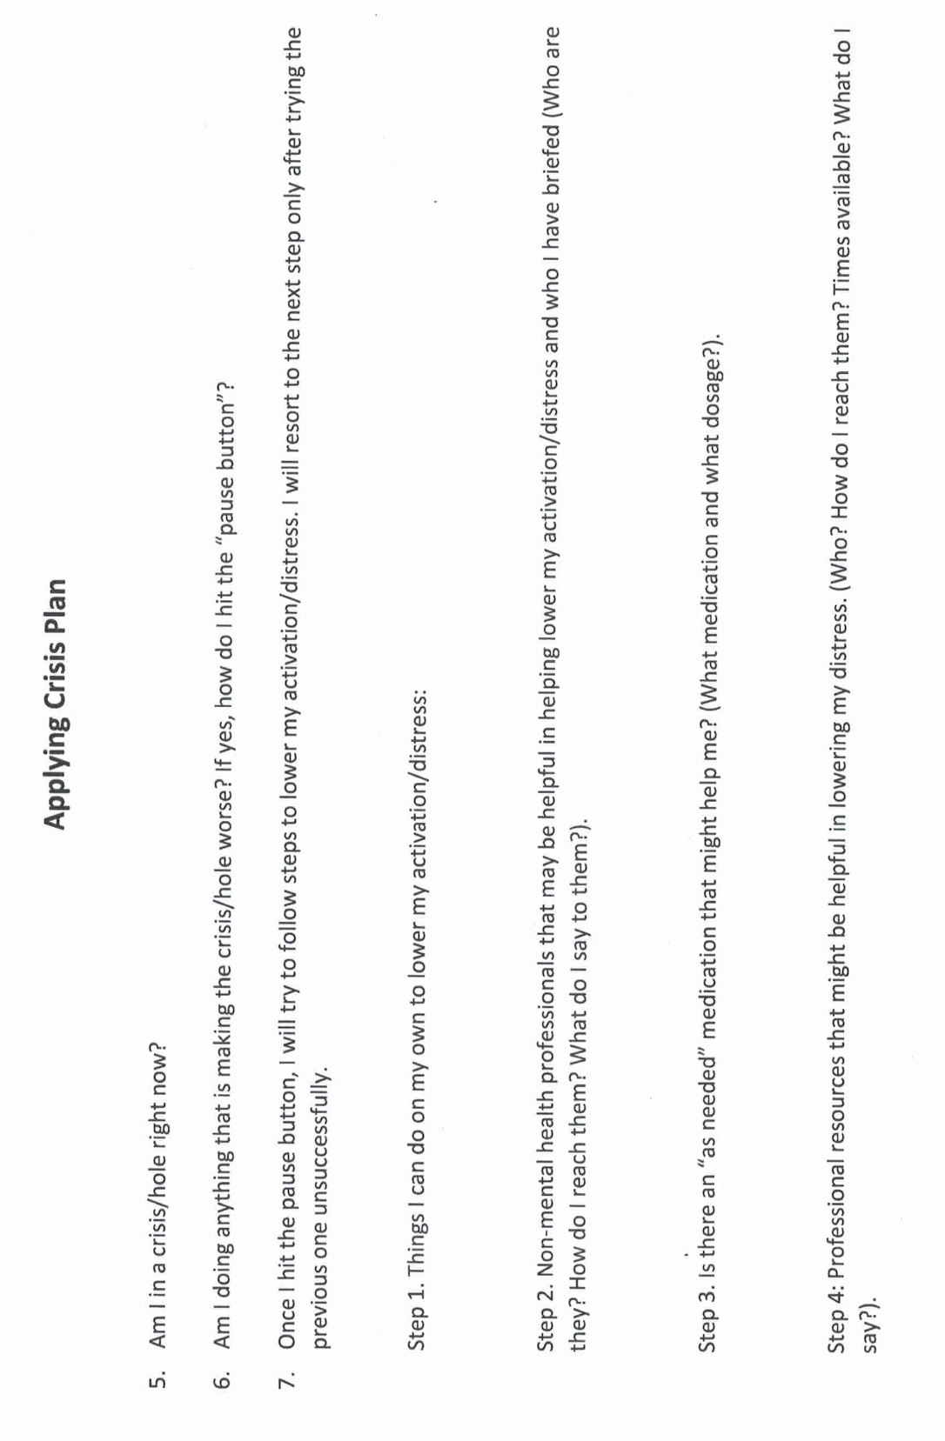

Slide 92
PSYCHOTHERAPEUTIC INTERVENTIONS PROVEN TO REDUCE SUICIDE RISK
Evidence-Based Therapies for Suicidality
Dialectical Behavior Therapy (DBT): Best evidence for reducing suicide attempts in BPD
Cognitive Behavioral Therapy (CBT): Helps reduce suicidal ideation and cognitive distortions
Collaborative Assessment and Management of Suicidality (CAMS): Targets suicidal drivers directly
Brief Cognitive Behavioral Therapy for Suicide Prevention (BCBT-SP): Proven effective in reducing post-attempt suicidality
Mentalization-Based Treatment (MBT): Enhances emotion regulation in personality disorders
Supportive Approaches with Emerging Evidence
Acceptance and Commitment Therapy (ACT): Promotes values-based living and diffusion from suicidal thoughts
Compassion-Focused Therapy (CFT): Reduces self-criticism and shame
Internal Family Systems (IFS): Addresses exiles and protectors linked to suicidality
Effective therapy focuses on emotion regulation, cognitive restructuring, connection, meaning, trauma processing and restoring a full life.
Therapeutic alliance with a professional is itself is a powerful protective factor.

Slide 93
INTERNAL FAMILY SYSTEMS AND SUICIDAL THOUGHTS
In Internal Family Systems (IFS), suicidal ideas are understood not as a sign of a “broken” or “disordered” self, but as the extreme distress of parts of the psyche that have lost hope or are trying to protect the system from unbearable pain. IFS brings a compassionate, non-pathologizing lens to these experiences:
1. Understanding Suicidal Parts- IFS assumes that every part has a positive intent, even those with destructive impulses. Suicidal parts are usually protectors. They may believe that ending life is the only way to:
• Escape unbearable suffering.
• Stop other parts (like exiles carrying trauma) from overwhelming the system.
• Regain control in a situation that feels hopeless or chaotic.
They are not “evil” or “crazy” parts, but desperate ones that have run out of strategies. Therapy begins by helping the client’s Self (the calm, compassionate center) get curious about these parts rather than fearing or fighting them.
2. Differentiating the Parts- IFS distinguishes among:
• The suicidal part (which holds the impulse or plan).
• Exiles (often younger parts burdened with pain, shame, or trauma that the suicidal part wants to stop feeling).
• Managers (parts that try to maintain control, function, and safety, often panicking when suicidal parts appear).
IFS helps the client separate from these parts enough to befriend and understand each one’s role.

Slide 94
INTERNAL FAMILY SYSTEMS AND SUICIDAL THOUGHTS
3. Creating Connection and Safety- IFS therapists don’t rush to eliminate suicidal thoughts. Instead, they:
• Help the person establish a Self-to-part relationship: “I see you, I understand how bad it feels, and I want to help you, not get rid of you.”
• Explore what the suicidal part fears would happen if it didn’t exist.
• Collaboratively build internal agreements (e.g., “I won’t act on this while we keep listening to you together.”)
• Ensure external safety through standard crisis planning, while keeping the inner work compassionate and curious.
4. Healing the Exiles- As trust develops, the suicidal protector often reveals the exiled parts it’s protecting those holding deep burdens of grief, shame, trauma, or worthlessness. When these exiles are witnessed and unburdened, the suicidal protector no longer needs to use such extreme strategies. It often transforms into a gentle guardian, using its fierce energy to protect life rather than end it.
5. The Therapist’s Stance- IFS therapists stay grounded in Self-energy, calm, curious, connected, and avoid polarization (e.g., “We have to stop you” vs. “We can’t stop you”). They balance safety (collaborating on external supports, emergency plans) with respect for the internal system’s wisdom and autonomy.
In short, IFS sees suicidal ideation not as an enemy, but as an invitation to listen more deeply to the parts of us that feel hopeless, burdened, or unseen and to bring the Self’s compassion to them

Slide 95
PHARMACOTHERAPY AND SUICIDALITY
Medications That May Reduce Suicide Risk
SSRIs/SNRIs: ↓ suicidal thoughts in adults; ↑ risk in youth (especially first 2–4 weeks)
Lithium: Strong protective effect in bipolar disorder; ↓ impulsivity and suicide attempts
Clozapine: Only FDA-approved drug for suicidality in schizophrenia
Ketamine/Esketamine: Rapid ↓ in suicidal ideation in severe depression (short-term)
Medications That May Increase Suicide Risk
Antidepressants (youth): SSRIs may ↑ suicidality early in treatment in people <25
Antiepileptics: Some (e.g., topiramate, levetiracetam) linked to ↑ suicide risk
Benzodiazepines: Long-term use may worsen depression or disinhibition
Stimulants: May help ADHD; misuse or rebound can increase risk
Medication effects on suicidality depend on age, diagnosis, and timing.
Close monitoring, especially during medication changes, is essential.

Slide 96

A suicidal person’s willing involvement in the suicide prevention process is of the utmost importance. Their insights into what works for them, what doesn’t, and their personal experiences is essential to the effectiveness of the crisis plan.
If the suicidal person is not cooperating with family, friends, and mental health professionals, preventing suicide can be extremely challenging if not impossible.
Some ways family friends and mental health professionals can enhance collaboration include:
Establishing a trusting relationship can encourage the individual to open up over time. Listening without judgment and showing empathy can help.
Encouraging them to seek professional help can be beneficial. Mental health professionals can provide guidance and support that may be more effective than informal support.
If there is an immediate risk of harm, it’s crucial to prioritize safety. This may involve family or friends contacting emergency services or a crisis hotline for guidance.
Change takes time, and it’s important to be patient. Sometimes, individuals may need time to come around to the idea of collaboration. Even if they are not ready to collaborate, offering consistent support and letting them know you are there for them can make a difference.
While crisis plans are vital in suicide prevention, and collaboration is crucial, there are ways to support suicidal individuals even if they are not initially cooperative.
SUICIDE AND THE THERAPEUTIC ALLIANCE

Slide 97
effective suicide intervention
1. have a clear model for their intervention.
2. be transparent with clients.
3. do psychoeducation.
4. address expectations.
5. be consistent.
6.collaborate with clients, be client centered
7. have healthy boundaries.
Effective suicide intervention and prevention requires that professionals be able to do a number of things with clients who experience suicidal thoughts:

Slide 98
WORKING WITH PEOPLE EXPERIENCING SUICIDAL THOUGHTS
1. Assessment: screening, evaluation, and triage, risk factors, lethality and chronicity
2. Interventions
3. Prevention
4. Building resiliency
5. DBT’s approach to suicidality
6. How to effectively seek professional help

Slide 99
Suicide prevention refers to the collection of efforts to reduce the long-term risk of suicide of individuals, and in communities, and societies.

Slide 100
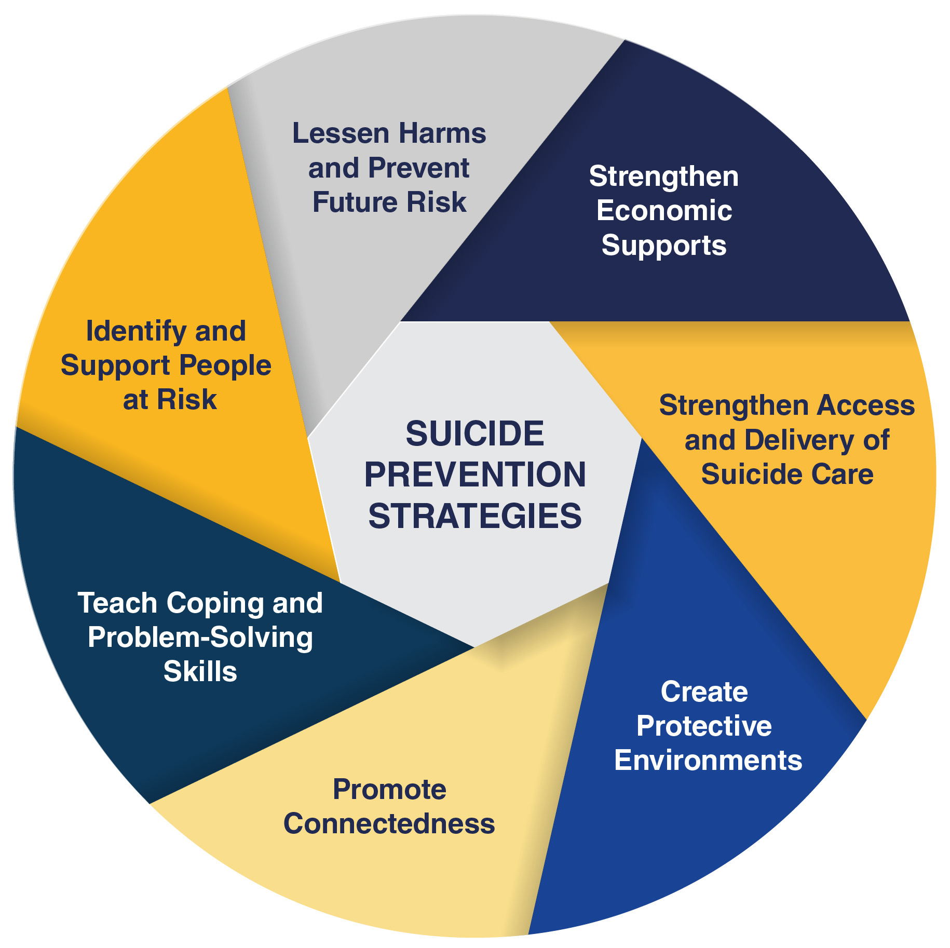
2. SUICIDE PREVENTION
Suicide prevention strategies
1. Strengthen economic supports: strengthen household financial security, develop housing policies.
2. Strengthen access to and delivery of suicide care: make resources more easily accessible
3. Create protective environments: reduce access to lethal means among people at risk for suicide, develop policies to reduce alcohol use
4. Promote connectedness: engage individuals with community and peers.
5. Teach coping and problem-solving skills
6. Identify and support people at risk
7. Lessen harm and prevent future risk.
Notes:
In contrast to the acute suicide intervention, suicide prevention refers to…

Slide 101

SOCIOECONOMIC INTERVENTIONS THAT REDUCE SUICIDE RISK
1. Income Support & Poverty Reduction. Examples: Minimum wage increases, cash transfers, unemployment
insurance. Why it works: Reduces financial stress and despair.
2. Universal Health & Mental Health Care. Examples: Universal medical care expansion, community clinics, school-based services. Why it works: Improves access to care for those at risk
3. Employment & Education Programs. Examples: Job training, re-entry education, youth employment support. Why it works: Builds purpose, routine, and hope
4. Housing Stability. Examples: Subsidized housing, eviction prevention, Housing First. Why it works: Reduces stress and instability
5. Community Connection & Social Integration. Examples: Peer support, elder connection programs, cultural initiatives. Why it works: Counters isolation and strengthens belonging
6. Means Restriction. Examples: Gun control, safe storage laws, bridge barriers. Why it works: Prevents impulsive suicide attempts
7. Reducing Inequality. Examples: Progressive taxation, labor protections, anti-discrimination policies. Why it works: Promotes fairness, dignity, and societal cohesion

Slide 102
WORKING WITH PEOPLE EXPERIENCING SUICIDAL THOUGHTS
1. Assessment: screening, evaluation, and triage, risk factors, lethality and chronicity
2. Interventions
3. Prevention
4. Building resiliency
5. DBT’s approach to suicidality
6. How to effectively seek professional help

Slide 103
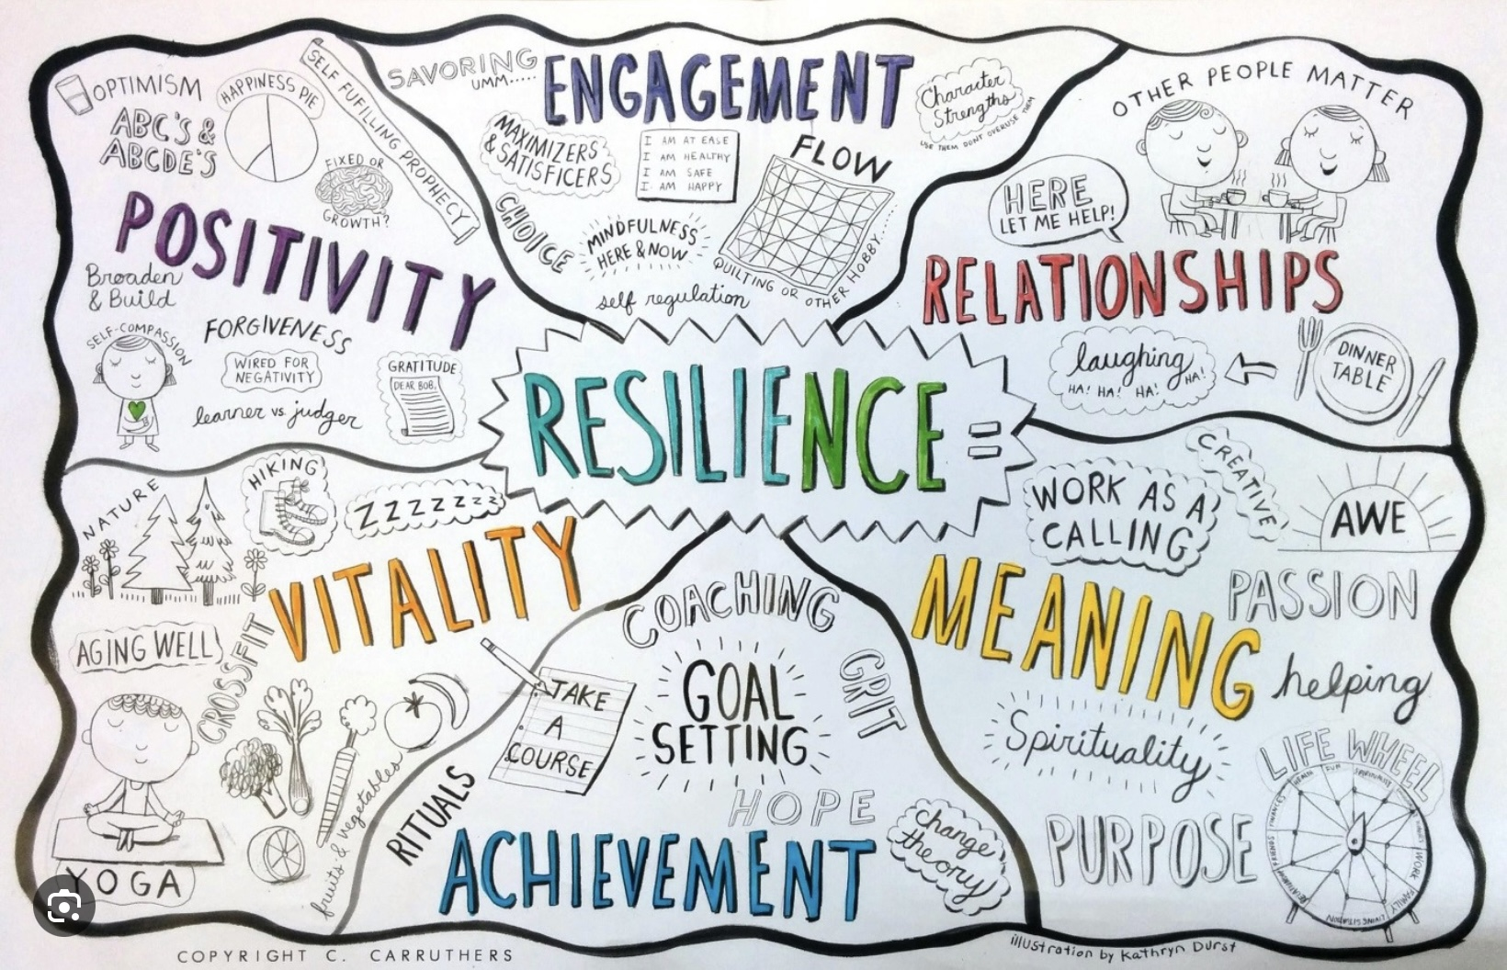
BUILDING RESILIENCY
DBT asserts that the best way to work with people experiencing suicidal thoughts is to help them build a life worth living
A life worth living includes among other things engagement with life, good relationships, a sense of meaning and achievement, vitality and positivity.(see slide)
The overall goal of the simple course is to help people build a life worth living. A life worth living makes us resilient when dealing with the inevitable stresses of life.

Slide 104
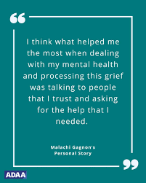
REASONS FOR LIVING
Even when experiencing suicidal thoughts, many people find powerful reasons to keep going including:
Love and responsibility for family, children, or friends
Moral, ethical, or spiritual beliefs about life
Fear of death or uncertainty about what comes after
Hope that circumstances or feelings may change
Commitments, goals, or unfinished responsibilities
Support from friends, therapy, or community
Enjoyment of activities, passions, or beauty in life
Concern about the impact on loved ones or others

Slide 105
WORKING WITH PEOPLE EXPERIENCING SUICIDAL THOUGHTS
1. Assessment: screening, evaluation, and triage, risk factors, lethality and chronicity
2. Interventions
3. Prevention
4. Building resiliency
5. DBT’s approach to suicidality
6. How to effectively seek professional help

Slide 106
Dialectical behavioral therapy was originally conceived as an approach to working with people experiencing self-harm and suicidal thoughts. How does DBT approach this work? And is it effective?

Slide 107
HIGHLIGHTS OF HOW DBT’s approaches working with SUICIDALITY
DBT introduced a number of novel suicide intervention and prevention strategies to support its overall aim of helping people to increase their resilience. These strategies include:
1) A patient centered approach or patient-professional partnership which contrasts with the medical model of the professional taking charge and making decisions for the personal who has suicidal ideas. The emphasis in DBT is on helping the person develop and implement a crisis plan rather than having the professional take control and be the person’s safety plan.
2) The avoidance of involuntary commitment which is seen as toxic to the therapeutic partnership.
3) The emphasis on building a life worth living as the best safeguard to suicide.
4) Placing the therapeutic emphasis on prevention, and intervention and not resorting to hospitalizations after an attempt because at that point the person has already chosen a solution to their distress.
5) Making continuing in therapy contingent on the success of that therapy as evidenced by a reduction in self-harm and suicidality. Improvement in these areas is a prerequisite for the yearly DBT therapeutic contracts to be renewed.
6) The use of a mutually pre-agreed yearly number of respite days in a safe professional environment. The patient chooses when to access these days but the total number cannot be exceeded.

Slide 108
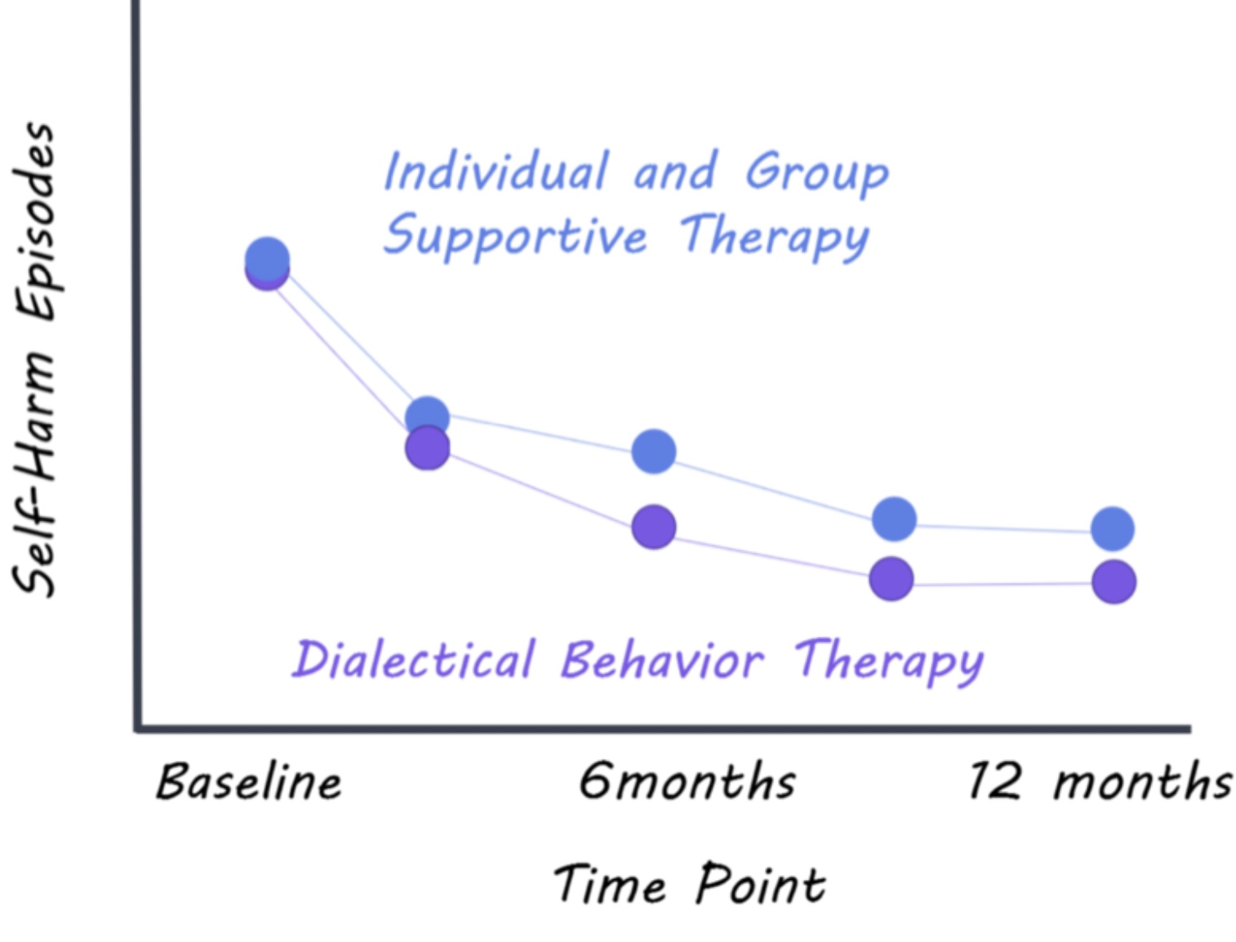
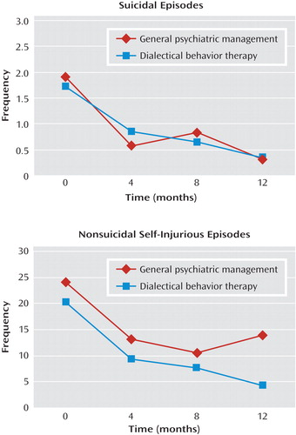
DOES DBT REDUCE SELF-HARM AND SUICIDALITY?
EVALUATION OF SELF-HARM AND SUICIDE PREVENTION APPROACHES

Slide 109
Do you have any suggestions for how someone who has suicidal ideation might seek professional help (including presenting to the ER or contacting crisis)?

Slide 110
WORKING WITH PEOPLE EXPERIENCING SUICIDAL THOUGHTS
1. Assessment: screening, evaluation, and triage, risk factors, lethality and chronicity
2. Interventions
3. Prevention
4. Building resiliency
5. DBT’s approach to suicidality
6. How to effectively seek professional help

Slide 111

Resorting to professional help
To improve your chances of accessing appropriate and helpful professional resources, consider the following:
1. Get to know the crisis resources available in your area. It may be easier to get the help you need from someone you already know and trust.
2. Have a crisis plan ready. The last part of the crisis plan considers how to access professional help
3. When possible, share the crisis plan with the professionals you are seeking help from, if possible before the crisis, if not during the crisis.
4. Work out beforehand what help you need from professionals by specifying it in your crisis plan
5. Use assertiveness scripts to ask for specific forms of help (these scripts will be covered in the interpersonal effectiveness module)
6. Ask if the hospital or professional you work with uses hospitalization contracts ?
7. Use the edit, splice, and paste technique to work with a past crisis in which you accessed professional help to rehearse more effective approaches in case they are needed in the future.
Keep in mind that while all mental health professionals would ideally be understanding, sometimes we can also be judgemental.

Slide 112



Slide 113

PRACTICE USING SKILLS TOOLS AND STRATEGIES

Slide 114
Notes:
Ann's crisis plan
In one of the sessions with her psychiatrist, and worked on a crisis prevention plan for the whole she fell into around the time of her weekly meetings with Jane.
Working with the crisis plan template, and recognize the unhelpful behavior was that, although she forced herself to attend these meetings, she wanted to run away from them, and after the meetings, she withdrew from her usual activities and ruminated.
She was triggered by this work situation because she felt she had no control and felt pressured and devalued.
The warning signs that she was in this whole, word that she would eat more, cry, ruminate, be unable to sleep, isolate herself, and avoid people. Being alone made it worse.
People may fall into holes at unpredictable times, in which case it is crucial to be aware of the warning signs and triggers so that they do not miss the fact that they are in a whole. Ann's patterns were more predictable.
Although she also ruminated during the remainder of the week, and felt most distressed from the day before, to the day after, her meetings with Jane. She felt some relief after the meetings when her worst fears had not materialized. Being aware of this time pattern was helpful in implementing the crisis plan.
As and reviewed the distress tolerance module in the skills training workbook, she thought that distraction, self soothing, and self-care would be good skills to use when she began to ruminate about work.
She decided that the most helpful skills, deal with the whole itself, be radical acceptance, practice relaxation, commitment to valued action, and using coping thoughts and strategies.
And had previously taken a cognitive behavioural therapy course and was familiar with thought records. It seemed to her that DBT's "coping thoughts" were similar, if less structured than thought records. She was good at doing thought records and decided to structure her crisis plan around one.
The situation was that the nursing home had new owners, and and had to meet weekly with chain the manager.
Her feelings around this were anxiety and sadness.
Her automatic thoughts were "I won't be able to cope", "working at the nursing home won't be the same and will be awful", and "I will lose my job and income and I will be poor".
The fact that supported her automatic thinking were:
She did struggle to cope
The company that had taken over the nursing home did not care about her in the way Ezra and Ruth did.
To this company nursing homes were a business and making money was important.
If she did lose her job, should be financially in distress.

Slide 116

OPEN DISCUSSION

Slide 117

Ann’s crisis plan
ANN’S CRISIS PLAN Pages 69-73 of the simple manual
Notes:
We previously describe the steps involved in preparing a crisis plan. Today, using Ann as an example, we will illustrate how that is done. AndAnn, as all other clients presented in this manual, is not a real person, the composition of many real people.
Ann
Ann was raised by a perfectionistic and critical single mother, who spent long hours at work managing a restaurant. Ann told her therapist that she had felt sad and lonely for as long as she could remember. She had a few romantic relationships but it always ended up getting hurt and had long ago decided she is better off living alone with her three cats.
Ann, now in her late 50s, hat for the last 25 years been a nurse in a family-run Mennonite nursing home. For the last 15 years she was the staff manager. Her job was the highlight her for otherwise quiet life, and she considered her patients her family.
Ann embraced the nursing homes commitment to making the residence last year's as meaningful as possible. She was rewarded with her great appreciation. And was like a daughter to the elderly couple, Ezra, and Ruth, who owned and ran the home. They did not think of the home as a business, but as a service to the residents and employees.
With the support of this "family", and managed her low grade chronic depression anxiety well, never missing a day of work.
When Ezra began to show signs of dementia, and was devastated. The couple continued to run the home for as long as they could, while looking for a new owner who would carry on their philosophy of care. Eventually, unable to wait any longer, they reluctantly sold to a company that ran nursing homes all over the province.
This transition was extremely difficult for an, and her anxiety and depression worsened. A new general manager, Jane, took over the home, and was tasked by the new owners, with introducing the company's policies and procedures.
As and was a nurse in charge, she was required to meet with Jane once a week, to report on the staff's progress with the transition. Although Jane was always pleasant and polite, it was clear to and, that the nursing home would be run very differently, and that the financial bottom line had become an important consideration.
And started seeing her psychiatrist more often during this trying time. The tweak her medications, but that seemed to be of limited help. And not feel she had many options, she could not see herself, in her 50s, finding another job, and could not afford to retire. If she went on disability, she would leave her beloved patients, and was afraid she would become more withdrawn and depressed.
She and her psychiatrist concluded that, although this was a stressful and challenging situation, and's dysregulated emotions contributed significantly to her symptoms. They decided that the current acute whole, within and's longer-term chronic "valley", was anticipating and meeting with Jane every week. They decided to do a crisis plan.

Slide 118
CANADA AND ONTARIO’S NATIONAL SUICIDE PREVENTION STRATEGY

Slide 119
Canada has a national suicide prevention strategy. The Government of Canada launched the Federal Framework for Suicide Prevention in 2016, which outlines a coordinated and collaborative approach to preventing suicide in Canada. This framework aims to raise awareness, reduce stigma, promote mental health and wellness, and provide support for those at risk of suicide. Additionally, each province and territory in Canada also has its own suicide prevention initiatives and programs in place.
The framework is based on four key pillars:
Promoting mental health and wellness: This pillar focuses on promoting positive mental health and well-being for all Canadians, as well as reducing the stigma associated with mental illness and suicide.
Preventing suicide and self-harm: This pillar aims to prevent suicide and self-harm through early intervention, improved access to mental health services, and targeted interventions for at-risk populations.
Supporting those affected by suicide: This pillar focuses on providing support and resources for individuals and communities affected by suicide, including bereavement support and crisis intervention services.
Improving surveillance and data collection: This pillar aims to improve the collection and analysis of data on suicide and self-harm in Canada in order to better understand the factors contributing to suicide and to inform prevention efforts.
Some concrete initiatives of the Canadian Federal Framework for Suicide Prevention include:
1. Public awareness campaigns: The framework supports public awareness campaigns to reduce stigma around mental health and suicide, raise awareness about available resources, and promote help-seeking behaviors.
2. Training programs: The framework includes initiatives to train healthcare professionals, educators, and community members in suicide prevention strategies, risk assessment, and intervention techniques.
3. Crisis intervention services: The framework supports the development and expansion of crisis intervention services, such as helplines and crisis centers, to provide immediate support to individuals in crisis.

Slide 120
4. Research and data collection: The framework includes initiatives to support research on suicide prevention, improve data collection on suicide and self-harm, and use evidence-based practices to inform prevention efforts.
5. Support for at-risk populations: The framework includes targeted initiatives to support at-risk populations, such as Indigenous communities, LGBTQ+ individuals, youth, and veterans, who may face unique challenges related to mental health and suicide.
These initiatives are designed to work together to create a comprehensive and coordinated approach to suicide prevention in Canada, with the goal of reducing the number of suicides and suicide attempts and promoting mental health and well-being for all Canadians

Slide 121
Ontario also has an official suicide prevention strategy. The Ontario government released a comprehensive plan called the Ontario Suicide Prevention Strategy in 2019. This strategy aims to reduce the incidence of suicide in the province by focusing on prevention, intervention, and postvention efforts. The strategy includes initiatives such as increasing access to mental health services, promoting mental health awareness and education, enhancing training for healthcare professionals, and providing support for individuals at risk of suicide. Additionally, the Ontario Suicide Prevention Network works to coordinate and implement suicide prevention efforts across the province.
Some concrete initiatives of the Ontario Suicide Prevention Strategy include:
1. Increasing access to mental health services: The strategy aims to improve access to mental health services, including crisis intervention, counseling, and support services, for individuals at risk of suicide.
2. Promoting mental health awareness and education: The strategy includes initiatives to raise awareness about mental health and suicide prevention, reduce stigma, and promote help-seeking behaviors in the community.
3. Enhancing training for healthcare professionals: The strategy includes training programs for healthcare professionals to improve their skills in suicide risk assessment, intervention, and postvention.
4. Supporting high-risk populations: The strategy includes targeted initiatives to support high-risk populations, such as Indigenous communities, LGBTQ+ individuals, youth, and seniors, who may face unique challenges related to mental health and suicide.
5. Implementing postvention efforts: The strategy includes postvention efforts to provide support and resources for individuals and communities affected by suicide, including bereavement support and crisis intervention services.
These initiatives are part of a comprehensive and coordinated approach to suicide prevention in Ontario, with the goal of reducing the incidence of suicide and promoting mental health and well-being across the province.

Slide 122


See you next session

Slide 123

video
Week 4 of simple

Slide 124


Slide 125
The bridge between suicide and life why I don’t want to die anymore suicide; its time to talk about it
VIDEO LINKS
t

Slide 126
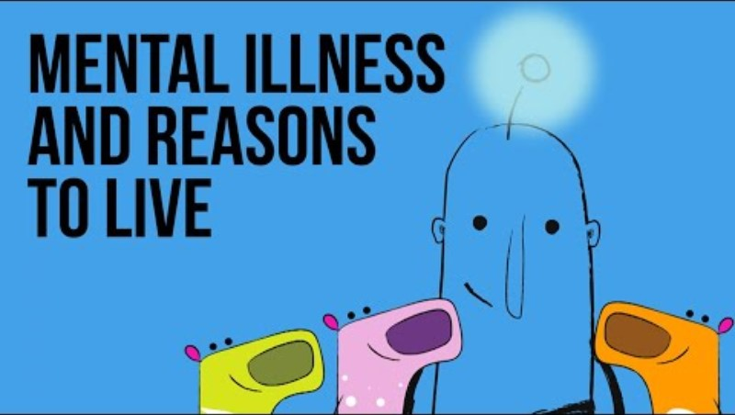

Slide 127


Slide 128


Slide 129
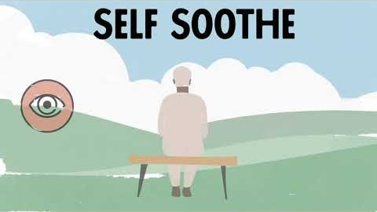

Slide 130
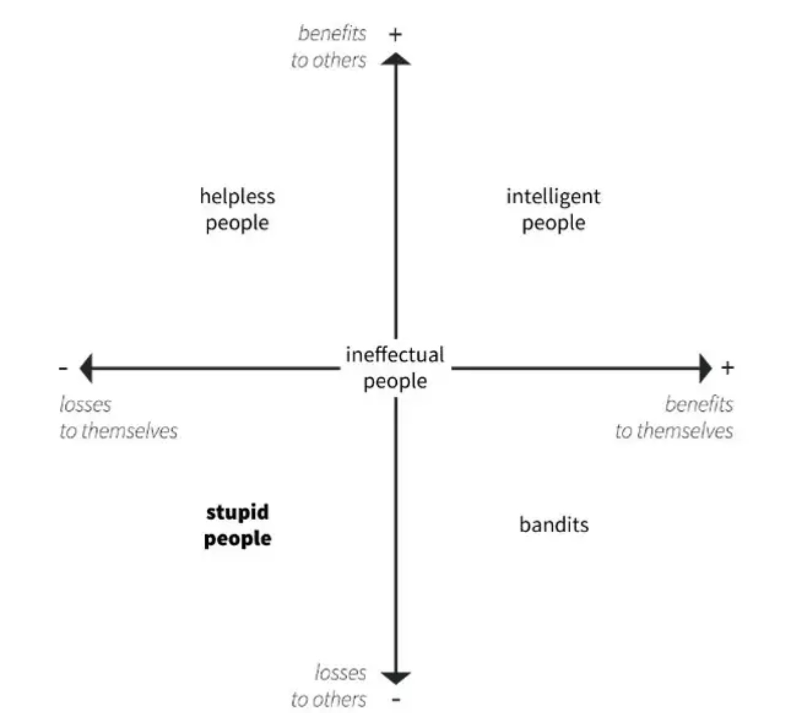
2024-25 Question
Can you show the grid you talked about last week when you mentioned the “theories of stupidity”.
You talked about how instincts are affected by the environment for example the care system is affected by the early care a child receives, this is described by attachment theory . Do instincts and how they are affected by the environment affect individuals only or do they also affect groups of people or societies?
Human interactions are influenced by a variety of instincts and innate behaviors. These instincts can shape how individuals perceive, communicate, an. This instinct drives behaviors like forming friendships, seeking companionship, and relate to one another.
Humans have an inherent need to form social bonds and connections building family units. It is rooted in the evolutionary advantages of cooperation and mutual support.
Most people have an instinctual capacity for empathy, allowing them to understand and share the feelings of others. This can lead to altruistic behaviors, where individuals act in the interest of others, sometimes at a personal cost.
Hierarchies and the pursuit of status are instinctual behaviors observed in many species, including humans. Individuals may instinctively seek to improve their social standing or align themselves with higher-status individuals or groups.
Humans have instincts related to territoriality and the maintenance of personal space. These instincts can influence how individuals react to physical proximity and territorial boundaries in social settings.
People often have an instinctual tendency to categorize others as belonging to an "in-group" (those who are similar or familiar) or an "out-group" (those who are different or unfamiliar). This can affect trust, cooperation, and conflict.
While these instincts can guide behavior, it's important to note that human interactions are also shaped by cultural, social, and individual factors. Education, personal experiences, and societal norms can modify or override instinctual behaviors, leading to a wide range of social dynamics.
Just like instincts can be affected by a person’s experience, social instincts can be affected by culture. For example, greed is a distortion of the seeking instinct and hunger for power over others a distortion of the pursuit of status.

