Slide 1
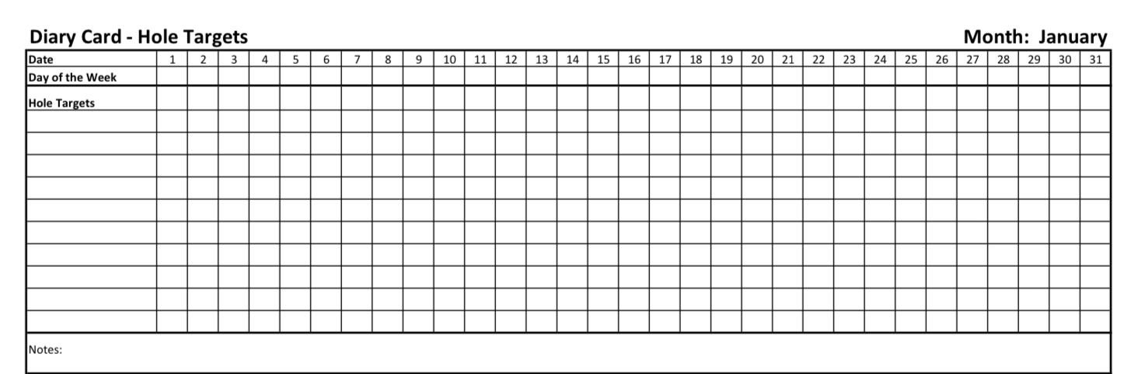
Welcome to simple week 5
distress tolerance skills part III
Introducing the second simple tool: holes diary cards

Slide 2



Slide 3
week 1- orientation and overview- sessions 1 and 2 of simple manual. week 2- introducing distress tolerance-p. 1-13 of dbt workbook and crisis plans-session 3 of the manual. week 3- the theoretical foundations of the simple course. session 4, 6, and 8 of the manual. week 4- distress tolerance p. 14-32 of dbt workbook. Suicide and self-harm session 5 of the manual. week 5- distress tolerance p. 33-46 of dbt workbook. Introducing the second tool: holes diary cards- session 7 of manual. Our first practice: crisis plans week 6- distress tolerance p. 47-68 of dbt workbook. finding your diary card targets- session 9 of manual. our second practice- holes diary cards. week 7- introducing personality- session 10 of manual. week 8- distress tolerance p. 69-90 of dbt workbook. introducing chain analysis-session 11 of manual. week 9- what shapes personality-session 12 of manual. week 10-introducing mindfulness skills p.90-109 of dbt workbook. advanced chain analysis- session 13 of manual. our third practice-chain analysis. week 11- attachment theory- session 14 of manual. week 12- mindfulness skills p. 110-131 of dbt workbook. introducing rational mind remediation-session 15 of manual. week 13- the dynamic-maturational model of attachment and adaptation- session 16 of manual. week 14-mindfulness skills p. 131-147 of dbt workbook. reviewing all the tools-session 17 of manual. our fourth practice-rational mind remediation. week 15-stress-session 18 of manual. week 16-introducing emotion regulation skills p.148-182 of dbt workbook. introducing the goals diary card procedure-session 19 of manual.

Slide 4
PRACTICE SESSIONS SCHEDULE
preparation
1. Week 5 October 29 Crisis Plans Chris G.
2. Week 6 November 5 October 29, 1:30 Holes diary cards Barb H.
3. Week 10 December 3 November 26, 1:30 Chain analysis Ashley S.
4. Week 14 January 14 January 7, 1:30 Rational mind remediation Helga H.
5. Week 18 February 11 February 4, 1:30 goals diary card
6. Week 25 April 15 April 8, 1:30 IFS workbook 1 Elaine S.
7. Week 26 April 22 April 15 IFS workbook 2 Dinko T.
8.Week 27 April 29 April 22 IFS workbook 3
9. Week 28 May 6 April 29 IFS workbook 4
10.Week 32 June 3 May 27 1:30 PM Wise mind remediation

Slide 5


Slide 6
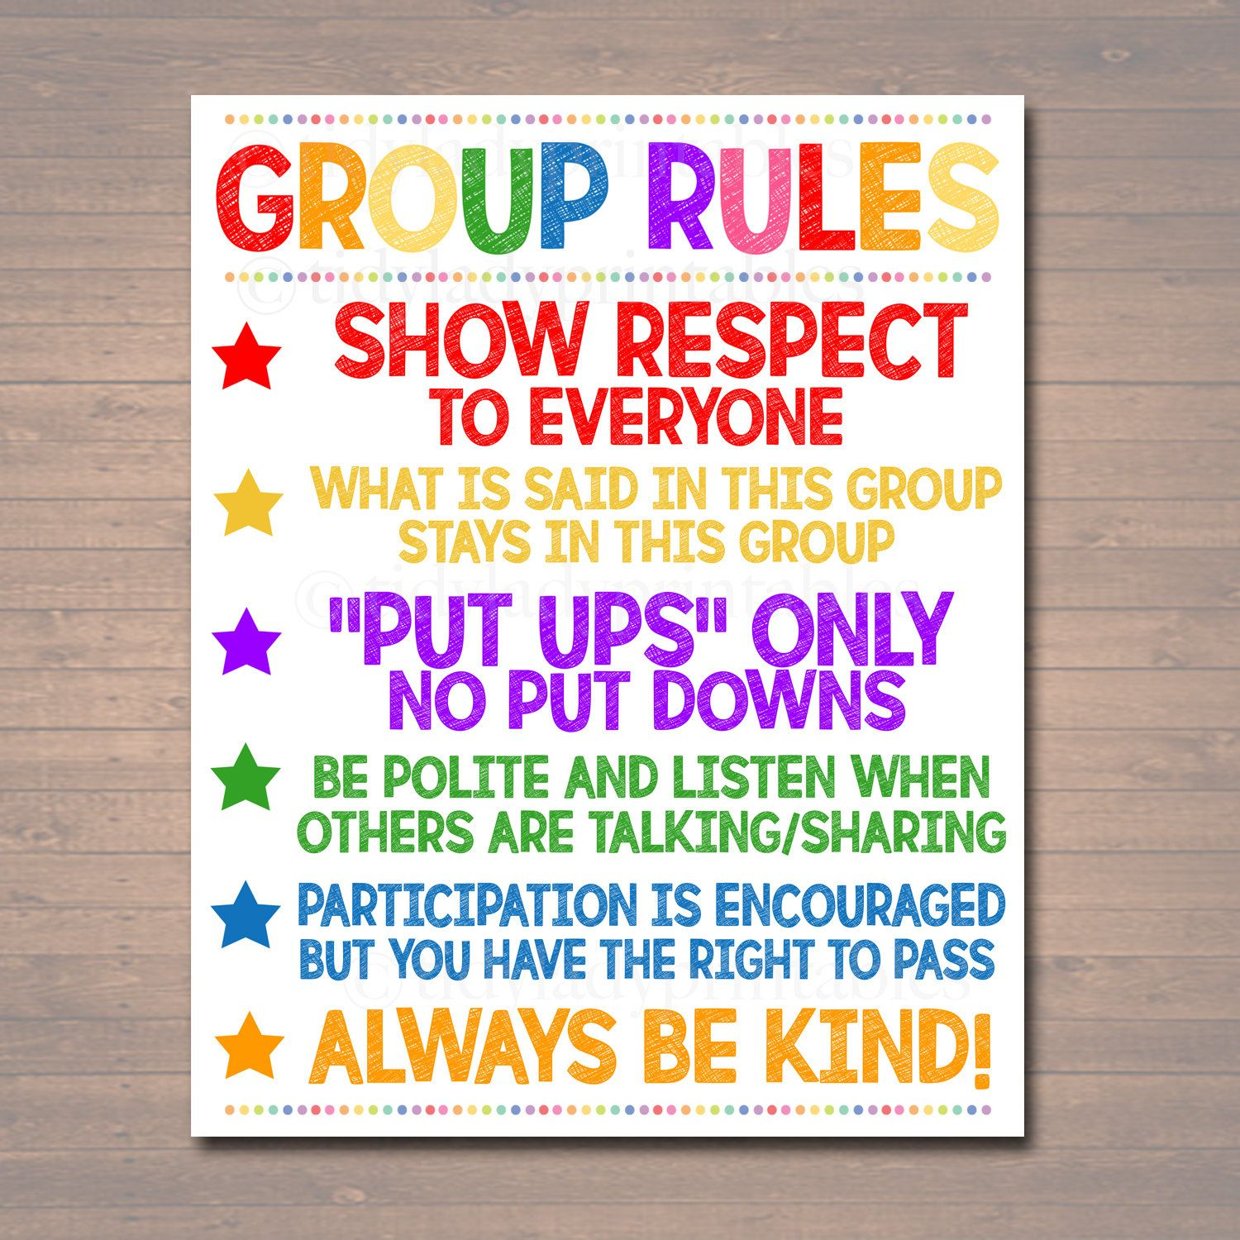
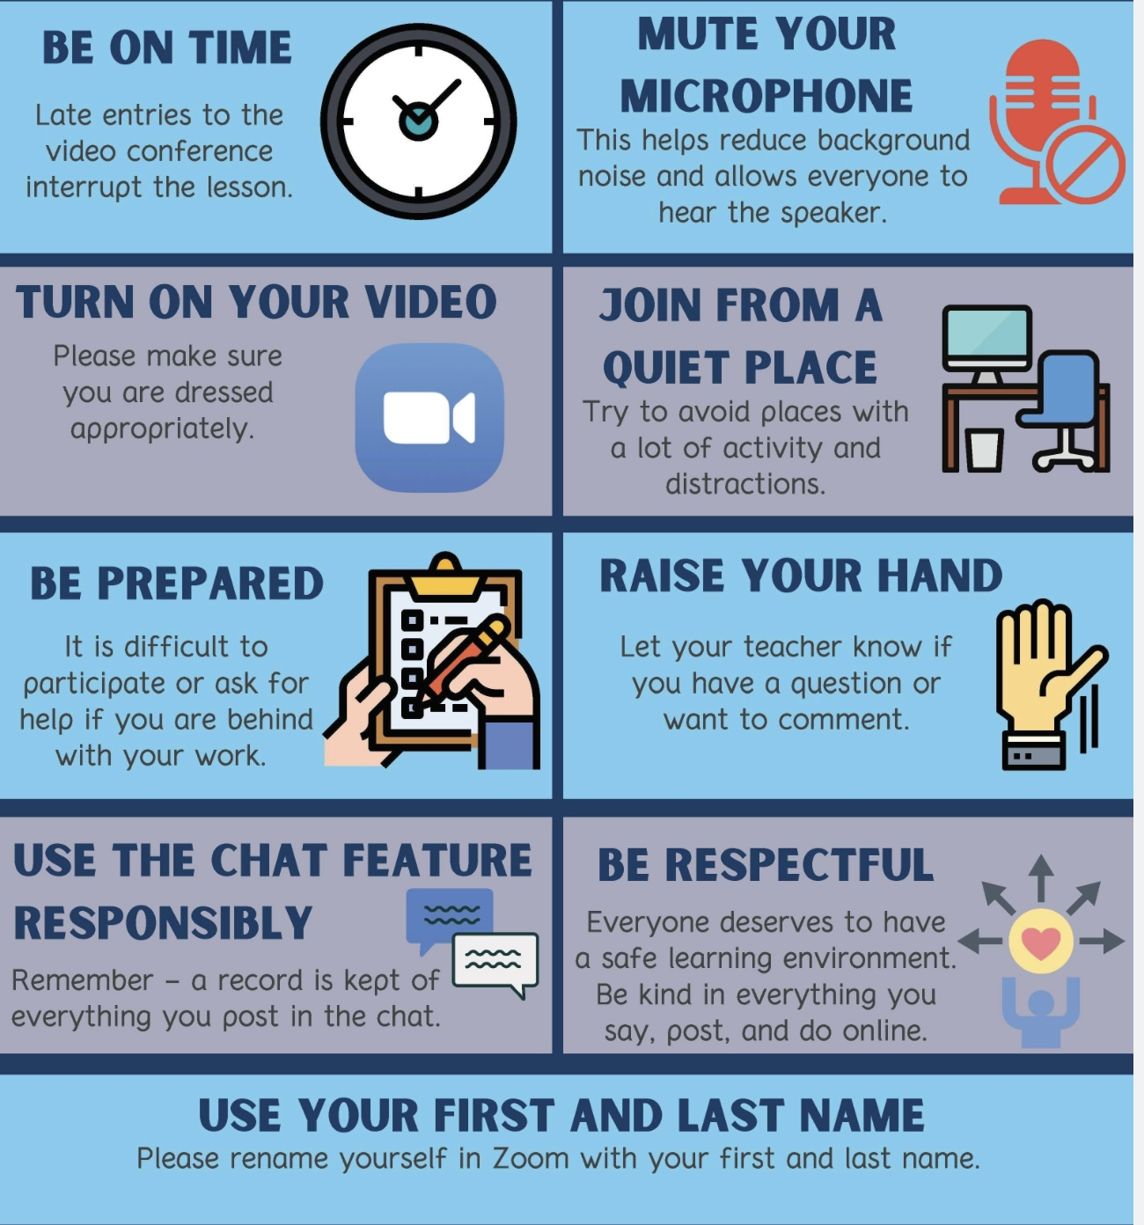
REMINDER PARTICIPANT AGREEMENTS
If you have questions, comments, or feedback, please save them for the two question periods. You can put them in the chat box or raise your real/virtual hand.
Keep comments, questions, and feedback relatively brief so everyone has a chance to participate.(one breath sharing)
If you’re on zoom, make sure no one can overhear what is being said
For reasons that will become clear later in the course please avoid giving advice to other participants about what they should or should not do. Validation, encouragement , and understanding are however very much appreciated.

Slide 7
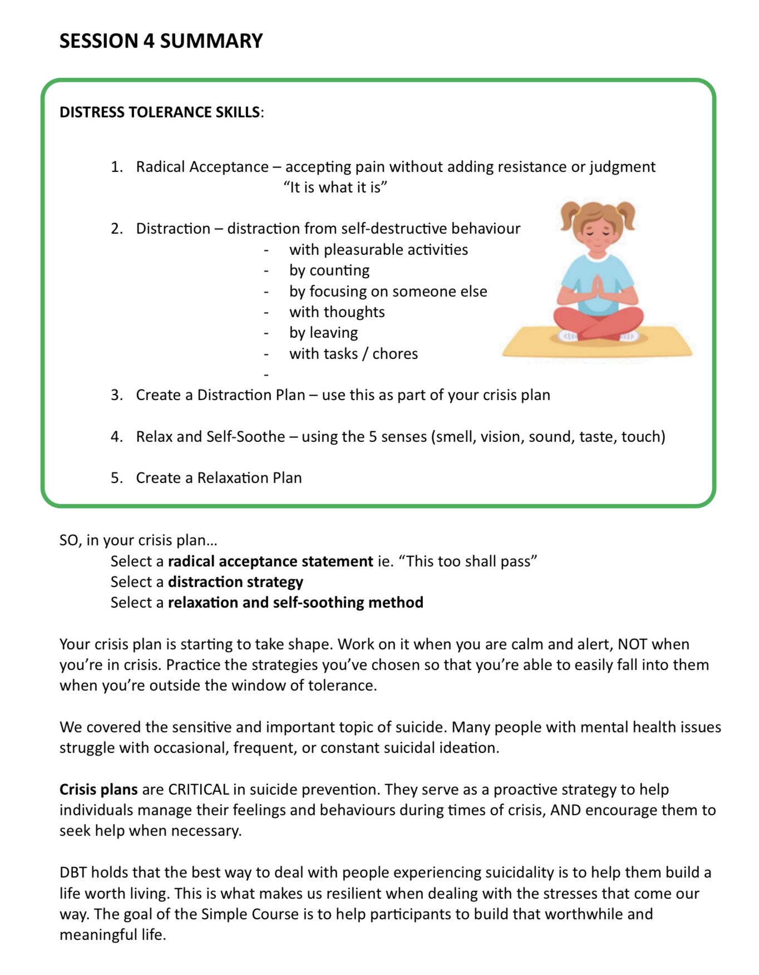
By Kate

Slide 8

Homework from the past week
Continue tracking and practicing the skills you are learning. Use the DBT diary card or keep your own skills list.
Submit questions or comments to itssimple2023@gmail.com
Skills training workbook p. 33-46.
Simple manual session 7
Create your distraction plan. Create your relaxation plan. You can incorporate both into your crisis plan.
Continue working on your crisis plans. Memorize them and practice them in your imagination. Use your distraction and relaxation plans to complete your crisis plans.

Slide 9
Homework for the coming week
Submit
Submit questions or comments to itssimple2023@gmail.com
Read
Simple manual session 8
Start
Find your targets and start using your diary card.
Use
Use all your distress tolerance skills to finish one or more crisis plans. Use editing, splicing, and pasting. Practice them in your imagination.
Keep
Keep tracking and practicing all the skills you’re learning. Use the DBT diary card or your own skills list.

Slide 10


Roger, the Avondale church custodian, asked us to kindly bring our indoor footwear and leave our outdoor shoes/boots under the bench at the entrance now that it’s about to get yucky.
WEEKLY ANNOUNCEMENTS

Slide 11

This past Monday we had our first boing group. 14 people came.
We worked on a crisis plan for Carolyn.
Our hope is that seeing examples of how crisis plans are prepared will help you prepare your own.
This coming Monday November 3rd we will likely focus on diary cards and finding your targets.
If you plan to attend simple, would like help figuring out the targets for your diary card and don’t mind doing that in front of the simple group, email us.
If you plan to come to boing and have any questions on anything we’ve covered so far, email us the question (or ask it Monday at the group)
If we have enough people interested in preparing a sensory soothing toolkit or crafting a personal dashboard, we can do that too. Email us and let us know what you’re interested in.
BOING GROUP

Slide 12
LAST WEEK’S IN PERSON POLL
1. I have suicidal thoughts (single choice)
a) Never 45%
b) Occasionally 40%
c) Often 10%
d) all the time 5%
2. I have attempted suicide
a) Never 65%
b) 1 or 2 times in my life 30%
c) More than 2 times 5%
3. I’ve self harmed without suicidal intent (includes cutting or scratching,
burning, hitting or punching objects or oneself, severe skin picking, taking
small overdoses, starving oneself or extreme exercise, intentionally
exposing self to extreme cold or heat etc. (single choice)
a) Never 40%
b) Occasionally 50%
c) Often 5%
d) Very often 5%
4. I have a good plan to deal with my suicidal and self harming thoughts
(single choice)
a) Yes 55%
b) No 35%
c) n/a 10%

Slide 13
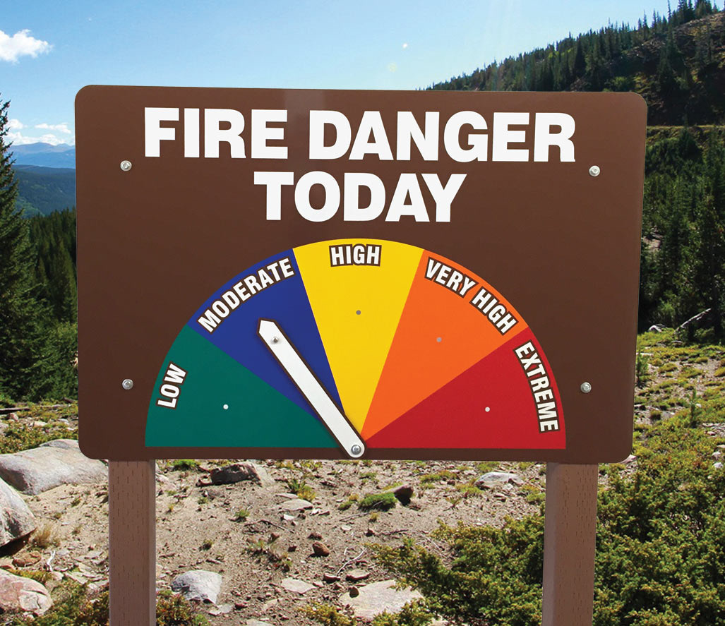

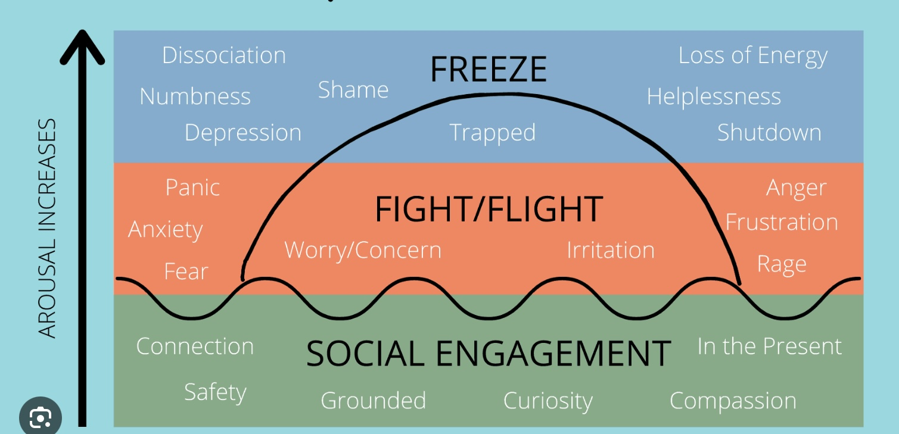

Check in regularly with your Personal dashboard
Spend a few moments checking in with yourself by asking:
1)What is the current risk that I’ll experience a state of crisis ?
Low b) Moderate c) high d) very high e) extreme
2) Am I in the window of tolerance?
a) Yes b) I’m a little outside c) very outside
3) What state of activation am I mostly in at the moment?
a) Calm b) Fight c) Flight d) Dissociated e) Depressed?
4) Where is my energy tank right now?
a) Full b) ¾ c) ½ d) near empty
CRISIS RISK
WINDOW OF TOLERANCE
STATE OF ACTIVATION
ENERGY RESERVES

Slide 14
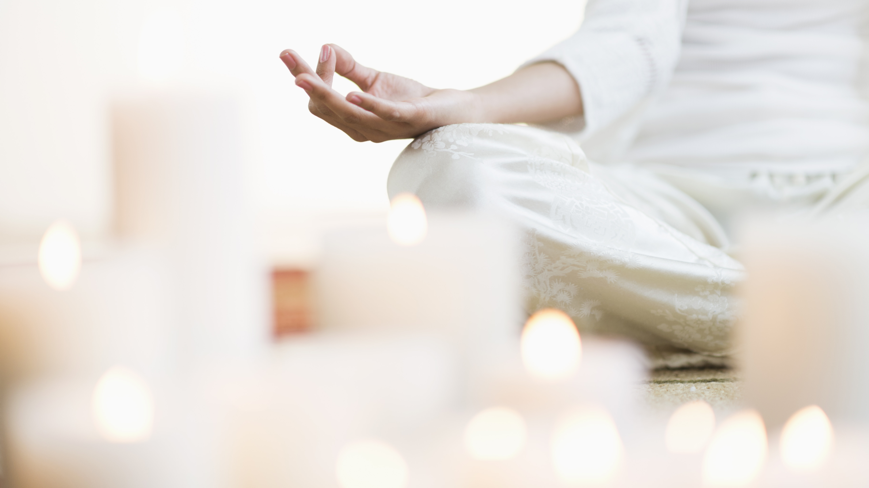
Warning about meditation
Feel free to skip it

Slide 15
CUE CONTROLLED RELAXATION
To begin, sit in a comfortable chair with your feet flat on the floor and your hands resting comfortably, either on the arms of the chair or in your lap.
Close your eyes.
Take a slow, long breath in through your nose. Feel your belly expand like a balloon as you breathe in. Hold it for five seconds: 1, 2, 3, 4, 5. Then release it slowly through your mouth. Feel your belly collapse like a balloon losing its air. Again, take a slow, long breath in through your nose and feel your stomach expand. Hold it for five seconds: 1, 2, 3, 4, 5. Then exhale slowly through your mouth. One more time: take a slow, long breath in through your nose and feel your stomach expand. Hold it for five seconds: 1, 2, 3, 4, 5. Then exhale slowly through your mouth.
Now begin to take slow, long breaths without holding them, and continue to breathe smoothly for the rest of this exercise.
Now, with your eyes still closed, imagine that a white beam of light shines down from the sky like a bright laser and lands on the very top of your head.
Notice how warm and soothing the light makes you feel. This could be a light from God, the universe, or whatever power makes you feel comfortable.
As you continue to breathe smoothly, taking slow, long breaths, notice how the light makes you feel more and more relaxed as it continues to shine on the top of your head.
Now, slowly, the warm, white light begins to spread over the top of your head like soothing water. And as it does, the light begins to loosen any muscle tension that you’re feeling on the top of your head.
Slowly, the light begins to slide down your body, and as it moves across your forehead, all the muscle tension there is released.
Then the white light continues down past your ears, the back of your head, your eyes, nose, mouth, and chin, and it continues to release any tension you’re holding there.
Notice how pleasantly warm your forehead feels.

Slide 16
Now, slowly, imagine that the light begins to move down your neck and over your shoulders, releasing any muscle tension. Then the light slowly proceeds down both of your arms and the front and back of your torso.
Feel the muscles in your upper and lower back release. Notice the soothing sensation of the white light as it moves across your chest and stomach.
Feel the muscles in your arms release as the light moves down to your forearms and then across both sides of your hands to your fingertips.
Now notice the light moving down through your pelvis and buttocks and feel the tension being released.
Again, feel the light move like soothing water across your upper and lower legs until it spreads across both the upper and lower surfaces of your feet.
Feel all of the tension leaving the muscles of your body as the white light makes your body feel warm and relaxed.
Continue to notice how peaceful and calm you feel as you continue to take slow, long, smooth breaths.
Observe how your stomach continues to expand as you inhale, and feel it deflate as you exhale.
Now, as you continue breathing, silently think to yourself “breathe in” as you inhale, and then silently think the word relax as you exhale.
Slowly inhale and think: “breathe in.” Slowly exhale and think: “relax.” As you do, notice your entire body feeling relaxed at the same time.
Feel all the muscle tension in your body being released as you focus on the word relax.
Again, inhale and think: “breathe in.” Exhale and think: “relax.” Notice your entire body releasing any muscle tension.
Again, inhale…“ breathe in.” Exhale…“ relax.” Feel all the tension in your body releasing.
Continue breathing and thinking these words at your own pace for several minutes.
With each breath, notice how relaxed your entire body feels.
When your mind begins to wander, return your focus to the words “breathe in” and “relax.”

Slide 17
Practice the cue-controlled relaxation technique twice a day, and record how long it takes you to feel relaxed.
With daily practice, this technique should help you relax more quickly each time.
Again, remember that the ultimate goal of this technique is to train your entire body to relax simply when you think of your cue word, such as “relax.”
This will only come with regular practice. Initially, you might also have to think of the white-light imagery and engage in slow, deep breathing to help yourself relax. But with practice, this technique can help you relax in many distressing situations.
You can also combine this exercise with the previous safe-place visualization. Engaging in cue-controlled relaxation first will help you feel even more safe and calm in that visualization process.
If you closed your eyes, you can now open them and take a moment to return to the room. Look around, notice where you are.

Slide 18

E-mailed questions, comments, feedback
Housekeeping
Could you be clearer about fawning?

Slide 19
Fawning” is not one of the classic physiological threat responses (fight, flight, freeze, faint), but it’s closely related and often considered a socially mediated survival strategy that arises in the same neurobiological context. Fawning refers to a trauma or stress response characterized by appeasing, placating, or people-pleasing behavior as a way to maintain safety, avoid conflict, or prevent rejection. It’s a learned adaptive response, especially in relationships where asserting oneself led to punishment or withdrawal of love.
While “fawn” isn’t a distinct autonomic state, it emerges from the same system that regulates fight, flight, and freeze. Fawning is a socially-oriented stress response, your body is activated (like in fight/flight), but the energy is redirected toward connection-seeking behaviors rather than confrontation or withdrawal.
Fawning and bullying are often linked, though they occupy opposite ends of the social stress spectrum. Understanding that link helps illuminate how both behaviors arise from the same underlying drive: to manage threat and preserve belonging.
Both fawning and bullying are responses to perceived threat or insecurity within a social hierarchy. Fawning is a submission strategy: The person has learned (often early in life) that safety or love depends on compliance, pleasing, or self-erasure. When faced with power, conflict, or rejection, they appease to stay safe or accepted. Bullying is a dominance strategy: The person has learned (often also early) that controlling or intimidating others restores a sense of safety or power when they themselves feel threatened, humiliated, or powerless.
Both are adaptive strategies to regulate fear and maintain control, just through opposite routes: Fawn: “If I keep you
happy, I’ll be safe.” Bully: “If I make you afraid, I’ll be safe.”

Slide 20
In many relationships or systems (schools, families, workplaces): Fawning individuals often become targets of bullying because their boundaries are weak and their compliance reduces social resistance. Bullies sometimes seek fawning
individuals to reaffirm their control and avoid mutual vulnerability. Both roles can alternate, a person may fawn toward
those above them (e.g., a boss or parent) and bully those below (e.g., a sibling or coworker) as the same pattern
cascades down the hierarchy.
Both responses tend to emerge from relational trauma or chronic insecurity: A child who had to appease a volatile
caregiver develops fawning as a nervous-system shortcut to safety. A child who felt powerless or humiliated may
develop bullying as a preemptive defense against being hurt again. Both represent adaptations to unsafe attachment
systems, one through submission, the other through domination.
Recovery from either end of this spectrum involves 1) recognizing the underlying fear (of rejection, loss, or
powerlessness) 2) reconnecting to the body to notice arousal before automatic behaviors take over building boundaries and assertive communication and 3) cultivating mutuality through relationships based on equality rather than submission or control.

Slide 21

What we will do today
Practice preparing a crisis plan with Chris
Simple manual session 7 introducing the second Simple tool: holes diary cards.
Skills training workbook p. 33-46 “advanced distress tolerance skills” which include;
1. safe place visualization,
2 .cue-controlled relaxation,
3. rediscover your values,
4. values-based behavior,
5. higher power.
Kate’s summary.

Slide 22
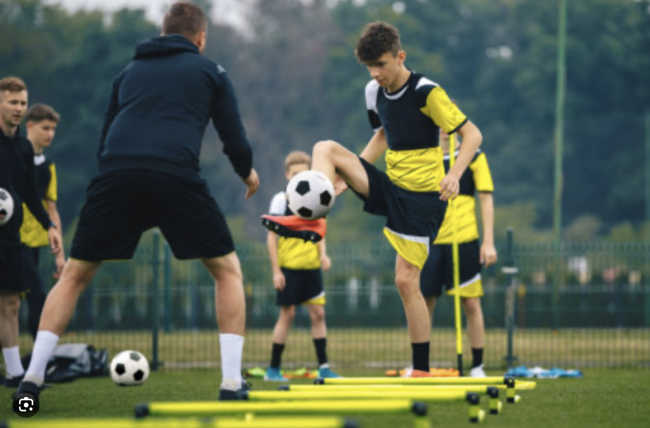
PRACTICE USING SKILLS TOOLS AND STRATEGIES
Crisis plans with Chris

Slide 23
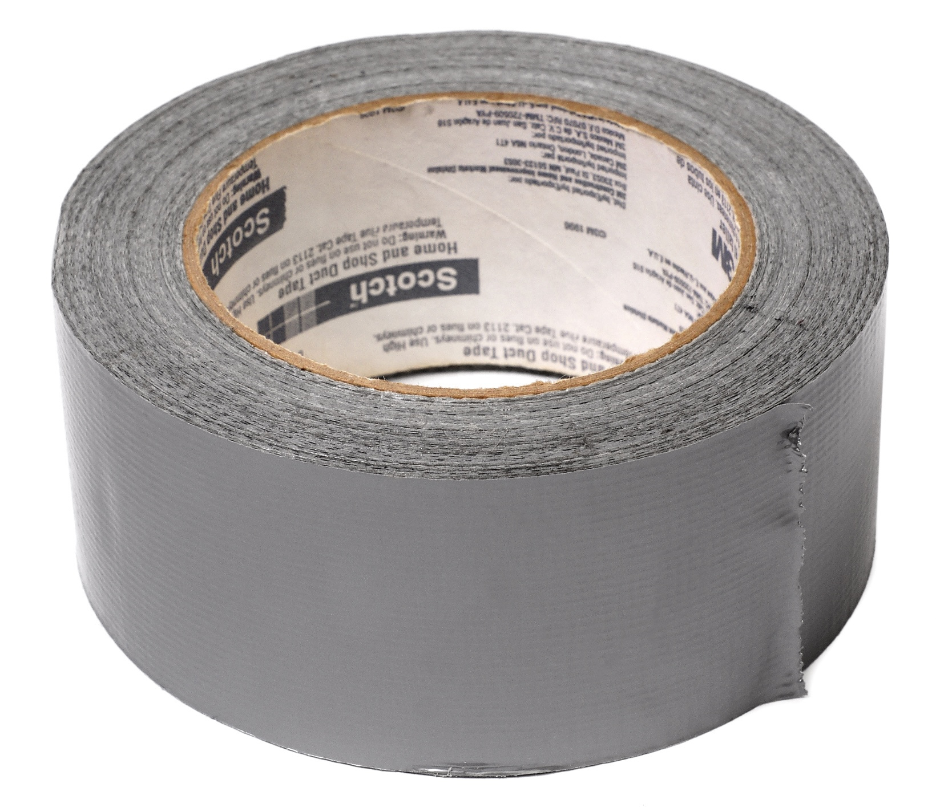


Slide 24
RESULTS ON IN PERSON POLL FROM LAST WEEK
1. Which of the following “holes” do you sometimes or often fall into(multiple choice
Substance use or other addictive behaviors ​​41%
Destructive impulsive behavior ​​​​27%
Patterns of dysfunctional interpersonal interactions​ 45%
Negative self-talk ​​​​​​​91%
Being overly critical of others ​​​​​50%
Dysregulated anger, anxiety, despair, or numbing out ​86%
Problems with boundaries-such as being unable to say no​ 73%
Any repeated behaviors' you later regret ​​​​45%
Withdrawing or running away​​​​​​ 77%
Thinking of and actually hurting yourself​​​​ 23%
Suicidal thoughts ​​​​​​​​36%
2. With respect to your thought holes, which thought do you most often have about yourself? (multiple choice)
I’m incompetent ​​​​​​​50%
I’m an imposter​​​​​​​ 14%
I’m defective ​​​​​​​64%
I’m unworthy ​​​​​​​59%
I’m shameful​​​​​​​ 23%
I’m guilty ​​​​​​​​41%
I’m unsafe​​​​​​​​ 18%
I’m vulnerable​​​​​​​ 27%
I’m out of control​​​​​​​ 27%

Slide 25
3. I’m in crisis…(single choice)
All the time ​​​​​​​​0%
Very often​​​​​​​​ 36%
Often ​​​​​​​​​41%
Sometimes ​​​​​​​​23%
Rarely ​​​​​​​​0%
4. When I’m in crisis I feel…(multiple choice)
Angry​​​​​​​​​ 36%
Anxious ​​​​​​​​91%
In despair ​​​​​​​​77%
Confused or lost​​​​​​​ 41%
Numb​​​​​​​​ 45%
Like I’m in a bottomless hole​​​​​ 50%
5. My crisis typically lasts…(multiple choice)
Minutes​​​​​​​​ 32%
b. Hours ​​​​​​​​45%
c. Days ​​​​​​​​​59%
d) Weeks​​​​​​​​ 9%
e) Months ​​​​​​​​5%
f) They never stop​​​​​​​ 14%

Slide 26
6. In a crisis I tend to think that …(multiple choice)
I’m worthless ​​​​​​​55%
I’m shameful ​​​​​​​50%
I’m unlovable ​​​​​​​50%
I don’t belong ​​​​​​​59%
I’m bad ​​​​​​​​27%
I’m irreparably flawed​​​​​​ 55%
7. In a crisis…
I tend to keep it all inside​​​​​ 77%
I tend to let it out​​​​​​​ 45%

Slide 27

Crisis plan algorithm
Developing your crisis plans and becoming skilled at using them involves 8 steps: This is the first Simple algorithm.
1. Understand the concept of holes you keep falling into or the specific crisis for which you are going to use the crisis plans
2. Identify some of the thoughts, feelings or behaviors that occur during the crisis that you want to work on. This is step 1 on the crisis plan template.
3. Complete the rest of your crisis plan template
4. Recall, in your mind, a real crisis from the past in which you fell into the hole you are working on and use the "editing, splicing, and pasting" technique, along with your skills and tools, to imagine a different outcome that incorporates your crisis plan.
5. Stay in the window of tolerance while editing, splicing, and pasting by pendulating.
6. Repeatedly visualize the new edited, spliced, and pasted version of the situation until you can visualize it without effort.
7. When a new crisis occurs work with it following these same steps.
8. practice, practice, practice.

Slide 28
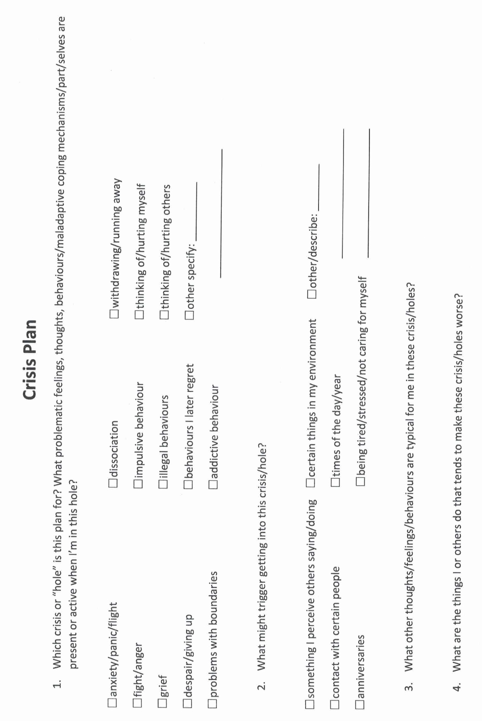
Notes:
Ann's crisis plan
In one of the sessions with her psychiatrist, and worked on a crisis prevention plan for the whole she fell into around the time of her weekly meetings with Jane.
Working with the crisis plan template, and recognize the unhelpful behavior was that, although she forced herself to attend these meetings, she wanted to run away from them, and after the meetings, she withdrew from her usual activities and ruminated.
She was triggered by this work situation because she felt she had no control and felt pressured and devalued.
The warning signs that she was in this whole, word that she would eat more, cry, ruminate, be unable to sleep, isolate herself, and avoid people. Being alone made it worse.
People may fall into holes at unpredictable times, in which case it is crucial to be aware of the warning signs and triggers so that they do not miss the fact that they are in a whole. Ann's patterns were more predictable.
Although she also ruminated during the remainder of the week, and felt most distressed from the day before, to the day after, her meetings with Jane. She felt some relief after the meetings when her worst fears had not materialized. Being aware of this time pattern was helpful in implementing the crisis plan.
As and reviewed the distress tolerance module in the skills training workbook, she thought that distraction, self soothing, and self-care would be good skills to use when she began to ruminate about work.
She decided that the most helpful skills, deal with the whole itself, be radical acceptance, practice relaxation, commitment to valued action, and using coping thoughts and strategies.
And had previously taken a cognitive behavioural therapy course and was familiar with thought records. It seemed to her that DBT's "coping thoughts" were similar, if less structured than thought records. She was good at doing thought records and decided to structure her crisis plan around one.
The situation was that the nursing home had new owners, and and had to meet weekly with chain the manager.
Her feelings around this were anxiety and sadness.
Her automatic thoughts were "I won't be able to cope", "working at the nursing home won't be the same and will be awful", and "I will lose my job and income and I will be poor".
The fact that supported her automatic thinking were:
She did struggle to cope
The company that had taken over the nursing home did not care about her in the way Ezra and Ruth did.
To this company nursing homes were a business and making money was important.
If she did lose her job, should be financially in distress.

Slide 29
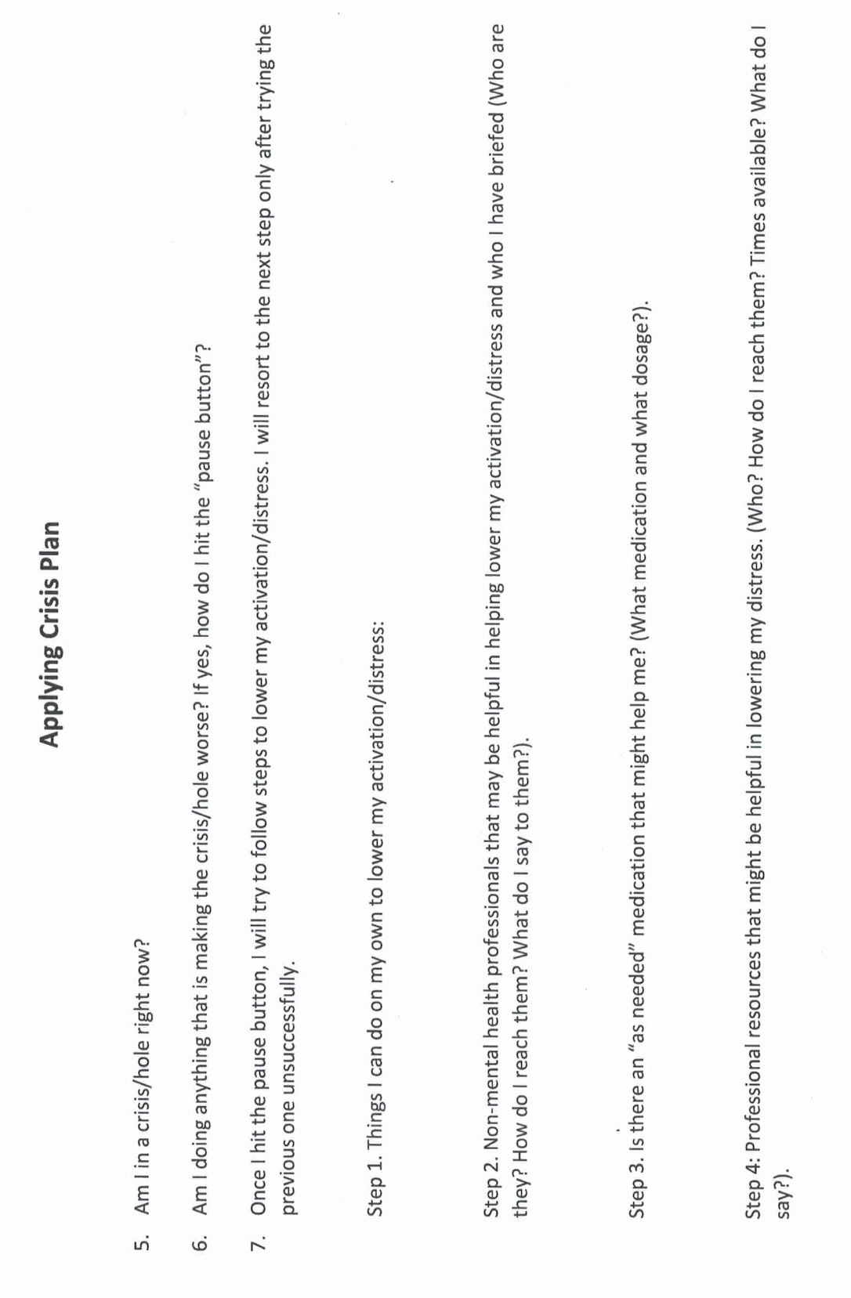

Slide 30
ANN’S INTERMEDIARY TARGETS
We met Ann in week 2 as she worked on a crisis plan. She was the nurse working at a family run nursing home that had been sold to new owners. Ann was trying to adjust to a stressful and challenging situation without becoming overwhelmed by her lifelong symptoms of anxiety and depression. Ann was particularly anxious about her weekly meetings with her supervisor Jane. She had prepared, and in her imagination practiced, a crisis plan to help her with these feelings and thoughts. Ann found this helpful. She liked using the “personal dashboard” because it helped her to pay attention to her feelings before they became overwhelming. She was also becoming more aware of the importance her energy balance and the importance of staying in the window of emotional tolerance. When she noticed that she was becoming activated, she reviewed the coping thoughts that she had chosen to use. She also though of her values; being of service to the residents.
Ann now wanted to find intermediate targets for her diary card. She recalled that they are the same as the holes used in the crisis plan: feelings, thoughts, or behaviours occurring when she was struggling to cope.
Using the wheel of feelings, Ann recognized that when she was emotionally activated, she often felt fear and sadness. Other emotions from the wheel that she related to were scared, anxious, worried, vulnerable, and fragile.
Ann realized her negative thoughts tended to fall into the categories of all or nothing, emotional reasoning, and catastrophizing.
Her behaviours were all internalizing; withdrawal, fixating on certain thoughts, and avoiding social situations.
Looking at this list, Ann thought she would use “ruminating on negative thoughts” and “withdrawing” as her intermediate targets. Being artistic, Ann decided she would use a pallet of colors, ranging from canary yellow to crimson red, to rate her targets.

Slide 31
M T W T F S S
ruminating
withdrawal.

Slide 32

The 6 tools:
Crisis plans
Holes diary cards
Chain analysis
Mature adult remediation
Goals diary cards
Wise mind remediation

Slide 33
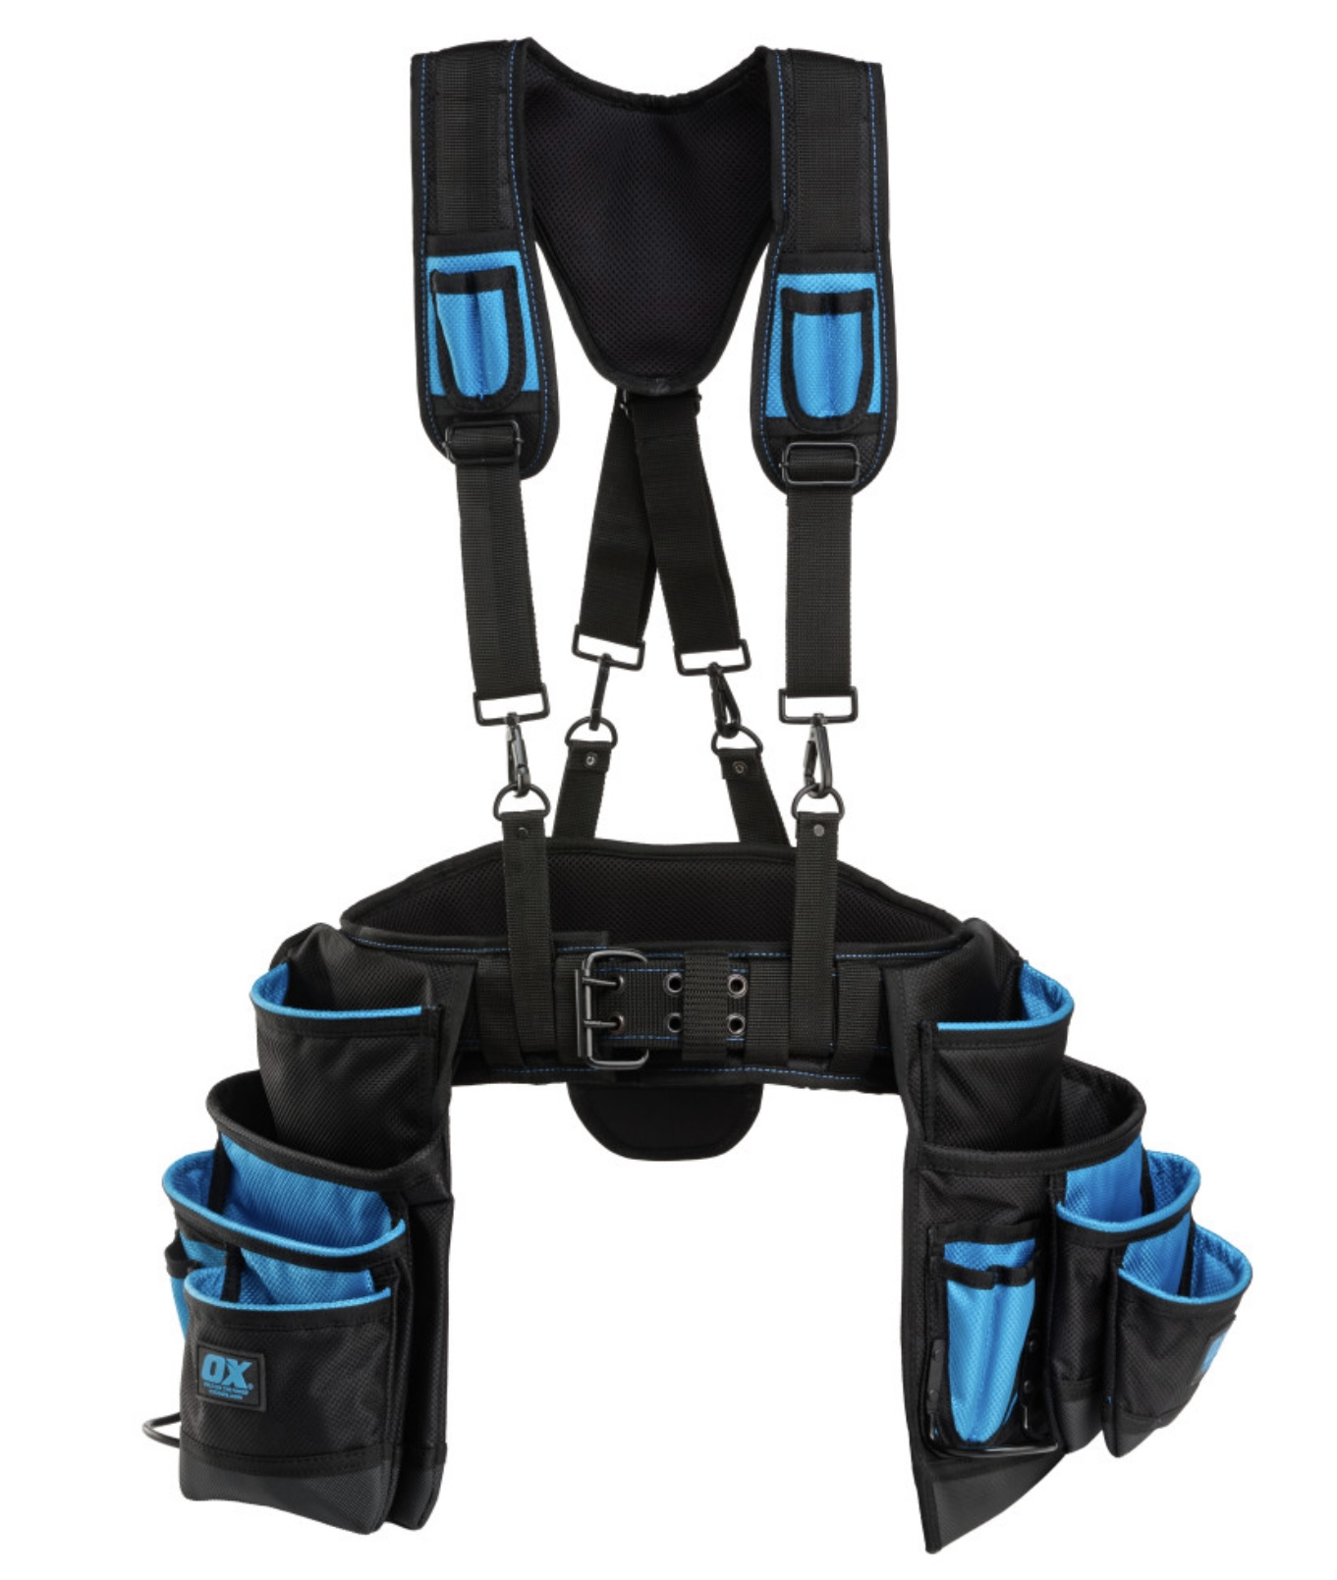
THE FIRST TOOL
THE SECOND TOOL
Crisis plans
Holes diary cards

Slide 34

simple tools
We previously discussed the first Simple tool
Crisis plans
Today we introduce the second Simple tool
Holes diary cards

Slide 35
THE HOLES DIARY CARD TEMPLATE
Targets for change
Squares for ratings
Days of the month

Slide 36
M T W T F S S
struggling.
4 3 6 2 3 10 9
sad.
5 4 7 1 2 8 7
withdrawing
9 8 6 6 5 10 10

Slide 37

The WHAT, How, and why, of “holes” diary cards
1. crisis plans holes and diary card targets
2. topography
3. finding your targets for change
4. why do a holes diary card
5. making diary cards a habit

Slide 38

Are holes diary card targets and crisis plan holes the same thing ?

Slide 39
The WHAT, How, and why, of “holes” diary cards
1. crisis plans holes and diary card targets
2. topography
3. finding your targets for change
4. why do a holes diary card
5. making diary cards a habit

Slide 40


1. Crisis plan holes and diary card targets
crisis hole
Both crisis plans and holes diary cards are ways of identifying and working with the “holes in the sidewalk” we fall into. They are very similar but with some slight differences.
The crisis plan’s holes in the sidewalk metaphor has an all or nothing quality, either we're in a crisis and at the bottom of the hole or we’re not in a hole at all.
Holes diary cards are more subtle recognizing that there are many degrees of severity or intensity of dysregulated feelings, thoughts, and behaviors. In that way, they are like a spiral staircase rather than a hole.
Because of this, the metaphor we use for crisis is that of a “hole”, while the one we use for diary cards is of “stairs” with steps.
In our holes diary cards, we arbitrarily choose a stairwell that has 10 steps, each step representing a different intensity of the dysregulated feelings, thoughts, or behaviors. We call these dysregulated thoughts, feelings, or behaviors targets for change. (or just “targets”)- this word can create some confusion.
10 is the bottom step of the stairs, 1 is the top step closest to the sidewalk. 10 is the most intense, 1 the least. When you are lower in the staircase, you’re more likely to be in crisis and outside the window of tolerance.
If you prefer, instead of using a numerical 1-10 scale you can use colors ex. Yellow, orange, red, black, which may make it easier to visualize the intensity of the targets.
diary cards steps
Notes:
You are already familiar with the concept of falling into "holes". When we are in crisis we fall into a "hole". The crisis plans are ways of getting out of these holes faster and eventually avoiding them. What holes were to crisis plans, targets are to diary cards. Targets are short for targets for change. Targets are quite like holes.

Slide 41
The WHAT, How, and why, of “holes” diary cards
1. crisis plans holes and diary card targets
2. topography
3. finding your targets for change
4. why do a holes diary card
5. making diary cards a habit

Slide 42
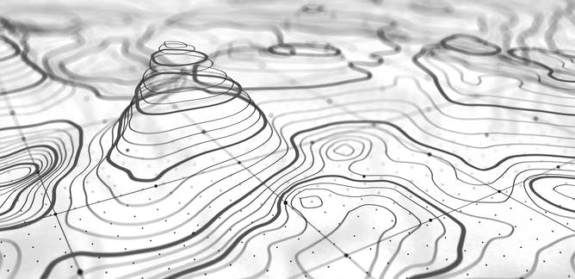
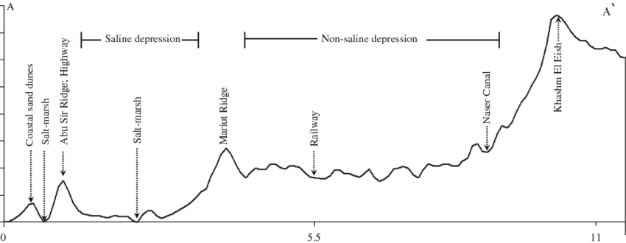
2. In geography “Topography” refers to the arrangement of the physical features, especially the elevation of a certain terrain. In simple we use the word topography to describe how the intensity of a person’s target emotions, thoughts or behaviors fluctuate over a period of time, in other words the topography tracks our journey up and down the stairwell over time.
The “topography” of our target dysregulated feelings, thoughts, or behaviors, can be depicted as a graph in which the horizontal axis is time while the vertical is the variation in intensity of our feelings, thoughts, and behaviors.
These variations can occur faster or slower, over the course of minutes, weeks or even months and years.

Slide 43
TOPOGRAPHY

Slide 44
The WHAT, How, and why, of “holes” diary cards
1. crisis plans holes and diary card targets
2. topography
3. finding your targets for change
4. why do a holes diary card
5. making diary cards a habit

Slide 45


Diary card targets
= crisis plan holes
3. FINDING YOUR TARGETS FOR CHANGE
Diary cards targets are similar to crisis plan holes.
As we said earlier, however, there is a slight difference: crisis plan holes are all or nothing, you’re either in a crisis or you’re not, diary card targets vary in intensity from mild to severe.
Like crisis plan holes, diary card targets are dysregulated physical states, emotions, thoughts, behaviors, or maladaptive coping strategies, that recur in your life, and that you have decided are problematic and want to change.
Examples of holes diary card targets include substance abuse, gambling, or any other addiction. Engaging in dysfunctional social interactions. Self-blaming, and rumination. Excessive irritability or anger towards others. Notice how these overlap with crisis plan holes.
Targets can also be any of the holes suggested in the checkboxes in item 1 of the crisis plan template : anxiety, anger, despair, problems with boundaries, impulsive behaviors, behaviors a person later regrets, withdrawing/running away, and thinking of/actually hurting self/others.
In other words, you can use as your diary card targets the holes you chose to work with in your crisis plans.

Slide 46
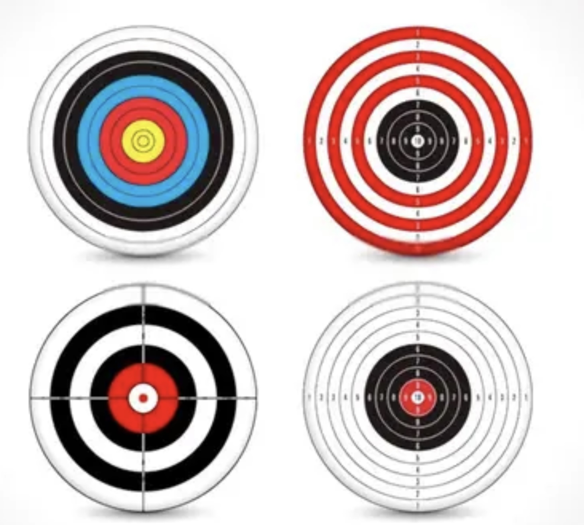
3 TYPES OF DIARY CARD TARGETS
There are beginner, intermediate, and advanced diary card targets. All the examples we have gave above are intermediate targets.
If you have trouble finding an intermediate target, use a “beginner target” in your diary card instead.
Beginner targets are more generic and catch-all than intermediate ones. They are easier to use than the more specific intermediate targets. Beginner targets include struggling, feeling bad, being upset, losing it, getting into trouble, or falling into a hole. Start with one of these.
We won’t discuss advanced targets until later in the course when we explore internal family systems part selves. If you don’t know what IFS is, don’t worry, we’ll get to it.

Slide 47
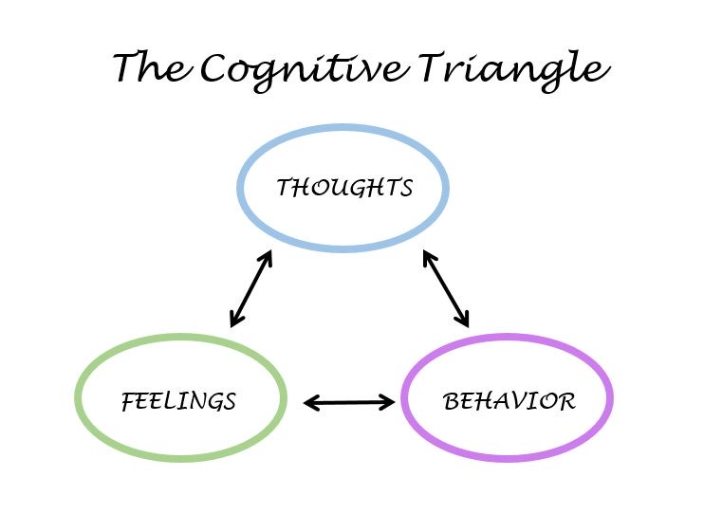
Diary card Targets
Like crisis plan holes, diary card targets can be:
1. Feelings: to help you identify your feelings consult the wheel of feelings (see below) which we also used in trying to identify crisis plan holes.
2. Thoughts: consider ANTS or automatic negative thoughts (below)
3. Behaviors: consult externalizing vs. internalizing behaviors (below}
4. Maladaptive coping strategies: are defined as coping strategies that in the short term decrease your distress but increase it over the long term. Ex. Substance use, self-harm, unhealthy eating.

Slide 48
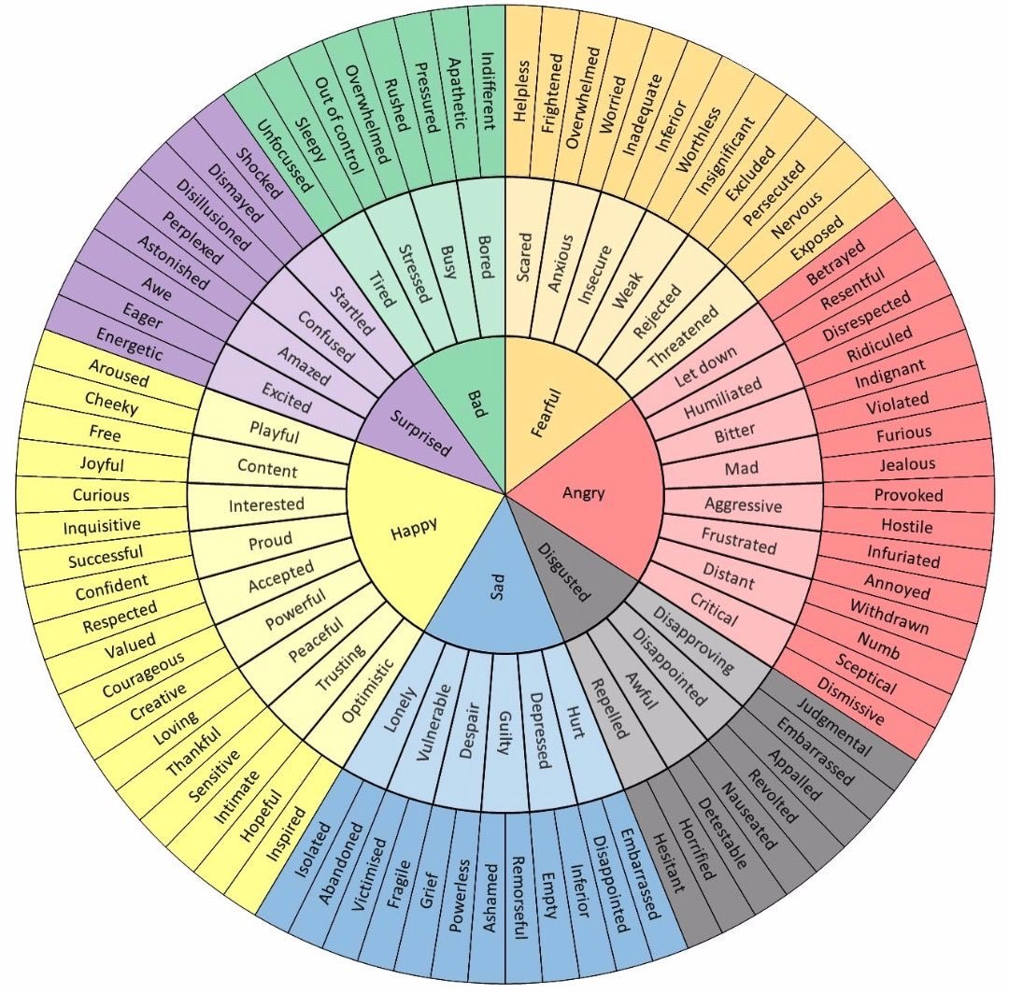
Which feelings from the wheel of feelings do you experience frequently and not necessarily when circumstances entirely merit it?
Notes:
The wheel of feelings, the list of cognitive errors and automatic negative thoughts, and that of internalizing and externalizing behaviours helped you find your holes. They can also help you find your targets which may be the same as your holes or different from them.

Slide 49
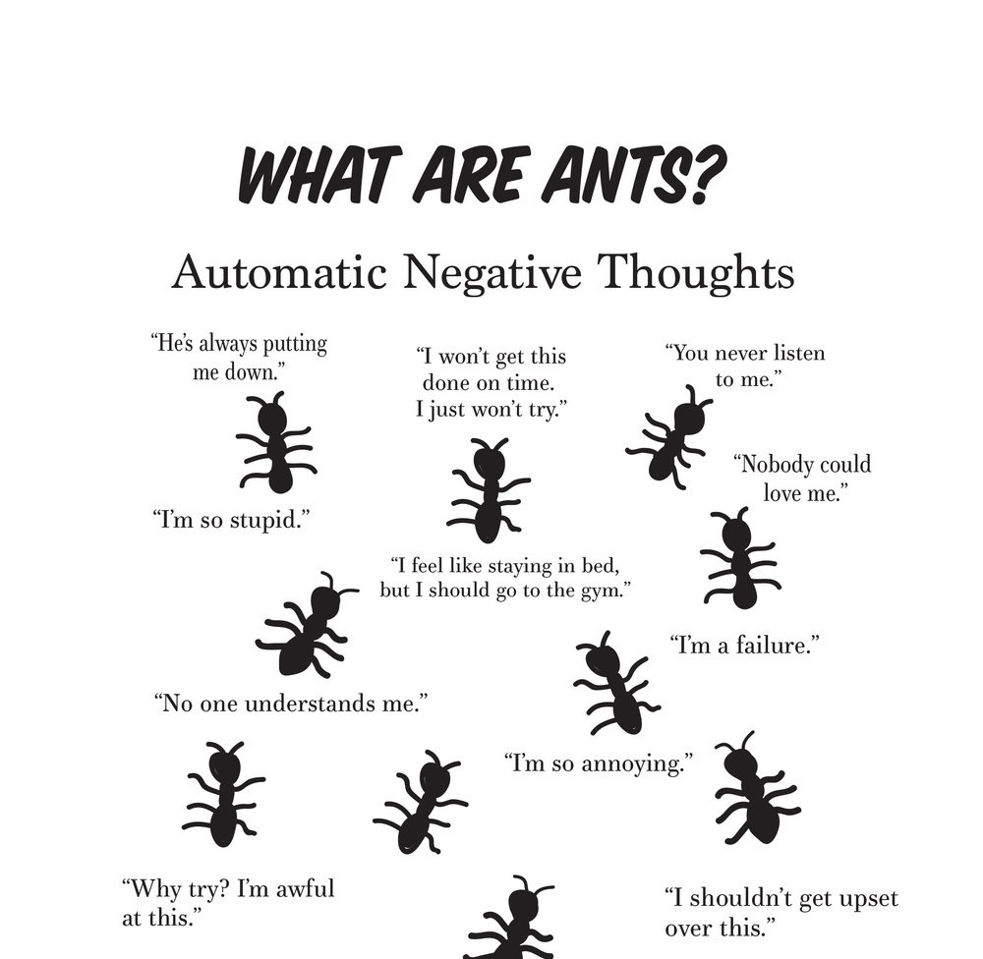
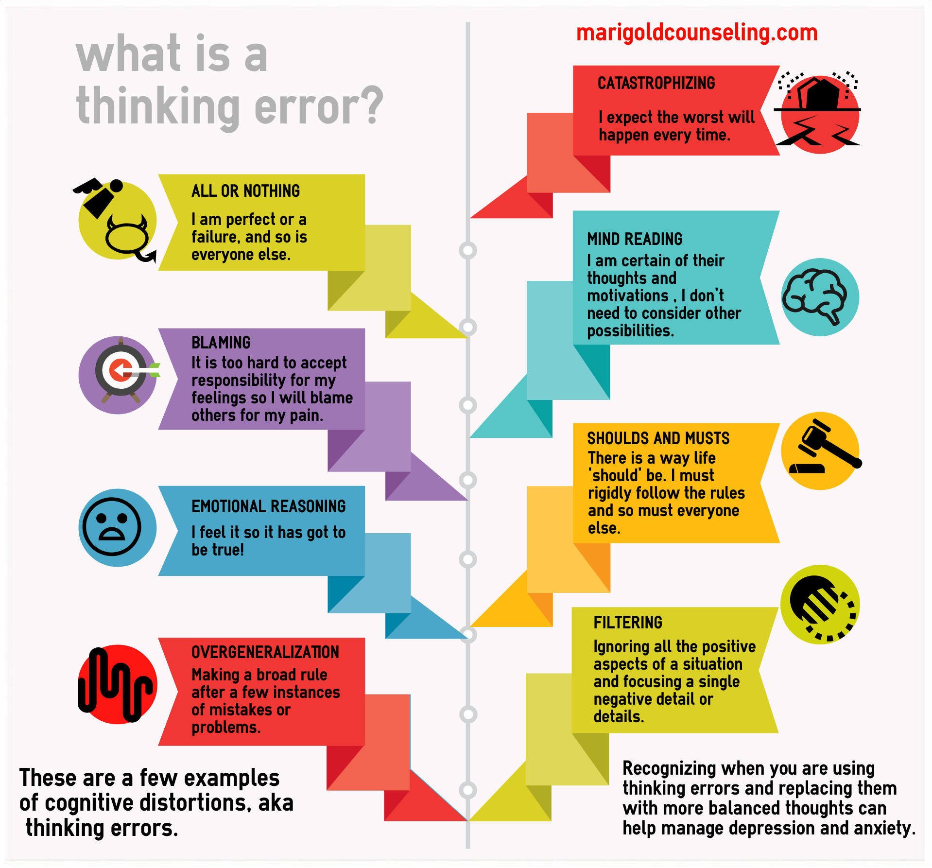
Which thoughts from among the ANTS (below) do you frequently have and not necessarily when circumstances entirely merit it?

Slide 50
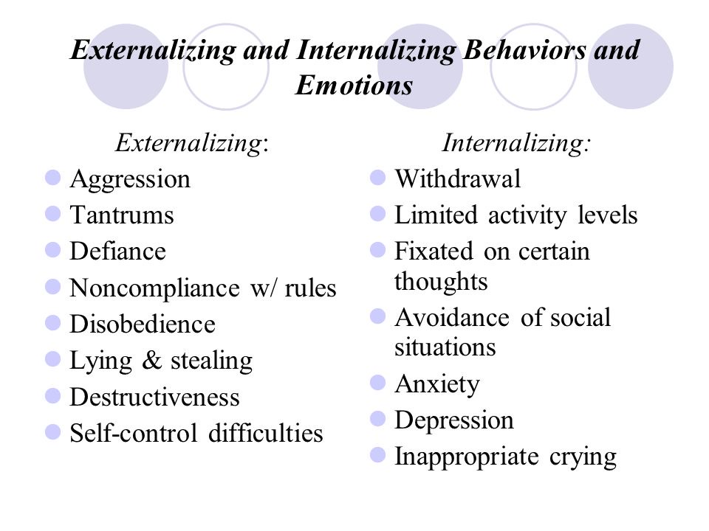
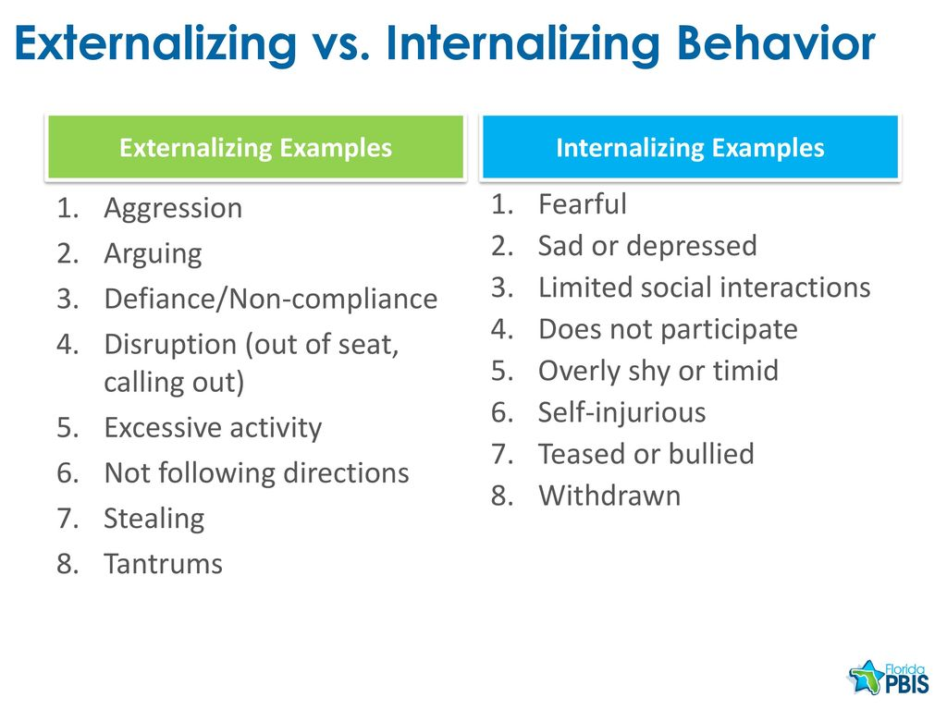
Which behaviors from the lists below do you frequently have and not necessarily when circumstances entirely merit it?

Slide 51

HOW TO FIND YOUR intermediate targets
1. Think about a time when you have been in a hole or crisis, outside the window of tolerance, “lost it”, “struggled”, “felt bad”, “got into trouble”, or were “very upset”. (in other words, start with a beginner targets)
2. When this happened, what were your dominant feelings, thoughts, or behaviors? (use the wheel of feelings, thinking errors and ANTS, and the internalizing and externalizing behaviors slides to help you)
3. From these choose from 1 to 3 feelings, thoughts, or behaviors that a)you experience frequently, b)are problematic for you, and c)you want to change.
4. These are your intermediate targets.
Intermediate targets change over time so go through this same process occasionally especially if your life circumstances are changing.

Slide 52
RESULTS ON IN PERSON POLL FROM LAST WEEK
1. Which of the following “holes” do you sometimes or often fall into(multiple choice
Substance use or other addictive behaviors ​​41%
Destructive impulsive behavior ​​​​27%
Patterns of dysfunctional interpersonal interactions​ 45%
Negative self-talk ​​​​​​​91%
Being overly critical of others ​​​​​50%
Dysregulated anger, anxiety, despair, or numbing out ​86%
Problems with boundaries-such as being unable to say no​ 73%
Any repeated behaviors' you later regret ​​​​45%
Withdrawing or running away​​​​​​ 77%
Thinking of and actually hurting yourself​​​​ 23%
Suicidal thoughts ​​​​​​​​36%
2. With respect to your thought holes, which thought do you most often have about yourself? (multiple choice)
I’m incompetent ​​​​​​​50%
I’m an imposter​​​​​​​ 14%
I’m defective ​​​​​​​64%
I’m unworthy ​​​​​​​59%
I’m shameful​​​​​​​ 23%
I’m guilty ​​​​​​​​41%
I’m unsafe​​​​​​​​ 18%
I’m vulnerable​​​​​​​ 27%
I’m out of control​​​​​​​ 27%

Slide 53
3. I’m in crisis…(single choice)
All the time ​​​​​​​​0%
Very often​​​​​​​​ 36%
Often ​​​​​​​​​41%
Sometimes ​​​​​​​​23%
Rarely ​​​​​​​​0%
4. When I’m in crisis I feel…(multiple choice)
Angry​​​​​​​​​ 36%
Anxious ​​​​​​​​91%
In despair ​​​​​​​​77%
Confused or lost​​​​​​​ 41%
Numb​​​​​​​​ 45%
Like I’m in a bottomless hole​​​​​ 50%
5. My crisis typically lasts…(multiple choice)
Minutes​​​​​​​​ 32%
b. Hours ​​​​​​​​45%
c. Days ​​​​​​​​​59%
d) Weeks​​​​​​​​ 9%
e) Months ​​​​​​​​5%
f) They never stop​​​​​​​ 14%

Slide 54
6. In a crisis I tend to think that …(multiple choice)
I’m worthless ​​​​​​​55%
I’m shameful ​​​​​​​50%
I’m unlovable ​​​​​​​50%
I don’t belong ​​​​​​​59%
I’m bad ​​​​​​​​27%
I’m irreparably flawed​​​​​​ 55%
7. In a crisis…
I tend to keep it all inside​​​​​ 77%
I tend to let it out​​​​​​​ 45%

Slide 55
Notes:
A template is a structured form that helps you carry out the steps prescribed in the algorithm. There are many different crisis plans templates. This one is a compilation of some of the best features of other templates.

Slide 56
Let’s take 5 minutes now to find between one and three targets for your holes diary card.
Remember if you can’t come up with an intermediate target start with a beginner one such as struggling, feeling bad, being upset, losing it, getting into trouble, or falling into a hole.
Write the target down on your holes diary card.
The co-leaders will go around the room answering your questions if you have any.
We’ll use the break question period to prioritize questions about targets and holes diary cards.
Next Monday in boing we’ll discuss targets and holes diary cards.
Please commit to keeping a holes diary card for the next week (and for the duration of the course) it’s difficult to use any of the other tools and skills if you’re not doing a holes diary card.
Holes diary cards usually take 1-2 minutes a day to complete but are an essential component of changing the things you want to change in your life.

Slide 57
Irritation with perceived negativity

Slide 58
The WHAT, How, and why, of “holes” diary cards
1. crisis plans holes and diary card targets
2. topography
3. finding your targets for change
4. why do a holes diary card
5. making diary cards a habit

Slide 59
4. Why do holes diary cards?
To change the behaviors, thoughts, or feelings that you have chosen as your targets: 1) you must identify what they are, then 2) you must keep focusing, being aware, or being mindful of them.
Diary cards promote mindfulness by keeping you focused on and thinking about the behaviors, thoughts, or feelings that are problematic and that you want to change. Doing this you are setting an intention to change.
While crisis plans are a good tool to use when you’re at the bottom of a hole, diary cards will help you to become more mindful of when your problematic thoughts, feelings, or behaviors arise and you’re not in a full crisis.
Diary cards are the foundation you need to use any of the other simple tools. To use a metaphor, building a house requires that you follow a certain order starting with the foundation, then the frame, wiring and plumbing…
Don’t confuse the “holes diary card” with the “dbt skills diary card” or the “goals diary card” which is tool # 5.
There are different versions of holes diary cards. For example, some people who don’t want to leave a paper trail use electronic ones.

Slide 60
The WHAT, How, and why, of “holes” diary cards
1. crisis plans holes and diary card targets
2. topography
3. finding your targets for change
4. why do a holes diary card
5. making diary cards a habit

Slide 61
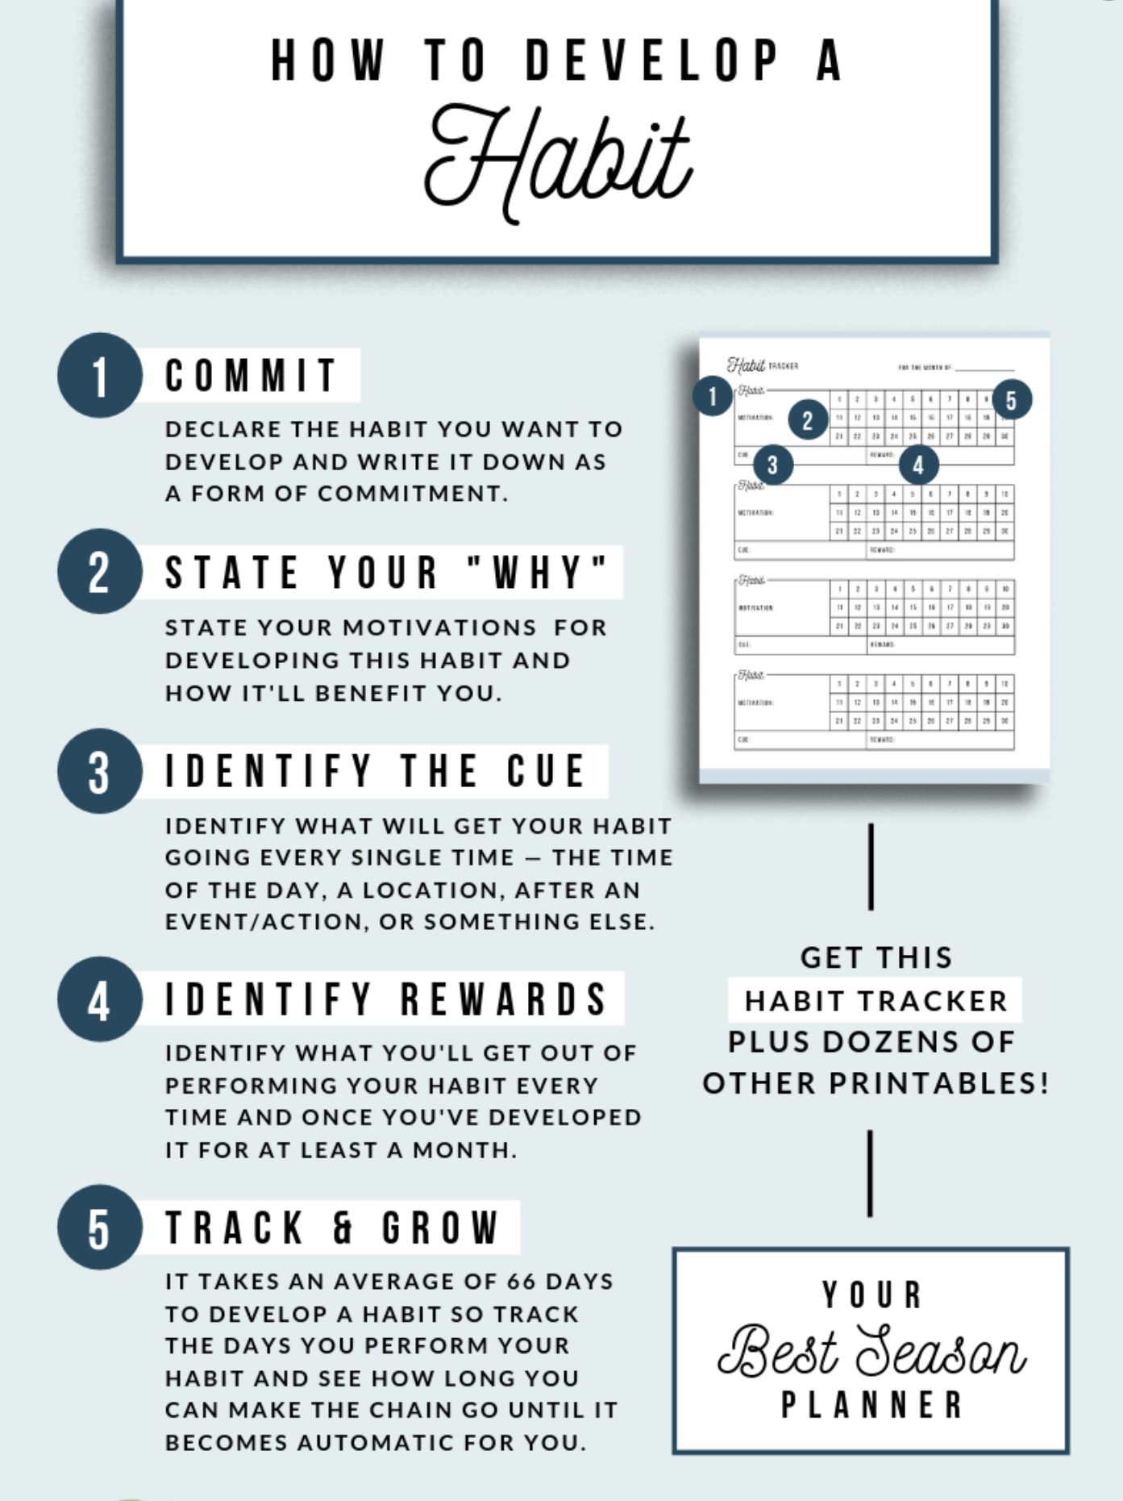

5. Making diary cards a habit
Notes:
Using diary cards regularly can be a challenge as might be developing any healthy habit. There are proven ways that help develop habits. The book tiny habits by BJ Fogg tackles this subject.

Slide 62
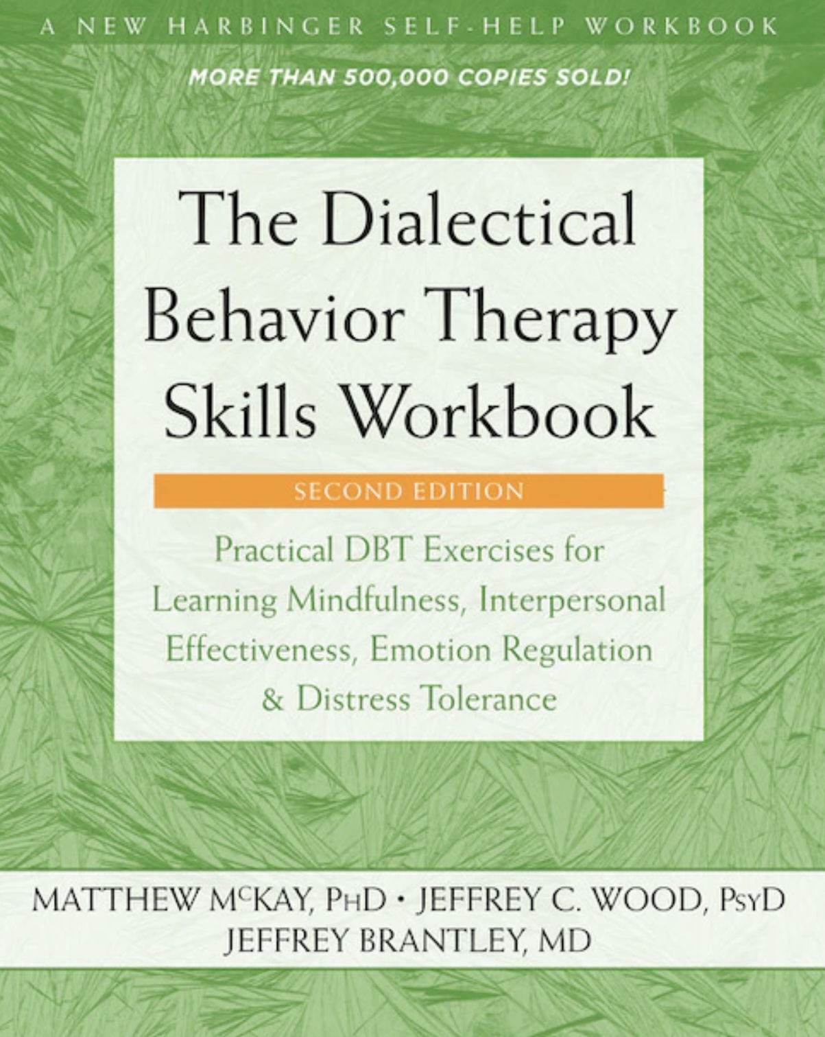
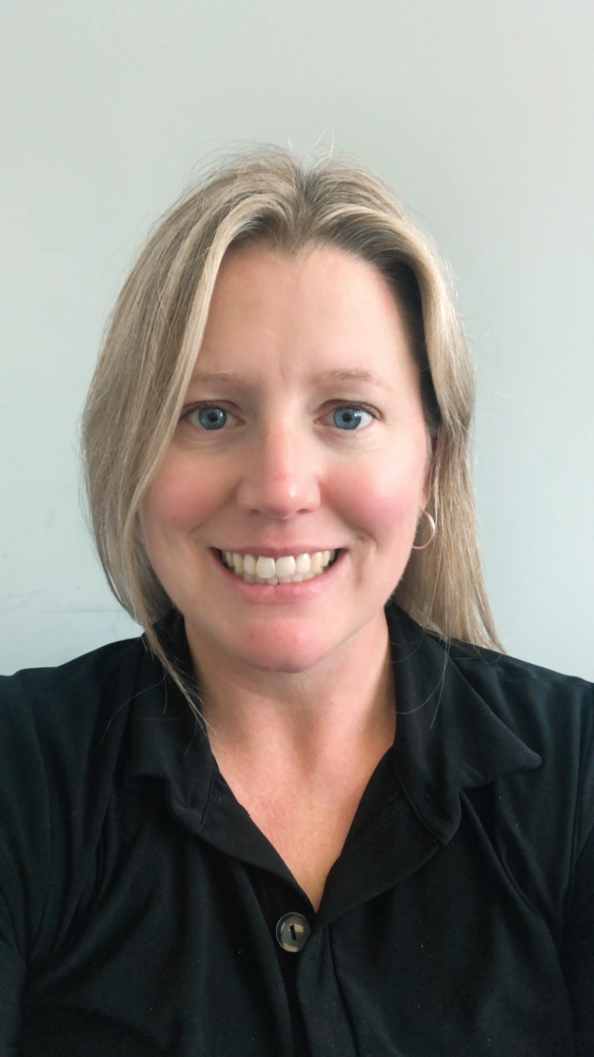
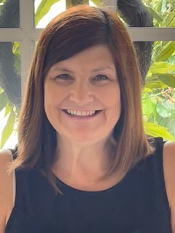
JOAN
NICOLE

Slide 63

Distress tolerance part 3
Advanced distress tolerance
Skills training workbook Pages 33-46

Slide 64
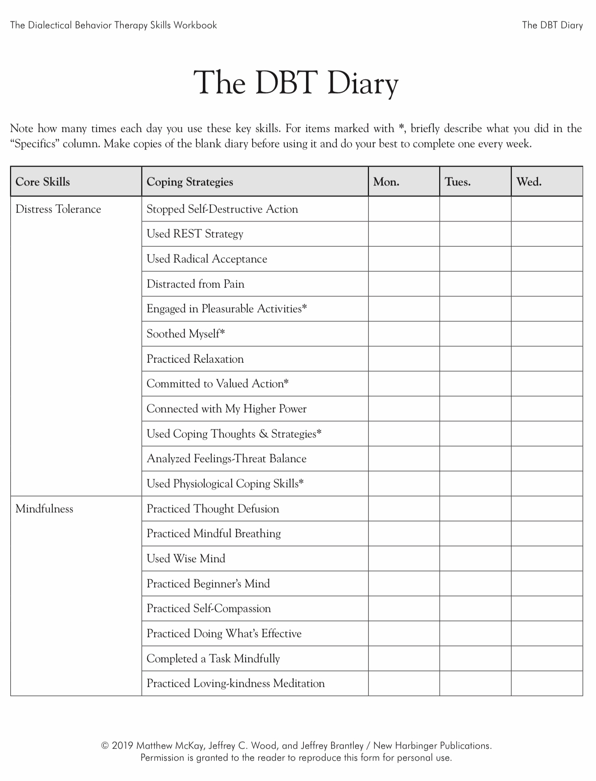
Today
X
Today
X
Today
X

Slide 65
PERSONAL SKILLS LIST UP TO THE PRESENT
Grounding skills- Set a daily intention
“ - Sensory soothing toolkit
“ -The 5,4,3,2,1 method
“ -The emotional freedom technique
REST (or PEST) Pause
Radical acceptance statements (please specify)
Distraction plan “
Self-soothing plan “

Slide 66

skills we will cover today
1. Safe-place Visualization
2. Cue-Controlled Relaxation
3. Rediscovering your values
4. Rehearsing value-based behavior
5. Connecting with your higher power

Slide 67
Subjects and skills we will cover today
1. Safe-place Visualization
2. Cue-Controlled Relaxation
3. Rediscovering your values
4. Rehearsing value-based behavior
5. Connecting to your higher power

Slide 68


1. Safe-Place visualization
Visualizing a safe place reduces distress and helps us return to the window of tolerance
When we imagine a safe, relaxing place, our body responds by relaxing.
The body can’t tell the difference between being in a real safe, relaxing place and imagining we are in one.
Do your safe-place visualization in a quiet place where there are no distractions
Follow the instructions on page 33 of the skills training manual. Record the text on your phone and listen to it. You can also find guided safe place visualizations on YouTube.
Try the safe-place visualization recorded on this slide.

Slide 69
Subjects and skills we will cover today
1. Safe-place Visualization
2. Cue-Controlled Relaxation
3. Rediscovering your values
4. Rehearsing value-based behavior
5. Connecting to your higher power

Slide 70

2. Cue-controlled relaxation
We did a cue controlled relaxation for our mindfulness exercise today.
A ”cue” is a word or phrase that through practice and repletion we learn to associate with a physical state of relaxation. We used the word relax but you can choose a different word.
Cue controlled relaxation involves repeating a word or phrase while at the same time deliberately relaxing our muscles
Try it by following the instructions on page 35 of the workbook. Record them on your phone and listen to them.
This technique takes time and repeated practice to master but can be very effective
Eventually just thinking or saying the cue word will automatically trigger relaxation
To get good at cue-controlled relaxation we need to practice it twice a day for at least 2 weeks
Use the practice recorded here.

Slide 71
Subjects and skills we will cover today
1. Safe-place Visualization
2. Cue-Controlled Relaxation
3. Rediscovering your values
4. Rehearsing value-based behavior
5. Connecting to your higher power

Slide 72
3. Rediscovering your values
To rediscover your values, do the “Valued Living Questionnaire” on page 38 of the workbook
Start by rating the importance that each of the listed values holds for you
Then decide how much time and effort you want to invest in fostering these values
Are there discrepancies between your values and what you spend most of your time doing? If there are, how might you adjust your time/energy to better align with your values?
Use the “Committed Action Worksheet” on page 40 to create intentions and a plan to realign your life with your values
”Values” are ethics, principles, ideals, standards, or morals
Thinking of our values can help us tolerate distress
Sometimes we forget why we are doing something difficult and lose sight of our goals

Slide 73
VALUED LIVING QUESTIONNAIRE (Wilson, 2002)
Life Component: Less Important-> Moderately Important-> Extremely Important
Family (other than romantic relationships or parenting) 0 1 2 3 4 5 6 7 8 9 10
Romantic relationships (marriage, life partners, dating, and so on) 0 1 2 3 4 5 6 7 8 9 10
Parenting 0 1 2 3 4 5 6 7 8 9 10
Friends and social life 0 1 2 3 4 5 6 7 8 9 10
Work 0 1 2 3 4 5 6 7 8 9 10
Education and training 0 1 2 3 4 5 6 7 8 9 10
Recreation, interests, hobbies, music, and art 0 1 2 3 4 5 6 7 8 9 10
Spirituality and religion 0 1 2 3 4 5 6 7 8 9 10
Citizenship and community life 0 1 2 3 4 5 6 7 8 9 10
Self-care (exercise, diet, relaxation, and so on) 0 1 2 3 4 5 6 7 8 9 10

Slide 74
Committed Action Worksheet
(Adapted from Olerud & Wilson, 2002)
A component of my life that I value is…
My intention for this component is
The committed actions that I’m willing to take include the following (be sure to note when you’ll begin these actions):
2. A component of my life that I value is
My intention for this component is
The committed actions that I’m willing to take include the following (be sure to note when you’ll begin these actions):
3. A component of my life that I value is
My intention for this component is
The committed actions that I’m willing to take include the following (be sure to note when you’ll begin these actions):

Slide 75
Subjects and skills we will cover today
1. Safe-place Visualization
2. Cue-Controlled Relaxation
3. Rediscovering your values
4. Rehearsing value-based behavior
5. Connecting to your higher power

Slide 76
4. Rehearsing values-based behavior
cognitive rehearsal involves:
1. Identifying the situation in which what we did, and our values don’t align
2. Identifying what we might have done had we acted in accordance with our values
4. Imagining ourselves in the situation and noting any barriers and challenges to doing what is in accordance with our values
5. Visualizing ourselves doing our values-based behavior
6. Imagining people responding well
7. Repeating the visualization
When trying to align our lives with our values we will face many challenges
We may for example have negative thoughts such as “I can’t do this”
Identifying potential challenges and imagining how to overcome challenges can be helpful
This is called “cognitive rehearsal”
The editing, splicing and pasting technique is a type of cognitive rehearsal that we’ll use all the time.

Slide 77
Subjects and skills we will cover today
1. Safe-place Visualization
2. Cue-Controlled Relaxation
3. Rediscovering your values
4. Rehearsing value-based behavior
5. Connecting with your higher power

Slide 78

5. CONNECTING WITH YOUR Higher power
Connecting with a higher power, whatever you understand this to be, can help you feel grounded, empowered, calm, and safe
It can connect you to something bigger than yourself or the “big picture”
Faith in a higher power gives many people a sense of meaning that helps them cope with distress
A higher power need not be traditionally religious concept like God.
A higher power can include Nature, The universe, or The goodness of others
We will return to a discussion of spirituality towards the end of the course

Slide 79

To help you Connect to your higher power
You might try to ask yourself the following questions:
What are some of my beliefs about a higher power that give me strength/comfort?
Why are these beliefs important to me?
How do these beliefs make me feel?
How do these beliefs make me feel about others?
How do these beliefs make me feel about life in general?
How do I honor these beliefs in my daily life?
What else would I be willing to do in order to strengthen my beliefs?
What can I do to remind myself of my beliefs on a regular basis?
How can I remind myself of my beliefs when I feel distressed?

Slide 80
UPDATED PERSONAL SKILLS LIST
Grounding skills- Set a daily intention
“ - Sensory soothing toolkit
“ -The 5,4,3,2,1 method
“ -The emotional freedom technique
REST (or PEST) Pause
Radical acceptance statements (please specify)
Distraction plan “
Self-soothing plan
Safe place visualization
Cue controlled relaxation
Rediscovering your values (please specify)
Rehearse values-based behavior or edit/splice/paste
Connect with your higher power “

Slide 81



Slide 82

video
Session 7 of simple

Slide 83


Slide 84
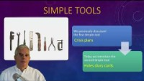

Slide 85
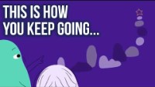

Slide 86
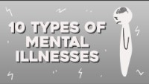

Slide 87
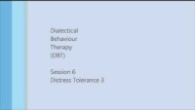

Slide 88
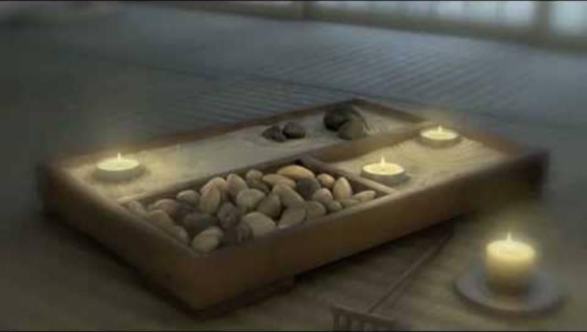

Slide 89


Slide 90


Slide 91


Slide 92

OPEN DISCUSSION

Slide 93

See you next session

