Slide 1

Welcome to Week 6 of simple
1) practice week: holes diary cards with Barb
2) distress tolerance skills part 4
3)2nd annual simple jeopardy world series
Love is not a noun it’s a verb that needs to be conjugated every day
Notes:
In the first half of this week’s session we explore advanced distress tolerance skills. In 2 weeks we review physiological distress tolerance skills and in 4 weeks we start mindfulness skills. The second half of the session is review and practice. We don’t introduce new material we consolidate that which we have already introduced by reviewing the crisis plan and goals diary card tools as well as the four strategies. We then can either discuss Ann and Bruce whose case studies are presented in session 9 of the manual or we can work with one of the participants developing and clarifying crisis plans and diary cards. To start I’ve linked a video entitled “how does social change happen” which you can watch on the website.

Slide 2
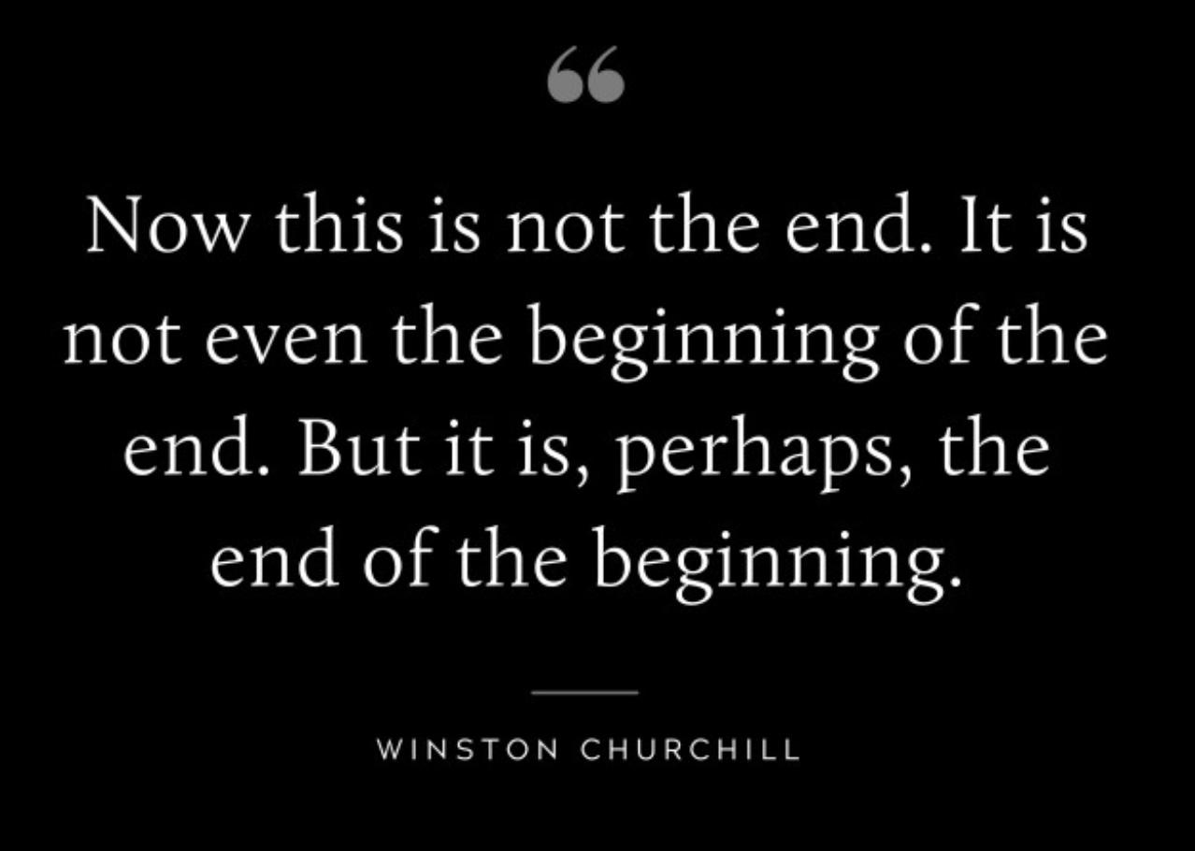




Slide 3


PROPOSITION 51
We the people of the simple course declare the results of the 2025 World Series null and void. The World Series championship will now be decided by a winner take all playoff jeopardy game between the Avondale Angels and the Zoom Zen masters to be held on November 5th 2025. The winning team will henceforth be accorded all the honors, rights and privileges attached to the tittle of simple jeopardy world champions.
YES NO

Slide 4
week 1- orientation and overview- sessions 1 and 2 of simple manual. week 2- introducing distress tolerance-p. 1-13 of dbt workbook and crisis plans-session 3 of the manual. week 3- the theoretical foundations of the simple course. session 4, 6, and 8 of the manual. week 4- distress tolerance p. 14-32 of dbt workbook. Suicide and self-harm session 5 of the manual. week 5- distress tolerance p. 33-46 of dbt workbook. Introducing the second tool: holes diary cards- session 7 of manual. Our first practice: crisis plans week 6- distress tolerance p. 47-68 of dbt workbook. finding your diary card targets- session 9 of manual. Our second practice- holes diary cards. Jeopardy championship match. week 7- introducing personality- session 10 of manual. week 8- distress tolerance p. 69-90 of dbt workbook. introducing chain analysis-session 11 of manual. week 9- what shapes personality-session 12 of manual. week 10-introducing mindfulness skills p.90-109 of dbt workbook. advanced chain analysis- session 13 of manual. our third practice-chain analysis. week 11- attachment theory- session 14 of manual. week 12- mindfulness skills p. 110-131 of dbt workbook. introducing rational mind remediation-session 15 of manual. week 13- the dynamic-maturational model of attachment and adaptation- session 16 of manual. week 14-mindfulness skills p. 131-147 of dbt workbook. reviewing all the tools-session 17 of manual. our fourth practice-rational mind remediation. week 15-stress-session 18 of manual. week 16-introducing emotion regulation skills p.148-182 of dbt workbook. introducing the goals diary card procedure-session 19 of manual.

Slide 5

Mindfulness practice
Feel free to skip it. Will be followed by a moment of silence

Slide 6



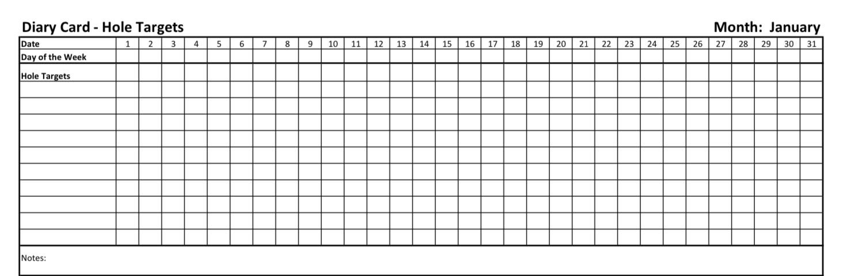
Check in regularly with your NEW Personal dashboard
Spend a few moments checking in with yourself by asking:
1)What is the current risk that I’ll experience a state of crisis ?
Low b) Moderate c) high d) very high e) extreme
2) Am I in the window of tolerance?
a) Yes b) I’m a little outside c) very outside
3) Where is my energy tank right now?
Full b) ¾ c) ½ d) near empty
4) Have I been tracking my targets using the holes diary card ? how would I rate my targets right now?
CRISIS RISK
WINDOW OF TOLERANCE
ENERGY RESERVES
RATING MY TARGETS

Slide 7


Slide 8
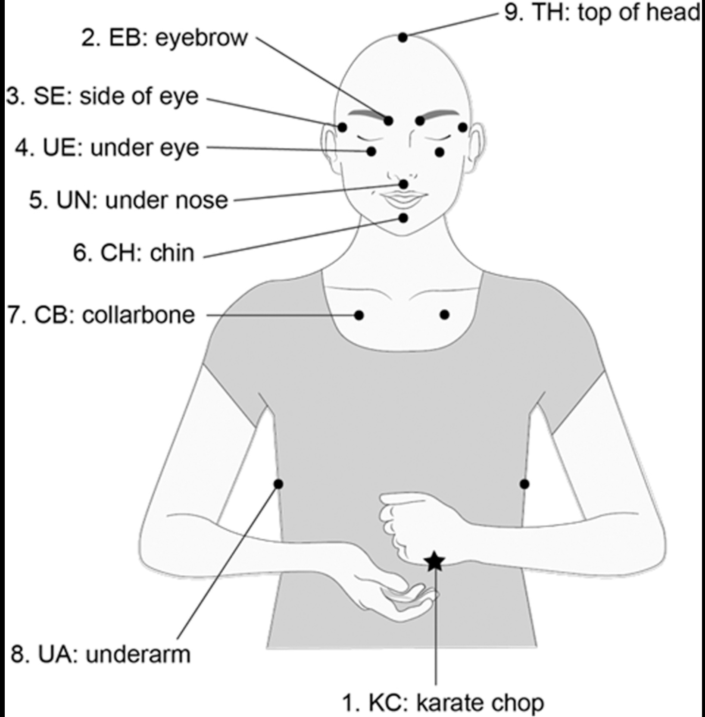
EMOTIONAL FREEDOM TECHNIQUE
EFT tapping is used to reduce stress, anxiety, pain, or distressing emotions. It involves:
1. Focusing on an emotion, thought, or physical sensation that’s bothering you. Consider using your holes diary card target as your focus;
2. Tapping lightly on specific acupuncture meridian points on the body while repeating calming statements.
Step-by-Step Instructions
1. Identify the issue
Choose a single problem to focus on, something you can feel emotionally or physically right now (e.g., “I feel anxious about tomorrow’s meeting”). Consider if you might use one of your holes diary card targets.

Slide 9
2. Rate the intensity
On a 0–10 scale, rate how strong the emotion or discomfort feels right now.
(This helps you gauge change after tapping.)
3. Create your setup statement
This combines self-acceptance with acknowledging the problem. For example:
“Even though I feel anxious about tomorrow’s meeting, I deeply and completely accept myself.”
You’ll repeat this phrase three times while tapping on the karate chop point.
4. Locate the tapping points
Use two or three fingers to tap about 7–10 times on each point while repeating a reminder phrase (a short version of your issue, like “this anxiety”).
Here are the standard points, in order:
1. Karate Chop Point – side of hand (fleshy part under the pinky)
2. Top of Head – crown of the head
3. Eyebrow – inner edge of eyebrow near the bridge of the nose
4. Side of Eye – outer edge of the eye socket
5. Under Eye – directly below the pupil
6. Under Nose – between nose and upper lip

Slide 10
7. Chin – between lower lip and chin
8. Collarbone – about an inch below and to either side of the collarbone knob
9. Under Arm – about four inches below the armpit (bra-line for women, mid-rib for men)
You can tap on one side or both; either is fine.
5. Perform the tapping round
Say your reminder phrase (“this anxiety,” “this sadness,” etc.) as you tap through each point in order.
6. Re-rate the intensity
After one or two rounds, pause and rate your intensity again (0–10).
If it hasn’t dropped enough, adjust your phrase to reflect progress:
“Even though I still have some of this anxiety, I accept myself.”
Repeat until the rating drops to a comfortable level (often below 2–3).
Optional Finishing Steps
• Take a deep breath, place your hand on your heart, and notice any shift in your body.
• You might end with a positive round (e.g., “I’m open to feeling calm and confident now.”)

Slide 11
Tips
• Tap gently, enough to feel contact, not to cause soreness.
• Stay focused on the issue, not on “getting rid of it.”
• If strong emotions arise, pause and breathe.
• You can use EFT for many issues, stress, pain, cravings, self-doubt, anger, etc.

Slide 12

Notes:
Some reminders which apply to people who are viewing the YouTube videos as part of a group facilitated by a mental health care professional.

Slide 13
Homework from last week
Submit
Submit questions or comments to itssimple2023@gmail.com
Read
Skills training workbook p. 47-68 (from “live in the present moment to create an emergency coping plan) Simple manual session 9
Have
have targets in your diary card and use it.
Continue
Continue reviewing and practicing your crisis plans

Slide 14
Homework for the coming week
Submit
Submit questions, comments or feedback to itssimple2023@gmail.com
Read
Have
Have your targets in your diary card and use it daily
Continue
Continue reviewing and practicing your crisis plans.
Continue
Continue tracking all the skills you’ve learned using your skills list
Simple manual session 10 introduction to personality

Slide 15
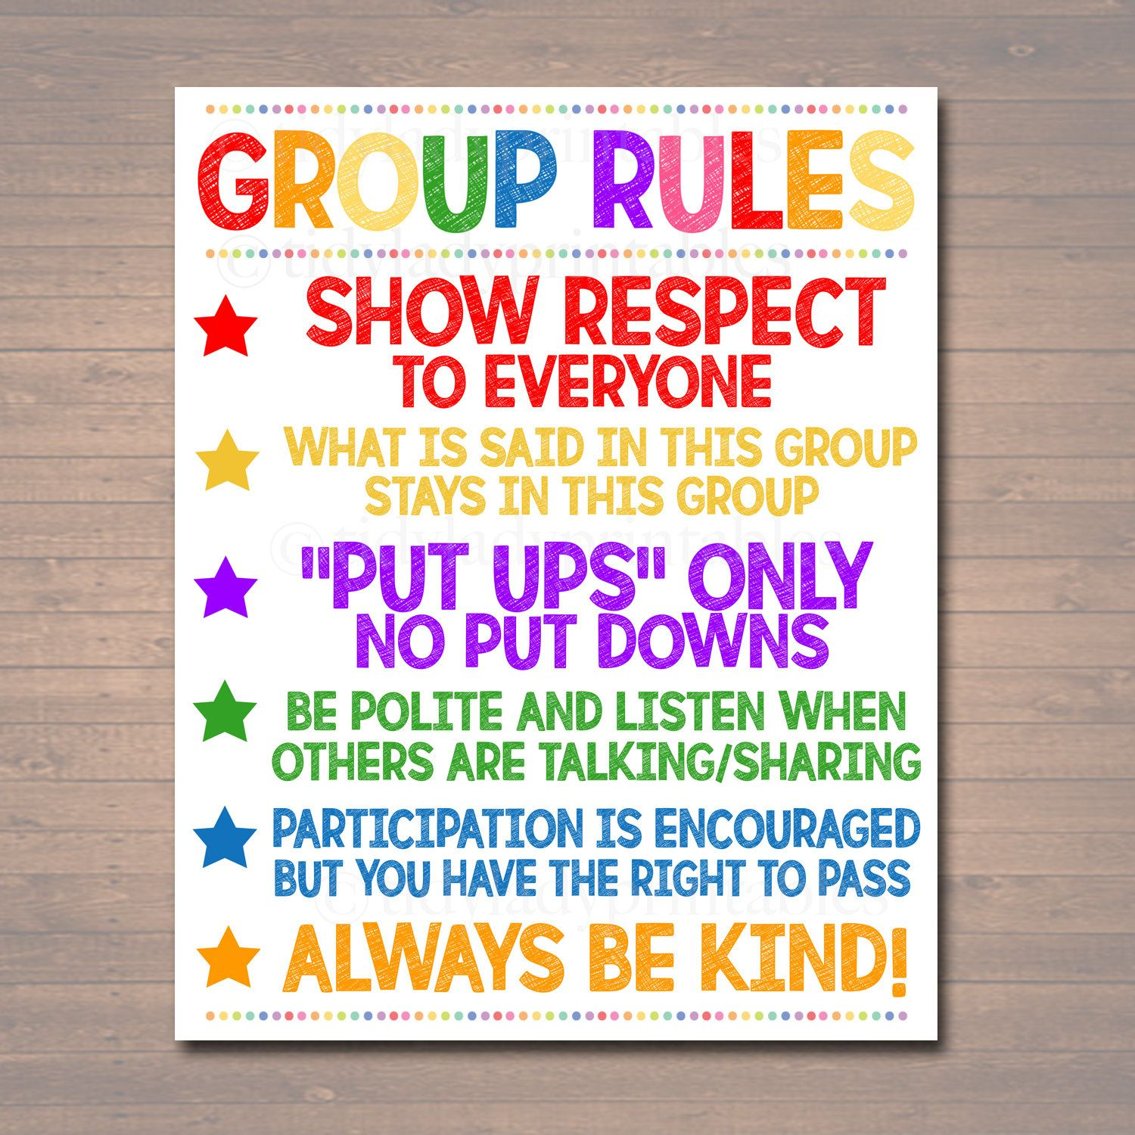
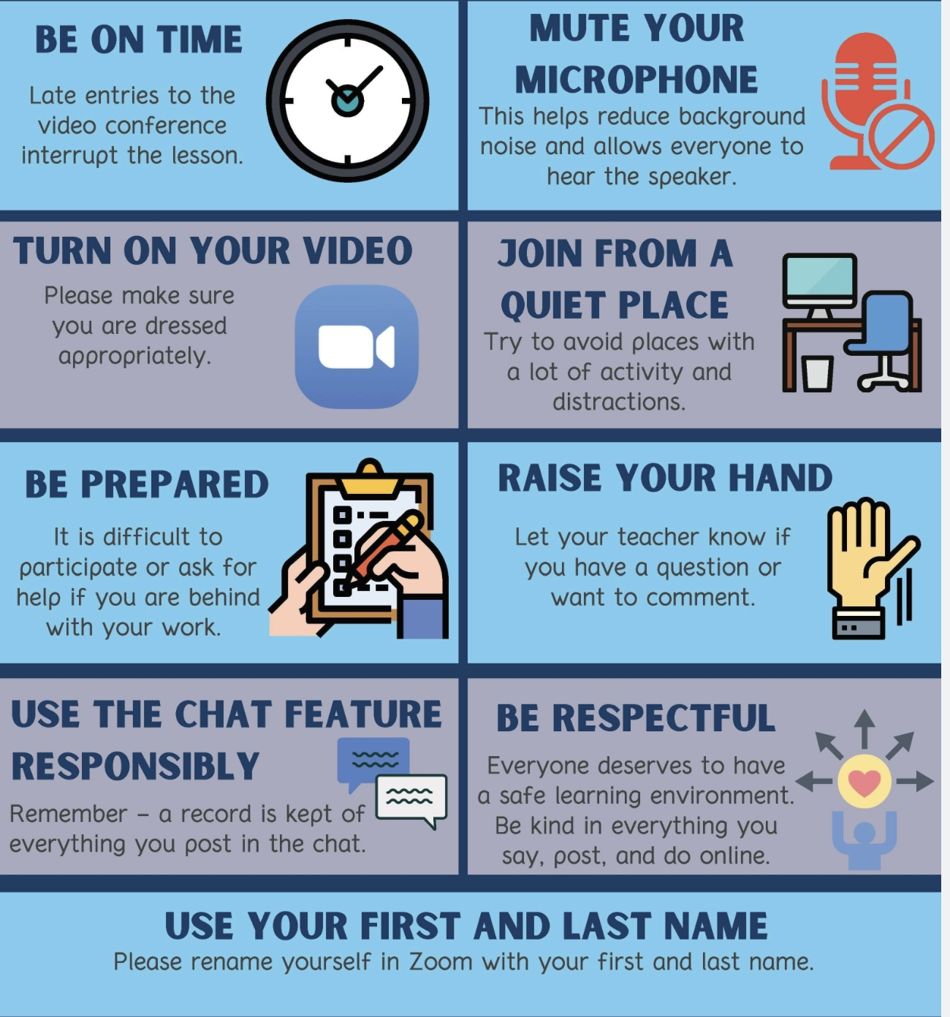
REMINDER PARTICIPANT AGREEMENTS
If you have questions, comments, or feedback, please save them for the two question periods. You can put them in the chat box or raise your real/virtual hand.
Keep comments, questions, and feedback relatively brief so everyone has a chance to participate.(one breath sharing)
If you’re on zoom, make sure no one can overhear what is being said
For reasons that will become clear later in the course please avoid giving advice to other participants about what they should or should not do. Validation, encouragement , and understanding are however very much appreciated.

Slide 16

Reminder- Roger, the Avondale church custodian, asked us to kindly bring our indoor footwear and leave our outdoor shoes/boots under the bench at the entrance now that it’s about to get yucky.
So as to not overwhelm you, this week we won’t introduce any new material.
Crisis plans and holes diary cards very important. We want to make sure everyone understands how to do them.
Next week we’ll start a discussion of a key topic: understanding your personality, or what shapes and how you can change your thoughts, feelings and behaviors.
WEEKLY ANNOUNCEMENTS

Slide 17
In today’s poll we’ll ask you if you’re interested in a “homework group”
We’d hold it just before the Boing group on Monday. Boing starts at 1 pm the homework group would start at 12:30 and run until 1.
The purpose of the group would be to encourage you to keep up with the skills and tool homework by being accountable and having a place where you can share the obstacles you’re encountering and find strategies and encouragement to overcome them.
We would pair people up (using breakout rooms for those on zoom) and Dr. Cleto would be around to answer any questions. (he would bring his lunch and you could too)
To start and keep this going we would like to have at least 8 people.
If you want to do boing but don’t want to do homework group, just join us at the regular time 1 pm
WEEKLY ANNOUNCEMENTS

Slide 18
We had our second boing group this past Monday. 17 people came.
We worked on finding targets for holes diary cards.
People felt that the discussion helped them understand and find their targets and start doing their holes diary card.
Next Monday we can talk about any of the material we’ve covered so far; the distress tolerance skills, crisis plans, holes diary cards, the techniques and strategies, suicidal thinking and self-harm.
Anything else you can think of.
Email us questions or subjects you’d like to talk about or let us know what they are when we do boing check-in.
WEEKLY ANNOUNCEMENTS

Slide 19
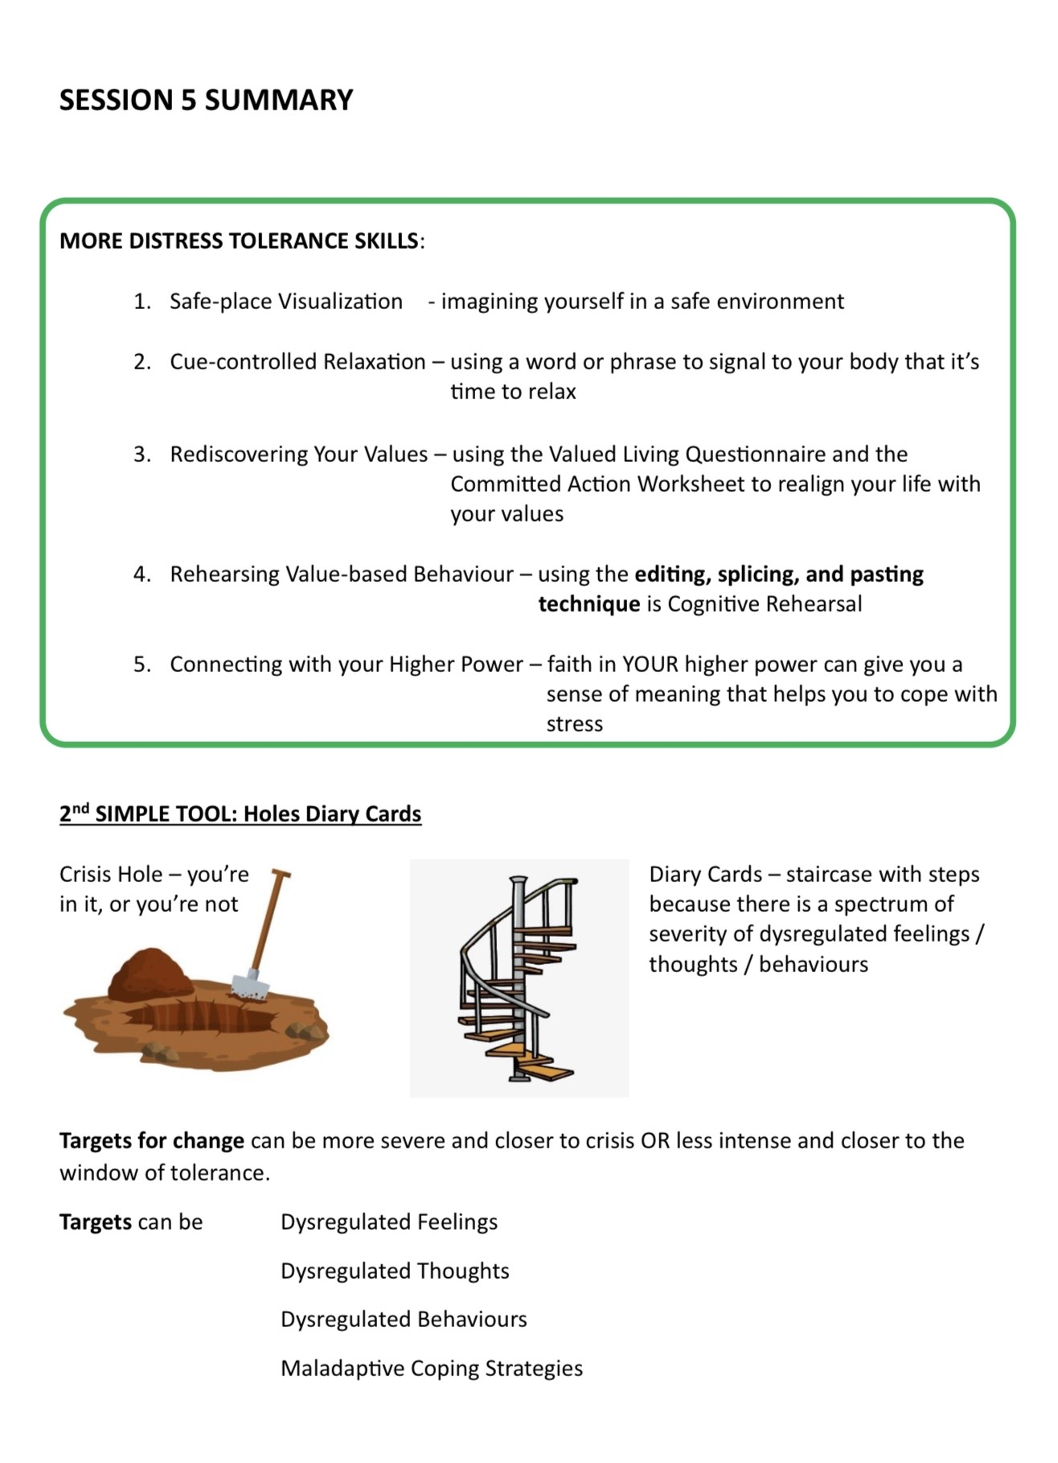
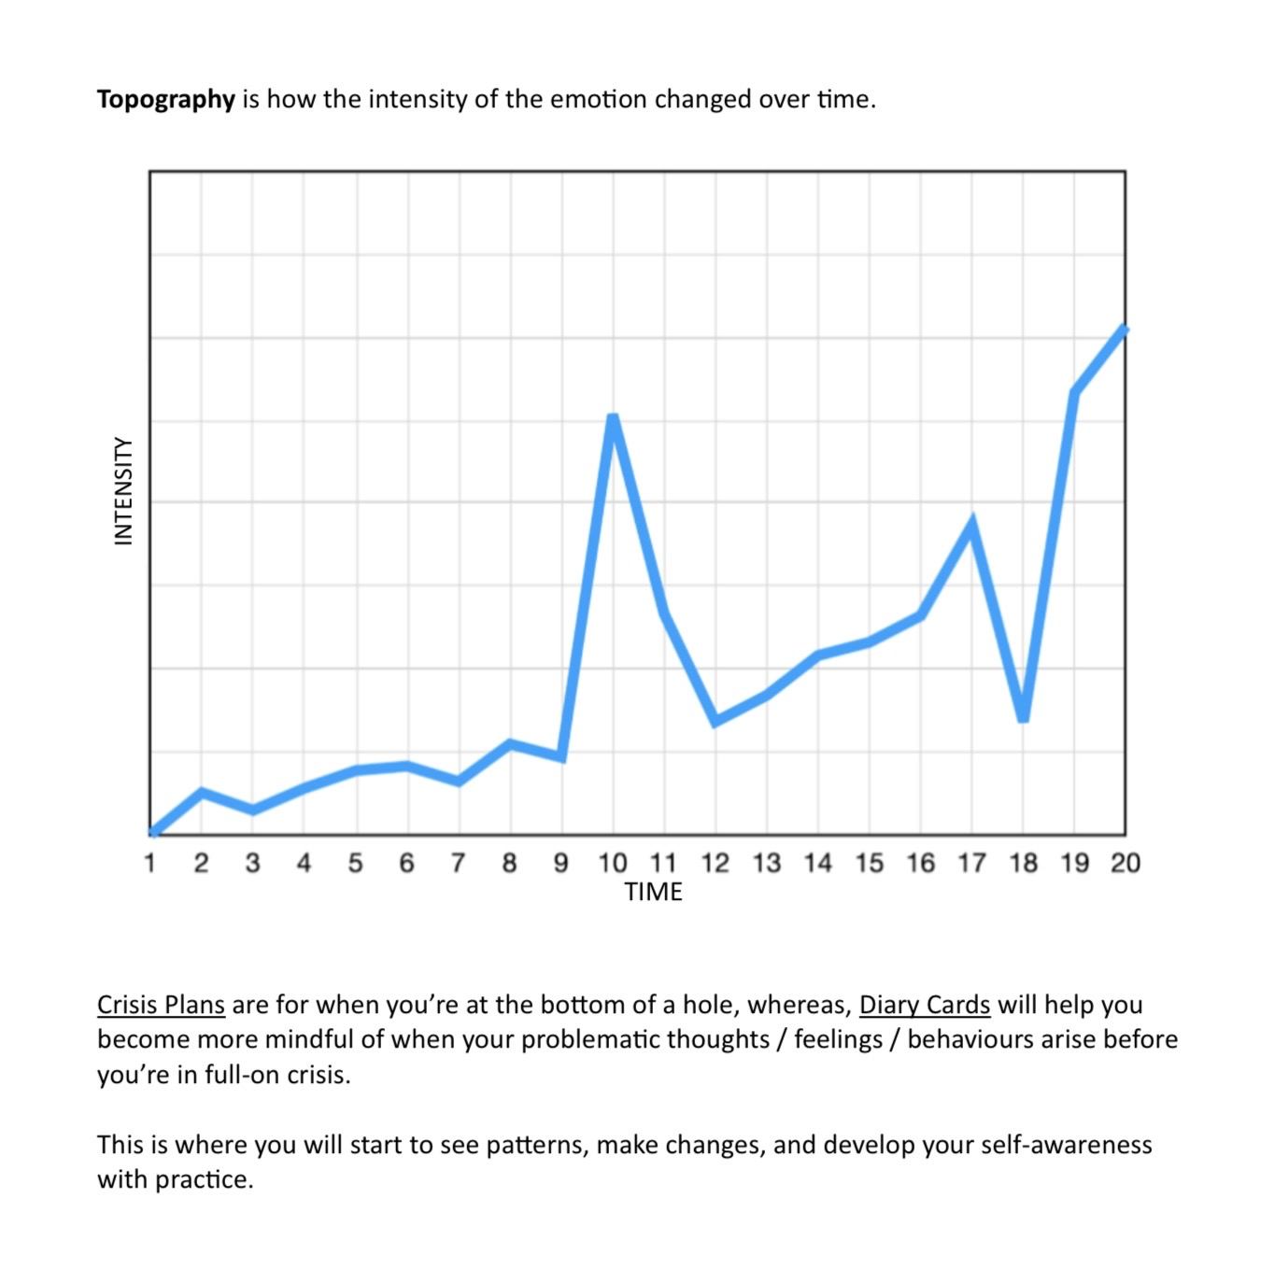

Slide 20

E-mailed questions, comments, feedback, HOUSEKEEPING

Slide 21
If I’m on zoom, do I need to have my camera on all the time?
ZOOM PARTICIPANT AGREEMENT
Please mute your microphone when not using it
Please have your camera on at the beginning of the session and during question period . You may turn it off during PowerPoint slide presentations or if you need to step out of the group. It’s important that we see each other so that we can establish trust and ensure confidentiality.
Please make sure no one at your end who is not taking part in the course can see or overhear other group participants .
When you have questions, comments, feedback please chat them to the co-leaders or save them for the question periods when you can raise your hand icon and wait until one of the co leaders gets to you.

Slide 22
If I’m on zoom, do I need to sign in with my name or can I just leave it in the default setting such as “iPhone” or “iPad”?
SIMPLE COURSE CODE OF CONDUCT AGREEMENT (all participants)
Everyone in the course will strive to interact with others in a kind and respectful manner. We will strive to validate, avoid judgments and assume the best about each other.
Personal information, including names, should not be discussed with anyone outside of the course. What happens in simple stays in simple.
Participants are encouraged to arrive on time and stay until the end of the session.
Participants are encouraged to do the assigned homework between sessions.
If you are doing the course in person and become ill with a potentially transmissible condition, please do the course virtually until you are well. (If you need the zoom link, please email us)
Active participation is encouraged but not necessary. (you don’t ever have to say anything)
During discussions participants may provide examples from their own experiences. Please keep in mind, however, that discussing some subjects such as traumatic relationships, self-harm, suicide, substance abuse etc. may trigger others. (save this for boing)
If in person course participants needs to leave the room to take a reregulation break, please let the facilitators know .
In person course participants will strive to avoid side conversations when another individual is speaking.
Course participants are encouraged to not engage in dysregulated behaviors with other participants outside of the course.
Course participants are encouraged to avoid forming new romantic relationships with other participants for the duration of the course.
Course participants are strongly discouraged to attend sessions under the influence of drugs or alcohol.
If you are doing the course in-person, please legibly write your first and last name on the attendance sheet as you come into the room. If you are doing it virtually, please enter your first name and the initial of your last name on the screen.(for obvious reasons we don’t want to let people not registered for the course into zoom.)
Notes:
The Simple course etiquette agreement has evolved organically over the years. It is a code of conduct which participants in coleaders agree to abide by.

Slide 23
E-mailed questions, comments, feedback, HOUSEKEEPING
I was thinking about the practice with Chris last week and I’m trying to understand why people who have parents they can’t rely on or trust are so much more susceptible to developing mental health problems when they then experience traumatic events?

Slide 24
I was thinking about the practice with Chris last week and I’m trying to understand why people who have parents they can’t rely on or trust and have attachment issues as a result, are so much more susceptible to developing mental health problems when they then experience traumatic events?
When something frightening or overwhelming happens, your body’s alarm system, the fight, flight, or freeze response, gets switched on. It’s your body’s way of keeping you safe from danger.
But if you’ve been through trauma, your body may start to believe that danger is always nearby. Even when you’re not in real danger, your system stays partly stuck in fight, flight, or freeze mode. You feel tense, anxious, or shut down more often than calm and relaxed.
Now, attachment adds another layer. Normally, when we’re scared or upset, we look for comfort and safety in someone we trust. But if, early on, we learned that comfort wasn’t really available, or that people could hurt or reject us instead, then our system gets an extra painful message: “When I’m scared, there’s nowhere safe to go.”
So, trauma says: “The world isn’t safe.”
And insecure attachment says: “People aren’t safe either.”
When, for a person, both are true, the body and emotions have nowhere to rest. This is why people with attachment wounds often have more trouble calming down after trauma and can end up feeling emotionally overwhelmed or out of control for long periods of time.

Slide 25

What we will do today
Practice with Barb: holes diary cards
Skills training workbook p. 47-68 with Joan and Nicole: distress tolerance part 4 - advanced distress tolerance continued:
1. Live in the present moment
2. Use self encouraging coping thoughts.
3. Radical acceptance.
4. Self affirming statements
5. Feelings – threat balance
6. Create new coping strategies.
7. Create an emergency coping plan
World series of Simple Jeopardy with your hosts Joan and Nicole
Kate’s summary

Slide 26
PRACTICE SESSIONS SCHEDULE
preparation
2. Today Holes diary cards Barb H.
3. Week 10 December 3 November 26, 1:30 Chain analysis Ashley S.
4. Week 14 January 14 January 7, 1:30 Rational mind remediation Helga H.
5. Week 18 February 11 February 4, 1:30 goals diary card
6. Week 25 April 15 April 8, 1:30 IFS workbook 1 Elaine S.
7. Week 26 April 22 April 15 IFS workbook 2 Dinko T.
8.Week 27 April 29 April 22 IFS workbook 3
9. Week 28 May 6 April 29 IFS workbook 4
10.Week 32 June 3 May 27 1:30 PM Wise mind remediation

Slide 27
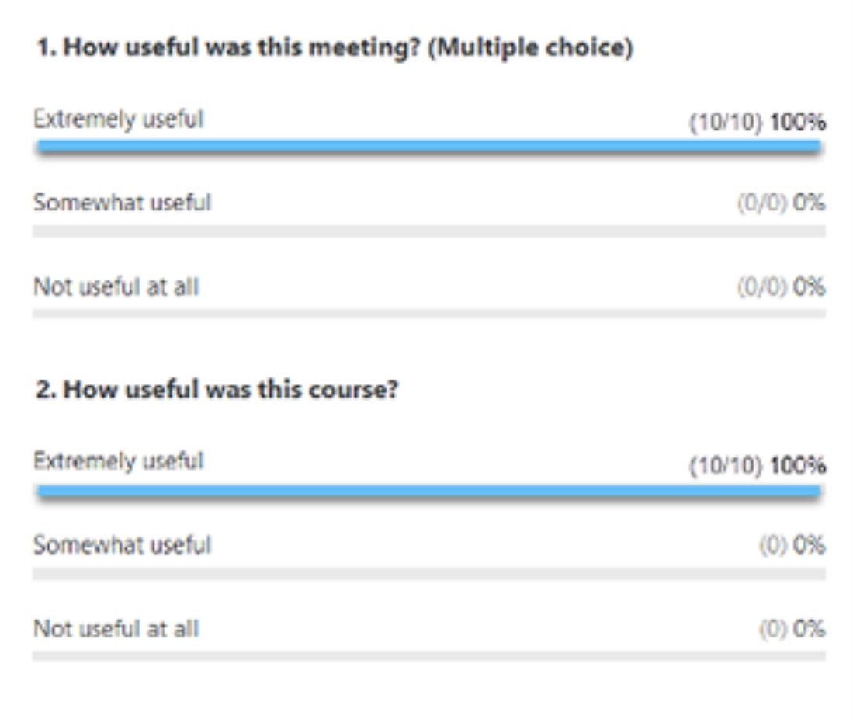
Week 6 POLL
In today’s poll we ask if anyone is interested in attending a “homework group”
It would be held just before the Boing group on Mondays. Boing starts at 1 pm, the homework group would start at 12:30 and run until 1.
The purpose of the group would be to encourage participants to keep up with the skills and tool homework by being accountable and having a place where they can share the obstacles they are encountering and find strategies and encouragement to overcome them.
We would pair people up (using breakout rooms for those on zoom) and Dr. Cleto would be around to answer any questions. ( bring your lunch)
To start and keep this going we would like to have at least 8 people.
If you want to do boing but don’t want to do homework group, just join us at the regular time 1 pm

Slide 28

PRACTICE USING SKILLS TOOLS AND STRATEGIES
HOLES DIARY CARDS AND TARGETS with Barb.

Slide 29
THE HOLES DIARY CARD
A QUICK REVIEW

Slide 30

THERE’S A HOLE IN MY SIDEWALK
A central metaphor in the course
I walk down the street.
There is a deep hole in the sidewalk.
I fall in.
I am lost… I am helpless.
It isn’t my fault.
It takes forever to find a way out.
I walk down the same Street.
There is a deep hole in the sidewalk.
I pretend I don’t see it.
I fall in again.
I can’t believe I am in the same place.
But it isn’t my fault.
It still takes me a long time to get out.
I walk down the same Street.
There is a deep hole in the sidewalk.
I see it is there.
I still fall in. It’s a habit.
My eyes are open.
I know where I am.
It is my fault. I get out immediately.
I walk down the same Street.
There is a deep hole in the sidewalk.
I walk around it.
I walk down another Street.”
Portia Nelson (2)

Slide 31
TRACKING THE HOLES YOU KEEP FALLING INTO:
THE HOLES DIARY CARD TEMPLATE
Targets for change
Squares for ratings
Days of the month

Slide 32
M T W T F S S
struggling.
4 3 6 2 3 10 9
sad.
5 4 7 1 2 8 7
withdrawing
9 8 6 6 5 10 10

Slide 33
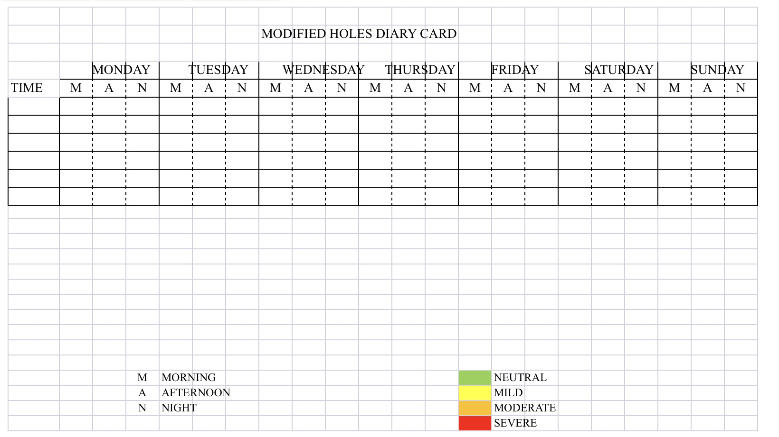

Slide 34
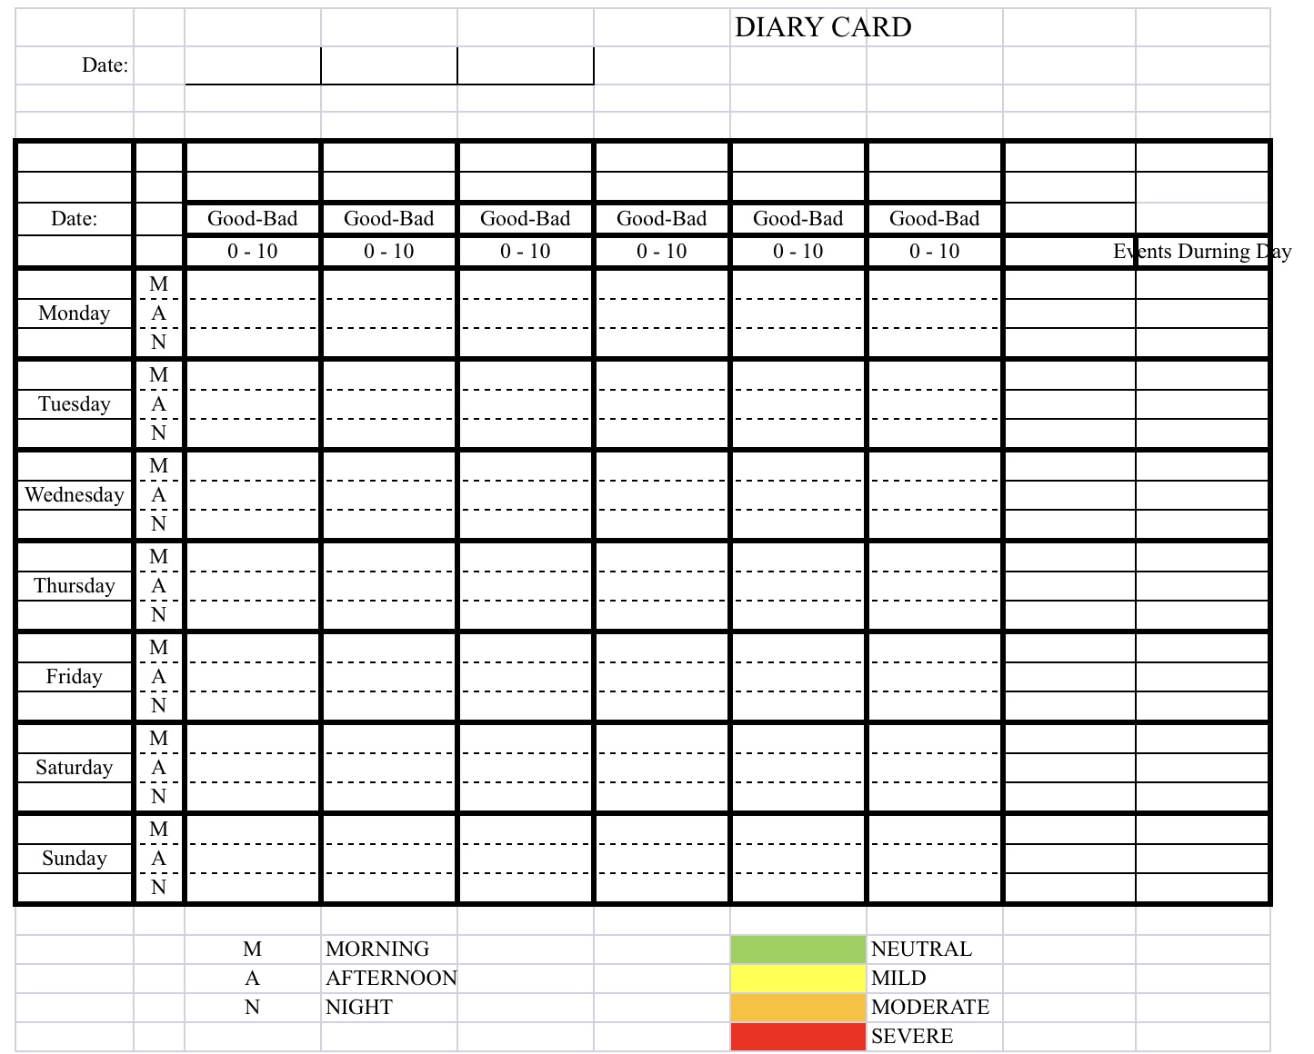

Slide 37


1. Crisis plan holes and diary card targets
crisis hole
Both crisis plans and holes diary cards are ways of identifying and working with the “holes in the sidewalk” we fall into. They are similar but with some differences.
The crisis plan’s holes in the sidewalk metaphor has an all or nothing quality, either we're in a crisis and at the bottom of the hole or we’re not in a hole at all.
Holes diary cards are more subtle recognizing that there are many degrees of severity or intensity of dysregulated feelings, thoughts, and behaviors. In that way, they are like a spiral staircase rather than a hole.
Because of this, the metaphor we use for crisis is that of a “hole”, while the one we use for diary cards is of “stairs” with steps.
In our holes diary cards, we arbitrarily choose a stairwell that has 10 steps, each step representing a different intensity of the dysregulated feelings, thoughts, or behaviors. We call these dysregulated thoughts, feelings, or behaviors targets for change. (or just “targets”)
10 is the bottom step of the stairs, 1 is the top step closest to the sidewalk. 10 is the most intense, 1 the least. When you are lower in the staircase, you’re more likely to be in crisis and outside the window of tolerance.
If you prefer, instead of using a numerical 1-10 scale you can use colors ex. Yellow, orange, red, black, which may make it easier to visualize the intensity of the targets.
diary cards steps
Notes:
You are already familiar with the concept of falling into "holes". When we are in crisis we fall into a "hole". The crisis plans are ways of getting out of these holes faster and eventually avoiding them. What holes were to crisis plans, targets are to diary cards. Targets are short for targets for change. Targets are quite like holes.

Slide 38

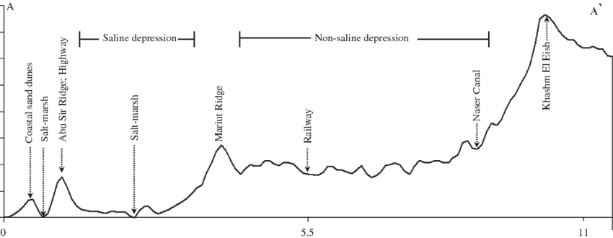
2. In geography “Topography” refers to the arrangement of the physical features, especially the elevation of a certain terrain. In simple we use the word topography to describe how the intensity of a person’s target emotions, thoughts or behaviors fluctuate over a period of time, in other words the topography tracks our journey up and down the stairwell over time.
The “topography” of our target dysregulated feelings, thoughts, or behaviors, can be depicted as a graph in which the horizontal axis is time while the vertical is the variation in intensity of our feelings, thoughts, and behaviors.
These variations can occur faster or slower, over the course of minutes, weeks or even months and years.

Slide 39
TOPOGRAPHY

Slide 40


Diary card targets
= crisis plan holes
3. FINDING YOUR TARGETS FOR CHANGE
Diary cards targets are similar to crisis plan holes.
As we said earlier, however, there is a slight difference: crisis plan holes are all or nothing, you’re either in a crisis or you’re not, diary card targets vary in intensity from mild to severe.
Like crisis plan holes, diary card targets are dysregulated physical states, emotions, thoughts, behaviors, or maladaptive coping strategies, that recur in your life, and that you have decided are problematic and want to change.
Examples of holes diary card targets include substance abuse, gambling, or any other addiction. Engaging in dysfunctional social interactions. Self-blaming, and rumination. Excessive irritability or anger towards others. Notice how these overlap with crisis plan holes.
Targets can also be any of the holes suggested in the checkboxes in item 1 of the crisis plan template : anxiety, anger, despair, problems with boundaries, impulsive behaviors, behaviors a person later regrets, withdrawing/running away, and thinking of/actually hurting self/others.
In other words, you can use as your diary card targets the holes you chose to work with in your crisis plans.

Slide 41

3 TYPES OF DIARY CARD TARGETS
There are beginner, intermediate, and advanced diary card targets. All the examples we have gave above are intermediate targets.
If you have trouble finding an intermediate target, use a “beginner target” in your diary card instead.
Beginner targets are more generic and catch-all than intermediate ones. They are easier to use than the more specific intermediate targets. Beginner targets include struggling, feeling bad, being upset, losing it, getting into trouble, or falling into a hole. Start with one of these.
We won’t discuss advanced targets until later in the course when we explore internal family systems part selves. If you don’t know what IFS is, don’t worry, we’ll get to it.

Slide 42
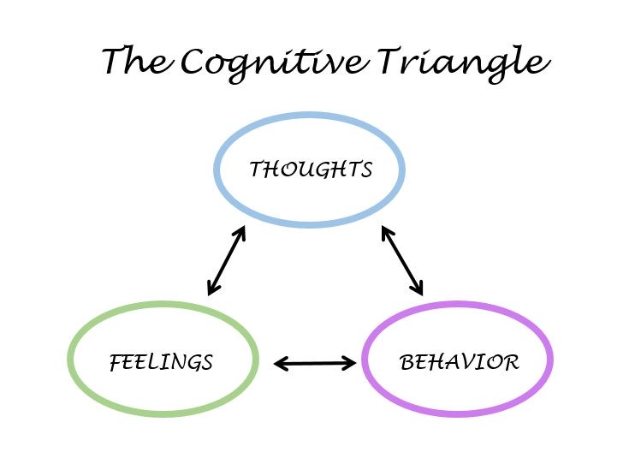
Diary card Targets
Like crisis plan holes, diary card targets can be:
1. Feelings: to help you identify your feelings consult the wheel of feelings (see below) which we also used in trying to identify crisis plan holes.
2. Thoughts: consider ANTS or automatic negative thoughts (below)
3. Behaviors: consult externalizing vs. internalizing behaviors (below}
4. Maladaptive coping strategies: are defined as coping strategies that in the short term decrease your distress but increase it over the long term. Ex. Substance use, self-harm, unhealthy eating.

Slide 43
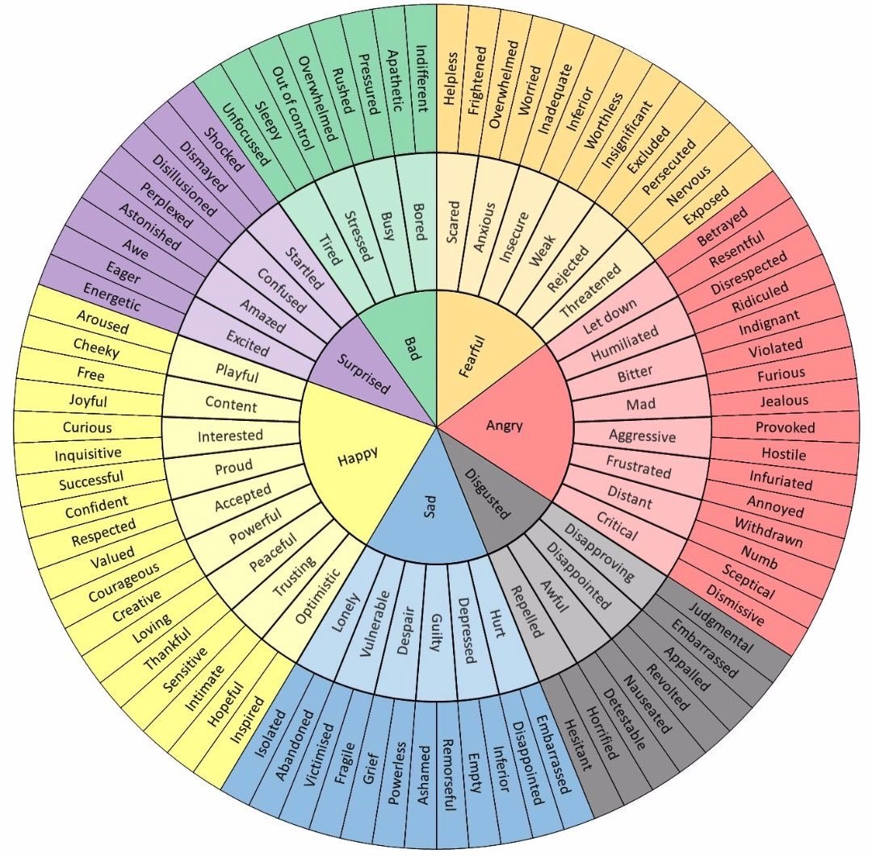
Which feelings from the wheel of feelings do you experience frequently and not necessarily when circumstances entirely merit it?
Notes:
The wheel of feelings, the list of cognitive errors and automatic negative thoughts, and that of internalizing and externalizing behaviours helped you find your holes. They can also help you find your targets which may be the same as your holes or different from them.

Slide 44
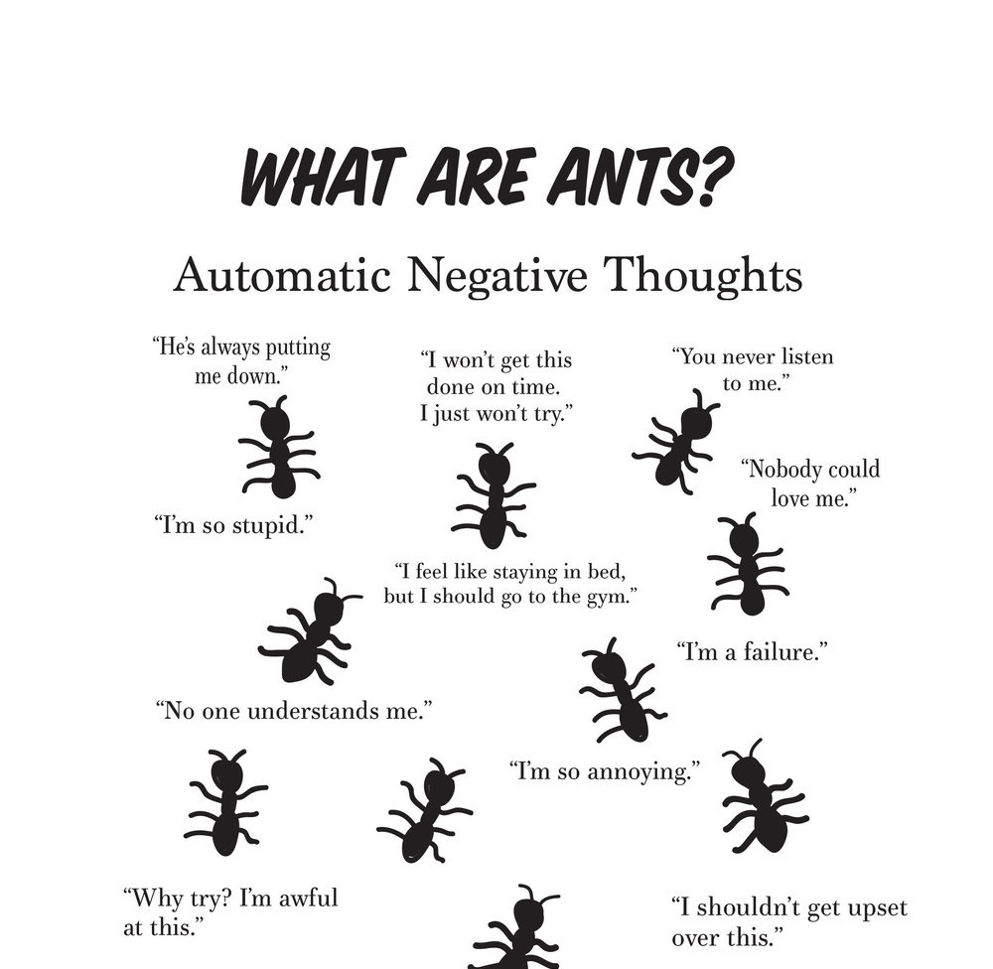
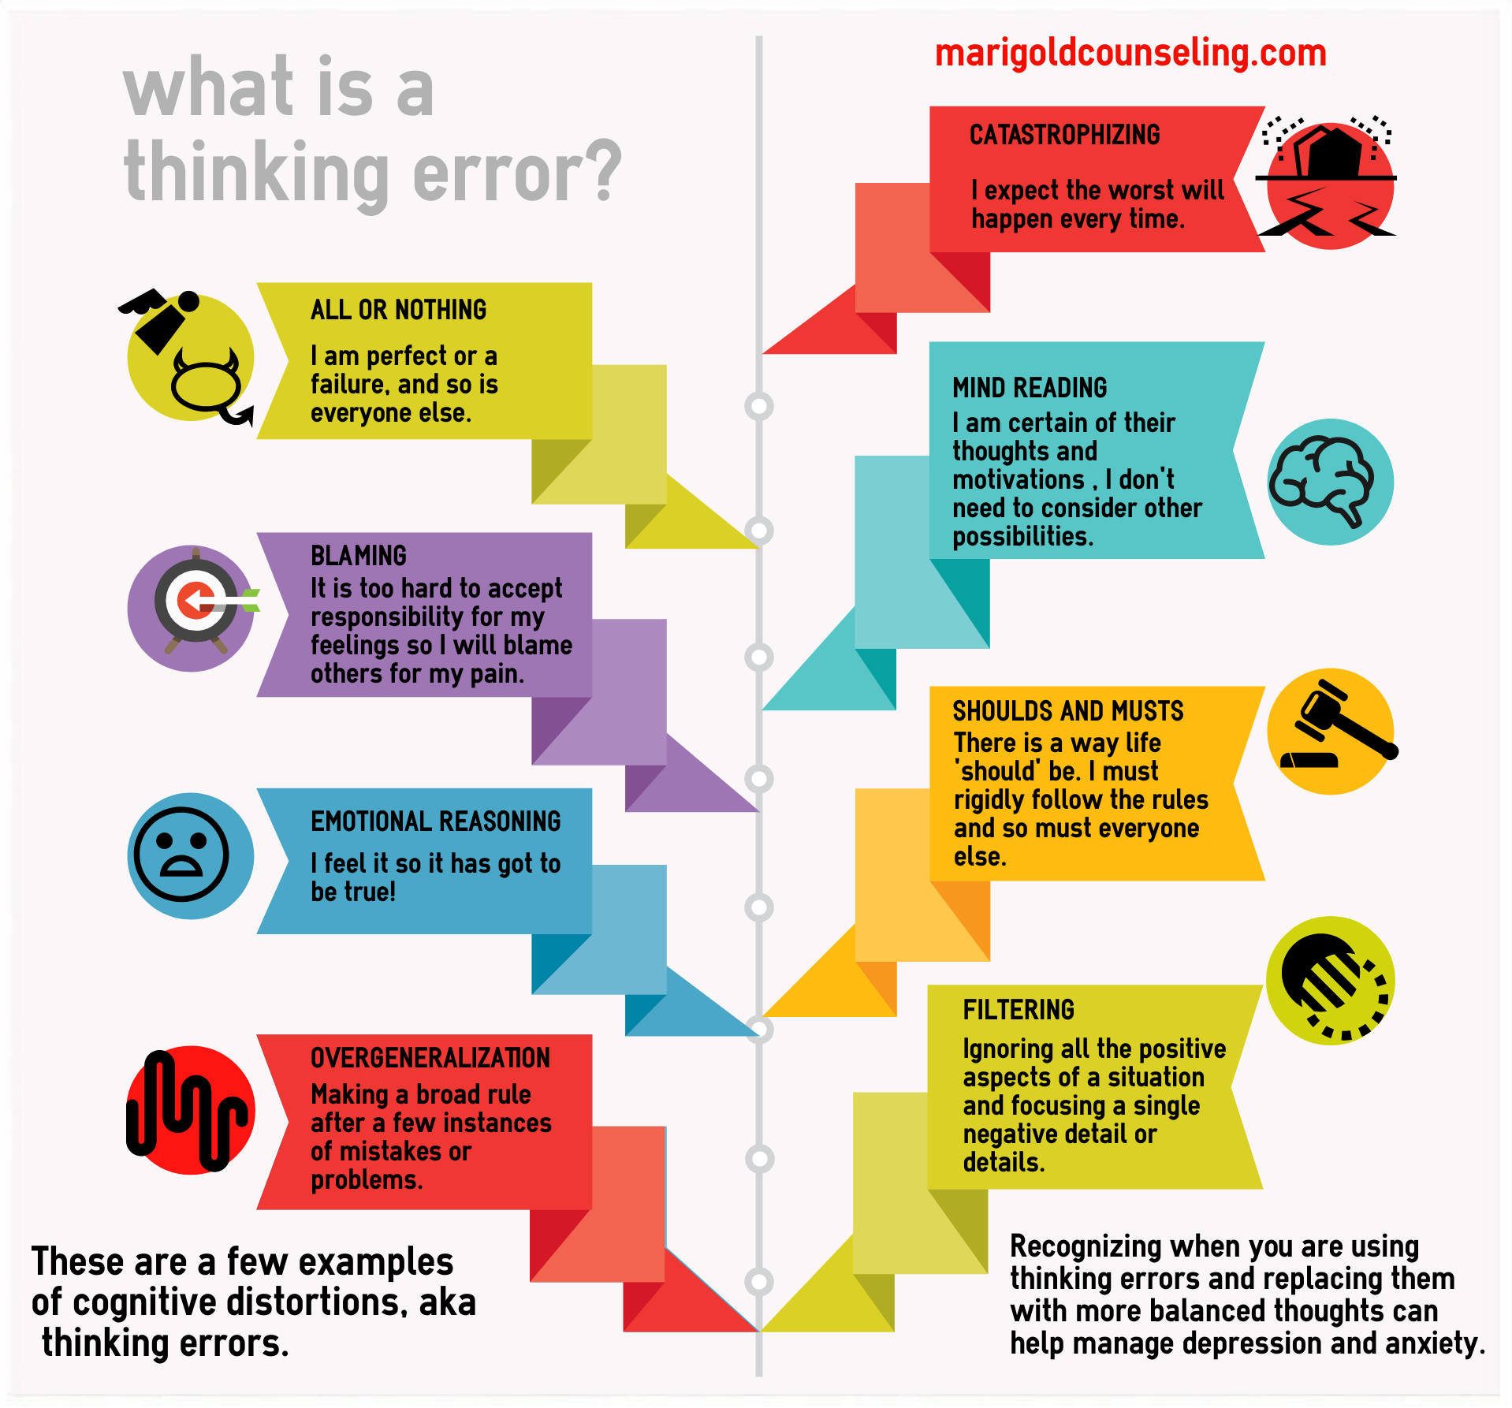
Which thoughts from among the ANTS (below) do you frequently have and not necessarily when circumstances entirely merit it?

Slide 45
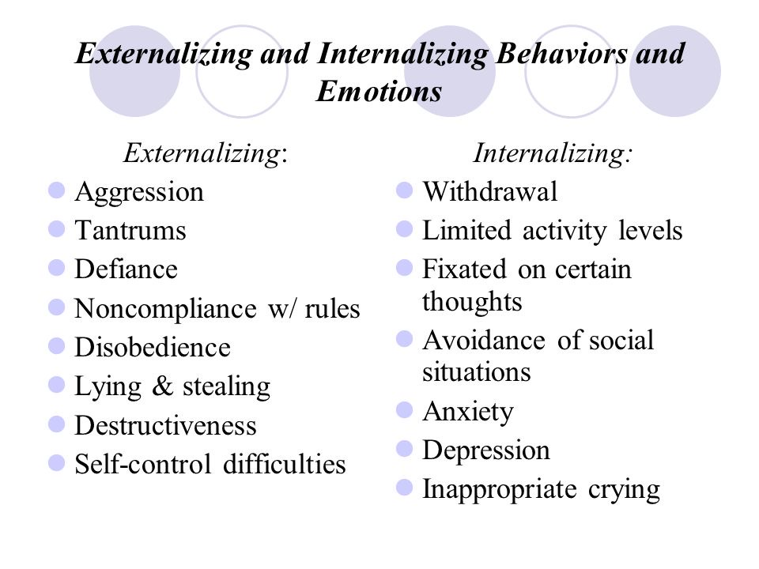
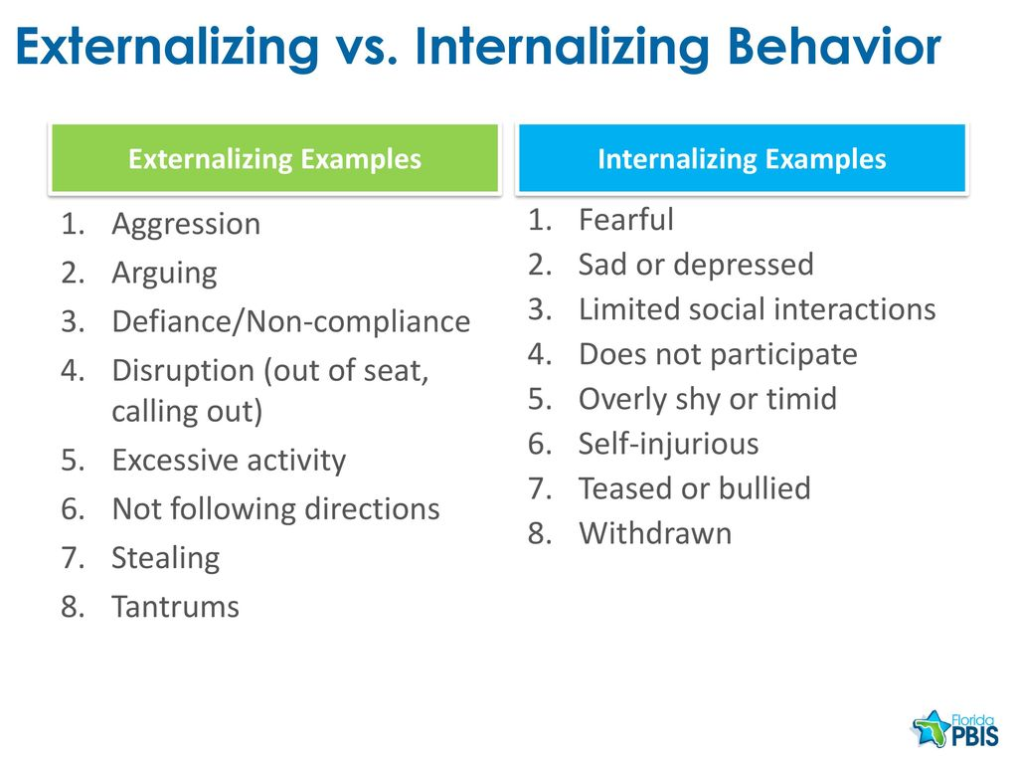
Which behaviors from the lists below do you frequently have and not necessarily when circumstances entirely merit it?

Slide 46

HOW TO FIND YOUR intermediate targets ALGORITHM
1. Think about a time when you have been in a hole or crisis, outside the window of tolerance, “lost it”, “struggled”, “felt bad”, “got into trouble”, or were “very upset”. (in other words, start with a beginner targets)
2. When this happened, what were your dominant feelings, thoughts, or behaviors? (use the wheel of feelings, thinking errors and ANTS, and the internalizing and externalizing behaviors slides to help you)
3. From these choose from 1 to 3 feelings, thoughts, or behaviors that a)you experience frequently, b)are problematic for you, and c)you want to change.
4. These are your intermediate targets.
Intermediate targets change over time so go through this same process occasionally especially if your life circumstances are changing.

Slide 47
4. Why do holes diary cards?
To change the behaviors, thoughts, or feelings that you have chosen as your targets: 1) you must identify what they are, then 2) you must keep focusing, being aware, or being mindful of them.
Diary cards promote mindfulness by keeping you focused on and thinking about the behaviors, thoughts, or feelings that are problematic and that you want to change. Doing this you are setting an intention to change.
While crisis plans are a good tool to use when you’re at the bottom of a hole, diary cards will help you to become more mindful of when your problematic thoughts, feelings, or behaviors arise and you’re not in a full crisis.
Diary cards are the foundation you need to use any of the other simple tools. To use a metaphor, building a house requires that you follow a certain order starting with the foundation, then the frame, wiring and plumbing…
Don’t confuse the “holes diary card” with the “dbt skills diary card” or the “goals diary card” which is tool # 5.
There are different versions of holes diary cards. For example, some people who don’t want to leave a paper trail use electronic ones.

Slide 48
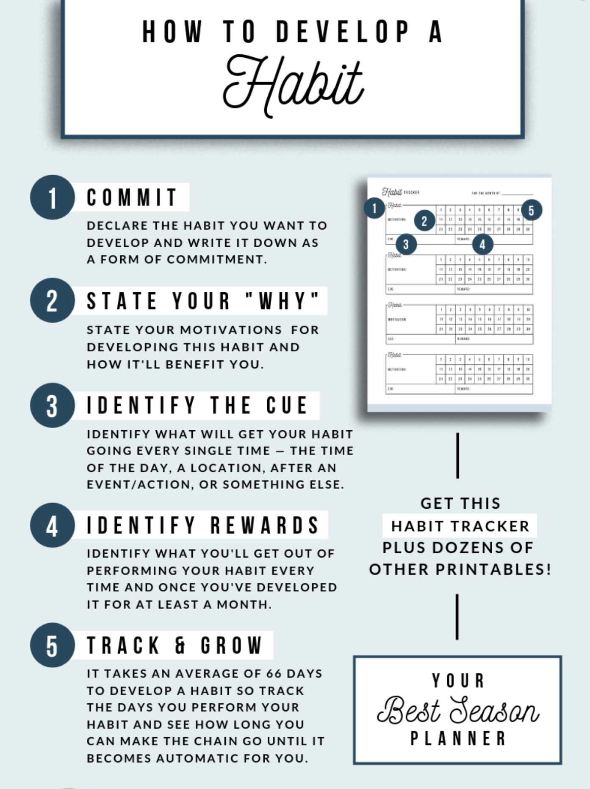

5. Making diary cards a habit
Notes:
Using diary cards regularly can be a challenge as might be developing any healthy habit. There are proven ways that help develop habits. The book tiny habits by BJ Fogg tackles this subject.

Slide 49
M T W T F S S
.

Slide 50
OUR PRACTICE
PLEASE PAUSE RECORDING

Slide 51
END OF HOLES DIARY CARD PRACTICE
PLEASE RESUME RECORDING

Slide 52
I FEEL I’M BAD: GUILT VS SHAME
Guilt is about behavior, when you feel guilt, the focus is on “I did something wrong” (or “I failed to do something I should have done”). The self remains intact; the image is “I am a person who did a bad act,” rather than “I am bad.” Guilt invites repair, accountability, the possibility of change.
Shame is about identity, it says “I am bad,” “I am unlovable,” “I am too much,” “I am not enough” or “I am evil”. It isn’t just “I did a bad thing” but “There is something wrong with me.”
With guilt the response is usually to acknowledge the act, repair the relationship, and restore self-integrity. With shame, the response is more often hiding, shrinking, numbing, and protecting the “bad self” from exposure and further humiliation.
When people struggle with persistent shame, the therapeutic work isn’t simply about “reducing shame” but about using wise mind to see the shame as a result of past hurts.
Where does shame often come from? When a child is abused or neglected by parents or caregivers’ rather than learning “I am safe, I matter, I belong” the child learns “There must be something wrong with me that led to my being abused or neglected.”
Abused and neglected children don’t blame or stop loving their caregivers, they blame and stop loving themselves.
From this type of shame come many longstanding difficulties such as an inability to love or trust, constant self-criticism, perfectionism, hiding and avoidance and the use of numbing strategies to cope.

Slide 53
OUR RESPONSE TO OTHER’S HURT: EMPATHY VS COMPASSION
Empathy is feeling with or sensing and experiencing another person’s emotional state. Our emotion matches their emotion. When we’re empathic with someone outside the window of tolerance we are also outside the window of tolerance. Empathy can therefor lead to “empathic distress”.
Compassion is feeling for or caring and wanting to alleviate another person’s suffering while remaining in the window of tolerance.
Empathy is more likely to produce kindness and the willingness to help when it is accompanied by compassion.
Understanding the difference between empathy and compassion helps us shift from “I feel your pain/you are your pain” to “I see your pain, I walk with you, I hold you, and we imagine healing, repair, transformation”.
For people carrying a lot of shame which says “I am bad,” “I’m too much,” “I’m alone in this” another’s empathy shares that “badness,” potentially reinforcing it. Compassion on the other hand says “I see your pain, it does not define you, you matter, we are in this together.”
Compassion says “I am with you” rather than “I am merging with you.” This helps the compassionate person not burn out while still being emotionally available.
Metaphorically empathy is like entering the hole in the sidewalk of a wounded person and feeling the pain with them; compassion is lighting a flashlight in the hole, sitting with the person, offering a hand, and encouraging them to find the way out. This is therapy!

Slide 54
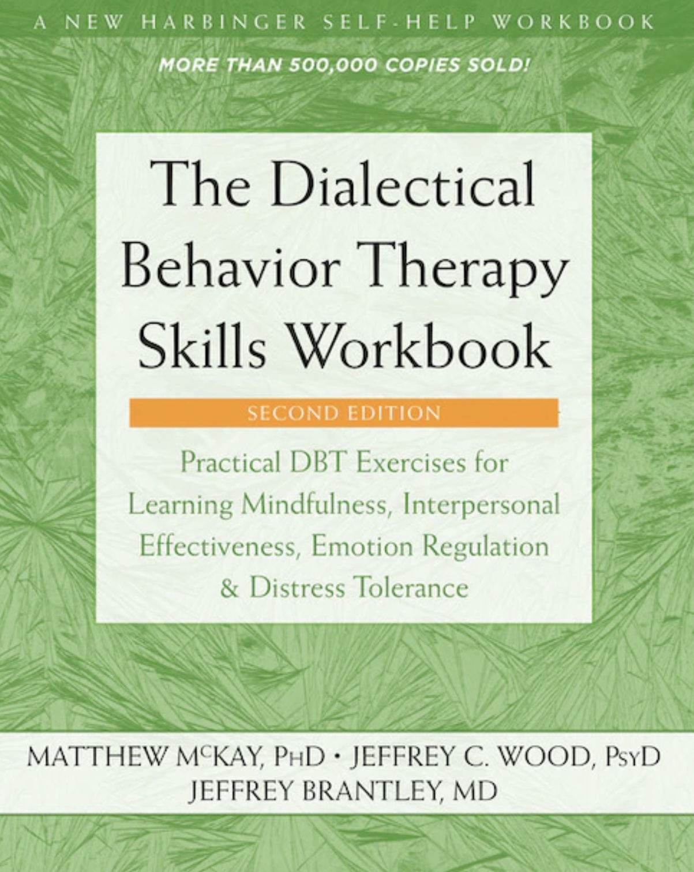


JOAN
NICOLE

Slide 55
UPDATED PERSONAL SKILLS LIST
Distress tolerance skills, so far
Grounding skills- Set a daily intention
“ - Sensory soothing toolkit
“ -The 5,4,3,2,1 method
“ -The emotional freedom technique
REST (or PEST) Pause
Radical acceptance statements (please specify)
Distraction plan “
Self-soothing plan
Safe place visualization
Cue controlled relaxation
Rediscovering your values (please specify)
Rehearse values-based behavior or edit/splice/paste
Connect with your higher power “

Slide 56
UPDATED PERSONAL SKILLS LIST
Distress tolerance skills, today
Grounding skills- Set a daily intention
“ - Sensory soothing toolkit
“ -The 5,4,3,2,1 method
“ -The emotional freedom technique
REST (or PEST) Pause
Radical acceptance statements (please specify)
Distraction plan “
Self-soothing plan
Safe place visualization
Cue controlled relaxation
Rediscovering your values (please specify)
Rehearse values-based behavior or edit/splice/paste
Connect with your higher power
14. Live in the present moment
15. Use self-encouraging coping thoughts
16. Radical acceptance
17. Use self-affirming statements
18. Balance feelings and threat
19. Create new coping strategies
20. Create an emergency coping plan
There is a lot of redundancy in the course. Meaning we repeat the same thing in different ways.
For example, skill 12 = edit/splice/paste technique
Self-encouraging coping thoughts and self-affirming statements are part of rational mind remediation
Mindfulness skills are built into tools etc.
See skills list and review on website

Slide 57
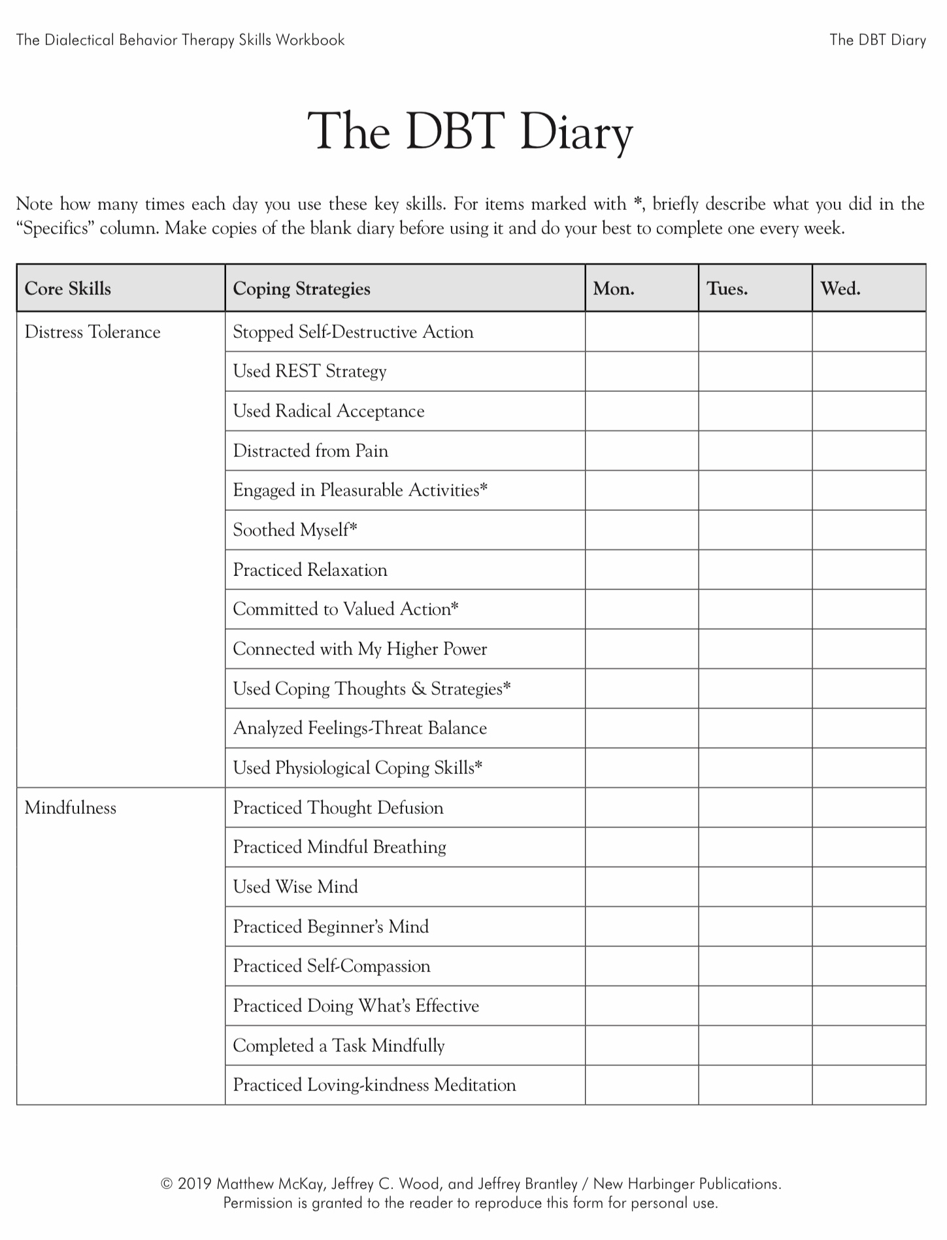
Today
X
Today
X

Slide 58

Distress tolerance week 4
Today we review P. 47 to 68 of skills training workbook, advanced distress tolerance skills, which covers 7 topics:
1. Live in the present moment
2. Use self encouraging coping thoughts.
3. Radical acceptance.
4. Self affirming statements
5. Feelings – threat balance
6. Create new coping strategies.
7. Create an emergency coping plan

Slide 59
Distress tolerance week 4
1. Live in the present moment
2. Use self encouraging coping thoughts.
3. Radical acceptance.
4. Self affirming statements
5. Feelings – threat balance
6. Create new coping strategies.
7. Create an emergency coping plan

Slide 60

Living in the present moment
Most people spend a lot of time mentally traveling to the past or the future
When we mentally travel, we stop paying attention to and miss the present moment.
“Time traveling” to the past or future not only takes us away from the present moment, but it can also bring with it lots of pain when we catastrophize or worry about something that hasn’t happened yet or ruminate on something that already has and can’t be changed.
We can however set an intention to be mindful of and try to reduce time travelling by making it a target in our holes diary card. This can help us stay in the present moment
If you’re feeling distressed, ask yourself if you’re time travelling.
If you catastrophize or ruminate a lot, use these habits of mind as targets in your holes diary card. This is a good way of becoming more aware of when it’s happening

Slide 61

GROUNDING YOURSELF IN THE PRESENT
If you are distressed, notice or be mindful of your thoughts, ask yourself if you are time traveling. If you bring your focus back or ground yourself to the present.
To focus or ground yourself in the present, try:
1) Noticing your breath. This returns you to the present
2) Noticing your bodily sensations.
3) Using any of the other distress tolerance skills you’ve learned (see your list)
4)Practicing the “Listening to Now” and “Mindful Breathing” exercises on page 48 and 49 of the workbook
Remember you can use time travelling , catastrophizing or ruminating as targets in your holes diary card to become more mindful of these.

Slide 62
LISTENING TO NOW EXERCISE
Sit in a comfortable chair. Turn off any distractions, like your phone, radio, computer, and television.
Take slow, long breaths, in through your nose and out through your mouth. Feel your stomach expand like a balloon each time you breathe in and feel it deflate each time you exhale.
Now, as you continue to breathe, simply listen. Listen to any sounds you hear outside your home, inside your home, and inside your own body. Count each sound that you hear. When you get distracted, return your focus to listening. Maybe you hear cars, people, or airplanes outside. Perhaps you hear a clock ticking or a fan blowing inside. Or maybe you hear the sound of your own heart beating inside your body.
Actively and carefully listen to your environment and count as many sounds as you can.
Try this exercise for five minutes and notice how you feel afterward.
A variation of this listening exercise will help you stay focused on the present moment while you’re in a conversation with another person.
If you notice that your attention is beginning to wander and you start thinking about your past or future, focus your attention on something that the person is wearing, like a button on their shirt, a hat they’re wearing, or their collar. Note to yourself what color the item is and what it looks like.
Sometimes this can snap you out of your time traveling. Now continue to listen, and if your mind begins to wander again, do the same thing and try to keep listening.

Slide 63
MINDFUL BREATHING EXERCISE
To begin, find a comfortable place to sit in a room where you won’t be disturbed for as long as you’ve set your timer. Turn off any distracting sounds.
Take a few slow, long breaths and relax. Place one hand on your stomach and imagine your belly filling up with air as you breathe instead of your lungs.
Now slowly breathe in through your nose and then slowly exhale through your mouth as if you’re blowing out birthday candles. Feel your stomach rise and fall as you breathe. Imagine your belly filling up with air like a balloon as you breathe in, and then feel it effortlessly deflate as you breathe out.
Feel the breath moving in across your nostrils, and then feel your breath blowing out across your lips. As you breathe, notice the sensations in your body. Feel your lungs fill up with air.
Notice the weight of your body resting on whatever you’re sitting on.
With each breath, notice how your body feels more and more relaxed. Now, as you continue to breathe, begin counting your breaths each time you exhale. You can count either silently to yourself or aloud.
Count each exhalation until you reach 4 and then begin counting at 1 again.
To begin, breathe in slowly through your nose and then exhale slowly through your mouth.
Count 1. Again, breathe in slowly through your nose and slowly out through your mouth.
Count 2. Repeat, breathing in slowly through your nose, and then slowly exhale.
Count 3. Last time—breathe in through your nose and out through your mouth.
Count 4. Now begin counting at 1 again. When your mind begins to wander and you catch yourself thinking of something else, return your focus to counting your breaths. Try not to criticize yourself for getting distracted. Just keep taking slow breaths into your belly, in and out. Imagine filling up your belly with air like a balloon. Feel it rising with each inhalation and falling with each exhalation.
Keep counting each breath, and with each exhale, feel your body relaxing, deeper and deeper. Keep breathing until your alarm goes off, and then slowly return your focus to the room.

Slide 64
Distress tolerance week 4
1. Live in the present moment
2. Use self encouraging coping thoughts.
3. Radical acceptance.
4. Self affirming statements
5. Feelings – threat balance
6. Create new coping strategies.
7. Create an emergency coping plan

Slide 65

Self Encouraging coping thoughts
Many people feel better when others encourage them, however there are times when we’re distressed and all alone.
Learning self encouragement statements and making them a personal mantra can be very helpful
Self-encouraging coping statements or thoughts might for example remind us of how strong we’ve been in the past and how we survived previous distressing situations
Use them when you’re feeling distressed. Use them in your crisis plan
Some examples of self-encouragement include: “This too shall pass", "I can be anxious and still deal with the situation". "I'm strong enough to handle what’s happening to me right now” (see next slide for more examples)
Come up with your own self encouragement statements.

Slide 66
LIST OF ENCOURAGING COPING THOUGHTS
“This situation won’t last forever.”
“I’ve already been through many other painful experiences, and I’ve survived.”
“This too shall pass.“
“My feelings make me uncomfortable right now, but I can accept them.”
“I can be anxious and still deal with the situation.”
“I’m strong enough to handle what’s happening to me right now.”
“This is an opportunity for me to learn how to cope with my fears.”
“I can ride this out and not let it get to me.”
“I can take all the time I need right now to let go and relax.”
“I’ve survived other situations like this before, and I’ll survive this one too.”
“My anxiety/ fear/ sadness won’t kill me; it just doesn’t feel good right now.”
“These are just my feelings, and eventually they’ll go away.”
“It’s okay to feel sad/ anxious/ afraid sometimes.”
“My thoughts don’t control my life; I do.”
“I can think different thoughts if I want to.”
“I’m not in danger right now.” “So what?”
“This situation sucks, but it’s only temporary.”
“I’m strong and I can deal with this.”

Slide 67
Distress tolerance week 4
1. Live in the present moment
2. Use self encouraging coping thoughts.
3. Radical acceptance.
4. Self affirming statements
5. Feelings – threat balance
6. Create new coping strategies.
7. Create an emergency coping plan

Slide 68

Radical Acceptance
DBT urges us to balance change and acceptance
This means balancing our desire to change some of our behaviors, thoughts, or emotional reactions while at the same time accepting that in the present, we’re having those same thoughts, behaviors, and emotional reactions
In this course it may feel like we’re focusing mostly on the change aspect. Radical acceptance reminds us of the importance of accepting things as they are, warts and all.
Radical Acceptance is accepting something completely without judging it
Accepting things as they are does not mean we condone pain, injustices or abuse, It means we accept that there is suffering in the world, we’re flawed, and our responsibility is to try to do our best with our circumstances.

Slide 69
Distress tolerance week 4
1. Live in the present moment
2. Use self encouraging coping thoughts.
3. Radical acceptance.
4. Self affirming statements
5. Feelings – threat balance
6. Create new coping strategies.
7. Create an emergency coping plan

Slide 70

Self-Affirming Statements
Self affirming statements are similar to self encouraging statements.
The difference is that self encouragement is about what we can do while self affirmation is about who we are
Self-affirmation helps our self-esteem. It reminds us of our good qualities, and can help us cope with distressing situations
When we’re distressed our thoughts about ourselves can become more negative. Ruminating on these negative thoughts can dig us deeper into a hole.
Ex. of self-affirming statements include “I am a good person", "I'm becoming a better person everyday”, “I am here for a reason”, “I am not perfect, but I get better everyday” for more examples see list on the left.
These too can become your mantra.( see more examples in the next slide)

Slide 71
SELF-AFFIRMING STATEMENTS
“I might have some faults, but I’m still a good person.”
“I care about myself and other people.”
“I accept who I am.”
“I love myself.”
“I’m a good person, not a mistake.”
“I’m good and nobody’s perfect.”
“I embrace both my good and bad qualities.”
“Today I take responsibility for everything I do and say.”
“I’m becoming a better person every day.”
“I’m a sensitive person who experiences the world differently.”
“I’m a sensitive person with rich emotional experiences.”
“Each day I do the best I can.”
“Even though I forget sometimes, I’m still a good person.”
“Even though bad things happened to me in the past, I’m still a good person.”
“Even though I’ve made mistakes in the past, I’m still a good person.”
“I’m here for a reason.”
“There’s a purpose to my life, even though I might not always see it.”
“I radically accept myself.”

Slide 72
Take a few minutes, pick 2 self encouraging coping thoughts and 2 self-affirming statements from the list provided and write them down. Save them for your crisis plan.
“This situation won’t last forever.”
“I’ve already been through many other painful experiences, and I’ve survived.”
“This too shall pass.“
“My feelings make me uncomfortable right now, but I can accept them.”
“I can be anxious and still deal with the situation.”
“I’m strong enough to handle what’s happening to me right now.”
“This is an opportunity for me to learn how to cope with my fears.”
“I can ride this out and not let it get to me.”
“I can take all the time I need right now to let go and relax.”
“I’ve survived other situations like this before, and I’ll survive this one too.”
“My anxiety/ fear/ sadness won’t kill me; it just doesn’t feel good right now.”
“These are just my feelings, and eventually they’ll go away.”
“It’s okay to feel sad/ anxious/ afraid sometimes.”
“My thoughts don’t control my life; I do.”
“I can think different thoughts if I want to.”
“I’m not in danger right now.” “So what?”
“This situation sucks, but it’s only temporary.”
“I’m strong and I can deal with this.”
“I might have some faults, but I’m still a good person.”
“I care about myself and other people.”
“I accept who I am.”
“I love myself.”
“I’m a good person, not a mistake.”
“I’m good and nobody’s perfect.”
“I embrace both my good and bad qualities.”
“Today I take responsibility for everything I do and say.”
“I’m becoming a better person every day.”
“I’m a sensitive person who experiences the world differently.”
“I’m a sensitive person with rich emotional experiences.”
“Each day I do the best I can.”
“Even though I forget sometimes, I’m still a good person.”
“Even though bad things happened to me in the past, I’m still a good person.”
“Even though I’ve made mistakes in the past, I’m still a good person.”
“I’m here for a reason.”
“There’s a purpose to my life, even though I might not always see it.”
“I radically accept myself.”

Slide 73
Distress tolerance week 4
Today we review P. 47 to 68 of skills training workbook, advanced distress tolerance skills, which covers 7 topics:
1. Live in the present moment
2. Use self encouraging coping thoughts.
3. Radical acceptance.
4. Self affirming statements
5. Feelings – threat balance
6. Create new coping strategies.
7. Create an emergency coping plan

Slide 74
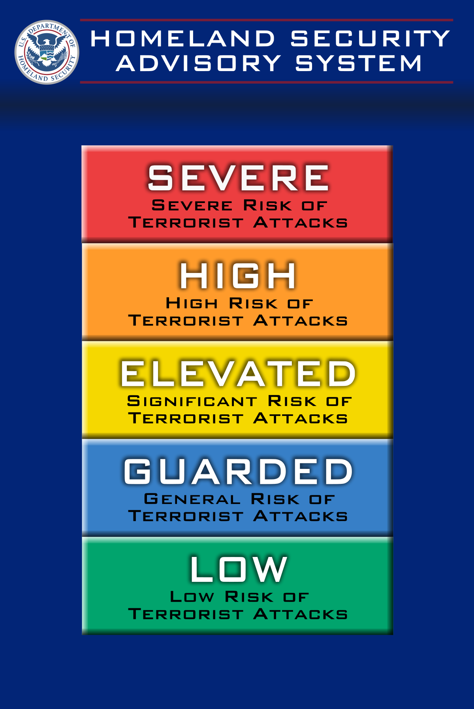
Feelings-threat balance (FTB-COPE)
Intense emotions are usually accompanied by urges to act.
Impulsive acting on these urges can make our lives more difficult and dig us deeper into a hole.
We can use the feelings-threat balance to assess the objective level of threat in our environment and determine whether we 1) should take action in response to a perceived or subjective threat or 2) not act impulsively and focus on coping with our feelings. (REST)
Emotional reasoning refers to the human tendency to believe that a strong feeling confirms the truth about a situation. Ex. If we feel intense anxiety, it must mean we’re facing something very dangerous
When there is balance between our feelings and the threat it is best to take action because there is realistic threat. (objective threat = subjective threat)
When there is a discrepancy between our feelings and the threat, then it is preferable to cope and try to not respond to a situation with emotion driven behavior. ( subjective threat > objective threat)

Slide 75
Distress tolerance week 4
Today we review P. 47 to 68 of skills training workbook, advanced distress tolerance skills, which covers 7 topics:
1. Live in the present moment
2. Use self encouraging coping thoughts.
3. Radical acceptance.
4. Self affirming statements
5. Feelings – threat balance
6. Create new coping strategies.
7. Create an emergency coping plan

Slide 76
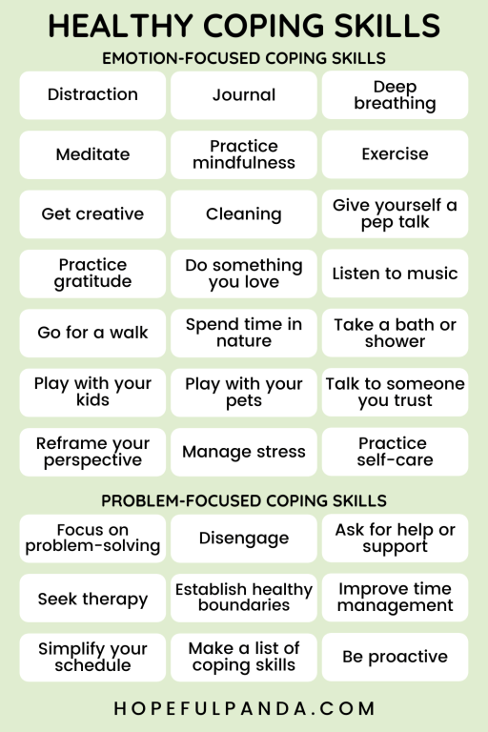
Create New coping Strategies
In the last 4 skills sessions we’ve covered most of the distress tolerance skills. In two weeks, we will discuss the last distress tolerance skills the physiological skills. The emotional freedom technique we did as our mindfulness exercise today can be considered a physiological skill.
On pages 64-65 of the workbook there is a template to help us reflect on the “videos” of previous distressing situations we’ve encountered and consider what new coping strategies we could’ve used instead.
This can also be done by using the holes diary card, chain analysis, and the editing/splicing and pasting technique. If you have limited time, use the simple tools and bypass these workbook exercises

Slide 77
Distress tolerance week 4
Today we review P. 47 to 68 of skills training workbook, advanced distress tolerance skills, which covers 7 topics:
1. Live in the present moment
2. Use self encouraging coping thoughts.
3. Radical acceptance.
4. Self affirming statements
5. Feelings – threat balance
6. Create new coping strategies.
7. Create an emergency coping plan
This is on p.67 of the workbook; we do however encourage you to try the more comprehensive simple crisis plan.

Slide 78

Crisis plan algorithm
Developing your crisis plans and becoming skilled at using them involves 8 steps: This is the first Simple algorithm.
1. Understand the concept of holes you keep falling into or the specific crisis for which you are going to use the crisis plans
2. Identify some of the thoughts, feelings or behaviors that occur during the crisis that you want to work on. This is step 1 on the crisis plan template.
3. Complete the rest of your crisis plan template
4. Recall, in your mind, a real crisis from the past in which you fell into the hole you are working on and use the "editing, splicing, and pasting" technique, along with your skills and tools, to imagine a different outcome that incorporates your crisis plan.
5. Stay in the window of tolerance while editing, splicing, and pasting by pendulating.
6. Repeatedly visualize the new edited, spliced, and pasted version of the situation until you can visualize it without effort.
7. When a new crisis occurs work with it following these same steps.
8. practice, practice, practice.

Slide 79
Crisis plan algorithm
Developing your crisis plans and becoming skilled at using them involves 8 steps: This is the first Simple algorithm.
1. Understand the concept of holes you keep falling into or the specific crisis for which you are going to use the crisis plans
2. Identify some of the thoughts, feelings or behaviors that occur during the crisis that you want to work on. This is step 1 on the crisis plan template.
3. Complete the rest of your crisis plan template
4. Recall, in your mind, a real crisis from the past in which you fell into the hole you are working on and use the "editing, splicing, and pasting" technique, along with your skills and tools, to imagine a different outcome that incorporates your crisis plan.
5. Stay in the window of tolerance while editing, splicing, and pasting by pendulating.
6. Repeatedly visualize the new edited, spliced, and pasted version of the situation until you can visualize it without effort.
7. When a new crisis occurs work with it following these same steps.
8. practice, practice, practice.

Slide 80
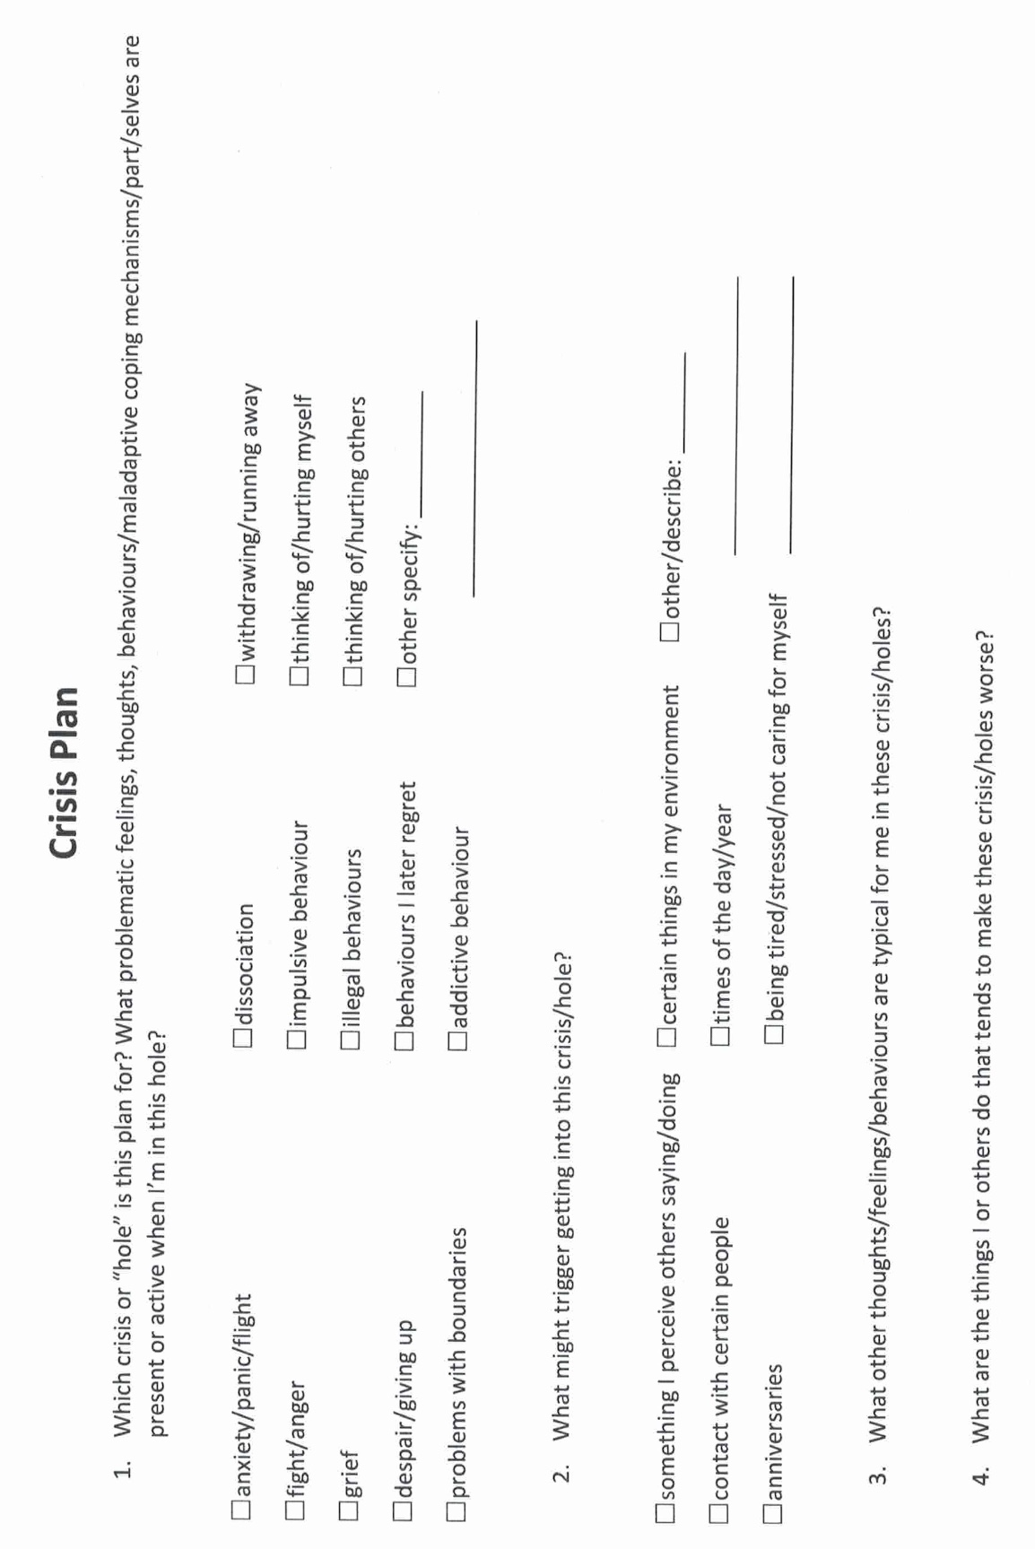
Notes:
A template is a structured form that helps you carry out the steps prescribed in the algorithm. There are many different crisis plans templates. This one is a compilation of some of the best features of other templates.

Slide 81
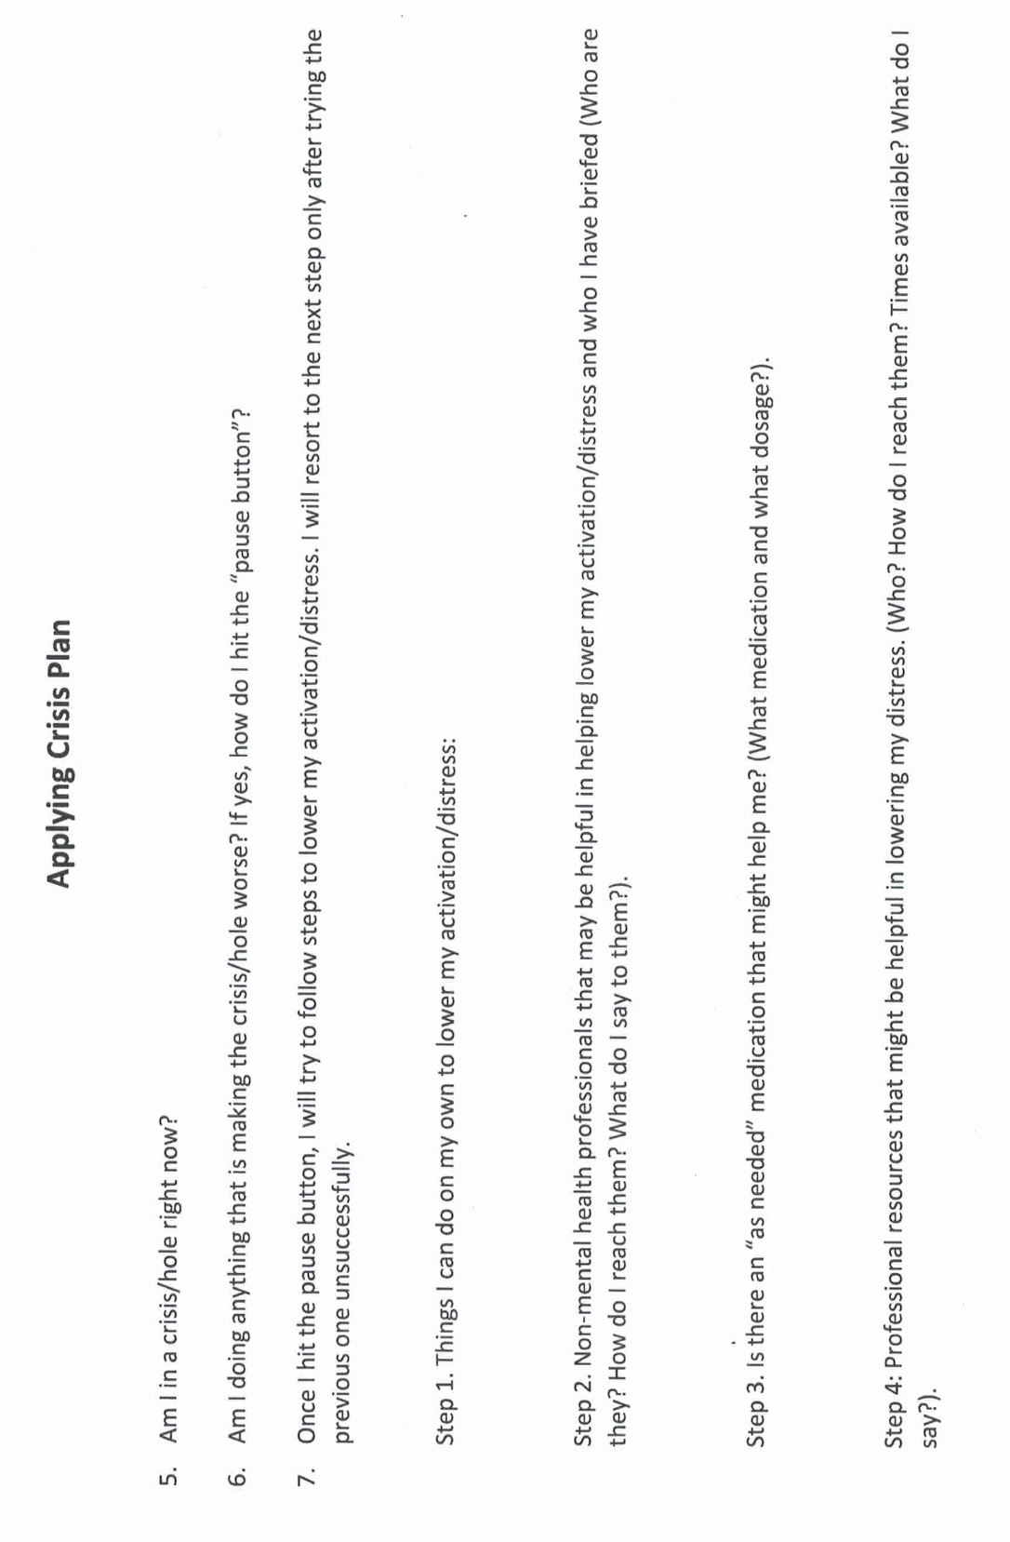

Slide 82
UPDATED PERSONAL SKILLS LIST
Distress tolerance skills
Grounding skills- Set a daily intention
“ - Sensory soothing toolkit
“ -The 5,4,3,2,1 method
“ -The emotional freedom technique
REST (or PEST) Pause
Radical acceptance statements (please specify)
Distraction plan “
Self-soothing plan
Safe place visualization
Cue controlled relaxation
Rediscovering your values (please specify)
Rehearse values-based behavior or edit/splice/paste
Connect with your higher power “
14. Live in the present moment
15. Use self-encouraging coping thoughts
16. Radical acceptance
17. Use self-affirming statements
18. Balance feelings and threat
19. Create new coping strategies
20. Create an emergency coping plan

Slide 83
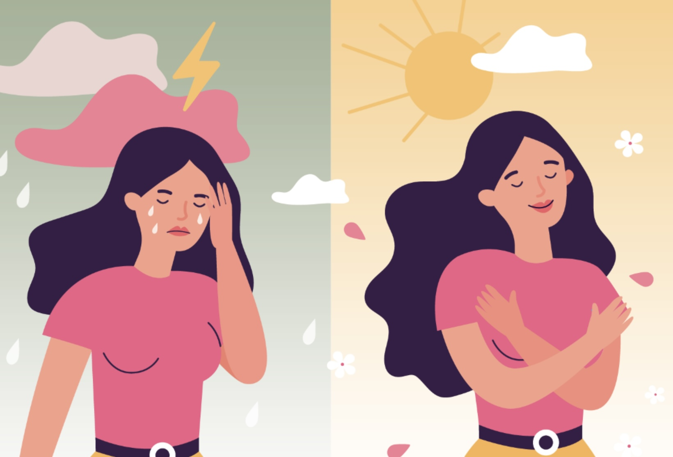
WEEK 6 of SIMPLE
MID SESSION 10 MINUTE break

Slide 84
WEEK 6 OF SIMPLE
WELCOME BACK FROM THE BREAK

Slide 85


WELCOME TO THE 2ND ANNUAL SIMPLE JEOPARDY WORLD SERIES
FEATURING THE
VS.
Wednesday, November 5 at the Avondale center

Slide 87
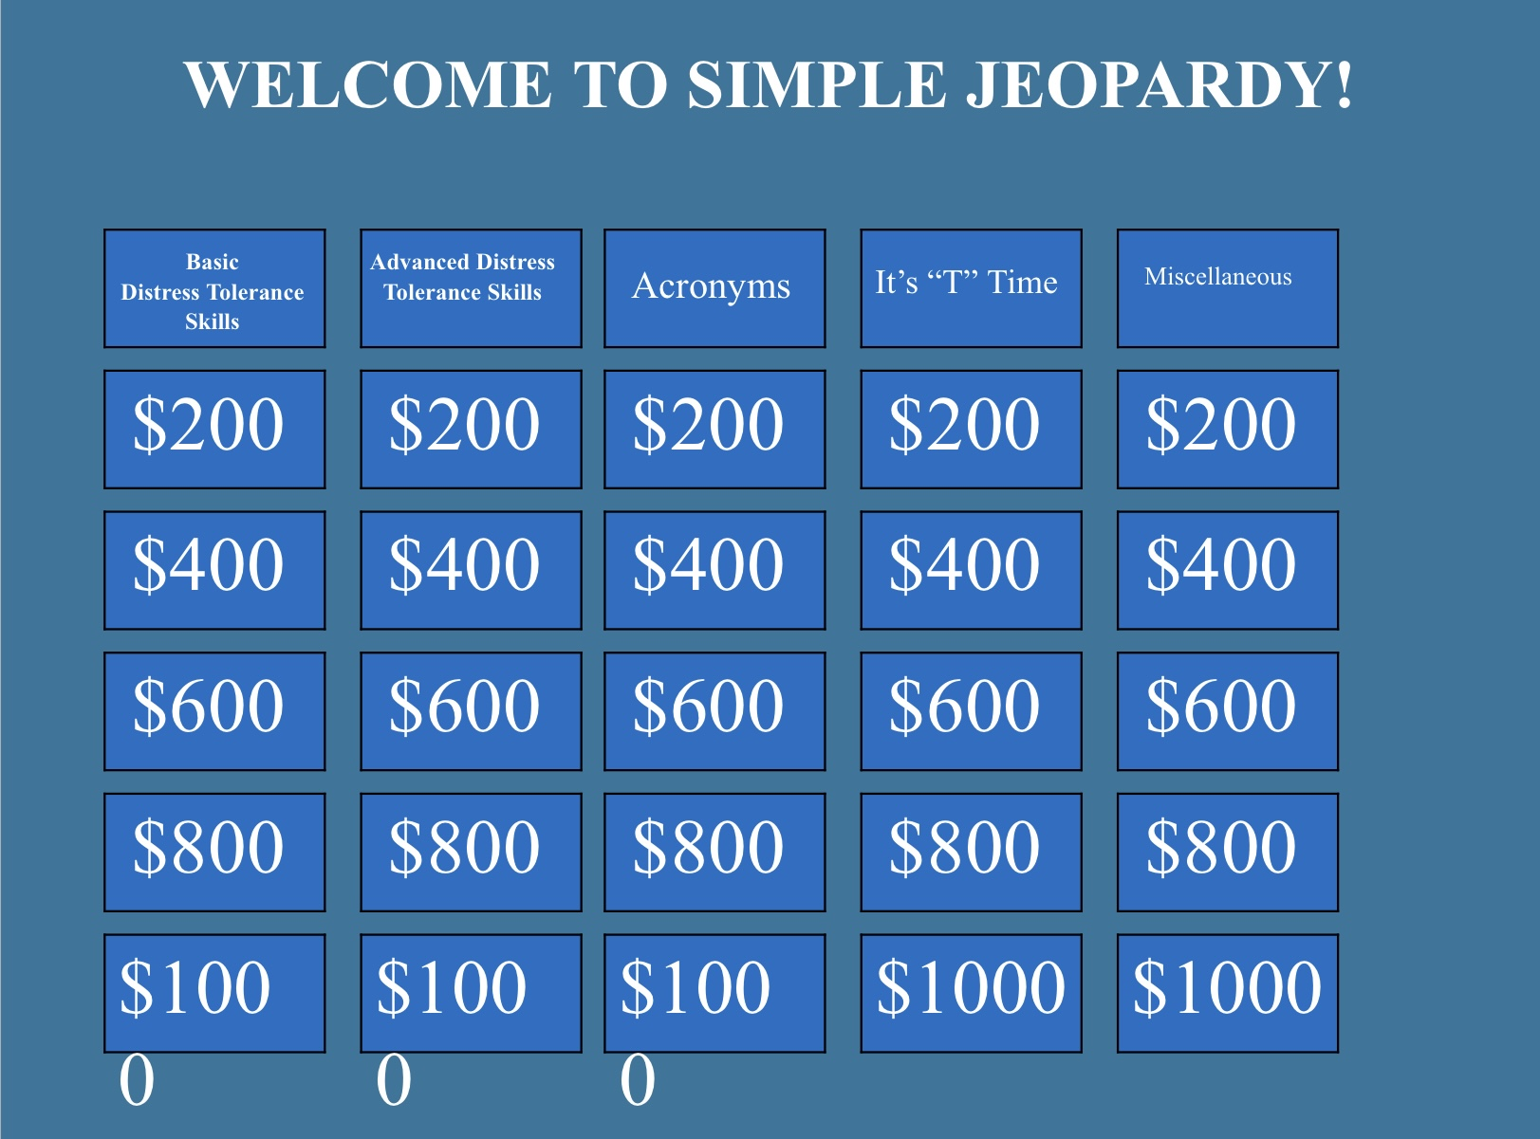

Slide 88
REVIEW OF ALL THE SKILLS PRESENTED SO FAR

Slide 89
UPDATED PERSONAL SKILLS LIST
Distress tolerance skills
Grounding skills- Set a daily intention
“ - Sensory soothing toolkit
“ -The 5,4,3,2,1 method
“ -The emotional freedom technique
REST (or PEST) Pause
Radical acceptance statements (please specify)
Distraction plan “
Self-soothing plan
Safe place visualization
Cue controlled relaxation
Rediscovering your values (please specify)
Rehearse values-based behavior or edit/splice/paste
Connect with your higher power
14. Live in the present moment
15. Use self-encouraging coping thoughts
16. Radical acceptance
17. Use self-affirming statements
18. Balance feelings and threat
19. Create new coping strategies
20. Create an emergency coping plan

Slide 90
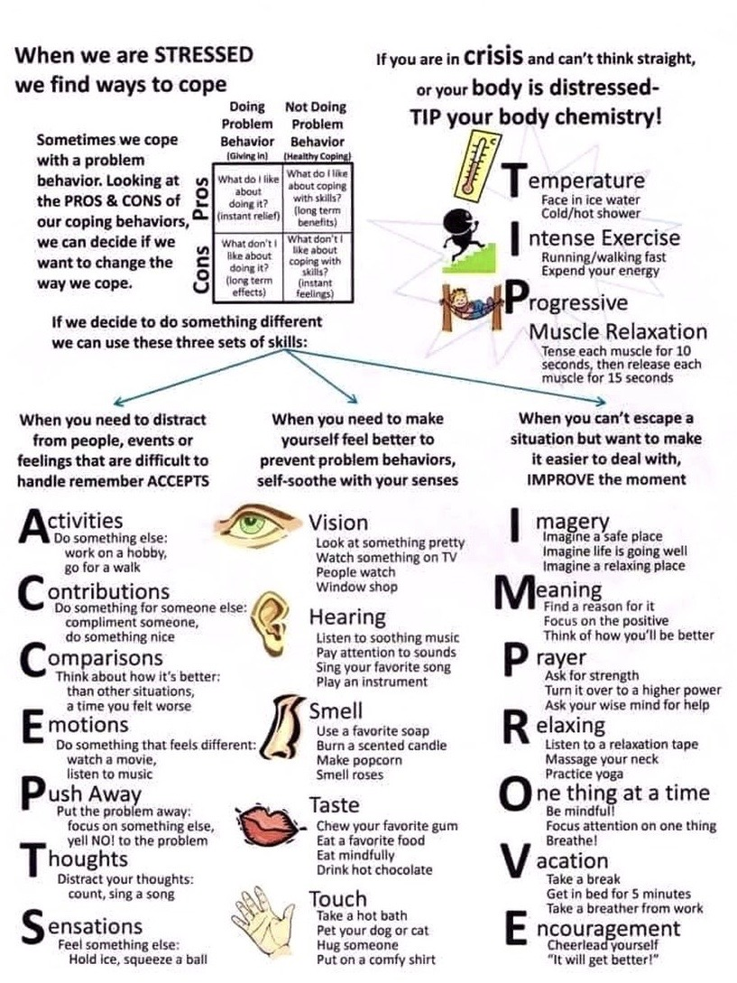
Notes:
These acronyms may be helpful in remembering the skills and the distress tolerance module.

Slide 91
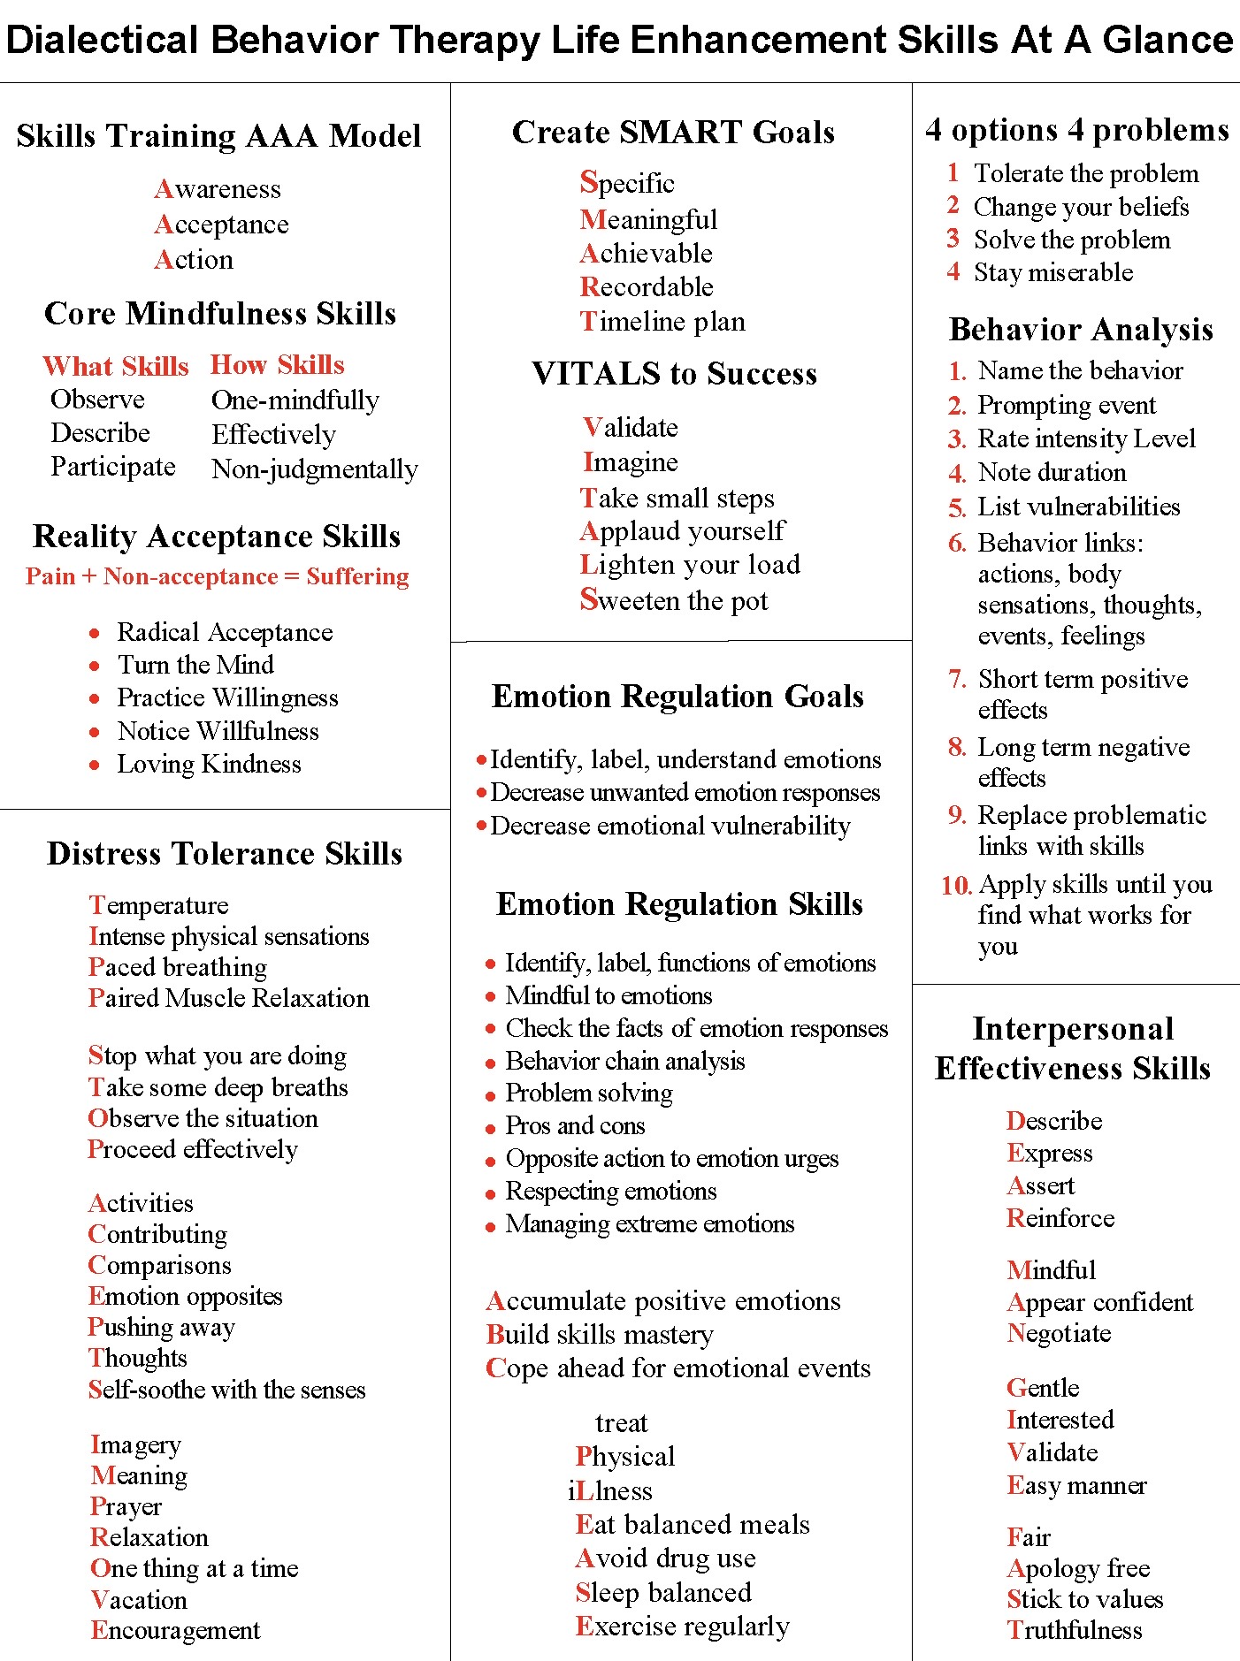
Notes:
These are some of the common acronyms used in all four modules.

Slide 92
UPDATED PERSONAL SKILLS LIST
Distress tolerance skills
Grounding skills- Set a daily intention
“ - Sensory soothing toolkit
“ -The 5,4,3,2,1 method
“ -The emotional freedom technique
REST (or PEST) Pause
Radical acceptance statements (please specify)
Distraction plan “
Self-soothing plan
Safe place visualization
Cue controlled relaxation
Rediscovering your values (please specify)
Rehearse values-based behavior or edit/splice/paste
Connect with your higher power
14. Live in the present moment
15. Use self-encouraging coping thoughts
16. Radical acceptance
17. Use self-affirming statements
18. Balance feelings and threat
19. Create new coping strategies
20. Create an emergency coping plan

Slide 93
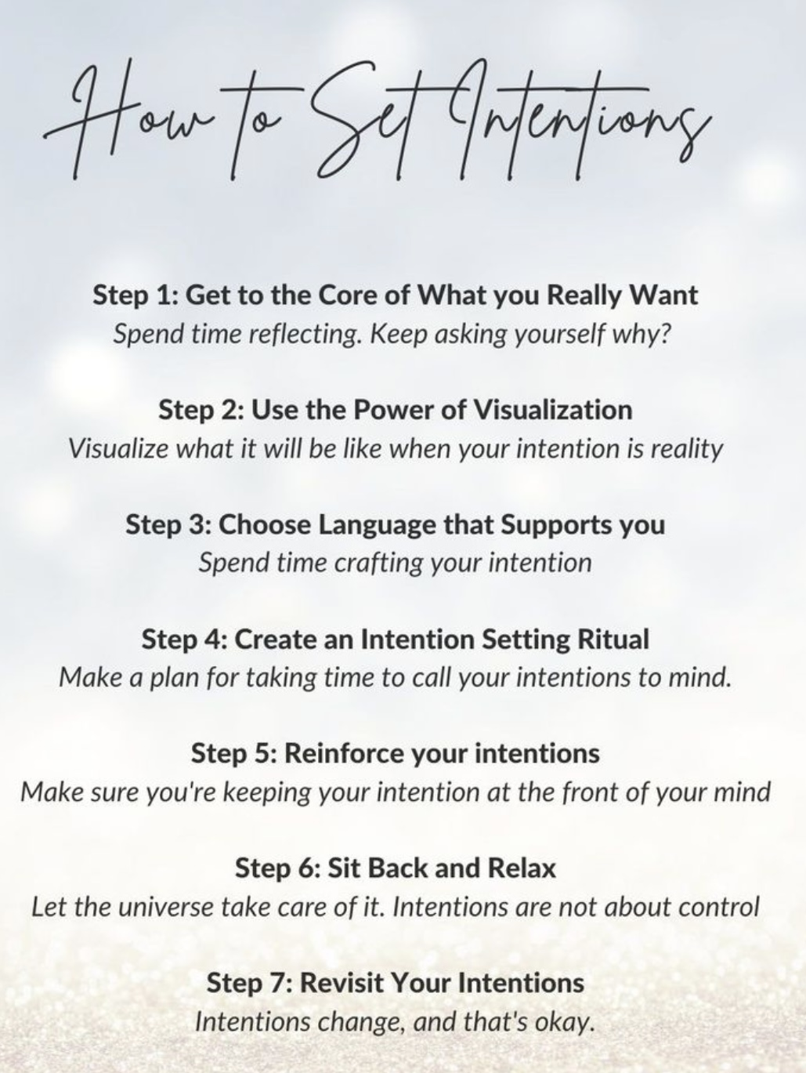
1.SET A DAILY INTENSION
Setting an intention involves consciously deciding what you want to focus on or achieve in a particular area of your life. It’s about clarifying your goals, desires, or feelings and aligning your actions and mindset with those aspirations. This practice can be done in various ways, such as through meditation, journaling, or simply taking a moment to reflect.
When you set an intention, you’re not just wishing for something to happen; you’re actively committing to a mindset or a course of action that can help you manifest your goals. It can be as specific as wanting to improve your health or as broad as seeking more joy in your daily life. The key is to be clear and positive about what you want to invite into your life!

Slide 94
THE BENEFITS OF SETTING INTENTIONS
Setting an intention can have several benefits, particularly in the context of personal growth, learning, and achieving goals.
Setting an intention helps clarify what you want to achieve, making it easier to focus your efforts and resources
Intentions can serve as a source of motivation, providing a reason to take action and stay committed to your goals.
The process of setting an intention encourages mindfulness, helping you to be present and aware of your thoughts and actions.
Intentions often promote a positive outlook, encouraging you to view challenges as opportunities for growth rather than obstacles.
Setting intentions allows you to align your actions with your core values and beliefs, leading to a more fulfilling and authentic life.
Intentions can enhance your focus by directing your attention toward specific outcomes, reducing distractions and increasing productivity.
When faced with setbacks, having a clear intention can help you stay resilient and committed to your goals, reminding you of your purpose.
Intentions can guide your decision-making process, making it easier to choose actions that align with your desired outcomes.
Sharing your intentions with others can create a sense of accountability, encouraging you to follow through on your commitments.
Setting intentions fosters a growth mindset, encouraging you to embrace challenges, learn from experiences, and continuously improve.
By incorporating intention-setting into your daily routine, you can create a more purposeful and fulfilling approach to learning and personal development.

Slide 95

REST- S is for Set an Intention
When we step away, back, or pause while experiencing dysregulated emotions we create the space to come up with a plan for what we’re going to do that will avoid making things worse.
Stepping back allows us to be less emotional and more rational and make better choices. We will learn to do this throughout the course.
We will learn to develop new ways of thinking, reacting emotionally and behaving when we explore the simple remediation tools (rational and wise mind remediation).
Our intention using these tools, will be to replace our maladaptive reactions with more adaptive ones.

Slide 96
UPDATED PERSONAL SKILLS LIST
Distress tolerance skills
Grounding skills- Set a daily intention
“ - Sensory soothing toolkit
“ -The 5,4,3,2,1 method
“ -The emotional freedom technique
REST (or PEST) Pause
Radical acceptance statements (please specify)
Distraction plan “
Self-soothing plan
Safe place visualization
Cue controlled relaxation
Rediscovering your values (please specify)
Rehearse values-based behavior or edit/splice/paste
Connect with your higher power
14. Live in the present moment
15. Use self-encouraging coping thoughts
16. Radical acceptance
17. Use self-affirming statements
18. Balance feelings and threat
19. Create new coping strategies
20. Create an emergency coping plan

Slide 97
THE SENSORY SOOTHING TOOLKIT

Slide 98


Slide 99
UPDATED PERSONAL SKILLS LIST
Distress tolerance skills
Grounding skills- Set a daily intention
“ - Sensory soothing toolkit
“ -The 5,4,3,2,1 method
“ -The emotional freedom technique
REST (or PEST) Pause
Radical acceptance statements (please specify)
Distraction plan “
Self-soothing plan
Safe place visualization
Cue controlled relaxation
Rediscovering your values (please specify)
Rehearse values-based behavior or edit/splice/paste
Connect with your higher power
14. Live in the present moment
15. Use self-encouraging coping thoughts
16. Radical acceptance
17. Use self-affirming statements
18. Balance feelings and threat
19. Create new coping strategies
20. Create an emergency coping plan

Slide 100
THE 5,4,3,2,1 METHOD

Slide 101
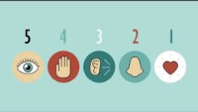
Notes:
In the sessions I provide links to videos that illustrate aspects of the material we are discussing in the course. Because of copyright laws I cannot post the video itself, instead you can view the video by pressing "Ctrl" on your computer as you click "click here for video"

Slide 102
UPDATED PERSONAL SKILLS LIST
Distress tolerance skills
Grounding skills- Set a daily intention
“ - Sensory soothing toolkit
“ -The 5,4,3,2,1 method
“ -The emotional freedom technique
REST (or PEST) Pause
Radical acceptance statements (please specify)
Distraction plan “
Self-soothing plan
Safe place visualization
Cue controlled relaxation
Rediscovering your values (please specify)
Rehearse values-based behavior or edit/splice/paste
Connect with your higher power
14. Live in the present moment
15. Use self-encouraging coping thoughts
16. Radical acceptance
17. Use self-affirming statements
18. Balance feelings and threat
19. Create new coping strategies
20. Create an emergency coping plan

Slide 103
THE EMOTIONAL FREEDOM TECHNIQUE

Slide 104


Slide 105
UPDATED PERSONAL SKILLS LIST
Distress tolerance skills
Grounding skills- Set a daily intention
“ - Sensory soothing toolkit
“ -The 5,4,3,2,1 method
“ -The emotional freedom technique
REST (or PEST) Pause
Radical acceptance statements (please specify)
Distraction plan “
Self-soothing plan
Safe place visualization
Cue controlled relaxation
Rediscovering your values (please specify)
Rehearse values-based behavior or edit/splice/paste
Connect with your higher power
14. Live in the present moment
15. Use self-encouraging coping thoughts
16. Radical acceptance
17. Use self-affirming statements
18. Balance feelings and threat
19. Create new coping strategies
20. Create an emergency coping plan

Slide 106
REST (OR PEST) PAUSE

Slide 107

1. REST- R IS FOR Relax
If you’re in crisis:
Stop what you’re doing, want to do or are about to impulsively do.
Take a breath. Count to 10, 50 or 100
Step away or back to allow yourself to have a different perspective
Don’t act impulsively
Remind yourself that this is an opportunity to behave differently than you have in the past which did not turn out well.

Slide 108
UPDATED PERSONAL SKILLS LIST
Distress tolerance skills
Grounding skills- Set a daily intention
“ - Sensory soothing toolkit
“ -The 5,4,3,2,1 method
“ -The emotional freedom technique
REST (or PEST) Pause
Radical acceptance statements (please specify)
Distraction plan “
Self-soothing plan
Safe place visualization
Cue controlled relaxation
Rediscovering your values (please specify)
Rehearse values-based behavior or edit/splice/paste
Connect with your higher power
14. Live in the present moment
15. Use self-encouraging coping thoughts
16. Radical acceptance
17. Use self-affirming statements
18. Balance feelings and threat
19. Create new coping strategies
20. Create an emergency coping plan

Slide 109
RADICAL ACCEPTANCE STATEMENTS

Slide 110
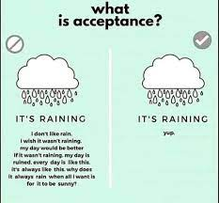
Radical Acceptance
OF PAIN
Radical acceptance helps us better tolerate pain by changing our attitude to it.
When we are in physical or psychological pain, we often judge it and react with blame, anger, anxiety, and general non-acceptance of the pain. These judgements are a form of resistance to the pain.
Resisting pain often makes it worse. Not only are we experiencing pain but we’re also experiencing the resistance or rejection of it which is also painful. Pain is made worse by our rejection of it.
Resistance and non-acceptance of pain may also keep us from doing what is under our control to deal with the cause of the pain.
Radical acceptance asks us to accept the pain without adding resistance or judgement.
Accepting the pain does not mean that pain is a good thing. Instead, it helps us focus on what we can do to alleviate the pain rather than spending our energy futilely fighting, resisting and judging it .

Slide 111
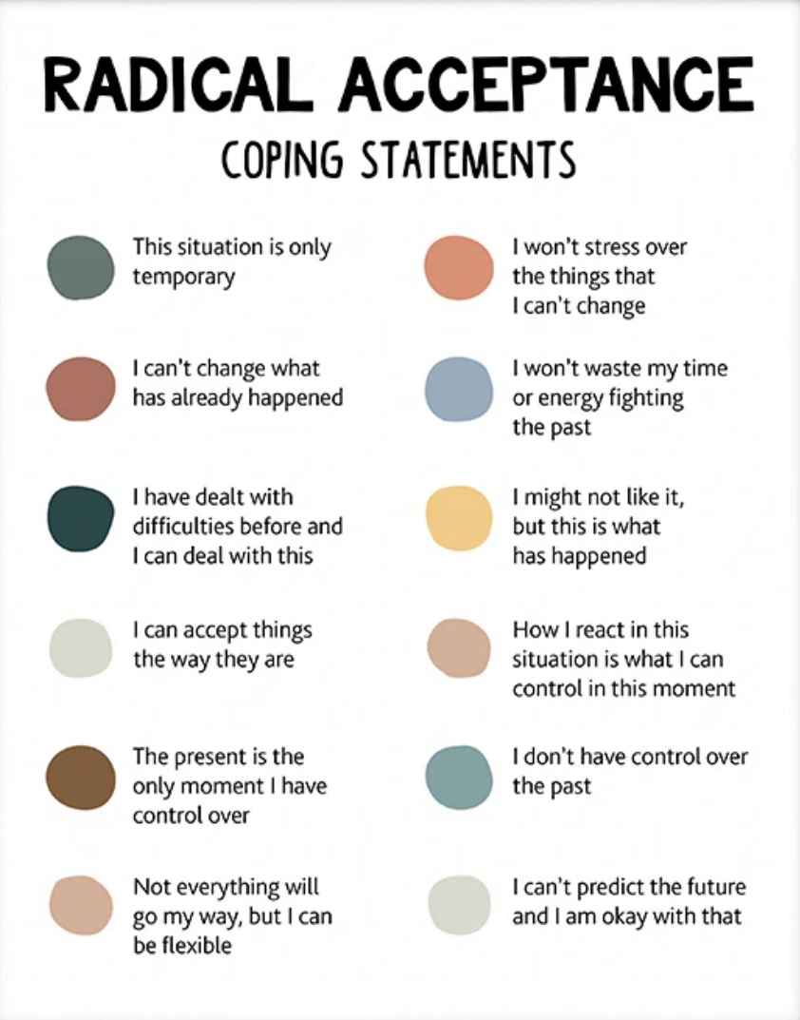
Radical acceptance coping statements
On the left are some examples of radical acceptance coping statements.
Choose one or more statements from this list for your own use. Add this to your list.
Or come up with your own statements
Think of them as your distress “mantra”
The key is to use these when you’re in pain and find yourself resisting it.
Make radical acceptance coping statements part of your crisis plan.

Slide 112
UPDATED PERSONAL SKILLS LIST
Distress tolerance skills
Grounding skills- Set a daily intention
“ - Sensory soothing toolkit
“ -The 5,4,3,2,1 method
“ -The emotional freedom technique
REST (or PEST) Pause
Radical acceptance statements (please specify)
Distraction plan “
Self-soothing plan
Safe place visualization
Cue controlled relaxation
Rediscovering your values (please specify)
Rehearse values-based behavior or edit/splice/paste
Connect with your higher power
14. Live in the present moment
15. Use self-encouraging coping thoughts
16. Radical acceptance
17. Use self-affirming statements
18. Balance feelings and threat
19. Create new coping strategies
20. Create an emergency coping plan

Slide 113

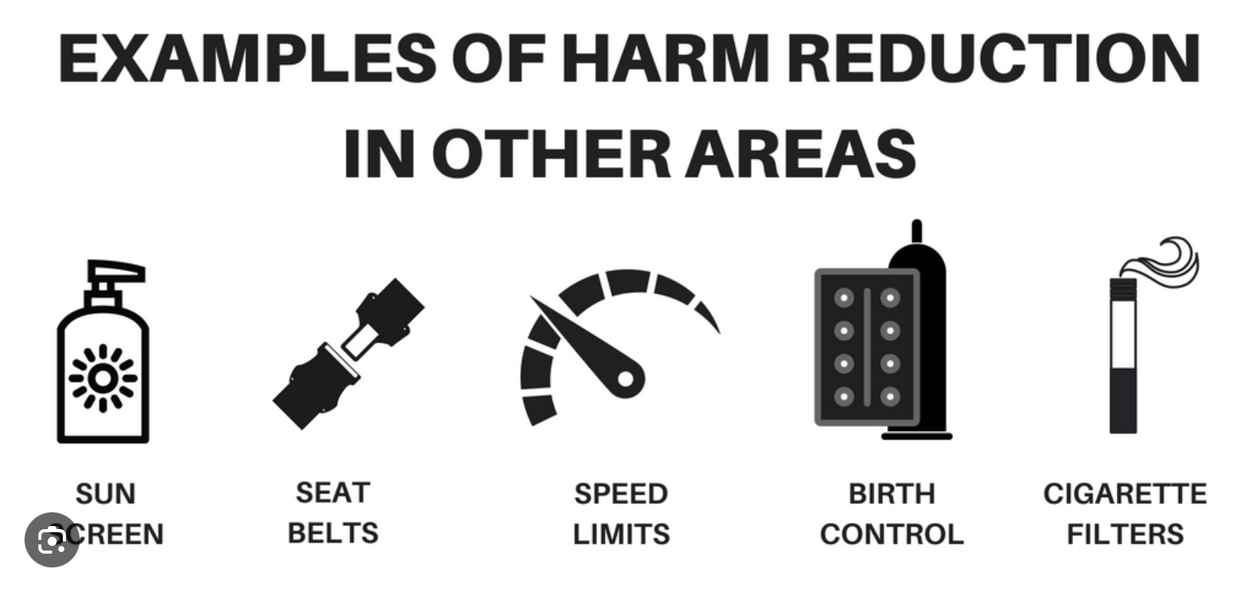
2. DISTRACT AND HARM REDUCE FROM SELF-DESTRUCTIVE BEHAVIORS
We sometimes use self-destructive strategies to try to sooth pain but over the long term they make pain worse.
Self destructive strategies cause sooth over the short term but cause more damage over the long term.
We can use distraction to try to not engage in self-destructive behaviors.
We can also try harm reduction which is doing something to the self-destructive strategy and that sooths us but is less harmful over the long run.
Ex. Hold an ice cube in your hand as long as you can. Snap a rubber band on your wrist , pop balloons with faces you’ve drawn.
You can incorporate distraction and harm reduction into your crisis plan. Then edit, splice and paste it into our “videos” of a crisis.

Slide 114
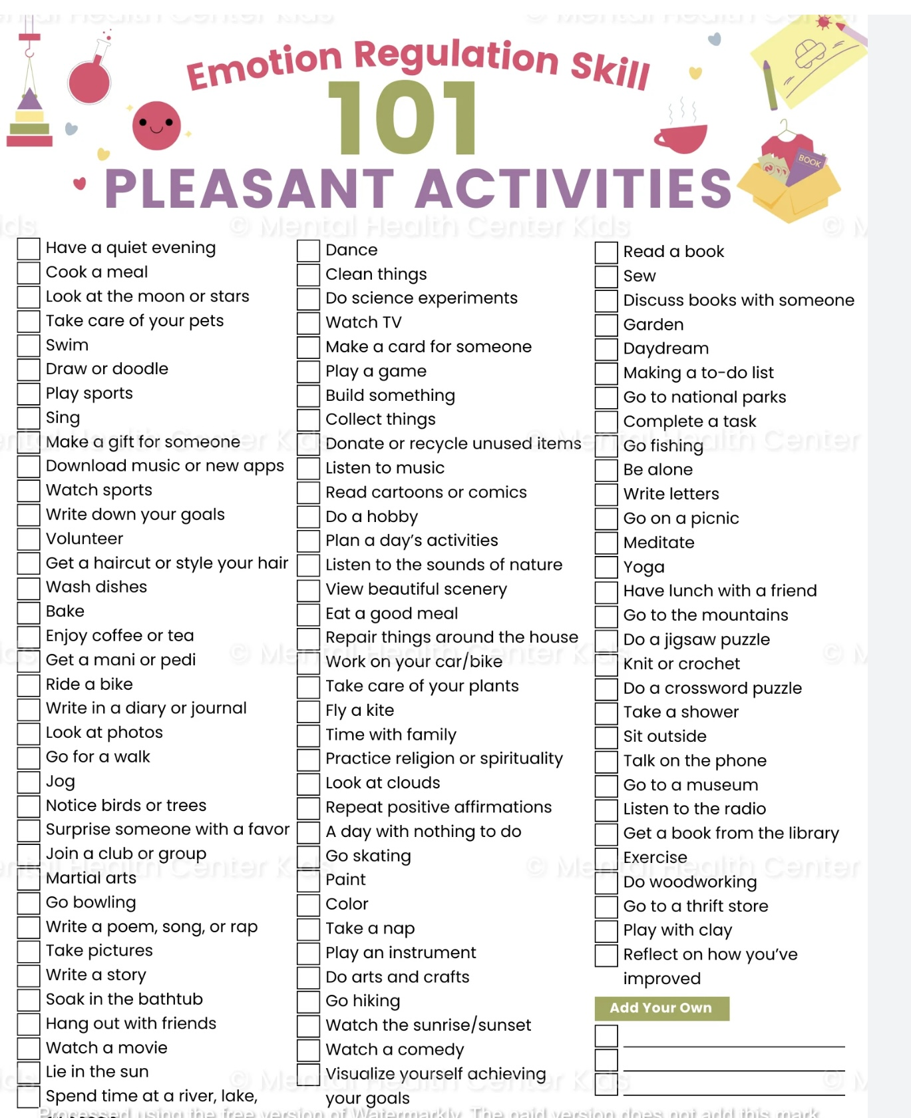
DISTRACT WITH PLEASURABLE ACTIVITIES
Review the list of pleasurable activities on pages 18-20 of the workbook
Check off the activities you are likely to use
Engage in these activities as often as you can, don’t wait until you’re in crisis
Sometimes doing something that makes you feel good is the best way to distract yourself from painful emotions
Remember to use these in your distraction plan

Slide 115
2. Focus on someone else
Pay attention to someone else
Do something for someone else
Take your attention off yourself
Think of someone you care about
3. With thoughts
Distract your thoughts
Remember past pleasant events
Observe nature
Imagine your wildest fantasy coming true. What would it be?
4. By leaving
Distract yourself by leaving
Sometimes it’s helpful to just leave and create some distance between you and the problem
5. With tasks/Chores
Distract yourself with tasks/chores
Take care of yourself or your environment
1. By counting
Distract by counting breaths, subtracting numbers
OTHER WAYS OF DISTRACTING YOURSELF

Slide 116
UPDATED PERSONAL SKILLS LIST
Distress tolerance skills
Grounding skills- Set a daily intention
“ - Sensory soothing toolkit
“ -The 5,4,3,2,1 method
“ -The emotional freedom technique
REST (or PEST) Pause
Radical acceptance statements (please specify)
Distraction plan “
Self-soothing plan
Safe place visualization
Cue controlled relaxation
Rediscovering your values (please specify)
Rehearse values-based behavior or edit/splice/paste
Connect with your higher power
14. Live in the present moment
15. Use self-encouraging coping thoughts
16. Radical acceptance
17. Use self-affirming statements
18. Balance feelings and threat
19. Create new coping strategies
20. Create an emergency coping plan

Slide 117

Relax and Self Soothe
When we are in the window of emotional tolerance, that is calm or alert, we think more clearly and make better choices
Relaxation and self-soothing strategies can bring us back into the window of tolerance
We can relax and self-sooth using any of our 5 senses

Slide 118

SMELL
Light a candle, use incense
smell perfume, essential oils, or freshly baked bread/cookies
Go to a place with a comforting smell
Go to a forest or a farm

Slide 119

vision
Make a collage
Find a picture of or go to a place that’s visually soothing
Carry a photo of someone you admire or love

Slide 120

sound
Listen to…
music
Audio books/ podcast
Nature sounds
White noise machine
Guided meditations

Slide 121

Taste
Prepare and eat favorite meal
Or comfort food
Drink cold or hot drinks
Try gum, mints, candy
Chew on ice cubes
Prepare and drink fresh juicy fruit

Slide 122

touch
Use your self-soothing kit
Carry something soft and comforting in your pocket
Try a using prayer bead
Take warm or cold showers
Get a massage
Play with a pet
Wear comfortable clothes

Slide 123

PUTTING IT TOGETHER: select your:
1) radical acceptance statement
2) distraction strategy
3) relaxation and self soothing method and use these IN your crisis plan

Slide 124
UPDATED PERSONAL SKILLS LIST
Distress tolerance skills
Grounding skills- Set a daily intention
“ - Sensory soothing toolkit
“ -The 5,4,3,2,1 method
“ -The emotional freedom technique
REST (or PEST) Pause
Radical acceptance statements (please specify)
Distraction plan “
Self-soothing plan
Safe place visualization
Cue controlled relaxation
Rediscovering your values (please specify)
Rehearse values-based behavior or edit/splice/paste
Connect with your higher power
14. Live in the present moment
15. Use self-encouraging coping thoughts
16. Radical acceptance
17. Use self-affirming statements
18. Balance feelings and threat
19. Create new coping strategies
20. Create an emergency coping plan

Slide 125


Slide 126


Safe-Place visualization
Visualizing a safe place reduces distress and helps us return to the window of tolerance
When we imagine a safe, relaxing place, our body responds by relaxing.
The body can’t tell the difference between being in a real safe, relaxing place and imagining we are in one.
Do your safe-place visualization in a quiet place where there are no distractions
Follow the instructions on page 33 of the skills training manual. Record the text on your phone and listen to it. You can also find guided safe place visualizations on YouTube.
Try the safe-place visualization recorded on this slide.

Slide 127
To begin, sit in a comfortable chair with your feet flat on the floor and your hands resting comfortably, either on the arms of the chair or in your lap. Close your eyes. Take a slow, long breath in through your nose. Feel your belly expand like a balloon as you breathe in. Hold it for five seconds: 1, 2, 3, 4, 5. Then release it slowly through your mouth. Feel your belly collapse like a balloon losing its air. Again, take a slow, long breath in through your nose and feel your stomach expand. Hold it for five seconds: 1, 2, 3, 4, 5. Then exhale slowly through your mouth. One more time: take a slow, long breath in through your nose and feel your stomach expand. Hold it for five seconds: 1, 2, 3, 4, 5. Then exhale slowly through your mouth. Now begin to take slow, long breaths without holding them, and continue to breathe smoothly for the rest of this exercise. Now, with your eyes still closed, imagine that a white beam of light shines down from the sky like a bright laser and lands on the very top of your head. Notice how warm and soothing the light makes you feel. This could be a light from God, the universe, or whatever power makes you feel comfortable. As you continue to breathe smoothly, taking slow, long breaths, notice how the light makes you feel more and more relaxed as it continues to shine on the top of your head. Now, slowly, the warm, white light begins to spread over the top of your head like soothing water. And as it does, the light begins to loosen any muscle tension that you’re feeling on the top of your head. Slowly, the light begins to slide down your body, and as it moves across your forehead, all the muscle tension there is released. Then the white light continues down past your ears, the back of your head, your eyes, nose, mouth, and chin, and it continues to release any tension you’re holding there. Notice how pleasantly warm your forehead feels. Now, slowly, imagine that the light begins to move down your neck and over your shoulders, releasing any muscle tension. Then the light slowly proceeds down both of your arms and the front and back of your torso. Feel the muscles in your upper and lower back release. Notice the soothing sensation of the white light as it moves across your chest and stomach. Feel the muscles in your arms release as the light moves down to your forearms and then across both sides of your hands to your fingertips. Now notice the light moving down through your pelvis and buttocks and feel the tension being released. Again, feel the light move like soothing water across your upper and lower legs until it spreads across both the upper and lower surfaces of your feet. Feel all of the tension leaving the muscles of your body as the white light makes your body feel warm and relaxed.

Slide 128
Continue to notice how peaceful and calm you feel as you continue to take slow, long, smooth breaths. Observe how your stomach continues to expand as you inhale, and feel it deflate as you exhale. Now, as you continue breathing, silently think to yourself “breathe in” as you inhale, and then silently think your cue word as you exhale. [If your cue word is something other than “relax,” use that word in the following instructions.] Slowly inhale and think: “breathe in.” Slowly exhale and think: “relax.” As you do, notice your entire body feeling relaxed at the same time. Feel all the muscle tension in your body being released as you focus on your cue word. Again, inhale and think: “breathe in.” Exhale and think: “relax.” Notice your entire body releasing any muscle tension. Again, inhale…“ breathe in.” Exhale…“ relax.” Feel all the tension in your body releasing. Continue breathing and thinking these words at your own pace for several minutes. With each breath, notice how relaxed your entire body feels. When your mind begins to wander, return your focus to the words “breathe in” and “relax.” Practice the cue-controlled relaxation technique twice a day, and record how long it takes you to feel relaxed. With daily practice, this technique should help you relax more quickly each time. Again, remember that the ultimate goal of this technique is to train your entire body to relax simply when you think of your cue word, such as “relax.” This will only come with regular practice. Initially, you might also have to think of the white-light imagery and engage in slow, deep breathing to help yourself relax. But with practice, this technique can help you relax in many distressing situations. You can also combine this exercise with the previous safe-place visualization. Engaging in cue-controlled relaxation first will help you feel even more safe and calm in that visualization process.

Slide 129
UPDATED PERSONAL SKILLS LIST
Distress tolerance skills
Grounding skills- Set a daily intention
“ - Sensory soothing toolkit
“ -The 5,4,3,2,1 method
“ -The emotional freedom technique
REST (or PEST) Pause
Radical acceptance statements (please specify)
Distraction plan “
Self-soothing plan
Safe place visualization
Cue controlled relaxation
Rediscovering your values (please specify)
Rehearse values-based behavior or edit/splice/paste
Connect with your higher power
14. Live in the present moment
15. Use self-encouraging coping thoughts
16. Radical acceptance
17. Use self-affirming statements
18. Balance feelings and threat
19. Create new coping strategies
20. Create an emergency coping plan

Slide 130

Cue-controlled relaxation
A ”cue” is a word or phrase that through practice and repletion we learn to associate with a physical state of relaxation
Cue controlled relaxation involves repeating a word or phrase while at the same time deliberately relaxing our muscles
Try it by following the instructions on page 35 of the workbook. (see next 2 slides).Record them on your phone and listen to them.
This technique takes time and repeated practice to master but can be very effective
Eventually just thinking or saying the cue word will automatically trigger relaxation
To get good at cue-controlled relaxation we need to practice it twice a day for at least 2 weeks
Try the one recorded here.

Slide 131
UPDATED PERSONAL SKILLS LIST
Distress tolerance skills
Grounding skills- Set a daily intention
“ - Sensory soothing toolkit
“ -The 5,4,3,2,1 method
“ -The emotional freedom technique
REST (or PEST) Pause
Radical acceptance statements (please specify)
Distraction plan “
Self-soothing plan
Safe place visualization
Cue controlled relaxation
Rediscovering your values (please specify)
Rehearse values-based behavior or edit/splice/paste
Connect with your higher power
14. Live in the present moment
15. Use self-encouraging coping thoughts
16. Radical acceptance
17. Use self-affirming statements
18. Balance feelings and threat
19. Create new coping strategies
20. Create an emergency coping plan

Slide 132
Rediscovering your values
To rediscover your values, do the “Valued Living Questionnaire” on page 38 of the workbook
Start by rating the importance that each of the listed values holds for you
Then decide how much time and effort you want to invest in fostering these values
Are there discrepancies between your values and what you spend most of your time doing? If there are, how might you adjust your time/energy to better align with your values?
Use the “Committed Action Worksheet” on page 40 to create intentions and a plan to realign your life with your values
”Values” are ethics, principles, ideals, standards, or morals
Thinking of our values can help us tolerate distress
Sometimes we forget why we are doing something difficult and lose sight of our goals

Slide 133
VALUED LIVING QUESTIONNAIRE (Wilson, 2002)
Life Component: Less Important-> Moderately Important-> Extremely Important
Family (other than romantic relationships or parenting) 0 1 2 3 4 5 6 7 8 9 10
Romantic relationships (marriage, life partners, dating, and so on) 0 1 2 3 4 5 6 7 8 9 10
Parenting 0 1 2 3 4 5 6 7 8 9 10
Friends and social life 0 1 2 3 4 5 6 7 8 9 10
Work 0 1 2 3 4 5 6 7 8 9 10
Education and training 0 1 2 3 4 5 6 7 8 9 10
Recreation, interests, hobbies, music, and art 0 1 2 3 4 5 6 7 8 9 10
Spirituality and religion 0 1 2 3 4 5 6 7 8 9 10
Citizenship and community life 0 1 2 3 4 5 6 7 8 9 10
Self-care (exercise, diet, relaxation, and so on) 0 1 2 3 4 5 6 7 8 9 10

Slide 134
Committed Action Worksheet
(Adapted from Olerud & Wilson, 2002)
A component of my life that I value is…
My intention for this component is
The committed actions that I’m willing to take include the following (be sure to note when you’ll begin these actions):
2. A component of my life that I value is
My intention for this component is
The committed actions that I’m willing to take include the following (be sure to note when you’ll begin these actions):
3. A component of my life that I value is
My intention for this component is
The committed actions that I’m willing to take include the following (be sure to note when you’ll begin these actions):

Slide 135
UPDATED PERSONAL SKILLS LIST
Distress tolerance skills
Grounding skills- Set a daily intention
“ - Sensory soothing toolkit
“ -The 5,4,3,2,1 method
“ -The emotional freedom technique
REST (or PEST) Pause
Radical acceptance statements (please specify)
Distraction plan “
Self-soothing plan
Safe place visualization
Cue controlled relaxation
Rediscovering your values (please specify)
Rehearse values-based behavior or edit/splice/paste
Connect with your higher power
14. Live in the present moment
15. Use self-encouraging coping thoughts
16. Radical acceptance
17. Use self-affirming statements
18. Balance feelings and threat
19. Create new coping strategies
20. Create an emergency coping plan

Slide 136
4. Rehearsing values-based behavior
cognitive rehearsal involves:
1. Identifying the situation in which what we did, and our values don’t align
2. Identifying what we might have done had we acted in accordance with our values
4. Imagining ourselves in the situation and noting any barriers and challenges to doing what is in accordance with our values
5. Visualizing ourselves doing our values-based behavior
6. Imagining people responding well
7. Repeating the visualization
When trying to align our lives with our values we will face many challenges
We may for example have negative thoughts such as “I can’t do this”
Identifying potential challenges and imagining how to overcome challenges can be helpful
This is called “cognitive rehearsal”
The editing, splicing and pasting technique is cognitive rehearsal.

Slide 137
UPDATED PERSONAL SKILLS LIST
Distress tolerance skills
Grounding skills- Set a daily intention
“ - Sensory soothing toolkit
“ -The 5,4,3,2,1 method
“ -The emotional freedom technique
REST (or PEST) Pause
Radical acceptance statements (please specify)
Distraction plan “
Self-soothing plan
Safe place visualization
Cue controlled relaxation
Rediscovering your values (please specify)
Rehearse values-based behavior or edit/splice/paste
Connect with your higher power
14. Live in the present moment
15. Use self-encouraging coping thoughts
16. Radical acceptance
17. Use self-affirming statements
18. Balance feelings and threat
19. Create new coping strategies
20. Create an emergency coping plan

Slide 138

5. CONNECTING WITH YOUR Higher power
Connecting with a higher power, whatever you understand this to be, can help you feel grounded, empowered, calm, and safe
It can connect you to something bigger than yourself or the “big picture”
Faith in a higher power gives many people a sense of meaning that helps them cope with distress
A higher power need not be traditionally religious concept like God.
A higher power can include Nature, The universe, or The goodness of others
We will return to a discussion of spirituality towards the end of the course

Slide 139

To help you Connect to your higher power
You might try to ask yourself the following questions:
What are some of my beliefs about a higher power that give me strength/comfort?
Why are these beliefs important to me?
How do these beliefs make me feel?
How do these beliefs make me feel about others?
How do these beliefs make me feel about life in general?
How do I honor these beliefs in my daily life?
What else would I be willing to do in order to strengthen my beliefs?
What can I do to remind myself of my beliefs on a regular basis?
How can I remind myself of my beliefs when I feel distressed?

Slide 140
UPDATED PERSONAL SKILLS LIST
Distress tolerance skills
Grounding skills- Set a daily intention
“ - Sensory soothing toolkit
“ -The 5,4,3,2,1 method
“ -The emotional freedom technique
REST (or PEST) Pause
Radical acceptance statements (please specify)
Distraction plan “
Self-soothing plan
Safe place visualization
Cue controlled relaxation
Rediscovering your values (please specify)
Rehearse values-based behavior or edit/splice/paste
Connect with your higher power
14. Live in the present moment
15. Use self-encouraging coping thoughts
16. Radical acceptance
17. Use self-affirming statements
18. Balance feelings and threat
19. Create new coping strategies
20. Create an emergency coping plan

Slide 141
Living in the present moment
Many of us spend a lot of time mentally traveling to the past or the future
When we do that, we’re not paying attention to and miss the present moment.
“Time traveling” to the past or future not only takes us away from the present moment, but it can also bring with it lots of pain when we catastrophize or worry about something that hasn’t happened yet or ruminate on something that already has and can’t be changed.
If we set an intention and practice to not mentally time travel, we can learn to be more mindful of, and stay in the present moment
Especially when we are distressed, we might ask ourselves where we mentally are. Are we in the past, the future, or the present?
If catastrophize or ruminate a lot use these as targets in your holes diary card. This is a good way of becoming more aware of the problem and setting an intention to change it.

Slide 142
If you a FREQUENT time traveler:
When you are distressed, notice your thoughts, ask yourself if you are time traveling? If so, bring your focus back to the present.
To focus on the present, try:
1) Noticing your breath. This returns you to the present
2) Noticing your bodily sensations. Sensations of pain or tension may accompany time travel.
3) Using any of the other distress tolerance skills you’ve learned
4)Practicing the “Listening to Now” and “Mindful Breathing” exercises on page 48 and 49 of the workbook
5) Use time travelling , catastrophizing or ruminating as targets in your holes diary card to become more mindful of it.

Slide 143
LISTENING TO NOW
Sit in a comfortable chair. Turn off any distractions, like your phone, radio, computer, and television.
Take slow, long breaths, in through your nose and out through your mouth. Feel your stomach expand like a balloon each time you breathe in and feel it deflate each time you exhale.
Now, as you continue to breathe, simply listen. Listen to any sounds you hear outside your home, inside your home, and inside your own body. Count each sound that you hear. When you get distracted, return your focus to listening. Maybe you hear cars, people, or airplanes outside. Perhaps you hear a clock ticking or a fan blowing inside. Or maybe you hear the sound of your own heart beating inside your body.
Actively and carefully listen to your environment and count as many sounds as you can.
Try this exercise for five minutes and notice how you feel afterward.
A variation of this listening exercise will help you stay focused on the present moment while you’re in a conversation with another person.
If you notice that your attention is beginning to wander and you start thinking about your past or future, focus your attention on something that the person is wearing, like a button on their shirt, a hat they’re wearing, or their collar. Note to yourself what color the item is and what it looks like.
Sometimes this can snap you out of your time traveling. Now continue to listen, and if your mind begins to wander again, do the same thing and try to keep listening.

Slide 144
MINDFUL BREATHING
To begin, find a comfortable place to sit in a room where you won’t be disturbed for as long as you’ve set your timer. Turn off any distracting sounds.
Take a few slow, long breaths and relax. Place one hand on your stomach and imagine your belly filling up with air as you breathe instead of your lungs.
Now slowly breathe in through your nose and then slowly exhale through your mouth as if you’re blowing out birthday candles. Feel your stomach rise and fall as you breathe. Imagine your belly filling up with air like a balloon as you breathe in, and then feel it effortlessly deflate as you breathe out.
Feel the breath moving in across your nostrils, and then feel your breath blowing out across your lips. As you breathe, notice the sensations in your body. Feel your lungs fill up with air.
Notice the weight of your body resting on whatever you’re sitting on.
With each breath, notice how your body feels more and more relaxed. Now, as you continue to breathe, begin counting your breaths each time you exhale. You can count either silently to yourself or aloud.
Count each exhalation until you reach 4 and then begin counting at 1 again.
To begin, breathe in slowly through your nose and then exhale slowly through your mouth.
Count 1. Again, breathe in slowly through your nose and slowly out through your mouth.
Count 2. Repeat, breathing in slowly through your nose, and then slowly exhale.
Count 3. Last time—breathe in through your nose and out through your mouth.
Count 4. Now begin counting at 1 again. When your mind begins to wander and you catch yourself thinking of something else, return your focus to counting your breaths. Try not to criticize yourself for getting distracted. Just keep taking slow breaths into your belly, in and out. Imagine filling up your belly with air like a balloon. Feel it rising with each inhalation and falling with each exhalation.
Keep counting each breath, and with each exhale, feel your body relaxing, deeper and deeper. Keep breathing until your alarm goes off, and then slowly return your focus to the room.

Slide 145
UPDATED PERSONAL SKILLS LIST
Distress tolerance skills
Grounding skills- Set a daily intention
“ - Sensory soothing toolkit
“ -The 5,4,3,2,1 method
“ -The emotional freedom technique
REST (or PEST) Pause
Radical acceptance statements (please specify)
Distraction plan “
Self-soothing plan
Safe place visualization
Cue controlled relaxation
Rediscovering your values (please specify)
Rehearse values-based behavior or edit/splice/paste
Connect with your higher power
14. Live in the present moment
15. Use self-encouraging coping thoughts
16. Radical acceptance
17. Use self-affirming statements
18. Balance feelings and threat
19. Create new coping strategies
20. Create an emergency coping plan

Slide 146
Self Encouragement
Many of us feel better when others encourage us, however there are times when we’re distressed and are alone
Learning self encouragement statements and making them our mantras can be very helpful
Self-encouraging coping statements or thoughts might remind us of how strong we’ve been in the past and how we survived previous distressing situations
Use them when you start to feel distress.
Some examples of self-encouragement: “This too shall pass", "I can be anxious and still deal with the situation". "I'm strong enough to handle what’s happening to me right now”
Come up with your own self encouragement statements.

Slide 147
LIST OF COPING THOUGHTS
“This situation won’t last forever.”
“I’ve already been through many other painful experiences, and I’ve survived.”
“This too shall pass.“
“My feelings make me uncomfortable right now, but I can accept them.”
“I can be anxious and still deal with the situation.”
“I’m strong enough to handle what’s happening to me right now.”
“This is an opportunity for me to learn how to cope with my fears.”
“I can ride this out and not let it get to me.”
“I can take all the time I need right now to let go and relax.”
“I’ve survived other situations like this before, and I’ll survive this one too.”
“My anxiety/ fear/ sadness won’t kill me; it just doesn’t feel good right now.”
“These are just my feelings, and eventually they’ll go away.”
“It’s okay to feel sad/ anxious/ afraid sometimes.”
“My thoughts don’t control my life; I do.”
“I can think different thoughts if I want to.”
“I’m not in danger right now.” “So what?”
“This situation sucks, but it’s only temporary.”
“I’m strong and I can deal with this.”

Slide 148
UPDATED PERSONAL SKILLS LIST
Distress tolerance skills
Grounding skills- Set a daily intention
“ - Sensory soothing toolkit
“ -The 5,4,3,2,1 method
“ -The emotional freedom technique
REST (or PEST) Pause
Radical acceptance statements (please specify)
Distraction plan “
Self-soothing plan
Safe place visualization
Cue controlled relaxation
Rediscovering your values (please specify)
Rehearse values-based behavior or edit/splice/paste
Connect with your higher power
14. Live in the present moment
15. Use self-encouraging coping thoughts
16. Radical acceptance
17. Use self-affirming statements
18. Balance feelings and threat
19. Create new coping strategies
20. Create an emergency coping plan

Slide 149
Radical Acceptance
Dialectics in DBT urges us to balance change and acceptance
This means realizing we might need to change some of our behaviors, thoughts, or emotional reactions while at the same time accepting that in the present, we have those thoughts, behaviors, and emotional reactions
In this course it may feel like we’re focusing mostly on the change aspect. Radical acceptance reminds of the importance of accepting things as they are, warts and all.
Radical Acceptance is accepting something completely without judging it
Accepting things as they are does not mean we condone injustices or abuse, It means we accept that there is suffering in the world, we’re flawed, and our responsibility is to try to do our best.

Slide 150
UPDATED PERSONAL SKILLS LIST
Distress tolerance skills
Grounding skills- Set a daily intention
“ - Sensory soothing toolkit
“ -The 5,4,3,2,1 method
“ -The emotional freedom technique
REST (or PEST) Pause
Radical acceptance statements (please specify)
Distraction plan “
Self-soothing plan
Safe place visualization
Cue controlled relaxation
Rediscovering your values (please specify)
Rehearse values-based behavior or edit/splice/paste
Connect with your higher power
14. Live in the present moment
15. Use self-encouraging coping thoughts
16. Radical acceptance
17. Use self-affirming statements
18. Balance feelings and threat
19. Create new coping strategies
20. Create an emergency coping plan

Slide 151
Self-Affirming Statements
These are similar to self encouraging statements. However, self encouragement is about what we can do, self affirmation is about who we are
Self-affirmation helps our self-esteem. It reminds us of our good qualities, and can give us strength in distressing situations
When we’re distressed our thoughts about ourselves can become more negative. Ruminating on these negative thoughts can dig us deeper into our hole.
Ex of self-affirming statements include “I am a good person", "I'm becoming a better person everyday”, “I am here for a reason”, “I am not perfect, but I get better everyday” for more examples see list on the left.
These too can become your mantra.

Slide 152
SELF-AFFIRMING STATEMENTS
“I might have some faults, but I’m still a good person.”
“I care about myself and other people.”
“I accept who I am.”
“I love myself.”
“I’m a good person, not a mistake.”
“I’m good and nobody’s perfect.”
“I embrace both my good and bad qualities.”
“Today I take responsibility for everything I do and say.”
“I’m becoming a better person every day.”
“I’m a sensitive person who experiences the world differently.”
“I’m a sensitive person with rich emotional experiences.”
“Each day I do the best I can.”
“Even though I forget sometimes, I’m still a good person.”
“Even though bad things happened to me in the past, I’m still a good person.”
“Even though I’ve made mistakes in the past, I’m still a good person.”
“I’m here for a reason.”
“There’s a purpose to my life, even though I might not always see it.”
“I radically accept myself.”

Slide 153
UPDATED PERSONAL SKILLS LIST
Distress tolerance skills
Grounding skills- Set a daily intention
“ - Sensory soothing toolkit
“ -The 5,4,3,2,1 method
“ -The emotional freedom technique
REST (or PEST) Pause
Radical acceptance statements (please specify)
Distraction plan “
Self-soothing plan
Safe place visualization
Cue controlled relaxation
Rediscovering your values (please specify)
Rehearse values-based behavior or edit/splice/paste
Connect with your higher power
14. Live in the present moment
15. Use self-encouraging coping thoughts
16. Radical acceptance
17. Use self-affirming statements
18. Balance feelings and threat
19. Create new coping strategies
20. Create an emergency coping plan

Slide 154
Feelings-threat balance (FTB-COPE)
Intense emotions may be accompanied by urges to act impulsively.
Acting on impulsive urges can make our lives more difficult and dig us deeper into our holes.
We can use the feelings-threat balance to assess the objective level of threat in our environment and determine whether we 1) should take action in response to a perceived or subjective threat or 2) do nothing immediately but cope with our feelings. (REST)
Emotional reasoning refers to the human tendency to believe that a strong feeling confirms the truth about a situation. Ex. If we feel intense anxiety, it must mean we’re facing something very dangerous
When there is balance between our feelings and the threat it is best to take action because there is realistic threat. (objective threat = subjective threat)
When there is a discrepancy between our feelings and the threat, then it is preferable to cope and try to not respond to a situation with emotion driven behavior. ( subjective threat > objective threat)

Slide 155
UPDATED PERSONAL SKILLS LIST
Distress tolerance skills
Grounding skills- Set a daily intention
“ - Sensory soothing toolkit
“ -The 5,4,3,2,1 method
“ -The emotional freedom technique
REST (or PEST) Pause
Radical acceptance statements (please specify)
Distraction plan “
Self-soothing plan
Safe place visualization
Cue controlled relaxation
Rediscovering your values (please specify)
Rehearse values-based behavior or edit/splice/paste
Connect with your higher power
14. Live in the present moment
15. Use self-encouraging coping thoughts
16. Radical acceptance
17. Use self-affirming statements
18. Balance feelings and threat
19. Create new coping strategies
20. Create an emergency coping plan

Slide 156
Create New coping Strategies
In the last 4 skills sessions we’ve covered most of the distress tolerance skills. In two weeks, we will discuss the last distress tolerance skills the physiological skills.
On pages 64-65 of the workbook there is a template to help us reflect on the “videos” of previous distressing situations we’ve encountered and consider what new coping strategies we could’ve used instead.
This can also be done by using the holes diary card, chain analysis, and the editing/splicing and pasting technique. If you have limited time, use the simple tools and bypass these workbook exercises

Slide 157
UPDATED PERSONAL SKILLS LIST
Distress tolerance skills
Grounding skills- Set a daily intention
“ - Sensory soothing toolkit
“ -The 5,4,3,2,1 method
“ -The emotional freedom technique
REST (or PEST) Pause
Radical acceptance statements (please specify)
Distraction plan “
Self-soothing plan
Safe place visualization
Cue controlled relaxation
Rediscovering your values (please specify)
Rehearse values-based behavior or edit/splice/paste
Connect with your higher power
14. Live in the present moment
15. Use self-encouraging coping thoughts
16. Radical acceptance
17. Use self-affirming statements
18. Balance feelings and threat
19. Create new coping strategies
20. Create an emergency coping plan

Slide 158
Crisis plan algorithm
Developing your crisis plans and becoming skilled at using them involves 8 steps: This is the first Simple algorithm.
1. Understand the concept of holes you keep falling into or the specific crisis for which you are going to use the crisis plans
2. Identify some of the thoughts, feelings or behaviors that occur during the crisis that you want to work on. This is step 1 on the crisis plan template.
3. Complete the rest of your crisis plan template
4. Recall, in your mind, a real crisis from the past in which you fell into the hole you are working on and use the "editing, splicing, and pasting" technique, along with your skills and tools, to imagine a different outcome that incorporates your crisis plan.
5. Stay in the window of tolerance while editing, splicing, and pasting by pendulating.
6. Repeatedly visualize the new edited, spliced, and pasted version of the situation until you can visualize it without effort.
7. When a new crisis occurs work with it following these same steps.
8. practice, practice, practice.

Slide 159
Notes:
A template is a structured form that helps you carry out the steps prescribed in the algorithm. There are many different crisis plans templates. This one is a compilation of some of the best features of other templates.

Slide 161


practice finding diary card targets YouTube video session 9- 10:55-20:42 minutes

Slide 162
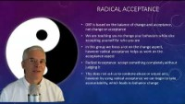

Slide 163
Finding diary card targets - Bruce
Notes:
Bruce’s and Ann’s stories are told on pages of the Simple manual. These examples are meant to help you find your intermediate holes diary cards. If you’re doing the course with the assistance of a mental health professional either as part of a group or individually they may be able to assist you with this process.

Slide 164
Algorithm for finding your intermediate targets
1. Think about a time when you have been in a hole or crisis, outside the window of tolerance, “lost it”, “struggled”, “felt bad”, “got into trouble”, or were very upset. (in other words start with a beginner targets)
2. When this happened, what were your dominant feelings, thoughts, or behaviors? (use the wheel of feelings, thinking errors and ANTS, and the internalizing and externalizing behaviors slides to help you)
3. From these choose from 1 to 3 feelings, thoughts, or behaviors that you experience frequently, are problematic for you, and you want to change.
4. These are your intermediate targets.
Intermediate targets change over time so go through this same process occasionally especially if your life circumstances are changing.

Slide 165
feeling hurt
withdrawing
catastrophizing

Slide 166
Finding diary card targets - Ann

Slide 167
ruminating on negative thoughts
withdrawing

Slide 168
If you’re having trouble finding a target
ALGORITHM FOR FINDING YOUR INTERMEDIATE TARGETS
If you are having trouble finding an intermediate target, start with one of the beginner targets: “feeling bad”, “having a bad moment”, “losing it", or "falling into a hole”.
These are generic target that cover most holes people fall into.
If you track these, you’ll then be able to identify feelings, thoughts, and behaviors associated with them which will help you rename the target and make it more specific to you.
To figure out intermediate targets starting from beginner ones, follow the intermediate holes diary card target algorithm:
1. Think about a time when you have been in a hole or crisis, outside the window of tolerance, “lost it”, “struggled”, “felt bad”, “got into trouble”, or were very upset. (in other words start with a beginner targets)
2. When this happened, what were your dominant feelings, thoughts, or behaviors? (use the wheel of feelings, thinking errors and ANTS, and the internalizing and externalizing behaviors slides to help you)
3. From these choose from 1 to 3 feelings, thoughts, or behaviors that you experience frequently, are problematic for you, and you want to change.
4. These are your intermediate targets.
Intermediate targets change over time so go through this same process occasionally especially if your life circumstances are changing.

Slide 169



Slide 170

OPEN DISCUSSION

Slide 171

video
Week 6 of simple

Slide 173


Slide 174


Slide 175


Slide 176


Slide 177


Slide 178


Slide 179
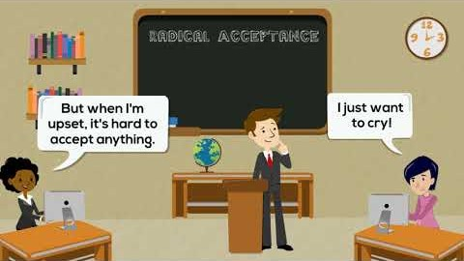

Slide 180


See you next session

Slide 181
PARENTAL ESTRANGEMENT AND ALIENATION
Parental estrangement and parental alienation are related but distinct concepts that involve disruptions in the parent-child relationship. I mentioned them here because they have come up many times in conversations I’ve been involved in recently.
Parental estrangement refers to a situation where there is a breakdown or severing of the relationship between a parent and a child, often an adult child. This can result in little to no contact between the parties involved.
The causes of estrangement can be complex and varied, including unresolved conflicts, differing values or lifestyles, past abuse or neglect, mental health issues, or significant life changes. It can be initiated by either the parent or the child.
Estrangement is often characterized by a lack of communication, emotional distance, and sometimes a complete severance of the relationship. It can be temporary or permanent, depending on the circumstances and willingness of both parties to reconcile.
Parental alienation occurs when one parent deliberately influences a child to reject or distance themselves from the other parent, often during or after a divorce or separation. This is typically seen in the context of custody disputes.
The alienating parent may engage in behaviors such as badmouthing the other parent, limiting contact, or creating a narrative that portrays the other parent negatively. The goal is often to undermine the child's relationship with the targeted parent.
Parental alienation can lead to the child exhibiting unjustified hostility or fear toward the targeted parent, refusing contact, or aligning exclusively with the alienating parent. It can have long-term emotional and psychological effects on the child.
Both parental estrangement and parental alienation involve significant emotional distress and can have lasting impacts on family dynamics. While estrangement can arise from a variety of factors and is not always intentional, alienation is typically a deliberate act by one parent to damage the child's relationship with the other parent.

Slide 182
There’s been a recent marked interest in awareness and interest in both parental estrangement and alienation and a perception that these issues may be becoming more common. We do not however have statistics that allow us to determine whether rates of parental estrangement and alienation are indeed on the rise, but several factors may contribute to this perception.
There is growing awareness and discussion around family dynamics, mental health, and interpersonal relationships, which may lead to more people recognizing and reporting issues of estrangement and alienation. This increased visibility can create the perception that these issues are more prevalent.
Societal shifts, such as changing family structures, increased mobility, and evolving cultural norms around individualism and self-care, may contribute to estrangement. People may feel more empowered to distance themselves from toxic or unhealthy relationships, including family ties.
With high rates of divorce and complex custody arrangements, the potential for parental alienation can increase. Legal systems and mental health professionals are more attuned to recognizing and addressing alienation, which can bring more cases to light.
While technology can facilitate communication, it can also contribute to misunderstandings and conflicts. Social media can amplify familial tensions or provide platforms for airing grievances, potentially leading to estrangement.

Slide 183
There are several books and articles that explore the various aspects of parental estrangement and alienation.
Books on estrangement:
- "When Parents Hurt: Compassionate Strategies When You and Your Grown Child Don't Get Along" by Joshua Coleman. This book offers strategies for parents dealing with estrangement from their adult children, focusing on understanding and healing.
- "Fault Lines: Fractured Families and How to Mend Them" by Karl Pillemer. Based on research and interviews, this book explores family estrangement and offers advice on reconciliation.
- "Done With The Crying: Help and Healing for Mothers of Estranged Adult Children" by Sheri McGregor. This book provides support and guidance for parents experiencing estrangement from their adult children.
- "Family Estrangement: A Matter of Perspective" by Kylie Agllias. This book examines the causes and impacts of family estrangement, offering insights from both personal stories and research.
Articles on estrangement:
- "The Hidden Pain of Family Estrangement" by Mark S. Rye and Crystal L. Park, published in Psychology Today. This article discusses the emotional impact of estrangement and offers suggestions for coping.
- "Understanding Family Estrangement: What Is It and Why Does It Happen?" by Lucy Blake, published in The Psychologist. This article explores the reasons behind family estrangement and its psychological effects.
- "The Long Reach of Family Estrangement" by Joshua Coleman, published in The Atlantic. This article examines the complexities and emotional toll of estrangement within families.

Slide 184
Books on parental alienation:
"Divorce Poison: How to Protect Your Family from Bad-mouthing and Brainwashing" by Dr. Richard A. Warshak - This book provides insights into how parental alienation can occur and offers strategies for preventing and addressing it.
"The Parental Alienation Syndrome: A Family Therapy and Collaborative Systems Approach to Amelioration" by Linda J. Gottlieb - This book explores therapeutic approaches to dealing with parental alienation.
"Adult Children of Parental Alienation Syndrome: Breaking the Ties That Bind" by Amy J. L. Baker - This book focuses on the long-term effects of parental alienation on children and offers guidance for healing.
"Co-Parenting with a Toxic Ex: What to Do When Your Ex-Spouse Tries to Turn the Kids Against You" by Amy J. L. Baker and Paul R. Fine - This book provides practical advice for dealing with a co-parent who may be attempting to alienate your children.
Articles on parental alienation:
"Parental Alienation: What Is It, and What Data Support It?" by Joan S. Meier - This article, published in the Family Court Review, examines the concept of parental alienation and the evidence supporting it.
"The Impact of Parental Alienation on Children: An Overview of the Research" by Jennifer J. Harman and Zeynep Biringen - This article reviews the research on how parental alienation affects children and their relationships.
"Parental Alienation Syndrome: A Critical Review of the Evidence" by Paul R. Fine and Amy J. L. Baker - This article critically examines the evidence for and against the concept of parental alienation syndrome.

