Slide 1
BOING GROUP AND HOMEWORK GROUPS GROUP

Slide 2



Slide 3
RESULTS ON IN PERSON POLL FROM LAST WEEK
1. Which of the following “holes” do you sometimes or often fall into(multiple choice
Substance use or other addictive behaviors ​​41%
Destructive impulsive behavior ​​​​27%
Patterns of dysfunctional interpersonal interactions​ 45%
Negative self-talk ​​​​​​​91%
Being overly critical of others ​​​​​50%
Dysregulated anger, anxiety, despair, or numbing out ​86%
Problems with boundaries-such as being unable to say no​ 73%
Any repeated behaviors' you later regret ​​​​45%
Withdrawing or running away​​​​​​ 77%
Thinking of and actually hurting yourself​​​​ 23%
Suicidal thoughts ​​​​​​​​36%
2. With respect to your thought holes, which thought do you most often have about yourself? (multiple choice)
I’m incompetent ​​​​​​​50%
I’m an imposter​​​​​​​ 14%
I’m defective ​​​​​​​64%
I’m unworthy ​​​​​​​59%
I’m shameful​​​​​​​ 23%
I’m guilty ​​​​​​​​41%
I’m unsafe​​​​​​​​ 18%
I’m vulnerable​​​​​​​ 27%
I’m out of control​​​​​​​ 27%

Slide 4
3. I’m in crisis…(single choice)
All the time ​​​​​​​​0%
Very often​​​​​​​​ 36%
Often ​​​​​​​​​41%
Sometimes ​​​​​​​​23%
Rarely ​​​​​​​​0%
4. When I’m in crisis I feel…(multiple choice)
Angry​​​​​​​​​ 36%
Anxious ​​​​​​​​91%
In despair ​​​​​​​​77%
Confused or lost​​​​​​​ 41%
Numb​​​​​​​​ 45%
Like I’m in a bottomless hole​​​​​ 50%
5. My crisis typically lasts…(multiple choice)
Minutes​​​​​​​​ 32%
b. Hours ​​​​​​​​45%
c. Days ​​​​​​​​​59%
d) Weeks​​​​​​​​ 9%
e) Months ​​​​​​​​5%
f) They never stop​​​​​​​ 14%

Slide 5
6. In a crisis I tend to think that …(multiple choice)
I’m worthless ​​​​​​​55%
I’m shameful ​​​​​​​50%
I’m unlovable ​​​​​​​50%
I don’t belong ​​​​​​​59%
I’m bad ​​​​​​​​27%
I’m irreparably flawed​​​​​​ 55%
7. In a crisis…
I tend to keep it all inside​​​​​ 77%
I tend to let it out​​​​​​​ 45%

Slide 6
WHAT ARE CRISIS and crisis plans ?
A crisis is a time of perceived intense difficulty, trouble, or danger.
Crisis plans and distress tolerance skills are the first material introduced in DBT and the Simple course because crisis are critical events that absolutely need to be understood and managed before anything else. Crisis have the potential to be devastating, but when skillfully managed, they can help us learn to cope better in the future.
To develop crisis plans you will need the DBT distress tolerance skills. That is why the first simple tool, crisis plans, are introduced at the same time as are the DBT distress tolerance skills which we will discuss over the next few weeks
A personal crisis is a state of feeling which might be associated with an internal experience of confusion and anxiety to a degree that formally successful coping mechanisms fail us, and ineffective decisions and behaviors take their place. As a result, the person in crisis may feel confused, vulnerable, anxious, afraid, angry, guilty, hopeless or helpless.
Notes:
Many people don't take crisis plans, for example fire drills, or flight safety instruction seriously. They falsely assume that if an emergency happens, they will calmly figure out what to do. This is a common fallacy. In a real emergency people's rational brain frequently shuts off and their emotional brain takes over. In a real emergency many people panic and are unable to do simple things. Research has clearly shown that it's those people who take crisis plan seriously, and practice them repeatedly, that do the best in an emergency.

Slide 7

Preparing for future crisis they are likely to face is very important because it equips individuals with the skills, tools and strategies needed to manage overwhelming situations effectively.
Those who prepare for crisis do much better than those who haven’t because:
1. Knowing they have a plan can alleviate anxiety and fear associated with potential crises, allowing individuals to approach stressors with a clearer mindset.
2. Prepared individuals can respond more quickly and effectively to crises, as they have already thought through their options and know what steps to take.
3. As discussed in the previous slide, preparation often involves identifying and practicing coping strategies, which can enhance resilience and emotional regulation during difficult times.
4. Those who prepare often communicate their needs and plans to their support network; this makes it more likely for help to be available when needed.
PREPARING FOR A CRISIS

Slide 8

four techniques AND strategies FOR TOOL USE
When using the tools:
1. follow the steps described in the algorithms provided. This will help you adhere to good problem-solving practices.
2. become more mindful of your internal personal “dashboard” or “instrument panel” by:
a) Monitoring your energy balance.
b) Being mindful of your crisis risk level.
c) Staying in the window of emotional tolerance
d) being aware of your state of activation
3. Stay in the window of tolerance by pendulating.
4. Use editing, splicing and pasting of the “videos” of problematic thoughts, feelings or behaviors to practice and develop new ones.
Notes:
The dashboard of the car gives the driver critical information about the state of the vehicle. This is extremely useful in avoiding trouble such as running out of gas. In simple we suggest people develop and imaginal dashboard with four instruments that helps them be mindful of their physiological states and stay out of trouble by for example filling their "gas tank" before they run out of gas.

Slide 9

Crisis plan algorithm
Developing crisis plans and becoming skilled at using them involves 8 steps:
1. Understand the concept of holes you keep falling into. Choose a specific instance of a crisis for which you want to develop a crisis plan. (crisis are deep holes)
2. Identify some of the thoughts, feelings or behaviors that occur during the particular crisis you’ve chosen. (This is step 1 on the crisis plan template.)
3. Complete the remainder of the crisis plan template for that crisis
4. As vividly as possible imagine the particular crisis you are working with. Use the "editing, splicing, and pasting" technique, along with your skills and tools, to imagine a different outcome that incorporates your crisis plan.
5. Stay in the window of tolerance while editing, splicing, and pasting by pendulating.
6. Repeatedly visualize the new edited, spliced, and pasted version of the situation until you can visualize it without effort.
7. When a new crisis occurs work with it following these same steps.
8. practice, practice, practice.
the first Simple algorithm

Slide 10
THERE’S A HOLE IN MY SIDEWALK
I walk down the street.
There is a deep hole in the sidewalk.
I fall in.
I am lost… I am helpless.
It isn’t my fault.
It takes forever to find a way out.
I walk down the same Street.
There is a deep hole in the sidewalk.
I pretend I don’t see it.
I fall in again.
I can’t believe I am in the same place.
But it isn’t my fault.
It still takes me a long time to get out.
I walk down the same Street.
There is a deep hole in the sidewalk.
I see it is there.
I still fall in. It’s a habit.
My eyes are open.
I know where I am.
It is my fault. I get out immediately.
I walk down the same Street.
There is a deep hole in the sidewalk.
I walk around it.
I walk down another Street.”
Portia Nelson

Slide 11
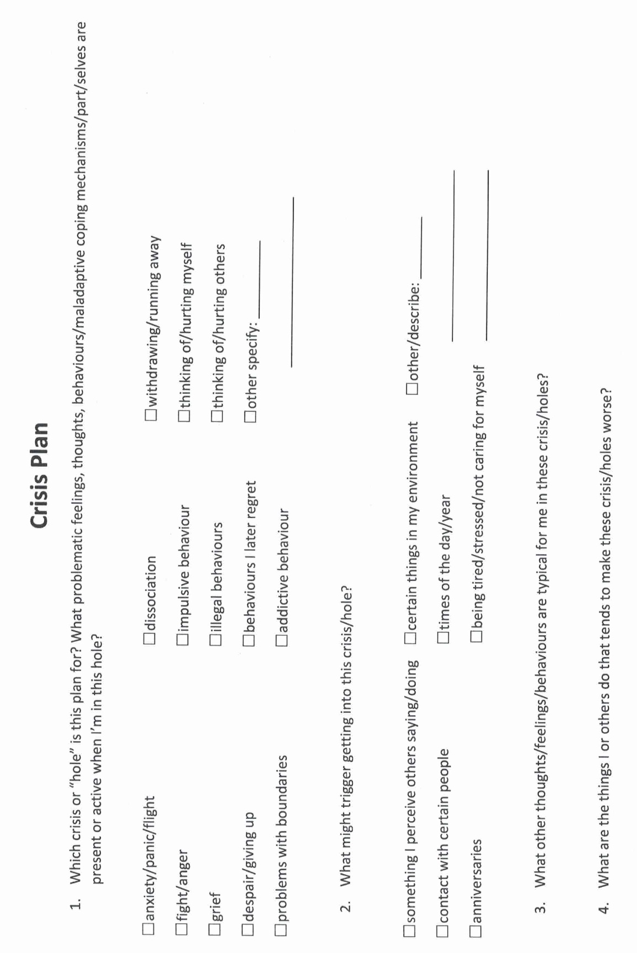
Step 2. of the algorithm Identifying the “holes” you want to work on
Identifying the holes you want to work on is the first item in the crisis plan template
Holes are any dysregulated, problematic, repetitive patterns of thoughts, feelings, or behaviors that you want to change.
Examples of holes include:
Any kind of substance abuse. Any other addiction such as gambling
Any destructive impulsive behavior
Engaging in repeated dysfunctional interpersonal interactions
Self blaming in a ruminative way or negative self talk
Being overly critical of others
Any dysregulated emotion such as anxiety, anger, or despair
Problems with boundaries, not being able to say no when appropriate. Being passive, aggressive or both.
Any frequently recurring behavior that you later regret
Withdrawing or running away
Thinking of, or actually hurting yourself
Suicidal thoughts
Etc.
It’s helpful to consider physical, emotional, thinking, and behavior holes separately although they go together:

Slide 12
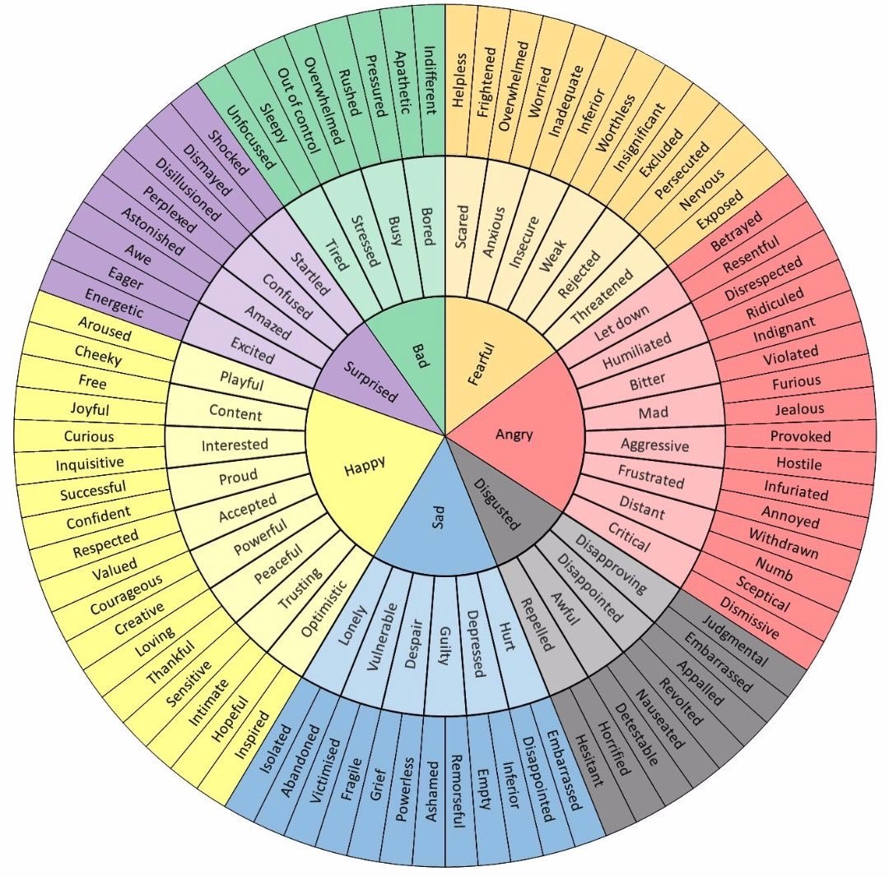
2.Feeling wheel: Finding your emotional holes
To find your “emotional holes” using the feeling wheel:
Think of a specific recent crisis you found yourself in and is a common type of crisis for you.
Try to identify one or more feelings you experienced during that crisis
For help identifying your feeling consider the innermost circle of the wheel.
Work from the center towards the periphery of the circle to further home in on your feelings.
These are your “emotional holes” or the feelings you tend to experience in a crisis

Slide 13
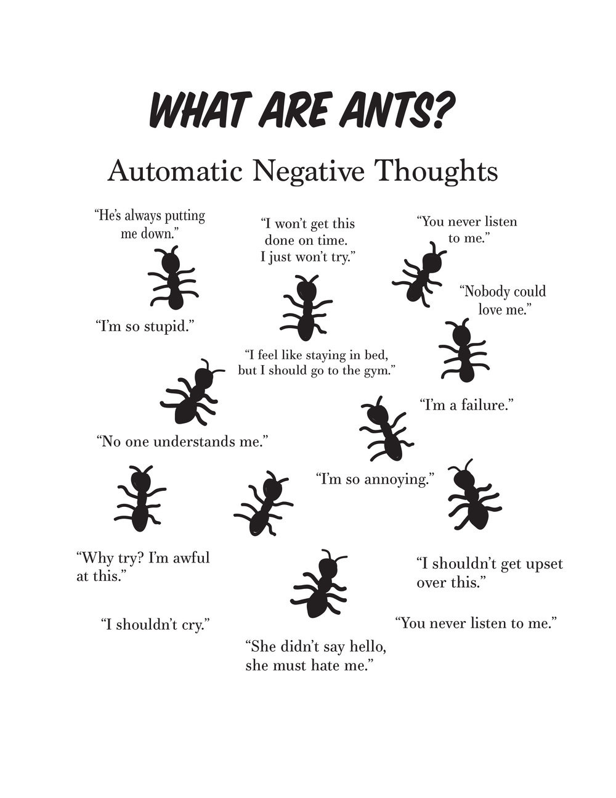
2. FINDING YOUR THINKING HOLES
To find your “thought holes”:
Think of a specific recent crisis you found yourself in and that is a common type of crisis for you.
Try to identify a few of the thoughts you had during the crisis .
Automatic negative thoughts are also referred to as ruminative thoughts because they repeat over and over again.
Thought holes or negative thoughts tend to fall into one of several categories
Consider which category your thoughts belonged to: thoughts of being 1) incompetent, 2) an impostor, 3) defective, 4) unworthy, 5) shameful, 6) guilty, 7) unsafe, 8) vulnerable, or 9) out of control.
You may have been so overwhelmed during your crisis that your thinking was disorganized, and you are unable to recall or identify any coherent thoughts

Slide 14
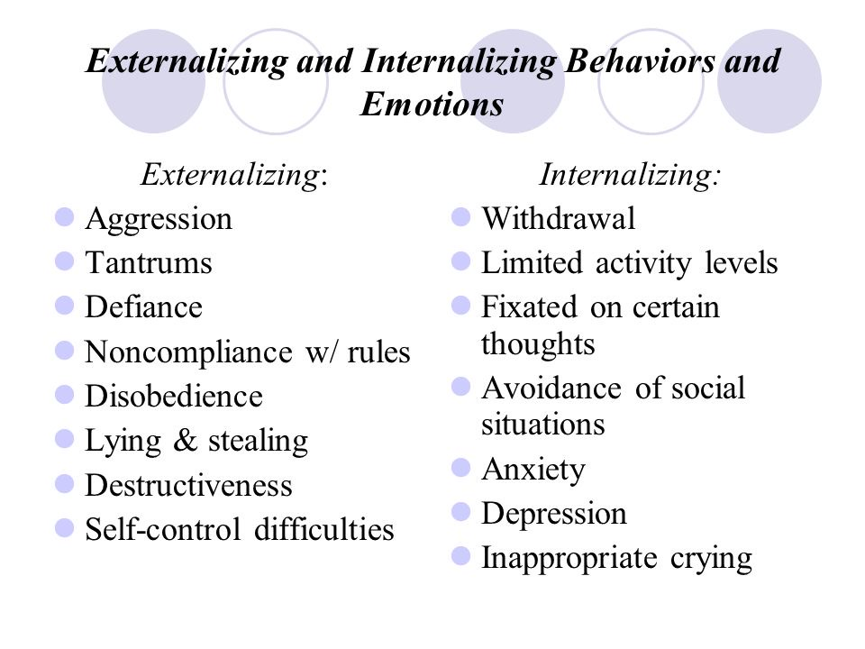
2. FINDING YOUR BEHAVIORAL HOLES
Externalizing and internalizing behaviors
To find your behavioral holes
Think of one or more behaviors you tend to engage in when you’re in the crisis you are working on.
Internalizing behaviors are inner directed while externalizing are directed outward to others or the environment.

Slide 15
Notes:
A template is a structured form that helps you carry out the steps prescribed in the algorithm. There are many different crisis plans templates. This one is a compilation of some of the best features of other templates.

Slide 16
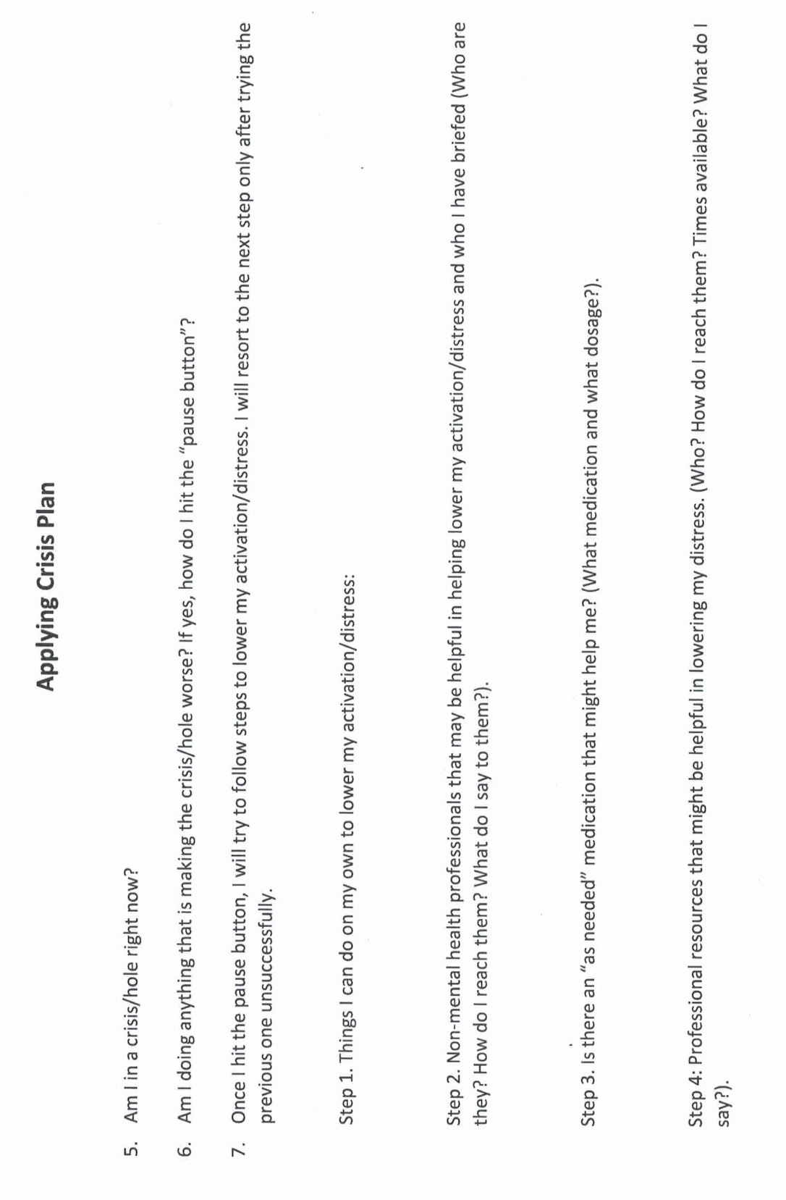

Slide 17
Crisis plan algorithm
Developing crisis plans and becoming skilled at using them involves 8 steps:
1. Understand the concept of holes you keep falling into. Choose a specific instance of a crisis for which you want to develop a crisis plan. (crisis are deep holes)
2. Identify some of the thoughts, feelings or behaviors that occur during the particular crisis you’ve chosen. This is step 1 on the crisis plan template.
3. Complete the remainder of the crisis plan template for that crisis
4. As vividly as possible imagine the particular crisis you are working with. Use the "editing, splicing, and pasting" technique, along with your skills and tools, to imagine a different outcome that incorporates your crisis plan.
5. Stay in the window of tolerance while editing, splicing, and pasting by pendulating.
6. Repeatedly visualize the new edited, spliced, and pasted version of the situation until you can visualize it without effort.
7. When a new crisis occurs work with it following these same steps.
8. practice, practice, practice.
the first Simple algorithm

Slide 18
UPDATED PERSONAL SKILLS LIST
Distress tolerance skills
Grounding skills- Set a daily intention
“ - Sensory soothing toolkit
“ -The 5,4,3,2,1 method
“ -The emotional freedom technique
REST (or PEST) Pause
Radical acceptance statements (please specify)
Distraction plan “
Self-soothing plan
Safe place visualization
Cue controlled relaxation
Rediscovering your values (please specify)
Rehearse values-based behavior or edit/splice/paste
Connect with your higher power “
14. Live in the present moment
15. Use self-encouraging coping thoughts
16. Radical acceptance
17. Use self-affirming statements
18. Balance feelings and threat
19. Create new coping strategies
20. Create an emergency coping plan
21. Box breathing
22. Cold temperatures
23. High intensity exercise
24. Progressive muscular relaxation
25. Paced breathing
26. Side to side eye movement.

Slide 19
UPDATED PERSONAL SKILLS LIST
Mindfulness skills
1. Focus on a single minute
2. Focus on a single object
3. Band of light
4. Inner-Outer Experience
5. Record Three Minutes of Thoughts
6. Thought Diffusion
7. Describe Your Emotion
8. Focus Shifting
9. Mindful Breathing
10. Mindful Awareness of Emotion
11. Wise mind
12.how to make Wise mind decisions
13. Radical acceptance
14. Judgements and labels
15. Self compassion
16. Mindful communication
17. Being mindful in our daily life
18. How to do tasks mindfully
19. How to be mindful of our activities
20. Resistances and hindrances to mindfulness practice
21. Exploring mindfulness further
22. Mindfulness and meditation
23. Using kindness and compassion
24. Paying attention to spaciousness and stillness

Slide 20
UPDATED PERSONAL SKILLS LIST
Emotional regulation skills
How do emotions work?
Recognizing emotions
Overcoming barriers to healthy emotions
Reducing physical vulnerability
Reducing cognitive vulnerability
5. Increasing Positive Emotions
6. Being mindful of your emotions without judgement
Emotion exposure.
Doing the opposite of your emotions
9. Problem Solving

Slide 21
TODAY-UPDATED PERSONAL SKILLS LIST
Interpersonal effectiveness skills
1.Mindful attention
2. Compassion for others
3. Passive vs. aggressive behavior
4. I want-they want ratio
5. I want-I should ratio
6. Key interpersonal skills
7. Blocks to using interpersonal skills
8. Knowing what you want
9. Modulating the intensity of a request
10. Making a simple request
11. Designing basic assertiveness scripts and
12. Assertive listening

Slide 22

In item 7 of the template steps 2 and 4 ask that people seek help from family, friends or from professionals. What are some of the challenges associated with doing that?

Slide 23

Help from others
The ideal and the reality
Trying to get help from family and friends can backfire. Some people can make the crisis worse.
Seek help only from those that are likely to be helpful
Prepare the person beforehand. Make sure they are willing to help and know what you need and what they should do
Many people do not have family or friends that might help when they’re in crisis
Getting help from professionals can be difficult especially if you don’t know the system or the person, you’re dealing with.
If you can, get to know the professional crisis resources that may be available to you.
We will talk more about this when in session 5 we discuss suicidal thoughts
Notes:
People be they family, friends, or mental health professionals who have a negative emotional footprint, have difficulty staying in the window of emotional tolerance and easily becomes dysregulated, or are judgmental rather than understanding may make a crisis worse rather than better.

Slide 26
ANN’S CRISIS PLAN (p.69 of the manual)
Ann was raised by a perfectionistic and critical single mother, who spent long hours at work managing a restaurant. Ann told her therapist that she had felt sad and lonely for as long as she could remember. As a teenager and young adult she had a few romantic relationships but had always ended up getting hurt and had long ago decided she was better off living alone with her three cats.
Ann, now in her late 50’ s, had for the last 25 years been a nurse in a family-run Mennonite nursing home. For the last 15 years she was the staff manager. Her job was the highlight of her otherwise quiet life, and she considered her patients her family.
Ann embraced the nursing home’s commitment to making the resident’s last years as meaningful as possible. She was rewarded with their great appreciation. Ann was like a daughter to the elderly couple, Ezra, and Ruth, who owned and ran the home. They did not think of the home as a business, but as a service to their residents and employees. With the support of this “family”, Ann managed her low-grade chronic depression and anxiety well, never missing a day of work.
When Ezra began to show signs of dementia, Ann was devastated. The owners of the home continued to run it for as long as they could, while looking for someone who would carry on their philosophy of care. Eventually, unable to wait any longer, they reluctantly sold to a company that ran nursing homes all over the province.
This transition was extremely difficult for Ann, and her anxiety and depression worsened. A new general manager, Jane, took over the home, and was tasked by the new owners, with introducing the company’s policies and procedures. As Ann was the nurse in charge, she was required to meet with Jane once a week, to report on the staff’s progress with the transition. Although Jane was always pleasant and polite, it was clear to Ann, that the nursing home would be run very differently, and that the financial bottom line had become an important consideration.

Slide 28
ANN’S CRISIS PLAN (p. 69)
Ann started seeing her psychiatrist more often during this trying time. They tweaked her medications, but that seemed to be of limited help. Ann did not feel she had many options, she could not see herself, in her 50’ s, finding another job, and could not afford to retire. If she went on disability, she would leave her beloved patients, and was afraid she would become more withdrawn and depressed.
She and her psychiatrist concluded that, although this was a stressful and challenging situation, Ann's dysregulated emotions contributed significantly to her symptoms. They decided that the current “acute hole”, within Ann’s longer-term chronic “valley”, was anticipating and meeting with Jane every week. They decided to work on a crisis plan.
In one of the sessions with her psychiatrist, Ann worked on a crisis prevention plan for the hole she fell into around the time of her weekly meetings with Jane. Working with the crisis plan template, Ann recognized the
1. unhelpful or problematic behavior was that, although she forced herself to attend these meetings, she wanted to run away from them, and after the meetings, she withdrew from her usual activities and ruminated.
She was 2. triggered by this work situation because she felt she had no control and felt pressured and devalued.
The 3. warning signs that she was in this hole, were that she would eat more, cry, ruminate, be unable to sleep, isolate herself, and avoid people.
Being alone 4. made it worse.
People may fall into holes at unpredictable times, in which case it is crucial to be aware of the warning signs and triggers so that they do not miss the fact that they are in a hole. Ann’s patterns were more predictable. Although she also ruminated during the remainder of the week, Ann felt most distressed from the day before, to the day after, her meetings with Jane. She felt some relief after the meetings when her worst fears had not materialized. Being aware of this time pattern was helpful in implementing the crisis plan.

Slide 29
ANN’S CRISIS PLAN
As Ann reviewed the distress tolerance module in the skills training workbook, she thought that 7. step 1 distraction, self soothing, and self-care would be good skills to use when she began to ruminate about work. She decided that the most helpful skills, to deal with the hole itself, would be radical acceptance, practiced relaxation, commitment to valued action, and using coping thoughts and strategies.(we will be discussing these over the next few weeks)
Ann had previously taken a cognitive behavioral therapy course and was familiar with thought records. It seemed to her that DBT’s “coping thoughts" were similar, if less structured than thought records. She was good at doing thought records and decided to structure her crisis plan around one.
Coping thoughts/thought records:
The situation was that the nursing home had new owners, and Ann had to meet weekly with Jane the manager. Her feelings around this were anxiety and sadness. Her automatic thoughts were "I won't be able to cope", "working at the nursing home won't be the same and will be awful", and "I will lose my job and income and I will be poor". The facts that supported her automatic thinking were: She did struggle to cope. The company that had taken over the nursing home did not care about her in the way Ezra and Ruth did. To this company nursing homes were a business and making money was important. If she did lose her job, she would be in financial distress. The facts that did not support her automatic thinking were: Ann was often told she was an excellent nurse and had coped with many difficult situations at work before. Jane had told her that she and her new employers valued her experience and familiarity with the residents, knew she was part of what made this nursing home special, wanted to keep that quality, and would work with her to do that, while at the same time introducing some changes.
Ann had done some research, and knew the company had a good reputation and ran their other nursing homes well. She also realized that poverty was a long way away and that she had many options before she got to that point. A balanced perspective, DBT’s coping thoughts, was: Although she was struggling, she had coped and adapted to many challenges before this. Although this was a change, the company had a good reputation and wanted to keep her, the staff, and the residents happy, and wanted to work with her

Slide 31
ANN’S CRISIS PLAN
Ann also realized that her fear of authority figures, and of people in general, had to do with the relationship she had with her mother as a child. Jane was not like her mother and so far, had been kind and respectful with her. Working through the thought record, Ann was reassured and slightly surprised by how much calmer and more confident she felt by the end of the session.
She also decided to…
“commit to valued action” by frequently reminding herself that succeeding at her job was not just about her, she owed it to Ezra and Ruth and to the residents. This was her purpose in life, she was good at it, and was proving to her mother that she was not worthless like she had always been made to feel. Succeeding in this new challenge would help her to heal from her traumatic childhood.
Ann had shared her struggles with Ruth and told her about the crisis plan.
7. step 2 Ruth suggested she come to their house weekly for supper, the day before meeting with Jane, and agreed to spend some time helping Ann refocus on her principles and goals.
Algorithm steps 6 and 8 Ann also resolved that she would devote 20 minutes every evening to visualizing herself in Wise mind, knowing her strengths and what was important: working with Jane so that the nursing home would continue to serve the residents, while maintaining high staff morale.
While doing the visualization, she would be mindful of her activation and breath, to ensure she remained in the window emotional of tolerance.
Ann is still working at the nursing home. She gained confidence from having managed the transition successfully and is given a lot of autonomy by Jane and the new company’s management.

Slide 32
THE HOLES DIARY CARD
A QUICK REVIEW

Slide 33

THERE’S A HOLE IN MY SIDEWALK
A central metaphor in the course
I walk down the street.
There is a deep hole in the sidewalk.
I fall in.
I am lost… I am helpless.
It isn’t my fault.
It takes forever to find a way out.
I walk down the same Street.
There is a deep hole in the sidewalk.
I pretend I don’t see it.
I fall in again.
I can’t believe I am in the same place.
But it isn’t my fault.
It still takes me a long time to get out.
I walk down the same Street.
There is a deep hole in the sidewalk.
I see it is there.
I still fall in. It’s a habit.
My eyes are open.
I know where I am.
It is my fault. I get out immediately.
I walk down the same Street.
There is a deep hole in the sidewalk.
I walk around it.
I walk down another Street.”
Portia Nelson (2)

Slide 34
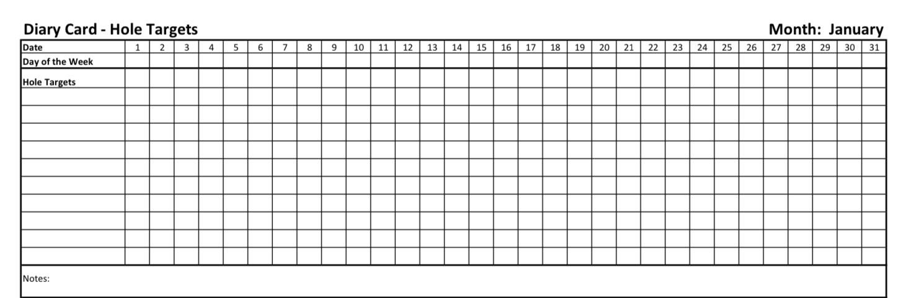
TRACKING THE HOLES YOU KEEP FALLING INTO:
THE HOLES DIARY CARD TEMPLATE
Targets for change
Squares for ratings
Days of the month

Slide 35
M T W T F S S
struggling.
4 3 6 2 3 10 9
sad.
5 4 7 1 2 8 7
withdrawing
9 8 6 6 5 10 10

Slide 36
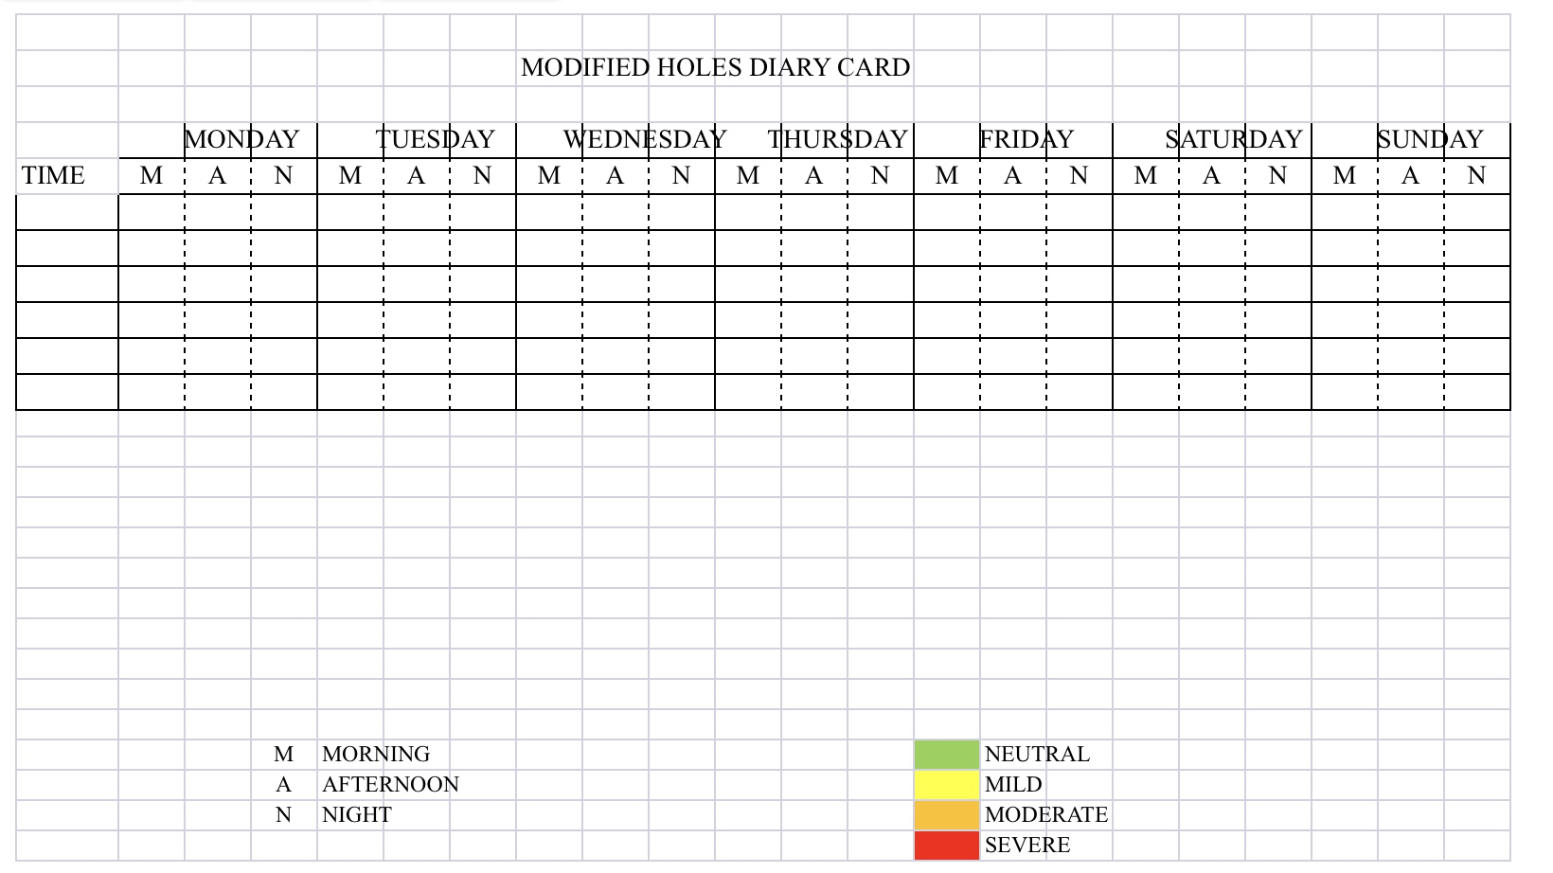

Slide 37
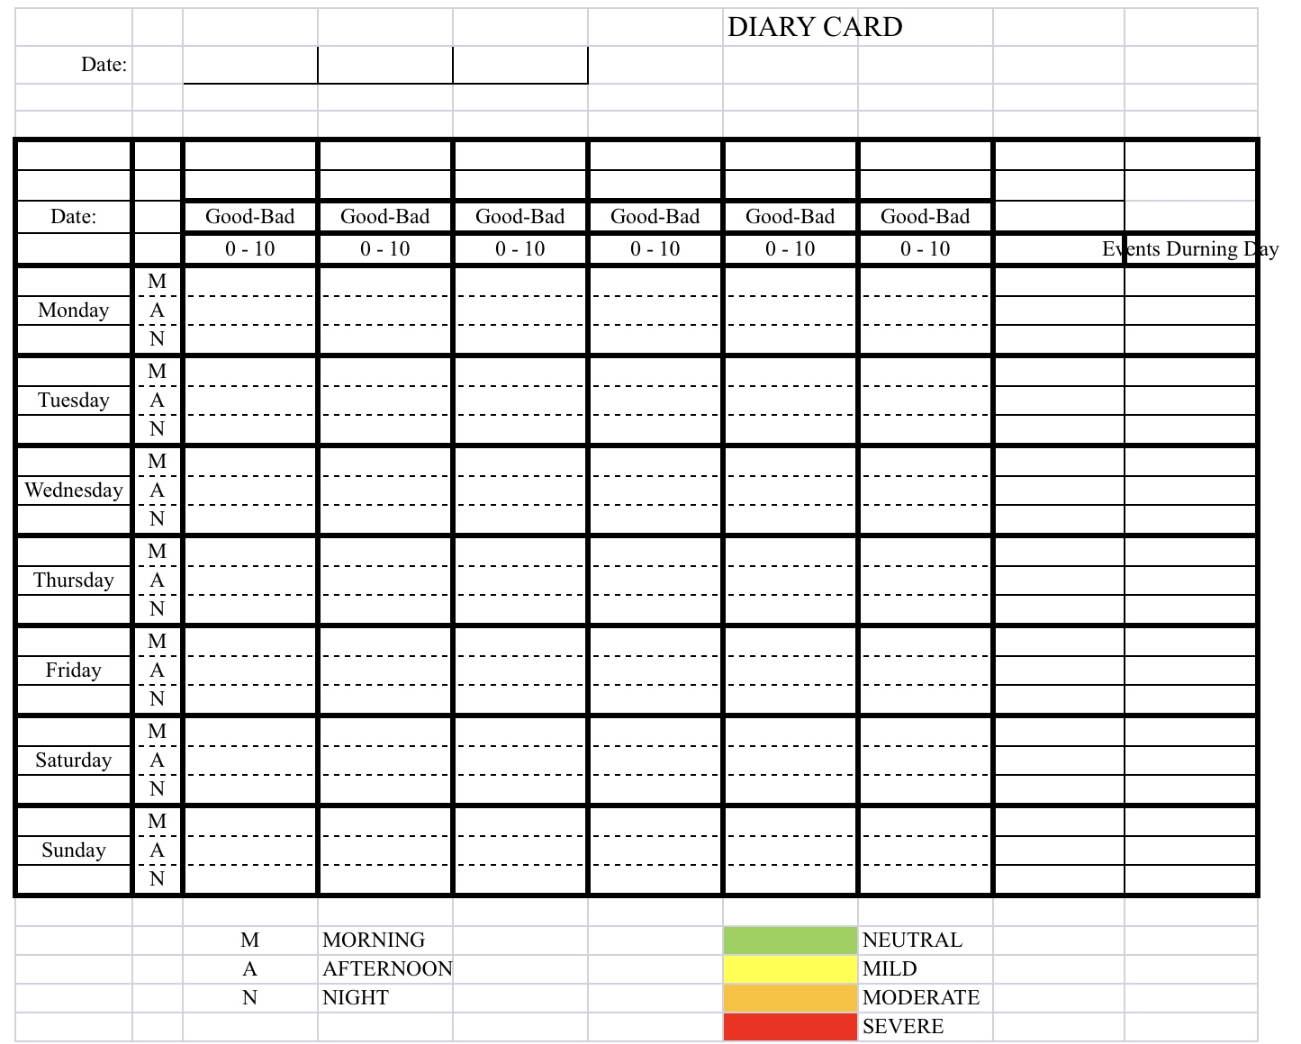

Slide 40


1. Crisis plan holes and diary card targets
crisis hole
Both crisis plans and holes diary cards are ways of identifying and working with the “holes in the sidewalk” we fall into. They are similar but with some differences.
The crisis plan’s holes in the sidewalk metaphor has an all or nothing quality, either we're in a crisis and at the bottom of the hole or we’re not in a hole at all.
Holes diary cards are more subtle recognizing that there are many degrees of severity or intensity of dysregulated feelings, thoughts, and behaviors. In that way, they are like a spiral staircase rather than a hole.
Because of this, the metaphor we use for crisis is that of a “hole”, while the one we use for diary cards is of “stairs” with steps.
In our holes diary cards, we arbitrarily choose a stairwell that has 10 steps, each step representing a different intensity of the dysregulated feelings, thoughts, or behaviors. We call these dysregulated thoughts, feelings, or behaviors targets for change. (or just “targets”)
10 is the bottom step of the stairs, 1 is the top step closest to the sidewalk. 10 is the most intense, 1 the least. When you are lower in the staircase, you’re more likely to be in crisis and outside the window of tolerance.
If you prefer, instead of using a numerical 1-10 scale you can use colors ex. Yellow, orange, red, black, which may make it easier to visualize the intensity of the targets.
diary cards steps
Notes:
You are already familiar with the concept of falling into "holes". When we are in crisis we fall into a "hole". The crisis plans are ways of getting out of these holes faster and eventually avoiding them. What holes were to crisis plans, targets are to diary cards. Targets are short for targets for change. Targets are quite like holes.

Slide 41

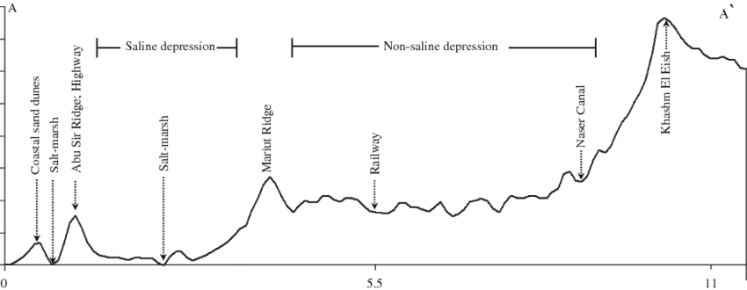
2. In geography “Topography” refers to the arrangement of the physical features, especially the elevation of a certain terrain. In simple we use the word topography to describe how the intensity of a person’s target emotions, thoughts or behaviors fluctuate over a period of time, in other words the topography tracks our journey up and down the stairwell over time.
The “topography” of our target dysregulated feelings, thoughts, or behaviors, can be depicted as a graph in which the horizontal axis is time while the vertical is the variation in intensity of our feelings, thoughts, and behaviors.
These variations can occur faster or slower, over the course of minutes, weeks or even months and years.

Slide 42
TOPOGRAPHY

Slide 43


Diary card targets
= crisis plan holes
3. FINDING YOUR TARGETS FOR CHANGE
Diary cards targets are similar to crisis plan holes.
As we said earlier, however, there is a slight difference: crisis plan holes are all or nothing, you’re either in a crisis or you’re not, diary card targets vary in intensity from mild to severe.
Like crisis plan holes, diary card targets are dysregulated physical states, emotions, thoughts, behaviors, or maladaptive coping strategies, that recur in your life, and that you have decided are problematic and want to change.
Examples of holes diary card targets include substance abuse, gambling, or any other addiction. Engaging in dysfunctional social interactions. Self-blaming, and rumination. Excessive irritability or anger towards others. Notice how these overlap with crisis plan holes.
Targets can also be any of the holes suggested in the checkboxes in item 1 of the crisis plan template : anxiety, anger, despair, problems with boundaries, impulsive behaviors, behaviors a person later regrets, withdrawing/running away, and thinking of/actually hurting self/others.
In other words, you can use as your diary card targets the holes you chose to work with in your crisis plans.

Slide 44

3 TYPES OF DIARY CARD TARGETS
There are beginner, intermediate, and advanced diary card targets. All the examples we have gave above are intermediate targets.
If you have trouble finding an intermediate target, use a “beginner target” in your diary card instead.
Beginner targets are more generic and catch-all than intermediate ones. They are easier to use than the more specific intermediate targets. Beginner targets include struggling, feeling bad, being upset, losing it, getting into trouble, or falling into a hole. Start with one of these.
We won’t discuss advanced targets until later in the course when we explore internal family systems part selves. If you don’t know what IFS is, don’t worry, we’ll get to it.

Slide 45
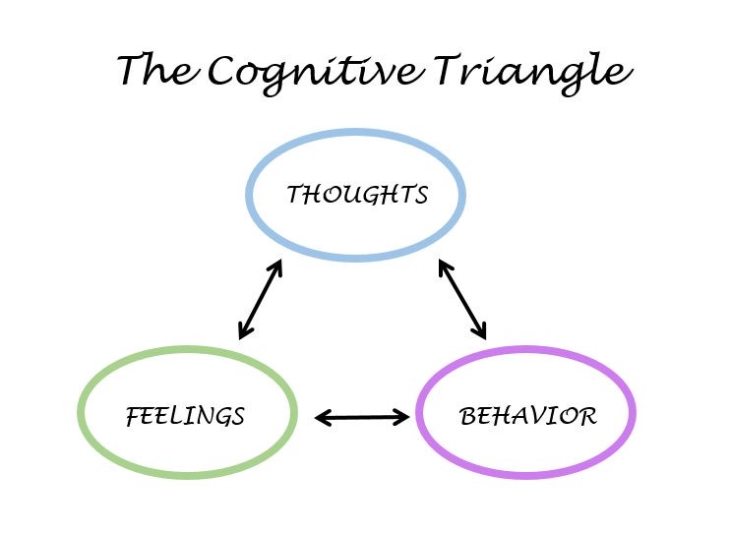
Diary card Targets
Like crisis plan holes, diary card targets can be:
1. Feelings: to help you identify your feelings consult the wheel of feelings (see below) which we also used in trying to identify crisis plan holes.
2. Thoughts: consider ANTS or automatic negative thoughts (below)
3. Behaviors: consult externalizing vs. internalizing behaviors (below}
4. Maladaptive coping strategies: are defined as coping strategies that in the short term decrease your distress but increase it over the long term. Ex. Substance use, self-harm, unhealthy eating.

Slide 46
Which feelings from the wheel of feelings do you experience frequently and not necessarily when circumstances entirely merit it?
Notes:
The wheel of feelings, the list of cognitive errors and automatic negative thoughts, and that of internalizing and externalizing behaviours helped you find your holes. They can also help you find your targets which may be the same as your holes or different from them.

Slide 47
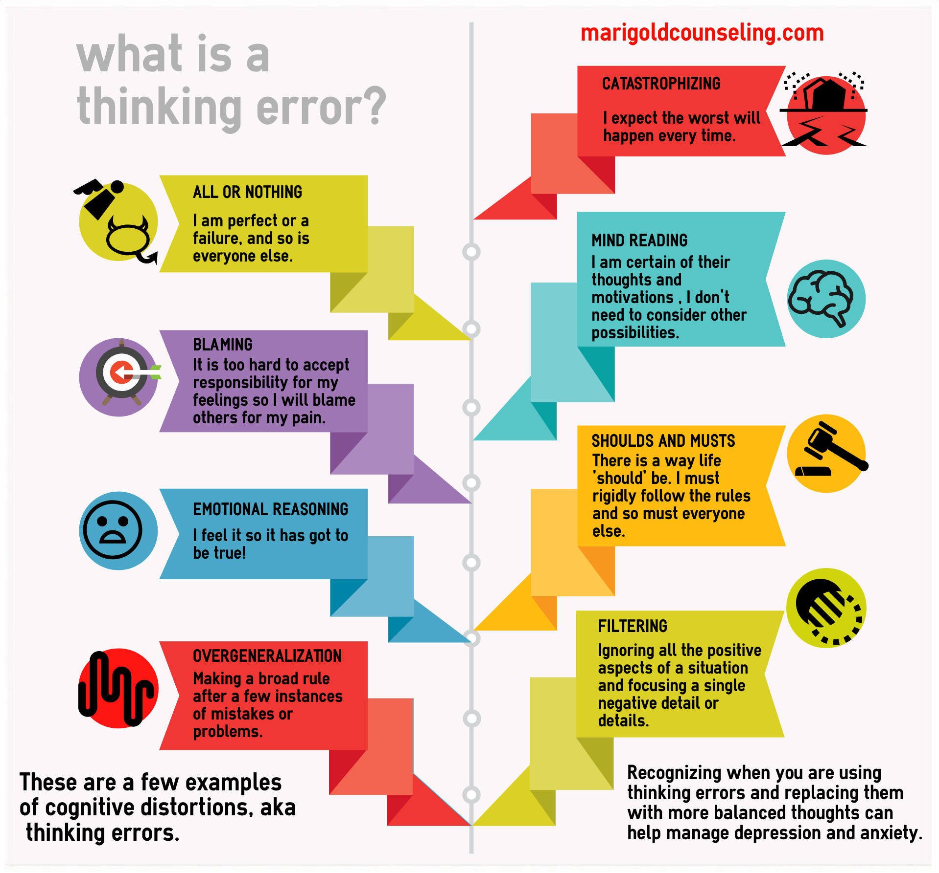
Which thoughts from among the ANTS (below) do you frequently have and not necessarily when circumstances entirely merit it?

Slide 48
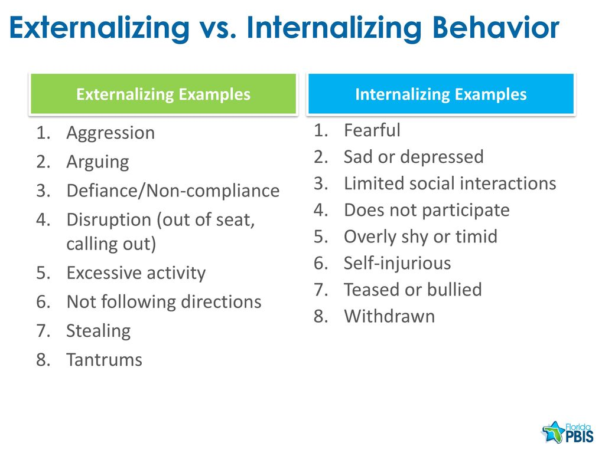
Which behaviors from the lists below do you frequently have and not necessarily when circumstances entirely merit it?

Slide 49

HOW TO FIND YOUR intermediate targets ALGORITHM
1. Think about a time when you have been in a hole or crisis, outside the window of tolerance, “lost it”, “struggled”, “felt bad”, “got into trouble”, or were “very upset”. (in other words, start with a beginner targets)
2. When this happened, what were your dominant feelings, thoughts, or behaviors? (use the wheel of feelings, thinking errors and ANTS, and the internalizing and externalizing behaviors slides to help you)
3. From these choose from 1 to 3 feelings, thoughts, or behaviors that a)you experience frequently, b)are problematic for you, and c)you want to change.
4. These are your intermediate targets.
Intermediate targets change over time so go through this same process occasionally especially if your life circumstances are changing.

Slide 50
4. Why do holes diary cards?
To change the behaviors, thoughts, or feelings that you have chosen as your targets: 1) you must identify what they are, then 2) you must keep focusing, being aware, or being mindful of them.
Diary cards promote mindfulness by keeping you focused on and thinking about the behaviors, thoughts, or feelings that are problematic and that you want to change. Doing this you are setting an intention to change.
While crisis plans are a good tool to use when you’re at the bottom of a hole, diary cards will help you to become more mindful of when your problematic thoughts, feelings, or behaviors arise and you’re not in a full crisis.
Diary cards are the foundation you need to use any of the other simple tools. To use a metaphor, building a house requires that you follow a certain order starting with the foundation, then the frame, wiring and plumbing…
Don’t confuse the “holes diary card” with the “dbt skills diary card” or the “goals diary card” which is tool # 5.
There are different versions of holes diary cards. For example, some people who don’t want to leave a paper trail use electronic ones.

Slide 51
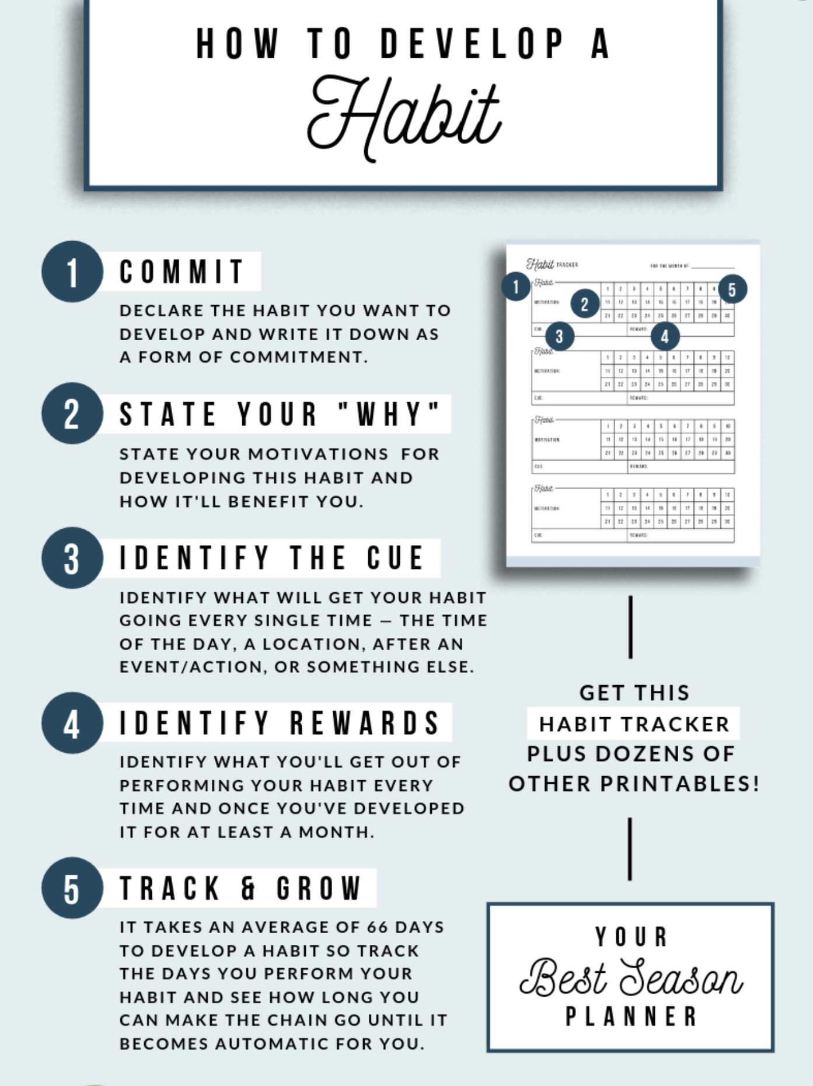

5. Making diary cards a habit
Notes:
Using diary cards regularly can be a challenge as might be developing any healthy habit. There are proven ways that help develop habits. The book tiny habits by BJ Fogg tackles this subject.

Slide 52
M T W T F S S
.

Slide 53
I HAVE ADHD WHICH MAKES DOING THE HOMEWORK VERY CHALLENGING DO YOU HAVE ANY SUGGESTIONS?
This is a common challenge for course participants with ADHD or ADHD-like traits. The goal is to make the executive functioning load as light as possible so that participants can focus on reflection and integration rather than organization. ADHD brains often struggle to hold and sequence multiple steps.
Keep all handouts, exercises, and notes in a single three-ring binder with 32 tabs. Label it “Simple Course”
Under each weekly tab print and keep 1. Kate’s summaries 2. the homework slide 3. your holes diary card. 4. the template of any other tool that was part of the homework that week 5. an updated skills list.
Build a “Paper Ritual”: Paperwork is easiest when paired with a ritual and a cue. Choose a consistent day/time and place (same desk, table, or even café) to do the homework. Pair the homework with something pleasant, favorite music, tea, or a candle. Frame it as “time for personal growth and healing,” not “homework.”
Use “micro-goals” like: “Spend five minutes every evening doing holes diary card and 30 minutes once a week doing the rest of the homework”.
Come to homework group or find a homework buddie to work with once a week. Track your progress after your homework time.
Use digital templates (fillable PDFs or Google Docs) if you lose papers easily. Apps like Notion, Evernote, or Apple Notes can serve as a digital “Simple Journal.” Set a recurring reminder (“Simple holes diary card time – everyday at 7pm”).
Disorganization is not laziness; it’s a cognitive pattern related to time perception and working memory. The course itself can become a supportive laboratory for practicing new habits of attention and structure. The course isn’t about being perfectly organized it’s about building gentle systems that help your deeper self have room to emerge.

Slide 54
HOMEWORK GROUP STRUCTURE
Purpose: Support each other in following through with course tools, skills and strategies without advice-giving.
Time Structure (15 minutes per person if groups of 2 or 10 minutes if groups of 3)
• 1 minute — Quick intro + one-breath check-in with personal dashboard: window of tolerance, crisis risk and energy levels.
• 14 minutes — Guided homework reflection.
Roles
Reflector: Shares honestly about homework progress and obstacles.
Sounding Board: Mostly listens. No advice — use curiosity, not fixing.
Witness (optional): If 3 people, this person gently keeps time and structure.
Reflection Questions (write your answers)
1. Clarity: Do I understand all items of the homework? What feels unclear?
2. Follow-through: Did I do the homework this week? If not, what didn’t I do and what got in the way?
3. Process and Habits: Am I approaching the homework effectively? Which homework habit will I commit to this week?
4. Next Action: What is one small concrete step I will take before our next meeting?

Slide 55
HOMEWORK GROUP STRUCTURE
Closing (15 seconds)
• Reflector states their tiny next step (one sentence).
Sounding board: Your job is to help the reflector hear themselves, not fix them.
HOMEWORK HABITS CHECKLIST
Circle or check what you will try this week.
1. Preparation habits
■ I schedule a specific time for homework.
■ I choose a consistent location with minimal distractions.
■ I gather what I need ahead of time (notebook, worksheet, pen).
2. Focus & pacing habits
■ I start with a tiny step (2–5 minutes).
■ I use a timer (10–15 minutes).
■ I remove distractions (phone away / Do Not Disturb).

Slide 56
HOMEWORK HABITS CHECKLIST
3. Tracking & organization habits
■ I keep materials in one place (binder / folder / notebook).
■ I write down insights right after doing the homework.
4. Self-compassion habits
■ I aim for progress, not perfection.
■ I notice resistance without judgment.
5. Accountability habits
■ I review my week: What worked? What didn’t?
■ I share honestly with my buddy — even when I didn’t do it.
Micro commitment:
This week I will focus on: ■ Time ■ Place ■ Tiny step ■ Timer ■ Other please specify:

Slide 57
Homework for the coming week
Submit
Submit questions, comments or feedback to itssimple2023@gmail.com
Read
Have
Have your targets in your diary card and use it daily
Continue
Continue reviewing and practicing your crisis plans.
Continue
Continue tracking all the skills you’ve learned using your skills list
Simple manual session 10 introduction to personality

