Slide 1

WELCOME TO WEEK 8 OF SIMPLE
Introducing the third tool: holes or chain analysis
The physiological distress tolerance skills

Slide 2
week 1- orientation and overview- sessions 1 and 2 of simple manual. week 2- introducing distress tolerance-p. 1-13 of dbt workbook and crisis plans-session 3 of the manual. week 3- the theoretical foundations of the simple course. session 4, 6, and 8 of the manual. week 4- distress tolerance p. 14-32 of dbt workbook. suicide prevention session 5 of the manual. our first practice- crisis plans. week 5- distress tolerance p. 33-46 of dbt workbook. introducing holes diary cards- session 7 of manual. week 6- distress tolerance p. 47-68 of dbt workbook. finding your diary card targets- session 9 of manual. our second practice- holes diary cards. week 7- introducing personality- session 10 of manual. week 8- distress tolerance p. 69-90 of dbt workbook. introducing holes (chain) analysis-session 11 of manual. week 9- what shapes personality-session 12 of manual. week 10-introducing mindfulness skills p.90-109 of dbt workbook. advanced chain analysis- session 13 of manual. our third practice-chain analysis. week 11- attachment theory- session 14 of manual. week 12- mindfulness skills p. 110-131 of dbt workbook. introducing rational mind remediation-session 15 of manual. week 13- the dynamic-maturational model of attachment and adaptation- session 16 of manual. week 14-mindfulness skills p. 131-147 of dbt workbook. reviewing all the tools-session 17 of manual. our fourth practice-rational mind remediation. week 15-stress-session 18 of manual. week 16- what makes life worth living?. Introducing the goals diary card procedure-session 19 of manual.

Slide 3
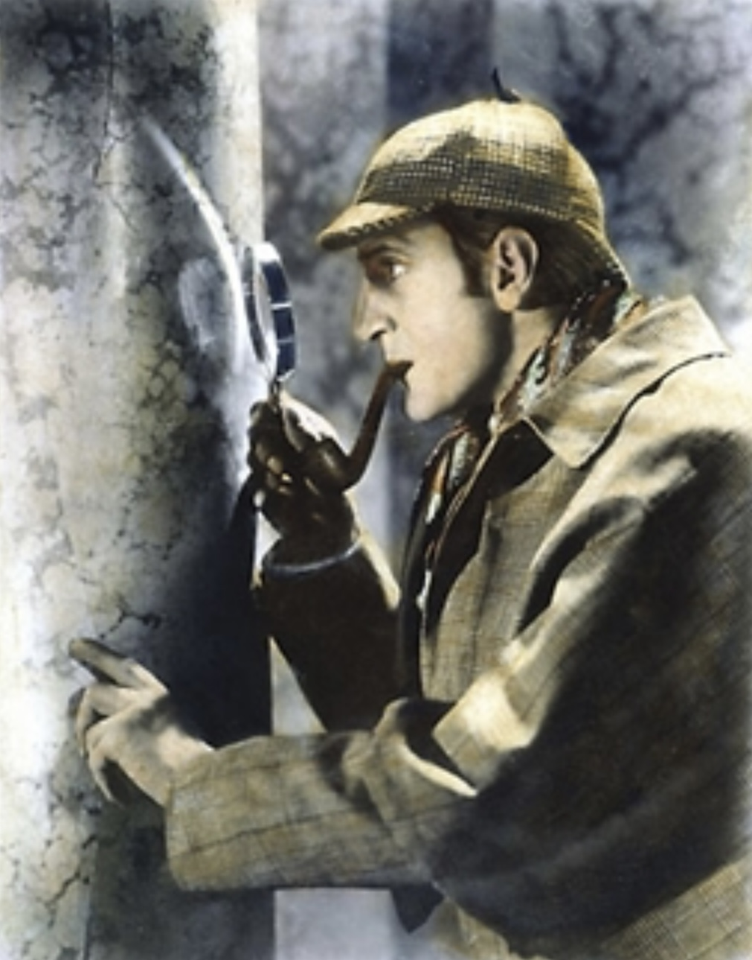

Slide 4


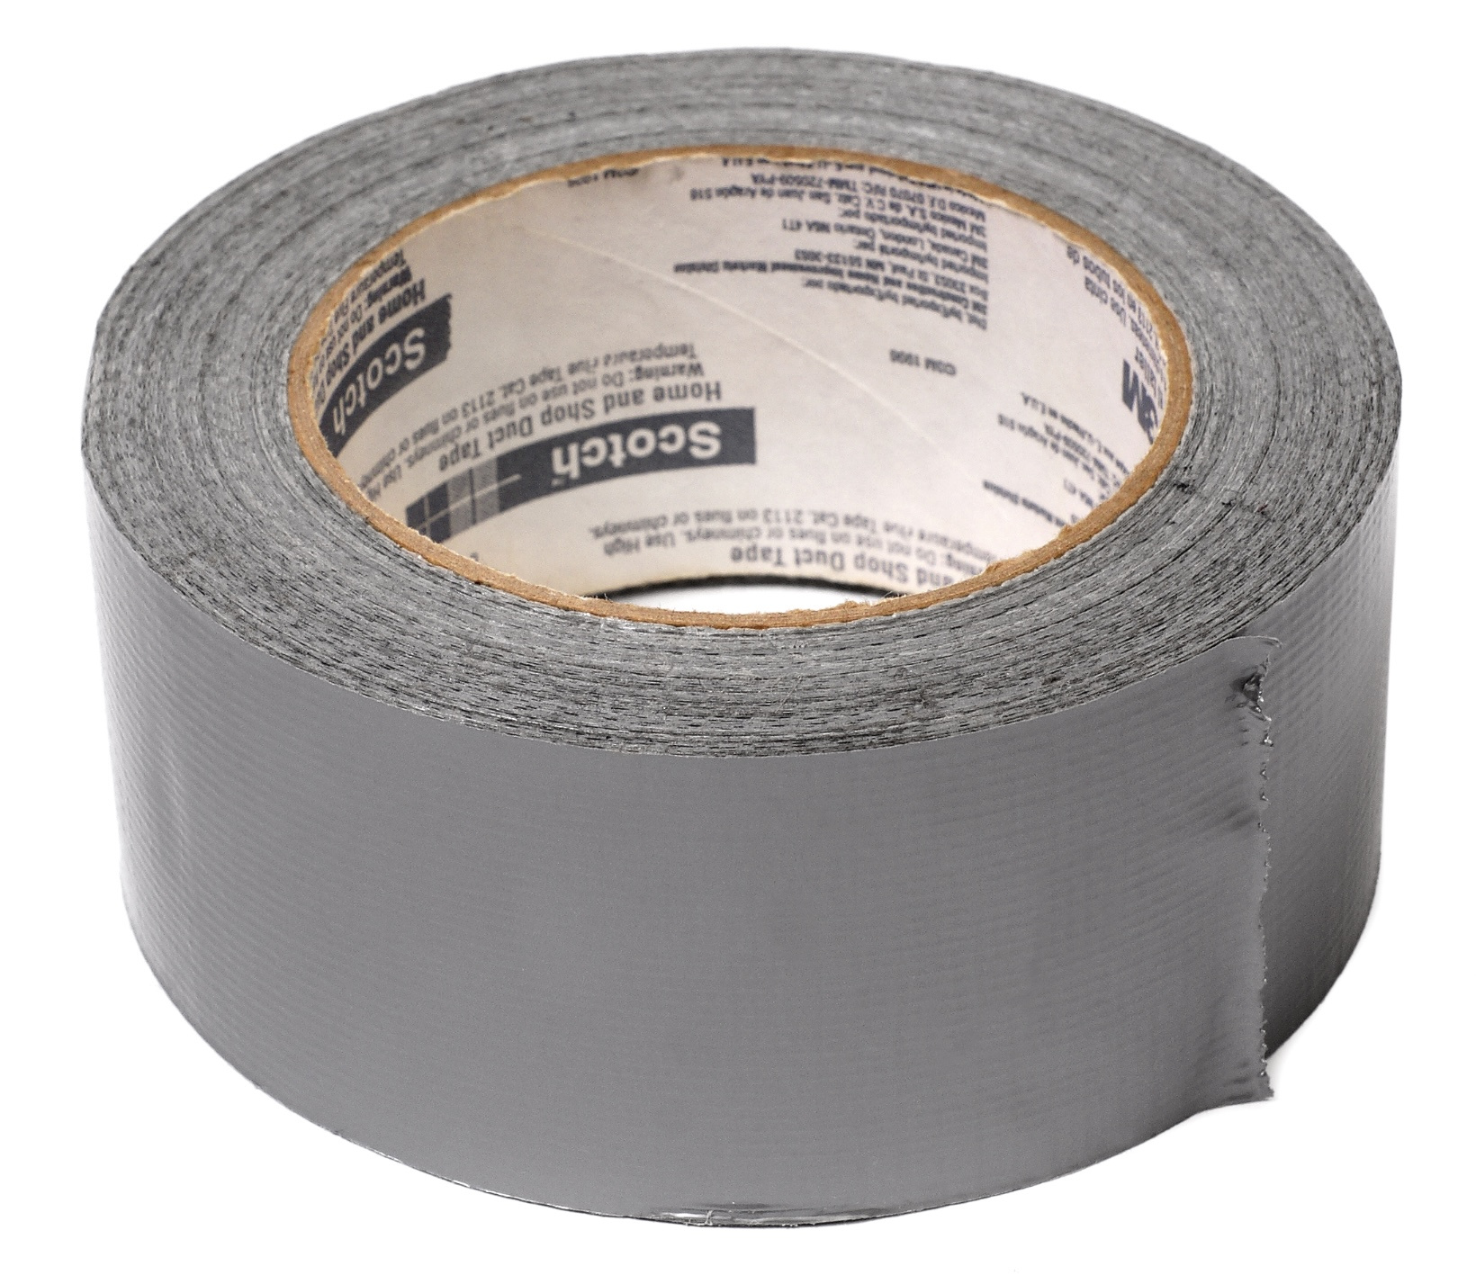


Crisis plans holes
Holes diary cards steps
Use crisis plan tool and distress tolerance skills to get out of holes
Today the holes (chain) analysis magnifying glass
Diary card toolbelt
In the crisis plans and when trying to find targets for our holes diary cards, we already explored some features of the holes we repeatedly fall into.
Today we’ll discuss how holes (chain) analysis deepen the exploration of the features of our holes by looking at them under a magnifying glass.
An in-depth knowledge of the thoughts feelings and behaviors that make up our holes will eventually help us understand where the holes came from and will be a critical part of getting out of them faster and eventually avoiding them.

Slide 5

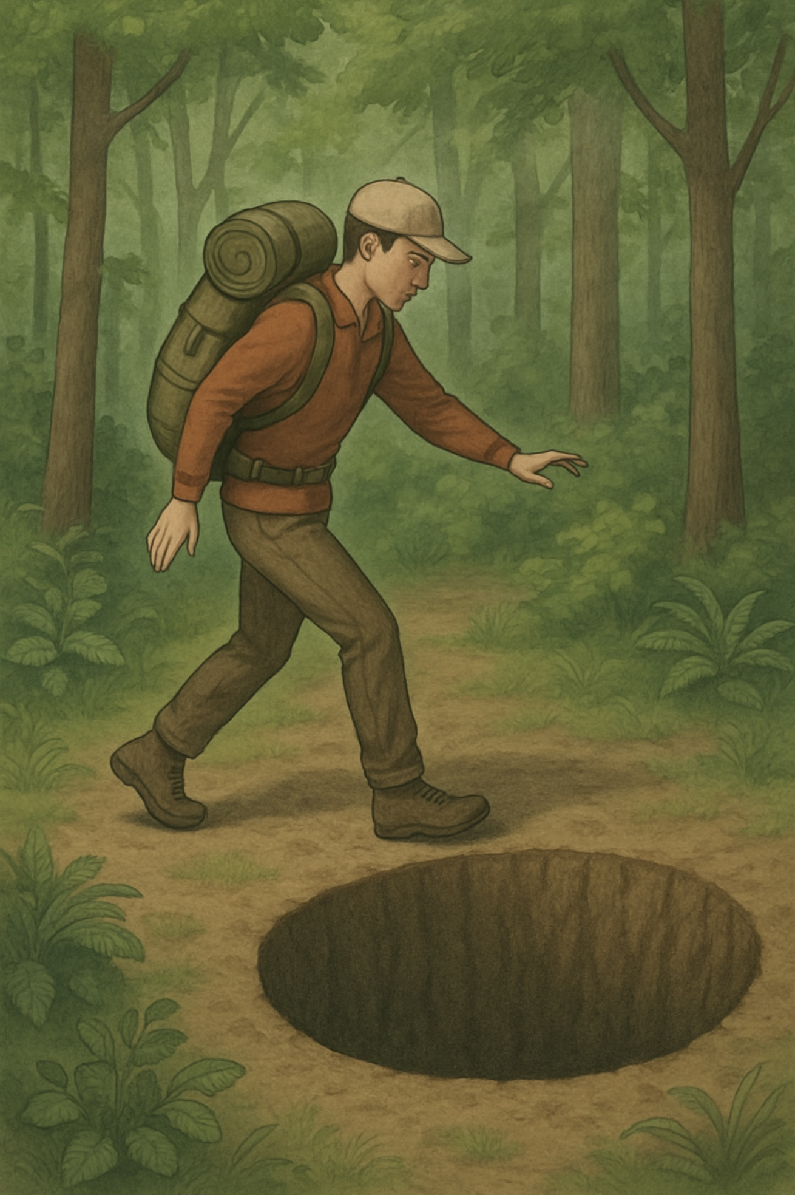
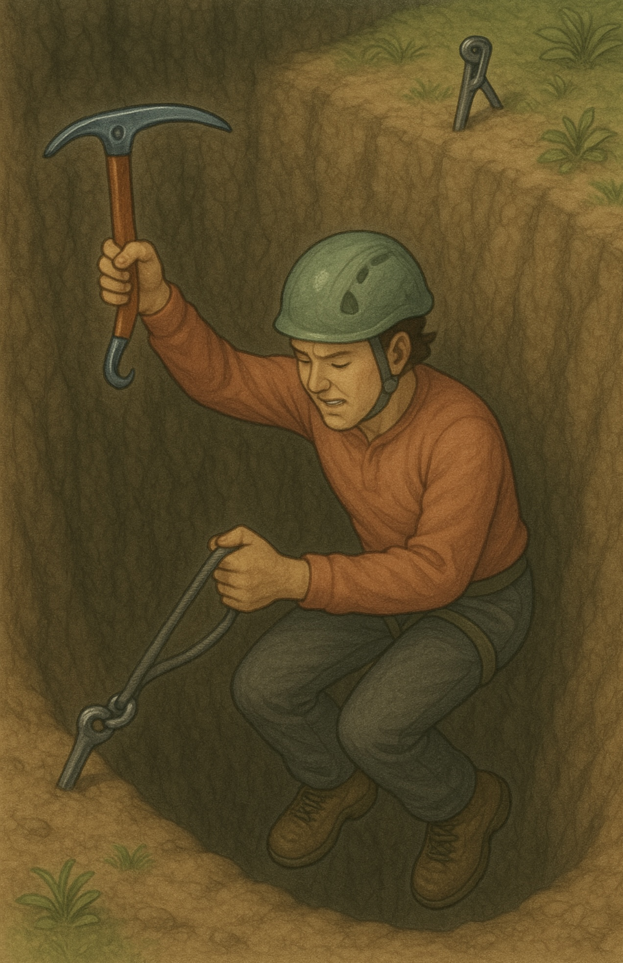
I walk down the same Street.
There is a deep hole in the sidewalk.
I see it is there.
I still fall in. It’s a habit.
My eyes are open.
I know where I am.
It is my fault. I get out immediately. (using my tools, skills and strategies)
I walk down the street.
There is a deep hole in the sidewalk.
I fall in.
I am lost… I am helpless.
It isn’t my fault.
It takes forever to find a way out. (But I start using holes diary cards and holes analysis)
I walk down the same Street.
There is a deep hole in the sidewalk.
I pretend I don’t see it.
I fall in again.
I can’t believe I am in the same place.
But it isn’t my fault.
It still takes me a long time to get out.
I walk down the same Street.
There is a deep hole in the sidewalk.
I walk around it. (using my wise mind)
I walk down another Street.”

Slide 6

Warning about meditation
Feel free to skip it. Followed by a moment of silence

Slide 7
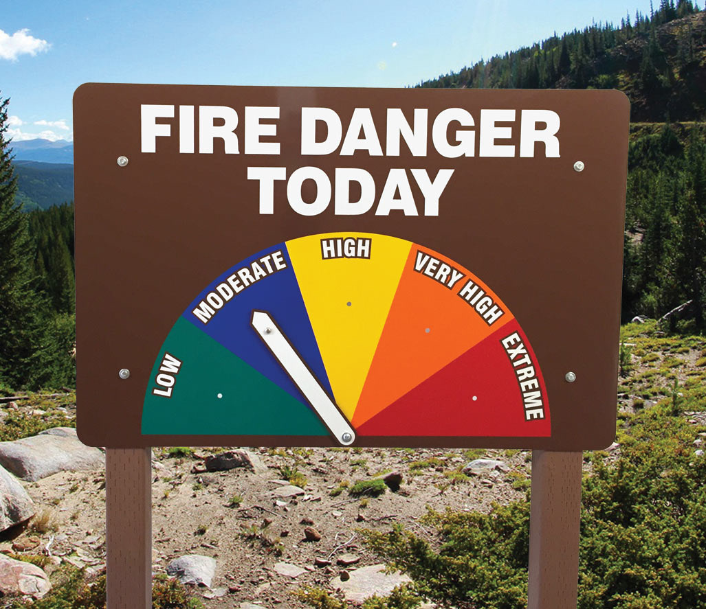
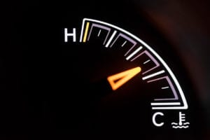
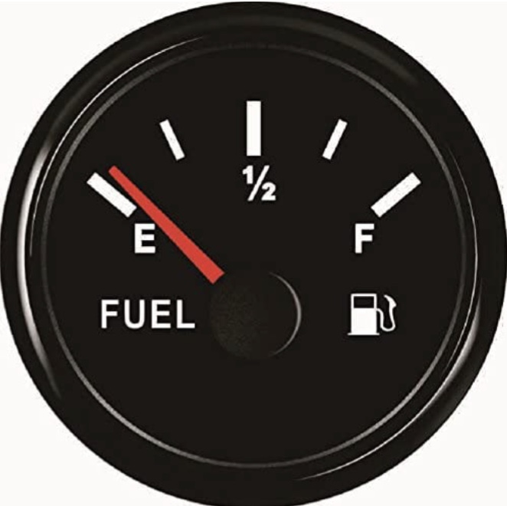
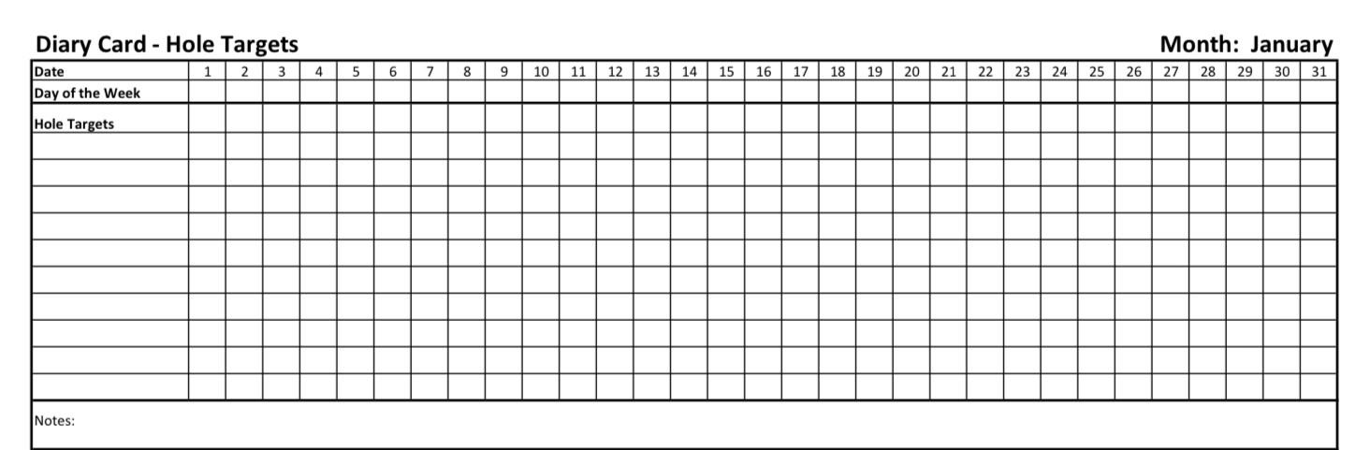
Check in regularly with your Personal dashboard
Spend a few moments checking in with yourself by asking:
1)What is the current risk that I’ll experience a state of crisis ?
Low b) Moderate c) high d) very high e) extreme
2) Am I in the window of tolerance?
a) Yes b) I’m a little outside c) very outside
3) Where is my energy tank right now?
Full b) ¾ c) ½ d) near empty
4) Have I been tracking my targets using the holes diary card ? how would I rate my targets right now?
CRISIS RISK
WINDOW OF TOLERANCE
ENERGY RESERVES
RATING MY TARGETS

Slide 8
5-MINUTE PROGRESSIVE MUSCLE RELAXATION SCRIPT
Begin by inviting everyone to settle.
“Take a comfortable seat, or lie back if you prefer.
Let your hands rest loosely.
If you’re comfortable, allow your eyes to close.
Take a slow breath in… and an easy breath out.”
1. Start With the Breath (30 seconds)
“Let’s begin by noticing the breath.
A gentle inhale through the nose…
and a slow, relaxed exhale through the mouth.
Imagine the breath softening your whole body from the inside.”
2. Hands and Arms (45 seconds)
“Now form a gentle fist with both hands.
Not too tight—just enough to feel the muscles activate.
Hold that tension… for 3… 2… 1…
and release.
Let your fingers relax, let your forearms soften.

Slide 9
Again—gently tighten the muscles in your arms,
as if you’re slowly bending your elbows or bringing your hands toward your shoulders.
Hold… 3… 2… 1…
and release.
Let the arms grow heavier and looser.”
3. Shoulders and Neck (45 seconds)
“Now lift your shoulders slightly toward your ears—
just a small movement.
Feel the tension…
Hold… 3… 2… 1…
and let them drop and sink.
Next, lightly press your shoulder blades together,
as though opening the chest just a little.
Hold that mild tension… 3… 2… 1…
and release.
Let the whole upper body soften.”

Slide 10
4. Face and Jaw (45 seconds)
“Bring your attention to your face.
Gently scrunch the muscles around your eyes and forehead—
a light squeeze.
Hold… 3… 2… 1…
and release. Feel the smoothness return.
Now softly clench your jaw—just enough to notice.
Hold… 3… 2… 1…
and release.
Let your tongue rest wherever it wants.
Let the whole face loosen.”
5. Chest and Stomach (45 seconds)
“Take a slightly deeper breath in,
and gently tighten the muscles in your chest and stomach—
not forcing the breath, just a mild activation.
Hold… 3… 2… 1…
and exhale, letting the torso soften and settle.
Notice the warmth spreading as the muscles relax.”

Slide 11
6. Legs and Feet (45 seconds)
“Now gently tighten your thighs—just a small squeeze.
Hold… 3… 2… 1…
and release.
Then curl your toes downward or point your feet slightly.
Feel the calves and feet activate.
Hold… 3… 2… 1…
and release.
Let the legs become heavy and grounded.”
7. Global Release (30 seconds)
“Take one slow breath in…
and as you exhale, imagine the whole body letting go.
Arms loose, shoulders soft, jaw relaxed, legs heavy.
Feel the calm settling through the body.”

Slide 12
8. Closing (30 seconds)
“Take one more deep breath in…
and a long, easy breath out.
When you’re ready, gently wiggle your fingers and toes.
Let your eyes open whenever it feels natural.
Notice how your body feels right now—
a little softer, a little more settled.”

Slide 13


Slide 14
SIMPLE COURSE SCHEDULE 2025-26
Week 1- October 1
Week 2- October 8
Week 3- October 15
Week 4- October 22
Week 5- October 29
Week 6- November 5
Week 7- November 12
Today Week 8- November 19
Week 9- November 26
Week 10- December 3
Week 11- December 10
Week 12- December 17
December 24 and 31 no course
Week 13- January 7
Week 14- January 14
Week 15- January 21
Week 16- January 28
Week 17- February 4
Week 18- February 11
Week 19- February 18
Week 20- February 25
Week 21- March 4
March 11 and 18 no course
Week 22- March 25
Week 23- April 1
Week 24- April 8
Week 25- April 15
Week 26- April 22
Week 27- April 29
Week 28- May 6
Week 29- May 13
Week 30- May 20
Week 31- May 27
Week 32- June 3

Slide 15
PRACTICE SESSIONS SCHEDULE
preparation
practice
3. Week 10 December 3 November 26, 1:30 Holes Chain analysis Dinko T.
4. Week 14 January 14 January 7, 1:30 Rational mind remediation Helga H.
5. Week 18 February 11 February 4, 1:30 goals diary card
6. Week 25 April 15 April 8, 1:30 IFS workbook 1 Elaine S.
7. Week 26 April 22 April 15 IFS workbook 2 Dinko T.
8.Week 27 April 29 April 22 IFS workbook 3
9. Week 28 May 6 April 29 IFS workbook 4
10.Week 32 June 3 May 27 1:30 PM Wise mind remediation

Slide 16
Homework from the last session
Submit
Submit questions , comments, feedback to itssimple2023@gmail.com
Read
Read skills training workbook p. 69-90. All of the physiological distress tolerance skills.
Read
Simple manual session 11
Have
have targets in your diary card and use it.
Continue
Continue reviewing and practicing your crisis plans
Keep
Continue practicing and tracking the skills you are learning.

Slide 17

Homework for the coming week
Submit questions, comments, feedback to itssimple2023@gmail.com
Read simple manual session 12
Do at least 2 holes chain analysis in the next week
Continue reviewing and practicing your crisis plans and doing holes diary cards
Continue practicing and tracking all the skills you’ve learned. use your skills list
Keep it in your binder under the current week’s tab and review the homework habits checklist each week. If there’s an item you haven’t checked on the list consider setting a goal to do it(you don’t have to come to the homework group to do that)
We will repost this slide at the break if there’s anything that’s not clear please ask us.

Slide 18
HOMEWORK HABITS CHECKLIST
Circle or check what you will try this week.
1. Preparation habits
■ I schedule a specific time for homework.
■ I choose a consistent location with minimal distractions.
■ I gather what I need ahead of time (notebook, worksheet, pen).
2. Focus & pacing habits
■ I start with a tiny step (2–5 minutes).
■ I use a timer (10–15 minutes).
■ I remove distractions (phone away / Do Not Disturb).

Slide 19
HOMEWORK HABITS CHECKLIST
3. Tracking & organization habits
■ I keep materials in one place (binder / folder / notebook).
■ I write down insights right after doing the homework.
4. Self-compassion habits
■ I aim for progress, not perfection.
■ I notice resistance without judgment.
5. Accountability habits
■ I review my week: What worked? What didn’t?
■ I share honestly with my buddy — even when I didn’t do it.
Micro commitment:
This week I will focus on: ■ Time ■ Place ■ Tiny step ■ Timer ■ Other please specify:

Slide 20
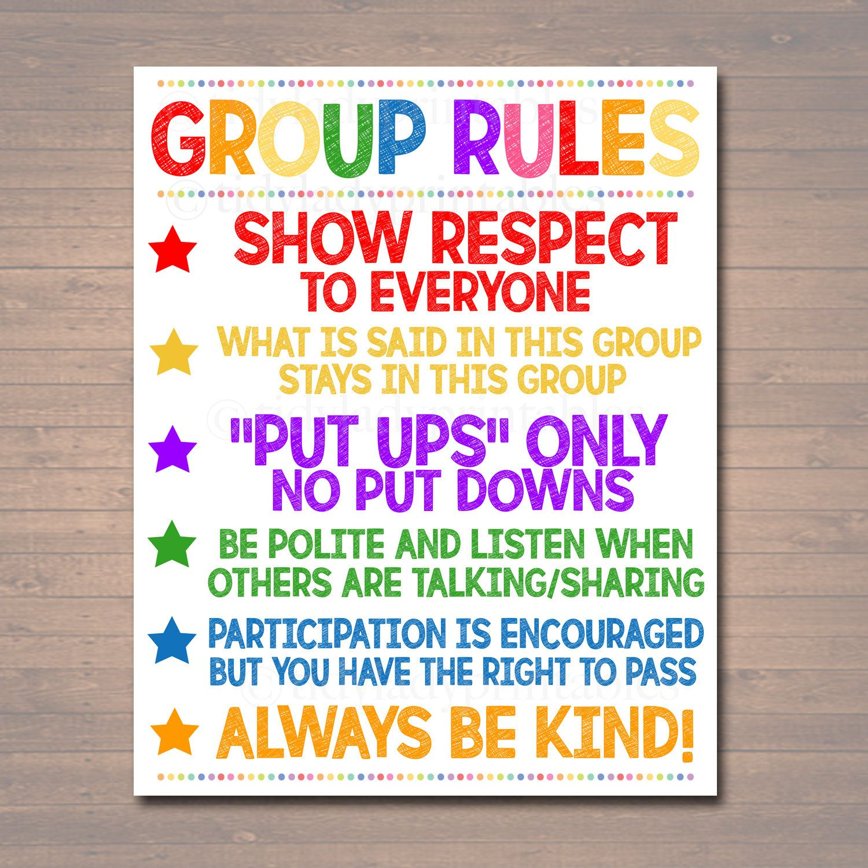

REMINDER PARTICIPANT AGREEMENTS
If you have questions, comments, or feedback, please save them for the two question periods. You can put them in the chat box or raise your real/virtual hand.
Keep comments, questions, and feedback relatively brief so everyone has a chance to participate.(one breath sharing)
If you’re on zoom, make sure no one can overhear what is being said
For reasons that will become clear later in the course please avoid giving advice to other participants about what they should or should not do. Validation, encouragement , and understanding are however very much appreciated.

Slide 21

We’re having a holidays get together
December 22, 12:30-2:30
Board room of Stratford family health team 444 Douro st. 2nd floor
Pizza and drinks provided.
There will also be a gift exchange. (crafts, poems and regifts encouraged)
There will be games, music and merriment for everyone.
Unfortunately, the room can only accommodate about 20 people so we’ll invite the first 20 people that email us at itssimple2023@gmail. We’ll send you a confirmation.
Reminder: there is no homework group Dec. 2 from 12:30 to 1:00. The boing group will be held as usual on that day from 1 to 2:30 pm
WEEKLY ANNOUNCEMENTS

Slide 22
WEEK 7 POLL RESULTS
Week 7 Poll- RESULTS
1. For each of the 5 OCEAN or big 5 traits please rate yourself high, low or intermediate. Start with openness (Single Choice)
a) High 28%
b) Low 22%
c) Intermediate 50%
2. Conscientiousness (Single Choice)
a) High 56%
b) Low 11%
c) Intermediate 33%
3. Extroversion (Single Choice)
a) High 28%
b) Low 56%
c) Intermediate 17%
4. Agreeableness (Single Choice)
a) High 61%
b) Low 0%
c) Intermediate 39%
5. Neuroticism (Single Choice)
a) High 33%
b) Low 11%
c) Intermediate 56%
6. Some researchers think “Sensitivity” as in highly sensitive people should also be considered along the big 5 traits. Rate yourself on sensitivity (Single Choice)
a) High 94%
b) Low 0%
c) Intermediate 6%

Slide 23
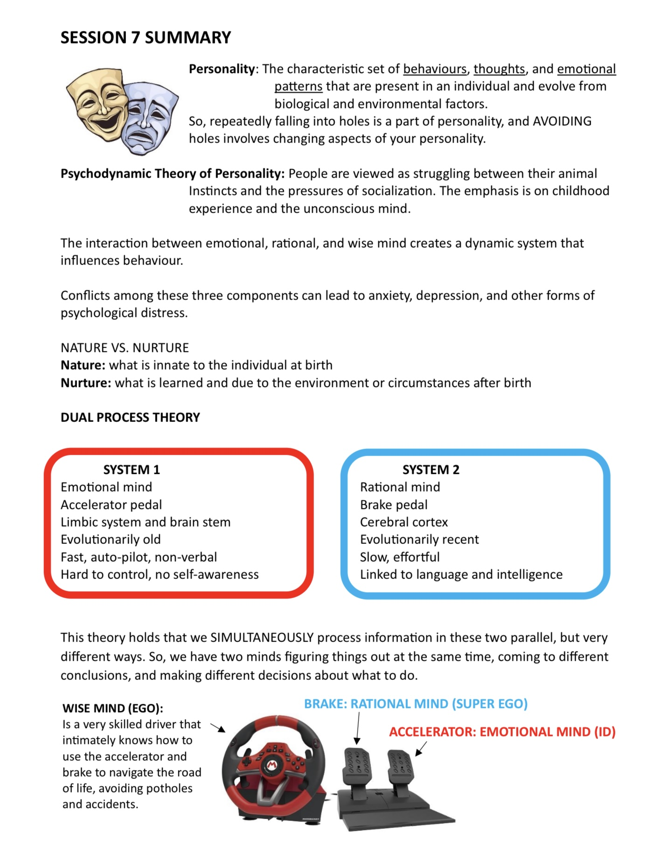
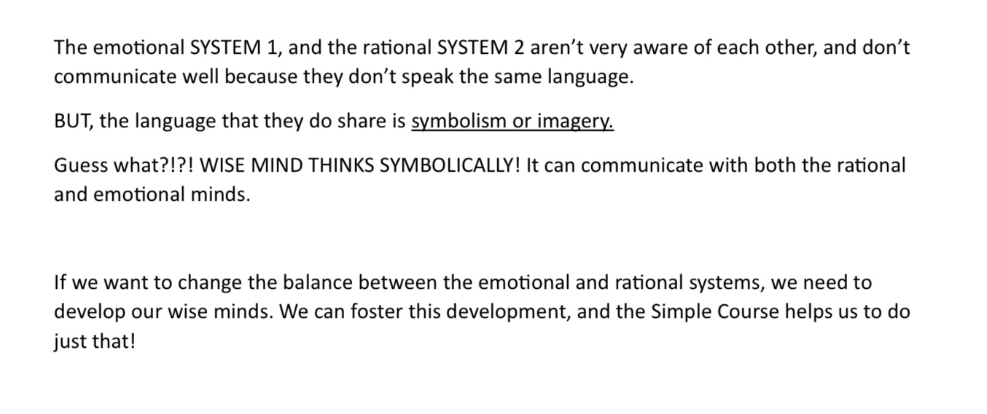

Slide 24

E-mailed questions, comments, feedback
Housekeeping

Slide 25
WHAT IS THE DIFFERENCE BETWEEN HEALTHY AND UNHEALTHY GIVING?
When we talk about healthy giving, caring, compassion, and generosity, we’re not just talking about the act itself. We’re talking about its overall effect on your system over time.
A simple way to look at it is through the green–yellow–red model:
With healthy giving you often start in green (in the window of tolerance, well regulated, grounded, resourced). When you give to others you briefly dip into yellow or red because giving takes effort, however over the long term you return to green or even deepen your green. This pattern suggests the giving is sustainable, reciprocal, and aligned with your values. It nourishes both you and the relationship.
With unhealthy giving you may start in green yellow or red, but giving repeatedly, over the long term puts you deeper into yellow or red. The pattern stays this way, giving, over the long term depletes, overextends, makes you anxious or resentful and disconnected from yourself. This suggests the giving is costly, unsustainable, or tied to deeper patterns such as guilt, fear, people-pleasing, or old relational wounds. This kind of giving becomes a good target for understanding and change.
It’s not the act of giving that determines whether it’s healthy or unhealthy, it’s the pattern over time and the state you end up in. If the long-term outcome is green, the giving is likely healthy. If the long-term outcome is yellow or red, it’s worth exploring what’s driving it.

Slide 26
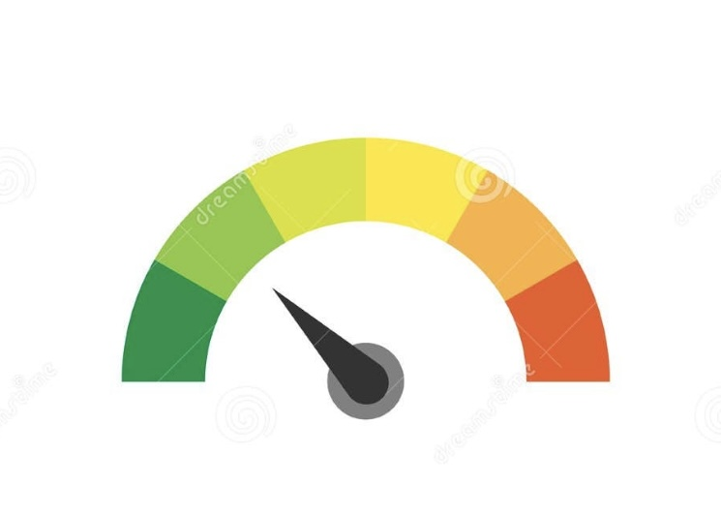
I’M HAVING TROUBLE FOCUSING OR CONCENTRATING ON WEDNESDAY MORNINGS SO I MISS A LOT OF WHAT’S BEING SAID. WHAT CAN I DO?
It’s so important that you have noticed that your mind is racing, you’re distracted and can’t focus during the sessions. That’s a very human experience, and it fits directly into what we’re learning. The material in this course is best absorbed when your body is in a state of calm or alert, inside your window of tolerance. When the mind is racing, that’s usually a sign you’re outside that window, which makes it much harder to take in new ideas. In those moments, the first step isn’t to push yourself to concentrate, but to bring yourself back into your optimal range using the skills we’ve already covered: grounding, breath and body-based regulation, distress-tolerance strategies, self-soothing, distraction and refocusing, and checking your personal dashboard. These aren’t side skills, they’re what allow learning and reflection to happen.
There’s also a second piece: while we try to make the course as engaging as possible, part of the work is learning to train your attention. Whether the challenge is ADHD, anxiety, rumination, or simply a wandering mind, the practice is gently bringing your attention back, again and again, just like in mindfulness. The course itself becomes a training ground. If this is a recurring pattern, you might add a target like ‘Ability to absorb material / ability to refocus attention’ to your holes diary card, especially on course days. The goal isn’t perfection; the goal is practice, notice, regulate, and return to the present moment and the course material with kindness.
OPTIONAL DASHBOARD ATTENTION GUAGE
% attention I’m paying
100 0

Slide 27
You’ve mentioned different types of therapeutic approaches; cognitive behavioral therapy, dialectical behavioral therapy and internal family systems. Don’t CBT and DBT also treat trauma? What is different about IFS?
Great question which deserves a full answer.

Slide 28






Slide 29
DIAGNOSING AND REPAIRING A PROBLEM
When your car suddenly breaks down, you don’t do a full inspection. You do a quick triage: “Is it the battery?”. “Is there gas?”. “Is something hanging off?”.
This is a quick diagnostic, fast, simple, and meant to get you back on the road.
Then you try the quick fixes such as duct tape the bumper, add coolant, tighten the loose battery cable or call a friend or CAA.
That’s what a crisis plan does. It’s not about understanding the deeper reasons you’re having car trouble; it’s about quickly dealing with the situation.
If the quick fix doesn’t work, you take the car to your neighborhood mechanic. They don’t tear the whole car apart, they use practical diagnostics such scanning the computer codes, looking at the brake pads, checking the alignment, testing the battery and listening to how the engine sounds
This is similar to CBT or DBT diagnostics. For example, DBT chain analysis is like the mechanic’s step-by-step investigation while the CBT thought records are like identifying the faulty “wiring” between thoughts, feelings, and behaviors. These methods look for the patterns that cause everyday problems.
Then the mechanic does the repairs that improve daily functioning such as replacing brake pads, fixing the misalignment, changing the oil or repairing the sensors.
These are CBT/DBT-level repairs, they improve your day-to-day functioning without going into the deepest layers of history.

Slide 30
DIAGNOSING AND REPAIRING A PROBLEM
Sometimes the neighborhood mechanic says: “The real problem is deeper. You need to take this to the dealership they have the specialized tools and skills.”
The dealership or manufacturer uses the most advanced diagnostics such as taking apart the engine, checking the frame, reading the deep-level computer logs or assessing damage from old accidents you barely remember.
This level of diagnostics is what trauma therapy does. It’s like Internal Family Systems (IFS), where you map out your parts, EMDR, where you track how old memories still fire in the present or Somatic trauma work, where you assess how trauma lives in the body
These methods reveal the deeper structure, the foundation, the original injuries, the parts of the system that have been protecting you for decades. Then trauma therapy does the slow, expert-level repairs such as rebuilding the engine, straightening the frame, replacing the damaged wiring from past crashes or restoring what was never built safely in the first place. This is the level at which old trauma is healed, not just managed.

Slide 31
DIAGNOSING AND REPAIRING A PROBLEM
Roadside crisis plans: do a quick triage, realize you’re in a hole, don’t make it worse, use a crisis plan to stabilize the situation and get you home safely. This is not deep, not diagnostic it just focuses on immediate safety.
Neighborhood Garage CBT and DBT: Do more thorough but practical diagnostics, such as finding intermediate holes and repairing patterns of everyday thoughts and behaviors.
Dealership Specialist trauma therapy: Does advanced diagnostics such as understanding internal family parts or advanced holes diary card targets. It does deep structural restoration of these parts which carry wounds, early injuries that form foundational patterns of thinking, feeling and behaving.

Slide 32
WHY TRAUMA THERAPY REQUIRES A DEEP UNDERSTANDING OF THE MIND
So far, we’ve compared three levels of diagnostic depth, roadside (Crisis Plan), neighbourhood garage (CBT/DBT) and dealership specialist (Trauma Therapy, e.g., IFS). IFS and other trauma therapies require a more complex theoretical understanding of the mind.
CBT analyzes automatic thoughts, beliefs, and behaviours using thought records while DBT analyzes triggers, emotions, urges, sensations using chain (holes) analysis. These tools tell you what is happening and what contributes to it, they do not ask why these patterns developed during childhood or how attachment history shapes them. These deeper questions require a different level of understanding.
Trauma therapies like IFS are like taking the car to the manufacturer’s dealership. A dealership doesn’t just use the neighbourhood mechanic’s tools. It accesses the deepest part of the car’s internal computer and the systems built at the factory, before the car ever drove its first mile.
IFS does something very similar; it goes beneath the surface patterns to the mind’s internal architecture. It asks which part of you is driving this moment? Is this a protector, a firefighter, or an exiled part? What is the original emotional injury that this part was created to protect? When did this part take on its role, in childhood? adolescence? adulthood? Is this reaction connected to an old attachment wound? And what does this part fear would happen if it didn’t do its job?

Slide 33
WHY TRAUMA THERAPY REQUIRES A DEEP UNDERSTANDING OF THE MIND
To answer these questions, we need a map of the mind’s deeper structure, not just a list of thoughts or behaviours. Because many parts were formed during early attachment experiences, we need to understand anxious, avoidant, and disorganized attachment patterns, childhood emotional neglect, parentification and how early trauma shapes the nervous system.
Because trauma reorganizes the nervous system, we also need to understand fragmentation of the self and dissociation, hypervigilance, body-based memory and fight-flight-freeze responses.
Trauma therapies like IFS require that we understand these concepts because they don’t just fix the symptoms, they aim to repair the original wounds. This is why in such therapies the assessment has to go deeper than CBT or DBT.
CBT/DBT like neighbourhood garage diagnostics looks at patterns we can see: thoughts → emotions → behaviours, triggers → responses, skill deficits and unhelpful habits
IFS/Trauma Therapy like dealership-Level Diagnostics looks at the deep internal design of the mind: early attachment wounds, trauma imprints, parts and subpersonalities, protective systems, original injuries and unconscious dynamics.
To work effectively at this deeper level, you need the equivalent of the dealership’s wiring diagrams (psychodynamics), the factory’s manual on early development (attachment theory), and the crash report of previous accidents (trauma theory)

Slide 34
There are three stages of trauma therapy
1. emotional regulation
2. trauma processing and
3. reclaiming a full life.
CBT was originally developed to treat anxiety and depression. It’s a good stage 1 trauma therapy
DBT was originally developed to treat emotional dysregulation. It’s a good stage 1 trauma therapy
IFS was originally developed to treat trauma. It’s a good stage 2 trauma therapy.

Slide 35

What we will do today
Introducing the third simple tool – holes (chain) analysis
Skills training workbook p. 69-9o Physiological distress tolerance skills.

Slide 36

The 6 tools:
Crisis plans
Holes diary cards
Holes (chain) analysis
Rational mind remediation
Goals diary cards
Wise mind remediation

Slide 37
Holes chain analysis
Today we’ll introduce holes or chain analysis. (going forward we’ll refer to it as holes analysis.
There are beginner, intermediate and advanced assessment or diagnostic tools. (remember beginner, intermediate and advanced targets for the holes diary card.)
Holes analysis is the tool used by your neighborhood garage to assess or diagnose the problem. It does a more in-depth assessment than the road side crisis plans.
Holes analysis are called thought records in CBT and chain analysis in DBT. They are the assessment or diagnostic tools used in these therapeutic approaches. These approaches also have tools to fix the problems.
In internal family systems, a form of trauma therapy, the assessment or diagnostic tool is getting to know your parts (advanced targets for the holes diary card)
Don’t forget to keep working on the first 2 tools we learned crisis plans and holes diary cards.

Slide 38
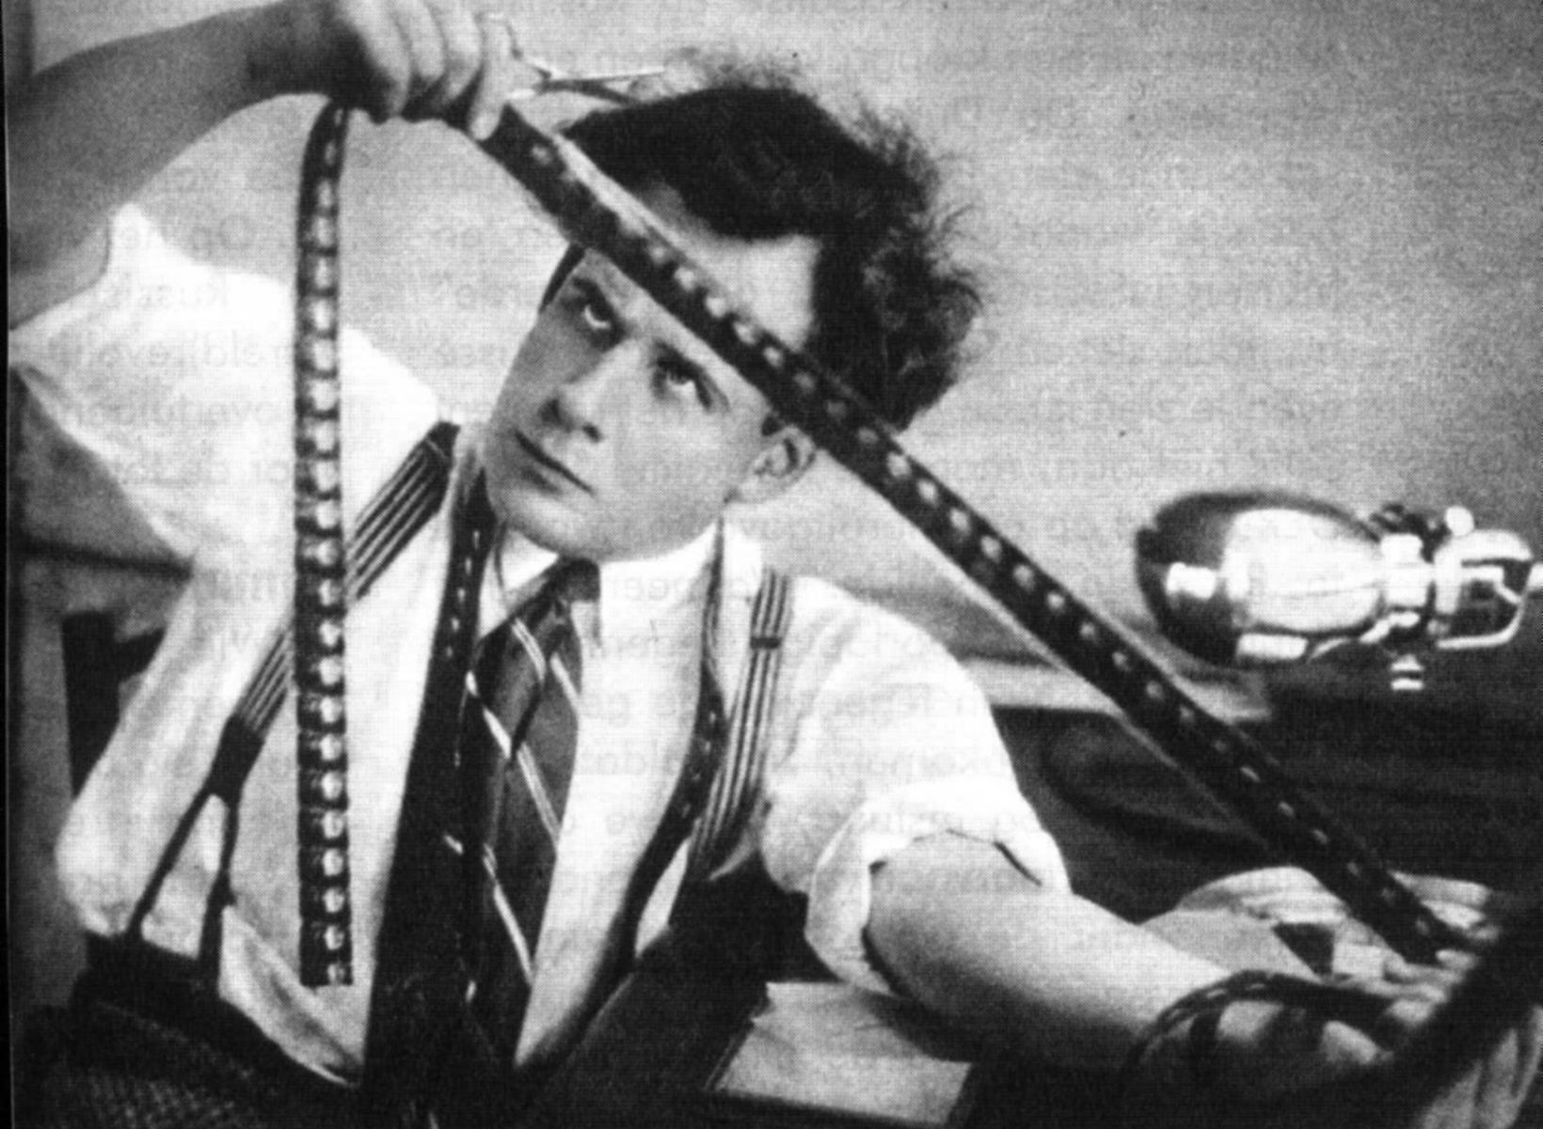
HOLES CHAIN ANALYSIS: ASSESSING THE PROBLEM

Slide 39
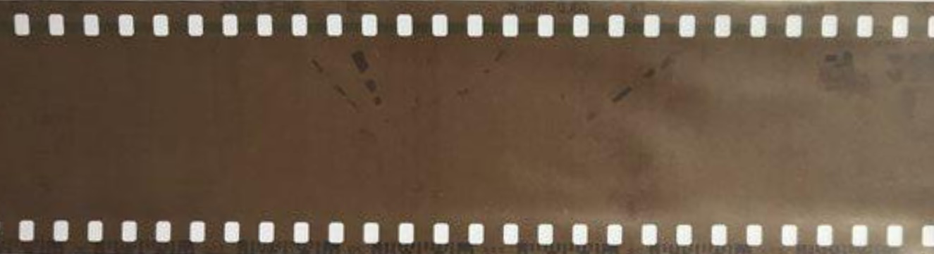
Assessment of
video of falling into hole
Trigger
Emotional mind: dysregulated thoughts, feelings, behaviors and sensations -> suffering
Dashboard state
HOLES ANALYSIS
Two types of fixes
1.Rational mind remediation
Trigger
Using tools skills and strategies rational mind pastes in well regulated thoughts, feelings, behaviors and sensations to replace dysregulated ones -> pain but no suffering
Dashboard state
Wise mind is like an ideal parent that sees and understands emotional mind, it doesn’t overpower it, it holds it and comforts it and gently takes charge acting with reason and compassion-> radical acceptance
2.Wise mind remediation
I see and feel emotional mind, radically accept it and compassionately understand it …
Dashboard state
At the same time I also see that there is another way to think, feel and behave that will be better for everyone involved

Slide 40
THE THIRD TOOL HOLES ANALYSIS

Slide 41
DBT HOLES ANALYSIS TEMPLATE (cheat sheet)
What Happened? 2. Emotions Felt 3. Thoughts 4. Sensations 5. Behaviours/urges 6. pre-hole energy
☐ Tight chest
☐ Rapid heartbeat
☐ Shallow breathing
☐ Nausea
☐ Knot in stomach
☐ Sweaty palms
☐ Shaking
☐ Muscle tension
☐ Hot face / flushing
☐ Cold hands/feet
☐ Light-headedness
☐ Numbness
☐ Restlessness / agitation
☐ Other: ____
Describe the
situation factually.
☐ Anxiety / Fear
☐ Anger / Rage
☐ Irritation /
Frustration
☐ Sadness / Grief
☐ Shame
☐ Guilt
☐ Hurt
☐ Loneliness
☐ Embarrassment
☐ Overwhelm
☐ Numbness
☐ Other: ____
☐ I’m not good
enough.
☐ This is my fault.
☐ They are judging
me.
☐ Something bad
will happen.
☐ I can’t handle this.
☐ I’m going to fail.
☐ They don’t care
about me.
☐ I always screw up.
☐ Catastrophizing
☐ All-or-nothing
thinking
☐ Mind-reading
☐ Other: ____
☐ Withdrew / shut
down
☐ Lashed out
☐ Avoided /
escaped
☐ People-pleased
☐ Over-apologized
☐ Argued /
escalated
☐ Used substances
☐ Overate /
restricted
☐ Reassurance-
seeking
☐ Compulsive
checking
☐ Tried to control
☐ Self-harm
urges/actions
☐ Other: ____
☐ Very Low
☐ Low
☐ Moderate
☐ High
☐ Very High
☐ Contributing factors (describe):

Slide 42

Assessment or diagnosis remediation or repair
USES OF SIMPLE TOOLS
Help us identify and understand our issues or the holes we fall into:
Crisis plans
Holes diary cards
Holes analysis
Goals diary cards
Help us develop and implement approaches to changing our problems or get out of and avoid holes :
Crisis plans
Rational mind remediation
Goals diary cards
Wise mind remediation

Slide 43
WHAT IS A CBT THOUGHT RECORD?
A CBT thought record is a short worksheet that helps you slow down your reactions and understand how your thoughts affect your feelings and behaviour. It’s like taking a snapshot of your mind in a stressful moment so you can look at it more clearly. Instead of being swept away by anxiety, fear, anger, or sadness, a thought record helps you ask: “What went through my mind, what emotion did it create, and is there another way to look at this?”
It’s Helpful because most people notice their emotions right away (anxiety, shame, frustration) but don’t notice the thoughts that sparked them. A thought record helps you catch those hidden automatic thoughts, see whether they’re accurate or unhelpful, create a more balanced perspective, reduce the intensity of painful emotions, and choose wiser actions. Thought records are not about “positive thinking.” but about realistic thinking, seeing the situation more clearly. A thought record usually has six steps, all of them short and concrete:
1. Situation: What happened? (Just the facts: “My boss asked to speak with me.”)
2. Emotion: How did I feel, and how strong was it? (“Anxious, 80%.”)
3. Automatic Thought: What went through my mind in that moment? (“I’m in trouble. I’m going to be fired.”)
4. Evidence For: Is there anything that supports the thought? (“He did say he needed to talk.”)
5. Evidence Against: What are other possibilities or facts I’m ignoring?
(“He often asks people to talk about schedules; my performance reviews have been positive.”)
6. Balanced Thought: A more fair, realistic way of seeing it.
(“I don’t know why he wants to meet. It could be neutral or even helpful. I’ll find out when we talk.”)

Slide 44
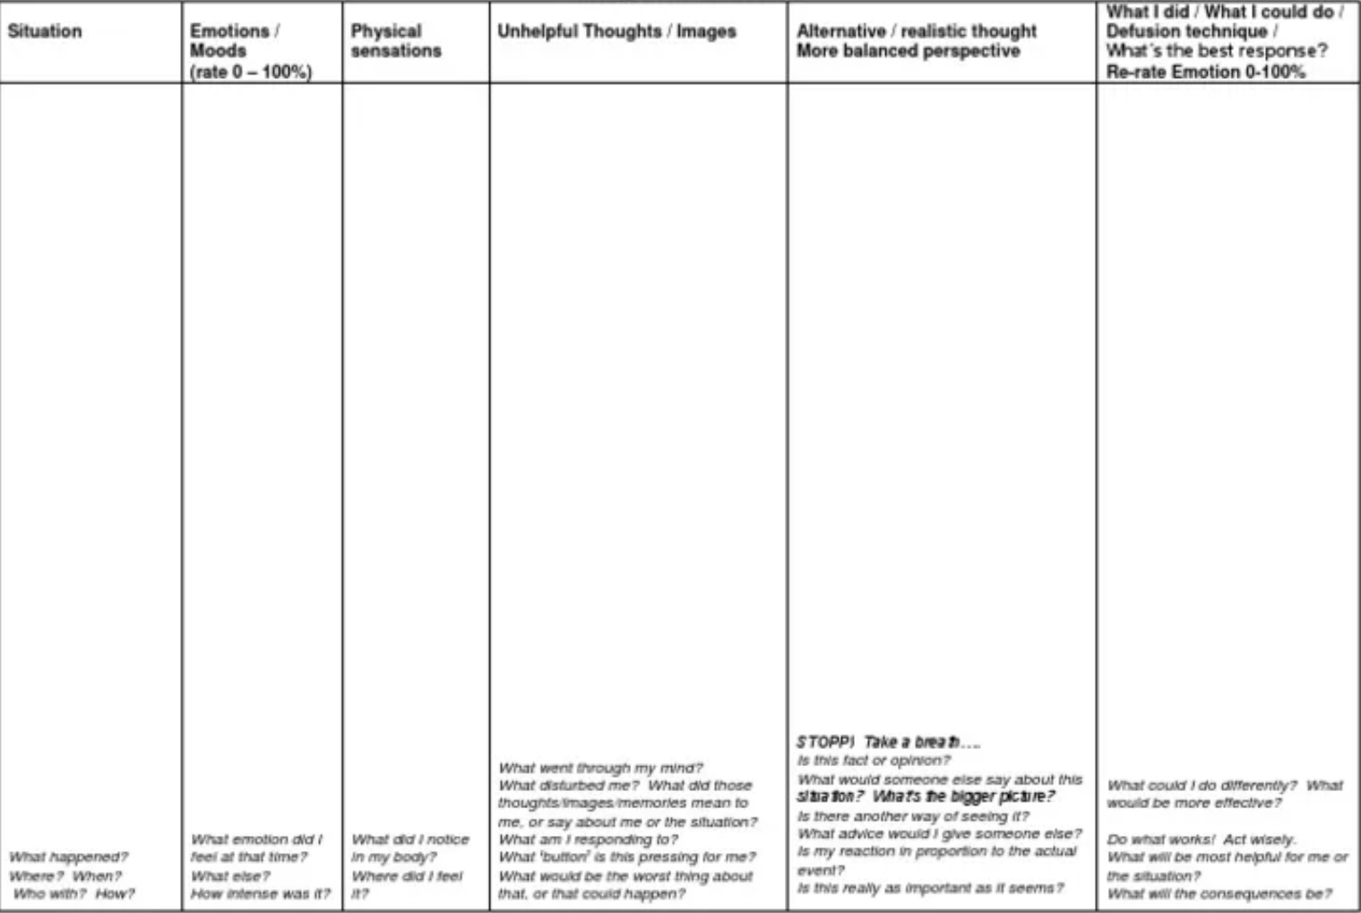
WHAT IS A CBT THOUGHT RECORD?
Outcome: Check in by asking if has the emotion shifted? (Anxiety drops from 80% → 40%.)
A thought record does not tell you what to feel. It doesn’t shame or judge you. It doesn’t pretend everything is fine. It simply helps you think more clearly, which usually helps you feel better.
A CBT thought record is a tool that helps you understand what thoughts are driving your emotions, and lets you step back and look at the situation more realistically.
We’ll discuss CBT when we introduce rational mind remediation in week 12.

Slide 45
CBT THOUGHT RECORD VS. DBT HOLES ANALYSIS
DBT adapted CBT in order to work with dysregulated emotion. You’ll find many similarities between the two approaches for example chain analysis are modified thought records.
Both thought records and holes analysis help people slow down automatic reactions and reflect on what’s happening inside them, increase awareness of thoughts, emotions, behaviours links, support emotion regulation by identifying patterns that maintain suffering. Both aim to replace unhelpful habits with more skillful, balanced responses, and are often used in therapy as homework or between-session practice.
There are some significant differences between the two. CBT thought records focus on unhelpful thoughts (“cognitive distortions”) that drive emotions and behaviours. Its goal is to identify, challenge, and replace inaccurate or unhelpful beliefs and help people develop a more balanced, realistic way of thinking.
DBT holes analysis on the other hand focus on the sequence of events that led to a problematic behaviour (e.g., anger outburst, self-harm, avoidance). Its goal is to identify vulnerabilities, triggers, links in the chain, and missing skills and help people understand why the behaviour made sense and what skills could replace it next time.
In a thought record the focus is on cognitions (automatic thoughts, core beliefs). Emotions tied to those thoughts. Evidence for/against the thought and alternative, more balanced thought.
In a holes analysis the focus is on a behavioural chain or step-by-step sequence of event → thought → feeling → sensation → urge → action → consequence). It also takes into account vulnerability factors (sleep, stress, illness, hunger, old wounds), and skill deficits (emotion regulation, distress tolerance, interpersonal skills). It emphasizes solution analysis or what skills to use next time.

Slide 46
CBT THOUGHT RECORD VS. DBT HOLES ANALYSIS
Thought records can be used when someone is anxious, depressed, catastrophizing, self-critical and the main problem is distorted thinking. Holes analysis are helpful when a person engages in dysregulated behaviours (anger, self-harm, impulsivity, avoidance, substance use) and wants to understand what set up the behaviour and how to prevent it. The focus is on skills training and behavioural change rather than changing beliefs.
The CBT thought record template lists:
1. Situation
2. Emotion(s)
3. Automatic thought(s)
4. Evidence for
5. Evidence against
6. Balanced thought
7. Outcome (emotion shift)
The DBT Holes analysis template lists:
1. Vulnerability factors
2. Prompting event
3. Links in the chain (thoughts, feelings, sensations, urges, actions)
4. Problem behaviour
5. Consequences
6. Missing skills
7. Plan to repair
8. Skills to use next time
CBT thought record ask “What thought made me suffer, and how can I think about it differently?” The DBT chain analysis asks “What sequence of events made this behaviour happen, and what skills can I use next time?”

Slide 47
DBT HOLES ANALYSIS TEMPLATE
What Happened? 2. Emotions Felt 3. Thoughts 4. Sensations 5. Behaviours/urges 6. pre-hole energy
☐ Tight chest
☐ Rapid heartbeat
☐ Shallow breathing
☐ Nausea
☐ Knot in stomach
☐ Sweaty palms
☐ Shaking
☐ Muscle tension
☐ Hot face / flushing
☐ Cold hands/feet
☐ Light-headedness
☐ Numbness
☐ Restlessness / agitation
☐ Other: ____
Describe the
situation factually.
☐ Anxiety / Fear
☐ Anger / Rage
☐ Irritation /
Frustration
☐ Sadness / Grief
☐ Shame
☐ Guilt
☐ Hurt
☐ Loneliness
☐ Embarrassment
☐ Overwhelm
☐ Numbness
☐ Other: ____
☐ I’m not good
enough.
☐ This is my fault.
☐ They are judging
me.
☐ Something bad
will happen.
☐ I can’t handle this.
☐ I’m going to fail.
☐ They don’t care
about me.
☐ I always screw up.
☐ Catastrophizing
☐ All-or-nothing
thinking
☐ Mind-reading
☐ Other: ____
☐ Withdrew / shut
down
☐ Lashed out
☐ Avoided /
escaped
☐ People-pleased
☐ Over-apologized
☐ Argued /
escalated
☐ Used substances
☐ Overate /
restricted
☐ Reassurance-
seeking
☐ Compulsive
checking
☐ Tried to control
☐ Self-harm
urges/actions
☐ Other: ____
☐ Very Low
☐ Low
☐ Moderate
☐ High
☐ Very High
☐ Contributing factors (describe):

Slide 48
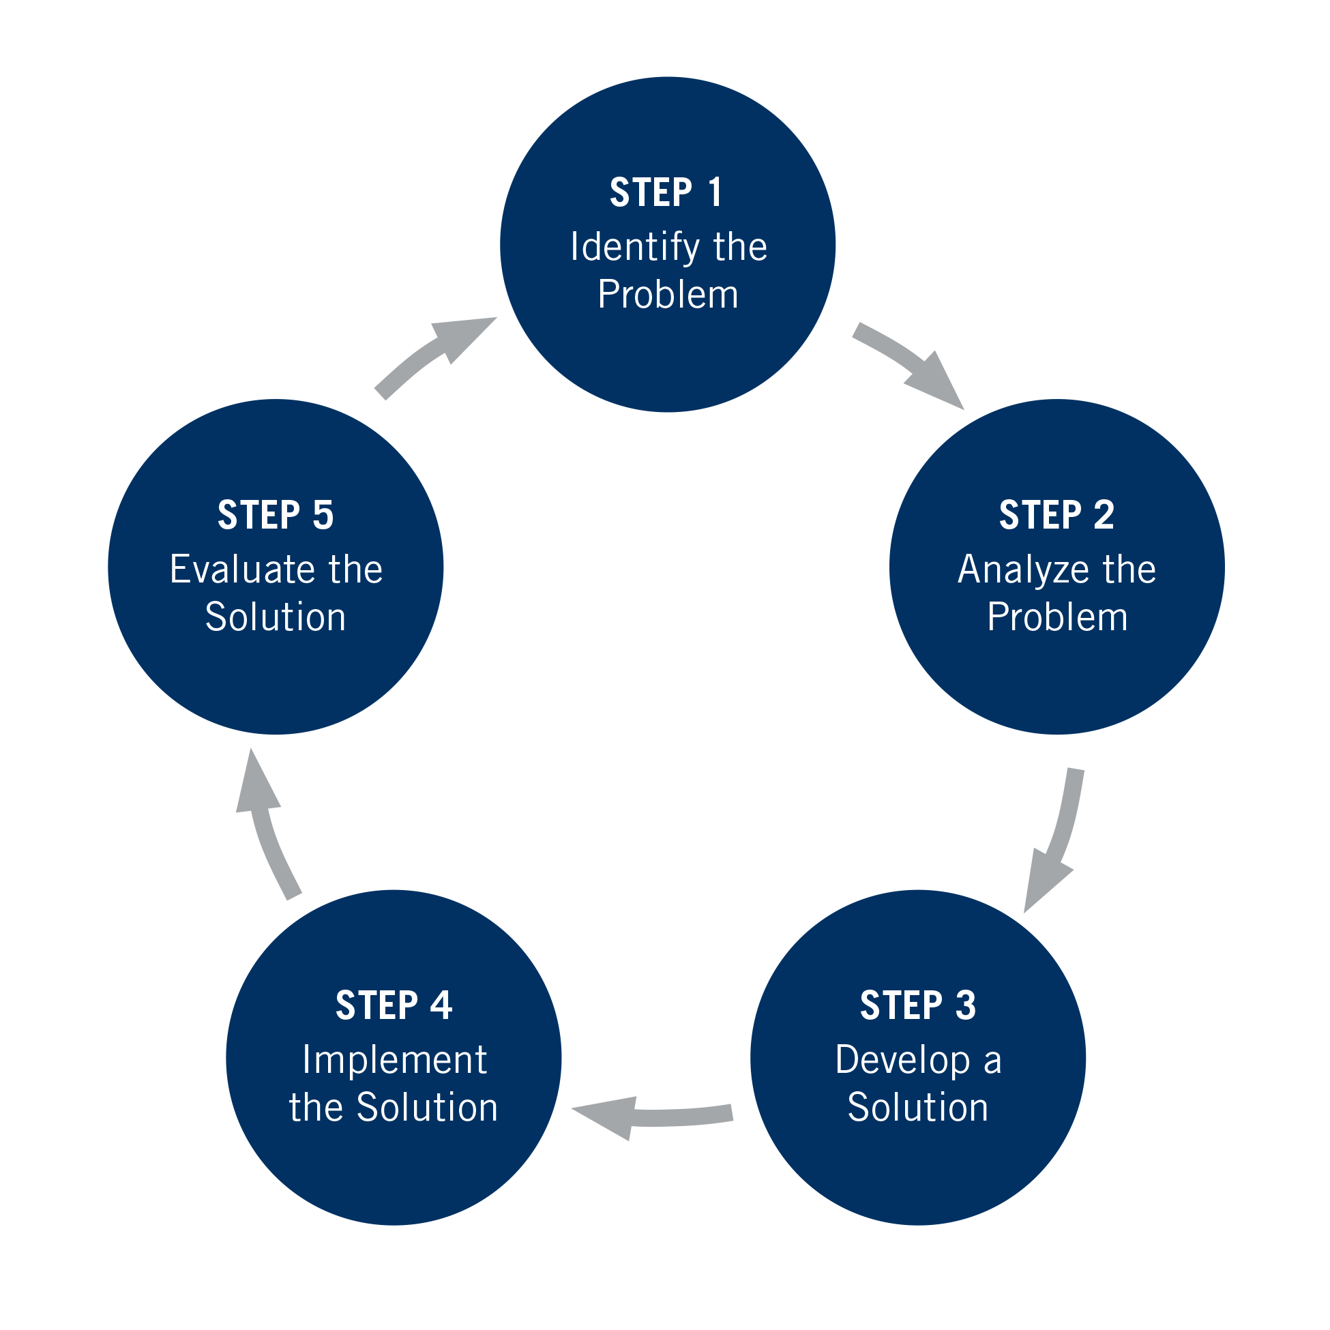
STEPS 1 and 2 of GOOD Problem solving
Holes diary cards with their targets help us with step 1 of good problem solving which is identifying the problem.(the target)
Holes analysis helps us with step 2 of good problem solving which is analyzing the problems that we have previously identified and designated as our “holes” or “targets”. Analyzing the problems helps us better understand them.
Notes:
Doing holes diary cards, we identify the problems that we want to work on and called him "targets" for change. These targets are the holes we fall into.
When we worked on crisis plans, we identified holes and then analyze them using the crisis plan template. We considered the triggers for as falling into those holes and explored other features of the holes such as accompanying thoughts, feelings and behaviors.
This analysis of the holes we fell into is essentially what we do in chain analysis: when our targets become activated, we analyze what might have triggered that activation, and consider the feelings, thoughts, and behaviors that were present during the activation.

Slide 49
To do holes analysis you need to be doing holes diary cards
HOLES DIARY CARD

Slide 50
HOLES ANALYSIS ALGORITHM
1) start with your completed holes diary card (on the left)
2) choose a day when the numbers for one or more of your targets were
higher than baseline.
3) ask yourself at what point in time the numbers went up from baseline.
4) use the holes analysis template to understand what happened, what you
felt, thought, and did.
5) Remember to stay in window of tolerance by pendulating
6)What was the topography of your activation?
7) Was there a trigger(s) for the activation?
8)What did you feel when activated ?
9) Notice the sensations in your body without judging or trying to change them 10) What thoughts were associated with each feeling listed in step 8) above?
11)What behaviors or urges were associated with each feeling listed in step 8) above?
12)What was your energy balance before the activation? 0-10
Notes:
Following good problem-solving strategies, to do a chain analysis use the algorithm and the template. It may be helpful to divide the algorithm into two parts. Part I is what you need to do before doing a chain analysis. Part II is how to do the chain analysis itself.

Slide 51
ALGORITHM steps 1,2 and 3
1) start with your completed holes diary card
2) choose a day when the numbers for one or more of your targets were higher than baseline.
3) ask yourself at what point in time the numbers went up from baseline.
M T W T F S S
struggling.
4 3 6 2 3 10 9
sad.
5 4 7 1 2 8 7
withdrawing
9 8 6 6 5 10 10

Slide 52
ALGORITHM step 4
4) use the holes analysis template to understand what happened, what you felt, thought, and did. Do steps 1-8 on chain analysis template.
HOLES ANALYSIS TEMPLATE
Remember to stay in window of tolerance by pendulating
What was the topography of your activation?
Was there a trigger(s) for the activation?
What did you feel when activated ?
Notice the sensations in your body without judging or trying to change them
What thoughts were associated with each feeling listed above?
What behaviors or urges were associated with each feeling?
What was your energy balance before the activation? 0-10
1.
2.
3.
4.
5.
6.
7.
8.

Slide 53
DBT HOLES ANALYSIS TEMPLATE
What Happened? 2. Emotions Felt 3. Thoughts 4. Sensations 5. Behaviours/urges 6. pre-hole energy
☐ Tight chest
☐ Rapid heartbeat
☐ Shallow breathing
☐ Nausea
☐ Knot in stomach
☐ Sweaty palms
☐ Shaking
☐ Muscle tension
☐ Hot face / flushing
☐ Cold hands/feet
☐ Light-headedness
☐ Numbness
☐ Restlessness / agitation
☐ Other: ____
Describe the
situation factually.
☐ Anxiety / Fear
☐ Anger / Rage
☐ Irritation /
Frustration
☐ Sadness / Grief
☐ Shame
☐ Guilt
☐ Hurt
☐ Loneliness
☐ Embarrassment
☐ Overwhelm
☐ Numbness
☐ Other: ____
☐ I’m not good
enough.
☐ This is my fault.
☐ They are judging
me.
☐ Something bad
will happen.
☐ I can’t handle this.
☐ I’m going to fail.
☐ They don’t care
about me.
☐ I always screw up.
☐ Catastrophizing
☐ All-or-nothing
thinking
☐ Mind-reading
☐ Other: ____
☐ Withdrew / shut
down
☐ Lashed out
☐ Avoided /
escaped
☐ People-pleased
☐ Over-apologized
☐ Argued /
escalated
☐ Used substances
☐ Overate /
restricted
☐ Reassurance-
seeking
☐ Compulsive
checking
☐ Tried to control
☐ Self-harm
urges/actions
☐ Other: ____
☐ Very Low
☐ Low
☐ Moderate
☐ High
☐ Very High
☐ Contributing factors (describe):
ALGORITHM step 4 cheat sheet

Slide 54
ALGORITHM step 4
4) use the holes analysis template to understand what happened, what you felt, thought, and did. Do steps 1-8 on chain analysis template.
HOLES ANALYSIS TEMPLATE
Remember to stay in window of tolerance by pendulating
What was the topography of your activation?
Was there a trigger(s) for the activation?
What did you feel when activated ?
Notice the sensations in your body without judging or trying to change them
What thoughts were associated with each feeling listed above?
What behaviors or urges were associated with each feeling?
What was your energy balance before the activation? 0-10
1.
2.
3.
4.
5.
6.
7.
8.

Slide 55

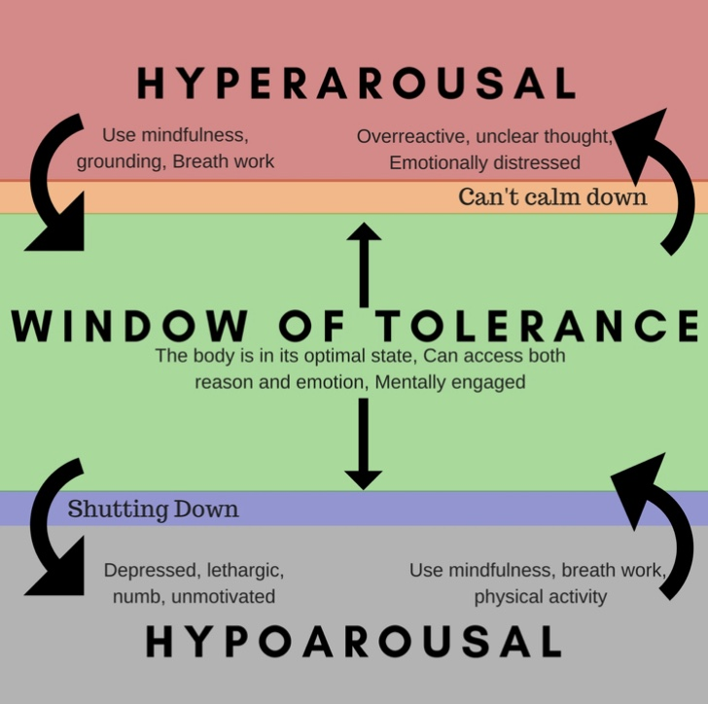
5) Remember to stay in window of tolerance by pendulating
Pendulating, which comes from the word pendulum, means swinging from one thing or place to another.
When people have feelings, they also have thoughts and images that accompany those feelings.
One way of soothing yourself, when you are experiencing intense negative feelings, and bringing yourself back to the window of tolerable emotions, involves distraction or self-soothing: you learn to identify that you are emotional and learn to have alternative thoughts, a soothing inner dialogue, and/or calming and soothing images. When you are better regulated you can then revisit the original thoughts you were having
To get good at pendulating you have to plan and practice it as we will further discuss when we talk about crisis plans.

Slide 56
ALGORITHM step 4
4) use the holes analysis template to understand what happened, what you felt, thought, and did. Do steps 1-8 on chain analysis template.
HOLES ANALYSIS TEMPLATE
Remember to stay in window of tolerance by pendulating
What was the topography of your activation?
Was there a trigger(s) for the activation?
What did you feel when activated ?
Notice the sensations in your body without judging or trying to change them
What thoughts were associated with each feeling listed above?
What behaviors or urges were associated with each feeling?
What was your energy balance before the activation? 0-10
1.
2.
3.
4.
5.
6.
7.
8.

Slide 57
TOPOGRAPHY

Slide 58
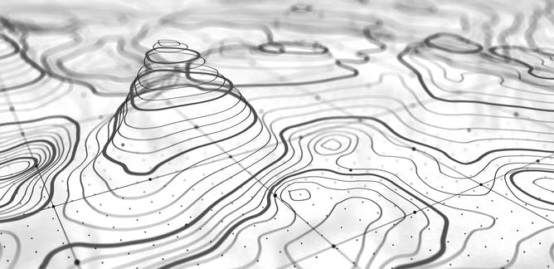
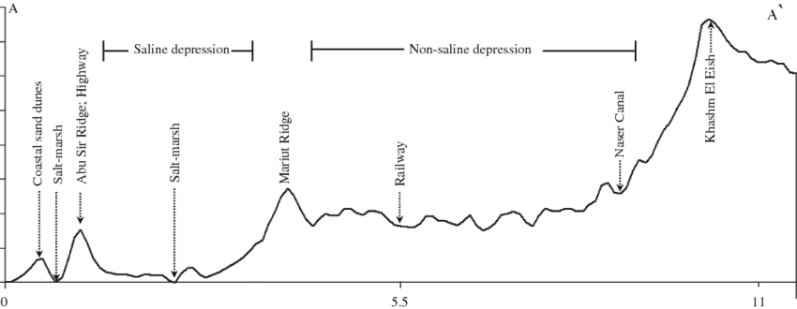
6)What was the topography of your activation?
Topography: How the intensity of your targets (emotions, thoughts, behaviors) changes over the course of a period of activation – how you go up and down the steps

Slide 59
ALGORITHM step 4
4) use the holes analysis template to understand what happened, what you felt, thought, and did. Do steps 1-8 on chain analysis template.
HOLES ANALYSIS TEMPLATE
Remember to stay in window of tolerance by pendulating
What was the topography of your activation?
Was there a trigger(s) for the activation?
What did you feel when activated ?
Notice the sensations in your body without judging or trying to change them
What thoughts were associated with each feeling listed above?
What behaviors or urges were associated with each feeling?
What was your energy balance before the activation? 0-10
1.
2.
3.
4.
5.
6.
7.
8.

Slide 60
DBT HOLES ANALYSIS TEMPLATE
What Happened? 2. Emotions Felt 3. Thoughts 4. Sensations 5. Behaviours/urges 6. pre-hole energy
☐ Tight chest
☐ Rapid heartbeat
☐ Shallow breathing
☐ Nausea
☐ Knot in stomach
☐ Sweaty palms
☐ Shaking
☐ Muscle tension
☐ Hot face / flushing
☐ Cold hands/feet
☐ Light-headedness
☐ Numbness
☐ Restlessness / agitation
☐ Other: ____
Describe the
situation factually.
☐ Anxiety / Fear
☐ Anger / Rage
☐ Irritation /
Frustration
☐ Sadness / Grief
☐ Shame
☐ Guilt
☐ Hurt
☐ Loneliness
☐ Embarrassment
☐ Overwhelm
☐ Numbness
☐ Other: ____
☐ I’m not good
enough.
☐ This is my fault.
☐ They are judging
me.
☐ Something bad
will happen.
☐ I can’t handle this.
☐ I’m going to fail.
☐ They don’t care
about me.
☐ I always screw up.
☐ Catastrophizing
☐ All-or-nothing
thinking
☐ Mind-reading
☐ Other: ____
☐ Withdrew / shut
down
☐ Lashed out
☐ Avoided /
escaped
☐ People-pleased
☐ Over-apologized
☐ Argued /
escalated
☐ Used substances
☐ Overate /
restricted
☐ Reassurance-
seeking
☐ Compulsive
checking
☐ Tried to control
☐ Self-harm
urges/actions
☐ Other: ____
☐ Very Low
☐ Low
☐ Moderate
☐ High
☐ Very High
☐ Contributing factors (describe):

Slide 61
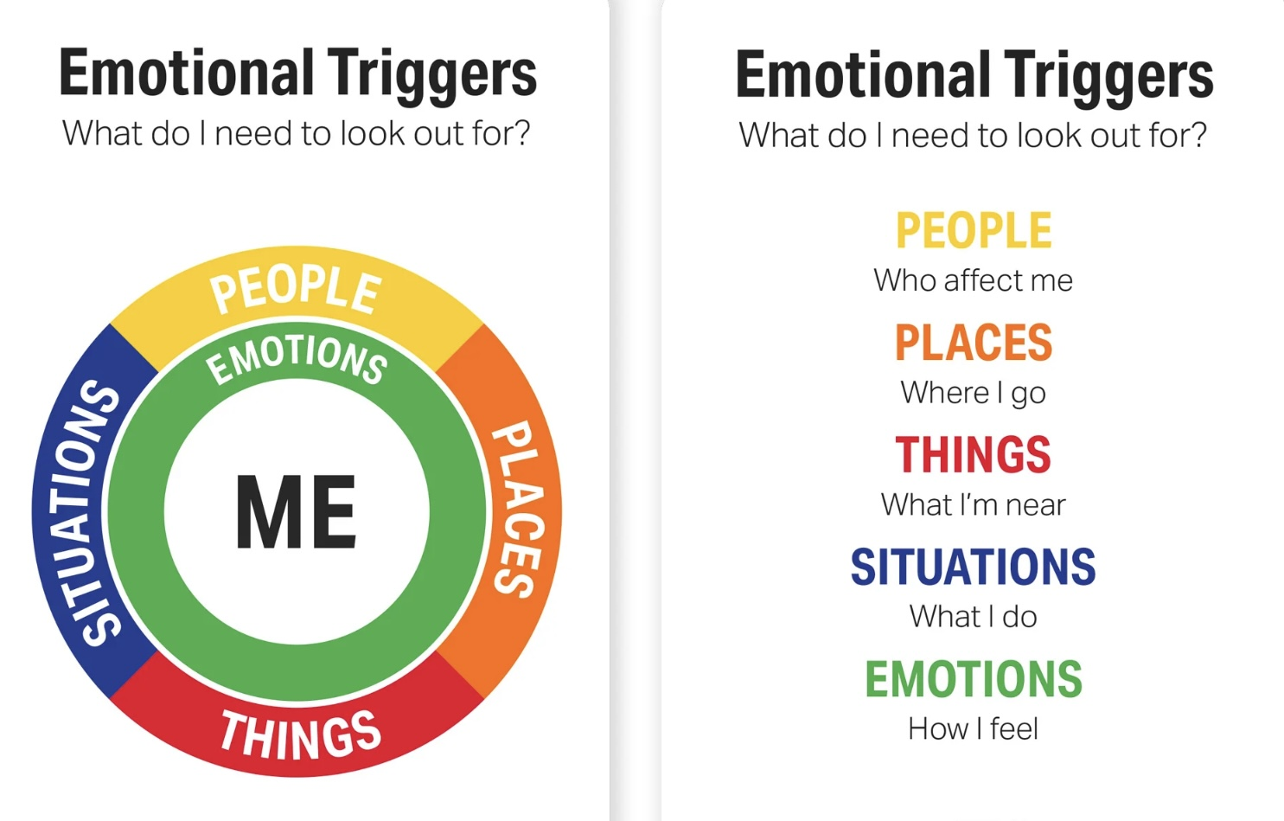
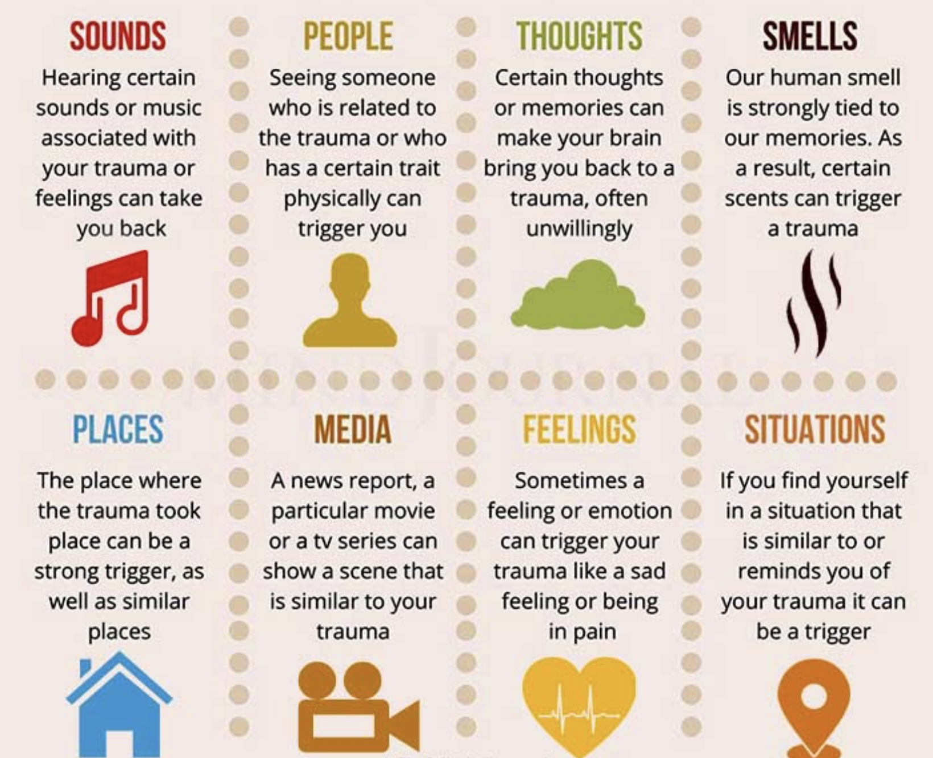
7) Was there a trigger(s) for the activation?

Slide 62
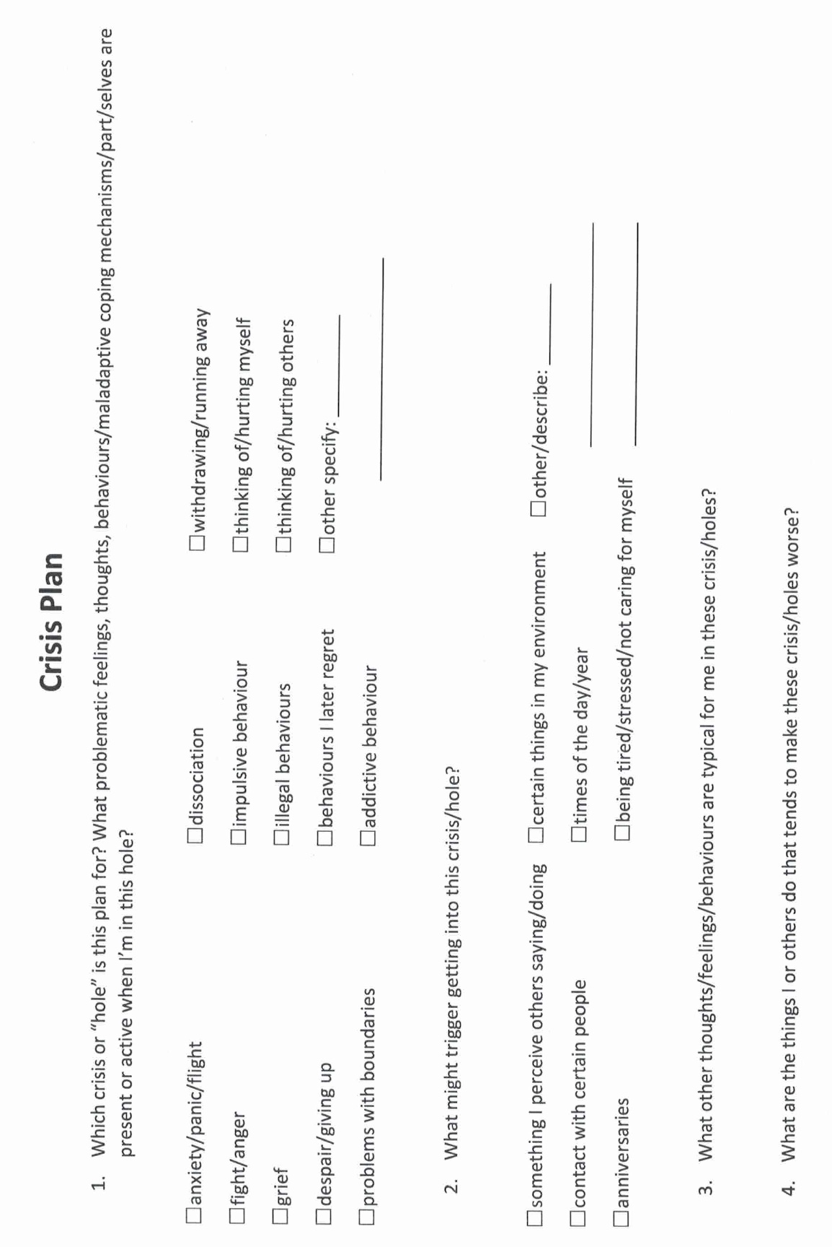
Notes:
A template is a structured form that helps you carry out the steps prescribed in the algorithm. There are many different crisis plans templates. This one is a compilation of some of the best features of other templates.

Slide 63
HOLES ANALYSIS TEMPLATE
Remember to stay in window of tolerance by pendulating
What was the topography of your activation?
Was there a trigger(s) for the activation?
What did you feel when activated ?
Notice the sensations in your body without judging or trying to change them
What thoughts were associated with each feeling listed above?
What behaviors or urges were associated with each feeling?
What was your energy balance before the activation? 0-10
1.
2.
3.
4.
5.
6.
7.
8.

Slide 64
DBT HOLES ANALYSIS TEMPLATE
What Happened? 2. Emotions Felt 3. Thoughts 4. Sensations 5. Behaviours/urges 6. pre-hole energy
☐ Tight chest
☐ Rapid heartbeat
☐ Shallow breathing
☐ Nausea
☐ Knot in stomach
☐ Sweaty palms
☐ Shaking
☐ Muscle tension
☐ Hot face / flushing
☐ Cold hands/feet
☐ Light-headedness
☐ Numbness
☐ Restlessness / agitation
☐ Other: ____
Describe the
situation factually.
☐ Anxiety / Fear
☐ Anger / Rage
☐ Irritation /
Frustration
☐ Sadness / Grief
☐ Shame
☐ Guilt
☐ Hurt
☐ Loneliness
☐ Embarrassment
☐ Overwhelm
☐ Numbness
☐ Other: ____
☐ I’m not good
enough.
☐ This is my fault.
☐ They are judging
me.
☐ Something bad
will happen.
☐ I can’t handle this.
☐ I’m going to fail.
☐ They don’t care
about me.
☐ I always screw up.
☐ Catastrophizing
☐ All-or-nothing
thinking
☐ Mind-reading
☐ Other: ____
☐ Withdrew / shut
down
☐ Lashed out
☐ Avoided /
escaped
☐ People-pleased
☐ Over-apologized
☐ Argued /
escalated
☐ Used substances
☐ Overate /
restricted
☐ Reassurance-
seeking
☐ Compulsive
checking
☐ Tried to control
☐ Self-harm
urges/actions
☐ Other: ____
☐ Very Low
☐ Low
☐ Moderate
☐ High
☐ Very High
☐ Contributing factors (describe):

Slide 65
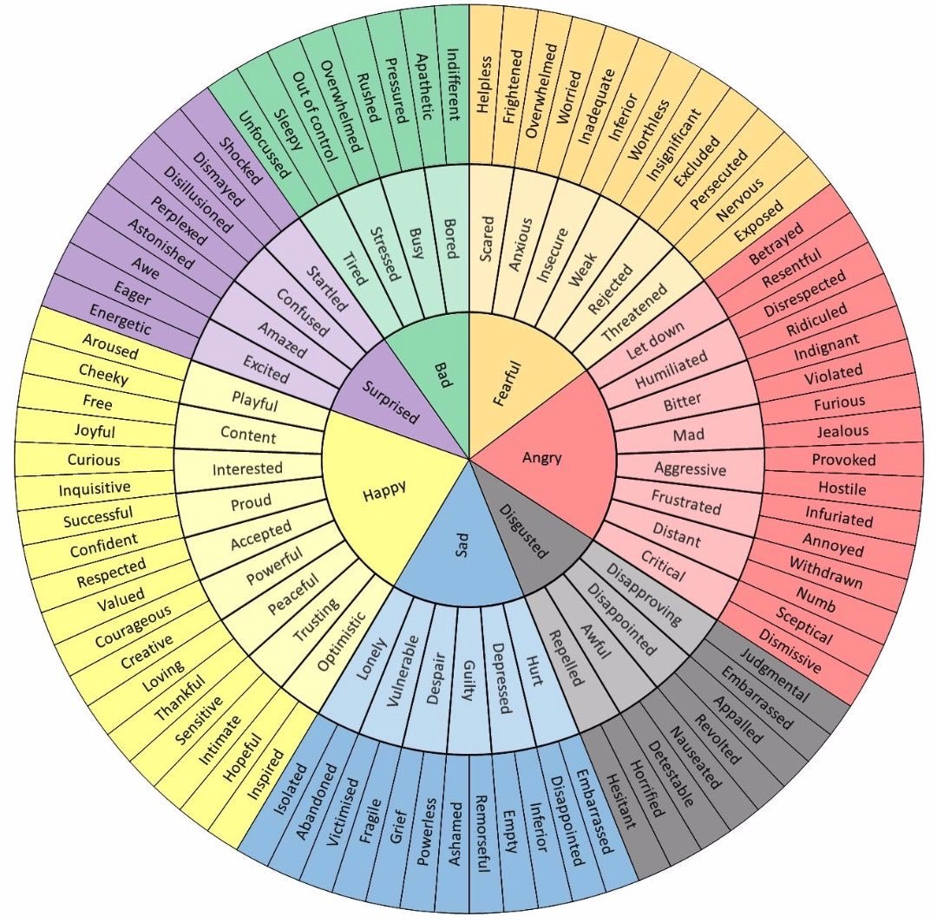
8)What did you feel when activated ?
Notes:
The wheel of feelings, the list of cognitive errors and automatic negative thoughts, and that of internalizing and externalizing behaviours helped you find your holes. They can also help you find your targets which may be the same as your holes or different from them.

Slide 66
HOLES ANALYSIS TEMPLATE
Remember to stay in window of tolerance by pendulating
What was the topography of your activation?
Was there a trigger(s) for the activation?
What did you feel when activated ?
Notice the sensations in your body without judging or trying to change them
What thoughts were associated with each feeling listed above?
What behaviors or urges were associated with each feeling?
What was your energy balance before the activation? 0-10
1.
2.
3.
4.
5.
6.
7.
8.

Slide 67
DBT HOLES ANALYSIS TEMPLATE
What Happened? 2. Emotions Felt 3. Thoughts 4. Sensations 5. Behaviours/urges 6. pre-hole energy
☐ Tight chest
☐ Rapid heartbeat
☐ Shallow breathing
☐ Nausea
☐ Knot in stomach
☐ Sweaty palms
☐ Shaking
☐ Muscle tension
☐ Hot face / flushing
☐ Cold hands/feet
☐ Light-headedness
☐ Numbness
☐ Restlessness / agitation
☐ Other: ____
Describe the
situation factually.
☐ Anxiety / Fear
☐ Anger / Rage
☐ Irritation /
Frustration
☐ Sadness / Grief
☐ Shame
☐ Guilt
☐ Hurt
☐ Loneliness
☐ Embarrassment
☐ Overwhelm
☐ Numbness
☐ Other: ____
☐ I’m not good
enough.
☐ This is my fault.
☐ They are judging
me.
☐ Something bad
will happen.
☐ I can’t handle this.
☐ I’m going to fail.
☐ They don’t care
about me.
☐ I always screw up.
☐ Catastrophizing
☐ All-or-nothing
thinking
☐ Mind-reading
☐ Other: ____
☐ Withdrew / shut
down
☐ Lashed out
☐ Avoided /
escaped
☐ People-pleased
☐ Over-apologized
☐ Argued /
escalated
☐ Used substances
☐ Overate /
restricted
☐ Reassurance-
seeking
☐ Compulsive
checking
☐ Tried to control
☐ Self-harm
urges/actions
☐ Other: ____
☐ Very Low
☐ Low
☐ Moderate
☐ High
☐ Very High
☐ Contributing factors (describe):

Slide 68
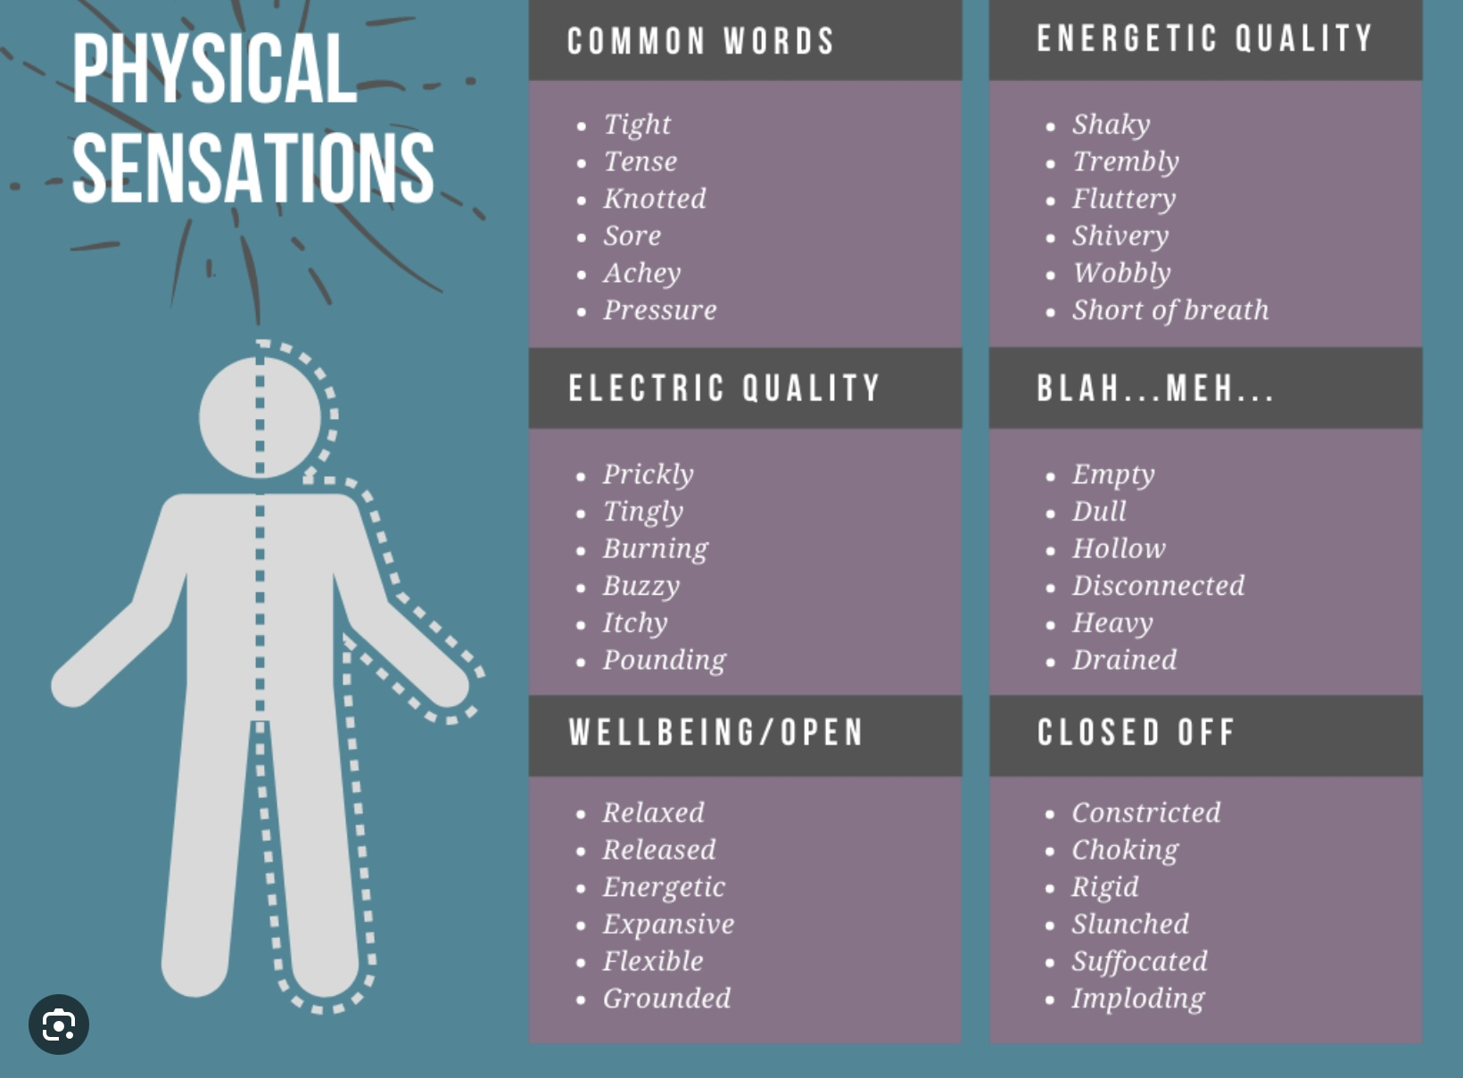
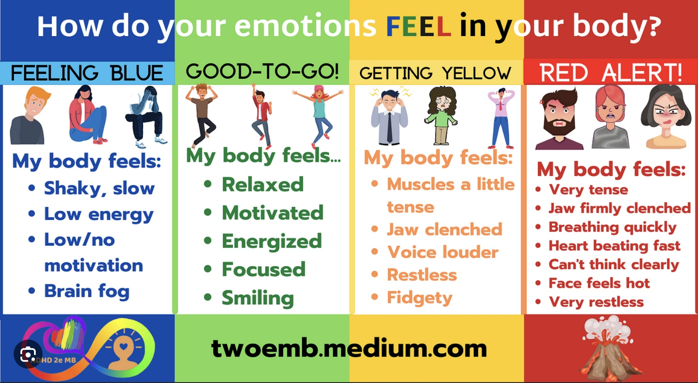
9) Notice the sensations in your body without judging or trying to change them

Slide 69
HOLES ANALYSIS TEMPLATE
Remember to stay in window of tolerance by pendulating
What was the topography of your activation?
Was there a trigger(s) for the activation?
What did you feel when activated ?
Notice the sensations in your body without judging or trying to change them
What thoughts were associated with each feeling listed above?
What behaviors or urges were associated with each feeling?
What was your energy balance before the activation? 0-10
1.
2.
3.
4.
5.
6.
7.
8.

Slide 70
DBT HOLES ANALYSIS TEMPLATE
What Happened? 2. Emotions Felt 3. Thoughts 4. Sensations 5. Behaviours/urges 6. pre-hole energy
☐ Tight chest
☐ Rapid heartbeat
☐ Shallow breathing
☐ Nausea
☐ Knot in stomach
☐ Sweaty palms
☐ Shaking
☐ Muscle tension
☐ Hot face / flushing
☐ Cold hands/feet
☐ Light-headedness
☐ Numbness
☐ Restlessness / agitation
☐ Other: ____
Describe the
situation factually.
☐ Anxiety / Fear
☐ Anger / Rage
☐ Irritation /
Frustration
☐ Sadness / Grief
☐ Shame
☐ Guilt
☐ Hurt
☐ Loneliness
☐ Embarrassment
☐ Overwhelm
☐ Numbness
☐ Other: ____
☐ I’m not good
enough.
☐ This is my fault.
☐ They are judging
me.
☐ Something bad
will happen.
☐ I can’t handle this.
☐ I’m going to fail.
☐ They don’t care
about me.
☐ I always screw up.
☐ Catastrophizing
☐ All-or-nothing
thinking
☐ Mind-reading
☐ Other: ____
☐ Withdrew / shut
down
☐ Lashed out
☐ Avoided /
escaped
☐ People-pleased
☐ Over-apologized
☐ Argued /
escalated
☐ Used substances
☐ Overate /
restricted
☐ Reassurance-
seeking
☐ Compulsive
checking
☐ Tried to control
☐ Self-harm
urges/actions
☐ Other: ____
☐ Very Low
☐ Low
☐ Moderate
☐ High
☐ Very High
☐ Contributing factors (describe):

Slide 71
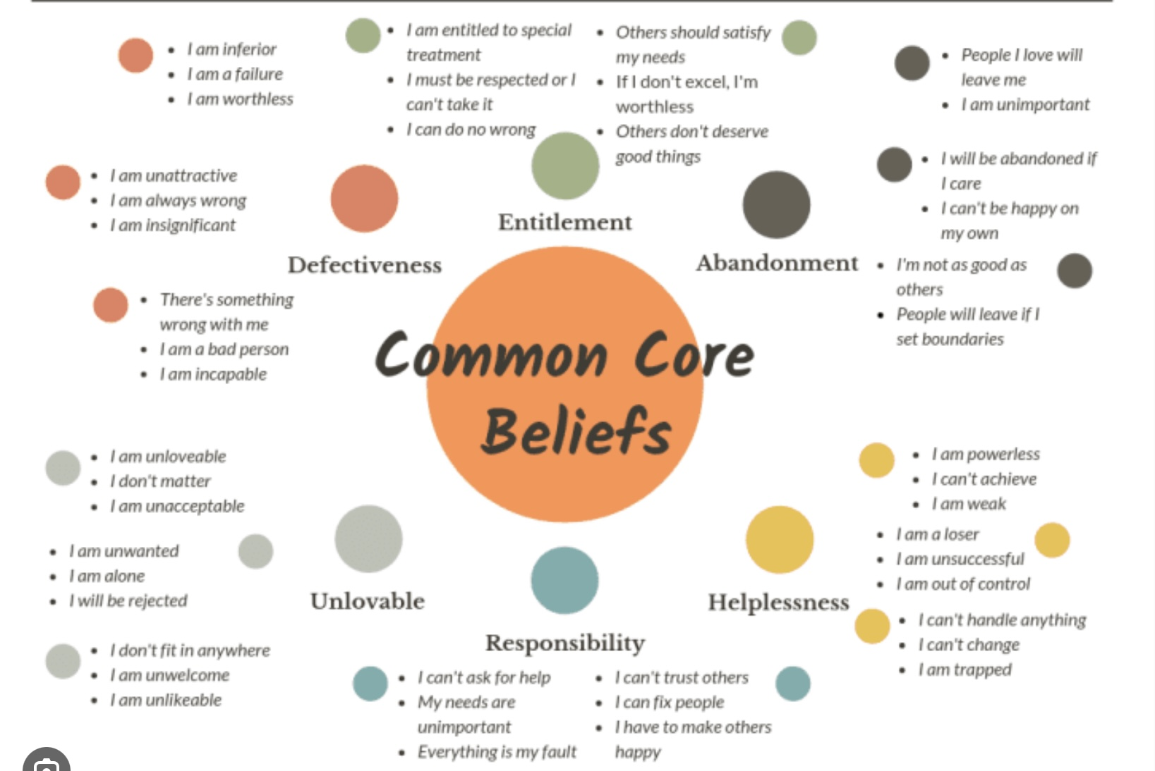
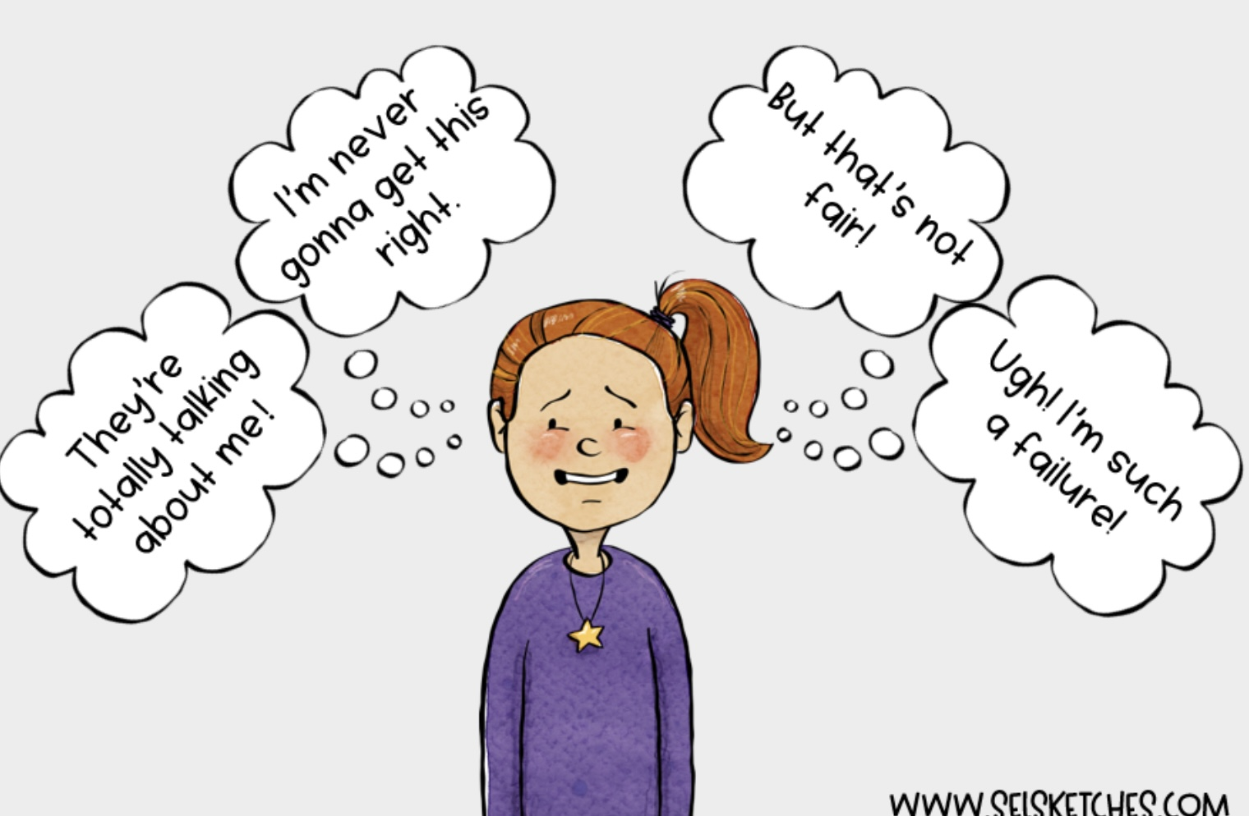
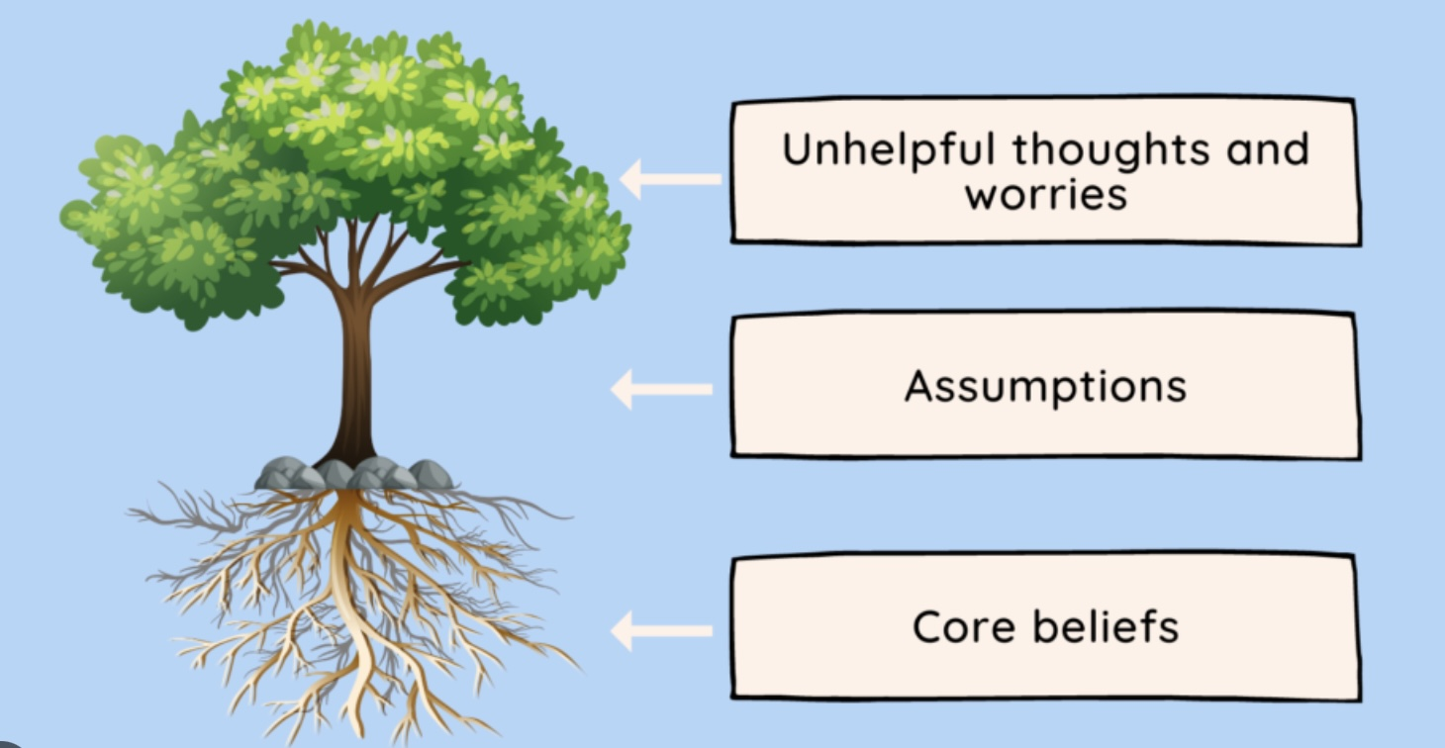
10) What thoughts were associated with each feeling listed in step 8) above?

Slide 72
HOLES ANALYSIS TEMPLATE
Remember to stay in window of tolerance by pendulating
What was the topography of your activation?
Was there a trigger(s) for the activation?
What did you feel when activated ?
Notice the sensations in your body without judging or trying to change them
What thoughts were associated with each feeling listed above?
What behaviors or urges were associated with each feeling?
What was your energy balance before the activation? 0-10
1.
2.
3.
4.
5.
6.
7.
8.

Slide 73
DBT HOLES ANALYSIS TEMPLATE
What Happened? 2. Emotions Felt 3. Thoughts 4. Sensations 5. Behaviours/urges 6. pre-hole energy
☐ Tight chest
☐ Rapid heartbeat
☐ Shallow breathing
☐ Nausea
☐ Knot in stomach
☐ Sweaty palms
☐ Shaking
☐ Muscle tension
☐ Hot face / flushing
☐ Cold hands/feet
☐ Light-headedness
☐ Numbness
☐ Restlessness / agitation
☐ Other: ____
Describe the
situation factually.
☐ Anxiety / Fear
☐ Anger / Rage
☐ Irritation /
Frustration
☐ Sadness / Grief
☐ Shame
☐ Guilt
☐ Hurt
☐ Loneliness
☐ Embarrassment
☐ Overwhelm
☐ Numbness
☐ Other: ____
☐ I’m not good
enough.
☐ This is my fault.
☐ They are judging
me.
☐ Something bad
will happen.
☐ I can’t handle this.
☐ I’m going to fail.
☐ They don’t care
about me.
☐ I always screw up.
☐ Catastrophizing
☐ All-or-nothing
thinking
☐ Mind-reading
☐ Other: ____
☐ Withdrew / shut
down
☐ Lashed out
☐ Avoided /
escaped
☐ People-pleased
☐ Over-apologized
☐ Argued /
escalated
☐ Used substances
☐ Overate /
restricted
☐ Reassurance-
seeking
☐ Compulsive
checking
☐ Tried to control
☐ Self-harm
urges/actions
☐ Other: ____
☐ Very Low
☐ Low
☐ Moderate
☐ High
☐ Very High
☐ Contributing factors (describe):

Slide 74
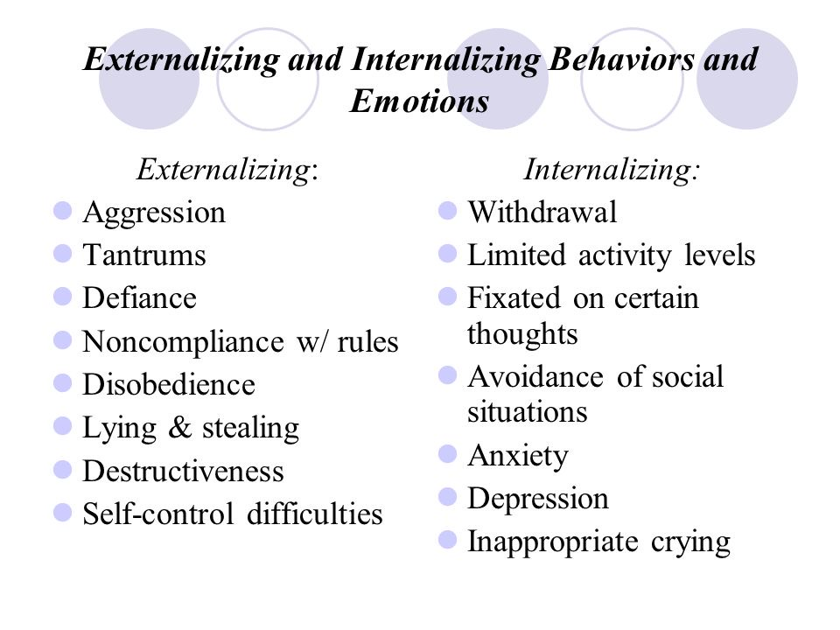
11)What behaviors or urges were associated with each feeling listed in step 8) above?

Slide 75
HOLES ANALYSIS TEMPLATE
Remember to stay in window of tolerance by pendulating
What was the topography of your activation?
Was there a trigger(s) for the activation?
What did you feel when activated ?
Notice the sensations in your body without judging or trying to change them
What thoughts were associated with each feeling listed above?
What behaviors or urges were associated with each feeling?
What was your energy balance before the activation? 0-10
1.
2.
3.
4.
5.
6.
7.
8.

Slide 76
DBT HOLES ANALYSIS TEMPLATE
What Happened? 2. Emotions Felt 3. Thoughts 4. Sensations 5. Behaviours/urges 6. pre-hole energy
☐ Tight chest
☐ Rapid heartbeat
☐ Shallow breathing
☐ Nausea
☐ Knot in stomach
☐ Sweaty palms
☐ Shaking
☐ Muscle tension
☐ Hot face / flushing
☐ Cold hands/feet
☐ Light-headedness
☐ Numbness
☐ Restlessness / agitation
☐ Other: ____
Describe the
situation factually.
☐ Anxiety / Fear
☐ Anger / Rage
☐ Irritation /
Frustration
☐ Sadness / Grief
☐ Shame
☐ Guilt
☐ Hurt
☐ Loneliness
☐ Embarrassment
☐ Overwhelm
☐ Numbness
☐ Other: ____
☐ I’m not good
enough.
☐ This is my fault.
☐ They are judging
me.
☐ Something bad
will happen.
☐ I can’t handle this.
☐ I’m going to fail.
☐ They don’t care
about me.
☐ I always screw up.
☐ Catastrophizing
☐ All-or-nothing
thinking
☐ Mind-reading
☐ Other: ____
☐ Withdrew / shut
down
☐ Lashed out
☐ Avoided /
escaped
☐ People-pleased
☐ Over-apologized
☐ Argued /
escalated
☐ Used substances
☐ Overate /
restricted
☐ Reassurance-
seeking
☐ Compulsive
checking
☐ Tried to control
☐ Self-harm
urges/actions
☐ Other: ____
☐ Very Low
☐ Low
☐ Moderate
☐ High
☐ Very High
☐ Contributing factors (describe):

Slide 77
12)What was your energy balance before the activation? 0-10
Low High
High Low
CRISIS RISK
Low Outside
High Inside
ENERGY RESERVES
WINDOW OF TOLERANCE

Slide 78
algorithm
HOLES ANALYSIS
TEMPLATE
Remember to stay in window of tolerance by pendulating
What was the topography of your activation?
Was there a trigger(s) for the activation?
What did you feel when activated ?
Notice the sensations in your body without judging or trying to change them
What thoughts were associated with each feeling listed above?
What behaviors or urges were associated with each feeling?
What was your energy balance before the activation? 0-10
Find a higher than your baseline number on your holes diary to do a chain analysis
1. Map out the “topography” of the intensity of your activation around the time period for which you are doing the holes analysis. How did the intensity of your feelings, thoughts, and behaviors change over time?
2. On the holes analysis template, note in writing, if there were any events that were triggers for your increase in activation ?
3. Note in writing, on the template, the sequence of feelings you experienced during this period. Rate each on a scale of 0-10 with 10 being the most intense you’ve ever felt this feeling
4. Observe and note the physical sensations you experienced during the activation without judging or trying to change them
5. Note in writing, on the template, the thoughts that accompanied each of your feelings
6. Note what you did, or wanted to do but stopped yourself from doing during the period of activation
7. Note on a 0-10 scale what your energy balance, reserves or stores (how full your gas tank), and crisis risk were just prior to the time for which you’re doing the chain analysis.

Slide 79
DBT HOLES ANALYSIS TEMPLATE
What Happened? 2. Emotions Felt 3. Thoughts 4. Sensations 5. Behaviours/urges 6. pre-hole energy
☐ Tight chest
☐ Rapid heartbeat
☐ Shallow breathing
☐ Nausea
☐ Knot in stomach
☐ Sweaty palms
☐ Shaking
☐ Muscle tension
☐ Hot face / flushing
☐ Cold hands/feet
☐ Light-headedness
☐ Numbness
☐ Restlessness / agitation
☐ Other: ____
Describe the
situation factually.
☐ Anxiety / Fear
☐ Anger / Rage
☐ Irritation /
Frustration
☐ Sadness / Grief
☐ Shame
☐ Guilt
☐ Hurt
☐ Loneliness
☐ Embarrassment
☐ Overwhelm
☐ Numbness
☐ Other: ____
☐ I’m not good
enough.
☐ This is my fault.
☐ They are judging
me.
☐ Something bad
will happen.
☐ I can’t handle this.
☐ I’m going to fail.
☐ They don’t care
about me.
☐ I always screw up.
☐ Catastrophizing
☐ All-or-nothing
thinking
☐ Mind-reading
☐ Other: ____
☐ Withdrew / shut
down
☐ Lashed out
☐ Avoided /
escaped
☐ People-pleased
☐ Over-apologized
☐ Argued /
escalated
☐ Used substances
☐ Overate /
restricted
☐ Reassurance-
seeking
☐ Compulsive
checking
☐ Tried to control
☐ Self-harm
urges/actions
☐ Other: ____
☐ Very Low
☐ Low
☐ Moderate
☐ High
☐ Very High
☐ Contributing factors (describe):

Slide 80
?
BRUCE’S HOLES ANALYSIS P. 108-110 of manual
Bruce was a 66-year-old, 6’3”, charming and friendly, owner of an auto body shop. He humorously quipped that he was still floored that Sandra, his wife, had put up with his b… s…. for more than forty years.
Over the last 25 years, Bruce had seen several psychiatrists and psychotherapists, who had diagnosed him with chronic depression. His symptoms fluctuated in intensity from relatively mild to severe with accompanying occasional suicidal ideation.
Bruce had tried several different medications; some helped for a short period of time and then “wore off”. He had come to believe that they were not the answer. He hated their side effects: feeling emotionally disconnected, gaining weight, and losing his libido.
Bruce joined the Simple group and was learning to use diary cards. He joked that he had always been a problem student and so he was happy to keep using the beginner target “feeling bad” forever.
At one of the group sessions, Bruce volunteered to work on his diary cards to find intermediate targets.

Slide 81
algorithm
HOLES ANALYSIS
TEMPLATE
Remember to stay in window of tolerance by pendulating
What was the topography of your activation?
Was there a trigger(s) for the activation?
What did you feel when activated ?
Notice the sensations in your body without judging or trying to change them
What thoughts were associated with each feeling listed above?
What behaviors or urges were associated with each feeling?
What was your energy balance before the activation? 0-10
Find a higher than your baseline number on your holes diary to do a holes analysis
1. Map out the “topography” of the intensity of your activation around the time period for which you are doing the holes analysis. How did the intensity of your feelings, thoughts, and behaviors change over time?
2. On the chain analysis template, note in writing, if there were any events that were triggers for your increase in activation ?
3. Note in writing, on the template, the sequence of feelings you experienced during this period. Rate each on a scale of 0-10 with 10 being the most intense you’ve ever felt this feeling
4. Observe and note the physical sensations you experienced during the activation without judging or trying to change them
5. Note in writing, on the template, the thoughts that accompanied each of your feelings
6. Note what you did, or wanted to do but stopped yourself from doing during the period of activation
7. Note on a 0-10 scale what your energy balance, reserves or stores (how full your gas tank), and crisis risk were just prior to the time for which you’re doing the chain analysis.

Slide 82
”As he was doing the chain analysis, Bruce was becoming emotional. He remembered his personal dashboard and using his preferred distress tolerance skill repeatedly worked on returning to the window of emotional tolerance needed to continue to do therapeutic work”

Slide 83
UPDATED PERSONAL SKILLS LIST
Distress tolerance skills
Grounding skills- Set a daily intention
“ - Sensory soothing toolkit
“ -The 5,4,3,2,1 method
“ -The emotional freedom technique
REST (or PEST) Pause
Radical acceptance statements (please specify)
Distraction plan “
Self-soothing plan
Safe place visualization
Cue controlled relaxation
Rediscovering your values (please specify)
Rehearse values-based behavior or edit/splice/paste
Connect with your higher power “
14. Live in the present moment
15. Use self-encouraging coping thoughts
16. Radical acceptance
17. Use self-affirming statements
18. Balance feelings and threat
19. Create new coping strategies
20. Create an emergency coping plan
21. Box breathing
22. Cold temperatures
23. High intensity exercise
24. Progressive muscular relaxation
25. Paced breathing
26. Side to side eye movement.

Slide 84
algorithm
CHAIN ANALYSIS
TEMPLATE
Find a higher than your baseline number on your holes diary to do a holes analysis
1. Map out the “topography” of the intensity of your activation around the time period for which you are doing the holes analysis. How did the intensity of your feelings, thoughts, and behaviors change over time?
2. On the chain analysis template, note in writing, if there were any events that were triggers for your increase in activation ?
3. Note in writing, on the template, the sequence of feelings you experienced during this period. Rate each on a scale of 0-10 with 10 being the most intense you’ve ever felt this feeling
4. Observe and note the physical sensations you experienced during the activation without judging or trying to change them
5. Note in writing, on the template, the thoughts that accompanied each of your feelings
6. Note what you did, or wanted to do but stopped yourself from doing during the period of activation
7. Note on a 0-10 scale what your energy balance, reserves or stores (how full your gas tank), and crisis risk were just prior to the time for which you’re doing the chain analysis.
Remember to stay in window of tolerance by pendulating
What was the topography of your activation?
Was there a trigger(s) for the activation?
What did you feel when activated ?
Notice the sensations in your body without judging or trying to change them
What thoughts were associated with each feeling listed above?
What behaviors or urges were associated with each feeling?
What was your energy balance before the activation? 0-10

Slide 85
BRUCE’S HOLES DIARY CARD
Feeling bad 3 3 1 0 4 4 9 8 8 6 4 4 3

Slide 86
algorithm
HOLES ANALYSIS
TEMPLATE
Remember to stay in window of tolerance by pendulating
What was the topography of your activation?
Was there a trigger(s) for the activation?
What did you feel when activated ?
Notice the sensations in your body without judging or trying to change them
What thoughts were associated with each feeling listed above?
What behaviors or urges were associated with each feeling?
What was your energy balance before the activation? 0-10
Find a higher than your baseline number on your holes diary to do a holes analysis
1. Map out the “topography” of the intensity of your activation around the time period for which you are doing the holes analysis. How did the intensity of your feelings, thoughts, and behaviors change over time?
2. On the chain analysis template, note in writing, if there were any events that were triggers for your increase in activation ?
3. Note in writing, on the template, the sequence of feelings you experienced during this period. Rate each on a scale of 0-10 with 10 being the most intense you’ve ever felt this feeling
4. Observe and note the physical sensations you experienced during the activation without judging or trying to change them
5. Note in writing, on the template, the thoughts that accompanied each of your feelings
6. Note what you did, or wanted to do but stopped yourself from doing during the period of activation
7. Note on a 0-10 scale what your energy balance, reserves or stores (how full your gas tank), and crisis risk were just prior to the time for which you’re doing the chain analysis.

Slide 87
BRUCE’S HOLES DIARY CARD MACROTOPOGRAPHY
Feeling bad 3 3 1 0 4 4 9 8 8 6 4 4 3

Slide 88
BRUCE’S HOLES ANALYSIS MICROTOPOGRAPHY
Microtopography: “Suddenly, they were passed on the road, by a large and loud pick-up truck, which seemed to have come out of nowhere, and had, after recklessly overtaking them, swerved back into their lane, just a couple of feet ahead of their vehicle. Sandra, a corrections officer, did not endure misbehavior well, and reaching over to the steering wheel, blasted the horn for what seemed like an eternity. For a moment, Bruce froze, and then, briskly pushed Sandra’s hand away, and gave her his angriest look. Not a word was spoken for the remainder of the drive. Sandra, quietly indignant, stared out the window.”

Slide 89
algorithm
HOLES ANALYSIS
TEMPLATE
Remember to stay in window of tolerance by pendulating
What was the topography of your activation?
Was there a trigger(s) for the activation?
What did you feel when activated ?
Notice the sensations in your body without judging or trying to change them
What thoughts were associated with each feeling listed above?
What behaviors or urges were associated with each feeling?
What was your energy balance before the activation? 0-10
Find a higher than your baseline number on your holes diary to do a holes analysis
1. Map out the “topography” of the intensity of your activation around the time period for which you are doing the holes analysis. How did the intensity of your feelings, thoughts, and behaviors change over time?
2. On the holes analysis template, note in writing, if there were any events that were triggers for your increase in activation ?
3. Note in writing, on the template, the sequence of feelings you experienced during this period. Rate each on a scale of 0-10 with 10 being the most intense you’ve ever felt this feeling
4. Observe and note the physical sensations you experienced during the activation without judging or trying to change them
5. Note in writing, on the template, the thoughts that accompanied each of your feelings
6. Note what you did, or wanted to do but stopped yourself from doing during the period of activation
7. Note on a 0-10 scale what your energy balance, reserves or stores (how full your gas tank), and crisis risk were just prior to the time for which you’re doing the chain analysis.

Slide 90
BRUCE’S HOLES ANALYSIS
Triggers: “Bruce said that he had been to the funeral of an elderly aunt. It had taken place in a town a 2-hour drive from his home. After the funeral, he and Sandra were driving back. Bruce was quietly absorbed in his thoughts. Having contact with his family always had an effect on him. Suddenly, they were passed on the road, by a large and loud pick-up truck, which seemed to have come out of nowhere, and had, after recklessly overtaking them, swerved back into their lane, just a couple of feet ahead of their vehicle. Sandra, a corrections officer, did not endure misbehavior well, and reaching over to the steering wheel, blasted the horn for what seemed to Bruce, like an eternity.”

Slide 91
algorithm
CHAIN ANALYSIS
TEMPLATE
Find a higher than your baseline number on your holes diary to do a holes analysis
1. Map out the “topography” of the intensity of your activation around the time period for which you are doing the holes analysis. How did the intensity of your feelings, thoughts, and behaviors change over time?
2. On the holes analysis template, note in writing, if there were any events that were triggers for your increase in activation ?
3. Note in writing, on the template, the sequence of feelings you experienced during this period. Rate each on a scale of 0-10 with 10 being the most intense you’ve ever felt this feeling
4. Observe and note the physical sensations you experienced during the activation without judging or trying to change them
5. Note in writing, on the template, the thoughts that accompanied each of your feelings
6. Note what you did, or wanted to do but stopped yourself from doing during the period of activation
7. Note on a 0-10 scale what your energy balance, reserves or stores (how full your gas tank), and crisis risk were just prior to the time for which you’re doing the chain analysis.
Remember to stay in window of tolerance by pendulating
What was the topography of your activation?
Was there a trigger(s) for the activation?
What did you feel when activated ?
Notice the sensations in your body without judging or trying to change them
What thoughts were associated with each feeling listed above?
What behaviors or urges were associated with each feeling?
What was your energy balance before the activation? 0-10

Slide 92
BRUCE’S HOLES ANALYSIS
Emotions: “Naming his emotions, Bruce thought he had felt: Sad-hurt, depressed, guilty, vulnerable, and lonely.” Angry-humiliated, frustrated, and annoyed Fearful-scared, anxious, insecure, and rejected. These feelings were awfully familiar to him; he had felt them often.”
Thoughts associated with these feelings: “Driving home, Bruce had been feeling sad, thinking about his dysfunctional family of origin that he had seen at the funeral. When Sandra honked the horn, he thought she was inappropriate, rude, and confrontational, and was going to get them in trouble. He thought she did not understand him and only added to his pain. This happened all the time and would just keep happening, he would never be happy. Sandra had honked the horn because she was upset with him for being distant and quiet.”
Behaviors: “Using the list of internalizing and externalizing behaviors, Bruce realized: He had become withdrawn. He limited his activity level. He had fixated on a series of negative thoughts. He had looked depressed.”
“These feelings thoughts and behaviors were some of the features of the hole Bruce had fallen into. Because similar fights happened between him and Sandra about once a month, and took several days to recover from, Bruce was eager to find ways of avoiding them.”

Slide 93
algorithm
HOLES ANALYSIS
TEMPLATE
Find a higher than your baseline number on your holes diary to do a holes analysis
1. Map out the “topography” of the intensity of your activation around the time period for which you are doing the holes analysis. How did the intensity of your feelings, thoughts, and behaviors change over time?
2. On the holes analysis template, note in writing, if there were any events that were triggers for your increase in activation ?
3. Note in writing, on the template, the sequence of feelings you experienced during this period. Rate each on a scale of 0-10 with 10 being the most intense you’ve ever felt this feeling
4. Observe and note the physical sensations you experienced during the activation without judging or trying to change them
5. Note in writing, on the template, the thoughts that accompanied each of your feelings
6. Note what you did, or wanted to do but stopped yourself from doing during the period of activation
7. Note on a 0-10 scale what your energy balance, reserves or stores (how full your gas tank), and crisis risk were just prior to the time for which you’re doing the holes analysis.
Remember to stay in window of tolerance by pendulating
What was the topography of your activation?
Was there a trigger(s) for the activation?
What did you feel when activated ?
Notice the sensations in your body without judging or trying to change them
What thoughts were associated with each feeling listed above?
What behaviors or urges were associated with each feeling?
What was your energy balance before the activation? 0-10

Slide 94
BRUCE’S HOLES ANALYSIS
Personal dashboard prior to incident: “Bruce said that he had been to the funeral of an elderly aunt. It had taken place in a town a 2-hour drive from his home. After the funeral, he and Sandra were driving back. Bruce was quietly absorbed in his thoughts. Having contact with his family always had an effect on him. Suddenly, they were passed on the road, by a large and loud pick-up truck, which seemed to have come out of nowhere, and had, after recklessly overtaking them, swerved back into their lane, just a couple of feet ahead of their vehicle. Sandra, a corrections officer, did not endure misbehavior well, and reaching over to the steering wheel, blasted the horn for what seemed like an eternity.”

Slide 95
BREAK
Homework for the coming week
Submit questions, comments, feedback to itssimple2023@gmail.com
Read simple manual session 12
Do at least 2 chain analysis in the next week
Continue reviewing and practicing your crisis plans and doing holes diary cards
Continue practicing and tracking all the skills you’ve learned. use your skills list
Use the homework habits checklist each week

Slide 96
If time permits after Joan and Nicole present the physiological distress tolerance skills and Kate does the summary, we’ll try using the holes analysis cheat sheet and your holes diary card to practice a holes analysis.

Slide 97
algorithm
HOLES ANALYSIS
TEMPLATE
Find a higher than your baseline number on your holes diary to do a holes analysis
1. Map out the “topography” of the intensity of your activation around the time period for which you are doing the holes analysis. How did the intensity of your feelings, thoughts, and behaviors change over time?
2. On the holes analysis template, note in writing, if there were any events that were triggers for your increase in activation ?
3. Note in writing, on the template, the sequence of feelings you experienced during this period. Rate each on a scale of 0-10 with 10 being the most intense you’ve ever felt this feeling
4. Observe and note the physical sensations you experienced during the activation without judging or trying to change them
5. Note in writing, on the template, the thoughts that accompanied each of your feelings
6. Note what you did, or wanted to do but stopped yourself from doing during the period of activation
7. Note on a 0-10 scale what your energy balance, reserves or stores (how full your gas tank), and crisis risk were just prior to the time for which you’re doing the holes analysis.
Remember to stay in window of tolerance by pendulating
What was the topography of your activation?
Was there a trigger(s) for the activation?
What did you feel when activated ?
Notice the sensations in your body without judging or trying to change them
What thoughts were associated with each feeling listed above?
What behaviors or urges were associated with each feeling?
What was your energy balance before the activation? 0-10

Slide 98
DBT HOLES ANALYSIS TEMPLATE
What Happened? 2. Emotions Felt 3. Thoughts 4. Sensations 5. Behaviours/urges 6. pre-hole energy
☐ Tight chest
☐ Rapid heartbeat
☐ Shallow breathing
☐ Nausea
☐ Knot in stomach
☐ Sweaty palms
☐ Shaking
☐ Muscle tension
☐ Hot face / flushing
☐ Cold hands/feet
☐ Light-headedness
☐ Numbness
☐ Restlessness / agitation
☐ Other: ____
Describe the
situation factually.
☐ Anxiety / Fear
☐ Anger / Rage
☐ Irritation /
Frustration
☐ Sadness / Grief
☐ Shame
☐ Guilt
☐ Hurt
☐ Loneliness
☐ Embarrassment
☐ Overwhelm
☐ Numbness
☐ Other: ____
☐ I’m not good
enough.
☐ This is my fault.
☐ They are judging
me.
☐ Something bad
will happen.
☐ I can’t handle this.
☐ I’m going to fail.
☐ They don’t care
about me.
☐ I always screw up.
☐ Catastrophizing
☐ All-or-nothing
thinking
☐ Mind-reading
☐ Other: ____
☐ Withdrew / shut
down
☐ Lashed out
☐ Avoided /
escaped
☐ People-pleased
☐ Over-apologized
☐ Argued /
escalated
☐ Used substances
☐ Overate /
restricted
☐ Reassurance-
seeking
☐ Compulsive
checking
☐ Tried to control
☐ Self-harm
urges/actions
☐ Other: ____
☐ Very Low
☐ Low
☐ Moderate
☐ High
☐ Very High
☐ Contributing factors (describe):

Slide 99
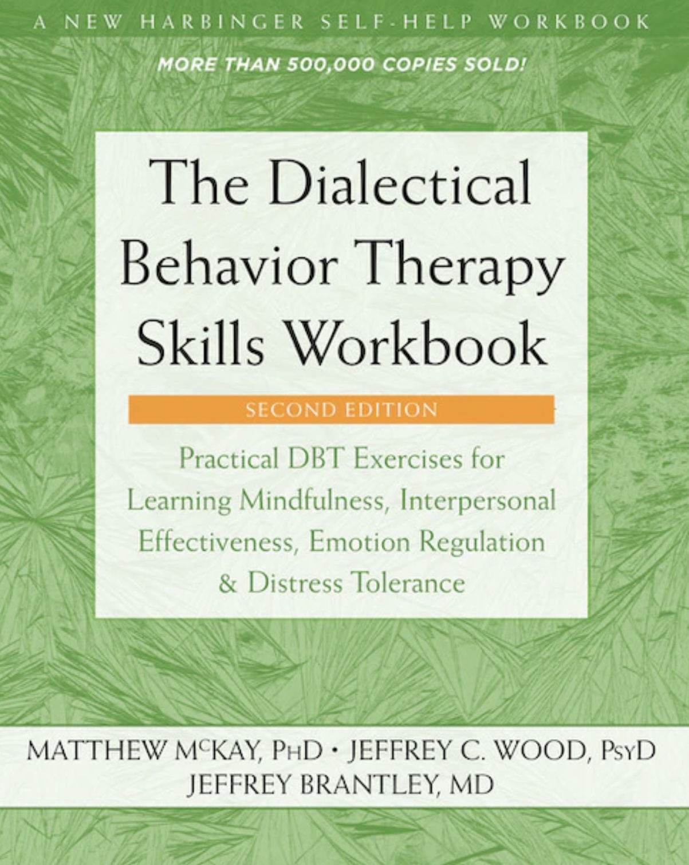


JOAN
NICOLE

Slide 100
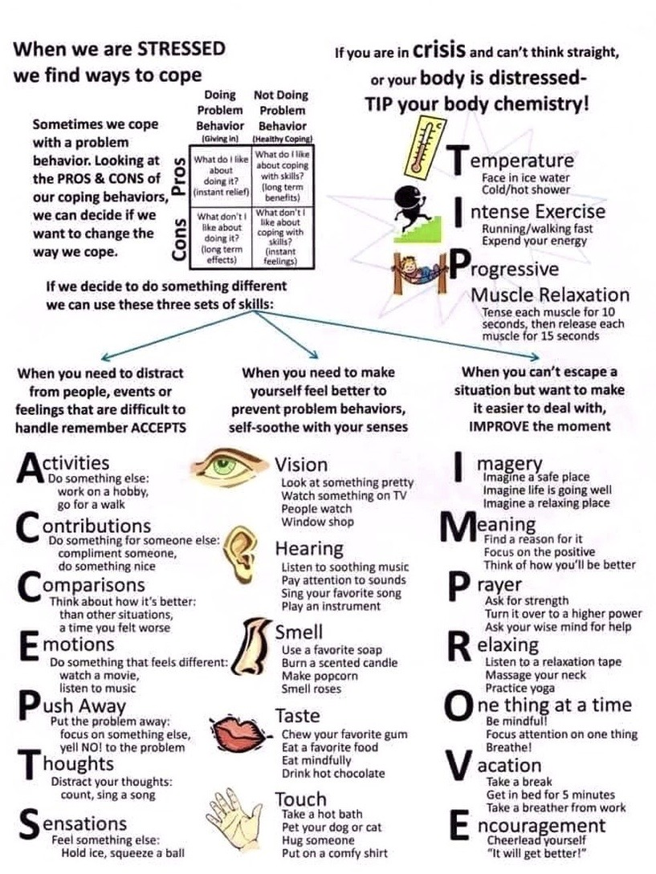
workbook p. 69-90 distress tolerance 5
Today is our last distress tolerance skills session
We’ll discuss the TIPPSE “physiological” distress tolerance skills. (physiological skills make you tippsy with an e)
TIPPSE=
1. T is for temperature,
2. I for intense exercise, (HIIT - high intensity interval training),
3. P for progressive muscular relaxation
4. P is for paced breathing
5. S is for side-to-side eye movement and
6. E is for emotional freedom technique
In the next skills session, we’ll start discussing mindfulness skills

Slide 101
UPDATED PERSONAL SKILLS LIST
Distress tolerance skills
Grounding skills- Set a daily intention
“ - Sensory soothing toolkit
“ -The 5,4,3,2,1 method
“ -The emotional freedom technique
REST (or PEST) Pause
Radical acceptance statements (please specify)
Distraction plan “
Self-soothing plan
Safe place visualization
Cue controlled relaxation
Rediscovering your values (please specify)
Rehearse values-based behavior or edit/splice/paste
Connect with your higher power “
14. Live in the present moment
15. Use self-encouraging coping thoughts
16. Radical acceptance
17. Use self-affirming statements
18. Balance feelings and threat
19. Create new coping strategies
20. Create an emergency coping plan
21. Box breathing
22. Cold temperatures
23. High intensity exercise
24. Progressive muscular relaxation
25. Paced breathing
26. Side to side eye movement.

Slide 102
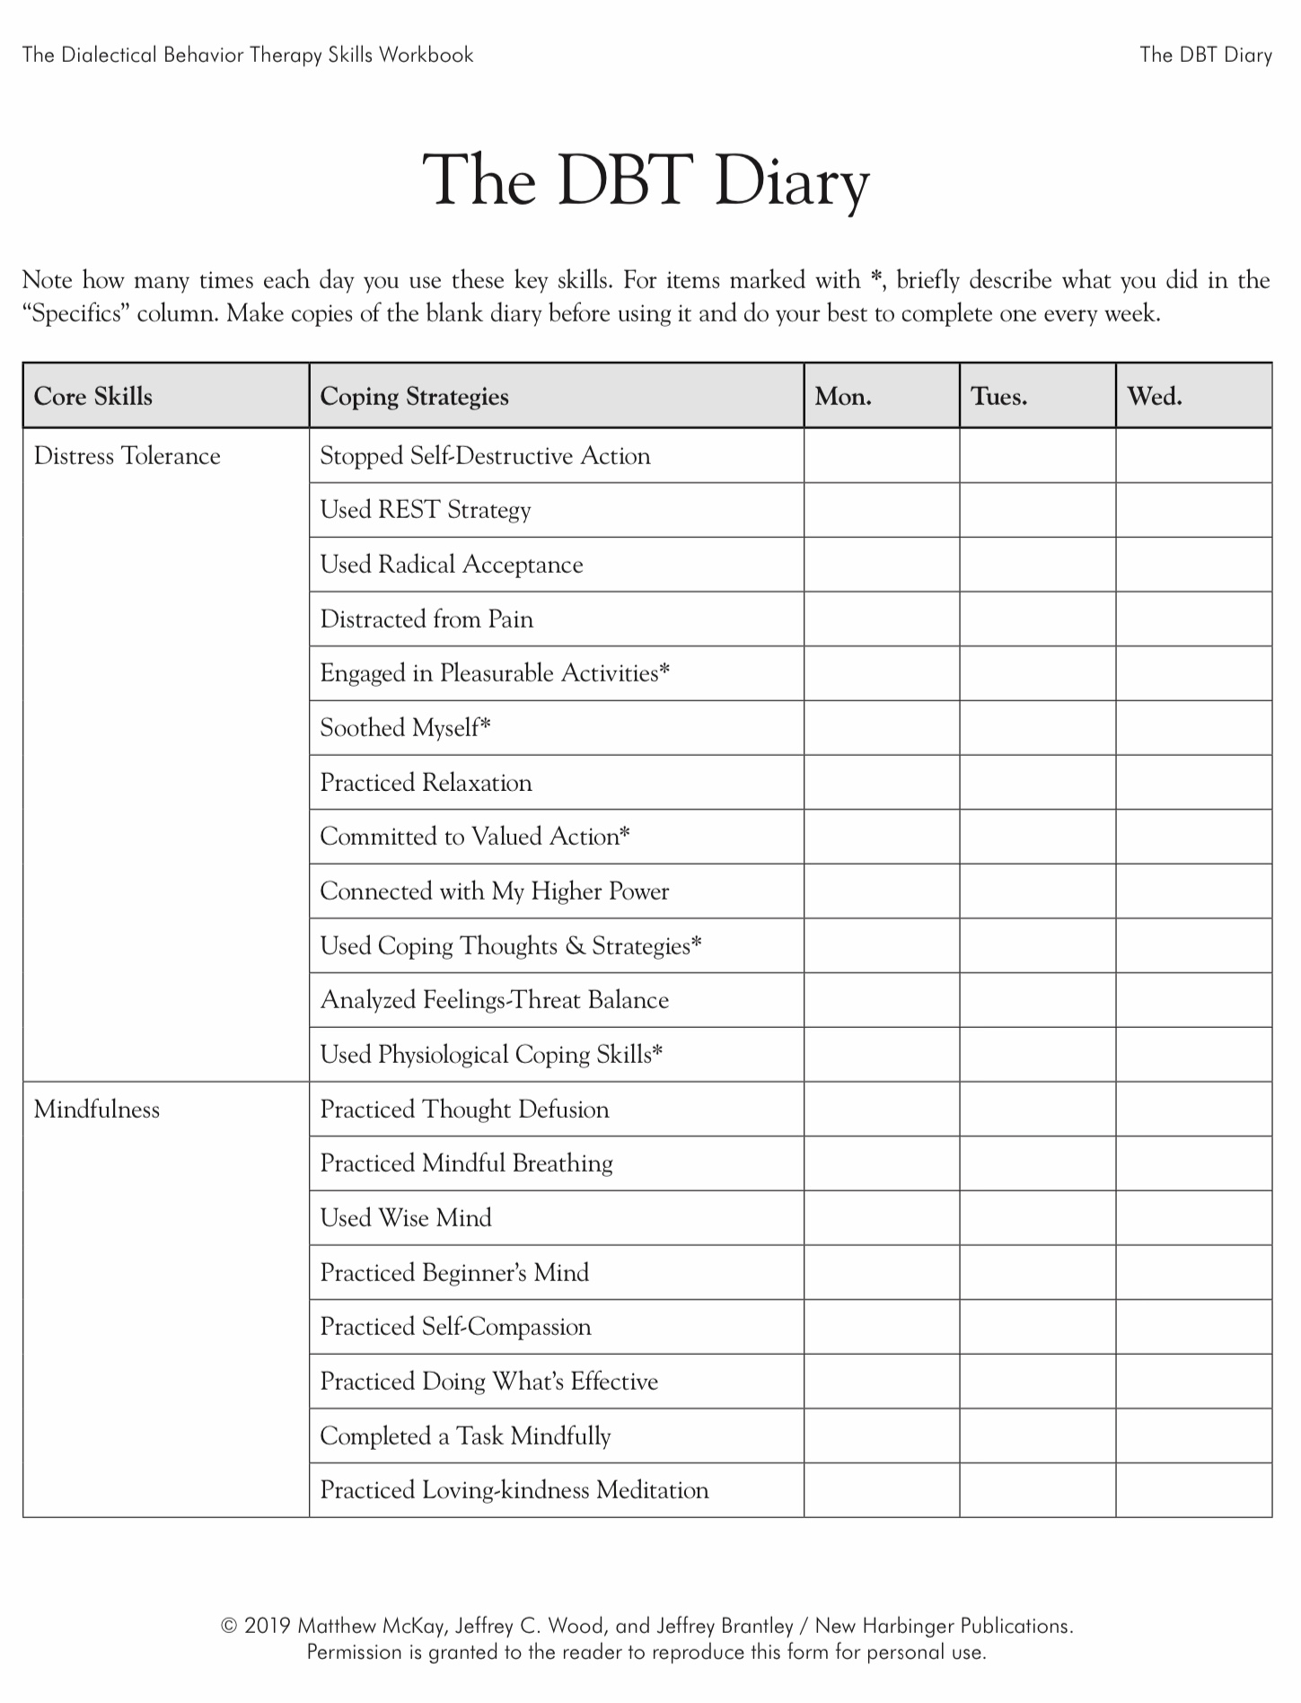
Today
X

Slide 103
THE DBT PHYSIOLOGICAL DISTRESS TOLERANCE SKILLS
When we’re overwhelmed, whether it’s panic, anger, shame, or a sudden spike of stress, our body often takes over long before our mind can catch up. In those moments, trying to “think your way out of it” usually doesn’t work. The emotional brain is too activated, the thinking brain is partially offline, and advice like “calm down” or “think differently” can feel impossible. That’s why DBT teaches a set of physiological distress tolerance skills.
These skills work directly with your nervous system, quickly shifting your body out of crisis mode so your mind can become available again. Think of them as “Emergency brakes” for your nervous system. They don’t solve the problem, but they help you get out of the emotional danger zone so you can then use your other coping skills.
These techniques don’t require insight, deep reflection, or perfect self-control. They rely on simple biological reflexes built into all of us. When you activate those reflexes, your heart rate drops, your breathing stabilizes, your muscles release, and your emotional intensity comes down.
These skills can help slow down racing thoughts, reduce panic or overwhelm, interrupting an urge to yell, shut down, self-harm, escape, shift from “survival mode” back into “thinking mode” and give you a moment of control when everything feels out of control
These skills are fast-acting, practical, and research-backed. They work not because you’re trying harder, but because they leverage your body’s built-in calming systems, your vagus nerve, your dive reflex, and your emergency energy systems.
You don’t have to master these skills immediately. Just knowing they exist, and practicing them a few times, gives you real tools you can use the next time your emotions suddenly surge.
Each one is simple. Each one works quickly and each one gives you a way to stay safe, grounded, and in control long enough to contemplate and respond rather than simply reacting.

Slide 104
Why are physiological skills so helpful?
they can quickly reduce the intensity of overwhelming emotions
they are biological in nature, easy to use and don’t require much thought
they trigger the parasympathetic relaxation response, which promotes a return to the window of tolerance

Slide 105
REMEMBER TO…
keep track of the skills that work best for you so you can use them
add a physiological coping strategy to your favorites list
be mindful of any medical issues that might impact your blood pressure, balance or heart rate

Slide 106
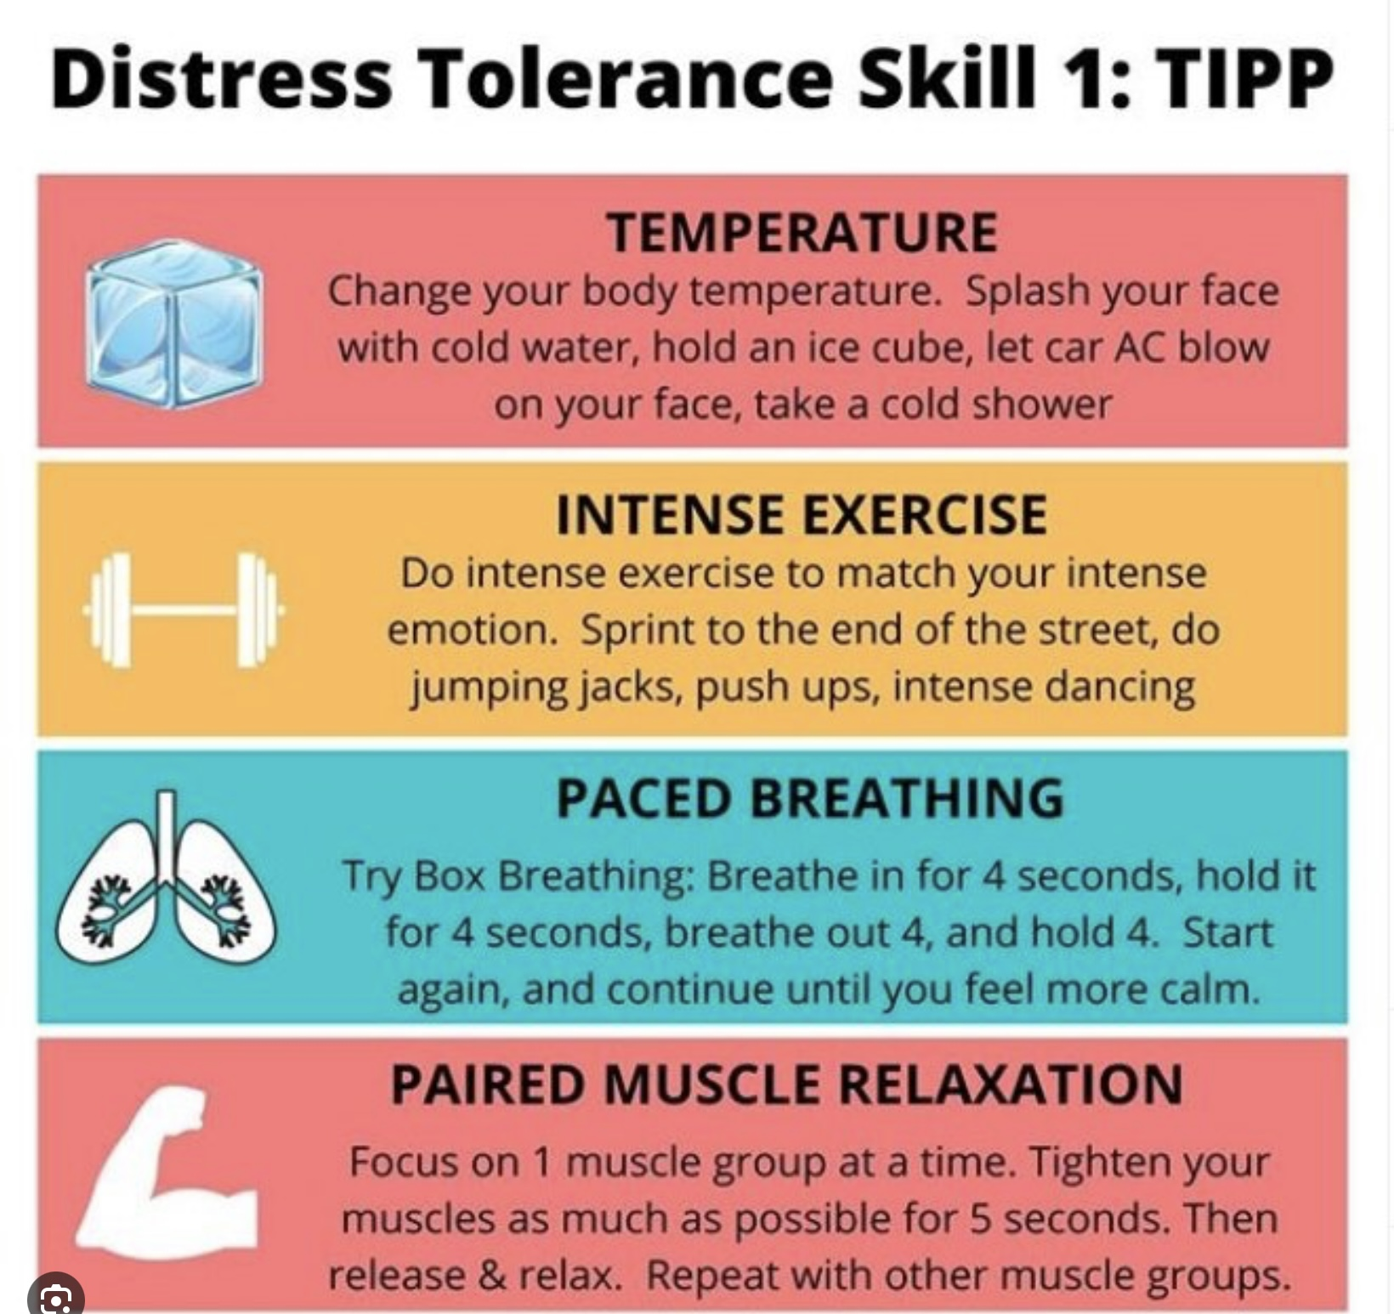
PHYSIOLOGICAL DISTRESS TOLERANCE SKILLS
S E
1. Using cold Temperatures
2. High intensity interval training
3. Paced slow breathing
4. Progressive muscular relaxation
5. Side-to-side eye movement
6. Emotional freedom technique/tapping

Slide 107
PHYSIOLOGICAL DISTRESS TOLERANCE SKILLS
S E
1. Using cold Temperatures
2. High intensity interval training
3. Paced slow breathing
4. Progressive muscular relaxation
5. Side-to-side eye movement
6. Emotional freedom technique/tapping

Slide 108

1. Using Cold temperatures
This technique activates the body's diving reflex. It is present in most mammals
The diving reflex allows us to conserve oxygen while under water by slowing our metabolism
To stimulate this reflex, submerge your face in very cold water.
This results in your heart rate slowing down
Alternatively, you can run your hands under cold water, take a cold shower, or use an ice pack

Slide 109
PHYSIOLOGICAL DISTRESS TOLERANCE SKILLS
S E
1. Using cold Temperatures
2. High intensity interval training
3. Paced slow breathing
4. Progressive muscular relaxation
5. Side-to-side eye movement
6. Emotional freedom technique/tapping

Slide 110

2.High-intensity interval training
Research has clearly demonstrated that exercise is an effective treatment for mild to moderate depression, anxiety, panic disorders and PTSD
Despite the proven benefits, many people experiencing mental health issues find it difficult to regularly engage in exercise
In HIIT you alternate between short intervals of high and low intensity exercise. HIIT has been shown to have equal benefits to exercising for longer periods of time
Can be an accessible strategy as you don’t need a gym and this technique can be applied to many types of exercises
Try the HIIT log on pages 76-77 of the workbook

Slide 111
PHYSIOLOGICAL DISTRESS TOLERANCE SKILLS
S E
1. Using cold Temperatures
2. High intensity interval training
3. Paced slow breathing
4. Progressive muscular relaxation
5. Side-to-side eye movement
6. Emotional freedom technique/tapping

Slide 112

3. PACED Slow breathing
The goal is to regulate the rate at which you breathe to help you relax
Your breathing rate directly influences your heart rate and nervous system
Inhalation causes our heart rate to speed up and exhalation causes it to slow down
It’s easy to confuse which should be longer the inhalation or exhalation. Find a way to remember think for example “save the best for last”
Count to 10 with each cycle of inhalation and exhalation. Count 1-4 for the inhalation, and 5-10 for the exhalation
It’s important that the exhalation be longer than the inhalation

Slide 113
PHYSIOLOGICAL DISTRESS TOLERANCE SKILLS
S E
1. Using cold Temperatures
2. High intensity interval training
3. Paced slow breathing
4. Progressive muscular relaxation
5. Side-to-side eye movement
6. Emotional freedom technique/tapping

Slide 114
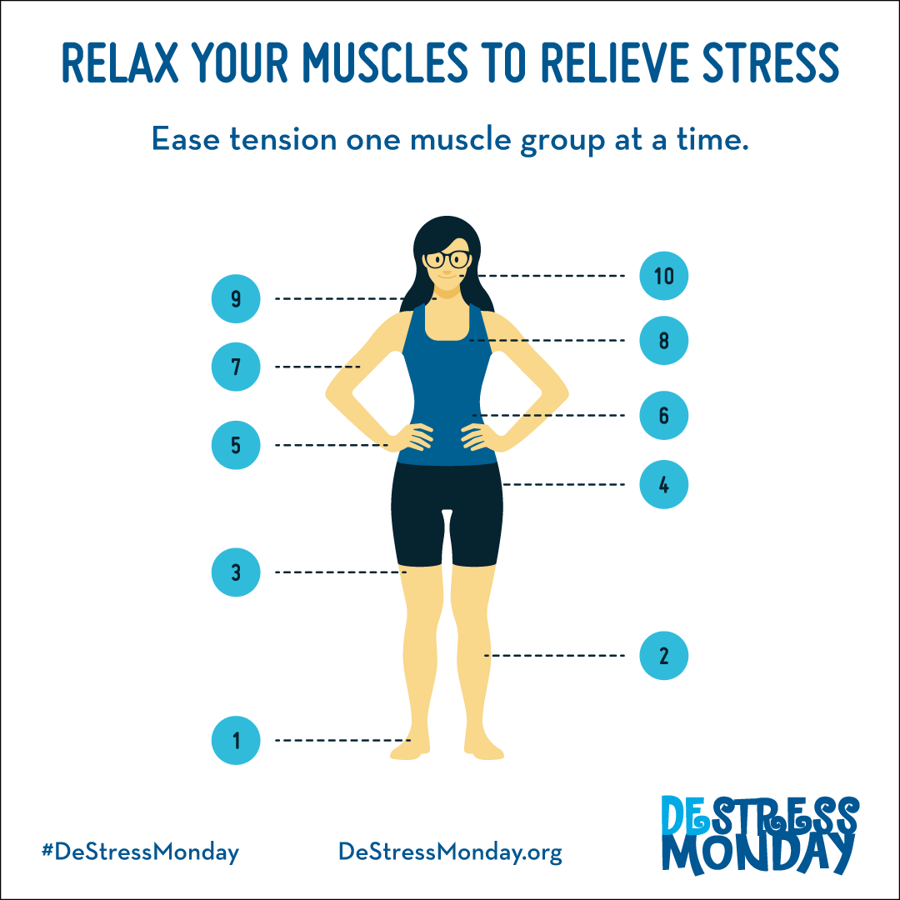
4. Progressive muscular relaxation
1. Requires systematically tightening and relaxing specific muscle groups to soothe anxiety
2. Typically, when we are experiencing anxiety or stress, we tighten our muscles
3. Emotional stress= muscle tension
4. Not only can progressive relaxation help with immediate distress, but it can also prevent future distress because muscles can’t be relaxed and tense at the same time
5. Dr. Wolpe created a short form of this technique by using cue words to train your muscles to release tension page 81-82
6. Tense muscles, release quickly, pause to notice sensations, repeat

Slide 115

Tensing muscles
There are 3 types of muscular tension choose the one that feels right for you
Active tension: tighten a groups of muscles until you notice the tension, then hold for 5 seconds, then relax
Threshold tension: A subtler version of active tension, tense muscles only to the point of barely noticing any tension. This may be helpful if you have muscular injuries
Passive tension: Requires you to notice tension in an area as opposed to creating tension in that area. Focus your thoughts on releasing the tension. ex. Think of tension melting away

Slide 116
PHYSIOLOGICAL DISTRESS TOLERANCE SKILLS
1. Using cold Temperatures
2. High intensity interval training
3. Paced slow breathing
4. Progressive muscular relaxation
5. Side-to-side eye movement
6. Emotional freedom technique/tapping

Slide 117
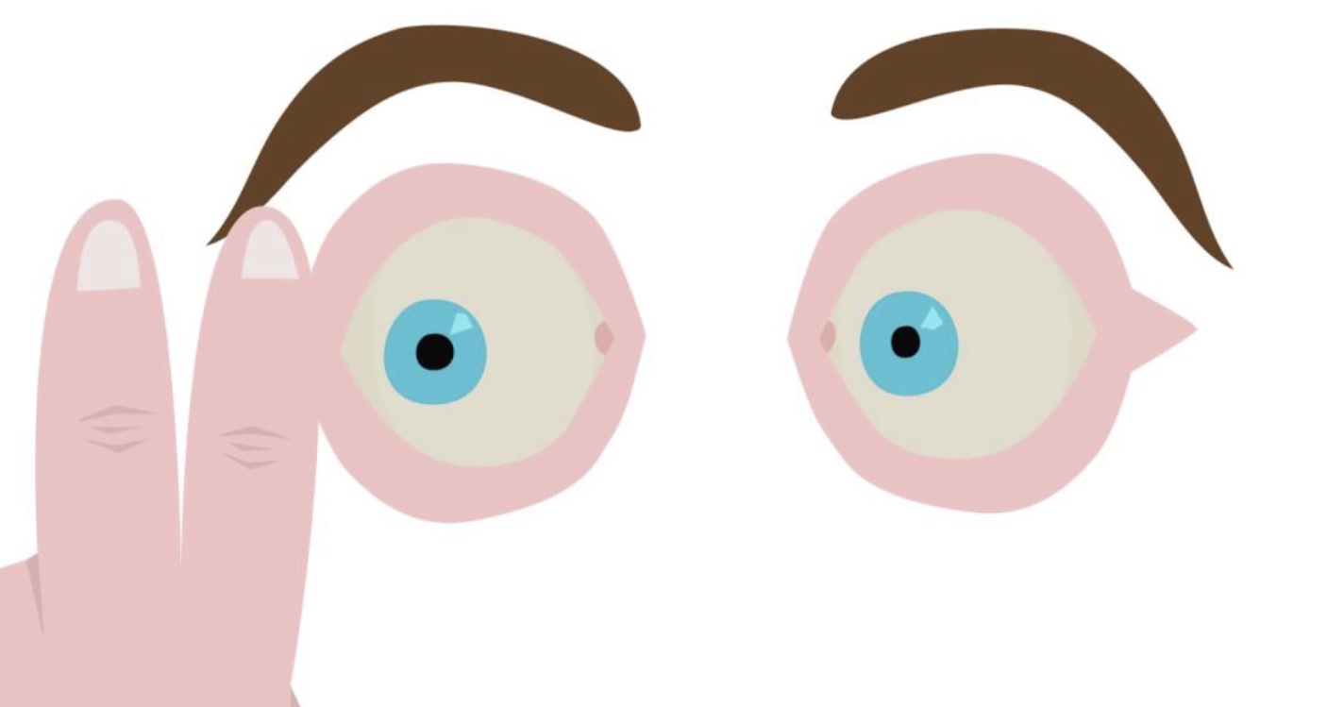
1. Side-to-side eye movement
Also known as bilateral stimulation
Is one of the components of EMDR (eye movement desensitization and reprocessing)
Requires you to move your eyes back and forth at a comfortable pace for 30 seconds
Research has shown that this technique helps reduce emotional distress and has a relaxing effect
You can practice this technique while recalling a mildly disturbing memory

Slide 118
WHAT IS EMDR?
EMDR stands for Eye Movement Desensitization and Reprocessing. It’s a therapy developed to help people heal from traumatic or overwhelming experiences.
When something very upsetting happens, the brain sometimes doesn’t process the memory properly. It gets “stuck” in its original form, with the same images, emotions, body sensations, and beliefs that were present at the time. That’s why reminders of the event can feel so intense, even years later. EMDR helps the brain finish the natural healing process that didn’t happen after the trauma.
How it works
1. You bring up a difficult memory, just enough so your brain knows what you’re working on.
2. At the same time, the therapist guides you through left-right stimulation
(usually moving their fingers back and forth for your eyes to follow, or tapping, or tones).
3. This left-right rhythm seems to activate the brain’s natural processing system, similar to what happens during REM sleep (the dreaming stage).
4. As the brain processes, the memory loses its “emotional charge.”
People often recall the same event later but feel calmer, more distant from it, and less triggered.
5. The therapist also helps you replace old negative beliefs (“I’m powerless,” “I’m unsafe”) with more accurate and helpful ones.

Slide 119
WHAT IS EMDR?
What EMDR feels like
Most people describe it as:
noticing the memory becoming less sharp or less painful
new insights popping up
body tension releasing
feeling more grounded and in control
What EMDR doesn’t do
It doesn’t erase the memory
It doesn’t hypnotize
It doesn’t require long descriptions of the trauma
Instead, it helps the brain digest the memory so it can be stored in a healthier way.

Slide 120
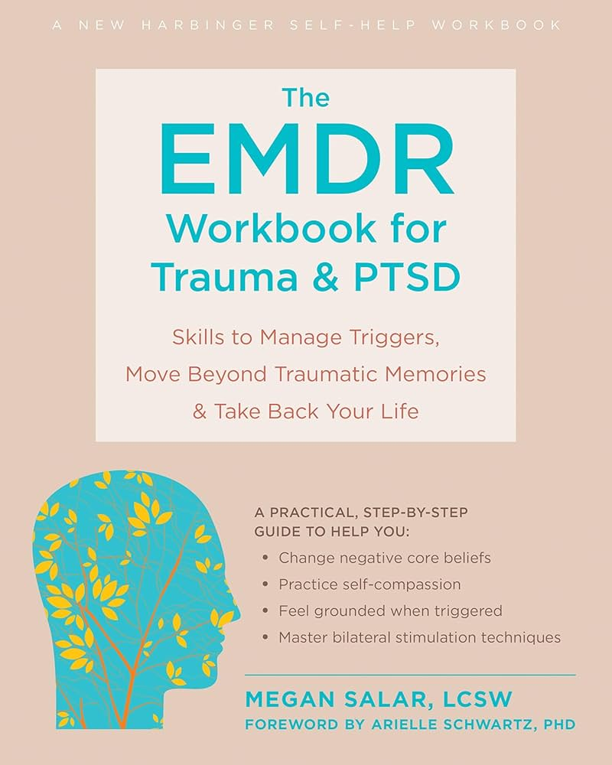

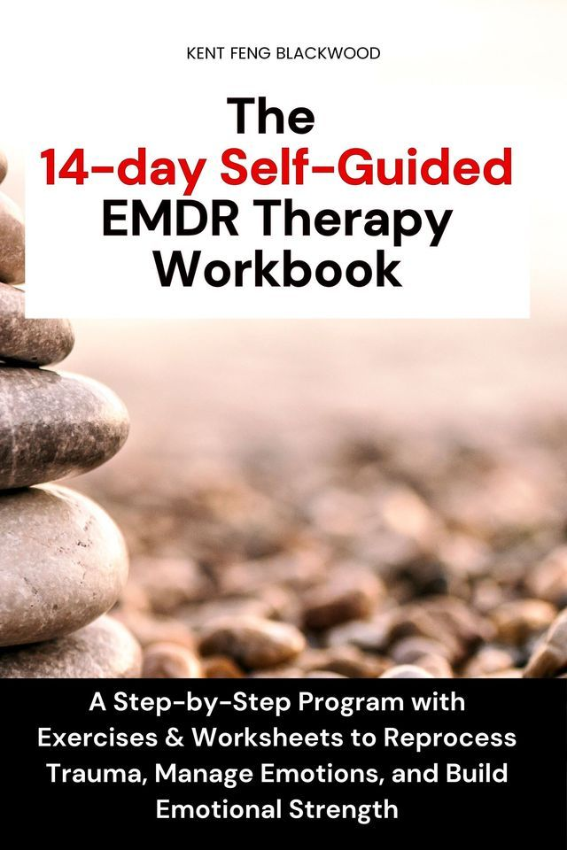
EMDR workbooks don’t teach you to do the full EMDR therapy by yourself, but they do guide you through safe, simplified versions of EMDR principles.

Slide 121
PHYSIOLOGICAL DISTRESS TOLERANCE SKILLS
1. Using cold Temperatures
2. High intensity interval training
3. Paced slow breathing
4. Progressive muscular relaxation
5. Side-to-side eye movement
6. Emotional freedom technique/tapping

Slide 122
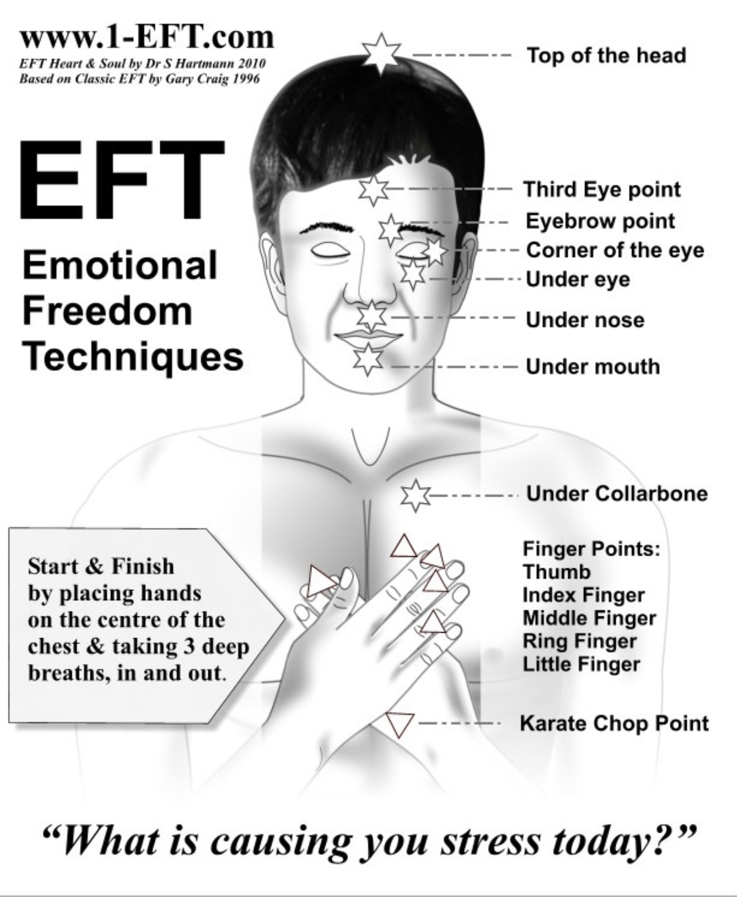
6. EMOTIONAL FREEDOM TECHNIQUE/TAPPING
Involves 6 steps:
1. Rate your emotional intensity level on a scale of 0 – 10
2. Prepare a "set up statement": "even though (your issue) a deeply and completely accept myself"
3. Say the statement out loud three times while tapping the karate point on your hand
4. Tap the other points starting from the top of your head and ending under your arms. Keep repeating your statement. For each point repeat the statement is 5 to 10 times
5. After one go through rate your emotional intensity level again.
6. Repeat the process until your score is down to 1.
There are many EFT videos on YouTube. Script can be found under week 7 mindfulness practice.

Slide 123

practice physiological skills and add them to your “skills toolkit” use them in your crisis plans or whenever you need to return to the window of tolerance
In 2 weeks, we start mindfulness skills…
PHYSIOLOGICAL SKILLS

Slide 124
SUMMING UP: DISTRESS TOLERANCE SKILLS
Over the past few weeks, we’ve explored the DBT distress tolerance skills designed to help you survive emotional storms without making things worse. These skills aren’t about fixing the problem, changing other people, or transforming long-term patterns. They are about getting you safely through the moment when you feel overwhelmed, flooded, or at risk of reacting in ways you may later regret.
Some important things to remember:
1. You don’t have to “think your way out” of every crisis. When emotions are intense, the thinking brain goes offline. Distress tolerance skills give you practical things you can do when logic, insight, and reasoning aren’t available. They are meant to be incorporated into a crisis plan.
2. These skills work with your body, not against it. Whether it’s cooling your face, using paced breathing, grounding your senses, or doing a short burst of movement, you’ve learned techniques that shift your nervous system out of crisis mode and into a calmer, more manageable state.
3. Distress tolerance skills create a pause, just long enough to choose. They don’t erase the emotion, but they lower the intensity so you can avoid harm, break old patterns, ride the wave rather than get pulled under it and make wiser decisions. That pause is the space where change becomes possible.

Slide 125
SUMMING UP: DISTRESS TOLERANCE SKILLS
4. You now have a menu of strategies you can reach for. You practiced:
• Physiological skills (temperature change, paced breathing, muscle relaxation, exercise)
• Distraction and grounding tools
• Self-soothing with the five senses
• Reality acceptance skills like radical acceptance, willingness, and turning the mind
Not every skill will work for every moment. That’s normal. The goal is to have options, a toolkit, not a single hammer.
5. These skills get easier and more reliable with practice. Like any muscle, the more you use them, the more automatic they become. Even short, imperfect practice counts. Over time, you’ll notice you’re catching yourself earlier, calming faster, and making choices that line up better with the life you want.
6. You deserve tools that help you through suffering. Distress tolerance doesn’t ask you to deny your pain, ignore your history, or suppress your emotions. Instead, it teaches you how to move through difficult moments with safety, stability, and self-respect.
Distress tolerance skills help you survive emotional intensity without self-sabotage so you can respond, rather than react, and move toward a life that feels more stable and more your own.

Slide 126
UPDATED PERSONAL SKILLS LIST
Distress tolerance skills
Grounding skills- Set a daily intention
“ - Sensory soothing toolkit
“ -The 5,4,3,2,1 method
“ -The emotional freedom technique
REST (or PEST) Pause
Radical acceptance statements (please specify)
Distraction plan “
Self-soothing plan
Safe place visualization
Cue controlled relaxation
Rediscovering your values (please specify)
Rehearse values-based behavior or edit/splice/paste
Connect with your higher power “
14. Live in the present moment
15. Use self-encouraging coping thoughts
16. Radical acceptance
17. Use self-affirming statements
18. Balance feelings and threat
19. Create new coping strategies
20. Create an emergency coping plan
21. Box breathing
22. Cold temperatures
23. High intensity exercise
24. Progressive muscular relaxation
25. Paced breathing
26. Side to side eye movement.

Slide 127



Slide 128
If time permits after Joan and Nicole present the physiological distress tolerance skills and Kate does the summary, we’ll try using the holes analysis cheat sheet and your holes diary card to practice a holes analysis.

Slide 129
algorithm
HOLES ANALYSIS
TEMPLATE
Find a higher than your baseline number on your holes diary to do a holes analysis
1. Map out the “topography” of the intensity of your activation around the time period for which you are doing the holes analysis. How did the intensity of your feelings, thoughts, and behaviors change over time?
2. On the holes analysis template, note in writing, if there were any events that were triggers for your increase in activation ?
3. Note in writing, on the template, the sequence of feelings you experienced during this period. Rate each on a scale of 0-10 with 10 being the most intense you’ve ever felt this feeling
4. Observe and note the physical sensations you experienced during the activation without judging or trying to change them
5. Note in writing, on the template, the thoughts that accompanied each of your feelings
6. Note what you did, or wanted to do but stopped yourself from doing during the period of activation
7. Note on a 0-10 scale what your energy balance, reserves or stores (how full your gas tank), and crisis risk were just prior to the time for which you’re doing the holes analysis.
Remember to stay in window of tolerance by pendulating
What was the topography of your activation?
Was there a trigger(s) for the activation?
What did you feel when activated ?
Notice the sensations in your body without judging or trying to change them
What thoughts were associated with each feeling listed above?
What behaviors or urges were associated with each feeling?
What was your energy balance before the activation? 0-10

Slide 130
DBT HOLES ANALYSIS TEMPLATE
What Happened? 2. Emotions Felt 3. Thoughts 4. Sensations 5. Behaviours/urges 6. pre-hole energy
☐ Tight chest
☐ Rapid heartbeat
☐ Shallow breathing
☐ Nausea
☐ Knot in stomach
☐ Sweaty palms
☐ Shaking
☐ Muscle tension
☐ Hot face / flushing
☐ Cold hands/feet
☐ Light-headedness
☐ Numbness
☐ Restlessness / agitation
☐ Other: ____
Describe the
situation factually.
☐ Anxiety / Fear
☐ Anger / Rage
☐ Irritation /
Frustration
☐ Sadness / Grief
☐ Shame
☐ Guilt
☐ Hurt
☐ Loneliness
☐ Embarrassment
☐ Overwhelm
☐ Numbness
☐ Other: ____
☐ I’m not good
enough.
☐ This is my fault.
☐ They are judging
me.
☐ Something bad
will happen.
☐ I can’t handle this.
☐ I’m going to fail.
☐ They don’t care
about me.
☐ I always screw up.
☐ Catastrophizing
☐ All-or-nothing
thinking
☐ Mind-reading
☐ Other: ____
☐ Withdrew / shut
down
☐ Lashed out
☐ Avoided /
escaped
☐ People-pleased
☐ Over-apologized
☐ Argued /
escalated
☐ Used substances
☐ Overate /
restricted
☐ Reassurance-
seeking
☐ Compulsive
checking
☐ Tried to control
☐ Self-harm
urges/actions
☐ Other: ____
☐ Very Low
☐ Low
☐ Moderate
☐ High
☐ Very High
☐ Contributing factors (describe):

Slide 131

OPEN DISCUSSION

Slide 132


See you next session

Slide 133
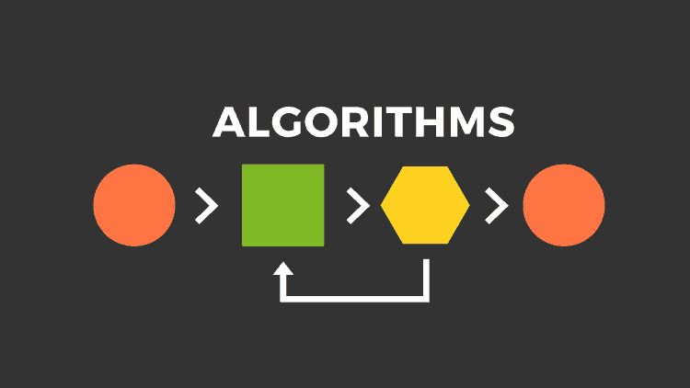
Crisis plan algorithm
Developing your crisis plans and becoming skilled at using them involves 8 steps: This is the first Simple algorithm.
1. Understand the concept of holes you keep falling into or the specific crisis for which you are going to use the crisis plans
2. Identify some of the thoughts, feelings or behaviors that occur during the crisis that you want to work on. This is step 1 on the crisis plan template.
3. Complete the rest of your crisis plan template
4. Recall, in your mind, a real crisis from the past in which you fell into the hole you are working on and use the "editing, splicing, and pasting" technique, along with your skills and tools, to imagine a different outcome that incorporates your crisis plan.
5. Stay in the window of tolerance while editing, splicing, and pasting by pendulating.
6. Repeatedly visualize the new edited, spliced, and pasted version of the situation until you can visualize it without effort.
7. When a new crisis occurs work with it following these same steps.
8. practice, practice, practice.

Slide 134
Notes:
A template is a structured form that helps you carry out the steps prescribed in the algorithm. There are many different crisis plans templates. This one is a compilation of some of the best features of other templates.

Slide 135
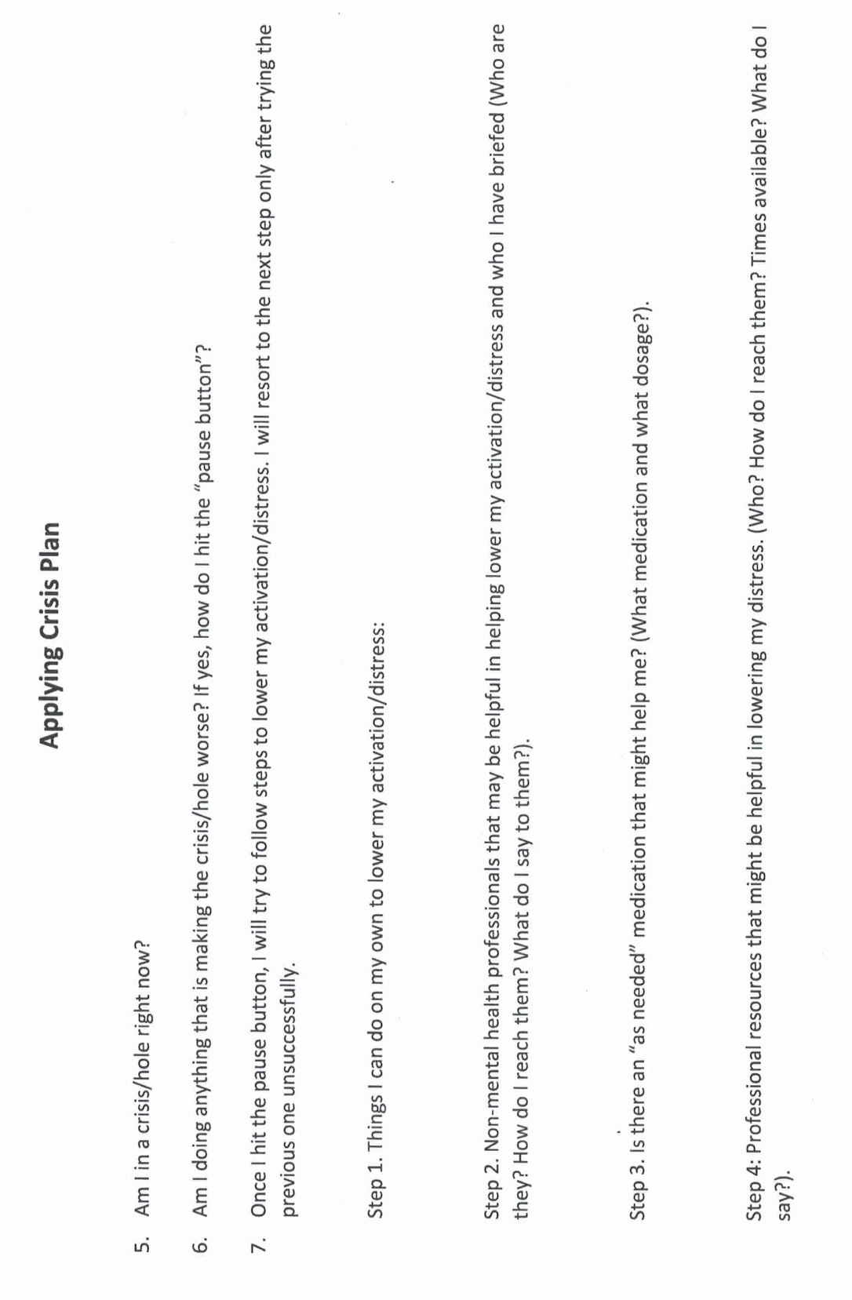

Slide 136
M T W T F S S
struggling.
4 3 6 2 3 10 9
sad.
5 4 7 1 2 8 7
withdrawing
9 8 6 6 5 10 10

Slide 137
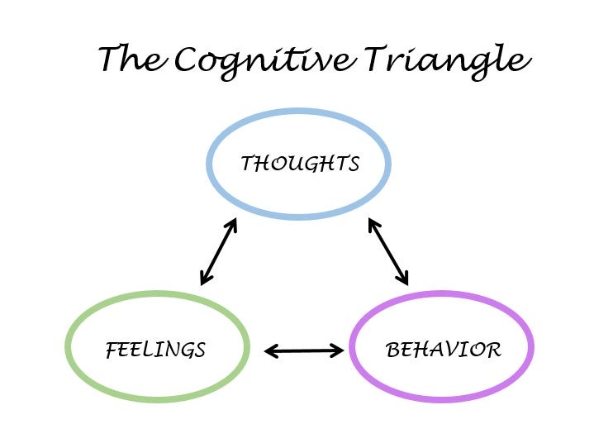
Diary card Targets
Like crisis plan holes, diary card targets can be:
1. Feelings: to help you identify your feelings consult the wheel of feelings (see below) which we also used in trying to identify crisis plan holes.
2. Thoughts: consider ANTS or automatic negative thoughts (below)
3. Behaviors: consult externalizing vs. internalizing behaviors (below}
4. Maladaptive coping strategies: are defined as coping strategies that in the short term decrease your distress but increase it over the long term. Ex. Substance use, self-harm, unhealthy eating.

Slide 138

Algorithm for finding intermediate targets
1. Think about a time when you have been in a hole or crisis, outside the window of tolerance, “lost it”, “struggled”, “felt bad”, “got into trouble”, or were very upset. (in other words, start with a beginner targets)
2. When this happened, what were your dominant feelings, thoughts, or behaviors? (use the wheel of feelings, thinking errors and ANTS, and the internalizing and externalizing behaviors slides to help you)
3. From these choose from 1 to 3 feelings, thoughts, or behaviors that you experience frequently, are problematic for you, and you want to change.
4. These are your intermediate targets.
Intermediate targets change over time so go through this same process occasionally especially if your life circumstances are changing.

Slide 139
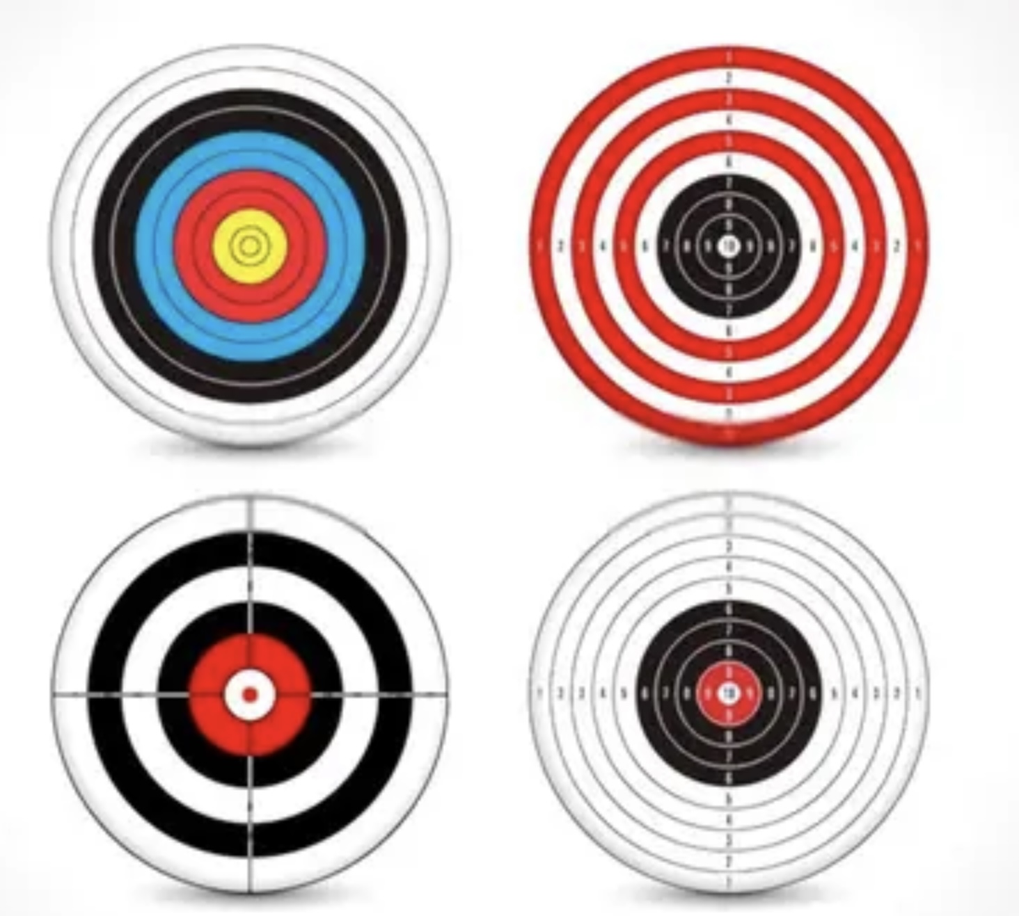
3 TYPES OF DIARY CARD TARGETS
There are beginner, intermediate, and advanced diary card targets. All the examples we have gave above are intermediate.
If you have trouble finding an intermediate target, use a “beginner target” in your diary card instead.
Beginner targets are more generic and catch-all than intermediate ones. They are easier to use than the more specific intermediate targets. Beginner targets include struggling, feeling bad, being upset, losing it, getting into trouble, or falling into a hole. Start with one of these.
We won’t discuss advanced targets until later in the course when we explore internal family systems part selves. If you don’t know what IFS is, don’t worry, we’ll get to it.

Slide 140

video
Week 8 of simple

Slide 141
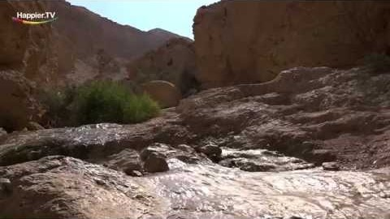

Slide 142
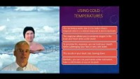

Slide 143
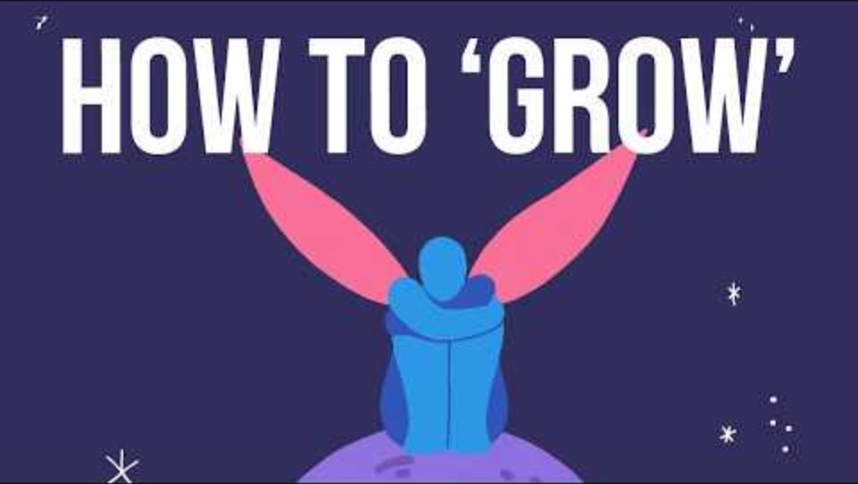

Slide 144
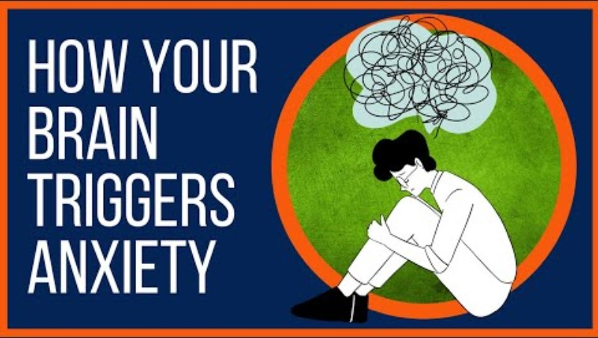

Slide 145
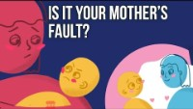
https://www.youtube.com/watch?v=bjMRgOmMRcY

Slide 146


Slide 147


Slide 148
