Slide 1

Welcome to week 11 of simple attachment THEORY
“ I forgive you for not being everything I needed you to be” Barb and her Higher Power

Slide 2
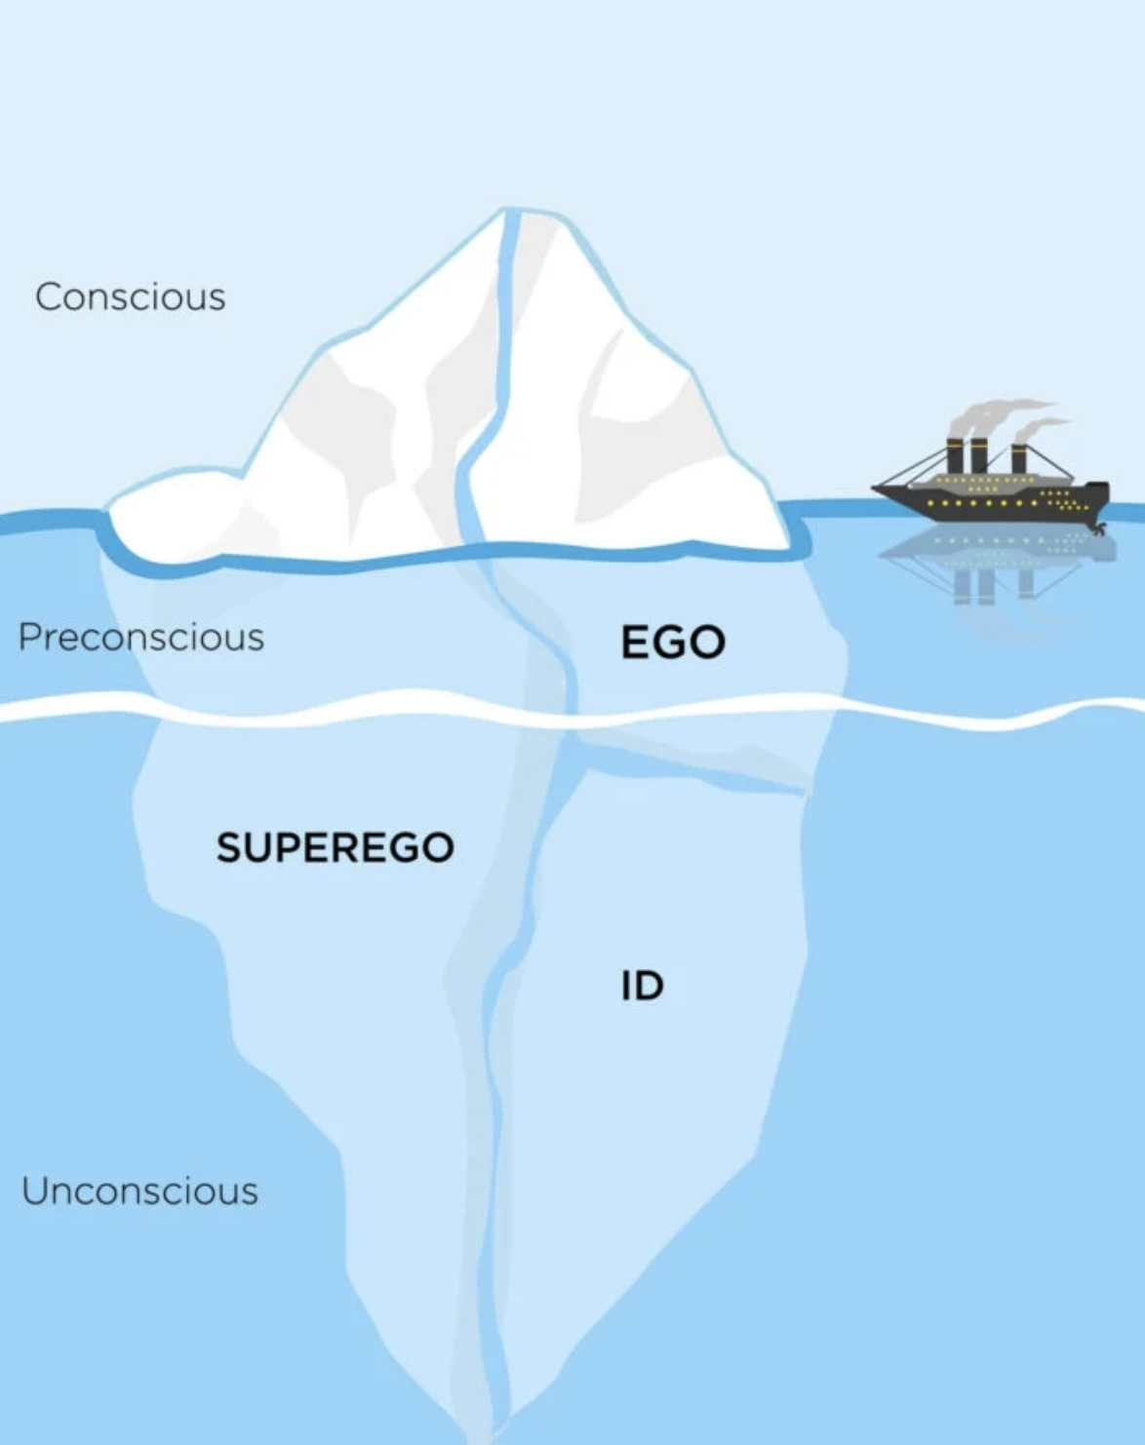


Slide 3
SIMPLE COURSE SCHEDULE 2025-26
Week 1- October 1
Week 2- October 8
Week 3- October 15
Week 4- October 22
Week 5- October 29
Week 6- November 5
Week 7- November 12
Week 8- November 19
Week 9- November 26
Week 10- December 3
Week 11- December 10
Week 12- December 17
December 24 and 31 no course
Week 13- January 7
Week 14- January 14
Week 15- January 21
Week 16- January 28
Week 17- February 4
Week 18- February 11
Week 19- February 18
Week 20- February 25
Week 21- March 4
March 11 and 18 no course
Week 22- March 25
Week 23- April 1
Week 24- April 8
Week 25- April 15
Week 26- April 22
Week 27- April 29
Week 28- May 6
Week 29- May 13
Week 30- May 20
Week 31- May 27
Week 32- June 3

Slide 4
week 1- orientation and overview- sessions 1 and 2 of simple manual. week 2- introducing distress tolerance-p. 1-13 of dbt workbook and crisis plans-session 3 of the manual. week 3- the theoretical foundations of the simple course. session 4, 6, and 8 of the manual. week 4- distress tolerance p. 14-32 of dbt workbook. suicide prevention session 5 of the manual. our first practice- crisis plans. week 5- distress tolerance p. 33-46 of dbt workbook. introducing holes diary cards- session 7 of manual. week 6- distress tolerance p. 47-68 of dbt workbook. finding your diary card targets- session 9 of manual. our second practice- holes diary cards. week 7- introducing personality- session 10 of manual. week 8- distress tolerance p. 69-90 of dbt workbook. introducing chain analysis-session 11 of manual. week 9- what shapes personality-session 12 of manual. week 10- Our third practice-holes chain analysis. Introducing mindfulness skills p.90-109 of dbt workbook. Advanced chain analysis- session 13 of manual. week 11- attachment theory- session 14 of manual. week 12- mindfulness skills p. 110-131 of dbt workbook. introducing rational mind remediation-session 15 of manual. week 13- the dynamic-maturational model of attachment and adaptation- session 16 of manual. week 14-mindfulness skills p. 131-147 of dbt workbook. reviewing all the tools-session 17 of manual. our fourth practice-rational mind remediation. week 15-stress-session 18 of manual. week 16-introducing emotion regulation skills p.148-182 of dbt workbook. introducing the goals diary card procedure-session 19 of manual.

Slide 5

Warning about meditation
Feel free to skip it. Followed by a moment of silence

Slide 6




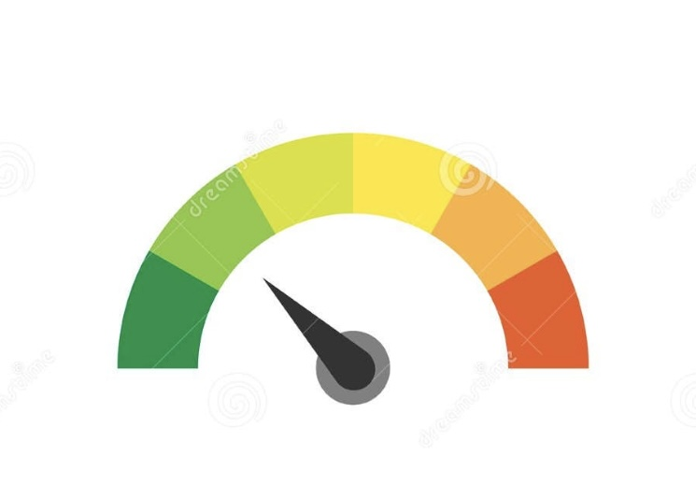
Check in regularly with your Personal dashboard
Spend a few moments checking in with yourself by asking:
1)What is the current risk that I’ll experience a state of crisis ?
Low b) Moderate c) high d) very high e) extreme
2) Am I in the window of tolerance?
a) Yes b) I’m a little outside c) very outside
3) Where is my energy tank right now?
Full b) ¾ c) ½ d) near empty
4) Have I been tracking my targets using the holes diary card ? how would I rate my targets right now?
5) How well am I focusing on what I’m doing. (for example, the course)
CRISIS RISK
WINDOW OF TOLERANCE
ENERGY RESERVES
RATING MY TARGETS
ATTENTION METER
% attention I’m paying
100
0

Slide 7
“SAFE HARBOR” MEDITATION
Begin by settling into a comfortable position…
Let your body soften…
And take a slow, steady breath in…
…and a long, gentle breath out.
Allow your eyes to close or soften.
1. The Ocean of Your Life
Imagine now that you are a small ship on a wide ocean.
The water stretches all the way to the horizon, calm and glistening in the light.
Feel the gentle rise and fall beneath you…
the rocking that reminds you that you are held by something larger than yourself.
Notice the sky above — open, spacious, and patient.
This ocean is the landscape of your life: your feelings, your needs, your hopes.
Allow yourself to float here for a moment…
Simply breathing with the sea.
2. Sensing the Weather
Now imagine that the weather around you begins to shift.
Not in a frightening way — just the natural changes of life.
A breeze becomes a wind…
Clouds gather…
Waves lift gently, then a bit more.
These changing conditions represent the ways you feel stress…
loneliness…
anxiety…
uncertainty…
or simply the need for comfort.
Notice that every ship, no matter how sturdy, encounters weather like this.
You’re not doing anything wrong.
Storms are part of being human.
3. Finding the Harbor
As the waves rise around you, look ahead and see a harbor.
It’s a place of refuge…
a place where you can turn inward, rest, and feel held.
This harbor represents safety —
the safety that others once gave you,
and the safety you can learn to give yourself.
Imagine guiding your ship gently toward this harbor…
The closer you come, the calmer the water becomes.
Lights appear along the entrance, soft and steady, like someone saying:
“Welcome home. I’m here.”
Let your ship glide into this safe space…
Feel the quiet…
Feel the anchoring…
Feel the exhale that comes when you know you can rest.

Slide 8
4. Anchoring in Safety
Now imagine dropping your anchor.
Hear the quiet sound of it touching the harbor floor.
Your ship becomes steady…
still…
supported.
Bring your attention to your body.
Where do you feel this anchoring?
Maybe in your chest…
your belly…
your shoulders…
Wherever you notice it, breathe into that place.
Allow yourself to feel what secure attachment feels like in this moment:
“I am allowed to seek safety.”
“I am allowed to rest.”
“I am worthy of protection and care.”
Let these words settle inside you like warm light.
5. The Inner Harbor
Now, gently imagine that the harbor you’re resting in isn’t just out there in the world.
It is also inside you.
You carry a harbor within your own heart —
a place where you can welcome yourself,
comfort yourself,
and hold your own storms with gentleness.
Take one last slow breath in…
and as you breathe out, feel that inner harbor become a little stronger…
a little more familiar…
a little more your own.
When you’re ready, softly open your eyes.
Bring this sense of steadiness with you into the rest of your day.

Slide 9


Slide 10
PRACTICE SESSIONS SCHEDULE
practice
4. Week 14 January 14 January 7, 1:30 Rational mind remediation Helga H.
5. Week 18 February 11 February 4, 1:30 goals diary card Nicole L
6. Week 25 April 15 April 8, 1:30 IFS workbook 1 Elaine S.
7. Week 26 April 22 April 15 IFS workbook 2 Dinko T.
8.Week 27 April 29 April 22 IFS workbook 3 Barb H.
9. Week 28 May 6 April 29 IFS workbook 4
10.Week 32 June 3 May 27 1:30 PM Wise mind remediation Rob T.
preparation
We still need a volunteer for the IFS practice May 6.

Slide 11

Homework FROM
LAST WEEK
Submit questions or comments to itssimple2023@gmail.com
Read Simple manual session 14
Do at least 2 advanced chain analysis In the next week
Continue reviewing and practicing your crisis plans and doing diary cards.
Continue tracking all the skills you’ve learned using your skills list
Review the homework habits checklist each week. If there’s an item you haven’t checked on the list consider setting a goal to do it(you don’t have to come to the homework group to do that)
Do the attachment style questionnaire.

Slide 12
Homework for the next week
Submit questions or comments to itssimple2023@gmail.com
Read skills training workbook p. 110-131.( for 1st edition and eBook readers please see next slide.)
Simple manual session 15
Do at least 2 advanced chain analysis In the next week
Continue reviewing and practicing your crisis plans and doing your holes diary cards.
Continue tracking all the skills you’ve learned using your skills list
Review the homework habits checklist each week. If there’s an item you haven’t checked on the list consider setting a goal to do it(you don’t have to come to the homework group to do that)

Slide 13

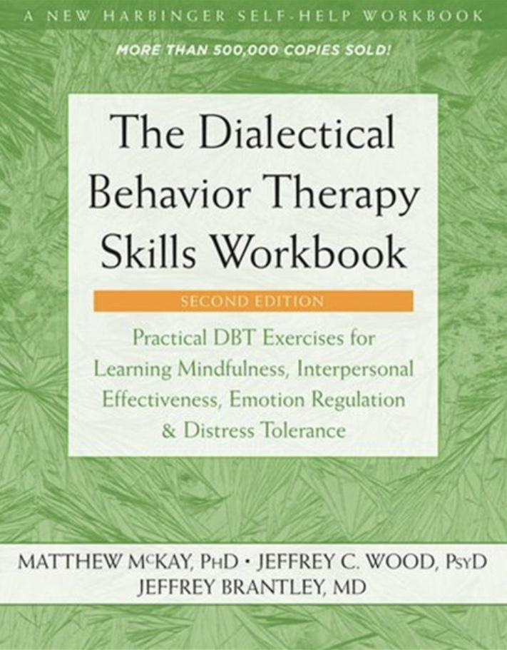
DBT Advanced Mindfulness skills
Skills training workbook Pages 110-131
Advanced mindfulness skills
1. Wise mind
2. How to make Wise mind decisions
3. Radical acceptance
4. Judgements and labels
5. Self compassion… and
6.Mindful communication

Slide 14
HOMEWORK HABITS CHECKLIST
Circle or check what you will try this week.
1. Preparation habits
■ I schedule a specific time for homework.
■ I choose a consistent location with minimal distractions.
■ I gather what I need ahead of time (notebook, worksheet, pen).
2. Focus & pacing habits
■ I start with a tiny step (2–5 minutes).
■ I use a timer (10–15 minutes).
■ I remove distractions (phone away / Do Not Disturb).

Slide 15
HOMEWORK HABITS CHECKLIST
3. Tracking & organization habits
■ I keep materials in one place (binder / folder / notebook).
■ I write down insights right after doing the homework.
4. Self-compassion habits
■ I aim for progress, not perfection.
■ I notice resistance without judgment.
5. Accountability habits
■ I review my week: What worked? What didn’t?
■ I share honestly with my buddy — even when I didn’t do it.
Micro commitment:
This week I will focus on: ■ Time ■ Place ■ Tiny step ■ Timer ■ Other please specify:

Slide 16
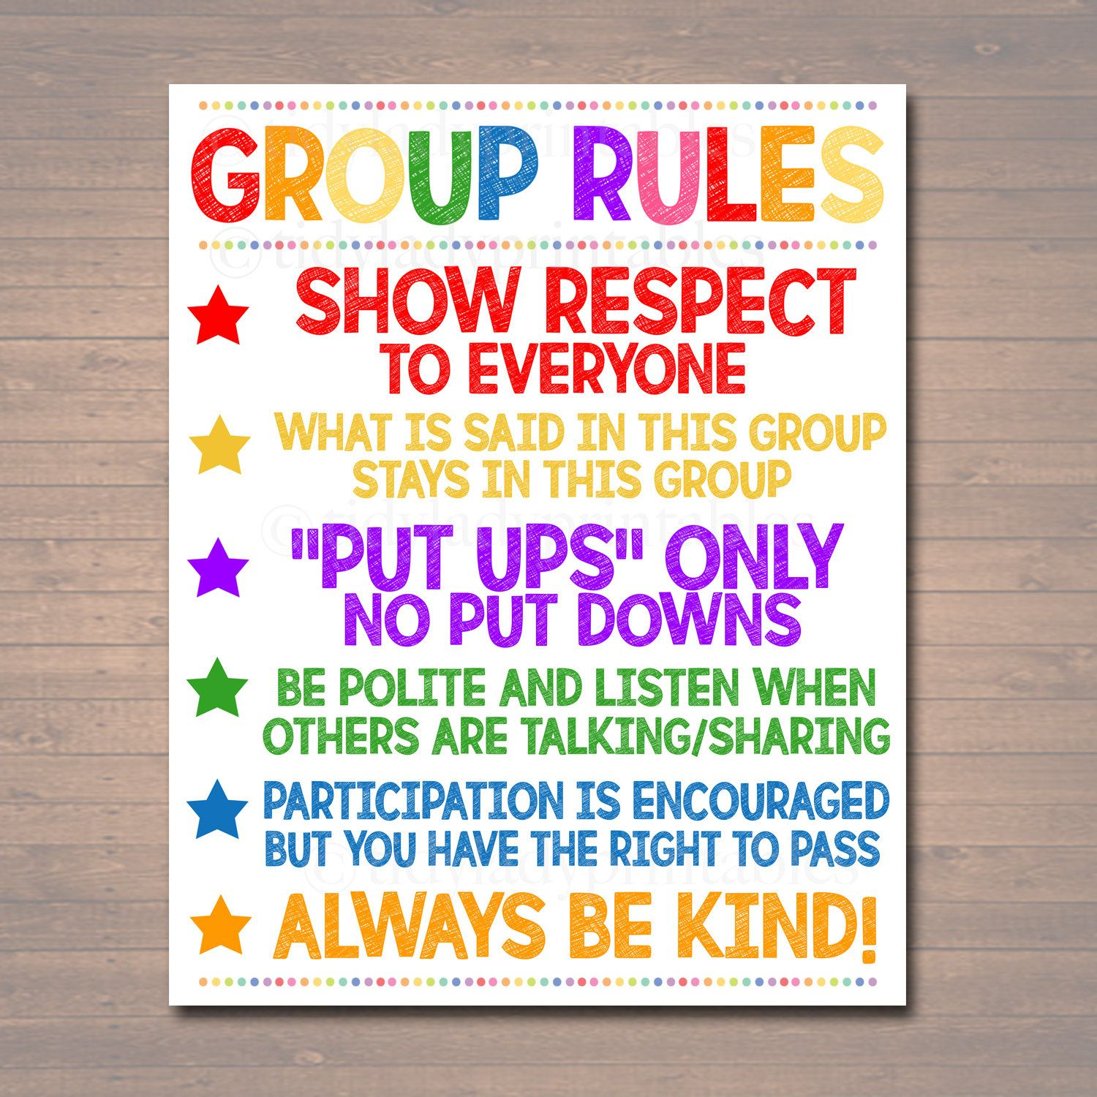
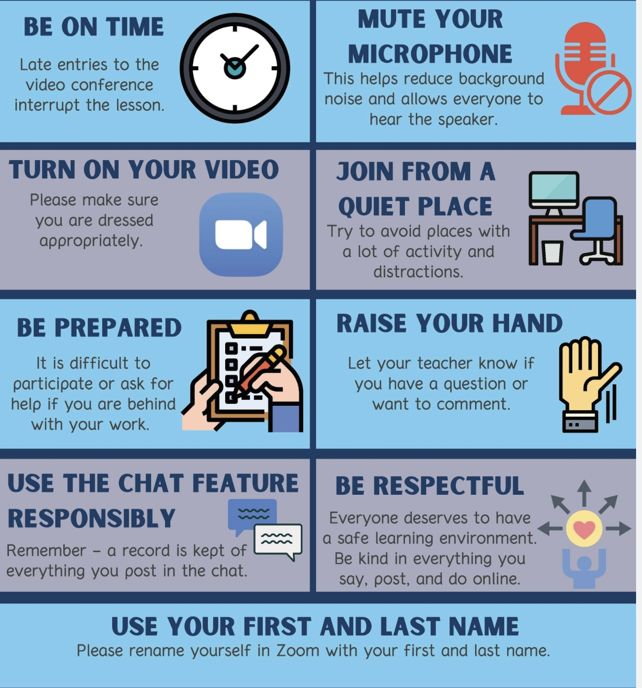
REMINDER PARTICIPANT AGREEMENTS
If you have questions, comments, or feedback, please save them for the two question periods. You can put them in the chat box or raise your real/virtual hand.
Keep comments, questions, and feedback relatively brief so everyone has a chance to participate.(one breath sharing)
If you’re on zoom, make sure no one can overhear what is being said
For reasons that will become clear later in the course please avoid giving advice to other participants about what they should or should not do. Validation, encouragement , and understanding are however very much appreciated.

Slide 17

We’re having a holidays get together
December 22, 12:30-2:30
Board room of Stratford family health team 444 Douro st. 2nd floor
Pizza and drinks provided.
There will also be a gift exchange. (crafts, poems and regifts encouraged)
email us at itssimple2023@gmail.
If you are doing the course on zoom and would rather do it in person there’s lots of room.
WEEKLY ANNOUNCEMENTS

Slide 18
HOLIDAYS GET TOGETHER DECEMBER 22, 12:30-2:30 RSVP’S
Helga
Lynn
Charlene
Patrick
Nicole
Manny
Paula + 1
Brittany
Lee
Dinko
Michelle
Jacqui

Slide 19
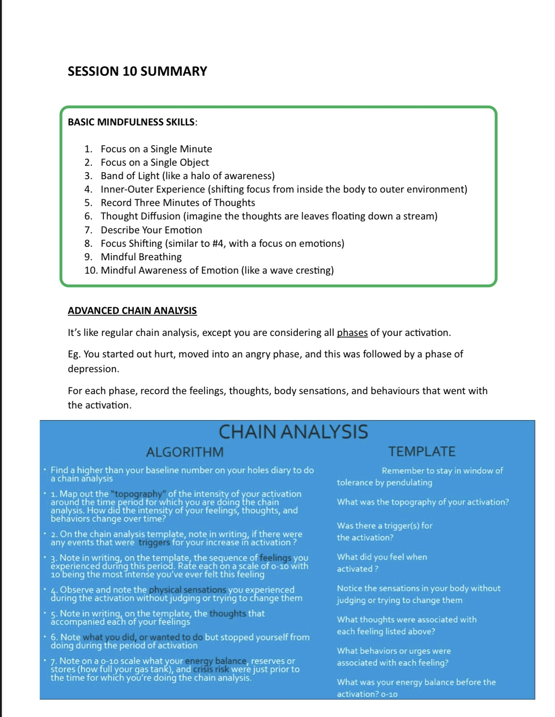

Slide 20

E-mailed questions, comments, feedback

Slide 21
SHOW OF HANDS
As always, we’ve had some very good questions this week. We try to address most questions that are asked. These question may interest one person or many people, so because our time is limited, going forward, we’ll read each question and ask for a show of hands ( in-person participants since it’s more difficult to do this with virtual participants) “who wants the answer read out loud?”. If at least half of the participants do, we’ll read it. If fewer than half do, but you want to read the answer, all the slides are on our website.
Note: The question today is so important that we’ll share it with everyone.

Slide 22
I’M STILL LIVING IN AN ABUSIVE RELATIONSHIP, IS THIS COURSE GOING TO HELP ME HEAL?
Yes this work may be even more important for those who are still living within difficult or abusive environments but the kind of healing possible must be understood realistically.
There are two kinds of healing: “Safety-Based” and “Self-Based”. In a perfect world, all trauma therapy would take place in environments that are physically and emotionally safe, but many people trying to heal cannot change their environment because of finances, disability, or unavoidable family obligations. So, we have to distinguish two types of healing:
A. Safety-based healing: This happens when the environment is stable and non-abusive. People can rebuild trust, experiment with vulnerability, and reorganize their nervous system with fewer external threats.
B. Self-based healing: This occurs even when the environment is imperfect or still triggering. Here, the focus is on regulating the nervous system in the moment, protecting vulnerable parts, building internal boundaries, not internalizing the behaviour of others, and staying in wise mind even when others are dysregulated.
Self-based healing is possible even when the environment is still hard. It often becomes a form of inner emancipation long before the person can create outer emancipation.
It’s natural to fear that if the abuse is still you cannot heal but trauma is not only what happens to you, it’s also what happens inside you now in response. Even if the original “abuser” is still present, or even if the patterns replay in new relationships, you can still heal your relationship to yourself. The most important shift is from automatic activation to curiosity about the activation, and from absorbing the other person’s behaviour to recognizing whose energy belongs to whom.

Slide 23
This means that while your external behaviour might not change right away, your internal world can change dramatically. When that happens you no longer absorb blame or shame. You see the abuser’s behaviour as a result of their psychological issues rather than a verdict about your worth. You can then assert healthy boundaries without turning them against yourself and you may eventually feel empowered to change your situation when feasible. This is not “full healing” but it is the beginning of healing and sometimes the most crucial part.
Erikson teaches us that humans develop through eight stages. Trauma interrupts these stages, but they can be revisited later in life. Even in an abusive household, a person can practice autonomy, build identity separate from the family, experience small acts of initiative, cultivate industry, competence, pleasure, and mastery, access intimacy or trust through friendships, partners, or group spaces and experience generativity by caring for their own selves. You can be actively re-running the missing developmental stages within their own nervous system, even if their environment is not ideal. This is profound developmental repair.
That your old patterns repeat themselves in new relationships doesn’t mean that nothing is changing. Repetition with partners or other figures is extremely common but the meaning shifts as healing progresses. At first the repetition is unconscious and you automatically activate. Later you’ll become more aware of the patterns and make them targets for change. You begin to notice the patterns earlier, soothe yourself better, communicate more clearly, choose different responses, refuse harmful dynamics and eventually choose different partners or patterns entirely. In other words, the pattern may still happen, but your relationship to the pattern transforms.
When the abuse continues as you’re trying to heal, the course can help regulate your nervous system, reduce self-blame and shame, build internal boundaries, reduce automatic reactivity, create strategic distance internally, even when physical distance isn’t yet possible, give hope, clarity, orientation, and agency and lay the groundwork for eventual change.
You cannot force a mother or partner to change, you may not be able to escape an actively dangerous environment or fully heal trauma that is still being inflicted daily. You can however stay safer internally and prepare yourself to make clearer, safer, more empowered decisions externally. This is very significant healing work.

Slide 24
I HAVEN’T HAD ANY CONTACT WITH MY FAMILY FOR THREE YEARS. I’M TORN ABOUT IT, BUT I FEEL I NEED TO PROTECT MYSELF FROM THEM. I RECENTLY HEARD ABOUT FAMILY ESTRANGEMENT. CAN YOU TELL US MORE ABOUT IT?
Great question but to answer it will be helpful if we’ve first talked about attachment so, let’s come back to it at the end of the session.

Slide 25
The homework buddy system is meant to support your learning, not add pressure. It’s perfectly normal for a pairing to need a reset, to adjust expectations, or even to come to a graceful close. To keep the process healthy for both people, I invite each pair to have a brief check-in using the following script:
Buddy Check-In Script (2–3 minutes each)
1. “Is this arrangement still working for me?”
2. “Do I feel heard, respected, and supported?”
3. “Am I able to give roughly what I receive?”
Each buddy takes a turn answering these questions honestly but kindly. If either person feels the arrangement is not the right fit, you can say something like: “I’ve enjoyed working with you, but I think I need to make a change in how I approach the homework. This isn’t about you, it’s about finding the support structure that works best for me right now.” Or “I’m noticing I’m not able to give this partnership the attention it deserves. I think it’s kindest if we shift out of the buddy arrangement for now.” This is not a rejection, it’s practicing healthy boundaries and good self-care.
2. A Simple Checklist for Healthy Buddy Partnerships. Each partner can privately rate the following items (Yes / Sometimes / No):
Communication
• □ I feel comfortable speaking honestly with my buddy.
• □ My buddy communicates clearly and respectfully.
• □ We both show up prepared for our check-ins.
Balance
• □ We both get roughly equal time to talk.
• □ Neither person becomes the “therapist” or the “patient.”
• □ We both take turns offering and receiving support.
Emotional Safety
• □ I feel heard, not judged.
• □ I don’t leave the interactions feeling drained or anxious.
• □ There is no pressure to overshare or to minimize my needs.
Practical Fit
• □ Our schedules match enough that meetings aren’t stressful.
• □ The format (phone/Zoom/text) works for both of us.
• □ The level of structure feels right for both of us.
Overall
• □ This partnership supports my growth.
• □ I would choose to continue with this person.
If two or more items are consistently marked “No,” it may be a sign to renegotiate or step away.
⸻
3. Language for Ending or Restructuring Gracefully
Offer these as templates they can use:
If it’s a mismatch of needs/availability
“I’m realizing our schedules or styles aren’t lining up as well as I’d hoped. I think it’s best if I shift how I do my homework, but I’ve appreciated our connection.”
If they need a different kind of support
“I’ve noticed I need a different rhythm or structure for my homework than what we’ve been doing. Thank you for the time you’ve shared with me.”
If there’s no problem, just a preference
“This has been helpful, and I’m grateful. I think I’m going to try working independently or in a different format for now.”
If they want to continue but with new boundaries
“I’d like to keep working together, but I realize I need shorter calls / more structure / less emotional intensity. Would that work for you?”
⸻
4. Framing for the Group (Optional Script to Read)
Here’s a brief message you can tell the group:
“The purpose of a homework buddy is to support your learning—not to create obligation. Healthy relationships include honest check-ins and the freedom to renegotiate.
If the buddy arrangement works, fantastic. If it doesn’t, ending it kindly is not a failure; it’s good boundary work and part of developing Wise Mind.”

Slide 26
Emotional Safety
• □ I feel heard, not judged.
• □ I don’t leave the interactions feeling drained or anxious.
• □ There is no pressure to overshare or to minimize my needs.
Practical Fit
• □ Our schedules match enough that meetings aren’t stressful.
• □ The format (phone/Zoom/text) works for both of us.
• □ The level of structure feels right for both of us.
Overall
• □ This partnership supports my growth.
• □ I would choose to continue with this person.
If two or more items are consistently marked “No,” it may be a sign to renegotiate or step away.
If it’s a mismatch of needs/availability you can say something like “I’m realizing our schedules or styles aren’t lining up as well as I’d hoped. I think it’s best if I shift how I do my homework, but I’ve appreciated our connection.” or “I’ve noticed I need a different rhythm or structure for my homework than what we’ve been doing. Thank you for the time you’ve shared with me.” or “This has been helpful, and I’m grateful. I think I’m going to try working independently or in a different format for now.”
If you want to continue but with new boundaries you might say something like “I’d like to keep working together, but I realize I need shorter calls / more structure / less emotional intensity. Would that work for you?”
The purpose of a homework buddy is to support your learning, not to create obligation. Healthy relationships include honest check-ins and the freedom to renegotiate. If the buddy arrangement works, fantastic. If it doesn’t, ending it kindly is not a failure; it’s good boundary work and part of developing Wise Mind.

Slide 27
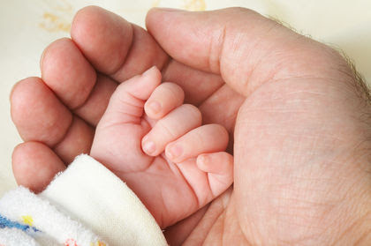
Review and preview
So far, we’ve talked about the evolution of the emotional, rational and wise minds…
Personality classifications, theories, and development…
Temperament - psychological and biological theories…
Character - parenting styles: authoritative, authoritarian, permissive, and uninvolved and how they affect personality development…
Today we’ll talk about attachment theory and how attachment plays a critical role in the shaping of personality.
Remember that attachment is an instinct, it’s part of our biological hardware. Like any instinct, it gets shaped by the environment we grow up in. Today we’re going to look at how this built-in attachment system is shaped by our earliest relationships, and how those early experiences influence the patterns of how we relate to others that we carry into adulthood.

Slide 28

What are the origins of attachment theory?

Slide 29

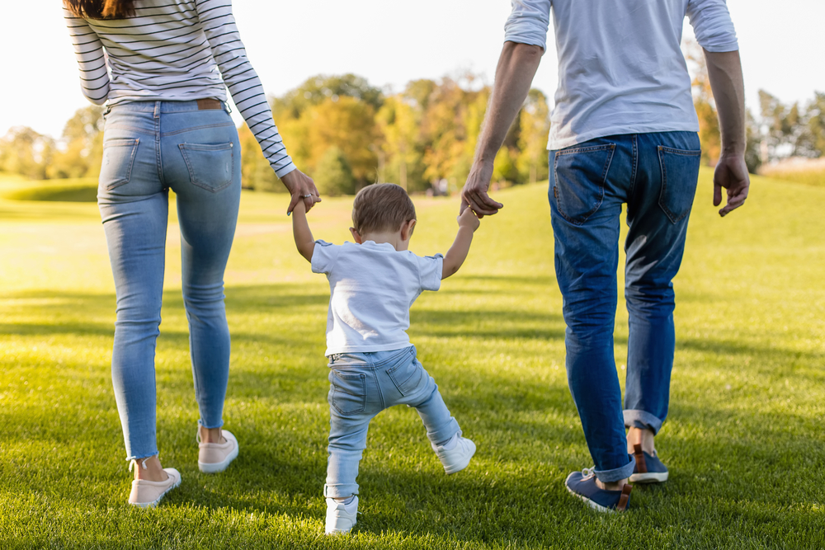
Attachment in infancy and childhood
Notes:
Attachment plays a huge role in psychological health. If you will recall along with seeking/avoidance, sexuality, fight or flight, and play it is one of the human instincts that underpin emotions. To understand how important a role attachment plays in our emotional well-being let's explore its story.

Slide 30
EARLY 20TH CENTURY BELIEFS ABOUT CHILD UPBRINGING
In the early 20th century, the idea that infants only needed physical nourishment (food, hygiene, warmth) to grow into healthy adults dominated psychology and medicine. Paying attention to children’s emotional and psychological needs was thought to be unimportant and even damaging. This belief was rooted in several interwoven historical, cultural, and scientific currents.
Behaviorism as espoused by John B. Watson, and B.F. Skinner dominated early 20th century psychology. Behaviorists emphasized observable behavior and downplayed inner emotional or unconscious processes. John Watson argued against expressing affection to children, fearing it would create dependency and weakness. In his book Psychological Care of Infant and Child (1928), he famously advised parents to avoid hugging and kissing their children too much. Infants, in this view, were shaped primarily by reinforcement, rewards and punishments, not by emotional bonds.
Sigmund Freud emphasized the importance of early childhood in the formation of personality but focused more on the child’s internal drives, like libido or aggression, than on relational needs in infancy. While Freud acknowledged mother-infant relationships, he believed that for the most part infants loved their mother because she satisfied their hunger.
In the late 19th and early 20th centuries, many infants in orphanages and hospitals were cared for physically but received little emotional or physical affection. The high mortality rates in these institutions were attributed to disease and hygiene, not to emotional neglect. Infants were often kept in clean but sterile environments and separated from caregivers to avoid infection, a practice that further deprived them of human contact.
In Victorian and early 20th century Western societies, emotional restraint and early independence were considered virtues. Excessive mothering was feared to produce weak, overly dependent children. Love was often seen as a harmful indulgence.
Before the mid-20th century, there was little scientific study on the emotional development of infants or the consequences of maternal deprivation. Without evidence to the contrary, physical care was considered sufficient.

Slide 31
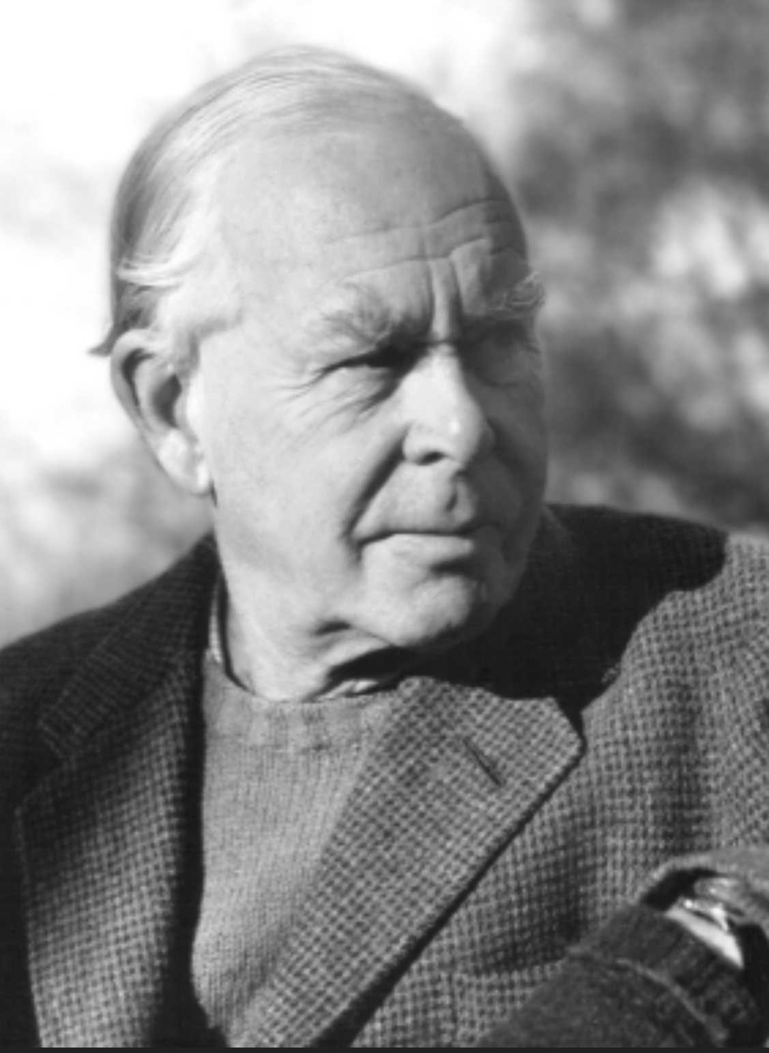
Edward John
Mostyn Bowlby
John Bowlby was born in 1907 into an upper middle class British family. His father, Sir Anthony Alfred Bowlby, was a baronet and surgeon to King Edward VII. Sir Anthony had lost his own father when he was 5 years old.
Because of his work, Sir Anthony lived in court with his wife, and the couple spent very little time with their children, who were raised by nannies.
When he was 4 years old John Bowlby’s beloved nanny left the family. Later he would describe this event as a traumatic loss. At age 7 Bowlby was sent to a boarding school. He saw this as a great source of emotional suffering later writing: “ I wouldn’t send a dog away to boarding school.”
In 1922 Bowlby, aged 15, enrolled in medical school. Later he underwent psychoanalytical training completing it in 1937. Bowlby thought relationships were critical in the development of personality. This challenged conventional Freudian thinking which focused almost exclusively on the fantasy life of the child. Because of his beliefs, he was not a good fit with his orthodox training analyst Joan Riviere.
In 1936 he begun working at the London child guidance clinic where, from among his patients, he studied a series of 44 juvenile delinquents. In 1940 he published a paper entitled “44 juvenile thieves, their characters and home life” in which he postulated a connection between early parental deprivation and a “criminal character”.
The idea that there might be a connection between childhood conditions and delinquency was, in Bowlby’s time widely rejected. In 1946, Bowlby went to work at London’s Tavistock Clinic, home to Anna Freud and Melanie Klein two of the world’s most renown psychoanalysts.
Bowlby transformed his own pain into a framework that helped the world better understand the needs of children.
Notes:
John Bowlby, a British child psychiatrist, made a huge contribution to our understanding of attachment and because of this has come to be known as the father of attachment. His biography gives an indication why he was interested in this subject.

Slide 32
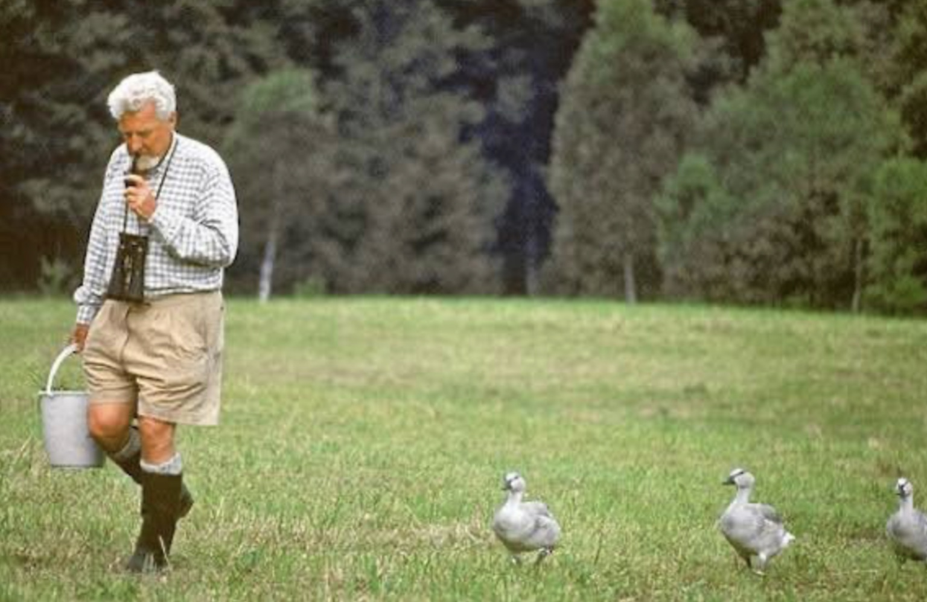
Bowlby’s “attachment theory” drew from several sources.
He was familiar with ethologist’s Konrad Lorenz’s work on imprinting in geese and began to think that a similar process occurred in human infants.
Psychoanalyst René Spitz working with institutionalized infants was also at this time documenting the severe emotional and developmental disturbances he saw in babies deprived of maternal care, even if they received adequate physical care.
In the 1950s Harry Harlow was conducting groundbreaking research with rhesus monkeys demonstrating among many other things that infant monkeys preferred soft, comforting surrogate mothers over wire ones that provided food, highlighting the primacy of contact comfort over nourishment.
INFLUENCES ON BOWLBY
Imprinting, as Lorenz described in geese, is a rapid, early-life learning process in which goslings form a strong attachment to the first moving object they see, often their mother, but in his experiments, sometimes Lorenz or his students.

Slide 33
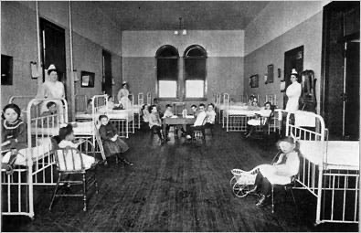
Maternal deprivation
Bowlby was also influenced by Harry Edelston, a British psychiatrist who was very concerned about the effects of hospitalizations on children. Common practice at that time was that parents were not allowed contact with their children during the hospitalizations. This was thought important in preventing the transmission of infections, and maintaining order.
Edelston thought this practice, significantly harmed children’s mental health especially if hospitalizations were prolonged and involved painful procedures. The medical community rejected this idea. They focused on children’s physical needs and were oblivious to their emotional ones.
Incensed at this state of affairs, Bowlby hired James Robertson, a social worker, who was passionate about changing the traditional children hospitalization practices.
In 1952 Bowlby and Robertson made a film “ a two-year-old goes to hospital” which finally got their message through and led to reforms to the system, eventually allowing parents unlimited access to hospitalized children.
Among his many books and articles Bowlby wrote a trilogy that cemented his legacy: “ Attachment and loss” Volume I “Attachment”, Volume II “Separation” and Volume III ”Loss-sadness and depression”

Slide 34


Slide 35

Bowlby realized that the commonality between the 44 juvenile delinquents he studied and the children that had been harmed by hospitalizations was that they had both endured a significant period of "maternal deprivation" (at that time mothers were the primary caregivers- Today we’d call this parental deprivation or neglect)
Bowlby, drawing on his own personal experience, realized that parents and children formed a lasting psychological connection which he named attachment.
Bowlby came to believe that attachment served the evolutionary purpose of keeping the infant close to the mother, thus improving the child's chances of survival. He also believed that the earliest bonds formed by children with their caregivers have a tremendous impact on personality and well-being that lasts throughout an individual’s life.
Bowlby defined the attachment instinct as the capacity for connection with others that is present at birth in every normal human baby, and that is shaped by early experience with caregivers. He argued that attachment styles established by age two determine how individuals relate to others and to the world for the remainder of their lives
MATERNAL DEPRIVATION

Slide 36
Were there other important figures that contributed to attachment theory?

Slide 37
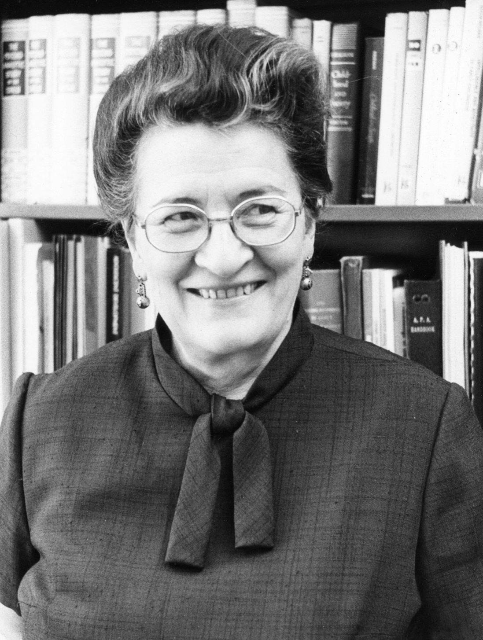
MARY AINSWORTH
Mary Ainsworth’s (1913 – 1999) contribution to attachment theory was as important as Bowlby’s. Whereas Bowlby was more of a theoretician, Ainsworth was an experimenter.
Ainsworth was born in the USA but moved to Canada at a young age. She was close to her father but not to her mother.
She began studying psychology at the University of Toronto in 1929 at age 16.
In 1942 she joined the Canadian Army and was stationed in Kitchener; she rose to the rank of major.
After discharge from the army, she taught at the University of Toronto where she met her future husband. She followed him to England and then to Uganda where he completed his PhD training and did research in psychology. Although she was far more accomplished than he, she made many personal sacrifices to advance his career. They later divorced.
During her time in London, she answered an ad and was hired by Bowlby to do research on attachment. They became lifelong collaborators.
In Uganda she got a small grant and set out to study how mother’s behavior impacted children’s developing personality. To do this she observed the behavior of mothers and their children in a small rural village.
To study attachment, she developed the “strange situation” scenario which demonstrated attachment in the real world and allowed research into it.
In 1975 she took an academic post at the University of Virginia where she remained for the rest of her career.

Slide 38
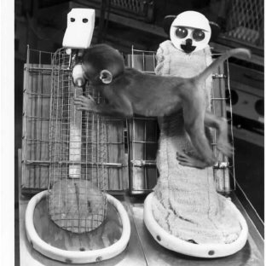
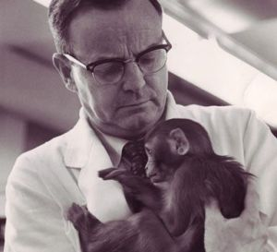
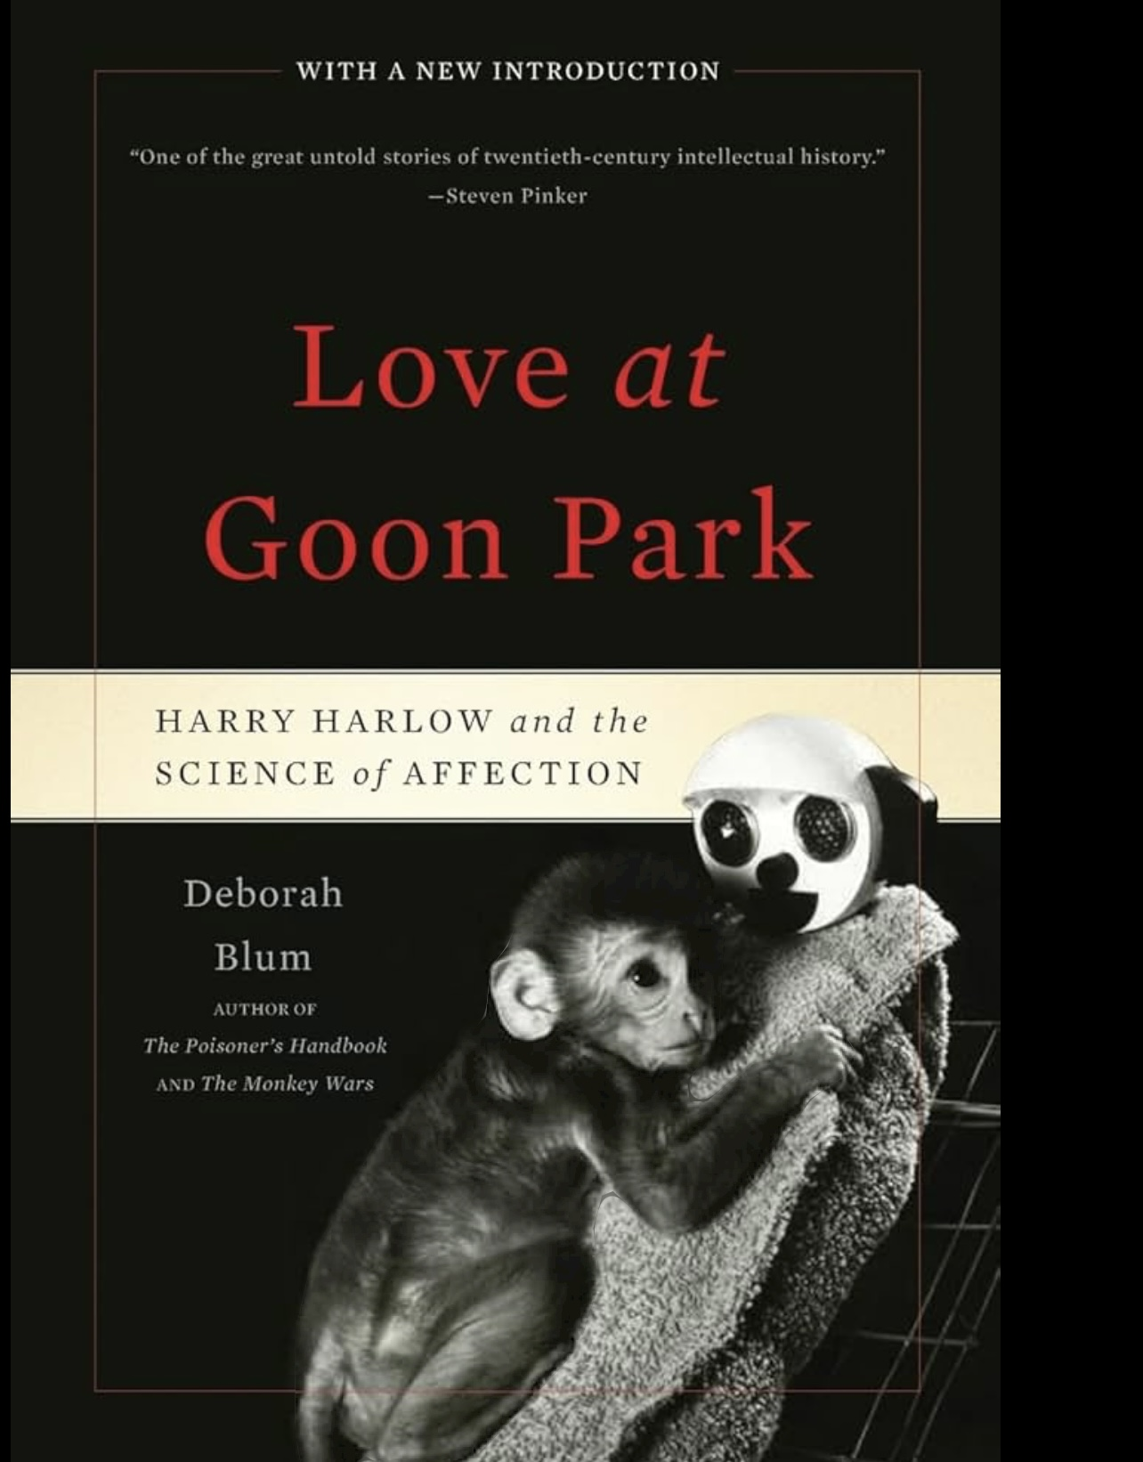
Ainsworth's observations of Ugandan mothers parenting and its effects on the psychosocial development of their children was inspired by Harry Harlow's work with rhesus monkeys.
Harlow noticed that the type of parenting his monkeys received greatly affected their ability to learn, and to adapt socially. This observation inspired him to carry out the experiments for which he is famous in which he raised his monkeys under a series of different conditions including with 1) their mother 2) with a cloth “mother” 3) with a wire mesh more. These conditions clearly impacted the monkey's psychosocial development with those raised with a real mother being the best and those raised with the wire mesh the least well adjusted.
Notes:
Harry Harlow initially intended to study learning in monkeys. To do this he needed to breed and raise monkeys. Doing this he quickly of parenting his monkeys greatly affected their ability to learn, and to adapt socially. This observation inspired him to carry out the experiments for which he is famous in which he raised his monkeys under a series of different conditions including 1) their mother 2) with a cloth “mother” 3) with a wire mesh more. These conditions clearly impacted the monkeys psychosocial development with those raised with a real mother being the best and those raised with the wire mesh the least well adjusted.
Ainsworth was familiar with Harlow’s work. Working in a small rural village in Uganda she saw that children were also more or less well socially adjusted and began to study how the quality of the mother’s care affected the children.
Ainsworth needed a way to classify the children’s adjusted and in a flash of inspiration devised the “strange situation” which despite its simplicity reveals an enormous amount about the child’s psychosocial development and adjustment.

Slide 39
What is Ainsworth’s “strange situation” that demonstrates attachment in the real world?

Slide 40
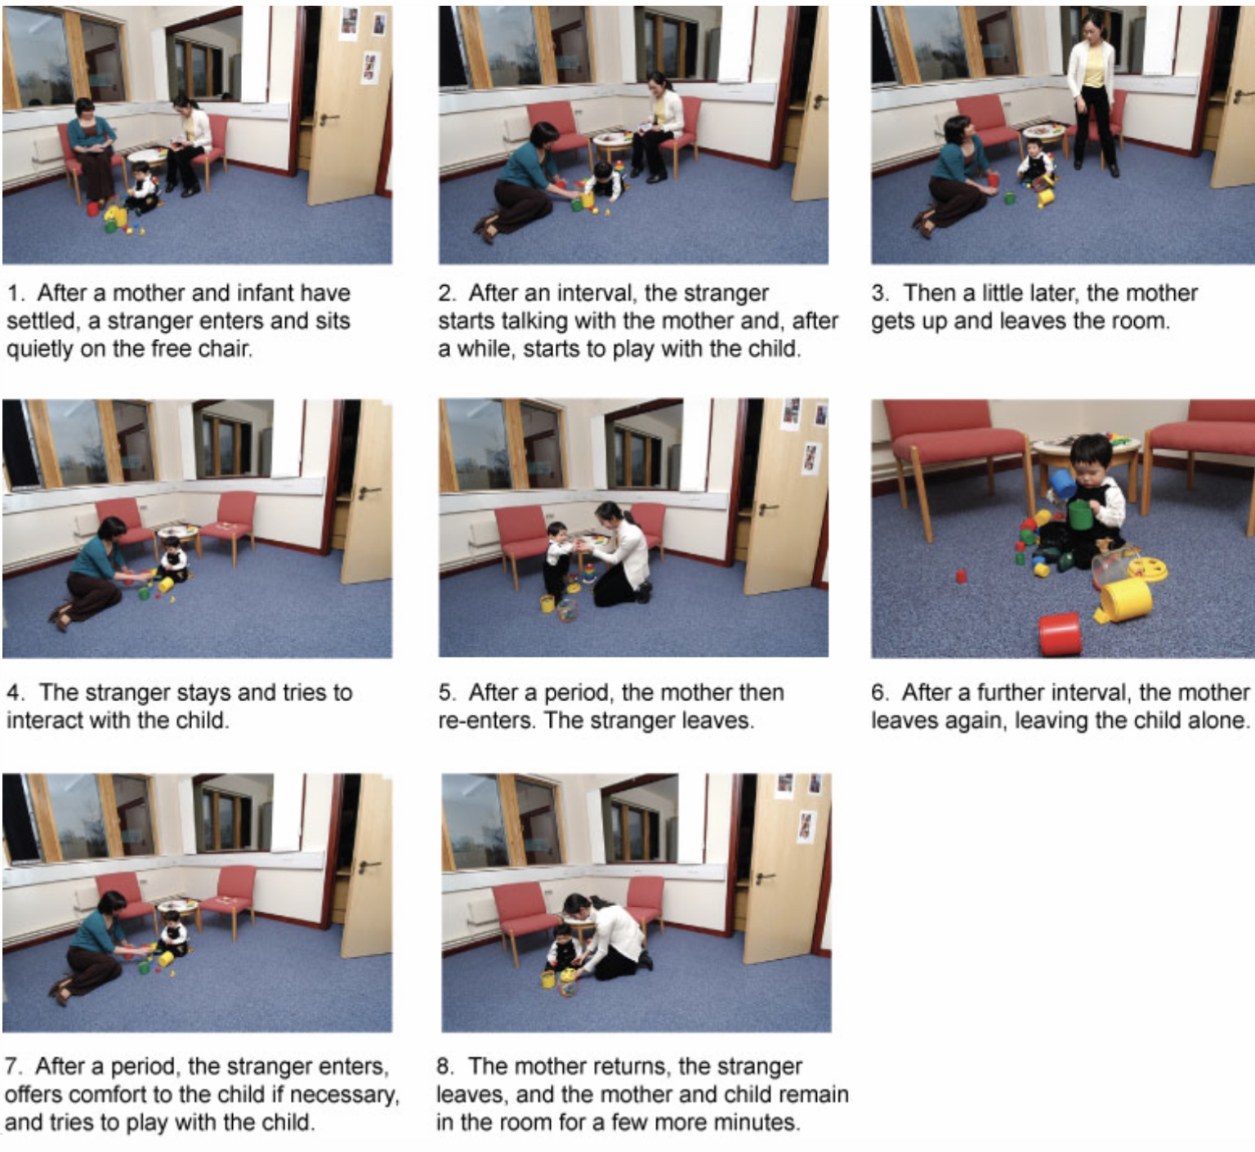
Determining attachment style in infants (0 – 1 years old )
Ainsworth’s Strange Situation is a structured lab procedure that observes how infants respond to brief separations and reunions with their caregiver, revealing patterns of attachment.
It is used to determine infants' attachment styles (secure, anxious, avoidant,).

Slide 41
AINSWORTH’S STRANGE SITUATION
Episode 1: Introduction (30 seconds)
• Who is present: Infant, caregiver, and researcher
• The caregiver and infant are introduced to the room.
• The researcher explains the procedure and then leaves.
Episode 2: Free Play (2–3 minutes)
• Who is present: Infant and caregiver
• The infant is encouraged to explore the toys in the room.
• The caregiver is told to respond only if the child initiates interaction.
• Purpose: Establish a baseline for the child’s exploration and use of the caregiver as a secure base.
Episode 3: Stranger Enters (3 minutes)
• Who is present: Infant, caregiver, and stranger
• A stranger enters, talks to the caregiver, and then gradually approaches the infant.
• The caregiver then leaves the room quietly.
• Purpose: Assess how the child reacts to a stranger with and without the caregiver present.
Episode 4: First Separation (3 minutes)
• Who is present: Infant and stranger
• The infant is left alone with the stranger.
• The stranger may try to comfort or play with the infant if they are distressed.
• Purpose: Observe the infant’s separation anxiety and how they respond to comfort from a stranger.

Slide 42
AINSWORTH’S STRANGE SITUATION
Episode 5: First Reunion (3 minutes)
• Who is present: Infant and caregiver
• The caregiver returns and comforts the infant if needed.
• The stranger leaves.
• Purpose: Assess the infant’s reaction to reunion do they seek contact, resist, or avoid the caregiver?
Episode 6: Second Separation (up to 3 minutes)
• Who is present: Infant alone
• The caregiver leaves the room again, leaving the infant alone.
• Purpose: This is often the most stressful part of the procedure. It reveals the child’s ability to self-soothe or cope with distress.
Episode 7: Stranger Returns (3 minutes)
• Who is present: Infant and stranger
• The stranger re-enters and may try to comfort or engage the infant.
• Purpose: Assess the infant’s ability to be soothed by someone other than the caregiver.
Episode 8: Second Reunion (3 minutes)
• Who is present: Infant and caregiver
• The caregiver returns and the stranger leaves.
• The caregiver comforts the infant if needed.
• Purpose: This is the most critical episode for determining attachment style, based on how the infant reacts to the caregiver’s return.

Slide 43
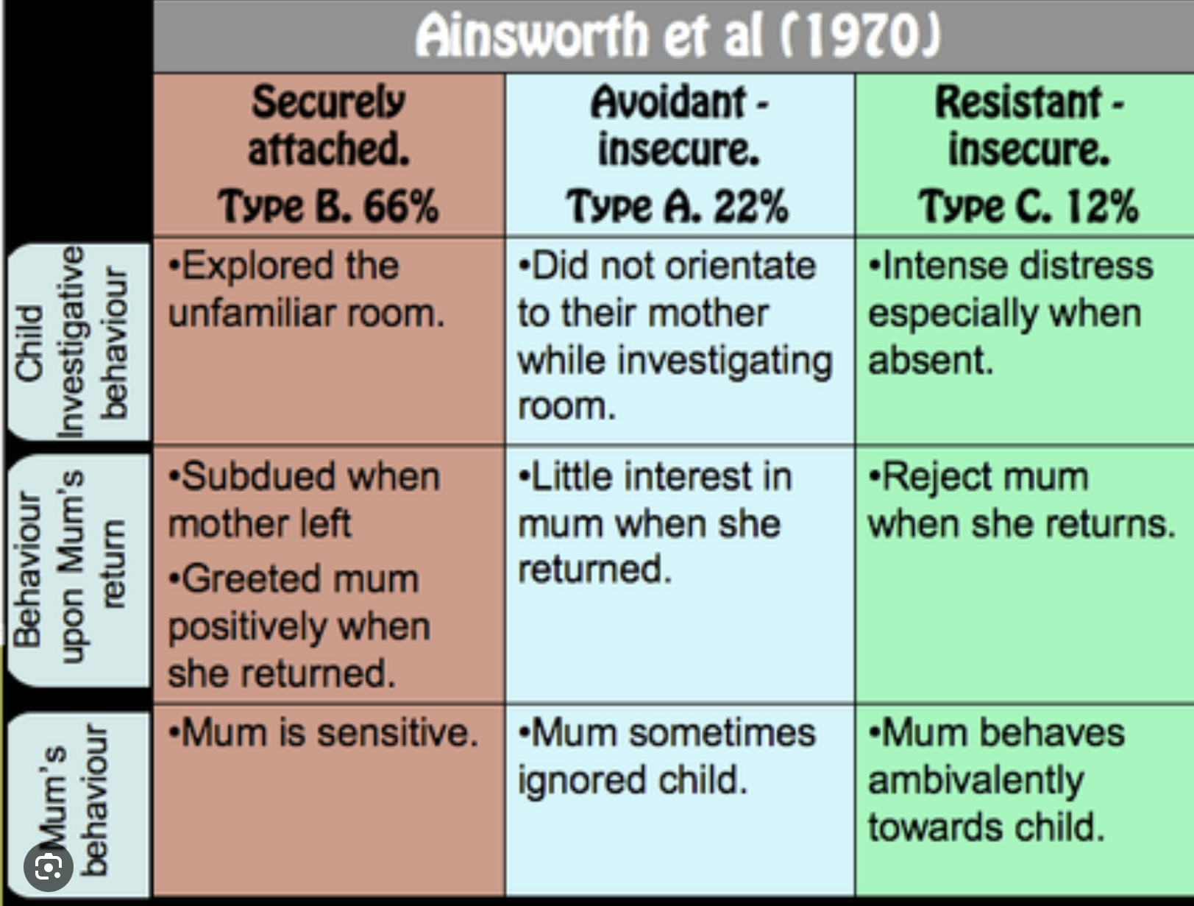
BEHAVIOR IN STRANGE SITUATION AND ATTACHMENT STYLES

Slide 44
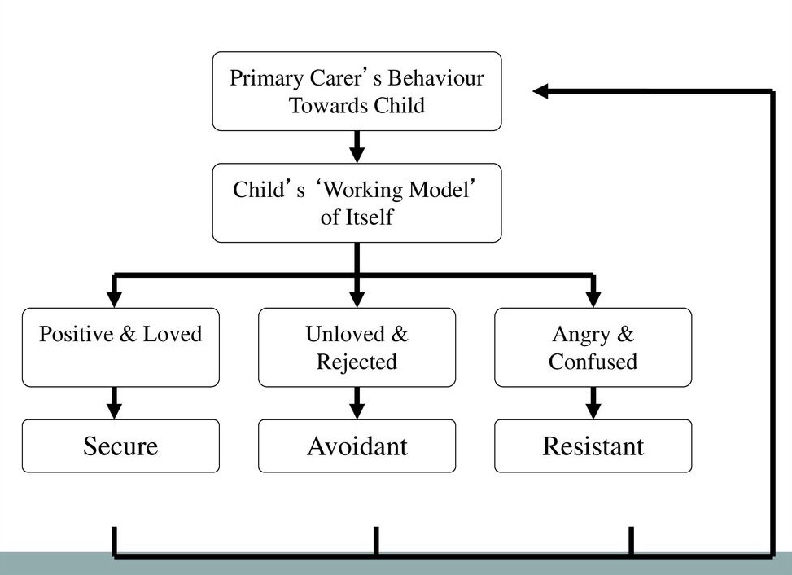
Ainsworth’s attachment classification (A, B, C)
B
A
C
Notes:
Ainsworth theorized that the primary caregiver's behavior towards a child gave rise in the child's mind to a working model of itself and the world. When the child saw himself as positive and loved that child was classified as "securely attached". When the child had a working model in which it was unloved and rejected, the child was classified as avoidant. Finally if the child experienced anger and confusion it was deemed to be "resistant".

Slide 45

parents of securely attached children
Ainsworth also studied the parents of securely attached children wondering what parental characteristics promoted secure attachment.
She found that the parents of securely attached children scored high on scales of :
Sensitivity: the ability to correctly interpret and respond appropriately to the infant’s signals
Acceptance: the warmth, affection, care, comfort, concern, nurturance, support or simply love that children experience from their parents and other caregivers
Cooperation: the extent to which the parent helps the child work towards their appropriate goals.
Emotional accessibility: involves the parent actively listening, empathizing with, understanding, and appropriately responding to a child’s emotions
The parents of securely attached children provided what Baumrind would later categorize as authoritative or warm and structured parenting
Notes:
Ainsworth and her collaborators then set out to identify the characteristics of parents securely attached children…

Slide 46
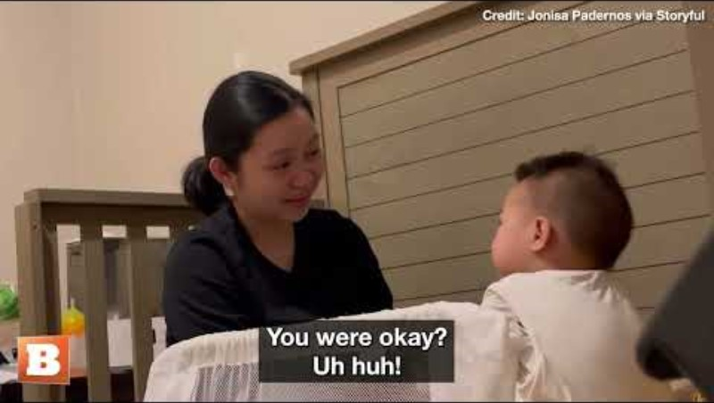

Slide 47
So, there’s three attachment classifications secure, avoidant and resistant or anxious?

Slide 48
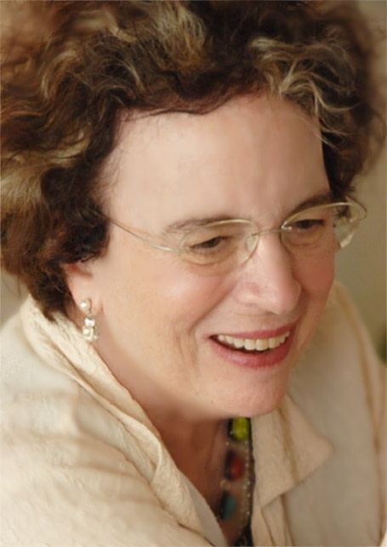
The 2nd generation of attachment theorists and researchers: MARY MAIN
Mary Main (1943 – ) was a professor of psychology at the University of California, Main introduced a 4th attachment style; “disorganized” to add to Ainsworth's secure, avoidant, and resistant.
Disorganized children do not fit in the other 3 classifications.
In the strange situation they appear confused and exhibit contradictory behaviors such as calling a caregiver and backing away or freezing when the caregiver enters the room
Main also developed the adult attachment interview a coding system for assessing attachment styles in adults.
Notes:
No. For infants, Mary Main, who belongs to the second generation of attachment theorists and researchers came up with a fourth classification which she called disorganized.
Keep in mind that these categories apply to infants in the strange situation. Attachment styles in adults are known by slightly different names. I will talk about this after we talk about attachment in adults.

Slide 49
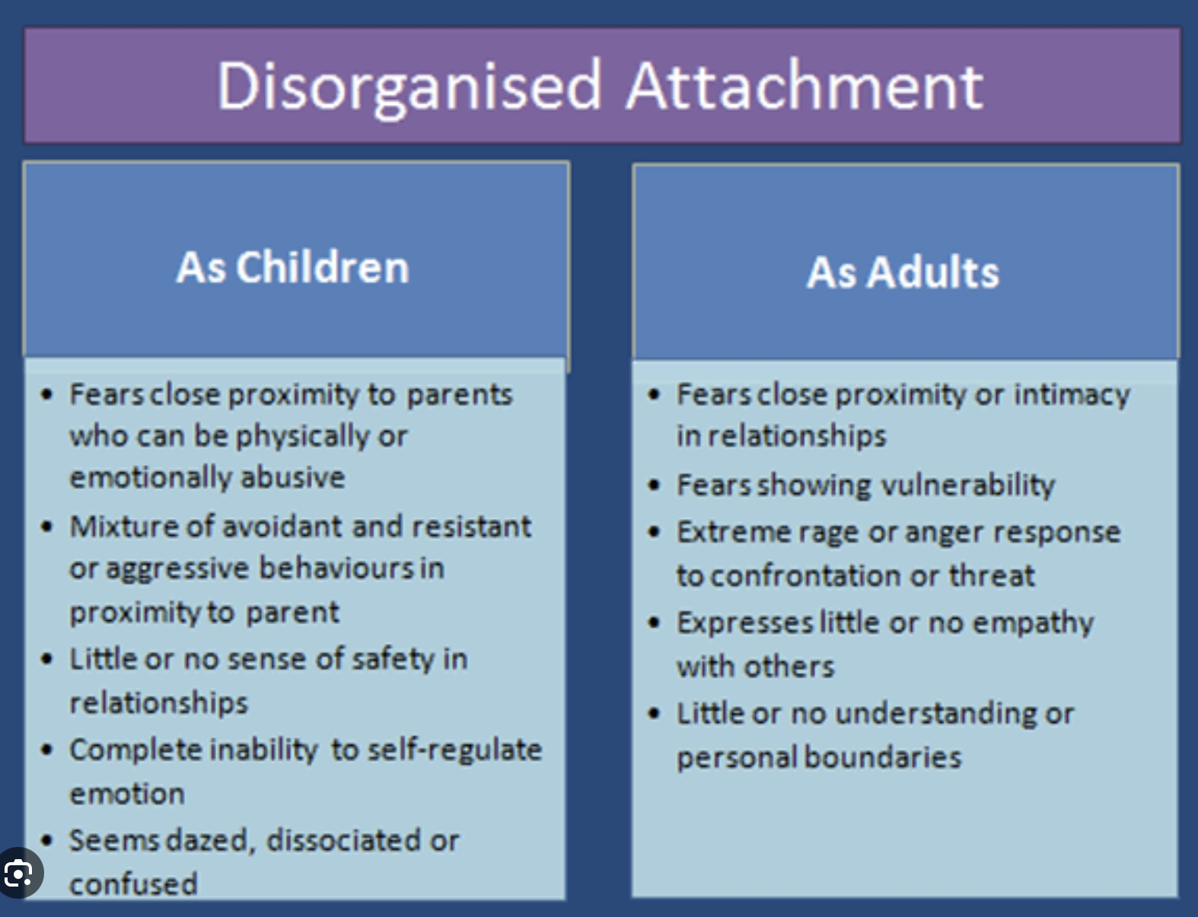

Slide 50
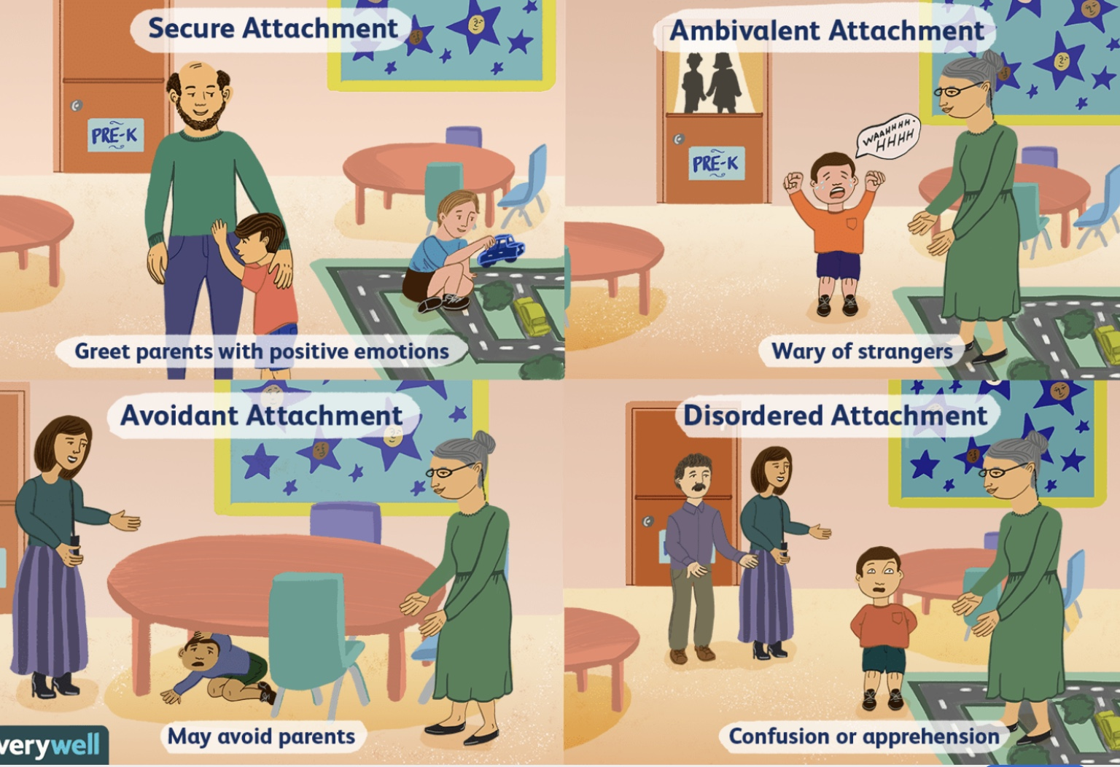
Notes:
This slide depicts some of the behaviours of children in the strange situation.

Slide 51
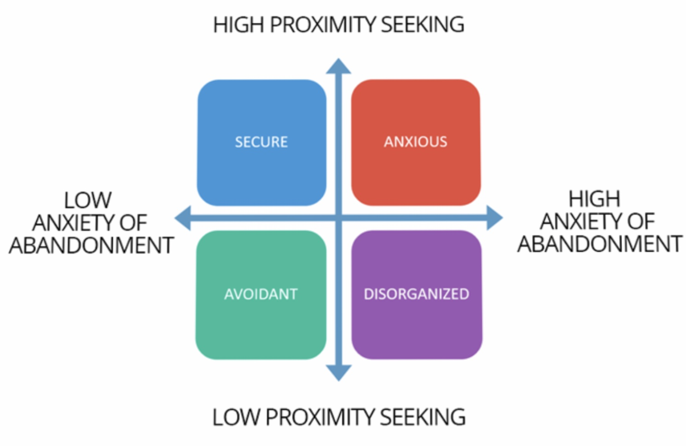
proximity seeking, and abandonment anxiety
The four attachment styles can be mapped along the vertical Axis of
1) low to high proximity seeking,(how intensely do infants seek contact with an attachment figure)
and the horizontal axis of 2) low to high abandonment anxiety.( how intensely do infants react when left by an attachment figure)
Secure infants have little fear of being abandoned and seek close relationships.
Anxious infants are fearful of being abandoned and seek close relationships.
Avoidant infants have little fear of being abandoned and do not seek close relationships.
Disorganized infants are fearful of being abandoned and waiver between seeking close relationships and then distancing themselves from them.
These infant patterns hold in adulthood.
Notes:
The different attachment types are adaptations to the type of parenting. The child, in order to survive, has to do whatever is possible to maintain some kind of attachment to their parent. Attachment adaptations are strategies employed by the child to maintain that attachment even if it is very tenuous.

Slide 52
Can you explain again the evolutionary purpose of attachment?

Slide 53

THE attachment instinct
Attachment is an instinct, and like all the other instincts it promotes survival. Instincts evolved over millions of years, not for present day conditions.
Human infants have a long period of immaturity and helplessness during which they need the protection of a caregiver in order to survive. This hinges on attachment and its parental counterpart caregiving.
One metaphor for the role of attachment in the child’s psychosocial development is that of a boat which needs a safe harbour from which to explore the sea, and to which it can return regularly but especially during turbulent times.
If the harbour is safe and accessible (Erikson’s trust/mistrust and autonomy stages) the boat is more likely to feel safe to leave the harbour and explore the sea (autonomy – saying no to the harbour but returning there when needed)
Without a safe harbour the boat never strays far from land (anxious attachment) or leaves land behind altogether and spends all its time alone in the dangerous seas (avoidant attachment).
If both the harbour and the sea are dangerous, the boat is not sure where to go. It runs away from both the danger of the harbour and that of the sea. It has nowhere else to go and wonders apparently aimlessly between the harbour and the sea (disorganized attachment).
When the “harbour” is unsafe, inaccessible, or dangerous, attachment disorders arise, and the child’s psychosocial development is impaired.
Trust in the safety of the “harbour”, that is in the caregivers, is the foundation upon which Erikson’s subsequent stages of psychosocial development are built (autonomy, initiative, industry, identity, intimacy, generativity, ego integrity.)
Attachment disorders are disorders of trust and deeply affect psychosocial development and personality.

Slide 54
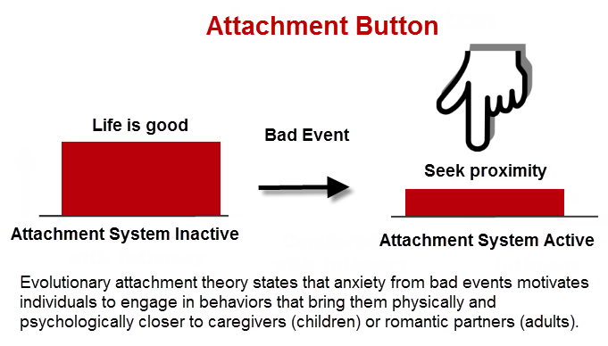
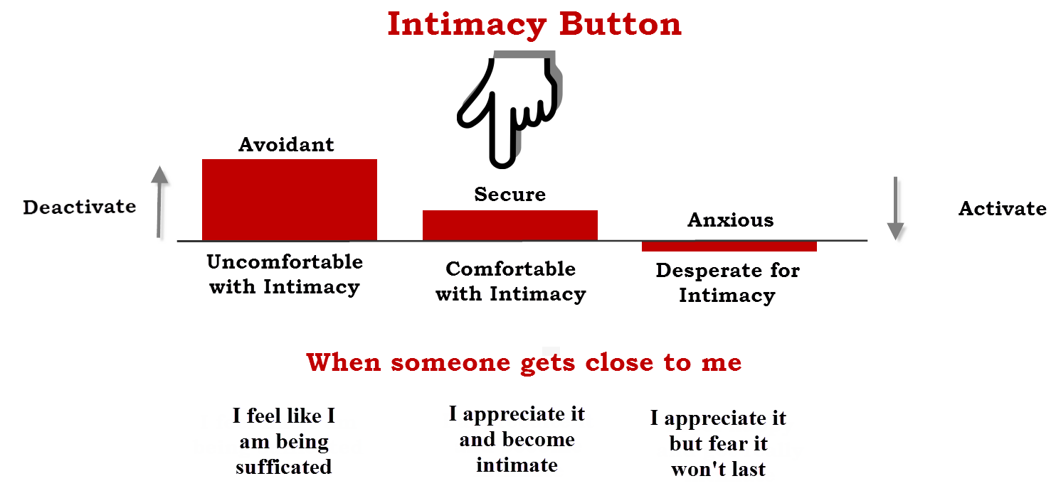
DANGER AND proximity seeking
The attachment system is a survival circuit: when we sense physical or emotional danger, it is automatically activated to seek closeness with a protective figure thereby finding safety through connection.
When faced with a threat (conflict, separation, rejection, danger), people tend to fall into predictable patterns shaped by their early attachment learning and styles.
The securely attached reach out for closeness while staying regulated. They communicate their needs clearly, accept comfort, and recover balance after reassurance. They trust that connection will restore safety.
The anxious attached attachment signals are hyperactivated. They protest, cling, demand reassurance, and become preoccupied with the partner’s availability. They seek closeness intensely but feel perpetually unsure it will last.
The avoidantly attached attachment signals are deactivated. They withdraw, minimize feelings, distract with work or solitude, and insist on self-reliance. They suppress their need for comfort and create emotional distance.
The disorganisedly attached are conflicted between whether to approach or avoid the attachment figure. They may seek comfort but simultaneously push it away, alternating between clinging and withdrawal, and showing sudden anger or shutdown. Connection is both longed for and feared, leading to confusion and instability.
ATTACHMENT INSTINCT
Notes:
The attachment system is activated by danger. When the child faces danger, to escape that danger it seeks proximity with the parental figure.
The parental figure then response to the child seeking intimacy in a variety of different ways: 1) if the parent is attuned and responsive to the child, intimacy develops. 2) if the parent is distracted but potentially capable of responding, the child becomes desperate for intimacy. This is called anxious attachment. 3) if the parent is unresponsive no matter what the child does, the child becomes uncomfortable with intimacy. This is called avoidant attachment. 4) if the parent poses a threat or is dangerous to the child seeking intimacy, the child becomes confused and frozen. This is called disorganized attachment.

Slide 55
THE ATTACHMENT HARBOUR
Today there will be a poll asking you to name your attachment style. If you didn’t have a chance to do the attachment style questionnaire we suggested last week, ask yourself as we go through the following descriptions, what kind of harbour your caregivers provided for you.
Imagine that each of us begins life as a small sailing boat on a vast ocean. Our attachment figures, parents, caregivers, partners later in life, are our harbors. When the waters are calm, we can explore, grow, and sail far. But when storms come, fear, loneliness, illness, stress, we instinctively look for a stable harbor where we can anchor safely. Attachment styles reflect what kind of harbors we learned we had.
1. Secure attachment is a good harbor; reliable, open, and safe. The entrance is wide and calm. The lights are clear. The caregivers signal, “You’re welcome here. I’m glad you came back.” The ship can leave to explore the world knowing it can always return. Securely attached people believe: “If I’m in distress, someone will come.” “I am worth caring for.” “The world is navigable.” They develop confidence both in seeking closeness and exploring independently.
2. Anxious attachment is a harbor that’s difficult to enter. This harbor exists, but the entrance is unpredictable. Sometimes the gates are open, sometimes closed. The boat circles repeatedly, unsure: Will they let me in? The storm outside feels terrifying because safe anchorage is never guaranteed. When the harbor does open, the ship clings tightly, afraid to leave again. Anxiously attached people learned that care is inconsistent. They feel: “I need reassurance constantly.” “If I move away, I might lose the harbor forever.” “I must stay close, or I won’t be safe.” Their system remains tuned to fear of abandonment.

Slide 56
THE ATTACHMENT HARBOUR
3. Avoidant attachment is a harbor that’s impossible to enter. Here, the harbor looks like a possibility from afar, but as the ship approaches: There is no opening. No one signals back. The ship learns to weather storms alone. Eventually, it stops trying to approach at all. Avoidantly attached people learned early that seeking comfort doesn’t work. They believe: “The harbor never really helps.” “I’m safer relying on myself.” “Neediness is dangerous.” So, they sail alone, especially when seas get rough.
4. Disorganized attachment is a dangerous harbor. This harbor is deeply confusing. The harbor is where the ship should be safe… But there are jagged rocks, unpredictable waves, even storms inside the harbor itself. Approaching the harbor brings relief and danger. The ship doesn’t know whether to anchor or flee. Its compass becomes unreliable, safety and threat are mixed. People with disorganized attachment have caregivers who were frightening, frightened, unpredictable, or chaotic. They learned: “My source of safety is also a source of fear.” “I don’t know how to find refuge.” “I must protect myself from the very people I need.” This leads to contradictory behaviors: seeking closeness and then panicking, freezing, or pushing away.

Slide 57
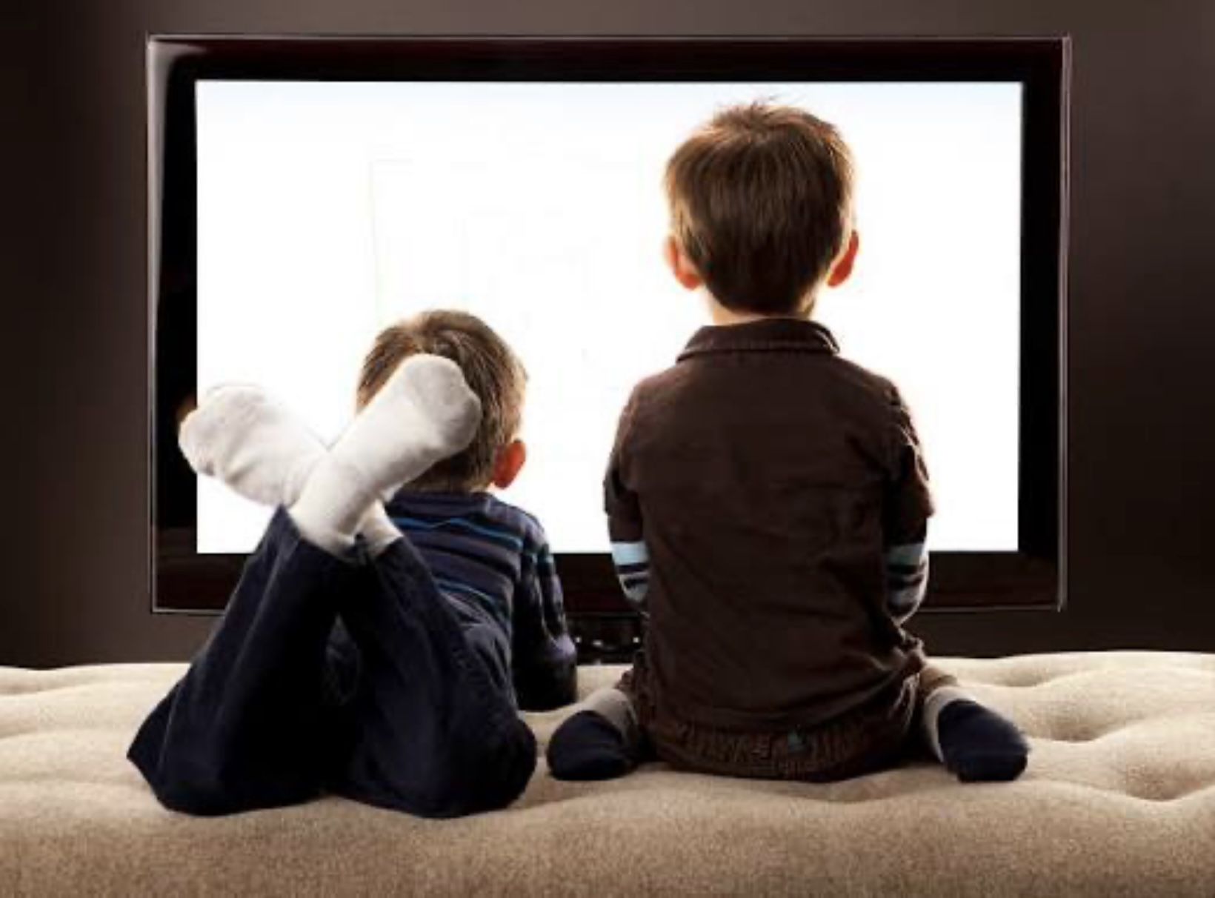
When we interact with our environment, we can be calm and in the window of tolerance, socially engaged, and in discover mode. In this physiological state we are curious, explore, take risks, engage in play, learn, and try new things.
Alternatively, we can be outside the window of tolerance, fight or flight, threat-detection, survival, or defend mode. This kicks in when people feel a threat, danger or anxiety. In defend mode a person is worried, alert to harm, reactive, cautious, and often shrinks back instead of expanding outward. Chronic defend mode means persistent anxiety, fear, and avoidance.
Children need caregivers who make them feel safe by being responsive and consistent. From this secure base they can then feel confident to explore the world, knowing they have a safe relationship to return to if something goes wrong.
Over the last few decades, as the world has in fact become safer for children, caregivers have come to believe that the threats children face in the world are much greater and have become overprotective. Modern parenting in many places has tilted too far toward safety-concerns, limiting free play and autonomy.
This has had several consequences: children are more fragile because they have not benefitted from the immunization (antifragility) effects of manageable adversity. Children are also less able to move into explore and discover mode; they are remaining closer to home emotionally, less able or willing to take risks and more likely to go into defend mode.
EXPLORE OR DEFEND

Slide 58
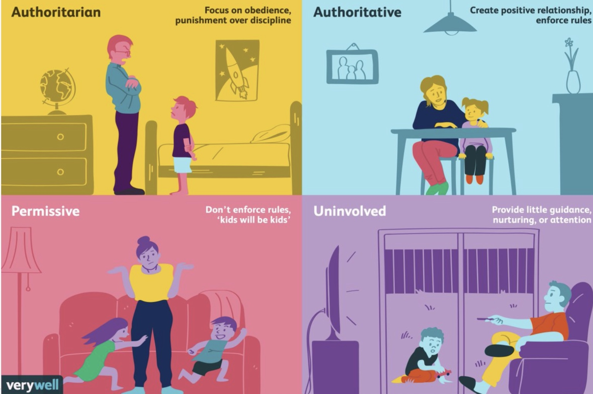
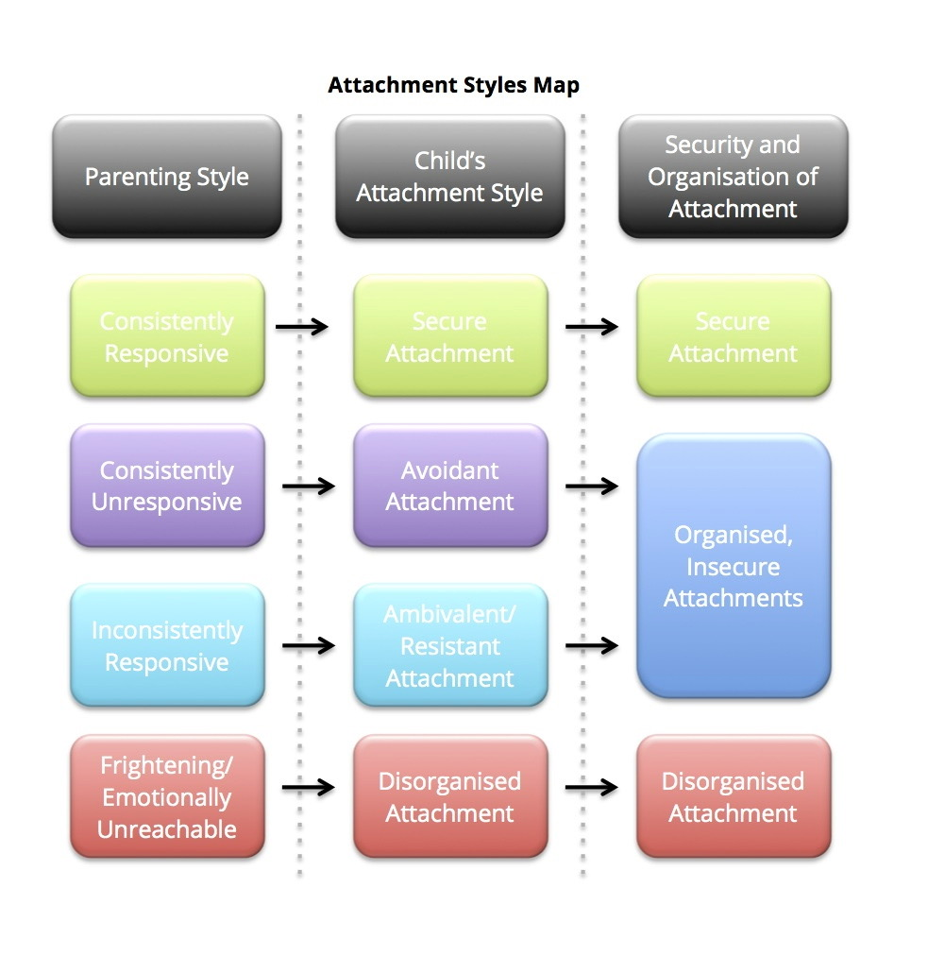
Parenting styles and types of attachment
AUTHORITATIVE
AUTHORITARIAN
PERMISSIVE
UNINVOVED
Notes:
Baumrind’s parenting styles, which we discussed two weeks ago, not surprisingly corelate with attachment types.

Slide 59
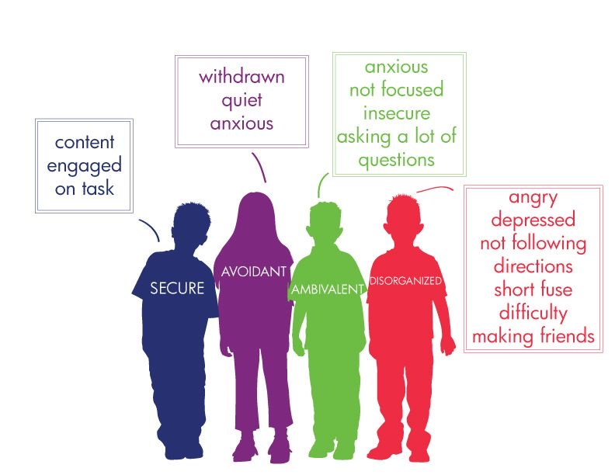
Attachment styles and behavior in the early school years
Notes:
For most people infant attachment styles persist through the lifespan and manifests differently at different ages. In the early school years, for instance, children's behavior can be very indicative of their attachment style…

Slide 60
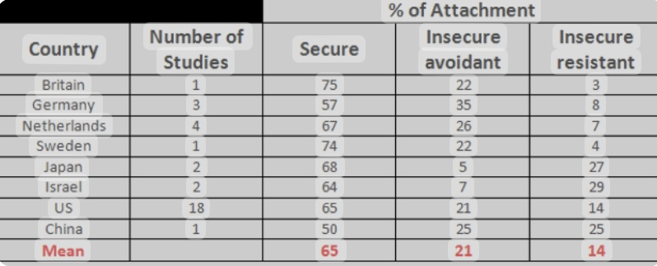
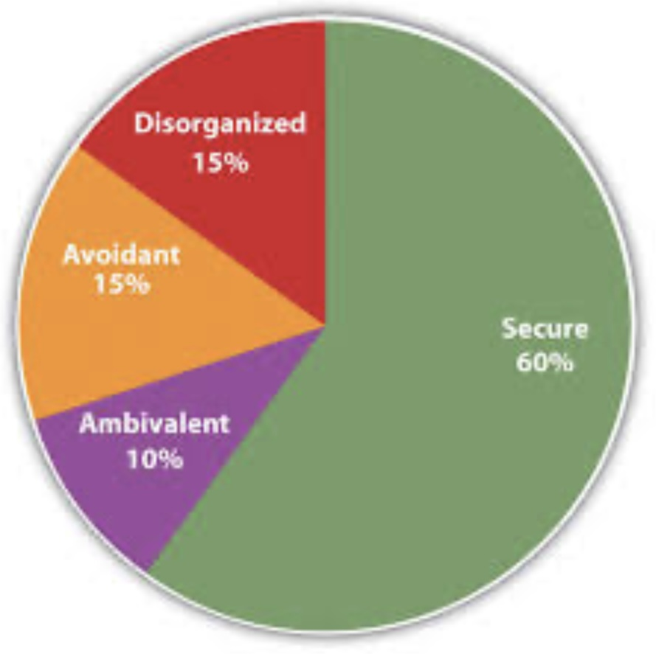
Prevalence of THE attachment styles
Notes:
The prevalence of the different attachment styles varies by country. In the Scandinavian social democracies, where there is a lower Ginni coefficient and more social services and supports, there is a higher prevalence of secure attachment. In the United States over 1/3 of the population has an insecure form of attachment. Considering the consequences of insecure attachment, this is neglected problem of unimaginable portions.

Slide 61
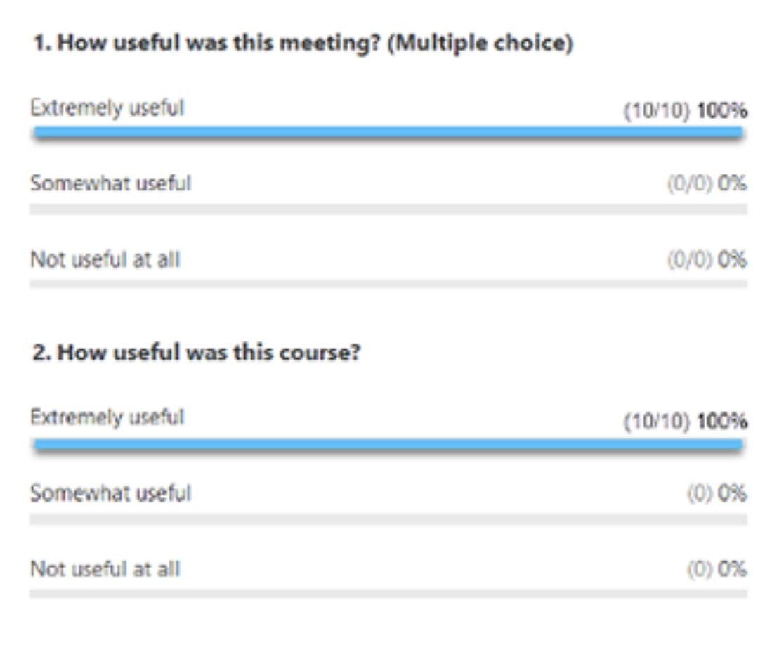
ZOOM POLL
Please answer the following question
Answers are anonymous
In person participants please answer the page that was handed out.

Slide 62
So far, we've talked about attachment in infants and children. Is attachment also important in adult mental health?

Slide 63



attachment in adults

Slide 64
Corresponding infant/adult attachment styles
adult
infant
A - Ambivalent/resistant
B - Secure
C - avoidant
D - disorganized
Anxious/preoccupied
Secure
Dismissing/avoidant
Fearful/avoidant
Notes:
Before we talk about adult attachment, let's clarify one point that can be confusing. Equivalent attachment styles have traditionally been referred to by different names in infants and adults.

Slide 65
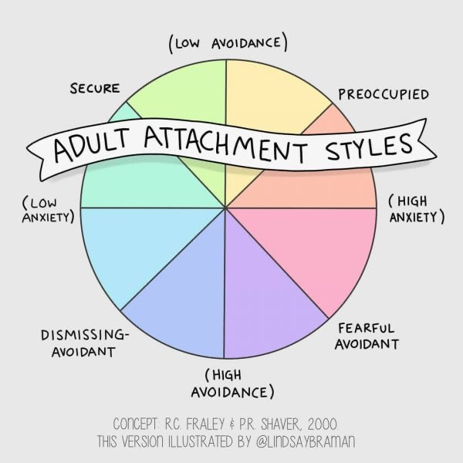
to make it Simpler
When, in the course, we refer to types of attachment, we won’t distinguish infant from adult styles.
So, when you hear us say:
Secure, we mean secure in children and adults
Anxious, we mean ambivalent/resistant in children and anxious/preoccupied in adults
Avoidant, we mean avoidant in children and dismissing in adults
Disorganized, we mean disorganized in children and fearful/avoidant in adults.
I’ve met attachment purists that think I’m a troglodyte for doing this.
Note that while in the majority of people attachment style remains the same over the course a lifetime, in a significant percentage it changes. This is called earned secure and insecure.
This change often occurs in the context of intimate relationships. One study, for example, found that 22% of partners changed their attachment style in the first two years of marriage.

Slide 66
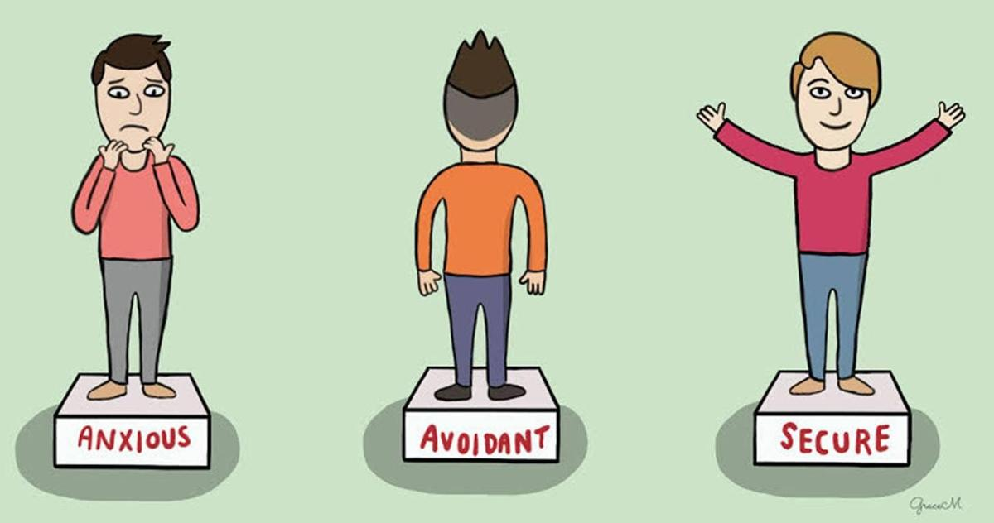
Determining attachment style
There are only two reliable ways to determine attachment styles. The strange situation in infants, which we have already discussed, and the adult attachment inventory in adults.
The Adult attachment inventory (AAI) was devised by George, Kaplan, and Mary Maine in 1984.
It consists of a 60-to-90-minute interview composed of 18 questions designed to assess an adult’s childhood experiences and their current state of mind with regards to attachment.
Ex. of questions in the inventory:
Can you give me five adjectives to describe your early relationship with your mother/father?
What happened when you are emotionally upset or physically hurt?
How have these experiences influenced the kind of person you are today?
Adult attachment inventory interviews are transcribed verbatim and coded according to a classification system.
Lengthy and expensive training is involved in learning to administer it
Notes:
Attachment styles in infants are determined using the strange situation. A method for determining attachment style in adults was first published in 1984.

Slide 67
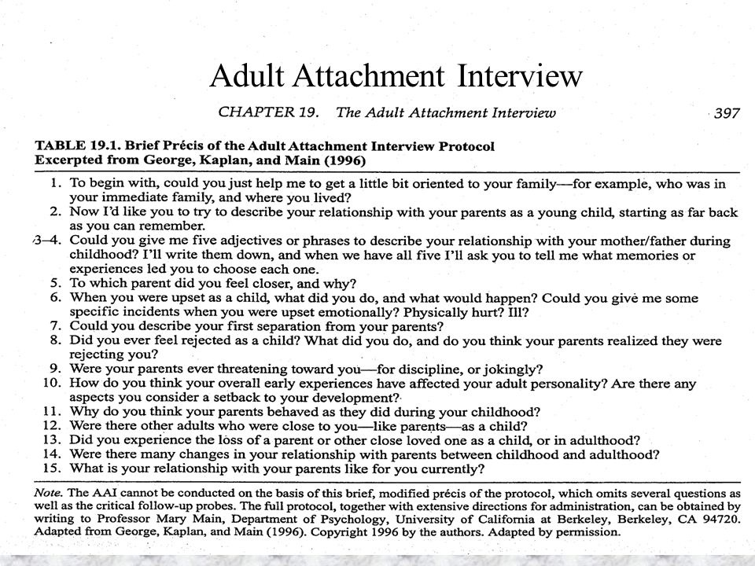
Sample questions from adult attachment inventory
Notes:
The questions on the adult attachment interview our apparently simple determining adult attachment style from a person's answer is however quite complex and requires extensive training. As a result very for professionals are trained to do it.

Slide 68
EARNED OR ACQUIRED SECURE ATTACHMENT
Acquired secure attachment refers to a state in adulthood (or later adolescence) in which a person who did not grow up with secure attachment nevertheless becomes secure through later corrective experiences, intentional healing, or stable relational environments. It is earned rather than established in infancy. This is often called earned security in the Adult Attachment Interview (AAI) literature.
People with acquired secure attachment typically have histories of adversity, inconsistency, or trauma, but have made sense of their experiences. They show a capacity for coherent, reflective narratives about their childhood, even if the childhood was painful. They demonstrate resilience, emotional flexibility, and self-soothing, even though these skills were not modeled in childhood. They can form stable, reciprocal, emotionally attuned relationships in adulthood.
Research shows that earned-secure adults resemble secure adults in present-day functioning, relationships, parenting, and emotion regulation. The pathway to earned secure is typically through a later attachment figure for example a romantic partner, a therapist, a stable mentor or a close friend. These later secure relationships provide the missing experiences of safety, attunement, and being known, allowing the person to reconsolidate how they see themselves and others.
Acquired secure attachment is associated with lower rates of depression and anxiety, improved parenting sensitivity, higher reflective functioning, and greater neural integration. In essence early wounds are reorganized when the nervous system encounters reliably safe connection.

Slide 69
EARNED OR ACQUIRED INSECURE ATTACHMENT
Earned or acquired insecure attachment is the mirror phenomenon of earned secure a person who began life with secure attachment, but who later becomes insecure in adulthood due to chronic stress, trauma, betrayal, abandonment, or prolonged relational instability. It reflects a loss of trust in the reliability of others and in one’s own internal working models.
People with acquired insecure attachment often previously functioned securely, often well into adulthood but show a gradual or sudden shift toward avoidant, ambivalent, or disorganized adaptations. They experience changes in emotion regulation, such as heightened anxiety, emotional numbing, hypervigilance, or compulsive self-reliance. They struggle to maintain stable relationships that once came naturally.
Research shows that major rupture events such as loss, betrayal, abusive relationships, chronic invalidation, or traumatic stress, can undermine previously secure states. This may result in a collapse of the internal working model, such that the person no longer expects comfort to be available, no longer trusts their own worth, and no longer anticipates consistency.
Acquired insecurity is linked to higher rates of depression, anxiety, and PTSD, increased physiological stress responsivity, reduced reflective functioning and shifts in caregiving representations (e.g., becoming more intrusive, withdrawn, or inconsistent). Importantly, this form of insecurity is not fixed, it can be reorganized. Attachment is always developmental, not a life sentence.

Slide 70
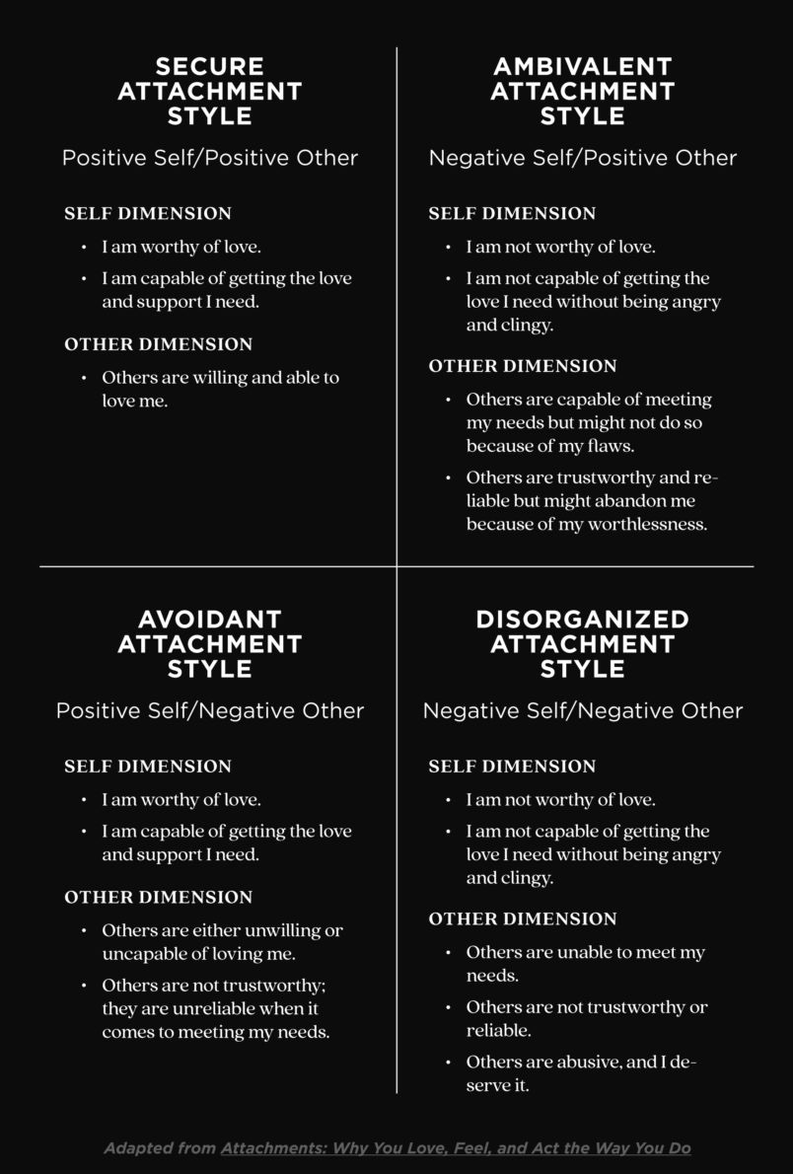
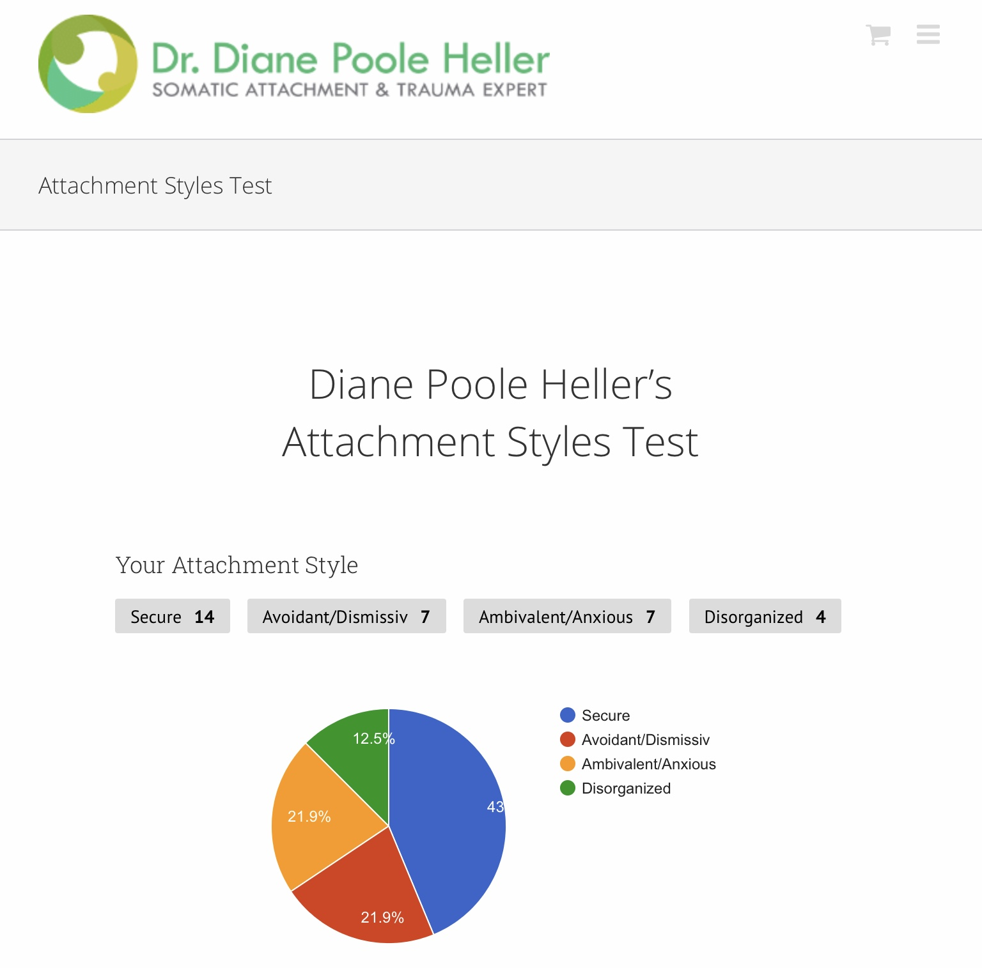
Some attachment researchers see attachment styles as dimensions not categories, meaning you may be predominantly secure but have a bit of anxious, avoidant or disorganized. This makes sense because children may develop different attachment styles to different caregivers
Diane Poole Heller’s free online attachment styles test is dimensional. Beware of its reliability.
Notes:
One way to think of the different attachment styles in adults is to consider that each style has characteristic views about the self and about others, called the self and other dimension. Secure attachment has positive self and positive other, anxious negative self and positive other, avoidant positive self and negative other, and disorganized negative self and negative other.
In reality while we may have a dominant attachment style, we tend to have different proportions of features of all the styles.
There are online, unscientific, but interesting attachment style tests such as Diane Poole Hellers that depict this

Slide 71
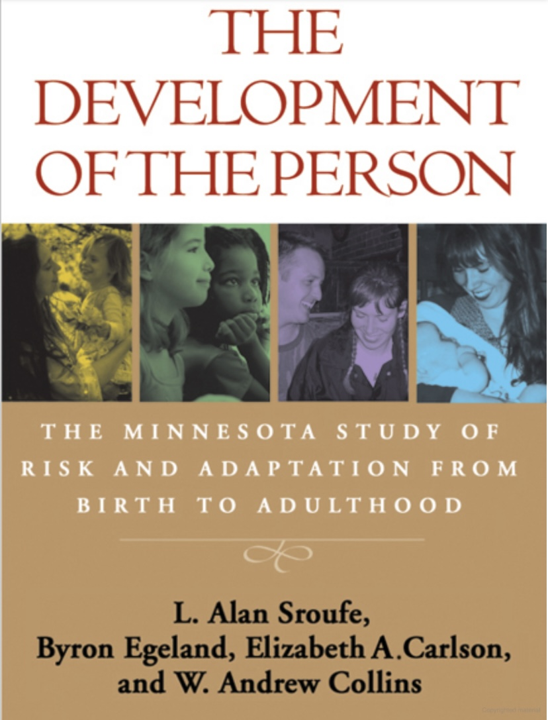
ATTACHMENT OVER
THE LIFESPAN
We owe much of what we know about attachment and adult personality to L. Alan Sroufe. Sroufe was the founder and principal investigator of the Minnesota longitudinal study of parents and children that began in 1975 and continues to the present.
The Minnesota longitudinal study recruited a sample of 267 first-time mothers in their third trimester of pregnancy through the many Minneapolis public health department branches. Wide-ranging assessments of the mother's characteristics, circumstances, parental expectations, and prenatal care were carried out when the mothers were recruited into the study.
The study focused on social relationship experiences: what people think about their experiences, risk and protective factors, and issues of continuity and change.

Slide 72
ATTACHMENT OVER
THE LIFESPAN
The goal of the study has been to trace the course of individual development and to understand the factors that led towards good outcomes or poor outcomes.
The investigators studied how people developed at different points in their lives and across diverse settings. Many of the study's findings are summarized in the book" the development of the person“
The investigators continued to assess mothers and children after the birth of the child. In infancy, assessments of parents, children's temperament, and observations of parent-child interactions were carried out at birth and at 3, 6 and 12 months. Thereafter assessments were conducted every six months until age 2 1/2, yearly through the third grade, three times between ages 9 and 13 and at ages 16, 17 1/2, 19, 23, 26 and 28.

Slide 73
KEY FINDINGS OF THE MINNESOTA LONGITUDINAL STUDY
Mother Baby Strange situation Preschool Teachers Aged 6 Mid childhood Adult
secure
Is warm , Sensitively attuned, consistent. Quickly responds to babies' cries.
Readily explores using mother as secure base. Cries least of the three groups. Most compliant with mother. Most easily put down after being held.
Actively seeks mother when distressed. Maintains contact on reunion, readily comforted.
Easily makes friends. Popular. Flexible and resilient under stress. Spends more time with peers. Good self-esteem.
With parents: warm and enthusiastic. Able to be open and to engage in meaningful exchanges. Comfortable with physical contact.
Forms close friendships, and can sustain them in larger peer groups
Easy access to a wide range of feelings and memories, positive and negative. Balanced view of parents. If insecure in childhood, has worked through hurt and anger. Usually has securely attached children
Treat in warm, matter-of-fact, age-appropriate ways.
Mother is often emotionally unavailable or rejecting. dislikes neediness may applaud independence
By the end of the first year, baby seeks little physical contact with mother, randomly angry with her, and responsive to being held but often upset when put down
Avoids mother when distressed, seems blasé
Often angry, aggressive, defiant. May be isolated, disliked. Hangs around teachers, withdraws when in pain.
No close friends, or friendships marked by exclusivity, jealousy. Often isolated from the group
Become controlling and angry
With parents: abrupt, neutral, unenthusiastic exchanges. Absence of warm physical contact
Dismissing of the importance of love and connection. Often idealizes parents but actual memories don't corroborate. Shallow, if any self-reflection. Usually has avoidantly attached children
avoidant
Baby cries a lot, Is clingy and demanding, often angry, upset by small separations, chronically anxious in relation to mother, limited in exploration.
Trouble functioning in peer groups. Difficulty sustaining friendships when in larger groups.
Still embroiled with anger and hurt at parents. Unable to see own responsibility in relationships. Dreads abandonment. Usually has ambivalent attached children
Mother is unpredictable or chaotic. Often attentive but out of sync with baby. Most tuned in to baby's fear
Regretful and easily overwhelmed by anxiety. In mature, overly dependent on teacher. May be victimized by bullies.
Mixes intimacy seeking with hostility. Affect is cute or ingratiating. Maybe worried about mother’s when apart
Ambivalent
Difficult to sooth after separation. Angry and seeking comfort simultaneously.
Teachers indulge, excuse, and infantilize

Slide 74
We've talked about some of the problems that arise from insecure types of attachment. What are the benefits of having secure attachment?

Slide 75
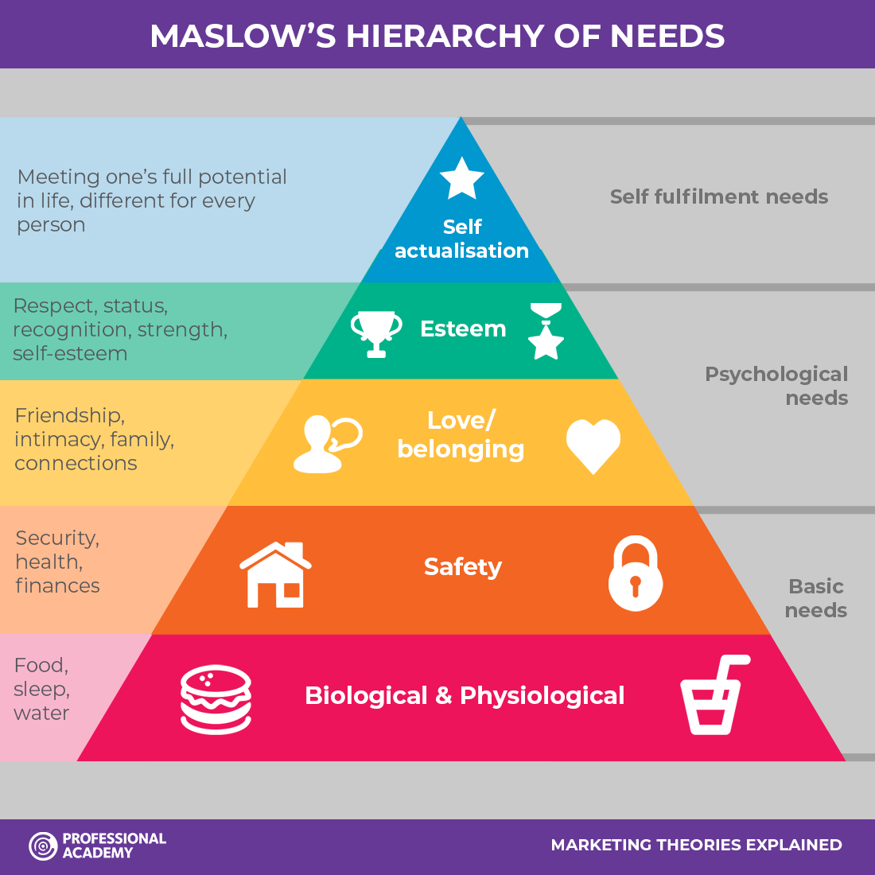
The gifts of secure attachment
Secure attachment contributes to good mental health in that it confers on securely attached adults' psychological “gifts” which include:
1) A healthy relation to self; positive self-esteem and a clear sense of self ( perception of the collection of characteristics that define you.)
2) The capacity to self sooth and stay in the window of tolerance
3) A capacity for healthy relationships to others ; especially intimate care-based relationships with healthy boundaries, and the ability to repair and to love.
4) A feeling of purpose in life, a meaningful occupation, connections to nature and to a transpersonal story about the universe.
5) Relative safety from interpersonal danger
All these are items higher on Maslow’s hierarchy of human needs
In contrast adults with attachment disorders may struggle with some of these

Slide 76
Why do people with insecure attachment styles tend to experience more difficulties in close relationships?

Slide 77
HOW ATTACHMENT PATTERNS SHAPE LATER-LIFE RELATIONSHIPS
Attachment is the template the nervous system builds in early life for answering three questions:
1. Am I safe?
2. Are others reliable?
3. What do I need to do to stay connected?
These early lessons become implicit operating systems. They show up later in adulthood as 1) how we seek closeness 2) how we handle conflict 3) how we regulate emotions with another 4) what we expect from love 5) what we fear in intimacy and 6) how we respond to unmet needs.
Attachment patterns are not fixed traits. They are survival strategies learned early that continue only until new experiences or healing provide better options.

Slide 78
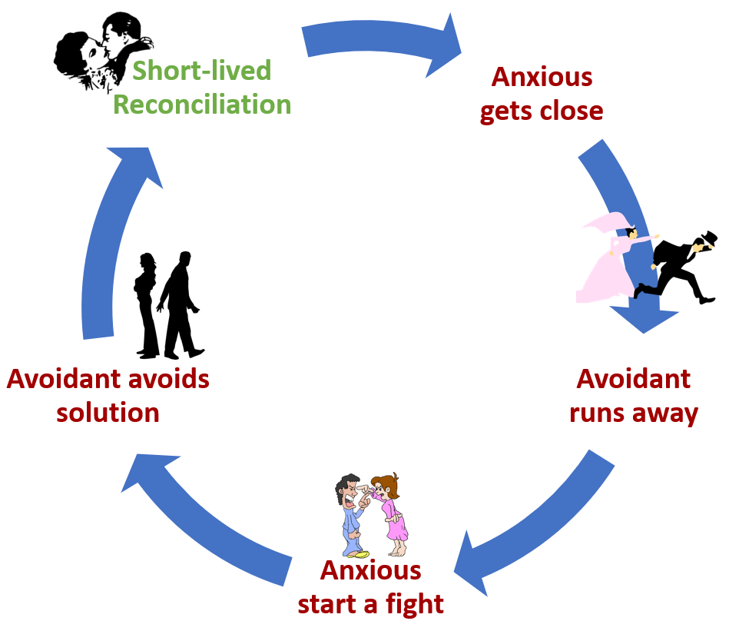
ATTACHMENT AND Relationship difficulties
People often assume that conflicts in intimate relationships are mostly related to concrete issues such disagreements over values, money, politics, sex, housework contributions, raising children etc.
However, couples with secure attachment frequently have different views on some of these concrete issues but if they have a care based rather than transactional relationship, they can stay well regulated, use good communication and repair skills, and work out their differences in a mutually satisfactory way.
When these issues become a chronic source of conflict it’s often because of underlying attachment issues and people’s inability to repair relationship breaches.
Many relationships are very difficult because people don’t know that the real nature of their problems has to do with attachment and communication and don’t know how to approach these difficulties.
Common problematic attachment patterns in couples include: 1) one partner being more anxious the other more avoidant 2) a partner with disorganized style (alternatively feeling suffocated and abandoned) Much more on this on our session on relationships.
To be effective couple’s therapy must be attachment informed.
Typical pattern in an anxious/avoidant relationship

Slide 79
E-mailed questions, comments, feedback

Slide 80
I HAVEN’T HAD ANY CONTACT WITH MY FAMILY FOR THREE YEARS. I’M TORN ABOUT IT BUT I FEEL I NEED TO PROTECT MYSELF FROM THEM. I RECENTLY HEARD ABOUT FAMILY ESTRANGEMENT. CAN YOU TELL US MORE ABOUT IT?

Slide 81
FAMILY ESTRANGEMENT THROUGH THE LENS OF ATTACHMENT
Family estrangement is often described as a relational rupture, but it is more accurate to say it is the end point of a long attachment pattern. Research increasingly shows that estrangement is not random, it follows predictable attachment lines.
1.Estrangement is unlikely in people with secure attachment, whether from childhood or earned in adulthood. Securely attached people tend to have: a stable sense of self-worth, moderate expectations of others, capacity for repair after conflict, and greater emotional flexibility. Their internal working models assume: “My needs matter, and others can be reliable.” Because of this, they usually don’t need to cut off family relationships. Even when hurt, secure individuals tend to: attempt dialogue, set boundaries, seek mutual understanding, repair ruptures and move toward connection rather than away. So, estrangement among securely attached people, is possible but relatively rare, and usually driven by severe or unsafe circumstances.
2. Estrangement becomes more likely in people with insecure attachment especially the more dysregulated forms. a) people with avoidant patterns tend toward emotional distancing, cope through self-reliance and suppression, may cut off relationships rather than risk vulnerability and view closeness as dangerous or intrusive. Estrangement for people with avoidant patterns is often a protective strategy: “I can’t stay connected and stay safe.” b) people with anxious patterns experience high emotional activation in relationships, fear abandonment and rejection, are prone to conflict cycles or boundary-testing and feel overwhelmed by inconsistency. Estrangement in people with anxious patterns often follows repeated cycles of hurt, unmet needs, and emotional exhaustion.

Slide 82
FAMILY ESTRANGEMENT THROUGH THE LENS OF ATTACHMENT
c) disorganized attachment style is marked by trauma, fear, and contradictory impulses, and is most strongly associated with estrangement. This is the result of high conflict, difficulty regulating emotions, inability to form predictable patterns of closeness, relationships that oscillate between enmeshment and cutoff, and a fear-based system that sees family as both needed and dangerous. Here estrangement is often a final survival strategy, not a choice.
3. The often-overlooked scenario is when someone becomes earned secure. They learn what respectful, attuned relating feels like, their nervous system recalibrates to expect reciprocity, they develop boundaries that protect their well-being, their tolerance for mistreatment, manipulation, or emotional neglect drops dramatically and they become aware of patterns they previously normalized. Meanwhile, their family may still operate from avoidant, anxious, or disorganized patterns, use old roles (scapegoat, caretaker, golden child), expect the person to remain in an outdated relational script, and resist or punish the new, healthier boundaries. This creates an attachment mismatch. Suddenly, the person who is now earned secure can see the insecure dynamics clearly, sometimes for the first time: “I thought this was normal. Now I know it’s not healthy. I can’t go back to pretending.” In this case, estrangement is often an act of self-protection and self-respect, not rejection.
4. Earned secure individuals may initiate estrangement because they want a relational life that reflects their new internal working model, no longer tolerate chronic invalidation or emotional harm, want to protect their mental health and healing trajectory, recognize that repair requires both sides, the family system may be unwilling or unable to change or choose to break generational patterns for the sake of their own children. Estrangement, here, is often a boundary with compassion, not a punishment. “I still care about them, but I can’t be in that environment anymore.”

Slide 83
IS FAMILY ESTRANGEMENT ON THE RISE?
A recent survey by Cornell family estrangement & reconciliation project found that 27% of American adults reported being estranged from one or more family members.
Other sources similarly estimate that “about 1 in 4” people have at some point cut off or significantly reduced contact with family.
In a another recent U.S. study, 6% of adults reported estrangement from their mother and approximately 26% reported estrangement from their father. Average age of first estrangement (with a parent) is often in the early to mid-twenties (e.g. ~23 for paternal estrangement, ~26 for maternal) in some surveys.
While many estrangements are with parents, estrangement with siblings appears rarer: one earlier large-scale study cited by researchers estimates fewer than 5% of Americans are completely estranged from a sibling.
Researchers and clinicians believe estrangement is rising. The fact that recent surveys identify 25–30%+ estrangement rates suggest the phenomenon is surprisingly common. Some authors refer to estrangement as a “silent epidemic,” drawing a parallel to divorce.

Slide 84
Are longstanding mental health issues related to insecure types of attachment?

Slide 85
ATTACHMENT ISSUES AND MENTAL HEALTH DIAGNOSIS
The core issue of insecure attachment is that when early caregiving is inconsistent, rejecting, or frightening, a child’s attachment system doesn’t stabilize. Instead of learning “I can depend on others and regulate with them,” the child learns strategies to cope with uncertainty or danger. These strategies, anxious, avoidant, or disorganized, are adaptive in the childhood environment but create vulnerabilities later.
Each insecure attachment type shapes an internal working model or fundamental emotional belief or map of the world.
With anxious attachment it’s “I’m not enough / others will leave.” This leads to hypervigilance, rumination, and dependence.
With avoidant attachment it’s “My needs are too much / others won’t be there.” This leads to suppression, emotional distance, and self-reliance at a cost.
With disorganized attachment it’s “Others are both comfort and danger.” This leads to confusion, fragmentation, and fear of intimacy.
These models unconsciously guide expectations in adult relationships, work, and self-regulation. These attachment-based strategies can evolve into enduring problems.
Anxious attachment is frequently associated with chronic anxiety, depressive episodes, fear of abandonment, and borderline traits.
Avoidant attachment is associated with emotional numbness, loneliness, substance use, and depression.
While disorganized attachment is associated with dissociation, trauma-related disorders, personality disorder traits, and an unstable self-image.
These strategies are self-reinforcing: the anxious person clings and gets rejected, which confirming their fears
The avoidant withdraws and feels empty, confirming beliefs about being alone
The disorganized partner both seeks and fears intimacy, creating chaos.
Without corrective experiences such as therapy, or secure relationships, these cycles repeats and solidify into longstanding mental health issues

Slide 86
Is insecure attachment always a parenting failure?

Slide 87
IS INSECURE ATTACHMENT ALWAYS A PARENTING FAILURE ?
When we talk about attachment, it’s easy for people to assume that insecure attachment is the result of bad parenting. The reality is more complex and more compassionate. Attachment is a relationship between two nervous systems, the child’s and the parent’s. Sometimes the child brings a temperament so extreme or biologically sensitive that even good, loving, attuned parents struggle to become a source of comfort and safety.
Babies come into the world with very different nervous systems. Some infants are extremely reactive to sound, touch, and change, easily overwhelmed, difficult to soothe, and prone to intense distress even with loving care. This is temperament, it’s inborn or wired into the child’s biology long before any parenting begins. Think of it like starting life in a stormy little body. Some babies arrive as a gentle breeze, and a steady wind others as a a full-blown hurricane.
Even caring, attuned parents can struggle to soothe an extremely reactive infant. When a baby’s distress is intense, unpredictable and long-lasting parents may feel like nothing they do helps. They hold, rock, soothe, feed, sing, but the baby’s nervous system remains dysregulated. This doesn’t mean the parents are doing anything wrong. It means the child’s internal system is so activated that co-regulation cannot easily take root, even in a warm home.
The Attachment that forms may be “Insecure” but not because of a lack of love. If the baby’s nervous system continues to flood easily, they might develop anxious attachment because they never feel fully settled or safe, avoidant attachment because being held feels overwhelming or disorganized attachment if their internal sensations are chaotic or frightening. In these cases, the “insecure” pattern reflects biology, not a parent’s shortcomings.

Slide 88
IS INSECURE ATTACHMENT ALWAYS A PARENTING FAILURE ?
This is especially true in certain situations. Research shows this pattern in highly sensitive infants, infants with neurodevelopmental differences (e.g., early ASD traits), infants who had difficult births or early medical trauma, infants with biological or genetic vulnerabilities, and infants with sensory processing challenges. These children sometimes cannot be soothed consistently enough to form secure attachment, even with responsive parents.
Insecure attachment does not always mean neglect, abuse, poor parenting or lack of love. It sometimes means the child’s nervous system struggled to receive comfort, the child’s internal world was too overwhelming to settle, and the parent and child simply had a harder starting point. Parents in these situations often love their children fiercely and try incredibly hard. The insecurity reflects the child’s early neurobiology, not the parent’s heart. This is not to blame the child, clearly, they did not choose their temperament. It’s not a blame game, it’s an effort to understand the complexity of the territory.
Attachment grows like a plant. Some seeds sprout in any soil. Some need perfect conditions. Some are so sensitive that even with sunlight, water, and care, they still grow in a twisted or fragile way. It’s neither the seed’s nor the gardener’s fault.

Slide 89
Why do people with insecure attachment styles always feel like something is not right but can’t put their finger on what it is?

Slide 90
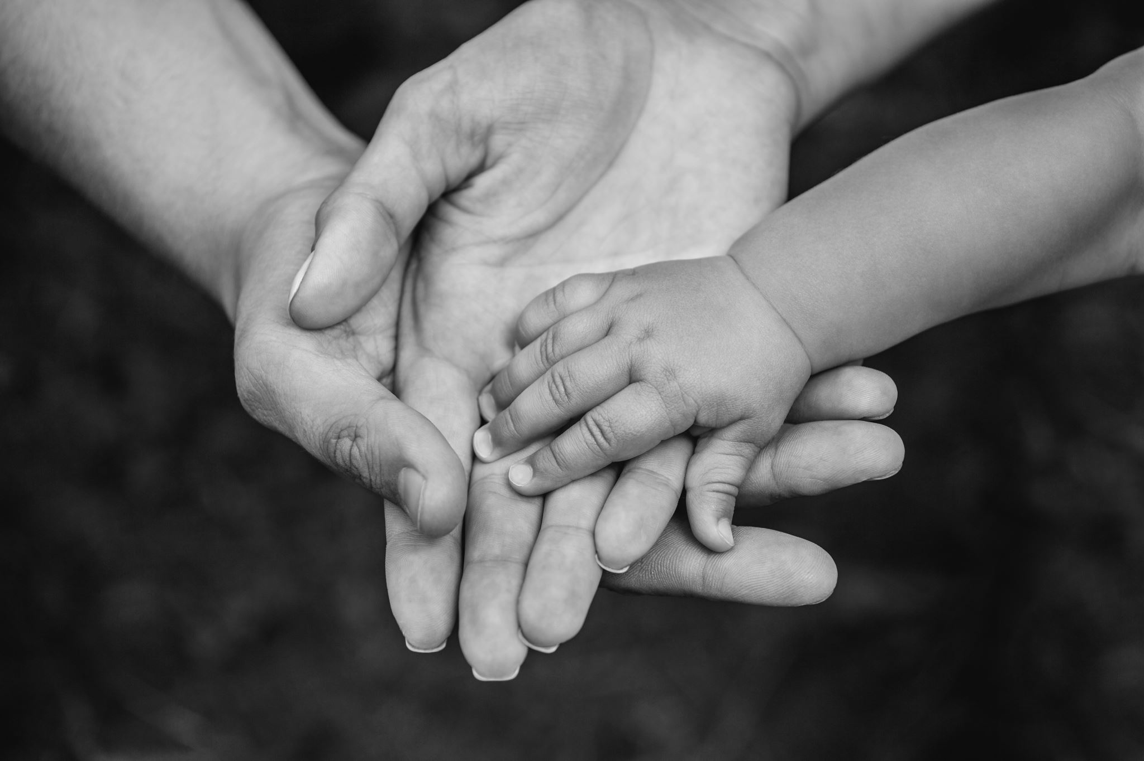
The development of attachment styles: cycles of wellbeing, and distress in infants and adults
The concept of “Cycles of wellbeing and distress” helps us to understand how different attachment patterns develop.
We will discuss:
1. The cycle of well-being in infants and children
2. The cycle of well-being in adults
3. The development of cycles of distress in disordered attachment and how this interferes with the person being able to stay in the window of emotional tolerance.

Slide 91
The development of attachment styles: cycles of wellbeing, and distress in infants and adults
1. The cycle of well-being in infants and children
2. The cycle of well-being in adults
3. The development of cycles of distress in disordered attachment and how this interferes with the person being able to stay in the window of emotional tolerance.

Slide 92
1. The cycle of wellbeing in infants and children
Physical/emotional
pain, discomfort
High activation protest
Soothing by attuned, available parental figure
Decreased activation
Wellbeing
STRESS

Slide 93
The development of attachment styles: cycles of wellbeing, and distress in infants and adults
1. The cycle of well-being in infants and children
2. The cycle of well-being in adults
3. The development of cycles of distress in disordered attachment and how this interferes with the person being able to stay in the window of emotional tolerance.

Slide 94
2. The cycle of wellbeing in secure adults
Physical/emotional
Pain, discomfort
High activation protest
Soothing by internalized “others", learnt skills, as well as connections to others and the world
Decreased activation
Wellbeing
STRESS

Slide 95
The development of attachment styles: cycles of wellbeing, and distress in infants and adults
1. The cycle of well-being in infants and children
2. The cycle of well-being in adults
3. The development of cycles of distress in disordered attachment and how this interferes with the person being able to stay in the window of emotional tolerance.

Slide 96
3. Cycle of distress/insecure attachment
More Physical/emotional
Pain, discomfort
High activation
Protest/dissociation
Partial or no soothing or more pain from caregiver
Partial decrease or increase in activation
Persistent high activation
No wellbeing, chronic distress
STRESS

Slide 97
Can you summarize how attachment affects personality development?

Slide 98
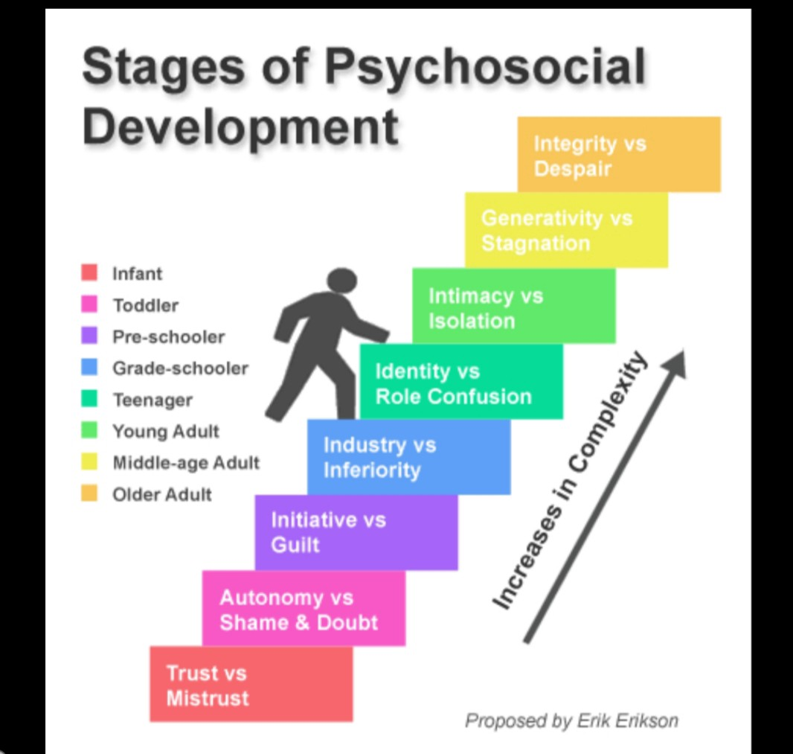
Attachment and psychosocial development
Attachment theory postulates that the kind of emotional connection we have to caregivers in early life is critical to psychosocial development.
Psychosocial development describes how personality develops, and how social skills are learned from infancy through adulthood.
Erik Erikson offered a model in which personality develops in a predetermined order through eight stages of development from infancy to old age.
Erikson’s first stage “trust versus mistrust”, which is negotiated in the first 18 months of life, is successfully resolved in secure but not in insecure attachment.
The establishment of trust or secure attachment allows the child to proceed to the second stage of development “autonomy versus shame and doubt”.
Healthy autonomy manifests in the willfulness of the “terrible two’s” which is an expression of the sense of stability and security necessary to grow and take risks.
Mistrust or insecure attachment leads to an impairment of psychosocial development which affects all of Erikson’s subsequent developmental stages.

Slide 99

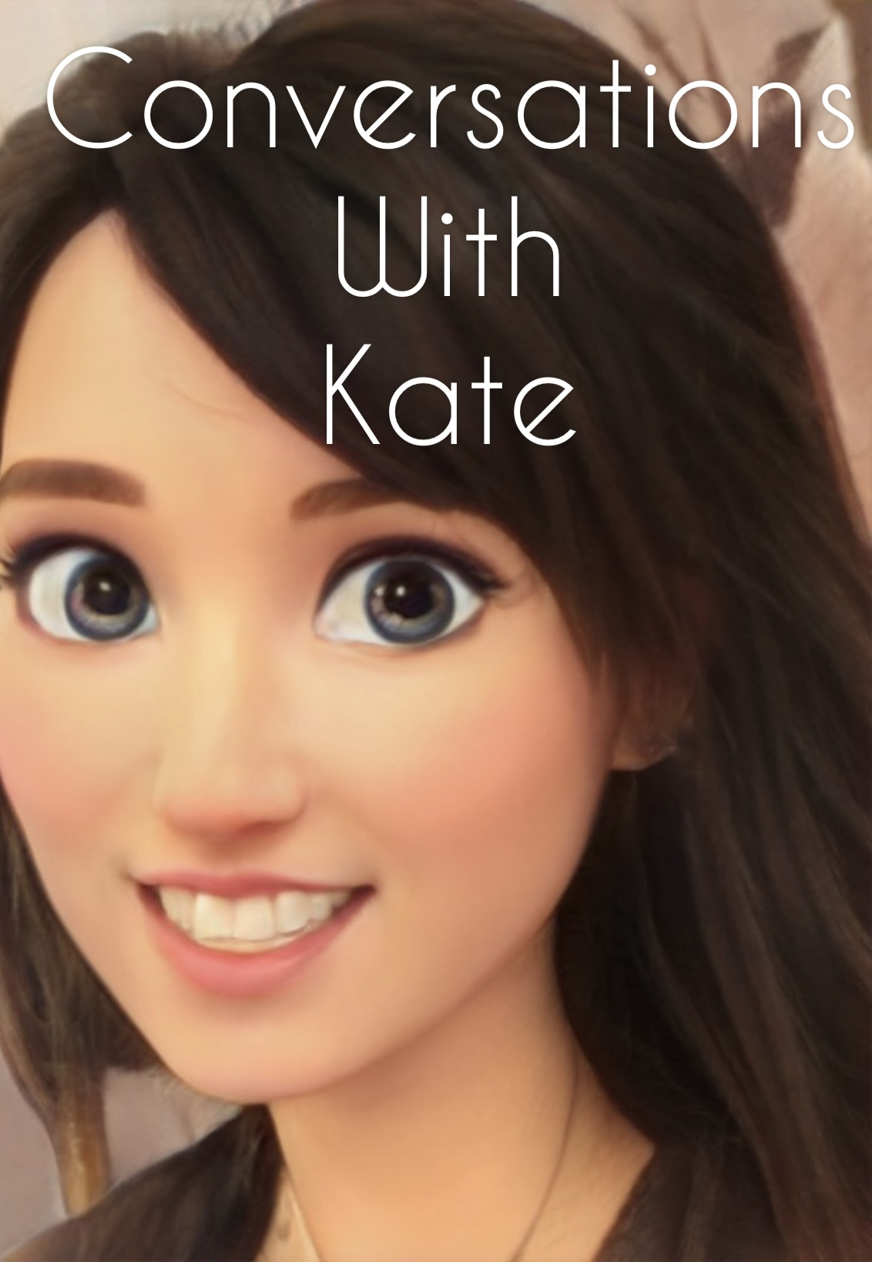

Slide 100

OPEN DISCUSSION

Slide 101

See you next session

Slide 102

video
Week 11 of simple

Slide 103


Slide 104
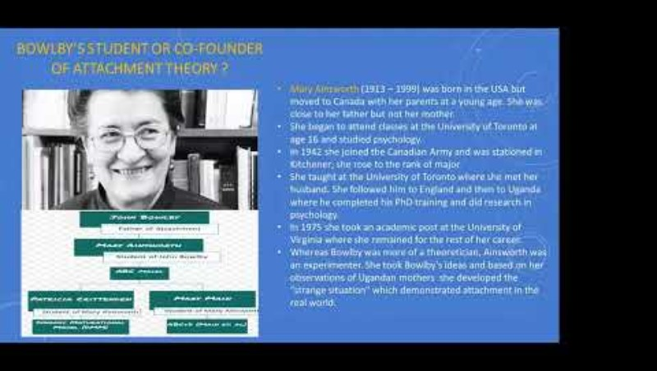

Slide 105
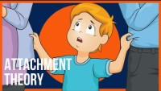

Slide 106
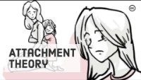

Slide 107
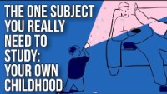

Slide 108


Slide 109
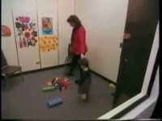

Slide 110
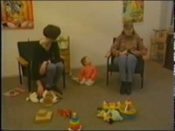

Slide 111
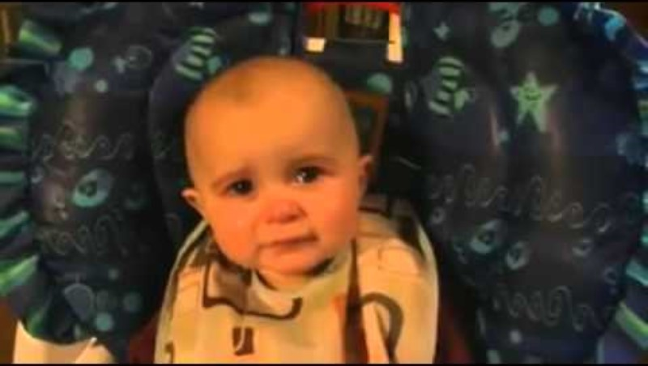

Slide 112
(1)John Bowlby was a British psychologist, psychiatrist, and psychoanalyst known for his pioneering work in attachment theory. He was born on February 26, 1907, in London, England, and passed away on September 2, 1990. Bowlby studied medicine at the University of Cambridge and later pursued a career in child psychiatry.
One of his most significant contributions to psychology was the development of attachment theory, which emphasizes the importance of early relationships between infants and their caregivers in shaping later development and behavior. Bowlby's work has had a profound influence on the fields of psychology, child development, and psychotherapy.
Throughout his career, Bowlby held various academic and clinical positions, including serving as the head of the Children's Department at the Tavistock Clinic in London. He also wrote several influential books, including "Attachment and Loss," which further elaborated on his theory of attachment.
John Bowlby's work has had a lasting impact on our understanding of human relationships and development, and he is widely regarded as one of the most influential psychologists of the 20th century

Slide 113
(2)Konrad Lorenz was an Austrian zoologist, ethologist, and ornithologist who is best known for his pioneering work in the study of animal behavior, particularly in the field of ethology. He was born on November 7, 1903, in Vienna, Austria, and passed away on February 27, 1989.
Lorenz is considered one of the founding figures of modern ethology, which is the scientific study of animal behavior in their natural environments. He is known for his research on instinctive behavior, imprinting, and the social behavior of animals, particularly birds.
One of Lorenz's most famous contributions to the field of ethology is his research on imprinting, a form of rapid learning that occurs during a critical period in an animal's development. He famously conducted experiments with geese and ducks, demonstrating how these birds imprint on the first moving object they see after hatching, often following it as if it were their parent.
Lorenz's work on imprinting and other aspects of animal behavior had a significant impact on the fields of biology, psychology, and anthropology. He was awarded the Nobel Prize in Physiology or Medicine in 1973, along with Karl von Frisch and Nikolaas Tinbergen, for their contributions to the study of animal behavior.
Konrad Lorenz's research and writings have had a lasting influence on our understanding of animal behavior and the evolutionary basis of social behavior in animals

Slide 114
(3)Mary Ainsworth was a Canadian developmental psychologist known for her groundbreaking work in attachment theory. She was born on December 1, 1913, in Glendale, Ohio, and passed away on March 21, 1999. Ainsworth is best known for her research on the attachment bond between infants and their caregivers.
Ainsworth's research, conducted in collaboration with John Bowlby, focused on the ways in which infants form attachments to their primary caregivers and how these early relationships influence later development. She is particularly known for developing the "Strange Situation" procedure, a laboratory experiment designed to assess the quality of attachment between infants and their caregivers.
Through her research, Ainsworth identified different attachment styles, such as secure attachment, insecure-avoidant attachment, and insecure-ambivalent attachment, each of which has implications for the child's emotional and social development. Her work has had a profound impact on our understanding of the importance of early relationships in shaping a child's development and well-being.
Ainsworth held various academic positions throughout her career, including serving as a professor at Johns Hopkins University. She received numerous awards and honors for her contributions to the field of developmental psychology, and her research continues to be influential in the study of child development and attachment.
Mary Ainsworth's work has had a lasting impact on the field of psychology, particularly in the areas of attachment theory and child development. She is widely regarded as one of the most influential psychologists of the 20th century

Slide 115
Ainsworth identified several key traits of securely attached children based on her research in attachment theory. Securely attached children typically exhibit the following characteristics:
1. Proximity Seeking: Securely attached children feel comfortable seeking proximity to their primary caregiver when they are distressed or in need of comfort. They see their caregiver as a secure base from which to explore the world.
2. Exploration and Curiosity: Securely attached children are curious, independent, and eager to explore their environment. They feel confident to venture out and engage with the world around them because they trust that their caregiver will be there to provide support and comfort when needed.
3. Emotional Regulation: Securely attached children are able to regulate their emotions effectively, seeking comfort from their caregiver when upset and using their caregiver as a source of security and reassurance.
4. Social Competence:Securely attached children tend to have positive social relationships with others, as they have a strong foundation of trust and security from their early attachment experiences.
These traits of securely attached children reflect a healthy and secure attachment bond with their primary caregiver. Such children are likely to develop a positive sense of self, healthy relationships with others, and effective coping mechanisms for dealing with stress and challenges. Secure attachment in early childhood is associated with better emotional regulation, social skills, and overall well-being throughout life

Slide 116
Mary Ainsworth also identified several key traits of parents of securely attached children based on her research in attachment theory. Parents of securely attached children typically exhibit the following characteristics:
1. Sensitive and Responsive: Parents of securely attached children are attuned to their child's needs and emotions, responding promptly and appropriately to their cues for comfort and support. They are sensitive to their child's signals and provide a secure base from which the child can explore the world.
2. Consistent and Predictable: Parents of securely attached children provide a consistent and predictable caregiving environment, establishing routines and boundaries that help the child feel safe and secure. They are reliable sources of comfort and support for their child.
3. Warm and Affectionate: Parents of securely attached children show warmth, affection, and emotional availability towards their child. They express love and care through physical touch, verbal expressions, and positive interactions that foster a strong emotional bond.
4. Emotionally Available: Parents of securely attached children are emotionally available and responsive to their child's emotional needs. They validate their child's feelings, provide comfort during times of distress, and help the child regulate their emotions effectively.
5. Supportive of Independence: Parents of securely attached children encourage their child's independence and autonomy, while also being available for support and guidance when needed. They foster a sense of security and confidence in their child's exploration of the world.
These traits of parents of securely attached children reflect a secure and nurturing caregiving environment that promotes the development of a strong attachment bond between parent and child. By providing sensitive, responsive, and supportive care, parents can help their child develop a secure attachment style that lays the foundation for healthy emotional and social development

Slide 117
(4)Harry Harlow was an American psychologist known for his groundbreaking research on social isolation, maternal separation, and the importance of contact comfort in the development of infant attachment. He was born on October 31, 1905, in Fairfield, Iowa, and passed away on December 6, 1981.
One of the most important aspects of Harry Harlow's work was his series of experiments with rhesus monkeys, in which he studied the effects of maternal separation and social isolation on their behavior and development. Harlow's research challenged prevailing beliefs at the time that feeding was the primary basis for infant-mother attachment.
Harlow's most famous experiments involved surrogate mothers made of wire and cloth. He found that infant monkeys preferred the cloth mother, even when it did not provide food, demonstrating the importance of contact comfort and emotional support in attachment relationships. This research highlighted the critical role of social and emotional interactions in the development of healthy attachment bonds.
Additionally, Harlow's work shed light on the negative effects of maternal deprivation and social isolation on the psychological well-being of primates, emphasizing the importance of early social experiences in shaping behavior and emotional development.
Despite controversy surrounding the ethics of his experiments, Harry Harlow's research significantly influenced our understanding of attachment, social behavior, and the psychological effects of early experiences on development. His work continues to be studied and cited in the fields of psychology, child development, and animal behavior.

Slide 118
(5)Mary Main is a prominent developmental psychologist known for her significant contributions to attachment theory. She is best known for her work on the development of the Adult Attachment Interview (AAI) and the discovery of the Disorganized Attachment classification.
Mary Main's most important work revolves around her research on adult attachment and the ways in which early attachment experiences influence adult relationships and mental health. She collaborated with Mary Ainsworth, the pioneer of attachment theory, and developed the Adult Attachment Interview as a tool to assess adults' attachment patterns based on their early caregiving experiences.
One of Mary Main's key contributions to attachment theory was the identification of the Disorganized Attachment classification. This attachment pattern reflects a lack of coherent attachment strategies in children, often resulting from experiences of trauma, abuse, or inconsistent caregiving. Mary Main's research highlighted the importance of this unique attachment classification and its implications for understanding the impact of early adverse experiences on later development.
Mary Main's work has significantly advanced our understanding of attachment theory and its relevance across the lifespan. Her research on adult attachment and the Disorganized Attachment classification has had a profound influence on the field of developmental psychology and continues to shape our understanding of how early attachment experiences impact individuals' relationships and well-being.

Slide 119
(6)Attachment styles, as identified by attachment theory, can manifest differently at different ages. The four main attachment styles are Secure, Insecure-Avoidant, Insecure-Ambivalent/Resistant, and Disorganized. Here's how these attachment styles may manifest at different ages:
1. Infancy (0-2 years):
- Secure Attachment: Infants with secure attachment seek comfort from their caregivers when distressed, use them as a secure base for exploration, and show distress when separated but are easily soothed upon reunion.
- Insecure-Avoidant Attachment: Infants with insecure-avoidant attachment may avoid or ignore their caregiver, show little distress upon separation, and may not seek comfort upon reunion.
- Insecure-Ambivalent/Resistant Attachment: Infants with insecure-ambivalent/resistant attachment may be clingy and show extreme distress upon separation, but may also resist comfort or be difficult to soothe upon reunion.
- Disorganized Attachment: Infants with disorganized attachment may exhibit contradictory behaviors, such as approaching the caregiver while showing fear or confusion, displaying disoriented behaviors, or freezing in the presence of the caregiver.
2. Early Childhood (2-6 years):
- Secure Attachment: Children with secure attachment tend to be more independent, have better social skills, and show resilience in dealing with stress and challenges.
- Insecure-Avoidant Attachment: Children with insecure-avoidant attachment may struggle with forming close relationships, have difficulty expressing emotions, and may be more self-reliant but less likely to seek help when needed.
- Insecure-Ambivalent/Resistant Attachment: Children with insecure-ambivalent/resistant attachment may have difficulty regulating emotions, exhibit clingy behavior in relationships, and may struggle with trust and intimacy.
- Disorganized Attachment: Children with disorganized attachment may exhibit behavioral and emotional difficulties, have challenges in self-regulation, and may show signs of trauma or unresolved issues in relationships.

Slide 120
3. Adolescence and Adulthood:
- Secure Attachment: Individuals with secure attachment tend to have positive self-esteem, healthy relationships, and effective coping strategies in dealing with stress and challenges.
- Insecure Attachment: Insecure attachment styles may persist into adolescence and adulthood, impacting relationships, emotional regulation, and mental health. However, individuals can develop more secure attachment patterns through therapy, self-awareness, and supportive relationships.
Attachment styles can influence individuals' behaviors, emotions, and relationships across the lifespan. Understanding one's attachment style and its manifestations at different ages can provide insights into how early attachment experiences continue to shape development and interpersonal dynamics throughout life

Slide 121
(7)The Adult Attachment Interview (AAI) is a semi-structured interview developed by psychologist Mary Main and her colleagues to assess adults' attachment patterns based on their early caregiving experiences. The AAI is widely used in research and clinical settings to understand individuals' internal working models of attachment and how these models influence their relationships and mental health.
Some key points about the Adult Attachment Interview:
1. Purpose: The primary purpose of the AAI is to explore adults' thoughts, feelings, and memories about their early attachment relationships with caregivers. By asking open-ended questions and probing for specific details, the interviewer aims to uncover the individual's attachment patterns and representations of attachment experiences.
2. Structure: The AAI typically consists of a series of questions about the individual's childhood experiences, relationships with caregivers, and attachment-related memories and emotions. The interview is designed to elicit narratives that reveal the individual's attachment style, including secure, insecure-avoidant, insecure-ambivalent/resistant, or disorganized patterns.
3. Scoring: Trained coders analyze the content of the AAI transcripts to assign attachment classifications based on established criteria. These classifications provide insights into the individual's attachment patterns, internal working models, and the impact of early attachment experiences on their adult relationships and psychological well-being
4. Clinical Applications: In clinical settings, the AAI can be used to assess individuals' attachment styles and inform therapeutic interventions. Understanding a client's attachment patterns can help therapists tailor treatment approaches to address attachment-related issues, such as difficulties in forming and maintaining relationships, emotional regulation, and coping with stress.
5. Research Significance: The AAI has been instrumental in advancing our understanding of adult attachment and its links to early caregiving experiences. Research using the AAI has highlighted the continuity of attachment patterns from infancy to adulthood, the impact of attachment on mental health outcomes, and the role of attachment in shaping interpersonal relationships.

Slide 122
(8)The Minnesota Longitudinal Study of Risk and Adaptation (MLSRA) is a comprehensive research project that has followed a cohort of individuals from birth to adulthood to investigate the impact of early experiences, such as attachment relationships, on development and outcomes later in life. Here are some of the most relevant findings from the study:
1. Attachment and Development: The MLSRA has provided valuable insights into the long-term effects of early attachment relationships on various aspects of development. Researchers have found that secure attachment in infancy is associated with better social and emotional outcomes in childhood and adulthood, including higher levels of self-esteem, better relationship quality, and lower levels of psychopathology.
2. Parenting and Child Outcomes: The study has highlighted the importance of parenting practices and the quality of parent-child relationships in shaping children's development. Positive parenting behaviors, such as warmth, responsiveness, and consistency, have been linked to better cognitive, social, and emotional outcomes in children across different developmental stages
3. Resilience and Risk Factors: The MLSRA has examined factors that contribute to resilience in the face of adversity. Researchers have identified protective factors, such as supportive relationships, adaptive coping strategies, and positive self-regard, that can mitigate the negative effects of risk factors, such as poverty, family dysfunction, and exposure to trauma.
4. Mental Health and Well-being: The study has shed light on the links between early experiences and mental health outcomes in adulthood. Researchers have found that individuals with a history of secure attachment are less likely to experience mental health problems, such as depression, anxiety, and substance abuse, compared to those with insecure attachment patterns.
5. Intergenerational Transmission of Attachment: The MLSRA has also explored the intergenerational transmission of attachment patterns. Researchers have found that parents' attachment styles influence their children's attachment patterns, highlighting the continuity of attachment across generations and the importance of early caregiving experiences in shaping attachment relationships.

Slide 123
The Minnesota Longitudinal Study of Risk and Adaptation has provided valuable insights into the complex interplay between early experiences, attachment relationships, parenting practices, and developmental outcomes across the lifespan. The findings from the study have implications for understanding resilience, mental health, and the long-term impact of early experiences on individual development

