Slide 1


Welcome BACK! to week 13 of simple the DYNAMIC-maturational model OF
ATTACHMENT AND ADAPTATION (DMM)

Slide 2
SIMPLE COURSE SCHEDULE 2025-26
Week 1- October 1
Week 2- October 8
Week 3- October 15
Week 4- October 22
Week 5- October 29
Week 6- November 5
Week 7- November 12
Week 8- November 19
Week 9- November 26
Week 10- December 3
Week 11- December 10
Week 12- December 17
December 24 and 31
Week 13- January 7
Week 14- January 14
Week 15- January 21
Week 16- January 28
Week 17- February 4
Week 18- February 11
Week 19- February 18
Week 20- February 25
Week 21- March 4
March 11 and 18 no course
Week 22- March 25
Week 23- April 1
Week 24- April 8
Week 25- April 15
Week 26- April 22
Week 27- April 29
Week 28- May 6
Week 29- May 13
Week 30- May 20
Week 31- May 27
Week 32- June 3

Slide 3
week 1- orientation and overview- sessions 1 and 2 of simple manual. week 2- introducing distress tolerance-p. 1-13 of dbt workbook and crisis plans-session 3 of the manual. week 3- the theoretical foundations of the simple course. session 4, 6, and 8 of the manual. week 4- distress tolerance p. 14-32 of dbt workbook. suicide prevention session 5 of the manual. our first practice- crisis plans. week 5- distress tolerance p. 33-46 of dbt workbook. introducing holes diary cards- session 7 of manual. week 6- distress tolerance p. 47-68 of dbt workbook. finding your diary card targets- session 9 of manual. our second practice- holes diary cards. week 7- introducing personality- session 10 of manual. week 8- distress tolerance p. 69-90 of dbt workbook. introducing chain analysis-session 11 of manual. week 9- what shapes personality-session 12 of manual. week 10-introducing mindfulness skills p.90-109 of dbt workbook. advanced chain analysis- session 13 of manual. our third practice-chain analysis. week 11- attachment theory- session 14 of manual. week 12- mindfulness skills p. 110-131 of dbt workbook. introducing rational mind remediation-session 15 of manual. week 13- the dynamic-maturational model of attachment and adaptation- session 16 of manual. week 14-mindfulness skills p. 131-147 of dbt workbook. reviewing all the tools-session 17 of manual. our fourth practice-rational mind remediation. week 15-stress-session 18 of manual. week 16-introducing emotion regulation skills p.148-182 of dbt workbook. introducing the goals diary card procedure-session 19 of manual.

Slide 4

Warning about meditation
Feel free to skip it. Followed by a moment of silence

Slide 5


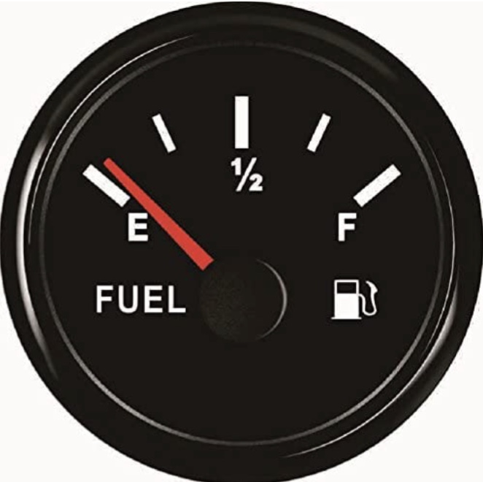
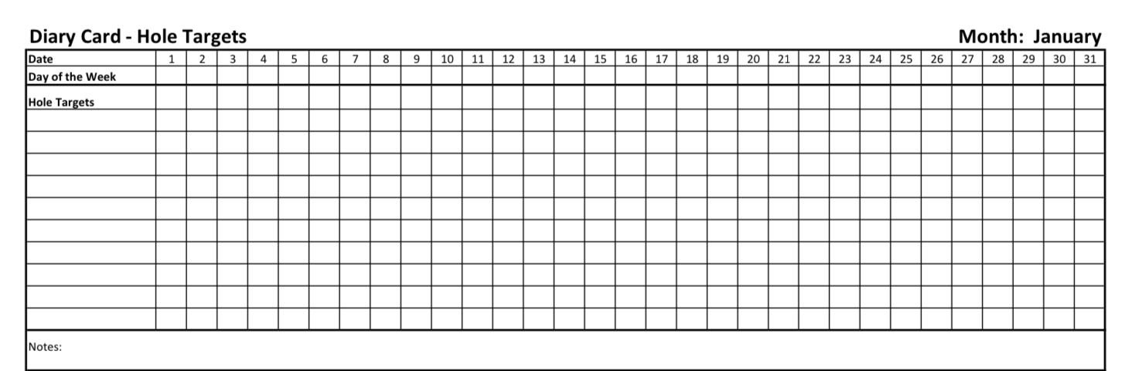
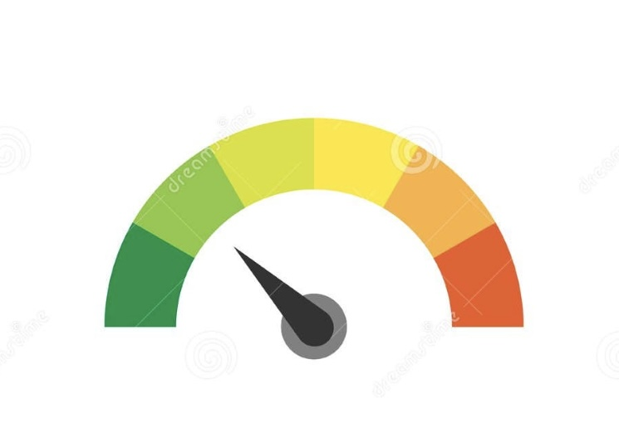
Check in regularly with your Personal dashboard
Spend a few moments checking in with yourself by asking:
1)What is the current risk that I’ll experience a state of crisis ?
Low b) Moderate c) high d) very high e) extreme
2) Am I in the window of tolerance?
a) Yes b) I’m a little outside c) very outside
3) Where is my energy tank right now?
Full b) ¾ c) ½ d) near empty
4) Have I been tracking my targets using the holes diary card ? how would I rate my targets right now?
5) How well am I focusing on what I’m doing. (for example, the course)
CRISIS RISK
WINDOW OF TOLERANCE
ENERGY RESERVES
RATING MY TARGETS
ATTENTION METER
% attention I’m paying
100
0

Slide 6
FIVE-MINUTE MINDFULNESS PRACTICE: RETURNING, LENGTHENING, BEGINNING AGAIN
Invite people to sit comfortably, feet on the floor, hands resting easily.
Let’s begin by simply arriving.
If it feels okay, allow your eyes to close…
or soften your gaze.
Take a slow breath in through the nose…
and a longer breath out through the mouth.
Again—
in…
and out.
And one more time, letting the shoulders drop as you exhale.
Now, take a moment to notice that we are back.
Back in this room.
Back in this shared work.
Back in a rhythm that may feel familiar, or may feel slightly new again.

Slide 7
FIVE-MINUTE MINDFULNESS PRACTICE: RETURNING, LENGTHENING, BEGINNING AGAIN
The holidays have passed.
Christmas, New Year’s—whatever those days held for you: joy, grief, exhaustion, relief, disappointment, connection, loneliness…
You don’t need to sort it out now.
Just acknowledge: those days are behind us.
Let yourself place them gently down.
Now bring your attention to something quiet and true about this time of year.
The days are getting longer.
It’s subtle—almost imperceptible at first—
but each day carries a little more light than the one before.
Nothing dramatic.
No sudden transformation.
Just a gradual, faithful return.
Notice how that mirrors healing.

Slide 8
FIVE-MINUTE MINDFULNESS PRACTICE: RETURNING, LENGTHENING, BEGINNING AGAIN
Growth rarely happens in big moments.
It happens in small increments.
A little more awareness.
A little more choice.
A little more light.
Bring your attention to your breath again.
As you inhale, imagine breathing in light—
not bright or blinding, just gentle and steady.
As you exhale, imagine letting go of what no longer needs to be carried into this next stretch of time.
No forcing.
No fixing.
Just making space.
Now, I’d like to invite—not demand—
an intention, rather than a resolution.

Slide 9
FIVE-MINUTE MINDFULNESS PRACTICE: RETURNING, LENGTHENING, BEGINNING AGAIN
Not something you should do…
but something you’re willing to lean toward.
It might sound like:
• “I want to meet myself with more kindness.”
• “I want to stay present when things are hard.”
• “I want to soften my grip on old patterns.”
• “I want to continue healing, even when it’s slow.”
Let the intention be alive, not rigid.
Something that can breathe and evolve.
If nothing comes, that’s okay too.
The intention might simply be: to stay engaged.
Now, place a hand on your chest or abdomen if that feels grounding.
Feel the steadiness of your body beneath you.
The chair supporting you.
The floor holding you.

Slide 10
FIVE-MINUTE MINDFULNESS PRACTICE: RETURNING, LENGTHENING, BEGINNING AGAIN
You are here.
You showed up.
And healing doesn’t ask for perfection—
only presence and persistence.
Like the lengthening days,
this work unfolds quietly, faithfully, over time.
Take one final, deeper breath in…
and let it go slowly.
When you’re ready, gently open your eyes…
bringing this sense of beginning again with you.
Welcome back.

Slide 11


Slide 12
PRACTICE SESSIONS SCHEDULE
preparation
practice
4. Week 14 January 14 Today January 7, 1:30 Rational mind remediation Helga H.
5. Week 18 February 11 February 4, 1:30 goals diary card Nicole L
6. Week 25 April 15 April 8, 1:30 IFS workbook 1 Elaine S.
7. Week 26 April 22 April 15 IFS workbook 2 Dinko T.
8.Week 27 April 29 April 22 IFS workbook 3 Barb H.
9. Week 28 May 6 April 29 IFS workbook 4
10.Week 29 May 13* May 6 1:30 PM* Wise mind remediation Rob T.
We still need a volunteer for the IFS practice May 6.
* Note that these dates have been changed

Slide 13
Homework from December 17
Submit
Submit questions or comments to itssimple2023@gmail.com
Read
Simple manual session 16
Do
Do at least 2 rational mind remediations
Continue
Continue reviewing and practicing your crisis plans, diary cards and holes analysis
Continue
Continue tracking all the skills you’ve learned using your skills lists.
Review
the homework habits checklist each week. If there’s an item that you haven’t checked on the list, consider setting a goal to do it(you don’t have to come to the homework group to do that)

Slide 14

Homework for the next week
Submit questions or comments to itssimple2023@gmail.com
Read skills training workbook p. 148- 182.
Simple manual session 17 goals diary card
Do at least 2 rational mind remediations In the next week
Continue reviewing and practicing your crisis plans, diary cards, and chain analysis.
Continue tracking all the skills you’ve learned using your skills list. Review
Review the homework habits checklist each week. If there’s an item that you haven’t checked on the list, consider setting a goal to do it(you don’t have to come to the homework group to do that)

Slide 15
FOR THOSE WHO DON’T HAVE THE SECOND EDITION OF THE WORKBOOK THESE ARE THE TOPICS WE’LL COVER NEXT WEEK
1. Being mindful in our daily life
2. How to do tasks mindfully
3. How to be mindful of our activities
4. Resistances and hindrances to mindfulness practice
5. Exploring mindfulness further
6. Mindfulness and meditation
7. Using kindness and compassion
8. Paying attention to spaciousness and stillness

Slide 16
HOMEWORK HABITS CHECKLIST
Circle or check what you will try this week.
1. Preparation habits
■ I schedule a specific time for homework.
■ I choose a consistent location with minimal distractions.
■ I gather what I need ahead of time (notebook, worksheet, pen).
2. Focus & pacing habits
■ I start with a tiny step (2–5 minutes).
■ I use a timer (10–15 minutes).
■ I remove distractions (phone away / Do Not Disturb).

Slide 17
HOMEWORK HABITS CHECKLIST
3. Tracking & organization habits
■ I keep materials in one place (binder / folder / notebook).
■ I write down insights right after doing the homework.
4. Self-compassion habits
■ I aim for progress, not perfection.
■ I notice resistance without judgment.
5. Accountability habits
■ I review my week: What worked? What didn’t?
■ I share honestly with my buddy — even when I didn’t do it.
Micro commitment:
This week I will focus on: ■ Time ■ Place ■ Tiny step ■ Timer ■ Other please specify:

Slide 18

WEEKLY ANNOUNCEMENTS
If you’re doing the course on zoom and would rather do it in person, there’s room!

Slide 19
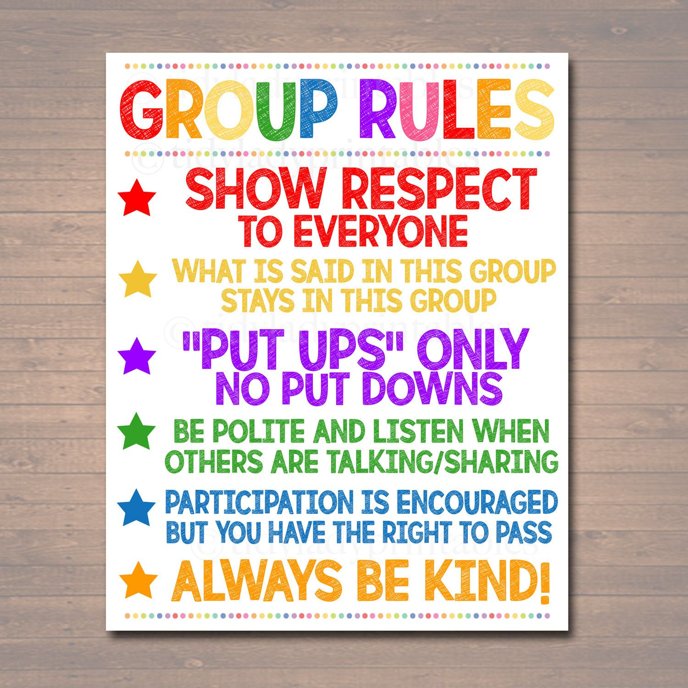
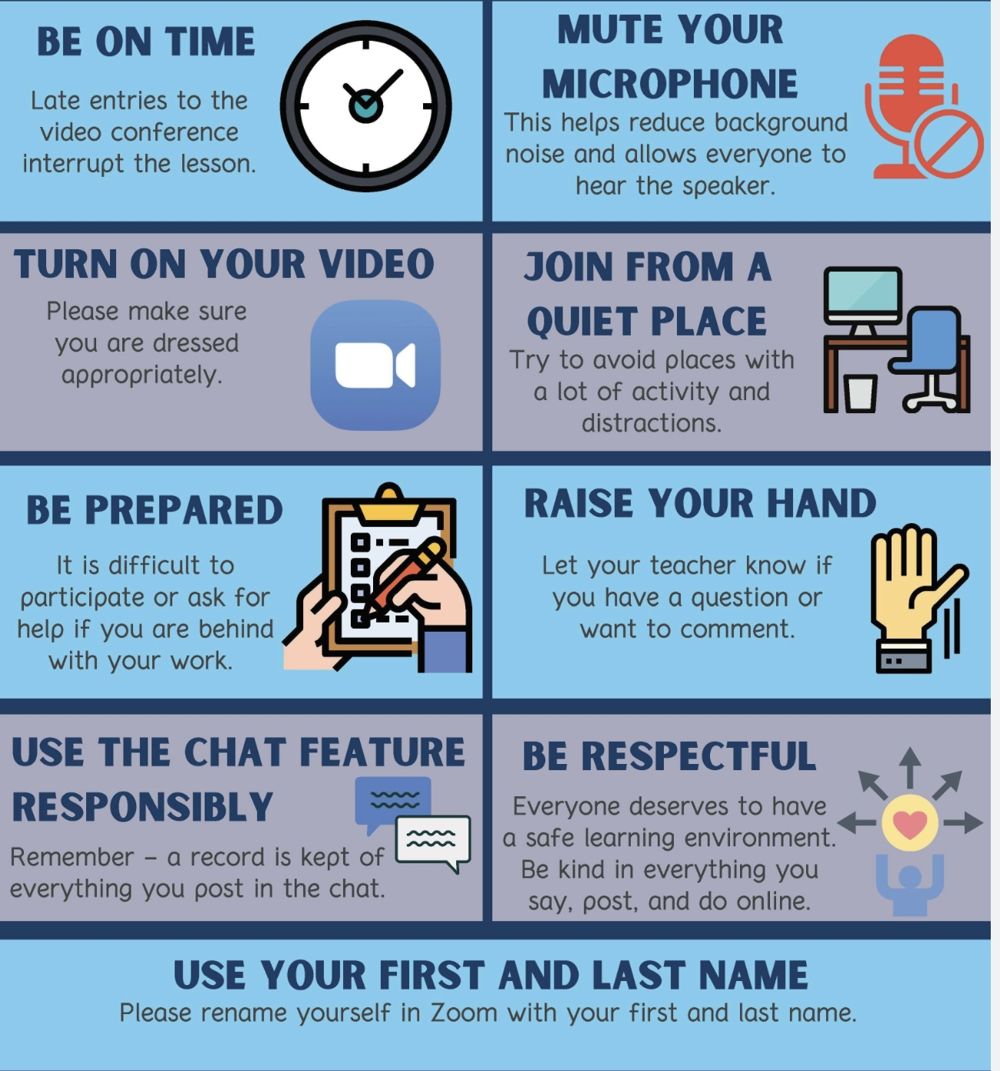
REMINDER PARTICIPANT AGREEMENTS
If you have questions, comments, or feedback, please save them for the two question periods. You can put them in the chat box or raise your real/virtual hand.
Keep comments, questions, and feedback relatively brief so everyone has a chance to participate.(one breath sharing)
If you’re on zoom, make sure no one can overhear what is being said
For reasons that will become clear later in the course please avoid giving advice to other participants about what they should or should not do. Validation, encouragement , and understanding are however very much appreciated.

Slide 20
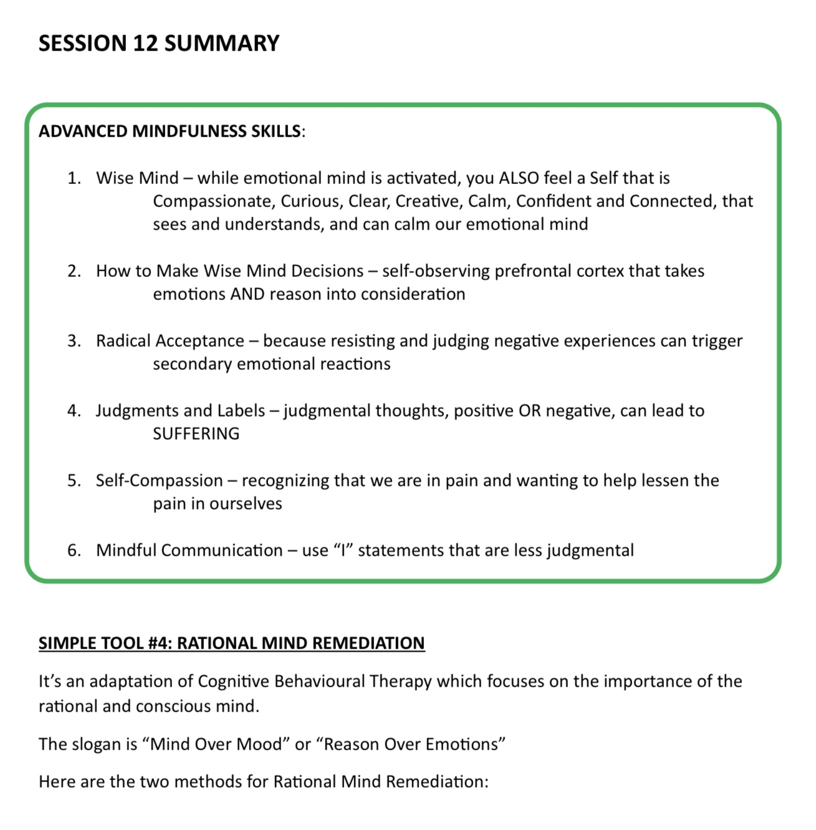
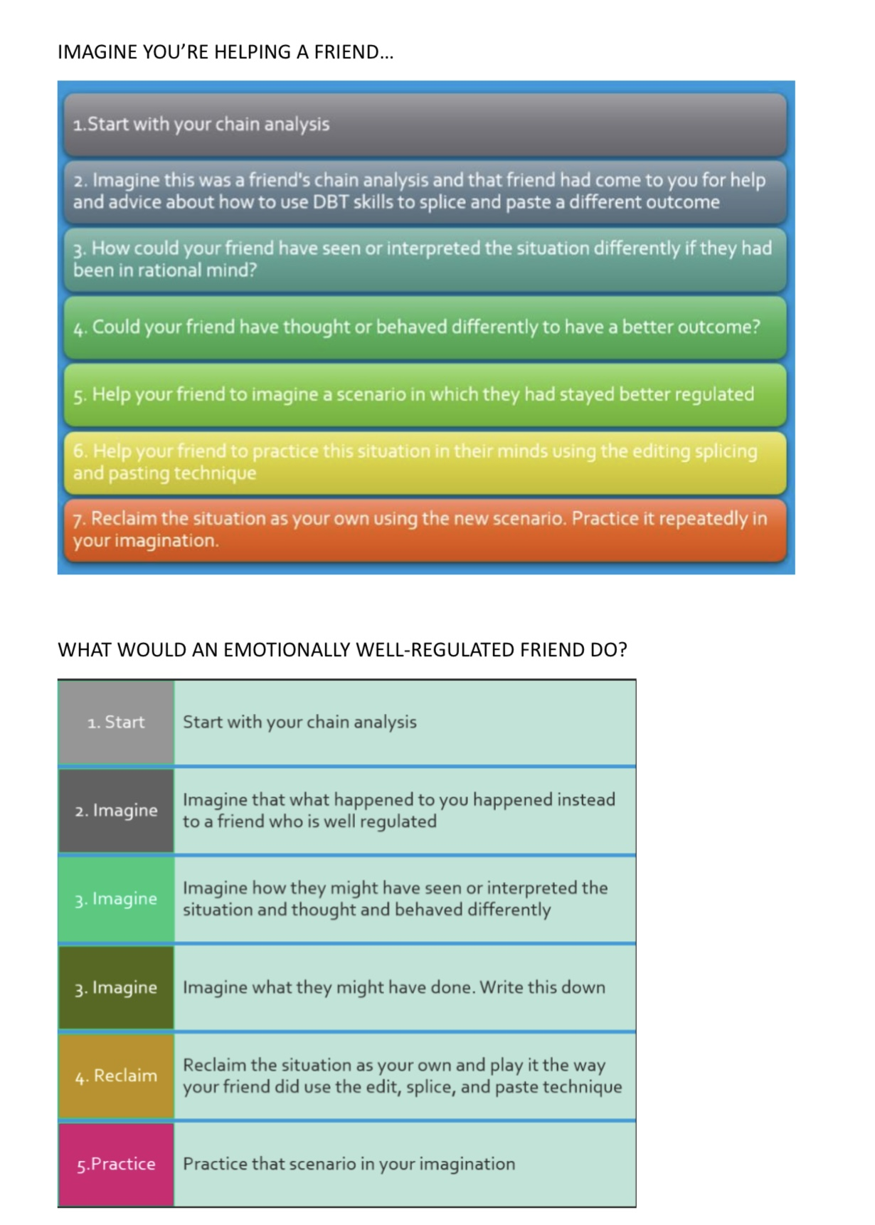

Slide 21

E-mailed questions, comments, feedback

Slide 22

A quick review:
In week 11 we discussed Attachment theory : Bowlby, Ainsworth, Main.
Attachment in infancy : avoidant, anxious, secure, disorganized also called the A, B, C, D or Ainsworth/Main model
Attachment in adults

Slide 23

What we will do today
Today we will cover Simple manual’s session 16.
Advanced attachment theory: Patricia Crittenden’s dynamic maturational model of attachment and adaptation which is also known as the developmental maturational model or DMM.
We’ll also briefly discuss repetition compulsion.
Link to Wikipedia article on DMM

Slide 24
Before we get into today’s material, please note that what we’re going to talk about today, the Dynamic-Maturational Model is dense. Don’t expect to understand all of it, remember all of it, or place yourself neatly anywhere in the model.
This is not a diagnostic exercise. It’s not a test. And it’s definitely not a way of deciding what’s ‘wrong’ with you or with anyone else.
Instead, try to listen with curiosity. Notice what feels familiar. Notice what lands emotionally. Notice if your body tightens, relaxes, or drifts as we go along, because that, in itself, is part of what we’re talking about today.
One of the core ideas in the DMM is that what looks like problems are often solutions that once kept us safe. So, if you recognize yourself in any of these patterns don’t judge, try to understand.
You don’t need to track every detail. Let the model wash over you a bit. Take what resonates, let the rest go, and trust that understanding often comes later, after we’ve had time to ‘wrestle’ with ideas like these.

Slide 25

What is the DMM?
What’s the difference between the DMM and the Ainsworth/Main ABCD model?
Some definitions to keep in mind.
Somatic mind, our 4th mind.
An overview of the DMM
Disruptions of information flow between the 3 centers and mental health issues
The types of disruption of information flow
Disrupted information flow and psychological disorders
The PIE model in…
in infancy
in pre-school year
in early school years
in adolescence
in adulthood
Important remarks of the DMM
Repetition compulsion
WHAT WE WILL COVER TODAY
Patricia Crittenden (1945-

Slide 26
WHAT IS THE DMM?

Slide 27
WHAT IS THE DMM?
The Dynamic maturational model of attachment and adaptation is also referred to as the dynamic maturational model or the DMM for short.
The Ainsworth/Main model which we discussed in week 11 is also known as the ABCD model.
The DMM is Patricia Crittenden’s attachment-based model explaining how people across their developmental journey adapt their thinking, emotions, and bodily responses to stay safe from danger, and how these adaptations can become rigid or distorted when danger is chronic.
The DMM can be seen as “attachment theory on steroids”

Slide 28
WHAT’S THE DIFFERENCE BETWEEN THE DMM AND THE AINSWORTH/MAIN ABCD MODEL?

Slide 29
LIMITATIONS OF THE Ainsworth/Main model
The ABCD model of attachment that we already talked about has several limitations.
1) It doesn’t take human cognitive and psychosocial development over the lifespan into consideration in its account of how attachment adaptations manifest. Since the A,B,C,D model only studied attachment styles in infants and in adults, it does not describe attachment adaptations that arise in pre-school, schoolyears, adolescence and adulthood.
2) The A, B, C, D model of attachment is simplistic; children develop not just one attachment style but different ones to different attachment figures. The strange situation only studied attachment to one caregiver usually mothers.
3) Disorganized attachment is found in about 10-15% of classified children and a very significant proportion of all adults presenting for mental health care, especially those with diagnosis of complex PTSD, and BPD. The A,B,C,D model does not consider disorganized attachment to be an adaptation but rather a “ falling apart” or “breakdown” of adaptation.
4) The ABCD model doesn’t explain mental health diagnosis such as delusional disorders and psychopathy.
Patricia Crittenden’s DMM tries to address these shortcomings. The DMM is a complex map that builds on the traditional attachment model bringing more fine detail to this evolving theory. It also fits well with trauma theory and the internal family systems model both of which we’ll be talking about in future sessions.

Slide 30
THE DMM: ADVANCED ATTACHMENT THEORY
The DMM is a developmental, clinical, and evolutionary expansion of the traditional ABCD attachment model. It is particularly helpful for working with adults experiencing personality issues arising from their attachment styles.
The ABCD model tells us that something is wrong but not how it works or how it developed. The DMM sees attachment strategies not as disorders but as intelligent, self-protective adaptations to danger. The ABCD model helped us name different patterns, Crittenden’s model helps us understand why those patterns formed, how they change over time, and how they continue to protect us, even when they cause suffering.
In the ABCD model disorganized attachment is a catch-all for fear, collapse, and contradiction. In the DMM “disorganized” behaviors are understood as extreme forms of organized self-protective strategies, combining avoidant and anxious features and developing after infancy. The behavior of people with disorganized attachment style is not chaotic, it is strategic, patterned, and meaningful.
The DMM replaces shame with respect, pathology with purpose, “what’s wrong with you?” with “what happened, and how did you adapt so brilliantly?” That is why, the DMM is so helpful in trauma-informed work.

Slide 31
SOME DEFINITIONS TO KEEP IN MIND

Slide 32
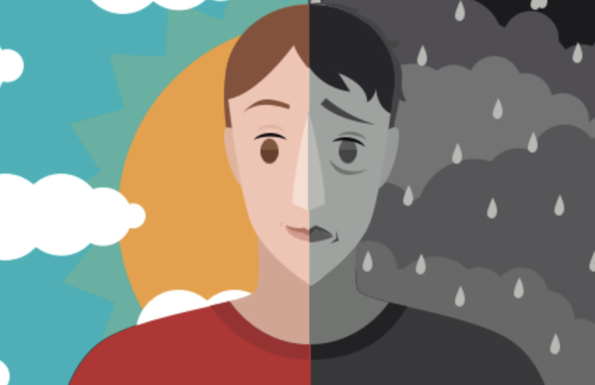
SOME DEFINITIONS TO KEEP IN MIND
To understand the DMM, we need to recall the difference between emotions, feelings, and affect.
Emotions –are states that involves three distinct components: A) a subjective experience or feeling B) a physiological or biological response and C) a behavioral or expressive response.
Darwin proposed that there are a few basic emotions including fear, disgust, anger, surprise, happiness, sadness, embarrassment, excitement, contempt, shame, pride, satisfaction and amusement. These basic emotions can be combined, in the same way primary colors can, to produce more complex emotional experiences.
Feelings – are the subjective or conscious experience associated with an emotion.
Affect – is the behavioral or expressive response associated with an emotion. Note that what a person might be feeling, and the emotion they are displaying outward, their affect, may be completely different.
Remember also that so far, we’ve discussed three “minds”: rational, emotional and wise.
Notes:
Before we talk about the developmental maturational model let's define a few terms that we will be using.

Slide 33
Before we talk theory, notice your body right now. Is it tight? Calm? Tired? Your body state shapes how you’ll hear this information.

Slide 34
SOMATIC MIND, OUR 4TH MIND

Slide 35

SOMATIC MIND, OUR 4TH MIND
This is a very challenging but perhaps one of the most important sections in the whole course. It has profound implications. To understand it you may have to came back to it after the session and “wrestle” with it. Many important ideas need to be wrestled with before we understand them.
So far in the course, have become familiar with the concepts of emotional, rational, and wise minds. There is a fourth “mind” we haven’t talked about yet: the somatic or visceral mind.
French Philosopher Rene Descartes (1596-1650) introduced the separation of body and mind that today we take for granted. When Descartes separated body and mind, he was focusing on the rational thinking mind which does indeed seem separate from the body.
Essentially what Descartes was saying is that the tip of the iceberg is separate from the part of it that is under the water. It obviously isn’t. From this perspective what we call “mind” is our conscious mind while what we call “body” is our unconscious mind.
If in Human “mind” we include in additional to Wise, rational and emotional minds also the “somatic mind”, then the separation between body and mind disappears and it begins to make more sense to think of body and mind as two aspects of the same thing.
Body is mind seen from the outside and mind is body seen from the inside.
This idea also makes the health of the body and that of the mind inseparable.

Slide 36
Descartes separated mind and body by focusing on rational thought, which can feel separate from the body. But this is like saying the tip of an iceberg is separate from what’s underwater, it isn’t. When we include the somatic (bodily) mind along with emotional, rational, and wise mind, body and mind are no longer separate but two views of the same system. This means mental and physical health are inseparable.

Slide 37
AN OVERVIEW OF THE DMM

Slide 38
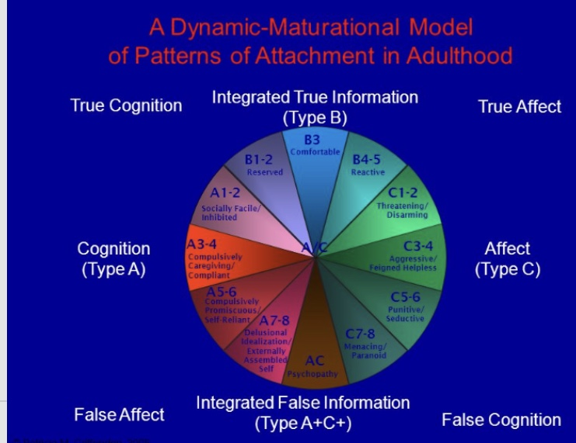
AN overview OF The dmm?
Patricia Crittenden, like Mary Main, was one of Mary Ainsworth’s students.
Recall that Main coined the term “disorganized attachment” as a fourth attachment type to describe the 10-15% of children who, in the strange situation, could not be categorized into one of the other of Ainsworth’s three types of attachment. Disorganized attachment is the type of attachment present in most people diagnosed with “Borderline personality disorder”
In disorganized attachment, the parental figure who would, under ideal circumstances, be expected to ensure the infant’s safety is also perceived as being dangerous and causes the infant fear. When the infant is confronted with an external threat, it is conflicted about approaching this dangerous attachment figure to seek safety from that external threat. Main saw this hesitant and confused behavior as a “falling apart” or “breaking down” of attachment adaptations and deemed it not adaptive.
In the DMM the ABCD linear model becomes a “pie” with slices each describing a different attachment adaptation style. All DMM attachment adaptations are considered adaptive.
According to the DMM how AC and D strategies manifest changes as the person develops from infancy to pre-school, school age, adolescence, and adulthood. The DMM describes how attachment issues present during those periods.

Slide 39
EVOLUTIONARY SURVIVAL STRATEGIES
Body(somatic) → Emotion → Thought (rational)→ BEHAVIOR

Slide 40
survival strategies
DMM considers that humans have evolved 3 parallel survival strategies that are involved in the development of attachment adaptations, they are the 1. somatic, 2. emotional, and 3. rational survival strategies. Survival strategies are ways to stay safe in the face of danger.
Each of these evolutionary survival strategies is associated with an “information center” located in a particular nervous system region: 1. the somatic visceral information center is in our bodies and is linked to the autonomic nervous system 2. the emotional information center is in our limbic brain, and 3. the rational information center is in our cortical brain.

Slide 41
EVOLUTIONARY SURVIVAL STRATEGIES
Body(somatic) → Emotion → Thought (rational)→ BEHAVIOR

Slide 42
survival strategies
1) The first survival strategy is a somatic visceral/body/gut strategy associated with the physiology and arousal states of the autonomic Nervous System. It controls where on the arousal curve organisms are; calm/alert, hyper (fight/flight), or hypo aroused (depressed/dissociated/collapsed/freeze).
Animals without a brain, such as certain invertebrates, do not have the same complex nervous systems that facilitate the fight-or-flight response as seen in vertebrates. However, they can still exhibit basic defensive behaviors that are analogous to fight, flight, or freeze responses, albeit in simpler forms. These behaviors are typically governed by simple neural circuits or reflexes rather than a centralized brain.
Some brainless animals, like jellyfish or sea anemones, have nerve nets that allow them to respond to stimuli. For example, a jellyfish might contract its body to move away from a threat, which is akin to a flight response. The molecules involved in this response in jellyfish are the same as those in Humans. Many simple organisms can exhibit a freeze-like response as a form of defense. For example, certain types of worms might become immobile when threatened, relying on camouflage or stillness to avoid detection by predators.
These responses are generally automatic and triggered by specific stimuli, rather than conscious decisions. They are the result of evolutionary adaptations that have enabled these organisms to survive in their environments despite lacking a centralized brain. The simplicity of these responses reflects the simplicity of their nervous systems, which are designed to handle basic survival tasks.

Slide 43
EVOLUTIONARY SURVIVAL STRATEGIES
Body(somatic) → Emotion → Thought (rational)→ BEHAVIOR

Slide 44
SURVIVAL STRATEGIES
2) The second survival strategy is emotional and is associated with the limbic system, and brain stem. It is instinctual/habitual and does not distinguish past from present or one individual from another. Its logic is associative (dreamlike). The emotional brain mediates the relationship between internal somatic/body arousal states and their external expression/affect so as to maximize the chances of survival.
Animals with minimal or no cortex, such as reptiles and certain other vertebrates, use emotional survival strategies, that are typically more instinctual and less complex than those seen in animals with a well-developed cortex, like mammals.
These animals can display basic emotional responses such as aggression, fear, or submission. For example, a reptile may hiss or puff up its body to appear larger when threatened, which is a form of defensive aggression.
Many of their survival strategies are driven by instinct rather than complex emotional processing. For instance, turtles may retreat into their shells when they sense danger, a behavior that doesn't require higher-order processing but is effective for survival.
Some animals with less developed cortices can still learn through conditioning. For example, a fish might learn to associate a particular stimulus with food and react accordingly, demonstrating a basic form of learning that supports survival. In species that live in groups, such as certain birds or fish, social behaviors like flocking or schooling can enhance survival. These behaviors may not be driven by emotions as we understand them, but they serve a similar function in promoting safety and cohesion.
While these animals do not have complex emotional experiences in the way humans or mammals do, their feelings and behaviors are adaptive responses to environmental challenges. These responses are largely driven by the more primitive parts of the brain, such as the brainstem and limbic system, which are involved in basic survival functions.

Slide 45
EVOLUTIONARY SURVIVAL STRATEGIES
Body(somatic) → Emotion → Thought (rational)→ BEHAVIOR

Slide 46
SURVIVAL STRATEGIES
3) The third survival strategy is based on cognition or rational thinking and is associated with the cerebral cortex. This strategy processes information from the world in a cause-effect logic, and chronological fashion, it distinguishes past from present, and one individual from another.
Humans use all three survival strategies. We “feel” the somatic and limbic survival strategies, but they are largely unconscious. We “think” the rational survival strategy making it conscious.
Often the somatic and limbic information centers are using survival strategies without people being consciously aware that this is happening. This is what happens in attachment disorders. In these cases, the rational brain fabricates an explanation for what is going on that often has nothing to do what is really going on at the level of those centers. (we’ll talk more about this in a minute.)

Slide 47
DISRUPTIONS OF INFORMATION FLOW BETWEEN THE 3 CENTERS AND MENTAL HEALTH ISSUES
SOMATIC ↔ EMOTIONAL ↔ COGNITIVE
“TRUE INFORMATION” VS “DISTORTED INFORMATION” FLOW

Slide 48
Mental health ISSUES AS Disruptions in information BETWEEN THE 3 CENTERS
To review: the DMM describes three types of information related to the emotional, rational and somatic mind we just described.
Somatic (visceral) information- refers to body or “gut feelings”, related to the different states of arousal (calm, fight/flight, freeze).
Emotional information- emotions are the integration of perceived body feelings coming from a person's state of arousal, (internal information), with information provided by the senses (external information.)
Cognitive information- the rational brain perceives information from the other two centers and adds a narrative or story to the emotional and somatic information.

Slide 49
INFORMATION EXCHAGE BETWEEN THE 3 CENTERS IN SECURE ATTACHMENT
Information is continuously exchanged between our three brain or information centers, but that exchange is deeply affected by attachment. This information exchange adapts in order to promote our survival.
In securely attached emotionally healthy people there is a free unhindered exchange of information, or information flow, between the somatic, emotional, and rational minds.
This unhindered exchange is in DMM called true information. True information is when somatic information is accurately integrated into emotional information which is accurately interpreted by cognitive narratives. This is a process of self-empathy, attunement, or of knowing what is happening inside of you.
This true information free flow happens in securely attached children who have attuned and responsive parents. The parents are attuned and responsive to the whole child or to what is happening in their somatic, emotional, and cognitive centers. This attunement then teaches the child, by example, to become self-attuned to those centers as well.
Securely attached people are aware or attuned to their somatic states. (fight/flight, calm/alert and freeze)

Slide 50
INFORMATION EXCHAGE BETWEEN THE 3 CENTERS IN INSECURE ATTACHMENT
In insecurely attached people, in order to maintain some form of attachment to the parental figure, which is necessary for survival, the information exchanged between the somatic, emotional, and cognitive levels is unconsciously distorted. This distortion is an adaptation that tries to maintain attachment in unfavourable circumstances.
In order to preserve attachment and survive, the person has to unconsciously transform information by minimizing, denying, falsifying, omitting , or creating a delusional “reality”.
This happens in children and adults whose attachment figures are not optimally attuned and responsive. These people don’t accurately integrate somatic information into emotions or correctly interpret emotions into narratives. This distorting of information is a failure of self-knowledge and self-empathy.
Information is not only exchanged between the three levels within the individual but is also exchanged between individuals. If the information is distorted within the individual, it is also going to be distorted when that individual interacts with other people.
According to the DMM, psychological healing and growth in people with attachment disorders involves improving the quality and veracity of information exchange within themselves and between them and others. This is self knowledge and empathy for others. Insecurely attached people because they often live in fight/flight and freeze habituate to and become unaware of them.

Slide 51
SPECIFIC DISTORTIONS OF AFFECT AND COGNITION
ways in which emotions become altered
ways in which thoughts become altered
1. Alterations in the Intensity of emotions and affect – emotions and affect can be dialed up, and displayed prominently, or hidden, suppressed, or repressed.
Emotions and affect are dialed up when that’s required to get the attention of a less than optimally attuned, preoccupied, parental figure (anxious attachment)
The intensity of emotions and affect can be dialed down when the attention of a parental figure is unattainable or punitive (avoidant attachment)
There can be combinations of dialing up and down in same person.
2. Alterations in displayed emotion(affect) – false positive affect is when negative internal states or feelings are outwardly displayed as positive affect.
false negative affect is when neutral or positive internal states or feelings are displayed as negative affect
1. Distorted, omitted, falsified, denied, or delusional thoughts and beliefs are habitual ways of thinking about the self, others and relationships that develop as adaptations to certain parental environments serving to keep the child safe, but which then lock that child, as they age, into certain patterns of relating to non-parental figures that often results in distressed relationships.
These altered thoughts become the person’s worldviews, or how they see themselves, others and the world.
Ex. I’m or others are evil or worthless.
I had wonderful parents (when they were not.)

Slide 52
MENTAL HEALTH AND DISRUPTIONs OF INFORMATION
From infancy and through the course of early development, the somatic, affective, and cognitive nervous system centers exchange information and adapt to promote attachment or connection to caretakers which is necessary for safety and survival. The DMM uses several terms to describe the “truthfulness” of that information exchange:
True cognition is when the person’s conscious cognitive story and memories about their attachment relationships are an accurate representation of what those relationships were really like and corresponds to their somatic memory . Ex. “my parents were caring and concerned” and this is substantiated by independent evidence.
True affect is when the person’s affect or how they outwardly express emotions in their attachment relationships is an accurate representation of what their internal emotions are
True cognition and true affect are hallmarks of secure attachment. The securely attached person can safely outwardly show and express their somatic states and emotions through verbal and nonverbal communication trusting that the attachment will be preserved.
In insecure relationships people do not trust that it is safe to outwardly show, express or even to allow themselves to feel their somatic arousal states and emotions.
With unattuned and/or not appropriately responsive caregivers to secure and preserve attachment and ensure survival and procreation, infants unconsciously learn to distort, omit, falsify, deny, or have delusional thoughts and express false affects. Distortions learned in infancy continue unless they are repaired.
Understanding these distortions of information exchange can help us understand how attachment issues lead to a wide range of psychological problems.

Slide 53
1. Minimizing information (common in Avoidant strategies)
Situation: A child is frightened when their parent becomes angry or withdrawn, but the parent becomes more rejecting when the child shows distress.
Somatic signals: Tight chest, Increased heart rate, Freeze response
Emotional truth: Fear, Sadness, Longing for comfort
Cognitive distortion (minimization): “I’m fine.”, “It doesn’t hurt.”, “I shouldn’t be upset.”
What gets minimized: Emotion (“I don’t feel scared”), Somatic meaning (“This isn’t fear, it’s nothing”)
Adult echo: Chronic tension without emotional awareness. “I don’t know what I feel”. Caretaking others while ignoring self. The body still knows, but the mind has learned not to listen.
2. Denying information (more extreme Avoidant strategies)
Situation: A parent is frightening, shaming, or unpredictable, but the child is dependent on them and cannot afford to see them as unsafe.
Somatic signal: Stomach pain before parent comes home. Insomnia. Startle response
Emotional truth: Fear, Anger, Hurt
Cognitive distortion (denial): “My parent is a good parent.”, “Other kids have it worse.”, “They did their best.”
What gets denied: Causality (the parent as source of fear). Meaning of bodily arousal.
Adult echo: Idealization of harmful relationships. Difficulty recognizing abuse or neglect. Self-blame instead of accurate attribution. Reality is rewritten so attachment can survive.
EXAMPLES OF INFORMATION DISTORTION

Slide 54
3. Omitting information (selective attention)
Situation: A child learns that only certain information is “safe” to notice or express.
Example: Anger leads to punishment. Sadness leads to withdrawal. Only compliance brings closeness
Distortion process: Anger is omitted from awareness. Needs are not registered. Memory becomes incomplete
Internal experience: “I don’t remember being angry as a child.”. “Nothing bad really happened.”
Adult echo: Gaps in autobiographical memory. Difficulty advocating for oneself, Somatic symptoms without narrative. What isn’t allowed to be known cannot be remembered.
4. Falsifying information (common in anxious strategies)
Situation: A caregiver responds inconsistently, sometimes attentive, sometimes unavailable, so the child must amplify signals to maintain proximity.
Somatic signal: Heightened arousal, Agitation, Panic.
Emotional truth: Fear of abandonment, Desperation
Cognitive distortion (falsification/exaggeration): “This is an emergency.”. “If I don’t act now, I’ll be left.”. “Something terrible is happening.”
What gets falsified: Intensity of threat. Immediacy of danger.
Adult echo: Catastrophic thinking. Relationship crises over small cues. Feeling “too much” but unable to down-regulate. Intensity becomes the language of attachment.
EXAMPLES OF INFORMATION DISTORTION

Slide 55
5. Reversing meaning (particularly dangerous distortion)
Situation: A parent is frightening but also the only source of comfort.
Somatic signal: Fear in the presence of caregiver.
Emotional conflict: “I need you”. “You scare me”
Cognitive solution (reversal): “I’m afraid because I love them so much.”. “If I were better, they wouldn’t get angry.”
Result: Fear is attributed to self, not environment. Attachment is preserved at the cost of self-trust.
Adult echo: Shame-based identity. Confusing love with fear. Trauma bonding. The child protects the attachment by sacrificing the truth.
EXAMPLES OF INFORMATION DISTORTION

Slide 56
In insecure attachment, the problem isn’t that people don’t feel or sense danger, it’s that they have to change the meaning of what they feel in order to stay attached to the people they depend on. Attachment safety comes first; accuracy comes second.

Slide 57
MENTAL HEALTH AND DISRUPTIONS OF INFORMATION FLOW
Cognitive center- cerebral cortex
Emotional - limbic system, brainstem
Somatic- autonomic nervous system
Interprets emotional information into a narrative
Integrates information from body (ANS) and the environment (senses) producing a quick emotional response
“Body memory” in the form of autonomic baseline tone and reactivity(autonomic nervous system)
Summarizing: The DMM postulates that mental health issues arise when the information flow or exchange between the nervous system’s three information centers (somatic, emotional and cognitive) is distorted or disrupted.
The free flow of information between the nervous system’s three information centers may be disrupted during psychosocial development to promote attachment and to defend against danger. It may also be disrupted by trauma.
The free flow of information can be restored when Wise mind becomes aware of and repairs these information exchange distortions or disruptions.
As we will see the DMM theory brings together several concepts including nervous system physiology, attachment theory, personality development, and dissociation.
Information flow
Information flow

Slide 58
What are you noticing in yourself right now?

Slide 59
DISRUPTED INFORMATION FLOW AND PSYCHOLOGICAL DISORDERS
somatic ↔ emotional ↔ cognitive
“true information” vs “distorted information” flow
THIS IS THE MOST IMPORTANT PART OF OUR DISCUSSION TODAY BUT NOT EASY TO UNDERSTAND!

Slide 60
DISRUPTED INFORMATION FLOW AND PSYCHOLOGICAL DISORDERS
In Patricia Crittenden’s model, psychological distress often arises not because people are irrational, but because information is being distorted as it moves between the three systems we’ve discussed: 1. Somatic / physiological information (heart rate, muscle tension, gut sensations, breath) 2. Emotional / limbic information (fear, shame, urgency, disgust) 3. Rational / cognitive information (thoughts, explanations, stories about what’s happening)
When these systems are working well, they exchange information flexibly and accurately. When they are not, the mind does something very understandable, but ultimately misleading.
Step 1: Chronic Arousal Feels Like Danger. Imagine someone who lives in chronic fight/flight (somatic) experiencing elevated heart rate, shallow breathing, muscle tension and a constant background sense of urgency or threat. This is not a momentary stress response. It’s a long-standing physiological state.
The limbic system (emotional) does not know why the body is aroused, only that it is. From an evolutionary perspective, high arousal usually means something dangerous is happening so the limbic system quite reasonably concludes “If the body feels this activated, there must be a threat.”
Step 2: The Limbic System Looks Outside for an Explanation. Once the limbic system detects danger-level arousal, it turns outward to the senses. What am I seeing? What am I touching? What am I eating? What might contaminate me? What might make me unsafe? The crucial distortion is that internal physiological danger is misattributed to external causes. The system confuses “My body is in danger” with “There is danger out there.”

Slide 61
DISRUPTED INFORMATION FLOW AND PSYCHOLOGICAL DISORDERS
Step 3: The Rational Mind Builds a Story to Make Sense of the Fear. Now the rational information centers step in. Their job is to explain what’s happening, but they are working with distorted input: A body screaming “danger” and a limbic system convinced something is wrong. So, the rational mind does what it does best: it constructs a narrative,
for example, “Bacteria are everywhere. I must constantly wash my hands.” which is at the root of OCD, or “My body is dangerous. If I gain weight, something terrible will happen.” and “Food is the problem. Restriction keeps me safe.” These narratives feel logical, compelling, and urgent and importantly, they temporarily partially reduce anxiety. That’s why they stick.
Step 4: Why These Solutions Are False (But Not Stupid):The behaviors, washing, checking, restricting, do lower anxiety briefly but they are solving the wrong problem. The real issue is not bacteria, food or body weight. The real issue is chronic, unregulated physiological arousal that never gets resolved. Because the arousal remains, the danger signal keeps firing, so the mind keeps tightening the story and escalating the behavior. This is how people become trapped in cycles that look irrational from the outside but feel absolutely necessary from the inside.
In Crittenden’s terms, distorted information exchange means that the body sends danger signals, the emotional brain assumes there must be an external threat, and the rational mind creates a story to explain it. The story is convincing, but it’s false, not because the person is wrong, but because the danger is coming from inside the nervous system, not from the world.”
True healing doesn’t come from arguing with the narrative alone as CBT does. It comes from reducing baseline physiological arousal, restoring accurate information flow between body, emotion, and cognition and helping the nervous system learn that it is safe to stand down. When that happens, the narrative often loosens on its own. The mind no longer needs to invent dangers once the body stops broadcasting emergency signals.

Slide 62
DISRUPTED INFORMATION FLOW AND PSYCHOLOGICAL DISORDERS
The same mechanism also explains major psychosomatic conditions:
Irritable Bowel Syndrome (IBS). Chronic autonomic arousal sensitizes the gut–brain axis; normal visceral sensations are misread as danger, producing pain, urgency, and bowel disturbance without structural disease.
Chronic Pain Syndromes (e.g., fibromyalgia, tension headaches). Persistent fight/flight amplifies nociceptive signaling; the nervous system learns pain in the absence of ongoing tissue injury.
Chronic Fatigue Syndrome / ME. Dysregulated stress physiology and immune signaling produce profound exhaustion; effort itself is interpreted by the system as threat.
Functional Neurological Disorder (FND). Motor or sensory symptoms arise when emotional and somatic information bypass conscious integration and express directly through the body.
Panic Disorder. Benign physiological arousal (heart rate, breathlessness) is misinterpreted as catastrophic danger, triggering escalating feedback loops.
Somatic Symptom Disorder / Health Anxiety: Heightened interoceptive awareness plus limbic threat bias leads to excessive meaning-making around bodily sensations.
Temporomandibular Joint Disorder (TMJ) & Bruxism: Chronic tension and hyperarousal are expressed through sustained muscle activation rather than conscious emotional processing.
In all psychosomatic conditions, chronic physiological arousal is misread by the emotional brain as evidence of danger, and the rational mind constructs explanations that locate the threat in the body rather than in dysregulated nervous-system signaling. The body carries unresolved danger signals; the mind explains them as disease.

Slide 63
THE DMM PIE MODEL
tracking the development of secure and insecure attachment through the lifespan

Slide 64
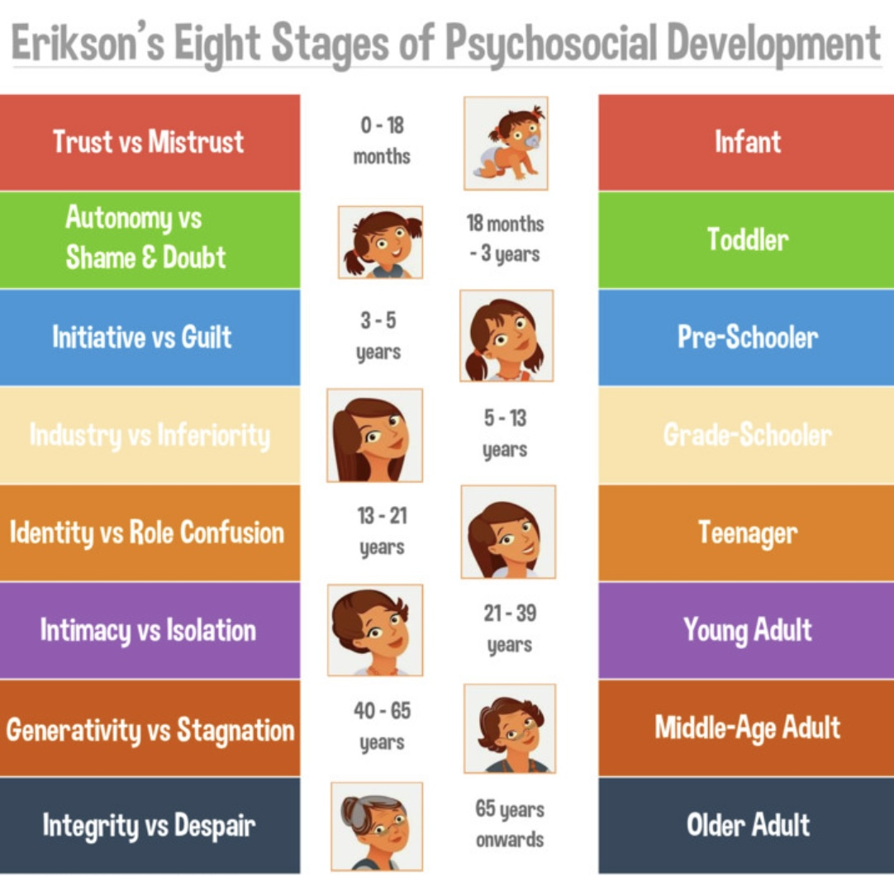
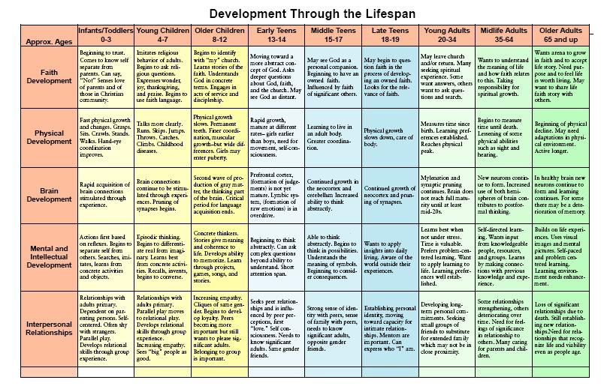
THE DEVELOPMENT OF SECURE AND INSECURE ATTACHMENT
Many other aspects of human development have been studied: physical, brain, intellectual, interpersonal, moral, spiritual, kinesthetic, etc.
The Ainsworth/Main model of attachment is limited in that it is not a developmental model: It studies attachment but does not track how adaptations evolve over the lifespan.
The Study of human personality development involves looking at the continuous process of change that occurs in humans through their lifespan.
We’ve already explored Erik Erikson’s developmental model which looks at the psychosocial task's individual must accomplish as they mature.
The DMM address this gap.
The DMM looks at how attachment manifests as a person develops from infancy to adulthood.
Many people identify with the attachments style expressions that we discussed (secure, avoidant, anxious, disorganized) but identify even more with the evolving attachment adaptations that Crittenden describes.

Slide 65
THE DMM PIE MODEL
To understand how attachment issues lead to distortions of information exchange between the 3 information centers and distorted affect and cognition and how this leads to psychological problems arising in the course of human development, we have to understand Crittenden’s “pie model”
The DMM classification circle maps self-protective attachment strategies that come on-line as a person matures.
As we move down the circle, we see greater distortion of thinking and emotions and greater severity of the psychological issues.
Note that using adaptive strategies that are lower on the pie does not mean we’re more broken. It means the environment demanded more protection.

Slide 66
DMM ADAPTATIONS AND PSYCHOPATHOLOGY
In the Developmental-Maturational Model, adaptations/survival strategies emerge in a sequence that follows development. Early in life, children rely on simpler adaptations to stay safe and maintain attachment. If those strategies work, even imperfectly, they tend to be reused and refined over time. More complex, intense, or extreme adaptations don’t appear unless the earlier ones fail to provide enough safety.
When a child repeatedly discovers that a younger strategy doesn’t protect them, the system is forced to “upgrade” to a later-developing one. These later strategies can look more severe or pathological, not because the person is worse, but because the environment required stronger measures to survive.
The Developmental-Maturational Model helps us understand increasing psychopathology as the accumulation of survival adaptations, not the emergence of illness out of nowhere. When earlier, simpler strategies fail to keep a person safe, emotionally or physically, the nervous system is forced to adopt later, more powerful ones. Each step up the developmental ladder involves greater distortion of information, more intense arousal, and more rigid patterns of thinking and relating.
What we label as “more severe psychopathology” is often the result of these later-stage adaptations becoming dominant and over-generalized, strategies that once preserved survival but now operate in contexts where they cause suffering. In this model, severity reflects how much protection was required, not how broken a person is.

Slide 67
THE DMM PIE MODEL IN INFANCY

Slide 68
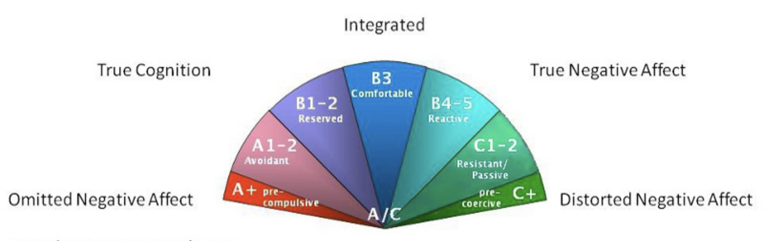
Attachment Adaptations developing in infancy
The top 3 slices of the pie are labelled B’s 1 to 5 and are variations of secure attachment
The 2 slices to the left of the B’s of the pie are the avoidant A’s while the 2 slices to the right of the B’s are the anxious C’s. In the center of the pie are the A/C or disorganized types of attachment which combine features of A’s avoidant and C’s anxious.
These avoidant, anxious and disorganized responses are the classical adaptations seen in strange situation
In infancy the Ainsworth/Main, ABCD model and the DMM are the same
However , from infancy on people develop different adaptations not described in the classical model

Slide 69

In infancy ( up to 18 months)
With an attuned/responsive and predictable parent, the secure child can safely express their bodily sensations and feelings because what they express is seen and accepted by the parental figure as what it really is ; a developmentally appropriate expression of the infant’s inner world .
With a partially unattuned parent, the infant may have to “dial up” their affect, or behavioral expression of sensations and emotions, in order to connect and stay safe. This distortion of affect manifests as anxious attachment.
With a very unattuned but predictable parent , dialing up affect doesn’t help promote attachment, so the infant minimizes affect and relies on cognitive strategies to try to figure out the parent’s patterns and adapt to them. This distortion manifests as avoidant attachment.
With an unpredictable, threatening, or unattuned parent, neither cognitive nor affective strategies are very effective in promoting safe attachment, so the infant goes back and forth between the two and is not organized around a particular one. Without a strategy to attach and obtain some soothing, the infant more easily becomes overwhelmed and has extreme states of arousal which may result in states of dissociation.
As children mature into adults, they can only manifest attachment adaptations associated with the stages of development they have already reached.
Notes:
How do secure, anxious, and avoidant infants process information differently?

Slide 70
Anxious (C) infant: Cries intensely, clings, arches, and is hard to soothe. Distress escalates rather than settles because only strong affect reliably brings the caregiver back.
Strategy: amplify emotion to secure care.
Avoidant (A) infant: Rarely cries, looks away, stiffens or self-soothes. Appears calm, but physiological stress is high. The infant has learned that signaling need doesn’t work.
Strategy: suppress signals to avoid rejection.

Slide 71
THE DMM PIE MODEL IN PRE-SCHOOL YEARS

Slide 72
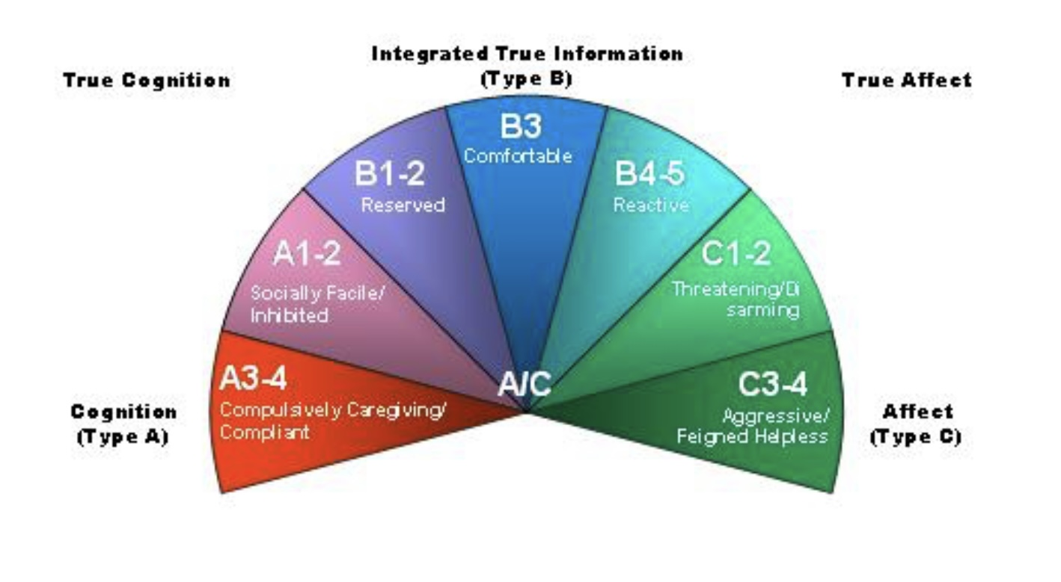
Attachment Adaptations developing during pre-school years
Pre-school aged children (2-6 years old) may develop new avoidant and anxious cognitive and affective attachment strategies: on the left of the pie are 1. A 3-4 compulsive caregiving/compliance and on the right 2. C 3-4 aggressive/feigned helpless
Notes:
It is in the preschool years that the developmental maturational model goes beyond the A,B,C,D model and introduces two new attachment adaptations.

Slide 73

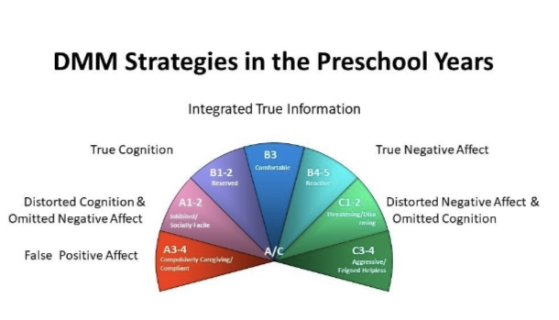
Pre-school adaptations ( 2-6 years old )
Beyond infancy the “avoidance” in avoidant attachment manifests in ways that aren’t necessarily behavior avoidance as seen in the strange situation, what is avoided is emotions, including their own, as well as perceived danger. Same applies to anxious.
Avoidant A 3-4 – The compulsive caregiving and compliance attachment adaptation is a rational strategy that uses false positive affect while looking after an incompetent parent and hiding or suppressing feelings of hurt and abandonment. This strategy says :“I need to take care of my mother so that if anything goes wrong, she’s there to protect me, if she’s depressed, I’m going to comfort her, bring her things and be cheerful, I will get more of her attention this way. I will be obedient and anticipate her needs, so I don't get punished. I will anticipate her needs.” These children have given up attending to their own needs and focus on the parent’s needs. They smile even when they hurt, they make others feel good. (people pleasers, parentified children)
Anxious C 3-4 – Aggressive and feigned incompetence attachment adaptation is an affective/emotional strategy that uses minimized cognition and distorted negative affect: Feelings of hurt, abandonment and anger caused by unavailable parents are modified and either “dialed up” in aggressive demanding of attention via open aggression such as hitting, kicking and screaming and then when negative attention is given by the caregiver, dialed down in displays of helplessness and feigned incompetence such physical illnesses or not being able to do or understand things they were formally able to do (tie shoes).

Slide 74
Anxious (C) preschooler: Becomes dramatic, oppositional, or helpless. May exaggerate injuries, regress, or act out to pull attention. Emotional intensity is used to control proximity.
Strategy: use emotion and behavior to manage the caregiver.
Aggressive / Feigned Incompetence: The person secures attention or control either by intimidation or by appearing helpless. Aggression demands engagement; incompetence invites rescue, both prevent abandonment.
Avoidant (A) preschooler: Over-compliant, “good,” or prematurely helpful. May caretake siblings or parent. Avoids asking for help and minimizes distress.
Strategy: be undemanding and useful to stay connected.
Compulsive Caregiving / Compliance: The person stays safe by taking care of others and suppressing their own needs. Being helpful, agreeable, or “good” becomes the way to preserve attachment and avoid rejection or harm.

Slide 75
THE DMM PIE MODEL IN EARLY SCHOOL YEARS

Slide 76
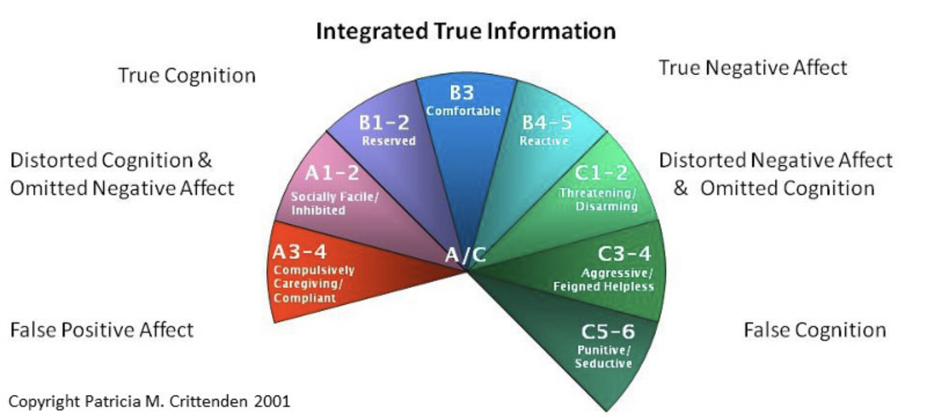
attachment adaptations developing during early school years
School age children (6-12 years old) develop of a new anxious attachment strategy: to the right of the pie C 5-6 Punitive/seductive
Notes:
In the school years developmental maturational model introduces one new adaptation punitive/seductive.

Slide 77

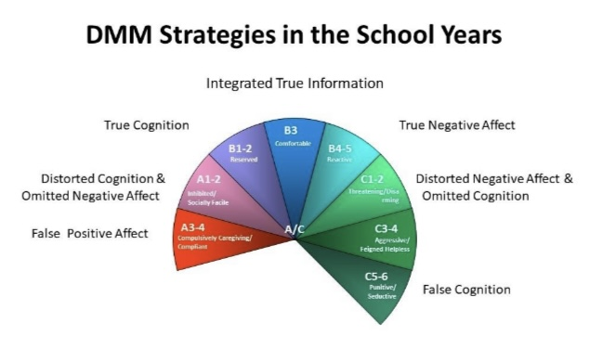
School year adaptations
(6-12 years old)
Anxious C 5-6. The punitive-seductive attachment adaptation is an emotional/affective strategy in which the cognitive information transmitted is false i.e. The child lies as a way of maintaining connections. Emotional strategies rely on trying to seduce others by flattery, praise, attention, etc. and punishing those who cannot be seduced.
These are the kids who are bullies, belong to gangs, and steal.
The punitive kids use false thinking or deception. They lead you to think you know what they are going to do and then they “stab you in the back”. They make you think they really like you.
The punitive child is obsessed with revenge
The seductive child is obsessed with being rescued by potential but sometimes predatory attachment figures.
These strategies are learned at home in dysfunctional families as they work better than any other strategies to maintain attachment.

Slide 78
Anxious (C-strategy) child: A 6-year-old whose caregiver is inconsistently available becomes highly tuned to emotional cues. When the parent looks distracted, the child becomes louder, more distressed, or dramatic. They may exaggerate pain or fear, cling, cry intensely, or become oppositional—not to manipulate, but to amplify affect so the caregiver cannot ignore them. The child feels unsafe unless the attachment figure is emotionally engaged.
Core strategy: maximize emotion to pull the caregiver close.
Avoidant (A-strategy) child: A 6-year-old whose caregiver is consistently rejecting or overwhelmed by emotion learns to down-regulate attachment needs. The child appears independent, calm, and “easy.” They rarely cry, don’t seek comfort when hurt, and may caretake the parent instead. Distress is minimized or hidden, because showing need leads to rejection or punishment.
Punitive / Seductive: The person alternates between blame and charm. Punishment keeps others close through fear or guilt; seduction keeps them close through attraction and emotional intensity.

Slide 79
THE DMM PIE MODEL IN ADOLESCENCE

Slide 80
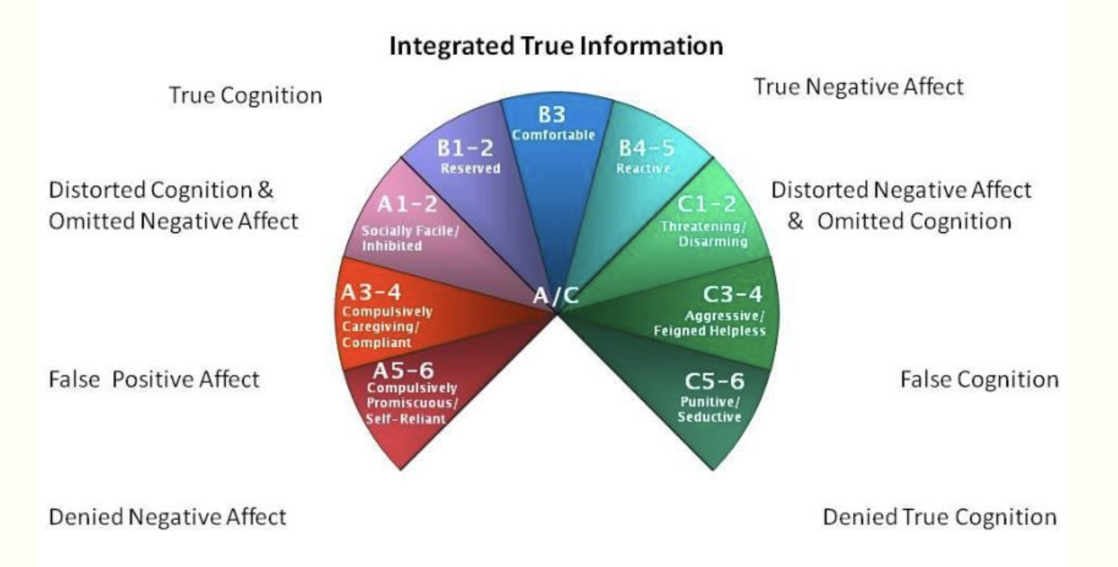
ATTACHMENT ADAPTATIONS DEVELOPING DURING ADOLESCENCE
Puberty (age 12-adulthood) sees the development of a new avoidant strategy: to the left of the pie A 5-6 compulsively self-reliant/promiscuous
Notes:
In puberty the developmental maturational model introduces one new strategy compulsively self-reliant/promiscuous.

Slide 81

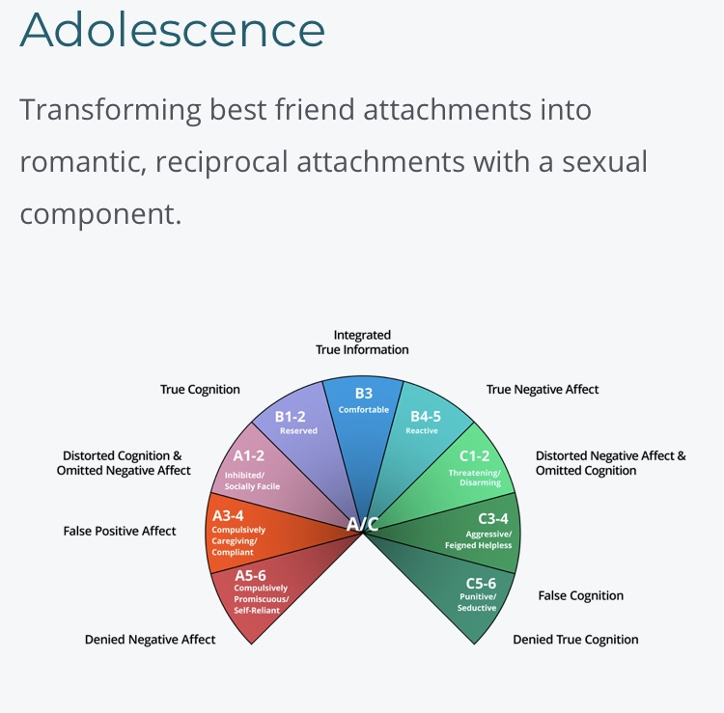
Adolescence adaptations
( 12 – adulthood)
Keep in mind that highly stressed children often become “adolescents” or reach puberty faster than those who are less stressed.
Avoidant. A 5-6 Compulsively promiscuous and/or self-reliant attachment adaptations: The common denominator in these two strategies is the absence of, or shutting down of, the capacity for emotional connection to others because that connection was never present in the relationship with the caregivers. These kids don’t know what love feels like.
Emotional connection and love is substituted by compulsive self-reliance in which the adolescent “ doesn’t need anyone”. This contrasts with the healthy self-reliance seen in adolescents who can make intimate connections.
Self- reliance may co-exist with or be independent of compulsive promiscuity which is the repeated attempt to connect with others physically, without having the ability for emotional connection that is present in people with secure attachment. Consciously, individuals crave connection while emotionally they can’t stand it, hence emotion is dialed down. With these kids no other strategy worked to keep them safe.
The self-reliant say to themselves: “only me, no one is trustworthy, it’s only what I can do for myself. The promiscuous say : “I think there could be a person out there for me but it’s not anyone I know; it could be a stranger.” They make superficial relationships that they carry to physical intimacy very quickly then find the person doesn’t live up to their expectations and they go back to compulsive self-reliance.
These kids are often depressed. They also run physical and psychological risks as they deny or repress negative affect: “I don’t feel pain, I’m not frightened”

Slide 82
Anxious (C) adolescent: Emotionally volatile, preoccupied with relationships, sensitive to rejection. Uses anger, drama, or crisis to keep others engaged. Thinking becomes affect-driven.
Strategy: intensify emotion to prevent abandonment.
Avoidant (A) adolescent: Emotionally shut down, dismissive, or hyper-rational. Values independence, avoids vulnerability, may withdraw or appear detached from peers and family.
Strategy: detach emotionally to avoid needing others.
Compulsively Promiscuous or Self-Reliant: The person avoids dependence by either keeping relationships superficial and replaceable, or by insisting on radical independence. Attachment is tolerated only when it doesn’t create vulnerability.

Slide 83
THE DMM PIE MODEL IN ADULTHOOD

Slide 84
Adult attachment adaptations developing in adults
Adults develop 3 new strategies: to the left of the pie 1)avoidant A 7-8 delusional idealization, externally assembled self, to the right 2)anxious C 7-8 menacing/paranoid, and at the bottom 3) disorganized AC psychopathy
Notes:
In adult hood the developmental maturational model introduces four new strategies delusional idealization/externally assembled self, menacing/paranoid, and psychopathy.

Slide 85

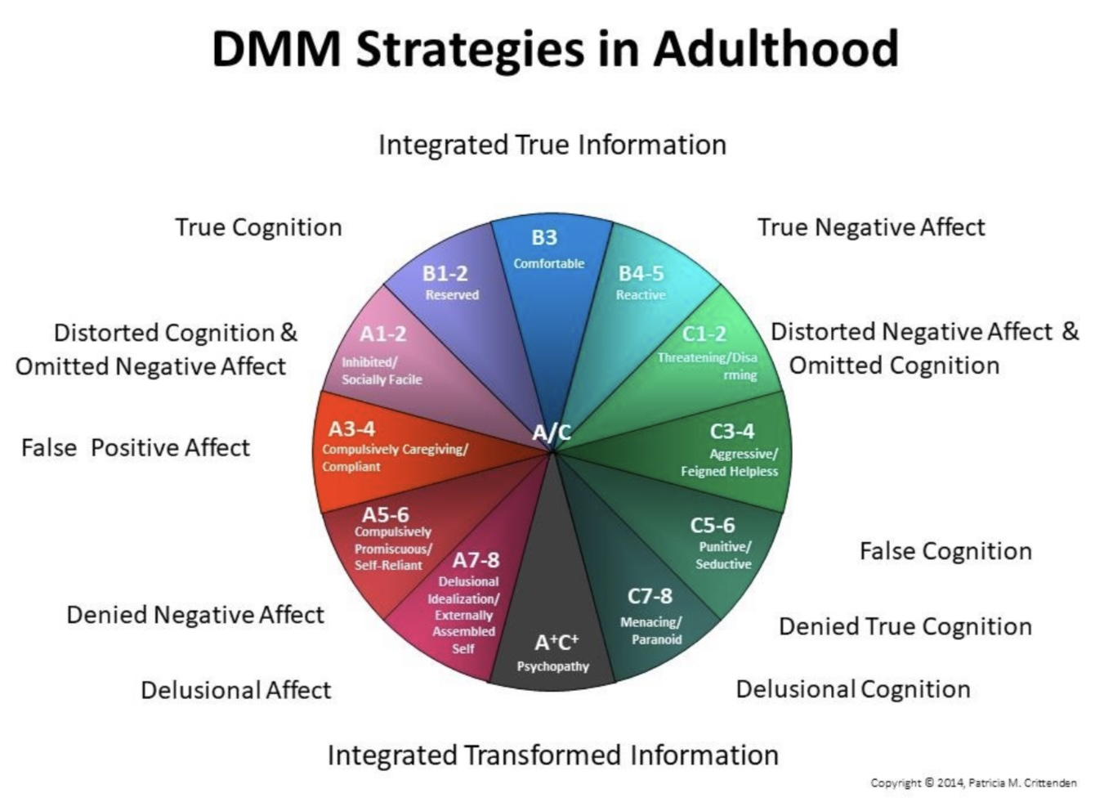
Adult adaptations
A 7 in the delusional idealization attachment adaptation, delusional positive affect is present as negative emotions are completely buried and what the person feels is the opposite. Examples of this are the hostage syndrome or the idealizing of the person that endangered you and you could not protect yourself from. The delusional person denies the information that the perpetrator was dangerous and idealizes them instead. The person also creates or imagines events that did not happen.
A 8 in the externally assembled self attachment adaptation, the self is not generated from within but rather from without. The person is given information about who they are often by professionals and then offers that information as who they really are. There are often inconsistencies in these narratives, and they are often told in the third person :”so and so says I am this…”
C 7-8 In the Menacing and/or paranoid attachment adaptation the person is constantly suspicions of and threatening towards everyone
A/C In the Psychopathy attachment adaptation the person unconsciously makes up a persona that perfectly connects both cognitively and emotionally with whoever they are with. Psychopaths feel like they are everyone’s soulmate except it’s totally unreal something others eventually learn. They are connecting chameleon geniuses.
These strategies are very difficult to work with therapeutically, especially without strong motivation or external containment.
Intelligent psychopaths with good impulse control can be very successful.

Slide 86
Anxious (C) adult: Preoccupied with relationships, reassurance-seeking, prone to emotional flooding. Interprets ambiguity as threat and uses affect to maintain closeness.
Strategy: manage others through emotion.
Avoidant (A) adult: Highly self-sufficient, uncomfortable with dependency, intellectualizes feelings. Minimizes needs and often partners with more emotionally expressive people.
Strategy: manage closeness by limiting vulnerability.
Delusional Idealization: The person preserves attachment by denying danger or neglect and idealizing caregivers or partners. Reality is reshaped so the relationship can be experienced as safe and loving.
Externally Assembled Self: The person constructs identity and worth through external rules, roles, or approval. Inner signals are mistrusted; guidance must come from outside to maintain stability and belonging.
Menacing and/or Paranoid: The person stays safe by assuming threat and striking first, psychologically or physically. Vigilance and intimidation prevent surprise, betrayal, or loss of control.
Psychopathy: The person abandons attachment as a strategy for survival. Others are treated as objects to be used or avoided; emotional connection is experienced as dangerous or irrelevant.
When you hear these descriptions, remember: these strategies only arise when earlier ones failed to keep someone safe

Slide 87
Most adults use strategies from multiple ages. This is not a ladder you climb or a pit you fall into.
This is not a diagnostic model
Strategies layer, they don’t replace one another
Change is possible because these are learned adaptations
Which descriptions felt familiar, even if you didn’t like them?
Which strategies feel old rather than current?”

Slide 88
Where did your attention go?

Slide 89
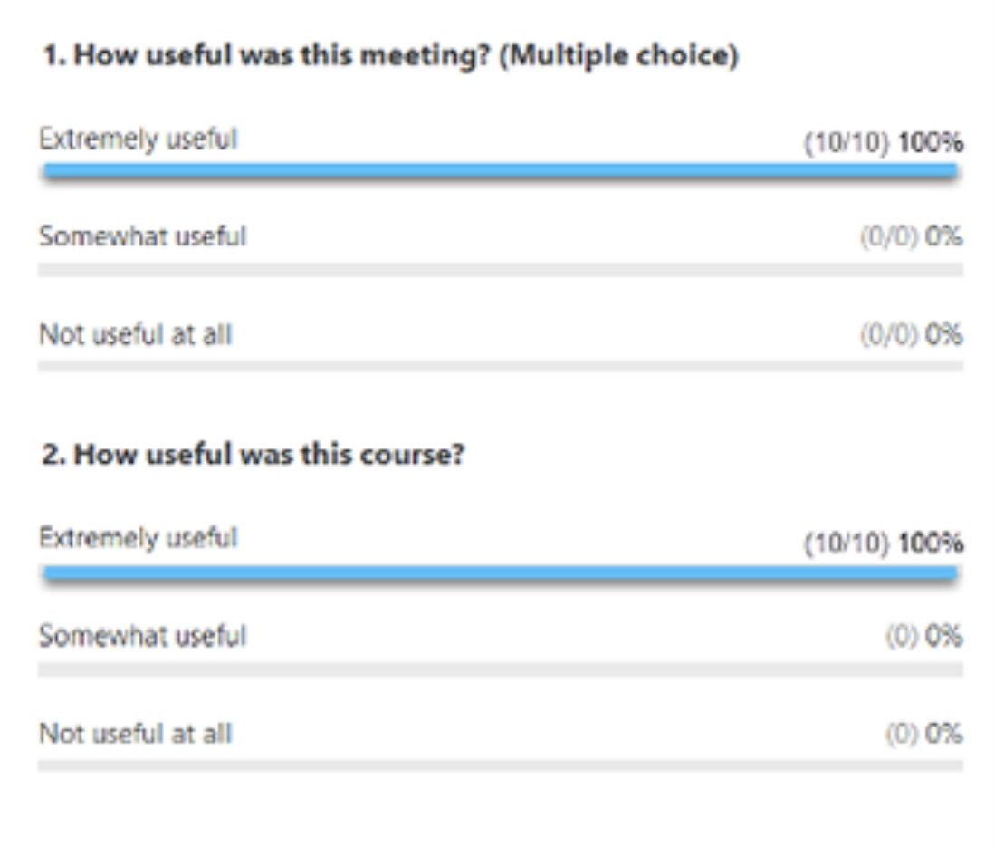
ZOOM POLL
Please answer the following question
Answers are anonymous
In person participants please answer the page that was handed out.

Slide 90
IMPORTANT REMARKS ON THE DMM

Slide 91
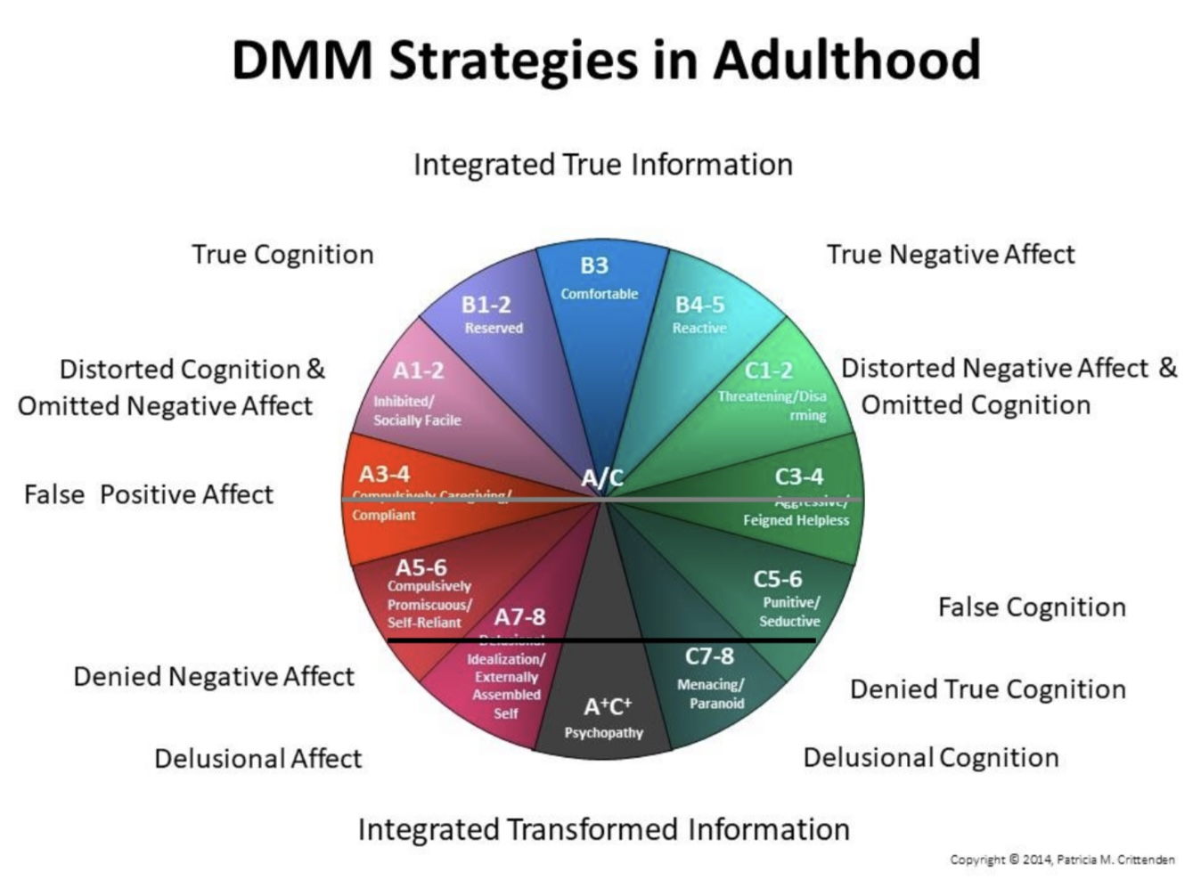
Important remarks on the DMM
You may relate to one or more of the attachment adaptations arising at different ages that we described.
Adults may or may not still be using one or more of the attachment adaptations that developed earlier in their lives in their relationships.
If the information exchange between your three centers has improved, you may no longer be using the strategies you once did
Over a lifetime the “truthfulness” of the information exchange can worsen, remain the same or improve.
If the information exchange between your three centers has improved, you may no longer be using strategies you once did
Information exchange is increasingly distorted as we proceed down the circle from the top.
People who use strategies in the upper half of circle are unlikely to have significant psychological disorders. The further down the circle are the strategies that you use the more serious your psychological disorder
The people using the strategies between the the grey and black lines in the circle on the left of the slide are the most likely to come for mental health services
Those using strategies that fall below the black line are often are a danger to themselves or to others and may need a protective environment

Slide 92
IMPORTANT REMARKS ON THE DMM
Crittenden’s central idea is that attachment is not a fixed style but a set of self-protective strategies that keep changing in response to danger and development. Infants have very crude self-protective tools. Preschoolers use more sophisticated cognitive and behavioral strategies such as compulsions, aggression, and feigned helplessness. In this same way school age kids, adolescents and adults use progressively more complex, subtle, and cognitively intricate strategies such as coercion, manipulation, dissociation, somatization, borderline and antisocial patterns, and, at the extreme end, psychopathy.
More complex strategies don’t “replace” earlier ones, they layer or stack and each strategy becomes a part of the person’s defensive repertoire. Some adults still rely mainly on preschool adaptations, while others move into the severe adolescent and adult adaptations. Some stay in “compulsively caregiving” while others develop psychopathy.
Development pushes new strategies only when 1. The environment demands it, and 2. The child has the cognitive and emotional capacity to generate the next level of strategy. If either of these is missing, the person stabilizes around an earlier form of adaptation. So, for example, if early danger is chronic miscuing, mild but confusing and requires pleasing others to maintain safety, the child may never need to develop advanced, coercive, cognitively complex danger-management strategies. They can get by with strategies like compliance, compulsive caregiving, and being useful. Those strategies often remain dominant even in adulthood.

Slide 93
IMPORTANT REMARKS ON THE DMM
If the environment becomes more dangerous or chaotic later. If for example there is physical abuse, sexual threats, caregiver unpredictability, exposure to antisocial peers or repeated ruptures in adolescence, the child or adolescent must develop more complex strategies that require abstract thinking, planning, manipulation, splitting, using sexuality, disinhibition, dissociation or coercion. These become the dominant adult patterns, which in their most severe forms show up as borderline or psychopathic patterns.
The critical thing is that new adaptations only appear if survival requires them. Some strategies require developmental capacities that only come online after certain ages. Preschool strategies require basic representational thinking. School-age strategies require rule learning, perspective-taking. Adolescent strategies require abstract cognition, future thinking, complex relational maps. If trauma occurs before these capacities develop only early strategies are available. If trauma occurs after these capacities develop, later, more complex and more severe strategies can emerge.
If early danger is persistent, consistent and similar across years, the early adaptations become over-practiced and get “locked in.” They become the default mode network of attachment. Even when cognition grows later, the person may not update their strategy because the early strategy always “worked well enough”, it kept them alive ad later cognitive skills got directed elsewhere (e.g., school, job, intellect), not toward relationships. Conversely, when danger escalates or becomes more complex later the child must develop coercive aggression, misleading communication, sexualized strategies, splitting and idealization, cold abstraction or dissociative solutions. These require older developmental machinery. Thus, severe adult patterns typically reflect danger from the school-age through adolescent years, not infancy alone.

Slide 94
IMPORTANT REMARKS ON THE DMM
Some adults keep early preschool strategies as dominant because their early environment demanded compliance/caregiving but did not escalate later. They therefor had no need to develop more severe strategies, and early parts get entrenched. Later danger may have been mild, or they may have had supportive adults later or their temperament may lean toward inhibition or social conformity. These adults often present as over-responsible, over-controlled, anxious to please, self-effacing, tightly regulated and kind but rigid
Other adults end up with more severe adolescent/adult adaptations because danger escalated in middle childhood or adolescence, they encountered unpredictable, violent, sexualized, and chaotic environments. Their cognition also matured enough to build more complex strategies to survive. They needed, coercive control, manipulation, self-aggrandizement, shutting off empathy and predatory or dissociative capacities to stay safe. These strategies are more severe because they were designed for more severe danger.
Consider a toolbox metaphor. Attachment strategies are like tools in a toolbox. In preschool you get your first tools compliance, caregiving, aggression, helplessness. In school age you get new tools lying, rivalrous competition, rule-bending. In adolescence and adulthood, you get advanced tools coercion, seduction, intimidation, dissociation, psychopathy. But you only add a tool if your environment requires it. Some people never need the dangerous adult tools, so they keep using their preschool tools their whole lives. Others grow up in environments that force them to build the complex survival tools and those become their dominant strategies. Some have early tools that sit in the toolbox, not dominant, but still present and activated in certain situations.
Attachment strategies aren’t fixed personality traits; they’re survival tools you learned at the developmental stage when life felt most dangerous. If danger escalated later, you added more complex tools. If it stayed the same, the early tools stayed in charge.

Slide 95
IMPORTANT REMARKS ON THE DMM
Patricia Crittenden’s Dynamic-Maturational Model of Attachment and Adaptation expands Bowlby and Ainsworth’s
attachment theory in a way that makes it directly relevant to trauma, dissociation, and even to parts-based models like
Internal Family Systems (IFS).
In the DMM, attachment patterns are not static “types” (secure, avoidant, ambivalent, disorganized). Instead, they are
developmentally adaptive strategies that individuals construct to maximize safety in their caregiving environment. This
move reframes what might look like pathology (avoidance, controlling, self-sacrifice, even dissociation) as creative
survival strategies. This perspective dovetails with IFS’s core idea: even our most “extreme” parts are protective
adaptations rather than defects.
Crittenden emphasizes how repeated danger or misattunement shapes attentional and memory processes. Under
threat, children may exclude certain types of information (e.g., emotional cues, bodily sensations, or causal reasoning)
to stay safe. These exclusions can fragment experience, laying the groundwork for dissociation or compartmentalized
self-states. This maps directly onto how IFS understands parts that “hold” trauma and remain cut off from the rest of the
system.
Unlike the classic ABCD model of attachment, the DMM outlines a developmental sequence of increasingly complex
strategies. As the child matures, strategies can become more flexible, or more rigid, depending on danger and support.
This resonates with trauma therapy: healing involves reopening developmental pathways that were closed down, giving
the person access to more adaptive strategies that weren’t safe to develop earlier.
Crittenden’s descriptions of “self-protective strategies” parallel how IFS describes managers, firefighters, and exiles.
Avoidant strategies resemble protective managers (suppressing vulnerability). Ambivalent strategies echo
hyper-activating parts that keep danger in view. Disorganized/complex strategies line up with firefighters or dissociative
fragments. Both frameworks affirm that beneath all of this lies an integrative, healing Self, whether you call it IFS’s “Self”
or the capacity for secure attachment.

Slide 96
IMPORTANT REMARKS ON THE DMM
Attachment theory offers a developmental map. Trauma/dissociation research explains how overwhelming
experiences fragment memory and self. IFS provides a practical therapeutic method for dialoguing with and unburdening those fragments. The DMM provides the connective tissue: a way to see attachment strategies as the developmental link between early caregiving, later trauma adaptations, and the internal multiplicity that IFS works with.
In short: Crittenden’s model reframes attachment as a dynamic set of survival strategies that can mature, or become distorted, depending on danger. This not only explains how trauma and dissociation emerge but also sets
the stage for therapies like IFS that work with those fragmented adaptations compassionately and systemically.

Slide 97
IN SUMMARY
Patricia Crittenden’s Developmental Maturational Model (DMM) has advanced attachment theory by extending John Bowlby and Mary Ainsworth’s work into a more dynamic, lifespan-oriented framework that integrates attachment with trauma, adaptation, and developmental pathways.
The DMM takes attachment theory from categories to strategies. Whereas Ainsworth identified attachment styles (secure, avoidant, ambivalent), Crittenden reframed these as self-protective strategies that children and adults use to maintain safety and connection. This emphasizes that even “insecure” patterns are adaptations to real developmental contexts, not fixed traits.
Crittenden placed perceived danger and trauma at the heart of attachment. She showed how experiences of threat (e.g., neglect, abuse, inconsistent care) shape strategies for processing information and regulating emotion. This broadened attachment theory to directly address maltreatment, dissociation, and psychopathology, which were underdeveloped in the original model.
The DMM also highlights how attachment involves attention and memory processes, what information is noticed, distorted, or excluded in the service of staying safe in relationships. This explains how attachment impacts cognition, not just emotion or behavior, and links attachment to broader models of the mind.
The DMM emphasizes that attachment strategies evolve across the lifespan. Children, adolescents, and adults may deploy different forms of avoidance, ambivalence, or integration as they mature. This makes the model especially useful in clinical work with adults, where early categories (like Ainsworth’s) don’t fully capture complexity.
By mapping how different strategies can become rigid or maladaptive under chronic threat, Crittenden provided clinicians with a framework to understand disorders such as trauma-related dissociation, personality disorders, and entrenched relational problems. The model helps therapists see symptoms as logical outcomes of survival strategies.
In short: Crittenden advanced attachment theory by reframing “styles” as adaptive strategies, integrating trauma and danger, focusing on information processing, extending attachment across the lifespan, and providing clinicians with a more nuanced, trauma-informed framework.

Slide 98
REPETITION COMPULSION
Here we move from how strategies form… to how they quietly choose our relationships for us.

Slide 99

the impulse to repeat
VS. the desire to do better
Repetition compulsion is a psychological phenomenon in which a person unconsciously repeatedly relives and reexperiences life patterns related to past traumatic events and circumstances. This includes reenacting the event or putting oneself in situations where the event is likely to happen again.
Sigmund Freud described two instincts 1) Eros, the drive for life, love, creativity, healthy sexuality, self-satisfaction and species preservation. He also described 2)Thanatos, from the Greek word for "death" as the drive towards aggression, sadism, distraction, violence, masochism, and death.
Freud thought that repetition compulsion was explained in part by the death instinct.
Attachment theorists believe that repetition compulsion occurs when adults engage in the same type of relationship or attachment patterns as they did when they were children. These patterns were adaptations that ensured their survival as children but in adulthood keep them replaying and reliving dysfunctional relationships.
To quote philosopher Alain DeButon: “We are not drawn to people who will make us happy, we are drawn to those who resemble people from our childhood and who feel familiar.”
Repetition compulsion or the “ I feel I have a target on my back” syndrome
Link repetition compulsion
Notes:
Yes, but let's start by defining repetition compulsion…

Slide 100
Attachment based Explanations for repetition compulsion
We are we drawn to certain people and “ fall in love“ with them for mostly unconscious reasons.
According to Sue Johnson there are at least 3 different kinds of experience that we lump into what we call “love” : 1. sexual or physical attraction, 2. Platonic, agape or friendship-based attraction and 3. attachment-based attraction.
Attachment is seeking connection originally for the sake of survival. In secure attachment that “love” connection manifests in adults as people “seeing“, “hearing”, caring for, and respecting each other and accepting who the other is.
In people with insecure attachment, the attachment instinct adapts so as to seek connection and security from more or less attuned and predictable parenting figures who may have difficulty seeing, hearing, caring for, accepting and respecting the child.
These parenting figures may be more or less attuned, predictable, punishing, and dangerous, but children still find ways to attach to or bond with them because evolutionarily that’s all they’ve got in order to survive. Hence their attachment system becomes primed or set up to be in these relationships, not healthy secure ones. It’s all they know. They did not experience secure relationships.
As adults because of this early attachment priming, they are attracted, drawn to, and fall “in love” with the same type of people they were attached to in early life and not to people with more secure types of attachment. Those are the relationships in which as children they sought safety. They continue to seek safety in same type of relationship but tragically keep failing to find the safety and connection they crave and need.

Slide 101
Attachment based Explanations for repetition compulsion
That is why we often “fall in love” with people, whose attachment style may resemble that of our early attachment figures. So…
If you’re mostly securely attached, you’re more likely to fall in love with a person who is also securely attached, as insecurely attached people are less likely to feel like the right fit. But…
If you have significant insecure attachment, you are more likely to “fall in love” with people who, after the “honeymoon phase", do not not know how to see, hear , care for, and respect you. You may find yourself in relationships that resemble those you experienced as a child. You might be better off with a securely attached person whom you may not feel an attachment attraction to.
With securely attached partners you have better chances of eventually learning to have a relationship in which you listen to, care for and respect each other. This may be a case of faking it until you make it. You may eventually learn what healthy love is.

Slide 102
Attachment based Explanations for repetition compulsion continued…
One question we’re often asked in the course is how one might pick a secure partner if they are insecurely attached ?
To answer that let’s review what “love” is ? It is at least 3 things…
Agape, Platonic, or friendship love – is a compatibility or sharing of values, morals, interests, preferences, and play styles leading to a mutual attraction between people in which sexual attraction is not important
Eros or erotic love – is an attraction based on sexual or physical attraction in which there may or may not be compatibility and secure or insecure attachment
Attachment love- is an attraction to people whose attachment style is like that of parental figures
Our misguided ideal of romantic love – is an idealized relationship that combines sexual attraction, secure attachment, and compatibility, a trifecta which is extremely rare. (see Alan DeButon)

Slide 103
Attachment based Explanations for repetition compulsion continued…
A reasonable expectation of a good marriage/partnership – is reasonably secure relating between the partners, in face of inevitably waning of sexual attraction, along with reasonable compatibility but with inevitable areas of incompatibility in terms of values, morals, interests, preferences and playstyles. Both partners have realistic expectations of the relationship and are more care based than transactional.
Bad marriage/partnership – is insecure attachment between the partners, waning sexual attraction, and many areas of incompatibility, along with high expectations from the relationship, and an inability to repair relationship “holes”
Suggested discussion question for the breakout rooms: How do you choose a securely attached partner if you have insecure attachment ?

Slide 104
As we come to the end of today’s session, I want to pull us back from the details and land on a few big ideas.
First: the patterns we’ve talked about today, attachment strategies, information distortions, repetition compulsion, are not character flaws. They are survival strategies. They formed because, at some point in development, they worked.
Second: these strategies are not who you are. They’re tools your nervous system learned to use when life felt dangerous or unpredictable. And like any tool, they can be updated when they’re no longer needed.
Third: awareness matters. When information begins to flow more accurately between body, emotion, and thinking, when Wise Mind is present, choice slowly replaces compulsion.
Repetition compulsion isn’t about wanting to suffer. It’s about the nervous system returning to what feels familiar in the hope that this time it will finally feel safe.
The work we’re doing in this course is not about forcing change. It’s about creating enough safety, understanding, and compassion that change becomes possible.
If today stirred things up, that’s okay. You don’t need to resolve anything tonight. Just notice what stayed with you. That’s often where the work begins.
Thank you for staying with material that isn’t easy but is deeply human.

Slide 105
WHY THE DMM MATTERS
• It replaces shame with meaning
• It explains severity without moralizing
• It links attachment, trauma, somatics, and parts
• It gives hope by showing strategies can update
CLOSING TAKEAWAY
These strategies once kept you safe
They are not your identity
Awareness creates choice

Slide 106

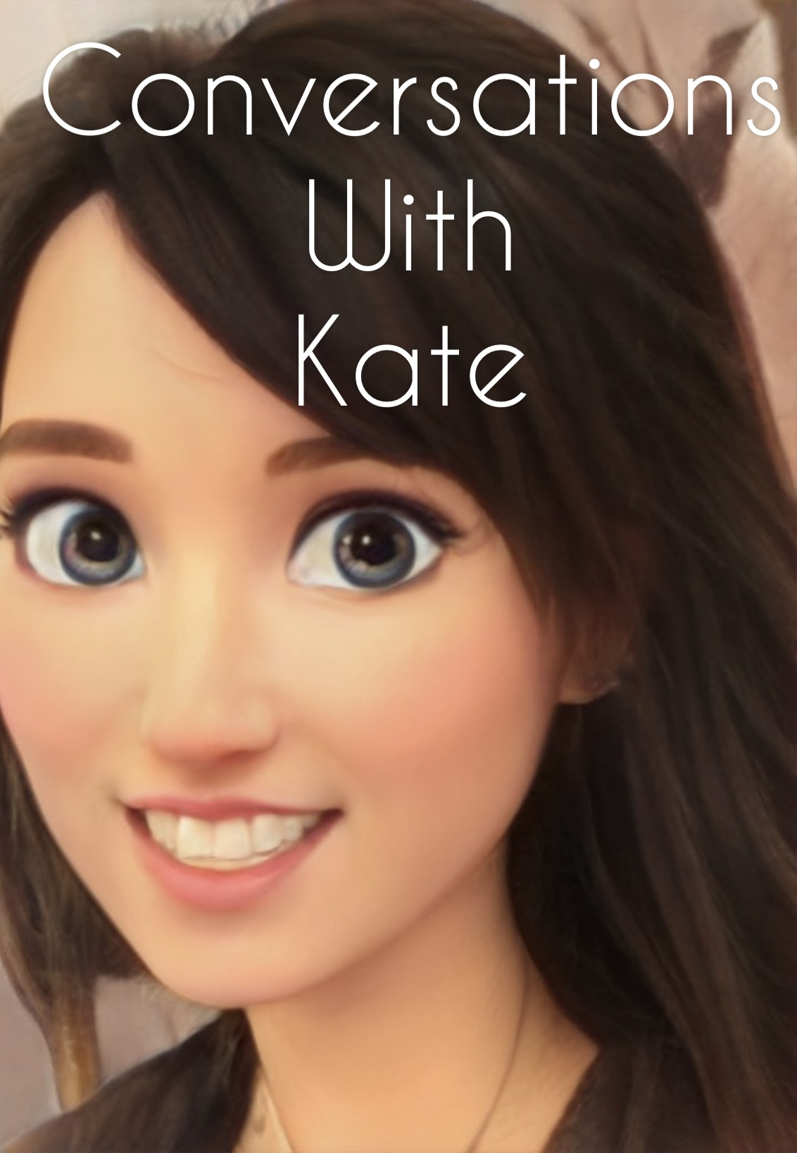

Slide 107
ALAN DEBUTON QUOTATIONS
“We see, repetition compulsion in people who seek the same sort of partners again, and again, exhibiting behavior that remains disturbingly consistent across relationships. We favor and are drawn to relationship patterns that we’ve experienced in the past because no matter how painful or unfulfilling they may be, they offer the second-rate security of being familiar. Fairburn explained it as an unconscious commitment to those we worshipfully loved as children. No matter how much they hurt us, we don’t want to give them up. Many, including Freud, have seen in repetition an effort to master early trauma. In the process of repetition, the very meaning of love becomes totally perverted. It may come to mean pining after the unavailable, being seduced and rejected, being treated with contempt, being engaged in sadomasochistic warfare, being worshiped and adore as a paragon of strength, and so on.”
“A girl who is brought up by a cold, domineering mother, and a kind, but ineffectual father will tend to see similar qualities in others, with the result that she behaves towards them, at times, as if they were emotional and behavioral copies of her parents. An act of coolness by a close, female friend causes her whole painful relationship with her mother to be activated within her. Suddenly she is drenched in feelings of being small, oppressed and helpless. The friend may indeed have been cool, even somewhat rejecting, but there is an irrational intensity to the woman’s reaction. Meanwhile, she persistently sees the men in her life as weak, despite their evident strengths, and accomplishments. The power of her expectations is such that she actually brings out the weakness in many of the men who are close to her, so that the weak side is all she ever knows or relates to”

Slide 108

video
Week 13 of simple

Slide 109


Slide 110
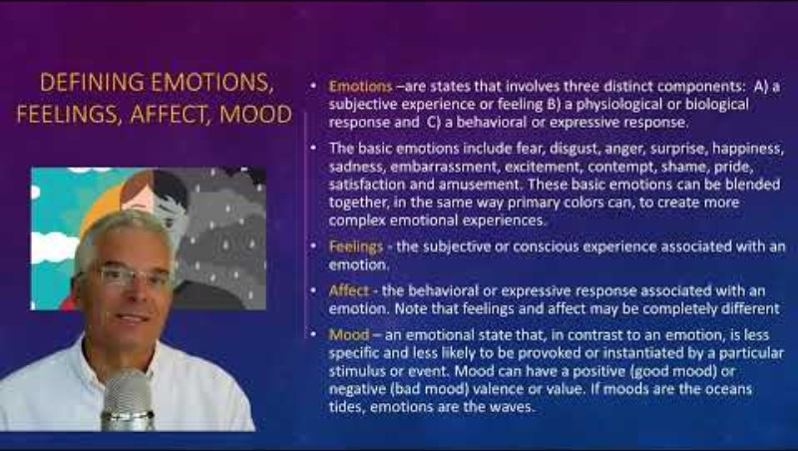

Slide 111


Slide 112
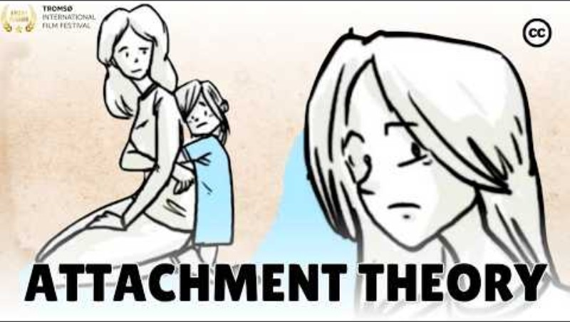

Slide 113
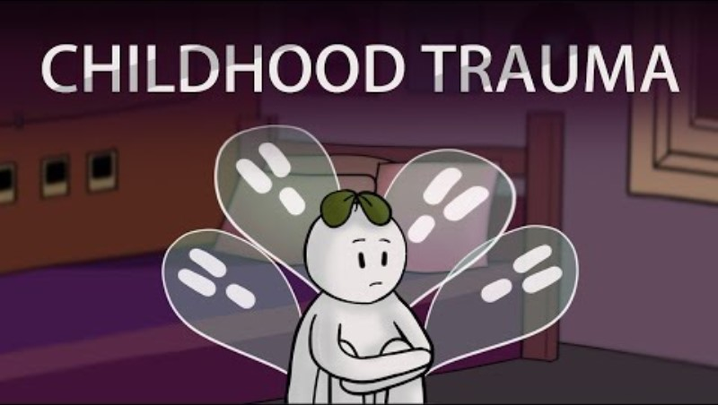

Slide 114
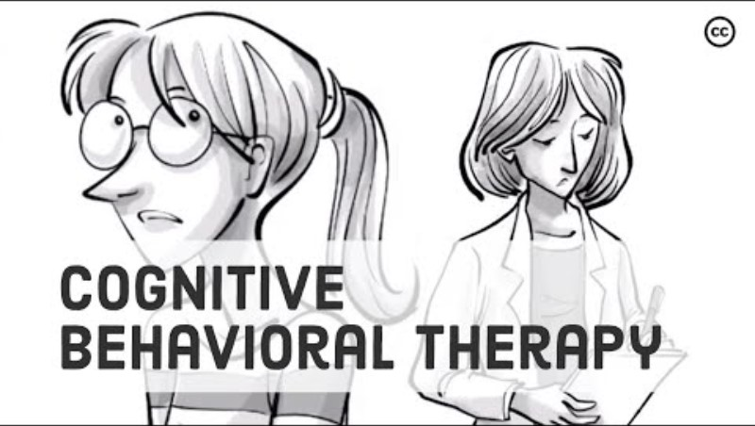

Slide 115


Slide 116


Slide 117

OPEN DISCUSSION

Slide 118

See you next session

Slide 119
(1)Patricia Crittenden is a developmental psychologist known for her work in attachment theory. She was born in 1945 in the United States. Crittenden studied under Mary Ainsworth, a pioneer in attachment theory, and went on to develop her own theory known as the Dynamic-Maturational Model (DMM) of attachment and adaptation.
Crittenden's work focuses on the impact of childhood experiences on adult attachment patterns and how these patterns influence relationships and behavior throughout life. She has conducted extensive research on attachment across different cultures and has worked with children and families in various settings.
Crittenden's contributions to the field of attachment theory have been influential in understanding the complex interplay between early experiences, attachment patterns, and psychological well-being. Her work continues to be studied and applied in clinical practice, research, and education.

Slide 120
(2)The Dynamic-Maturational Model (DMM) of attachment and adaptation, developed by Patricia Crittenden, is a comprehensive and nuanced approach to understanding attachment patterns and their impact on development. The DMM builds upon the traditional attachment theory developed by John Bowlby and Mary Ainsworth, but expands on it by incorporating a broader range of attachment patterns and behaviors.
One key aspect of the DMM is its focus on the dynamic nature of attachment relationships and how they evolve over time in response to changing circumstances and experiences. Crittenden emphasizes the importance of considering not only the quality of attachment relationships but also the individual's adaptive strategies and coping mechanisms in different situations.
The DMM identifies four main attachment patterns: secure-autonomous, insecure-dismissing, insecure-preoccupied, and insecure-disorganized. These patterns are based on a combination of the individual's internal working models of attachment, their emotional regulation strategies, and their ability to seek support and maintain relationships.
The DMM provides a comprehensive framework for understanding how attachment patterns develop, how they influence behavior and relationships, and how they can be modified through intervention and support. It is widely used in clinical practice, research, and education to help individuals and families understand and improve their attachment relationships for better psychological well-being

