Slide 1


Welcome to week 14 of simple advanced mindfulness skills and practice WEEK

Slide 2
SIMPLE COURSE SCHEDULE 2025-26
Week 1- October 1
Week 2- October 8
Week 3- October 15
Week 4- October 22
Week 5- October 29
Week 6- November 5
Week 7- November 12
Week 8- November 19
Week 9- November 26
Week 10- December 3
Week 11- December 10
Week 12- December 17
December 24 and 31
Week 13- January 7
Week 14- January 14
Week 15- January 21
Week 16- January 28
Week 17- February 4
Week 18- February 11
Week 19- February 18
Week 20- February 25
Week 21- March 4
March 11 and 18 no course
Week 22- March 25
Week 23- April 1
Week 24- April 8
Week 25- April 15
Week 26- April 22
Week 27- April 29
Week 28- May 6
Week 29- May 13
Week 30- May 20
Week 31- May 27
Week 32- June 3

Slide 3
week 1- orientation and overview- sessions 1 and 2 of simple manual. week 2- introducing distress tolerance-p. 1-13 of dbt workbook and crisis plans-session 3 of the manual. week 3- the theoretical foundations of the simple course. session 4, 6, and 8 of the manual. week 4- distress tolerance p. 14-32 of dbt workbook. suicide prevention session 5 of the manual. our first practice- crisis plans. week 5- distress tolerance p. 33-46 of dbt workbook. introducing holes diary cards- session 7 of manual. week 6- distress tolerance p. 47-68 of dbt workbook. finding your diary card targets- session 9 of manual. our second practice- holes diary cards. week 7- introducing personality- session 10 of manual. week 8- distress tolerance p. 69-90 of dbt workbook. introducing chain analysis-session 11 of manual. week 9- what shapes personality-session 12 of manual. week 10-introducing mindfulness skills p.90-109 of dbt workbook. advanced chain analysis- session 13 of manual. our third practice-chain analysis. week 11- attachment theory- session 14 of manual. week 12- mindfulness skills p. 110-131 of dbt workbook. introducing rational mind remediation-session 15 of manual. week 13- the dynamic-maturational model of attachment and adaptation- session 16 of manual. week 14- Our fourth practice-rational mind remediation. Mindfulness skills p. 131-147 of dbt workbook. Reviewing all the tools-session 17 of manual. week 15-stress-session 18 of manual. week 16-introducing emotion regulation skills p.148-182 of dbt workbook. introducing the goals diary card procedure-session 19 of manual.

Slide 4

Warning about meditation
Feel free to skip it. Followed by a moment of silence

Slide 5


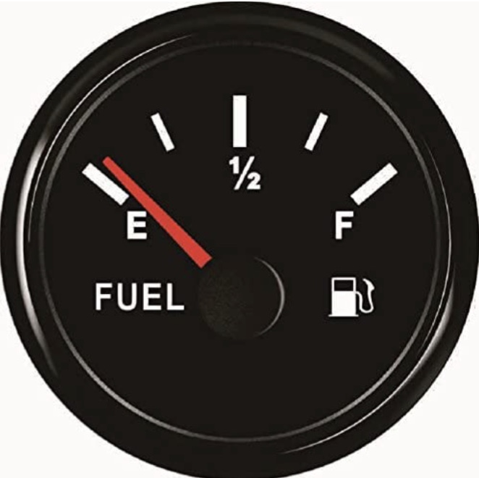
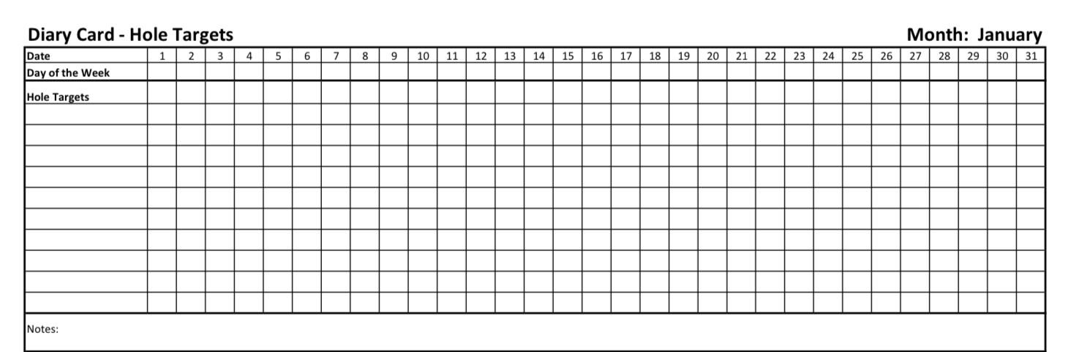

Check in regularly with your Personal dashboard
Spend a few moments checking in with yourself by asking:
1)What is the current risk that I’ll experience a state of crisis ?
Low b) Moderate c) high d) very high e) extreme
2) Am I in the window of tolerance?
a) Yes b) I’m a little outside c) very outside
3) Where is my energy tank right now?
Full b) ¾ c) ½ d) near empty
4) Have I been tracking my targets using the holes diary card ? how would I rate my targets right now?
5) How well am I focusing on what I’m doing. (for example, the course)
CRISIS RISK
WINDOW OF TOLERANCE
ENERGY RESERVES
RATING MY TARGETS
ATTENTION METER
% attention I’m paying
100
0

Slide 6
FIVE-MINUTE LOVING-KINDNESS MEDITATION
Invite participants to sit comfortably, feet on the floor, hands resting gently.
Let’s begin by arriving.
If it feels comfortable, allow your eyes to close,
or soften your gaze.
Take a slow breath in through the nose…
and a gentle breath out through the mouth.
Again…
in…
and out.
Allow the body to settle.
Now, bring your attention to your heart area—
not to change anything, just to notice.
Loving-kindness is not something we force.
It’s something we allow to emerge, gently, at its own pace.

Slide 7
FIVE-MINUTE LOVING-KINDNESS MEDITATION
If warmth or kindness feels difficult today, that’s okay.
You can begin with neutrality or curiosity.
First, bring to mind yourself.
Perhaps picture yourself as you are right now…
or as someone who is trying their best.
Silently offer these phrases, or words that feel true for you:
May I be safe.
May I be at ease.
May I be kind to myself.
May I grow toward healing.
Let the words land softly, without pressure.
Now bring to mind someone who feels easy to care about—
a friend, a loved one, a pet, or even a kind presence.
Notice what it feels like to hold them in awareness.

Slide 8
FIVE-MINUTE LOVING-KINDNESS MEDITATION
Offer the same wishes:
May you be safe.
May you be at ease.
May you be treated with kindness.
May you grow toward healing.
Now, gently expand your awareness to this group.
Each person here carrying their own history, struggles, and hopes.
No one here is untouched by pain.
As a quiet intention, offer:
May we be safe together.
May we be met with understanding.
May we support one another’s healing.
May we grow, slowly and steadily.
If it feels appropriate, you might extend loving-kindness outward—
to people in your life,
or simply to all those who are struggling in similar ways.

Slide 9
FIVE-MINUTE LOVING-KINDNESS MEDITATION
You might say:
May all beings be safe.
May all beings find moments of peace.
May all beings move toward healing.
Now, return your attention to your breath.
Notice the body sitting here.
Grounded. Present.
Loving-kindness doesn’t mean liking everything,
or excusing harm.
It means recognizing shared humanity—
including your own.
Take one final, gentle breath in…
and let it go.
When you’re ready, softly open your eyes.

Slide 10


Slide 11
PRACTICE SESSIONS SCHEDULE
preparation
practice
4. Week 14 January 14 Rational mind remediation Helga H.
5. Week 18 February 11 February 4, 1:30 goals diary card Nicole L
6. Week 25 April 15 April 8, 1:30 IFS workbook 1 Elaine S.
7. Week 26 April 22 April 15 IFS workbook 2 Dinko T.
8.Week 27 April 29 April 22 IFS workbook 3 Barb H.
9. Week 28 May 6 April 29 IFS workbook 4
10.Week 29 May 13* May 6 1:30 PM* Wise mind remediation Rob T.
We still need a volunteer for the IFS practice May 6.
* Note that these dates have been changed

Slide 12

Homework from LAST week
Submit questions or comments to itssimple2023@gmail.com
Read skills training workbook p. 148- 182.
Simple manual session 17 practicing the simple tools
Do at least 2 rational mind remediations In the next week
Continue reviewing and practicing your crisis plans, diary cards, and chain analysis.
Continue tracking all the skills you’ve learned using your skills list. Review
Review the homework habits checklist each week. If there’s an item that you haven’t checked on the list, consider setting a goal to do it(you don’t have to come to the homework group to do that)

Slide 13
Homework for the coming week
Submit
Submit questions or comments to itssimple2023@gmail.com
Read
Simple manual session 18 stress and trauma
Do
Do at least 2 rational mind remediations in the next week
Continue
Continue reviewing and practicing crisis plans, diary cards and chain analysis.
Continue
Continue tracking and practicing all the skills you’ve learned
Review
the homework habits checklist each week. If there’s an item that you haven’t checked on the list, consider setting a goal to do it

Slide 14
HOMEWORK HABITS CHECKLIST
Circle or check what you will try this week.
1. Preparation habits
■ I schedule a specific time for homework.
■ I choose a consistent location with minimal distractions.
■ I gather what I need ahead of time (notebook, worksheet, pen).
2. Focus & pacing habits
■ I start with a tiny step (2–5 minutes).
■ I use a timer (10–15 minutes).
■ I remove distractions (phone away / Do Not Disturb).

Slide 15
HOMEWORK HABITS CHECKLIST
3. Tracking & organization habits
■ I keep materials in one place (binder / folder / notebook).
■ I write down insights right after doing the homework.
4. Self-compassion habits
■ I aim for progress, not perfection.
■ I notice resistance without judgment.
5. Accountability habits
■ I review my week: What worked? What didn’t?
■ I share honestly with my buddy — even when I didn’t do it.
Micro commitment:
This week I will focus on: ■ Time ■ Place ■ Tiny step ■ Timer ■ Other please specify:

Slide 16

WEEKLY ANNOUNCEMENTS
In the course we frequently experiment with new approaches in the hope this will improve your experience. Sometimes it seems to, other times it doesn’t.
That was the spirit in which we tried the homework group Mondays from 12:30 to 1.
Attendance at that group has rapidly declined. This is important feedback for us. We thank you for trying it out. We will continue our “experimentation”
As of next week, we won’t be having the homework group.
There is still a lot of interest in the boing group Mondays 1-2:30, as long as that’s the case we will continue it.
Anyone wanting to change from zoom to in person attendance is welcome.

Slide 17
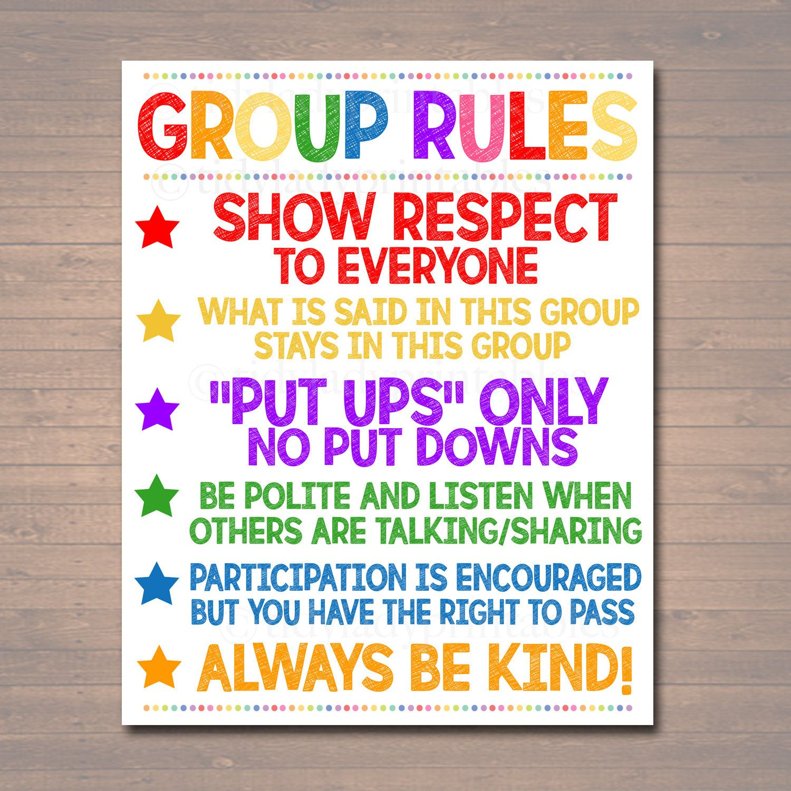
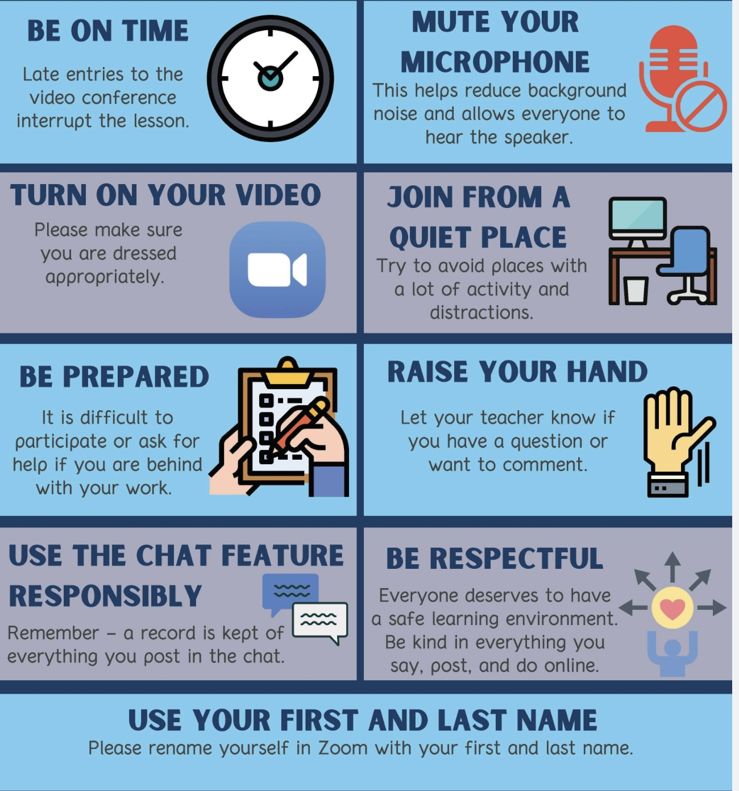
REMINDER PARTICIPANT AGREEMENTS
If you have questions, comments, or feedback, please save them for the two question periods. You can put them in the chat box or raise your real/virtual hand.
Keep comments, questions, and feedback relatively brief so everyone has a chance to participate.(one breath sharing)
If you’re on zoom, make sure no one can overhear what is being said
For reasons that will become clear later in the course please avoid giving advice to other participants about what they should or should not do. Validation, encouragement , and understanding are however very much appreciated.

Slide 18
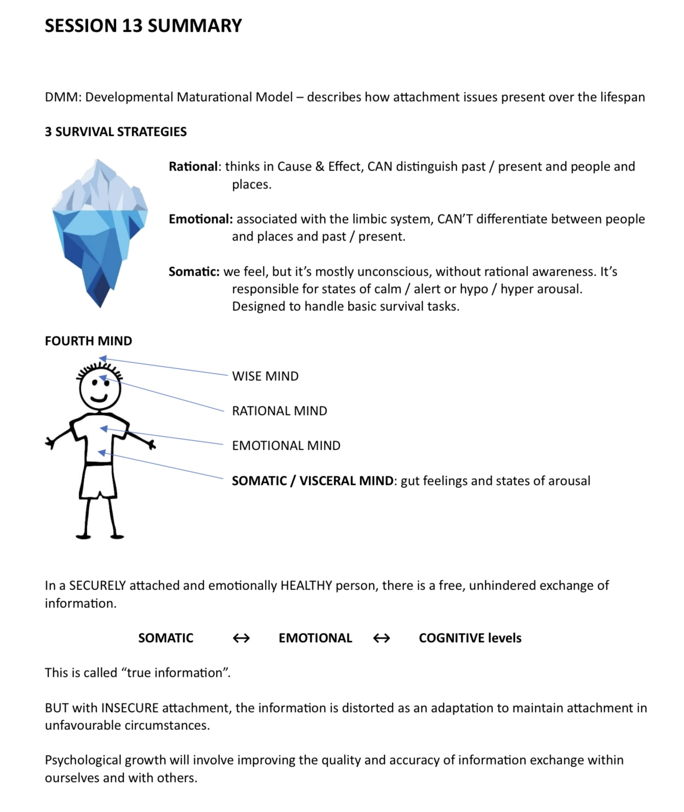
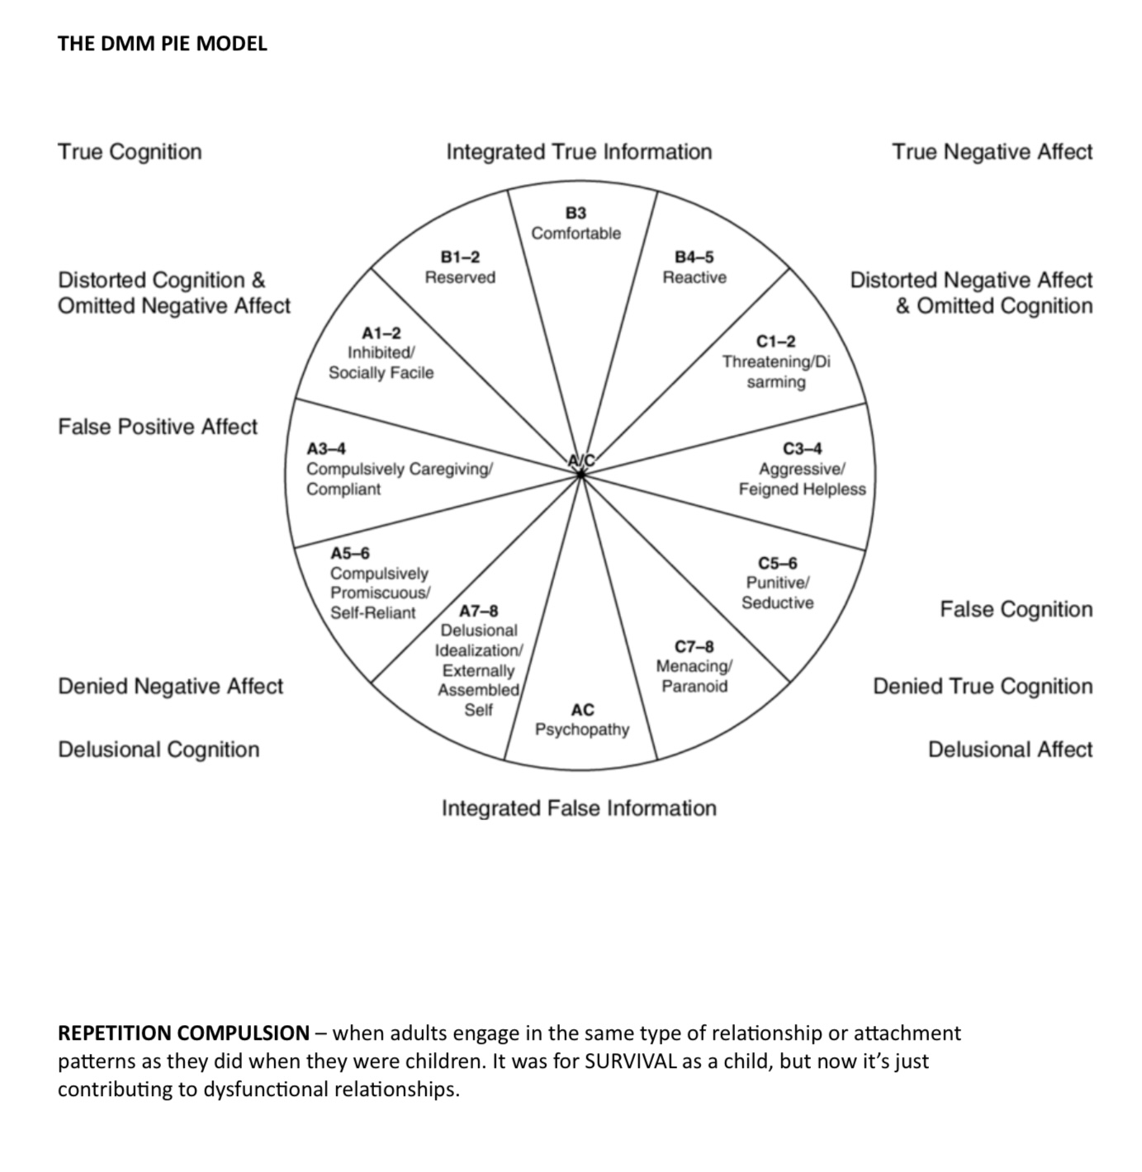
KATE’S SUMMARIES

Slide 19
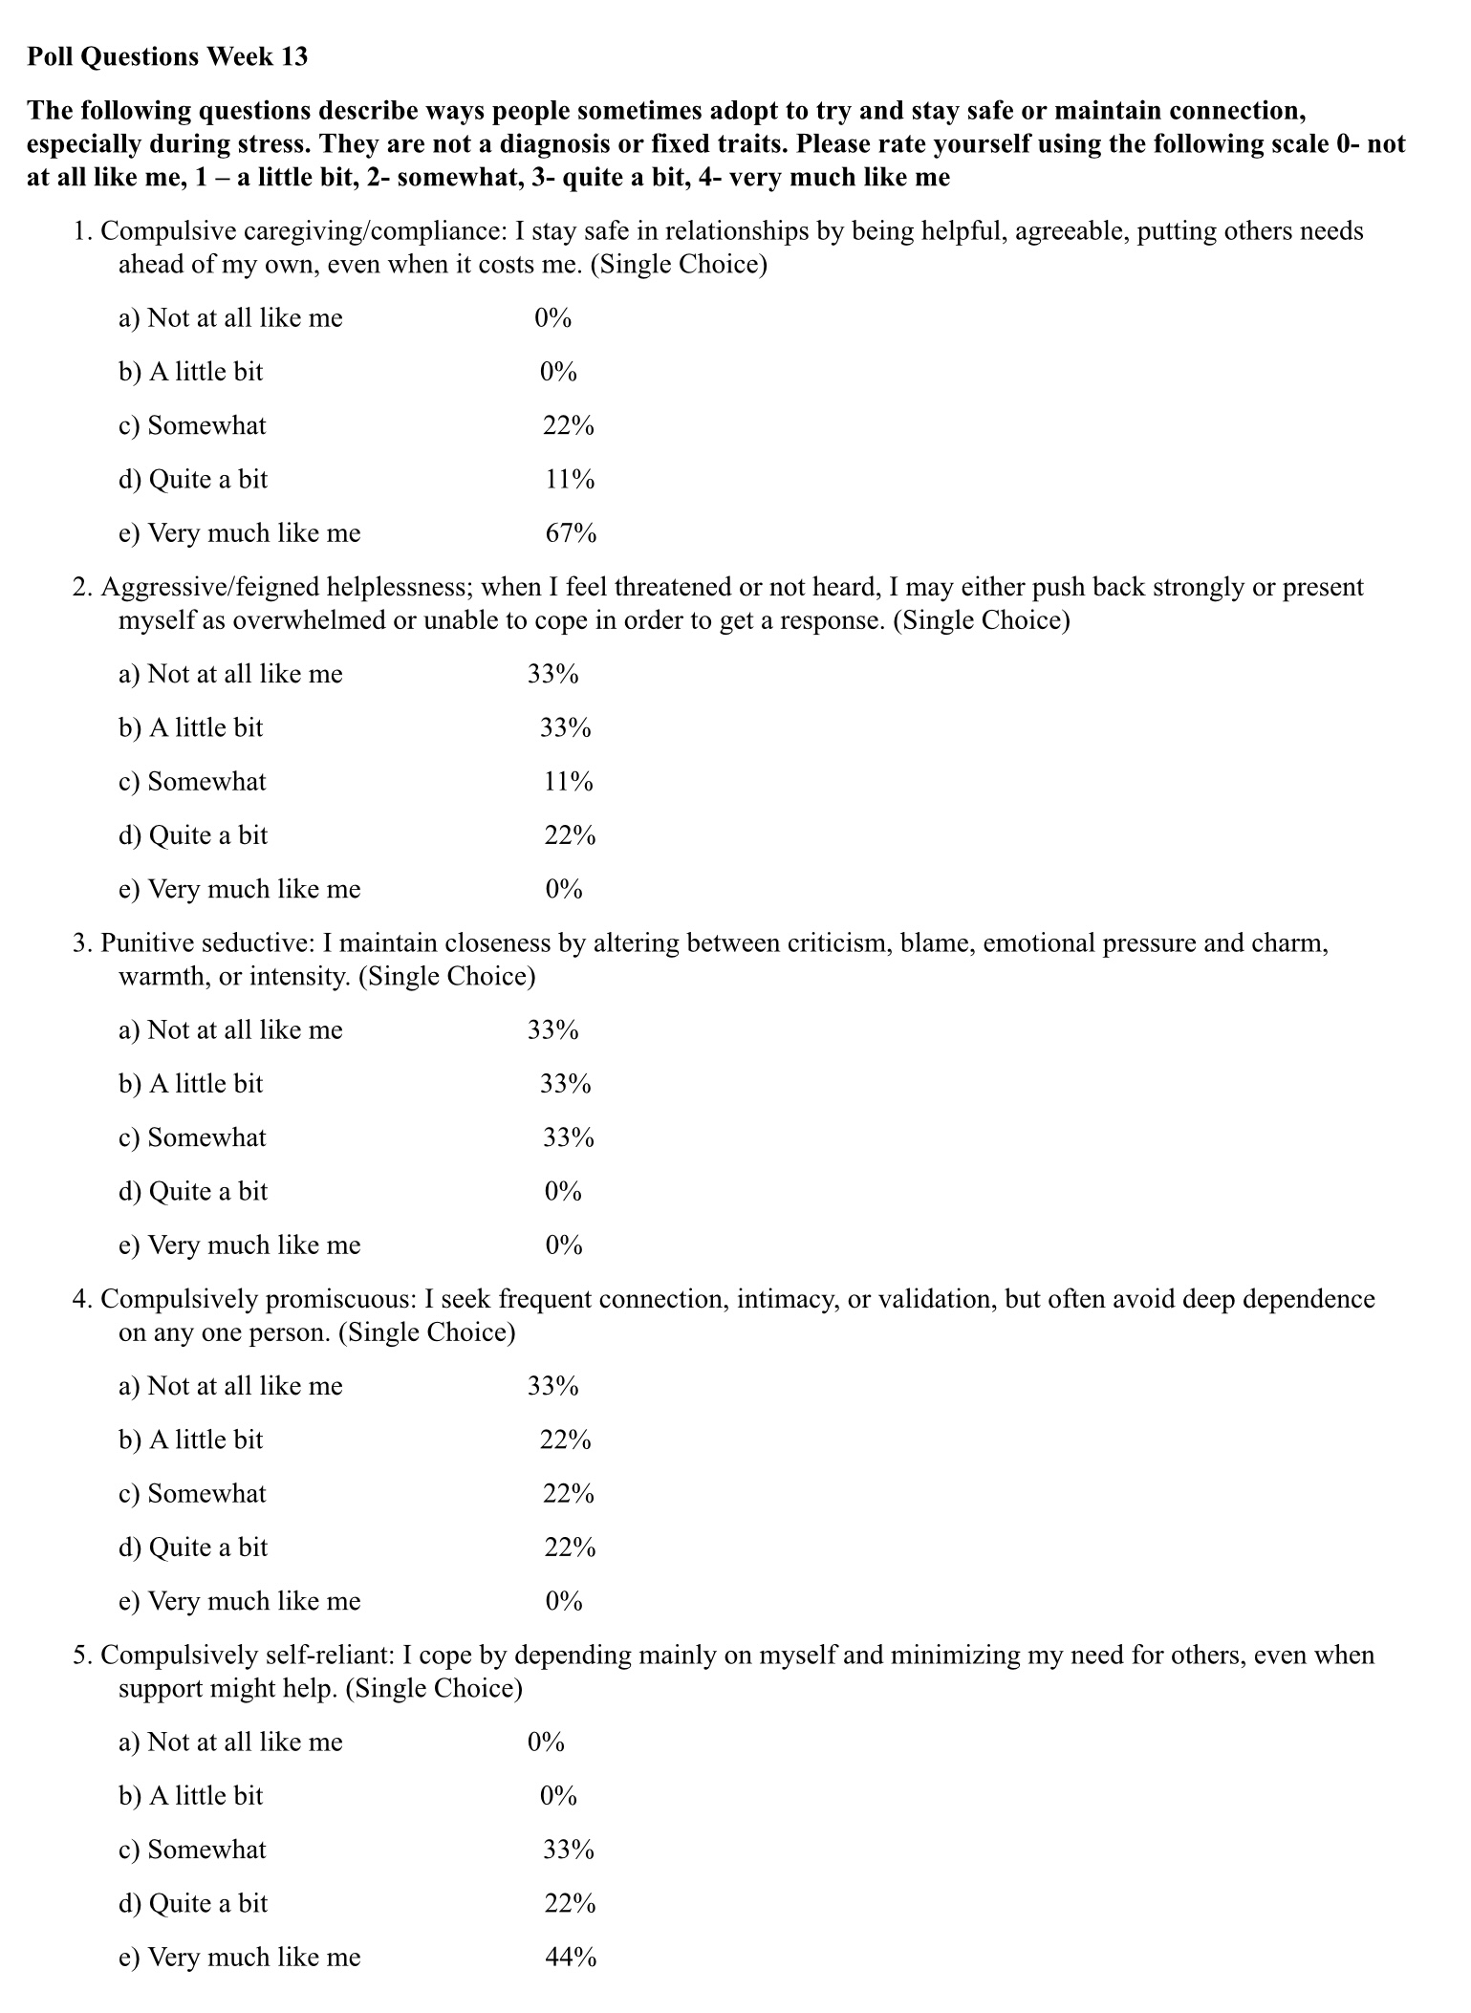

Slide 20

E-mailed questions, comments, feedback

Slide 21
As always, we’ve had some very good questions this week. We try to address most questions that are asked. These question may interest one person or many people.
Until we find a better way, we’ll post answers that we think may be of interest to most people but unfortunately because of time we cannot read all of them in the sessions. We will therefor arbitrarily read out only a few of the many excellent questions you’ve asked.
We’ll however read out all the questions and invite everyone to go to the website’s PowerPoint presentations and go over the answers with more time.

Slide 22
Question whose answer we will read out today

Slide 23
How does Patricia Crittenden’s DMM model conceive of what work needs to be done to help children who use “acting out” anxious attachment, externalizing adaptations such as aggressive demands for attention/helplessness and incompetence or punitive/seductive?
In the dmm model, children who show “acting out”, anxious attachment and externalizing adaptations are understood not as presenting with behavioral problems, but as using developmentally adaptive solutions to dangerous, inconsistent, or overwhelming caregiving.
These children are typically using disorganized attachment strategies which, as you might remember combine anxious and avoidant ones. These kids externalizing “misbehavior” not poor impulse control, as it is often labelled, it is a survival strategy. These children’s behavior is an attempt to deal with danger, misattunement, or rejection coming from caregivers.
The question if we’re trying to help these children can’t be “how do we stop this behavior?” but “what danger does the behavior manage, and how can the child mature beyond it?”
The dmm says that therapeutic or healing “work”, should not focus primarily on behavioral control but on helping the child feel safe; by reducing the danger they perceive with their attachment figures and increasing predictability, and non-retaliatory caregiving. Until danger decreases, maturation and behavioral change cannot occur.
Common components of this work include 1) helping kids name their feelings without acting them out. (use your words)
2) Help them understand links between feeling, thought, consequence, and relationship outcome. (chain analysis like)
3) Help caregivers and kids to go from using coercive strategies to using cooperative ones.

Slide 24
Different externalizing strategies/behaviors require different approaches:
a) aggressive demands for attention attempt to force caregivers to respond when have trouble doing so.
The work, in this case, is to teach kids ask for care in assertive rather than aggressive ways and to help caregivers respond to these assertive requests before things get out of hand.
b) helplessness / incompetence strategies are attempts to prevent abandonment by the kid appearing needy or incapable.
The work, in this case, is therefor to support the kid to feel safe when they show competence and to reward their attempts at autonomy without caregiver withdrawal. At the same time, caregivers need to learn to tolerate the child’s independence
c) punitive / seductive strategies are attempts to control powerful or emotionally unavailable caregivers.
The work, in this case, is therefor to establish clear, non-eroticized, non-retaliatory boundaries between the caregivers and the child, and to help the child give up inappropriate responsibility and establish in the child-caregiver relationship age-appropriate dependency.
As you can see, the dmm doesn’t focus just on the child but on the child caregiver dynamic. Caregivers of these children often experience them as manipulative, oppositional, or dangerous and respond with withdrawal, punishment, or counter-control. The work is to help caregivers change how they see the child’s behavior not as misbehavior but as self-protection. For the child’s behavior to change the caregiver must change by healing and growing. This view is often not well accepted by caregivers who believe the problem is exclusively the child’s’.
Dmm therapy aims to help caregivers respond with calm authority, emotional containment, and consistent availability but this can only be achieved if they heal their own attachment issues. Without caregiver healing and growth, child change is difficult. In other words, to help your children you have to work on your own stuff first and their change will follow.

Slide 25
This is long-term, relationship-focused work with a strong emphasis on caregiver involvement, commitment and willingness to change. This contrasts with typical therapeutic approaches that place the emphasis on the child, assume appropriate parenting and use reward–punishment behavioral techniques and skills-based behavior management.
In summary, in the dmm, helping children with acting-out “misbehaving” attachment adaptations means reducing the danger they feel, and increasing caregiver reliability, so that coercive survival strategies are no longer necessary and can be replaced by more flexible, reflective, and cooperative ways of relating.

Slide 26
We will only read out the following question, not the answer, and invite those interested to go to the website after the session

Slide 27
I was trying to set boundaries with my teenage daughter, and she told me she hated me because I’m a narcissist. These days I hear that term thrown around all the time almost like an insult. What is narcissism?
Narcissism is increasingly used as a moral label rather than a psychological description. When we use it to judge “that person is a narcissist” it turns a survival strategy into a character flaw, shuts down curiosity, and absolves us from asking what developmental or relational dangers shaped it. Used this way, the word becomes a weapon: it simplifies complex human adaptations into villains, fuels polarization, and prevents understanding, accountability, or change. When narcissism becomes an insult rather than a lens, we stop understanding and start condemning and that’s what makes it dangerous.
From a psychological perspective, narcissism isn’t one personality type, it’s a family of adaptations organized around protecting a fragile sense of self-worth. The differences we see are stylistic: how the person secures validation, control, and protection from shame or dependency.
Commonly described forms of narcissism include:
1. Phallic Narcissist: Overtly confident, dominant, competitive, often sexually or professionally boastful. Uses power, conquest, status, or masculinity/femininity to assert superiority. Intolerant of vulnerability; shame is warded off through display and control. Often admired initially, then experienced as intimidating or dismissive. Core strategy: “I prove my worth by winning, conquering, or dominating.”
2. Charming (or Exhibitionistic) Narcissist: Warm, engaging, socially skilled, often charismatic. Gains admiration through likability, humor, generosity, or inspiration. Can feel emotionally validating at first but struggles with true reciprocity. Relationships often feel one-sided over time. Core strategy: “I stay lovable and admired so I don’t get abandoned or exposed.”

Slide 28
3. Grandiose Narcissist: Classic DSM-style presentation. Inflated self-importance, entitlement, superiority. Minimizes others’ needs, reacts strongly to criticism. Often low insight into impact on others. Core strategy: “I stay safe by being above others.”
4. Vulnerable (or Covert) Narcissist: Appears shy, sensitive, or self-effacing. Deeply preoccupied with rejection, humiliation, or invisibility. Oscillates between grandiose fantasy and shame. May feel misunderstood, resentful, or quietly entitled. Core strategy: “I protect myself by withdrawing while privately needing recognition.”
5. Communal Narcissist: Derives superiority from being moral, spiritual, helpful, or self-sacrificing. Identity organized around being “the good one”. Can be subtly controlling or guilt-inducing. Often unrecognized as narcissistic because of prosocial behavior. Core strategy: “I am superior because I am more caring or evolved than others.”
6. Malignant Narcissist. Combines narcissistic traits with paranoia, aggression, or antisocial features. More likely to exploit, manipulate, or dehumanize others. Often shaped by severe early danger or betrayal. Core strategy: “The world is dangerous; I must dominate or destroy to survive.”
Across all types, narcissism is organized around protecting the self from shame, dependency, and collapse. Shared features include: A fragile or unstable core self, often hidden beneath confidence or charm. External regulation of self-worth (admiration, status, control, validation). Difficulty tolerating vulnerability, dependency, or mutuality. Strong reactions to criticism, rejection, or loss of status. Relationships used, often unconsciously, to stabilize the self.
In DMM / developmental terms, these are later-stage survival adaptations: They emerge when earlier attachment strategies were insufficient. They prioritize self-protection over reciprocity. They involve distortions of emotional and relational information to prevent
Narcissistic styles differ in how they seek safety, but they share the same task: keeping a vulnerable self from falling apart. What looks like arrogance, charm, or entitlement is often a carefully built structure holding up a self that once did not feel securely held.

Slide 29
WHY NARCISSISM IS SO PREVALENT IN OUR CULTURE.
1. Our Culture Rewards Narcissistic Adaptations. From an attachment and DMM perspective, strategies that once helped people survive unsafe relationships are now culturally reinforced.
Modern Western culture: Rewards self-promotion over mutuality. Values independence over interdependence. Confuses visibility with worth. Treats vulnerability as weakness and competence as virtue
What would once have been a defensive adaptation now looks like success.
2. Early Attachment Disruptions Are Widespread. Many children grow up with caregivers who are: Emotionally unavailable or overwhelmed. Stressed, distracted, or preoccupied (often by work or screens). Loving but inconsistent, intrusive, or conditional
The child learns: “I must perform, excel, or manage myself to stay connected.” This lays the groundwork for narcissistic strategies: self-reliance, image-management, and emotional minimization.
3. Consumerism Trains Us to Build an Externally Assembled Self. Our culture constantly answers the question “Who am I?” with: What you own. What you achieve. How you appear. How much attention you command
In DMM terms, this fosters an externally assembled self: Identity is regulated from the outside. Self-worth rises and falls with admiration. Shame is managed through comparison and display.
4. Social Media Amplifies Narcissistic Survival Strategies. Social platforms: Reward curation, not authenticity. Reinforce grandiosity, victimhood, and outrage. Encourage constant comparison
These are not moral failures, they are algorithmically reinforced attachment strategies: Visibility = safety. Validation = regulation. Disagreement = threat. The nervous system adapts accordingly.
5. We Lack Initiation Into Mature Adulthood. Traditional cultures provided: Elders. Rites of passage. Communal meaning. Containment of ego. Modern culture largely does not.
Without these: Development stalls at performance and identity-building. The second-half-of-life task (humility, generativity, meaning) is postponed or never reached. Narcissistic strategies remain unchallenged because nothing invites their surrender
⸻
6. Shame Is Private, Image Is Public
Our culture:
• Publicly rewards confidence
• Privately leaves people alone with shame
This creates:
• Inflated self-presentation
• Fragile inner worlds
• Rage or collapse when admiration is withdrawn
In attachment terms:
The self becomes a defended structure, not a relational one.
⸻
7. Trauma Without Community Produces Narcissism, Not Evil
When trauma is:
• Chronic
• Relational
• Unwitnessed
• Unrepaired
People do not become cruel—they become self-protective, image-focused, and control-oriented.
Narcissism is often:
What trauma looks like when competence replaces connection.
⸻
One-Paragraph Teaching Summary (Very Shareable)
“Narcissism is so prevalent in our culture because many of the strategies that once helped people survive emotionally unsafe relationships are now rewarded by society. We live in a world that values performance over presence, independence over connection, and image over authenticity. Early attachment disruptions, consumerism, and social media all encourage an externally assembled sense of self. What looks like excess ego is often a sophisticated attempt to manage shame, insecurity, and unmet attachment needs in a culture that offers little relational containment.”
⸻
One-Line Reframe (For Discussion)
Narcissism is not a moral failing—it’s an adaptation that our culture actively trains and rewards.

Slide 30
WHY NARCISSISM IS SO PREVALENT IN OUR CULTURE.
6. Shame Is Private, Image Is Public. Our culture: Publicly rewards confidence. Privately leaves people alone with shame. This creates: Inflated self-presentation. Fragile inner worlds. Rage or collapse when admiration is withdrawn
In attachment terms: The self becomes a defended structure, not a relational one.
7. Trauma Without Community Produces Narcissism, Not Evil. When trauma is: Chronic. Relational. Unwitnessed
Unrepaired. People do not become cruel, they become self-protective, image-focused, and control oriented.
Narcissism is often What trauma looks like when competence replaces connection.
Narcissism is so prevalent in our culture because many of the strategies that once helped people survive emotionally unsafe relationships are now rewarded by society. We live in a world that values performance over presence, independence over connection, and image over authenticity. Early attachment disruptions, consumerism, and social media all encourage an externally assembled sense of self. What looks like excess ego is often a sophisticated attempt to manage shame, insecurity, and unmet attachment needs in a culture that offers little relational containment.

Slide 31

What we will do today
Today we’ll start with a practice session. Helga has kindly volunteered to work with us today.
Then Joan and Nicole will review p. 131 to 147 of the skills training workbook which presents advanced mindfulness skills
Time permitting, we can briefly review the tools and strategies we have discussed so far, or give examples of how to use the tools we’ve talked about.

Slide 32
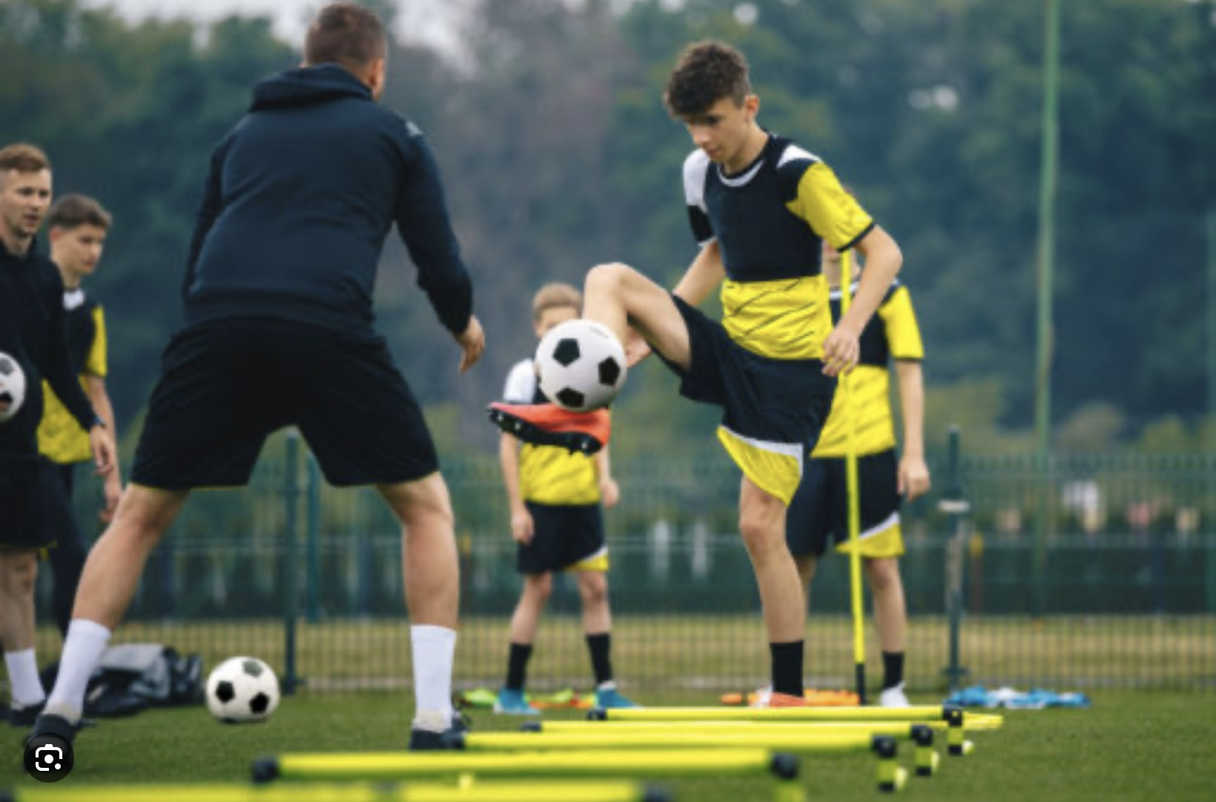
BRIEF REVIEW OF TOOL 4 RATIONAL MIND REMEDIATION

Slide 33
HACKING THOUGHT RECORDS: RATIONAL MIND REMEDIATION
Any method that gets you out of emotional thinking and into rational thinking is, in essence, doing a thought record. One of the simplest and most powerful “hacks” for going from emotional to rational mind is to ask yourself:
A) If a good friend came to you with the exact same situation, what would you say to them? Or:
B) If a calm, well-regulated friend were in this situation, how would they handle it?
This works because:
• When we imagine someone else, we automatically shift into rational thinking.
• We become more generous, thoughtful, and evidence-based.
• We stop catastrophizing.
• We gain access to the very wisdom that emotions were blocking.
In other words, this hack bypasses the entire formal structure of a thought record but produces the same end result, a cognitive reframe. It gets the person into the part of their brain that can evaluate evidence, consider context, and see nuance. This captures the essence of the thought record.

Slide 34
RATIONAL MIND REMEDIATION — “FRIEND HACK” ALGORITHM
1. What Happened? Describe the triggering event in one or two sentences. Event:
2. What Am I Feeling? Name the emotions and rate their intensity (0–100%).
3. What Is the Hot Thought? What is the most upsetting thought, the one that feels most true in the moment?
Hot Thought:
Next do either step 4 A) or 4 B)
4. A) If a Friend Were in This Situation… Imagine a friend you care about. They come to you with the exact same situation.
I) What would I tell them?
II) What perspective would I offer them?
4. B) If a Calm, Well-Regulated Friend Were in My Shoes…Imagine someone who is grounded, thoughtful, and balanced.
I) How would they see this situation?
II) What would they probably do next?
5. My Balanced (Wise Mind) Thought. After considering the above, write a more balanced, realistic, compassionate interpretation of what happened to you. Balanced Thought:
6. Re-rate the Emotions. After doing the exercise, rate your emotions again. (0-100%)

Slide 35

1. ALGORITHM A- How to do Rational mind remediation by imagining you’re helping a friend
1.Start with your chain analysis
2. Imagine this was a friend's chain analysis and that friend had come to you for help and advice about how to use DBT skills to splice and paste a different outcome
3. How could your friend have seen or interpreted the situation differently if they had been in rational mind?
4. Could your friend have thought or behaved differently to have a better outcome?
5. Help your friend to imagine a scenario in which they had stayed better regulated
6. Help your friend to practice this situation in their minds using the editing splicing and pasting technique
7. Reclaim the situation as your own using the new scenario. Practice it repeatedly in your imagination.
Dissociative technique 1

Slide 36

2. algorithm B- what would an emotionally well-regulated friend do ?
1. Start
Start with your chain analysis
2. Imagine
Imagine that what happened to you happened instead to a friend who is well regulated
3. Imagine
Imagine how they might have seen or interpreted the situation and thought and behaved differently
3. Imagine
Imagine what they might have done. Write this down
4. Reclaim
Reclaim the situation as your own and play it the way your friend did use the edit, splice, and paste technique
5.Practice
Practice that scenario in your imagination
Dissociative technique 2

Slide 37
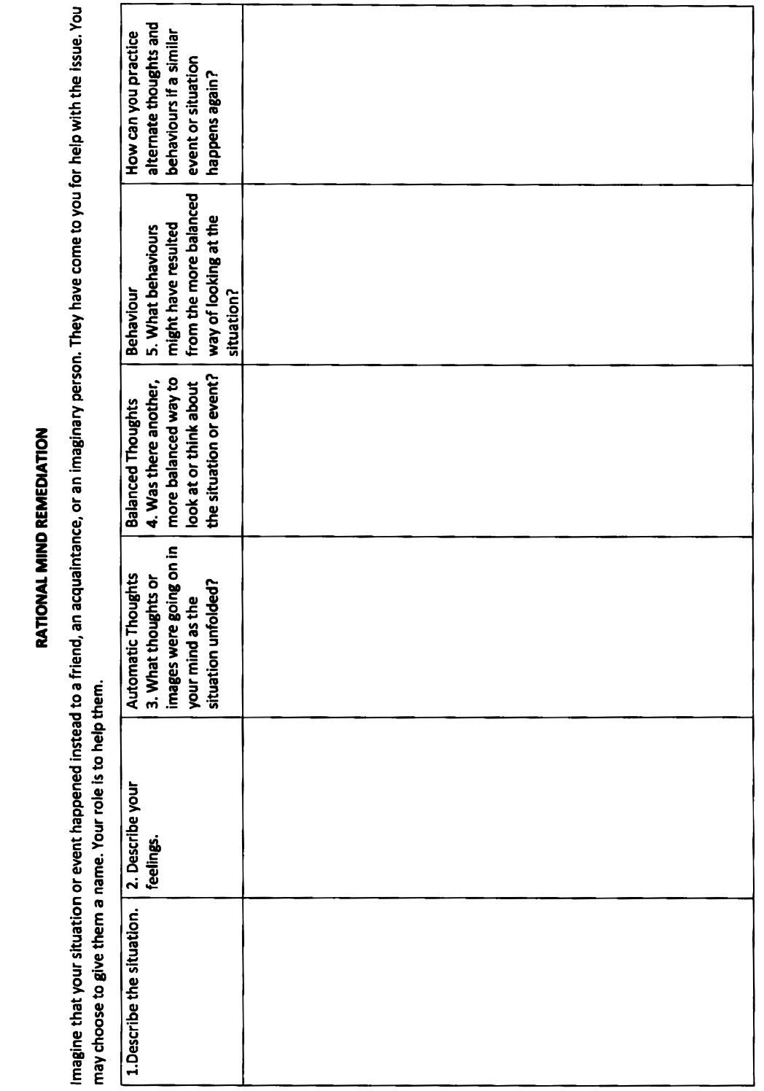
RATIONAL MIND REMEDIATION TEMPLATE

Slide 38

Some portions of this session have been intentionally removed. In the live course, we include “practices” with volunteers during which we use the tools, skills and strategies to work on real situations from their lives.
To protect their privacy and create a safe learning environment, those segments are not included in the YouTube version you are watching.
We will pause the recording now and resume it after the practice.
PAUSE RECORDING.
YOUTUBE

Slide 39
TOOL 4 RATIONAL MIND REMEDIATION PRACTICE

Slide 40
SUMMARY OF RATIONAL MIND REMEDIATION PRACTICE WITH H.

Slide 41
HACKING THOUGHT RECORDS: RATIONAL MIND REMEDIATION
Any method that gets you out of emotional thinking and into rational thinking is, in essence, doing a thought record. One of the simplest and most powerful “hacks” for going from emotional to rational mind is to ask yourself:
A) If a good friend came to you with the exact same situation, what would you say to them? Or:
B) If a calm, well-regulated friend were in this situation, how would they handle it?
This works because:
• When we imagine someone else, we automatically shift into rational thinking.
• We become more generous, thoughtful, and evidence-based.
• We stop catastrophizing.
• We gain access to the very wisdom that emotions were blocking.
In other words, this hack bypasses the entire formal structure of a thought record but produces the same end result, a cognitive reframe. It gets the person into the part of their brain that can evaluate evidence, consider context, and see nuance. This captures the essence of the thought record.
H. used another way to get to rational mind: she asked for her brother’s and her best friend take on the situation. They were in rational mind and gave her a balanced view which she accepted and helped her go from seeing the situation emotionally to seeing it rationally. This resulted in relationship repair.

Slide 42
RATIONAL MIND REMEDIATION — “FRIEND HACK” ALGORITHM
1. What Happened? Describe the triggering event in one or two sentences. Event: H. wants to get a dog but needs her son to come with her to the Humane society. He does not want to get a dog and doesn’t want to go.
2. What Am I Feeling? Name the emotions and rate their intensity (0–100%). Hurt, sad, helpless, angry, panicked
3. What Is the Hot Thought? What is the most upsetting thought, the one that feels most true in the moment?
Hot Thought: He doesn’t care about me, I will lose him, I can’t do things I want to do, That’s so unfair.

Slide 43
RATIONAL MIND REMEDIATION — “FRIEND HACK” ALGORITHM
Next do either step 4 A) or 4 B)
4. A) If a Friend Were in This Situation… Imagine a friend you care about. They come to you with the exact same situation.
I) What would I tell them?
II) What perspective would I offer them?
4. B) If a Calm, Well-Regulated Friend Were in My Shoes…Imagine someone who is grounded, thoughtful, and balanced.
I) How would they see this situation?
II) What would they probably do next?
H. did a variation of these strategies she asked for her brother’s and her best friend take on the situation. They were in rational mind and gave her a balanced view which she accepted and helped her go from seeing the situation emotionally to seeing it rationally.

Slide 44
RATIONAL MIND REMEDIATION — “FRIEND HACK” ALGORITHM
5. My Balanced (Wise Mind) Thought. After considering the above, write a more balanced, realistic, compassionate interpretation of what happened to you. Balanced Thought: What happened has to be seen in context. Both my husband and I had very difficult childhoods. Despite that we largely made it worked and spared or kids much of the pain we endured as children. It wasn’t perfect and one of the problematic patterns is that my husband and I weren’t always equal partners in decision making. Sometimes I uncomfortably submitted to him and his need for control. This is what led to us separating after which he went downhill and eventually died a couple of years ago. I was devastated and couldn’t function, and my son moved in to help me and also for his own financial reasons. We fell into a similar pattern I experienced in my marriage. As I got better, my son still, like my husband felt he needed to be in control. I was uncomfortable with this with my husband but was even more uncomfortable with it with my son. I recognize this is a longstanding mostly unconscious pattern. My son is doing what unconsciously he feels he needs to do for both him and I to survive. I’ve done DBT before and realize I sacrifice my self-respect and objectives to preserve relationships. My “uncomfortable submission” is towards the passive end of the passive-assertive-aggressive spectrum. This one instance is an example of a bigger dynamic I’m working on healing. I need to keep working on it and practice being assertive. Using “uncomfortable submission” in my holes diary card is an option.
6. Re-rate the Emotions. After doing the exercise, rate your emotions again. (0-100%)

Slide 45
RATIONAL MIND REMEDIATION — “FRIEND HACK” ALGORITHM
H. did a rational mind assertiveness script with her son. (we will talk about assertiveness scripts in the interpersonal assertiveness section of the DBT skills). He listened to her and she listened to him and went to the Humane society.
Recently he told her he might be falling in love with the dog. This is a beautiful example of rational mind remediation, relationship repair and therapeutic work.

Slide 46
Some portions of this session have been intentionally removed. In the live course, we include “practices” with volunteers during which we use the tools, skills and strategies to work on real situations from their lives.
To protect their privacy and create a safe learning environment, those segments are not included in the YouTube version you are watching.
We will pause the recording now and resume it after the practice.
RESUME RECORDING.
YOUTUBE

Slide 47


DBT SKILLS
ADVANCED MINDFULNESS

Slide 48

DBT SKILLS
ADVANCED MINDFULNESS
This is the last week of mindfulness skills
In two weeks, we start the emotional regulation skills module
Today we’ll explore several subjects :
1. Being mindful in our daily life
2. How to do tasks mindfully
3. How to be mindful of our activities
4. Resistances and hindrances to mindfulness practice
5. Exploring mindfulness further
6. Mindfulness and meditation
7. Using kindness and compassion
8. Paying attention to spaciousness and stillness

Slide 49
DBT SKILLS
1. Being mindful in our daily life
2. How to do tasks mindfully
3. How to be mindful of our activities
4. Resistances and hindrances to mindfulness practice
5. Exploring mindfulness further
6. Mindfulness and meditation
7. Using kindness and compassion
8. Paying attention to spaciousness and stillness

Slide 50

BEING MINDFUL IN OUR DAILY LIFE
Being mindful of our sensations, feelings, thoughts and behaviors at important times is critical if we want to understand ourselves, grow and heal.
Being mindful in this way takes effort and practice and is easy to overlook. Crisis plans, holes diary cards and chain analysis can help
To develop more mindfulness, we strongly suggest you use these simple tools.
We also suggest you commit to other regular mindfulness practices. Using cues can help us remember to do this more often.
Cues might include wearing a bracelet, using sticky notes, timers, apps (reminders to breathe), etc.

Slide 51

EX. OF DAILY MINDFULNESS practice
The workbook recommends that we choose one of the following mindfulness practices and commit to doing it for a few minutes every day:
Be mindful of our breathing, sensations or thoughts- count our breath, notice our sensations, or catch & diffuse thoughts
Do a self-compassion meditation- Pair mindful breathing with compassionate statements
Do a somatic meditation- focus on our body sensations.
Do everyday common tasks mindfully – For a period of time during the day do all the things we normally do in life, while staying focused on our thoughts, emotions, physical sensations, and actions in the present moment.
Doing a mindfulness practice helps us build the mindfulness muscles that are required when we need to be mindful of old patterns of thinking, feeling and behavior so we can substitute them by new more adaptive ones. Mindfulness practices are one of the treatments recommended for ADHD.

Slide 52
DBT SKILLS
1. Being mindful in our daily life
2. How to do tasks mindfully
3. How to be mindful of our activities
4. Resistances and hindrances to mindfulness practice
5. Exploring mindfulness further
6. Mindfulness and meditation
7. Using kindness and compassion
8. Paying attention to spaciousness and stillness

Slide 53

Doing TASKS MINDFULLY and spiritually
Sufism, the mystical branch of Islam emphasizes “dhikr” (remembrance of God) and strives to live with constant awareness of the Divine presence in every action.
Doing the dishes is not just scrubbing plates, but purifying the heart, remembering gratitude for the food that was on them.
Cleaning the house is sweeping away dust as one sweeps away ego and distraction, making the space ready for presence. Cooking can be preparing food as an act of love and service, seasoning it with remembrance and intention, turning nourishment into prayer.
In this way, even ordinary chores become spiritual practice.
The acronym FLAME can help us do everyday tasks more mindfully and spiritually:
Focus and shift our attention to be mindful of the present moment.
Let go of distracting thoughts and judgements
Use radical Acceptance to remain nonjudgmental
Use wise Mind to make healthy decisions
Do what’s Effective to accomplish our goals

Slide 54
When Indira Gandhi was Prime Minister of India, facing moments of intense political pressure, such as cabinet crises, military decisions, or party revolts, those around her sometimes noticed something odd: instead of pacing or talking it through, she would go into her kitchen and begin scrubbing pots and pans.
When asked why, she is said to have replied in some version of: “When everything feels overwhelming, I return to something simple and real. My hands know what to do, and my mind becomes clear.”
Before modern neuroscience had language for it, Gandhi knew how to ground her nervous system returning it to calm/alert. : When her mind veered towards fight/flight she used a rhythmic, purposeful, and sensory task to pendulate and her rational and wise mind come back online.

Slide 55
DBT SKILLS
1. Being mindful in our daily life
2. How to do tasks mindfully
3. How to be mindful of our activities
4. Resistances and hindrances to mindfulness practice
5. Exploring mindfulness further
6. Mindfulness and meditation
7. Using kindness and compassion
8. Paying attention to spaciousness and stillness

Slide 56

Being MINDFUL OF OUR ACTIVITIES
Mindfulness means:
Focusing on one thing at a time in the present moment. This helps us regulate our emotions
Learning to identify and separate judgmental thoughts from our experiences
Develop wise or self-observing mind
To build a consistent mindfulness practice use the “Mindfulness Activities Record” template found on pages 138-39 of the skills workbook. It helps you track how long you spend doing mindfulness activities.

Slide 57
A young student went to a great Zen archer and said, “I want to learn to hit the bullseye.”
The master replied, “Then forget the bullseye.”
This confused the student. “But isn’t that the whole point?”
The master handed him a bow and said, “Stand.” He corrected his feet. Then his spine. Then his shoulders. Then his breathing. Then how he held the bow. Then how he drew the string. Then how he released.
For weeks, the student did nothing but stand, draw, and release, sometimes without even shooting an arrow. Sometimes he shot at a blank wall. Frustrated, the student protested: “When will I learn to hit the target?”
The master answered, “You are still trying to hit something. That is why you miss.”
So, the student kept practicing the movements, not to succeed, not to win, not to impress, but simply to do them exactly.
Over months, then years, the movements stopped feeling forced. The bow lifted itself. The string drew itself. The arrow released itself.
One day, without aiming, without thinking, without wanting, the arrow flew and struck the exact center of the target.
The master said quietly, “Now it has shot.”

Slide 58
DBT SKILLS
1. Being mindful in our daily life
2. How to do tasks mindfully
3. How to be mindful of our activities
4. Resistances and hindrances to mindfulness practice
5. Exploring mindfulness further
6. Mindfulness and meditation
7. Using kindness and compassion
8. Paying attention to spaciousness and stillness

Slide 59
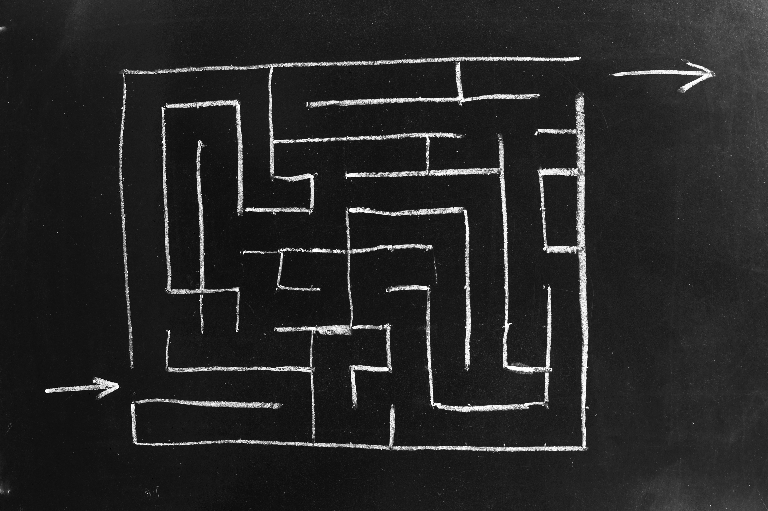
common HINDERANCES to mindfulness
Buddhism describes 5 hindrances (panca nivaranani) to mindfulness.
Desire- refers to the wish for things to be different than they are right now
Aversion- is being angry with or having ill will towards what is. Judgment is an example of aversion
Sleepiness- feeling sleepy, heavy, or dull. Sleepiness can be the result of fatigue or an act of unconscious resistance to facing scary or painful emotions that might arise during a mindfulness practice
Restlessness- Experiencing restless thoughts, feelings, or sensations that take us away from the practice.
Doubt- Having thoughts such as “I can’t handle this. I don’t know what to do. What good is this? Or this is not for me.”

Slide 60
The hindrances arise whenever the mind forgets that experience can be allowed, and instead tries to grab, fight, escape, or control it.

Slide 61

Working WITH HINDRANCES
To work with hindrances first and foremost, we need to notice and nonjudgmentally acknowledge them.
They can become a focus of our practice, and we can learn from them
Desire: Recall that no matter how many times you get what you desire, you always want more
Aversion: Recognize that anger and ill will are great teachers. Balance these feelings with compassion and kindness
Sleepiness: recognize that it is a powerful feeling that demands your full attention. Use an active mindfulness practice such as mindful walking.
Restlessness: Use a narrow focus such as counting breaths for your mindfulness practice
Doubt: If your mind is racing, concentrate your attention on the present moment. Engage with mindfulness teachers or inspirational readings

Slide 62
DBT SKILLS
1. Being mindful in our daily life
2. How to do tasks mindfully
3. How to be mindful of our activities
4. Resistances and hindrances to mindfulness practice
5. Exploring mindfulness further
6. Mindfulness and meditation
7. Using kindness and compassion
8. Paying attention to spaciousness and stillness

Slide 63

MINDFULNESS AND MEDITATION
DBT’s mindfulness component was inspired by Buddhist meditation traditions which Linehan practiced.(she became a Buddhist nun.)
P. 142 of the workbook entitled “Exploring Mindfulness Further” invites us to try different meditation practices
The objective is to help us gain a deeper appreciation of mindfulness and how it supports and promotes mental health
Although these practices are grounded in spiritual traditions, they do not require adherence to specific religious beliefs

Slide 64
DBT SKILLS
1. Being mindful in our daily life
2. How to do tasks mindfully
3. How to be mindful of our activities
4. Resistances and hindrances to mindfulness practice
5. Exploring mindfulness further
6. Mindfulness and meditation
7. Using kindness and compassion
8. Paying attention to spaciousness and stillness

Slide 65

KINDNESS & COMPASSION
Some meditation practices focus on fostering the 5 “Heart” qualities which are gratitude, gentleness, generosity, empathy, and loving-kindness
Working on kindness and compassion helps us be nonjudgmental
Loving-kindness mediations have been shown to promote physical and psychological healing
Loving-kindness is described as a deep friendliness and welcoming or as a quality embodying compassion and cherishing, filled with forgiveness and unconditional love
At the beginning of the session today we did a Loving-Kindness Mediation, there are many available on YouTube. Try them.

Slide 66
DBT SKILLS
1. Being mindful in our daily life
2. How to do tasks mindfully
3. How to be mindful of our activities
4. Resistances and hindrances to mindfulness practice
5. Exploring mindfulness further
6. Mindfulness and meditation
7. Using kindness and compassion
8. Paying attention to spaciousness and stillness

Slide 67

SPACIOUSNESS & STILLNESS
Sometimes struggling to be nonjudgmental or to relax during mediation is a sign that we are not resting in our WHOLENESS
Often, we over identify with an active and present smaller part or parts of ourself
Consider the metaphor of the OCEAN and its waves
The waves and the OCEAN are one. The turbulence of a storm will eventually pass and even during the storm the deeper water is calm.
Our depth is the OCEAN, our surface sensations, feelings and thoughts are the waves.
Sometimes we identify with the temporary waves and forget the permanence and calm of the OCEAN depths

Slide 68
Before we do our Zoom poll today, please keep in mind that the poll questions are not tests. They’re also not about whether you’ve been ‘good’ or ‘bad’. They’re simply a mindful way of reflecting on where you are right now.
One of the core ideas behind emotional regulation and mindfulness is that we can’t work with what we don’t see. So, this week’s poll is really just about seeing and noticing what has changed, what hasn’t, what feels easy, and what feels hard.
Some of you may notice your window of tolerance has grown. Some of you may feel it hasn’t. Some of you may understand the material very well but struggle to use it. All of that is completely human, and all of it belongs here. As you answer the poll, I invite you to let go of how you think you should be doing and just answer from your honest experience. That honesty is what actually creates growth, not getting the ‘right’ answer.

Slide 69
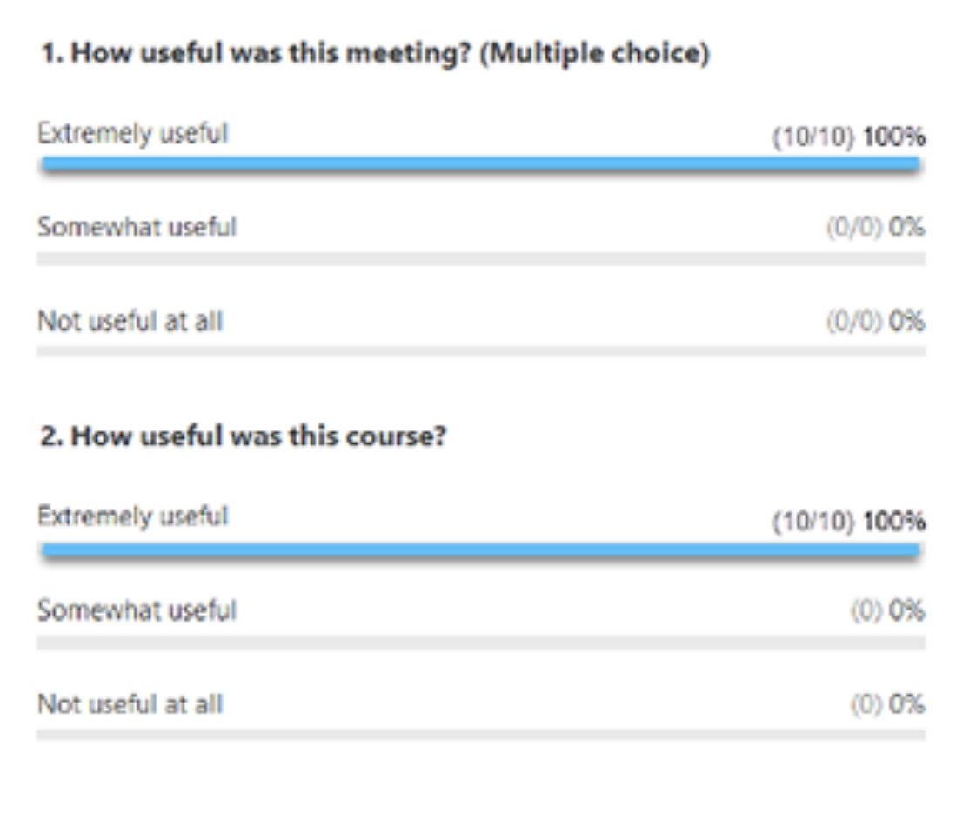
ZOOM POLL
Please answer the following question
Answers are anonymous
In person participants please answer the page that was handed out.

Slide 70


Slide 72

Samantha p. 183
Notes:
Samantha, or Sam as she liked to be call, was a 22-year-old university student who was attending the simple course. Sam had been living with her boyfriend Steve, for six months. Steve worked full-time as a trainer at a fitness club.
Sam noticed a pattern in her relationship with Steve that, she now realized, had been present in her previous relationships as well: Steve always wanted to do things as a couple, together time, however, often irritated Sam, who prefer to be by herself or with friends.
This had become an issue, which Steve wanted to "work out", but their discussions had gone nowhere and had, several times, ended in shouting matches that Sam had walked out on.
Steve wondered if Sam wanted to be with him at all and accused her of being "distant". She, in turn, saw him as "needy". Because she had felt the same with her previous partners, Sam was beginning to wonder if this had something to do with her.
Sam had worked on a crisis plan and was walking away from fights earlier before things got out of hand. She told Steve, ahead of time, that she would do this. Although he was not happy about it, the "timeouts", allowed both to cool down. Their fights became less intense, but the underlying issue remained unresolved.

Slide 73
Samantha was a 22-year-old University student who was attending the Simple group. Sam had been living with her boyfriend Steve, for 6 months. Steve worked full-time as a trainer at a fitness club. Sam noticed a pattern in her relationship with Steve that, she now realized, had been present in her previous relationships as well: Steve always wanted to do things as a couple, together time, however, often irritated Sam, who preferred to be by herself or with friends. This had become an issue, which Steve wanted to “work out”, but their discussions had gone nowhere and had, several times, ended in shouting matches that Sam had walked out on. Steve wondered if Sam wanted to be with him at all and accused her of being “distant”. She, in turn, saw him as “needy”. Because she had felt the same about her previous partners, Samantha was beginning to wonder if this had something to do with her. Sam had worked on a crisis plan and was walking away from fights earlier before things got out of hand. She had told Steve, ahead of time, that she would do this. Although he was not happy about it, the “timeouts”, allowed both to cool down. Their fights became less intense, but the underlying issue remained unresolved.
Sam’s diary card targets When she first started doing diary cards, Sam used the beginner target “falling into a hole”, a generic “catch all” target. Sam was hoping to find more specific intermediate targets and at one of the sessions, asked for help doing that. Sam looked at her diary cards for the previous two weeks. There were several 0’ s in a row, then a day which she rated a 7. That was followed by two days that were 4’ s, and two more that were 1’ s. Sam explained that, after one of her afternoon classes, she had been invited by classmates to go for pizza. The small group had ended up at someone’s apartment watching a movie. She knew Steve would want her to call to let him know she would be late but, determined to maintain her independence, she had defiantly decided not to do that. When Sam got home at 11 pm Steve, fuming, was waiting up for her. They started falling into their usual hole, but recalling her crisis plan, Sam immediately left, and spent a couple of days at her parents. This description of events gave her some ideas for possible intermediate targets: “Conflict with Steve” was an obvious one. She wondered if there were others. Sam said that she often felt “irritated” and “frustrated” with Steve. Sometimes, she also felt “guilty”, “lonely” and “sad”. Replacing “falling into a hole” with “feeling irritated with Steve” made sense to Sam. Feeling irritated with her partners was a longstanding hole for Sam.

Slide 74
Feeling irritated with Steve
Notes:
When Sam first started doing diary cards, she used the beginner target "falling into a hole", a generic "catch all" target. Sam was hoping to find a more specific intermediate target and at one of the sessions asked for help doing that.
Sam looked at her diary cards for the previous two . There were several 0’s in a row, then a day which she rated a 7. That was followed by two days that were 4's, and two more that were 1's.
Sam explained that, after one of her afternoon classes, she had been invited by classmates to go for pizza. The small group had ended up at someone's apartment watching a movie. She knew Steve would want her to call to let him know she would be late but, determined to maintain her independence, she had defiantly decided not to do that.
When Sam got home at 11 PM Steve, fuming, was waiting up for her. They started falling into their usual hole, but recalling her crisis plan, Sam immediately left and spent a couple of days at her parents.
This description of events gave her some ideas for possible intermediate targets: "conflict with Steve" was an obvious one. She wondered if there were others. Sam said that she often felt "irritated" and "frustrated" with Steve. Sometimes, she also felt "guilty", "lonely", and "sad".
Replacing falling into a hole with "feeling irritated with Steve" made sense to Sam. Feeling irritated with her partners was a long-standing hole for Sam.

Slide 75
chain analysis algorithm
Start with a high score in your hole's diary card
Step 1. Create a “topographic” profile of the intensity of your activation around the time period for which you are doing a chain analysis.
Step 2. On the template note if there were any events that may have contributed to or triggered your increase in activation ?
Step 3. Note the sequence of emotions you felt during this period. Rate each on a scale of 0-10 with 10 being the most intense you’ve ever felt this emotion
Step 4. Notice your sensations without judging or trying to change them
Step 5. Note the thoughts that go with each of your emotions
Step 6. Note what you did or wanted to do but stopped yourself during this time period
Step 7. Note on a 0-10 scale what your energy balance, reserves or stores (how full your gas tank was) prior to the time for which you’re doing the chain analysis.
Notes:
Sam was intrigued and wanted to explore why she became so irritated by her partners. She decided to do a chain analysis. Sam realized that when she was working on finding intermediate targets, she had already explored parts of the chain analysis.

Slide 76
CHAIN ANALYSIS TEMPLATE
Stay in window of tolerance by pendulating
1. what was the topography of your activation?
2. was there a trigger(s)?
3. what did you feel?
4. notice the sensations in your body without judging or trying to change them
5. what thoughts were associated with each feeling?
6. what behaviors or urges were associated with each feeling?
7. what was your energy balance before the activation? 0-10
Notes:
The "topography" of Sam's activation was clear from her diary card ratings. She had also explored the event that triggered her and the feelings she had experienced: irritation and frustration at first, but later guilt, loneliness, and sadness.
Having completed these columns of the chain analysis, Sam reflected on the thoughts that had accompanied her feelings: she liked her space and doing things on her own, or with her friends. She could only spend so much time with Steve, particularly now that they were living together. He seemed to want to spend more time with her then she did with him. She felt suffocated and did not want to lose her independence.
After the initial irritation, Sam started to feel guilty: Steve was a nice guy, he was always doing things for her, and cared a lot about her. His family was close, there were kind to each other, and liked spending time together.
Sam's family, on the other hand, had always been critical, cold, and distant. Maybe what she felt had something to do with her upbringing and her "internal working model”. Maybe she had trouble loving and getting close to people. Maybe she would always feel this way and would be lonely for the rest of her life.
When Sam got home, after the night out with her friends, and Steve was angry, she just wanted to leave the situation and avoid conflict. Her crisis plan provided her with a good excuse for doing that. Over the time she stayed at her parents, they had not even asked her why she had come home, just how long she planned to stay.
After a couple of emotionally cool days at home, Sam longed to return to Steve, who seemed genuinely interested in her and what she did. At the same time, she was afraid that their pattern would just keep repeating.

Slide 77
Sam’s chain analysis Sam was intrigued and wanted to explore why she became so irritated by her partners. She decided to do a chain analysis. Sam realized that when she was working on finding the intermediate targets, she had already explored parts of the chain analysis. The “topography” of Sam’s activation was clear from her diary card ratings. She had also explored the event that triggered her and the feelings she had experienced: irritation and frustration at first, but later guilt, loneliness, and sadness. Having completed those columns of the chain analysis, Sam reflected on the thoughts that had accompanied her feelings: She liked her space and doing things on her own, or with her friends. She could only spend so much time with Steve, particularly now that they were living together. He seemed to want to spend more time with her than she did with him. She felt suffocated and did not want to lose her independence. After the initial irritation, Sam started to feel guilty: Steve was a nice guy, he was always doing things for her, and cared a lot about her. His family was close, they were kind to each other, and liked spending time together. Sam’s family, on the other hand, had always been critical, cold, and distant. Maybe what she felt had something to do with her upbringing and her “internal working model”. Maybe she had trouble loving and getting close to people. Maybe she would always feel this way and be lonely for the rest of her life. When Sam got home, after the night out with her friends, and Steve was angry, she just wanted to leave the situation and avoid conflict. Her crisis plan provided her with a good excuse for doing that. Over the time she stayed at her parents they had not even asked why she had come home, just how long she planned to stay. After a couple of emotionally cool days at home, Sam longed to return to Steve, who seemed genuinely interested in her and what she did. At the same time, she was afraid that their pattern would just keep repeating.

Slide 78
1. How to do Rational mind remediation by imagining you’re helping a friend
Start with your chain analysis
Imagine this was a friend's chain analysis and that friend had come to you for help and advice about how to use DBT skills to splice and paste a different outcome
How could your friend have seen or interpreted the situation differently?
Could your friend have thought or behaved differently and to have a better outcome?
Help your friend to imagine a scenario in which they had stayed better regulated
Help your friend to practice this situation in their minds using the editing splicing and pasting technique
Reclaim the situation as your own using the new scenario. Practice it repeatedly in your imagination.
Notes:
Sam worked on a rational mind remediation. She imagined that a friend of hers had just gone through a similar "coming home late" situation. She shared with Sam what happened and was desperate for advice.
Sam thought her friend had issues with getting close to her partners and needed to work on that. She thought her friend could use "feeling irritated by others" as a target in her diary card. Sam suggested that rather than acting on her irritation, her friend be mindful, and curious about it. She should spend some time with the sensations they came along with being irritated.
One of her friends automatic thoughts was that others were needy. An alternative thought was that she had trouble with intimacy. Around this issue, the friend should be gentle with herself, but perhaps set a goal of slowly being able to be more intimate with people. Sam realized that she could not be intimate because she did not trust anyone and to compensate, she had learned to be self-sufficient.
Sam wanted to offer her friend concrete suggestions that could be implemented and came up with 1) start using "feeling irritated with people" in her diary card. 2) apply the "edit, splice, and paste" technique to the incident: run the "mental videos" of the incident up to the point when she came home after being out with her friends. As she started to feel suffocated and irritated by her partners questioning, she could splice in an alternative thought: "I do feel irritated, but he has a point; I could have called to let him know I'll be coming home late. This may be an example of my tendency to push people away when they start getting close to me." 3) practice this new "video" every day for a few minutes. 4) picture, in her imagination, telling her boyfriend what she had learned about intimacy, and what she was trying to do. Eventually, when she felt ready, she could do this in real life.
Having written those suggestions for her friend, Sam then took ownership of them and made them her homework.

Slide 79
Sam’s rational mind remediation Sam worked on a rational mind remediation. She imagined that a friend of hers had just gone through a similar “coming home late” situation. The friend shared with Sam what happened and was desperate for advice. Sam thought her friend had issues with getting close to her partners and needed to work on that. She thought her friend could use “feeling irritated by others” as a target in her diary card. Sam suggested that rather than acting on her irritation, her friend be mindful, and curious about it. She should spend some time with the sensations that came along with being irritated. One of her friend’s automatic thoughts was that others were needy. An alternative thought was that she had trouble with intimacy. Around this issue, the friend should be gentle with herself, but perhaps set a goal of slowly being able to be more intimate with people. Sam realized that she could not be intimate because she did not trust anyone and to compensate had learned to be self-sufficient. Sam wanted to offer her friend concrete suggestions that could be implemented and came up with:
Start using “feeling irritated with people” in her diary card.
Apply the “edit, splice and paste” technique to the incident: run the “mental video” of the incident up to the point when she came home after being out with her friends. As she started to feel suffocated and irritated by her partners questioning, she could splice in an alternative thought: “I do feel irritated, but he has a point; I could have called to let him know I would be coming home late. This may be an example of my tendency to push people away when they start getting close to me.
Practice this new “video” every day for a few minutes.
Picture, in her imagination, telling her boyfriend what she had learned about intimacy, and what she was trying to do. Eventually, when she felt ready, she could do this in real life.
Having written down these suggestions for her friend, Sam then took ownership of them and made them her homework.

Slide 80

Allison p. 186
Notes:
Allison was a 42-year-old married mother of a 12-year-old son. She worked as an office manager. Allison was doing simple because of her long-standing issues with depression.
When Allison was five years old, her loving mother had died in a car accident, leaving her and her three-year-old sister, in the care of their father. Allison's father, Joe, a partner in a successful accounting firm, coped with the tragedy by immersing himself in his work, while the girls were looked after by a series of nannies.
On Allison's ninth birthday, Joseph announced that he was marrying their latest nanny. Ingrid, a 23-year-old Eastern European young woman, was strict and emotionally distant from the girls, but she was attractive, hard-working, and had taken on many extra household responsibilities. She not only looked after the children, but cleaned the house, and was a good cook. After the wedding, Allison's and her sister’s relationship with Ingrid did not improve.
Two years before Allison started therapy, her father had died. Ingrid was left in charge of this sizable estate. As her arthritis was increasingly limiting her mobility, Ingrid sponsored one of her European nieces, to come work for her. The two women got along well. Often, when Allison visited, they spoke in their native language, which Allison did not understand.
Allison and her sister began to worry when Ingrid, who, while Joseph was alive had always been frugal, started spending large sums of money and making poor investment decisions. Allison thought Ingrid was being influenced by the niece, and worried that what her father had spent his life saving, would be squandered.

Slide 81
Allison was a 42-year-old married mother of a 12-year-old son. She worked as an office manager. Allison was doing Simple because of her longstanding issues with depression. When Allison was five years old, her loving mother had died in a car accident, leaving her and her three-year-old sister, in the care of their father. Allison’s father, Joseph, a partner in a successful accounting firm, coped with the tragedy by immersing himself in his work, while the girls were looked after by a series of nannies. On Allison nineth birthday, Joseph announced that he was marrying their latest nanny. Ingrid, a 23-year-old Eastern European young woman, was strict and emotionally distant with the girls, but attractive, hard working, and had taken on many extra household responsibilities. She not only looked after the children, but cleaned the house, and was a great cook. After the wedding, Allison’s and her sister’s relationship with Ingrid did not improve. Two years before Allison started therapy, her father had died. Ingrid was left in charge of his sizeable estate. As her arthritis was increasingly limiting her mobility, Ingrid sponsored one of her European nieces, to come work for her. The two women got along well. Often, when Allison visited, they spoke in their native language, which she did not understand. Allison and her sister began to worry when Ingrid, who, while Joseph was alive had always been frugal, started spending large sums of money and making poor investment decisions. Allison thought Ingrid was being influenced by the niece, and worried that what her father had spent his life saving, would be squandered. Allison had suffered from depression and anxiety since she was a teen, but her symptoms got worse following her father’s death. She had decided to use “depression” and “anxiety” as her holes diary card targets. Allison’s diary card revealed that her “depression” always seemed to hover around a 4 or 5/ 10. Her anxiety spiked whenever she had something to do with Ingrid. She decided to do a chain analysis for one such spike.

Slide 82
Depression 4 5 3 5 7 8
Anxiety 5 5 4 3 10 10
Notes:
Allison had suffered from depression and anxiety since she was a teenager, but her symptoms got worse following her father's death. She had decided to use "depression" and "anxiety" as her holes diary cards targets.
Allison's diary card revealed that her depression always seemed to hover around the 4 or 5/10. Her anxiety spiked whenever she had something to do with Ingrid. She decided to do a chain analysis for one such spike.

Slide 83
Allison’s diary card revealed that her “depression” always seemed to hover around a 4 or 5/ 10. Her anxiety spiked whenever she had something to do with Ingrid. She decided to do a chain analysis for one such spike.
Allison’s chain analysis As had long been their habit, Allison and her sister had come “home” for a visit on a Sunday afternoon. They found, in the driveway, a large new Cadillac SUV. Ingrid proudly announced that she had just purchased it. Allison reviewed the topography of her activation: while her anxiety had been higher for at least the last year, it spiked whenever she visited Ingrid, particularly when she found yet more evidence of her financial irresponsibility. With the help of the “feeling wheel”, Allison identified feeling anxiety, sadness, frustration, and anger, during the SUV incident. She linked the anxiety and frustration to the thought of seeing her father’s estate being depleted, and not knowing what to do about it. She was sad that this was how her life had turned out. After he married Ingrid, Joseph spent more and more time at work, and hardly ever saw the children. The girl’s relationship with Ingrid had never improved, and Allison had coped by being compliant and keeping her feelings and thoughts to herself. She was frustrated and angry that Ingrid’s niece seemed to be manipulating her. Whenever Allison had approached Ingrid about this, she would dismiss it, and tell her that she worried too much. Just as she had always done, Allison internalized her behaviour, ruminated, and lost sleep. She had withdrawn from some of her usual activities and was irritable and curt with people around her.

Slide 84
Chain analysis
Stay in window of tolerance by pendulating
1. what was the topography of your activation?
2. was there a trigger(s)?
3. what did you feel?
4. notice the sensations in your body without judging or trying to change them
5. what thoughts were associated with each feeling?
6. what behaviors or urges were associated with each feeling?
7. what was your energy balance before the activation? 0-10
Notes:
As had long been their habit, Allison and her sister had come "home" for a visit on a Sunday afternoon. They found, in the driveway, a large new Cadillac SUV. Ingrid proudly announced that she had just purchased it.
Allison reviewed the topography of her activation: while her anxiety had been higher for at least the last year, it spiked whenever she visited Ingrid, particularly when she found yet more evidence of her financial irresponsibility.
With the help of the "feeling wheel", Allison identified feeling anxiety, sadness, frustration, and anger, during the SUV incident.
She linked the anxiety and frustration to the thought of seeing her father's estate being depleted, and not knowing what to do about it.
She was sad that this was how her life had turned out. After he married Ingrid, Joseph spend more and more time at work, and hardly ever saw the children. The girl’s relationship with Ingrid had never improved, and Allison had coped by being compliant and keeping her feelings and thoughts to herself.
She was frustrated and angry that Ingrid’s niece seemed to be manipulating her. Whenever Allison had approached Ingrid about this, she would dismiss it, and tell her that she worried too much.
Just as she had always done, Allison internalized her behavior, ruminated, and lost sleep. She had withdrawn from some of her usual activities and was irritable and cuet with people around her.

Slide 85
2. alternative rational mind remediation what would an emotionally well-regulated friend do ?
Start
Start with your chain analysis
Imagine
Imagine that what happened to you happened instead to a friend who is well regulated
Imagine
Imagine how they might have seen or interpreted the situation and thought and behaved differently
Imagine
Imagine what they might have done. Write this down
Reclaim
Reclaim the situation as your own and play it the way your friend did use the edit, splice, and paste technique
Practice
Practice that scenario in your imagination
Notes:
Allison imagined the same situation was happening to a friend who had well-regulated emotions. Marjorie, whom she had known since high school, was kind but assertive. What would Marjorie do in this situation?
Marjorie would not be intimidated. This was an unfair situation, and it was reasonable to address it rather than put up with it. Marjorie would not keep her feelings and thoughts to herself. She would, in a kind but assertive way, explained to her stepmother what she felt, thought, and wanted to see happen; the stepmother was entitled to spend her father's money, but not to throw it away foolishly.
If this conversation went nowhere, Marjorie would find out what her legal rights work, and if she did not have a legal recourse, try to maintain a cordial relationship with the stepmother and negotiate. If she exhausted her options, she would simply walk away. It would be sad, but she did not want to waste her life feeling resentment and anger. Marjorie, like Allison, was financially comfortable. Inheriting some of her father's largest state would be nice, but it would not be a life changer.
After imagining what Marjorie would do, Allison considered how she could apply it to herself and decided on an action plan: 1) she would use the "mental video" of the visit when she found the SUV in the driveway. She would then splice and edit out the part in which she kept her feelings and thoughts to herself while stewing on them. She had done that all her life.
Instead, she would paste in an assertive conversation, in which she explained to Ingrid how she felt, her thoughts, and what she planned to do. Imagining this conversation, activated Allison, and she knew she had to practice it for some time while, to stay in the window of tolerance, she pedulated.
2) in her imagination, Allison practiced this conversation, not expecting to have a real conversation with Ingrid anytime soon. She felt this took some of the pressure off.
3) Allison knew a family lawyer whom she trusted and decided she would call him to make an appointment to review her legal options.
4) she felt that if trying to work things out not produce results, she would not be held hostage by the potential inheritance and would distance herself from Ingrid.
Allison realize that her feelings, thoughts, and behaviours, in this present day situation, were similar to those she had as a little girl. Her adult self needed to step up and protect this frightened child.

Slide 86
Allison’s rational mind remediation Allison imagined that a similar situation was happening to a friend who had well-regulated emotions. Marjorie, whom she had known since high school, was kind but assertive. What would Marjorie do in this situation? Marjorie would not be intimidated. This was an unfair situation, and it was reasonable to address it rather than put up with it. Marjorie would not keep her feelings and thoughts to herself. She would, in a kind but assertive way, explain to her stepmother what she felt, thought, and wanted to see happen; the stepmother was entitled to spend their father’s money, but not to throw it away foolishly. If this conversation went nowhere, Marjorie would find out what her legal rights were, and if she did not have a legal recourse, try to maintain a cordial relationship with the stepmother and negotiate. If she exhausted her options, she would simply walk away. It would be sad, but she did not want to waste her life feeling resentment and anger. Marjorie, like Allison, was financially comfortable. Inheriting some of her father’s large estate would be nice, but it would not be a life changer. After imagining what Marjorie would do, Allison considered how she could apply it to herself and decided on an action plan:
She would use the “mental video” of the visit when she found the SUV in the driveway.
She would then splice and edit out the part in which she kept her feelings and thoughts to herself while stewing in them. She had done that all her life. Instead, she would paste in an assertive conversation, in which she explained to Ingrid how she felt, her thoughts, and what she planned to do. Imagining this conversation, activated Allison, and she knew she had to practice it for some time while, to stay in the window of tolerance, she pendulated.
In her imagination, Allison practiced this conversation, not expecting to have a real conversation with Ingrid anytime soon. She felt this took some of the pressure off. Allison knew a family lawyer whom she trusted and decided she would call him to make an appointment and review her legal options. She felt that if trying to work things out did not produce results, she would not be held hostage by the potential inheritance and would distance herself from Ingrid.
Allison realized that her feelings, thoughts, and behaviours, in this present-day situation, were similar to those she had as a little girl. Her adult self needed to step up and protect this frightened child.

Slide 87

George p. 189
Notes:
George was a retired factory worker, whose grown children had long ago moved away. George and Doris had been married for 40 years; it was a stable but unhappy relationship, as Doris was constantly criticizing George.
The most recent dispute was over his sleeping habits; George liked to stay up until 3 AM and did not get up until noon. Doris complained that, because of this, she had to be quiet in the mornings and could not have her friends over.
Doris punished George by being extra loud in the mornings, slamming doors and cupboards as she did housework. She would also stonewall him. George tried to ignore her and spent most of his day in the garage, which he had converted to workshop, tinkering with various projects.

Slide 88
George was a retired factory worker, whose grown children had long ago moved away. George and Doris had been married for 40 years; it was a stable but unhappy relationship, as Doris was constantly criticizing George. The most recent dispute was over his sleeping habits: George liked to stay up until 3 AM and did not get up until noon. Doris complained that, because of this, she had to be quiet in the mornings and could not have her friends over. Doris punished George by being extra loud in the mornings, slamming doors and cupboards as she did housework. She would also stonewall him. George tried to ignore her and spent most of his day in the garage, which he had converted to a workshop, tinkering with various projects. George’s diary cards George used “isolation”, “anxiety”, and “conflicts with Doris” as his holes diary card targets.

Slide 89
isolation
activation?
activation?
anxiety
Conflicts with doris
Notes:
George used "isolation", "anxiety", and "conflicts with Doris" as his holes diary targets

Slide 90
CHAIN ANALYSIS TEMPLATE
Stay in window of tolerance by pendulating
1. what was the topography of your activation?
2. was there a trigger(s)?
3. what did you feel?
4. notice the sensations in your body without judging or trying to change them
5. what thoughts were associated with each feeling?
6. what behaviors or urges were associated with each feeling?
7. what was your energy balance before the activation? 0-10
Notes:
George decided to do a chain analysis focusing on the recent incident: he'd just gotten up from bed and was having breakfast, it was 11 AM, Doris walked into the kitchen, grab something, and left, slamming the door so hard that the sleeping cat instantly jumped into the air and looked terrified.
George too, felt terrified, but could not put thoughts to that feeling. He did a flash; as a child he had been terrified in the same way by his father's angry outbursts.
George hurriedly prepared his breakfast, and took it out to the workshop, where he knew he would be safe. He sued themselves with his woodworking. He knew Doris would cool down and her hot anger would turn cold. He could handle that better. He felt sad that this was his life.

Slide 91
George’s chain analysis George decided to do a chain analysis focusing on a recent incident: He had just gotten up from bed and was having breakfast, it was 11 a.m., Doris walked into the kitchen, grabbed something, and left, slamming the door so hard that the sleeping cat instantly jumped into the air and looked terrified. George too, felt terrified, but could not put thoughts to that feeling. He did have a flash; as a child he had been terrified in this same way by his father’s angry outbursts. George hurriedly prepared his breakfast, and took it out to the workshop, where he knew he would be safe. He soothed himself with his woodworking. He knew Doris would cool down and her hot anger would turn cold. He could handle that better. He felt sad that this was his life.

Slide 92
1. How to do Rational mind remediation by imagining you’re helping a friend
Start with your chain analysis
Imagine this was a friend's chain analysis and that friend had come to you for help and advice about how to use DBT skills to splice and paste a different outcome
How could your friend have seen or interpreted the situation differently?
Could your friend have thought or behaved differently and to have a better outcome?
Help your friend to imagine a scenario in which they had stayed better regulated
Help your friend to practice this situation in their minds using the editing splicing and pasting technique
Reclaim the situation as your own using the new scenario. Practice it repeatedly in your imagination.
Notes:
George imagined that a situation like his, involving a critical wife and sleep habits, had happened to a friend, John. Not knowing what to do, John had come to George for advice.
George thought that John's wife was bad tempered and mean to him. John should either stand up to her or leave her he had worked all his life to support his family, and now that he was retired, he deserves some peace. She had no right to treat him this way.
George is not playing John for sleeping until noon, it was a way of avoiding his wife. George wondered why John, who like him was 6 foot two and wait 250 pounds was afraid of his 5 foot one, 105 pound wife. That was clearly not rational, but John had been afraid of angry people all of his life, it started in childhood
George suggested that John consider the following: 1) in his imagination practice telling his wife how he felt, what he thought, and what he wanted: for her to at least be civil.
2) George thought that John's wife might get even angrier if you told her this: they just had to reassure himself that there is no way she could physically harm him.
3) if that did not work, John should seriously consider separating from his wife. He would take a financial hit but would survive. He might be lonely, but he was lonely now. He should not have to live in permanent fear.
Advising John about what to do was easy, but George could not imagine doing these things himself, just thinking about it frightened him. George decided that for the time being he would only practice this in his imagination. When his fear was activated, he would use pen Julie to thoughts that he was safe, to stay in the window of tolerance. George would replace the usual "video" in which he was intimidated by his wife and remained passive, with one in which he was calmly assertive. He had to massive this in his imagination before he could contemplate doing it in real life.

Slide 93
George’s rational mind remediation George imagined that a situation like his, involving a critical wife and sleep habits, had happened to a friend, John. Not knowing what to do, John had come to George for advice. George thought that John’s wife was bad tempered and mean to him. John should either stand up to her or leave her. He had worked hard all his life to support his family, and now that he was retired, he deserved some peace. She had no right to treat him this way. George did not blame John for sleeping until noon, it was a way of avoiding his wife. George wondered why John, who like him was 6’2” and weighed 250 pounds was afraid of his 5’1” 105-pound wife. That was clearly not rational, but John had been afraid of angry people all his life, it has started in childhood. George suggested that John consider the following:
In his imagination practice telling his wife how he felt, what he thought, and what he wanted: for her to at least be civil. George thought that John’s wife might get even angrier if he told her this, but he just had to reassure himself that there was no way she could physically harm him. If that did not work, John should seriously consider separating from his wife. He would take a financial hit but would survive. He might be lonely, but he was lonely now. He should not have to live in permanent fear.
Advising John about what to do was easy, but George could not imagine doing these things himself, just thinking about it frightened him. George decided that for the time being he would only practice this in his imagination. When his fear was activated, he would use pendulation to thoughts that he was safe, to stay in the window of tolerance. George would replace the usual “video” in which he was intimidated by his wife and remained passive, with one in which he was calmly assertive. He had to master this in his imagination before he could contemplate doing it in real life.

Slide 94

Kelly p. 190
Notes:
Kelly was a 42-year-old married mother of three young children. She had worked in a bank but three years ago, had left that job to spend more time at home. Her eldest son, a 13-year-old Scott, have been diagnosed with ADHD, and a learning disorder. Scott was bright but impulsive, disorganized, and undisciplined, even for a boy his age.
Scott could do well at school but required constant structure and supervision. Providing this for Scott was exhausting, especially because her husband, who ran his own business, spent 70 hours a week at work.
Kelly checked Scott's homework every day. She arranged with his teachers that they would email her the homework Scott was supposed to do and she would use a behavioural program, giving him a token reward for completing it. He could use these tokens to "buy privileges".
For his health class, Scott had been asked to list what he liked and did not like about his life, why he did or did not like these things, and how he thought he could change them. Kelly was intrigued when she heard about the homework from the teacher, and rather than just give it in a cursory glance, to make sure it was done, she read it all.
Kelly was extremely upset by what Scott wrote; he did not like her because she was too strict and would not let him do the things that he enjoyed.

Slide 95
Kelly was a 42-year-old married mother of three young children. She had worked in a bank but three years ago, had left that job to spend more time at home. Her oldest son, 13-year-old Scott, had been diagnosed with ADHD, and a learning disorder. Scott was bright but impulsive, disorganized, and undisciplined, even for a boy his age. Scott could do well at school but required constant structure and supervision. Providing this for Scott was exhausting, especially because her husband, who ran his own business, spent 70 hours a week at work. Kelly checked Scott’s homework every day. She arranged with his teachers that they would email her the homework Scott was supposed to do and she would use a behavioral program, giving him a token reward for completing it. He could use these tokens to “buy privileges”. For his health class, Scott had been asked to list what he liked and did not like about his life, why he did or did not like those things, and how he thought he could change them. Kelly was intrigued when she heard about the homework from the teacher, and rather than just give it a cursory glance, to make sure it was done, she read it all. Kelly was extremely upset by what Scott wrote: He did not like her because she was too strict and would not let him do the things that he enjoyed. Kelly’s diary card Kelly had grown up in a home with parents who were constantly bickering and ignored her and her older brother. Kelly suffered from chronic low-grade depression, punctuated by episodes of more severe symptoms, during which she struggled to function. Her diary card targets were “feeling hurt and rejected”, “feeling despair” and “anger and frustration”. Following the incident with Scott’s homework, her numbers across all the targets had been much higher.

Slide 96
rejected
despair
anger
Notes:
Kelly had grown up in a home with parents who are constantly bickering and ignored her and her older brother. Kelly suffered from chronic low-grade depression, punctuated by episodes of more severe symptoms, during which she struggled to function.
Her diary card targets were "feeling hurt and rejected", "feeling despair" and "anger and frustration". Following the incident with Scott's homework, her numbers across all the targets had been much higher.

Slide 97
CHAIN ANALYSIS TEMPLATE
Stay in window of tolerance by pendulating
1. what was the topography of your activation?
2. was there a trigger(s)?
3. what did you feel?
4. notice the sensations in your body without judging or trying to change them
5. what thoughts were associated with each feeling?
6. what behaviors or urges were associated with each feeling?
7. what was your energy balance before the activation? 0-10
Notes:
Kelly remarked that, as she read the essay, she started feeling hurt and sad. It was a very steep downhill. She had remained down and was now, after four days, just beginning to recover.
She had felt hurt, rejected, sad, angry, frustrated and in despair.
Kelly ruminated on how she loved Scott, wanted the best for him, and had gone to great lengths to find a way to help him to be more responsible. She put tremendous effort into this, and he hated her for it.
Scott had also written that he much preferred his father, who was seldom home, but did take him fishing, hunting, snowmobiling, and dirt biking when he was.
Kelly thought she was a terrible mother, nobody had ever liked her, not even her parents. She wondered what was wrong with her. Did she not do all she could to please people and get their approval? She had worked hard with the school and with a psychologist to come up with this plan for Scott, and they had emphasized how critical this was for his future.
She wanted to give up and run away. She wanted to go to bed and never get up. She checked those urges, but it took all her energy to keep attending to her daily chores and routines. She was present in body but not in spirit.

Slide 98
Kelly’s Chain analysis Kelly remarked that, as she read the essay, she started feeling hurt and sad. It was a very steep downhill. She had remained down and was now, after four days, just beginning to recover. She had felt hurt, rejected, sad, angry, frustrated and in despair. Kelly ruminated on how she loved Scott, wanted the best for him, and had gone to great lengths to find a way to help him to be more responsible. She put tremendous effort into this, and he hated her for it. Scott had also written that he much preferred his father, who was seldom home, but who did take him fishing, hunting, snowmobiling, and dirt biking. Kelly thought she was a terrible mother, nobody had ever liked her, not even her parents. She wondered what was wrong with her. Did she not do all she could to please people and get their approval? She had worked hard with the school and with a psychologist to come up with this plan for Scott, and they had emphasized how critical this was for his future. She wanted to give up and run away. She wanted to go to bed and never get up. She checked those urges, but it took all her energy to keep attending to her daily chores and routines. She was present in body but not in spirit.

Slide 99
2. alternative rational mind remediation what would an emotionally well-regulated friend do ?
Start
Start with your chain analysis
Imagine
Imagine that what happened to you happened instead to a friend who is well regulated
Imagine
Imagine how they might have seen or interpreted the situation and thought and behaved differently
Imagine
Imagine what they might have done. Write this down
Reclaim
Reclaim the situation as your own and play it the way your friend did use the edit, splice, and paste technique
Practice
Practice that scenario in your imagination
Notes:
Kelly was close to a cousin, Sally, with whom she frequently spoke on the phone. Sally had a nine-year-old son who had been diagnosed with ADHD and was a handful.
Sally was emotionally well-regulated and assertive. Kelly decided to imagine Sally in her situation.
Sally would say that being a parent is a hard job. Sometimes the right thing to do is the hard thing and it is not popular. Kids often want to do the easy thing. That is not always good for them in the long term, the parent's role is to help them to do the hard thing that is the right thing. Besides, what kid has not said at some point that they hate their parents.
As Kelly work through this, and imagine what Sally would feel, think, and do, her demeanor changed, she straightened up, sounded more self-assured and even began to smile.
Kelly would use Sally's thoughts and paste them onto her video from the homework incident. In her imagination she would go over the new edited video every night for the next week.

Slide 100
Kelly’s rational mind remediation Kelly was close to a cousin, Sally, with whom she frequently spoke on the phone. Sally had a nine-year-old son who had also been diagnosed with ADHD and was a handful. Sally was emotionally well-regulated and assertive. Kelly decided to imagine Sally in her situation. Sally would say that being a parent is a hard job. Sometimes the right thing to do is the hard thing and it is not popular. Kids often want to do the easy thing. That is not always good for them in the long term, and the parent’s role is to help them to do the hard thing that is the right thing. Besides, what kid has not said at some point that they hate their parents. As Kelly worked through this, and imagined what Sally would feel, think, and do, her demeanor changed, she straightened up, sounded more self-assured and even began to smile. Kelly would use Sally’s thoughts and paste them unto her video from the homework incident. In her imagination she would go over the new edited video every night for the next week

Slide 101

Practice USING THE SIMPLE TOOLS and strategies
Crisis plans
Holes diary card
Chain analysis
Rational mind remediation
Following good problem-solving practices
Editing splicing and pasting
Pendulating to stay in the window of tolerance
Being mindful of our personal dashboard
Notes:
In the second part of today's session, we will give you examples of how to use the tools. Please note that as with previous examples these are not actual real people but rather composite of different ones. I did however try to make the scenarios as realistic as possible. All these examples can be found in the simple manual session 17 pages 183 to 192.

Slide 102
Practice USING THE SIMPLE TOOLS and strategies
Crisis plans
Holes diary card
Chain analysis
Rational mind remediation
Following good problem-solving practices
Editing splicing and pasting
Pendulating to stay in the window of tolerance
Being mindful of our personal dashboard
Notes:
In the second part of today's session, we will give you examples of how to use the tools. Please note that as with previous examples these are not actual real people but rather composite of different ones. I did however try to make the scenarios as realistic as possible. All these examples can be found in the simple manual session 17 pages 183 to 192.

Slide 103
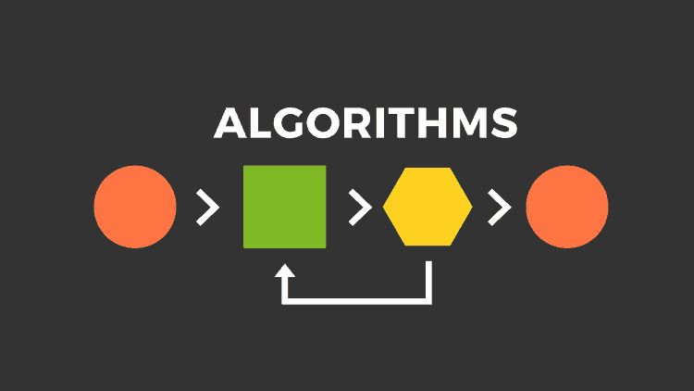
Crisis plan algorithm
Developing your crisis plans and becoming skilled at using them involves 8 steps: This is the first Simple algorithm.
1. Understand the concept of holes you keep falling into or the specific crisis for which you are going to use the crisis plans
2. Identify some of the thoughts, feelings or behaviors that occur during the crisis that you want to work on. This is step 1 on the crisis plan template.
3. Complete the rest of your crisis plan template
4. Recall, in your mind, a real crisis from the past in which you fell into the hole you are working on and use the "editing, splicing, and pasting" technique, along with your skills and tools, to imagine a different outcome that incorporates your crisis plan.
5. Stay in the window of tolerance while editing, splicing, and pasting by pendulating.
6. Repeatedly visualize the new edited, spliced, and pasted version of the situation until you can visualize it without effort.
7. When a new crisis occurs work with it following these same steps.
8. practice, practice, practice.

Slide 104
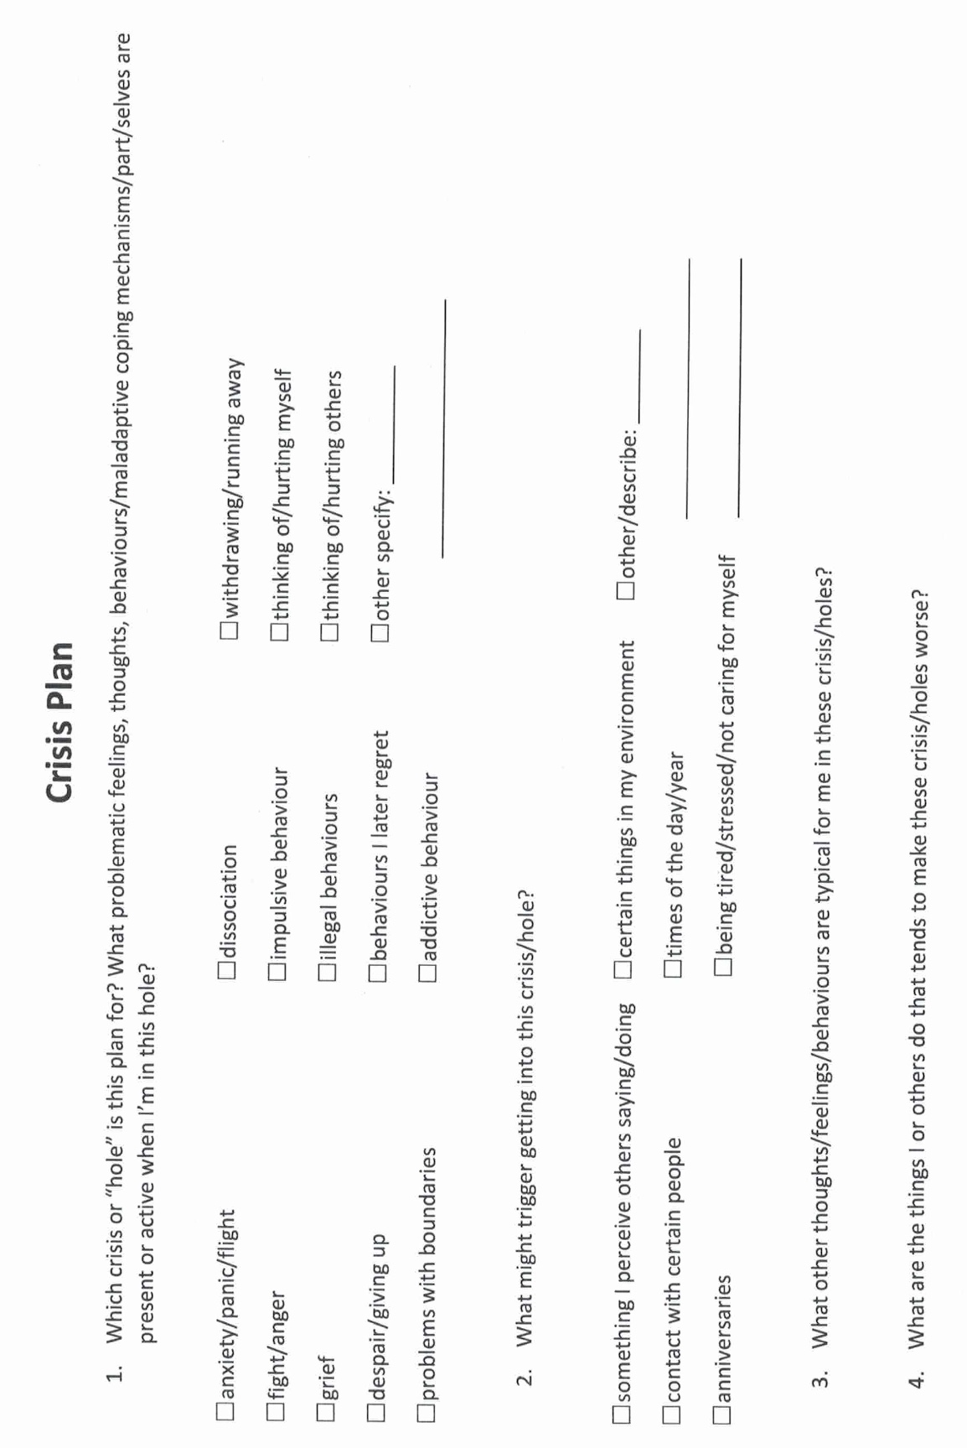
Notes:
A template is a structured form that helps you carry out the steps prescribed in the algorithm. There are many different crisis plans templates. This one is a compilation of some of the best features of other templates.

Slide 105
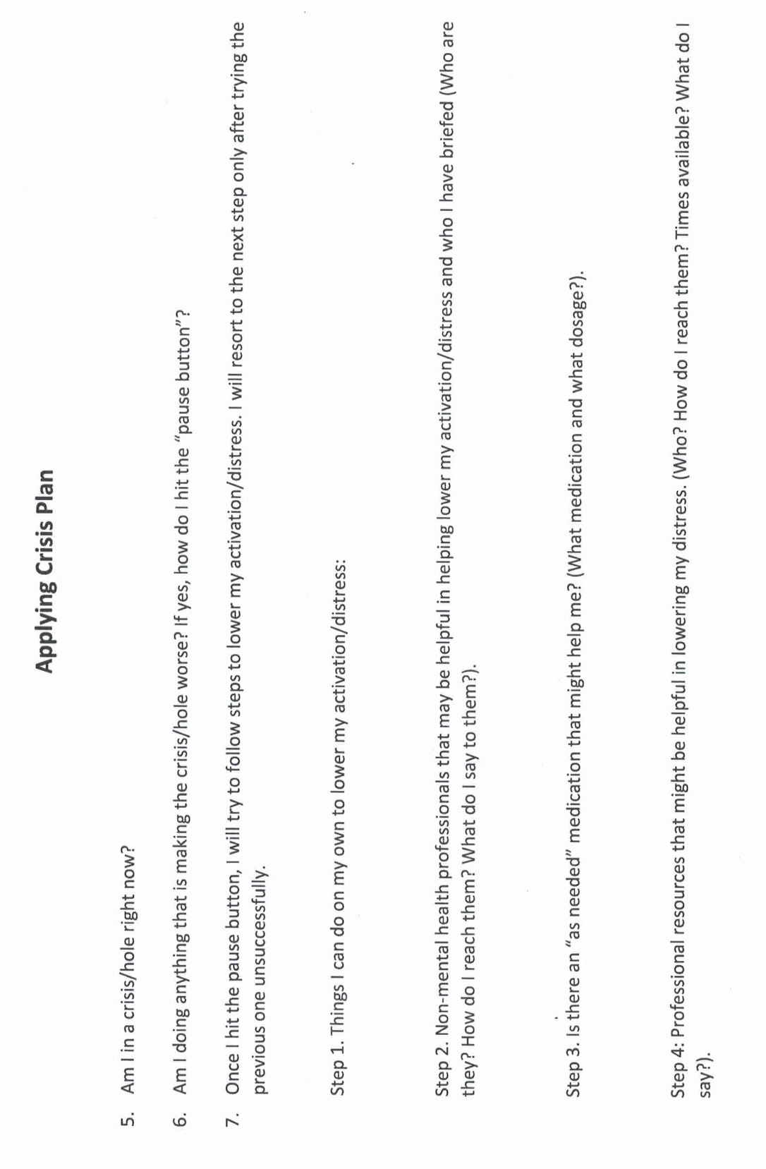

Slide 106
Practice USING THE SIMPLE TOOLS and strategies
Crisis plans
Holes diary card
Chain analysis
Rational mind remediation
Following good problem-solving practices
Editing splicing and pasting
Pendulating to stay in the window of tolerance
Being mindful of our personal dashboard
Notes:
In the second part of today's session, we will give you examples of how to use the tools. Please note that as with previous examples these are not actual real people but rather composite of different ones. I did however try to make the scenarios as realistic as possible. All these examples can be found in the simple manual session 17 pages 183 to 192.

Slide 107
dysregulation
Fawning/people pleasing
Notes:
When Sam first started doing diary cards, she used the beginner target "falling into a hole", a generic "catch all" target. Sam was hoping to find a more specific intermediate target and at one of the sessions asked for help doing that.
Sam looked at her diary cards for the previous two . There were several 0’s in a row, then a day which she rated a 7. That was followed by two days that were 4's, and two more that were 1's.
Sam explained that, after one of her afternoon classes, she had been invited by classmates to go for pizza. The small group had ended up at someone's apartment watching a movie. She knew Steve would want her to call to let him know she would be late but, determined to maintain her independence, she had defiantly decided not to do that.
When Sam got home at 11 PM Steve, fuming, was waiting up for her. They started falling into their usual hole, but recalling her crisis plan, Sam immediately left and spent a couple of days at her parents.
This description of events gave her some ideas for possible intermediate targets: "conflict with Steve" was an obvious one. She wondered if there were others. Sam said that she often felt "irritated" and "frustrated" with Steve. Sometimes, she also felt "guilty", "lonely", and "sad".
Replacing falling into a hole with "feeling irritated with Steve" made sense to Sam. Feeling irritated with her partners was a long-standing hole for Sam.

Slide 108
Practice USING THE SIMPLE TOOLS and strategies
Crisis plans
Holes diary card
Chain analysis
Rational mind remediation
Following good problem-solving practices
Editing splicing and pasting
Pendulating to stay in the window of tolerance
Being mindful of our personal dashboard
Notes:
In the second part of today's session, we will give you examples of how to use the tools. Please note that as with previous examples these are not actual real people but rather composite of different ones. I did however try to make the scenarios as realistic as possible. All these examples can be found in the simple manual session 17 pages 183 to 192.

Slide 109
chain analysis algorithm
Start with a high score in your hole's diary card
Step 1. Create a “topographic” profile of the intensity of your activation around the time period for which you are doing a chain analysis.
Step 2. On the template note if there were any events that may have contributed to or triggered your increase in activation ?
Step 3. Note the sequence of emotions you felt during this period. Rate each on a scale of 0-10 with 10 being the most intense you’ve ever felt this emotion
Step 4. Notice your sensations without judging or trying to change them
Step 5. Note the thoughts that go with each of your emotions
Step 6. Note what you did or wanted to do but stopped yourself during this time period
Step 7. Note on a 0-10 scale what your energy balance, reserves or stores (how full your gas tank was) prior to the time for which you’re doing the chain analysis.
Notes:
Sam was intrigued and wanted to explore why she became so irritated by her partners. She decided to do a chain analysis. Sam realized that when she was working on finding intermediate targets, she had already explored parts of the chain analysis.

Slide 110
CHAIN ANALYSIS TEMPLATE
Stay in window of tolerance by pendulating
1. what was the topography of your activation?
2. was there a trigger(s)?
3. what did you feel?
4. notice the sensations in your body without judging or trying to change them
5. what thoughts were associated with each feeling?
6. what behaviors or urges were associated with each feeling?
7. what was your energy balance before the activation? 0-10
Notes:
The "topography" of Sam's activation was clear from her diary card ratings. She had also explored the event that triggered her and the feelings she had experienced: irritation and frustration at first, but later guilt, loneliness, and sadness.
Having completed these columns of the chain analysis, Sam reflected on the thoughts that had accompanied her feelings: she liked her space and doing things on her own, or with her friends. She could only spend so much time with Steve, particularly now that they were living together. He seemed to want to spend more time with her then she did with him. She felt suffocated and did not want to lose her independence.
After the initial irritation, Sam started to feel guilty: Steve was a nice guy, he was always doing things for her, and cared a lot about her. His family was close, there were kind to each other, and liked spending time together.
Sam's family, on the other hand, had always been critical, cold, and distant. Maybe what she felt had something to do with her upbringing and her "internal working model”. Maybe she had trouble loving and getting close to people. Maybe she would always feel this way and would be lonely for the rest of her life.
When Sam got home, after the night out with her friends, and Steve was angry, she just wanted to leave the situation and avoid conflict. Her crisis plan provided her with a good excuse for doing that. Over the time she stayed at her parents, they had not even asked her why she had come home, just how long she planned to stay.
After a couple of emotionally cool days at home, Sam longed to return to Steve, who seemed genuinely interested in her and what she did. At the same time, she was afraid that their pattern would just keep repeating.

Slide 111
Advanced chain analysis
Time ------ --------------------------------------------→
Feelings
Thoughts
Behaviours
Feelings
Thoughts
behaviours
Feelings
Thoughts
behaviours
PHASE 1
PHASE 2
PHASE 3…
Notes:
Remember that a chain analysis is a snapshot of a moment of activation. An advanced chain analysis in contrast is a movie of a longer period of activation in which feelings, thoughts, and behaviours aren't static, they change over time.

Slide 112
Practice USING THE SIMPLE TOOLS and strategies
Crisis plans
Holes diary card
Chain analysis
Rational mind remediation
Following good problem-solving practices
Editing splicing and pasting
Pendulating to stay in the window of tolerance
Being mindful of our personal dashboard
Notes:
In the second part of today's session, we will give you examples of how to use the tools. Please note that as with previous examples these are not actual real people but rather composite of different ones. I did however try to make the scenarios as realistic as possible. All these examples can be found in the simple manual session 17 pages 183 to 192.

Slide 113
1. How to do Rational mind remediation by imagining you’re helping a friend
Start with your chain analysis
Imagine this was a friend's chain analysis and that friend had come to you for help and advice about how to use DBT skills to splice and paste a different outcome
How could your friend have seen or interpreted the situation differently?
Could your friend have thought or behaved differently and to have a better outcome?
Help your friend to imagine a scenario in which they had stayed better regulated
Help your friend to practice this situation in their minds using the editing splicing and pasting technique
Reclaim the situation as your own using the new scenario. Practice it repeatedly in your imagination.
Notes:
Sam worked on a rational mind remediation. She imagined that a friend of hers had just gone through a similar "coming home late" situation. She shared with Sam what happened and was desperate for advice.
Sam thought her friend had issues with getting close to her partners and needed to work on that. She thought her friend could use "feeling irritated by others" as a target in her diary card. Sam suggested that rather than acting on her irritation, her friend be mindful, and curious about it. She should spend some time with the sensations they came along with being irritated.
One of her friends automatic thoughts was that others were needy. An alternative thought was that she had trouble with intimacy. Around this issue, the friend should be gentle with herself, but perhaps set a goal of slowly being able to be more intimate with people. Sam realized that she could not be intimate because she did not trust anyone and to compensate, she had learned to be self-sufficient.
Sam wanted to offer her friend concrete suggestions that could be implemented and came up with 1) start using "feeling irritated with people" in her diary card. 2) apply the "edit, splice, and paste" technique to the incident: run the "mental videos" of the incident up to the point when she came home after being out with her friends. As she started to feel suffocated and irritated by her partners questioning, she could splice in an alternative thought: "I do feel irritated, but he has a point; I could have called to let him know I'll be coming home late. This may be an example of my tendency to push people away when they start getting close to me." 3) practice this new "video" every day for a few minutes. 4) picture, in her imagination, telling her boyfriend what she had learned about intimacy, and what she was trying to do. Eventually, when she felt ready, she could do this in real life.
Having written those suggestions for her friend, Sam then took ownership of them and made them her homework.

Slide 114
2. alternative rational mind remediation what would an emotionally well-regulated friend do ?
Start
Start with your chain analysis
Imagine
Imagine that what happened to you happened instead to a friend who is well regulated
Imagine
Imagine how they might have seen or interpreted the situation and thought and behaved differently
Imagine
Imagine what they might have done. Write this down
Reclaim
Reclaim the situation as your own and play it the way your friend did use the edit, splice, and paste technique
Practice
Practice that scenario in your imagination
Notes:
Allison imagined the same situation was happening to a friend who had well-regulated emotions. Marjorie, whom she had known since high school, was kind but assertive. What would Marjorie do in this situation?
Marjorie would not be intimidated. This was an unfair situation, and it was reasonable to address it rather than put up with it. Marjorie would not keep her feelings and thoughts to herself. She would, in a kind but assertive way, explained to her stepmother what she felt, thought, and wanted to see happen; the stepmother was entitled to spend her father's money, but not to throw it away foolishly.
If this conversation went nowhere, Marjorie would find out what her legal rights work, and if she did not have a legal recourse, try to maintain a cordial relationship with the stepmother and negotiate. If she exhausted her options, she would simply walk away. It would be sad, but she did not want to waste her life feeling resentment and anger. Marjorie, like Allison, was financially comfortable. Inheriting some of her father's largest state would be nice, but it would not be a life changer.
After imagining what Marjorie would do, Allison considered how she could apply it to herself and decided on an action plan: 1) she would use the "mental video" of the visit when she found the SUV in the driveway. She would then splice and edit out the part in which she kept her feelings and thoughts to herself while stewing on them. She had done that all her life.
Instead, she would paste in an assertive conversation, in which she explained to Ingrid how she felt, her thoughts, and what she planned to do. Imagining this conversation, activated Allison, and she knew she had to practice it for some time while, to stay in the window of tolerance, she pedulated.
2) in her imagination, Allison practiced this conversation, not expecting to have a real conversation with Ingrid anytime soon. She felt this took some of the pressure off.
3) Allison knew a family lawyer whom she trusted and decided she would call him to make an appointment to review her legal options.
4) she felt that if trying to work things out not produce results, she would not be held hostage by the potential inheritance and would distance herself from Ingrid.
Allison realize that her feelings, thoughts, and behaviours, in this present day situation, were similar to those she had as a little girl. Her adult self needed to step up and protect this frightened child.

Slide 115
Practice USING THE SIMPLE TOOLS and strategies
Crisis plans
Holes diary card
Chain analysis
Rational mind remediation
Following good problem-solving practices
Editing splicing and pasting
Pendulating to stay in the window of tolerance
Being mindful of our personal dashboard
Notes:
In the second part of today's session, we will give you examples of how to use the tools. Please note that as with previous examples these are not actual real people but rather composite of different ones. I did however try to make the scenarios as realistic as possible. All these examples can be found in the simple manual session 17 pages 183 to 192.

Slide 116
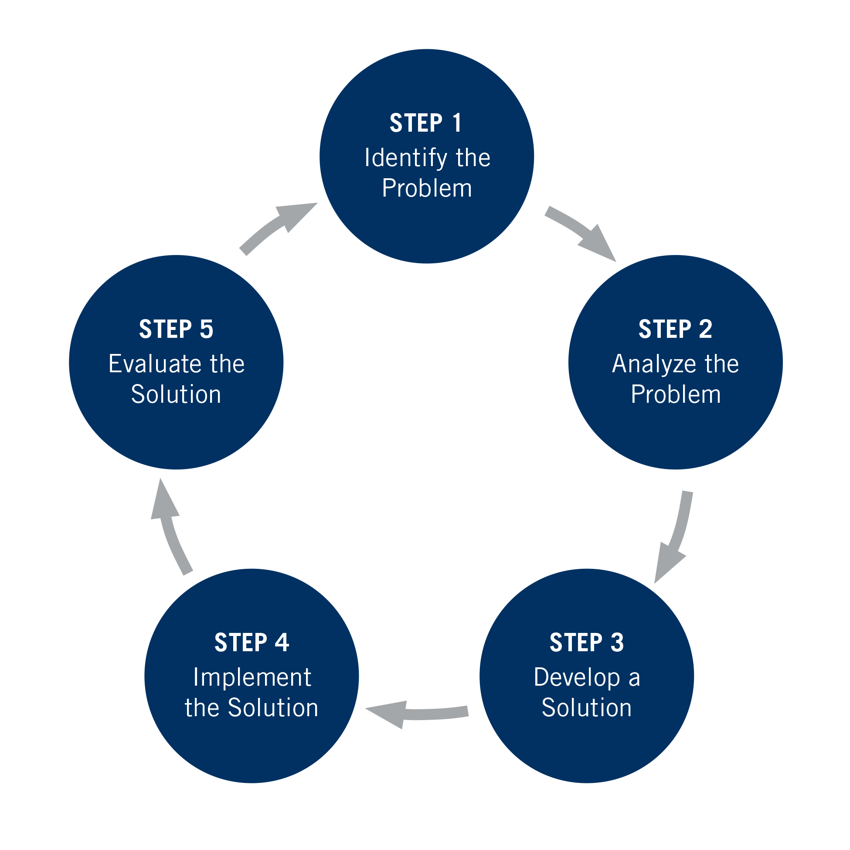

Slide 117
Practice USING THE SIMPLE TOOLS and strategies
Crisis plans
Holes diary card
Chain analysis
Rational mind remediation
Following good problem-solving practices
Editing splicing and pasting
Pendulating to stay in the window of tolerance
Being mindful of our personal dashboard
Notes:
In the second part of today's session, we will give you examples of how to use the tools. Please note that as with previous examples these are not actual real people but rather composite of different ones. I did however try to make the scenarios as realistic as possible. All these examples can be found in the simple manual session 17 pages 183 to 192.

Slide 118


Editing, splicing and pasting while pendulating to stay in window of tolerance
We all have memories or mental “videos” of times we’ve been dysregulated or fallen into holes.
When we are learning to get out of holes, these memories or videos are invaluable in helping us practice alternative ways of thinking, feeling, and behaving.
In Simple we’re going to learn to edit these old videos by splicing them and pasting in new more desirable and adaptive thoughts, feelings, and behaviors that get us out of our holes.
As we visualize these videos, we may get activated so we will need to know how to sooth ourselves by “pendulating”, then resuming our work on the videos.
+

Slide 119
Practice USING THE SIMPLE TOOLS and strategies
Crisis plans
Holes diary card
Chain analysis
Rational mind remediation
Following good problem-solving practices
Editing splicing and pasting
Pendulating to stay in the window of tolerance
Being mindful of our personal dashboard
Notes:
In the second part of today's session, we will give you examples of how to use the tools. Please note that as with previous examples these are not actual real people but rather composite of different ones. I did however try to make the scenarios as realistic as possible. All these examples can be found in the simple manual session 17 pages 183 to 192.

Slide 120
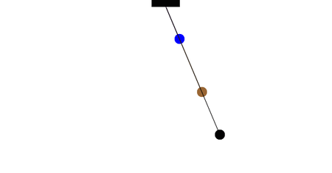
Stay in your window of tolerance by pendulating
Pendulating, which comes from the word pendulum, means swinging from one thing or place to another.
When people have feelings, they also have thoughts and images that accompany those feelings.
One way of soothing yourself, when you are experiencing intense negative feelings, and bringing yourself back to the window of tolerable emotions, involves distraction or self-soothing: you learn to identify that you are emotional and learn to have alternative thoughts, a soothing inner dialogue, and/or calming and soothing images. When you are better regulated you can then revisit the original thoughts you were having
To get good at pendulating you have to plan and practice it .
Distressing thoughts/feelings
Distracting/soothing
Images/thoughts/sensations

Slide 121
Practice USING THE SIMPLE TOOLS and strategies
Crisis plans
Holes diary card
Chain analysis
Rational mind remediation
Following good problem-solving practices
Editing splicing and pasting
Pendulating to stay in the window of tolerance
Being mindful of our personal dashboard
Notes:
In the second part of today's session, we will give you examples of how to use the tools. Please note that as with previous examples these are not actual real people but rather composite of different ones. I did however try to make the scenarios as realistic as possible. All these examples can be found in the simple manual session 17 pages 183 to 192.

Slide 122
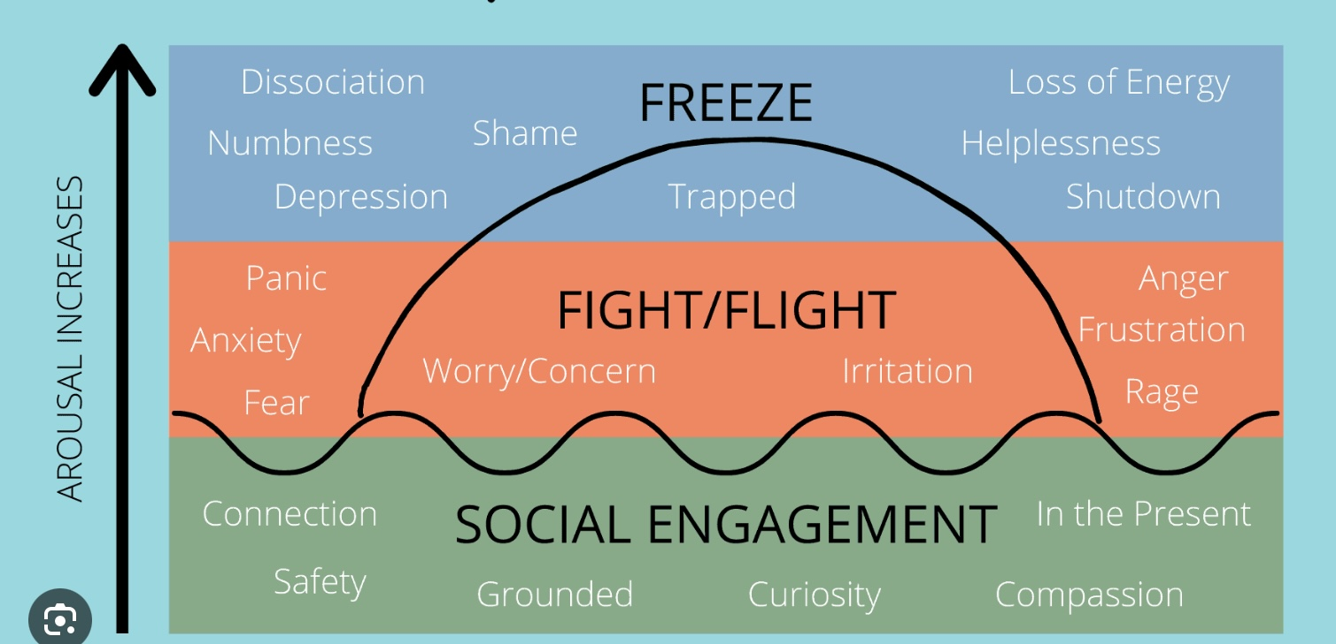
Check in regularly with your Personal dashboard
Spend a few moments checking in with yourself by asking:
1)What is the current risk that I’ll experience a state of crisis ?
Low b) Moderate c) high d) very high e) extreme
2) Am I in the window of tolerance?
a) Yes b) I’m a little outside c) very outside
3) What state of activation am I mostly in at the moment?
a) Calm b) Fight c) Flight d) Dissociated e) Depressed?
4) Where is my energy tank right now?
a) Full b) ¾ c) ½ d) near empty
CRISIS RISK
WINDOW OF TOLERANCE
STATE OF ACTIVATION
ENERGY RESERVES

Slide 123
ZOOM POLL
Please answer the following question
Answers are anonymous
In person participants please answer the page that was handed out.

Slide 124

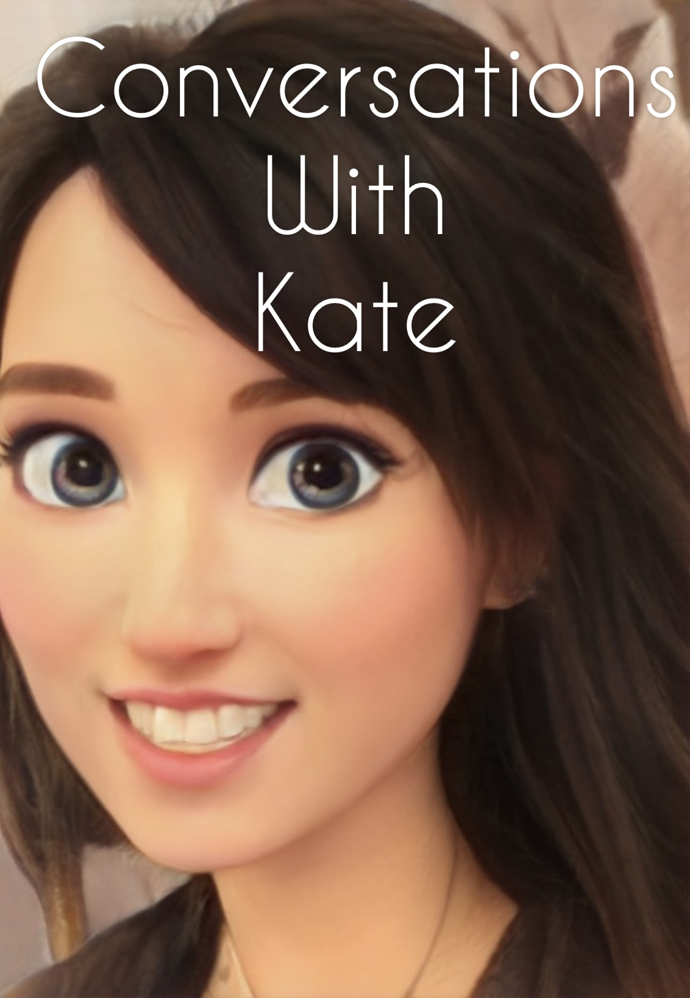

Slide 125

OPEN DISCUSSION

Slide 126

See you next session

Slide 127

video
Week 14 of simple

Slide 128


Slide 129
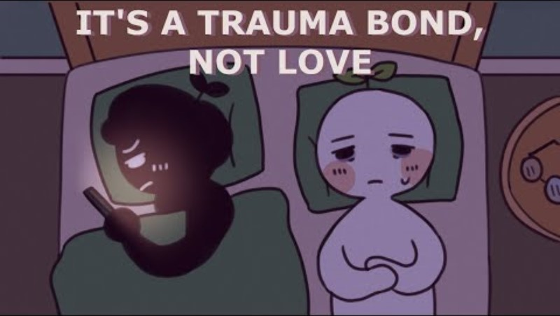

Slide 130
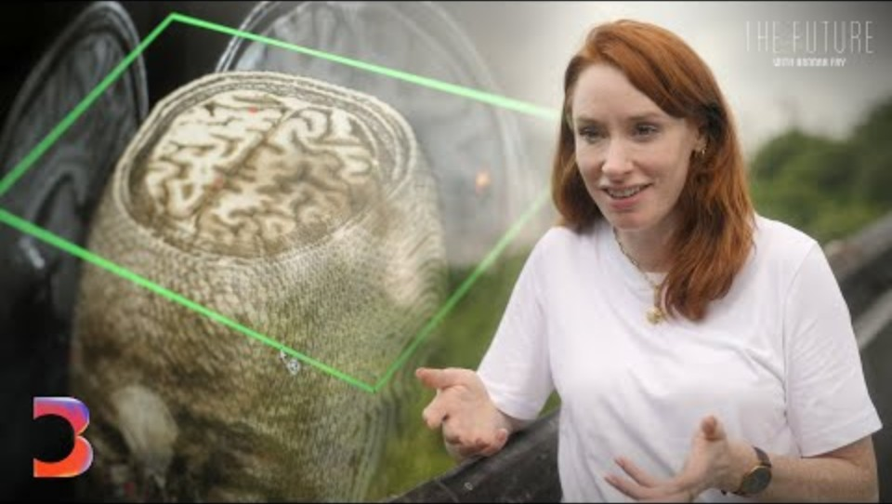

Slide 131


Slide 132
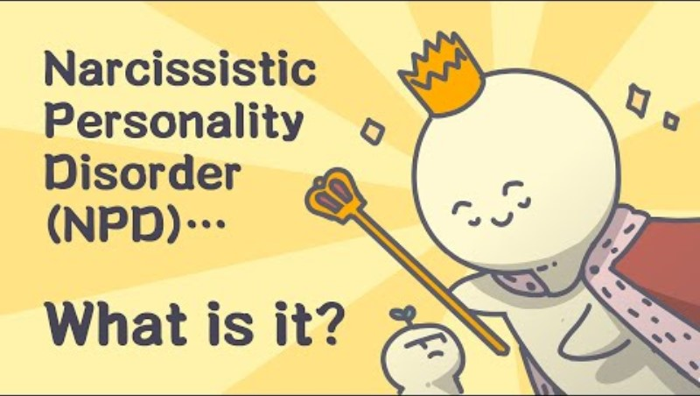

Slide 133
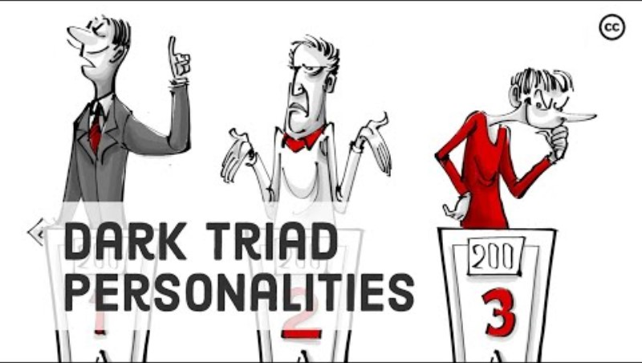

Slide 134


Slide 135


Slide 136
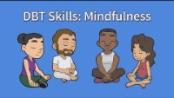

Slide 137


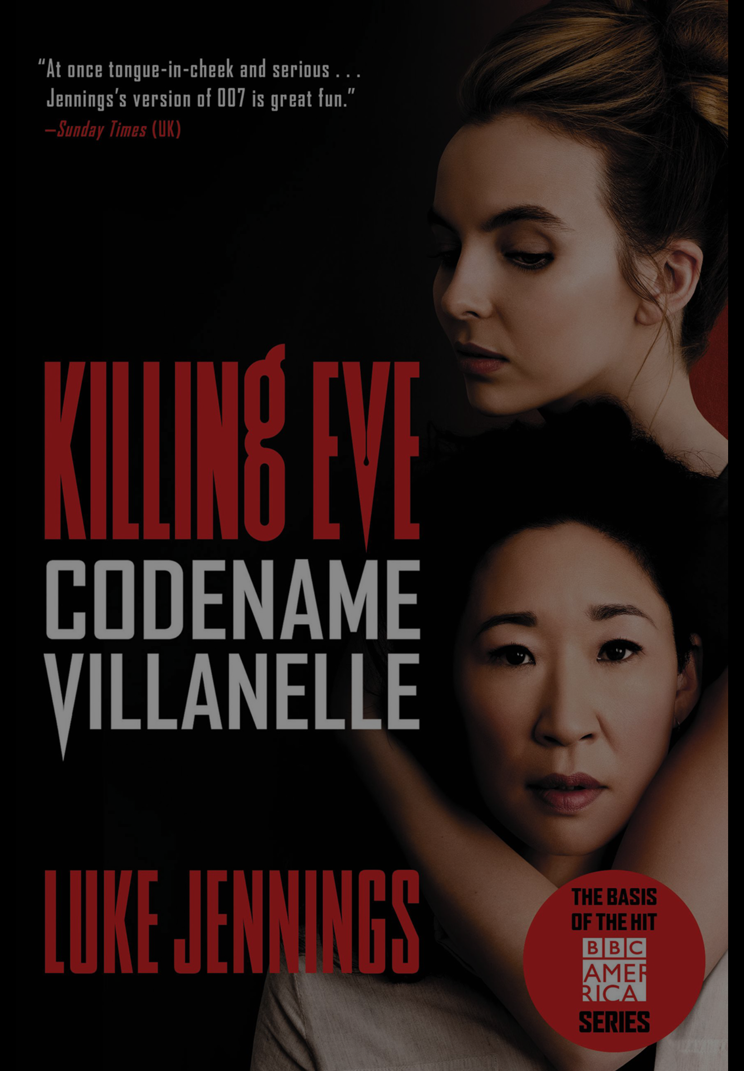
The movie the talented Mr. Ripley was based on a series of novels by Patricia Highsmith. There are innumerable movies and books about psychopaths.
Some terms:
Psychopathy- Is a neuropsychiatric disorder marked by 1) deficient emotional responses, 2) lack of empathy, and 3) poor behavioral controls, commonly resulting in 4) persistent antisocial deviance and criminal behavior. The term psychopathy is used interchangeably with…
Antisocial personality disorder, sometimes called sociopathy, which is a mental health condition characterized by 1) a limited capacity for empathy and a 2) long-term pattern of disregard or violation of the rights of others. Other notable symptoms include 3) impulsivity and reckless behavior, 4) a lack of remorse after hurting others, 5) deceitfulness,6) irresponsibility, and 7) aggressive behavior.
Empathy has been divided into “affective empathy” which is the ability to feel other people's feelings and “cognitive empathy” which is the ability to think other people's thoughts.
Different psychiatric diagnosis are associated with deficient emotional empathy these include narcissistic and borderline personality disorders, antisocial personality disorder, and autism spectrum disorders.
From a dynamic perspective attachment issues also reduce the ability to empathize. Being accurately seen at the somatic, emotional, and rational levels fosters self empathy which then allows a person to empathize with others. When the free flow of information between the three different centers is impaired empathy is impaired. Most people with impairments in empathy do not however have other features of psychopathy.
Link the psychopath test

