Slide 1


Slide 2
SIMPLE COURSE SCHEDULE 2025-26
Week 1- October 1
Week 2- October 8
Week 3- October 15
Week 4- October 22
Week 5- October 29
Week 6- November 5
Week 7- November 12
Week 8- November 19
Week 9- November 26
Week 10- December 3
Week 11- December 10
Week 12- December 17
December 24 and 31
Week 13- January 7
Week 14- January 14
Week 15- January 21
Week 16- January 28
Week 17- February 4
Week 18- February 11
Week 19- February 18
Week 20- February 25
Week 21- March 4
March 11 and 18 no course
Week 22- March 25
Week 23- April 1
Week 24- April 8
Week 25- April 15
Week 26- April 22
Week 27- April 29
Week 28- May 6
Week 29- May 13
Week 30- May 20
Week 31- May 27
Week 32- June 3

Slide 3
week 1- orientation and overview- sessions 1 and 2 of simple manual. week 2- introducing distress tolerance-p. 1-13 of dbt workbook and crisis plans-session 3 of the manual. week 3- the theoretical foundations of the simple course. session 4, 6, and 8 of the manual. week 4- distress tolerance p. 14-32 of dbt workbook. suicide prevention session 5 of the manual. our first practice- crisis plans. week 5- distress tolerance p. 33-46 of dbt workbook. introducing holes diary cards- session 7 of manual. week 6- distress tolerance p. 47-68 of dbt workbook. finding your diary card targets- session 9 of manual. our second practice- holes diary cards. week 7- introducing personality- session 10 of manual. week 8- distress tolerance p. 69-90 of dbt workbook. introducing chain analysis-session 11 of manual. week 9- what shapes personality-session 12 of manual. week 10-introducing mindfulness skills p.90-109 of dbt workbook. advanced chain analysis- session 13 of manual. our third practice-chain analysis. week 11- attachment theory- session 14 of manual. week 12- mindfulness skills p. 110-131 of dbt workbook. introducing rational mind remediation-session 15 of manual. week 13- the dynamic-maturational model of attachment and adaptation- session 16 of manual. week 14-mindfulness skills p. 131-147 of dbt workbook. reviewing all the tools-session 17 of manual. our fourth practice-rational mind remediation. week 15-stress-session 18 of manual. week 16-introducing emotion regulation skills p.148-182 of dbt workbook. introducing the goals diary card procedure-session 19 of manual.

Slide 4


Warning about meditation
Feel free to skip it. Followed by a moment of silence

Slide 5
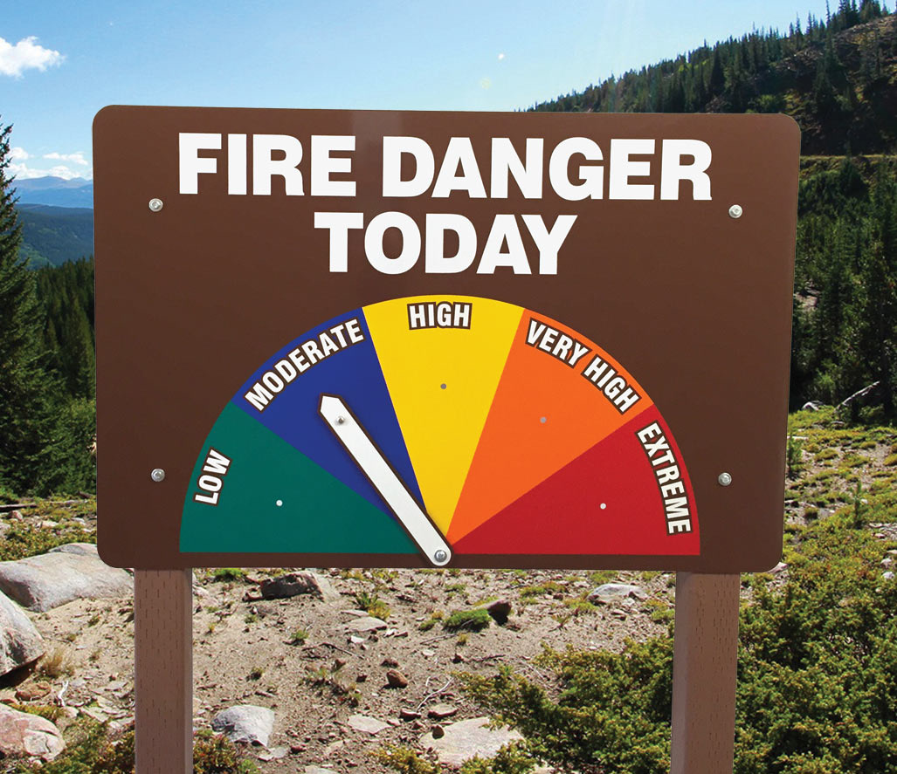

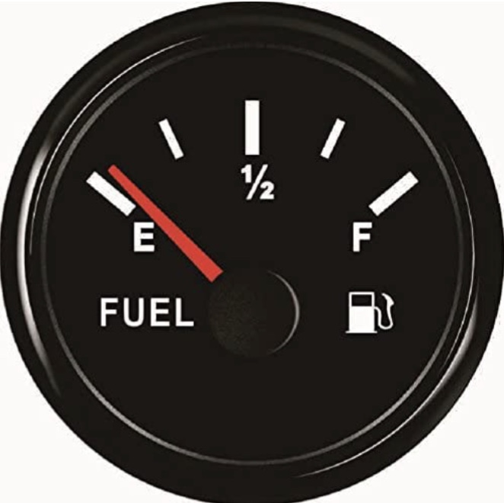
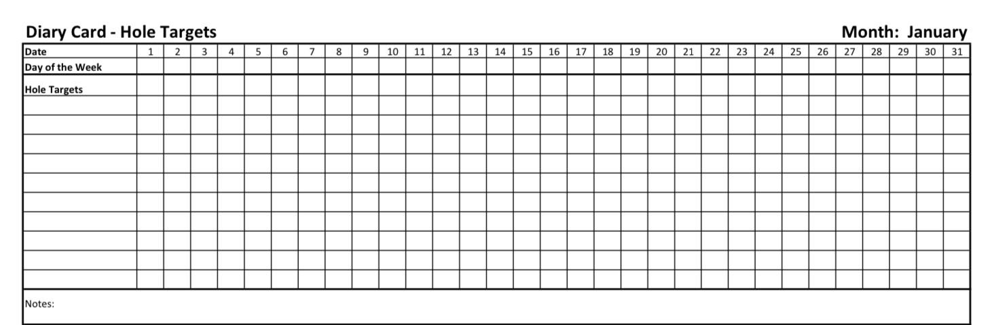
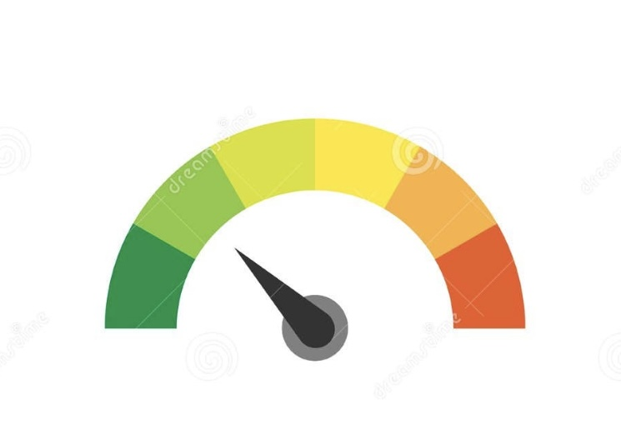
Check in regularly with your Personal dashboard
Spend a few moments checking in with yourself by asking:
1)What is the current risk that I’ll experience a state of crisis ?
Low b) Moderate c) high d) very high e) extreme
2) Am I in the window of tolerance?
a) Yes b) I’m a little outside c) very outside
3) Where is my energy tank right now?
Full b) ¾ c) ½ d) near empty
4) Have I been tracking my targets using the holes diary card ? how would I rate my targets right now?
5) How well am I focusing on what I’m doing. (for example, the course)
CRISIS RISK
WINDOW OF TOLERANCE
ENERGY RESERVES
RATING MY TARGETS
ATTENTION METER
% attention I’m paying
100
0

Slide 6
5-MINUTE MINDFULNESS PRACTICE: SETTLING A STRESSED NERVOUS SYSTEM
Let’s take a few minutes to pause together.
You don’t need to change anything or do this perfectly. Just allow yourself to arrive.
Minute 1: Arriving
Begin by noticing the surface supporting you — the chair beneath you, your feet on the floor.
If it feels okay, let your eyes gently close, or soften your gaze.
Take one slow breath in through the nose… and a longer breath out through the mouth.
Again — in… and out.
We’re not trying to relax yet. We’re just letting the nervous system know: nothing else is required of you right now.
Minute 2: Noticing Stress in the Body
Bring your attention into your body.
Notice where stress is most present today.

Slide 7
5-MINUTE MINDFULNESS PRACTICE: SETTLING A STRESSED NERVOUS SYSTEM
You might feel it as tightness, pressure, heat, heaviness, buzzing, or numbness.
There’s no need to analyze it. Just notice.
If your mind drifts, that’s normal. Gently bring your attention back to the body.
Minute 3: Allowing Without Fixing
Now, instead of trying to get rid of the stress, see if you can simply make a little room for it.
You might silently say: ‘This is what my nervous system is doing right now.’
Stress is not a failure. It’s a signal.
Notice that you can be aware of stress without being consumed by it.
There is stress — and there is also awareness.
Minute 4: Gentle Regulation
Bring your attention to your breath again.
“

Slide 8
Without forcing it, allow your exhale to be slightly longer than your inhale.
Longer exhales help the body begin to stand down.
As you breathe out, imagine the body letting go just a little — not all at once — just a few percent.
If it helps, you might place a hand on your chest or abdomen.
Minute 5: Integrating Wise Awareness
Now notice something important: you are not just stressed.
You are the one noticing the stress.
This observing presence — calm, steady, curious — is always here, even when the nervous system is activated.
You don’t need to get rid of stress to be okay.
You just need enough space to relate to it differently.
When you’re ready, gently bring your attention back to the room. Wiggle your fingers and toes and open your eyes. Stress doesn’t mean something is wrong with you. It means your system has been trying to cope. Awareness is the first step toward giving it another option.

Slide 9


Slide 10
PRACTICE SESSIONS SCHEDULE
preparation
practice
5. Week 18 February 11 February 4, 1:30 goals diary card Nicole L
6. Week 25 April 15 April 8, 1:30 IFS workbook 1 Elaine S.
7. Week 26 April 22 April 15 IFS workbook 2 Dinko T.
8.Week 27 April 29 April 22 IFS workbook 3 Barb H.
9. Week 28 May 6 April 29 IFS workbook 4 Meaghan
10.Week 29 May 13* May 6 1:30 PM* Wise mind remediation Rob T.
We now have a full slate of volunteers but if anyone would like on a “substitute list” in case someone can’t make it, as happened last week, please let us know.
* Note that this date have been changed

Slide 11
Homework from last week
Submit
Submit questions or comments to itssimple2023@gmail.com
Read
Simple manual session 18
Do
Do at least 2 rational mind remediations In the next week
Continue
Continue reviewing and practicing crisis plans, diary cards and chain analysis.
Continue
Continue tracking and practicing all the skills you’ve learned

Slide 12

Homework from last week
Submit questions, comments, or feedback to itssimple2023@gmail.com
Read Simple manual session 19
Do at least 2 rational mind remediations In the next week
Continue reviewing and practicing your crisis plans, diary cards, and chain analysis.
Continue tracking all the skills you’ve learned using your skills list.
Review the homework habits checklist each week. If there’s an item that you haven’t checked on the list, consider setting a goal to do it.

Slide 13
HOMEWORK HABITS CHECKLIST
Circle or check what you will try this week.
1. Preparation habits
■ I schedule a specific time for homework.
■ I choose a consistent location with minimal distractions.
■ I gather what I need ahead of time (notebook, worksheet, pen).
2. Focus & pacing habits
■ I start with a tiny step (2–5 minutes).
■ I use a timer (10–15 minutes).
■ I remove distractions (phone away / Do Not Disturb).

Slide 14
HOMEWORK HABITS CHECKLIST
3. Tracking & organization habits
■ I keep materials in one place (binder / folder / notebook).
■ I write down insights right after doing the homework.
4. Self-compassion habits
■ I aim for progress, not perfection.
■ I notice resistance without judgment.
5. Accountability habits
■ I review my week: What worked? What didn’t?
■ I share honestly with my buddy — even when I didn’t do it.
Micro commitment:
This week I will focus on: ■ Time ■ Place ■ Tiny step ■ Timer ■ Other please specify:

Slide 15

Reminder: the homework group has been cancelled but boing continues Mondays 1-2:30.
It’s an opportunity to better get to know other group members and to explore informally and in greater depth the material we cover on Wednesdays.
WEEKLY ANNOUNCEMENTS

Slide 16
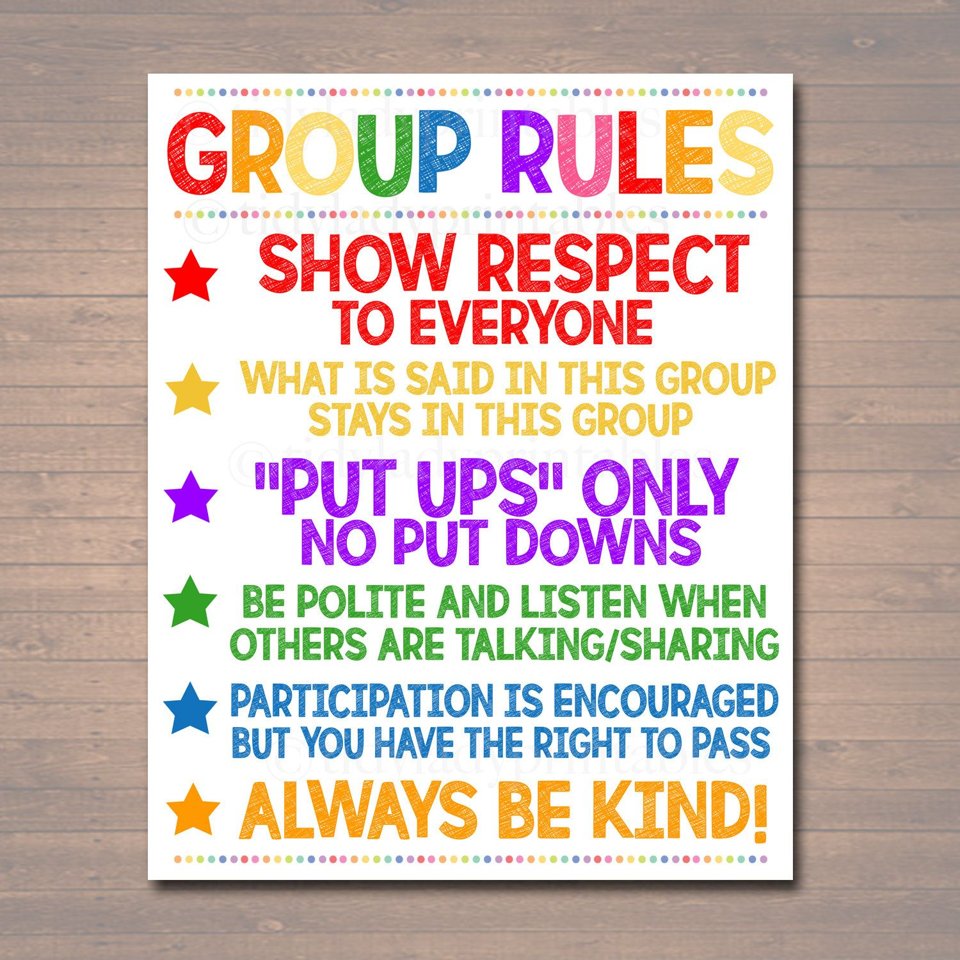
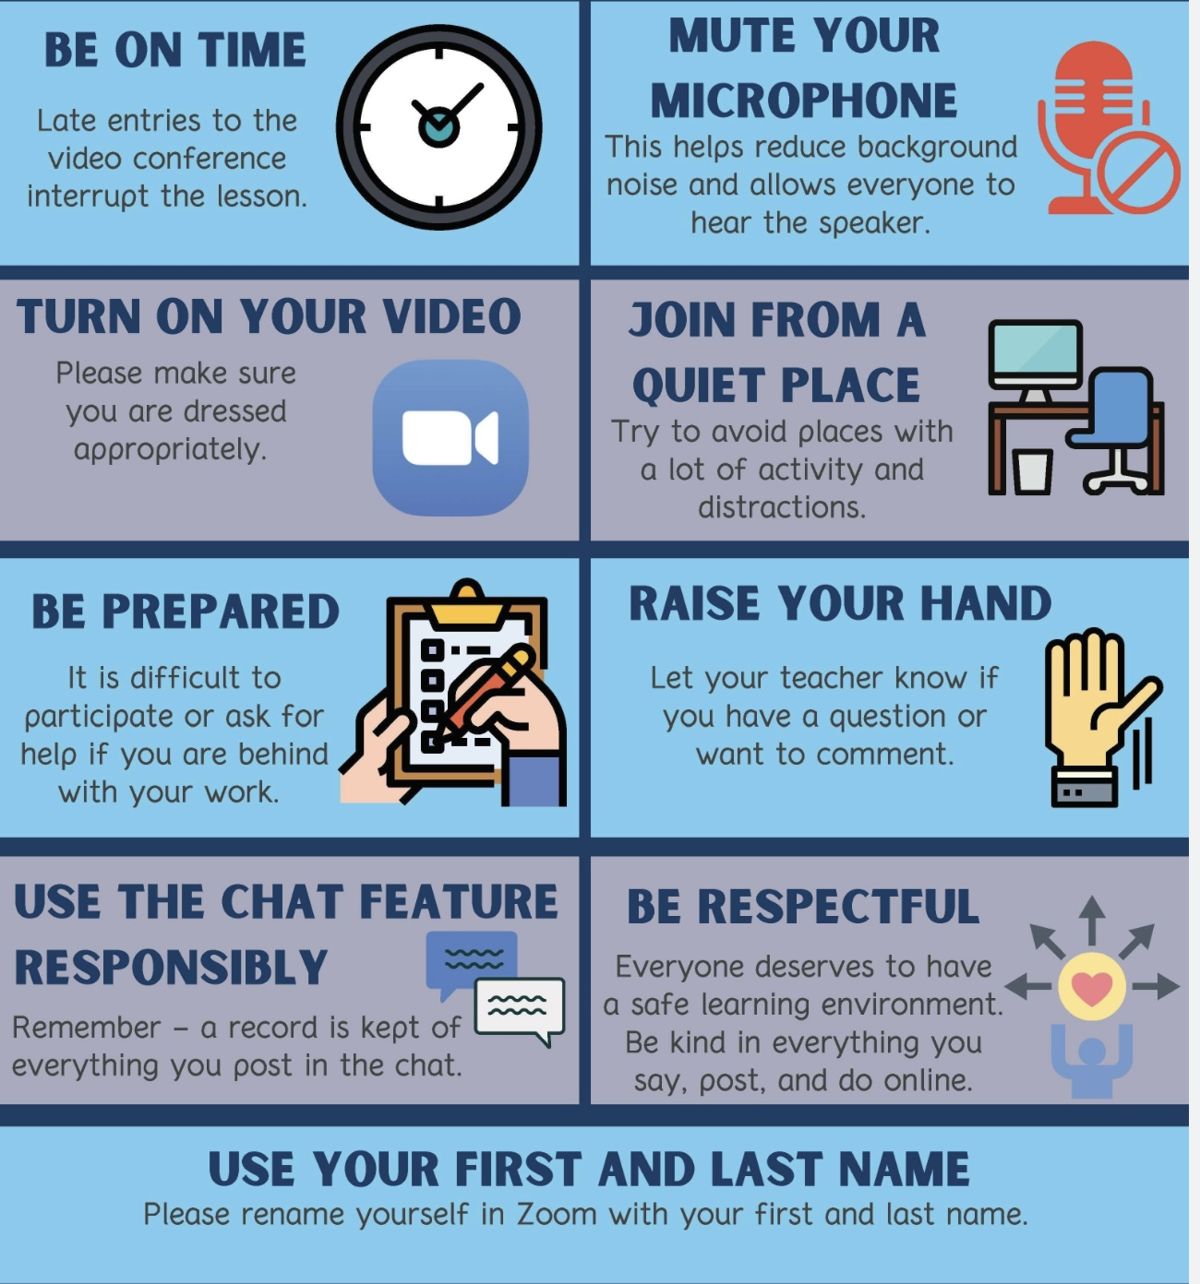
REMINDER PARTICIPANT AGREEMENTS
If you have questions, comments, or feedback, please save them for the two question periods. You can put them in the chat box or raise your real/virtual hand.
Keep comments, questions, and feedback relatively brief so everyone has a chance to participate.(one breath sharing)
If you’re on zoom, make sure no one can overhear what is being said
For reasons that will become clear later in the course please avoid giving advice to other participants about what they should or should not do. Validation, encouragement , and understanding are however very much appreciated.

Slide 17
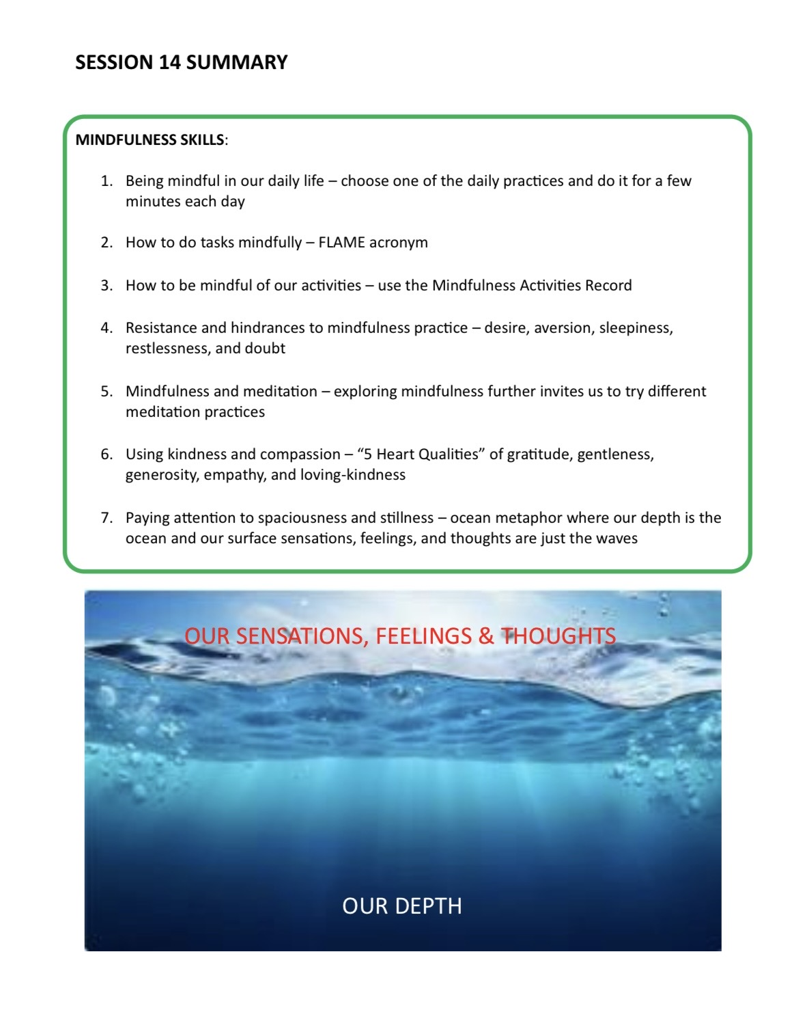

Slide 18
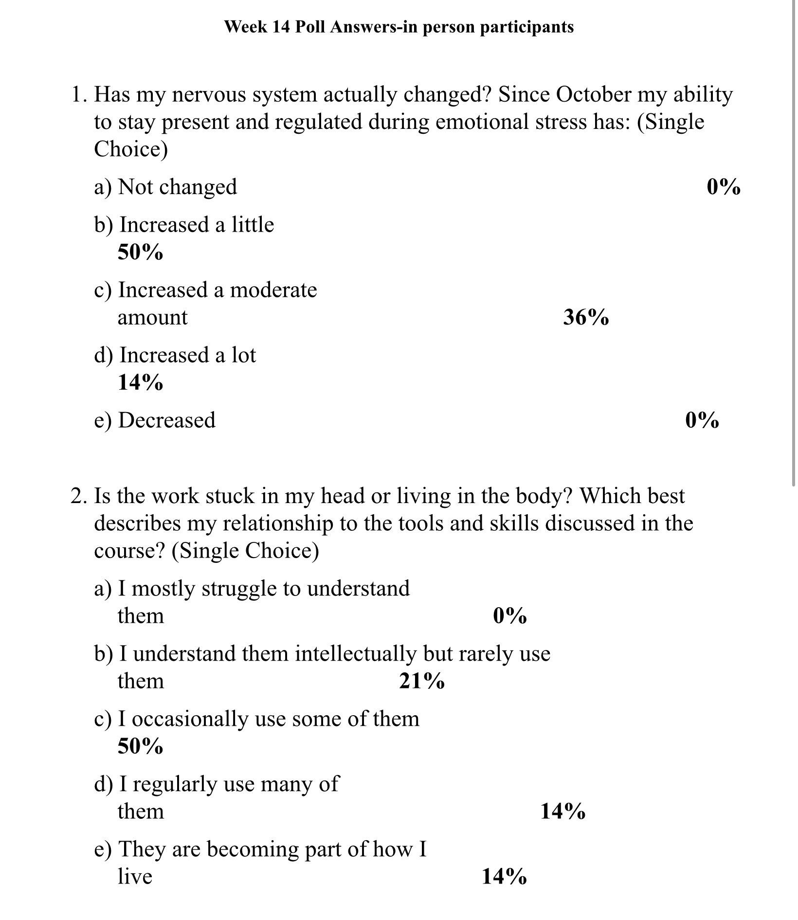
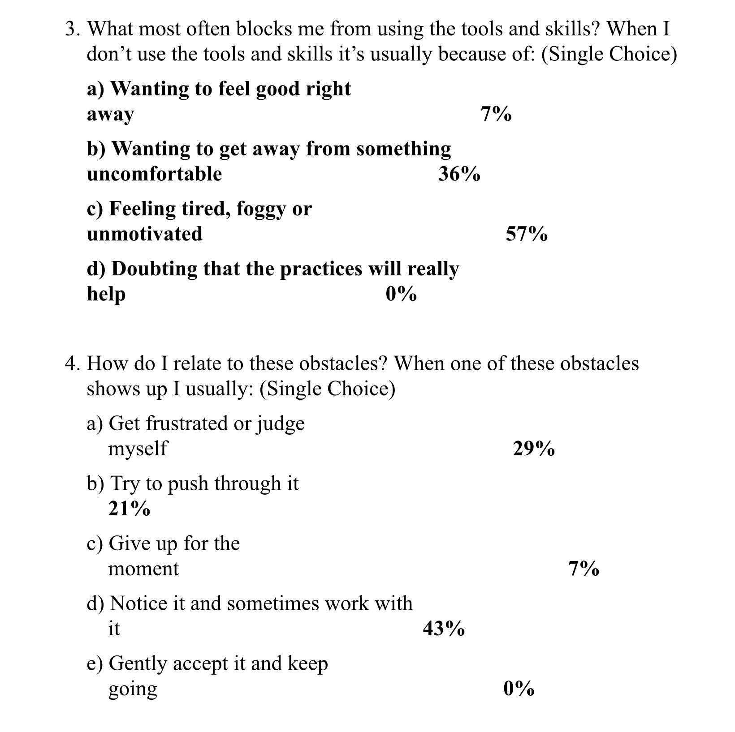
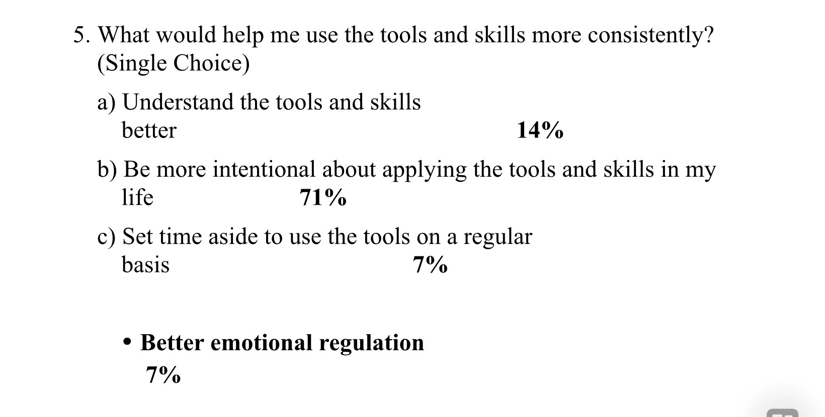

Slide 19

E-mailed questions, comments, feedback

Slide 20
As always, we’ve had some very good questions this week. We try to address most questions that are asked. These question may interest one person or many people.
Until we find a better way, we’ll post answers that we think may be of interest to most people but unfortunately because of time we cannot read all of them in the sessions. We will therefor arbitrarily read out only a few of the many excellent questions you’ve asked.
We’ll however read out all the questions and invite everyone to go to the website’s PowerPoint presentations and go over the answers with more time.

Slide 21
Question whose answer we will read out today

Slide 22
What can I do if when I try to use the DBT tools and skills I often end up dissociating?
Using the DBT tools and skills can inadvertently push people with trauma spectrum disorders outside their window of tolerance and trigger dissociation.
Dissociation is a protective response (dissociation can be seen as an IFS protector). Using DBT skills can feel like we’re shutting down other ways we use to protect ourselves from pain such as distraction by staying busy or focusing on a task or on other people. Using skills comes from Wise/rational mind but may feel to some IFS protectors like we’re submitting or losing control.
If focusing inward, for example on mindful imagery or body sensations causes dissociation, then we start by focusing on the outside world, with movement, and orientation. We practice grounding before mindfulness, activation before calming and connection before observation.
DBT skills can be trauma-safe if instead of observing internal states, practicing breathing techniques and body scans we keep our eyes open, and ground and orient ourselves by for example naming 5 things we can see around us, describe their colors, and shapes and keep our eyes moving slowly around the room
If our eyes close or we go inward and start to drift, that’s a cue to open our eyes and orient outward.
Movement-based skills may be helpful in preventing dissociation: standing instead of sitting, pressing feet firmly into the floor, pushing hands against thighs or chair or gently rocking or shifting weight.
Gently using TIPP skills can also be trauma safe: applying cold water to wrists or face.

Slide 23
Using the self-soothing tool kit or distracting with the 5 senses: holding a textured object, tasting mint, or a sour candy.
It’s helpful to start by deliberately practicing skills very briefly, 10 to 20 seconds, and then checking “Am I more or less present?” If dissociation increases, then stop we immediately and re-orient.
We can try to track early warning signs of dissociation by noticing fuzzy vision, heaviness, feeling far away, losing words or feeling suddenly calm/numb. The moment we notice these signs, the goal is not to push through the skill, but to come back to the room. We might also consider using “dissociation” as an intermediate holes diary card target. (or choose a dissociated part as an advanced holes diary card target.
Don’t feel you have to push through or use the skills no matter what. Sometimes the most skillful thing is not using a DBT skill at all, but instead doing something grounding, relational, or activating: walking, talking to someone, listening to music, being in nature or doing a light task.
If using skills makes us dissociate, that doesn’t mean DBT isn’t for us. It means our nervous system needs a different entry point. It is equating “calm” with danger and needs slower pacing, grounding skills and integration with trauma-informed approaches such as IFS.

Slide 24
We will only read out the following question, not the answer, and invite those interested to go to the website after the session

Slide 25
Some people seem to have hard lives yet the are happy, others have everything and they are miserable. How do you explain that?
According to psychologist Sonja Lyubomirsky’s who researches human happiness there is a 50-10-40 breakdown meaning:
~50% of the differences in people’s long-term happiness (subjective well-being) are attributed to a genetic set point, stable temperament and inherited tendencies toward positive or negative affect. This means half of baseline happiness levels are rooted in biology and personality traits.
~10% is influenced by life circumstances, things like income, health status, marital status, nationality, and other demographic conditions. These factors have surprisingly limited explanatory power for happiness in most research.
~40% lies in the domain of intentional activities, voluntary thoughts, behaviors, goals, and practices people choose to cultivate (e.g., gratitude, relationships, kindness, mindfulness, engagement in meaningful goals). These activities are the part most under our control and the focus of interventions that can raise well-being.
Lyubomirsky emphasizes that while genetics and circumstances set a baseline and context, deliberate, sustained activities and cognitive habits can meaningfully increase happiness over time. The 40% portion represents the “40 percent solution”, the idea that nearly half of what determines our happiness comes from what we do intentionally and thus is changeable through effort and practice.

Slide 26
HOW TO MAXIMIZE THE 40% UNDER OUR CONTROL
The intentional activities that Lyubomirsky identifies as most reliably contributing to the “40% under our control” in her research are:
1. Gratitude Regularly noticing and savoring what is good in one’s life (e.g., gratitude journaling, appreciation letters). → Shifts attention away from threat and scarcity.
2. Kindness & Contribution Performing intentional acts of kindness and generosity. → Strengthens social bonds and sense of meaning.
3. Relationships Investing time and care in close, supportive relationships. → One of the strongest predictors of well-being across cultures.
4. Meaningful Goals Pursuing intrinsically meaningful, values-aligned goals rather than external rewards. → Increases engagement and purpose.
5. Mindset & Cognitive Framing Cultivating optimism, reframing setbacks, and reducing rumination. → Directly alters emotional tone without changing circumstances.
6. Savoring & Mindful Presence Fully inhabiting positive experiences as they occur. → Counteracts hedonic adaptation.
7. Physical Activity & Self-Care Exercise, sleep, and basic bodily care. → Improves mood regulation and resilience.
8. Commitment & Fit Practices work best when they fit the person and are done consistently but flexibly. → Happiness gains fade if activities become rote or externally imposed.

Slide 27
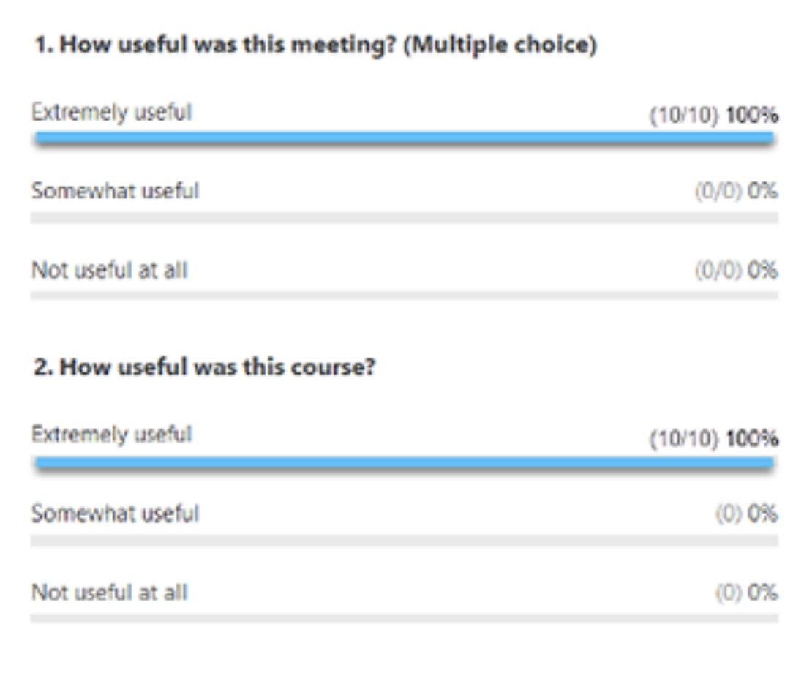
PLEASE NOTE
NEXT WEEK’S POLL
Next week’s session looks at the importance of meaning in our lives.
We will, as our poll, do the “Meaning in life questionnaire”
As we did last week, we ask you to do the questionnaire at home and score it.
If you would like you can anonymously share your score with next week as our poll.
We will be emailing the following slides out to everyone.

Slide 28
NEXT WEEK’S POLL
The meaning of life questionnaire
The meaning in life questionnaire isn’t a test and there’s no ‘right’ score. It is a scale we’re hoping will encourage you to think about meaning in your life. Some people feel a strong sense of meaning but aren’t actively searching. Others are searching deeply but don’t yet feel they’ve found it. Both positions are deeply human, and both tell us something important about where we are right now.

Slide 29
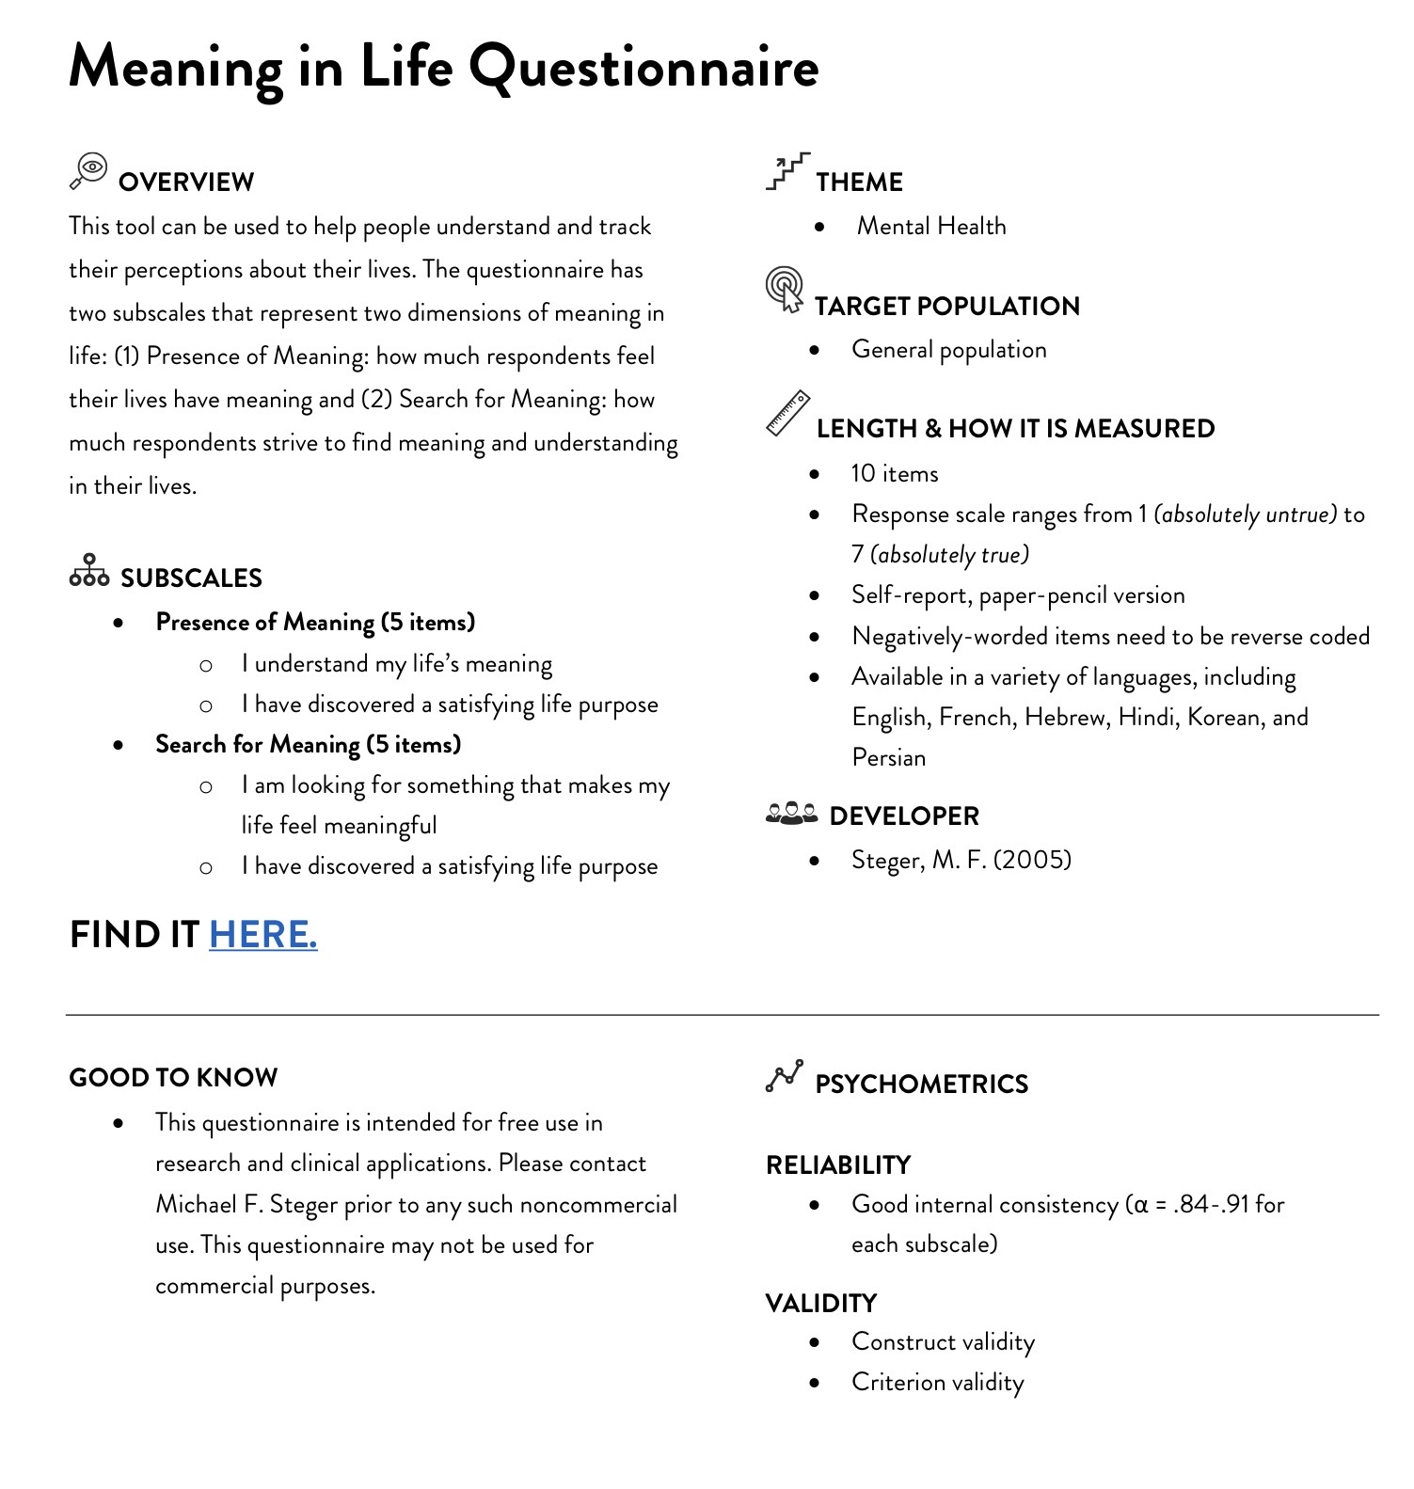
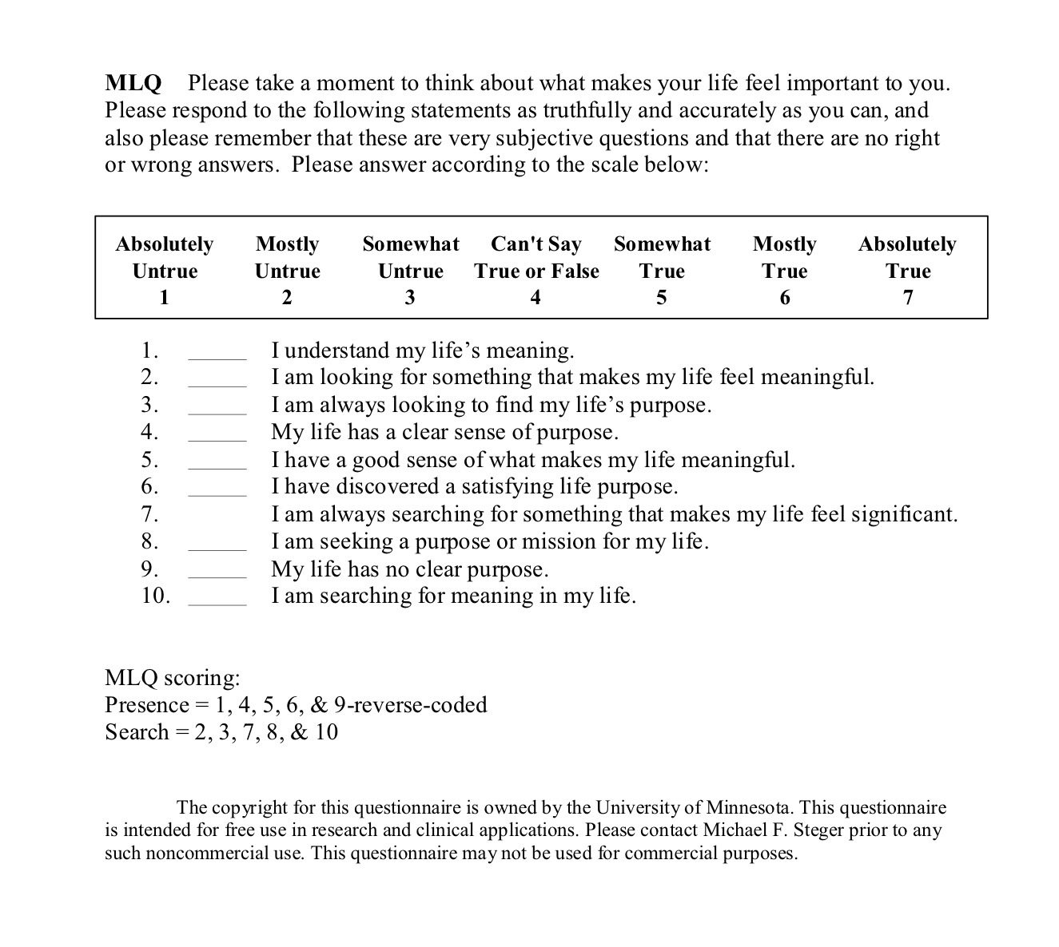

Slide 30
MLQ-P SCORE INTERPRETATION
The MLQ-P consists of two subscales:
1) Presence of Meaning (MLQ-P): Higher scores mean you feel your life is full of meaning and purpose.
2) Search for Meaning (MLQ-S): Higher scores mean you are actively looking for meaning or purpose.
Combined Patterns: High P / Low S (e.g., >24 P, <24 S): You feel your life has valued meaning and purpose, leading to high life satisfaction, optimism, and positive emotions.
Low P / High S (e.g., <24 P, >24 S): You feel your life lacks meaning and are actively searching, which can cause distress and dissatisfaction, often a target in therapy.
High P / High S: You have a sense of meaning but are still exploring or deepening it, common in transitional periods like adolescence.
How Scores are Calculated Scale: Items are rated 1 (Absolutely Untrue) to 7 (Absolutely True).
Reverse Coding: Item 9 ("My life has no clear purpose") is reversed (e.g., a '1' becomes a '7’).
Subscale Scores: Sum the items for each subscale (5 items per subscale, max 35 each).

Slide 31
WHY THE MLQ-P MATTERS
The MLQ helps individuals and therapists understand
1) their current sense of purpose and
2) Whether they are satisfied with their meaning or actively searching.
Higher meaning is linked to better mental health.

Slide 32

What we will do today
Today we will talk about stress
In 2 weeks, we’ll discuss traumatic stress
in 4 weeks, we’ll explore dissociation

Slide 33

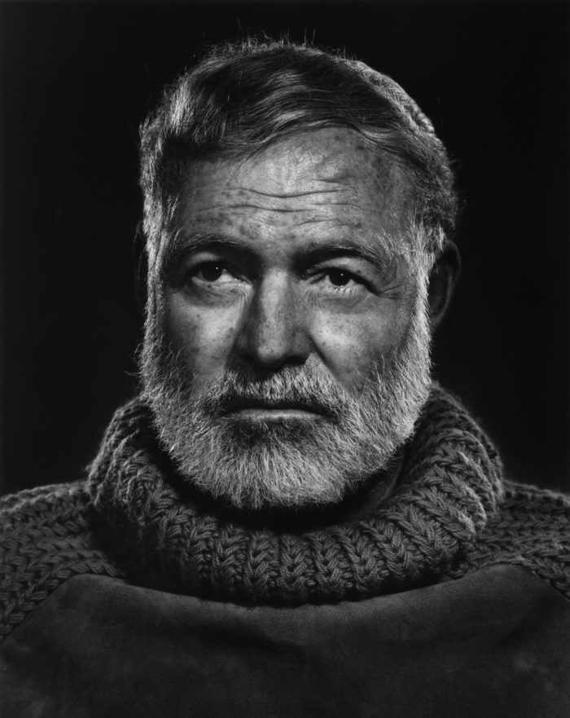

STRESS AND TRAUMA
“ Resilient individuals divine remedies for injuries; they know how to turn serious accidents to their advantage; that which does not kill them makes them stronger”
Frederick Nietzsche Ecce Homo
“The world breaks everyone and afterwards many are stronger at the broken places.”
Ernest Hemingway – a farewell to arms
Notes:
Yes let's start with quotations about stress and resilience from two people, who in their live's, faced enormous stress.

Slide 34
INTRODUCTION TO STRESS AND TRAUMA

Slide 35
STRESS TRAUMA AND PERSONALITY
One of the goals of this course is to be a simple ”owners manual” to the mind.
In our quest to survive and thrive in an often-hostile world we are constantly interacting with and being challenged by our environment. If each time we faced an environmental challenge, we had to figure out anew the best response to it, we would not survive.
Our responses to our often-hostile world are therefor pre-programmed. Personality is what we call that pre-programming. Personality, along with the immune and endocrine systems, are our first line of defense or protection from environmental challenges.
In the course, we’ve been exploring what leads to emotional dysregulation; those recurring patterns in our thinking, feeling, and behaving that constitute personality and cause us to fall into “holes.”
So far, we’ve explored how personality is influenced by three important factors: 1) temperament; what we’re born with. 2) character; what happens to us and how the world treats us and 3) integration; how we reflect on, influence, and gradually change ourselves over time.
We’ve discussed how personality “lives” in our 4 minds; the somatic, emotional, rational and self-aware minds and how instincts are the basis of emotions.
We’ve also considered how attachment, an instinctive system shaped by our early caregivers, can either support emotional regulation or contribute to dysregulation when safety and connection are inconsistent or threatening.

Slide 36
STRESS TRAUMA AND PERSONALITY
Today, we begin exploring another influence on our personalities and a major cause of emotional dysregulation: stress and trauma.
Stress and trauma affect another instinctive system, our fight, flight, freeze, and collapse responses. Stress and trauma don’t just live in our thoughts; they live in our nervous systems and bodies. They shape what feels safe, what feels dangerous, how quickly we react, and how hard it is to pause, reflect, and choose.
If we want to understand ourselves more fully, why we fall into certain holes, why some situations overwhelm us, and what true healing and growth require, we need to understand stress and trauma.
As we continue the journey of trying to understand ourselves we may also want to remind ourselves why approaches like DBT and IFS are so essential in healing and growth.
Under conditions of stress, especially chronic or traumatic stress, our nervous systems are pulled out of balance. We shift out of calm, rational, flexible states and into survival modes. In DBT language, we move out of rational mind and into emotion mind.

Slide 37
STRESS TRAUMA AND PERSONALITY
DBT gives us practical tools and skills to stabilize our nervous system. These help us slow down, widen our window of tolerance, and regain enough balance to reflect rather than react.
IFS, which we’ll begin exploring in week 21of the course, March 4th, adds another layer. It helps us understand that under stress, different “parts” or “sub-personalities” that exist in our “internal family” take over and why, when stress is high, access to our real calm, clear and compassionate core Self becomes so difficult.
Understanding stress and trauma helps us understand why the tools and skills sometimes feel so hard to use, why extreme parts of us sometimes take over, and why healing is not about forcing change, but about restoring safety.

Slide 38
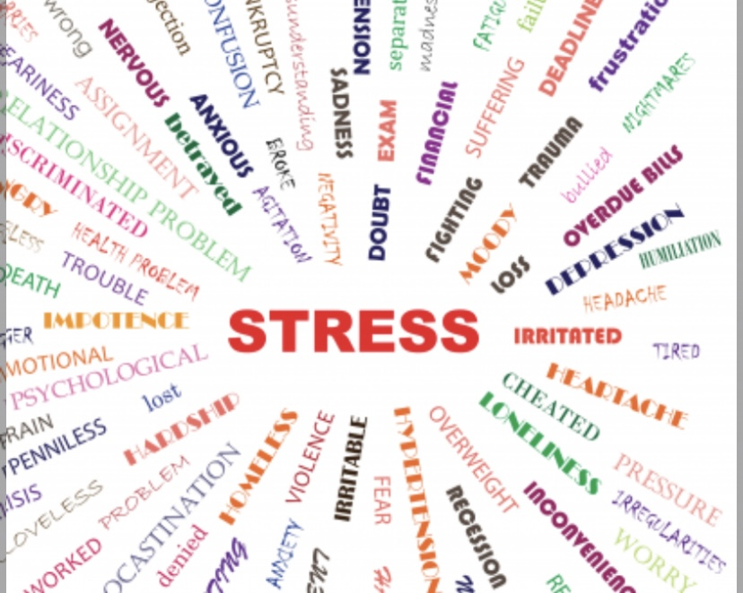
TODAY
Defining stress
Stress, fear and anxiety
Diagnosing stress
Intensity and duration of stress
Types of stressors: socioeconomic, discrimination, gaslighting
Statistics, Gen Z and the stress epidemic
Assessing stress
The stress response
Polyvagal theory
Arousal states
How stress affects body and mind: signs and symptoms, performance
How stress affects children
Life history theory

Slide 39
DEFINING STRESS

Slide 40
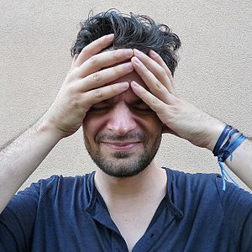
SOME definitions
Worldwide, stress is by far the most common cause of illness or feeling physically or emotionally unwell.
A stressor- is a physical or psychological challenge to the well being of an organism
Stress- is an organisms physiological and psychological reaction to a stressor .
Stressors and stress can be acute, longer term or chronic and range from mild to severe. Acute, lower intensity stressors are less damaging and even strengthen the organism. Chronic, high intensity stressors are more harmful to the organism.
Antifragility means benefiting from stress, shocks, or disorder, growing stronger instead of just resisting damage. Something fragile breaks under stress. Something robust resists stress but doesn’t improve. Something antifragile improves because of stress.
Resilience- the capacity to withstand or to recover quickly from stressful circumstances
Eustress- is physical or psychological stress that benefits or strengthens the organism (ex. exercise or engaging in an intellectually or emotionally challenging activity)
Distress- Is an aversive state of stress to which the person cannot fully adapt but which may not have long term negative effects
Traumatic stress- is a stressor that emotionally overwhelms the individual’s coping mechanisms and may have long term consequences such as PTSD or complex PTSD
Stress coping resources – determine how people cope with stress. They include attachment style, coping skills, social supports, socioeconomic factors etc.. These resources determine, for each person, the point at which eustress becomes distress, and distress, traumatic stress
Notes:
And now, let's define some terms.

Slide 41
STRESS, FEAR AND ANXIETY

Slide 42
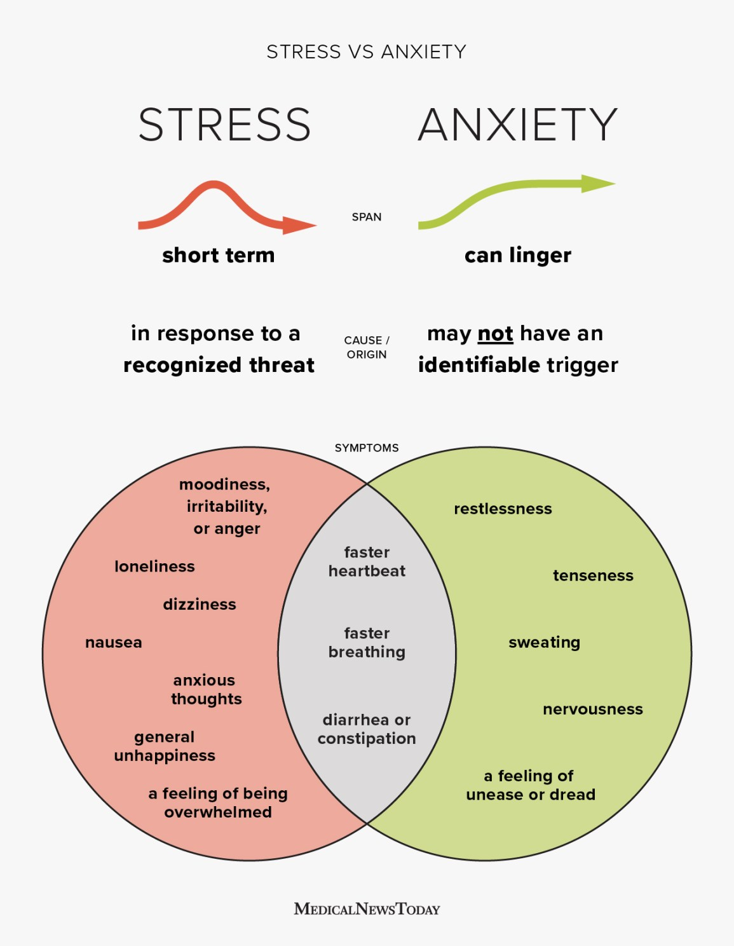
Stress, anxiety and fear
Stress is a normal reaction to challenges in life. It can cause physical and emotional symptoms, but it usually settles when the situation improves.
Anxiety is different. It is when worry and physical symptoms become excessive and long-lasting, often continuing even when there is no clear threat.
Fear is usually brief and linked to a clear danger, while anxiety tends to linger and feel more vague or uncertain.
Trauma, chronic stress, and attachment difficulties can disrupt the body’s stress system, making people more vulnerable to anxiety and depression later in life.

Slide 43
STRESS AND EMOTIONAL DYSREGULATION
When emotions are dysregulated, the body stays stuck in a high-alert or shut-down state instead of calm and balanced.
Because of this, the brain interprets everyday situations as dangerous or overwhelming, triggering a strong stress response.
People in this state also have more difficulty using healthy coping strategies, which makes stress last longer. This creates a vicious cycle: stronger stress, poorer coping, and more ongoing stress.
Research shows that people with early life adversity have much stronger stress hormone responses even to mild stressors
Cognitive center- cerebral cortex
Emotional - limbic system, brainstem
Somatic- autonomic nervous system
Interprets emotional information into a narrative
Integrates information from body (ANS) and the environment (senses) producing a quick emotional response
“Body memory” in the form of autonomic baseline tone and reactivity(autonomic nervous system)

Slide 44
DIAGNOSING STRESS
How does the diagnostic and statistical manual- DSM categorize stress related disorders?

Slide 45
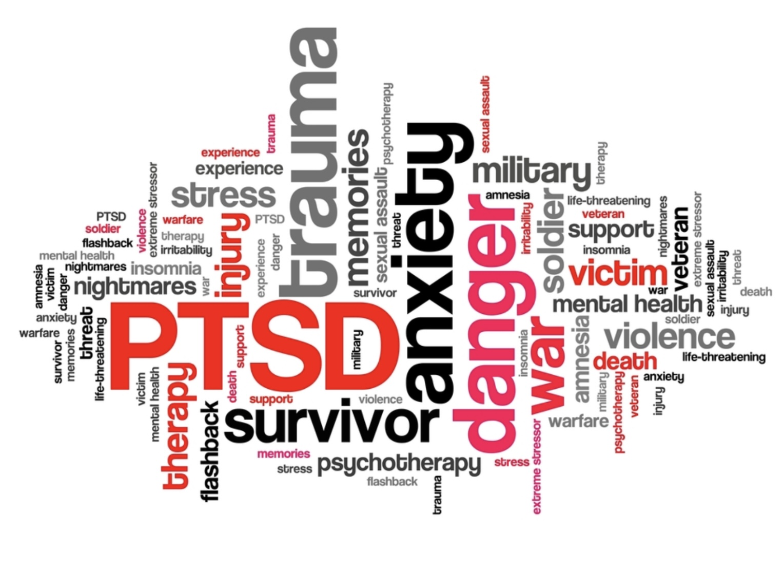
DIAGNOSING STRESS
Stress contributes to all mental health problems, but in some conditions, it plays a central role.
This happens especially when stress is chronic, severe, or traumatic.
Stress plays a central role in: “anxiety disorders”- panic disorder, generalized anxiety disorder, social phobia, specific phobias.
“Obsessive-compulsive, stereotypic and related disorders”- obsessive-compulsive disorder, body dysmorphia, hoarding, hair pulling, skin picking.
“Trauma and stress related disorders”- PTSD, acute stress disorder, adjustment disorders, reactive attachment disorders
“Dissociative disorders”- dissociative identity disorder, depersonalization/derealization, dissociative amnesia

Slide 46
1. INTENSITY AND 2. DURATION OF STRESS

Slide 47
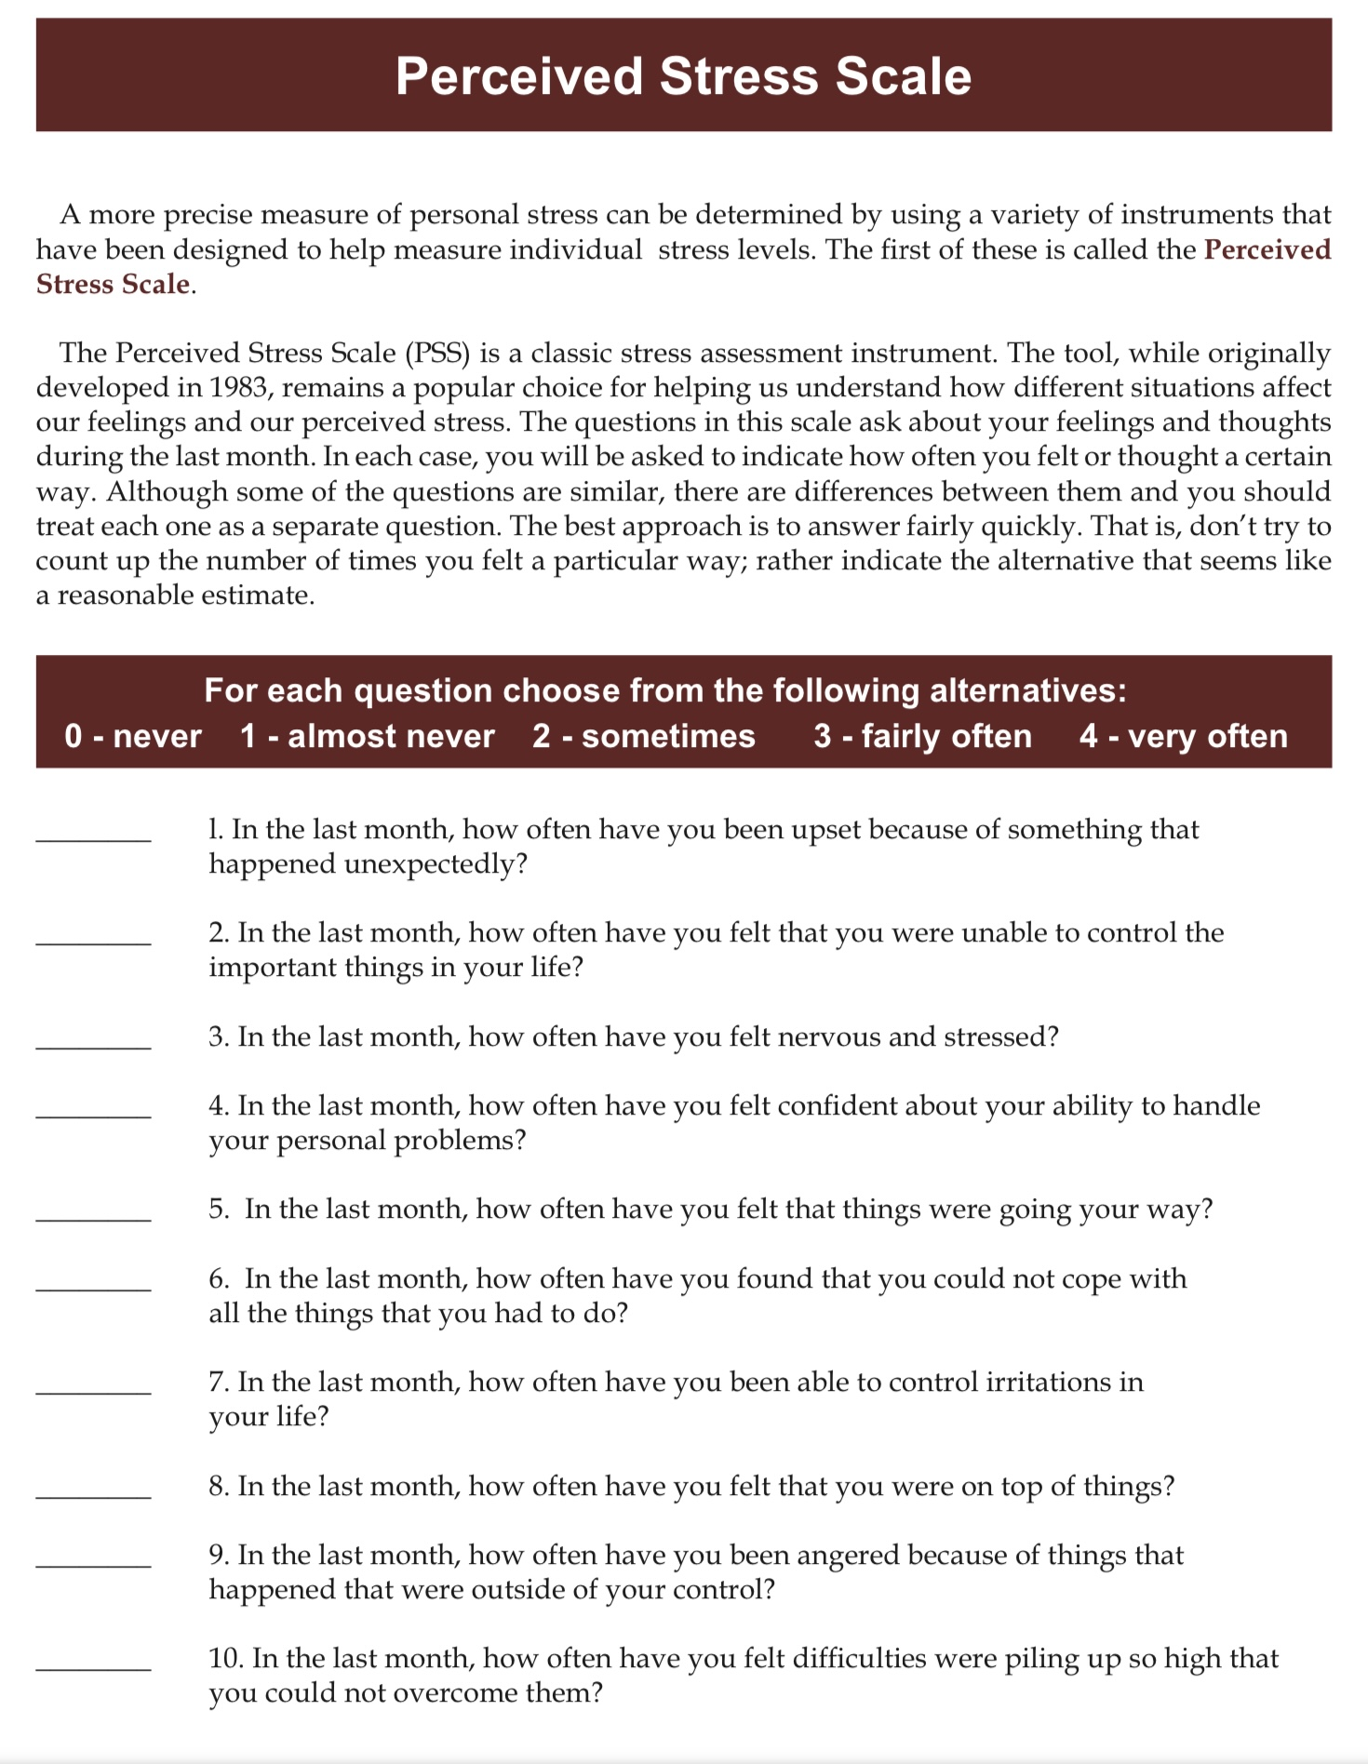
Perceived stress =intensity + duration of stress – coping resources available to the individual
The perceived stress scale measures a person stress level or the degree to which situations in their life are perceived as stressful. Factors affecting the stress level include intensity and duration of the stressor, coping skills and the person’s baseline physiological activation patterns (temperament + character)
Positive or eustress is associated with brief increases in heart rate, intensified focus, and mild elevations in levels of stress hormones.
Tolerable stress (aka. Distress) is associated with serious but temporary stress responses mitigated by positive buffering influences for example self-regulation skills or supportive relationships.
Toxic stress involves intense and prolonged activation of stress response systems without sufficient positive buffering influences.
1. INTENSITY OF STRESS
Notes:
Stressors can be different in terms of their intensity.

Slide 48
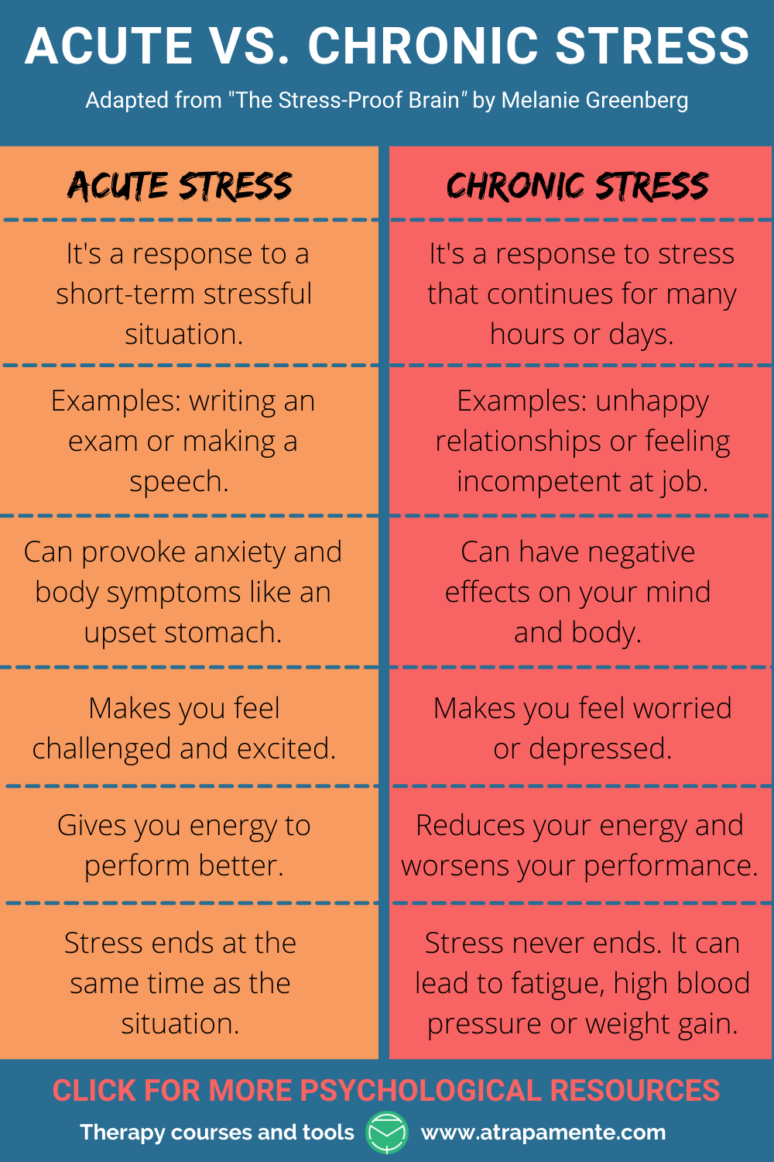
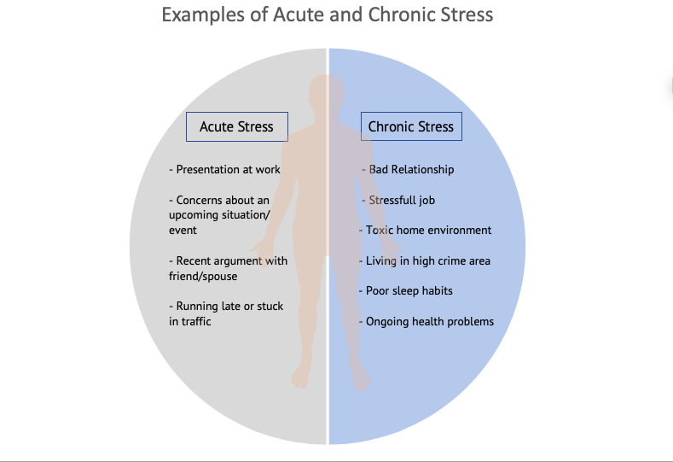
2.DURATION OF STRESS
The stress response is part of our fight-or-flight system.
Short-term stress is normal, helpful, and supports survival.
Long-term stress can develop when stressors are chronic, emotions are poorly regulated, or stress and dysregulation reinforce each other in a vicious cycle.
As stress becomes more intense and long-lasting, the stress system becomes dysregulated and causes physical and psychological harm.
Severe or toxic stress can eventually lead to shutdown states, such as depression, dissociation, or emotional collapse
Notes:
Stressors can also differ in terms of their duration. Acute and chronic stress are quite different.

Slide 49
Stress has three layers
World (what happened)
Body (arousal)
Identity (what it made of me)

Slide 50
WORLD (WHAT HAPPENED)
What has life done to us?

Slide 51
VARIETY OF STRESSORS: SOCIOECONOMIC, DISCRIMINATION, GASLIGHTING, ETC.

Slide 52
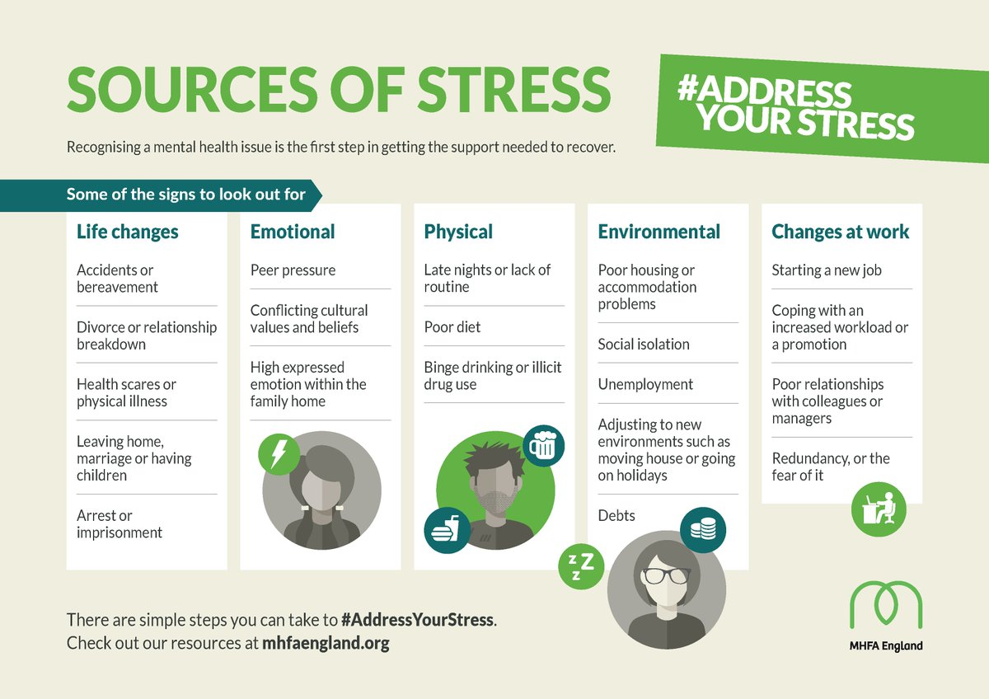
TYPES OF STRESSORS
Many different things can cause stress. Stress isn’t only triggered by negative events, positive life changes like marriage, having a baby, starting a new job, moving, or traveling can also be stressful.
Common stressor include:
1. Sensory inputs such as pain, bright lights, noise, temperature extremes
2. Environmental circumstances such as food, water, or housing insecurity, pollution, and lack of freedom or mobility.
3. Social circumstances such as dealing with difficult people, break ups, divorce, marriage, births, deaths.
4. Life experiences such as poverty, unemployment, insufficient sleep.
5. Adverse experiences during development such as maternal exposure to trauma or toxic substances, attachment issues, infant/child abuse and neglect.
Notes:
The nature of stressors can also be quite different.

Slide 53

THE WORLD’S #1
Stressor
Humans are driven by instincts, such as seeking, attachment, and fight-or-flight, to get what we need to survive.
How a society distributes resources strongly affects how stressful life is for its people. Inequality and economic injustice create chronic stress and are among the biggest causes of illness worldwide.
Chronic stress makes it harder for people to think clearly, plan, and do the difficult things needed to change their situation. As a result, escaping poverty through “willpower alone” is very rare.
Upward mobility depends on social justice, and as inequality rises, upward mobility falls
Notes:
An enormously important type of stressor is socioeconomic

Slide 54
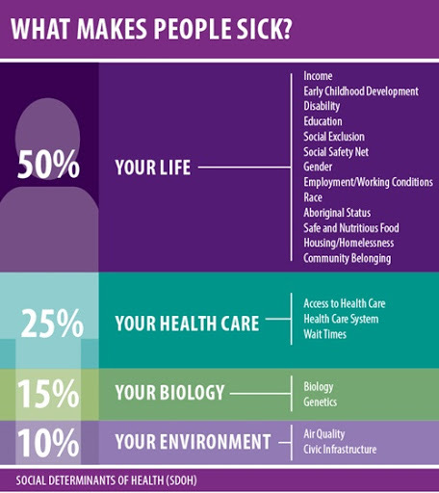
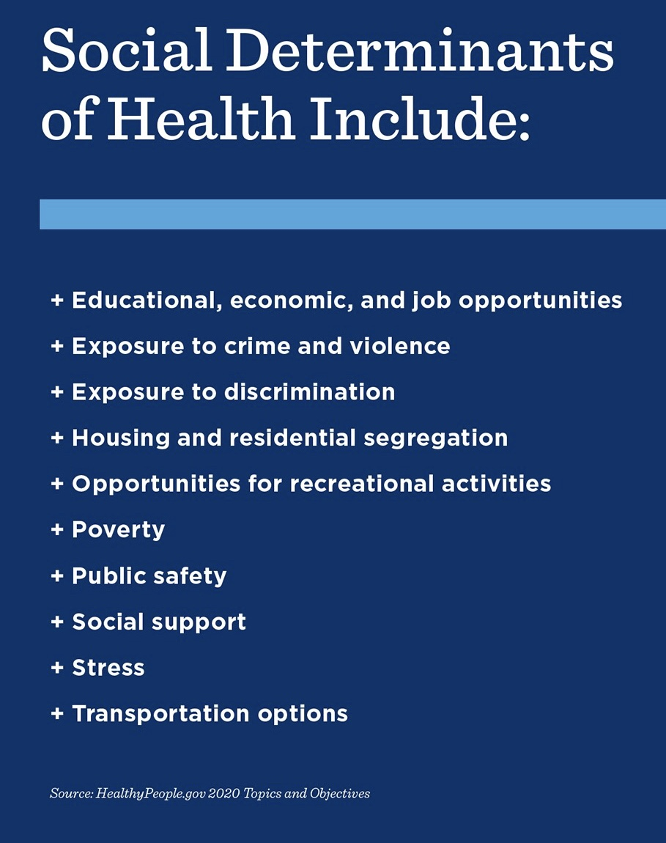
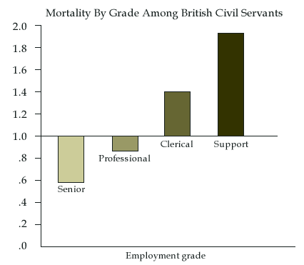
Why Socioeconomic stress is the most important health concern
1. “Your Life” and how stressful it is, is the variable that has the biggest impact on your health.
The health care you receive, your biology and your physical environment are comparatively less important factors
2. The social factors and circumstances that impact your health are called social determinants of health.
The most important social determinants of health include:
3. The Whitehall studies of British civil servants clearly showed that the more control you have over your life, the longer and healthier life you live.
Longevity and health depends on a person’s place in the social hierarchy.
Whitehall studies
Notes:
We have already considered how critical social economic stressors are to health.

Slide 55

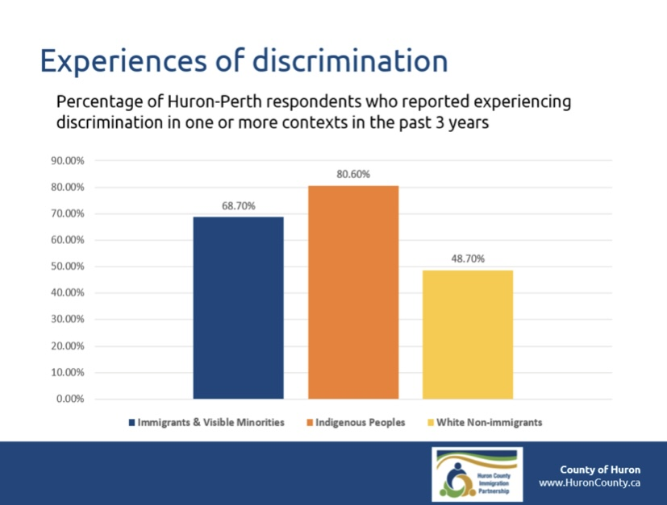
COMMON BUT OVERLOOKED STRESSORS
EVERYDAY STRESSORS
Notes:
There are other stressors that are common but often overlooked.

Slide 56
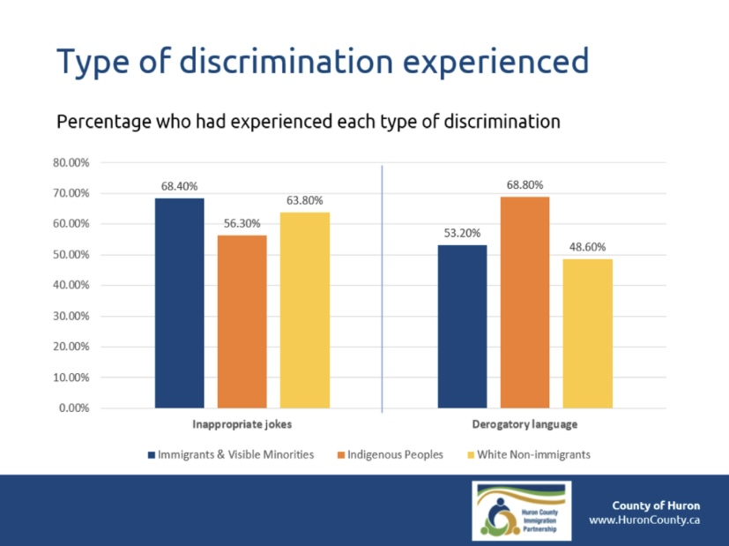

Slide 57
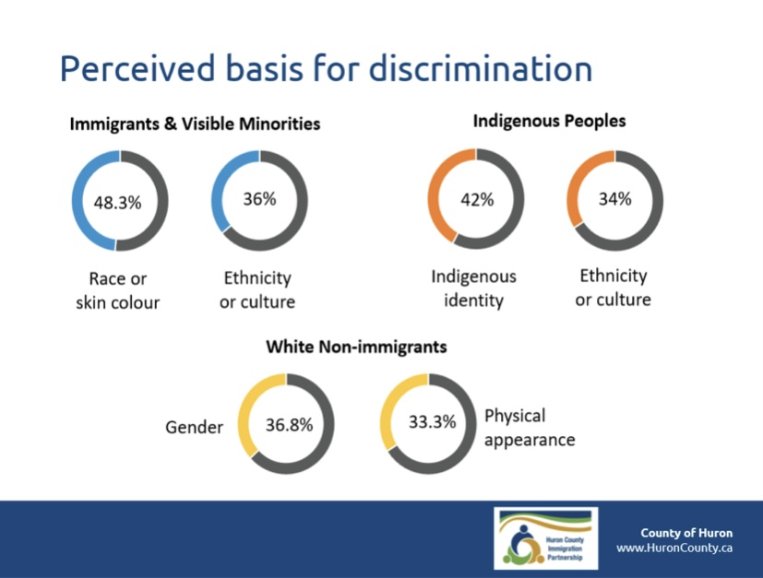

Slide 58

GASLIGHTING
The term “gaslighting” comes from the title of the 1938 British stage play “gaslight” in which a male character uses psychological manipulation to make a female character question her sanity.
Gas lighting is when one person, for their own gain, intentionally tries to twist another person's perception of reality.
Typical gas lighting statements include: "you're overreacting", "you need help", "you're upset over nothing", "you must be confused again", "you're so dramatic", "I never said that", "why are you so defensive?", "It's your fault", "you're so sensitive", "stop imagining things“, "I was just joking", "you’re remembering things wrong", "it's always something with you".
Gas lighting is a form of emotional abuse and a chronic stressor in many relationships.
Other examples of subtle common emotional abuse include 1) withholding affection as a punishment, 2) not telling a person what they did wrong but expecting them to ask for forgiveness, 3) intentionally being forgetful about things and events that are important to the other person and 4) being patronizing.
Gaslighting quiz
Notes:
Gas lighting is a stressor and type of emotional abuse that recently has been much talked about.

Slide 59

Operational or occupational stress injury refers to lasting psychological harm from doing high-stress service work, such as policing, firefighting, emergency response, or frontline healthcare.
Moral injury or moral distress happens when people act in ways, or witness situations, that violate their deeply held values; moral injury is more severe, while moral distress is usually milder.
Burnout is emotional, physical, and mental exhaustion caused by prolonged stress, often related to work or caregiving, and is not the same as depression, even though they can look similar.
Leadership and workplace culture matter greatly: abusive, exploitative, or psychologically unhealthy leadership can severely damage morale and mental health.
WORK RELATED STRESS
Work related stress link

Slide 60
FREQUENTLY UNRECOGNIZED STRESSORS
Being neurodivergent (for example, autistic, ADHD, dyslexic) often means moving through a world that is designed with neurotypical norms and expectations in mind. Social rules, school systems, workplaces, and even sensory environments (lighting, noise, schedules) are usually tailored for typical ways of processing information and relating to others.
For neurodivergent people, this creates a constant background stressor, a need to mask differences, adapt to environments that overload or misunderstand them, or repeatedly repair small ruptures in social and professional interactions. Over time, this ongoing mismatch functions like chronic stress, even when no single event looks dramatic from the outside.
By the same token, there are other life experiences where the everyday environment is misaligned with one’s capacities, expectations, or identity. These too can function as chronic stressors, they include:
Immigration to an unfamiliar culture: navigating a language barrier, new norms, different values, and possible discrimination means that even simple interactions can carry strain.
Living with a visible or invisible disability: constant negotiation with spaces, systems, and attitudes that aren’t accessible.
Belonging to a stigmatized minority group: dealing with prejudice, microaggressions, or the burden of representation.
Chronic illness: the daily management of symptoms, medical appointments, and limited energy narrows life choices.
Gender or sexual identity not affirmed by mainstream culture: the stress of concealment, invalidation, or outright hostility.
In each of these cases, the stress isn’t only from specific events, but from the continuous friction between the individual’s way of being and the larger environment’s design or expectations.

Slide 61
Take 30 seconds and just notice what that stirred in you.

Slide 62
STATISTICS, GEN Z AND THE STRESS EPIDEMIC
Is it true that the younger generations are more stressed than the older ones ?

Slide 63
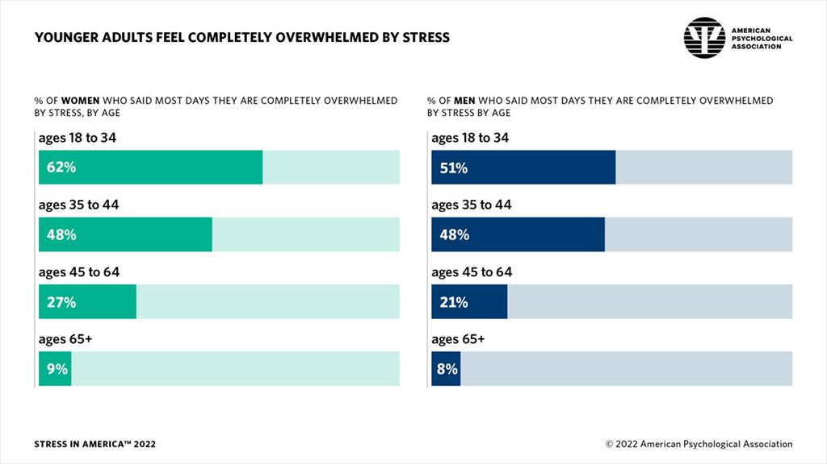
% OF WOMEN AND MEN WHO REPORT BEING OVERWHELMED BY STRESS BY AGE 2022

Slide 64
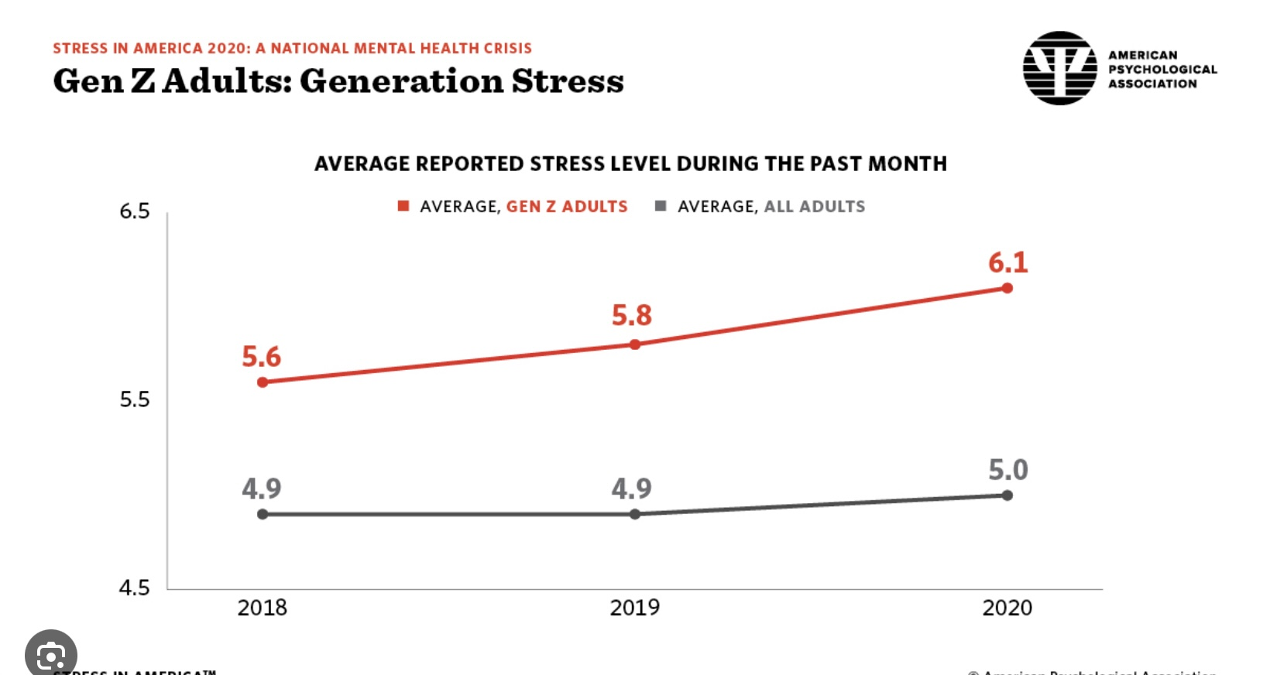
REPORTED STRESS LEVEL ON A 0-10 SCALE FOR
GEN Z (11-26 Y.O.) vs. ALL ADULTS FROM 2018-20

Slide 65
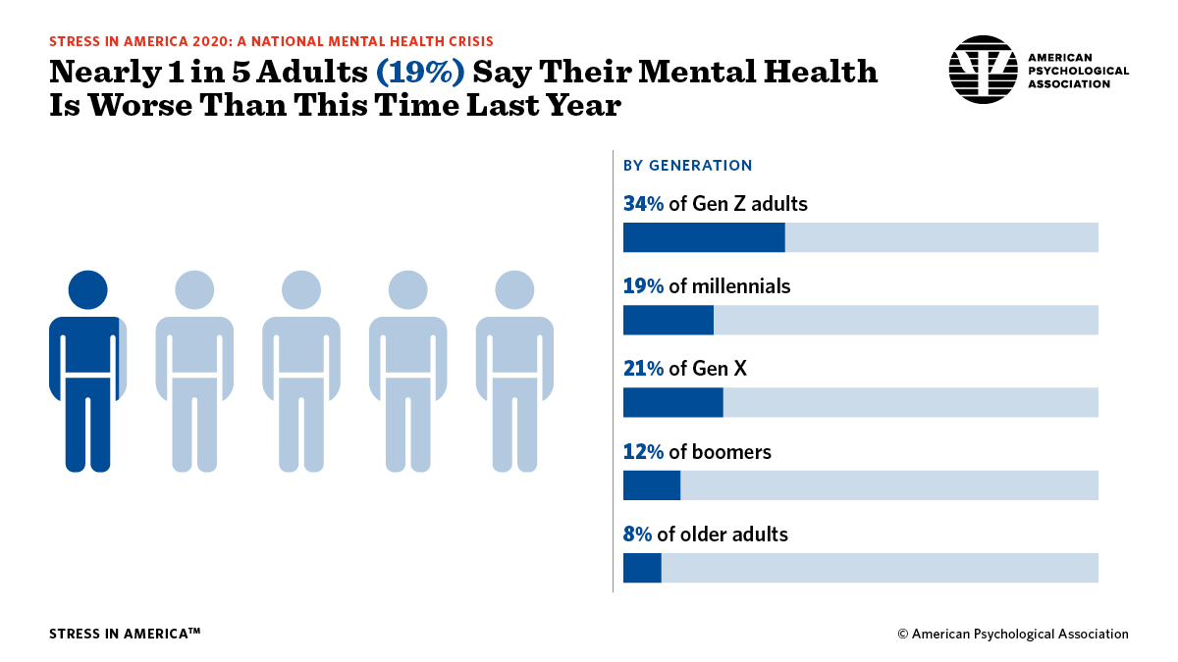
% OF ADULTS REPORTING WORSENING MENTAL HEALTH BY GENERATION 2020

Slide 66
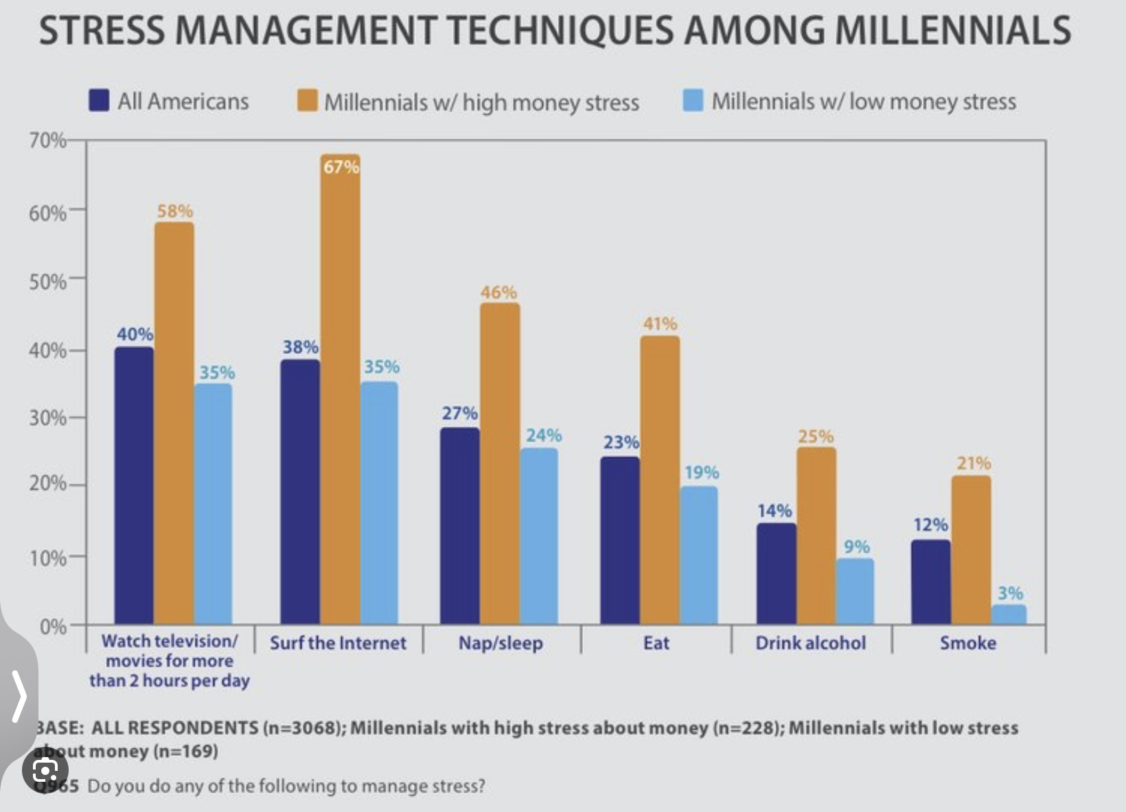
STRATEGIES USED BY MILLENIALS(born 1980-95)/ALL AMERICANS TO COPE WITH STRESS

Slide 67
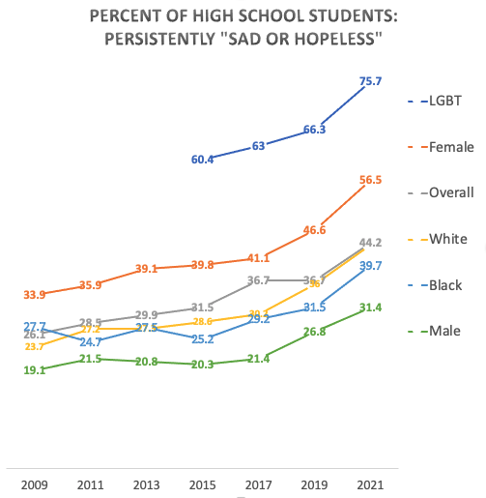
gen Z’s mental health
Gen Z (or iGen) includes people born between about 1997 and 2012.
Rates of anxiety, depression, and suicidality have risen sharply in this generation, especially among girls. Many factors may be contributing, including changes in parenting, social media and smartphones, academic pressure, biological factors, and worry about the future.
Some researchers suggest that an increased focus on emotional safety may reduce opportunities for young people to learn resilience through difficult experiences.
The causes for Gen Z’s deteriorating mental health are complex and multifactorial, making this an important topic for discussion rather than simple answers.

Slide 68
WHY GEN Z IS SO STRESSED
There are several overlapping reasons why Gen Z (and even younger generations) tend to report higher stress compared to older cohorts like Boomers
1. Technology & Social Media: Constant comparison: Platforms amplify curated success, beauty, and lifestyles, fueling insecurity. 24/7 connectivity: No escape from peer pressure, bullying, or news of crises. Attention economy: Apps are designed to maximize engagement, which keeps stress levels chronically high.
2. Economic & Career Pressures: Precarious jobs: Gig economy, automation fears, fewer stable careers. Cost of living: Housing, education, and healthcare costs have risen far faster than wages. Debt burdens: Especially student debt in many countries, creating early financial anxiety.
3. Global Uncertainty: Climate anxiety: Feeling responsible for or powerless against existential threats. Political polarization: Growing up amid culture wars and instability. Polycrisis awareness: Social media and news amplify awareness of overlapping global crises (pandemics, wars,
inequality).
4. Family & Social Changes: Less unstructured play: More supervised, structured childhoods reduce resilience-building experiences. Later milestones: Delayed financial independence, marriage, or home ownership create feelings of being “behind.” Higher expectations: Pressure to “achieve” academically, socially, and professionally in a hyper-competitive environment.

Slide 69

Social media algorithms are designed to keep people engaged, but in doing so they often increase stress.
They tend to show content that reinforces existing beliefs and amplifies strong emotions like fear or anger, which keeps the body in a fight-or-flight state.
The constant stream of information and notifications can be overwhelming, leading to mental overload and reduced clarity.
Algorithms also promote social comparison and validation seeking, which can increase anxiety about self-worth and social status.
ALGORITHMS AND STRESS

Slide 70
ALGORITHMS AND STRESS
Algorithms that prioritize trending topics and real-time updates can exacerbate FOMO, leading users to feel anxious about missing important information or social interactions.
The impact of these stressors on the brain can be significant:
Prolonged exposure to stress-inducing content can activate the body's fight or flight response, releasing stress hormones like cortisol and adrenaline. This state is designed for short-term survival, not prolonged activation.
Chronic stress can impair cognitive functions such as attention, memory, and decision-making. It can reduce the brain's ability to process information clearly and rationally, leading to difficulties in thinking critically and making informed decisions.
Stress can also affect emotional regulation, making individuals more reactive and less able to manage their emotions effectively.
To mitigate these effects, it can be helpful for individuals to practice digital mindfulness, set boundaries for technology use, and engage in activities that promote relaxation and mental well-being. Additionally, increased awareness of how algorithms influence behavior can empower users to make more conscious choices about their digital consumption.

Slide 71
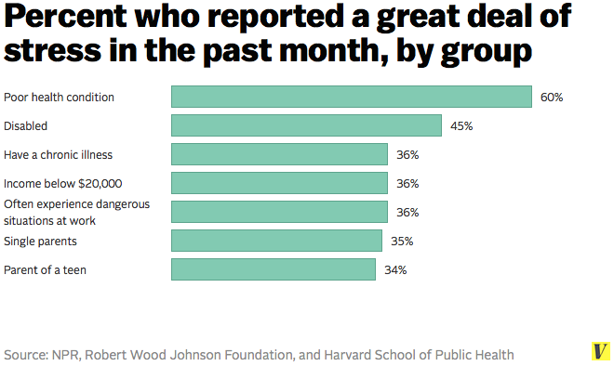
WHO IS THE MOST STRESSED?
Notes:
If we define illness broadly as feeling physically or emotionally unwell, then stress is by far the most common source of illness in the world

Slide 72
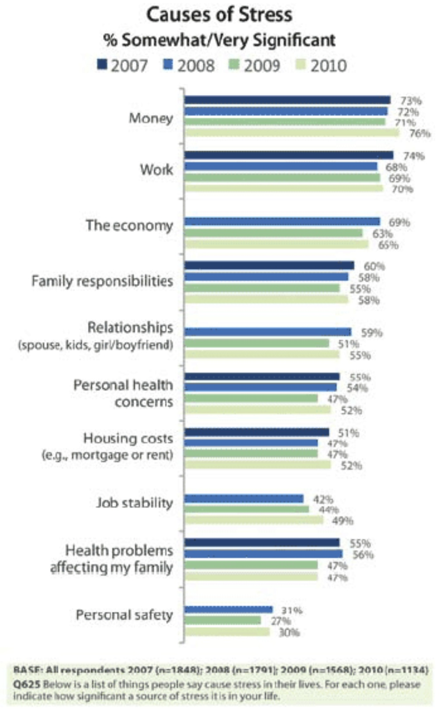
WHAT ARE AMERICANS MOST STRESSED BY 2007-10

Slide 73
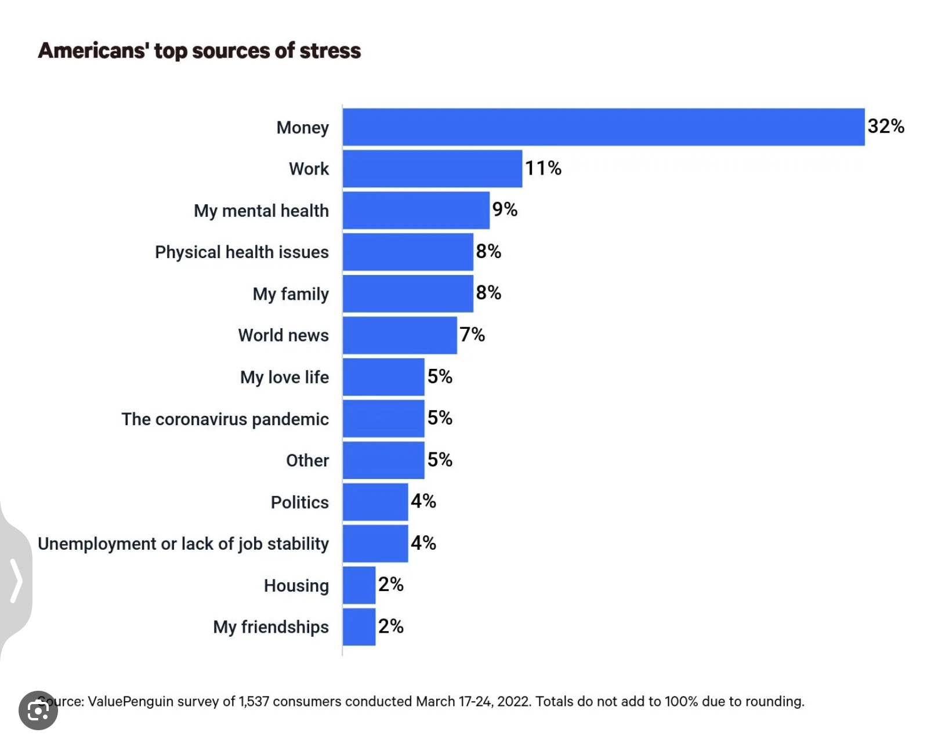
WHAT WERE AMERICANS STRESSED BY IN 2022?

Slide 74
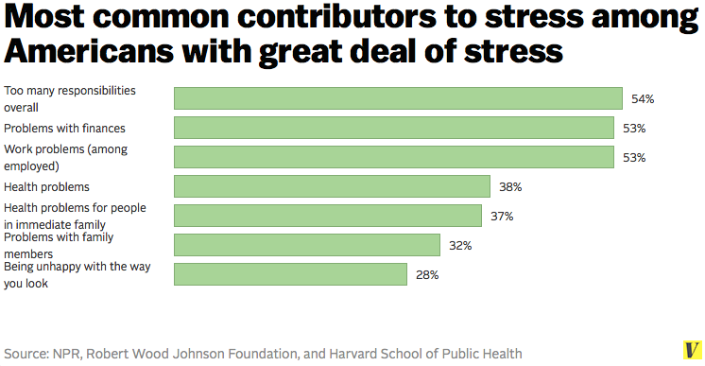
WHAT ARE THE CAUSES OF STRESS AMONG THE MOST STRESSED?

Slide 75
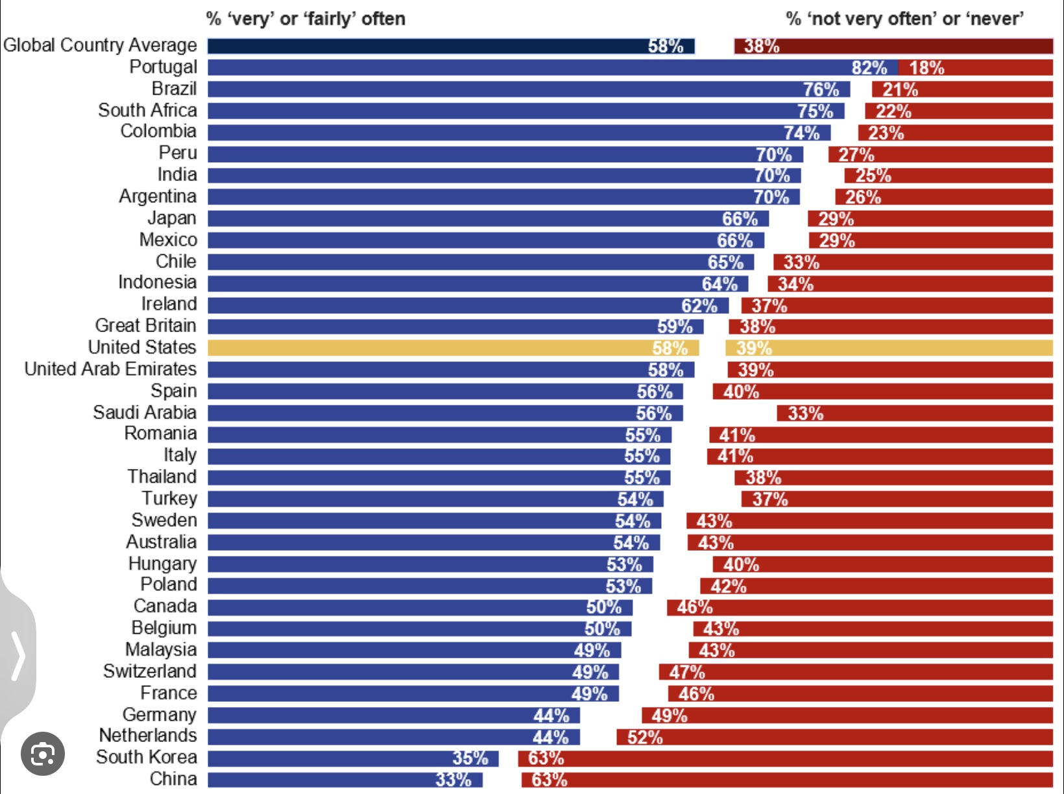
% OF PEOPLE REPORTING SIGNIFICANT STRESS BY COUNTRY 2019

Slide 76
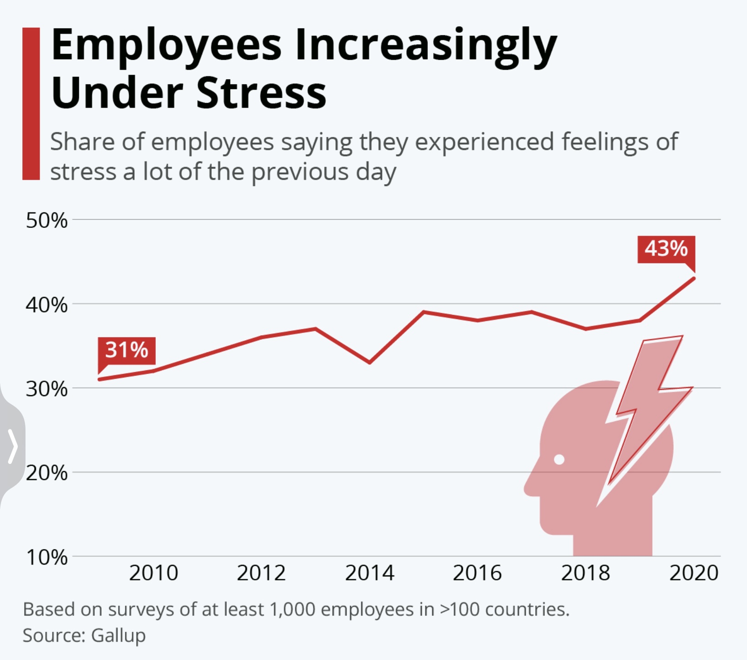
% OF WORKERS REPORTING SIGNIFICANT WORK-RELATED STRESS 2010-20

Slide 77
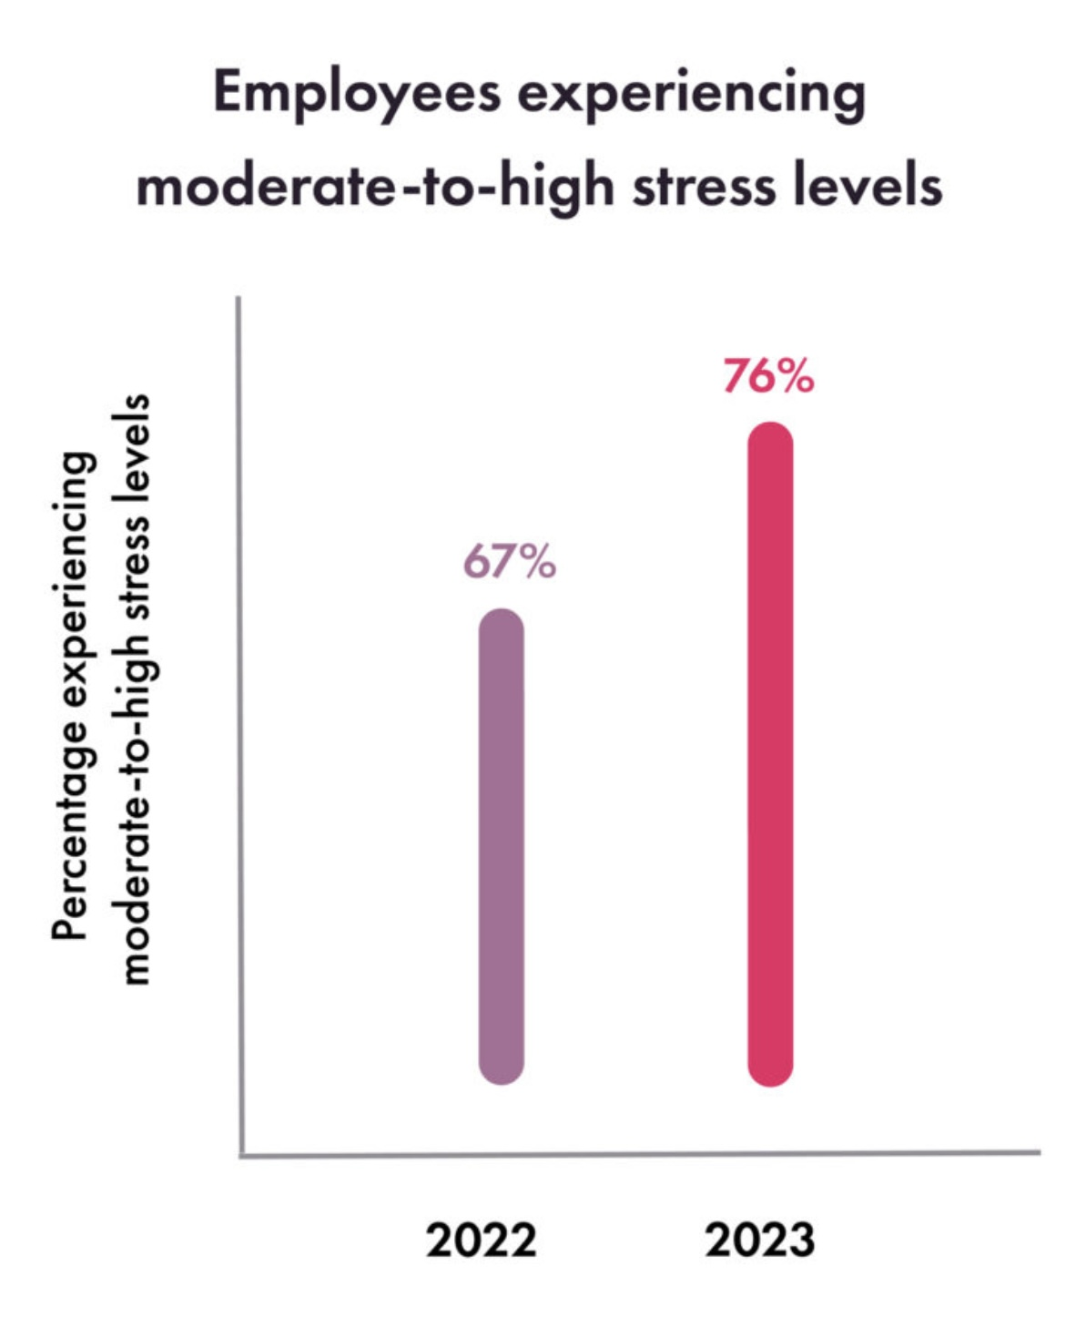
% OF WORKERS REPORTING SIGNIFICANT WORK-RELATED STRESS 2022-23

Slide 78
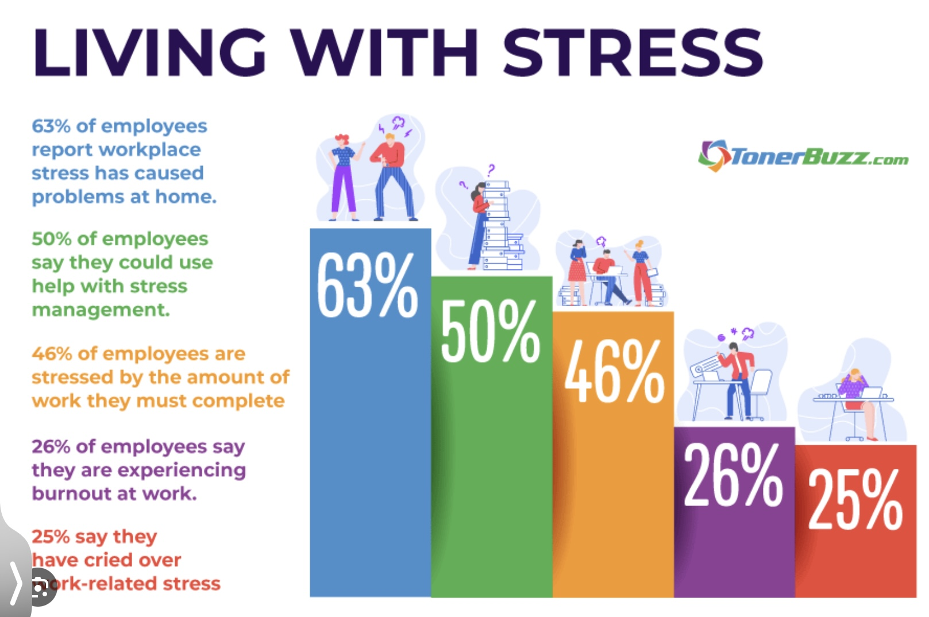
WHAT WORKERS SAY ABOUT THEIR STRESS 2018

Slide 79
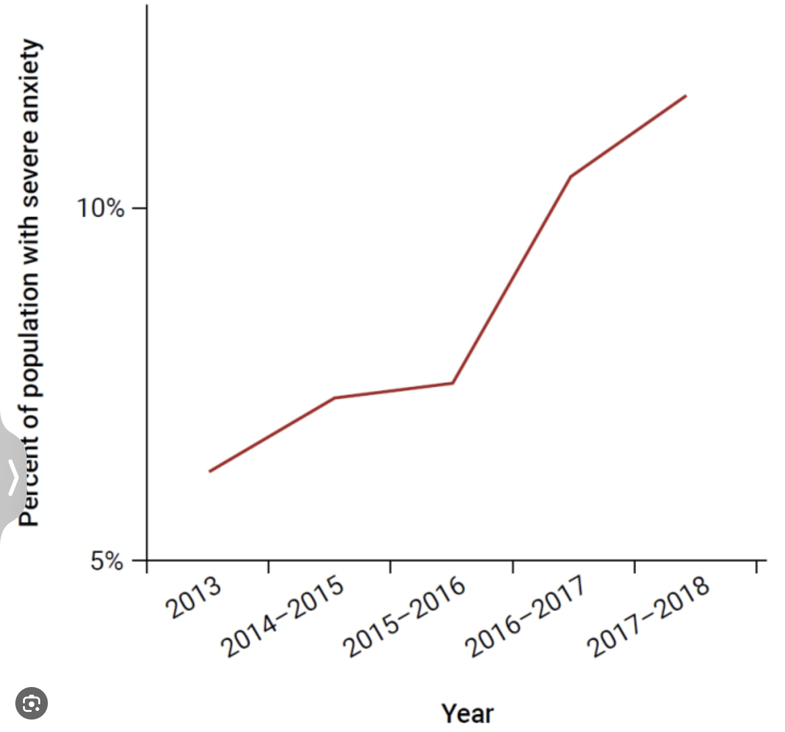
% OF POPULATION REPORTING SEVERE ANXIETY 2013-18

Slide 80
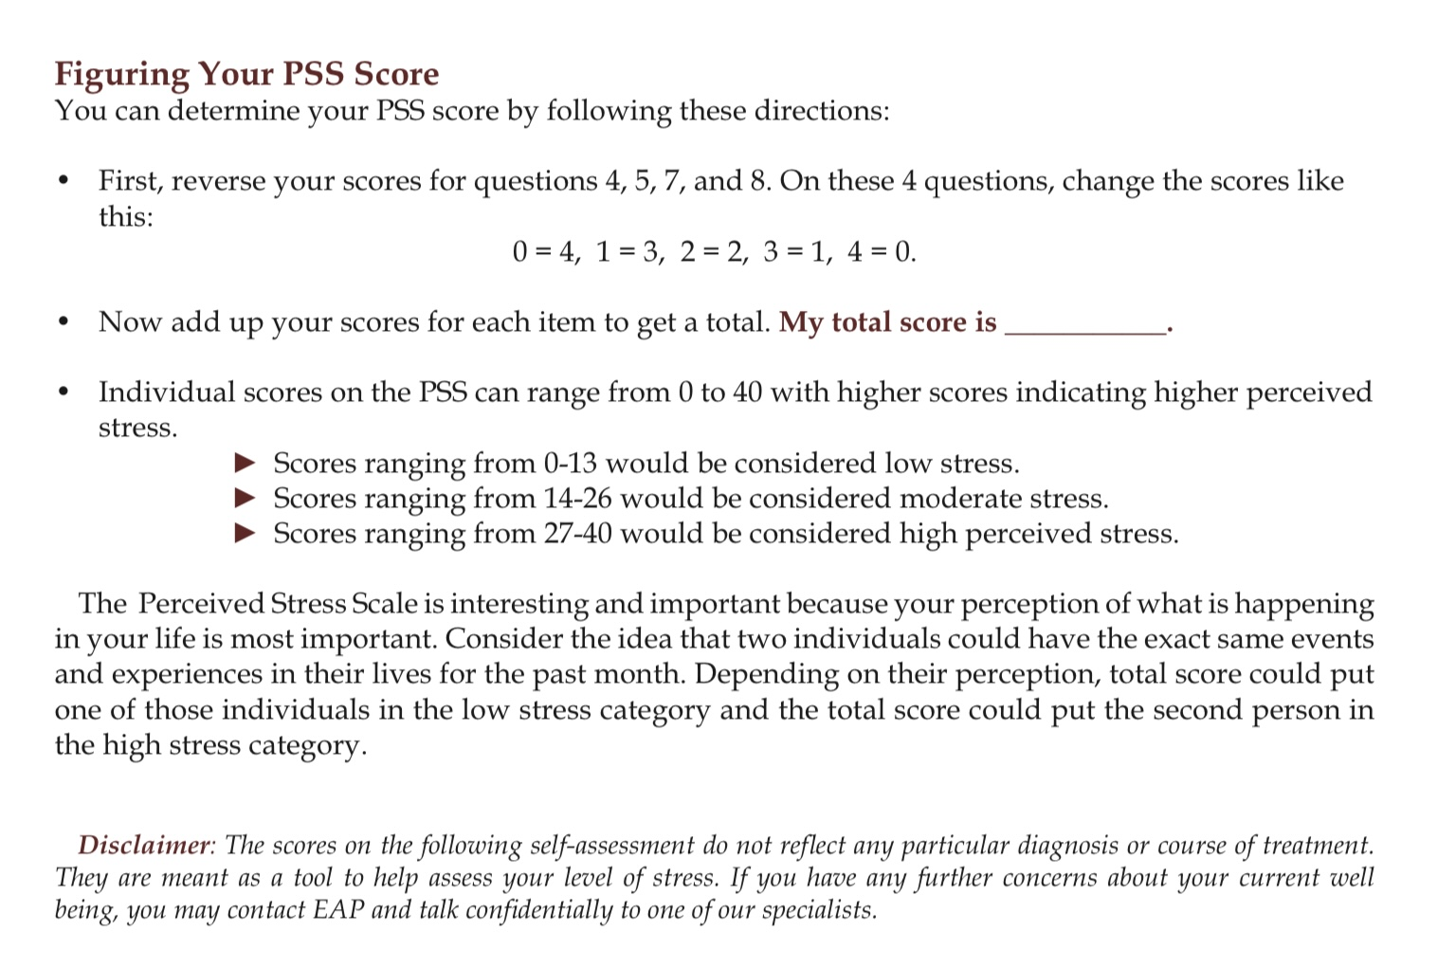
Don’t overthink the questions, answer them quickly.
If figuring out your PSS score is too confusing to do during the session, don’t worry, don’t do it
To score your PSS: 1) for questions 1, 2, 3, 6,9 ,10 simply add your numbers on the answers ex. Never=0 almost never= 1, sometimes= 2 etc.
2) for questions 4, 5, 7, and 8 reverse the scores ex. Never=4, almost ever=3 sometimes=2 fairly often=1 very often=0
3) add your numbers. Do you fall into low, moderate, or high perceived stress ranges?

Slide 81
BODY (AROUSAL)
What is happening to our nervous systems?

Slide 82
ASSESSING STRESS
Are there ways of objectively assessing how much stress a person is experiencing?

Slide 83
Dear Simple group members:
Our January 21st session, week 15 will be on “stress”. There are two widely used scales that attempt to objectify levels of stress that people are experiencing: the Holmes and Rahe and the Perceived stress scale. Our week 15 poll will simply ask you for your scores on these scales. To participate in that poll please complete both scales on your own before the January 21st session, calculate your scores and have them handy next week when we launch the poll. We think the session will be more meaningful to you if you’ve completed these scales.
Thank you

Slide 84
Don’t overthink the questions, answer them quickly.
If figuring out your PSS score is too confusing to do during the session, don’t worry, don’t do it
To score your PSS: 1) for questions 1, 2, 3, 6,9 ,10 simply add your numbers on the answers ex. Never=0 almost never= 1, sometimes= 2 etc.
2) for questions 4, 5, 7, and 8 reverse the scores ex. Never=4, almost ever=3 sometimes=2 fairly often=1 very often=0
3) add your numbers. Do you fall into low, moderate, or high perceived stress ranges?

Slide 85
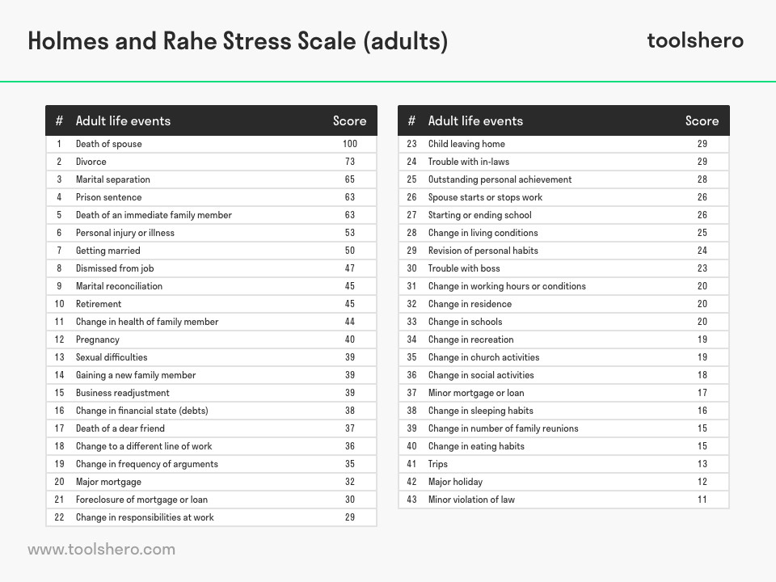
HOLMES AND RAHE SCALE
The Holmes and Rahe scale attempts to objectify the amount of stress a person is experiencing.
To figure out your Holmes and Rahe score 1) check off from the list all the stressful life events you have you experienced in the past year. 1) add the scores associated with each. That is your total score.
The Holmes and Rahe scale is a risk assessment tool which predicts a person’s likelihood of having physical, and/or psychological health problems and needing to access health care in the near future.

Slide 86
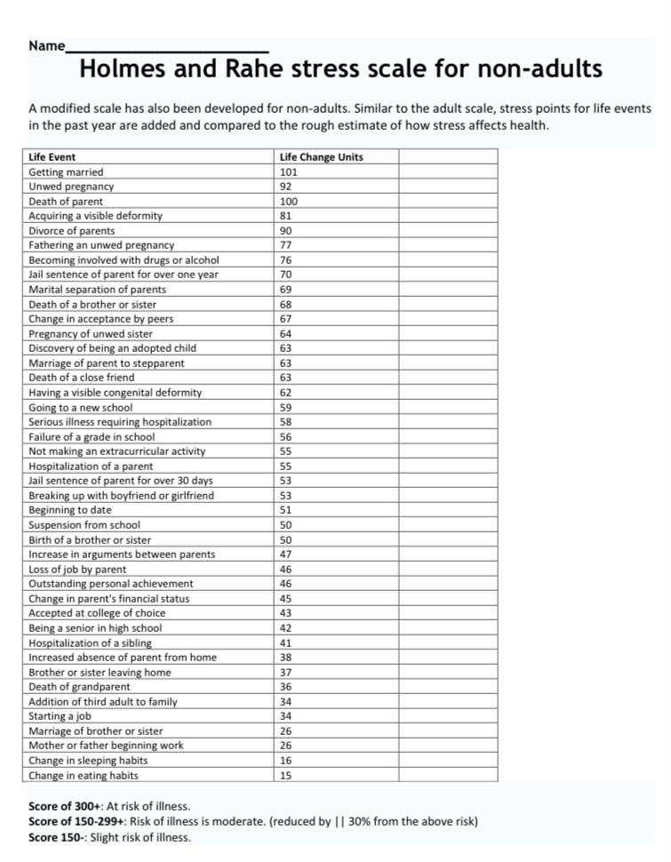
HOLMS STRESS SCALE FOR CHILDREN

Slide 87
ZOOM POLLS
Throughout the year we will be doing polls to better understand some of your thoughts, feelings and needs from the course.
We’ll look at the answers of zoom participants immediately after we do the polls.
We’ll share the answers of in person participants at the beginning of the session the week after the poll.
Answers are anonymous

Slide 88
The Holmes and Rahe scale estimates the risk a of stress-related illness in the next 12–24 months. Scores:
0–149 = Low life-change stress ~30% risk
150–299 = Moderate stress load ~50% risk
300+ = High stress load ~80% risk
A score of over 300 doesn’t mean you will get sick, it means your body is carrying so much accumulated adaptation demand that the probability of illness, depression, anxiety, or burnout becomes very high unless there is recovery, support, and stabilization.
This scale predicts: depression, anxiety disorders, immune suppression, cardiovascular events, relapse of medical illness and work disability.
It measures “wear and tear on the system.”

Slide 89
The Perceived Stress Scale (PSS-10) measures how overwhelmed, unpredictable, and overloaded life feels right now. Scores:
0–13 Low perceived stress- Nervous system feels mostly safe and manageable
14–26 Moderate stress- Strain present; coping is working but taxed
27–40 High stress- Nervous system in sustained alarm or overload
High PSS scores correlate strongly with: anxiety and depression, sleep problems, emotional dysregulation, ptsd symptoms, chronic pain, cardiovascular risk
This scale measures “how threatened and out of control the system feels.”

Slide 90
HOLMES–RAHE + PERCEIVED STRESS SCALE INTERPRETATION
HOLMES–RAHE PSS INTERPRETATION
High High Life is objectively heavy, and the nervous system is overwhelmed → highest risk
High Low Moderate Many demands, but coping and support still functioning
Low High Internal stress likely driven by trauma, burnout, or nervous-system sensitization
Low Low System is relatively well regulated

Slide 91
WHAT THE SCORES MEAN
You’ve just completed two very different ways of measuring stress, and together they tell us something far more useful than either one alone.
The Holmes–Rahe scale looks at what has happened to you over the last year: losses, changes, demands, disruptions. It’s a kind of life-weather report. A high score doesn’t mean you’re weak; it means you’ve been living through a lot of change. Even positive changes, marriage, a new job, moving, tax the nervous system, because every change requires adaptation. This scale is really measuring how much wear and tear life has placed on your system.
The Perceived Stress Scale looks at something different. It doesn’t ask what happened. It asks how it feels to be you right now. Do you feel overwhelmed? out of control? unable to catch up? This is more like a reading of your inner climate. Two people can live through the same year and have very different PSS scores, because their nervous systems, histories, and meanings are different.
When we put these two together, we get something very powerful. If both are high, it usually means life has been objectively heavy and your nervous system is struggling to carry it, this is the highest-risk zone for burnout, depression, and illness.
If Holmes–Rahe is high, but PSS is lower, it means you’ve had a lot on your plate, but your coping, support, or regulation is still holding, though you may still need rest and recovery.
If Holmes–Rahe is low, but PSS is high, that often tells us something very important: that your nervous system is running on alarm even when life isn’t especially demanding, often because of past trauma, chronic stress, or attachment wounds.
And when both are low, it usually means your system is relatively well regulated right now.
These numbers are not grades. They are gauges, like your personal dashboards, telling you how much strain your system is under and how close it may be to overload. The goal is not to get a “better” score. The goal is to listen to what your body and nervous system are asking for: rest, safety, support, meaning, or gentler ways of meeting life.

Slide 92
LIMITS OF THE HOLMES AND RAHE SCALE
The Holmes and Rahe scale was developed decades ago and focuses mainly on major life events, things like losses, changes, or transitions. It doesn’t do a great job of capturing more chronic, pervasive stressors such as ongoing social tension, cultural polarization, or distress related to current events and how these strain relationships with family and friends.
Those kinds of stresses may not show up as a single ‘event,’ but they can be emotionally taxing over time and very real contributors to stress. If parts of your stress weren’t reflected in your score, that doesn’t mean they’re insignificant, it means the tool has limits, and your lived experience is what matters.
From a DBT perspective, these ongoing social and value conflicts act like a chronic invalidating environment, increasing emotional vulnerability and making skill use harder so DBT focuses on building regulation and effectiveness even when the stress can’t be removed.

Slide 93
THE STRESS RESPONSE
What happens biologically when we’re stressed ?

Slide 94
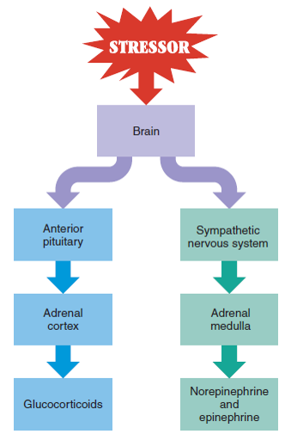
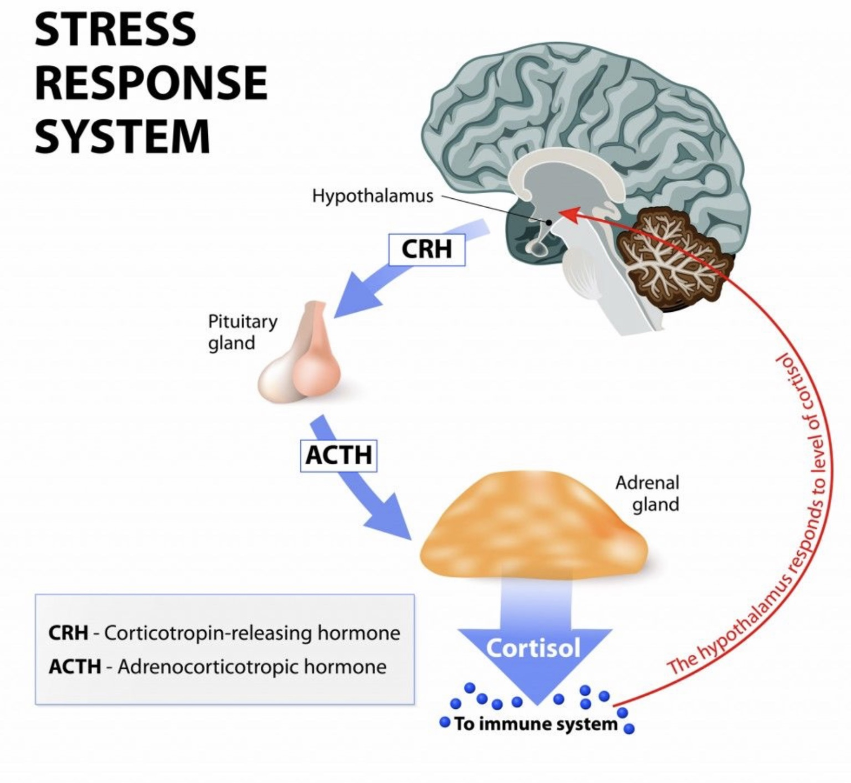
the two components of The stress response
1. Endocrine response (slower)
The hormonal stress response is the body’s way of preparing to deal with a perceived threat. It involves a cascade of hormones primarily from the hypothalamic-pituitary-adrenal (HPA) axis and the sympathetic nervous system.
When a threat is perceived (physical danger, emotional stress, etc.) the amygdala (a brain region involved in fear) signals the hypothalamus.
The hypothalamus activates the sympathetic nervous system. This causes the adrenal medulla (inner part of adrenal glands) to release adrenaline (epinephrine) and noradrenaline (norepinephrine) resulting in increased heart rate, blood pressure, and energy availability.
The hypothalamus also releases CRH (corticotropin-releasing hormone). which triggers the pituitary gland to release ACTH (adrenocorticotropic hormone).
ACTH stimulates the adrenal cortex (outer part of adrenal glands) to release cortisol.
Cortisol mobilizes energy by increasing glucose in the bloodstream. It also suppresses non-essential systems (like digestion and immunity) and helps the body sustain a prolonged response to stress.
Once the threat passes, feedback mechanisms help the body return to baseline. Chronic stress, however, can dysregulate this system and contribute to health issues.
Notes:
The body's stress response is controlled by two systems: the endocrine, and the autonomic nervous systems.
The endocrine stress response uses hormones to transmit information. These hormones include cortisol and adrenaline. The most important players in the endocrine stress response are the hypothalamus, pituitary gland, and adrenal gland.
There are other components of the endocrine system that are not directly related to the stress response these include the thyroid and gonads.
The autonomic nervous system uses electrical signals and neurotransmitters to transmit information. It has two main branches the sympathetic which is involved with preparing the body for action, and the parasympathetic which is involved in physiological repair and energy conservation. The sympathetic branch is the accelerator, the parasympathetic the brakes.

Slide 95
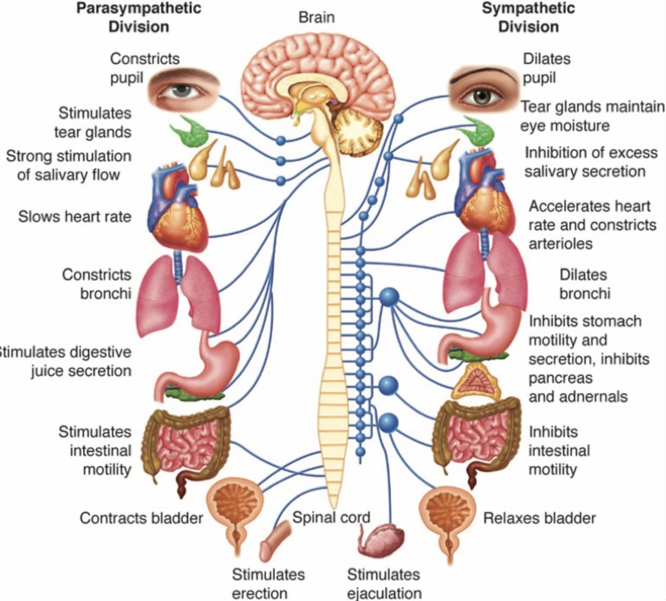
the two components of The stress response
2. Autonomic nervous system response (faster)
The autonomic stress response is the body’s automatic, unconscious reaction to stress, regulated by the autonomic nervous system (ANS), which has two main branches:
The sympathetic Nervous System (SNS) – “Fight or Flight”. It is activated during stress or perceived threat. Prepares the body for action: Increases heart rate and blood pressure, dilates pupils, slows digestion, releases glucose for energy and causes adrenaline release from the adrenal medulla
The parasympathetic Nervous System (PNS) – “Rest and Digest” is activated when the threat has passed. It calms the body and restores balance: It slows heart rate, promotes digestion, facilitates recovery and repair and conserves energy.
The autonomic stress response is a rapid, involuntary shift from parasympathetic to sympathetic dominance when faced with a challenge.
After the stressor is removed, the parasympathetic system works to restore homeostasis (internal balance). This system allows the body to respond quickly to danger—and recover once it’s safe again.
Notes:
The body's stress response is controlled by two systems: the endocrine, and the autonomic nervous systems.
The endocrine stress response uses hormones to transmit information. These hormones include cortisol and adrenaline. The most important players in the endocrine stress response are the hypothalamus, pituitary gland, and adrenal gland.
There are other components of the endocrine system that are not directly related to the stress response these include the thyroid and gonads.
The autonomic nervous system uses electrical signals and neurotransmitters to transmit information. It has two main branches the sympathetic which is involved with preparing the body for action, and the parasympathetic which is involved in physiological repair and energy conservation. The sympathetic branch is the accelerator, the parasympathetic the brakes.

Slide 96
The stress response is the body’s way of preparing for danger. When a threat is sensed, the brain quickly releases stress hormones that raise heart rate, blood pressure, and energy so we can act.
Short-term, this response is helpful and protective. Once the threat passes, the body is meant to settle back to normal.
Chronic stress, however, keeps this system turned on too long, which can disrupt the body and contribute to health problems

Slide 97
POLYVAGAL THEORY
What is the evolutionary function of the stress response ?

Slide 98

polyvagal theory
Stephen Porges’s polyvagal theory explains the physiology and function of the stress response. It describes the different states of arousal or activation of the autonomic nervous system and revolutionized our understanding of trauma.
The human nervous system has been evolving for hundreds of millions of years. It is, what is called, phylogenetically ancient.
The autonomic nervous system (ANS) connects the central nervous system and emotional brain via the vagus nerve with the body all the internal organs and muscles.
Like cars, the ANS has one accelerator and two breaks. The accelerator is called the sympathetic branch. As with a car that is in gear but at a standstill, if you don't press the break, it will slowly go forward.
The parasympathetic branch is the break. It has two components: the dorsal and the ventral nuclei .1) The dorsal nucleus is phylogenetically ancient and like the handbrake is all or nothing. When it is activated, it results in immobilization. It is a survival strategy 2) The ventral nucleus evolved in the last 200 million years when mammals came into existence. Like the foot brake it is incremental. It is concerned with health, growth, and restoration. It is activated when we are calm, and our body is repairing itself and storing energy. Our ventral vagus baseline tone is greatly affected by attachment and social interactions.
Stephen Porges
Notes:
One way to look at what the stress response does for us is to consider Stephen Porges polyvagal theory…
Consider the life of a wild animal such as a gazelle living in the Serengeti plains of Africa.
Gazelles spend most of their time grazing. As they do that, they are "calm". The calm state of autonomic activation is like an idling car; the sympathetic engine is turned on, and the car would slowly move forward, were it not for the parasympathetic breaks also being on.
Imagine that a lion suddenly appears in the distance. As a line approaches, the gazelle’s sympathetic nervous engine progressively accelerates. As it does, the parasympathetic breaks stay on, and the gazelle does not move, but becomes increasingly fearful. Then suddenly, when the lion is close, the gazelle’s parasympathetic breaks release, unleashing the sympathetic accelerator: the chase is on.
These increasing states of activation are called alert, and fight/flight. The state of activation at which the gazelle’s sympathetic activation is at a maximum and the parasympathetic breaks stop her from moving is referred to as hyper freeze, literally frozen in fear. When the breaks release, the gazelle goes from hyper freeze to full flight.
The gazelle then either escapes or is caught. If it is caught, it is likely to go into a state of activation known as hypo freeze or feign death. In this state, the parasympathetic "handbrake" goes on, causing a drastic decrease in sympathetic and physiological activity that is difficult to distinguish from death, when the engine stops completely.
In hypo freeze, or feign death, the gazelle is hardly breathing, its heart rate is extremely slow, and it may be unconscious, or in an altered state of consciousness. In this state, if it is killed by the lion, it's death may be relatively painless. If for some reason, it is spared, pray are known to suddenly switch from hypo freeze, back into fight or flight, escape and survive
The "arousal curve", which describes an organism's physiological state of activation in response to stressors, helps us to understand human stress and trauma. We become physiologically activated when our resources become depleted, or we feel threatened.
In humans, the increasing states of activation are referred to using a variety of terms: calm, concern, worry, anxiety, apprehension, fear, panic, and terror. Hypo freeze is a state of dissociation that can manifest as helplessness, depression, or numbness

Slide 99
Polyvagal theory explains how the nervous system responds to safety and danger and has deepened our understanding of trauma. Our stress system is very old, shaped by evolution over hundreds of millions of years.
The autonomic nervous system connects the brain to the body through the vagus nerve and controls arousal and calm.
It works like a car: one accelerator (fight/flight) and two brakes. One brake causes shutdown or collapse when danger feels overwhelming. The other, more evolved brake supports calm, connection, healing, and restoration.
This calming system is strongly shaped by safe relationships and attachment.

Slide 100

THE POLYVAGAL SYSTEM IN ACTION
Gazelle at the Watering Hole
1. Social Engagement (Ventral Vagal): Calm, connected, grazing safely with the herd.
2. Threat Detected (Lions Approach): Sympathetic arousal → hyper-vigilance, heart rate increases, muscles prime for flight.
3. Targeted & Chased: Full sympathetic fight/flight → sprinting, focused survival response.
4. Captured/Overwhelmed: Dorsal vagal shutdown → collapse, immobilization, feigned death.
5. Escape Opportunity: Sudden shift back to sympathetic drive → explosive flight response.
6. Safe Again: Gradual return to ventral vagal state → rejoining herd, calming.

Slide 101
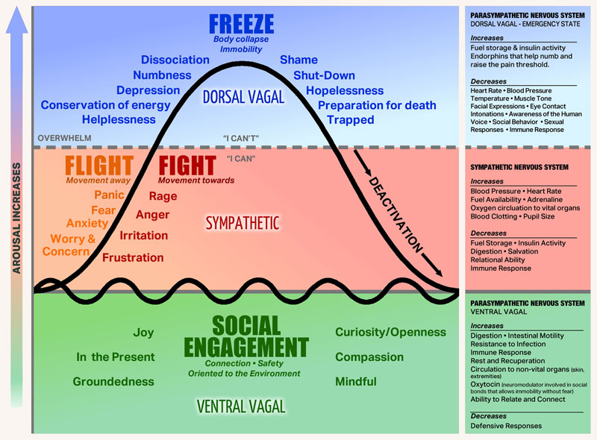
POLYVAGAL AROUSAL AND MENTAL HEALTH CONDITIONS
When we are calm or alert, our parasympathetic and sympathetic systems are in balance, and we are curious and ready to explore. We are in discovery mode.
When we are acutely stressed our sympathetic nervous system is hyperactivated. Our adrenaline, and cortisol are high, our heart rate elevated, and our attention narrowed. We are in fight/flight or in defend state.
When we are overwhelmed our dorsal parasympathetic branch of the nervous system is activated and we shut down or collapse. We collapse. This is a form of defense through immobilization rather than the mobilization of fight/flight.
Anxiety disorders are chronic hyperactivation of the sympathetic nervous system.
Depression and dissociation are chronic hyperactivation of the dorsal parasympathetic associated low energy, blunted affect, slowed physiology, protective disengagement, body numbing, and narrowed awareness.

Slide 102
When your Perceived Stress Scale score is high, it usually means that your nervous system is not in ventral vagal safety, it is living in fight-flight or shutdown.

Slide 103
AROUSAL STATES

Slide 104
The Four Arousal states
1. calm-alert, 2. Fight/flight, 3. freeze, 4. Fawn
We are in the window of tolerance when
We are outside the window of tolerance when
We are calm, or alert
We play, and engage socially
We cooperate with each other; we are care based
We feel expanded and relaxed, we are flexible
We regulate one another
We are receptive
We are open to learning
We are in ventral parasympathetic activation
We are in fight, flight, freeze, or fawn
We fight, run away, collapse or appease.
We compete or comply; we are transactional
We feel contracted or tense, we are rigid
We dysregulate each other
We are reactive
We stick to and defend our beliefs or submit to those of others
We are in high sympathetic or dorsal parasympathetic activation
If a person who is in the window of tolerance spends time with one who is outside the window of tolerance, eventually they tend to synchronize and either both be in, or out the of the that window
Same thing happens with groups of people.
Notes:
Whether a person is predominantly inside or outside the window of tolerance is part of personality. People who are able to stay well-regulated tend to present very differently than those who are not.

Slide 105
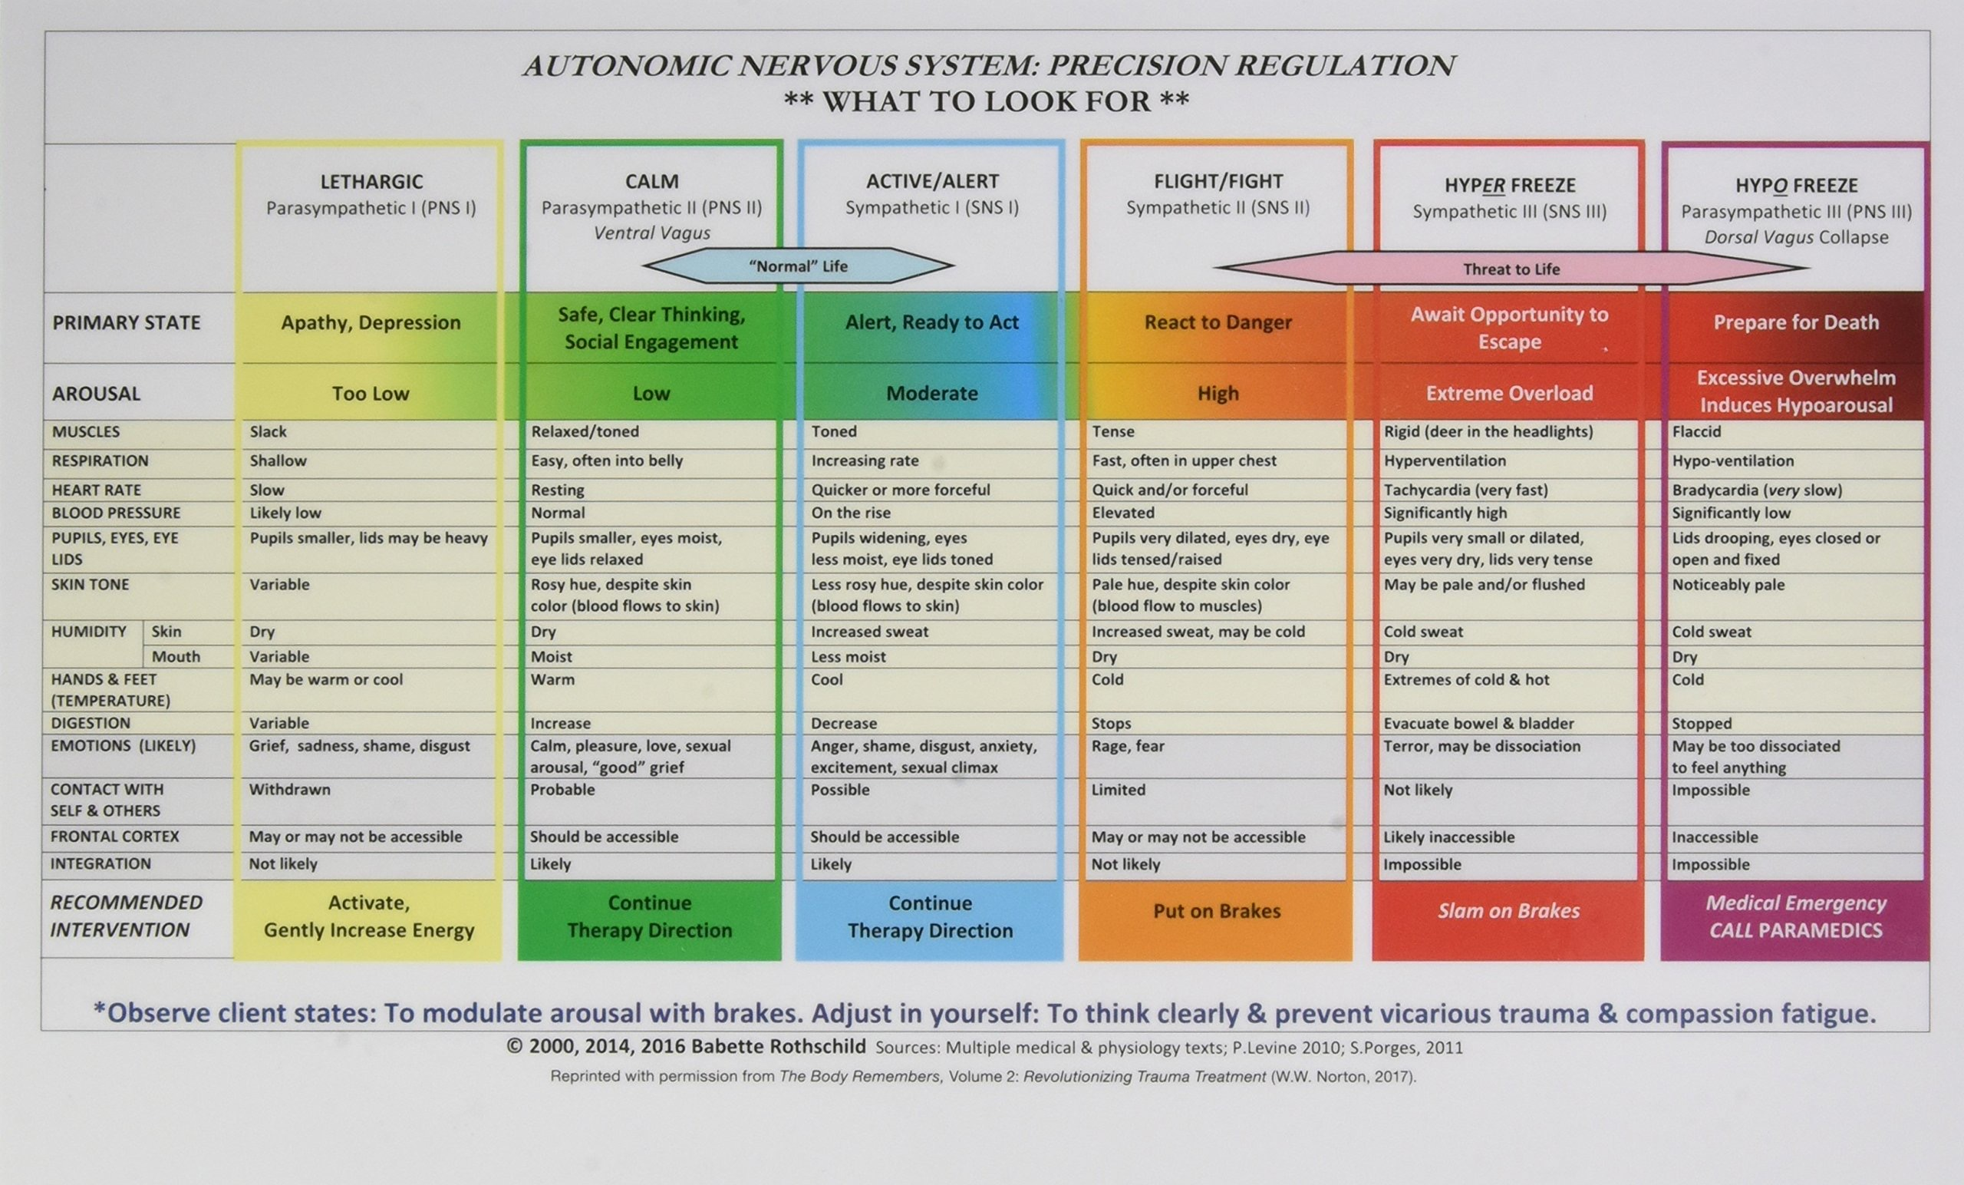
Notes:
The states of polyvagal activation have been summarized by author Babette Rothschild, in a color-coded chart. The chart emphasizes that psychotherapy is only possible when the client is in the therapeutic window of activation that includes the calm and alert states

Slide 106
IDENTITY (WHAT IT MADE OF ME)
How does this shape our experience?

Slide 107
HOW STRESS AFFECTS BODY AND MIND: SIGNS AND SYMPTOMS, PERFORMANCE
How do stressors and stress affect the body and the mind?

Slide 108

how stressors Affect body and mind
Stress can start in the body (like infections, toxins, injury, or poor nutrition) or in the mind (like loneliness, conflict, or negative self-image), but all stress affects both body and mind.
A common pathway for all stress is inflammation. Short-term inflammation helps protect us, but chronic inflammation causes damage.
The immune system, nervous system, and stress system work together to protect us, but chronic stress can dysregulate them, causing them to function poorly or even turn against the body.
This dysregulation is linked to autoimmune illness, anxiety, depression, and other psychiatric conditions.
In the brain, chronic stress can disrupt microglia, immune cells that normally support brain health but, when overactivated, can damage brain cells and connections, contributing to mental illness.

Slide 109

EFFECTS OF STRESS ON THINKING, EMOTIONS, BODY, AND BEHAVIOR
Notes:
The effect of stressors on body and mind can be divided into cognitive, emotional, physical, and behavioural manifestations.

Slide 110

STRESS MADE ME DO IT

Slide 111

HOW STRESS AFFECTS PERFORMANCE
The Yerkes-Dodson curve shows that performance is best at moderate levels of stress or arousal.
Too little stress leads to underperformance, while too much stress impairs thinking and functioning.
In short: some stress helps, too much hurts.
Notes:
The Yerkes-Dodson curve maps human performance with the different states of activation. Not surprisingly the function best when our gas tank is full, and we are in calm/alert.

Slide 112
HOW STRESS AFFECTS CHILDREN
Does stress affect children differently than adults?

Slide 113

Children’s stress systems are still developing, so they rely heavily on attachment figures.
Securely attached children’s caregivers act as stress buffers, helping regulate the child’s nervous system, keeping stress tolerable and promoting resilience.
Insecurely attached children’s caregivers become stress enhancers, amplifying stress, and making it overwhelming.
Children “borrow” adult regulation, while adults can self-regulate more independently.
Chronic stress in children keeps their nervous system on high alert, disrupting learning, attention, and emotional regulation. Over time this can impair brain development, erode confidence, and make it harder to build secure relationships, setting them up for struggles in school, relationships, and coping later in life.
We will look at this in more detail in 2 weeks when we consider the ACE’s studies.
STRESSED CHILDREN
Notes:
Children are able to cope with mild or positive stress on their own. When the stress is more severe, the presence of attuned and responsive adult makes a huge difference as the weather it is tolerable or toxic. Tolerable stress has very different effects on children then does exposure to toxic stress.

Slide 114

Children’s vulnerability to stress
Chronic and/or severe stress is even more damaging to children than it is to adults
In part that’s because children have fewer resources such as coping skills, ability to leave a bad situation, and ability to fight back than do adults.
They are also in the “window of learning” during which they form internal “maps” of the world that tend to persist once they are are formed. People’s baseline state of activation is set early in life and tends to persist. It can be changed later but that requires effort and/or luck of sustained positive experiences
If they grow up in a stressful and dangerous world their bodies adapt for survival and their immune, autonomic, and central nervous systems are chronically set on high alert/activation
If they are overstressed, they don’t learn well which sets them up for failure in school and for bullying
They are also more likely to adopt “scarce resource, fast reproduction life strategies” : they tend to mature earlier, have more partners and children, and function in fight/flight, fawn or freeze.

Slide 115
LIFE HISTORY THEORY

Slide 116

Life history theory
Warning this material may trigger some people so please keep in mind that these are not personality types or moral traits. They are survival algorithms written by early danger or safety.
Life history theory tends to generate emotional responses in people even if there’s good scientific support for it.
Life history theory studies the diversity of life history strategies used by different organisms as well as the causes and results of these variations in their life cycles.
Life history theory proposes that highly stressed animals, humans included, are more likely to develop “fast life strategies” than those who experience low stress.
Faster vs. slower life histories differ in physiology, psychological outlook, and mating and parenting strategies.
Slower vs. Faster life histories are not categories but a spectrum
Faster life strategies are also more common in people with more severe attachment disorders and developmental trauma.
Temperament is also an important determinant in the evolution of these strategies
As with other evolutionary psychology theories there is controversy around some of these ideas.
Some people feel insulted by them.
Life history theory link
Notes:
Stress also affects how fast children develop.

Slide 117
FAST LIFE HISTORY STRATEGIES
Are adaptations to unpredictable, unsafe, or resource-scarce environments.
General pattern: prioritize immediate rewards, survival, and reproduction
Examples: Growing up in a chaotic or dangerous environment and learning to act quickly, take risks, and focus on the present. Early puberty and earlier sexual activity. Short-term relationships rather than long-term pair bonding. Having children earlier, often with less long-term planning. Impulsivity, sensation-seeking, aggression, or hypervigilance. Difficulty delaying gratification (“take what you can, when you can”). Focus on immediate needs rather than long-term goals (saving, education)
Clinical echoes: trauma-related hyperarousal, impulsivity, substance use, some externalizing disorders

Slide 118
SLOW LIFE HISTORY STRATEGIES
Are adaptations to safe, stable, resource-rich environments
General pattern: prioritize long-term planning, investment, and cooperation
Examples: Growing up with consistent caregiving and predictable resources. Later puberty and delayed sexual activity. Long-term relationships and pair bonding. Having children later, with high investment in each child. Strong capacity for self-control and delayed gratification. Long-term planning: education, career building, saving. Emphasis on cooperation, trust, and social stability
Clinical echoes: resilience, emotional regulation, capacity for reflection and future-oriented thinking
These are adaptive strategies, not character flaws. People don’t choose fast or slow strategies; they develop in response to early environments.

Slide 119
FAST LIFE HISTORY STRATEGY — CLINICAL VIGNETTES
Vignette 1: “You take the chance while you can”
A 28-year-old man grew up with frequent moves, parental substance use, and unpredictable caregiving. He is quick to act, easily bored, and struggles with impulsivity. He forms intense relationships that burn out quickly and has difficulty saving money or planning long term. When stressed, he goes straight into fight-or-flight.
Clinical frame: His nervous system learned early that the future is uncertain, so survival depends on acting now.
Vignette 2: “Hyper-alert and reactive”
A woman in her early 30s with a history of childhood violence is highly attuned to threat. She reacts strongly to perceived rejection, uses substances to regulate emotions, and finds it hard to tolerate boredom or stillness.
Clinical frame: A fast strategy optimized for danger—speed, vigilance, and immediate relief—now creates problems in a safer adult environment.

Slide 120
SLOW LIFE HISTORY STRATEGY — CLINICAL VIGNETTES
Vignette 3: “Delay and invest”
A 35-year-old professional grew up in a stable home with predictable routines and emotional support. He delayed relationships until finishing school, saves money, plans carefully, and tolerates stress without becoming overwhelmed.
Clinical frame: His nervous system expects stability, making long-term investment feel safe and worthwhile.
Vignette 4: “Future-oriented regulation”
A woman raised with consistent caregivers and strong social supports experiences stress but can pause, reflect, and ask for help. She chooses long-term goals over immediate relief and recovers quickly from setbacks.
Clinical frame: A slow strategy shaped by safety—self-regulation, trust, and future planning.
These strategies are adaptive responses to early environments, not personality flaws. Problems arise when a strategy that once ensured survival is carried into a context where it no longer fits.
Being aware of this can help us “slow down”.

Slide 121
THE STRESS MAP
How life load and nervous system state interact
Two Ways Stress Shows Up
Life Load | Nervous System Load
Holmes–Rahe Scale | Perceived Stress Scale (PSS)
What has happened to you | How overwhelmed you feel
Measures change, loss, demands | Measures threat, unpredictability, control
What the year has asked of you | How heavy life feels inside

Slide 122
WHAT EACH SCALE IS REALLY MEASURING
Holmes–Rahe = “Wear and tear on the system”
Predicts risk of stress-related illness over the next 12–24 months
0–149 → Low (~30% risk)
150–299 → Moderate (~50% risk)
300+ → High (~80% risk)
PSS = “How threatened and out of control the system feels”
0–13 → Low (mostly safe)
14–26 → Moderate (strained but coping)
27–40 → High (nervous system in alarm or overload)
HIGH SCORES DO NOT MEAN
You are weak, you are failing or you are broken. They mean your nervous system has been working hard to survive what life has asked of you.

Slide 123
Our nervous systems learned these patterns to survive.
That means they can also learn new ones, slowly, safely, and in connection

Slide 124



Slide 125

OPEN DISCUSSION

Slide 126

See you next session

Slide 127

video
Week 15 of simple

Slide 128


Slide 129


Slide 130


Slide 131


Slide 132


Slide 133


Slide 134


Slide 135


Slide 136


Slide 137


Slide 138


Slide 139


Slide 140


Slide 141
(1)The Whitehall Study of British civil servants, conducted by Sir Michael Marmot and colleagues, found a strong correlation between job status and health outcomes. The study showed that the lower a person's job status, the higher their risk of health issues such as heart disease, stress, and overall mortality. This highlighted the significant impact of social determinants, such as employment status, on health disparities
Some of the key conclusions of the Whitehall studies include:
1. The importance of social determinants, such as job status, on health outcomes.
2. The presence of a social gradient in health, where individuals in lower job positions have poorer health outcomes compared to those in higher positions.
3. The role of psychosocial factors, such as job stress and control, in influencing health.
4. The need for policies and interventions to address health inequalities and improve overall population health.
The Whitehall studies have been instrumental in shaping our understanding of the social determinants of health and the importance of addressing inequalities in health outcomes.

Slide 142
(2)The Holmes and Rahe Stress Scale, also known as the Social Readjustment Rating Scale, was developed by psychiatrists Thomas Holmes and Richard Rahe in 1967. The scale was created based on a study that aimed to investigate the relationship between stressful life events and illness.
Holmes and Rahe identified a list of 43 life events that could potentially cause stress, such as marriage, divorce, job loss, and death of a loved one. Each event was assigned a numerical value based on the perceived amount of stress it could cause. Participants in the study were asked to indicate which events they had experienced in the past year, and their total score was used to estimate their risk of developing stress-related health issues.
The use of the Holmes and Rahe Stress Scale involves individuals identifying and tallying up the life events they have experienced over a specific period, typically the past year. The total score is then compared to a key that indicates the level of stress and the associated risk of health issues. The scale is often used in research and clinical settings to assess the impact of life events on stress levels and to help individuals understand the potential health risks associated with significant life changes.
While the Holmes and Rahe Stress Scale has been widely used and cited in research, it is important to note that the scale has limitations. Not all individuals react to life events in the same way, and the scale does not account for individual differences in coping mechanisms, resilience, and social support. Therefore, while the scale can provide a general indication of stress levels, it should be used as one tool among many in assessing an individual's overall well-being and risk of stress-related health issues.

Slide 143
(3)Life history theory is a branch of evolutionary biology that seeks to understand how organisms allocate their time and energy resources to various life activities, such as growth, reproduction, and survival, in order to maximize their fitness in different environments. The theory is based on the idea that organisms have limited resources and must make trade-offs between competing life history traits to optimize their reproductive success.
Some of the main findings of life history theory include:
1. Trade-offs between growth, reproduction, and survival: Organisms face trade-offs in allocating resources to different life history traits. For example, investing more energy in reproduction may come at the expense of growth or survival, leading to different life history strategies depending on environmental conditions and life history trade-offs.
2. Environmental influences on life history strategies: Organisms adjust their life history strategies in response to environmental cues such as resource availability, predation risk, and competition. For example, in unpredictable or harsh environments, organisms may adopt a "fast" life history strategy characterized by early reproduction and high reproductive effort, while in stable environments, a "slow" life history strategy with delayed reproduction and greater investment in growth and survival may be favored.
3. Life history diversity within and between species: Different species and populations exhibit a wide range of life history strategies, reflecting adaptations to their specific ecological niches and environmental conditions. Life history traits such as age at first reproduction, litter size, and lifespan can vary significantly across species and populations.
4. Evolutionary trade-offs and constraints: Evolutionary trade-offs between life history traits can constrain the evolution of optimal strategies. For example, investing more resources in reproduction may enhance immediate fitness but reduce future reproductive success or survival, leading to complex evolutionary dynamics and the maintenance of variation in life history strategies within populations.
Life history theory provides a framework for understanding the diversity of life history strategies observed in nature and the evolutionary processes that shape the allocation of resources to growth, reproduction, and survival in different organisms

Slide 144
(4)Jean Twenge's book "iGen: Why Today's Super-Connected Kids Are Growing Up Less Rebellious, More Tolerant, Less Happy--and Completely Unprepared for Adulthood--and What That Means for the Rest of Us" explores the characteristics and behaviors of the generation born between 1995 and 2012, often referred to as Generation Z or iGen. Some of the main conclusions drawn by Twenge in the book include:
1. The impact of technology: Twenge highlights the role of smartphones, social media, and digital technology in shaping the behaviors and attitudes of iGen. She discusses how constant connectivity has influenced social interactions, mental health, and overall well-being.
2. Changes in social trends: Twenge points out shifts in iGen's attitudes towards social issues, relationships, and traditional markers of adulthood such as driving, dating, and working. She discusses how these changes may be influenced by the unique societal and technological context in which iGen has grown up.
3. Mental health concerns: Twenge addresses the rising rates of anxiety, depression, and loneliness among iGen, linking these trends to factors such as screen time, social media use, and societal pressures.
4. Preparation for adulthood: Twenge raises concerns about iGen's readiness for adulthood, citing challenges in developing independence, resilience, and coping skills in the face of increasing societal and technological complexities.
Twenge's book offers insights into the characteristics and challenges faced by the iGen generation and raises important questions about the implications of these trends for individuals and society as a whole.

Slide 145
(5)The term "gaslighting" originated from a 1938 play called "Gas Light" by Patrick Hamilton, which was later adapted into a film in 1944. In the story, a husband manipulates his wife into believing she is going insane by dimming the gas lights in their home and then denying that the lights are flickering when she notices it. This psychological manipulation and emotional abuse tactic became known as gaslighting.
The term has since evolved to describe a form of manipulation where one person seeks to make another person doubt their own perceptions, memories, and sanity. Gaslighting is often used in abusive relationships or in situations where one person seeks to gain power and control over another by causing them to question their reality. The term has gained popularity in psychology and popular culture to describe this type of manipulative behavior.

