Slide 1


Welcome to Week 17 of simple
THE trauma spectrum disorders
Please start recording at 9 am

Slide 2
week 17- the stress and trauma related disorders-session 20 of manual.
week 18- emotional regulation skills p.183-206 of dbt workbook. our fifth practice session-the goals diary card procedure- session 21 of manual
week 19- structural dissociation theory and the treatment of the traumatic spectrum disorders- session 22 of manual.
week 20- introducing interpersonal skills p.207-241 of dbt workbook. Review of all the skills
week 21-introducing internal family systems (ifs)-session 24 of manual. introducing the ifs workbook and ifs workbook guided ai assisted self therapy
week 22- Spirituality, religion, and health- session 26 of manual.
week 23-interpersonal skills and putting it all together p.242-265 of dbt workbook. states of activation as essential trailheads and the four pillars of recovery from trauma-session 27 of manual.

Slide 3
SIMPLE COURSE SCHEDULE 2025-26
Week 1- October 1
Week 2- October 8
Week 3- October 15
Week 4- October 22
Week 5- October 29
Week 6- November 5
Week 7- November 12
Week 8- November 19
Week 9- November 26
Week 10- December 3
Week 11- December 10
Week 12- December 17
December 24 and 31
Week 13- January 7
Week 14- January 14
Week 15- January 21
Week 16- January 28
Week 17- February 4
Week 18- February 11
Week 19- February 18
Week 20- February 25
Week 21- March 4
March 11 and 18 no course
Week 22- March 25
Week 23- April 1
Week 24- April 8
Week 25- April 15
Week 26- April 22
Week 27- April 29
Week 28- May 6
Week 29- May 13
Week 30- May 20
Week 31- May 27
Week 32- June 3

Slide 4

Warning about meditation
Feel free to skip it. Followed by a moment of silence

Slide 5
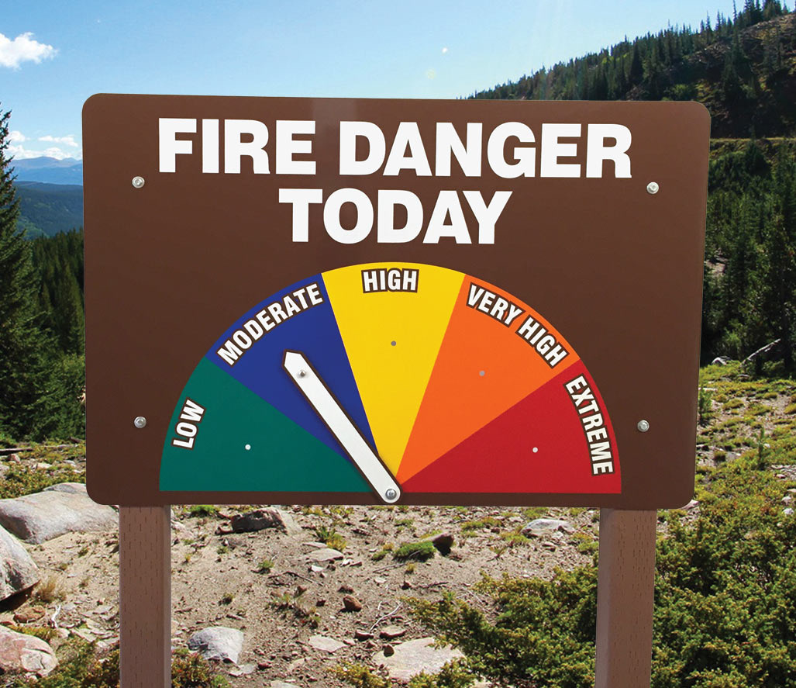




Check in regularly with your Personal dashboard
Spend a few moments checking in with yourself by asking:
1)What is the current risk that I’ll experience a state of crisis ?
Low b) Moderate c) high d) very high e) extreme
2) Am I in the window of tolerance?
a) Yes b) I’m a little outside c) very outside
3) Where is my energy tank right now?
Full b) ¾ c) ½ d) near empty
4) Have I been tracking my targets using the holes diary card ? how would I rate my targets right now?
5) How well am I focusing on what I’m doing. (for example, the course)
CRISIS RISK
WINDOW OF TOLERANCE
ENERGY RESERVES
RATING MY TARGETS
ATTENTION METER
% attention I’m paying
100
0

Slide 6
FIVE-MINUTE TRAUMA-INFORMED GROUNDING MEDITATION
Theme: Staying oriented, resourced, and in choice (don’t read black type)
0:00–0:45 — Opening & Choice
Before we begin, just a reminder:
you are always in control of this practice.
You can keep your eyes open or closed,
shift your posture,
or stop at any time.
Nothing needs to be forced.
We’re not trying to relive anything,
just noticing what helps the body feel a little safer,
right now.
0:45–1:45 — Orientation to the Present
Let’s begin by orienting to where we are.
If your eyes are open, gently look around the room.
If they’re closed, imagine the room you’re in.

Slide 7
FIVE-MINUTE TRAUMA-INFORMED GROUNDING MEDITATION
Notice three things you can see…
two things you can hear…
and one thing you can physically feel—
perhaps the chair supporting you,
or your feet on the floor.
1:45–2:45 — Grounding Through Contact
Now, bring attention to points of contact.
Notice where your body is being held—
the floor, the chair, the backrest.
You don’t have to relax anything.
Just notice what’s already supporting you.
If it feels helpful, you might gently press your feet into the floor
or your hands together,
just enough to feel your own strength.

Slide 8
FIVE-MINUTE TRAUMA-INFORMED GROUNDING MEDITATION
2:45–3:45 — Resourcing
Now, let’s bring to mind something that feels neutral or comforting.
It might be a place,
a memory,
a person,
or even a simple activity—
walking, drinking tea, sitting in the sun.
Notice what happens in your body when you think of this.
If nothing changes, that’s perfectly okay.
3:45–4:30 — Gentle Breath Awareness (Optional)
If it feels okay, notice your breath—
not controlling it,
just noticing where it’s easiest to feel.
If the breath ever feels uncomfortable,
you can return to feeling your feet,
or looking around the room.

Slide 9
FIVE-MINUTE TRAUMA-INFORMED GROUNDING MEDITATION
4:30–5:00 — Closing & Re-Orientation
As we finish, gently bring your attention back to the room.
Notice the sounds, the light, the sense of being here.
Trauma narrows the nervous system’s sense of time and safety.
Each moment of grounding like this
is a small reminder that now is not then.
When you’re ready,
carry this sense of choice and orientation into the rest of our work.

Slide 10


Slide 11
PRACTICE SESSIONS SCHEDULE
preparation
practice
5. Next Week 18 February 11 Today February 4, 1:30 goals diary card Nicole L
6. Week 25 April 15 April 8, 1:30 IFS workbook 1 Elaine S.
7. Week 26 April 22 April 15 IFS workbook 2 Dinko T.
8.Week 27 April 29 April 22 IFS workbook 3 Barb H.
9. Week 28 May 6 April 29 IFS workbook 4 Meaghan
10.Week 29 May 13* May 6 1:30 PM* Wise mind remediation Rob T.
We now have a full slate of volunteers but if anyone would like on a “substitute list” in case someone can’t make it, as happened last week, please let us know.

Slide 12
Last week we suggested you focus on the goals diary card procedure rather than other parts of the homework

Slide 13
Homework from last week
Submit
Submit questions or comments to itssimple2023@gmail.com
Read
Simple manual session 20
Do
Do the goals diary card procedure over the next week
Continue
Continue reviewing and practicing your crisis plans, diary cards, chain analysis and rational mind remediations
Continue
Continue tracking all the skills you’ve learned using your DBT diary card. Practice them.
Review
the homework habits checklist each week. If there’s an item that you haven’t checked on the list, consider setting a goal to do it(you don’t have to come to the homework group to do that)

Slide 14
Homework for the next week
Submit
Submit questions or comments to itssimple2023@gmail.com
Read
Read skills training workbook p. 148-206.
Continue
Continue reviewing and practicing your crisis plans, diary cards, chain analysis, and rational mind remediations.
Do
Do the wellness assessment tool, choose your goals.
Continue
Continue tracking all the skills you’ve learned using your DBT diary card. Practice them.
Simple manual session 21.

Slide 15
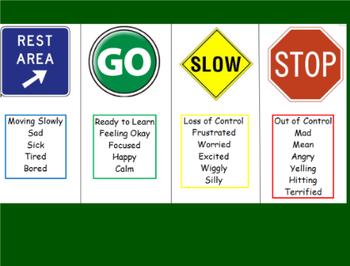
Skills training workbook p. 148-182 introducing emotional regulation
FOR THOSE WHO DON’T HAVE THE SECOND EDITION OF THE WORKBOOK THESE ARE THE TOPICS WE’LL COVER NEXT WEEK
Today we’ll review emotional regulation skills on pages 148 to 206 of the workbook. It starts by asking two questions:
Your emotions: what are they ?
How do emotions work?
We’ll discuss the 9 emotion regulation skills presented in the workbook:
Recognizing emotions
Overcoming barriers to healthy emotions
Reducing physical vulnerability
Reducing cognitive vulnerability
Increasing Positive Emotions
6. Being mindful of your emotions without judgement
7. Emotion exposure
Doing the opposite of your emotions
Problem Solving

Slide 16
HOMEWORK HABITS CHECKLIST
Circle or check what you will try this week.
1. Preparation habits
■ I schedule a specific time for homework.
■ I choose a consistent location with minimal distractions.
■ I gather what I need ahead of time (notebook, worksheet, pen).
2. Focus & pacing habits
■ I start with a tiny step (2–5 minutes).
■ I use a timer (10–15 minutes).
■ I remove distractions (phone away / Do Not Disturb).

Slide 17
HOMEWORK HABITS CHECKLIST
3. Tracking & organization habits
■ I keep materials in one place (binder / folder / notebook).
■ I write down insights right after doing the homework.
4. Self-compassion habits
■ I aim for progress, not perfection.
■ I notice resistance without judgment.
5. Accountability habits
■ I review my week: What worked? What didn’t?
■ I share honestly with my buddy — even when I didn’t do it.
Micro commitment:
This week I will focus on: ■ Time ■ Place ■ Tiny step ■ Timer ■ Other please specify:

Slide 18

WEEKLY ANNOUNCEMENTS
Last week we emailed you slides meant to help you think about your “personal religious myth”.
Ideally you will have worked on this by week 31 May 27, our circle of meaning session.

Slide 19


REMINDER PARTICIPANT AGREEMENTS
If you have questions, comments, or feedback, please save them for the two question periods. You can put them in the chat box or raise your real/virtual hand.
Keep comments, questions, and feedback relatively brief so everyone has a chance to participate.(one breath sharing)
If you’re on zoom, make sure no one can overhear what is being said
For reasons that will become clear later in the course please avoid giving advice to other participants about what they should or should not do. Validation, encouragement , and understanding are however very much appreciated.

Slide 20
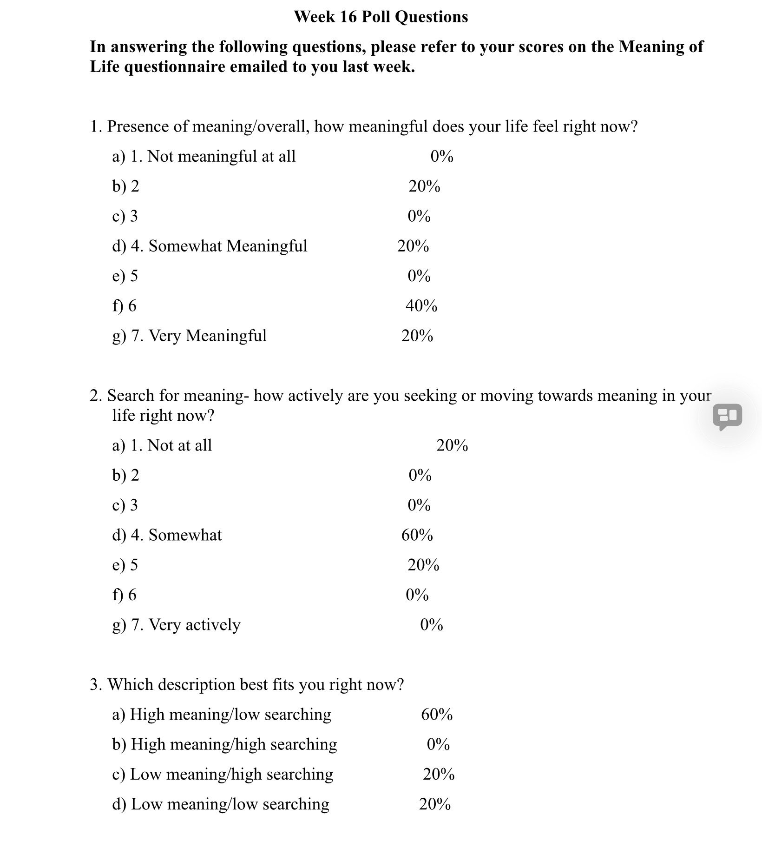

Slide 21

E-mailed questions, comments, feedback

Slide 22
As always, we’ve had some very good questions this week. We try to address most questions that are asked. These question may interest one person or many people.
Until we find a better way, we’ll post answers that we think may be of interest to most people but unfortunately because of time we cannot read all of them in the sessions. We will therefor arbitrarily read out only a few of the many excellent questions you’ve asked.
We’ll however read out all the questions and invite everyone to go to the website’s PowerPoint presentations and go over the answers with more time.

Slide 23
Question whose answer we will read out today

Slide 24
We will only read out the following question, not the answer, and invite those interested to go to the website after the session.

Slide 25
Now for today’s session: The trauma spectrum disorders.
Thank you, Joan and Nicole.

Slide 26
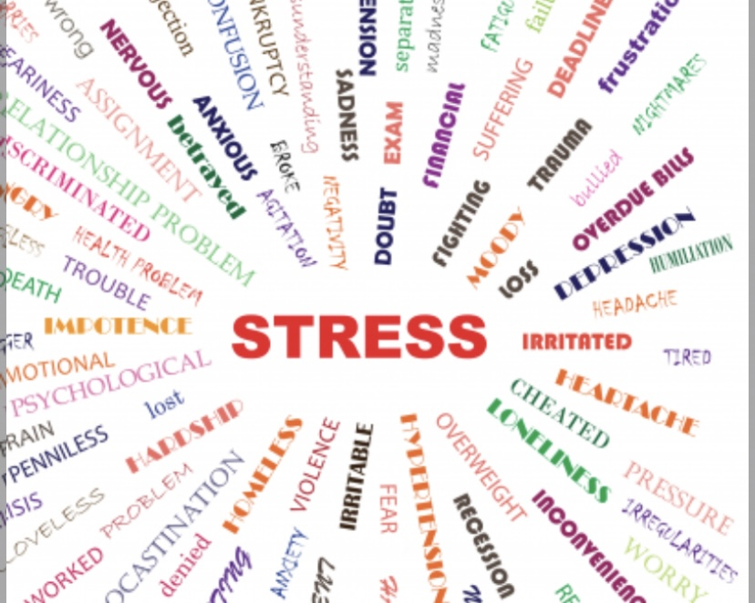
Defining stress
Stress, fear and anxiety
Diagnosing stress
Intensity and duration of stress
Types of stressors: socioeconomic, discrimination, gaslighting
Statistics, Gen Z and the stress epidemic
Assessing stress
The stress response
Polyvagal theory
Arousal states
How stress affects body and mind: signs and symptoms, performance
How stress affects children
Life history theory
2 WEEKS AGO, WE
TALKED ABOUT STRESS

Slide 27

Today WE’LL TALK ABOUT the
Trauma spectrum disorders
We will cover the material presented in session 20 of the Simple manual.
1)Trauma and the traumatic spectrum disorders
2) How is trauma assessed
3) The trauma spectrum in children
4) The Adverse Childhood Events studies
5) Implicit and explicit memory
6) The physiology of trauma
7) Outcomes of the trauma spectrum disorders
8) Psychiatry’s blind spot for trauma
9) Trauma informed care
10) Controversies surrounding memory and trauma

Slide 28
Today’s material goes deep. You don’t need to apply everything we’ll discuss to yourself. Remember to notice what’s going on inside of you, step back, and ground yourself. As we try to help you understand trauma we want to avoid you reliving it in the next couple of hours.

Slide 29
“Trauma is an overwhelming experience that leaves you in a state of helplessness and collapse” Pierre Janet
“Prolonged fight flight leads to heartbreaking and gut-wrenching sensations”
Charles Darwin
“Being traumatized is an illness of not being alive in the present”
Pierre Janet
“Who is there for you is just as important as what happened to you”
Bessel Van de kolk
“The danger is that trauma becomes part of your identity rather than something to be resolved” Bessel Van de kolk

Slide 30
QUESTIONS MENTAL HEALTH ENCOURAGES YOU TO ASK
Traditional mental health encourages you to ask: “what is wrong with me?”
Trauma informed mental health… “what happened to me?”
Culturally informed mental health… “what happened to my people?”
Liberation mental health… “what continues to happen to me and to my people?”
“...Trauma informed mental health suggests that something has happened in the past and that through good therapy we learn how to get over by becoming more integrated and resilient so that we can get on with our lives. Liberation mental health says that we’re all born into oppressive systems in which some of us fare better than others. We can’t neglect to recognize these oppressive systems and that no one is free until everyone is free from their oppression.”
Linda Thai

Slide 31
TRAUMA AND THE TRAUMATIC STRESS DISORDERS
Post traumatic stress disorder or PTSD is the best known of what the DSM calls “stress and trauma related disorders” when was the term PTSD first used, and what exactly is PTSD ?

Slide 32

A BRIEF HISTORY OF “TRAUMA”
The first known recorded use of the word “trauma”, is found, along with a fairly accurate description of the symptoms present in this condition, in the journal of Samuel Peeps.
Peeps was a survivor of the great London fire of 1666 which gutted the central parts of the city. The symptoms Peeps experienced and described after narrowly escaping death in the fire are diagnostic of PTSD
The term “trauma" began to be commonly used in the late 19th century because of the frequent factory and mining accidents that were a feature of the industrial revolution.
In World War I many soldiers who experienced combat trauma what was then called “shell shock”. Officers thinking these soldiers were cowards feigning an illness to try to get out of fighting, promptly sent them back to the front. Many of those that couldn’t return to combat, were court-martialed or summarily shot for “desertion”.
PTSD only started to be recognized as a legitimate mental health condition during the Vietnam war.
PTSD as a diagnosis was first incorporated into the DSM-3 in 1980.

Slide 33
A review OF SOME DEFINITIONS
Stressor- a physical or psychological challenge to the well being of an organism
Stress- an organisms physiological and psychological reaction to a stressor
Eustress- manageable stress that is beneficial and makes the organism more resilient
Distress- An aversive state of stress to which the organism cannot fully adapt
Traumatic stress- occurs when the stressor emotionally overwhelms the individual’s coping mechanisms and leads to the traumatic stress spectrum disorders. Traumatic stress is a life-threatening event that is perceived by the experiencer as inescapable.
Notes:
Yes, let’s start with the definitions and some preliminary comments about stress and trauma.

Slide 34
TYPES OF TRAUMA
To understand the stress and trauma related disorders, it’s essential to consider the nature of the traumatic event and how it impacts a person.
1) the nature of the traumatic event: several distinct types of traumatic events have been described including:
A) single incident trauma such as natural disasters, terrorism, assaults, or accidents
B) complex trauma describes repeated or ongoing trauma such as child neglect, or ongoing emotional, verbal, physical, or sexual abuse.
C) vicarious trauma results from being exposed to others experiencing trauma and
D) intergenerational trauma which describes the impact of trauma experienced by previous generations and passed on to the next generation.
2) the psychological and functional impact of the event on the person: How a stressor impacts someone depends on the person’s “resources”. Individuals with more resources generally cope better with traumatic experiences.
Resources include connections to helpful others, the support of social institutions, access to nature, a sense of contributing to the world, a sense that the world is meaningful, and attachment related coping skills such as ability to be mindful, self-soothe, have a healthy sense of self, and healthy relationships.
Notes:
Yes, let’s start with the definitions and some preliminary comments about stress and trauma.

Slide 35
A MAP OF OUR SESSION ON TRAUMA
Before we go any further, let’s lay out a map for what we will talk about today. Hopefully this will make the material feel less overwhelming.
Everything starts with a stressor, something that challenges the nervous system. This could be a single event, something repeated, or something developmental.
The body automatically generates a stress response, fight, flight, freeze, or collapse. This part is biological and automatic.
The key is whether the stress is escapable or inescapable? If the person can escape, physically or psychologically, the system usually settles again. Calm eventually returns.
But if the stress is inescapable, especially when the person is helpless, dependent, or trapped, the mind has one last option, dissociation. Dissociation isn’t a failure; it’s an emergency survival adaptation.
When dissociation happens, the experience doesn’t get stored as a story, it gets stored as an implicit memory, body sensations, emotional states, and action tendencies.
These implicit memories don’t show up as conventional memories, they show up as dysregulation; anxiety, numbness, rage, shutdown, and relational patterns.
Over time, people who have experienced this follow different trajectories: Many recover, some develop chronic symptoms, some reorganize their personalities around survival, and some experience post-traumatic growth.
Everything we’re discussing today fits somewhere on this map.

Slide 36
HOW STRESSORS AFFECT THE BODY AND MIND

Slide 37

As we previously discussed, along with seeking and avoidance, sexuality, attachment, and play, fight/flight is one of the instinctual brain systems
The fight and flight system is associated with emotions in the fear and anger spectrum.
From birth, each person has a temperamentally set predisposition to feel a certain amount of fear and anger.
Environmental factors, including parenting and attachment styles, interact with the person’s temperamental setpoint for anger and fear producing further alterations in the intensity with which these emotions manifest in the person.
Environmental influences can increase or decrease temperamental setpoints. For example, authoritative parenting and secure attachment tend to moderate a person’s temperamental predisposition for fear or anger whereas insecure types of attachment tend to exacerbate temperamentally set predispositions for fear or anger.
Chronic stress and traumatic events dysregulate the fight and flight system contributing to long-term alterations in a person’s experiences of anger and fear.
FIGHT AND FLIGHT

Slide 38
THE STRESS AND TRAUMA RELATED DISORDERS

Slide 39
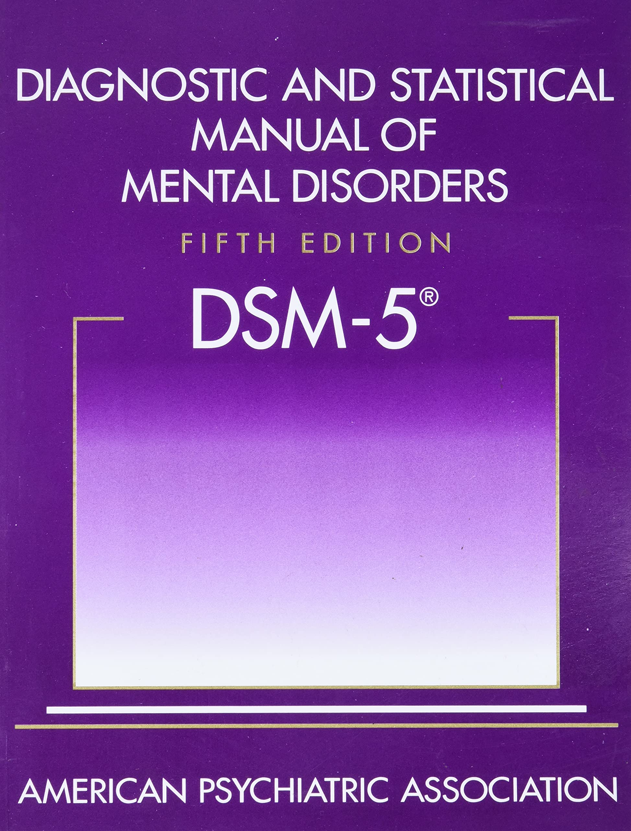
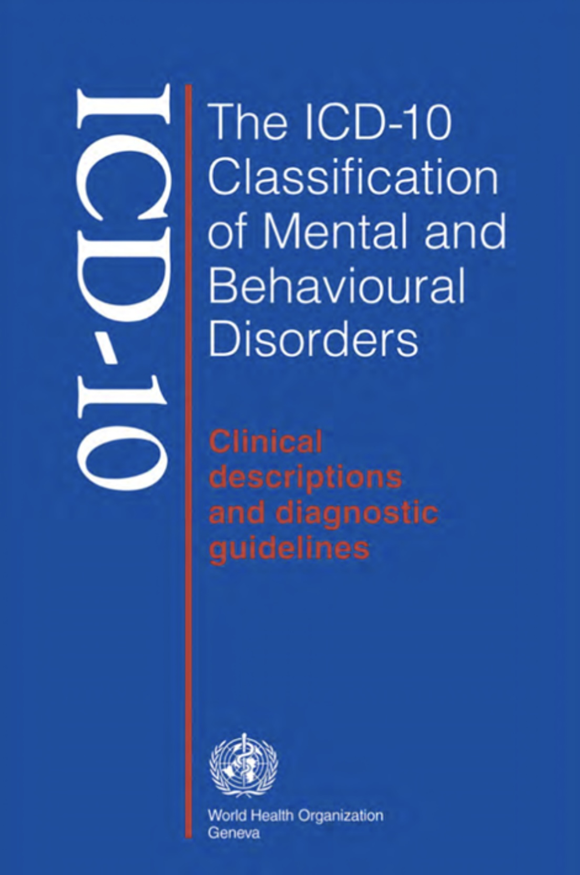
TRAUMA AND STRESS RELATED DISORDERS
The DSM and ICD (international classification of diseases) list several diagnosis that they consider to be caused by stress. There are 5 “trauma and stressor related disorders” in the DSM 5 :
1. Post traumatic stress disorder.
2. Acute stress disorder
3. Reactive attachment disorder.
4. Disinhibited social engagement disorder
5. Adjustment disorders
The ICD-11, includes all 5 DSM diagnosis but also lists
6. complex PTSD as a category
The previous edition of the ICD, The ICD-10 also listed a diagnosis of
7. enduring personality change after a catastrophic experience
Notes:
Let's start with the diagnostic And statistical manual of mental disorders fifth edition. As we've said before it's a highly influential compendium published by the American psychiatric Association. It lists mental health disorders and their diagnostic criteria.

Slide 40
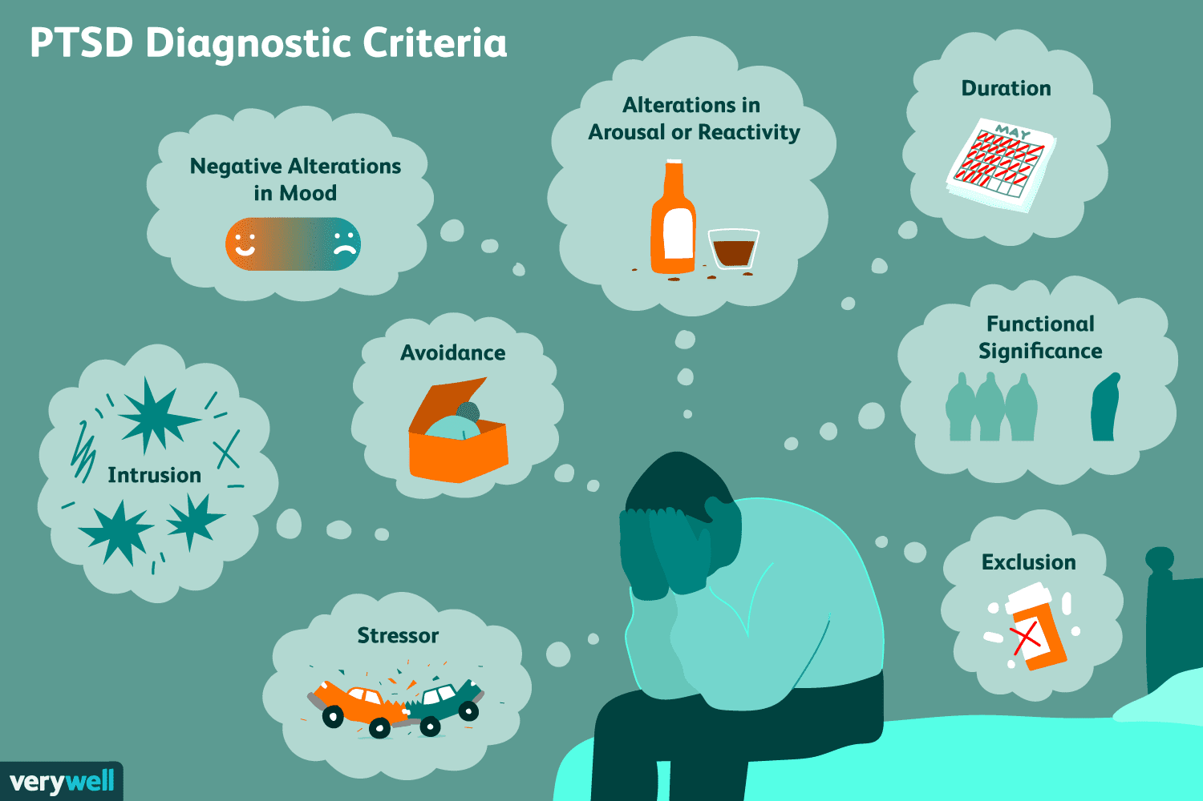
PTSD DIAGNOSTIC CRITERIA
PTSD is the best known of the stress and trauma related diagnosis. The diagnosis of PTSD requires:
1) a) experiencing, b) observing someone else experience c) learning of someone close to you having experienced, or d) being repeatedly exposed to aversive details of a traumatic life-threatening event that is followed by:
2) persistent reexperiencing of the event and intrusive symptoms in the form of flashbacks, intrusive thoughts etc.
3) avoidance of cues that remind the person of the event such as people, places or certain thoughts.
4) alterations in thinking and mood such as distorted thoughts about the cause and consequences of the trauma.
6
5
4
7
3
2
8
1

Slide 41
PTSD DIAGNOSTIC CRITERIA
5) anxiety or hyperarousal symptoms such as sleep disturbances, being easily startled etc.
6) the symptoms must have lasted for at least one month. (if duration is 3 days-1 month the diagnosis of ACUTE STRESS DISORDER should be made. Symptoms are present less than 3 days are not considered pathological
7) symptoms significantly affect the person’s functioning
8) symptoms are not better explained by another condition
6
5
4
7
3
2
8
1

Slide 42
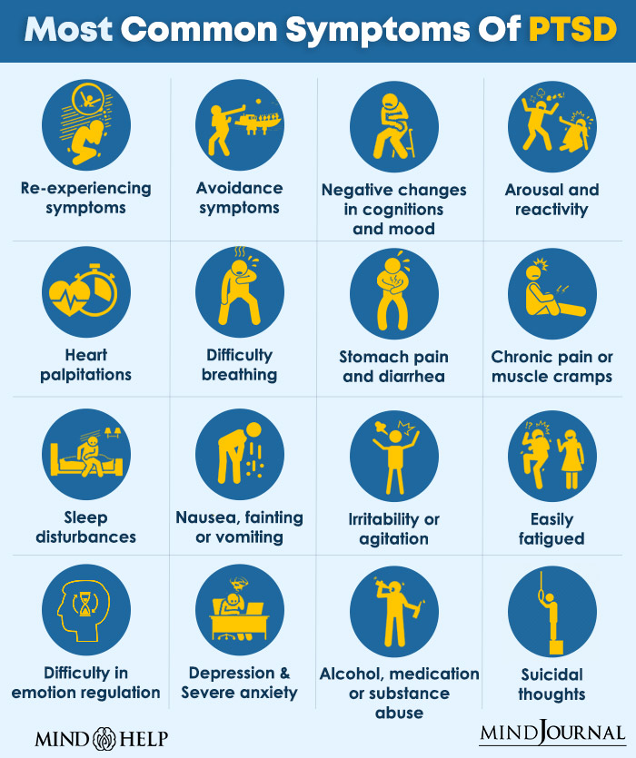
The most common PTSD symptoms fall into 4 clusters:
Re-experiencing: heart palpitations, difficulty breathing, stomach pain and diarrhea, chronic pain, nausea or vomiting intrusive memories, flashbacks, nightmares, distress when reminded
Avoidance: avoiding thoughts, feelings, people, places, or situations linked to the trauma
Negative mood and cognition: emotional numbing, guilt or shame, negative beliefs about self/world, loss of interest, detachment, easily fatigued, depression and severe anxiety, suicidal thoughts
Hyperarousal: hypervigilance, exaggerated startle, irritability, agitation, sleep disturbances, concentration problems, alcohol, medication or substance abuse.
cluster 1
cluster 2
cluster 3
cluster 4
Notes:
The list of signs and symptoms associated with PTSD is extensive and includes

Slide 43
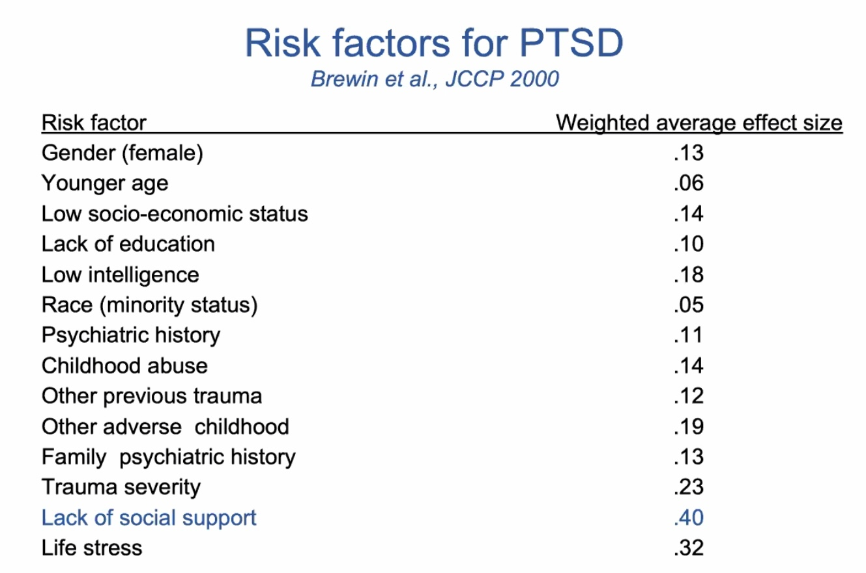
WHO IS MOST AT RISK FOR DEVELOPING PTSD?
In order of importance a number of factors significantly contribute to the risk of a person developing PTSD:
1. Trauma severity and chronicity – interpersonal, prolonged, inescapable trauma (especially betrayal) carries the highest risk
2. Lack of social support after the trauma – poor validation, isolation, or ongoing threat markedly increases risk
3. Prior trauma and adverse childhood experiences (ACEs) – sensitizes stress systems and shapes threat appraisal
4. Peritraumatic factors – intense fear, helplessness, dissociation during the event
5. Cumulative life stress – ongoing losses, financial strain, illness, migration, or relational conflict
6. Pre-existing mental health vulnerability – anxiety, depression, substance use, neuroticism
7. Biological vulnerability – genetic risk, HPA-axis dysregulation, heightened autonomic reactivity
8. Meaning-making and appraisal – shame, moral injury, or inability to integrate the experience into a coherent
Notes:
In epidemiology, a risk factor is a variable associated with an increased risk of having a condition. The size effect describes how significantly a risk factors a associated with a diagnosis. The highest association in this list is lack of social supports.

Slide 44
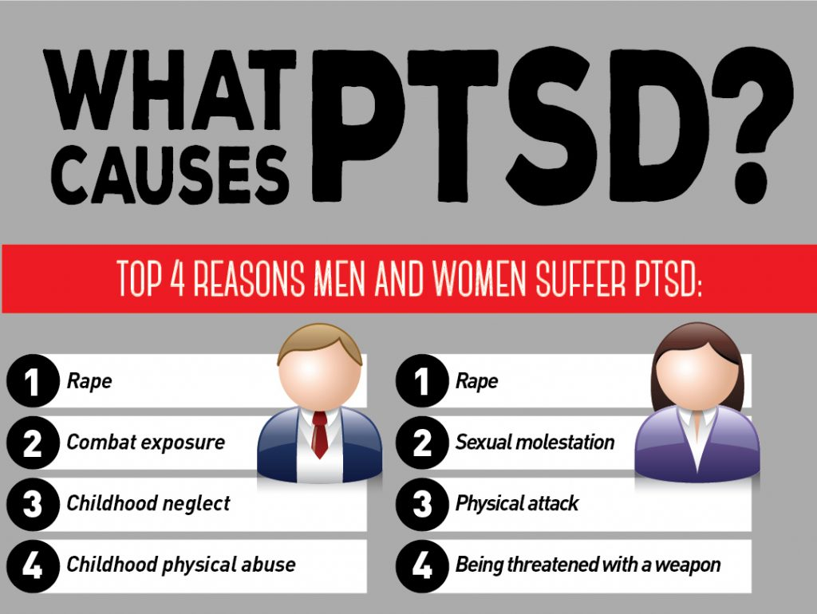
MOST COMMON ONE EVENT CAUSES OF PTSD IN MEN VS. WOMEN
Most common one-event causes of PTSD:
Women – 1. Sexual assault / rape (including attempted assault) 2. Severe physical assault or intimate partner violence 3. Sudden traumatic loss (violent death of a child, partner) 4. Serious accidents (motor vehicle collisions, especially with perceived helplessness) 5. Medical trauma (obstetric emergencies, invasive procedures with loss of control)
Men – 1. Combat exposure (ambush, IED, witnessing death) 2. Severe physical assault (random or occupational) 3. Serious accidents (motor vehicle, industrial, falls) 4. Witnessing violent death or serious injury 5. Life-threatening occupational trauma (first responders, police, firefighters)
Interpersonal trauma (intentional harm by another human) carries higher PTSD risk than accidents for both sexes.
Women have higher PTSD rates overall, largely driven by sexual violence exposure.
Men experience more traumatic events overall, but a lower conditional PTSD rate per event.
These are statistical patterns, not absolutes, individual meaning, context, and support matter more than category.
Notes:
The most common immediate causes of PTSD differ with gender

Slide 45
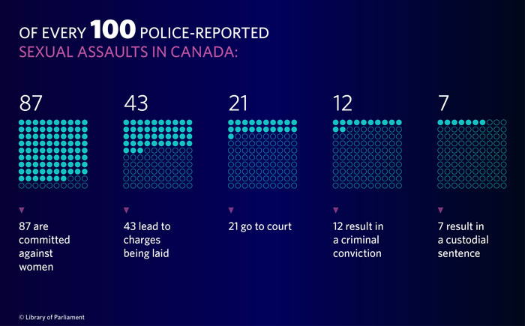
THE UNDERREPORTING AND PROSECUSSION OF SEXUAL ASSAULT 2018
Sexual assault is any unwanted sexual activity or touching without clear, voluntary consent, involving acts like forced kissing, touching, or penetration, and it's a crime that violates a person's sexual integrity, often stemming from force, threats, or abuse of power.
A Canadian national survey revealed that in 2018 there were 460,000 sexual assaults. (Canadian population 37 million) that’s 12 people out of every 100. 90% of sexual assault victims are women.
Of these only 15,200 were reported to police.
Of those charges were laid in 5544.
Of those 2824 were prosecuted.
Of those 1519 were convicted.
Notes:
Sexual assault is very common. Less than 10% of all incidents are reported to police. Out of every 100 Police Reported Sexual Assaults in Canada, only 43 lead to charges being laid, 21 go to court, 12 result in a criminal conviction, and 7 result in a custodial sentence.

Slide 46
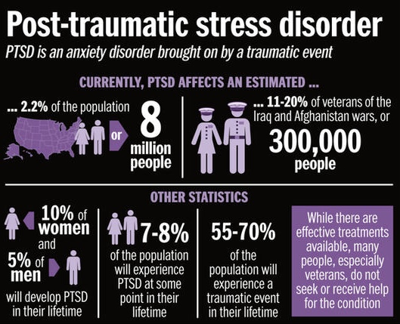
NORTH AMERICAN PTSD Statistics
A traumatic event is a shocking, dangerous, or distressing experience that overwhelms a person's ability to cope, involving actual or threatened death, serious injury, or sexual violence, and can be a one-time occurrence or ongoing, leading to significant emotional and physical distress like fear, helplessness, or horror.
70% of North Americans experience at least one traumatic event in their lifetime.
20% of people who experience a traumatic event develop PTSD.
8% of people will develop PTSD at some point in their lives.
2.2% of people currently meet the diagnosis of PTSD that’s 920000 people.
Notes:
While 70% of American adults will experience at least one traumatic event, only 20% of those will develop PTSD. One in 13 people in the US will develop PTSD at some point in their life, that's an estimated 8 million people.
Women are twice as likely to develop PTSD as our man. Up to 20% of veterans and first responders develop PTSD
Indigenous women are 3 to 5 times more likely to be objects of silence than non-indigenous women and five times more likely to die from that violence

Slide 47
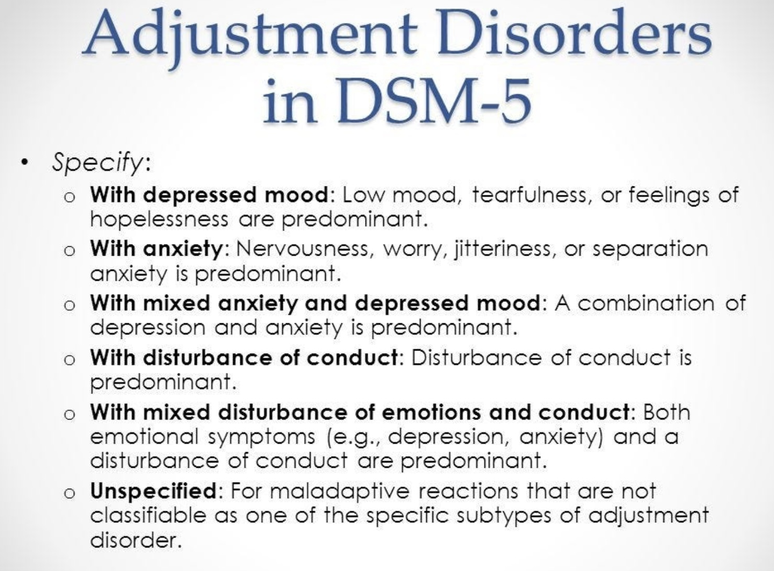
ADJUSTMENT DISORDERS
The diagnosis an adjustment disorder is made when emotional or behavioral symptoms develop within three months of the occurrence of an identifiable stressor.
The symptoms or behaviors are clinically significant, as evidenced by one or both of the following 1. Marked distress that is out of proportion to the severity or intensity of the stressor, taking into account the external context and cultural factors that might influence the symptom severity and presentation. 2. Significant impairment in social occupational or other important areas of functioning.
The symptoms do not represent normal bereavement
Once the stressor or its consequences have ended, the symptoms do not persist for more than an additional six months
Six subtypes of adjustment disorders are described in the DSM-5:

Slide 48
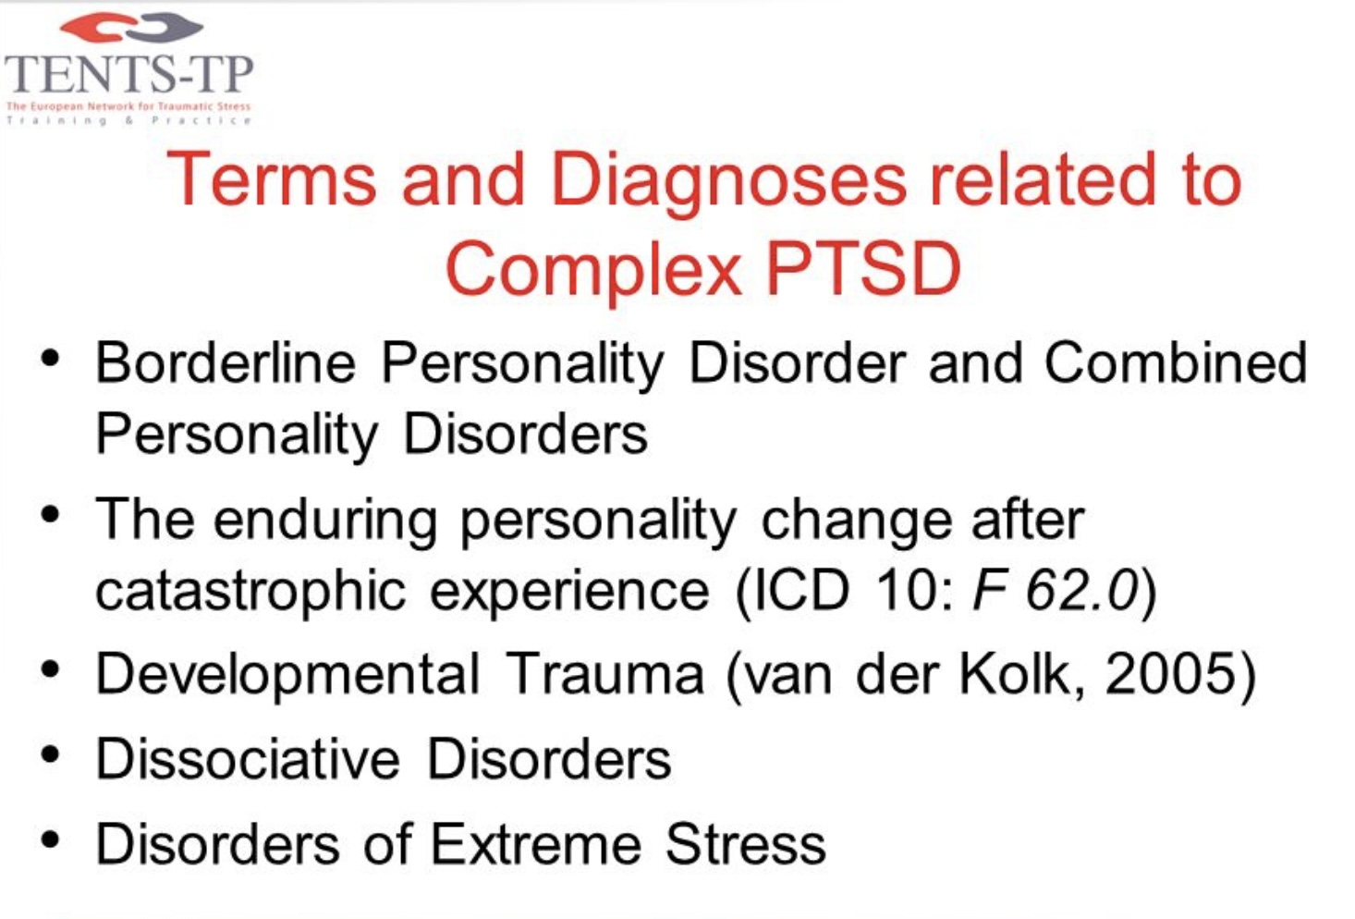
ENDURING PERSONALITY CHANGE AFTER A CATASTROPHIC EXPERIENCE
Enduring personality change after a catastrophic experience was an ICD – 10 diagnosis made following prolonged exposure to life threats.
PTSD may precede and be present along with it.
Features of this diagnosis included:
1) a hostile mistrustful attitude towards the world.
2) social withdrawal
3) feelings of emptiness or hopelessness
4) chronic feelings of being on edge or threatened
5) estrangement
This diagnosis was not included in the 11th edition of the ICD as it was replaced by complex PTSD.
Several terms and diagnosis are closely related to complex PTSD

Slide 49
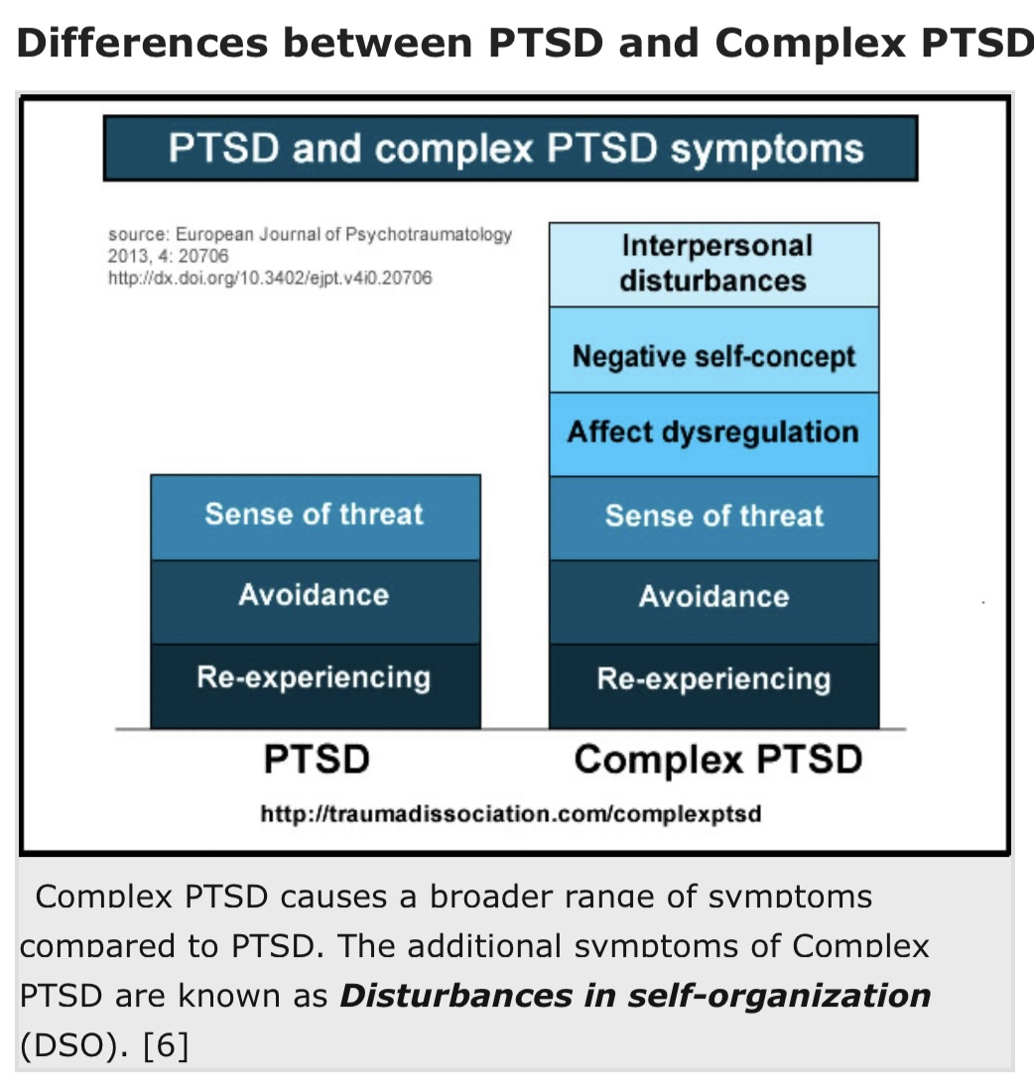
The ICD – 11 recognizes that the reactions of some people following traumatic events extend beyond previous definitions of PTSD.
In contrast to the DSM-V, the ICD – 11 formally defines the diagnosis of complex PTSD.
According to the ICD – 11, complex PTSD consists of the same core symptoms of PTSD, but has three additional groups of symptoms which are sometimes referred to as "disturbances in self organization”. They are:
1) problems in affect regulation such as marked irritability or anger or feeling emotionally numb.
2) beliefs about oneself as diminished, defeated or worthless, accompanied by feelings of shame, guilt or failure related to the traumatic events.
3) difficulties in sustaining relationships and feeling close to others.
PTSD VS. COMPLEX PTSD

Slide 50
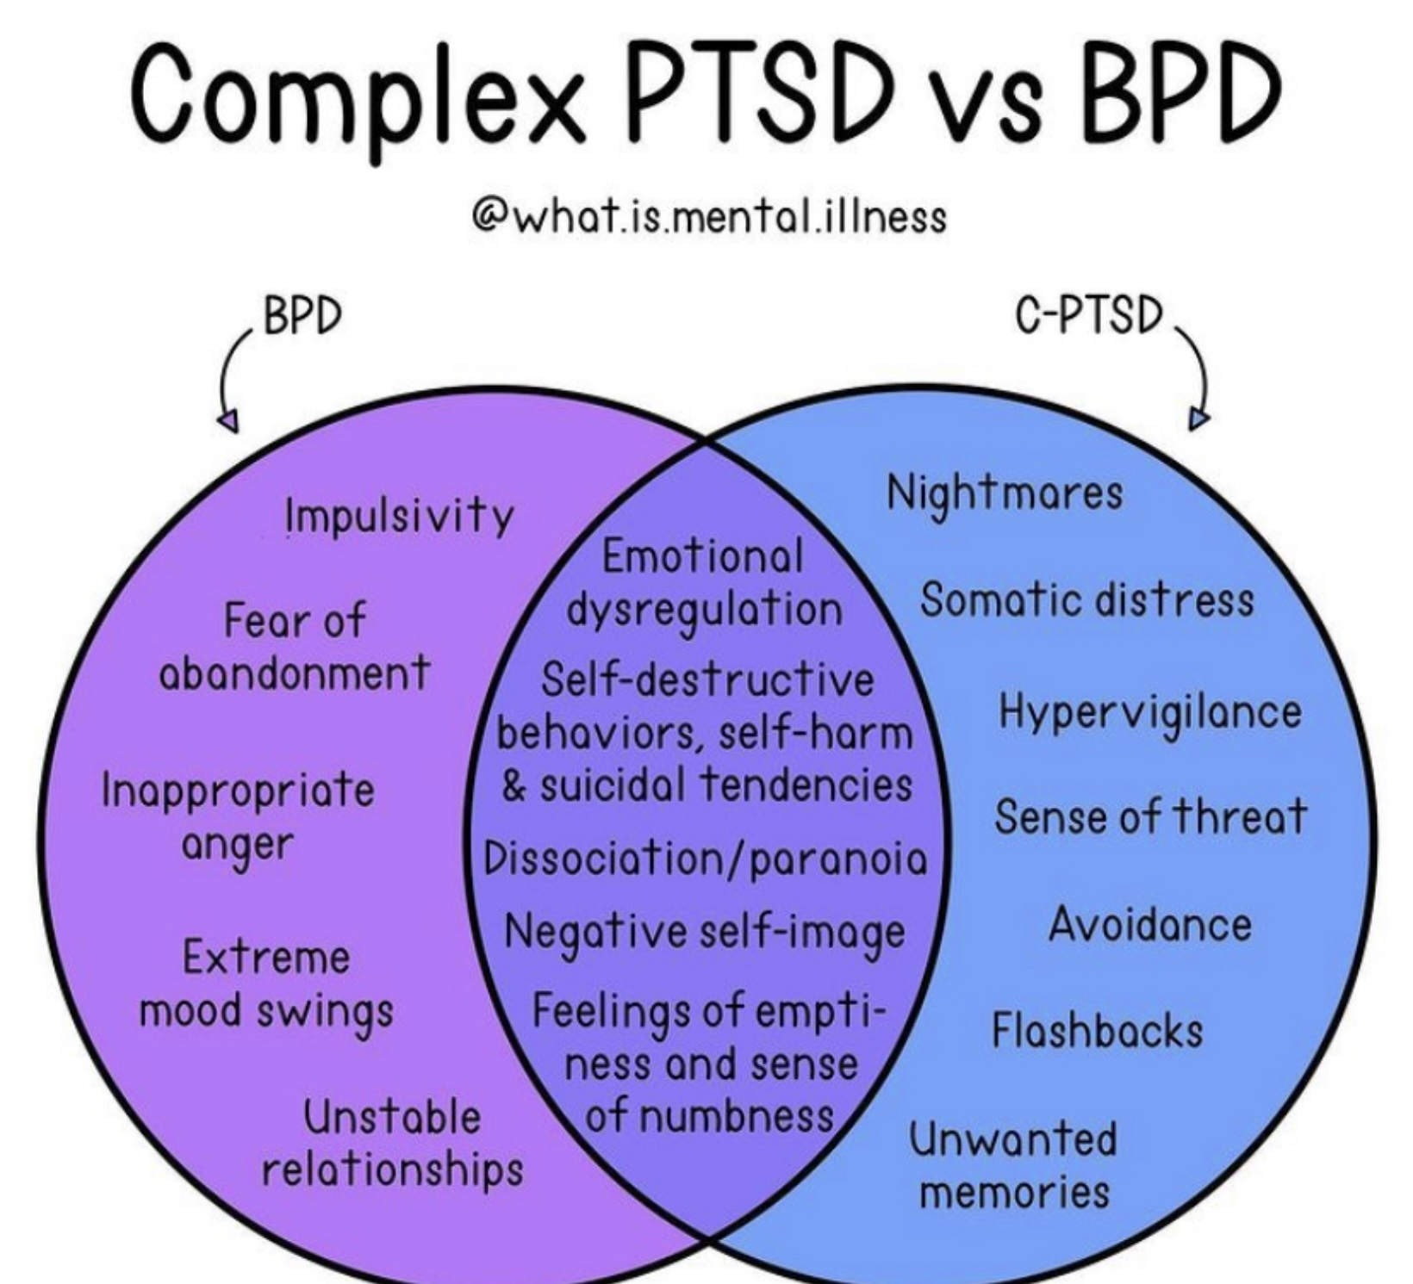
COMPLEX PTSD AND BORDERLINE PD
Similarities
• Emotional dysregulation: Both involve intense, rapidly shifting emotions and difficulty calming down.
• Relationship instability: Fear of abandonment, conflict, and turbulent connections are common.
• Identity disturbance: Struggles with self-concept, feeling “empty” or disconnected.
• Trauma link: Both are strongly associated with childhood trauma, especially chronic neglect or abuse.
Differences
• Core origin
• C-PTSD: Results from prolonged, repeated trauma, often in childhood (e.g., abuse, captivity, domestic violence).
• BPD: Considered a personality disorder, shaped by a mix of temperament, attachment disruptions, and trauma.
• Symptoms specific to each
• C-PTSD: Persistent re-experiencing, avoidance, hyperarousal (like PTSD), plus emotional numbing, shame, guilt, and difficulty trusting others.
• BPD: More marked fear of abandonment, impulsivity, self-harm, and rapid swings in how others are perceived (idealization → devaluation).
• Sense of self
• C-PTSD: Identity shaped by trauma, often feelings of worthlessness and permanent damage.
• BPD: Identity is unstable, shifting with mood and relationships, not always trauma-centered.
• Course and treatment
• C-PTSD: Treated with trauma-focused therapies (e.g., EMDR, somatic therapies, trauma-informed CBT).
• BPD: Treated with structured therapies like DBT, schema therapy, or MBT, focused on emotion regulation and interpersonal effectiveness.

Slide 51
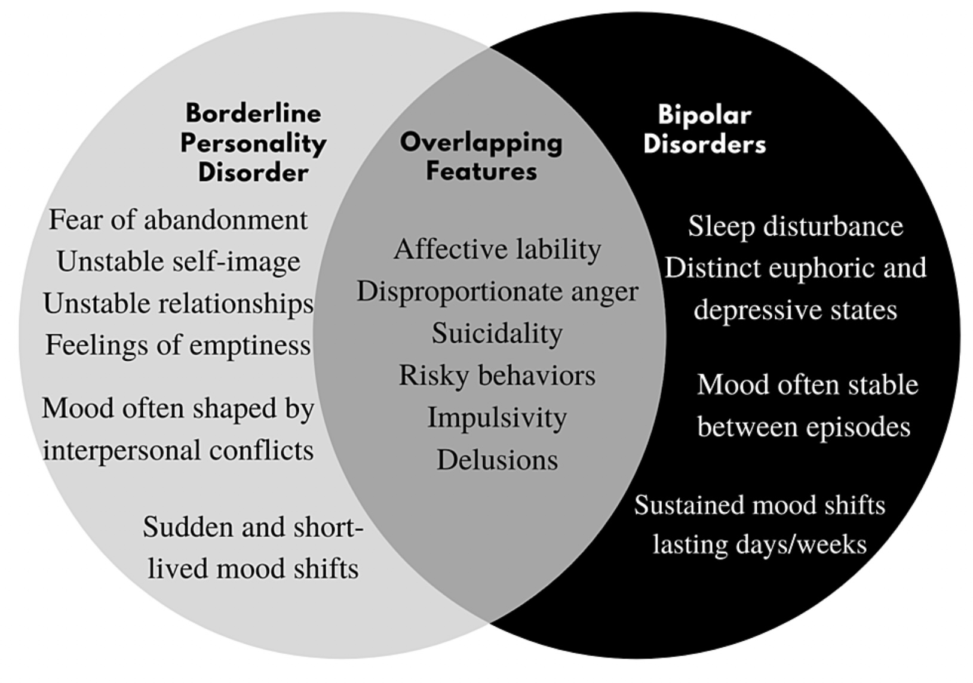
BORDERLINE PD VS BIPOLAR DISORDER
Similarities
• Both involve intense mood swings and instability that can disrupt relationships and functioning.
• Both may include impulsivity, risky behaviors, and suicidality.
Differences
• Borderline Personality Disorder:
• Mood shifts are rapid, reactive, and triggered by relationships or stress (hours → a day).
• Core features: fear of abandonment, unstable identity, chronic emptiness, interpersonal chaos.
• Bipolar Disorder:
• Mood episodes are longer-lasting (days → weeks) and more biological/episodic, not just situational.
• Alternates between mania/hypomania (elevated or irritable mood, high energy, decreased sleep, grandiosity) and depression.

Slide 52
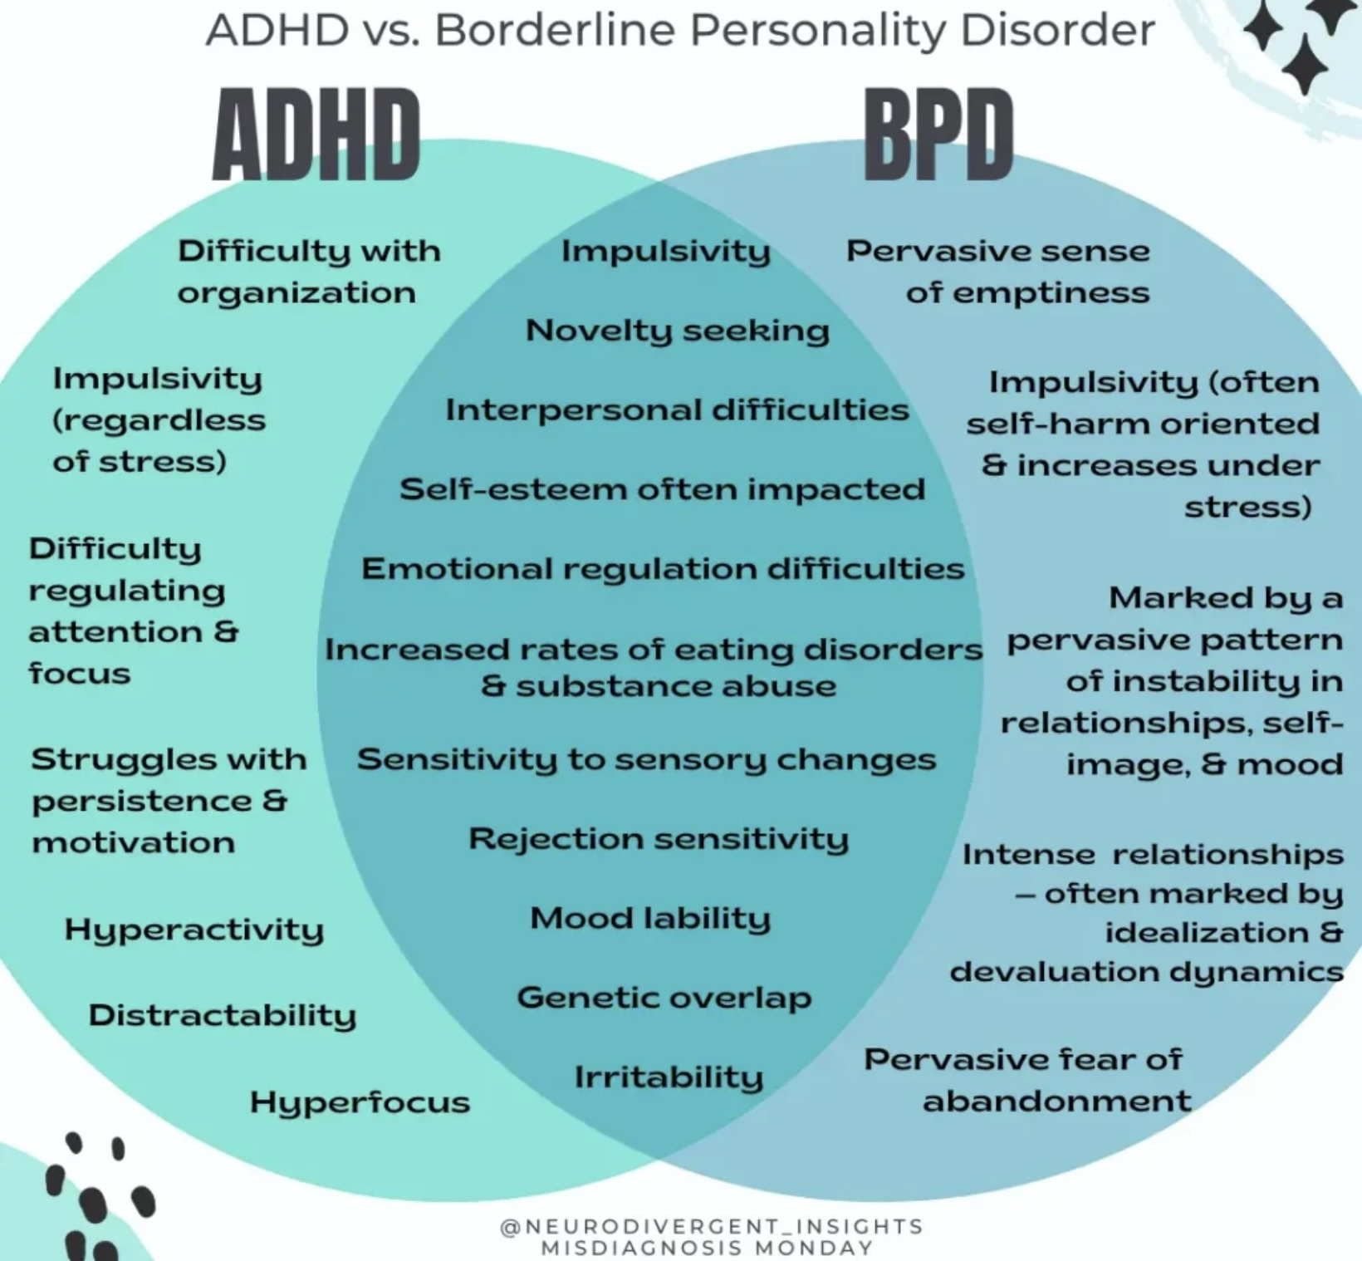
ADHD VS. BORDERLINE PD
Similarities
• Both can show impulsivity, emotional instability, and difficulties in relationships.
• Both often start in childhood/adolescence and are linked with executive function challenges.
Differences
• ADHD: Core problem is attention and impulse regulation (distractibility, disorganization, hyperactivity). Mood changes are short-lived and situational.
• BPD: Core problem is emotion regulation and identity instability (fear of abandonment, unstable self-image, chronic emptiness). Mood shifts are intense, relational, and longer-lasting.

Slide 53
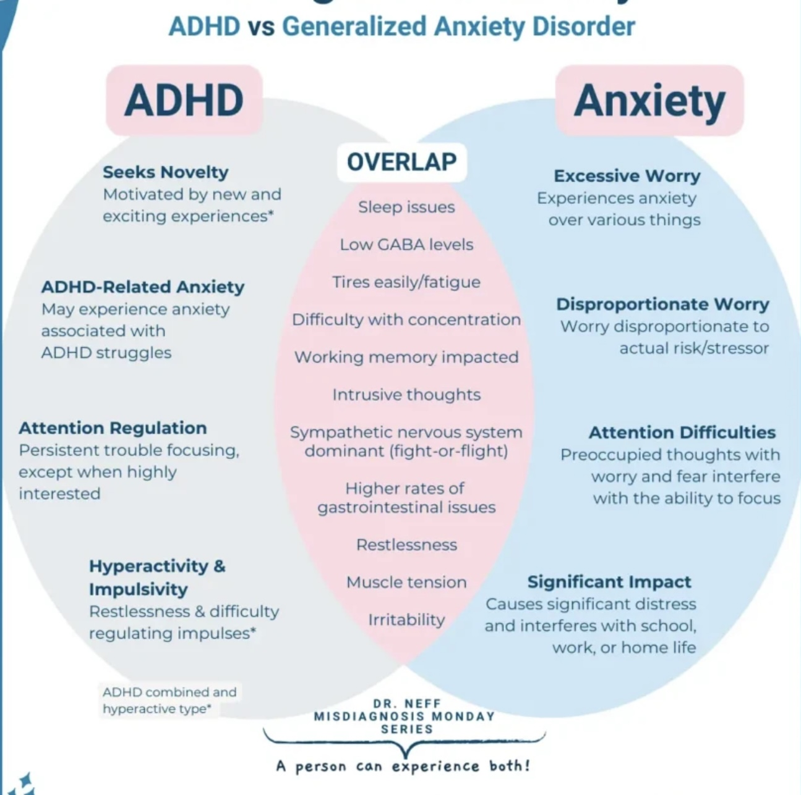
ADHD
• Core issue: attention regulation (inattention, distractibility, impulsivity, hyperactivity).
• Symptoms improve when highly interested/stimulated.
• Difficulties with organization, time management, follow-through.
Generalized Anxiety Disorder (GAD)
• Core issue: excessive worry and tension across many areas of life.
• Symptoms worsen with stress and uncertainty.
• Difficulties with restlessness, muscle tension, sleep, and constant “what if” thinking.
ADHD VS. GENERALIZED ANXIETY

Slide 54
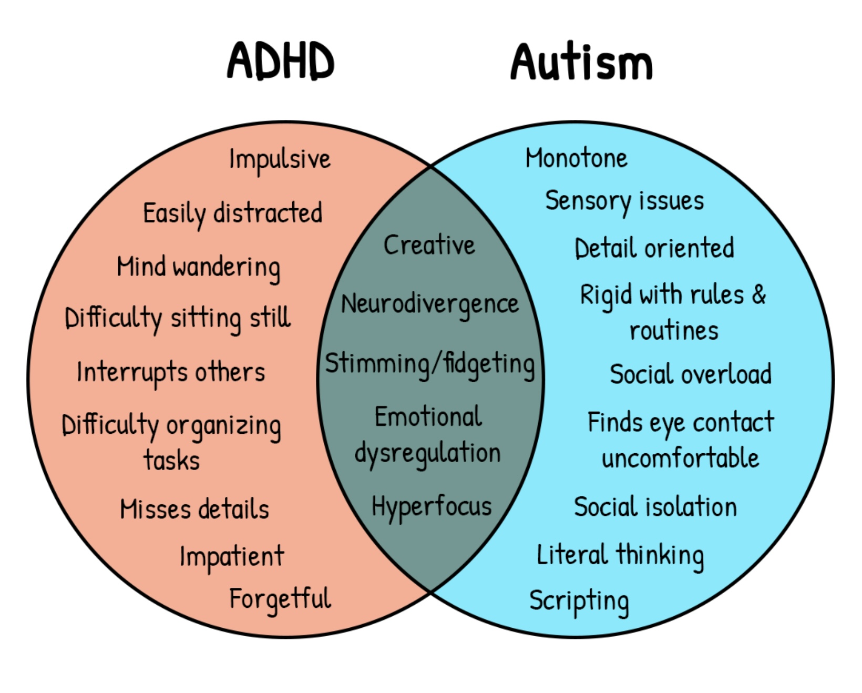
ADHD VS. AUTISM SPECTRUM
Similarities
• Both are neurodevelopmental conditions that start in childhood.
• Can involve social difficulties, emotional dysregulation, sensory sensitivities, and executive function challenges.
• High rates of co-occurrence (many people have both).
Differences
• ADHD: Core issue is attention and impulse regulation → distractibility, restlessness, disorganization, acting before thinking.
• Autism: Core issue is social communication and sensory/behavioral differences → difficulty with social reciprocity, preference for routines, intense interests, and different sensory processing.

Slide 55
ASSESSING TRAUMA
How is PTSD diagnosed?

Slide 56
DIAGNOSING PTSD: CLINICAL PRACTICE AND ASSESSMENT TOOLS
To diagnose PTSD mental health professionals, rely on:
1. A structured clinical interview to assess if the person meets these key criteria:
• Exposure to actual or threatened death, serious injury, or sexual violence
• Intrusion symptoms (e.g., flashbacks, nightmares)
• Avoidance of trauma-related thoughts, feelings, or reminders
• Negative alterations in mood and cognition (e.g., guilt, detachment)
• Arousal/reactivity changes (e.g., hypervigilance, sleep disturbance)
• Symptoms must persist >1 month and cause significant distress or impairment…
2. Standardized assessment tools are often used to support diagnosis, track symptom severity, or for research purposes:
• Clinician-Administered PTSD Scale for DSM-5 (CAPS-5):Gold standard structured interview. Rates frequency & intensity of symptoms
• PTSD Checklist for DSM-5 (PCL-5): Self-report questionnaire. Screens for PTSD and monitors treatment response
• Life Events Checklist (LEC-5): Assesses exposure to potentially traumatic events
• Structured Clinical Interview for DSM Disorders (SCID-5):Broad diagnostic tool, includes PTSD module
3. Clinical judgment and context
• Always considers differential diagnoses (e.g., depression, anxiety, substance use)
• Cultural, developmental, and contextual factors are taken into account
• Diagnosis may evolve as trust builds and more trauma history is disclosed

Slide 57
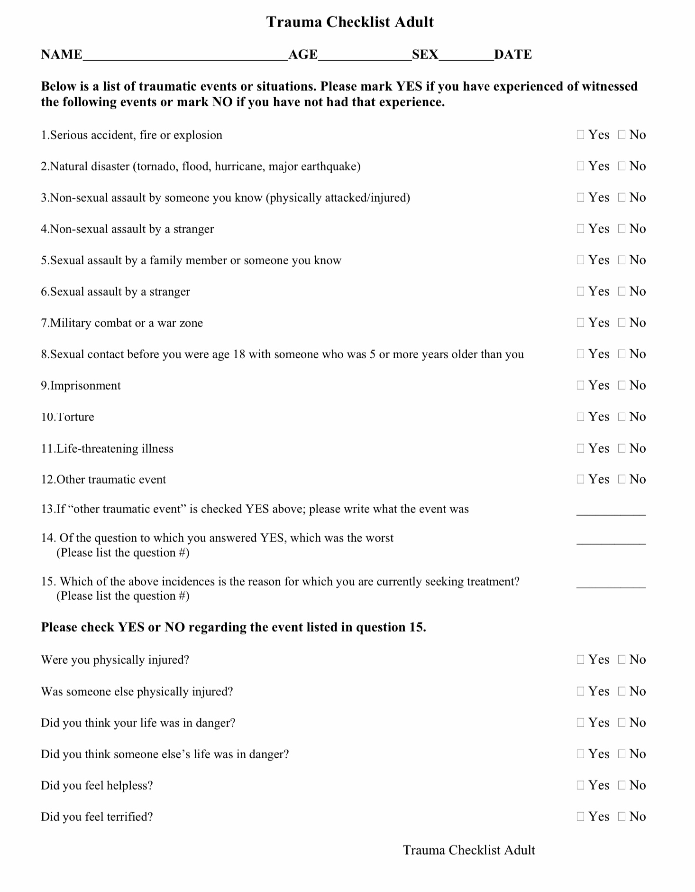
1. Nature of traumatic event
The trauma checklist – Adult (TCA) is frequently used, structured screening tool that helps organize trauma exposure and its impact across four domains:
Nature of the traumatic event - Identifies what happened: type of trauma (e.g., assault, accident, disaster), frequency, duration, age at exposure, and whether it was interpersonal or accidental.
Person’s perception and immediate effects - Captures how it was experienced: fear, helplessness, horror, dissociation, perceived threat to life or integrity during the event.
2. Person’s perception and immediate effects of event
Notes:
One of the best, self administered, tools for diagnosing PTSD is the "trauma checklist adult". It probes into four different aspects of the trauma 1) the nature of the traumatic event 2) the person's perception of and immediate effect of the event ...

Slide 58
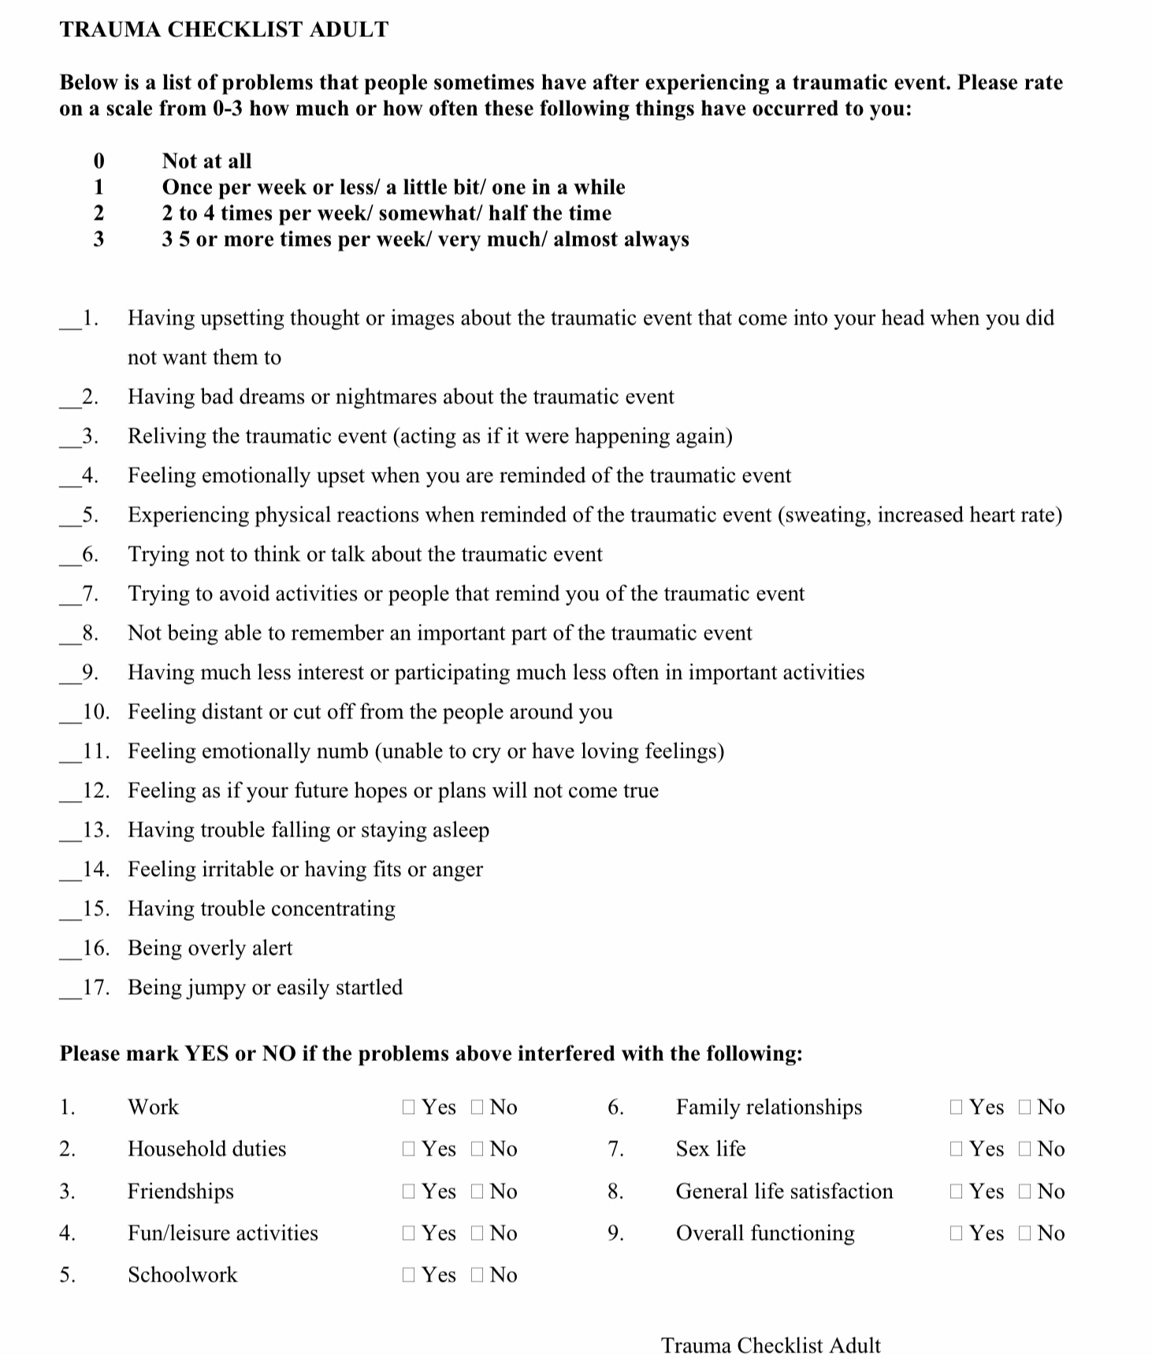
3. Symptoms experienced
3. Symptoms experienced - Assesses current and past trauma symptoms: re-experiencing, avoidance, emotional numbing, negative mood/cognitions, and hyperarousal.
4. Functional impairment - Evaluates impact on life: relationships, work/school, daily functioning, emotional regulation, and quality of life.
The TCA links what happened, how it was experienced, what symptoms emerged, and how much it disrupts living, helping distinguish exposure from impact.
4. Type of functional impairment
Notes:
3) the symptoms the person is experiencing and 4) the areas of functional impairment.

Slide 59
THE TRAUMA SPECTRUM IN CHILDREN
Are traumatic spectrum disorders and their diagnosis different in children than in adults?

Slide 60
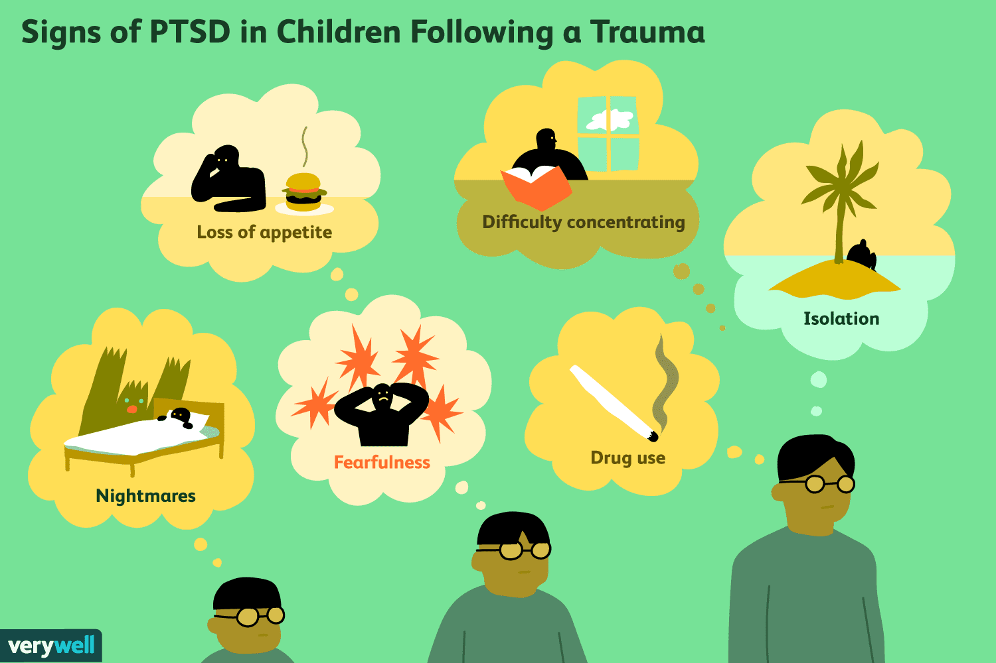
THE TRAUMA SPECTRUM IN CHILDREN
The diagnosis of PTSD can be made in children 6 years of age or younger who are exposed to life threatening events, serious injury, or sexual violence.
Exposure includes 1) being the victim,2) being a witness especially when the victim is a primary care giver, or 3) learning that a caregiver was the victim
Children are significantly more vulnerable to trauma than adults.
Events that are often traumatic for a child, who is helpless without a caretaker, may not be so traumatic to adults ex. being left by a significant figure or having a serious medical procedures.
Caregivers are often involved in children’s trauma either directly or through neglect leaving the child at increased risk of exposure to predators, accidents, or misadventures.
As for adults, childhood traumatic events can be brief and single instance or prolonged and repeated.
Prolonged and repeated childhood trauma often leads to the DSM diagnosis of 1) reactive attachment or 2) disinhibited social engagement disorders.
Both these diagnosis overlap significantly with the concepts of complex PTSD, personality disorders and dissociative disorders.

Slide 61

REACTIVE ATTACHMENT AND DISINHIBITED SOCIAL ENGAGEMENT
The DSM-V trauma and stressor related disorders category includes two diagnosis for which symptoms must be present before the age of 5:
1) Reactive attachment disorder- These children present with A) emotionally withdrawn behavior. B) social and emotional disturbances: reduced responsiveness, limited affect, irritability, sadness, fearfulness. C) they have been exposed to extremes of insufficient care in the form of social neglect and deprivation, repeated changes in caregivers, rearing in unusual settings etc.
2) Disinhibited social engagement disorder- These children present with A) reduced or absent reticence when interacting with him unfamiliar adults. B) behaviors not limited to impulsivity that include social disinhibited behavior. C) they have been exposed to extremes of insufficient care.
The reactive attachment and disinhibited social engagement disorders are caused by developmental trauma
If a parent abuses or abandons a child, the child doesn’t stop loving the parent, they stop loving themselves.

Slide 62
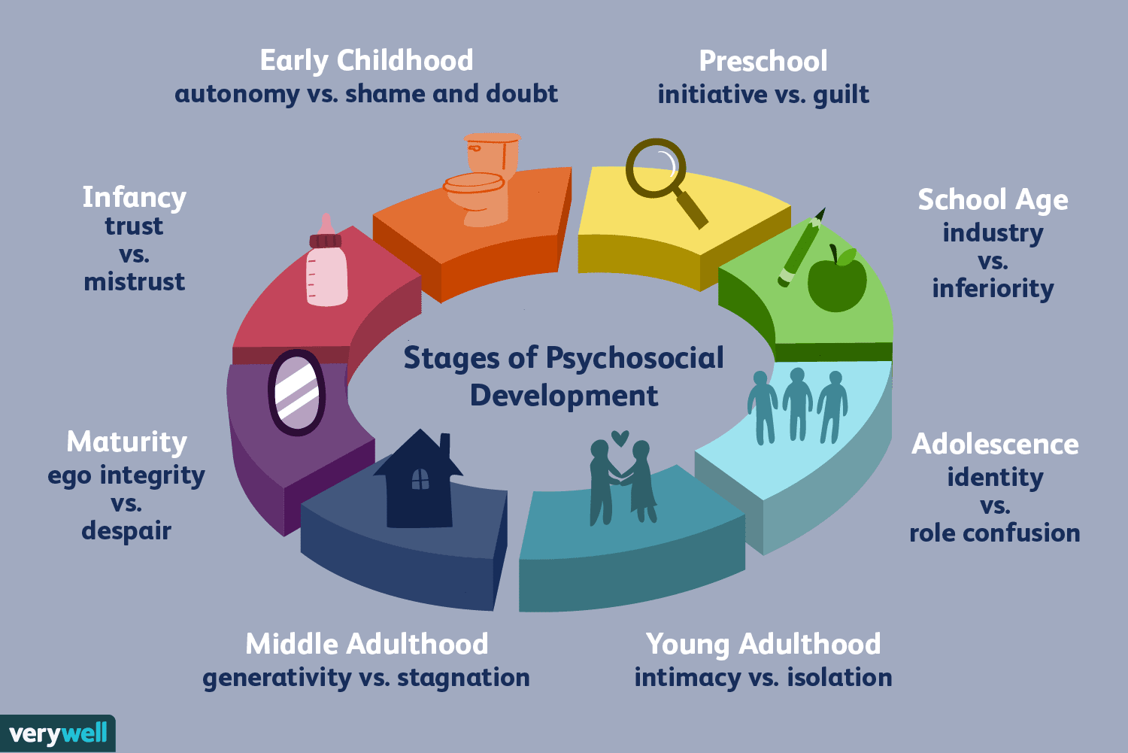
developmental trauma and attachment
1. The term “developmental trauma” refers to trauma that occurs when the child/adolescent is going through the stages of psychosocial development
2. Children and adolescents are particularly vulnerable to chronic and traumatic stressors because they don’t have the same resources as , and depend for protection on parental figures who may or may not protect them and who are sometimes the perpetrators of the trauma
4. Children with insecure attachment types are particularly susceptible to stressors. Not only do they have poorer coping skills which might never have been modelled for them, but they are also less likely to have an attuned and responsive parental figure to protect them from harm.
5. “Attachment trauma” refers to trauma caused by parental figures and leads to both attachment and trauma spectrum disorders in children
3. Parents who are stressed have more difficulty being attuned to their children and teaching them how to self-sooth which makes these children more vulnerable to stress and trauma. Having a parent who is mentally ill can also be traumatic
6. Any early life stressor that is beyond the capacity of the child to deal with can interfere with psychosocial development which will then manifest as personality-based issues
Notes:
There are two types of trauma that children experience that are very significant. They are attachment and developmental trauma

Slide 63
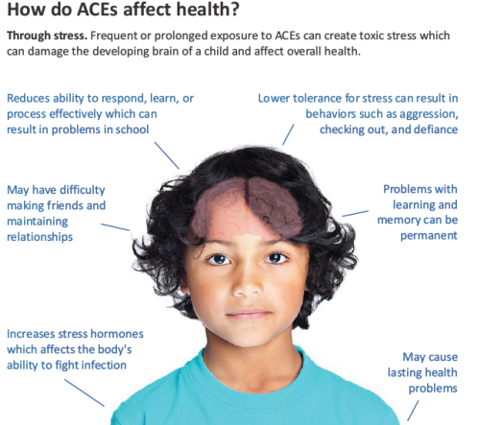
Developmental or childhood trauma occurs when a child experiences an event or series of events as overwhelmingly distressing. This often results in lasting mental and physical effects which may include:
1) affects the child’s perception of reality
2) wires the child’s brain to expect danger.
3) primes fight, flight and freeze response reducing the window of tolerance
4) creates relationship problems and makes it difficult to make friends and maintain relationships
5) takes away the child's sense of safety
6) increases the stress hormones flowing through their body.
7) creates a sense of helplessness.
8) results in serious behavioral problems
9) Reduces their ability to respond, learn, and process information effectively which can result in school problems.
10) Causes lasting physical health problems
Early trauma predisposes children to a cascade of trauma in that their symptoms make it more likely that they will experience trauma again and again.
LONG TERM EFFECTS OF DEVELOPMENTAL TRAUMA
Notes:
Because children are so vulnerable the consequences of trauma in childhood are an enormous.

Slide 64
THE ADVERSE CHILDHOOD EVENT STUDIES
What are the adverse childhood event studies?

Slide 65
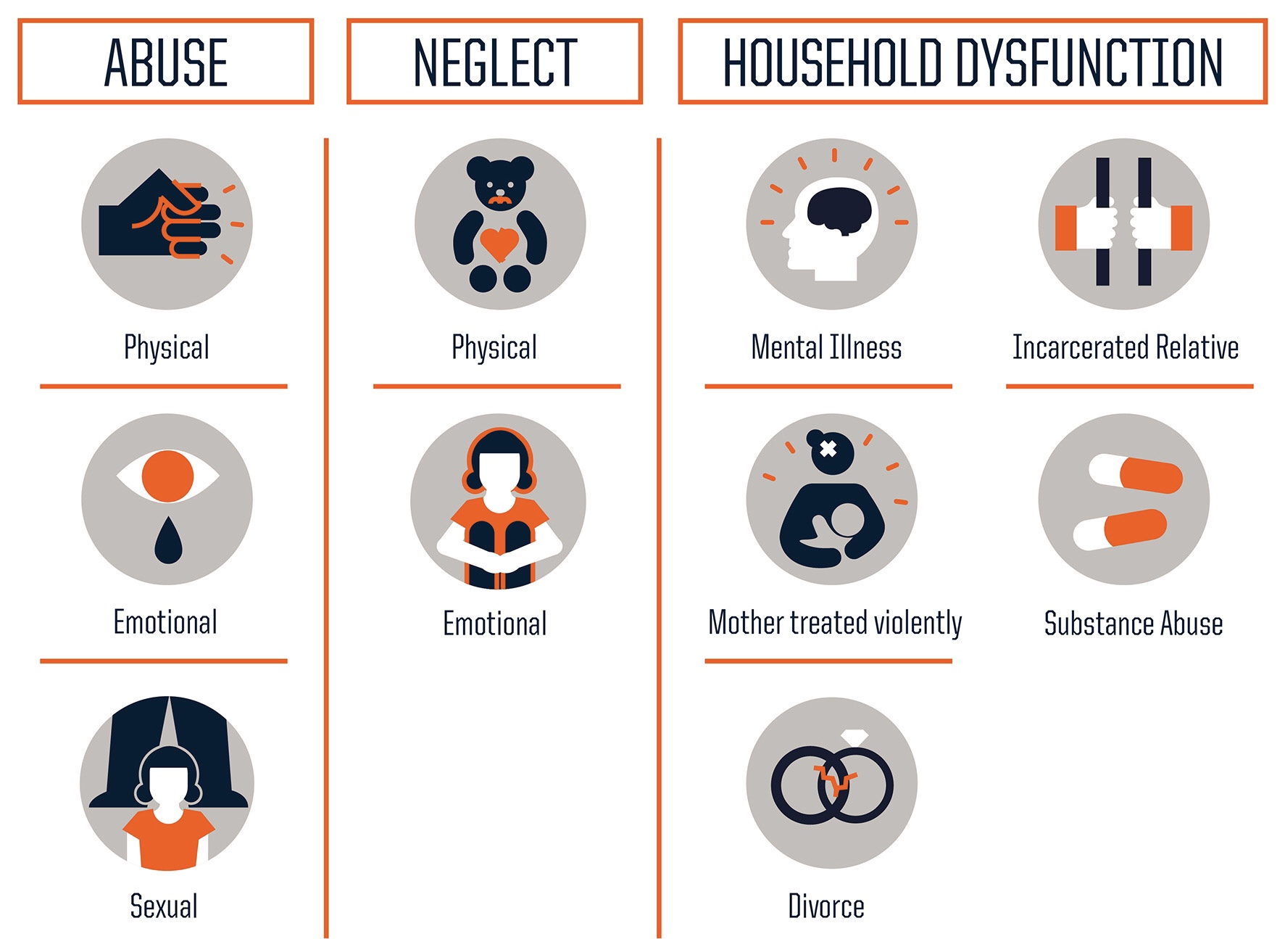
the ACE studies
The ACE’s main researcher was Vincent Felitti. The studies were funded by Keizer Permanente and set out to find the most important early life correlates of later life psychological and physical health issue. The study involved over 17,000 adult patients.
Results were first published in 1998, concluding that 10 categories of adversity in childhood correlated with health outcomes in adult hood more than any other variable. When this data was first published it was largely ignored.
Adverse childhood experiences (or events), are common forms of childhood trauma which encompass various forms of physical and emotional abuse, neglect, and household dysfunction experienced in childhood.
ACE's have been strongly linked to premature death as well as to various health conditions including mental disorders.
Notes:
The ACE studies principal researcher was Vincent Felitti. The studies were sponsored by the American health maintenance and insurance organization Kaiser Permanente and involved over 17,000 adult patients. Kaiser Permanente was looking for early life risk factors for later life poor physical and mental health. They found that by far the most significant risk factor was adverse childhood experiences.

Slide 66
Childhood trauma the ACE studies
Toxic stress linked to childhood maltreatment is related to a number of neurological changes in the function and structure of the brain.
ACE follow up studies are beginning to identify specific biological changes and biomarkers associated with different kinds of ACE’s.
What is incredible about this data is that the population involved in the ACE studies were middle class San Diegans, 70% white and 70% college educated. The study population was quite privileged.
They all had access to an expensive private health care plan either paid by their employer, meaning they were working, or paid by them which meant they were reasonably affluent
This begs the question of what these statistics would have looked like if a less privileged, lower SE class sample had been studied instead.
Notes:
The ACE studies principal researcher was Vincent Felitti. The studies were sponsored by the American health maintenance and insurance organization Kaiser Permanente and involved over 17,000 adult patients. Kaiser Permanente was looking for early life risk factors for later life poor physical and mental health. They found that by far the most significant risk factor was adverse childhood experiences.

Slide 67
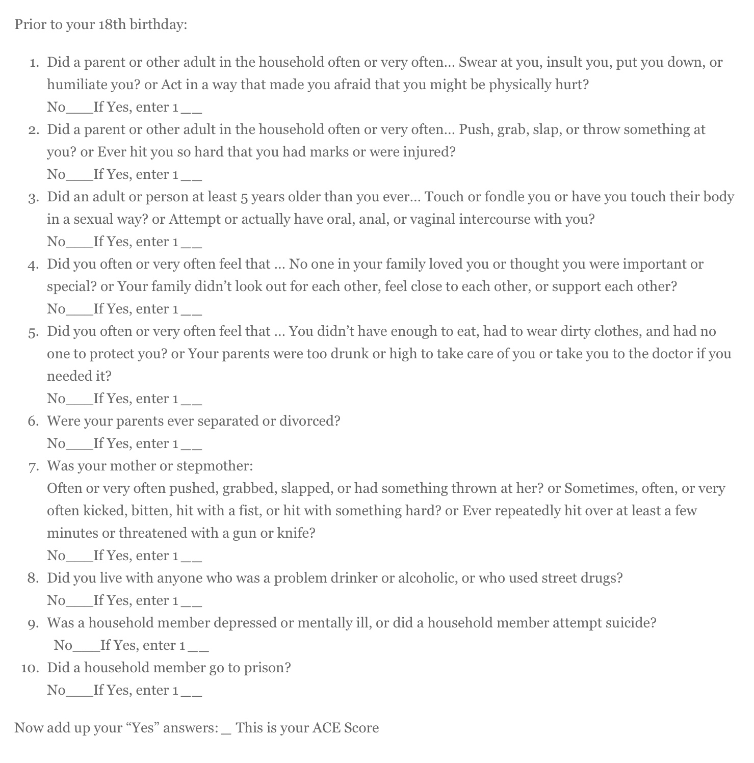
THE ACE QUESTIONNAIRE
Notes:
The ACE questionnaire consists of 10 questions. It is scored 0 to 10.

Slide 68
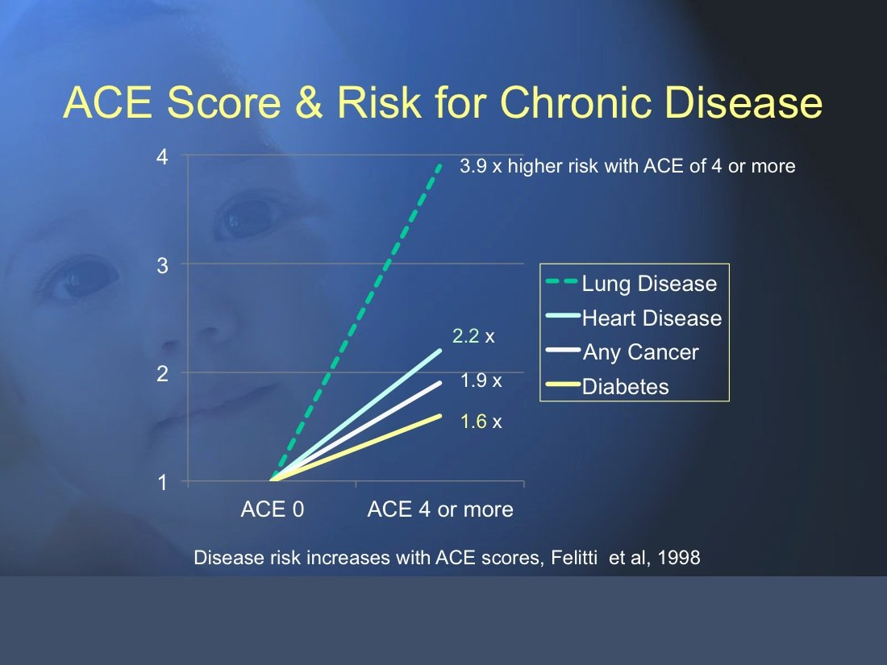
In the study’s relatively well to do population, researchers found that 62% of adults had experienced at least one ACE, and 16.7% had experienced four or more.
The most common ACE was emotional or verbal abuse followed by parental separation or divorce, substance abuse by a household member, physical abuse, witnessing domestic violence, and having a household member with mental illness.
11.4% of the sample had suffered sexual abuse
The study found that those with adverse childhood experiences were at higher risk for heart, lung, and liver disease, obesity, diabetes, depression, suicide attempts, sexually transmitted diseases, cancer, stroke, COPD and substance abuse.
The higher the score on the ACE questionnaire the more likely people were to be in poor psychological and/or physical health.
The higher the ACE score the more people’s life potential was negatively impacted as reflected in lower graduation rates, academic achievement, and more time on disability.
KEY FINDINGS OF
THE STUDIES
Notes:
The ACE studies led to some remarkable findings

Slide 69
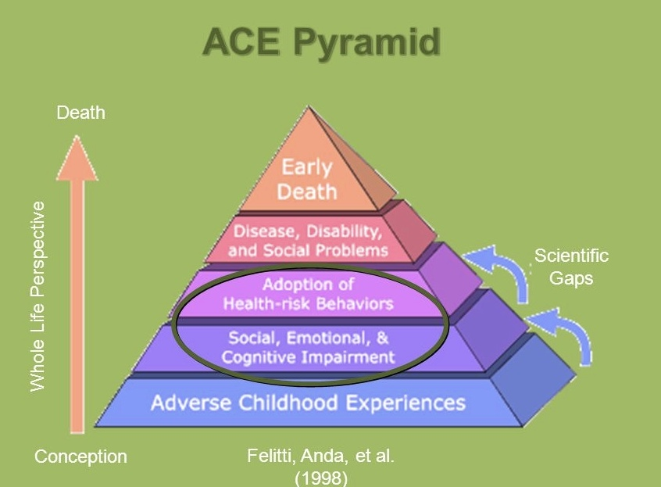
MECHANISMS FOR INCREASED MORBIDITY AND MORTALITY WITH ACE’s
50% of the excess morbidity and mortality arising from ACE’s is attributable to high risk behavioral or lifestyle factors (such as belonging to gangs, crime, unhealthy eating, smoking, substance use etc.) that more common in populations with ACE’s.
The other 50% however is independent of behavior and lifestyle so that even study participants with high ACE scores that led healthy, low risk lives, had significantly more morbidity and mortality than people with similar lifestyles but no ACE’s
Kids who have 4 or more ACE’s have 32 X the rate of learning and behavior problems than kids with no ACE’s. Many of them are misdiagnosed with ADHD and treated with stimulants.
Keep in mind that social, academic, behavioral and cognitive issues impair children’s psychosocial development
Other adversities besides the 10 listed in the ACE questionnaire are also likely to lead to toxic stress including: community violence, homelessness, discrimination, foster care, bullying, repeated medical procedures, life threatening illnesses, death or loss of a caregiver, and in teenagers verbal or physical violence from romantic partner, and incarceration.
Notes:
The mechanisms for the increased morbidity and mortality that follows adverse childhood events was also investigated.

Slide 70
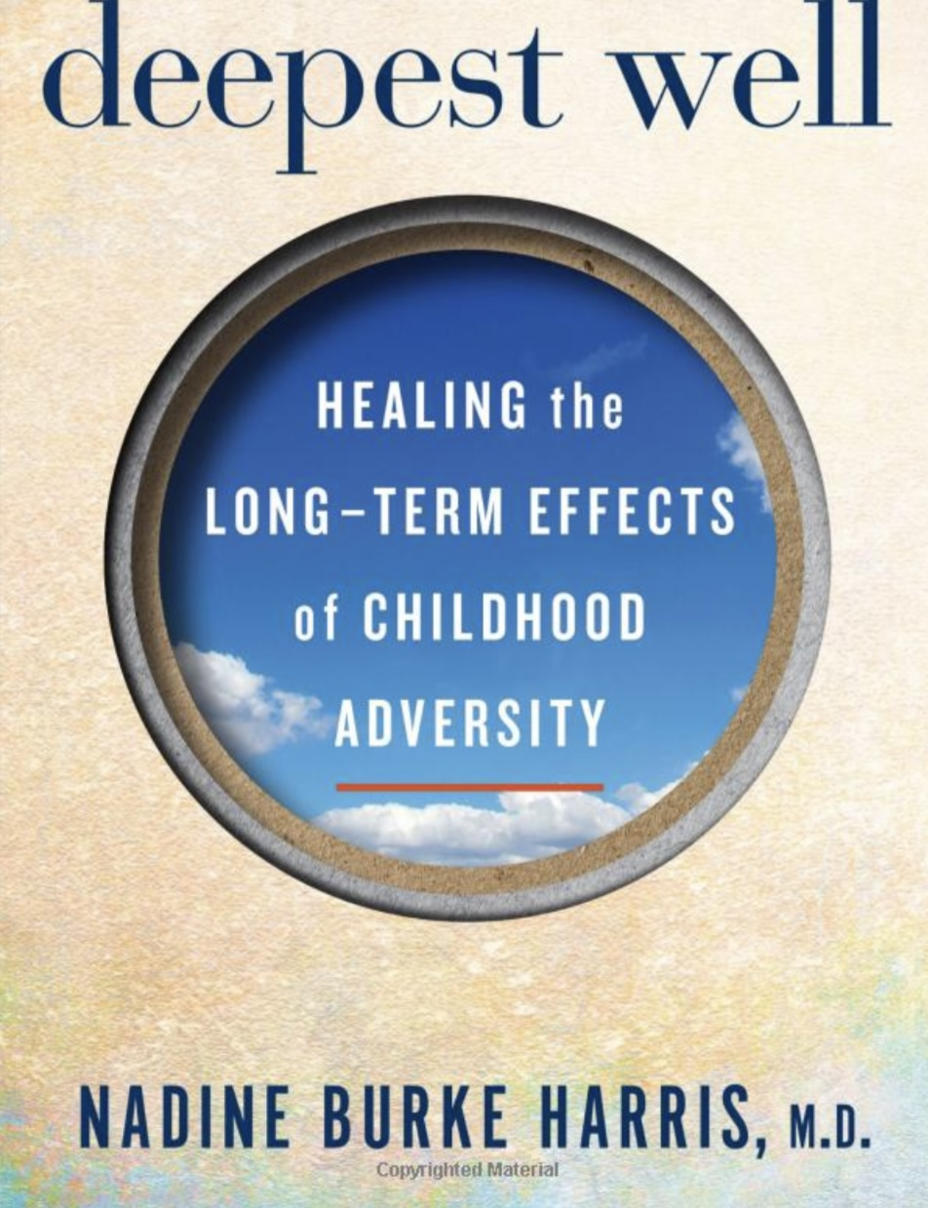
Adverse childhood events occur more often in children with insecure, than those with secure types of attachment and in families with authoritarian, permissive, and especially uninvolved parenting than they do in those with authoritative parenting.
Secure attachment provides not just parental protection but also teaches the child emotional regulation skills which are protective from adverse events.
Orchid vs. dandelion children are genetically different in their susceptibility to ACE’s. Orchids have temperamental suboptimal polyvagal regulation in response to a stressor. This can however be moderated by maternal sensitivity. Orchid children with a highly sensitive mother have normal polyvagal regulation.
Michael Meaney, studying attachment in animals , found that rat moms sooth their pups by licking them. Securely attached mom’s/pups' dyads do a lot of licking. Secure attachment/licking reduces the pup’s cortisol/stress levels for the remainder of their lives.
Maternal soothing helps the pups to become low on anxiety and aggression and to become parents who are themselves secured attached/high lickers of their own offspring.
Insecurely attached mom/pup dyads do a lot less licking and the pups have higher emotional reactivity/cortisol levels and become high anxiety/aggression low licking parents, who tend to have insecurely attached offspring who are themselves high on anxiety/aggression
ACEs AND ATTACHMENT
Notes:
Adverse childhood events are related to parenting and attachment styles

Slide 71
ACEs AND ATTACHMENT
High stress and poor stress regulation also leads to injury to telomeres which are the “bumpers” of the cell’s DNA. This leads to more rapid cell senescence and premature aging of organs which is part of the mechanism for the increased morbidity and mortality with high ACE’s.
“Home” toxic stress, that is stress caused by the caregivers, is far more damaging than “community” toxic stress.
During the break I’ll put up the ACE questionnaire take it and note your score. Next week for the poll you can anonymously share it with us if you choose.
Notes:
Adverse childhood events are related to parenting and attachment styles

Slide 72
ACE scores don’t diagnose PTSD, depression, or ADHD but they tell us what kind of nervous system a person is bringing into adulthood.

Slide 73
IMPLICIT AND EXPLICIT MEMORY
Are there more than one type of memory ?

Slide 74
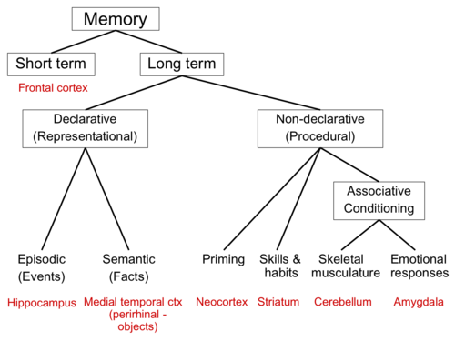
Memory
To understand the trauma spectrum disorders and how they develop, we must first discuss memory. Recall the three information centers: somatic, emotional and rational. Each of these information centers has its own very distinctive memory system.
Therefor there are several types of memory which fall into two categories 1) explicit (rational) and 2) implicit memory (somatic and emotional).
1) Explicit memory is also referred to as declarative or representational memory – it is the rational, conscious, intentional recollection of factual information, previous experiences, and concepts. It is what most people think of when they think of memory. Explicit memory includes :
A) autobiographical or episodic memories
B) semantic memories – involves recall of words, concepts or numbers.
Explicit memories of previous experiences are not indelible. Rather than a permanent recording our memory of events is more like a Wikipedia page that can be altered by us and other people whenever it is retrieved.
Types of memory
Notes:
PTSD is primarily a memory disorder. To understand why we need to explore memory in greater depth.

Slide 75
Memory and trauma
2) Implicit memory is also referred to as unconscious, non-declarative or procedural memory – does not require the conscious or explicit recollection of past events or information and the individual may be unaware that remembering has occurred. Implicit memory Includes :
A) priming – improved performance on tasks people have been subconsciously prepared for. Ex. the word “nurse” is recognized more quickly following the mention of the word “doctor” than following the word bread.
B) Skills and habits – the body memory involved in skills such as riding a bicycle, or skating
C) Skeletal musculature – “body memory” posture and body responses based on previous experiences
D) Emotional responses/activation states – the effects that past emotional experiences bring to bear on present emotional responses to events in the environment.
Types of memory
Notes:
PTSD is primarily a memory disorder. To understand why we need to explore memory in greater depth.

Slide 76
Contrasting Implicit and explicit memory
explicit
implicit
Can be activated together or independently of one another
System II- rational brain
Hippocampus and medial temporal cortex
Conscious, experienced as images and words
“mind”
Slow, takes effort
Logical, consequential decision making
System I- emotional somatic brain
Amygdala
Unconscious, experienced as body feelings
“heart”
Fast, no effort
Automatic pilot, experience-based decision making
Whereas explicit traumatic memories recall for us the story of the trauma, Implicit traumatic memories make us relive the trauma.
Notes:
To summarize the differences between implicit and explicit memories: implicit memory is associated with system I or the emotional brain whereas explicit memory is associated with system II or the rational brain…

Slide 77

IMPLICIT MEMORY and trauma
Implicit or “emotional” memory is the system that is mostly affected by trauma.
Implicit memories manifest as physiologic activation states (calm, alert, fight/flight, freeze), feelings, sensations, and dreams. Implicit memories are unconscious somatic and psychological manifestations that are not expressed as stories or images, the way explicit memories are.
Posttraumatic spectrum disorders occur when traumatic memories are "stored“ in the implicit memory system without being processed.
The activation states, somatic and emotional flashbacks and emotional dysregulation present in people with traumatic spectrum disorders are manifestations of their implicit memories.
Implicit memories often emerge spontaneously or after being triggered by a present-day stimulus.
To use a computer metaphor, a traumatic experience may create a “document” which is filed in our implicit “computer” memory system. Triggers open that document on the screen displacing other windows or screens we may have been viewing. To avoid reliving these horrific memories, the person starts to isolate to avoid triggers.
Notes:
Posttraumatic spectrum disorders occur when traumatic memories are "stored" unprocessed in implicit memory. Remember that…

Slide 78
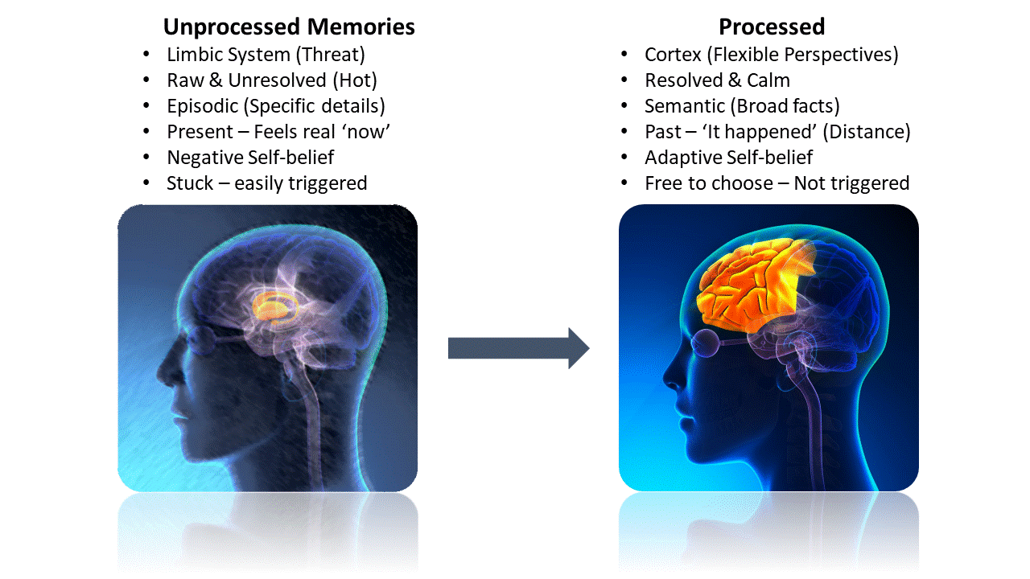
traumatic memories and emotional dysregulation
Unprocessed traumatic memories, or complexes are implicit memories that retain the unmodified emotional and somatic memory of a traumatic event.
“unprocessed” or “unresolved” implicit/unconscious traumatic memories are a feature of the traumatic spectrum disorders and a common cause of emotional dysregulation
People living with unprocessed or unresolved traumatic memories often have dysregulated emotions but rather than associating these dysregulated emotions with past trauma they attribute them to present day circumstances and events.
Recognizing dysregulated emotions and understanding they may have as much or more to do with the past, as with the present, is an important step in healing from trauma.
Sometimes the dysregulated emotions associated with unresolved trauma are misdiagnosed by mental health professionals as the mood swings of bipolar disorder or other mental health conditions.
However, dysregulated emotions related to trauma tend not to respond as well to treatment with medications as classical bipolar disorder
It is not a person’s fault they have dysregulated emotions but society does hold people responsible for their behavior even when stems from dysregulated emotions.
While, ultimately, it is the person’s responsibility to manage and heal their dysregulation, society and mental health professionals can either facilitate or at times inadvertently hinder this healing process
Notes:
The healing of trauma spectrum disorders involves processing unprosessed memories. Unprosessed memories are stored in the limbic system and are… In contrast process memories are stored in the cortex and are…

Slide 79
HOW TRAUMATIC STRESS LEADS TO THE UNPROCESSED TRAUMATIC MEMORIES PRESENT IN THE TRAUMA SPECTRUM DISORDERS

Slide 80
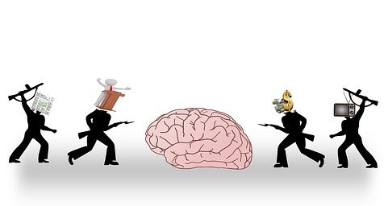
traumatic stress
AND ptsd
Traumatic stress may lead to PTSD and other trauma spectrum disorders when the stressor is perceived by the person to be life-threatening and inescapable.
If the person can’t escape a life-threatening traumatic event physically, they will instead escape it mentally by dissociating from the experience. This dissociation leads to the traumatic memory being “encapsulated” as an implicit traumatic memory or a “dissociated traumatic complex”
When people dissociate from a traumatic event, they can either escape 1) “downward” into their reptilian brainstem and feel numb/dead/empty as if in a void or bottomless hole, and/or 2) less often they may go “upward” and have a transcendent experience such as a near death, or out of body experience.
Unprocessed traumatic “complexes” are dissociated or “exiled” from the conscious memory in order to protect the integrity of the mind from the pain they carry. We’ll have much more to say about this when in future sessions we discuss dissociation and internal family systems.
“Dissociated traumatic complexes” exist autonomously in our implicit memory but their containment and maintenance requires enormous “mental energy” leaving less energy available for all the other functions of the mind including psychosocial growth
When these traumatic complexes are triggered and activated, the person goes into emotional mind and their emotional mind’s energy consumption soars leaving very little energy for any other mental functions. This is called limbic highjack.
Notes:
How does traumatic stress lead to PTSD?

Slide 81
ACTIVATION CURVES
Traumatic stress not resulting in PTSD
Inescapable traumatic stress resulting in PTSD
No escape
x
hyperfreeze
activated
.
calm
hypofreeze
Dissociated unprocessed traumatic complex
Requiring significant energy
Notes:
When a person encounters a traumatic stress that takes them to the extremes of activation either hypo or hyper activation, but they are able to escape PTSD is unlikely to occur.
In contrast when the traumatic stress is for some reason inescapable, the person cannot escape physically, they escape mentally by dissociating the memory of the event in the form of an un-process traumatic complex.
Much of attachment trauma is inescapable, after all the child cannot choose to leave their family. This is why attachment trauma is highly likely to lead to posttraumatic spectrum disorders such as complex PTSD.

Slide 82
OUTCOMES OF THE TRAUMA SPECTRUM DISORDERS
Does experiencing a traumatic stressor always lead to PTSD or a trauma spectrum disorder?

Slide 83
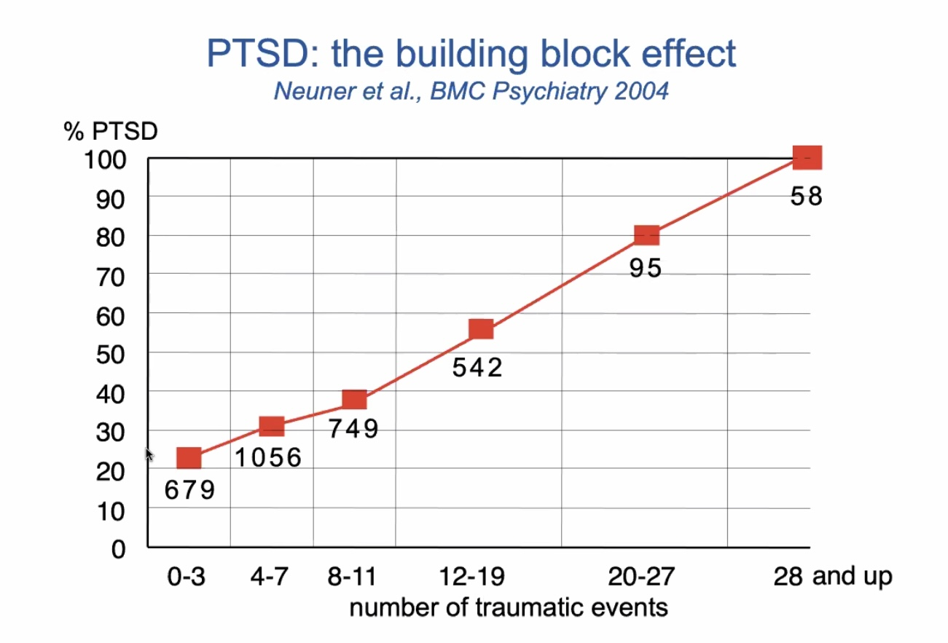
THE BUILDING BLOCK EFFECT
Trauma/PTSD have a dose–response relationship. (the higher the total exposure to trauma the more likely it is to lead to a PTSD condition.
Each traumatic event adds load to the nervous system. One or two events may be integrated, especially with safety and support. But as traumatic exposures accumulate, particularly early, interpersonal, or repeated ones, the system becomes overwhelmed.
After a certain threshold, even resilient people are likely to develop PTSD symptoms.
This doesn’t mean people are “weak” but rather that trauma has exceeded their coping ability and pushed their nervous system into chronic fight/flight mode.
Notes:
PTSD is sometimes thought of as arising from a single event. In fact, most people who develop PTSD have experienced multiple traumatic events. The more traumatic events a person experiences, the more likely they are to develop PTSD.

Slide 84
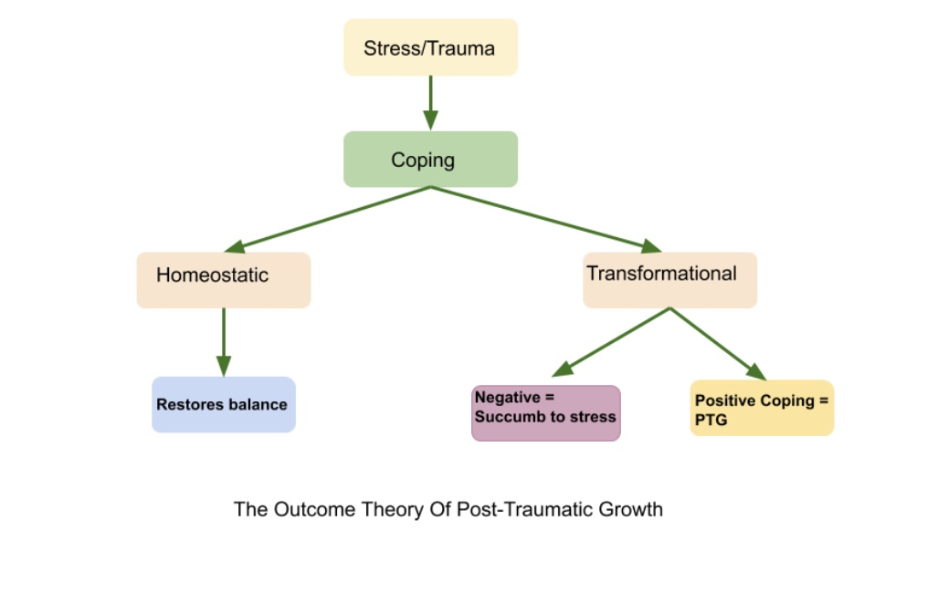
Outcomes of traumatic stress
One of the features of living organisms is homeostasis which is the ability to return to a state of steady internal, physical and psychological conditions.
After a traumatic event, homeostasis tries to restore our balance and return us to the calm state we were in before the traumatic experience. Traumatic stress that leads to a traumatic stress disorder overwhelms our homeostatic capacity and transforms our nervous systems.
Most people who experience traumatic stress
1) spontaneously recover and return to normal functioning.
2) When the person’s coping resources cannot fully deal with the traumatic experience the person may be positively or negatively transformed.
The trauma spectrum disorders are the negative transformation.
Posttraumatic growth is a positive transformation.
People can also experience a combination of posttraumatic stress symptoms and posttraumatic growth.
.
Notes:
One trajectory that's not depicted in the previous slide is posttraumatic growth. The seven trajectories posttraumatic stress that we have mentioned fall into three outcomes: homeostasis, negative transformation, and positive transformation.

Slide 85
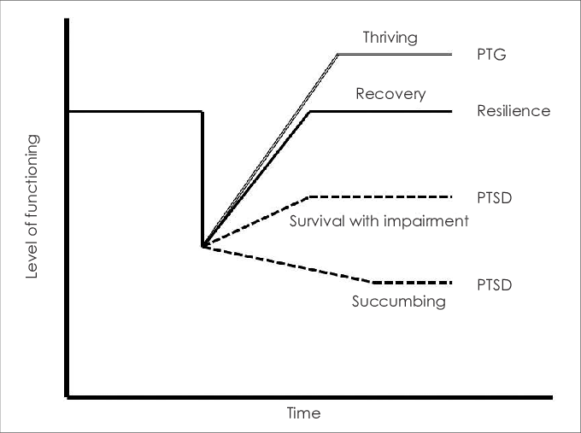
FOUR OUTCOMES OF TRAUMATIC SPECTRUM DISORDERS
In people with traumatic spectrum disorders functioning is initially impaired then over time there may be different outcomes: the person may
1. Succumb
2. Survive with an impairment.
3. People who are resilient or have more resources can better cope and eventually recover and return to the same level of functioning they had prior to the trauma.
4. Following trauma people may also experience posttraumatic growth a transformation which changes their patterns of thinking, feeling and behaving, in other words their personality, in a positive way.
Mystical experiences are a part of trauma they are a way back from trauma. Our ancestors suffered more pain and trauma and therefore had more mystical or religious experiences than we do in our relatively safe society. Jeffrey Kripal

Slide 86
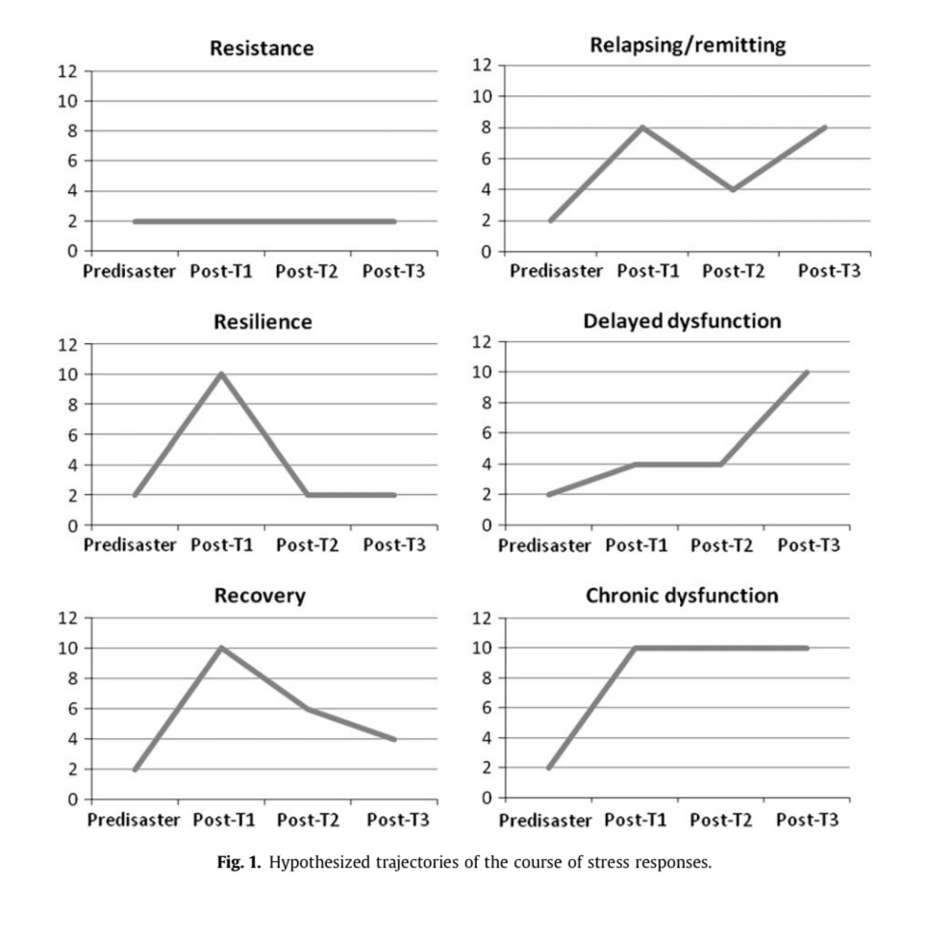
TRAUMATIC STRESS TRAJECTORIES
Resistance: Minimal disruption; functioning remains largely intact despite exposure.
Resilience: Initial symptoms occur, but the system self-regulates and returns to baseline.
Recovery: Significant early symptoms that gradually resolve over time with integration or support.
Relapsing–remitting: Symptoms come and go, often reactivated by stress or reminders.
Delayed dysfunction: Little early disturbance, followed by later-emerging symptoms when coping capacity erodes.
Chronic dysfunction: Persistent symptoms with limited return to baseline without targeted intervention.
Notes:
Six different posttraumatic stress trajectories have been identified. These graphs depict the level of distress and dysfunction of the person starting just before the trauma, labelled as "predisaster".

Slide 87
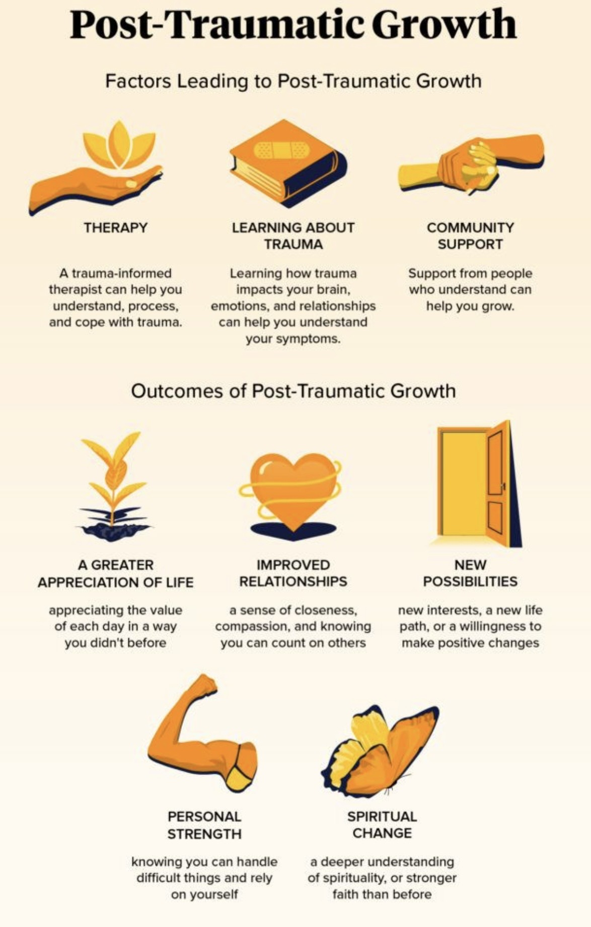
Outcomes of traumatic stress
Posttraumatic growth refers to the positive effects that can result from people experiencing traumatic events.
Posttraumatic growth is predicted by personality traits of optimism and religiousness, the ability to make meaning and a coherent narrative of the experiences, emotional openness (rather than avoidance), social support and a place to safely disclose, a spiritual or existential framework, active coping skills and a sense of self-efficacy and time to integrate (rather than just reducing symptoms)
Commonly reported elements of posttraumatic growth include, greater appreciation and new possibilities for life, deeper relationships and compassion, increased personal strength, shifted priorities and values, an expanded sense of meaning or spirituality, increased exploration of existential questions like death and purpose, and an increased value placed on small things in life.
Notes:
One trajectory that's not depicted in the previous slide is posttraumatic growth. The seven trajectories posttraumatic stress that we have mentioned fall into three outcomes: homeostasis, negative transformation, and positive transformation.

Slide 88
WHY SOME PEOPLE ARE MORE PRONE TO DEVELOPING TRAUMATIC SPECTRUM DISORDERS

Slide 89
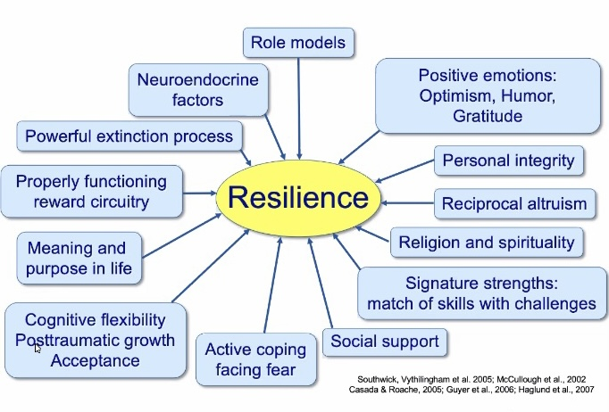
TRAUMA RESILIENCY AND VULNERABILITY
People differ in their vulnerability to trauma because of differences in biology, development, meaning, and connection.
Risk increases when stress systems are easily sensitized, early attachment is disrupted, coping is rigid, and support is thin.
Resilience grows when people have secure role models, flexible stress hormones, a sense of meaning or faith, cognitive flexibility, active problem-solving, strong social bonds, reciprocal altruism, personal integrity, and positive emotions like optimism, humor, and gratitude, which help the nervous system recover and re-regulate.
Notes:
There are a number of protective factors that predict resilience to traumatic stress or posttraumatic growth.

Slide 90
RESILIENCE
George Bonanno, a professor of clinical psychology at Columbia University, is a pioneer in the field of loss and trauma. His work fundamentally shifts the focus from "pathology" or what goes wrong, to "resilience" or how humans naturally cope. His core argument is that human beings are far more resilient than they are given credit for. He defines resilience not as a personality trait, but as an outcome: a stable trajectory of healthy functioning after highly adverse event(s).
THE FOUR TRAJECTORIES OF TRAUMA: Bonanno's research tracks people over years after a tragedy, like 9/11 or the loss of a spouse. He found that people generally fall into one of four patterns:
Resilience: (65%+): The most common outcome. These individuals may feel temporary distress but maintain relatively stable physical and psychological health.
Recovery: People who experience significant distress for several months or years but eventually return to their baseline.
Chronic: A smaller group (often around 10%) who experience long-term, debilitating psychological struggle.
Delayed: A pattern where symptoms appear much after the event(s).

Slide 91
CHALLENGING TRAUMA MYTHS
Bonanno is renown for “dismantling” several commonly held beliefs in psychology and popular culture:
Myth: trauma is permanent. He argues that contrary to the "body keeps the score" narrative that trauma leaves irreversible scars on the brain, Bonanno’s suggests that for most people, the "scars" heal. Our biology is designed to recover from stress.
Myth: you must do "grief work." He challenges the idea that you must "process" or "work through" every negative emotion. In fact, he says that his research shows that people who "grieve less" or even use "repressive coping" (avoiding the pain) often fare better than those forced to relive it.
Myth: the stages of grief. He strongly disputes the idea that there are universal "stages", like denial, anger, etc. that everyone must pass through. He views grief as an oscillation, a "flexible" process where you move in and out of sadness, sometimes even laughing or feeling joy shortly after a loss.
Myth: professional intervention is always better. He warns against "Critical Incident Stress Debriefing", forcing victims to talk right after an event, noting that for many, it can actually interfere with their natural recovery process and cause more harm.

Slide 92
FLEXIBILITY AS THE KEY TO RESILIENCE
In his book The End of Trauma, Bonanno introduces the concept of Cognitive Flexibility as the key to resilience. Rather than a single "resilience gene," it's about a three-step process:
Challenge Appraisal: "What is happening to me right now?"
Goal Selection: "What do I need to do to get through this moment?"
Regulatory Flexibility: Choosing the right tool, e.g., seeking help, distracting oneself, or facing the pain, for that specific situation.

Slide 93
PSYCHIATRY’S BLIND SPOT FOR TRAUMA
Overall are mental health professionals good at diagnosing and treating trauma spectrum disorders ?

Slide 94

contemporary PSYCHIATRY’S blind spot for trauma
Freud initially proposed that trauma particularly that of a sexual nature was the major cause of his patient's issues. Later he rejected his own earlier theory replacing it with the oedipal theory which held that memories of trauma were in fact the child’s wishes or phantasies.
This suppression of trauma dominated 20th century psychiatry and traumatic causes for psychiatric symptoms were largely ignored
DSM 5 is 947 pages long and lists 297 disorders. Only 6 of those 297 diagnosis in the DSM are classified as trauma and stress related disorders, taking up only 25 of DSM’s 947 pages.
Of those 6 diagnoses only one is occasionally made by psychiatrists; PTSD.
Bessel Van Der Kolk, a psychiatrist, researcher and one of most respected traumatologists in the world has said: “despite the scant attention psychiatry pays to trauma… if you take every condition that is very significantly related to trauma out of DSM, you’re left with a pamphlet…”
In 2012 despite much lobbying the DSM V committee refused to incorporate complex PTSD into the DSM-5 citing lack of evidence
There are of course psychiatric conditions that are not related to trauma and may be mostly biological.
Notes:
Mainstream psychiatry has a poor track record for diagnosing and treating trauma spectrum disorders. One can go as far as to say that modern medicine and psychiatry have blind spots for trauma.

Slide 95

Why The blind spot?
Since the late 40’s there have been significant pharmaceutical breakthroughs in psychiatry which have improved and saved the lives of many people suffering from conditions such as major depression, anxiety disorders, bipolar disorder, and schizophrenia. Psychiatric medications have however also caused much harm.
Today most psychiatrists follow a medical model which focuses on diagnosing psychiatric conditions for which medications are then prescribed. Most psychiatrists know little about psychology or psychotherapy. This was not always the case.
Starting in the 1970’s the pharmaceutical industry, by investing huge amounts of money in marketing, the American psychiatric association, departments of psychiatry, thought leaders, and research began to exert more and more influence on the education and practices of psychiatrists.
At the same time government health care programs increasingly covered psychiatric, but not psychological care
Consider also that it takes a lot less time to make a diagnosis based on symptoms than to understand what causes the symptoms in a particular person…And that psychotherapy is more difficult, and time consuming to learn and practice than pharmacotherapy.
… This goes a long way to explaining psychiatry’s blind spot.
However, trauma and attachment-based issues are very common and don’t tend to respond well to a medical biological approach or to medications . People with attachment and trauma related issues are therefor often not well served by mainstream psychiatry or public health care systems. They need trauma informed care.
Notes:
There are several reasons for this blind spot.

Slide 96
TRAUMA INFORMED CARE
What is trauma informed care?

Slide 97
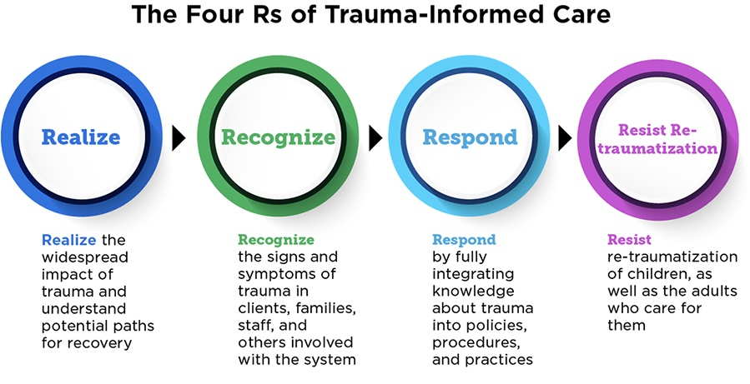
trauma-informed care
The single most significant predictor that an individual will end up in the mental health care system is a history of trauma.
Trauma informed care starts from the principal that trauma is an almost universal experience among people living with mental health and psychosocial difficulties.
Trauma informed healthcare providers ask, "what has happened to you?" Not "what is wrong with you?".
They are non-judgmental, convey hope, acknowledge alternative views, are respectful, and avoid jargon. They are patient centered.
Healthcare providers skilled at working with people who have experienced trauma are good at self-regulating and staying in the window of emotional tolerance even when the people they are working with are very distressed.
Trauma informed care follows the four R’s model…
“who is there for you is as important as what has happened to you?“ Bessel van der Kolk
Notes:
The concept of trauma informed care has arisen to try to counter the blind spot. The four R's are the pillars of trauma informed care.

Slide 98
CONTROVERSIES SURROUNDING MEMORY AND TRAUMA
Is there a consensus among the mental health community on the issues we’ve been talking about today or are there some controversies ?

Slide 99
Before we talk about memory debates, I want to be clear about a guiding principle: healing does not require certainty about historical truth.

Slide 100
controversies around trauma and memory
In the mid 1890’s Freud proposed his seduction theory : “hysteria” was caused, he claimed, by repressed memories of early childhood abuse. (based on J. Breuer’s treatment of Anna O.)
He abandoned the seduction theory in 1897 for his theory of infantile sexuality of which the Oedipal complex was the center piece. In a letter to W. Fleiss he gave his reasons : 1) recovering the traumatic memories did not cure the patient as he had originally hypothesized. 2) His sister had “hysterical” symptoms, and he couldn't accept his father had sexually molested her. 3) The unconscious can’t tell fact from fiction.
After Freud, Psychology and Psychiatry neglected developmental and attachment trauma until attachment theory started to shine a light on it again. Kaplan and Sadock's textbook of psychiatry, the bible of every psychiatric resident, in its 1980 edition reported the rate of father/daughter incest was about 1/1,000,000 and held that it was generally a positive experience.
In the 1980’s and 90’s trauma was rediscovered. Books such as the 1988’s “The courage to heal” by Ellen Bass suggested that a wide range of psychiatric symptoms were indicators the person experiencing them had been sexually abused even if that person had no explicit memory of any such event. Many therapists inspired by this, revisited Freud’s seduction theory and thought that to heal, people had to recover these memories.
Notes:
There are a number of controversies, challenges, and open questions in the field of trauma spectrum disorder studies…

Slide 101
controversies around trauma and memory
This led to the “memory wars” which were marked by academic, public, and legal debates about the veracity of recovered memories
Recovered memories – a memory of a traumatic event such as sexual abuse experienced typically during childhood that is forgotten and then recalled many years later.
False memories – refers to cases in which people remember events differently from the way they happened or , in the most dramatic cases, remember events that never happened at all.
The issue of recovered memories was associated with much grief and led to a flurry of police investigations including some involving allegations of ritual satanic abuse. This led to a backlash spearheaded by the false memory syndrome foundation which was largely comprised of family members who maintained they had been falsely accused of sexual abuse.
Some therapists were successfully sued, and some accusers retracted their stories. In other cases, corroboratory evidence was found to confirm the veracity of recovered memories. Some who were accused admitted the memories were true
Notes:
There are a number of controversies, challenges, and open questions in the field of trauma spectrum disorder studies…

Slide 102
Controversies around trauma and memory continued
Memory has many different components; some are quite malleable.
Different memory systems become functional at different stages of development : somatic and emotional memory are operative from before birth, but explicit or rational memory typically comes online at ages 3-4 when language develops.
Stress and trauma affect focus, attention, and memory. Explicit memory follows literal, material world, logic of causality and temporality. Implicit memory follows symbolic, dreamlike, imaginative logic, making no distinction between past from present or one person from another.
False memories have been repeatedly experimentally implanted in people.
Some recovered traumatic memories can’t be corroborated. These include recovered memories of events such as alien abduction and ritual satanic abuse. These may be false memories underlying which there may be a traumatic core (at the level of the somatic and emotional memory centers) that is symbolically represented in cognition.

Slide 103
Controversies around trauma and memory continued
My position is that dissociation is very real and a mechanism through which memories can be repressed. Most people who have been abused remember some parts of the abuse but not others. Fewer don’t remember any aspect of the abuse at all. There are however some mental health that dispute this.
Some people who have had traumatic experiences don’t remember them at all but in some situations have somatic and emotional flashbacks. (ex. when having sex) From these flashback they go on to reconstruct narratives of abuse. Many of these narratives have been corroborated.
Recovering traumatic memories doesn’t directly lead to healing. Trauma work can be done with somatic and emotional memories as they manifest in the present without trying to recover repressed memories.
My sense is that therapists should neither encourage nor discourage the recovery of memories. If repressed memories emerge in therapy therapists don’t need to be certain weather these memories are true or false, they should, however, consider them to be deeply important and meaningful to the person and of help in understanding them.

Slide 104
challenges and open questions in trauma
As a society, we are becoming increasingly trauma aware and there is more openness, acceptance, information, and various forms of peer support for people suffering from trauma spectrum disorders. We also have much more knowledge about trauma treatments.
Unfortunately, professional services are sorely lagging behind public awareness and scientific knowledge. Trauma treatment can be long and complicated and not many professionals are adequately trained to provide it. Access to and quality of care are problems for people who have experienced trauma
Those who may be trained are often not funded by public health care.
Some of the controversies in the field of trauma include :
To what extent are conditions such as chronic depression, anxiety, and ADHD, genetic, related to stress, past trauma, or environmental factors such as economic factors, the educational system, nutrition, and social media?
Does using the word “traumatic” to refer to common everyday stressors trivialize trauma
Are our emotional immune systems becoming inept because childhood is so structured by parents. ( as for example argued in Haidt’s “The coddling of the American mind”)
Are we increasingly becoming a victimhood culture ? one which divides people into two groups: the privileged oppressors, and the underprivileged oppressed. Victims/oppressed are given the moral high ground and must be defended from oppressors. Oppressors are identified on the basis of race, gender, socioeconomic, and educational status. Microaggressions are seen as rampant and to be dealt with by such strategies as the creation of safe spaces and “cancelling”. Questions for the breakout rooms

Slide 105
In trauma work, meaning, regulation, and integration matter more than factual reconstruction.

Slide 106
Before we end today, let your eyes gently look around the room.
Name three neutral or pleasant things you can see.
Feel your feet on the floor or your body in the chair.
Now bring to mind one small thing that helps you feel steadier a person, a place, a memory, a value, or even your breath.
You don’t have to feel calm, just slightly more okay.
As you hold that in mind, take one slow breath in through the nose and a longer breath out through the mouth.
Let your body register: I’m here, and this moment is safe enough.

Slide 107



Slide 108

See you next session

Slide 109

video
Week 17 of simple

Slide 110
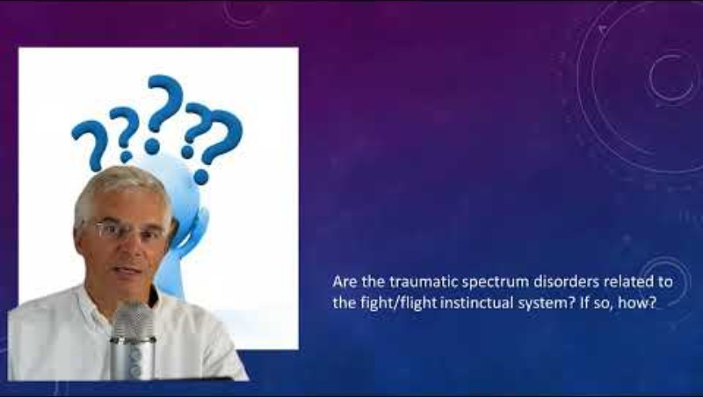

Slide 111
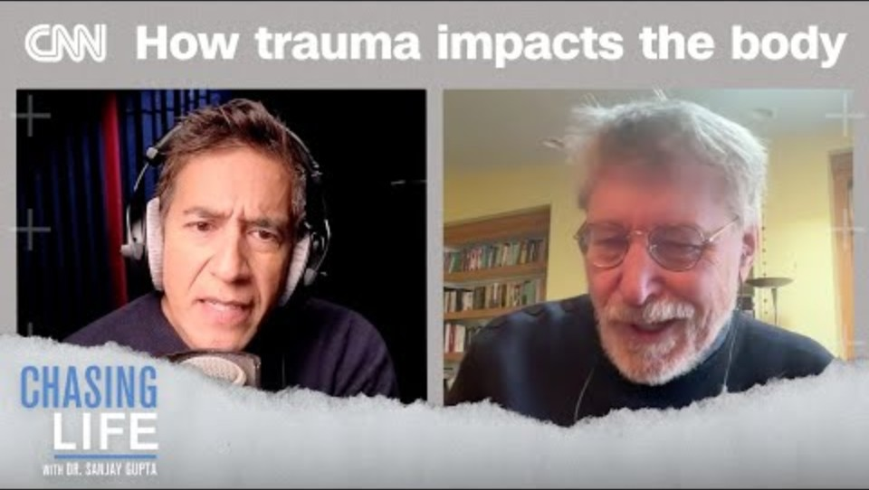

Slide 112


Slide 113


Slide 114


Slide 115


Slide 116
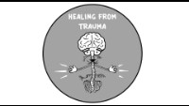

Slide 117


Slide 118


Slide 119


Slide 120
(1)Adverse Childhood Experiences (ACEs) studies are a series of research studies conducted by the Centers for Disease Control and Prevention (CDC) and Kaiser Permanente in the 1990s. The main findings of these studies show a strong correlation between childhood trauma and negative health outcomes later in life.
The original ACEs study identified ten types of adverse childhood experiences: physical abuse, sexual abuse, emotional abuse, physical neglect, emotional neglect, household substance abuse, household mental illness, parental separation or divorce, domestic violence, and incarcerated household member. The study found that individuals who experienced a higher number of ACEs were more likely to suffer from a range of health issues, including chronic diseases, mental health disorders, substance abuse, and even early death.
These findings have had a significant impact on public health and have led to a greater understanding of the long-term effects of childhood trauma. They have also influenced the development of trauma-informed care and interventions aimed at preventing and mitigating the impact of ACEs on individuals' health and well-being

Slide 121
(2)"The Deepest Well" by Nadine Burke Harris is a book that explores the impact of childhood adversity on health. Dr. Burke Harris, a pediatrician and founder of the Center for Youth Wellness, discusses the groundbreaking ACEs study and its implications for understanding the link between childhood trauma and long-term health outcomes.
In the book, Dr. Burke Harris shares stories from her own medical practice and research to illustrate how childhood trauma can affect physical and mental health throughout a person's life. She explains how toxic stress can disrupt the body's stress response system, leading to a higher risk of chronic diseases, mental health disorders, and other health issues.
"The Deepest Well" also offers practical advice on how individuals, families, and communities can address and prevent the impact of childhood adversity. Dr. Burke Harris advocates for a trauma-informed approach to healthcare and social services that takes into account the effects of trauma on individuals' health and well-being.
The book provides a compelling look at the importance of understanding and addressing childhood trauma to improve health outcomes and build resilient communities

Slide 122
(3)Implicit and explicit memory are two types of long-term memory that differ in terms of how information is stored and retrieved.
1. Implicit Memory:
- Implicit memory is unconscious and automatic.
- It involves the recall of information without conscious effort.
- It is typically used for skills and procedures that have been learned through repetition and practice.
- Examples of implicit memory include riding a bike, tying shoelaces, or playing a musical instrument.
- Implicit memory is often preserved in conditions where explicit memory is impaired, such as in cases of amnesia.
2. Explicit Memory:
- Explicit memory is conscious and intentional.
- It involves the recall of information with conscious effort and awareness.
- It is used for remembering facts, events, and experiences that can be consciously retrieved and described.
- Examples of explicit memory include remembering the name of a friend, recalling a specific event from the past, or reciting a poem.
- Explicit memory is more likely to be affected by aging, brain injury, or neurodegenerative diseases.
In summary, implicit memory is non-conscious and involves skills and procedures, while explicit memory is conscious and involves facts and events. Both types of memory play important roles in our daily lives and contribute to our overall cognitive functioning.

Slide 123
(4)Post-traumatic growth refers to the positive psychological changes that can occur as a result of struggling with and coping with a traumatic event or adversity. While trauma can have profound negative effects on individuals, some people may also experience personal growth and positive changes in the aftermath of trauma. Here are some key points about post-traumatic growth:
1. Increased Resilience: Going through a traumatic experience can sometimes lead to an increased sense of resilience. People may develop new coping strategies, problem-solving skills, and a greater ability to adapt to challenges.
2. Enhanced Relationships: Some individuals report that their relationships improve after experiencing trauma. They may develop a deeper appreciation for their loved ones, increased empathy, and a stronger sense of connection with others.
3. Greater Appreciation for Life: Trauma can lead to a shift in perspective, with individuals valuing life and its precious moments more deeply. They may develop a greater sense of gratitude and a heightened awareness of the present moment.
4. Personal Strength: Overcoming adversity can foster a sense of personal strength and self-confidence. People may discover inner resources and qualities they didn't know they had, leading to increased self-esteem and self-efficacy.
5. Spiritual Growth: Some individuals may experience a deepening of their spiritual or existential beliefs following trauma. They may find meaning and purpose in their suffering, leading to a greater sense of spiritual connection or a reevaluation of their values and priorities.
It's important to note that post-traumatic growth is not a universal response to trauma, and not everyone will experience it. However, for those who do, it can be a powerful and transformative process that helps individuals find meaning, resilience, and personal growth in the face of adversity

Slide 124
(5)Bessel van der Kolk is a prominent psychiatrist and author known for his work in the field of trauma and its effects on mental health. He is considered a leading expert in the study and treatment of trauma-related disorders. Some of his main contributions to psychiatry include:
1. Research on Trauma: Bessel van der Kolk has conducted extensive research on the impact of trauma on the brain, body, and mental health. He has studied how trauma can affect memory, emotions, and behavior, and has contributed to our understanding of trauma-related disorders such as post-traumatic stress disorder (PTSD).
2. Development of Trauma Treatment Approaches: Van der Kolk has been instrumental in developing innovative approaches to treating trauma, including somatic experiencing, neurofeedback, and yoga therapy. He has emphasized the importance of addressing both the psychological and physiological aspects of trauma in treatment.
3. Advocacy for Trauma-Informed Care: Van der Kolk is a strong advocate for trauma-informed care in mental health settings. He has raised awareness about the prevalence and impact of trauma on individuals' well-being and has called for a more holistic and compassionate approach to treating trauma-related disorders.
4. Authorship: Bessel van der Kolk is the author of several influential books on trauma, including "The Body Keeps the Score: Brain, Mind, and Body in the Healing of Trauma," which has become a seminal work in the field. His writings have helped to educate clinicians, researchers, and the general public about the complex nature of trauma and the importance of trauma-informed care.
Bessel van der Kolk's work has had a significant impact on the field of psychiatry, particularly in the areas of trauma research, treatment, and advocacy. His contributions have helped to shape our understanding of trauma and have influenced the development of more effective and compassionate approaches to helping individuals heal from traumatic experiences

Slide 125
(6)"The Body Keeps the Score: Brain, Mind, and Body in the Healing of Trauma" is a groundbreaking book by psychiatrist Bessel van der Kolk that explores the impact of trauma on the brain, body, and overall well-being. Here is a summary of the key themes and insights from the book:
1. Understanding Trauma: Van der Kolk delves into the complex nature of trauma and its effects on the brain, nervous system, and emotional regulation. He explains how traumatic experiences can become stored in the body and impact an individual's physical and mental health.
2. The Role of the Body: The book emphasizes the importance of recognizing the role of the body in trauma and healing. Van der Kolk discusses how trauma can manifest in physical symptoms, such as chronic pain, autoimmune disorders, and somatic complaints, and explores the connection between the mind and body in trauma recovery.
3. Treatment Approaches: Van der Kolk outlines various treatment approaches for trauma, including somatic experiencing, neurofeedback, yoga, and mindfulness practices. He highlights the importance of addressing both the psychological and physiological aspects of trauma in therapy and emphasizes the need for holistic and integrative approaches to healing.
4. Neuroscience and Trauma: The book integrates findings from neuroscience research to explain how trauma affects the brain and nervous system. Van der Kolk discusses the neurobiological mechanisms underlying trauma-related disorders, such as PTSD, and explores how interventions can help regulate the stress response and promote healing.
5. Hope and Resilience: Despite the profound impact of trauma, the book also offers a message of hope and resilience. Van der Kolk shares stories of individuals who have overcome trauma and found healing through various therapeutic approaches, highlighting the potential for recovery and transformation.
"The Body Keeps the Score" is a comprehensive and insightful exploration of trauma and its effects on the body and mind. It offers valuable perspectives on trauma recovery, treatment approaches, and the importance of addressing the holistic needs of individuals who have experienced trauma

