Slide 1
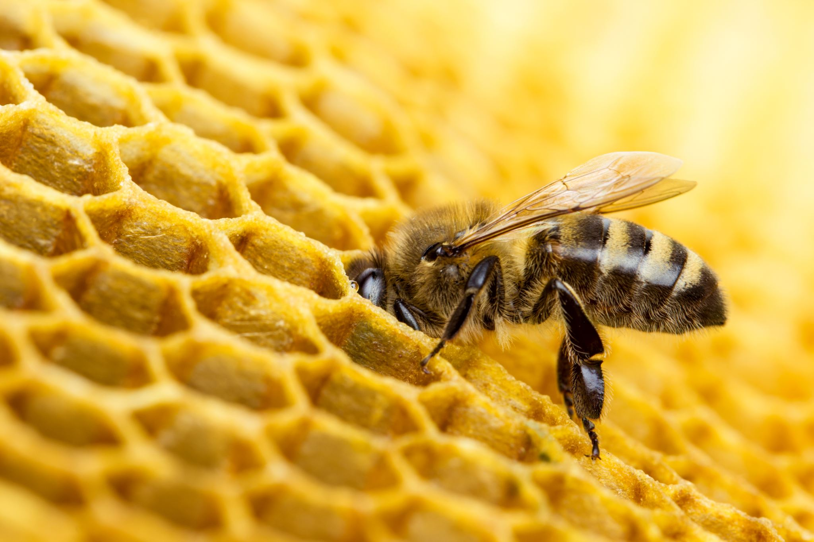
Welcome to week 18 of simple emotional regulation skills
Practice session
Please start recording at 9 am

Slide 2
week 17- the stress and trauma related disorders-session 20 of manual.
week 18- emotional regulation skills p.148-206 of dbt workbook. Our fifth practice session-the goals diary card procedure- session 21 of manual
week 19- structural dissociation theory and the treatment of the traumatic spectrum disorders- session 22 of manual.
week 20- introducing interpersonal skills p.207-241 of dbt workbook. Review of all the skills
week 21-introducing internal family systems (ifs)-session 24 of manual. introducing the ifs workbook and ifs workbook guided ai assisted self therapy
week 22- Spirituality, religion, and health- session 26 of manual.
week 23-interpersonal skills and putting it all together p.242-265 of dbt workbook. states of activation as essential trailheads and the four pillars of recovery from trauma-session 27 of manual.

Slide 3
SIMPLE COURSE SCHEDULE 2025-26
Week 1- October 1
Week 2- October 8
Week 3- October 15
Week 4- October 22
Week 5- October 29
Week 6- November 5
Week 7- November 12
Week 8- November 19
Week 9- November 26
Week 10- December 3
Week 11- December 10
Week 12- December 17
December 24 and 31
Week 13- January 7
Week 14- January 14
Week 15- January 21
Week 16- January 28
Week 17- February 4
Week 18- February 11
Week 19- February 18
Week 20- February 25
Week 21- March 4
March 11 and 18 no course
Week 22- March 25
Week 23- April 1
Week 24- April 8
Week 25- April 15
Week 26- April 22
Week 27- April 29
Week 28- May 6
Week 29- May 13
Week 30- May 20
Week 31- May 27
Week 32- June 3

Slide 4
PRACTICE SESSIONS SCHEDULE
preparation
practice
5. Today 18 February 11 goals diary card Nicole L
6. Week 25 April 15 April 8, 1:30 IFS workbook 1 Elaine S.
7. Week 26 April 22 April 15 IFS workbook 2 Dinko T.
8.Week 27 April 29 April 22 IFS workbook 3 Barb H.
9. Week 28 May 6 April 29 IFS workbook 4 Meaghan
10.Week 29 May 13* May 6 1:30 PM* Wise mind remediation Rob T.
We now have a full slate of volunteers but if anyone would like on a “substitute list” in case someone can’t make it, as happened last week, please let us know.

Slide 5

Warning about meditation
Feel free to skip it. Followed by a moment of silence

Slide 6
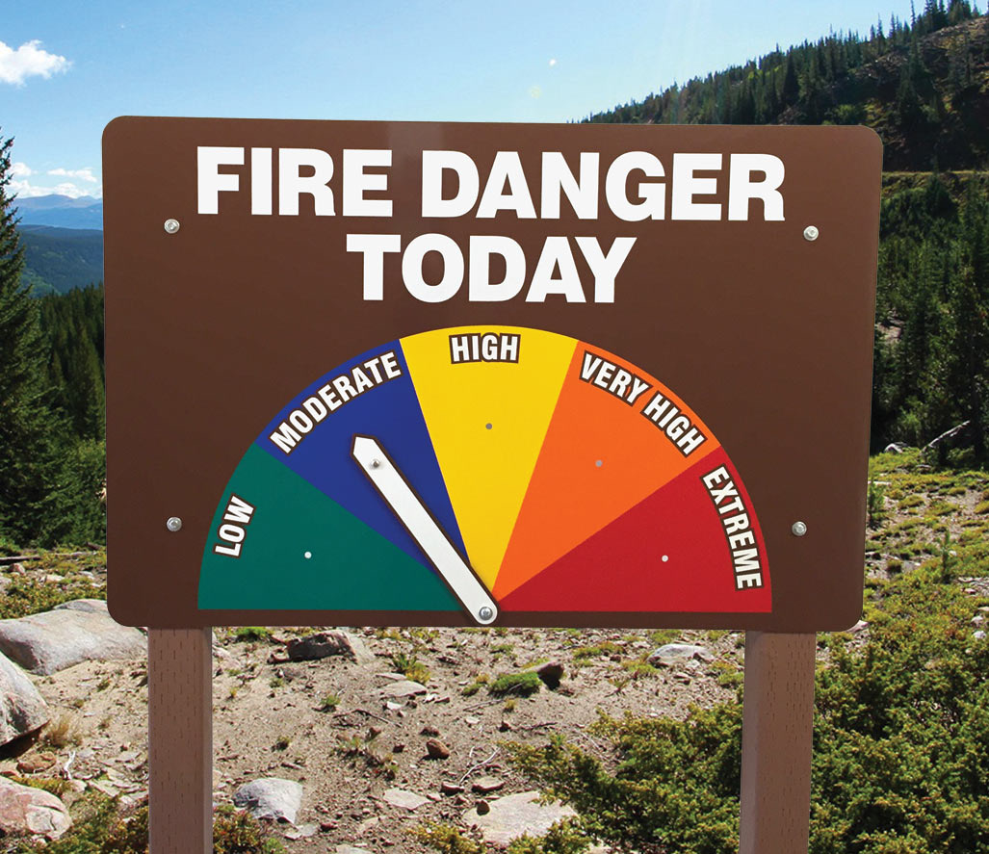


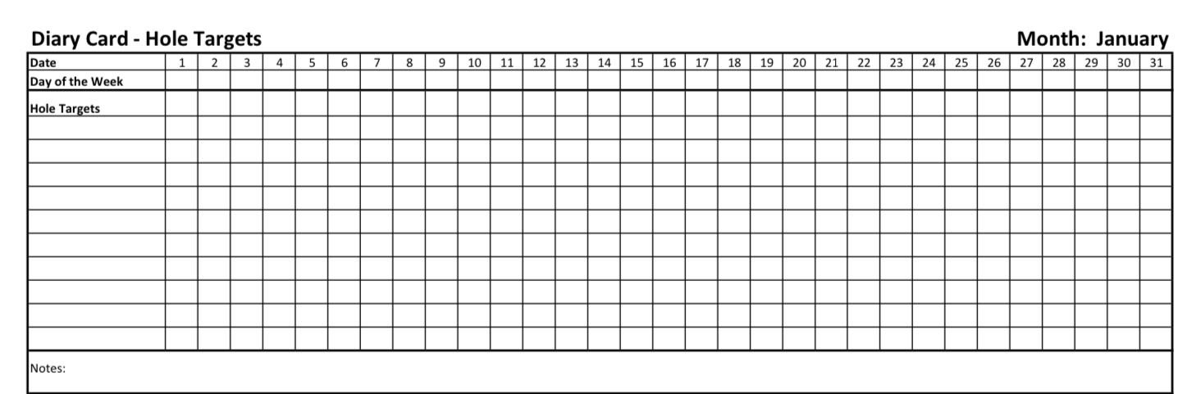
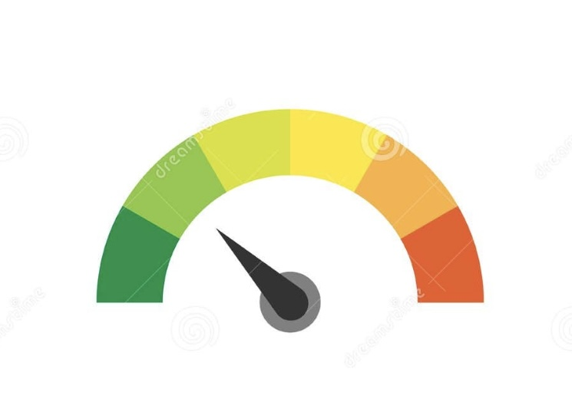
Check in regularly with your Personal dashboard
Spend a few moments checking in with yourself by asking:
1)What is the current risk that I’ll experience a state of crisis ?
Low b) Moderate c) high d) very high e) extreme
2) Am I in the window of tolerance?
a) Yes b) I’m a little outside c) very outside
3) Where is my energy tank right now?
Full b) ¾ c) ½ d) near empty
4) Have I been tracking my targets using the holes diary card ? how would I rate my targets right now?
5) How well am I focusing on what I’m doing. (for example, the course)
CRISIS RISK
WINDOW OF TOLERANCE
ENERGY RESERVES
RATING MY TARGETS
ATTENTION METER
% attention I’m paying
100
0

Slide 7
5-Minute Mindfulness Meditation: From Holes to the Mountain
Begin by finding a comfortable position.
Let your feet rest on the floor, or your body settle into whatever supports you.
If it feels right, allow your eyes to close.
Take a slow breath in… and a long, steady breath out.
1. Arriving (30 seconds)(Please don’t read black type)
Begin by noticing that you are here… in this moment… safe enough, still enough, to turn toward yourself.
Let the breath be natural.
Let the body soften in its own time.
As you breathe, imagine a quiet path stretching out before you—the path of your life, unfolding step by step.
2. The Sidewalk and the Holes (1 minute)
Picture yourself standing on that path.
Notice the familiar holes—the emotional drops, the old patterns, the places you sometimes fall.
Not as failures, not as flaws… simply as features of the terrain you’ve been walking for a long time.

Slide 8
5-Minute Mindfulness Meditation: From Holes to the Mountain
Notice how your body responds when you see the holes:
Is there tightening? Weariness? Maybe understanding?
Take a breath and honour the work you’ve already done—learning how to climb out, how to see the patterns clearly, how to walk with more awareness.
Let a small sense of respect or appreciation rise in you—for the part of you that keeps learning.
3. Turning Upward (1 minute)
Now gently shift your gaze from the sidewalk to the horizon.
Imagine that ahead of you rises a mountain—Maslow’s mountain, the mountain of becoming, the mountain of what truly matters.
You don’t need to climb it right now.
Just let it appear.
Notice that the mountain is not a demand.
It is an invitation.
A quiet calling toward meaning, purpose, and the unfolding of your deepest self.

Slide 9
5-Minute Mindfulness Meditation: From Holes to the Mountain
Take a slow breath in…
And imagine the breath filling you with the smallest spark of possibility.
4. Finding Your First Foothold (1 minute)
Now imagine yourself taking one small step toward the base of this mountain.
Not a heroic leap.
Just a shift in direction—from avoiding holes to moving toward something that matters.
Ask yourself gently, without pressure:
What is one value, one direction, one quality of life I long for?
It may be connection.
Or peace.
Or creativity.
Or aliveness.
It may be something quiet and simple.

Slide 10
5-Minute Mindfulness Meditation: From Holes to the Mountain
Let that word or intention settle into you.
Feel how the body responds to it—maybe softening, maybe energizing, maybe simply noticing.
This intention is your first foothold.
5. Becoming the Climber (1 minute)
Now imagine yourself at the base of the mountain, feeling its presence behind your breath.
You have everything you need to climb:
the awareness to see the holes,
the tools to climb out of them,
and the beginnings of direction.
And remember: a healthy personality—Erikson’s stages, the experiences you’ve gathered, the strengths you’ve earned—are the muscles of your climb.
Some muscles are strong.
Some are tender.
All of them can be trained.

Slide 11
5-Minute Mindfulness Meditation: From Holes to the Mountain
Take a breath in…
and on the exhale, feel the strength of the climber within you—steady, curious, capable of growth.
6. Returning (30 seconds)
Bring your attention back to your body in the room.
Feel the weight of the chair, the support beneath you.
Let one more slow breath rise and fall.
When you’re ready, open your eyes.
Carry with you this simple truth:
You are learning not only how to avoid falling…
but how to rise toward what makes life meaningful

Slide 12


Slide 13

Homework from last week
Submit questions or comments to itssimple2023@gmail.com
Read skills training workbook p. 148-206.
Read Simple manual session 21 .
Continue reviewing and practicing your crisis plans, diary cards, chain analysis, and rational mind remediations.
Do the wellness assessment tool, choose your goals.
Continue tracking all the skills you’ve learned using your DBT diary card. Practice them.
Review the homework habits checklist each week. If there’s an item that you haven’t checked on the list, consider setting a goal to do it(you don’t have to come to the homework group to do that)

Slide 14
Homework for THE COMING week
Submit questions or comments to itssimple2023@gmail.com
Read Simple manual session 22.
Continue reviewing and practicing your crisis plans, diary cards, chain analysis, and rational mind remediations.
Do the wellness assessment tool, choose your goals.
Continue tracking all the skills you’ve learned using your DBT diary card. Practice them.
Review the homework habits checklist each week. If there’s an item that you haven’t checked on the list, consider setting a goal to do it(you don’t have to come to the homework group to do that)

Slide 15
HOMEWORK HABITS CHECKLIST
Circle or check what you will try this week.
1. Preparation habits
■ I schedule a specific time for homework.
■ I choose a consistent location with minimal distractions.
■ I gather what I need ahead of time (notebook, worksheet, pen).
2. Focus & pacing habits
■ I start with a tiny step (2–5 minutes).
■ I use a timer (10–15 minutes).
■ I remove distractions (phone away / Do Not Disturb).

Slide 16
HOMEWORK HABITS CHECKLIST
3. Tracking & organization habits
■ I keep materials in one place (binder / folder / notebook).
■ I write down insights right after doing the homework.
4. Self-compassion habits
■ I aim for progress, not perfection.
■ I notice resistance without judgment.
5. Accountability habits
■ I review my week: What worked? What didn’t?
■ I share honestly with my buddy — even when I didn’t do it.
Micro commitment:
This week I will focus on: ■ Time ■ Place ■ Tiny step ■ Timer ■ Other please specify:

Slide 17
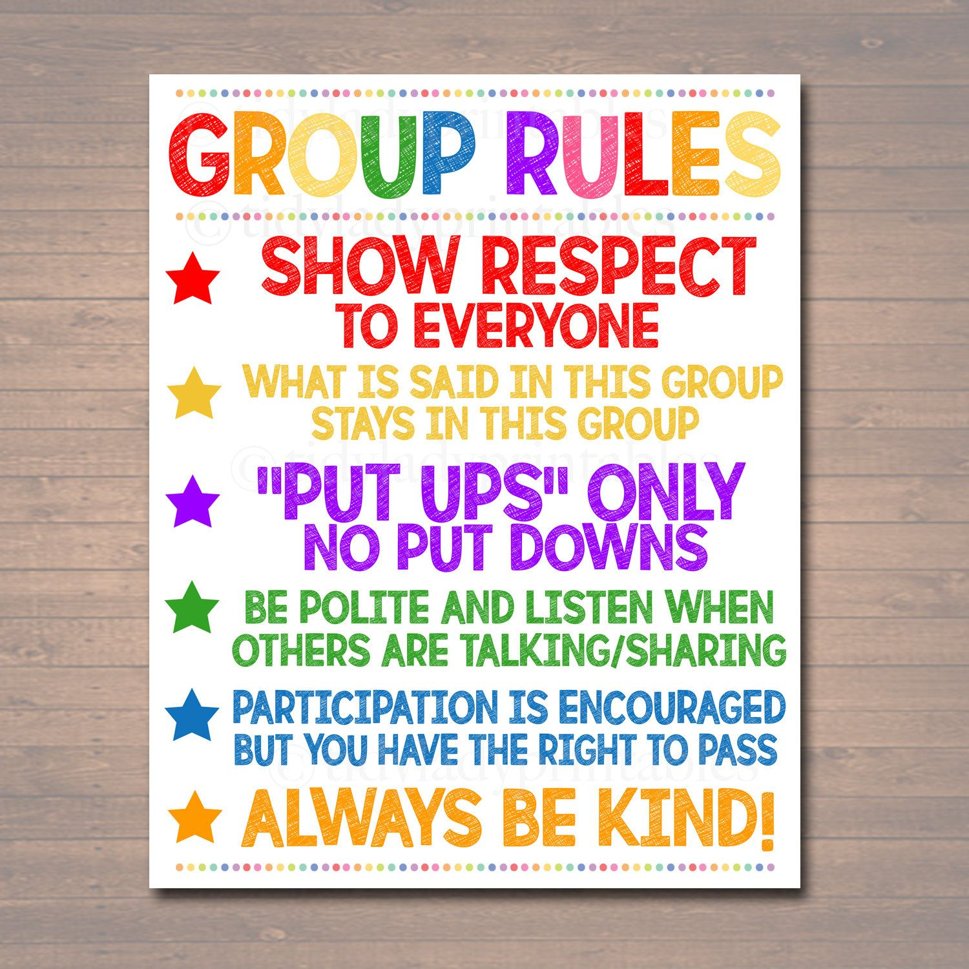
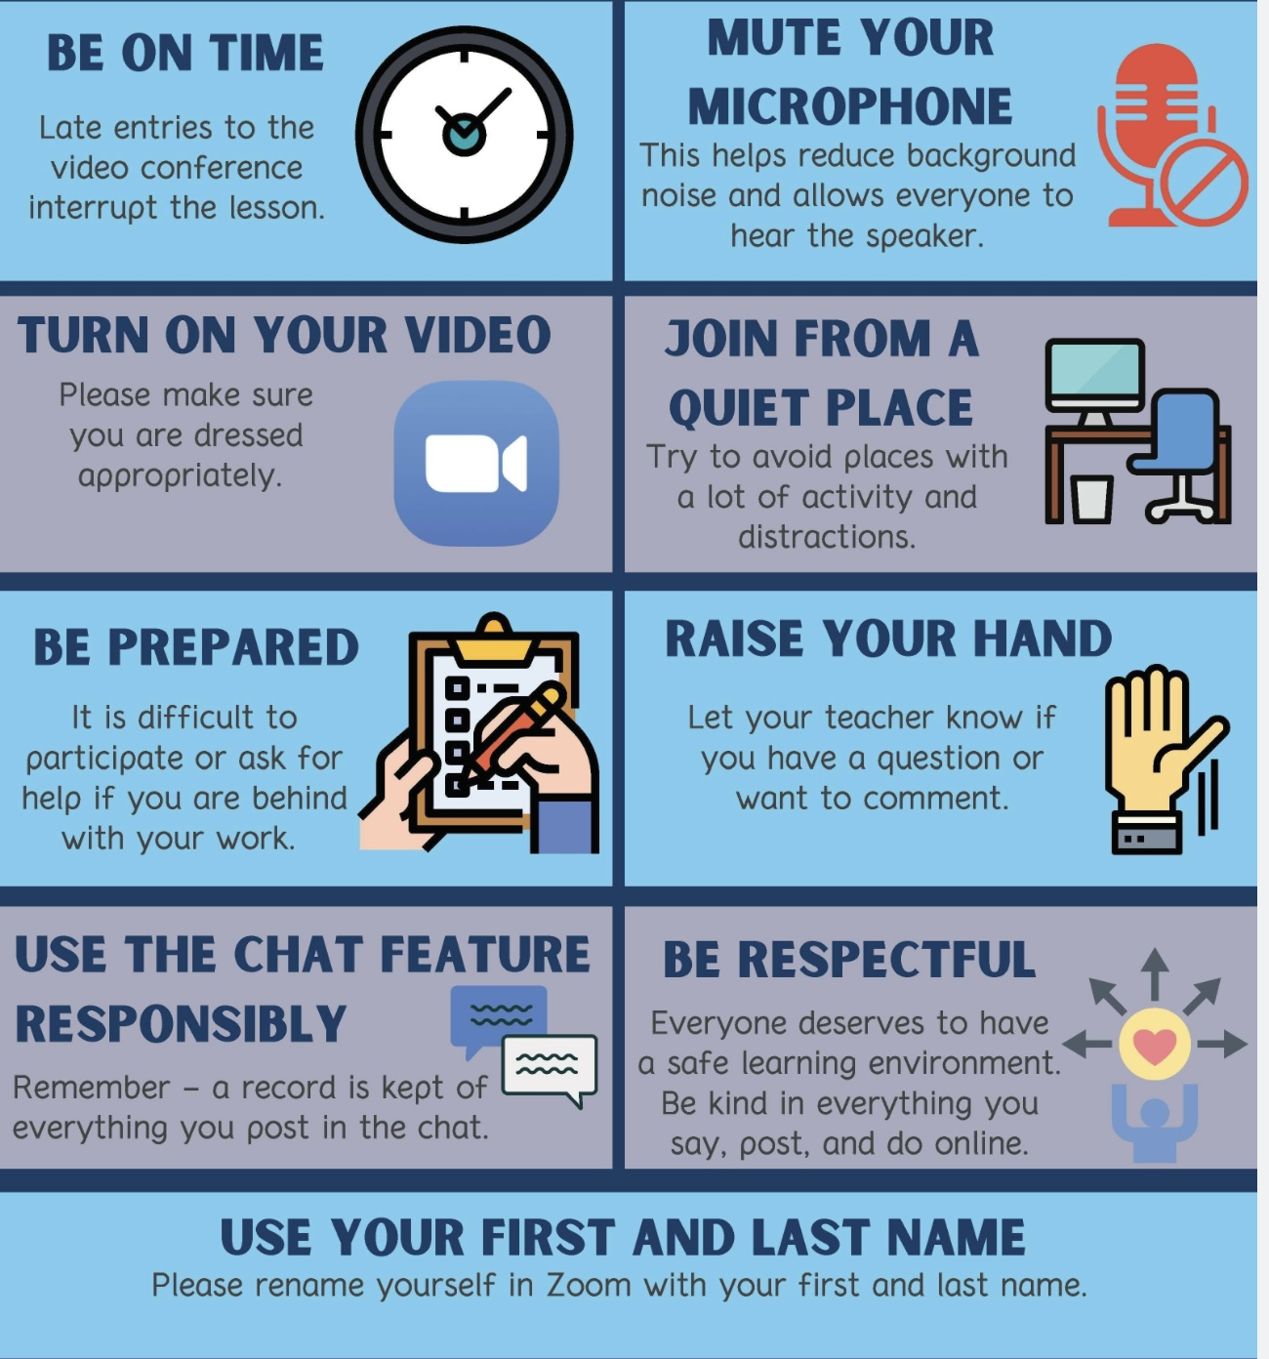
REMINDER PARTICIPANT AGREEMENTS
If you have questions, comments, or feedback, please save them for the two question periods. You can put them in the chat box or raise your real/virtual hand.
Keep comments, questions, and feedback relatively brief so everyone has a chance to participate.(one breath sharing)
If you’re on zoom, make sure no one can overhear what is being said
For reasons that will become clear later in the course please avoid giving advice to other participants about what they should or should not do. Validation, encouragement , and understanding are however very much appreciated.

Slide 18

This coming Monday, February 16 is a holiday, family day. There won’t be a boing group.
To clarify, we resent out an email last week meant to help you with the homework.
There’s 57 slides total and 2 parts. The first part is how to do the goals diary card. The second is for our May 27th circle of meaning session and it guides you through how to reflect on your “my” “our” and “The” stories.
This week we also sent out an email containing the brief dissociation scale. If you’d like fill it out and score it. We’ll invite you to anonymously share your score with us in the week 19 poll on February 18th. That session is on dissociation and doing the scale may make the subject more relevant for you.
WEEKLY ANNOUNCEMENTS

Slide 19

E-mailed questions, comments, feedback

Slide 20
As always, we’ve had some very good questions this week. We try to address most questions that are asked. These question may interest one person or many people.
Until we find a better way, we’ll post answers that we think may be of interest to most people but unfortunately because of time we cannot read all of them in the sessions. We will therefor arbitrarily read out only a few of the many excellent questions you’ve asked.
We’ll however read out all the questions and invite everyone to go to the website’s PowerPoint presentations and go over the answers with more time.

Slide 21
Question whose answer we will read out today

Slide 22
CAN YOU TELL US MORE ABOUT THE CONNECTIONS BETWEEN PTSD AND COMPLEX PTSD AND AUTISM SPECTRUM DISORDERS.
People on the autism spectrum experience trauma differently making it difficult to diagnose.
Autistic people, compared to neurotypicals are more likely to experience bullying, social exclusion, humiliation, sensory overwhelm, repeated misunderstandings, inappropriate discipline, and have educational and family experiences that feel intrusive or shaming. For many autistic people, trauma is especially linked to loss of predictability, betrayal of rules and expectations or being punished for not understanding implicit social norms. This can produce persistent threat perception even in objectively safe environments.
These experiences may not meet a narrow definition of “traumatic events” but can, for these people be traumatic, especially when they are prolonged and inescapable. The result is that people on the spectrum or having other neurodivergences may have PTSD even when they don’t report an “obvious” overwhelming trauma.
There is an also overlap in the symptoms of PTSD and autism which may complicate diagnosis:
PTSD FEATURES can resemble those of Autism spectrum
Avoidance Preference for routine
withdrawal Hypervigilance Sensory sensitivity
Emotional numbing flat affect
Irritability Meltdowns or shutdowns
Sleep disturbance Long-standing sleep issues

Slide 23
In people on the spectrum “re-experiencing” sensations that originally occurred during the traumatic experience may not look like classic PTSD flashbacks. Autistic individuals more often have sensory or somatic rather than narrative flashbacks. They may also reenact the trauma.
Many autistic adults have difficulty identifying and describing internal states. They may simply say: “I just feel wrong”, or complain of physical symptoms such as GI distress, headaches, exhaustion.
The result is that PTSD is under-recognized in people on the spectrum and often misdiagnosed as anxiety, depression, or “just part of autism.”
There is also a higher risk of misdiagnosis in both directions: PTSD is missed and symptoms attributed entirely to autism or autism is missed and a diagnosis of PTSD is made without recognizing neurodevelopmental differences.
Standard PTSD screening questions don’t pick up trauma in people on the spectrum very well.
When assessing PTSD in autistic individuals, it helps to ask about sensory memories, explore chronic relational trauma, and obtain information from family and friends.

Slide 24
We will only read out the following question, not the answer, and invite those interested to go to the website after the session.

Slide 25


Slide 26
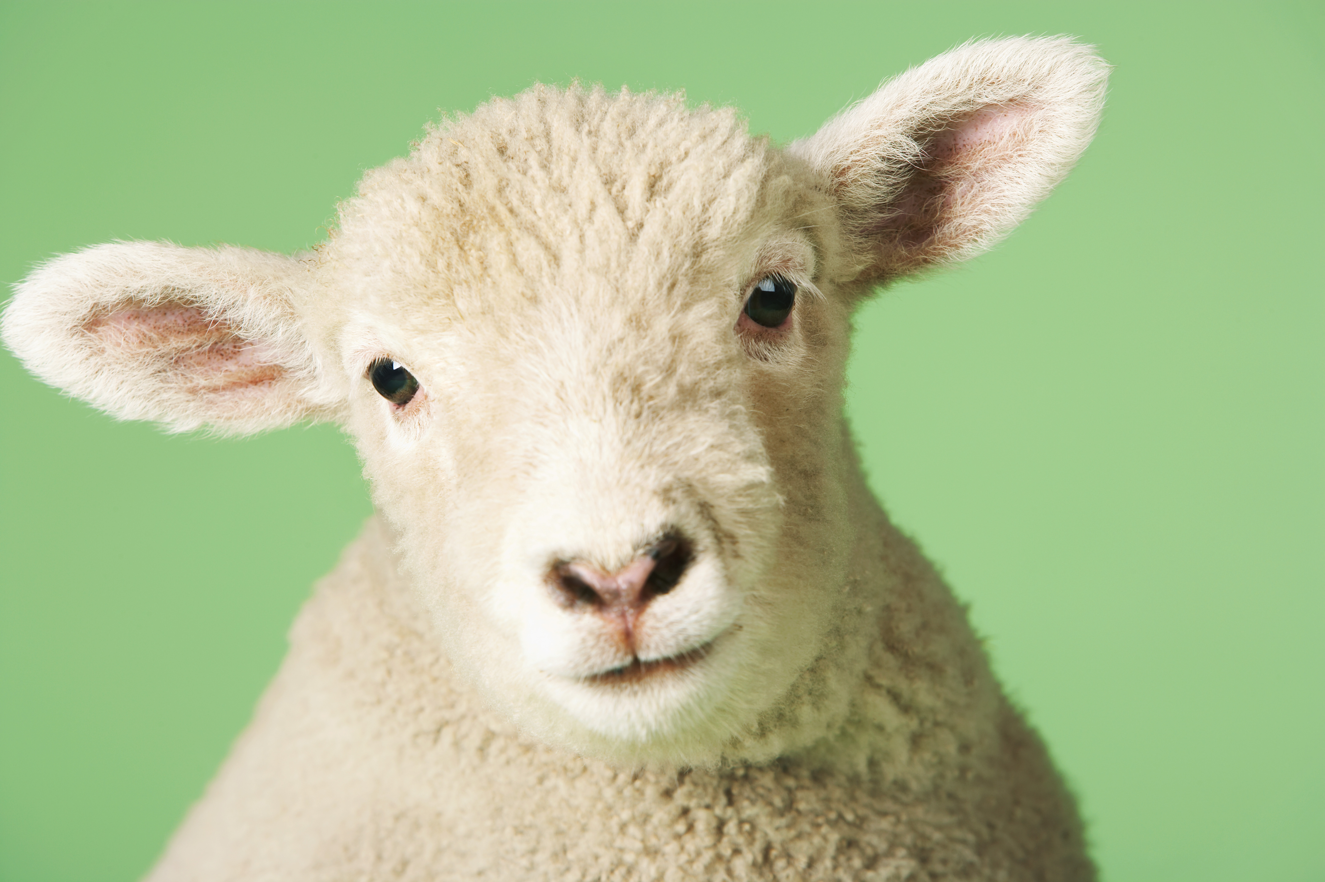
What we will do today
Today we’ll briefly review how to choose goals for the goals diary card.
We’ll then do a practice with Nicole
After that Joan and Nicole will review the emotional regulation skills that are presented in the skills training workbook pages 148 to 206.
We can have an extended Q & A period around choosing goals
We can also briefly review the simple tools and strategies and answer any questions you may have about them.
Or we can watch on YouTube the 4 examples of how to use all the skills we’ve covered so far. (These examples can be also found in the Simple manual P. 225-237)

Slide 27

BEFORE OUR PRACTICE TODAY LET’S DO A BRIEF REVIEW OF THE GOALS DIARY CARD PROCEDURE OUR 5TH TOOL.

Slide 28

The 6 tools:
Crisis plans
Holes diary cards
Chain analysis
Rational mind remediation
The Goals diary card procedure
Wise mind remediation

Slide 29
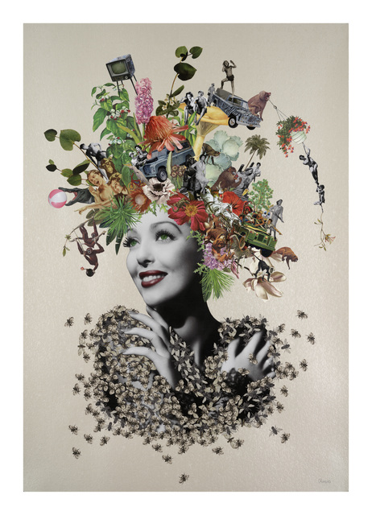
Prescribing connection and the goals diary card
1. The goals diary card procedure starts from the understanding that many mental health issues are partly related to how changes in modern society have eroded the connections that are essential to human well being
2. The goals diary card procedure is a way of assessing how connected we are and systematically trying to restore the connections we may have lost
3. Without these connections we cannot fully develop and realize our human potential and be meaningfully happy
4. The goals diary card focuses on bringing about positive behavioral changes that will bring us closer to realizing our full human potential as described by Maslow by also working through the Eriksonian stages of psychosocial development
5. The goals diary card procedure is a rational/wise mind approach that promotes personality growth
Notes:
Absolutely. Thank you for the segue

Slide 30
Goals diary card procedure algorithm
Step 1
1. Track your usual activities for a week using a blank week calendar.
This will give you a snapshot of your typical routine and allow you to assess its balance.
2. Rate yourself 0-10 on each of Maslow’s needs/wellness domains (see slide below)
Step 2
3. Complete the wellness assessment tool. Choose 1-3 “proximal activities” for your goals.
4. Consider which of your Maslow’s needs are met and which of Erickson’s stages you have mastered.
Step 3
5. “Schedule” the activities you have chosen on a blank weekly schedule.
6. Use the goals diary card template to track your progress with these activities
Step 4
7. If you have accomplished a goal, choose another from the wellness assessment tool and use it as a target in your goal's diary card template. Repeat the same process starting with step 2.
Notes:
The goals diary card procedure is an algorithm with four steps. We will go through each step individually.

Slide 31
Goals diary card procedure algorithm
Step 1
1. Track your usual activities for a week using a blank week calendar.
This will give you a snapshot of your typical routine and allow you to assess its balance.
2. Rate yourself 0-10 on each of Maslow’s needs/wellness domains (see slide below)
Step 2
3. Complete the wellness assessment tool. Choose 1-3 “proximal activities” for your goals.
4. Consider which of your Maslow’s needs are met and which of Erickson’s stages you have mastered.
Step 3
5. “Schedule” the activities you have chosen on a blank weekly schedule.
6. Use the goals diary card template to track your progress with these activities
Step 4
7. If you have accomplished a goal, choose another from the wellness assessment tool and use it as a target in your goal's diary card template. Repeat the same process starting with step 2.
Notes:
The goals diary card procedure is an algorithm with four steps. We will go through each step individually.

Slide 32
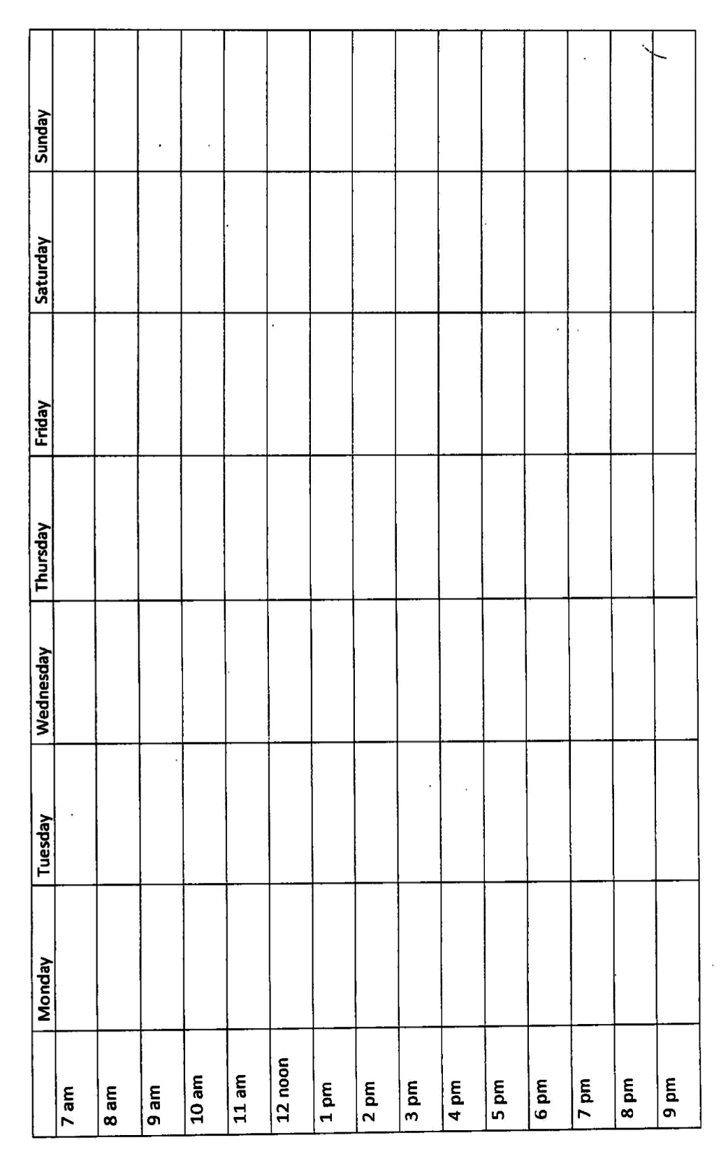
Step 1
Notes:
You can use this blank schedule to track your weekly activities.

Slide 33
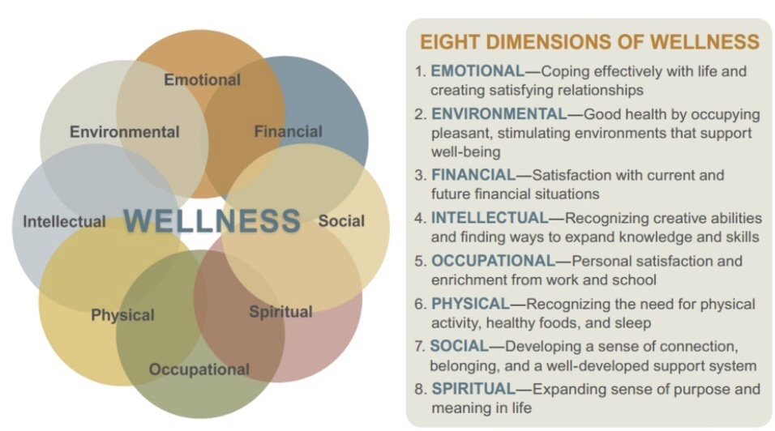
Step 1

Slide 34
Rating yourself on Maslow’s needs/Wellness Domains
A very subjective “BIG PICTURE” assessment
Step 1
Instructions:
For each area, rate how satisfied or well-resourced you feel right now, using a scale from 0 to 10.
• 0 = not at all / very distressed / severely lacking
• 5 = mixed / adequate / could be better
• 10 = thriving / deeply satisfying / well supported
There are no right or wrong answers—this is about your lived experience.
1. Emotional Wellness: How well am I able to understand, express, and regulate my emotions?
(Feeling balanced, resilient, and able to cope with stress.) Rating (0–10):
2. Spiritual Wellness: To what degree do I feel my life has meaning, purpose, or connection to something larger than myself? (This may include faith, values, nature, awe, or a sense of belonging.)
Rating (0–10):
3. Physical Wellness: How well am I caring for my body and feeling physically healthy and energized?
(Sleep, movement, nutrition, pain, medical issues.) Rating (0–10):
4. Social Wellness: How supported, connected, and understood do I feel by others?(Quality of relationships, not quantity.). Rating (0–10):
Notes:
Once you’ve completed your tracking of activities for a week, consider the eight dimensions of wellness and based on your activities rate yourself 0 to 10 on each of those dimensions.

Slide 35
Rating yourself on Maslow’s needs/Wellness Domains
5. Financial Wellness: How secure and in control do I feel regarding my finances? (Ability to meet needs, manage stress related to money, plan ahead.). Rating (0–10):
6. Occupational Wellness: How meaningful, manageable, and aligned does my work or daily role feel?
(Paid work, caregiving, volunteering, or life roles.). Rating (0–10):
7. Intellectual Wellness: How engaged and stimulated do I feel mentally? (Learning, curiosity, creativity, reflection, growth.) Rating (0–10):
8. Environmental Wellness: How supportive and calming is my physical environment? (Home, workspace, neighborhood, access to nature, safety, order.) Rating (0–10):
Optional reflection questions:
• Which number surprises me most?
• Which domain feels most urgent right now?
• Which domain, if improved even slightly, might positively affect the others?
9. How much time do you spend each day in unproductive activities or maladaptive coping? Hours: __
Notes:
Once you’ve completed your tracking of activities for a week, consider the eight dimensions of wellness and based on your activities rate yourself 0 to 10 on each of those dimensions.

Slide 36
Goals diary card procedure algorithm
Step 1
1. Track your usual activities for a week using a blank week calendar.
This will give you a snapshot of your typical routine and allow you to assess its balance.
2. Rate yourself 0-10 on each of Maslow’s needs/wellness domains (see slide below)
Step 2
3. Complete the wellness assessment tool. Choose 1-3 “proximal activities” for your goals.
4. Consider which of your Maslow’s needs are met and which of Erickson’s stages you have mastered.
Step 3
5. “Schedule” the activities you have chosen on a blank weekly schedule.
6. Use the goals diary card template to track your progress with these activities
Step 4
7. If you have accomplished a goal, choose another from the wellness assessment tool and use it as a target in your goal's diary card template. Repeat the same process starting with step 2.
Notes:
The goals diary card procedure is an algorithm with four steps. We will go through each step individually.

Slide 37
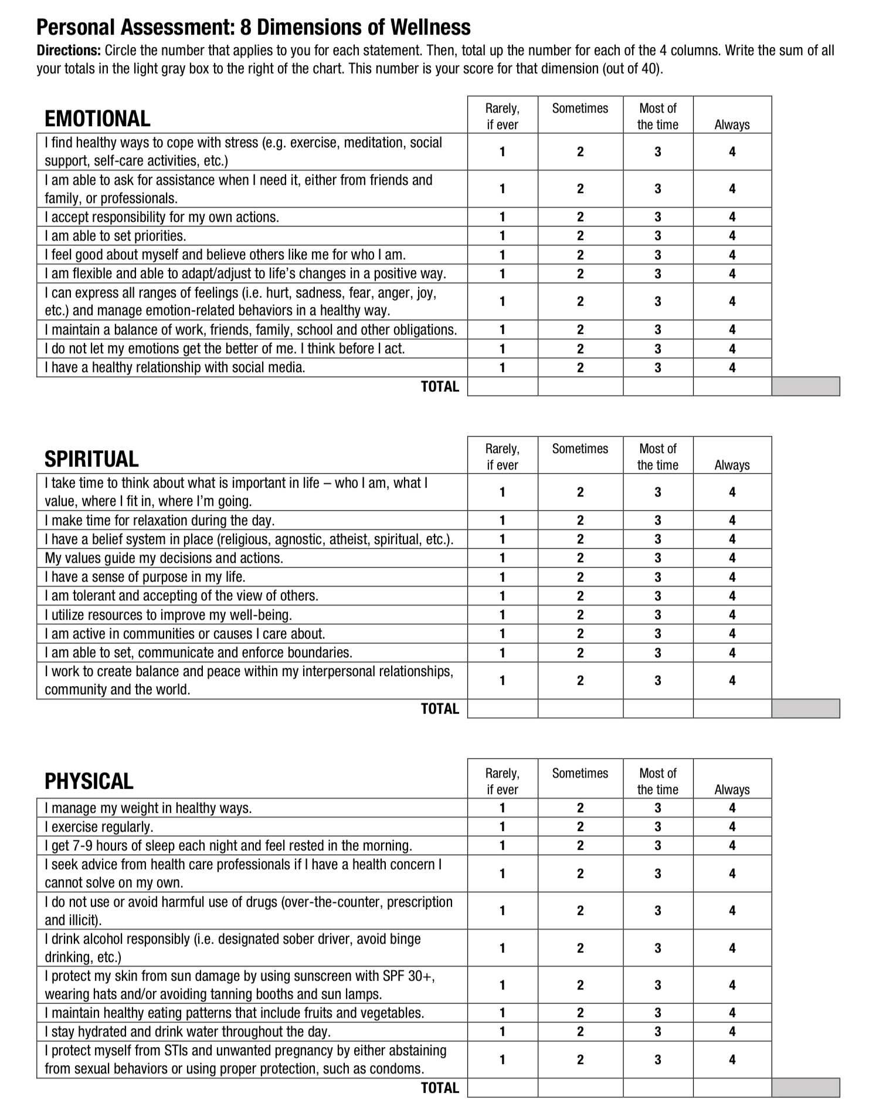
Step 2
The wellness assessment tool
A more objective, “FINE GRAIN” assessment

Slide 38
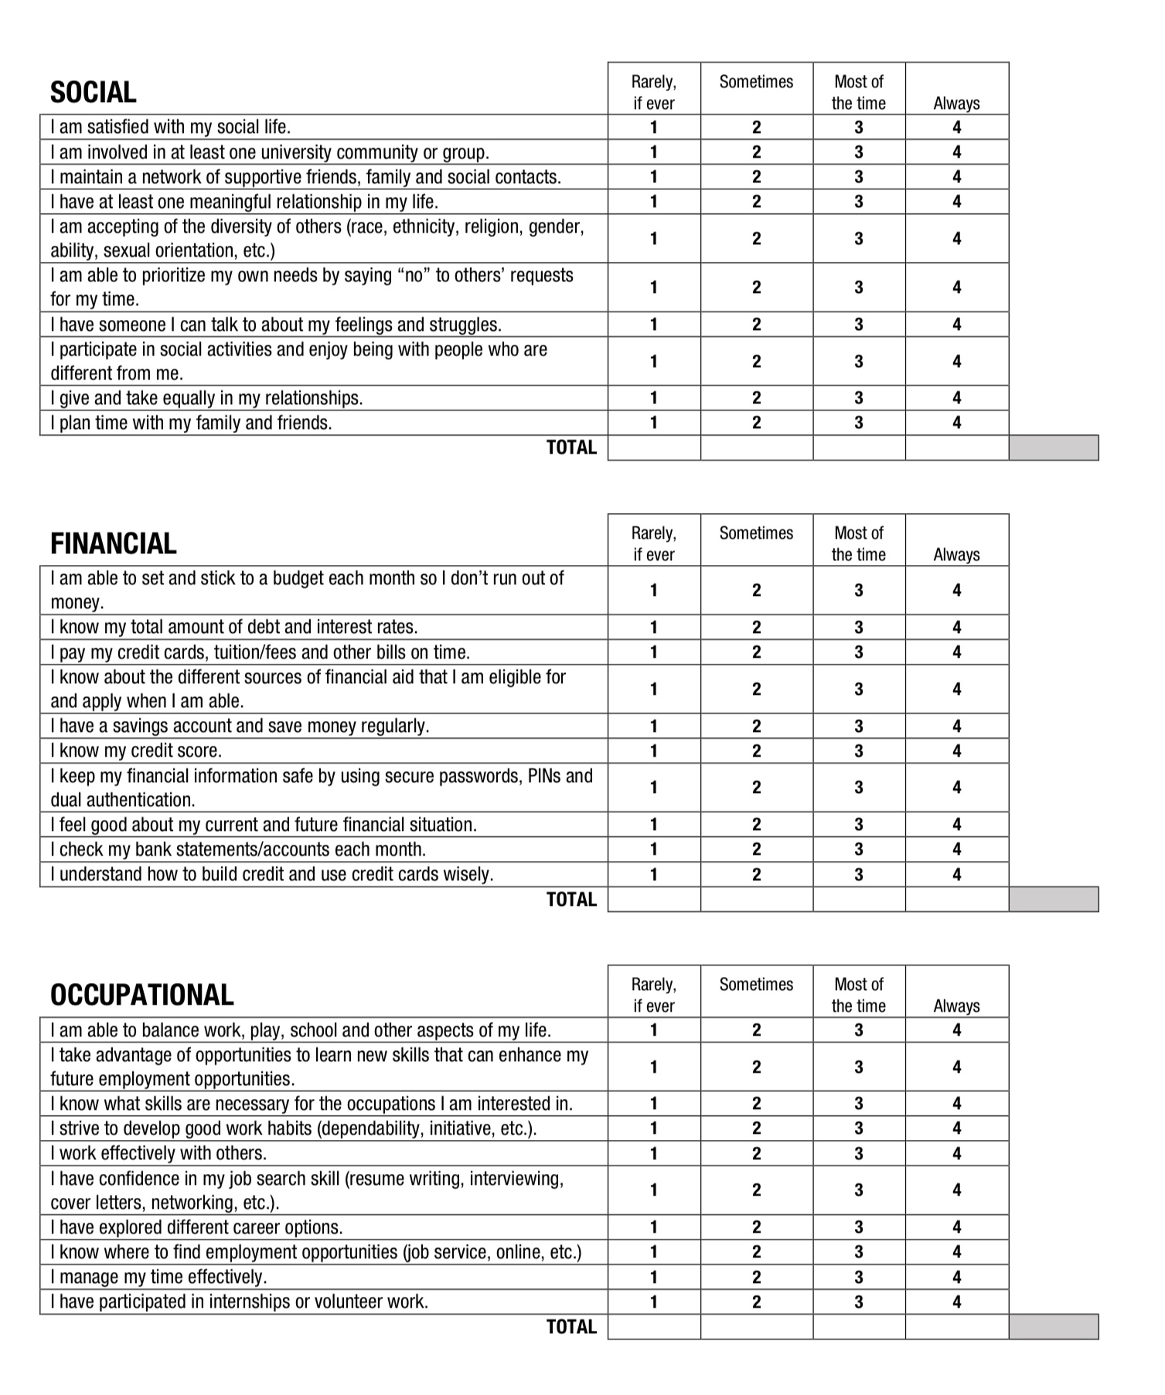

Slide 39
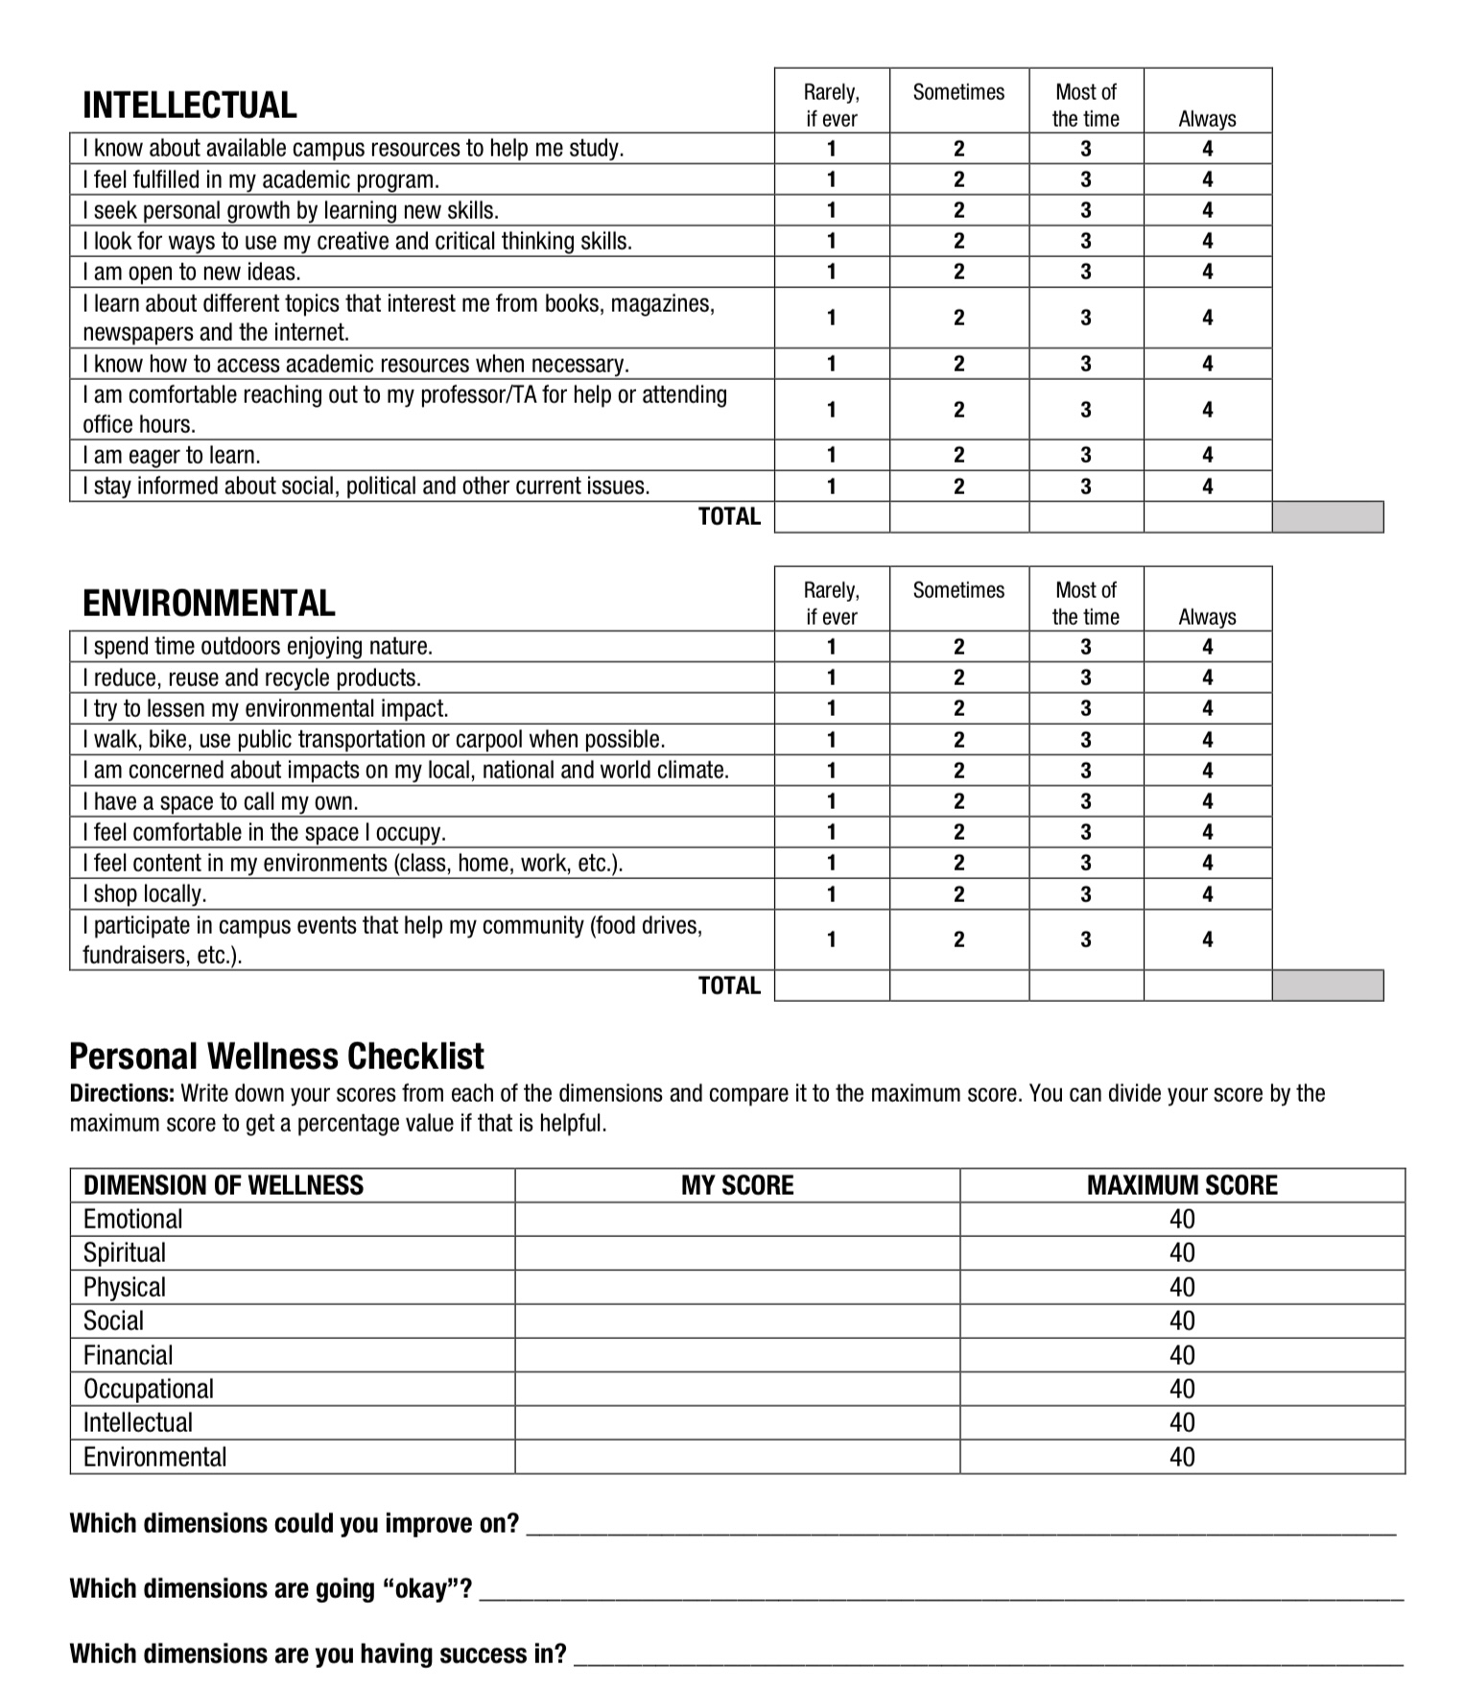

Slide 40
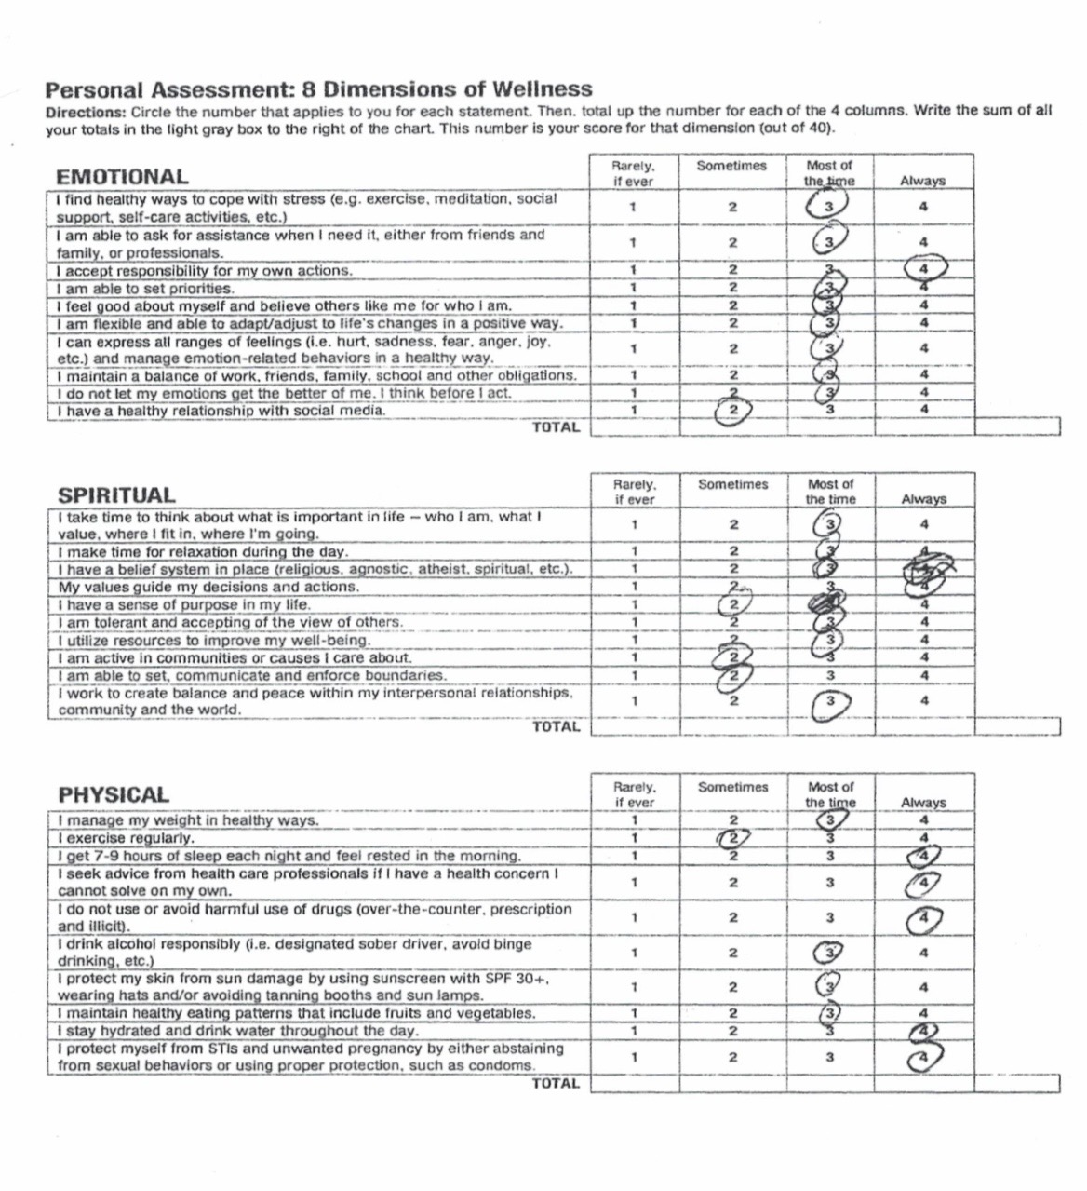

Slide 41
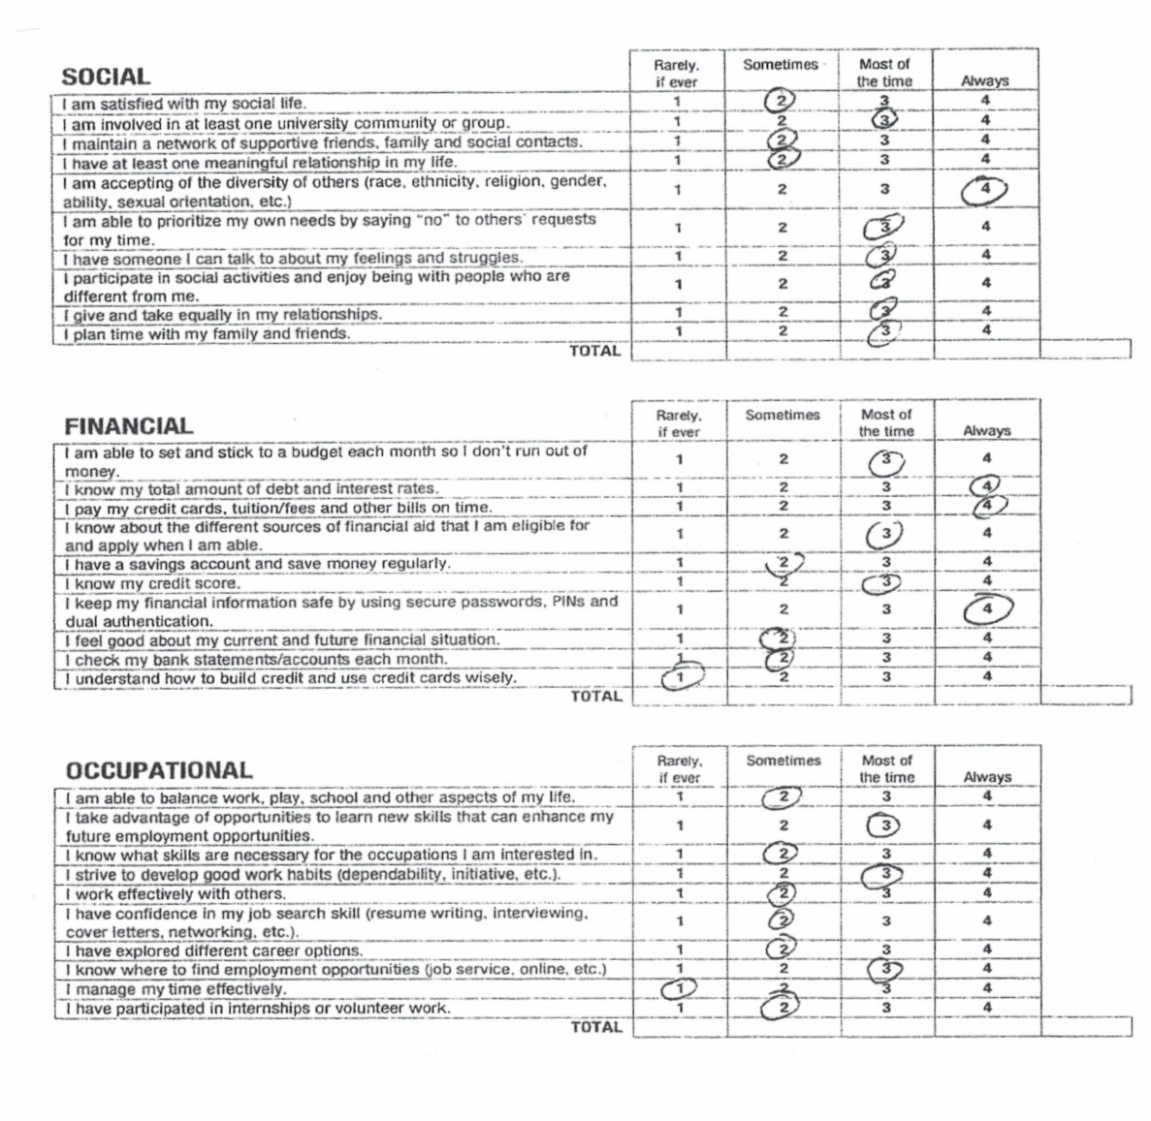

Slide 42
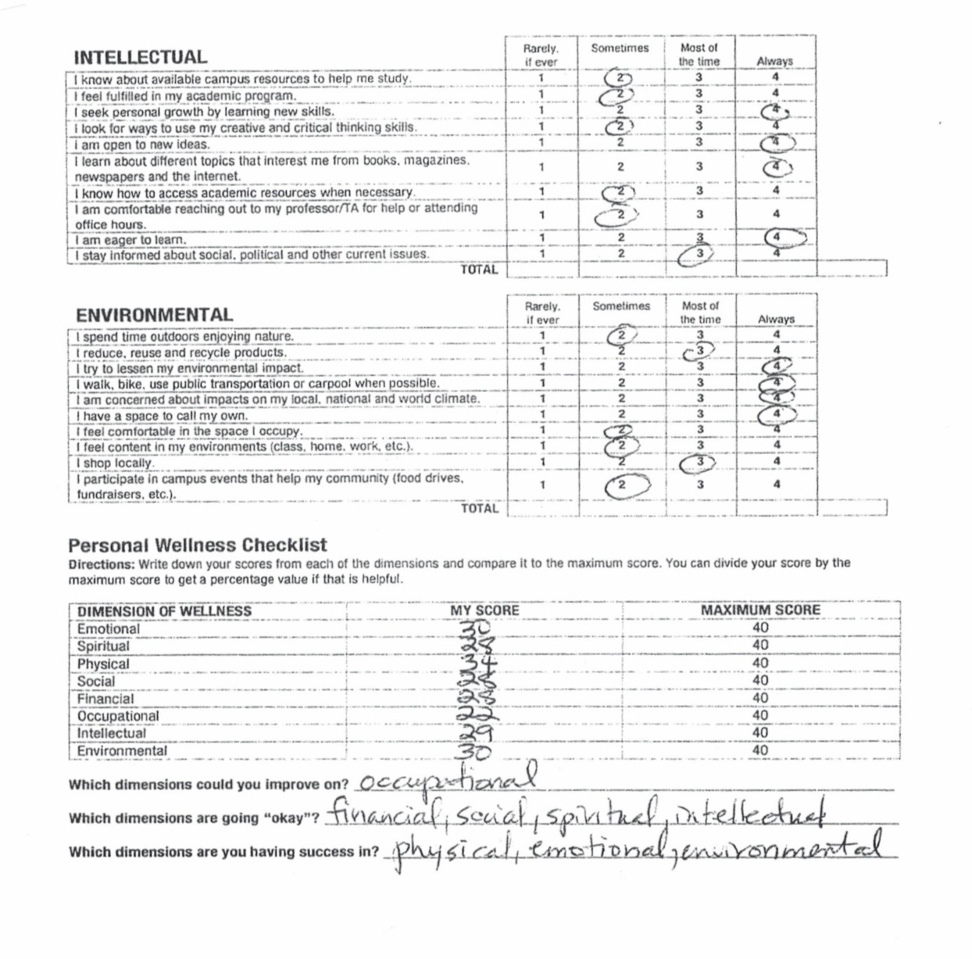

Slide 43
Goals diary card procedure algorithm
Step 1
1. Track your usual activities for a week using a blank week calendar.
This will give you a snapshot of your typical routine and allow you to assess its balance.
2. Rate yourself 0-10 on each of Maslow’s needs/wellness domains (see slide below)
Step 2
3. Complete the wellness assessment tool. Choose 1-3 “proximal activities” for your goals.
4. Consider which of your Maslow’s needs are met and which of Erickson’s stages you have mastered.
Step 3
5. “Schedule” the activities you have chosen on a blank weekly schedule.
6. Use the goals diary card template to track your progress with these activities
Step 4
7. If you have accomplished a goal, choose another from the wellness assessment tool and use it as a target in your goal's diary card template. Repeat the same process starting with step 2.
Notes:
The goals diary card procedure is an algorithm with four steps. We will go through each step individually.

Slide 44
Step 3
See a friend
Walk
Walk
Walk

Slide 45
Goals diary card
Step 3
Dates | 1 | 2 | 3 | 4 | 5 | 6 | 7 | 8 | 9 | 10 | 11 | 12 | 13 | 14 | 15 | 16 | 17 | 18 | 19 | 20 | 21 | 22 | 23 | 24 | 25 | 26 | 27 | 28 | 29 | 30 | 31
Goals
Walk 3 x/week
See a friend 1 x /week

Slide 46
Goals diary card procedure algorithm
Step 1
1. Track your usual activities for a week using a blank week calendar.
This will give you a snapshot of your typical routine and allow you to assess its balance.
2. Rate yourself 0-10 on each of Maslow’s needs/wellness domains (see slide below)
Step 2
3. Complete the wellness assessment tool. Choose 1-3 “proximal activities” for your goals.
4. Consider which of your Maslow’s needs are met and which of Erickson’s stages you have mastered.
Step 3
5. “Schedule” the activities you have chosen on a blank weekly schedule.
6. Use the goals diary card template to track your progress with these activities
Step 4
7. If you have accomplished a goal, choose another from the wellness assessment tool and use it as a target in your goal's diary card template. Repeat the same process starting with step 2.
Notes:
The goals diary card procedure is an algorithm with four steps. We will go through each step individually.

Slide 47
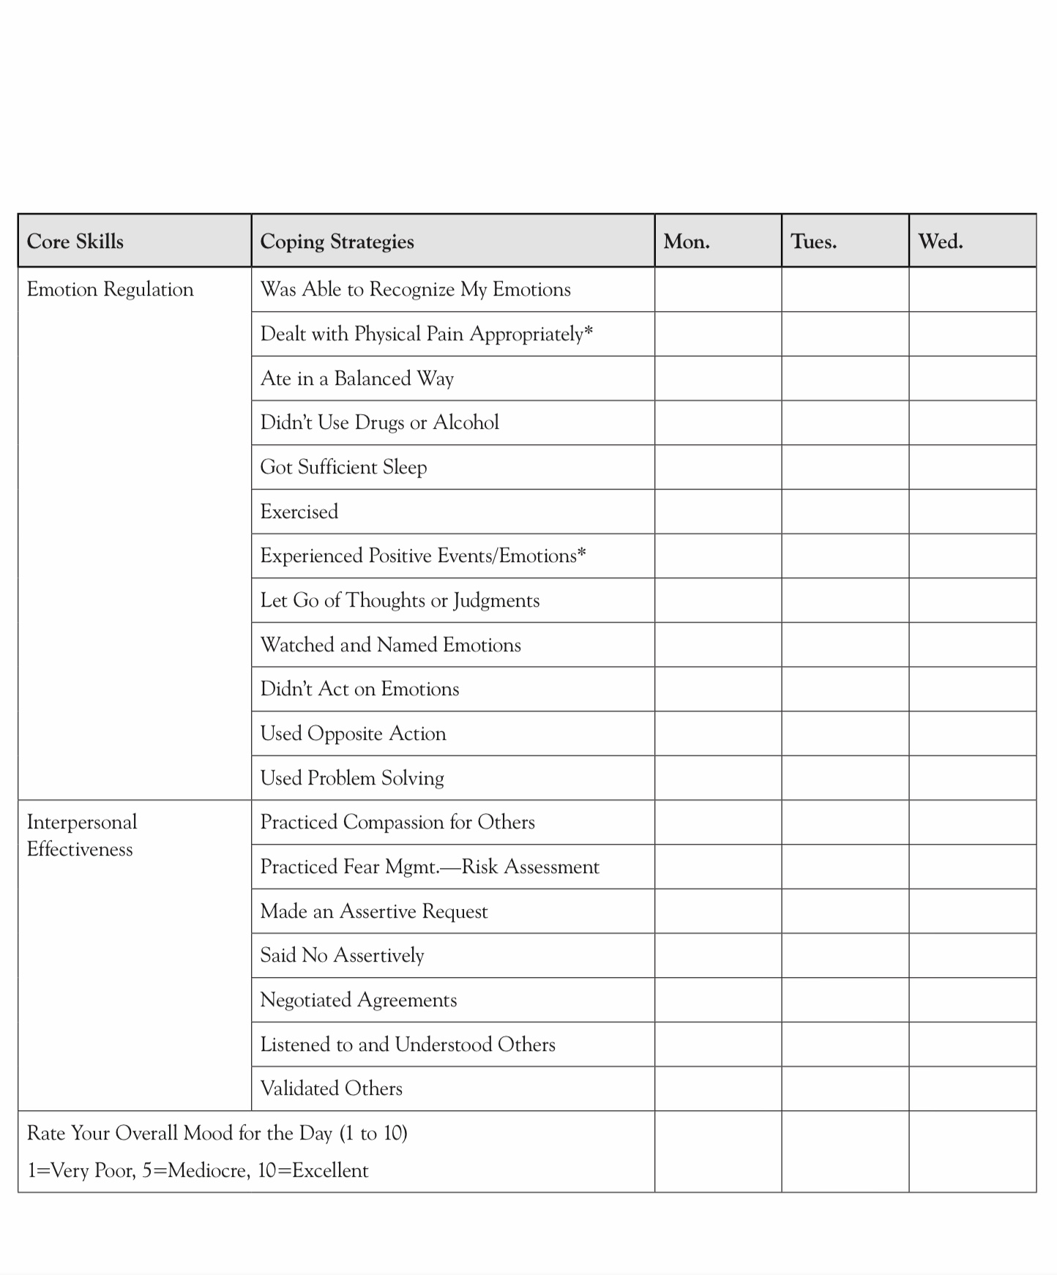

PRACTICING SIMPLE TOOLS AND STRATEGIES AND DBT SKILLS
ACHIEVING YOUR GOALS: THE GOALS DIARY CARD PROCEDURE

Slide 48


INTRODUCING THE 3rd SET OF DBT SKILLS
EMOTION REGULATION
FLASH QUIZZ- Name the 2 sets of skills we’ve already covered

Slide 49
WHAT IS THE DIFFERENCE BETWEEN DBT’S DISTRESS TOLERANCE AND EMOTION REGULATION SKILLS?
Distress tolerance and emotional regulation are quite different.
Distress tolerance is about surviving distressing times without making things worse. Distress tolerance skills are used when emotions are very intense, and the situation cannot be changed immediately. They help us get through a crisis, reduce the intensity of overwhelming emotions, and help us avoid impulsive or harmful reactions. They provide short-term relief until the thinking brain comes back online.
Distress tolerance is like having a life jacket when you’re sailing in a storm. You can’t stop the storm, but you can keep yourself afloat until it passes.
You use distress tolerance when you’ve fallen into a hole.

Slide 50
WHAT IS THE DIFFERENCE BETWEEN DBT’S DISTRESS TOLERANCE AND EMOTION REGULATION SKILLS?
Emotion Regulation is about understanding, preventing, and avoiding suffering. Emotion regulation skills are used when we’re not in a crisis. They help us understand what we’re feeling and why, reduce our vulnerability to extreme emotions, strengthen our “wise mind”, and change emotional responses that don’t fit the situation.
Emotion regulation is like keeping our sailboat in good shape so that if we encounter storms the boat is better equipped to withstand them.
Emotional regulation is about avoiding falling into holes.
Distress tolerance is about short-term survival during periods of intense emotions whereas emotional regulation is about long-term emotional health.

Slide 51
UPDATED PERSONAL SKILLS LIST
Distress tolerance skills
Grounding skills- Set a daily intention
“ - Sensory soothing toolkit
“ -The 5,4,3,2,1 method
“ -The emotional freedom technique
REST (or PEST) Pause
Radical acceptance statements (please specify)
Distraction plan “
Self-soothing plan
Safe place visualization
Cue controlled relaxation
Rediscovering your values (please specify)
Rehearse values-based behavior or edit/splice/paste
Connect with your higher power “
14. Live in the present moment
15. Use self-encouraging coping thoughts
16. Radical acceptance
17. Use self-affirming statements
18. Balance feelings and threat
19. Create new coping strategies
20. Create an emergency coping plan
21. Box breathing
22. Cold temperatures
23. High intensity exercise
24. Progressive muscular relaxation
25. Paced breathing
26. Side to side eye movement.

Slide 52
UPDATED PERSONAL SKILLS LIST
Mindfulness skills
1) Focus on a single minute
2) Focus on a single object
3) Band of light
4) Inner-Outer Experience
5) Record Three Minutes of Thoughts
6) Thought Diffusion
7) Describe Your Emotion
8) Focus Shifting
9) Mindful Breathing
10) Mindful Awareness of Emotion
11) Wise mind
12)how to make Wise mind decisions
13) Radical acceptance
14) Judgements and labels
15) Self compassion
16) Mindful communication
17. Being mindful in our daily life
18. How to do tasks mindfully
19. How to be mindful of our activities
20. Resistances and hindrances to mindfulness practice
21. Exploring mindfulness further
22. Mindfulness and meditation
23. Using kindness and compassion
24. Paying attention to spaciousness and stillness

Slide 53
TODAY
Emotional regulation skills
Recognizing emotions
Overcoming barriers to healthy emotions
Reducing physical vulnerability
Reducing cognitive vulnerability
5. Increasing Positive Emotions
6. Being mindful of your emotions without judgement
Emotion exposure.
Doing the opposite of your emotions
Problem Solving

Slide 54
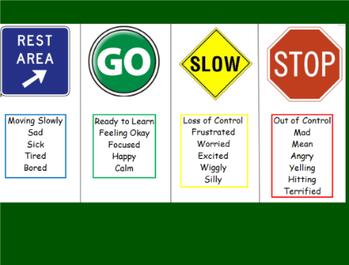
Skills training workbook p. 148-182 introducing emotional regulation
Today we’ll review emotional regulation skills on pages 148 to 206 of the workbook. It starts by asking two questions:
What are emotions ?
How do emotions work?
We’ll discuss the 9 emotion regulation skills presented in the workbook:
Recognizing emotions
Overcoming barriers to healthy emotions
Reducing physical vulnerability
Reducing cognitive vulnerability
Increasing Positive Emotions
6. Being mindful of your emotions without judgement
7. Emotion exposure
Doing the opposite of your emotions
Problem Solving

Slide 55
Skills training workbook p. 148-206 emotional regulation skills
What are emotions ?
How do emotions work?
Recognizing emotions
Overcoming barriers to healthy emotions
Reducing physical vulnerability
Reducing cognitive vulnerability
Increasing Positive Emotions
Being mindful of your emotions without judgement
Emotion exposure.
Doing the opposite of your emotions
Problem Solving

Slide 56
WHAT ARE EMOTIONS AND HOW DO THEY WORK ?
Note that in the theory part of this course we’ve already comprehensively explored emotions: their instinctual basis, how they may become dysregulated, (temperament, attachment, trauma) etc. and how to begin to reregulate them.
In light of this, the descriptions of emotions offered in the DBT workbook may sound simplistic to you.
Remember that in this part of our session today we are merely reviewing what is in the workbook.

Slide 57

Your Emotions: What are they?
Like ways of thinking and behaving emotional responses are unique ways in which each of us responds to the world. Emotional patterns are part of personality.
Psychologists describe primary and secondary emotions.
Primary emotions are our initial reactions to what happened in the environment.
Secondary emotions are our emotional reactions to our judgements about what happened. They are our feelings about the judgements we make about what happened.
Ex. Recently one of the co-leaders lost a pair of bran new expensive prescription sunglasses. Their primary emotion was slight sadness.
After experiencing the primary emotion they could have gone down a number of paths, for example: 1) acceptance: It is what it is, stuff happens, I won’t care about this in one month. 2) judgement: I’m so stupid, they were so expensive, why wasn’t I more careful, I’m always doing stuff like this.3) judgement: My wife must have put them somewhere when she was cleaning the house.
If we don’t nonjudgmentally accept what happens, we may experience a chain reaction of distressing secondary emotions
Emotion regulation skills help us have better regulated secondary emotions

Slide 58
Skills training workbook p. 148-206 emotional regulation skills
Your emotions: what are they ?
How do emotions work?
Recognizing emotions
Overcoming barriers to healthy emotions
Reducing physical vulnerability
Reducing cognitive vulnerability
Increasing Positive Emotions
Being mindful of your emotions without judgement
Emotion exposure.
Doing the opposite of your emotions
Problem Solving

Slide 59

How do emotions work?
The workbook describes how emotions are associated with neuronal electrical and chemical brain activity.
Stimuli in our environment are perceived by our five senses, transmitted as electrical signals by the nervous system and interpreted in the brain
Much of the emotional processing seems to take place in the limbic system which is also receiving information from the somatic centers. Emotions are affected by memories of past experiences.
A part of emotions is behaviors or behavioral urges.
In the simple course’s theory section, we go in greater detail into all this

Slide 60
Skills training workbook p. 148-206 emotional regulation skills
Your emotions: what are they ?
How do emotions work?
Recognizing emotions
Overcoming barriers to healthy emotions
Reducing physical vulnerability
Reducing cognitive vulnerability
Increasing Positive Emotions
Being mindful of your emotions without judgement
Emotion exposure.
Doing the opposite of your emotions
Problem Solving

Slide 61

Skill 1 Recognizing our emotions
Intense emotions, like giant ocean waves, may seem irresistible and we may feel unable to do anything about them.
If, however, we foster wise mind which observes rather than acts on emotions, we may be better able to influence emotions.
To do this we must recognize that our emotions are strongly activated and observe our feelings thoughts and behaviors.
We can slow down and step outside of emotions by using the simple tools including the chain analysis. This is easier to practice with “videos from the past”.(editing, splicing and pasting.)
Chain analysis examine past events, emotions, thoughts and behaviors allowing us to develop a deeper understanding of our emotional reactions and how they impact our thoughts and behaviors.

Slide 62
EMOTIONAL RECORDS: the DBT workbook’s version of chain analysis
1) To recognize your emotions, ask the following questions:
When did the situation happen?
What happened?
Why do you think it happened?
How did the situation make you feel emotionally and physically?
What did you want to do as a result of how you felt?
What did you do and say?
How did your emotions and actions affect you later?
2) Emotional Records allow us to label our feelings
Saying our feelings out loud highlights our emotions and deflates distressing feelings
Use the emotional record and answer the following questions:
When and where did it happen?
How did you feel?
Did you say how you felt out loud?
What did you do after you recognized how you felt?
Our suggestion is to stick with the chain analysis tool it’s the same as the workbook’s emotional records

Slide 63
Skills training workbook p. 148-206 emotional regulation skills
Your emotions: what are they ?
How do emotions work?
Recognizing emotions
Overcoming barriers to healthy emotions
Reducing physical vulnerability
Reducing cognitive vulnerability
Increasing Positive Emotions
Being mindful of your emotions without judgement
Emotion exposure.
Doing the opposite of your emotions
Problem Solving

Slide 64
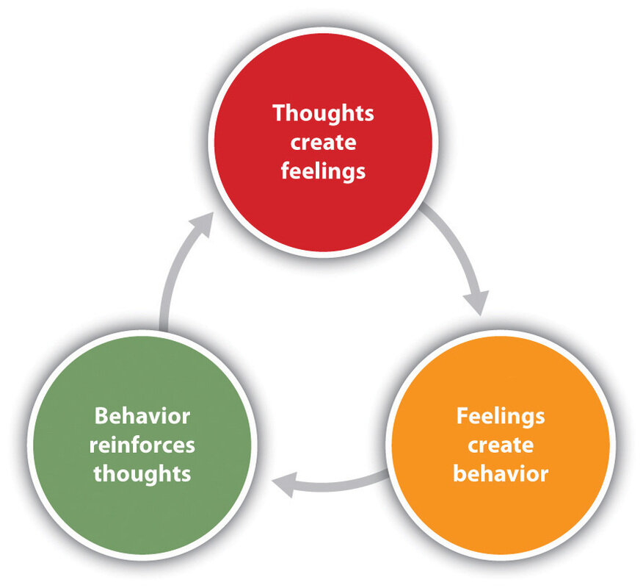
Overcoming barriers to healthy emotions
Once we start to observe our emotions, we can try to notice how they influence our behaviors and thoughts
We’ll also notice that while emotions affect our thoughts and behaviors, they are also influenced by our thought and behaviors. It’s a loop.
It’s easy to get caught in a vicious feedback cycle of self-destructive behaviors and self-criticism
There are also virtuous feedback cycles between healthy behaviors and positive self-statements.
Cognitive behavioral therapy and rational mind remediation work to change negative thoughts and behavioral cycles to virtuous ones and consequently influence emotions positively.

Slide 65
Emotions and Behaviors
Emotions, thought, behaviors, and physical sensations are all connected
Intense distressing emotions often lead to intense behavioral reactions, such as self-destructive behaviors which then lead to more self-defeating thoughts and behaviors
People often get stuck in these self-harm vicious cycles because they are rewarding in that they temporarily relieve the intense emotion
We are likely to repeat behaviors when they are rewarded, this is true for both self-destructive and healthy behaviors

Slide 66
COMMON SELF-DEFEATING BEHAVIORS
1. Self-harm
Self-harm is often used to distract from emotional pain
Self-harm tends to be effective in the short term because the endorphins it releases dull our physical and emotional pain.
This short-term reward reinforces the self-harm behavior
There are however long-term negative consequences to coping in this way.
Self-harm is a maladaptive form of coping.
2. Manipulation of others
Manipulation is an attempt to forcefully sway another person’s emotions to get them to act or feel in a certain way. Ex. “If you really loved me, you’d cancel your plans, I guess I don’t really matter to you.”
Manipulation tends to be effective in the short term as it may produce a sense of control or that we have won
Over the long-term manipulation almost always negatively impacts relationships
Difficulties in relationships are a major source of distress
Gaslighting is a form of manipulation Ex. “I never said that you’re imagining things.”

Slide 67

Recognizing our Self-Destructive Behaviors Worksheet
We can use the worksheet on p. 171 of the workbook to observe our self-destructive behaviors
This allows us to identify the self-destructive behaviors we engage in and to consider the ways in which they are rewarding

Slide 68

Thinking about our self-destructive ways of coping can trigger self-judgement and distressing emotions.
It is important to non-judgmentally accept ourselves for acting the way we do now while striving at the same time to reduce self-destructive behaviors.
We can acknowledge instances (videos) in which we were self-destructive and using editing splicing and pasting practice alternative more adaptive thoughts, feelings and behaviors.
OBSERVING SELF-DESTRUCTIVE BEHAVIORS WITHOUT JUDGMENT

Slide 69
Skills training workbook p. 148-206 emotional regulation skills
Your emotions: what are they ?
How do emotions work?
Recognizing emotions
Overcoming barriers to healthy emotions
Reducing physical vulnerability
Reducing cognitive vulnerability
Increasing Positive Emotions
Being mindful of your emotions without judgement
Emotion exposure.
Doing the opposite of your emotions
Problem Solving

Slide 70

Skill 3. Reducing Physical Vulnerabilities
To be able to better regulate emotions and access wise mind, keep your “gas tank” as full as possible and your dashboard in “the green” by:
Eating healthy
Avoiding over & undereating
Minimizing drugs and alcohol
Doing regular physical exercise
Doing what you can to get good sleep
Treating illness and physical pain
Reducing physical tension and stress

Slide 71
Skills training workbook p. 148-206 emotional regulation skills
Your emotions: what are they ?
How do emotions work?
Recognizing emotions
Overcoming barriers to healthy emotions
Reducing physical vulnerability
Reducing cognitive vulnerability
Increasing Positive Emotions
Being mindful of your emotions without judgement
Emotion exposure.
Doing the opposite of your emotions
Problem Solving

Slide 72
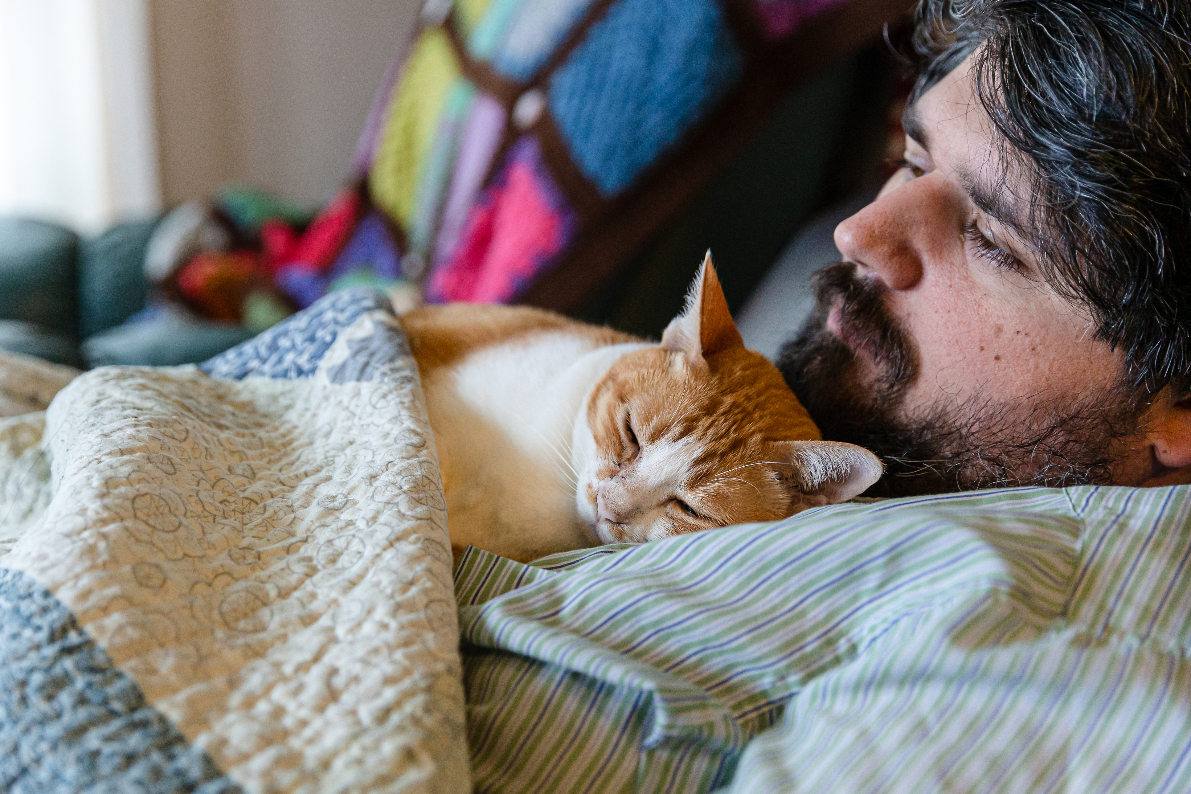
SKILL 4. REDUCING COGNITIVE VULNERABILITIES
Remember that our thoughts influence how we feel
Thoughts that often elicit distressing emotions include “I’m an idiot”, ”I’m a failure”, “Something is wrong with me”
Using emotion regulation skills, we can learn to cope with distressing thoughts
Do a chain analysis for a time you were emotionally activated especially if you were angry at yourself, notice any negative thoughts, edit splice and paste them with alternative kinder thoughts about yourself.

Slide 73
REDUCE COGNITIVE VULNERABILITY
1. With Thought & Emotion Diffusion
We discussed thought diffusion in the mindfulness skills module p. 100 of the workbook
To review: using your imagination, you can picture thoughts and emotions floating away
Choose a visualization that works for you
Remember to be mindful and non-judgmental
2. With Coping Thoughts
Coping thoughts soothe emotions and remind us of our strengths and successes
We discussed coping thoughts in the distress tolerance module p. 50 of the workbook
Select a few kind coping thoughts that work for you. “Mistakes happen; nobody’s perfect”, “This too shall pass”, “I’m strong and I can deal with this” etc.
Use them regularly.

Slide 74

Reducing Cognitive vulnerability
We can reduce our cognitive vulnerability by balancing our thoughts and feelings:
Sometimes we get stuck “filtering” thoughts.
Filtering thoughts means we focus on only part of what’s happening, filtering out the positive and focusing on the negative. Ex. You give a presentation at work. Afterwards, several colleagues come up to say they learned a lot, appreciated your clarity, and enjoyed your examples. But one person makes a small critical comment: “You went a little fast on the last slide.” Filtering thought: Instead of holding both truths, that most feedback was positive and there was one constructive comment, you focus only on the criticism and tell yourself: “I messed up the whole presentation. I’m terrible at this.”
Balancing our thoughts and feelings requires us to look at the bigger picture by looking for evidence that goes against our distressing thoughts and feelings
This can be done using thought records or rational mind remediation

Slide 75
Skills training workbook p. 148-206 emotional regulation skills
Your emotions: what are they ?
How do emotions work?
Recognizing emotions
Overcoming barriers to healthy emotions
Reducing physical vulnerability
Reducing cognitive vulnerability
Increasing Positive Emotions
Being mindful of your emotions without judgement
Emotion exposure.
Doing the opposite of your emotions
Problem Solving

Slide 76
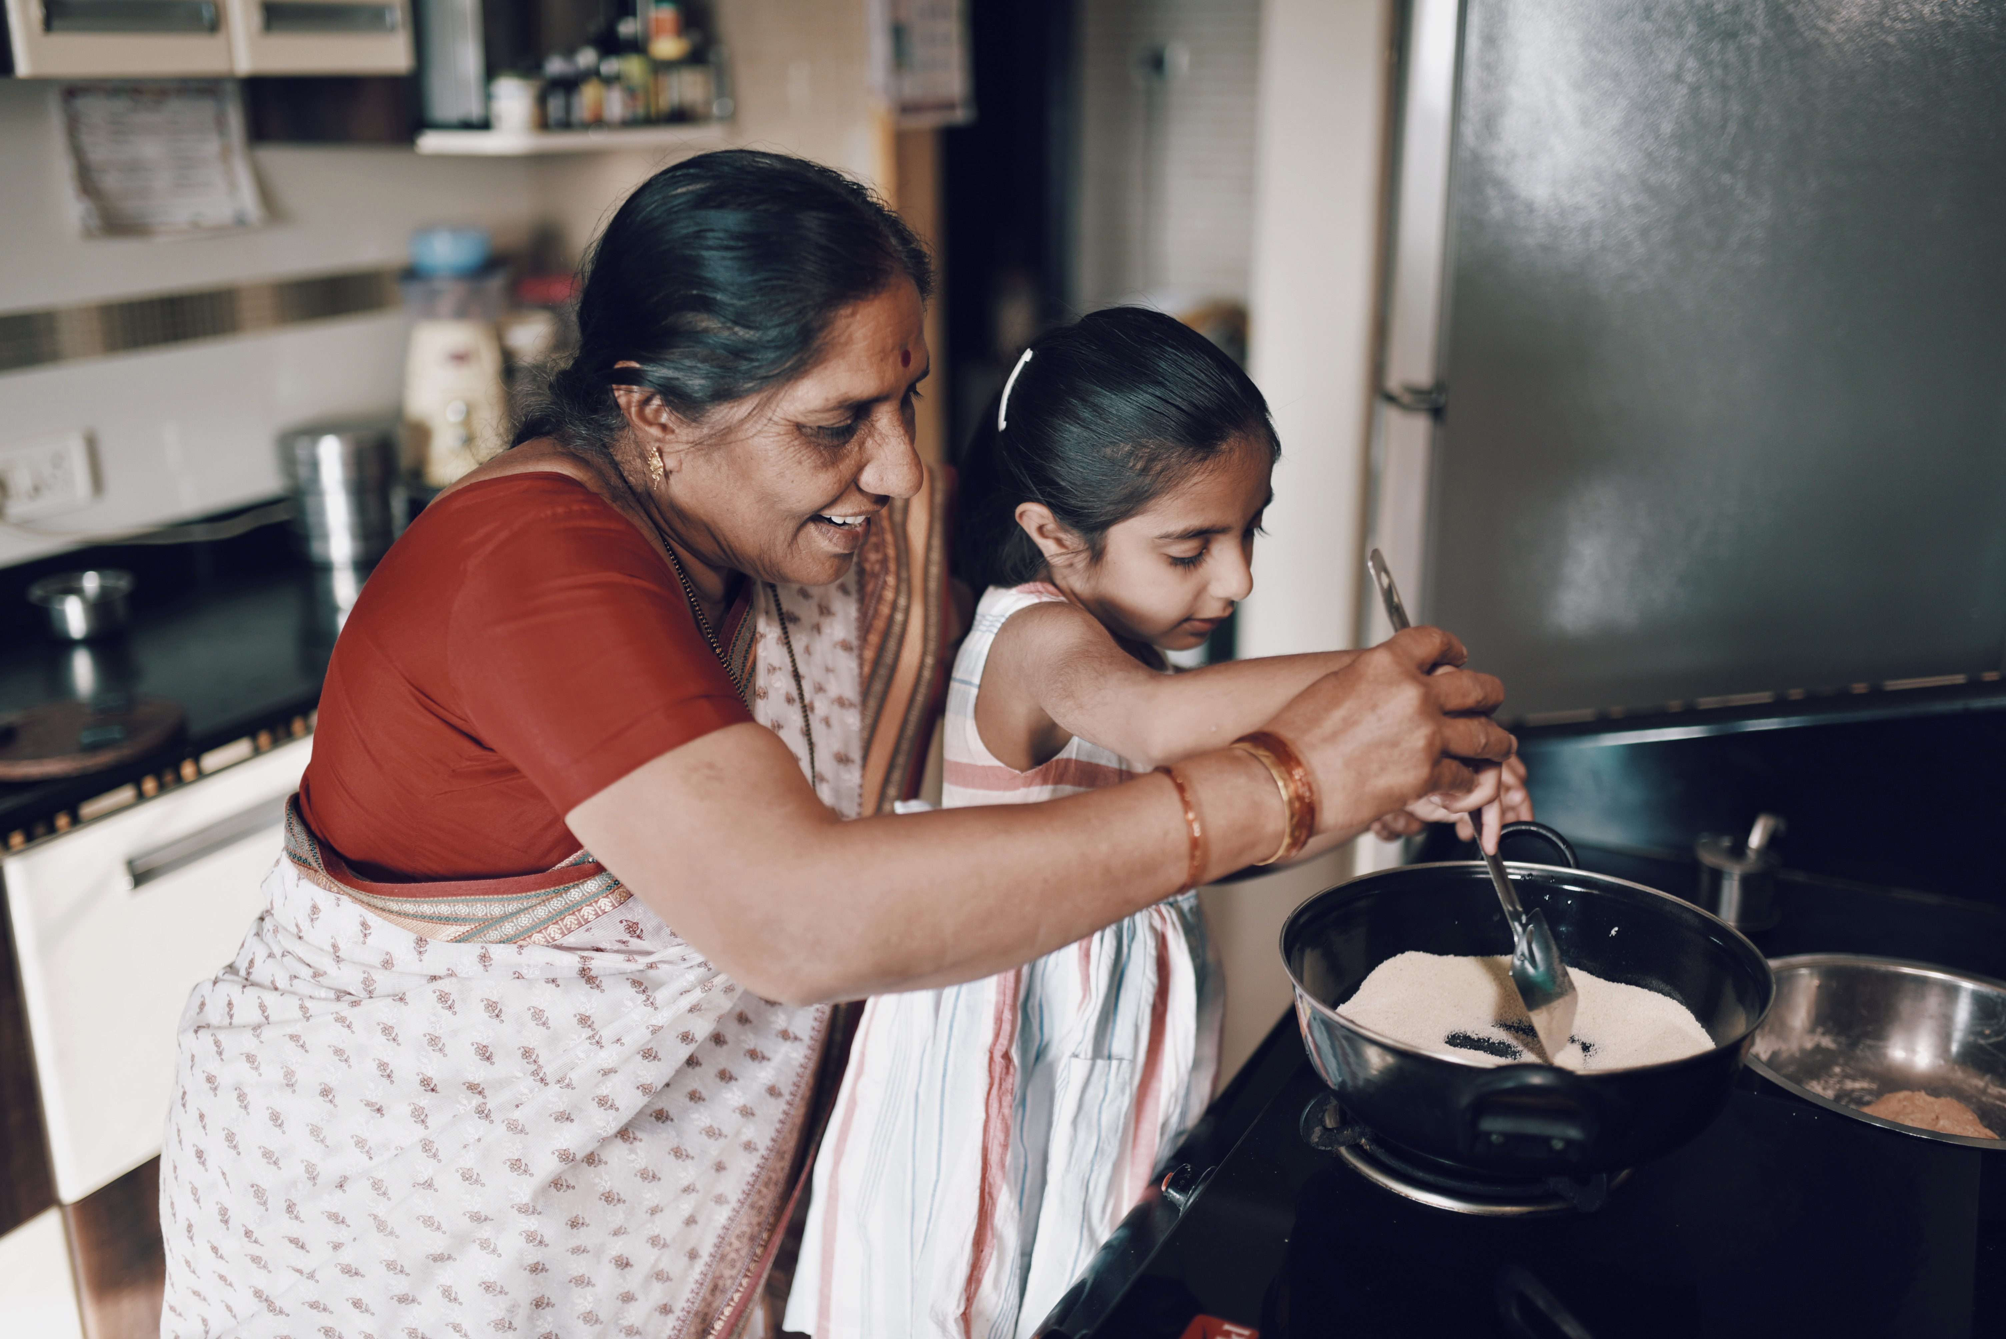
Skill 5. Increasing
Positive Emotions
To be emotionally well regulated we need not just to cope with distressing emotions, we also need to foster our positive experiences and emotions.
It’s easy to overlook the positive and focus on the negative that leads to distressing emotions
Planning positive pleasurable experiences and activities can foster positive emotions
Review the “Big List of Pleasurable Activities” p. 18-20 of the workbook
Use the Pleasurable Activities Log on p. 184-85 to reflect on how these activities influence your emotions

Slide 77
Skills training workbook p. 148-206 emotional regulation skills
Your emotions: what are they ?
How do emotions work?
Recognizing emotions
Overcoming barriers to healthy emotions
Reducing physical vulnerability
Reducing cognitive vulnerability
Increasing Positive Emotions
Being mindful of your emotions without judgement
Emotion exposure.
Doing the opposite of your emotions
Problem Solving

Slide 78
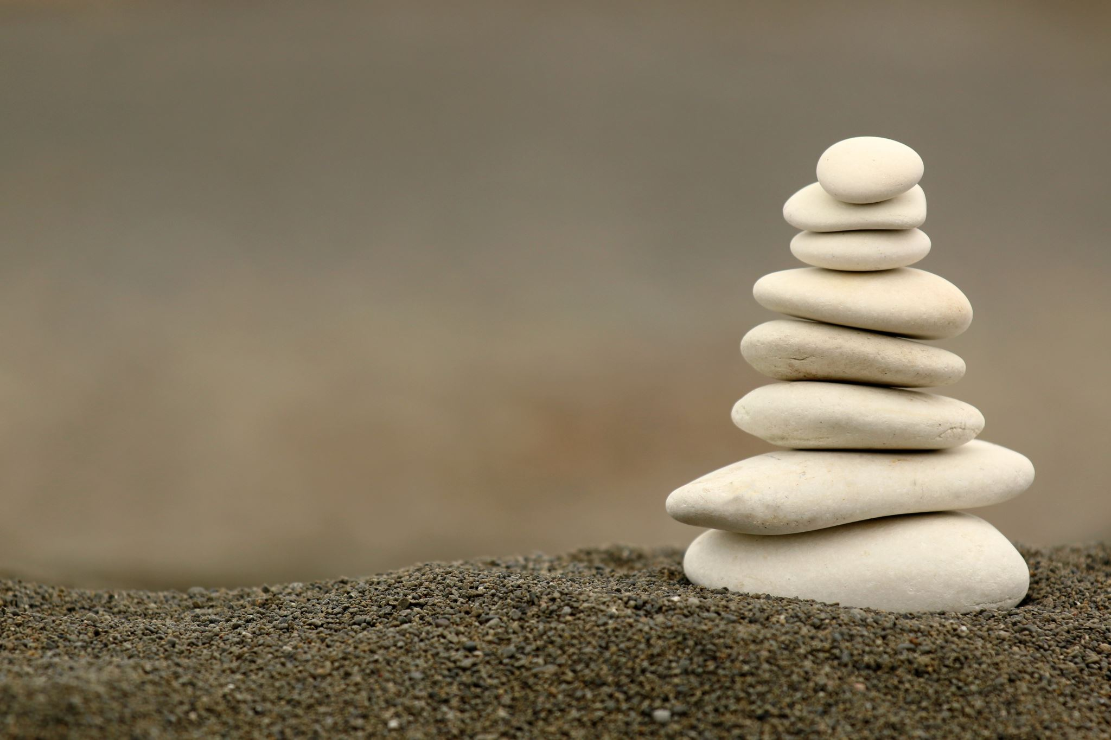
SKILL 6. BEING MINDFUL OF YOUR EMOTIONS WITHOUT JUDGEMENT
Being mindful and nonjudgemental of our emotions reduces the chance that they will increase in intensity and become overwhelming.
Try the “being mindful of your emotions without judgement” exercise on page 187 of the workbook.
When you realize you are judging your emotions, use the “imagining letting go” technique on page 188 of the workbook. For example, imagine placing the judgement you’re making on a leaf and letting it float down a stream, around a bend, and out of sight.
Noticing and letting go of judgements about emotions requires practice and involves several steps listed in the workbook on pages 188 and 189.

Slide 79
Skills training workbook p. 148-206 emotional regulation skills
Your emotions: what are they ?
How do emotions work?
Recognizing emotions
Overcoming barriers to healthy emotions
Reducing physical vulnerability
Reducing cognitive vulnerability
Increasing Positive Emotions
Being mindful of your emotions without judgement
Emotion exposure.
Doing the opposite of your emotions
Problem Solving

Slide 80

SKILL 7. EMOTIONAL EXPOSURE
Being aware of and dealing with our emotions instead of avoiding them is an integral part of dialectical behavioral therapy. Practicing exposing ourselves to our emotions, helps us accept and be less afraid of them.
Try the “emotional log” on pages 190 and 191, alternatively do the holes diary cards and chain analysis as these tools also expose you to the challenging emotions you experienced when you were in your holes.
Doing a chain analysis will likely make you re-experience some of the emotions you felt during the episode for which you’re doing the chain analysis. When, as you do the chain analysis, you notice that you’re becoming activated, soothe yourself and return to the window of tolerable emotions by pendulating to a resource. When you’re calmer, resume working on the chain analysis.
On pages 192 and 193 of the workbook there's an exercise that will help you to experience, observe, and soothe challenging emotions. This exercise will help you face difficult emotions while remaining closer to the window of tolerance.

Slide 81
Skills training workbook p. 148-206 emotional regulation skills
Your emotions: what are they ?
How do emotions work?
Recognizing emotions
Overcoming barriers to healthy emotions
Reducing physical vulnerability
Reducing cognitive vulnerability
Increasing Positive Emotions
Being mindful of your emotions without judgement
Emotion exposure.
Doing the opposite of your emotions
Problem Solving

Slide 82

SKILL 8. Opposite action
Impulsively acting on some of our emotions can backfire. For example, attacking someone verbally may damage that relationship. Acting on our emotions can also intensify conflicts and emotions.
“Opposite action” can help diffuse emotions.
On page 195 of the workbook, you will find several examples of “opposite action”. Ex. if you're angry and want to attack, criticize, hurt, or shout at someone- first imagine yourself validating, and being gentle with them. Once you’ve gotten good at practicing opposite action in your imagination, using editing, splicing and pasting, try doing it in real life.
The workbook describes six steps to creating opposite action and offers you an “opposite action planning worksheet” along with examples.

Slide 83
Skills training workbook p. 148-206 emotional regulation skills
Your emotions: what are they ?
How do emotions work?
Recognizing emotions
Overcoming barriers to healthy emotions
Reducing physical vulnerability
Reducing cognitive vulnerability
Increasing Positive Emotions
Being mindful of your emotions without judgement
Emotion exposure.
Doing the opposite of your emotions
Problem Solving

Slide 84

SKILL 9. PROBLEM SOLVING
This skill is essentially a chain analysis and a rational mind remediation combined.
Compare chain analysis and rational mind remediation and contrast them with the problem-solving skill described on pages 199 to 203 of the workbook.
We suggest that for simplicity you stick with chain analysis and rational mind remediation.

Slide 85

WEEKLY REGULATOR
The weekly regulator worksheet found on page 204 of the workbook is a reminder to use the emotional regulation skills we have discussed in this and the previous skills sessions.
In some ways the weekly regulator overlaps with the DBT diary card. It too is a reminder to practice your skills.
In the spirit of DBT we radically accept that it's very difficult to find the time and make the commitment to using all the tools and skills. As much as we radically accept that we also exhort you to try. If you do you will find that the benefits you get from this course go up exponentially.

Slide 86
UPDATED PERSONAL SKILLS LIST
Emotional regulation skills
How do emotions work?
Recognizing emotions
Overcoming barriers to healthy emotions
Reducing physical vulnerability
Reducing cognitive vulnerability
5. Increasing Positive Emotions
6. Being mindful of your emotions without judgement
Emotion exposure.
Doing the opposite of your emotions
Problem Solving

Slide 87
practicing the goals diary card procedure using 4 case studies
YouTube video 7:41-41:21

Slide 88


Slide 89


Slide 90

Review of THE SIMPLE TOOLS and strategies
Crisis plans
Holes diary card
Chain analysis
Rational mind remediation
The goals diary card procedure
Following good problem-solving practices
Editing splicing and pasting
Pendulating to stay in the window of tolerance
Being mindful of our personal dashboard
Notes:
In the second part of today's session, we will give you examples of how to use the tools. Please note that as with previous examples these are not actual real people but rather composite of different ones. I did however try to make the scenarios as realistic as possible. All these examples can be found in the simple manual session 17 pages 183 to 192.

Slide 91
Review of THE SIMPLE TOOLS and strategies
Crisis plans
Holes diary card
Chain analysis
Rational mind remediation
The goals diary card procedure
Following good problem-solving practices
Editing splicing and pasting
Pendulating to stay in the window of tolerance
Being mindful of our personal dashboard
Notes:
In the second part of today's session, we will give you examples of how to use the tools. Please note that as with previous examples these are not actual real people but rather composite of different ones. I did however try to make the scenarios as realistic as possible. All these examples can be found in the simple manual session 17 pages 183 to 192.

Slide 92
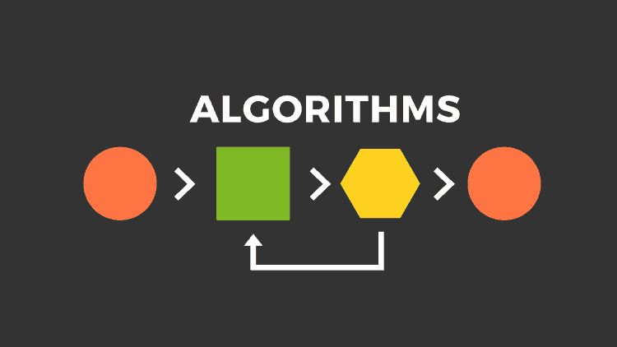
Crisis plan algorithm
Developing your crisis plans and becoming skilled at using them involves 8 steps: This is the first Simple algorithm.
1. Understand the concept of holes you keep falling into or the specific crisis for which you are going to use the crisis plans
2. Identify some of the thoughts, feelings or behaviors that occur during the crisis that you want to work on. This is step 1 on the crisis plan template.
3. Complete the rest of your crisis plan template
4. Recall, in your mind, a real crisis from the past in which you fell into the hole you are working on and use the "editing, splicing, and pasting" technique, along with your skills and tools, to imagine a different outcome that incorporates your crisis plan.
5. Stay in the window of tolerance while editing, splicing, and pasting by pendulating.
6. Repeatedly visualize the new edited, spliced, and pasted version of the situation until you can visualize it without effort.
7. When a new crisis occurs work with it following these same steps.
8. practice, practice, practice.

Slide 93
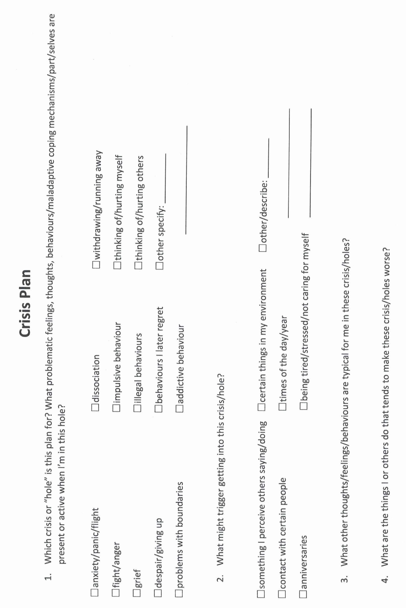
Notes:
A template is a structured form that helps you carry out the steps prescribed in the algorithm. There are many different crisis plans templates. This one is a compilation of some of the best features of other templates.

Slide 94
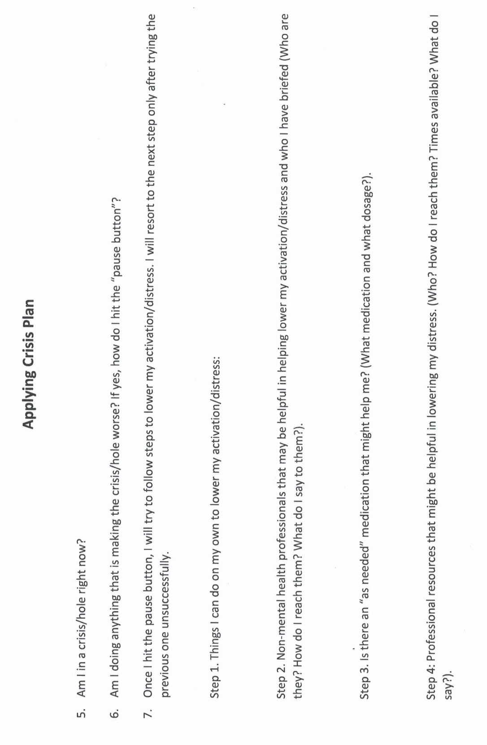

Slide 95
Review of THE SIMPLE TOOLS and strategies
Crisis plans
Holes diary card
Chain analysis
Rational mind remediation
The goals diary card procedure
Following good problem-solving practices
Editing splicing and pasting
Pendulating to stay in the window of tolerance
Being mindful of our personal dashboard
Notes:
In the second part of today's session, we will give you examples of how to use the tools. Please note that as with previous examples these are not actual real people but rather composite of different ones. I did however try to make the scenarios as realistic as possible. All these examples can be found in the simple manual session 17 pages 183 to 192.

Slide 96
Family visits dysregulation
Dysregulation with husband
Notes:
When Sam first started doing diary cards, she used the beginner target "falling into a hole", a generic "catch all" target. Sam was hoping to find a more specific intermediate target and at one of the sessions asked for help doing that.
Sam looked at her diary cards for the previous two . There were several 0’s in a row, then a day which she rated a 7. That was followed by two days that were 4's, and two more that were 1's.
Sam explained that, after one of her afternoon classes, she had been invited by classmates to go for pizza. The small group had ended up at someone's apartment watching a movie. She knew Steve would want her to call to let him know she would be late but, determined to maintain her independence, she had defiantly decided not to do that.
When Sam got home at 11 PM Steve, fuming, was waiting up for her. They started falling into their usual hole, but recalling her crisis plan, Sam immediately left and spent a couple of days at her parents.
This description of events gave her some ideas for possible intermediate targets: "conflict with Steve" was an obvious one. She wondered if there were others. Sam said that she often felt "irritated" and "frustrated" with Steve. Sometimes, she also felt "guilty", "lonely", and "sad".
Replacing falling into a hole with "feeling irritated with Steve" made sense to Sam. Feeling irritated with her partners was a long-standing hole for Sam.

Slide 97
Practice USING THE SIMPLE TOOLS and strategies
Crisis plans
Holes diary card
Chain analysis
Rational mind remediation
The goals diary card procedure
Following good problem-solving practices
Editing splicing and pasting
Pendulating to stay in the window of tolerance
Being mindful of our personal dashboard
Notes:
In the second part of today's session, we will give you examples of how to use the tools. Please note that as with previous examples these are not actual real people but rather composite of different ones. I did however try to make the scenarios as realistic as possible. All these examples can be found in the simple manual session 17 pages 183 to 192.

Slide 98
chain analysis algorithm
Start with a high score in your hole's diary card
Step 1. Create a “topographic” profile of the intensity of your activation around the time period for which you are doing a chain analysis.
Step 2. On the template note if there were any events that may have contributed to or triggered your increase in activation ?
Step 3. Note the sequence of emotions you felt during this period. Rate each on a scale of 0-10 with 10 being the most intense you’ve ever felt this emotion
Step 4. Notice your sensations without judging or trying to change them
Step 5. Note the thoughts that go with each of your emotions
Step 6. Note what you did or wanted to do but stopped yourself during this time period
Step 7. Note on a 0-10 scale what your energy balance, reserves or stores (how full your gas tank was) prior to the time for which you’re doing the chain analysis.
Notes:
Sam was intrigued and wanted to explore why she became so irritated by her partners. She decided to do a chain analysis. Sam realized that when she was working on finding intermediate targets, she had already explored parts of the chain analysis.

Slide 99
CHAIN ANALYSIS TEMPLATE
Stay in window of tolerance by pendulating
1. what was the topography of your activation?
2. was there a trigger(s)?
3. what did you feel?
4. notice the sensations in your body without judging or trying to change them
5. what thoughts were associated with each feeling?
6. what behaviors or urges were associated with each feeling?
7. what was your energy balance before the activation? 0-10
Notes:
The "topography" of Sam's activation was clear from her diary card ratings. She had also explored the event that triggered her and the feelings she had experienced: irritation and frustration at first, but later guilt, loneliness, and sadness.
Having completed these columns of the chain analysis, Sam reflected on the thoughts that had accompanied her feelings: she liked her space and doing things on her own, or with her friends. She could only spend so much time with Steve, particularly now that they were living together. He seemed to want to spend more time with her then she did with him. She felt suffocated and did not want to lose her independence.
After the initial irritation, Sam started to feel guilty: Steve was a nice guy, he was always doing things for her, and cared a lot about her. His family was close, there were kind to each other, and liked spending time together.
Sam's family, on the other hand, had always been critical, cold, and distant. Maybe what she felt had something to do with her upbringing and her "internal working model”. Maybe she had trouble loving and getting close to people. Maybe she would always feel this way and would be lonely for the rest of her life.
When Sam got home, after the night out with her friends, and Steve was angry, she just wanted to leave the situation and avoid conflict. Her crisis plan provided her with a good excuse for doing that. Over the time she stayed at her parents, they had not even asked her why she had come home, just how long she planned to stay.
After a couple of emotionally cool days at home, Sam longed to return to Steve, who seemed genuinely interested in her and what she did. At the same time, she was afraid that their pattern would just keep repeating.

Slide 100
Advanced chain analysis
Time ---------------------------------------------------→
Feelings
Thoughts
Behaviours
Feelings
Thoughts
behaviours
Feelings
Thoughts
behaviours
Notes:
Remember that a chain analysis is a snapshot of a moment of activation. An advanced chain analysis in contrast is a movie of a longer period of activation in which feelings, thoughts, and behaviours aren't static, they change over time.

Slide 101
Review of THE SIMPLE TOOLS and strategies
Crisis plans
Holes diary card
Chain analysis
Rational mind remediation
The goals diary card procedure
Following good problem-solving practices
Editing splicing and pasting
Pendulating to stay in the window of tolerance
Being mindful of our personal dashboard
Notes:
In the second part of today's session, we will give you examples of how to use the tools. Please note that as with previous examples these are not actual real people but rather composite of different ones. I did however try to make the scenarios as realistic as possible. All these examples can be found in the simple manual session 17 pages 183 to 192.

Slide 102

1. How to do Rational mind remediation by imagining you’re helping a friend
Start with your chain analysis
Imagine this was a friend's chain analysis and that friend had come to you for help and advice about how to use DBT skills to splice and paste a different outcome
How could your friend have seen or interpreted the situation differently?
Could your friend have thought or behaved differently and to have a better outcome?
Help your friend to imagine a scenario in which they had stayed better regulated
Help your friend to practice this situation in their minds using the editing splicing and pasting technique
Reclaim the situation as your own using the new scenario. Practice it repeatedly in your imagination.
Notes:
Sam worked on a rational mind remediation. She imagined that a friend of hers had just gone through a similar "coming home late" situation. She shared with Sam what happened and was desperate for advice.
Sam thought her friend had issues with getting close to her partners and needed to work on that. She thought her friend could use "feeling irritated by others" as a target in her diary card. Sam suggested that rather than acting on her irritation, her friend be mindful, and curious about it. She should spend some time with the sensations they came along with being irritated.
One of her friends automatic thoughts was that others were needy. An alternative thought was that she had trouble with intimacy. Around this issue, the friend should be gentle with herself, but perhaps set a goal of slowly being able to be more intimate with people. Sam realized that she could not be intimate because she did not trust anyone and to compensate, she had learned to be self-sufficient.
Sam wanted to offer her friend concrete suggestions that could be implemented and came up with 1) start using "feeling irritated with people" in her diary card. 2) apply the "edit, splice, and paste" technique to the incident: run the "mental videos" of the incident up to the point when she came home after being out with her friends. As she started to feel suffocated and irritated by her partners questioning, she could splice in an alternative thought: "I do feel irritated, but he has a point; I could have called to let him know I'll be coming home late. This may be an example of my tendency to push people away when they start getting close to me." 3) practice this new "video" every day for a few minutes. 4) picture, in her imagination, telling her boyfriend what she had learned about intimacy, and what she was trying to do. Eventually, when she felt ready, she could do this in real life.
Having written those suggestions for her friend, Sam then took ownership of them and made them her homework.

Slide 103

2. alternative rational mind remediation what would an emotionally well-regulated friend do ?
Start
Start with your chain analysis
Imagine
Imagine that what happened to you happened instead to a friend who is well regulated
Imagine
Imagine how they might have seen or interpreted the situation and thought and behaved differently
Imagine
Imagine what they might have done. Write this down
Reclaim
Reclaim the situation as your own and play it the way your friend did use the edit, splice, and paste technique
Practice
Practice that scenario in your imagination
Notes:
Allison imagined the same situation was happening to a friend who had well-regulated emotions. Marjorie, whom she had known since high school, was kind but assertive. What would Marjorie do in this situation?
Marjorie would not be intimidated. This was an unfair situation, and it was reasonable to address it rather than put up with it. Marjorie would not keep her feelings and thoughts to herself. She would, in a kind but assertive way, explained to her stepmother what she felt, thought, and wanted to see happen; the stepmother was entitled to spend her father's money, but not to throw it away foolishly.
If this conversation went nowhere, Marjorie would find out what her legal rights work, and if she did not have a legal recourse, try to maintain a cordial relationship with the stepmother and negotiate. If she exhausted her options, she would simply walk away. It would be sad, but she did not want to waste her life feeling resentment and anger. Marjorie, like Allison, was financially comfortable. Inheriting some of her father's largest state would be nice, but it would not be a life changer.
After imagining what Marjorie would do, Allison considered how she could apply it to herself and decided on an action plan: 1) she would use the "mental video" of the visit when she found the SUV in the driveway. She would then splice and edit out the part in which she kept her feelings and thoughts to herself while stewing on them. She had done that all her life.
Instead, she would paste in an assertive conversation, in which she explained to Ingrid how she felt, her thoughts, and what she planned to do. Imagining this conversation, activated Allison, and she knew she had to practice it for some time while, to stay in the window of tolerance, she pedulated.
2) in her imagination, Allison practiced this conversation, not expecting to have a real conversation with Ingrid anytime soon. She felt this took some of the pressure off.
3) Allison knew a family lawyer whom she trusted and decided she would call him to make an appointment to review her legal options.
4) she felt that if trying to work things out not produce results, she would not be held hostage by the potential inheritance and would distance herself from Ingrid.
Allison realize that her feelings, thoughts, and behaviours, in this present day situation, were similar to those she had as a little girl. Her adult self needed to step up and protect this frightened child.

Slide 104
Review of THE SIMPLE TOOLS and strategies
Crisis plans
Holes diary card
Chain analysis
Rational mind remediation
The goals diary card procedure
Following good problem-solving practices
Editing splicing and pasting
Pendulating to stay in the window of tolerance
Being mindful of our personal dashboard
Notes:
In the second part of today's session, we will give you examples of how to use the tools. Please note that as with previous examples these are not actual real people but rather composite of different ones. I did however try to make the scenarios as realistic as possible. All these examples can be found in the simple manual session 17 pages 183 to 192.

Slide 105
Goals diary card procedure algorithm
Step 1
1. Track your usual activities for a week using a blank week calendar.
This will give you a snapshot of your typical routine and allow you to assess its balance.
2. Rate yourself 0-10 on each of Maslow’s needs/wellness domains (see slide below)
Step 2
3. Complete the wellness assessment tool. Choose 1-3 “proximal activities” for your goals.
4. Consider which of your Maslow’s needs are met and which of Erickson’s stages you have mastered.
Step 3
5. “Schedule” the activities you have chosen on a blank weekly schedule.
6. Use the goals diary card template to track your progress with these activities
Step 4
7. If you have accomplished a goal, choose another from the wellness assessment tool and use it as a target in your goal's diary card template. Repeat the same process starting with step 2.
Notes:
The goals diary card procedure is an algorithm with four steps. We will go through each step individually.

Slide 106
Review of THE SIMPLE TOOLS and strategies
Crisis plans
Holes diary card
Chain analysis
Rational mind remediation
The goals diary card procedure
Following good problem-solving practices
Editing splicing and pasting
Pendulating to stay in the window of tolerance
Being mindful of our personal dashboard
Notes:
In the second part of today's session, we will give you examples of how to use the tools. Please note that as with previous examples these are not actual real people but rather composite of different ones. I did however try to make the scenarios as realistic as possible. All these examples can be found in the simple manual session 17 pages 183 to 192.

Slide 107
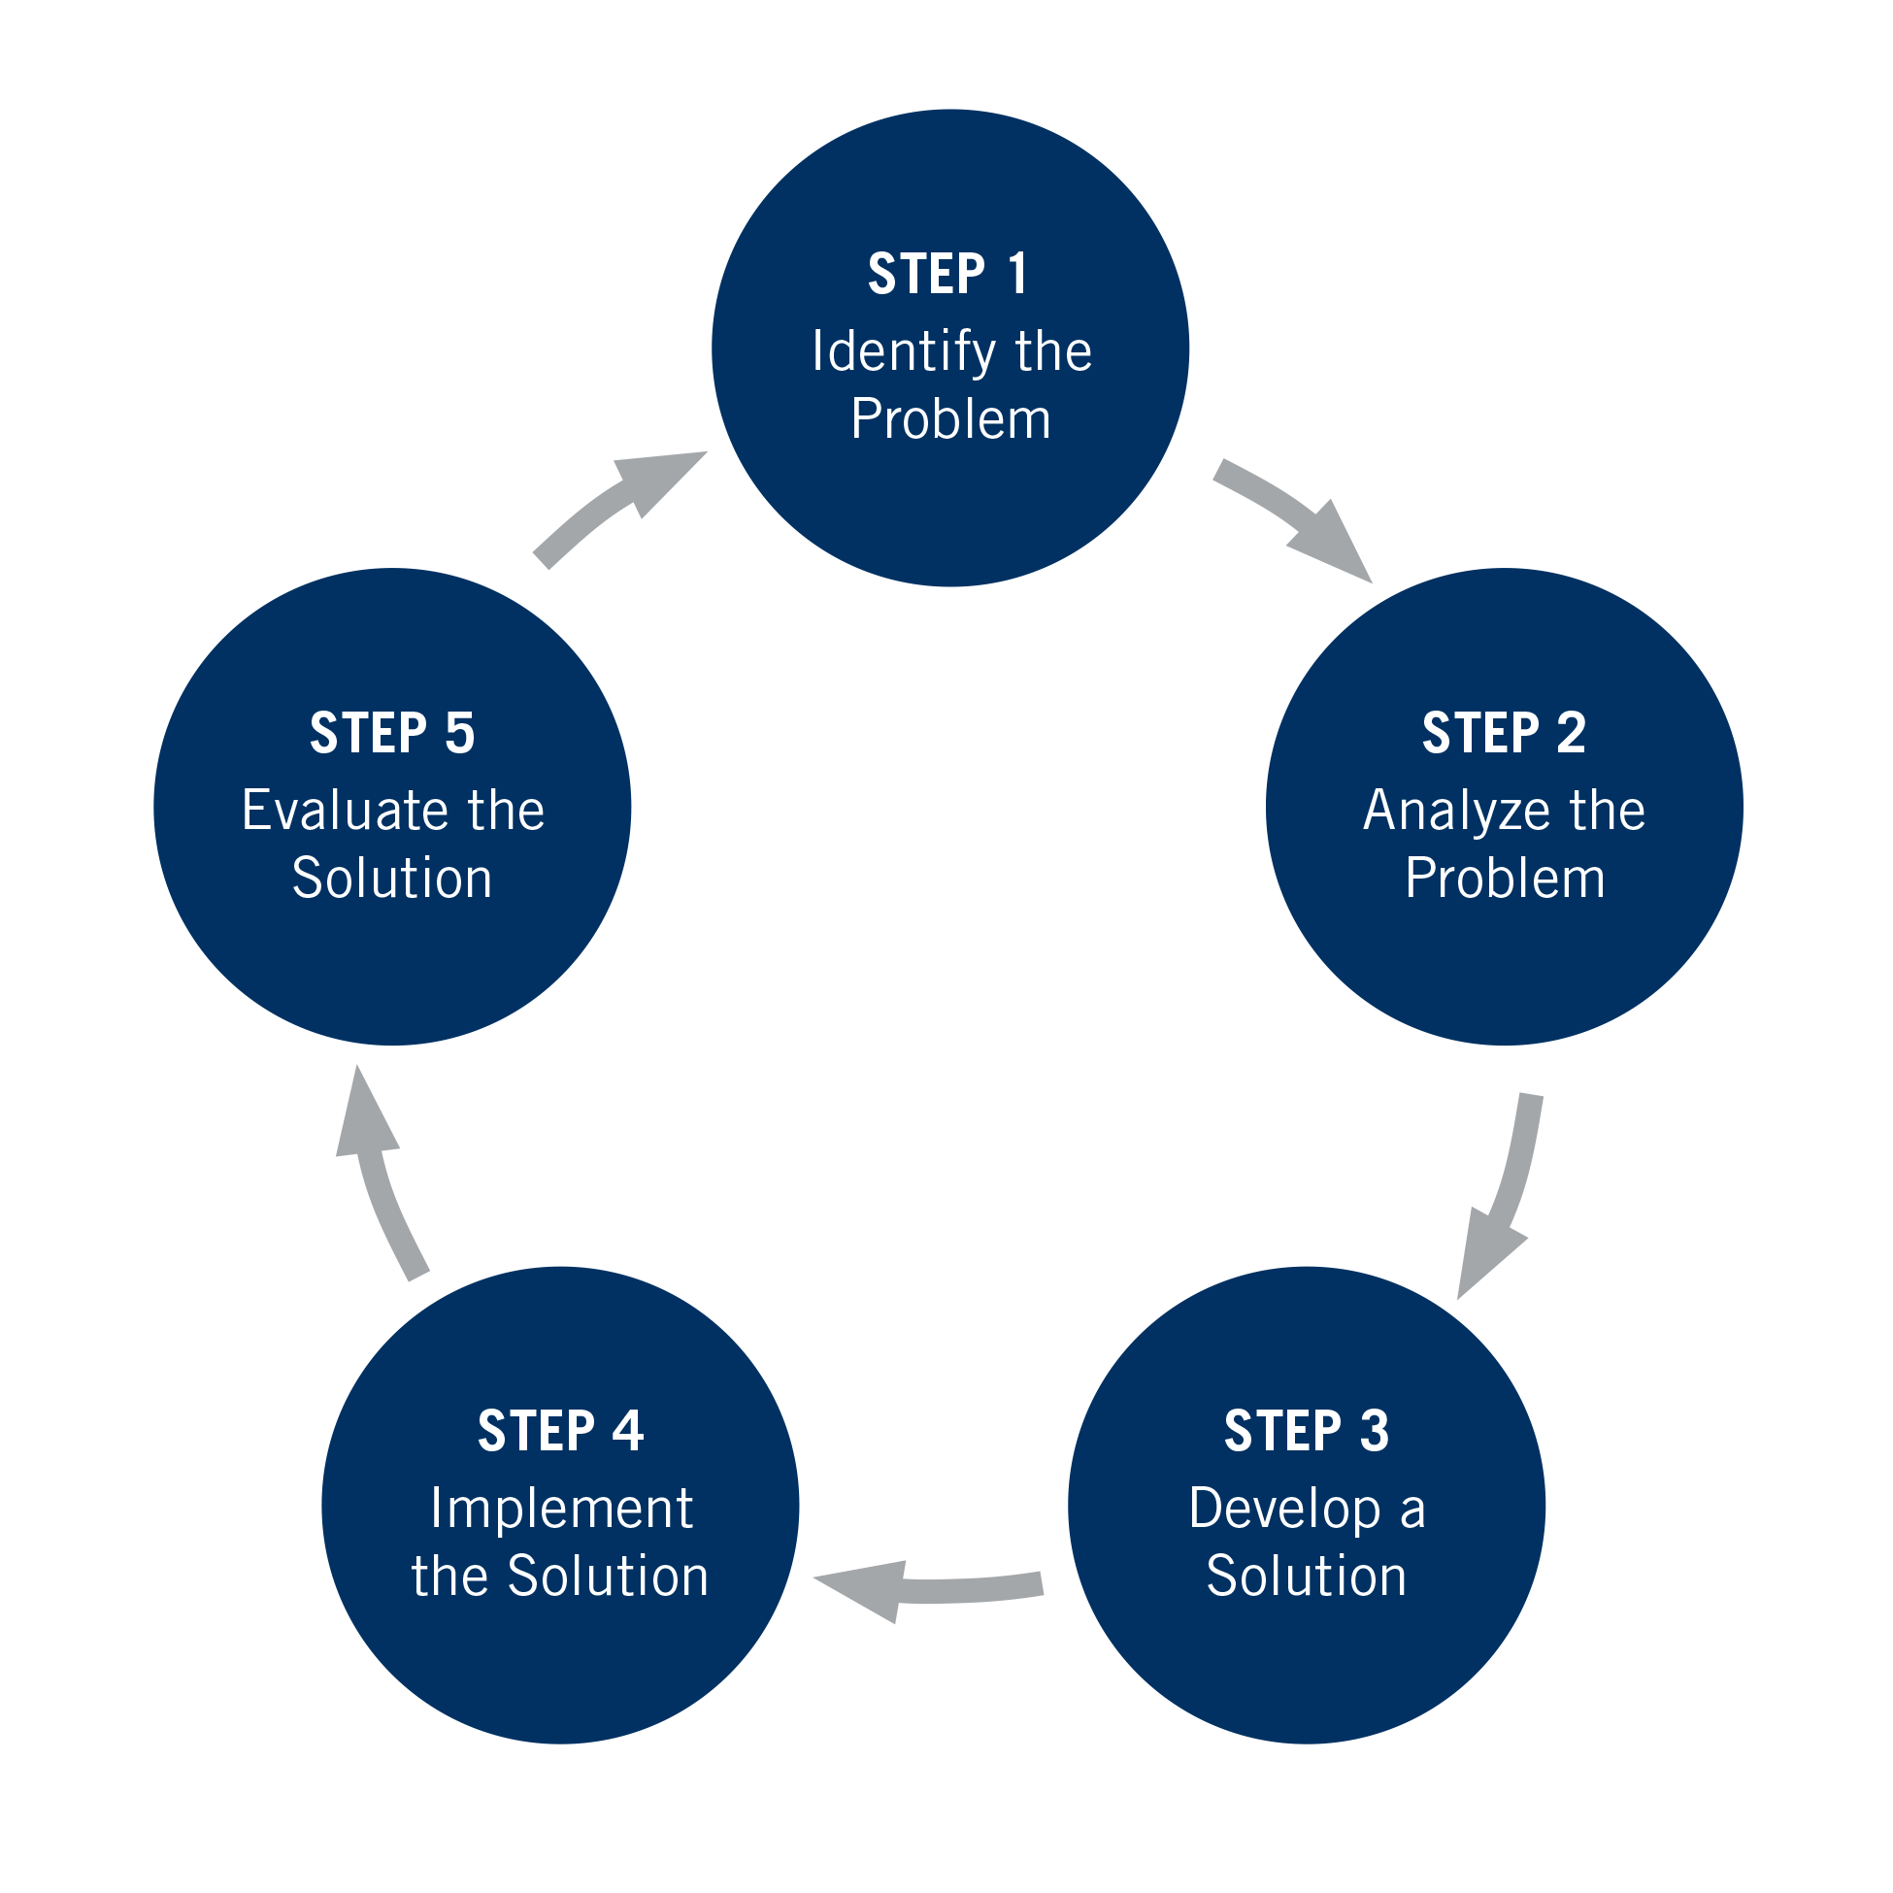

Slide 108
Review of THE SIMPLE TOOLS and strategies
Crisis plans
Holes diary card
Chain analysis
Rational mind remediation
The goals diary card procedure
Following good problem-solving practices
Editing splicing and pasting
Pendulating to stay in the window of tolerance
Being mindful of our personal dashboard
Notes:
In the second part of today's session, we will give you examples of how to use the tools. Please note that as with previous examples these are not actual real people but rather composite of different ones. I did however try to make the scenarios as realistic as possible. All these examples can be found in the simple manual session 17 pages 183 to 192.

Slide 109
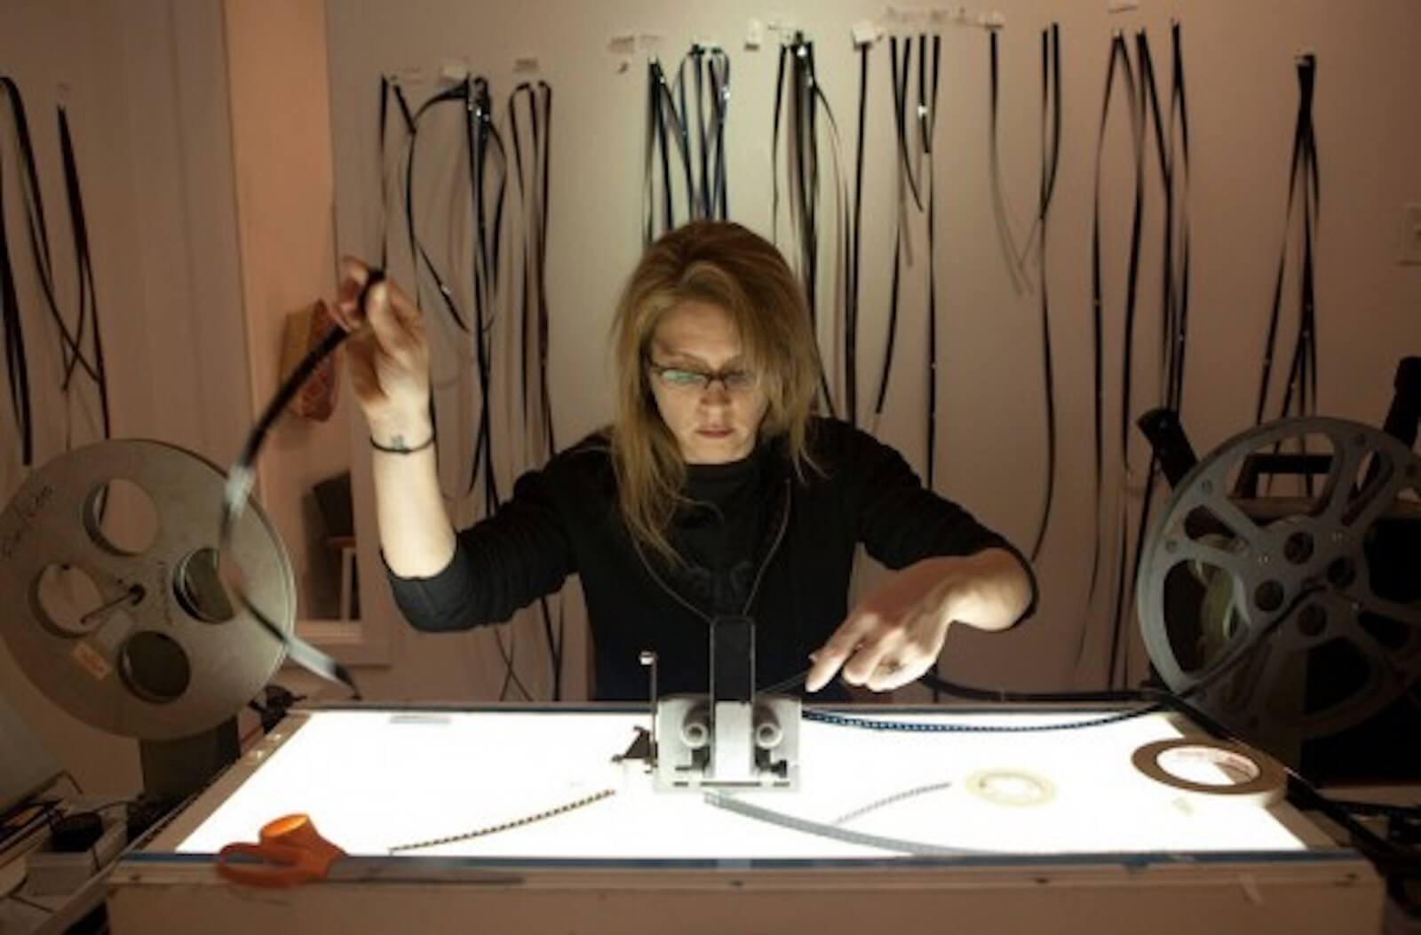

Editing, splicing and pasting while pendulating to stay in window of tolerance
We all have memories or mental “videos” of times we’ve been dysregulated or fallen into holes.
When we are learning to get out of holes, these memories or videos are invaluable in helping us practice alternative ways of thinking, feeling, and behaving.
In Simple we’re going to learn to edit these old videos by splicing them and pasting in new more desirable and adaptive thoughts, feelings, and behaviors that get us out of our holes.
As we visualize these videos, we may get activated so we will need to know how to sooth ourselves by “pendulating”, then resuming our work on the videos.
+

Slide 110
Review of THE SIMPLE TOOLS and strategies
Crisis plans
Holes diary card
Chain analysis
Rational mind remediation
The goals diary card procedure
Following good problem-solving practices
Editing splicing and pasting
Pendulating to stay in the window of tolerance
Being mindful of our personal dashboard
Notes:
In the second part of today's session, we will give you examples of how to use the tools. Please note that as with previous examples these are not actual real people but rather composite of different ones. I did however try to make the scenarios as realistic as possible. All these examples can be found in the simple manual session 17 pages 183 to 192.

Slide 111
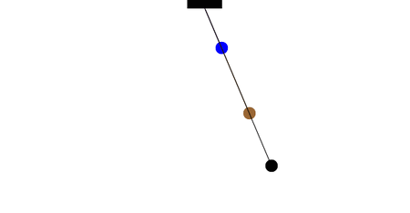
Stay in your window of tolerance by pendulating
Pendulating, which comes from the word pendulum, means swinging from one thing or place to another.
When people have feelings, they also have thoughts and images that accompany those feelings.
One way of soothing yourself, when you are experiencing intense negative feelings, and bringing yourself back to the window of tolerable emotions, involves distraction or self-soothing: you learn to identify that you are emotional and learn to have alternative thoughts, a soothing inner dialogue, and/or calming and soothing images. When you are better regulated you can then revisit the original thoughts you were having
To get good at pendulating you have to plan and practice it .
Distressing thoughts/feelings
Distracting/soothing
Images/thoughts/sensations

Slide 112
Review of THE SIMPLE TOOLS and strategies
Crisis plans
Holes diary card
Chain analysis
Rational mind remediation
The goals diary card procedure
Following good problem-solving practices
Editing splicing and pasting
Pendulating to stay in the window of tolerance
Being mindful of our personal dashboard
Notes:
In the second part of today's session, we will give you examples of how to use the tools. Please note that as with previous examples these are not actual real people but rather composite of different ones. I did however try to make the scenarios as realistic as possible. All these examples can be found in the simple manual session 17 pages 183 to 192.

Slide 113
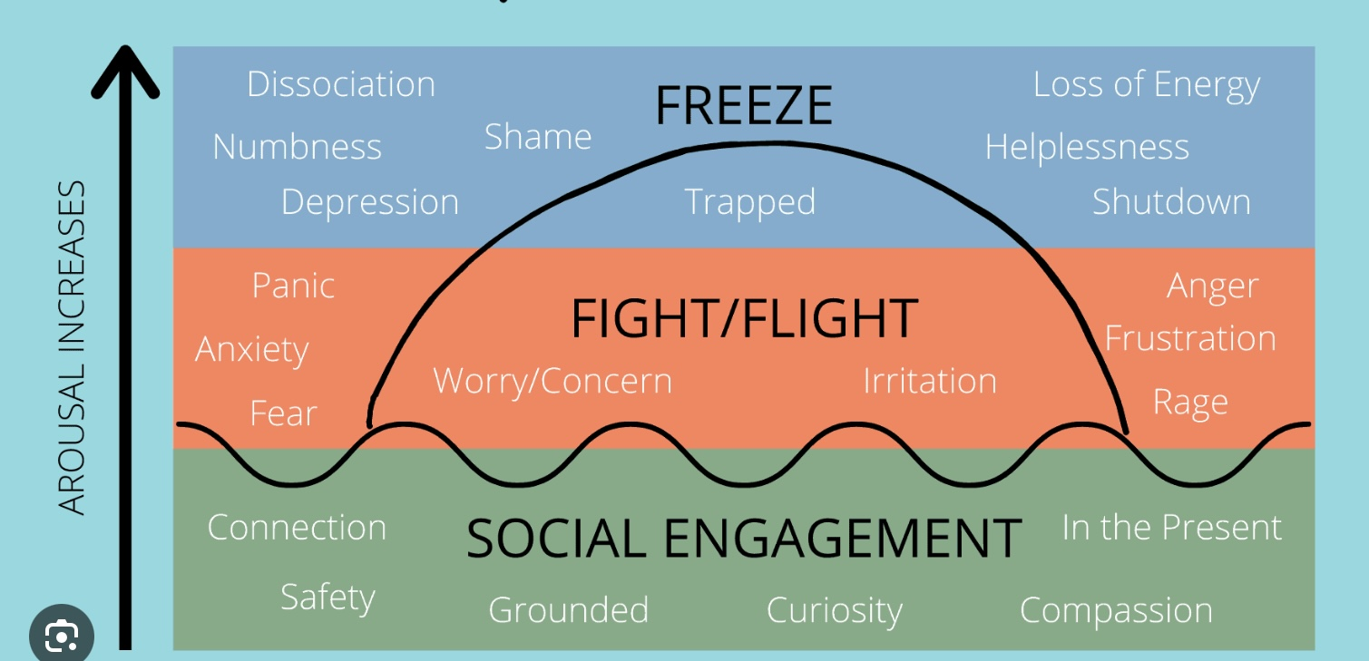
Check in regularly with your Personal dashboard
Spend a few moments checking in with yourself by asking:
1)What is the current risk that I’ll experience a state of crisis ?
Low b) Moderate c) high d) very high e) extreme
2) Am I in the window of tolerance?
a) Yes b) I’m a little outside c) very outside
3) What state of activation am I mostly in at the moment?
a) Calm b) Fight c) Flight d) Dissociated e) Depressed?
4) Where is my energy tank right now?
a) Full b) ¾ c) ½ d) near empty
CRISIS RISK
WINDOW OF TOLERANCE
STATE OF ACTIVATION
ENERGY RESERVES

Slide 114
Practice USING THE SIMPLE TOOLS and strategies
Crisis plans
Holes diary card
Chain analysis
Rational mind remediation
The goals diary card procedure
Following good problem-solving practices
Editing splicing and pasting
Pendulating to stay in the window of tolerance
Being mindful of our personal dashboard
Notes:
In the second part of today's session, we will give you examples of how to use the tools. Please note that as with previous examples these are not actual real people but rather composite of different ones. I did however try to make the scenarios as realistic as possible. All these examples can be found in the simple manual session 17 pages 183 to 192.

Slide 115
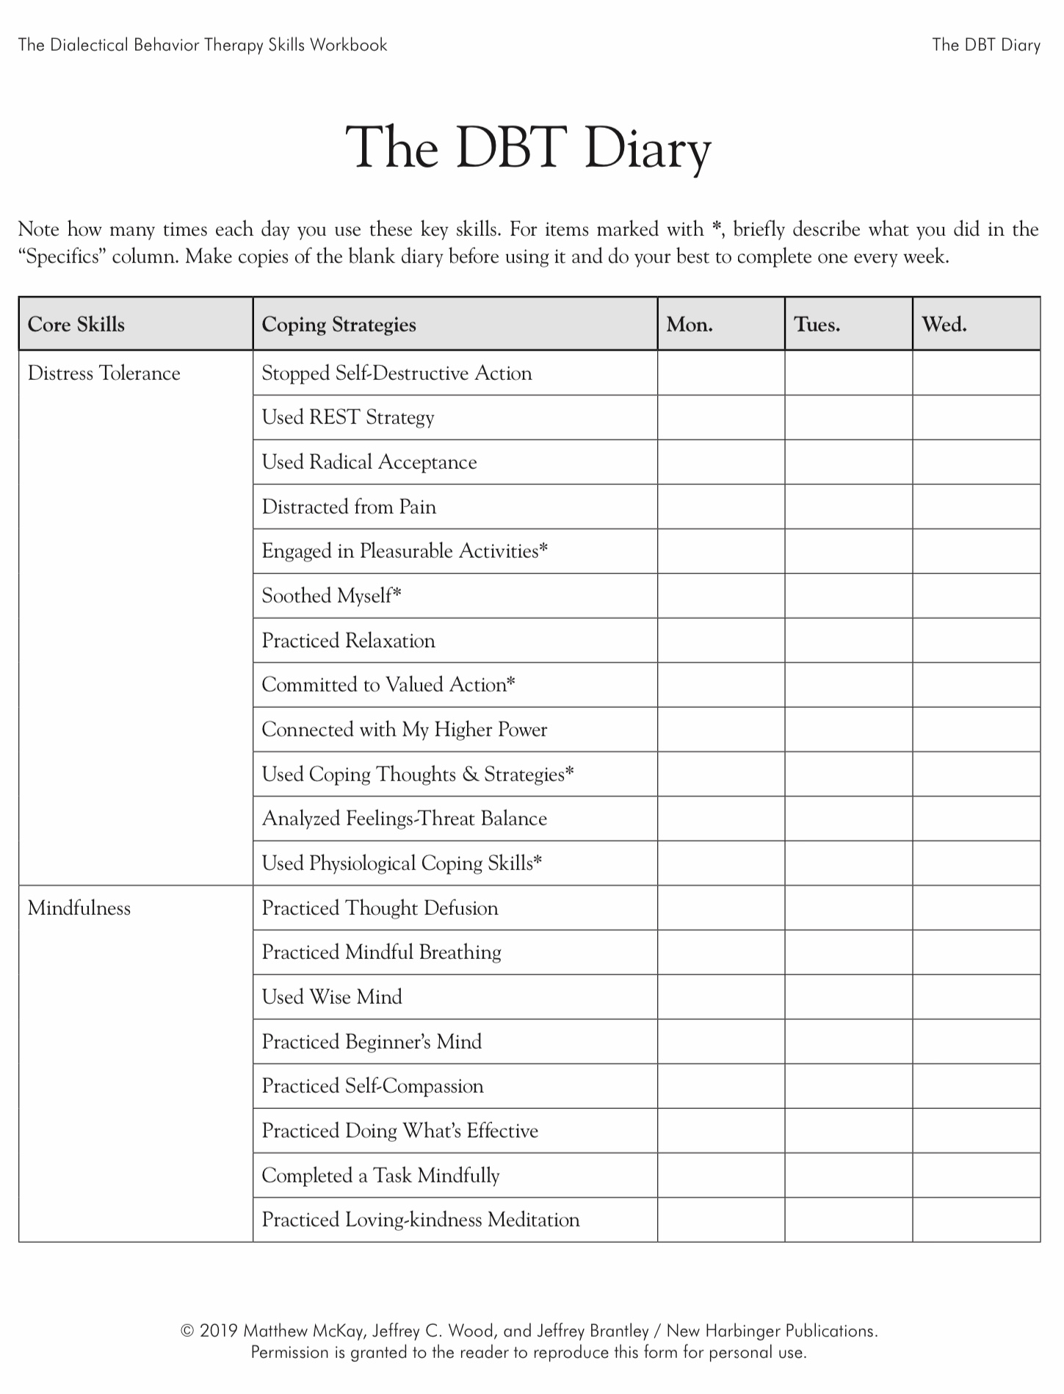

Slide 117
WEEK 18 of simple break

Slide 118
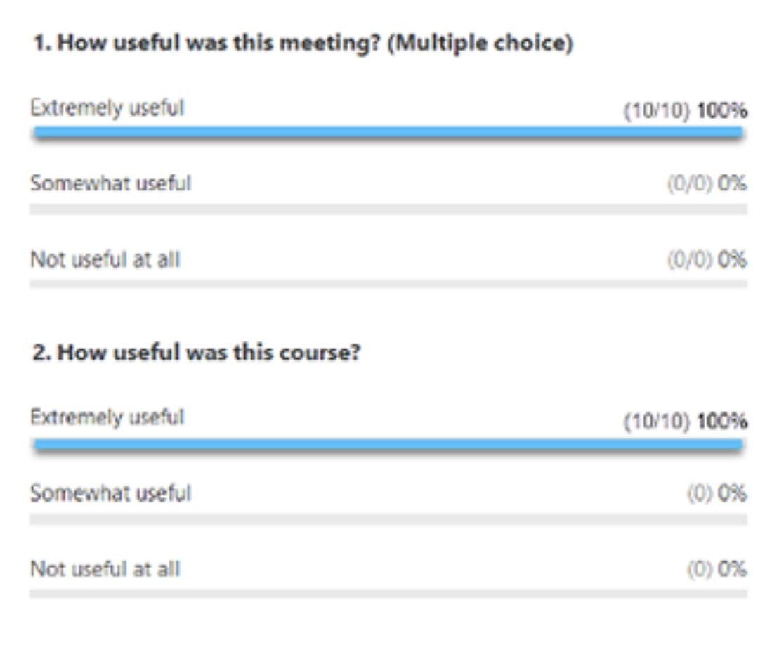
ZOOM POLL
Please answer the following question
Answers are anonymous
In person participants please answer the page that was handed out.

Slide 119
week 18 of SIMPLE welcome back from the break

Slide 120



See you next session

Slide 121
Editing, splicing and pasting while pendulating to stay in window of tolerance
Notes:
Mary had started using the editing splicing and pasting technique, along with rational mind remediation, to splice balanced, alternative thoughts, onto the memories of the times she had done too much for others or ruminated. She was beginning to see small changes in herself.

Slide 122
Goals diary card procedure algorithm
Step 1
1. Track your activities for a week using a blank week calendar.
This will give you a snapshot of your typical routine and allow you to assess its balance.
2. Rate yourself 0-10 on each of Maslow’s needs/ wellness domains (see slide below)
Step 2
3. Complete the wellness assessment tool. Choose 1-3 “proximal activities” for your goals.
4. Consider which of your Maslow’s needs are met and which of Erickson’s stages you have mastered.
Step 3
5. “Schedule” the activities you have chosen on a blank or other weekly schedule.
6. Use the goals diary card to track your progress with these activities
Step 4
7. If you have accomplished a goal, choose another from the wellness assessment tool and use it in your goal's diary card… repeat.
Notes:
Because each tool she had learned had been helpful, Mary was curious to see what impact the goals diary card procedure was going to have.

Slide 123
Mary completed the hour by hour monitoring of her activities for one week
Notes:
Mary completed the hour by hour monitoring of her activities for one week

Slide 124
Goals diary card procedure algorithm
Step 1
1. Track your usual activities for a week using a blank week calendar.
This will give you a snapshot of your typical routine and allow you to assess its balance.
2. Rate yourself 0-10 on each of Maslow’s needs/wellness domains (see slide below)
Step 2
3. Complete the wellness assessment tool. Choose 1-3 “proximal activities” for your goals.
4. Consider which of your Maslow’s needs are met and which of Erickson’s stages you have mastered.
Step 3
5. “Schedule” the activities you have chosen on a blank weekly schedule.
6. Use the goals diary card template to track your progress with these activities
Step 4
7. If you have accomplished a goal, choose another from the wellness assessment tool and use it as a target in your goal's diary card template. Repeat the same process starting with step 2.
Notes:
The goals diary card procedure is an algorithm with four steps. We will go through each step individually.

Slide 125
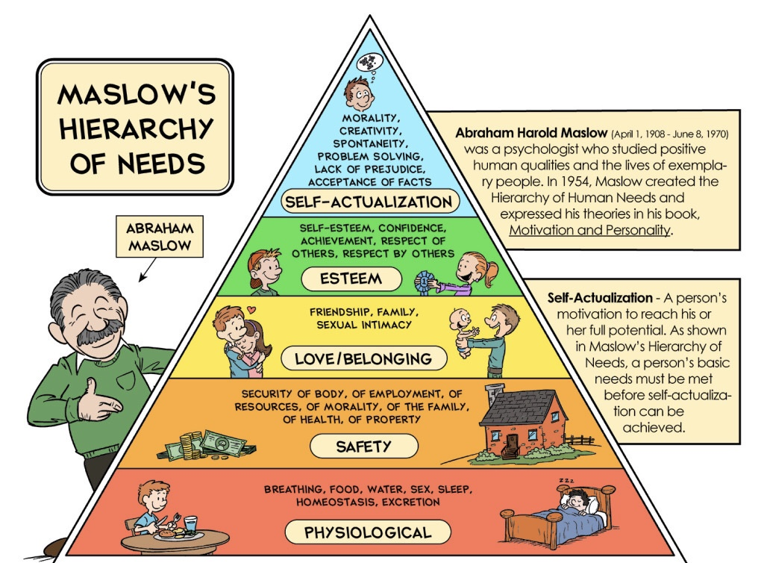
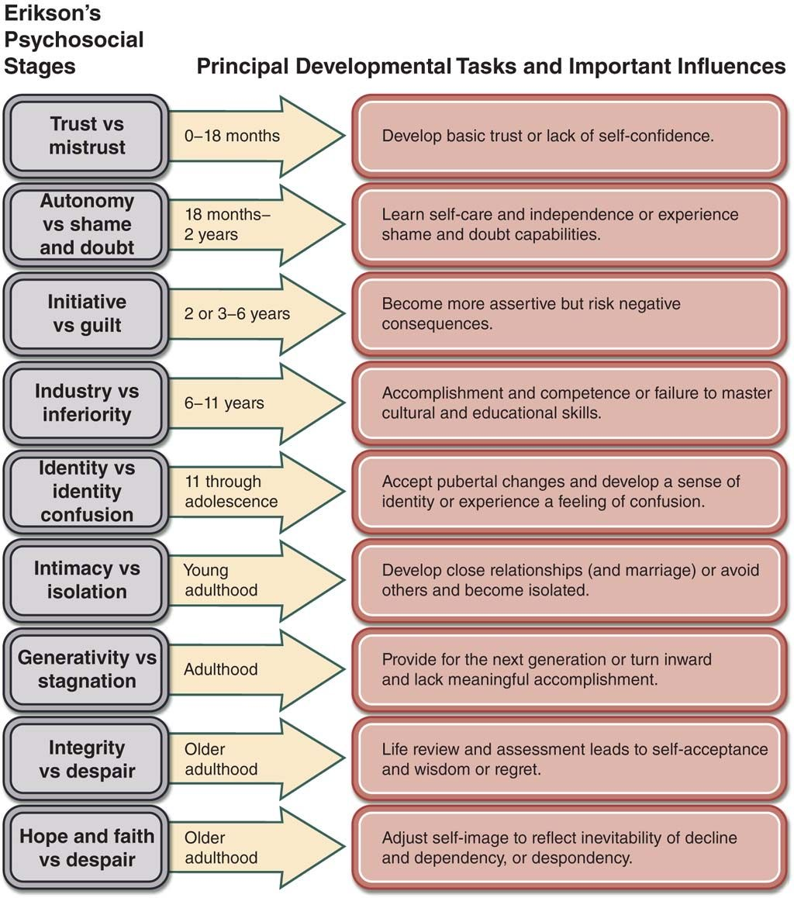
Notes:
As she reflected on her wellness assessment tool, she concluded that her biological, physiological, and safety, Maslow's needs, were well met. She also saw that she loved her family but not herself. She spent all her time looking after them but continue to feel she did not do enough. She could not imagine why they loved her, she did not feel worthwhile, or deserving of recognition.
Mary thought that she had mastered all of Erickson's tasks up to identity versus role confusion. She had done quite well in high school, both academically and in sports, but that had not translated into a sense of self-worth. Mary thought of Crittenden's attachment classifications and had identified both herself and her mother as "compulsive caretakers".
Although able to come to these conclusions rationally, Mary's emotional mind remained firmly in control, making her feel that looking after herself was selfish, and if she did more of that, her husband and children would suffer.

Slide 126

video
Week 18 of simple

Slide 127
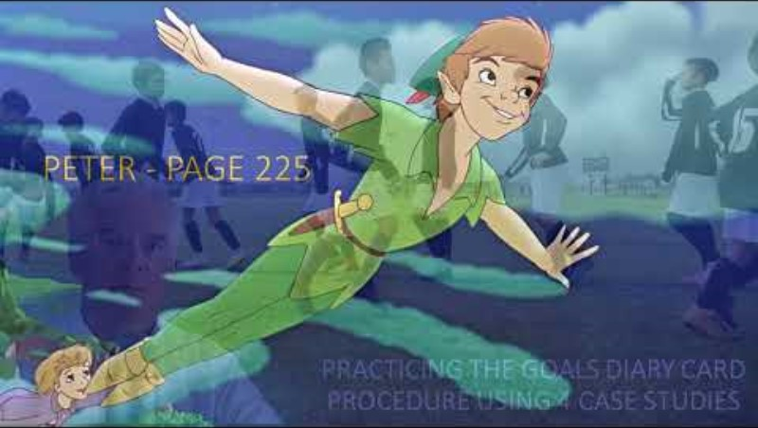

Slide 128


Slide 129


Slide 130


Slide 131


Slide 132
UPDATED PERSONAL SKILLS LIST
Emotional regulation skills
How do emotions work?
Recognizing emotions
Overcoming barriers to healthy emotions
Reducing physical vulnerability
Reducing cognitive vulnerability
5. Increasing Positive Emotions
6. Being mindful of your emotions without judgement
Emotion exposure.
Doing the opposite of your emotions
Problem Solving

Slide 133
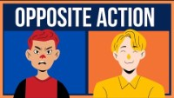

Slide 134
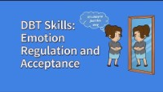

Slide 135

Peter - page 225
Notes:
Peter was a 37-year-old single man, living with his two cats, in a geared to income apartment. He was the only child of a single mom, Marjorie who, when Peter was growing up, to make ends meet, worked 50 hours a week as a personal support worker.
Marjorie was a kind person who had been taken advantage of by a series of abusive partners. When Peter was five, his father left, and Marjorie vowed that she would never again be in a relationship with a man.
Marjorie was a hands-off parent who was at a loss as to what to do when Peter, in grade 6, started skipping classes and "hanging out" with a group of rebellious boys. She met with Peter's teachers, the principal, and the school counsellor, but that had not helped.
Marjorie's best friend consoled her, saying that Peter was just going through a phase, and things would get better. When Peter started buying expensive items including an electric guitar, a PlayStation, and a computer, Marjorie got worried. Peter had unconvincing explanations for where he got the money.
When Peter turned 16, he dropped out of school altogether. By that point, Marjorie knew she had no control over him. She had given him ultimatums, but he would shrug, roll his eyes, and ignore her.
He began spending more and more time away from home, sometimes, he would be missing for weeks. Marjorie heard rumors that Peter was selling drugs. She was not surprised.
By the time Peter was 19, Marjorie rarely saw him. She was devastated, when one day she got a call from a nurse on the mental health unit of the local hospital, saying Peter had been hospitalized.
Peter's behavior had become increasingly erratic, and he had wild mood fluctuations. He would stay awake for days at a time. When he got into a fight at a coffee shop, police were called, and took a very disheveled and disorganized Peter to the emergency room, from where he was admitted to psychiatry.
Peter wanted to leave the hospital and was involuntarily committed. At first, he was agitated and aggressive, and was started on antipsychotics. He was eventually diagnosed with schizoaffective disorder and prescribed mood stabilizers. Over the next two years, Peter would be discharged from hospital, stop his medications, relapse, and end up back in the hospital.
He was eventually referred to an assertive community treatment team, an outpatient multidisciplinary mental health team, that through intensive contact with clients is often able to build good therapeutic alliance is with them.
Working with the team led to a gradual but significant improvement in Peter's mental health. By the time he was in his late 20s, he was sober, compliant with medication, and not engaging in illegal behaviors. Around that time, Peter started having panic attacks, agoraphobia, and social anxiety. He started to only be able to leave his apartment when accompanied by a member of the act team. He spent most of his days playing video games or watching TV.
Peter was discharged from the act team and was referred to a psychiatrist, who after doing a history, and getting to know Peter, began to question the schedule schizoaffective diagnosis.
When Peter was given that diagnosis, he had been using crystal meth, which can induce psychosis. When Peter stopped using the drug, his thought disorder, delusions, and hallucinations, had all improved. It had been years since Peter had symptoms of psychosis. Now, his main problems were anxiety and depression.
Peter was an intelligent man, who reflecting on his life, saw himself as a failure. Almost all of his high school friends and acquaintances, were now married, had families and jobs. He knew three who had become police officers. He was embarrassed and ashamed, remembering that one of his former high school friends, who had become a paramedic, had on a couple of occasions, been the one that answered emergency call that brought him to the hospital.

Slide 136
Peter was a 37-year-old single man, living with his two cats, in a geared to income apartment. He was the only child of a single mom, Marjorie who, when Peter was growing up, to make ends meet, worked 50 hours a week as a personal support worker. Marjorie was a kind person who had been taken advantage of by a series of abusive partners. When Peter was 5, his father left, and Marjorie vowed that she would never again be in a relationship with a man. Marjorie was a hands-off parent who was at a loss as to what to do when Peter, in grade 6, started skipping classes and “hanging out” with a group of rebellious boys. She met with Peter’s teachers, the principal, and the school counsellor, but that had not helped. Marjorie’s best friend consoled her, saying that Peter was just going through a phase, and things would get better. When Peter started buying expensive items including an electric guitar, a PlayStation, and a computer, Marjorie got worried. Peter had unconvincing explanations for where he got the money. When Peter turned 16, he dropped out of school altogether. By that point, Marjorie knew she had no control over him. She had given him ultimatums, but he would shrug, roll his eyes, and ignore her. He began spending more and more time away, sometimes, he would not come home for weeks. Marjorie heard rumors that Peter was selling drugs. By the time Peter was 19, Marjorie rarely saw him. She was devastated, but not surprised, when one day she got a call from a nurse on the mental health unit of the local hospital, saying Peter had been hospitalized. Peter’s behavior had become increasingly erratic, and he had wild mood fluctuations. He would stay awake for days at a time. When he got into a fight at a coffee shop, police were called, and took a very disheveled and disorganized Peter to the emergency room, from where he was admitted to psychiatry. Peter wanted to leave the hospital and was involuntarily committed. At first, he was agitated and aggressive, and was started on antipsychotics. He was eventually diagnosed with schizoaffective disorder and prescribed mood stabilizers. Over the next 2 years, Peter would be discharged from hospital, stop his medications, relapse, and end up back in the hospital. He was eventually referred to an assertive community treatment team, an outpatient multidisciplinary mental health team, that through intensive contact with clients is often able to build good therapeutic alliances with them. Working with the team led to a gradual but significant improvement in Peter’s mental health.

Slide 137
By the time he was in his late 20’ s, he was sober, compliant with medication, and not engaging in illegal behaviours. Around that time, Peter started having panic attacks, agoraphobia, and social anxiety. He started to only be able to leave his apartment when accompanied by a member of the ACT team. He spent most of his days playing video games or watching TV. Peter was discharged from the ACT team and was referred to a psychiatrist, who after doing a history, and getting to know Peter, began to question the schizoaffective diagnosis. When Peter was given that diagnosis, he had been using crystal meth, which can induce psychosis. When Peter stopped using the drug, his thought disorder, delusions, and hallucinations, had all improved. It had been years since Peter had symptoms of psychosis. Now, his main problems were anxiety and depression. Peter was an intelligent man, who reflecting on his life, saw himself as a failure. Almost all his high school friends and acquaintances, were now married, had families and jobs. He knew three who had become police officers. He was embarrassed and ashamed, remembering that one of his former high school friends, who had become a paramedic, had on a couple of occasions, been the one that answered the emergency call that brought him to the hospital.

Slide 138
Notes:
Peter wanted to make some changes in this life but found it difficult. He started the simple course. He related to Maslow's hierarchy of needs. His basic needs, the biological, physiological, and for safety, were met. His psychological needs for connection with others respect, status, recognition, and self-esteem were not
Peter's development had stopped when he reached Erickson's stage of "industry versus inferiority” at which 6 to 11-year-olds, learn to cope with social and academic demands and develop a sense of competence. Stuck at this stage, Peter felt inferior.

Slide 139
Peter wanted to make some changes in his life but found it difficult. He started the Simple course. He related to Maslow’s hierarchy of needs. His basic needs, the biological, physiological, and for safety, were met. His psychological needs for connection with others, respect, status, recognition, and self-esteem were not. Peter’s development had stopped when he reached Erickson’s stage of “industry versus inferiority” at which 6 to 11-year-olds, learn to cope with social and academic demands and develop a sense of competence. Stuck at this stage, Peter felt inferior.
Peter worked on the “goals diary card procedure”: Step 1-tracking activities for a week: On self-care Peter gave himself a 7/ 10–he shaved and showered everyday and kept things relatively tidy in his apartment. He went grocery shopping once a week with his mom and tried to eat a healthy diet. On looking after his physical needs, he gave himself an 8/ 10–when he had worked with the ACT team, he had learned to keep track of all his appointments, manage his finances, and take his medications, go to bed, and get up at regular times. He had also gotten into the habit of walking on a trail or hiking at least twice a week with a neighbour.” On looking after his emotional needs, he gave himself a 5/ 10–Peter accepted whatever help he was given, he was enjoying the Simple course, and did his homework regularly. He also had an AA sponsor with whom he had been talking for years, and with whom he attended the occasional AA meeting. On social health, intellectual health and spiritual health, Peter scored himself much lower. Step 2-completing the wellness assessment tool: After tracking his activities for a week, Peter was not surprised that he scored relatively well on material well-being and physical health, but much lower on the other domains of the questionnaire. After some brainstorming, he decided that he would work on “getting closer to family members”. His mother’s family was close knit, and Peter had many cousins, aunts, and uncles. Various family members got together, at least once a week, to do a variety of activities. His cousins went fishing, snowmobiling, and to antique cars shows. They often asked Peter to join them. Because of his anxiety, Peter had always refused their invitations. He feared they would judge him. He decided he”

Slide 140
Goals diary card procedure algorithm
Step 1
1. Track your usual activities for a week using a blank week calendar.
This will give you a snapshot of your typical routine and allow you to assess its balance.
2. Rate yourself 0-10 on each of Maslow’s needs/wellness domains (see slide below)
Step 2
3. Complete the wellness assessment tool. Choose 1-3 “proximal activities” for your goals.
4. Consider which of your Maslow’s needs are met and which of Erickson’s stages you have mastered.
Step 3
5. “Schedule” the activities you have chosen on a blank weekly schedule.
6. Use the goals diary card template to track your progress with these activities
Step 4
7. If you have accomplished a goal, choose another from the wellness assessment tool and use it as a target in your goal's diary card template. Repeat the same process starting with step 2.
Notes:
The goals diary card procedure is an algorithm with four steps. We will go through each step individually.

Slide 141
Notes:
Step 1 – tracking activities for a week:

Slide 142
Rating yourself on Maslow’s needs/Wellness Domains
Rate each of the following 7 areas on a subjective 0-10 scale where 0 = none of your needs in that area are met, and 10 = all your needs in that area are met.
1. Meeting self-care needs – looking after personal hygiene, caring for home environment, planning meals, grocery shopping, cooking and healthy eating habits, healthy relaxation and rest, etc.. Score: __
2. Meeting physical and safety needs – safe from aggression and crime, safe and secure housing, sufficient income and budgeting, adequate sleep, sufficient exercise, good health, spending time in nature, etc.. Score: __
3. Meeting emotional needs – ability to manage stress, ability to stay in the window of emotional tolerance, ability to ask for and receive help when appropriate, able to use emotional regulation strategies, paying attention to and working on improving your mental health, meditating, having appropriate supports and mental health guidance, etc.. Score: __
4. Meeting social needs- having a balanced social life with partners, friends, and acquaintances, giving and receiving support, meeting new people, not being lonely, etc.. Score: __
5. Meeting intellectual needs-being curious, learning new things, reading, following news political and social issues, joining clubs that stimulate your mind, etc.. Score: __
6. Meeting spiritual needs-doing activities that help you transcend yourself, being in nature, loving animals, healthy giving to others and the world, etc.… Score: __
7. How much time do you spend each day in unproductive activities or maladaptive coping? Hours: __
To total your score, add items 1-6 and from this subtract item 7. The higher score the better you are doing on the “wellness” domains score
Notes:
Once you’ve completed your tracking of activities for a week, consider the eight dimensions of wellness and based on your activities rate yourself 0 to 10 on each of those dimensions.

Slide 143
Peter worked on the “goals diary card procedure”: Step 1-tracking activities for a week: On self-care Peter gave himself a 7/ 10–he shaved and showered everyday and kept things relatively tidy in his apartment. He went grocery shopping once a week with his mom and tried to eat a healthy diet. On looking after his physical needs, he gave himself an 8/ 10–when he had worked with the ACT team, he had learned to keep track of all his appointments, manage his finances, and take his medications, go to bed, and get up at regular times. He had also gotten into the habit of walking on a trail or hiking at least twice a week with a neighbour.” On looking after his emotional needs, he gave himself a 5/ 10–Peter accepted whatever help he was given, he was enjoying the Simple course, and did his homework regularly. He also had an AA sponsor with whom he had been talking for years, and with whom he attended the occasional AA meeting. On social health, intellectual health and spiritual health, Peter scored himself much lower.

Slide 144
Goals diary card procedure algorithm
Step 1
1. Track your usual activities for a week using a blank week calendar.
This will give you a snapshot of your typical routine and allow you to assess its balance.
2. Rate yourself 0-10 on each of Maslow’s needs/wellness domains (see slide below)
Step 2
3. Complete the wellness assessment tool. Choose 1-3 “proximal activities” for your goals.
4. Consider which of your Maslow’s needs are met and which of Erickson’s stages you have mastered.
Step 3
5. “Schedule” the activities you have chosen on a blank weekly schedule.
6. Use the goals diary card template to track your progress with these activities
Step 4
7. If you have accomplished a goal, choose another from the wellness assessment tool and use it as a target in your goal's diary card template. Repeat the same process starting with step 2.
Notes:
The goals diary card procedure is an algorithm with four steps. We will go through each step individually.

Slide 145
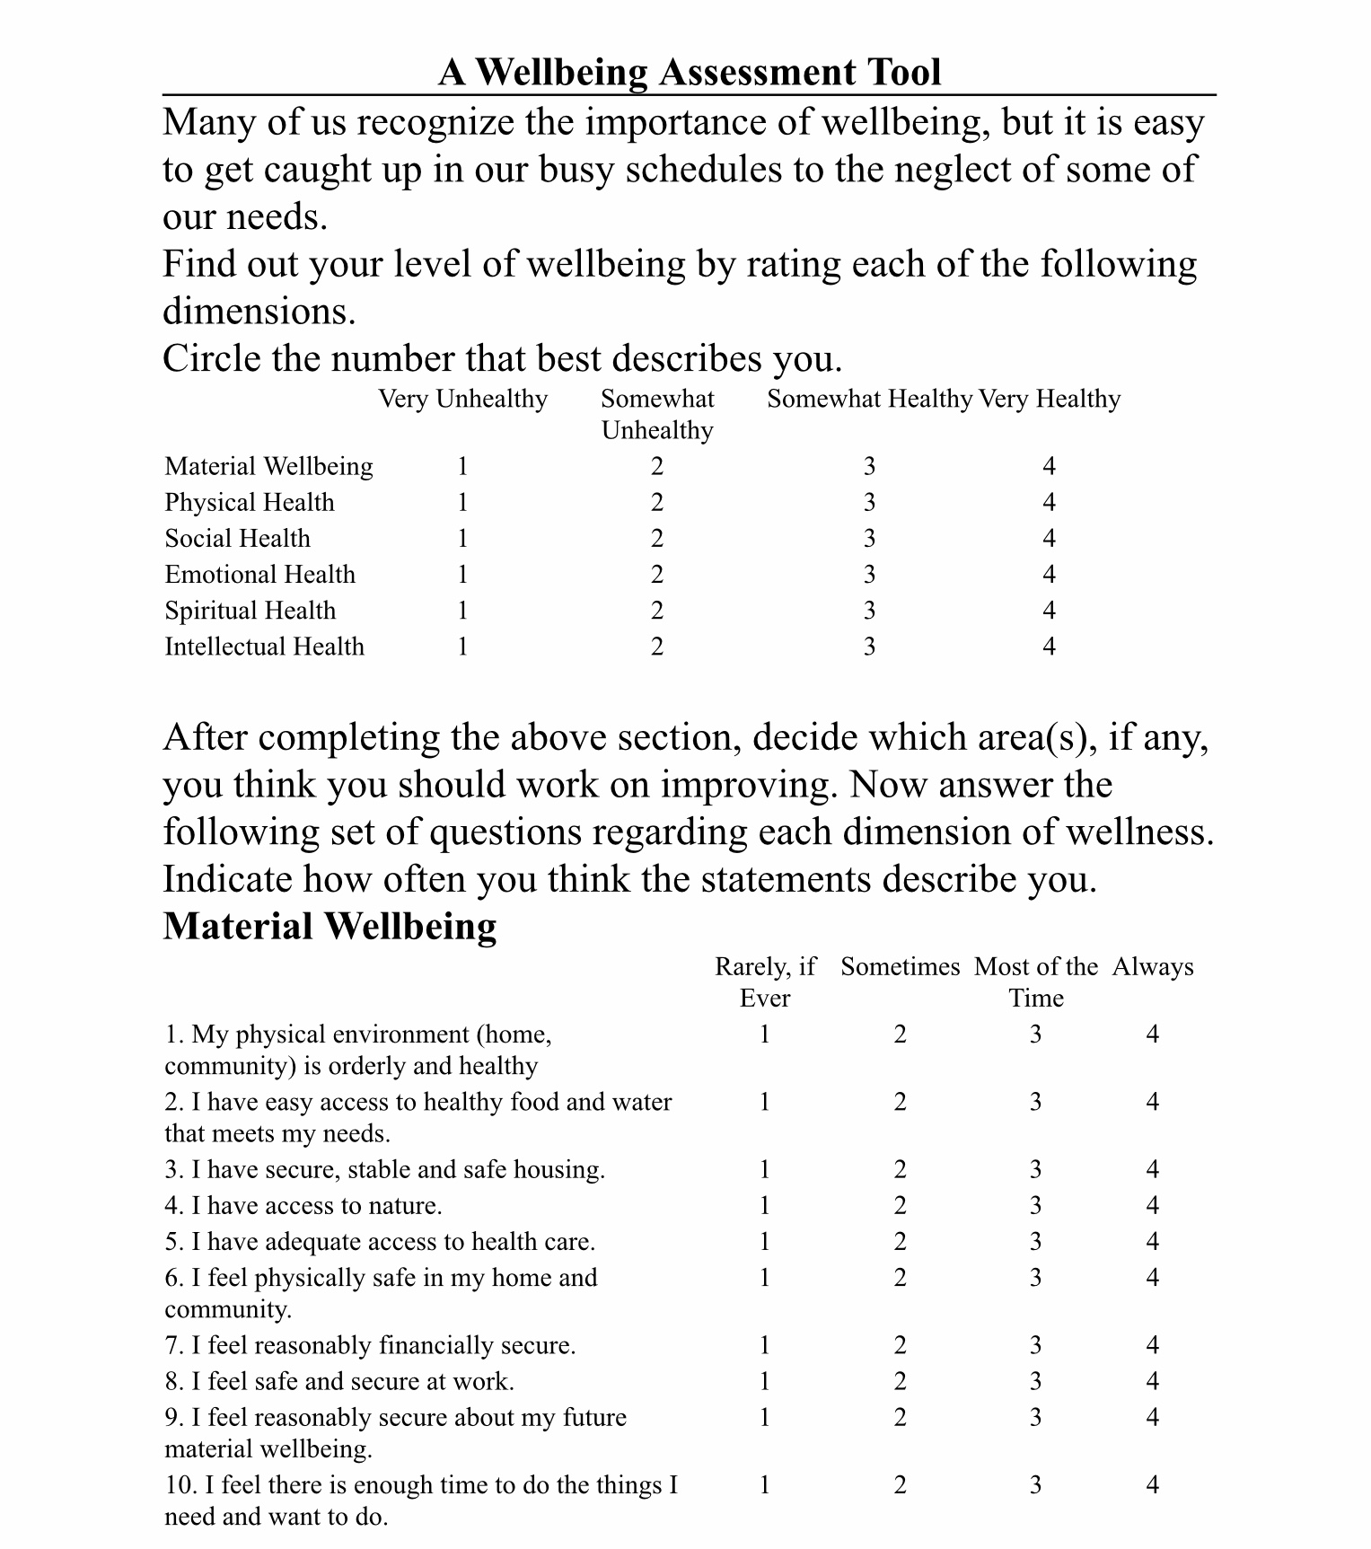
Notes:
After tracking his activities for a week, Peter was not surprised that he scored relatively well on material well-being and physical health, but much lower on the other domains of the questionnaire.

Slide 146
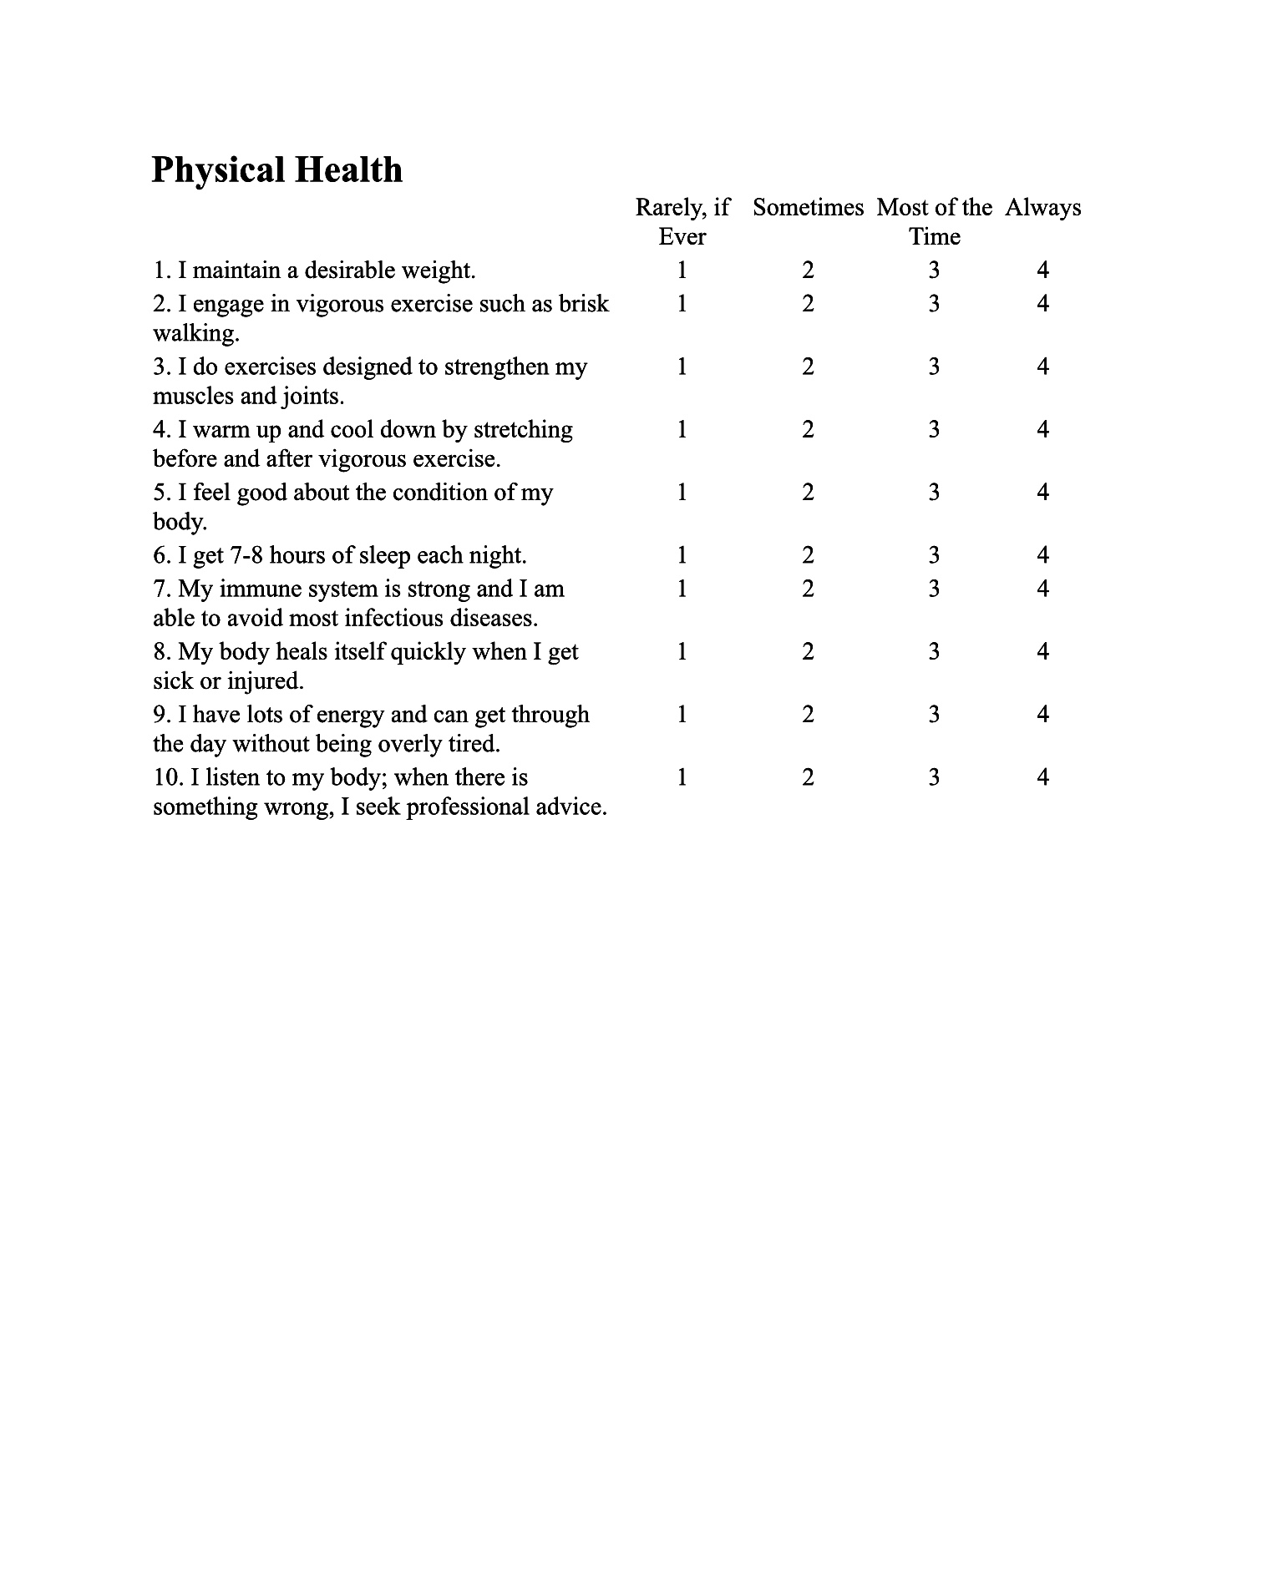

Slide 147
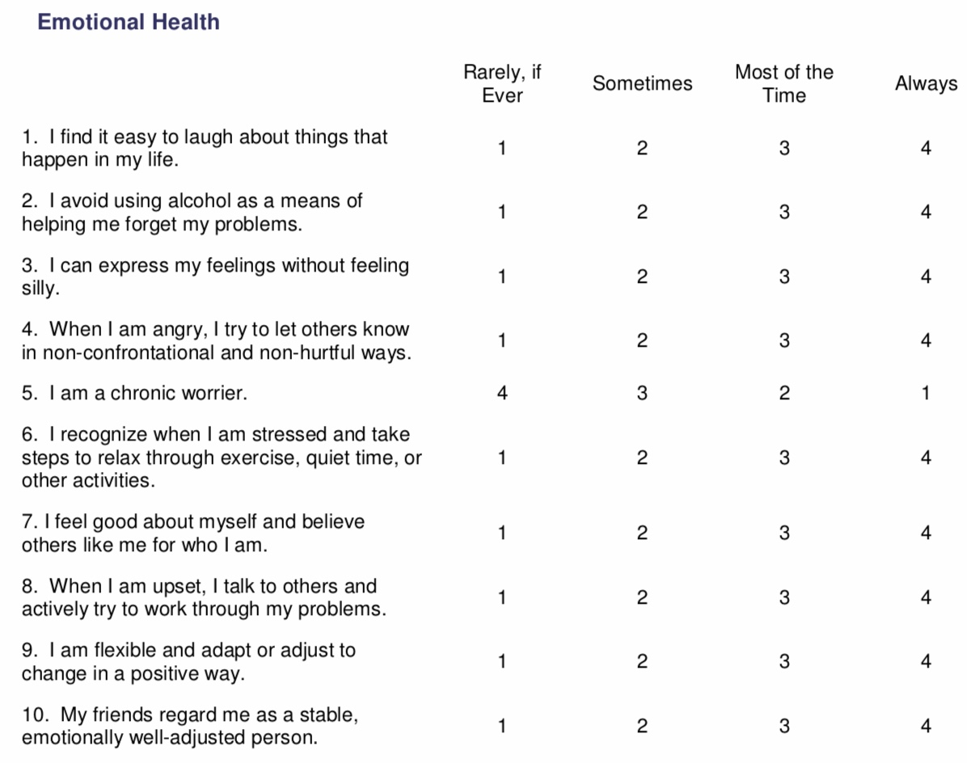

Slide 148
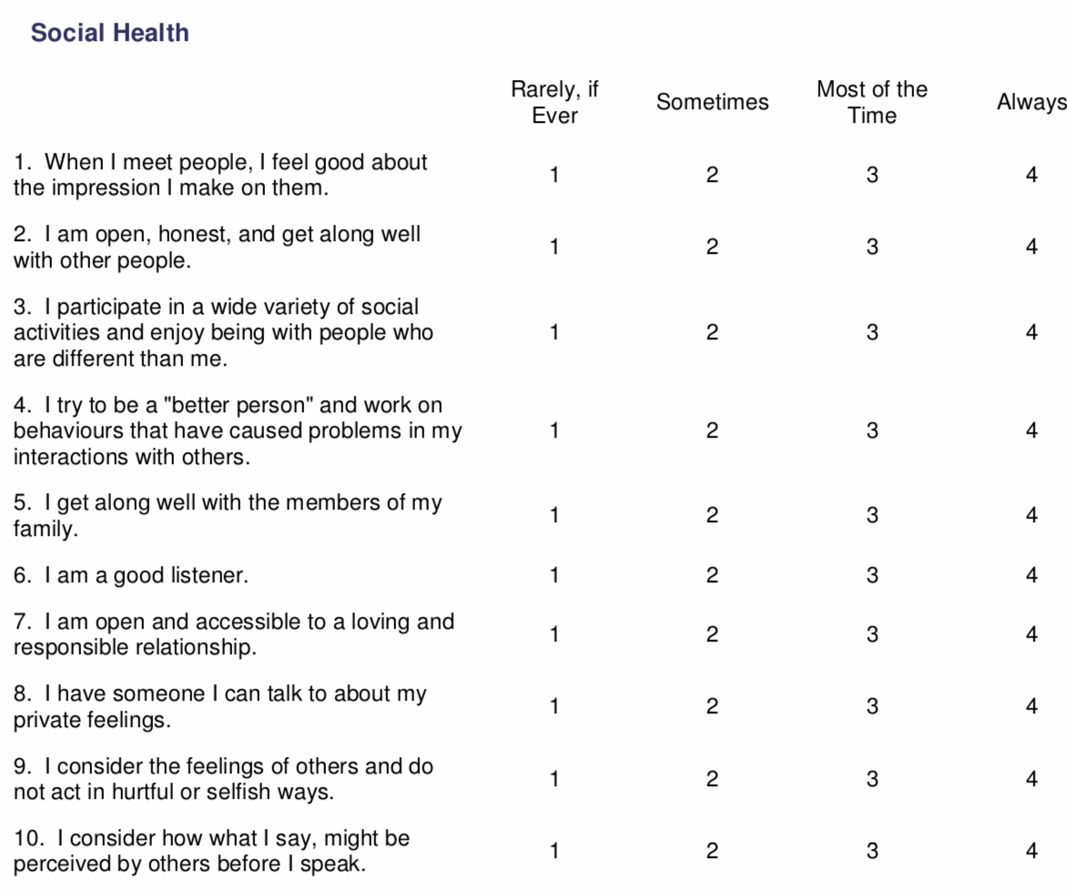

Slide 149
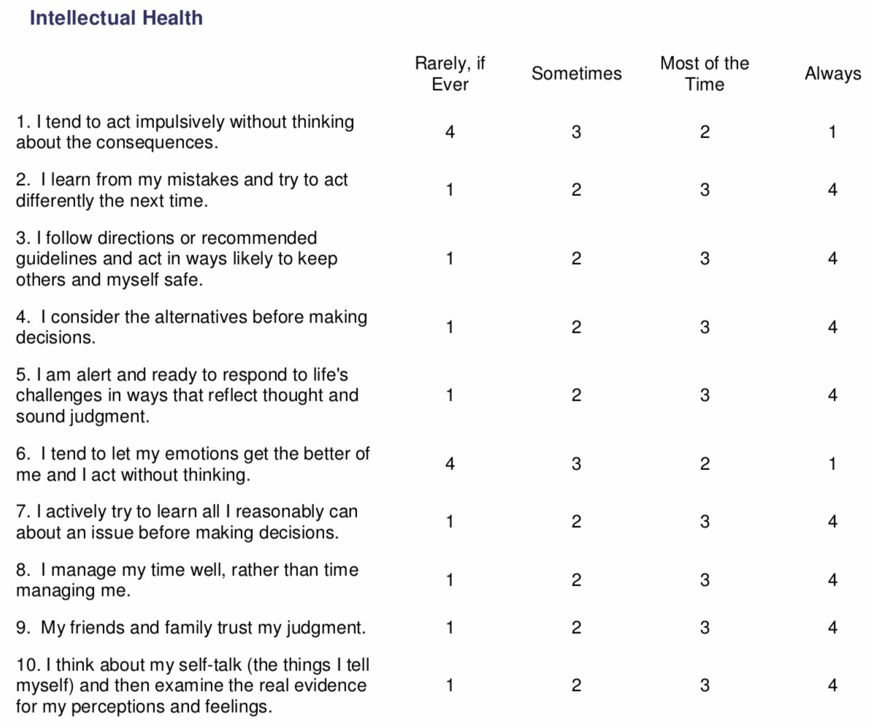

Slide 151
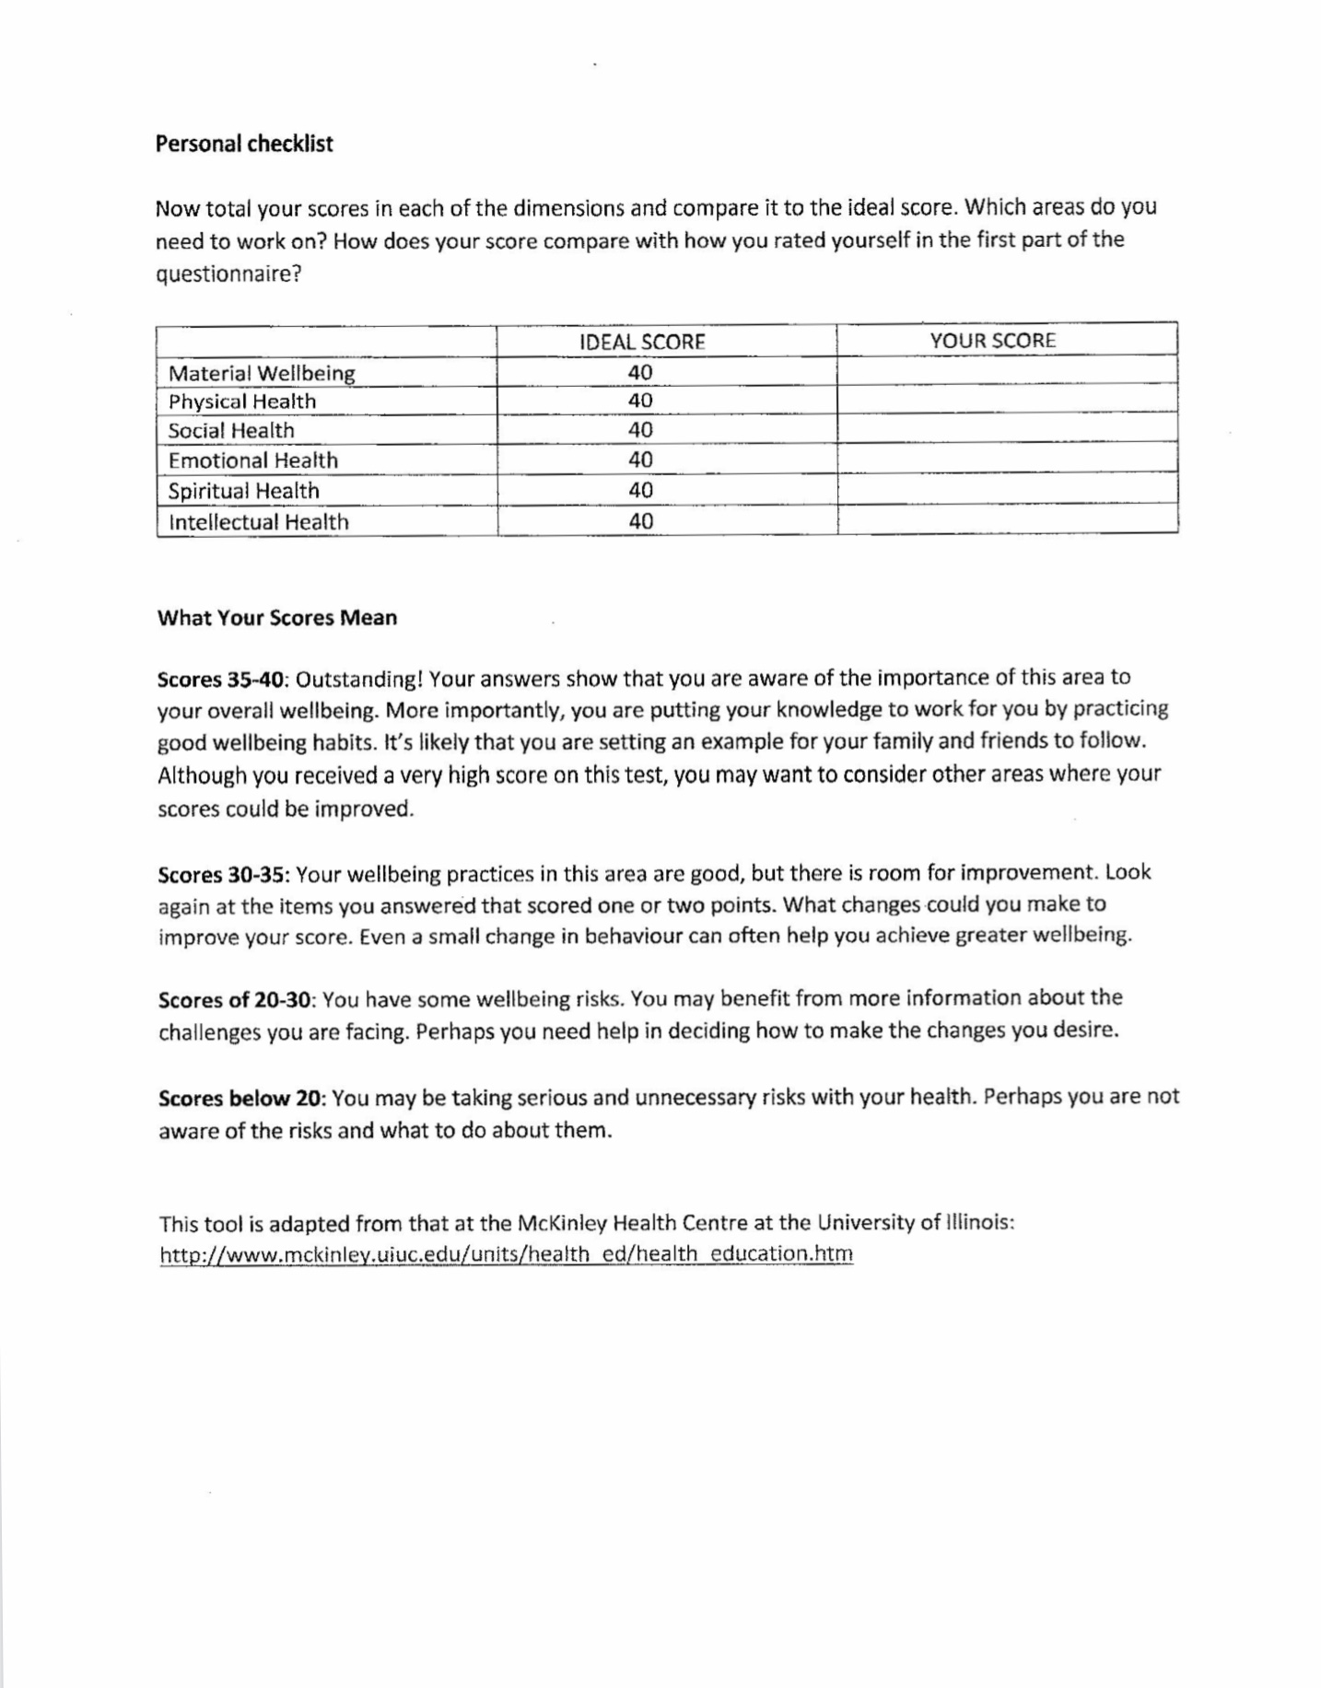

Slide 152
Step 2-completing the wellness assessment tool: After tracking his activities for a week, Peter was not surprised that he scored relatively well on material well-being and physical health, but much lower on the other domains of the questionnaire.
After some brainstorming, he decided that he would work on “getting closer to family members”. His mother’s family was close knit, and Peter had many cousins, aunts, and uncles. Various family members got together, at least once a week, to do a variety of activities. His cousins went fishing, snowmobiling, and to antique cars shows. They often asked Peter to join them. Because of his anxiety, Peter had always refused their invitations. He feared they would judge him. He decided he would confront his fears and set as a goal to “be more involved with his family”. Peter committed to attending the Saturday night get together, at which several of his cousins watched sports. They drank moderately but were respectful of Peter’s sobriety and he did not think that would be a problem. As a second goal Peter decided that if he received an invitation from a family member to do any other activity, he would accept. Peter’s goals became “going to the cousins Saturday night sports get togethers” and “accepting family invitations to do activities”.

Slide 153
Goals diary card peter
Dates | 1 | 2 | 3 | 4 | 5 | 6 | 7 | 8 | 9 | 10 | 11 | 12 | 13 | 14 | 15 | 16 | 17 | 18 | 19 | 20 | 21 | 22 | 23 | 24 | 25 | 26 | 27 | 28 | 29 | 30 | 31
Goals
Cousins Saturday night
Accept family invitations
Notes:
After some brainstorming, Peter decided that he would work on "getting closer to family members". His mother's family was close knit, and Peter had many cousins, aunts, and uncles.
Various family members got together, at least once a week, to do a variety of activities. His cousins went fishing, snowmobiling, and when the car shows. They often asked Peter to join them.
Because of his anxiety, Peter had always refused their invitations. He feared they would judge him. He decided he would confront his fears and set as a goal to "be more involved with his family“
Peter committed to attending the Saturday night get together, at which several of his cousins watched sports. They drank moderately but were respectful of Peter sobriety and he did not think that would be a problem.
As a second goal Peter decided that if he received an invitation from a family member to do any other activity, he would accept
Peter's goals became "going to the cousins Saturday night sports get together's" and "accepting family invitations to do activities"

Slide 154
Step 3–tracking activities using the goals diary card: Peter was committed to his goals and consistently did them. Initially he felt anxious when he participated in family activities, but eventually the anxiety subsided. One of the targets he was tracking, on his holes diary card, was “feeling judged by others”. That feeling was triggered when he did family activities. This gave Peter the opportunity to practice his Simple tools, skills, and strategies.
As he worked on rational mind remediations, he eventually started to believe that rather than judging him, his cousins were proud of the progress he was making.
Step 4–choosing other goals: After 4 months of working on his 2 initial goals, Peter felt that they had become part of his routine. He now had little anxiety associated with doing these activities and looked forward to them. He felt that the overall quality of his life had improved. Seeing this change, was very encouraging for Peter, and his determination to continue along this path was strengthened.

Slide 155
Cousins Saturday night
Go over to mom’s
Notes:
Peter committed to attending the Saturday night get together, at which several of his cousins watched sports. They drank moderately but were respectful of Peter sobriety and he did not think that would be a problem.
As a second goal Peter decided that if he received an invitation from a family member to do any other activity, he would accept
Peter's goals became "going to the cousins Saturday night sports get together's" and "accepting family invitations to do activities"

Slide 156
Feeling judged
Notes:
Peter was committed to his goals and consistently did them. Initially he felt anxious when he participated in family activities, but eventually the anxiety subsided.
One of the targets he was tracking, on his holes diary card, was "feeling judged by others". That feeling was triggered when he did family activities. This gave Peter the opportunity to practice is simple tools, skills, and strategies. As he worked on rational mind remediation's, he eventually started to believe that rather than judging him, his cousins were proud of the progress he had made.

Slide 157
Goals diary card procedure algorithm
Step 1
1. Track your usual activities for a week using a blank week calendar.
This will give you a snapshot of your typical routine and allow you to assess its balance.
2. Rate yourself 0-10 on each of Maslow’s needs/wellness domains (see slide below)
Step 2
3. Complete the wellness assessment tool. Choose 1-3 “proximal activities” for your goals.
4. Consider which of your Maslow’s needs are met and which of Erickson’s stages you have mastered.
Step 3
5. “Schedule” the activities you have chosen on a blank weekly schedule.
6. Use the goals diary card template to track your progress with these activities
Step 4
7. If you have accomplished a goal, choose another from the wellness assessment tool and use it as a target in your goal's diary card template. Repeat the same process starting with step 2.
Notes:
The goals diary card procedure is an algorithm with four steps. We will go through each step individually.

Slide 158

Mary - page 229
Notes:
Mary was a 31-year-old married mother of three children. She had worked in a bank until her youngest child, who had Down syndrome was born. Mary and her husband Bill had decided she would stay home, until all the children were in school.
Mary was attending the simple course hoping to understand why, as far back as she could remember, she had felt anxious and depressed. When she heard other people stories, she felt guilty, most had very difficult life's and it made sense that they had psychological issues, but she had two loving parents. What was wrong with her?
Mary began to realize that she had a harsh inner critic, that was constantly attacking her, and finding fault with all that she did. No matter how hard she tried, she could never do enough for others, and was never good enough.
She also discovered that she had a "all or nothing" thinking pattern; either things were perfect, or they were terrible. She saw herself negatively, and others and the world positively. She learned that this was typical of people with anxious attachment.
As the course progressed, Mary began to understand why she felt the way she did; her mother was a kind woman, who would never hurt a fly, and she had loved Mary, but she had terrible self-esteem. Mary's mother was a people pleaser who could never say no and was terrified of the judgement of others. Mary had learned to be that way through her mother's example.
Mary had picked up on how frightened her mother was of the world and concluded that the world must be frightening. It was helpful to understand this but how which she change it? At home, Mary put everyone else before herself, and was often exhausted. She also constantly analyse everything she did in the worst possible light.
Mary decided to use as her holes diary card targets; "being tired/exhausted", "feeling guilty", and "ruminating".
She felt that tracking these targets, helped her to focus on the issues that she wanted to work on. Being conscientious, Mary regularly did chain analysis and was becoming increasingly mindful of how her feelings, thoughts, behaviours, and energy levels were connected.
Mary had started using the editing splicing and pasting technique, along with rational mind remediation, to splice balanced, alternative thoughts, onto the memories of the times she had done too much for others, or ruminated. She was beginning to see small changes in herself.

Slide 159
Mary was a 31-year-old married mother of three children. She had worked in a bank until her youngest child, who had Down’s syndrome was born. Mary and her husband Bill had decided she would stay home, until all the children were in school. Mary was attending the Simple group hoping to understand why, as far back as she could remember, she had felt anxious and depressed.
When she heard other people stories, she felt guilty, most had very difficult lives and it made sense that they had psychological issues, but she had two loving parents. What was wrong with her? Mary began to realize that she had a harsh inner critic, that was constantly attacking her, and finding fault with all that she did. No matter how hard she tried, she could never do enough for others, and was never good enough.
She also discovered that she had a “all or nothing” thinking pattern; either things were perfect, or they were terrible. She saw herself negatively, and others and the world positively. She learned this was typical of people with anxious attachment.
As the course progressed, Mary began to understand why she felt the way she did; her mother was a kind woman, who would never hurt a fly, and she had loved Mary, but had terrible self-esteem. Mary’s mother was a people pleaser who could never say no and was terrified of the judgement of others. Mary had learned to be that way through her mother’s example. Mary had picked up on how frightened her mother was of the world and concluded that the world must be frightening. It was helpful to understand this but how would she change it?
At home, Mary put everyone else before herself, and was often exhausted. She also constantly analyzed everything she did in the worst possible light.
Mary decided to use as her holes diary card targets; “being tired/exhausted”, “feeling guilty” and “ruminating”. She felt that tracking these targets, helped her to focus on the issues that she wanted to work on. Being conscientious, Mary regularly did chain analysis and was becoming increasingly mindful of how her feelings, thoughts, behaviours, and energy levels, were connected. Mary had started using the editing, splicing, and pasting technique, along with rational mind remediation, to splice balanced, alternative thoughts, onto the memories of the times she had done too much for others, or ruminated . She was beginning to see small changes in herself.

Slide 160
Goals diary card procedure algorithm
Step 1
1. Track your usual activities for a week using a blank week calendar.
This will give you a snapshot of your typical routine and allow you to assess its balance.
2. Rate yourself 0-10 on each of Maslow’s needs/wellness domains (see slide below)
Step 2
3. Complete the wellness assessment tool. Choose 1-3 “proximal activities” for your goals.
4. Consider which of your Maslow’s needs are met and which of Erickson’s stages you have mastered.
Step 3
5. “Schedule” the activities you have chosen on a blank weekly schedule.
6. Use the goals diary card template to track your progress with these activities
Step 4
7. If you have accomplished a goal, choose another from the wellness assessment tool and use it as a target in your goal's diary card template. Repeat the same process starting with step 2.
Notes:
The goals diary card procedure is an algorithm with four steps. We will go through each step individually.

Slide 161
Being tired/exhausted
Feeling guilty
ruminating
Notes:
Mary decided to use as her holes diary card targets; "being tired/exhausted", "feeling guilty", and "ruminating".

Slide 162
Mary started working on her goals diary card procedure: Step 1 Because each tool she had learned had been helpful, Mary was curious to see what impact the goals diary card procedure was going to have.
She completed the hour-by-hour monitoring of her activities for one week. She then rated herself on each of the domains of well-being: She was good at basic self-care: she looked after her hygiene, the house was immaculate, she was organized with her shopping, and made delicious and nutritious meals for the whole family. She did not, however, spend any time relaxing. Mary did not do so well looking after her physical needs. She did all the housework and child-rearing. She was her family's designated driver, taking the kids to all the sports, they participated in, doctors and dentist’s appointments, friends. She did a million other things for them. She had not exercised in years, she had not walked in nature by herself, basically she did nothing for herself. Mary did not look after her emotional health. She was always stressed, would not think of asking anyone for help, and apart from taking the Simple course and” doing the homework, she had not paid much attention to herself, or worked on her issues. She felt that taking the course was helping but also, she felt guilty and selfish taking time for herself. She could be doing things for her family.

Slide 163
She did a chain analysis and a rational mind remediation for these feelings and was beginning to deal with them. Mary did occasionally meet with her parents and siblings but had long ago stopped trying to stay connected with her university and work friends. Mary liked listening to the radio and watched some TV shows when she was doing things around the house. It distracted her and transported her to another world allowing her to escape. She felt she had a good grasp of social and political issues, but never had the opportunity to discuss these with anyone. Before getting married, Mary had attended church regularly. She found it gave her a sense of community, but her attendance dropped as she got busier with her family, and after her last child, she stopped going altogether. Mary did not spend any time on unproductive activities, but she worried about using maladaptive soothing as when 5 p.m. rolled around, she could not wait to have a glass of white wine. If she was honest with herself she had to admit that the glass she drank from, had gotten larger over the years.

Slide 164
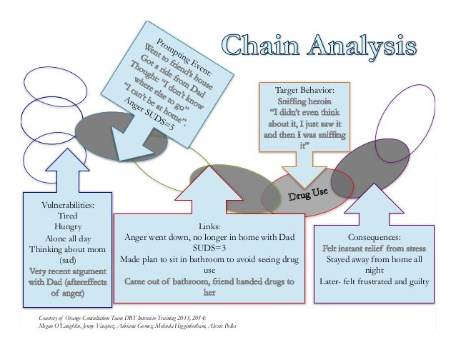
HOW TO DO A chain analysis
Find a higher than your baseline number on your holes diary to do a chain analysis
1. Map out the “topography”of the intensity of your activation around the time period for which you are doing the chain analysis. How did the intensity of your feelings, thoughts, and behaviors change over time?
2. On the chain analysis template, note in writing, if there were any events that were triggers for your increase in activation ?
3. Note in writing, on the template, the sequence of feelings you experienced during this period. Rate each on a scale of 0-10 with 10 being the most intense you’ve ever felt this emotion
4. Observe and note the physical sensations you experienced during the activation without judging or trying to change them
5. Note in writing, on the template, the thoughts that accompanied each of your feelings
6. Note what you did, or wanted to do but stopped yourself from doing during the period of activation
7. Note on a 0-10 scale what your energy balance, reserves or stores (how full your gas tank), and crisis risk were just prior to the time for which you’re doing the chain analysis.

Slide 165
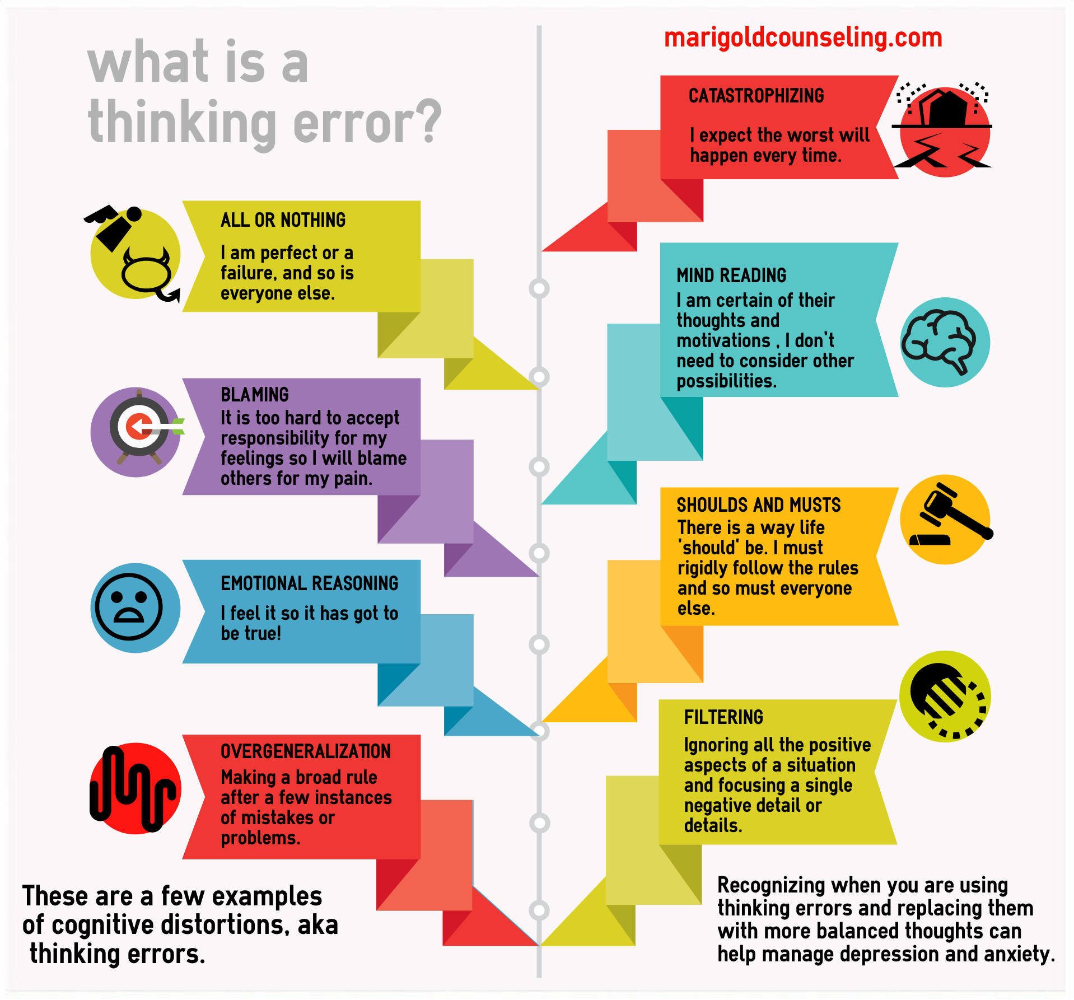
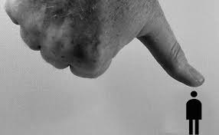
Notes:
She also discovered that she had a "all or nothing" thinking pattern; either things were perfect, or they were terrible. She saw herself negatively, and others and the world positively. She learned that this was typical of people with anxious attachment.

Slide 166
Chain analysis template
Stay in window of tolerance by pendulating
1. what was the topography of your activation?
2. was there a trigger(s)?
3. what did you feel?
4. notice the sensations in your body without judging or trying to change them
5. what thoughts were associated with each feeling?
6. what behaviors or urges were associated with each feeling?
7. what was your energy balance before the activation? 0-10

Slide 167
Step 2 Mary completed and scored the wellness assessment tool. As she reflected on it, she concluded that her biological, physiological, and safety, Maslow needs, were well met. She also saw that she loved her family but not herself. She spent all her time looking after them but continued to feel she did not do enough. She could not imagine why they loved her, she did not feel worthwhile, or deserving of recognition. Mary thought that she had mastered all of Erickson’s tasks up to identity versus role confusion. She had done quite well in high school, both academically and in sports, but that had not translated into a sense of self-worth. Mary thought of Crittenden’s attachment classifications and had identified both herself and her mother as “compulsive caretakers”. Although able to come to these conclusions rationally, Mary’s emotional mind remained firmly in control, making her feel that looking after herself was selfish, and if she did more of that, her husband and children would suffer.
Recognizing the power of emotional mind, Mary did a rational mind remediation; if a friend came to her with a similar problem seeking advice, what would she say? She told the “friend” that it was admirable how devoted and loving she was with her family, but at the same time rather than” being joyful, she was often filled with sadness and fear. Mary offered her friend her own mother’s example: she too had been loving and devoted to her family, Mary was grateful for that, but realized that inadvertently, her mother had passed along her low self-esteem to her. She did not want to do that to her kids. In retrospect, Mary said, she wished her mother had paid more attention to herself. Her family’s physical needs were important, but she needed to consider their psychological needs as well. Working on her feelings, thoughts, and self-esteem, was not selfish, it was healthy, and something she would be modelling for her children. This rational mind perspective made sense; Mary wrote it down so that she could look at it when she felt guilty.
Mary had already committed to devoting four hours a week to the Simple course. Her husband, seeing the positive changes, was supportive, the time Mary was devoting to herself was not hurting the family. She shared what she was learning with her husband, he told her that while appreciating all she did, he wished she would do more for herself. Mary decided that just as she had reserved four hours a week for Simple, she would devote another two hours, for an activity of her choice.

Slide 168
Rating yourself on Maslow’s needs/Wellness Domains
Rate each of the following 7 areas on a subjective 0-10 scale where 0 = none of your needs in that area are met, and 10 = all your needs in that area are met.
1. Meeting self-care needs – looking after personal hygiene, caring for home environment, planning meals, grocery shopping, cooking and healthy eating habits, healthy relaxation and rest, etc.. Score: __
2. Meeting physical and safety needs – safe from aggression and crime, safe and secure housing, sufficient income and budgeting, adequate sleep, sufficient exercise, good health, spending time in nature, etc.. Score: __
3. Meeting emotional needs – ability to manage stress, ability to stay in the window of emotional tolerance, ability to ask for and receive help when appropriate, able to use emotional regulation strategies, paying attention to and working on improving your mental health, meditating, having appropriate supports and mental health guidance, etc.. Score: __
4. Meeting social needs- having a balanced social life with partners, friends, and acquaintances, giving and receiving support, meeting new people, not being lonely, etc.. Score: __
5. Meeting intellectual needs-being curious, learning new things, reading, following news political and social issues, joining clubs that stimulate your mind, etc.. Score: __
6. Meeting spiritual needs-doing activities that help you transcend yourself, being in nature, loving animals, healthy giving to others and the world, etc.… Score: __
7. How much time do you spend each day in unproductive activities or maladaptive coping? Hours: __
To total your score, add items 1-6 and from this subtract item 7. The higher score the better you are doing on the “wellness” domains score
Notes:
Once you’ve completed your tracking of activities for a week, consider the eight dimensions of wellness and based on your activities rate yourself 0 to 10 on each of those dimensions.

Slide 169
Notes:
Mary completed and scored the wellness assessment tool.

Slide 170
1. How to do Rational mind remediation by imagining you’re helping a friend
Start with your chain analysis
Imagine this was a friend's chain analysis and that friend had come to you for help and advice about how to use DBT skills to splice and paste a different outcome
How could your friend have seen or interpreted the situation differently if they had been in rational mind?
Could your friend have thought or behaved differently to have a better outcome?
Help your friend to imagine a scenario in which they had stayed better regulated
Help your friend to practice this situation in their minds using the editing splicing and pasting technique
Reclaim the situation as your own using the new scenario. Practice it repeatedly in your imagination.

Slide 171
During that time, her husband said he would be happy to take care of the children, or if he had a work commitment, get a babysitter. In high school Mary had been an accomplished swimmer. Doing” children, she, and a friend, had trained together. It had been more than physical exercise; they had supported each other through difficult times. Mary was excited at the prospect of doing that again and resolved to ask her friend if she wanted to join her. At first, Mary only wanted to devote one day a week for two hours to swimming, but her husband talked her into doing it twice a week for 1 ½ hours each time. He was thrilled that Mary was doing this and started brainstorming how to find a babysitter, and what activities he could do with the children while she was away. When Mary committed to something, she did it. Her friend, also a mother, jumped at Mary’s invitation, and they started swimming together again. This readjustment of her schedule did, predictably, cause Mary considerable anxiety. She felt guilty and selfish. When she saw these targets increase on her holes diary card, she revisited her chain analysis and went back to her rational mind remediation and editing, splicing, and pasting. She eventually noticed that these changes made her more excited about life and that somehow her children were also happier.

Slide 172
swimming
swimming
Notes:
Mary had already committed to devoting four hours a week to the simple course. Her husband, seeing the positive changes, was supportive, the time Mary was devoting herself was not hurting the family. She shared what she was learning with her husband, he told her that while appreciating all she did, he wished she would do more for herself.
Mary decided that just as she had reserved four hours a week for simple, she would devote another two hours for an activity of her choice. During that time, her husband said he would be happy to take care of the children, or if he had a work commitment, get a babysitter.
In high school Mary had been an accomplished swimmer. Doing fast laps at the pool relaxed and invigorated her. Before she had children, she, and a friend, had trained together. It had been more than physical exercise; that support each other through difficult times.
Mary was excited at the prospect of doing that again and resolved to ask her friend if she wanted to join her. At first, Mary only wanted to devote one day a week for two hours to swimming, but her husband talked her into doing it twice a week for 1 1/2 hours each time. He was thrilled that Mary was doing this and started brainstorming how to find a babysitter, and what activities he could do with the children while she was away.
When Mary committed to something, she did it. Her friend, also a mother, jumped at Mary's invitation, and they started swimming together again
This readjustment of her schedule did, predictably, cause Mary considerable anxiety. She felt guilty and selfish. When she saw these targets increase on her holes diary card, she revisited her chain analysis and went back to her rational mind remediation and editing, splicing, and pasting.
She eventually noticed that these changes made her more excited about life and that somehow her children were also happier.

Slide 173
Goals diary card
Dates | 1 | 2 | 3 | 4 | 5 | 6 | 7 | 8 | 9 | 10 | 11 | 12 | 13 | 14 | 15 | 16 | 17 | 18 | 19 | 20 | 21 | 22 | 23 | 24 | 25 | 26 | 27 | 28 | 29 | 30 | 31
Goals
swimming

Slide 174
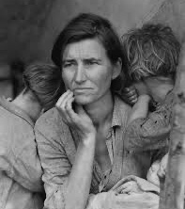
Dolores - page 232
Notes:
Dolores was a 60-year-old married woman, whose two children had long ago left home. She worked part time in retail. Her husband, Harry was a plumber.
Dolores was an only child. She suspected her parents had never wanted children. In her family's living room, above the fireplace, hung a huge, cross-stitched piece that proclaimed, "children should be seen not heard". When she had learned about the different types of parenting, she instantly realized that hers, was the poster family for authoritarian parenting.
Dolores had been referred to a psychiatrist by her family doctor. She had a long history of depression accompanied by physical symptoms including back pain, irritable bowel, chronic fatigue, and migraine headaches.
She was skeptical of psychiatry and psychiatric medications. She had once been prescribed antidepressants and had felt terribly nauseous. After a few days she had thrown the bottle in the garbage.
Dolores and her husband had reached an unspoken agreement: "don't ask, don't tell": Dolores lived with her chronic low-grade depression and multiple physical ailments, enduring it with a stiff upper lip. Harry spent a lot of time in his workshop, fashioning himself an inventor of various plumbing contraptions. He was often joined by a similar minded brother-in-law.
There was no physical or emotional intimacy between Dolores and Harry. Dolores rationally thought that Harry was not a bad person and he had "put up" with her for nearly 40 years, but she could not help but to feel annoyed by him. She felt guilty about this. The each had their tasks around the house but could go days saying little to each other.
As she learned about attachment, Dolores realized that she fit the description for an avoidant style. She had learned as a child to push down her emotions and cover them up with a precocious maturity. She identified with the concept of the cycle of distress; she had never been happy; she had not learned to soothe herself, just to shut down her emotions.
Dolores thought of the gifts of secure attachment which she did not have; a healthy sense of self, the capacity to self soothe, and an ability to have healthy relationships.

Slide 175
Dolores was a 60-year-old married woman, whose two children had long ago left home. She worked part time in retail. Her husband, Harry was a plumber. Dolores was an only child. She suspected her parents had never wanted children. In her family’s living room, above the fireplace, hung a large, cross-stitched piece that proclaimed, “children should be seen not heard”. When she had learned about the different types of parenting, she instantly realized that hers, was the poster family for authoritarian parenting. Dolores had been referred to a psychiatrist by her family doctor. She had a long history of depression accompanied by physical symptoms including back pain, irritable bowel, chronic fatigue, and migraine headaches. She was skeptical of psychiatrists and psychiatric medications. She had once been prescribed antidepressants and had felt terribly nauseous. After a few days, she had thrown the bottle in the garbage. Dolores and her husband had reached an unspoken agreement: “don’t ask, don’t tell.”: Dolores lived with her chronic low-grade depression and multiple physical ailments, enduring it with a stiff upper lip. Harry spent a lot of time in his workshop, fashioning himself an inventor of various plumbing contraptions. He was often joined by a similar minded brother-in-law. There was no physical or emotional intimacy between Dolores and Harry.
Dolores rationally thought that Harry was not a bad person and he had “put up” with her for nearly 40 years, but she” could not help but to feel annoyed by him. She felt guilty about this. They each had their tasks around the house but could go days saying little to each other. As she learned about attachment, Dolores realized that she fit the description for an avoidant style. She had learned as a child to push down her emotions and cover them up with a precocious maturity. She identified with the concept of the cycle of distress; she had never been happy; she had not learned to soothe herself, just to shut down her emotions. Dolores thought of the gifts of secure attachment which she did not have; a healthy sense of self, a capacity to self-soothe, and an ability to have healthy relationships.
The targets in her holes diary card were “irritation”, with others but especially with Harry, “critical thoughts about others”, “loneliness” and “despair”. Dolores had never felt seen or heard and it made her angry, but she had learned to suppress that anger. She could not imagine allowing anyone to see what was going on behind her façade, they would be appalled.

Slide 176
Irritation
Critical thoughts
Loneliness
despair
Notes:
The targets in her holes diary card were "irritation", with others but especially with Harry, "critical thoughts about others", "loneliness" and "despair". Dolores had never felt seen or heard and it made her angry, but she had learned to suppress that anger. She could not imagine allowing anyone to see what was going on behind her façade, they would be appalled
As Dolores learned about mindfulness, she started to see herself from a wise mind perspective. The theory she was learning helped her to make sense of her experiences. Sharing with others in group, made her feel less alone, and she was beginning to have some hope that she might change.

Slide 177
As Dolores learned about mindfulness, she started to see herself from a Wise mind perspective. The theory she was learning helped her to make sense of her experiences. Sharing with others in group, made her feel less alone, and she was beginning to have some hope that she might change.
She started working on the goals diary card procedure. On the surface she had a good balance; she was busy enough between her housework and her part-time job. She also spent time looking after her elderly parents and babysitting her grandchildren. She even found time to go for walks with a neighbour. The problem was not with the variety of things she was doing, it was that she did them without much positive emotion, always feeling slightly irritated.
Her psychological needs for intimacy and connection were not met, and she did not have much self-esteem. When she thought about Erickson’s stages, she realized she had never learned to trust because no one had been available to see her or hear her. She had created a “false self” or façade, and pretended everything was normal, going through the motions of becoming independent, autonomous, and fulfilling the roles of a mature adult. She felt all this was an act.
Dolores realized that to grow, she had to learn to trust and be intimate with others, but at 60 years of age, this seemed to her to be an impossible task. Even as she thought this, she realized it was her despair talking.
She wondered what she would say to a friend who shared with her a similar problem, perhaps that “A journey of a thousand miles starts with a single step.. When she came up with that advice for her “friend”, it seemed so appropriate for her that she started a project to cross stitch the phrase and hang it in her living room.
Dolores’s goals diary card targets became “to allow people to see her more” and “to see others, especially her husband Harry, from a gratitude perspective”. Dolores was already allowing her

Slide 178
Dolores was already allowing her psychotherapist to see her. No one had seen her in this way before, it was strange and scary, but the therapist seemed to nevertheless continue to like her. Maybe other people might not be appalled if she were to open up.
The person she felt she could do that the most easily with, was her cleaning lady. They were about the same age, and Barb had started cleaning Dolores’s house when the kids were little. They had become friends and Barb continued to clean Dolores’s house, even though now, there was not much to clean. They had gotten into the habit of, midway through the day, having tea together and talking, sometimes for hours. Dolores thought that Barb was someone she could safely open up to.
Her therapist suggested that rather than doing it in real life right away, Dolores might do it in her imagination first, working out what she would say and imagining Barb’s reaction. Dolores thought she could use the same imaginal technique to see Harry through the lens of gratefulness rather than irritation. Dolores now saw the way forward; these were small steps, but they pointed a path towards shedding some of her façade and being more real.

Slide 179
Notes:
When Dolores contemplated Maslow's hierarchy of needs she realized her psychological needs for intimacy and connection had never been met, she did not have much self-esteem either. When she thought about Erickson's stages, she realized she had never learned to trust because no one had been available to see her or hear her. She had created a "false self" or façade, and pretended everything was normal going through the motions of becoming independent, autonomous, and fulfilling the roles of a mature adult. She had felt all this was an act.
Dolores realized that to grow, she had to learn to trust and be intimate with others, but at 60 years of age, this seemed to her to be an impossible task. Even as she thought this, she realized it was her despair talking.

Slide 180
Rating yourself on Maslow’s needs/Wellness Domains
Rate each of the following 7 areas on a subjective 0-10 scale where 0 = none of your needs in that area are met, and 10 = all your needs in that area are met.
1. Meeting self-care needs – looking after personal hygiene, caring for home environment, planning meals, grocery shopping, cooking and healthy eating habits, healthy relaxation and rest, etc.. Score: __
2. Meeting physical and safety needs – safe from aggression and crime, safe and secure housing, sufficient income and budgeting, adequate sleep, sufficient exercise, good health, spending time in nature, etc.. Score: __
3. Meeting emotional needs – ability to manage stress, ability to stay in the window of emotional tolerance, ability to ask for and receive help when appropriate, able to use emotional regulation strategies, paying attention to and working on improving your mental health, meditating, having appropriate supports and mental health guidance, etc.. Score: __
4. Meeting social needs- having a balanced social life with partners, friends, and acquaintances, giving and receiving support, meeting new people, not being lonely, etc.. Score: __
5. Meeting intellectual needs-being curious, learning new things, reading, following news political and social issues, joining clubs that stimulate your mind, etc.. Score: __
6. Meeting spiritual needs-doing activities that help you transcend yourself, being in nature, loving animals, healthy giving to others and the world, etc.… Score: __
7. How much time do you spend each day in unproductive activities or maladaptive coping? Hours: __
To total your score, add items 1-6 and from this subtract item 7. The higher score the better you are doing on the “wellness” domains score
Notes:
Once you’ve completed your tracking of activities for a week, consider the eight dimensions of wellness and based on your activities rate yourself 0 to 10 on each of those dimensions.

Slide 181
1. How to do Rational mind remediation by imagining you’re helping a friend
Start with your chain analysis
Imagine this was a friend's chain analysis and that friend had come to you for help and advice about how to use DBT skills to splice and paste a different outcome
How could your friend have seen or interpreted the situation differently if they had been in rational mind?
Could your friend have thought or behaved differently to have a better outcome?
Help your friend to imagine a scenario in which they had stayed better regulated
Help your friend to practice this situation in their minds using the editing splicing and pasting technique
Reclaim the situation as your own using the new scenario. Practice it repeatedly in your imagination.

Slide 182
Goals diary card
Dates | 1 | 2 | 3 | 4 | 5 | 6 | 7 | 8 | 9 | 10 | 11 | 12 | 13 | 14 | 15 | 16 | 17 | 18 | 19 | 20 | 21 | 22 | 23 | 24 | 25 | 26 | 27 | 28 | 29 | 30 | 31
Goals
Allow people to see me
Practice gratitude
Notes:
Dolores is goals diary card targets became "to allow people to see her more" and "to see others, especially her husband Harry, from a gratitude perspective". Dolores was already allowing her psychotherapist to see her. No one had seen her in this way before, it was strange and scary, but the therapist seemed to nevertheless continue to like her.
Maybe other people might not be appalled if she were to open up. The person she felt she could do that the most easily with, was her cleaning lady. They were about the same age, and Barb had started cleaning Dolores's house when the kids were little. They had become friends and Barb continue to clean Dolores's house, even though now, there was not much to clean. They had gotten into the habit of, midway through the day, having tea together and talking, sometimes for hours
Dolores thought that Barb was someone she could safely open up to. Her therapist suggested that rather than doing it in real life right away, Dolores might do it in her imagination first, working out what she would say and imagining Barb's reaction.
Dolores thought she could use the same imaginal technique to see Harry through the lens of gratefulness rather than irritation. Dolores now saw the way forward; these were small steps, but they pointed a path towards shedding some of her façade and being more real.

Slide 183
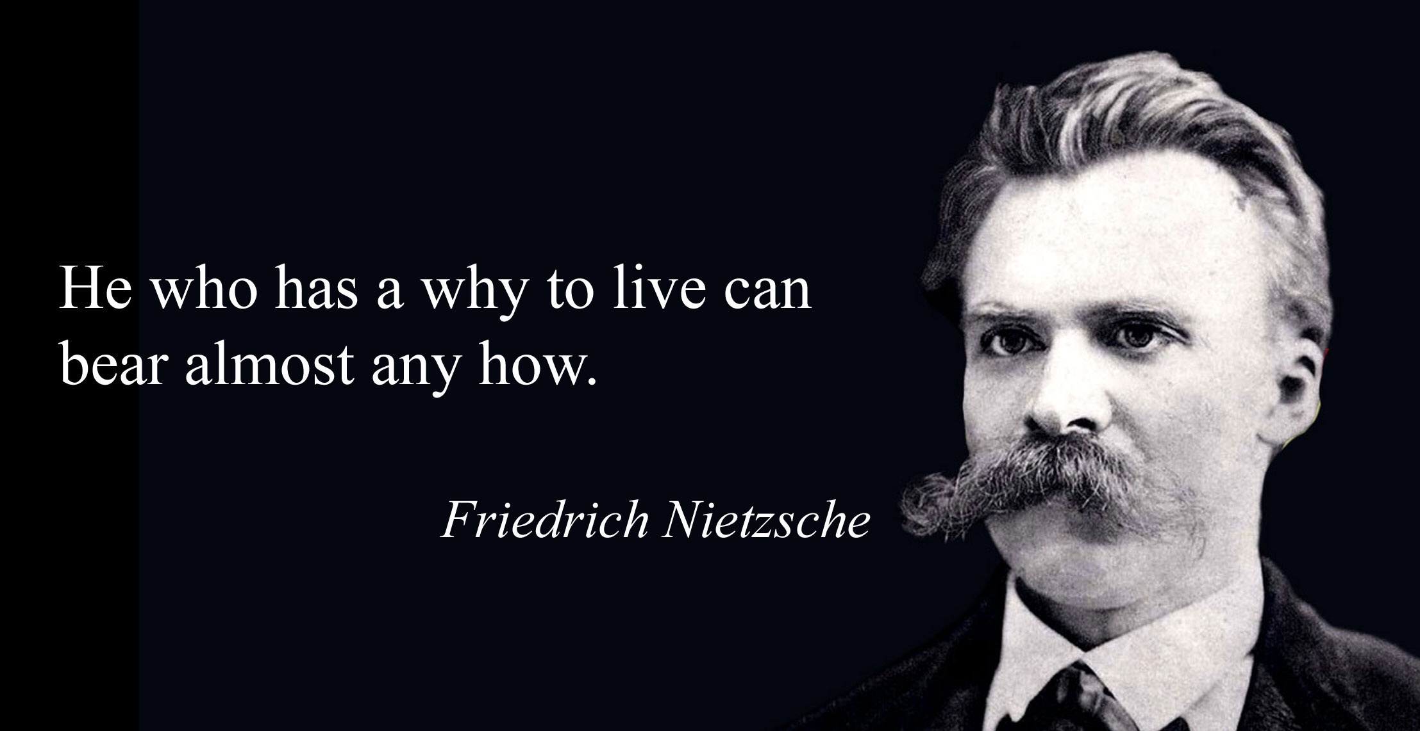
Fred - page 234
Notes:
Fred, a 69-year-old widowed man, was born in Twillingate, Newfoundland. His parents had been hard-working, long-suffering pious people, who had only had one child. Fred's father was a fisher and his mother worked in a fishing processing plant
It was clear from an early age that Fred did not fit in with his family or his community. He was a brilliant student, with an inquiring mind, a child who the local teachers could not keep up with. Fred found school boring but read voraciously.
For while he contemplated becoming a priest one of his best friends revealed that he had been sexually abused by the parish Catholic priest, Fred, then 15 lost his faith, and became an atheist, which further alienated him from the people around him. To get along, Fred learned to keep his thoughts to himself.
It was ironic that when he finished high school, Fred got a scholarship from the Catholic diocese to attend university. He could not wait to escape and accepted an offer from the University of Toronto.
Fred did an undergraduate degree in biology and a Masters in biochemistry. He thought of becoming an academic, but he had fallen in love, wanted to marry, and decided to follow the more practical path of becoming a high school science teacher.
Fred was happy with his wife and his profession. He only regretted not having children, not having made his "mark" in life.
Fred taught high school biology for 30 years and retired in his mid-50s hoping to enjoy his retirement. Within a year of his retirement, his wife died from brain cancer, it was a slow and painful death.
Fred never entirely recovered from this tragedy. He had friends, most of them couples, he enjoyed hiking, loved going on bicycle trips in Europe, was financially secure, but he always felt empty. He experienced a return of the loneliness he had felt growing up.
Since his wife's death, Fred woke up every morning feeling dread. He wondered "is this all there is?" Witnessing his wife's decline and death had been soul shattering, she had been the kindest person he knew. How could anybody think there was a God if such things happened? What was the point of it all?
Fred had started therapy with a smart, young, cognitive behavioural therapist, and worked hard at using the strategies offered to him, but therapy and not make much difference. Fred also tried several antidepressants which had only made him gain weight.
He joined the simple course. At first, he was very sceptical but then became intrigued. He thought most of the material was useful, but the spiritual aspects of the course were just plain flaky.

Slide 184
Sense of dread
Loneliness
despair
Notes:
Fred's holes diary card targets were his "sense of dread", "loneliness", and "despair". Fred felt his greatest struggles were about life's meaning. He firmly rejected the traditional concept of God which she had been raised with, in favour of the modern stage of growth materialist view: the universe is made of matter, there is no soul or spirit, and death is the end.
He was intrigued by the discussions of integral theory, philosophy, and spirituality. He began to read critiques of philosophical materialism and found them credible. Fred worked on his goals diary card procedure

Slide 185
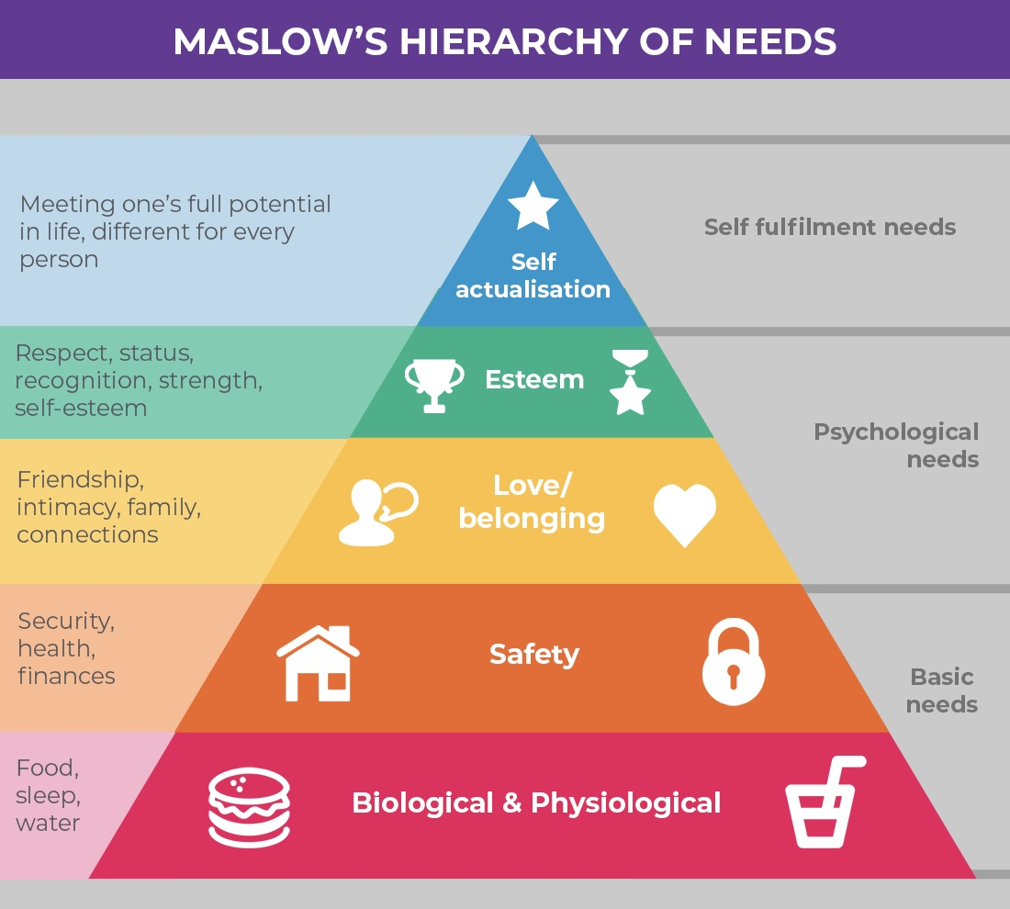
Notes:
In Maslow's hierarchy he was struggling with self-actualization, and he confronted Erickson's despair every day. He had loved his wife and was grateful to have had her in this life but had regrets for not having children and not fulfilling his potential. He felt he would soon die and be totally forgotten. He dreaded getting old and losing his independence.

Slide 186
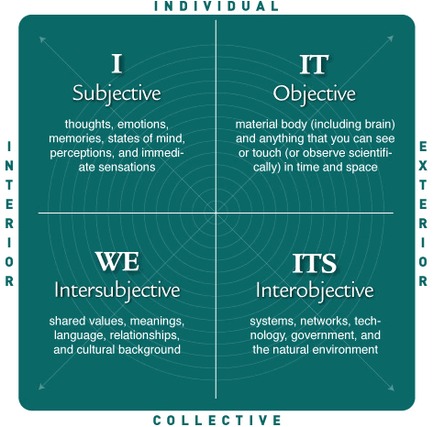
The 4 quadrants of integral theory
Notes:
Fred liked the notion that ideas and beliefs our not absolute certainties about the world, but maps that keep evolving as new information comes to light. A friend recommended he read Adam Grant's book "think again; the power of knowing what you don't know".
Grant, an organizational psychologist, and professor at Wharton, examines the reasons why we cling to our beliefs, and choose not to look at you evidence that might challenge them. He advocates for a culture of learning and exploration, in which we can question our opinions and in which being wrong, is not a failing, but a part of growth.
Fred thought about Ken Wilber's four quadrants, and how Galileo, a man of faith, had realized that mathematical descriptions worked for the individual outer quadrant, the material world, but not for the individual inner quadrant, the world of the mind, imagination, and soul. He had not reject spirituality but simply decided to explore mathematical maps of the material world.
Fred became interested in exploring "maps" of the inner realm. He started to read the works of the great mystics and visionaries of the great spiritual traditions, from the Hindu sages to the Buddha, Jesus, and Mohammed. He began to find materialist science's rejection of this wisdom thoughtless and arrogant

Slide 187
Goals diary card
Dates | 1 | 2 | 3 | 4 | 5 | 6 | 7 | 8 | 9 | 10 | 11 | 12 | 13 | 14 | 15 | 16 | 17 | 18 | 19 | 20 | 21 | 22 | 23 | 24 | 25 | 26 | 27 | 28 | 29 | 30 | 31
Goals
Fostering spirituality
Notes:
Fred realized he did not have to abandon his belief in science to explore the inner realm. The two were completely compatible. He began to see how spirituality opens people up to wonder, awe, love, compassion, joy, and hope.
Fred found the Hindu forest dweller stage of life an intriguing notion and saw how being a "householder" was no longer meaningful for him. Fred returned to his passion for reading, now supplemented by listening to podcasts, featuring congenial "forest guides" such as Brian Swimme, Richard Rohr, John O'Donohue, Mary Oliver, Anne Lamott, Paula D'Arcy, and Francis of Assisi.

