Slide 1

Welcome to simple Week 19
DISSOCIATION and the treatment of the traumatic spectrum disorders
Please start recording at 9 am

Slide 2
week 17- the stress and trauma related disorders-session 20 of manual.
week 18- emotional regulation skills p.148-206 of dbt workbook. our fifth practice session-the goals diary card procedure- session 21 of manual
week 19- dissociation and the treatment of the traumatic spectrum disorders- session 22 of manual.
week 20- introducing interpersonal skills p.207-241 of dbt workbook. Review of all the skills
week 21-introducing internal family systems (ifs)-session 24 of manual. introducing the ifs workbook and ifs workbook guided ai assisted self therapy
week 22- Spirituality, religion, and health- session 26 of manual.
week 23-interpersonal skills and putting it all together p.242-265 of dbt workbook. states of activation as essential trailheads and the four pillars of recovery from trauma-session 27 of manual.

Slide 3
SIMPLE COURSE SCHEDULE 2025-26
Week 1- October 1
Week 2- October 8
Week 3- October 15
Week 4- October 22
Week 5- October 29
Week 6- November 5
Week 7- November 12
Week 8- November 19
Week 9- November 26
Week 10- December 3
Week 11- December 10
Week 12- December 17
December 24 and 31
Week 13- January 7
Week 14- January 14
Week 15- January 21
Week 16- January 28
Week 17- February 4
Week 18- February 11
Week 19- February 18
Week 20- February 25
Week 21- March 4
March 11 and 18 no course
Week 22- March 25
Week 23- April 1
Week 24- April 8
Week 25- April 15
Week 26- April 22
Week 27- April 29
Week 28- May 6
Week 29- May 13
Week 30- May 20
Week 31- May 27
Week 32- June 3

Slide 4

Warning about meditation
Feel free to skip it. Followed by a moment of silence

Slide 5





Check in regularly with your Personal dashboard
Spend a few moments checking in with yourself by asking:
1)What is the current risk that I’ll experience a state of crisis ?
Low b) Moderate c) high d) very high e) extreme
2) Am I in the window of tolerance?
a) Yes b) I’m a little outside c) very outside
3) Where is my energy tank right now?
Full b) ¾ c) ½ d) near empty
4) Have I been tracking my targets using the holes diary card ? how would I rate my targets right now?
5) How well am I focusing on what I’m doing. (for example, the course)
CRISIS RISK
WINDOW OF TOLERANCE
ENERGY RESERVES
RATING MY TARGETS
ATTENTION METER
% attention I’m paying
100
0

Slide 6
5-Minute Mindfulness Meditation for Dissociation
Opening (30–45 seconds)
Before we begin, I want to remind you that this is an invitation, not a requirement.
You’re welcome to keep your eyes open or closed, to shift position, or to stop at any point.
If at any time this feels like too much, you can orient to the room—look around, feel your feet, or gently move.
Dissociation is not a failure. It’s a protective response—the nervous system doing its best to keep us safe.
Today, we’re not trying to force ourselves to be present.
We’re simply practicing coming back a little, in a way that feels tolerable.
Grounding Through the Senses (1½ minutes)
Let’s begin by orienting to the room.
Gently look around or imagine the room if your eyes are closed.
Notice three things you can see—shapes, colors, light, shadow.
Now notice two things you can hear—near or far, inside or outside the room.
No need to label them as good or bad.
And notice one physical sensation that feels neutral or mildly pleasant—
perhaps the weight of your body on the chair, your feet on the floor, or your hands resting.

Slide 7
5-Minute Mindfulness Meditation for Dissociation
If you feel distant, foggy, or unreal, that’s okay.
Simply noticing that is already a form of presence.
Gentle Embodiment (1½ minutes)
Now, we’ll bring awareness to the body in a very light, respectful way.
See if you can notice the outline of your body—
where you end and the chair, floor, or clothing begins.
Without trying to change anything, notice:
Is there more sensation in the upper body or lower body?
More inside or on the surface?
If at any point the body feels too far away or too intense,
you can return to the room, open your eyes, or press your feet gently into the floor.
Just staying within what feels manageable.

Slide 8
5-Minute Mindfulness Meditation for Dissociation
Breath as an Anchor (1 minute)
We’ll now bring in the breath—not to control it,
but to use it as a soft reference point.
See if you can notice where the breath is easiest to feel—
the nose, chest, or belly—or simply the sense of air moving in and out.
There’s no right depth or rhythm.
If the breath disappears from awareness, that’s okay.
Just gently come back when you notice.
If dissociation shows up as numbness, distance, or blankness,
you might silently say to yourself:
‘Something in me is protecting me right now.’
Choiceful Re-Engagement (45 seconds)
Before we close, notice:
Is there one small way you can signal safety to your nervous system?
Maybe that’s pressing your feet into the floor,
stretching your fingers,
or gently naming where you are and what day it is.
You’re practicing the skill of returning, not forcing, not fixing.

Slide 9
5-Minute Mindfulness Meditation for Dissociation
Closing (30 seconds)
As we come back, take a moment to notice:
What feels slightly more present, even by one percent?
When you’re ready, gently re-orient—open your eyes, move, look around.
Thank your system for what it’s learned over time.
Dissociation helped you survive.
Now you’re slowly teaching your nervous system that return is possible, and safe.

Slide 10


Slide 11
PRACTICE SESSIONS SCHEDULE
preparation
practice
6. Week 25 April 15 April 8, 1:30 IFS workbook 1 Elaine S.
7. Week 26 April 22 April 15 IFS workbook 2 Dinko T.
8.Week 27 April 29 April 22 IFS workbook 3 Barb H.
9. Week 28 May 6 April 29 IFS workbook 4 Meaghan
10.Week 29 May 13* April 22 3 pm Wise mind remediation Rob T.
We now have a full slate of volunteers but if anyone would like on a “substitute list” in case someone can’t make it, as happened last week, please let us know.

Slide 12
Homework from LAST WEEK
Submit
Submit questions or comments to itssimple2023@gmail.com
Read
Simple manual session 22.
Continue
Continue reviewing and practicing your crisis plans, diary cards, chain analysis, rational mind remediations and goals diary cards.
Continue
Continue tracking all the skills you’ve learned using the skills lists. Practice them.

Slide 13
Homework for next week
Submit
Submit questions or comments to itssimple2023@gmail.com
Continue
Continue reviewing and practicing your crisis plans, diary cards, chain analysis, rational mind remediations, and goals diary cards.
Use
Use templates to start becoming acquainted with your part selves, doing wise mind chain analysis, fostering your wise mind, and soothing your parts.
Continue
Continue tracking all the skills you’ve learned using your skills lists. Practice them.
Read
Skills training workbook p.207-241 (double skills training session)

Slide 14
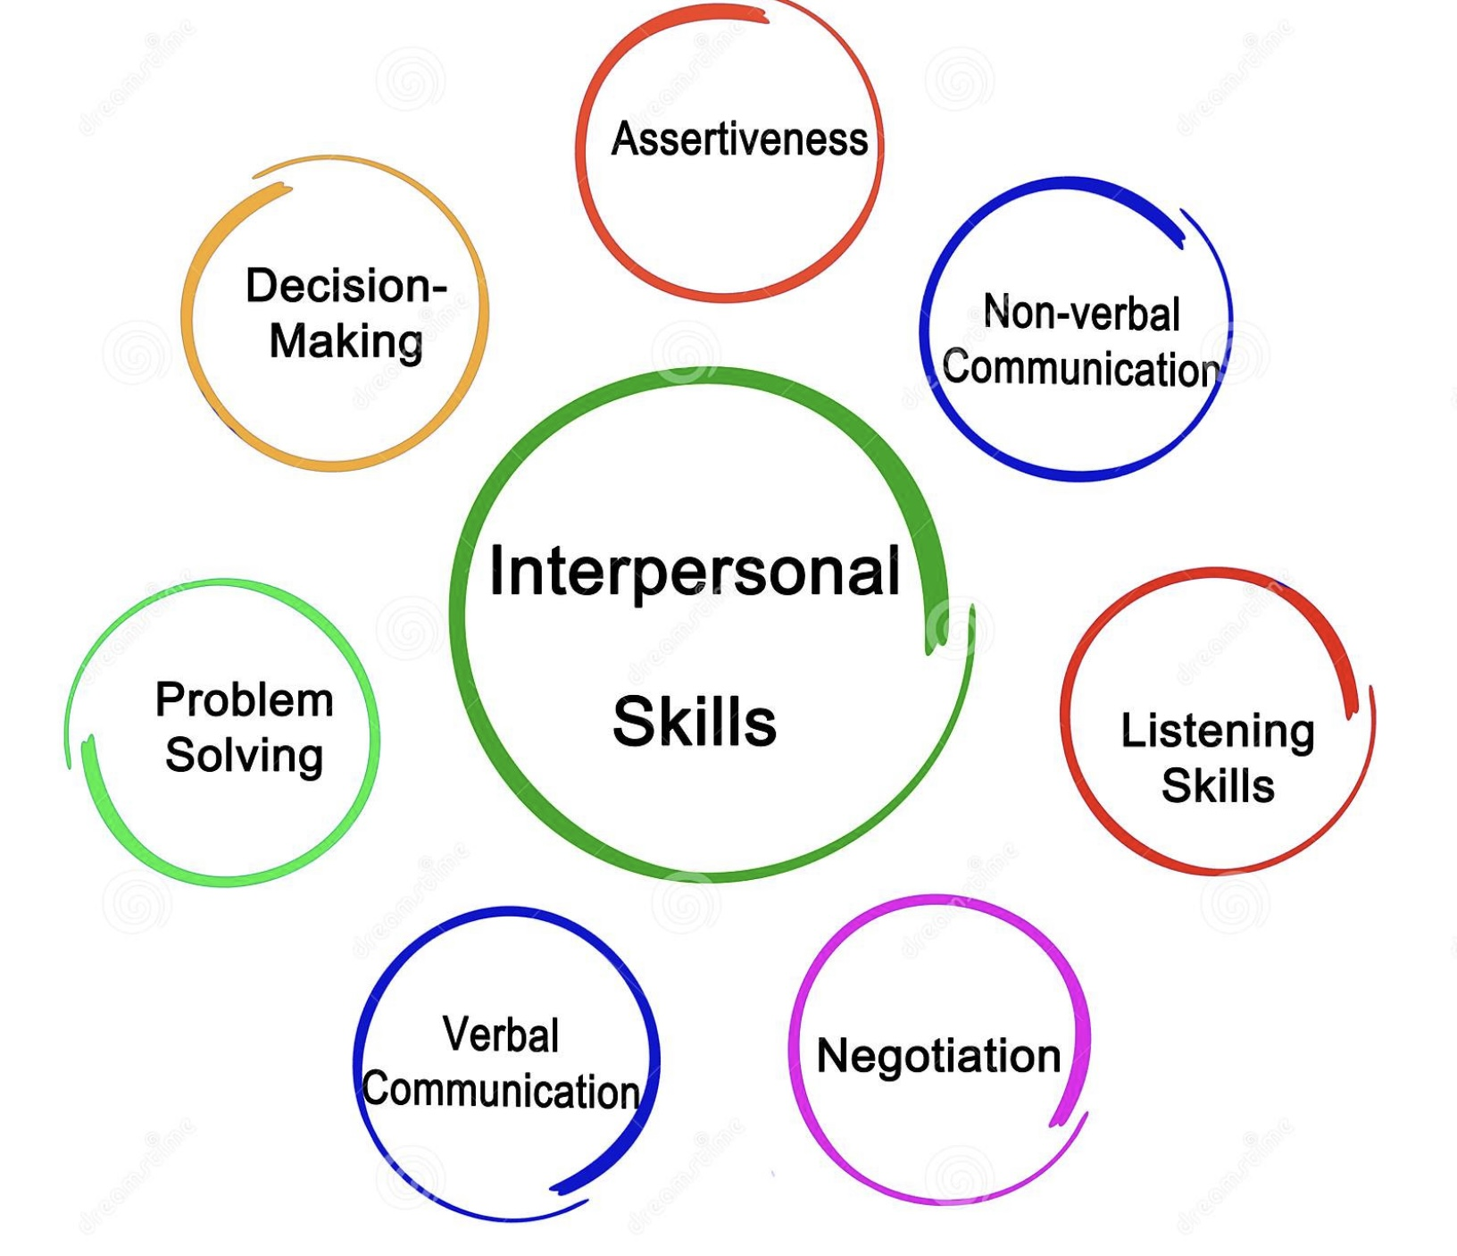
FOR THOSE WHO DON’T HAVE THE SECOND EDITION OF THE DBT Skills training workbook HERE’S WHAT WE’LL COVER NEXT WEEK p. 207-241 interpersonal skills
This section of the workbook covers seven topics
1. Mindful attention
2. Compassion for others
3. Passive vs. aggressive behavior
4. I want-they want ratio
5. I want-I should ratio
6. Key interpersonal skills
7. Blocks to using interpersonal skills
8. Knowing what you want
9. Modulating the intensity of a request
10. Making a simple request
11. Designing basic assertiveness scripts and
12. Assertive listening

Slide 15
HOMEWORK HABITS CHECKLIST
Circle or check what you will try this week.
1. Preparation habits
■ I schedule a specific time for homework.
■ I choose a consistent location with minimal distractions.
■ I gather what I need ahead of time (notebook, worksheet, pen).
2. Focus & pacing habits
■ I start with a tiny step (2–5 minutes).
■ I use a timer (10–15 minutes).
■ I remove distractions (phone away / Do Not Disturb).

Slide 16
HOMEWORK HABITS CHECKLIST
3. Tracking & organization habits
■ I keep materials in one place (binder / folder / notebook).
■ I write down insights right after doing the homework.
4. Self-compassion habits
■ I aim for progress, not perfection.
■ I notice resistance without judgment.
5. Accountability habits
■ I review my week: What worked? What didn’t?
■ I share honestly with my buddy — even when I didn’t do it.
Micro commitment:
This week I will focus on: ■ Time ■ Place ■ Tiny step ■ Timer ■ Other please specify:

Slide 17


REMINDER PARTICIPANT AGREEMENTS
If you have questions, comments, or feedback, please save them for the two question periods. You can put them in the chat box or raise your real/virtual hand.
Keep comments, questions, and feedback relatively brief so everyone has a chance to participate.(one breath sharing)
If you’re on zoom, make sure no one can overhear what is being said
For reasons that will become clear later in the course please avoid giving advice to other participants about what they should or should not do. Validation, encouragement , and understanding are however very much appreciated.

Slide 18

WEEKLY ANNOUNCEMENTS
We think we my have fixed the zooming in and out problem. Please let us know.

Slide 19
THANK YOU
On February 9’s boing group we had a great discussion about what some people are struggling with in the course.
Our personality is what it is because what it is has helped us to survive in the world. To ask us to change something which has helped us survive is akin to asking us to jump off a tall building while reassuring us that we’ll be alright. Emotionally it’s extremely difficult to believe and to do it we need a lot of “handholding” or coaching.
This brings us to the main problem with this course. It gives us theory and provides us with tools and skills, but it falls short on coaching us individually on how to practically use that theory, tools and skills. It’s as if were learning the theory of carpentry but never applied our tools and skills to a real woodworking project.
We also talked about how the course can be quite activating. From an IFS perspective it may activate parts of us that feel shame, are anxious, procrastinate or are perfectionistic. When such parts are activated, we may be inadvertently repeating patterns from our past.
One of the suggestions that came out of that boing group is for the co-leaders to summarize both at the beginning and at the end of the session the key points to retain from the session.
We agreed that it’s so very important to be able to put our thoughts and feelings such as these into words and feel safe doing it. We concluded that what is most important is to be kind and compassionate with ourselves and with each other.
Thank you to all those who contributed to this important discussion and to everyone who continues to attend the course.

Slide 20

E-mailed questions, comments, feedback

Slide 21
As always, we’ve had some very good questions this week. We try to address most questions that are asked. These question may interest one person or many people.
Until we find a better way, we’ll post answers that we think may be of interest to most people but unfortunately because of time we cannot read all of them in the sessions. We will therefor arbitrarily read out only a few of the many excellent questions you’ve asked.
We’ll however read out all the questions and invite everyone to go to the website’s PowerPoint presentations and go over the answers with more time.

Slide 22
Question whose answer we will read out today

Slide 23


Slide 24

IN OUR EXPLORATION OF TRAUMA, WE HAVE SO FAR DISCUSSED
Stress and the stress response
Adult, developmental, and attachment trauma
How to assess trauma
The consequences of trauma
The Adverse Childhood Events studies
Trauma as a disorder of implicit memory
How understanding the states of autonomic activation is key to understanding the trauma related disorders
Psychiatry's blind spot for trauma
Trauma informed care
“Talking about your trauma doesn’t make you a victim. Making your trauma your identity does.”

Slide 25

WHY ARE WE TALKING ABOUT DISSOCIATION TODAY?
It’s been said that trauma spectrum disorders are a disorder of time. Part of you knows it’s 2026. You go to work. You function. You try to live your life. But another part of you is still reacting as if it’s the moment of danger. That part isn’t just remembering the trauma, it’s reliving it.
In our minds trauma creates a time dissociation. One part of us tries to move forward, another part remains behind frozen in the moments of the trauma.
The treatment of the trauma spectrum disorders isn’t about erasing the past. It’s about helping the part that’s stuck in trauma time learn that the danger is over.
Treatment of trauma is typically divided into three phases:
Phase one helps us feel safe enough in the present. That’s the goal of DBT, expanding the window of tolerance.
Phase two helps the stuck part update its clock, moving the memory from ‘happening now’ to ‘something that happened. That’s the goal of IFS.
Phase three helps all parts of resume a full life.
Healing happens when no part of you is left alone in the past.
Structural dissociation theory explains the fragmentation of the self. The three stages of treatment describe the pathway back toward integration.

Slide 26

today
What is dissociation?
Neodissociation theory
Structural dissociation theory
How dissociation arises from trauma
Primary structural dissociation
Types of flashbacks
Features of PTSD
Secondary structural dissociation
Tertiary structural dissociation
Neodissociation vs. structural dissociation theories
Controversies in the diagnosis of dissociative identity disorder
Treatment of the trauma spectrum disorders
How simple addresses the three stages of trauma therapy
Special considerations in the treatment of trauma

Slide 27
PART 1 WHAT DISSOCIATION FEELS LIKE AND WHY IT HAPPENS

Slide 28
WHAT IS DISSOCIATION?

Slide 29
DISSOCIATION AS A DEFENSE AGAINST OVERWHEMING STRESSORS
Dissociation is a psychological defense mechanism. Defense mechanisms are automatic psychological strategies the mind uses to reduce the stress or anxiety created by internal or external stressors. They protect us from feeling overwhelmed, ashamed, frightened, or conflicted.
Level Examples Function
Mature defenses Sublimation, humor, suppression Regulate while staying integrated
Neurotic defenses Repression, intellectualization Keep conflict out of awareness
Immature defenses Projection, splitting, denial Distort reality to reduce anxiety
Dissociative defenses Disconnect from experience itself
Most defenses distort experience. Dissociation removes experience from awareness. It is the nervous system’s last-ditch protection when other defenses fail.

Slide 30
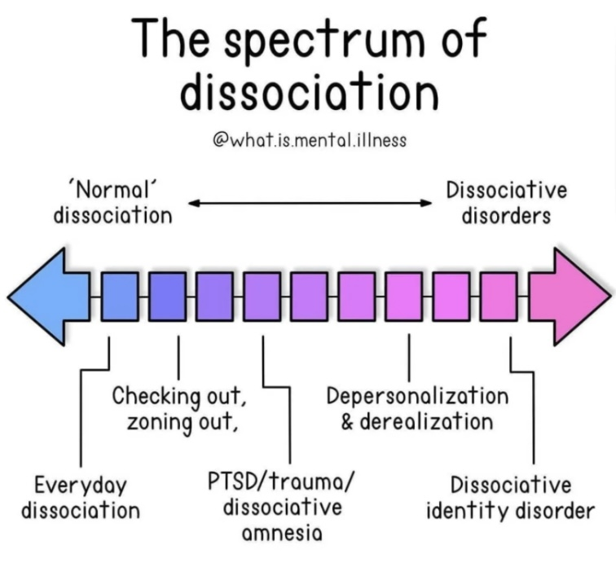



WHAT IS DISSOCIATION?
Definition: in its common usage, the term “dissociation” refers to a disconnection between things usually associated with each other.
In psychology, dissociation refers to a wide array of psychological experiences, ranging from a mild emotional detachment from our immediate surroundings, such as happens when we’re driving long distances, to a more severe disconnection from our physical and emotional experiences.
Spectrum: Individual instances of dissociation are best understood as lying on a spectrum. In mild cases, dissociation can, in the presence of stress, be a healthy coping mechanism or defense. Daydreaming is a benign example of mild dissociation. Towards the pathological end of the dissociative spectrum are the DSM dissociative disorders.
Metaphor: As do Humans, trees adapt to the stress of wind by bending. Every tree has a breaking point (traumatic stress) at which rather than bending branches will break.
After a windstorm, a few or many, small or large tree branches may break.(spectrum of dissociative disorders)
The degree of damage a tree sustains depends on the severity of the wind, the resilience of the tree and other resources or protective factors such as other trees sheltering each other from the wind.

Slide 31
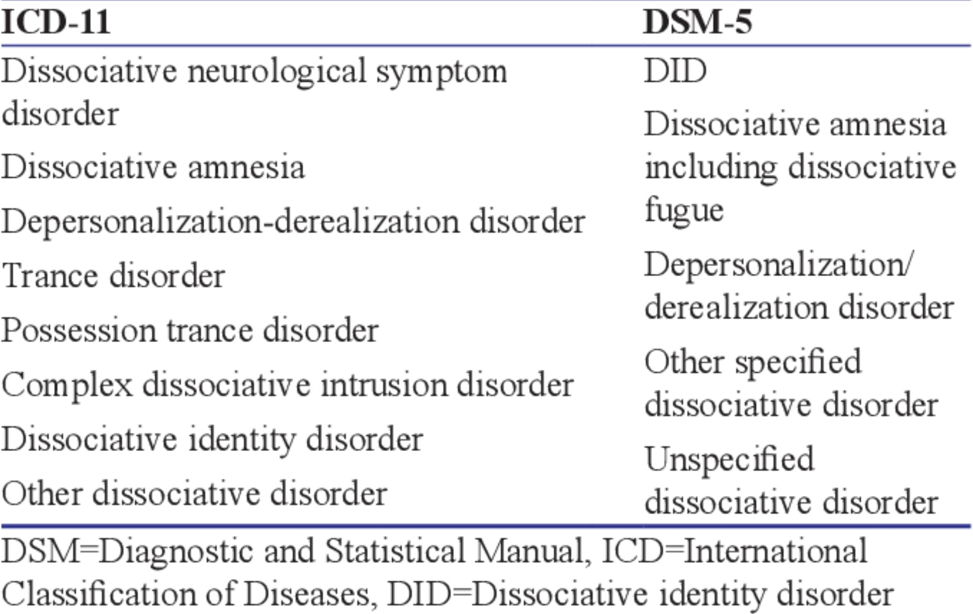
DISSOCIATION related diagnosis
The major characteristic of all dissociative phenomena is a detachment from reality, rather than a loss of reality as is the case in psychosis. (sometimes it’s difficult to tell dissociation and psychosis apart and sometimes the two merge)
The DSM 5 lists five dissociative disorders:
1. dissociative identity disorder,
2. dissociative amnesia including dissociative fugue
3. depersonalization derealization disorder.
4. other specified dissociative disorder and
5. unspecified dissociative disorder.
The DSM doesn’t make an explicit link between dissociation and the trauma spectrum disorders.

Slide 32
I’m not going to go through this slide in the session, I encourage you to go to the website if you want to explore it further.
=

Slide 33
DISSOCIATION related diagnosis
ICD-10, the International classification of disease 11th edition, also lists, in addition to the five DSM’s dissociative disorders described above:
6. dissociative neurological symptom disorder which includes psychogenic paralysis, unexplained pain and other sensations, and pseudo seizures.
7. trance disorder
8. possession trance disorder and
9. complex dissociative intrusion disorder
As we will see when we consider dissociative identity disorder, dissociative experiences are sometimes not integrated into the usual sense of self resulting, for people experiencing them, in discontinuities of conscious awareness and memory.

Slide 34
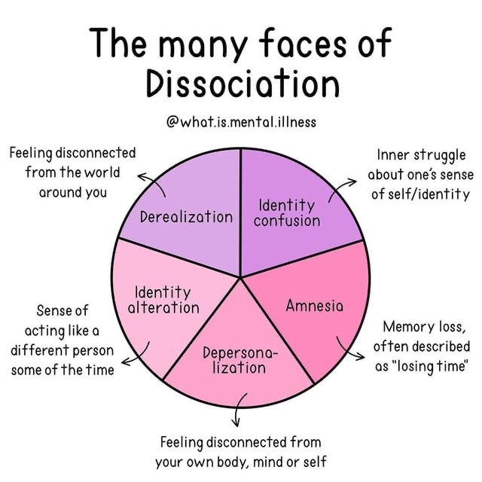
THE 5 CORE FEATURES OF DISSOCIATION
1. Derealization (feeling disconnected from the world around you) is an alteration in the perception of the external world, causing those with the condition to perceive it as unreal, distant, distorted or falsified. Other symptoms include feeling as if one's environment is lacking in spontaneity, emotional coloring, and depth.
2. Depersonalization (feeling disconnected from your own body, mind or self) can consist of a detachment within the self, regarding one's mind or body or being a detached observer of oneself. It can be described as feeling like one is on "autopilot" and that the person's sense of individuality or selfhood has been hindered or suppressed
Notes:
Psychological dissociation refers to the disintegration of functions of the nervous system that are normally integrated. In psychologically healthy people the emotional, rational, and self observing brains communicate and cooperate optimally. Each of these brains however can separate itself from the others. The classical type of dissociation seen in hypo freeze is when the self observing, rational, and higher levels of the emotional brain shut down, and the reptilian brain which preserves basic life functions takes over.
There are other forms of dissociation however, for instance being hyper rational may be a form of dissociation in which the emotional brain shuts down as does the self observing brain. This type of dissociation is commonly used by avoidantly attached people.
Dissociation presents in many different ways. This includes identity confusion which is an inner struggle about one sense of self/identity. Amnesia which presents as memory loss that is often described as "losing time"…

Slide 35
THE 5 CORE FEATURES OF DISSOCIATION
3. Identity confusion (inner struggle about one’s sense of identity or self) is a pronounced difficulty achieving a cohesive sense of self. Someone with identity confusion may constantly wrestle with separate often adversarial identities that are engaged in a battle for control of the person's mind and body.
4. Dissociative amnesia (memory loss often described as losing time) is characterized by retrospectively reported memory gaps. These gaps involve an inability to recall personal information, usually of a traumatic or stressful nature.
5. Identity alteration (sense of acting like a different person some of the time) involves pronounced changes in behavior, memory and thinking over periods of time.
Notes:
Psychological dissociation refers to the disintegration of functions of the nervous system that are normally integrated. In psychologically healthy people the emotional, rational, and self observing brains communicate and cooperate optimally. Each of these brains however can separate itself from the others. The classical type of dissociation seen in hypo freeze is when the self observing, rational, and higher levels of the emotional brain shut down, and the reptilian brain which preserves basic life functions takes over.
There are other forms of dissociation however, for instance being hyper rational may be a form of dissociation in which the emotional brain shuts down as does the self observing brain. This type of dissociation is commonly used by avoidantly attached people.
Dissociation presents in many different ways. This includes identity confusion which is an inner struggle about one sense of self/identity. Amnesia which presents as memory loss that is often described as "losing time"…

Slide 36
In this session we’ll present two theories that seek to explain dissociation and then we’ll compare and contrast them:
Neodissociation theory
2. Structural dissociation theory

Slide 37
1. NEODISSOCIATION THEORY

Slide 38
NEODISSOCIATION THEORY
Neodissociation theory proposes that consciousness is made up of semi-independent mental systems such as attention, memory, perception, and self-monitoring that usually work together. Under certain conditions these mental systems can become functionally disconnected.
Neodissociation theory comes out of experimental psychology and hypnosis research.
It proposes that:
The mind is modular.
Dissociation is a state-based separation of mind functions.
Dissociated processes can continue operating outside awareness.
There is still one person, one self, just poor internal communication.
Examples of such disconnection of mental functions include:
Hypnotic analgesia where pain processing occurs, but awareness of it is blocked and
Automatic behaviors (“I don’t know why I did that”)
The emphasis in Neodissociation theory research is on determining which functions are offline, what triggers this and how can integration be restored.

Slide 39
2. STRUCTURAL DISSOCIATION THEORY
What is structural dissociation theory ?

Slide 40
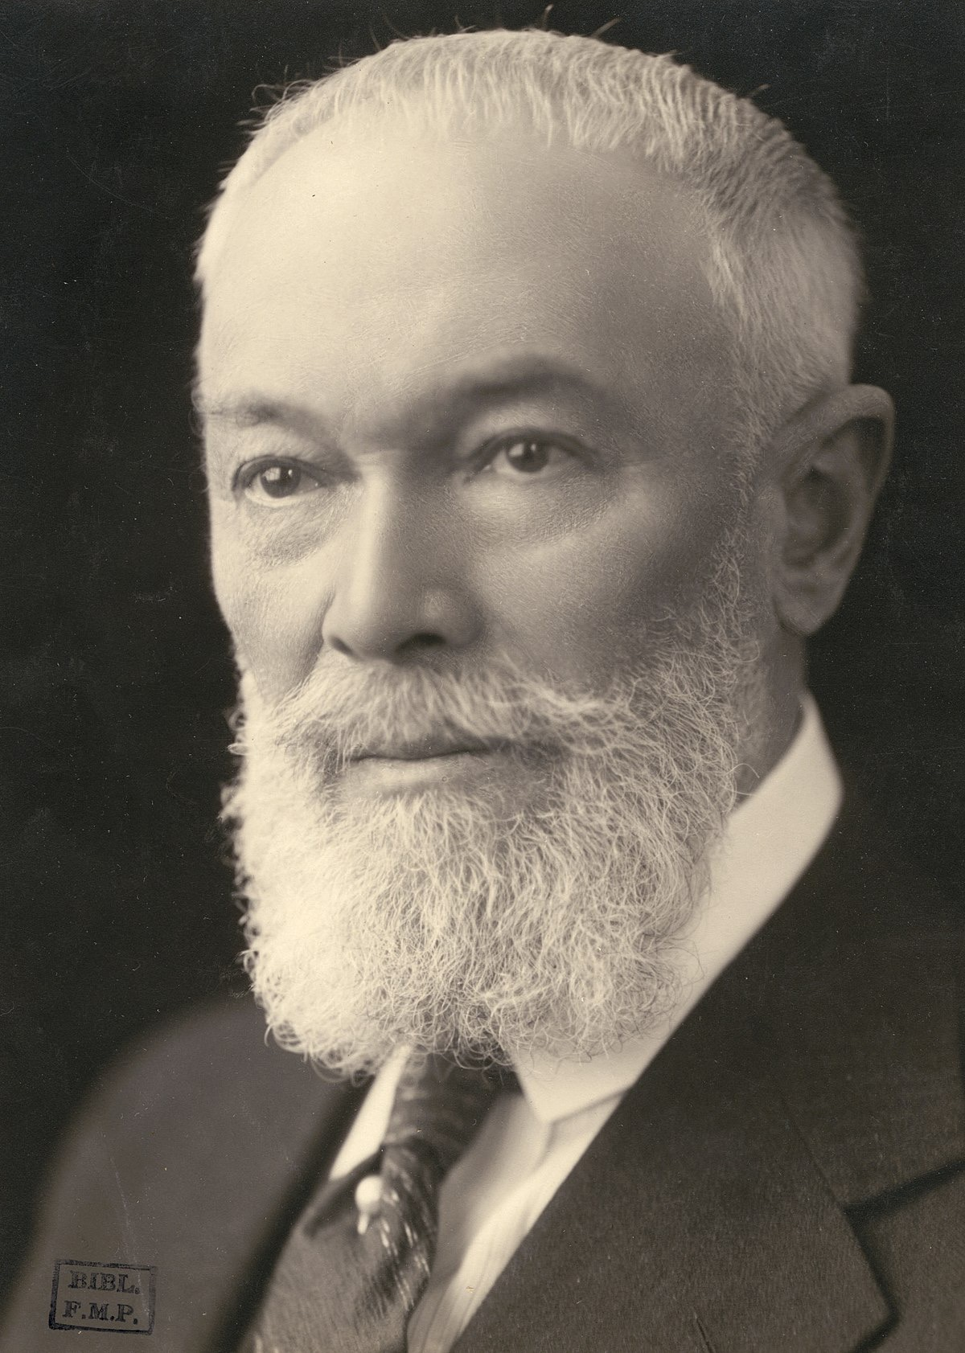
THE ORIGINs OF structural dissociation theory
Pierre Marie Felix Janet was a pioneering French psychologist, physician, philosopher and psychotherapist who coined the term dissociation and described its importance in mental health by postulating a theory called “structural dissociation”.
Pierre Janet was 3 years younger than Freud.
He studied under Jean-Martin Charcot at Paris’s Hospital La Salpetriere where in 1885 Freud also spent 3 months learning about “hysteria”.
Janet was one of the first psychologists to draw a clear connection between a person’s past trauma and symptoms presenting later in life. Unlike Freud he never abandoned this idea.
Freud acknowledged his debt to Janet. Janet doesn’t have as high a profile in modern psychology as Freud possibly because unlike the later he was humble and avoided the spotlight .
In the late 1980’s Ellert, Nijenhuis, Onno van der Hart, and Kathy Steele built on Janet’s work and expanded structural dissociation theory into its present-day form
Pierre Janet 1859-1947
Notes:
Structural dissociation theory is a psychodynamic theory that's over 100 years old. It is one of the theories about dissociation that makes the most sense.French physician and philosopher Pierre Janet proposed this theory.

Slide 41

WHAT IS Structural dissociation theory?
Structural dissociation theory describes three types of psychopathological dissociation:
primary, secondary and tertiary structural dissociation.
Structural dissociation theory proposes that people with these trauma related disorders experience a dissociation of their personality into separate parts, each part having its own psychobiological characteristics.
Although the theory describes three types of dissociation, there is no clear demarcation between the three and they are thought to be on a continuum or spectrum of severity.

Slide 42
WHAT IS Structural dissociation theory?
These three types of dissociation correspond to traditional diagnostic categories:
1. Primary structural dissociation = PTSD
2. Secondary structural dissociation = Complex PTSD
3. Tertiary structural dissociation = dissociative identity disorder
A person with a trauma related disorder can experience a combination of symptoms from any of these three. Ex. Someone with predominantly PTSD can present with some DID symptoms.
The type of dissociation a person develops depends on the balance between the duration and severity of the trauma and the person’s coping resources.

Slide 43
HOW DISSOCIATION ARISES FROM TRAUMA
Can we review how dissociation results from trauma?

Slide 44
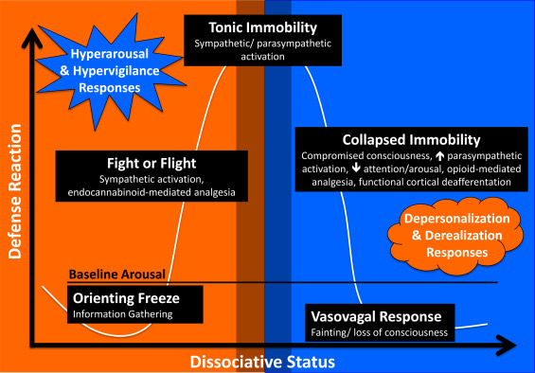
THE ORIGINS OF DISSOCIATION IN 3 STEPS
Step 1)When faced with a life-threatening danger, an organism first goes into a fight or flight state of activation.
Step 2) When the organism perceives that life-threatening danger as physically inescapable, it leaves or psychologically dissociates from the situation by going into a freeze state of activation. (Tonic to collapsed immobility is when the branch of the metaphorical tree breaks. Dorsal parasympathetic brake)
REALM OF DISSOCIATIVE EXPERIENCES
Notes:
Recall the arousal curve in which we have the window of tolerable emotions. Outside that window is hyper activation of which hyper freeze or the orienting response and fight or flight are both features. Also outside the window of tolerance is hypo activation which is depression or depersonalization. Hypo activation is when the handbrake's of the dorsal parasympathetic nervous system go on and the organism goes into feigned death in which the heart slows down as those respiration and virtually every other bodily function. It is here in this dorsal parasympathetic activation that the organism goes into reptilian brain mode. That's classical dissociation.

Slide 45
Activation curves
Traumatic stress not resulting in PTSD
Inescapable traumatic stress resulting in PTSD
X
No escape (Tonic immobility)
hyperfreeze
(Collapsed immobility)
activated
calm
← Dissociated unprocessed
emotional memory
hypofreeze
Step 3) The unprocessed dissociated memory of the traumatic situation is then encoded in its original form with accompanying activation states, physical sensations, emotions, and visual images in the somatic, emotional, and rational memory systems. To use a computer metaphor, a traumatic dissociated experience is like a document or file that is saved into the computer memory and no longer present as an open window. Triggers however reopen the document or file.
Notes:
When a person faces a traumatic stress the first responses to fight back or flee. That's fight or flight. When the traumatic stress appears to be physically inescapable by fighting back or fleeing, then all that's left is escaping mentally into the reptilian brain. That escape leaves behind and unprocessed emotional memory of the trauma which is stored in a "file" in the emotional brain.

Slide 46
HOW IS DISSOCIATION DIAGNOSED?

Slide 47
ASSESSMENT OF DISSOCIATIVE DISORDERS
The assessment and diagnosis of dissociative disorders typically involves a combination of clinical interviews, structured diagnostic instruments, and self-report questionnaires. These tools help clinicians identify the presence and severity of dissociative symptoms, distinguish between different types of dissociative disorders (e.g., DID, dissociative amnesia, depersonalization/derealization disorder), and differentiate dissociation from other conditions such as psychosis or PTSD. The most commonly used and validated assessment tools and scales are:
Structured Interviews
1. Structured Clinical Interview for DSM-5 Dissociative Disorders (SCID-D): Gold standard for diagnosing dissociative disorders. Assesses five core dissociative symptoms: amnesia, depersonalization, derealization, identity confusion, and identity alteration. Requires trained clinicians.
2. Dissociative Disorders Interview Schedule (DDIS): Semi-structured interview developed by Dr. Colin Ross. Assesses dissociative symptoms, trauma history, and comorbidities (e.g., somatization, borderline traits). Suitable for research and clinical use.
Self-Report Measures
3. Dissociative Experiences Scale (DES): 28-item self-report screening tool. Measures a wide range of dissociative symptoms (e.g., absorption, amnesia, depersonalization). A DES score >30 is suggestive of a dissociative disorder, though not diagnostic on its own.
4. Multidimensional Inventory of Dissociation (MID): Comprehensive 218-item self-report instrument developed by Paul Dell. Assesses 23 dissociative symptom clusters and provides detailed profiles. Used in clinical and research settings, often for complex dissociative presentations.
5. Somatoform Dissociation Questionnaire (SDQ-20): 20-item self-report questionnaire. Focuses on somatoform dissociation, such as pain, paralysis, or anesthesia without organic cause. Particularly useful in evaluating dissociation in trauma survivors with physical symptoms.

Slide 48
THE 3 TYPES OF DISSOCIATION

Slide 49
PRIMARY STRUCTURAL DISSOCIATION

Slide 50
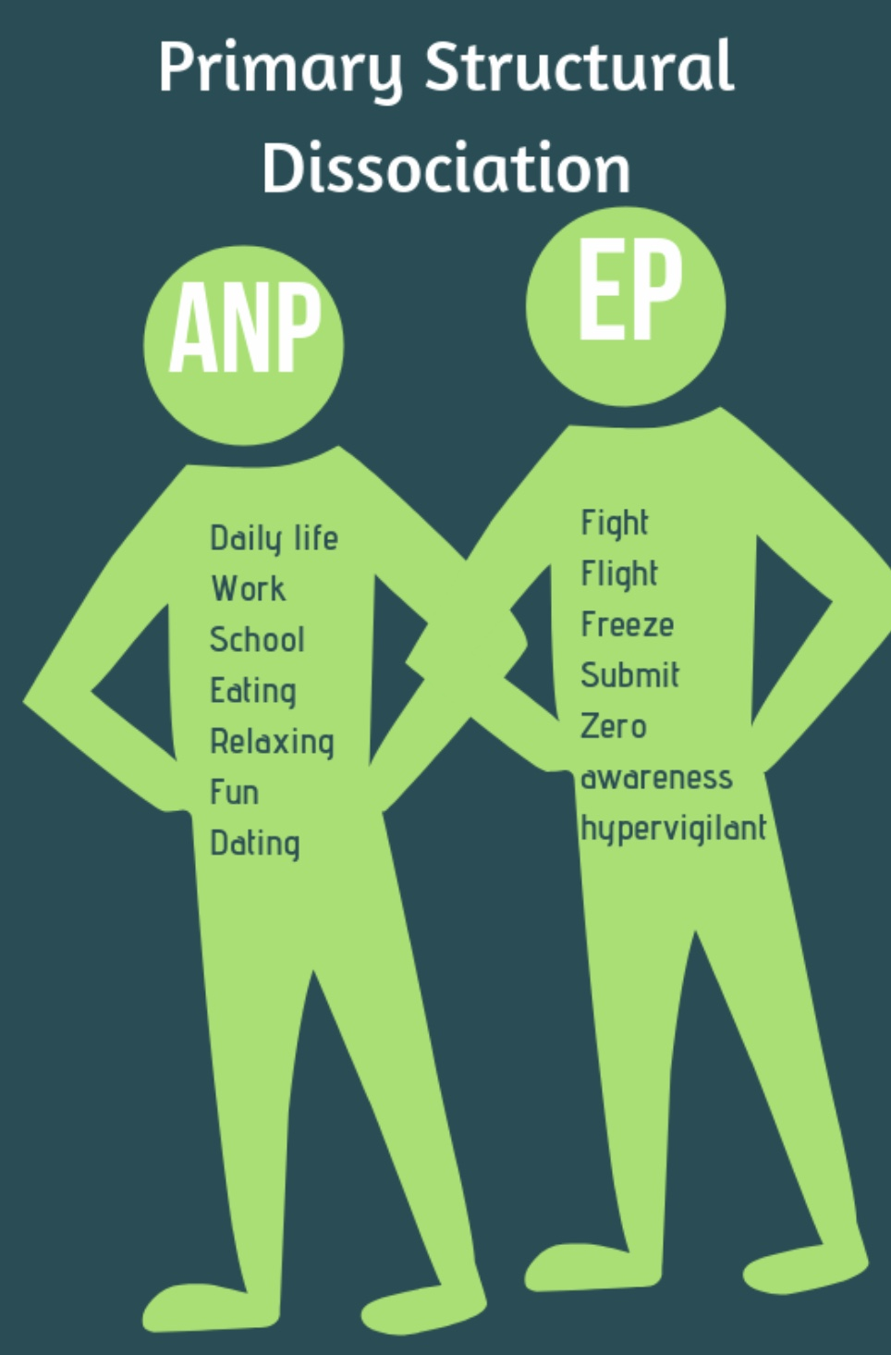
Structural dissociation (SDT) theory considers that humans have a rational and an emotional mind/brain which normally function in an integrated fashion.(recall DMM’s three information centers and the triune brain)
It then postulates that in PTSD or primary structural dissociation the mind dis-integrates or splits into two parts:
1. An apparently normal part or ANP that tries to carry on with the usual business of life… and
2. A dissociated emotional part or EP, whose primary concern is defence and survival. This part carries the unprocessed dissociated traumatic memories that occasionally resurface and manifest as flashbacks, dysregulated emotions, and the physiological arousal states of fight, flight, freeze, and fawn.
At times, the person with PTSD functions mostly in their apparently normal part ANP, while at other times the traumatized dissociated emotional part EP is triggered and takes over.
1. 2.
A.K.A. PTSD
Notes:
Let's start with primary structural dissociation which is another term for posttraumatic stress disorder.
Structural dissociation theory recognizes that there is an emotional and a rational brain. It theorizes that trauma splits or dissociates personality into two components: the emotional part and the apparently normal part…

Slide 51
How are the apparently normal part or ANP and the emotional part or EP different?

Slide 52
Functions of the ANP and ep in ptsd
APPARENTLY NORMAL PART
EMOTIONAL PART
Is also known as the daily life action system. It carries on actions that are concerned with the survival of the species:
exploration (work, study)
play
energy management: sleep, eating, preparing food, housecleaning etc.
attachment
Socializing
Reproduction
Caretaking
Is also known as the defensive action system. It carries on actions that are concerned with the survival of the individual.
Fight
flight
freeze
total submission/collapse
social submission
attachment cry
Recuperation following the threat: rest, isolation, wound care, and gradual return to daily activities.
Structural dissociation theory’s emotional part is the “computer file or document" that's created by the trauma and stored in the somatic and emotional memory systems. It occasionally, and sometimes unpredictably, resurfaces into the computer “window” of everyday life as a flashback
Notes:
According to structural dissociation theory the apparently normal part belongs to the daily life action system, the emotional part belongs to the defensive action system. These systems have different functions…

Slide 53
When you feel suddenly hijacked that may be your EP

Slide 54
TYPES OF FLASHBACKS
How does structural dissociation explain PTSD flashbacks ?

Slide 55
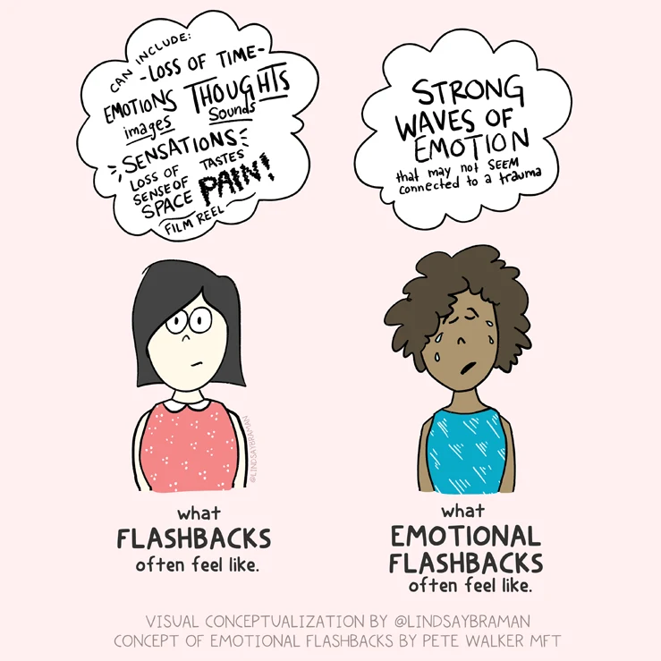
TYPES OF FLASHBACKS
Flashbacks are a common experience in people with trauma related disorders and can be thought of as the surfacing of the EP
The pop psychology understanding of a flashback is that it is the reexperiencing of the trauma as a visual image with an auditory component.
Such images and sounds are however only the conscious or rational mind memory of the trauma.
There are at least three distinct types of flashbacks each associated with one of the three information processing centers we talked about when we discussed Patricia Crittenden’s DMM.
Notes:
Yes, and that file poping into the screen is called a "flashback"…

Slide 56
3 TYPES OF FLASHBACKS
1) cognitive flashbacks in which the traumatic memory is reexperienced as a visual or auditory experience. The pop psychology version.
2) emotional flashbacks in which the intense emotions felt during the trauma are reexperienced and
3) somatic flashbacks in which the pain and bodily sensations felt during the trauma are reexperienced
While people with trauma related disorders readily associate their visual and auditory flashbacks with their trauma, they may not as readily associate somatic or emotional flashbacks with the trauma.
In fact, people are often at a loss as to how to explain somatic and emotional flashbacks when they occur independent of cognitive memories of the trauma.
They often attribute the somatic sensations and emotional reactions to something happening in the present rather than to their trauma.
Notes:
Yes, and that file poping into the screen is called a "flashback"…

Slide 57
FEATURES OF PTSD
I know we already covered this on our session on trauma, but can we quickly review the symptoms that people with primary structural dissociation or PTSD experience?

Slide 58
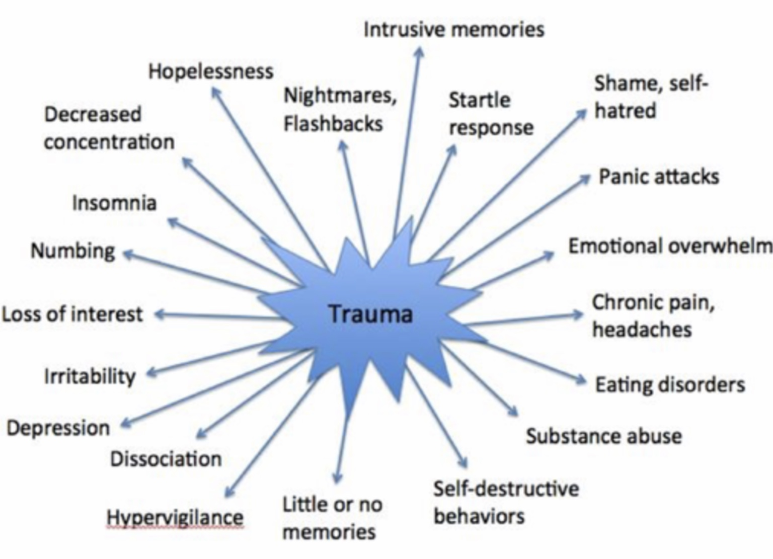
REVIEW OF SYMPTOMS IN PTSD
Notes:
This unprocessed dissociated traumatic memory pops up in the screen of the mind when triggered by something that resembles the original trauma event. The presence of these dissociated traumatic memories gives rise to the trauma spectrum symptoms which include…

Slide 59
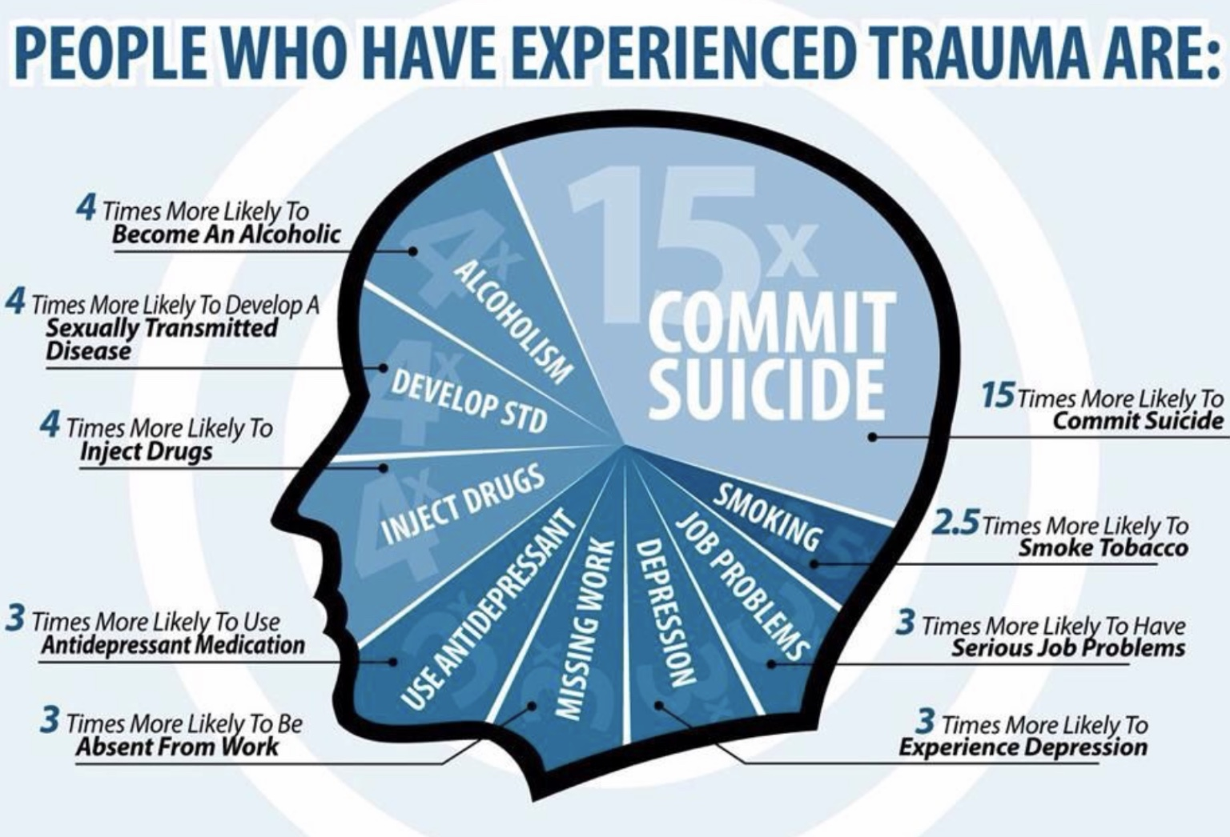
SOME FEATURES OF PTSD A REVIEW
People who have experienced trauma are at a much greater risk for other issues such as substance abuse, suicide, depression, sexually transmitted diseases, and unemployment.
In some ways PTSD presents differently in men and women.
10% of all women develop diagnosable PTSD compared to only 4% of all men.
Women are at a much greater risk of sexual assault or abuse, child abuse, and domestic violence.
Risk factors for developing PTSD include genetic predispositions, lack of social support, neurological impairments, previous trauma, pre-existing mental health conditions, and significant life stressors.
The posttraumatic stress disorders are often misdiagnosed as mood, anxiety and personality disorders.
There is a significant overlap between symptoms of the posttraumatic stress disorders and of ADHD. Both can present with easy distractibility, difficulty listening, disorganization, hyperactivity, restlessness and difficulty sleeping.

Slide 60

ptsd: avoidance, depression, and vulnerability
For people suffering from trauma related disorders, reminders of the trauma can trigger the EP to surface. They try to avoid this surfacing by avoiding triggers.
Eventually the person avoids more and more things and becomes more agoraphobic to the point that many people with trauma related disorders become housebound
As their life becomes more restricted, they become more disconnected from others, a meaningful occupation, engagement with the world, nature, and a meaningful cosmic story. This is in part why people with PTSD are also often depressed.
The avoidance of potential triggers and memories perpetuates PTSD since the processing of the traumatic memories requires some degree of controlled exposure to triggers . By not facing their fears people with PTSD remain victims of the trauma rather than becoming survivors.
The more avoidance there is, the less the ANP is able to maintain a semblance of apparent normality
How trauma impacts people depends on their resources : at one end of the resource's spectrum are people with secure attachment, who had normal psychosocial development prior to a single event trauma. They have more resources and are less likely to develop PTSD. If they do, their prognosis is better.
At the other of the resource's spectrum are people with insecure forms of attachment, and developmental trauma who likely have psychosocial developmental issues. They often have fewer resources and are more likely to be retraumatized and to experience the more severe types of the post traumatic disorders.

Slide 61
FEATURES OF PTSD
Can you review how the type of parenting a person receives plays a role in their predisposition to developing PTSD?

Slide 62
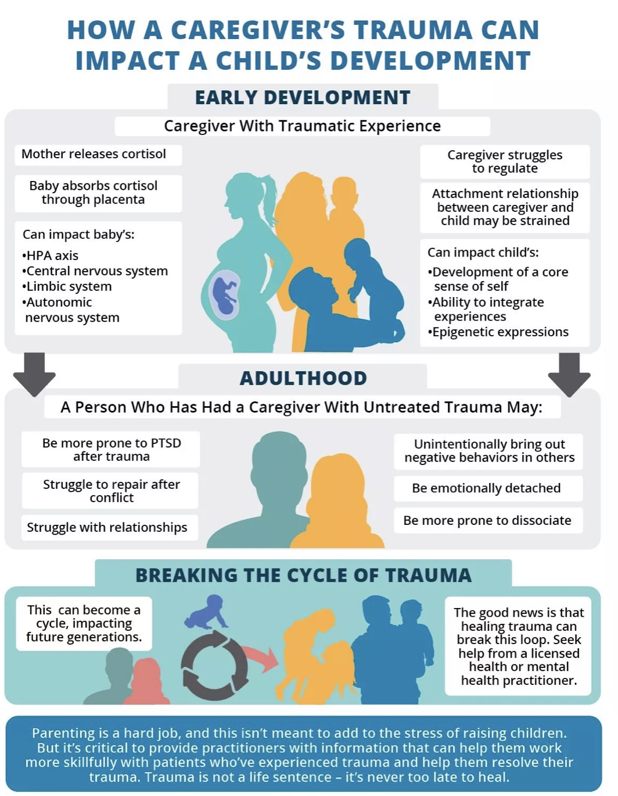
There are several ways in which trauma can be passed from one generation to another
Epigenetically – trauma alters the expression of the parents' genes, and this is passed on to the child
Intra-uterine environment – a mother who has a trauma spectrum disorder has elevated stress hormones which cross the placenta and impact the fetus's development
Attachment issues – parents with trauma spectrum disorders trauma tend to have insecure attachment types. Insecure attachment styles are often passed on from generation to generation
Caregiver difficulties with emotional regulation – emotional regulation is learned via modelling. Parents who struggle with emotional regulation may have difficulty teaching their children to emotionally regulate
Lack of psychosocial resources – Trauma spectrum disorders corelate with economic insecurity and fewer social supports. A child growing up in such an environment will also have fewer psychosocial resources and be more vulnerable to trauma.
People who have trauma spectrum disorders often feel guilty that they may pass some of their struggles on to their children. They often ask what can I do to help my children? The consensus answer seems to be "do what you can to heal and grow yourself that healing and growth will also be passed on to your children."
MULTIGENERATIONAL TRAUMA
Notes:
There are three main ways by which a parent/caregiver's trauma can impact a child's development.
1) epi genetically. We have already discussed this and won't repeat that here.
2) the mother's hormones especially cortisone affect the baby's development in the womb.
3) PTSD and its accompanying emotional dysregulation impact attachment style.
A person who has a caregiver with untreated trauma may therefore be more prone to PTSD after trauma, struggled to repair after interpersonal conflict, struggle with relationships, and be more prone to emotional dysregulation.

Slide 63
SECONDARY STRUCTURAL DISSOCIATION
What is secondary structural dissociation or complex PTSD and how is it different from primary structural dissociation or PTSD?

Slide 64
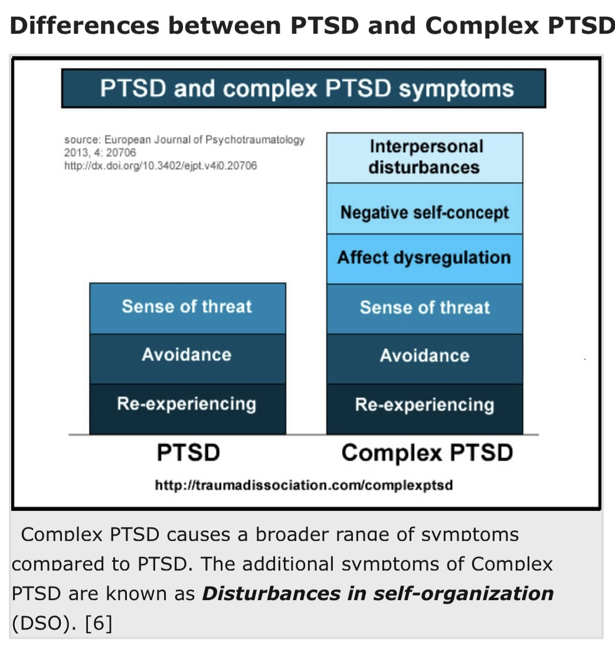
HOW C-PTSD/SECONDARY STRUCTURAL DISSOCIATION MANIFEST ?
Complex PTSD often results from exposure to severe stressors that are 1) repetitive or prolonged 2) in children involve harm or abandonment by caregivers or other ostensibly responsible adults and 3) occur at developmentally vulnerable times in the victim's life.
Like PTSD, people with complex PTSD feel 1) a sense of threat, 2) reexperience the trauma in the form of flashbacks, and 3) avoid potential triggers.
In addition, people with complex PTSD also experience 4) affect dysregulation, 5) negative self-concept, and 6) interpersonal disturbances all of which are not typically present in PTSD.

Slide 65
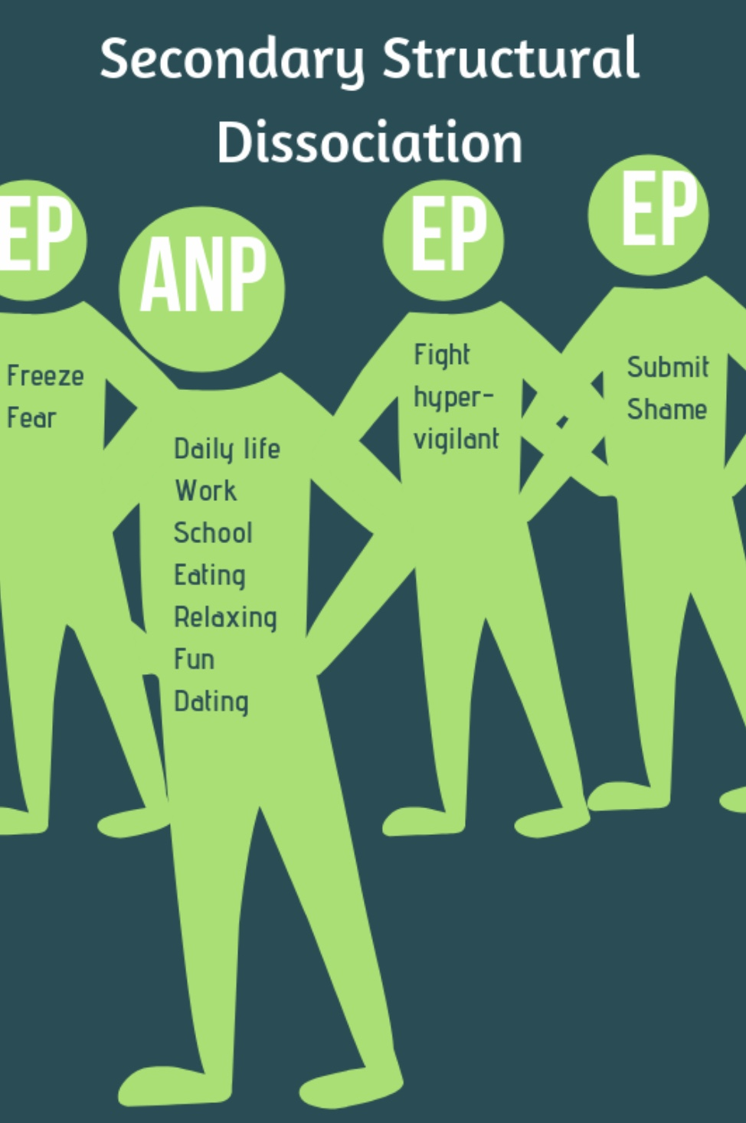
Secondary structural dissociation is a more severe form of dissociation. It is often associated with disorganized attachment, and attachment/developmental trauma.
Children and adults with insecure attachment are more vulnerable to trauma and more likely to experience multiple traumatic events
As with primary structural dissociation/PTSD, in secondary structural dissociation, after traumatic experiences, an apparently normal part (ANP) tries to carry on with normal everyday life.
But, in secondary structural dissociation, because there may have been multiple traumas and/or an increased vulnerability, there are multiple split off emotional parts, (EP’s) each arising from a different trauma and each carrying different implicit memories.
2
4
3
1
A.K.A. COMPLEX PTSD
Notes:
Secondary structural dissociation is also known as complex PTSD. On the spectrum of dissociative disorders, it is more severe than primary structural dissociation or PTSD

Slide 66
These traumas may have happened at different ages and stages of development, and the trauma that gave rise to them may not be a discreet one-time event but ongoing over a significant period. (as in ongoing child or partner abuse)
As we will see when we talk about internal family systems, it’s useful to think of these EP’s as having distinct personalities, ages, ways of thinking, feeling, behaving, and distinct states of activation (fight, flight, freeze, or fawn)
In secondary Structural dissociation, while the person consciously experiences themselves as a single individual, emotionally, they feel they are different people.(Dr. Jekyll and Mr. Hyde)
2
4
3
1
A.K.A. COMPLEX PTSD
Notes:
Secondary structural dissociation is also known as complex PTSD. On the spectrum of dissociative disorders, it is more severe than primary structural dissociation or PTSD

Slide 67
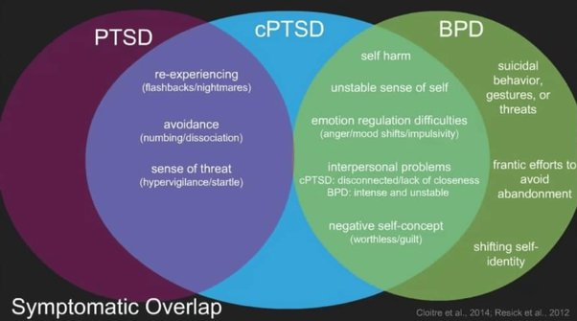
Remember that these are general categories arrived at by consensus of select experts. Each person's experience is unique. Don't get bogged down self diagnosing
While they are distinct concepts, posttraumatic stress disorder, complex posttraumatic stress disorder and borderline personality disorder overlap
PTSD and c PTSD share flashbacks/nightmares, numbing/dissociation and hypervigilance/startle
c PTSD and BPD share self-harm, an unstable sense of self, emotional regulation difficulties, interpersonal problems, and a negative self-concept
BPD Overlaps significantly with disorganized attachment style and features suicidal behavior, frantic efforts to avoid abandonment, and shifting self-identity
SYMPTOM OVERLAP BETWEEN PTSD, C-PTSD, AND Borderline PD
Notes:
Complex PTSD overlaps both with PTSD and borderline personality disorder. Most people with borderline personality disorder have complex PTSD and/or a disorganized attachment style

Slide 68
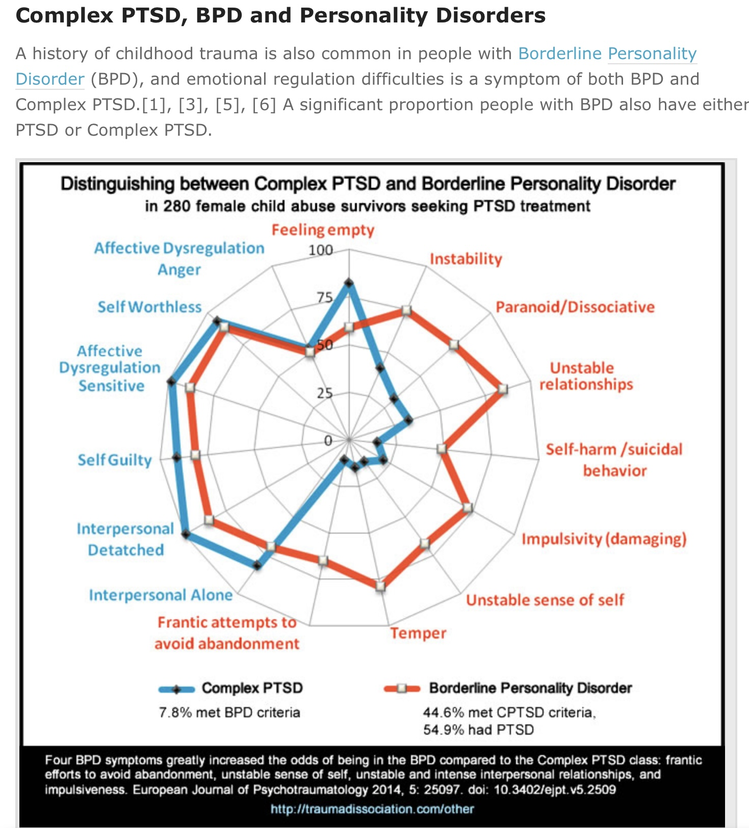
A history of childhood trauma is common but not always present in people diagnosed with BPD.
A history of trauma is always present in people diagnosed with c PTSD.
A person can be diagnosed with both BPD and PTSD or cPTSD. 8% of people diagnosed with cPTSD also met criteria for BPD. 45% of people with BPD met cPTSD criteria. 55% of people diagnosed with BPD also met criteria for PTSD
Most people diagnosed with BPD have a disorganized attachment style
BPD and cPTSD overlap in 1) low self-worth 2) feelings of guilt 3) feeling detached and alone 4) sensitivity to slights 5) feels of anger
The symptoms that are found more frequently in BPD than in c PTSD are: 1) frantic efforts to avoid abandonment 2) unstable sense of self 3) unstable and intense interpersonal relationships and 4) impulsiveness
In my opinion psychiatry is not doing a good job in trying to classify emotional dysregulation. Take all these labels with a huge grain of salt
While there is a lot of interest in these distinctions keep in mind that humans are complex and that psychiatric labels are imperfect, limited, political, evolving ways of trying to understand this complexity
C-PTSD, AND BPD

Slide 69
TERTIARY STRUCTURAL DISSOCIATION
What is tertiary structural dissociation?

Slide 70
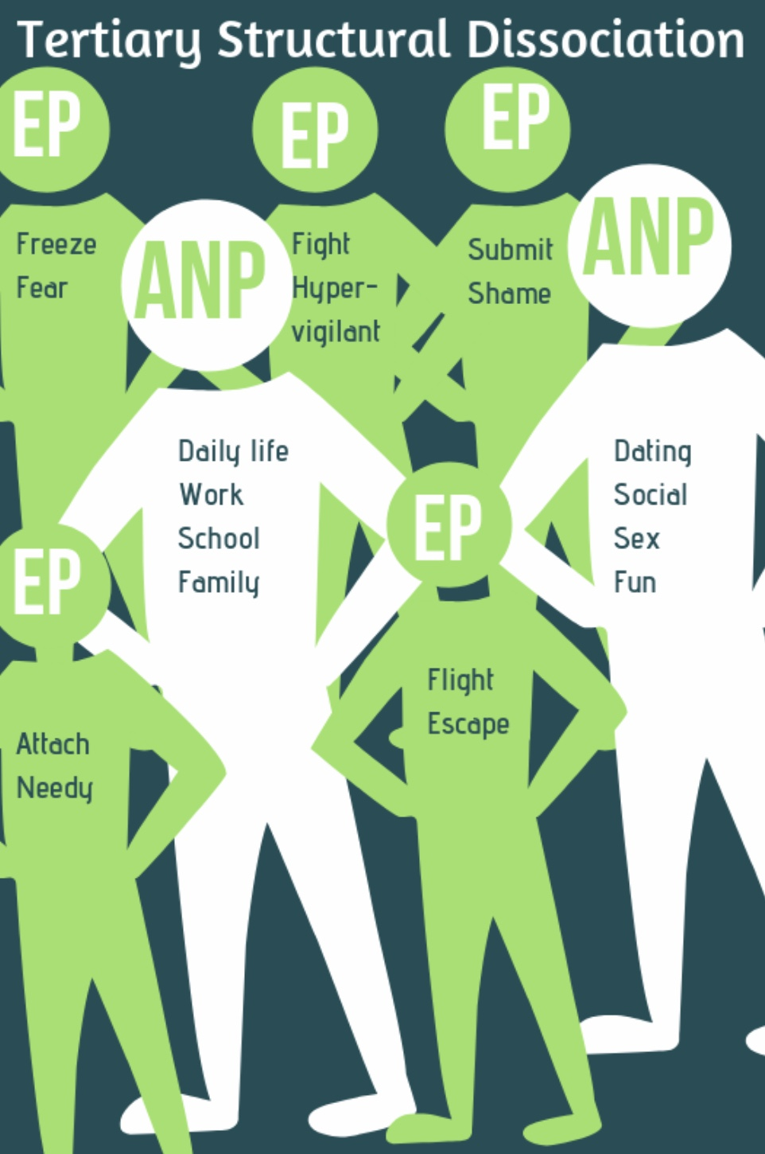
Dissociative identity disorder or tertiary structural dissociation used to be called “multiple personality disorder”. It is the most severe form of dissociation.
According to structural dissociation theory, in tertiary structural dissociation, there is such an imbalance between the severity and duration of the trauma and the person’s coping resources, that the emotional mind’s dissociative coping mechanisms are insufficient to protect the self from the trauma and the apparently normal and conscious self also splits or fragments. This creates two or more conscious mind parts or alters that have distinct personalities and states of activation.
Each “alter” of the apparently normal part ANP ( I and II) may have a function in the overall personality system. Ex. One goes to work, another socializes, others protect the person…
1
3
2
II
I
5
4
A.K.A. Dissociative identity disorder
Notes:
Tertiary structural dissociation is dissociative identity disorder.

Slide 71
In only 5% of people experiencing DID is there blatant switching of parts. DID is difficult to diagnose because in 95% of people behavior changes are subtle.
Dissociative identity disorder is at the frontier of our understanding of the trauma related disorders, and perhaps because of that, is a subject around which there much debate and controversy.
Imaging studies have compared DID individuals to actors and studied alters who are blind while the main personality is not.
While some experts consider all parts present in primary, secondary, and tertiary structural dissociation as being on a dissociative spectrum, others differentiate “ego states” in which parts retain a shared sense of belonging to a person as a whole and are less distinct, autonomous, and amnesic and “dissociative states” in which each part has its own sense of identity with discreet self-representations, autobiographical memory and personal experiences or a sense of I, me, and mine.
1
3
2
II
I
5
4
A.K.A. Dissociative identity disorder
Notes:
Tertiary structural dissociation is dissociative identity disorder.

Slide 72
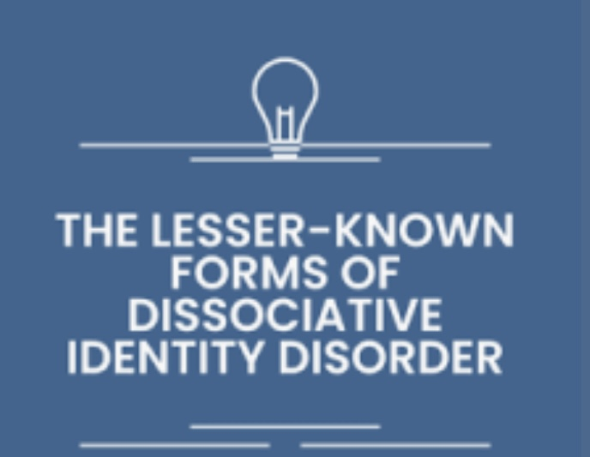
Overt and covert DID refer to different manifestations of DID.
Overt DID, the 5%, is when the presence of different identities is clearly visible to observers. Individuals with overt DID may experience noticeable switches between identities, which can result in changes in behavior, voice, or demeanor that others can observe. People around them usually notice these sudden changes, making overt DID more recognizable.
Covert DID, the 95%, on the other hand, is less apparent to others. The identity switches may be more subtle, and individuals might not outwardly show distinct changes when transitioning between identities. Instead, they might feel these shifts internally, experiencing changes in thoughts, emotions, or attitudes. Because of these intricacies, covert DID can be more challenging to diagnose and may often remain hidden from those around the individual.
OVERT AND COVERT DID

Slide 73
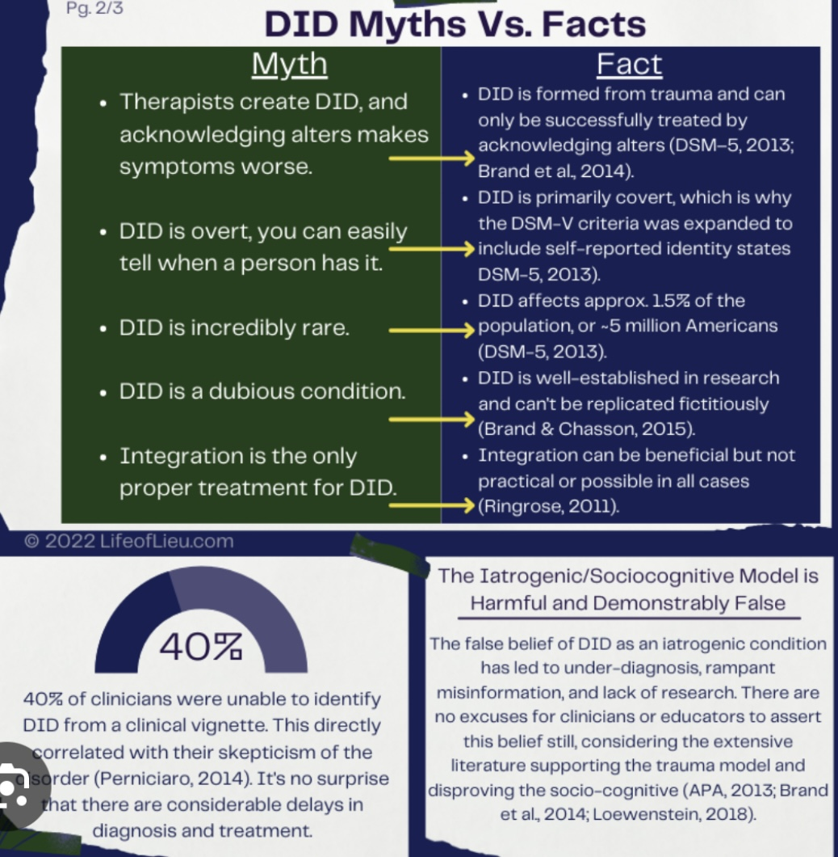
MISDIAGNOSING COVERT DID
Covert Dissociative Identity Disorder (DID) can sometimes be misdiagnosed as other mental health conditions. Because the symptoms of covert DID are less apparent and more subtle than overt DID, it can lead clinicians to consider other diagnoses. Common misdiagnoses for covert DID include:
Major Depressive Disorder: Due to mood fluctuations and feelings of hopelessness that can accompany DID.
Bipolar Disorder: Because of the shifts in mood and behavior, which might resemble the manic and depressive episodes in bipolar disorder.
Schizophrenia: Some individuals with DID may report hearing voices (from their alternate identities), which can be confused with the auditory hallucinations seen in schizophrenia.
Borderline Personality Disorder: Overlaps can occur with emotional instability and identity confusion, common in both conditions.
Post-Traumatic Stress Disorder (PTSD): Since DID often develops as a response to severe trauma, the two conditions can share symptoms like flashbacks and dissociation.

Slide 74
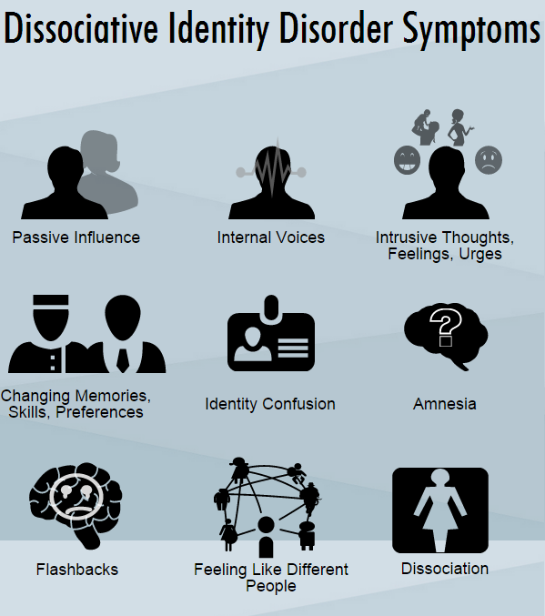
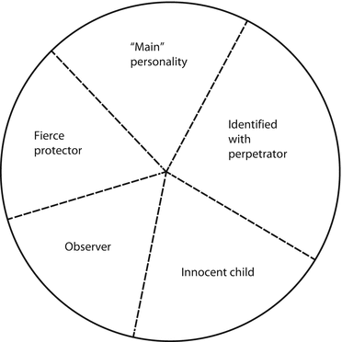
COMMON DID SYMPTOMS
COMMON DID ALTERS
Common types of alters in dissociative identity disorder include: the host, child alters, internal self-helper, opposite sex alters, persecutor, protector, sexual alters, suicidal altar, teen alter.
Less common alters include animal alter, baby and infant, caretaker, demonic, military or political, non- human, robot or machinelike, and supernatural alters
Notes:
In dissociative identity disorder/tertiary structural dissociation the emotional parts become "alters". Just as there are common emotional parts, there are common alters.
People with dissociative identity disorder present with a number of characteristic symptoms.

Slide 75
NEODISSOCIATION VS. STRUCTURAL DISSOCIATION THEORIES

Slide 76
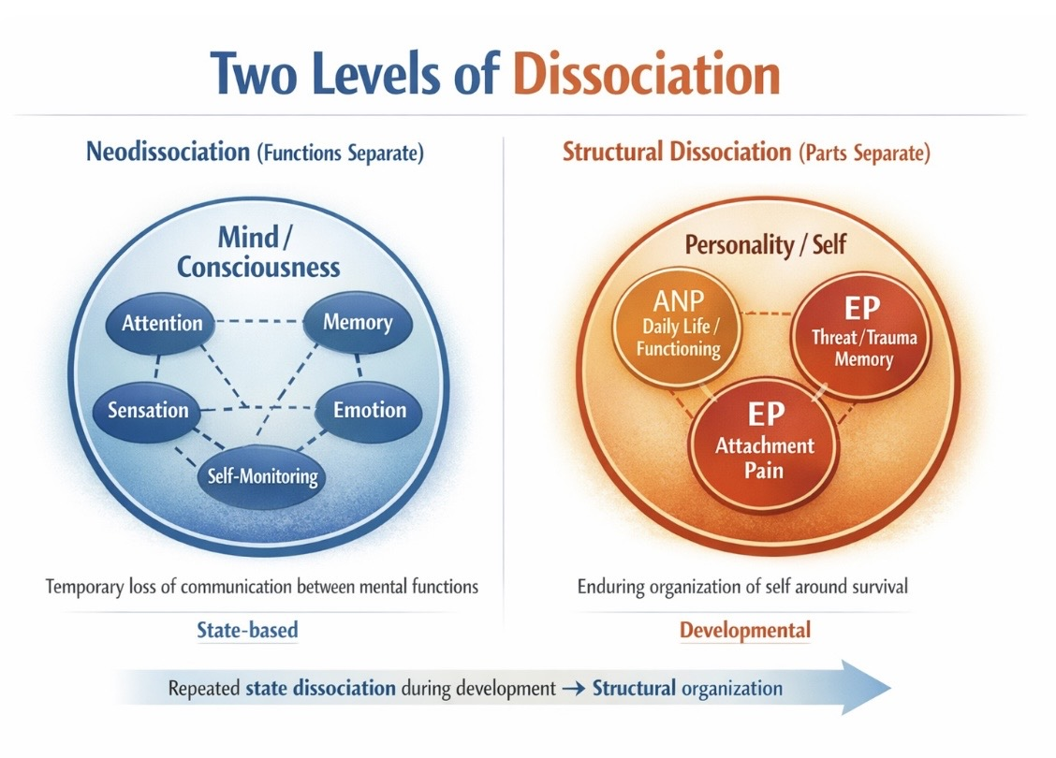

Slide 77
TWO WAYS OF UNDERSTANDING DISSOCIATION
Psychiatry uses two complementary models to describe dissociation.
Neodissociation theory sees dissociation as a temporary disconnection between mental functions. Awareness, memory, sensation, emotion can uncouple. It sees this as temporary and reversible. The mind’s semi-independent systems under stress stop communicating well resulting in numbing or shutdown, autopilot functioning, depersonalization / derealization or dissociative amnesia. Dissociation is a capacity, not a disorder and is often adaptive in the short term. Treatment focuses on restoring connection, awareness, and regulation
Structural dissociation theory sees dissociation as a developmental organization of the personality where different self-states carry different survival roles. It sees this as long-term and integration requires work. Chronic trauma disrupts integration during development. The personality organizes into parts with different jobs ANPs manage daily life and avoid trauma. EPs carry fear, pain, and survival responses. Healing requires insight, safety, pacing, and cooperation between parts. Integration is gradual, not forced.
Neodissociation explains how dissociation happens. Structural dissociation explains what the self becomes when dissociation repeatedly happens during development.
Neodissociation helps you understand shutdown, numbing, autopilot and the sense that “I wasn’t really there”. Structural dissociation helps you understand inner conflicts, parts that sabotage or protect you and rapid shifts in identity, emotion, or behavior.
.

Slide 78
Where do you see yourself on this dissociation map?

Slide 79

ZOOM POLL
Please launch poll (dissociation symptom scale)
Then share zoom results

Slide 80
HOW TO THINK ABOUT YOUR DSS-B SCORE
Remember that dissociation is not a disorder. It’s a capacity of the nervous system, a way the system creates distance, numbness, or automatic functioning when things feel overwhelming, unsafe, or too much to process all at once.
This scale helps us notice how often our system has been using this strategy lately.
0–4: Minimal dissociative symptoms: This suggests our nervous system has mostly been able to stay present and integrated over the past week. That doesn’t mean we never dissociate, everyone does sometimes, but it hasn’t been a prominent coping strategy recently.
5–12: Mild to moderate dissociation: This range is very common, especially during stress, fatigue, illness, emotional load, or relational strain. It suggests our system occasionally uses spacing out, emotional numbing, or autopilot to manage demands. This isn’t a problem to fix, just a pattern to notice with curiosity.
13 and above: Elevated dissociation: This suggests dissociation has been a frequent or relied-upon strategy recently. Often this reflects a nervous system that learned, at some earlier point, that distance was the safest or most efficient way to cope. This doesn’t mean something is “wrong,” but it may be worth gentle exploration, especially around safety, overwhelm, boundaries, and support.
Note that scores can change week to week depending on stress, sleep, health, and life events. Please don’t use these scores to label yourself, instead think of them as a way your nervous system protects itself.

Slide 81
CONTROVERSIES IN THE DIAGNOSIS OF DISSOCIATIVE IDENTITY DISORDER
Is the diagnosis of dissociative identity disorder controversial ?

Slide 82
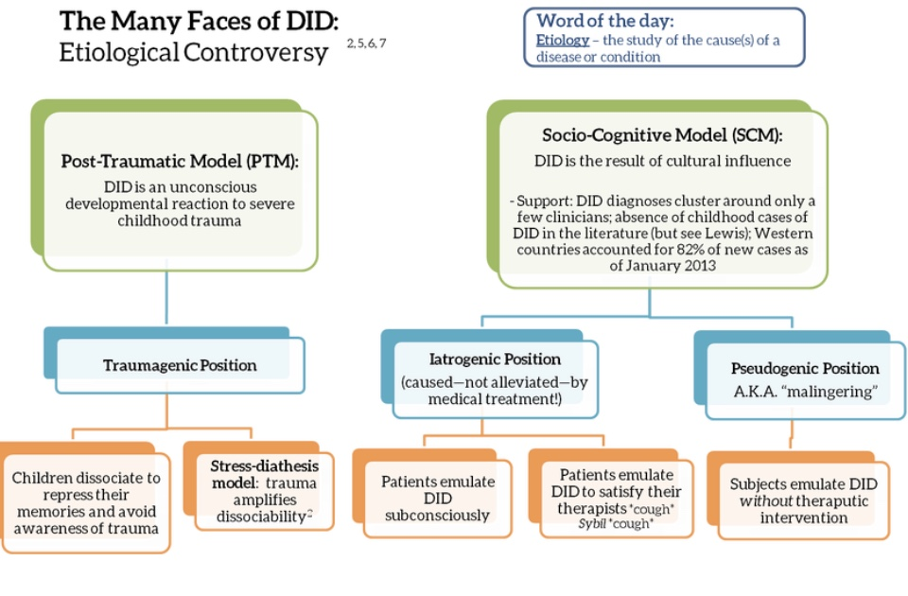
There is some controversy surrounding DID and its causes. In the simple course we follow and have presented the 1) post-traumatic model of DID. There is however also the…
2) Socio-cognitive model which proposes two alternative explanations for DID A) the iatrogenic- which suggests that DID is in part induced by therapists, and B) the pseudogenic position which suggests that some individuals feign DID for “secondary” gain. Many experts in the field now hold that these models are compatible. Click link which explores this controversy
Notes:
Yes there is. In this course we support the posttraumatic model described on the left hand of the slide.
The socio-cognitive model is however supported by many authorities in the field. It suggests to other possible explanations for dissociative identity disorder: iatrogenesis and pseudo-genesis.

Slide 83
PART 2 HOW HEALING HAPPENS

Slide 84
TREATMENT OF THE TRAUMA SPECTRUM DISORDERS
If PTSD, complex PTSD, and DID or primary, secondary and tertiary dissociation are all on the dissociative spectrum, are they treated following similar principles?

Slide 85
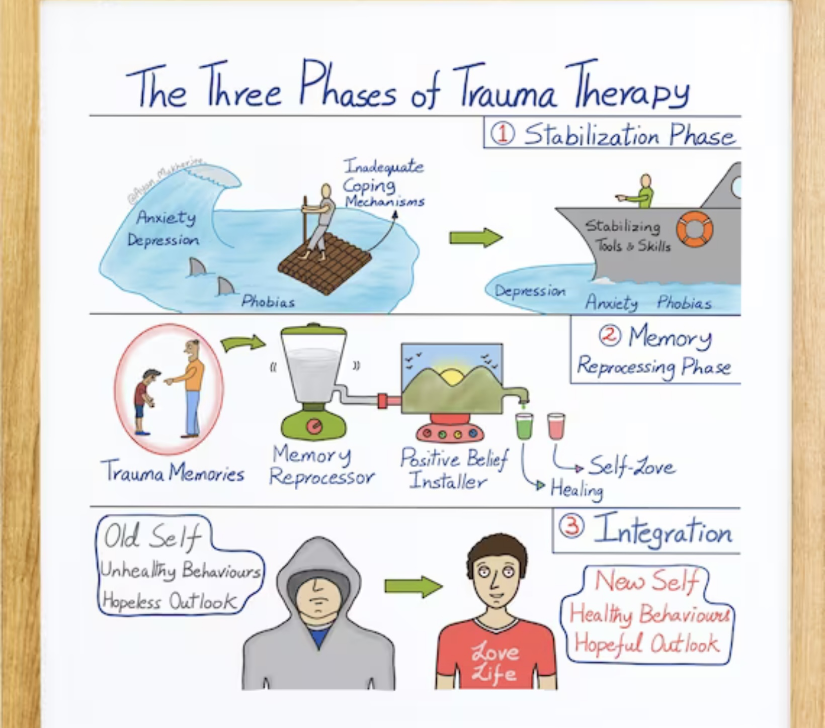
Treatment of TRAUMA spectrum disorders
Today there is more scientific knowledge, public awareness, and peer initiatives in the fields of trauma and its treatment than there’s ever been, but there is also a great lack of well-trained trauma treatment providers, programs and resources.
We are in a situation akin to that which the treatment of acute lymphocytic leukemia, the most common type of childhood cancer, was in in the 1970’s when it had a 90% mortality rate. Today the mortality rate of ALL has dropped to 10%. This is not because we have any new treatments. We are still using all the same ones as we did 50 years ago. What has changed is that we’re much better at using those treatments in a uniform systematic way.
Similarly with dissociative/trauma spectrum disorders, if we were better at using the treatments we’ve known about for 100 years effectively, we’d have much better treatment outcomes.
The body keeps the score by Bessel van der Kolk describes several evidence based effective treatments for the trauma spectrum disorders

Slide 86
Treatment of TRAUMA spectrum disorders
In this segment of today’s session, we will explore the three phases of treatment for dissociative trauma spectrum disorders which are the common denominator of all trauma treatment approaches. Keep in mind that treatment needs, of course, to be individualized for each person. For instance, people with single event PTSD who have good resources may not need to spend a lot of time in phase I of treatment and may be able to proceed directly to phase II.
On the other hand, people who have fewer “resources” may need to spend considerable time in phase I stabilization whereas those with significant psychosocial developmental issues may need to spend considerable time in phase III
We will also explore how specific treatment issues arise in each of the three types of structural dissociation. For example, shame is an important consideration in secondary structural dissociation/complex PTSD. We’ll explore why.
In week 23 we’ll talk about the four pillars of trauma therapy which are psychoeducation, mindfulness, body movement and trauma informed therapies.
Soon we will start discussing Wise mind remediation and Internal family systems which are both phase II trauma processing approaches.

Slide 87
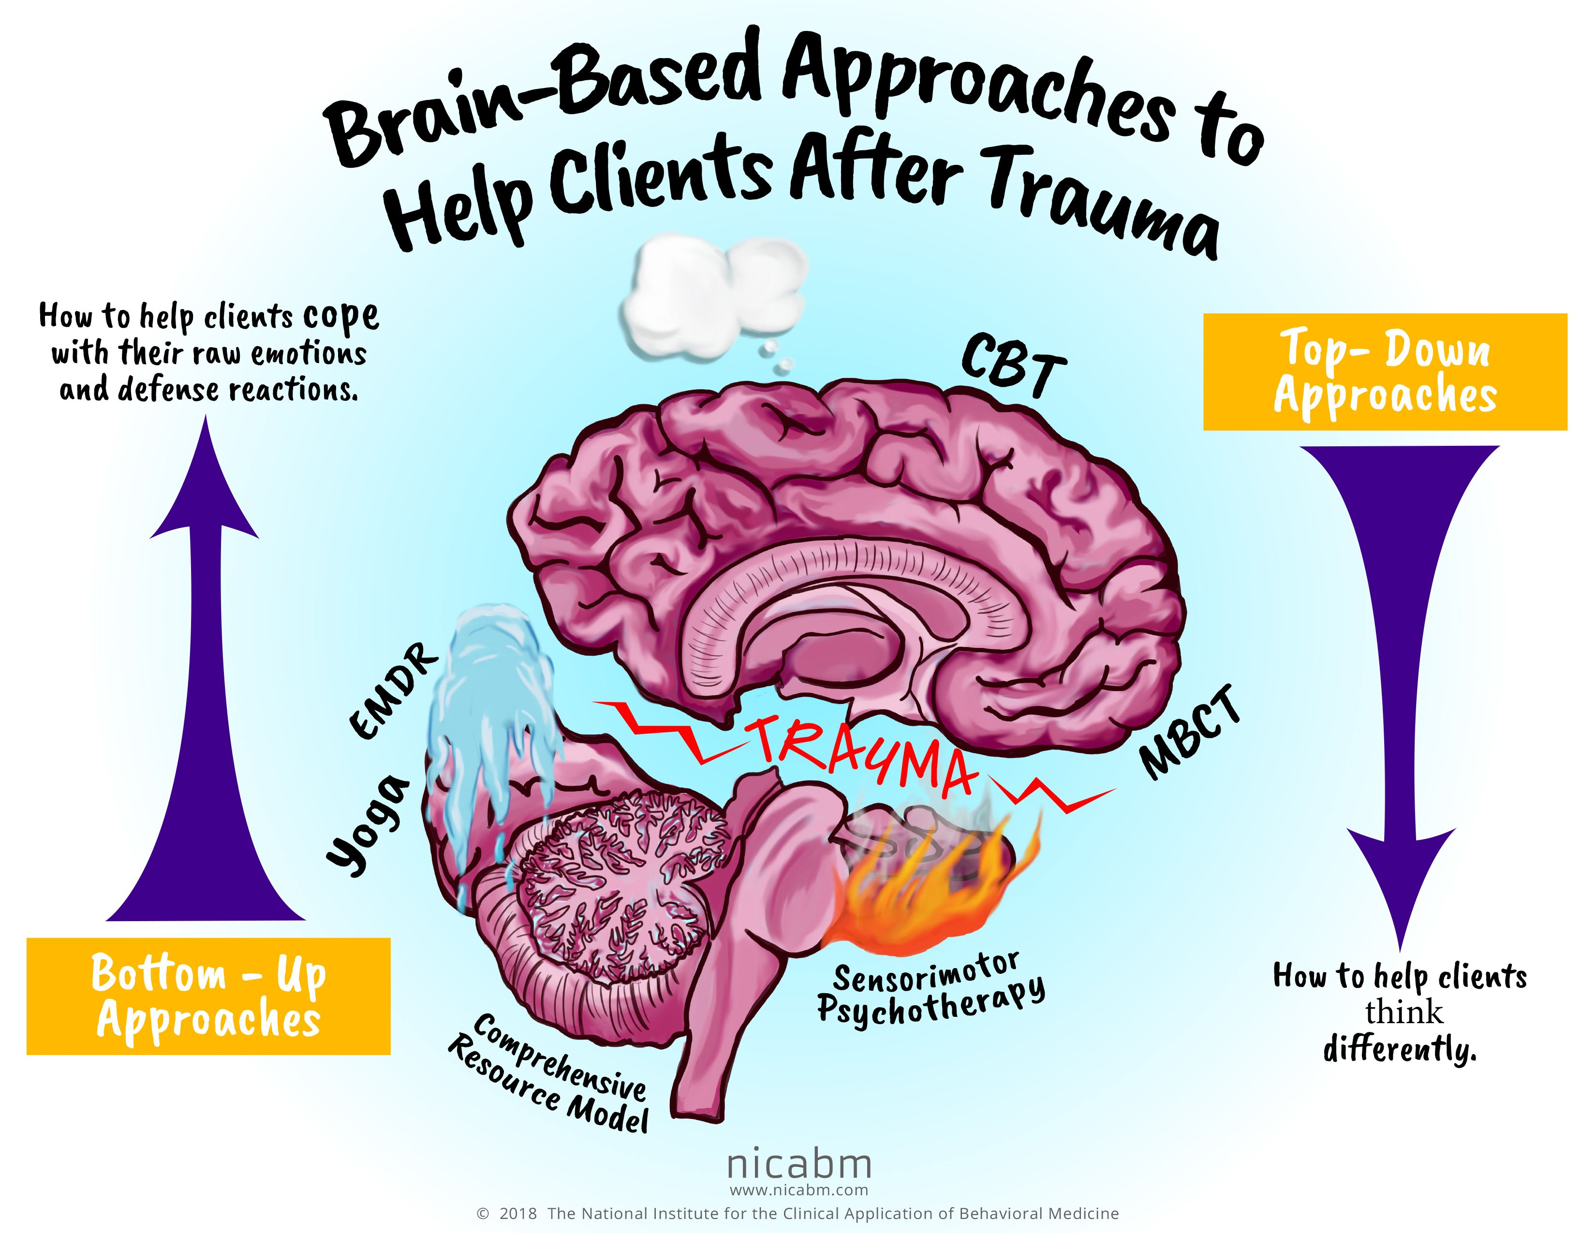

BOTTOM UP VS. TOP-DOWN APPROACHES
Trauma treatment approaches are commonly grouped into “top down” or “bottom up” categories. “Top” refers to the rational brain, thinking, or cognition, “bottom” to the body or somatic information center. Trauma affects all three information processing centers, but specific treatment approaches tend to target primarily the body or thinking.
Top-down approaches help people think differently, bottom-up help people cope with their sensations, emotions, and action urges.
For example, CBT and MBCT are top-down approaches, Yoga, EMDR, and the sensorimotor therapies bottom up.
Notes:
The treatment approaches to, have been divided into bottom-up, those approaches that target the body and secondarily affect thinking. And top-down, those approaches that target thinking and secondarily affect the body. The ideal trauma treatment incorporates elements of both.
Bessel van der Kolk has written the classic text on the trauma spectrum disorders and their treatment.

Slide 88
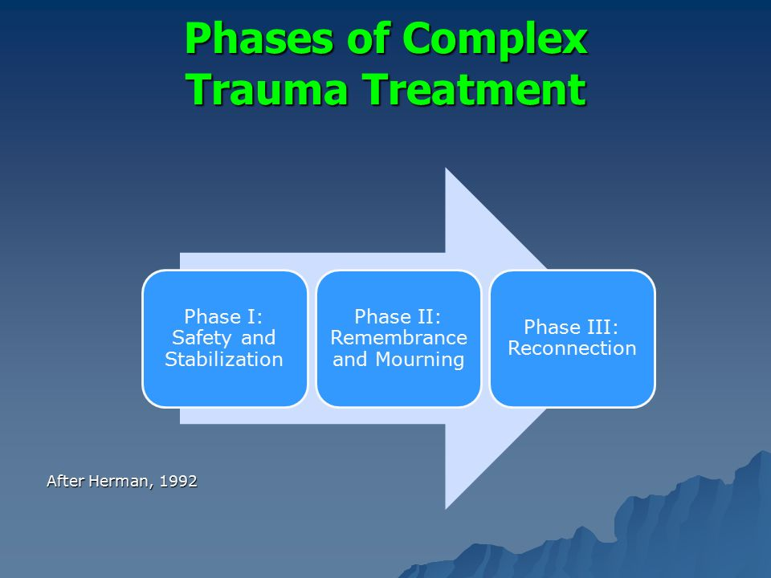
General Principles of Therapy of dissociative and trauma spectrum disorders
The foundations underlying the treatment approaches for the dissociative and trauma spectrum disorders have not changed much since the time of Pierre Janet.
There are three phases (or stages) to the active stage treatment of trauma spectrum dissociative disorders be they primary, secondary, or tertiary dissociation.
Phase 1 deals with the person’s safety and aims to stabilize them. DBT does this.
phase 2 deals with remembrance and mourning of past trauma. IFS does this.
phase 3 deals with reconnecting with the world of other people, nature, the universe and a meaningful occupation. The goals diary card procedure addresses this.

Slide 89
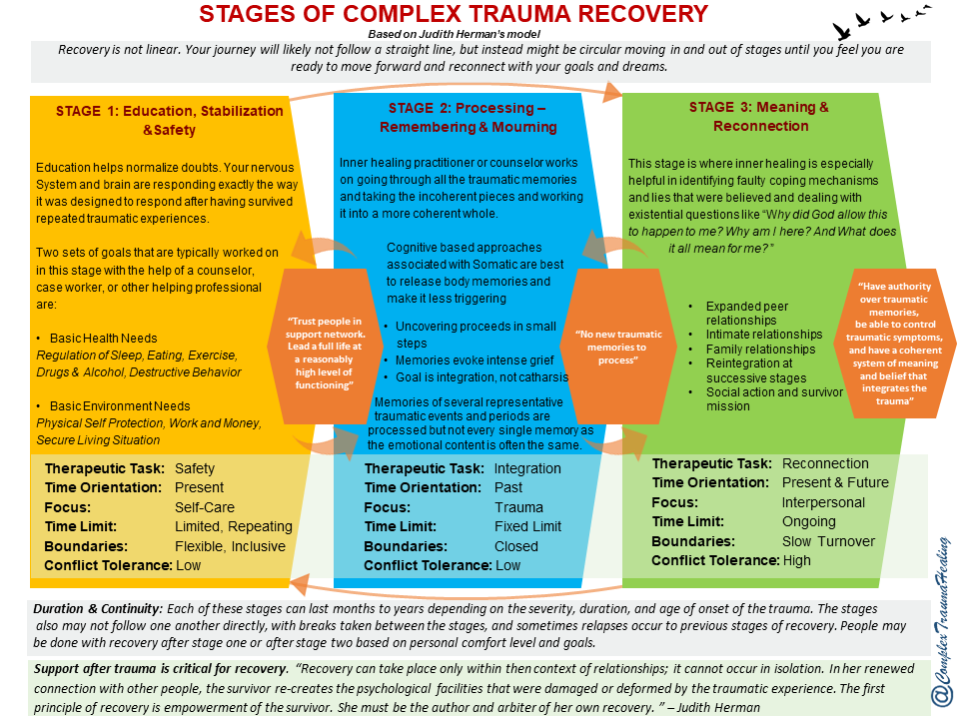
Notes:
This slide describes in greater detail the work to be done at each of the stages of trauma recovery. In the following slides we will consider each of the stages.

Slide 90
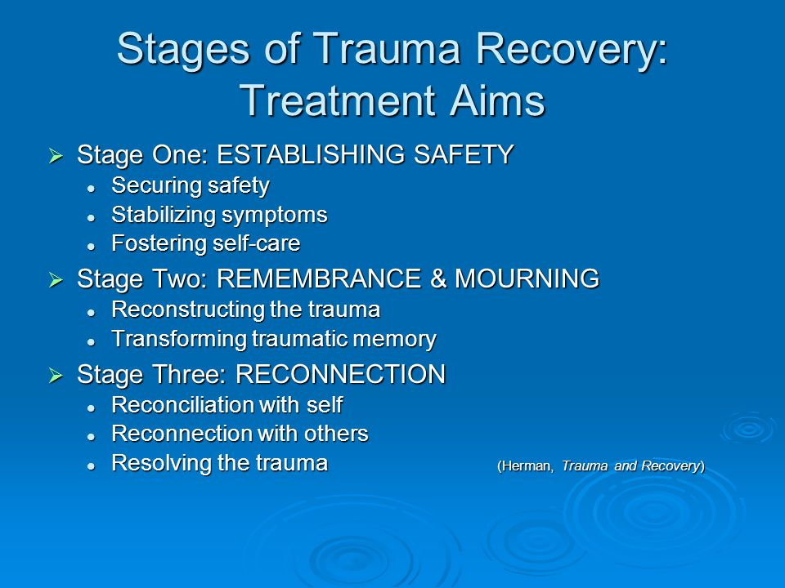
THE GOALS OF EACH OF THE STAGES OF TREATMENT
Notes:
Each of the stages of treatment has a different goal.

Slide 91
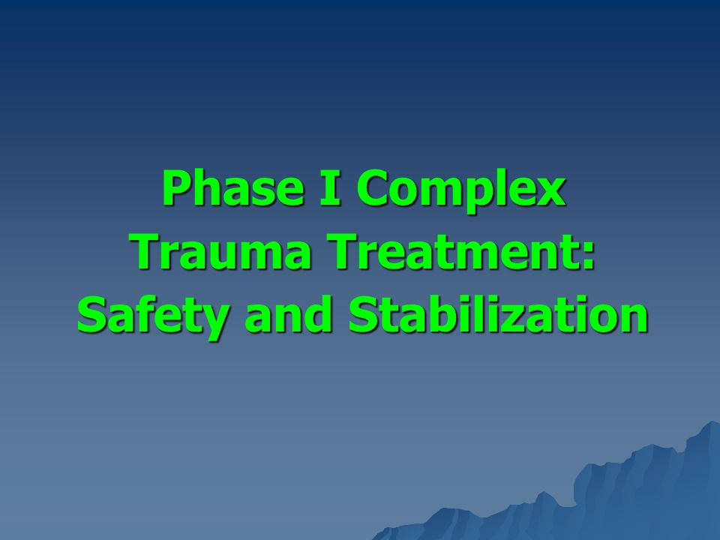
Stage I in the healing of trauma spectrum disorders involves:
1) developing a personal roadmap for the healing process.
2) developing realistic and attainable goals and setting up a plan of action for achieving those goals in a practical timeframe
3) establishing a sense of stability and safety in interpersonal relationships, one's own body, and all other areas of life
4) learning how to regulate emotions, and how to manage psychological and behavioral symptoms that may contribute to a sense of instability and overall personal suffering
5) beginning to recognize and tap into resources and inner strength.
6) developing crucial coping mechanisms and life skills, geared towards effectively managing painful experiences and regulating emotional, mental, and physical responses.

Slide 92
Practically, Stage I stabilization goals include reduction and elimination of drug and alcohol abuse, promotion of good health, safe housing, adequate income, adequate transportation and setting and keeping a healthy schedule.
The main goals of stage I are developing a sense of personal safety, cultivating a healthy self-care routine and learning to regulate emotions and behaviors appropriately.
Once these basic necessities and skills become fully integrated into our lives, we will be able to do the stage II working through painful memories with far less mental and emotional repercussions. It is, however, not always necessary for everyone to do the stage II work of processing traumatic memories.

Slide 93
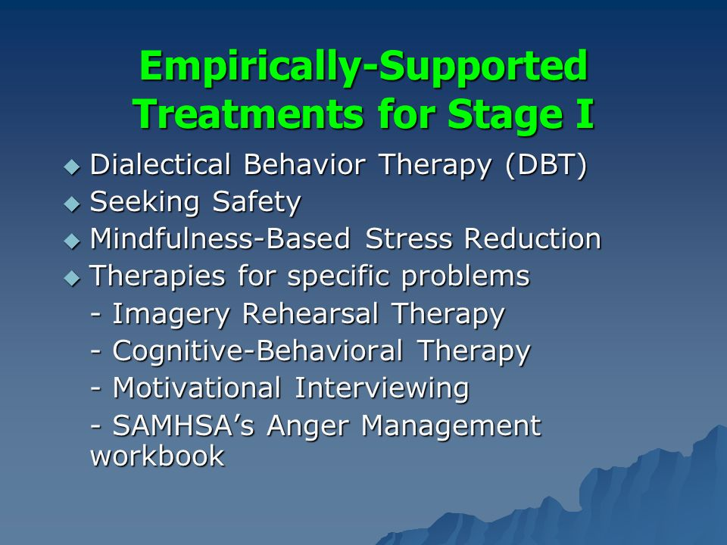
Phase I treatment (stabilization) can be lengthy in people who have prominent dissociative features.
When people start working on phase II or processing trauma, which can trigger dysregulation, they need phase I stabilization skills to pendulate back to the window of tolerance.
Stabilization skills include:
1) learning to observe somatic sensations. This is a somatic experiencing technique
2) developing and installing “resources”. This is done in approaches such as EMDR through resourcing which refers to identifying and instilling coping resources that help us to deal with difficult situations. It is also part of DBT skills.
3) developing spiritual resources
4) building social supports
5) engaging in pleasant activities
6) healing the brain using neurofeedback
Empirically supported stage I treatments include DBT, mindfulness-based stress reduction, cognitive behavioral therapy, imagery rehearsal therapy, and motivational interviewing.

Slide 94
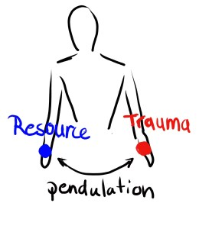
The importance of stage I
“resources” FOR STAGE II work
In trauma therapy a "resource" is anything that helps the therapeutic process. Resources can be supportive friends, therapists, therapy animals, learnt skills etc. Resources help bring people back to the window of tolerance.
When processing trauma, it is critical that the person stay in the window of tolerance
All trauma processing strategies involve some kind of imaginal, real life, or virtual exposure to implicit and/or explicit traumatic memories with pendulation to resources when the person is leaving the therapeutic window. Thus, pendulation between trauma and resources.
“Dual focus”, or the shifting of focus between trauma and resources, is the common factor of many phase 2 approaches including EMDR.
This is why phase I work which fosters resources is so important before embarking on processing trauma
If you try to do phase II work but don’t have resources to help bring you back to the window of tolerance, exploration of dissociated traumatic memories will only further traumatize you.

Slide 95
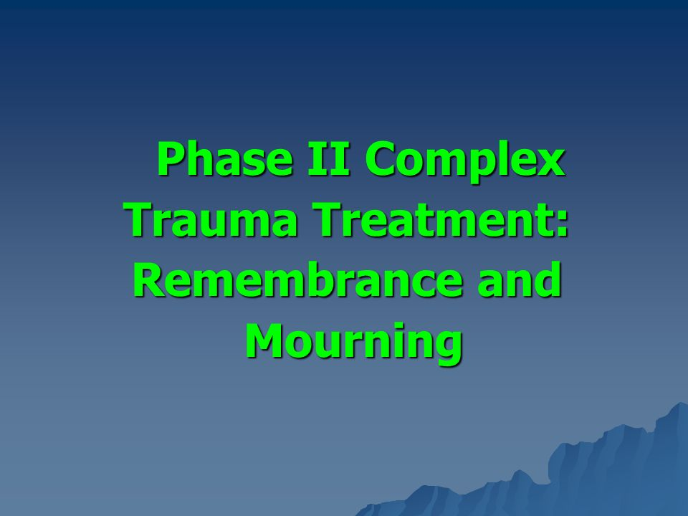
Stage II of trauma recovery is frequently referred to as "remembrance and mourning". Once an individual has developed a strong and functional set of coping skills and feels reasonably safe and secure in their surroundings, it becomes possible to address long buried memories.
The main work the second stage of trauma recovery involves:
1)discussing and evaluating painful and traumatic memories with the intention of restructuring the role they play in people’s lives.
2) Working through trauma -related grief brought about by unwanted or abusive experiences, and the impact they had and continue to have on people's lives.
3) mourning the loss of good experiences that have not yet occurred, or did not have the chance to occur, because of persistent, trauma -related symptoms.

Slide 96
4) discussing painful memories is not always necessary to achieve the personal goals established in the first stage of trauma recovery. Remember stages will vary depending on personal history and personality. Some people may find that memories that were once perceived as too painful to examine are no longer causing any grief or inner turmoil.
5) if memories are still disruptive and have been found to continuously pose a threat to long-term recovery from related issues, there are several "memory processing" methods that can be employed during this stage of recovery such as EMDR or sensorimotor therapies.

Slide 97
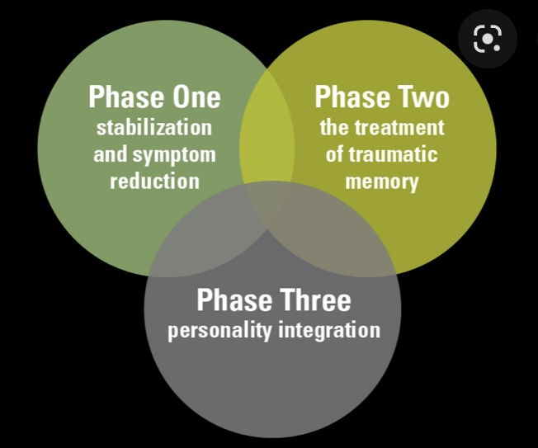
STAGE III WORK
Stage III the third and final stage of trauma recovery focuses largely on reconnecting with people, personally meaningful activities, and all other aspects of a meaningful, fulfilling and healthy life.
In this stage, we need to develop a new sense of self. Traumatic experiences will no longer play a defining role in our lives, and we will be mentally and emotionally set free from the painful and limiting chains of the past. Steps toward self-actualization and empowerment will be taken, and the human spirit, in all its awe-inspiring resilience, will begin truly and thoroughly recovering from the devastating effects of traumatic experiences.

Slide 98
STAGE III WORK
It is important to keep in mind that recovery is a highly individualized process, and it will look quite different for every individual. It is common for those who have suffered trauma to want to feel better as quickly as possible. However, recovering from trauma is a process that requires consistency, commitment, and self compassion.
Recovering from trauma does not mean we will be completely free of intrusive thoughts or feelings, rather, we will reclaim our life, love, and authentic self.

Slide 99
Three Phases of Treatment
Stabilize
Process
Reconnect

Slide 100
TREATMENT OF THE TRAUMA SPECTRUM DISORDERS
The previous slides described the general type of work to be done at each of the stages of treatment. Can you tell us more about the specific therapeutic modalities that are offered by therapists ?

Slide 101
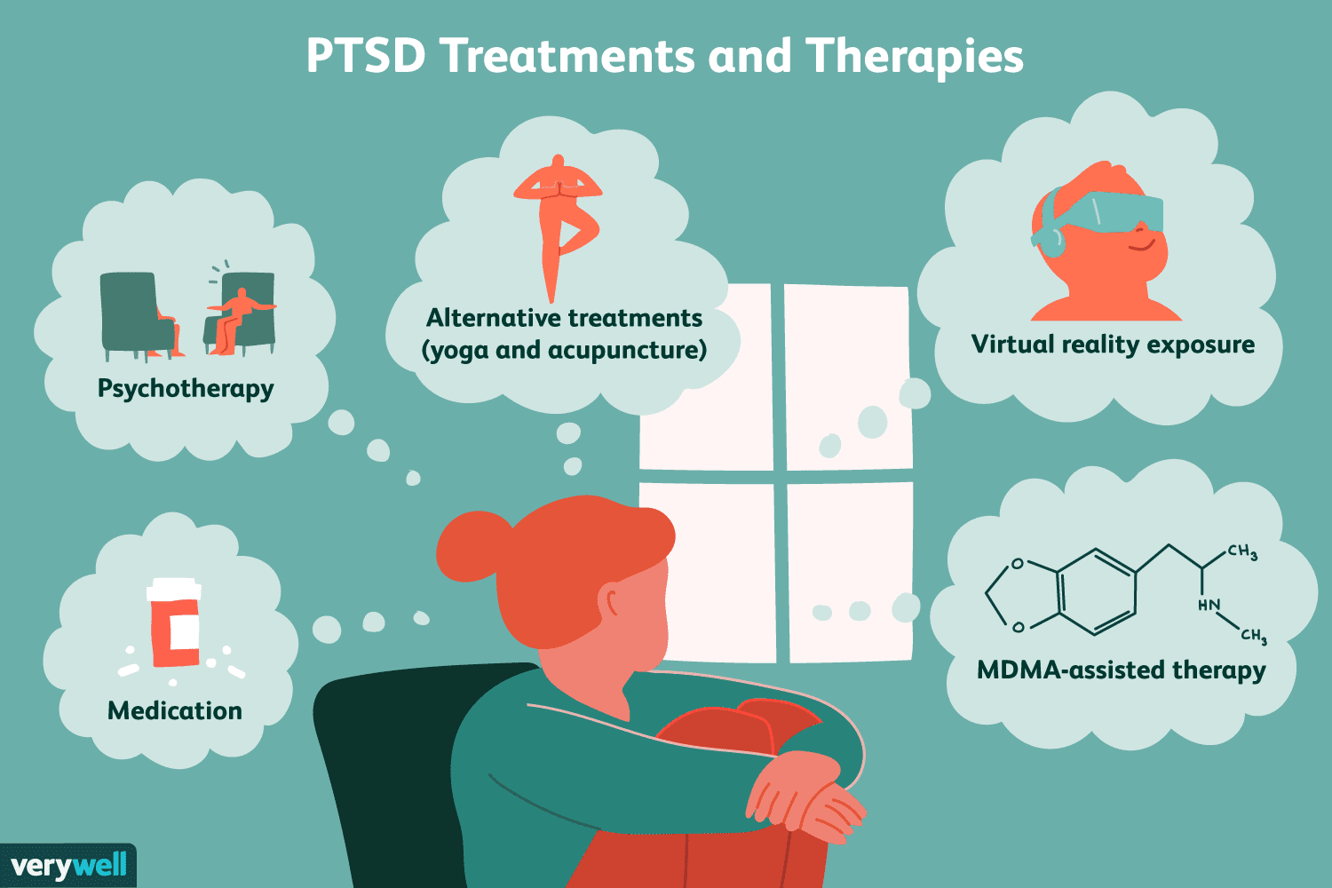
SPECIFIC TRAUMATIC SPECTRUM TREATMENTS
Notes:
Several different approaches have been used to treat trauma spectrum disorders

Slide 102
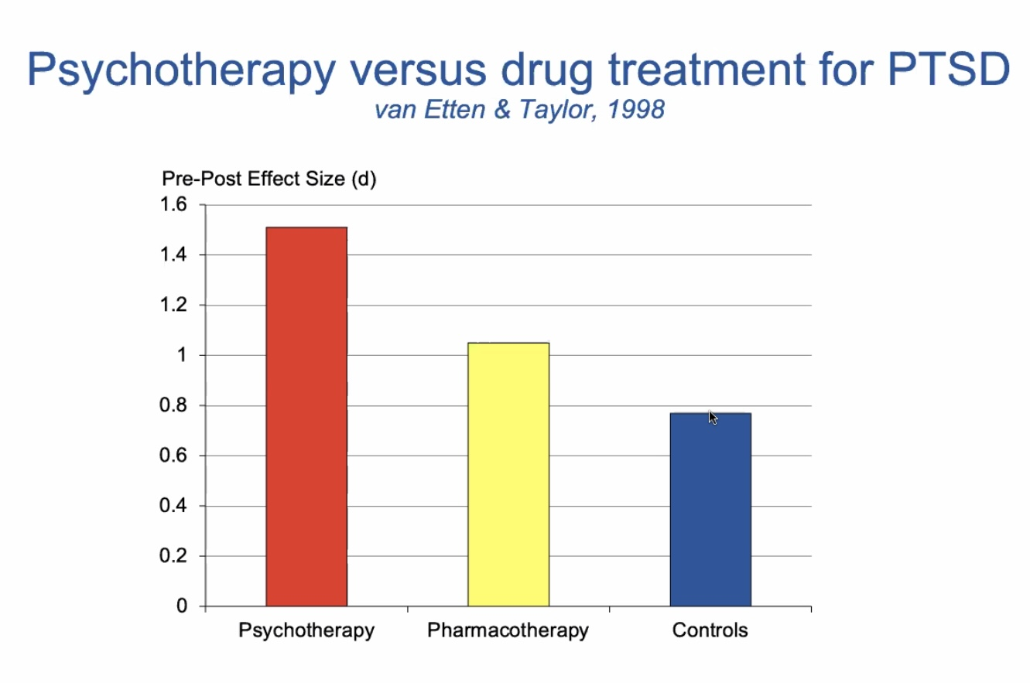
Notes:
The higher the bar on this graph the more effective the treatment.

Slide 103
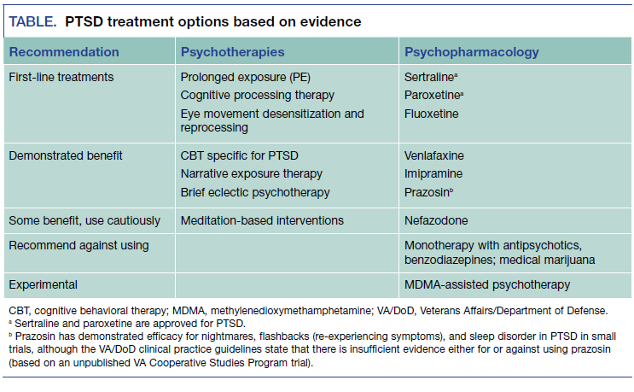
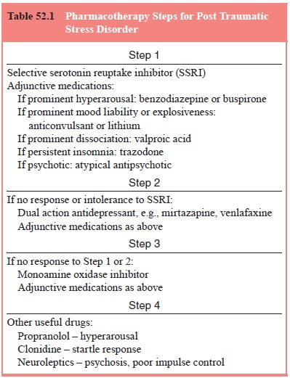
Rx OF PTSD
Notes:
This slide lists psychotherapies and psychopharmacology that has been found helpful in the treatment of ptsd.

Slide 104
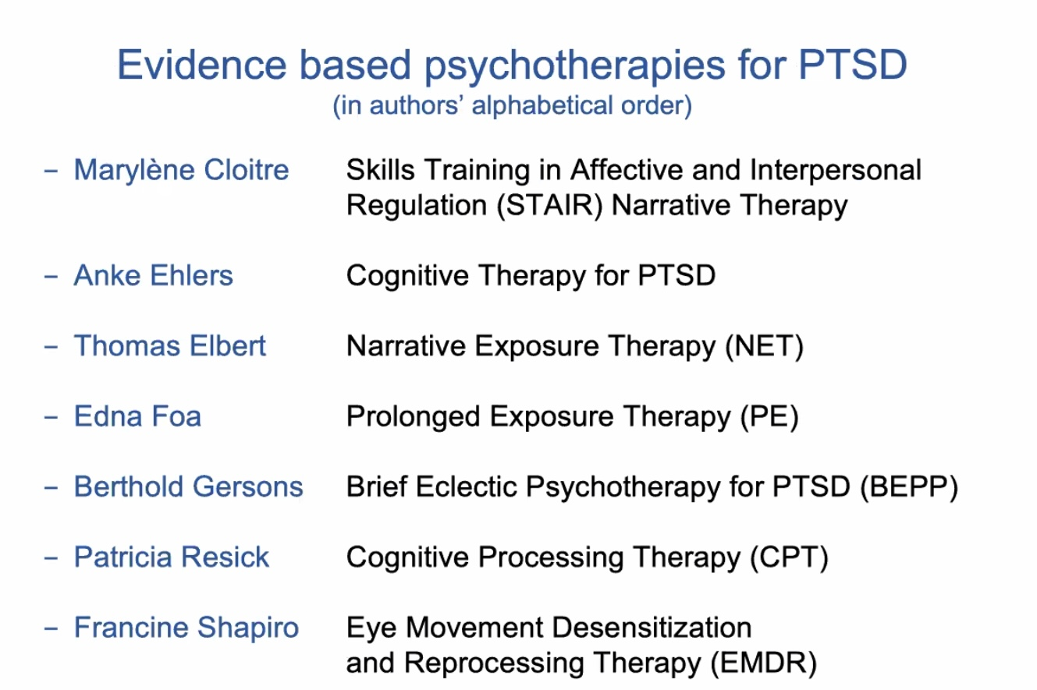
Notes:
This slide lists the models for which there is evidence in the treatment of the traumatic spectrum disorders. The slides following this one describe each model in slightly greater length.

Slide 105
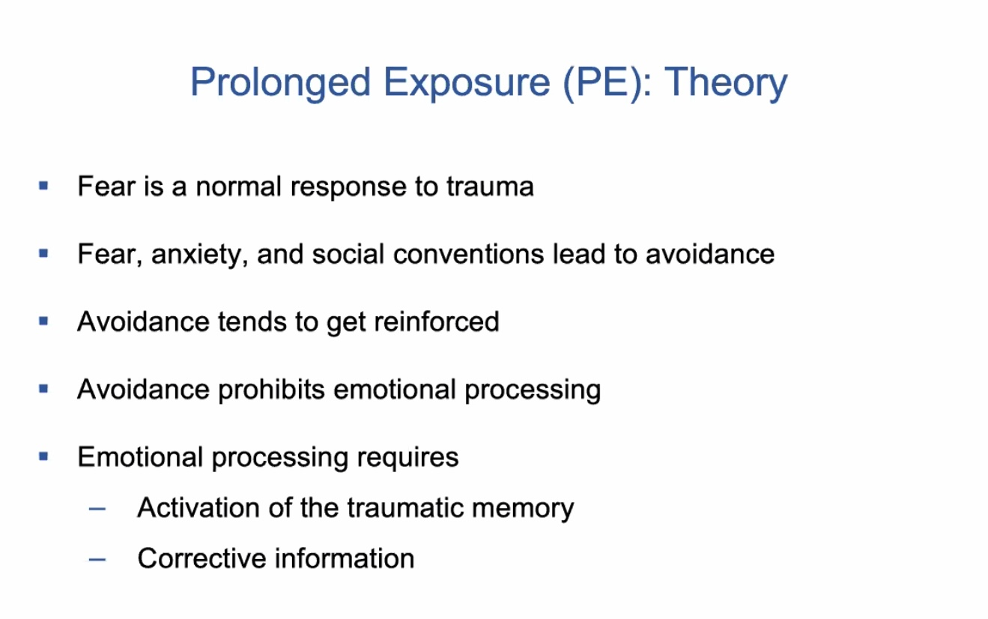

Slide 106
PROLONGED EXPOSURE (PE) THERAPY
PE is a well-established, evidence-based treatment for post-traumatic stress disorder (PTSD) that helps people recover by systematically confronting trauma-related memories and avoided situations in a safe, therapeutic way.
PE’s Core idea is that PTSD persists in part because traumatic memories and reminders are avoided. Avoidance reduces distress short-term but prevents emotional processing and keeps fear responses alive. PE works by helping the nervous system relearn that these memories and cues are not dangerous in the present.
PE involves:
1. Psychoeducation: Clients learn how PTSD works and why avoidance maintains symptoms.
Imaginal exposure: The person repeatedly revisits and narrates the traumatic memory in session, in detail and in the present tense, allowing fear, grief, or shame to rise and naturally settle.
In-vivo exposure: Between sessions, clients gradually approach safe but avoided situations (e.g., driving, crowds, certain places), using a planned hierarchy.
Processing: After exposure, therapist and client reflect on what was learned—often correcting beliefs such as “I can’t tolerate this” or “I’m still in danger.”
Mechanisms of change: Habituation and inhibitory learning (fear diminishes without avoidance). Increased distress tolerance. Updating trauma-related beliefs about safety, control, and self-efficacy
Format: Typically, 8–15 weekly sessions. Highly structured and collaborative. Requires active engagement and homework
Strengths: One of the most empirically supported PTSD treatments. Especially effective for fear-based trauma symptoms
Limitations / cautions: Can feel emotionally demanding early on. Requires careful pacing for complex PTSD, dissociation, or unstable safety

Slide 107
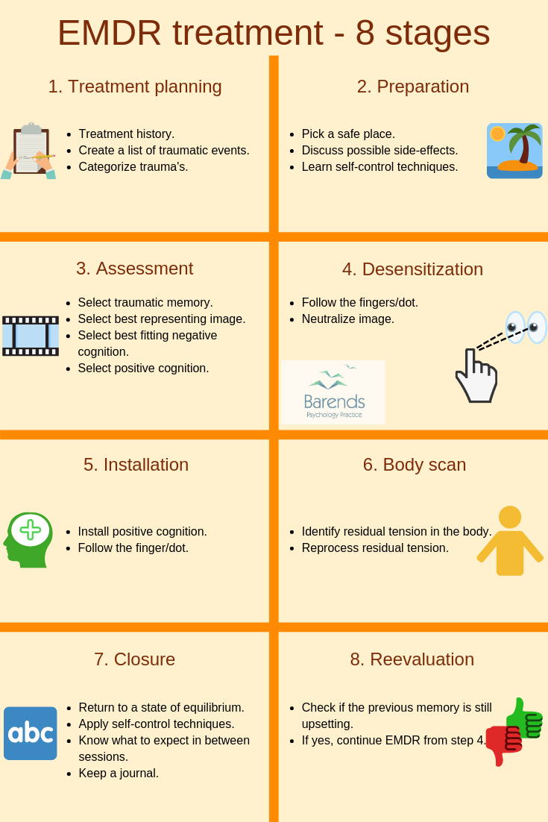
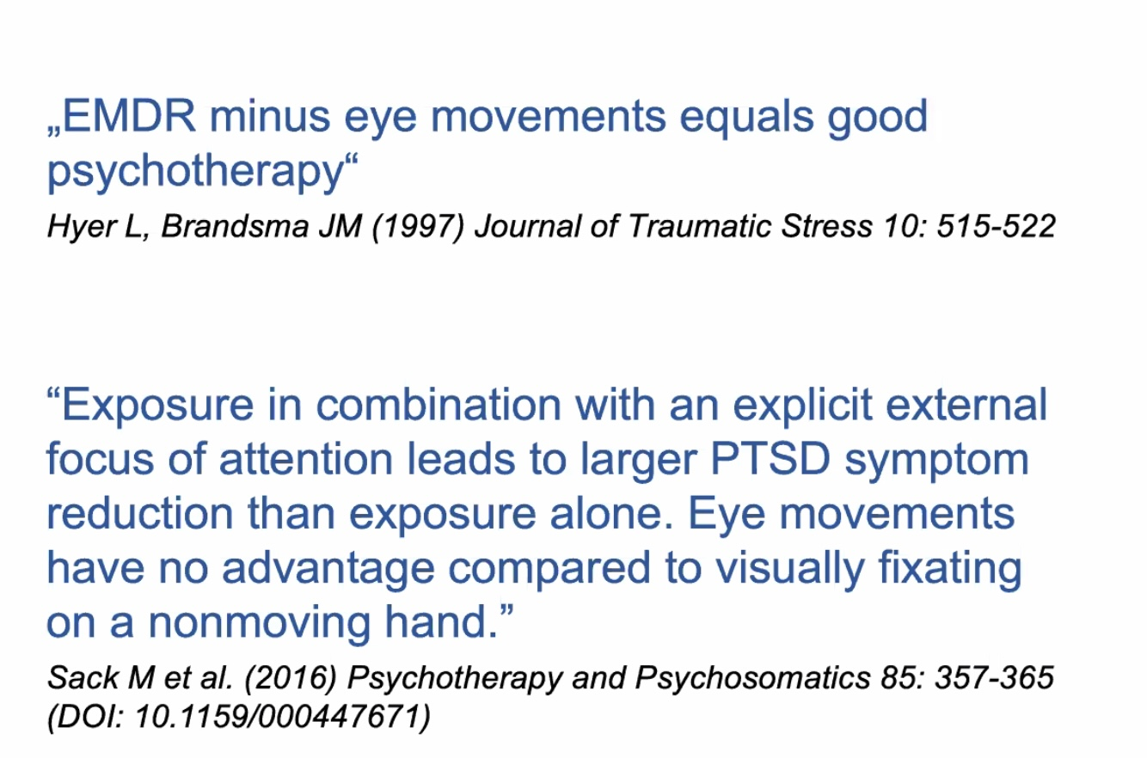

Slide 108
EYE MOVEMENT DESENSITIZATION AND REPROCESSING (EMDR)
EMDR is an evidence-based psychotherapy for PTSD that helps people process traumatic memories, so they become less emotionally distressing and less intrusive.
The Core idea in EMDR is that Traumatic experiences can become “stuck” in the brain in an unprocessed form, maintaining vivid memories, strong emotions, and negative beliefs. EMDR aims to help the brain reprocess these memories so they are integrated into normal autobiographical memory rather than relived as present danger.
EMDR involves:
Targeting a traumatic memory (image, emotion, body sensation, and negative belief such as “I am unsafe” or “I am powerless”)
Bilateral stimulation (most commonly guided eye movements, but also tapping or tones) while the client briefly attends to the memory
Spontaneous associative processing, allowing thoughts, emotions, and sensations to shift without detailed verbal recounting
Mechanisms of change (theories): Facilitates adaptive memory reprocessing. Reduces emotional intensity and physiological arousal. Updates negative core beliefs to more adaptive ones (e.g., “I survived,” “I am safe now”)
Structure: Follows a standardized 8-phase protocol (history, preparation, assessment, desensitization, installation, body scan, closure, reevaluation). Typically 6–12 sessions, though complex trauma may take longer. Less homework and less prolonged verbal exposure than PE
Strengths: Strong evidence base for PTSD. Often well tolerated by patients who struggle with prolonged verbal exposure
Cautions: Requires careful preparation for dissociation or complex trauma. Effectiveness depends on adequate stabilization and therapist training
In short, EMDR helps trauma memories move from being relived to being remembered, reducing their emotional and physiological charge.

Slide 109
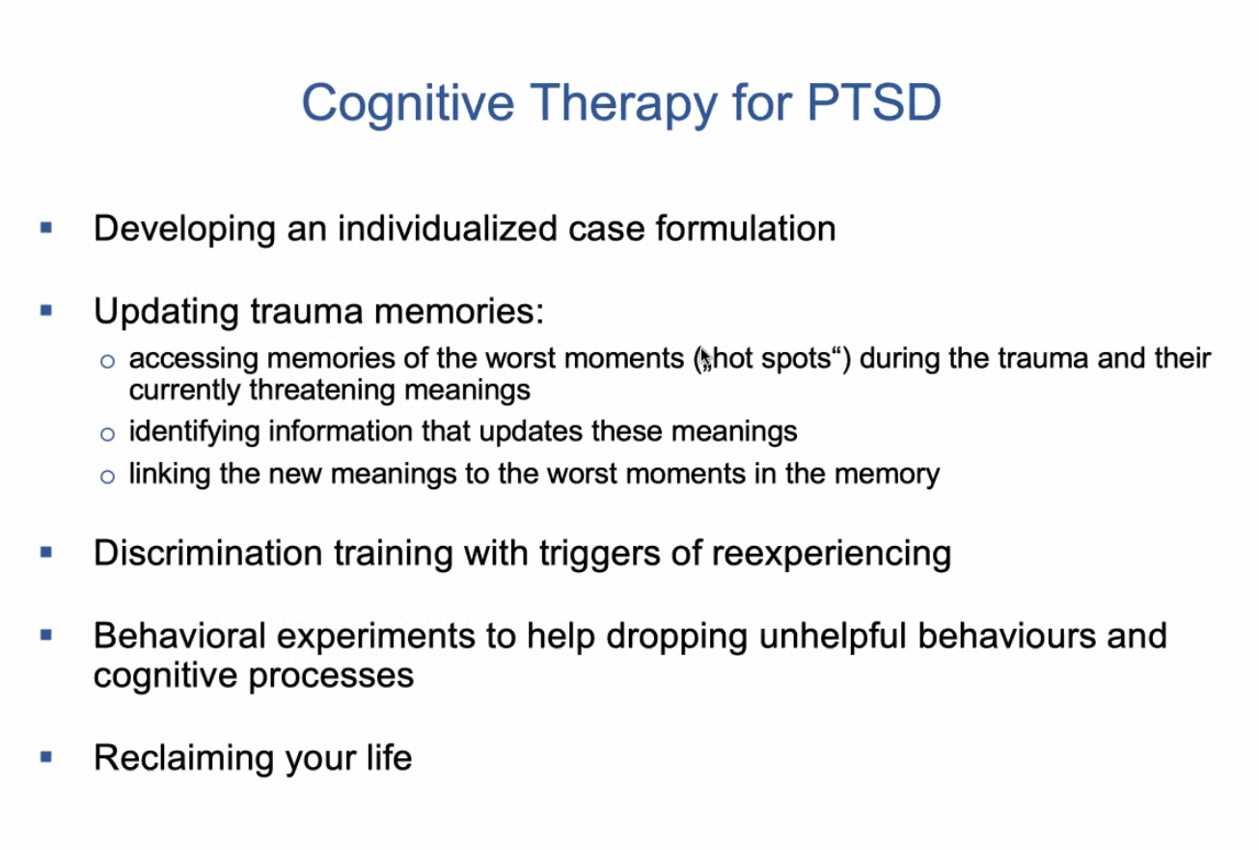

Slide 110
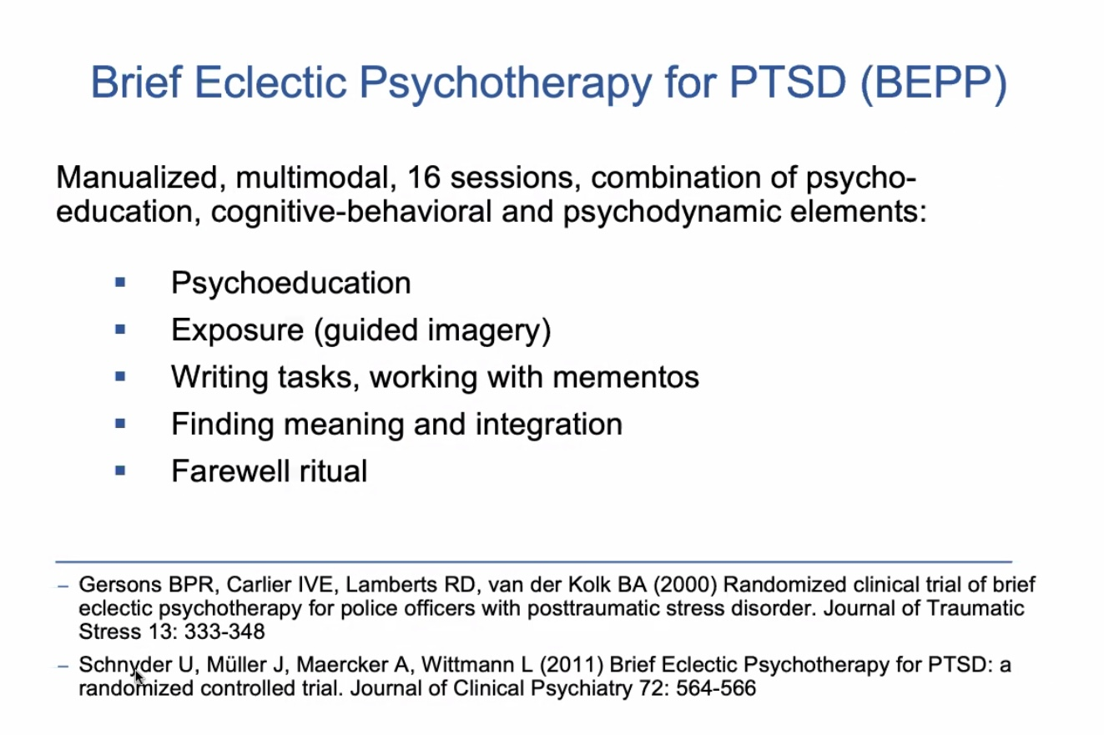

Slide 111
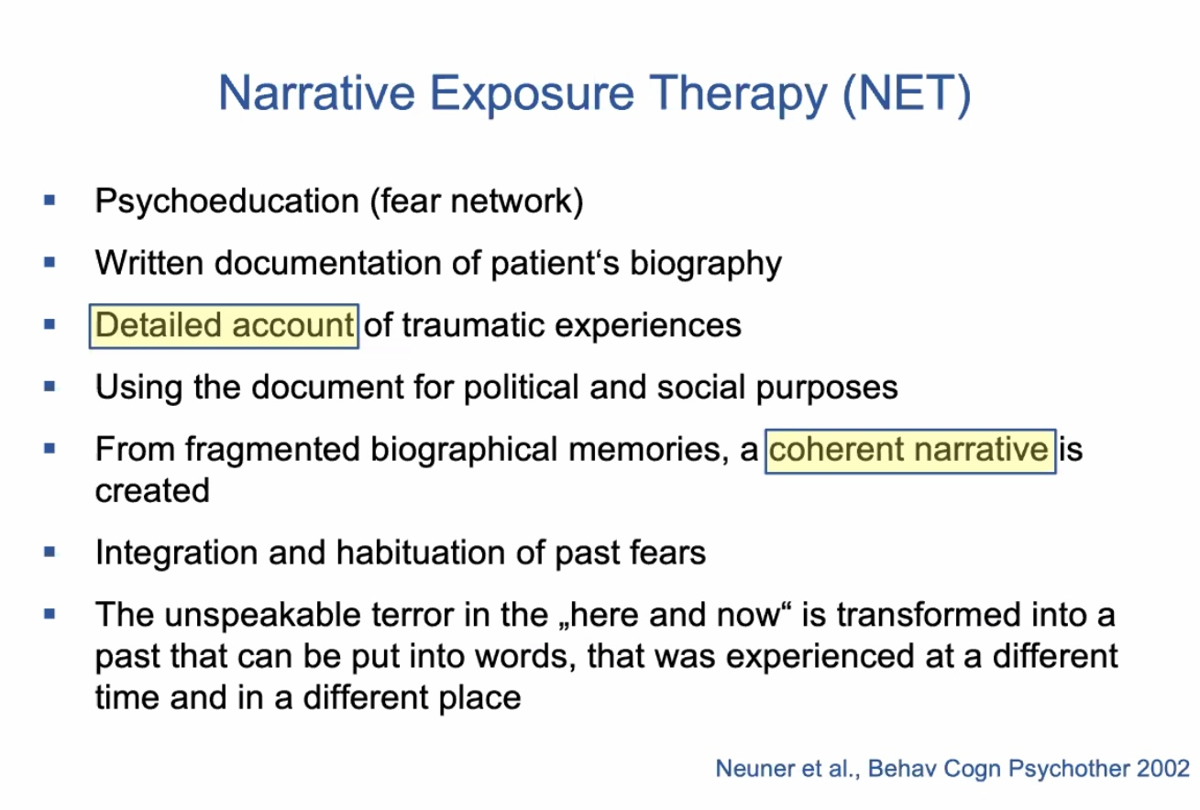

Slide 112
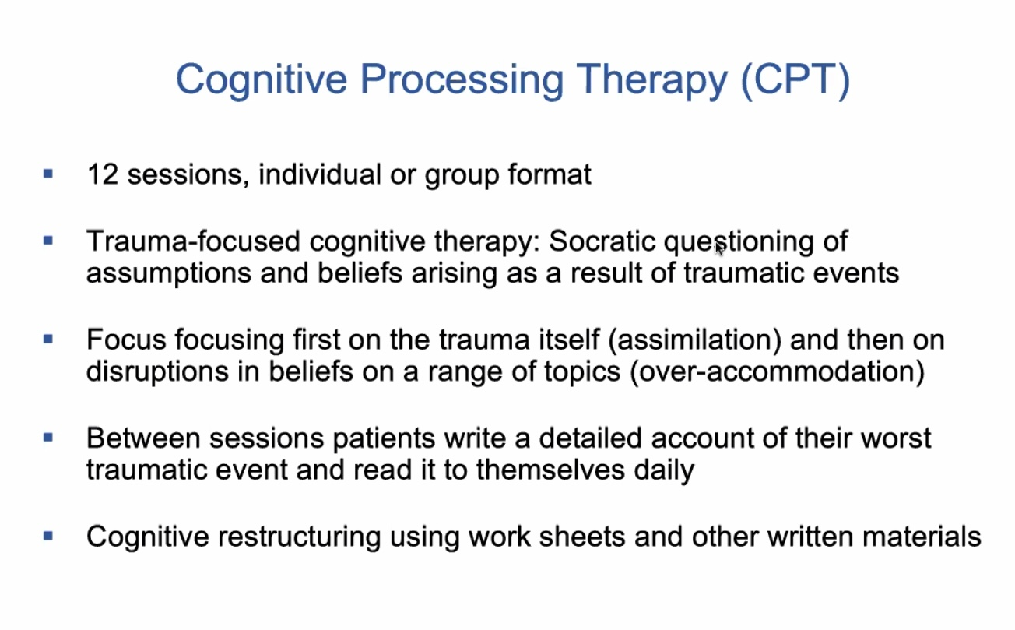
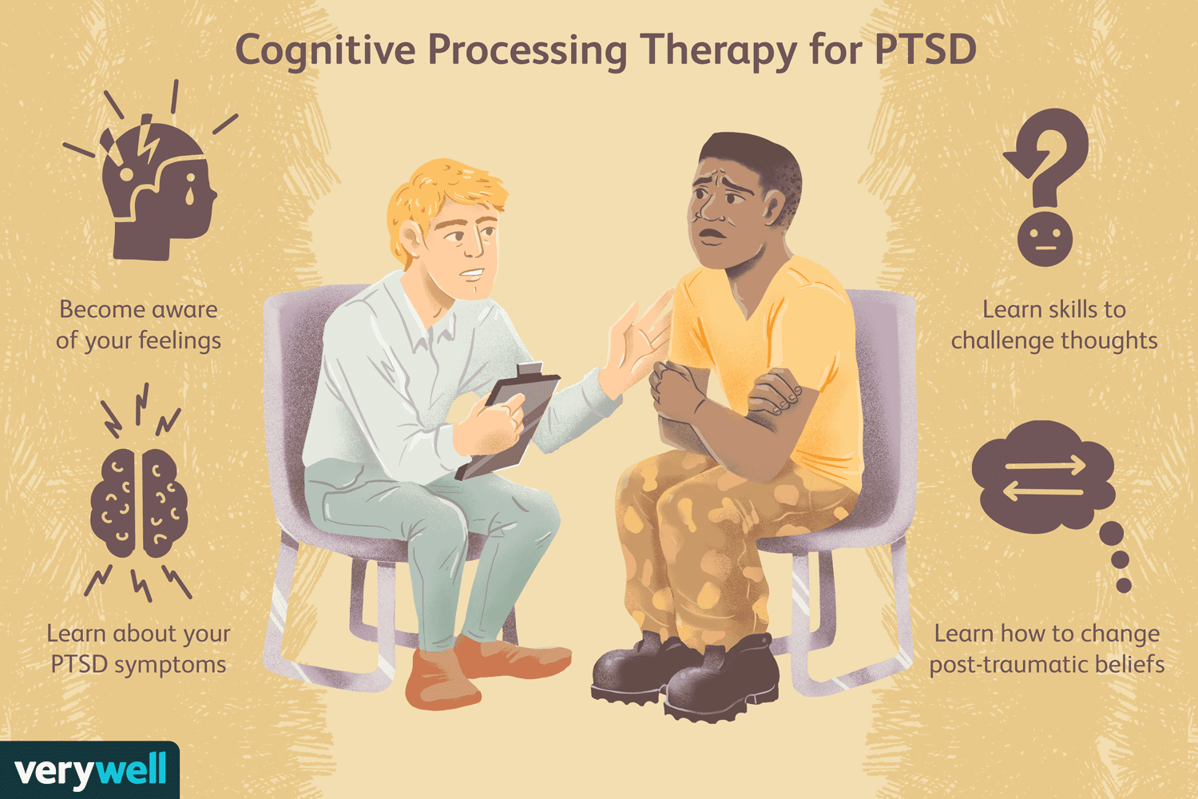

Slide 113

EXPOSURE : IMAGINATION, REAL LIFE, VIRTUAL

Slide 114
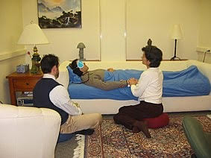
Psychedelic assisted psychotherapy

Slide 115
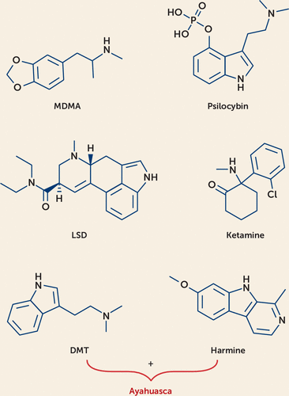
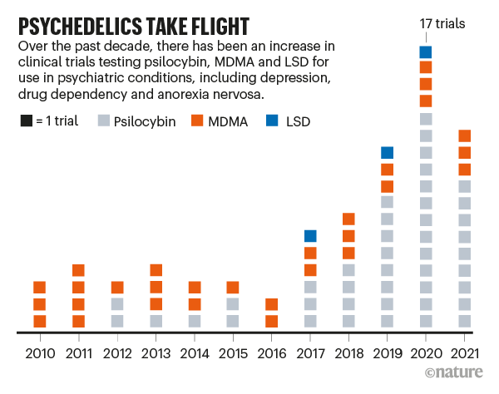
AGENTS USED IN PSYCHEDELIC ASSISTED PSYCHOTHERAPY
mescaline

Slide 116
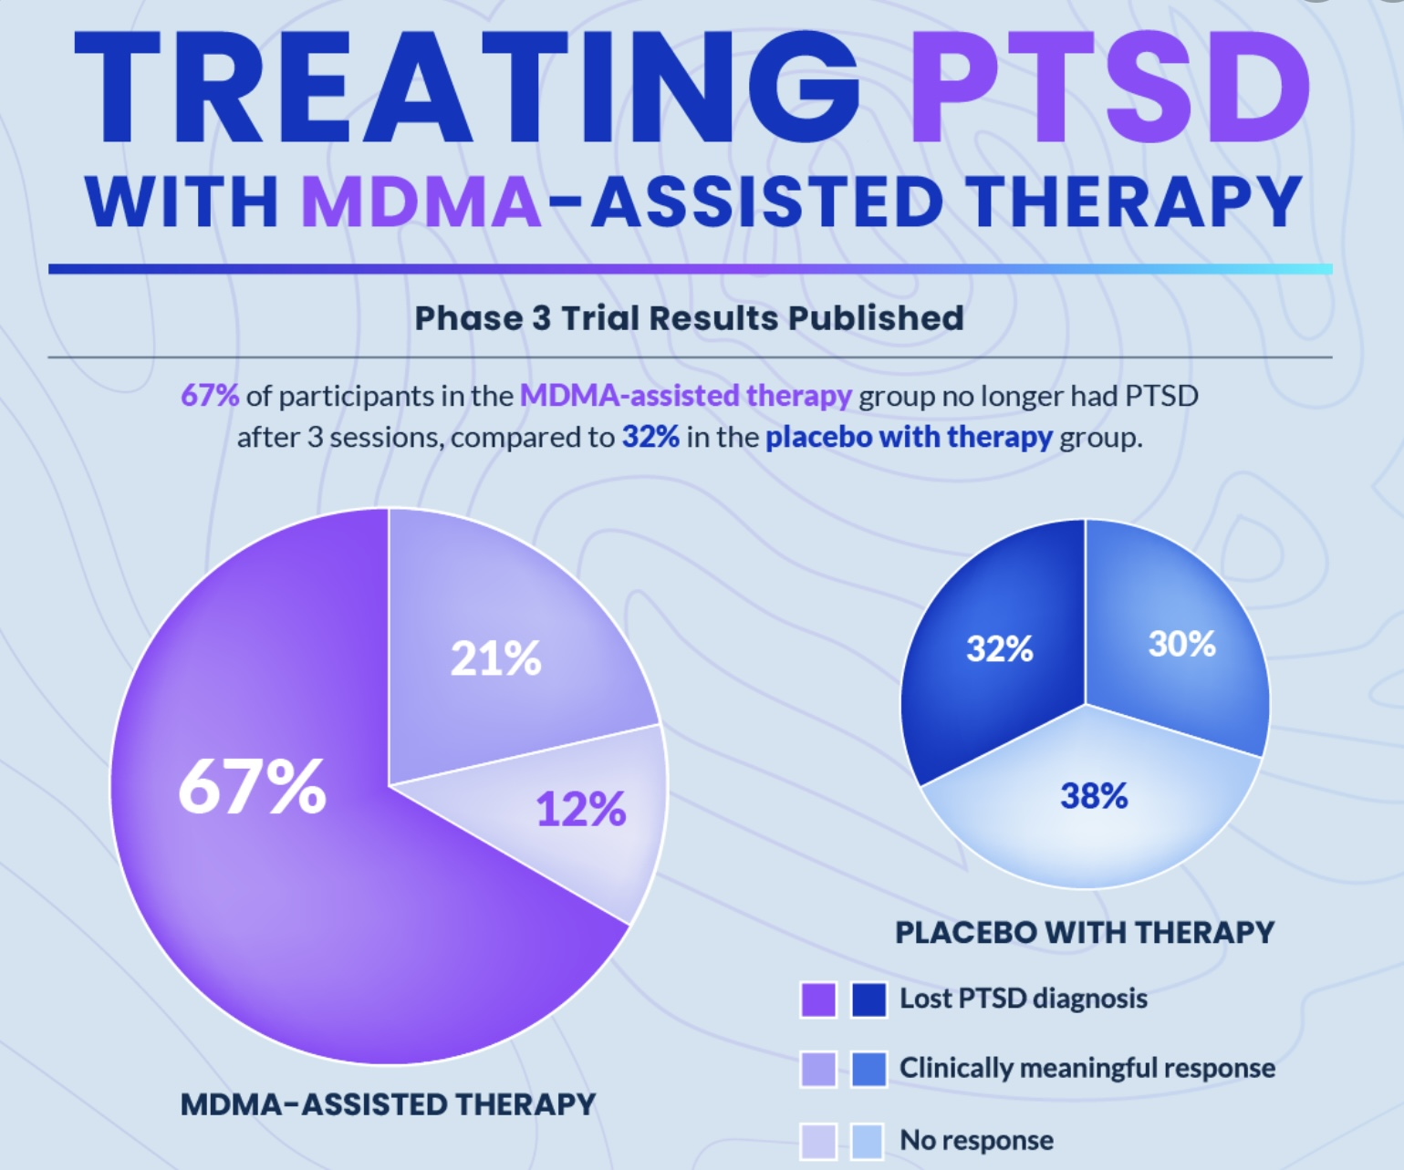
WHY PSYCHEDELICS IN
TRAUMA TREATMENT?
Trauma spectrum disorders, especially complex trauma, often involve nervous systems that cannot access traumatic memory without either flooding or shutting down. Psychedelics are being revisited because they appear to temporarily soften defensive rigidity, increasing emotional openness, trust, and flexibility in a controlled setting.
In trauma, the brain wants to fight or run away, psychedelics may temporarily reduce the intensity of these protective parts so the system can safely process the trauma.
Studies show that MDMA (most relevant for PTSD) significantly reduced trauma symptoms. After treatment many participants no longer met PTSD criteria. In these studies MDMA was administered in structured psychotherapy, not recreationally
Psilocybin studies show strong evidence for depression. Early data also suggests benefit in trauma-related disorders.
These medicines are regulated and availability for treatment is very limited (basically you have to be in a study)
These are not substances people take on their own and heal. The therapeutic effect appears to come from careful guided preparation followed by the medicine session and then integration. The integration phase is often more important than the medicine.

Slide 117
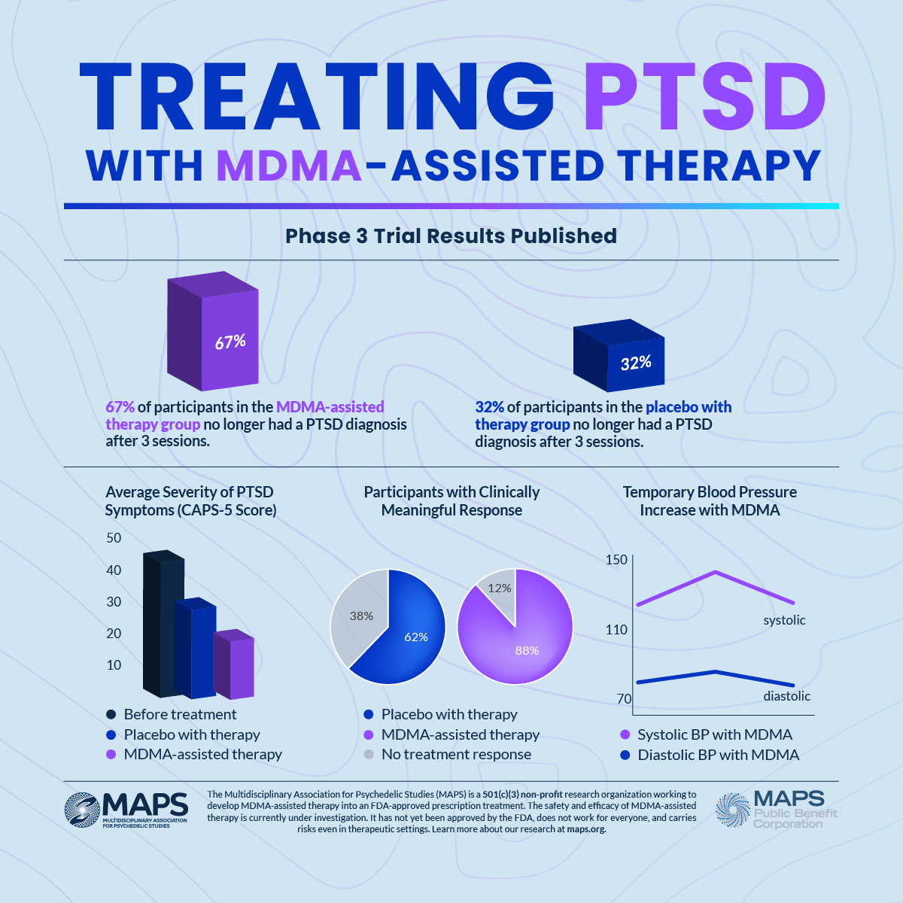

Slide 118
COMPARING MDMA PSILOCYBIN AND KETAMINE
MDMA appears particularly suited to trauma because it reduces fear while increasing trust and emotional openness. People can revisit traumatic memories without the same level of threat activation. It is probably the most trauma-specific of the three. Illegal, but accessible for select patients via special access.
Psilocybin tends to soften rigid identity structures. For some trauma survivors, especially those whose identity is fused with shame, this can allow a profound shift in self-perception May increase destabilization in fragile structures. illegal; clinical trials and special access possible.
Ketamine works differently. It’s not a classic psychedelic. It can rapidly reduce depressive symptoms and suicidality, sometimes within hours. It is often administered medically, as an anesthetic, rather than psychotherapeutically. It has less consistent trauma processing evidence. Dissociation can be therapeutic or destabilizing. Approved for medical/therapeutic use under regulated conditions.
LSD, DMT, Mescaline illegal available for research only.
MDMA seems to help people feel safe enough to revisit trauma. Psilocybin may help them reinterpret their story. Ketamine may help them get unstuck from severe depressive collapse.

Slide 119
PSYCHADELICS PROMISE AND CAUTION
Potential Benefits
Reduced avoidance
Increased emotional access
Improved connection
Breakthrough experiences
Risks
Psychological destabilization
Worsening anxiety
Dissociation
Not appropriate for
Active psychosis
Bipolar I disorder
Unstable personality structure
Certain cardiac conditions
REALITY
It can create a temporary therapeutic window
It may reduce fear and rigidity long enough to process trauma
It requires careful screening, preparation, and integration
It can destabilize vulnerable nervous systems
Healing still depends on relational safety and long-term integration
HYPE
It cures trauma
One breakthrough session can fix years of suffering.
It’s a shortcut to healing
It dissolves the ego permanently
It’s spiritual awakening in a pill.
Trauma healing is not about erasing the past. It’s about increasing our capacity to stay present with it. Psychedelics may be one emerging tool, but they are not a shortcut around the work of integration, relationship, and meaning.

Slide 120
BESSEL VAN DER KOLK RESEARCH ON PSYCHEDELICS
Bessel van der Kolk, has in the last 10 years turned significant attention to the potential of psychedelic-assisted
therapy, particularly with MDMA and psilocybin, in treating trauma and PTSD. His conclusions are grounded in his
participation in clinical research, especially through collaboration with MAPS (Multidisciplinary Association for
Psychedelic Studies).
1. MDMA-assisted therapy is highly effective for complex PTSD: MDMA when combined with psychotherapy, allows trauma survivors to revisit painful memories without being overwhelmed by fear or shame. In the Phase 3 trials led by MAPS, which van der Kolk was involved in, two-thirds of participants no longer met the criteria for PTSD after treatment. MDMA helps patients access and process traumatic material with greater empathy, self-compassion, and emotional safety.
2. Talk Therapy Alone Often Falls Short. Van der Kolk has long argued that conventional therapies (like CBT) often do
not adequately reach the deep, embodied impact of trauma. Psychedelics offer a powerful means of bypassing the
limitations of verbal therapy, allowing access to nonverbal, experiential processing and neurobiological reset.
3. Psychedelics Work on the Brain in Profound Ways. MDMA and psilocybin can decrease activity in the amygdala
(fear center) and increase connectivity in the default mode network, supporting self-reflection and emotional integration. He sees this as aligned with his belief that trauma lives not just in memory, but in the body and brain’s threat systems.

Slide 121
BESSEL VAN DER KOLK RESEARCH ON PSYCHEDELICS
4. Psychedelics Facilitate Relational Healing and Self-Compassion: A key trauma outcome is alienation from self and
others. Under MDMA, patients often experience empathy, forgiveness, and connection, even toward perpetrators,
themselves, or dissociated parts of themselves. This allows for a reconnection of fragmented inner experience, similar
to what van der Kolk has long emphasized as crucial to healing.
5. Clinical Use Must Be Structured, Supportive, and Ethical. Van der Kolk stresses that psychedelics are not magic
bullets. Their benefits emerge only in the context of skilled, supportive psychotherapy, proper preparation, and
integration. He advocates for rigorous training and ethical standards to prevent harm and misuse as these therapies
expand.
6. The Future of Trauma Treatment Must Include Expanded Consciousness Work. He believes altered states of
consciousness, including those induced by psychedelics, yoga, EMDR, and bodywork, are essential for accessing
and resolving trauma. Psychedelics, in particular, offer a new paradigm for healing that aligns with his holistic view of
trauma: not just a disorder of memory, but of body, brain, and soul.

Slide 122
No medicine replaces phase I safety or phase III meaning.

Slide 123



Slide 124
NEUROFEEDBACK
Neurofeedback is a non-invasive, brain-based intervention used in trauma treatment to help people regulate dysregulated neural patterns associated with chronic stress and PTSD.
The Core idea in neurofeedback is that Trauma can leave the brain stuck in patterns of hyperarousal (fight/flight), hypoarousal (shutdown), or unstable switching between the two. Neurofeedback provides real-time feedback on brain activity (via EEG), allowing the brain to gradually learn more stable and regulated states.
Neurofeedback involves:
EEG sensors monitor brainwave activity
The client receives immediate feedback (e.g., visual or auditory cues)
When the brain shifts toward healthier patterns, it is “rewarded”
Over repeated sessions, the nervous system learns improved self-regulation
It targets: Hypervigilance and startle response. Emotional reactivity and mood instability. Sleep disturbance. Dissociation or shutdown. Impaired affect regulation
In trauma treatment it is often used as a bottom-up approach. Can be especially helpful for clients who are overwhelmed by verbal or exposure-based therapies. Frequently used as a stabilization or adjunct to trauma therapies such as PE, EMDR, or IFS
Evidence: Growing but mixed evidence base. Strong clinical support for improving arousal regulation. Less robust evidence than PE or EMDR for core PTSD symptom resolution
Strengths: Nonverbal and experiential. Can increase emotional tolerance and window of affect. Helpful for complex trauma and developmental trauma
Limitations: Requires many sessions. Access, cost, and protocol variability
Best viewed as complementary, not standalone, trauma treatment
In short: neurofeedback helps trauma survivors by training the nervous system to feel safe again, making deeper psychological work more possible.

Slide 125

Therapeutic alliance
Stabilization
Psychoeducation
Emotional regulation
Exposure
Finding meaning
Processing memories
Mobilizing resources
Notes:
Although there are many different approaches to the treatment of trauma, many of these approaches share common elements.

Slide 126


Slide 127
THE TREATMENT OF DISSOCIATIVE IDENTITY DISORDER
The treatment of Dissociative Identity Disorder (DID) is typically long-term, psychotherapy-based, and guided by a phase-oriented model rather than rapid trauma exposure.
The Core principles of DID therapy: Treatment focuses less on eliminating “parts” and more on improving cooperation, safety, and integration of experience. It follows The three phases of treatment model 1. Stabilization and safety (often the longest phase) 2. Trauma processing 3. Integration and rehabilitation
Goals: Greater continuity of identity, memory, and affect. Increased flexibility and shared functioning. Improved relational, occupational, and life functioning
Integration may mean: Full fusion into one identity or Stable, cooperative multiplicity with minimal dissociation
Role of medication: No medication treats DID itself. Medications may help comorbid conditions (PTSD, depression, anxiety, sleep disturbance) Careful monitoring is essential due to dissociative sensitivity
What distinguishes DID treatment: Avoids early exposure-based therapy. Emphasizes safety, pacing, and relational containment. Accepts dissociation as adaptive before helping it soften. Requires therapist consistency and long-term commitment
In short Treatment of DID is about helping a severely traumatized system move from fragmentation toward coherence, from internal fear toward internal cooperation, and from survival toward living—slowly, safely, and relationally.

Slide 128


Notes:
Because it is the most severe form of structural dissociation, the treatment of dissociative identity disorder is the most challenging. Experts agree that there are three main goals in the treatment of the ID: 1) cooperative arrangement between altar/parts 2) partial integration 3) final fusion.
Because there are so few people who specialize in the treatment of DID, it is extremely difficult to access expert effective treatment.

Slide 129
HOW SIMPLE ADDRESSES THE THREE STAGES OF TRAUMA THERAPY
Is simple a stage I, II, and III therapy ?

Slide 130

Simple addresses all three stages of trauma therapy
Stage I and II work focus on the bottom half of Maslow’s pyramid : meeting physiological and safety needs and staying safely in the window of tolerance. In simple we spend a lot of time discussing emotional regulation and building resources.
Stage III work focuses on top half of pyramid : Developing connections, self-esteem and a sense of meaning.
The goals diary card procedure outlines our various needs, helps us assess which are and aren’t met, and sets out a systematic approach to pursuing our need for connection.
Stage three work pursues establishing a meaningful life through connections. It focuses on the upper half of Maslow’s pyramid or love and belonging, self-esteem, and self-actualization
Stage three fosters psychosocial growth through Erikson’s stages of achieving a healthy identity, the capacity for true intimacy, the desire to give back to the world, and to find meaning in life.
This requires stages I and II work first.

Slide 131
SPECIAL CONSIDERATIONS IN THE TREATMENT OF TRAUMA
Clearly the treatment of the trauma related disorders is complex. Is there anything else we might have left out that you think is important for us to know?

Slide 132

SHAME AND GUILT
Guilt is the feeling that we have done something wrong
Shame, in contrast, is the feeling we have when we evaluate our actions, feelings, and behaviors and conclude that we are inadequate or deficient. Shame encompasses the whole of ourselves; it generates a wish to hide, to disappear or even to die. Shame is the feeling of inferiority.
Shame is the belief in one's inferior status or the feeling that one does not conform to social norms and expectations.
Shame is frequently associated with complex PTSD. Enduring prolonged abuse, whether it be by a caregiver, partner, relative, or coworker, leaves the person with a false internalized belief that they are innately bad, defective, and not good enough.
Shame is associated with trust issues, being a people pleaser, self sabotage, feeling undeserving of love, never feeling safe, feeling as if you must be perfect, constantly feeling like you've done something wrong, and a chronic sense of worthlessness and not being good enough.
People experience external shame in the form of thoughts and feelings about how they exist in the mind of others and internal shame or self-directed evaluations, thoughts and feelings about inadequacies and flaws.

Slide 133

SHAME: A FEATURE OF ATTACHMENT ISSUES AND CAREGIVER TRAUMA
When most of us think of an abused child, we rationally know the child does not deserve the abuse. We consider the abuser to be entirely at fault for the abuse.
If, however, as adults, we are in an abusive relationship, over time, we often come to believe that the problem is with us.(gaslighting-Stockholm syndrome.)
That is because we come to feel the situation from emotional mind and emotional mind dominates rational mind.
The emotional mind is fully developed at birth, the rational mind isn’t, it starts to develop at age 3-4 and is only fully developed by our mid 20’s.
The abused child doesn’t have the capacity to think rationally about their situation. They can only “feel” the situation. The model that forms in their mind is that of 1) an all-knowing, all-powerful adult who is angry at them and repeatedly holds them at fault, and 2) their frightened, or despairing/abandoned selves .
Shame, the feeling that there is something fundamentally wrong, evil, unlovable, not good enough, or different and that I will be abandoned, in danger, unhappy and that it is my fault is born in this caregiver child dynamic. This deep-rooted feeling is resistant to change by rational mind re-framing.
This kind of shame is extremely common in people with attachment and developmental trauma issues.

Slide 134

Shame often result in people stopping or never engaging in treatment.
Shame impedes social connection and cuts the individual off from the support and soothing that may come from others including therapists.
The power imbalance between patient and therapist, and the unilateral exposure of the patients most intimate thoughts and feelings can further contribute to a feeling of shame in therapy.
The lack of trust present in complex PTSD starts with early attachment issues and the failure to negotiate Erickson's stage of trust versus mistrust.
The development of a trusting and secure relationship whether it be with a mentor, friend, partner, or therapist is key in the repair of shame.
SHAME IN THERAPY

Slide 135

RE-TRAUMATIZATION
Re-traumatization happens when a person suffering from a trauma related disorder is exposed to people, incidents, or environments that cause them to relive the previous trauma, almost as if it were occurring again.
Because we are drawn not to relationships that are good for us but to those that are familiar, re-traumatization is common.
In a therapeutic setting transference and countertransference can result in re-traumatization.
Re-traumatization often affects vulnerable people in contact with healthcare settings.
Re-traumatization can be prevented through trauma informed care.
Notes:
The last but perhaps most important subject will touch on in the session is re-traumatization. Re-traumatization can occur both through the system, as well as in individual relationships with care providers.

Slide 136

TRAUMA INFORMED CARE: WHAT HELPS
Notes:
The answer to re-traumatization is trauma informed care. Trauma informed care is contingent on a number of factors…

Slide 137


Notes:
Finally here are three books that might help you to better understand the traumatic spectrum disorders.

Slide 138

5 TAKEAWAYS
Dissociation is adaptive before it becomes problematic.
Trauma dissociates or splits survival parts EP’s from daily life parts ANP’s across time.
Avoidance keeps trauma alive.
Healing happens in phases.
No shortcut replaces safety and integration.

Slide 139



Slide 140

VIDEO Week 19 of simple

Slide 141


Slide 142


Slide 143


Slide 144


Slide 145


Slide 146


Slide 147


Slide 148


Slide 149


See you next session

Slide 150
what if life gets so busy you don’t have time to use the tools ?
I have a rational mind and a wise mind response to this very important and common question.
The rational mind has to do with the back-end vs. the front-end time commitment.
Using the skills tools and strategies would be a good goal in that it can help with physiological, safety, psychological and spiritual needs. Every goal you set will require that you use skills and tools. If you are struggling to find goals start with setting time aside to use skills and tools every week. Even 15 minutes twice weekly will make big difference. The important thing is being accountable.
Doing something inefficiently (or if you keep falling into holes) takes so much more time than doing it efficiently.
The wise mind response has to do with our unconscious resists change. How much time do we spend on social media or watching TV each day? It takes wise mind to do the hard thing when the hard thing is the right thing to do.
We live in an attention economy, and our attention is drawn to certain things and not to others. It is drawn to things that providing us immediate gratification and high emotional intensity.
People are also drawn to chaos as its familiar its repetition compulsion, it distracts us from our pain, and it validates our view of the world.
Our parts resist change.

Slide 151
(1)Structural dissociation theory is a psychological theory that was developed by Onno van der Hart, Ellert Nijenhuis, and Kathy Steele. It is based on the idea that the mind is structured into different parts or self-states, each with its own thoughts, feelings, and memories. According to this theory, dissociation is a normal and adaptive response to trauma, where the mind separates different parts of the self in order to cope with overwhelming experiences.
In structural dissociation theory, there are two main parts of the self: the apparently normal part (ANP) and the emotional part (EP). The ANP is responsible for day-to-day functioning and is often unaware of traumatic memories, while the EP holds the emotional and traumatic memories. When a person experiences trauma, these parts of the self can become fragmented and disconnected, leading to symptoms of dissociation and other psychological disorders.
Therapy based on structural dissociation theory aims to help individuals integrate these different parts of the self, so that they can process and heal from traumatic experiences. By understanding and working with these different self-states, individuals can develop a more cohesive sense of self and reduce symptoms of dissociation.

Slide 152
(2)Flashbacks are a common symptom of post-traumatic stress disorder (PTSD) and can be distressing experiences where a person feels as though they are reliving a traumatic event. There are several different types of flashbacks that individuals may experience:
1. Visual flashbacks: These involve vivid images or scenes from the traumatic event that play out in the person's mind as if they are happening in the present moment.
2. Emotional flashbacks: These involve intense emotions or feelings related to the traumatic event, such as fear, sadness, or anger, that can be triggered by certain stimuli or reminders.
3. Sensory flashbacks: These involve sensations or physical feelings associated with the traumatic event, such as pain, smells, sounds, or tastes, that can be triggered by sensory cues in the environment.
4. Dissociative flashbacks: These involve a sense of detachment or disconnection from reality, where the person may feel like they are outside of their body or watching themselves from a distance.
It's important to note that flashbacks can vary in intensity and duration, and may be triggered by specific cues or reminders of the traumatic event. It's also important for individuals experiencing flashbacks to seek support from mental health professionals to learn coping strategies and techniques to manage and reduce the impact of these distressing experiences.

