Slide 1

Welcome to WEEK 20 of simple introducing interpersonal skills
“out beyond ideas of wrongdoing and right doing there is a field, I'll meet you there” Rumi
Please start recording at 9 am

Slide 2
week 17- the stress and trauma related disorders-session 20 of manual.
week 18- emotional regulation skills p.183-206 of dbt workbook. our fifth practice session-the goals diary card procedure- session 21 of manual
week 19- structural dissociation theory and the treatment of the traumatic spectrum disorders- session 22 of manual.
week 20- introducing interpersonal skills p.207-241 of dbt workbook. Review of all the skills
week 21-introducing internal family systems (ifs)-session 24 of manual. introducing the ifs workbook and ifs workbook guided ai assisted self therapy
week 22- Spirituality, religion, and health- session 26 of manual.
week 23-interpersonal skills and putting it all together p.242-265 of dbt workbook. states of activation as essential trailheads and the four pillars of recovery from trauma-session 27 of manual.

Slide 3
LAST MINUTE CHANGE
I’ve decided to reverse the order of sessions 21 and 22. In the past we introduced IFS before exploring spirituality this year, we’ll do the opposite.
Let me explain why. In this course, we consider mental health from a biopsychosocialspiritual perspective. According to this model Spirituality is one of the core dimensions of being human.
In the course we’ve already explored:
Biological maps such as instincts and polyvagal theory and how these inform trauma.
Psychological maps mostly based on psychodynamic theory such as attachment theory and Erikson’s stages.
Social maps such as social determinants of health
So, it makes sense to introduce a Spirituality map which is just as foundational as these other three maps to the approach we are taking in this course.
In the Spirituality session, we’ll introduce Ignatian Spirituality which will sound very familiar to most people. It essentially says that the thoughts, feelings, and impulses that arise within us do so because of the influence of spirits that are more or less mature and that our role is to learn to discern and choose which we listen to. To do that we use a deep observing center embodied in the figure of Jesus. ( or the Buddha, Socrates, Confucious, Muhammad, etc. in other traditions)

Slide 4
LAST MINUTE CHANGE
This Christian model is based on philosophical idealism which many modern people think has been thoroughly debunked by scientific materialism (or physicalism). Many contemporary thinkers are now presenting very compelling arguments for exactly the opposite. Idealist views are now debunking materialist ones.
The Ignatian spiritual map, although using different language, bears an uncanny resemblance not only to IFS but also to Jungian psychology and Bernardo Kastrup’s analytical idealism.
By exploring spirituality first, we lay the groundwork. Then when we introduce IFS, it won’t feel as strange. Hopefully it will feel like a map describing something you already recognize from your own experience.
Before our March break we’ll have the Spirituality session and when we come back refreshed we’ll dive into Internal family systems.

Slide 5
week 17- the stress and trauma related disorders-session 20 of manual.
week 18- emotional regulation skills p.183-206 of dbt workbook. our fifth practice session-the goals diary card procedure- session 21 of manual
week 19- structural dissociation theory and the treatment of the traumatic spectrum disorders- session 22 of manual.
week 20- introducing interpersonal skills p.207-241 of dbt workbook. Review of all the skills
week 21- Spirituality, religion, and health- session 26 of manual.
week 22- introducing internal family systems (ifs)-session 24 of manual. introducing the ifs workbook and ifs workbook guided ai assisted self therapy
week 23-interpersonal skills and putting it all together p.242-265 of dbt workbook. states of activation as essential trailheads and the four pillars of recovery from trauma-session 27 of manual.

Slide 6
SIMPLE COURSE SCHEDULE 2025-26
Week 1- October 1
Week 2- October 8
Week 3- October 15
Week 4- October 22
Week 5- October 29
Week 6- November 5
Week 7- November 12
Week 8- November 19
Week 9- November 26
Week 10- December 3
Week 11- December 10
Week 12- December 17
December 24 and 31
Week 13- January 7
Week 14- January 14
Week 15- January 21
Week 16- January 28
Week 17- February 4
Week 18- February 11
Week 19- February 18
Week 20- February 25
Week 21- March 4- Spirituality
March 11 and 18 no course
Week 22- March 25- Intro to IFS
Week 23- April 1
Week 24- April 8
Week 25- April 15
Week 26- April 22
Week 27- April 29
Week 28- May 6
Week 29- May 13
Week 30- May 20
Week 31- May 27
Week 32- June 3

Slide 7

Warning about meditation
Feel free to skip it. Followed by a moment of silence

Slide 8
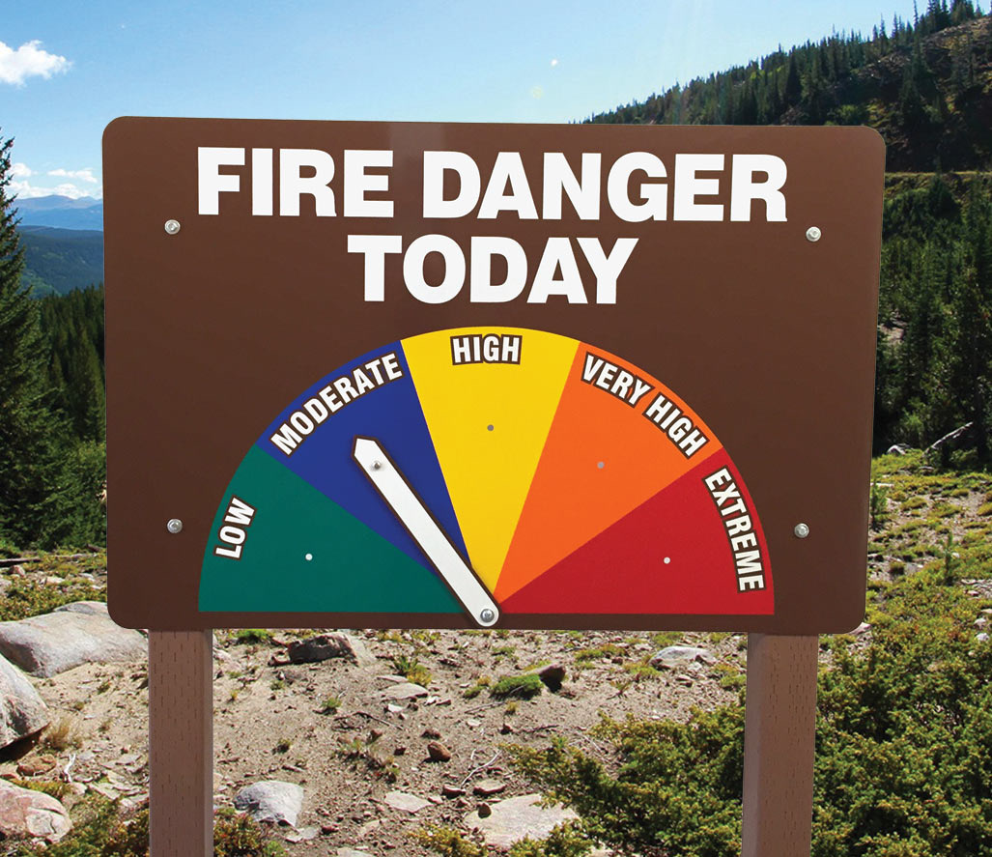

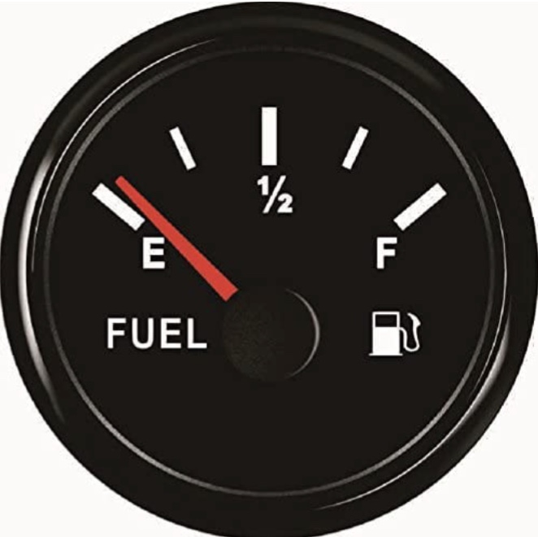
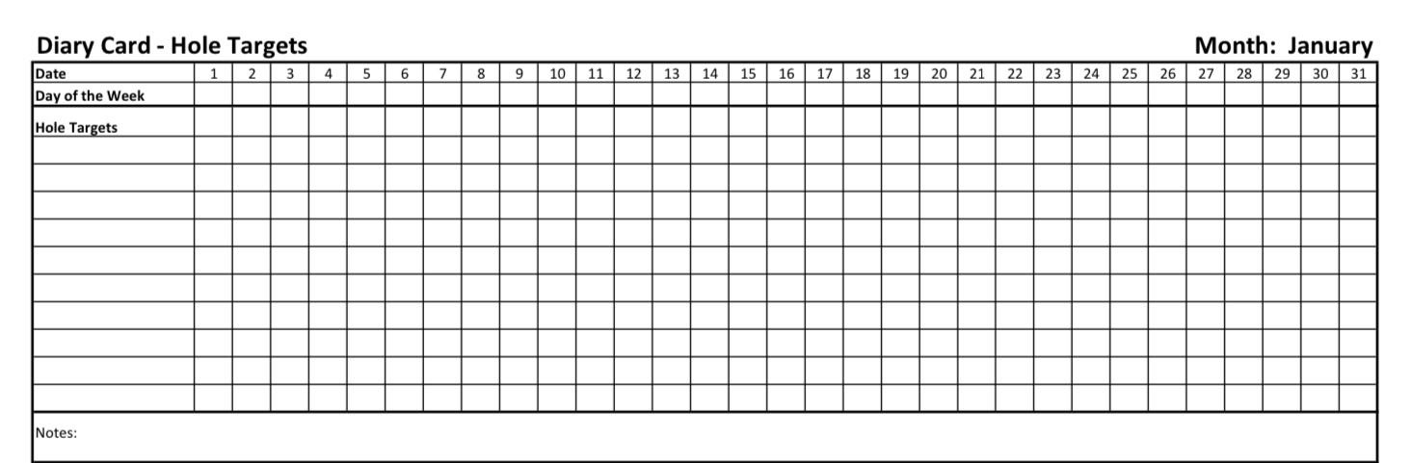

Check in regularly with your Personal dashboard
Spend a few moments checking in with yourself by asking:
1)What is the current risk that I’ll experience a state of crisis ?
Low b) Moderate c) high d) very high e) extreme
2) Am I in the window of tolerance?
a) Yes b) I’m a little outside c) very outside
3) Where is my energy tank right now?
Full b) ¾ c) ½ d) near empty
4) Have I been tracking my targets using the holes diary card ? how would I rate my targets right now?
5) How well am I focusing on what I’m doing. (for example, the course)
CRISIS RISK
WINDOW OF TOLERANCE
ENERGY RESERVES
RATING MY TARGETS
ATTENTION METER
% attention I’m paying
100
0

Slide 9
FIVE-MINUTE MINDFULNESS PRACTICE-WISE MIND IN RELATIONSHIP
(Settling – ~30 seconds)
Let’s begin by taking a comfortable posture, feet on the floor and sitting in a way that feels supportive.
If it feels safe, you may gently close your eyes or simply soften your gaze.
Take a slow breath in through the nose…
and a longer breath out through the mouth.
Allow your body to settle.
(Grounding in the body – ~1 minute)
Bring your attention to the points of contact between your body and what’s supporting you
the chair, the floor, gravity holding you.
Notice your breath as it is, without changing it.
Just observing the rise and fall…
the body breathing itself.
If your mind wanders, that’s not a problem.
Gently bring your attention back to the breath and the body.

Slide 10
FIVE-MINUTE MINDFULNESS PRACTICE-WISE MIND IN RELATIONSHIP
(Emotional mind & rational mind – ~1 minute)
Now, silently acknowledge that each of us has different ways of knowing.
You might notice your emotional mind, your sensations, feelings, impulses, and urges.
No need to analyze them. Just notice them.
You might also notice your rational mind, your thoughts, plans, judgments, explanations.
Again, just notice.
Neither your thoughts or your feelings are right or wrong.
They are just part of being human.
(Wise Mind – ~1½ minutes)
Now imagine a place within you that is able to see both your emotional and your rational minds.
In DBT we call this Wise Mind.
Wise Mind is not loud.
It doesn’t argue.
It has a calm, grounded quality.

Slide 11
FIVE-MINUTE MINDFULNESS PRACTICE-WISE MIND IN RELATIONSHIP
From Wise Mind, you can sense:
• What matters to you
• What you need
• What the situation actually calls for
Take a few breaths resting here.
If it helps, you might silently say on the inhale: “Here”
and on the exhale: “Now.”
(Interpersonal effectiveness – ~1 minute)
From this Wise Mind place, gently bring to mind the fact that relationships are where emotions are most activated.
Without bringing up a specific conflict, just notice:
• The part of you that wants to be understood
• The part that wants to protect itself
• The part that wants connection
Let all of those parts be welcome.
DBT interpersonal skills are not about winning or pleasing
they are about effectiveness:
honoring your needs, respecting the other person, and maintaining your self-respect.

Slide 12
FIVE-MINUTE MINDFULNESS PRACTICE-WISE MIND IN RELATIONSHIP
Simply notice what it feels like in your body to imagine responding from Wise Mind in relationships.
(Closing – ~30 seconds)
As we end, bring your attention back to the room.
Notice the sounds around you.
Feel your feet on the floor.
Take one last slow breath in…
and out.
When you’re ready, gently open your eyes.
Everything we’ll be learning in DBT interpersonal effectiveness relies on wise mind, pausing, noticing, and choosing how to respond rather than reacting.

Slide 13


Slide 14
PRACTICE SESSIONS SCHEDULE
practice
6.Week 24 April 8 April 1, 1:30 Part 1 p. 1-63 ?
7. Week 25 April 15 April 8, 1:30 Part 2 p. 65-99 Elaine S.
8. Week 26 April 22 April 15, 1:30 Part 3 p. 103-137 Dinko T.
9.Week 27 April 29 April 22, 1:30 Part 4 p. 141-175 Barb H.
10. Week 28 May 6 April 29, 1:30 Part 5 p. 179-207 Meaghan
11.Week 29 May 13* April 22, 3 pm Wise mind remediation Rob T.
Preparation IFS Workbook

Slide 15
Homework from last week
Submit
Submit questions or comments to itssimple2023@gmail.com
Continue
Continue reviewing and practicing your crisis plans, diary cards, chain analysis, rational mind remediations, and goals diary cards.
Continue
Continue tracking all the skills you’ve learned using your skills lists. Practice them.
Read
Skills training workbook p.207-241 (double skills training session)

Slide 16

Homework for the COMING week
Submit questions or comments to itssimple2023@gmail.com
Read Simple manual session 26 on Spirituality and mental health.
Continue reviewing and practicing crisis plans, diary cards, chain analysis, rational mind remediation, and goals diary cards.
Continue tracking all the skills you’ve learned using skills lists. Practice them.

Slide 17
HOMEWORK HABITS CHECKLIST
Circle or check what you will try this week.
1. Preparation habits
■ I schedule a specific time for homework.
■ I choose a consistent location with minimal distractions.
■ I gather what I need ahead of time (notebook, worksheet, pen).
2. Focus & pacing habits
■ I start with a tiny step (2–5 minutes).
■ I use a timer (10–15 minutes).
■ I remove distractions (phone away / Do Not Disturb).

Slide 18
HOMEWORK HABITS CHECKLIST
3. Tracking & organization habits
■ I keep materials in one place (binder / folder / notebook).
■ I write down insights right after doing the homework.
4. Self-compassion habits
■ I aim for progress, not perfection.
■ I notice resistance without judgment.
5. Accountability habits
■ I review my week: What worked? What didn’t?
■ I share honestly with my buddy — even when I didn’t do it.
Micro commitment:
This week I will focus on: ■ Time ■ Place ■ Tiny step ■ Timer ■ Other please specify:

Slide 19
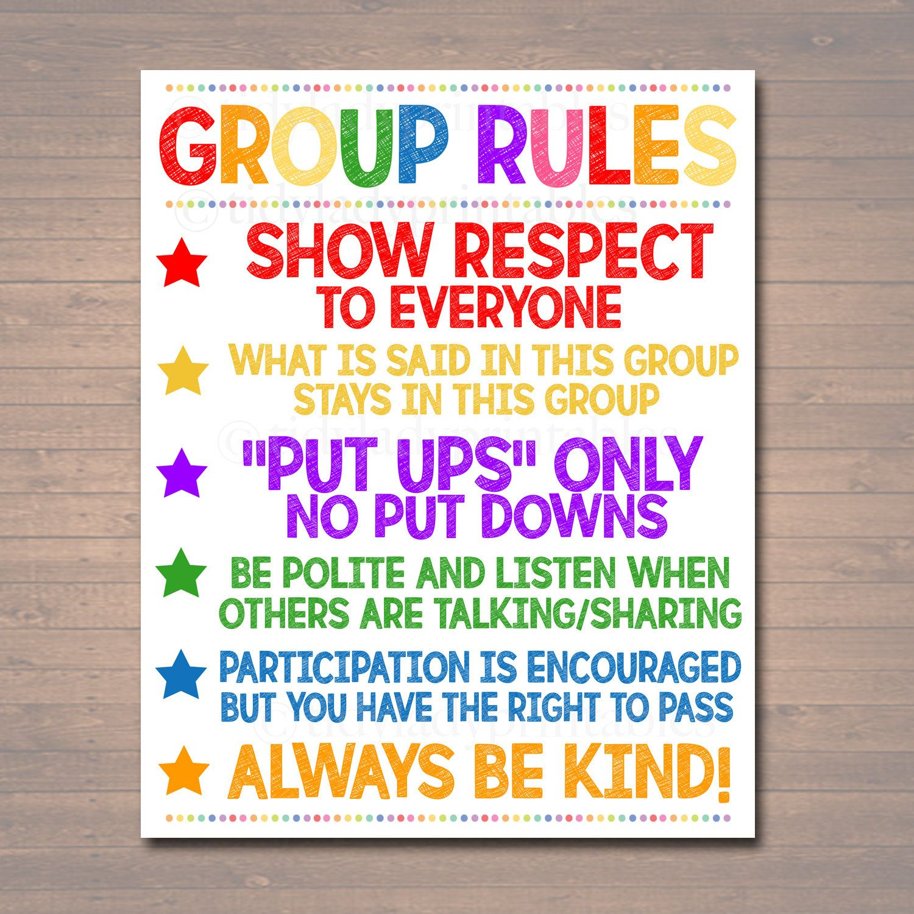
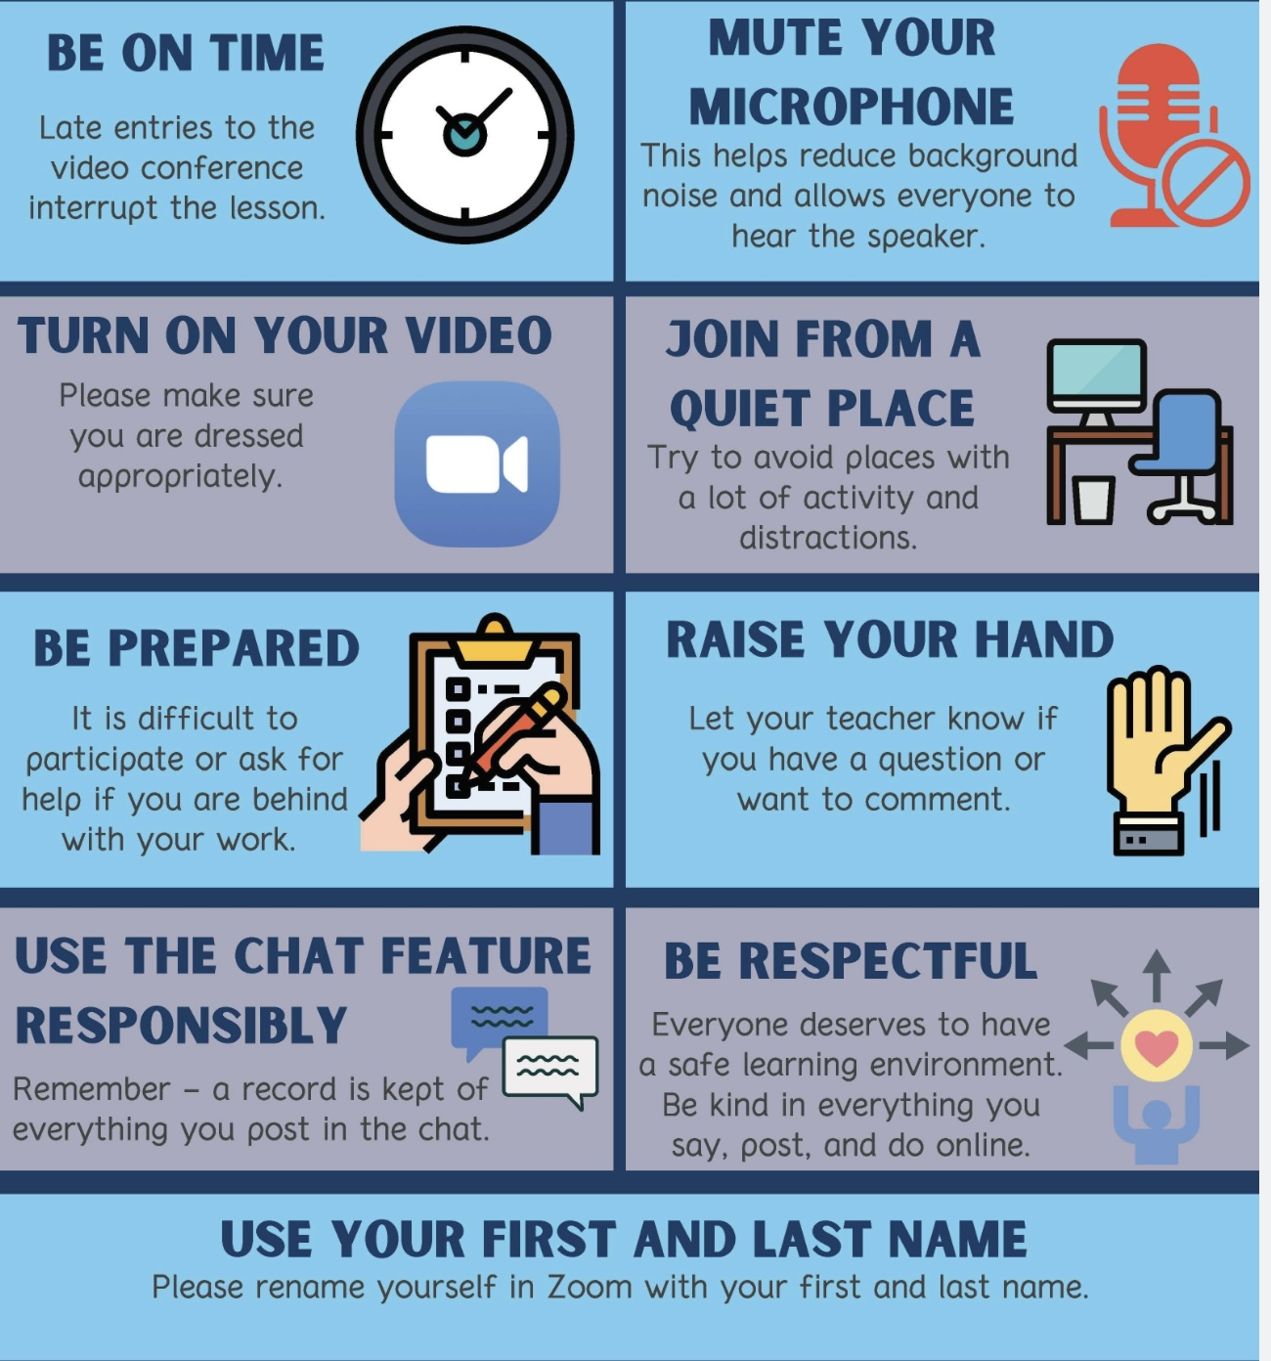
REMINDER PARTICIPANT AGREEMENTS
If you have questions, comments, or feedback, please save them for the two question periods. You can put them in the chat box or raise your real/virtual hand.
Keep comments, questions, and feedback relatively brief so everyone has a chance to participate.(one breath sharing)
If you’re on zoom, make sure no one can overhear what is being said
For reasons that will become clear later in the course please avoid giving advice to other participants about what they should or should not do. Validation, encouragement , and understanding are however very much appreciated.

Slide 20

WEEKLY ANNOUNCEMENTS

Slide 21

E-mailed questions, comments, feedback

Slide 22
Question whose answer we will read out today

Slide 23
Last week, session 19, we talked about dissociation, structural dissociation theory and the three stages of trauma therapy. Is grief also considered a trauma that might cause people to dissociate and if so, do the three stage of trauma therapy also apply to its treatment?

Slide 24
GRIEF THROUGH THE LENS OF THE NERVOUS SYSTEM
When someone we love dies, grief is not just emotional reaction, it is also biological process in which our nervous system moves through predictable states. We can think of grief in three broad phases:
Phase of Grief | Nervous System State | What It Looks Like
Protest | Sympathetic (fight/flight) | Crying, searching, agitation, yearning
Despair | Dorsal vagal (shutdown) | Slowing down, heaviness, withdrawal
Integration | Ventral vagal (connection) | Sadness with connection, meaning making

Slide 25
THE THREE PHASES OF GRIEF
Phase 1. Protest: asks “Where are you?”
At first, when we lose someone, our nervous system mobilizes. We cry, search, feel panic, anger, and longing.
From an attachment perspective, this is protest behavior, the system is trying to bring the person back. From a polyvagal perspective, this is sympathetic activation. This is adaptive, it means we loved the person.
Phase 2. Despair: asks “What’s the point?”
When protest doesn’t bring the person back, we shift into a slower, heavier state. We may feel numb, empty, exhausted and withdrawn. This is dorsal vagal activation, a shutdown response. But there are two kinds of dorsal states:
Traumatic collapse: Frozen fear, shame, dissociation.
Grief slowing: A biological quieting that allows for conservation of energy, reduced stimulation and internal processing.
Healthy mourning usually involves the second type, a natural slowing down.
Phase 3. Integration: Sadness with connection
The goal of grief is not simply to feel better but to reach a point where we can remember the person, feel sad, cry, talk about them, and still feel connected to life.
That is ventral vagal sadness or connected grief. Healthy grief is sadness with connection. It is very different from sympathetic panic and dorsal shutdown

Slide 26
COMPLICATED GRIEF
Grief becomes pathological when the system gets stuck. Healthy grief moves between states. Pathology is stuckness. We might get stuck in: Sympathetic protest → chronic anxiety, agitation or dorsal collapse → depression, numbness, dissociation. Movement is health. Rigidity is pathology.
In uncomplicated grief, even though we feel devastated, our personality stays integrated. We may cry in the morning, go to work in the afternoon and feel waves of sadness but we are still one self moving between states.
In traumatic or complicated grief, something different happens. This often happens when the loss is sudden, violent. guilt-ridden, or layered on prior trauma. When that happens, the experience may not integrate. Instead, the nervous system organizes into parts.
One part (an Emotional Part, EP) becomes stuck in the moment of rupture. That part may hold sympathetic protest (“Where are you?!”) and/or dorsal despair (“Nothing matters.”). This part is not grieving in present time. It is living in the moment of the hospital room, the phone call, the accident scene.
Another part (the Apparently Normal Part, ANP) may avoid the loss: by going to work, avoiding reminders and saying “I’m fine” but it isn’t integrated it’s just surviving. This is where complicated grief lives.
Trauma spectrum disorders are a pathology of time; a part of the person is stuck in the past.

Slide 27
HEALTHY MOURNING VS DISSOCIATED GRIEF
Healthy Mourning
Movement between states
Sadness in present time
Tears with connection
Meaning-making possible
Can approach the memory
Traumatic / Dissociated Grief
Segregated parts
A part stuck in past time
Panic or collapse when reminded
Meaning frozen or shattered
Avoidance of memory

Slide 28
THE THREE-STAGE MODEL IN GRIEF
Stage 1 – Stabilization
If we approach trauma too quickly, the EP floods by panicking, or collapsing. So, we need to widen the window of tolerance. This allows the ANP to tolerate contact with grief without being overwhelmed.
Stage 2 – Trauma Processing
Here the stuck part begins to realize: “This happened in the past.” The goal of phase 2 is not to erase grief but to unfreeze trauma-time. The memory becomes something remembered, not relived.
Stage 3 – Integration
Integration happens when the memory becomes autobiographical and we can say
“He died.” feel sadness but not annihilation. Grief becomes connected sadness instead of nervous system collapse.

Slide 29
Ex of healthy grief: “I miss my mother every day. Sometimes I cry. I feel sad, but I’m okay.”
Pathological grief that is structurally dissociated: EP part: “She’s gone. I can’t survive.”
ANP: “I don’t want to talk about it.” The split is the problem, not the grief.
Grief itself is not dissociation, but when grief overwhelms our integrative capacity, the nervous system organizes into parts. Grief becomes traumatic when a part of us remains stuck in the moment of rupture. Treatment helps that part realize time has moved forward, so grief can become sadness instead of trauma.

Slide 30


INTRODUCING THE 4th and last SET OF DBT SKILLS
interpersonal effectiveness skills- Workbook Pages 207-241
ANOTHER FLASH QUIZZ- Name the 3 sets of skills we’ve already covered

Slide 31


Slide 32
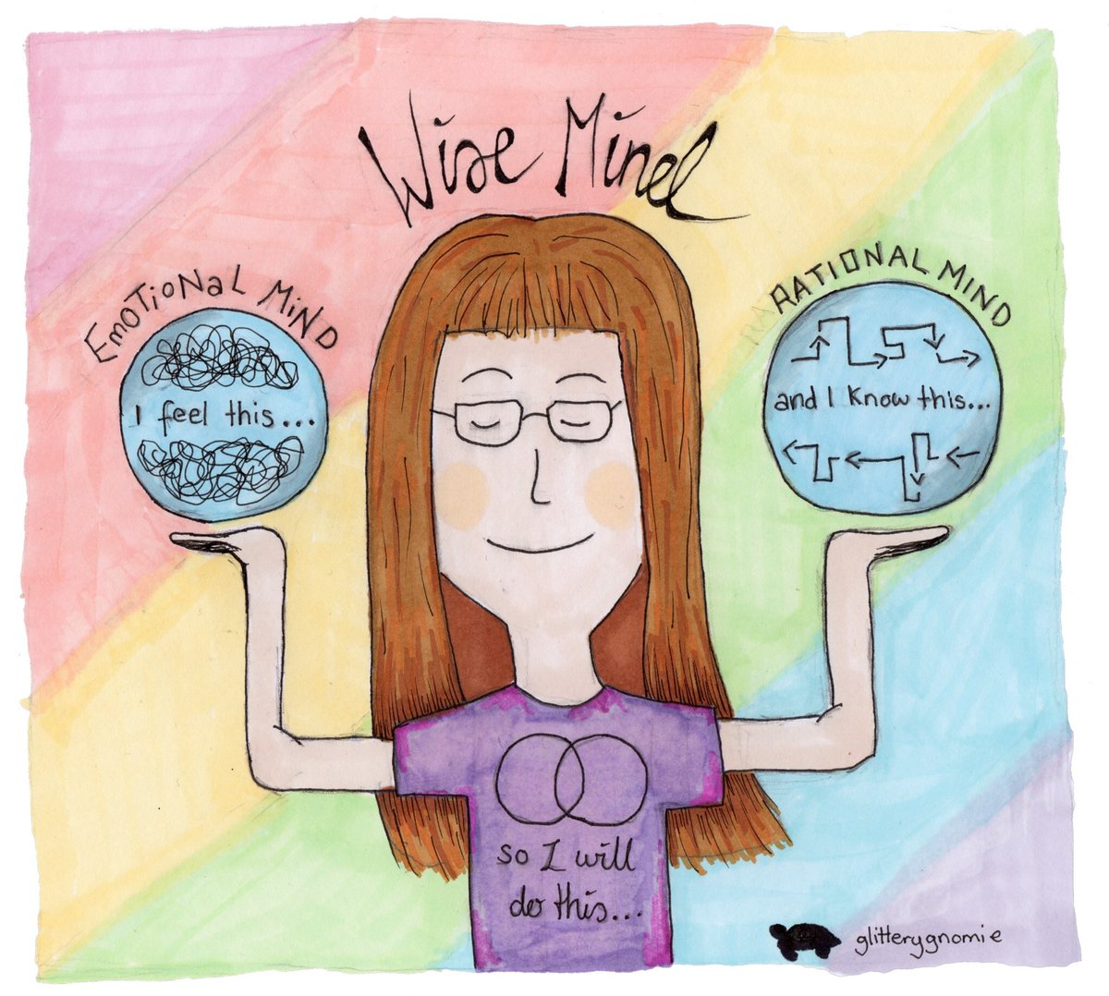
INTERPERSONAL EFFECTIVENESS

Slide 33
UPDATED PERSONAL SKILLS LIST
Distress tolerance skills
Grounding skills- Set a daily intention
“ - Sensory soothing toolkit
“ -The 5,4,3,2,1 method
“ -The emotional freedom technique
REST (or PEST) Pause
Radical acceptance statements (please specify)
Distraction plan “
Self-soothing plan
Safe place visualization
Cue controlled relaxation
Rediscovering your values (please specify)
Rehearse values-based behavior or edit/splice/paste
Connect with your higher power “
14. Live in the present moment
15. Use self-encouraging coping thoughts
16. Radical acceptance
17. Use self-affirming statements
18. Balance feelings and threat
19. Create new coping strategies
20. Create an emergency coping plan
21. Box breathing
22. Cold temperatures
23. High intensity exercise
24. Progressive muscular relaxation
25. Paced breathing
26. Side to side eye movement.

Slide 34
UPDATED PERSONAL SKILLS LIST
Mindfulness skills
1) Focus on a single minute
2) Focus on a single object
3) Band of light
4) Inner-Outer Experience
5) Record Three Minutes of Thoughts
6) Thought Diffusion
7) Describe Your Emotion
8) Focus Shifting
9) Mindful Breathing
10) Mindful Awareness of Emotion
11) Wise mind
12)how to make Wise mind decisions
13) Radical acceptance
14) Judgements and labels
15) Self compassion
16) Mindful communication
17. Being mindful in our daily life
18. How to do tasks mindfully
19. How to be mindful of our activities
20. Resistances and hindrances to mindfulness practice
21. Exploring mindfulness further
22. Mindfulness and meditation
23. Using kindness and compassion
24. Paying attention to spaciousness and stillness

Slide 35
UPDATED PERSONAL SKILLS LIST
Emotional regulation skills
How do emotions work?
Recognizing emotions
Overcoming barriers to healthy emotions
Reducing physical vulnerability
Reducing cognitive vulnerability
5. Increasing Positive Emotions
6. Being mindful of your emotions without judgement
Emotion exposure.
Doing the opposite of your emotions
9. Problem Solving

Slide 36
TODAY-UPDATED PERSONAL SKILLS LIST
Interpersonal effectiveness skills
1.Mindful attention
2. Compassion for others
3. Passive vs. aggressive behavior
4. I want-they want ratio
5. I want-I should ratio
6. Key interpersonal skills
7. Blocks to using interpersonal skills
8. Knowing what you want
9. Modulating the intensity of a request
10. Making a simple request
11. Designing basic assertiveness scripts and
12. Assertive listening

Slide 37
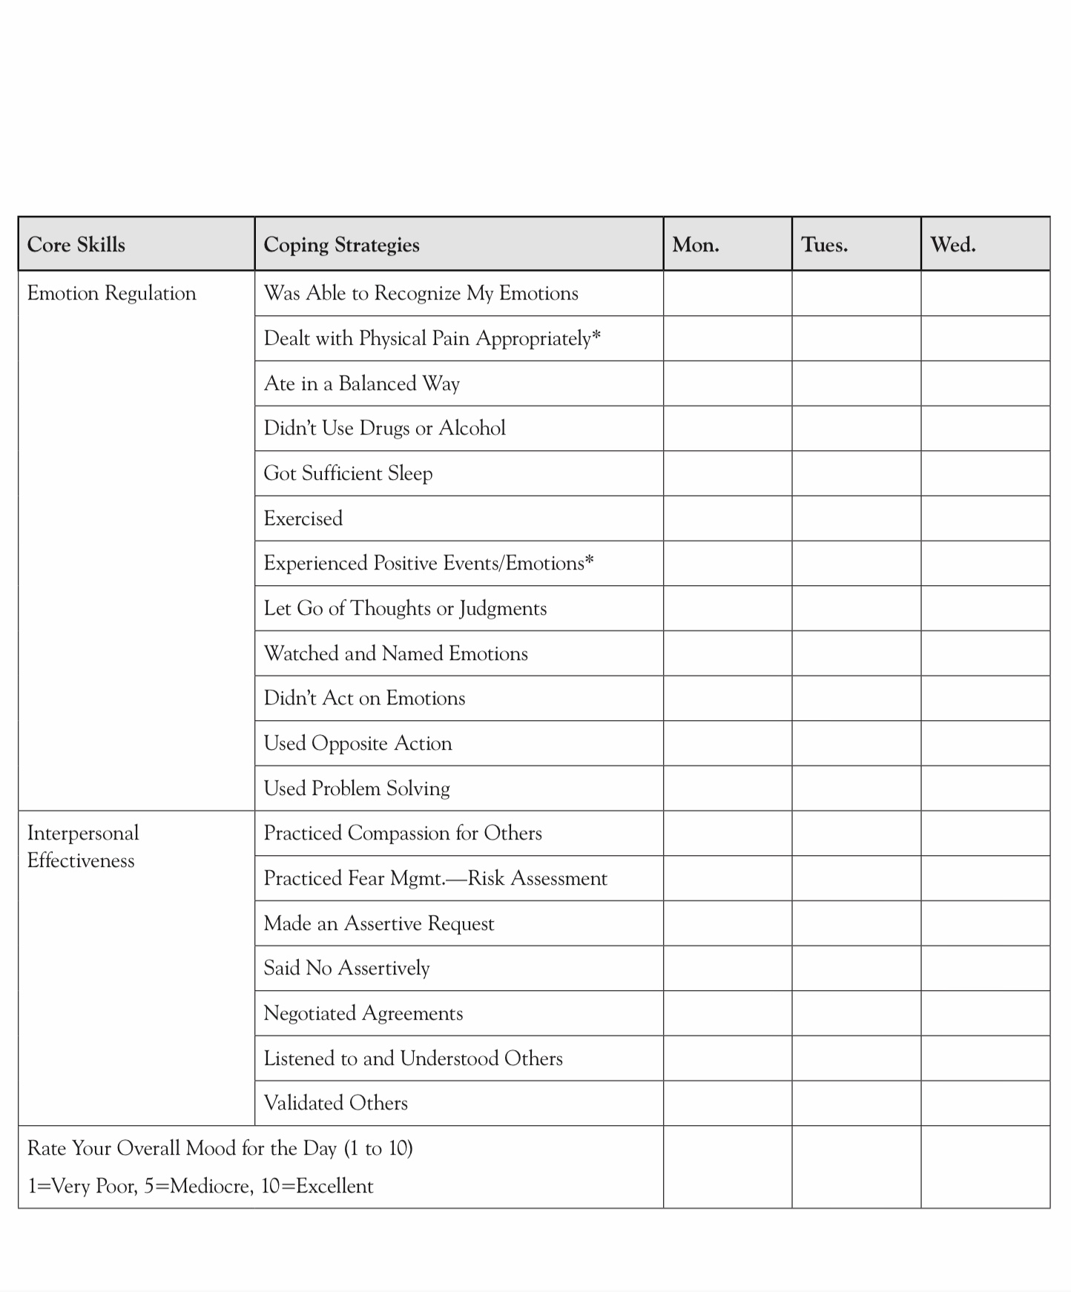
SKILLS DISCUSSED TODAY
X
X
X
X
X
X
X

Slide 38
What are interpersonal skills?

Slide 39

What are interpersonal skills?
1. Social skills: any competence facilitating interaction and communication with others
3. Assertiveness skills: expressing your point of view clearly and directly while respecting others
4. Negotiation Skills: a way to achieve an outcome with a formal discussion between two people who have different aims or intentions
2. Listening skills: listening attentively, understanding, reflecting on, responding to, and retaining what others say
Interpersonal skills can be subdivided into 4 skills sets:
Interpersonal skills are the skills required to effectively communicate and interact with others.

Slide 40
INTERPERSONAL EFFECTIVENESS: FOUR CORE SKILL SETS
1. Social Skills: These are the skills that help us initiate, build, and maintain relationships. They include things like making appropriate small talk, joining conversations, expressing interest, and responding to social cues. Social skills help relationships get started and create a sense of ease and connection.
2. Listening Skills: Listening skills help us understand others and feel understood. They include paying attention, not interrupting, reflecting back what we hear, asking clarifying questions, and noticing tone and body language. Good listening reduces misunderstandings and helps regulate emotions on both sides of an interaction.
3. Assertiveness Skills: Assertiveness skills help us express our needs, feelings, and limits clearly and respectfully. They allow us to say yes, say no, make requests, and set boundaries, without aggression or excessive apology. Assertiveness protects self-respect while still valuing the relationship.
4. Negotiation Skills: Negotiation skills help us handle differences, conflicts, and competing needs.
They include compromise, problem-solving, validating the other person’s perspective, and finding workable middle ground. Negotiation recognizes that in real relationships, no one gets everything they want, but everyone deserves to be heard.

Slide 41
INTERPERSONAL SKILLS- RATE YOURSELF 0-10
In your mind give yourself a 0 to 10 score on each of these four core interpersonal skills sets. Take a trying to understand rather than judging yourself perspective.
1. Social Skills: These are the skills that help us initiate, build, and maintain relationships. They include things like making appropriate small talk, joining conversations, expressing interest, and responding to social cues. Social skills help relationships get started and create a sense of ease and connection.
My score:
2. Listening Skills: Listening skills help us understand others and feel understood. They include paying attention, not interrupting, reflecting back what we hear, asking clarifying questions, and noticing tone and body language. Good listening reduces misunderstandings and helps regulate emotions on both sides of an interaction.
My score:
3. Assertiveness Skills: Assertiveness skills help us express our needs, feelings, and limits clearly and respectfully. They allow us to say yes, say no, make requests, and set boundaries, without aggression or excessive apology. Assertiveness protects self-respect while still valuing the relationship.
My score:
4. Negotiation Skills: Negotiation skills help us handle differences, conflicts, and competing needs.
They include compromise, problem-solving, validating the other person’s perspective, and finding workable middle ground. Negotiation recognizes that in real relationships, no one gets everything they want, but everyone deserves to be heard.
My score:

Slide 42
INTRAPERSONAL VS. INTERPERSONAL SKILLS
Intrapersonal emotional regulation skills are skills used to understand, manage, and modulate one’s own emotional states. These include recognizing and naming emotions, identifying triggers and patterns, using mindfulness to stay grounded, applying distress tolerance techniques (e.g., self-soothing, distraction, opposite action), reframing thoughts to reduce emotional intensity.
With intrapersonal emotional regulation skills, the goal is to regulate within yourself, keeping emotions from overwhelming or shutting you down.
Interpersonal emotional regulation skills by contrast, are used to manage emotions in relation to others, how you express feelings, set boundaries, ask for needs, and maintain relationships under emotional stress. This includes communicating assertively and kindly, listening and validating others’ emotions, negotiating or problem-solving conflicts, balancing self-respect, relationship goals, and effectiveness ( DEAR MAN, GIVE, FAST) and regulating emotions that arise during interactions (e.g., anger, shame, fear of rejection)
With interpersonal emotional regulation skills, the goal is to regulate interactions between people, keeping relationships stable and satisfying even when emotions run high.
The DBT emotion regulation module teaches intrapersonal regulation, how to understand and manage your emotions. The interpersonal effectiveness module focuses on interpersonal regulation, how to navigate relationships and emotional exchanges with others skillfully.

Slide 43

THE benefits of good interpersonal skills
1) Good interpersonal skills help us be more effective at dealing with people
2) They improve our chances of getting our needs met
3) They help us negotiate conflicts without damaging relationships
4) They strengthen our self-respect by giving us alternatives to old, damaging patterns of anger or withdrawal

Slide 44
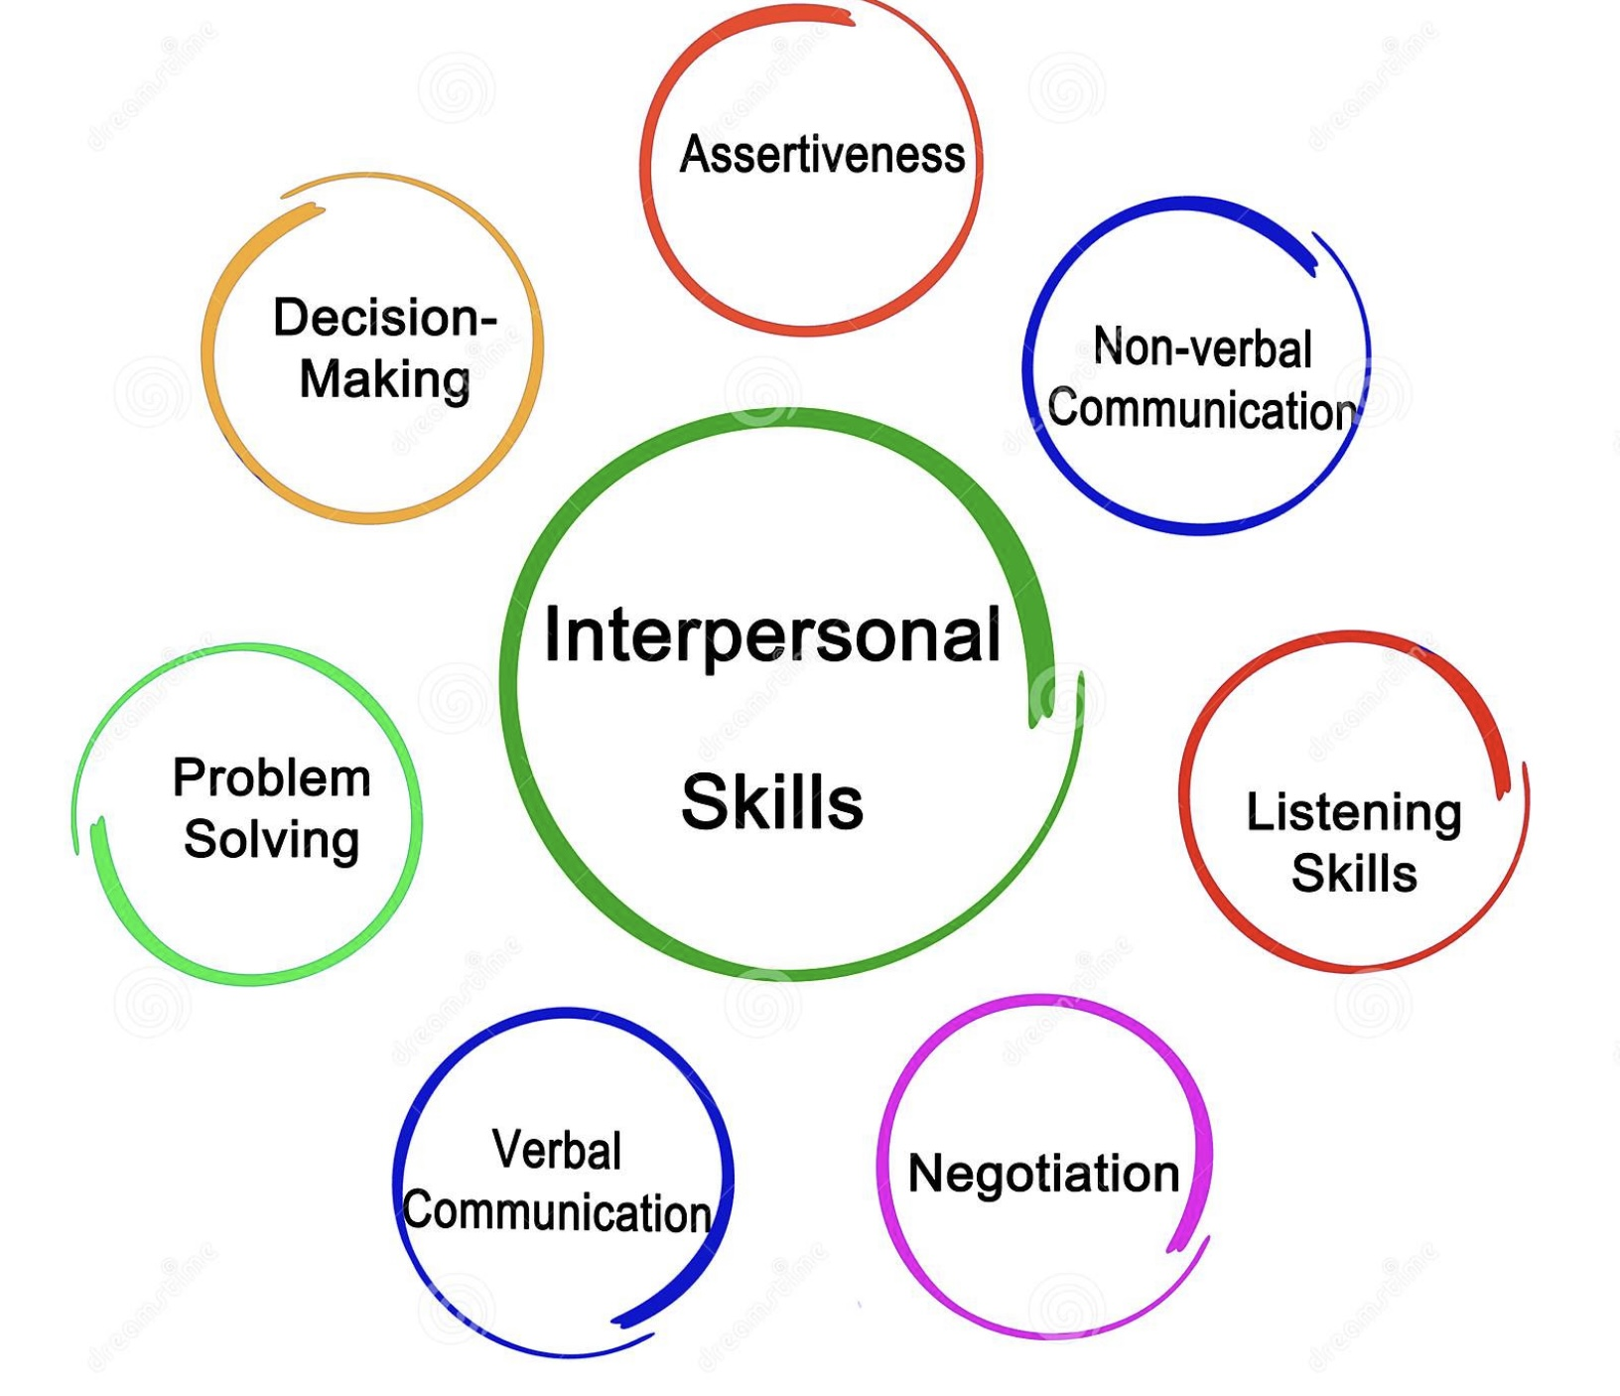
Skills training workbook p. 207-241 interpersonal SKILLS
1. Mindful attention
2. Compassion for others
3. Passive vs. aggressive behavior
4. I want-they want ratio
5. I want-I should ratio
6. Key interpersonal skills
7. Blocks to using interpersonal skills. Knowing what you want
9. Modulating the intensity of a request
10. Making a simple request
11. Designing basic assertiveness scripts
12. Assertive listening

Slide 45
Skills training workbook p. 207-241 interpersonal SKILLS
1. Mindful attention
2. Compassion for others
3. Passive vs. aggressive behavior
4. I want-they want ratio
5. I want-I should ratio
6. Key interpersonal skills
7. Blocks to using interpersonal skills. Knowing what you want
9. Modulating the intensity of a request
10. Making a simple request
11. Designing basic assertiveness scripts
12. Assertive listening

Slide 46

DISTRACTED LISTENING VS. MINDFUL ATTENTION
Interpersonal skills require that we be mindfully attentive with others, or in other words, that we be attuned to the other persons thoughts, feelings and reactions and truly pay attention to the communication process between us and them.
Mindfulness listening skills involve paying attention to not just what other people are saying but also to their facial expressions, body language, tone, and choice of words. This helps us to understand their feelings, thoughts, and behaviors and the evolving state of our interaction with them.
Listening mindfully requires that we pay attention to everything other people are communicating rather than distractedly listening by focusing on our own thoughts, and emotions and preparing what we’re going to say or do next.
Paying mindful attention to others allows us to notice potential trouble or holes that may be brewing and helps us figure out how to avoid them.
To practice being mindfully attentive in interactions try the mindful attention exercise found on p. 208 of the workbook

Slide 47
Skills training workbook p. 207-241 interpersonal SKILLS
1. Mindful attention
2. Compassion for others
3. Passive vs. aggressive behavior
4. I want-they want ratio
5. I want-I should ratio
6. Key interpersonal skills
7. Blocks to using interpersonal skills. Knowing what you want
9. Modulating the intensity of a request
10. Making a simple request
11. Designing basic assertiveness scripts
12. Assertive listening

Slide 48

Compassion
All living beings experience pain and suffering
Compassion involves recognizing, empathizing with, and trying to reduce the pain of another living being.
Compassion is an important part of healthy relationships
If we take a compassionate attitude, we recognize that, given who they are, people are doing their best even when they are being a**holes.
In difficult interactions it may be helpful to consider what the other person is or has gone through in their lives to get here.

Slide 49
What’s the difference between compassion and empathy?

Slide 50
COMPASSION AND EMPATHY
Empathy is the ability to feel with another person. It involves sensing, resonating with, or understanding another person’s emotional experience from the inside.
• “I feel what you’re feeling.”
• Empathy can be emotional (feeling it in the body) or cognitive (understanding their perspective)
• It helps other people feel seen and understood
• When unbounded, empathy can lead to emotional overload or burnout
Compassion is the ability to care about another person’s suffering while staying grounded in the window of tolerance. It includes empathy, but adds kindness, perspective, and a wish to help, without becoming overwhelmed.
• “I care about your suffering, and I want to respond wisely.”
• Compassion involves warmth, concern, and wise action
• It supports boundaries and self-regulation
• And it is more sustainable over time
The difference is empathy feels with; compassion cares for.
• Empathy connects us emotionally
• Compassion allows us to stay present without drowning

Slide 51
COMPASSION AND EMPATHY
In DBT terms: Empathy lives primarily in emotional Mind. It involves emotional resonance, feeling another person’s pain, fear, or distress in your own body. Empathy is essential for connection, but on its own it can lead to over-involvement, loss of boundaries, or emotional flooding. When empathy causes a person to repeatedly be outside the window of tolerance they may try to distance themselves, fix or minimize in problems in order to manage their distress. This sounds reasonable but often feels cold or invalidating to others.
Compassion arises from Wise Mind. Wise Mind integrates empathy with perspective, values, and regulation. From Wise Mind, we can care deeply without being pulled out of the window of tolerance.
Wise Mind compassion = empathy + grounding + choiceful action

Slide 52
COMPASSION AND EMPATHY
Example
Situation: A friend is very distressed and repeatedly texting you late at night about their relationship crisis.
EMPATHY (from emotional mind): “ You feel their pain so strongly that you stay up all night responding, even though you’re exhausted and resentful the next day.” (Connection without boundaries → burnout)
Rational mind response: “This is unreasonable. I can’t deal with this. They’re being dramatic.” (Boundaries without warmth → rupture)
COMPASSION (from Wise Mind): “I care about them and I also need rest. I can acknowledge their pain now and set a limit.”
Wise mind response: “I can hear how painful this is for you, and I really care. I’m going to sleep now, but we can talk more tomorrow.” (Warmth + boundary + self-respect)
Empathy pulls us into the emotion; compassion lets us stay connected while choosing an effective response.

Slide 53
Skills training workbook p. 207-241 interpersonal SKILLS
1. Mindful attention
2. Compassion for others
3. Passive vs. aggressive behavior
4. I want-they want ratio
5. I want-I should ratio
6. Key interpersonal skills
7. Blocks to using interpersonal skills. Knowing what you want
9. Modulating the intensity of a request
10. Making a simple request
11. Designing basic assertiveness scripts
12. Assertive listening

Slide 54
Communication styles passive assertive aggressive
COMMUNICATION STYLES LIE ON A SPECTRUM RANGING FROM PASSIVE TO ASSERTIVE TO AGGRESSIVE, EACH STYLE HAS BENEFITS AND DRAWBACKS:
Feels safe because we go with the flow and avoid conflict
But requires us to abandon our own needs
And creates a build up of frustration and resentment
It may cause us to blow up, become depressed or run away
It tends to destroy relationships
It is more common in the avoidantly attached
Is often present when people have a strong sense of how things should be (right vs. wrong)
Is associated with a desire to control others
We use it when we apply pressure to try to control situations and get our way
It is often associated with anger
It makes people afraid and pushes them away
It too tends to destroy relationships
It is more common in the anxiously attached
Passive aggressive style combines both passivity with indirect or cold aggression .

Slide 55
PASSIVE, ASSERTIVE, AND AGGRESSIVE: THREE WAYS TO HANDLE A SITUATION
Situation 1: A friend often interrupts you while you’re talking.
Passive Response: “It’s fine… I probably talk too much anyway.” (You give up your voice to keep the peace.) Emotion underneath: resentment, hurt, or powerlessness. Outcome: the friend doesn’t realize there’s a problem; you feel unheard.
Assertive Response: “I really value our conversations. When I get interrupted, I lose my train of thought, could I finish what I was saying before you jump in?” (You express your needs respectfully and clearly.) Emotion underneath: self-respect and care for the relationship. Outcome: you’re heard, and the relationship can adjust and grow.
Aggressive Response: “You always interrupt me, you’re so rude!” (You assert your need by attacking or blaming.) Emotion underneath: frustration or anger. Outcome: the other person feels defensive, conflict increases.

Slide 56
PASSIVE, ASSERTIVE, AND AGGRESSIVE: THREE WAYS TO HANDLE A SITUATION
Situation 2: A co-worker leaves a shared workspace messy.
Passive Response: “Oh well, I’ll just clean it up, it’s easier that way.” You avoid conflict but build silent frustration. The problem continues.
Assertive Response: “I notice the table gets messy after we work here. Can we agree to clean up before leaving so we both have a clear space?” You describe the issue without blame and invite cooperation. The relationship stays respectful and productive.
Aggressive Response: “You’re such a slob, clean up your mess or I’m reporting you.” You express your frustration by attacking. The relationship suffers and resistance increases.

Slide 57
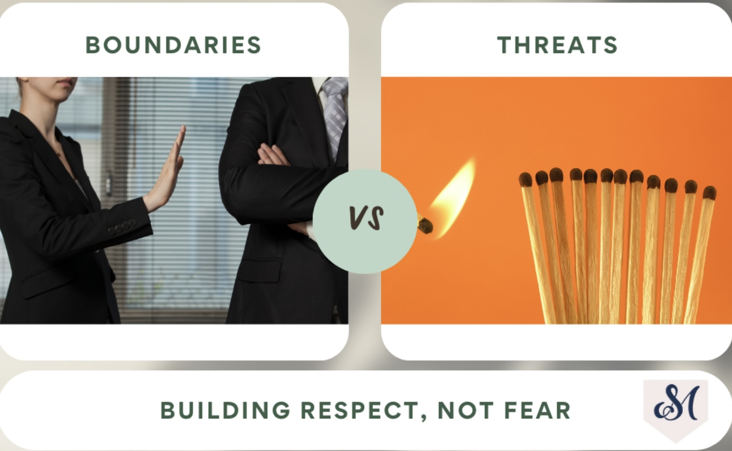
A boundary is something you set to take care of yourself. It defines what you will do to protect your well-being, values, or safety, without requiring the other person to change. Example: “If you raise your voice, I’m going to step outside until we can talk calmly.” You’re not telling them what to do, you’re saying what you will do.
A key feature of a boundary is that it’s about your behavior, not somebody else’s. It’s non-controlling, they remain free to choose their actions. It’s consistent and calm, not reactive or punitive. It comes from self-respect, not power or fear. In essence a boundary protects your space; it doesn’t invade theirs.
BOUNDARIES VS. THREATS

Slide 58
BOUNDARIES VS. THREATS
A threat tries to control someone else’s behavior through fear or pressure. It’s a demand followed by a punishment if the person doesn’t comply. For example, saying “If you raise your voice again, you’ll regret it.” This is not about protecting yourself; it’s about forcing compliance.
Key features of a threat are that it’s about changing the other person’s behavior. It’s controlling or coercive. It’s emotionally charged, often said in anger or frustration and it damages trust and safety rather than building it.

Slide 59
Skills training workbook p. 207-241 interpersonal SKILLS
1. Mindful attention
2. Compassion for others
3. Passive vs. aggressive behavior
4. I want-they want ratio
5. I want-I should ratio
6. Key interpersonal skills
7. Blocks to using interpersonal skills. Knowing what you want
9. Modulating the intensity of a request
10. Making a simple request
11. Designing basic assertiveness scripts
12. Assertive listening

Slide 60

I Want They Want Ratio
Typically, in relationships, each person wants and tries to get their needs met
Sometimes both people want the same thing and there are no conflicts
Other times, however, people’s needs conflict
To communicate effectively when our needs conflict with those of others we must:
  1. Know what we need and be able to clearly express it
  2. Know what the other person needs
  3. Compromise so that both we and the other person can get some part of what we need
  4. Give what we can to meet the other person’s needs

Slide 61
I WANT / THEY WANT RATIO
In DBT interpersonal effectiveness, we aim to balance:
• What I want or need
• What the other person wants or needs
Problems arise when the ratio is very lopsided:
• All “I want” → aggressive, entitled, relationship-damaging
• All “they want” → passive, self-erasing, resentment-building
Effectiveness lives in the middle.

Slide 62
I WANT / THEY WANT RATIO
Example situation: You want a weekend off work. Your manager wants full staffing.
All they want (ratio skewed away from self): “It’s fine, I’ll work. I don’t want to cause problems.” (Immediate peace → long-term resentment and burnout)
All I want (ratio skewed away from relationship): “I’m not coming in. That’s your problem.” (Short-term relief → damaged relationship and consequences)
Balanced DBT Ratio (Wise Mind): “I’ve worked the last three weekends and I’m feeling burned out. I’d like this weekend off. I know coverage matters; can we look at options together?” (Self-respect + relationship + problem-solving)
DBT asks: How can I speak in a way that honors what I want while acknowledging what they want?
• Too much “I want” → control
• Too much “they want” → collapse
• Wise Mind → balance and effectiveness

Slide 63
Skills training workbook p. 207-241 interpersonal SKILLS
1. Mindful attention
2. Compassion for others
3. Passive vs. aggressive behavior
4. I want-they want ratio
5. I want-I should ratio
6. Key interpersonal skills
7. Blocks to using interpersonal skills. Knowing what you want
9. Modulating the intensity of a request
10. Making a simple request
11. Designing basic assertiveness scripts
12. Assertive listening

Slide 64
THE “I WANT / I SHOULD” RATIO
“I want”: Comes from emotional mind. It reflects urges, feelings, fears, anger, and longing. It often sounds like: “I want to avoid this”, “I want them to understand”, “I want to explode or disappear”
“I should”: Comes from rule-bound rational mind. It reflects duty, guilt, social rules, self-criticism. It often sounds like: “I should be nicer”, “I should just suck it up”, “I should know better”
The problem is:
Too much “I want” → impulsive, reactive behavior.
Too much “I should” → resentment, shame, emotional suppression
Wise Mind emerges when neither dominates and both are acknowledged.
A healthy interpersonal stance usually sounds like: “I want X… and I understand Y… so I will do Z.” That is Wise Mind integrating emotional truth (wants) with values, facts, and long-term goals (shoulds)

Slide 65
THE “I WANT / I SHOULD” RATIO
Example 1: Interpersonal Effectiveness. Your partner is late again.
Emotional Mind (“I want” heavy): “I want to yell. I want them to know how disrespectful this is.”
Overcontrolled Rational Mind (“I should” heavy): “I should be understanding. I should not make a big deal out of this.”
Wise Mind (Balanced Ratio): “I want reliability, and I also know things happen. I should speak up calmly, so this doesn’t keep building.”
Resulting behavior (DEAR MAN–style): “When you’re late without telling me, I feel frustrated. I’d like a text if you’re running late so I can plan better.”
Example 2: Boundary-Setting: A friend asks for a last-minute favor you don’t want to do.
Emotional Mind: “I want to say no and never help again.”
Overcontrolled Rational Mind: “I should say yes. They need me.”
Wise Mind: “I want rest tonight, and I value being a supportive friend. I can say no this time without rejecting them.”
Wise Mind response: “I can’t help tonight, but I could another day.”

Slide 66
Skills training workbook p. 207-241 interpersonal SKILLS
1. Mindful attention
2. Compassion for others
3. Passive vs. aggressive behavior
4. I want-they want ratio
5. I want-I should ratio
6. Key interpersonal skills
7. Blocks to using interpersonal skills. Knowing what you want
9. Modulating the intensity of a request
10. Making a simple request
11. Designing basic assertiveness scripts
12. Assertive listening

Slide 67

6 Key Interpersonal Skills
Knowing what you want : Clearly express what you’re feeling, thinking and what you want
Asking for what you want (in a way that protects the relationship): The next section of the workbook will give us a method for doing this in a way that is effective
Negotiating areas of conflicting wants: Recognize that each person’s needs are valid and that to have a good relationship you need to compromise

Slide 68
6 Key Interpersonal Skills
4. Getting information: To communicate effectively you must understand what the other person needs, fears, hopes for, etc.
5. Saying no (in a way that protects the relationship): learning to say no in an assertive way that sets firm boundaries while validating the other persons needs is an important part of effective communication
6. Acting according to your values: Reflect on your values and the kinds of relationships you want. Learn how to act in ways that incorporate your values into your relationships ex. Trustworthy, loving, committed, truthful, transparent

Slide 69
Skills training workbook p. 207-241 interpersonal SKILLS
1. Mindful attention
2. Compassion for others
3. Passive vs. aggressive behavior
4. I want-they want ratio
5. I want-I should ratio
6. Key interpersonal skills
7. Blocks to using interpersonal skills. Knowing what you want
9. Modulating the intensity of a request
10. Making a simple request
11. Designing basic assertiveness scripts
12. Assertive listening

Slide 70

7 obstacles to effective communication
1. Aggressive habits- Sometimes we communicate in ways that create fear, shame or hurtful psychological pressure
2. Passive habits- Sometimes we shut down, surrender or give in to someone to avoid conflict. This leads to us becoming frustrated, resentful and leads to passive aggressive behavior
3. Overwhelming emotions- Distressing emotions impact our ability to communicate effectively. Sometimes we lose control and say or do things that we later regret.
4. Failure to identify needs- Communication skills fail when we don’t know what we want because then we can’t ask for what we need

Slide 71
7 obstacles to effective communication
5. Fear- Fear can push us to use aggressive or aversive communication strategies or causes us to avoid. This leads to ineffective communication
6. Toxic Relationships- It is difficult to use effective, constructive communication skills when we are engaged with people who consistently use negative, destructive ones. It’s important that we are aware when this is the case. If these encounters can’t be avoided, planning how to deal with them can be very helpful
7. Myths- Myths or core beliefs we hold about relationships such as 1.we can’t ask for what we need or 2. we can’t say no, can paralyze us and get in the way of effective communication

Slide 72
KNOWING WHAT WE WANT:OUR LEGITIMATE RIGHTS
how do we know that what we’re asking for is legitimate and neither too little or too much?

Slide 73

1. Knowing our legitimate rights
7. To protest any mistreatment or criticism that feels bad to you
8. To negotiate for change
9. To ask for help, emotional support, or anything else you need
10. To say no
11. To not have to justify yourself to others
12. To not take responsibility for someone else’s problems
13. To sometimes inconvenience or disappoint others
1. To need things from others
2. To sometimes put yourself first
3. To feel and express your emotions/pain
4. To be the final judge of your beliefs and to accept them as legitimate
5. To your opinions and convictions
6. To your experience even if it’s different from that of others
we have the right to…

Slide 74
KNOWING WHAT WE WANT THEN ASKING FOR OUR LEGITIMATE RIGHTS
If we know what we want what’s a good way to ask for it?

Slide 75

Knowing what we want
If you’re in an interpersonal situation that requires negotiation:
1. Identify and state the feelings you are experiencing about the situation.
2. Put those feelings into words.
3. State what you would like the other person to change: Do more of …Less of…Stop doing …Start doing…When …Where …Frequency…
4. Organize all this information into one or more clear sentences.

Slide 76
Skills training workbook p. 207-241 interpersonal SKILLS
1. Mindful attention
2. Compassion for others
3. Passive vs. aggressive behavior
4. I want-they want ratio
5. I want-I should ratio
6. Key interpersonal skills
7. Blocks to using interpersonal skills. Knowing what you want
9. Modulating the intensity of a request
10. Making a simple request
11. Designing basic assertiveness scripts
12. Assertive listening

Slide 77

Modulate Intensity Of Asking
Increase or decrease the intensity with which you ask for what you want or need by considering:
1. How urgent is my need for what I’m asking?
2. How vulnerable is the other person or the relationship to this request?
Rate urgency of your need and vulnerability of the other person/relationship on a scale from 1. = low urgency of need, person/relationship highly vulnerable to 10. = high urgency need, person/relationship not vulnerable
With less urgent needs and more vulnerable person/relationship we want to dial down intensity of asking
With more urgent need and less vulnerable person/relationship we want to dial up the intensity of asking

Slide 78
Skills training workbook p. 207-241 interpersonal SKILLS
1. Mindful attention
2. Compassion for others
3. Passive vs. aggressive behavior
4. I want-they want ratio
5. I want-I should ratio
6. Key interpersonal skills
7. Blocks to using interpersonal skills. Knowing what you want
9. Modulating the intensity of a request
10. Making a simple request
11. Designing basic assertiveness scripts
12. Assertive listening

Slide 79

Making a simple Request
Offer a brief justification: Explain the issue in one sentence
Add a softening statement communicating that you are reasonable and non demanding: “Would you mind if …”
Add a direct specific request
Present your request in a clear and calm manner
End with an appreciation statement which reinforces the other person’s behavior: Ex. "This will really help me out”

Slide 80
Skills training workbook p. 207-241 interpersonal SKILLS
1. Mindful attention
2. Compassion for others
3. Passive vs. aggressive behavior
4. I want-they want ratio
5. I want-I should ratio
6. Key interpersonal skills
7. Blocks to using interpersonal skills. Knowing what you want
9. Modulating the intensity of a request
10. Making a simple request
11. Designing basic assertiveness scripts
12. Assertive listening

Slide 81
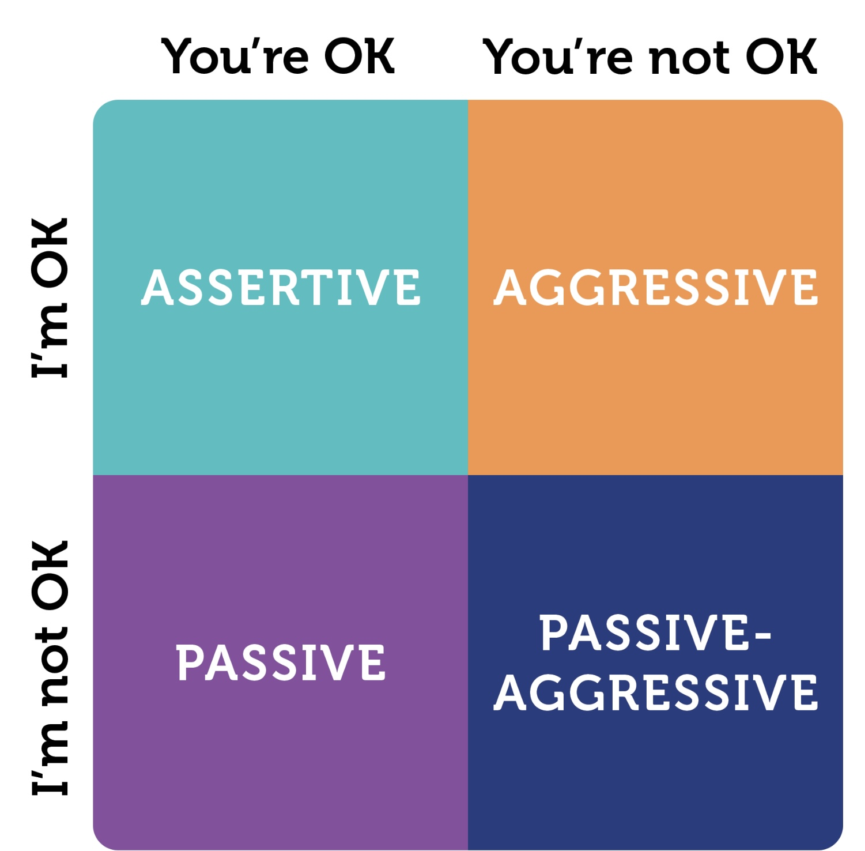
Basic Assertiveness Scripts
Include:
I think: Focus on facts (not judgements or assumptions)
I Feel: Give a brief non-judgmental description of any emotion triggered by situation. Don’t dress up ”you” statements as “I” statements ex. I feel that you are selfish
I want: State what you’d like the person to do. Make sure that you request:
  A) Behavioral change
  B) One change at a time
  C) Something that can be changed now
  D) something specific and Concrete
An appreciation, reinforcement or self-care statement

Slide 82

Example of
Assertiveness Script
I think - I’ve been working against a deadline and haven’t had time to cook dinner
I feel - I’m pretty anxious and overwhelmed that I might not get this done
I want - Could you whip something together from leftovers so I can keep working?
Self- Care - If that doesn’t work for you, I can order pizza

Slide 83
Skills training workbook p. 207-241 interpersonal SKILLS
1. Mindful attention
2. Compassion for others
3. Passive vs. aggressive behavior
4. I want-they want ratio
5. I want-I should ratio
6. Key interpersonal skills
7. Blocks to using interpersonal skills. Knowing what you want
9. Modulating the intensity of a request
10. Making a simple request
11. Designing basic assertiveness scripts
12. Assertive listening

Slide 84
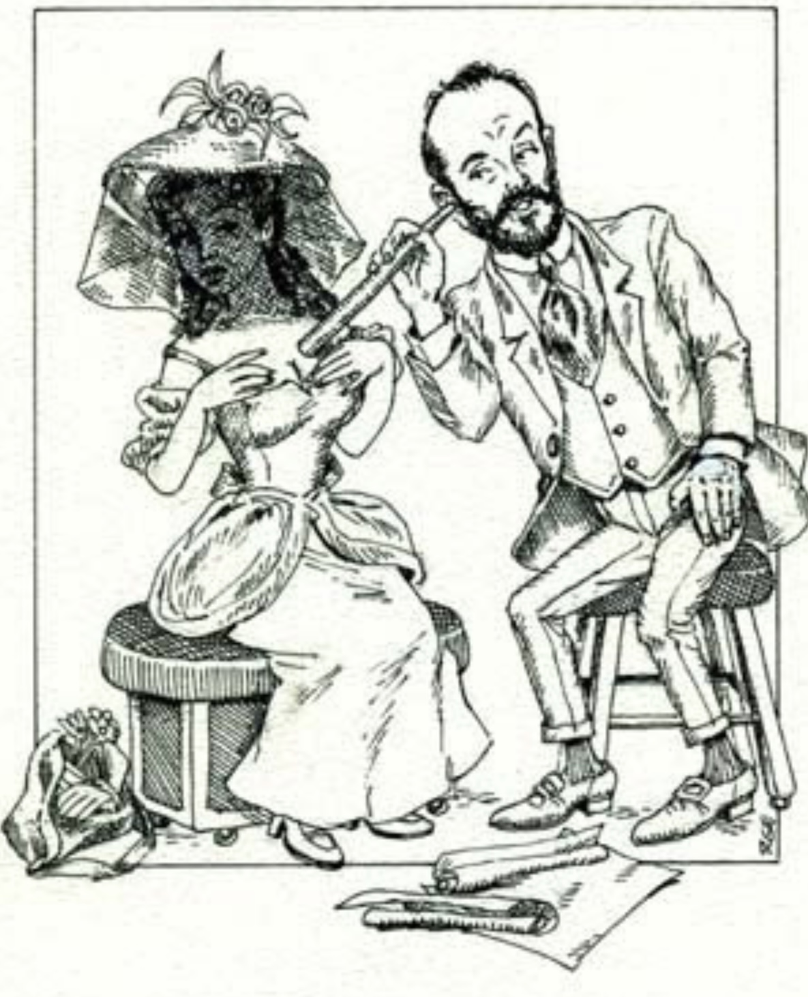
Assertive Listening
Good communication is a two-way street; it’s not just about your needs and wants
Active or assertive listening is required for effective communication
Active listening helps you to better understand other people’s needs and wants, how they might conflict with yours and how to negotiate a mutually satisfying agreement
Actively listening questions include:
  1. What’s the central issue for you?
  2. How do you make sense of the situation?
  3. What are you struggling with?
  4. How does that make you feel?
  5. What do you think needs to change?
  6. What would you like me to do to help with this?

Slide 85

Blocks to active Listening
There are a few issues that commonly interfere with active listening:
Assuming what the other person is thinking/feeling
Rehearsing: Planning what you’re going to say
Filtering: Listening only to what is relevant to you
Judging: Evaluating instead of trying to understand
Daydreaming: Getting caught up in fantasy/ memories

Slide 86
Blocks to active Listening
Advising: Focusing on suggestions/solutions
Sparring: Invalidating the person by arguing/debating
Being right: Ignoring communication that you were wrong
Derailing: changing the subject
Placating: Agreeing too quickly

Slide 87
WHAT IS DBT’s DEAR MAN GIVE FAST?
(the most iconic acronym in DBT)

Slide 88
DBT’s DEAR MAN–GIVE–FAST is a structured way to communicate effectively by balancing three goals at once:
• DEAR MAN: clearly ask for what you want or say no (get your objective met)
• GIVE: communicate with care and validation (protect the relationship)
• FAST: act with honesty and self-respect (protect your values and dignity)
DEAR MAN says what you need, GIVE says it kindly, FAST says it without betraying yourself.

Slide 89
DEAR MAN GIVE FAST
DEAR MAN – Getting Your Objective Met
D – Describe: State the facts only, without interpretation or blame. What actually happened?
E – Express: Name your feelings using “I” statements. How did this affect me emotionally?
A – Assert: Make a clear, specific request or say no directly. What am I asking for or setting as a boundary?
R – Reinforce: Explain why it helps (you, them, or the relationship). What’s the benefit of saying yes?
M – Mindful: Stay focused and calm; don’t get pulled into side arguments. Repeat your point if needed.
A – Appear confident: Use a steady voice, eye contact, relaxed posture. Act as if your request is reasonable.
N – Negotiate: Be willing to problem-solve or compromise when appropriate. What’s an alternative if this exact request doesn’t work?

Slide 90
DEAR MAN GIVE FAST
GIVE – Maintaining the Relationship
G – Gentle: Be respectful; no attacks, threats, or sarcasm.
I – Interested: Listen and show curiosity about the other person’s view.
V – Validate: Acknowledge the other person’s feelings or perspective. “That makes sense given…”
E – Easy manner: Use a calm, non-intense tone; a little warmth or humor if natural.

Slide 91
DEAR MAN GIVE FAST
FAST – Maintaining Self-Respect
F – Fair. Be fair to yourself and the other person.
A – (No) Apologies for existing. Don’t apologize for having needs or values.
S – Stick to values. Speak and act in line with what matters to you.
T – Truthful. Don’t exaggerate, minimize, or manipulate.
DEAR MAN gets results, GIVE protects the relationship, FAST protects self-respect.

Slide 92
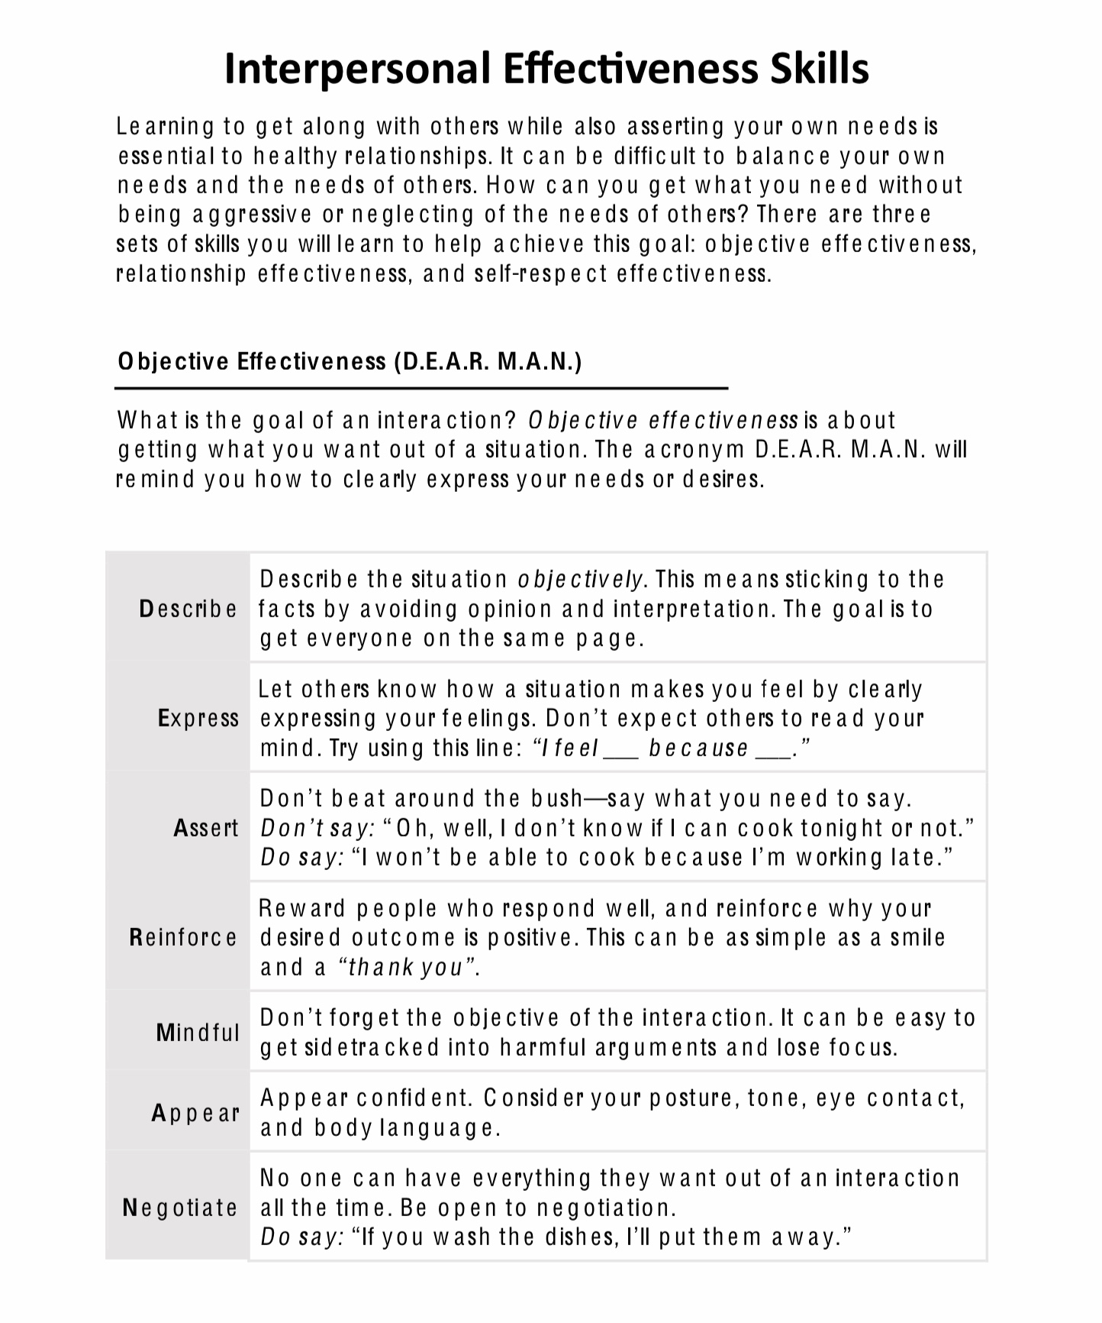

Slide 93
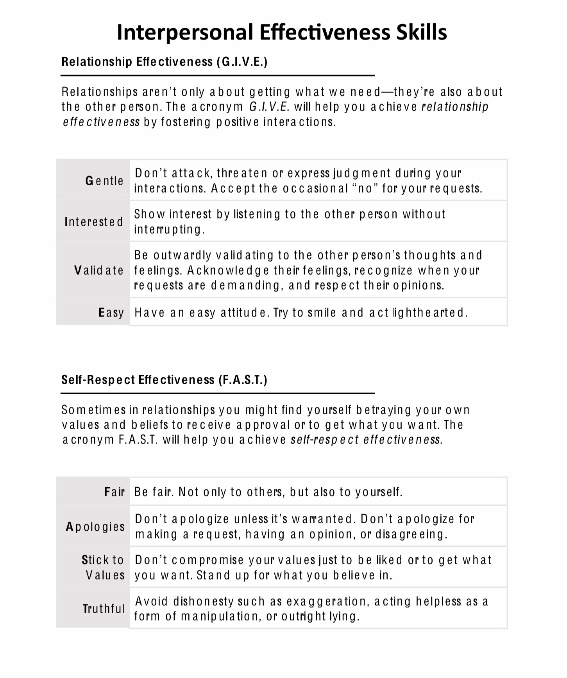

Slide 94

DBT’s assertiveness script : dear man give fast
Describe situation
Express your thoughts and feelings
Assert what you would like
Reinforce why what you want is good for both
Mindfully- Stick to one situation
Appear confident
Negotiate…And be
Gentle
Interested
Validating
Easy in manner…also
Be fair
Don’t over apologize
Stick to your values
Be truthful
what you do
Dear man describes objectives effectiveness or getting what you need or want in the interaction
Give describes relationship effectiveness or maintaining a good relationship if that is important to you
Fast describes self-respect effectiveness or maintaining your self-respect
Or how to juggle 1. getting your objectives met, with 2. preserving the relationship, and 3. maintaining your self-respect
how to do it

Slide 95
EXAMPLES OF HIGH-EMOTION INTERPERSONAL SITUATIONS
We’ll now consider some examples of high-emotion interpersonal situations, each shown in three steps:
1. How it’s often handled poorly
2. What goes wrong
3. How the same situation can be handled skillfully using DBT’s DEAR MAN + GIVE + FAST
Situation 1: A Partner Keeps Cancelling Plans at the Last Minute
Poorly handled:
“You always cancel. You obviously don’t care about me. I’m sick of being treated like an afterthought.”
What’s happening
• This takes a judgemental approach. Accusations and mind-reading
• Emotional mind in the driver’s seat
• The other person becomes defensive or withdraws

Slide 96
Skillful handling of the same situation “A Partner Keeps Cancelling Plans at the Last-Minute” using DEAR MAN + GIVE + FAST. Here we take a non-judgemental, trying to understand approach.
DEAR MAN (what you ask for)
• Describe: “We’ve had three plans cancelled in the last month.”
• Express: “I feel disappointed and unimportant when that happens.”
• Assert: “I’d like more reliability around plans.”
• Reinforce: “It would help me feel closer and more relaxed with you.”
• Mindful: Stay on topic; don’t bring up old grievances
• Appear confident: Calm voice, steady posture
• Negotiate: “If evenings are hard, could we plan shorter daytime meetups?”
GIVE (how you say it)
• Gentle: No sarcasm or raised voice
• Interested: “What’s been making this hard for you?”
• Validate: “I get that your schedule has been overwhelming.”
• Easy manner: Warm tone, maybe even a small smile
FAST (self-respect)
• Fair: To both of you
• No Apologies (for having needs)
• Stick to values: Honesty and connection
• Truthful: No exaggerations like “always” or “never”
.

Slide 97
EXAMPLES OF HIGH-EMOTION INTERPERSONAL SITUATIONS
Situation 2: A Colleague Takes Credit for Your Work in a Meeting
Poorly handled
“Wow, must be nice to steal someone else’s ideas. Next time I’ll just keep my mouth shut.”
What’s happening
• Passive-aggressive attack
• Loss of credibility
• Conflict escalates or goes underground
Skillful handling of the same situation using DEAR MAN + GIVE + FAST
DEAR MAN
• Describe: “In the meeting, the proposal I developed was presented without my name.”
• Express: “I felt frustrated and overlooked.”
• Assert: “I’d like my contributions to be clearly acknowledged.”
• Reinforce: “That helps me stay engaged and collaborative.”
• Mindful: Don’t get pulled into side issues
• Appear confident: Direct eye contact, neutral tone
• Negotiate: “Could we clarify roles before presentations?”

Slide 98
GIVE
• Gentle: “I wanted to check in about something from the meeting.”
• Interested: “How did you see that discussion?”
• Validate: “I know things move fast in those meetings.”
• Easy manner: Calm, professional tone
FAST
• Fair: Not shaming or blaming
• No Apologies: You didn’t do anything wrong
• Stick to values: Integrity and mutual respect
• Truthful: Stick to observable facts
DEAR MAN helps you ask effectively,
GIVE helps you protect the relationship,
FAST helps you protect your self-respect.

Slide 99
ROLE PLAY 1 EMOTIONAL MIND
We’ll now role play same situation handled two different ways.
ROLE PLAY 1
Emotional Mind (Unskillful)
Context: Alex and Jamie are partners. Jamie has cancelled plans at the last minute—again.
Alex (tight voice, irritated): So, you cancelled again. I shouldn’t be surprised. You always do this.
Jamie (defensive): That’s not fair. Things came up. You’re overreacting.
Alex (escalating): Overreacting? I rearranged my whole evening. Clearly, I’m just not a priority for you.
Jamie (cold): I can’t deal with this right now. Nothing I do is ever good enough for you.
Alex (sarcastic): Right. Just cancel next time without even pretending to care.
(Pause)

Slide 100
Notice the
• Accusations (“always,” “never”)
• Mind-reading and global judgments
• Escalation → withdrawal
• No clear request, no resolution

Slide 101
ROLE PLAY 1 USING DEAR MAN+GIVE+FAST
Context (same situation): Same people Alex and Jamie. Same cancellation. Different approach.
Alex (calm, grounded): Jamie, can I talk with you for a minute about tonight?
Jamie: Okay.
Alex — Describe: This is the third time in the past month that our plans were cancelled the day of.
Alex — Express: When that happens, I feel disappointed and kind of unimportant.
Jamie (softening): I didn’t realize it felt that way to you.
Alex — Assert: What I’m asking for is more reliability when we make plans.

Slide 102
Alex — Reinforce: It would help me feel closer to you and less anxious about scheduling time together.
Jamie: I can see why that matters. My workdays have been unpredictable lately.
Alex — Validate (GIVE): That makes sense. I know you’ve been under a lot of pressure at work.
Alex — Interested & Gentle: Can you tell me what’s been making evenings hard?
Jamie: By the end of the day I’m exhausted and sometimes I just don’t have it in me.
Alex — Negotiate: Would it work better if we planned shorter check-ins on workdays and saved longer plans for weekends?
Jamie: Yes—that actually feels doable.
Alex — FAST (self-respect): Thanks for talking it through. I wanted to be honest without attacking you.
(Pause)

Slide 103
Notice:
• Facts instead of accusations
• Feelings without blame
• Clear request
• Relationship preserved (GIVE)
• Self-respect maintained (FAST)
The second version isn’t about being nice, it’s about being clear, respectful, and effective.

Slide 104
YOUR TURN TO USE DEAR MAN + GIVE + FAST
DEAR MAN GIVE FAST EXERCISE:
1. We’ll divide the in-person participants into 4 groups each group will be assigned one of 4 scenarios.( the scenarios and the templates will be given out to in-person participants on week 19.)
Zoom participants choose one of the four scenarios. Work on your own.
2. Take 15 minutes: Using the template write a full DEAR MAN + GIVE + FAST script
3. In-person groups choose one person to read script out loud.
4. After each group reads their script, we’ll reflect together on:
• What felt hard?
• Where did emotional mind want to take over?
• How does this shift toward Wise Mind?

Slide 105
YOUR TURN- SCENARIO 1
Four Common Emotional-Mind Interpersonal Scenarios
Scenario 1: Feeling Unappreciated → Withdrawal or Passive Aggression
Emotional mind thought: “I do everything for everyone, and nobody notices or cares.”
Situation: A participant feels they are always the one who plans family gatherings and helps others. No one thanks them, and a sibling recently made a dismissive comment.
Typical emotional-mind responses: Withdrawing and doing nothing next time. Sarcasm (“Don’t worry, I’ll just do it myself… again”). Exploding after holding resentment too long
Interpersonal goal: Ask for appreciation or shared responsibility without attacking or withdrawing.

Slide 106
YOUR TURN- SCENARIO 2
Scenario 2: Fear of Rejection → Over-Apologizing or Not Asking
Emotional mind thought: “If I ask for what I need, they’ll think I’m needy or selfish.”
Situation: A participant needs a schedule change at work or wants a friend to text back more reliably but avoids bringing it up.
Typical emotional-mind responses: Saying nothing and feeling resentful. Excessive apologizing. Asking indirectly or hinting
Interpersonal goal: Make a clear request while maintaining self-respect and the relationship.

Slide 107
YOUR TURN- SCENARIO 3
Scenario 3: Feeling Criticized → Defensiveness or Counterattack
Emotional mind thought: “They’re attacking me. I have to defend myself.”
Situation: A partner says, “You’re always on your phone when I talk to you.”
Typical emotional-mind responses: “You do the same thing!”. Explaining, justifying, or minimizing. Shutting down
Interpersonal goal: Stay engaged, validate the other person, and express needs without escalating.

Slide 108
YOUR TURN- SCENARIO 4
Scenario 4: Anger About Boundaries → Explosive or Avoidant Response
Emotional mind thought: “This isn’t fair. They’re taking advantage of me.”
Situation: A friend or family member repeatedly asks for last-minute favors that the participant doesn’t want to do.
Typical emotional-mind responses: Saying yes and feeling resentful. Exploding later. Cutting off contact
Interpersonal goal: Set a boundary clearly, kindly, and respectfully.

Slide 109
YOUR TURN TO USE DEAR MAN + GIVE + FAST
DEAR MAN (Getting Objectives Met)
D – Describe (facts only):
“When __________________________ happens…”
E – Express (feelings, not accusations):
“I feel __________________________.”
A – Assert (clear request or boundary):
“I’m asking for / I need __________________________.”
R – Reinforce (why it helps both sides):
“That would help because __________________________.”

Slide 110
YOUR TURN TO USE DEAR MAN + GIVE + FAST
M – Mindful:
• Stay on topic
• Ignore attacks or distractions
A – Appear confident:
• Calm voice
• Upright posture
N – Negotiate:
“If that doesn’t work, I’m open to __________________________.”
GIVE (Maintaining the Relationship)
G – Gentle: Tone is respectful, no insults or threats
I – Interested: “I want to understand your perspective…”
V – Validate: “I can see how that makes sense given…”
E – Easy manner: Calm, not intense or sarcastic
FAST (Maintaining Self-Respect)
F – Fair:
Fair to self and other
A – (No) Apologies for existing:
Apologize only if appropriate
S – Stick to values:
“This matters to me because…”
T – Truthful:
No exaggeration, no minimizing
⸻
How to Run the Exercise (Simple & Effective)
1. Assign one scenario per small group
2. Ask them to:
• Identify emotional mind thoughts
• Name the interpersonal goal
• Write a full DEAR MAN + GIVE + FAST script
3. Have groups read their script aloud
4. Reflect together:
• What felt hard?
• Where did emotional mind want to take over?
• How does this shift toward Wise Mind?

Slide 111
YOUR TURN TO USE DEAR MAN + GIVE + FAST
FAST (Maintaining Self-Respect)
F – Fair: Fair to self and other
A – (No) Apologies for existing: Apologize only if appropriate
S – Stick to values: “This matters to me because…”
T – Truthful: No exaggeration, no minimizing

Slide 112
YOUR TURN TO USE DEAR MAN + GIVE + FAST
DEAR MAN GIVE FAST EXERCISE:
1. We’ll divide the in-person participants into 4 groups each group will be assigned one of 4 scenarios.
Zoom participants choose one of the four scenarios. Work on your own.
2. Take 15 minutes: Using the template write a full DEAR MAN + GIVE + FAST script
3. In-person groups choose one person to read script out loud.
4. After each group reads their script, we’ll reflect together on:
• What felt hard?
• Where did emotional mind want to take over?
• How does this shift toward Wise Mind?

Slide 113
CBT VS. DBT VS. RATIONAL MIND REMEDIATION
At this point you might be wondering what the differences and similarities between an assertiveness script, a CBT thought record and simple’s rational mind remediation are.
1. Similarities; Why DEAR MAN / GIVE / FAST can look like CBT
Both DBT scripts and CBT tools are:
• Structured and explicit (step-by-step rather than intuitive)
• Externally scaffolded (you “borrow” the structure until it becomes internal)
• Designed to interrupt automatic patterns
• Behaviorally oriented (what you say or do, not just what you feel)
In practice, both help people move from: reactive, habitual responses → to deliberate, intentional responding. At this level, DEAR MAN and CBT thought records can feel like cousins.
2. Differences:
A. What they are trying to change
CBT (Thought Records & Behavioral Experiments)
• Primary target: beliefs, interpretations, predictions
• Question: “Is this thought accurate, helpful, or testable?”
• Change pathway: distorted cognition → emotion → behavior
DBT DEAR MAN / GIVE / FAST
• Primary target: interpersonal behavior under emotional load
• Question: “What response will be effective here?”
• Change pathway: emotional arousal + relationship context → skillful action
DBT is less interested in whether a thought is true and more interested in whether an action is effective.

Slide 114
CBT VS. DBT VS. RATIONAL MIND REMEDIATION
Differences
B. Internal vs relational focus
CBT
• Largely intrapersonal
• Even behavioral experiments are often about testing my prediction
DBT interpersonal scripts
• Fundamentally relational
• Explicitly balance:
• my needs (DEAR MAN)
• the relationship (GIVE)
• my self-respect (FAST)
CBT asks: “What happens if I do X?”
DBT asks: “How do I stay regulated, connected, and intact while doing X?”
C. Relationship to emotion
CBT
• Often aims to down-regulate emotion by correcting cognition
• Emotion is something to be reappraised
DBT
• Assumes emotion will be present
• Skills are designed to work despite emotional activation

Slide 115
CBT VS. DBT VS. RATIONAL MIND REMEDIATION
DEAR MAN is not: “When I calm down, I’ll assert myself.” It is: “Even while activated, I can follow a skillful structure.”
D. Outcome criteria
CBT
• Did the belief change?
• Was the prediction disconfirmed?
• Did symptoms reduce?
DBT
• Did I:
• get my objective met?
• maintain the relationship?
• keep my self-respect?
These are values-based outcomes, not just symptom outcomes.

Slide 116
CBT VS. DBT VS. RATIONAL MIND REMEDIATION
3. Is DEAR MAN / GIVE / FAST a form of rational mind remediation?
Partly—but that’s not the best way to understand it. DEAR MAN / GIVE / FAST is Wise Mind scaffolding, not pure Rational Mind remediation.
• It uses rational structure (clear steps, sequencing, planning)
• But it does not suppress emotion
• And it explicitly includes values, dignity, and relationship awareness
If CBT thought records primarily strengthen Rational Mind, then: DBT interpersonal scripts strengthen the bridge between emotional mind and action.
They help people:
• stay regulated enough to act
• without requiring emotional resolution first
• and without denying what they feel
CBT helps people think differently so they can feel and act differently. DBT helps people act differently even while they feel intensely.
• CBT: “Let’s check the accuracy of this thought.”
• DBT: “Given how intense this is, how can I respond skillfully?”
DEAR MAN / GIVE / FAST is not just rational mind remediation. It is a Wise Mind behavioral template for moments when:
• emotions are high,
• stakes are relational,
• and old patterns would normally take over.

Slide 117

HOSTED BY JOAN NICOLE
THE DBT SHOW ABOUT NOTHING

Slide 118

SKILL #1
D- Describe
E- Express
A- Assert
R- Reinforce
M- Mindful
A- Appear Confident
N- Negotiate

Slide 119

Scenario One: The Close Talker
Someone stands way too close when talking.
https://www.youtube.com/watch?v=Ipeh0WFAnhc

Slide 120

Discussion Questions…
What does Kramer usually do? Does he clearly ask for space?
What would DEAR MAN sound like in this situation?
Describe:_________________________________________________
Express:__________________________________________________
Assert:___________________________________________________
Reinforce:________________________________________________
Mindful:__________________________________________________
Appear Confident:________________________________________
Negotiate:________________________________________________

Slide 121
D: “When we are talking and you stand very close…
E: …I start to feel uncomfortable and get distracted”.
A: “Could you take a small step back when we are talking?”
R: “It would help me focus better on our conversation.”
M: “I just need a bit more space while we are talking” (repeat softly if needed, stay focused on your goal)
A: Even if this feels awkward, say “I’m more comfortable with a little more space.”
N: Be flexible. For example, if they say “What? I am not that close!” You could say: “If it helps, I can step back too!”

Slide 122
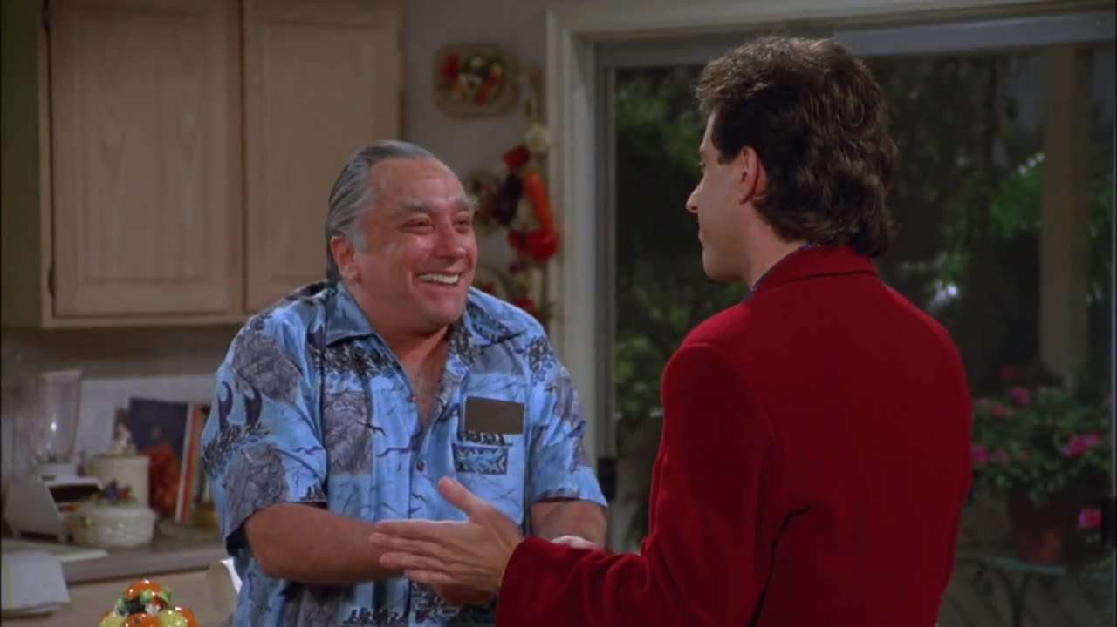
Scenario Two: The Pen
Jerry accepts a pen from his parent’s friend. His parents become upset and embarrassed socially.
https://www.youtube.com/watch?v=V3Vm_ksWreM

Slide 123

Discussion Questions…
What went wrong?
How would using the GIVE approach change the outcome?

Slide 124

Gentle: Instead of sarcasm, “I didn’t realize it would upset you.”
Interested: “Help me understand how this bothered you.”
Validate: “I can see how that might have felt embarrassing.”
Easy Manner: Soft tone, maybe light humour.

Slide 125
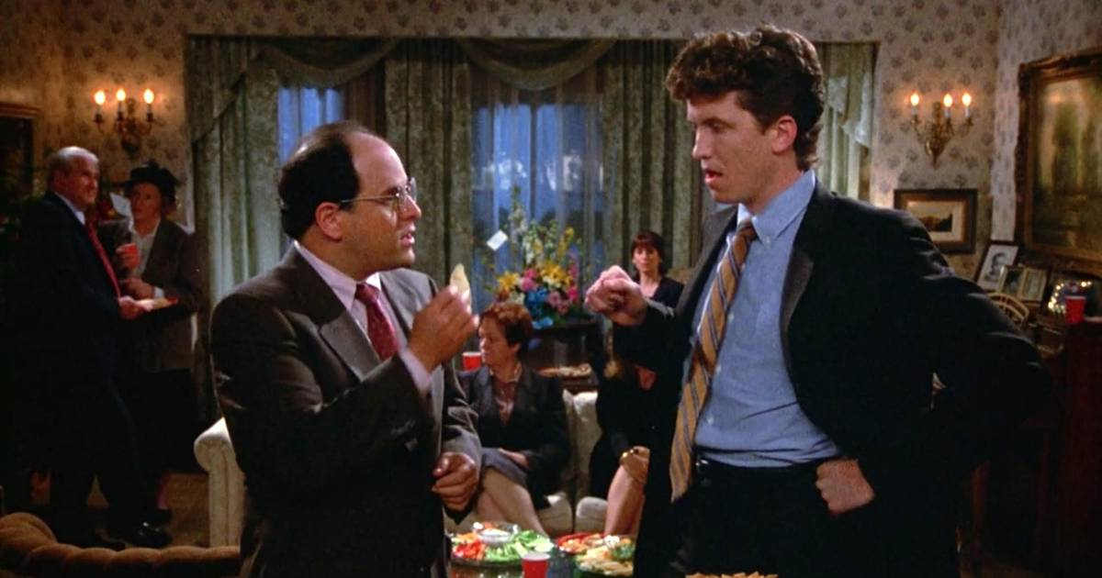
Scenario Three: Double Dipping The Chip
Someone calls George out!
https://www.youtube.com/watch?v=KLOyChP2AWA

Slide 126
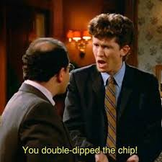
Discussion Questions…
Was the confrontation effective?
Did either person use FAST?
How could someone set a boundary with escalating?
Using the FAST acronym, please give us an example of a different response this gentleman could have said to George?

Slide 127

An example using the FAST acronym:
“Hey, when you double dip it feels unhygienic to me.” “Would you please use a new chip?”

Slide 128

You can be kind without being a doormat. You can be firm without being a villain.

Slide 129


Slide 130



Slide 131

practicing the goals diary card procedure using 4 case studies
YouTube video 7:41-41:21

Slide 132


Slide 133

Review of THE SIMPLE TOOLS and strategies
Crisis plans
Holes diary card
Chain analysis
Rational mind remediation
The goals diary card procedure
Following good problem-solving practices
Editing splicing and pasting
Pendulating to stay in the window of tolerance
Being mindful of our personal dashboard
Notes:
In the second part of today's session, we will give you examples of how to use the tools. Please note that as with previous examples these are not actual real people but rather composite of different ones. I did however try to make the scenarios as realistic as possible. All these examples can be found in the simple manual session 17 pages 183 to 192.

Slide 134
Review of THE SIMPLE TOOLS and strategies
Crisis plans
Holes diary card
Chain analysis
Rational mind remediation
The goals diary card procedure
Following good problem-solving practices
Editing splicing and pasting
Pendulating to stay in the window of tolerance
Being mindful of our personal dashboard
Notes:
In the second part of today's session, we will give you examples of how to use the tools. Please note that as with previous examples these are not actual real people but rather composite of different ones. I did however try to make the scenarios as realistic as possible. All these examples can be found in the simple manual session 17 pages 183 to 192.

Slide 135
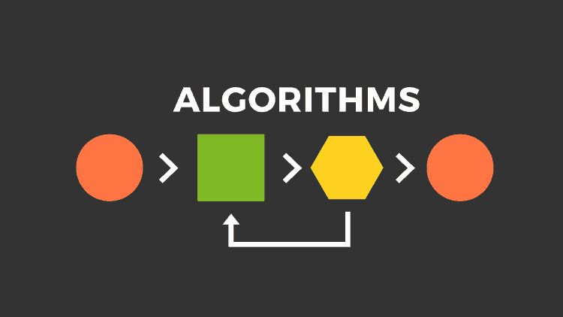
Crisis plan algorithm
Developing your crisis plans and becoming skilled at using them involves 8 steps: This is the first Simple algorithm.
1. Understand the concept of holes you keep falling into or the specific crisis for which you are going to use the crisis plans
2. Identify some of the thoughts, feelings or behaviors that occur during the crisis that you want to work on. This is step 1 on the crisis plan template.
3. Complete the rest of your crisis plan template
4. Recall, in your mind, a real crisis from the past in which you fell into the hole you are working on and use the "editing, splicing, and pasting" technique, along with your skills and tools, to imagine a different outcome that incorporates your crisis plan.
5. Stay in the window of tolerance while editing, splicing, and pasting by pendulating.
6. Repeatedly visualize the new edited, spliced, and pasted version of the situation until you can visualize it without effort.
7. When a new crisis occurs work with it following these same steps.
8. practice, practice, practice.

Slide 136
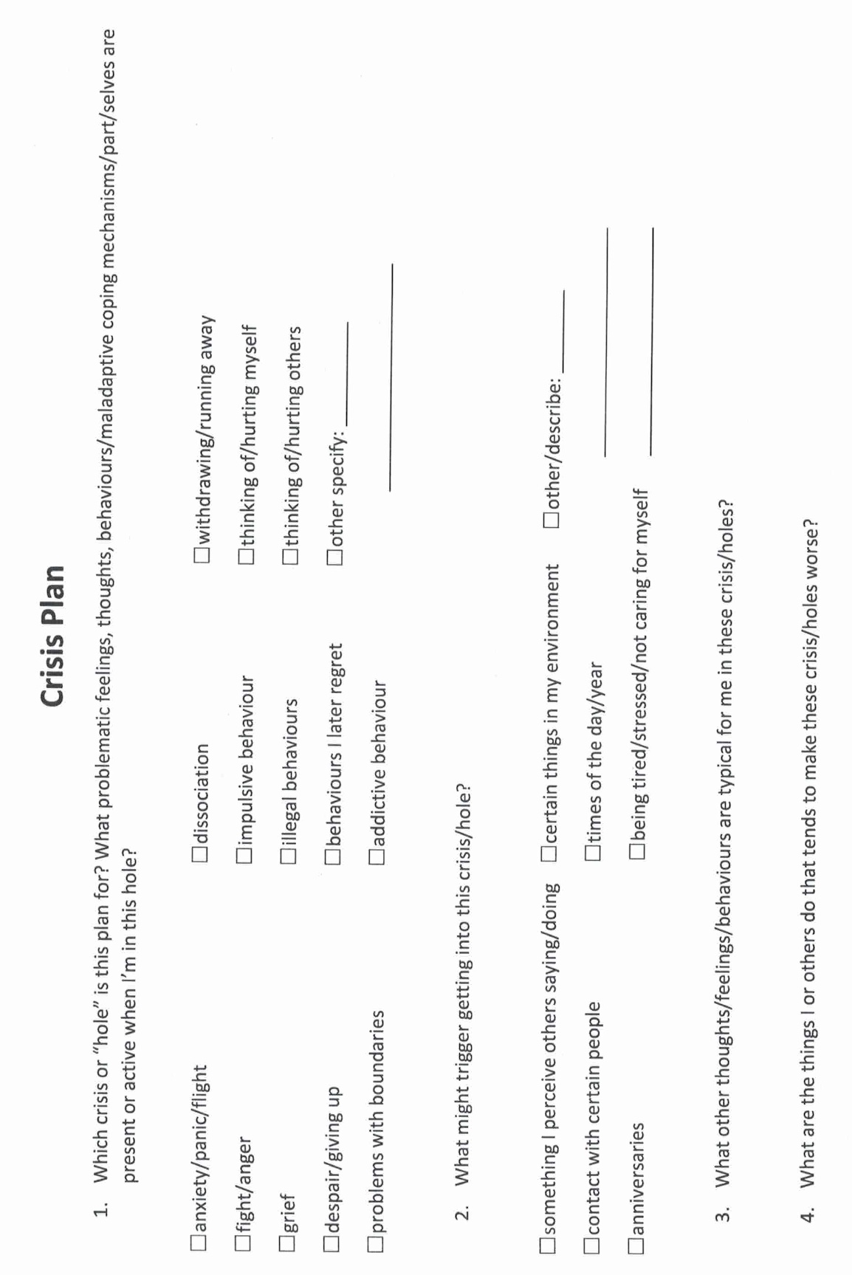
Notes:
A template is a structured form that helps you carry out the steps prescribed in the algorithm. There are many different crisis plans templates. This one is a compilation of some of the best features of other templates.

Slide 137
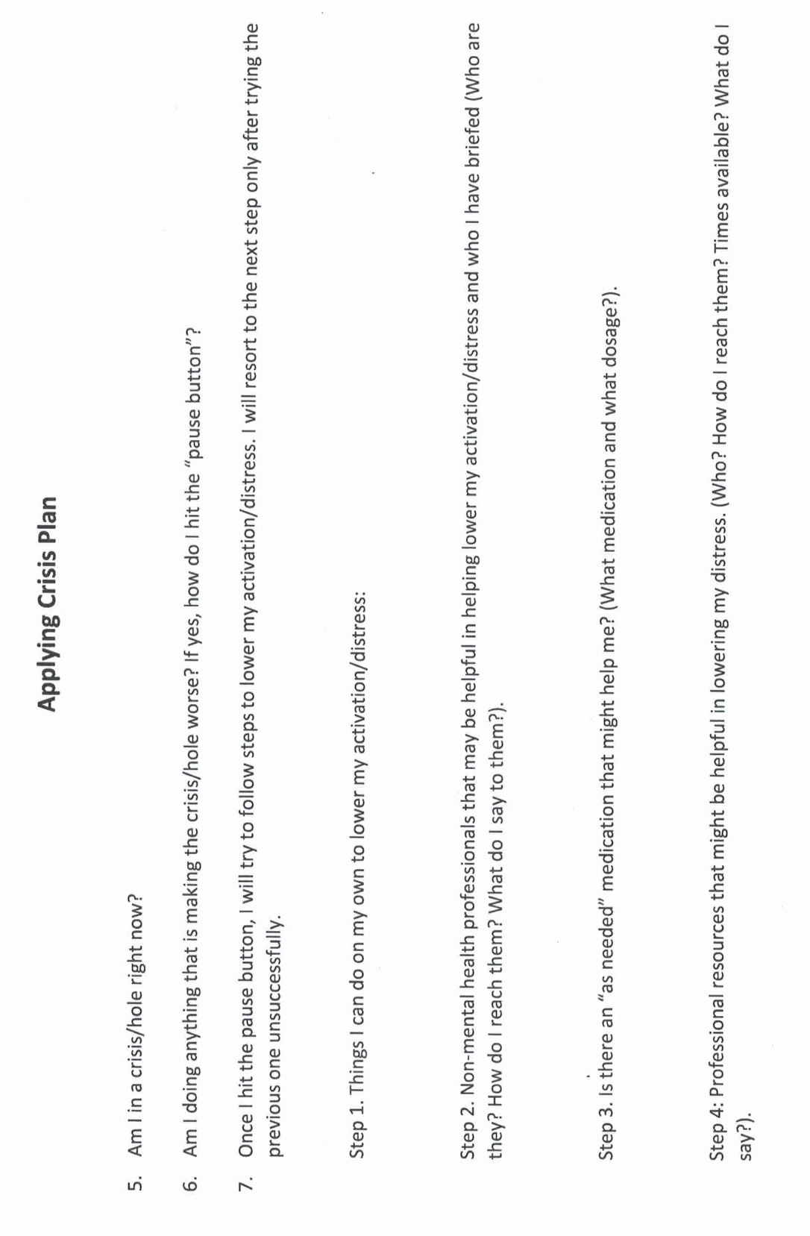

Slide 138
Review of THE SIMPLE TOOLS and strategies
Crisis plans
Holes diary card
Chain analysis
Rational mind remediation
The goals diary card procedure
Following good problem-solving practices
Editing splicing and pasting
Pendulating to stay in the window of tolerance
Being mindful of our personal dashboard
Notes:
In the second part of today's session, we will give you examples of how to use the tools. Please note that as with previous examples these are not actual real people but rather composite of different ones. I did however try to make the scenarios as realistic as possible. All these examples can be found in the simple manual session 17 pages 183 to 192.

Slide 139
Family visits dysregulation
Dysregulation with husband
Notes:
When Sam first started doing diary cards, she used the beginner target "falling into a hole", a generic "catch all" target. Sam was hoping to find a more specific intermediate target and at one of the sessions asked for help doing that.
Sam looked at her diary cards for the previous two . There were several 0’s in a row, then a day which she rated a 7. That was followed by two days that were 4's, and two more that were 1's.
Sam explained that, after one of her afternoon classes, she had been invited by classmates to go for pizza. The small group had ended up at someone's apartment watching a movie. She knew Steve would want her to call to let him know she would be late but, determined to maintain her independence, she had defiantly decided not to do that.
When Sam got home at 11 PM Steve, fuming, was waiting up for her. They started falling into their usual hole, but recalling her crisis plan, Sam immediately left and spent a couple of days at her parents.
This description of events gave her some ideas for possible intermediate targets: "conflict with Steve" was an obvious one. She wondered if there were others. Sam said that she often felt "irritated" and "frustrated" with Steve. Sometimes, she also felt "guilty", "lonely", and "sad".
Replacing falling into a hole with "feeling irritated with Steve" made sense to Sam. Feeling irritated with her partners was a long-standing hole for Sam.

Slide 140
Review of THE SIMPLE TOOLS and strategies
Crisis plans
Holes diary card
Chain analysis
Rational mind remediation
The goals diary card procedure
Following good problem-solving practices
Editing splicing and pasting
Pendulating to stay in the window of tolerance
Being mindful of our personal dashboard
Notes:
In the second part of today's session, we will give you examples of how to use the tools. Please note that as with previous examples these are not actual real people but rather composite of different ones. I did however try to make the scenarios as realistic as possible. All these examples can be found in the simple manual session 17 pages 183 to 192.

Slide 141
chain analysis algorithm
Start with a high score in your hole's diary card
Step 1. Create a “topographic” profile of the intensity of your activation around the time period for which you are doing a chain analysis.
Step 2. On the template note if there were any events that may have contributed to or triggered your increase in activation ?
Step 3. Note the sequence of emotions you felt during this period. Rate each on a scale of 0-10 with 10 being the most intense you’ve ever felt this emotion
Step 4. Notice your sensations without judging or trying to change them
Step 5. Note the thoughts that go with each of your emotions
Step 6. Note what you did or wanted to do but stopped yourself during this time period
Step 7. Note on a 0-10 scale what your energy balance, reserves or stores (how full your gas tank was) prior to the time for which you’re doing the chain analysis.
Notes:
Sam was intrigued and wanted to explore why she became so irritated by her partners. She decided to do a chain analysis. Sam realized that when she was working on finding intermediate targets, she had already explored parts of the chain analysis.

Slide 142
CHAIN ANALYSIS TEMPLATE
Stay in window of tolerance by pendulating
1. what was the topography of your activation?
2. was there a trigger(s)?
3. what did you feel?
4. notice the sensations in your body without judging or trying to change them
5. what thoughts were associated with each feeling?
6. what behaviors or urges were associated with each feeling?
7. what was your energy balance before the activation? 0-10
Notes:
The "topography" of Sam's activation was clear from her diary card ratings. She had also explored the event that triggered her and the feelings she had experienced: irritation and frustration at first, but later guilt, loneliness, and sadness.
Having completed these columns of the chain analysis, Sam reflected on the thoughts that had accompanied her feelings: she liked her space and doing things on her own, or with her friends. She could only spend so much time with Steve, particularly now that they were living together. He seemed to want to spend more time with her then she did with him. She felt suffocated and did not want to lose her independence.
After the initial irritation, Sam started to feel guilty: Steve was a nice guy, he was always doing things for her, and cared a lot about her. His family was close, there were kind to each other, and liked spending time together.
Sam's family, on the other hand, had always been critical, cold, and distant. Maybe what she felt had something to do with her upbringing and her "internal working model”. Maybe she had trouble loving and getting close to people. Maybe she would always feel this way and would be lonely for the rest of her life.
When Sam got home, after the night out with her friends, and Steve was angry, she just wanted to leave the situation and avoid conflict. Her crisis plan provided her with a good excuse for doing that. Over the time she stayed at her parents, they had not even asked her why she had come home, just how long she planned to stay.
After a couple of emotionally cool days at home, Sam longed to return to Steve, who seemed genuinely interested in her and what she did. At the same time, she was afraid that their pattern would just keep repeating.

Slide 143
Advanced chain analysis
Time ---------------------------------------------------→
Feelings
Thoughts
Behaviours
Feelings
Thoughts
behaviours
Feelings
Thoughts
behaviours
Notes:
Remember that a chain analysis is a snapshot of a moment of activation. An advanced chain analysis in contrast is a movie of a longer period of activation in which feelings, thoughts, and behaviours aren't static, they change over time.

Slide 144
Review of THE SIMPLE TOOLS and strategies
Crisis plans
Holes diary card
Chain analysis
Rational mind remediation
The goals diary card procedure
Following good problem-solving practices
Editing splicing and pasting
Pendulating to stay in the window of tolerance
Being mindful of our personal dashboard
Notes:
In the second part of today's session, we will give you examples of how to use the tools. Please note that as with previous examples these are not actual real people but rather composite of different ones. I did however try to make the scenarios as realistic as possible. All these examples can be found in the simple manual session 17 pages 183 to 192.

Slide 145

1. How to do Rational mind remediation by imagining you’re helping a friend
Start with your chain analysis
Imagine this was a friend's chain analysis and that friend had come to you for help and advice about how to use DBT skills to splice and paste a different outcome
How could your friend have seen or interpreted the situation differently?
Could your friend have thought or behaved differently and to have a better outcome?
Help your friend to imagine a scenario in which they had stayed better regulated
Help your friend to practice this situation in their minds using the editing splicing and pasting technique
Reclaim the situation as your own using the new scenario. Practice it repeatedly in your imagination.
Notes:
Sam worked on a rational mind remediation. She imagined that a friend of hers had just gone through a similar "coming home late" situation. She shared with Sam what happened and was desperate for advice.
Sam thought her friend had issues with getting close to her partners and needed to work on that. She thought her friend could use "feeling irritated by others" as a target in her diary card. Sam suggested that rather than acting on her irritation, her friend be mindful, and curious about it. She should spend some time with the sensations they came along with being irritated.
One of her friends automatic thoughts was that others were needy. An alternative thought was that she had trouble with intimacy. Around this issue, the friend should be gentle with herself, but perhaps set a goal of slowly being able to be more intimate with people. Sam realized that she could not be intimate because she did not trust anyone and to compensate, she had learned to be self-sufficient.
Sam wanted to offer her friend concrete suggestions that could be implemented and came up with 1) start using "feeling irritated with people" in her diary card. 2) apply the "edit, splice, and paste" technique to the incident: run the "mental videos" of the incident up to the point when she came home after being out with her friends. As she started to feel suffocated and irritated by her partners questioning, she could splice in an alternative thought: "I do feel irritated, but he has a point; I could have called to let him know I'll be coming home late. This may be an example of my tendency to push people away when they start getting close to me." 3) practice this new "video" every day for a few minutes. 4) picture, in her imagination, telling her boyfriend what she had learned about intimacy, and what she was trying to do. Eventually, when she felt ready, she could do this in real life.
Having written those suggestions for her friend, Sam then took ownership of them and made them her homework.

Slide 146

2. alternative rational mind remediation what would an emotionally well-regulated friend do ?
Start
Start with your chain analysis
Imagine
Imagine that what happened to you happened instead to a friend who is well regulated
Imagine
Imagine how they might have seen or interpreted the situation and thought and behaved differently
Imagine
Imagine what they might have done. Write this down
Reclaim
Reclaim the situation as your own and play it the way your friend did use the edit, splice, and paste technique
Practice
Practice that scenario in your imagination
Notes:
Allison imagined the same situation was happening to a friend who had well-regulated emotions. Marjorie, whom she had known since high school, was kind but assertive. What would Marjorie do in this situation?
Marjorie would not be intimidated. This was an unfair situation, and it was reasonable to address it rather than put up with it. Marjorie would not keep her feelings and thoughts to herself. She would, in a kind but assertive way, explained to her stepmother what she felt, thought, and wanted to see happen; the stepmother was entitled to spend her father's money, but not to throw it away foolishly.
If this conversation went nowhere, Marjorie would find out what her legal rights work, and if she did not have a legal recourse, try to maintain a cordial relationship with the stepmother and negotiate. If she exhausted her options, she would simply walk away. It would be sad, but she did not want to waste her life feeling resentment and anger. Marjorie, like Allison, was financially comfortable. Inheriting some of her father's largest state would be nice, but it would not be a life changer.
After imagining what Marjorie would do, Allison considered how she could apply it to herself and decided on an action plan: 1) she would use the "mental video" of the visit when she found the SUV in the driveway. She would then splice and edit out the part in which she kept her feelings and thoughts to herself while stewing on them. She had done that all her life.
Instead, she would paste in an assertive conversation, in which she explained to Ingrid how she felt, her thoughts, and what she planned to do. Imagining this conversation, activated Allison, and she knew she had to practice it for some time while, to stay in the window of tolerance, she pedulated.
2) in her imagination, Allison practiced this conversation, not expecting to have a real conversation with Ingrid anytime soon. She felt this took some of the pressure off.
3) Allison knew a family lawyer whom she trusted and decided she would call him to make an appointment to review her legal options.
4) she felt that if trying to work things out not produce results, she would not be held hostage by the potential inheritance and would distance herself from Ingrid.
Allison realize that her feelings, thoughts, and behaviours, in this present day situation, were similar to those she had as a little girl. Her adult self needed to step up and protect this frightened child.

Slide 147
Review of THE SIMPLE TOOLS and strategies
Crisis plans
Holes diary card
Chain analysis
Rational mind remediation
The goals diary card procedure
Following good problem-solving practices
Editing splicing and pasting
Pendulating to stay in the window of tolerance
Being mindful of our personal dashboard
Notes:
In the second part of today's session, we will give you examples of how to use the tools. Please note that as with previous examples these are not actual real people but rather composite of different ones. I did however try to make the scenarios as realistic as possible. All these examples can be found in the simple manual session 17 pages 183 to 192.

Slide 148
Goals diary card procedure algorithm
Step 1
1. Track your usual activities for a week using a blank week calendar.
This will give you a snapshot of your typical routine and allow you to assess its balance.
2. Rate yourself 0-10 on each of Maslow’s needs/wellness domains (see slide below)
Step 2
3. Complete the wellness assessment tool. Choose 1-3 “proximal activities” for your goals.
4. Consider which of your Maslow’s needs are met and which of Erickson’s stages you have mastered.
Step 3
5. “Schedule” the activities you have chosen on a blank weekly schedule.
6. Use the goals diary card template to track your progress with these activities
Step 4
7. If you have accomplished a goal, choose another from the wellness assessment tool and use it as a target in your goal's diary card template. Repeat the same process starting with step 2.
Notes:
The goals diary card procedure is an algorithm with four steps. We will go through each step individually.

Slide 149
Review of THE SIMPLE TOOLS and strategies
Crisis plans
Holes diary card
Chain analysis
Rational mind remediation
The goals diary card procedure
Following good problem-solving practices
Editing splicing and pasting
Pendulating to stay in the window of tolerance
Being mindful of our personal dashboard
Notes:
In the second part of today's session, we will give you examples of how to use the tools. Please note that as with previous examples these are not actual real people but rather composite of different ones. I did however try to make the scenarios as realistic as possible. All these examples can be found in the simple manual session 17 pages 183 to 192.

Slide 150
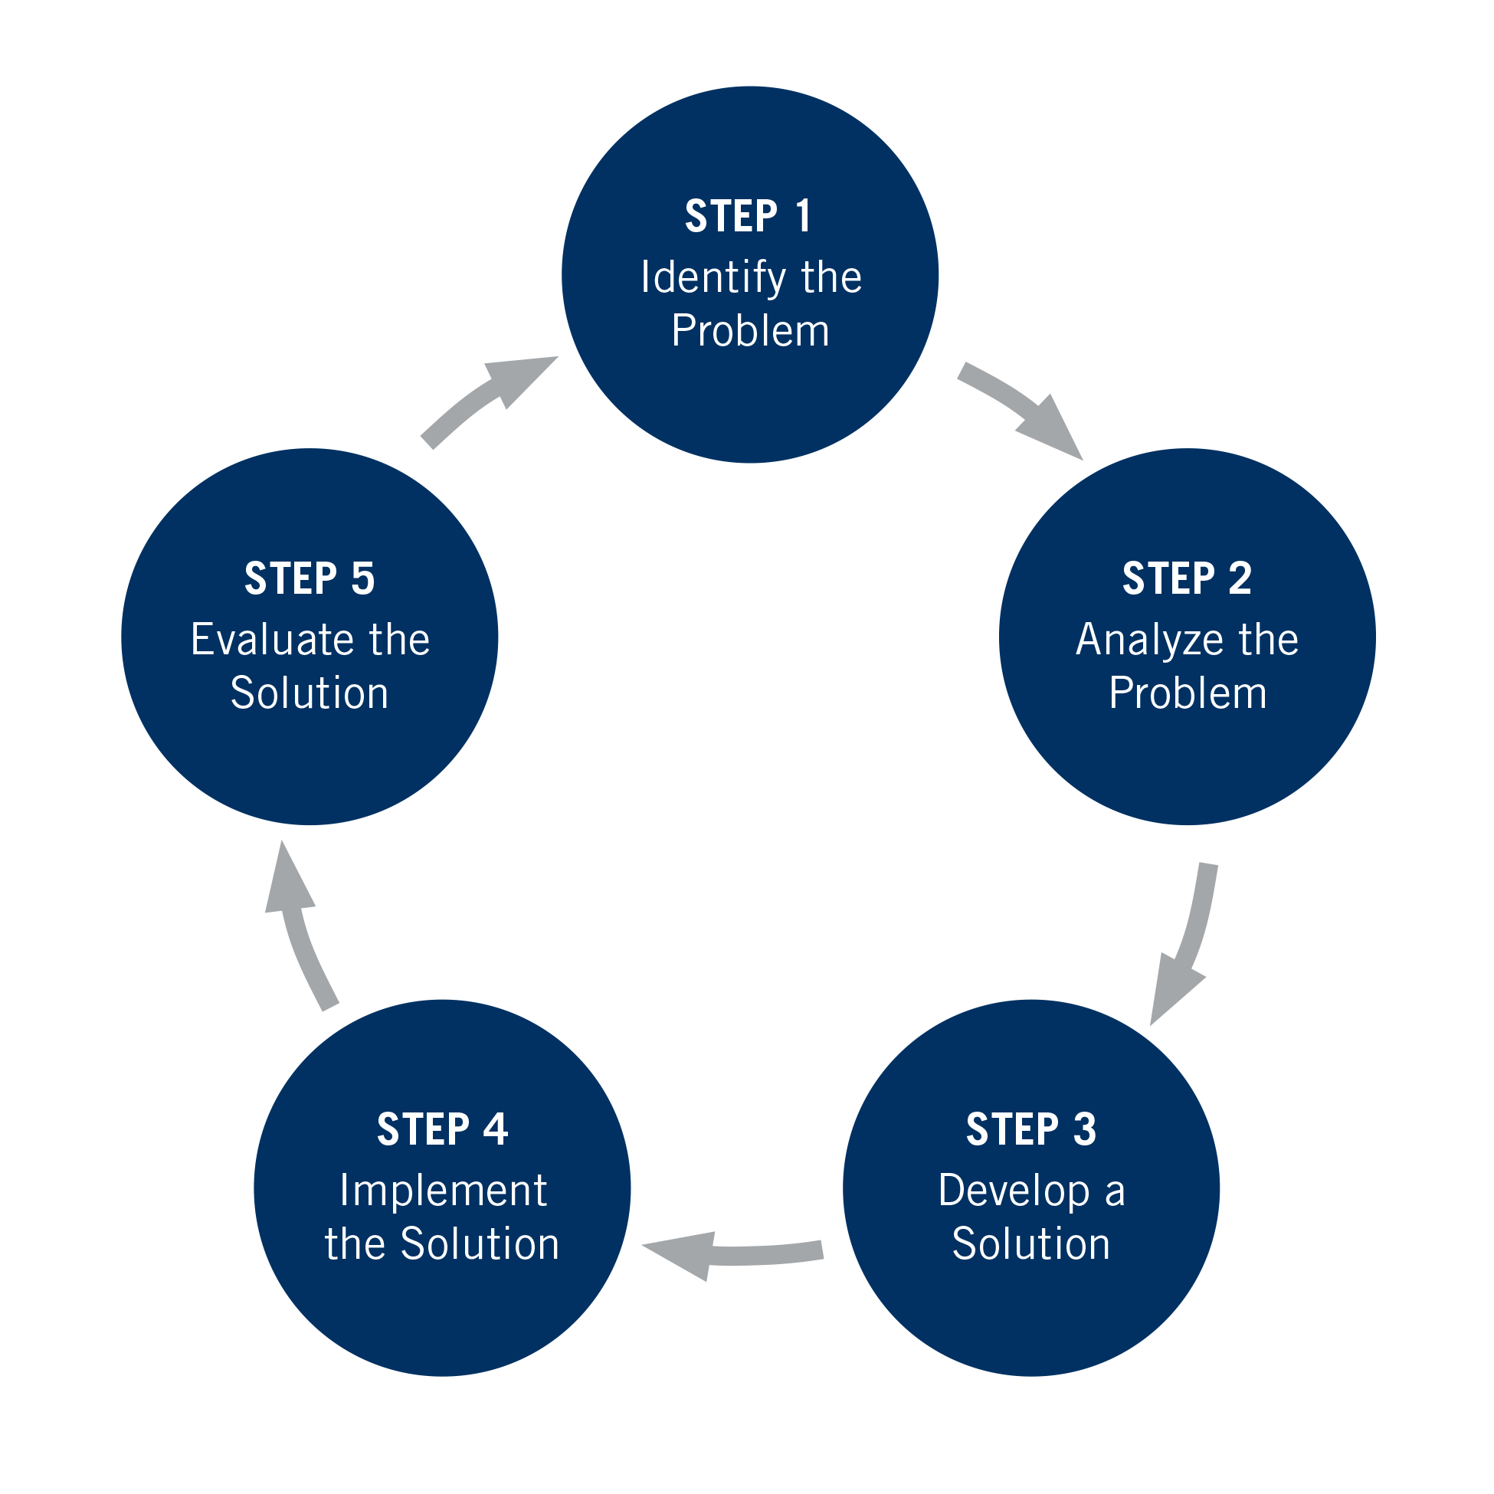

Slide 151
Review of THE SIMPLE TOOLS and strategies
Crisis plans
Holes diary card
Chain analysis
Rational mind remediation
The goals diary card procedure
Following good problem-solving practices
Editing splicing and pasting
Pendulating to stay in the window of tolerance
Being mindful of our personal dashboard
Notes:
In the second part of today's session, we will give you examples of how to use the tools. Please note that as with previous examples these are not actual real people but rather composite of different ones. I did however try to make the scenarios as realistic as possible. All these examples can be found in the simple manual session 17 pages 183 to 192.

Slide 152


Editing, splicing and pasting while pendulating to stay in window of tolerance
We all have memories or mental “videos” of times we’ve been dysregulated or fallen into holes.
When we are learning to get out of holes, these memories or videos are invaluable in helping us practice alternative ways of thinking, feeling, and behaving.
In Simple we’re going to learn to edit these old videos by splicing them and pasting in new more desirable and adaptive thoughts, feelings, and behaviors that get us out of our holes.
As we visualize these videos, we may get activated so we will need to know how to sooth ourselves by “pendulating”, then resuming our work on the videos.
+

Slide 153
Review of THE SIMPLE TOOLS and strategies
Crisis plans
Holes diary card
Chain analysis
Rational mind remediation
The goals diary card procedure
Following good problem-solving practices
Editing splicing and pasting
Pendulating to stay in the window of tolerance
Being mindful of our personal dashboard
Notes:
In the second part of today's session, we will give you examples of how to use the tools. Please note that as with previous examples these are not actual real people but rather composite of different ones. I did however try to make the scenarios as realistic as possible. All these examples can be found in the simple manual session 17 pages 183 to 192.

Slide 154

Stay in your window of tolerance by pendulating
Pendulating, which comes from the word pendulum, means swinging from one thing or place to another.
When people have feelings, they also have thoughts and images that accompany those feelings.
One way of soothing yourself, when you are experiencing intense negative feelings, and bringing yourself back to the window of tolerable emotions, involves distraction or self-soothing: you learn to identify that you are emotional and learn to have alternative thoughts, a soothing inner dialogue, and/or calming and soothing images. When you are better regulated you can then revisit the original thoughts you were having
To get good at pendulating you have to plan and practice it .
Distressing thoughts/feelings
Distracting/soothing
Images/thoughts/sensations

Slide 155
Review of THE SIMPLE TOOLS and strategies
Crisis plans
Holes diary card
Chain analysis
Rational mind remediation
The goals diary card procedure
Following good problem-solving practices
Editing splicing and pasting
Pendulating to stay in the window of tolerance
Being mindful of our personal dashboard
Notes:
In the second part of today's session, we will give you examples of how to use the tools. Please note that as with previous examples these are not actual real people but rather composite of different ones. I did however try to make the scenarios as realistic as possible. All these examples can be found in the simple manual session 17 pages 183 to 192.

Slide 156
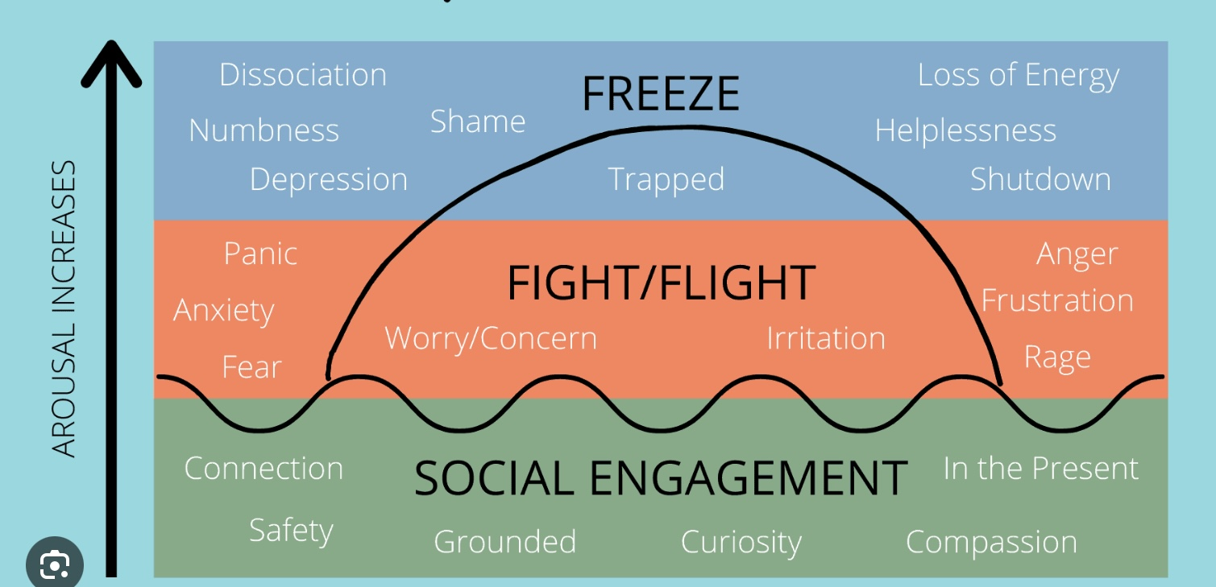
Check in regularly with your Personal dashboard
Spend a few moments checking in with yourself by asking:
1)What is the current risk that I’ll experience a state of crisis ?
Low b) Moderate c) high d) very high e) extreme
2) Am I in the window of tolerance?
a) Yes b) I’m a little outside c) very outside
3) What state of activation am I mostly in at the moment?
a) Calm b) Fight c) Flight d) Dissociated e) Depressed?
4) Where is my energy tank right now?
a) Full b) ¾ c) ½ d) near empty
CRISIS RISK
WINDOW OF TOLERANCE
STATE OF ACTIVATION
ENERGY RESERVES

Slide 157
Review of THE SIMPLE TOOLS and strategies
Crisis plans
Holes diary card
Chain analysis
Rational mind remediation
The goals diary card procedure
Following good problem-solving practices
Editing splicing and pasting
Pendulating to stay in the window of tolerance
Being mindful of our personal dashboard
Notes:
In the second part of today's session, we will give you examples of how to use the tools. Please note that as with previous examples these are not actual real people but rather composite of different ones. I did however try to make the scenarios as realistic as possible. All these examples can be found in the simple manual session 17 pages 183 to 192.

Slide 158
UPDATED PERSONAL SKILLS LIST
Distress tolerance skills
Grounding skills- Set a daily intention
“ - Sensory soothing toolkit
“ -The 5,4,3,2,1 method
“ -The emotional freedom technique
REST (or PEST) Pause
Radical acceptance statements (please specify)
Distraction plan “
Self-soothing plan
Safe place visualization
Cue controlled relaxation
Rediscovering your values (please specify)
Rehearse values-based behavior or edit/splice/paste
Connect with your higher power “
14. Live in the present moment
15. Use self-encouraging coping thoughts
16. Radical acceptance
17. Use self-affirming statements
18. Balance feelings and threat
19. Create new coping strategies
20. Create an emergency coping plan
21. Box breathing
22. Cold temperatures
23. High intensity exercise
24. Progressive muscular relaxation
25. Paced breathing
26. Side to side eye movement.

Slide 159
UPDATED PERSONAL SKILLS LIST
Mindfulness skills
1) Focus on a single minute
2) Focus on a single object
3) Band of light
4) Inner-Outer Experience
5) Record Three Minutes of Thoughts
6) Thought Diffusion
7) Describe Your Emotion
8) Focus Shifting
9) Mindful Breathing
10) Mindful Awareness of Emotion
11) Wise mind
12)how to make Wise mind decisions
13) Radical acceptance
14) Judgements and labels
15) Self compassion
16) Mindful communication
17. Being mindful in our daily life
18. How to do tasks mindfully
19. How to be mindful of our activities
20. Resistances and hindrances to mindfulness practice
21. Exploring mindfulness further
22. Mindfulness and meditation
23. Using kindness and compassion
24. Paying attention to spaciousness and stillness

Slide 160
UPDATED PERSONAL SKILLS LIST
Emotional regulation skills
How do emotions work?
Recognizing emotions
Overcoming barriers to healthy emotions
Reducing physical vulnerability
Reducing cognitive vulnerability
5. Increasing Positive Emotions
6. Being mindful of your emotions without judgement
Emotion exposure.
Doing the opposite of your emotions
9. Problem Solving

Slide 161
TODAY-UPDATED PERSONAL SKILLS LIST
Interpersonal effectiveness skills
1.Mindful attention
2. Compassion for others
3. Passive vs. aggressive behavior
4. I want-they want ratio
5. I want-I should ratio
6. Key interpersonal skills
7. Blocks to using interpersonal skills
8. Knowing what you want
9. Modulating the intensity of a request
10. Making a simple request
11. Designing basic assertiveness scripts and
12. Assertive listening

Slide 162
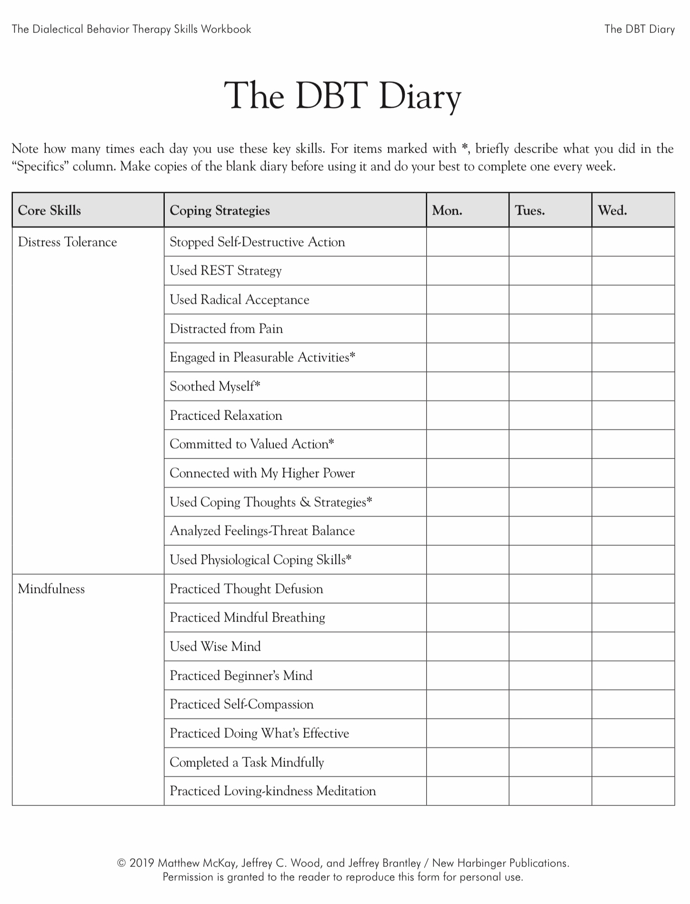

Slide 164


Slide 165
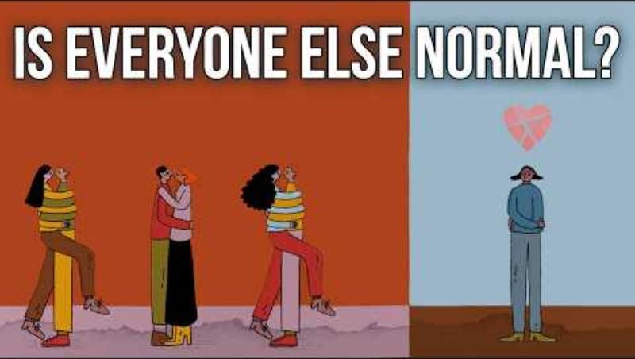

Slide 166
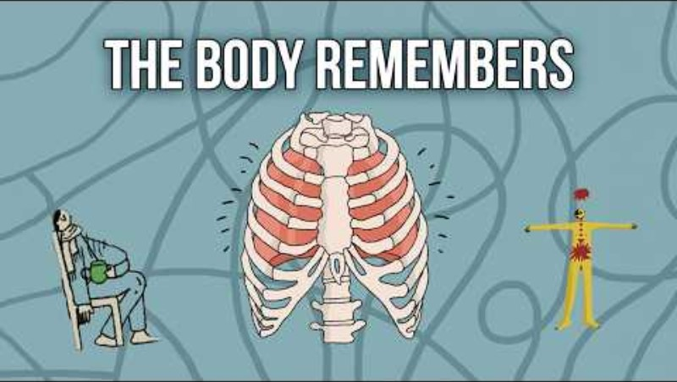

Slide 167
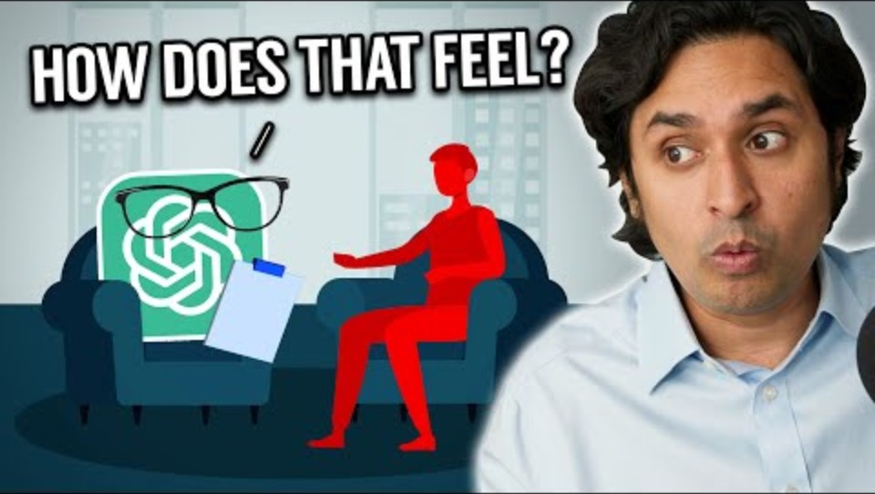

Slide 168


Slide 169



Slide 170


Slide 171
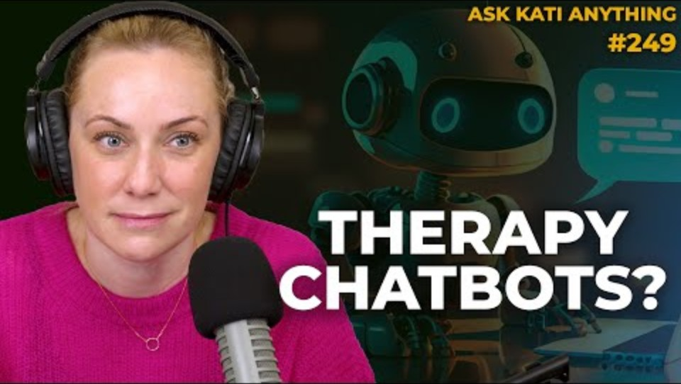

Slide 172


Slide 173


Slide 174
