Slide 1


Welcome to Week 21 of simple spirituality, religion, and health
Please start recording at 9 am

Slide 2

Warning about meditation
Feel free to skip it. Followed by a moment of silence

Slide 3





Check in regularly with your Personal dashboard
Spend a few moments checking in with yourself by asking:
1)What is the current risk that I’ll experience a state of crisis ?
Low b) Moderate c) high d) very high e) extreme
2) Am I in the window of tolerance?
a) Yes b) I’m a little outside c) very outside
3) Where is my energy tank right now?
Full b) ¾ c) ½ d) near empty
4) Have I been tracking my targets using the holes diary card ? how would I rate my targets right now?
5) How well am I focusing on what I’m doing. (for example, the course)
CRISIS RISK
WINDOW OF TOLERANCE
ENERGY RESERVES
RATING MY TARGETS
ATTENTION METER
% attention I’m paying
100
0

Slide 4
FIVE-MINUTE GUIDED MEDITATION
Walking by Lantern Light (Soft, slow pace—about 5 minutes when read aloud.)
Begin by finding a comfortable seat. Let your spine lengthen gently, as if creating space for breath.
Let your shoulders soften. Let your hands rest wherever they fall naturally.
Take a slow breath in… and a long, unhurried breath out.
Again… in… and out.
Now imagine yourself standing on a quiet path at dusk. The air is calm and cool. There is enough light to make out the shape of the world around you, but the sun has set, and the full landscape is hidden.
Look down at your hand. You’re holding a lantern. The lantern glows warmly, just enough light to see the few steps ahead. Not the whole path. Not the distant horizon. Just the next few feet.
Notice how your body responds to this gentle, limited light. Is there tension? A desire to see further? Or perhaps a quiet ease in knowing you don’t have to. Take a breath in… and out. Now, slowly, begin to walk.

Slide 5
FIVE-MINUTE GUIDED MEDITATION
Walking by Lantern Light (Soft, slow pace—about 5 minutes when read aloud.)
Feel the earth beneath your feet. With every step, the path ahead becomes visible, but only as you move. This is the rhythm of faith: light enough for the next step, trust enough for the one after that.
Let your breath match your steps. Inhale… step… Exhale… step…
Allow any places in you that crave certainty, that want the whole map, the full plan, the total guarantee, to be seen with kindness. These are protective parts wanting safety. Let them know: “It’s okay. We only need enough light for this moment.”
Feel the soft, warm glow of the lantern. Each step you take is a conversation with the unknown. A gentle agreement: I don’t need to know everything. I only need to know what’s next.
Let the path reveal itself as you go. Let the darkness around you be simply mystery, not danger, not threat, just the portion of life that hasn’t spoken yet.
Take another slow breath in… and a long breath out.

Slide 6
FIVE-MINUTE GUIDED MEDITATION
Walking by Lantern Light (Soft, slow pace—about 5 minutes when read aloud.)
As you come to the end of this meditation, imagine pausing on the path.
Look at the lantern in your hand again. Feel its warmth. Feel your own steadiness.
Say quietly inside yourself, in whatever words feel right: “I can walk by lantern light.” “I don’t need certainty to keep moving.” “The path will show itself.”
Let one more gentle breath move through you. When you’re ready, bring your awareness back to the room, back to your body, back to this moment.
Open your eyes.

Slide 7
week 17- the stress and trauma related disorders-session 20 of manual.
week 18- emotional regulation skills p.183-206 of dbt workbook. our fifth practice session-the goals diary card procedure- session 21 of manual
week 19- structural dissociation theory and the treatment of the traumatic spectrum disorders- session 22 of manual.
week 20- introducing interpersonal skills p.207-241 of dbt workbook. Review of all the skills
week 21- Spirituality, religion, and health- session 26 of manual.
week 22- introducing internal family systems (ifs)-session 24 of manual. introducing the ifs workbook and ifs workbook guided ai assisted self therapy
week 23-interpersonal skills and putting it all together p.242-265 of dbt workbook. states of activation as essential trailheads and the four pillars of recovery from trauma-session 27 of manual.

Slide 8
PREVIEW OF COMING SESSIONS
week 22 –Introduction to internal family systems.
Week 23 – Wrap up of DBT workbook. Last interpersonal skills and putting it all together p.242-265 of dbt workbook. States of activation as essential IFS trailheads and the four pillars of recovery from trauma.
Weeks 24-28 - ifs workbook guided AI assisted Self-therapy
Week 29 - introducing wise mind remediation and using it to heal and grow-Session 23 of manual. Workbook slides Section II Using IFS every day to heal and grow.
Week 30 -relationships and their repair-session 28 of manual.
Week 31 - Searching for meaning circle
Week 32 - Wrap up, evaluation, brunch
Week 33 - Pilot session; Bonding and sexuality.

Slide 9
SIMPLE COURSE SCHEDULE 2025-26
Week 1- October 1
Week 2- October 8
Week 3- October 15
Week 4- October 22
Week 5- October 29
Week 6- November 5
Week 7- November 12
Week 8- November 19
Week 9- November 26
Week 10- December 3
Week 11- December 10
Week 12- December 17
December 24 and 31
Week 13- January 7
Week 14- January 14
Week 15- January 21
Week 16- January 28
Week 17- February 4
Week 18- February 11
Week 19- February 18
Week 20- February 25
Week 21- March 4
Weeks of March 11 and 18 no course or boing
Week 22- March 25
Week 23- April 1
Week 24- April 8
Week 25- April 15
Week 26- April 22
Week 27- April 29
Week 28- May 6
Week 29- May 13
Week 30- May 20
Week 31- May 27
Week 32- June 3 Week 33 – June 10

Slide 10
PRACTICE SESSIONS SCHEDULE
practice
6.Week 24 April 8 April 1, 1:30 Part 1 p. 1-63 Anna P.
7. Week 25 April 15 April 8, 1:30 Part 2 p. 65-99 Elaine S.
8. Week 26 April 22 April 15, 1:30 Part 3 p. 103-137 Dinko T.
9.Week 27 April 29 April 22, 1:30 Part 4 p. 141-175 Barb H.
10. Week 28 May 6 April 29, 1:30 Part 5 p. 179-207 Meaghan
11.Week 29 May 13* April 22, 3 pm Wise mind remediation Rob T.
Preparation IFS Workbook

Slide 11


Slide 12

Homework for the past week
Submit questions or comments to itssimple2023@gmail.com
Read Simple manual session 26 on Spirituality and mental health.
Continue reviewing and practicing crisis plans, diary cards, chain analysis, rational mind remediation, and goals diary cards.
Continue tracking all the skills you’ve learned using skills lists. Practice them.

Slide 13

Homework for MARCH 25
Submit questions or comments to itssimple2023@gmail.com
Read skills training workbook p. 242-265 the last skills session.
Simple manual session 24 an introduction to internal family systems
Use all your tools: crisis plans, chain analysis, rational mind remediations, and goals diary cards.
Continue tracking all the skills you’ve learned using the skills lists. Practice them.

Slide 14
FOR PEOPLE WHO DON”T HAVE THE SECOND EDITION: Skills training workbook p. 242-265
Advanced interpersonal effectiveness skills
1. DEALING with resistance and conflict
2. How to Negotiate
4. Exposure based cognitive rehearsal
5. state-dependent learning
6. practice
3.How to understand problem interactions
7. WRAPPING UP

Slide 15
HOMEWORK HABITS CHECKLIST
Circle or check what you will try this week.
1. Preparation habits
■ I schedule a specific time for homework.
■ I choose a consistent location with minimal distractions.
■ I gather what I need ahead of time (notebook, worksheet, pen).
2. Focus & pacing habits
■ I start with a tiny step (2–5 minutes).
■ I use a timer (10–15 minutes).
■ I remove distractions (phone away / Do Not Disturb).

Slide 16
HOMEWORK HABITS CHECKLIST
3. Tracking & organization habits
■ I keep materials in one place (binder / folder / notebook).
■ I write down insights right after doing the homework.
4. Self-compassion habits
■ I aim for progress, not perfection.
■ I notice resistance without judgment.
5. Accountability habits
■ I review my week: What worked? What didn’t?
■ I share honestly with my buddy — even when I didn’t do it.
Micro commitment:
This week I will focus on: ■ Time ■ Place ■ Tiny step ■ Timer ■ Other please specify:

Slide 17


REMINDER PARTICIPANT AGREEMENTS
If you have questions, comments, or feedback, please save them for the two question periods. You can put them in the chat box or raise your real/virtual hand.
Keep comments, questions, and feedback relatively brief so everyone has a chance to participate.(one breath sharing)
If you’re on zoom, make sure no one can overhear what is being said
For reasons that will become clear later in the course please avoid giving advice to other participants about what they should or should not do. Validation, encouragement , and understanding are however very much appreciated.

Slide 18


WEEKLY ANNOUNCEMENTS
There will be no boing group March 9 or 16.
Boing will resume March 23.
The next Wednesday session is March 25.
If you haven’t already, please get the IFS workbook, you will need it to do the homework starting on April 8.
Week 30 on May 20th is entitled Wise mind intimate relationship repair. We think it’s one of the most important sessions in the whole course. It also covers a lot of material. Extraordinarily, that session will be extended until 1 pm. You don’t have to stay that long.
We’ve also added a pilot session “intimate bonding and sexuality” that we’re going to “workshop” on June 10. If we get positive feedback on it, we’ll add it to next years course.

Slide 19
WEEKLY ANNOUNCEMENTS
Some people in the group have become “homework buddies” speaking weekly about their struggles with homework, with understanding the course and how they are managing it.
If that’s something you’d like to try please email us and we’ll try to pair you up.

Slide 20

E-mailed questions, comments, feedback

Slide 21
Question whose answer we will read out today

Slide 22
I had a situation with my partner following which, using the DEAR MAN GIVE FAST template you gave us last week, I worked on an assertiveness script.
I then tried approaching him and using the script to discuss the situation. Unfortunately, both of us very quickly switched to emotional mind and were unable to have a conversation and repair.
Am I doing something wrong? Why isn't the dear man assertiveness script working for me?

Slide 23
DBT interpersonal skills work very well, when we can stay in rational or Wise mind. The problem is that intimate relationships are the fastest way to lose access to both.
You knew the skill and prepared a DEAR MAN GIVE FAST assertiveness script. You tried sharing it with your partner who said one sentence from emotional mind and suddenly you’re triggered and find yourself in emotional mind as well.
If we regulate our nervous systems and stay in wise mind, we can communicate skillfully. The problem is that in attachment relationships we get easily triggered and activated. Once activated we often don’t know how to do a DEAR MAN GIVE FAST script.
We are in emotional mind and care about survival, belonging, not being abandoned, and not being shamed.
DBT teaches us what to say. IFS will help us understand who is saying it. DBT works beautifully if Wise mind or Self is leading. It struggles when emotional mind has the wheel.
Intimate relationships activate attachment and old patterns. Old patterns live in IFS parts. When we are blended with parts, rational mind shrinks. So, we try to use skills but we’re trying to use skills from inside a triggered 8-year-old. No wonder they fail.

Slide 24
DBT says: Regulate. Stay in wise mind. Communicate skillfully.
IFS asks: Who just got activated? What are they afraid of? What are they protecting?
IFS doesn’t replace DBT but creates the internal conditions that make using DBT possible.
In intimate relationships we don’t just relate to our partner. Our parts relate to their parts.
DBT alone + trigger → Emotional mind → Try skill, fail → Escalation
DBT + IFS + Trigger → Notice part → unblend → Self leads → Use skill
IFS widens the space between trigger and response. In that widened space, DBT works.
Interpersonal skills are powerful, but the most powerful relationship skill is being in Self when you use them.
DBT interpersonal skills assume we can access rational or wise mind and often we can, with coworkers, acquaintances, even friends. But intimate relationships activate attachment and attachment activates our parts. When we are blended, we are no longer in rational mind we’re in survival mind. That’s why sometimes the skills don’t work.
Internal Family Systems gives us a way to notice who is activated, unblend, and return to Self. When Self is leading and we are in wise mind, DBT works beautifully.

Slide 25
SPIRITUALITY, RELIGION, AND HEALTH

Slide 26
Session 31 The searching for meaning circle, compliments today’s session. You’ll get the most out of session 31 if you work on your “my” “ours” and “the stories” homework which we emailed out a few weeks ago and again last week.

Slide 27
The decisive question for Humanity is whether or not, we are related to something infinite. Carl Jung
Spirits’ drive to serve something bigger than oneself is the opposite of instinct or the drive to act towards one’s own survival Bernardo Kastrup
Let me keep my mind on what matters, which is mostly standing still and learning to be astonished. Mary Oliver

Slide 28

Why are we talking about Spirituality in this course?

Slide 29
WHY TALK ABOUT SPIRITUALITY?
Mental health involves a whole human being, embedded in a body, a mind, a history, relationships, culture, and a sense, explicit or implicit, of what life is about.
In this course we look at mental health from a wholistic biopsychosociospiritual perspective. We have previously discussed:
1) biological factors such as genetics, brain chemistry, inflammation, hormones, and medications
2) psychological factors such as emotions, thoughts, coping styles, trauma, attachment, personality and
3) social factors such as relationships, work, family, culture, belonging, power and inequality.
Today we look at mental health through a spiritual lens.
Spirituality unlike religion does not necessarily imply belief in a God or a particular set of beliefs. Spirituality is a mindset that asks questions such as: what gives my life meaning? What helps me endure suffering? Am I part of something that’s larger than myself? And what makes life worth continuing when things are hard?
Whether we consciously think about these questions or not, we all have answers to them, even if these answers are unspoken, fragmented, or borrowed.
From a mental health perspective, spirituality is about meaning-making, values, purpose, connection, hope, transcendence, and the frameworks people use to understand their lives and their suffering.

Slide 30
WHY TALK ABOUT SPIRITUALITY?
If we leave spirituality out of our discussion of mental health, we risk:
1. Treating symptoms without fully understanding the person: Two people can share similar diagnosis, trauma history, and treatment and do very differently. The difference between them may have to do with whether they experience their suffering as meaningless or meaningful, whether they feel fundamentally alone or connected and whether they see their life as already over or still unfolding. These are spiritual variables, whether we name them or not.
2. Mistaking existential distress for pathology: Many people seek treatment not because something is “wrong” with their brain, but because they feel empty, disconnected, hopeless and cut off from a sense of direction or purpose. If we only use biological or psychological lenses, we may try to medicate, analyze, or skill-train what is actually a crisis of meaning.
3. Missing powerful sources of healing: For many people, spiritual resources such as practices like meditation, prayer, ritual, narratives about forgiveness, redemption, growth, communities and a sense of sacredness or awe are among the strongest protective factors they have. Ignoring them ignores powerful sources of healing.

Slide 31
WHY TALK ABOUT SPIRITUALITY?
Mental health emerges from the interaction of biopsychosociospiritual factors. Considering a spiritual perspective in mental health does not mean we’re rejecting science. It says that our search for meaning is as important as the biological, psychological, and social maps we’ve considered so far. Meaning shapes how suffering is experienced, interpreted, and endured.
Today we’re not trying to convince you of anything or tell you that you should adopt the spiritual myth that, at this point in our life, fits for us.
The goal today is to expand the lens through which we’re looking at mental health, recognize dimensions of our experience that are already present and become more skillful at noticing how meaning, values, and purpose shape our mental health.

Slide 32
WHY TALK ABOUT SPIRITUALITY?
Structural dissociation theory tells us that trauma and grief dissociate and disconnect our EP’s or emotional parts from the present-day world as these parts get stuck in the trauma time of the past.
Polyvagal theory tells that in trauma and grief, we get stuck in disconnected ventral vagal collapse. Healing from trauma or grief thus involves moving from a shutdown, dorsal vagal collapsed state into a more alive, ventral vagal connected state.
Connection is a very significant component of healing. We don’t come out of collapse through insight or understanding alone. We come out through connection with something or someone that makes us feel we are safe and we belong.
Connection can be to another person, to meaningful work, to nature or to our deeper self. All of these help move the nervous system toward life again.
Spirituality adds a profound type of connection. It suggests that connection is not something we must create because it is already the nature of the universe. If at a deep level we are connected to everything, then healing is not about inventing connection, but about rediscovering it. In that sense, spirituality becomes a kind of master key because once we have faith in the oneness of everything that faith assumes, that we are connected to IFS’s Self, to others (attachment), to purpose (meaningful occupation), and to nature (belonging in the living world).
It is through these connections that the nervous system finds its way back from collapse into vitality. Spirituality doesn’t replace psychology or biology; it is a portal to a field of connection that healing depends on.

Slide 33
Spirituality, the way we interpret it here, is not about believing anything.
It is about how humans relate to meaning, suffering, and connection.

Slide 34
Why I’m certain that the Spiritual myth that currently fits for me isn’t true?
“We don’t see reality as it is; we see reality as it appears through the lenses of our senses and the categories of our mind.” I. Kant
“Find a religious myth that for you passes intellectual scrutiny, live your life as if it were true, while knowing that ultimately, you’ll never be able to ascertain its veracity” Bernardo Kastrup

Slide 35
CERTAINTY DOUBT AND FAITH
Some people equate faith in a religion with certainty and see doubt as the opposite of faith.
Others believe in real spirituality certainty is the opposite of faith.
Certainty says: “I already know.” “There is nothing left to explore.” “There is one right answer, and I have it.” It closes the mind and the heart. It stops curiosity, humility, and growth.
Real faith, in contrast, is the capacity to move forward without needing guarantees. It’s not blind belief, it is openness, a willingness to trust, to explore, and to stay in relationship with mystery.
Real faith says: “I don’t know everything, and I don’t need to.” “I am willing to stay present, to listen, to keep learning.” “I can live with ambiguity, complexity, and unfolding truth.” Where certainty shuts things down, faith keeps things alive.
Real faith isn’t the absence of doubt; it’s the ability to stay grounded and open even when we don’t have complete answers. It’s the posture that allows connection, growth, and meaning to continue.

Slide 36

FAITH AND CERTAINTY A METAPHOR
Imagine you’re walking down a winding forest path at night.
Certainty is believing you have a giant spotlight that shows the entire forest, every bend, every outcome, every risk.
In life’s journey that kind of light doesn’t exist.
Faith, is the willingness to move forward with the light provided by the small lantern that we’ve been granted. Seeing only enough to take the next step, trusting the path will continue to reveal itself, knowing we don’t need to see the whole map to walk it well.
Certainty says, “I go because I can see everything”
Faith says, “I go knowing I can only see the next step”
Faith opens us, certainty shuts us down from the great mystery.
The spiritual path only reveals itself in the faith we place in continuing down the dark winding forest path called existence.

Slide 37

The current spiritual myth I have faith in but am certain is not the world as it really is, only as I perceive it through my limited senses and categories of my mind.

Slide 38
MY CURRENT WORKING WORLDVIEW
Again, in this session, we’re not suggesting anyone needs to be spiritual or religious, that one religion or spiritual belief is superior to another, or that my current religious myth is true.
We are however claiming that spirituality and religion can give us meaning and have profound impacts on our mental health and well-being.
Currently my spirituality is inspired by:
1) the Philosophical Idealist tradition (especially Bernardo Kastrup’s analytical idealism)
2) Aldous Huxley’s perennial philosophy
3) Huston Smith’s views on religion and
4) the approach to Spirituality of the Unitarian Universalist movement. What are these?

Slide 39
MY CURRENT WORKING WORLDVIEW
1. Philosophical Idealism: is the view that the physical or material realm that seems to be all around us isn’t the fundamental realm of existence, it is secondary to mind or consciousness albeit one that is very different from the human mind or consciousness we experience.
2.Perennial philosophy: is the idea that all major world religions share a single, universal truth or origin, particularly regarding spiritual reality and the human connection to the divine.
3. Huston Smith’s views on religion: were that all religions hold essential truths and should be respected. He emphasized experiencing religion personally, not just studying it intellectually.
4. Unitarian Universalist Church: is a liberal religious movement that promotes individual spiritual growth, values diversity of belief, and upholds principles like justice, compassion, and the search for truth, rather than adhering to a fixed creed or set of beliefs.

Slide 40

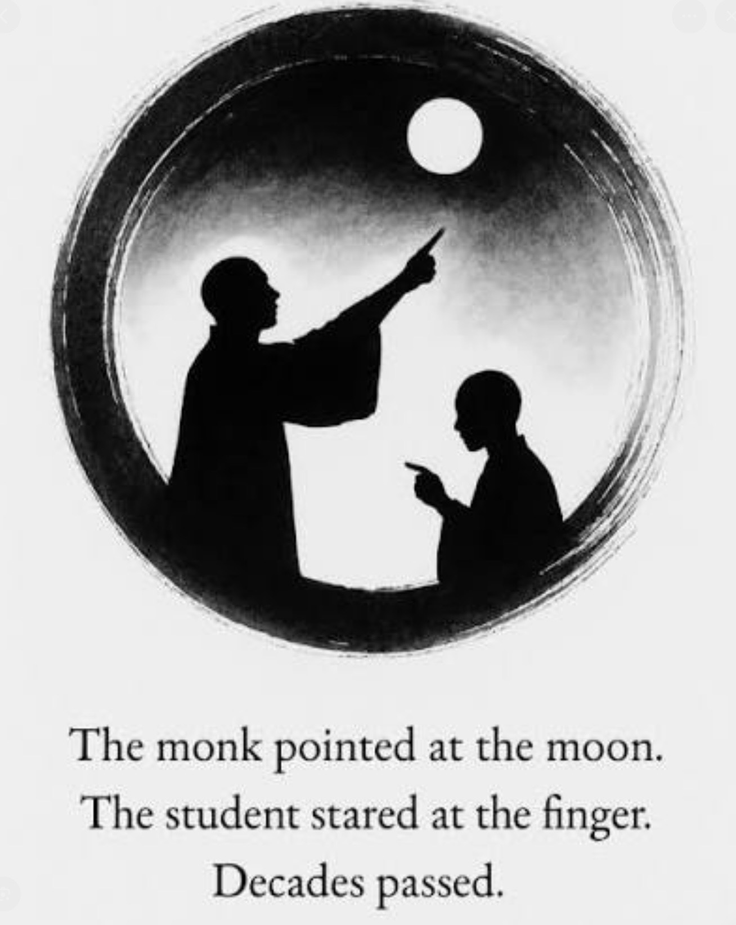
TWO CENTRAL METAPHORS
The Moon Reflected in Many Buckets Image: There is one moon in the sky. Below it are many buckets filled with water. Each bucket reflects the same moon. The moon represents Universal consciousness (or God, or ultimate reality).The buckets represent individual beings. The water is the mind or nervous system. Each person appears separate, just as each reflection looks separate. But the light in each of us is not separate. It is the same moon, reflected through different forms. In this metaphor consciousness is one, appearing as many. Individuality is real at one level, but at a deeper level, we share the same source. Differences between people are like differences in the water, still, rippled, muddy, clear, but the moon itself is unchanged. This metaphor is about identity. It answers the question: What are we, really?
The Finger Pointing at the Moon Image: Someone points at the moon. The finger is not the moon. It only directs your attention toward it. The moon represents ultimate reality, God, or universal consciousness. The finger represents religious doctrines, spiritual practices, philosophies, and theologies. Different traditions point in different ways. But none of them are the moon. They are maps, not the territory. In this metaphor the danger is mistaking the teaching for the reality. The emphasis is on the humility of understanding that no theory captures the Whole. This metaphor is about knowledge and interpretation. It answers the question: How do we talk about or approach ultimate reality?
Both metaphors assume there is one ultimate reality, emphasize that appearances of multiplicity can be misleading and invite humility and depth. Both fit beautifully with the perennial philosophy intuition that truth is one, though expressed in many forms.

Slide 41
MOON IN BUCKETS FINGER POINTING AT MOON
Is about what we are Is about how we understand
Focuses on identity and consciousness Focuses on theology and language
One light reflected in many beings Many teachings pointing to one reality
Unity beneath multiplicity Interpretations beneath unity

Slide 42
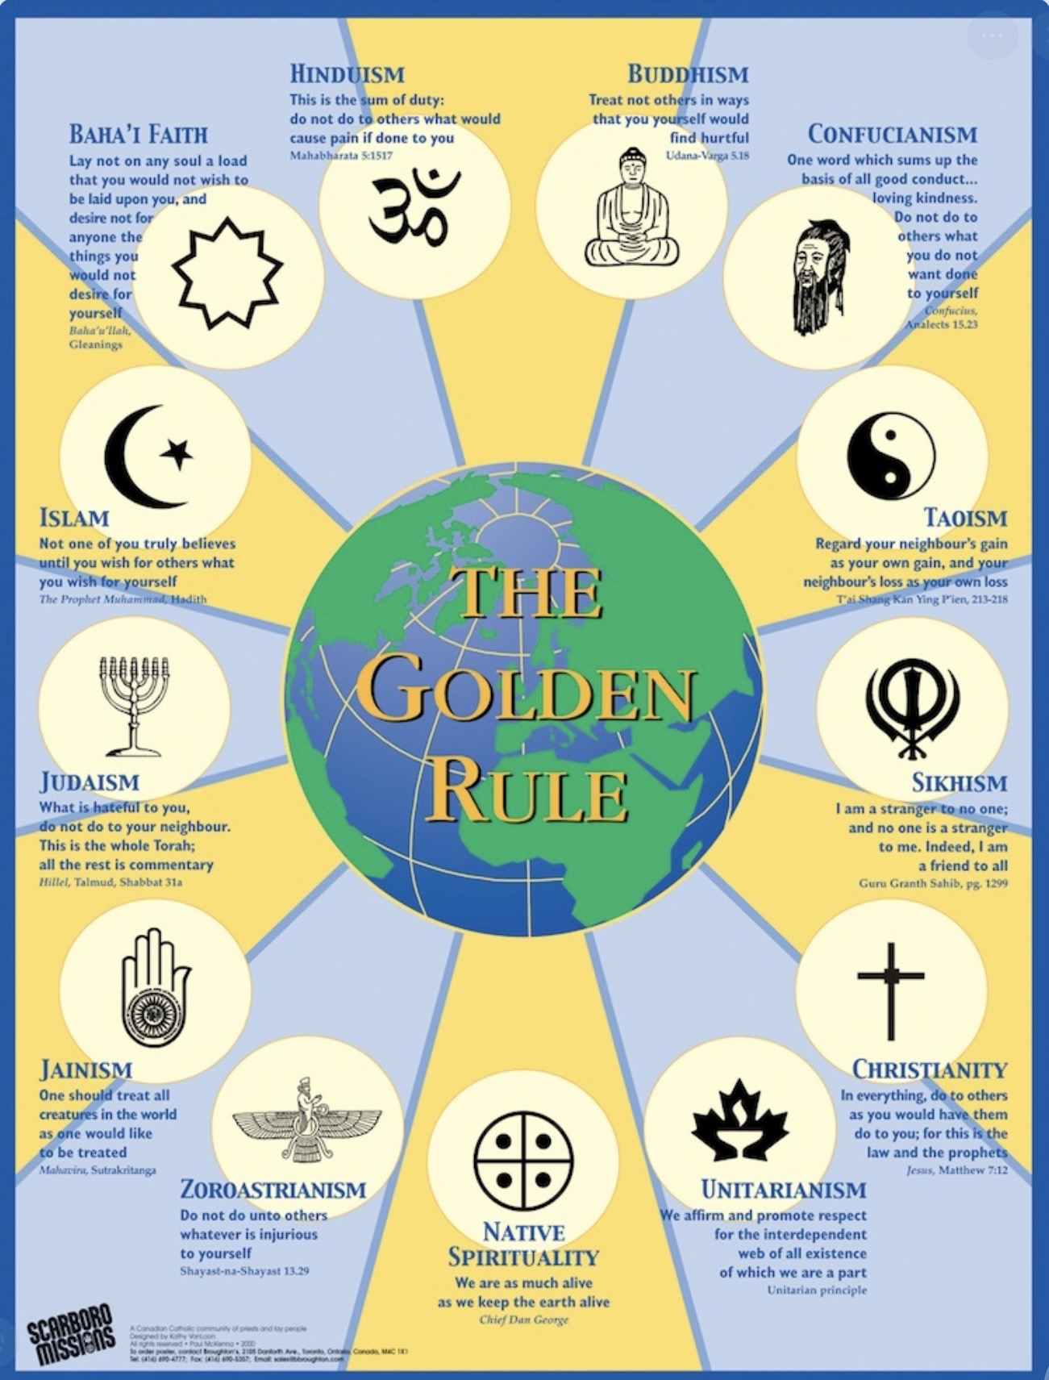
A literal interpretation treats religious stories and teachings as factual descriptions of reality.
A metaphorical interpretation sees them as symbolic stories that point to deeper truths about life, meaning, and mystery.
My faith is shaped by the perennial philosophy’s idea that many of the world’s religious traditions are different maps of the same mysterious ineffable territory.
I embrace each of these traditions when I understand their stories, symbols, and doctrines metaphorically rather than literally. As fingers pointing to the moon, not the moon itself.
The moon is the mystery at the heart of reality; the traditions are beautiful ways of gesturing toward it, not final descriptions of it.

Slide 43




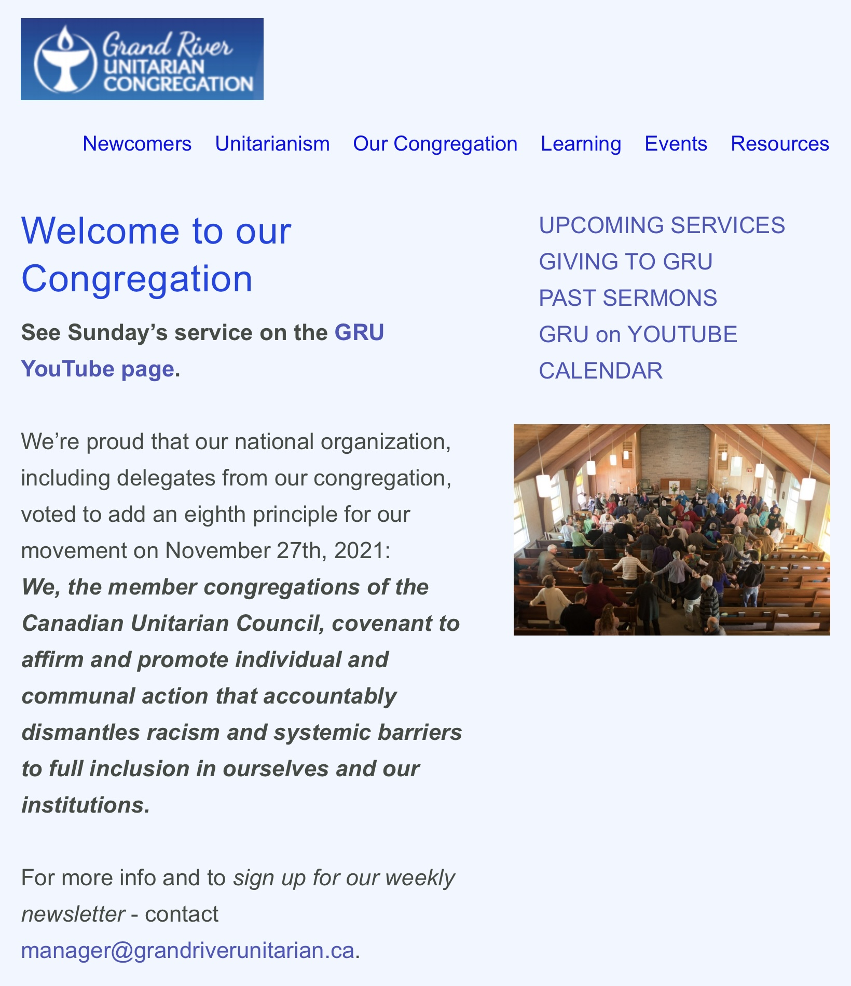
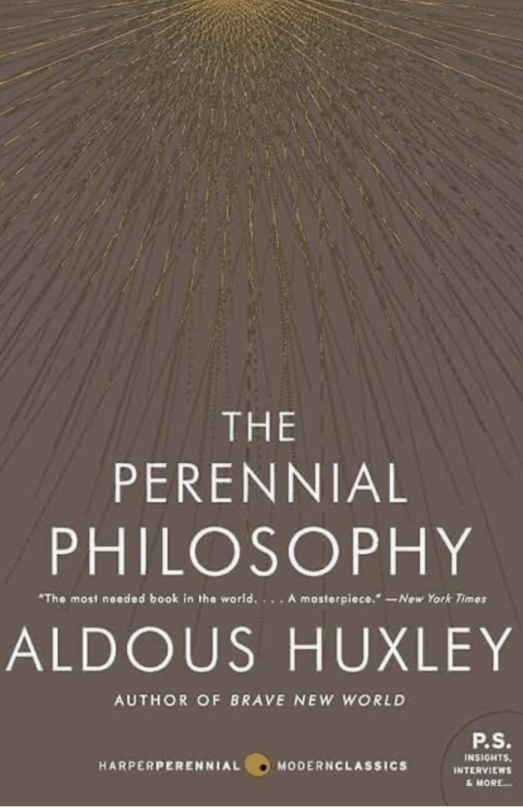

Slide 44

What is the difference between spirituality and religion?

Slide 45
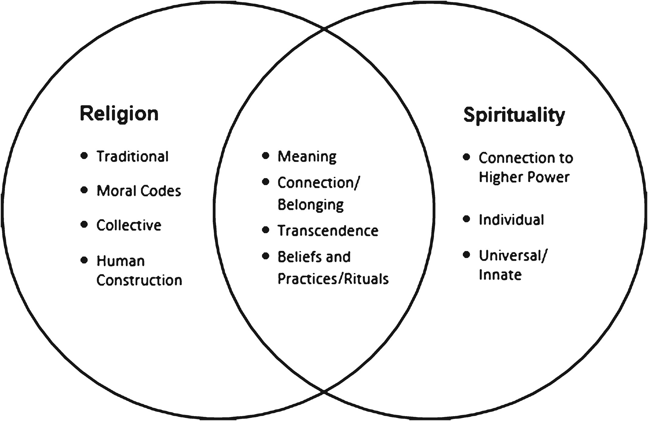
definitions
Religion- a particular system of faith and worship. The belief in and worship of a superhuman controlling power, especially a personal God or gods.
Spiritual- The quality of being concerned with the human Spirit or Soul as opposed to material or physical things. The feelings, thoughts, and experiences that arise in the search for the sacred
Sacred- the divine, higher power or ultimate reality as defined by the person
Transcendent- relating to a spiritual or nonphysical realm
Belief – trust or confidence in something in the physical realm
Faith- trust or confidence in something in the spiritual realm. A lack of resistance to what you hope is possible.
Dogma- a principle or set of principles laid down by an authority as incontrovertibly true.
Scientism- the approach which studies only those phenomena that are explainable by current theories and dismisses phenomena that are “anomalous” or cannot be explained by current theory.
Mystical- inspiring a sense the spiritual mystery, awe, wonder, and fascination.
One can be religious without having significant spiritual experiences. One can be spiritual and not be religious.

Slide 46
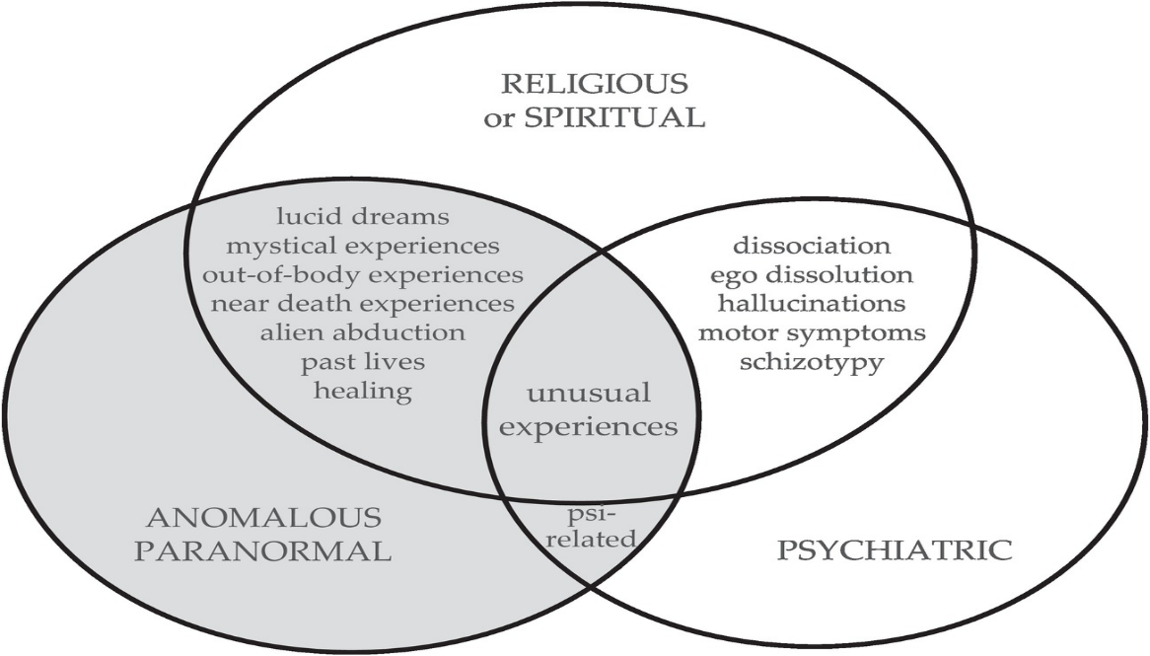
The terms supernormal/paranormal and supernatural are often confused particularly among skeptics who in the same stroke reject both.
Supernormal or paranormal: are terms coined by Frederic Myers referring to an act of nature that science cannot yet explain. The paranormal includes concepts such as : prophecies, revelations, divination, miracles, reincarnation, karma, extracorporeal consciousness, (out of body and near-death experiences) remembering past lives, magic, witchcraft, alien encounters, Psi (Synchronicity, precognition, apparition experiences etc.)
Parapsychology : the study of alleged psychic paranormal phenomena most often extrasensory perception, telepathy, precognition, clairvoyance, and psychokinesis.
Supernatural : Christian category describing the interference of some entity from outside the natural world upon the natural world. Also referred to as miracles. Something science will never explain. The supernatural includes concepts such as : Deities, supernatural beings, angels, demons, ghosts, spirits
More definitions

Slide 47

Spiritual states of consciousness are mental states anyone can experience.
Some people experience them frequently, others rarely or never. This ability may be in part related to personality.
Spirituality is a state of consciousness in which we transcend our small s self and feel a loving connection or at one with something or someone outside of ourselves. It is a spectrum.
Spirituality is a felt connection to something greater than ourselves that is essential to our wellbeing.
Without spirituality it may be difficult to find meaning and purpose in life.
Spiritual experiences often arise when ordinary identity loosens through awe, loss, love, trauma, or sexuality.
Intense spiritual experiences are called mystical experiences. Mystical experiences are “noetic but ineffable”, meaning they typically present the experiencer with an alternative reality that is much more convincing than ordinary reality, but which can’t be described in words.
WHAT IS SPIRITUALITY ?

Slide 48
Spiritual experiences can also be negative, that is, experiences of altered or expanded consciousness that feel distressing rather than uplifting:
Ego dissolution without integration – feeling the boundaries of self dissolve into terrifying chaos or nothingness rather than unity or love.
Encounter with a “dark presence” – perceiving malevolent or oppressive forces during meditation or spontaneous mystical states.
Overwhelming awe or cosmic insignificance – an encounter with vastness that induces panic, dread, or existential despair. Mystical psychosis – losing the ability to distinguish mystical insight from delusion, leading to disorganization or fear.
Spiritual emergency – rapid awakening experiences that flood the psyche with more transpersonal energy than it can handle, causing confusion or breakdown.
WHAT IS SPIRITUALITY ?

Slide 49
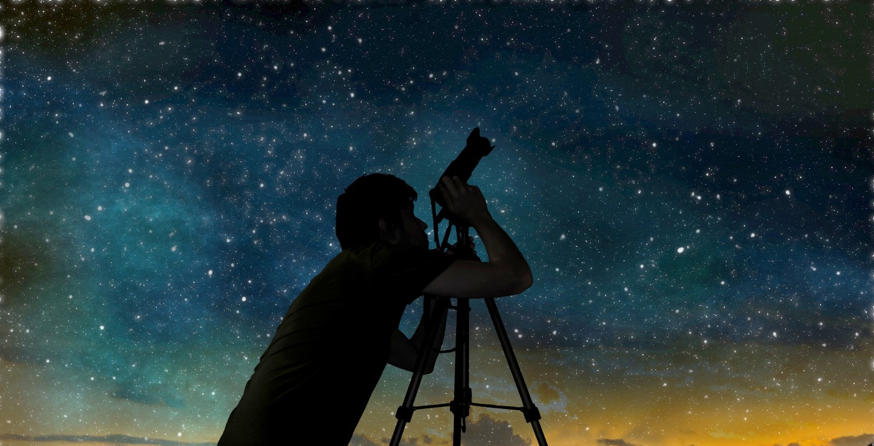
FOSTERING spirituality
Spiritual states are altered state of consciousness and can be fostered in a variety of ways including rituals, rites of passage, pilgrimages, gratitude practices, fasting, using mind altering substances, connecting with nature, or through contemplation and meditation.
Many activities foster spiritual experiences include silent retreats, walking in a forest, looking at the night sky, or reading the writings of or listening to spiritually gifted people. Spirituality, like Wise mind, to which it is related, must be fostered. We must make space for it.
Activities that foster spirituality are known as self-transcendent practices.
Some self-transcendent practices (e.g., meditation, nature exposure, meaning-focused interventions) have shown effects comparable to antidepressants in mild to moderate depression in certain studies.

Slide 50

What is mysticism and how is it related to spirituality ?

Slide 51
MYSTICISM
Mystical experiences are intense spiritual experiences which have a combinations of eight characteristics:
The experience of unity between the person and the universe
Certainty of the knowledge obtained
Transcendence of time and space
A feeling of sacredness
Paradoxality in terms of ordinary thinking
Ineffability(impossible to describe)
Transiency
Lasting positive changes in attitude and behavior
Mysticism : is the belief that union with the deity or the absolute may be attainable through contemplation or self-surrender.
One can have a mystical experience or if mysticism is central in their lives be a mystic.
A mystic is a person who seeks a spiritual experience to raise and expand their awareness of self, the universe, reality, and the laws that govern all three.

Slide 52

What is the difference between spirituality and religion?

Slide 53
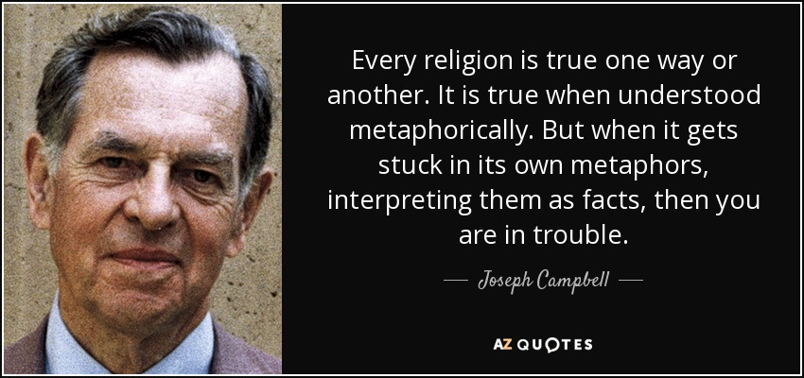

Slide 54
“We have made God a being rather than being itself.”
Father Richard Rohr

Slide 55
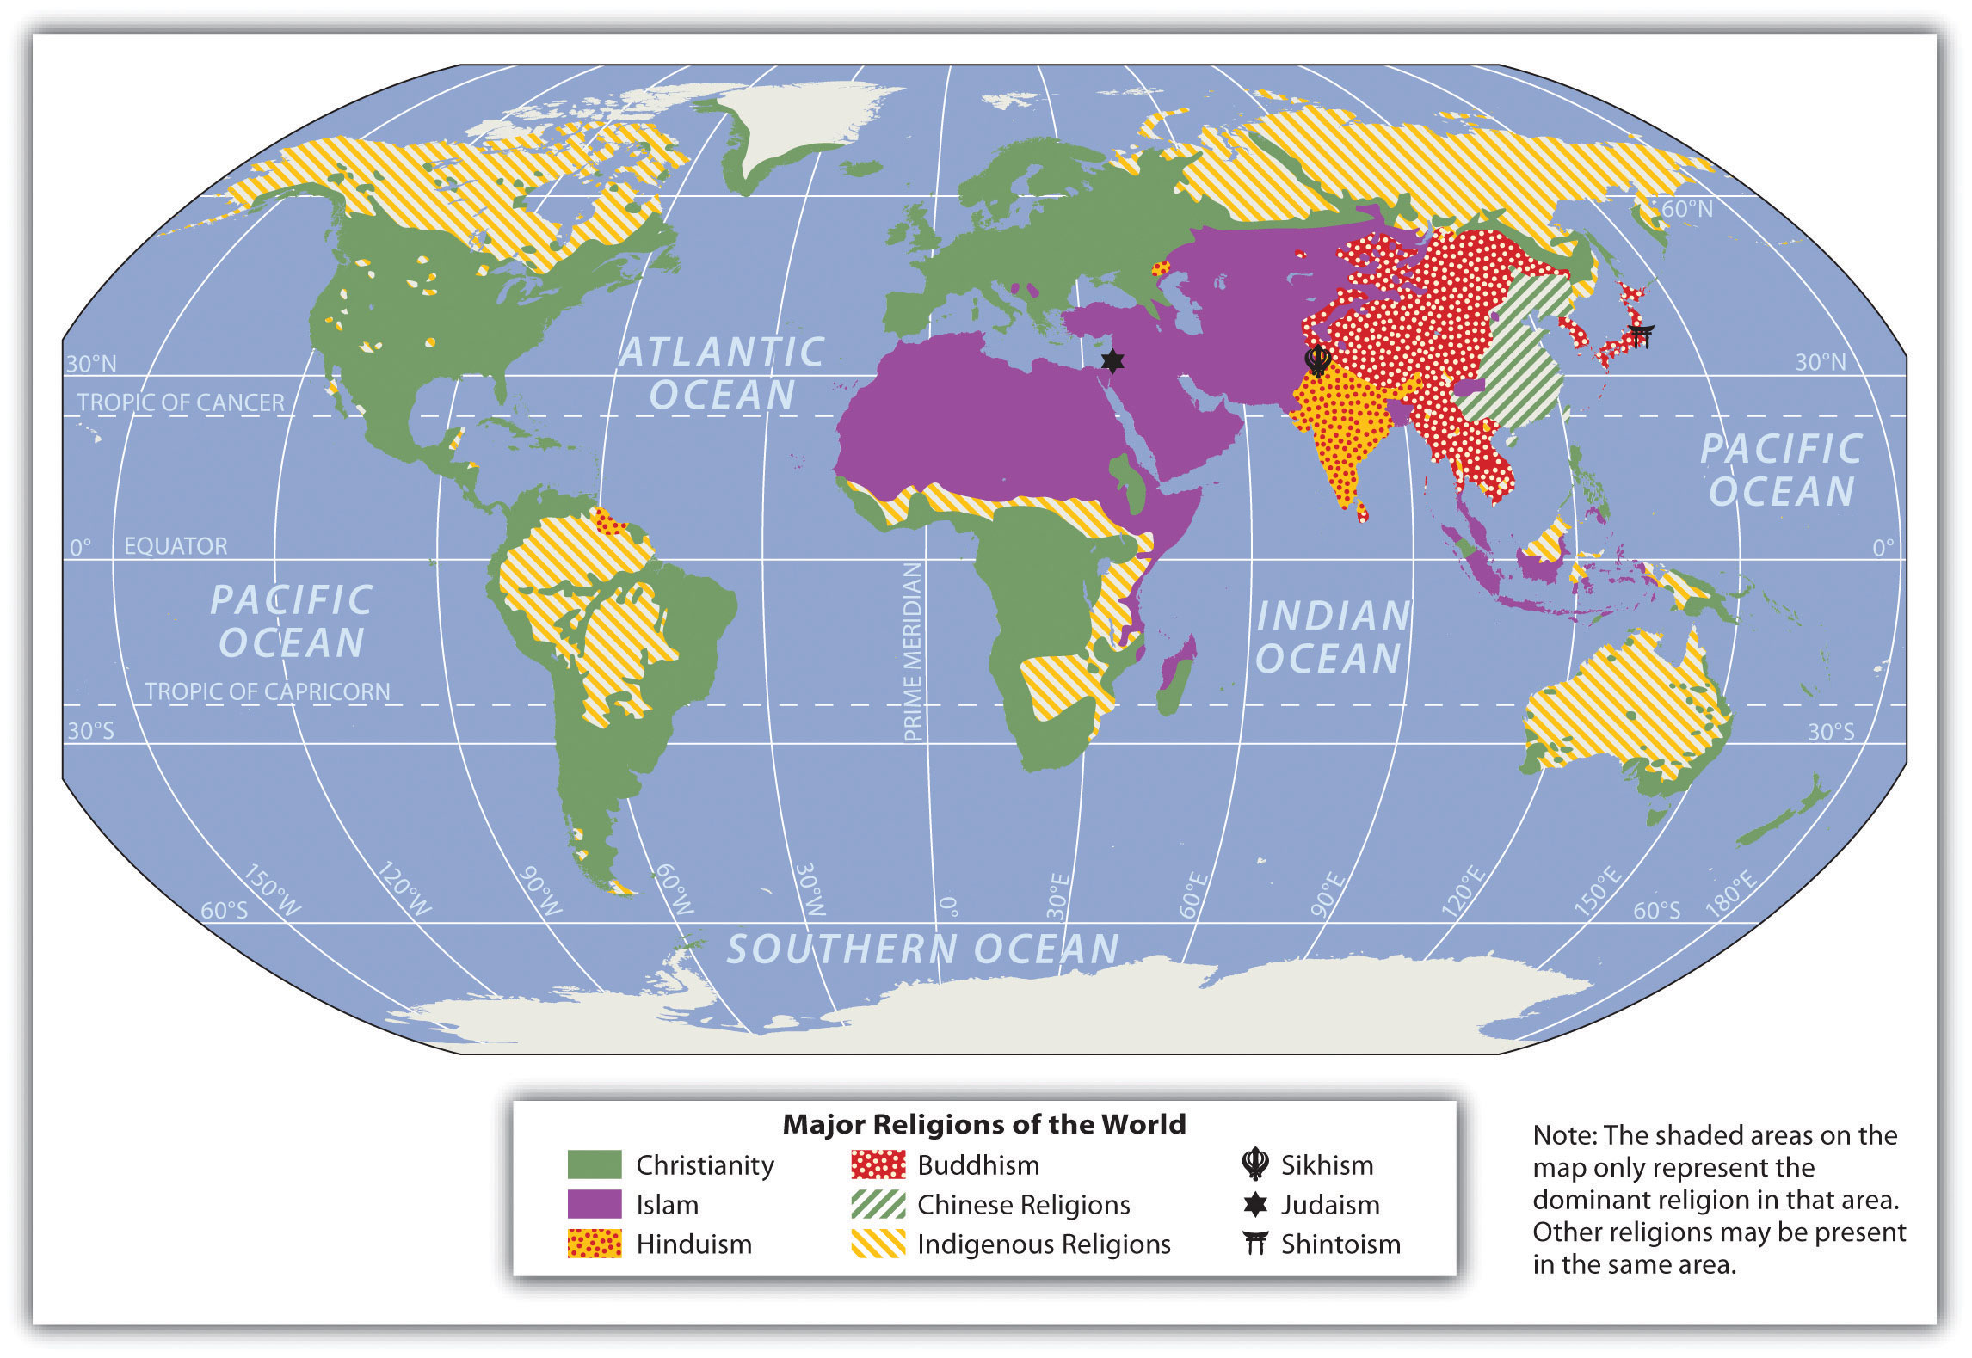
The difference between Spirituality and religion
Spirituality is to religion as a game of pickup hockey on a pond is to the NHL.
A pickup game is a simple, playful, joyful, personal, and spontaneous experience with few rules and no financial incentives.
The NHL is big business, a highly complex organization with many parts including an administration (Vatican, diocese) the players (ministers) the fans (congregants) etc. .
There are four main “families”, or “leagues” of religions: 1. Indigenous, 2. Western,(Judaism, Christianity, and Islam) 3. East Asian,( Daoism, Taoism, Shintoism) and 4. South Asian (Hinduism, Buddhism)
Each of these families arose in a different geographical region and focused on the dominant concerns of their societies: South Asian religions focused on psychology, East Asian on how to live together, and Western religions on our interaction with the material world.

Slide 56
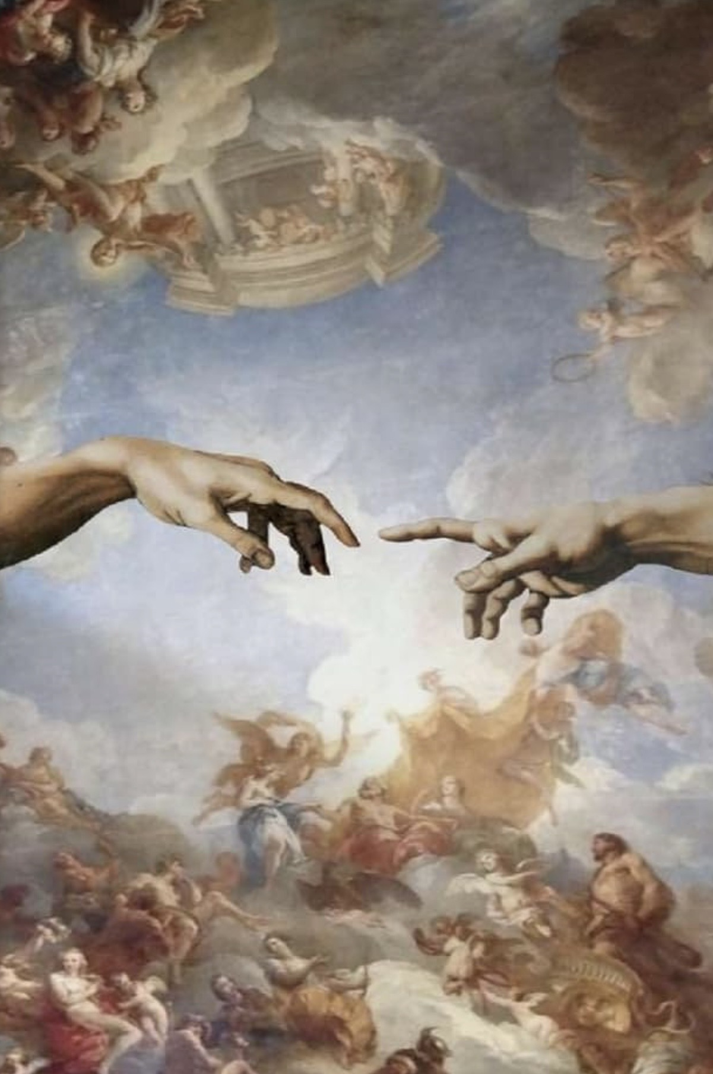
Where does the human spiritual impulse come from?
"The whole impetus of life is to transcend and get beyond the separateness, insignificance, and transience of the ordinary human condition through association with something timeless and boundless." Oliver Sacks

Slide 57

The origins of spirituality
Homo sapiens became a distinct species approximately 200,000 years ago but the cognitive revolution only occurred about 70,000 years ago.
According to anthropologist Ian Tattersall what distinguishes us from other species is that, since the cognitive revolution, we’re capable of 1) symbolic thought which greatly enhances our ability to 2)“mentally time travel”.
1) symbolic thought means we can “mentally dissect our animate and inanimate surroundings into a mass of intangible symbols that we can recombine to produce new images of the world as it is and as it might be, and as a result we live at least partly, in worlds of our own intellectual creation, rather than in the world as nature presents it to us.”. In other words, we imagine realities that have no existence in the physical world.
The “realm beyond the earthly realm” which is the concern of spirituality and religion is an example of a reality that does not have an obvious existence in the modern Western world. We only get glimpses of this realm from across a “veil”.
2) Mental time travel means we can project ourselves into the past and the future and know that, someday, we are going to die.
Birth and death are mysterious transitions. Knowing that some day we are going to, and seeing our loved ones die, leads us to wonder where we came from before birth and where we’re going to after death.

Slide 58

Through the ages, most humans have thought of death as a passage from the material world to a realm that is invisible but at least as real as the earthly one.
Today many people believe there is no such other realm.
Some of the earliest archeological evidence of “religious” rituals involve death and burial. Prehistorical burial sites are typically located in deep caves, which were believed, by the cultures that created them, to be the passageways to the other realm or underworld.
The evidence for this other realm comes to humans in mystical experiences, dreams, near death experiences, communications with the deceased etc.
This evidence is recorded in art, mythology, religion, and popular culture, and is in our day also being explored using scientific methodology.
This evidence is dismissed by materialist scientism without even being considered.
THE TWO REALMS
(

Slide 59
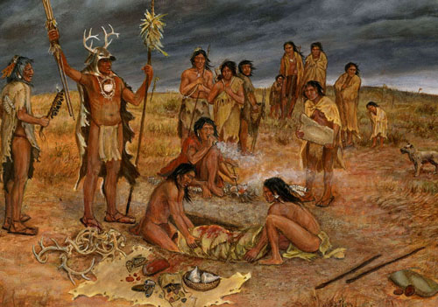
The origins of religion
Religion is socially organized spirituality.
Until about 12,000 BCE homo sapiens survived by hunting and gathering and lived in bands of up to 150 people. In hunter gatherer bands there was some division of labour around gender and age but not a great deal of “specialization”.
Hunter gatherers did not, as we do today, experience themselves as separate individuals, instead they felt intimately connected to each other, to nature, to their work and to the symbolic stories in their imaginations.
Their experiences of the physical everyday outer realm and of the other worldly realm accessed in dreams, rituals, visions, the imagination and altered states of consciousness were integrated. Hunter gatherers believed that spirits animated everything and were everywhere. This is known as animism.
There were always some individuals who were more talented at dealing with the physical everyday realm and those who seemed to have privileged access or be drawn to the other worldly realm.

Slide 60
The origins of religion
Because many illnesses appeared to be caused by invisible forces, shamans were also the earliest “healers”. Illnesses were therefor often explained as punishment for sins, possession by evil spirits, or the will of the gods.
As, over time, social organization become increasingly more complex, there was further role specialization. Interdependent priest and ruler/warrior classes arose. Both vied to create and control the society’s myths, culture, rules, technology, and institutions.
Throughout history the rulers/warriors have concerned themselves with the material realm while the Shamana and priests attended to the spiritual realm.
Often rulers/warriors and priests competed for power (and money, fame and sex) .

Slide 61

What is the fundamental nature of the universe?

Slide 62
THE OLDEST QUESTION
Humans have always asked deep questions. The ancient Greek philosophers organized the questions Humans have asked into “areas of inquiry” and gave them names:
Epistemology: Investigates the nature and scope of knowledge, including how we acquire knowledge, what constitutes knowledge, and the limits of understanding.
Ethics: Concerned with questions of right and wrong, morality, and values. It explores ethical theories and principles to guide human behavior.
Logic: Studies reasoning, arguments, and the principles of sound reasoning. It deals with the structure of valid arguments and the nature of rational thought.
Aesthetics: Focuses on the nature of beauty, art, and taste. It examines the philosophy of art and our experiences of beauty and aesthetic value.
Political Philosophy: Explores theories of justice, rights, power, and governance. It delves into concepts of authority, freedom, and political organization.
Philosophy of Mind: Investigates the nature of the mind, consciousness, and mental processes. It explores questions about the relationship between the mind and the body.
Philosophy of Science: Examines the foundations, methods, and implications of scientific inquiry.

Slide 63
THE OLDEST QUESTION
But of all these the oldest and most fundamental question Humans have asked is “what is the basic nature of the world?” The Greeks called the answers given to this question metaphysics.

Slide 64
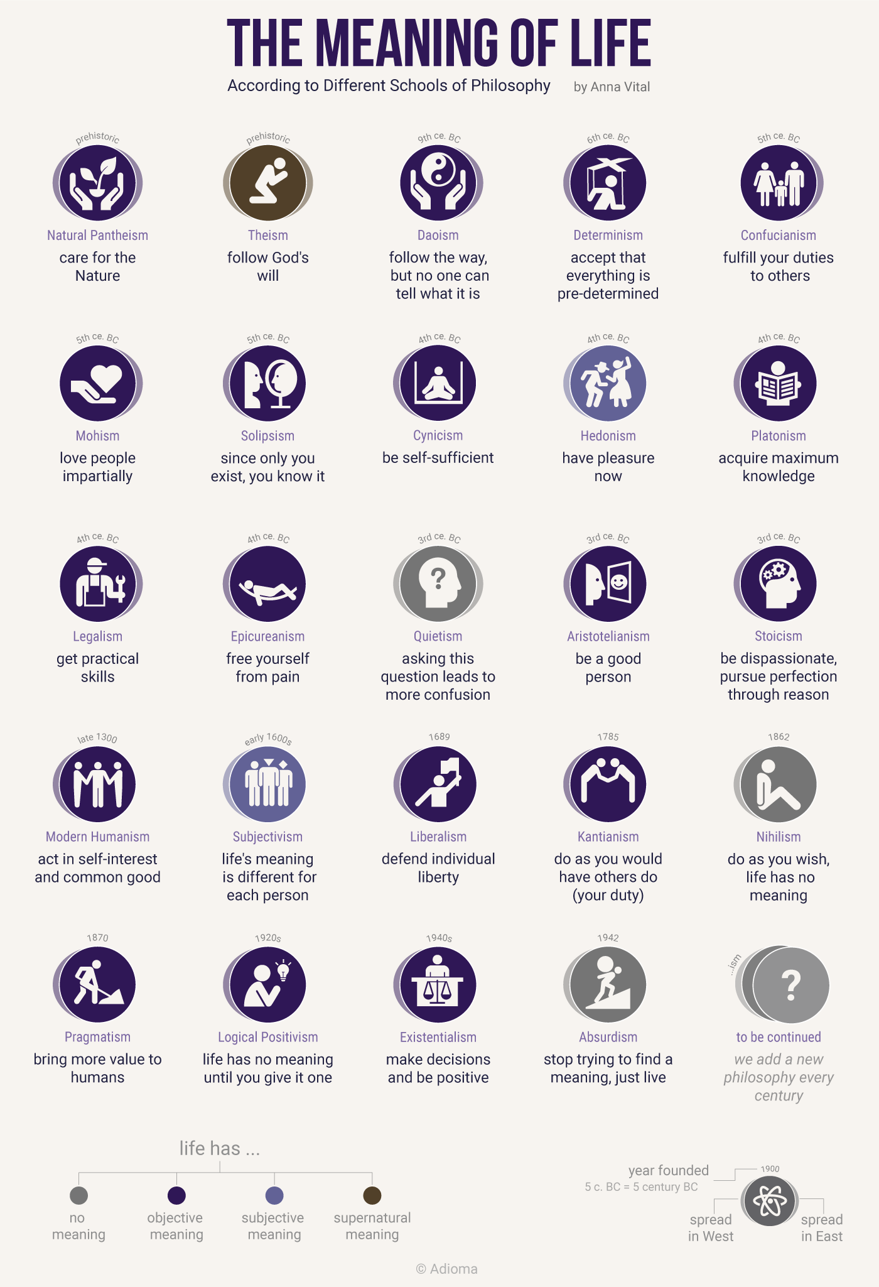
WHAT IS THE BASIC NATURE OF THE WORLD?
Philosophers have offered two main answers to this question:
1. Idealists, believe that there is more than the material realm that is readily apparent to us and that “meaning” can only be found in our connection to that other realm.
The meaning of this physical world can only be understood in terms of that other world that is veiled from us.

Slide 65
WHAT IS THE BASIC NATURE OF THE WORLD?
Philosophers have offered two main answers to this question:
2. Physicalists or materialists think that there is no realm other than the physical one that is readily apparent to us.
The only meaning in life is that which we choose to give it. Existentialists are materialists who have tried to find meaning in this kind of world.

Slide 66
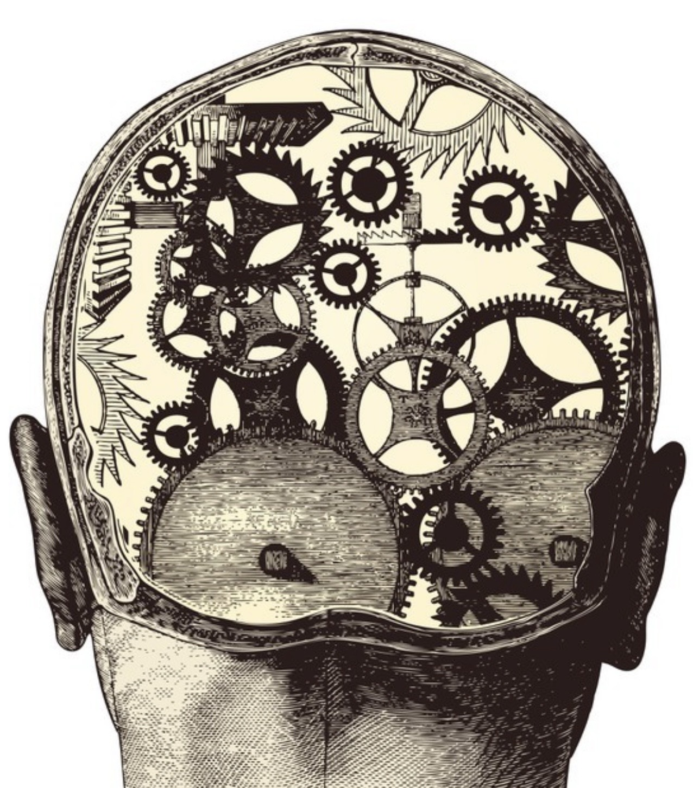
What if anything do physicalism/materialism and idealism have to do with mental health?

Slide 67
METAPHYSICS AND MENTAL HEALTH
PHYSICALISM/MATERIALISM
IDEALISM
The only realm that exists is the “material” realm of elementary particles and forces.
Each of the 17 elementary particles described by quantum field theory is an energy event or ripple organized by a fundamental quantum field .
Mind or consciousness is nothing but a complex organization of “matter.”
The universe arose spontaneously out of nothing and there is no inherent meaning to existence only that which we choose to give it. (the existentialist position)
Philosophical or metaphysical physicalism or materialism is still the dominant modern Western cultural view which we are indoctrinated in by a “scientific” education.
It has led to a “crisis of meaning”, a part of the polycrisis we are currently experiencing.
Matter or elementary particles and forces are not fundamental. Mind or consciousness is fundamental, and “matter” arises from mind.
Christian metaphysics is an example of idealism.
Idealism has been the overwhelmingly dominant view held by most cultures, religious and philosophical traditions.
Until the 19th century the traditional view that the sacred, spiritual or mental realm was the creative force behind the physical realm was accepted by most scientists and laypeople.
“Modernity and postmodernity” ushered in an era in which physicalism became dominant.
The findings of quantum physics launched a renaissance of idealism.
Many prominent thinkers now view idealism as the most logical metaphysical position. (see for example Bernardo Kastrup)

Slide 68
METAPHYSICS AND MENTAL HEALTH
Philosophical physicalism assumes that the mind is produced by the brain, and therefore “you” are nothing more than your individual body and brain processes. You have no connection to anything greater than yourself.
Meaning, purpose, and responsibility all fall squarely on the individual. This aligns with Western individualism; success, happiness, and even suffering are seen as your responsibility.
Mental health challenges can thus be interpreted as personal failures rather than systemic or existential struggles.
A purely physicalist framework can unintentionally leave out belonging and meaning:
1) The emphasis on the autonomous self has cut people off from deeper senses of belonging.
2) People feel they must “fix themselves” alone.
3) If consciousness is seen as an accident of neural chemistry, experiences of suffering can feel meaningless fueling hopelessness or nihilism.

Slide 69
MATERIALISM, IDEALISM, AND MENTAL HEALTH
Philosophical idealism, in contrast, holds that consciousness is the fundamental reality, and that each person is a local expression of a greater universal mind. You are not an isolated accident but part of an unfolding cosmic story.
This has a profound effect on our sense of meaning, instead of being trapped inside an individual brain, the self is seen as porous, connected, and participating in something larger.
This can have many positive effects on mental health:
1) Feeling oneself embedded in the greater whole can relieve loneliness.
2) Struggles and growth are not just “my” burden but part of evolution’s unfolding.
3) Recognizing shared participation in mind-at-large fosters empathy and reduces stigma and self-blame.

Slide 70
MATERIALISM, IDEALISM, AND MENTAL HEALTH
In Short: physicalism + individualism → “It’s all on you” → isolation, shame, pressure.
Idealism + universal unfolding → “You are part of something greater” → belonging, meaning, resilience.

Slide 71

Idealism = a material realm + a hidden spiritual realm.
materialism = only one visible material realm

Slide 72
If idealism is true, connection is built into reality.
If materialism is true, connection must be built through relationship.
Either way connection heals.

Slide 73


TWO METAPHORS FOR HOW WE SEE OURSELVES
The physicalist view says: You are a flower that sprouted by chance in the soil. Your bloom is yours alone, and your survival depends only on how strong your stem is and how favorable the weather. If you wilt, it’s on you. This sense of radical independence can leave a flower/us feeling isolated, exposed, and fragile, always comparing its bloom to the others, always fearing the frost.
The idealist view says: You are a flower growing from the branch of a great tree. Your beauty and fragility are real, but you are not separate, you are fed by the sap, supported by the roots, and part of the life of the whole tree. Even when your petals fall, what you are continues in the living trunk. In this view, your struggles and joys are not just private matters, but expressions of the unfolding of the entire tree of life. You belong. You are needed. You are not alone.

Slide 74

What does idealism say about this hidden realm?

Slide 75
“The animating essence of religion is the belief that there is an unseen order and that our supreme good lies in adjusting ourselves thereto.” William James

Slide 76
The realm Behind the veil
In the course we have discussed how trauma and attachment issues can lead to dissociation giving rise to the emotional parts of structural dissociation or the part selves of IFS.
Many cultures have believed that birth is the original trauma that dissociates an individual’s consciousness from a Universal consciousness, ”higher power”, God, or causal realm. Before birth we were one with that universal consciousness, and with birth we become the dissociated individual private consciousnesses we experience in this life.
Serious investigators have documented evidence supporting this view, for example young children who have memories of previous lives. (University of Virginia division of perceptual studies.)
If we are indeed dissociated parts of a Universal Consciousness, does “healing” from being our fragmented individual separate selves involve realizing, experiencing, and living according to our Universal consciousness nature? What does that mean? How do we return to that Oneness? And how would that heal us?
What have people seen when they’ve peeked behind the veil that spiritual and religion traditions hold separates us from a mysterious sacred realm. What are the Soul, the Spirit and the Sacred.

Slide 77
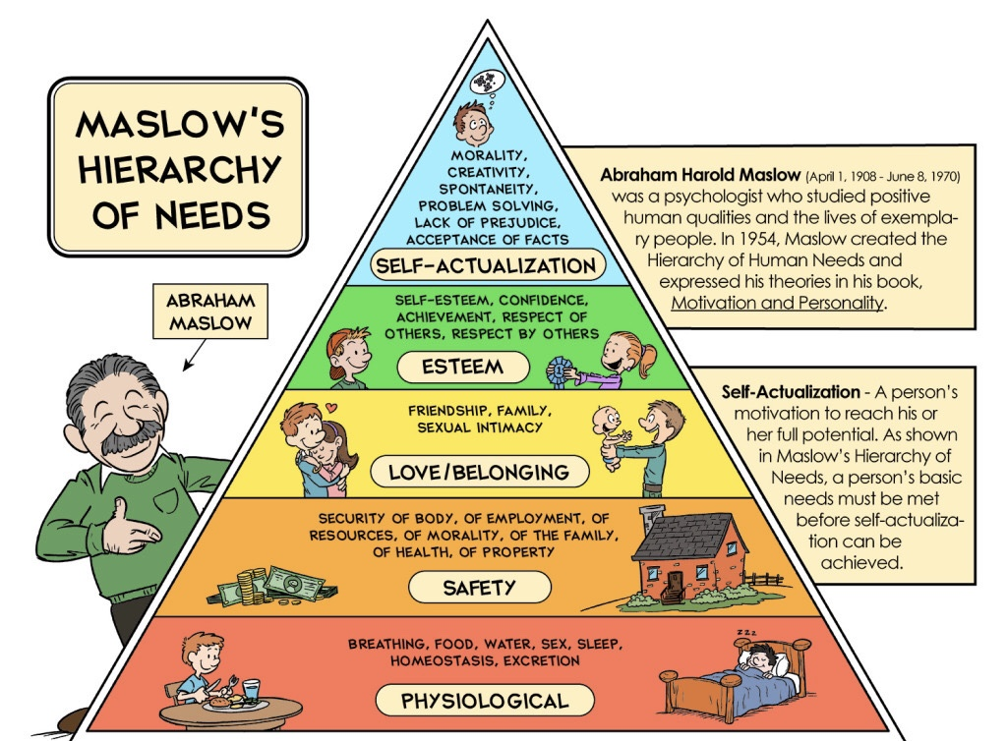
Did Maslow include the Human spiritual impulse in his hierarchy of needs?

Slide 78
SELF-ACTUALIZATION VS. SELF-TRANCENDENCE
As we previously considered Maslow outlined a hierarchy of human needs:
1) biological needs for ex. food, water, sleep, air
2) psychological for safety and esteem
3) social for love and belonging and
4) spiritual for self-transcendence.
Maslow’s concept of self-actualization is one of the most well-known ideas in humanistic psychology, but less commonly discussed is how, later in life, he expanded his thinking to include a further stage: self-transcendence.
Self-actualization is the process of realizing and fulfilling one’s own potential. It involves becoming the most authentic version of oneself.
Self-actualized individuals are: Autonomous, independent, creative, spontaneous, deep, have meaningful relationships, a realistic perception of the world, they accept themselves and others, have peak experiences, and pursue personal growth and purpose.
Notes:
Abraham Maslow's hierarchy of needs is an integral answer to what the meaning of life is and what makes it worth living.

Slide 79
Maslow’s SEF-ACTUALIZATION VS. SELF-TRANCENDENCE
Originally, self-actualization was the highest level in Maslow’s hierarchy of needs. In his later writings (particularly in the last years before his death in 1970), Maslow suggested that self-transcendence goes beyond and includes” self-actualization in the hierarchy of needs. He believed that truly fulfilled individuals don’t just develop themselves, they go beyond themselves.
Self-transcendence refers to going beyond the self, to serve something greater than oneself, such as a cause, a community, a spiritual ideal, or humanity as a whole.
Self-transcendence involves: A shift from ego-centered concerns to altruistic or cosmic perspective, a loss of self in moments of service or awe, a feeling of unity with all beings or the universe, more frequent and sustained peak experiences, which Maslow later called plateau experiences, longer, quieter moments of deep connection or meaning and spiritual or mystical though not necessarily religious inclinations.
Notes:
Abraham Maslow's hierarchy of needs is an integral answer to what the meaning of life is and what makes it worth living.

Slide 80

Where does spirituality fit in our journeys of healing and growth towards our full human potential?

Slide 81
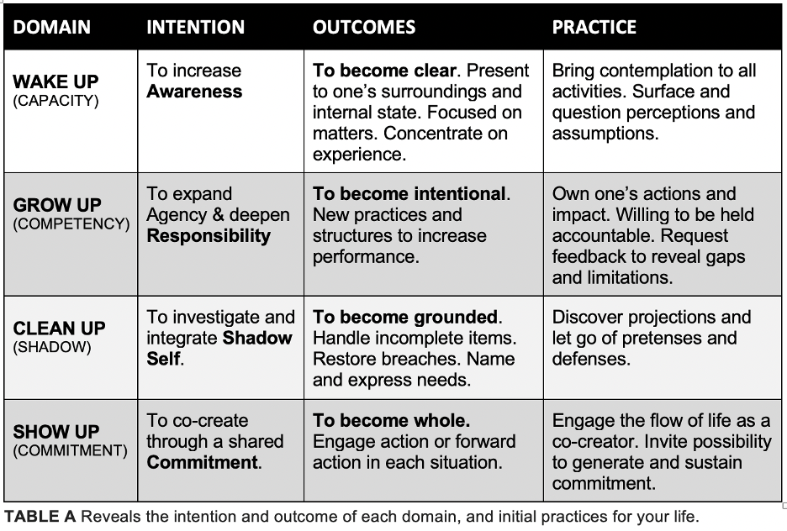
FOUR TYPES OF growth
Integral theory describes four types of growth:
1. Cleaning up – is the first step in growth. Cleaning up is learning to identify, deal with, and avoid our “holes in the sidewalk”. It is recognizing and working with our “shadow”, the dark side our personality, or our parts.
2. Growing up - involves moving from more to less egocentric perspectives and behaviors.
3. Showing up – means participating in the world and connecting meaningfully with ourselves, others, a community, a meaningful occupation, and a meaningful worldview. It is about finding our purpose in life or giving our gift to the world.

Slide 82
FOUR TYPES OF growth
4. Waking up – means becoming more spiritual or moving from identifying with the “weather” or individual self, to identifying with the “sky” or universal consciousness or SELF. It is the realization that as Pierre Teilhard de Chardin wrote “We are not human beings having a spiritual experience. We are spiritual beings having a human experience.”
Healthy growth involves all these and promotes healing.
In the course we have already discussed 1. cleaning up, 2. growing up and 3. showing up.
Today we’re talking about 4. Waking up or fostering spirituality and how it affects our physical and mental health.

Slide 83
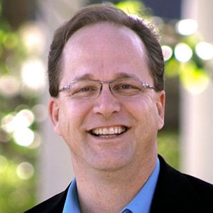
What is the evidence that there is another realm that is veiled from us?
Jeffrey Kripal

Slide 84
THE EVIDENCE FOR A VEILED REALM
Jeffrey Kripal (1962- ) is a scholar who has spent his career exploring altered states of consciousness, and anomalous experiences and their link to spirituality. Kripal is known for his work in the fields of religious studies and the study of the paranormal. He is a professor at Rice University in Houston, Texas, where he has served as the J. Newton Rayzor Chair in Philosophy and Religious Thought.
He says that many people are leaving the traditional religions because these traditions fail to meaningfully engage with the issues they are concerned about. For many people traditional religions don’t seem relevant anymore.
As traditional religion may be becoming more irrelevant, new spiritual stories are emerging which are bringing meaning and purpose back into many people’s lives, because they make better sense of the world we live in.
Kripal's work explores the idea that anomalous or paranormal experiences, have played a foundational role in the development of all major religions.
Kripal suggests that religions have their roots in extraordinary experiences, such as visions, mystical encounters, and otherworldly communications that are classified as paranormal. These and other paranormal experiences such as telepathy, precognition, and encounters with non-ordinary realities can offer us valuable insights into the nature of consciousness and the sacred.
Kripal argues that these experiences are often dismissed or marginalized in mainstream religious and academic contexts but are profound and transformative for those who experience them.

Slide 85

Kripal maintains that these experiences have historically been interpreted within religious frameworks, helping to shape the beliefs and practices of various faiths.
He argues that these extraordinary experiences continue to occur and influence individuals today, though they may be interpreted differently in contemporary contexts.
He suggests that modern accounts of paranormal phenomena, such as UFO sightings, near-death experiences, and psychic phenomena, are part of a broader spectrum of human experiences that challenge our physicalist or materialist (one realm only) understanding of reality.
Kripal believes that the paranormal invites us to reconsider the nature of consciousness and reality itself. He thinks that these experiences indicate that our current physicalist scientific paradigm is limited in its ability to fully explain the complexities of human experience. Kripal is very sympathetic to an idealist worldview.
THE EVIDENCE FOR A
VEILED REALM

Slide 86
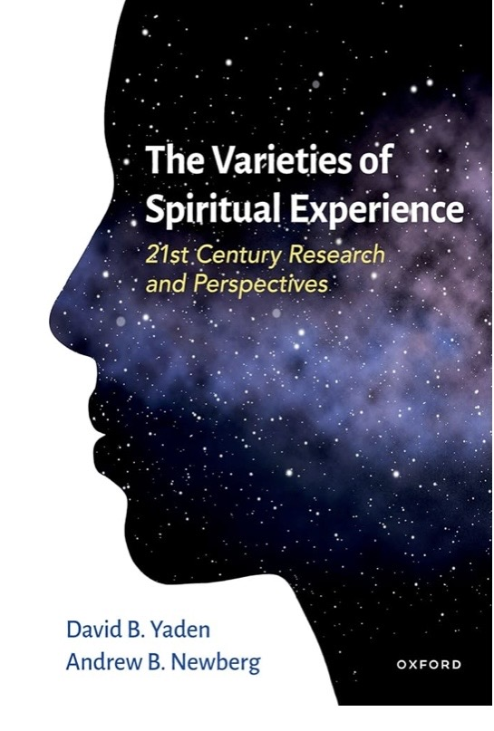
Are there different types of spiritual experiences?

Slide 87
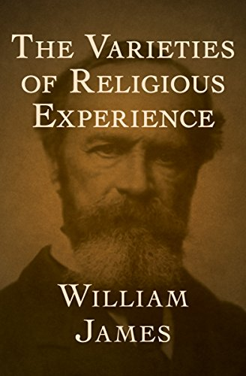

THE VARIETIES OF SPIRITUAL EXPERIENCES
William James (1842-1910) was an American physician, philosopher, historian, and “the father of American psychology”. (and brother of writer Henry James)
In his book "the varieties of religious experience" James aims to survey the varieties of religious or spiritual experiences from a psychological perspective and to present the findings and implications for philosophy.
Like Jeffrey Kripal, James felt that religious or spiritual experiences were at the very heart of religion. Much of his book concentrates on descriptions and first-hand accounts of religious/spiritual experiences.
Sceptics view some of these as examples of psychological disorders, but James disagreed and placed such accounts as central to any understanding of religion.

Slide 88
THE VARIETIES OF SPIRITUAL EXPERIENCES
James was also president of the British society for Psychical research which was devoted to the study of the paranormal.
He challenged his colleagues not to let a narrow mindset prevent an honest appraisal of paranormal phenomena.
James and his distinguished colleges in the society (including Nobel prize Laureates), investigated the paranormal using rigorous scientific methods.
They concluded that 95% of claims were fraudulent but 5%, after scrupulous controls to detect fraud, seemed legitimate
James wrote: “Our view of the world is truly shaped by what we decide to hear”
His life and work is very entertainingly captured in Deborah Blum's book “Ghost Hunters”

Slide 89
"Our normal waking consciousness, rational consciousness as we call it, is but one special type of consciousness. Whilst all about it, parted from it by the flimsiest of screens there lie potential forms of consciousness entirely different, we may go through life without suspecting their existence but applied the requisite stimulus and at a touch they are there in all their completeness. Definite types of mentality which probably somewhere have their field of application and adaptation. No account of the universe in its totality can be final which leaves these other forms of consciousness quite disregarded, how to regard them is the question“
William James

Slide 90
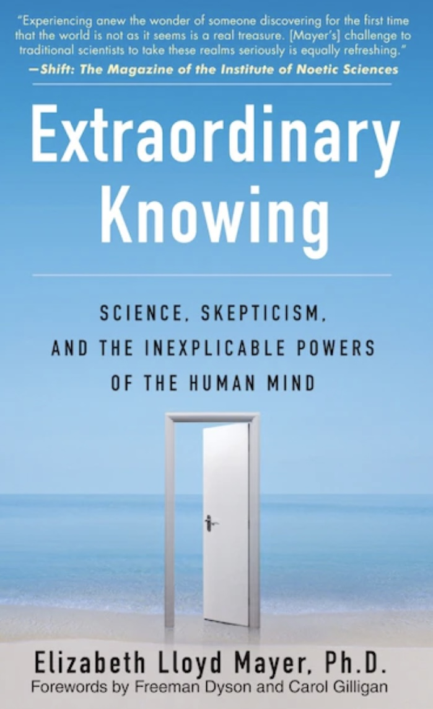
THE VARIETIES OF SPIRITUAL EXPERIENCES
There are many anomalous cognitive phenomena that have been studied using scientific methodology, with some findings being validated but remaining controversial within mainstream science because they cannot be explained by current materialist theories.
These include dream telepathy, faith healing, Chinese energy medicine -Qigong, the healing power of prayer, ESP, out of body experiences, remote viewing, presentiment, and precognition.
These are sometimes thought of as “weak signals” that are drowned out by the noise of ordinary life but are nevertheless present, much like stars are present in the sky during the day but drowned out by the light from the sun.
The way to experience them is to reduce the interior and exterior noise.
A 2020 survey asked over 1100 US University professors about ESP. It revealed that 55% of natural scientists, 66% of social scientists, and 77% of arts, humanities, and education professors reported believing that ESP is entirely an established fact or a likely possibility. Interestingly only 34% of psychology professors reported similar beliefs.

Slide 91
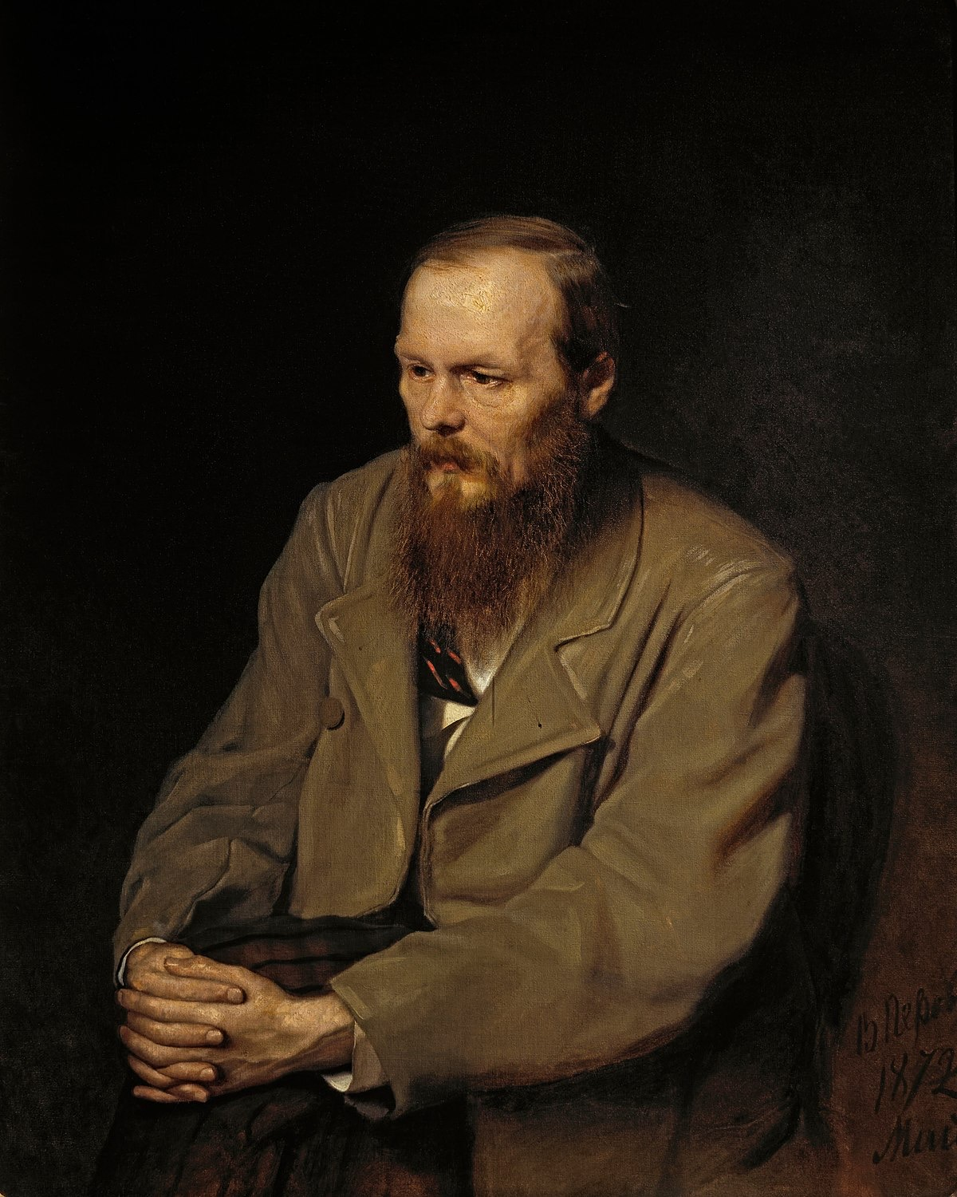
Fyodor Dostoevsky
A type of paranormal spiritual experience that has been much studied is near-death experiences or NDE’s.
NDE's, are experiences which occur, by definition, when a person comes close to death. In some cases, the person is deemed to be "clinically dead" but is resuscitated. In other there is an imminent threat of death. NDE’s are strikingly similar one to another.
NDE’s often include out of body experiences in which accurate information was acquired that would be difficult to explain unless the person was able to perceive the world from a perspective outside of their body.
The Russian writer Fyodor Dostoevsky had a near-death experience when he was subjected by the Czar to a mock execution and given a last-minute reprieve. Following this, he experienced posttraumatic growth. The experience deeply influenced his writing, leading to his exploration of the themes of suffering, redemption, and the complexities of the human psyche in his novels.
VARIETIES OF SPIRITUAL AND RELIGIOUS EXPERIENCES

Slide 92
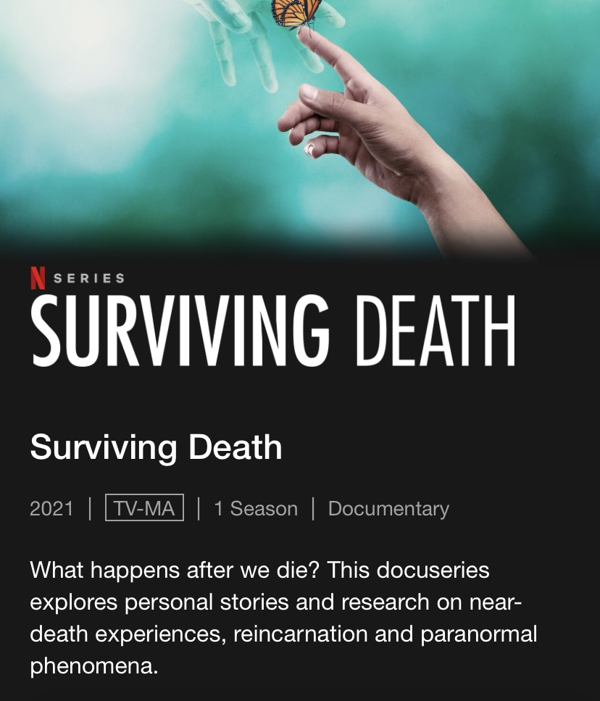
VARIETIES OF SPIRITUAL AND RELIGIOUS EXPERIENCES
There is some evidence that the baptism rite of passage as performed for example by John the Baptist on Jesus was designed to induce an NDE by drowning and subsequent resuscitation.
This practice was adopted in symbolic form by Anabaptists and Baptists and was a prelude to being “born again” which was meant to describe the changes in personality following a near death experience.

Slide 93
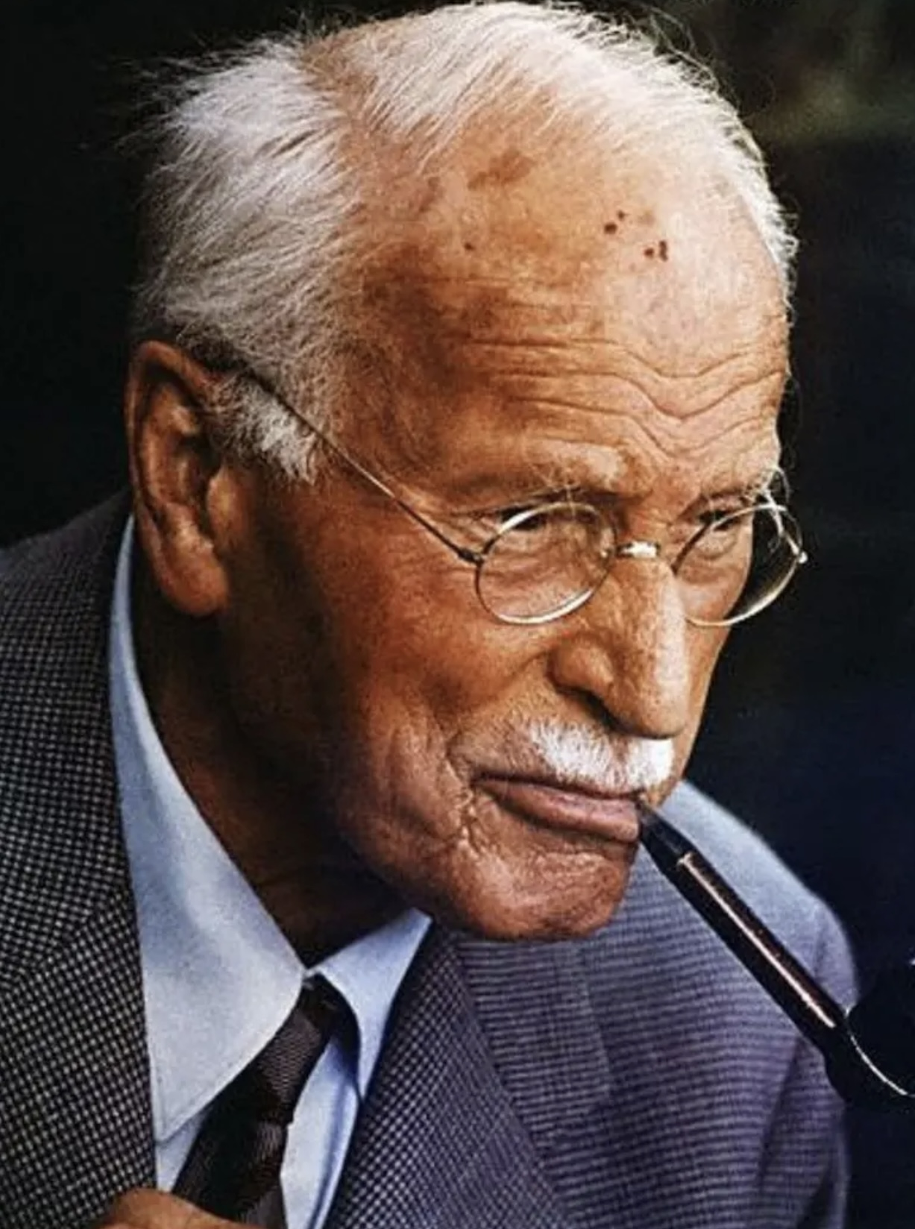
VARIETIES OF SPIRITUAL AND RELIGIOUS EXPERIENCES
In 1944, following a heart attack, Carl Jung’s had a near-death experience. Jung described this experience as a confrontation with death that led to a deep personal transformation and renewal of his sense of purpose and meaning in life. This event had a profound effect on his psychological insights and work.
Following his near-death experience, Jung became more interested in exploring the spiritual and transcendent aspects of human existence. He delved deeper into the study of mythology, religion, and alchemy, seeking to understand the collective unconscious and the archetypal symbols that shape human behavior and beliefs.
Jung's near-death experience also influenced his concept of the "transcendent function," which he described as a process of integrating conscious and unconscious elements of the psyche to achieve wholeness and individuation. This concept became central to his later work on the process of psychological growth and self-realization.
Jung's near-death experience served as a catalyst for his exploration of the deeper layers of the human psyche and his development of key concepts that have had a lasting impact on the field of psychology. It inspired him to delve into the mysteries of the human mind and spirit, leading to a deeper understanding of the complexities of the human experience and the quest for self-discovery and personal transformation

Slide 94
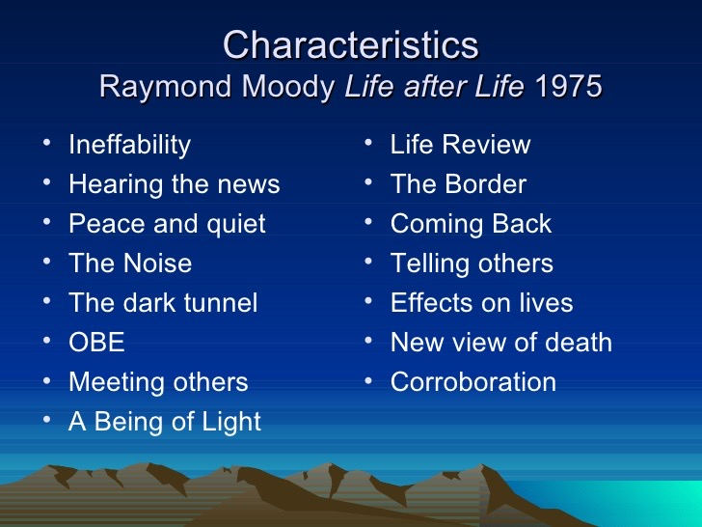
Following near-death experiences People often experience significant changes in their personality including:
They lose their fear of death and have the strength and believe in life after death. They have a new sense of purpose or mission and heightened self-esteem.
They have more compassion and love for others and less concern with material gain, recognition, or status. They have a greater desire to serve others and an increased ability to express feelings.
They have a greater appreciation and zest for life, an increased focus on the present, and a deeper religious faith or heightened spirituality, search for knowledge, and appreciation for nature.
They experience paranormal phenomena with greater frequency including other out of body experiences, apparitions, extrasensory perception, precognition, and spiritual, mystical or transcendental experiences.
They may experience heightened or unusual sensations, mental changes, increased energy, and decreased need for sleep
CHARACTERISTICS OF NEAR-DEATH EXPERIENCES

Slide 95
“When we die, we go on dreaming, we just can’t wake up.” Rupert Sheldrake

Slide 96
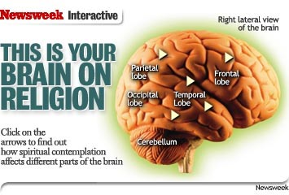
How does modern materialist science explain religious experiences?

Slide 97
THE NEUROLOGY OF SPIRITUALITY
Modern materialist/physicalist science says that fundamentally all that exist are particles and forces and that Soul and Spirit are fantasies, fairy tales or made-up stories that gave our evolutionary ancestors a survival advantage likely because they promoted group cohesion.
Materialist neuroscientists tell us that spiritual experiences can be wholly explained by:
1) When we’re in a “spiritual state” the brain’s parietal lobe, which helps us have a sense of separate self, deactivates. As that happens, the boundaries between the self and the external world dissolve.
2) At the same time the brain’s frontal lobe, which helps us to focus our attention and concentrate on things, shuts down. That is experienced as a loss of willful control; we’re no longer making something happen but instead that something is happening to us.
3) When the left hemisphere of the brain goes “offline” as in a type of stroke, people also have spiritual/mystical experiences . (Neuroscientist Jill Bolte Taylor wrote about her experience with a left hemisphere stroke in “My stroke of insight”)

Slide 98
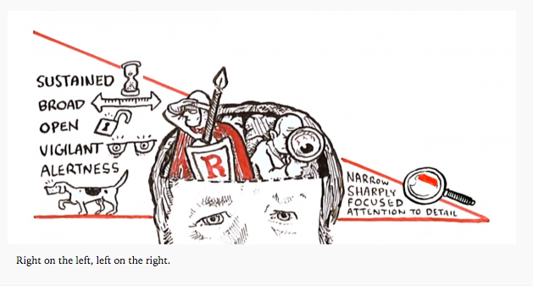
Why do so many scientists today reject the idea of another realm?

Slide 99
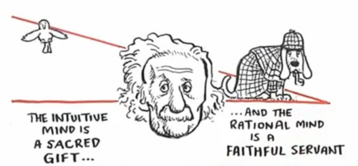
Ian McGilchrist, in his book “The Master and His Emissary”, argues that the right hemisphere of the brain sees the world as whole, relational, and meaningful, while the left hemisphere focuses on parts, mechanisms, and control. Both are necessary.
In modern Western culture, the “emissary”, the left hemisphere style of thinking, has become dominant. It privileges what can be measured, reduced, and manipulated, and tends to dismiss what cannot be easily quantified.
So, when spiritual or mystical phenomena don’t fit neatly into a materialist framework, many scientists reject them not because the studies are necessarily weak, but because the very possibility of another realm doesn’t fit their underlying worldview. It’s less a scientific conclusion and more a metaphysical assumption about what is allowed to be real.
In that sense, the debate isn’t just about data, it’s about which hemisphere’s way of knowing is in charge.
THE BRAIN’S HEMISPHERES

Slide 100
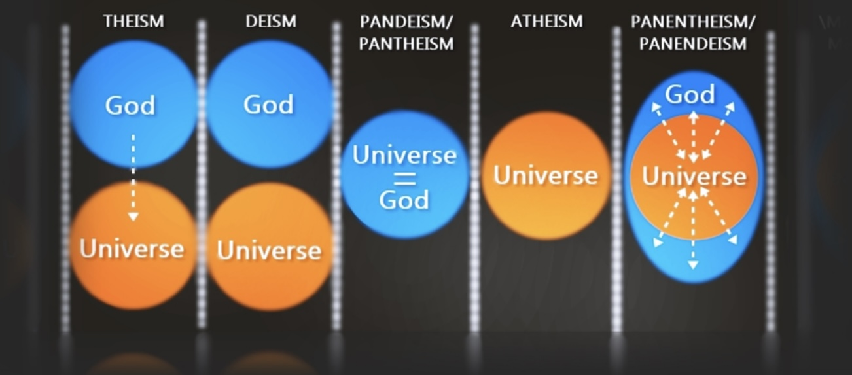
What are the different ideas about the nature of God and her relationship to the physical realm?

Slide 101
THE VARIETIES OF RELIGIOUS BELIEFS
Our beliefs about God and her relationship to the physical realm can be divided into a number of different positions:
1. Theism is the belief in a God or gods that sustain a personal relationship to their creation ( and to us, so that for example through prayer we can ask God to intercede in our lives.)
2.Deism is the belief that a God or gods created the universe but do not intervene in its unfolding or have a personal relationship to their creation. So that prayer does not change anything.
3. Pantheism is the belief that all is God. God is the same as the universe. The 17th century Jewish philosopher Baruch Spinoza is perhaps the best-known pantheist.
Baruch Spinoza believed that the universe is what God looks like from the outside, and God what the universe feels like from the inside. From the outside a person looks like a material body but we know that body has an inner experience of consciousness. Similarly, Spinoza believed, the universe has an inner experience of consciousness which is the mind of God. That consciousness is impossible for humans to conceive of or describe but it’s about love and oneness.

Slide 102
THE VARIETIES OF RELIGIOUS BELIEFS
When Einstein was asked if he believed in God, he famously replied: “I believe in Spinoza’s God, who reveals himself in the lawful harmony of all that exists, but not in a God who concerns himself with the fate and the doings of mankind”.
4. Panentheism is the belief that God is the universe but also more.
5. Atheism rejects that God or gods exists
6. Agnosticism is the belief that the existence of God, or the divine or the supernatural is unknown or unknowable.

Slide 103
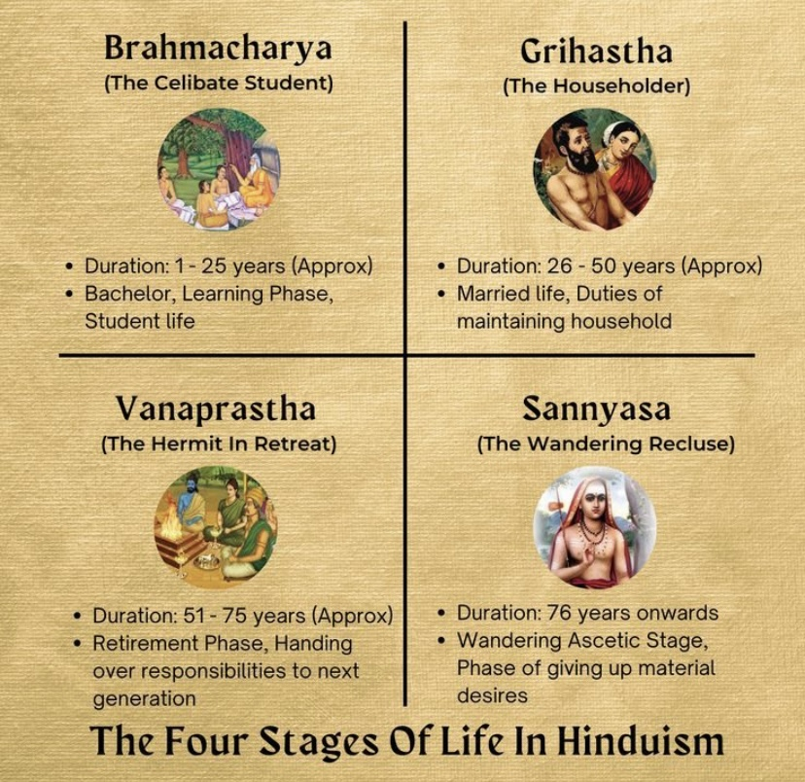
Does our spirituality tend to change as we get older?

Slide 104
THE FIRST AND SECOND HALVES OF LIFE
THE FIRST HALF ,PLEASURE, THE MUNDANE
The pursuit of pleasure and avoidance of pain is called hedonism. It is often a priority in the first half of life.
It’s about immediate gratification, easily achieved, short term, secular, takes, can be bought
Helps fulfill Maslow’s physiological and safety needs
Is associated with seeking, lust, fight, individualism

Slide 105
THE FIRST AND SECOND HALVES OF LIFE
THE SECOND HALF, MEANINGFUL HAPPINESS, THE SACRED
The pursuit of meaningful happiness is called eudaimonism. It is a priority for a healthy second half of life.
It’s about delayed gratification, difficult to achieve, long term, no habituation, wisdom traditions, gives, cannot be bought
Requires connection to something or someone else, cannot be hacked with substances. Attached to Maslow’s love/belonging, esteem and self-actualization needs
Associated with attachment, play, the common good

Slide 106
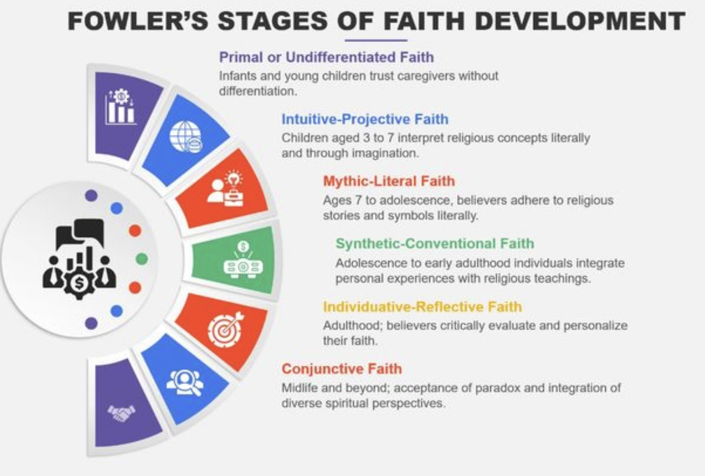
MEANING AND SPIRITUAL GROWTH
Both meaning and spiritual growth involve moving beyond the small, isolated self. Feeling life is meaningful comes from sensing that we belong to something larger, relationships, values, purpose, or a deeper order of reality.
Spiritual growth is the cultivation of that same capacity: widening identity, deepening attention, and aligning how we live with what we experience as ultimately real or sacred. Meaning is the felt outcome; spiritual growth is the process that generates it.

Slide 107
JAMES FOWLER’S STAGES OF FAITH DEVELOPMENT
Just as we develop psychologically, we also develop in how we make meaning of life’s biggest questions about purpose, suffering, belonging, and what ultimately matters. James Fowler proposed that faith develops in stages. By “faith,” he did not mean religion alone, but the deeper framework through which we understand life what we trust, what gives life meaning, and how we see our place in the world.
These stages are not about being more or less spiritual, but about different ways of organizing experience. Each reflects a way of relating to truth, authority, and mystery that can evolve across the lifespan.
Stage 0 – Primal Faith (Infancy)- Faith is formed through basic trust or mistrust, shaped by how safe, cared for, and soothed the world feels.
Stage 1 – Intuitive–Projective Faith (Early childhood)-Faith is imaginative and emotional. Stories, images, and feelings dominate; God or meaning is experienced in magical, literal ways.

Slide 108
JAMES FOWLER’S STAGES OF FAITH DEVELOPMENT
Stage 2 – Mythic–Literal Faith (School age)- Beliefs are concrete and rule-based. Stories are taken literally; fairness and reward/punishment thinking (“good things happen to good people”) are central.
Stage 3 – Synthetic–Conventional Faith (Adolescence & many adults)- Faith is shaped by belonging. Beliefs come largely from one’s community or authority figures and are rarely questioned; identity and faith are fused.
Stage 4 – Individuative–Reflective Faith (Young to mid-adulthood)- Faith is examined and owned personally. People question inherited beliefs, tolerate doubt, and develop a more autonomous worldview.
Stage 5 – Conjunctive Faith (Midlife and beyond, for some)- Faith becomes more paradox-friendly. People hold tensions (reason and mystery, justice and mercy) and appreciate other traditions without losing their own.
Stage 6 – Universalizing Faith (Rare)- Faith is lived as radical compassion and justice. Identity extends beyond tribe or self toward universal love (e.g., Gandhi, Martin Luther King Jr.).

Slide 109
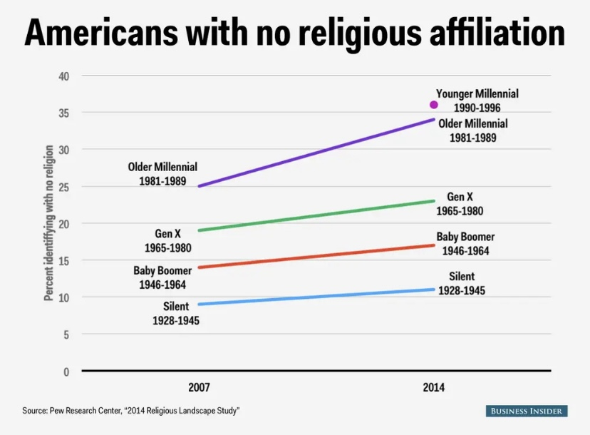
Is organized religion in contemporary western cultures on the decline? If so, why?

Slide 110
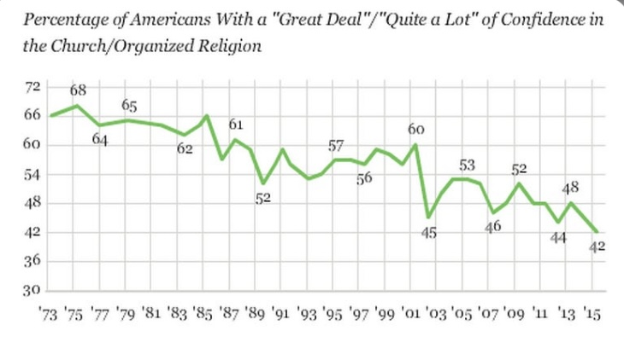
RELIGION ON THE DECLINE
In the US, between 1991 and 2018, the percentage of the population describing themselves as Christian dropped from 70% to 40%.
Over the same period, the percentage of people describing themselves as having no religion rose from 20% to 50%.
The younger you are, the less likely you are to be religiously affiliated.
In the US between 1973 and 2015 the percentage of the population reporting a great deal/quite a lot of confidence in the church/organized religion dropped from 68% to 42%

Slide 111
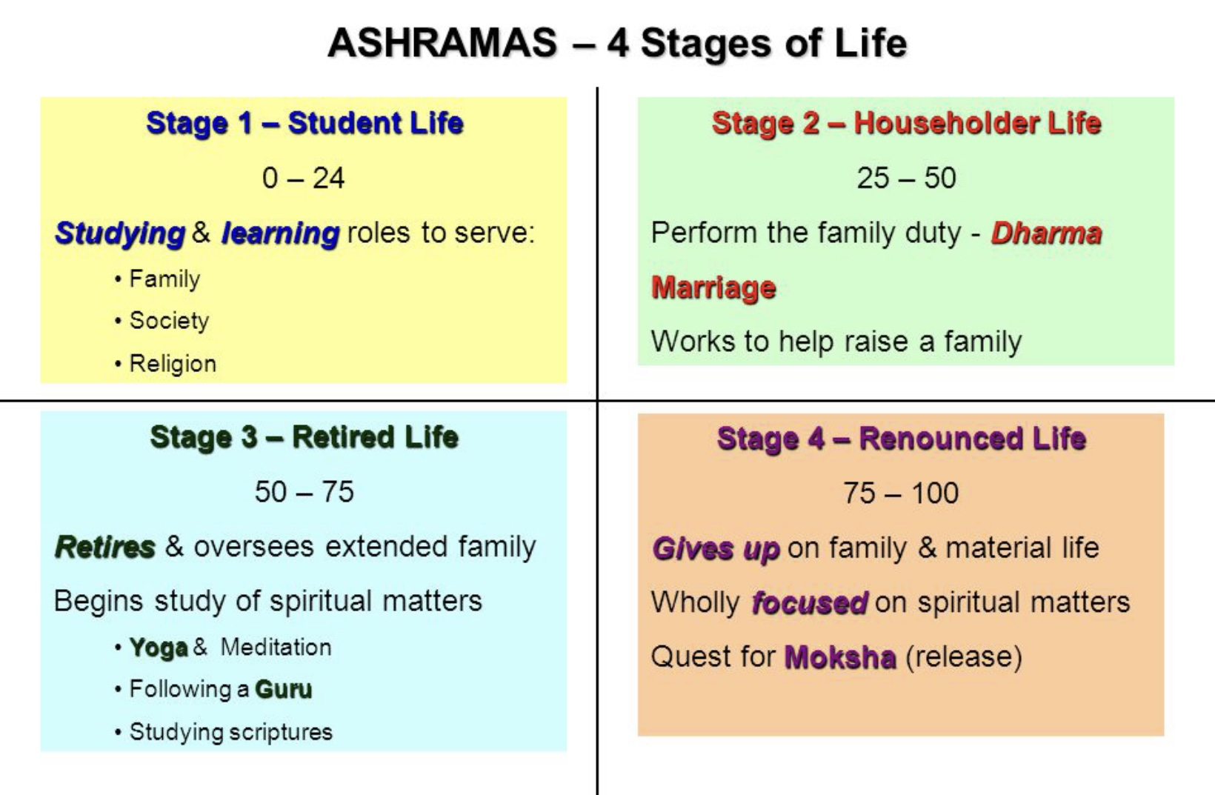
Three reasons why religion is on the decline in the west
1. Modernity
2. Capitalism
Amount of consumption
Materialist stages/individual priorities
more
Idealist/spiritual
stages/collective priorities
less
Modernity, today’s dominant philosophically materialist worldview denying that soul and spirit exist fosters individual over collective priorities and the pursuit of pleasure over that of happiness.
Capitalism is driven by consumption and promotes priorities and lifestyles of the first half of life when people typically consume more than in the second half of life. Today we have very few models for a healthy second half of life.

Slide 112
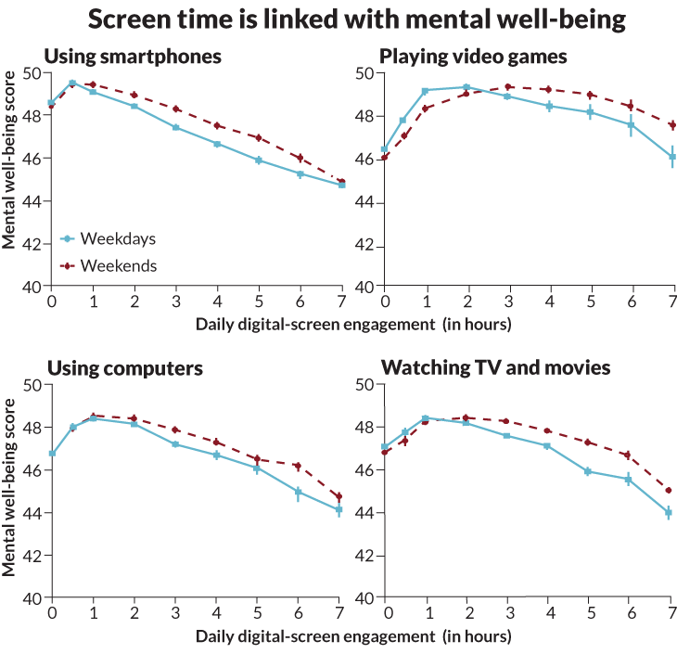
THREE REASONS WHY RELIGION IS ON THE DECLINE IN THE WEST
3. OUR PRIORITIES
A third reason why religion has been declining in the West has to do with people's priorities
Over a lifetime the average North American spends 27 years sleeping, over 8 years watching TV, almost 7 years using social media, 4 years eating and drinking, 2 years shopping, 2 years socializing, and 18 months doing housework.
Daily, the average North American spends almost 7 1/2 hours either watching TV or using mobile devices.
These statistics were pre-pandemic. During the pandemic, the total amount of time spent watching TV or using mobile devices skyrocketed to over 13 hours per day.
This is significant for our mental health because while participating in a religious community has been found to improve mental well-being through connection, screen time in its various forms worsens mental health in large part because of the disconnection from community that accompanies it.
A Kaiser family foundation study found that 22% of North American adults said they often or always feel lonely or isolated. Of those, 58% reported mental health issues, 55% physical health issues, while 33% said their loneliness affected their ability to work.
Fostering spirituality involves “timefulness” or being mindful of time and how we use this most precious of our resources.

Slide 113
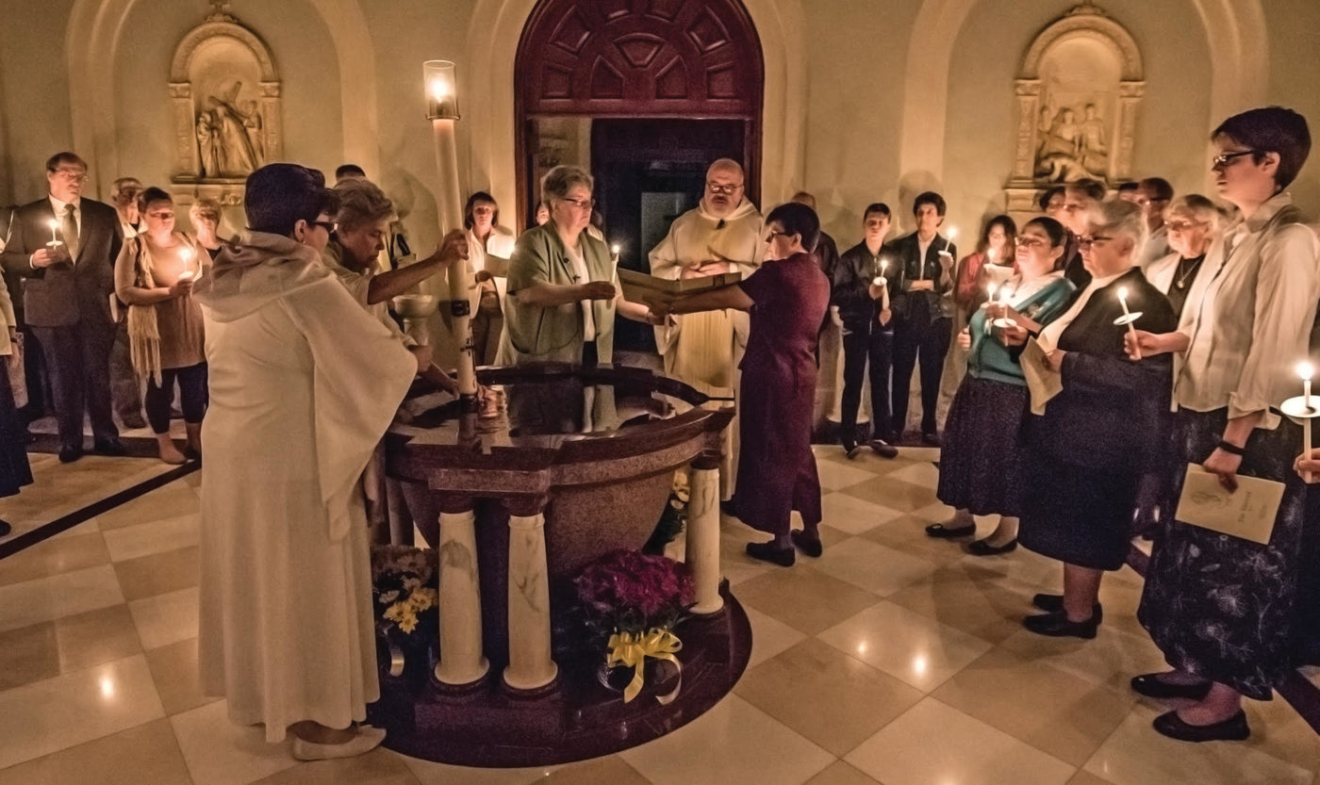
What are the health benefits from being religious or spiritual?

Slide 114
BENEFITS OF SPIRITUALITY AND RELIGION
An enormous amount of literature in the form of scholarly articles and academic books has been published describing the benefits of spirituality and religion in promoting health and healing.
This literature has reported on a wide range of benefits of religion and spirituality including greater marital stability, less substance abuse, lower suicide rates, lower rates of anxiety and depression, a better metabolic profile, and less pain.
Spirituality and religion have been reported to facilitate grieving of losses, corelate with positive self-esteem and confidence, promote better relationships, provide a sense of meaning and purpose, enhance feelings of belonging, improve the capacity for problem-solving, and increase hope
People who have regular spiritual or religious practices live longer, heal faster from illness and surgery, and cope better with illnesses, pain, and life stressors.
Religious and spiritual people have available to them several coping strategies including seeking control through a partnership with God, asking for God's forgiveness and for help and forgiving others, finding strength and comfort from spiritual beliefs ,and finding support from spiritual or religious communities.

Slide 115
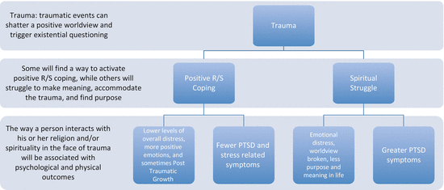
TRAUMA AND SPIRITUALITY
Trauma is a profoundly negative experience that can cause disintegration and dissociation of the self.
Spiritual and mystical experiences, on the other hand, can be profoundly positive experiences that may promote integration and healing of the self
When the self is in danger we can fall or dissociate into the abyss of nothingness or rise into the embrace of SELF
Self-transcendent interventions including Wise mind remediation seek to help people rise from the abyss of nothingness into the embrace of the self-transcendence
Before you can transcend the self, we must find the Self and connect with it which is the goal of stage one of trauma therapy and the first 5 Simple tools.
Many stage II trauma approaches involve reconnection
Since spirituality is about genuine connection many stage II trauma approaches are spiritual.
= Religious/
spiritual

Slide 116

Is there an explanation why spirituality and religion help our physical and mental health?

Slide 117
FOSTERING MEANINGFUL CONNECTION AND WELLBEING
Theories have been offered to attempt to explain why spirituality and religion have physical and mental health benefits.
1) Victor Frankel – Frankel was a psychiatrist and Auschwitz survivor. In his book "man's search for meaning" he proposed that when external circumstances in our life are beyond our control, the attitude we choose to take towards those circumstances is within our control. Frankel believes that the spiritual journey relates to our inner struggle to shape our attitude towards illness, impossible circumstances, and even death itself.
2) The coherence hypothesis – coherence is the sense of meaning that religious or spiritual faith gives people when they are in difficult circumstances beyond their control. It has been shown in many studies to be one of the key principles underlying the impact of religion and spirituality on health.
Statements conveying coherence include "the pain you're facing is the Buddha appearing before you finding ways to free you from your own attachments, the very attachments that has made you suffer again and again" or "any time you feel a difficult emotion or have a stressful event it is a good chance to practice a skill and learn to use the skill more effectively“ or “The pain you feel God feels”
The serenity prayer seeks to evoke a coherence mindset.

Slide 118

If it helps our physical and mental wellbeing, why doesn’t medicine incorporate spirituality into its approach to illness ?

Slide 119
HEALTH CARE AND SPIRITUAL CARE
It is still taboo for healthcare professionals to address patients' spiritual needs.
Western healthcare professionals receive very little education about spirituality and spiritual care. Most healthcare professionals feel that working with religious or spiritual issues is outside their area of expertise. Very few go on to refer patients with these concerns to spiritual care providers.
A survey of people in psychotherapy reported that a large majority had a desire to discuss religious or spiritual topics with their therapist and indicated that religion and spirituality were of central importance to their healing and growth.
When they did have such discussions, most reported feeling validated and acknowledged by the therapist’s interventions
In a large USA poll of people receiving physical healthcare, 65% said they wished their healthcare professionals would talk with them about their spiritual beliefs. In the same poll only 10% said that any healthcare professional had ever spoken with them about this subject.

Slide 120

Are there psychotherapeutic models that incorporate spirituality?

Slide 121
SPIRITUALLY INFORMED PSYCHOTHERAPY MODELS
Simple
Internal family systems
dialectical behavioral therapy,
mindfulness-based stress reduction,
Jungian therapy
acceptance and commitment therapy,
transpersonal psychotherapy,
twelve-step programs,
Psychedelic assisted psychotherapy
Virtual reality overview effect therapy
Spiritual direction
Many other stage II trauma therapies

Slide 122
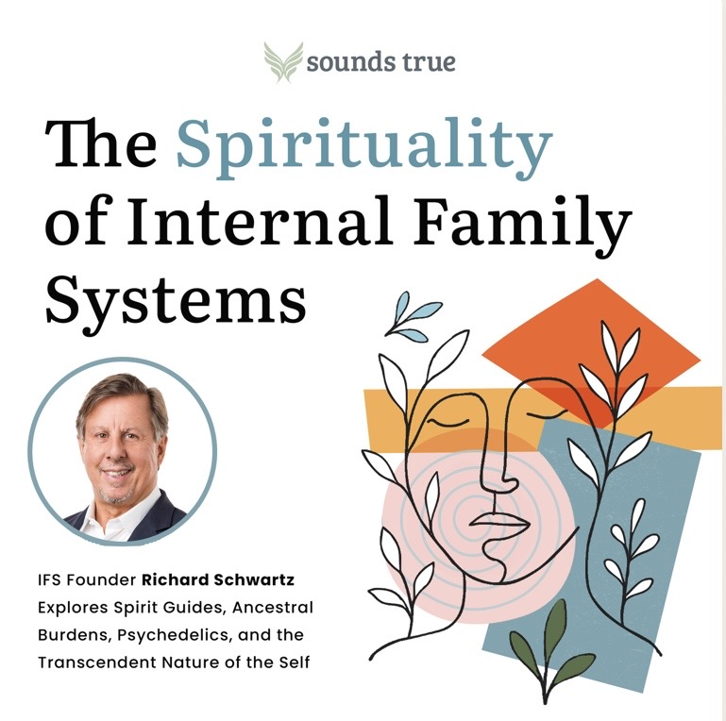

Slide 123

Does the dsm list any spiritual/religious problems as diagnosis ?

Slide 124
RELIGIOUS AND SPIRITUAL PROBLEMS IN THE DSM
The Diagnostic and statistical manual of mental disorders (DSM-V) has a diagnostic category entitled “Religious and Spiritual problems” which includes two diagnosis
1) Spiritual distress refers to when an individual is unable to find sources of meaning, hope, peace, strength, or connection in life. Spiritual distress can occur when a person's beliefs and what is happening in their life conflict.
This distress can have detrimental effects on physical and mental health. Common triggers for spiritual distress are trauma, facing a life-threatening or terminal illness, bereavement, and social isolation.
2) Spiritual Emergencies are crisis during which the process of growth and change becomes chaotic and overwhelming. In spiritual emergencies, the self becomes disorganized and overwhelmed by an infusion of spiritual energies which it is not yet able to integrate.
The person may become fearful and confused and have difficulty coping with their daily life, job and relationships.
Spiritual emergencies can occur in the course of religious and spiritual experiences such as: psychic openings, kundalini awakenings, possession experiences, visionary experiences, near-death experiences, shamanic crisis, and Alien encounters.
The term “spiritual emergency” was first used by Stan and Christina Groff at the founding of the spiritual emergency network in 1978.

Slide 125
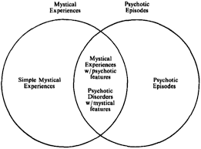
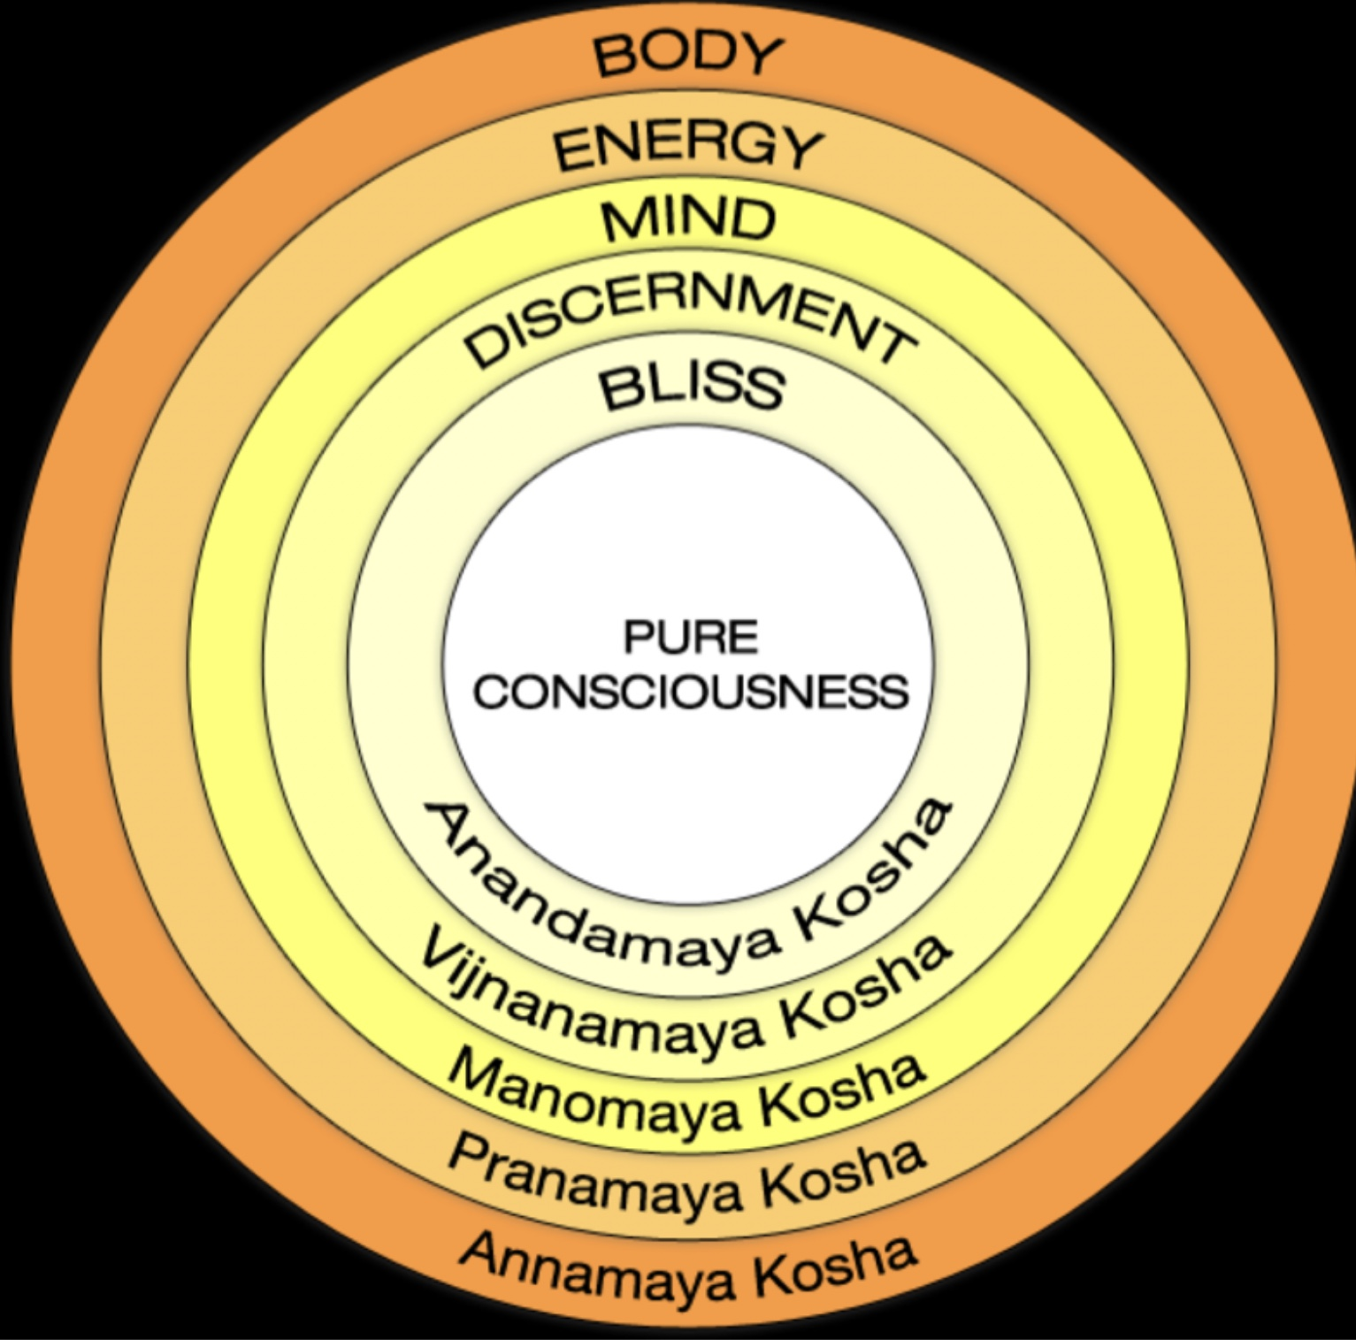
ARE SPIRITUAL EMERGENCIES PSYCHOSIS OR MYSTICAL EXPERIENCES?
Spiritual emergencies, mystical experiences and psychosis are altered states of consciousness that, are in many ways, similar.
In all these states the person is no longer grounded only in the physical realm but also experiences the spiritual realm as being very real.
The difference between these 3 states is that while in a mystical experience the person “swims” or “threads water” in the “ocean” of the spiritual realm, in psychosis and spiritual emergencies the person appears to be drowning in it.
In psychosis and spiritual emergencies, the person experiences the spiritual realm but loses contact with the physical realm.
Mystics, on the other hand, discover that the physical world and the spiritual world behind the veil are two equally real aspects of the same thing. Mystics have a foothold in each of those realms

Slide 126
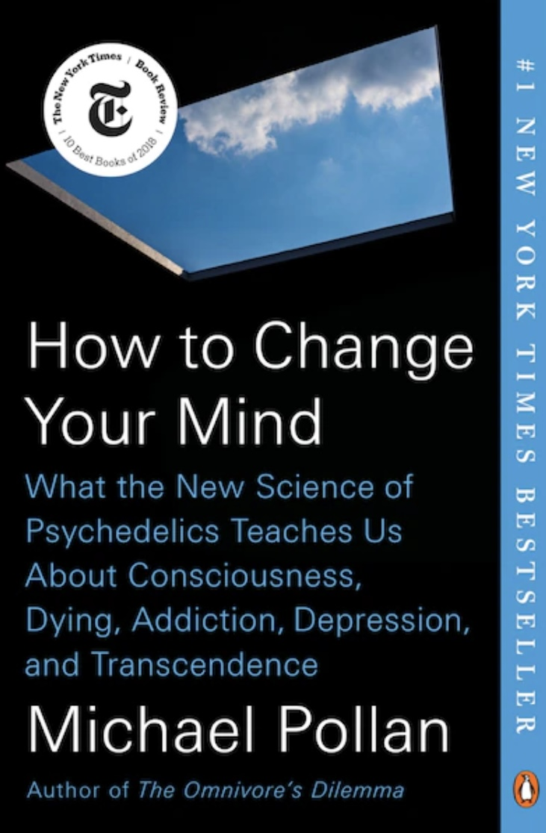
Is part of the healing effect of psychedelics that they promote spiritual experiences?

Slide 127
In his book and Netflix series, “how to change your mind”, Michael Pollan explores the history and science of psychedelics and the pioneering work of mental health professionals using them in the treatment of mental health conditions such as trauma spectrum disorders, addictions, and depression associated with terminal illnesses.
He describes the two types of consciousness that have been explored in psychology 1) “spotlight consciousness” which is very directly aimed at something. 2) “lantern consciousness” which is associated with young children. Instead of fixing on one point it illuminates everything and takes in everything as if it has never been seen before.
Some say wisdom and spiritual richness is reexperiencing the joy and freshness of lantern consciousness after spending much of adult life in spotlight consciousness.
Psychedelics (meaning “mind manifesting” aka Entheogens or “eliciting the God within”) allow some people to reexperience lantern consciousness. In it they are reminded of the world and its wonders in a way they may have forgotten.
This is very similar to experiencing the world from MacGilchrist’s right brain.
Psychedelics may facilitate spiritual growth through the dissolution of the personal ego and by acting as reminders that beyond the ego we are part of universal consciousness. When a person deeply realizes this is their true nature, they may transcend feelings such as fear and hopelessness.

Slide 128

PSYCHEDELICS IN PSYCHIATRY
Some of the psychedelics that have shown promise in treating psychiatric disorders in clinical research settings include psilocybin (the active ingredient in magic mushrooms), MDMA (commonly known as ecstasy), and ketamine. Psilocybin, in particular, has been studied for its potential therapeutic effects in treating conditions such as depression, anxiety, and PTSD.
MDMA has shown promise in treating PTSD, while ketamine is used for treatment-resistant depression. These substances are typically administered in controlled settings under the supervision of trained professionals as part of a comprehensive treatment program.
It's important to note that the use of psychedelics for psychiatric treatment is still in the experimental stage and not yet widely available as a standard treatment option
As of now, ketamine is the only psychedelic that is legally approved for treating psychiatric disorders in both Canada and the U.S.. It is approved for use in treatment-resistant depression and is often administered in a clinical setting under the supervision of healthcare professionals. Other psychedelics such as psilocybin and MDMA are still classified as illegal substances in most countries and are only used in clinical research settings under special permissions and regulations. However, there is growing interest and research in the therapeutic potential of these substances, and there may be changes in regulations in the future as more evidence of their efficacy and safety emerges
Psychedelics induce a profound altered state of consciousness. These altered states can lead to a range of psychological effects, including spiritual experiences, which some researchers believe may play a role in their therapeutic benefits.
However, the exact mechanisms by which psychedelics work to treat psychiatric disorders are still not fully understood and are an active area of research.

Slide 129
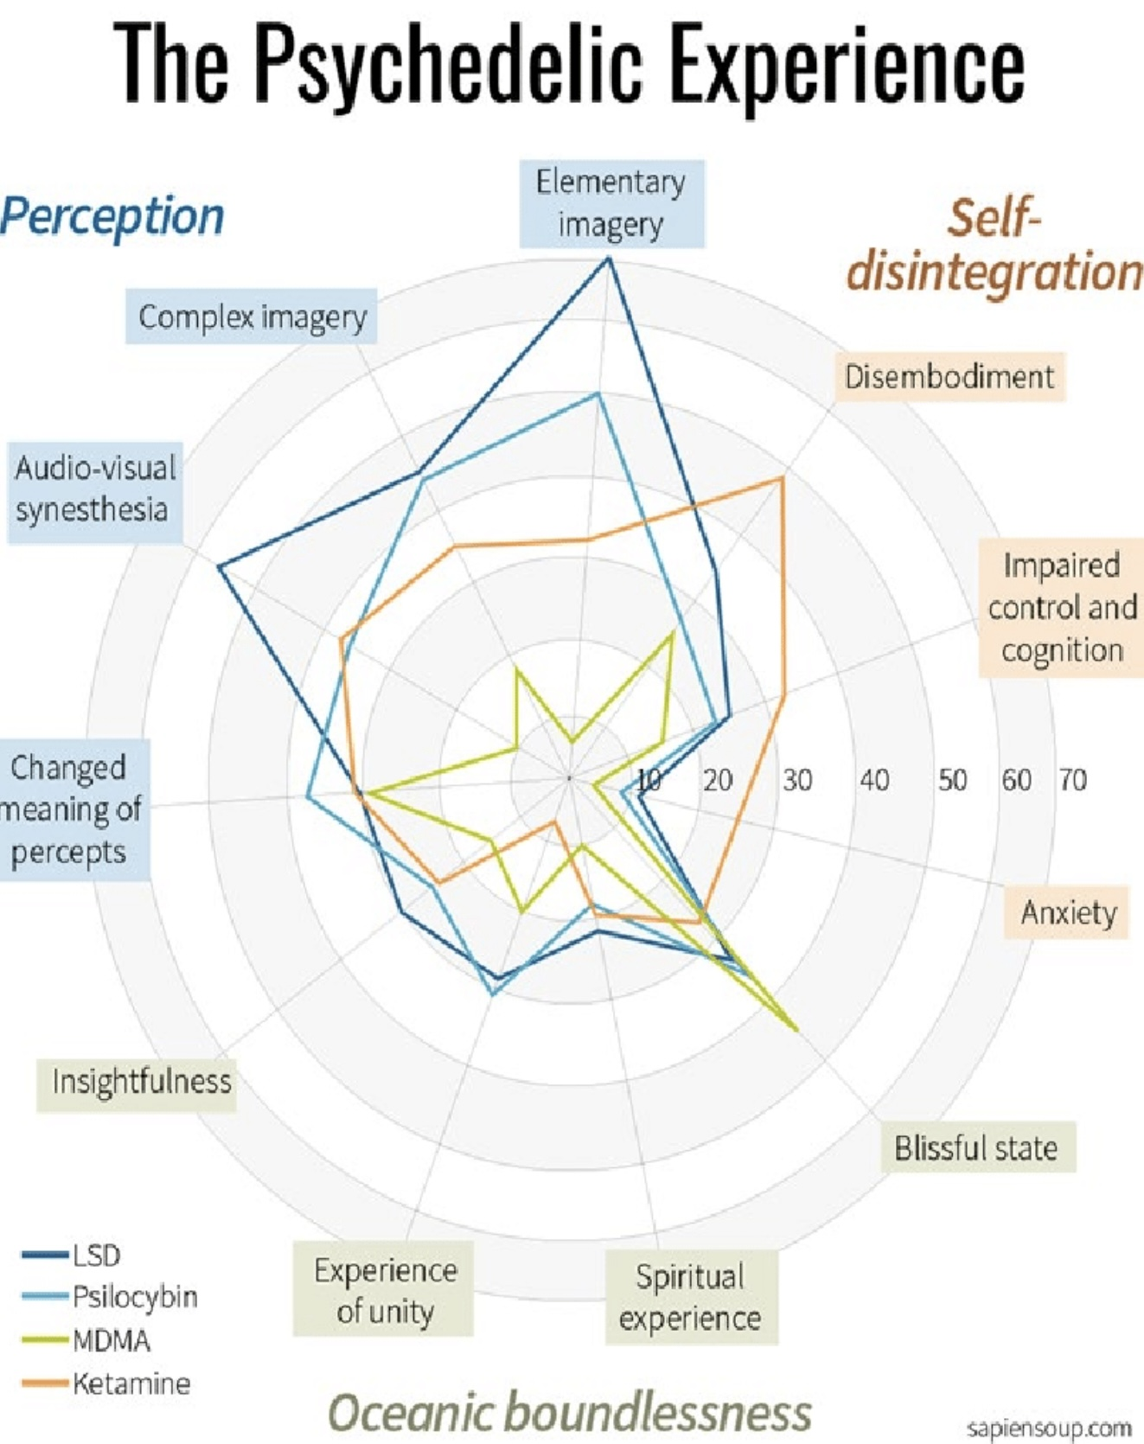
States of altered consciousness induced by psychedelics such as psilocybin, MDMA, and ketamine may help heal psychiatric issues through a variety of mechanisms.
1)These substances can lead to profound changes in perception, cognition, and emotions, which may help individuals break free from rigid patterns of thinking and behavior that contribute to their psychiatric symptoms.
2) They also facilitate healing is by promoting neuroplasticity, or the brain's ability to reorganize and form new connections. Neuroplasticity may help individuals develop new perspectives and ways of coping with their symptoms.
Additionally, psychedelics can 3) induce mystical or spiritual experiences that have been associated with increased feelings of interconnectedness, meaning, and purpose. These experiences can lead to a sense of profound insight, acceptance, and emotional release, which may help individuals process and integrate difficult emotions and experiences.
Furthermore, 4) altered states of consciousness can also reduce activity in certain brain regions associated with the default mode network, which is involved in self-referential thinking and rumination. By quieting these regions, psychedelics may help individuals transcend their ego and access deeper layers of consciousness, leading to a greater sense of self-awareness and emotional healing.

Slide 130
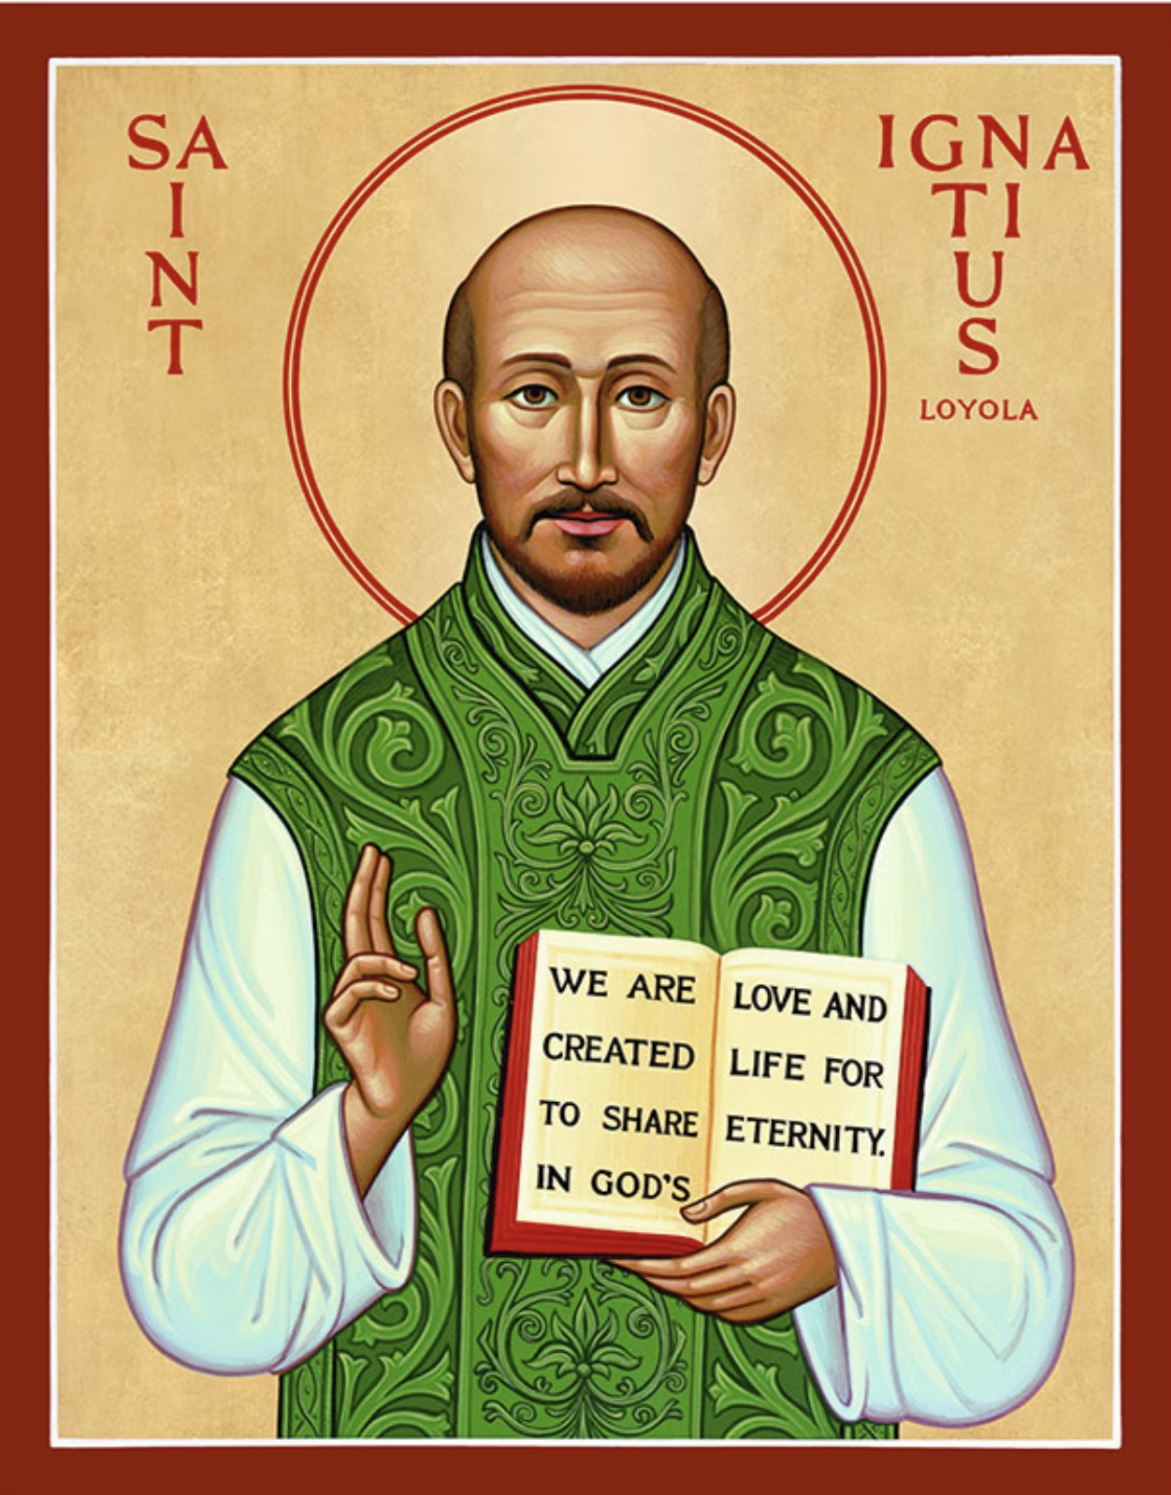
Spiritual maps: Ignatian spirituality, the IFS of the 15th century

Slide 131
Ignatius of Loyola was a Spanish priest and theologian who, in 1534, founded the Society of Jesus, commonly known as the Jesuits.
Born in 1491 in the Basque region of Spain, he initially pursued a military career but underwent a profound spiritual transformation after being injured in battle. Following his recovery, he devoted himself to religious life and education.
Ignatius is known for his spiritual writings, particularly the "Spiritual Exercises”.
The Spiritual Exercises are a set of meditations, prayers, and contemplative practices which are designed to deepen one's relationship with God, discern God's will, and foster spiritual growth and transformation. They are typically undertaken in a retreat setting over a period of 30 days, but they can also be adapted for shorter periods or daily life.
Participants engage in structured meditations on the life of Jesus Christ, contemplating his teachings, actions, and the mysteries of faith.
In the Ignatian Spiritual Exercises, the figure of Jesus plays a central and transformative role. The exercises are designed to help individuals deepen their relationship with Jesus, understand His life and teachings, and follow His example more closely.
A significant portion of the Spiritual Exercises involves meditating on the life of Jesus as depicted in the Gospels. Participants are encouraged to use their imagination to place themselves in the scenes of Jesus' life, experiencing His actions, words, and emotions firsthand. This imaginative prayer helps individuals connect with Jesus on a personal and emotional level.

Slide 132
The exercises aim to inspire participants to emulate Jesus' virtues and values, such as love, humility, compassion, and service. By contemplating His life, individuals are encouraged to reflect on how they can incorporate these qualities into their own lives.
Jesus serves as a model for discernment and making choices aligned with God's will. Participants are guided to seek God's guidance in their decisions, much like Jesus did throughout His ministry, and to align their lives with His teachings.
Reflecting on the Passion, death, and Resurrection of Jesus is a crucial part of the exercises. These meditations invite participants to experience the depth of Jesus' love and sacrifice, leading to a deeper understanding of the meaning of suffering, redemption, and hope.
Through prayer and reflection, individuals are encouraged to converse with Jesus as a friend and to seek His guidance and companionship in their spiritual journey.
Jesus is the focal point of the Ignatian Spiritual Exercises, serving as both a model and a companion for those seeking spiritual growth and transformation.
The exercises emphasize discernment of spirits, helping individuals distinguish between influences that lead them toward or away from God. Regular reflection on one's thoughts, actions, and motivations is encouraged to foster self-awareness and spiritual growth.
Participants are guided to develop indifference to worldly attachments, seeking freedom to follow God's will.

Slide 133
The Ignatian Spiritual Exercises offer a holistic approach that integrates spirituality and psychology to foster growth and healing.
From a spiritual perspective, the exercises help individuals discern God's will in their lives, deepen their faith, and cultivate virtues such as humility, gratitude, and love. They encourage a personal encounter with God and aim to transform one's life in accordance with Christian values.
Psychologically, the exercises promote self-awareness and emotional intelligence. They encourage introspection and reflection, helping individuals understand their motivations, desires, and fears. By fostering a deeper understanding of oneself, the exercises can lead to personal growth, improved decision-making, and a greater sense of peace and purpose.

Slide 134


Slide 135
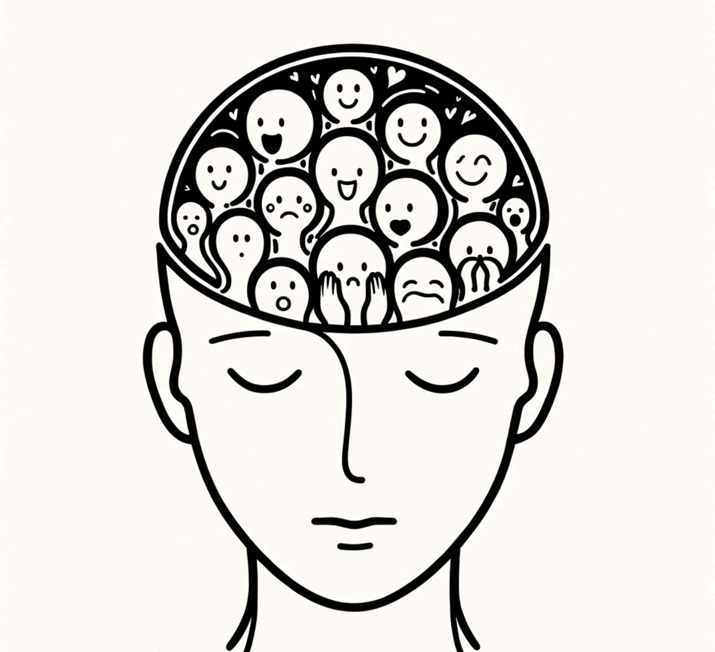
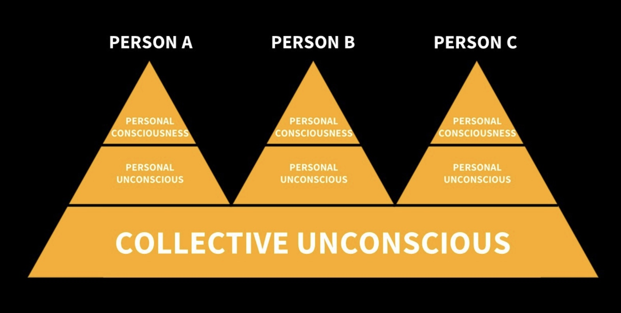
Closing reflection: different maps, similar landscape.

Slide 136
Before we take our two-week March break, I want to leave you with something.
Jungian psychology, Internal Family Systems, and Ignatian spirituality come from very different times and traditions. They use different language and were developed in different contexts. And yet, when you look closely, they are describing something remarkably similar.
All three say that the Human mind is not just one simple, single thing.
Jung spoke about archetypes, the shadow, and the deeper layers of the unconscious.
Ignatian spirituality speaks about different “spirits” influencing us, some more mature, some less so.
And as you will see IFS speaks about parts, protectors, exiles, and managers, each with distinct personalities and roles. Different words with one intuition: There is multiplicity within us.
All these three maps of the mind also say that healing involves becoming aware of what is influencing us, bringing what is hidden into awareness and learning to relate wisely to the different voices inside us.
Jung called this individuation, integrating the shadow and becoming whole.
Ignatian spirituality calls it discernment, learning to notice which spirits move us toward love and which move us toward fear.
And as we will discuss IFS calls it Self-leadership, allowing the compassionate, calm center of us to lead our parts. Again, different language. Same movement toward integration and maturity.
All three maps of the mind use imagination: Jung through dreams and symbols, Ignatius through imaginative participation in Gospel scenes and IFS through inner dialogue and imagery.

Slide 137
And all three are not just about reducing symptoms but about growth, wholeness, alignment and transformation.
After our March break, we’ll begin exploring Internal Family Systems more deeply. As we do, it may help to remember that IFS is not arising out of nowhere, but echoing Jung, Ignatius and many other maps Humans have long intuited.
The similarity between these maps coming from very different traditions is reminiscent of what the perennial philosophy suggests, that across cultures and centuries, human beings keep rediscovering similar truths about the structure of the psyche and the nature of healing. Different maps, same terrain a convergence of many buckets reflecting the same moon.
So, as we move into IFS, I invite you to hold it lightly, not as something entirely new, but as one more language describing something human beings have long intuited: That we are multiple. That we can grow in awareness and that there is something wise at our center capable of leading us toward integration.

Slide 138
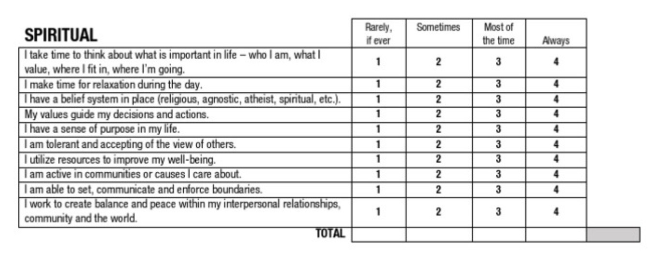
I also invite you to reflect on your personal wellness assessment’s spiritual wellness section. We often overlook our spiritual wellness. How could you foster yours?

Slide 140
1. Mental health is not just biological, psychological and social it is also shaped by meaning.
Even if we never use spiritual language, we all live by answers to:
What gives life purpose?
What helps us endure suffering?
What connects us to something larger?
2. Spirituality is not about belief, it is about connection.
Connection to:
self
others
nature
values
purpose
or a larger reality
When connection grows, resilience grows.

Slide 141
3. Experiences of awe, love, trauma or loss can loosen our usual sense of self.
This can feel healing or overwhelming. Integration matters.
4. Whether reality is ultimately material or conscious, healing involves connection.
If materialism is true → connection must be built.
If idealism is true → connection is already present.
Either way connection heals.
5. Growth is not only about fixing symptoms.
It includes:
Cleaning up
Growing up
Showing up
Waking up
Spiritual growth is the widening of identity beyond the isolated self.
6. Different traditions describe similar inner realities.
Jung → archetypes
Ignatius → spirits
IFS → parts
Different maps
Similar terrain
7. Spirituality can support healing by helping us:
find coherence
reduce isolation
endure suffering
serve something larger than ourselves
8. As we move into IFS after the break,
remember:
IFS is not introducing something foreign —
it is giving language to something humans have long intuited:
We are multiple
We can grow in awareness
And there is something wise at our center.
Optional Closing Line (spoken)
You don’t have to believe anything from today —
only notice what gives your life meaning, connection, and direction.

Slide 142
6. Different traditions describe similar inner realities.
Jung → archetypes
Ignatius → spirits
IFS → parts
Different maps similar terrain
7. Spirituality can support healing by helping us:
find coherence
reduce isolation
endure suffering
serve something larger than ourselves

Slide 143
8. As we move into IFS after the break, remember:
IFS is not introducing something foreign, it is giving language to something humans have long intuited:
We are multiple
We can grow in awareness
And there is something wise at our center.
You don’t have to believe anything from today, only notice what gives your life meaning, connection, and direction.

Slide 144



Slide 145

See you next session

Slide 146

VIDEO Week 22 of simple

Slide 147


Slide 148
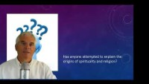

Slide 149
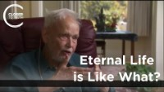

Slide 150
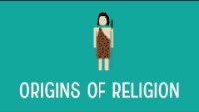

Slide 151


Slide 152


Slide 153


Slide 154
(1)The idea of birth as a separation from universal consciousness suggests that when we are born into the physical world, we become disconnected from a higher or universal source of knowledge, wisdom, and interconnectedness. This concept posits that prior to birth, we are part of a unified and all-encompassing consciousness, but the act of being born into a physical body marks a separation from this state of unity.
This idea is often associated with spiritual and philosophical perspectives that emphasize the interconnectedness of all beings and the notion of a universal or divine consciousness that underlies reality. Proponents of this concept argue that the experience of being born into a physical body introduces limitations, individuality, and a sense of separateness that can lead to feelings of isolation, longing, and a search for connection with something greater than ourselves.
Some spiritual traditions, such as certain schools of Hinduism, Buddhism, and mystical interpretations of Christianity, have explored the idea of birth as a separation from universal consciousness. These traditions often emphasize practices such as meditation, prayer, and spiritual contemplation as a means of reestablishing a connection with the divine or transcendent aspects of existence.

Slide 155
(2) Ian Tattersall is a prominent paleoanthropologist known for his work in the fields of human evolution and anthropology. Some of his main ideas and contributions include:
1. Species Concept: Tattersall has written extensively on the concept of species and the process of speciation in the context of human evolution. He has explored how different species of hominins (ancestors of modern humans) evolved and diverged over time, leading to the diversity of human species that existed in the past.
2. Cognitive Evolution: Tattersall has studied the evolution of human cognition and behavior, particularly the development of symbolic thought, language, and cultural complexity in early humans. He has explored how these cognitive abilities contributed to the success and adaptability of our species.
3. Molecular Anthropology: Tattersall has also contributed to the field of molecular anthropology, which uses genetic and molecular data to study human evolution. He has examined genetic evidence to trace the evolutionary relationships between different human populations and species.
4. Paleoanthropological Research: Tattersall has conducted fieldwork and research on fossil hominins, including Neanderthals and early humans, to better understand their biology, behavior, and evolutionary history. His work has shed light on the diversity and complexity of the human evolutionary tree.
5. Evolutionary Theory: Tattersall has written about the broader implications of human evolution for our understanding of evolutionary theory and the nature of human uniqueness. He has explored how the study of human evolution can inform our understanding of biological and cultural diversity.
Overall, Ian Tattersall's main ideas revolve around the study of human evolution, the origins of human cognition and behavior, and the diversity of early human species. His work has contributed significantly to our understanding of the evolutionary history of our species and the complex processes that shaped the development of modern humans.

Slide 156
(3) Modern science approaches the study of religion from a variety of perspectives, seeking to understand the psychological, social, and cultural aspects of religious beliefs and practices. Here are some ways in which modern science explains religion:
1. Evolutionary Psychology: Some scientists propose that religious beliefs and practices may have evolved as adaptive traits that conferred survival and reproductive advantages to early human societies. For example, beliefs in supernatural beings or forces could have promoted social cohesion, cooperation, and group solidarity, enhancing the survival of communities.
2. Neuroscience: Studies in neuroscience have explored the neural mechanisms underlying religious experiences, such as meditation, prayer, and feelings of transcendence. Neuroimaging studies have shown that certain brain regions are activated during religious practices, suggesting that these experiences have a biological basis.
3. Psychology: Psychologists study the cognitive and emotional processes that contribute to religious beliefs, such as cognitive biases, social influences, and emotional experiences. They investigate how individuals develop and maintain religious beliefs, how these beliefs shape behavior and attitudes, and how they provide meaning and purpose in life.
4. Anthropology: Anthropologists examine the cultural and social dimensions of religion, studying how beliefs, rituals, and practices vary across different societies and historical periods. They explore how religion functions as a system of meaning, identity, and social organization within human communities.
5. Sociology: Sociologists analyze the role of religion in shaping social institutions, norms, and values. They study how religious beliefs influence social behavior, political attitudes, and group dynamics, as well as how religious organizations interact with broader social structures.
6. Cognitive Science of Religion: This interdisciplinary field combines insights from cognitive psychology, anthropology, and evolutionary theory to study the cognitive mechanisms that underlie religious beliefs and behaviors. Researchers investigate how concepts like agency detection, theory of mind, and teleological reasoning contribute to the formation and transmission of religious ideas.

Slide 157
(4) "The Master and His Emissary: The Divided Brain and the Making of the Western World" is a book written by psychiatrist and author Iain McGilchrist. The book explores the relationship between the two hemispheres of the brain and their influence on human cognition, culture, and society. Here are some of the main ideas presented in "The Master and His Emissary":
1. Hemispheric Differences: McGilchrist argues that the left and right hemispheres of the brain have distinct functions and ways of perceiving the world. He suggests that the right hemisphere is more holistic, intuitive, and attuned to the broader context, while the left hemisphere is more analytical, focused on details, and inclined towards abstraction.
2. Master and Emissary Metaphor: The title of the book refers to the relationship between the two hemispheres, with the right hemisphere symbolized as the "Master" and the left hemisphere as the "Emissary." McGilchrist suggests that the balance between these two modes of thinking is essential for healthy cognition and decision-making.
3. Cultural Implications: McGilchrist explores how the dominance of left-hemisphere thinking in Western culture has influenced various aspects of society, including science, technology, politics, and art. He argues that an overreliance on left-hemisphere modes of thinking has led to a narrow, fragmented view of the world and contributed to societal challenges.
4. Nature of Consciousness: The book delves into the nature of consciousness and the role of the brain in shaping our subjective experience of reality. McGilchrist suggests that the hemispheres play a crucial role in how we perceive, interpret, and interact with the world around us.
5. Implications for Education and Healthcare: McGilchrist discusses the implications of hemispheric differences for education, healthcare, and personal well-being. He suggests that a more balanced approach that integrates the strengths of both hemispheres can lead to improved learning, creativity, and overall mental health.

Slide 158
(5) Rapacious capitalism refers to an extreme form of capitalism characterized by aggressive and exploitative practices that prioritize profit maximization at the expense of social welfare, environmental sustainability, and ethical considerations. In rapacious capitalism, businesses and individuals engage in ruthless and predatory behaviors to accumulate wealth and power, often disregarding the negative consequences for society, workers, and the environment.
Key characteristics of rapacious capitalism include:
1. Exploitation: Rapacious capitalism often involves the exploitation of labor, resources, and markets for the benefit of a small elite, leading to economic inequality, social injustice, and worker exploitation.
2. Short-term Profit Maximization: Companies operating under rapacious capitalism focus on short-term gains and shareholder value, sometimes at the expense of long-term sustainability, innovation, and ethical business practices.
3. Lack of Regulation: In a rapacious capitalist system, there may be weak or inadequate regulations governing business practices, allowing for monopolistic behavior, environmental degradation, and financial manipulation.
4. Corporate Greed: Rapacious capitalism is driven by corporate greed and a relentless pursuit of profit, often leading to unethical practices, corruption, and disregard for social responsibility.
5. Environmental Degradation: The pursuit of profit in rapacious capitalism can result in environmental degradation, pollution, and resource depletion, as companies prioritize economic growth over environmental conservation and sustainability.
Critics of rapacious capitalism argue that it exacerbates social inequality, undermines democratic institutions, and perpetuates a cycle of exploitation and environmental destruction. They advocate for more ethical, sustainable, and socially responsible forms of capitalism that prioritize the well-being of people and the planet over short-term profits. Efforts to reform and regulate capitalism, promote corporate social responsibility, and address systemic issues of inequality and injustice are seen as ways to counter the negative effects of rapacious capitalism and create a more equitable and sustainable economic system

Slide 159
(6) Spirituality and religion are often used interchangeably, but they refer to distinct concepts with some overlapping characteristics. Here are the key differences between spirituality and religion:
1. Definition:
- Spirituality: Spirituality is a personal, subjective experience of connection to something greater than oneself. It involves seeking meaning, purpose, and transcendence in life, often through practices such as meditation, prayer, mindfulness, and self-reflection.
- Religion: Religion is a structured system of beliefs, practices, rituals, and values shared by a community or group of people. It typically includes organized institutions, doctrines, scriptures, and clergy, and is often associated with specific traditions, rituals, and moral codes.
2. Personal vs. Institutional:
- Spirituality: Spirituality is a personal and individualistic journey of self-discovery and inner growth. It focuses on one's inner experience, personal beliefs, and relationship with the divine or spiritual realm.
- Religion: Religion is a communal and institutionalized system of beliefs and practices that govern the beliefs and behaviors of a group of people. It often involves organized rituals, ceremonies, and communal worship.
3. Flexibility vs. Tradition:
-*Spirituality: Spirituality is often more flexible and adaptable, allowing individuals to explore and define their beliefs and practices based on personal experiences and insights.
- Religion: Religion is rooted in tradition, with established doctrines, rituals, and practices that are passed down through generations. It provides a sense of continuity, community, and shared identity.

Slide 160
4. Dogma vs. Personal Growth:
- Spirituality: Spirituality emphasizes personal growth, self-awareness, and inner transformation. It encourages individuals to explore their beliefs, values, and purpose in a way that resonates with their own experiences and understanding.
- Religion: Religion often involves adherence to specific dogmas, doctrines, and moral codes prescribed by the religious tradition. It provides a framework for belief and behavior that is shared by members of the religious community.
5. Inclusivity vs. Exclusivity:
- Spirituality: Spirituality can be inclusive and open to diverse beliefs, practices, and experiences. It focuses on the universal aspects of human experience and seeks to cultivate compassion, empathy, and interconnectedness.
- Religion: Religion can sometimes be exclusive, defining boundaries between believers and non-believers based on shared beliefs, practices, or affiliations. It may emphasize the uniqueness and superiority of its own teachings and traditions.
While spirituality and religion have distinct characteristics, they are not mutually exclusive, and many people incorporate elements of both in their spiritual beliefs and practices. Some individuals may find meaning and connection through organized religion, while others may prefer a more personal and eclectic spiritual path. Ultimately, both spirituality and religion offer ways for individuals to explore their relationship with the divine, the transcendent, and the deeper dimensions of existence.

Slide 161
(7) Mysticism is a spiritual practice or belief that involves the pursuit of direct, personal experience of the divine, spiritual truths, or ultimate reality through intuition, contemplation, meditation, or other mystical practices. Mysticism transcends traditional religious doctrines and rituals, focusing instead on the inner, experiential aspects of spirituality. Here are some key characteristics of mysticism:
1. Direct Experience: Mysticism emphasizes the importance of direct, unmediated experiences of the divine or transcendent reality. Practitioners seek to connect with the divine through personal encounters, visions, insights, or states of consciousness that go beyond intellectual understanding.
2. Unity and Oneness: Mysticism often emphasizes the idea of unity and oneness, suggesting that all existence is interconnected and part of a larger, unified reality. Mystical experiences may involve a sense of merging with the divine, the universe, or the collective consciousness.
3. Transcendence of Ego: Mystical practices aim to transcend the limitations of the ego and the individual self, leading to a sense of ego dissolution or transcendence. This can result in a feeling of unity with all beings, a loss of the sense of separate self, and a deep connection to the cosmos.
4. Mystery and Paradox: Mysticism embraces mystery, paradox, and the ineffable nature of the divine. It acknowledges the limitations of language and concepts in describing spiritual experiences and often uses symbols, metaphors, and poetry to convey mystical insights.
5. Contemplative Practices: Mysticism often involves contemplative practices such as meditation, prayer, silence, and reflection. These practices are aimed at quieting the mind, opening the heart, and cultivating a receptive state of awareness conducive to mystical experiences.
6. Ecstasy and Union: Mystical experiences can be characterized by feelings of ecstasy, bliss, awe, and profound love. Practitioners may describe a sense of union with the divine, a feeling of being overwhelmed by divine presence, or a deep sense of peace and serenity.

Slide 162
7. Variety of Traditions: Mysticism is found in various religious and spiritual traditions around the world, including Christianity, Islam, Judaism, Hinduism, Buddhism, Sufism, and Taoism, as well as in non-religious or esoteric traditions. Each tradition offers unique practices, teachings, and interpretations of mysticism.
Mysticism is a deeply personal and transformative spiritual path that invites individuals to explore the mysteries of existence, the nature of reality, and the depths of consciousness. It offers a way to connect with the divine, experience profound spiritual insights, and cultivate a sense of awe, wonder, and interconnectedness with all of creation

Slide 163
(8) The goals and priorities of individuals can shift significantly between the first half of life and the second half of life, reflecting changes in personal development, values, and life experiences. Here are some key differences in the goals of the first half of life compared to the second half of life:
First Half of Life:
1. Identity Formation: In the first half of life, individuals often focus on establishing their identity, exploring their interests, talents, and values, and defining who they are in relation to others and society.
2. Education and Career Building: Many people in the first half of life prioritize education, career advancement, and financial stability. They may focus on building a successful career, gaining skills and experience, and achieving professional goals.
3. Relationships and Family: Developing relationships, forming friendships, and starting a family are common goals in the first half of life. Individuals may seek companionship, love, and connection with others, and may prioritize building a family and raising children.
4. Exploration and Adventure: The first half of life is often a time of exploration, experimentation, and adventure. Individuals may travel, try new experiences, and seek personal growth through challenges and new opportunities.
5. Achievement and Recognition: Many people in the first half of life strive for achievement, success, and recognition in their chosen field. They may set ambitious goals, work hard to accomplish them, and seek external validation and approval.
in their later years

Slide 164
Second Half of Life:
1. Self-Reflection and Meaning-Making: In the second half of life, individuals may focus more on self-reflection, introspection, and making sense of their life experiences. They may seek deeper meaning, purpose, and wisdom gained from their life journey.
2. Personal Growth and Fulfillment: The second half of life can be a time of personal growth, self-actualization, and inner fulfillment. Individuals may prioritize well-being, self-care, and cultivating a sense of inner peace and contentment.
3. Legacy and Contribution: Many people in the second half of life think about their legacy, the impact they want to leave on the world, and how they can contribute to future generations. They may focus on giving back, mentoring others, or engaging in philanthropic activities.
4. Spirituality and Transcendence: The second half of life often brings a deepening of spiritual or existential concerns. Individuals may explore questions of meaning, mortality, and the nature of existence, seeking transcendence and connection to something greater than themselves.
5. Relationships and Community: While relationships remain important in the second half of life, the focus may shift towards deeper connections, meaningful friendships, and supportive communities. Individuals may prioritize quality relationships and social connections that nourish their well-being.
Overall, the goals of the first half of life tend to be more focused on external achievements, identity formation, and exploration, while the goals of the second half of life often shift towards inner growth, personal fulfillment, legacy-building, and spiritual development. This transition reflects a natural evolution in priorities and values as individuals navigate different stages of life and seek deeper meaning and fulfillment

Slide 165
(9) The decline of religion in the West can be attributed to a combination of social, cultural, and demographic factors that have influenced people's beliefs, attitudes, and behaviors towards organized religion. Here are some key reasons why religion is on the decline in the West:
1. Secularization: The process of secularization, which involves the diminishing influence of religion in public life, institutions, and individual beliefs, has been a significant factor in the decline of religion in the West. As societies become more secularized, religious institutions lose their authority and influence over people's lives.
2. Individualism: The rise of individualism in Western societies has led to a shift towards personal autonomy, self-expression, and independence. Many individuals prioritize personal values, experiences, and beliefs over traditional religious teachings and doctrines.
3. Scientific and Technological Advancements: The advancements in science, technology, and rational thinking have challenged traditional religious beliefs and practices. As people rely more on scientific explanations for natural phenomena and technological solutions for societal issues, the need for religious explanations diminishes.
4. Changing Social Norms: Shifts in social norms and values, such as greater acceptance of diversity, equality, and human rights, have led some individuals to question or reject traditional religious teachings that may be perceived as outdated or discriminatory.

Slide 166
5. Scandals and Hypocrisy: Instances of religious scandals, corruption, and hypocrisy within religious institutions have eroded trust and credibility in organized religion. These negative perceptions can drive people away from participating in religious communities.
6. Education and Knowledge: Higher levels of education and access to information have contributed to a more critical and questioning attitude towards religious beliefs and practices. Individuals who are more educated may be less likely to adhere to traditional religious teachings that conflict with scientific knowledge or critical thinking.
7. Generational Differences: Younger generations in the West, such as Millennials and Gen Z, are less likely to identify with organized religion compared to older generations. Younger people may prioritize spirituality, personal growth, and social justice issues over institutionalized religion.
8. Cultural Diversity and Globalization: Increased cultural diversity and globalization have exposed people to a wide range of beliefs, practices, and worldviews, leading to a more pluralistic and inclusive approach to spirituality and religion. Some individuals may adopt eclectic or non-traditional spiritual practices instead of adhering to a single religious tradition.
While religion may be on the decline in the West, it's important to note that spirituality, personal beliefs, and ethical values continue to play a significant role in people's lives. Many individuals still seek meaning, purpose, and connection through spiritual practices, mindfulness, meditation, and community engagement, even if they do not identify with organized religion. The decline of religion in the West reflects broader societal changes and the evolving landscape of spirituality and belief systems in contemporary Western societies

Slide 167
(10)The loneliness epidemic refers to the widespread and growing issue of social isolation and loneliness affecting individuals in modern societies. There are several factors contributing to the loneliness epidemic, including:
1. Social Changes: Rapid societal changes, such as urbanization, migration, and increased mobility, have disrupted traditional social networks and community structures. People may live far away from family and friends, leading to feelings of isolation and disconnection.
2. Technological Advances: While technology has connected people in many ways, it has also contributed to feelings of loneliness and isolation. Excessive use of social media, online interactions, and digital communication can sometimes replace meaningful face-to-face connections and deepen feelings of loneliness.
3. Individualism: The emphasis on individualism in modern societies can lead to a focus on personal achievements, self-reliance, and independence, sometimes at the expense of nurturing strong social connections and relationships.
4. Work and Lifestyle Changes: Demands of modern work life, long working hours, and a culture of busyness can leave little time for meaningful social interactions and relationships. High levels of stress and burnout can also contribute to feelings of loneliness and isolation

Slide 168
5. Aging Population: As populations age, there is an increasing number of older adults who may experience social isolation due to factors such as retirement, loss of friends and family members, and limited mobility.
6. Stigma and Mental Health: There can be a stigma associated with admitting feelings of loneliness, which may prevent individuals from seeking help or reaching out for social support. Loneliness is also linked to mental health issues such as depression and anxiety, which can exacerbate feelings of isolation.
7. Lack of Community and Social Support: In some communities, there may be a lack of social infrastructure, such as community centers, support groups, or accessible public spaces, where people can connect and build relationships.
The loneliness epidemic is a complex and multifaceted issue that can have serious consequences for individuals' physical, mental, and emotional well-being. Chronic loneliness has been linked to a range of health problems, including increased risk of heart disease, depression, anxiety, and cognitive decline.
Addressing the loneliness epidemic requires a multi-faceted approach that involves building strong social connections, fostering community engagement, promoting mental health awareness, and creating supportive environments that prioritize human connection and well-being. Encouraging meaningful interactions, empathy, and compassion in everyday life can help combat feelings of loneliness and create a more connected and supportive society.

Slide 169
(11) Social media algorithms can be considered corrosive for several reasons, as they have the potential to negatively impact individuals, communities, and society as a whole. Here are some reasons why social media algorithms are often seen as corrosive:
1. Echo Chambers and Filter Bubbles: Social media algorithms are designed to show users content that aligns with their interests and preferences, creating echo chambers where individuals are exposed to information that reinforces their existing beliefs. This can lead to polarization, tribalism, and a lack of exposure to diverse perspectives.
2. Misinformation and Disinformation: Algorithms prioritize engaging and sensational content that is more likely to be shared and commented on, regardless of its accuracy. This can lead to the spread of misinformation, fake news, and conspiracy theories, undermining trust in reliable sources of information.
3. Addictive Design: Social media algorithms are often optimized to keep users engaged for longer periods of time, leading to addictive behaviors and excessive use. Features like infinite scrolling, notifications, and personalized content recommendations can contribute to a cycle of compulsive usage and distraction
4. Mental Health Impact: Constant exposure to curated and idealized representations of others' lives on social media can lead to feelings of inadequacy, comparison, and low self-esteem. The pressure to present a perfect image online can contribute to anxiety, depression, and other mental health issues.
5. Privacy Concerns: Social media algorithms collect vast amounts of personal data from users to tailor content recommendations and targeted advertising. This raises concerns about privacy, data security, and the potential for manipulation or exploitation of user information.
6. Algorithmic Bias: Algorithms can perpetuate biases and discrimination based on factors such as race, gender, and socio-economic status. Biased algorithms may result in unfair treatment, exclusion, or reinforcement of stereotypes in content recommendations and user interactions.

Slide 170
7. Impact on Society: The spread of divisive and inflammatory content on social media can contribute to social unrest, political polarization, and the erosion of trust in institutions. Algorithms that prioritize engagement over accuracy can amplify sensationalism and conflict, leading to a more hostile online environment.
While social media algorithms can enhance user experience and personalize content, their negative effects highlight the importance of promoting transparency, accountability, and ethical considerations in algorithm design and implementation. Encouraging critical thinking, media literacy, and responsible online behavior can help mitigate the corrosive impact of social media algorithms and foster a healthier digital environment for individuals and communities.

Slide 171
(12) Spirituality and religion have been linked to various health benefits, both mental and physical. Some of the potential benefits include:
1. Reduced stress: Engaging in spiritual practices or religious rituals can help individuals feel a sense of calm and peace, reducing stress levels.
2. Improved mental health: Studies have shown that spirituality and religion can be associated with lower rates of depression, anxiety, and other mental health issues.
3. Increased resilience: Belief in a higher power or a greater purpose can help individuals cope with challenges and setbacks, leading to greater resilience.
4. Enhanced well-being: Many people report feeling a sense of purpose, meaning, and fulfillment through their spiritual beliefs, which can contribute to overall well-being.
5. Social support: Religious communities often provide a strong social support network, which can be beneficial for mental and emotional health.
6. Healthy behaviors: Some religious practices, such as meditation, prayer, and fasting, can promote healthy behaviors and lifestyle choices.

Slide 172
(13) Victor Frankl was an Austrian neurologist, psychiatrist, Holocaust survivor, and the founder of logotherapy, a form of existential analysis. His main ideas revolve around the search for meaning and purpose in life, even in the face of suffering and adversity. Here are some of Victor Frankl's key ideas:
1. Search for Meaning: Frankl believed that the primary drive in human beings is not pleasure (as Freud suggested) or power (as Adler suggested), but the pursuit of meaning. He argued that finding meaning in one's life is essential for mental health and well-being.
2. Freedom of Choice: Frankl emphasized that even in the most challenging circumstances, individuals have the freedom to choose their attitude and response to the situation. This idea is central to his concept of "tragic optimism," the ability to find hope and meaning in suffering.
3. Responsibility: Frankl believed that individuals have a responsibility to find meaning in their lives and to live in a way that aligns with their values and beliefs. He famously said, "When we are no longer able to change a situation, we are challenged to change ourselves."
4. Existential Vacuum: Frankl observed that many people in modern society experience an "existential vacuum," a sense of emptiness and meaninglessness. He argued that this vacuum can lead to feelings of depression, anxiety, and despair.
5. Logotherapy: Frankl developed logotherapy as a form of psychotherapy that focuses on helping individuals find meaning in their lives. The therapy emphasizes the importance of values, purpose, and responsibility in overcoming psychological challenges.
Overall, Victor Frankl's main ideas center around the importance of finding meaning and purpose in life, taking responsibility for one's choices and actions, and maintaining hope and resilience in the face of adversity. His work continues to inspire people around the world to live more meaningful and fulfilling lives.

Slide 173
(14) The coherence hypothesis in religion suggests that religious beliefs and practices are structured in a way that creates a coherent and consistent worldview for individuals. This hypothesis posits that religious systems provide a framework that helps believers make sense of the world, their place in it, and the nature of reality.
According to the coherence hypothesis, religious beliefs and practices are interconnected and mutually reinforcing, creating a cohesive system of meaning and values. This coherence helps individuals navigate life's challenges, find purpose and direction, and maintain a sense of stability and order in an otherwise chaotic world.
In essence, the coherence hypothesis suggests that religion offers a comprehensive and integrated worldview that addresses fundamental questions about existence, morality, and the divine. By providing a coherent framework for understanding the world, religion can offer believers a sense of security, identity, and belonging.
It's important to note that the coherence hypothesis is just one perspective on the role of religion in human life, and there are other theories and interpretations that offer different insights into the nature and function of religious beliefs and practices

Slide 174
(14) Traditional healthcare systems often focus primarily on the physical and sometimes the mental aspects of health, while spiritual needs are often overlooked or not given as much attention. There are several reasons why traditional healthcare may not be as effective in addressing people's spiritual needs:
1. Lack of Training: Healthcare providers may not receive adequate training in addressing spiritual needs or may not feel comfortable discussing spiritual matters with patients. This can lead to a lack of awareness or sensitivity to the importance of spirituality in overall well-being.
2. Biomedical Model: Traditional healthcare is often based on a biomedical model that focuses on diagnosing and treating physical symptoms and diseases. This model may not always take into account the holistic nature of health, which includes spiritual, emotional, and social dimensions.
3. Time Constraints: Healthcare providers may have limited time during appointments to address all aspects of a patient's well-being, including their spiritual needs. This can result in spiritual concerns being overlooked in favor of addressing more immediate medical issues.
4. Secular Approach: Some healthcare settings may have a secular orientation that prioritizes evidence-based practices and medical interventions over spiritual or religious considerations. This can create a barrier to addressing spiritual needs in a healthcare setting.
5. Stigma: There may be stigma or discomfort associated with discussing spiritual beliefs in a healthcare setting, leading patients and providers to avoid conversations about spirituality altogether.
Despite these challenges, there is a growing recognition of the importance of addressing spiritual needs in healthcare. Integrative medicine approaches, palliative care programs, and initiatives to promote cultural competence and patient-centered care are beginning to incorporate spiritual care into healthcare practices. By acknowledging and addressing the spiritual dimension of health, healthcare providers can better support the overall well-being of their patients

Slide 175
William James, an American philosopher and psychologist, explored the nature of religious experiences in his seminal work "The Varieties of Religious Experience." Here are some of the main ideas from the book:
1. Pluralism of Religious Experience: James argued that religious experiences are diverse and varied, reflecting the individual and cultural differences among believers. He emphasized that there is no single, universal religious experience, but rather a multitude of experiences that can be classified into different categories.
2. Personal and Subjective Nature of Religious Experience: James highlighted the personal and subjective nature of religious experiences, emphasizing that they are deeply individual and cannot be easily generalized or explained through objective analysis. He focused on the inner, emotional, and transformative aspects of religious experiences.
3. “The "More": James introduced the concept of the "More," which refers to a transcendent, ineffable, and mysterious aspect of religious experiences that goes beyond rational understanding. He suggested that religious experiences often involve encounters with this "More," which can be transformative and profound.
4. Healthy-minded vs. Sick-souled Religiousness: James distinguished between two types of religious experiences: healthy-minded and sick-souled. Healthy-minded individuals tend to have positive, uplifting religious experiences that emphasize happiness, optimism, and well-being. In contrast, sick-souled individuals may have more intense, dramatic, and tumultuous religious experiences that involve suffering, struggle, and despair.
5. The Varieties of Mystical Experience: James explored mystical experiences as a distinct category of religious experiences characterized by a sense of unity, interconnectedness, and transcendence. He discussed the common features of mystical experiences across different religious traditions and cultures.
6. Pragmatic Approach to Religion: James adopted a pragmatic approach to religion, focusing on the practical consequences and effects of religious experiences on individuals' lives. He argued that the value of religious experiences lies in their ability to enhance personal growth, meaning, and fulfillment.
Overall, "The Varieties of Religious Experience" is a groundbreaking work that sheds light on the complexity, richness, and significance of religious experiences in human life. James' exploration of the diversity and depth of religious experiences continues to influence the fields of psychology, philosophy, and religious studies to this day.

Slide 176
(16) Near-death experiences (NDEs) are profound personal experiences that can occur when a person is close to death or in a situation where death is imminent. These experiences typically involve a range of sensations, such as feeling detached from the body, moving through a tunnel or towards a light, encountering deceased loved ones or spiritual beings, and experiencing a sense of peace, love, and transcendence.
Some common elements reported in near-death experiences include:
1. Out-of-Body Experience: Many individuals report feeling as though they have left their physical body and are observing themselves from a different perspective.
2. Tunnel Phenomenon: Some people describe moving through a tunnel or a passageway towards a bright light or a feeling of warmth and love.
3. Encounters with Deceased Loved Ones: It is not uncommon for individuals to report seeing deceased relatives, friends, or spiritual beings during a near-death experience.
4. Life Review: Some people describe a panoramic review of their life, where they relive significant events and experiences, often with a sense of understanding and acceptance.
5. Feelings of Peace and Love: Many individuals report feelings of profound peace, love, and interconnectedness during a near-death experience.
6. Reluctance to Return: Some individuals report feeling reluctant to return to their physical body and the earthly realm after experiencing a sense of peace and transcendence during a near-death experience.
Near-death experiences are a subject of ongoing scientific and philosophical inquiry. While some researchers attribute these experiences to physiological and psychological factors, others view them as evidence of an afterlife or a spiritual dimension beyond the physical realm. The study of near-death experiences continues to raise important questions about consciousness, the nature of reality, and the meaning of life and death

Slide 177
(17) The concepts of "spotlight consciousness" and "lantern consciousness" are terms used to describe different modes of attention and awareness in the field of psychology and philosophy. Here's a brief overview of each concept:
1. Spotlight Consciousness:
- Definition: Spotlight consciousness refers to a focused and narrow mode of attention that highlights specific stimuli or information while filtering out distractions. It is akin to shining a spotlight on a particular object or task, directing one's attention to a specific point of focus.
- Characteristics: In spotlight consciousness, individuals are deeply immersed in a particular task, thought, or experience, often to the exclusion of other stimuli. This mode of consciousness is associated with intense concentration, heightened awareness, and a sense of being fully engaged in the present moment.
- Example: When you are completely absorbed in reading a book, solving a puzzle, or having a deep conversation, you are likely experiencing spotlight consciousness, where your attention is sharply focused on a specific activity or stimulus.
2. Lantern Consciousness:
- Definition: Lantern consciousness, on the other hand, refers to a more diffuse and inclusive mode of awareness that encompasses a broader range of stimuli and perspectives. It is like illuminating a larger area with a lantern, allowing for a wider field of vision and understanding.
- Characteristics: In lantern consciousness, individuals maintain a more open and receptive state of mind, taking in multiple stimuli, ideas, and experiences simultaneously. This mode of consciousness is associated with a sense of expansiveness, interconnectedness, and receptivity to diverse perspectives.
- Example: When you are engaged in activities that require multitasking, creative brainstorming, or contemplation of complex issues from different angles, you may be operating in lantern consciousness, where your awareness is more expansive and inclusive.
In summary, spotlight consciousness involves a focused and selective mode of attention, while lantern consciousness entails a more diffuse and inclusive awareness. Both modes of consciousness play important roles in cognitive processes, perception, and subjective experience, offering different ways of engaging with the world and oneself.

Slide 178
(18) Jeffrey J. Kripal is a scholar of religion and philosophy known for his innovative and interdisciplinary approaches to the study of mysticism, spirituality, and the paranormal. Here are some of Jeffrey Kripal's main ideas and contributions to the field:
1. Comparative Mysticism: Kripal explores mystical experiences across different religious traditions and cultures, emphasizing the commonalities and universal themes that underlie diverse mystical practices and beliefs. He seeks to uncover the underlying structures of mystical experiences and their transformative potential for individuals and societies.
2. Interdisciplinary Approach: Kripal draws on a wide range of disciplines, including psychology, neuroscience, philosophy, and cultural studies, to investigate the nature of consciousness, religious experiences, and the boundaries of human perception. He integrates insights from various fields to offer a holistic understanding of mystical phenomena.
3. The Paranormal and Supernatural: Kripal examines the intersections between the paranormal, supernatural, and religious experiences, challenging traditional boundaries between science and spirituality. He explores how encounters with the unknown, mystical, and extraordinary can expand our understanding of reality and human consciousness.
4. The Evolution of Religion: Kripal explores the evolution of religious beliefs, practices, and experiences over time, highlighting the dynamic and transformative nature of spirituality in response to cultural, social, and historical changes. He investigates how religious traditions adapt and evolve in the modern world.
5. The Human Potential for Transcendence: Kripal explores the human capacity for transcendence, creativity, and self-transformation through mystical experiences, altered states of consciousness, and encounters with the sacred. He emphasizes the transformative power of mystical experiences in shaping individual identity and collective consciousness.
6. The Role of Imagination and Symbolism: Kripal emphasizes the role of imagination, symbolism, and narrative in shaping religious experiences and beliefs. He explores how myths, symbols, and narratives influence our understanding of the divine, the mystical, and the unknown.

Slide 179
Overall, Jeffrey Kripal's work challenges conventional boundaries and assumptions in the study of religion, mysticism, and spirituality, offering fresh perspectives on the nature of consciousness, human potential, and the mysteries of existence. His interdisciplinary approach and innovative insights continue to inspire scholars and readers interested in exploring the depths of the human experience

Slide 180
(19) The perennial philosophy is a perspective that suggests there is a common thread of truth or wisdom that runs through all major world religions and philosophies. It proposes that beneath the surface differences of beliefs and practices, there is a universal truth or essence that is shared by all spiritual traditions. This idea has been explored by various philosophers and thinkers throughout history, including Aldous Huxley in his book "The Perennial Philosophy."

Slide 181
(20) Unitarian Universalism is a liberal religious movement that emphasizes the inherent worth and dignity of every individual, freedom of belief, and the search for truth and meaning. It is a non-dogmatic faith that draws from various religious traditions, philosophies, and sources of inspiration.
Some of the main principles and ideas of Unitarian Universalism include:
1. The inherent worth and dignity of every person: Unitarian Universalism affirms the value and worth of every individual, regardless of their background, beliefs, or identity.
2. Justice, equity, and compassion in human relations: Unitarian Universalists are committed to promoting social justice, equality, and compassion in their interactions with others and in society at large.
3. Acceptance of one another and encouragement to spiritual growth: Unitarian Universalism encourages open-mindedness, acceptance of diversity, and personal growth in spiritual exploration.
4. A free and responsible search for truth and meaning: Unitarian Universalists believe in the importance of seeking truth and meaning through personal inquiry, critical thinking, and exploration of various sources of wisdom.
5. The interconnected web of existence: Unitarian Universalism recognizes the interdependence of all life and the interconnectedness of the natural world, emphasizing the importance of environmental stewardship and care for the planet.
These principles guide the beliefs and practices of Unitarian Universalist communities, which often focus on inclusivity, social justice activism, and personal spiritual growth

Slide 182
(21) The evidence for the existence of the sacred came to our ancestors in several ways.
1) Some individuals had personal experiences of the divine, in the form of visions, dreams, or feelings of transcendence. Such mystical experiences, were strongly felt by individuals to be direct encounters with the divine or spirits. These experiences were taken as proof of a reality beyond the physical world.
2)The performance of rituals, sacrifices, and ceremonies fostered altered states of consciousness and access to a realm of experience often populated by spirits or deities.
3) The sharing of these experiences within a community reinforced the existence of a spiritual world.
4) These experiences were passed down the generations in the form of stories and myths that provided a framework for understanding the world.
5) Many ancient cultures practiced divination, seeking knowledge or guidance from the divine through various methods, such as interpreting omens, reading oracles, or using sacred texts. These practices often had mystical dimensions, as individuals sought to understand their fate or the will of the gods.
6) Some ancient societies had mystery cults, which offered initiates secret knowledge and experiences related to the divine. These cults often included elaborate rituals, initiations, and teachings that emphasized personal transformation and mystical experiences.
7) Mystical rituals were commonly used for healing purposes, addressing physical, emotional, or spiritual ailments. Shamans, priests, or healers would perform rituals to invoke divine assistance, channel spiritual energy, or facilitate healing through sacred practices.
The mundane, in contrast, refers to the ordinary, everyday aspects of life that are not considered sacred. The mundane encompasses daily tasks, work, and interactions that are part of human existence but do not carry spiritual significance. This can include eating, commuting, and household chores.
The mundane is often concerned with practical matters, survival, and the functioning of society. It is grounded in the physical world and everyday realities. Unlike the sacred, which may require special knowledge or initiation to access, the mundane is universally accessible and part of everyone's experience

Slide 183
(22) Many prehistoric cultures held animist spiritual views. Animism attributes spiritual essence or consciousness to non-human entities, including animals, plants, rocks, and even natural phenomena like rivers and mountains. Animism is characterized by the idea that these entities possess a life force or spirit, which can influence the world and human experiences.
The animistic worldview inherently includes the notion of a sacred realm, where these spirits interact with humans and influence their lives. Animism emphasizes the interconnectedness of all living and non-living things. It suggests that humans are part of a larger ecological and spiritual web.
Many animistic cultures hold a deep respect for nature, viewing it as sacred. This often leads to practices that promote environmental stewardship and sustainability.
Animistic beliefs often involve rituals, ceremonies, and practices aimed at honoring spirits, seeking their guidance, or ensuring harmony with the natural world. These can include offerings, prayers, and storytelling.
Animism is not a single, uniform belief system; it varies widely across different cultures and regions. Indigenous peoples around the world, such as many Native American, African, and Aboriginal Australian groups, often incorporate animistic beliefs into their worldviews.
Animism is considered one of the earliest forms of religion and has influenced many other religious traditions. Elements of animistic thought can be found in various spiritual and religious practices, including shamanism and polytheism.

Slide 184
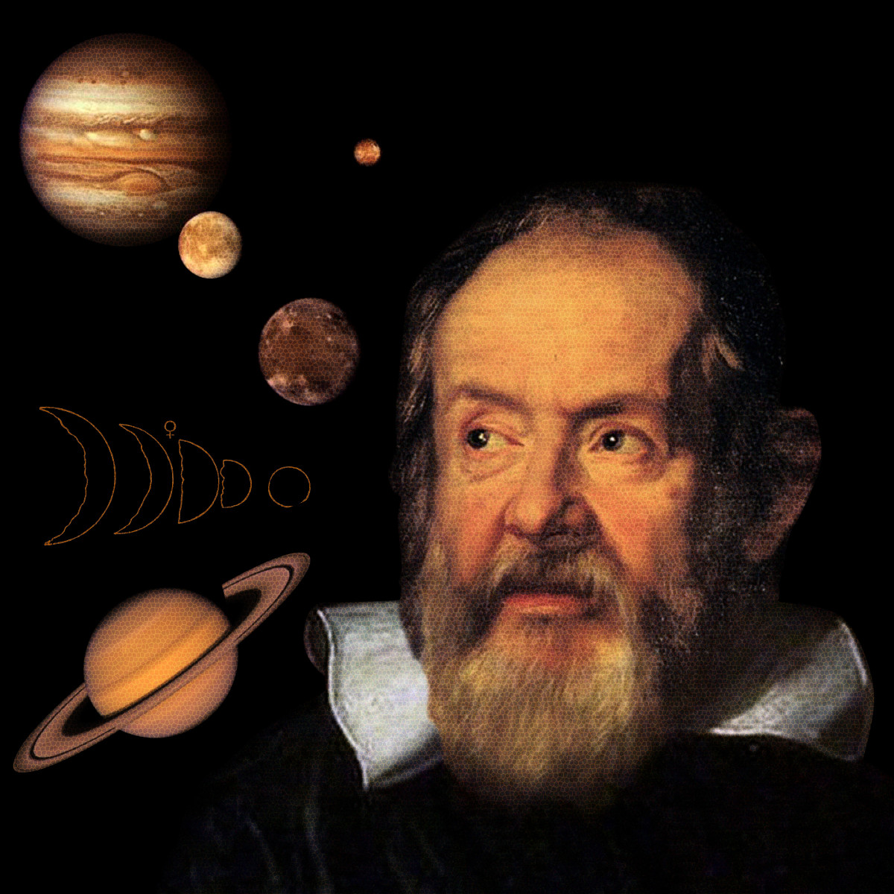
Giordano Bruno (1548-16oo) one of the first astronomers to support a Copernican heliocentric cosmology, which challenged the 2000-year-old catholic church sanctioned geocentric Ptolemaic and Aristotelean worldview was burned at the stake.
To avoid the same fate and to try to make astronomy and science more acceptable to the church authorities, Galileo (1564-1642), one of the fathers of the scientific revolution and a religiously devout catholic, devised a compromise by which science would study only the physical outer world, which was amenable to mathematical modelling.
Meanwhile the non-physical realm of the mind, Soul, and Spirit, which everyone at that time recognized was far more important but not amenable to mathematical analysis, was to remain the domains of the church and the theologians.
This strategy of separating the mundane from the sacred worked well at first.
Until the 19th century most humans were absolutely convinced of the existence of these two separate but complementary realms: 1. The visible, this worldly, material, mundane realm and the more important 2. invisible, other worldly, immaterial, sacred realm.
THE RISE OF SCIENCE AND DECLINE OF RELIGION

Slide 185

The rise of science and decline of religion
By the end of the 19th century, the accumulated successes of science, with its underlying materialist metaphysics, ushered in the modern and postmodern stages of development with their belief that all that exists is matter, and that Soul and Spirit are outdated, unscientific, superstitious fairytales.
With modernity, a hard separation arose between the mundane and sacred realms.
Today people at the traditional stage continue to believe that the sacred other worldly realm is real and essential and want to preserve it, but materialism, the metaphysics of modernity and post-modernity, denies their existence.
When it is wedded to a materialist metaphysics, science becomes dogmatic “scientism” which refuses to even consider phenomena that don’t fit with its materialist assumptions. Good science, by contrast, is interested in all phenomena.
The Integral stage of development, in contrast to previous stages, embraces both science and spirituality, integrating the best from each of these traditions.

Slide 186
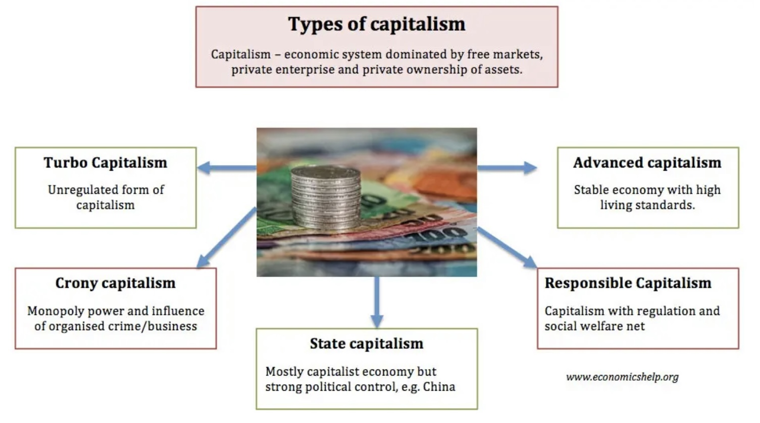
THE LONELINESS EPIDEMIC (10)
There are internal or personality related, and external or environment related reasons why we’re individually more unhappy.
The culture we live in and its stories, values, institutions, etc. plays a role in our collective unhappiness.
We’ve explored these when we discussed, the GINI coefficient, social determinants of health, and the concept of cruel optimism
If social changes, such as the growing use of social media, make us so unhappy why doesn’t someone do something about it?
Modernity’s economic system is capitalism which comes in different forms
In its current free market, neo-liberal, turbo form, capitalism churns people and nature into capital
Modernity’s abandonment of spirituality cuts us off from a path to happiness through meaning and connection and that is made worse by the increasing social and economic inequality that is a feature of unregulated capitalism.
“God speaks to us very quietly, so we need to cut down the noise and distractions to hear Him and to foster Wise mind and spirituality.” Jesuit spirituality

Slide 187

In place of happiness, the new media, especially social media, using profit driven algorithms, serves us up a constant addictive stream of emotionally dysregulated outrage and self-absorption which gives us a brief and addictive dopamine high.
This, over the short term, distracts us from the real causes of our unhappiness while over the long term, like all addictions, it makes us feel much worse since it takes us away from doing the things in life that are truly meaningful.
The new media algorithms also promote the blaming of scapegoats rather than a thoughtful search for the real causes of our unhappiness which would incriminate unregulated capitalism and the algorithms that serve it.
Through addictions, we unsuccessfully attempt to treat our unhappiness with cheap and brief pleasures that only increase our unhappiness. When we are addicted, we pay for the brief high with long term consequences to our health, involvement in the world, self-esteem etc.
A society which addictively pursues pleasure is not an optimal environment for child or adult growth and healing
What positive economic statistics hide is that the economy is rotten at its core. Compared to the 1960’s 4x as many men ages 18-35 have given up on looking for work. On average these men spend 2000 hours a years engaged with screens
The Titanic is sinking and rather than cooperating with each other, the passengers are fighting one another. Some evidence suggests Biden is actually reversing inequality trends of the last 40 years.
SOCIALLY CORROSIVE
ALGORITHMS(11)

Slide 188
EVOLVING
WORLDVIEWS
THE AXIAL AGE refers to a period circa 500-300 BCE during which most of the four main religious and spiritual traditions emerged in Greece, India, Israel, and China. The axial age gave rise to the traditional worldview which was disseminated by philosopher, mystics, prophets and sages, respectively.
mind
2.TRADITIONAL
a)The ground of being, the creative potential, God, the universal, quantum field , causal body, Plato’s sun
b)subtle body, forms/puppeteers, angels, collective unconscious, archetypes
matter
The transcendent realm, God, causal body, The Tao, Plato’s sun
1.PRE-HISTORIC PRIMAL
c)dissociated personal mind, shadows, body, life
hunter gatherer
animism
3. MODERN
Everything in the world is alive and permeated by spirit
The world
matter
4. EMERGING WORLDVIEW
Mind and matter are two aspects of the same thing. Mind is what matter feels like from the inside, matter is what mind looks like from across a dissociative life boundary
Mind/humanity
Mind/brain

