Slide 1
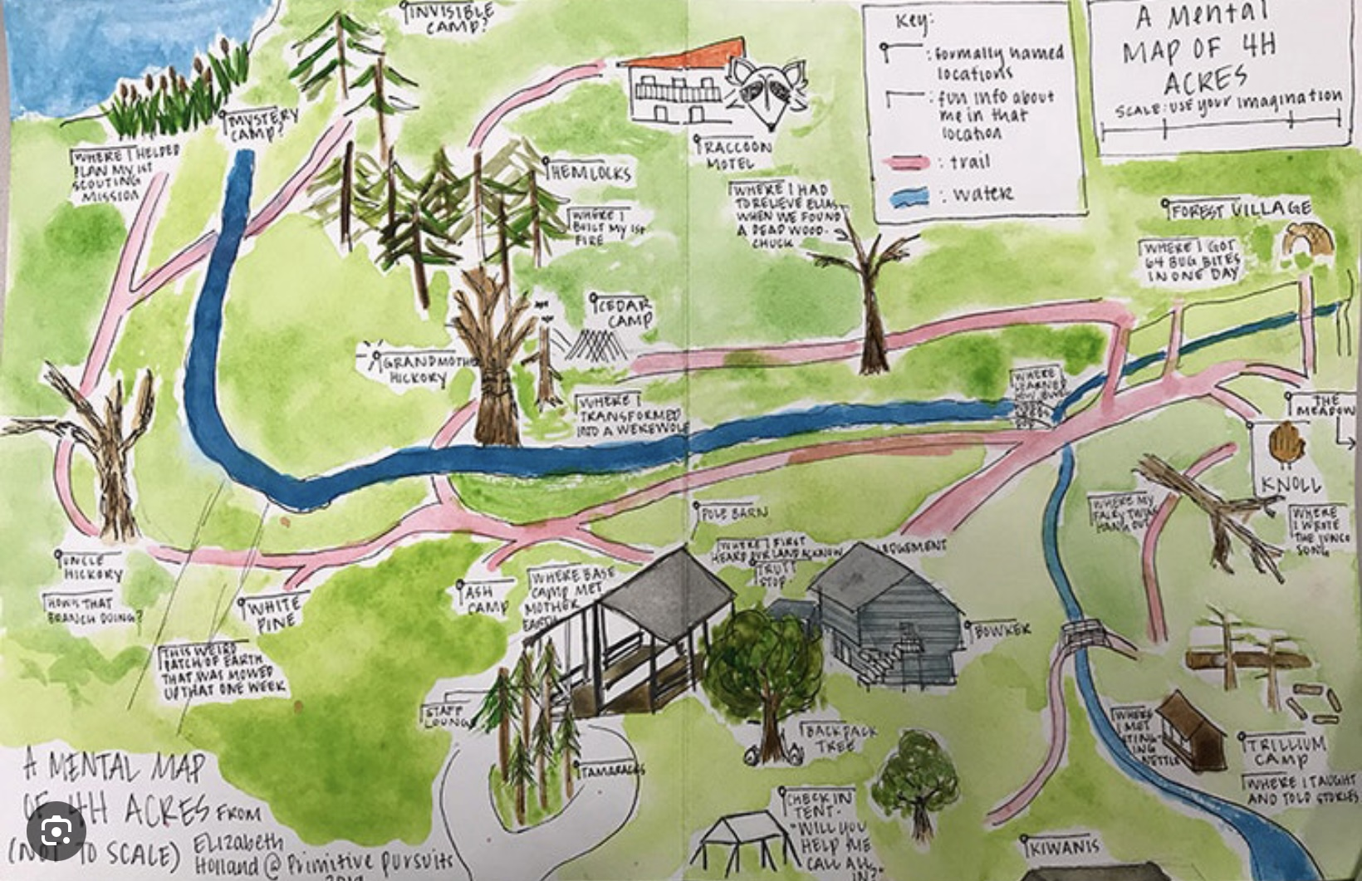
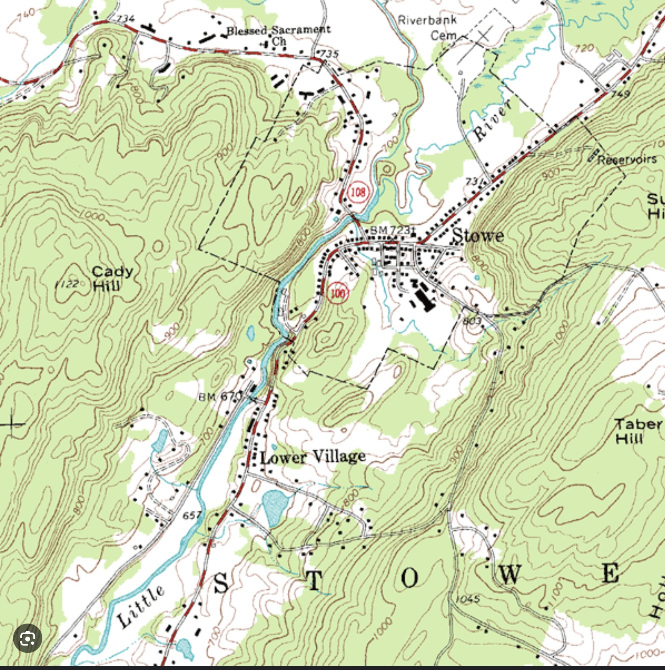

1.Wrapping up DBT
2.THE FOUR PILLARS OF RECOVERY FROM TRAUMA
3.Introducing IFS please start recording at 9 am
WELCOME BACK - WEEK 22 OF SIMPLE

Slide 2
week 17- the stress and trauma related disorders-session 20 of manual.
week 18- emotional regulation skills p.183-206 of dbt workbook. our fifth practice session-the goals diary card procedure- session 21 of manual
week 19- structural dissociation theory and the treatment of the traumatic spectrum disorders- session 22 of manual.
week 20- introducing interpersonal skills p.207-241 of dbt workbook. Review of all the skills
week 21- Spirituality, religion, and health- session 26 of manual.
Today: week 22- 1.Wrapping up DBT p. 242-265 of dbt workbook
2.The four pillars of recovery from trauma
3. Introducing IFS
week 22- an overview of internal family systems (ifs)-session 24 of manual. introducing the ifs workbook and ifs workbook guided ai assisted self therapy

Slide 3
WEEK 22 – TRANSITION TO IFS TRAUMA PROCESSING
Wrapping up DBT
The four pillars of trauma therapy
Overview of sessions 22-29
Maps for healing
Why IFS?
IFS includes and transcends
Same holes different maps
What is IFS?
WEEK 23 – ORIENTATION TO THE IFS MODEL
• What is IFS?
• How it integrates prior models
• How to find parts using trailheads
• Roadmap for the next 6 weeks

Slide 4
SIMPLE COURSE SCHEDULE 2025-26
Week 1- October 1
Week 2- October 8
Week 3- October 15
Week 4- October 22
Week 5- October 29
Week 6- November 5
Week 7- November 12
Week 8- November 19
Week 9- November 26
Week 10- December 3
Week 11- December 10
Week 12- December 17
December 24 and 31
Week 13- January 7
Week 14- January 14
Week 15- January 21
Week 16- January 28
Week 17- February 4
Week 18- February 11
Week 19- February 18
Week 20- February 25
Week 21- March 4
March 11 and 18 no course
Week 22- March 25
Week 23- April 1
Week 24- April 8
Week 25- April 15
Week 26- April 22
Week 27- April 29
Week 28- May 6
Week 29- May 13
Week 30- May 20
Week 31- May 27
Week 32- June 3

Slide 5
PRACTICE SESSIONS SCHEDULE
practice
6.Week 24 April 8 April 1, 1:30 Part 1 p. 1-63 Anna P. Practice next week
7. Week 25 April 15 April 8, 1:30 Part 2 p. 65-99 Elaine S.
8. Week 26 April 22 April 15, 1:30 Part 3 p. 103-137 Dinko T.
9.Week 27 April 29 April 22, 1:30 Part 4 p. 141-175 Barb H.
10. Week 28 May 6 April 29, 1:30 Part 5 p. 179-207 Meaghan
11.Week 29 May 13* April 22, 3 pm Wise mind remediation Rob T.
Preparation IFS Workbook

Slide 6

Warning about meditation
Feel free to skip it. Followed by a moment of silence

Slide 7


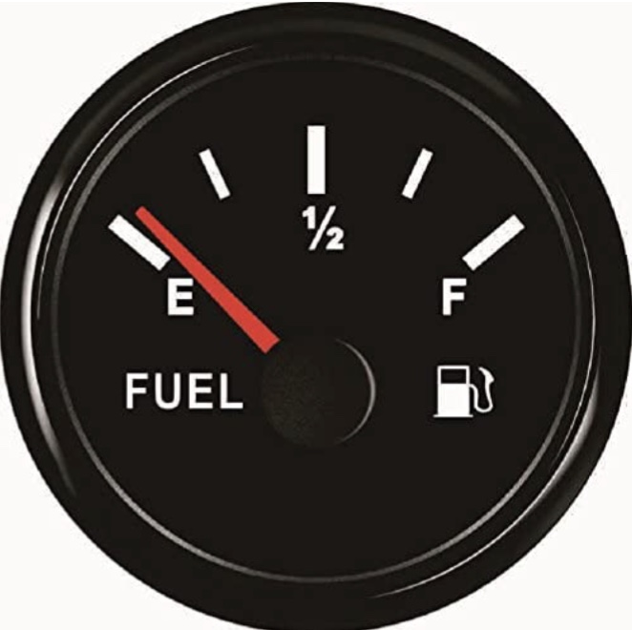
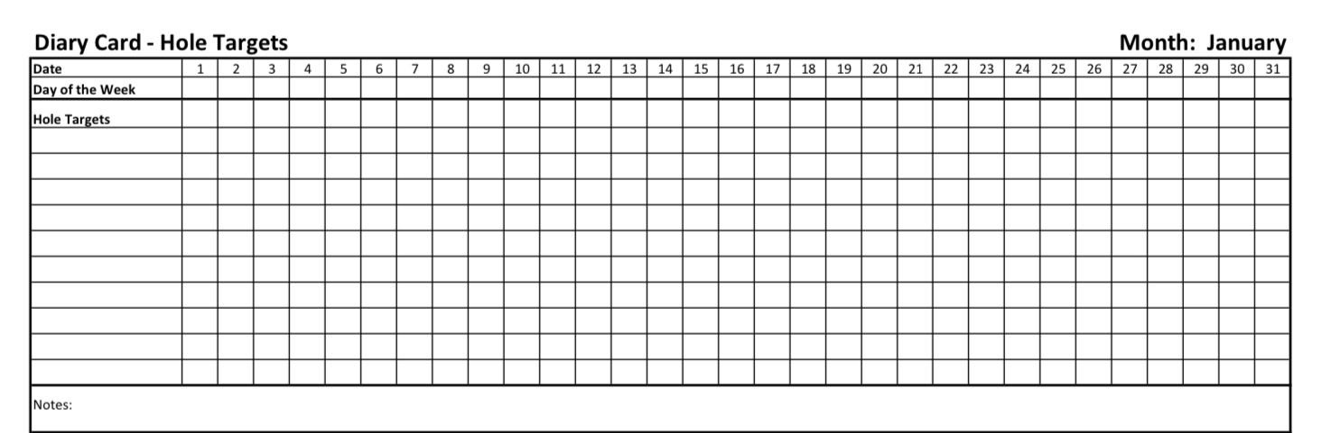

Check in regularly with your Personal dashboard
Spend a few moments checking in with yourself by asking:
1)What is the current risk that I’ll experience a state of crisis ?
Low b) Moderate c) high d) very high e) extreme
2) Am I in the window of tolerance?
a) Yes b) I’m a little outside c) very outside
3) Where is my energy tank right now?
Full b) ¾ c) ½ d) near empty
4) Have I been tracking my targets using the holes diary card ? how would I rate my targets right now?
5) How well am I focusing on what I’m doing. (for example, the course)
CRISIS RISK
WINDOW OF TOLERANCE
ENERGY RESERVES
RATING MY TARGETS
ATTENTION METER
% attention I’m paying
100
0

Slide 8
5-MINUTE MEDITATION “CHANGING MAPS ON THE JOURNEY”
Let’s begin by taking a moment to settle. Sit comfortably. Let your feet rest on the floor, your hands on your lap.
If it feels comfortable, allow your eyes to close, or simply soften your gaze.
Take a slow breath in… and a long breath out.
Again, breathe in gently… and let the breath leave your body slowly.
Allow your shoulders to drop a little. Let the muscles of your face soften. Just notice that you are here.
Now imagine that you have been walking on a long journey. Along the way you have been using a very helpful map.
This map has helped you navigate difficult terrain — strong emotions, stressful situations, painful memories.
This map has given you practical tools: how to pause, how to regulate emotions, how to ride the waves of distress without being overwhelmed.
You might think of this map as the one we have been studying together — the map of Dialectical Behavior Therapy.
Take a moment to silently acknowledge the usefulness of this map. Perhaps noticing one skill or idea that has been helpful for you. Just hold that sense of appreciation for a moment.

Slide 9
5-MINUTE MEDITATION “CHANGING MAPS ON THE JOURNEY”
Now imagine that you arrive at a quiet place on the path. You pause. You gently fold up the map you have been using. You don’t throw it away. You keep it with you. It is still part of your journey. But now you are about to open another map.
This new map does not replace the first one. Instead, it shows you something different. It begins to reveal the inner landscape. Mountains and valleys inside you. Different voices, emotions, and parts of yourself that have been trying to help you survive.
As you imagine opening this new map, see if you can feel a sense of curiosity. Not judgment. Not pressure. Just curiosity about the inner world.
Now gently bring your attention inward. Notice that within you there are different feelings… different impulses… different perspectives.
Perhaps one part of you feels hopeful about exploring this. Another part might feel skeptical or cautious. All of those responses are welcome.
Just notice that the mind is not a single voice — it is more like a community of parts. And beneath those parts, see if you can sense a deeper place inside you. A place that can observe. A place that can be curious. A place that can listen with calm and compassion.
In Internal Family Systems, this deeper place is called Self. For a moment, simply rest in that observing awareness.

Slide 10
5-MINUTE MEDITATION “CHANGING MAPS ON THE JOURNEY”
Now take one more slow breath.
As you breathe in, imagine stepping forward on your journey. You still carry the tools you have learned. And now you are opening a new map — one that will help you explore your inner world with curiosity and compassion.
When you’re ready, gently bring your attention back to the room. And open your eyes.

Slide 11


Slide 12
Homework from last week
Submit
Submit questions or comments to itssimple2023@gmail. com
Read
Read skills training workbook p. 242-265.
Use
Use all your tools: crisis plans, chain analysis, rational mind remediations, and goals diary cards.
Continue
Continue tracking all the skills you’ve learned using your skills lists. Practice them.

Slide 13
Homework for
NEXT week
Submit
Submit questions or comments to itssimple2023@gmail. com
Read
Simple manual session 27
Use
Use all your tools: crisis plans, chain analysis, rational mind remediations, and goals diary cards.
Continue
Continue tracking all the skills you’ve learned using your skills lists. Practice them.

Slide 14
HOMEWORK HABITS CHECKLIST
Circle or check what you will try this week.
1. Preparation habits
■ I schedule a specific time for homework.
■ I choose a consistent location with minimal distractions.
■ I gather what I need ahead of time (notebook, worksheet, pen).
2. Focus & pacing habits
■ I start with a tiny step (2–5 minutes).
■ I use a timer (10–15 minutes).
■ I remove distractions (phone away / Do Not Disturb).

Slide 15
HOMEWORK HABITS CHECKLIST
3. Tracking & organization habits
■ I keep materials in one place (binder / folder / notebook).
■ I write down insights right after doing the homework.
4. Self-compassion habits
■ I aim for progress, not perfection.
■ I notice resistance without judgment.
5. Accountability habits
■ I review my week: What worked? What didn’t?
■ I share honestly with my buddy — even when I didn’t do it.
Micro commitment:
This week I will focus on: ■ Time ■ Place ■ Tiny step ■ Timer ■ Other please specify:

Slide 16
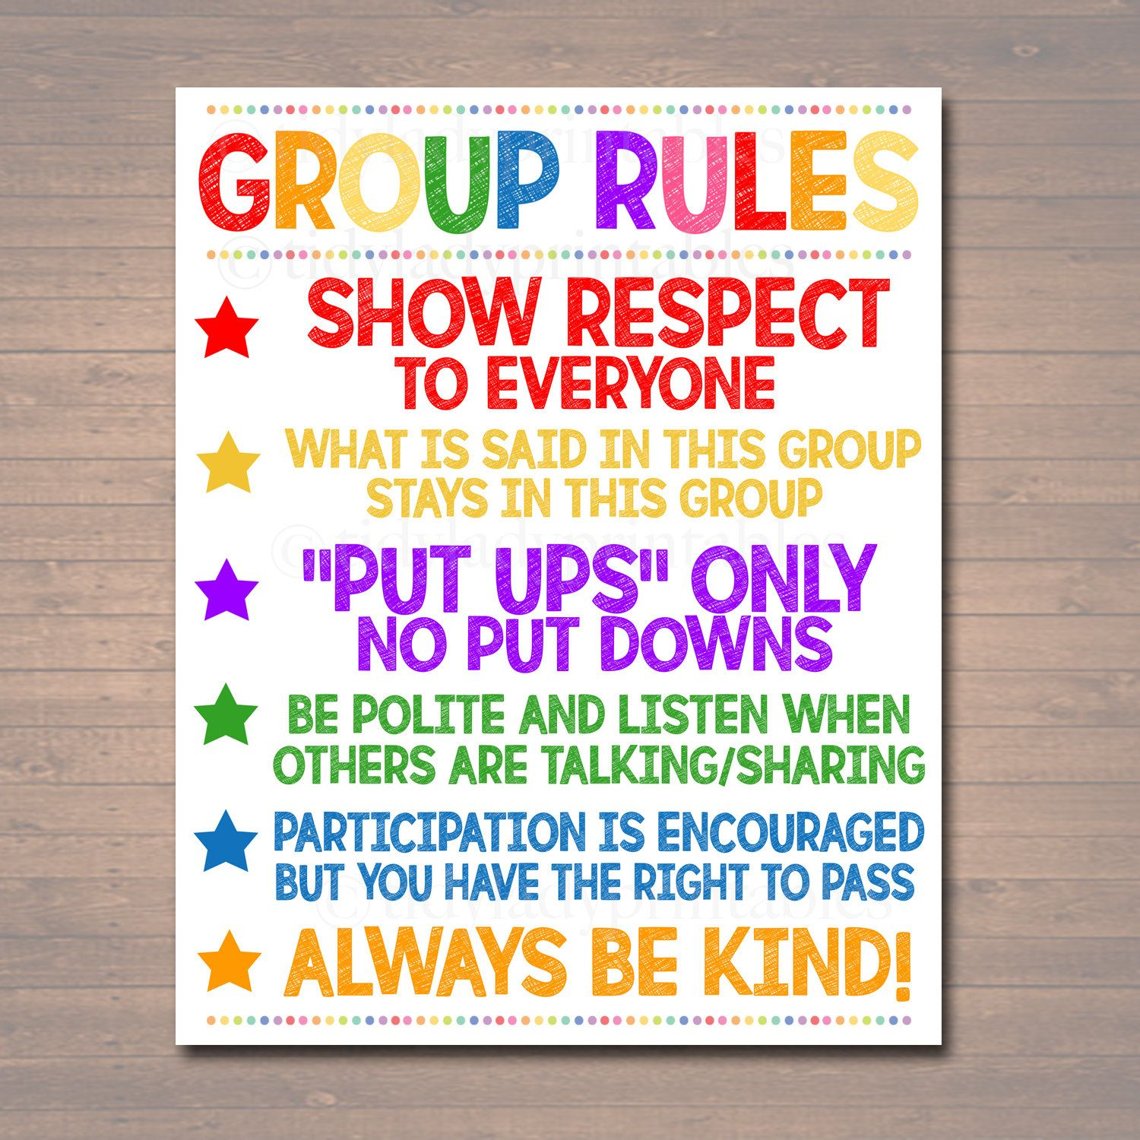
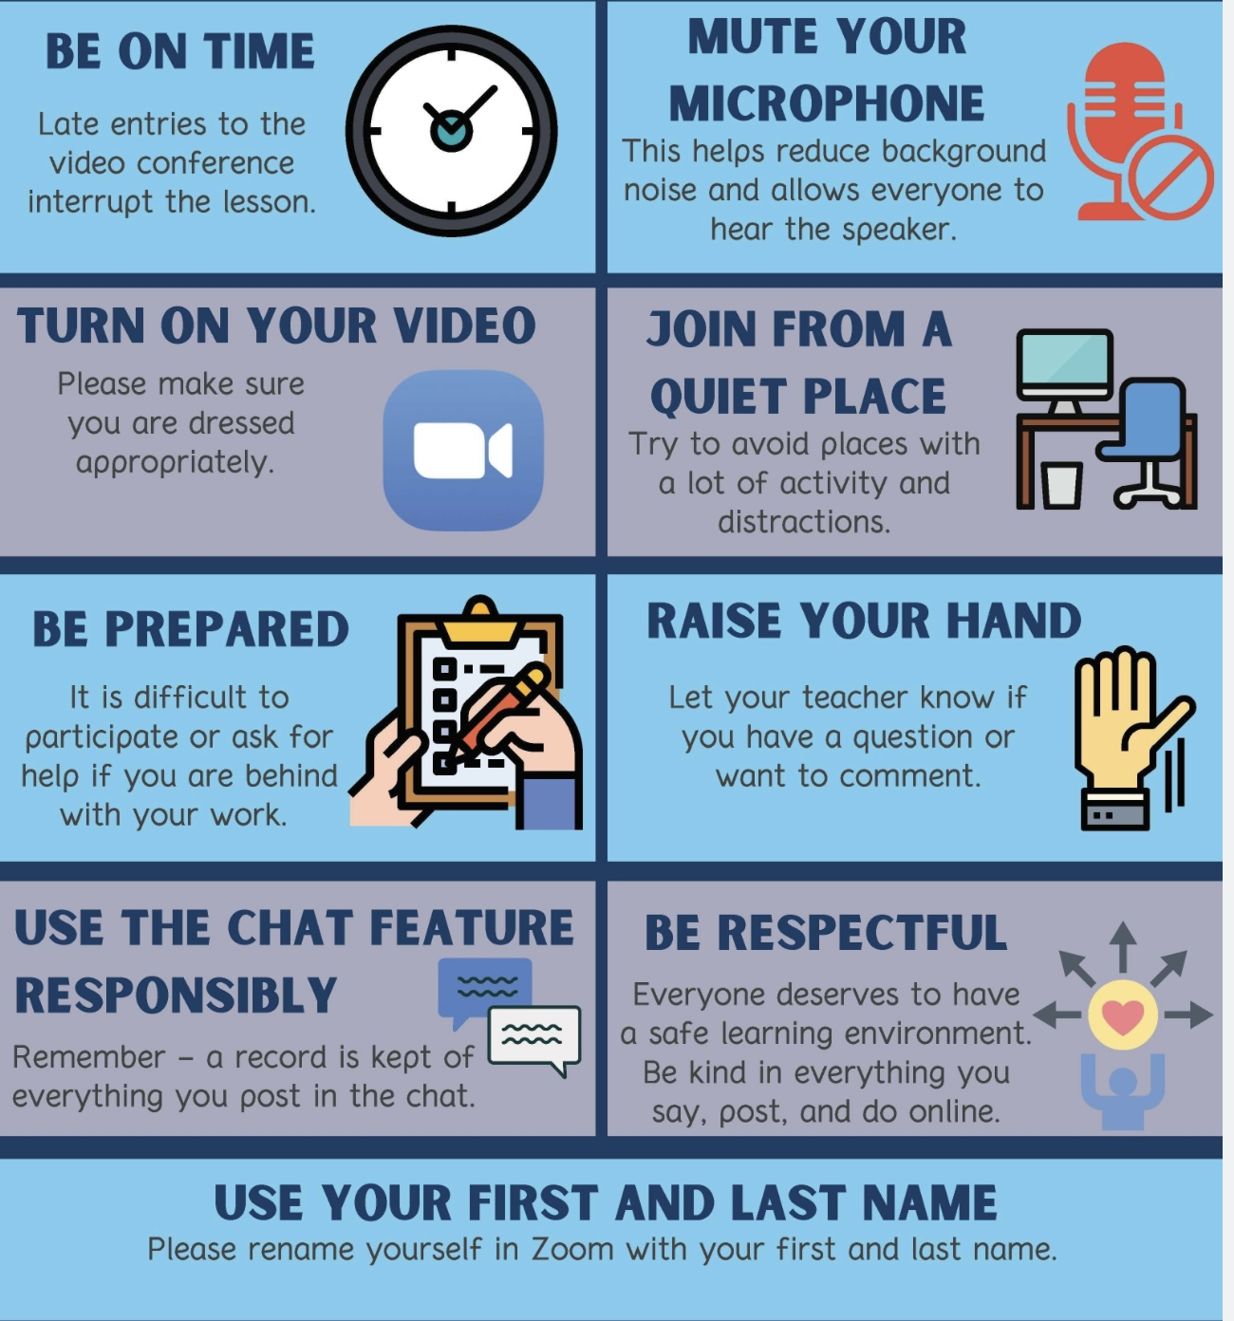
REMINDER PARTICIPANT AGREEMENTS
If you have questions, comments, or feedback, please save them for the two question periods. You can put them in the chat box or raise your real/virtual hand.
Keep comments, questions, and feedback relatively brief so everyone has a chance to participate.(one breath sharing)
If you’re on zoom, make sure no one can overhear what is being said
For reasons that will become clear later in the course please avoid giving advice to other participants about what they should or should not do. Validation, encouragement , and understanding are however very much appreciated.

Slide 17
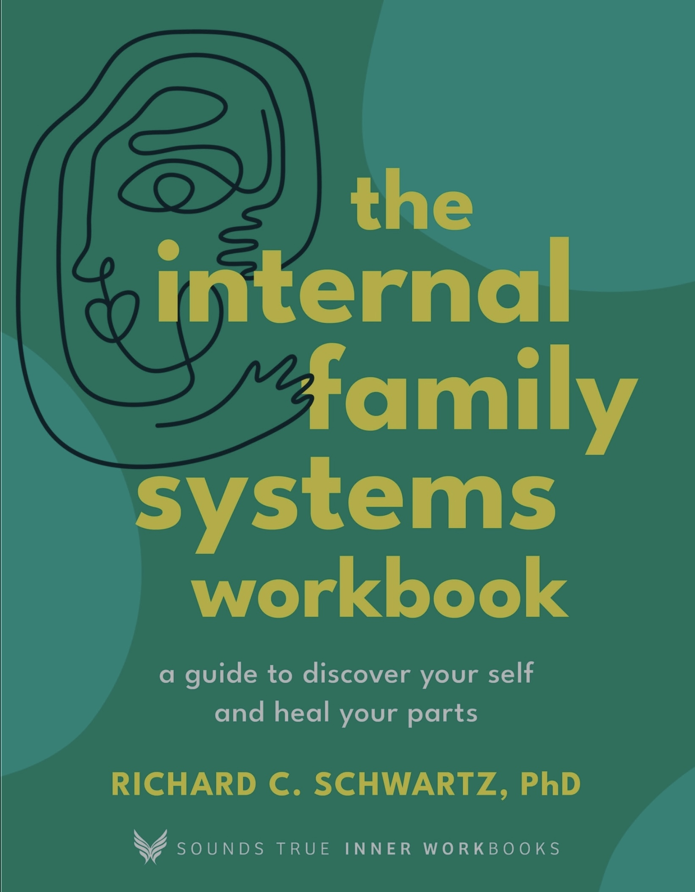

Please make sure you have the internal family systems workbook. We will start using it session 24, on April 8.
WEEKLY ANNOUNCEMENTS

Slide 18
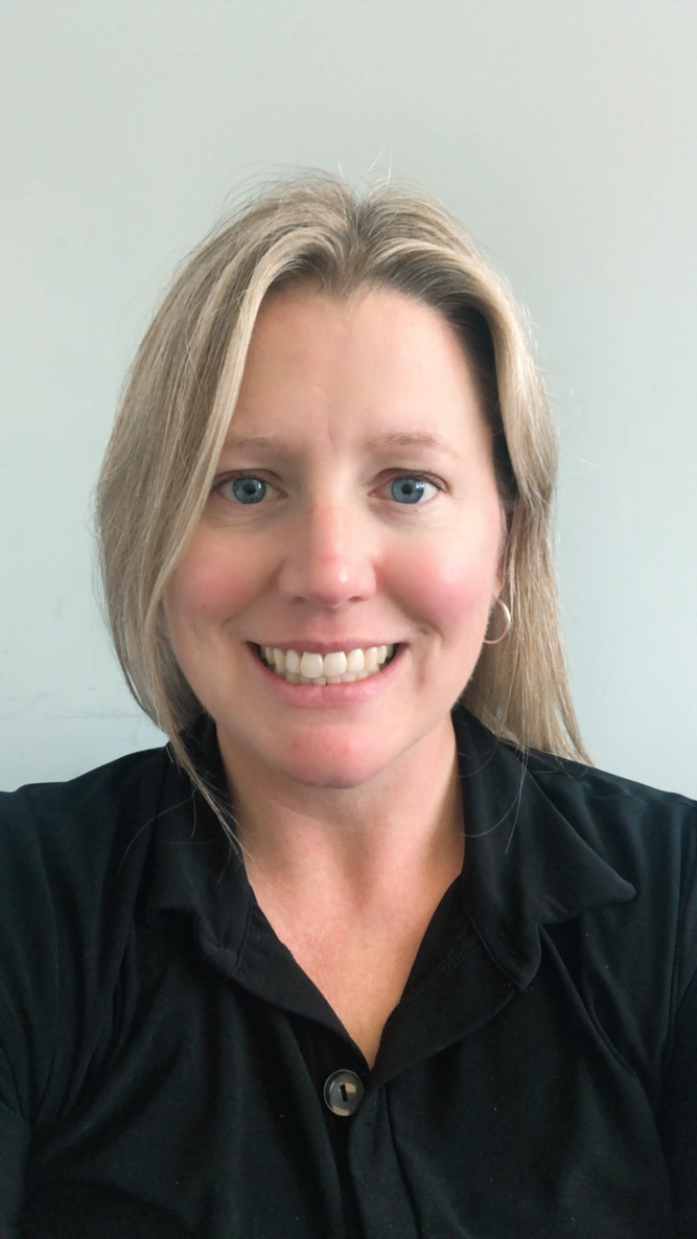
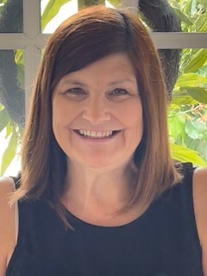

DBT WRAP UP
Workbook Pages 242-265

Slide 19
UPDATED PERSONAL SKILLS LIST
Distress tolerance skills
Grounding skills- Set a daily intention
“ - Sensory soothing toolkit
“ -The 5,4,3,2,1 method
“ -The emotional freedom technique
REST (or PEST) Pause
Radical acceptance statements (please specify)
Distraction plan “
Self-soothing plan
Safe place visualization
Cue controlled relaxation
Rediscovering your values (please specify)
Rehearse values-based behavior or edit/splice/paste
Connect with your higher power “
14. Live in the present moment
15. Use self-encouraging coping thoughts
16. Radical acceptance
17. Use self-affirming statements
18. Balance feelings and threat
19. Create new coping strategies
20. Create an emergency coping plan
21. Box breathing
22. Cold temperatures
23. High intensity exercise
24. Progressive muscular relaxation
25. Paced breathing
26. Side to side eye movement.

Slide 20
UPDATED PERSONAL SKILLS LIST
Mindfulness skills
1) Focus on a single minute
2) Focus on a single object
3) Band of light
4) Inner-Outer Experience
5) Record Three Minutes of Thoughts
6) Thought Diffusion
7) Describe Your Emotion
8) Focus Shifting
9) Mindful Breathing
10) Mindful Awareness of Emotion
11) Wise mind
12)how to make Wise mind decisions
13) Radical acceptance
14) Judgements and labels
15) Self compassion
16) Mindful communication
17. Being mindful in our daily life
18. How to do tasks mindfully
19. How to be mindful of our activities
20. Resistances and hindrances to mindfulness practice
21. Exploring mindfulness further
22. Mindfulness and meditation
23. Using kindness and compassion
24. Paying attention to spaciousness and stillness

Slide 21
UPDATED PERSONAL SKILLS LIST
Emotional regulation skills
How do emotions work?
Recognizing emotions
Overcoming barriers to healthy emotions
Reducing physical vulnerability
Reducing cognitive vulnerability
5. Increasing Positive Emotions
6. Being mindful of your emotions without judgement
Emotion exposure.
Doing the opposite of your emotions
9. Problem Solving

Slide 22
TODAY-UPDATED PERSONAL SKILLS LIST
Interpersonal effectiveness skills
1.Mindful attention
2. Compassion for others
3. Passive vs. aggressive behavior
4. I want-they want ratio
5. I want-I should ratio
6. Key interpersonal skills
7. Blocks to using interpersonal skills
8. Knowing what you want
9. Modulating the intensity of a request
10. Making a simple request
11. Designing basic assertiveness scripts
12. Assertive listening
13. Dealing with resistance and conflict
14. How to negotiate
15. How to understand problem interactions
16.Exposure based cognitive rehearsal
17. State dependent learning
18. Practice
19. Putting it all together
20. Daily practice for emotional health
21. The skills list/DBT diary card

Slide 23
Skills training workbook p. 244-258
Advanced interpersonal effectiveness skills
1. DEALING with resistance and conflict
2. How to Negotiate
Exposure based cognitive rehearsal
4. state-dependent learning
5. practice
3.How to understand problem interactions

Slide 24
Skills training workbook p. 244-258
Advanced interpersonal effectiveness skills
1. DEALING with resistance and conflict
2. How to Negotiate
Exposure based cognitive rehearsal
4. state-dependent learning
5. practice
3.How to understand problem interactions

Slide 25
COPING WITH RESISTANCE AND CONFLICT
In session 30 we will spend a whole session, 4 hours if you’re willing, on challenging intimate relationships.
There is overlap between the following material (dealing with resistance and conflict)and session 30 which will bring in an IFS lens through which to consider difficulties in intimate relationships.

Slide 26

Coping with resistance and conflict p. 244
If there is frequent conflict in some of our relationships, it may be because some obstacle is stopping us from using the DEAR MAN GIVE FAST interpersonal DBT skills we’ve learned to resolve it.
What are the most common obstacles to using DBT interpersonal skills ?
1. Passive habits- Sometimes we shut down, surrender or give in to others to avoid conflict. This makes us frustrated, resentful and leads to passive aggressive behavior
2. Aggressive habits- Sometimes we communicate in ways that create fear, shame or hurtful psychological pressure in others

Slide 27
PASSIVE, ASSERTIVE, AND AGGRESSIVE HABITS THREE WAYS TO HANDLE ONE SITUATION
Situation 1: A friend often interrupts you while you’re talking.
Passive Response: “It’s fine… I probably talk too much anyway.” (You give up your voice to keep the peace.) Emotion underneath: resentment, hurt, or powerlessness. Outcome: the friend doesn’t realize there’s a problem; you feel unheard. Aggressive Response: “You always interrupt me, you’re so rude!” (You assert your need by attacking or blaming.) Emotion underneath: frustration or anger. Outcome: the other person feels defensive, conflict increases.
Assertive Response: “I really value our conversations. When I get interrupted, I lose my train of thought, could I finish what I was saying before you jump in?” (You express your needs respectfully and clearly.) Emotion underneath: self-respect and care for the relationship. Outcome: you’re heard, and the relationship can adjust and grow.
Situation 2: A co-worker leaves a shared workspace messy.
Passive Response: “Oh well, I’ll just clean it up, it’s easier that way.” You avoid conflict but build silent frustration. The problem continues.
Aggressive Response: “You’re such a slob, clean up your mess or I’m reporting you.” You express your frustration by attacking. The relationship suffers and resistance increases.
Assertive Response: “I notice the table gets messy after we work here. Can we agree to clean up before leaving so we both have a clear space?” You describe the issue without blame and invite cooperation. The relationship stays respectful and productive.

Slide 28
Coping with resistance and conflict p. 244
More obstacles to using DBT interpersonal skills:
3. Overwhelming emotions- Intense emotions may impact our ability to communicate effectively. Sometimes we lose control and say or do things that we later regret.
4. Failure to identify needs- Communication skills may fail when we don’t know what we want and can’t ask for what we need

Slide 29
Coping with resistance and conflict p. 244
Still more obstacles to using DBT interpersonal skills:
5. Fear- Fear can push us to use aggressive or aversive communication strategies or causes us to avoid. This leads to ineffective communication
6. Toxic Relationships- It is difficult to use effective, constructive communication skills when we are engaged with people who consistently use negative, destructive ones. It’s important that we are aware when this is the case. If these encounters can’t be avoided, planning how to deal with them can be very helpful
7. Myths- Myths or core beliefs we hold about relationships such as 1.we can’t ask for what we need or 2. we can’t say no, can paralyze us and get in the way of effective communication

Slide 30
Coping with resistance and conflict p. 244
If we’re are using the DEAR MAN GIVE FAST assertiveness skills we discussed in the last couple of skills sessions, but they are not helping resolve our interpersonal conflicts it may be due to resistance from the other person. In this case certain conflict management skills may be useful:
A) Mutual validation: the person may not be listening to us because they do not feel heard. We could acknowledge and appreciate their experience and express that we understand where they're coming from.
B) Broken record: distill what we want into one sentence. Keep confidently repeating that sentence as many times as is necessary

Slide 31
Coping with resistance and conflict p. 244
More conflict management skills:
C) Probing: Ask the person what it is about what we have said that bothers them
D) Clouding: Agree with part of what they've said without accepting everything
E) Assertive delay: Tell the person we need time to think and consider before continuing the conversation. (an example of the pause technique)
The workbook offers examples of each of these strategies

Slide 32
Skills training workbook p. 244-258
Advanced interpersonal effectiveness skills
1. dealing with resistance and conflict
2. How to Negotiate
Exposure based cognitive rehearsal
4. state-dependent learning
5. practice
3.How to understand problem interactions

Slide 33
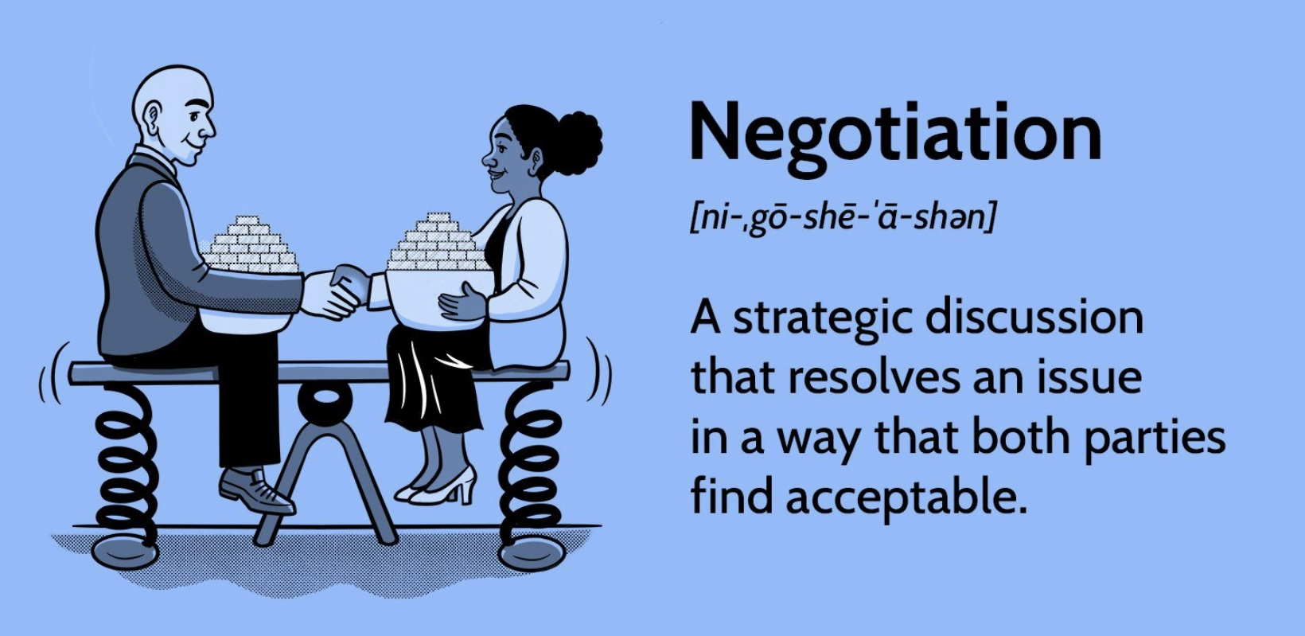
2. How to Negotiate P. 246
When negotiating assume that each party has valid needs.
Follow the RAVEN acronym:
Relax: accept conflict calmly
Avoid the aversive: stay positive
Validate: the other's persons needs and concerns
Examine: your values
use a Neutral voice

Slide 34
USING RAVEN STEP BY STEP
Scenario You want your partner to help more with household chores, but past conversations have escalated into arguments.
R – Relax (Before speaking, you slow yourself down) You take two slow breaths, notice the tightness in your chest, and wait until you’re no longer in emotional mind. Internal stance: “I want this to be effective, not a win-lose fight.”
A – Avoid the Aversive (You avoid criticism, sarcasm, threats, or loaded language) Avoid: “You never help around here. I do everything.” Instead, you start cleanly: “Can we talk about how chores are divided?”
V – Validate the Other Person’s Concerns (You show that their perspective makes sense, even if you disagree) “I know you’ve been really exhausted after work lately, and I get that when you come home you just want to shut your brain off.” This lowers defensiveness and keeps the conversation collaborative.

Slide 35
USING RAVEN STEP BY STEP
E – Examine Your Values (You silently check what really matters to you) Internal clarification: “I value fairness, teamwork, and staying emotionally connected—more than being ‘right.’” This keeps you anchored if tension rises.
N – Neutral Voice (You speak calmly, evenly, and without emotional charge) “What I’m noticing is that when most of the chores fall to me, I start to feel resentful. What I’m asking is whether we could agree on a more balanced plan—maybe you take care of dishes on weekdays, and I’ll handle laundry.” Tone is steady, factual, and non-accusatory.
Why this works: Relax keeps you in Wise Mind. Avoid the Aversive prevents emotional mind escalation. Validate preserves the relationship. Examine Values keeps your long-term goals in view. Neutral Voice maximizes the chance of cooperation

Slide 36
Skills training workbook p. 244-258
Advanced interpersonal effectiveness skills
1. dealing with resistance and conflict
2. How to Negotiate
Exposure based cognitive rehearsal
4. state-dependent learning
5.practice
3.How to understand problem interactions

Slide 37

3. How to understand problem interactions P. 248
If, despite using assertiveness skills, and the strategies to deal with resistance discussed above, we still do not feel heard, we might try to figure out what went wrong in the interaction by using the “communication effectiveness checklist” on pages 249 to 251 of the workbook.
Remember we don’t have to do this “live” we can use it with the editing splicing and pasting technique.

Slide 38
COMMUNICATION EFFECTIVENESS CHECKLIST
1. Were we clear about our goals?
2. Did we use aversive strategies?
3. Did we use passive strategies?
4. Were there blocks to communication?
5. Was our intensity level appropriate?
6. Were there assertiveness problems?
7. Did we run into blocks to listening?
8. Did we forget the conflict management strategies?
9. Was there a negotiation breakdown?

Slide 39
ANOTHER INTERESTING TAKE ON DIFFICULT RELATIONSHIPS
We’ll just briefly mention it and invite you to explore it further on your own if you’re interested

Slide 40
HIGH CONFLICT PEOPLE (HCP)
The term “high conflict people” was developed primarily by attorney and therapist Bill Eddy, who noticed a pattern of behavior in people he encountered in legal and therapeutic settings.
High conflict people are individuals with a persistent pattern of thinking, feeling, and behaving that increases conflict rather than resolving it. The key distinction is that most people, even in difficult situations, move toward resolution. HCPs tend to escalate conflict, often unconsciously.
Eddy identifies four defining traits:
1. All-or-nothing thinking — They see situations, and especially people, in black-and-white terms: totally good or totally evil, completely right or completely wrong.
2. Unmanaged emotions — They experience and express emotions with an intensity that seems disproportionate to the situation, and struggle to self-regulate.
3. Extreme behaviors — They may act in ways that most people would consider over-the-top — sending dozens of emails, making public scenes, filing repeated legal complaints, etc.
4. Preoccupation with a “Blame Target” — Almost always, an HCP has someone they’ve identified as the cause of all their problems. This target absorbs enormous energy, hostility, and blame, even when the facts don’t support it.
HCP behavior often (though not always) overlaps with certain personality disorders, particularly:
∙ Borderline (fear of abandonment, emotional swings)
∙ Narcissistic (entitlement, lack of empathy)
∙ Antisocial (disregard for rules and others)
∙ Paranoid (suspicion, perceived persecution)

Slide 41
HIGH CONFLICT PEOPLE (HCP)
Importantly, not everyone with a personality disorder is an HCP, and not every HCP has a diagnosable disorder.
HCPs tend to interpret neutral or even kind behavior as threatening. They often lack insight into their own role in conflicts, feel genuinely victimized, and attract sympathizers (“negative advocates”) who amplify the conflict further.
Understanding HCPs is useful in many contexts — divorce and custody disputes, workplace conflicts, neighbor disputes, and family dynamics. The approach that works with most people (reason, empathy, compromise) often backfires with HCPs and can fuel escalation instead.
Eddy’s framework suggests specific communication strategies (like his BIFF Response — Brief, Informative, Friendly, Firm) tailored to reducing conflict without feeding the cycle.
Catching the pattern early can save enormous stress. Watch for these signals:
1) The blame is always external: They have a story where they are always the victim and someone else is always the villain. There’s rarely any self-reflection or acknowledgment of their own role in problems.
2) Intensity that feels “off”: Early in a relationship (personal or professional), they may seem unusually passionate, devoted, or aggrieved. Things escalate faster than feels normal, deep intimacy, fierce loyalty, or intense animosity very quickly.
3) Black-and-white talk about others: Listen for how they describe people from their past, ex-partners, former bosses, family members. If nearly everyone is either a saint or a monster, that’s a flag.

Slide 42
4) Crises are constant: There always seems to be a dramatic situation unfolding. The chaos follows them, not just their circumstances.
5)They test your loyalty early: They may subtly (or not so subtly) pressure you to take their side, criticize mutual acquaintances, or prove you’re “with them.”
How to communicate with HCPS: The standard toolkit, logical debate, expressing hurt feelings, trying to prove you’re right, tends to backfire badly. Instead use the BIFF response (Bill Eddy’s core framework):
Brief — short responses give less material to attack or misinterpret
Informative — stick to neutral facts, not emotions or opinions
Friendly — a warm, non-reactive tone disarms escalation
Firm — clear boundaries on what you will and won’t engage with
Don’t JADE: Avoid Justifying, Arguing, Defending, or Explaining yourself excessively. HCPs often use your explanations as ammunition, and over-explaining signals that you can be drawn in.
Avoid the hook: HCPs will often say something outrageous specifically to provoke a reaction. Reacting confirms for them that you’re engaged in the conflict. Staying calm, not cold, just calm, is protective.
Empathize without agreeing: You can acknowledge their feelings without validating distorted thinking. Phrases like “I can see this is really frustrating for you” reduce emotional heat without conceding false points.
Keep everything in writing: In professional or legal contexts especially, written communication creates a record and slows down the reactive dynamic that HCPs thrive in.

Slide 43
HOW TO PROTECT YOURSELF EMOTIONALLY FROM HCPs
This is often the hardest part, because HCPs are frequently people we care about or are deeply entangled with.
1) Accept that you cannot fix them: This is the most important shift. HCP patterns are deeply ingrained. Trying to reason, heal, or love someone out of high-conflict behavior usually results in exhaustion and more conflict.
2) Manage your own reactivity: HCPs are often unconsciously skilled at finding emotional triggers. Therapy, mindfulness, or even just pausing before responding can help you stay grounded rather than reactive.
3) Limit your exposure where possible: Reduce contact where you can. If you can’t (co-parenting, a family member, a coworker), create structure, defined communication channels, limited personal disclosure, clear boundaries on topics.
4) Don’t share vulnerabilities: Personal struggles, insecurities, or private information can be stored and used against you later, often in ways you wouldn’t expect.
Build a support network outside the relationship: HCPs can be isolating, sometimes deliberately, often as a side effect of the drama they create. Maintaining friendships and trusted relationships outside is essential for perspective and resilience.
Name the pattern to yourself: Simply having a framework — “this is high conflict behavior; it’s not about me”, creates psychological distance that is genuinely protective. It helps you stop internalizing the blame they project.
The through-line across all three areas is this: the goal isn’t to win, fix, or even be understood by an HCP, it’s to manage your own responses so the conflict doesn’t consume you. That reframe alone tends to be freeing for people dealing with these dynamics.

Slide 44
Skills training workbook p. 244-258
Advanced interpersonal effectiveness skills
1. dealing with resistance and conflict
2. How to Negotiate
Exposure based cognitive rehearsal
4. state-dependent learning
5. practice
3.How to understand problem interactions

Slide 45

EXPOSURE BASED COGNITIVE REHEARSAL P. 253
This section of the workbook describes practical ways of practicing, rehearsing and using the DBT skills:
state dependent learning
4) practicing cognitive skills

Slide 46
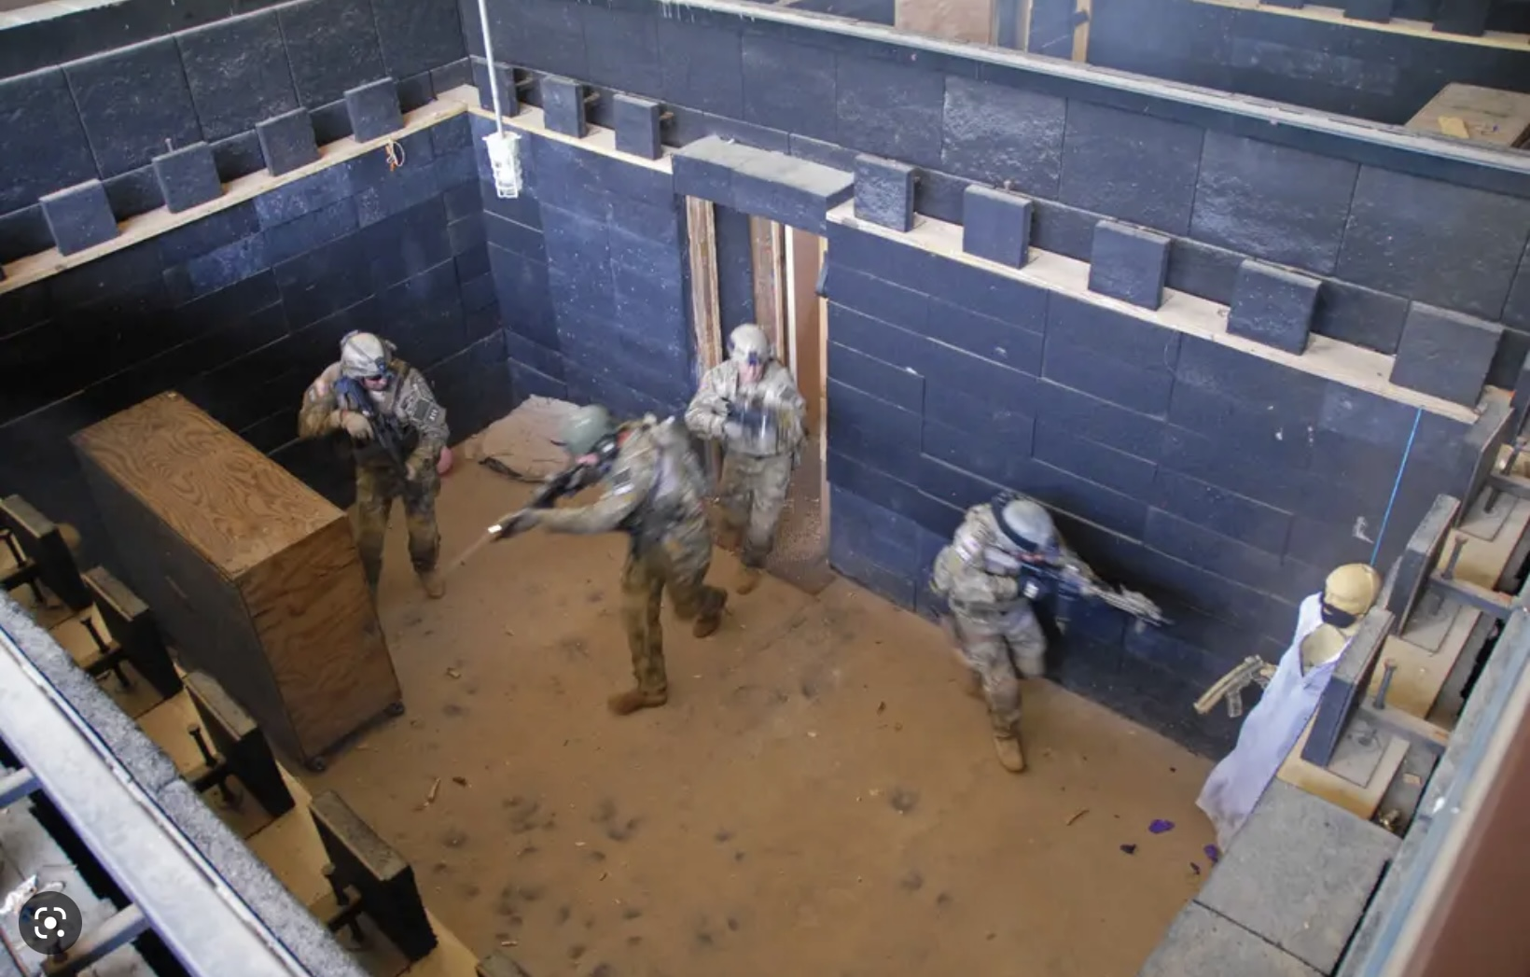
4. state-dependent learning P. 253
State-dependent learning is a psychological concept that suggests that memory and recall are influenced by the internal state of an individual at the time of learning and at the time of recall. This theory proposes that information is best recalled when the individual's internal state (such as mood, emotions, or physiological states) at the time of learning matches their internal state at the time of recall.
In other words, if a person learns something in a particular state (e.g., happy, anxious, alert), they are more likely to remember and recall that information when they are in a similar state.
State-dependent learning theory highlights the importance of considering the context and conditions under which learning takes place, as they can impact memory retrieval.

Slide 47
EXPOSURE BASED COGNITIVE REHEARSAL
Exposure based cognitive rehearsal is a way of accounting for the effects of state-dependent learning as we learn and practice DBT skills.
When using the editing, splicing and pasting technique and pendulating we are doing exposure based cognitive learning.
Editing, splicing and pasting give us a chance to practice our new skills while exposed to the same situation and triggers as in the original situation.

Slide 48
Skills training workbook p. 244-258
Advanced interpersonal effectiveness skills
1. DEALING with resistance and conflict
2. How to Negotiate
Exposure based cognitive rehearsal
4. state-dependent learning
5. practice
3.How to understand problem interactions

Slide 49

5. Practicing
coping skills P.254
The workbook’s description of how to practice state dependent learning is very similar to the editing, splicing, and pasting technique:
1 Visualize a difficult situation you have been in, in which you were activated.
2 Choose one of the skills you've learned such as radical acceptance, distraction, self soothing, safe place visualization, opposite action, etc. Imagine yourself using this skill while in the situation.
3 Splice your old thoughts, feelings and behaviors in the situation and paste in the new imagined ones using the skills.
4 Make sure you stay in the window of tolerance while doing this. Pendulate.
Go over the examples of how to do this on pages 255 – 256 of the workbook
We suggest you stick with editing, splicing and pasting.

Slide 50

The practice effect P. 256
The more often we visualize the new edited, spliced, and pasted scenarios the better we will become at using the DBT skills.
We can practice visualizing our new edited, spliced, and pasted scenarios with as many past situations in which we became activated and showed up as high numbers in our holes diary card as possible.

Slide 51
Skills training workbook pages 259-265 closing remarks on the skills training workbook
1. Putting it all together
2. Daily practices for emotional health
3. The DBT diary card

Slide 52
Skills training workbook pages 259-265
1. Putting it all together
2. Daily practices for emotional health
3. The DBT diary card

Slide 53

1. Putting it all together P. 259
It’s not our fault if we have mental health issues but it’s our responsibility and that of society to work at improving these issues.
We won’t improve our collective mental health if we don’t understand how the mind works, don’t have the right approaches to address our issues, and don’t understand how society impacts these issues.
Improving our mental health is possible but requires the right tools, skills, strategies, commitment, hard work and very importantly, social supports and conditions that promote mental health.
We already discussed the concept of “cruel optimist” in which individuals are made to feel responsible for issues that are primarily systemic.
We are also familiar with Rudolph Virchow’s assertion that “Medicine is a social science, and politics nothing but medicine at a larger scale”
Improving mental health requires that we commit not only to improving our personal mental health but also that of our families, communities, countries, and world as a whole.

Slide 54
Skills training workbook pages 259-265
1. Putting it all together
2. Daily practices for emotional health
3. The DBT diary card

Slide 55

2. Daily practices for emotional health P.259
A practical way of committing and working towards improving mental health is to have a daily mental health practice.
The workbook suggests 5 daily practices:
1. mindfulness
2. deep relaxation
3. self-observation
4. Affirmation
5. Committed action
It lists the sections of the workbook that describe each of these practices
The simple course suggests that we do a daily holes diary card and when our numbers are high, use the appropriate tools to assess and remedy the issues, so that we learn to get out of our holes and heal the pain that our exiles carry.
It also suggests working on our goals diary card and on healing trauma using the wise mind remediation procedure.

Slide 56
Skills training workbook pages 259-265
1. Putting it all together
2. Daily practices for emotional health
3. The DBT diary card

Slide 57
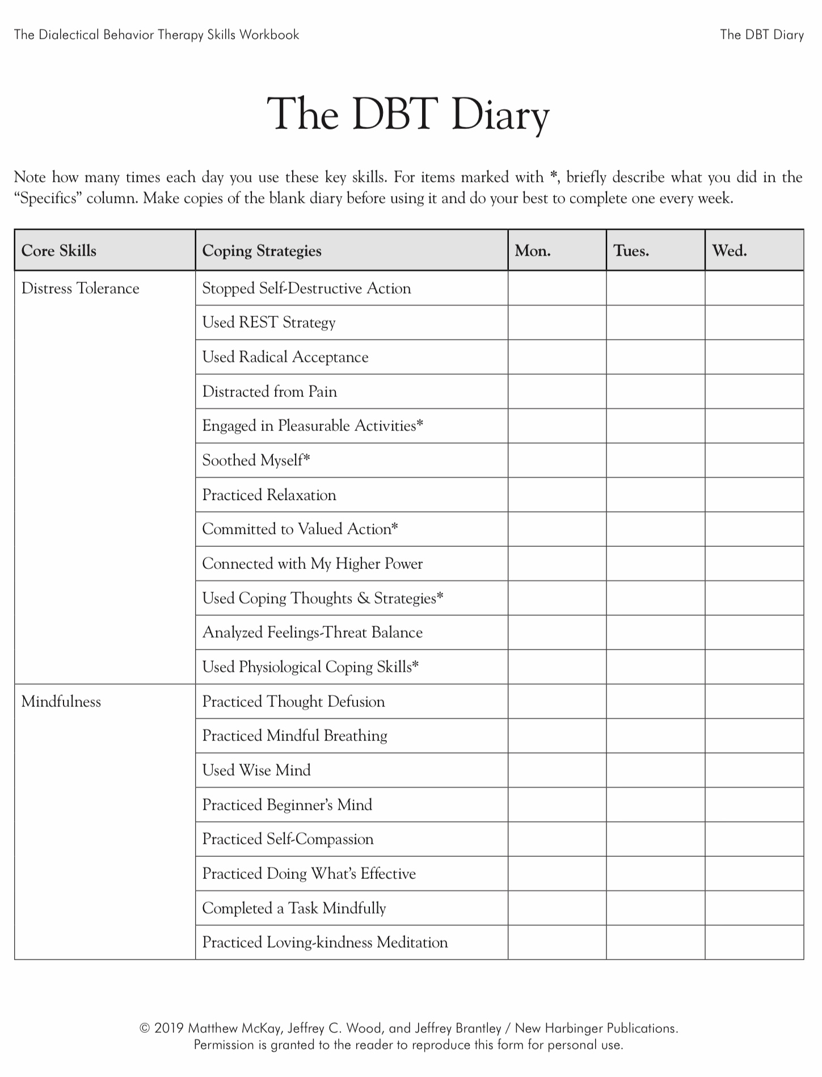
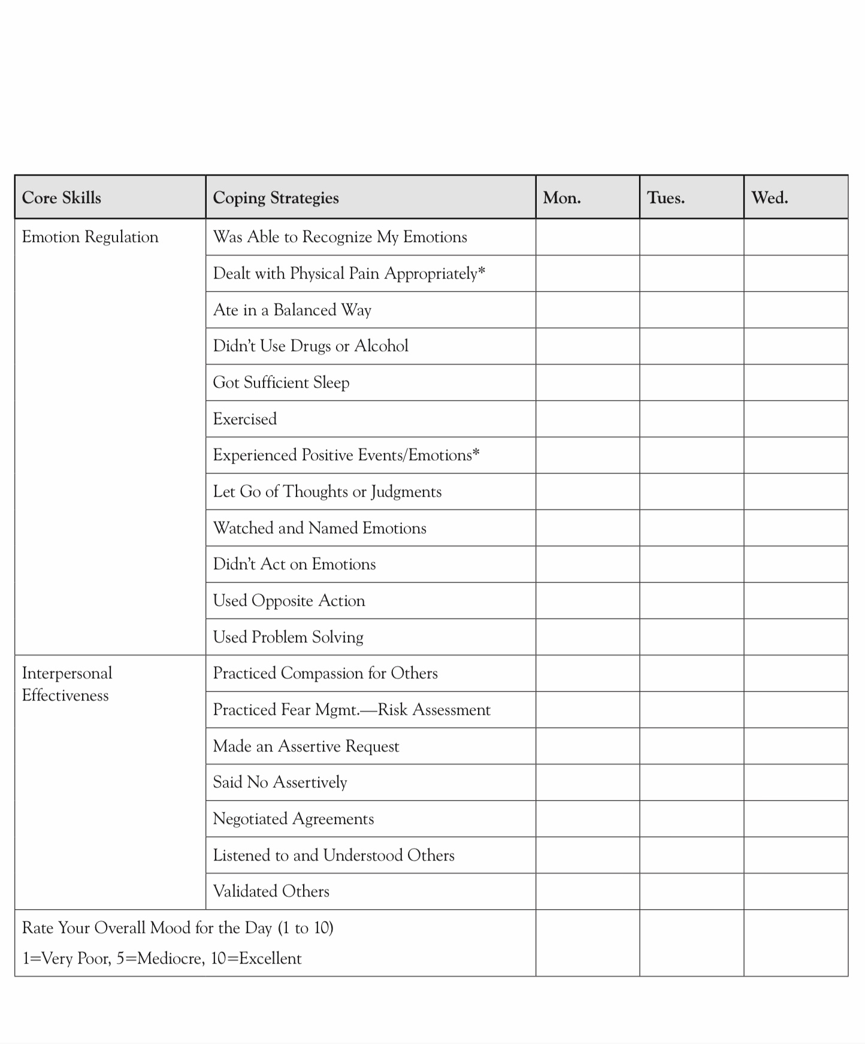
3. The skills list/DBT diary card P. 262
Along with the tools and strategies, we’ll need skills to repair our holes.
The skills lists (see next 4 slides) and DBT diary card remind us of, and helps us review, all the skills we’ve learned in the 4 DBT modules
Review them.
And that brings us to the end of the DBT skills training workbook

Slide 58
UPDATED PERSONAL SKILLS LIST
Distress tolerance skills
Grounding skills- Set a daily intention
“ - Sensory soothing toolkit
“ -The 5,4,3,2,1 method
“ -The emotional freedom technique
REST (or PEST) Pause
Radical acceptance statements (please specify)
Distraction plan “
Self-soothing plan
Safe place visualization
Cue controlled relaxation
Rediscovering your values (please specify)
Rehearse values-based behavior or edit/splice/paste
Connect with your higher power “
14. Live in the present moment
15. Use self-encouraging coping thoughts
16. Radical acceptance
17. Use self-affirming statements
18. Balance feelings and threat
19. Create new coping strategies
20. Create an emergency coping plan
21. Box breathing
22. Cold temperatures
23. High intensity exercise
24. Progressive muscular relaxation
25. Paced breathing
26. Side to side eye movement.

Slide 59
UPDATED PERSONAL SKILLS LIST
Mindfulness skills
1) Focus on a single minute
2) Focus on a single object
3) Band of light
4) Inner-Outer Experience
5) Record Three Minutes of Thoughts
6) Thought Diffusion
7) Describe Your Emotion
8) Focus Shifting
9) Mindful Breathing
10) Mindful Awareness of Emotion
11) Wise mind
12)how to make Wise mind decisions
13) Radical acceptance
14) Judgements and labels
15) Self compassion
16) Mindful communication
17. Being mindful in our daily life
18. How to do tasks mindfully
19. How to be mindful of our activities
20. Resistances and hindrances to mindfulness practice
21. Exploring mindfulness further
22. Mindfulness and meditation
23. Using kindness and compassion
24. Paying attention to spaciousness and stillness

Slide 60
UPDATED PERSONAL SKILLS LIST
Emotional regulation skills
How do emotions work?
Recognizing emotions
Overcoming barriers to healthy emotions
Reducing physical vulnerability
Reducing cognitive vulnerability
5. Increasing Positive Emotions
6. Being mindful of your emotions without judgement
Emotion exposure.
Doing the opposite of your emotions
9. Problem Solving

Slide 61
TODAY-UPDATED PERSONAL SKILLS LIST
Interpersonal effectiveness skills
1.Mindful attention
2. Compassion for others
3. Passive vs. aggressive behavior
4. I want-they want ratio
5. I want-I should ratio
6. Key interpersonal skills
7. Blocks to using interpersonal skills
8. Knowing what you want
9. Modulating the intensity of a request
10. Making a simple request
11. Designing basic assertiveness scripts
12. Assertive listening
13. Dealing with resistance and conflict
14. How to negotiate
15. How to understand problem interactions
16.Exposure based cognitive rehearsal
17. State dependent learning
18. Practice
19. Putting it all together
20. Daily practice for emotional health
21. The skills list/DBT diary card

Slide 62
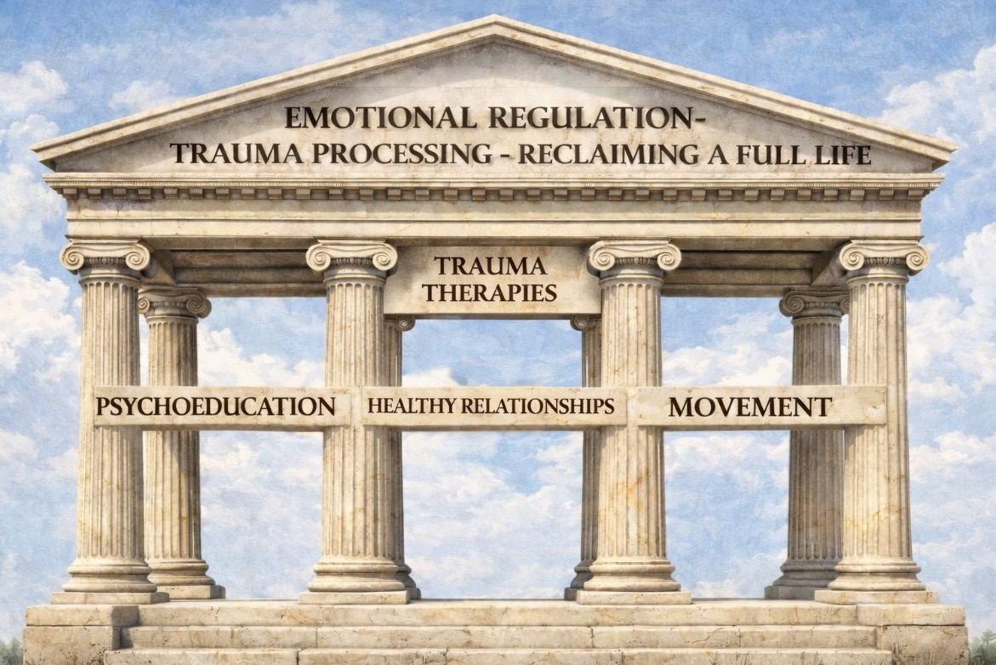
2. THE FOUR PILLARS OF TRAUMA RECOVERY

Slide 63
THE FOUR PILLARS OF TRAUMA RECOVERY
In our discussion of structural dissociation theory, we talked about the three stages of trauma therapy:
I. stabilization,
II. Remembrance and mourning or processing trauma, and
III. resuming paused psychosocial growth.
Today we’ll briefly consider a complimentary concept the four pillars of trauma recovery.

Slide 64
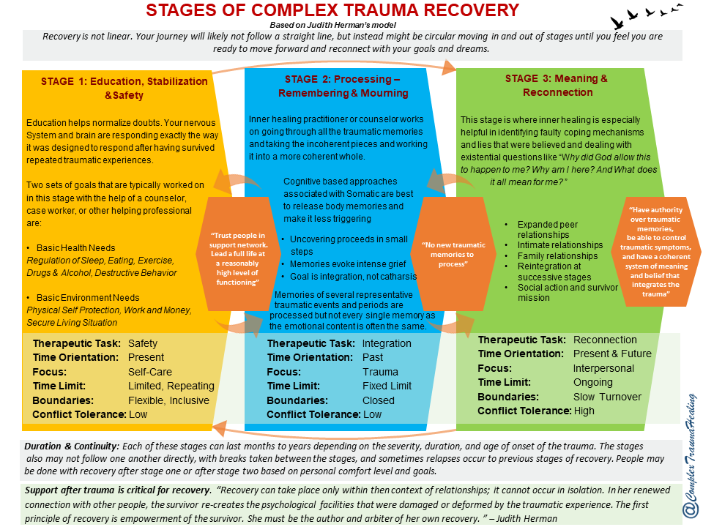
REVIEW: THE 3 stages of trauma THERAPY
To briefly review, the 3 stages of trauma therapy are:
Stage I education, stabilization and safety.
Stage II Processing the trauma
Stage III reconnecting, finding meaning, and developing to your full potential.
These stages describe the sequence in which therapy often approaches the treatment of trauma .
It’s not advisable, for example, to work on Stage II “processing” before being good at Stage I “stabilization” or having the skills and tools necessary to return to the window of tolerance.

Slide 65
How are the four pillars of trauma recovery related to the three stages of trauma therapy?

Slide 66
THE 4 Pillars of trauma recovery
Unlike the 3 stages, the 4 pillars of trauma recovery are not a sequence of the work to be done.
The 4 pillars are parts of trauma work, that like in a Greek temple underlie or support all 3 stages of trauma therapy.
In other words, the 4 pillars help us accomplish each of the 3 stages
Let’s briefly review these 4 pillars which are incorporated into Simple.

Slide 67

PSYCHOEDUCATION
Trauma healing rests on four interdependent pillars. None of them is sufficient alone, and all of them reinforce each other. Together, they create the conditions for safety, integration, and post-traumatic growth (the 3 stages).
The first pillar- Psychoeducation: is the process of learning how trauma actually works, biologically, psychologically, relationally, so that we can understand why and how our symptoms and lived experience make sense.
Trauma creates confusion: Why am I like this? Why do I overreact? Why can’t I just get over it? Psychoeducation replaces shame with explanation. When people can name what is happening, for example “This is my sympathetic system getting activated”, they feel less defective and more empowered. Understanding becomes the first step toward regulating.

Slide 68
The second pillar- Healthy Relationships: Trauma almost always occurs in the context of disrupted or unsafe relationships. Healing requires relational experiences that provide safety, attunement, predictable care, and the chance to rewire attachment patterns. Healing relationships can be with a professional, in group therapy, with friends or partners who model emotional safety, mentors, or a community.
The nervous system is a social organ. It learns safety through another safe nervous system. Healthy relationships provide co-regulation when someone becomes dysregulated, mirroring and validation, boundaries, and a sense of belonging. When people experience healthy relational patterns, they gradually replace the old trauma-driven ones.
Safe relationships are the most powerful regulator of the nervous system. When someone is reliably present and attuned, our system receives the message: You are not alone. You are safe enough. This supports the shift into ventral vagal the state where connection, calm, and meaning are possible.
HEALTHY RELATIONSHIPS

Slide 69
TRAUMA-INFORMED THERAPIES
The third pillar- Trauma-Informed Therapies: are structured, evidence-based, trauma-specific modalities that help the person safely process traumatic memories. Evidence-based trauma-informed therapies include IFS, EMDR, trauma-focused CBT, somatic therapies, sensorimotor psychotherapy, DBT, ACT, Ego-state therapies, and polyvagal-informed interventions.
Trauma is stored not in the rational brain but in the body, in implicit memory, fear networks, and attachment templates. Trauma therapies help unburden frozen emotional states, update the nervous system’s threat response, replace traumatic with coherent meaning, and integrate the past into a stable sense of self.
Without targeted trauma-informed interventions, psychoeducation alone rarely changes entrenched trauma patterns. This pillar is about deep change, not just coping.

Slide 70
The fourth pillar- Movement: Trauma lives in the body and movement is how we free it. Movement reconnects the individual with body awareness, regulates rhythms, completes fight–flight impulses that were interrupted, grounds, and orients. During trauma, the body often initiates an impulse to run, fight, block, scream, or reach but cannot complete it. This creates stuck physiological activation. Movement helps reconnect the prefrontal cortex and the body, release chronic muscular tension, downshift sympathetic arousal, expand the window of tolerance, provide mastery, pleasure, and embodiment. In trauma therapy, movement is not optional, it is essential.
In polyvagal terms, trauma often leaves us stuck in sympathetic survival activation (fight/flight) and dorsal vagal shutdown (collapse, numbness). The pathway back to connection is physiological. The nervous system moves through states via the body.
Gentle, rhythmic, regulated movement walking, stretching, rocking, yoga, and breath-linked motion help the system transition out of shutdown or survival mode.
MOVEMENT

Slide 71
THE FOUR PILLARS OF TRAUMA THERAPY
In summary: relationships provide safety, movement restores physiological flow, therapy processes what was stuck and understanding reduces fear.
Together, these four pillars support the nervous system’s journey back into connection.
To better understand how do these pillars fit together, think of trauma therapy as a house:
Psychoeducation is the blueprint that helps you understand the architecture of the house.
Healthy relationships are the foundations that make the house solid and safe.
Trauma-informed therapies are like structural renovations, where unstable old structures are repaired.
Movement is the electrical system, ensuring energy flows through the whole house and doesn’t get stuck.

Slide 72
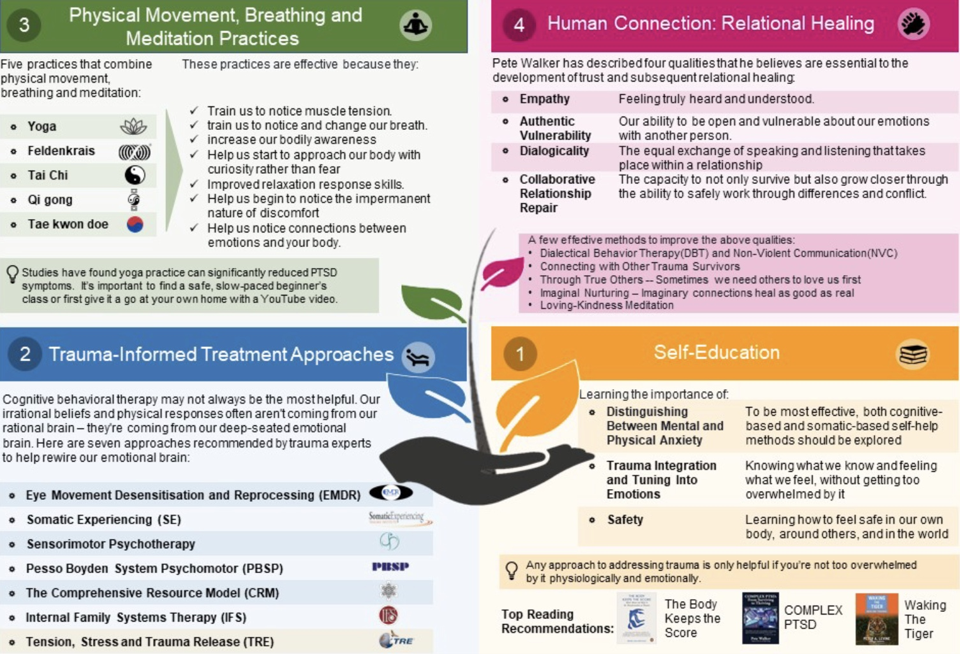
The four Pillars of trauma recovery
Notes:
Conventional psychiatric and psychological approaches are often not helpful in people with attachment and trauma spectrum disorders. Since the "rediscovery" of these disorders in the 1980s, there is an emerging consensus that their treatment rests on four pillars…

Slide 73
STAGES = WHEN WE DO THINGS (TIMELINE)
PILLARS = WHAT WE NEED (INGREDIENTS)

Slide 74

3. SWITCHING FROM A DBT TO AN IFS MAP
“What is this thing we call a self, when there seem to be so many agencies within me, each with its own knowledge, dispositions, and will?”
Bernardo Kastrup in The Daimon and the Soul of the West

Slide 75
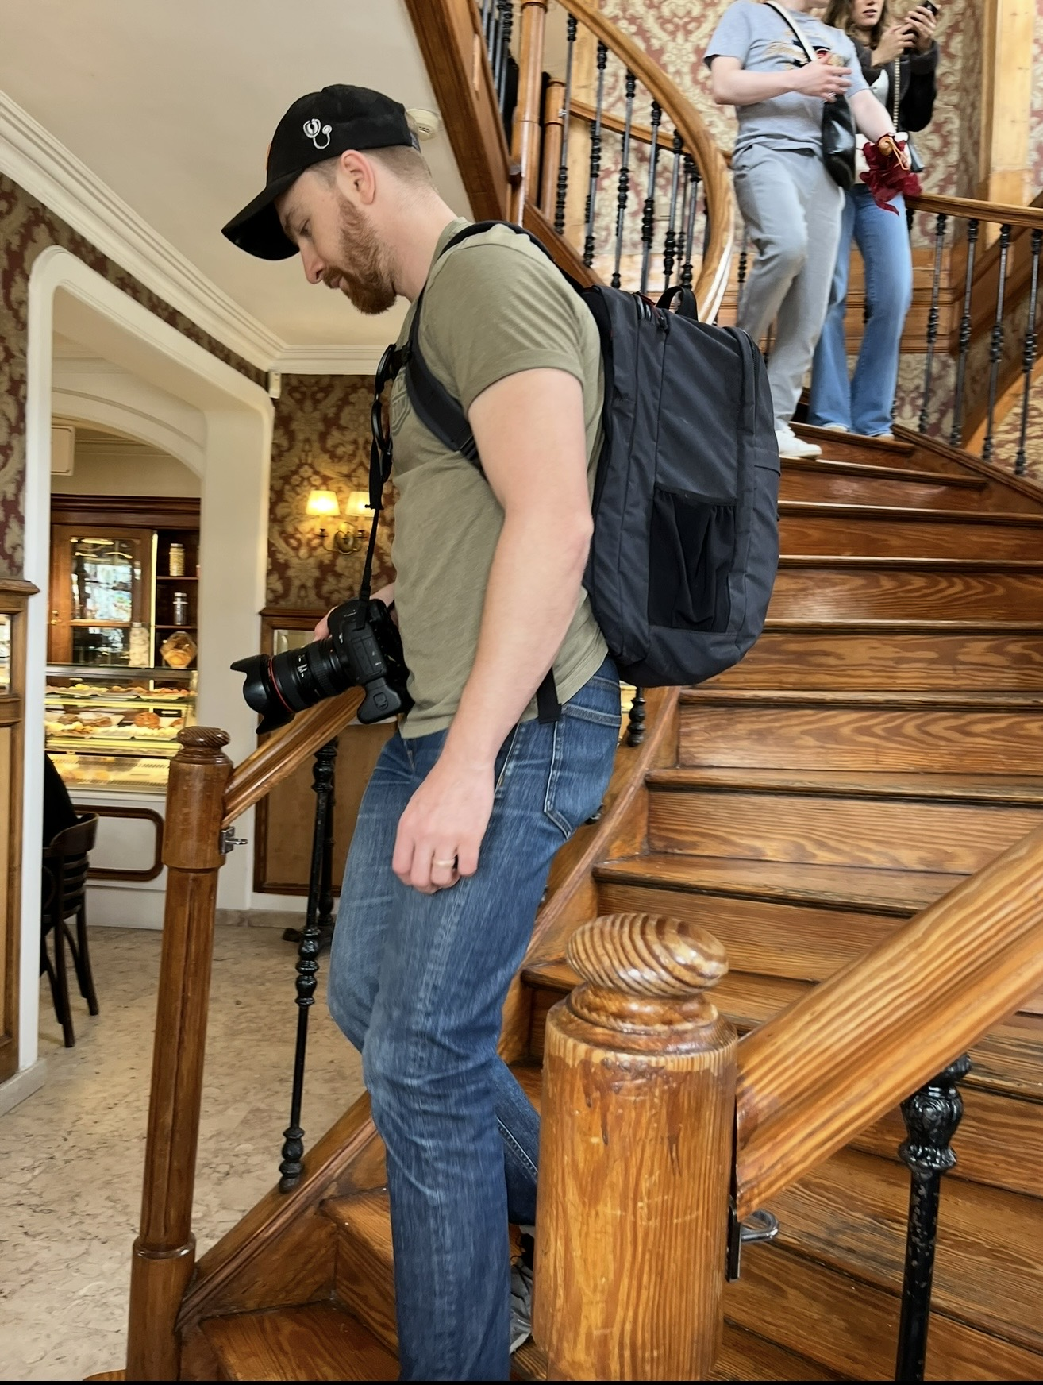
Welcome Stu Dow MSW.
IFS therapist

Slide 76
WEEK 22 – TRANSITION TO TRAUMA PROCESSING
• Wrapping up DBT
Trauma therapy frameworks
Overview of sessions 22-29
Maps for healing
Why IFS?
IFS includes and transcends
Same holes different maps
WEEK 23 – ORIENTATION TO THE IFS MODEL
• What is IFS?
• How it integrates prior models
• How to find parts using trailheads
• Roadmap for the next 6 weeks

Slide 77

OVERVIEW OF WEEKS 22–29
Remember that one of the main goals of the simple course is to help us get out of the “holes in the sidewalk” we regularly fall into more quickly and eventually avoid these holes altogether.
To do this, we started by naming these holes (targets for change) and listing them in our holes diary cards.
Then, over the past several months, we explored tools, skills and maps to help us understand the holes and heal ourselves. We discussed DBT skills and models of trauma and attachment.
In this last section of the course we turn toward a model that integrates much of what previously discussed: Internal Family Systems.
This and the next week, weeks 22 and 23, will orient us to IFS.
In weeks 24 to 29 we will work through Richard Schwartz’s The Internal Family Systems Workbook which focuses on identifying our parts, understanding our protectors, contacting Self and unburdening our trauma.

Slide 78
Maps for healing

Slide 79
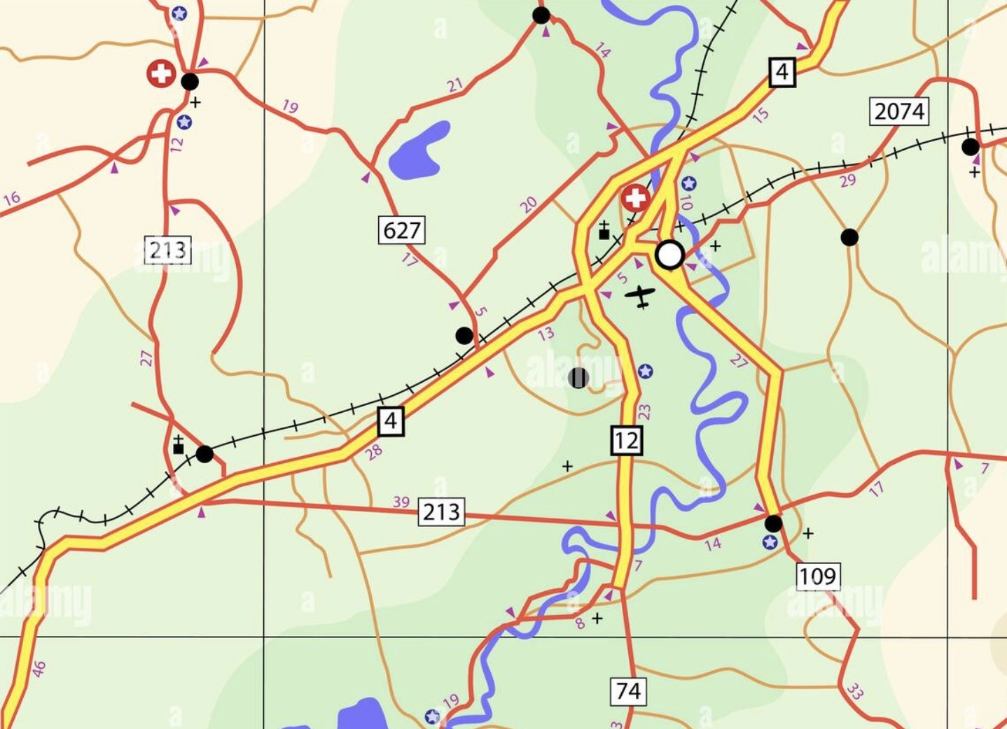

MAPS OF THE MIND
Not all maps show the same level of detail. The simplest maps are little more than lists of roads. They tell us how to get from point A to point B, but they don’t show us much about the surrounding landscape. We know where the roads are, but not what the territory is really like.
More advanced maps start adding context. They show landmarks, rivers, parks, mountains, and neighborhoods. These maps help us orient ourselves better. We begin to understand not just the roads, but the environment we’re traveling through.

Slide 80
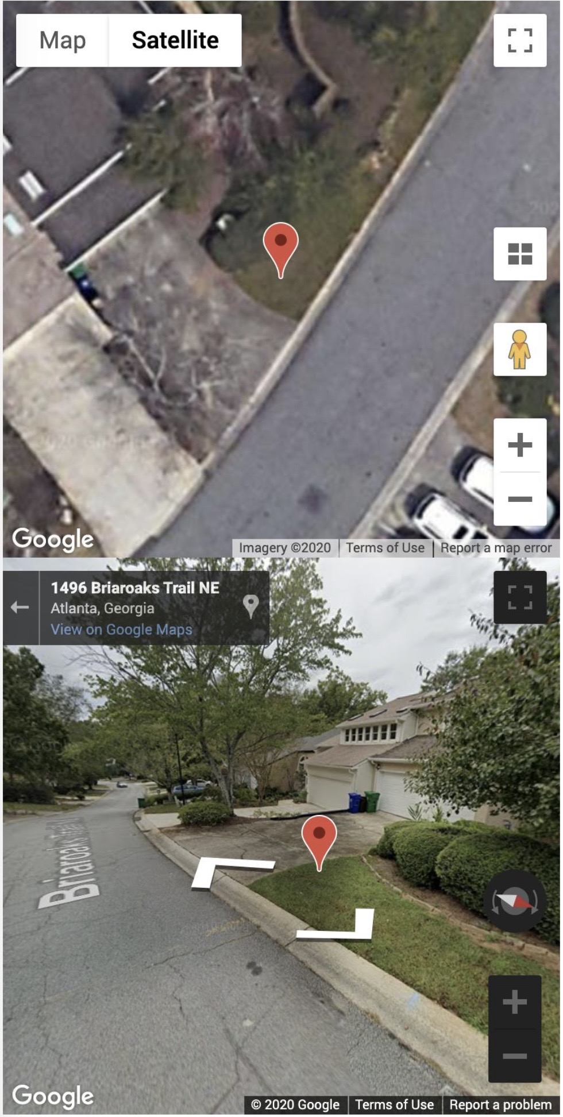
MAPS OF THE MIND
Then there are digital maps with 360-degree street view, like those in Google Maps. Such maps allow us to almost stand inside the environment. We can turn in different directions, see buildings, notice the terrain, and get a much richer sense of where we are and how to navigate.
Each kind of map can still get us somewhere, but the richer the map, the easier it is to understand where we are and how to move forward.
Better maps of the mind make healing easier.
Biological psychiatry gives us useful but simple maps.
Psychological and trauma models give us richer ones.
Internal Family Systems includes but goes beyond biological and psychological maps by offering a multidimensional map of the mind and a clear pathway for healing.

Slide 81
How does IFS include or integrate other theories and models we have already discussed?

Slide 82
Integration (IFS — biopsychosociospiritual)
IFS includes but goes beyond biological and psychological models.
Psychological Model (attachment, trauma, instincts)
Biological mechanism (neurotransmitters circuits etc.)

Slide 83
Throughout the course we’ve been exploring different maps of the mind.
Biological psychiatry describes suffering using diagnoses like depression or anxiety and focuses on brain circuits and medications.
Psychological models expand that map by helping us understand attachment patterns, trauma responses, and nervous system states like fight, flight, or freeze.
Internal Family Systems includes those insights but goes beyond them by giving us a map of a family of parts that make up our minds, protect us and carry our wounds. At the center of that map is Capital S Self.
In the IFS model, healing happens when the parts learn to trust Self and allow it to lead the family. In this process our wounded parts release the burdens they took on through trauma and attachment issues.
Biological and psychological models help us navigate the territory of the mind, but IFS helps us meet and care for the parts of us that inhabit that territory.

Slide 84
DBT helps us manage our reactions.
IFS helps us understand the parts of us that are reacting.
Up until now, we’ve been working with thoughts, feelings, and behaviors. IFS invites us to meet the parts of us that generate them.

Slide 85
MAPS OF MIND AND HOLES
Different maps of the mind use different names for the holes we fall into. Remember however that they are describing the same terrain.
Biological Map → Diagnostic Holes: When we use a biological psychiatry map, the holes we identify are diagnoses: Depression, Anxiety disorders, ADHD, Dissociative disorders etc.…
Diagnosis tell us something important about our mental health, but they are not very specific.
The main interventions the biological maps point to is medication and biological stabilization. These may be helpful but they are often not sufficient for deeper healing.

Slide 86
MAPS OF MIND AND HOLES
Psychological Maps → Developmental or Trauma Holes: Psychological models give us more detailed descriptions of the holes we fall into.
Attachment theory describes holes such as avoidant, anxious and disorganized attachment.
Structural dissociation trauma theory describes holes such as dissociated emotional parts. (EPs and ANPs).
Polyvagal theory describes holes such as chronic sympathetic activation, and dorsal vagal shutdown.
These psychological models include biology but transcend it by explaining how experiences and relationships shape who we are. They help us understand how, over time, our holes developed.

Slide 87
MAPS OF MIND AND HOLES
IFS Map → Parts Carrying Burdens: IFS goes one step further than the biological and psychological maps. Instead of describing the holes as a diagnosis or psychological concepts, it identifies part selves, within the psyche, that embody the holes.
What biology might call depression IFS might see as a hopeless exile, a self-critical manager or a numbing firefighter.
What attachment theory calls avoidant attachment IFS might see as a protective distancing manager or a parts that suppresses vulnerable feelings.
What structural dissociation calls Emotional Parts IFS might see as exiles.
In IFS the “holes” we fall into are associated with a specific part carrying a specific burden, which can be approached directly with compassion and Self leadership.
Different models use different languages but describe the same territory.
IFS may not be the territory itself, but it is one of the most complete and intuitive maps we currently have for understanding who we are and how healing can happen.

Slide 88
HOW IFS INTEGRATES MODELS WE PREVIOUSLY EXPLORED
Previous Model | How IFS Integrates It
Polyvagal theory | Parts often correspond to nervous system states
Attachment theory | Parts carry attachment wounds
Trauma theory | Exiles carry traumatic burdens
DBT | Skills help regulate protectors

Slide 89
IFS IS A MORE COMPLETE VIEW OF THE MIND
INTERNAL FAMILY SYSTEMS
(Parts + Self leadership + healing) Includes: • Trauma theory • Attachment theory • Polyvagal states • Cognitive patterns • Inner multiplicity • Spiritual dimension (Self)
↑
TRANSCEND
│
PSYCHOLOGICAL MODELS
(Attachment, DBT, trauma theory, polyvagal theory) Includes: • Thoughts • Emotions
• Relationships • Meaning • Behavioral patterns
↑
TRANSCEND
│
BIOLOGICAL MODELS
(Neuroscience, brain circuits, medication) Focus on: • Neurons • Neurotransmitters • Brain networks • Physiology

Slide 90
RICHER MAPS LEAD TO DEEPER HEALING
INTERNAL FAMILY SYSTEMS (360° view of the psyche) • Mind understood as a system of parts • Trauma held in exiles • Protective parts organized around safety • Healing through Self leadership • Integrates biological, psychological, relational, and spiritual dimensions
Includes + Transcends ↓
PSYCHOLOGICAL / TRAUMA MODELS (Attachment, polyvagal theory, trauma theory) • Nervous system states (fight, flight, collapse) • Developmental attachment patterns • Trauma stored in the body and mind • Healing through relationship, regulation, and meaning
Includes + Transcends ↓
BIOLOGICAL PSYCHIATRY (Basic road map) • Brain circuits • Neurotransmitters • Genetics • Diagnosis and medication treatment

Slide 91
DIFFERENT MAPS OF THE SAME INNER TERRITORY
DSM DIAGNOSIS
(Depression, Anxiety) What part feels this way?
STATES OF ACTIVATION
(Fight • Flight • Freeze • Fawn) What part goes into this state?
ATTACHMENT STYLES
(Avoidant • Anxious • Disorganized) What part learned this strategy?

Slide 92
MECHANISM → MODEL → INTEGRATION
One of the goals of the simple course has been to expand our mental health “maps” in order to more accurately reflect the territory of the mind.
We started from the mechanical reductionistic map that biological psychiatry offers us with its neurotransmitters and synapses. We then spent much of the course considering to psychological maps.
For the remainder of the course we’ll again switch maps to an integrative and intuitive biopsychosociospiritual one; Internal family systems.
The arc of the course has been from mechanism to psychological model and finally now to integration.
Biological mechanisms: In biological psychiatry, diagnosis is based on mechanisms, neurotransmitters, synapses, and circuits. This map can be very helpful:
Depression → serotonin, dopamine
Anxiety → amygdala activation
ADHD → executive circuitry
Trauma → stress hormones
That’s a mechanical map, useful but limited.

Slide 93
MECHANISM → MODEL → INTEGRATION
Psychological models: As the course progressed, we widened our map. We began looking at the instincts that underlie emotions and how they are affected by attachment patterns and trauma.
Psychological models aren’t just mechanisms. They don’t just ask ‘What neurotransmitter is low in this person’s brain?’ They ask ‘What happened to this person?’ ‘What did their nervous system learn?’ ‘What attachment patterns formed?’” Psychological maps are more complex, feel more human and explains the mind better.
Integration: All year, we’ve been building towards what we’ll be doing now: integration.
Internal Family Systems doesn’t reject biology, trauma theory or attachment. It includes and transcends those perspectives. It gives us an integrative and intuitive biopsychosociospiritual map of the mind.
In this session, the last one before we begin to work our way through the internal family systems workbook, I want to summarize the overlap, similarities and differences between the conventional biological psychiatry mechanistic diagnostic approach, the psychological perspective and IFS.

Slide 94
METAPHYSICS A REVIEW
PSYCHIATRY’S PROJECT
Identify malfunction
Correct mechanism
Reduce symptoms
IDEALISM
Consciousness is primary
Matter appears within consciousness
Mind is fundamental
PHILOSOPHICAL MATERIALIST
Matter is fundamental
Brain produces mind
Neurons → chemicals → symptoms
Consciousness emerges from biology
The materialist reductionistic mechanistic map works well for issues such as strokes, delirium, epilepsy and severe psychosis.
It struggles to explain meaning, shame, grief, attachment longing, inner multiplicity, the experience of self and spiritual experience.

Slide 95
DIFFERENT APPROACHES DIFFERENT METAPHYSICS
In our session on spirituality, we touched on metaphysics which among other questions asks, “what is the fundamental nature of the Universe?”
A subtle but very important point that no one may have noticed is that as we’ve expanded our perspective from mechanism to psychological models to IFS, our underlying metaphysics has quietly changed from materialism to idealism.
Biological psychiatry largely rests on a materialist metaphysics. Malfunctioning neurons → chemical imbalance → symptoms.
The approaches that feel (to me at least) most intuitive, and closer to the truth; Jungian psychology, Ignatian spirituality, and IFS don’t merely add spirituality onto a materialist metaphysics. They assume an idealist metaphysics. These models feel more intuitive because they rest on a different assumption about what is the fundamental nature of the Universe.
In an idealist metaphysics consciousness is fundamental. Matter appears within consciousness. The brain does not produce mind; it mediates or filters it.
IFS’s Self is not a byproduct of neurons, it is a spiritual concept that transcends the individual. For a long time, Richard Schwartz avoided mentioning this for fear IFS wouldn’t be accepted. In recent years he has been more open about it.

Slide 96

Some wisdom traditions suggest that when we are born, we don’t become truly separate from the larger mind or reality — we just experience ourselves as separate. It’s a bit like being a wave that forgets it’s part of the ocean. Spiritual experiences — like deep connection with ourselves, others, nature, or meaningful work — may be moments when that sense of separation softens. In IFS terms, Self can be understood as our inner connection to this deeper wholeness. Just as secure attachment connects us to a caring person in the outer world, connection to Self is like secure attachment to the deeper ground of being within us.

Slide 97
Why IFS and why now ?

Slide 98
WHY IFS?
1. IFS is a stage 2 trauma processing approach which helps us to work directly with our wounded parts.
2. IFS integrates everything we’ve previously learned
3. IFS provides an intuitive and very compelling map of the psyche
4. IFS allows us to interact directly with our unconscious
5. IFS can be self-directed

Slide 99
My take on ifs

Slide 100
MY TAKE ON IFS
After you’ve been in psychiatry for a while, you develops a healthy skepticism for the new fashionable therapeutic approaches that are constantly being developed. You watch these new approaches arrive with great enthusiasm, each promising to be the model that finally transforms psychotherapy.
The old adage that what is helpful about many of these new approaches is not new and what is new is not that helpful always seemed right to me.
Some approaches do bring something genuinely valuable, but over time their limitations become clearer. They settle into a more modest role, helpful, but partial.
Internal Family Systems feels different to me. Not because it claims to replace what came before, but because it seems to integrate much of what we have already learned in this course.
It resonates deeply with depth psychology (Freud and Jung) in its serious engagement with the unconscious, not as something vague or symbolic, but as a living inner world with structure, intention, and history.
It fits naturally with trauma theory, where symptoms are understood as adaptations rather than pathologies
Strikingly, it also aligns with spiritual traditions that speak of a compassionate, witnessing awareness capable of holding suffering without being overwhelmed by it.

Slide 101
MY TAKE ON IFS
What is most compelling about IFS is how, for so many people it accurately reflects their lived experience.
People already know, intuitively, that they are not a single, unified self. They say, “Part of me wants this, part of me doesn’t,” or “Something in me takes over.” IFS doesn’t impose a foreign framework; it gives language and structure to something people already feel.
At the same time, IFS avoids the abstraction that can distance other depth approaches from everyday clinical work. It is practical without being reductive, relational without being sentimental.
Ethically, IFS carries the deeply humane stance that every part of us makes sense in context, that even our most troubling patterns began as attempts to protect, and that healing comes not through elimination or control, but through understanding and relationship.
I don’t believe IFS is a complete map of the human mind, nor do I think it will fully replace other approaches. But my sense is that it may endure in a different way, not as a passing fashionable fad, but as a foundational framework.
In that sense, IFS feels less like a trend and more like a classic, a way of seeing the human psyche that integrates what we have learned about suffering, adaptation, meaning, and compassion and does so in a way that feels both clinically grounded and deeply true.

Slide 102
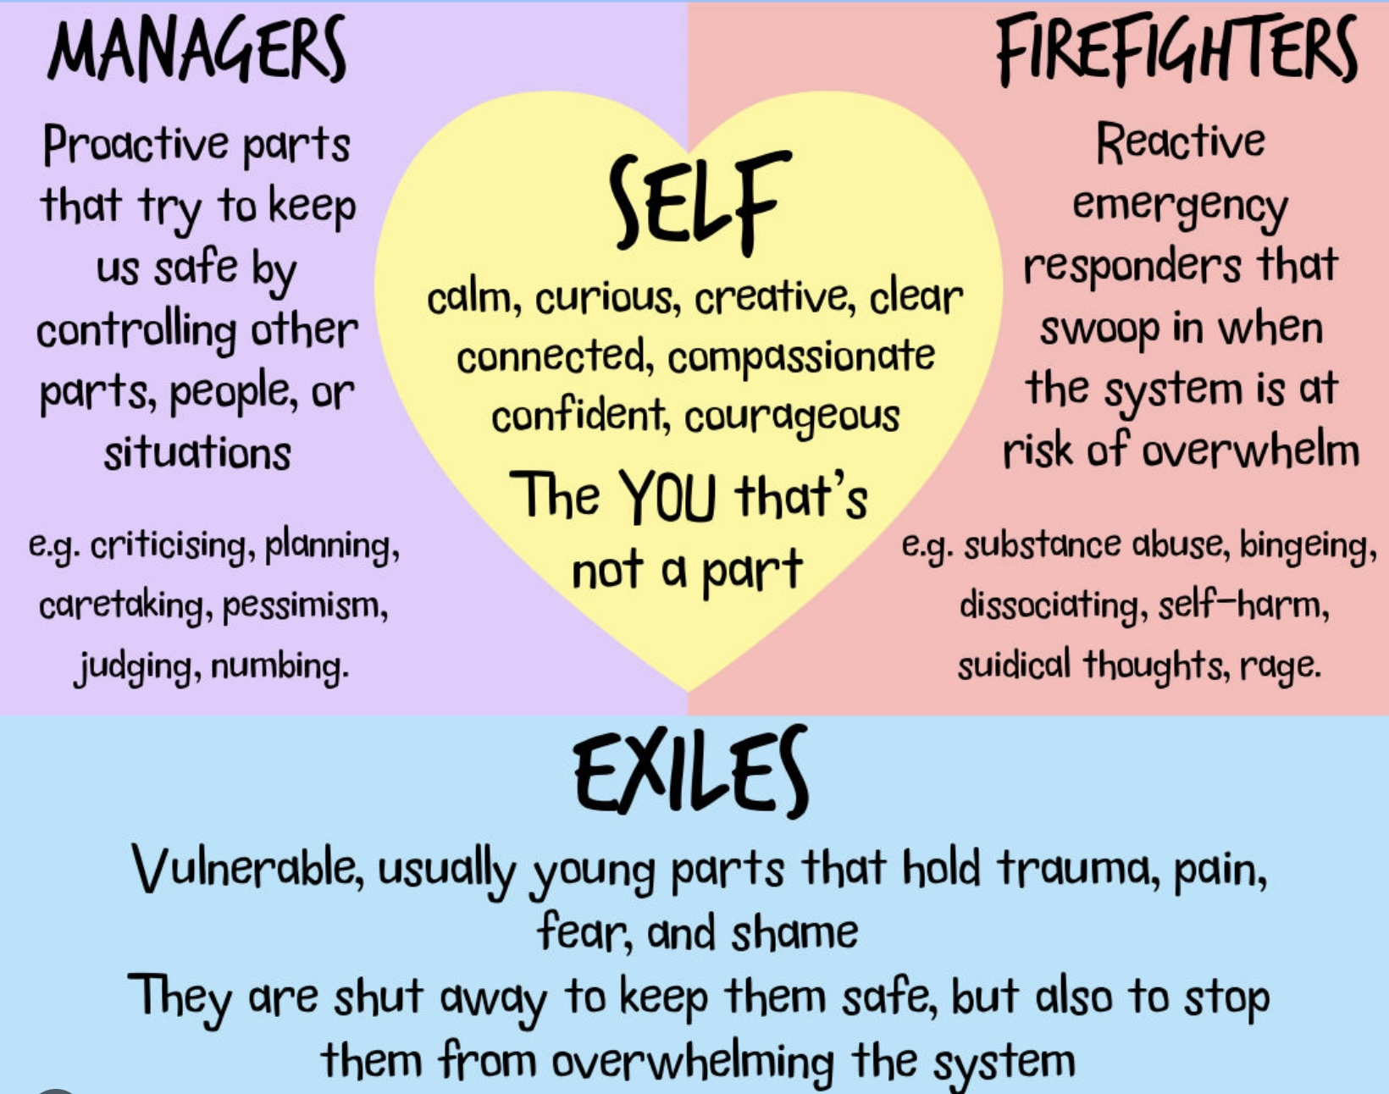
NEXT WEEK
Which we’ll start today time permitting
Origins of internal family systems
An overview of IFS
My take on IFS
The 4 types of parts
Burdens
The self
Interactions between the parts
Healing in IFS
Unburdening parts
Therapist parts
Accessing your capital S Self
Identifying parts
Integrating IFS spirituality and other models we’ve previously considered

Slide 103
What is the origin story of internal family systems?

Slide 104

The idea that the human mind is controlled by unseen forces has a long history.
Hindu, Greek and Roman mythology saw a whole host of gods as influencing human affairs and the Human mind.
These gods had distinct personalities, domains they reigned over (like war, love, the sea), and favored or punished individuals or cities. Other entities such as spirits, daimons, and fates also played roles.
Jewish and Christian theology, introduced the notion of one omnipotent God. It nevertheless retained a complex spiritual realm that included angels, archangels, demons and The Holy Spirit.
Christianity also holds that many spiritual beings can influence the human mind. For example: Angels protect or communicate with humans. Demons tempt, oppress, or possess. The Holy Spirit inspires prophecy, inner conviction, and transformation.
THE PERENIAL ROOTS OF IFS

Slide 105

Long before IFS, Ignatian spirituality assumed that the human person is not a single, unified voice but a field of inner movements, desires, fears, impulses, and consolations, some leading toward life and some away from it.
Ignatius of Loyola invited people to notice these inner voices with curiosity and discernment, rather than suppressing or automatically obeying them.
Jungian psychology carried a similar insight. Jung saw the psyche not as one unified self, but as a living system made up of different inner figures and forces, such as archetypes and complexes, each with its own influence on our thoughts, emotions, and behavior.
THE PERENIAL ROOTS OF IFS

Slide 106
THE IDEA OF MULTIPLE MINDS APPEARS IN MANY TRADITIONS
Ancient religions- inner spirits or forces
Jung- complexes and archetypes
Psychoanalysis- parts of the psyche, id, ego, superego
Trauma theory- dissociated parts

Slide 107

Paul Federn
A BRIEF HISTORY
OF MIND
In modern times, Freud thought of the psyche or mind as being influenced by three distinct entities the id, ego, and superego.
In Freud’s lineage Paul Federn (1871-1950) an Austrian-American psychoanalyst and an early follower of Freud thought the mind was made up of more than just three parts. Federn’s idea was taken up and further developed by Italian psychoanalyst Edoardo Weiss (1889-1970) who then inspired John Watkins’s work.
John Watkins (1913-2012) is best known for his work in the areas of hypnosis, dissociation, and multiple personalities. Along with his wife Helen, he conceptualized the mind as being composed of multiple parts. Watkins was the first to develop this idea into a psychotherapeutic approach.
Richard C. Schwartz an American psychologist and family therapist popularized this multiple part approach to understanding the mind and called it Internal Family Systems. This approach is in many ways like ancient mythologies.
Richard C. Schwartz.
Notes:
Yes, let's briefly look at the history of internal family systems.

Slide 108
An overview of internal family systems

Slide 109
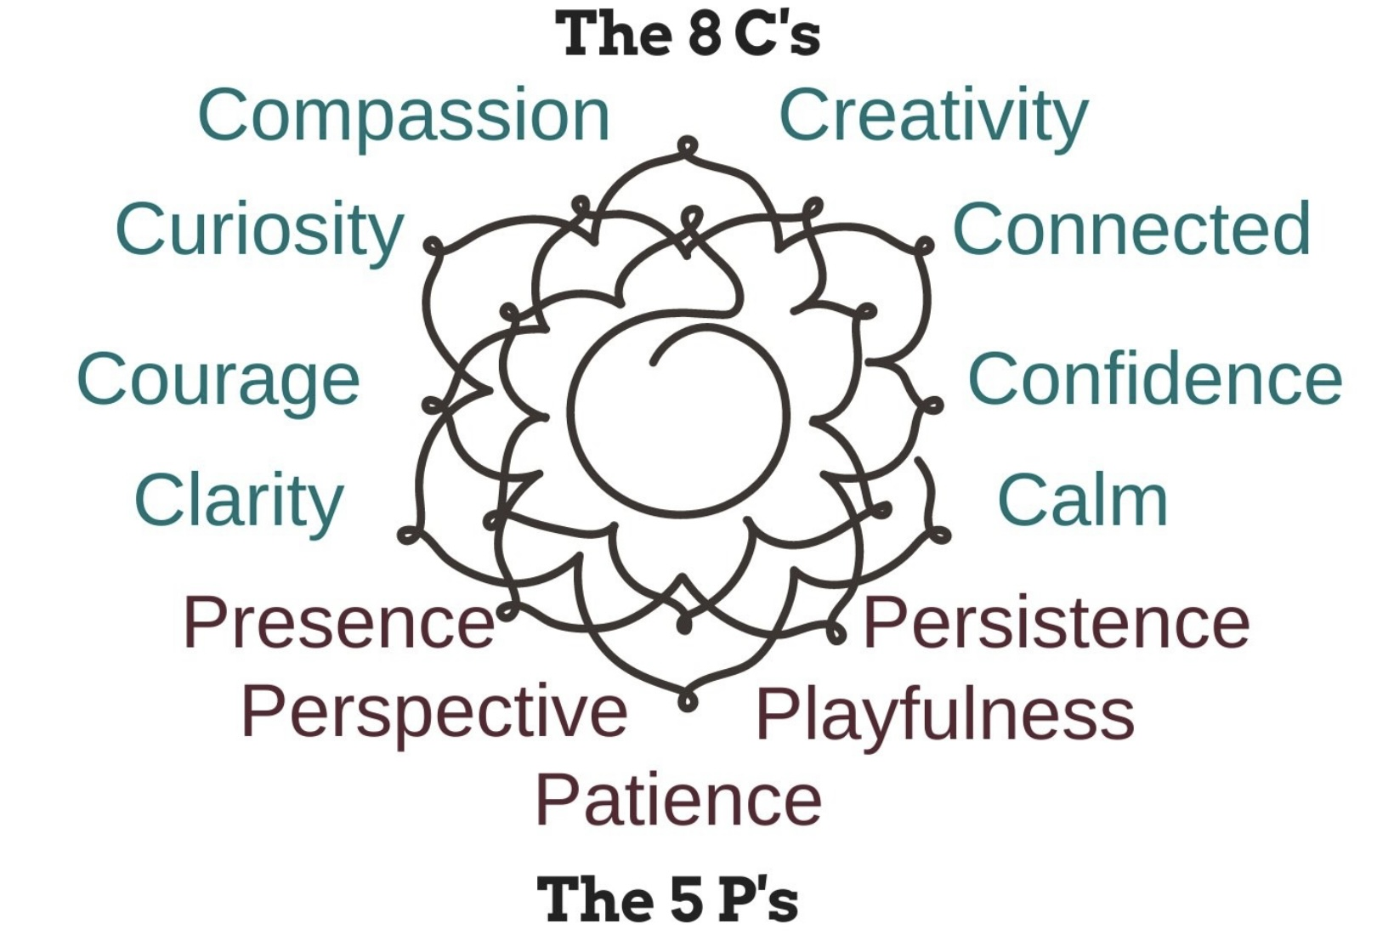
IFS AN overview
Like other approaches before it (CBT, DBT, EMDR etc.), IFS is today having its moment in the limelight.
Richard C. Schwartz who popularized the approach was inspired to start thinking in this way as he worked with patients suffering from eating disorders who he often heard say: “a part of me thinks, feels, or wants x… but another part, thinks, feels, or wants y…”. He took this literally and started asking his patients to tell him about their different parts.
IFS sees everyone’s mind as consisting of discrete subpersonalities or parts. The difference between a psychologically healthy person and one that struggles, is that in the former, parts are “unburdened” whereas in the latter they are “burdened”.
Parts become burdened by painful experiences or as survival adaptations in people with insecure attachment and/or trauma. Many burdened parts arise in infancy and childhood, but burdened parts can also develop later in life.
.

Slide 110
IFS AN overview
According to IFS, at a person’s core is the True Self, a concept that is somewhat like Wise mind.
The True Self, much like Wise mind or (Daniel P. Brown’s) ideal parent, is compassionate, creative, connected, confident, calm, curious, courageous, clear, present, persistent, playful, patient and has perspective. (Schwartz’s 8C’s, 5P’s.)
Different burdened internal family parts may be in conflict with and fighting each other. When this happens, Self may be hard to hear above all this noisy commotion, and conflict.
Each internal family part has its own feelings, perspective, interests, memories, viewpoints, and will to survive.
Each part has an origin story in the individual's life and is an adaptation needed to survive the circumstances at that time.
Individual parts may not be aware that they are part of a greater whole. Sometimes they are not aware of each other.

Slide 111
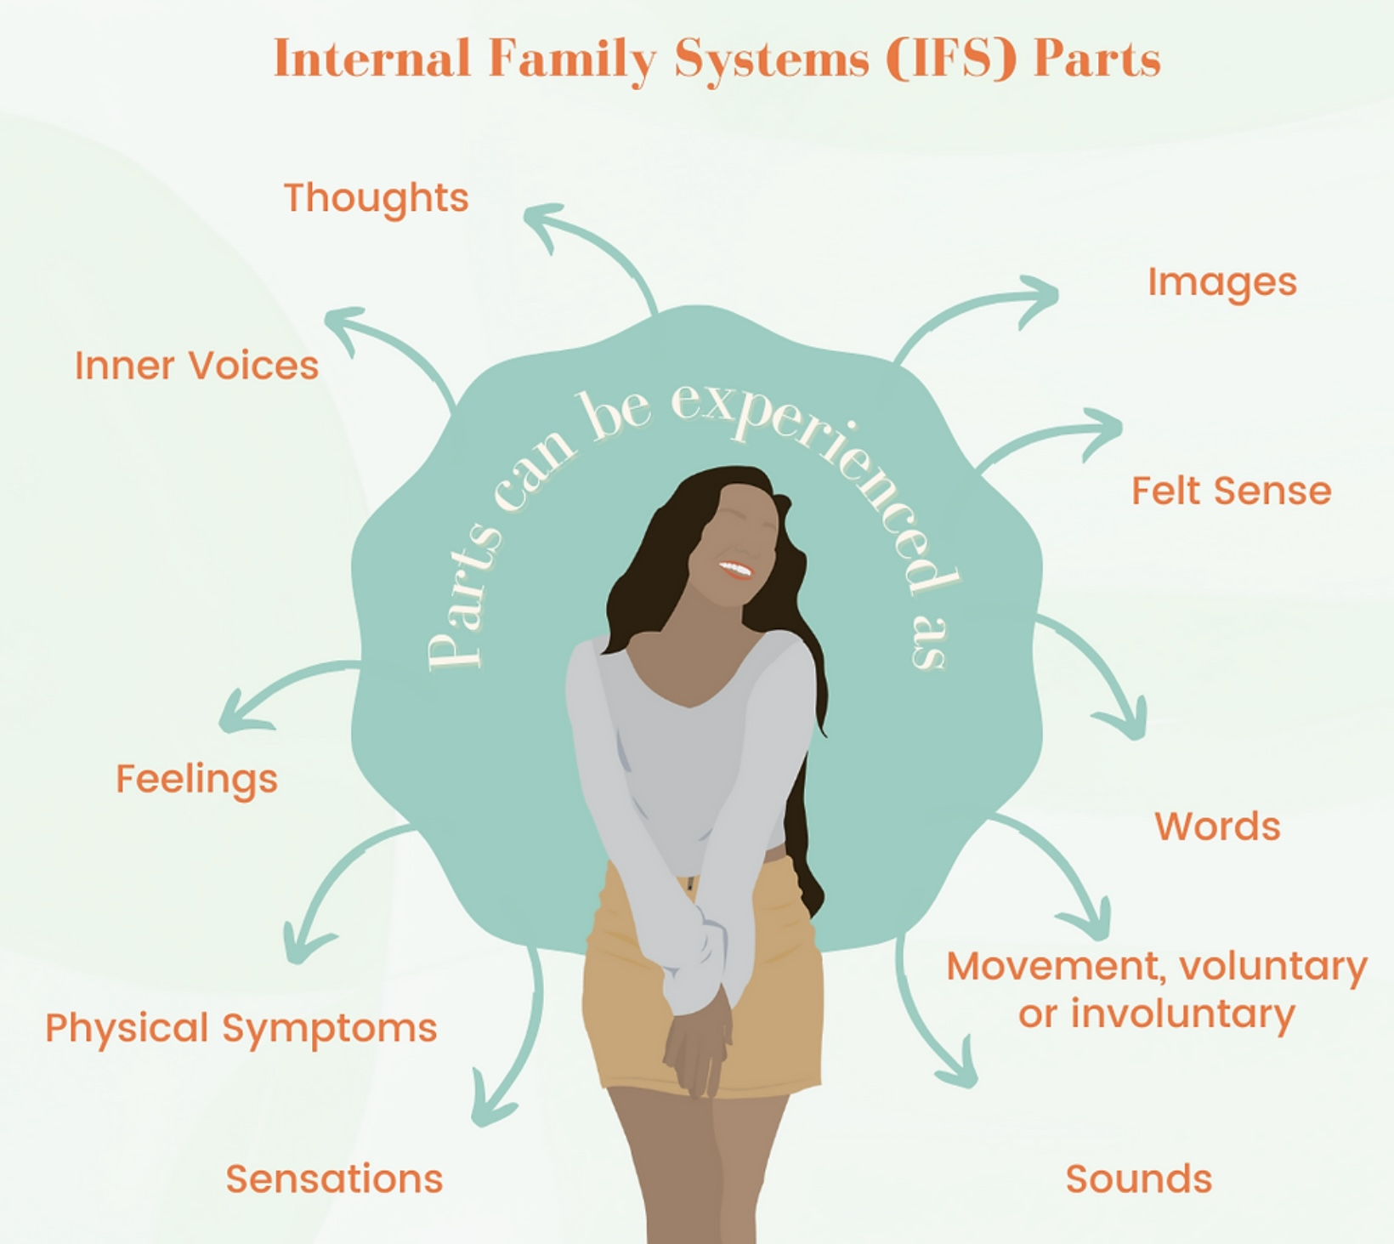
IFS AN overview
At various points in time, different parts may become dominant in the “self-system”. When a part dominates or takes over, the person is said to have become blended with that part. More than one part can be activated at the same time.
Parts that are activated at the same time interact with one another often in conflict but sometimes as allies.
Being emotional, parts don’t have the rational brain’s ability to distinguish one person from another or the past from the present. They are what is called frozen in time. That is why people react emotionally to someone in the present as if they were someone from their past.
The goal of IFS is to bring harmony to the internal family as the parts learn to trust the Real Self/Wise/Ideal parent which sees and empathizes with all of them.
Trusting wise mind, parts then allow it to lead the internal family system.

Slide 112
The 4 types of ifs parts

Slide 113
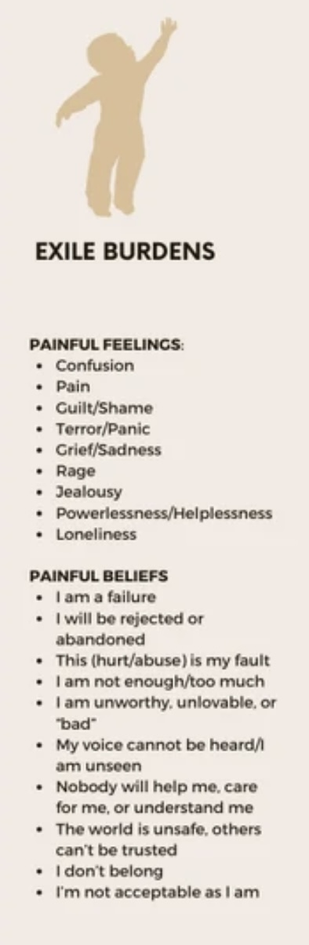
EXILES
Exiles are typically young, vulnerable parts that have experienced distress and/or trauma.
Because they carry so much pain, which the person feels when they emerge into awareness, they are isolated or exiled from the conscious mind for their own and the mind’s protection.
Exiles constantly seek to be heard and validated and often resort to extreme measures in their efforts to try to escape the silence they are condemned to in their prison or exile
Exiles live in trauma time in that they are frozen in the past when the trauma occurred, their identity is the trauma.
When exiles escape their confinement and emerge in consciousness, the person reexperiences the emotions and sensations that occurred at the time of the trauma.
Exiles appear as flashbacks or in nightmares. These are the “burdens” or pain of past traumas.
Notes:
Let's first talk about the exiles. In a person there can be one or several exiles. We said that they are the dissociated traumatic complexes which carry the pain of the trauma.…

Slide 114
EXILES
Exiles sometimes reenact the original trauma by seeking out and being in relationship with someone who resembles an abusive caregiver or partner from the past. They seek what is familiar.
This is their attempt at a “redo”. They try to fix the past and escape their trauma by getting into a situation similar to the one that traumatized them hoping that this time the outcome will be different and they will be seen, heard understood responded to appropriately, taken care of or saved.
Ex. They will fix an abusive partner with their love or control and then get from them the love and appreciation they never got from an abusive parent.
Notes:
Let's first talk about the exiles. In a person there can be one or several exiles. We said that they are the dissociated traumatic complexes which carry the pain of the trauma.…

Slide 115

PROTECTORS: MANAGERS AND FIREFIGHTERS
Two types of parts are charged by the small s self system with protecting it from the pain of past trauma and attachment issues carried by the exiles these are the
1) managers and
2) firefighters.
The role of both the managers and firefighters is to keep the exiles imprisoned or safely in exile so that they don’t overwhelm the conscious mind with their pain.
Protectors use many different defense strategies such as intellectualizing, denial, distraction, criticism, and control to accomplish this.
Managers are proactive and tend to be socially approved.
Firefighters are reactive, and they’re often not very welcomed by other parts.

Slide 116
1) Managers are the front-line “staff” working day in and day out to keep the exiles contained.
2) Firefighters are only called in when the exiles have overwhelmed the managers who can no longer contain them in the usual manner .

Slide 117
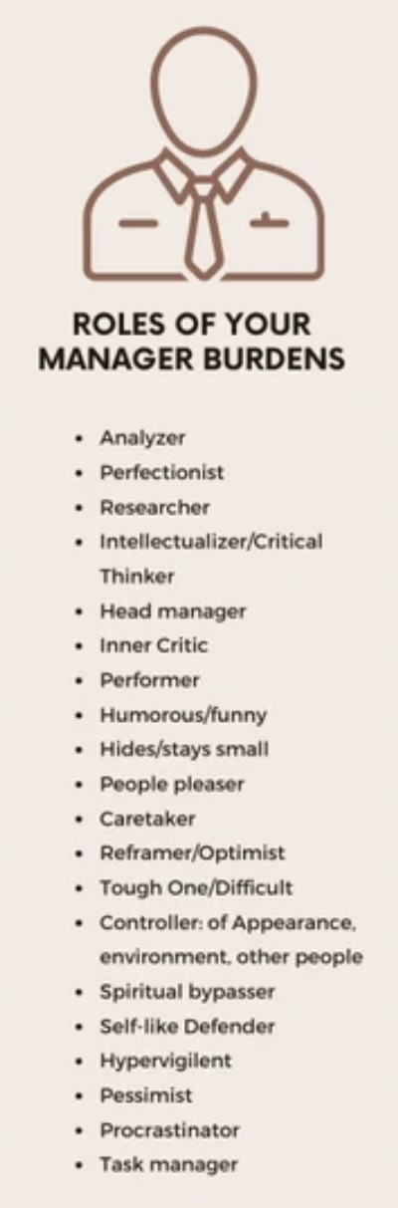
1) THE MILDER MANAGERS
The managers are milder and often reasonably well behaved. They work on avoiding any situation which might trigger an exile to escape.
Managers present as part selves that are controlling, perfectionistic, overly intellectual, obsessive, or self/other critical.
They can also be reclusive, passive, emotionally detached, phobic, or hyper alert.
Remember that the managers do all this to keep the pain carried by the exiles at bay. If we deliberately try to stop the managers from doing what they do, for example through behavior modification, the exiles, and their pain, may then surface.
This is why people with trauma are often perfectionistic, obsessive, driven, or can’t stand still.
Stopping these behaviors without understanding what we are doing may cause a lot of pain. This is one of the problems with CBT strategies such as exposure and response prevention.

Slide 118
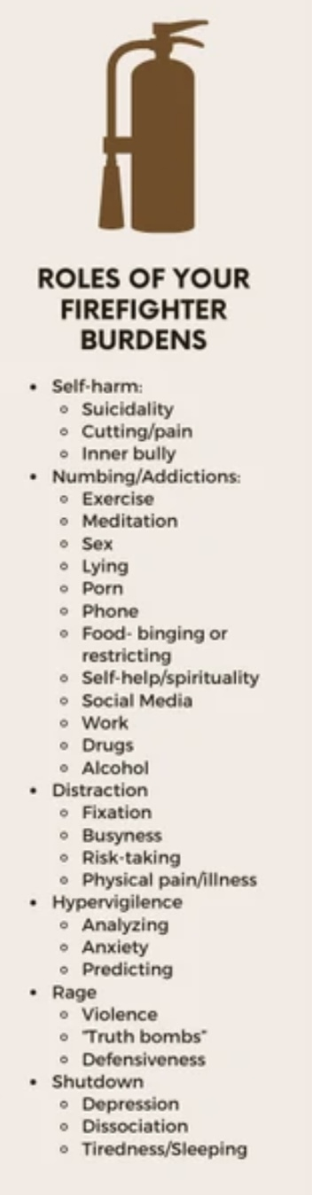
2) THE FIERCE FEARLESS
FIREFIGHTERS
Remember that the firefighters take over only when the exiles have escaped the control of the managers, and the pain the exiles carry emerges into consciousness.
Unlike the milder managers, firefighters tend to be impulsive reckless and destructive. Their job is to extinguish or put out feelings, thoughts, body sensations, memories, images, and anything else associated with the trauma that the exile is carrying. Their job is to get rid of the pain no matter what the cost. When they are done, they often leave a mess behind.
Typical firefighter behaviors, thoughts, and feelings include abusive drinking, drug use, eating and all addictive behaviors, self-harm and suicidal ideation, rage, violence, impulsivity and dissociation.
Firefighters can be reasonably well behaved, socially acceptable and resemble managers for example when they manifest as excessive reliance on TV, Internet, computer games, shopping, exercising, sleeping, or working.
They can also be poorly behaved and socially unacceptable when they manifest as addictions, affairs, rage, violence, abusive behavior, suicide, crime, stealing, self injury, or eating disorders.
The behavior of the firefighters is often harshly disapproved of by the managers and the mature adult, and this can trigger further cycles of destructive behavior.

Slide 119
Managers → prevent everyday pain
Firefighters → stop pain when it breaks through
Manager: perfectionism
Firefighter: drinking

Slide 120

Sometimes a protector becomes so extreme (rageful, addictive, dissociative, self-attacking) that the rest of the system turns against it: “You are too much. You’re causing problems.” So that protector itself gets pushed away or suppressed.
Exiled protectors still believe they are protecting, often feel misunderstood or blamed and can carry shame about their own strategies.
Example: A child grows up in an unpredictable, emotionally unsafe home. When attachment pain overwhelms them, a firefighter part develops. Its strategy may be to binge eat, drink, self-harm or erupt into a rage. All these behaviors serve to shut down pain when it floods the system.
These behaviors cause the self system significant problems which other parts fear, and will try to suppress, disown or shame. These parts don’t disappear they go into exile underground.
EXILED PROTECTORS

Slide 121
EXILED PROTECTORS
Ex. A 42-year-old professional woman with complex trauma who presents as controlled, competent, and high-functioning. She hasn’t binged in years but after a very stressful situation, she suddenly feels flashes of rage and urges to drink.
From an IFS perspective a firefighter part once used anger and alcohol to shut down terror. That part was hated and banished into exile. It now emerges when the competent managers fail to handle the pain.
An ordinary firefighter says: “Let me handle this.” in contrast an exiled firefighter says: “I’m not allowed to exist… but I still have to act when things get bad.”
An exiled firefighter is a part that once saved us in extreme moments but later got shamed and pushed away for the very strategies that kept us alive.

Slide 122

THE MATURE ADULT
In IFS we often talk about Self as the seat of calm, compassion, and perspective. But in everyday life, many of us don’t access Self very often.
What we access instead is something I call the “mature adult.” The mature adult is not emotional; it’s rational, thoughtful, and goal-oriented. It’s the part of us that understands consequences, makes plans, sets limits, and tries to keep life running. In that sense, it’s a real strength.
I think of it as a part, because it gets into arguments with our emotional parts. It can be impatient with them, critical of them, or try to override them and unlike Self, it doesn’t automatically relate with curiosity or compassion, it relates with logic, persuasion, and control.
Self has a perspective on parts. The mature adult is in the system, negotiating and sometimes fighting with them. It’s wise, but not spacious. Helpful, but not healing by itself.
In our work, we don’t try to get rid of the mature adult. We help it step back just enough so that Self can come forward and so that the emotional parts can finally be understood rather than managed.

Slide 123
IFS itself does not use the term ‘mature adult.’ I'm using it to describe the rational manager part many of us identify with in daily life.

Slide 124
TAKEAWAY: IFS IN 3 SENTENCES
We all have parts
Parts developed to protect us
Healing happens when Self leads the system
Everything we discussed today and will explore in the coming weeks grows from these three ideas.
DBT helps us manage emotional storms.
IFS will help us understand the parts of us that create the storms.

Slide 125


