Slide 1
Week 23 of simple
OVERVIEW OF internal family systems
*please start recording at 9am*

Slide 2

Warning about meditation
Feel free to skip it. Followed by a moment of silence

Slide 3





Check in regularly with your Personal dashboard
Spend a few moments checking in with yourself by asking:
1)What is the current risk that I’ll experience a state of crisis ?
Low b) Moderate c) high d) very high e) extreme
2) Am I in the window of tolerance?
a) Yes b) I’m a little outside c) very outside
3) Where is my energy tank right now?
Full b) ¾ c) ½ d) near empty
4) Have I been tracking my targets using the holes diary card ? how would I rate my targets right now?
5) How well am I focusing on what I’m doing. (for example, the course)
CRISIS RISK
WINDOW OF TOLERANCE
ENERGY RESERVES
RATING MY TARGETS
ATTENTION METER
% attention I’m paying
100
0

Slide 4
AN IFS MINDFULNESS PRACTICE: MEETING OUR INNER WORLD WITH CURIOSITY
Settling (≈1 minute)
Let’s begin by finding a comfortable position— feet on the floor, or body supported by the chair.
If it feels okay, gently allow your eyes to close, or soften your gaze.
Take a slow breath in through the nose… and an easy breath out through the mouth. No need to change your breathing— just noticing it.
Noticing the body being breathed. Allow yourself to arrive here, exactly as you are.
Turning Attention Inward (≈1 minute)
Now, gently shift your attention inside. Not to fix anything. Not to calm anything. Just to notice.
You might become aware of sensations in the body— tightness, ease, restlessness, warmth, numbness.
Whatever is here is okay.
And you might also notice thoughts, images, memories, emotions, or a general sense of mood.

Slide 5
A FIRST IFS MINDFULNESS PRACTICE: MEETING OUR INNER WORLD WITH CURIOSITY
In this work, we call these experiences “parts.” Not parts in a broken sense— but parts as aspects of being human.
There is no need to name them yet. Just noticing something is here.
Meeting a Part with Curiosity (≈1½ minutes)
If it feels safe enough, see if one experience gently stands out right now.
It could be a feeling in the body, a worried thought, an urge to analyze, a sense of fatigue, or even a part that says, “I don’t like this.”
Whatever arises— see if you can turn toward it, with curiosity.
You might silently say: “I notice you.” or “I’m aware of you being here.”
You’re not trying to change it. You’re not trying to understand it fully. You’re simply allowing it to be seen.
Notice how you’re relating to this part. Is there openness? Impatience? Judgment? Distance?
Whatever your response is— that, too, is just another part. And that’s okay.

Slide 6
A FIRST IFS MINDFULNESS PRACTICE: MEETING OUR INNER WORLD WITH CURIOSITY
Introducing the Observing Self (≈1 minute)
Now, see if you can sense the place from which you are noticing. There is something in you that can observe thoughts, feelings, and sensations without being any one of them.
In IFS, we call this Self— the natural capacity for awareness, calm, curiosity, and compassion.
You don’t have to force this. Just notice: “I am the one who is noticing.” And from this place, see if you can offer the part you noticed a bit of kindness— like you might offer to a child or a friend.
Nothing dramatic. Just a gentle presence.
Closing (≈30–45 seconds)
As we come to the end of this practice, remember you didn’t do this wrong. Whatever showed up— or didn’t— was exactly right for today.
Over the coming weeks, we’ll get to know these inner parts more deeply, with respect and care, at a pace that feels safe.

Slide 7
A FIRST IFS MINDFULNESS PRACTICE: MEETING OUR INNER WORLD WITH CURIOSITY
For now, take one more slow breath in… and out. And when you’re ready, gently open your eyes, bringing this quality of curiosity with you.

Slide 8
SIMPLE COURSE SCHEDULE 2025-26
Week 1- October 1
Week 2- October 8
Week 3- October 15
Week 4- October 22
Week 5- October 29
Week 6- November 5
Week 7- November 12
Week 8- November 19
Week 9- November 26
Week 10- December 3
Week 11- December 10
Week 12- December 17
December 24 and 31
Week 13- January 7
Week 14- January 14
Week 15- January 21
Week 16- January 28
Week 17- February 4
Week 18- February 11
Week 19- February 18
Week 20- February 25
Week 21- March 4
March 11 and 18 no course
Week 22- March 25
Week 23- April 1
Week 24- April 8- Parlour*
Week 25- April 15
Week 26- April 22- Parlour*
Week 27- April 29
Week 28- May 6
Week 29- May 13
Week 30- May 20- 9am to 1pm
Week 31- May 27
Week 32- June 3
Week 33- June 10 pilot
* For the in-person participants only: on April 8 and 22 the Kiwanis festival will be using the front of the church where we usually meet so we’ll be meeting in the parlour which is the room we used the past few years. (enter the building from the back where the parking lot is.)

Slide 9
PRACTICE SESSIONS SCHEDULE
practice
6.Next week’s (April 8) practice preparation is today (April 1, 1:30) Part 1 p. 1-63 with Anna P.
7. Week 25 April 15 April 8, 1:30 Part 2 p. 65-99 Elaine S.
8. Week 26 April 22 April 15, 1:30 Part 3 p. 103-137 Dinko T.
9.Week 27 April 29 April 22, 1:30 Part 4 p. 141-175 Barb H.
10. Week 28 May 6 April 29, 1:30 Part 5 p. 179-207 Meaghan
11.Week 29 May 13* April 22, 3 pm Wise mind remediation Rob T.
Preparation IFS Workbook

Slide 10


Slide 11
Homework from Last week
Submit
Submit questions or comments to itssimple2023@gmail. com
Read
Simple manual session 27
Use
Use all your tools: crisis plans, chain analysis, rational mind remediations, and goals diary cards.
Continue
Continue tracking all the skills you’ve learned using your skills lists. Practice them.

Slide 12
Homework for
THE coming week
Submit
Submit questions or comments to itssimple2023@gmail. com
Use
Use all your tools: crisis plans, chain analysis, rational mind remediations, and goals diary cards.
Continue
Continue tracking all the skills you’ve learned using your skills lists. Practice them.
Make sure you have sessions 24 to 29 PowerPoint or PDF slides that were emailed out. You will need these to do the IFS work over the next few weeks. If you don’t have them, please email us at itssimple2023@gmail.com. Part 1, p. 1-63 of the workbook will be the homework next week.

Slide 13
HOMEWORK HABITS CHECKLIST
Circle or check what you will try this week.
1. Preparation habits
■ I schedule a specific time for homework.
■ I choose a consistent location with minimal distractions.
■ I gather what I need ahead of time (notebook, worksheet, pen).
2. Focus & pacing habits
■ I start with a tiny step (2–5 minutes).
■ I use a timer (10–15 minutes).
■ I remove distractions (phone away / Do Not Disturb).

Slide 14
HOMEWORK HABITS CHECKLIST
3. Tracking & organization habits
■ I keep materials in one place (binder / folder / notebook).
■ I write down insights right after doing the homework.
4. Self-compassion habits
■ I aim for progress, not perfection.
■ I notice resistance without judgment.
5. Accountability habits
■ I review my week: What worked? What didn’t?
■ I share honestly with my buddy — even when I didn’t do it.
Micro commitment:
This week I will focus on: ■ Time ■ Place ■ Tiny step ■ Timer ■ Other please specify:

Slide 15

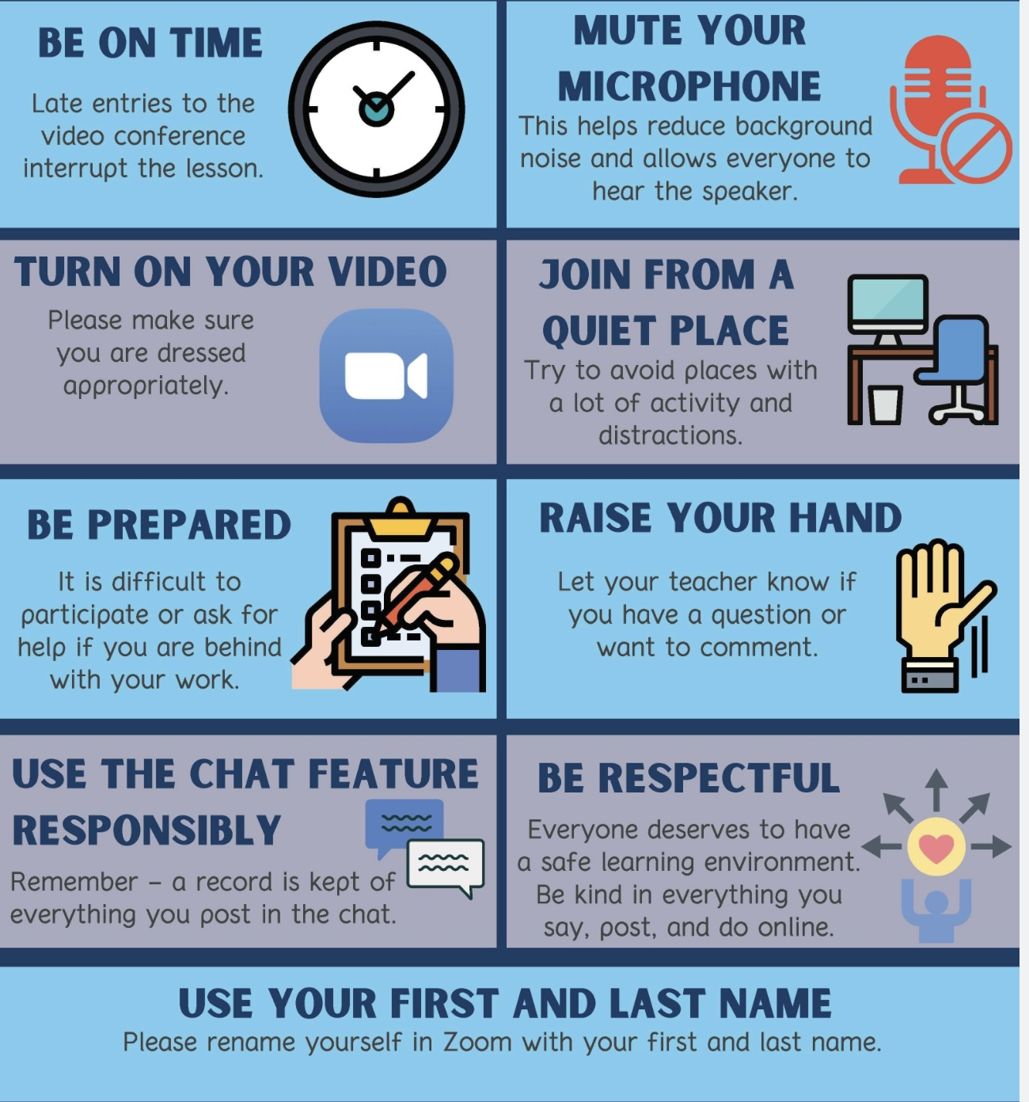
REMINDER PARTICIPANT AGREEMENTS
If you have questions, comments, or feedback, please save them for the two question periods. You can put them in the chat box or raise your real/virtual hand.
Keep comments, questions, and feedback relatively brief so everyone has a chance to participate.(one breath sharing)
If you’re on zoom, make sure no one can overhear what is being said
For reasons that will become clear later in the course please avoid giving advice to other participants about what they should or should not do. Validation, encouragement , and understanding are however very much appreciated.

Slide 16

Session 30 on May 20th is entitled “Self-led intimate relationship repair”. We think it’s a very important session in that it addresses difficulties in intimate relationships and how to approach them. It brings together DBT’s interpersonal effectiveness skills with what you’ll learn in IFS. It also reviews the major couple’s therapy approaches.
It covers a lot of material so extraordinarily, that session will be extended until 1 pm. You’re welcome to leave at 12 if you’ve had enough.
We’ve also added a pilot informal session “intimate bonding and sexuality” that we’re going to “workshop” on June 10. If we get positive feedback on it, we’ll formally add it to next years course.
WEEKLY ANNOUNCEMENTS

Slide 17
Starting next week, the homework will be to work through the IFS workbook.
Last week we emailed everyone the PowerPoint/PDF slides for sessions 24 to 29. you can use those to do the homework. ( It’s about 800 slides)
These slides are also now available on the website. (itssimple2021.com)
As with other parts of the course, you’ll get more out of IFS if you do the work.
For the in-person participants only: on April 8 and 22 the Kiwanis festival will be using the front of the church where we usually meet so we’ll be meeting in the parlour which is the room we used the past few years. (enter the building from the back where the parking lot is.)
WEEKLY ANNOUNCEMENTS

Slide 18

E-mailed questions, comments, feedback

Slide 19
We had tons of good questions and comments this past week.
1. Question whose answer we will read out today:

Slide 20
last week, you compared the simple group to a fancy restaurant and most of the rest of psychiatry and psychiatrists to going to McDonald’s. That comparison activated me. I really like my psychiatrist. Don't you think your comparison was a bit presumptuous?

Slide 21
That’s a really fair comment, and we appreciate you calling that out. When we used that comparison, we weren’t trying to suggest that this group is better than the rest of psychiatry, or that other approaches are somehow inferior. That would be too simplistic, and honestly, not accurate.
What we were trying to point to is something more specific. In this course, we put a lot of time into choosing and preparing the material, trying to integrate different models, making them accessible, and offering something that’s thoughtful and cohesive. In that sense, we do think the content of the course is high quality and carefully prepared.
But that’s where the fancy restaurant metaphor breaks down and where your point is absolutely right. The course runs into problems in the delivery. We don’t have the resources for individualized attention, pacing things to each person, or walking alongside each of the participants in a sustained way. So, in that sense, the course not a “fine dining experience” at all.
Had we been more careful with how we framed things last week we might have refined our restaurant metaphor. We do take great care with how we prepare the “food” but the format or service is more like a buffet. You take what fits for you, at your own pace, and some things may land more than others.
We should have emphasized how different settings serve different purposes. What happens in individual therapy, standard psychiatric care, or other programs can offer forms of support and depth that this course simply can’t and vice versa.
We are grateful for your very perceptive and accurate comment. It’s a helpful correction and a good reminder for us to stay grounded.

Slide 22
We’ll now briefly summarize the answers to two questions that were submitted but we also provide a fuller answer which we invite you to review on your own on the website.

Slide 23
When I went over the slides for week 22 that you posted on the website I noticed a section on high conflict people. I think you said that because of a technical glitch we didn’t discuss this idea last week. I thought it was an interesting idea and that it might be good to bring it to other people’s attention.

Slide 24
1. HIGH CONFLICT PEOPLE (HCP) A SUMMARY
Core Idea: Some people repeatedly create conflict, not just because of situations, but due to enduring patterns of thinking, emotion, and behavior.
4 Key pattern: 1) Blame others (externalizes responsibility) 2) All-or-nothing thinking (rigid, black–white views) 3) Intense unmanaged emotions 4) Extreme behaviors (escalation, impulsivity, aggression, withdrawal)
This is driven by: 1) Underlying insecurity / threat sensitivity 2) personality patterns 3) Conflict becoming a maladaptive coping strategy
Common types of HCP: 1) Blamers 2) Distrusters 3) Avoiders 4) Volatile/reactive patterns
Key insight: You can’t reason your way out of conflict with HCP. Focus on managing interaction, not changing their personality.
Practical approach: Don’t take it personally. Set clear boundaries. Use brief, calm, structured responses. Emphasize choices and consequences.
Takeaway: High conflict is a pattern in some people, not an event, manage the pattern, not the argument.
Much more on this in session 30 where we take an IFS lens to interactions with HCP.

Slide 25
READ ON YOUR OWN: HIGH CONFLICT PEOPLE (HCP)
The term “high conflict people” was developed primarily by attorney and therapist Bill Eddy, who noticed a pattern of behavior in people he encountered in legal and therapeutic settings.
High conflict people are individuals with a persistent pattern of thinking, feeling, and behaving that increases conflict rather than resolving it. The key distinction is that most people, even in difficult situations, move toward resolution. HCPs tend to escalate conflict, often unconsciously.
Eddy identifies four defining traits:
1. All-or-nothing thinking — They see situations, and especially people, in black-and-white terms: totally good or totally evil, completely right or completely wrong.
2. Unmanaged emotions — They experience and express emotions with an intensity that seems disproportionate to the situation, and struggle to self-regulate.
3. Extreme behaviors — They may act in ways that most people would consider over-the-top — sending dozens of emails, making public scenes, filing repeated legal complaints, etc.
4. Preoccupation with a “Blame Target” — Almost always, an HCP has someone they’ve identified as the cause of all their problems. This target absorbs enormous energy, hostility, and blame, even when the facts don’t support it.
HCP behavior often (though not always) overlaps with certain personality disorders, particularly:
∙ Borderline (fear of abandonment, emotional swings)
∙ Narcissistic (entitlement, lack of empathy)
∙ Antisocial (disregard for rules and others)
∙ Paranoid (suspicion, perceived persecution)

Slide 26
HIGH CONFLICT PEOPLE (HCP)
Importantly, not everyone with a personality disorder is an HCP, and not every HCP has a diagnosable disorder.
HCPs tend to interpret neutral or even kind behavior as threatening. They often lack insight into their own role in conflicts, feel genuinely victimized, and attract sympathizers (“negative advocates”) who amplify the conflict further.
Understanding HCPs is useful in many contexts — divorce and custody disputes, workplace conflicts, neighbor disputes, and family dynamics. The approach that works with most people (reason, empathy, compromise) often backfires with HCPs and can fuel escalation instead.
Eddy’s framework suggests specific communication strategies (like his BIFF Response — Brief, Informative, Friendly, Firm) tailored to reducing conflict without feeding the cycle.
Catching the pattern early can save enormous stress. Watch for these signals:
1) The blame is always external: They have a story where they are always the victim and someone else is always the villain. There’s rarely any self-reflection or acknowledgment of their own role in problems.
2) Intensity that feels “off”: Early in a relationship (personal or professional), they may seem unusually passionate, devoted, or aggrieved. Things escalate faster than feels normal, deep intimacy, fierce loyalty, or intense animosity very quickly.
3) Black-and-white talk about others: Listen for how they describe people from their past, ex-partners, former bosses, family members. If nearly everyone is either a saint or a monster, that’s a flag.

Slide 27
4) Crises are constant: There always seems to be a dramatic situation unfolding. The chaos follows them, not just their circumstances.
5)They test your loyalty early: They may subtly (or not so subtly) pressure you to take their side, criticize mutual acquaintances, or prove you’re “with them.”
How to communicate with HCPS: The standard toolkit, logical debate, expressing hurt feelings, trying to prove you’re right, tends to backfire badly. Instead use the BIFF response (Bill Eddy’s core framework):
Brief — short responses give less material to attack or misinterpret
Informative — stick to neutral facts, not emotions or opinions
Friendly — a warm, non-reactive tone disarms escalation
Firm — clear boundaries on what you will and won’t engage with
Don’t JADE: Avoid Justifying, Arguing, Defending, or Explaining yourself excessively. HCPs often use your explanations as ammunition, and over-explaining signals that you can be drawn in.
Avoid the hook: HCPs will often say something outrageous specifically to provoke a reaction. Reacting confirms for them that you’re engaged in the conflict. Staying calm, not cold, just calm, is protective.
Empathize without agreeing: You can acknowledge their feelings without validating distorted thinking. Phrases like “I can see this is really frustrating for you” reduce emotional heat without conceding false points.
Keep everything in writing: In professional or legal contexts especially, written communication creates a record and slows down the reactive dynamic that HCPs thrive in.

Slide 28
HOW TO PROTECT YOURSELF EMOTIONALLY FROM HCPs
This is often the hardest part, because HCPs are frequently people we care about or are deeply entangled with.
1) Accept that you cannot fix them: This is the most important shift. HCP patterns are deeply ingrained. Trying to reason, heal, or love someone out of high-conflict behavior usually results in exhaustion and more conflict.
2) Manage your own reactivity: HCPs are often unconsciously skilled at finding emotional triggers. Therapy, mindfulness, or even just pausing before responding can help you stay grounded rather than reactive.
3) Limit your exposure where possible: Reduce contact where you can. If you can’t (co-parenting, a family member, a coworker), create structure, defined communication channels, limited personal disclosure, clear boundaries on topics.
4) Don’t share vulnerabilities: Personal struggles, insecurities, or private information can be stored and used against you later, often in ways you wouldn’t expect.
Build a support network outside the relationship: HCPs can be isolating, sometimes deliberately, often as a side effect of the drama they create. Maintaining friendships and trusted relationships outside is essential for perspective and resilience.
Name the pattern to yourself: Simply having a framework — “this is high conflict behavior; it’s not about me”, creates psychological distance that is genuinely protective. It helps you stop internalizing the blame they project.
The through-line across all three areas is this: the goal isn’t to win, fix, or even be understood by an HCP, it’s to manage your own responses so the conflict doesn’t consume you. That reframe alone tends to be freeing for people dealing with these dynamics.

Slide 29
2. Last week you mentioned that DBT’s wise mind, IFS’s capital S self and Daniel P. Brown’s ideal parent figure were related concepts. Can you elaborate?

Slide 30
WISE MIND CAPITAL S SELF AND THE IDEAL PARENT FIGURE
These three concepts, wise mind, Self, and the ideal parent figure, are really different ways of pointing to the same underlying capacity: a regulated, compassionate, non-reactive state from which healing can occur.
DBT frames this state as a skill we can access in the moment.
IFS sees it as an innate core Self that can heal our parts.
The ideal parent figure provides that same healing through an internalized experience of secure attachment.
They’re not identical, but they’re deeply related, three different maps pointing to the same territory: the place in us, or available to us, where we are calm enough, safe enough, and connected enough for real healing to happen.

Slide 31
READ ON YOUR OWN: WISE MIND CAPITAL S SELF AND THE IDEAL PARENT FIGURE
Wise mind, Capital S Self and the ideal parent figure all point to a state or capacity that is:
Calm, regulated, and not overwhelmed
Wise, compassionate, and non-reactive
Able to hold difficult emotions without being taken over
Oriented toward healing, integration, and connection
Each is a way of describing what it feels like when we are not dominated by our survival parts.
There are however some important differences between these three:
DBT’s Wise Mind is
A skill or state you access
A balance of emotion mind + rational mind
Practical, teachable, moment-to-moment
Less explicitly “spiritual”

Slide 32
IFS’s Self (capital S) is
An inherent core presence (always there)
Characterized by the 8 C’s (calm, curiosity, compassion, etc.) and 5 P’s
Relates to parts and heals them
Often experienced as deep, even sacred
Ideal Parent Figure (Daniel P. Brown) is
An internalized relational experience
Provides felt safety, attunement, and secure attachment
Built through imagery and repetition
Especially focused on repairing attachment wounds

Slide 33
You can think of them as three doorways into the same healing process:
Wise Mind → helps us regulate dysregulated emotions
Self → provides a relationship to parts that allows deep healing
Ideal Parent Figure → creates the secure attachment environment needed for repair
Wise Mind = state of balance
Self = healing presence within
Ideal Parent = healing relationship internalized
All three move a person from reactivity → regulation → connection → integration

Slide 34
For the following questions we will only read out the question, not the answer, and invite those interested to go to the website after the session.

Slide 35
What is the difference between small s self and Capital S Self?

Slide 36
As we will explore today, in Internal Family Systems, small-s self refers to our everyday personality, the habits, roles, and identities we usually operate from.
Capital-S Self refers to a deeper core of awareness within us that is calm, curious, compassionate, and able to relate wisely to our parts.
Many spiritual and philosophical traditions also distinguish between a small self and a capital-S Self. The small self refers to our everyday identity, the personality shaped by our history, roles, fears, desires, and social conditioning. The capital-S Self refers to a deeper level of awareness or being that observes these experiences but is not limited by them. In many traditions, this deeper Self is experienced as spacious, compassionate, and connected to something larger than the individual ego.
In IFS, healing happens when our parts begin to trust and be guided by this capital-S Self.

Slide 37
What is spiritual bypass?

Slide 38
Spiritual bypass is when spiritual ideas or practices are used to avoid dealing with real psychological pain or unresolved issues. Instead of working through emotions like grief, anger, or trauma, a person may hide behind statements like “everything happens for a reason” or “I should just stay positive.” True spirituality usually involves facing and integrating our pain, not bypassing it.

Slide 39
I understand that healing from trauma and pathological grief happens when people’s nervous system goes from being stuck in polyvagal theory’s dorsal vagal collapse to through connection to others, nature, meaningful work etc. moving towards ventral vagal activation. Does this also explain the healing that happens in IFS?

Slide 40
You’re right from a polyvagal perspective, trauma and deep grief often push the nervous system into a dorsal vagal state, a state of shutdown, numbness, isolation, and disconnection. Healing happens when the nervous system can move back toward the ventral vagal state, which is the state of safety, openness, and connection.
What reliably helps that shift happen is connection: connection with caring people, with meaningful activity, with nature, and with our deeper sense of self.
Internal Family Systems (IFS) offers a way of understanding what this connection looks like inside the mind. When people are traumatized, the painful experiences are often carried by exiles, parts of us that become isolated or dissociated in order to protect the rest of the system. These parts tend to live in states that resemble dorsal vagal shutdown: fear, shame, loneliness, or collapse.
Healing occurs when these exiled parts are reconnected to the Self (capital S). In IFS, the Self is the calm, compassionate, grounded center of the person. When exiles feel seen, understood, and cared for by the Self, they begin to feel safe again.
In nervous-system language, that internal connection helps move the system from dorsal vagal shutdown toward ventral vagal connection. Polyvagal theory, IFS and spiritual traditions such as Ignatian spirituality describe the same healing movement from different angles:
Polyvagal theory: healing = moving from shutdown to connection
IFS: healing = parts reconnecting with Self
Spiritual traditions: healing = reconnecting with a deeper or truer self
In that sense, Self in IFS can be understood as the inner source of connection that allows the nervous system and the wounded parts within it, to move from isolation and collapse back into safety, relationship, and life.

Slide 41
TAKEAWAY
Trauma isolates parts of us in states of shutdown; healing occurs when those parts reconnect, through the compassionate presence of Self, allowing the nervous system to move from dorsal vagal collapse back into ventral vagal connection

Slide 42
2-MINUTE EXERCISE: NOTICING YOUR PARTS
Before we start talking about IFS, let’s try a very brief exercise.
Take a moment and think about a recent situation where part of you wanted to do something, and another part of you resisted.
This could be something small. For example: Part of you wanted to eat something unhealthy, and another part wanted to stick to your diet. Part of you wanted to go to bed early, and another part wanted to stay up watching something. Part of you wanted to say something to someone, and another part held back.
Just take a few seconds and let one example come to mind.
Now ask yourself two simple questions:

Slide 43
2-MINUTE EXERCISE: NOTICING YOUR PARTS
First: What did each part want?
One part might have wanted comfort, pleasure, escape, rest, approval, or connection.
Another part might have wanted discipline, safety, control, or responsibility.
Second: Which part won?
Did the part that wanted the action win?
Or did the part that resisted it win?
Just notice that inner conversation.
What IFS suggests is that this kind of experience, “part of me wants this, and part of me wants something else”, is not unusual or pathological.
It is simply how the human mind works.
In IFS we take these everyday experiences seriously and begin to understand the different parts of ourselves that are involved, and how, in their own way, they are trying to help us.

Slide 44
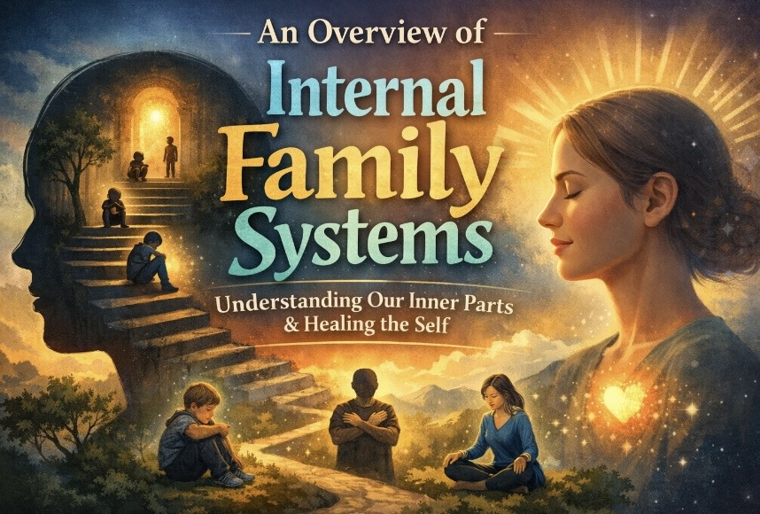

Slide 45
LAST WEEK- WEEK 22 – TRANSITION TO TRAUMA PROCESSING
Wrapping up DBT
Trauma therapy frameworks: the three stages and four pillars
Overview of sessions 22-29
Maps for healing
Why IFS?
Same holes different maps
THIS WEEK-WEEK 23 – ORIENTATION TO THE IFS MODEL
• What is IFS?
• How it integrates prior models
• How to find parts using trailheads
• Roadmap for the next 6 weeks

Slide 46
Weeks 24 to 29
Week 24- April 8, IFS workbook Part One: Getting to Know Your Self & Parts P.17
Week 25- April 15, IFS Workbook Part Two: Appreciating Your Overworked Managers P. 63
Week 26- April 22, IFS Workbook Part Three: Befriending Your Activated Firefighters P. 101
Week 27- April 29, IFS Workbook Part Four: Embracing Your Burdened Exiles P.139
Week 28- May 6, IFS Workbook Part Five: Accessing Your Unlimited Self-Leadership P. 177
Week 29- May 13, Simple Manual Session 23 Wise mind remediation

Slide 47
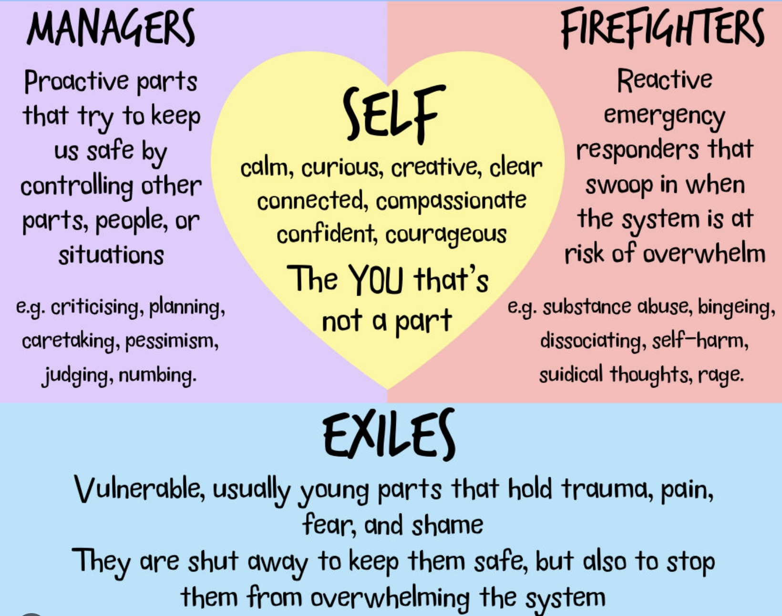
TODAY
The 4 types of parts
Burdens
The self
Interactions between the parts
Healing in IFS
Unburdening parts
Therapist parts
Accessing your capital S Self
Identifying parts
Integrating IFS spirituality and other models we’ve previously considered
What you need to know for sessions 24 to 29

Slide 48
WHERE WE LEFT OFF LAST WEEK

Slide 49
THE 4 TYPES OF IFS PARTS
Exiles
Managers
Firefighters
Rational manager

Slide 50
QUICK RECAP: EXILES AND PROTECTORS
Last week we introduced the basic IFS map: wounded parts called exiles carry the pain of past experiences, and protective parts, managers and firefighters, work hard, in different ways, to keep that pain out of awareness.
What we experience as symptoms is actually the pain carried by those parts and the pain arising from their interactions.
Exiles are:
  Young, vulnerable parts carrying trauma, pain, and unmet needs
  Often pushed out of awareness to protect the system
  When activated → intense emotions, flashbacks, nightmares
  Can drive repetition of old patterns (trying to “redo” the past)

Slide 51
QUICK RECAP: EXILES AND PROTECTORS
Protectors = Managers & Firefighters
  Their job: keep exiles from overwhelming us
  Managers (proactive): control, plan, avoid, please, criticize
  Firefighters (reactive): act fast to shut down pain (e.g., impulsivity, distraction)
  Both use strategies like control, denial, distraction, intellectualizing
Big Picture
  The system is organized around protecting us from exile pain
  What looks like “symptoms” are actually protective strategies

Slide 52
TAKEAWAY
1) Managers are the front-line “staff” working day in and day out to keep the exiles contained.
2) Firefighters are only called in when the exiles have overwhelmed the managers who can no longer contain them in the usual manner .
Let’s now look at these parts in a little more detail.

Slide 53

The managers are protectors that are milder and typically well behaved. They work on avoiding any situation which might trigger an exile to escape.
Managers may present as part selves that are controlling, perfectionistic, overly intellectual, obsessive, or self/other critical. They can also be reclusive, passive, emotionally detached, phobic, or hyper alert.
Managers are why people who have experienced trauma might be perfectionistic, obsessive, driven, or can’t stand still.
Remember that the managers do what they do to keep the pain carried by the exiles at bay. If we deliberately try to stop the managers from doing what their job, for example through behavior modification, the exiles, and their pain, may then surface.
Stopping manager behaviors without understanding what we are doing may cause a lot of pain. This is one of the problems with CBT strategies such as exposure and response prevention.
THE MILDER MANAGERS (the nice prison guards

Slide 54

2) THE FIERCE FEARLESS
FIREFIGHTERS
(the riot squad)
Firefighters take over only when the exiles have escaped the control of the managers, and their pain emerges into consciousness.
Unlike the milder managers, firefighters tend to be impulsive reckless and destructive. Their job is to extinguish or put out feelings, thoughts, body sensations, memories, images, and anything else associated with the trauma that the exile is carrying. Their job is to get rid of the pain no matter what the cost. When they are done, they often leave a mess behind.
Typical firefighter behaviors, thoughts, and feelings include abusive drinking, drug use, eating and all addictive behaviors, self-harm and suicidal ideation, rage, violence, impulsivity and dissociation.

Slide 55
2) THE FIERCE FEARLESS
FIREFIGHTERS
(the riot squad)
Firefighters can at times be reasonably well behaved, socially acceptable and resemble managers for example when they manifest as excessive reliance on TV, Internet, computer games, shopping, exercising, sleeping, or working.
The problem is that their behavior, over the long term, tends to cause more damage than that of the managers.
They can also be poorly behaved and socially unacceptable when they manifest as addictions, affairs, rage, violence, abusive behavior, suicide, crime, stealing, self injury, or eating disorders.
The behavior of the firefighters is often harshly disapproved of by the managers, and this can trigger further cycles of destructive behavior.

Slide 56

EXILED PROTECTORS
(Imprisoned prison guards)
Sometimes a protector becomes so extreme (rageful, addictive, dissociative, self-attacking) that the rest of the system turns against it: “You are too much. You’re causing problems.” So that protector itself gets pushed away or suppressed.
Exiled protectors still believe they are protecting, often feel misunderstood or blamed and can carry shame about their own strategies.
Example: A child grows up in an unpredictable, emotionally unsafe home. When attachment pain overwhelms them, a firefighter part develops. Its strategy may be to binge eat, drink, self-harm or erupt into a rage. All these behaviors serve to shut down pain when it floods the system.
These behaviors cause the self system significant problems which other parts fear, and will try to suppress, disown or shame. These firefighters don’t disappear they go into exile underground.

Slide 57
EXILED PROTECTORS (Imprisoned prison guards)
Example: A 42-year-old professional woman with complex trauma who presents as controlled, competent, and high-functioning. She hasn’t binged in years but after a very stressful situation, she suddenly feels flashes of rage and urges to drink.
From an IFS perspective a firefighter part once used anger and alcohol to shut down terror. That part was hated and banished into exile. It now emerges when the competent managers fail to handle the pain.
An ordinary firefighter says: “Let me handle this.” in contrast an exiled firefighter says: “I’m not allowed to exist… but I still have to act when things get bad.”
An exiled firefighter is a part that once saved us in extreme moments but later got shamed and pushed away for the very strategies that kept us alive.
This is why alcoholics anonymous maintains “once an alcoholic, always an alcoholic” the firefighter might be in exile but he hasn’t disappeared.

Slide 58
Managers → prevent pain on day-to-day basis
Firefighters → stop pain when it breaks through
Exiled protectors → while trying to protect us from pain cause so much pain they are exiled themselves by other parts.

Slide 59

THE RATIONAL MANAGER
IFS’s Self, which we will soon discuss, is the seat within us of calm, compassion, and perspective.
In everyday life, for most people, it’s not self that leads the internal family.
Most of us, when we’re in the window of tolerance and in DBT’s rational mind, are being led by a “mature adult” which IFS refers to as the rational manager.
Unlike most other protectors, the mature adult/rational manager is not an emotional part; it’s rational, thoughtful, and goal-oriented. It’s the part of us that understands consequences, makes plans, sets limits, and tries to keep life running smoothly.

Slide 60
THE RATIONAL MANAGER
IFS sees the rational manager as a part, because it exist at the same level as other parts.
The rational manager can get into arguments with our emotional parts, be impatient with them, critical of them, or try to override them.
Unlike Self, it doesn’t automatically relate to other parts with curiosity or compassion, it relates to them with logic, persuasion, and control.
Self has a perspective on parts. The mature adult/rational manager is in the system, negotiating and sometimes fighting with other parts. It’s wise, but not spacious. Helpful, but not healing by itself.
In IFS work, we don’t try to get rid of the mature adult. We help it step back just enough so that Self can come forward and so that the emotional parts can finally be understood rather than managed.

Slide 61
TAKE AWAY
“Mature adult”, DBT’s “rational mind” and IFS’s “rational manager” are very similar concepts .

Slide 62

IFS’s 6 BURDENS
Personal
Legacy
Cultural
Exile’s
Protectors
Unattached

Slide 63
BURDENS
In IFS, "burdens" are the stored emotional wounds, painful beliefs, feelings, and memories, carried by parts, especially exiles.
Burdens are usually caused by adverse past experiences or trauma. Burdens distort the natural roles and functioning of healthy parts, leading to internal conflict and distress.
In people who experience emotional dysregulation, overwhelming emotions and their accompanying thoughts and behaviors are often a manifestation of burdens (e.g., shame, fear, abandonment pain flooding consciousness).
Emotional dysregulation = the moment-to-moment experience of activated burdens
IFS work = helping parts release those burdens, reducing future dysregulation

Slide 64
TYPES OF BURDENS
IFS identifies several types of burdens:
1. Personal Burdens: These are burdens that originate from an individual's personal experiences, such as trauma, loss, or difficult relationships. They often manifest as extreme beliefs or emotions, like shame, guilt, or fear.
2. Legacy Burdens: These burdens are inherited from family or cultural backgrounds. They can be passed down through generations and might include beliefs or patterns related to identity, worth, or behavior that were relevant or necessary in previous generations but may no longer serve the individual.
They are not the result of an individual's direct experiences but are inherited from family, cultural, or societal influences. For example, a legacy burden might be a pervasive sense of shame or fear that has been transmitted through family stories, cultural narratives, or historical trauma.
In IFS therapy, identifying and addressing legacy burdens can help individuals release these inherited influences and live more freely.

Slide 65
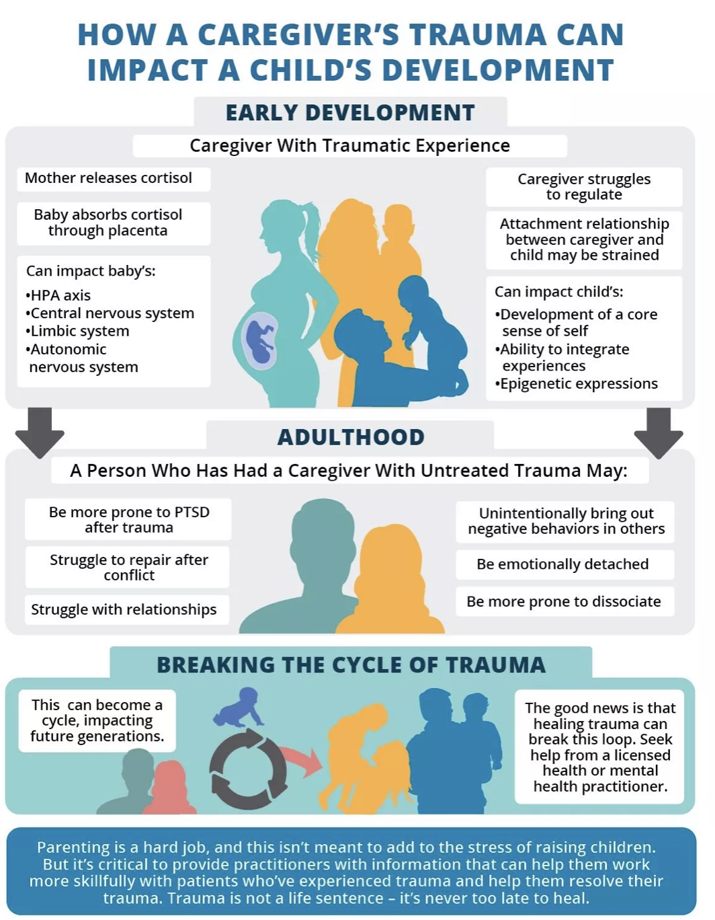
Ex. First generation Canadians whose parents immigrated from southern Europe in the 50’s,60’s and 70’s as poorly educated economic refugees, may feel inferior to people whose families have been here for many generations and may feel they need to work harder than others to succeed.
Other examples: children of holocaust survivors much more likely to develop PTSD. Children born in the 6 months following 9/11 to mothers living in New York have a much higher rate of anxiety disorders than the general population.
We previously discussed the ways trauma can be passed from one generation to another: 1) Epigenetically, 2) As a result of Intra-uterine environmental factors, 3) through attachment issues 4) because of caregiver difficulties with emotional regulation and 5) because of lack of psychosocial resources. All these mechanisms may contribute to how legacy burdens are transmitted.
EX. OF LEGACY BURDENS

Slide 66
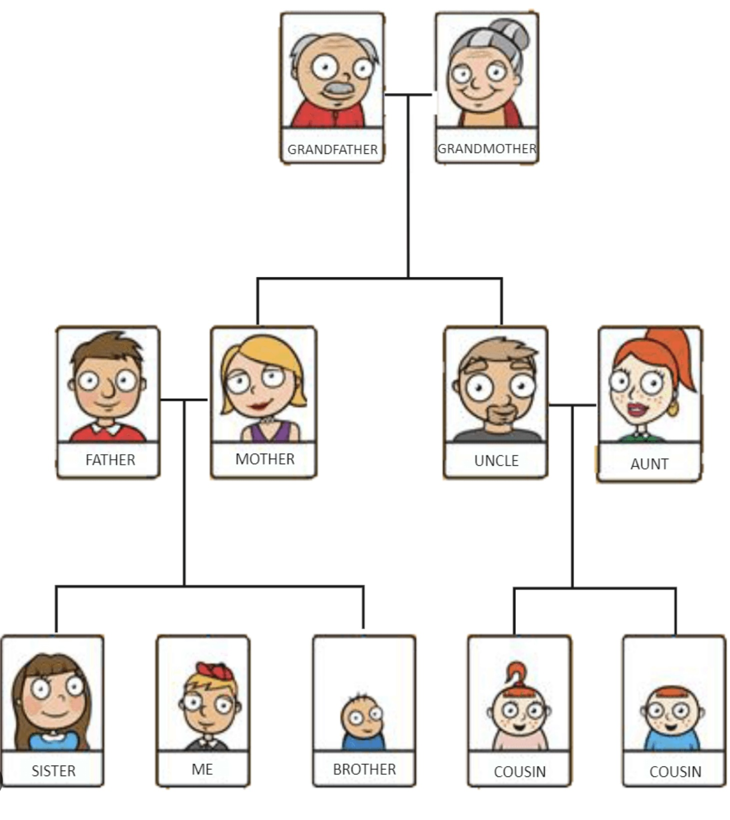
MAPPING
LEGACY BURDENS
To identify and understand what your legacy burdens might be, try:
1) Do a family tree
2) for each person write down mental health issues including substance use, and trauma. Notice if there are patterns that repeat. Ex. Not being assertive, being a people pleaser or an overachiever.
3) ask if some vulnerability affecting your ancestors also affects you?
4) ask yourself what proportion of that vulnerability is just you and what proportion comes from your family.
5) ask the legacy burden if it would be willing to let go of the burden and if not, what is it afraid might happen if it does.

Slide 67
TYPES OF BURDENS
3. Cultural Burdens: These burdens arise from societal norms, stereotypes, or cultural expectations. They can include pressures to conform to certain roles or behaviors based on gender, race, or socioeconomic status.
Western individuals may for example carry the cultural burdens of racism, consumerism and extreme individuality.

Slide 68
EXAMPLE OF CULTURAL BURDEN
A woman grows up in a culture where emotional restraint is highly valued, she repeatedly hears messages like: “Don’t make a scene.” “Be strong.” “Keep your feelings to yourself.”
Over time, one of her manager parts takes on a cultural burden: “Showing emotion is weakness.”
This part works hard to suppress tears, stay composed and avoid vulnerability.
Meanwhile, an exile carries sadness, longing to be comforted and fear of being rejected if she shows her true feelings

Slide 69
TYPES OF BURDENS
4. Exiles' Burdens: Exiles burdens often include feelings of worthlessness, abandonment, or vulnerability.
5. Protectors' Burdens: Protectors burdens might include beliefs that they must be vigilant, controlling, or self-sacrificing to keep the system safe.
6. Unattached Burdens: These burdens are not tied to any specific part within the individual's internal system. Instead, they are seen as external energies or influences that have attached themselves to the person, often as a result of traumatic or overwhelming experiences.
Unattached burdens can manifest as intrusive thoughts, emotions, or sensations that don't seem to belong to any particular part. In IFS, the goal is to help the individual recognize and release these burdens, allowing the internal system to function more harmoniously.
Both legacy burdens and unattached burdens highlight the importance of understanding the broader context of an individual's experiences, including intergenerational and external influences, in the process of healing and self-discovery.

Slide 70

THE CAPITAL S SELF

Slide 71
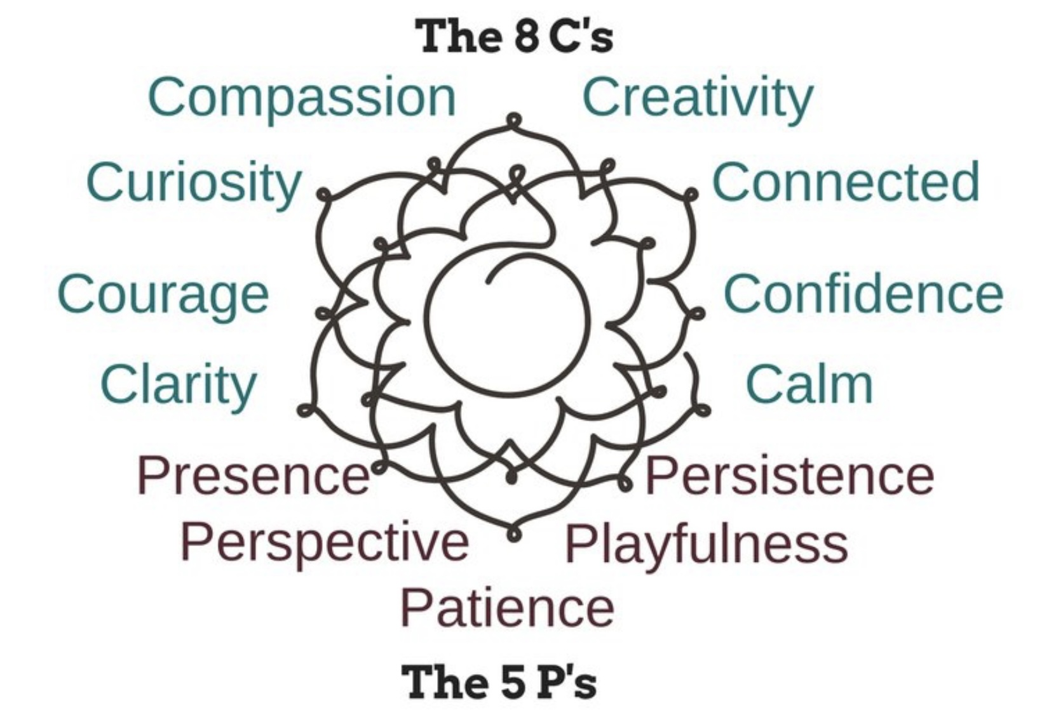
SELF
Self is not a part, Self is who we really are. It’s the witness, the observer.
Self is characterized by the 8 C’s: curiosity, compassion, courage, confidence, clarity, calm, connectedness, and creativity.
And 5 P’s: presence, perspective, patience, playfulness and persistence.
Anytime we’re not feeling these qualities to a large degree, a part has taken us over or hijacked us. This means that most of us spend the vast majority of our lives hijacked by parts. (some of the time the rational manager)

Slide 72
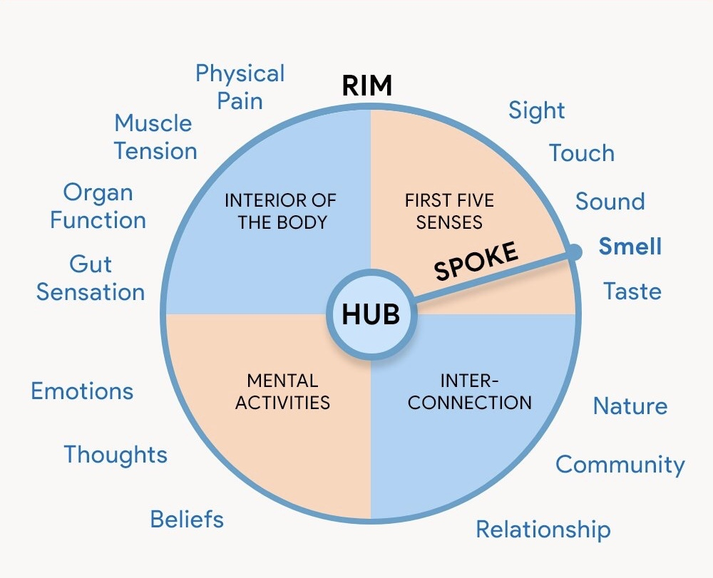
SELF
To some IFS therapists, including Dick Schwartz, the Self is a spiritual concept that is similar to pure consciousness, universal mind, or how God sees the world through each one of us.
Self exists on a different plane from the parts. It’s like the sun on a stormy day. A disastrous storm can blow down the trees and cause mudslides and destroy your house, that’s our everyday life, but when the cloud's part, the sun is still there, undirtied, undamaged, untouched. Self cannot be damaged or even dirtied and it’s always there even when life gets really stormy.
It is consciousness before it is directed at an object. We come closest to this state of consciousness in deep dreamless sleep.
Metaphorically it has been described as the hub at the center of the “wheel of awareness”. From this hub radiates a “spoke of attention” which directs the objectless consciousness of Self like a spotlight on objects which consists of 1) our internal world or minds which includes our inner sensations, feelings, thoughts, and the imagination and 2) the external world perceived by our senses.
The Self is the perspective of the hub which knows that only it is real and permanent while all the objects it briefly focuses on through the experiences of sentient beings are mirages. Self is the same in all of us.
The wheel of awareness
Notes:
To understand the spiritual associations of wise mind is helpful to consider the Hindu concepts of the gross, subtle, and causal body's and the wheel of awareness.
We have already discussed the metaphysical idealist in the list view that what is the most essential in the universe is the causal body which is pure consciousness without experience. From the causal body arises the subtle body, and the gross body.
The gross body is all that is material. In an inversion of the in the list notion, in the West we see the gross body as what is essential in the universe.
Consider a bicycle wheel with a hub, a spoke, and a written. The hub is the pure consciousness of the causal body, the spoke is where consciousness in humans is directed at a particular moment in time. The rim is all that exists in both the gross and subtle body's.
All the pain, the trauma, and the drama in our life's occurs at the rim, the hub is unaffected by it.
Normally, the spoke wonders spontaneously all over the rim. Personality can be seen as the rims Favorite spots to wonder to. But through awareness and meditation we may have more influence as to where the spoke direct itself to. Realizing that we have this power and learning to exercise it is one of the goals of the simple course.
The metaphor of the sky and the weather that exists on it has been used to illustrate the relationship between wise mind and common human experience. Wise mind is the sky, human experience is the weather. It can change from sunny to stormy but that does not affect the sky upon which it exists.

Slide 73

A metaphor for Capital S Self, which we previously discussed, is the Moon reflected in many buckets of water.
Each bucket is different, just as people are different, but the moon that’s reflected in each bucket is only one. It does not split itself into pieces. The same moon appears in every bucket that reflects it.
Some reflections may look brighter, others dimmer, or more distorted depending on the bucket and the water in it, but the source of the light, the moon, never changes.
In the same way, even thought we feel separate and individual, the Capital S Self within us, like the moon, is the same in all of us. It is One seeing the world from many different perspectives.
The buckets, our bodies and individual minds, take many different forms, the moon, the Self is the single awareness behind them all.
To quote Alan Watts “You are an aperture through which the universe is looking at and exploring itself”.

Slide 74
OTHER IFS TERMS YOU MAY COME ACROSS

Slide 75
GUIDES
Richard Schwartz talks about “guides” as special kinds of inner helpers or sources of wisdom that people sometimes encounter when doing inner work.
Once you start getting to know your parts, the hurt parts, the protective parts, the angry or fearful ones, sometimes something new shows up. It’s not really a “part” in the usual sense. It feels calm, kind, and wise. Schwartz calls these guides.
A guide can appear in many forms: A loving inner voice that offers reassurance. A sense of light, warmth, or presence. An image, like an animal, ancestor, teacher, or spiritual figure or even just a deep knowing that seems to come from beyond your usual self.
Guides are not something you have to “believe in.” They’re simply experiences that many people naturally have once they open up inside. They seem to help the Self, that inner center of calm, curiosity, and compassion, connect more deeply with something larger.
Schwartz says that guides can come from within or beyond the individual mind. He doesn’t insist they’re “real beings” or “imaginary,” but invites people to stay curious. What matters most is that they help, they bring healing, wisdom, and perspective. Sometimes, a guide might help a part feel safe enough to let go of its burden, or it might help you stay connected to Self when the inner work gets difficult. You can think of it as your inner teacher, spirit, or intuition, whatever fits your worldview. The guide isn’t there to take over; it’s there to support your Self and your healing.

Slide 76
GUIDES AND SELF
IFS Self is our core being, innate, always present, characterized by the 8 Cs and 5 P’s. It is us at our deepest level.
Guides are inner figures (or sensed presences) that offer help, wisdom, or support. They are not Self; they are usually parts or symbolic/archetypal representations.
Self = the source of healing
Guides = helpers that point toward or support Self-led healing
Self is the sun
Guides are lanterns that help you find it

Slide 77
EXERCISE: MEETING A GUIDE
Close your eyes or soften your gaze.
Take a few slow breaths. Notice your body sitting in the chair, your feet on the ground, your breath moving in and out.
Let yourself feel as safe and present as you can. You might say aloud: “See if you can bring your awareness to the calm, curious part of you, the part that can notice everything inside without judging. That’s your Self.”
Now, in this quiet space, imagine that you could receive some gentle guidance, not from your thinking mind, but from a deeper or higher place. It might come as an image, a sense of light, a voice, or a feeling of presence.
If something or someone appears, maybe an image of a person, an animal, a symbol, or even just a sense of calm, notice what it’s like. You don’t have to make anything happen. Just stay open and curious.
What do you want me to know right now? rest in silence for a minute or two, letting any impressions arise naturally.
Take a deep breath and gently come back to the room. Jot down what you noticed. Did something or someone appear? What qualities did it have (kind, strong, peaceful, wise…)? How did it make you feel?
There’s no right or wrong here. For some, a guide appears clearly; for others, it’s more like a quiet sense of support. Either way, it’s an expression of the Self’s connection to something larger.

Slide 78
TAKE AWAY 3 SENTENCE SUMMARY
We all have parts
Parts developed to protect us
Healing happens when Self leads the system
Everything we discussed today and will explore in the coming weeks grows from these three ideas.
DBT helped us manage emotional storms.
IFS will help us understand the parts of us that create the storms.

Slide 79

INTERACTIONS BETWEEN PARTS

Slide 80
INTERACTIONS BETWEEN PARTS
Every family seems to have a baseline level of conflict. Some families are high others low conflict.
Like insecurely attached families, burdened internal family parts typically have unresolved conflicts that erupt repeatedly producing high conflict internal families.
During conflicts between Internal family parts, the person is often outside the window of emotional tolerance
Conflicts occur between managers and firefighters, managers and exiles, and firefighters and exiles.
These conflicts can give rise to overwhelming anxiety, anger, despair, depression, confusion, and dissociation.
The pain arising from the conflict between parts adds to the pain burdened parts already carry.
Notice how the conflict between parts, which arose to deal with the pain of trauma, itself causes significant distress.
This is like having a very conflicted family where each person is themselves very distressed fighting inside your mind.

Slide 81
Typical things that managers say to firefighters include "don't you ever stop and think?". "You are totally out of control!". "You should be ashamed of yourself!". "You are hopeless!“ “you’re an idiot”…
Typical things that firefighters say back to managers are "F**k off". "I just felt like it". "I deserve this!" "Try and make me…". "I don't give dam". "Watch me!“
The mature adult/rational manager part often feels ashamed of the protector’s behavior and wants to get rid of these protectors. (people often ask the question “how do I get rid of the parts I don’t like?)
Managers are often very critical of exiles. This criticism tends to mirror explicit or implicit criticism the person heard or sensed as a child. These self-critical managers are known as “internal critics”.
They developed to preemptively protect the child (or person) by internally keeping them in line so that they would avoid external criticism from caregivers or partners.
WHAT PARTS SAY TO EACH OTHER

Slide 82

HEALING IN IFS

Slide 83

We have already explored how we all have access to Self. Many of us can’t see or feel Self because we’re focused on the stormy “weather” and cannot feel the calm sun and sky that is always there, no matter the weather.
Self is calm and quiet and may be difficult to appreciate because emotional parts, “the weather”, can be so dramatic or noisy.
Self has the ability to see all other parts within us non- judgmentally. If allowed by the parts to lead, it is a natural leader.
The Real Self values all parts, believes they all have good intentions, and want to play a positive role in the system.
Real Self leadership promotes healing and safe containment for parts.
SELF HEALING
Notes:
No, parts are fragmented because of trauma. Wise mind or the real self is whole. It is what we were before we became fragmented. The more fragmented we are the more difficult it may be to access wise mind. Wise mind is to the parts as an ideal parent is to her children

Slide 84

In Internal Family Systems, the Self is like the North Star: it is always present and steady. During the day, the sun’s brightness hides Polaris from view, just as strong emotions and protective parts can shine so brightly that they obscure the Self.
When daylight dims, the Polaris the Self is still there, unchanged, quietly guiding from behind the noise.

Slide 85

The Self sees, empathizes, appreciate, and wants to securely communicate with the managers, firefighters, and exiles but unless these parts agree and begin to trust it, they will continue to do what they have always done.
Self sees and understands the conflicts between the parts and wants to work on resolving them.
Because they are the most receptive, Self usually first works with mild managers addressing their fears, being patient, and being respectful of the pace they want to work at.
It then identifies and works with the dangerous firefighters which may have previously been dealt with by using crisis plans.
It only begins working with exiles when the managers grant their permission.
WISE OR IDEAL PARENTING

Slide 86
WISE OR IDEAL PARENTING
When working with one part, Self frequently checks in with other parts to make sure they are okay.
Healing happens when the Real Self becomes a figure whom parts trust and feel safe with. Real self can then lead the system.
The focus in IFS is on developing and nurturing the relationships between the Real Self and the various other parts of the system.
IFS uses many different techniques for engaging with parts for example IFS therapists often ask the person to ask the part what it is afraid would happen if it didn’t do its job, or whose energy they are carrying.
IFS also assigns homework asking the person to engage in imaginary encounters with their parts.

Slide 87
THE GOAL OF IFS
In IFS therapy, the goal is to help parts release burdens so they can return to their natural, healthy states. This process involves accessing the Self, which can provide the compassion, clarity, and courage needed to facilitate healing and integration.
IFS therapy involves finding a part to focus on. Very often this is quite easy, parts are right on the surface. For example, with someone who is full of rage or fear therapists find the protectors involved, check with them, and get their permission to connect with the vulnerable parts they are protecting.
Therapists don’t expect protectors to change their behavior right away. They just want their permission to go inside and help the exiles they’ve been protecting. If they don’t grant it right away, they listen respectfully to their concerns until they feel comfortable relaxing back.
Once parts have granted access to an exile, therapists meet the exile and witness it completely, finding out whatever it wants them to know about how hard it was back when it took on the burdens it carries. Therapists then help this exile come forward in time to a safe and comfortable place.
After that, therapists help the exile let go of the extreme emotions, beliefs, and energies, the burdens, it took on back then.
Only then, when the exile is unburdened, safe, and free, do therapists ask the protector to consider changing its behavior.

Slide 88
THE GOAL OF IFS
The real healing in IFS takes place between the client’s Self and the client’s parts. It’s not something therapists bring in from the outside.
Therapists trust that each client has deep, healing wisdom inside themselves, and they respect that. In IFS, therapists ask some important, questions. One is: “How do you feel toward that part?” Then they wait until they hear one of the C qualities.
If there is no Self there, therapists work with whatever parts are interfering with the connection until Self is present.
This process develops that inner Self-to-part connection. This Self-to-part relationship is the primary locus of healing. It stops the civil war and turns the client’s inner system into a cooperating orchestra or team.
IFS is a revolutionary approach to healing. Many forms of psychotherapy, including most cognitive behavioral therapy, are essentially about increasing the strength of the managers to control the system. This can be helpful, but it leaves the basic underlying dynamic unchanged. If we do this, much of our life energy is spent on our parts fighting and struggling against each other. When we can free the exiles and release the protectors from their extreme roles, there’s much more life energy and joy as well as the eight C qualities of Self.

Slide 89
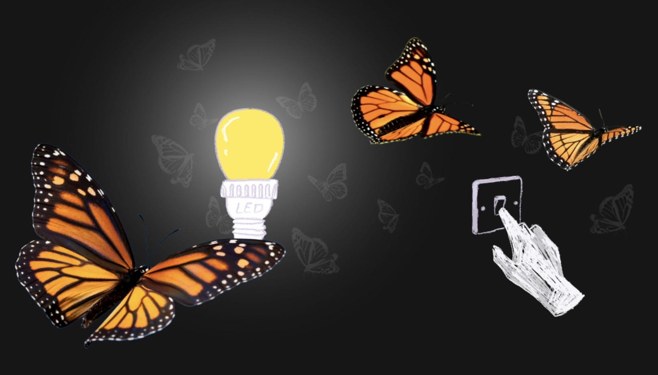
UNBURDENING AS HEALING

Slide 90
UNBURDENING AS HEALING
Unburdening in IFS is the moment when a part is finally able to let go of what it has been carrying that does not truly belong to it.
To be unburdened a part must be in a trusting relationship with Self which has witnessed and validated its original pain or memory. As this occurs, the part realizes that the system will be safe even if it is no longer carrying the burden.
The burden is then symbolically released (e.g., letting it go into light, water, fire, earth, whatever feels right to the part). After unburdening the part remains, but it becomes lighter and often shifts into a healthy, preferred role at the same time, the self system becomes more flexible, regulated, and Self-led.
Unburdening does not get rid of parts, as they fear, it frees them to be who they were meant to be.

Slide 91
THE UNBURDENING ALGORITHM
IFS uses directives and questions to help parts unburden but the power of the approach comes from the presence and witnessing of the part and its burden by the Self.
1. CONFIRMING READINESS AND CONSENT: Unburdening never proceeds without explicit permission. Common questions therapists ask parts at this stage include “Are you ready to let go of what you’ve been carrying?” “Is there anything you still need before releasing this burden?” “Do you feel safe enough with me and with Self to do this now?” “Are there any other parts that need reassurance before we continue?” (If protectors hesitate, the work pauses.)
2. NAMING THE BURDEN HELPS EXTERNALIZE WHAT THE PART IS HOLDING: Questions at this point may include “What is it you’ve been carrying all these years?” “Is it a belief, a feeling, an image, or something else?” “What does it say about you or the world?” “Where do you feel it in or around your body?”. Common burdens include “I’m bad,” “I’m alone,” terror, shame, rage, or worthlessness.
3. LOCATING THE BURDEN KEEPS THE PROCESS EMBODIED AND CONCRETE: This is typically done by asking “Where do you notice that burden right now?” “What shape, weight, temperature, or color does it have?” “Do you feel it inside you, on you, or around you?”
4. CHOOSING HOW TO RELEASE IT: The part chooses the method and symbol. “How would you like to let it go?” “Would you prefer fire, water, light, wind, earth, or something else?” “What feels most right or natural to you?”

Slide 92
THE UNBURDENING ALGORITHM
5. THE UNBURDENING DIRECTIVE: Simple, present-tense, invitational language is used “When you’re ready, let that burden go in the way you chose.” “You don’t have to carry this anymore.” “Notice what happens as it leaves.”
6. CHECKING FOR COMPLETION: This ensures the release actually occurred. “Is the burden fully gone?” “Is there any residue left?” “Do you feel lighter, different, or the same?” If not complete, the process gently continues.
7. INVITING IN QUALITIES (RE-PATTERNING) : Nature, Self, or sacred sources are used to replenish the space left in the unburdening. “What would you like to invite in to replace what left?” “Where would you like it to come from, inside you, nature, light, something sacred?” “Let it fill the space where the burden used to be.”
8. UPDATING THE PART: Helps the part orient to present time. “How old are you now?” “Do you still believe what the burden told you?” “Look around, what do you notice about the present?” Who is here with you now?”
9. NEW ROLE OR PLACE: This supports long-term integration. “Where would you like to live now?” “Would you like a new role or simply to rest?” “How would you like to stay connected to Self?”
10. CHECK-IN WITH OTHER PARTS: This is essential for closure as it prevents backlash or symptom substitution. “How do other parts feel about this change? “Is there anything they need to feel safer now?” “Are they willing to adjust their roles given what’s happened?”

Slide 93

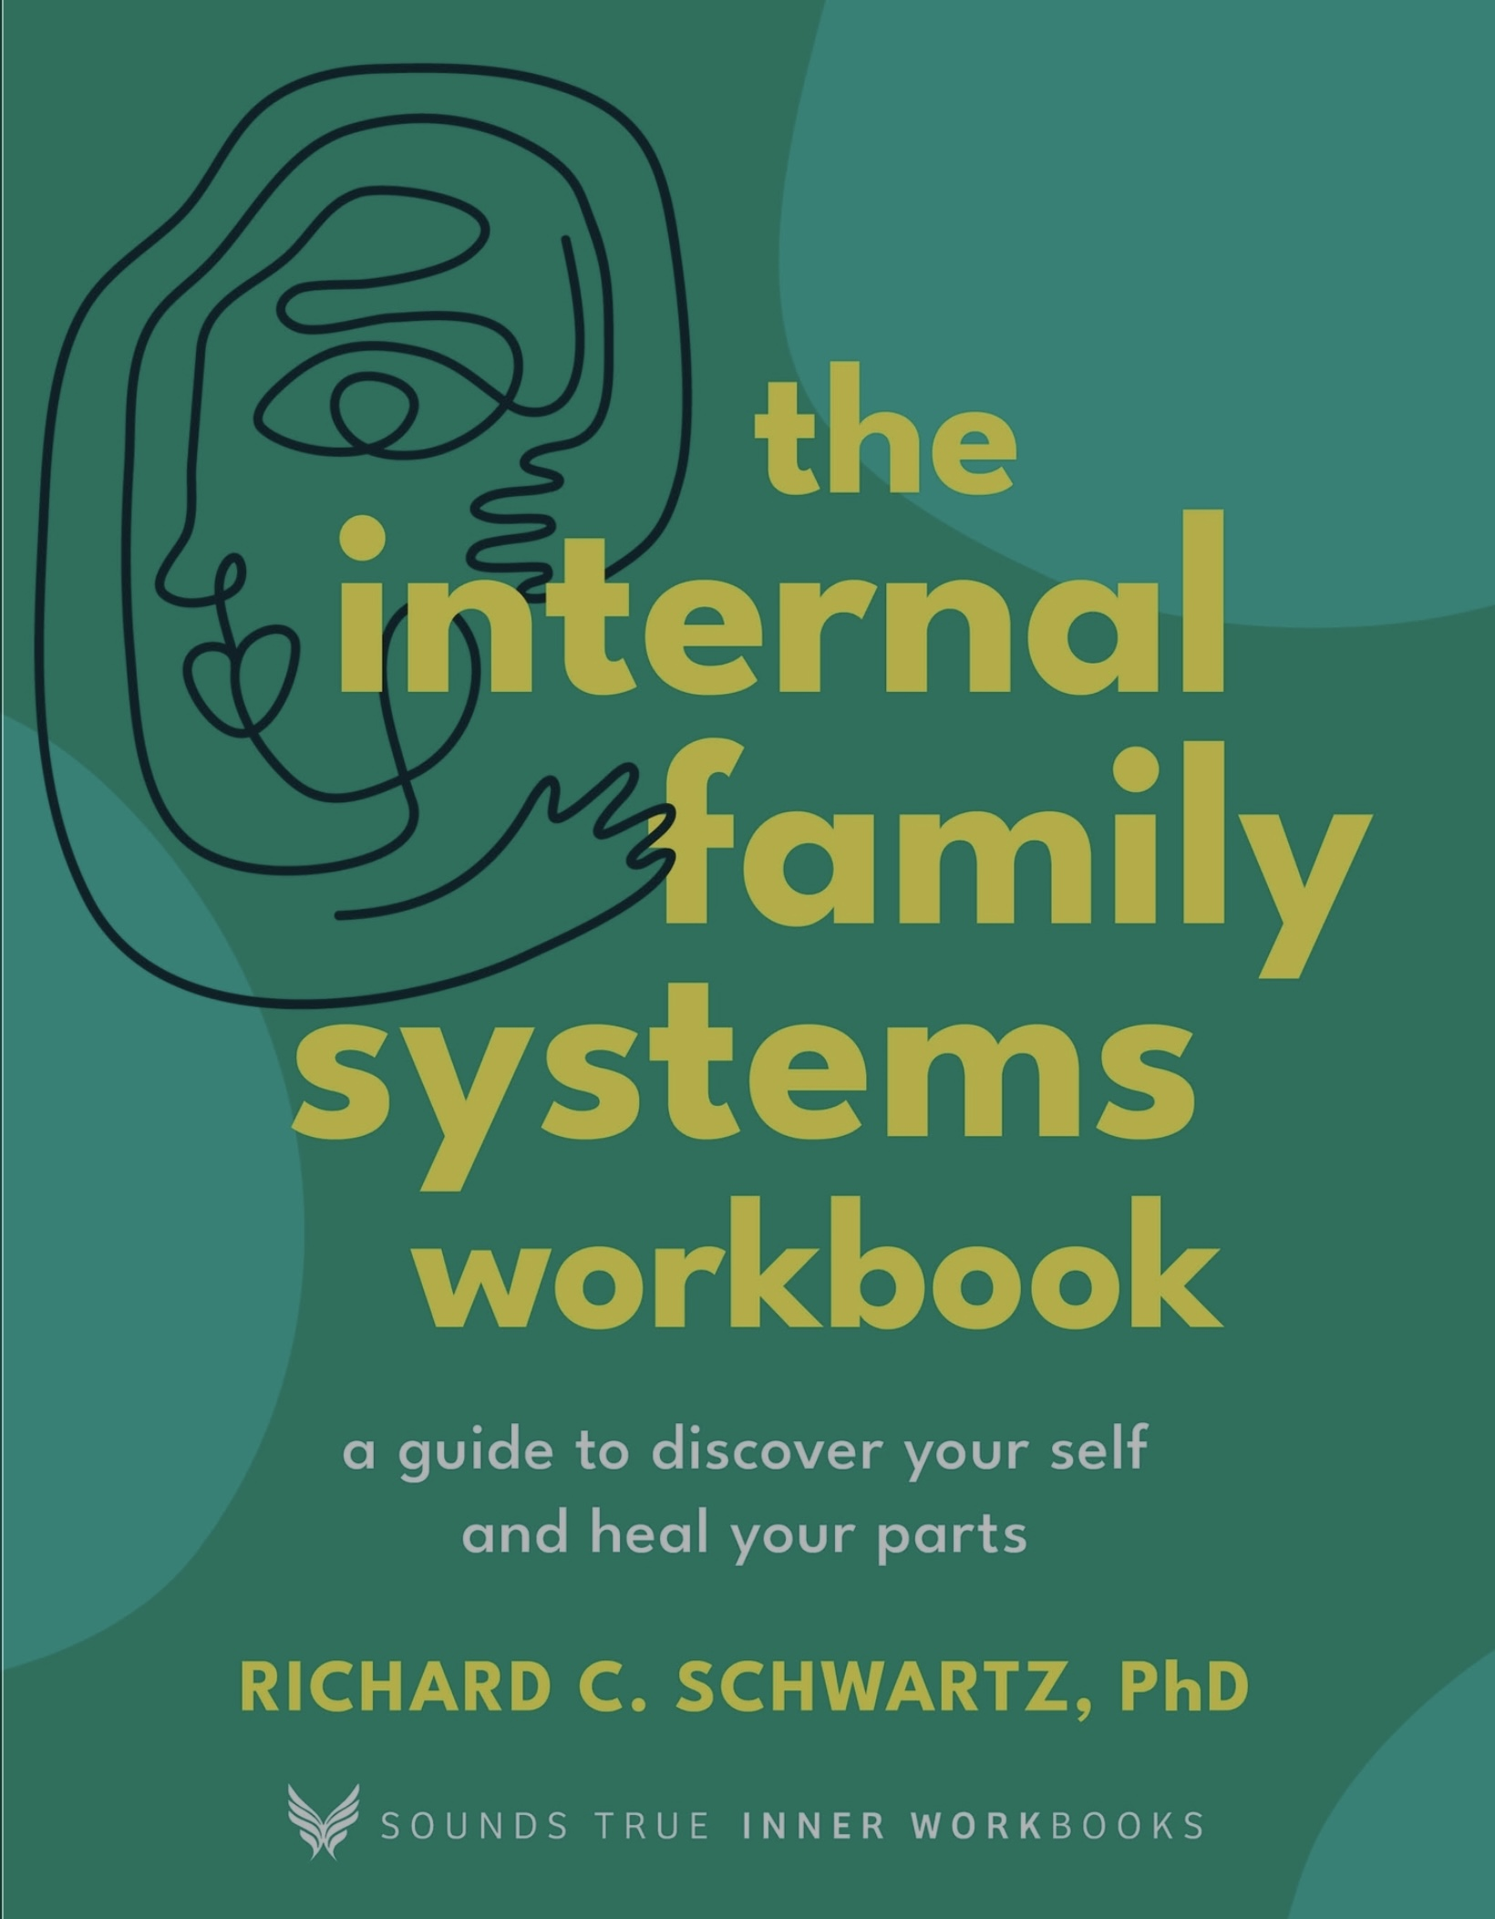

Slide 94
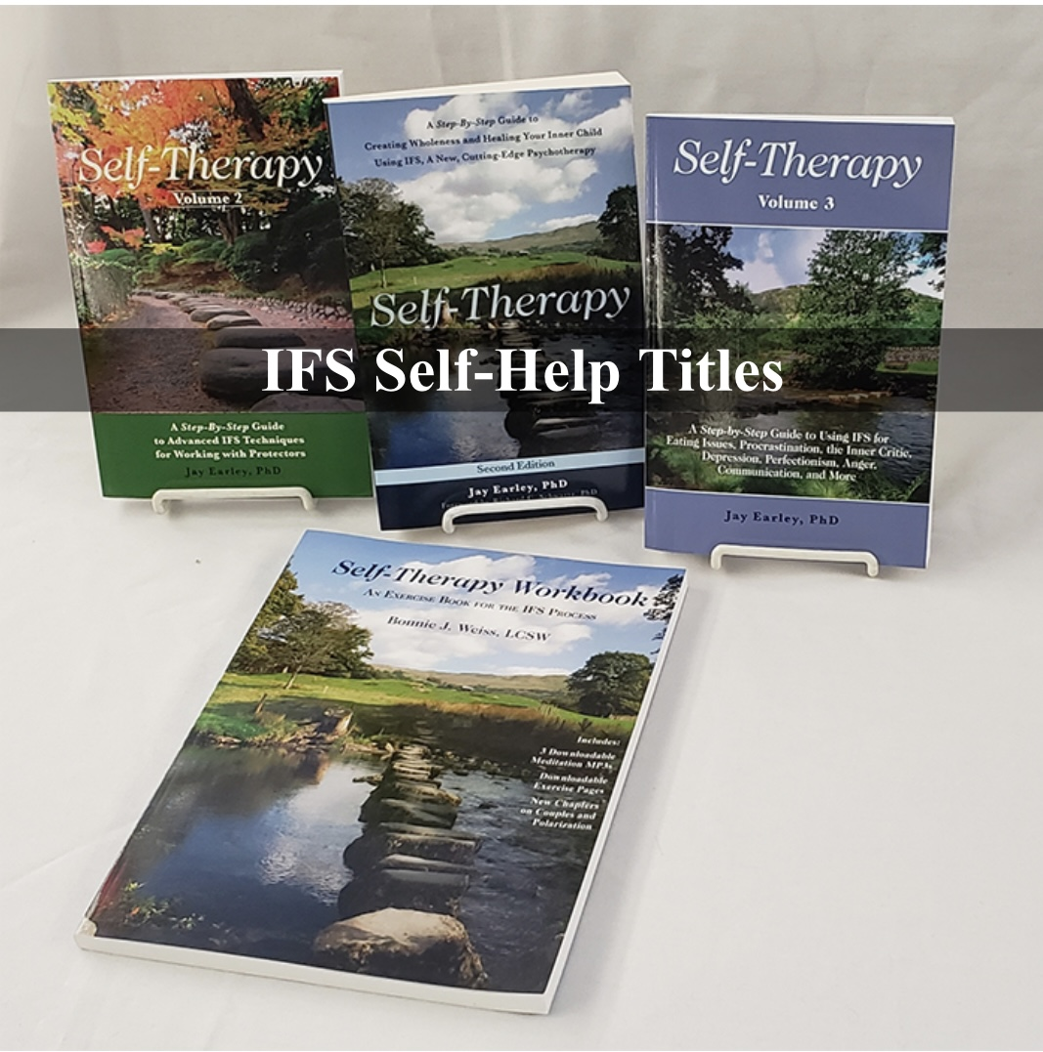
IFS SELF-HELP MANUALS
Self-therapy Volumes 1,2,3 by Jay Earley
Self-therapy workbook by Bonnie Weiss

Slide 95
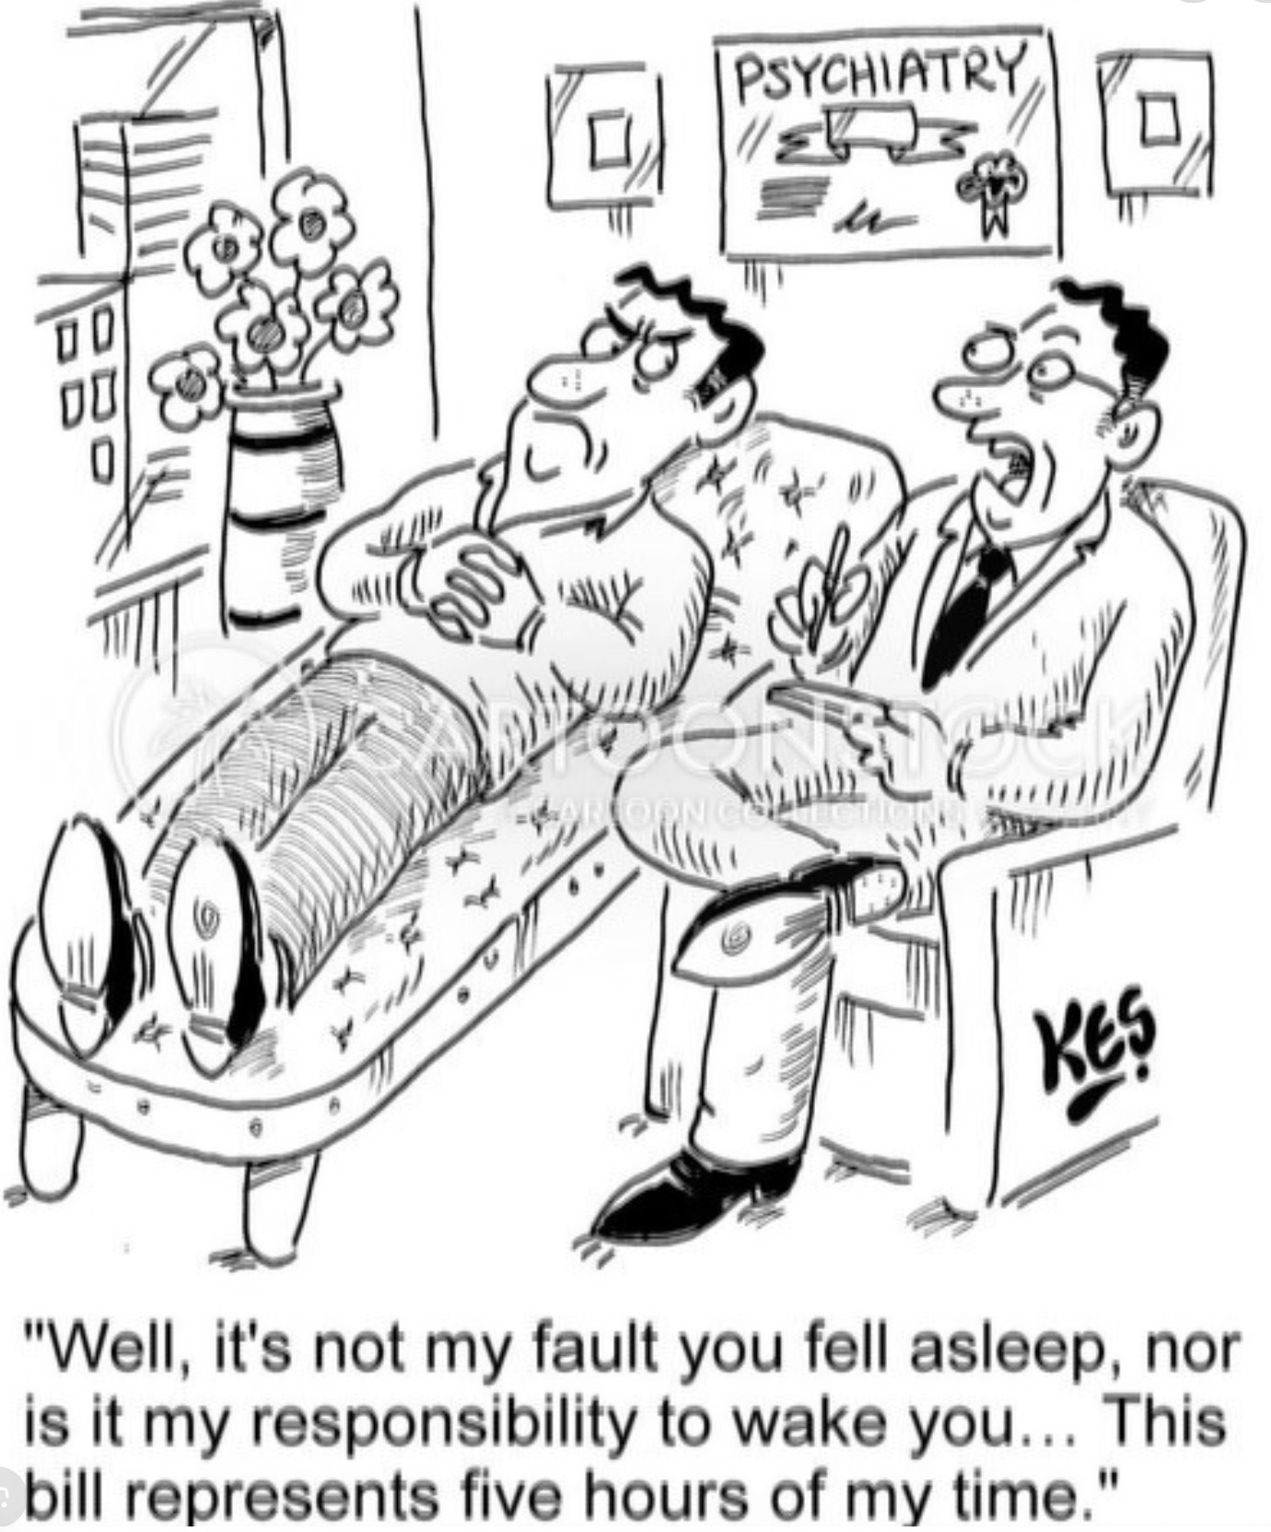
THERAPIST PARTS

Slide 96

Many people become therapists because they struggle with mental health issues and consciously or unconsciously, are trying to understand and heal these issues.
Many therapists have perfectionistic, rescuer, caretaker intellectualizing, internal and external critical, fawning, and people pleasing parts.
If therapists are not aware of their parts and are unable to stay in Self when working with clients, their parts may become activated and negatively affect therapy.
When there is a problem in therapy it is often because unrecognized parts are interfering with the therapeutic process.
These interfering parts may be mainly the therapist's, the clients, or of both interacting together.
When a therapist is in Self, they are in the window of emotional tolerance and are patient, persistent, present, playful, and have perspective.
The therapist staying in Self when a client's parts are activated and helping the client become mindful of these parts is a critical element in helpful therapy.
THERAPIST’S INTERNAL FAMILY PARTS

Slide 97
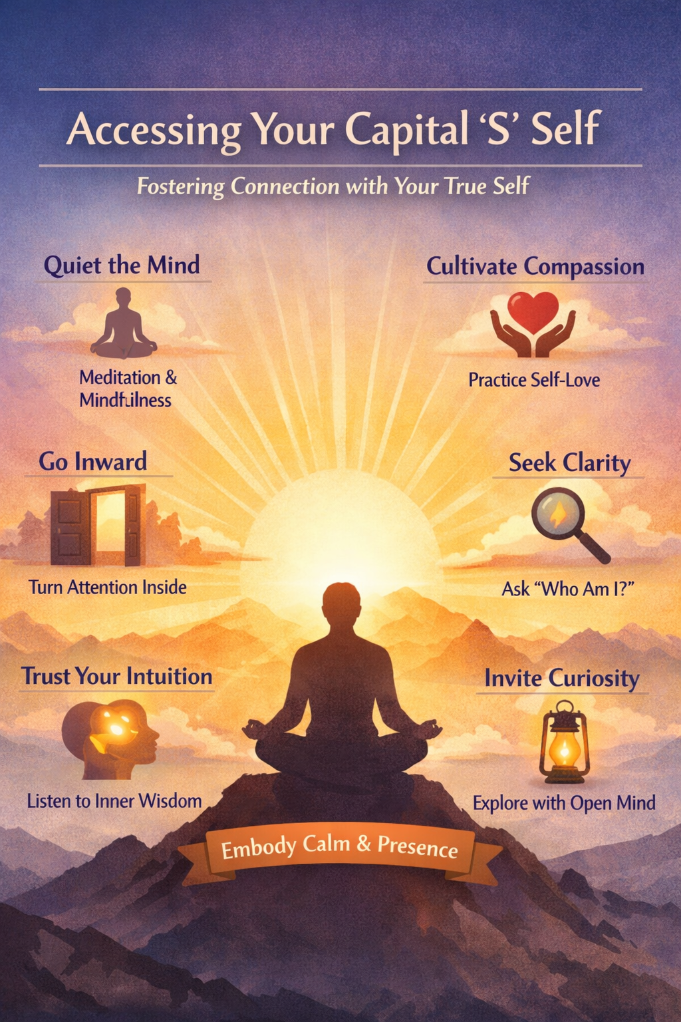
ACCESSING OUR CAPITAL S SELF

Slide 98
ACCESSING OUR CAPITAL S SELF
Self doesn’t become real by assertion, but by enactment. Every time you respond to a part with curiosity instead of judgment, you are strengthening Self the way a muscle strengthens with use.
The Eight Cs are felt signals (calm, curiosity, compassion, clarity, confidence, courage, creativity and connectedness).
The five Ps are relational stances. (Presence, Patience, Perspective, Persistence, and Playfulness)
Together they are sensory-affective cues that parts learn to recognize. Parts don’t believe in Self because of theory. They believe because of how Self feels.
Many parts took on extreme roles because, early on, no consistently safe, attuned, regulating presence was available. Through repeated Self-to-part interactions, Self begins to function as a secure base, safe haven, affect regulator and a meaning-maker. Parts are eventually able to give up their roles because a better internal leader that resembles an ideal parent reliably shows up and takes them on.

Slide 99
ACCESSING OUR CAPITAL S SELF
We are not inventing Self. We are training access to a naturally organizing, integrative capacity of the mind. Just as attention trains perception, relationships shape attachment and practice shapes neural pathways …relational attention trains who leads internally.
Humans have always learned how to experience invisible but organizing presences. IFS simply turns that capacity inward, in the service of healing.
In IFS, Self often starts as an idea, much the way God starts as an idea for many religious people. Cultural anthropologist Tanya Luhrmann in her book “how God becomes real” shows that through disciplined attention and relationship, the idea of God becomes a felt presence.
Something similar happens with Self. We help people practice relating from a calm, curious, compassionate place inside. At first, it may feel imagined or borrowed. But parts respond to how they’re treated, not to theory. Over time, Self becomes experientially real, steady, trustworthy, and present. When that happens, parts no longer need to work so hard. They finally have a parent inside who can lead.

Slide 100

ACCESSING OUR CAPITAL S SELF
At first, Self may feel abstract or imagined. Like a tulpa (a presence that becomes experientially real through attention and relationship), Self becomes felt and reliable through practice.
Over time → “I’m pretending” → “This is a real place in me.”
Trauma lives in our parts; healing happens as Self relates to those parts. For Self to be healing it needs to be practiced into existence until it becomes a vivid tangible presence within us.

Slide 101
SELF AS AN INTERSUBJECTIVE REALITY
We tend to think that something is either real, like a rock, or not real, like the imagination. But there’s a third category: that of ideas that exist between people.
Money, financial markets, laws and nations are examples of ideas in this third category. These all only exist because we collectively believe in them, but once we believe them into existence, they shape our lives in very real ways.
Historically, the Gods be they Greek, Roman Or Christian function in this way, they begin as ideas, but become living realities that organize our experience, behavior, and meaning.
This is a ‘tulpa-like’ process, not meaning they’re not real, but that when they are shared, they take on a life of their own.
The Self may be like this too. In a strictly materialist framework, the Self may not feel real but if we consistently pay attention to the idea, and foster a relationship with it, a Self can become just as real and influential as money or the markets.
That Self may be constructed in this way doesn’t mean there isn’t a reality behind it. Just as religious symbols may point to something deeper, the finger pointing at the moon we previously discussed, intersubjective realities such as Self may be pointing toward aspects of reality that we don’t fully understand.

Slide 102

TULPAS
A tulpa is a mentally constructed, intentionally cultivated inner figure that becomes experienced as having relative autonomy, presence, and agency through sustained attention, imagination, and relationship. Tulpas are often felt as real, even when understood to be mind-generated.
The concept of tulpas originates in Tibetan Buddhist practices, where intentionally visualized deities or thought-forms were cultivated through disciplined meditation.
The idea entered Western discourse in the late 19th–early 20th century via Theosophy and writers like Alexandra David-Néel, who popularized the term.

Slide 103
FOSTERING CAPITAL S SELF
Access to capital S Self is essential in IFS because only Self has the qualities (the 8 Cs and 5 Ps) that allow parts to feel safe enough to unburden and change. Parts do not heal when another part is in charge; they heal when they are seen, understood, and related to by a calm, compassionate, non-agenda-driven presence. Self provides the internal leadership and “ideal parent” function that parts trust, without it, parts remain defensive, polarized, or stuck in their roles.
In her book “How God Becomes Real” , cultural anthropologist Tanya Luhrmann shows that evangelical Christians don’t usually start by experiencing God as a vivid presence. Instead, they:
1. Practice attention through prayer, scripture, and journaling.
2. Learn interpretive rules such as “this thought may be God,” or “this feeling matters”.
3. Engage relationally by speaking to, listening for God.
4. Receive social reinforcement as their community normalizes the experiences.
Over time, what began as an imaginative exercise becomes felt, relational, and trustworthy.
Luhrmann borrows the idea of tulpas / tulpamancy to name this process: a mental representation becomes experientially autonomous and relational through sustained attention and affective investment. Crucially, this is not delusion, it’s a trained mode of perception.
IFS does something very similar: Capital-S Self is not created but revealed, yet it becomes operational only through practice. At first, “Self” can sound abstract or aspirational. Clients often say “I don’t feel Self. I don’t know it.” That’s where Luhrmann’s concept of the Tulpa can helps us.

Slide 104
In IFS, we are doing something very similar to what Luhrmann describes in How God becomes real: We are helping people learn to experience an internal presence, the Self, as real, reliable, and relational. Early on, Self may feel imagined, weak, conceptual and something that has been borrowed from the therapist. That’s stage one. Just as evangelicals practice God into felt reality, IFS clients practice Self into lived presence.
Tulpa process IFS process
Focused attention Mindful unblending
Relational engagement Speaking from Self to parts
Affective investment Compassion, warmth, patience
Repetition Daily check-ins, micro-interventions
Autonomy emerges Self responds spontaneously
Trust develops Parts relax their roles
Over time, Self stops feeling like: “Something I’m pretending to be” and starts feeling like: “The place in me that knows how to be with things.”

Slide 105
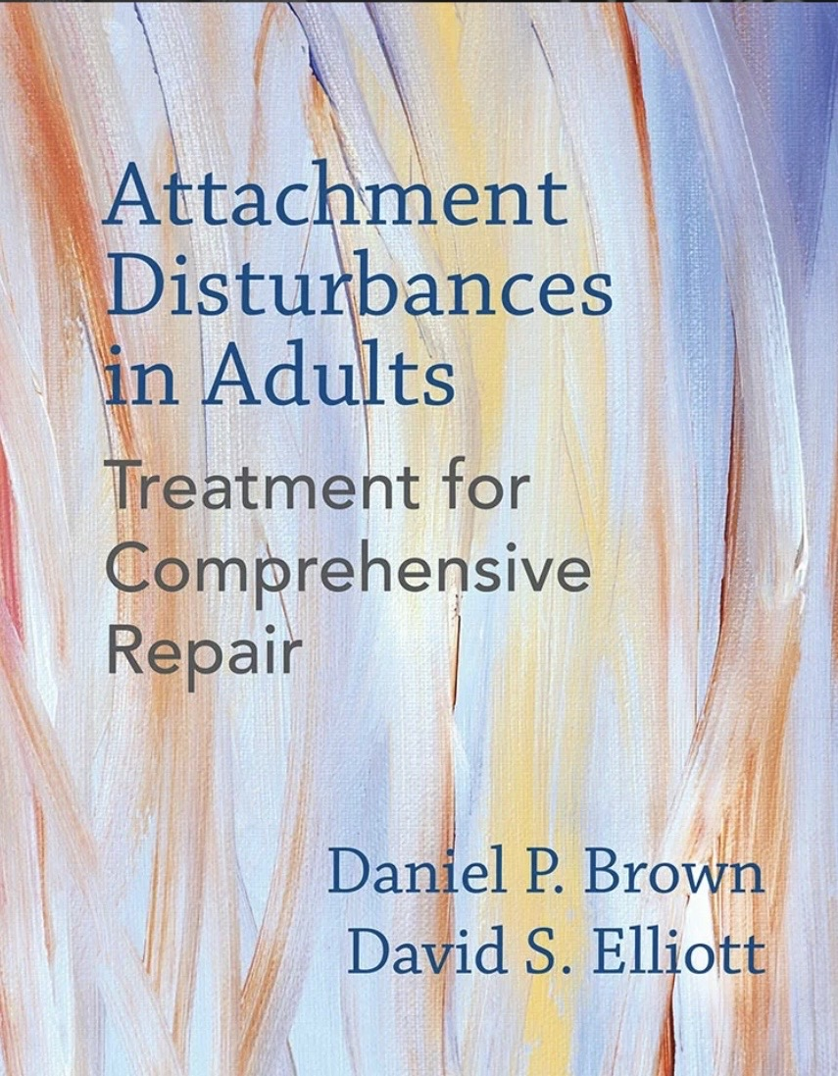
THE IDEAL PARENT FIGURE
Daniel Brown’s Ideal Parent Figure (IPF) protocol is an attachment-focused therapeutic method in which a person repeatedly imagines ideal caregivers who provide protection, soothing, delight, and support for autonomy, so that the nervous system can internalize a secure attachment pattern that may not have developed in childhood. Over time, these imagined but consistent experiences create a felt internal secure base, reducing reactivity and improving emotional regulation and relationships.
Both the Ideal Parent Figure protocol and IFS intentionally cultivate a reliable inner relational presence that the nervous system experiences as safe, attuned, and regulating.
In IPF, imagined ideal parents provide a secure base that becomes internalized. In IFS, Self provides calm, compassionate leadership to parts. In both, repeated felt experience, not insight, leads to internal secure attachment, reduced reactivity, and a more self-led system.

Slide 106
IDENTIFYING OUR PARTS
Exiles
• The Abandoned Child
• The Worthless / Shame Part
• The Scared Child
• The Lonely Part
Firefighters
• The Addictive Part
• The Numbing Part
• The Angry / Explosive Part
• The Avoider / Escapist
• The Self-Harm Part
Managers
• The Inner Critic
• The Perfectionist
• The Pleaser
• The Controller
• The Achiever
• The Caretaker

Slide 107
A PRIMER FOR IDENTIFYING OUR PARTS
How does we identify our internal family systems parts?
We’ll be spending a lot of time on this in sessions 24 to 29 as we work through the IFS workbook
Today we won’t spend much time on this material but in the coming weeks as we try to identify and get to know our parts, we’ll be looking for trailheads, clues or tracks that we can follow that will lead us to your parts.
In identifying our parts we’re not starting from scratch. All the “holes” we’ve already identified, be they diagnosis such as depression or anxiety or psychological patterns such as attachment styles are trailheads to our parts.
Come back to this section over the next few weeks as you’re learning to identify your parts.

Slide 108

In Internal Family Systems therapy, "trailheads" refer to signals or cues that indicate the presence of different "parts" within an individual's internal system.
These trailheads can be thought of as starting points or clues that guide a person toward discovering their internal parts. Recognizing these parts is key to the IFS process
Trailheads help us find parts. Notice the similarity between trailheads and the “holes” we identified for our holes diary cards.
Parts are “advanced” holes diary card targets.
THE KEY TO IDENTIFYING PARTS
TRAILHEADS

Slide 109
COMMON TRAILHEADS
A strong emotion like anger, sadness, anxiety, or joy can serve as a trailhead. For instance, if someone feels a sudden surge of anger in a particular situation, it might indicate an "angry part" that could be explored.
Repetitive or automatic behaviors can also be trailheads. A compulsion to overwork or procrastinate might point to specific parts influencing those behaviors.
Persistent or intrusive thoughts can be signals from parts. Negative self-talk, for example, might be coming from a critical part trying to protect the individual in some way.
Physical sensations, like tension in the shoulders or a knot in the stomach, might act as trailheads guiding you to parts that hold specific emotions or memories.
Intrusive Images or Memories can sometimes surface and indicate the presence of a part that holds particular experiences or traumas.

Slide 110
IDENTIFYING PARTS
Noticing patterns in relationships or life choices can show the influence of certain parts. For instance, always feeling the need to please others might point to a people-pleasing part.
Once trailheads are identified, IFS therapy involves:
Approaching these trailheads with curiosity rather than judgment. This can lead to a deeper understanding of the parts and their roles.
Engaging in a compassionate internal dialogue with these parts to learn about their needs, fears, and roles within the internal family system.
Working towards healing the wounds of these parts and integrating them into a more balanced and cohesive self-system.
Trailheads are essential in IFS because they serve as guides on the journey to recognizing, understanding, and ultimately healing the various parts within oneself.

Slide 111

identifying internal family parts
Infants and children may structurally dissociate into parts because 1) they experienced attachment injuries. 2) they experienced inescapable fear. Or 3) they experience inescapable pain.
The exiles that arise from these experiences can feel hurt, abandoned, panicked, grief, or be numb.
Exiles that dissociated before the child developed language do not have explicit memories, words, and images accompanying the implicit memories they carry. These exiles carry pain from events that are not consciously remembered. When this pain emerges the rational information center does not know what to attribute it to.
When exiles are activated, and the person feels their pain they may attribute this pain to present day circumstances or to some brain chemical imbalance. They seldom think of this pain as the surfacing into the conscious mind of a preverbal exile and the experiences it embodies .

Slide 112
identifying internal family parts
Because implicit memories are more often triggered in intimate relationships than in casual ones, and therapy is an intimate relationship, mental health professionals trying to establish an emotional connection with a patient may trigger implicit memories and be perceived as were the hurtful figures from that persons past.
This can lead to a re-enactment in the therapeutic setting of past traumatic relationships.
This is a form of “repetition/compulsion”.

Slide 113
common parts
The abandoned child
The worthless ashamed child
The scared child
The lonely child
The controller
The achiever
The caretaker
The addicted part
The numb part
The angry/explosive part
The avoider/escapist
The self-harm part
The Hurt child
The Internal critic
The External critic
The perfectionist
The people pleaser
The workaholic
The compulsive care giver
The indulger
The procrastinator
The wild child
The mature adult
The rationalizer
This list is offered in the spirit of lists of popular children names. As with your child you can name your parts whatever you want. We suggest you let Self choose the name as other parts of you may want to give a part a name that is judgemental.

Slide 114
COMMON PARTS
Exiles
• The Abandoned Child
• The Worthless / Shame Part
• The Scared Child
• The Lonely Part
Firefighters
• The Addictive Part
• The Numbing Part
• The Angry / Explosive Part
• The Avoider / Escapist
• The Self-Harm Part
Managers
• The Inner Critic
• The Perfectionist
• The Pleaser
• The Controller
• The Achiever
• The Caretaker

Slide 115
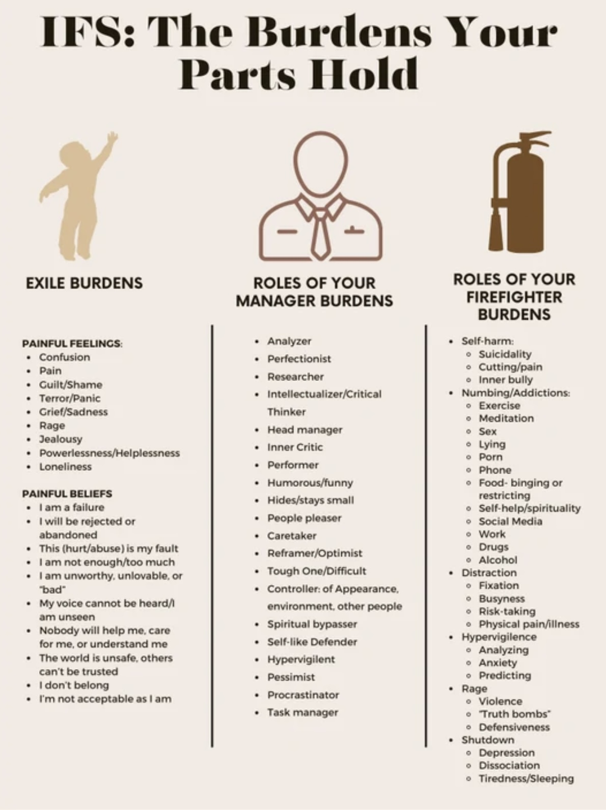
common parts
Common internal family parts include:
The Hurt child : grieving, abandoned, unheard, neglected, panicked dissociated, numb
The Internal critic : which aims its criticism at the hurt child. It often represents the caregivers internalized critical voice. The constant negative self-talk/criticism causes fear and shame in the hurt child part.
The External critic : often arises in adolescence. Aims its criticism at others. “They don’t care” “they are stupid”… etc. associated with anger, rebellion, and breaking the rules.
The perfectionist, people pleaser, workaholic, and compulsive care giver try to be perfect or please others in order to achieve some measure of emotional relief, calm, connection, attachment, and acceptance
Inner active cards is a deck of 74 frequently occurring IFS parts

Slide 116
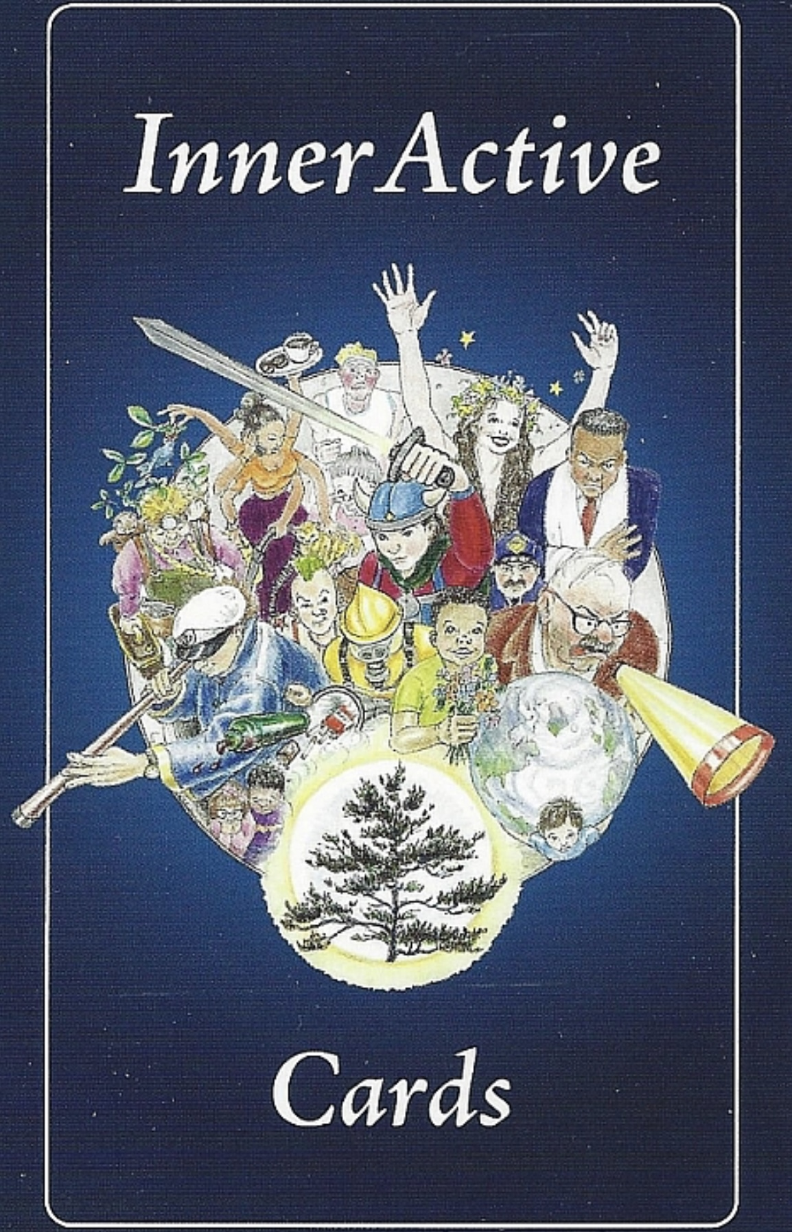
common parts
The indulger : dissociates from the pain of the exile through addictions (substances, food, sex, consumerism etc.)
The procrastinator : passive aggressively resists the control of the parental figure. May feign incompetence.
The wild child: impulsive, fearless, protective, takes on perpetrators.
The mature adult: is rational and reasonable but doesn’t understand the other parts and is often in conflict with them.
Inner active cards is a deck of 74 frequently occurring IFS parts

Slide 117
TRAILHEADS THAT MAY BE FAMILIAR
As we begin working with Internal Family Systems, and trying to identify our parts, we’re not starting from scratch. Many of us already recognize patterns in ourselves from other models. We may identify with a diagnosis like depression or anxiety, with nervous system states like fight, flight, or freeze, or with attachment styles like avoidant or anxious.
In IFS these patterns can serve as trailheads; entry points that lead us to parts of the psyche. If we notice we are frequently shutdown, we may have a protective part that uses collapse to keep us safe.
If we recognize avoidant attachment pattern, this may point to a distancing manager part protecting vulnerable exiles.
Different models are simply different maps of the same inner system. IFS helps us translate those descriptions into the parts that are carrying burdens or trying to protect us.
Diagnoses describe the symptom. Attachment describes the relationship pattern. IFS helps us meet the part that is producing it. Think of these as different languages describing the same inner territory, IFS is the language that lets us speak directly with the characters inside the system.
So, the different psychological languages we’ve learned, diagnoses, attachment styles, and nervous system states can all help us locate the parts that IFS works with. They are not different problems. They are simply different maps pointing to the same inner system.

Slide 118
FINDING IFS PARTS BASED ON DESCRIPTION WE IDENTIFY WITH
MAP LANGUAGE DESCRIPTION OF THE HOLE TRANSLATION IN IFS
Biological psychiatry Depression
Exiles carrying despair + protectors managing pain
Attachment theory Avoidant attachment Distancing manager parts
Trauma theory Emotional Parts (EP) Exiles
Polyvagal theory Dorsal shutdown
Protectors using collapse or numbing

Slide 119
WHAT TO ASK WHEN IDENTIFYING PARTS
If you identify with DSM diagnosis, states of activation, or attachment styles these questions may help you find some of your parts:
DSM DIAGNOSIS
(Depression, Anxiety) - What part of me feels this?
STATES OF ACTIVATION
(Fight, Flight, Freeze, Fawn) - What part of me goes into this state?
ATTACHMENT STYLES
(Avoidant, Anxious, Disorganized) - What part of me learned this strategy?

Slide 120
PARTS TYPICALLY ASSOCIATED WITH DIFFERENT ATTACHMENT STYLES
Attachment styles can provide clues to IFS parts
Attachment Style | Typical Protective Strategy | Common IFS Parts
Avoidant | Distance from emotional vulnerability | Distancing manager parts, intellectualizing parts, self-reliant parts, dismissive protectors
Anxious | Seek reassurance and closeness | Clinging manager parts, approval-seeking parts, hypervigilant parts
Disorganized | Simultaneous approach and avoidance | Conflicted protectors, chaotic firefighters, terrified exiles, distrustful managers

Slide 121
ATTACHMENT STYLE AND IFS PARTS
Avoidant attachment often involves: • Managers that suppress vulnerability • Protectors that emphasize independence • Exiles carrying unmet attachment needs.
Anxious Attachment Often involves: • Managers seeking reassurance or closeness • Hypervigilant protectors scanning for rejection • Exiles carrying fears of abandonment
Disorganized Attachment Often involves: • Highly polarized protectors • chaotic firefighter responses • deeply frightened exiles. These systems may oscillate between approach and avoidance.
Attachment styles describe relationship patterns. IFS helps us discover the parts inside the system that are creating those patterns
Attachment styles describe how the system behaves in relationships. IFS shows us the inner characters that are producing that behavior.

Slide 122
SIMPLE ALGORITHM FOR FINDING YOUR INTERNAL FAMILY PARTS
You can use this algorithm to find parts:
1. Start with your holes diary card
2. Then do a regular chain analysis
3. As you do the chain analysis, consider if the different feelings, thoughts, and behaviors you had in the situation may have belonged to an IFS part.
5. Consider this in light of the most common family systems parts described on the previous slide. Do your parts correspond to any of those?
6. Once you have identified some of your parts use the “become familiar with your parts” template below to get to know your parts better.

Slide 123
Becoming acquainted with part selves TEMPLATE
Part self | What does it look like? How old is it? | What does it typically feel? | What state of activation is it usually in? | What are its typical thoughts?(if any) | What are its typical behaviors or behavior urges?
1
2
3
4
5
Consider the origin story of each of these parts. When and why did it arise in your life to protect you ? How did it protect you ?

Slide 124
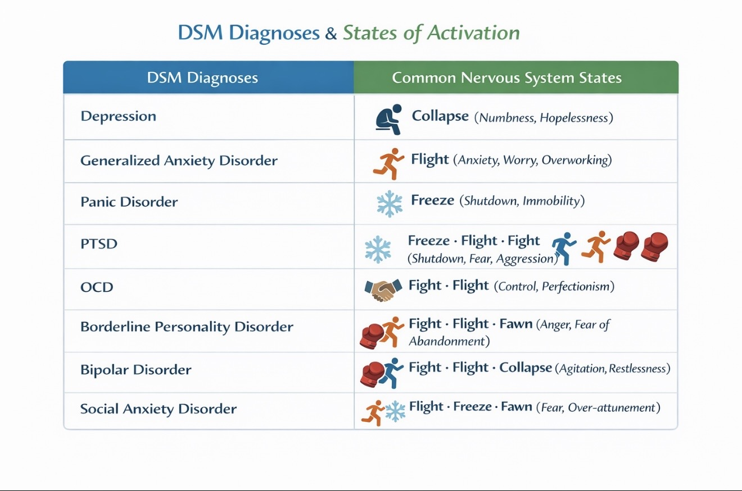
STATES OF ACTIVATION AS TRAILHEADS
If you're not sure what your dominant states of activation are:
Do you identify with a mental health diagnosis or has someone suggested a diagnosis to you?
Use the illustration on the left to go from the diagnosis to the state of activation associated with it.

Slide 125
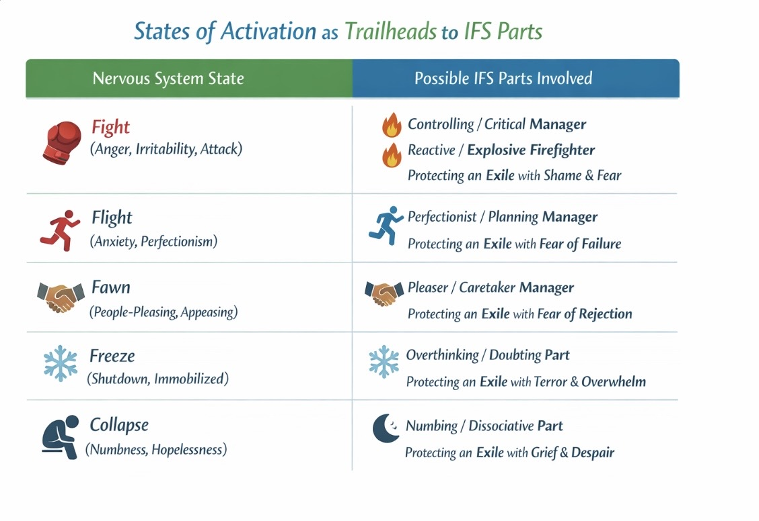
STATES OF ACTIVATION AS TRAILHEADS
Our dominant states of activation are trailheads to our dominant IFS parts.
Consider what your dominant states of activation are and use the illustration on the left as a trailhead to your IFS parts.

Slide 126
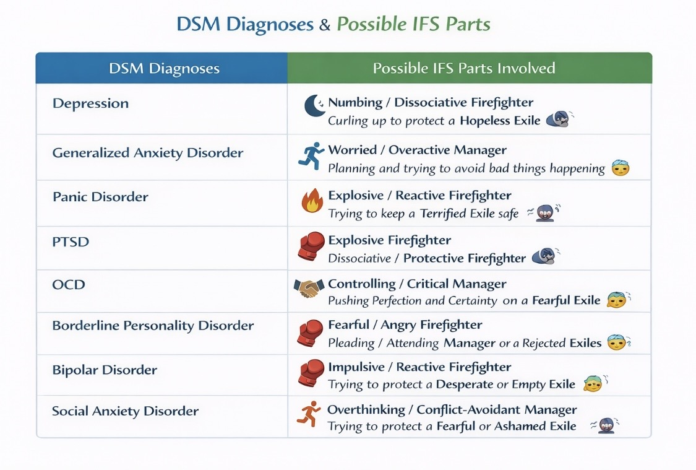
DIAGNOSES AS IFS TRAILHEADS
Do you identify with or have you been given a mental health diagnosis?
Use the illustration on the left as a trailhead map for IFS parts associated with common mental health diagnosis.

Slide 127
PSYCHIATRIC DIAGNOSES AS IFS TRAILHEADS
From a trauma-informed perspective, many psychiatric diagnoses such as depressive disorders, dissociative disorders, and anxiety disorders, are not simply “illness categories.” Instead, they can be understood as dominant, long-standing autonomic states that the nervous system has learned to be in, in response to overwhelming experience.
In this view, trauma not only creates memories, but it also shapes modes of functioning, stable patterns of physiology, attention, emotion, and behaviour. These modes often correspond almost perfectly to DSM diagnostic clusters. You might think of them as survival states that have become trait-like.
In IFS, a trailhead is simply something that tells you: “A part is activated here.” Psychiatric diagnoses are essentially trailheads or stable constellations of parts organized around a shared survival logic.

Slide 128
PSYCHIATRIC DIAGNOSES AS IFS TRAILHEADS
Depression often reflects a dominant shutdown state that emerges when fight and flight didn’t work, attachment didn’t soothe, and collapse became the safest available option.
The system lowers metabolic output, narrows attention, blunts affect, and goes inward. It is the nervous system saying: “It’s safer not to feel, not to hope, and not to reach.” From a trauma informed perspective, the symptoms of depression become trailheads for parts.
Common protector parts revealed by depressive symptom states include
1) the numbing part which blunts affect to prevent overwhelm.
2) the hopeless part which insists nothing will work to stop further disappointment
3) the collapse part which makes the body heavy and inactive to reduce interpersonal threat and
4) the inner critic which attacks motivation to prevent risk.
Common exiles beneath depressive states include
1) the Helpless Child
2) the grief-burdened part
3) the lonely part who learned not to reach and
4) the shamed part who believes they are not worthy. Thus, “having depression” is not one coherent thing, it is a cluster of activated protector parts managing deeper unbearable affect.

Slide 129
PSYCHIATRIC DIAGNOSES AS IFS TRAILHEADS
Anxiety disorders often reflect a nervous system that has learned that “Threat is constant and vigilance is required.”
Trauma sensitizes the amygdala (threat detection), the sympathetic system (mobilization), and attention networks (hyper-alert scanning). The result is a persistent fight-flight activation state.
Common protector parts present in people with anxiety disorders include
1) the vigilant part – constantly scanning for danger.
2) the catastrophizer – preparing for the worst to prevent harm.
3) the perfectionistic part – avoiding criticism or failure.
4) the avoidant part – preventing exposure to perceived threats.
The most common exiles underneath these protectors are
1) the terrified child
2) the part that couldn’t keep the family safe
3) the part that learned the world is unpredictable and
4) the shamed part expecting rejection.

Slide 130
PSYCHIATRIC DIAGNOSES AS IFS TRAILHEADS
Dissociation is both a biological safety strategy, and a psychological survival mechanism. Dissociative symptoms serve as direct trailheads to both protectors and exiles.
Protector parts commonly dominating dissociative states include
1) the detacher – pulls awareness away to prevent overwhelm.
2) the numbing/spacing out part – shuts off sensation.
3) the apparently normal part (ANP) – focuses on tasks to keep life going
4) the emotional part (EP) – holds overwhelming affect in a sealed compartment.
Common exiles beneath these protectors include
1) the trauma holder
2) the frozen child
3) the part containing sensory fragments (images, sensations, body memories) and
4) the part that dissociated during the original trauma.

Slide 131
Common protector parts in people with depressive symptoms include 1) the numbing part which blunts affect to prevent overwhelm. 2) the hopeless part which insists nothing will work to stop further disappointment 3) the collapse part which makes the body heavy and inactive to reduce interpersonal threat and 4) the inner critic which attacks motivation to prevent risk.
Common exiles beneath these depressive states include 1) the Helpless Child 2) the grief-burdened part 3) the lonely part who learned not to reach AND 4) the shamed part who believes they are not worthy. Thus, “having depression” is not one coherent thing, it is a cluster of activated protector parts managing deeper unbearable affect.
Common protector parts present in people with anxiety disorders include 1) the vigilant part – constantly scanning for danger. 2) the catastrophizer – preparing for the worst to prevent harm. 3) the perfectionistic part – avoiding criticism or failure. 3) the avoidant part – preventing exposure to perceived threats.
Common exiles underneath anxious protectors are 1) the terrified child 2) the part that couldn’t keep the family safe 3) the part that learned the world is unpredictable and 3) the shamed part expecting rejection. Thus, anxiety is a mobilized survival state that reveals the protectors who keep watch.
Common protector parts in people with dissociative states include 1) the detacher – pulls awareness away to prevent overwhelm. 2) the numbing/spacing out part – shuts off sensation. 3) the apparently normal part (ANP) – focuses on tasks to keep life going 4) the emotional part (EP) – holds overwhelming affect in a sealed compartment.
Common exiles beneath dissociated protectors include 1) the trauma holder 2) the frozen child 3) the part containing sensory fragments (images, sensations, body memories) and 4) the part that dissociated during the original trauma.

Slide 132
ALGORITHM FOR FINDING IFS PARTS BASED ON PSYCHIATRIC DIAGNOSIS
Step 1 — Identify your dominant autonomic arousal or activation state
Depression → collapse / shutdown. Anxiety → hyperarousal. Dissociation → disconnection / fragmentation
Step 2 — Ask which protectors are creating this state? Every symptom pattern arises from a protector strategy, e.g.: “My body is heavy, and I can barely move” → Collapse Protector. “I can’t stop worrying” → Vigilance Protector. “I feel nothing and lose time” → Detacher or Dissociative Protector.
Step 3 — Ask: What is this protector protecting? This takes you directly to the exile.
Step 4 — Discover the exile’s burden This reveals: trauma memories, overwhelming affects, core beliefs (“I’m unlovable,” “I’m unsafe,” “I’m alone,” etc.)
Step 5 — Bring Self-energy (curiosity, compassion, connection) to this process as the diagnosis no longer defines you and your parts tell the real story.

Slide 133
In summary from a trauma-informed perspective, many psychiatric diagnoses are not illnesses in the traditional sense, they are survival states the nervous system learned to live in. Depression is a collapse state. Anxiety is a hyperarousal state. Dissociation is a disconnection state.
Each of these states is produced by protector parts trying to prevent deeper pain. In IFS, we use the symptoms of these diagnoses as trailheads, signs that a part is active. Once we’ve found the protector, we can eventually discover the exile it is protecting and bring Self-energy to the system. This transforms the diagnosis from a label into a map of the inner world.

Slide 134
Can psychosomatic illnesses also be trailheads for IFS parts ?

Slide 135
IFS AND PSYCHOSOMATIC ILLNESSES
According to Internal Family Systems theory, chronic pain and other psychosomatic illnesses can be a manifestation of parts. Parts can significantly influence the body and the body, in turn, can reflect their distress or burden. IFS is built on the assumption that psychological conflicts can be embodied. That is, parts that carry emotional burdens, especially exiles, may express their pain somatically when they are not acknowledged or integrated.
For example, 1) a protector part that fears vulnerability may create tension or stiffness to guard the body from a perceived threat, 2) an exile part carrying shame or trauma might manifest through chronic fatigue, gut issues, or pain syndromes like fibromyalgia, or 3) a caretaker part that over functions and never rests may drive the body toward burnout or autoimmune conditions.
IFS reframes symptoms not as malfunctions but as messages from parts trying to be heard. Chronic pain might be a protector’s strategy to slow the person down and avoid situations that feel unsafe. A flare-up in symptoms might occur when a trauma-linked exile is triggered and doesn’t have a safe outlet for its emotion. Illness or pain may be the only way a part knows to get the Self’s attention.

Slide 136
IFS AND PSYCHOSOMATIC ILLNESSES
This is similar in spirit to what body-centered psychotherapies like Somatic Experiencing or sensorimotor psychotherapy also suggest: the body remembers what the mind avoids.
In an IFS-informed approach to chronic pain or illness, the therapist or practitioner helps the client:
1. Notice and describe the symptom in bodily terms (e.g., tightness, burning, heaviness).
2. Ask inside: “What part of me is showing up here?”
3. Contact the part expressing itself through the symptom.
4. Get curious about its role, fears, and what it’s protecting.
5. Invite the Self to lead bringing compassion, curiosity, and calm to the part.
6. Work with the part to unburden it, allowing the symptom to soften or resolve over time.

Slide 137
IFS AND PSYCHOSOMATIC ILLNESSES EXAMPLES
A woman with migraines discovered they were linked to a part that felt overwhelmed by others’ expectations and used pain to escape social obligations.
A man with chronic lower back pain found a vigilant protector part that stayed tense to prevent “emotional collapse,” which he feared would happen if he let go.
A person with irritable bowel syndrome (IBS) identified a terrified exile holding childhood humiliation and a protector that clenched the abdomen to “keep everything in.”
In each of these cases, befriending the parts, understanding their roles, and unburdening them led to symptom relief or even full remission.
While traditional models sometimes imply that symptoms are “all in your head”, IFS emphasizes that symptoms are very real, but their source may be psychological and relational and healing can occur through inner dialogue.
IFS suggests that the body is a stage where parts act out their dramas when they don’t feel seen or safe. When we turn toward the symptom with curiosity rather than suppression, we may find that it is not the enemy but a loyal messenger waiting to be heard.

Slide 138
What do physical or mental health diagnosis and dominant states of activation have to do with IFS parts?

Slide 139
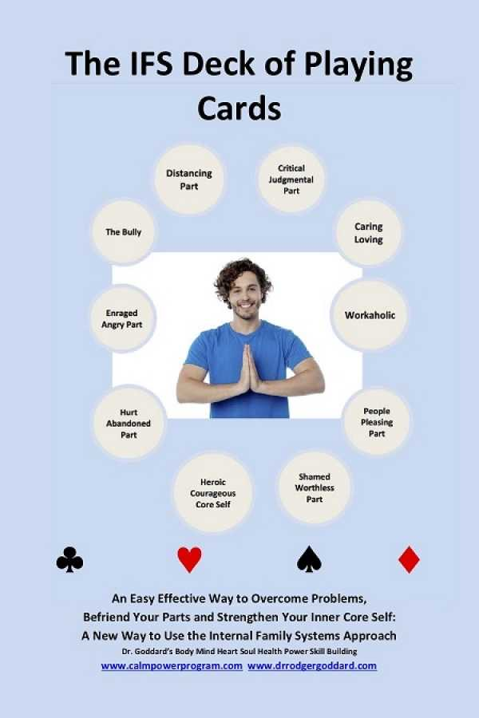
FINDING PART SELVES
Today we’ll explore other ways of finding our part selves by considering our physical and mental health diagnosis and our dominant states of activation as trailheads for our IFS parts?
Many of us spend a significant part of our lives in fight, flight, freeze, or fawn. These states of activation and the diagnosis attached to them may be trailheads for our IFS.
For example:
We may be chronically depressed because we have a dominant part that is in a freeze state.
We may be chronically anxious because we have a dominant part in flight.
We may be chronically irritated or angry because of a dominant fight part.
We may be chronically appeasing or people pleasing because of a dominant fawn part.
Not every one of our parts is dominant, some parts may just be occasionally activated. It is particularly important to pay attention to the ones that are dominant.
Becoming aware of our dominant states of activation may be a good way to identify our dominant IFS parts.
Notes:
At this point it would be helpful for you to know how to find your parts and to have identified some of them.

Slide 140
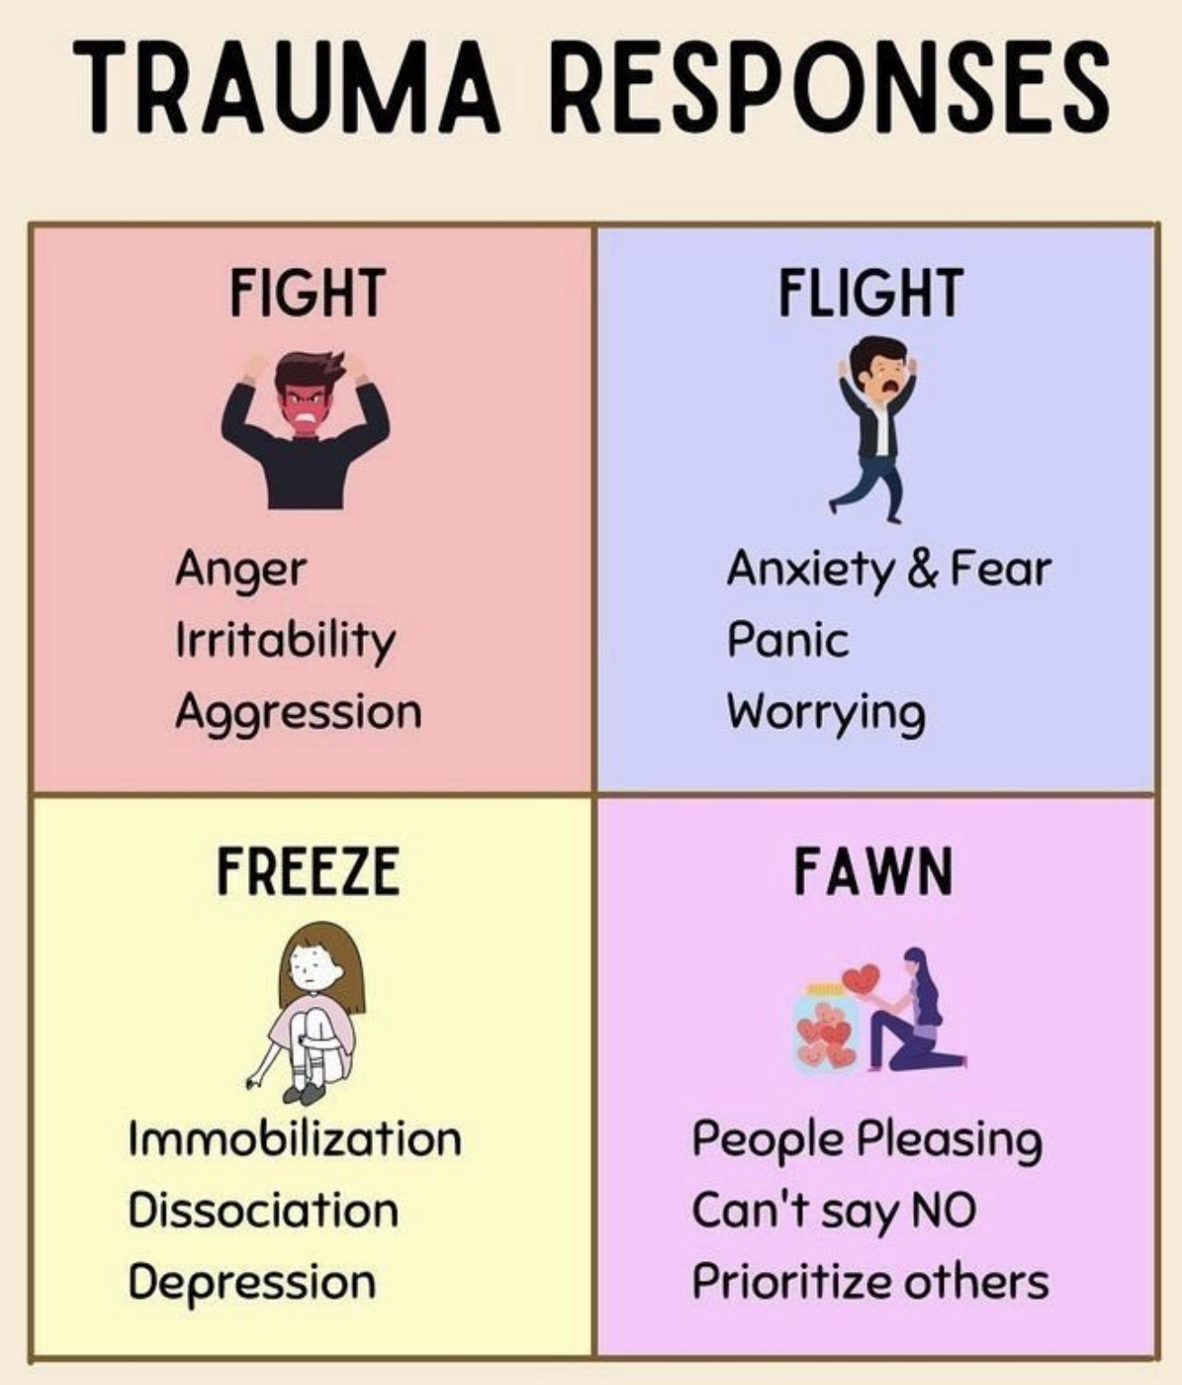
We have been exploring biological, psychological, social and spiritual factors that play important roles in mental health.
One way to think of common mental or physical health diagnosis such as depression, anxiety, dissociation, pain, fatigue, or anger is as ways IFS parts are showing up.
In other words, recurrent and/or chronic physical or psychological symptoms might be explained as manifestations of IFS parts that are chronically activated.
We’ve already considered how IFS parts have their own feelings, thoughts, and typical ways of behaving. Today we’ll add that IFS parts may also have a diagnosis and be in a particular activation state .
This means that our dominant physical or psychological symptoms and diagnosis and our activation states may sometimes be explained as the manifestations of IFS parts.
Symptoms, diagnosis and activation states, because they tend to be obvious, may be particularly good trailheads for finding our dominant parts.
THE ACTIVATION OF IFS
PART SELVES

Slide 141
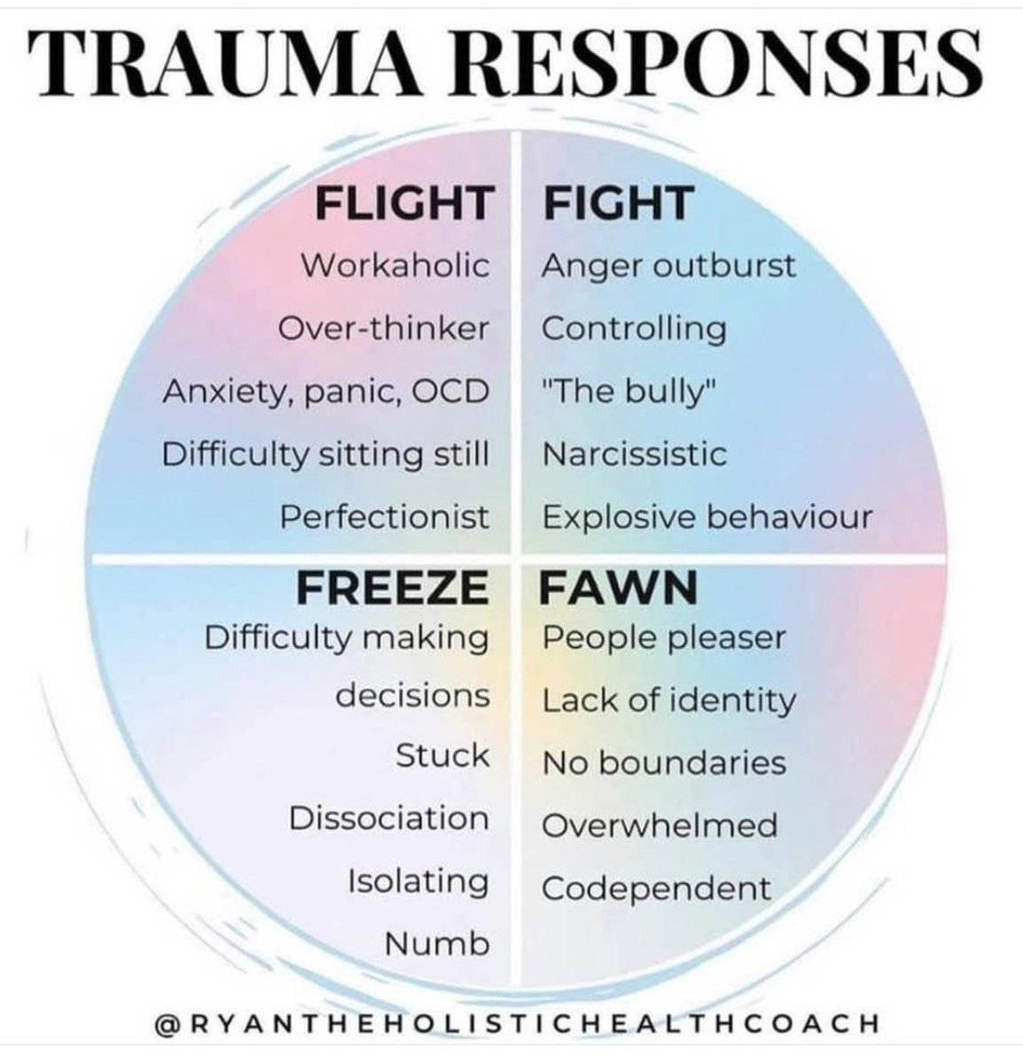
dominant part selves and states of activation
At some point in our lives, we all experience the calm/alert, fight, flight, freeze, and fawn states of physiological activation/arousal.
If the rational mature adult part is dominant in us, we likely spend most of our lives in a calm/alert state which is where we like to be.
If, however, we experience significant emotional dysregulation we may spend much of our lives in states of fight, flight, freeze, or fawn, which are all outside the window of tolerance.
Alternatively, some people who experience emotional dysregulation, may also spend considerable time in mature adult calm/alert but when their fight, flight, freeze, or fawn states are activated, that activation may be so intense that it causes them a lot of difficulties.
Notes:
Sometimes a person's personality is dominated by a particular state of activation which could be fight, and people were predominantly angry, flight, in people who are predominantly anxious, fawn, and people were predominantly trying to please others, or freeze, in people were predominantly dissociated or depressed.
Understanding that there can be dominant internal family systems part selves that dominate the personality helps us understand why people find themselves chronically in these various states of activation.

Slide 142
dominant part selves and states of activation
Each IFS part self can be seen as being predominantly in one state of physiological activation. (fight, flight, freeze or fawn)
The state of activation we experience most frequently or intensely is often a clue to which part selves are dominant in our system.
Because of its importance in our lives, this part may be an “advanced” diary card target or hole we want to pay significant attention to
One of the steps of Wise mind remediation is identifying our internal family system part selves.
Paying attention to the states of activation we most frequently experience can help us identify our dominant part selves.
Notes:
Sometimes a person's personality is dominated by a particular state of activation which could be fight, and people were predominantly angry, flight, in people who are predominantly anxious, fawn, and people were predominantly trying to please others, or freeze, in people were predominantly dissociated or depressed.
Understanding that there can be dominant internal family systems part selves that dominate the personality helps us understand why people find themselves chronically in these various states of activation.

Slide 143
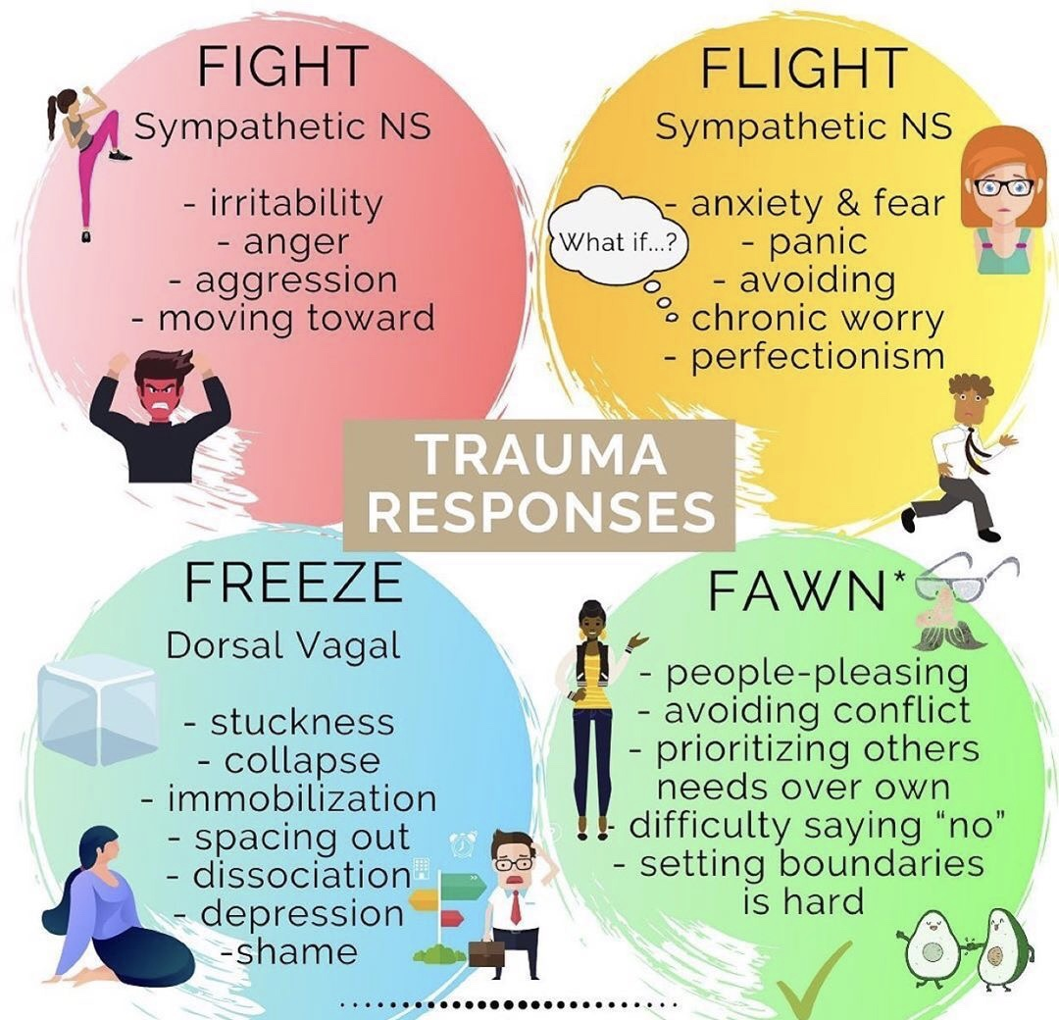
WHAT ARE YOUR DOMINANT STATES OF ACTIVATION?
Which states of activation do you most frequently find yourself in, is it calm, fight, flight, freeze, or fawn?
Remember that calm and alert are arousal states in the window of tolerance (tolerable emotions).
Fight and flight are hyperaroused states, so that if we’re in these states, we may feel angry, irritated, annoyed, fearful, anxious, panicky and uncertain a lot of the time.
Freeze and fawn are hypoaroused states, so that if we’re in these states, we may feel depressed, sad, numb, stuck, ashamed, unworthy, numb, and empty a lot of the time.
If we’re frequently in fight we may have dominant IFS outer critic parts.
If we’re frequently in fawn and flight, we may have dominant IFS inner critic parts.
In flight we want to run away and avoid, in fight and fawn we want to run towards, in freeze we can’t go nowhere.
Fight and flight are active, fawn and freeze are passive.

Slide 144
When people begin IFS work, they often discover that their mind is much more complex than they expected. Parts that seemed irrational begin to make sense. Over the next eight sessions we’re not trying to fix ourselves quickly. We’re learning a new way to relate to our inner world, with curiosity instead of judgment.

Slide 145
WHAT YOU NEED TO KNOW BEFORE STARTING TO WORK ON SESSIONS 24 to 29: IFS WORKBOOK GUIDED AI ASSISTED SELF THERAPY

Slide 146

IFS WORKBOOK GUIDED AI ASSISTED SELF THERAPY
Weeks 22 to 29, 8 out of our 32 weeks or a third of simple are devoted to Internal Family Systems.
The backbone of this part of the course will be working through the IFS workbook together. To get the full benefit, it is essential to engage with the workbook alongside our sessions, as the learning builds through direct experience, not just discussion.
Up to this point, DBT skills and theory have been the main focus. That work helped us understand ourselves better and develop the ability to stay within our window of tolerance.
Now we move deeper and begin processing trauma using IFS.
This kind of work can be activating, which is why self-regulation is a requirement, not an optional skill. The tools you have already learned are what make it possible to do this work safely and effectively.
Here’s a brief overview of what we will do:

Slide 147
Week 24- April 8, IFS workbook Part One: Getting to Know Your Self & Parts P.17
Week 25- April 15, IFS Workbook Part Two: Appreciating Your Overworked Managers P. 63
Week 26- April 22, IFS Workbook Part Three: Befriending Your Activated Firefighters P. 101
Week 27- April 29, IFS Workbook Part Four: Embracing Your Burdened Exiles P.139
Week 28- May 6, IFS Workbook Part Five: Accessing Your Unlimited Self-Leadership P. 177
Week 29- May 13, Simple Manual Session 23 Wise mind remediation

Slide 148
FORMAT FOR WEEKS 24 TO 29
Over the next six weeks, we’re going to work through the Internal Family Systems Workbook. The book is divided into five parts, and we’ll spend one week on each part. The final week we’ll present the last simple tool “Wise Mind Remediation” which incorporates IFS.
Each of the 5 parts of the workbook includes three kinds of material: 1) Understanding the IFS model 2) IFS Mindfulness exercises and 3) Instructions on how to do the actual IFS work.
For these “how to do the actual work” sections, we won’t just explain them, we’ll show you what they look like when used in real life.
Each of the 6 sessions will have two halves. In the first half Kate and Stu will walk through personal examples that Kate worked on ahead of time. These show you what the work looks like when someone actually does it. After each segment of this work, we’ll pause briefly for questions or comments.

Slide 149
FORMAT FOR WEEKS 24 TO 29
In the second half of the session, after the break, Luis will work with a volunteer using material they prepared during the previous week. This gives you a second example, which hopefully will help you better understand how to do the IFS work.
The most important thing is that you don’t just watch the examples but do the actual work yourself. On the slides you’ll see a section called “Now You.” That’s your invitation to take what you’ve seen and apply it to your own system during the week. The goal is that, by seeing the work twice and then practicing it yourself, you begin to internalize the process.

Slide 150
Each week: learn → see it done twice → then do it yourself.

Slide 151
IFS WORKBOOK GUIDED AI ASSISTED SELF THERAPY
If, as you work through the IFS workbook, you notice a significant deterioration in your emotional state and are unable to use emotional regulation skills to return to regulate, please stop the work immediately. If necessary, use the crisis plan you prepared at the beginning of the simple course. Remember this is stage II trauma work and to do it you need the skills and tools you learned doing the stage I work of learning to better regulate your emotions.
The Wise mind remediation procedure is the sixth in the last tool discussed in the simple course. It is a tool adapted to do stage II trauma work of remembrance, mourning and processing.
Stage II trauma work is often lengthy and cannot be done in one read and work through of the material here outlined. For example, it is helpful to repeatedly return to the beginning sections of the workbook when trying to identify parts you have not previously explored.
Once you've identified these parts you will also need to explore them further. This will include considering the exiles they are protecting and engaging in conversations between these newly discovered parts and the Self.

Slide 152
IFS WORKBOOK GUIDED AI ASSISTED SELF THERAPY
Working through the IFS workbook will help you start working on all the steps outlined in the Wise mind remediation procedure:
1. Become acquainted with your internal family part selves.
2. Use the internal family part selves you have identified in step 1 as advanced targets in your holes diary cards.
3. Following the template provided do a wise mind chain analysis
4. Strengthen or foster your access to Wise mind.
5. Allow Wise mind to become acquainted with your parts or the members of your internal family. Wise mind will see, understand, and soothe, or be an ideal parent to your internal family parts.
After you’ve worked through the workbook, your long-term trauma healing work might consist of whenever you become significantly activated doing
a) Step 3 a wise mind Chain analysis and
b) Step 5) the Wise mind parenting of your internal family parts.

Slide 153
Ideally this work would be done with the help of a skilled trauma therapist familiar with the internal family systems model. Unfortunately, for many people, such a therapist may be unaffordable or unavailable. While not perfect, workbooks such as the internal family systems workbook used in combination with AI can fill some of the gaps in resources and help you heal and grow.
This work can be done on your own, or as an adjunct to a group such simple or to individual therapy.
The PowerPoint slides we’ll use have been taken from the internal family systems workbook. At certain points in the work, for example when using feelings, thoughts or behaviors to discover new parts, Luis and Kate used AI to facilitate their self exploration. The texts of the prompts they used when interacting with AI are included and are meant to inspire and guide your exploration of your internal family using AI.
We recommend that you start working on the IFS workbook this week, Week 22 (March 25, 2025-26) of the simple course. This will give you approximately 3 months to work through the workbook.
This will give you a good understanding of Self, your parts and how to do IFS work.
We recommend that once you’ve worked through the workbook, over the long term you continue using the wise mind remediation procedure:
1) Keep using a holes diary card using advanced part selves as targets.
2) When an event activates you, do a Wise mind chain analysis and remediation.
3) Use editing splicing and pasting.
4) Engage in visualization/dialogue between Self/Wise mind and your parts in the context of the event.( for examples of how to do this see the manual session 25 Bruce and 27 Jennifer.)
If a part you’re unfamiliar with what arises use what you have learned in the workbook (and if you find it helpful use AI) to explore what may be a new part.

Slide 154
OUTLINE OF THE IFS SECTION OF THE COURSE
Part I Exploring your internal family: Becoming familiar with Self and your parts using the IFS workbook.
Part II Using IFS every day to heal and grow with the Wise mind remediation procedure.

Slide 155
Part I Exploring your internal family: Becoming familiar with Self and your parts using the IFS workbook

Slide 156
CONTENTS OF THE IFS WORKBOOK
Introduction to IFS
Setting Your Intention
IFS Self-assessment
An Intro Meditation
Part One: Getting to Know Your Self & Parts P.17
An Invitation to Go Within
Discovering Your Self
The Difference Between Self and Parts
One Part: A Meditation
Getting in Touch with Your Emotions
Find, Focus, and Flesh Out
Feel Toward
Befriending and Fear
The Path: A Meditation A Part of Me Feels . . .
Speaking for, Not Speaking from: Part 1
Speaking for, Not Speaking from: Part 2

Slide 157
Real-World Scenarios
Mapping Your Parts
A One-Minute Daily Check-In
Part Two: Appreciating Your Overworked Managers P. 63
Your Internal Managers Self-assessment
All Parts Welcome: A Meditation
Who’s the Boss: Exploring Manager Parts
It’s the Thought That Counts
Strengthening Relationship: A Meditation
Befriending a Manager
Interviewing a Part
What Are You Afraid Of?
Showing a Little Appreciation for Managers
Embodiment: A Meditation
Find It in the Body: Managers
Checking in with an Inner Critic: A Meditation
Part Three: Befriending Your Activated Firefighters P. 101
Your Internal Firefighters Assessment
Firefighters to the Rescue
All Parts Welcome, All Behaviors Are Not

Slide 158
Find It in the Body: Firefighters
Firefighter Meditation
Befriending a Firefighter
What Are They Protecting?
Coming in Hot
The Fun Parts
Showing a Little Appreciation for Firefighters
Fire Drill: A Meditation
On Guard: Responding to Other People’s Firefighters
Part Four: Embracing Your Burdened Exiles P.139
Exiles Inventory
Heart: A Meditation
Find It in the Body: Exiles
The Story of Your Life
Personal Burdens
Cultural & Legacy Burdens
Heirlooms
Unburdening
Holding Discomfort
Self-portrait
Exile Meditation
Reparenting Your Parts

Slide 159
An Adventure with an Inner Exile
Part Five: Accessing Your Unlimited Self-Leadership P. 177
Self-leadership Assessment
Courage: A Meditation
Becoming a Self-led Leader
End of Day Inventory
Outward Bound
A Playlist for Your Parts
Accessing Self-energy
Self-care Checklist
Self-love A Picture Is Worth a Thousand Words
Being Your Own Hope Merchant
IFS Practices for Everyday Life
Trailheads for Future Exploration
A Closing Letter from Dick
IFS Resources
Acknowledgments
About the Author
About Sounds True

Slide 160
INTEGRATING IFS WITH OTHER MODELS WE’VE PREVIOUSLY CONSIDERED
We have over the last few sessions discussed a lot of different concepts among them:
internal family system parts
dissociated unprocessed emotional memories
developmental maturational model’s adaptations and
structural dissociation theory's emotional parts and apparently normal parts.
Having so many terms can get a bit confusing.
You may be asking how these various concepts are related

Slide 161
SUMMARY
Internal family systems exiles are dissociated unprocessed emotional memories
Cycles of distress produce developmental trauma and give rise to developmental maturational model’s attachment adaptations. (pie model)
The developmental maturational model’s attachment adaptations arise from attachment-based cycles of distress and are internal family system’s protector part selves
Structural dissociation theory’s emotional parts, (EP’s) are internal family system’s exiles.
The developmental maturational model’s attachment adaptations are internal family systems protectors

Slide 162
How is personality affected by dominant states of activation?
YouTube video 14:58-22:40 minutes

Slide 163


Slide 164
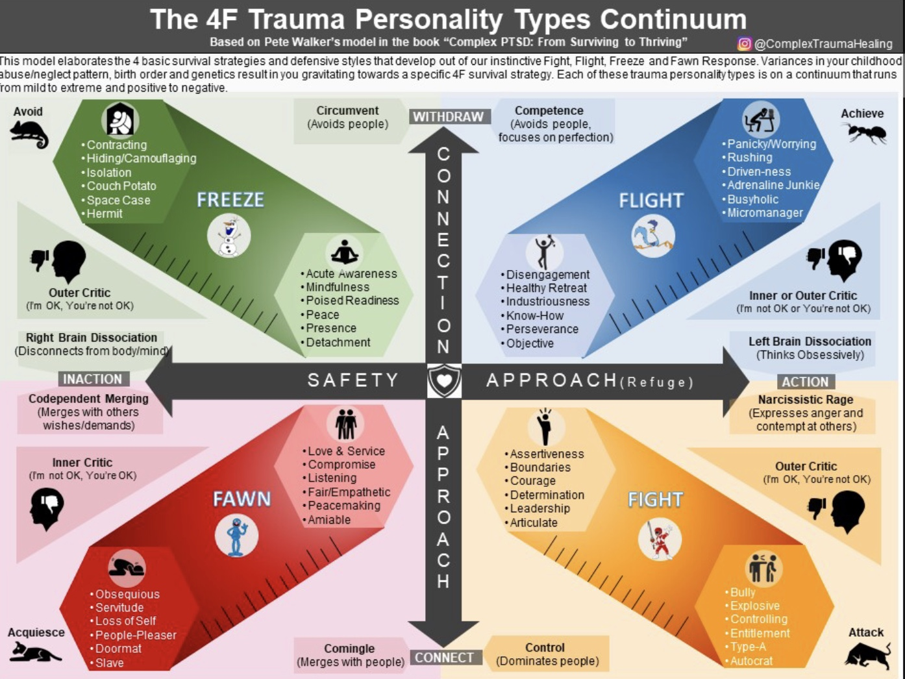
Notes:
Trauma can give rise to the four F's personality types. The four F's are fight, flight, freeze, and fawn. A person who has experienced trauma is on a spectrum for any of these from less to more intense. A person's personality can also incorporate more than one of these types.
The 4F trauma personality types lie on two axes depicted in this slide by the vertical and horizontal arrows.
The horizontal arrow has to do with the seeking/avoidance instinct. Seeking implies action or as avoidance implies inaction. Fight and flight are about action, freeze and fawn are about inaction.
The vertical arrow has to do with the attachment instinct which is about approach and connection. Fawn and fight seek to connect. Freeze and flight disconnect or withdraw.

Slide 165
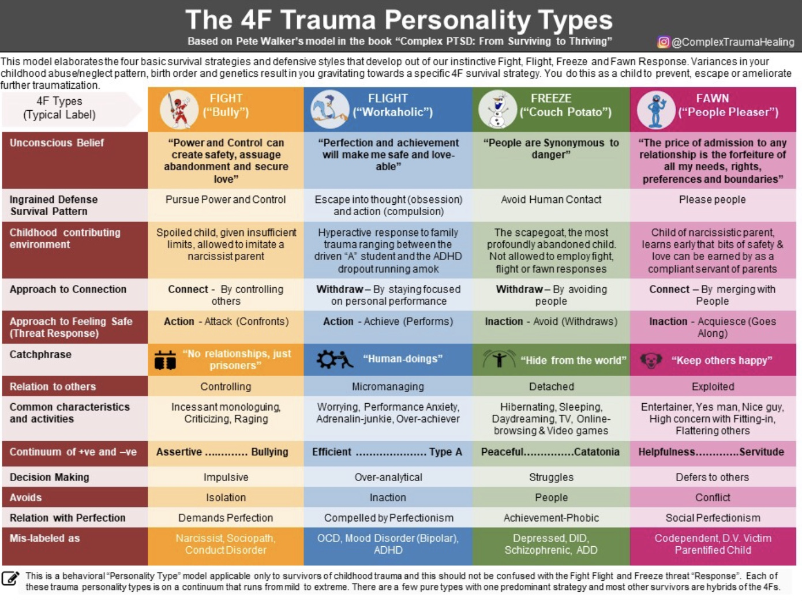
Notes:
When fight parts our dominant in a person's internal family systems, the person may be irritable, angry, aggressive, and attacking.
Healthy, and adaptive "fight" that does not dominate the self system, consist of the being assertive, having good boundaries, being courageous, determined, and assuming leadership.
Unhealthy "fight", which is controlling and exile, is seen in bullies, and people were explosive, controlling, or entitled.
Core beliefs of fight parts include "power and control can create safety, assuage abandonment, and secure love."
People with prominent flight parts tend to control conversations, be critical of others, and be explosive.
These parts pursue power, and control. They connect with others by controlling them. They demand perfection, are impulsive, and avoid isolation.
They may arise in families in which children are given insufficient limits and learn to imitate narcissistic parents.
Fight parts may exert different degrees of control over the internal family system. They may be present for only short periods of time or most of the time.
People with significant fight parts may be diagnosed as narcissistic or sociopathic.
When flight parts dominate
Flight parts are anxious, fearful, and panicky. They avoid, can be perfectionistic, and worry constantly.
Healthy "flight" that does not dominate the self system is healthy retreat and disengagement, which often has components of perseverance and industriousness.
Unhealthy "flight", which is controlling and exile, involves constant panicking and worrying, mindless and frantic activity, busyness, micromanagement, and obsessive-compulsive thoughts and behaviours.
Core beliefs of perfectionists and workaholics parts include "perfection and achievement will make me safe and lovable".
Flight parts pursue safety by escaping into obsessive thought and compulsive actions. They withdraw from connections and stay focused on personal performance. They are over analytical and avoid inaction.
Children and adolescents with significant flight parts, range from the driven "A" student to the ADHD dropout
People with significant flight parts may over worry, be anxious about their performance, and overachieve, and are frequently diagnosed with mood disorders, obsessive-compulsive disorder, or ADHD.
When Fawn parts dominate
Fawn parts avoid conflicts at all costs. They prioritize other people's needs, people please, and have a hard time setting boundaries, and saying no.
Healthy fawning that does not dominate the self system involves loving and being of service to others, compromising, listening and being agreeable.
Unhealthy fawning which is controlling and exile, consists of acquiescing to others by being servile, obsequious, a Finding parts seek to keep others happy, connecting with them by merging and deferring to them. To avoid conflict, they demand social perfection of themselves.
doormat, or a people pleaser.
Core beliefs of fawning parts include "the price of admission to any relationship is the forfeiture of all my needs, rights, preferences, and boundaries."
People with significant fawning parts are often children of narcissistic parents. They learned that some safety and love can be earned by being a compliant servant of the parents.
People with significant fawn parts can be entertainers, "nice guys", "yes men or women", overly concerned with flattering others, and fitting in. They are often labelled as codependent or parental fight children.
When freeze parts dominate
Freeze parts escape by dissociating. They space out, become immobile, or depressed.
Healthy "freeze" that is not dominate the self system involves "living in the moment" and the dissociation from everyday life and states of mindfulness, presence, or detachment.
Unhealthy freeze involves contracting, hiding/camouflaging, isolating, withdrawing, or being a hermit.
Core beliefs of freeze parts include "people are synonymous with danger."
Freeze parts pursue safety by avoiding human contact or withdrawing from others.
People with prominent freeze parts tend to have grown up in the most dysfunctional families, in which they were scapegoated, abandoned, not allowed to employ fight, flight, or fawn responses.
For these people, establishing a therapeutic alliance with the therapist may be challenging. Relational healing with partners, friends, or pets can be very helpful.
People with significant freeze parts hide from the world; they hibernate, sleep a lot, daydream, watch TV, or play video games. They are often diagnosed with depression, dissociative identity disorder, ADD, or schizophrenia.

Slide 166
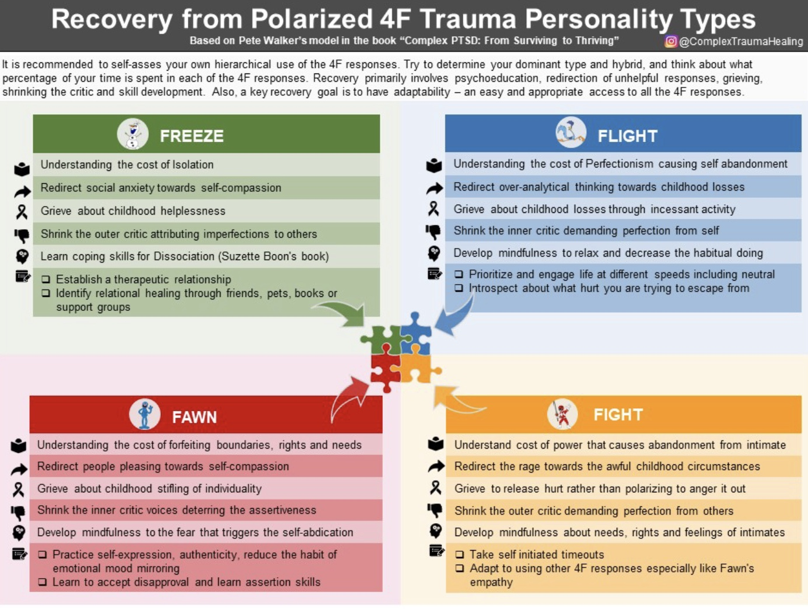
Notes:
For people with prominent fight parts, recovery involves understanding the cost of their behavior and redirecting their anger towards childhood circumstances which must be grieved. They need to learn to become mindful of their needs, rights, and feelings of others, and to see them from wise mind, rather than from the perspective of their harsh outer critic.
For People with prominent flight parts, recovery involves understanding the cost of their perfectionism or compulsive behavior and redirecting their thinking towards childhood losses they are grieving through their incessant activity. They must become mindful of their constant physical and psychological activity and learn to relax and decrease it. They also need to appease their inner critical parts that demand perfection.
Recovery for people with prominent Fawn parts involves understanding the cost of forfeiting boundaries,'s rights,'s and needs. They need to grieve the stifling of individuality during their childhood, and redirect people pleasing towards self compassion. They need to appease their inner critic, which stops them from being assertive, and to accept disapproval.
Recovery, in people with significant freeze parts, involves understanding the cost of isolation, and redirecting social anxiety toward self compassion. They need to grieve the childhood helplessness and learn coping skills for dissociation.

Slide 167
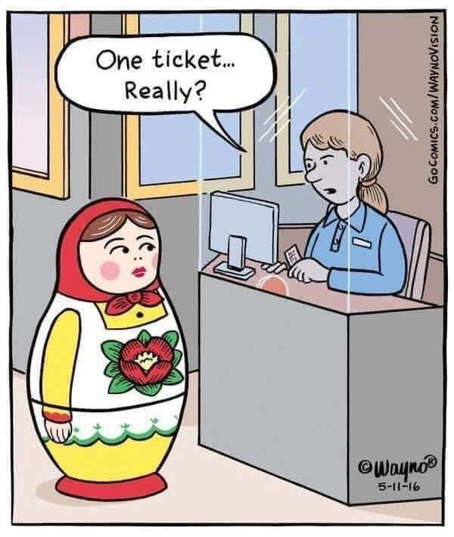
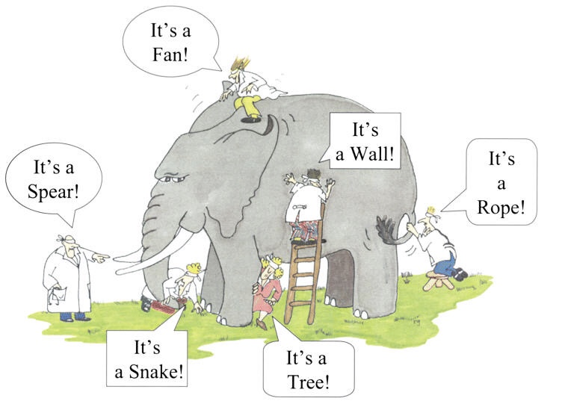
PUTTING IT ALL TOGETHER
Warning: To understand how these concepts are interrelated and overlap you’ll have wrestle with this material. It’s not essential that you do so. If you do want, this is an outline and I encourage you to review these slides at your leisure.
Notes:
They do. This is the case in which different models use different languages to talk about more or less the same thing. Using all those different languages can make it really confusing. I don't think it has to be if we can agree on a common language.

Slide 168
The origin of ifs parts :
Activation curves
Traumatic stress not resulting in PTSD
Inescapable traumatic stress resulting in PTSD
including developmental and attachment trauma
hyperfreeze
No escape
activated
calm
hypofreeze
Dissociated unprocessed emotional memory
Internal family systems exiles have much in common with unprocessed traumatic memories or attachment injuries.
Notes:
We already said that internal family systems exiles are dissociated and processed emotional memories.

Slide 169
2. Physical and or
emotional pain,
= temporarily hurt child
3. protest
4. Soothing by attuned other
5. Decreased activation
1. Well being
Integrating 1. The DMM, 2. Structural dissociation theory,
3. Internal family systems and 4. the cycles of well-being/distress
1. Child/Real Self seeks love, connection, and wellbeing
2. physical, and, or emotional pain,
Temporary hurt child
3. Protest --> Inadequately soothed
or punished hurt child
Permanently hurt = exile
4. Exiles develop protectors or adaptations to preserve some form of attachment
Secure attachment
Attachment
trauma
Cycles of distress = developmental trauma
(lead to)
developmental maturational model’s attachment adaptations
Notes:
We also previously considered the cycle of well-being which is fostered by secure attachment. When the child is in physical or emotional pain, she protests. When there are soothing and attuned parents, most of the time the child's pain is soothed and their activation decreases restoring their well-being.
When there is developmental trauma such as attachment trauma the child seeks the love and connection that are necessary to protect her from the world. When the child is hurt by neglect, or abuse, their need for soothing isn't met when they protest. Instead they are ignored or even punished. This lack of attunement and appropriate response is traumatic and inescapable and leads to the formation of an exile. To try to preserve some form of attachment internal family system protectors or developmental maturational models adaptations develop.

Slide 170
INTEGRATING 1. THE DEVELOPMENTAL MATURATIONAL MODEL, 2. STRUCTURAL DISSOCIATION THEORY, 3. INTERNAL FAMILY SYSTEMS AND 4. THE CYCLES OF DISTRESS/WELLBEING
The Real Self embodied in the child thrives in and seeks love, connection, and wellbeing.
Attachment issues arise when there are significant temperamental issues and/or inadequate parental attunement and/or responsiveness so that the child's pain is not soothed. That unsoothed pain dissociates into an exile that is burdened with the unsoothed pain.
To maintain attachment and avoid alienating the parent, the child who carries this exile develops different cognitive and emotional strategies attachment adaptations described in the DMM model.
These DMM strategies are internal family system’s protector part selves.
Internal family system’s protectors, both managers and firefighters can be thought of as attachment adaptations.
The perfectionist for example can be seen as an attempt to avoid getting into trouble. The procrastinator as passive resistance to the parent-critic etc.
Child/Real Self seeks love, connection, and wellbeing
physical, emotional pain -->
Temporarily hurt child
Inadequately soothed or punished hurt
Child -->
Exile
Exiles develop protectors or adaptations to preserve some form of attachment.

Slide 171
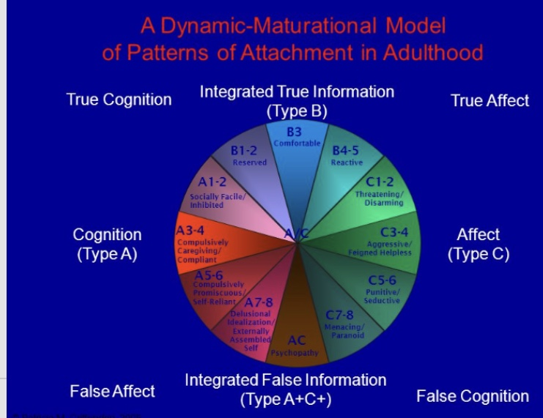
integrating 1. THE DMM, 2. Structural dissociation theory,
3. internal family systems AND 4. the cycles of well-being/distress
Physical/emotional
Pain, discomfort
protest
Soothing by attuned other
Decreased activation
Well being
The developmental maturational model’s attachment adaptations arise from attachment-based cycles of distress and are internal family system’s protector part selves

Slide 172
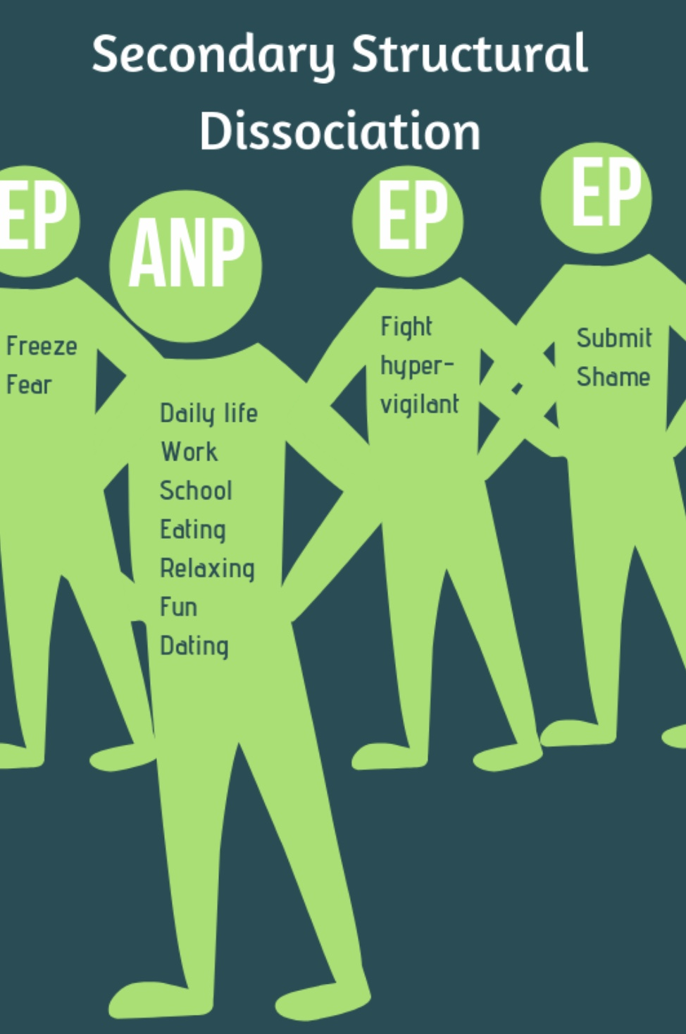
INTEGRATING 1. THE DEVELOPMENTAL MATURATIONAL MODEL, 2. STRUCTURAL DISSOCIATION THEORY, 3. INTERNAL FAMILY SYSTEMS AND 4. THE CYCLES OF DISTRESS/WELLBEING
Structural dissociation theory’s emotional parts, (EP’s) are internal family system’s exiles.
The developmental maturational model’s attachment adaptations are internal family systems protectors

Slide 173
Internal family system Part selves and the dissociation spectrum
Internal family systems part selves are structural dissociation theory’s emotional parts (EP’s)
In psychologically healthy people the mature adult part is a healthy integrated part that performs the usual life roles associated with being an adult: being a good partner, parent, worker, citizen, friend etc.. The mature adult leads the self-system in everyday life.
In people with traumatic spectrum disorders the part selves frequently lead the self-system and the more they do so, the more the mature adult part becomes a façade, until the façade disappears altogether, and the person is always blended with their parts. The mature adult part becomes the apparently normal part or ANP.
The goal of therapy is to foster Wise mind, which like an ideal parent knows and loves all parts, its “children” or parts.
The parts eventually get to know and learn to trust Wise wise and can be soothed by it. Then they allow it to lead and integrate the internal family system.
An integrated internal family self-system is lead not by emotional parts but by Wise mind. It is a securely attached internal family

Slide 174



Slide 175

See you next session

Slide 176
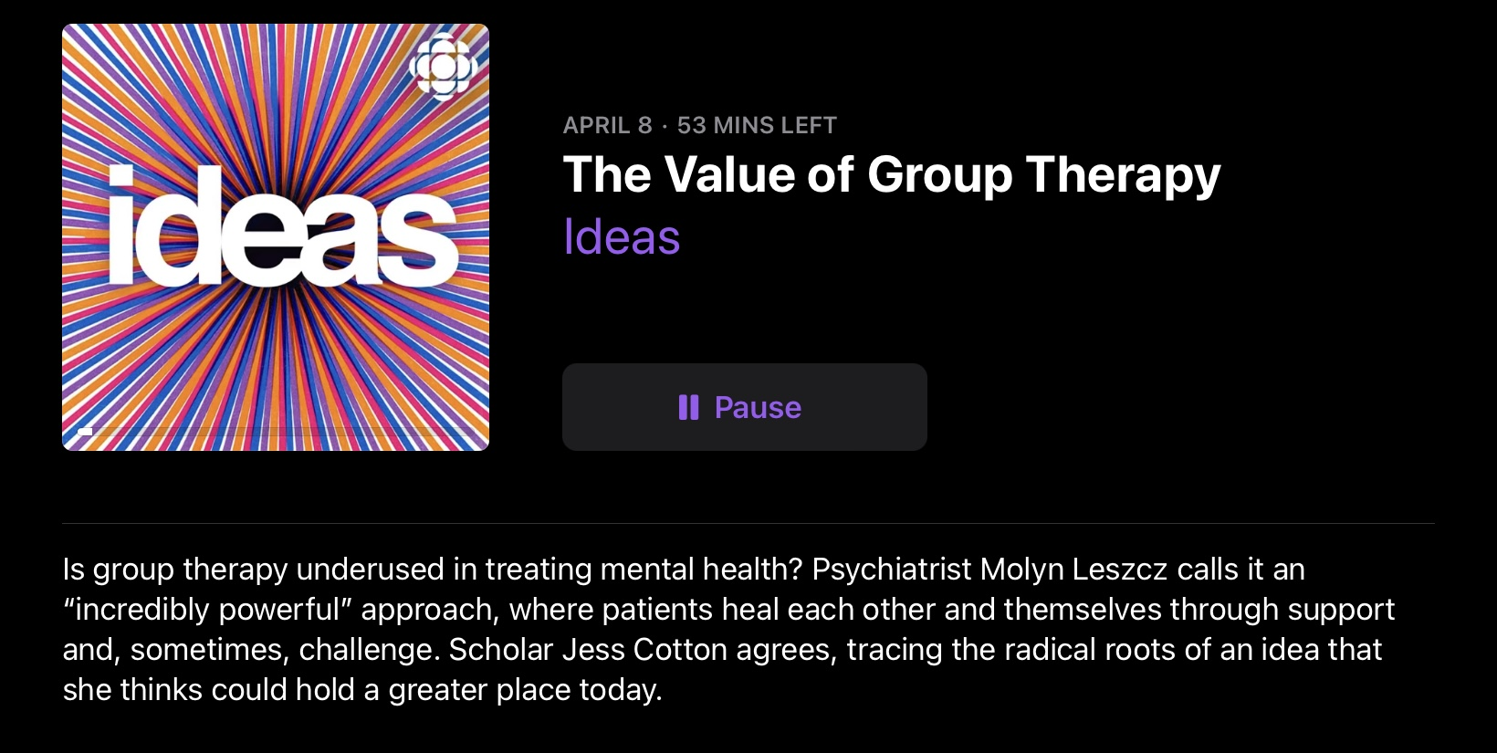
link

Slide 177

VIDEO Week 21 of simple

Slide 178


Slide 179
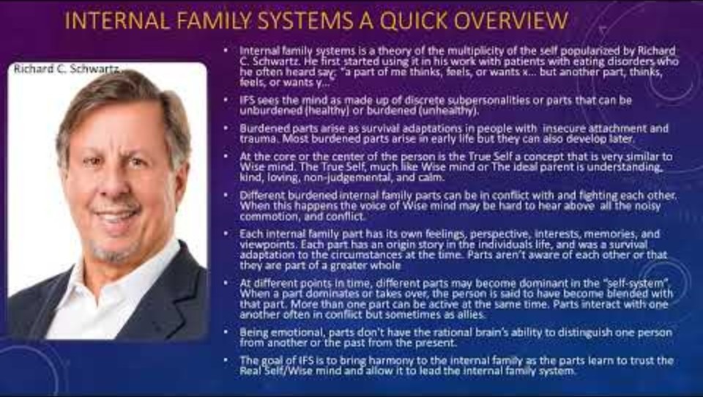

Slide 180


Slide 181
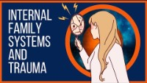

Slide 182
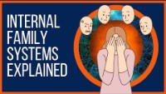

Slide 184
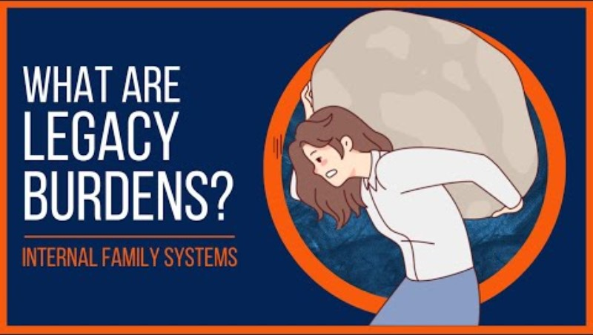

Slide 185


Slide 186
MY INTERPRETATION OF IFS
A physicalist metaphysics assumes the only realm that exists is the material (subatomic particles and forces). Many spiritual and idealist philosophical traditions, in contrast, describe more than one realm of existence.
Take for example Christianity which describes three realms. The first is the Creator which allows for everything to exist and is not physical, the second is an intermediary realm of spirits and the third is the common everyday material and physical realm.
Despite our modern-day prevailing belief that only a physical realm exists the whole of the evidence, I believe, supports a multiple realm existence.
IFS says that everyone “has” parts. “Has” assumes that parts exist within each person, specifically, in each person’s mind. This is compatible with the physicalist theory that the brain produced the mind, the productive theory.
Idealism holds permissive, transmissive or two aspects of the same thing theories of the relationship between brain and mind.
From an idealist perspective parts, that IFS sees as being present in individual mind are Platonic shadows in the cave wall that exist as forms in the hands of the puppeteers. The prisoners see the shadows as reality while the enlightened philosopher understands they are projections in a world in which what is real is the Creator or in Plato’s cave metaphor sun.

Slide 187
So instead of each person “having” parts, an idealism informed IFS would hold that each person is “influenced” by parts that exist in a non-physical realm.
If we accept this idealist informed IFS, how do we then account for the fact that different people are preferentially influenced by certain parts more than others?
To use Kastrup’s metaphor the eddy that is individual consciousness receives information about our physical environment from our senses. This physical environment being mind at large perceived across a dissociative boundary by our sense organs.
Throughout history and across various cultures, many traditions and belief systems have held the idea that in addition to the material world sensory organs, humans also possess sensory organs or faculties that enable perception beyond the physical world. These spiritual or non-physical senses are thought to provide insight into realities that aren't accessible through our ordinary five senses.
In Hindu and yogic traditions, chakras are considered centers of spiritual power in the human body. Each chakra is associated with different aspects of consciousness and is thought to be a gateway to higher spiritual realms.
Practices like yoga and meditation are believed to enhance one's ability to perceive spiritual realities through the awakening of these energy centers.

Slide 188
In various Buddhist traditions, meditation and mindfulness are paths to achieving heightened states of awareness, leading to insights into the true nature of reality that go beyond ordinary sensory perception.
Similar to Hindu beliefs, the concept of the "third eye" is seen as a means to perceive spiritual truths.
Some Christian mystics speak of spiritual senses that allow individuals to experience God's presence or perceive divine truths beyond physical reality, often through prayer and contemplation.
Sufis emphasize the idea of an inner vision or insight, which allows adherents to perceive spiritual realities and develop a deeper understanding of their connection to God through practices like dhikr (remembrance) and meditation.
Theosophists and other Western esoteric traditions often speak of clairvoyance and other forms of extrasensory perception (ESP) as means to access spiritual knowledge and perceive non-physical entities or realms.
These traditions and belief systems suggest that just as we have eyes to see and ears to hear the physical world, there are analogous faculties or senses that allow perception of the spiritual or non-physical dimensions of existence.

Slide 189
It is also a common but mistaken belief that what we perceive closely corresponds to what is “out there.”
Psychologists have studied this idea and have introduced the concepts of perceptual set and top-down processing.
These two concepts describe how our expectations, prior knowledge, emotions, and experiences influence the way we perceive sensory information illustrating the significant role that mental states and cognitive frameworks play in shaping our perception of reality.
Perceptual set theory suggests that our expectations and preconceptions create a mental framework that shapes how we interpret sensory information. If we are expecting to see something, our brain is more likely to interpret ambiguous sensory information in a way that aligns with those expectations.
Bottom-up processing describes how cognitive processes are driven by sensory inputs coming into the brain, top-down processing, in contrast, involves using existing knowledge, expectations, and understanding to interpret and give meaning to sensory information. This can lead to seeing what we expect to see, rather than what is objectively present.
Perceptual set and bottom-up processing are influenced by several factors. The environment and situational context in which perception occurs can guide expectations. What a person desires or aims to achieve can bias their perception. Cultural norms and knowledge can shape expectations and therefore perception. Emotions can strongly influence what people notice and how they interpret sensory input.

Slide 190
Top-down processing and perceptual set theory apply to cognitive processes associated with the physical senses (sight, sound…), but it would be reasonable to argue that these concepts may also apply to the “spiritual” senses. Using Kastrup’s metaphor what is already in the “eddy” affects what comes into the eddy.
In Kastrup’s idealist model of individual consciousness as an eddy in a great body of water that is mind at large, it also makes sense to imagine that the environment proximal to each eddy is somewhat different and is affected by the eddy itself. different from that of another in a different location in the body of water. That “spiritual” environment consisting of “spirits” that have the most influence on us is also likely to be affected by the eddies of our caregivers and other significant figures.
IFS holds that Self is a spiritual concept equating it with objectless awareness, mind at large or God. When we are able with our spiritual sense organ to perceive that realm, we are very close to the mystical experience of unity with all of creation. We are perhaps sensing a realm that is more real that the spiritual realm. The realm of God the ever present, all understanding, benevolent and supremely comforting parental figure.
This understanding highlights the remarkable similarities between IFS, Jungian psychology and Ignatian spirituality that we’ll explore in the searching for meaning session.

