Slide 1

Welcome to Week 30 of Simple
Self-led relationship repair

Slide 2
SIMPLE COURSE SCHEDULE 2025-26
Week 1- October 1
Week 2- October 8
Week 3- October 15
Week 4- October 22
Week 5- October 29
Week 6- November 5
Week 7- November 12
Week 8- November 19
Week 9- November 26
Week 10- December 3
Week 11- December 10
Week 12- December 17
December 24 and 31
Week 13- January 7
Week 14- January 14
Week 15- January 21
Week 16- January 28
Week 17- February 4
Week 18- February 11
Week 19- February 18
Week 20- February 25
Week 21- March 4
March 11 and 18 no course
Week 22- March 25
Week 23- April 1
Week 24- April 8
Week 25- April 15
Week 26- April 22
Week 27- April 29
Week 28- May 6
Week 29- May 13
Week 30- May 20
Week 31- May 27
Week 32- June 3
Week 33- June 10

Slide 3
THE NEXT THREE WEEKS
Week 31- May 27- Bringing meaning and purpose into your life- Our circle of meaning session.
Week 32- June 3- Joan and Nicole’s end of the year special- course highlights- Feedback- Brunch
Week 33- June 10- Sexuality and bonding pilot session.

Slide 4

Warning about meditation
Feel free to skip it. Followed by a moment of silence

Slide 5
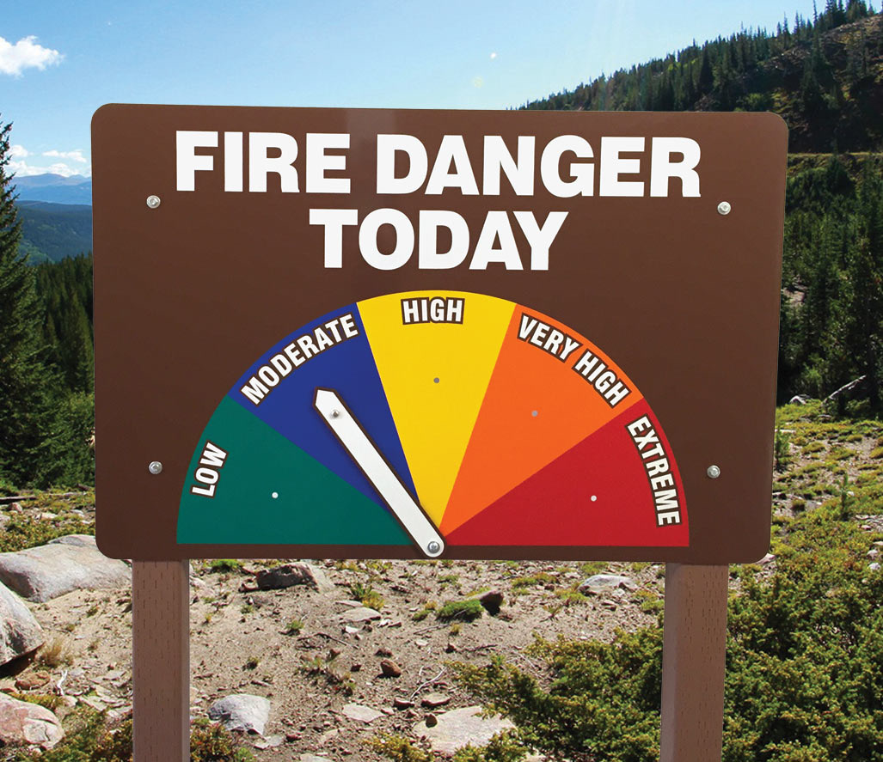

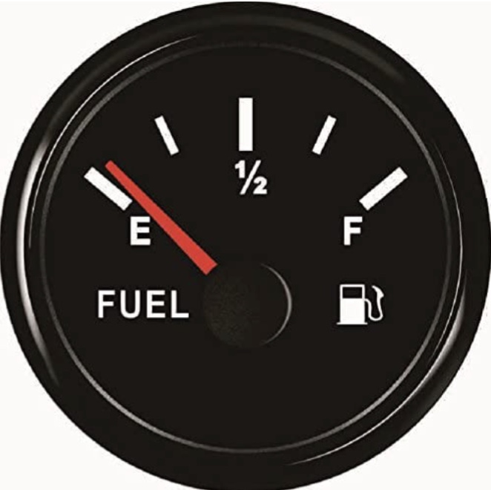
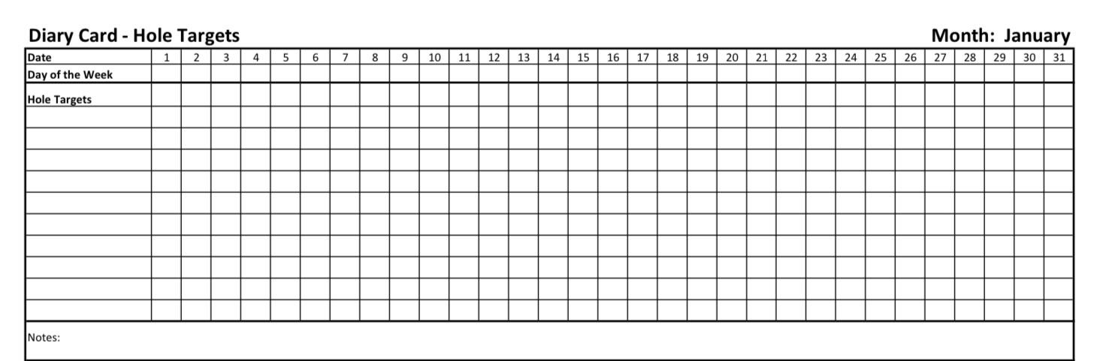
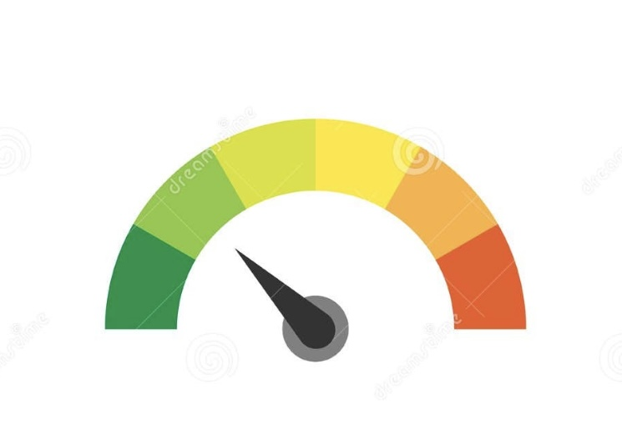
Check in regularly with your Personal dashboard
Spend a few moments checking in with yourself by asking:
1)What is the current risk that I’ll experience a state of crisis ?
Low b) Moderate c) high d) very high e) extreme
2) Am I in the window of tolerance?
a) Yes b) I’m a little outside c) very outside
3) Where is my energy tank right now?
Full b) ¾ c) ½ d) near empty
4) Have I been tracking my targets using the holes diary card ? how would I rate my targets right now?
5) How well am I focusing on what I’m doing. (for example, the course)
CRISIS RISK
WINDOW OF TOLERANCE
ENERGY RESERVES
RATING MY TARGETS
ATTENTION METER
% attention I’m paying
100
0

Slide 6
5-MINUTE GUIDED HARBOR MEDITATION
Begin by settling in.
Allow your body to find a posture that feels steady but not rigid…
Supported, yet spacious.
Take a slow breath in…
And a long, gentle breath out.
Let the pace of your breathing begin to match the calm rise and fall of the sea.
Now, imagine you are a ship on open water.
Feel the quiet strength of your hull beneath you,
the gentle rocking of the waves,
the vast sky spreading out in every direction.
You are capable.
You have weathered storms.
You know how to navigate.

Slide 7
But every ship needs a harbor.
Ahead of you, notice a harbor coming into view.
Your harbor.
A place meant for you.
A place of refuge, repair, and belonging.
The water becomes calmer as you approach.
The air softens.
The lighthouse glows with a steady, warm light—
a reminder that guidance is always available
when we allow ourselves to receive it.
As you enter the harbor,
notice the docks extending toward you like open arms,
ready to welcome you exactly as you are—
tired or strong, confused or clear, hurting or hopeful.
There is no performance here.
No need to justify your presence.
This harbor exists simply because you exist.

Slide 8
Now slowly imagine dropping anchor.
Feel the gentle heaviness as you settle.
The sense of being held.
Of being allowed to stop trying,
just for these few moments.
Let the soft waves lap against the sides of the ship.
Let your nervous system feel the rhythm of safety.
Pause here…
breathing…
resting…
arriving.
In this harbor, your inner world becomes quiet enough for you to listen.
Perhaps a part of you that has been anxious can exhale.
Perhaps a part that has been avoidant can come a little closer.
Perhaps a part that has been wounded or vigilant
can feel just a hint of what safety might be like.

Slide 9
You don’t need to fix anything.
Just allow these parts of you to be near the shore—
warmed by the lighthouse,
soothed by still water,
held without pressure.
Now take a moment to imagine that this harbor is not outside you—
it is within you.
The lighthouse is your own awareness.
The calm waters are your own breath.
The welcoming docks are the compassion you offer yourself.
And the steady foundations
are the parts of you that have survived every storm to this day.
You are not looking for a safe harbor.
You are building one.
Take one more slow breath in…
And gently release it.
Feel the quiet anchoring inside your chest,
the soft steadiness in your belly,
the warmth of your own presence.

Slide 10
When you are ready,
slowly lift the anchor…
knowing that you can always return—
to this harbor,
to this breath,
to this inner place of safety.

Slide 11
ALTERNATIVE 5-MINUTE GUIDED MEDITATION
Begin by settling into your seat.
Let your shoulders lower, let your hands soften, and let the breath lengthen just a little.
You’re not trying to relax on purpose — you’re simply allowing the body to come home.
Take a slow, gentle breath in…
and a slow, full breath out.
Let your awareness gather.
You are entering this space as Self — calm, curious, compassionate.
Step 1 — Bring up the “video clip”
Allow one short moment of conflict with your partner to come into awareness.
Just 10–60 seconds of the moment where the energy shifted — where connection fell away.
See if you can watch it as though it’s playing on a screen in front of you.
You are not in it.
You are observing it with spaciousness and care.

Slide 12
5-MINUTE GUIDED MEDITATION
Step 2 — Notice which parts appear
As the scene unfolds, notice the first part of you that reacts.
Maybe a tightening, a tone change, a defensive thought.
Gently greet this part:
“I see you. I’m right here.”
Let the video continue.
A second part may appear… perhaps anger, withdrawal, a pleaser, an intellectualizer, a critic.
You’re simply noting the sequence.
Step 3 — Pause the scene
Pause the video at the moment you lost Self —
the moment a part stepped in to protect you.
Turn toward that part now.
Let your voice be warm inside:
“I understand why you came in. Thank you for trying to protect me.”

Slide 13
5-MINUTE GUIDED MEDITATION
Ask it softly:
“What were you afraid would happen?”
Let it answer.
Step 4 — Meet the exile it protects
If the protector is willing, ask:
“Who are you protecting?”
Let the younger, more vulnerable part come forward — the one carrying the hurt.
Offer it your presence:
“I’m here with you now.”
“You’re not alone.”
Let the exile feel your compassion, your steady Self energy.

Slide 14
5-MINUTE GUIDED MEDITATION
Step 5 — Replay the scene from Self
Return now to the screen.
Let the same conflict moment play again — but this time, you remain in Self.
Notice how Self responds differently:
Your tone, your clarity, your calm.
Notice what your Self understands now about both you and your partner.
Let the scene end with spaciousness.
Step 6 — Integration
Place a gentle hand on your heart or belly if that feels right.
Tell your parts:
“I’m here. I can lead us now.”
“Thank you for showing me what hurt.”
“We’ll try it differently next time.”
Let a breath in…
and a slow breath out.
When you’re ready, return to the room.

Slide 15


Slide 16

Homework from last week
Submit questions or comments to itssimple2023@gmail.com
Use all tools and all skills
Read session 28 of the manual

Slide 17
Homework for NEXT week
Submit questions or comments to itssimple2023@gmail.com
Use all tools and all skills
Start thinking about and giving us your feed back for the course. Complete the online feedback form.

Slide 18
HOMEWORK HABITS CHECKLIST
Circle or check what you will try this week.
1. Preparation habits
■ I schedule a specific time for homework.
■ I choose a consistent location with minimal distractions.
■ I gather what I need ahead of time (notebook, worksheet, pen).
2. Focus & pacing habits
■ I start with a tiny step (2–5 minutes).
■ I use a timer (10–15 minutes).
■ I remove distractions (phone away / Do Not Disturb).

Slide 19
HOMEWORK HABITS CHECKLIST
3. Tracking & organization habits
■ I keep materials in one place (binder / folder / notebook).
■ I write down insights right after doing the homework.
4. Self-compassion habits
■ I aim for progress, not perfection.
■ I notice resistance without judgment.
5. Accountability habits
■ I review my week: What worked? What didn’t?
■ I share honestly with my buddy — even when I didn’t do it.
Micro commitment:
This week I will focus on: ■ Time ■ Place ■ Tiny step ■ Timer ■ Other please specify:

Slide 20
SIMPLE COURSE WEEKS 31 AND 32
The following slides will be helpful for weeks 31 and 32 of the simple course. They have been emailed out. If you didn’t get them, email us.
You can also find them on the website.

Slide 21
In week 31 of the course, our circle of meaning session, we’ll be considering the concept of the cosmic egg which proposes three levels of stories that underlie our sense of meaning.
We’ve already emailed out slides which will help you prepare for that session.
We are really hoping there will be a lot of participation.
We won’t read these slides today, we just want to make them available to you, so you have an opportunity to work on them ahead of time.

Slide 22
YOUR LIFE’S MEANING AND PURPOSE
Before you work on this session, we invite you to reflect your sense of meaning and purpose. It may help to complete the meaning in life questionnaire and the purpose in life scale

Slide 23
There are two common ways psychologists try to capture whether life feels meaningful for a person.
The Meaning in Life Questionnaire looks at two simple questions: Does my life feel meaningful right now? Am I searching for meaning? So, it recognizes that meaning has two parts — having it and looking for it. You can feel meaningful and not be searching… or feel lost and actively searching.
The Purpose in Life Scale is a bit different. It asks: Does my life have direction? Do I feel guided by goals or a sense of mission? The PLS focusses more on purpose, having a sense that your life is going somewhere.
A simple way to think about the difference is: Meaning is about feeling that life matters Purpose is about feeling that life is headed somewhere. You can have one without the other. Someone may feel life is meaningful through love, beauty, or connection, even without a clear mission. Another person may have strong goals and direction but still feel empty.

Slide 24
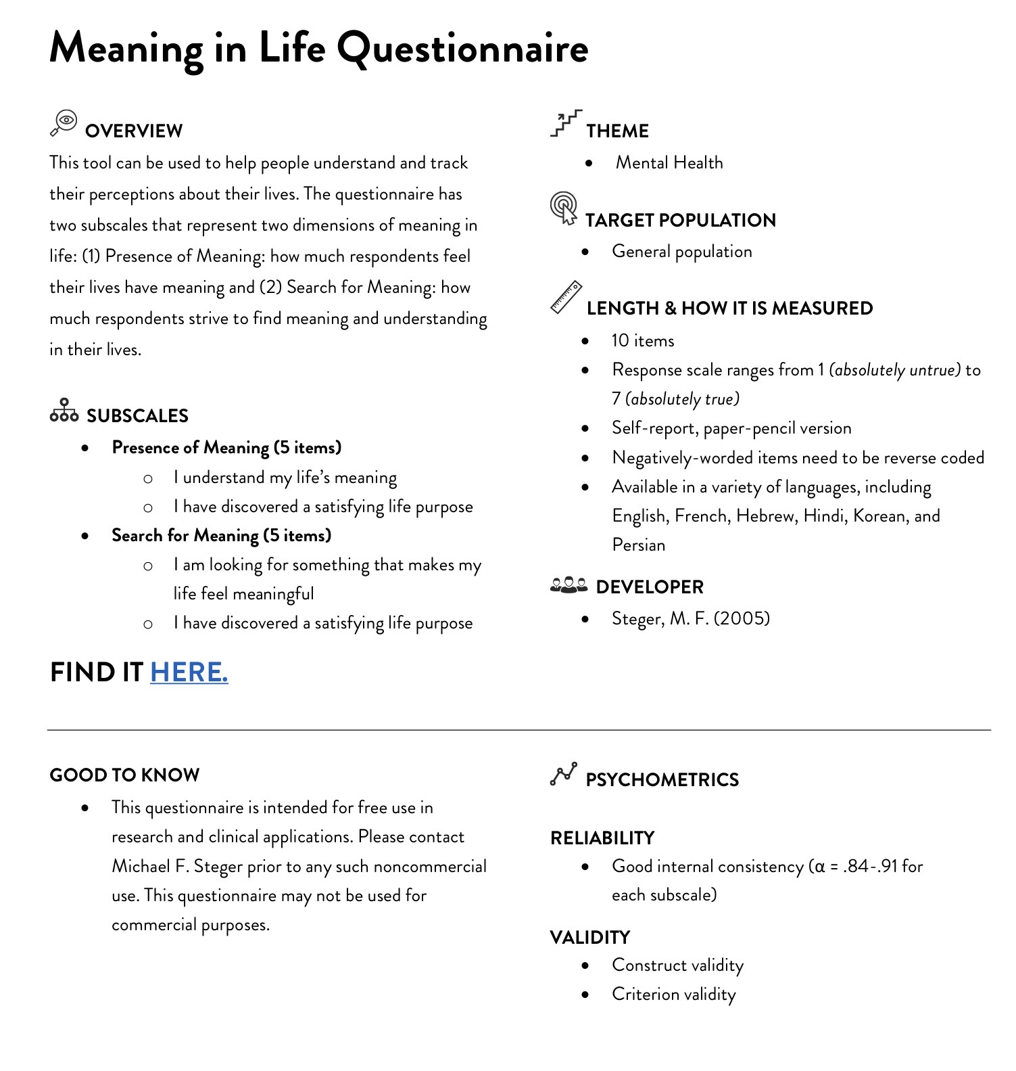
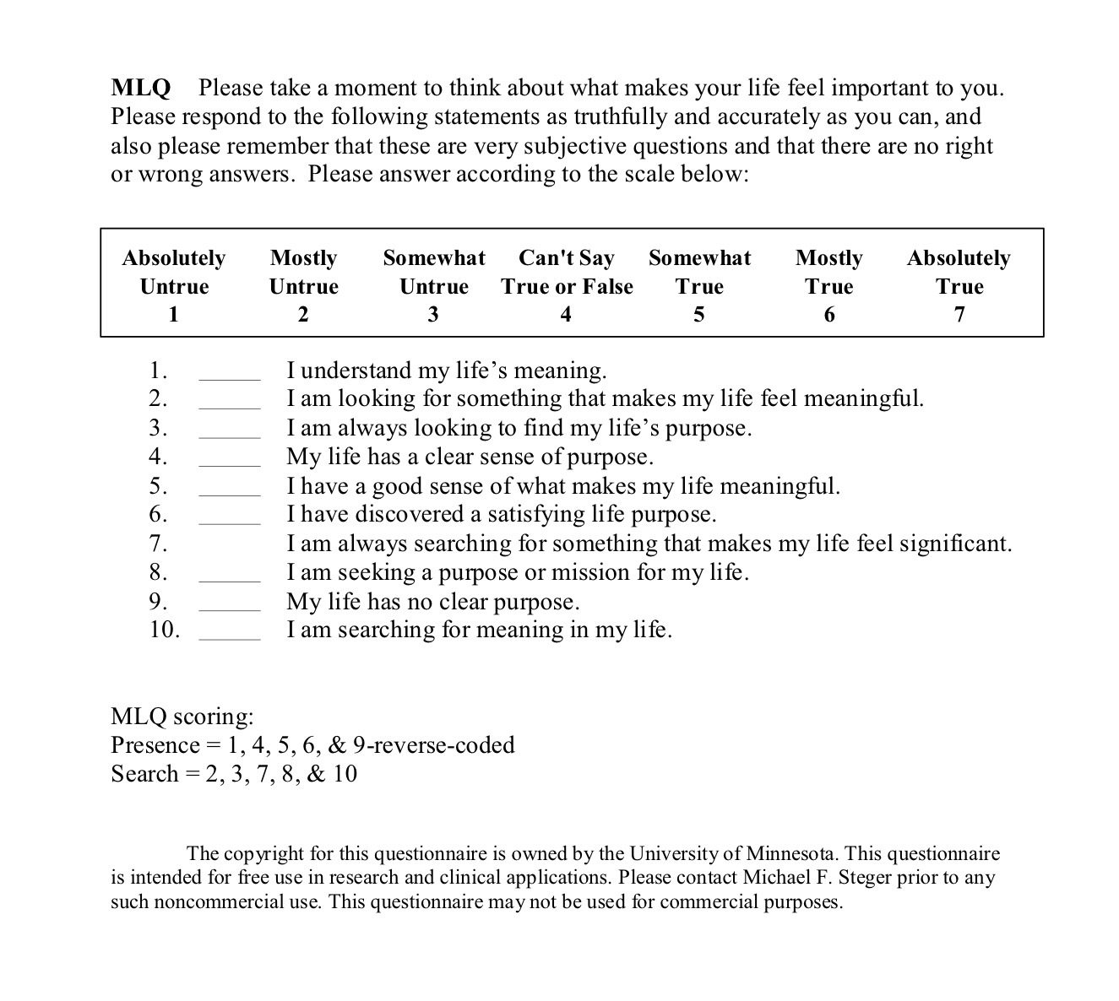

Slide 25
The Meaning in Life Questionnaire, developed by Michael Steger and colleagues (2006), generates two independent subscale scores — Presence of Meaning and Search for Meaning — each ranging from 5 to 35. The instrument uses a 7-point Likert scale and its robust two-factor structure has been replicated numerous times, making it a benchmark measure in existential and positive psychology.
The threshold of 24 (the scale midpoint on a 5–35 range) is the conventional interpretive anchor, though Steger explicitly notes the MLQ has no clinical cut scores — it measures across the full range of human functioning.
The Four Score Profiles (Steger’s Framework)
The two subscales interact in meaningful ways, and Steger’s own scoring guide describes four interpretive quadrants:
High Presence / Low Search (above 24 / below 24)
Individuals in this pattern feel their lives have valued meaning and purpose and are not actively seeking further meaning. They tend to be highly satisfied with life, optimistic, with healthy self-esteem. They frequently experience positive emotions like love and joy, and rarely feel afraid, angry, or sad. They tend to hold traditional values, are often active in religious pursuits, and would likely be described by others as conscientious, organized, and socially outgoing.
Low Presence / High Search (below 24 / above 24)
This is the most clinically significant pattern. Poor mental health, including clinical levels of depression, has been associated with the combination of lower Presence and higher Search scores. This profile maps onto what some researchers call a “meaning moratorium” — one senses something is missing and is actively, often anxiously, looking for it.

Slide 26
High Presence / High Search (both above 24)
Intriguingly, when individuals have high scores on Presence and Search simultaneously, they also report high levels of psychological well-being. This suggests that for people who already have a robust sense of meaning, continued exploration of that meaning deepens rather than destabilizes wellbeing.
Low Presence / Low Search (both below 24)
Individuals in this pattern probably do not feel their lives have valued meaning or purpose and are not actively exploring it. They may not find the idea of thinking about life’s meaning very interesting or important. They may not always be satisfied with life or optimistic about the future and may occasionally or often feel anxious or depressed. This pattern — sometimes called “meaning diffusion” — may reflect existential disengagement rather than distress.
Subscale Correlates
Presence is positively related to well-being, intrinsic religiosity, extraversion and agreeableness, and negatively related to anxiety and depression. Search is positively related to religious quest, rumination, past-negative and present-fatalistic time perspectives, negative affect, depression, and neuroticism, and negatively related to future time perspective and well-being.
Health and Mortality Research
The downstream health correlates of meaning are among the more striking findings in the positive psychology literature.

Slide 27
Physical Health and Functioning
A study of over 1,000 community-dwelling adults across the lifespan found that individuals who perceive their lives to be more meaningful have better outcomes across a wide variety of psychological and physical measures of health and well-being. The mean Presence score in that sample was 26.7 (above the midpoint), with Search at 18.9 (below the midpoint) — suggesting the population norm leans toward presence without active seeking.
Overall, higher levels of meaning are clearly associated with better physical health, as well as with behavioral factors that decrease the probability of negative health outcomes or increase that of positive health outcomes.
A higher sense of purpose is associated with improved health behaviors (increased physical activity, increased preventive healthcare use, healthier sleep, reduced drug misuse), improved biological functioning (reduced allostatic load, reduced inflammation), and better physical health outcomes including improved physical functioning and reduced risk of cardiovascular disease, cognitive impairment, and mortality.
Cardiovascular Disease and Mortality
The mortality data are particularly robust. A meta-analysis of ten prospective studies with over 136,000 participants found a significant association between higher purpose in life and reduced all-cause mortality (adjusted pooled relative risk = 0.83) and reduced cardiovascular events (adjusted pooled relative risk = 0.83).
In one large study of nearly 7,000 older adults, those with the lowest levels of purpose had more than 2.6 times the risk of mortality from heart, circulatory, and blood conditions compared to those with the highest levels of purpose.
The Harvard/Health and Retirement Study data showed stark differences in absolute mortality risk: people with the highest sense of purpose had a 15.2% mortality risk over eight years, compared to 36.5% for those with the lowest sense of purpose. Importantly, in analyses stratified by socioeconomic status, people with the highest level of purpose consistently tended to have lower mortality risk across all levels of SES.

Slide 28
Purpose as a Buffer Against Poor Health
One particularly nuanced finding: purpose appears to moderate the relationship between poor health and death. Greater purpose in life predicts meaningful reductions in mortality associated with poorer self-rated health among middle-aged and older adults — that is, rating one’s health as poor was more detrimental (in terms of mortality) for those who also reported low purpose in life.

Slide 29
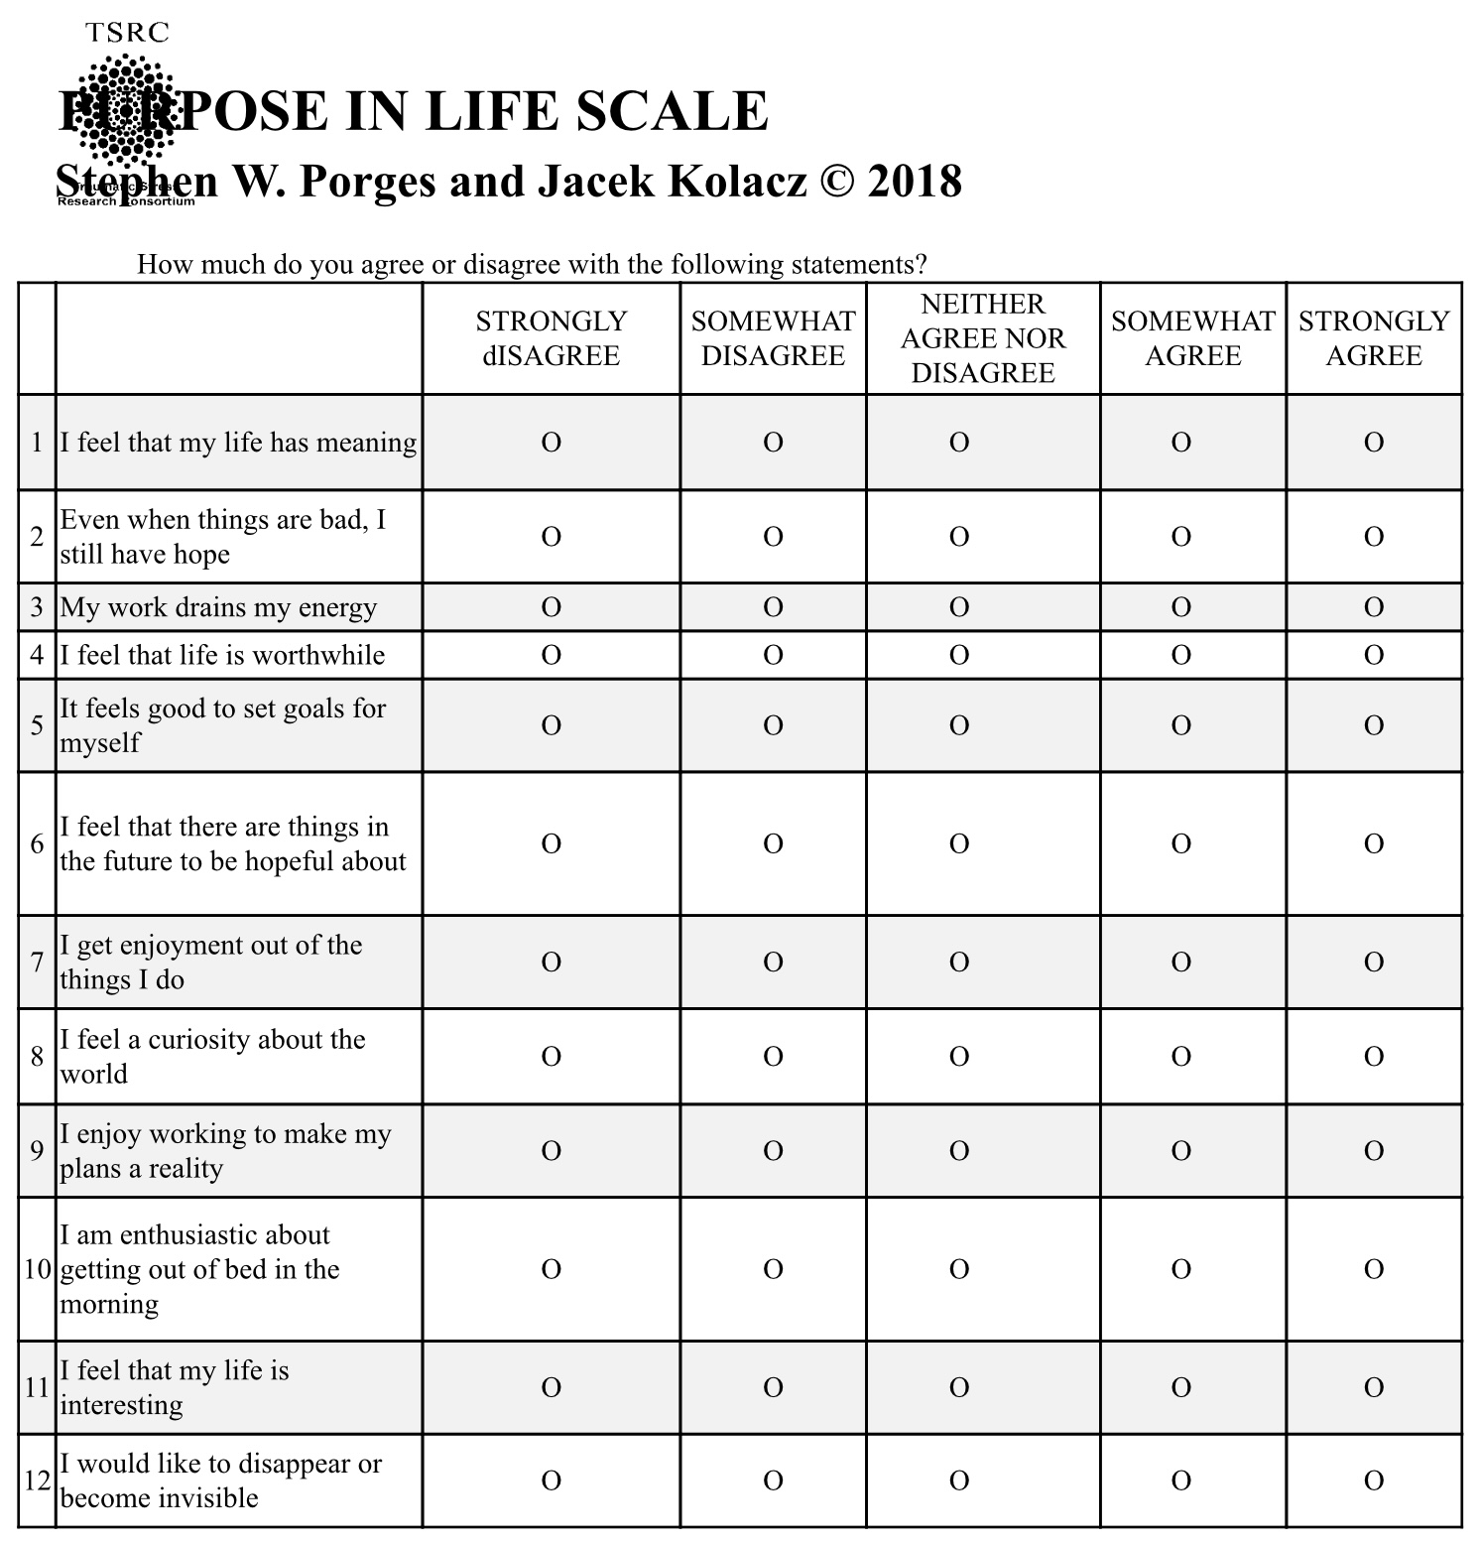
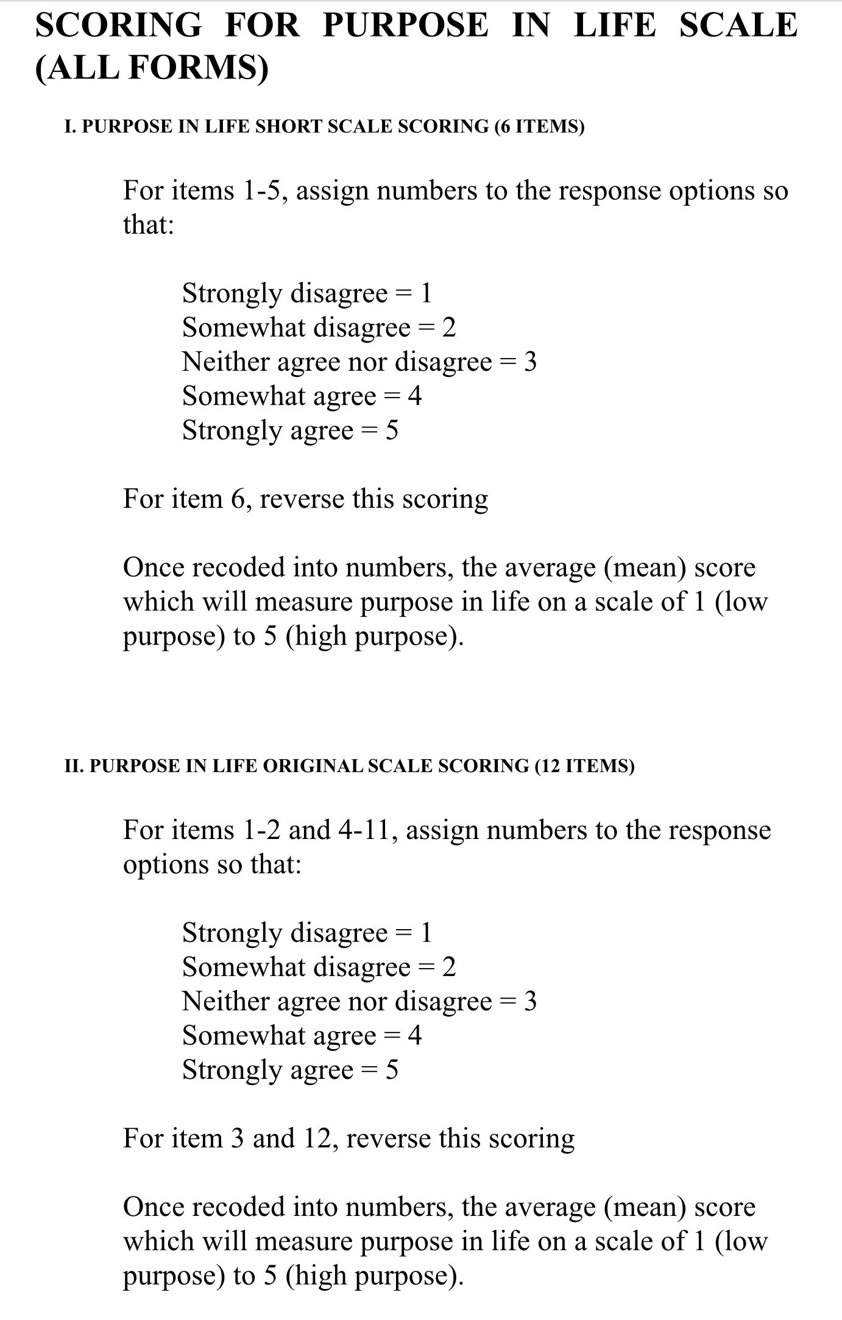

Slide 30
PURPOSE IN LIFE SCALE INTERPRETATION
Total Score Range: The total score typically ranges from 12 to 60 (assuming a 1 to 5 scoring range per item).
Higher Scores: Higher scores are associated with positive outcomes, such as:
  Greater life satisfaction and overall well-being.
  Lower levels of depression and anxiety.
  A sense that one's life is goal-oriented and has clear direction.
Lower Scores: Lower scores may suggest:
  An absence of purpose, sometimes described as existential frustration or emptiness.
  Potential for higher levels of stress or psychological distress.
Note on Norms: While higher scores generally mean greater purpose, specific cutoff points for "high" versus "low" can depend on the population being studied. Researchers often compare individual scores to established norms for specific age groups or clinical populations.
For the exact scoring instructions and scale manual, you can refer to the Traumatic Stress Research Consortium website, where the scale is hosted.

Slide 31
PURPOSE AND HEALTH
• In people who already have heart disease, each one-point increase on a 6-point purpose-in-life scale was associated with a 27 % lower risk of having a heart attack over a two-year period.
• Among older adults, a one-point increase in purpose corresponded to a 22 % lower risk of stroke.
• Studies have linked stronger purpose in life with reduced incidence of Alzheimer’s disease by more than half and milder cognitive decline.
• In gene-expression studies, “hedonic” well-being (pleasure-oriented) was associated with higher expression of inflammatory genes and lower expression of genes involved in antiviral and antibody responses; whereas “eudaimonic” well-being (purpose/meaning oriented) showed the opposite, healthier patterns of gene expression.
• Purpose is also correlated with better engagement in preventive health behaviors (e.g. screenings, vaccinations).
• People with strong purpose may have greater telomerase activity (an enzyme important for chromosome maintenance) and thus possibly slower cellular aging.

Slide 32
In week 31 of the course, our circle of meaning session, we’ll be considering the concept of the cosmic egg which proposes three levels of stories that underlie our sense of meaning.
We’ve already emailed out slides which will help you prepare for that session. In addition we’re also inviting you to think about and write down the answers to the following questions and bring them with you for week 31.

Slide 33
1. MY STORY — Who am I, really?
When do I feel most myself?
What gives me dignity even when I fail?
What part of me feels most alive now?
Key word or phrase: _______________________
2. OUR STORY — Where do I belong?
Which communities, relationships, or traditions see me?
Where do I contribute rather than perform?
Who would notice if I were missing?
Key word or phrase: _______________________

Slide 34
3. THE STORY — What holds my life?
What larger story feels true enough to live by?
What restores awe, humility, or trust?
Where do I sense meaning beyond usefulness?
Key word or phrase: _______________________
INTEGRATION
Which story currently feels strongest?
Which feels neglected or conflicted?
What small shift could bring them into better harmony?
One gentle intention for the next season of life:

Slide 35
Exploring meaning

Slide 36

I BELIEVE IN…
Seeking to understand myself, society and the universe while remaining mindful that I do not have access to ultimate truths.
Embracing stories about myself, society, and the universe that are true, good, and beautiful.
Allowing these stories to guide my life.

Slide 37
The Cosmic Egg of Meaning
Exploring My Story, Our Story, and The Story
Circle of Meaning Session

Slide 38
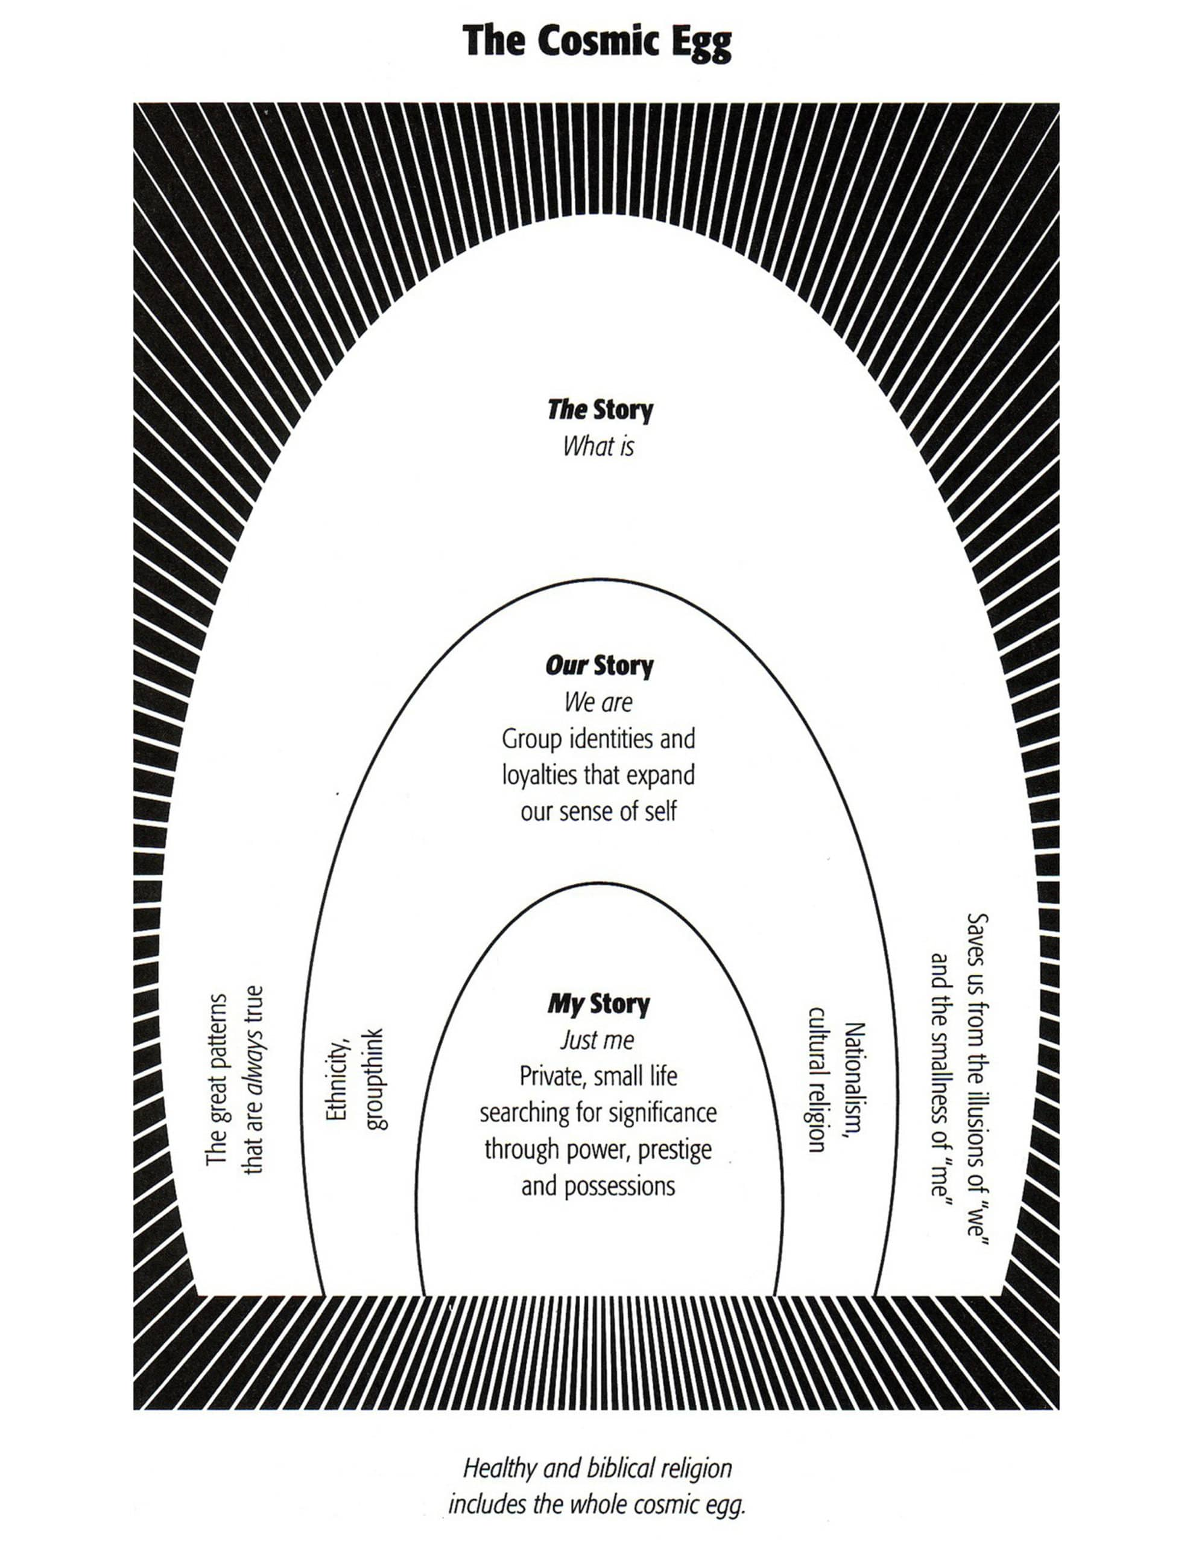
THREE LEVELS OF MEANING: MY, OURS AND THE STORIES

Slide 39
Introduction: The Cosmic Egg (Richard Rohr)
Meaning has three levels:
- My Story: Personal identity
- Our Story: Collective identity
- The Story: Transcendent or spiritual context
Today we'll reflect on all three, then explore how they intersect to shape our sense of meaning and purpose.

Slide 40
“ A healthy psyche lives within at least three levels of meaning… that is within three sets of stories: “my”, “ours”, and “The” story.” Richard Rohr
In our search for meaning or to make sense of our lives we turn to three interconnected stories. Like Russian dolls, these three stories are embedded or nestled within each other. The all-encompassing stories that envelop all others are “The stories” within which are “Our stories” which in turn contain “My stories”.
“The stories” describe the universe, all that exists and the origins of existence, the great patterns that are thought to always be true. “The stories” can save us from the smallness of “My stories” and the illusions of “Our stories”.
"Our stories" are the collective narratives shared by families, cultural or ethnic communities, and nations. In Western cultures, there are various unique subcultures, each with a different version of "Our story." These narratives enhance our understanding of identity.
“My stories” are our personal stories. They describe who each of us is and how we may or not feel and think we are significant. It guides us in our everyday life. Psychology and psychotherapy encourages the exploration of “My stories”.

Slide 41
Feeling that our lives is closely tied to our perception of having purpose and value. Having purpose is having an important reason for being alive, while feeling valued is believing and feeling that we are important, worthy or useful.
Feeling that we have purpose and value require that we have healthy connections with ourselves, others, nature, a meaningful occupation and the universe. If as children, we are well loved, we are shown, by the way we are seen by loving parental figures, that we have purpose and value. When we are loved as children, we are more likely to develop a healthy “My story”.
Our sense of meaning depends not only on having a healthy “My story” and sense of self, but also on being part of communities with healthy “Our stories” and “The stories”. All these stories then guide our lives.

Slide 42
1. My Story – Who am I?
• Who and what are the key people events or moments that have shaped who you are today?
• What personal beliefs, values, principles or experiences guide your life and give it meaning?
• When do you feel most fully yourself? Who is the most authentic you?

Slide 43
2. Our Story – Where do I belong?
• What groups or communities have most shaped your identity?what do they believe? How do they treat others?
• What collective stories, struggles, or rituals have made you feel connected or purposeful?
• How has your culture or family influenced what you see as meaningful?

Slide 44
3. The Story – Why are we here?
• What are the biggest questions you ask about existence, life, and the universe?
• Do you sense a larger story or force that holds your life within it?
• What spiritual, philosophical, or scientific story do you most resonate with?

Slide 45
Reflecting Across the Three Stories
• Which story makes you feel most valued, seen, or alive?
• Which gives you the clearest sense of purpose?
• Are your stories coherent—or are they in tension?
- If in harmony, what does that feel like?
- If in conflict, what might be trying to emerge?

Slide 46
Rewriting a Story
• If you could rewrite one of these stories to feel more true or meaningful,
which one would it be?
• What is one small way you might begin that rewriting?

Slide 47
WEEK 32
The following slides will help think about the course and give us feedback in week 32, June 3rd.
We won’t read them today; we just want to make sure you have them.

Slide 48
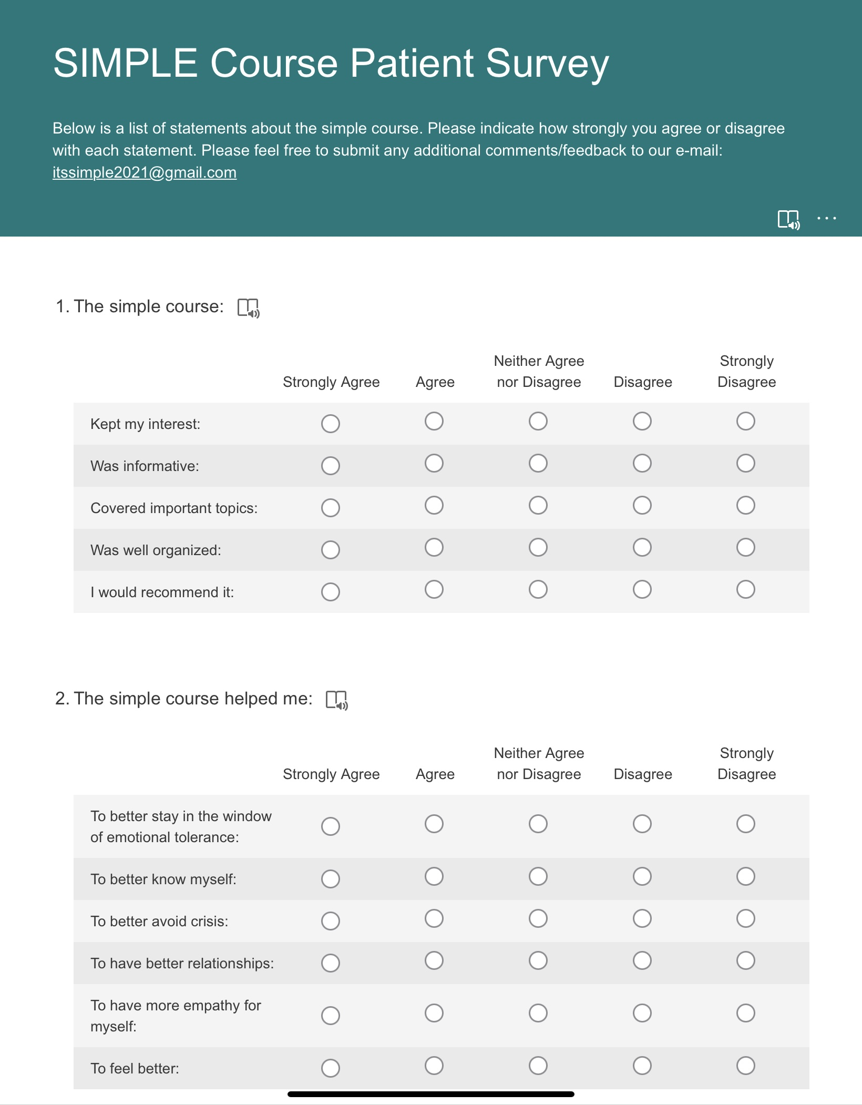
Simple course survey and end of year rating scales
As we approach the end of the course we’re inviting you to think what kind of experience you had doing the course this year.
In week 32 we’ll have brunch and ask you for feedback on the course.
In addition to that feed back we’d also be very grateful if you clicked on the following link and gave us your feedback on line. https://forms.office.com/r/6qFT4dVTUS
Your suggestions and feedback are critical so that we can continue to adapt the course to participants needs
The survey asks the following questions:

Slide 49
SIMPLE COURSE SURVEY
1. THE SIMPLE COURSE:
1. agree agree neither agree nor disagree disagree strongly disagree
Kept my interest
Was informative
Covered important topics
Was well organized
I would recommend it
2. THE COURSE HELPED ME:
Expand my window of tolerance
Better understand myself
Better avoid holes
Have better relationships
Have more self-empathy
Feel better overall
3. THE CO-LEADERS WERE:
Knowledgeable
Competent/skilled
Friendly/approachable
Attuned to the group
Sensitive
Professional

Slide 50
SIMPLE COURSE FEEDBACK GUIDE FOR WEEK 32
On week 32 we will use the following questions to guide our feed back discussion
Please reflect on these questions beforehand.

Slide 51
SIMPLE COURSE FEEDBACK GUIDE FOR WEEK 32
This feedback section is not about grading you or us. It’s about helping us understand what actually landed, what didn’t, and what might help the course serve future participants even better. We’re especially interested in concrete examples and honest reflections, both appreciative and critical.
People give better feedback when they write before they speak. Please think about and write your answers to the following questions and bring them to week 32.
A. What Helped Most:
What parts of the Simple Course were most helpful or meaningful for you? (e.g., specific topics, metaphors, exercises, group processes, or moments)
Was there a particular concept or practice that “clicked” for you? What made it click?
What, if anything, surprised you in a good way?
B. What Was Less Helpful or Hard to Engage With
What parts of the course felt less helpful, repetitive, confusing, or hard to engage with?
Were there topics that felt either too much, too little, or not well-timed?
Was anything missing that you expected, or didn’t expect, to matter as much as it did? (It’s okay if something that was helpful for others wasn’t helpful for you.)
C. Process & Pacing (How It Was Delivered)
How did the pacing of the course feel over 32 weeks? (Too fast, too slow, uneven, or just right)
How was the balance between teaching, discussion, exercises, and reflection?
How did the length of sessions and the overall structure work for you

Slide 52
SIMPLE COURSE FEEDBACK
D. Group Experience & Safety
What aspects of the group environment helped you feel safe, engaged, or understood?
Was there anything about the group process that made participation harder?
Did you feel you had enough space to reflect and speak, or too much pressure to do so?
E. Integration & Carry-Forward
What ideas, skills, or perspectives do you imagine continuing to use after the course?
Has the way you relate to yourself, others, or stress changed in any lasting way?
If someone asked you, six months from now, “What stayed with you from the course?”—what might you say?
F. Suggestions for Improvement
If we were to change or improve one or two things next year, what would you most want us to consider?
Are there topics you would expand, trim, move earlier/later, or present differently?
Is there something you wish we had done more—or less—of?
If possible, please focus on one or two concrete suggestions rather than many small ones.
We are genuinely interested in your feedback. Not everything can be changed, but everything is taken seriously. Thank you for helping shape what this course is becoming.

Slide 53
Simple course survey and end of year rating scales
As we approach the end of the course, we’re inviting you to think about your experience doing it.
In week 32 we’ll have brunch and ask you for feedback on the course.
In addition to that feed back we’d also be very grateful if you clicked on the following link and gave us your feedback online. https://forms.office.com/r/6qFT4dVTUS
Your suggestions and feedback are critical so that we can continue to adapt the course to participants needs
The survey asks the following questions:

Slide 54

In two weeks, week 32 June 3rd we’ll have brunch. We hope to have a rough idea of how much food and drinks to bring.
If you’re attending in person today we’ll do a show of hands now. who will be coming June 3rd in person?
If you’re on zoom today, please raise your hand now if you’re coming in person on June 3rd. Keep it raised until Lauren has counted everyone.
Thank you.
Remember today we’re going until 1 pm unless we collapse before then. Feel free to leave earlier if you have to.
WEEKLY ANNOUNCEMENTS

Slide 55
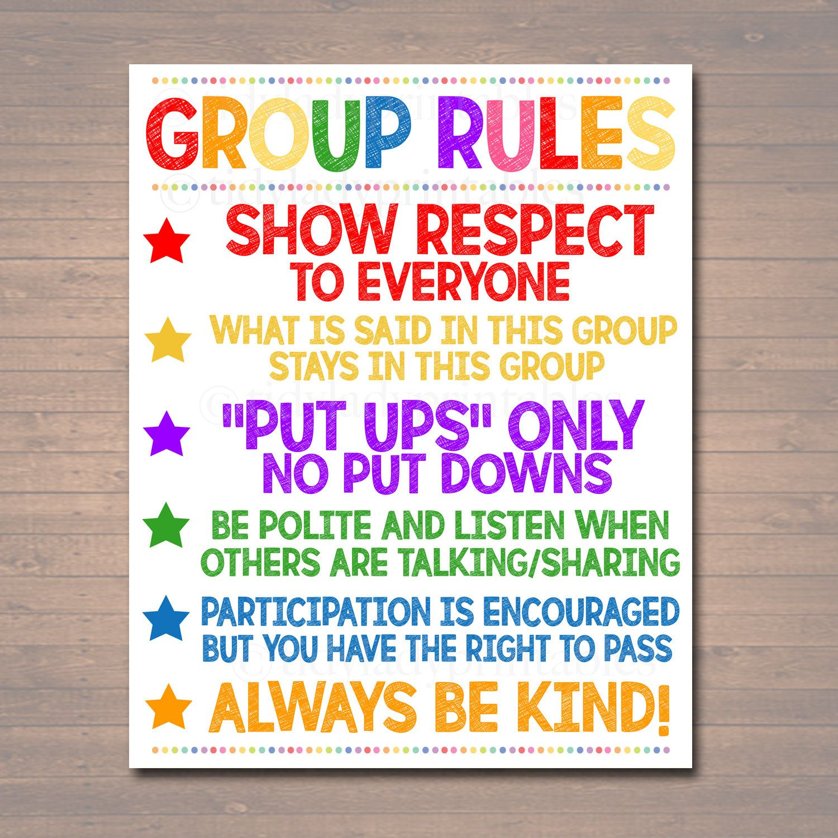
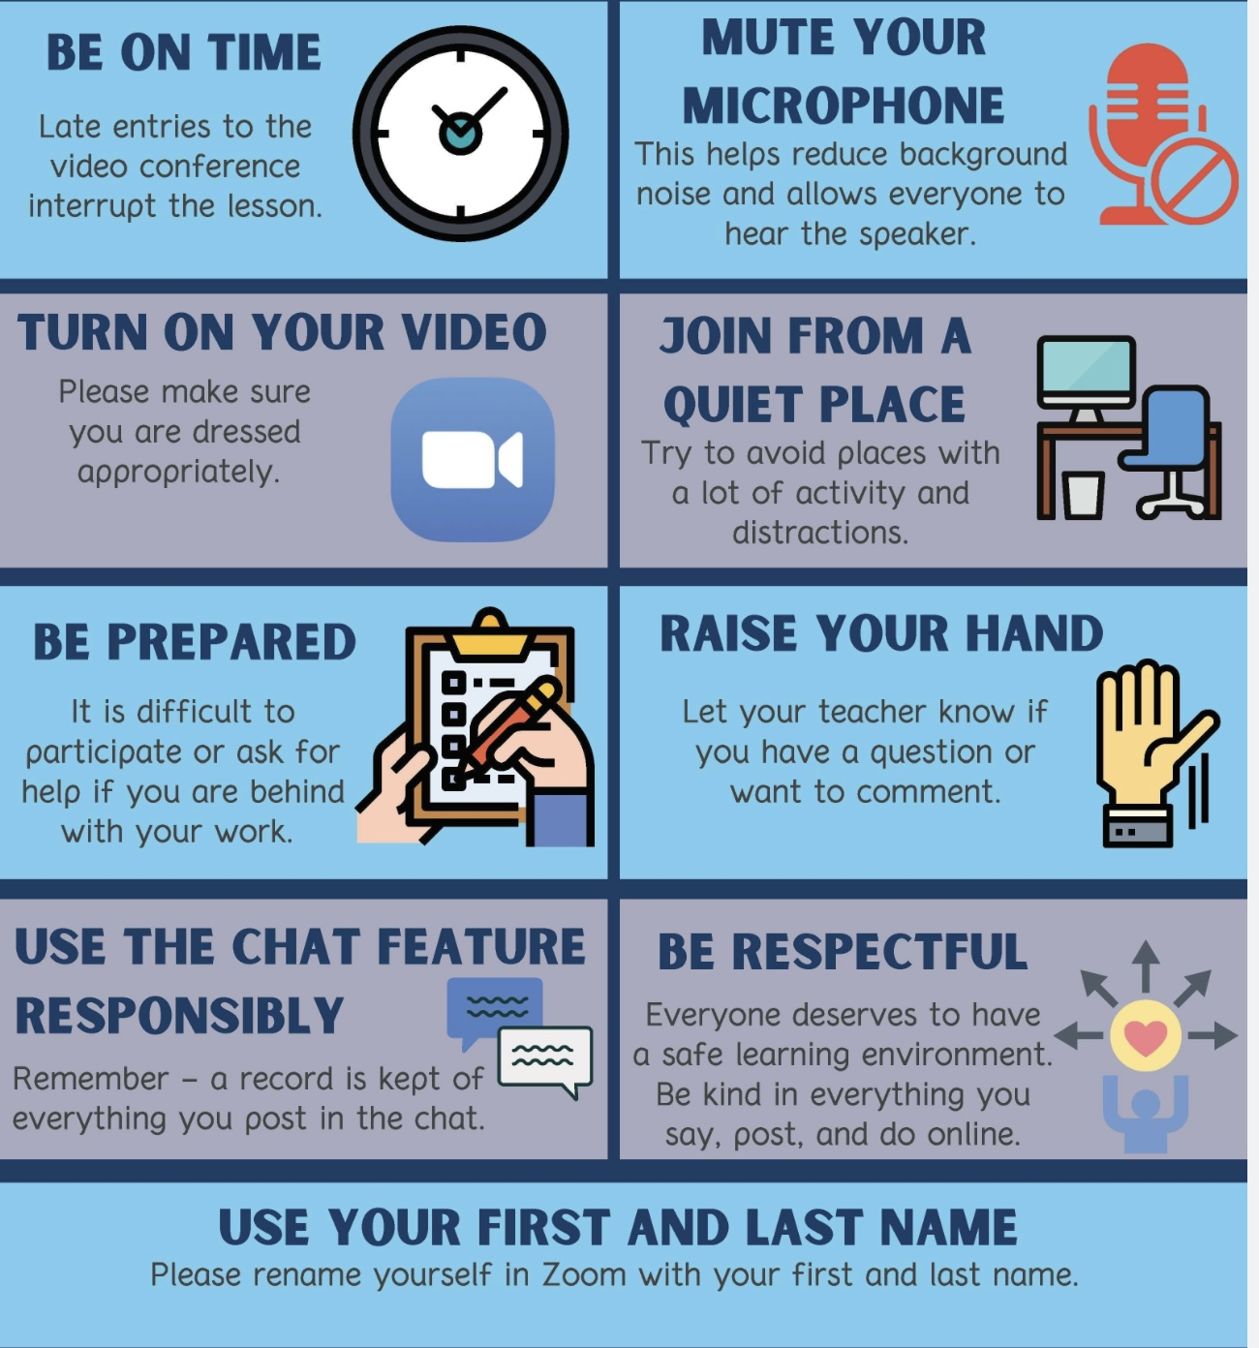
REMINDER PARTICIPANT AGREEMENTS
If you have questions, comments, or feedback, please save them for the two question periods. You can put them in the chat box or raise your real/virtual hand.
Keep comments, questions, and feedback relatively brief so everyone has a chance to participate.(one breath sharing)
If you’re on zoom, make sure no one can overhear what is being said
For reasons that will become clear later in the course please avoid giving advice to other participants about what they should or should not do. Validation, encouragement , and understanding are however very much appreciated.

Slide 56

Poll

Slide 57

What we will do today
Today we’ll talk about:
Healthy and unhealthy relationships.
Relationship “holes” and how to repair them

Slide 58
A BLESSING FOR EMPATHY AND EMOTIONAL CONNECTION
May your heart grow soft to the subtle stirrings within and between.
May you learn to hear not only the words but the silences, the sigh behind the sentence, the ache behind the anger, the longing behind the pause.
May your presence become a refuge for the ones you love, not because you have the answers, but because you offer your listening as a gift.
May you have the courage to reveal your own inner world, not polished, not perfected, but true, so that love can find real ground to root and rise.
May empathy become more than a feeling, but a way of being, slow, spacious, tender.
And may your connections deepen not through agreement, but through shared vulnerability, through kindness, and through care.
(end of Joan/Nicole section)

Slide 59

PARTS AND Self in relationships
In sessions 24 to 29 we’ve explored internal family systems. We’ve learned that IFS sees the Self assuming leadership of a person’s parts as an important step in growth and healing.
Today we will see how relationship repair, healing, and growth involves Self assuming leadership of the parts of the everyone in a relationship.
Self can be mindful of our own parts, but it can also be aware and understanding of the parts of people we’re in relationship with.
This is key to relationship healing and growth.

Slide 60

relationships, health, and happiness
what are some of the major factors affecting the quality of relationships?
why are intimate relationships sometimes so difficult?
attachment issues in intimate relationships
common relationship conflict patterns
is relationship repair possible?
does the repair of relationship holes require different skills, tools or strategies?
weighing staying, leaving, or staying and working toward change
three intimate relationship repair approaches
IFS’s approach to relationship repair “You’re the one you’ve been waiting for”
alternative algorithms for relationship repair
TOPICS WE’LL COVER TODAY

Slide 61
RELATIONSHIPS, HEALTH, AND HAPPINESS

Slide 62
RELATIONSHIPS, HEALTH, AND HAPPINESS
The Harvard study of adult development began in 1938 and is still ongoing. It is one of the longest-running studies of adult development in history. The study followed two groups of men: one group consisted of 268 Harvard College sophomores, and the other group consisted of 456 disadvantaged inner-city youths from Boston. These men were followed until their death. When they married or had children, the study also began tracking their family members.
Every year the study collected extensive information from the participants about their physical and emotional health, relationships, and overall well-being. The study has provided valuable insights into what factors contribute to a happy and fulfilling life and has helped researchers better understand the connections between lifestyle, relationships, and overall health.
Investigators, now using AI, (sorry Elaine) have been "mining" the troves of information gathered. From this data have come numerous books and countless academic articles. Some of the most important findings of the Harvard Longitudinal Study of Adult Development include:

Slide 63
RELATIONSHIPS, HEALTH, AND HAPPINESS
1. Good relationships are key to a happy and fulfilling life: The study found that the quality of relationships with family, friends, and community members was a strong predictor of overall well-being and happiness.
2. Social connections are important for physical and mental health: The study showed that individuals with strong social connections tend to live longer and have better physical and mental health outcomes.
3. Personal growth and development continue throughout life: The study demonstrated that individuals have the capacity for personal growth and development well into old age, challenging the notion that personality is fixed and unchanging.
4. Happiness is contagious: The study found that happiness spreads through social networks, suggesting that our own happiness can be influenced by the happiness of those around us.
The Harvard Longitudinal Study of Adult Development has provided valuable insights into what factors contribute to a fulfilling and meaningful life, highlighting the importance of these four essential cornerstones of health and happiness.

Slide 64

“A toxic relationship is one in which we can’t get to a point we’re ok with each other” Robert Waldinger (current director of the study and Zen sensei)

Slide 65
MAJOR DIMENSIONS AND FACTORS AFFECTING THE QUALITY OF RELATIONSHIPS

Slide 66
DIMENSIONS AND FACTORS AFFECTING RELATIONSHIP QUALITY
What’s the difference between relationship dimensions and relationship factors?
Relationship dimensions are the core experiential qualities of the relationship itself. They describe what the relationship feels like and how it functions when you are inside it: e.g. trust, emotional safety, mutual care, boundaries, repair, shared meaning, autonomy/interdependence.
You can think of these as the health indicators or outcomes of a relationship.
Relationship factors are the inputs, capacities, and conditions that shape those dimensions. They describe what each person brings, what skills are available, and what pressures are acting on the system: e.g. attachment style, emotional regulation, communication skills, personality traits (OCEAN), stressors, growth mindset, commitment These are the drivers that influence whether the dimensions flourish or deteriorate.
Dimensions = what is happening in the relationship
Factors = why it is happening
Two couples may value the same dimensions (trust, safety, intimacy) but differ greatly in the factors available to sustain them.
This distinction helps shift conversations from blame (“What’s wrong with us?”) to understanding and leverage (“What factors could we strengthen to improve these dimensions?”)

Slide 67

dimensions predicting relationship quality
what the relationship feels like and how it functions when you are inside it

Slide 68
8 QUALITY PREDICTIVE DIMENSIONS
There are eight essential dimensions that reliably predict relationship quality across the lifespan.
1. Trust
2. Emotional Safety
3. Mutual Care & Responsiveness
4. Boundaries
1. Trust, the foundational dimension. Trust means: I can predict your emotional responses. You will not intentionally harm me. You repair with me when something goes wrong.
Low trust leads to anxiety, hypervigilance, distancing, or conflict cycles. High trust leads to nervous system calm, openness, exploration.
2. Emotional Safety. A relationship where you can show your true feelings without fear. Safety includes: No shaming or ridicule. Consistent attunement. Capacity for calm conflict resolution. This is the “safe harbor” quality in attachment.
3. Mutual Care & Responsiveness is not just caring about each other but caring for each other in practice. It includes support during stress. Willingness to help. Remembering what matters to the other person. Empathic responses to emotional needs.
Insecure relationships often lack reciprocity or consistency.
5. Communication & Repair
6. Shared Meaning / Values
7. Autonomy + Interdependence
8. Emotional Regulation (Self + Co-regulation)

Slide 69
4. Boundaries. Healthy relationships require flexible, respectful boundaries. Boundaries determine: Where I end and you begin. What I take responsibility for. What I will and will not accept
Too rigid boundaries leads to emotional distance. Too porous leads to enmeshment and codependence.
5. Communication. Not just talking but being understood. Healthy communication involves: Clarity. Active listening. Curiosity. Speaking from parts that aren’t blended (IFS lens). Repair after misunderstandings. Communication is the “bridge” between two inner worlds.
6. Shared Meaning & Values. Deep relationships involve some degree of a shared worldview. Priorities. life direction. meaning-making. rituals, culture, or spiritual orientation
This doesn’t require identical values, only compatibility and mutual respect.
7. Autonomy & Interdependence. Two poles that must be balanced: Autonomy = I have my own identity. Interdependence = I can depend on you and you on me.
Healthy relationships weave these together. Unhealthy ones swing toward: Fusion (no autonomy). Avoidance (no interdependence)
8. Emotional Regulation Between Partners. Great relationships don’t avoid stress; they regulate through it.
This includes co-regulation (we calm each other). Self-regulation (I manage my own nervous system). Ability to stay connected during conflict.
Disorganized or trauma-driven dynamics often fail here.

Slide 70

• Trust → the lighthouse that remains steady
• Emotional safety → calm waters inside the harbor
• Mutual care → the repair crews and replenishment stations
• Boundaries → the break walls that keep storms out
• Communication → the clear channels guiding ships in
• Shared meaning → the map both sailors use
• Autonomy & interdependence → two ships able to sail freely but return safely
• Emotional regulation → the harbor’s ability to stay stable through tides and weather
HARBOUR METAPHOR VERSION

Slide 71
FACTORS AFFECTING relationship quality
the inputs, capacities, and conditions that shape what the relationship feels like and how it functions

Slide 72
FACTORS AFFECTING THE QUALITY OF INTIMATE RELATIONSHIPS
1. Attachment Styles
2. Communication Skills
3. Emotional Regulation
4. Mutual Support
5. Conflict Resolution Ability
6. Shared Values and Goals
7. Trust and Safety
8. Physical Intimacy and Affection
9. External Stressors
10. Individual Well-Being
11. Commitment and Investment
12. Novelty and Growth
13. Ocean
14. Growth mindset

Slide 73
FACTORS AFFECTING THE QUALITY OF INTIMATE RELATIONSHIPS
1. Attachment Styles-Early experiences with caregivers influence how people connect emotionally.
2. Communication Skills- Clear, honest, and empathetic communication supports trust and intimacy; poor communication often leads to misunderstandings and resentment.
3. Emotional Regulation -The ability to manage one’s emotions, especially during conflict, greatly affects relationship stability and satisfaction.
4. Mutual Support -Partners who feel seen, supported, and validated tend to experience stronger bonds.
5. Conflict Resolution Ability -It’s not whether conflict happens, but how it’s handled. Repairing after arguments is crucial.
6. Shared Values and Goals -Alignment (or at least respect) around big life goals, values, and priorities strengthens intimacy over time.

Slide 74
FACTORS AFFECTING THE QUALITY OF INTIMATE RELATIONSHIPS
7. Trust and Safety -Feeling emotionally and physically safe is foundational. Betrayal (emotional or otherwise) can deeply harm relationships.
8. Physical Intimacy and Affection -Touch, sex, and non-sexual affection help maintain closeness, depending on each partner’s needs and preferences.
9. External Stressors -Financial pressures, work stress, health issues, or family conflicts can strain relationships, especially if partners don’t team up to face them.
10. Individual Well-Being -Mental health, self-esteem, and emotional maturity of each partner impact what they bring into the relationship.
11. Commitment and Investment -Feeling mutually committed, not just out of obligation, but desire, strengthens resilience through hard times.
12. Novelty and Growth -Relationships thrive when they keep evolving, with partners discovering new experiences together rather than stagnating.

Slide 75
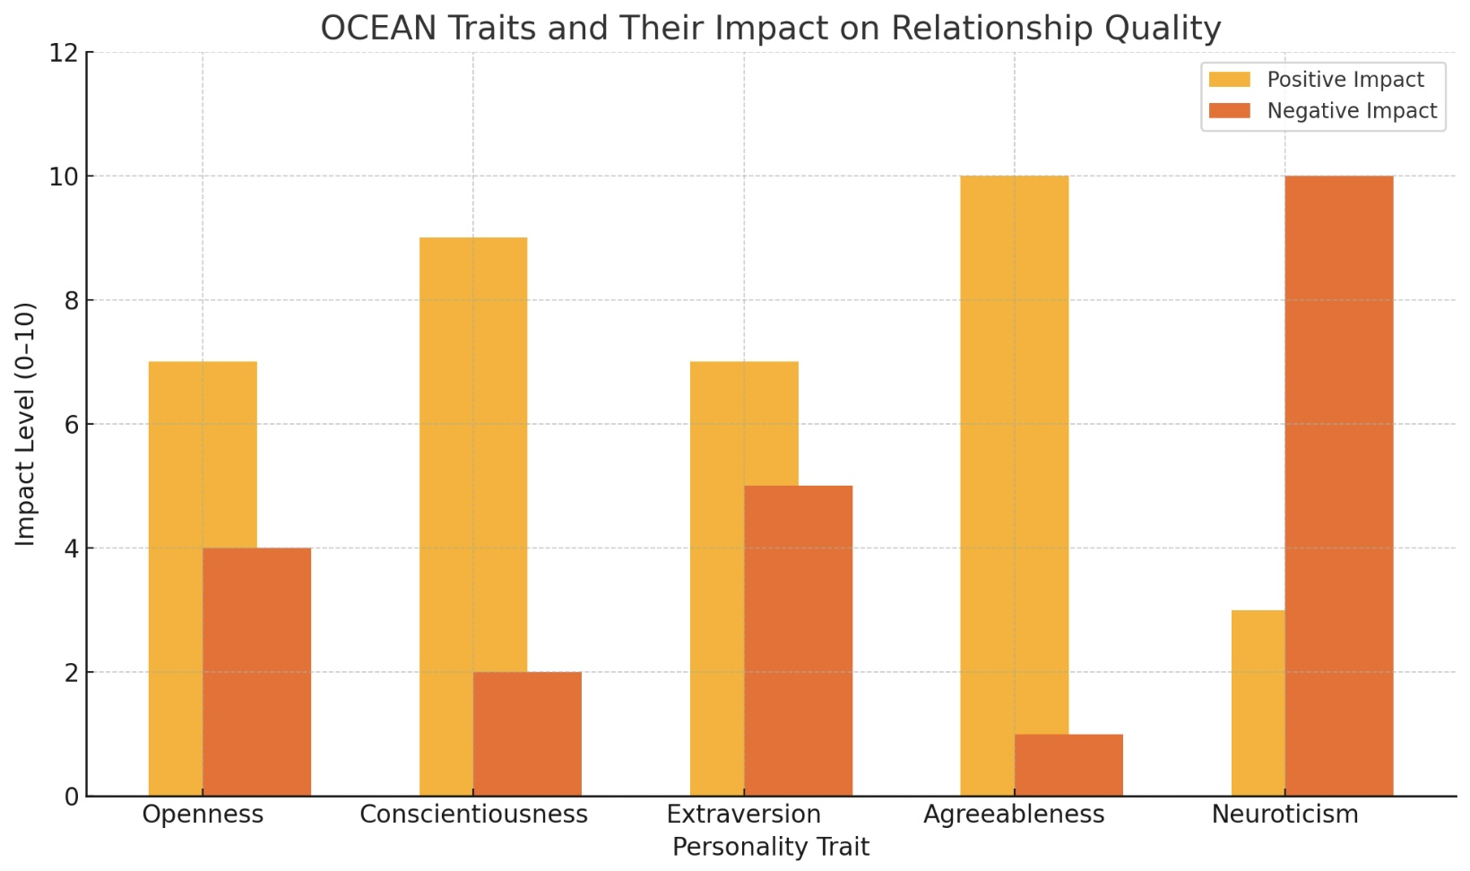
13. OCEAN traits

Slide 76
14. Growth vs. Fixed mindset
Growth mindset is a concept developed by psychologist Carol Dweck, and it basically means believing that abilities, intelligence, and even personal qualities can be developed through effort, learning, and perseverance rather than being fixed traits you’re born with.
In the context of relationships, a growth mindset means believing that:
• Challenges and conflicts are opportunities to grow together, not signs of doom.
• Relationship skills like communication, empathy, trust-building, and emotional regulation can improve with effort.
• Mistakes and setbacks are normal parts of development, not proof that you’re “bad” at relationships.
Growth Mindset Positively Impacts Relationships:
1. Better Conflict Resolution-Partners are more likely to see problems as temporary and solvable, rather than evidence that the relationship is broken.
2. Greater Resilience-Couples with a growth mindset bounce back from hard times better because they expect to evolve through challenges.
3. More Empathy and Patience-Believing that people can grow helps partners be more forgiving of each other’s flaws or mistakes.
4. Deeper Emotional Intimacy-Growth-oriented partners are willing to learn about each other continually, keeping the emotional connection alive over time.
5. Reduced Defensiveness-When feedback isn’t seen as an attack on a “fixed” self, it’s easier to hear constructive criticism without collapsing into shame or anger.

Slide 77
THE RISKS OF FIXED MINDSET IN RELATIONSHIPS
If someone has a fixed mindset about relationships, they might think:
• “If we fight, we must not be soulmates.”
• “I’m just not good at relationships, I’ll never change.”
• “My partner will never change, so there’s no point.”
This can lead to:
• Giving up quickly during tough times
• Escalating blame and resentment
• A deep fear of vulnerability and failure
Growth mindset relationships are more adaptive, more resilient, and often happier over the long term.
They aren’t “perfect”, they’re learning together, which is actually more powerful.

Slide 78

Why ARE INTIMATE
RELATIONSHIPS SO DIFFICULT?

Slide 79
THE HIDDEN EMOTIONAL ENGINE BENEATH “RATIONAL” ARGUMENTS
Most people in intimate relationships such as parent-child or couples believe that when they’re arguing, they are disagreeing over the content of the dispute, who said what, who forgot what, who’s right or wrong. The real engine driving such arguments is however almost always emotional rather than rational. Underneath the surface, one or both people feels misunderstood, hurt, or unseen. That emotional pain activates protectors, often anger, defensiveness, or criticism, and these protectors start talking to each other instead of the partners’ deeper, softer selves.
So, what looks like a ‘disagreement’ is actually hurt parts protesting their pain. The sequence in such an argument is typically:
1. Trigger event (small or large)
2. One person feels unseen, misunderstood, or disrespected
3. Their protective anger activates (retaliation, sarcasm, shutting down, etc.)
4. The partner feels attacked and their own protector activates
5. The escalation becomes a protector-to-protector battle.
People think they’re arguing about the dishwasher, who’s late, or tone of voice but they’re actually saying: “Do I matter to you?” “Do you see me?” “Am I safe with you?” or “Are you on my side?” This moves the argument out of the rational mind and into emotional attachment alarm and defensive parts.

Slide 80
INSECURE ATTACHMENT THE RELATIONSHIP KILLER
Insecure attachment patterns can make relationships difficult because they are strategies for surviving emotional threat, not for mutual regulation. When someone has insecure attachment:
1. Closeness can feel unsafe leading to withdrawal, shutdown, or defensiveness, or
2. distance can feel unsafe leading to clinging, protest, anger, or control.
As a result, partners often misread each other’s intentions, react from fear rather than trust, escalate or disengage instead of repairing and trigger each other’s old, unhealed expectations about closeness
In short, two nervous systems organized around self-protection rather than secure connection can easily get locked into cycles that feel confusing, exhausting, and painful, especially when both people deeply want the relationship to work.

Slide 81
HOW EARLY ATTACHMENT PATTERNS
SHAPE LATER-LIFE RELATIONSHIPS
Attachment is the template the nervous system builds in early life for answering three questions:
1. Am I safe?
2. Are others reliable?
3. What do I need to do to stay connected?
These early lessons become implicit operating systems. They show up later in adulthood as 1) how we seek closeness 2) how we handle conflict 3) how we regulate emotions with another 4) what we expect from love
5) what we fear in intimacy 6) how we respond to unmet needs
Attachment patterns are not fixed traits. They are survival strategies learned early that continue only until new experiences or healing provide better options.

Slide 82
HOW ATTACHMENT SHAPES LATER RELATIONSHIP BEHAVIORS
People with different attachment styles differ in:
• how quickly they trust
• how much closeness feels comfortable
• how they express needs
• how they handle conflict
• how they respond to absence or silence
• how they interpret other people’s motives
• how they regulate emotion with another person
Attachment patterns are not about “good” or “bad”, they are about the strategies the nervous system learned to stay safe.

Slide 83
ADULT ATTACHMENT PATTERNS A REVIEW
1. Secure Attachment: Core belief: “I am lovable and others are dependable.”
Characteristics: comfortable with closeness and autonomy. communicates directly. repairs conflict effectively, expects relationships to be safe and stable
2. Anxious / Preoccupied Attachment: Core belief: “Others may leave. I must stay close.”
Characteristics: heightened fear of abandonment. seeks reassurance. sensitive to emotional shifts. may protest distance or conflict
3. Avoidant / Dismissing Attachment: Core belief: “Others are unreliable. I must rely on myself.”
Characteristics: values independence, uncomfortable with vulnerability, withdraws in conflict, emotions feel overwhelming or shameful.
4. Disorganized / Fearful-Avoidant Attachment: Core belief: “I want closeness, but closeness is dangerous.”
Characteristics: rapid shifts between pursuing and distancing. difficulty regulating emotions. fears both abandonment and intimacy. often rooted in developmental trauma

Slide 84

ATTACHMENT Issues in intimate relationships

Slide 85
THE MOST COMMON RELATIONSHIP COMBINATIONS & HOW THEY INTERACT
1. Anxious + Avoidant (the classic pursuer–distancer dynamic). This is the most common dysfunctional pairing.
How it works: The anxious partner seeks closeness when distressed. The avoidant partner withdraws to feel safe.
This creates a looping cycle: 1. Anxious partner moves closer → 2. Avoidant partner feels overwhelmed → 3. Avoidant pulls away → 4. Anxious partner feels abandoned → 5. Anxious moves closer again, more intensely
Emotional tone: frustration, confusion, longing, misattunement. Nervous system: one hyperactivated, one shut-down. This often recapitulates childhood patterns almost perfectly.
2. Anxious + Anxious (“two storm-driven ships”). Both partners fear abandonment, escalate quickly, struggle with emotional regulation. Interactions feel intense, dramatic, and often exhausting.
Emotional tone: passion + volatility. Common outcome: short, intense relationships or chronic conflict.
3. Avoidant + Avoidant (“two harbors with high walls”). Both partners value independence, avoid emotional depth, may live parallel lives. Interactions are calm but emotionally flat.
Emotional tone: peaceful distance. Common outcome: low conflict but low intimacy; “roommates rather than lovers.”
4. Secure + Anxious. The secure partner: provides reassurance, models healthy communication, doesn’t shame neediness. Over time, the anxious partner becomes less preoccupied.
Emotional tone: healing, stabilizing. Outcome: anxious partner often becomes earned-secure.

Slide 86
THE MOST COMMON RELATIONSHIP COMBINATIONS & HOW THEY INTERACT
5. Secure + Avoidant. The secure partner respects autonomy, invites emotional connection gently, doesn’t pursue when the avoidant withdraws. Over time, the avoidant partner often becomes more open and expressive.
Emotional tone: gentle expansion. Outcome: avoidant partner becomes more comfortable with intimacy.
6. Secure + Secure. The rarest but most stable combination. Interactions: open communication, rapid repair, balanced closeness and independence, mutual regulation.
Emotional tone: resilient, warm, collaborative.
7. Disorganized + Any Style. This pattern is the most challenging because the person’s inner template is contradictory.
Emotional tone: intense, confusing, unpredictable.
+ Anxious: both fear abandonment, both dysregulate, high emotional volatility.
+ Avoidant: disorganized partner triggers avoidant withdrawal, avoidant withdrawal triggers disorganized fear, both feel unsafe
+ Secure: secure partner can help regulate; relationship becomes healing if trauma is processed

Slide 87
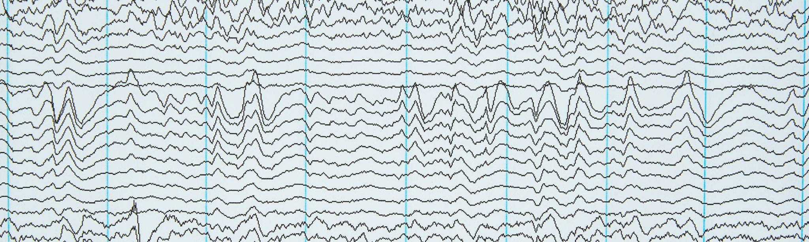
Common INTIMATE RELATIONSHIP conflict patterns
There are many patterns of conflict in intimate relationships. Which do you think applies to you?

Slide 88
COMMON ARGUMENT DYNAMICS
A. Pursuer–Withdrawer Cycle (Attachment-based). One partner pursues; the other withdraws. Both believe the other is the problem.
Pursuer: escalates, pushes for discussion, raises intensity. Part driving them: an anxious, young part needing connection.
Withdrawer: shuts down, goes quiet, avoids. Part driving them: an avoidant protector trying to keep everyone safe
Both feel abandoned in different ways. This is the most common argument pattern in adult relationships.
Example: Sophie wants to talk immediately after an upsetting comment at dinner. Daniel feels overwhelmed, shuts down, and says, “Can we not do this right now?”. Sophie escalates, interpreting his silence as “I don’t matter.” Daniel withdraws further, interpreting her intensity as danger. Both feel abandoned in different ways.
B. “Content Fight” That Hides a “Meaning Fight”. The couple argues about logistics (the plans, the dishes, the finances) but the actual fight is about meaning: “Do you respect me?” “Are you taking me for granted?” “Do you believe I’m competent?” “Is my perspective valid?”. In IFS terms the content is the protector’s language; the meaning comes from an exile’s emotional need.
Example: Mark and Jenna get into a 40-minute fight about who left the garage door open. On the surface: they’re arguing about responsibility, timelines, and who remembers correctly. Underneath: Mark feels criticized and incompetent. Jenna feels dismissed and alone with the household load. Their protectors (anger, defensiveness) take over, and they argue facts instead of feelings.

Slide 89
C. Symmetrical Escalation (“You raise volume, I raise volume”). Both partners mirror each other’s escalation: One criticizes then the other counters with a bigger criticism. One yells then the other yells louder. One defensively justifies then the other fact-corrects more aggressively. It becomes a competition of protectors, each trying to restore dignity, control, or safety.
Example: Rita raises her voice in frustration after feeling unheard. Andre raises his voice in response: “Why are you yelling?” Rita yells louder: “I’m yelling because YOU don’t listen!” Soon they’re both shouting about whose tone is worse. Two protectors are fighting for dignity and safety.
D. Scorekeeping and “historical” arguments. Triggered by something small in the present, but suddenly the argument is about: “You always…” “Remember last year when you…” “This is just like the time you…”. This happens when old injuries (exiles) get activated and spill into the current moment.
Example: Tom forgets to text that he’ll be late. His partner, Maya, becomes deeply upset and brings up three past times when she felt abandoned. Tom defends himself with explanations from those earlier events. The present argument collapses underneath years of unprocessed pain.
E. Triangulating a third element. The couple drags in a third factor, kids, finances, work, ex-partners, parents, instead of talking about the vulnerable feelings between them. This protects them from intimacy but traps them in impersonal conflict.
Example: When tension rises between Maria and John, Maria keeps turning to their teenage daughter for support: “Tell your father I’m not being unreasonable.” The daughter becomes the third point in their triangle, temporarily stabilizing the tension but increasing long-term conflict and confusion.

Slide 90
F. “Debater vs. Emotionalizer” Dynamic. One partner goes intellectual and logical while the other expresses emotion. The intellectualizer uses facts, logic, correction → meant to bring control. The emotionalizer expresses hurt, overwhelm, fear → meant to bring closeness. Each feels invalidated by the other’s style.
Example: During an argument about finances, Alex responds with logic, spreadsheets, and “facts.” Their partner, Sam, is speaking from hurt and overwhelm: “I feel scared when money gets tight.” Alex keeps debating; Sam feels dismissed. They are in two different modes—rational debate versus emotional expression
This is very common in cross-attachment relationships (anxious + dismissing).
G. “We’re Both Right but in Different Ways” Conflict. Each partner is telling their truth from different emotional time zones: One speaks from the Present (“You’re yelling right now”). The other speaks from the Past (“I’m reacting because you dismissed me earlier”). Both are correct, but they’re not answering the same question.
Example: Jamie says, “We need more time together to stay close.” Taylor says, “I need more alone time to recharge.” Both perspectives are true and valid, one rooted in connection needs, the other in autonomy needs, but they appear contradictory until both truths are acknowledged
H. Protest vs. Protest (Two hurt parts yelling ‘See my pain!’). Both partners are essentially saying: “See my hurt!”
“Validate me first!” “No, you hurt me more!”. Both are pro­testing disconnection rather than causing it.
Example: When one partner pulls away even slightly, both escalate. If Lee feels ignored, they raise their voice. Jordan reacts to that by pressing even harder: “No, you’re not listening!". Instead of protest–withdraw, it becomes protest–protest: two nervous systems in alarm, each demanding connection but communicating threat.

Slide 91
COMMON ARGUMENT DYNAMICS
Most couples’ arguments aren’t about facts. They’re about feelings. Protectors get activated, and the couple stops being able to hear each other from a calm, connected Self. Once hurt parts take over, they protect themselves with anger, withdrawal, logic, or criticism, and these protective strategies clash. What looks like a disagreement is usually two wounded parts trying to be seen.

Slide 92

Fight/fight
COMMON RELATIONSHIP ACTIVATION PATTERNS:
Notes:
If people in a relationship, are able to stay in the window of tolerance that is in calm or alert most of the time, that is likely to be a good relationship. The more frequently they are outside the window in their interactions, the more difficult the relationship tends to be. Knowing what we know about this states of activation, we can predict what the patterns of conflicts in relationships are likely to be. In any particular relationship some of these patterns will be more common than others.

Slide 93

Fawn/fight

Slide 94

Fight/flight

Slide 95

Fight/freeze

Slide 96

Relationship TYPES

Slide 97
HEALTHY RELATIONSHIP TYPES
Think of every relationship as a harbor and each person as a ship navigating the waters of life. A harbor can offer safety, nourishment, and rest… or it can be difficult to enter, unpredictable, or even dangerous. Different relationship styles create different kinds of harbors.
1. A secure relationship is one in which both people feel safe, seen, valued, and soothed. In a secure relationship people are emotionally responsive and consistent, conflicts are repaired rather than avoided, each person can be independent and connected and there is high trust, and low drama. This mirrors secure attachment, a “safe harbor” that steadies both partners.
Secure Harbor: The harbor is well-lit, calm, predictable, and welcoming. The ship knows it can enter in storms and rest without fear.
Clinical example: Maria and Daniel argue sometimes, but they always come back together to repair. When Maria feels overwhelmed, she reaches out; Daniel responds warmly. Daniel trusts that Maria won’t leave when things get hard. Both can sail out into life confidently knowing there is a safe place to return.

Slide 98
HEALTHY RELATIONSHIP TYPES
2. An interdependent relationship involves two autonomous individuals who choose mutual reliance. In an interdependent relationship there is a healthy balance of closeness and independence, support for the growth of both people and for each partner’s own life and identity
Interdependent Harbor: Two sturdy docks connected by a strong bridge. Ships come and go freely, supported but not confined.
Clinical example: Aisha and Tom each have rich independent lives, friends, hobbies, and careers. They rely on one another but don’t collapse into one another. When stress hits, they lean in, but they never lose themselves.
3. Supportive and nurturing relationships enhance wellbeing, resilience, and meaning. They encourage each person’s goals, they provide warm, predictable emotional environments, good communication and shared values.
Supportive / Nurturing Harbor: A harbor with repair crews, replenishment stations, and steady lighthouses. It strengthens ships for the journey.
Clinical example: After losing his job, Evan leans on his partner, who listens, validates, and encourages him. Their communication feels like gentle tides, responsive and attuned.

Slide 99
UNHEALTHY RELATIONSHIP TYPES
4. Toxic relationships consistently damage wellbeing. They feature manipulation, instability, volatility, criticism, contempt, gaslighting and emotional or physical harm. In these relationships there is no psychological safety. They are often rooted in insecure attachment, trauma, or personality disorders.
Toxic Harbor: Looks calm from afar, but close up is full of hidden rocks, sudden storms, and unstable docks.
Clinical example: Sarah never knows which version of her partner she’s coming home to, warm or raging. Even when things are calm, she prepares for the next explosion. Her nervous system is always on alert.
5. Codependent relationships are those where self-worth, identity, or stability depends on the other person. In these relationships one or both partners over function, excessively caretake or rescue, have poor boundaries and identity fusion (“I don’t know who I am without you”) Interdependence = two whole people connected. Codependence = two incomplete selves fused.
Codependent Harbor: The docks are fused together. If one ship tries to leave, everything shakes.
Clinical example: Mark can’t make decisions without checking with Lily. Lily feels responsible for Mark’s emotional state and exhausts herself managing it. Both are afraid that if they separate even briefly, everything will fall apart.

Slide 100
UNHEALTHY RELATIONSHIP TYPES
6. An enmeshed relationship is one with diffused boundaries. There is often overinvolvement in each other’s emotions, and lack of individuality. Decisions are made as a merged unit, autonomy is threatening and the relationship can feel suffocating.
Enmeshed Harbor: There are no boundaries, the harbors have merged into one tangled waterway. Ships can’t move freely; leaving feels like betrayal.
Clinical example: A mother and adult daughter who talk ten times a day, share every detail, and panic when the other is unavailable. Autonomy feels dangerous.
7. A narcissistic or exploitative relationship is where one person uses the other to regulate their self-esteem. Needs are highly one-sided, there is a lack of empathy, an idealization and devaluation cycle and the partner becomes an “appliance” for validation.
Narcissistic / Exploitative Harbor: One harbor looks beautiful but only serves the needs of its own lighthouse. Ships are welcomed only if they shine back admiration.
Clinical example: Chris feels adored at first, then slowly devalued. His partner expects constant praise and becomes cold or critical when he has needs of his own.

Slide 101
UNHEALTHY RELATIONSHIP TYPES
8. A trauma-bonded relationship is one that is reinforced by cycles of abuse and intermittent reward. There are often high highs and low lows, relief moments feel like “love”, the abused partner feels unable to leave, and their nervous system becomes conditioned to unpredictability. This is common in childhood trauma reenactments.
Trauma-Bonded Harbor: The harbor alternates between storms and sudden moments of calm.
The unpredictability creates a powerful psychological tether.
Clinical example: Anna’s partner cycles between cruel outbursts and tearful apologies. The relief she feels during the apologies is so profound that she stays, even while being harmed.
9. Avoidant relationships are marked by emotional distance and self-protection. Intimacy feels overwhelming, there is high independence, low vulnerability, and withdrawing or shutting down during conflicts.
Avoidant Harbor: The harbor is almost impossible to enter. High walls, few docks, and no visible lighthouse.
Clinical example: When Leo’s partner gets emotional, he shuts down, withdraws, or works longer hours. He wants connection but feels safest alone.
10. Anxious relationships are fueled by fear of abandonment. They often involve pursuing, clinging, checking, hyper-focus on partner’s emotional shifts, high sensitivity to rejection, and quick escalation of conflicts.
Anxious Harbor: The harbor is there, but the entrance is narrow and difficult.
Ships worry they won’t be let in during storms, so they circle anxiously.
Clinical example: Jasmine texts repeatedly when her partner is quiet. She fears abandonment so strongly that small delays feel like storms.

Slide 102
ATTACHMENT-INFORMED RELATIONSHIP TYPES
11. Disorganized Relationship is a relationship in which the partner is simultaneously the source of safety and danger. Characteristically in these relationships there are approach–avoid cycles, intense fear and intense yearning, and rapid shifts between closeness and withdrawal. These relationships are often rooted in unresolved trauma.
Disorganized Harbor: Is the most confusing harbor. The lighthouse flickers unpredictably. Inside the harbor there are hidden reefs, jagged rocks, and shifting tides. The ship both longs to enter and fears the danger.
Clinical example: Tamara clings to her partner when she feels abandoned, then becomes terrified of the closeness she just sought. Her partner feels confused: she both approaches and pushes away, sometimes in the same hour.
12. Earned-secure relationships are those where one or both partners originally had insecure attachment but have developed secure functioning. In these relationships the capacity for repair increases, and emotional regulation and boundaries improve. These changes are often the result of therapy, insight, and supportive partners.
Earned-Secure Harbor: A harbor that once had broken docks and poor lighting but has gradually been repaired. It is now stable, welcoming, and trustworthy.
Clinical example: Ben grew up with chaos, but through therapy and healthy relationships, he has learned to communicate, repair, and co-regulate. His relationship is now a safe anchoring point, for both partners.

Slide 103
DYNAMIC OR PATTERN-BASED RELATIONSHIPS
13. Complementary relationship are ones in which each partner adopts opposite but mutually reinforcing roles. For example: Pursuer–distancer, caregiver–dependent, rational–emotional. These relationships can be healthy or unhealthy depending on flexibility.
Complementary Harbor: Two very different harbors that happen to fit together like puzzle pieces, sometimes helpfully, sometimes rigidly.
Clinical example: One partner pursues (storm-driven ship), the other distances (narrow harbor). They lock into a predictable dance unless both learn flexibility.
14. Transactional relationships are based primarily on exchange of needs, resources, or benefits.
They are characterized by low emotional depth, high focus on usefulness or reciprocity and are stable only as long as the “contract” holds.
Transactional Harbour: like two ships docking, trading supplies, and then heading back out to sea without ever truly anchoring together.
Clinical Example: Alex and Jordan have been together for 15 years. Their life runs like a well-managed port: • Bills are paid on time • Tasks are divided fairly • Kids are transported and scheduled efficiently They rarely fight, but they also rarely share feelings. When Alex is distressed, Jordan offers solutions (“Did you call the doctor? Did you talk to your boss?”) rather than emotional support. Both say the relationship is “fine,” but Alex describes feeling lonely in a well-run life

Slide 104
DYNAMIC OR PATTERN-BASED RELATIONSHIPS
15. In parallel relationships two people live side-by-side with minimal emotional overlap. They are peaceful but emotionally disengaged, there is little conflict, but also little intimacy and people feel like roommates rather than partners.
Parallel Harbor: Two harbors side-by-side with almost no interaction. Peaceful but lonely.
Clinical example: Couples who rarely fight but rarely talk. Like two ships permanently docked, never venturing into each other’s waters.
16. Conflict-dominant relationship are relationships where conflict becomes the organizing principle. They feature frequent blame, criticism, escalation, and little repair. Partners bond through fighting, not connection. These often mirror chaotic childhood homes. Conflict-dominant harbor: is always turbulent, there are frequent storms, waves are constantly crashing against the docks, repairs rarely last and calm feels unfamiliar or even uncomfortable
Clinical Example: Sophie and Mark argue almost daily. Small misunderstandings escalate quickly, and both raise their voices within minutes. When things are calm, they feel distant, so conflict becomes their default way of reconnecting, a storm they both know how to enter but never quite know how to leave.
17. Healing relationship are those that facilitate growth and integration. These relationships are high in compassion, there is a willingness to explore patterns, non-defensive communication, and partners help each other repair old wounds.
Healing Harbor: A harbor that helps repair old damage. A place where storms from the past finally meet calm water.
Clinical example: A securely attached partner helps someone with trauma learn regulation, boundaries, and safety. Over time, old relational wounds heal in the warmth of consistent presence.

Slide 105
Relationships vary widely, from secure and supportive to toxic and traumatic. Some relationships help us feel safe and whole; others activate our old wounds. Many patterns mirror attachment styles: anxious relationships cling, avoidant relationships distance, and disorganized relationships both pull and push. Codependent relationships fuse identity, while interdependent relationships support growth. Recognizing these patterns helps us understand what kind of relational “harbor” we built internally, and how we can begin to build a safer one.
Every relationship is like a harbor. Some are safe, stable, and welcoming. Others are difficult to enter, dangerous, unpredictable, or fused without boundaries. Our attachment histories shape the kinds of harbors we build, and the storms we generate. Healing is possible. We can learn to repair broken docks, widen the entrance, strengthen the lighthouse, and become a harbor where others feel safe to anchor.

Slide 106

CAN YOUR RELATIONSHIP BE repaired?

Slide 107
INDICATORS THAT REPAIR IS POSSIBLE
1. Willingness to Self-Reflect (Parts-Awareness). Partners can identify their own emotional reactions and “parts” rather than only pointing at the partner’s faults. They can say things like “I know I shut down when I’m overwhelmed” rather than “You make me shut down.” Why it helps: It shifts dynamics from blame to curiosity; opens the door to IFS, EFT, and other attachment-based work.
2. Capacity for Emotion Regulation. The ability to stay within the window of tolerance long enough to work through conflict. Even modest improvements (e.g., pausing, grounding, breath work) enhance the couple’s ability to communicate. Why it helps: Couples therapy becomes possible when partners can stay present rather than collapse into fight/flight/freeze.
3. Mutual Goodwill. A basic assumption that the partner is not the enemy. There is still warmth, affection, or at least a desire to repair. Why it helps: Preserved goodwill allows partners to interpret each other’s behaviour less catastrophically.
4. Ability to Hold Two Realities at Once. Couples who can tolerate “both/and”: “I was hurt and I know you didn’t intend harm.” Why it helps: Reduces polarization. Makes empathy possible.

Slide 108
INDICATORS THAT REPAIR IS POSSIBLE
5. Insight Into the Role of Early Attachment. When partners understand that current reactivity often comes from younger parts, not from malice. Why it helps: De-pathologizes both partners; activates compassion; opens space for healing.
6. Accountability and Willingness to Repair. The ability to say: “I see what I did. I’m sorry. I want to do this differently.” Why it helps: Repair is the single strongest predictor of relationship stability.
7. Realistic Expectations. Understanding that therapy is not fast, and that healing requires practice. Why it helps: Prevents disappointment-impatience spirals that lead to dropout or blame.
8. Supportive Context. Low external stress (financial, medical, parenting burdens). Why it helps: More bandwidth for emotional work.

Slide 109
INDICATORS THAT REPAIR IS LESS LIKELY
1. High Emotional Reactivity and Poor Regulation. When either partner is routinely outside the window of tolerance (rage, panic, disconnection). Why it hinders: There is no “self-to-self” communication possible, only parts-to-parts combat.
2. Blame Without Self-Reflection. “If you would just change, we’d be fine.” Why it hinders: Externalizing the problem removes agency; therapy becomes a courtroom.
3. Criticism, Contempt, and Stonewalling (also known as Gottman’s “Four Horsemen”). These are the strongest predictors of separation. Why it hinders: They erode goodwill, break down attachment safety, and activate protectors in both partners.
4. Chronic Avoidance. Refusal to engage emotionally, avoiding vulnerability, or intellectualizing every conflict. Why it hinders: Prevents deeper attachment repair and blocks the partner from ever reaching the underlying wounds.

Slide 110
INDICATORS THAT REPAIR IS LESS LIKELY
5. Trauma With No Individual Work. When trauma activations dominate the couple’s dynamic but each partner refuses or lacks access to individual therapy. Why it hinders: Partners become each other’s trigger, and the relationship becomes an emotional minefield.
6. Asymmetrical Motivation. One partner wants change; the other is ambivalent or resistant. Why it hinders: Creates a pursuer-distancer dynamic that therapy amplifies rather than resolves.
7. Affairs or Ongoing Boundary Violations Without Repair. Especially if there is continued secrecy or minimization. Why it hinders: No attachment security can be rebuilt on an unstable foundation.
8. Addictions or Severe Untreated Mental Illness. Why it hinders: These overwhelm the relational system; stabilization must come first.

Slide 111
GOTTMAN’S 4 HORSEMEN OF THE RELATIONSHIP APOCALYPSE
John Gottman’s Four Horsemen of the Relationship Apocalypse are four communication patterns that reliably predict relationship breakdown when they become habitual. They describe how conflict is handled, not whether conflict exists, and they are powerful because they escalate negativity, erode trust, and block repair.
Criticism attacks a partner’s character or identity rather than addressing a specific behavior. Focuses on “who you are” instead of “what happened”. Often uses always or never and invites defensiveness rather than problem‑solving Example: Turning a complaint into a global judgment about the person.
Contempt expresses disdain, superiority, or disgust and is the most destructive of the four. Includes sarcasm, mockery, eye‑rolling, sneering. Communicates moral or intellectual superiority. Strongly predicts divorce and health problems. Contempt signals that one partner no longer sees the other as an equal.
Defensiveness is self‑protection through denial or counter‑attack. Refusing responsibility. Making excuses. Blaming the other partner. While it feels protective, defensiveness escalates conflict because it blocks accountability and resolution.

Slide 112
GOTTMAN’S 4 HORSEMEN OF THE RELATIONSHIP APOCALYPSE
Stonewalling occurs when one partner withdraws from interaction entirely. Emotional shutdown. Silence, minimal responses. Avoidance during conflict. It often appears after prolonged exposure to criticism or contempt and reflects physiological overwhelm rather than indifference.
The four patterns tend to form a destructive cycle: Criticism triggers defensiveness. Defensiveness fuels contempt. Contempt leads to emotional withdrawal. Stonewalling deepens disconnection. Without repair, this cycle becomes self‑reinforcing and increasingly rigid over time.
Gottman’s work shows that relationship failure is rarely about incompatibility or conflict frequency. It is about how partners communicate under stress. The Horsemen are not occasional mistakes; they are repeated interaction patterns that signal a breakdown in mutual respect, safety, and emotional regulation. Recognizing them early allows couples to replace them with healthier alternatives and restore cooperation rather than escalation.

Slide 113
KEY PROGNOSTIC PREDICTORS OF GOOD VS BAD OUTCOMES
This is a synthesis from EFT, IFS-informed relational work, Gottman research, and trauma/attachment literature.
Best Predictors of GOOD Outcome
• Presence of at least one secure-enough internal working model (one partner with some stable attachment capacity).
• Mutual willingness to soften protectors and explore younger parts.
• Early signs of successful “de-escalation” (fewer blowups or shutdowns).
• Emotional accessibility and responsiveness (ARE model from EFT).
• The couple’s ability to repair within the session even once.
• Being able to see each other with “fresh eyes” after parts-work.

Slide 114
KEY PROGNOSTIC PREDICTORS OF GOOD VS BAD OUTCOMES
Best Predictors of POOR Outcome
• Dominance of contempt (Gottman: 93% predictive of dissolution).
• Unwillingness to take responsibility or examine one’s own parts.
• Couples who reenact trauma without capacity for regulation.
• Persistent parallel lives (absence rather than conflict).
• Partners who fundamentally dislike each other.
• One partner feeling unsafe, not emotionally unsafe only, but physically or coercively unsafe.

Slide 115
IFS PREDICTORS OF GOOD VS BAD OUTCOMES
Healing requires Self-to-Self contact. Thus, good prognosis depends on whether each partner can, at least occasionally, access: Curiosity, Compassion, Calm, Clarity, Courage, Connectedness and Creativity.
Poor prognosis occurs when polarizations between protectors dominate and neither partner can unblend long enough to witness or soothe younger, wounded parts.
Good outcomes happen when:
• Both partners are willing to look inward (parts-awareness).
• They can regulate enough to stay in the conversation.
• There is basic goodwill.
• They repair after conflict.
• They can see the younger parts under each other’s protectors.
Poor outcomes happen when:
• Partners stay in attack/defend cycles.
• Trauma activation overwhelms capacity.
• Contempt dominates.
• There is no accountability or willingness to repair.
• The relationship feels unsafe or one-sided.

Slide 116
COUPLE FACTORS THAT AFFECT FUTURE WELL-BEING
These are the most important domains research consistently shows predict long-term health, psychological stability, and life satisfaction.
A. Safety & Stability Most important factor. • Is there physical safety? • Is there emotional safety? • Does conflict escalate to frightening levels? • Are there patterns of coercion, control, intimidation, or humiliation? If there is persistent danger, attempts at change are usually harmful rather than helpful.
B. Respect & Basic Kindness A relationship cannot improve without these: • Is there basic goodwill left? • Do partners treat each other with respect, even when upset? • Are apologies possible? • Is contempt common (the single strongest predictor of relationship breakdown)?
C. Capacity & Willingness for Change Not desire alone, but capacity, too. • Does each partner take responsibility for their part in the cycle? • Are they willing to learn skills (emotion regulation, communication, repair)? • Do they reduce harmful behaviors over time? • Are both open to feedback? • Does either partner refuse all influence?
D. Attachment Patterns & How They Interact • Is each person’s attachment pattern workable? • Do their patterns create a predictable, mutually painful cycle? • Is either partner actively doing healing work? • Can the couple interrupt the cycle together?
E. Emotional Climate The “felt” sense of the relationship: • Ratio of kindness/connection to conflict/withdrawal • Level of chronic tension • Presence of warmth, laughter, and shared softness • Do you like who you become in this relationship?

Slide 117
COUPLE FACTORS THAT AFFECT FUTURE WELL-BEING
F. Shared Vision & Values • Do you want compatible lives? • Are your values aligned enough (integrity, affection, money, parenting, lifestyle)? • Do you want the same type of relationship?
G. Personal Growth & Identity • Does this relationship support or suppress who you are becoming? • Do you feel smaller, frightened, or distorted? • Does your partner value your growth? • Do you feel you can speak the truth safely?
H. Impact on Children If applicable: • Are the children safe? • What is the emotional climate they are exposed to? • Would staying model healthy relationships or normalize harmful ones? • Would leaving reduce or increase conflict?
I. Practical Realities: these matter, but are not the only factors: • Housing, finances, career • Social supports • Access to therapy, community • Impact of leaving on stability and functioning
J. Your Health & Nervous System • What does your body feel like at home? • Are you chronically dysregulated, vigilant, or shut down? • Do you feel fundamentally alone in the relationship?

Slide 118
DOES THE REPAIR OF RELATIONSHIP HOLES REQUIRE DIFFERENT SKILLS, TOOLS OR STRATEGIES THAN THE ONES WE’VE LEARNED SO FAR IN THE COURSE?

Slide 119

interpersonal holes from INDIVIDUAL holes to COLLECTIVE holes
AND individual wise mind AND collective wise mind
Relationships include those with partners, parents, children, other relatives, friends, ex’s, co-workers, bosses, therapists, medical professionals, etc. Relationship holes are an important subset of all the holes in the sidewalk we fall into. We use the same tools, skills, and strategies but there are some special consideration when doing this work, that we will explore today.
Notes:
Yes, by relationships we mean those that we have with…

Slide 120
YOUR OPTIONS IF YOU’RE IN A DIFFICULT RELATIONSHIP

Slide 121
THE 4 Options for people in difficult relationships
1. Status quo: continue relationship as is
2. Leave: leave the relationship
3. Repair: work at improving the relationship by developing better interpersonal regulation skills and Wise mind
Different part selves in a person may prefer different options
4 . The most popular, but most unrealistic option is wishing/hoping the other person would and pressuring them to change.
Each option has advantages and disadvantages. Consider these carefully
People often stay together or continue a relationship even if they are not attracted to or like each other. Some of the reasons for this include habit, social expectations and pressure, “the kids”, a sense of duty, fear of the other person (fawning), finances, fear of change, their vows, etc.. As Socrates taught us, it’s possible to be meaningfully happy even if your life is spent close to a difficult person. Such a relationship may even provide fuel for growth.

Slide 122

WEIGHING 1. Staying, 2. Leaving, 3.Staying AND Working TOWARD CHANGE OR 4. MAINTAINING THE STATUS QUO.

Slide 123
Trying to repair a difficult relationship can be a lot of work. how do you decide if you should do the hard work or simply leave the relationship?

Slide 124
WEIGHING STAY, LEAVE, OR STAY AND WORK TOWARD CHANGE
Many people cannot make this decision because multiple parts have conflicting agendas: A protector who longs for safety. An exile who is terrified of abandonment. A caretaker who feels responsible for the partner. A hopeful part who believes change is possible. A fearful part who believes leaving is impossible. A rational part who sees the data clearly. A loyal part tied to history, memories, or vows.
The goal is not to silence any of them but to 1. Identify the parts 2. Hear each part’s fears and hopes 3. Unblend enough to let Self lead the decision. A good decision is one made from clarity, courage, calm, compassion, and connection, not from fear, guilt, fantasy, or panic.
When people are deciding whether to stay in a difficult relationship or leave, it’s important to recognize that two different parts of the mind are involved:
1. Rational Mind This is the part that makes lists, weighs pros and cons, looks at patterns, and evaluates long-term consequences. It’s logical, organized, and future oriented.
2. Emotional Mind This is the part that feels love, fear, loneliness, hope, shame, longing, and memories. It responds to attachment needs, trauma histories, and the desire for connection. It often pulls us to stay or to leave for intensely felt reasons. Neither of these minds is “wrong.” They simply speak different languages.
The checklist we use, the one outlining factors that affect long-term well-being, is a product of Rational Mind. It helps you step back and see the relationship from a broader perspective: safety, stability, mutual care, emotional health, growth, impact on children, financial realities, and so on. But no one makes relationship decisions on logic alone.

Slide 125
WEIGHING STAY, LEAVE, OR STAY AND WORK TOWARD CHANGE
We are bonded creatures. Attachment, fear of loss, dreams for the future, trauma triggers, and core needs pull from the Emotional Mind. So, the checklist is not meant to make the decision for you. It’s meant to support the emergence of Wise Mind. Ideally the decision to stay, leave or change comes from your Wise mind or Self. Wise Mind/Self is the integration point, the place where rational clarity and emotional truth meet. Wise Mind says: “My feelings matter and the facts matter.” “My long-term well-being matters and my attachments matter.” “I won’t make a decision from panic, nor from denial, but from grounded presence.”
The checklist helps because it gives structure and clarity, but the decision comes from a deeper internal place, the place in you that can hold both heart and mind at the same time. Wise Mind is not pressured. It’s spacious. It allows the truth to rise from within.
This checklist comes from Rational Mind. But real decisions about love and commitment are emotional decisions. The purpose of the list is not to replace your feelings, it’s to support you in finding Wise Mind. Wise Mind integrates both your emotional reasons for staying or leaving and your rational ones. It lets you make a grounded decision that honours both truth and feeling.

Slide 126
CHECKLIST: WEIGHING STAY, LEAVE, OR STAY AND WORK TOWARD CHANGE
rate each item as: (+) a positive factor, (–) a negative factor, or (?) uncertain/mixed.
RELATIONSHIP WELL-BEING CHECKLIST
1. Safety & Stability
☐ I feel physically safe.
☐ I feel emotionally safe enough to be vulnerable.
☐ Conflicts do not escalate into intimidation or fear.
☐ There is no coercion, control, or emotional cruelty.
☐ I do not have to shrink or silence myself to avoid harm.
2. Respect & Basic Kindness
☐ We treat each other with basic respect, most of the time.
☐ There is no chronic contempt, ridicule, or belittling.
☐ Each person can apologize and repair.
☐ There is still some goodwill and gentleness.

Slide 127
CHECKLIST: WEIGHING STAY, LEAVE, OR STAY AND WORK TOWARD CHANGE
rate each item as: (+) a positive factor, (–) a negative factor, or (?) uncertain/mixed.
3. Willingness & Capacity for Change
☐ Both partners are willing to work on the relationship.
☐ Each takes responsibility for their own parts.
☐ Both are open to learning new skills.
☐ Harmful behaviors decrease over time with effort.
☐ One partner is not doing all the emotional labor.
4. Attachment Dynamics
☐ We can understand our attachment patterns.
☐ We are not stuck in a chronic pursue–withdraw, attack–defend, or collapse–overwhelm cycle. ☐ Each partner is willing to explore their own history.
☐ There is enough felt safety to do healing work.

Slide 128
CHECKLIST: WEIGHING STAY, LEAVE, OR STAY AND WORK TOWARD CHANGE
rate each item as: (+) a positive factor, (–) a negative factor, or (?) uncertain/mixed.
5. Emotional Climate
☐ There is more kindness than conflict.
☐ There is warmth, affection, and some joy.
☐ I do not dread interactions.
☐I generally like who I am in this relationship. 6. Shared Vision & Values
☐ We want similar kinds of lives.
☐ Our values are compatible enough.
☐ We agree on what a healthy relationship looks like.
☐ We share long-term intentions (or can find a workable middle).
7. Personal Growth
☐ I feel able to grow in this relationship.
☐ My partner supports (or at least doesn’t resist) my development.
☐ I do not feel chronically diminished, silenced, or distorted.
☐ I can be myself.

Slide 129
CHECKLIST: WEIGHING STAY, LEAVE, OR STAY AND WORK TOWARD CHANGE
rate each item as: (+) a positive factor, (–) a negative factor, or (?) uncertain/mixed.
8. Impact on Children (If applicable)
☐ The environment is emotionally safe for children.
☐ The relationship models healthy relating.
☐ Staying would not expose them to chronic conflict or fear.
☐ Leaving would likely reduce rather than increase harm.
9. Practical Realities
☐ I have access to support (family, friends, community).
☐ My finances can sustain a transition if needed.
☐ I have the emotional bandwidth for either rebuilding or separating.
☐ There is a feasible path forward for stability.
10. My Health & Nervous System
☐ I am not chronically anxious, hypervigilant, or shut down at home. ☐ My body feels mostly safe with this person.
☐ My stress level is manageable.
☐ I feel more alive than depleted.

Slide 130
SCORING/REFLECTION: More +’s suggests working toward change may be viable. More –’s suggests leaving (or at least stepping back) may improve well-being. Many ? suggests further exploration, therapy, or temporary stabilization before deciding.

Slide 131
3 APPROACHES TO RELATIONSHIP REPAIR
John Gottman, Stan Tatkin and Sue Johnson
renown couple’s therapists

Slide 132


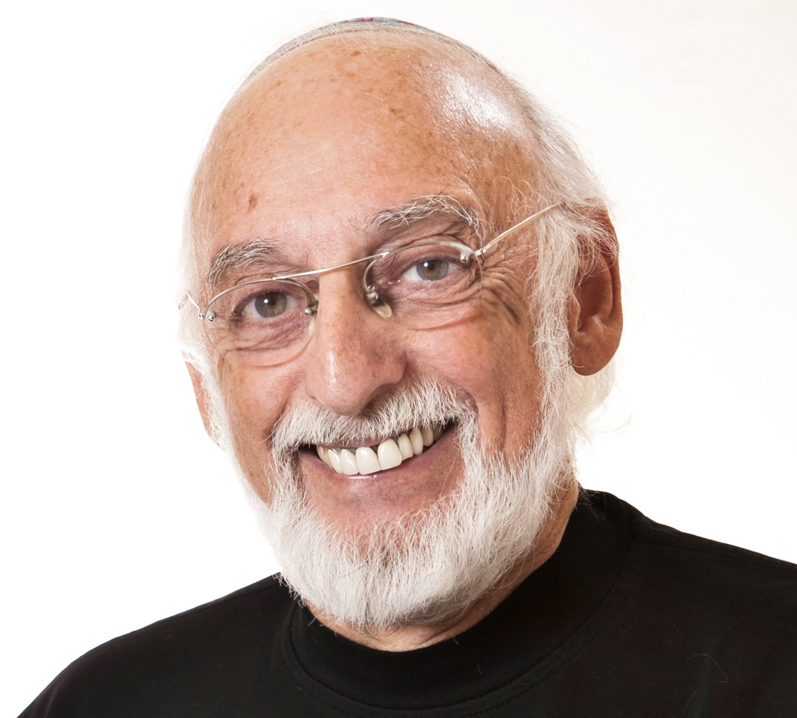
3 RENOWN RELATIONSHIP THERAPISTS
Sue Johnson
Stan Tatkin
John Gottman

Slide 133
JOHN GOTTMAN (THE GOTTMAN INSTITUTE)
Gottman studied couples scientifically for decades and is famous for predicting divorce with 90% accuracy.
Communication Skills: Gottman highlights the importance of soft startups (raising issues gently) versus harsh startups (attacking), which predict success or failure.
Emotional Regulation: He identifies the need to avoid flooding (emotional overwhelm) during conflict, advocating for self-soothing techniques.
Conflict Resolution Ability: Gottman’s “Four Horsemen” (Criticism, Contempt, Defensiveness, Stonewalling) damage relationships; successful couples replace these with antidotes like appreciation, responsibility, and repair attempts.
Trust and Safety: Gottman emphasizes that everyday “emotional bids” (small requests for attention) build or erode trust over time.
Novelty and Growth: His idea of the Love Map (deep knowledge of each other’s worlds) encourages partners to keep learning about each other.

Slide 134
GOTTMAN’S DAILY STRESS-REDUCING CONVERSATION
Practice:
• Spend 20 minutes a day talking about anything other than the relationship — just your stresses, your day, your feelings.
• Focus on listening, empathizing, not solving.
• Example prompts: “What was the high point of your day? What was hard for you today?”
Why it works:
It builds friendship and emotional connection and prevents outside stress from poisoning the relationship.

Slide 135
STAN TATKIN-PSYCHOBIOLOGICAL
APPROACH TO COUPLE THERAPY
Tatkin focuses on how our nervous systems, early attachment experiences, and unconscious processes shape relationships.
Attachment Styles: Tatkin bases much of his work on the idea that secure-functioning couples actively create safety, regardless of their individual attachment histories.
Emotional Regulation: He emphasizes that partners act as each other’s “primary regulators”: when one is upset, the other helps calm them, and vice versa.
Mutual Support: Tatkin stresses that couples should operate as a two-person system rather than as independent competitors.
Trust and Safety: In Tatkin’s view, the core goal is a secure functioning relationship, where agreements prioritize the relationship over individual self-interest.
External Stressors: Tatkin believes couples must form a “couple bubble” — a protective sphere where the relationship takes priority over external threats and distractions.

Slide 136
STAN TATKIN: “THE COUPLE BUBBLE”
Practice:
• Make a spoken commitment like: “We protect each other in public and in private.”
• Then, when something comes up (a mistake, stress, someone flirts with you, etc.), you choose the relationship first, not your own ego or impulses.
• Regularly remind each other: “We are a team. We have each other’s backs.”
Why it works:
It builds safety and mutual loyalty at a deep, even biological level, your nervous systems calm down because you know you’re not alone.

Slide 137
SUE JOHNSON
FOUNDER OF EMOTIONALLY FOCUSED THERAPY
Johnson focuses heavily on emotional connection as the foundation.
Attachment Styles: Her model is directly based on adult attachment theory — all about creating a secure emotional bond.
Emotional Regulation: Helping partners reach for each other in vulnerability rather than withdrawing or attacking is central.
Trust and Safety: Emotional responsiveness (Are you there for me when I need you?) builds strong, resilient trust.

Slide 138
SUE JOHNSON: “HOLD ME TIGHT” CONVERSATIONS
Practice:
• Choose a quiet time. Each person shares one fear or vulnerability (even something simple like “I feel lonely sometimes”), while the other listens with warmth and reaches out physically (touching hand, hugging, whatever feels right).
• Then switch roles.
• Key words to hold onto: softness, no judgment, stay connected even if it feels awkward.
Why it works:
It deepens emotional bonding — being vulnerable and met with care literally rewires attachment patterns toward security.

Slide 139
3 TINY PRACTICES TO STRENGTHEN YOUR RELATIONSHIP EVERY DAY
Gottman – Daily Stress-Reducing Conversation (10–15 minutes) A short daily check-in about external stressors (work, family, health), not relationship problems. It helps by building friendship and emotional attunement; lowers baseline stress so couples don’t misdirect tension at each other. Tiny practice: One partner speaks; the other listens with curiosity, empathy, and validation—no fixing.
Tatkin – The Couple Bubble. A shared agreement that the relationship comes first and partners actively protect each other’s sense of safety. It helps by creating a secure, predictable “we-space” where both partners feel prioritized. Tiny practice: Ask daily, “What do you need from me today to feel safe, supported, or not alone?”
Sue Johnson – Hold Me Tight Conversations (micro-moments) Brief emotional check-ins that name vulnerability and attachment needs. It helps by turning conflict and distance into moments of bonding by reaching instead of protecting. Tiny practice: Use simple attachment language “I’m feeling overwhelmed and need reassurance,” followed by a responsive, caring reply.
These three tiny practices work together; Gottman regulates stress, Tatkin establishes safety and loyalty and Johnson deepens emotional bonding.
Practiced briefly but daily, these create a relationship that feels calmer, safer, and more emotionally connected without needing long, heavy conversations.

Slide 140

IFS RELATIONSHIP WORK
you’re the one you’ve been waiting for

Slide 141

YOU’RE THE ONE YOU’VE BEEN WAITING FOR
In this 2008 book, “You’re the one You’ve been waiting for” Richard Schwartz, offers a way of understanding relationships using an IFS perspective. The book focuses on romantic relationships, but its lessons apply to any close relationship. Schwartz argues that most of our relationship struggles aren’t really caused by the other person, they come from our own wounded parts being triggered. For example, if your partner ignores a text, a part of you might panic, not just because of the text, but because a much younger part remembers what it felt like to be rejected or abandoned.
Rather than blaming the other person or trying to fix them, Schwartz encourages us to turn inward with curiosity and compassion. Our Self can gently connect with these wounded parts and help them heal. When we do this, we stop expecting someone else to rescue us or make us whole. We become, as the title says, the one we’ve been waiting for.

Slide 142
The book teaches us to
1. recognize when parts are getting activated, especially in conflict.
2. Pause and turn inward with compassion instead of reacting impulsively.
3. Listen to parts without judging them or trying to get rid of them. And…
4. Lead from the Self, which brings clarity, calm, and connection
In relationships, this approach helps us stop repeating old patterns. Instead of attacking, withdrawing, or people-pleasing, we can stay present and open.
Healing ourselves from the inside out creates room for deeper love and real intimacy, not the kind based on fixing each other, but the kind built on mutual acceptance and understanding.
YOU’RE THE ONE YOU’VE BEEN WAITING FOR

Slide 143
IFS INTIMATE RELATIONSHIP WORK
In couples, the heart of remediation, or intimate relationship therapy is the shift from reacting to understanding. Protector parts are fast, automatic, and often inherited from earlier attachment experiences.
REACTING (Protector-driven)
• Anger → “You’re attacking me.”
• Withdrawal → “I need to hide.”
• Fact-correcting → “I need control.”
• Criticism → “Notice my pain!”
• Defensiveness → “Protect my dignity.”
Moving from reacting to understanding means:
1. Slowing down the physiological escalation. (Pause, breathe, regulate the nervous system)
2. Identifying the protector part that took over. (“This is my ‘criticized child’ part, not my whole self.”)
3. Naming the unmet emotional need. (To feel respected, seen, valued, safe)
4. Turning toward the partner with curiosity rather than defense. (“Help me understand what hurt here.”)
5. Repairing the rupture. (Empathy, acknowledgment, softening, apologizing where appropriate)
UNDERSTANDING (Self-led)
This is the shift into curiosity, empathy, and meaning-making:
• “What part of me just got triggered?”
• “What was the deeper message behind what I said?”
• “What is my partner actually feeling beneath their reaction?”
• “What is this really about?”
• “Can I respond instead of react?”

Slide 144
IFS INTIMATE RELATIONSHIP WORK
Arguments improve not when we solve the content, but when we understand the emotion beneath the content, when we move from protector-to-protector battles to Self-to-Self conversations.” Richard Schwartz’s central message is simple and powerful: Most of the pain in our intimate relationships comes from exiled parts looking to our partners to heal wounds that actually belong to our past. Real intimacy begins when we bring Self leadership into our relationships, we become the ones our own parts have been waiting for.
The Core Problem: “Burdened Love”. Schwartz explains that most couples operate from a form of burdened love, where childhood wounds drive adult patterns. In burdened love we exile vulnerable parts (child parts carrying shame, fear, loneliness, unworthiness). Other parts take on protector roles (over-functioning, criticizing, shutting down, controlling, pleasing).

Slide 145
IFS INTIMATE RELATIONSHIP WORK
We unconsciously expect our partner to soothe these exiles. Make us feel worthy. Prevent old wounds from being triggered and provide perfect attunement. This creates impossible expectations and chronic disappointment. Partners then trigger each other’s protectors, and the relationship becomes a cycle of mutual activation rather than connection.
The central insight of IFS couples work is “Your Exiles Are Looking for You, Not Your Partner”. Instead of trying to get our partner to heal our wounds, IFS teaches us to turn toward our exiles with curiosity, compassion, and calm. Unburden them. Provide them with the attunement and care they seek.
When exiles feel cared for, protectors soften. When protectors soften, we can relate from Self instead of survival strategies. This is why Schwartz says: “You are the one you’ve been waiting for.”

Slide 146
IFS INTIMATE RELATIONSHIP WORK
How Relationships Trigger Parts:
Schwartz describes a pattern familiar to all couples:
1. Something small happens.
2. An exile gets activated (e.g., “I’m not important,” “I’m alone,” “I’m being abandoned”).
3. A protector immediately takes over:
• Anger
• Withdrawal
• Pleasing
• Control
• Logic / intellectualizing
• Criticizing
• Shutting down
4. The partner’s protectors respond in kind.
5. The couple enters a polarization, where protector fights protector.

Slide 147
IFS INTIMATE RELATIONSHIP WORK
The partners think they’re arguing about:
• dishes
• tone of voice
• money
• sex
• bedtime routines
But they’re actually arguing about:
• acceptance
• visibility
• safety
• worth
• connection
• vulnerability

Slide 148
IFS INTIMATE RELATIONSHIP WORK: THE PATH TO “UNBURDENED LOVE”
In intimate relationships unburdened love is the goal. It happens when partners lead with Self energy rather than protectors.
Remember the eight C’s of Self: Calm, Curiosity, Compassion, Confidence, Creativity, Courage, Clarity and Connectedness.
In unburdened love partners can see each other accurately, not through the distortions of past wounds. They can respond rather than react. They can repair ruptures quickly. There is room for each partner’s full spectrum of emotions and needs. Intimacy becomes safe.
Schwartz emphasizes that Self is not fragile, it is the most relational, steady part of us.
Schwartz describes three styles of love based on how parts operate.
1. Young love partners from exiles who show up as clinging, jealousy, dependency, fear of abandonment and demands for reassurance
2. Protector love partnering from defender parts who show up as control, criticism, perfectionism, withdrawal, over-functioning and emotional distance.
3. Self-led love is the goal, it shows up as openhearted, curious, non-defensive, playful, honest, and deeply connected
Only Self-led love can transform the system of the relationship.

Slide 149
IFS INTIMATE RELATIONSHIP WORK: “GOING INSIDE BEFORE GOING OUTSIDE”
Schwartz teaches us when triggered to:
1. Pause
2. Ask: “What part of me is activated right now?”
3. Turn inward: “What does this part need?”
4. Bring compassion, understanding, and presence to the part.
5. Then and only then turn toward your partner.
This prevents the protector-to-protector battles that drive conflict cycles and allows a Self-to-Self conversation instead.

Slide 150
IFS INTIMATE RELATIONSHIP WORK: “GOING INSIDE BEFORE GOING OUTSIDE”
This means
A. Your partner is not responsible for healing your childhood wounds.
B. Your partner is not your parent and can’t be.
C. Self-leadership is the foundation of healthy intimacy.
D. Love deepens when partners can: Notice their parts, care for their own system, speak for their parts, not from them and be curious about their partner’s parts
E. When both partners do this, conflict becomes connection.
IFS teaches that our partners trigger our old wounds so that we can finally heal them, not through them, but through our own Self leadership. Partners can be tormentors or torMENTORS.

Slide 151
IFS RELATIONSHIP WORK
Step by step and algorithm

Slide 152
SUMMARY OF IFS CONFLICT EDIT SPLICE AND PASTE ALGORITHM
START
1. Choose the “Video Clip”. Pick a short, specific conflict moment. Where did connection break?
2. Watch the “Video” from a Calm Distance. Observe, don’t relive. Which parts appear? In what order?
3. Pause at the Moment You Lost Self. Identify the protector taking over. What did it fear?
4. Turn Toward the Protector. Offer curiosity, compassion, understanding. Thank it for trying to help. Ask what it needs.
5. Meet the Exile Beneath the Protector. Let the protector show you the vulnerable one. Soothe, comfort, witness.
6. Replay the Scene While Staying in Self. Run the same moment again internally. How would Self speak, act, or listen here?
7A. IF YOU’RE WORKING ALONE. Integrate internally. What did my parts learn? What will Self try next time?
7B. IF BOTH PARTNERS ARE WILLING. Take turns sharing Self-led narratives. Speak for parts, not from them. The partner listens without defending.
8. Update the System. Support protectors. Reinforce Self leadership. Integrate new pattern.
END — New Neural Template Installed. Self-led conflict blueprint strengthens.

Slide 153
IFS CONFLICT EDIT SPLICE AND PASTE ALGORITHM
A step-by-step method to rework relationship conflicts from Self
STEP 1 — Choose the “Video Clip” of the Conflict. Pick one specific argument or moment of tension. Keep it short — 10–60 seconds of “the moment things went sideways.”
Ask yourself: Where exactly did I notice the shift from connection to conflict? What was the moment my body tightened or my voice changed? This isolates the crucial segment where your parts became activated.
STEP 2 — Watch the “Video clip” from a calm distance (Not to relive, but to observe) Imagine sitting in a theatre watching the conflict unfold on a screen. At this point your job is not to judge anything but to notice what showed up inside you.
Let the video roll and ask: Which parts of me got activated first? Second? Third? What did each part try to do? (protect, defend, retreat, argue, explain, criticize, shut down) What was the vulnerable exile underneath that the protector was guarding? You are mapping the sequence of parts.

Slide 154
IFS CONFLICT EDIT SPLICE AND PASTE ALGORITHM
A step-by-step method to rework relationship conflicts from Self
STEP 3 — Pause the Video at the first moment you lost Self. Look for the moment where you: raised your voice, shut down, defended, lectured, got sarcastic, withdrew, escalated, froze, intellectualized or tried to win. This is the protector takeover moment.
Ask: Who took the wheel there? What was it afraid would happen if it didn’t protect me? This begins the internal dialogue.
STEP 4 — Turn toward that part with compassion. Now invite Self energy forward (curiosity, calm, compassion).
Say internally to the part: I see you. I get why you jumped in. You were trying to protect me. You don’t have to handle this alone. Let me be with you now.
Let the part tell you: what it feared, what it needed, what it believed about the partner. When the part feels heard, it softens.

Slide 155
IFS CONFLICT EDIT SPLICE AND PASTE ALGORITHM
A step-by-step method to rework relationship conflicts from Self
STEP 5 — Find and comfort the exile(s). Protector parts always guard something more tender.
Ask the softened protector: Who are you protecting? Can you show me the one you’re worried about?
When the exile appears, bring Self energy to it. Offer: warmth, presence, understanding, soothing, grounding and acknowledgment of its pain
The exile does not need the partner to change; it needs you. Stay until it feels calmer or less alone.
STEP 6 — Replay the conflict while staying in Self. Return to the theatre. Run the video again, same situation, same partner, same words, but now: You remain seated in Self. Let your compassionate, centered Self respond instead of the protector.
Ask: How would Self have spoken? What tone would Self use? What would Self understand about my partner’s pain in that moment? What boundary or truth could Self state without aggression or collapse? You are building a new internal template. This is the healing moment.

Slide 156
IFS CONFLICT EDIT SPLICE AND PASTE ALGORITHM
A step-by-step method to rework relationship conflicts from Self
STEP 7 A — If the Partner Is Not Doing Reciprocal Work. Stop here and integrate. You do not need your partner’s participation for this to create relief and clarity. You can hold the insight privately and allow your system to reorganize around Self leadership. This is often enough to shift the dynamic.

Slide 157
IFS CONFLICT EDIT SPLICE AND PASTE ALGORITHM
A step-by-step method to rework relationship conflicts from Self
STEP 7 B — If both partners are able: share Self-led narratives. If the partner is willing and able to do reciprocal work:
Set the Structure: Each person takes a turn speaking from Self. Each person speaks for their parts, not from them. The listening partner does not interrupt, correct, or defend.
The sharing partner says: Here’s the one I saw protecting me. Here’s what that part feared. Here’s the hurt exile underneath. Here’s how I reacted. Here’s what my Self understands now. They narrate the internal sequence, not the partner’s wrongdoing.
The listening partner says only: “Thank you for sharing that.” “I can understand why that part felt that way.” and “Is there anything that part still needs me to know?”
Then switch roles. This is powerful because both people are: regulated, vulnerable, curious and compassionate. It transforms conflict into intimacy.

Slide 158
IFS CONFLICT EDIT SPLICE AND PASTE ALGORITHM
A step-by-step method to rework relationship conflicts from Self
STEP 8 — Update the system. After sharing (or after solo work) ask internally: What did each part learn? What will we try next time? What boundary or communication pattern needs refinement? How can Self lead earlier in the sequence next time? You are rewiring the conflict cycle.
STEP 9 — Close with Gratitude and Integration. Thank the protector(s) and exile(s) for showing themselves. Affirm: I’m here now. I can lead. We can do this differently next time. This seals the work.
In summary: take a conflict memory → identify the parts that were activated → soothe them → replay the scene from Self → optional: share Self-led insights with your partner → update the system.
This turns arguments into opportunities for repair and growth — even if you’re the only one doing the work.

Slide 159
SUMMARY OF IFS CONFLICT EDIT SPLICE AND PASTE ALGORITHM
START
1. Choose the “Video Clip”. Pick a short, specific conflict moment. Where did connection break?
2. Watch the “Video” from a Calm Distance. Observe, don’t relive. Which parts appear? In what order?
3. Pause at the Moment You Lost Self. Identify the protector taking over. What did it fear?
4. Turn Toward the Protector. Offer curiosity, compassion, understanding. Thank it for trying to help. Ask what it needs.
5. Meet the Exile Beneath the Protector. Let the protector show you the vulnerable one. Soothe, comfort, witness.
6. Replay the Scene While Staying in Self. Run the same moment again internally. How would Self speak, act, or listen here?
7A. IF YOU’RE WORKING ALONE. Integrate internally. What did my parts learn? What will Self try next time?
7B. IF BOTH PARTNERS ARE WILLING. Take turns sharing Self-led narratives. Speak for parts, not from them. The partner listens without defending.
8. Update the System. Support protectors. Reinforce Self leadership. Integrate new pattern.
END — New Neural Template Installed. Self-led conflict blueprint strengthens.

Slide 160
TWO pathways to Relationship repair
1. Only one person is committed to doing the work
2. Both people are committed to the work
Change is possible in both cases, but each requires a different approach and algorithm

Slide 161
IFS RELATIONSHIP WORK
Step by step and algorithm for conversation between two partners

Slide 162
STEP BY STEP ALGORITHM FOR CONVERSATION BETWEEN TWO PARTNERS
This version begins after each partner has completed their own internal conflict rewind. It provides an algorithm for the conversation that follows step 7B above, that is if both partners are willing to take turns sharing Self-led narratives, speaking for parts, not from them and to listen without defending.
The goal is not to rehash the argument. The goal is to understand each person’s internal sequences, the parts, needs, wounds, fears, and protector strategies that drove the conflict. It turns conflict into connection.

Slide 163
STEP BY STEP ALGORITHM FOR CONVERSATION BETWEEN TWO PARTNERS
PARTNER VERSION: STEP-BY-STEP
1. Set the Conditions for Safety: Both partners agree on: No interruptions. No correcting or fact-checking. No defending. No “but you…”. No counter-arguments. No analysis of the partner’s parts.
Each person will share from Self energy, as best they can. If either partner drops into protectors, pause and regulate before continuing.
2. Decide Who Goes First. This is important: The partner who feels least activated begins, they have more access to Self. The other partner listens first. Their job is to understand, not to justify.
3. The Sharing Partner Speaks “FOR” Their Parts. The speaking partner uses a simple template:
A. “Here is the first part I noticed in the conflict…” Describe the part, not the partner’s behavior. “A fearful part showed up.” “A perfectionistic part. “A small exile who felt invisible.”

Slide 164
STEP BY STEP ALGORITHM FOR CONVERSATION BETWEEN TWO PARTNERS
B. “This is what that part felt…” “It felt threatened.” “It felt overwhelmed.” “It felt criticized.” “It felt alone.”
C. “This is what that part feared…” “It was afraid of being dismissed.” “Afraid of abandonment.” “Afraid of not mattering.”
D. “This is how it protected me…” “It shut down.” “It snapped.” “It explained.” “It withdrew.”
E. “Underneath, there was an exile who held this pain…” Describe the hurt part gently, if comfortable.
F. “Here is what I understand now, from Self…” “I can see how intense that was.” “It wasn’t really about the dishwasher; it was about worth.” “I can see how young that part felt.”
G. “Here’s what this part of me needs going forward…” Keep it simple, concrete, and relational. This entire sequence is a Self-led narrative, not a critique of the partner.

Slide 165
STEP BY STEP ALGORITHM FOR CONVERSATION BETWEEN TWO PARTNERS
4. The Listening Partner’s Only Job: Witness With Compassion. The listener holds curiosity and warmth. The only permitted responses are: “Thank you for sharing that.” “I can see why that part felt that way.” “Is there anything else that part wants me to know?” “That makes sense.” “I hear you.” No corrections. No reinterpretations. No explanations. No problem-solving. No counter-story. The listener does not share their own parts yet. They simply receive.
5. Switch Roles. Now the second partner becomes the sharing partner and moves through the same 7-step Self-led narrative: 1. The first activated part
2. What it felt
3. What it feared
4. How it protected
5. The exile underneath
6. What Self now understands
7. What that part needs going forward
The partner who just shared now listens with openness and gentleness.
6. Optional: Mutual Understanding Step
After both have shared:
Each partner may offer a Self-led statement of understanding, such as:
• “I didn’t know that’s what your part was feeling.”
• “Thank you for trusting me with that.”
• “That helps me understand the intensity.”
• “I can see how that protector was trying to help.”
This reinforces trust and attunement.
7. Create a Joint “Next Time” Plan
Now both partners, from Self, ask:
• What can we do differently next time this pattern begins?
• How can we help each other notice protectors early?
• What signals tell us we’re leaving Self?
• What small repair actions work for us?
Keep it simple:
• a hand gesture
• a pause word
• a grounding breath together
• a 5-minute break rule
• a sentence like, “A part of me is getting activated.”
This becomes the couple’s Self-led conflict blueprint.
Each partner first does their own internal repair. Then they come together and take turns sharing, from Self, the sequence of parts that were activated. The partner listens without defending, which transforms conflict into mutual understanding and deeper connection.

Slide 166
STEP BY STEP ALGORITHM FOR CONVERSATION BETWEEN TWO PARTNERS
6. Optional: Mutual Understanding Step. After both have shared: Each partner may offer a Self-led statement of understanding, such as: “I didn’t know that’s what your part was feeling.” “Thank you for trusting me with that.” “That helps me understand the intensity.” “I can see how that protector was trying to help.” This reinforces trust and attunement.
7. Create a Joint “Next Time” Plan. Now both partners, from Self, ask: What can we do differently next time this pattern begins? How can we help each other notice protectors early? What signals tell us we’re leaving Self? What small repair actions work for us?
Keep it simple: a hand gesture, a pause word, a grounding breath together, a 5-minute break rule, a sentence like, “A part of me is getting activated.”
This becomes the couple’s Self-led conflict blueprint. Each partner first does their own internal repair. Then they come together and take turns sharing, from Self, the sequence of parts that were activated. The partner listens without defending, which transforms conflict into mutual understanding and deeper connection.

Slide 167
SUMMARY STEP BY STEP ALGORITHM FOR CONVERSATION BETWEEN TWO PARTNERS
START
1. Both partners complete their own internal conflict rewind. Each identifies activated protectors, feared outcomes, exiles underneath, Self-led alternative responses.
2. Set Conditions for Safety. Agree to no interruptions, no defending, no counter-arguments, no correcting or “fact-checking”, to speak for parts, not from parts
3. Choose Who Goes First. Partner with the most access to Self begins. Other partner listens only.
4. Partner A Shares Their Self-Led Narrative
A. The first part that got activated
B. What the part felt
C. What it feared
D. How it protected
E. The exile under the protector
F. What Self understands now
G. What the part needs moving forward
5. Partner B Listens With Compassion. Allowed responses only: “Thank you for sharing.” “I can see why that part felt that way.” “Is there anything else that part wants me to know?” “That makes sense.”
6. Switch Roles. Partner B shares their Self-led narrative. Partner A listens with openness.

Slide 168
SUMMARY STEP BY STEP ALGORITHM FOR CONVERSATION BETWEEN TWO PARTNERS
START
1. Both partners complete their own internal conflict rewind. Each identifies activated protectors, feared outcomes, exiles underneath, Self-led alternative responses.
2. Set Conditions for Safety. Agree to no interruptions, no defending, no counter-arguments, no correcting or “fact-checking”, to speak for parts, not from parts
3. Choose Who Goes First. Partner with the most access to Self begins. Other partner listens only.
4. Partner A Shares Their Self-Led Narrative
A. The first part that got activated
B. What the part felt
C. What it feared
D. How it protected
E. The exile under the protector
F. What Self understands now
G. What the part needs moving forward

Slide 169
SUMMARY STEP BY STEP ALGORITHM FOR CONVERSATION BETWEEN TWO PARTNERS
5. Partner B Listens With Compassion. Allowed responses only: “Thank you for sharing.” “I can see why that part felt that way.” “Is there anything else that part wants me to know?” “That makes sense.”
6. Switch Roles. Partner B shares their Self-led narrative. Partner A listens with openness.
7. Mutual Understanding Step (Optional). Each partner may offer brief Self-led reflections: “I didn’t know that’s what you were feeling.” “That helps me understand you better.”
8. Joint ‘Next Time’ Plan. Together, decide: How to notice early protector activation, A word or gesture that means “pause”, What Self-led repair looks like, How to support each other’s vulnerable parts next time
END — A Self-led conflict repair creates deeper intimacy and safety

Slide 170
IFS CONFLICT REWIND & REPAIR — TWO PARTNER VERSION ALGORITHM
7. Mutual Understanding Step (Optional). Each partner may offer brief Self-led reflections: “I didn’t know that’s what you were feeling.” “That helps me understand you better.”
8. Joint ‘Next Time’ Plan. Together, decide: • How to notice early protector activation • A word or gesture that means “pause” • What Self-led repair looks like • How to support each other’s vulnerable parts next time
END — A Self-led conflict repair creates deeper intimacy and safety

Slide 171
IFS COUPLES CONFLICT REPAIR CHECKLIST
Before You Begin
_ Each partner has done internal conflict rewind
_ Each partner can access some Self energy
_ Both agree to safety conditions
Sharing Partner (Self-Led Narrative)
_ I speak for my parts, not from them
_ I identify the first protector that showed up
_I name what that protector felt
_I name what it feared
_I describe how it tried to protect me
_I mention the exile underneath
_I share what my Self understands now
_I state what the part needs moving forward
_I avoid describing my partner’s behavior as the problem
_I stay connected to Self as best I can
Listening Partner
_ I listen without interrupting
_ I do not defend, correct, or explain
_ I do not give my version of the story
_ I stay regulated
_ I respond only with: “Thank you for sharing.” “I can see why that part felt that way.” “I’m here with you.”
_ I hold curiosity, warmth, and presence
After Both Have Shared
_ We each name something we now understand differently
_ We notice how our protectors were trying to help
_ We identify any vulnerable parts needing reassurance
_ We affirm commitment to Self-led interaction
Next Time Plan
_ We choose a “pause” signal
_ We agree how to respond when protectors appear
_ We identify one small change each of us can try
_ We appreciate each other’s willingness to do the work

Slide 172
IFS RELATIONSHIP WORK
Repair template

Slide 173
IFS PARTNER REPAIR TEMPLATE
The following is a structured template that you can read aloud to your partner.
A. Opening (both say together or one reads aloud) “Let’s agree to speak from Self as much as possible, and to speak for our parts, not from them. Let’s agree to listen without defending or interrupting. This is for understanding, not for determining who’s right.”
B. Partner A Shares Their Inner Sequence. Partner A says: 1. “The first part that showed up in me was…” (Name the protector.) 2. “This part felt…” (Describe the emotion.) 3. “This part feared…” (Describe the underlying worry or anticipated pain.) 4. “This part tried to protect me by…” (Withdrawal, anger, logic, etc.) 5. “Underneath, I found an exile who felt…” (Fear, loneliness, shame, invisibility.) 6. “From Self, I now understand that…” (Insight / perspective.) 7. “Going forward, this part of me needs…” (Reassurance, boundaries, patience, softer tone, etc.)

Slide 174
IFS PARTNER REPAIR TEMPLATE
C. Partner B Responds. Partner B says only: “Thank you for sharing that.” “I see why that part felt that way.” “That makes sense.” or “Is there anything else that part wants me to know?” Nothing else. No explanations. No corrections. No perspective-taking. Just compassionate witnessing.
D. Switch Roles. Partner B now shares their parts sequence using the exact same 7 steps. Partner A listens using the same compassionate responses.
E. Mutual Understanding (Optional). Partner A says: “One thing I understand better now is…” Partner B says: “One thing I understand better now is…” Keep it short, gentle, Self-led.
F. “Next Time” Collaborative Plan. Together, each partner answers: 1. “Here’s one cue that tells me my protector is taking over…” 2. “Here’s how I’ll try to let you know a part is activated…” 3. “Here’s one thing that helps me stay in Self during conflict…”4. “Here’s one thing I can offer you when you’re activated…”
Close by thanking each other.

Slide 175
IFS RELATIONSHIP WORK
Role play

Slide 176
IFS COUPLES CONFLICT REPAIR — ROLE PLAY
Two partners, Alex and Jamie, reworking an argument using IFS
STAGE SETTING: Alex and Jamie are going to walk through the IFS conflict repair process. Notice how they speak for parts, not from them, and how the listening partner only reflects and witnesses. Alex and Jamie sit facing each other. Both take a breath. They begin.
OPENING AGREEMENT: Alex and Jamie (together): “Let’s each try to speak from Self as much as we can. Let’s speak for our parts, not from them. We’ll listen without interrupting, correcting, or defending.”
PARTNER A SHARES FIRST
Alex: “I’ll start. The argument we’re working with is when you came home late from work. I’ll share the sequence of parts I noticed.”
1. The first part that showed up- Alex: “The first part that got activated was a worried, anxious protector. It showed up the moment I realized you were late and hadn’t texted.”

Slide 177
IFS COUPLES CONFLICT REPAIR — ROLE PLAY
2. What the part felt- Alex: “That part felt abandoned and tense. It was scanning for danger.”
3. What the part feared- Alex: “It was afraid that I didn’t matter, that I wasn’t a priority. It believed I might be left alone again.”
4. How it protected. Alex: “So it protected me by getting sharp with you the moment you walked in. It went into a controlling tone: ‘Why didn’t you text me? You always do this.’”
5. The exile underneath. Alex: “When I paused later and checked inside, I found a younger exile. A little one who once waited for someone who didn’t come home. That exile felt scared and forgotten.”
6. What Self now understands. Alex (slowly): “From Self, I understand now that this wasn’t about you not texting. It was about an old fear waking up inside me. You were the nearest person, so the fear came out as anger.”

Slide 178
IFS COUPLES CONFLICT REPAIR — ROLE PLAY
7. What the part needs moving forward. Alex: “That exile needs reassurance that I matter and that I’m not being left behind. And my protector needs me to slow down and check inside before speaking.”
PARTNER B RESPONDS — Jamie (calmly, warmly): “Thank you for sharing that. I can see why that part felt that way. That makes sense. Is there anything else that part wants me to know?” (Alex shakes head no. No defending. No explaining. No correcting the story.)
SWITCH ROLES — PARTNER B SHARES Jamie: “Okay. I’ll share my parts’ sequence.”
1. The first part that showed up. Jamie: “The first part that showed up when I walked in was a tired, shut-down protector. I had a really draining day.”
2. What the part felt. Jamie: “That part felt overwhelmed and just wanted peace.”
3. What the part feared. Jamie: “It was afraid that if it didn’t shut down, the evening would turn into another long fight. It dreaded conflict.”

Slide 179
IFS COUPLES CONFLICT REPAIR — ROLE PLAY
4. How it protected. Jamie: “So it protected me by going cold and quiet. I barely said hello and walked past you to the kitchen.”
5. The exile underneath. Jamie: “And underneath that withdrawal, I found a younger exile…who grew up in a house where getting emotional was dangerous. That exile still believes that speaking up will make everything worse.”
6. What Self now understands. Jamie (gently): “From Self, I understand that I wasn’t shutting you out—I was shielding that scared child part. I didn’t know your protector was reacting to old fears too.”
7. What the part needs moving forward. Jamie: “The exile in me needs gentleness and space to warm up. And my protector needs permission to slow down instead of disappearing.”
PARTNER A RESPONDS Alex (warmly): “Thank you for telling me that. I can see why that part shut down. That helps me understand what happened. Is there anything that part needs from me right now?”
Jamie: “No, just this understanding.”
MUTUAL UNDERSTANDING STEP. Alex: “One thing I understand better now is that you withdrawal wasn’t about not caring. It was a scared part trying to stay safe.” Jamie: “And I understand that your anger wasn’t really anger—it was fear of being forgotten.”
NEXT-TIME PLAN. And now they create a simple plan. Alex: “When I feel my anxious protector rising, I’ll try to name it. ‘A part of me is getting scared.’ I’ll try to pause before speaking.” Jamie: “And if I feel myself withdrawing, I’ll say, ‘A part of me is overwhelmed and needs a minute.’ I’ll try not to disappear.” Alex: “And I’ll try not to interpret your quiet as rejection.” Jamie: “And I’ll try not to interpret your questions as attack.”

Slide 180
IFS COUPLES CONFLICT REPAIR — ROLE PLAY
Jamie: “No, just this understanding.”
MUTUAL UNDERSTANDING STEP. Alex: “One thing I understand better now is that your withdrawal wasn’t about not caring. It was a scared part trying to stay safe.”
Jamie: “And I understand that your anger wasn’t really anger—it was fear of being forgotten.”
NEXT-TIME PLAN. And now they create a simple plan. Alex: “When I feel my anxious protector rising, I’ll try to name it. ‘A part of me is getting scared.’ I’ll try to pause before speaking.”
Jamie: “And if I feel myself withdrawing, I’ll say, ‘A part of me is overwhelmed and needs a minute.’ I’ll try not to disappear.”
Alex: “And I’ll try not to interpret your quiet as rejection.”
Jamie: “And I’ll try not to interpret your questions as attack.”

Slide 181
CLOSING. Alex and Jamie (together): “Thank you for doing this with me.” They take a slow breath together.
END OF ROLE PLAY

Slide 182

IFS RELATIONSHIP WORK
What to keep in mind when one partner
does the repair work

Slide 183
Is it possible to improve a relationship if only one person is working at it?
Absolutely, because relationships are systems. Any input into a system changes the whole system
But in this case only one person is at the action stage of change
In a conflict, one person may go into their usual mode of activation: fight, flight, freeze, or fawn, while the other tries to stay in Self and the window of tolerance
This is the basis of nonviolent resistance movements. Jesus when he turned the other cheek – It’s not easy to do.
Change is easier and more likely if both people in the relationship are at the action stage.
One of the things that makes this difficult is that when two people interact they tend to mirror the other’s activation states and both be in or out of the window of tolerance

Slide 184

Challenges when only one person is committed to the repair work
People in a relationship develop mental models of each other
Emotional dysregulation affects these mental models
When one person is learning to stay in rational/wise mind the other person’s mental map of them doesn't immediately change and they will assume that the person doing the work is playing games
If one person is more able to stay in Self, over the long term the other person’s mental models of them are more likely to change
This process is slow and can be triggering and frustrating because one person may be making a big effort to change but may not be given any credit for that work
If the other person is precontemplative and thinks you’re solely to blame for the problems and you stop engaging them the way you previously did, they may think it’s an admission they were right and have “won”. That can trigger in you more hurt and feelings of being misunderstood.

Slide 185
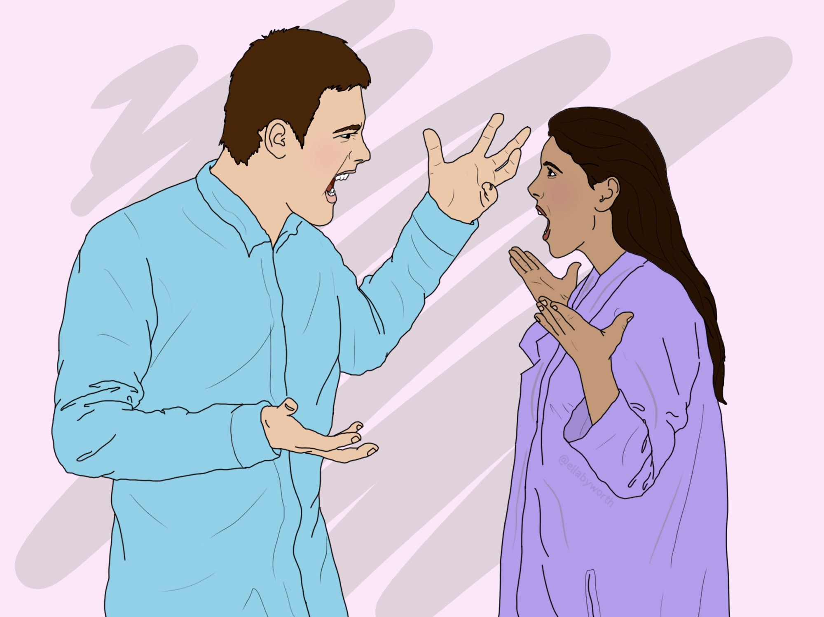
General Principles of
Relationship repair
If you are the only one working at the action stage of change, you will have to do a lot of editing, splicing and pasting work. You will have to foster Self
You will have to become good at staying in the window of emotional tolerance no matter what the other person does that might trigger you
You may want to review “coping with resistance and conflict skills”: pages 244-252 of skills training workbook
You may also want to consider if the relationship is worth the amount of work and effort that you will need to put into it
If you’re not reasonably physically safe in a relationship, repair is impossible . Your number one priority as long as stay in the relationship should be to be physically safe
If you are committed to staying in a difficult relationship you may have to adjust your expectations that the other person will give you what you need and settle for simply trying to make the relationship less conflictual.
Notes:
Yes we can but before we do let's just consider some general principles of relationship repair that apply in both cases

Slide 186
IFS RELATIONSHIP WORK
IFS conflict repair role play- when only one partner is self-led

Slide 187
IFS CONFLICT REPAIR ROLE PLAY- WHEN ONLY ONE PARTNER IS SELF-LED
This script shows one partner (Taylor) doing responsible, Self-led IFS work. The other partner (Riley) showing protector-driven behaviours (defensive, dismissive, irritated). The conflict still moving toward resolution because only one person stays in Self. It models realism without shaming the unwilling partner
STAGE SETTING: In this scenario, Taylor wants to use IFS to repair a conflict. Riley is not ready for ‘parts work’ today, and that’s okay. You’ll see how one partner, rooted in Self, can change the entire dynamic even when the other remains in protectors.”
OPENING: Taylor: “Thanks for sitting with me for a couple minutes. I did some inside work on what happened yesterday, and I’d like to share what I learned about myself. You don’t need to do anything. I’m not asking you to do parts work. Just hearing me out is enough.”
Riley (shrugs, guarded): “Okay, fine. Just… keep it short.” ( Riley is in a protector. Taylor stays grounded.)

Slide 188
IFS CONFLICT REPAIR ROLE PLAY- WHEN ONLY ONE PARTNER IS SELF-LED
TAYLOR SHARES THEIR INTERNAL SEQUENCE (NO JUDGMENT, NO BLAME)
1. Naming the activated protector. Taylor: “When we were arguing, the first part that showed up in me was a panicked, anxious protector. It got really loud inside.”
2. What the part felt and feared. Taylor: “That part felt scared and alone. It was afraid that I didn’t matter to you.” (Riley rolls eyes.)
3. How the protector behaved. Taylor: “So that fear came out as controlling questions and a sharp tone. That was my protector trying to manage the fear inside.”
4. The exile underneath. Taylor: “When I checked in later, I found a younger part of me underneath, one that hates the feeling of being left behind.”
5. Self understanding. Taylor: “From Self, I can see now that the argument wasn’t really about what time you got home. It was that old exile feeling triggered.”
6. What Taylor is not asking for. Taylor: “I’m not asking you to change or agree or do anything special. I just wanted to let you know what was happening inside me so you don’t have to guess.”

Slide 189
IFS CONFLICT REPAIR ROLE PLAY- WHEN ONLY ONE PARTNER IS SELF-LED
RILEY RESPONDS IN A PROTECTOR-DRIVEN WAY (REALISTIC, NON-IDEAL). Riley: “I mean… I didn’t do anything wrong. You’re kind of overthinking this.”
Taylor (still Self-led): “I hear that. And I’m not saying you did anything wrong. I’m just explaining what was happening inside me so there’s less confusion next time.” (Riley softens about 5%. A protector feels less attacked.)
OPTIONAL TINY REQUEST (NOT A DEMAND). Taylor: “One thing that helps my system settle is just a short check-in text when plans change. Only if you’re able. If not, I’ll keep working with this part on my end.” (Carried by Self, not by demand. Riley doesn’t feel controlled.) Riley (less defensive now): “Yeah… I can probably do that most of the time.”
TAYLOR DOES THE SELF-LED REPAIR WITHOUT EXPECTING RECIPROCITY. Taylor: “And just so you know — I’m going to work with that fear part in me so it doesn’t jump in so fast next time. I don’t want to aim that panic at you.” (Riley exhale. This is a big shift.).

Slide 190
IFS CONFLICT REPAIR ROLE PLAY- WHEN ONLY ONE PARTNER IS SELF-LED
RILEY (NOW LESS GUARDED) MAKES A MINOR, REALISTIC RESPONSE. Riley: “Okay. I mean… I didn’t know you felt all that. I’m not great at this emotional stuff, but thanks for telling me.” This is a huge relational success given where we started.
TAYLOR CLOSES THE REPAIR. Taylor: “Thank you for listening. That’s all I needed today.”
Riley: “Okay. That was… fine. I appreciate you explaining it.”
This script shows something important; you do not need two Self-led partners to make progress. One Self-led partner shifts the entire system. Taylor modeled: speaking for parts, no blame, no demands, radical ownership of their own inner system, offering the partner freedom rather than pressure, and staying in Self even when met with protectors. Riley’s protectors softened because they were not being attacked or coerced.

Slide 191
ALTERNATIVE RELATIONSHIP REPAIR ALGORITHMS
Working on the relationship by yourself

Slide 192
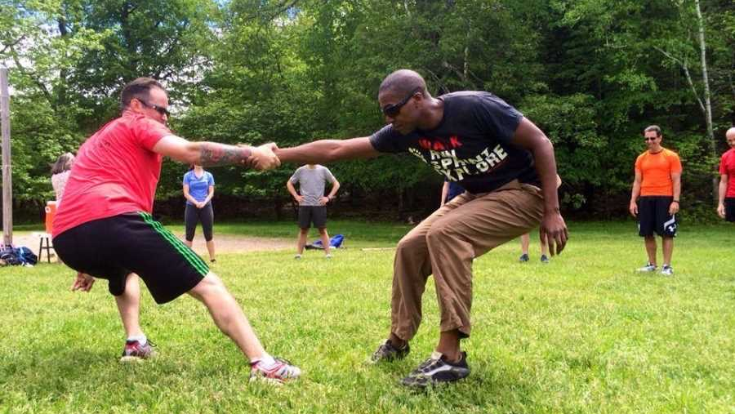
1. WORKING ON RELATIONSHIP BY YOURSELF

Slide 193

Steps 1-6 when working on relationship repair by yourself
1. Use “relationship issues/conflict” as the target on your holes diary card
2. Do a Wise mind chain analysis when your diary card numbers are high.
3. Determine which of your internal family parts were activated by the situation. If you can, do the same for the other person.
4. Determine the dominant states of activation you and the other person were in.( Fight/flight/freeze/fawn) Determine what your dominant parts felt, thought, and did or wanted to do? If you can do the same for the other person
5. Allow Wise mind to understand, interact, dialogue with, and soothe each of your parts
6. Ask what Wise mind would feel, think, and do, if it understood both yours and the other person’s parts and it was leading the self-system. Use the edit, splice, and paste technique to imagine the situation unfolding with Wise mind leading the family system.
Notes:
The algorithm for when you're working on relationship repair by yourself has 13 steps.

Slide 194
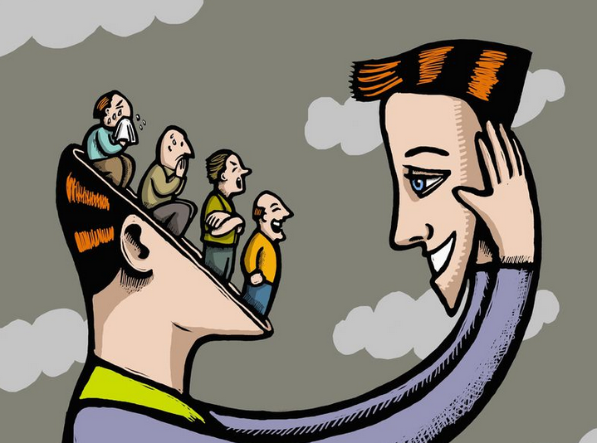
Steps 7-12 when working on relationship repair by yourself
7. Imagine the other person resisting and escalating
8. despite this resistance and escalation, Imagine your Wise mind staying in the lead of your system. Use “coping with resistance and conflict” skills
9. keep your personal dashboard in mind. Stay in window of emotional tolerance
10. Do not attempt to do this in a real situation until you have done it many times in your imagination
11. Even if you don’t do this in a real situation right away, the work you are doing in your imagination will start to affect the relationship
12. As you do this work, keep exploring ways in which you or others can help the other person progress through the stages of change towards being more ready to change.
13. if you are not physically safe in the relationship but for some reason can’t leave, your number one priority is to do whatever it takes to stay physically safe. (that may be avoiding triggering the other person)

Slide 195


Editing, splicing and pasting while pendulating to stay in window of tolerance
Notes:
These are some of the key points. Don't try to do repair on a newly arising situation. Use your memory bank of past conflicts, do repair on those. As you do this work pendulate to stay in the window of tolerance

Slide 196
wise mind Chain analysis
Event linked with activation | Estimate of % of response That was well-regulated vs. dysregulated | Parts that were activated-(consider changes with topography) | Feelings and arousal states of each part | Thoughts of each part, if any | Behavior or urges of each part | Conflicts between parts
 |  | Part 1
 |  | 2
 |  | 3
 |  | 4
 |  | 5
Notes:
Do a wise mind chain analysis for your experience

Slide 197
Interpersonal wise mind chain analysis
Activation of dominant part | What does dominant part feel, think, and do? | How does wise mind sooth dominant part? | What does Wise mind feel, think, and do? Consider an assertiveness script
me Other person
Notes:
Once you done a personal wise mind chain analysis for yourself, try putting yourself in the other person's shoes and doing a wise mind chain analysis for them..

Slide 198
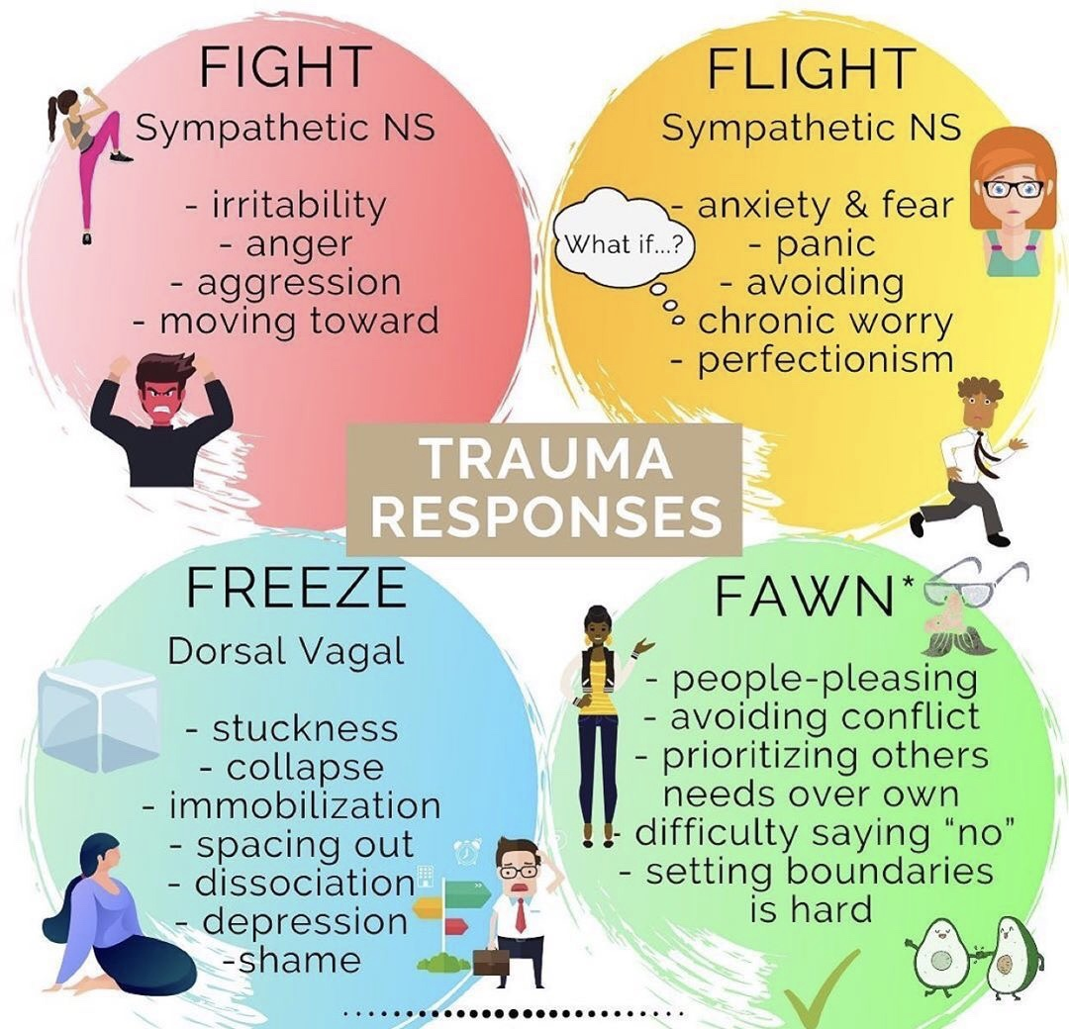
SOLO Relationship repair summary
Use relationship issues as diary card target.
Starting from the wise mind chain analysis do a Wise mind remediation. Consider the dominant state of activation of your and the other persons parts. Are you in fight/fight, fight/freeze, fight/fawn, fight/flight?
When your diary card scores are high do a Wise mind chain analysis. This will help you to understand which of your parts are being activated. Consider what parts are activated in the other person
Use the edit, splice, paste technique and practice the new “video” in your imagination.

Slide 199
Example of when only one person is doing the relationship repair work
YouTube video session 28, 31:18 to 38:29 minutes

Slide 200

SHEILA AND YVONNE
31:15 minutes
Notes:
Sheila was a 42-year-old married mother of two children. Sheila had been best friends with Yvonne since they were three years old. As children they had lived across the street from each other, from grades 1 to 12 they had attend the same schools and had been maids of honour at each other's weddings.
Sheila who worked at a cheese factory since she was 18 years old, had over the years been promoted in the company, and was now shift supervisor. Five years previously, a position had become available at the factory and she'll encourage Yvonne to apply. It was a well-paying job with good benefits.
Unfortunately, since they had started working together, Sheila found herself frequently activated in her interactions with Yvonne. She did her best to hide this, and Yvonne seemed unaware of the issue.
Sheila who is taking part in the simple course, made these problematic interactions with Yvonne and interpersonal target in her holes diary card. The most recent incident that had activated Sheila had involved a man Yvonne had met online and started dating. Bill was a handsome, smooth, "businessman" who frequented fancy restaurants and drove an expensive convertible. Yvonne was over the moon and has started investing in one of Bill's ventures.
To do this Yvonne had borrowed $10,000 by remortgaging the semi-detached house that she had bought out from her ex in their divorce. She also started encouraging other employees at the factory to invest and if you had attended a seminar Bill had given and put up between 1000 and $5000. Sheila was afraid this would turn to one of the train wrecks that seem to be the story of Yvonne's life, but as she had always done, listened quietly to her friend, delighted in her happiness, and was supportive.
When Bill suddenly disappeared and cannot be reached, Yvonne was beside herself. She made a missing's person's report to the police if you days later received a call from a detective who told her she was almost certainly the victim of a scam. Yvonne was devastated and became depressed. She stopped working, was not taking care of herself, or paying her bills. As she had done so often before, Sheila stepped up to help her friend and discovered Yvonne's finances were a mess.
The time she was a child, Yvonne had a hard life and seemed helpless. Sheila felt horrible for all Yvonne's misfortunes and felt it was her duty to protect her friend who had no one else she could turn to.
Sheila started to realize that Yvonne getting into trouble, becoming depressed, and needing rescue is a pattern. She is to think it was just bad luck but had come to believe that Yvonne was somehow self sabotaging. At first, she thought this was deliberate that as she learned about the unconscious, she became convinced that Yvonne was unaware why she repeatedly ended up in the circumstances, and felt she had a target on her back.
It makes sense for Sheila to see this is a hole that Yvonne can falling into her which she was pre-contemplative. She also realized by rescue her friend she was enabling the pattern to continue. This was also her whole.
Sheila started working on a wise mind chain analysis/remediation for the bill incident. Sheila realized that the fawning part of her had been activated. She could not say no to people, especially Yvonne. She was mature adult part knew that can 10 Ewing in the role of the rescuer was not helpful. Sheila's inner critic would however stepped in and overruled the mature adult: how could she be so selfish? She could not deny her best friend in need. Yvonne suffered from anxiety and depression she would not step 10, things would get even worse and who knows what would happen then… She cannot bear the thought. Sheila agonized is her internal parts argued with each other.
From a young age Sheila had been the grown up in her family as her immature parents constantly bickered. She consoled her two younger siblings and made sure they were looked after. She realized she was reenacting the spatter with Yvonne.
Yvonne had poor boundaries and a defective "trust metre". She longed for someone to protect her and jumped in with both feet if someone signalled, they would. But it all fell apart, she would become blended with her helpless, despairing, abandoned child, in flight and freeze activation. At those times Sheila became Yvonne's exile's funding protector.
Sheila recognize that Yvonne was only going to change if she learned about how her mind worked and started working on her holes. If her fawning compulsive caretaker continued to rescue Yvonne, they would both keep falling into holes together and she would be contributing to her friend -containing to repeat this pattern.
By rescue me Yvonne, Sheila was enabling her to continue in her current pattern by sheltering her from the consequences of her behavior. Consequences are how the world gives us feedback and negative consequences are powerful motivators to do things differently. If people have to deal with negative consequences of their personality patterns and are at the same time offer the way forward, they have an incentive to take it.
Yvonne had another locus of control and learned helplessness which Sheila was reinforcing by rescuing her. As Sheila stepped back, Yvonne had to begin gradually taking some control over her life and actions. People expect the solutions to their problems to come from the outside, may not feel they can take control over their lives and may escalate the pressure on others to rescue them by becoming more helpless or even suicidal. This is sometimes labelled manipulative behavior implying that this conscious and plan. Understanding the unconscious mind helps us to see that it is not.
Yvonne had never done psychotherapy and was not familiar with the concepts that Sheila had learned in the simple course, but she was curious and often asked Sheila about it. She was confident her friend would, with a little encouragement, take the course.
In the interim Sheila would use the bill incident to practice wise mind remediation. Rescue me Yvonne was not all or nothing, there would be a transition as she worked with her compulsive caregiver and inner critic soothing them encouraged him to step back as wise mind took over leadership in her relationship with Yvonne.
She saw how Yvonne would only grow if they stop reenacting their unconscious patterns. Sheila had to stop enabling or being codependent with Yvonne. Yvonne's parts would resist this, perhaps becoming even more helpless, and Sheila had to do the work on her own and learn boundaries. It be short and medium-term pain for long-term gain.
She could be loving and caring with her friend, healthy forms of fawning, without rescuing her. This man she loved her friend enough not to persist in a self-defeating pattern.

Slide 201


Slide 202
ALTERNATIVE RELATIONSHIP REPAIR ALGORITHMS
Two people working together

Slide 203

2. WORKING TOGETHER
ON THE RELATIONSHIP
Notes:
The algorithm for working on a relationship by yourself has 13 steps and they are all done in your mind's eye or imagination. The algorithm for working on a relationship together has 14 steps. The first six are almost identical to the other algorithm but the last eight are done with the other person in the relationship. Let's go over it.

Slide 204
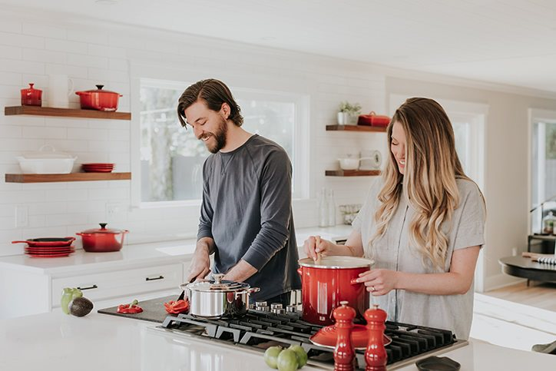
Steps 1-6 When Working together on relationship
1. Both people use “relationship issues/conflicts” as their holes diary card target
2. When there’s a high score each person does their own Wise mind chain analysis and wise mind remediations
3. They each determine what their dominant parts felt, thought, and did, or wanted to do, and their dominant state of activation. (Fight/flight/freeze/fawn)
4. They allow Wise mind to understand, interact, dialogue with, and soothe each of their dominant parts.
5. They ask what Wise mind would feel, think , and do, if it understood theirs and the other person’s parts and it was leading the self-system. Using the edit, splice and paste technique they imagine the situation unfolding with Wise mind leading the system
6. They practice this repeatedly in their imagination

Slide 205
wise mind Chain analysis
Event linked with activation | Estimate of % of response That was well-regulated vs. dysregulated | Parts that were activated-(consider changes with topography) | Feelings and arousal states of each part | Thoughts of each part, if any | Behavior or urges of each part | Conflicts between parts
 |  | Part 1
 |  | 2
 |  | 3
 |  | 4
 |  | 5

Slide 206
Interpersonal wise mind chain analysis
Activation of dominant part | What does dominant part feel, think, and do? | How does wise mind sooth dominant part? | What does Wise mind feel, think, and do? Assertiveness script
me Other person

Slide 207
When you are ready to practice together
Use a graduated exposure approach
Keep your personal dashboard in mind
If you go out of the window of tolerance, take a break to reregulate
Follow the steps. Don’t go off on tangents
A “referee” to keep the rules might help
Notes:
After the first six steps, if you are ready to practice together, you need to keep a few things in mind.

Slide 208
Steps 7-14 when working ON relationship with the other person
7. After practicing steps 1-6 individually repeatedly until each person has mastered them, together choose an incident from the ones you’ve worked on that you both agree was least problematic and therefor easier to work with
8. Pick a time to get together and work on this incident when both of your gas tanks are as full as possible, and you are both in the window of tolerance
9. Have a crisis plan ready in case you fall into a hole. Use STOP, PAUSE, or a time out. Share your crisis plan with the other person before doing this work
10. Have a Wise mind assertiveness script (DEAR MAN GIVE FAST) about the situation you chose to focus on ready and share it with the other person. This script communicates your wise mind remediation.
11. While you do your assertiveness script, the other person listens without interrupting and withholding nonverbal language. Once you are finished the other person summarizes, in a validating way, the essence of what they heard you say, without introducing their perspective or correcting what they think are your misperceptions.
12. Both people are paying attention to make sure they stay in window of tolerance. They each have a crisis plan ready
13. The two people switch roles. According themselves equal amounts of time
14. It can be helpful to do this with a coach that reminds people of the rules.
The structure of this work is important but so is the process. People have to strive to cooperate not compete

Slide 209

Communicating effectively and assertively
People stay in the window of tolerance
And feel safe
And heard
If this happens, they will have a secure relating experience which feels good
Notes:
The main goal of this exercise is to learn to communicate effectively and assertively while staying in the window of tolerance…

Slide 210
Example of two people working together to repair a relationship
YouTube video 42:42 to 50:08 minutes

Slide 211

KIM AND CHRIS
42:42
Notes:
Chris and Kim
Chris was a 35-year-old married sous chef who worked in a restaurant alongside his head chef wife Kim
Chris was doing the simple course and had identified an interpersonal whole he frequently fell into with Kim. The most recent instance of this whole had occurred when Kim had asked Chris to cancel wine order because the restaurant had excess stock. This was something that usually fell to the restaurant manager, who that week was on vacation. Chris had completely forgotten and a few days later the wine was delivered. The staff and scrambled to find a place to properly store it.
The delivery and come as they were preparing for a busy night and Kim had snapped at Chris in front of everyone: "I thought I told you to cancel the wine order".
Although Chris and Kim fell into interpersonal holes, Kim was supportive and interested in what Chris was doing in therapy. She often asked them about what he was learning and read the simple manual sessions that Chris was working on. Both she and Chris agreed that they fell into interpersonal holes which were quite painful for both as their aftereffects lingered for days and cause tension between them at home and at work.
Chris and Kim agreed that they would use the "wine delivery" incident to do mutual repair work.
Chris and Kim started working on separate wise mind chain analysis and remediation's. When Kim was not sure about how to do something, she would consult with Chris. They were happy to be working on their issues together.
When Kim had snapped at him Chris felt hurt. This was partly well-regulated, but as her child and inner critic had also been activated. Chris's critic asked: "what's wrong with you? Why can't you do anything right? Why are you such a disappointing screwup? And told him "you're going to fail because you're a fake and only made it this far by writing on Kim's coattails".
Chris felt he had been caught making a terrible mistake and there was no escape. He was in between hyper and hypo freeze or fight and freeze. In the states he had trouble concentrating and was not his usual efficient self in the kitchen. Other staff had to step up to compensate. This made Kim angrier as she felt Chris was doing this on purpose to get back at her, she thought he was stonewalling her or being passive-aggressive.
Chris realized his reaction was dysregulated. When Kim snapped, is her child had been activated. He felt transported back to childhood and its interactions with his demanding and angry father. Chris's attachment adaptation had been to internalize his father's angry criticism as an inner clinic.
This inner critic was the internal working model of what Chris's world was like an protected him by making him more compliant with his father's demands thereby helping him avoid an escalation of his father's anger and displeasure.
Chris's father had extraordinary expectations of his son. He had to be a top athlete, scholar, and a son who unconditionally admired and loved him. When Chris fell short of the standards, he was chastised and ridiculed and emotionally abused. His father saw him as in a disappointment and failure in Chris's internal critic came to see Chris in that way to. If he was a failure, he wasn't acceptable and will be cast out of the family and be doomed.
His father's anger was terrifying and Chris being a child and unable to escape his family resorted to "leaving mentally", dissociating, or "freezing". Chris realized that in his interpersonal holes with Kim is dominant activation was freeze.
Chris's wise mind knew that Kim had some issues with anger. Kim had realize that her anger was dysregulated and often apologize to Chris. When Kim's external critic was activated, she saw Chris is an incompetent failure. While in the rational minds world Chris and Kim were in present-day reality, in their emotional world they were playing conflicts from their families of origin.
Kim really did love Chris and wanted to make things better between them. Chris knew that repair of his relationship with Kim was possible and that it would help to heal his internal family. When they fell into holes they did not endanger the other.
A part of Chris was terrified of doing an assertiveness script for the wine incident even if at first this was only in his imagination and with no definite timeframe when he would have to shared with Kim.. He knew that for his parts, sharing this with Kim, was the same as confronting his father. He would have to internal imaginal work to soothe his parts before he could be ready to do an assertiveness script with Kim.
As Chris worked on his wise mind chain analysis/remediation, he visualized the wine incident but instead of seeing just him and Kim he pictured from his wise mind perspective the interaction of their parts: his frozen petrified child, his internal critic, and Kim's external critic. He was also aware that their wise minds had a common goal.
He repeatedly replayed the situation this is imagination. He became better and not being blended with the frozen petrified child and from wise mind began to be able to comforted. Eventually he was able to visualize the whole situation from wise mind while staying in the window of tolerance.
Kim had been doing the same work on her own. Eventually they agreed they were ready to share their assertiveness crypts with each other. Chris did his first. They are both familiar with the wine ordering incident. Instead of expressing his feelings and thoughts Chris described the parts of him that had been activated: is petrified child and his inner critic. Is petrified child did not have any coherent thoughts. His inner critic had thought he was a failure and would be abandoned. Chris asserted that what he would like in the future was to remain in wise mind and in the window of emotional tolerance.
Kim was touched by Chris's openness and vulnerability and they both shed a few tears. She had come to a similar understanding of what happened. She recognized are dysregulated external critic and how it looked negatively upon Chris. Her mature adult and wise mind however signs a kind, considerate, hard-working, and lovable. Kim's goal was to understand and sooth her outer critic so that it would not lead in her interactions with Chris.
The wine incident was not the last time Kim and Chris fell into an interpersonal whole page subsequent time they did, prepare was easier.

Slide 213

VIDEO Week 28 of simple

Slide 214
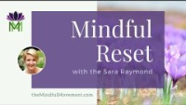

Slide 215


Slide 216
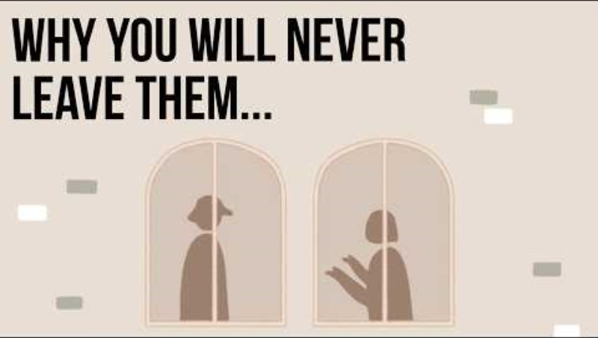

Slide 217
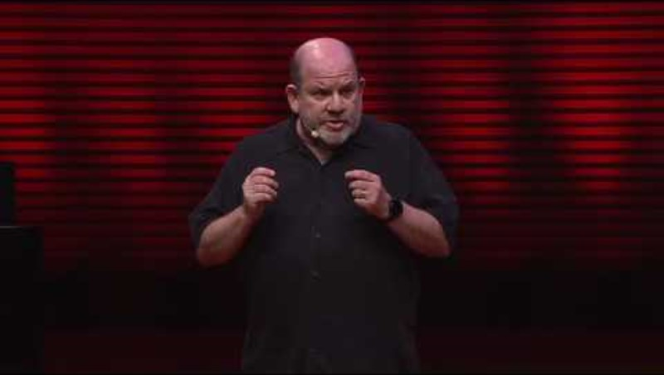

Slide 218


Slide 219


Slide 220


Slide 221


Slide 222
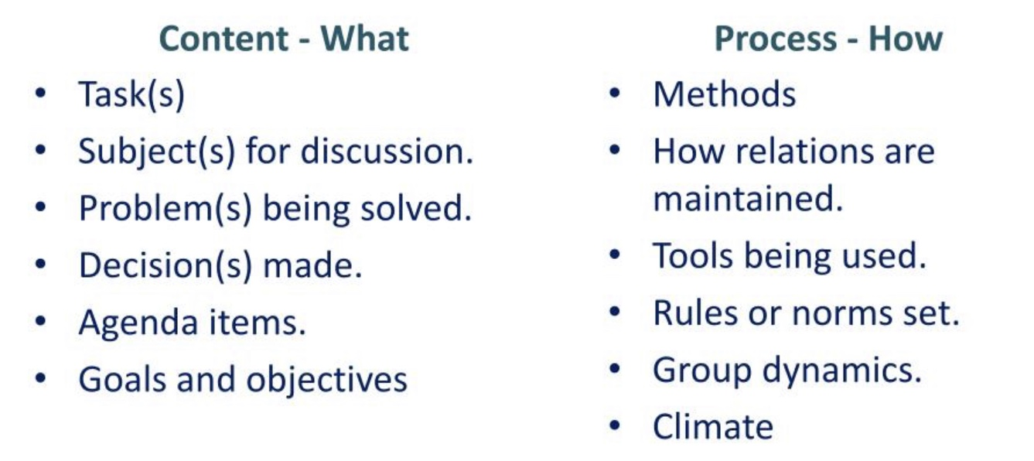
communication content and process (1)
Good communication is an essential component of good relationships
Communication can be divided into two parts: 1. the content and 2. the process.
The content of communication is the subject that is being talked about. In couples, for example, discussion topics that tend to be contentious include sex, money, relationship with families of origin, parenting, neatness, and division of labour. In other relationships contentious subjects often include politics, gender, religion, ideas, and status.
Content is the what of interactions
The process of communication is the manner in which people communicate. Are they agreeable or disagreeable? in or out of the window of tolerance? empathic or unemphatic? cooperative or competitive? Transactional or care based ? Are they good or poor problem solvers? Are they assertive, passive, or aggressive? Do they trust one another?
Process is the how, of interactions.
The common assumption is that people fall into interpersonal holes or conflict because they disagree on the content of the conversation. Most of the time, however, the problem is with the process.
The interpersonal process between people is related to their personalities and all the factors that contribute to it including attachment styles and what part selves are involved in the interaction.
Notes:
To begin to understand why relationships are so difficult it's useful to distinguish the concepts of content and process

Slide 223
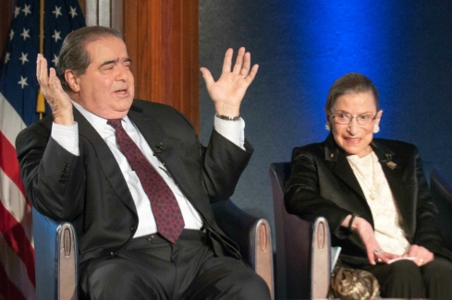
Heated agreements and agreeable disagreements
The concept of heated agreements and agreeable disagreements illustrates the differences between content and process.
People can have “heated agreements” in which they essentially agree with each other on almost all aspects of the content while their process is antagonistic, outside the window of tolerance and significantly involves part selves Ex. Groups whose ideas overlapped 99% can be bitter enemies.
People can also disagree profoundly on content while their process remains very agreeable, cooperative, pleasant, and they remain in the window of tolerance, respect, like, are open to, and learn from each other. They remain in rational mind or Self. Ex RBG and Anthony Scalia.
Learning to get out of interpersonal holes, or resolve conflict, does not mean people have to agree on the content. Resolving conflict focuses on the process and understating the parts that may become activated.
In any relationship between people each person has better or worse interpersonal process skills which are related to their openness, empathy, agreeableness, and ability to stay in window of emotional tolerance.
Relationships are easier and more pleasant between people who have high interpersonal process skills and good emotional regulation.
Unfortunately, with our current communication technologies our communication skills seem to be getting worse
“I love Nico, but I’d love to strangle him” RBG

Slide 224
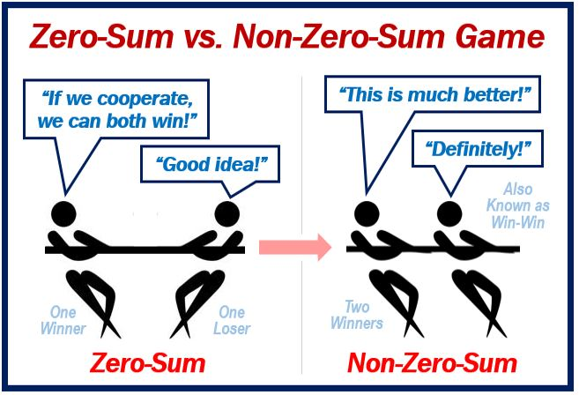
Care based VS. transactional relationships (2)
The type of process that happens in a relationship depends on a number of factors including on whether the relationship is care based or transactional.
In a care-based relationship you being happy makes me happy. You being sad makes me sad. I want to make you happy, and you reciprocate. It’s win-win. Empathy and love are unifying emotions that makes us feel as if we were one organism.
In a transactional relationship what makes me happy is to get as much from you as possible. I care more about my needs and happiness than about yours. It’s zero sum. There are no unifying emotions between us, and we feel like two separate organisms
In care-based relationships there’s more play within the window of tolerance. When issues arise people in this type of relationship are more likely to deal with the issues, compromise, and resolve them for their mutual benefit.
In transactional relationships there is more competition and emotional mind. In transactional relationship conflictual situations, emotional mind and parts are more often activated and there’s less resolution of issues and repair of the relationship.
(3)
Notes:
Another important aspect to consider if we want to understand why relationships can be so difficult is that of care based versus transactional relationships

Slide 225
Care based VS. transactional relationships (2)
In transactional relationships there is more competition and emotional mind. In transactional relationship conflictual situations, emotional mind arises more often and there’s less resolution of issues and repair of the relationship.
Every relationship is somewhere on the care-based to transactional spectrum. This is closely related to where the people in the relationship are on the attachment spectrum, how much they love or empathize with one another.
People with secure attachment are more likely to have care-based relationships, be able to stay in the window of tolerance, play, have richer connections and greater life satisfaction
Care based vs. transactional relationships also have to do with people’s circle of concern or empathy. What am I concerned with ? 1) only my own well-being, 2) that of my family, 3) my community 4) my nation 5) the whole world
One of the challenges in a relationship is for both people to stay in window of emotional tolerance, understanding, empathic and loving when dealing with difficult issues.
Where on the spectrum from care based to transactional are your relationships?
(3)
Notes:
Another important aspect to consider if we want to understand why relationships can be so difficult is that of care based versus transactional relationships

Slide 226

Relationships and Repetition compulsion
Another factor affecting the process of relationships is repetition compulsion. Our interactions with another, usually intimate, person may be well regulated or dysregulated. Reactions are dysregulated when issues from the past and parts, significantly affect subsequent relationships. Ex. We were hurt by someone in the past and expect people who we are in intimate relationships with to hurt us. We think and behave according to this expectation.
Unconsciously but intensely, we are drawn to people who feel familiar to us and resemble significant figures from our past. We are not drawn to people who are good for us.
If we had kind and loving parents, kind and loving people will feel familiar and we’ll be attracted to them
If we grew up with neglectful or abusive parents , neglectful and abusive people will feel familiar to us, and we’ll be attracted to them.
This is why, as adults, we may repeatedly end up in relationships that resemble those of our childhood. This is a form of repetition compulsion.

Slide 227
Relationships and Repetition compulsion
In repetition compulsion people repeat the emotional patterns of their past.
Many people feel their lives are a series of crisis. Often this has to do with external factors such as socioeconomic stressors. Sometimes, however, people are unconsciously drawn to chaos because it energizes their firefighters and keeps the pain of their exiles at bay.
Sometimes repetition compulsion also draws us to figures such as politicians or religious leaders, who feel familiar to us and with whom we may also reenact issues from our childhood
Understanding this phenomenon is key to avoiding repeatedly getting into difficult relationships patterns
If you grew up in a neglectful or abusive home think twice before choosing a partner with your heart or emotional mind, consider instead choosing them with your head or rational mind.

Slide 228
likelihood of conflict in a relationship
Process in relationships is significantly affected by how well regulated, or able to stay in the window of emotional tolerance, people in that relationship are. The more dysregulation the greater the likelihood of conflict. Hence if you want to improve the relationship don’t wait for the other person to become better regulated, become better regulated yourself. Process is also affected by where, on the stages model of change, people in the relationship are with respect to problems in the relationship
Person 1
Well regulated
Dysregulated but wanting to change and able to use skills tools etc.
Dysregulated wanting to change but unable to use skills, tools, etc.
Dysregulated and precontemplative
LESS LIKELYHOOD OF CONFLICT
Person 2
Well regulated
Dysregulated but wanting to change and able to use skills tools etc.
Dysregulated wanting to change but unable to use skills, tools etc.
Dysregulated and precontemplative
MORE LIKELYHOOD OF CONFLICT
Notes:
The likelihood that there will be conflicts between two people depends on how well-regulated each one of them is.

Slide 229
Likelihood that REPAIR a Relationship is repairable
If you’re trying to decide if you should commit to the hard work of relationship repair or leave the relationship it may be helpful to take the following into account
Relationship “growth” is the journey in which people in the relationship go from being led mostly by emotional mind or IFS’s part selves to being led increasingly by interpersonal Wise mind.
The prognosis for growth in a relationship ranges from:
1) Two mostly emotionally well-regulated people, able to access wise mind and who have good interpersonal skills are most likely to make adaptive changes and grow in their relationship. Followed by…
2) One well regulated person, able to access wise mind who has good interpersonal skills and one dysregulated with poorer interpersonal skills and difficulty accessing wise mind.
3) Two dysregulated people at the action stage of relationship change and learning interpersonal skills and a developing the ability to access wise mind
4) Two dysregulated people but only one is at action stage for learning interpersonal skills
5) Two dysregulated people who are precontemplative to the need to learn interpersonal skills and who don’t have access to wise mind.
HIGH
LOW
Notes:
Earlier we looked at the likelihood that there will be conflict in a relationship in terms of people's dysregulation. That aligns closely with the likelihood that people in a relationship can grow and learn to repair their relationship

Slide 230
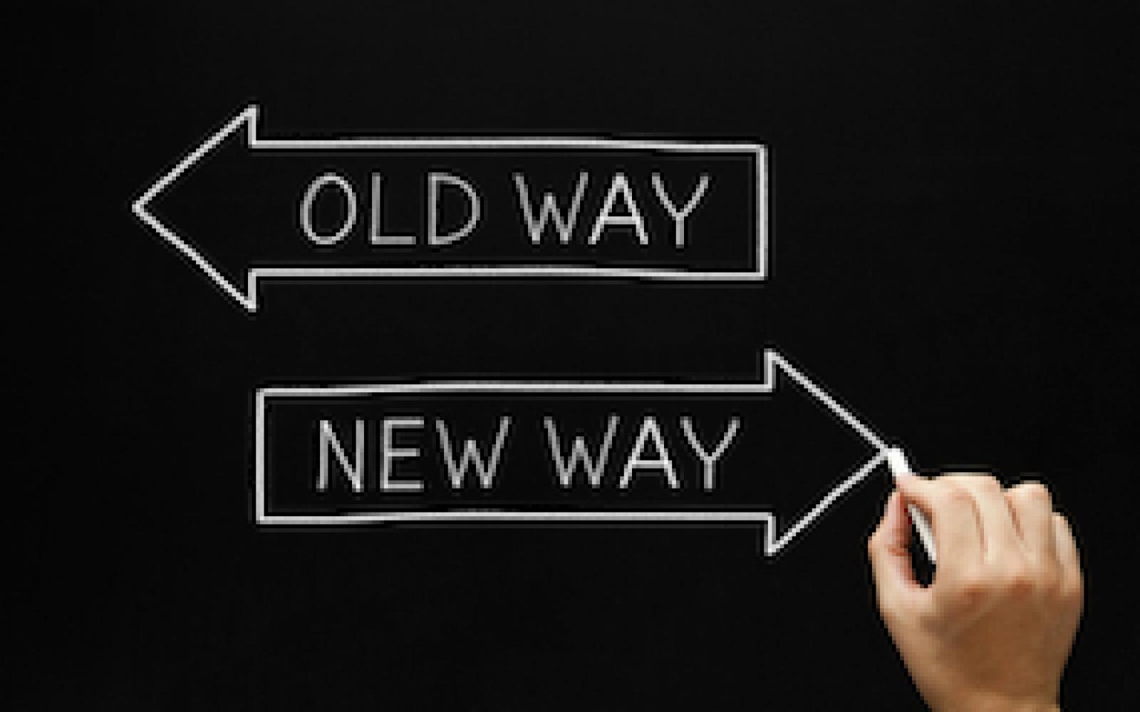
What are the signs that a relationship is repairable?
Signs pointing to a repairable relationship:
1) People in the relationship accept they are part of the problem.
2) The have some access to Wise mind
3) They are committed to the relationship and willing to devote time to the work of repairing it
4) They have some openness to being vulnerable
5) They are psychologically minded
6) The relationship has significant positive aspects
7) People in the relationship are working towards being able to stay in the window of emotional tolerance
8) They can empathize with the other
9) They are high high on the traits of agreeableness and openness.
Consider these factors in yourself and the person with whom you want to work on relationship repair when assessing the likelihood that change, repair, and growth will happen.
You can score them by adding one point for each of these criteria you and the other person in the relationship meet. The higher the score the more likely relationship repair is possible.
Notes:
There are a number of other indicators suggesting relationship repair is possible

Slide 231
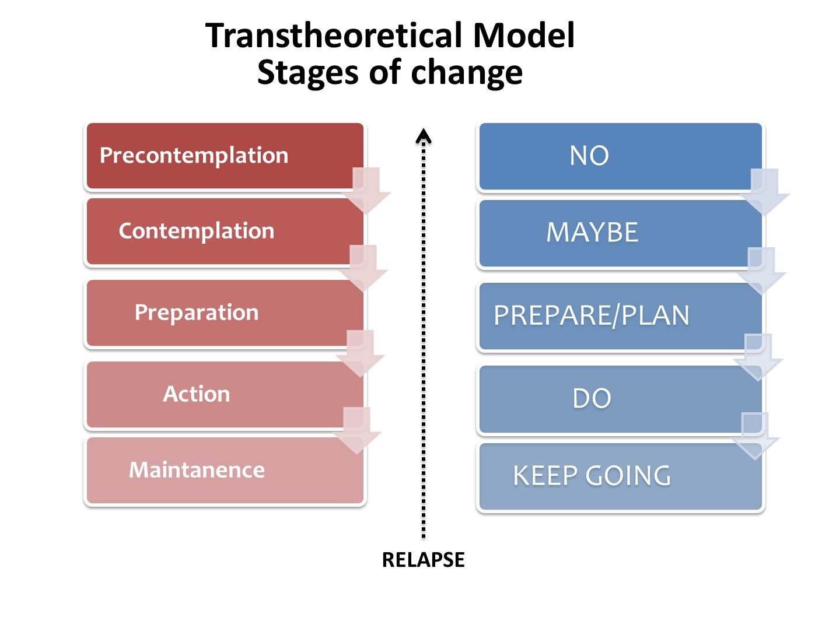
Are you ready to repair your relationships?
People’s readiness for relationship change is well described the stages model of change. What stage of change is each person at with respect to problems in the relationship?
People who are precontemplative think the problems in the relationship are all the other person's fault
People who are contemplative believe they bear some responsibility for the problems in the relationship but do not yet have the skills, tools and strategies needed to make changes
Those who are at the action stage not only believe they bear some responsibility for the problems but are also starting to use some tools, skills and strategies needed to make changes
Which stage of change are you at in the relationships you want to change? What stage is the other person at?
Notes:
A key factor to repairing a relationship is where each person places the blame or responsibility for the problems in the relationship

Slide 232

attachment and repair of relationships
The process in relationship is significantly affected by people‘s attachment styles which contribute to whether they relate securely or insecurely to each other.
Relationship road holes repair work requires secure relating or : 1) an ability to stay in the window of emotional tolerance 2) owning one’s role in the damage and responsibility for the repair 3) working towards a more care-based relationship instead or a contractual/transactional one 4) communication skills 5) tools and skills 6) wise mind
In secure relating, care-based relationships – “holes” come up on the relationship “road”, but people use their communication skills, emotional regulation skills, and wise mind to repair the holes as soon as they come up so that the relationship “road” remains in good shape.
As people in relationships progressively move towards the less securely relating transactional end of the spectrum they tend to not know how or are not able to make regular maintenance “road” repairs, so the damage accumulates, and the state of the “road” steadily deteriorates until it seems beyond repair and people either become resigned to travelling on a terrible road or decide to abandon it. Alternatively, they can learn how to repair the road.
People often blame the other for the road damage but everyone in the relationship contributes to it. Some people however may do far more damage to the road than others.
Notes:
Let's explore the metaphor of "holes" arising in a relationship…

Slide 233

Key considerations in interpersonal conflicts
1. In a conflict, how much is your response proportionate to the circumstances? In other words, are your reactions well-regulated or dysregulated?
2. How much are your reactions related to the activation of your part selves?
3. How much are your reactions related to attachment issues and trauma ?
4. Consider that the more dysregulation you experience the more interpersonal time you tend to spend outside the window of emotional tolerance
5. And that when you are with another person your emotional dysregulation is highly contagious
6. And, that Interpersonal dysregulation causes damage to the relationship road.

Slide 234
(1) In communication, content refers to the actual information or message being conveyed, while process refers to how that information is communicated.
Content is the substance of the communication - the words, ideas, and facts that are being shared. It is the explicit message that the sender is trying to convey to the receiver. For example, if someone says, "I need you to pick up some groceries on your way home," the content of the message is the request to pick up groceries.
Process, on the other hand, refers to the way in which the message is communicated. This includes nonverbal cues, tone of voice, body language, and other aspects of communication that can influence how the message is received. Process communication can impact the meaning of the content and how it is interpreted by the receiver. For example, if someone says, "I need you to pick up some groceries on your way home" in a frustrated tone of voice, the process of communication may convey a sense of urgency or annoyance that is not explicitly stated in the content of the message.

Slide 235
Some examples to illustrate the difference between content and process in communication:
1. Content: A manager tells an employee, "Your report was submitted late."
Process: The manager says this in a calm and neutral tone, without showing any visible signs of frustration or anger. However, the employee perceives the message as critical and feels judged based on the content of the message.
2. Content: A friend says, "I'm fine" when asked how they are doing.
Process: The friend says this with a forced smile and avoids making eye contact. The process of communication, including the tone of voice and body language, suggests that the friend may not actually be fine, despite the content of the message.
3. Content: A partner says, "I love you."
Process: The partner says this with a warm smile, maintains eye contact, and reaches out to hold hands. The process of communication, including nonverbal cues, enhances the emotional impact of the content and conveys sincerity and affection.
In these examples, the content of the message is the explicit information being conveyed, while the process of communication includes nonverbal cues, tone of voice, and other factors that influence how the message is perceived and understood. Understanding both content and process in communication can help individuals communicate more effectively and empathetically

Slide 236
Understanding the difference between content and process in communication is important for several reasons:
1. Effective Communication: Recognizing the distinction between content and process helps individuals communicate more clearly and accurately. By paying attention to both the words being said (content) and how they are delivered (process), communicators can ensure that their message is received as intended.
2. Enhanced Understanding: Being aware of both content and process in communication can lead to a deeper understanding of the underlying message. Nonverbal cues, tone of voice, and other aspects of process communication can provide context and nuance to the content of a message, helping listeners interpret the message more accurately.
3. Improved Relationships: Understanding the impact of process communication can help build stronger relationships. Being attuned to nonverbal cues and emotional tones can foster empathy, trust, and connection in interactions, leading to more positive and meaningful relationships.
4. Conflict Resolution: Recognizing the difference between content and process can be valuable in resolving conflicts. By addressing both the explicit content of a message and the underlying emotions or nonverbal cues in the process of communication, individuals can navigate disagreements more effectively and find mutually satisfactory resolutions.
5. Enhanced Emotional Intelligence: Developing an awareness of both content and process in communication contributes to emotional intelligence. This awareness allows individuals to better regulate their own emotions, empathize with others, and navigate social interactions with greater sensitivity and effectiveness.
Overall, knowing the difference between content and process in communication is essential for effective, empathetic, and meaningful interactions in personal and professional relationships. It can lead to clearer communication, deeper understanding, improved relationships, and enhanced emotional intelligence.

Slide 237
(2) Care-based relationships are built on mutual trust, empathy, and emotional connection. In care-based relationships, individuals prioritize the well-being and happiness of the other person, and there is a sense of genuine concern and support for each other.
On the other hand, transactional relationships are based on exchanges of goods, services, or information. In transactional relationships, interactions are often focused on achieving a specific outcome or benefit, and there may not be the same level of emotional connection or investment in the other person's well-being.
In summary, care-based relationships are characterized by emotional support and genuine concern for the other person, while transactional relationships are more focused on exchanges and benefits.
(3) Zero-sum games are situations in game theory where one person's gain is exactly balanced by another person's loss. In other words, the total amount of resources or value in the game remains constant, and any gain by one player comes at the direct expense of another player. Examples of zero-sum games include competitive sports, where one team's win is the other team's loss, or poker, where the total amount of money in play remains the same.
Nonzero-sum games, on the other hand, are situations where the total amount of resources or value can increase or decrease based on the actions of the players. In nonzero-sum games, it is possible for all players to benefit or for some players to benefit while others do not lose. Cooperation and collaboration are often key strategies in nonzero-sum games to maximize overall gains for all players involved.
Understanding the difference between zero-sum and nonzero-sum games can help in decision-making and strategic planning in various situations, whether in business, politics, or everyday life.

Slide 238
(3) Zero-sum games are situations in game theory where one person's gain is exactly balanced by another person's loss. In other words, the total amount of resources or value in the game remains constant, and any gain by one player comes at the direct expense of another player. Examples of zero-sum games include competitive sports, where one team's win is the other team's loss, or poker, where the total amount of money in play remains the same.
Nonzero-sum games, on the other hand, are situations where the total amount of resources or value can increase or decrease based on the actions of the players. In nonzero-sum games, it is possible for all players to benefit or for some players to benefit while others do not lose. Cooperation and collaboration are often key strategies in nonzero-sum games to maximize overall gains for all players involved.
Understanding the difference between zero-sum and nonzero-sum games can help in decision-making and strategic planning in various situations, whether in business, politics, or everyday life. Zero-sum situations:
1. A tennis match: In a tennis match, one player wins while the other loses. The total points available in the match remain constant, making it a zero-sum game.
2. Budget allocation: In a scenario where a fixed budget must be divided among different departments, any increase in one department's budget must come at the expense of another department, making it a zero-sum situation.
3. Poker game: In a poker game, the total amount of money in play remains constant, and any winnings by one player come directly from the losses of other players, making it a zero-sum game.
Nonzero-sum situations:
1. Business partnerships: In a business partnership, both parties can benefit from collaboration by leveraging each other's strengths and resources to achieve mutual success, creating a nonzero-sum situation.
2. Trade agreements: International trade agreements can create mutual benefits for participating countries by increasing overall economic growth and prosperity, making it a nonzero-sum situation.
3. Team sports: In team sports like basketball or soccer, players work together to achieve a common goal of winning the game, and all players can benefit from teamwork and collaboration, creating a nonzero-sum situation.
Understanding the dynamics of zero-sum and nonzero-sum situations can help in navigating various interactions and decision-making processes to maximize outcomes for all parties involved

