Slide 1

Welcome to Week 31
Searching for meaning circle
Don’t walk behind me; I may not lead. Don’t walk in front of me; I may not follow. Just walk beside me and be my friend. Albert Camus
You are not a drop in the ocean. You are the entire ocean in a drop. Rumi
PLEASE START RECORDING

Slide 2
As we near the end of the simple course, I’d like to invite you to step back and reflect on the larger arc of what we’ve been exploring together.
Over the past 30 weeks, we’ve explored numerous topics: attachment theory, DBT, polyvagal theory, trauma, dissociation, Internal Family Systems, spirituality, and meaning. These may seem like different maps, models or languages but they all circle around one central human reality: the movement between connection and disconnection or between association and dissociation.
Mindfulness, for example, is fundamentally a practice of reconnection. When we become mindful, we reconnect with our thoughts, our feelings, our bodies, and our behaviors. Instead of operating automatically or unconsciously, we begin to become present to ourselves again.
Trauma theory tells a similar story. Trauma becomes especially painful when experience becomes fragmented and parts of ourselves become disconnected from one another. Structural dissociation theory suggests that overwhelming experiences can separate thoughts from feelings, memories from awareness, vulnerable parts from everyday functioning.
Healing, as we learned, involves not getting rid of parts of ourselves but reconnecting them. Re-establishing relationship within ourselves. IFS expresses this beautifully. It suggests that healing occurs as disconnected parts begin to reconnect with Self, a deeper center characterized by compassion, curiosity, calmness, courage, clarity, and connection.
Polyvagal theory also points us toward this same truth. When we move into dorsal vagal collapse, we become profoundly disconnected, from others, from hope, from vitality, from meaning, and even from ourselves. Healing involves movement back toward ventral vagal connection. But how do we move from collapse toward engagement, aliveness, or healing? Through reconnection. We reconnect with another person, with nature, with meaningful work, with creativity, with the body, with community, with spirituality, with purpose. Connection becomes the bridge out of collapse.

Slide 3
Beneath all of this lies a deep philosophical question: Why is connection so healing? Why are human beings transformed by love, belonging, meaning, and relationships? Why does disconnection wound us so profoundly? Different worldviews answer this question differently.
A materialist or physicalist worldview generally begins from the idea that reality is fundamentally made of separate elementary particles and forces. From this perspective, separation is primary. Connection is something that emerges later through interactions among fundamentally separate things. Mind and consciousness themselves are viewed as emerging from matter. So, in a sense, a physicalist view tells us we are fundamentally isolated beings trying to create connection.
But idealist and spiritual traditions begin somewhere very different. They begin with the intuition that reality is fundamentally unified — that consciousness, mind, spirit, or being itself is primary. Different traditions express this differently — Universal Mind, Brahman, Buddha Nature, God, the Tao, the Ground of Being — but beneath the differences lies a common intuition: that fundamentally, we belong to one another.
In this view, connection is primary. Disconnection comes later. Healing, then, is not creating connection out of nothing — it is rediscovering a connection that was always there beneath the fragmentation. This connects deeply with the “Cosmic Egg” idea you explored in preparation for today’s circle of meaning. Meaning exists in layers.
There is My Story — the intimate story of my own life. My Story exists within Our Story: family, culture, relationships, community, humanity. And My and Our stories exist within The Story — the larger questions of existence itself:
Why are we here? What is all this? What gives life meaning? What is consciousness? What is love? What is this universe trying to become?

Slide 4
Personal My Stories become more meaningful when they are connected to larger “Our” stories. But those “Our” stories themselves become more healing when held within a larger The Story that is meaningful. And this may be one reason spirituality has always mattered so deeply to human beings.
The word religion may come from the Latin religare, meaning “to bind back together” — to reconnect, to rebind. And reconnecting us that is one of spirituality’s deepest functions.
Spirituality reconnects us not only to a cosmic purpose larger than the isolated ego, but also to ourselves, to one another, to nature, and to meaningful work. It is not separate from the rest of what we have studied in this course — it is the broadest frame that unifies it.
DBT reconnects us with awareness and choice. Attachment theory reconnects us through safe relationship. Polyvagal theory reconnects us through safety and co-regulation. IFS reconnects parts of ourselves with Self. Meaning reconnects us with purpose. And spirituality reconnects us with the larger whole.
The idea of connection and disconnection also extends beyond individual psychology into society itself. The social scientist Robert Putnam has written extensively about how societies themselves can become fragmented and disconnected. In books like Bowling Alone and The Upswing, he describes how modern culture has increasingly shifted toward isolation, distrust, polarization, loneliness, and excessive individualism. People become disconnected not only from themselves, but from neighbors, communities, institutions, and shared purpose.
In a hopeful note, Putnam reminds us that we have been here before. In The Upswing, he describes the late 1800s and early 1900s, what historians often call the Gilded Age, as another period marked by inequality, fragmentation, social disconnection, and extreme individualism. And yet society gradually began moving in another direction. People began rebuilding forms of connection: through community organizations, social reform movements, labor movements, public institutions, mutual responsibility and eventually initiatives like the New Deal. The culture slowly shifted from “I” back toward “we.”

Slide 5
Putnam’s work suggests that healing is possible not only for individuals, but also for societies. Just as trauma can disconnect parts of a person from one another, cultures themselves can become fragmented and dissociated. And just as healing for individuals involves reconnection, healing for societies may require rebuilding connection: to community, to shared meaning, to responsibility for one another, and to a larger common story. The work of healing needs to happen at many levels simultaneously — within individuals, within relationships, within communities, and within society itself.
Some contemporary writers have argued that our crisis of disconnection is not only psychological or social, but deeply civilizational. Paul Kingsnorth, in his book “Against the Machine,” argues that modern culture increasingly encourages us to experience ourselves and the world mechanistically, as systems to optimize, control, measure, and manipulate. In this worldview, human beings can gradually come to experience themselves less as living beings embedded in relationship, mystery, nature, and meaning, and more as isolated units inside an enormous machine.
This fits closely with something we have explored throughout this course. Many modern models implicitly encourage us to see ourselves mechanically: brains as machines, thoughts as computations, emotions as malfunctions, relationships as transactions, and human beings as collections of symptoms or diagnoses.
But over the course of this program, we have repeatedly moved toward more relational and living models. Attachment theory reminds us that we are shaped through relationship. Polyvagal theory reminds us that our nervous systems are constantly responding to connection and disconnection. IFS reminds us that we are not machines but living inner ecosystems made up of relationships among parts. Spirituality reminds us that meaning emerges not merely from control or productivity, but from participation in something larger than ourselves.
Kingsnorth’s critique suggests that one of the deepest dangers of “the Machine” is not simply technology itself, but a way of seeing reality that slowly strips away relationship, mystery, depth, belonging, and sacredness.

Slide 6
And perhaps that is why so many people today feel exhausted, fragmented, lonely, and spiritually adrift — even while surrounded by unprecedented technology and material comfort. Because human beings may not fundamentally be machines seeking optimization. Perhaps we are relational beings seeking reconnection: with ourselves, with one another, with nature, with meaning, and with a larger Story that allows life to feel coherent, alive, and sacred again.
And perhaps much of healing — individually and collectively — involves remembering that we belong not to a machine, but to a living whole.
And perhaps one of the deepest questions of our time is whether we can rediscover enough connection — enough “we” — to move collectively toward greater wholeness again.
So perhaps healing itself could be described very simply: the gradual movement from fragmentation toward reconnection. Not perfect wholeness, permanent peace or the elimination of suffering only increasing participation in connection — within ourselves, between ourselves, with the world around us, and with the deeper reality that holds us all.
And perhaps today, as we share our “My stories,” our “Our stories,” and our reflections on “The Story,” we are doing more than simply talking together. Perhaps we are practicing reconnection itself.

Slide 7

Warning about meditation
Feel free to skip it. Followed by a moment of silence

Slide 8





Check in regularly with your Personal dashboard
Spend a few moments checking in with yourself by asking:
1)What is the current risk that I’ll experience a state of crisis ?
Low b) Moderate c) high d) very high e) extreme
2) Am I in the window of tolerance?
a) Yes b) I’m a little outside c) very outside
3) Where is my energy tank right now?
Full b) ¾ c) ½ d) near empty
4) Have I been tracking my targets using the holes diary card ? how would I rate my targets right now?
5) How well am I focusing on what I’m doing. (for example, the course)
CRISIS RISK
WINDOW OF TOLERANCE
ENERGY RESERVES
RATING MY TARGETS
ATTENTION METER
% attention I’m paying
100
0

Slide 9
Take a comfortable position.
Allow your body to settle in whatever way feels natural and supportive.
You do not need to force yourself to relax.
Simply notice that you are here.
Notice the feeling of the chair beneath you…
the floor beneath your feet…
the gentle rhythm of breathing happening on its own.
And for a few moments, simply arrive.
[pause]
Notice the inhale…
and the exhale.
No need to change the breath.
Just allowing awareness to reconnect with this moment.
[pause]
As you sit here, notice that awareness can gently begin reconnecting you:
to sensations in the body…
to thoughts moving through the mind…
to emotions that may be present beneath the surface.
Not fixing.
Not analyzing.
Just reconnecting.
[pause]
Many of us spend much of life disconnected from parts of ourselves.
Disconnected from feelings we learned were unsafe…
Disconnected from needs that were not welcomed…
Disconnected from vulnerability, grief, fear, joy, or longing.
And sometimes this disconnection helped us survive.
So, as we sit here, we do not judge the parts of ourselves that disconnected.
We simply acknowledge:
they were trying to help us.
[pause]
Now gently bring attention to the experience of being here with others.
Even in silence, notice that we are not alone.
A room of human beings…
each carrying joys and wounds…
hopes and disappointments…
stories and questions.
And perhaps just beneath our differences lies something shared:
the longing to belong…
the longing to matter…
the longing to feel connected.
[pause]

Slide 10
If it feels comfortable, allow yourself to imagine roots extending downward from your body into the earth.
Connecting you to nature…
to life itself…
to something larger than the isolated self.
The air you breathe has been breathed by countless beings before you.
The atoms of your body were forged in ancient stars.
Your life is not separate from the universe.
You belong to this larger unfolding.
[pause]
Now gently reflect on the layers of story we have explored.
There is my story:
the intimate story of your own life.
Moments of love…
pain…
growth…
loss…
courage…
confusion.
And surrounding that is our story:
family…
community…
culture… humanity itself.
The people who shaped you…
the generations before you…
the communities that carried you and perhaps wounded you too.
[pause]
And beyond even that is the Story:
the great mystery of existence itself.
Why we are here.
What this life means.
What love is.
What consciousness is.
What connects us all.
You do not need answers right now.
Just allowing yourself to rest inside the mystery.
[pause]
Perhaps healing is not about becoming someone entirely new.
Perhaps healing is, at least in part, a remembering.
A gentle return.
A re-connection.
Reconnecting with the body…
with emotions…
with other people… with meaning…
with nature… with Self…
with whatever you experience as sacred or deeply real.
[pause]

Slide 11
And perhaps beneath all the fragmentation of life, there remains something unbroken.
A deeper ground of being.
A deeper connection.
Something that can hold all of our stories with compassion.
[pause]
As we prepare to enter our circle of meaning together today, perhaps we can do so with curiosity rather than certainty…
With openness rather than performance…
And with the willingness to listen:
to ourselves,
to one another,
and perhaps to the deeper Story moving quietly beneath all our lives.
[pause]
Now gently returning attention to the room…
Noticing the breath again…
The body again…
The people around you again.
And when you are ready, gently opening your eyes.

Slide 12
As you settle into your chair, allow yourself to arrive here fully.
You do not need to perform, explain, or solve anything right now.
Just arrive.
If it feels comfortable, allow your eyes to close, or soften your gaze.
Take a slow breath in…
…and a gentle breath out.
Again… breathing in…
…and breathing out.
Notice the support beneath you.
The chair holding you.
The floor beneath your feet.
The simple fact that, in this moment, you are held by something larger than yourself.
Allow your attention to move inward with curiosity rather than judgment.
Notice thoughts moving through the mind.
Stories. Memories. Plans. Worries. Hopes.
You do not need to push them away.
Simply notice them… like clouds moving across a wide sky.
Now bring awareness to your own life…
your “my stories.”
The small and large moments that have shaped you.
The struggles you have carried.
The relationships that formed you.
The moments of joy, heartbreak, courage, confusion, tenderness, loss, or healing.
Perhaps notice one image, one moment, or one feeling that represents part of your story.

Slide 13
And gently reflect:
What has mattered deeply to me?
What has wounded me?
What has called me forward?
What gives my life meaning?
Pause.
Now widen the circle a little further.
Beyond “my stories” are “our stories.”
The families we come from.
The communities that shaped us.
The cultures, traditions, songs, values, myths, and beliefs that we inherited.
The stories of being human together.
Reflect gently:
What larger stories have shaped my understanding of myself?
What stories have I embraced?
What stories have I struggled against?
Where have I felt belonging?
Where have I longed to belong?
Pause again.
And now widen the circle further still.
Beyond our stories are “the stories.”
The great human questions.
Why are we here?
What is this all about?
What does it mean to love?

Slide 14
To suffer?
To heal?
To become whole?
What connects us to one another?
What, if anything, carries us beyond ourselves?
You do not need answers.
Simply allow yourself to stand with humility and wonder before the mystery.
Perhaps imagine yourself within Richard Rohr’s cosmic egg:
your personal story resting inside the larger human story,
which itself rests inside the vast mystery of existence itself.
And notice:
you are not separate from it.
Your life matters within these circles.
Your joys matter.
Your wounds matter.
Your presence matters.
You are part of the human story.
And the human story is part of something larger still.
Take one more slow breath in…
…and out.
As we move into our circle today, may we listen deeply —
to ourselves,
to one another,
and perhaps even to the deeper story unfolding beneath all stories.
And when you are ready, gently return your awareness to the room.

Slide 15


Slide 16
SIMPLE COURSE SCHEDULE 2025-26
Week 1- October 1
Week 2- October 8
Week 3- October 15
Week 4- October 22
Week 5- October 29
Week 6- November 5
Week 7- November 12
Week 8- November 19
Week 9- November 26
Week 10- December 3
Week 11- December 10
Week 12- December 17
December 24 and 31
Week 13- January 7
Week 14- January 14
Week 15- January 21
Week 16- January 28
Week 17- February 4
Week 18- February 11
Week 19- February 18
Week 20- February 25
Week 21- March 4
March 11 and 18 no course
Week 22- March 25
Week 23- April 1
Week 24- April 8
Week 25- April 15
Week 26- April 22
Week 27- April 29
Week 28- May 6
Week 29- May 13
Week 30- May 20
Week 31- May 27
Week 32- June 3
Week 33- June 10

Slide 17
THE NEXT TWO WEEKS
Week 32- June 3- Joan and Nicole’s end of the year special- course highlights- Feedback- Brunch
Week 33- June 10- Sexuality and bonding pilot session.

Slide 18

Homework from LAST week
Submit questions or comments to itssimple2023@gmail.com
Use all tools and all skills
Start thinking about and giving us your feed back for the course. Complete the online feedback form.

Slide 19

Homework for the COMING week
Submit questions or comments to itssimple2023@gmail.com
If you’d like to do the course again next year, please send us your registration form
Think about the feed back on want to give us on the course. Complete the online feedback form.

Slide 20
HOMEWORK HABITS CHECKLIST
Circle or check what you will try this week.
1. Preparation habits
■ I schedule a specific time for homework.
■ I choose a consistent location with minimal distractions.
■ I gather what I need ahead of time (notebook, worksheet, pen).
2. Focus & pacing habits
■ I start with a tiny step (2–5 minutes).
■ I use a timer (10–15 minutes).
■ I remove distractions (phone away / Do Not Disturb).

Slide 21
HOMEWORK HABITS CHECKLIST
3. Tracking & organization habits
■ I keep materials in one place (binder / folder / notebook).
■ I write down insights right after doing the homework.
4. Self-compassion habits
■ I aim for progress, not perfection.
■ I notice resistance without judgment.
5. Accountability habits
■ I review my week: What worked? What didn’t?
■ I share honestly with my buddy — even when I didn’t do it.
Micro commitment:
This week I will focus on: ■ Time ■ Place ■ Tiny step ■ Timer ■ Other please specify:

Slide 22
NEXT WEEK
The following slides will help think about the course and give us feedback in next week’s session.
We won’t read them today; we just want to make sure you have them.

Slide 23

Simple course survey and end of year rating scales
As we approach the end of the course we’re inviting you to think what kind of experience you had doing the course this year.
In week 32 we’ll have brunch and ask you for feedback on the course.
In addition to that feed back we’d also be very grateful if you clicked on the following link and gave us your feedback on line. https://forms.office.com/r/6qFT4dVTUS
Your suggestions and feedback are critical so that we can continue to adapt the course to participants needs
The survey asks the following questions:

Slide 24
SIMPLE COURSE SURVEY
1. THE SIMPLE COURSE:
1. agree agree neither agree nor disagree disagree strongly disagree
Kept my interest
Was informative
Covered important topics
Was well organized
I would recommend it
2. THE COURSE HELPED ME:
Expand my window of tolerance
Better understand myself
Better avoid holes
Have better relationships
Have more self-empathy
Feel better overall
3. THE CO-LEADERS WERE:
Knowledgeable
Competent/skilled
Friendly/approachable
Attuned to the group
Sensitive
Professional

Slide 25
SIMPLE COURSE FEEDBACK GUIDE FOR WEEK 32
Next week we will use the following questions to guide our feed back discussion
Please reflect on these questions beforehand.

Slide 26
SIMPLE COURSE FEEDBACK GUIDE FOR WEEK 32
This feedback section is not about grading you or us. It’s about helping us understand what actually landed, what didn’t, and what might help the course serve future participants even better. We’re especially interested in concrete examples and honest reflections, both appreciative and critical.
People give better feedback when they write before they speak. Please think about and write your answers to the following questions and bring them to week 32.
A. What Helped Most:
What parts of the Simple Course were most helpful or meaningful for you? (e.g., specific topics, metaphors, exercises, group processes, or moments)
Was there a particular concept or practice that “clicked” for you? What made it click?
What, if anything, surprised you in a good way?
B. What Was Less Helpful or Hard to Engage With
What parts of the course felt less helpful, repetitive, confusing, or hard to engage with?
Were there topics that felt either too much, too little, or not well-timed?
Was anything missing that you expected, or didn’t expect, to matter as much as it did? (It’s okay if something that was helpful for others wasn’t helpful for you.)
C. Process & Pacing (How It Was Delivered)
How did the pacing of the course feel over 32 weeks? (Too fast, too slow, uneven, or just right)
How was the balance between teaching, discussion, exercises, and reflection?
How did the length of sessions and the overall structure work for you

Slide 27
SIMPLE COURSE FEEDBACK
D. Group Experience & Safety
What aspects of the group environment helped you feel safe, engaged, or understood?
Was there anything about the group process that made participation harder?
Did you feel you had enough space to reflect and speak, or too much pressure to do so?
E. Integration & Carry-Forward
What ideas, skills, or perspectives do you imagine continuing to use after the course?
Has the way you relate to yourself, others, or stress changed in any lasting way?
If someone asked you, six months from now, “What stayed with you from the course?”—what might you say?
F. Suggestions for Improvement
If we were to change or improve one or two things next year, what would you most want us to consider?
Are there topics you would expand, trim, move earlier/later, or present differently?
Is there something you wish we had done more—or less—of?
If possible, please focus on one or two concrete suggestions rather than many small ones.
We are genuinely interested in your feedback. Not everything can be changed, but everything is taken seriously. Thank you for helping shape what this course is becoming.

Slide 28
Simple course survey and end of year rating scales
As we approach the end of the course, we’re inviting you to think about your experience doing it.
Next week we’ll have brunch and ask you for feedback on the course.
In addition to that feed back we’d also be very grateful if you clicked on the following link and gave us your feedback online. https://forms.office.com/r/6qFT4dVTUS
Your suggestions and feedback are critical so that we can continue to adapt the course to participants needs

Slide 29

WEEKLY ANNOUNCEMENTS
Next week June 3rd we’ll have brunch during the session. We’re planning for about 14 in-person participants. If you haven’t already told us you’re coming or put your hand up last week, please let us know this week.
We will still do the session on zoom as well.
Next Monday is the last boing group.
Thank you.

Slide 30


REMINDER PARTICIPANT AGREEMENTS
If you have questions, comments, or feedback, please save them for the two question periods. You can put them in the chat box or raise your real/virtual hand.
Keep comments, questions, and feedback relatively brief so everyone has a chance to participate.(one breath sharing)
If you’re on zoom, make sure no one can overhear what is being said
For reasons that will become clear later in the course please avoid giving advice to other participants about what they should or should not do. Validation, encouragement , and understanding are however very much appreciated.

Slide 31
YOUR LIFE’S MEANING AND PURPOSE
Before you worked on this session, we invited you to reflect on your sense of meaning and purpose. We suggested you complete the meaning in life questionnaire and the purpose in life scale
We’re including those slides here again.
(end of Joan/Nicole section)

Slide 32
There are two common ways psychologists try to capture whether life feels meaningful for a person.
The Meaning in Life Questionnaire looks at two simple questions: Does my life feel meaningful right now? Am I searching for meaning? So, it recognizes that meaning has two parts — having it and looking for it. You can feel meaningful and not be searching… or feel lost and actively searching.
The Purpose in Life Scale is a bit different. It asks: Does my life have direction? Do I feel guided by goals or a sense of mission? The PLS focusses more on purpose, having a sense that your life is going somewhere.
A simple way to think about the difference is: Meaning is about feeling that life matters Purpose is about feeling that life is headed somewhere. You can have one without the other. Someone may feel life is meaningful through love, beauty, or connection, even without a clear mission. Another person may have strong goals and direction but still feel empty.

Slide 33

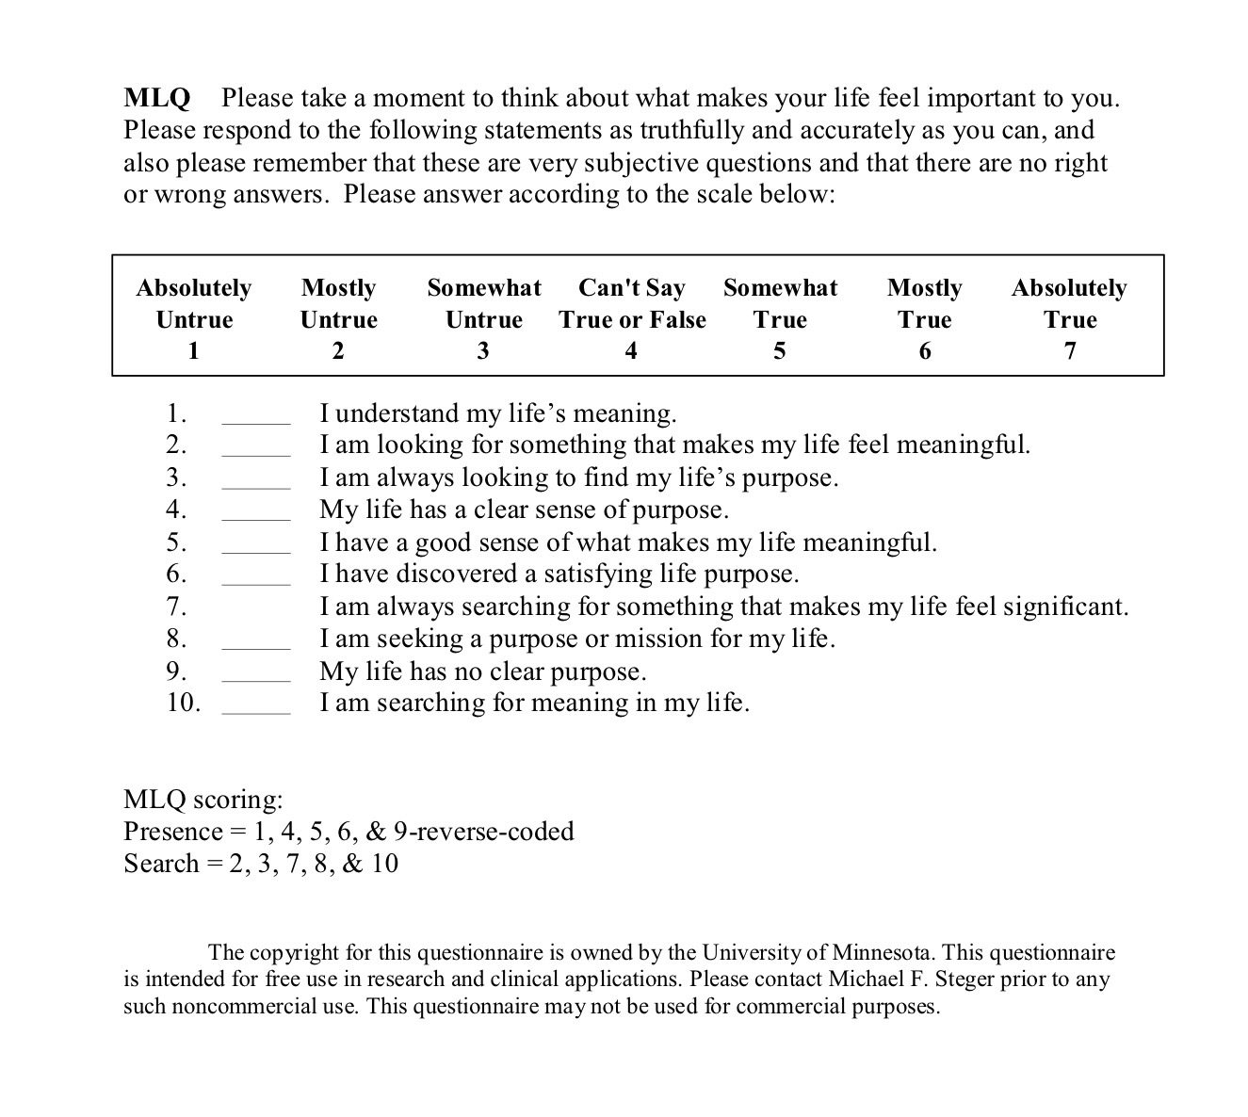

Slide 34
The Meaning in Life Questionnaire, developed by Michael Steger and colleagues (2006), generates two independent subscale scores — Presence of Meaning and Search for Meaning — each ranging from 5 to 35. The instrument uses a 7-point Likert scale and its robust two-factor structure has been replicated numerous times, making it a benchmark measure in existential and positive psychology.
The threshold of 24 (the scale midpoint on a 5–35 range) is the conventional interpretive anchor, though Steger explicitly notes the MLQ has no clinical cut scores — it measures across the full range of human functioning.
The Four Score Profiles (Steger’s Framework)
The two subscales interact in meaningful ways, and Steger’s own scoring guide describes four interpretive quadrants:
High Presence / Low Search (above 24 / below 24)
Individuals in this pattern feel their lives have valued meaning and purpose and are not actively seeking further meaning. They tend to be highly satisfied with life, optimistic, with healthy self-esteem. They frequently experience positive emotions like love and joy, and rarely feel afraid, angry, or sad. They tend to hold traditional values, are often active in religious pursuits, and would likely be described by others as conscientious, organized, and socially outgoing.
Low Presence / High Search (below 24 / above 24)
This is the most clinically significant pattern. Poor mental health, including clinical levels of depression, has been associated with the combination of lower Presence and higher Search scores. This profile maps onto what some researchers call a “meaning moratorium” — one senses something is missing and is actively, often anxiously, looking for it.

Slide 35
High Presence / High Search (both above 24)
Intriguingly, when individuals have high scores on Presence and Search simultaneously, they also report high levels of psychological well-being. This suggests that for people who already have a robust sense of meaning, continued exploration of that meaning deepens rather than destabilizes wellbeing.
Low Presence / Low Search (both below 24)
Individuals in this pattern probably do not feel their lives have valued meaning or purpose and are not actively exploring it. They may not find the idea of thinking about life’s meaning very interesting or important. They may not always be satisfied with life or optimistic about the future and may occasionally or often feel anxious or depressed. This pattern — sometimes called “meaning diffusion” — may reflect existential disengagement rather than distress.
Subscale Correlates
Presence is positively related to well-being, intrinsic religiosity, extraversion and agreeableness, and negatively related to anxiety and depression. Search is positively related to religious quest, rumination, past-negative and present-fatalistic time perspectives, negative affect, depression, and neuroticism, and negatively related to future time perspective and well-being.
Health and Mortality Research
The downstream health correlates of meaning are among the more striking findings in the positive psychology literature.

Slide 36
Physical Health and Functioning
A study of over 1,000 community-dwelling adults across the lifespan found that individuals who perceive their lives to be more meaningful have better outcomes across a wide variety of psychological and physical measures of health and well-being. The mean Presence score in that sample was 26.7 (above the midpoint), with Search at 18.9 (below the midpoint) — suggesting the population norm leans toward presence without active seeking.
Overall, higher levels of meaning are clearly associated with better physical health, as well as with behavioral factors that decrease the probability of negative health outcomes or increase that of positive health outcomes.
A higher sense of purpose is associated with improved health behaviors (increased physical activity, increased preventive healthcare use, healthier sleep, reduced drug misuse), improved biological functioning (reduced allostatic load, reduced inflammation), and better physical health outcomes including improved physical functioning and reduced risk of cardiovascular disease, cognitive impairment, and mortality.
Cardiovascular Disease and Mortality
The mortality data are particularly robust. A meta-analysis of ten prospective studies with over 136,000 participants found a significant association between higher purpose in life and reduced all-cause mortality (adjusted pooled relative risk = 0.83) and reduced cardiovascular events (adjusted pooled relative risk = 0.83).
In one large study of nearly 7,000 older adults, those with the lowest levels of purpose had more than 2.6 times the risk of mortality from heart, circulatory, and blood conditions compared to those with the highest levels of purpose.
The Harvard/Health and Retirement Study data showed stark differences in absolute mortality risk: people with the highest sense of purpose had a 15.2% mortality risk over eight years, compared to 36.5% for those with the lowest sense of purpose. Importantly, in analyses stratified by socioeconomic status, people with the highest level of purpose consistently tended to have lower mortality risk across all levels of SES.

Slide 37
Purpose as a Buffer Against Poor Health
One particularly nuanced finding: purpose appears to moderate the relationship between poor health and death. Greater purpose in life predicts meaningful reductions in mortality associated with poorer self-rated health among middle-aged and older adults — that is, rating one’s health as poor was more detrimental (in terms of mortality) for those who also reported low purpose in life.

Slide 38
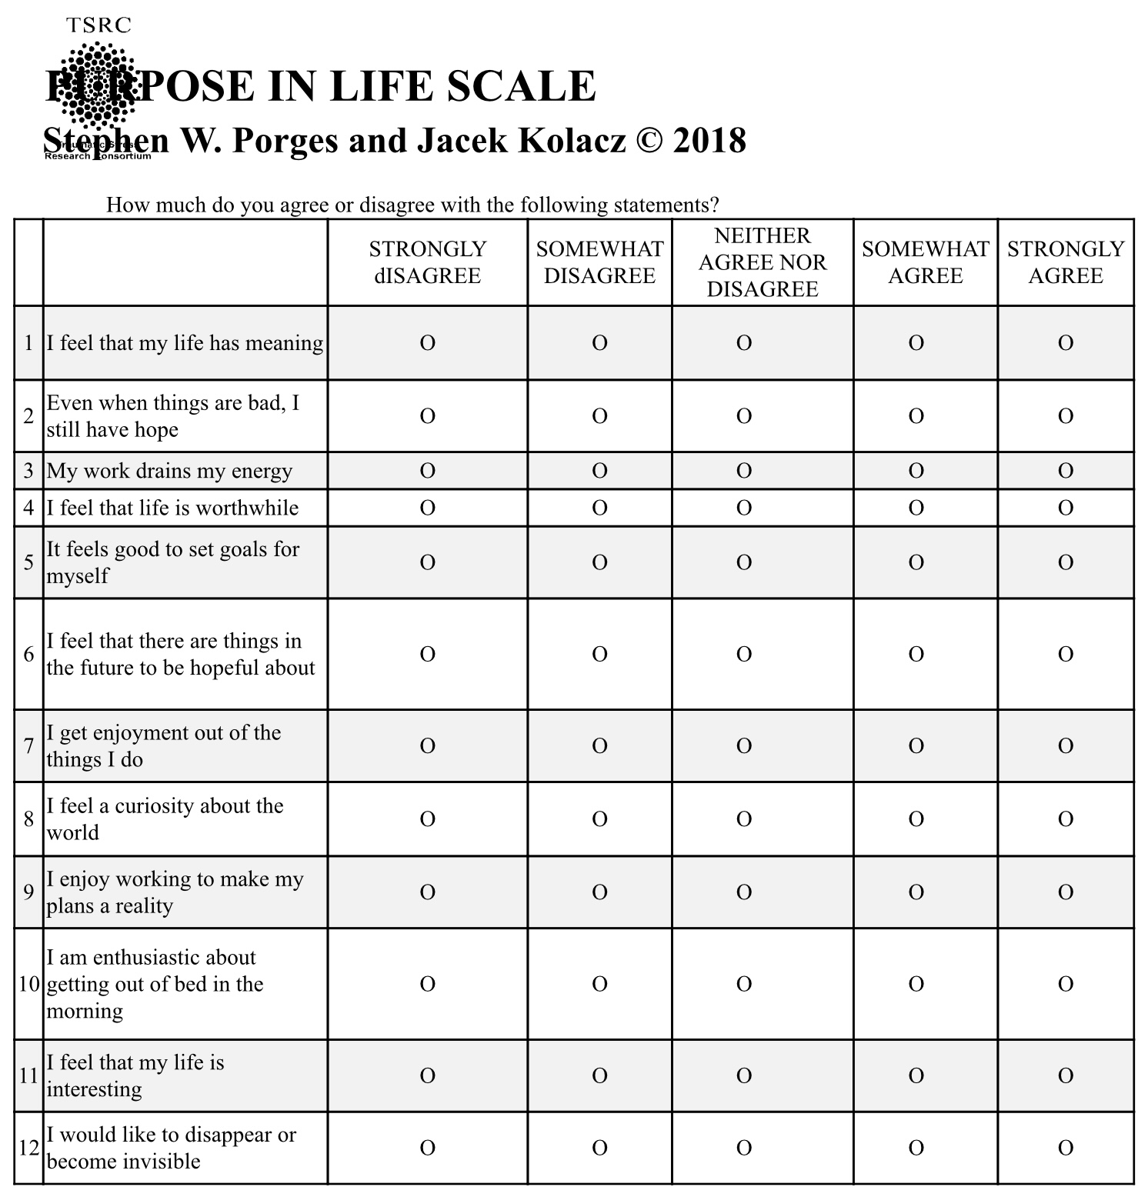


Slide 39
PURPOSE IN LIFE SCALE INTERPRETATION
Total Score Range: The total score typically ranges from 12 to 60 (assuming a 1 to 5 scoring range per item).
Higher Scores: Higher scores are associated with positive outcomes, such as:
  Greater life satisfaction and overall well-being.
  Lower levels of depression and anxiety.
  A sense that one's life is goal-oriented and has clear direction.
Lower Scores: Lower scores may suggest:
  An absence of purpose, sometimes described as existential frustration or emptiness.
  Potential for higher levels of stress or psychological distress.
Note on Norms: While higher scores generally mean greater purpose, specific cutoff points for "high" versus "low" can depend on the population being studied. Researchers often compare individual scores to established norms for specific age groups or clinical populations.
For the exact scoring instructions and scale manual, you can refer to the Traumatic Stress Research Consortium website, where the scale is hosted.

Slide 40
PURPOSE AND HEALTH
• In people who already have heart disease, each one-point increase on a 6-point purpose-in-life scale was associated with a 27 % lower risk of having a heart attack over a two-year period.
• Among older adults, a one-point increase in purpose corresponded to a 22 % lower risk of stroke.
• Studies have linked stronger purpose in life with reduced incidence of Alzheimer’s disease by more than half and milder cognitive decline.
• In gene-expression studies, “hedonic” well-being (pleasure-oriented) was associated with higher expression of inflammatory genes and lower expression of genes involved in antiviral and antibody responses; whereas “eudaimonic” well-being (purpose/meaning oriented) showed the opposite, healthier patterns of gene expression.
• Purpose is also correlated with better engagement in preventive health behaviors (e.g. screenings, vaccinations).
• People with strong purpose may have greater telomerase activity (an enzyme important for chromosome maintenance) and thus possibly slower cellular aging.

Slide 41
Exploring meaning

Slide 42

I BELIEVE IN…
Seeking to understand myself, society and the universe while remaining mindful that I do not have access to ultimate truths.
Embracing stories about myself, society, and the universe that are true, good, and beautiful.
Allowing these stories to guide my life.

Slide 43
The Cosmic Egg of Meaning
Exploring My Story, Our Story, and The Story
Circle of Meaning Session

Slide 44
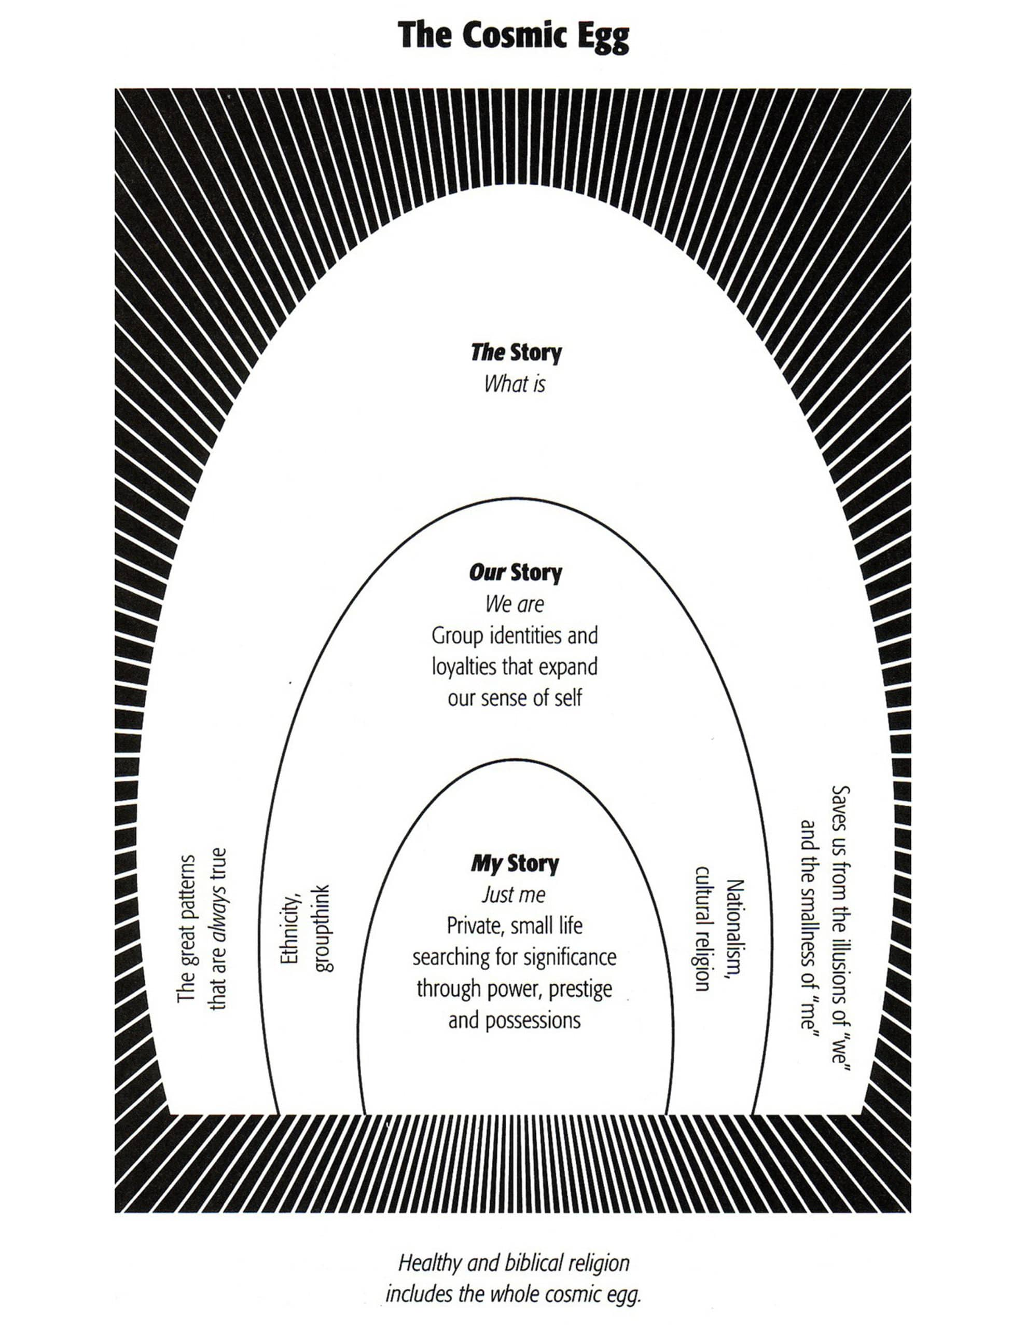
THREE LEVELS OF MEANING: MY, OURS AND THE STORIES

Slide 45
Introduction: The Cosmic Egg (Richard Rohr)
Meaning has three levels:
- My Story: Personal identity
- Our Story: Collective identity
- The Story: Transcendent or spiritual context
Today we'll reflect on all three, then explore how they intersect to shape our sense of meaning and purpose.

Slide 46
“ A healthy psyche lives within at least three levels of meaning… that is within three sets of stories: “my”, “ours”, and “The” story.” Richard Rohr
In our search for meaning or to make sense of our lives we turn to three interconnected stories. Like Russian dolls, these three stories are embedded or nestled within each other. The all-encompassing stories that envelop all others are “The stories” within which are “Our stories” which in turn contain “My stories”.
“The stories” describe the universe, all that exists and the origins of existence, the great patterns that are thought to always be true. “The stories” can save us from the smallness of “My stories” and the illusions of “Our stories”.
"Our stories" are the collective narratives shared by families, cultural or ethnic communities, and nations. In Western cultures, there are various unique subcultures, each with a different version of "Our story." These narratives enhance our understanding of identity.
“My stories” are our personal stories. They describe who each of us is and how we may or not feel and think we are significant. It guides us in our everyday life. Psychology and psychotherapy encourages the exploration of “My stories”.

Slide 47
Feeling that our lives is closely tied to our perception of having purpose and value. Having purpose is having an important reason for being alive, while feeling valued is believing and feeling that we are important, worthy or useful.
Feeling that we have purpose and value require that we have healthy connections with ourselves, others, nature, a meaningful occupation and the universe. If as children, we are well loved, we are shown, by the way we are seen by loving parental figures, that we have purpose and value. When we are loved as children, we are more likely to develop a healthy “My story”.
Our sense of meaning depends not only on having a healthy “My story” and sense of self, but also on being part of communities with healthy “Our stories” and “The stories”. All these stories then guide our lives.

Slide 48
1. My Story – Who am I?
• Who and what are the key people events or moments that have shaped who you are today?
• What personal beliefs, values, principles or experiences guide your life and give it meaning?
• When do you feel most fully yourself? Who is the most authentic you?

Slide 49
2. Our Story – Where do I belong?
• What groups or communities have most shaped your identity?what do they believe? How do they treat others?
• What collective stories, struggles, or rituals have made you feel connected or purposeful?
• How has your culture or family influenced what you see as meaningful?

Slide 50
3. The Story – Why are we here?
• What are the biggest questions you ask about existence, life, and the universe?
• Do you sense a larger story or force that holds your life within it?
• What spiritual, philosophical, or scientific story do you most resonate with?

Slide 51
Reflecting Across the Three Stories
• Which story makes you feel most valued, seen, or alive?
• Which gives you the clearest sense of purpose?
• Are your stories coherent or are they in tension?
- If in harmony, what does that feel like?
- If in conflict, what might be trying to emerge?

Slide 52
Rewriting a Story
• If you could rewrite one of these stories to feel more true or meaningful,
which one would it be?
• What is one small way you might begin that rewriting?

Slide 53

1. MY STORY – WHO AM I?
Luis

Slide 54
1. My Story – Who am I?
Who and what are the key people events or moments that have shaped who you are today?
My grandfather, mentors David, Fred, Gert and my wife and children. Getting into med school, going into psychiatry. The adversities I faced.
What personal beliefs, values, principles or experiences guide your life and give it meaning?
I am nothing but IFS like parts (that exist in a non-material realm) being seen by Self (the hub of the wheel of awareness, a version of we call God). This life is not about me I’m here to do the universes bidding.
When do you feel most fully yourself? Who is the most authentic you?
When I’m in Self.
Is there a song, poem or quotation that captures your “my story”?
I am light by India.Arie

Slide 55

1. MY STORY – WHO AM I?
NOW YOU

Slide 56
1. My Story – Who am I?
Who and what are the key people events or moments that have shaped who you are today?
What personal beliefs, values, principles or experiences guide your life and give it meaning?
When do you feel most fully yourself? Who is the most authentic you?
Is there a song, poem or quotation that captures your “my story”?

Slide 57
2. OUR STORY – WHERE DO I BELONG?
Luis

Slide 58
2. Our Story – Where do I belong?
• What groups or communities have most shaped your identity?what do they believe? How do they treat others?
Thinkers that challenge the status quo and are open, humble, curious, have a sense of humour and integrate various fields. My patients who face so much pain with so much courage.
• What collective stories, struggles, or rituals have made you feel connected or purposeful?
The idealist perspective that I’ve described at length in exploring meaning. A social justice perspective
• How has your culture or family influenced what you see as meaningful?
I’m an outsider and have fostered my identity around embracing that and rejecting bad conventionality.
Is there a song, poem or quotation that captures your “Our story”?

Slide 59
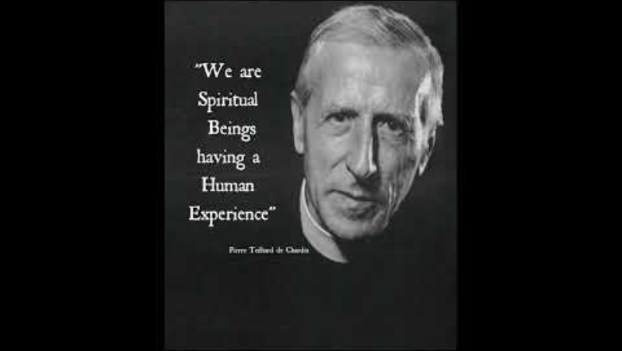

Slide 60
2. OUR STORY – WHERE DO I BELONG?
NOW YOU

Slide 61
2. Our Story – Where do I belong?
What groups or communities have most shaped your identity?what do they believe? How do they treat others?
What collective stories, struggles, or rituals have made you feel connected or purposeful?
How has your culture or family influenced what you see as meaningful?
Is there a song, poem or quotation that captures your “our story”?

Slide 62
3. THE STORY – WHY ARE WE HERE?
Luis

Slide 63
3. The Story – Why are we here?
What are the biggest questions you ask about existence, life, and the universe?
Why is there anything rather than nothing
Do you sense a larger story or force that holds your life within it?
absolutely
What spiritual, philosophical, or scientific story do you most resonate with?
That of Bernardo Kastrup, Rupert Sheldrake, Michael Levin and like-minded scientists
Is there a song, poem or quotation that captures your “The story”?
“Find a personal religious myth that passes intellectual scrutiny and resonates deeply for you. Live your life as if it were true even thought you will never be able to ascertain that it is.” Bernardo Kastrup

Slide 64
3. THE STORY – WHY ARE WE HERE?
NOW YOU

Slide 65
3. The Story – Why are we here?
What are the biggest questions you ask about existence, life, and the universe?
Do you sense a larger story or force that holds your life within it?
What spiritual, philosophical, or scientific story do you most resonate with?
Is there a song, poem or quotation that captures your “The story”?

Slide 66
REFLECTING ACROSS THE THREE STORIES
Luis

Slide 67
Reflecting Across the Three Stories
Which story makes you feel most valued, seen, or alive?
Which gives you the clearest sense of purpose?
Are your stories coherent—or are they in tension?
- If in harmony, what does that feel like?
- If in conflict, what might be trying to emerge?
Please see my “exploring meaning” presentation

Slide 68
REFLECTING ACROSS THE THREE STORIES
NOW YOU

Slide 69
Reflecting Across the Three Stories
Which story makes you feel most valued, seen, or alive?
Which gives you the clearest sense of purpose?
Are your stories coherent—or are they in tension?
- If in harmony, what does that feel like?
- If in conflict, what might be trying to emerge?

Slide 70
REWRITING A STORY
Luis

Slide 71
Rewriting a Story
If you could rewrite one of these stories to feel more true or meaningful, which one would it be?
The outline feels meaningful. I accept that truth is complex.
What is one small way you might begin that rewriting?
My model is open and it’s a pleasure to keep modifying it.

Slide 72
REWRITING A STORY
NOW YOU

Slide 73
Rewriting a Story
If you could rewrite one of these stories to feel more true or meaningful,
which one would it be?
What is one small way you might begin that rewriting?

Slide 74
Closing Blessing for the Circle of Meaning
As we draw this circle to a close,
may we carry forward not just words,
but the quiet transformations they stirred.
Let us give thanks
for each story offered in vulnerability,
for each silence that held space for the sacred,
for the courage it takes to speak from the soul
in a world so often rushed and guarded.
May the meanings glimpsed here
fragile, unfolding, unfinished
continue to ripple outward,
guiding us gently toward deeper presence in our days.
May we remember that meaning is not a thing to be found,
but a relationship to be lived:
in the way we listen,
the way we tend,
the way we love.
And as we part,
may we do so with fuller hearts,
a little more attuned
to the beauty and mystery of being alive together.
Go in peace,
go in wonder,
go in gratitude.
Amen.
Let it be so.

Slide 75
1. MY STORY — Who am I, really?
When do I feel most myself?
What gives me dignity even when I fail?
What part of me feels most alive now?
Key word or phrase: _______________________
2. OUR STORY — Where do I belong?
Which communities, relationships, or traditions see me?
Where do I contribute rather than perform?
Who would notice if I were missing?
Key word or phrase: _______________________

Slide 76
3. THE STORY — What holds my life?
What larger story feels true enough to live by?
What restores awe, humility, or trust?
Where do I sense meaning beyond usefulness?
Key word or phrase: _______________________
INTEGRATION
Which story currently feels strongest?
Which feels neglected or conflicted?
What small shift could bring them into better harmony?
One gentle intention for the next season of life:

Slide 77

SEARCHING FOR MEANING
LUIS CLETO

Slide 78
"The greatest danger for mankind is the blinding influence of ideas upon the facts of the real human being... fanatical ideologies that twist reality into a horror story.“ Carl Jung
"You can always count on Americans to do the right thing, after they've tried everything else.“ Winston Churchill
"Ever tried. Ever failed. No matter. Try again. Fail again. Fail better." Samuel Beckett
"That men do not learn very much from the lessons of history is the most important of all the lessons of history.“ Aldous Huxley

Slide 79
CONTENTS
Part I-Exploring meaning
Introduction
“My”, “Our” and “The stories”
Aligning My, Our and The stories
Understanding meaning: three key questions
Why is meaning important?
Meaning, goodness, truth and beauty
Happiness, meaning and the stages of life
A brief history of the search for meaning
Perspectives on meaning
Integral theory and meaning
Part II-Losing meaning
How “My” stories lose meaning.
Meaningful traditional stories.
Paradigm shifts.

Slide 80
The shift from a traditional to a modern story.
“Our” and “The” stories lose meaning.
The postmodern stage
Part III-Crisis
The polycrisis
A brief economic history
The gilded age
The great depression
The new deal
Neo-liberalism
The 2008 financial crisis
The decline of the American empire
Fake News
Part IV-Consequences
Cultural backlash
Populism and authoritarianism
The psychology of power and wealth
Authoritarian societies

Slide 81
Authoritarian cults
The new gilded age
Post-truth is pre-fascism
Part V-Anomalies
Anomalies in worldviews
Physicalism and Idealism
Immanuel Kant
Bernardo Kastrup
The quantum world
Brain and Mind
The variety of states of consciousness
Searching for a deeper reality
The study of anomalous experiences
Idealism’s understanding of anomalous phenomena
Anomalous experiences, death and trauma
The foundations of spiritual traditions
Mysticism, spirituality and religion

Slide 82
The perennial philosophy
Divine order
Idealism, physicalism and meaning
Part VI- Integral worldviews
The integral stage
Systems
Stories and systems
Integral scientific theories
Integral spirituality
Symbols and truth
Part VII- Growth and healing
Resources and resilience
Fragility
Resourcing systems
Individual growth and healing
Depth psychology
Internal family systems

Slide 83
Ignatian spirituality
Converging stories
As above so below
The dynamics of mind
Teilhard de Chardin
Healing Our and the stories
Part VIII-My personal spiritual myth
Questions a myth must answer
The dialogue
Appendixes:
1. The evolution of the universe
2. The history of metaphysics
3. Bernardo Kastrup’s idealism
4. Donald Hoffman’s theory
5. Rupert Sheldrake’s theory
6. Michal Levin’s theory
7. Synchronicity and quantum theory
8. Teilhard de Chardin’s theory
9. Putting it all together

Slide 84
10.Evolutionary patterns
11. Ignatian spirituality
In conclusion

Slide 85
“Searching for meaning” is divided into eight parts, each exploring different aspects of meaning and its significance in our lives.
Part I of "Searching for Meaning" is titled "Exploring Meaning."
“Exploring meaning” introduces the concept of meaning, its importance, and its relationship with goodness, truth, and beauty. It discusses the connection between happiness and meaning and provides a brief history of the search for meaning. It also considers how life stages and cultural perspectives influence the search for meaning. Part I ends with an exploration of how healthy personal, collective, and universal stories are critical in our search for meaning.
My, Our, and The Stories: The section explains the three levels of meaning: "My" stories (individual), "Our" stories (collective), and "The" stories (universal). It emphasizes the importance of aligning these three levels of stories to find meaning in life.
Understanding Meaning: Looks at three key questions we must ask to better understand the concept of meaning: Is meaning a personal or universal concept? Is meaning a subjective experience or an objective reality? Is meaning to be found or to be lived?
Why Meaning is Important: This part highlights the significance of finding and living a meaningful life. It discusses how meaning impacts well-being, motivation, and overall fulfillment.

Slide 86
Goodness, Truth, and Beauty: The relationship between these three transcendentals and meaning is explored.
Happiness, Meaning, and the Stages of Life: The difference between a happy life and a meaningful life is discussed. While happiness focuses on personal satisfaction and pleasure, meaning involves contributing to something larger than oneself. The stages of life influence the pursuit of happiness and meaning, with meaning being a primary concern of the second half of life.
A Brief History of the Search for Meaning: This section traces Human’s search for meaning back to the cognitive revolution. It discusses how enhanced language capabilities, abstract thinking, and complex social structures laid the groundwork for our search for meaning.
Part II of "Searching for Meaning" is titled "Losing Meaning."
“Losing meaning” delves into how potentially meaningful personal, societal, and universal stories come to lose meaning. It explores Western society's transition from a traditional to modern and post-modern worldviews and proposes that this transition is at the root of the current polycrisis of which the crisis of meaning is a part.
How “My” Stories Lose Meaning: This section explores how personal narratives, or "My" stories, can lose their significance. It discusses the impact of life events, trauma, and societal changes on an individual’s sense of meaning. The shift from traditional to modern stories is again highlighted, showing how changes in societal values and beliefs affects personal meaning.

Slide 87
Meaningful Traditional Stories: This part delves into the traditional stories that have historically provided meaning to individuals and societies. It examines how these stories have been passed down through generations and their role in shaping cultural and personal identities.
Paradigm Shifts: This section applies Thomas Kuhn’s concept of paradigm shifts to the cultural stage changes that have occurred in Western society, such as the transition from a traditional to a modern worldview. It explores how these shifts have influenced the way people perceive meaning and their place in the world.
The Shift from a Traditional to a Modern Story: This part elaborates on the transition from traditional narratives to modern ones. It examines the impact of scientific advancements, industrialization, and secularization on traditional stories and how these changes have led to a loss of meaning for many individuals.
“Our” and “The” Stories Lose Meaning: This section explores how collective and universal stories, or "Our" and "The" stories, lose their significance. It discusses the impact of societal changes, cultural shifts, and global events on collective meaning-making.
The Postmodern Stage: This part examines the postmodern stage and its impact on meaning. It discusses the characteristics of postmodernism, such as skepticism, relativism, and the rejection of grand narratives, and how these elements contribute to the loss of meaning in contemporary society.

Slide 88
Part III of the presentation "Searching for Meaning" is titled "Crisis."
“Crisis” discusses various aspects of the polycrisis, a term used to describe multiple, interconnected crises. It explores economic and political history, and why liberal democracy is in decline. It also examines how this decline has been accelerated by the rise of new media.
The Polycrisis: This section discusses the concept of polycrisis. It explores how different crises are interrelated and the impact they have on individuals and communities.
A Brief Economic History: This part provides an overview of significant economic events and their influence on society. It covers the historical period of the Gilded Age, the Great Depression, the New Deal, neoliberalism, and the 2008 financial crisis. Each of these events is related to the broader theme of losing meaning in society.
The Gilded Age: This section delves into the Gilded Age, a period of rapid economic growth and industrialization in the late 19th century. It examines the social and economic inequalities that emerged during this time.
The Great Depression: This part explores the Great Depression, a severe worldwide economic downturn that occurred in the 1930s. It discusses the impact of the depression on individuals and society.

Slide 89
The New Deal: This section covers the New Deal, a series of programs and policies implemented by President Franklin D. Roosevelt in response to the Great Depression. It examines how these measures aimed to restore meaning and hope to a struggling society.
Neoliberalism: This part discusses the rise of neoliberalism, an economic and political ideology that emphasizes free markets, deregulation, and privatization. It explores how neoliberal policies have contributed to social and economic inequalities.
The 2008 Financial Crisis: This section examines the 2008 financial crisis, a global economic downturn triggered by the collapse of the housing market in the United States. It discusses the impact of the crisis on individuals and society.
The Decline of the American Empire: This part explores the decline of the American empire, focusing on the political, economic, and social factors that have contributed to this decline.
Fake News: This section discusses the rise of the new media and its impact on society. It explores how misinformation and disinformation and fake news contribute to a loss of trust in institutions.

Slide 90
Part IV of the presentation "Searching for Meaning" is titled "Consequences."
“Consequences” examines the phenomena of cultural backlash, populism, and authoritarianism, and how these arise from the polycrisis. It also looks into the psychology of power and wealth, authoritarian societies, and cults.
Cultural Backlash: This section examines the phenomenon of cultural backlash, which refers to the reaction against progressive social changes. It explores how certain groups feel threatened by these changes and respond by clinging to traditional values and norms.
Populism and Authoritarianism: This part delves into the rise of populism and authoritarianism as responses to the polycrisis. It discusses how populist leaders exploit people's fears and frustrations to gain power and how authoritarian regimes use control and repression to maintain their authority.
The Psychology of Power and Wealth: This section explores the psychological effects of power and wealth on individuals and societies. It examines how the pursuit of power and wealth can lead to corruption, inequality, and a loss of meaning.
Authoritarian Societies: This part looks into the characteristics of authoritarian societies and how they suppress individual freedoms and dissent. It discusses the impact of living under authoritarian rule.

Slide 91
Cults: This section examines the nature of cults and how they manipulate and control their members. It explores the psychological tactics used by cult leaders to create a sense of belonging and purpose among followers, often at the expense of their autonomy and well-being.
Part V of the presentation "Searching for Meaning" is titled "Anomalies."
“Anomalies” explores anomalies in the modern and post-modern worldviews and considers how these anomalies arise from metaphysical physicalism. It surveys the study of anomalous experiences and discusses the foundations of spiritual traditions and the perennial philosophy.
Anomalies in Worldviews: This section explores the anomalies that arise in the modern and post-modern worldviews. It considers how these anomalies challenge our understanding of reality and meaning.
Physicalism and Idealism: This part delves into the philosophical perspectives of physicalism and idealism. It discusses how these metaphysical views influence our perception of reality and meaning.
Immanuel Kant: This section examines the contributions of Immanuel Kant to the understanding of reality and meaning. It explores his ideas on the nature of knowledge and the limits of human understanding.
Bernardo Kastrup: This part discusses the work of Bernardo Kastrup, a contemporary philosopher who advocates for idealism. It explores his arguments against physicalism and his views on the nature of consciousness.

Slide 92
The Quantum World: This section explores the implications of quantum mechanics for our understanding of reality and meaning. It discusses how the strange and counterintuitive phenomena observed in the quantum world challenge classical notions of reality.
Brain and Mind: This part examines the relationship between the brain and the mind. It explores how different philosophical perspectives, such as physicalism and idealism, interpret this relationship and its implications for meaning.
The Variety of States of Consciousness: This section discusses the different states of consciousness that humans can experience. It explores how these states can provide insights into the nature of reality and meaning.
Searching for a Deeper Reality: This part delves into the quest for a deeper understanding of reality. It discusses how different philosophical and spiritual traditions approach this quest and what they reveal about the nature of meaning.
The Study of Anomalous Experiences: This section examines the study of anomalous experiences, such as near-death experiences, mystical experiences, and other phenomena that challenge conventional understandings of reality.

Slide 93
Idealism’s Understanding of Anomalous Phenomena: This part explores how idealism interprets anomalous phenomena. It discusses how these experiences can be understood within the framework of a reality that is fundamentally mental or spiritual.
Anomalous Experiences, Death, and Trauma: This section examines the relationship between anomalous experiences, death, and trauma. It explores how these experiences can provide insights into the nature of reality and meaning.
The Foundations of Spiritual Traditions: This part discusses the foundations of various spiritual traditions. It explores how these traditions provide frameworks for understanding reality and meaning.
Mysticism, Spirituality, and Religion: This section examines the roles of mysticism, spirituality, and religion in the search for meaning.
The Perennial Philosophy: This part explores the concept of the perennial philosophy, which posits that there are universal truths underlying all spiritual traditions. It discusses how this philosophy provides a framework for understanding reality and meaning.
Divine Order: This section examines the idea of a divine order in the universe. It explores how this concept is understood in different spiritual and philosophical traditions and its implications for meaning.

Slide 94
Idealism, Physicalism, and Meaning: This part discusses the relationship between idealism, physicalism, and meaning. It explores how these metaphysical perspectives influence our understanding of reality and purpose.
Part VI of the presentation "Searching for Meaning" is titled "Integral Worldviews."
“Integral worldviews” introduces the integral stage of development and various integral worldviews. It covers systems theory, symbols and truth, integral scientific theories, and integral spirituality.
The Integral Stage: This section introduces the integral stage of development, which represents a more holistic and inclusive way of understanding reality. It emphasizes the importance of integrating various perspectives and dimensions of human experience to achieve a more comprehensive understanding of meaning.
Systems Theory: This part delves into systems theory, which explores how different components of a system interact and influence each other. It discusses the application of systems theory to understanding complex phenomena and how it can provide insights into the interconnectedness of various aspects of reality.
Symbols and Truth: This section examines the role of symbols in conveying truth and meaning. It explores how symbols can represent deeper truths and facilitate a more profound understanding of reality. The discussion includes the significance of symbols in different cultural and spiritual traditions.

Slide 95
Integral Scientific Theories: This part discusses integral scientific theories that aim to bridge the gap between science and spirituality. It explores how these theories integrate insights from various scientific disciplines to provide a more holistic understanding of reality and meaning.
Integral Spirituality: This section explores the concept of integral spirituality, which seeks to integrate spiritual practices and insights from different traditions. It discusses how integral spirituality can provide a more inclusive and comprehensive approach to understanding and experiencing meaning.
Part VII of the presentation "Searching for Meaning" is titled "Growth and Healing."
“Growth and Healing” focuses on the importance of resources and resilience in growth and healing. It also discusses three approaches to healing and growth that have much in common: Jungian psychology, internal family systems, and Ignatian spirituality.
Resources and Resilience: This section focuses on the importance of resources and resilience in growth and healing. It discusses how having access to resources, both internal and external, can enhance an individual's ability to cope with challenges and foster personal growth.
Fragility: This part delves into the concept of fragility and how it affects individuals' ability to grow and heal. It explores the factors that contribute to fragility and how addressing these factors can lead to greater resilience.

Slide 96
Resourcing Systems: This section examines the role of resourcing systems in supporting growth and healing. It discusses how systems, such as social support networks and community resources, can provide the necessary support for individuals to thrive.
Individual Growth and Healing: This part focuses on the processes and practices that promote individual growth and healing. It explores various approaches and techniques that can help individuals overcome challenges and achieve personal development.
Depth Psychology: This section discusses depth psychology, an approach to understanding the unconscious mind and its influence on behavior and emotions. It explores how depth psychology can be used to facilitate healing and personal growth.
Internal Family Systems: This part delves into the Internal Family Systems (IFS) model, which views the mind as composed of multiple sub-personalities or "parts." It discusses how IFS can be used to address internal conflicts and promote healing.
Ignatian Spirituality: This section explores Ignatian spirituality, a spiritual practice based on the teachings of St. Ignatius of Loyola. It discusses how Ignatian spirituality can provide a framework for personal growth and healing.

Slide 97
Converging Stories: This part examines the concept of converging stories, which refers to the alignment of personal, collective, and universal narratives. It discusses how aligning these stories can lead to a more meaningful and fulfilling life.
As Above So Below: This section explores the principle of "As Above So Below," which suggests that patterns and principles observed in the larger universe are reflected in individual lives. It discusses how this principle can be applied to personal growth and healing.
The Dynamics of Mind: This part delves into the dynamics of the mind and how understanding these dynamics can facilitate personal growth and healing. It explores various psychological and spiritual perspectives on the mind.
Teilhard de Chardin: This section discusses the work of Teilhard de Chardin, a French philosopher and Jesuit priest. It explores his ideas on the evolution of consciousness and their implications for personal growth and healing.
Healing Our and The Stories: This part examines the process of healing collective and universal narratives. It discusses how addressing and transforming these narratives can contribute to personal and societal well-being.

Slide 98
Part VIII of the presentation "Searching for Meaning" is titled "My Personal Spiritual Myth."
This final part presents, in the form of a dialogue, the author's personal evolving spiritual myth. It explores the questions a myth must answer and engages in an imaginary dialogue between prominent thinkers present and past to delve deeper into these questions.

Slide 99

SEARCHING FOR MEANING

Slide 100
PART I- EXPLORING MEANING
Introduction
“My”, “Our” and “The stories”
Aligning My, Our and The stories
Understanding meaning: Three key questions
Why is meaning important?
Meaning, goodness, truth and beauty
Happiness, meaning and the stages of life
A brief history of the search for meaning
Perspectives on meaning
Integral theory and meaning

Slide 101
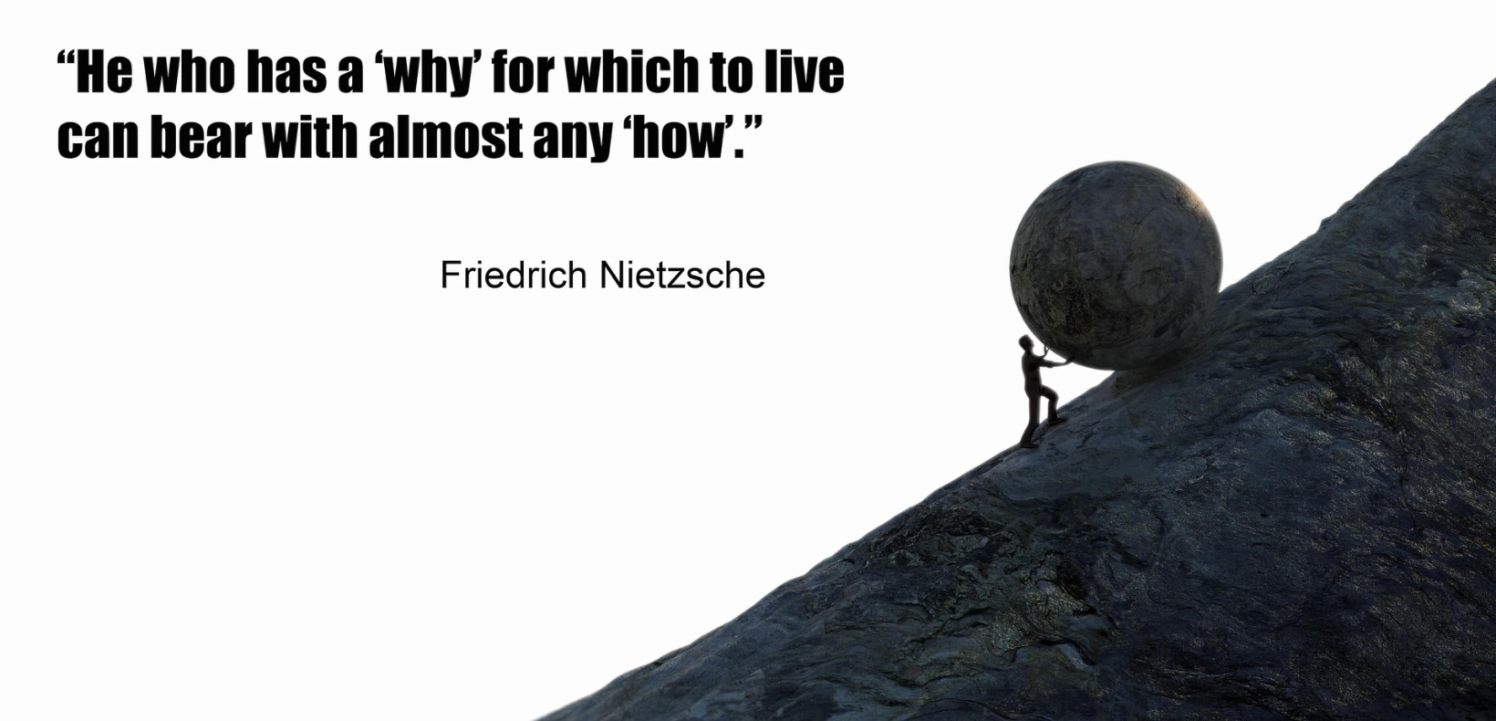
INTRODUCTION
Well, I woke up this mornin', feelin' like a lost dog,
Nothin' in this world seems to fit right,
My heart's a heavy stone, my soul's a broken log,
Just tryin' to find some meaning in this endless night.
Blues lyric

Slide 102
Personality is the armor that protects us from the stressors big and small that we encounter every day of our lives. Personality is influenced by the temperament that we are born with and by our experiences.
Attachment, or the type of relationship we have with our caretakers and early traumatic experiences can deeply affect the development of personality.
Friedrich Nietzsche(1844-1900) was a German philosopher, cultural critic, poet, and philologist who is best known for his profound and provocative ideas on religion, morality, culture, and philosophy. His works challenged traditional views and inspired existentialist, and postmodern thought.
By all accounts Nietzsche was a tortured soul.
Neuroatypicality, or neurodiversity, refers to variations in neurological functioning and includes conditions like autism, ADHD, and others. By today’s standards Nietzsche would be considered neuroatypical.
Nietzsche's father, Carl Ludwig Nietzsche, was a Lutheran pastor, and his mother, Franziska Nietzsche, came from a family with a strong religious background. Nietzsche's father died when Friedrich was just five years old, and shortly afterwards, his younger brother, Ludwig Joseph, also passed away. These losses profoundly affected Nietzsche who also lost the attention of his grieving mother.

Slide 103
During his youth Nietzsche's interactions with his peers were shaped by his remarkable intellectual abilities and personal demeanor, which stood out from a young age. Nietzsche was an exceptionally gifted student, which earned him the admiration of his teachers and the resentment of his classmates. His intense and serious demeanor made it difficult for him to connect with peers.
Nietzsche’s remained an outcast for most of his life as his works were misunderstood and misinterpreted by his contemporaries. This lack of understanding from both the public and his peers fueled his feelings of frustration and anguish.
Nietzsche's relationships with his family, particularly with his sister, were strained. Adding to his suffering, he fell in love multiple times, but his love was never reciprocated.
Throughout his life Nietzsche suffered from a range of painful and debilitating medical and mental health issues. He experienced chronic intense migraines, nausea and stomach pains and extreme fatigue and weakness.
In 1889 Nietzsche’s mental functions deteriorated. He was diagnosed with "general paralysis of the insane," a condition related to tertiary syphilis. From that point onward, he exhibited symptoms consistent with dementia, including confusion, cognitive dysfunction, and a loss of coherent speech and writing abilities. He lived in a state of mental incapacitation until his death in 1900.

Slide 104
Despite, or perhaps because of, his very challenging life Nietzsche was deeply engaged with searching for meaning. Nietzsche's philosophy centered around the idea of creating one's own values and purpose, a concept he referred to as the "will to power." This concept suggests that in the face of suffering individuals can find meaning through personal growth, creativity, and self-overcoming.
Nietzsche's famous assertion, "He who has a why to live for can bear almost any how," indicates that having a strong sense of purpose or meaning can help people endure difficulties. Although Nietzsche had to bear excruciating suffering “how's”, his philosophical work and vision gave him purpose and was his "why.“
People whose lives are a struggle, find Nietzsche's ideas empowering. He encourages us not to wait for someone or something to give our lives meaning but rather to seek it and create it. Nietzsche resilience and perseverance in the face of hardships have been an inspiration for many.
The search for meaning in existence is a fundamental aspect of the human condition that takes us deep into our own and the universe’s nature.
Humans possess a unique level of self-awareness and reflective thought which allows us to contemplate our own existence, the nature of life, and our place in the universe and leads us to question the purpose and meaning behind it all.

Slide 105
Awareness of our mortality prompts us to seek out meaning. Understanding that life is finite drives many to explore deeper questions regarding its significance and legacy.
Humans have a natural inclination to find patterns and coherence in the world. This drive extends to our own lives, where we seek a narrative and purpose that ties together experiences and events, offering a sense of order and direction.
Emotional experiences, ranging from joy and love to suffering and despair, propel individuals to search for meaning as a way to make sense of both positive and negative aspects of life.
Philosophical and moral inquiries arise from this search, as individuals seek not only personal meaning but also frameworks for how to live ethically and contribute to the broader human society.
The search for meaning is a response to all these elements, It's an attempt to find grounding and purpose in a complex and unpredictable world. A successful search offers a sense of fulfillment and understanding in the face of life's mysteries.
Meaning is the rational and emotional conviction that there is value and purpose to existence in general, and our own lives in particular. Carl Jung (1875-1961) the famous Swiss psychiatrist wrote “every human life contains a potential, if that potential is not fulfilled, then that life is wasted.” Jung was convinced that finding meaning is essential if we are to become fully realized human beings.

Slide 106
We start looking for meaning right after birth as we search the eyes, or windows to the soul, of our caregivers . If their eyes reflect love and they are attuned and appropriately responsive, we learn that our lives have value and purpose. If we are not so fortunate, and in their eyes we consistently see, pain, turmoil, suffering, anger, fear, self-centeredness, or a void, then we risk becoming ghosts hungry for love.
In Buddhism, "hungry ghosts," are beings that are characterized by intense desire and suffering. They inhabit one of the six realms of existence in the Buddhist cosmology. Hungry ghosts have enormous stomachs but tiny mouths and throats, making it impossible for them to satisfy their cravings. Hungry ghosts are consumed by an unsatiable hunger for love.
Hungry ghosts unfulfilled needs manifests in our society as the whole range of psychological issues we see in and around us. To attempt to satisfy this insatiable hunger, we consume the endless distractions, material objects, substances, and food that modern society offers us. The hungriest ghosts fight to be first in the line for the love substitutes; power, fame, wealth, and sex. The hungriest ghosts, men like Putin, Trump, and Musk become the commanders of the hungry ghost army in which we are the footsoldiers.
The good news is that we can heal and grow by finding and living out healthy and meaningful stories about ourselves, our societies and our universe.
“Searching for meaning” invites us to explore our minds, our society and the universe looking for answers. Some of us may have already found them. If that’s you, you don’t need to read any further. If, however, you’re looking for meaning in your life and in existence then you’re welcomed to join me on this search.

Slide 107
THREE LEVELS OF MEANING: MY, OURS AND THE STORIES

Slide 108
“ A healthy psyche lives within at least three levels of meaning… that is within three sets of stories: “my”, “ours”, and “The” story.” Richard Rohr
The human cognitive revolution 70,000 years ago, transformed curiosity, which we share with other animals, into a search for meaning.
In our search for meaning or to make sense of our lives we turn to three interconnected stories. Like Russian dolls, these three stories are embedded or nestled within each other.
The largest stories that envelop all others are “The stories” within which are “Our stories” which in turn envelop “My stories”.
“The stories” describe the universe, all that exists and the origins of existence. They describe the great patterns that are thought to always be true. “The stories” can save us from the smallness of “My stories” and the illusions of “Our stories”.
"Our stories" are the collective narratives shared by families, cultural or ethnic communities, and nations. In Western cultures, there are various unique subcultures, each with a different version of "Our story." These narratives enhance our understanding of identity.

Slide 109
“My story” is my individual story. It describes who I am and how I may or not be significant. It guides me in my everyday life. Psychology and psychotherapy encourages the exploration of “My stories”.
Having meaning in our lives is closely tied to our perception of having purpose and value. Having purpose is having an important reason for being alive, while feeling valued is having the feeling that we are important, worthy or usefulness.
Purpose and value don’t exist in isolation but in healthy connections with ourselves, others, nature, a meaningful occupation and the universe.
If as children, we are well loved, we are shown, by the way we are seen by loving parental figures, that we have purpose and value. When we are loved as children, we are more likely to develop a healthy “My story”.
Our sense of meaning depends not only on having a healthy “My story” and sense of self, but also on being part of communities with healthy “Our stories” and “The stories”. All these stories then guide our lives.

Slide 110
Aligning Meaningful Stories
Cognitive center- cerebral cortex
Emotional - limbic system, brainstem
Somatic- autonomic nervous system
Interprets emotional information into a narrative
Integrates information from body (ANS) and the environment (senses) producing a quick emotional response
“Body memory” in the form of autonomic baseline tone and reactivity(autonomic nervous system)
Information flow
Information flow

Slide 111
Attachment theorist’s Patricia Crittenden’s “dynamic maturational model of attachment and adaptation” describes how humans have evolved three parallel survival strategies; cognitive, emotional, and somatic. Each of these strategies is involved in the development of attachment adaptations and is associated with an anatomical information center, respectively the cerebral cortex, the limbic system and the enteric/autonomic nervous system.
Crittenden explores how, in securely attached emotionally healthy people, there is free, unhindered, exchange of true information between these three information centers.
In insecure attachment, which arises from unfavourable rearing circumstances, in contrast, to maintain some form of attachment to a caretaker, the information exchanged between the somatic, emotional, and cognitive centers is unconsciously distorted and its flow impaired.
This same information exchange occurs between “My” “Ours” and “The” levels of stories. In healthy individuals living in healthy societies with a healthy narrative about the universe, there is a highly meaningful free flow of information between the My, Our and The levels of stories. As any of these levels of stories lose meaning individuals and societies become less healthy.
By giving us purpose and making us feel we have value healthy “My”, “Our”, and “The” stories make life meaningful. In unhealthy My, Our and The stories tell we lose the sense of purpose and value.

Slide 112
Unhealthy stories at one level affect the stories at the other levels. For example, the modern scientific “The” story that holds that the universe is without meaning or purpose fosters an “Our” story which encourages the selfish pursuit of material resources because life is short life and there’s no accountability. These unhealthy “The and Our” stories, then in turn, can have a profoundly negative effect on “My” stories leaving us feeling that existence is meaningless and that the best we can hope is experiencing some pleasure for its short duration.
Unhealthy “My”, “Our” and “The” stories are also major contributors to physical, psychological, social and spiritual illnesses.
Finding meaning in our lives and in existence, means aligning ourselves with or reclaiming healthy “My”, “Our” and “The” stories. This process is a lifelong journey that involves spending time contemplating our lives, our societies and our narratives about the universe and existence. It involves being critical of and challenging the dominant culture that surrounds us today, its values and priorities. It involves finding and aligning our lives with healthy philosophical, spiritual, and scientific perspectives that resonate for us.
Meaningful aligning “My”, “Our” and “The” stories involves:
1) fostering in ourselves healthy values including compassion, integrity, creativity, and community.
2) setting meaningful goals that align with these values and our broader understanding of existence. These goals can be related to personal growth, relationships, career, or contributions to society.

Slide 113
3) taking time to reflect on our lives and whether they align with our values and beliefs.
4) seeking community and support by surrounding ourselves with people who share similar values or who inspire us and engaging in meaningful conversations and activities.
5) exploring different perspectives by reading, listening to, and engaging with diverse viewpoints on the meaning of life.
6) embracing lifelong learning by staying curious and open. This may involve formal education, travel, or simply being open to new experiences.
7) engaging in practices that foster connection such as meditation, mindfulness, or spending time in nature and
8) contributing to something larger than ourselves by engaging in activities that contribute to the well-being of others or the planet. This could be through volunteering, activism, or simply being a supportive friend or family member.
Compare the following meaningful and meaningless My, Our, and The stories:

Slide 114
Meaningful stories & stories lacking meaning
My story: I have a healthy sense of self, healthy relationships, and I’m able to self-sooth. There is free flow of information between my somatic, emotional and rational information centers. My attachment style is secure. I feel I’m basically OK and there is hope for the world.
Our story: I live in communities with ethical values that hold that I, and everyone else, is inherently important and valuable. These communities prioritize and promote the conditions necessary for everyone to thrive. Ex. Social democracies with less inequality and good social programs who value people above corporations and profits such as the Scandinavian countries which always score the highest on the world happiness index. Religious communities that rather than preach, practice their beliefs.
The story: the universe has meaning and purpose and everything in it, including human beings, also has purpose and value. Ex. Most theistic doctrines. Isaac Newton statement "this most beautiful system of the sun, planets and comets only proceed from the Council and Dominion of an intelligent and powerful being"
My story: I have an unhealthy sense of self; I struggle with relationships and with self-soothing. There is distorted information flow between my somatic, emotional and rational information centers. My attachment style is insecure and or I have unprocessed trauma. I believe there is something fundamentally wrong with me and or with the world.
Our story: the communities in which I live value some people more than others based on their wealth, power, fame, or physical features such as thinness. The interests of the “market”, and profit, are held to be more important than the promotion of the conditions required for everyone to thrive. Ex. The American society created by neo-liberalism with its free-market creed which places the market above people.
The story: the universe has no purpose or meaning. Life arose randomly. One day the universe will end, and all will be done. Ex. Nobel Prize laureate physicist Steven Weinberg who famously stated "the more the universe seems comprehensible the more it also seems pointless"

Slide 115
Meaningful My, Our, and The stories give us purpose and value. Meaningful stories help us connect and feel a part of something larger than ourselves. Meaningful stories help us see that our contribution is important and valuable. Human flourishing requires a free flow of true information between the somatic, emotional and rational centers but also between healthy, coherent and meaningful My, Ours, and The stories.

Slide 116
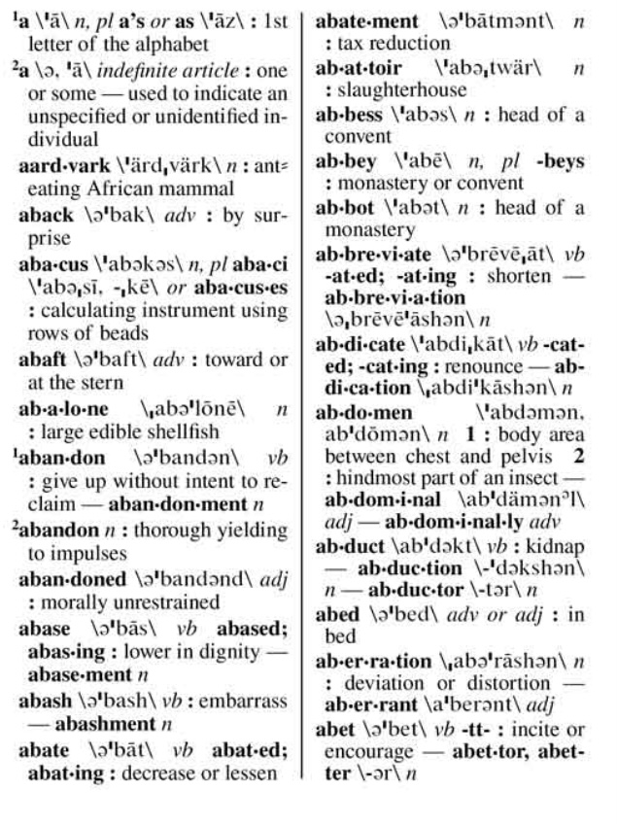
UNDERSTANDING MEANING: THREE KEY QUESTIONS

Slide 117
As we embark on this exploration of meaning there are three questions that we have to try to answer:
1) is meaning a personal or universal concept?
2) is meaning a subjective experience or an objective reality?
3) is meaning to be found or to be lived?
1) is meaning a personal or universal concept?
When we consider the concept of “meaning” we are usually referring to two distinct but related questions:
Is there meaning to the universe and existence? and Is my own life meaningful?
The concept of existence's meaning takes a Universal Perspective, which addresses broader philosophical and existential inquiries regarding the significance of life and of the universe itself. This perspective asks whether life possesses inherent value or purpose.
Various philosophical, religious, and scientific viewpoints offer different answers to this profound question. Some contend that the universe carries an intrinsic purpose or value, while others believe that it arose randomly and is devoid of inherent meaning.

Slide 118
The concept of a "meaningful universe" refers to the idea that the universe has inherent significance, purpose, or order beyond mere existence or randomness. This concept can be approached from various perspectives, each offering different interpretations:
The universe can be seen as having a purpose or direction, often suggesting a design or end goal. This view is common in theistic beliefs, where the universe's meaning is attributed to a creator or higher power with a divine plan.
The belief that the universe holds significance that can be uncovered through scientific exploration and understanding, is tied to the idea that humans and other forms of life have roles to play in a larger cosmic order.
The universe is meaningful due to the intricate connections and interactions among all its components, from galaxies to ecosystems, suggesting a harmony and balance that reflects a larger pattern or design.
Some philosophies propose that while the universe does not have inherent meaning, humans give it meaning through their observations, interactions, and the pursuit of knowledge and understanding.
In some spiritual and mystical traditions, the universe is perceived as a living entity with its own consciousness and purpose, offering meaning through its spiritual or energetic dimensions.

Slide 119
In contrast, to the universal perspective, meaning in an individual’s life refers to the significance and value that people attribute to their own existence. It considers their goals, passions, relationships, and beliefs.
Personal meaning is shaped by individual experiences, values, and aspirations, reflecting what provides a sense of direction and fulfillment.
A meaningful life is one that is rich in purpose, satisfaction, and significance. People who feel their lives are meaningful often report having a clear purpose or a sense of direction that aligns with their values and aspirations.
Having deep, fulfilling connections with others.
Feeling they’ve made or are making a positive contribution to the world.
Having a sense that they are continuing to grow and achieve personal goals.
Having a sense of self-worth and accomplishment.
Engaging in self-reflection and seeking a deeper understanding of life, themselves, and the larger universe.
And finding joy in everyday experiences and appreciating life's simple pleasures.
Personal value and purpose are profoundly subjective, what one individual and another find meaningful may differ significantly.
These personal and universal viewpoints interact and influence one another; for example, a person's sense of purpose may be shaped by their beliefs regarding broader existence, and conversely, their understanding of existence may be informed by their personal experiences.

Slide 120
2) is meaning a subjective experience or an objective reality?
Another important question we may ask is whether our sense that our lives and the universe are meaningful is just a psychological state, making it an entirely subjective experience, or whether that sense reflects an objective reality. In other words, is meaning just the product of our thoughts, emotions, and interpretations of experiences or do life and existence possess inherent, objective meaning and purpose?
As we will see, how we answer this question depends whether we lean towards a physicalist or idealist metaphysics. These philosophical perspectives offer different foundations for understanding reality.
Physicalism is the position that everything that exists is fundamentally physical, suggesting that reality is made up of matter and energy, governed by physical laws. Minds and consciousness are seen as products of physical processes.
In this view, meaning is a psychological experience derived from observable, measurable phenomena in the universe. Human experiences, accomplishments, and the beauty of the natural world provide significance. Meaning is constructed through our interactions with the material world and is understood in terms of human goals, values, and societal contributions.
Meaning can be found through scientific discovery and understanding the universe's workings. Knowledge and progress in science can deepen our appreciation of existence and help create narratives that provide purpose.

Slide 121
Evolutionary biology supports the notion that meaning is a psychological experience, positing that behaviors and psychological traits that promote survival and reproductive success are likely to be favored by evolution.
Social biologists offer several theories to explain how a sense of meaning may enhance survival:
1) a sense of meaning can foster mental well-being, resilience, and motivation, thus improving an individual’s capacity to tackle challenges and pursue goals that enhance survival and reproduction.
2) Being inherently social beings, humans benefit from a shared sense of meaning or purpose, which can strengthen social bonds and cooperation within groups. This unity can enhance group survival, as individuals collaborate to achieve common objectives, share resources, and protect one another from potential threats.
3) A sense of meaning can provide motivation and direction, encouraging individuals to set and pursue goals. This goal-oriented behavior can lead to personal achievements and innovations that benefit both the individual and the group, contributing to evolutionary success.
Existentialist philosophers align with this view. Theories such as that proposed by Viktor Frankl, assert that the pursuit of meaning is a fundamental human motivation, allowing individuals to discover meaning even in challenging situations through their attitudes and choices.
Humans naturally craft narratives and stories about their lives that help them form a coherent identity and sense of self. These narratives offer individuals a sense of continuity and purpose, which is advantageous for mental health and social interactions.

Slide 122
Philosophical idealism, in contrast to physicalism, holds that reality is fundamentally mental or spiritual. The physical world is a manifestation of a deeper, non-physical reality, a universal consciousness or mind.
For idealists, meaning is intrinsic to the fabric of reality itself. The universe has an underlying purpose or consciousness, giving life a deeper, predefined significance. Individual and collective experiences are part of a larger, meaningful narrative.
Meaning is discovered through introspection, spiritual practices, and exploring the mind's capabilities. Inner awareness and connection to a higher reality provide a framework for understanding life's purpose.
Our metaphysical perspective, idealism or physicalism deeply influences how we seek and define meaning in their lives. Many people find a balance between these two views, believing that while there may be elements of objective truth, which Humans may or may not have access to, our personal experiences and interpretations play a significant role in how we perceive and live out that meaning.
3) is meaning to be found or to be lived?
Another key question to consider that we should consider is whether meaning is something to be found or to be lived.
Notes:
))000

Slide 123
“Finding meaning” implies an exploratory process involving introspection, questioning, and seeking to understand one's purpose, values, and what gives life significance. This process is deeply personal and can vary greatly from person to person. It might involve exploring different philosophies, spiritual beliefs, or life experiences to discover what resonates most for us.
“Finding meaning” is not a one-time event but an ongoing journey. As people grow and change, their understanding of what is meaningful evolves. Often, people search for meaning during times of crisis or transition, when their existing beliefs and assumptions are challenged.
Once a person has a sense of what is meaningful, “living a meaningful life” involves applying that understanding to everyday actions and decisions. Living a meaningful life involves aligning our life with our values and purpose. This requires a commitment to living in a way that reflects our sense of meaning and making choices that are congruent with our values and purpose, even when it's challenging.
While finding meaning is about discovery, living a meaningful life is about experiencing fulfillment and satisfaction through living in accordance with that meaning.

Slide 124

Why meaning is important
WHY IS MEANING IMPORTANT?

Slide 125
Finding meaning and living a meaningful life are among the most important Human pursuits as they deeply impact our well-being, motivation, and overall sense of fulfillment. Studies show that individuals who perceive their lives as meaningful experience higher levels of happiness, life satisfaction, and psychological well-being.
Finding life meaningful is a vital aspect of mental health. Meaning serves as a protective factor against stress, anxiety, and depression, providing resilience during difficult times and assisting individuals in navigating challenges and loss. Meaning creates a framework for processing and integrating challenging experiences, thereby fostering personal growth.
A sense of purpose also positively influences physical health, potentially contributing to a longer and healthier life.
A sense of meaning provides us with direction and purpose, guiding our decisions and actions. It helps us set goals and pursue them with intention, this leads to a more focused and driven life. A life that is lived meaningfully is often a more engaged and motivated one. When people find meaning in their work, relationships, or activities, they are more likely to be passionate, committed, and productive.
Meaning often arises from connections with others and a sense of belonging to something larger than oneself, whether it's a community, cause, or belief system. These connections can provide support, companionship, and a shared sense of purpose. Many people find meaning in contributing to the well-being of others or leaving a positive legacy. This desire to make a difference can foster a sense of fulfillment and significance.
Exploring what gives life meaning can lead to a deeper understanding of one's identity, values, and beliefs. This self-awareness can enhance personal authenticity and integrity.

Slide 126
At a deeper existential level, finding meaning addresses fundamental questions about life, existence, and one's place in the universe. It can provide a sense of coherence and understanding in the face of life's uncertainties.
The search for meaning is a deeply personal journey that reflects the human desire to make sense of our experiences and to live a life that feels significant and worthwhile. This pursuit can lead to profound insights, personal transformation, and a richer, more satisfying life.

Slide 127

MEANING GOODNESS TRUTH AND BEAUTY
Is meaning a personal experience or a universal truth?

Slide 128
Philosophers refer to truth, goodness, and beauty as the "transcendentals". These are considered fundamental properties of being and are thought to be interconnected aspects of reality. The relationship between truth, goodness, beauty and meaning is a classic topic in philosophy.
Philosophy typically understands truth as the property of statements or beliefs that accurately reflect reality. Meaning is tied to truth because understanding the meaning of something involves grasping its true nature or essence. Truth is about correspondence to reality, and meaningful statements or actions are those that accurately reflect or convey reality.
Goodness is associated with morality and ethics. In philosophical terms, it is the quality of being desirable or having value. Goodness is also linked to the idea of the "good life," which involves living in accordance with moral virtues and achieving personal and communal well-being.
Meaning is connected to goodness in the sense that actions or lives imbued with meaning are aligned with what is considered good or virtuous. A meaningful life is one that pursues or embodies moral values, contributing to the well-being of oneself and others.
Beauty is a central topic in aesthetics, the branch of philosophy concerned with art and perception. Beauty is seen as a source of pleasure and inspiration, and it plays a role in shaping our understanding of harmony, proportion, and order.
Beauty is an expression of harmony and order, which can be deeply meaningful. The experience of beauty can evoke a sense of wonder and connection, providing insights into the nature of reality and our place within it. Meaningful experiences often have an aesthetic dimension, where beauty plays a crucial role.

Slide 129
The interplay between truth, goodness, and beauty has been a subject of philosophical inquiry for centuries. Truth, goodness and beauty have been seen as guiding principles that help us navigate and make sense of the world, offering insights into the nature of reality and human experience.

Slide 130

HAPPINESS, MEANING AND THE STAGES OF LIFE

Slide 131
The difference between a happy life and a meaningful life is a subject that has intrigued philosophers, psychologists, and thinkers for centuries. While the ideas of a happy and a meaningful life are interconnected, there are distinctions between two.
A happy life emphasizes personal satisfaction and pleasure. It's about experiencing positive emotions, minimizing discomfort, and achieving personal desires. A meaningful life, in contrast, involves contributing to something larger than oneself.
Happiness is often associated with the present moment. It’s about feeling good now and enjoying life’s pleasures. Meaningfulness tends to have a broader time perspective, incorporating past, present, and future. It involves understanding how life fits into a larger narrative.
Happiness can come from external sources, such as material possessions, social status, or pleasurable experiences. Meaning is derived from internal sources, such as personal growth, relationships, and a sense of purpose.
A happy life is generally characterized by positive emotions and the absence of negative emotions. A meaningful life can include a wider range of emotions, including negative ones, as challenges and struggles can contribute to a sense of purpose and fulfillment.
Happiness can be fleeting and dependent on circumstances. Meaning tends to be more enduring, providing a stable foundation that can sustain a person through life's ups and downs.

Slide 132
Happiness is more self-focused and is considered a healthy first half of life pursuit as in our early years, we tend to focus on personal fulfillment, pleasure, and the pursuit of joy. The first half of life is characterized by exploration, self-discovery, and the pursuit of experiences that bring immediate satisfaction.
Meaning transcends the self and is often associated with second half of life. As individuals age, they sometimes gain a deeper understanding of life’s complexities. This wisdom can shift priorities from seeking transient happiness to embracing a more nuanced view of fulfillment that includes acceptance, gratitude, and inner peace.
The second half of life can be a time for personal growth, during which individuals reassess their values and priorities. This can lead to new pursuits that align more closely with their evolving sense of self and purpose.
In the second half of life healthy developmental goals typically shift toward making positive contributions to the world and leaving a legacy. There’s also a greater emphasis on how one’s actions impact others and the world. This can lead to a greater focus on relationships, and community involvement.
In a healthy second half of life people seek fulfillment through purpose-driven activities, such as mentoring, volunteering, or pursuing passions that contribute to the greater good. They don’t abandon the pursuit of happiness; rather, they seek to balance happiness and meaning.
The second half of life is a time for individuals to align with a purpose that transcends the self and resonates on a larger scale. This can bring a sense of fulfillment and direction.

Slide 133
Engaging with a purpose that transcends personal interests provides a deeper sense of meaning in life by helping individuals feel connected to something greater than themselves. Having a purpose, helps guide our choices and priorities and focus on what truly matters, avoiding distractions that do not align with our values.
Happiness and a meaningful life are not mutually exclusive but overlap. Many people find that a meaningful life enhances their overall happiness, while happiness can contribute to a sense of meaning.

Slide 134

A BRIEF HISTORY OF THE SEARCH FOR MEANING

Slide 135
The cognitive revolution which occurred approximately 70,000 years ago was a period when Homo sapiens experienced significant changes in brain function, leading to enhanced language capabilities, abstract thinking, and complex social structures. These cognitive advancements laid the groundwork for our search for meaning.
The development of complex language allowed humans to share ideas, stories, and cultural practices. This ability to communicate abstract concepts enabled humans to ponder existential questions, share beliefs, and create shared narratives about the world and their place in it.
The cognitive revolution brought about the ability to think abstractly, which is essential for contemplating concepts such as purpose, morality, and the afterlife. This capacity for abstract thought allowed humans to develop religions, philosophies, and cultural myths that address the search for meaning.
As humans began to form larger and more complex social groups, they developed shared beliefs and cultural practices that helped to unify communities. These shared systems of meaning provided individuals with a sense of belonging and purpose within their social groups.
The cognitive revolution enhanced humans' ability to imagine possibilities beyond immediate reality. This imaginative capacity allowed for the creation of art, rituals, and symbols, all of which play a role in expressing and exploring the human search for meaning.
Advanced cognitive abilities enabled humans to plan for the future and solve complex problems. This foresight and strategic thinking contributed to the development of long-term goals and aspirations, further fueling the search for meaning in life.

Slide 136
The cognitive revolution provided humans with the mental tools necessary to explore and articulate their search for meaning. It set the stage for the development of culture, religion, and philosophy, all of which are central to how humans understand and interpret their existence.
The use of symbols in art and ritual demonstrates the development of abstract thinking, a key aspect of searching for deeper meaning beyond immediate physical experiences. Prehistorical customs like art and rituals provide fascinating insights into the cognitive and cultural development of early humans. Their study suggests that early humans were deeply engaged in the search for meaning and understanding of their world.
Pre-historic art, such as cave paintings and carvings, served as a form of communication and expression. Art was used to convey stories, record events, and express beliefs and emotions, indicating a desire to understand and share experiences. Many works of art and rituals were centered around animals, the seasons, and natural phenomena, indicating an attempt to make sense of and influence the natural world.
Rituals had spiritual or religious significance, suggesting that through them, early humans, were exploring concepts of life, death, and the afterlife. Burial practices, for example, hint at beliefs in an existence beyond death.
Engaging in shared rituals and creating art strengthened social bonds and community identity. This reflects an understanding of the importance of cooperation and collective meaning-making.

Slide 137
Archaeological findings and studies of contemporary indigenous cultures strongly suggest that our prehistoric ancestors believed in a sacred realm. Such beliefs are thought to have been a common aspect of early human societies.
Our ancestors found evidence for these beliefs in a variety of sources. Prehistoric people frequently encountered natural phenomena that were difficult to explain, such as thunderstorms, eclipses, and the changing seasons. These events were interpreted as manifestations of a hidden, powerful realm or the actions of unseen forces.
Experiences such as dreams, visions, and altered states of consciousness, potentially induced by fasting, meditation, or the use of psychoactive substances, also contributed to beliefs in an unseen realm. These experiences felt, as they still do today, vivid and real, providing a sense of contact with that other realm.
Archaeological evidence of ritualistic behavior, such as burial practices, cave paintings, and the construction of megalithic structures, suggests that prehistoric people engaged in activities that had spiritual and symbolic significance. These practices reinforced beliefs in a sacred realm.
Many prehistoric societies practiced animism, the belief that natural objects and phenomena possess a spiritual essence. Observing the interconnectedness of life and the environment led to the belief in a spiritual dimension that permeates the natural world.
Beliefs in unseen realms were passed down through generations via oral traditions, myths, and stories. These narratives helped to explain the world and provided a shared understanding of existence, reinforcing the belief in a sacred realm.

Slide 138
Prehistoric humans tried to connect with this sacred realm, reflecting their deep-seated quest for meaning and understanding of the universe.
Prehistoric communities engaged in rituals and ceremonies, involving dance, music, and chanting. It’s thought that these activities were designed to invoke spiritual experiences or communicate with deities or spirits.
Certain locations, such as caves, mountains, or bodies of water, were regarded as sacred. These spaces were used for rituals or as places of worship.
Evidence suggests that shamans or spiritual leaders played a role in mediating between the human and sacred realms. Through trance states or altered consciousness, shamans sought guidance or healing from spiritual entities.
The care taken in burial practices, including the inclusion of grave goods and the positioning of bodies, suggests beliefs in an afterlife or spiritual journey. This reflects a concern with existence beyond death and the continuation of the soul.
These practices demonstrate that prehistoric humans were not only aware of the mysteries of life and death but were also actively seeking to understand and engage with them. Their efforts to connect with a sacred realm highlight a profound search for meaning, purpose, and a sense of belonging in a vast and mysterious world.
Many ancient cultures, such as the Egyptians, Mesopotamians, and Celts, used myths to explain the mysteries of life and the cosmos. These myths were intertwined with religious beliefs and rituals.

Slide 139
Ancient Western cultures, before the development of formal philosophy, relied heavily on myths to make sense of the world. These myths served as foundational narratives that explained natural phenomena, human behavior, and the origins of the universe.
In ancient Greece myths were central to understanding the world. The Greeks had a rich tapestry of myths involving gods, goddesses, and heroes, which explained everything from the changing seasons to human virtues and vices. Greek myths were central to religious practices and cultural identity.
The Romans, like the Ancient Greek empire they conquered starting in the 3rd century BCE, also relied on myths, many of which were adaptations of Greek stories. Roman mythology provided explanations for the founding of Rome, the nature of the gods, and moral lessons.
Ancient mythology played an important role in giving meaning to the world. Myths provided explanations for natural events and phenomena that were otherwise mysterious. For example, the changing seasons, weather patterns, and celestial events were attributed to the actions of gods and goddesses. This helped people understand and predict their environment.
Myths also explored themes of human nature, morality, and behavior. Through stories of gods, heroes, and mythical creatures, people could reflect on virtues, vices, and the complexities of human emotions and relationships.
Creation myths addressed fundamental questions about the origins of the universe and humanity. These stories provided a sense of purpose and place within the larger cosmos.

Slide 140
Mythology was closely tied to religious practices and rituals. Myths provided the narratives behind religious ceremonies, festivals, and rites of passage, giving them deeper meaning and significance.
Myths offered comfort and guidance in dealing with life's uncertainties and challenges. They also provided narratives of resilience, transformation, and hope, helping people navigate difficult times.
Mythology served as a comprehensive framework through which people understood their world, their place in it, and the forces that shaped their lives. Myths were a key part of cultural identity, encapsulating the values, beliefs, and traditions of a society. They reinforced social norms and provided models of ideal behavior, helping to maintain social cohesion.
The gradual transition from mythology to philosophy as a way of explaining the world, began in ancient Greece around the 6th century BCE with thinkers like Thales, Anaximander, and Pythagoras. These early philosophers sought natural explanations for the world, moving away from mythological narratives. This shift marked the beginning of a more systematic and rational approach to understanding existence, leading to the development of Western philosophy.
Many influential philosophers have reflected on the meaning of life, each offering unique perspectives shaped by their cultural and philosophical contexts.
Known for his method of inquiry, Socrates (c. 470–399 BCE) emphasized the importance of self-examination and the pursuit of virtue. He believed that living a virtuous life was key to finding meaning and happiness.

Slide 141
Socrates’ most famous student, Plato (c. 427–347 BCE) explored the idea of an ideal realm of forms, where true meaning and knowledge reside. He believed that understanding these forms, especially the form of the Good, was essential to finding meaning.
Plato’s student, Aristotle(384–322 BCE) focused on the concept of eudaimonia, which translates as "flourishing" or "well-being." He argued that the meaning of life is found in living virtuously and fulfilling one's potential through rational activity.
Epicurus (341–270 BCE) taught that the meaning of life is to seek pleasure and avoid pain, emphasizing the importance of simple pleasures, friendship, and a tranquil mind.
Stoicism (e.g., Seneca, Epictetus, Marcus Aurelius) teaches that meaning is found in living in accordance with nature and accepting what is beyond our control. Virtue and wisdom are central to a meaningful life.
During the medieval period, scholars like Thomas Aquinas debated the nature of meaning, particularly how language relates to reality and divine truth. His focus was on reconciling classical philosophy with religious doctrine.
For Aquinas, the meaning of life was fundamentally about achieving eternal happiness through union with God. This was accomplished by living a virtuous life, guided by both reason and faith, and by cultivating a deep love for God and for other people.
His synthesis of Christian theology and Aristotelian philosophy provided a framework that influenced Western thought for centuries.

Slide 142
In the modern era, philosophers such as John Locke and Immanuel Kant examined meaning through the lens of human perception and cognition.
Immanuel Kant (1724–1804) emphasized the role of duty and moral law in finding meaning. He believed that living according to the categorical imperative and striving for the highest good were essential to a meaningful life. Kant's categorical imperative is a principle that suggests an action is morally right if it can be universally applied as a law that everyone should follow. Essentially, one should act only according to maxims that could be accepted as universal laws, treating others as ends in themselves and not merely as means to an end.
Kant's views on the meaning of life are deeply connected to living a moral life guided by reason and duty. This involves striving for a just and ethical society, where individuals respect each other's autonomy and work towards the highest good.
Philosophers like Ludwig Wittgenstein and Bertrand Russell explored meaning through language analysis. Wittgenstein's later work, particularly his "Philosophical Investigations," suggests that meaning arises from language use within specific life forms or "language games.“
Existentialism argues that life does not have a predetermined meaning, and it is up to each individual to create their own meaning through choices, actions, and authentic living. Existentialists emphasize the importance of embracing freedom, responsibility, and the inherent challenges of the human condition. Sartre, Camus and Frankl were prominent existentialists.

Slide 143
Jean-Paul Sartre (1905–1980) argued that life has no inherent meaning and that individuals must create their own purpose through choices and actions. He emphasized the importance of living authentically.
Albert Camus (1913–1960) explored the concept of the absurd, the conflict between humans' search for meaning and the indifferent universe. He argued that one can find meaning by embracing the absurd and living with passion.
Viktor Frankl (1905–1997) a psychiatrist and Holocaust survivor, developed logotherapy, which posits that finding meaning in life is a primary motivational force. He emphasized the importance of purpose, especially in the face of suffering.
Modern Western secular culture offers a variety of ways to approach the meaning of life, emphasizing personal autonomy, human connections, and empirical understanding. It encourages individuals to find their own paths to fulfillment and purpose, drawing on a blend of philosophical, scientific, and personal insights.
Throughout pre-history and history, the concept of meaning has evolved, reflecting shifts in culture thought and understanding. The idea of meaning remains a central topic of inquiry across multiple disciplines, as scholars continue to explore how it is constructed, communicated, and understood.

Slide 144

PERSPECTIVES ON MEANING

Slide 145
Many disciplines have contributed to our search for meaning and for how to live a meaningful life. Each has offered unique insights.
Philosophy explores the fundamental nature of existence, reality, and purpose. It encourages deep reflection and critical thinking about what constitutes a meaningful life and provides a framework for examining the ethical and existential dimensions of meaning.
Politics concerns itself with how society is structured and how power and resources are allocated. Political philosophers and political movements engage with meaning by asking what is a fairer and more just society and working towards it.
Psychology studies the mental processes and behaviors that contribute to a sense of purpose, such as resilience, motivation, and personal growth. It has provided insights into how individuals perceive and construct meaning in their lives.
Many scientific disciplines have contributed to the search for meaning by expanding our understanding of the universe and our place within it. Through the study of cosmology, biology, and psychology, science offers insights into the origins of life, the nature of consciousness, and the interconnectedness of all things.
While none of these disciplines offer conclusive answers to what is the meaning of life or how to live a meaningful life, many of the major traditional religions offer teachings that purport to reveal both.

Slide 146
Typically, religions associate a sense of purpose and meaning with a divine plan. This plan gives believers a sense of direction and motivation in their lives.
Religion often addresses fundamental questions about existence, such as the nature of life and death, the origin of the universe, and the purpose of human life, providing answers that can bring comfort and understanding. For believers these answers contribute to a sense of fulfillment and meaning, helping them navigate the complexities of life with a sense of purpose and belonging.
Religions also lay out guidelines for how to live a good and moral life which can help individuals make decisions and find meaning in their actions.
Religious beliefs offer hope and comfort, particularly in times of suffering or uncertainty. The belief in an afterlife, divine justice, or a benevolent deity can provide solace and reassurance.
Religious rituals and traditions can create a sense of continuity and connection to the past. They mark significant life events, providing structure and meaning to different stages of life.
Engaging with the divine or sacred, whether through prayer, meditation, or other practices, can offer a sense of transcendence and connection to something greater than oneself.
Religious congregations also often provide a strong sense of belonging and support. Being part of a community with shared beliefs can foster deep connections and a sense of identity.

Slide 147
Religion and spirituality are related but distinct concepts. Religion is typically defined as an organized system of beliefs, practices, rituals, and symbols designed to facilitate closeness to the divine or the sacred. Religion involves a community of believers and is characterized by established doctrines and institutions.
Spirituality, on the other hand, is more personal and individualistic. It refers to a sense of connection to something greater than oneself, which can involve a search for meaning in life, a connection to the universe, or a sense of inner peace and purpose. Spirituality is more fluid and less structured than religion.
Many spiritual practices focus on universal themes such as love, compassion, and interconnectedness, which are also common across various religious traditions. This universality allows spirituality to resonate with people from diverse backgrounds.
Spirituality often embraces inclusivity, welcoming insights and practices from multiple traditions. This openness allows individuals to draw from a wide range of beliefs and practices, creating a more holistic spiritual path.
Spirituality’s focus is on inner transformation and self-discovery rather than external rituals or adherence to specific religious laws. This inward journey can lead to personal growth and a deeper understanding of oneself and one's place in the world.
Spirituality is often more flexible and adaptable than traditional religions, allowing individuals to explore and incorporate practices that resonate with them personally, such as meditation, mindfulness, or yoga.
Many spiritual paths emphasize a deep connection with nature and the universe, fostering a sense of awe and reverence that transcends specific religious narratives.

Slide 148
Spirituality often values mystical experiences and direct encounters with the divine, which can occur outside the framework of organized religion.
By focusing on these aspects, spirituality can provide a path for individuals seeking meaning and connection beyond the constraints of traditional religious structures.

Slide 149
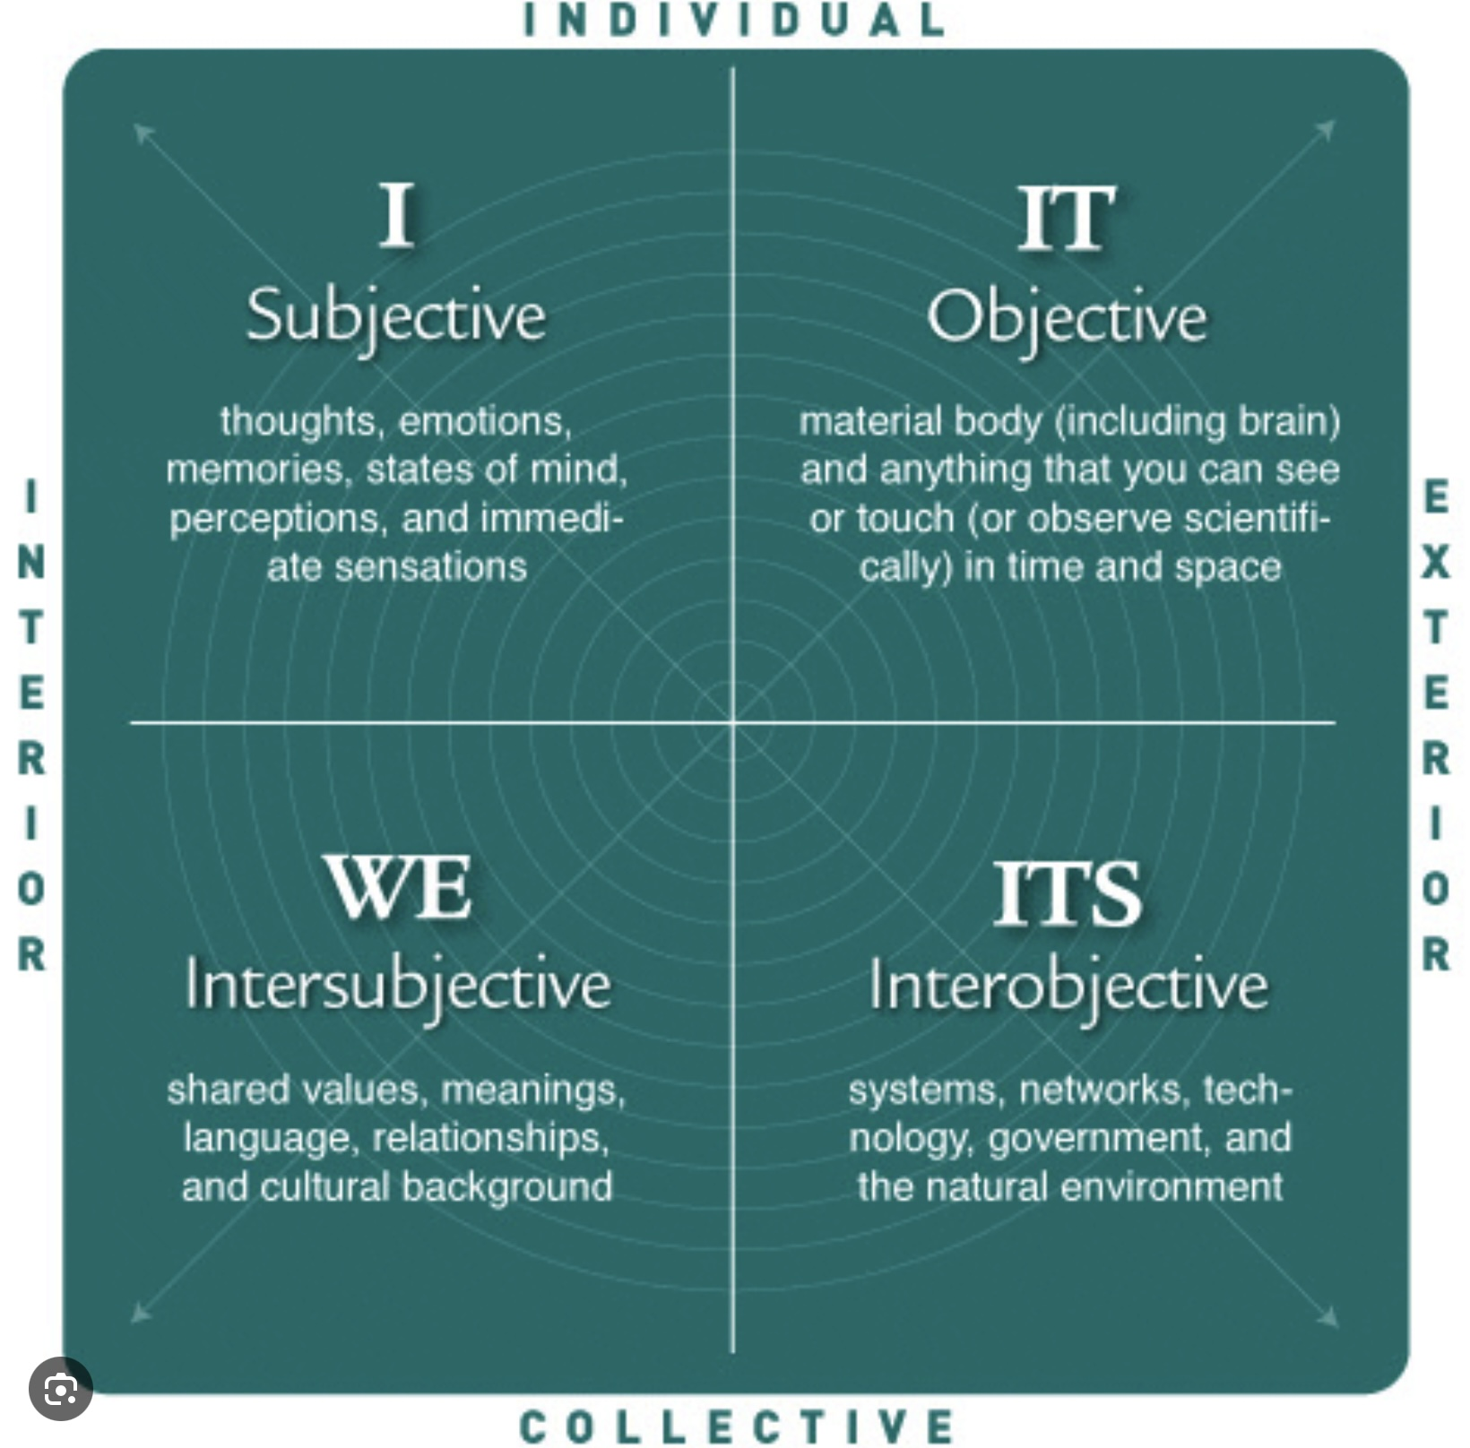
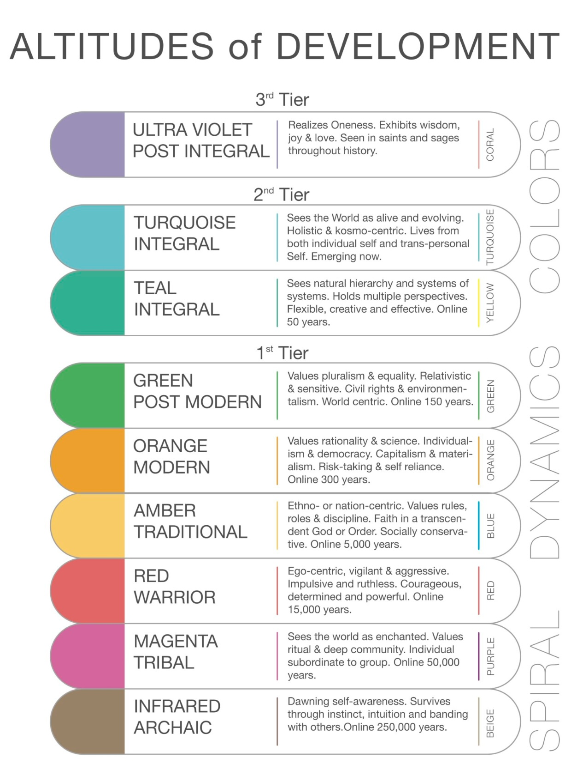
INTEGRAL THEORY AND MEANING

Slide 150
The concept of meaning is a profoundly important topic to which many disciplines and some of history’s most influential thinkers have contributed. Given the vastness of the subject, it’s difficult for someone setting out to explore it to know where to begin. Fortunately, there is an approach that offers us a gateway into our exploration.
Integral theory is a comprehensive framework, developed by philosopher Ken Wilber, that helps us understand and integrate various dimensions of human experience and knowledge. It aims to bring together insights from different disciplines, including psychology, philosophy, science, and spirituality, into a cohesive holistic model. We will explore meaning through the lens of integral theory.
Integral theory has five main concepts.
1. The AQAL (All Quadrants, All Levels) concept describes four quadrants that represent different perspectives on reality:
-The Interior-Individual quadrant focuses on personal, subjective experiences.
-The Exterior-Individual quadrant looks at observable, objective aspects of individuals.
-The Interior-Collective quadrant centers on shared cultural values and beliefs.
-The Exterior-Collective quadrant examines social systems and structures.
The AQAL model provides a framework for examining any phenomenon from multiple perspectives to achieve a more comprehensive understanding.

Slide 151
2. The levels (or Stages) concept describes the developmental stages through which individuals and cultures evolve. Various models of development are used in integral theory to describe stages in areas such as cognitive, moral, and spiritual development. The stages of development represent increasing levels of complexity and integration. Developmental stages help us understand how individuals and societies evolve over time and how different stages of development influence our perspectives and behaviors.
3. The lines concept refers to the different areas or lines of development, such as cognitive, emotional, moral, interpersonal, and spiritual intelligence. The lines model recognizes that people can develop differently across these lines, excelling in some areas while being less developed in others. This model also provides insight into the multifaceted nature of growth and highlights that development is not uniform across all areas of life.
4. The states concept refers to temporary states of consciousness that individuals may experience. These states includes waking, dreaming, meditative, and altered states of awareness. The states model differentiates between temporary peak experiences and permanent stages of development, recognizing that states can offer glimpses of stages yet to be achieved.
5. The types concept acknowledges the variety of personality types and differences in individual orientations. Examples include the Myers-Briggs Type Indicator typology, gender differences, and other personality frameworks. The types model ensures that the integral approach is flexible and inclusive, taking into account the rich diversity of human expression and orientation.

Slide 152
These five concepts are interwoven to provide a nuanced and versatile framework. They offer tools for engaging with the complexity of human experience and the intricacies of both personal and collective development.
AQAL:
Integral Theory's four quadrants offer a comprehensive framework for understanding complex issues by examining them from multiple perspectives. This approach is particularly relevant in addressing contemporary global and individual challenges.
The Interior-Individual quadrant highlights the importance of personal experiences, thoughts, and emotions. It is crucial in fields like psychology, personal development, and education. In mental health, understanding a person’s subjective experiences and personal narratives is key to effective therapy and healing. In education, catering to individual learning styles and fostering self-awareness can enhance student engagement and success.
The Exterior-Individual quadrant focuses on the biological and behavioral aspects of individuals. It is an essential perspective in the natural sciences and healthcare. In medicine, this perspective emphasizes diagnosing and treating physical conditions through observable data and medical interventions.
The Interior-Collective quadrant encompasses cultural norms, shared values, and worldviews, which are critical in understanding societal dynamics and cultural interactions. In multicultural settings, appreciating diverse cultural perspectives can foster inclusivity and mutual understanding. In organizational development, aligning company culture with shared values can enhance collaboration and morale.

Slide 153
The Exterior-Collective quadrant examines social systems, structures, and environments. It is key in sociology, political sciences, and environmental studies. In urban planning, considering infrastructure and systems helps design sustainable cities. In policy making, understanding socio-economic structures and their impacts can guide effective legislation and governance.
By incorporating insights from all four quadrants, Integral Theory facilitates a holistic approach to problem-solving. For instance, addressing climate change requires:
Understanding individual perceptions and values about the environment (Interior-Individual quadrant).
Assessing technological innovations and their impacts (Exterior-Individual quadrant).
Fostering global cultural shifts towards sustainability (Interior-Collective quadrant).
Implementing systemic changes in policies and infrastructure (Exterior-Collective quadrant).
The four quadrants provide a structured way to integrate diverse perspectives, making this model a valuable tool for developing more comprehensive and inclusive solutions in a complex world.
The levels or stages:
Integral theory’s stages of development, growth, or consciousness, describe the evolution of individual and collective awareness. These stages are part of Wilber's developmental model, which outlines how human consciousness evolves over time.

Slide 154
Integral stages of development apply both at a personal and a cultural level.
On a personal level, individuals go through various developmental stages throughout their lives. These stages include cognitive, emotional, and moral development, as described by theorists like Jean Piaget, Erik Erikson, and Lawrence Kohlberg. Each stage of development represents a new level of understanding and capability, allowing individuals to navigate the world with increasing sophistication.
Culturally, societies can also be seen as progressing through stages of development. This idea is explored in theories like those of anthropologist Jean Gebser, who suggests that cultures evolve through stages that reflect increasing complexity in worldviews, values, and social structures.
The development of individuals and cultures is interconnected. As individuals within a society develop, they contribute to cultural evolution by introducing new ideas, technologies, and social norms. Conversely, the cultural context influences personal development by providing the environment and resources necessary for growth.
Integral theory’s stages of development are not strictly linear or uniform. Different individuals and cultures may experience development in unique ways, influenced by historical, environmental, and social factors.
Additionally, the concept of stages is a framework to help us understand complexity and growth, but it doesn't imply that one stage is inherently better than another. Each stage has its own strengths and limitations, and the goal according to integral theory, is to integrate the best aspects of each stage.

Slide 155
Integral theory describes several stages of cultural evolution:
Archaic is the earliest stage. It was common among the earliest Homo Sapiens. It is characterized by basic survival instincts and a focus on immediate physical needs.
Next is the Magic stage. At this stage individuals see the world through a lens of magic and myth, often attributing supernatural qualities to natural phenomena. At this stage individuals are animists believing everything has a soul.
The Traditional or Mythic stage is next and is marked by the emergence of organized religion and mythological narratives that provide meaning and structure to life. This is Western culture from ancient Greece, to the Roman empire through to the 18th century. A significant percentage of people today are at this level.
At the Modern or Rational stage individuals begin to rely on reason, logic, and empirical evidence. This stage is associated with the Enlightenment and the rise of science. It is the dominant stage in our culture.
At the Post-modern or Pluralistic stage there is an appreciation for diversity, relativism, and multiple perspectives. This stage emphasizes social justice and equality. This equity, diversity and inclusion. People who identify as progressives are at this stage.
The leading edge of cultural evolution is the integral stage which seeks to integrate the insights of all previous stages, recognizing the value and limitations of each. It aims for a holistic understanding that transcends and includes earlier perspectives. Less than 5% of the population today is at this stage.

Slide 156
Figures that might be considered “enlightened” such as Jesus, The Buddha, Ghandi and Mandela had views.
Integral theory encourages the development of ever more inclusive and comprehensive worldviews that acknowledge the complexity and interconnectedness of all aspects of life.
Within integral theory’s framework, Wilber also outlines four processes associated with psychological growth that he calls "Cleaning Up," "Growing Up," "Showing Up," and "Waking Up."
Each of these processes addresses different aspects of personal and spiritual development. Each pertains to a unique dimension of growth and awareness, offering a comprehensive roadmap for holistic human development.
Cleaning up involves addressing and healing one's shadow aspects, or those parts of ourselves that are repressed or denied such as unresolved traumas, and unconscious biases. This is done as we become more aware of and integrate these parts. Cleaning up is crucial because without it, these shadow aspects distort our perception and hinder our overall growth and realization of potential.
Techniques such as psychotherapy, shadow work, and self-reflection are used in this aspect of development. This process helps individuals confront unresolved issues, traumas, and subconscious patterns.
By cleaning up, individuals develop healthier psyches, reducing internal conflicts and fostering emotional resilience.

Slide 157
Growing up refers to the maturation process in terms of psychological and moral development. As we grow up, we progress through various levels of maturity and complexity, such as Jean Piaget's stages of cognitive development, Lawrence Kohlberg's stages of moral development, or Robert Kegan's stages of adult development.
This is a process of moving through developmental stages where one's understanding of self, others, and the world becomes more complex and integrated. Growing up is about, over time, developing a more inclusive and sophisticated worldview. Growing up involves expanding our perspective-taking, empathy, and problem-solving abilities, allowing us to navigate the world with greater sophistication.
Showing Up involves being present and fully engaged with the world in all of its complexity. It includes understanding and participating in multiple aspects of life and acknowledging their interrelatedness. It involves activism, social responsibility, and fostering connections across different cultural, social, and ecological contexts.
Showing up is about applying our resources and insights to contribute positively to the world around us. Showing up encourages active participation in life, embracing one's roles and responsibilities across various domains, from personal to professional and societal.
Showing up means being accountable for one's actions and contributions, promoting integrity and effective collaboration with others.

Slide 158
Waking up is about experiencing spiritual awakening or enlightenment. It involves transcending the ego and realizing the deeper states of consciousness and connection to a greater whole, that are described in mystical and spiritual traditions.
Waking up focuses on attaining awareness of the interconnectedness of all things and the nature of reality beyond individual identity. Waking up involves practices like meditation, mindfulness, and other spiritual disciplines that facilitate shifts in consciousness toward enlightenment or non-dual awareness.
Waking up enables individuals to transcend ordinary awareness, fostering a sense of unity, peace, and compassion that profoundly impacts their outlook and interactions.
Integral theory proposes that well-rounded personal and spiritual development includes balancing psychological health (cleaning up), societal engagement (showing up), cognitive and emotional maturity (growing up), and spiritual insight (waking up).
By cleaning up shadow aspects, growing up developmentally, showing up in the world, and waking up spiritually, we can achieve a more holistic and integrated life, a benefit not only to ourselves but also to our communities.
Another of Integral theory’s core principles is the idea of "transcend and include”. Transcend and include refers to the notion that as individuals or systems evolve, they move to higher levels of development by transcending the limitations of previous stages while also integrating essential aspects of those earlier stages.

Slide 159
To transcend a stage means to move beyond it, achieving a more sophisticated and expansive perspective or capability. This involves leaving behind certain limitations and constraints associated with an earlier way of thinking or being. For example, a person might transcend a self-centered (egocentric) viewpoint as they develop a greater capacity for empathy and concern for others (ethnocentric or world-centric).
Include means retaining valuable lessons, skills, and insights from previous stages in a way that enriches the new, more complex stage. The strengths and positive attributes of earlier stages are integrated into a more comprehensive understanding. For instance, while a person might move beyond purely self-oriented motivations, they still include healthy self-care and self-awareness developed in earlier stages.
In the context of personal development or spiritual growth, "transcend and include" emphasizes that each stage of growth builds upon its predecessors. Rather than wholly discarding previous stages, individuals carry forward and integrate what is beneficial as they grow into new levels of understanding and awareness.
This principle rejects the idea of simply replacing old stages with new ones; instead, it promotes a holistic development path where all phases of growth are respected as necessary components of an individual's evolving consciousness. This approach helps in maintaining continuity and coherence in development, fostering a balanced and integrated progression.

Slide 160
PART II-LOSING MEANING
How “My” stories lose meaning.
Meaningful traditional stories.
Paradigm shifts.
The shift from a traditional to a modern story.
“Our” and “The” stories lose meaning.
The postmodern stage

Slide 161


Slide 162
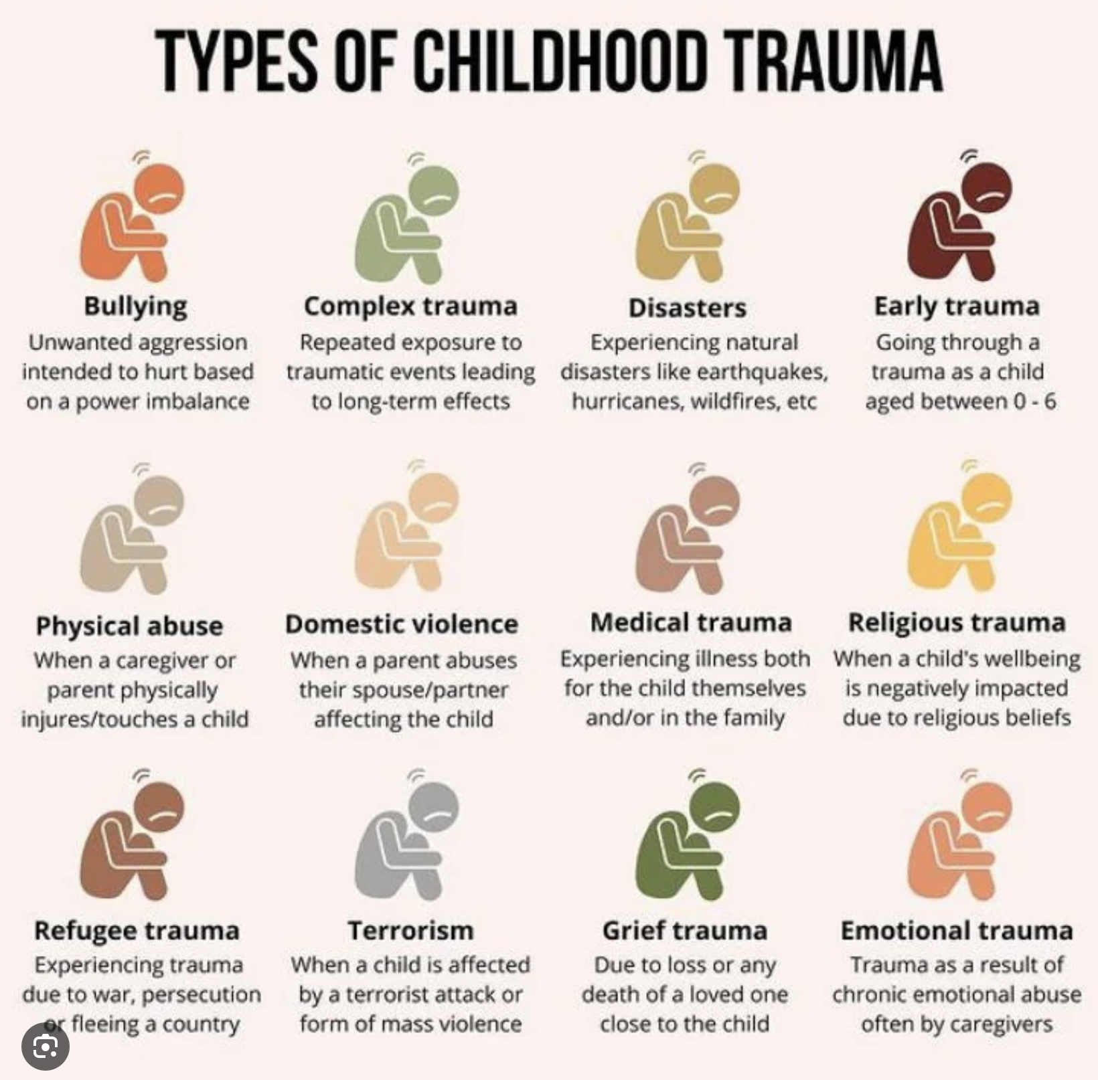
HOW “MY STORIES” LOSE MEANING

Slide 163
“My story” describes who I am and how I may or not be significant. It guides me in my everyday life. Psychology and psychotherapy encourages us to explore “My stories”. “My stories” significantly contribute to our sense of meaning. “My stories” are shaped by our psychosocial development and therefor by the temperament we’re born with, and by our experiences.
Trauma and Attachment issues are two important factors affecting psychosocial development, personality and “My stories”. Both can lead to difficulties forming trusting and meaningful relationships resulting in a sense of isolation and disconnection, emotional dysregulation, and a negative and fearful view of the world. These difficulties make it challenging to find stability and meaning in everyday life.
Attachment patterns formed in early relationships with our main caregivers, affect a person’s views of themselves and others. Individuals with secure attachment styles are more likely have a positive view of themselves and others. They are generally more capable of forming healthy, supportive, trusting relationships from which they derive a sense of meaning and purpose.
Those with an anxious attachment styles struggle with feelings of insecurity and a constant need for reassurance. This can lead to difficulties in finding meaning, as their focus might be more on seeking validation from others rather than exploring personal values and goals.

Slide 164
People with avoidant attachment styles prioritize independence and self-reliance, sometimes at the expense of close relationships. This can result in a more solitary search for meaning, which might be challenging if they avoid deep connections that could provide insight and support.
Individuals with a disorganized attachment styles may experience confusion and fear in relationships, making it difficult to find a stable sense of meaning. Their internal conflict can hinder the development of a coherent life narrative, which is essential for perceiving meaning in life.
While attachment styles influence how individuals experience and pursue meaning in life, they are not deterministic. People can work towards understanding and potentially altering their attachment styles through therapy, self-reflection, and building healthy relationships, which can, in turn, enhance their sense of meaning and purpose.
Conditions such as depression and anxiety that frequently result from significant trauma and attachment disorders also disrupt a person’s ability to perceive meaning and purpose in life.
To understand how trauma and attachment issues affect people’s sense of meaning it’s helpful to consider how they affect personality development.

Slide 165
Erik Erikson's stages of psychosocial development provide a framework for understanding how personality evolves and how individuals find meaning throughout their lives. Each of Erikson’s eight stages presents a specific conflict or challenge that must be resolved for healthy psychosocial development to occur.
Successfully navigating these stages can contribute to a person's sense of meaning and purpose, failure to do so can lead to a loss of meaning.
Erikson called his first stage Trust vs. Mistrust (Infancy). In this stage, developing a sense of trust in caregivers and the environment lays the foundation for feeling secure and valued, which is essential for finding meaning in relationships and the world.
Autonomy vs. Shame and Doubt (Early Childhood). As children gain independence, they learn to make choices and develop self-confidence. This autonomy fosters a sense of control and agency, contributing to a meaningful sense of self.
Initiative vs. Guilt (Preschool Age). Children begin to assert power and control through directing play and social interactions. Successfully taking initiative helps them develop a sense of purpose and the ability to set and pursue goals.
Industry vs. Inferiority (School Age). Mastering new skills and tasks leads to a sense of competence and achievement. Feeling industrious contributes to self-esteem and a sense of contribution, which are important for finding meaning in work and accomplishments.

Slide 166
Identity vs. Role Confusion (Adolescence). This stage involves exploring personal identity and values. Successfully forming a coherent identity helps individuals understand their place in the world and what gives their life meaning.
Intimacy vs. Isolation (Young Adulthood). Building deep, meaningful relationships is central to this stage. The ability to form intimate connections contributes to a sense of belonging and fulfillment, which are key components of life's meaning.
Generativity vs. Stagnation (Middle Adulthood). This stage focuses on contributing to society and helping the next generation. Generativity, or the desire to create and nurture, provides a sense of purpose and legacy.
The final stage, which occurs in late adulthood, known as "Integrity vs. Despair“, involves reflecting on the entirety of one's life and assessing if it was meaningful and fulfilling. When individuals find coherence, purpose, and significance in their lives, they experience a sense of integrity accepting life as it was lived. They acknowledge both successes and failures and feel a sense of completeness and satisfaction. This involves understanding and integrating their life story into a broader context, finding meaning in relationships, achievements, and even in challenges faced.
If, on the other hand, individuals struggle to find meaning in their past, they may experience despair. This can manifest as feelings of regret, bitterness, or a sense of wasted opportunities. Despair arises when individuals perceive their lives as lacking purpose or when they are unable to reconcile their past with their present sense of self.

Slide 167
As we progress through these stages, we confront and resolve conflicts that shape our understanding of ourselves and our place in the world. Successfully navigating these stages, Erikson suggests, leads to a deeper sense of meaning and fulfillment in life.
John Bowlby, the father of attachment theory, studied how parental absence, abandonment and neglect led to insecure attachment styles. Attachment theory describes the disastrous effects unattuned, neglectful, abusive or inappropriately responsive parenting can have on individuals and their “My story.”
Secure attachment is necessary for optimal psychosocial development. Secure attachment is about healthy trust in ourselves, society and the world.
Just as attachment issues with parental figures affects personality and our sense of meaning, the lack of healthy and meaningful “Our” and "The stories” in today’s modern and postmodern stages dominated culture make us “social” and "cosmic” neglected, abandoned or orphaned “children” who as a result develop insecure attachments to our communities, culture and to the universe we inhabit.
The consequences of this insecure attachment to our communities and to a meaningful story about the universe, albeit not as well studied, may be as damaging as insecure attachment to parental figures.
Healing which for many of us must take place before we’re able to feel that our lives are meaningful, has to take into account not only our unhealthy “My stories” but must also contend with problematic “Our and The stories.” Let’s now consider such stories.

Slide 168
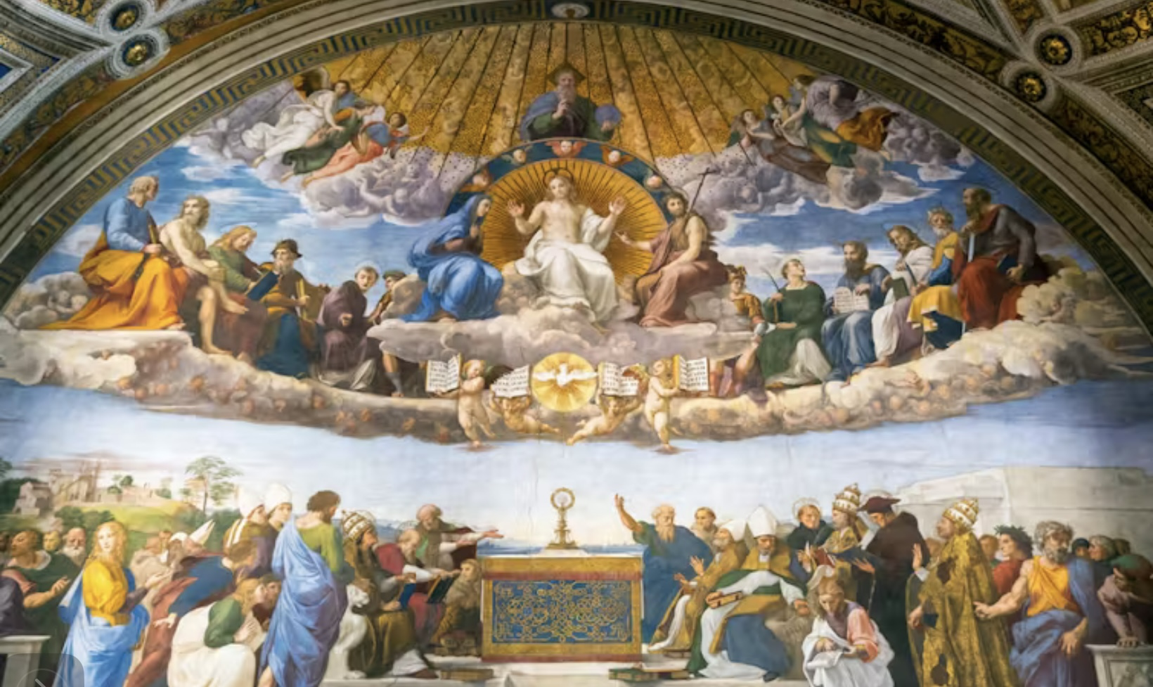
MEANINGFUL TRADITIONAL STORIES

Slide 169
Integral theory’s traditional stage dominated Western culture from the fall of the Roman Empire in the 5th century through the Renaissance in the 14th century and into the modern period in the 18th and 19th centuries. During this time, societies were largely agrarian, and social structures were heavily influenced by religion and feudal systems.
The traditional stage is characterized by narratives about the world and the universe that are deeply rooted in order, meaning, and a sense of divine or cosmic purpose. People at the traditional stage see the universe as ordered, purposeful, and guided by a divine will or cosmic plan. Everything has its place and functions according to a grand design decreed by a higher power governing the universe.
At this stage, people understand the world through the lens of religious beliefs. A divine authority, such as God or gods, is believed to be actively involved in the world, providing moral guidance and purpose to human life.
The universe is explained and understood through mythic narratives and symbols that convey deep truths and moral lessons. These stories often involve archetypal figures and events that illustrate the struggle between good and evil, order and chaos.
At the traditional stage there is a belief in fixed, eternal truths that are revealed through sacred texts, traditions, or religious teachings. These truths are seen as unchanging and provide a stable foundation for understanding the world.
The universe is perceived as having a hierarchical structure, with a clear order of beings and entities, from the divine down to humans and other creatures. This hierarchy, known as “the great chain of being”, is mirrored in social structures, which reinforce the importance of authority and tradition.

Slide 170
The traditional stage emphasizes order, stability, and structure. Traditional societies value hierarchy and clear roles within social structures, which are seen as necessary for maintaining social cohesion and continuity. Respect for authority and tradition is paramount. Leaders, whether religious, political, or familial, are often seen as embodying the wisdom and values of the culture, and their guidance is considered essential.
There is a strong emphasis on community and belonging, with individuals finding meaning and identity through their roles within a larger collective, often defined by religious, ethnic, or cultural affiliations. Cultural narratives emphasize belonging to a group and adhering to its norms and traditions.
At the traditional stage there can be a strong distinction between in-groups and out-groups, with a focus on loyalty to one's own group and skepticism or hostility toward outsiders. This can manifest in nationalism, religious exclusivity, or cultural conservatism.
Rituals and ceremonies are important for reinforcing cultural values and social bonds providing a sense of continuity and connection to the past.
Ethical and moral codes are often viewed as absolute and divinely ordained. Traditional narratives stress adherence to established moral laws and customs as a way to maintain social order and righteousness. In this moral universe actions have consequences, and there is a clear distinction between right and wrong.
Stories and myths play a central role in conveying cultural values and explaining the world. These narratives involve religious themes and are used to instill a sense of meaning and purpose.

Slide 171
Traditional narratives serve to provide a sense of meaning, purpose, and belonging within a stable social framework, they can, however, be rigid and resistance to change, as the emphasis on maintaining established norms limits openness to new ideas and perspectives.
While the best aspects of the traditional stage do provide a strong sense of meaning, throughout the period dominated by this stage life, for most people, was as described by Thomas Hobbes “solitary, poor, nasty brutish and short.”

Slide 172

Loss of meaning in My, Ours and The stories
PARADIGM SHIFTS

Slide 173
Philosopher of science Thomas Kuhn, in his seminal 1962 book "The Structure of Scientific Revolutions," describes a paradigm shift as a fundamental change in the basic concepts and experimental practices of a scientific discipline.
According to Kuhn, a paradigm shift occurs when the existing scientific framework or paradigm becomes inadequate to explain anomalies or new data, leading to a crisis. During this crisis, new ideas and theories emerge, eventually leading to a shift in the prevailing paradigm. For a paradigm shift to occur, Kuhn argues that the following are generally required:
1. Anomalies: Persistent problems or anomalies that cannot be explained by the current paradigm.
2. Crisis: Recognition of these anomalies leads to a crisis in confidence in the existing paradigm.
3. New Ideas: The development of new theories or ideas that better explain the anomalies.
4. Adoption: Gradual acceptance of the new paradigm by the scientific community, often involving a generational shift as new scientists adopt the new framework.
There are many similarities between the cultural stage shifts described in integral theory and Kuhnian scientific paradigm shifts. Both types of shifts involve a transformation in worldviews and require a reorganization of existing knowledge.

Slide 174
In both integral theory and Kuhn's philosophy of science, paradigm shifts involve a fundamental change in understanding and interpretation, whether it be in personal consciousness or scientific frameworks. New stages or scientific paradigms face resistance from those invested in the current ones, but when adopted they provide a more comprehensive understanding of reality.
The modern and postmodern worldviews have been the dominant frameworks for Western culture which, it is now clear, is in a serious crisis. This crisis points to the limitations and contradictions in these worldviews.
The modern and post-modern worldviews can also not explain a wide range of spiritual phenomena which have been part of the human experience from time immemorial, but which are now label “anomalous”.
The crisis we’re facing, and the anomalies the modern and post-modern stages cannot explain, result from their physicalist metaphysics which reduces complex phenomena to their simplest components, leading to a fragmented understanding of reality which overlooks the interconnectedness and holistic aspects of reality.

Slide 175
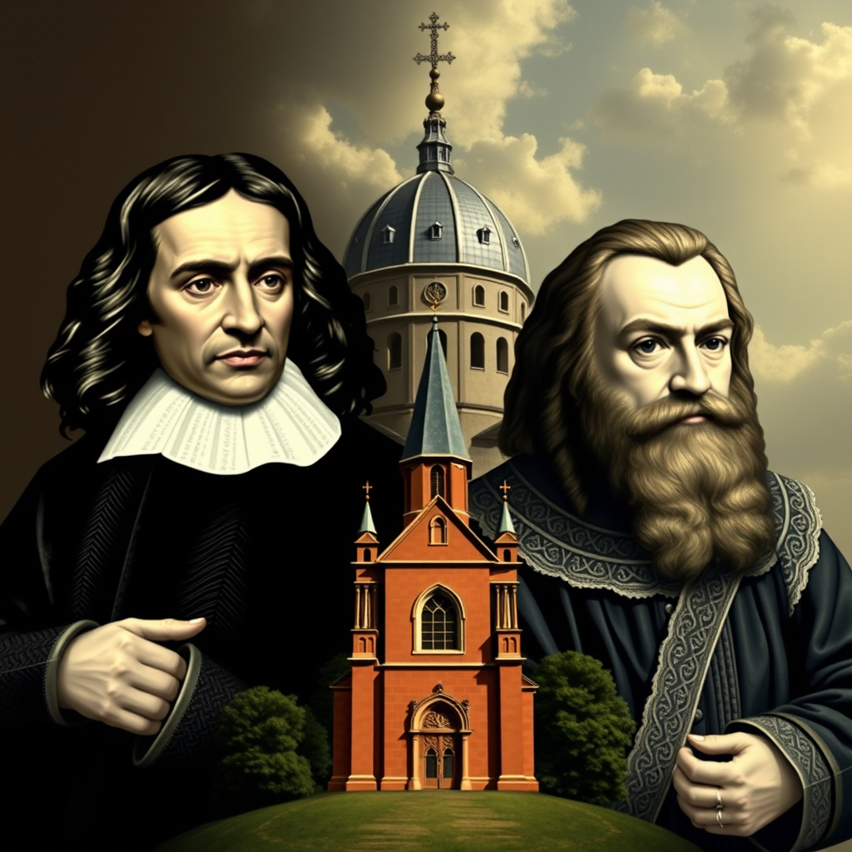
THE SHIFT FROM A TRADITIONAL TO A MODERN STORY

Slide 176
Up until the 16th century, Western beliefs about cosmology, biology, and physics were heavily influenced by medieval scholars like Thomas Aquinas. Aquinas and the Scholastic tradition, which sought to reconcile faith and reason, played a crucial role in integrating ancient Greek philosophy with Christian theology, creating a synthesis that dominated Western thought until the Scientific Revolution.
Prior to the scientific revolution, the geocentric model of the universe, which placed Earth at the center of creation, was widely accepted. This model was largely based on the work of Claudius Ptolemy, an ancient Greek astronomer. The Ptolemaic system was also influenced by Aristotle, who believed in a finite, spherical universe with Earth at its center. The geocentric view was in harmony with the teachings of the Catholic Church, which saw it as consistent with scriptural interpretations.
Before the scientific revolution biological understanding was primarily based on the works of Aristotle and Galen. Aristotle's classification of living organisms and his ideas about the "Great Chain of Being," which ranked all forms of life in a hierarchical order, were influential.
Galen, a Roman physician, contributed significantly to the understanding of human anatomy and physiology, although many of his ideas were based on animal dissection and were later found to be incorrect.
In physics, Aristotle's ideas dominated, particularly his belief that all matter was a combination, in varying proportions, of four elements: earth, water, air, and fire.

Slide 177
Alchemy and astrology were very influential, blending mystical and empirical approaches to understanding the natural world.
Before the scientific revolution, theories about the natural world were in harmony with the Catholic church’s views. The Scientific Revolution, which began in the 16th century, heralded the transition from traditional to modern science, challenging and eventually transforming the previously long-held beliefs about the world. Figures such as Copernicus, Galileo, Kepler, and Newton were key to this transition.
The Scientific Revolution began in Europe at the end of the Renaissance. Its birth is generally dated to the year 1543 and more specifically to the post-humous publication of Nicolaus Copernicus’s “On the revolutions of the heavenly spheres.“ Copernicus’ heliocentric model would eventually overturn Ptolemy's geocentric universe.
The Scientific revolution was a series of events that marked the emergence of modern science in which developments in mathematics, physics, astronomy, biology and chemistry transformed our views of nature and the world.
The scientific revolution and the ideas it generated slowly displaced the Catholic church endorsed 2000-year-old Aristotelian/Ptolemaic classical view of the world replacing it with the scientific method an approach based on deductive reasoning in which knowledge is sought by abandoning assumptions and attempting to observe nature with an open mind.

Slide 178
The Scientific Revolution was a transformative period in history, roughly spanning from the late 16th to the 18th centuries, during which significant advancements were made in scientific thought and practice. This era marked a departure from medieval and ancient explanations of the natural world, emphasizing observation, experimentation, and the application of reason. The scientific revolution transformed human thought.
Many factors contributed to the Scientific revolution including the Renaissance’s revival of classical learning, innovations such as the printing press, improvements in instruments like the telescope and microscope, the increasing importance of mathematics as a tool for understanding nature, and the questioning of traditional authorities, including the Church and ancient philosophers like Aristotle.
The Age of Exploration also expanded people’s knowledge of the world and introduced new phenomena that required explanation. The study of new plants, animals, and cultures encouraged a more empirical approach to science.
The establishment of scientific societies and institutions, such as the Royal Society in England, provided a platform for collaboration, communication, and validation of new ideas.
All these factors created an environment ripe for scientific inquiry and innovation, leading to groundbreaking discoveries and the establishment of modern scientific principles.

Slide 179
The Scientific Revolution was marked by the contributions of several key figures who made significant advancements in various fields of science. Some of the most influential scientists and thinkers from this period include:
Nicholas Copernicus (1473 – 1543) – Copernicus was a mathematician and astronomer who formulated a heliocentric model of the universe which eventually replaced the Ptolemaic geocentric model.
Andreas Vesalius (1514–1564) was a Flemish physician and anatomist, Vesalius is considered the founder of modern human anatomy. His work, “On the Fabric of the Human Body”, provided detailed descriptions and illustrations of human anatomy based on dissections, challenging many of the misconceptions held since antiquity.
Francis Bacon (1561-1626-) Bacon criticized scholars for relying too heavily on Aristotle and other ancient thinkers. He emphasized empiricism or doing experiments from which conclusions could then be drawn. Bacon laid the foundations of the scientific method.
Johannes Kepler (1571–1630) was a German mathematician and astronomer, Kepler is best known for formulating the laws of planetary motion. His three laws described the elliptical orbits of planets and provided a mathematical framework for understanding celestial mechanics.

Slide 180
Galileo Galilei (1564 – 1642) – Galileo was a philosopher, astronomer, and mathematician who made fundamental contributions to the sciences of motion, astronomy, and to the development of the scientific method. He was the first to use a telescope to make celestial observations. Infamously, church official Cesare Cremonini, refused to look through Galileo’s telescope at the moon choosing to believe it was a perfect sphere as doctrine had it, rather than riddled with craters.
William Harvey (1578–1657) was an English physician, Harvey is best known for his discovery of the circulation of blood in the human body. His work, “On the Motion of the Heart”, provided a groundbreaking understanding of the cardiovascular system.
Robert Boyle (1627–1691) was an Anglo-Irish chemist and physicist, Boyle is often referred to as the "father of modern chemistry." He is known for Boyle's Law, which describes the relationship between the pressure and volume of a gas. His work emphasized the importance of experimentation and the scientific method in chemistry.
Isaac Newton (1642 – 1726) – Newton is considered one of the greatest scientists of all time. His work laid the foundations for classical mechanics, and he made seminal contributions to optics. With Leibniz he shares credit for the development of calculus.
Gottfried Wilhelm Leibniz (1646–1716) was a German mathematician and philosopher, Leibniz contributed to calculus (independently of Newton) and made significant advances in mathematics and philosophy. His work laid the groundwork for later developments in both fields.

Slide 181
These and many other great scientists played pivotal roles in shaping the landscape of the Scientific Revolution, contributing to the development of new ideas, methodologies, and technologies that continue to influence modern science today.
The scientific method of inquiry developed during the scientific revolution is still used today. It is a systematic approach to inquiry used to investigate phenomena, acquire new knowledge, and correct and integrate previous knowledge. The scientific method is characterized by a series of steps that help ensure that its findings are reliable and valid. While the exact steps can vary, the scientific method generally includes several components:
1) Observing the world… (for example the planets and stars and their movements)
2) Based on these observations a specific question is formulated and…( what is the structure of the Universe?)
3) A hypothesis is proposed as a tentative explanation for the observed phenomenon... ( Heliocentric universe)
4) Experiments are designed and conducted to test the hypothesis…
5) Data is then collected and analyzed to determine whether it supports or refutes the hypothesis…
6) Based on an analysis of the data, a conclusion is drawn…
7) The results of the research are shared with the scientific community through publications, presentations, and discussions…
8)This allows other scientists to review, replicate, refute and build upon the findings.
Scientific inquiry is ongoing. New questions may arise from previous conclusions, leading to further investigation and refinement of knowledge.

Slide 182
As a scientific outlook became well established, there came to be two divergent and increasingly distinct ways of understanding the world; the scientific and the religious.
Science uses the scientific method and relies on empirical evidence, experimentation, and observation to draw conclusions.
Religion, on the other hand, relies on faith, personal spiritual experiences, divine revelations, sacred texts, rituals and teachings as sources of knowledge and understanding.
The relationship between science and religion evolved over centuries. The shift from the geocentric to the heliocentric model proposed by Copernicus and later supported by Galileo challenged the Church's teachings, which were based on biblical texts that adopted a geocentric Ptolemaic view of the Universe. This challenge to the established dogma initially led to a suppression of the scientific enterprise by the church authorities.
Infamously, in 1600, Giordano Bruno was burned at the stake for questioning the church’s dogma. Bruno (1548-1600) was an Italian philosopher, mathematician, and cosmological theorist. Bruno joined the Dominican Order at a young age and studied theology and philosophy. However, his unorthodox views soon led to his conflicts with the Church.

Slide 183
Bruno is renowned for his cosmological theories, which went beyond the Copernican model of the solar system. He proposed that the universe was infinite and contained numerous worlds similar to Earth, challenging the geocentric model and the notion of a finite universe. These views were considered heretical by the Catholic Church. In 1592, Bruno was arrested and tried for heresy by the Roman Catholic Church. Despite being given opportunities to recant, Bruno refused to renounce his beliefs.
After a prolonged trial, Bruno was declared a heretic and sentenced to death. He was burned at the stake in Rome on February 17, 1600. His execution is often cited as a stark example of the suppression of free thought and the clash between science and religious authority.
Giordano Bruno is remembered as a martyr for free thought and intellectual freedom. His ideas were ahead of his time and influenced later scientific and philosophical developments. Today, he is celebrated as a pioneer of modern cosmology and a symbol of the struggle for intellectual liberty.
The relationship between Galileo Galilei, René Descartes, and the Church played out as the church progressively lost and science gained influence over the Western worldview. This period saw the gradual development of a clearer distinction between science and religion, where science focused on understanding the physical universe through observation and experimentation, while religion addressed spiritual and moral questions.

Slide 184
Galileo's support for the heliocentric model brought him into conflict with the Catholic Church. In 1633, Galileo was tried by the Roman Catholic Inquisition and found guilty of heresy for advocating heliocentrism. He was forced to recant his views and spent the rest of his life under house arrest.
Galileo's trial highlighted the tensions between scientific inquiry and religious doctrine, underscoring the need for a clearer distinction between scientific explanations based on observation and experimentation and religious beliefs based on faith and scripture.
René Descartes (1596-1650) is known for his philosophical approach that emphasized doubt and reason. His famous dictum, "Cogito, ergo sum" ("I think, therefore I am"), reflects his method of systematic doubt and emphasis on the mind as the foundation of knowledge.
Descartes was very aware of Galileo's conflict with the Church and took a more cautious approach in his own work. He delayed the publication of some of his writings that could be seen as controversial, such as "The World," which supported heliocentrism.
Descartes proposed a form of dualism that separated the mind and the body. Today many see dualism as an attempt to delineate the realms of science (the physical world) and religion (the spiritual or mental realm).
This separation of spheres of inquiry worked well at first with science and religion temporarily peacefully co-existing.

Slide 185
The ideas and discoveries of the Scientific Revolution increasingly started to contribute to a broader cultural shift, which promoted secularism and challenged religious doctrine. This cultural shift soon affected all aspects of Western thought and paved the way for the Enlightenment.
The Enlightenment, also known as the Age of Reason, was an intellectual and cultural movement that emerged in Europe during the late 17th and 18th centuries. It emphasized reason, individualism, and skepticism of traditional authority, advocating for the application of scientific methods to understand and reform society. Enlightenment thinkers championed ideas such as liberty, progress, tolerance, fraternity, constitutional government, and the separation of church and state.
The Scientific Revolution laid the groundwork for the Enlightenment by challenging traditional views of the cosmos and nature, demonstrating the power of human reason and observation. Enlightenment thinkers were inspired by scientific advances and sought to apply similar principles of rational inquiry and empirical evidence to philosophy, politics, and society.
This led to a broader questioning of established norms and institutions, ultimately influencing revolutions and reforms across Europe and the Americas. The ideas and discoveries of the Scientific Revolution increasingly started to contribute to a broader cultural shift, which promoted secularism and challenged religious doctrine.

Slide 186
The enlightened was a watershed in the transition from the traditional to the modern stages of development.
While the Scientific Revolution provided the knowledge and methods that made technological advancements possible, the Enlightenment fostered a cultural and intellectual climate that encouraged innovation and the application of science to industry. Together, these movements set the stage for the profound changes brought about by the Industrial Revolution.
During the Middle Ages and the early Renaissance, the height of the traditional stage, the Church was the dominant force in Western culture. It wielded significant influence over various aspects of life, including politics, education, and morality. The Church was a central institution that provided spiritual guidance, and it played a key role in governance, with church leaders holding substantial power and authority. The Church was also a major patron of the arts.

Slide 187
The transition to the modern stage led to the separation of church and state. This was driven by the enlightenment thinkers desire for religious freedom, scientific progress, and political reform. Thinkers such as Locke, Voltaire, Rousseau, Diderot and Hume advocated for reason, individual rights, and secular governance, which led to a decline in the Church's direct political power.
The separation of church and state became more pronounced, allowing for greater religious diversity and the development of secular institutions. This shift paved the way for modern democratic societies where religious and governmental powers are distinct.
The modern stage is characterized by a rational, scientific, and individualistic worldview. The universe is primarily seen through a scientific lens. People at this stage value reason, evidence, and objective analysis. Progress, innovation, and the power of human reason to solve problems and improve the human condition are key ideas.
In the modern worldview the universe is seen as a vast, mechanistic system governed by natural laws that can be understood through scientific inquiry.
Individuals are seen as rational agents capable of independent thought and decision-making whose focus is on personal achievement, self-improvement, and the pursuit of individual goals. There is a strong emphasis on meritocracy, where individuals are valued based on their abilities, accomplishments, and contributions. Success is measured by material wealth, career advancement, and social status.

Slide 188
Human nature and behavior are also understood through scientific methods. Psychology, biology, and other sciences are used to explain human actions and motivations.
Society is viewed as a platform for progress and innovation. Technological advancements and scientific discoveries are seen as key drivers of societal improvement and economic growth.
The modern stage often aligns with capitalist economic systems and democratic governance. These systems are valued for promoting individual freedom, competition, and the efficient allocation of resources.
At the modern stage there is a strong emphasis on the rule of law, individual rights, and equality of opportunity. Legal systems are designed to protect individual freedoms and ensure fairness.
By the middle of the 19th century scientific progress had led to such enormous progress in knowledge and technology that the scientific community began to believe that they had arrived at a final and complete picture of the universe. Matter, it was thought, was the fundamental substance in the Universe. Mind was the result of complex arrangement of matter. This physicalist metaphysics had no place or need for the human Soul, the Spirit, or for God.
The hubris of this era was evident in Lord Kelvin's pronouncement “There is nothing new to be discovered in physics now. All that remains is to make more and more precise measurements.“ The 19th-century picture of a machine-like universe was reinforced by the mechanization that accompanied the Industrial Revolution.

Slide 189
People at the traditional stage believed in the existence of two realms:
1. The visible, this worldly, material, mundane realm and
2. the more important invisible, other worldly, immaterial, sacred realm.
Gradually, however, with the transition to the modern stage and as science helped us understand the natural world, people increasingly adopted a secular worldview and the authority of religion, and its institutions began to decrease. The other worldly, immaterial, sacred realm was no longer thought to be real. Its disappearance produced a crisis of meaning.

Slide 190

HOW “OUR” AND “THE” STORIES LOST MEANING

Slide 191
The modern worldview brought immense progress in terms of scientific knowledge, technological advancement, and increased personal freedoms. However, by overthrowing the religious absolute truths which provided a deep sense of meaning and community, it also set the stage for a growing sense of disenchantment.
The modern stage is characterized by an emphasis on rationality, science, and empirical evidence as a primary means of understanding the world. This way of understanding the world dismisses and undervalues subjective experiences, such as spirituality and the sacred realm that are intangible but give us meaning.
The expression "disenchantment of the world" refers to a process described by sociologist Max Weber (1864-1920), which denotes the decline of mystical and religious explanations of the world in favor of rational, scientific understanding. The concept suggests that as societies modernize, they move away from the traditional religious interpretations of reality to more secular worldviews.
“Disenchantment" also implies a loss of the wonder and meaning that was associated with pre-modern belief systems. Instead, the focus shifts to empirical evidence and rational thought, which while leading to a more systematic and predictable understanding of the universe, also results in feelings of alienation or a lack of purpose for individuals and whole cultures. Disenchantment is an important component of the meaning crisis.
The transition from the traditional to modern stages involved a shift from collective, religiously anchored meaning to a more individualistic and rational perspective.

Slide 192
While traditional communities were often close-knit, with shared values and practices, modernity placed a strong emphasis on individualism and personal freedom which empowered personal growth and self-expression.
Individualism however led to isolation and a lack of communal support while the focus on the self resulted in a fragmented sense of identity and purpose. The modern stage’s individualism and mobility weakened communal bonds and created feelings of isolation, and the loss of community support and shared identity contributed to a sense of meaninglessness.
The modern era equates progress with material success and consumerism. This focus on external achievements is associated with a neglect of inner fulfillment and purpose, resulting in a sense of emptiness when material possessions and status fail to provide lasting satisfaction.
Modernity has been marked by rapid technological advancement, which has both connected and alienated individuals. While technology offers unprecedented access to information and communication, it also leads to information overload and superficial interactions, detracting from deeper, more meaningful connections.
Traditional philosophy focuses on metaphysical and moral absolutes. The modern stage introduces skepticism and empiricism, emphasizing reason and evidence. While this shift advanced critical thinking and scientific inquiry, it also led to existential questions about the nature of truth and meaning, as absolute answers become less tenable.

Slide 193
At the traditional stage, meaning is derived from established structures such as religion, family, and community. These structures provide a shared narrative and a sense of belonging. As society moved into the modern stage, these structures began to be questioned and challenged, leading to a loss of the shared meaning they provided.
At the traditional stage, religion provides a central source of meaning, offering a shared narrative and moral framework. As societies transitioned to the modern stage, there was a move towards secularism and a questioning of religious authority. This led to a decline in religious participation and a sense of loss for those who relied on religious structures for meaning and community.
Traditional morality was typically based on established norms and religious teachings. The modern stage encouraged moral relativism and personal autonomy, which led to ethical ambiguity. While this allowed for greater personal freedom, it also resulted in confusion about right and wrong, contributing to a sense of moral disorientation.
In traditional societies, political systems were intertwined with religious and cultural narratives. The modern stage introduced secular governance and democratic ideals, which led to political fragmentation and polarization as diverse perspectives vied for influence. This created uncertainty and a lack of a cohesive national identity.
Witnessing that the moral frameworks provided by religion were being challenged by the forces of modernity, in 1882 Friedrich Nietzsche famously pronounced "God is dead" a commentary on the decline of traditional religious and metaphysical beliefs.

Slide 194
Nietzsche's statement was not a literal claim about the existence of God but rather a metaphorical expression of the cultural and philosophical changes of his time. He believed that the "death" of traditional beliefs could lead to both challenges and opportunities for humanity to redefine itself.
Nietzsche saw the rise of secularism and the questioning of religious institutions as a necessary but painful transition, in which humanity would have to create its own values and meanings in a world without apparent divine oversight.
Nietzsche explored ideas about the meaning of life, the nature of existence, and the concept of individual freedom. His critiques of traditional morality and religion, as well as his emphasis on the creation of one's own values paved the way for 20th century’s existentialist movement.

Slide 195

THE POSTMODERN STAGE

Slide 196
By the middle of the 20th century, the problems inherent in the modern worldview were becoming evident and the post-modern stage emerged critiquing and attempting to address these problems.
The postmodern stage of development, often referred to in integral theory as the "Green" stage, follows the modern stage and presents a worldview that emphasizes pluralism, relativism, and a deep appreciation for diversity and interconnectedness.
Some of the most influential post-modern thinkers include:
Jean-François Lyotard who is best known for his work "The Postmodern Condition," in which he describes postmodernity as characterized by a skepticism toward grand narratives and overarching theories.
Michel Foucault a French philosopher and social theorist known for his studies on power, knowledge, and discourse, particularly how they are used to control and define societal norms, as explored in works like "Discipline and Punish" and "The History of Sexuality.“
Jacques Derrida, the founder of deconstruction, focused on the instability of language and the concept that meanings are always deferred, as discussed in "Of Grammatology.“
Jean Baudrillard a French sociologist and philosopher known for his concepts of hyperreality and simulation, particularly in his work "Simulacra and Simulation," which examines how reality is constructed and experienced in the modern world.

Slide 197
Fredric Jameson an American literary critic and theorist who analyzed postmodernism as the cultural logic of late capitalism in works like "Postmodernism, or The Cultural Logic of Late Capitalism.“
Richard Rorty an American philosopher who contributed to the development of pragmatic philosophy in a postmodern context, emphasizing cultural and contingency narratives over a quest for absolute truths.
Judith Butler known for her work on gender theory, particularly "Gender Trouble," Butler explored the performative nature of gender and identity, challenging traditional binary classifications.
Encouraging a focus on diversity, pluralism, and the questioning of established norms and authorities, postmodern views have influenced a wide range of disciplines, including sociology, anthropology, and political science.
The post-modern worldview values diversity and inclusivity, recognizing the importance of multiple perspectives and voices. It emphasizes social justice, equality, and the empowerment of marginalized groups. It takes a critical stance toward traditional hierarchies and power structures challenging established norms and opposing systems of oppression and privilege.
The post-modern stage sees society as a tapestry of interconnected communities where collaboration and consensus-building are prioritized over competition and individualism.

Slide 198
Cultural relativism is a key feature of the postmodern stage which views cultural norms and values as context-dependent and to be respected in their own right.
Postmodern relativism questions the existence of universal or objective truths positing that what we consider "truth" is shaped by social, cultural, and linguistic contexts, and therefore, multiple, equally valid truths can coexist.
The Postmodern stage is skeptical of grand narratives or overarching explanations that claim to provide comprehensive accounts of history, culture, or human experience. Instead, it emphasizes local, fragmented, and diverse narratives.
Language is seen as a central element in shaping our understanding of reality. Postmodern relativism suggests that meaning is not fixed but is constructed through language and discourse, which are influenced by power dynamics and cultural contexts. This perspective holds that cultural norms and moral values are not absolute but are relative to specific societies or communities. What is considered right or true in one culture may not be so in another.
The post-modern stage celebrates cultural differences, with an emphasis on the richness that diverse traditions, languages, and artistic expressions bring to the human experience. It values narratives and stories as essential ways of understanding human experience, often highlighting the subjective and constructed nature of reality. It sees the universe as an interconnected web of relationships, where everything is interdependent. This perspective aligns with ecological awareness and a commitment to sustainability.

Slide 199
The post-modern stage takes a holistic approach to understanding the universe, integrating scientific, spiritual, and indigenous knowledge systems to appreciate the complexity and mystery of existence.
Postmodernism challenges traditional metaphysical concepts, such as objective reality, fixed essences, and universal truths. Instead, it emphasizes the contingent, constructed, and subjective nature of reality. Postmodern thinkers tend to argue that what we understand as "reality" is mediated through language, culture, and social practices, making it relative rather than absolute.
Postmodernism approaches metaphysical idealism and physicalism with skepticism. It rejects grand narratives and absolute truths, including those proposed by metaphysical idealism. Instead of asserting an overarching reality grounded in the mind or consciousness, postmodernism emphasizes the relativity of experience and interpretation.
Postmodernism approaches religion with a critical eye, questioning the authority and universality of religious narratives. It tends to highlight the diversity of religious experiences and beliefs, focusing on how they are socially and culturally constructed. Postmodern thinkers might see religious texts and practices as open to interpretation and reinterpretation, without a single, overarching truth. This perspective can lead to a more pluralistic and tolerant view of different religious traditions.

Slide 200
In the realm of spirituality, postmodernism often embraces a more individualized and eclectic approach. It encourages personal exploration and the blending of various spiritual traditions, practices, and beliefs. This can result in a focus on personal meaning and experience rather than adherence to a rigid set of doctrines. Postmodern spirituality is often less concerned with seeking absolute answers and more focused on personal fulfillment and transformation.
Postmodernism values plurality and diversity over singular explanations. In contrast to metaphysical idealism's potential claim of a unified immaterial reality, postmodern thought tends to emphasize fragmentation and the multiplicity of perspectives, suggesting that no single metaphysical account can encompass the complexity of human experience.
Postmodernists focus on the contingent nature of knowledge and the importance of context. They argue that what might be considered "reality" is profoundly shaped by historical, cultural, and social contexts, in contrast to the more static accounts of reality often posited by metaphysical idealism and physicalism.
Postmodern relativism has significantly impacted contemporary thought by encouraging a more nuanced understanding of knowledge, culture, and identity, highlighting the importance of context and perspective in shaping our realities.

Slide 201
Although, as with every other stage, post-modernism has contributed significantly to contemporary thought and our understanding of the world, some of its aspects are quite pernicious. Postmodern relativism has led to nihilism, whereby the rejection of objective truths results in a lack of meaning or value.
This rejection extends to the objectivity and reliability of scientific knowledge with the post-modern claim that scientific truths are merely social constructs.
The postmodern critique of grand narratives such as those offered by science, religion, or political ideologies has undermined the overarching stories that have traditionally provided people with a sense of purpose and direction. While this critique is valuable in highlighting the limitations and biases of these narratives, it has also left individuals without a clear sense of belonging or purpose as no alternative narratives are offered.
Postmodernism highlights the fragmented and constructed nature of reality, emphasizing the multiplicity of perspectives and experiences. While this enriches our understanding of complexity, it has also led to a fragmented sense of self and society. Without a unifying framework, individuals struggle to integrate these diverse perspectives into a coherent sense of identity and purpose.
The relativistic view of morality leads to ethical ambiguity, where it becomes difficult to critique harmful practices or defend human rights universally.

Slide 202
The postmodern emphasis on questioning authority and established norms has fostered skepticism and cynicism, leading to a distrust of institutions and traditional sources of meaning. This skepticism, while valuable in promoting critical thinking, also contributes to feelings of disillusionment and alienation.
The postmodern worldview, while offering valuable insights into diversity, pluralism, and the critique of power structures, accelerated the loss of meaning that began with the modern stage.

Slide 203
PART III- CRISIS
The polycrisis
A brief economic history
The gilded age
The great depression
The new deal
Neo-liberalism
The 2008 financial crisis
The decline of the American empire
Fake News

Slide 204

THE POLYCRISIS

Slide 205
The loss of meaning that individuals and societies are experiencing in the early decades of the 21st century has been called “the meaning crisis”.
The meaning crisis is characterized by a pervasive sense of disconnection, lack of purpose, and existential uncertainty. Traditional belief systems that once provided a sense of coherence and direction are increasingly being questioned and abandoned in the face of rapid technological, social, and cultural changes.
The meaning crisis isn’t, however, the only crisis we’re facing today. The term "polycrisis" was coined to describe the multiple crises we’re simultaneously confronting. Our era has not only lost meaning but also faces economic instability, climate change, political unrest, and more frequent public health emergencies.
These multiple crisis interact with and exacerbate each other, leading to a complex and unpredictable set of challenges. For example, economic inequity and loss of trust in government limit resources available for addressing climate change. Climate-related disasters in turn strain economies and exacerbate social and political tensions further eroding trust in experts and institutions. Public health crisis like the COVID pandemic disrupt economies and deepen existing inequalities, which in turn fuels more political instability. One crisis feeds another in a vicious cycle.
The polycrisis, with its interconnected and compounding challenges, has significantly impacted mental health, particularly among the most vulnerable populations, which are always the first to be affected by societal stressors. The uncertainty, unpredictability and stress associated with the multiple crises has caused the rates of mental health issues to skyrocket and people who face economic, social, or health-related insecurities experience these effects more intensely.

Slide 206
Exposure to crises such as natural disasters, conflict, or pandemics increases the rates of stress related conditions including post-traumatic stress disorder (PTSD). Vulnerable groups, including refugees, low-income communities, and those with pre-existing mental health conditions, are particularly susceptible.
Crises disrupt social networks and community support systems, leading people to feel isolated and lonely. Vulnerable individuals, such as the elderly or those with disabilities, find it more challenging to maintain social connections.
Financial instability and its associated stresses, job loss, housing insecurity, and lack of access to basic needs which is becoming widespread, also greatly exacerbate mental health issues.
Vulnerable populations have always faced barriers accessing mental health care, but lack of access has become worse as healthcare systems become ever more underfunded and overwhelmed.
The population that has been the most affected by the polycrisis are children and youth. Disruptions to education, increasingly stressed families, and intense exposure to new emotionally dysregulating digital technologies and algorithms whose effects are just beginning to be studied, have resulted in a catastrophic rise in mental health problems in the young.
The root cause of the polycrisis is the global modern economic and political system known as “end stage capitalism”. This system is designed to protect the interests of the wealthy and corporations even as it greatly damages the environment, society and 99% of the world’s population. Let’s now consider how this situation came to be.

Slide 207
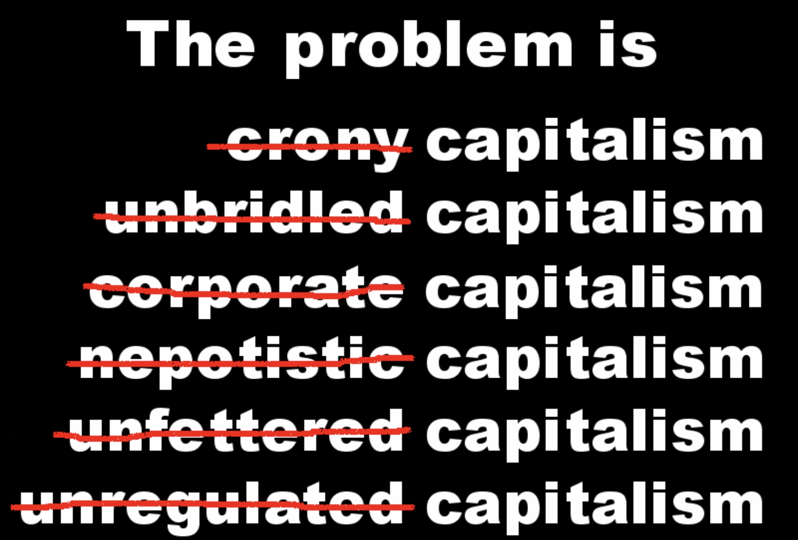
A BRIEF HISTORY OF THE ECONOMIC CRISIS

Slide 208
“Political language…is designed to make lies sound truthful, murder respectable, and to give an appearance of solidity to pure wind”. George Orwell
“The things you own end up owning you” Anon
“All experience has shown that mankind is more disposed to suffer while evils are sufferable than to right themselves by abolishing the forms to which they are accustomed.” The U.S. declaration of independence
“When plunder becomes a way of life for a group of men living together in society, they create for themselves in the course of time a legal system that authorizes it and a moral code that glorifies it.” Frederic Bastiat
“To understand something is to be liberated from it” Anon
“There’s enough in the world for everybody but not for everybody’s greed” Mahatma Ghandi

Slide 209
The six ages of Empire
The concept of the six ages that define the lifespan of an empire is a theoretical framework that describes the rise and fall of civilizations through distinct stages. This model is used by historians to analyze and understand the patterns and dynamics of empires.
The initial stage of an empire, the age of pioneers, is characterized by exploration and expansion. Pioneers, often driven by the search for resources, land, or religious freedom establish new territories. During this period, the foundations of the empire are laid. The focus is on survival, settlement, and establishing a foothold in new regions.
In the second stage, the age of conquests, the empire aggressively expands its borders through military conquest and strategic alliances. The focus is on building a powerful military, subjugating neighboring territories, and consolidating power. This age often sees significant territorial gains and the establishment of a dominant presence in a region.
With established territories, the empire shifts its focus to economic growth and trade which the model calls the age of commerce. Commerce flourishes as trade routes are developed, and markets expand. The emphasis during the age of commerce, is on building infrastructure, fostering trade relationships, and accumulating wealth. This period typically sees the rise of a merchant class and increased urbanization.

Slide 210
In the age of affluence, the empire reaches a peak of wealth and prosperity. Cultural and artistic achievements flourish, and there is an emphasis on luxury and leisure. The society enjoys a high standard of living, and there is often a focus on monumental architecture and public works. This age is marked by stability and confidence in the empire's power.
During the age of intellect, intellectual and cultural pursuits become the focus, with advancements in science, philosophy, and the arts. Education and knowledge are highly valued, and there is a flourishing of ideas and innovation. This period often sees the establishment of universities, libraries, and centers of learning, contributing to a rich cultural legacy.
The final stage is characterized by decline and decay. It is the age of decadence. A decadent empire becomes complacent and overextended, facing internal corruption, social unrest, and economic stagnation. There is often a loss of civic virtue and a focus on personal gain over the common good.
External pressures, such as invasions or competition, exacerbate the decline, ultimately leading to the empire's fall. Common features to every age of decadence are an undisciplined overextended military, a conspicuous display of wealth, a massive disparity between rich and poor, a desire to live off a bloated State, an obsession with sex and a debasement of the currency.
Though not every empire follows this exact pattern, these stages provide a well accepted historical framework for understanding the lifecycle of empires.

Slide 211
Today’s Empire is not confined to a territory such as the U.S. or China. The empire we see today is international global capitalism which shares many characteristics of historical empires. Like empires of the past, global capitalism exerts significant influence across the world shaping economies, cultures, and politics in numerous countries, and transcending national borders.
Instead of territorial control, global capitalism is about economic dominance. Multinational corporations, financial institutions, and global markets play roles similar to those of imperial powers, driving economic policies and practices worldwide.
Just as empires spread their cultures, global capitalism promotes certain cultural values, such as consumerism, individualism, and the pursuit of profit. This has led to a form of cultural homogenization, where local traditions and practices are influenced by global capitalist norms.
The power dynamics in global capitalism resembles those of empires, with wealth and decision-making concentrated in a few powerful corporations, people, and regions whose monopoly on power creates enormous inequality.
Unlike traditional empires that relied on physical territory, global capitalism is more adaptable to change, using technology and innovation to maintain and expand its influence.
There are many indications that the global capitalist empire has entered its age of decadence. To understand how this has happened let’s consider some economic trends seen over the last 150 years.

Slide 212

THE GILDED AGE

Slide 213
The Gilded Age refers to a period in U.S. history from roughly the 1870s to about 1900, characterized by rapid economic growth, industrialization, and significant social changes. The term "Gilded Age" was coined by Mark Twain and Charles Dudley Warner in their 1873 novel “The Gilded Age: A Tale of Today”, which satirized the era as one of serious social problems masked by a thin gold gilding.
The Gilded Age saw the expansion of production capabilities and industries such as steel, railroads, oil, and manufacturing. This period was also marked by significant technological advancements including the telephone, electric light, and the expansion of the railroad network.
Rapid industrialization led to the growth of cities as people moved from rural areas to urban centers in search of jobs. This urbanization brought about significant changes in living conditions and social dynamics.
During this period, the United States experienced a massive influx of immigrants, primarily from Europe, who provided labor for factories and contributed to the cultural diversity of the nation.
The era was also notorious for political corruption and patronage. Political machines, such as Tammany Hall in New York City, wielded significant influence and engaged in corrupt practices.
While the gilded age produced immense wealth for industrialists and entrepreneurs, it also led to stark income inequality. A small elite amassed vast fortunes, while most workers lived in poverty.
The harsh working conditions and low wages led to the rise of labor unions and frequent strikes. Notable labor conflicts included the Haymarket Riot, the Homestead Strike, and the Pullman Strike.

Slide 214
The gilded age was known for its “robber barons” a group of U.S. industrialists and financiers that amassed vast wealth and power over the economy and politics through their unscrupulous exploitative and monopolistic business practices.
The Industrial Revolution brought about significant technological innovations, such as the steam engine, railroads, and mechanized manufacturing. These advancements created new industries and opportunities for entrepreneurs to capitalize on.
The rapid industrialization led to unprecedented economic growth and the expansion of markets. This environment allowed ambitious individuals to build large enterprises and accumulate wealth.
As people moved to cities for work, there was a growing demand for goods and services, which further fueled industrial expansion and the rise of large corporations.
During this period, the U.S. government largely adhered to laissez-faire economic policies, which meant minimal interference in business activities. This lack of regulation allowed business leaders to engage in practices that prioritized profit over fair competition and worker rights.
Without antitrust laws, many of these industrialists were able to establish monopolies or near-monopolies in their industries. They often used tactics like predatory pricing, buying out competitors, and forming trusts to control markets.
The absence of labor laws allowed for poor working conditions, low wages, and long hours. Workers had little recourse against exploitation, which contributed to the industrialists' ability to maximize profits.

Slide 215
The wealth and power of the robber barons enabled them to exert considerable influence over politics, often through lobbying and corruption. This further entrenched their positions and staved off regulatory efforts.
Notable Robber Barons included: John D. Rockefeller who founded Standard Oil and controlled a significant portion of the oil industry. Andrew Carnegie who led the expansion of the American steel industry. J.P. Morgan a powerful banker who financed and consolidated industries and Cornelius Vanderbilt who built his fortune in railroads and shipping
Emile Durkheim (1858-1917) and Max Weber (1864-1920) who are considered as the fathers of the field of sociology observed and commented on the effects of the industrial revolution.
Durkheim was intrigued by how suicide rates, an indicator of mental illness, had increased dramatically in his native France, and throughout Europe, in the second half of the 19th century as the industrial revolution was occurring.
In his book “Suicide” Durkheim coined the term “anomie” to describe this phenomenon. Durkheim defined anomie as the uprooting or breakdown of moral values, standards, or guidance for individuals.
He observed that the industrial revolution had caused people to leave their traditional rural lives in which they were connected to families, communities, their work, the land and traditional religion. In their new roles as labourers in industrial cities they lost connections to old those traditions and ways of living that gave their lives meaning.

Slide 216
Durkheim also noted that the increase in suicide rates was more pronounced among protestants than Catholics. Catholics, he argued, seemed to be more able to stay connected to family and religion than protestants. This, Durkheim thought protected them from anomie and suicide.
Anomie, or the loss of meaning as people abandon traditional ways of life, often because of financial pressures, has affected many other communities such as native North Americans, and working-class people living in the American rust belt, Appalachia, and the Canadian “oil patch”.
Durkheim’s Anomie and the present-day “deaths of despair” are very similar concepts.
Notes:
Emile Durkheim and Max Weber, the fathers of sociology were very intrigued by this question.

Slide 217

THE GREAT DEPRESSION

Slide 218
The Gilded Age set the financial conditions that led to the Great Depression. The income inequality and uneven distribution of the benefits of growth along with the rise of speculative investments and questionable financial practices led to great economic instability. The lack of regulation during the Gilded Age and the subsequent decades allowed risky financial behavior to proliferate, leading to economic vulnerabilities.
The economic patterns prevalent during the Gilded Age, such as cycles of boom and bust, was enabled by the government’s laissez-faire attitude towards business which continued into the 1920s. The 1920s, following the great war, saw a soaring stock market that fueled a period of optimism referred to as the "Roaring Twenties“.
The lack of banking regulations resulted in a stock market bubble that burst in 1929. This led to the severe economic downturn.
The Great Depression was the result of a combination of economic factors. The crash of the stock market led to a dramatic loss of wealth, jobs and confidence in the economy, which in turn caused a reduction in consumer spending and investment.
Many banks had invested heavily in the stock market or made risky loans. When the market crashed, these banks faced insolvency, leading to widespread bank failures and loss of savings.
As people lost their savings and jobs, consumer spending plummeted, leading to a decline in production and further job losses. The decrease in demand for goods led to massive layoffs, which further reduced consumer spending in a vicious cycle.

Slide 219
The Smoot-Hawley Tariff Act of 1930 raised tariffs on imported goods, leading to retaliatory tariffs from other countries and a decrease in international trade.
The Dust Bowl in the central United States exacerbated the economic situation by devastating agricultural production.
During and following the Great Depression, the influence and fortunes of the robber barons and their successors went through significant changes.
The Great Depression led to increased scrutiny and regulation of large corporations. The New Deal policies introduced by President Franklin D. Roosevelt aimed to curb the power of monopolies and prevent the kind of economic practices that had contributed to the financial collapse. This resulted in antitrust actions and regulations that reduced the dominance of some of these large conglomerates.
The public perception of the robber barons had already been negative due to their ruthless business practices. The economic hardships of the Great Depression further fueled resentment towards these industrialists and their perceived role in creating economic inequality and instability. This shift in public sentiment supported political and regulatory changes.
Many of the original robber barons had already passed away by the time of the Great Depression, but their legacies continued through philanthropic efforts. For example, Andrew Carnegie and John D. Rockefeller had established foundations and donated substantial portions of their wealth to various causes. These philanthropic efforts helped to somewhat rehabilitate their public images.

Slide 220
The Great Depression had profound and far-reaching effects on people and society, both in the United States and around the world.
Unemployment rates soared reaching as high as 25% in the United States. Millions of people lost their jobs, leading to widespread financial insecurity and hardship.
With the loss of jobs, many families fell into poverty. Homelessness increased as people were unable to pay their rent or mortgages, leading to the creation of shantytowns, called "Hoovervilles," after President Herbert Hoover, who was blamed by many for the economic crisis.
The economic downturn led to a significant decline in living standards. Families had to cut back on basic necessities, and malnutrition became a serious issue, particularly among children.
The Great Depression had a severe psychological impact on those who lived through it. The loss of financial security and the struggle to survive led to increased levels of stress, anxiety, and depression.
Economic hardship forced many families to adapt. Some families broke apart as members left to seek work elsewhere, while others had to take in extended family members to share resources. Traditional gender roles were also challenged as women increasingly sought work to help support their families. Many people migrated in search of work, both within countries and internationally.
In the United States, the Dust Bowl, a severe drought that affected the Great Plains, compounded the economic challenges, leading to mass migrations, particularly to the West Coast.

Slide 221
The widespread hardship led to social unrest and increased demand for political change. In many countries, this resulted in the rise of new political movements and leaders who promised economic reform and relief for the suffering population.
The Great Depression played a significant role in the rise of totalitarian regimes in several countries, particularly in Europe. The economic turmoil and social instability created fertile ground for radical political movements that promised solutions to the widespread suffering and uncertainty.
The severe economic hardship caused by the Great Depression left many people desperate for change. Unemployment, poverty, and declining living standards made radical political solutions more appealing, as traditional democratic governments seemed unable to address the crisis effectively.
In many countries, the inability of democratic governments to effectively respond to the economic crisis led to disillusionment with democratic institutions. This disillusionment made authoritarian and totalitarian ideologies, which promised decisive action and stability, more attractive to the populace.
The economic instability provided an opportunity for extremist political parties to gain support. In Germany, for example, the Nazi Party, led by Adolf Hitler, capitalized on public discontent by blaming the economic woes on scapegoats like Jews and communists, and promising to restore Germany's prosperity and national pride.
The economic crisis exacerbated political polarization, with people gravitating towards extreme left or right-wing ideologies. This polarization led to political instability, which authoritarian leaders exploited to consolidate power.

Slide 222
The Great Depression intensified nationalist sentiments, as people sought to blame external forces or other nations for their economic troubles. This nationalism went hand-in-hand with militarism, as regimes like Nazi Germany and Fascist Italy sought to expand their territories as a means of economic recovery and national rejuvenation.
Totalitarian regimes promised swift and effective solutions to economic problems through centralized control and planning. In the Soviet Union, for example, Joseph Stalin implemented aggressive industrialization and collectivization policies, which were presented as necessary for economic recovery and growth.
While the Great Depression was not the sole cause of the rise of totalitarian regimes, it created conditions that facilitated their ascent. The combination of economic desperation, political instability, and social unrest provided an environment in which authoritarian leaders could gain power by promising order, stability, and national renewal.
.

Slide 223

THE NEW DEAL

Slide 224
The hardships of the Great Depression highlighted the need for comprehensive social and economic reforms. Calls for reform eventually led to the implementation of laws, regulations and protections that improved the conditions of the working class.
Many governments, most notably in the United States under Franklin D. Roosevelt's New Deal, expanded their role in the economy. In the U.S. significant changes in economic policy were implemented, including the development of Keynesian economics, which advocated for increased government intervention to manage economic cycles. This included providing social safety nets like Social Security, unemployment insurance, and various public works programs to create jobs and stimulate economic recovery.
The excesses and inequalities of the Gilded Age and the calamities of the great depression set the stage for the Progressive Era, which sought to address issues like monopolies, corruption, and social injustices through regulatory measures and reforms.
The New Deal, introduced by President Franklin D. Roosevelt, aimed to address the economic and political issues that culminated in the great depression through a series of programs and reforms.
The Emergency Banking Relief Act and the Glass-Steagall Act helped stabilize the banking system by providing government support and creating the Federal Deposit Insurance Corporation (FDIC) to insure bank deposits.

Slide 225
Programs like the Civilian Conservation Corps (CCC) and the Works Progress Administration (WPA) created millions of jobs in public works projects, helping to reduce unemployment.
The Securities Act of 1933 and the Securities Exchange Act of 1934 established regulations to prevent the kind of speculative practices that led to the stock market crash.
The Agricultural Adjustment Act aimed to raise crop prices by paying farmers to reduce production, addressing the agricultural crisis.
The National Industrial Recovery Act sought to stimulate industrial production and improve labor conditions through industry-wide codes.
The social Security Act of 1935 established a system of old-age benefits, unemployment insurance, and aid to families with dependent children, laying the groundwork for the modern welfare state. This act provided financial assistance to the elderly, unemployed, and disabled, helping to stabilize consumer spending.
The Wagner Act of 1935 strengthened labor unions by guaranteeing workers the right to collective bargaining and protecting union activities.
The Fair Labor Standards Act of 1938 established minimum wage and maximum hour standards, which helped improve the living conditions of low-wage workers. This was a step toward reducing income disparity.
.

Slide 226
The Federal Art Project, Federal Writers' Project, and Federal Theatre Project provided support for artists, writers, and performers, leading to a flourishing of American arts and culture.
The Rural Electrification Administration (REA) was created to bring electricity to rural areas, significantly improving the quality of life and economic productivity in those regions.
While the New Deal did not end the Great Depression entirely, it provided critical relief and reforms that helped stabilize the economy and laid the groundwork for economic recovery.
During the New Deal era, there were significant efforts to address economic inequality and promote social justice.
The New Deal's various job creation programs helped reduce unemployment and provided income to millions of Americans. This contributed to a reduction in economic inequality by providing work and wages to those who had been hardest hit by the Great Depression.
The New Deal's various job creation programs helped reduce unemployment and provided income to millions of Americans. This contributed to a reduction in economic inequality by providing work and wages to those who had been hardest hit by the Great Depression.

Slide 227
The New Deal included efforts to support marginalized groups, such as African Americans, women, and Native Americans, but these efforts were often limited and inconsistent. Programs like the Indian Reorganization Act of 1934 aimed to restore some self-governance to Native American tribes, but racial and gender inequalities persisted. Despite some progress, racial inequality remained a significant issue.
Many New Deal programs were administered locally and discriminated against African Americans, particularly in the South. For example, the exclusion of agricultural and domestic workers from Social Security initially left out many African American workers.
Women gained some new opportunities through New Deal programs, but they too continued to be relegated to lower-paying jobs and faced significant barriers to equality in the workforce.
The New Deal made important strides in addressing economic inequality and laying the groundwork for social welfare in the United States but its impact on social justice was uneven, with significant limitations in addressing racial and gender inequalities.
The New Deal marked a shift to an era that saw the Democratic Party become the dominant political force, with a strong coalition that included urban workers, ethnic minorities, and the rural poor.

Slide 228
As the economy recovered from the Great Depression, many of the industries previously dominated by the robber barons diversified. New industries emerged, and technological advancements shifted the focus away from the traditional sectors like railroads and steel, which had been the foundation of many robber barons' fortunes.
Despite the changes, some of the business empires built by the robber barons continued to wield significant influence. Companies like Standard Oil (which was broken up into several companies) and U.S. Steel remained major players in their respective industries, though under new regulatory constraints.
While the Great Depression marked the end of the era of the robber barons as they were originally known, the impact of their business practices and the wealth they accumulated continued to shape the American economic and social landscape for decades.

Slide 229

NEO-LIBERALISM

Slide 230
The classical and neoclassical schools of economics are two influential frameworks that have shaped economic thought and policy since the 1800s.
Classical economics emerged in the late 18th and early 19th centuries through the works of Adam Smith, David Ricardo, Thomas Malthus, and John Stuart Mill. Classical economists advocated for minimal government intervention in the economy, believing that free markets naturally regulate themselves through the forces of supply and demand. The term” invisible hand” coined by Adam Smith suggested that individuals pursuing their self-interest inadvertently contribute to the overall good of society.
Classical economists, particularly Ricardo, believed that the value of a good is determined by the labor required to produce it. They focused on how wealth is created and distributed in society, with particular emphasis on capital accumulation and land rents. Say’s Law a key principle of classical economics posits that supply creates its own demand, meaning that production inherently leads to consumption.
Neoclassical economics was developed in the late 19th century and remains influential today. Some of its early proponents included William Stanley Jevons, Carl Menger, and Léon Walras. Neoclassical economics introduced the concept of marginal utility, which suggests that the value of a good is determined by its additional (marginal) utility to consumers. It assumes that individuals make decisions to maximize their utility, and firms make decisions to maximize profits, based on available information.
Neoclassical economics focuses on how supply and demand interact to determine prices and quantities in markets, aiming for a state of equilibrium where supply equals demand and emphasizes the role of consumer preferences in determining what goods and services are produced.

Slide 231
Both the classical and neoclassical schools have significantly contributed to economic theory, influencing how economies are understood and managed. While classical economics laid the groundwork for free-market capitalism, neoclassical economics refined and expanded these ideas, incorporating more sophisticated analyses of consumer behavior and market dynamics.
The neoclassical school of economics provided much of the theoretical foundation for neoliberal policies. Neoclassical economics emphasizes the importance of free markets, rational decision-making, and the efficiency of market equilibrium. These principles underpin neoliberal policies, which advocate for minimal government intervention, deregulation, and free trade.
Both neoclassical economics and neoliberalism assume that individuals and corporations act rationally, seeking to maximize utility and profit, respectively. This assumption supports the neoliberal belief that markets are the best mechanism for allocating resources efficiently.
Neoclassical economics posits that markets, when left to operate freely, lead to efficient outcomes. Neoliberal policies are built on this idea, promoting policies that reduce government intervention, such as privatization and deregulation, to allow markets to function optimally.
Neoclassical economics generally views government intervention as potentially distorting market outcomes. Neoliberalism takes this a step further by advocating for a reduced role of the state in economic affairs, emphasizing the importance of individual freedom and entrepreneurship.

Slide 232
Neoliberal policies promote globalization, which aligns with neoclassical ideas about comparative advantage and the benefits of free trade. Both frameworks support the idea that open markets lead to increased efficiency and economic growth.
While neoclassical economics provides the theoretical basis, neoliberalism is more of a policy orientation that applies these principles in practical governance and economic management.
Neoliberalism is a conservative political and economic philosophy that became popular in the late 1970s. It advocates for free-market capitalism, deregulation, and a reduction in government intervention in the economy. It emphasizes the importance of individual liberty, private property rights, and competitive markets as the primary means of achieving economic growth and prosperity.
Neoliberalism promotes the idea that markets are the most efficient way to allocate resources and that they should be free from government regulation and intervention in order to encourage entrepreneurship, competition, and economic growth.
It supports the transfer of public services and assets to private ownership, with the belief that private enterprises are more efficient and innovative than government-run entities.
Neoliberalism promotes “trickle-down economics” the idea that suggests that benefits provided to the wealthy or businesses will eventually "trickle down" to the rest of the population
Neoliberalism became popular for several interconnected reasons, reflecting economic, political, and ideological shifts occurring in the 70s and 80s.

Slide 233
The 1970s were marked by economic challenges, including stagflation, a combination of stagnant economic growth and high inflation, which traditional Keynesian economic policies struggled to address. Neoliberalism, with its emphasis on free markets, deregulation, and reduced government intervention, was seen as a potential solution to these issues.
Economists like Milton Friedman and Friedrich Hayek were influential in promoting neoliberal ideas. Their critiques of government intervention and advocacy for free-market policies gained traction as policymakers and intellectuals sought alternatives to Keynesianism.
Key political figures, such as Margaret Thatcher in the United Kingdom and Ronald Reagan in the United States, championed neoliberal policies. Their leadership and electoral successes helped mainstream neoliberal ideas, emphasizing tax cuts, deregulation, and privatization as ways to stimulate economic growth.
The late 20th century saw increased globalization and technological advancements, which created a more interconnected global economy. Neoliberal policies were seen as a way to enhance competitiveness and adapt to these changes by promoting open markets and reducing trade barriers.
The ideological climate of the time shifted towards individualism and away from collective solutions. Neoliberalism's focus on individual responsibility and market-driven solutions resonated with this broader cultural shift, appealing to those who favored personal freedom and entrepreneurial spirit.

Slide 234
The perceived inefficiencies and failures of state-controlled economies, particularly in the Soviet Union and other socialist countries, reinforced the appeal of market-oriented reforms. Neoliberalism was seen as a viable alternative that could deliver better economic outcomes.
International institutions like the International Monetary Fund (IMF) and the World Bank began to advocate for neoliberal policies, often tying financial assistance to structural adjustment programs that included neoliberal reforms. This institutional support helped spread neoliberalism globally.
Neoliberalism's rise to prominence in the late 1970s was driven by a combination of economic challenges, influential intellectual and political figures, and a broader ideological shift towards market-based solutions.
Neoliberalism, a feature of the modern stage of growth, has greatly contributed to a loss of meaning in Western society:
By prioritizing individual success and competition over collective well-being and community it has eroded social bonds and communal values, leading to ever greater numbers of people feeling isolated and disconnected.
Neoliberal policies favoring lower taxes, particularly for corporations and the wealthy have reduced government revenue available for social programs, public services and institutions.
Public education, healthcare, and social welfare have been weakened. The role of these institutions as sources of community, support, and shared purpose has greatly diminished. As they have been gutted by budget cuts, people’s trust in these institutions has declined as people become skeptical about their value and called for further cuts.

Slide 235
The weakening of labor unions and collective bargaining rights associated with neoliberal reforms, undermined worker protections, contributing to wage stagnation, job insecurity and widening economic inequality.
This in turn contributed to social fragmentation by creating divisions between different socioeconomic groups. Disparities in wealth and opportunity then create divergent life experiences and priorities among populations, making it challenging to maintain cohesive social narratives.
Economic instability creates stress and uncertainty, making it difficult for individuals to find stability and meaning in their work and lives.
Neoliberalism has had an enormous negative effect on society as it weakened the institutions designed to help the most vulnerable and those dealing with adversity.
Neoliberal policies prioritize market efficiency and economic growth over wealth distribution and social justice. This has led to enormous income and wealth disparities. As the benefits of growth were unevenly distributed, the rich accumulated a disproportionate amount of wealth, while lower-income groups saw stagnant or declining real wages.
Privatization and reduced government spending on public services led to the erosion of essential services such as healthcare, education, and social welfare. This too disproportionately affected low-income and marginalized communities, who relied more heavily on these services.

Slide 236
Neoliberalism promotes “labor market flexibility”, which translates to job insecurity, precarious work conditions, and a decline in workers' rights. The weakening of labor unions and collective bargaining further exacerbated these issues, leaving workers with less power to negotiate for better wages and conditions.
The emphasis on deregulation and economic growth also causes environmental harm, as businesses prioritize profit over sustainable practices resulting in increased pollution, resource depletion, and a lack of accountability for environmental impacts.
The focus on individualism and competition inherent in neoliberal ideology undermined social cohesion and community solidarity. This led to increased social fragmentation and a decline in collective efforts to address societal challenges.
As neoliberal policies emphasize the role of the market over the state, there was a decline in civic engagement and participation in democratic processes. This disengagement led to a sense of powerlessness and a loss of collective purpose.
The emphasis on market efficiency and profit maximization also led to the commodification of various aspects of life, including education, healthcare, and even personal relationships. This shift undermined intrinsic values and reduced complex human experiences to mere economic transactions.

Slide 237
Neoliberal policies were implemented globally through institutions like the International Monetary Fund (IMF) and the World Bank, leading to negative impacts on developing countries. Structural adjustment programs, for example, prioritized debt repayment and economic liberalization over social welfare and development.
Integration of global markets through free trade led to increased economic opportunities and growth lifting many out of poverty worldwide but also contributing to job losses and wage stagnation in many sectors in developed countries, thereby exacerbating inequality.
Globalization is associated with cultural homogenization, where local traditions and identities are overshadowed by global consumer culture. This has resulted in a loss of cultural diversity and a weakening of cultural identity.
Neoliberalism promotes consumerism as a primary means of identity formation and fulfillment. This has led to a superficial sense of meaning based on material possessions rather than deeper, more enduring sources of purpose.
Neoliberalism marked a shift away from the economic policies of the New Deal era which focused on government intervention to promote social welfare, reduce inequality, and regulate markets to prevent abuses. Neoliberal policies led to the dismantling of many New Deal-era regulations designed to protect consumers and workers, and to prevent financial excesses.

Slide 238
Neoliberalism has led to enormous income inequality, social injustice, and environmental degradation. Its emphasis on market efficiency and profit has undermined government social programs, and worker, consumer and environmental protections leading to negative outcomes for all but the wealthiest segments of society
Neoliberalism concentrated power in the hands of a wealthy elite who became extremely politically influential. This influence resulted in more policies, such as massive tax cuts for the rich, that further favored the interests of that elite over those of the broader population. This contributed to political disenfranchisement and a decline in democratic accountability.
Democracy is government for and by the people, one person one vote. Capitalism, on the other hand, disproportionately gives power to the wealthy. Democracy and capitalism are therefor in conflict. It is the role of government to balance this conflict. During the gilded age, the balance greatly favored capitalists. The new deal balanced the scales, but neoliberalism has once again heavily tipped them towards the wealthy and corporations.
One way this imbalance is legitimized is through the propaganda disseminated by capitalist-controlled media such as X, Fox, and Facebook which echoing conservative political messages use emotion laden issues such as immigration and “the internal enemy” to distract the population from the real issue; a system that overwhelmingly favors the super privileged.
Many economists argue that neoliberal policies have led to a type of capitalism known as “end stage capitalism”, which describes a phase in capitalist economies where the system is perceived to be reaching its limits or is experiencing significant dysfunction.

Slide 239
End stage capitalism is characterized by increasing income inequality, monopolistic practices, environmental degradation, and a focus on short-term profits over long-term sustainability, all of which lead to social unrest and economic instability. End stage capitalism is the decadent stage of the global capitalist empire.
While neoliberal policies have contributed to economic growth and globalization the vast majority of the benefits they produced went to the very wealthy and this has given rise to levels of inequality rivaling those of the gilded age.
Neoliberalism is a failed ideology that has had an enormous negative impact on social equity, environmental sustainability, and the well-being of all members of society. Deregulation of financial markets, the hallmark of neoliberalism, increased financial volatility resulting in the 2008 global financial crisis.
So go historical cycles…

Slide 240
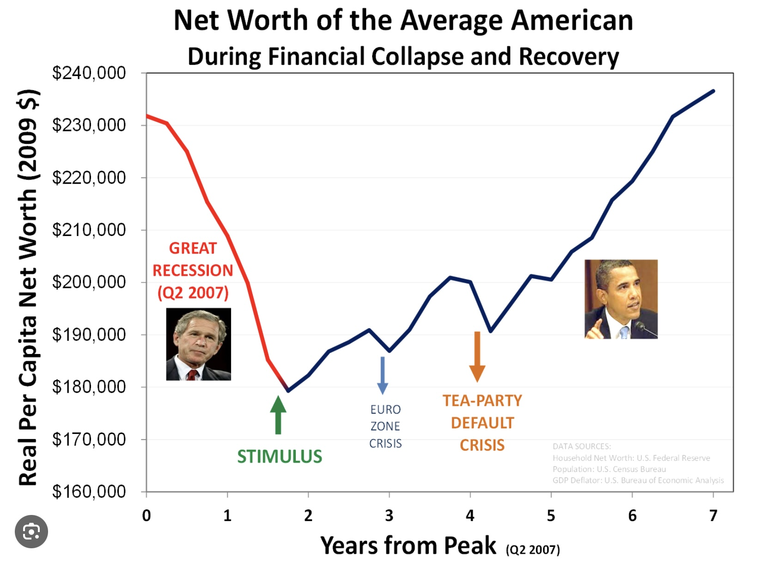
THE 2008 FINANCIAL CRISIS

Slide 241
The 2008 global financial crisis was the most severe economic downturn since the Great Depression. It was caused by a combination of factors most of which were the result of neoliberal economics.
In the early 2000s, there was a significant increase in housing prices in the United States, fueled by low interest rates and easy access to credit. This led to a housing bubble. Lenders began offering mortgages to borrowers with poor credit histories, known as subprime mortgages. These mortgages had adjustable rates that initially offered low payments which later increased significantly.
Banks and financial institutions bundled these risky mortgages into mortgage-backed securities (MBS) and collateralized debt obligations (CDOs), which they sold to investors worldwide. MBS’s and CDO’s were complex financial products which, despite their underlying risk, were given high ratings by complicit credit rating agencies.
Many financial institutions borrowed heavily to invest in these risky securities. While this was going on, neoliberal deregulation policies had eliminated regulation and oversight of financial institutions and markets, that might have checked these risky practices.
Financial institutions took out insurance against defaults on MBS and CDOs but again, because of deregulation, issuers did not have sufficient reserves to cover widespread defaults.
As interest rates rose and housing prices peaked, many homeowners with adjustable-rate mortgages could no longer afford their payments, leading to a wave of foreclosures.

Slide 242
The value of MBS and CDOs plummeted, causing massive losses for banks and financial institutions which insurers could not cover. Major institutions like Lehman Brothers collapsed, while others, such as Bear Stearns and AIG, required massive government bailouts to survive.
The banking sector's instability led to a severe credit crunch, as banks became unwilling to lend to each other or to businesses and consumers, exacerbating the economic downturn.
The crisis quickly spread globally, leading to a severe recession. Stock markets plunged, unemployment rose, and in many countries, economic growth stalled.
In response to this crisis, governments and central banks around the world implemented measures to stabilize the financial system, including massive bailouts, interest rate cuts, and fiscal stimulus packages. In the U.S., the Dodd-Frank Act was enacted to increase financial regulation and oversight to prevent a similar crisis in the future.
The 2008 Financial Crisis was a direct consequence of neoliberal policies and bears many resemblances to the 1929 great depression.
Key deregulatory measures, such as the repeal of the Glass-Steagall Act in 1999, allowed commercial banks to engage in investment banking activities. This increased risk-taking and contributed to the financial instability that led to the crisis.

Slide 243
Deregulation in the mortgage industry led to the proliferation of subprime loans, which were high-risk and often given to borrowers with poor credit. These loans were bundled into mortgage-backed securities, spreading risk throughout the financial system.
The lack of adequate regulatory oversight allowed financial institutions to engage in complex and opaque financial practices, such as the trading of derivatives, which amplified systemic risk.
There were many similarities between the 2008 financial crisis and the Great Depression, and both events had profound impacts on the global economy and subsequent political landscape.
The stock market crash of 1929 was a major trigger of the great depression leading to a collapse in confidence and a wave of bank failures. The 2008 collapse of major financial institutions and the bursting of the housing bubble led to a severe banking crisis.
In both cases, there was a significant contraction of credit as banks became insolvent and risk-averse, leading to reduced lending and a slowdown in economic activity.
The 1920s saw a speculative bubble in stocks, fueled by easy credit and margin buying. In 2008 the housing market bubble, driven by subprime mortgages and speculative investment in mortgage-backed securities, played a similar role.
Both crises had global repercussions, affecting economies worldwide. The interconnectedness of global markets meant that financial turmoil in the U.S. quickly spread to other countries.

Slide 244
During the Great Depression unemployment rates soared to about 25% in the United States. In the 2008 financial crisis while not as severe, unemployment rates rose significantly, peaking at around 10% in the U.S.
In both instances, governments eventually intervened with significant measures to stabilize the economy. In 2008 this was done through the Emergency Economic Stabilization Act, which included the Troubled Asset Relief Program, or TARP.
Both crises led to a dramatic loss of confidence among consumers and businesses, resulting in reduced spending and investment, which further deepened the economic downturns.
In the great depression the lack of effective financial regulation allowed for excessive risk-taking and speculation. In the 2008 financial crisis deregulation and inadequate oversight of financial markets and institutions contributed to the crisis.
Despite these similarities, there are also important differences, such as the speed and nature of government responses, the role of global financial systems, and the underlying economic conditions preceding each crisis. Nonetheless, both events underscored the importance of financial regulation and the potential consequences of unchecked speculative behavior.

Slide 245
The prominent American economist Alan Greenspan served as the Chairman of the Federal Reserve of the United States from 1987 to 2006. Appointed by President Ronald Reagan, he was reappointed by subsequent presidents and served as the Fed chairman for nearly two decades. During his tenure, Greenspan was a prominent advocate of free-market policies and was influential in shaping U.S. monetary policy.
Greenspan was a proponent of neoliberal economic policies, emphasizing deregulation, free markets, and limited government intervention in the economy.
After the 2008 financial crisis, Greenspan faced significant criticism for his role in advocating for deregulation and for not foreseeing the risks posed by the housing bubble and the financial practices that contributed to the crisis.
In October 2008, Greenspan testified before the US Congress, where he acknowledged a "flaw" in his free-market ideology. He admitted that he had underestimated the self-regulating power of markets, and the risks associated with complex financial instruments like derivatives.
While Greenspan did not fully denounce neoliberalism, his admission of a flaw in his economic philosophy was seen as a significant concession. He recognized that his belief in the ability of financial institutions to self-regulate had been misplaced, contributing to the crisis.
In subsequent interviews and writings, Greenspan has reflected on the limitations of market-based regulation and the need for more robust oversight to prevent future financial crises.

Slide 246
Since the 2008 financial crisis institutions have continued many high-risk financial practices. They have continued to create and trade of complex financial instruments, such as derivatives which obscure true risk levels.
Some provisions of Dodd-Frank have been rolled back, reducing oversight and potentially increasing systemic risk.
Large financial institutions remain critical to the global economy and have become “to large to fail” raising concerns about the systemic impact of their risk-taking behaviors.
While both the great depression and the 2008 crisis prompted regulatory responses, the Great Depression led to more foundational changes in financial regulation, whereas the response to the 2008 crisis has been criticized for not sufficiently addressing systemic risks and accountability.
The 2008 financial crisis led to significant public outrage over the lack of accountability for major financial institutions and their executives. While some financial institutions faced fines and settlements, no one from the major financial institutions was criminally prosecuted or punished. Most of the penalties were financial in nature but these costs were easily absorbed as part of the institutions operating expenses.

Slide 247
Despite the crisis, many executives from the affected institutions continued to earn substantial salaries and bonuses. In many cases, this happened at the very financial institutions that received government bailouts, which helped stabilize them and allowed them to continue operating, sometimes even profiting in the aftermath. This lack of individual accountability and the continued financial success of some of the people involved contributed to widespread criticism and disillusionment with government and financial institutions.
Today, despite the few regulatory measures put in place following the 2008 crisis, social and economic conditions in many ways resemble those present before the Great Depression.
Today as in the period preceding the Great Depression, we see significant economic inequality, with wealth concentrated among a small percentage of the population, reduced economic mobility and increased social tensions.
The years leading up to the Great Depression saw significant volatility and speculative bubbles in financial markets. Today, we also experience periods of market volatility and concerns about speculative investments, particularly in areas like technology stocks and cryptocurrencies.
Both periods are marked by rapid technological advancements. In the 1920s, the rise of automobiles, radios, and other technologies transformed society. Today, digital technology, automation, and artificial intelligence are reshaping economies and labor markets, leading to both opportunities and disruptions.

Slide 248
The global economy in the 1920s was interconnected, much like it is today. Economic troubles in one part of the world will quickly affect other regions, as seen in the global financial crisis of 2008 and the economic impacts of the COVID-19 pandemic.
Today as in the 1920s we are experiencing significant political polarization and the rise of populist movements as economic uncertainty and social change lead to increased support for leaders and parties that promise to disrupt the status quo.
Following President Trump’s re-election in 2024 we have seen a further massive move towards de-regulation and a flirtation with extremely controversial and volatile cryptocurrencies prompting warnings from many economists of an impending global depression, this time unlike 2008, without anyone in power at least in the U.S., competent to respond to such a catastrophe..

Slide 249


Slide 250
Richard Wolff, a well-known economist and critic of capitalism, offers various arguments to support his assertion that the U.S. and the global capitalist system are in decline or in the decadent stage of empire.
Wolff points to the growing wealth gap in the United States, stating that the concentration of wealth among a small elite undermines the economic stability and social cohesion necessary for sustained growth. He highlights the stagnation of real wages for most American workers over the past few decades, arguing that this limits consumer spending and economic dynamism.
The shift of manufacturing jobs overseas has led to job losses and economic decline in many American communities, which Wolff sees as a sign of weakening economic power.
He points out the increasing national debt and reliance on borrowing to fund government operations as unsustainable practices that are leading to economic instability.
Wolff argues that extreme political polarization and dysfunction hinder effective governance and policy-making, which are crucial for addressing economic challenges.
He sees the rise of other economic powers, particularly China, as a challenge to American economic dominance and influence.
He also points to the aging infrastructure in the U.S. as a sign of neglect and underinvestment, which can impede economic growth.
Wolff critiques the extensive military spending and interventions abroad, suggesting that these drain resources from domestic needs and contribute to economic strain.

Slide 251
Wolff also discusses how the working class is being squeezed in the context of the decline. He highlights how while productivity has increased over the decades, wages for the majority of workers have remained relatively stagnant. This disconnect means that workers are not benefiting proportionately from the economic growth they help generate.
The rise of gig and contract work, along with the decline of unionized labor, has led to increased job insecurity. Workers face less stable employment, fewer benefits, and reduced bargaining power.
The cost of essential goods and services, such as housing, healthcare, and education, has risen significantly, outpacing wage growth. This puts additional financial pressure on working-class families.
Many working-class individuals and families rely on credit to make ends meet, leading to high levels of personal debt. This debt has become a significant burden, limiting financial mobility and security.
Wolff points out the reduction in employer-provided benefits, such as healthcare and pensions, which shifts more financial responsibility onto workers.
The adoption of automation and the outsourcing of jobs to countries with lower labor costs have reduced the availability of well-paying jobs in certain sectors, further squeezing the working class.
Cuts to social programs and safety nets have left working-class individuals more vulnerable to economic downturns and personal financial crises.

Slide 252
Wolff concludes that since the early 1980s the political system has prioritized the interests of the wealthy and corporations over those of ordinary workers, implementing policies that do not adequately address the needs of the working class.
Wolff critiques the actions and strategies of elites in the context of the economic challenges faced by the working class. He claims that as America collapses elites further enrich themselves by squeezing the working class.
Elites are focusing on accumulating wealth, through financial markets, real estate, and other investments, rather than reinvesting in productive enterprises that could create jobs and raise wages.
They use their wealth to exert significant influence over the political system. This has resulted in policies that favor them, such as tax cuts for high-income individuals and corporations, deregulation, and weakened labor protections.
Elites engage in lobbying efforts to shape legislation in ways that protect their interests, sometimes at the expense of broader societal needs. Elites also support and benefit from globalization and outsourcing, which leads to cost savings for businesses but also result in job losses and wage suppression for domestic workers.
Wolff discusses how elites have increasingly focused on financial activities, such as stock buybacks and speculative investments, which can boost short-term profits but do not necessarily contribute to long-term economic growth or job creation.

Slide 253
He describes how they influence media narratives that downplay economic issues facing the working class and promote policies that benefit them.
Wolff also criticizes the use of tax havens and loopholes by wealthy individuals and corporations to minimize their tax liabilities, reducing public revenues that could be used for social programs and infrastructure.
While philanthropy can have positive impacts, Wolff critiques it as a means for elites to exert influence over public policy and priorities.
He argues that these actions contribute to the widening gap between the wealthy and the working class, exacerbating economic inequality and social tensions.
Wolff advocates for a proactive and organized response from the working class to address the challenges they face amidst the decline of the American empire.
He emphasizes the importance of collective action through unions and other worker organizations to increase bargaining power and advocate for better wages, benefits, and working conditions.
He encourages the working class to become more politically active, advocating for policies that address economic inequality and prioritize the needs of ordinary people over corporate interests.
Wolff stresses the importance of educating oneself and others about economic systems and the factors contributing to inequality. He believes that a well-informed populace is better equipped to demand change.
He is a strong proponent of exploring and supporting alternative economic models, such as worker cooperatives, which prioritize democratic decision-making and equitable distribution of profits.

Slide 254
He advocates for building solidarity among diverse groups within the working class to create a unified front capable of challenging entrenched power structures.
Wolff calls for systemic changes to address the root causes of economic inequality, such as reforming tax policies, strengthening social safety nets, and implementing policies that promote economic democracy.
He suggests that the working class should challenge corporate power and influence in politics, advocating for campaign finance reform and measures to reduce corporate lobbying.
Engaging in public discourse and raising awareness about economic issues can help shift public opinion and build momentum for change.
Wolff believes that these actions can empower the working class to push for a more equitable and sustainable economic system, countering the negative effects of the current trajectory of economic decline.

Slide 255

FAKE NEWS

Slide 256
Before discussing the new media’s role in the polycrisis let’s define a few terms.
Misinformation refers to false or misleading information that is spread, regardless of an intent to deceive. It often results from misunderstanding or lack of knowledge, and the person sharing it may actually believe it to be true.
Disinformation is deliberately false information spread with the intent to deceive or mislead people. Unlike misinformation, disinformation is knowingly created and distributed with the goal of influencing public opinion or obscuring the truth.
Propaganda involves information, often biased or misleading, used to promote a particular political cause or point of view. Propaganda can include both true and false information and is typically deployed systematically to influence emotions, attitudes, and public perception for strategic purposes.
Spin refers to a form of propaganda that involves presenting information in a biased way to influence or manipulate public perception. It's often used in politics to shape opinions about issues or events.
Malinformation involves the use of genuine information that is shared to inflict harm or damage on a person, organization, or country. It is not falsified but is often taken out of context or used in a harmful manner.

Slide 257
Fake News is a broad term that generally refers to news articles or pieces that are intentionally and verifiably false, designed to mislead and manipulate people.
Echo Chambers are environments, especially online, where information, ideas, or beliefs are amplified by communication and repetition inside a defined system, often isolating individuals from differing viewpoints.
Deepfakes are synthetic media in which a person in an existing image or video is replaced with someone else's likeness. Deepfakes are often used for deceptive purposes, presenting fake events as real.
Bot farms are networks of automated programs, often referred to as bots, that are used to perform specific repetitive tasks online. These tasks can range from relatively benign activities to more malicious purposes.
Bot farms are frequently used to create large numbers of fake social media accounts. These accounts can artificially inflate the number of followers, likes, or comments on a given profile or post. They can also be used to spread misinformation or amplify certain messages, thus influencing public opinion and potentially manipulating social discourse.
Understanding these concepts is crucial in navigating today’s information landscape, as they play significant roles in shaping public discourse and opinion.

Slide 258
We have so far explored how the modern and postmodern worldviews are associated with an economic and political system that has led the current loss of meaning and polycrisis. This process have been greatly accelerated by the rise of digital media and the internet which have transformed how information is consumed and disseminated.
Traditional media which in the past provided us with shared narratives and common reference points, has been replaced by a fragmented media landscape. Social media platforms and niche news sources allow individuals to curate their information environments, leading to echo chambers and polarized viewpoints. Increasing polarization has led to the fragmentation of narratives.
In many societies, political discourse has become more divisive, with competing narratives that emphasize conflict rather than common ground. This polarization has eroded trust in institutions and undermined a sense of shared purpose.
The initial promise of new media and technologies was rooted in the belief that they could democratize information, empower marginalized voices, and drive social change. That promise proved illusory as the new media has been co-opted by capitalism’s profit imperative and has greatly contributed to the decline of western society.

Slide 259
In the early days of the internet and digital media, there was a strong sense of optimism about their potential to foster open communication, collaboration, and transparency. Platforms like blogs, social media, and open-source projects were seen as tools to challenge traditional power structures and promote progressive causes.
New technologies provided unprecedented access to information and the ability to connect with others globally. This empowered individuals and grassroots movements to organize, share ideas, and advocate for social justice, environmental issues, and human rights.
As these technologies developed, companies began to recognize their commercial potential. Platforms that started as community-driven spaces became monetized through advertising, data collection, and subscription models. Profit motives began to influence the development and operation of these platforms.
The use of algorithms to personalize content and maximize user engagement prioritized sensational or divisive content and undermined the progressive goals of fostering understanding and dialogue. This shift was driven by the desire to capture user attention and generate advertising revenue.
The tech industry saw significant consolidation, with a few major companies dominating the market. This concentration of power allowed these companies to shape the digital landscape according to their business interests, sometimes at odds with progressive ideals.

Slide 260
The collection and use of personal data for profit raised concerns about privacy and surveillance. These practices often conflicted with the initial promise of empowering users and protecting their rights.
To attract top talent in a competitive industry large tech companies initially offered extraordinary working conditions to their workers. These perks often included flexible work hours, free meals, on-site amenities, generous salaries, and stock options. These benefits initially helped tech companies recruit and retain skilled employees. Over time tech’s relationship with labor has changed significantly.
As tech companies grew rapidly, maintaining the same level of personalized benefits and attention to employee needs became challenging. The sheer scale of operations made it difficult to sustain the unique culture and perks that were initially offered.
As companies expanded, the financial burden of maintaining extensive perks and benefits increased. This led to cost-cutting measures, which sometimes resulted in reduced employee satisfaction and a perception of declining workplace conditions.
As the workforce grew, so did awareness and advocacy around labor rights. Employees began organizing for better conditions, pay equity, and ethical business practices, sometimes clashing with management priorities.
Tech companies faced growing scrutiny from regulators and the public regarding labor practices, including issues like contractor treatment, diversity, and workplace harassment. This pressure led to defensive or anti-labor stances.

Slide 261
As companies matured, there was often a shift from a startup culture focused on innovation and employee satisfaction to a more corporate culture emphasizing efficiency, profitability, and shareholder value.
In response to perceived inequities and management practices, there have been increased efforts to unionize tech workers. Some companies have resisted these efforts, fearing loss of control over labor practices and increased costs.
The shift in the employer-employee relationship in the tech industry, coupled with broader economic and regulatory considerations, contributed to some tech leaders aligning themselves with the deregulatory policies of the Trump administration.
As tech companies grew in size and influence, they faced increasing scrutiny from regulators on issues such as antitrust, data privacy, and content moderation. The Trump administration's deregulatory stance was appealing to tech leaders who preferred less government intervention and more freedom to innovate and expand as they saw fit.
Trump’s deregulatory policies align with the economic interests of large corporations, including those in the tech industry. Lower taxes, reduced regulatory burdens, and a focus on economic growth is attractive to tech leaders looking to maximize profits and shareholder value.

Slide 262
The evolving employer-employee relationship in tech, characterized by a shift towards gig work, contract labor, and flexible employment models, benefits from a regulatory environment that is less restrictive. Deregulatory policies facilitate these labor practices by reducing compliance costs and allowing more flexibility in workforce management.
Many tech companies operate globally and benefit from policies that promote free trade and reduce barriers to international markets. The Trump administration's focus on renegotiating trade deals and reducing regulatory hurdles in certain areas aligns with the interests of tech companies seeking to expand their global reach.
The Tax Cuts and Jobs Act of 2017, which significantly reduced corporate tax rates, was a major incentive for tech companies to support or at least not oppose the Trump administration's policies. Lower taxes increase profitability and provide more capital for investment and growth.
There has been a significant rightward shift in Silicon Valley with many tech leaders feeling alienated by progressive cultural movements and policies that they perceived as restrictive and overly critical of the industry.
Wanting to protect their financial interests, tech leaders like Musk, Zuckerberg, Bezos and Thiel have shifted towards more conservative or libertarian viewpoints that emphasize individual freedom and less government control.
Israeli historian Yuval Harari in his book “Nexus: A brief history of information networks from the stone age to AI” describes the power and peril of algorithms.

Slide 263
Algorithms are complex programs that power artificial intelligence and determine what content users receive on their feeds. Algorithms analyze various factors, such as user behavior, engagement patterns, and content characteristics, to curate personalized experiences.
Social media platforms collect vast amounts of data on user interactions, including likes, shares, comments, and time spent on different posts and sites. Based on this data, profiles are created and constantly updated identifying user preferences, interests, and behaviors.
When new content is posted, algorithms rank it based on relevance to the user. The algorithm then delivers a tailored feed that aims to maximize user engagement, keeping users on the platform longer.
In the book, Harari describes how Algorithms, as a way of maximizing profits, were originally instructed to maximize engagement, that is to draw and retain people’s attention. Many of the problems with social media stem from this original instruction. Harari wonders what would have happened if instead algorithms had been asked to maximize human happiness.
AI algorithms have found that the best way to retain attention is to prioritize emotional, sensational, divisive and misleading content. This generates much more engagement than cool, rational and accurate content.

Slide 264
Algorithms reinforce a users already existing beliefs by showing them content similar to what they have previously engaged with, creating echo chambers, spreading misinformation, and manipulating public opinion by prioritizing sensational and misleading content. Algorithms have greatly contributed to societal polarization as each individual is only exposed to a few perspectives.
The digital revolution has also had a marked negative effects on mental health. Excessive engagement with screens and social media use has significantly contributed to the epidemic of anxiety, depression, and feelings of inadequacy that is especially prevalent in GenZ.
Mental health trends among Generation Z, born between 1997 and 2012, have, in recent years, garnered significant attention. Studies show that Gen Z experiences higher levels of anxiety and depression.
Factors contributing to this include academic pressure, and global issues such as climate change and political instability but what appears most significant is that Gen Z was the first generation to grow up with smart phones.
Social media contributes to feelings of inadequacy, cyberbullying, and social comparison. Many Gen Z individuals also report feeling pressure to maintain a perfect online persona.
Digital technology and social media algorithms, which have become ubiquitous, pose significant risks that can impact individual well-being and societal discourse.
Making vast amounts of information of overall mediocre quality readily available, led to a situation where anyone can access information on almost any topic. This ready access creates the illusion that expertise is less necessary and that everyone is equally well informed.

Slide 265
The abundance of online information available has led to confusion and difficulty in discerning credible sources making it challenging for individuals to identify trustworthy experts. This combined with the post-modern inspired notion that all beliefs and practices are equally valid has led to a dismissal of expert knowledge, especially if it conflicts with one’s personal or cultural beliefs. This has resulted in a preference for alternative viewpoints that align more closely with individual experiences or ideologies.
The rise of social media and online communities has created echo chambers where individuals are exposed primarily to viewpoints that reinforce their own. In such environments, expert opinions that contradict these views are dismissed or ridiculed, further eroding trust.
The prevalence of false online information exacerbates distrust in institutions and experts. When people encounter conflicting information, they tend to become skeptical of established authorities and experts.
Platforms like X and Facebook amplify influencers who lack expertise or credentials, allowing controversial minor celebrities with incendiary opinions to gain large followings and earn a lot of money. This leads to a preference for popular opinion over expert consensus.
Many contemporary issues, like climate change, public health, etc., are complex and multifaceted. This complexity leads to confusion and frustration, making it easier for people to dismiss expert opinions and adopt simplistic beliefs about the world.
There is a growing trend towards valuing personal experience and anecdotal evidence over academic or professional expertise. This leads to a more subjective understanding of truth.

Slide 266
These factors combined contribute to a climate where institutions and expertise are undervalued and questioned, impacting how society approaches knowledge and decision-making.
In the 2024 US election, regions without a local newspaper and robust local journalism voted disproportionality for Donald Trump compared to areas with active news outlets. Several theories that have been proposed to explain this phenomenon.
Local newspapers often provide critical information about local issues, government accountability, and community events. Without them, residents have less access to localized, nuanced information and more exposure to national media narratives, which skews perceptions toward broader political movements rather than local concerns.
In the absence of local news, residents rely more heavily on national news outlets, which are more partisan and polarized. This leads to a more homogenized political viewpoints that aligns with what is presented by these national sources.
Without the mitigating influence of local newspapers, people turn to social media for their news, where they are more likely to encounter echo chambers that reinforce existing beliefs and amplify partisan divides. Areas without local newspapers experience a general distrust in media, leading residents to favor outsider candidates who position themselves against mainstream media narratives.
Trump’s campaign effectively utilized anti-establishment rhetoric that resonated with voters harboring media skepticism.

Slide 267
Many areas without local newspapers tend to be rural or economically struggling. Trump’s messaging focused on appealing to socio-economic grievances and promising revitalization, which attracted voters in regions experiencing economic hardship.
Local newspapers serve as an important piece of social cohesion, providing a platform for civic engagement and community identity. Their absence has led to a decline in community-oriented perspectives and an increased susceptibility to divisive national political rhetoric.
The decline of local newspapers and news outlets has been a significant trend over recent decades. It has been driven by various economic, technological, and social factors. The rise of the internet and digital media has significantly changed how people consume news. Many consumers now prefer online news sources, social media platforms, and news apps for their convenience and immediacy, reducing the circulation and readership of traditional print newspapers.
Advertising revenue, once the financial backbone of local newspapers, has shifted to digital platforms like Google and Facebook, which offer targeted advertising options to businesses. This migration has greatly decreased the revenue streams for traditional newspapers. Younger generations increasingly rely on smartphones and social media for news consumption, which often doesn't include local news sources. This change in habits makes it challenging for local newspapers to attract and retain readership.

Slide 268
Many local newspapers have been bought by large media conglomerates, leading to cost-cutting measures, centralization of operations, staff reductions, and a lack of focus on local issues. This has resulted in a reduction in the quality and quantity of local news coverage.
The costs associated with printing and distributing physical newspapers continue to rise, making it financially unsustainable for many smaller or independent newspapers to operate.
Budget cuts often lead to reduced reporting staff, which impacts the ability of local news outlets to cover a range of issues or conduct in-depth investigative journalism.
The closure of numerous local newspapers has led to the emergence of "news deserts," areas that lack sufficient access to credible and comprehensive news about local events and issues.
Despite moving online, many local newspapers struggle with implementing successful subscription models to offset lost ad revenue, as consumers are often resistant to paying for news they can find elsewhere for free.
These challenges have combined to create a difficult environment for local newspapers, leading to closures or significant downsizing. The decline poses concerns for democracy, as local news is crucial for informing citizens, holding local officials accountable, and fostering community engagement.
Efforts to revitalize local journalism include initiatives like nonprofit news organizations, community-funded journalism, and local news cooperatives aiming to fill the void left by traditional local newspapers.

Slide 269
PART IV- CONSEQUENCES
Cultural backlash
Populism and authoritarianism
The psychology of power and wealth
Authoritarian societies
Authoritarian cults
The new gilded age
Post-truth is pre-fascism

Slide 270
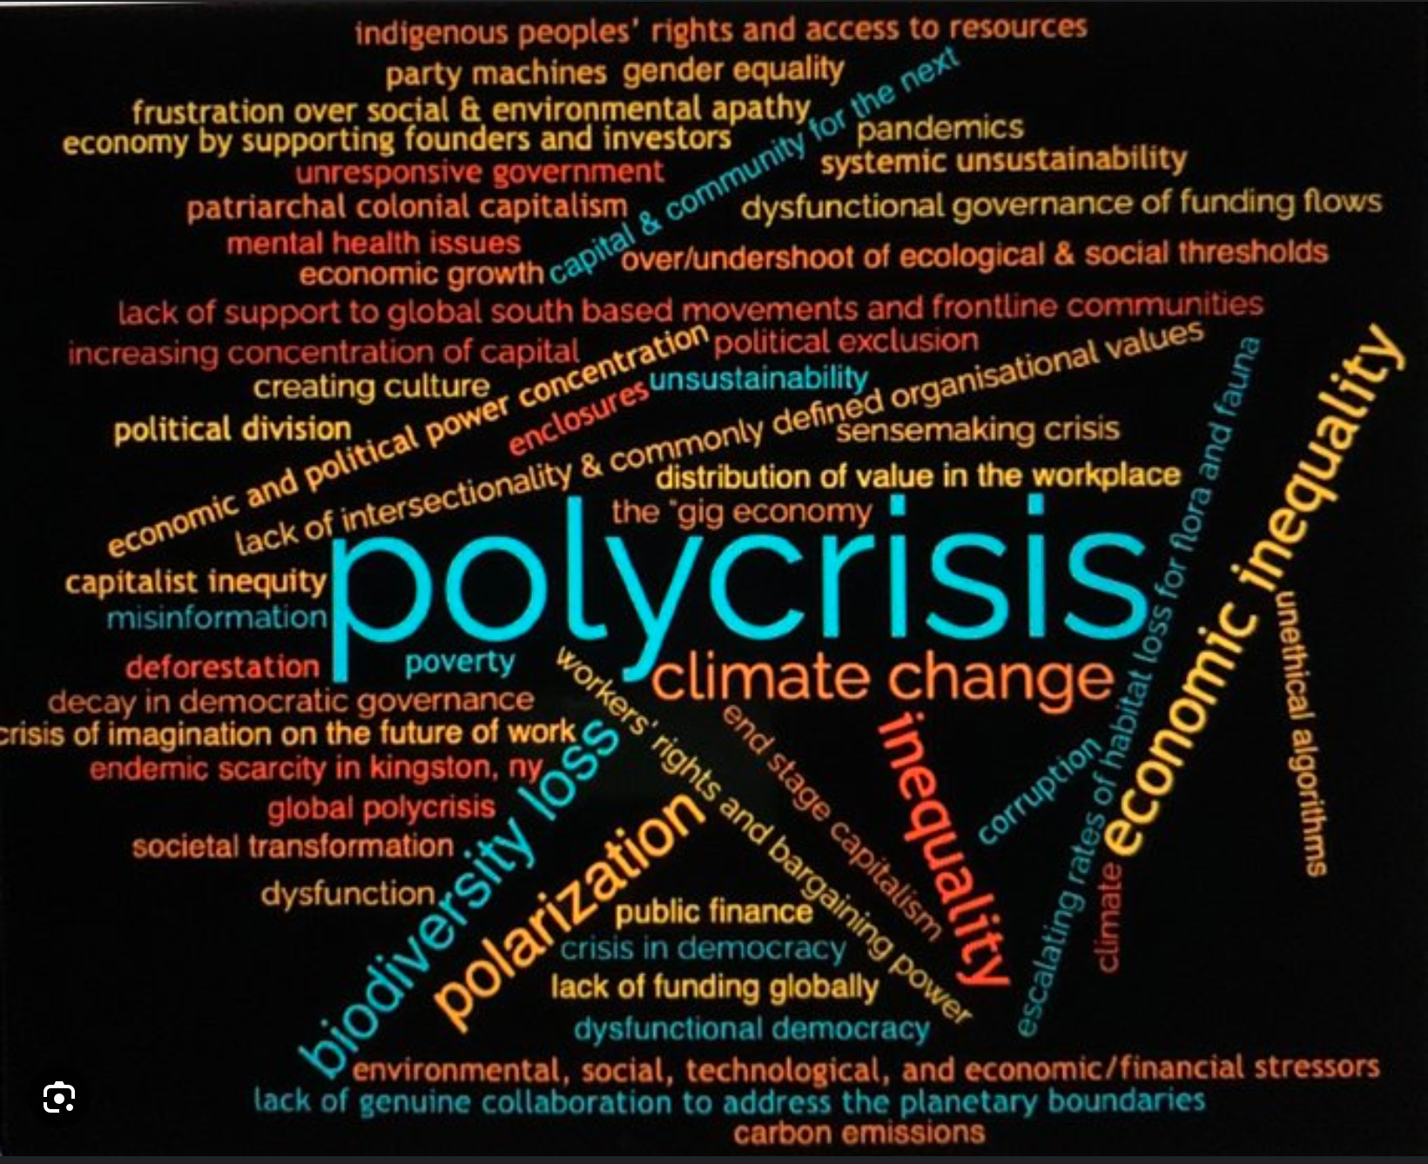

Slide 271
“To really understand something is to be liberated from it… a predatory capitalism’s truest enemy and Humanity’s greatest ally is the self-educated individual who has read, understood, delays gratification and walks around with their eyes wide open.” From the documentary “The four horses.”

Slide 272

CULTURAL BACKLASH

Slide 273
There’s no question that worldwide, most people are being or will soon be catastrophically affected by the polycrisis which has been primarily driven by end stage capitalism. There’s also no question that in many developed countries, over the last fifty years the 99% has seen a significant erosion of their economic prospects.
Over the same period, billions of people, primarily in India and China have seen their economic circumstances improve and, in the West, there has been social and cultural progress across various domains.
Since the 60s there has been substantial progress in civil rights, with movements advocating for racial equality, gender equality, and LGBTQ+ rights gaining ground. Landmark legislation and societal shifts have helped reduce discrimination and promoted inclusivity.
The feminist movement has made significant strides in advocating for women's rights, leading to greater gender equality in the workplace, politics, and society. Issues like equal pay, reproductive rights, and combating gender-based violence have received increased attention.
The fight for LGBTQ+ rights has seen considerable progress, with many countries legalizing same-sex marriage and implementing anti-discrimination laws. Pride movements have gained visibility and fostered greater acceptance and understanding.
Growing awareness of environmental issues has led to increased advocacy for sustainability and climate action.

Slide 274
There has also been a push for greater representation of diverse cultures and identities in media, literature, and the arts. This has helped to challenge stereotypes and promote a richer, more inclusive cultural landscape.
Over the last two decades, as this has happened, right wing politics has increasingly turned segments of the population who have lost ground economically against those that have benefitted from progressive cultural and social changes such as gender equality, LGBTQ+ rights and diversity, equity and inclusion initiatives.
The alliances and rifts this conflict has created has enabled right wing populists to continue their decadent stage capitalist agenda in an increasingly authoritarian fashion.
Right-wing politics have capitalized on economic anxieties and cultural shifts to create or exacerbate divisions between different segments of the population.
Over the last fifty years, globalization, technological advancements, and shifts in the labor market have led, for many workers, particularly those in traditional manufacturing and industrial sectors, to economic losses . These changes have resulted in unemployment, wage stagnation, and a sense of economic insecurity.
As progressive social changes have gained momentum, some segments of the population who have lost their former economic status, have perceived these shifts as threatening to traditional values and identities. Right-wing politics have framed these changes as being at odds with the interests and values of the working class, suggesting that the focus on social issues detracts from economic concerns.

Slide 275
The right-wing populist movements use rhetoric that emphasizes a divide between "ordinary people" and "elites," where the latter are portrayed as out of touch with the concerns of the working class. This narrative paints educated and progressive segments of the population as part of an elite that benefits from globalization and social changes at the expense of traditional workers.
Right-wing politics also uses identity politics to create a sense of "us vs. them," positioning themselves as defenders of national or cultural identity against perceived threats from multiculturalism, immigration, and diversity initiatives. This resonates with individuals who feel economically or culturally marginalized.
Diversity, Equity, and Inclusion or DEI is a framework or set of principles aimed at promoting fair treatment, equal access to opportunities, and the representation of diverse groups within organizations, communities, and society at large.
Diversity refers to the presence of diverse groups of race, ethnicities, gender, age, sexual orientation, disability and socioeconomic status within a given setting. The goal is to ensure a wide range of perspectives and experiences are represented.
Equity involves creating fair access to opportunities and resources for all individuals, taking into account systemic inequalities and barriers that might disadvantage certain groups. It focuses on leveling the playing field by addressing and rectifying imbalances.

Slide 276
Inclusion is about fostering an environment where all individuals feel valued, respected, and able to fully participate. It involves creating a culture where diverse voices are heard and integrated into decision-making processes.
Identity Politics refers to political positions or perspectives that are based on the interests and perspectives of social groups with which people identify. These groups are defined by race, gender, sexual orientation, religion, or other social identities. Identity politics emphasizes the importance of these identities in shaping individuals' experiences and political views. It seeks to address and advocate for the rights and needs of marginalized and underrepresented groups.
Intersectionality is a framework for understanding how various aspects of a person's social and political identities combine to create different modes of discrimination and privilege. Coined by legal scholar Kimberlé Crenshaw in 1989, the concept suggests that individuals can experience multiple, overlapping forms of discrimination based on factors such as race, gender, class, sexuality, ability, and more.
Diversity, Equity, and Inclusion (DEI) identity politics and intersectionality are influenced by a variety of intellectual traditions, including the postmodern worldview.
Postmodernism, with its skepticism of grand narratives and emphasis on the complexity and subjectivity of human experience, has contributed to the way DEI and identity politics are understood.

Slide 277
DEI and identity politics like postmodernism encourage the examination of power structures and the recognition of multiple, often marginalized, perspectives. Like postmodernism they also challenge the idea of universal truths and highlight the importance of individual and group narratives.
Both DEI and identity politics borrow from postmodernism in analyzing how language, culture, and societal norms perpetuate power imbalances.
DEI and identity politics draw not only from postmodernism but also from other intellectual and social movements, such as civil rights activism, feminist theory, and critical race theory. All these movements emphasize social justice, equality, and the dismantling of systemic oppression.
Although the DEI movement and identity politics aim to create more equitable and inclusive environments, they faced challenges and criticisms.
Many feel that identity politics excludes and marginalizes those who do not belong to specific groups. This has been perceived as reverse racism and has led to feelings of alienation among many individuals who might otherwise be allies. Focusing heavily on identity can result in commonalities being overlooked, creating divisions rather than fostering unity.
Identity politics can also lead to an "us vs. them" mentality, where individuals feel pressured to align with one side or another, leading to increased polarization. Conversations around identity can be complex and sensitive with misunderstandings leading to conflict or resentment frequently arising.

Slide 278
Some individuals resist changes proposed by the DEI movement because they perceive them as a threat to their own status and identity.
Divisions within liberal coalitions have occurred when factions have different viewpoints on key issues. In some Western democracies certain liberal groups have prioritized economic justice, while others have focused on racial and gender equality, DEI, identity politics and intersectionality.
As a result, Western liberal movements have lost a significant amount of working class which has shifted to movements such as MAGA.
As their economic prospects worsened, many working-class individuals began seeing liberals as elitist or out of touch with their everyday concerns, particularly as they focused on theoretical discussions of identity politics DEI and intersectionality. They saw this focus as detracting from broader policy initiatives that directly impact them, such as labor rights or economic reform.
Working-class voters generally prioritize economic issues such as jobs, wages, and healthcare over the social issues emphasized by DEI advocates. When they feel these economic concerns are not being addressed, they feel alienated.
There has also been a cultural disconnect as the priorities of DEI-focused groups do not resonate with the lived experiences of the working class, leading to feelings of exclusion or misunderstanding. This is compounded when the messaging around DEI issues is perceived as accusatory or dismissive of other groups.

Slide 279
The term "Woke" originally referred to being aware of social injustices and systemic inequalities, particularly regarding race. Over time, it expanded to include awareness of a broader range of social issues, such as gender, sexuality, and environmental concerns.
“Woke“ became so controversial and triggered such strong negative reactions among some segments of the population that it fell out of usage. Many saw "woke" culture as overly politically correct and extreme, feeling it imposed rigid standards on behavior and speech, which were perceived as limiting free expression.
In polarized environments, "woke" became a politicized term associated with ideologies that many people opposed, this led to resistance and backlash. The term came to be used pejoratively which diluted its original meaning and fostered negative connotations.
To many people “Woke” became particularly offensive when it was associated with “call out” tactics and culture.
Call-out culture refers to the practice of publicly highlighting or challenging individuals or organizations for behavior or statements considered offensive, problematic, or harmful. This often occurs on social media platforms, where users quickly amplify their criticisms to a wide audience.
The goal of call-out culture was originally to hold people accountable for their actions and to raise awareness about social issues. Call out culture however became public shaming which fostered hostility, discouraged open dialogue, and created a backlash.
Media outlets and political messaging also play significant roles in shaping perceptions and amplifying divisions among former liberal allies by portraying advocates of social justice as supporting positions that did not represent the broader movement.

Slide 280
Right-wing media, in particular, tend to frame social progress as a zero-sum game, where gains for marginalized groups are seen as losses for others.
Right-wing political agendas prioritize policies that appeal to economic and cultural insecurities, such as restricting immigration, opposing affirmative action, or rolling back regulations perceived as burdensome. These policies resonate with those who feel left behind by economic and social changes.
The term "cultural backlash" refers to this reaction against progressive social and cultural changes, driven by segments of the population who feel that their values, traditions, or social status are being threatened. This backlash can manifest in various forms, including political movements, voting patterns, and public discourse. It is often associated with a desire to return to or preserve traditional cultural norms and social hierarchies.
Cultural backlash is typically a response to rapid social changes, such as increased immigration, shifts in gender roles, and the expansion of rights for minority groups. These changes can create a sense of dislocation or loss among those who feel their cultural identity is being undermined.
The backlash often centers around issues of identity and values, with individuals feeling that their cultural or national identity is under threat. This can lead to increased nationalism, xenophobia, or resistance to multiculturalism.

Slide 281
Cultural backlash has significant political consequences, influencing elections and policy decisions. It fuels support for populist or right-wing parties and leaders who promise to restore traditional values and address the perceived threats posed by social change.
The backlash is sometimes more pronounced among older generations or demographic groups who feel left behind by cultural shifts. However, it can also be present among younger individuals who are disillusioned with the pace or direction of change
Populist authoritarian movements offer simple, compelling narratives that explain complex social and economic issues in terms of clear causes and solutions. These narratives appeal to many people because they reduce complexity and provide a sense of clarity and purpose.
Integral theory, encourages us to understand the dynamics of the cultural backlash. We need to recognize the legitimate needs and concerns that drive people towards authoritarianism and populism. Addressing the cultural backlash requires us to understand the perspectives of people at the traditional, modern, and postmodern stages and develop and offer a more inclusive and coherent framework that honors diversity while providing stability and meaning.

Slide 282

POPULISM AND AUTHORITARIANISM

Slide 283
History and evolutionary psychology teach us that during times of crisis groups of people unite behind strong authoritarian leaders. From an evolutionary perspective, humans have evolved to prioritize survival in times of threat.
In a crises, decisive and authoritative leadership is perceived as more effective in quickly mobilizing resources and making swift decisions. This leads us to instinctually prefer strong, authoritative leader figures who promise stability and protection.
History provides numerous examples of societies that gravitated towards authoritarian leaders during periods of crisis or instability. During economic downturns, wars, or social upheavals, populations have often supported leaders who offer clear, direct solutions and a sense of order, even at the cost of democratic principles, and even when the crisis were created by the authoritarian leaders themselves.
In times of uncertainty, people often experience heightened anxiety and fear. Authoritarian leaders appeal to these emotions by providing simple solutions and a promise of control, which can be comforting compared to the complexity and deliberation often associated with democratic processes.
Crisis situations often lead to a stronger in-group versus out-group mentality. Authoritarian leaders exploit this by uniting an in group against a common enemy or threat, reinforcing their position as the protector of the group.

Slide 284
Authoritarian leaders create or exploit crises to consolidate power and assume more control. This tactic is a well-documented strategy in political science and history, where leaders use real or manufactured crises to justify expanding their authority.
Authoritarian leaders create or exaggerate threats, such as external enemies, internal dissent, or economic instability, to rally public support and justify extraordinary measures. By presenting themselves as protectors against these threats, they can legitimize their actions and suppress opposition.
In times of genuine crisis, such as natural disasters, economic downturns, or security threats, authoritarian leaders often seize the opportunity to expand their powers. They might implement emergency measures, curtail civil liberties, and centralize decision-making, often promising that these actions are temporary but then extending them indefinitely.
By controlling the narrative and limiting access to information, authoritarian leaders can shape public perception of a crisis. Media controlled by the leader disseminates propaganda that depicts the leader as a savior while discrediting opponents or alternative viewpoints.
Crises are used as a pretext to crack down on political opposition and civil society. Under the guise of maintaining stability or security, authoritarian regimes may arrest dissidents, censor media, and restrict freedoms of assembly and expression.

Slide 285
Authoritarian leaders appeal to nationalism and calls for unity during crises, framing dissent as unpatriotic or dangerous. This strengthens their grip on power by rallying the population around a common cause or enemy
During crises, authoritarian leaders may push through legal and institutional changes that increase their control, such as altering constitutions, extending term limits, or restructuring government institutions to reduce checks and balances.
These tactics effectively consolidate a leader’s power but have severe long-term negative consequences, including erosion of democratic institutions, human rights abuses, and increased societal polarization.
Populism and authoritarianism are political concepts that describe different approaches to governance and political strategy. Populism seeks to represent the interests and voices of "ordinary people" against a perceived elite or establishment. Populist leaders often claim to speak for the "common people" and position themselves as outsiders challenging the status quo.
Populists are anti-elitist or opposed to the political, economic, or cultural elites, who are often blamed for societal problems. Populist movements often center around a charismatic leader who is seen as a champion of the people. Populists typically offer simplistic solutions to complex problems, appealing to emotions and common sense rather than detailed policy analysis.

Slide 286
Populism often involves dividing society into two groups: "the pure people" and "the corrupt elite.“ Populism can be found across the political spectrum, from left-wing (Bernie Sanders) to right-wing (Donald Trump), and can manifest in various forms depending on the cultural and political context.
Authoritarianism and populism often co-exist but are different concepts. Authoritarianism is a form of governance characterized by strong central power and limited political freedoms. In an authoritarian regime, political power is concentrated in the hands of a leader or a small group, and there is often little tolerance for political dissent or opposition.
In authoritarianism, power is concentrated in a leader or ruling party, with limited checks and balances. Political opposition, free press, and civil liberties are often restricted or suppressed and decisions are made by the ruling authority without the need for legislative approval or public input.
Authoritarian regimes may use force, intimidation, and propaganda to maintain control and suppress dissent.
While populism and authoritarianism are distinct concepts, they often intersect. For example, a populist leader may adopt authoritarian tactics to consolidate power and suppress opposition, claiming to do so in the name of the people.

Slide 287
In political discourse, "reactionary" refers to a political stance that seeks to return to a previous state of society, often idealizing the past and advocating for the reversal of modern changes. Reactionaries typically oppose progressive reforms and may desire to restore traditional social orders or institutions that they believe have been lost or undermined.
While both conservatives and reactionaries resist certain types of change, reactionaries are distinct in their desire to revert to an earlier era, rather than simply maintaining the status quo.
The slogan "Make America Great Again," popularized by Donald Trump, is reactionary in nature, as it evokes and appeals to those who believe that past policies, values, and social structures were more beneficial than current ones. It suggests that America has lost something valuable that needs to be restored.
Fascism is a far-right, authoritarian political ideology characterized by dictatorial power, forcible suppression of opposition, and strong regimentation of society and the economy. It emerged in the early 20th century, in Italy with Benito Mussolini being the first to adopt it as a governing philosophy. Fascism is often associated with ultranationalism, where the interests of the nation or race are placed above individual rights and freedoms.
Key characteristics of fascism include centralized control by a dictatorial leader, who maintains power through propaganda, censorship, and the use of force. An emphasis on national unity and identity, accompanied by xenophobia and racism. A glorification of military strength and values, with a focus on expanding national power and the elimination of political opposition and the control of media and public discourse to maintain the regime's power.

Slide 288
While not advocating for complete state ownership, through partnerships with business leaders, fascist regimes typically exert significant control over the economy.
The leader is portrayed as a heroic figure who embodies the nation's ideals and is beyond criticism.
Fascism is distinct from other authoritarian ideologies in its intense focus on nationalism and the idea of a homogeneous national community. It often arises in times of social, economic, or political instability, promising to restore national pride and order.
Fascism, as a formal political movement, never gained the same level of power or popularity in the United States as it did in some European countries. However, there were periods and groups in American history that exhibited fascist tendencies or expressed support for fascist ideologies, particularly during the 1930s.
Henry Ford, the founder of the Ford Motor Company, because of his support of Nazism and antisemitism is a controversial historical figure. Ford owned and published a newspaper called “The Dearborn Independent”, which in the 1920s ran a series of anti-Semitic articles.
Ford's writings and ideas found an audience in Nazi Germany. Adolf Hitler himself admired Ford and mentioned him in “Mein Kampf”. In 1938, Ford was awarded the Grand Cross of the German Eagle, a high honor given by Nazi Germany to foreigners. This award was seen as a recognition of Ford's influence and his anti-Semitic views.

Slide 289
Ford's business operations in Germany continued during the 1930s, and the company was involved in the German economy during the Nazi regime.
The 2008 financial crisis and the COVID pandemic ignited what was a smoldering global authoritarian populist movement which was further fueled by the growing economic disparities produced by neoliberal policies. This rise in the popularity of authoritarians represents people’s disillusionment with traditional capitalist economics which have undermined democratic principles.
As a result, many liberal democracies have had democratic institutions and norms, such as the independence of the judiciary, freedom of the press, and the integrity of elections weakened.
Populist authoritarian leaders have gained power in various parts of the world by appealing to nationalist sentiments and promising to address the grievances of those who feel left behind by globalization and growing economic inequality.
Advances in technology have enabled governments to increase surveillance and control over their populations, sometimes at the expense of privacy and civil liberties.
The rise of major authoritarian powers, such as China and Russia, has challenged the liberal democratic order and provided alternative governance models that some countries find appealing.

Slide 290
The polycrisis has left people across the globe looking for answers and change. Massively amplifying answers that serve their interests, voicing grievances about how unfairly they are treated and railing against the system while being the biggest part of the problem are oligarchs such Musk, Bezos, Zuckerberg and Thiel who control the dominant means of communication including cable news and algorithm driven social media.
Along with authoritarian leaders, oligarchs manipulate the public narrative producing societal polarization which distracts from the real caused of the crisis; their own greed.
Today’s media platforms amplify the spread of information, some accurate, the vast majority misleading. The sheer volume of information overwhelms individuals, making it difficult to discern credible sources from misinformation or disinformation. Constant exposure to crisis-related news on social media also leads to heightened anxiety and stress.
There are many similarities between the rise in authoritarian regimes following the Great Depression and that which we are currently seeing. Both periods experienced significant economic challenges. The Great Depression led to widespread unemployment and poverty, creating fertile ground for authoritarian leaders who promised stability and economic recovery. Similarly, the 2008 financial crisis and the economic disruptions caused by the COVID-19 pandemic, have contributed to public dissatisfaction and a desire for strong leadership.
Societies, in both eras, faced deep divisions and polarization. In the 1930s, class struggles, ideological conflicts, and nationalism were prevalent. Today, we see similar polarization along political, cultural, and economic lines.

Slide 291
After the Great Depression, many people lost faith in democratic institutions and traditional political parties, which were seen as ineffective in addressing the crisis. This paved the way for authoritarian figures who promised decisive action.
Today, there is widespread distrust in political institutions, media, and other traditional sources of authority, which has led to support for populist and authoritarian leaders.
Both periods saw a rise in nationalism and identity-based politics. In the 1930s, this manifested as aggressive nationalism and xenophobia. Today similar trends are observable, with increased focus on national identity and immigration issues
Authoritarian regimes in the 1930s effectively used propaganda to control public perception and maintain power. Today, the control and manipulation of information, including through digital platforms, play a significant role in bolstering authoritarian tendencies.
Worldwide there are a growing number of countries where leaders with authoritarian tendencies have come to power or become more popular:
In Turkey, President Recep Tayyip Erdoğan has been in power since 2003, initially as Prime Minister and then as President. Over the years, his government has been criticized for undermining democratic institutions, restricting press freedom, and consolidating power.

Slide 292
In Hungary, Prime Minister Viktor Orbán has been in power since 2010 and has been accused of eroding democratic norms, including weakening the judiciary, controlling the media, and altering election laws to favor his party.
In Brazil, Jair Bolsonaro, known as Brazil’s Trump, served as President from 2019 to 2023. His authoritarianism was particularly evident in his approach to the media, his handling of the COVID-19 pandemic, and his rhetoric against political opponents.
In the Philippines, Rodrigo Duterte, President from 2016 to 2022, was known for his tough stance on crime and his controversial war on drugs, which drew criticism for human rights abuses and extrajudicial killings.
In Russia, Vladimir Putin has been in power as either President or Prime Minister since 1999. His government has been characterized by a strong centralization of power, suppression of political dissent, and control over the media.
In Belarus, Alexander Lukashenko, often referred to as "Europe's last dictator," has been President since 1994. His government has been criticized for its lack of free and fair elections and its harsh crackdown on opposition and protests.

Slide 293
China is a one-party state ruled by the Communist Party of China (CPC). It has long been characterized by a lack of political pluralism and restrictions on freedoms such as speech, assembly, and the press. Under President Xi Jinping, who has been in power since 2012, there has been a noticeable consolidation of power. Xi has abolished presidential term limits, potentially allowing him to remain in power indefinitely.
Xi’s administration has intensified control over various aspects of society, including increased surveillance, censorship, and a crackdown on dissent. There have been significant international concerns regarding human rights abuses, particularly in regions like Xinjiang, where the treatment of Uyghur Muslims has drawn widespread condemnation.
India is the world's largest democracy, with a multi-party system and regular elections. However, in recent years, there have been concerns about democratic backsliding. Under Prime Minister Narendra Modi, who has been in power since 2014, there has been an erosion of democratic norms.
Concerns include the treatment of religious minorities, particularly Muslims, restrictions on press freedom, and the use of laws to stifle dissent. There have been reports of increased pressure on civil society, journalists, and political opponents. Some actions, such as the revocation of Jammu and Kashmir's special status and the implementation of the Citizenship Amendment Act, have sparked significant controversy and protests.

Slide 294
In Venezuela, President Nicolás Maduro has authoritarian tendencies. Maduro has been in power since 2013, following the death of his predecessor, Hugo Chávez. Over the years, his government has been criticized for several actions that are characteristic of authoritarian regimes.
In 2024 Maduro almost certainly lost the election to opposition leader Edmundo Gonzalez. Despite protests he remains in power and has extended his mandate until 2031.
In recent years, right-wing parties with authoritarian ambitions have also made significant gains in several European countries. These parties focus on issues such as immigration, national sovereignty, and economic nationalism.
In Italy, The Brothers of Italy, led by Giorgia Meloni, became the largest party in the 2022 general elections and Meloni became prime minister. Her election marked a shift towards the right. Her party has its roots in Italy's post-fascist movement.
In France, The National Rally, led by Marine Le Pen, has been a significant force in politics. Although Le Pen did not win the presidency in the 2022 elections, she advanced to the runoff, and her party has gained seats in the National Assembly.
In Sweden, The Sweden Democrats, a right-wing populist party, have been gaining influence. In the 2022 elections, they became the second-largest party in the Riksdag, Sweden's parliament, and have influenced government policy, particularly on immigration.

Slide 295
In Spain, Vox, a right-wing party, has grown in popularity and representation. It has become a significant force, advocating for national unity and stricter immigration controls.
In Poland, The Law and Justice Party (PiS) was in power from 2015 to 2023. It promoted a right-wing agenda focused on nationalism, conservative social policies, and judicial reforms that drew criticism from the European Union. It was replaced by the centrist government of Donald Tusk.
U.S. President Donald Trump and the MAGA movement, have shown very clear authoritarian tendencies in their willingness to undermine democratic norms and institutions.
Following the 2020 presidential election, Trump and many of his supporters made unsubstantiated claims of widespread voter fraud. These claims culminated in efforts to overturn the election results, including pressuring state officials and the events leading up to the January 6, 2021, Capitol riot.
Trump consistently attacks the media, labeling unfavorable coverage as "fake news" and referring to the press as the "enemy of the people." Such rhetoric has undermined public trust in independent media, a cornerstone of democracy.
Trump repeatedly expresses admiration for strongman leaders such as Putin, Kim Jong Un, and Orban and shows a preference for personal loyalty over institutional checks and balances. His first administration saw significant turnover, with many officials leaving or being dismissed, often after disagreements with Trump.

Slide 296
In both his first and second administrations Trump has used executive orders and emergency declarations to bypass Congress. While it is not uncommon for presidents to use executive orders, the context and content of Trump’s actions pushed the boundaries of executive power and came close to creating constitutional crisis.
Trump's rhetoric is filled with divisive language that polarizes the electorate. This deepens societal divisions and erodes the norms of civil discourse and compromise that are essential in a democratic society.
While advocating for law and order is not inherently authoritarian, Trump's approach often emphasizes a heavy-handed response to protests and civil unrest, which prioritizes order over civil liberties.
It is commonly thought that Trump’s authoritarian impulses were, during his first administration, checked by democratic “guardrails” which have been taken away as he embarks on his second administration and has surrounded himself with incompetent, corrupt and immoral sycophants.

Slide 297

THE PSYCHOLOGY OF POWER AND WEALTH

Slide 298
“Hurt people hurt people” popular saying
“ I think he’s a profoundly sad individual” Sam Altman’s comment about Elon Musk after Musk offered to buy Altman’s Open AI for 97 billion dollars.
"Donald suffered deprivations that would scar him for life." From clinical psychologist’s and Donald Trump’s niece Mary Trump’s book “Too Much and Never Enough: How My Family Created the World's Most Dangerous Man”
“Mamaw and Papaw ensured that Mom’s instability didn’t ruin my life. They couldn’t, however, entirely shield me from it. The experiences of my youth continue to haunt me, and I likely will never fully escape the legacy of my chaotic upbringing.” J.D. Vance from his memoir “Hillbilly Elegy”
“Trauma bonding is a strong emotional attachment that develops between individuals in an abusive relationship. It uses fear, excitement, and sexual feelings, to entangle another person. The bond is maintained through the unpredictability of the rewards and abuse, making it difficult for individuals to leave these toxic relationships.” Dr. Patrick Carnes, a prominent figure in the study of addiction and relationships

Slide 299
Some people pursue power and wealth with single-minded determination and a few of them become authoritarians or oligarchs.
Some wealthy and powerful people instead of being satisfied with their status and privilege are angry, resentful, and seeking to avenge slights and injustices they feel they have been subjected to, leaving behind, in the process, trails of devastation.
Some of these individuals have very unhealthy My stories that they project unto others and the world. Sometimes they end up forming trauma bonds with large segments of the population. Much has been written about the psychology of these individuals.
Attachment and trauma theory and the concept of repetition compulsion delve into how early experiences unconsciously influence behavior in adulthood.
Attachment theory, developed by John Bowlby and later expanded by Mary Ainsworth, explores how the bonds formed between infants and their primary caregivers shape their emotional and relational patterns throughout life. The theory identifies different attachment styles.
Secure Attachment typically results from consistent and responsive caregiving. Securely attached individuals tend to have healthy relationships and good emotional regulation.
Anxious Attachment can result from inconsistent caregiving, leading to adults who are often preoccupied with relationships and crave emotional closeness.

Slide 300
Avoidant Attachment often arises from caregivers who are emotionally unavailable, leading to adults who may struggle with intimacy and prefer emotional distance.
Disorganized Attachment results from caregivers who are frightening or erratic. This can lead to confused and disoriented behavior in relationships.
Repetition compulsion is a concept introduced by Sigmund Freud, describing how individuals repeat behaviors or patterns from past experiences, particularly those from childhood, even if they are maladaptive. This repetition is an unconscious attempt to resolve past conflicts or traumas. Repetition compulsion driven by developmental or attachment trauma offers us an explanation for the thinking and behavior of some of today’s most powerful world figures.
Mary L. Trump, in her book “Too Much and Never Enough: How My Family Created the World's Most Dangerous Man”, provides detailed insights into the family dynamics of Donald Trump's upbringing, focusing particularly on his parents, Fred and Mary Anne Trump.
Mary describes Fred Trump, her grandfather and Donald's father, as a dominant, sadistic and demanding presence in the family. He was a successful real estate developer who, above all else, valued accumulating wealth, power, and being tough. In the book Mary describes Fred’s emotional unavailability and how his primary concern was instilling a sense of competition and toughness in his sons. He valued traits like ruthlessness and self-reliance, often dismissing emotions as weaknesses.

Slide 301
Fred discouraged displays of empathy and emotional vulnerability, leading to a household where strength was equated with success and vulnerability with failure.
Mary suggests that Fred's influence greatly shaped Donald's worldview, fostering a need for constant validation and a tendency to view relationships through transactional lenses.
In the book Donald Trump's mother, Mary Anne, is described differently. Mary Anne was often absent due to health problems, particularly after a severe illness following the birth of Donald's younger brother. The book suggests this absence contributed to a lack of maternal nurturing during Donald's early years. While considered more nurturing than Fred, Mary Anne's frequent absence and focus on recovery meant she was not emotionally available.
The combination of Fred’s authoritative presence and Mary Anne’s physical and emotional absence had a significant impact on the family structure and on Donald’s development.
Bandy X. Lee's book, “The Dangerous Case of Donald Trump: 37 Psychiatrists and Mental Health Experts Assess a President”, includes essays from mental health professionals who express concerns about Donald Trump’s psychological health. While none of the contributors conducted a formal, in-person evaluation several themes and suggested diagnoses are discussed based on his public behaviors and statements.
Many contributors highlight traits consistent with narcissistic personality disorder, such as a need for excessive admiration, a sense of entitlement, and a lack of empathy for others.

Slide 302
Some essays suggest Trump exhibits traits associated with antisocial personality disorder, including a pattern of disregard for the rights of others, deceitfulness, and impulsivity.
A few experts discuss behaviors that could align with delusional disorder, particularly the presence of fixed beliefs that seem resistant to correction by factual information.
Malignant Narcissism a more severe condition that combines narcissistic personality disorder with antisocial behavior, paranoia, and sadism is also offered as a diagnosis.
Other observations highlight Trump’s impulsivity, difficulty with self-regulation, and poor impulse control, which affect his decision-making process.
Walter Isaacson's biography of Elon Musk explores various aspects of Musk's upbringing, portraying it as a challenging and, at times, extremely difficult period that influenced his character and ambitions. One of the most significant aspects of Musk's childhood was his relationship with his father, Errol Musk.
The biography describes Errol as a brilliant but emotionally abusive and complicated figure. Elon has spoken publicly about their strained relationship, describing many situations in which his father's behavior was manipulative and hurtful.
Elon Musk's parents divorced when he was young, leading to further emotional hardship. After the divorce, Musk chose to live with his father, a decision he later regretted.

Slide 303
Musk's school years in South Africa were marked by severe bullying. Isaacson details instances where Musk was physically attacked by peers, leaving both emotional and physical scars. These experiences contributed to Musk's sense of alienation and drive to prove himself.
The combination of a difficult home life and an unfriendly school environment pushed Musk towards isolation. He found solace in books and technology. This early interest in technology and science fiction laid the groundwork for his later ambitions and innovations.
Musk has been open about his ongoing struggles with mental health, including periods of chronic depression. He has also admitted using ketamine to self-medicate. Ketamine, originally developed as an anesthetic, has gained attention for its off-label use in treating severe depression when traditional antidepressants have been ineffective.
Ketamine has been used in controlled medical settings to help alleviate symptoms of depression. It is known for its fast-acting properties and can provide relief to individuals who have not responded to other treatments. Outside clinical settings, ketamine is used recreationally, leading to its reputation as a party drug. However, using it without medical supervision is risky.
Prolonged use of Ketamine can affect cognitive functions, leading to memory issues, difficulty concentrating, and impaired decision-making abilities.
There is a risk of developing a psychological dependence on ketamine, which can lead to increased usage and difficulties in stopping the drug.

Slide 304
Ketamine's dissociative effects make it a target for abuse, and habitual use can contribute to a pattern of addiction.
With long-term use, individuals may experience persistent feelings of depersonalization or dissociation, which can be distressing and affect one's sense of reality.
Paradoxically, while ketamine may initially alleviate symptoms of depression, long-term unsupervised use might in some individuals contribute to worsening mood disorders.
James David "J.D." Vance, in his autobiography “Hillbilly Elegy”, describes his tumultuous childhood in Middletown, Ohio, and Jackson, Kentucky. Raised mostly by his grandparents as his mother struggled with addiction and unstable relationships, Vance's early life was marked by economic hardship and family instability. His memoir details these challenges and how they shaped his views on culture and politics.
For each of these three prominent men, attachment theory and repetition compulsion offers a compelling perspective through which to view their personalities and behavior.
Erikson’s psychosocial development theory helps us understand how human personality develops while Maslow's hierarchy of needs describes the needs that Human have. We described the stages in the earlier section “How My stories lose meaning.

Slide 305
Erikson's stages of psychosocial development suggest that, at different life stages, as our personality develops, we go through a series of challenges. Each stage presents a specific conflict that serves as a turning point in development.
Successful resolution of these conflicts results in a healthy personality and the acquisition of certain competences and capabilities. If these challenges are not successfully navigated, personality is negatively impacted.
Each stage builds on the successful completion of earlier stages, and while the ages are approximate, they serve as a general framework for understanding personality development throughout the lifespan.
While Erikson described various stages of psychosocial development, Abraham Maslow proposed a hierarchy of Human needs that have to be met. The more these needs are met the more people are likely to be satisfied, fulfilled and ultimately self-actualized.
The hierarchy is depicted as a pyramid with five levels, each representing different human needs. The idea is that people are motivated to fulfill these needs in a particular order, starting from the bottom of the pyramid and moving upwards as each previous level is satisfied.
At the bottom of Maslow’s hierarchy are the physiological needs. These are the basic necessities for human survival, such as air, water, food, shelter, sleep, and clothing. These needs are the foundation and must be met before individuals can focus on higher-level needs.

Slide 306
Once physiological needs are satisfied, individuals seek safety and security. This includes personal and financial security, health and well-being, and safety from accidents and injury. Stability and protection are key concerns at this level.
Above physiological are psychological or esteem needs. As social creatures, humans have a need for love, friendship, and belonging. This involves forming intimate relationships, joining social groups, and feeling part of a community.
Esteem needs are divided into two categories: esteem for oneself (such as dignity, achievement, and independence) and the desire for reputation or respect from others (such as appreciation and recognition). Fulfillment leads to feelings of confidence and self-worth.
Self-actualization needs are the highest level of the pyramid and involve realizing personal potential, self-fulfillment, and seeking personal growth and peak experiences. They are about becoming the most that one can be.
Maslow later refined his model to include additional needs such as cognitive and aesthetic needs, as well as transcendence needs, but the original five-level model remains the most widely recognized.

Slide 307
A key point of the hierarchy is that higher-level needs become motivating factors only once lower-level needs are satisfied. However, it is important to understand that the hierarchy is not strictly linear, and people may move back and forth between different types of needs depending on their circumstances.
At the bottom of Maslow’s hierarchy are physical needs, above these psychological needs and at the top spiritual needs. Although all needs are critical a sense of meaning increases as one ascends the hierarchy.
Authoritarians, oligarchs and many other very wealthy and powerful people got to where they are because of an unhealthy fixation on the pursuit of power, wealth, fame and sex, or bottom of the hierarchy physiological and security needs.
This fixation can, from a psychological perspective, be seen as a compensation for being unable to have their higher on the hierarchy psychological esteem and self-realization needs met. This inability to have these needs met often results because of developmental issues and difficulties negotiating Erikson's stages of psychosocial development.
Take for example, someone who as a result of childhood issues has insecure attachment. Trust vs. mistrust is the first of Erikson’s stages of personality development. A child’s ability to trust or to love in a healthy way, develops if the infants' caretakers are attuned and appropriately responsive. Unresolved issues at this stage will affect the child’s personality development through all of Erikson’s subsequent stages.

Slide 308
If that child doesn’t successfully navigate the developmental stage of trust vs. mistrust, later in life they are likely to struggle with healthy identity formation, healthy love and the capacity to contribute to the world.
The conflict and distress that results from this makes it more likely, in an attempt to get their frustrated needs met, for people to turn to the pursuit of power, wealth, sex and fame in an attempt to define themselves, feel less isolated, find external validation and love.
Impaired psychosocial or personality development hinders people from being able to fulfill their psychological and spiritual needs condemning to compensate by hyper focusing on their physical and security needs. Over satisfying needs lower on the hierarchy can never, however, satisfy those that are higher up. This leaves these people in a very distressing psychological and spiritual voids. Not understanding the true source of their distress they may then blame the pain they experience on other people, whole groups, or institutions, and seek revenge and retribution by tearing them down.
Distress caused by unmet psychological and spiritual needs can lead individuals to channel their energies toward securing basic needs in an attempt to gain a sense of control, security, intimacy and esteem.
This compensation seldom satisfies their search for meaning and their sense of emptiness persists all their lives.
Sociopathy, psychopathy, and narcissism are all personality constructs linked by certain overlapping traits, but they also have distinct characteristics and origins. All three conditions involve difficulties in empathizing with others' feelings, which can lead to manipulative or exploitative behavior.

Slide 309
Individuals with these traits may engage in manipulative actions to achieve their goals, often without considering the impact on others. A focus on self-interest is common, though it manifests differently. They may prioritize their own needs, desires, or image over those of others.
All three conditions can lead to challenges in forming and maintaining healthy interpersonal relationships due to self-centered or harmful behaviors.
Psychopathy is thought to have a strong genetic or biological basis, with traits often present from a young age. It manifests as superficial charm, shallow emotions, and an absence of guilt or anxiety, even in high-stakes situations. The actions of psychopaths are often calculated and strategic, enabling psychopaths to blend into society more effectively.
Sociopathy is more associated with environmental influences, such as upbringing or traumatic experiences. Sociopaths tend to exhibit more impulsive and erratic behaviors with less regard for the consequences. They might form attachments but often have trouble maintaining them and view relationships as transactional.
Narcissism is characterized by grandiosity, a need for admiration, and a lack of empathy. The focus is largely on self-image and status. Narcissists often require excessive attention and admiration, and they may react negatively to criticism or perceived slights. Despite a façade of confidence, narcissists may have fragile self-esteem and are highly sensitive to perceived failures or shortcomings.

Slide 310
The "Dark Triad" refers to the presence in a person a trio of personality traits: narcissism, psychopathy and Machiavellianism.
Machiavellianism is named after the Italian diplomat and writer Niccolò Machiavelli, this trait involves manipulation, deceit, and a focus on self-interest and personal gain. Individuals high in Machiavellianism are strategic and calculated in their social interactions, prioritizing their own advantage over ethical considerations.
These traits are of great interest to psychology because they can predict antisocial or disruptive behaviors. While everyone is to some degree narcissistic, Machiavellian, and psychopathic, those who score high on the Dark Triad are much more likely to exhibit manipulative or harmful behavior in both personal and professional contexts.
Much work has been done studying whether political and business leaders have higher levels of psychopathic, sociopathic, narcissistic and Machiavellian traits compared to the general population.
Research into the personality traits among elites such as politicians, oligarchs, and the extremely wealthy suggest that these individuals exhibit higher levels of narcissism, psychopathy and Machiavellianism.
Narcissism is frequently seen in these individuals need for recognition and influence, as well as in their ability to project confidence and authority.

Slide 311
Machiavellianism manifests in their strategic thinking and manipulation. These traits are a potential advantage in environments such as politics and business where negotiation, power dynamics, and competitive strategies are critical.
The risk-taking fearlessness and lack of empathy present in psychopathy is frequently seen in high-pressure, cutthroat competitive environments.
In many cases these traits are hidden behind a charming façade.
There is some suggestion that the structures of power and wealth disproportionately attract or reward individuals with higher levels of these traits, rather than these environments necessarily fostering or increasing such traits. This could create a feedback loop where individuals with Dark Triad traits are more likely to rise in certain hierarchies.
Trump, Musk, Vance, Putin and many other powerful figures who exert enormous control over the fate of the world have profoundly unhealthy and troubling My, Our and The stories. Their unresolved psychological issues are projected unto the world and acted out in their endless grievances and search for revenge.
Their emotional dysregulation co-dysregulates large swaths of vulnerable people who are looking for an easy explanation for their own dire and declining circumstances. The result is that whole societies engage in repeating rather than repairing the emotional abusive patterns these leaders grew up with.

Slide 312
Most of these figures are precontemplative to their very serious psychological issues. At this point they are beyond help as they continue to cause suffering and destruction on a planetary scale. Their unhealthy My, Our and The stories combined with their great power and wealth pose an existential threat to all of us.

Slide 313

AUTHORITARIAN SOCIETIES
WHAT HAPPENS TO AUTHORITARIAN SOCIETIES

Slide 314
Historically, authoritarian societies exhibit several common trends. They typically concentrate power in the hands of a single leader or a small group. This centralization involves diminishing the role and influence of other branches of government, such as the legislature and judiciary. Power tends to become highly centralized, with leaders consolidating authority and ruling through decrees, and executive orders, rather than through legislative processes.
Authoritarian governments also undermine and dismantle democratic institutions, such as the free press, and electoral systems. This further limits checks and balances on their power.
There is a suppression of political opposition and dissent through censorship, intimidation, imprisonment, or violence against activists and opposition leaders. Authoritarian governments engage in systematic human rights abuses, including torture, extrajudicial killings, and the curtailment of freedoms of speech, assembly, and religion.
Authoritarian regimes frequently control media outlets and use propaganda to shape public perception and maintain support. This includes spreading misinformation, promoting state-approved narratives, and restricting access to independent and foreign media.
Authoritarian societies see a reduction in civil liberties, such as freedom of speech, assembly, and the press. Surveillance and restrictions on personal freedoms are common as the state seeks to maintain control over the population.

Slide 315
Many authoritarian regimes promote nationalism and use identity politics to unify the population under a common cause or enemy. This can involve emphasizing national pride, cultural superiority, or xenophobia.
Authoritarianism exacerbates social divisions, as leaders exploit ethnic, religious, or cultural differences to consolidate power and distract from governance failures.
Fear is a tool used by authoritarian regimes to maintain control. This can involve the use of secret police, arbitrary arrests, and human rights abuses to intimidate and silence critics.
While some authoritarian regimes hold elections, they are often manipulated to ensure the ruling party or leader remains in power. This involves voter suppression, rigging, and other forms of electoral fraud.
Authoritarian governments exert significant control over the economy, using it as a tool to reward supporters and punish adversaries. This can include state ownership of key industries, corruption, and patronage networks
While some authoritarian regimes have initially achieved economic growth, most face long-term economic challenges due to corruption, mismanagement, and lack of innovation, leading to even more inequality and social unrest.
Authoritarian regimes can contribute to regional instability, as their actions may provoke conflicts, refugee crises, or spillover effects in neighboring countries.
Authoritarian leaders also tend to pursue aggressive foreign policies or engage in human rights abuses that can lead to international sanctions, isolation, and conflict.

Slide 316
Despite efforts to suppress opposition, authoritarian societies often experience resistance and dissent, whether through underground movements, protests, or international pressure. Over time, authoritarian rule leads to widespread discontent, resulting in protests, uprisings, or revolutions as citizens seek to reclaim democratic rights and freedoms.
These trends can vary in intensity and form depending on the specific authoritarian regime and its historical and cultural context. Additionally, the global landscape and technological advancements have introduced new dynamics in how authoritarianism is practiced and resisted.
In many authoritarian regimes, leaders cultivate a cult of personality, portraying themselves as indispensable, heroic, or infallible. This can involve extensive use of state media to glorify the leader and suppress criticism.

Slide 317

AUTHORITARIAN CULTS

Slide 318
In his book, "The Cult of Trump," Steven Hassan, a psychologist and former member of the Unification Church, often referred to as the "Moonies", who has studied cults for forty years, applies his expertise to analyze the influence of Donald Trump over his supporters. Hassan who is known for his work on cults and mind control argues that many aspects of Trump’s MAGA following exhibit characteristics similar to those of cults.
Hassan describes Trump's leadership style and the loyalty he commands from his followers as a "cult of personality" involving an intense, uncritical admiration and devotion to a leader who is charismatic and able to manipulate followers.
Hassan suggests that Trump and his inner circle employ techniques similar to those used by cults to influence and control followers. These techniques include propaganda, disinformation, and emotional manipulation to create a sense of dependency and loyalty.
Hassan discusses how Trump's rhetoric fosters an "us vs. them" mentality, creating division and encouraging followers to view outsiders and critics as enemies. This is a common tactic in cults designed to strengthen group cohesion and loyalty. He argues that Trump exploits the fears, grievances, and vulnerabilities of his supporters, much like cult leaders do. By addressing these emotional needs, he gains their trust and allegiance.
The book highlights Trump's authoritarian tendencies, such as his disdain for dissent, attacks on the media, and the undermining of democratic institutions. Hassan suggests that these traits are consistent with those of cult leaders who seek to consolidate power and control.
Hassan expresses concern about the impact of Trump's influence on American democracy, warning that the cult-like dynamics undermine democratic norms and institutions.

Slide 319
Hassan describes cult leaders as authoritarians who are primarily motivated by power, money and sex. Such people often end up dominating organizations or nations due to a combination of personal traits, strategic behaviors, and systemic factors. These individuals tend to be ambitious and driven which leads them to pursue leadership positions aggressively, often working harder and longer than others to achieve their goals.
Many power-seekers possess strong charisma and persuasive skills, enabling them to influence others effectively. These traits can help them rally support, build networks, and gain followers, which are crucial for climbing organizational or political hierarchies.
People who seek power often invest time in building extensive networks of allies and supporters. These networks can provide crucial support, resources, and information, helping them consolidate and expand their influence.
Those who desire power often excel at strategic thinking and can navigate complex social and political landscapes. They are adept at identifying opportunities, leveraging resources, and forming alliances to advance their interests.
The pursuit of power, money and sex often involve taking significant risks. Individuals who are comfortable with risk-taking may be more willing to make bold moves that can lead to substantial gains in influence and resources.
These individuals often employ manipulation or opportunistic tactics to gain power. This can include exploiting weaknesses in others, manipulating information, or taking advantage of situations to position themselves favorably.

Slide 320
Many organizational and political systems are structured in ways that reward the pursuit of power and money. Hierarchical structures, competitive environments, and reward systems can incentivize behaviors that prioritize personal gain over collective well-being.
Hassan also describes several characteristics that make individuals more susceptible to joining cults. People undergoing significant life changes, such as moving to a new city, going through a breakup, or starting college, may be more vulnerable as they seek stability or new social connections. Those experiencing considerable stress or anxiety may look for groups that promise simple solutions or a sense of peace.
Individuals who are highly idealistic or seeking a deeper meaning in life can be more susceptible to groups that present an appealing and seemingly purposeful vision. A limited understanding of how manipulation works can make individuals more vulnerable to the subtle coercion tactics used by cults.
People who have strong needs for belonging or approval from others might find the close-knit community of a cult particularly appealing. Individuals with low self-esteem may be drawn to groups that offer them a sense of empowerment or increased self-worth.
Those who are socially isolated or feel like they don't fit in might be more inclined to seek out communities that promise acceptance and friendship.

Slide 321
Research in psychology and sociology supports Hassan’s claims, highlighting how social isolation, lack of purpose, and emotional vulnerability can increase susceptibility to cult influence. Studies on cult recruitment often emphasize the importance of social support networks and meaningful engagement in reducing vulnerability to indoctrination.
Drawing from his experience in helping individuals leave cults, Hassan also offers insights into how people can recognize and break free from undue influence, emphasizing the importance of critical thinking, open dialogue, and access to diverse perspectives.

Slide 322

THE NEW GILDED AGE

Slide 323
Some commentators and scholars have referred to contemporary economic and social conditions as the “new gilded age”
Like the original Gilded Age, the current era is characterized by significant income and wealth disparities. The wealthiest individuals and corporations have seen immense gains in wealth, while the vast majority of the population experienced stagnant wages and economic insecurity.
Just as the late 19th century saw transformative technologies like the railroad and electricity, today's world is experiencing rapid technological change with the rise of the internet, artificial intelligence, and biotechnology.
Large corporations, particularly in technology and finance, wield considerable economic power and influence, similar to the monopolies and trusts of the past.
Money controls politics, with wealthy individuals and corporations having significant sway over the political processes and policy-making.
The current continued growth of cities and the interconnectedness of global markets mirror the urbanization and expanding markets of the original Gilded Age.
As in the first gilded age we are once again living through an era of serious social problems masked by a thin gold gilding.

Slide 324
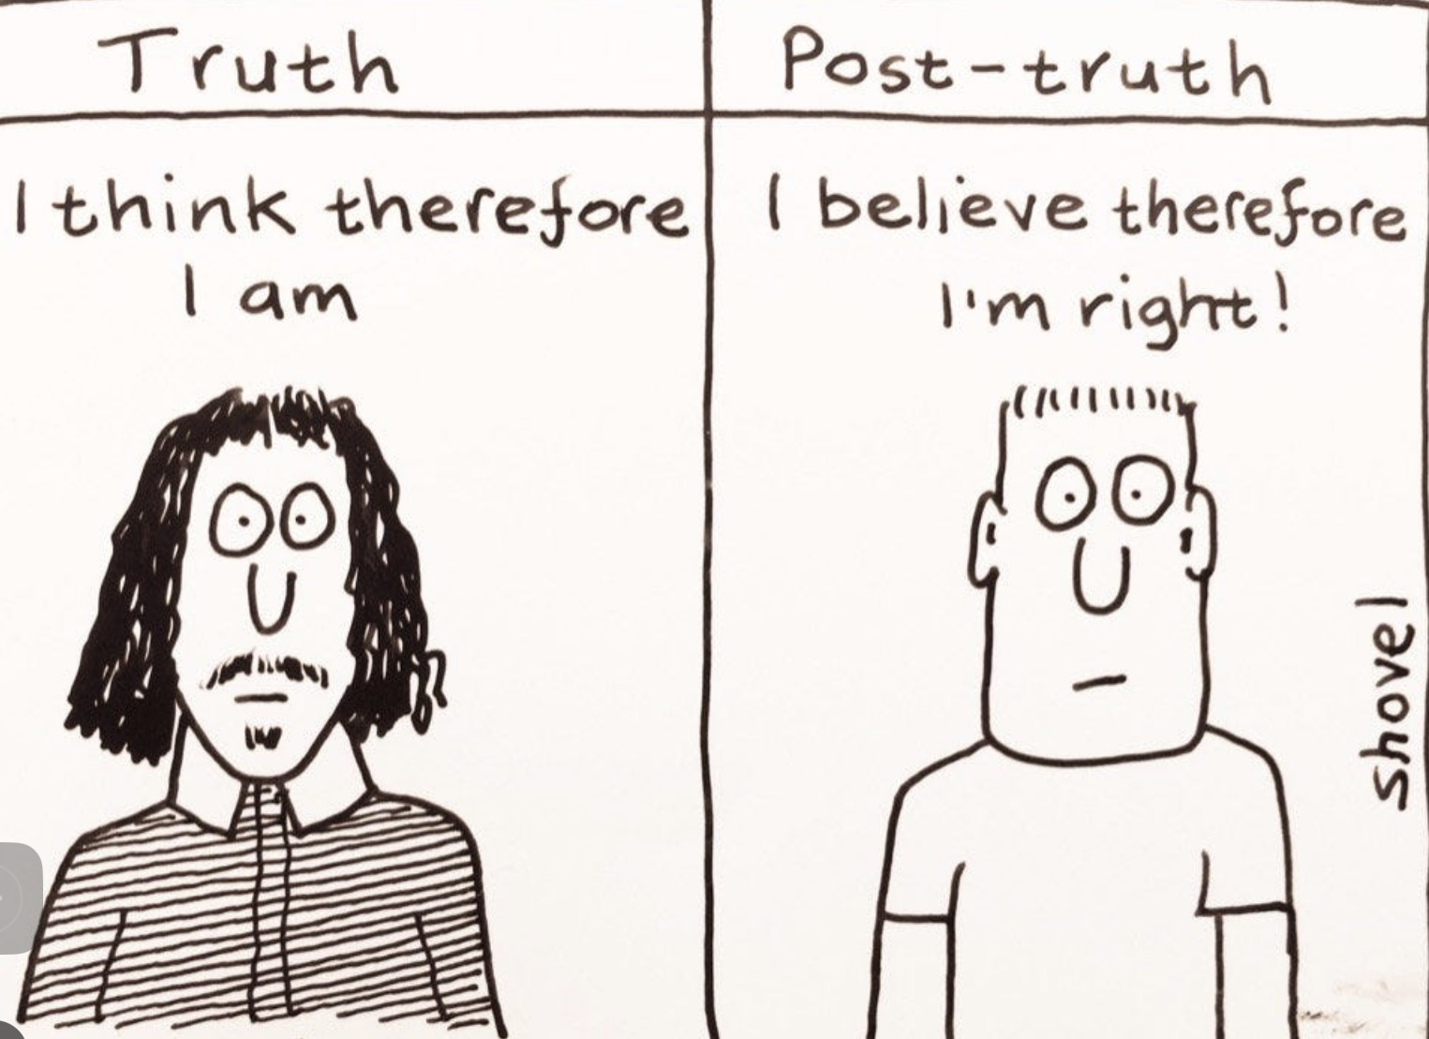

Slide 325
The term "post-truth" refers to a cultural and political context where objective facts and truth are less influential in shaping public opinion than appeals to emotion and personal belief. In a post-truth world, people are more likely to accept arguments based on their feelings or pre-existing beliefs rather than on factual evidence.
The concept gained prominence in the 2010s, especially during events like the Brexit referendum and the U.S. presidential election in 2016. It highlights the challenges posed by misinformation, fake news, and the echo chambers created by social media, where individuals can easily find information that reinforces their views, regardless of its accuracy.
In a post-truth world, the lines between fact and opinion become blurred, making it more difficult for people to engage in informed discussions and make decisions based on reliable information. Addressing this issue involves promoting media literacy, critical thinking, and encouraging open dialogue that respects evidence-based reasoning.
Timothy Snyder, a historian known for his work on totalitarianism and the history of Europe, argues that "post-truth is pre-fascism" to highlight the dangerous implications of a society that disregards objective truth. His statement suggests that when truth becomes irrelevant and facts are routinely dismissed or manipulated, fertile ground is created for authoritarian regimes to rise.

Slide 326
In a post-truth environment, where people are more likely to accept emotionally appealing narratives over factual ones, it becomes easier for demagogues to exploit these sentiments. By undermining trust in institutions, media, and experts, and by spreading misinformation, leaders can manipulate public perception and consolidate power.
This erosion of truth and trust can lead to a breakdown of democratic norms and make it easier for authoritarian figures to gain control, as they can more easily propagate their own version of reality without being held accountable.
Snyder's warning is rooted in historical examples where the manipulation of truth and the spread of propaganda have been used to pave the way for fascist regimes. By emphasizing the connection between post-truth and pre-fascism, Snyder is urging vigilance and the defense of truth as essential to maintaining democratic societies and preventing the rise of authoritarianism.
We’ve seen how the polycrisis of the modern and post-modern stages has led to feelings of instability and uncertainty leaving people looking for answers. This has provided an opportunity for authoritarian populist movements to rise to power by appealing to those who feel disoriented by the complexity and fluidity of contemporary life to whom they promise a return to simpler, more stable times.
This desire for stability can be seen as a longing for the clear structures and narratives provided by the earlier traditional stage.

Slide 327
Postmodernity’s emphasis on relativism and deconstruction leads to a sense of nihilism and meaninglessness. Populist movements react against this by promoting clear, absolute values and identities, offering a sense of certainty and purpose. By rejecting the relativism of postmodern thought, populist narratives attempt to re-establish a sense of right and wrong, rooted in traditional cultural and national identities.
The pluralism and multiculturalism championed by postmodern societies has led to identity crises, as traditional cultural and national identities are challenged and redefined. Populist movements often capitalize on these crises by emphasizing a return to “authentic” or “pure” identities, which can provide a sense of belonging and meaning.
This appeal to identity is particularly strong given the economic and social upheaval, that makes individuals feel their way of life is threatened.
Both modern and postmodern societies have led to increased complexity in governance and a perceived disconnect between elites and the general populace. Populist movements exploit this distrust, positioning themselves as champions of the “common people” against corrupt or out-of-touch elites. This narrative can restore a sense of agency and empowerment to those who feel marginalized or ignored by existing power structures.

Slide 328
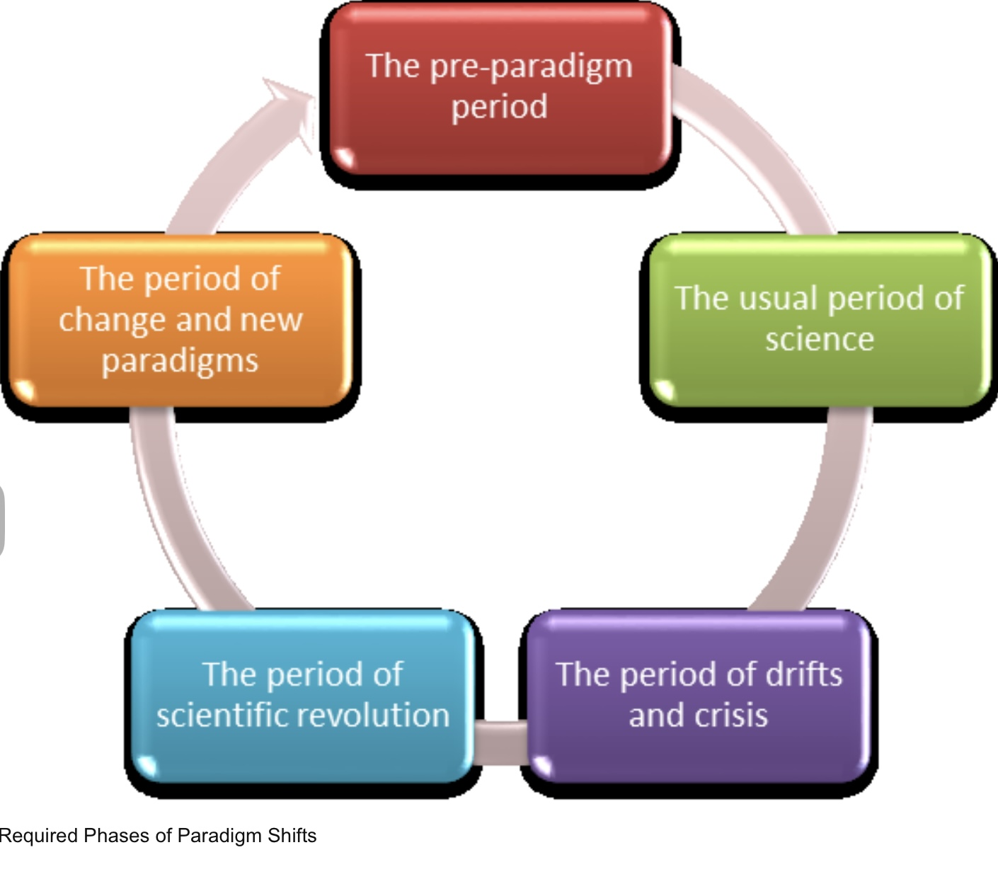
ANOMALIES IN WORLDVIEWS

Slide 329
PART V- ANOMALIES
Anomalies in worldviews
Physicalism and Idealism
Immanuel Kant
Bernardo Kastrup
The quantum world
Brain and Mind
The variety of states of consciousness
Searching for a deeper reality
The study of anomalous experiences
Idealism’s understanding of anomalous phenomena
Anomalous experiences, death and trauma
The foundations of spiritual traditions
Mysticism, spirituality and religion
The perennial philosophy
Divine order
Idealism, physicalism and meaning

Slide 330
We have so far argued that the polycrisis and its consequences can be seen as a failure of the traditional, modern and post-modern stages of development to address the challenges we’re currently facing, and that this failure signals the need for a shift in worldviews.
Worldviews that once provided a sense of coherence and direction are now, in the face of rapid technological, social, and cultural changes, increasingly unable to do so.
We have also seen how the modern stage’s physicalist metaphysics and the post-modern stage’s rejection of metaphysical “grand narratives” replaced the traditional stage’s meaningful idealism a portal to a sacred realm.
Physicalist metaphysics asserts that what is fundamental in the universe are impersonal inert physical substances and forces. This assertion leaves physicalists in the position of having to reject a whole range of spiritual “anomalous” phenomena that are incompatible with their metaphysics. Despite this, physicalism continues to have a grip on the imagination of a large percentage of people in Western culture.
We earlier discussed the similarities between Scientific paradigm shifts as described by Thomas Kuhn and the transitions between integral stages of development. We have also, at some length, discussed the meaning, ecological, economic and political polycrisis the modern and post- modern worldviews are unable to resolve.
In his work Kuhn argues that a sign a paradigm shift is needed is when the existing framework or paradigm is unable to explain data or observations.

Slide 331
We’ll now turn to discussing phenomena that the dominant physicalist metaphysics considers impossible, but which have been experienced and accepted by most humans through history as irrefutable evidence of a spiritual realm that has been widely considered more real than the physical world.
We’ll start by considering the philosophical debate between physicalism and idealism, then consider what contemporary physics and the study of mind and consciousness add to this debate. We’ll conclude by discussing how an Idealist integral paradigm explains these “anomalous” phenomena and addresses the polycrisis.

Slide 332
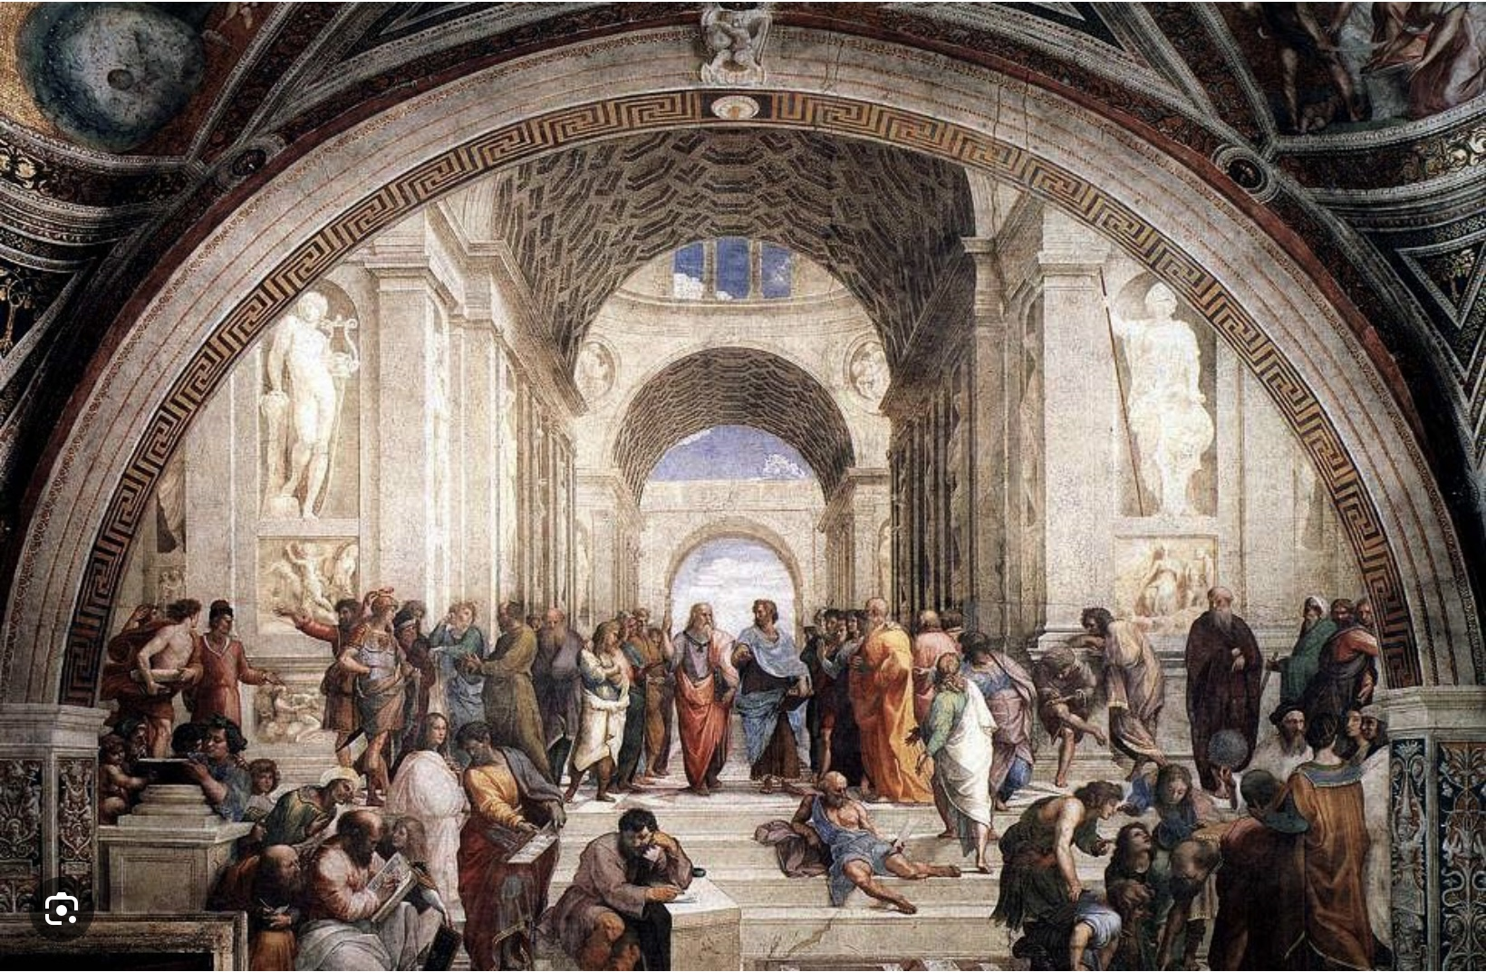
PHYSICALISM AND IDEALISM

Slide 333
Whether we find our lives and existence meaningful depends to a significant extent on whether we are metaphysical physicalists or idealists. This makes it very important to understand these philosophical positions.
Most people’s view is that the “world out there” exists independently of our perceptions and is exactly as we perceive it. Objects possess the properties we perceive them to have, such as color, shape, and texture, and these properties exist independently of any observer.
In philosophy this view is known as naïve realism. Naive realism’s great strength is that it aligns closely with our intuitive, everyday experience of the world.
The success of classical scientific explanations in fields like medicine, physics, and technology also reinforces the idea that the basic components of the “world out there” are entirely material or physical. This view is known as philosophical materialism or physicalism.
Philosophical materialism and physicalism are closely related concepts. Materialism is a philosophical viewpoint that asserts that the only thing that exists is matter, or that everything that exists is dependent upon material processes. In this view, all phenomena, including consciousness, thoughts, and emotions, can be explained in terms of material interactions.
Physicalism, on the other hand, is a broader concept. It holds that everything that exists is physical or that everything supervenes on, or is necessitated by, the physical.

Slide 334
Physicalism is often seen as an extension of philosophical materialism, incorporating not just matter but also physical forces and entities that might not be strictly material, such as energy, fields, and potentially even information, as understood in contemporary physics.
While both positions emphasize the primacy of the physical world, physicalism is often considered more compatible with the findings of modern science, which include non-material physical entities. Henceforth we will use the term “physicalism”.
While naïve realism and physicalism are the dominant popular culture views, many people also incorporate into their worldview aspects of spiritual, religious, or non-materialistic beliefs.
Both naïve realism and physicalism have, however, been convincingly refuted by philosophy and science.

Slide 335
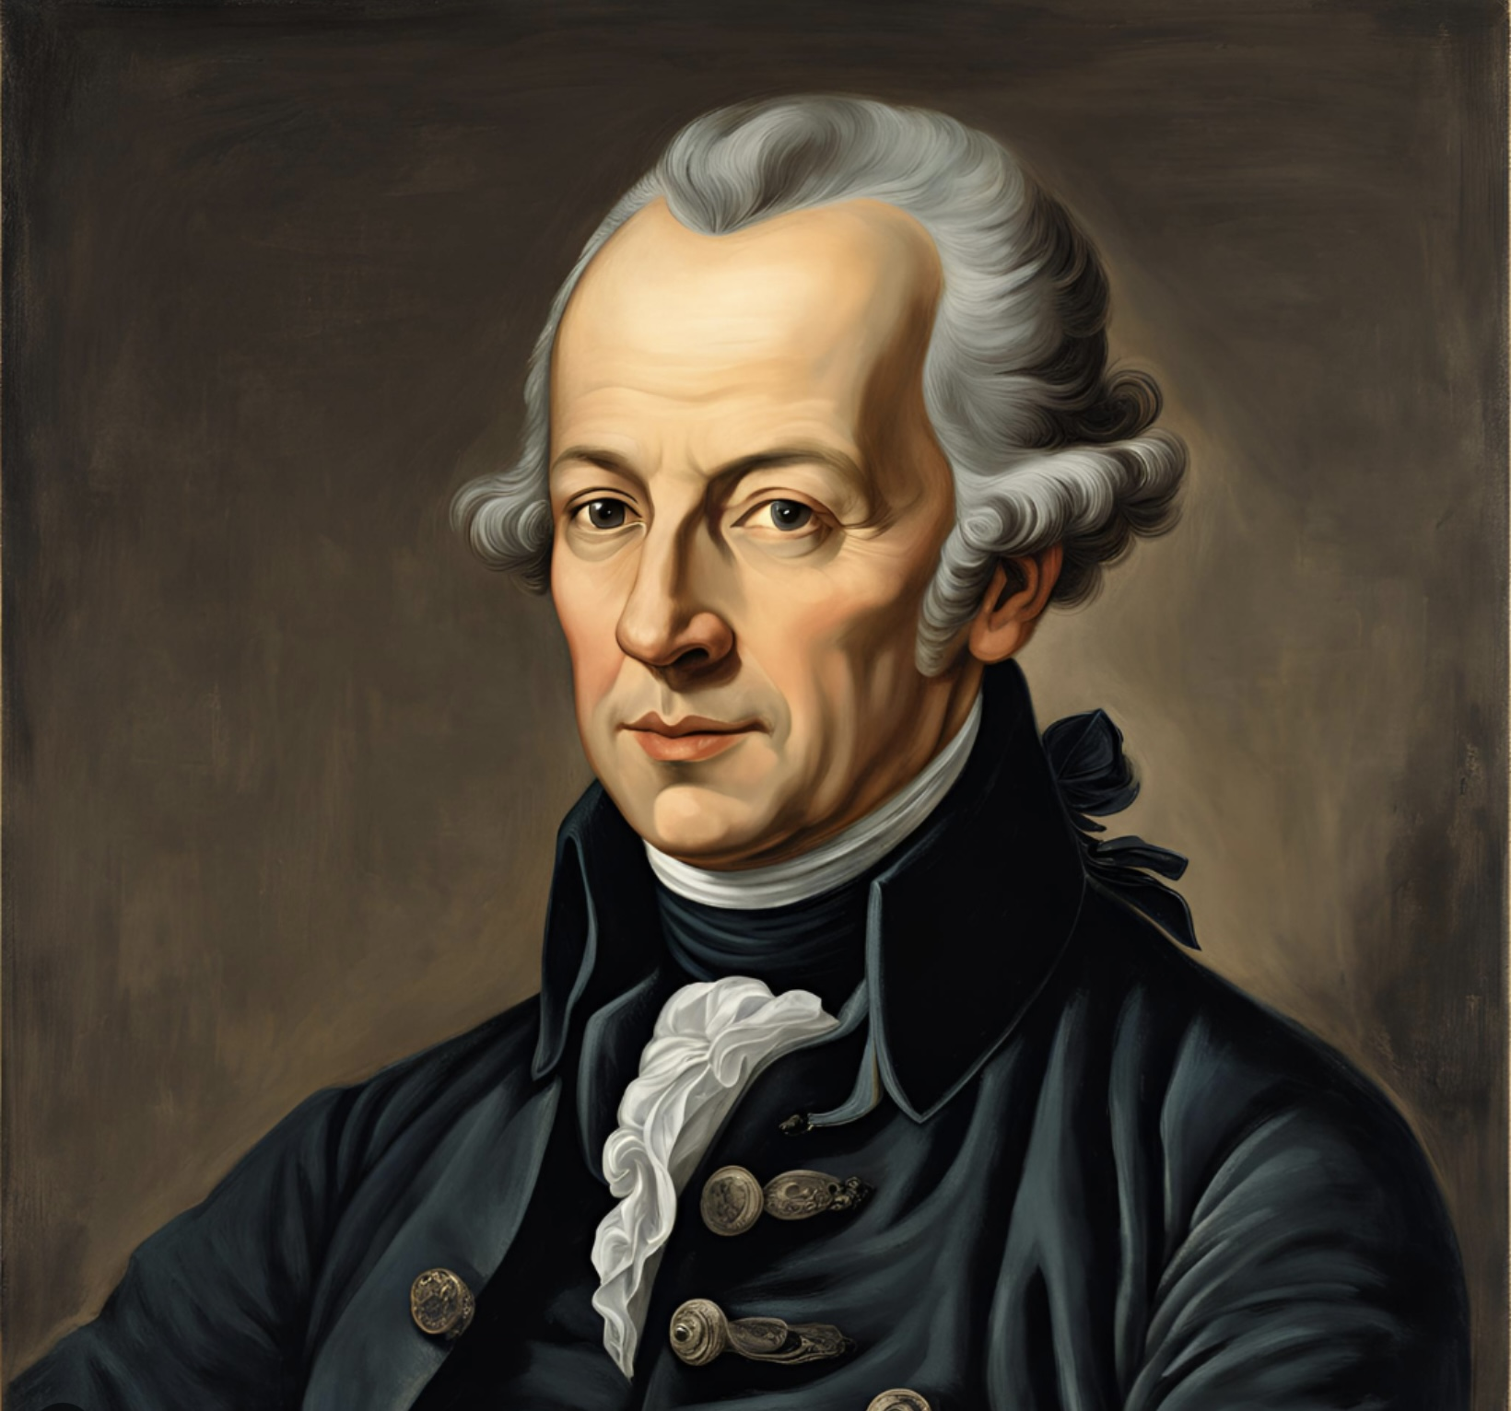
IMMANUEL KANT: REFUTING NAÏVE REALISM

Slide 336
Immanuel Kant (1724- 1804) was a German philosopher and one of the central figures in modern philosophy. The phrase "philosophical Copernican revolution" is used to describe Kant's transformative impact on philosophy, comparing it to the way Nicolaus Copernicus revolutionized astronomy.
Copernicus upended the prevailing belief that the Earth was the center of the universe, arguing that the Sun, not the Earth, was the center of the solar system. This fundamentally changed our understanding of the cosmos.
Similarly, Kant shifted the focus in philosophy from assuming that our knowledge must conform to the external world to the idea that the external world, as we know it, conforms to the structure of our minds.
Kant argued that our experience of reality is shaped by the mind's inherent structures and categories. This means that our knowledge is not just a passive reflection of the external world but is actively constructed by our minds. In other words, the mind plays a crucial role in shaping our experience of reality.
Kant introduced the concepts of the "phenomenal" and the "noumenal" to explain how we perceive and understand the world. The phenomenal World is the world as we experience it through our senses. It's the reality that appears to us, shaped by our perceptions and mental frameworks. Everything we see, hear, touch, and think about is part of the phenomenal world.
According to Kant, our knowledge is limited to this realm because our understanding is based on sensory experiences and the way our minds organize these experiences.

Slide 337
The Noumenal world, on the other hand, refers to the world as it is in itself, independent of our perceptions. It's the reality that exists beyond our sensory experience and understanding.
Kant believed that the noumenal world is inaccessible to us because we can't perceive it directly or know it through our senses. He argued that while we can have knowledge of phenomena, the noumenal world remains ultimately unknowable. With this argument Kant refuted naïve realism.
Kant’s distinction between the phenomenal and the noumenal worlds reoriented philosophical inquiry from seeking absolute truths about the external world to understanding the limits and conditions of human knowledge.
Kant's ideas on the active role of the mind in shaping experience influenced a wide range of disciplines, from epistemology and metaphysics to ethics and aesthetics.
As we explore the difference between Kant’s phenomenal and noumenal it’s helpful to consider evolution and how it determines our understanding of the world.
The universe exists at a vast range of size scales ranging from the microscopic quantum world to the macroscopic human sized world to the megascopic cosmological world.
Humans live and must survive in the macroscopic world. Our minds and senses evolved to survive in our human scale sized world. At this macroscopic scale, the world appears to feature cause and effect logic, linear time, and three dimensions. The world at this scale, Kant’s noumenal world, is understandable to human consciousness.

Slide 338
Humans do not live or need to survive at the microscopic or megascopic scales and consequently our minds and senses did not evolve to understand the world as it exists at these scales. The world at those scales lie in Kant’s noumenal realm and cannot be described by language or understood by the types of consciousness Humans experience.
This is what Richard Feynman was alluding to when he said; “I think you can safely say nobody understands quantum mechanics”. We cannot understand the noumenal world because our senses and cognition did not evolve to do so.
Religious scholar Huston Smith beautifully explains this idea: “Science has given us three domains of size the microscopic; quantum mechanics, the macroscopic; which is the world we are in, and the megaworld; where distances are measured in light years. Scientists say that you cannot describe the microworld or the megaworld using language. Language is geared to the macroworld, it will not fit the others. You have to have a special language, which is mathematics to describe those two worlds. If one cannot describe those two flanking worlds literally, what about God, which is greater than both of those by virtue that it includes those two. We have to have a special language to talk about God and that language is symbolism and metaphor. That gives a lie to literalism Which thinks you can describe God in ordinary language.”
The macro, human scale world is at its fundamental level the micro quantum world which is incomprehensible to our minds but can be described by mathematics. While we don’t know what the quantum world is, we can very accurately predict and model its behavior.
How does the microscopic quantum world behave?

Slide 339
One hundred years after the quantum revolution the best mathematical models we have of the quantum world are the standard model and quantum field theory.
The Standard Model of particle physics is a well-established theory that describes the fundamental particles and forces governing the universe, except for gravity.
The Standard Model classifies all known elementary particles into two main categories: fermions and bosons.
Fermions are the building blocks of matter and are divided into quarks and leptons. There are six types (or "flavors") of quarks: up, down, charm, strange, top, and bottom. Leptons include the electron, muon, tau, and their corresponding neutrinos.
Bosons are force-carrying particles. The Standard Model includes the photon (electromagnetic force), W and Z bosons (weak nuclear force), and gluons (strong nuclear force). The Higgs boson, discovered in 2012, is responsible for giving mass to other particles through the Higgs mechanism.
The Standard Model describes three of the four fundamental forces. The electromagnetic force is mediated by photons, it affects charged particles and is responsible for electricity, magnetism, and light.
The weak Nuclear Force is mediated by W and Z bosons and is responsible for processes like beta decay in nuclear reactions.

Slide 340
The Strong Nuclear Force is mediated by gluons, it holds quarks together within protons and neutrons and binds protons and neutrons within atomic nuclei.
The Higgs field and its associated particle, the Higgs boson, explain why some particles have mass. Particles acquire mass through their interaction with the Higgs field.
Despite its success, the Standard Model does not incorporate gravity, which is described by general relativity, and it does not explain dark matter or dark energy. It also does not account for the matter-antimatter asymmetry in the universe.
The Standard Model has been incredibly successful in predicting and explaining a wide range of experimental results, making it one of the most tested and confirmed theories in physics. Despite this success physicists continue to search for a more comprehensive theory that includes gravity and addresses the model's limitations.
The Standard Model is formulated as a quantum field theory, using complex mathematical structures to describe particle interactions and symmetries. Quantum Field Theory (QFT) is a fundamental theoretical framework in physics that combines classical field theory, quantum mechanics, and special relativity to describe how particles and fields interact.

Slide 341
In QFT, fields, not particles, are the primary entities. Every type of particle is associated with a corresponding field that permeates space and time. For example, the electromagnetic field is associated with photons.
Particles are seen as excitations or "quanta" of their respective fields. When a field is excited, it manifests as a particle. This perspective allows particles to be created and destroyed, which is essential for describing interactions.
QFT incorporates principles from both quantum mechanics, which governs the behavior of particles at small scales, and special relativity, which deals with the physics of high speeds and large distances. This combination ensures that QFT is consistent with the fundamental symmetries of nature.
Forces and interactions between particles are described as exchanges of virtual particles, which are temporary fluctuations in the fields. For example, electromagnetic interactions are mediated by the exchange of virtual photons.
QFT uses complex mathematical tools, such as Lagrangians, path integrals, and Feynman diagrams, to calculate probabilities of various physical processes. These tools allow physicists to make precise predictions about particle interactions.
QFT also involves dealing with infinities that arise in calculations. Renormalization is a process used to systematically remove these infinities, leading to finite and meaningful predictions.

Slide 342
QFT is the foundation for the Standard Model of particle physics, which describes the electromagnetic, weak, and strong nuclear forces. It is also used in condensed matter physics to study phenomena like superconductivity and the quantum Hall effect.
Quantum Field Theory is a powerful and successful framework that has led to many of the most accurate predictions in physics. Despite its complexity, it remains an essential tool for understanding the fundamental nature of the universe.
The standard model and QFT are incomplete but very accurate descriptions of how noumenal nature behaves. Nevertheless, they do not tell us what nature at the microscopic scale is. Nature is, at its fundamental level not what naïve realism tells us it is. It is also not the particles and forces physicalism tells us it is.

Slide 343
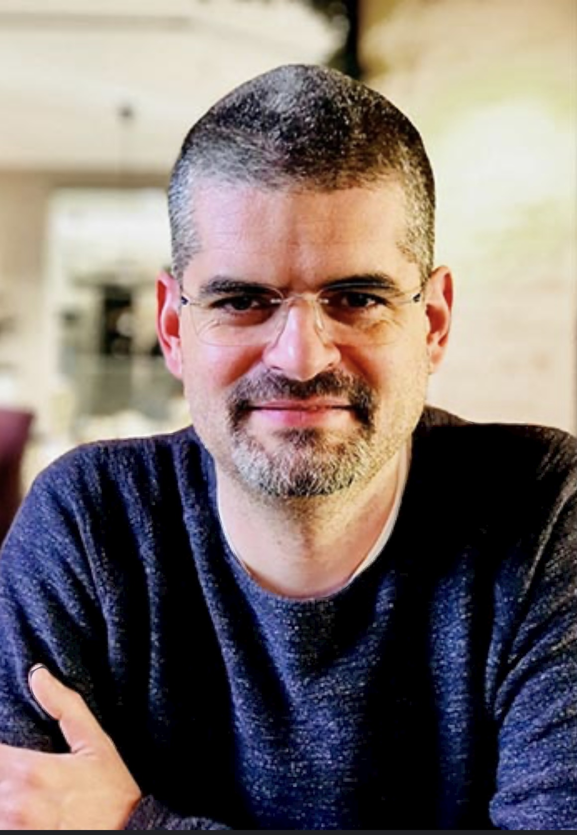
BERNARDO KASTRUP: REFUTING PHYSICALISM

Slide 344
While Kant and modern physics have refuted naïve realism, Bernardo Kastrup a contemporary philosopher has powerfully argued against physicalism, the position that everything, including consciousness, arises from physical processes.
Kastrup is known for his work on metaphysical idealism, a philosophical view that posits that reality is fundamentally mental or consciousness-based. He holds a Ph.D. in philosophy and another in computer engineering, and has worked in various fields, including artificial intelligence and computer science.
Kastrup has written several books and numerous essays outlining the shortcomings of a physicalism metaphysics and arguing for an idealist one.
With his deep knowledge of modern physics, he is ideally positioned to bridge the gap between science and philosophy. His work explores the nature of consciousness, the mind-body problem, and the philosophical implications of quantum mechanics.
Idealism holds that what we experience as the physical world is actually a construct of impersonal mind or consciousness. What we perceive as the physical world is not independent of our minds, instead, it is a manifestation of mental processes.
Idealists argue that all our knowledge of the world comes through perception, which is inherently a mental process. Thus, what we know as "reality" is actually a collection of perceptions, ideas, and sensations.

Slide 345
Idealism often arises as a critique of physicalism, which holds that reality is composed of physical matter and forces. Idealists argue that physicalism fails to account for the nature of consciousness and the subjective quality of experience.
According to idealism, objects do not have an existence independent of our perception. Instead, they are dependent on being perceived by a mind. This leads to the view that the universe is essentially a mental construct.
There are different forms of idealism, such as subjective idealism (which focuses on individual perceptions) and objective idealism (which posits a universal mind or consciousness that underlies all reality).
Idealism places consciousness at the center of its metaphysical framework, suggesting that understanding the mind is key to understanding the nature of reality itself.
Idealism has been the object of many critiques particularly around its perceived difficulty in explaining the apparent consistency and shared nature of the physical world among different observers. Thes critiques are systematically dealt with by Kastrup’s in his writings.
Kastrup builds his argument for idealism on the observation that everything we know, including the physical world, is experienced through consciousness, and thus consciousness should be considered fundamental rather than derivative.

Slide 346
He critiques physicalism for its inability to satisfactorily explain how subjective mental experience arises from physical processes arguing that idealism offers a more coherent solution by positing that what we perceive as the physical world is a manifestation of consciousness.
The difficulty explaining how physical processes give rise to subjective experience is an "explanatory gap" in physicalism that is known as the hard problem of consciousness. Kastrup argues that this explanatory gap is insurmountable within a physicalist framework. He maintains that what we perceive as reality is a construct of consciousness, and our perceptions rather than reveal an objective reality are shaped by mental processes.
Kastrup suggests that physicalism is ontologically extravagant because it posits a separate, independent physical world to account for experiences. He argues for an idealist perspective, where consciousness is fundamental, and the physical world is a manifestation of mental processes. He sees this as a more parsimonious explanation. By positing that only consciousness exists, idealism avoids the dualistic problem of explaining how two fundamentally different substances, mind and matter, interact.
Kastrup points to phenomena such as quantum mechanics, which challenge classical physicalist notions of an objective, observer-independent reality. He suggests that these phenomena are more easily explained if consciousness is fundamental.
Kastrup cites empirical evidence from quantum mechanics such as the observer effect and the role of measurement in determining the state of quantum systems to suggest that consciousness is integral to the existence of what we call reality.

Slide 347
Kastrup argues that idealism can better account for the nature of existence and the role of consciousness without resorting to the assumptions required by realism thus offering a more coherent metaphysical framework. He suggests that the apparent solidity and persistence of the physical world can be understood as patterns or regularities within a universal consciousness.
He uses the analogy of dreams to illustrate how a seemingly external and consistent world can arise from consciousness. Just as a dream is experienced as real while we are dreaming, our waking reality could similarly be a manifestation of a larger consciousness.
Kastrup critiques physicalism for its reliance on abstract mathematical models that do not inherently explain the qualitative aspects of experience. He argues that idealism better accounts for the richness of subjective experience.
Kastrup emphasizes the limits of human knowledge and perception, arguing that realism overextends by claiming access to a reality beyond these limits. He suggests that acknowledging these limits leads to a more coherent understanding of reality as fundamentally mental.
Kastrup's idealism is a modern reinterpretation of a longstanding philosophical tradition. He engages with both scientific findings and philosophical arguments to make his case. His work challenges the dominant physicalist paradigm and invites reconsideration of the nature of reality and consciousness.
We will probe deeper into Kastrup’s idealism in “my personal religious myth”

Slide 348

THE QUANTUM WORLD: ANOMALIES IN PHYSICALIST METAPHYSICS

Slide 349
Until the 19th century the traditional view that the sacred, spiritual or mental realm was the creative force behind the physical realm was accepted by most scientists and laypeople. In this view, altered states of consciousness and what physicalists consider “anomalous” phenomena and perceptions were seen as glimpses into this sacred realm providing evidence for it.
This traditional view changed in the 19th and 20th centuries as the modern stage with its metaphysical physicalism came to dominate the culture. Physicalism holds that particles and forces are the fundamental substances of the universe. Mind and consciousness are the products of complex arrangements of these particles and forces.
According to physicalists, altered states of consciousness and anomalous phenomena and perceptions are not glimpses into another realm because that other realm does not exist.
The physicalist view places a wide range of phenomena outside the legitimate scope of science and transforms science into scientism. Science and scientism are related but distinct concepts.
Science is a systematic enterprise that builds and organizes knowledge in the form of testable explanations and predictions about the universe. It relies on empirical evidence, experimentation, and the scientific method, which involves observation, hypothesis formulation, experimentation, and analysis. Science is open to revision and refinement as new evidence becomes available. Science encompasses a wide range of disciplines, from physics and chemistry to biology and social sciences.

Slide 350
The scientific method is metaphysically neutral, meaning it does not inherently commit to a particular metaphysics such as idealism or physicalism. The goal of science is to investigate and understand the natural world through observation, experimentation, and evidence, without being constrained by specific metaphysical assumptions.
This metaphysical neutrality allows science to remain open to new evidence and ideas, regardless of how they fit into existing worldviews. This openness is crucial for scientific progress, as it encourages the exploration of diverse hypotheses and theories.
By emphasizing empirical evidence and testable predictions, science can focus on what can be observed and measured, rather than on untestable metaphysical claims. This helps maintain objectivity and rigor in scientific investigations.
Metaphysical neutrality facilitates collaboration across disciplines with different philosophical perspectives. This can lead to more comprehensive and nuanced understandings of complex phenomena.
Science's adaptability is one of its strengths. By not being tied to a specific metaphysical framework, science can evolve and incorporate new paradigms as our understanding of the world deepens.
A metaphysically neutral science is more inclusive, allowing people with different philosophical or cultural backgrounds to engage with scientific inquiry without feeling that their worldview is being dismissed or marginalized.

Slide 351
While individual scientists may hold personal metaphysical beliefs, the practice of science itself benefits from maintaining a neutral stance. This neutrality ensures that science remains a flexible and open-ended endeavor, capable of adapting to new discoveries and insights.
Scientism is a term used to describe an over-reliance on or excessive belief in the power of scientific knowledge and techniques. It implies a worldview that regards science as the ultimate authority on all questions and often dismisses other forms of knowledge, such as philosophy, religion, or the arts. Scientism leads to the assumption that scientific methods are applicable to all aspects of life and that only scientific knowledge is valid or valuable.
While science is metaphysically neutral and applicable regardless of whether a physicalist or idealist paradigm most accurately describes the fundamental nature of the world, scientism is not, scientism takes a physicalist perspective and rejects idealism.
Scientism, with its physicalist bias approaches altered states of consciousness and anomalous perceptions with extreme skepticism if not outright rejection.
Scientism tries to reduce these complex experiences to their physiological or neurological components. Altered states of consciousness, such as those induced by meditation, psychedelics, or near-death experiences, are explained solely in terms of brain chemistry and neural activity.
Scientism prioritizes objective, measurable data over subjective experiences. As a result, personal accounts of altered states or anomalous perceptions are dismissed as unreliable or anecdotal unless they can be quantified or reproduced under controlled conditions.

Slide 352
Scientism demands rigorous empirical evidence to validate claims about altered states. This can be challenging, as such states are deeply personal and may not always lend themselves to traditional scientific investigation.
However, even when paranormal phenomena such as extrasensory perception, or precognition are rigorously studied and validated following strict scientific methodology, scientism still rejects them, ignores the investigators involved in this research, often accusing them of fraud, or tries to “debunk” their work.
Experiences that suggest a non-material aspects of consciousness challenge the physicalist view that underpins scientism. This leads to a dismissal of such experiences as unscientific or irrelevant.
Some forms of scientism pathologize altered states of consciousness, viewing them as symptoms of mental illness or dysfunction rather than potentially meaningful or transformative experiences.
Scientism also dismisses or undervalues explanations that come from non-scientific perspectives, such as spiritual or philosophical interpretations of altered states and anomalous perceptions.
Scientism delegitimizes altered states of consciousness and anomalous perceptions because they do not fit neatly into a physicalist paradigm. Within a scientistic framework, experiences that cannot be fully explained by current scientific understanding or that challenge the physicalist view are dismissed or considered less valid.
Not all scientists adhere to scientism. Historical many prominent scientists and today a growing number of researchers are open to studying altered states of consciousness and anomalous perceptions using a variety of methods, including interdisciplinary approaches that incorporate insights from psychology, neuroscience, and the humanities.

Slide 353
The scientific method is a powerful tool for investigating a wide range of phenomena, but it has limitations, especially when it comes to experiences that do not easily fit into a physicalist paradigm, including anomalous perceptions and altered states of consciousness.
The scientific method relies on empirical observation and measurement. Altered states of consciousness and anomalous perceptions are often subjective and personal, making them difficult to measure objectively. While tools like brain imaging can provide some insights, they may not capture the full richness of these experiences.
Scientific inquiry often requires that phenomena be reproducible and studied under controlled conditions. Altered states can be highly individual and context-dependent, making them challenging to reproduce consistently in a laboratory setting.
Altered states of consciousness and anomalous experiences often involve complex interactions between biological, psychological, and environmental factors. Understanding them fully may require interdisciplinary approaches that incorporate insights from fields like psychology, neuroscience, anthropology, and the humanities.
The scientific method traditionally prioritizes objective data, which can lead to the undervaluation of subjective experiences. However, qualitative research methods, such as phenomenology or narrative analysis, can be used to explore the subjective aspects of these phenomena.

Slide 354
There are three camps of opinion about the altered states of consciousness and anomalous perceptions and phenomena that have traditionally provided evidence for a non-physical realm.
Today the most popular view is the scientistic position that these phenomena should be rejected as at best ignorant and at worst as fraudulent and science should not waste time on them.
The second perspective holds that scientific methodology can be used to examine all phenomena even those considered spiritual or paranormal.
The third view, which is not incompatible with the second, is that while anomalous experiences and paranormal phenomena are in many cases real, by their nature they may not always be amenable to being studied using scientific methods.
Physicalists do not believe a deeper reality or spiritual realm exists. Idealist do, and there are two ways in which they explore this realm.
The first is based on the metaphors and mythologies that emerge from altered states of consciousness and anomalous phenomena and perceptions that are at the root of the major religious traditions.
The second is using scientific methodology and mathematics as illustrated by the theories of Rupert Sheldrake, Donald Hoffman and Giulio Tononi. It is these idealist explorations of a deeper or spiritual realm that we will now consider.

Slide 355
Although classical 19th century Newtonian mechanics supports a physicalist metaphysical perspective, and reasonably accurately mathematically describes the human sized macroscale, scientists at the beginning of the 20th century, discovered Newtonian mechanics could not accurately describe the quantum sized microscale or at the other end of the spectrum the very large or light speed megascale.
The discoveries of quantum and relativity physics revealed that nature at the very small and very large scales isn’t at all like the “reality” we perceive at the human sized macroscale which is shaped by our sensory and cognitive apparatus. At extreme scales, the world is so different as to be unimaginable by the human mind.
At these extreme scales, the Newtonian mechanical model is inadequate as a mathematical description of the world. This inadequacy is what led to the development of quantum physics and relativity which provide an incredibly accurate mathematical description of a world that remains incomprehensible to the human mind.
The quantum and relativity revolutions paved the way for modern physics and had profound implications for cosmology, particle physics, our understanding of the fundamental forces of nature and philosophy.
The quantum and relativity revolutions were two significant shifts in scientific understanding that in the early 20th century transformed our view of the physical universe.
The quantum revolution refers to the development of quantum mechanics, a branch of physics that emerged in the early 1900s. The quantum revolution revealed that matter is not constituted of particles, but that “matter” is something else that we are still struggling to understand. The quantum revolution fundamentally changed our understanding of atomic and subatomic processes.

Slide 356
The quantum revolution had profound implications for the debate between metaphysical physicalists and idealists. Quantum mechanics challenged the classical physicalist view that the physical world is entirely deterministic and can be fully understood through classical physics.
The probabilistic nature of quantum events, such as the behavior of particles, suggests that at a fundamental level, reality may not be as straightforward as physicalism posits.
The observer effect, where the act of measurement affects the system being observed, raises questions about the role of consciousness and observation in defining reality. This challenges the physicalist notion that the physical world exists independently of our observation and understanding.
Phenomena such as quantum entanglement suggest that particles can be instantaneously connected across vast distances, defying classical notions of locality. This challenges the physicalist view of separateness and independence of physical entities.
Quantum theory has been interpreted by some as indicating that consciousness plays a fundamental role in shaping reality. This aligns with an idealist metaphysical perspective.
Several key figures in the early development of quantum mechanics including Niels Bohr , Werner Heisenberg, David Bohm’s and Wolfgang Pauli espoused metaphysical idealist views.

Slide 357
While many of the pioneering scientists who first explored quantum physics understood that that their discoveries challenged the physicalist worldview this has never been understood by many other scientists or by the public.
Quantum physics is a major anomaly in the physicalist worldview, but because its concepts and implications are so difficult to grasp, that physicalist worldview continues to be a powerful force shaping the modern “The story”.
Scientism refuses to consider anomalies believing that phenomena that do fit with the current normal science are illegitimate or fraudulent and should be rejected without further study. Scientism is a type of fundamentalism that shares much with the religious fundamentalism that resisted the findings of the scientists who founded the scientific revolution.
Epistemology is the field in philosophy that concerns itself with the different ways of knowing. Epistemology is the study of knowledge, its nature, sources, limitations, and validity. It explores how we come to know things and what it means to "know" something. Epistemology considers that there a number of different ways of knowing the world.
Empirical knowledge is knowledge gained through sensory experience and observation. It is often associated with the scientific method, where knowledge is derived from experiments and empirical evidence.
Rational Knowledge is based on reason and logical deduction. It involves the use of reasoning processes to arrive at conclusions, often independent of sensory experience. Mathematics and formal logic are examples of domains where rational knowledge is predominant.

Slide 358
Intuitive knowledge involves understanding or knowing something immediately, without the need for conscious reasoning. Intuitive knowledge is often described as a "gut feeling" or an immediate insight.
Testimonial knowledge is knowledge acquired through the testimony of others. It relies on the credibility and reliability of sources, such as experts, witnesses, or written texts.
Authoritative knowledge is similar to testimonial knowledge. It involves accepting information as true based on the authority of the source. It can include knowledge from experts, religious texts, or cultural traditions.
A Priori knowledge is knowledge that is independent of experience and is known through reason alone. It includes propositions that are considered self-evident or logically necessary, such as mathematical truths.
A Posteriori knowledge is dependent on experience or empirical evidence. It is knowledge that comes after (or is posterior to) experience.
Constructivist knowledge suggests that knowledge is constructed by individuals or social groups, rather than being passively received from the environment. It emphasizes the role of social and cultural contexts in shaping knowledge.
Pragmatic knowledge focuses on the practical application and usefulness of knowledge. It evaluates the truth of a belief based on its success in practical application.

Slide 359
There has been a longstanding debate about how valid each of these different ways of knowing are. There is also a debate between those who attribute more value to the scientific or to the religious ways of knowing the world.
Those who claim science is a more valid and reliable way of knowing the world argue that science specifically addresses questions about the natural world and physical phenomena, making it a powerful tool for understanding and manipulating the environment.
They maintain that science is grounded in empirical observation and experimentation. This reliance on evidence makes scientific knowledge more adaptable and self-correcting over time. Scientific knowledge evolves as new discoveries are made, allowing for continual refinement and improvement.
They say this adaptability is a strength, as it reflects a commitment to understanding the world more accurately over time. Religion, they hold, while addressing moral, ethical, and existential questions, deals with matters that are not scientifically testable.
In this debate there are those who believe both science and spirituality are important ways of knowing the world and are equally valid. The difference is that science tells us about the material realm, spirituality the immaterial one. Scientism stands on physicalism. This is not a scientifically verified position but a metaphysical assumption that has significant evidence against it.
Scientism is a distortion of the scientific method, it eliminates on an unproven assumption a whole realm of Human experience that most human, including great thinkers and scientists have taken seriously.

Slide 360
The modern-day perceived superiority of scientific ways of knowing does not inherently diminish the value of spiritual knowledge. For many spirituality provides a convincing access to a deeper reality, a sense of meaning, a feeling of community, and ethical guidance that science cannot begin to address.
Scientism is one of the root causes of the disenchantment of the world.
Many of life's big questions such as the purpose of existence, the nature of love, and the concept of morality are not answerable by scientific inquiry. Scientism claims there is nothing but meaningless particles and forces.
A comprehensive and wise understanding of complex human experiences and societal issues requires insights from multiple disciplines, including philosophy, religion, ethics, and the arts. Balancing scientific understanding with other forms of knowledge and experience is crucial for a more holistic understanding of life.
Both the scientific and spiritual ways of knowing offer us valuable insights into the world, but they operate within different domains and address different kinds of questions about existence, meaning, and the nature of reality.
Science and religion can coexist and serve different purposes in people's lives. Each has its own strengths and limitations.
By reducing complex human experiences, emotions, and cultural phenomena to mere biological or chemical processes, scientism strips away the richness of human experience and leaves individuals feeling disconnected from the world and unable to find deeper meaning in life. Scientism is scientific knowledge which provides us excellent maps of the world but does not realize that “maps” are not the territory.

Slide 361
People who have reflected deeply on mysteries of the universe maintain that if we want a more comprehensive and wise understanding of the world and human experience it’s essential that we look at the world through both the scientific and the spiritual lenses.
There is little separating some quotations of great mystics from those of great scientists:
"You are not a drop in the ocean. You are the entire ocean in a drop." — Rumi
"When you look at the universe at its fundamental level, you realize that everything is interconnected in a way that is almost mystical." — John Archibald Wheeler
"The world is illusory; Brahman alone is real; Brahman is the world." — Ramana Maharshi
"Reality is merely an illusion, albeit a very persistent one." — Albert Einstein
"The eye through which I see God is the same eye through which God sees me; my eye and God's eye are one eye, one seeing, one knowing, one love." — Meister Eckhart
"The universe does not exist out there independent of us. We are inextricably linked to the universe, not only in our matter but in our consciousness." — John Archibald Wheeler
"The Tao that can be told is not the eternal Tao; the name that can be named is not the eternal name." — Lao Tzu
"If you think you understand quantum mechanics, you don't understand quantum mechanics." — Richard Feynman

Slide 362
We have so far considered:
1) how the current polycrisis is associated with the modern and post-modern worldviews. And…
2) how the metaphysical physicalism that entirely supports scientism, and the view that there is only a material realm, runs into significant validity and consistency issues when considered in light of philosophical thinking and modern physics.
We will probe deeper into that whole realm of immaterial experience that physicalism, and the modern and post-modern stages dismiss; altered states of consciousness, anomalous perceptions and experiences, and the paranormal.
We will consider if these are indeed, as scientism claims, brain chemical abnormalities or if they, as spirituality maintains, reveal something about the fundamental nature of reality.
Before doing that, we must however briefly first explore the relationship between the brain and the mind.

Slide 363
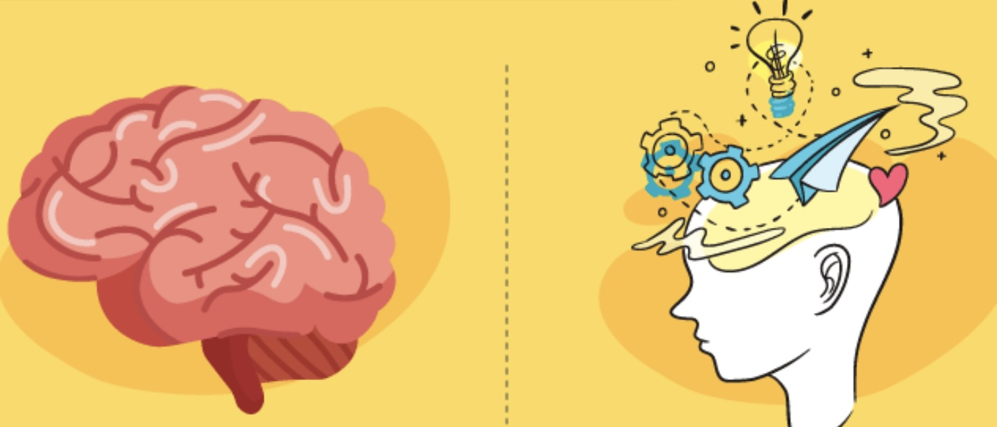
WHAT IS THE RELATIONSHIP BETWEEN BRAIN AND MIND?

Slide 364
Physicalism and Idealism have different views on what the relationship between brain and mind is. We need to consider these views if we want to understand why idealists believe that altered or anomalous states of consciousness, perception, and phenomena may give us access to a transcendent realm whereas physicalists believe they are brain malfunctions.
Most people consider that the state of wakefulness gives us more access to what is real than other states of consciousness. This “commonsense” view aligns with naïve realist and physicalism and is evolutionarily very adaptive. It is associated with another commonsense view about the relationship between the brain and the mind known as the productive theory.
The productive theory is the most commonly held of a number of theories describing the relationship between the mind and the brain. The productive theory posits that the mind is entirely produced by the brain's functions.
In this view, cognitive processes, emotions, and consciousness arise directly from the brain's physical and biochemical activities. The brain is a factory which receives information from the world and produces what we experience as mind.
Memory is stored in the brain by a videorecorder like function. This productive view suggests that understanding the brain's structure and function is key to understanding the mind. This theory is grounded in metaphysical physicalism.

Slide 365
The productive theory holds that altered or anomalous states of consciousness, such as those induced by meditation, psychoactive substances, or certain neurological events result from changes in brain activity.
For instance, psychedelic substances alter neurotransmitter levels, leading to changes in perception, mood, and cognition.
Different states of consciousness may involve the activation or deactivation of specific neural circuits. For example, during meditation, there might be increased activity in areas associated with attention and decreased activity in areas related to the sense of self.
According to the productive theory, altered states may also be associated with changes in brain wave patterns. For example, deep meditation or sleep might be linked to increased theta or delta waves, which are different from the beta waves typically seen in normal waking consciousness.
Changes in how different parts of the brain communicate can lead to altered experiences. For instance, a decrease in the usual filtering processes of the brain might allow for a more holistic or interconnected experience, often described in spiritual or mystical terms.
The productive theory explains altered states of consciousness as the result of specific changes in brain activity, whether through chemical, electrical, or structural alterations. The productive theory is metaphysically physicalist assuming that the physical is the ultimate substrate of reality.

Slide 366
There are other theories which offer alternative perspectives on the relationship between the brain and the mind. These theories share the view that the brain does not produce but may instead have an altogether different relationship to mind or consciousness. Implied in these theories is the idea that mind or consciousness exists beyond the brain.
According to the transmissive theory, much like a TV receives electromagnetic waves and transforms them into the images and sounds on a screen, the brain receives mental states or consciousness from an external source or realm that is separate from the physical brain.
The brain then transforms this external consciousness into what we experience in our minds. In other words, rather than being the origin of mental states the brain serves as a conduit, reducing valve or medium through which mental states are expressed or experienced. The brain functions like a filter or transmitter for consciousness, which exists independently of the brain.
Proponents of the transmissive theory argue that consciousness is a fundamental of the universe and that the brain acts as a filter or interface for this universal consciousness. The brain does not create consciousness but rather transmits it, suggesting a deeper reality where consciousness is primary.

Slide 367
According to this theory in some altered states of consciousness, such as those induced by meditation, psychedelics, or near-death experiences, the brain's filtering capacity may be reduced, allowing individuals to access a more expansive or universal consciousness. This allows for a broader or more direct experience of non-personal or universal consciousness, leading to perceptions and insights that are not typically accessible in ordinary states.
This, the proponents of the theory argue, is why people often report feelings of interconnectedness, transcendence, or spiritual insight during such experiences.
Another theory describing the relationship between brain and mind is known as the permissive theory. The permissive theory suggests that while the brain does not directly produce mental states it provides the necessary conditions for the mind to exist.
In this view, the brain acts as a facilitator, allowing for the emergence of consciousness and mental processes, but mind is something that exists independently of the brain's specific physical structure or processes.
The brain permits the emergence of consciousness rather than solely producing it. Metaphorically, the brain is a garden, and the mind are the flowers that grow in it, the garden provides the right conditions for the flowers to bloom, but the flowers themselves are not made of soil or water; they are distinct entities that flourish due to the garden's environment.

Slide 368
According to the permissive theory, altered states of consciousness occur when the brain changes its usual patterns of activity, allowing certain experiences to emerge by changing its usual constraints or patterns. For example, during deep meditation or psychedelic experiences, the brain might permit a greater flow of consciousness, leading to altered perceptions and states of awareness.
This could involve shifts in brain function that permit experiences outside the norm, such as heightened creativity, mystical experiences, or profound emotional insights.
The theory describing the relationship between brain and mind or consciousness which I find most appealing, is put forward by Bernardo Kastrup. Kastrup suggests that the brain does not produce, transmit or permit consciousness, rather the brain is what an individual's localized mind and consciousness looks like when seen from an outside third-party perspective.
An individual’s mind and their brain are different perspectives, the mind the interior the brain the exterior perspectives, on the same thing.
Kastrup believes that the universe is the outward or external appearance of the internal experience of universal mind. Similarly, The human body including the brain, a small part of the universe, are the external appearance of the internal experience of human consciousness or mind.
A universal mind that is the internal experience of the universe is the God of philosopher Baruch Spinoza which Einstein famously said he believed in.
Altered states of consciousness and anomalous perceptions, in Kastrup’s, the permissive and transmissive theories views may be opportunities to experience non-personal consciousness in a less restricted form. Because during these experiences we may be accessing a larger consciousness they may offer us insights into a realm that is not accessible when we are in an awake state and confined to our individual consciousness.
Kastrup’s, the permissive and transmissive theories all reflect a philosophical idealist stance on the mind-body problem. Such idealist theories of mind have been dominant throughout human history being held by Plato and all the traditional religions.
Having considered the relationship between brain and mind let’s now take a closer look at the variety of states of consciousness.

Slide 369
Altered states of consciousness and anomalous perceptions, in Kastrup’s, the permissive and transmissive theories views may be opportunities to experience non-personal consciousness in a less restricted form. Because during these experiences we may be accessing a larger consciousness, altered states of consciousness offer us insights into a realm that is not accessible when we are in an awake state and confined to our individual consciousness.
Kastrup’s, the permissive and transmissive theories all reflect a philosophical idealist stance on the mind-body problem. Such idealist theories of mind have been dominant throughout all of humanity’s existence.
Having considered the relationship between brain and mind let’s now take a closer look at the variety of states of consciousness.

Slide 370

THE VARIETY OF STATES OF CONSCIOUSNESS

Slide 371
Altered states of consciousness are states of awareness that differ significantly from the normal waking state. They include states experienced during meditation, hypnosis, sleep, or under the influence of psychoactive substances.
Anomalous perceptions are unusual sensory experiences that deviate from typical perception. They include hallucinations, illusions, synesthesia, déjà vu, jamais vu, out-of-body experiences, and near-death experiences.
Anomalous perceptions and altered states of consciousness are closely related concepts. While not all altered states result in anomalous perceptions, and not all anomalous perceptions occur during altered states, there is a significant overlap where changes in consciousness can lead to unusual sensory experiences.
In many cultures, altered states of consciousness and the resulting anomalous perceptions, are pursued for spiritual or religious reasons as they are seen as a means of gaining insight into or connecting with the divine.
If we assume Kastrup’s idealist premise that our individual minds or consciousness are dissociated parts or “alters” existing within a vast universal mind it does make sense that altered states of consciousness and anomalous perceptions, might help us access the universal mind.
Let’s consider the variety of states of consciousness and anomalous perceptions.

Slide 372
Humans experience not just awake consciousness but a wide range of other states of consciousness.
Wakefulness is the normal state of consciousness when a person is fully alert and aware of their surroundings. It involves active engagement with the environment and the ability to think, perceive, and interact.
There are however many other states of consciousness some quite normal and common others “anomalous” and less common.
Sleep is a natural, recurring state characterized by reduced consciousness, and decreased sensory activity. It includes different stages, such as REM (Rapid Eye Movement) sleep, where dreaming occurs, and non-REM sleep. In dreaming or REM sleep people experience vivid dreams that can be fantastical or reflect real-life experiences. Dreams are a unique state of consciousness with their own logic and narrative structure.
Meditation is a practice that involves focusing the mind and achieving a state of mental clarity and emotional calm. There are various forms of meditation, such as mindfulness and transcendental meditation, each leading to different experiences and states of consciousness.
Hypnosis is an altered state of consciousness characterized by focused attention, reduced peripheral awareness, and an enhanced capacity for response to suggestions. It has been used therapeutically to access the subconscious mind.
Daydreaming is a spontaneous and light form of altered consciousness where attention drifts away from the external environment to internal thoughts, fantasies, or memories.

Slide 373
A flow state, also known as "being in the zone," is a state of complete immersion and focus on an activity, often leading to enhanced performance and a sense of timelessness.
Intoxication is a state induced by substances such as alcohol or drugs, leading to altered perception, mood, and cognitive function.
All the above are common. There are also uncommon states of consciousness.
Lucid Dreaming, is a state, in which the dreamer becomes aware that they are dreaming and can sometimes exert control over the dream narrative and environment.
Trance States can occur in various cultural and religious contexts. They are sometimes induced by rhythmic music and dance and can lead to altered awareness and sometimes spiritual experiences.
Psychedelic states are states of consciousness induced by substances like LSD, psilocybin, or DMT, these states can lead to profound changes in perception, thought, and emotion, often accompanied by visual and auditory hallucinations.
Near-Death Experiences are profound psychological events that can occur to individuals close to death or in situations of extreme danger. They may involve out-of-body experiences, a sense of peace, or encounters with spiritual entities.

Slide 374
There are two other fundamental states of consciousness that everyone has access to but because they occur simultaneously, we seldom ever experience them in their pure form. These are the consciousness of the right and that of the left hemispheres of the brain.
Although the two hemispheres are normally integrated and function together, when the corpus callosum, which directly connects the hemispheres is severed, usually as a treatment for intractable epilepsy, their independence becomes more evident and it’s as if there were two very different individuals within the same body.
The nature of the right and left hemispheres and their relationship has been extensively explored by Iain McGilchrist, a psychiatrist and writer, and is described in his book "The Master and His Emissary: The Divided Brain and the Making of the Western World."
McGilchrist makes a very compelling case that the two hemispheres have distinct ways of perceiving and interacting with the world, which influence human thought and culture.
The Left Hemisphere is associated with analytical thinking, focusing on details, and breaking down complex information into parts. It excels at tasks that involve logic, language, and sequential processing. It tends to focus narrowly, concentrating on specific elements of a situation rather than the whole context.
The left hemisphere is adept at dealing with abstract concepts and symbols, such as language and mathematics. It often seeks to control and manipulate the environment, emphasizing certainty and predictability.

Slide 375
The Right Hemisphere, in contrast, is more holistic, perceiving the world in terms of relationships and context. It is better at understanding the bigger picture and integrating diverse information. It has a broader, more vigilant attention span, allowing it to be more open to new experiences and unexpected events.
The right hemisphere is linked to intuition, creativity, and the appreciation of art and music. It is more attuned to emotional and non-verbal communication. It emphasizes connection with others and the environment, fostering empathy and understanding.
McGilchrist maintains that the two hemispheres should ideally work together in balance, with the right hemisphere providing a contextual understanding and the left hemisphere offering detailed analysis.
McGilchrist also discusses how the way we pay attention to the world fundamentally shapes our experience and understanding of it. He emphasizes that attention is not a neutral act. It is an active process that involves selecting certain aspects of reality while ignoring others. The way we focus our attention can shape our perceptions, thoughts, and emotions.
McGilchrist argues that Western culture has increasingly favored the left hemisphere’s way of seeing the world, leading to an imbalance that affects various aspects of society, such as science, education, politics, and art.
This imbalance, according to McGilchrist, has resulted in a fragmented view of the world, that lacks depth and meaning. Modernity is associated with this left hemispheric dominance. In McGilchrist’s view, the left hemisphere's focus on analysis, categorization, abstraction, and linear thinking has become more pronounced in modern Western societies. This shift has implications for how meaning is perceived and experienced.

Slide 376
The left hemisphere excels at breaking things down into parts, analyzing details, and focusing on specific tasks. While these skills are essential for scientific and technological advancement, an overemphasis on them can lead to a fragmented view of the world. This fragmentation can result in a loss of the holistic understanding that the right hemisphere provides, which is crucial for perceiving interconnectedness and deeper meaning.
Modernity involves a reductionist approach, where complex phenomena are broken down into simpler components. While this can yield valuable insights, it can also strip away the richness and depth of experience, leading to a sense of meaninglessness. The right hemisphere, with its ability to see the bigger picture and appreciate context, is essential for maintaining a sense of meaning and purpose.
The left hemisphere's focus on individualism and control can contribute to a sense of disconnection from nature, community, and even one's own inner life. This disconnection can exacerbate feelings of isolation and loss of meaning, as people may feel cut off from the larger web of life.
Modern societies often prioritize material success and measurable outcomes, which align with left hemisphere thinking. This emphasis can overshadow the more intangible aspects of life that provide meaning, such as relationships, spirituality, and creativity, which are more aligned with right hemisphere functions.
A balance between the hemispheres perspectives is necessary for a well-rounded understanding of the world, and to restore a sense of meaning. By valuing the right hemisphere's holistic, intuitive, and empathetic ways of knowing, individuals and societies can cultivate a richer, more connected and empathic experience of the world.

Slide 377
The world we perceive is significantly influenced by the type of attention we apply. If we approach the world with a narrow, analytical focus, we will see it as a collection of discrete objects and problems to solve. Conversely, a more holistic, open attention might reveal a world rich with interconnectedness and meaning.
By suggesting that attention changes "what there is in the cosmos," McGilchrist is pointing to the idea that our perception and understanding of reality are not fixed. They are dynamic and can be transformed by the way we attend to the world. This has profound implications for everything from personal experience to scientific inquiry and cultural development.
McGilchrist's work highlights the power of attention in shaping not just our individual experiences but also our collective understanding of the universe. By becoming more aware of how we direct our attention, we can potentially alter our relationship with the world and uncover new dimensions of reality.
McGilchrist suggests that in children the right hemisphere naturally dominates. This explains why they often perceive the world in a more holistic and imaginative way, focusing on the overall context and emotional nuances rather than just the details. As children develop and are educated, there is a shift towards the left hemisphere's way of thinking, which emphasizes logic, categorization, and analysis.
There are some interesting parallels between the way children perceive the world and mystical experiences as both align with a dominance of the right hemisphere.

Slide 378
Children tend to experience the world with a sense of wonder, openness, and immediacy. They are often more attuned to the present moment and can perceive things in a more integrated and less compartmentalized way.
This is similar to the mystical experience, where individuals report a sense of unity with their surroundings, a deep connection to the present, and an intuitive understanding that transcends ordinary rational thought.
Mystical experiences are often described as ineffable, transcending language and conventional logic, which resonates with the right hemisphere's capacity to grasp the bigger picture and emotional depth. Both children and those who have mystical experiences perceive the world with a sense of awe and interconnectedness, seeing beyond the surface details to a deeper, more unified reality.
While mystical experiences and the way children perceive the world are not identical, they share a commonality in their emphasis on holistic perception, emotional richness, and a sense of unity with the world. This suggests that there may be a fundamental way of perceiving that is accessible to both children and those who have mystical experiences, rooted in the capabilities of the right hemisphere.
In her fascinating book "My Stroke of Insight," neuroscientist Dr. Jill Bolte Taylor beautifully illustrates McGilchrist’s points. Dr. Taylor describes her personal experience of having a stroke that greatly reduced the function of the left hemisphere of her brain. As a result, her right hemisphere temporarily became dominant.

Slide 379
Dr. Taylor writes about the profound sense of peace, interconnectedness, and euphoria she experienced during this time, likening it to spiritual experiences described in various contemplative and mystical traditions. She emphasizes how the right hemisphere's perspective can lead to a feeling of being part of something larger than oneself, fostering a sense of unity and compassion.
Her insights highlight the potential for the brain's right hemisphere to contribute to experiences that many people describe as spiritual or transcendent.

Slide 380

SEARCHING FOR A DEEPER REALITY

Slide 381
Having considered the relationship between brain and mind we are now better positioned to return to the question of whether it’s possible that altered states of consciousness and anomalous perceptions give us access to a fundamental realm or reality that is inaccessible in ordinary states of consciousness.
Physicalists argue that particles and forces are the fundamental components of nature and that the mind or consciousness is not a fundamental in the universe but simply the result of the complex arrangements of these physical entities in the brain. Consequently, they argue, altered states of consciousness are nothing more than glitches in the brain’s physical functions which reveal nothing about the world.
Idealists, in contrast, see the brain as permitting, transmitting or being a part of a greater consciousness external to the it. Consequently, for them, anomalous perceptions and altered states of consciousness may reveal aspects of that external consciousness not accessible in ordinary states of consciousness.
Idealism points to a realm that is obscured to ordinary perception and have advanced a number of arguments that suggest altered or anomalous states of consciousness provide access to that realm and deeper aspects of reality.
Ordinary consciousness relies on cognitive filters and biases to process information efficiently. Altered states might reduce these filters, allowing for a more direct or unmediated experience of a greater or deeper reality. This can lead to new insights or perspectives that are not accessible in a typical waking state.

Slide 382
Part of this deeper reality which Carl Jung called the collective unconscious can help us understand our personal and Humanity’s common motivations, desires, and fears, which are obscured in ordinary consciousness.
Mystical or spiritual experiences often involve a sense of unity with the universe or a higher power pointing to a fundamental interconnectedness of all things and offering us a deeper understanding of the nature of reality.
Altered states can enhance creativity and problem-solving by allowing individuals to think outside conventional patterns. This has led to breakthroughs and innovations that might not be possible within the constraints of ordinary consciousness.
Compelling evidence that anomalous perceptions and altered states of consciousness do indeed reveal a deeper reality comes from investigators who have taken these phenomena seriously and applied the scientific method to their study. There is a long lineage of such investigators, few more accomplished than William James.
William James (1842-1910) was a pioneering American philosopher and psychologist, often referred to as the "Father of American psychology“. He was a key figure in the development of psychology as a scientific discipline in the United States and made significant contributions to philosophy, particularly through his work on pragmatism and radical empiricism.

Slide 383
James's work has had a lasting impact on both psychology and philosophy. His ideas have influenced various fields, including education, religion, and psychotherapy. He is remembered for his open-mindedness, intellectual rigor, and commitment to understanding the complexities of the human experience.
James was interested in paranormal phenomena and explored it using scientific methodology. He believed that studying these phenomena could provide insights into the nature of consciousness and reality.
The term “paranormal” refers to phenomena that fall outside the scope of normal scientific understanding. The paranormal includes ghosts, telepathy, precognition, UFOs, and other unexplained occurrences.
Paranormal is used to describe anomalous experiences that don't align with typical sensory input, rational explanations and are not explained by current scientific theories.
The paranormal significantly overlaps with the anomalous experiences that often occur in altered states of consciousness. For example, during a deep meditative state, someone might report feeling a sense of unity with the universe or having a vision of a past life. During a near-death experience, individuals may report seeing bright lights or feeling detached from their bodies. In a séance individuals in a trance state may report communicating with spirits.
The Society for Psychical Research (SPR) is an organization founded in 1882 in London, dedicated to the scientific investigation of paranormal phenomena. Its primary aim is to understand events and experiences that are not readily explained by conventional scientific theories, such as telepathy, clairvoyance, hauntings, and other psychic phenomena.

Slide 384
The SPR was one of the first organizations to approach these phenomena from a scientific perspective. Its members have historically included a mix of prominent scientists, philosophers, and laypeople interested in exploring the boundaries of the human experience.
In 1884, James founded the American branch of the Society for Psychical Research. His involvement lent great credibility to the organization's efforts in the United States.
To the present the society continues to conduct research, publish a journal, and hold meetings and conferences to discuss developments in the field. It also maintains a library and archives of reports and case studies related to psychical research.
While the SPR has contributed to the study of paranormal phenomena, its work is met with skepticism from the broader scientific community. Nonetheless, it remains an important institution for those interested in exploring the mysteries of human consciousness and the potential for phenomena beyond the current scientific understanding.
James approached mystical and paranormal phenomena with an open-mind and scientific rigor maintaining a balance between skepticism and curiosity. He was critical of fraudulent claims and unscientific methods, yet he remained open to the possibility that some paranormal experiences could reveal important truths about the human mind and the universe.

Slide 385
James explored the connections between mystical experiences and the paranormal, considering them part of a broader spectrum of human consciousness. In his seminal work "The Varieties of Religious Experience." James emphasized the importance of personal religious and mystical experiences, documenting how such experiences could be deeply transformative and meaningful, regardless of their objective reality.
James believed that the study of paranormal phenomena could expand our understanding of human potential and the limits of consciousness. He was intrigued by the idea that the mind might possess capabilities that were not yet fully understood or recognized by conventional science.
James was intrigued by the claims of Spiritualism, a movement that gained popularity in the 19th century, which asserted that the living could communicate with the dead. He attended séances and observed mediums to understand these phenomena better.
One of James's most notable investigations was of the medium Leonora Piper, whom he studied over several years. He was impressed by her apparent abilities to provide accurate information about deceased individuals, which he believed could not be easily be explained by conventional means. While he remained cautious, he considered her a genuine case worthy of scientific study.
James approached the study of the paranormal with a philosophical openness, advocating for what he called "radical empiricism“. He believed that all experiences, including those deemed paranormal, should be studied without prejudice. He argued for the importance of expanding scientific inquiry to include phenomena that challenge conventional understanding.

Slide 386
While James did not claim definitive proof of paranormal phenomena, his investigations were influential in encouraging a more open-minded and systematic approach to the study of such experiences. His work helped lay the groundwork for future research in parapsychology and continues to be referenced by those interested in the intersection of psychology, philosophy, and the paranormal
William James's investigations of the paranormal were marked by a balance between skepticism and curiosity, reflecting his broader philosophical commitment to exploring the full range of human experience.

Slide 387
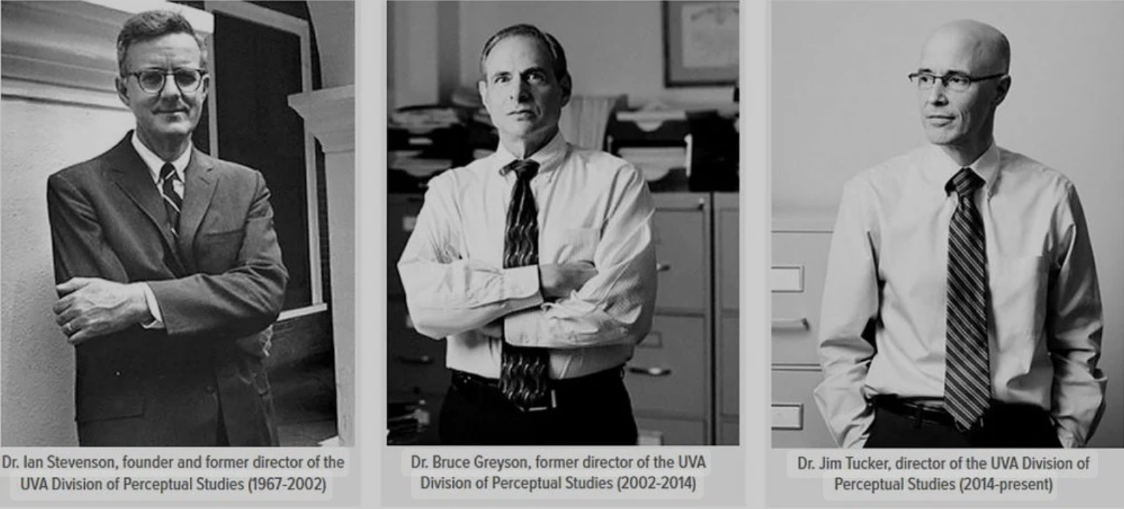
THE STUDY OF ANOMOULUS EXPERIENCES

Slide 388
The paranormal has long intrigued Humans and many individuals and organizations have approached its study with scientific rigor and an open mind.
Franz Mesmer (1734–1815) was an Austrian physician whose work on "animal magnetism" laid the groundwork for the study of hypnosis and influenced early investigations into psychic phenomena.
Sir William Crookes (1832–1919) was a respected British chemist and physicist who conducted experiments with mediums and claimed to have observed genuine paranormal phenomena, including materializations.
Harry Price (1881–1948) was a British psychic researcher and author known for his investigations into hauntings, including the famous Borley Rectory case. Price was one of the first to use scientific methods and equipment in his investigations.
J.B. Rhine (1895–1980) was an American botanist and psychologist who founded the Parapsychology Laboratory at Duke University. Rhine is considered the father of modern parapsychology, conducting experiments at Duke to study extrasensory perception (ESP) and psychokinesis (PK). He developed statistical methods to evaluate the results, finding evidence suggestive of psi phenomena.
Hans Holzer (1920–2009) was an Austrian-American paranormal researcher and author who investigated numerous hauntings and wrote extensively on ghosts and the afterlife. He is often credited with popularizing the term "ghost hunter.“

Slide 389
Dr. Ian Stevenson (1918-2007) was a psychiatrist at the University of Virginia. Stevenson is best known for his research into cases of children who claimed to remember past lives. He documented thousands of cases worldwide, focusing on those with verifiable details and physical traits, such as birthmarks, that corresponded to the previous life. His work suggested the possibility of reincarnation.
Dr. Erlendur Haraldsson (1921-2020) was a psychologist who studied a variety of paranormal phenomena, including apparitions, mediumship, and reincarnation. His research focused on cross-cultural studies and the psychological aspects of paranormal experiences.
Dr. Charles Tart (1937- ) is psychologist known for his work on altered states of consciousness and transpersonal psychology, Tart conducted research on out-of-body experiences (OBEs) and other psi phenomena. He argued for the scientific study of consciousness and the need to expand the boundaries of conventional psychology.
Dr. Rupert Sheldrake (1942- ) is a biologist who has explored telepathy, the sense of being stared at, and other psi phenomena. Sheldrake is known for his theory of "morphic resonance," which suggests that natural systems inherit a collective memory from all previous things of their kind.
Dr. Dean Radin( 1952- ) is a researcher in the field of parapsychology, Radin has conducted experiments on psi phenomena, including telepathy, precognition, and mind-matter interaction. He has published books and papers arguing that there is statistical evidence for these phenomena.

Slide 390
Dr. Jim Tucker (1960- ) continued the work of Ian Stevenson at the University of Virginia. Tucker has also focused on cases of children who claim to remember past lives, particularly in the United States. His research aims to explore the possibility of consciousness surviving physical death.
The University of Virginia's Division of Perceptual Studies (DOPS) is a research unit that has been investigating phenomena related to consciousness that are not easily explained by conventional scientific theories.
DOPS is well-known for its research on cases of young children who claim to remember past lives. The late Dr. Ian Stevenson, and later Dr. Jim Tucker, documented thousands of cases where children provide specific details about a previous life that could often be verified. Some of these cases included birthmarks or physical traits that matched injuries or conditions from the purported past life.
Researchers at DOPS have studied near death experiences. This research aims to understand the nature of these experiences and what they might suggest about consciousness and survival after death.
DOPS has explored out of body experiences, where individuals report perceiving the world from a location outside their physical body. These studies investigate the conditions under which OBEs occur and their implications for understanding consciousness.
The center has also examined reports of apparitions and the abilities of mediums who claim to communicate with the deceased. This research seeks to understand the nature of these experiences and their potential implications for consciousness and survival.

Slide 391
DOPS has investigated various altered states of consciousness, including those induced by meditation, hypnosis, and psychedelics, to explore their effects on perception and consciousness.
The center has also conducted research on psi phenomena, such as telepathy, precognition, and psychokinesis, to explore their existence and potential mechanisms.
The research at DOPS is seen by many as controversial challenging mainstream scientific views on consciousness and reality. The findings are interpreted in various ways, and while some see them as evidence of phenomena beyond current scientific understanding, others call for more rigorous methodologies and explanations within the framework of known psychological and neurological processes. Nonetheless, the work at DOPS continues to contribute to the broader conversation about the nature of consciousness and reality.
During his historic 1971 journey to the moon on Apollo 14, astronaut and test pilot Edgar Mitchell PhD (1930-2016) had a mystical experience which subsequently came to be known as the overview effect.
Inspired by this transformative experience, Mitchell founded IONS, the institute for noetic sciences. IONS conducts research into the nature of consciousness, exploring how it interacts with the physical world and how it might extend beyond the brain. This includes studies on meditation, intuition, and altered states of consciousness.

Slide 392
The organization investigates the potential for consciousness to influence physical systems, often referred to as "mind-matter interaction" or "psychokinesis." This includes experiments on the effects of intention on random number generators and other physical systems.
IONS explores human potential, including phenomena such as telepathy, precognition, and other forms of extrasensory perception (ESP). The goal is to understand whether these capacities exist and how they might be harnessed.
The institute examines the role of consciousness in health and healing, including the effects of practices like meditation and energy healing on physical and mental well-being. The institute has made many notable contributions to the study of the paranormal.
The Global consciousness project involves the collaboration with researchers worldwide. It investigates correlations between global events and changes in random data, suggesting a possible collective consciousness effect.
IONS has contributed to the growing body of evidence supporting the benefits of meditation for mental and physical health, as well as studies on intuition, suggesting that humans might have access to information beyond the normal sensory channels
The institute has explored theoretical frameworks that integrate consciousness into our understanding of the universe, challenging traditional materialistic views.

Slide 393
IONS continues to be a hub for interdisciplinary research, bringing together scientists, philosophers, and practitioners of the phenomena studied to explore the frontiers of consciousness. While some of their findings remain controversial and are met with skepticism by the mainstream scientific community, the institute plays a significant role in expanding the dialogue around the potential of human consciousness.
The Central Intelligence Agency has a history of involvement in investigations related to the paranormal, especially during the Cold War era. One of the most notable programs was known as "Project Stargate." This program began in the early 1970s and sought to investigate the potential use of psychic phenomena, such as remote viewing, for intelligence-gathering purposes.
Remote viewing involves attempting to visualize or perceive information about a distant or unseen target, and the CIA hoped that individuals with such abilities could be trained to gather intelligence. The program included several sub-projects and names over the years, like Grill Flame, Gondola Wish, and Sun Streak.
Project Stargate employed several individuals who claimed to have psychic abilities and was conducted with some degree of secrecy. The mission was to determine whether these abilities could have practical applications and contribute to national security. The program was eventually terminated in 1995, with a report concluding that remote viewing had not been useful for intelligence operations and that its results were too unreliable and inconsistent.

Slide 394
These and many other individuals and organizations have and continue to contribute to the study of paranormal phenomena by applying scientific methods and critical analysis. While much of the scientific community remains skeptical of many claims, the study of the paranormal continues to captivate both the public's imagination and that of many serious religious scholars, philosophers and scientists.

Slide 395
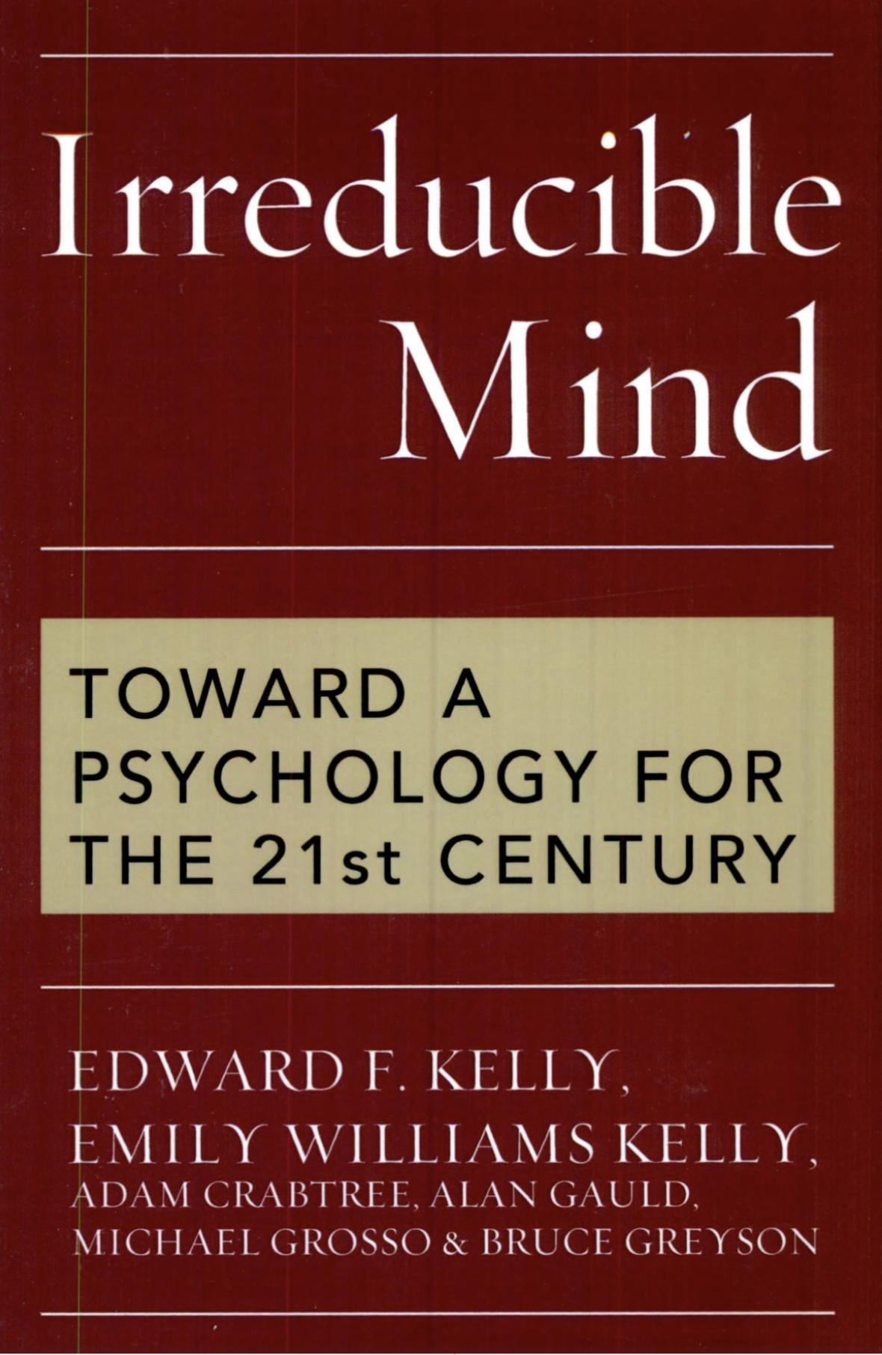
IDEALISM’S UNDERSTANDING OF ANOMALOUS PHENOMENA

Slide 396
A physicalist paradigm struggles to account for many well documented and investigated anomalous phenomena. These phenomena are from an idealist perspective, easily explained.
Savant syndrome is a rare condition in which individuals with developmental disorders, including autism spectrum disorders, demonstrate profound and prodigious capacities or abilities far in excess of what is considered normal.
Individuals with savant syndrome often have specific areas of expertise or talent, such as music, art, mathematics, or memory, while other cognitive abilities may remain impaired. Many savants have extraordinary memory capabilities, which often underpin their talents. Talents are usually limited to a specific area and are often accompanied by repetitive behaviors or intense focus on the subject.
In acquired savant syndrome, individuals develops extraordinary skills or abilities following a brain injury or disease, despite having no prior history of such talents. These abilities can also manifest in various domains, such as music, art, mathematics, speaking a new language or memory, and often emerge suddenly after the triggering event.
Research suggests that acquired savant syndrome usually involves damage to the brain's left hemisphere, which then leads to compensatory changes or heightened activity in the right hemisphere.

Slide 397
Mainstream neurology and psychology which hold to the productive explanation of the relationship between the brain and mind are at a loss as to how to explain acquired savant syndrome. The idealist transmissive, permissive or two aspects of the same thing brain mind theories, on the other hand have no difficulty doing so.
If we understand the brain as a filter or a reducing valve that limits the vast amount of information and potential consciousness available to us in a universal mind, then the brain's primary role is not to produce consciousness but to limit and shape it to allow us to function effectively in the world.
In the context of acquired savant syndrome, the reducing valve theory offers us an interesting perspective. If the brain acts as a filter, then damage to certain areas, such as the left hemisphere, might reduce the filtering capacity, allowing more raw, unfiltered information or abilities to emerge.
The right hemisphere, associated with holistic and creative processing, might be less constrained by the usual filtering mechanisms, leading to an expansion of consciousness or access to abilities that are typically suppressed or modulated by the brain's normal operations.
This could potentially explain the sudden emergence of extraordinary abilities in some individuals following brain injury.

Slide 398
Another phenomena a physicalist perspective cannot explain is terminal lucidity. Terminal lucidity is a phenomenon where individuals with severe mental impairments, such as dementia, Alzheimer's disease, or even those in a coma, unexpectedly regain mental clarity and coherence shortly before death.
This sudden return of cognitive abilities can be quite striking, allowing individuals to recognize loved ones, communicate meaningfully, or recall memories that previously seemed lost.
From an idealist perspective terminal lucidity is seen as evidence that consciousness is not entirely dependent on the brain's physical state. As the body approaches death, the mind may temporarily transcend physical limitations, allowing for a brief period of clarity.
As the body weakens, and the brain’s filtering function diminishes, and the mind is liberated from its physical constraints. This liberation could enable a clearer expression of consciousness, resulting in terminal lucidity.
If individual consciousness is part of a larger, universal consciousness, terminal lucidity could be interpreted as a moment when the individual mind reconnects with this greater consciousness, allowing access to knowledge and awareness beyond the damaged brain.
Idealists who believe in a non-physical realm view terminal lucidity as part of the transition process between realms. As the individual prepares to leave the physical world, they may experience a brief period of heightened awareness and clarity.

Slide 399
Yet another commonly reported phenomenon also occurring in people who are close to death, is communication with deceased loved ones. These "deathbed visions" or "end-of-life experiences" are reported across various cultures and have been documented throughout history.
Individuals nearing the end of life may describe seeing or conversing with deceased relatives, friends, or spiritual figures, often reporting feelings of comfort, peace, or reassurance.
These experiences vary widely but tend to share some common elements. The visions are often described as being more vivid and real than ordinary dreams or hallucinations and they frequently bring a sense of peace, acceptance, and reduced fear of death to the individual experiencing them.
Despite cultural differences, many of these experiences share similar themes and characteristics worldwide. They typically occur in the days or hours leading up to death.
In death-bed visions as in terminal lucidity, the transition between realms explanation is persuasive.
Spiritual phenomena are frequently associated with times of extreme stress or impending death. Out-of-body experiences (OBEs) which occur at these times have been extensively studied. OBE’s are phenomena where individuals perceive themselves as being outside their physical body, often observing it from a different vantage point. These experiences can occur spontaneously, during near-death experiences, in dreams, or during meditation and other altered states of consciousness.

Slide 400
If consciousness is not confined to the physical body OBEs are demonstrations of the mind's ability to exist independently of the physical body, and that consciousness can transcend physical boundaries.
Research on OBEs following rigorous scientific methodologies has been conducted by a number of scientists.
Dr. Bruce Greyson, a University of Virginia psychiatrist, is one of the leading figures in near death (NDEs) and out of body experiences research. Greyson has explored the transformative effects of NDEs and their implications for understanding consciousness.
While he maintains a scientific approach, he is very open to the idea that NDEs might suggest consciousness can exist independently of the brain. He developed the Greyson Scale to measure the features of NDEs and has published extensively on the subject.
Dr. Pim van Lommel, a Dutch cardiologist conducted a large-scale study on NDEs in cardiac arrest patients, which was published in the prestigious medical journal The Lancet in 2001. He has suggested that NDEs challenge the conventional understanding of consciousness as solely a product of brain activity.
Van Lommel has proposed that consciousness might be non-local and that the brain acts as a receiver or transmitter of consciousness.
Dr. Eben Alexander a neurosurgeon who experienced an NDE himself, has written about his experience in his book "Proof of Heaven." He argues that his NDE provided evidence for the existence of consciousness beyond the brain and supports an idealist perspective where consciousness is fundamental.

Slide 401
Dr. Raymond Moody’s pioneering work on NDEs was influential in bringing attention to the phenomenon. His open-minded approach to the spiritual and transformative aspects of NDEs aligns with idealist ideas.
These researchers, among others, have contributed to a growing body of work that explores the nature of consciousness and its potential independence from the physical brain. While their interpretations vary, they share an openness to perspectives that challenge physicalist views of consciousness.

Slide 402
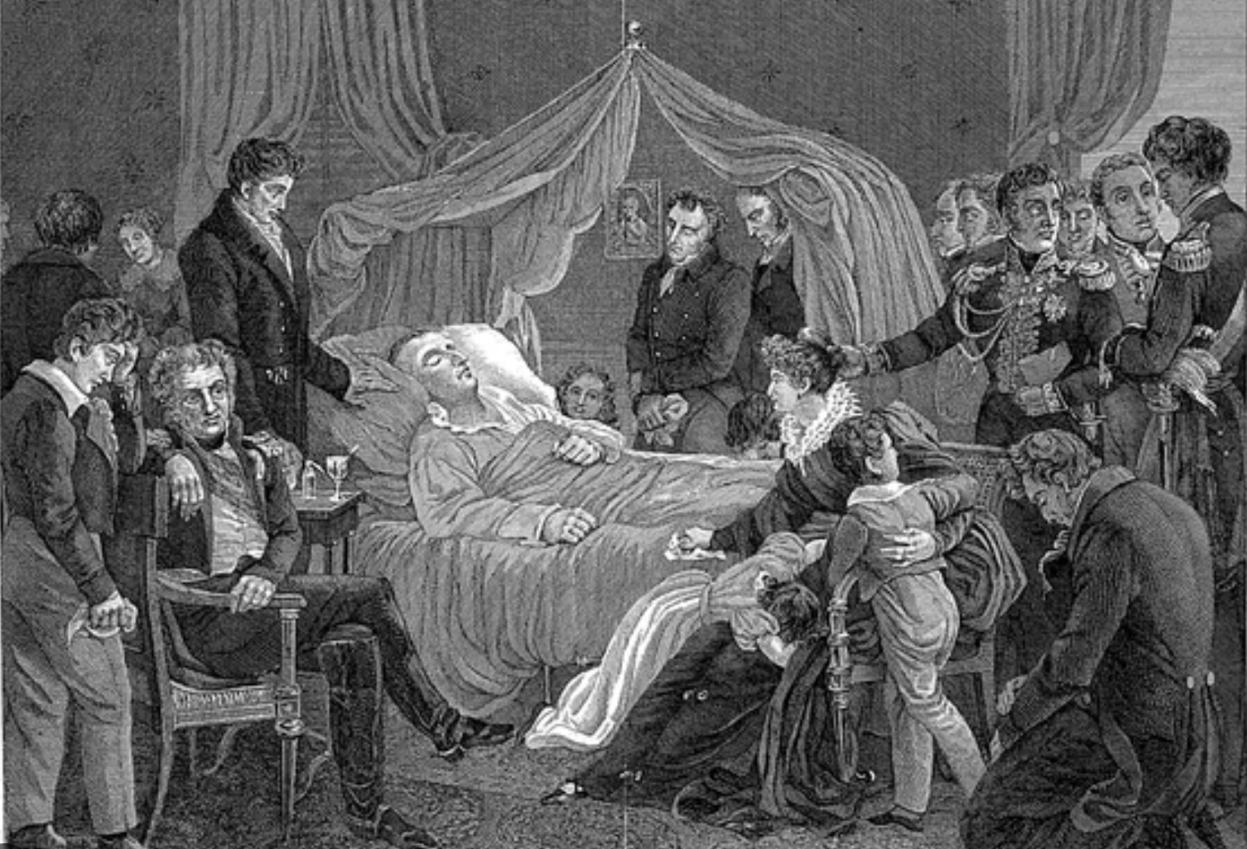
ANOMALOUS EXPERIENCES, DEATH AND TRAUMA

Slide 403
Anomalous experiences are frequently associated with death and trauma and Western cultures’ tendency to hide and deny death has negative effects on spiritual development.
Death has largely shifted from being a natural, community-inclusive event to a medicalized process often taking place in hospitals or other institutions. This leads to a perception of death as a failure of medicine rather than an inevitable part of life, reducing its visibility in everyday life.
Conversations about death and dying are often considered taboo or uncomfortable, leading to a lack of open dialogue. This avoidance can disconnect individuals from processing and understanding the realities of mortality, making it seem distant or frightening.
Western media and cultural narratives often prioritize youth, beauty, and vitality, which can result in the marginalization of aging and death. This can foster a fear of aging and a denial of the natural life cycle.
Avoidance of death can also contribute to fear and anxiety about mortality, inhibiting the acceptance that is often a key component of spiritual peace and growth. Without acknowledging death as a natural and inevitable part of existence, individuals may miss opportunities to live authentically and embrace life's transient nature, which is frequently emphasized in spiritual traditions.
Engaging with the concept of mortality is an opportunity for deep reflection on meaning, purpose, and values. Hiding death can limit these reflections, potentially weakening personal spiritual development.

Slide 404
Many spiritual traditions embrace the contemplation of death as a way to deepen understanding, encourage personal growth, and enhance spiritual development.
The Latin phrase Memento Mori part of the Christian Tradition means “remember you must die.” It encourages Christians to live with the awareness of mortality and is often symbolized by skulls or hourglasses. It serves as a reminder to live a virtuous life and focus on spiritual rather than material pursuits.
In Tibetan Buddhism, there are meditative practices focused on Yama, the lord of death. Meditators visualize their own death and reflect on the impermanence of life. This is intended to reduce fear of death and foster appreciation for the present moment.
The Four Reminders another Tibetan Buddhist meditative practice consists of reflections on the preciousness of human life, the reality of impermanence and death, the inevitability of karma, and the suffering inherent in samsara (the cycle of rebirth). These contemplations motivate practitioners to engage earnestly in spiritual practice.
In Hinduism, especially among certain ascetic traditions, practitioners may meditate in cremation grounds. This confrontation with death is meant to annihilate fear and attachment, encourage detachment from worldly desires, and foster self-realization.
Some modern spiritual movements incorporate the role of the death doula, who helps individuals prepare for their transition through conversations and rituals. This process includes reflecting on life’s meaning, resolving unresolved issues, and enhancing the spiritual quality of life and death.

Slide 405
The Bushido code of the samurai encouraged the daily contemplation of death, believing this awareness would lead to a fearless and honorable life. The practice aimed to align one's actions with values such as courage, loyalty, and self-discipline.
The Mexican Day of the Dead celebration involves honoring deceased loved ones in joyful remembrance, reflecting on the cycle of life and death. It’s a time to acknowledge death as a part of life, fostering a sense of continuance and community connection.
These practices share a common goal of transforming the fear of death into an opportunity for spiritual awakening, peace, and a deeper connection with the essence of life.
Elisabeth Kübler-Ross (1926-2004) was a Swiss-American psychiatrist best known for her pioneering work on death and dying. She introduced a model, known as the Five Stages of Grief, in her 1969 book "On Death and Dying.“ Kübler-Ross's philosophical perspective centered on a compassionate approach to end-of-life care, emphasizing the need for empathy and understanding toward those who are dying.
In her later years, Kübler-Ross became increasingly interested in experiences of near-death phenomena and the spiritual insights reported by those who had them. Although her scientific work focused on understanding and supporting the experiences of the dying and the bereaved, she was very open to the idea of an afterlife, viewing death as a potential continuation of the soul's journey rather than a final cessation.

Slide 406
Working in end-of-life palliative care, as Kubler-Ross did profoundly influences people's views on life and death due to constant engagement with patients facing the end of life. Encountering individuals who are approaching death can inspire a heightened appreciation for the present moment and the important aspects of life, such as relationships and personal well-being.
Palliative care staff frequently observe the things that genuinely matter to people nearing the end, like love, connection, and inner peace, which can lead them to reassess their own life priorities and values.
Constantly working with patients and families facing profound emotional and existential challenges tends to enhance one's empathy and compassion, leading to a more caring and understanding approach to others.
Regular interactions with death can demystify and destigmatize it, fostering a more accepting and balanced perspective on mortality. It may help individuals come to terms with their own finite nature and view death as a natural part of the human experience.
Confronting death regularly can lead to deeper spiritual or existential reflections, prompting individuals to ponder questions about meaning, purpose, and what might lie beyond death.
Western culture, in various ways, also minimizes and hides traumatic experiences. This is often due to societal attitudes, structural barriers, or cultural stigmas.

Slide 407
Traumatic experiences, particularly those involving abuse or violence, carry stigma that can lead to silence and shame. Victims may feel pressured to keep their experiences hidden due to fear of judgment or disbelief.
Western culture celebrates personal strength and success while undervaluing vulnerability. This can lead individuals to downplay or hide their trauma to conform to societal ideals of resilience and self-sufficiency.
Media tends to sensationalize and oversimplify trauma, which trivializes the complexity of real-life experiences. This contributes to misunderstandings and a lack of nuanced public discourse about trauma.
There is a general lack of comprehensive education about trauma, its effects, and its prevalence, which hampers understanding and empathy. This prevents society from adequately addressing and supporting trauma survivors.
Psychiatry has been complicit in this neglect of trauma. The medical model focuses on diagnosing and treating symptoms, such as those present in the trauma spectrum disorders, sometimes at the expense of addressing the underlying causes of trauma. This can lead to an emphasis on medication over therapeutic practices that explore personal narratives and social contexts.
A strictly medical perspective overlooks the social, environmental, and systemic factors that contribute to trauma and its perpetuation.

Slide 408
The medical approach often centers on individual treatment, which might neglect broader societal changes needed to prevent trauma or support survivors more effectively.
Approaches to treating trauma are enhanced by being spiritually informed and by recognizing and taking seriously the anomalous experiences many trauma survivors' encounter. A spiritually informed approach acknowledges that trauma affects not just the mind and body, but also the spirit. This fosters deeper healing by validating and integrating the search for meaning and purpose that often arises after trauma.
Recognizing anomalous experiences as potentially meaningful rather than dismissing them as pathological validates a survivor's reality. This acknowledgment reduces feelings of isolation and confusion and helps individuals integrate these experiences into their healing journey.
Trauma disrupts a person’s sense of identity and world view. Spiritual frameworks offer pathways for personal meaning-making, helping individuals reconcile and find coherence in their experiences.
Spiritual practices and beliefs facilitate a sense of connection to something greater, whether that’s a deity, a universal force, or the community. This connection can provide comfort, support, and strength in the healing process.
Rituals, meditation, or prayer can be powerful tools for healing. These practices help individuals process trauma, manage stress, and cultivate resilience by providing structure and solace.

Slide 409
Spirituality involves symbolic language and imagery, which aligns with and helps make sense of the symbolic nature of many anomalous experiences. Creative expression through art or storytelling can be used therapeutically to explore these themes.
By integrating spirituality and anomalous experiences into trauma treatment, practitioners can provide more comprehensive and empathetic care, acknowledging these aspects as integral parts of the human experience that can contribute to wholeness and recovery.
Spirituality plays a significant role in post-traumatic growth (PTG), which is the positive psychological change experienced as a result of struggling with highly challenging life circumstances.
Spirituality can provide a framework for understanding and interpreting traumatic events, helping individuals to make sense of their experiences. This process of meaning-making can help individuals find purpose in their suffering and see a greater significance in their lives beyond the trauma.
Spiritual beliefs can lead to a deeper appreciation of life and the present moment. People may come to value each day more profoundly, resulting in a richer and more satisfying life experience even after trauma.
Spirituality can foster a sense of belonging and connection, whether to a higher power, to the community, or to the universe. This connection can be a source of comfort and strength, reducing feelings of isolation that often accompany traumatic experiences.

Slide 410
Spiritual beliefs can cultivate hope and optimism, providing individuals with the resilience needed to envision a positive future. This hopeful outlook is crucial for recovery and growth after trauma.
Spiritual practices such as prayer, meditation, or rituals offer avenues for emotional expression and coping. These practices can help individuals process their emotions in healthy ways and reduce feelings of distress or anxiety.
Through spiritual growth, individuals may develop a renewed sense of personal strength and resilience. They may reinterpret their trauma as part of their spiritual journey, leading to a transformed self-view that embraces their newfound wisdom and capabilities.
Many spiritual traditions offer community support, which can be invaluable after trauma. Engaging with a spiritual community provides a network of care, compassion, and friendship, helping individuals feel supported and understood.
Spirituality can aid in the process of forgiveness, offering a pathway to release feelings of anger or bitterness toward oneself or others. This release is important for healing and moving forward.
Spirituality can serve as a powerful catalyst for post-traumatic growth, helping individuals to rebuild their lives with a deeper sense of purpose, connection, and resilience.

Slide 411

THE FOUNDATIONS OF SPIRITUAL TRADITIONS

Slide 412
Integral theory’s stages of development are one of the lenses through which we see and interpret the world. Many people today who have a modern or post-modern worldview see a physicalist soulless and meaningless universe.
The worldviews of the developmental stages that preceded the modern had idealist metaphysical perspectives which saw a realm normally obscured from normal awake consciousness as fundamental.
Altered states of consciousness and anomalous perceptions were considered the principal way people accessed this hidden realm. This hidden realm was given many different names; The noumenal, spiritual, celestial, supernatural, holy, imaginal, divine, sacred, heavenly, and transcendent, among others.
Most spiritual and contemplative traditions describe experiences of a sacred deeper reality as either a feeling of union or connection with everything or a state of emptiness or objectless awareness. These two poles of experience are described in Nisargadatta Maharaj’s famous quotation “Wisdom tells me I am nothing, Love tells me I am everything, between the two my life flows.”
The mystical experience of union or connection with everything resembles the way the right hemisphere of the brain perceives the world and Jill Taylor Bolte stroke experience. This spiritual experience is characterized by a profound sense of interconnectedness with all that exists and a dissolving of the boundaries between the individual and the world leading to a sense of oneness with the universe.
This experience is also often accompanied by feelings of love, peace, and joy, as the individual perceives themselves as part of a larger, harmonious whole.

Slide 413
In this state, the focus is on the abundance of connections and the richness of existence. It is an experience of fullness, where the self is expanded to include everything around it.
This anomalous state is described in mystical experiences across various traditions, where the divine or the universe is experienced as an all-encompassing presence.
In contrast to the feeling of union, the experience of emptiness or objectless awareness, is described as a state of pure awareness without attachment to objects, thoughts, or emotions. It is a state of profound stillness and clarity, where the usual contents of consciousness are absent, leaving a sense of spaciousness and freedom.
This is the state sometimes reported by very experienced meditators and is associated with Buddhist practices, where the concept of "emptiness" is central. Here, the emphasis is on the absence rather than presence. It is an experience of letting go, where the self is not expanded but rather dissolves into a state of pure being. This can lead to a deep sense of liberation and insight into the nature of reality, as one perceives the impermanence and interdependence of all things.
Jeffrey Kripal (1962- ) is a scholar that has spent his career exploring altered states of consciousness, anomalous experiences and their link to spirituality. Kripal is known for his work in the fields of religious studies and the study of the paranormal. He is a professor at Rice University in Houston, Texas, where he has served as the J. Newton Rayzor Chair in Philosophy and Religious Thought.

Slide 414
Kripal's research explores the intersections of religion, mysticism, and the paranormal, and he has written extensively on topics such as comparative mysticism, the history of religions, and the cultural impact of the supernatural. Some of his notable works include "Authors of the Impossible: The Paranormal and the Sacred" and "The Super Natural: A New Vision of the Unexplained," co-authored with Whitley Strieber.
Kripal's work explores the idea that anomalous experiences, associated with his concept of the paranormal, have played a significant role in the founding and development of major religions. He suggests that many religious traditions have their roots in extraordinary experiences, such as visions, mystical encounters, and otherworldly communications that could be classified as paranormal.
These and other paranormal experiences such as telepathy, precognition, and encounters with non-ordinary realities can, according to Kripal, offer us valuable insights into the nature of consciousness and the sacred.
He argues that these experiences are often dismissed or marginalized in mainstream religious and academic contexts, but they can be profound and transformative for those who experience them.
Kripal maintains that these experiences have historically been interpreted within religious frameworks, helping to shape the beliefs and practices of various faiths.
Kripal argues that these extraordinary experiences continue to occur and influence individuals today, though they may be interpreted differently in contemporary contexts. He suggests that modern accounts of paranormal phenomena, such as UFO sightings, near-death experiences, and psychic phenomena, are part of a broader spectrum of human experiences that challenge our physicalist understanding of reality.

Slide 415
Kripal believes that the paranormal invites us to reconsider the nature of consciousness and reality itself. He thinks that these experiences indicate that our current physicalist scientific paradigm is limited in its ability to fully explain the complexities of human experience. Kripal is very sympathetic to an idealist worldview.
Kripal’s distinguishes between the "imaginal" and the "imagination". Imagination is generally understood as the faculty of the mind that allows us to create images, ideas, and concepts that are not present to the senses. It is often associated with creativity, fantasy, and the ability to envision possibilities. In everyday language, imagination is seen as a mental process that can be whimsical or fictional, and it is sometimes dismissed as "just" imagination, implying a lack of reality or substance.
The concept of the imaginal is more nuanced and is associated with the work of French philosopher and Islamic scholar Henry Corbin. The imaginal realm is considered a kind of intermediate reality that is neither purely material nor purely mental.
It is a space where symbolic, archetypal, and spiritual realities can manifest and be experienced as real. In Kripal's work, the imaginal is seen as a bridge between the mundane world and the transcendent, where profound insights, mystical experiences, and encounters with the sacred can occur.
Kripal uses the concept of the imaginal to suggest that certain extraordinary or supernatural experiences, dismissed as mere products of the imagination, are actually encounters with deeper layers of reality.
The imaginal realm provides a framework for understanding how individuals can experience visions, mystical states, or paranormal phenomena that feel intensely real and meaningful, even if they do not conform to conventional notions of reality.

Slide 416
By distinguishing between the imagination and the imaginal, Kripal invites a reconsideration of how we understand and value paranormal experiences, encouraging an openness to the possibility that they reveal something significant about the nature of consciousness and the universe.
He holds that rather than dismissing the paranormal, we should open-mindedly explore these phenomena. His work invites a dialogue between science, spirituality, and the unexplained, urging us to expand our understanding of what is possible.
ln his work Jeffrey Kripal discusses a wide range of paranormal phenomena including UFOs, or unidentified flying objects (also known as UAP’s or unidentified aerial phenomena). UFO’s are objects observed in the sky that cannot be readily identified by the observer. The term "UFO" was popularized in the mid-20th century and is often associated with the idea of extraterrestrial spacecraft, although it simply refers to any aerial phenomenon that has not been explained.
UFO sightings have been reported throughout history, with descriptions varying widely. They can appear as lights, disks, cigar-shaped objects, or other forms, and are often noted for their unusual flight patterns and speeds.
While many UFO sightings can eventually be attributed to natural phenomena, human-made objects, or atmospheric conditions, a subset remains unexplained. In recent years, there has been renewed interest in the subject, with governments and scientific communities showing increased openness to investigating and discussing these phenomena.

Slide 417
Kripal also discusses other phenomenon.
Orbs of light are mysterious, luminous spheres that appear in a variety of contexts. These orbs can vary in size, color, and brightness, and are sometimes reported to move in unusual or seemingly intelligent ways. They are often associated with paranormal experiences, mystical encounters, and sightings of unidentified flying objects (UFOs).
Mystical visions are experiences where individuals report seeing divine figures, heavenly realms, or other spiritual imagery.
Prophetic dreams are dreams that are believed to convey messages from a divine source or predict future events.
Out-of-Body Experiences (OBEs) are instances where individuals feel as though they have left their physical body and can view it from an external perspective.
Near-Death Experiences (NDEs) are experiences reported by individuals who have come close to death, often involving feelings of peace, encounters with deceased loved ones, or seeing a bright light.
Psychic abilities includes phenomena such as telepathy (mind-to-mind communication), clairvoyance (seeing distant or future events), precognition (foreknowledge of events), and psychokinesis (moving objects with the mind).

Slide 418
Cryptids refers to creatures whose existence is not recognized by mainstream science, such as Bigfoot, the Loch Ness Monster, and the Chupacabra. These creatures are often part of local folklore and legend.
Time slips and anomalies are reported by people experiencing shifts in time, such as moving briefly into the past or future, or encountering temporal anomalies that defy normal chronological order.
Poltergeist activity involves unexplained physical disturbances, such as objects moving or being thrown, loud noises, or electrical malfunctions, often attributed to an unseen force or spirit.
Anomalous healing and energy work includes practices and experiences that involve healing or manipulation of energy fields, such as Reiki, faith healing, or other forms of alternative medicine that claim to work through non-physical means.
Some individuals claim to have memories of past lives, which they believe provide evidence of reincarnation or the continuation of consciousness beyond a single lifetime.
Synchronicities are meaningful coincidences that seem to transcend ordinary cause-and-effect relationships.
Apparitions and ghosts involve sightings of deceased individuals or otherworldly entities.
Kripal's believes that all these anomalous experiences challenge conventional understandings of reality and suggest a more complex, interconnected, and mysterious universe

Slide 419
Although these phenomena are frequently reported and widely discussed, they remain controversial and are typically not consider as valid subjects for scientific investigation. Research into these areas is only conducted within the fields of parapsychology and anomalistic psychology, which seek to explore and understand these experiences using scientific methods.
Kripal’s work was greatly inspired by William James. James believed that paranormal experiences were worthy of serious academic inquiry and should not be dismissed outright simply because they challenge conventional scientific paradigms. Kripal adopts a similar stance, encouraging a balanced exploration of the paranormal that respects both empirical evidence and the subjective nature of these experiences.
James's pluralistic perennial view that different religious and mystical experiences might all point to valid aspects of reality aligns with Kripal's interest in the diverse ways humans encounter the sacred and the supernatural.
James argued that these experiences could provide profound insights into the nature of reality. Kripal similarly values first-person accounts of paranormal and mystical experiences, seeing them as crucial data points that can expand our understanding of consciousness and reality.
James was critical of strict physicalism and reductionism, advocating for a broader understanding of consciousness that could accommodate mystical and paranormal phenomena. Kripal is inspired by this perspective, as he explores the limitations of physicalist explanations and considers alternative frameworks that might better account for extraordinary experiences.

Slide 420
William James's willingness to engage with the unknown and his commitment to exploring the full range of human experience deeply influenced Jeffrey Kripal's work, encouraging him to take a more inclusive and expansive approach to the study of the paranormal and the sacred.
As we continue our exploration of meaning it may help to briefly summarize what we have so far covered.
Humans interpret the world through the “lenses” of their cognition and senses and their “My, Our and The stories”.
Integral theory describes how “My, Our and The stories” evolve through stages such as traditional, modern and post-modern.
Each of these stages has a particular worldview. Once a worldview becomes unable to cope with the challenges that a society faces, after some resistance, it tends to be replaced by a worldview that is more adapted to the circumstances. Evidence that a worldview is not meeting the challenges comes in the form of crisis and anomalies.
We have described the polycrisis afflicting the current worldview and the “anomalies” it cannot explain. We also suggested that an idealist metaphysics can not only explain these anomalies but if a combined with an integral worldview begin to heal unhealthy My, Our, and The stories and address the polycrisis.

Slide 421

MYSTICISM, SPIRITUALITY AND RELIGION

Slide 422
The founders of the great religious traditions introduced transformative teachings and practices and were revered as spiritual leaders, prophets, and enlightened beings.
Siddhartha Gautama (Buddha) taught the Four Noble Truths and the Eightfold Path as a means to achieve enlightenment and liberation from suffering.
Jesus Christ’s teachings focused on love, compassion, forgiveness, and the Kingdom of God. His life and resurrection are seen as a path to salvation.
The Prophet Muhammad, the founder of Islam, received revelations that form the Quran. His teachings emphasize monotheism, social justice, and moral conduct.
Moses led the Israelites out of Egypt and received the Ten Commandments, which form a cornerstone of Jewish law and ethics.
Laozi the founder of Taoism wrote the "Tao Te Ching," which emphasizes living in harmony with the Tao, or the fundamental nature of the universe.
Guru Nanak, the founder of Sikhism, taught the oneness of God, equality, and devotion through honest living and service to others.

Slide 423
These figures all had profound spiritual insights and experiences that shaped their teachings and attracted followers. They all emphasized ethical conduct, compassion, and the importance of living a righteous life. Their teachings focus on personal and spiritual transformation, offering a path to liberation from suffering, sin, or ignorance.
They established communities and practices that helped preserve and spread their teachings, emphasizing the importance of community in spiritual life.
Despite cultural and historical differences, their teachings addressed universal human concerns, such as the nature of existence, the purpose of life, and the relationship between humanity and the divine.
These teachings contain profound insights and symbolic narratives that aim to convey deeper spiritual truths.
A historical divergence in Christianity also seen in other of great religious traditions has to do with which socio-economic groups they come to primarily serve.
In the Roman Empire of the 1st century CE, Christianity began as a movement of poor, marginalized and oppressed Jews. Jesus of Nazareth preached messages of love, compassion, and justice, emphasizing the importance of caring for the poor, the sick, and the outcast. His teachings resonated with those who were disenfranchised, offering hope and a sense of community.
The early Christian communities were composed of people from lower socio-economic backgrounds, including slaves and women, who found in Christianity a message of equality and spiritual liberation. The early church members often practiced communal living and shared resources, reflecting a radical commitment to social justice and mutual support.

Slide 424
As Christianity spread throughout the Roman Empire, it began to attract a more diverse following, including members of the middle and upper classes. The turning point came in the early 4th century when Emperor Constantine converted to Christianity and in 313 CE issued the Edict of Milan, granting religious tolerance to Christians and ending their persecution.
Constantine's conversion and subsequent patronage marked the beginning of Christianity's transformation from a persecuted sect to a state-supported religion.
At the end of the 4th century, with the establishment of Christianity as the official religion of the Roman Empire under Emperor Theodosius I, the church gained significant political and economic power. This newfound status led to changes in theology and practice.
The church's hierarchy became more structured, mirroring the political structures of the empire. The focus shifted from the radical egalitarianism of the early church to doctrines that supported the social order and the authority of the church and state.
Theologically, the emphasis on personal salvation and the afterlife grew, at the expense of the social and communal aspects of Jesus' teachings. The church began to align more closely with the interests of the powerful, often justifying the status quo and the authority of rulers.
This shift was reflected in the development of doctrines such as the divine right of kings and the church's role in legitimizing political power.

Slide 425
The history of the Christian church, as is the case with other religions, has been marked by many instances of the founders' teachings being abandoned in the pursuit of money, power and sex.
During the Middle Ages, the church faced corruption through practices like simony (the buying and selling of church offices) and the sale of indulgences (payments made for the reduction of punishment for sins). These practices were among the grievances that in the 16th century led to the Protestant Reformation.
Through much of its history, the catholic church wielded significant political power, often becoming entangled with secular rulers. This often led to corruption, as church leaders prioritized political alliances and power over spiritual responsibilities. The intertwining of church and state has, at times, led to the church being used to justify wars, colonization, and other political agendas.
Frequent examples of moral failings among church leaders, including adultery, fraud, and other unethical behaviors, have damaged the credibility of the church. These scandals highlight the gap between the church's teachings and the actions of its leaders.
Financial scandals have plagued various denominations, involving embezzlement, misuse of funds, and lavish lifestyles of some church leaders. These scandals often arise when financial transparency and accountability are lacking.
One of the most significant scandals in recent history involves the widespread sexual abuse of minors by clergy members, particularly within the Catholic Church. The subsequent cover-ups by church authorities, who often prioritized the institution's reputation over justice for victims, have led to widespread criticism and loss of trust.

Slide 426
Today, “Christian "movements that distort Jesus’s message, such as the prosperity gospel and white evangelism are very popular, especially in the U.S..
The prosperity gospel, also known as the "health and wealth gospel" or "prosperity theology," is a religious belief system that asserts that financial blessings and physical well-being are the will of God for believers. It suggests that faith, positive speech, and donations to religious causes will increase one's material wealth and health. This theology is often associated with televangelists and megachurches.
The prosperity gospel emphasizes the power of faith as a tool to achieve personal success and material prosperity. Believers are encouraged to "name it and claim it," suggesting that by declaring their desires and having unwavering faith, they can manifest wealth and health.
The gospel also advocates for the "power of positive confession," where speaking positively about one's desires and circumstances is believed to bring about positive outcomes.
Followers are encouraged to give money, or "seed," to the church or ministry with the promise that God will return their investment with increased wealth. This is sometimes referred to as "sowing a seed." It teaches that God wants believers to be prosperous and that material wealth is a sign of God's favor and blessing.
This practice shamelessly exploits followers, particularly those who are vulnerable and already in financial distress.

Slide 427
The term "white evangelicalism" typically refers to a subset of evangelicals in the United States who are both religiously and culturally characterized by a specific set of beliefs and practices. Evangelicalism is a diverse movement within Protestant Christianity known for emphasizing the authority of the Bible, the necessity of a personal conversion experience, and the importance of sharing the Christian faith. The "white" qualifier in "white evangelicalism" is used to denote a demographic and cultural distinction.
White evangelicals are a significant segment of the evangelical Protestant community in the United States. They are often studied separately due to distinct voting patterns, cultural preferences, and social attitudes that can differ from those of evangelicals from other racial or ethnic backgrounds.
Culturally, white evangelicals in the U.S. have often been associated with conservative values, both theologically and politically. They tend to prioritize issues such as opposition to abortion, support for traditional family structures, and religious liberty.
In recent decades, white evangelicals have become a powerful political force, particularly within the Republican Party. Their political engagement has been driven by social issues as well as broader themes of patriotism and perceived threats to religious freedoms.
The history of white evangelicalism in America is intertwined with various social and political movements, including the Moral Majority of the 1980s and debates over civil rights. This history has influenced the group's current identity and priorities.

Slide 428
The alignment of many white evangelicals with President Donald Trump has been a topic of significant discussion and analysis. While individual beliefs and motivations can vary widely, several factors and beliefs have been identified as contributing to this alignment.
Many white evangelicals supported Trump because of his commitment to appointing conservative judges, particularly to the Supreme Court. They viewed these appointments as crucial for advancing issues important to them, such as restrictions on abortion and religious freedom.
Among evangelicals there is a strong emphasis on protecting religious freedom, which many felt was under threat. They believed that Trump would defend their rights to practice their faith openly and maintain religious expressions in public life.
Many white evangelicals prioritize social issues such as opposition to abortion and same-sex marriage. They saw Trump as an ally who would advocate for policies aligned with their values.
Many evangelicals felt that American culture was moving away from traditional values and saw Trump as a defender against this shift. They appreciated his rhetoric that often resonated with their concerns about secularization and perceived moral decline.
For some, the support was a pragmatic decision. Despite reservations about Trump's personal behavior or rhetoric, they believed he would advance their policy goals more effectively than his opponents.

Slide 429
Trump's economic policies, including tax cuts and deregulation, appealed to some evangelicals who prioritize free-market principles and economic growth.
Many white evangelicals were drawn to Trump's emphasis on nationalism and his "America First" policies, which they felt aligned with their views on national identity and sovereignty.
Many white evangelical groups in the United States emphasize political and cultural issues over the core teachings of Jesus, such as love, compassion, humility, and caring for the marginalized. This suggests that political alignment and social issues overshadow for them the fundamental messages of the Gospel.
The white evangelical focus on political power and cultural dominance blatantly contradict the teachings of Jesus about loving one's neighbor, turning the other cheek, or caring for the poor and oppressed.
The prosperity gospel and white evangelism are only two of the many blatant divergences from the enlightened messages of the founders that have occurred within religious movements which have negatively affected the church's reputation and influence.
Many within the established church's continue to work towards transparency, accountability, and a return to the core values of their faith. Corruption and scandals have often led to reforms . Throughout history, movements for change have arisen in response to corruption. These include the monastic reforms of the Middle Ages, the Protestant Reformation, and various renewal movements within modern Christianity.

Slide 430
Within Christianity there have been movements that have sought to return to the roots of the religion and emphasize social justice and care for the marginalized. These include monastic communities, the Franciscan movement, and in the 20th century liberation theology.
These movements arose in response to perceived deviations from the original spirit of Christianity and sought to reclaim its message of compassion and justice for the poor and oppressed.
Many reformed movements within mainstream religions have emerged with a strong focus on ecological sustainability and social justice.
Green Christianity is a movement within various Christian denominations which emphasizes environmental stewardship as a core aspect of faith. It draws on biblical teachings about caring for creation and involves advocacy for sustainable practices, climate action, and conservation efforts. Groups like the GreenFaith initiative work across religious lines to promote environmental action.
Eco-Judaism is a movement within Judaism that focus on eco-friendly practices and social justice. This movement highlights Jewish teachings about the responsible use of natural resources and the ethical treatment of animals. Organizations like Hazon work to create healthier and more sustainable communities in accordance with Jewish values.

Slide 431
Many Muslims are turning to the Quran and Hadith to find guidance on environmental issues, emphasizing the concept of "khalifah" (stewardship) and the responsibility to protect the Earth. Initiatives like the Islamic Foundation for Ecology and Environmental Sciences promote sustainable living and ecological awareness within the Muslim community.
Founded by Thich Nhat Hanh, Engaged Buddhism integrates traditional Buddhist teachings with social activism. It addresses issues of social justice, human rights, and environmental sustainability, encouraging practitioners to apply mindfulness and compassion to societal challenges.
Within Sikhism, there is a growing emphasis on environmental responsibility, inspired by the teachings of Guru Nanak and subsequent Gurus about living in harmony with nature. The EcoSikh initiative works to promote environmental awareness and action within the Sikh community worldwide.
Many Hindus are drawing on ancient texts and teachings that emphasize the sacredness of nature and the interconnectedness of all life. Movements like the Bhumi Project, a notable Hindu environmental initiative, aim to mobilize Hindu communities worldwide to address environmental issues and promote sustainable living.
Mormon theology, as taught by The Church of Jesus Christ of Latter-day Saints (LDS Church), places a strong emphasis on peacemaking, which aligns with the teachings of Jesus.

Slide 432
Mormons believe in the teachings of Jesus Christ as outlined in the New Testament, including the Beatitudes from the Sermon on the Mount, where Jesus says, "Blessed are the peacemakers: for they shall be called the children of God" (Matthew 5:9). This forms a foundational principle for promoting peace and reconciliation.
Mormons are encouraged to apply these teachings in their daily lives by fostering understanding, resolving conflicts peacefully, and serving others. Humanitarian efforts and community service are seen as ways to promote peace and goodwill.
Reformed Mennonites are a branch of the Mennonite tradition, which is part of the Anabaptist movement that emerged during the Protestant Reformation. Like other Anabaptists, Reformed Mennonites strongly emphasize nonviolence and pacifism.
They believe in living a life of peace and reconciliation, avoiding military service and conflict. They advocate for a lifestyle that is distinct from secular society, emphasizing simplicity, humility, and modesty in dress and behavior. This separation is seen as a way to maintain spiritual purity and focus on their faith.
Reformed Mennonites place a strong emphasis on community life and mutual aid, supporting one another in times of need and working together to maintain their shared values and way of life. Following the teachings of Jesus Christ and living according to the principles of the New Testament is central to their faith. They emphasize obedience to the teachings of Christ as a way of demonstrating their commitment to God.

Slide 433
Reformed Mennonite worship services are typically simple and unadorned, focusing on scripture reading, preaching, and singing. They often meet in plain meetinghouses. They also often wear plain clothing as a symbol of their commitment to simplicity and modesty. This includes head coverings for women and simple attire for men.
Church discipline is an important aspect of maintaining the integrity of the community. Members hold each other accountable to the teachings of the church, and there are processes in place for addressing conflicts and transgressions.
The mystical visions of the founders of the great religions all pointed to an unseen otherworldly realm of love where all is one. This is the view of the “perennial philosophy” which suggests that there is a universal truth or core set of principles shared by all the world's major religious and spiritual traditions. The perennial philosophy holds that beneath the surface differences in religious practices and beliefs, there exists a common, timeless wisdom about the nature of reality, humanity, and the divine.

Slide 434
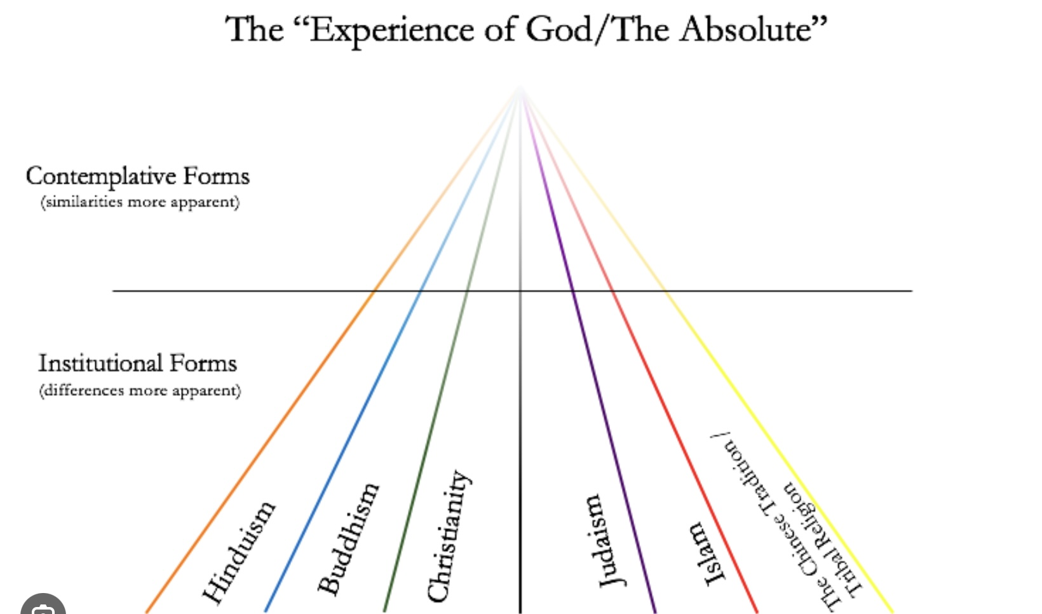
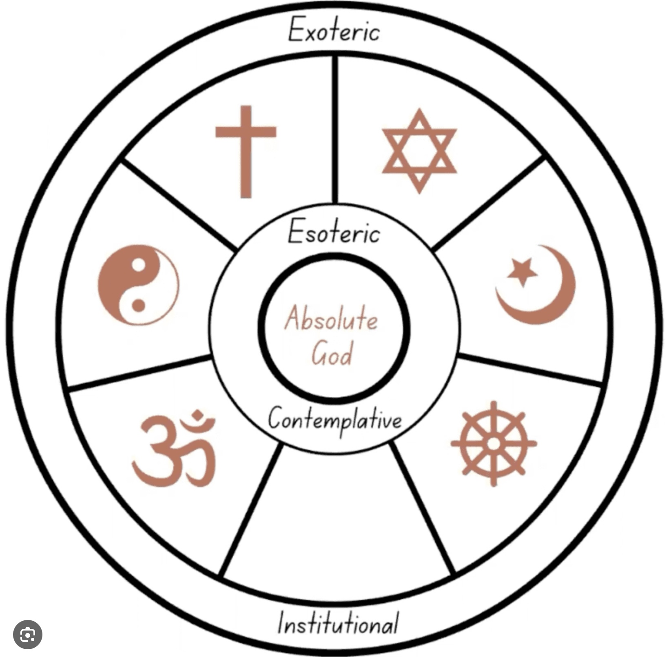
THE PERENIAL PHILOSOPHY

Slide 435
To briefly review, epistemology is the branch of philosophy concerned with the study of knowledge. It explores the nature, scope, and limits of human knowledge, addressing questions such as what is knowledge? how is knowledge acquired? what do we know? what justifies a belief? and what are the sources of knowledge?
Epistemology identifies several different ways or sources through which we acquire knowledge. These are referred to as "ways of knowing," and include perception, reason, intuition, testimony and introspection. In some religious contexts, knowledge is also believed to be acquired through divine revelation or faith. This involves accepting certain truths based on spiritual insight or religious doctrine.
Each of these ways of knowing has its strengths and limitations, and epistemologists explore how they interact and contribute to our overall understanding of the world.
Different cultures and traditions emphasize some ways of knowing over others, leading to diverse perspectives on how knowledge is best acquired and validated.
Huston Smith, a renowned scholar of world religions, categorizes the major religious traditions into five families, each emphasizing different aspects of human experience and spirituality.
East Asian religions include traditions like Confucianism, Taoism, and Shinto. These religions emphasize harmony with the natural world and social order. Confucianism, for example, focuses on ethical relationships and social harmony, while Taoism emphasizes living in accordance with the Tao, or the natural way of the universe.

Slide 436
Western religions encompass Judaism, Christianity, and Islam. These religions typically emphasize a relationship with a personal God and often focus on ethical conduct, justice, and salvation. They address how individuals can live in accordance with divine will and achieve a sense of purpose and meaning in life.
Indigenous religions around the world focus on the interconnectedness of humans, nature, and the spiritual world. They emphasize living in harmony with the earth and maintaining balance within the community and environment.
New religious movements include a wide array of contemporary spiritual movements that have emerged in response to modern challenges and cultural exchanges. These movements blend elements from various traditions and focus on personal growth, community, and adapting spirituality to contemporary life.
South Asian religions include Hinduism, Buddhism, Jainism, and Sikhism. These traditions focus on the psychological and spiritual aspects of life, exploring the nature of the self, consciousness, and liberation (moksha or nirvana). They address the inner journey and the transformation of consciousness.
Various schools of Hindu philosophy, such as Vedanta, Samkhya, and Yoga, offer sophisticated frameworks for understanding consciousness and concepts like the mind, the self, and the universe. Hindu philosophy categorizes different states of consciousness, such as waking, dreaming, deep sleep, and transcendental states, providing insights into the layers of human experience and the potential for higher awareness. They address the inner journey and the transformation of consciousness. Emphasizing non-dualism and the interconnectedness of all things, these explorations have led to a sophisticated idealist metaphysics.

Slide 437
Smith argues that South Asian religions have a far more sophisticated understanding of psychology, the mind, and consciousness than does Western contemporary culture and science. To think that because Western science has been very successful at discovering models that accurately describe the physical world gives it authority to speak about the mind, consciousness and the sacred realm, Smith believes, is a mistake.
Hinduism and Buddhism’s ancient texts delve deeply into the nature of the mind and consciousness. For example, the Upanishads, part of Hindu scripture, explore the nature of the Self (Atman) and its relationship to the Ultimate Reality (Brahman). Similarly, Buddhist texts like the Abhidharma analyze mental processes in detail.
These traditions have developed sophisticated meditative practices aimed at understanding and transforming the mind. Techniques like mindfulness are central to Buddhist practice and have been used for millennia to cultivate awareness and insight into the workings of the mind.
Concepts like the "five aggregates" in Buddhism provide a detailed analysis of human experience, breaking it down into components such as form, sensation, perception, mental formations, and consciousness. This framework provides a nuanced understanding of how experiences and identity are constructed.
South Asian traditions emphasize inner transformation and liberation (moksha or nirvana) as primary goals. This focus leads to a deep exploration of mental states, emotions, and the nature of suffering, with the aim of achieving profound psychological and spiritual freedom.

Slide 438
The integration of philosophical inquiry with practical techniques for mental cultivation is a hallmark of these traditions.
Many concepts and practices from South Asian traditions have influenced contemporary psychology, particularly in areas like mindfulness-based therapies. These practices have been recognized for their effectiveness in promoting mental health and well-being.
While Western culture has developed its own rich traditions of psychological and philosophical inquiry, particularly through the fields of psychology and cognitive science, the historical focus of South Asian religions on consciousness and the mind offers unique perspectives and methodologies that continue to enrich our understanding of these areas.
The tension between metaphorical mystical interpretations and literal interpretations of religious traditions is a common theme across many faiths. This tension relates to how adherents understand sacred texts, doctrines, and spiritual experiences.
Literal interpretations focus on understanding religious texts and teachings as factual and historical accounts. This approach emphasizes adherence to specific doctrines, rituals, and moral codes. It provides a clear framework for belief and practice, which can be comforting and stabilizing for communities.

Slide 439
Mystical interpretations, on the other hand, view religious texts and teachings as symbolic, aiming to uncover deeper spiritual truths and insights. This approach emphasizes personal spiritual experience, inner transformation, and the ineffable nature of the divine. Mystics within a tradition focus on the unity of all existence and the direct experience of the divine, which can sometimes challenge institutional authority and dogma.
The tension between literal and metaphorical interpretations of teachings leads to conflicts within religious communities, as literalists view mystical interpretations as undermining established beliefs, while mystics see literal interpretations as limiting spiritual understanding.
Some traditions and thinkers have worked to reconcile these approaches, recognizing the value of both literal and mystical perspectives in enriching faith and practice.
The increased awareness of the diversity of religious traditions around the world has led to different reactions from those who interpret faith literally and those who do so metaphorically.
Those who interpret their religion literally see the diverse religious landscape as a challenge to the unique authority and truth claims of their tradition. This can lead to a defensive stance, reinforcing strict adherence to scripture as an exclusive truth. Literal interpreters might fear that acknowledging commonalities across religions could dilute their faith’s distinctiveness and open the door to relativism, where all beliefs are seen as equally valid rather than one true path.

Slide 440
For some, religion is deeply intertwined with cultural and identity components. Encountering diverse beliefs may be perceived as a cultural threat, leading to resistance must preserve their own religious and cultural identity.
Those who interpret their religion metaphorically focus on deeper spiritual truths and principles rather than specific dogmas. Exposure to various religions can enrich their understanding, highlighting shared values like love, compassion, and the quest for transcendence.
Metaphorical interpreters are generally more open to interfaith dialogue, seeing it as an opportunity to explore different perspectives and integrate insights from multiple traditions into a broader spiritual worldview.
By focusing on the experiential and mystical dimensions of religion, these individuals may find resonances with the spiritual journeys and insights of others, fostering a sense of unity that aligns with the perennial philosophy.
Those drawn to metaphorical interpretations often view scriptures as symbolic narratives that convey deeper truths applicable to various contexts, leading to an appreciation of diverse expressions of the same underlying spiritual reality.
We have explored how in order to have meaningful My and Our stories, we also must have meaningful The stories.

Slide 441
With modernity the traditional Western Judeo-Christian The story, in its literal interpretation, was abandoned by many when they found that fundamental aspects of it contradicted the modern scientific The story.
Others, however, understood that the teachings not only of Christianity but of all religious traditions, are not meant to be taken literally but rather metaphorically and as myths.
This is the idea behind the perennial philosophy a perspective in philosophy and spirituality that suggests there is a universal truth or core set of principles shared by all the world's major religious and spiritual traditions. This idea posits that beneath the surface differences in religious practices and beliefs, there exists a common, timeless wisdom about the nature of reality, humanity, and the divine.
The term was popularized by Aldous Huxley in his 1945 book, "The Perennial Philosophy," where he explores this universal wisdom through the writings of mystics and spiritual thinkers from various traditions, including Christianity, Islam, Hinduism, Buddhism, and others. Huxley and other proponents of the Perennial Philosophy argue that these shared truths point to a deeper understanding of the human experience and our connection to a higher reality.
Mystical interpretations of the various traditions align with the perennial philosophy by emphasizing universal truths and the interconnectedness of all life. They seek to find common ground among different faiths, focusing on shared spiritual experiences and insights.

Slide 442
In today's diverse and interconnected world, the perennial philosophy and mystical interpretations of religious traditions can offer pathways for interfaith dialogue and cooperation, promoting a more inclusive and holistic understanding of spirituality that respects both the particularities of individual traditions and the universal truths they share.
According to Huxley all major spiritual traditions share common elements.
The belief in a transcendent reality or divine presence that underlies the physical world.
The idea that humans have a spiritual essence or soul that is connected to this divine reality.
A set of ethical guidelines that promote love, compassion, and selflessness, which are seen as pathways to spiritual growth.
The notion that individuals can have direct, transformative experiences of the divine or ultimate reality, often described as mystical or transcendent experiences.
The Perennial Philosophy emphasizes the unity of spiritual truths and encourages a sense of interconnectedness among all people and faiths.

Slide 443
The Parable of the Sower, which discusses the fertility of four different kinds of soil, is one of Jesus' well-known teachings found in the New Testament of the Bible. This parable is recorded in three of the Gospels: Matthew 13:1-23, Mark 4:1-20, and Luke 8:4-15.
In the parable, Jesus uses the analogy of a Sower planting seeds to illustrate how different people receive and respond to the message of the Kingdom of God.
Some seeds that are sown fall along the path or wayside, where the ground is hard, and the seeds cannot penetrate the soil. Birds come and eat the seeds. This represents people who hear the message but do not understand it or let it penetrate their hearts. The message is quickly taken away by external influences, similar to how birds eat the seeds.
Some seeds fall on rocky ground, where there is little soil. These seeds quickly sprout but are unable to take root due to the shallow soil, and they wither under the sun. This symbolizes individuals who receive the message with joy initially, but their commitment is superficial. When troubles or persecution arise, they quickly fall away because their faith has no deep roots.
Other seeds fall among thorns, which grow up and choke the young plants, preventing them from bearing fruit. This represents those who hear the message but are overwhelmed by life's worries, riches, and pleasures. These distractions choke their spiritual growth, making it unfruitful.

Slide 444
Finally, some seeds fall on good soil, where they take root, grow, and produce a bountiful harvest. This symbolizes individuals who hear the message, understand it, and apply it to their lives. Their faith grows and leads to positive transformation and fruitful outcomes.
The parable illustrates how different conditions of the heart affect the reception of spiritual truths. Jesus used this teaching to encourage self-reflection on the listeners' spiritual openness and readiness to receive and nurture the Gospel. It's a reminder of the importance of cultivating a heart that is receptive to spiritual growth and development.
James W. Fowler (1940-2015) was an American theologian and professor renowned for his work in the psychology of religion and faith development. His most notable work is the "Stages of Faith" developmental theory, which he introduced in his 1981 book "Stages of Faith: The Psychology of Human Development and the Quest for Meaning.“
In this book, Fowler outlined a framework for understanding how human beings develop faith and spiritual awareness throughout their lives. His model draws parallels to other developmental theories, such as those of Jean Piaget, Erik Erikson, and Lawrence Kohlberg, but specifically focuses on spiritual and faith development. Fowler described six stages of faith development :

Slide 445
stage 0: Primal or Undifferentiated Faith (Infancy) In this stage, infants develop basic trust and safety, which lay the groundwork for later faith development. It’s a very primal, pre-language faith based around the infant’s emotional and physical needs being met.
Stage 1: Intuitive-Projective Faith (Early Childhood) Typically seen in children aged 3-7, this stage is characterized by imagination and fantasy. Children’s faith is shaped by stories, images, and experiences, often imbued with feelings of wonder and mystery.
Stage 2: Mythic-Literal Faith (Middle Childhood) In this stage, usually around ages 7-12, individuals start to understand faith more literally. Stories and beliefs are interpreted in a concrete and literal way, and moral rules are learned and followed strictly.
Stage 3: Synthetic-Conventional Faith (Adolescence) Often occurring during adolescence and into adulthood, this stage involves conforming to the faith beliefs of one's community or significant others. The individual’s faith is largely shaped by external influences rather than personal reflection.
Stage 4: Individuative-Reflective Faith (Young Adulthood) In this stage, people begin to critically examine their beliefs and values, distancing themselves from the external authority of previous stages. It involves personal reflections and sometimes leads to a reconfiguration or deepening of faith.

Slide 446
Stage 5: Conjunctive Faith (Mid-Life) This stage is marked by an acknowledgment of paradox and transcendence. Individuals recognize the limits of logic and appreciate symbolic and metaphorical aspects of faith. They become more open to the faith traditions of others while deepening their own understanding.
Stage 6: Universalizing Faith (Rare Stage) Few people reach this stage, which is characterized by a profound sense of universal compassion and selfless love. Individuals at this stage live their lives in full response to their understanding of universal truths and principles, often seeking justice and inclusivity.
Fowler's stages of faith offer a framework for understanding how individuals interpret religious traditions, which can range from literal to metaphorical interpretations. This progression can be seen in relation to the concepts of the perennial philosophy and the search for meaning.
In the early stages, such as Mythic-Literal Faith (Stage 2), individuals often interpret religious stories and teachings literally. The focus is on concrete, tangible meanings, and there's little room for abstraction or metaphor.
As individuals progress to later stages, particularly Conjunctive Faith (Stage 5), they become more open to metaphorical interpretations. They start to appreciate the symbolic nature of religious texts and practices, recognizing deeper meanings beyond the literal narratives.

Slide 447
The perennial philosophy based on the notion that there is a common thread of universal truth underlying various religious and spiritual traditions, aligns well with the higher stages of Fowler's model, particularly Conjunctive Faith (Stage 5) and Universalizing Faith (Stage 6).
In these stages, individuals are more likely to see beyond the specifics of their own tradition and recognize commonalities with other faiths. They appreciate the universal principles that transcend particular doctrines and rituals.
The search for meaning evolves through Fowler's stages. Early stages may derive meaning from adherence to rules and narratives of religious teachings in a straightforward manner.
As individuals mature spiritually, particularly in the Individuative-Reflective Faith (Stage 4) and beyond, they explore deeper questions of existence and purpose. They seek meaning not just in the specific tenets of their faith, but in broader existential and ethical dimensions.
Later stages involve integrating personal experiences and new insights into a cohesive understanding of life's purpose, guided by universal principles of love, justice, and interconnectedness.

Slide 448
In the Parable of the Sower, seeds falling on hard ground (or the path) represent those who hear the message but don't understand or internalize it, allowing adversarial influences to quickly take the message away.
Applying this symbolism to groups such as the prosperity gospel and certain aspects of white evangelicalism provides a metaphorical lens to critique their theological and ethical foundations.
The prosperity gospel emphasizes material wealth as a sign of divine favor, which can be compared to seeds on hard ground because the message does not penetrate beyond superficial desires. The focus on external success prevent deeper spiritual truths from taking root, favoring temporary gains over enduring spiritual growth. The prosperity gospel equates material prosperity with spiritual maturity, overlooking core Christian tenets of sacrifice, humility, and service. The "hard ground" analogy reflects how such teachings fail to cultivate spiritual transformation.
White Evangelicalism is a rigid Ideology. In this context seeds falling on hard ground symbolize the inflexibility in doctrine and resistance to diverse perspectives. Such rigidity can limit openness to compassionately engaging with social issues and adapting to new understandings, analogous to spiritual teachings that cannot penetrate hardened positions.
The analogy also speaks to a potential unwillingness to engage in more complex theological or social conversations. When beliefs become entrenched, they might not allow for the growth that results from grappling with nuanced realities and embracing justice-oriented teachings inherent in a broader Christian doctrine.

Slide 449
For the prosperity gospel white evangelism and other movements that are at earlier stages of Fowler’s faith development, the metaphor of hard ground points to potential limitations in fully engaging with the rich and varied dimensions of spiritual and communal life. By focusing on surface-level interpretations or resisting adaptation, there's a risk of missing the depth and transformative potential that more fertile spiritual messages can cultivate.
Fowler's stages of faith provide a lens through which to view the evolving relationship between individuals and their religious traditions. As people move through the stages, they shift from a more literal understanding to one that embraces metaphor and universal truths, aligning closely with the principles of the perennial philosophy and a nuanced search for meaning.
Huxley believed that Hinduism, with its rich philosophical tradition, encapsulates many of the core principles found in the Perennial Philosophy and perhaps more explicitly than other religions, acknowledges and articulates the universal truths that underpin all spiritual traditions.
In his exploration of the Perennial Philosophy, Huxley highlighted several aspects of Hindu thought that resonate with this universal wisdom:
Hinduism's idea of Brahman as the ultimate, unchanging reality that transcends the material world aligns with the Perennial Philosophy's notion of a divine reality underlying all existence.

Slide 450
The Hindu belief in Atman, the inner self or soul, being identical with Brahman, mirrors the Perennial Philosophy's view of the human soul's connection to the divine.
Hinduism's recognition of multiple paths to spiritual realization, such as Bhakti (devotion), Jnana (knowledge), and Karma (action), reflects the Perennial Philosophy's acceptance of various ways to experience and understand the divine.
Hinduism's emphasis on personal spiritual experience and enlightenment, as seen in practices like meditation and yoga, aligns with the Perennial Philosophy's focus on direct, transformative encounters with the divine.
By pointing to Hinduism as embodying the Perennial Philosophy, Huxley was not suggesting that Hinduism is superior to other religions. Instead, he saw it as a comprehensive system that clearly articulates the universal truths present in all spiritual traditions.
In Hindu philosophy, the concepts of the gross, subtle, and causal realms is integral to understanding the nature of existence and consciousness. These realms correspond to different levels of reality and perception.
The gross realm refers to the physical world that is perceived through the five senses. It includes the tangible, material aspects of existence, such as the body and the physical environment. In this realm, perception is direct and sensory, involving interaction with the external world through sight, sound, touch, taste, and smell. The gross body is the physical body that operates in this realm, and it is subject to birth, growth, decay, and death.

Slide 451
The subtle realm encompasses the mental and energetic aspects of existence. It includes thoughts, emotions, intellect, and the vital life force. Perception in this realm is more internal and involves the mind and senses beyond the physical, such as intuition and imagination. The subtle body consists of the mind, intellect, ego, and the subtle senses. It survives physical death and carries karmic impressions that influence future incarnations.
The causal realm represents the deepest level of existence, associated with the seed or source of all experiences. It is the realm of pure potentiality and the unmanifest. Perception in the causal realm is non-dual and transcends ordinary sensory and mental processes. It is often described as a state of deep sleep or blissful awareness without specific content. The causal body is the most subtle aspect of the self, containing the blueprint for an individual's existence and the karmic seeds that give rise to the subtle and gross bodies.
In Hinduism, the ultimate goal is to transcend these realms and realize the True Self, which is beyond all three bodies and realms. This realization equates with enlightenment or liberation, where one experiences unity with the supreme consciousness and transcends the cycle of birth and rebirth. Practices such as meditation, yoga, and self-inquiry are employed to deepen awareness and facilitate the journey toward self-realization.
Plato’s metaphysics are illustrated in the Allegory of the cave which describes prisoners in a cave who see only shadows of real objects projected on a wall. The journey out of the cave into the sunlight represents the philosopher's ascent to the understanding of the Forms, which are the true, unchanging realities behind the shadows. The Cave represents the physical world and the limitations of sensory perception. The objects casting shadows are the forms or archetypes that give shape to the shadows. The Sun symbolizes the ultimate truth and the form of the Good, akin to the divine or the ultimate reality that allows for everything to exist.

Slide 452
In the Christian faith the physical world is a temporary, imperfect reflection of a higher spiritual reality. This material world is seen as a place of testing and growth.
Heaven, Hell and Purgatory are an intermediary realm populated by souls and spirits which are the essence of physical bodies.
God is the ground of all being or creator that allows everything to exist.
Although the Hindu, Plato’s, and Christian worldviews see the nature of reality, consciousness, and the divine through different metaphors and frameworks the parallels between them are striking.
All three systems propose multiple layers or realms of reality. Hinduism describes these as different bodies, Plato speaks of shadows versus true Forms, and Christianity contrasts the physical world with spiritual realm.
Each of these traditions highlights a transformative journey. In Hinduism, it involves realizing the self beyond both physical and mental dimensions; in Plato’s allegory, it signifies the move from deception to true understanding; in Christianity, it represents the soul's quest towards God.
All three philosophies recognize a higher, transcendent reality. For Hinduism, this is Brahman; in Plato’s thought, it is the origin of light; in Christianity, it is God.
Each tradition views ordinary perception as an illusion. In Hinduism, the Gross realm is illusory; in Plato's cave, it is the shadows seen by the prisoners; in Christianity, it is the distractions of earthly life. Enlightenment or salvation in all three systems is achieved by transcending these illusions.

Slide 453
These similarities underscore a timeless philosophy that reveals the common insights humans have discovered in their pursuit of understanding the profound truths of existence, seeking to rise above the limitations of the physical realm to connect with a higher reality.
These three systems like many other spiritual and philosophical traditions share a metaphysical idealist worldview.
Unitarian Universalism (UU) is a liberal religious movement that is characterized by a free and responsible search for truth and meaning. UU very closely aligns with the perennial philosophy.
Unitarian Universalism acknowledges and draws inspiration from a variety of sources, including world religions, humanist teachings, earth-centered traditions, and personal experience. This openness reflects the perennial philosophy's idea that universal truths can be found across different spiritual and philosophical systems.
UU is guided by seven principles that emphasize the inherent worth and dignity of every person, justice, equity, compassion, and respect for the interdependent web of all existence. These principles resonate with the perennial philosophy’s focus on the unity and interconnectedness of all life. The principles are:
1. The Inherent Worth and Dignity of Every Person.
2. Justice, Equity, and Compassion in Human Relations.

Slide 454
Acceptance of One Another and Encouragement to Spiritual Growth within the Congregations.
A Free and Responsible Search for Truth and Meaning.
The Right of Conscience and the Use of the Democratic Process Within Congregations and in Society at Large.
The Goal of World Community with Peace, Liberty, and Justice for All.
Respect for the Interdependent Web of All Existence of Which We Are a Part.
These principles reflect the inclusive and pluralistic nature of Unitarian Universalism, encouraging members to draw wisdom from various religious and philosophical traditions while fostering a commitment to social justice, environmental stewardship, and spiritual growth.
UUs place a strong emphasis on personal experience and reason as important aspects of spiritual growth and understanding. This aligns with the perennial philosophy's view that direct personal experience is a valid and essential path to understanding deeper truths.
The perennial philosophy suggests that at the core of all major religious and philosophical traditions are shared truths about the nature of reality and humanity. UU embraces this idea by seeking common ground among diverse beliefs and fostering a sense of global unity and understanding.

Slide 455
Unitarian Universalists actively engage in social justice work, which reflects the perennial philosophy’s emphasis on compassion and ethical living as expressions of spiritual truth.
Unitarian Universalism’s inclusive and exploratory approach to spirituality and ethics makes it a natural ally to the principles of the perennial philosophy, encouraging adherents to seek wisdom and truth from multiple sources and to live in harmony with others and the world.

Slide 456
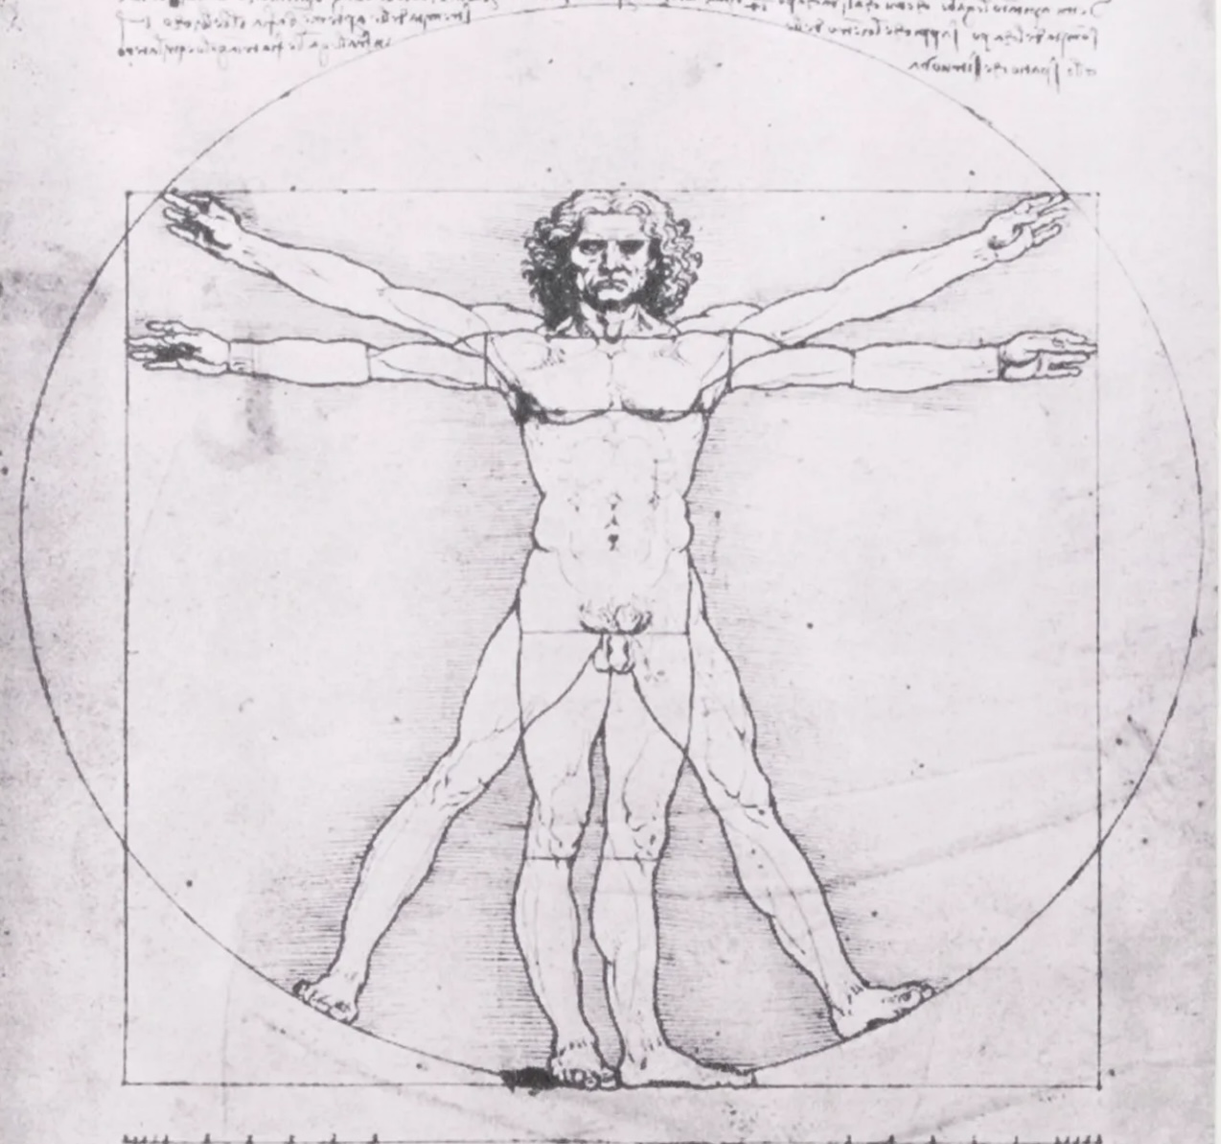
DIVINE ORDER

Slide 457
Although many contemporary scientists and mathematicians are physicalists, historically the vast majority have been deeply spiritual, often integrating their scientific and mathematical insights with their spiritual beliefs.
The most famous of all mathematicians, Pythagoras lived around 570–495 BCE. He founded the Pythagorean school, which was as much a religious and philosophical community as it was a mathematical one.
Pythagoras and his followers believed in the transmigration of souls and saw numbers as the fundamental building blocks of reality. Pythagoreans regarded mathematics as a means to purify the soul and achieve harmony with the divine order of the universe.
Pythagoras and his followers believed that numbers and mathematical relationships were fundamental to understanding the universe. They saw mathematics as a way to connect with the divine order of the cosmos.
The Pythagoreans believed that mathematics was a fundamental part of the universe and offered a glimpse into the sacred realm because they saw numbers and mathematical relationships as the underlying principles of reality.
The Pythagoreans observed that mathematical relationships could describe harmonious sounds in music, such as the ratios that determine intervals. They extended this idea of harmony to the cosmos, believing that mathematical order underpinned the structure of the universe.

Slide 458
They considered numbers to be a universal language that could explain natural phenomena. By understanding mathematical principles, they believed they were uncovering the divine order of the cosmos.
Numbers held mystical significance for the Pythagoreans. For example, they revered the number 10, which they called the "tetractys," as it represented the sum of the first four integers (1+2+3+4) and symbolized unity and completeness.
Pythagoras and his followers believed that understanding the mathematical nature of the universe could lead to spiritual purification and enlightenment.
They were fascinated by geometry and the idea that geometric shapes and figures could reveal deeper truths about reality. The Pythagorean theorem, for example, is a testament to their belief in the power of mathematical insights.
For the Pythagoreans, mathematics was not just a tool for measurement or calculation but a bridge to understanding the divine and the eternal truths of the universe.
Plato was heavily influenced by Pythagorean thought and believed that the material world was a shadow of a more perfect, abstract realm of forms or ideas. He considered mathematics a pathway to understanding these eternal forms, which he saw as the true reality.
Plato viewed mathematical forms as perfect and immutable, reflecting the ideal world of Forms that he believed lay beyond the physical world. Plato's philosophy was deeply intertwined with spiritual concepts, advocating for the pursuit of knowledge as a way to ascend to a higher understanding of reality.

Slide 459
While primarily known for his work in geometry, Euclid’s (c.300BCE)"Elements" laid the groundwork for viewing mathematics as a logical and structured system. This work influenced later thinkers who saw mathematical order as reflective of a higher, divine order.
Euclid’s work, particularly "The Elements," has been seen as having a quasi-spiritual aspect due to its emphasis on the eternal, perfect nature of geometrical truths. These truths were seen as reflections of a rational order that was harmonious and unchanging, aligning with the Pythagorean and Platonic view of mathematics as a way to connect with higher, abstract realities.
A student of Pythagoras and Euclid, Hypatia (c. 360–415 CE), was a renowned mathematician and philosopher in Alexandria. She taught Neoplatonism, which combined Plato's philosophy with religious and mystical elements, suggesting a deep connection between the cosmic order, mathematics, and spirituality.
Known for his laws of planetary motion, Johannes Kepler (1571-1630) was a key figure in the scientific revolution. He was a devout Lutheran who believed that understanding the cosmos was a way to glimpse the divine order that God had imposed on the universe.
Galileo Galilei (1564–1642) famously stated that the universe is written in the language of mathematics. He believed that mathematical laws governed the natural world, and understanding these laws was key to understanding the universe itself.

Slide 460
One of the most influential scientists of all time, Isaac Newton(1643-1727) made groundbreaking contributions to physics and mathematics. He was deeply religious and spent a significant amount of time studying the Bible and writing theological tracts. Newton saw his scientific work as an extension of his faith, exploring the laws set by a divine creator.
A mathematician, physicist, and inventor, Blaise Pascal (1623-1662) made important contributions to the study of fluids, geometry, and probability. Later in life, he had a profound religious experience, leading him to dedicate much of his time to theology and Christian philosophy. His work, “Pensées”, reflects his deep spiritual convictions.
Gottfried Wilhelm Leibniz (1646–1716) saw mathematics as a way to understand the divine plan. He believed in a pre-established harmony in the universe, where mathematical principles reflected the rational order set by God.
Known as the father of modern genetics, Gregor Mendel (1822-1884) was an Augustinian monk whose experiments with pea plants laid the foundation for the field of genetics. His monastic life provided him with the time and resources necessary to conduct his experiments.
A key figure in electromagnetism, James Clerk Maxwell (1831-1879) was a devout Christian who integrated his faith with his scientific work. He believed that studying the natural world was a way to understand God's creation.

Slide 461
While not religious in a traditional sense, Albert Einstein (1879-1955) had a deep sense of spirituality and often spoke about his awe and wonder at the universe. He famously remarked about respecting the mystery of the universe and spoke of a "cosmic religious feeling.“
Often considered the father of quantum theory, Max Planck (1858-1947) had a strong belief in a cosmic order and often spoke about the connection between science and a divine presence.
A founding figure in quantum mechanics, Niels Bohr (1885-1962) was open to philosophical and mystical interpretations of quantum phenomena, incorporating philosophical and spiritual ideas into his work.
A Belgian priest and astronomer, George Lemaitre (1894-1966) proposed what later became known as the Big Bang theory, suggesting that the universe expanded from an initial singularity. He saw no conflict between science and religion, viewing his scientific work as a way to appreciate the creation
Roger Penrose (b. 1931) a contemporary Nobel prize physicist and mathematician has explored the idea that mathematical structures exist in a Platonic realm of forms and that our physical universe is a manifestation of these structures.
A theoretical physicist known for his work in quantum theory and philosophy, David Bohm (1917-1992) explored the idea of wholeness and the implicate order, suggesting that the universe is guided by a deeper order beyond ordinary perception.

Slide 462
Francis Collins (1950- ) is a physician-geneticist who led the Human Genome Project and served as the director of the National Institutes of Health (NIH). He is also known for his Christian faith, which he explores in his book "The Language of God: A Scientist Presents Evidence for Belief." Collins advocates for the harmony between science and faith.
John Polkinghorne (1930-2021) was a theoretical physicist and an Anglican priest. He contributed significantly to the field of quantum mechanics before being ordained as a priest. Polkinghorne wrote extensively on the relationship between science and religion, arguing for their compatibility.
Jennifer Wiseman (1964- ) is an astrophysicist known for her work with the Hubble Space Telescope. She is also a committed Christian and has been active in discussions about the relationship between science and faith. Wiseman serves as the director of the American Association for the Advancement of Science's Dialogue on Science, Ethics, and Religion.
Allan Sandage (1926-2010) was a prominent astronomer who made significant contributions to our understanding of the universe's expansion. Late in his life, Sandage became a Christian, balancing his scientific work with his religious beliefs and exploring questions of existence and purpose.
Alister McGrath (1953- ) originally trained in molecular biophysics but became best known as a theologian. He writes about the dialogue between science and religion and addresses the intersection of scientific and theological thinking.

Slide 463
The idea that mathematics is the language of science and that "God is a mathematician" has been expressed by many mathematicians, scientists and philosophers. The concept is originally attributed to Galileo Galilei, who famously wrote, "The universe is written in the language of mathematics.”
The Nobel prize physicist Paul Dirac (1902-1984), known for his work in quantum mechanics contributed, "God used beautiful mathematics in creating the world." Dirac was struck by the elegance and simplicity of mathematical laws in physics.
Another Nobel laureate physicist Eugene Wigner (1902-1995) wrote a famous essay entitled "The Unreasonable Effectiveness of Mathematics in the Natural Sciences“. In it, Wigner explored the surprising ability of mathematics to describe the physical world accurately. He pondered why mathematical concepts, developed independently of empirical observations, so effectively explain natural phenomena.
These observations underscore a recurring theme in the history of science: the perception of a deep connection between mathematics and the natural world. This idea suggests that the universe operates according to mathematical principles, leading some to view mathematics as a reflection of a higher order or intelligence.
Leonardo da Vinci's "Vitruvian Man“ created around 1490 is one of the most famous drawings in the world. It is a study of the proportions of the human body, illustrating the blend of art and science during the Renaissance. The drawing is named after the ancient Roman architect Vitruvius, whose work "De Architectura" provided the inspiration for Leonardo's study.

Slide 464
The "Vitruvian Man" depicts a male figure in two superimposed positions with arms and legs apart, inscribed in both a circle and a square. This configuration demonstrates the ideal human body proportions as described by Vitruvius. For example, the length of a man's outspread arms is equal to his height, and the distance from the top of the head to the bottom of the chin is one-eighth of the total height.
The "Vitruvian Man" embodies the Renaissance ideal that art and science are interconnected. It illustrates the concept of human proportion, reflecting the belief that the human body is a microcosm of the universe and a model of harmony and balance.
The circle and square are symbolic in the drawing. The circle, often associated with the divine, represents the spiritual realm, while the square represents the material world. The positioning of the human figure within these shapes suggests the connection between humanity and the cosmos.
Vitruvius believed that architecture should reflect the proportions of the human body, which he considered the model of perfection. Leonardo's drawing translates this idea into a visual representation, linking architecture, art, and the human form.
The "Vitruvian Man" has become an enduring symbol of the intersection of art and science. It represents the quest for knowledge and understanding of the natural world through observation and measurement. The drawing continues to inspire artists, architects, and scientists, symbolizing the unity of different fields of study and the pursuit of harmony and balance in all things.

Slide 465
da Vinci's "Vitruvian Man" is a masterpiece that captures the essence of Renaissance thought, illustrating the ideal human proportions and the relationship between humanity and the universe. It remains a powerful symbol of the pursuit of knowledge and the interconnectedness of art, science, and philosophy.
The idea that God is a mathematician is a philosophical and theological interpretation that arises from the perceived order and precision in the universe. Some people see the mathematical nature of the universe as evidence of a higher intelligence or divine creator who designed the cosmos with mathematical principles. This view is often expressed by those who find a sense of wonder and awe in the mathematical elegance of the natural world.
Evidence that the natural world is written in the language of mathematics as mathematical principles and patterns is found throughout nature. Fibonacci Sequences and Golden Ratios appear in various natural phenomena, such as the arrangement of leaves, the branching of trees, and the spiral patterns of shells.
Fractals are complex geometric shapes, which can be split into parts, each of which is a reduced-scale copy of the whole, fractals are seen in snowflakes, mountain ranges, and coastlines.
The fundamental laws of physics, such as Newton's laws of motion, Maxwell's equations for electromagnetism, and Einstein's theory of relativity, are expressed mathematically and accurately describe how the universe operates. Mathematics is essential in predicting natural phenomena, from the orbits of planets to the behavior of subatomic particles.

Slide 466
Symmetry is a fundamental aspect of the natural world, seen in everything from the bilateral symmetry of animals to the radial symmetry of flowers. Geometry helps us understand these symmetrical patterns.
Plato's philosophy explored the relationship between the physical world and a higher realm of perfect forms or ideas. In his dialogue "Timaeus," Plato presents a cosmological account that suggests the universe is crafted by a divine craftsman, often referred to as the Demiurge. This craftsman uses eternal forms or ideas as blueprints to shape the cosmos, imbuing it with order and harmony.
Plato proposed that beyond the physical world lies a realm of perfect, immutable forms or ideas. These forms are the true reality, while the material world is merely a shadow or imitation of this higher realm.
Among these forms are perfect geometric shapes, which Plato believed to be the essence of all physical objects. The geometric forms represent the ideal versions of shapes we encounter in the material world.
In "Timaeus," Plato describes the Demiurge as a benevolent creator who imposes order on chaos by using the forms as templates. The Demiurge is guided by reason and aims to create a harmonious and orderly universe.
The Demiurge uses mathematical principles to structure the cosmos. This results in the geometric regularity and symmetry observed in nature, reflecting the influence of divine intelligence.

Slide 467
Plato saw mathematical relationships, such as harmony and proportion, as evidence of the universe's rational structure. These principles are reflected in the natural world, from the symmetry of living organisms to the orbits of celestial bodies.
By recognizing the geometric order in the physical world, Plato argued that we can glimpse the divine intelligence that shapes the universe. Mathematics and geometry thus serve as a bridge between the material and the spiritual, allowing us to understand the cosmos's underlying order.
The Platonic solids are a special class of three-dimensional geometric shapes that are highly symmetrical. Plato discussed them in his work "Timaeus" and associated them with the classical elements. There are exactly five Platonic solids:
1. Tetrahedron: Composed of 4 equilateral triangular faces, it represents the element of fire.
2. Cube (or Hexahedron): Composed of 6 square faces, it represents the element of earth.
3. Octahedron: Composed of 8 equilateral triangular faces, it represents the element of air.
4. Dodecahedron: Composed of 12 regular pentagonal faces, it represents the cosmos or the universe as a whole.
5. Icosahedron: Composed of 20 equilateral triangular faces, it represents the element of water.
These solids are unique because they are the only convex polyhedra with identical faces, vertices, and angles. Each vertex of a Platonic solid has the same number of faces meeting, and the angles between faces are the same throughout the solid.

Slide 468
The Platonic solids are seen as perfect forms due to their symmetry and uniformity. This perfection was thought to reflect a higher, divine order, suggesting that the universe itself is structured according to mathematical principles.
Plato associated each solid with a classical element, proposing that these shapes were the building blocks of the physical world. This idea ties into the belief that understanding these forms could provide insight into the nature of reality and the cosmos.
The idea that such perfect forms exist in a realm of pure thought or ideal forms aligns with Plato's theory of forms, where the physical world is just a shadow of a more real, abstract world. The Platonic solids, therefore, serve as a bridge between the tangible and the intangible, the material and the spiritual.
The Platonic solids have influenced not only philosophy but also art, architecture, and science throughout history. They have been used in various contexts to symbolize harmony, balance, and the interconnectedness of all things.
The golden ratio, often denoted by the Greek letter phi (φ), is a mathematical constant approximately equal to 1.6180339887. It is an irrational number, meaning it cannot be expressed as a simple fraction.
The golden ratio is defined algebraically as follows: if a line segment is divided into two parts, a and b, where the whole length (a + b) is to the longer part (a) as the longer part (a) is to the shorter part (b), then the ratio is the golden ratio.

Slide 469
The golden ratio has unique mathematical properties. For example, φ is the only number that, when added to 1, equals its square (φ + 1 = φ²). It also appears in the Fibonacci sequence, where the ratio of successive Fibonacci numbers approaches φ as the numbers increase.
The golden ratio is often associated with beauty and harmony. It has been used in art and architecture to create compositions that are aesthetically pleasing. Many artists and architects, including Leonardo da Vinci and Le Corbusier, employed the golden ratio in their works, believing it to produce a sense of balance and proportion.
The golden ratio appears in various natural phenomena. For instance, the arrangement of leaves around a stem, the pattern of seeds in a sunflower, and the spiral shells of certain mollusks all exhibit proportions that approximate the golden ratio. This has led to the belief that the golden ratio is a fundamental characteristic of natural growth patterns.
The golden ratio can be found in the proportions of the human body and other living organisms. Some studies suggest that faces and bodies that closely approximate the golden ratio are perceived as more attractive, although this is a topic of ongoing research and debate.
The golden ratio has fascinated mathematicians, scientists, and philosophers for centuries. Its frequent appearance in nature and its association with beauty and harmony have led to speculation about its deeper significance, suggesting that it might reflect an underlying order in the universe.

Slide 470
The Fibonacci sequence is a series of numbers where each number is the sum of the two preceding ones, usually starting with 0 and 1. So, the sequence begins: 0, 1, 1, 2, 3, 5, 8, 13, 21, and so on.
The Fibonacci sequence appears in various biological settings. For example, the arrangement of leaves around a stem, the branching of trees, the fruitlets of a pineapple, and the flowering of an artichoke all exhibit Fibonacci numbers.
The sequence can be seen in the family trees of honeybees and the spiral patterns of shells and horns.
Many flowers have a number of petals that is a Fibonacci number. For instance, lilies have 3 petals, buttercups have 5, and daisies can have 34, 55, or even 89 petals.
The Fibonacci sequence and other mathematical patterns like it are fascinating examples of how numbers can reveal underlying symmetries and order in the natural world.
These mathematical patterns suggest an underlying order in the universe, where complex structures and behaviors emerge from simple rules and relationships. They point to the possibility that the natural world is governed by mathematical principles, offering a glimpse into the intrinsic harmony and interconnectedness of all things.

Slide 471
The presence of these patterns in both living and non-living systems has inspired scientists, artists, and philosophers to explore the connections between mathematics, nature, and the cosmos, reinforcing the idea that mathematics can reveal deeper truths about the world we inhabit.
These ideas illustrate the deep connection between mathematics and spirituality. Many mathematicians, scientists and philosophers have viewed the mathematical order in nature as a reflection of a higher cosmic order and believed that understanding mathematics allowed one to glimpse the divine and eternal truths underlying the universe.
These ideas also exemplify how spiritual or religious beliefs can coexist with and complement scientific inquiry, driving humans to explore and understand the world in profound ways.

Slide 472
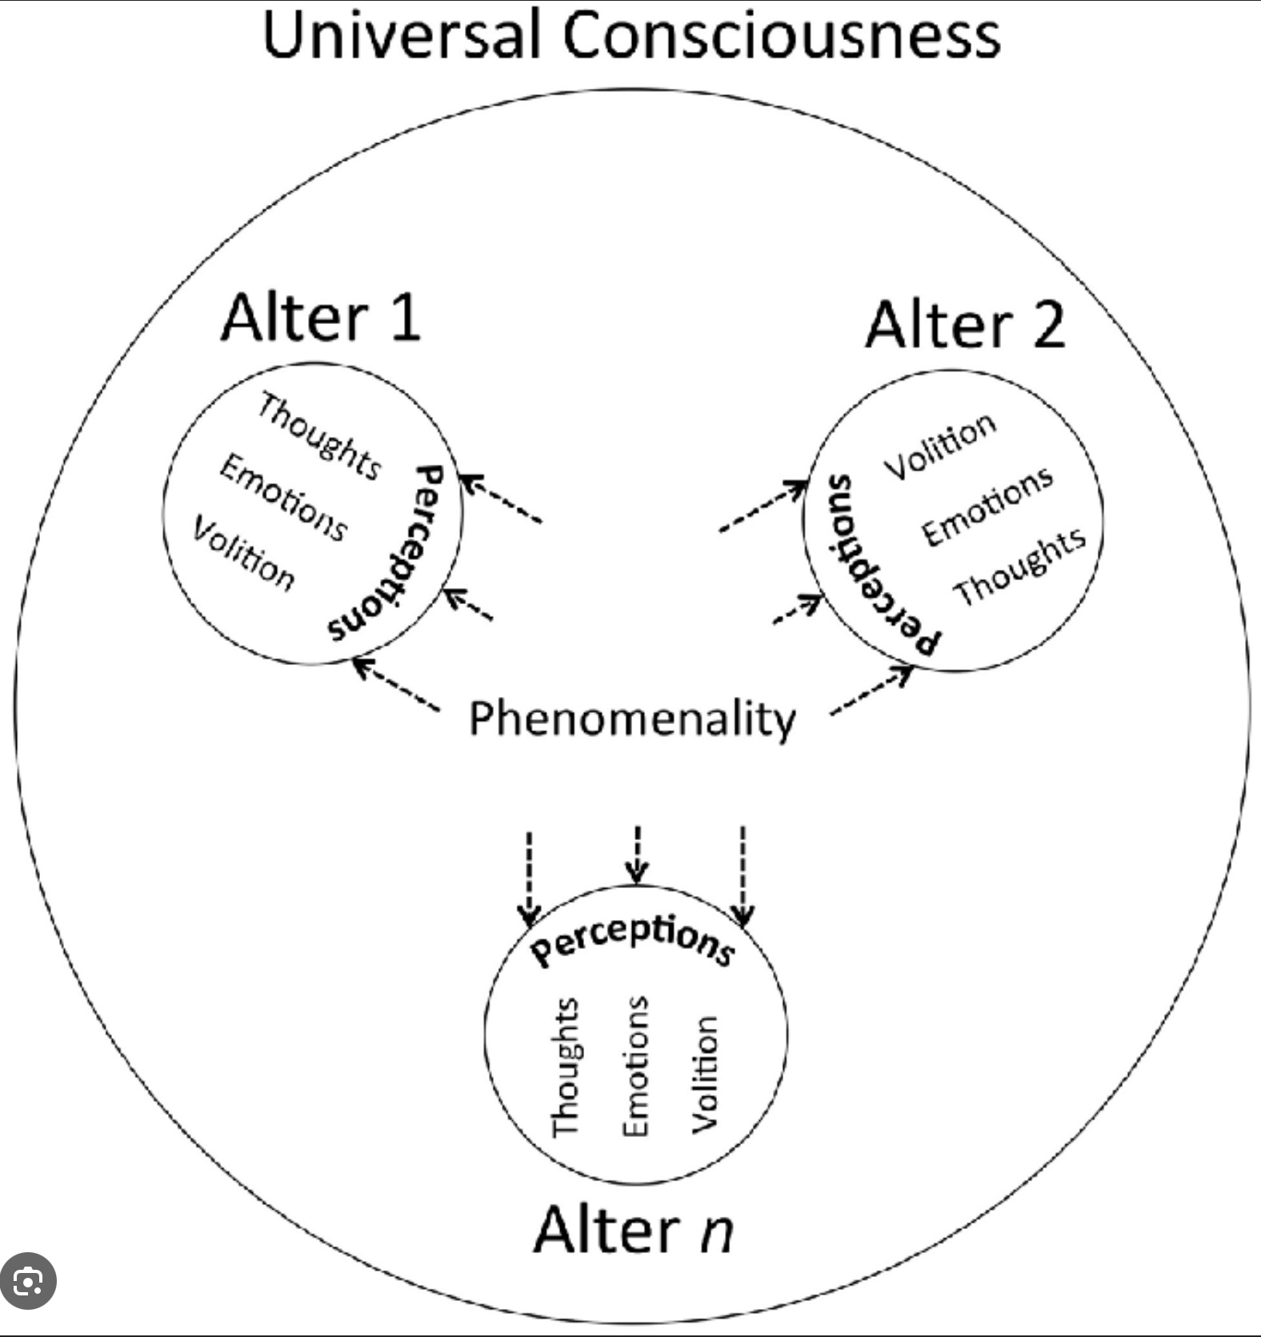
IDEALISM PHYSICALISM AND MEANING

Slide 473
Most spiritual traditions are metaphysically idealist emphasizing the primacy of consciousness or mind as the fundamental nature of reality. The perennial philosophy tells us that here are common themes to the meaningful “The” stories these traditions offer us.
Many spiritual beliefs see all beings and the universe as interconnected in line with idealism which suggests that individual consciousnesses are part of a larger, unified consciousness or mind. The notion that everything is connected gives life meaning in profound ways.
This interconnectedness fosters a sense of unity and belonging, suggesting that individuals are part of a larger whole. This perspective provides a sense of purpose and meaning, as one's actions and experiences contribute to the greater tapestry of existence.
If reality is fundamentally mental or spiritual, as idealism suggests, then life may be seen as having an inherent purpose or direction. This imbues individual lives with meaning, as each person is viewed as playing a unique role in the unfolding of a greater, meaningful reality.
The idea of interconnectedness can lead to a more compassionate and ethical worldview. If all beings are connected, then the well-being of others is intrinsically linked to one's own well-being. This can inspire actions that promote harmony, empathy, and altruism, adding depth and meaning to life through the pursuit of these values.

Slide 474
Idealism emphasizes the transcendence of individual limitations through connection with a greater consciousness. This can provide a sense of hope and meaning, as individuals may feel that they are not confined to their immediate circumstances but are part of a larger, meaningful journey.
Idealism encourages the exploration of inner reality and consciousness. This exploration can lead to personal growth, self-discovery, and a deeper understanding of one's place in the universe, all of which contribute to a meaningful life.
Spirituality often involves the belief in transcending the physical world to access higher states of awareness or divine realms. Idealism, which posits that reality is not limited to the material, naturally accommodates such transcendence.
Some spiritual traditions, like Advaita Vedanta and certain interpretations of Buddhism, advocate for a non-dual understanding of reality, where distinctions between self and other, or mind and matter, dissolve. Idealism, with its focus on a unified mental reality, resonates with these non-dual perspectives.
Many spiritual traditions hold beliefs in life after death, reincarnation, or the eternal nature of the soul. Idealism, which views consciousness as fundamental and not necessarily dependent on the physical body, is more compatible with these beliefs than physicalism.

Slide 475
Physicalist metaphysics which maintain that matter and physical forces are the essence of reality and that consciousness arises from these physical processes does not allow for any of the spiritual non-material aspects of existence we’ve been discussing and consequently disenchants the world.
An idealist perspective such as Kastrup’s, which we will return to in the last part of this exploration, does allow for another realm by suggesting that individual minds are dissociated alters of Universal mind.
This dissociation process is very similar to that occurring in dissociative identity disorder, (formerly multiple personality disorder), in which an alter dissociates from the host personality. Much like a drop of water is a part of the ocean, individual minds are a small part of a vast universal mind.
Having explored the crisis and anomalies associated with the modern and post-modern stages, let’s now consider how the emerging Integral stage worldview could explain the anomalies and begin healing different aspects of the polycrisis.

Slide 476
PART VI- INTEGRAL WORLDVIEWS
The integral stage
Systems
Stories and systems
Integral scientific theories
Integral spirituality
Symbols and truth

Slide 477

rediscovering meaning
THE INTEGRAL STAGE

Slide 478
To briefly review, at the traditional stage, religion provides a central source of meaning, offering a shared narrative and moral framework. The traditional stage, however, also makes a strong distinction between in-groups and out-groups, with a focus on loyalty to one's own group and skepticism or hostility toward outsiders. This can manifest in nationalism, religious exclusivity, or cultural conservatism.
While traditional narratives serve to provide a sense of meaning, purpose, and belonging within a stable social framework, they are also rigid and resistant to change, as their emphasis on maintaining established norms limits openness to new ideas and perspectives.
At the modern stage there is an emphasis on rationality, science, empirical evidence, and individualism and personal freedom that empowers personal growth and self-expression. The modern worldview however also dismisses or undervalues subjective experiences, spirituality, the sacred realm and the intangible aspects of life that contribute to meaning.
Its focus on the self results in a fragmented sense of identity. Its pursuit of external achievements leads to a neglect of inner fulfillment and purpose, resulting in a sense of emptiness when material possessions and status fail to provide lasting satisfaction.
The postmodern stage brings valuable insights into diversity, equality, and the complexity of human experience but also faces challenges such as its cultural relativism and a lack of a coherent framework for action and decision-making.

Slide 479
To begin to address the various aspects of the polycrisis and reclaim the spiritual realm we need a more inclusive and holistic framework which integrates the strengths of traditional, modern and postmodern perspectives while transcending their limitations.
This framework needs to recognize the validity of different perspectives and levels of development, foster a deeper sense of interconnectedness, promote a more balanced approach to personal and collective growth and address the complex challenges of our time.
The stage of growth that follows the post-modern is the integral stage. The integral stage combines the positive aspects of all the previous stages while also transcending their limitations. At the integral stage the strengths of all previous developmental stages are synthesized into a more comprehensive worldview. For this reason, it is called a “second tier” world view.
In integral theory the concept of "second tier" refers to a stage of consciousness that transcends and includes the earlier stages, referred to as "first tier." The distinction between first and second tier is significant because it marks a shift in how individuals perceive and integrate different perspectives.
First tier stages such as traditional, modern, and post-modern are exclusive and view their perspective as the only valid one. People at these stages struggle to appreciate or understand the perspectives of those at different stages.

Slide 480
Second tier begins with the "integral" stage, where individuals start to see the value in all previous stages and perspectives. They recognize that each stage has its own truth and importance. Second tier is characterized by a more inclusive, flexible, and holistic approach to understanding the world.
People operating at this level are more likely to appreciate complexity and integrate diverse viewpoints. Second tier worldviews have a lot in common with the perspectives of Wise mind or “Self”.
The term "second tier" is used to emphasize this significant leap in consciousness and understanding, where individuals move from a more fragmented and narrow view of the world to a more integrated and expansive one. This shift is seen as crucial for addressing complex global challenges, as it allows for more adaptive and comprehensive solutions.
The integral stage values and incorporates insights from all previous stages including the traditional, modern, and postmodern, recognizing the unique contributions each brings to understanding reality. By integrating these different perspectives, the integral stage creates a more nuanced and complete worldview that honors both diversity and unity. This synthesis allows for a more balanced approach that respects traditional values, embraces scientific progress, and acknowledges the importance of cultural and personal narratives.
The integral stage provides a holistic framework that considers multiple dimensions of human experience, including physical, emotional, mental, and spiritual aspects. This comprehensive approach helps individuals find meaning by addressing all facets of their lives. By acknowledging the interconnectedness of these dimensions, the integral stage encourages a more integrated sense of self and purpose.

Slide 481
The integral view sees human development and the universe as part of an ongoing evolutionary process. This perspective imbues life with a sense of purpose, as individuals and societies are seen as participants in the unfolding of greater complexity and consciousness. This evolutionary understanding provides a narrative that connects personal growth with larger cosmic and societal developments, offering a meaningful context for individual and collective actions.
The integral stage encourages individuals to discover and pursue their unique purpose and contribution to the world. By aligning personal goals with broader evolutionary aims, individuals can find deeper satisfaction and meaning in their lives. This focus on contribution and service fosters a sense of interconnectedness and responsibility, enhancing the meaning derived from one's actions and relationships.
The integral approach bridges the gap between science and spirituality, recognizing the value of both empirical knowledge and inner wisdom. This reconciliation allows individuals to draw meaning from both rational understanding and spiritual insight. By integrating these domains, the integral stage provides a more comprehensive and meaningful framework for exploring existential questions and the nature of reality.
At the integral stage society is seen through a systems-thinking lens, understanding the complex interconnections and interdependencies between various social, economic, and ecological systems. This approach promotes solutions that address root causes rather than symptoms. There is an acknowledgment of the evolutionary nature of human society, with a focus on fostering environments that support growth and development at both individual and collective levels.

Slide 482
The integral stage values inclusivity and diversity, appreciating the unique contributions of different cultures while seeking common ground and shared values. Cultural narratives and practices are understood as part of a larger evolutionary process.
The integral view seeks to transcend and include the strengths of each cultural stage, creating a richer and more nuanced cultural tapestry. Culture is seen as a dynamic interplay of various dimensions, including art, science, spirituality, and ethics. The integral view encourages a holistic understanding that honors both objective and subjective dimensions of cultural experience.
In the integral worldview the universe is an interconnected whole, where everything is part of a larger, evolving process. This perspective aligns with both scientific understandings of complexity and ecological interdependence and spiritual insights into unity and oneness.
The universe is seen as inherently meaningful, with an evolutionary impulse driving the emergence of greater complexity, consciousness, and compassion. This view provides a sense of purpose and direction, encouraging individuals to participate in the ongoing unfolding of the universe.
The integral stage reintroduces the meaning that was lost at the modern and post-modern stages by offering a more inclusive, integrated, and evolutionary perspective that connects individual experiences with larger patterns and purposes. It encourages individuals and societies to embrace complexity, foster growth, and work towards a more just, sustainable, and compassionate world.

Slide 483
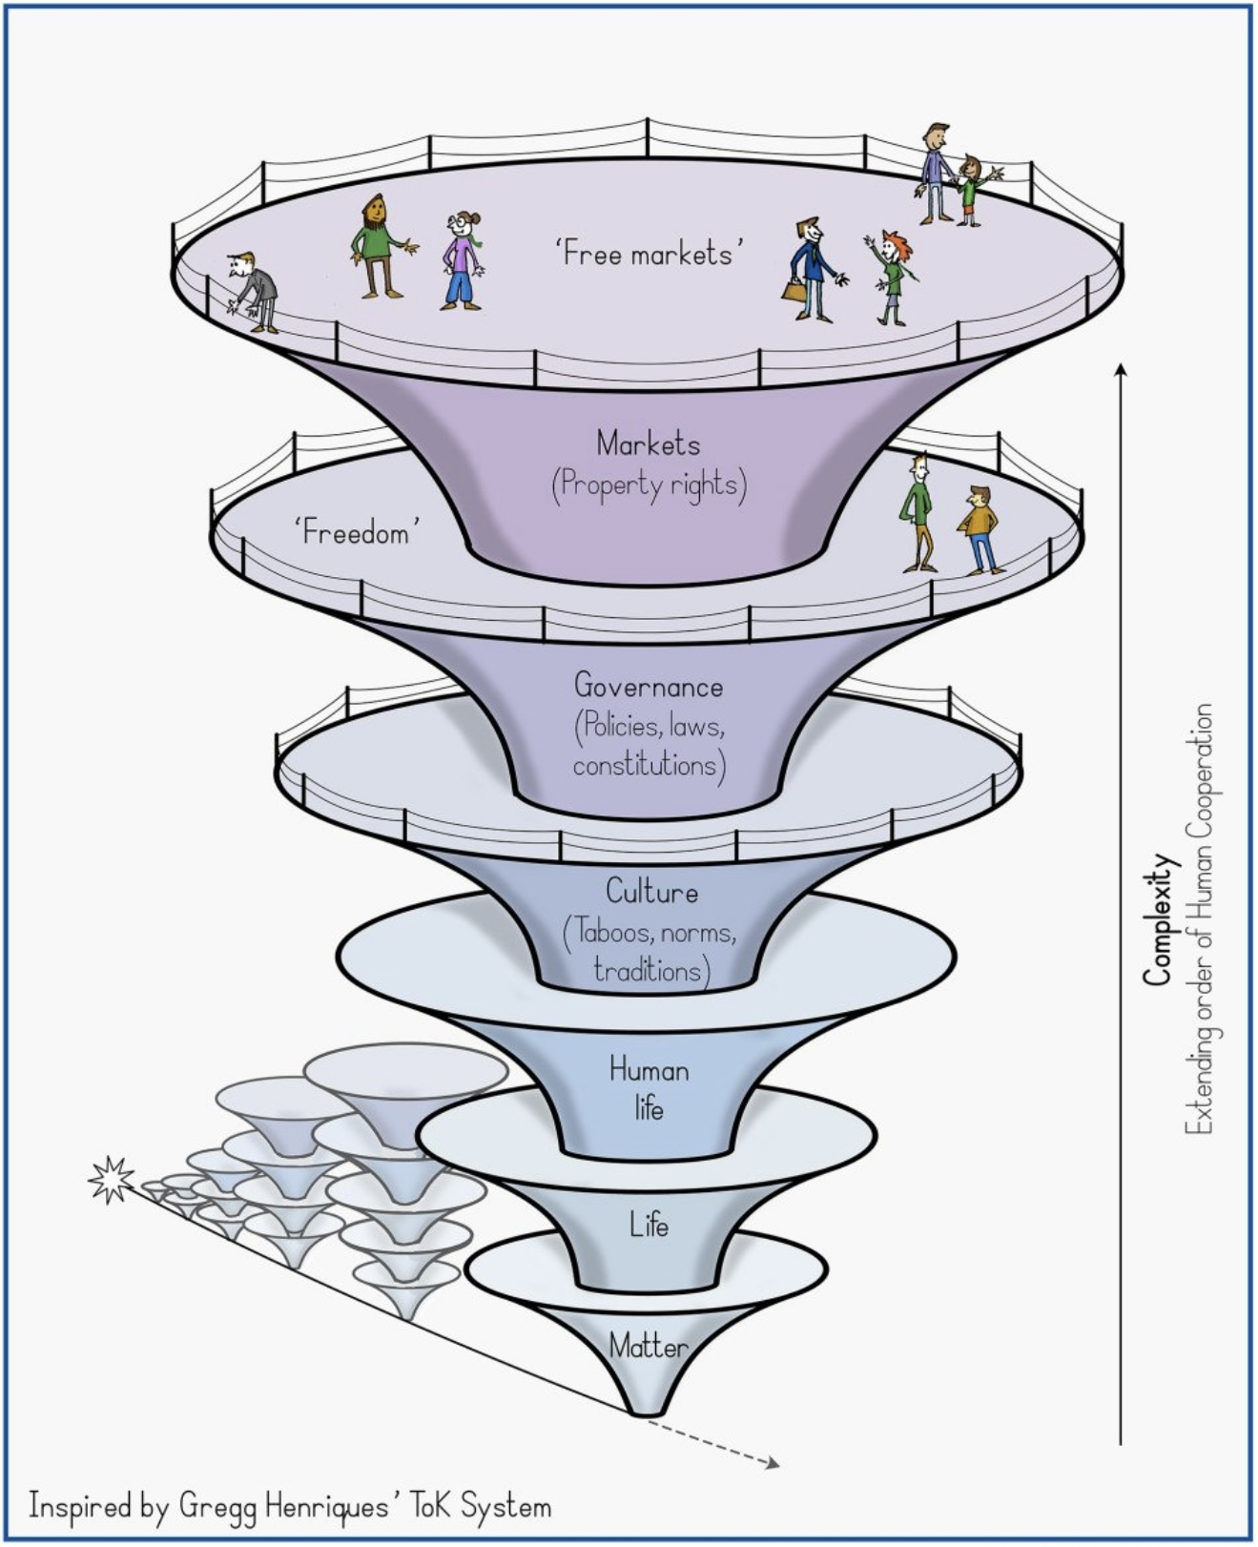

SYSTEMS

Slide 484
We’ve suggested that the modern stage’s left hemisphere centric, reductionist and individualistic worldviews, which at one point were the most culturally adapted worldviews, are no longer so. This is evident from the polycrisis this stage is associated with.
Integral theorists propose that a wholistic, systems oriented integral stage worldview is necessary to address the polycrisis and explain the anomalies that previous stages cannot. Such a worldview can also restore meaning to My, Our, and The stories which are necessary for us to heal and grow at the individual, collective and planetary levels.
To better understand the integral stage of development, it’s important to consider the nature of systems.
Systems are structured sets of components or elements that interact with each other to form a complex whole. They can be found in virtually every aspect of life and can be natural, or human made. Systems have some key characteristics:
1. Components: These are the individual parts or elements that make up the system. Each component has a specific role or function.
2. Interconnections: The components of a system are interconnected, meaning they interact and affect one another. The nature of these interactions can determine how the system behaves.

Slide 485
3. Purpose or Function: Systems are typically designed or naturally evolved to achieve specific goals or functions. For example, the purpose of a transportation system is to move people and goods from one place to another.
4. Boundaries: A system has defined boundaries that distinguish it from its environment. These boundaries can be physical or conceptual.
5. Inputs and Outputs: Systems often interact with their environment through inputs (resources, information, energy) and outputs (products, services, waste).
6. Feedback Loops: Systems often have feedback mechanisms that help them self-regulate. Feedback can be positive (amplifying changes) or negative (dampening changes).
There are many different types of systems:
Open Systems engage with their environment by exchanging energy, matter, or information. They are adaptable and tend to respond to changes in their surroundings. Examples include ecosystems, businesses, and living organisms. The defining feature of open systems is their capacity to evolve and react to external factors.
Closed Systems do not exchange matter with their surroundings, although they may allow energy exchange. They are generally more stable and predictable due to their isolation from outside influences. A sealed terrarium or a thermos bottle designed to minimize energy exchange serves as an example of a closed system.

Slide 486
Complex Systems are composed of numerous interconnected elements that interact in non-linear ways, resulting in emergent behaviors that are not easily predictable from the individual components' actions. Instances include weather systems, the internet, and economies.
Adaptive Systems can modify their behavior in response to environmental changes. They learn from their experiences and can evolve over time. Examples of adaptive systems include neural networks and certain biological systems.
Cybernetic Systems are identified by feedback loops that help maintain stability or accomplish specific objectives. They are frequently employed in control systems and robotics.
Social Systems, include families, communities, or societies, where individuals and groups interact based on social norms and structures.
Economic Systems such as markets or economies, where resources are allocated and distributed through various mechanisms.
Technological Systems like computer networks or software systems, where technology components work together to process information.
Ecological Systems comprising living organisms and their physical environment, interacting as an ecological unit.
Systems that are in equilibrium or maintain homeostasis display several important characteristics:
1. Balance of Forces: In an equilibrium state, the various forces or influences acting upon the system are in balance. For instance, in a chemical reaction that has reached equilibrium, the rate of the forward reaction matches the rate of the reverse reaction.
2. Stability: Such systems typically resist changes and revert to their equilibrium state following minor disturbances. This can be observed in ecosystems where predator-prey dynamics contribute to population stability.
3. Feedback Mechanisms: Homeostatic systems frequently incorporate feedback loops that aid in preserving stability. Negative feedback loops counteract fluctuations, facilitating the system's return to its set point. An example of this is body temperature regulation, which uses negative feedback to sustain a stable internal environment.

Slide 487
Systems that are in equilibrium or maintain homeostasis display several important characteristics:
1. Balance of Forces: In an equilibrium state, the various forces or influences acting upon the system are in balance. For instance, in a chemical reaction that has reached equilibrium, the rate of the forward reaction matches the rate of the reverse reaction.
2. Stability: Such systems typically resist changes and revert to their equilibrium state following minor disturbances. This can be observed in ecosystems where predator-prey dynamics contribute to population stability.
3. Feedback Mechanisms: Homeostatic systems frequently incorporate feedback loops that aid in preserving stability. Negative feedback loops counteract fluctuations, facilitating the system's return to its set point. An example of this is body temperature regulation, which uses negative feedback to sustain a stable internal environment.
4. Dynamic Equilibrium: Although the system may seem stable, there is often ongoing movement or change within it. For example, in a dynamic equilibrium, molecules are continually reacting, yet the overall concentrations remain unchanged.

Slide 488
Several factors can contribute to the loss of equilibrium in a system:
1. External Disturbances: Shifts in external conditions, such as variations in temperature, changes in resource availability, or environmental modifications, can disrupt equilibrium.
2. Internal Changes: Changes occurring within the system, such as genetic mutations in biological systems or shifts in population dynamics, can also result in disequilibrium.
3. Threshold Effects: Systems may possess thresholds that, when crossed, prevent them from maintaining equilibrium. Exceeding these thresholds can bring about significant alterations.
Several consequences ensue from an of irreversible loss of equilibrium in a system:
1. New Equilibrium State: The system may establish a new equilibrium state that can be significantly different from the prior one. This is often seen in ecological systems, where a new balance is formed following a disturbance.
2. System Collapse: In some instances, the system may collapse or disintegrate if it fails to adapt to the changes, resulting in functional loss or in an ecological context the extinction of a species.
3. Phase Transition: Systems may experience a phase transition to a different state, such as water transforming into ice or steam when certain temperature thresholds are crossed.

Slide 489
4. Chaotic Behavior: Certain systems may display chaotic behavior, where minor changes can lead to unpredictable and complex dynamics.
Understanding these dynamics is essential for effectively managing systems, whether they are ecological, economic, or technological, in order to avert undesirable outcomes and foster stability.
“Hierarchical or nested system." are systems contained within other systems. Cells, for example, are systems that are part of organ systems that are part of an entire organism system (a person), that in turn is a part of other systems such as families, societies, the economy, politics, ecosystems, the planet, and the whole universe.
Nested systems demonstrate how complex interactions and dependencies exist at various levels of biological and ecological organization. Each system plays a role and contributes to the overall function and balance of the larger systems it is part of.
Nested systems are interconnected, and changes or disruptions at one level can have cascading effects on others. For example, if cellular function is disrupted, e.g., due to disease or genetic mutations, it can impair the function of the entire organ. For instance, damaged heart cells can lead to heart disease, affecting the cardiovascular system.

Slide 490
Organs work together to maintain the health and functionality of an organism. Impairment of the cardiovascular system will impact the entire organism. Healthy organisms contribute to social systems. Illness or disability in individuals will affect their roles within families, communities, and societies. Conversely, social support can influence individual health, providing resources and emotional support.
Human social systems significantly impact ecosystems through activities like agriculture, urbanization, and industrialization. These activities can lead to habitat destruction, pollution, and climate change, affecting biodiversity and ecosystem health.
Healthy ecosystems provide the necessary conditions for life such as breathable air, drinkable water, food, and a tolerable climate. Ecosystems are able to absorb environmental stresses but become more vulnerable as stressors accumulate.
Unmanageable stressors cause the degradation of ecosystems and an accelerating extinction of forms of life. As this unfolds, social, political and economic systems also become more unstable. Crisis in each of these systems affect other system until the whole interconnected web of systems collapses.
Nestled systems are interdependent, and homeostasis at each level is crucial for the health and sustainability of the entire hierarchy. Understanding these relationships helps in addressing issues like environmental conservation, public health, and social well-being.

Slide 491
The global ecosystem is commonly viewed as an open system, primarily due to its continual exchange of energy and matter with the surrounding environment. The sun delivers energy to Earth in the form of sunlight, which drives numerous processes within the ecosystem, such as photosynthesis in plants. Moreover, Earth radiates energy back into space in the form of heat.
While Earth is relatively closed when it comes to the exchange of matter with outer space (as significant amounts of matter generally do not enter or leave the planet), it remains open regarding the circulation of matter within the global ecosystem. For example, water cycles through evaporation, condensation, and precipitation, while nutrients move through various ecosystems via processes like decomposition and consumption.
Human activities have further increased the openness of the global ecosystem by transferring large quantities of materials (including fossil fuels and minerals) and disrupting natural cycles (such as the carbon and nitrogen cycles).
The openness of the global ecosystem is crucial for supporting life, as it relies on the ongoing influx of solar energy and the recycling of nutrients to maintain ecological equilibrium.
Individuals, societies and the global ecosystem are interconnected nested systems, and we need a systemic perspective to understand their complexity and how deeply they influence each other.

Slide 492
Systemic thinking encourages us to look at the whole picture rather than just isolated parts. This holistic view reveals patterns and relationships that are missed with a reductionistic approach.
Many global challenges, such as climate change, economic inequality, and public health, are complex and multifaceted. Systemic thinking allows for more effective problem-solving by considering all contributing factors and their interactions.
By understanding the broader system, we can anticipate and mitigate unintended consequences of actions that might seem beneficial in isolation but are harmful in a larger context.
Systemic thinking often leads to more sustainable solutions because it considers long-term impacts and the sustainability of the entire system rather than focusing on short-term gains.
Understanding societies systemically fosters cultural sensitivity and appreciation for diversity, recognizing that different societies have unique dynamics and histories that influence their current state.

Slide 493

MY, OURS, AND THE STORIES AS SYSTEMS

Slide 494
My, Our and The stories are ideological, thought and cognitive systems coexisting with other systems such as biological and ecological ones. My, Our and The stories are frameworks through which individuals or groups perceive, interpret, and engage with the world. They are composed of beliefs, values, and perceptions that shape behavior and decision-making. These belief systems have a tremendous impact on the many other systems they are interconnected with.
Recall that My stories are the personal narratives that people create about their own identities, experiences, and roles in the world. These stories influence self-esteem, motivation, and behavior. For example, someone who sees themselves as resilient or has an internal locus of control may approach challenges with confidence.
Our stories are the collective narratives that societies hold about themselves, encompassing cultural values, traditions, and historical perspectives. These stories influence national identity, social norms, and policy-making. For instance, a society that values innovation may invest heavily in education and technology.
The stories reflect how people and societies perceive the universe and their place within it. They can encompass ideas about global cooperation, environmental stewardship, the origins of the universe and its metaphysics. For example, a spiritual story emphasizing interconnectedness might lead to international cooperation and efforts to address issues such as inequality and climate change.
My stories aggregate to influence Our stories. For instance, widespread personal experiences of inequality can lead to social movements and shifts in societal values.

Slide 495
Our stories in turn shape My stories. Cultural norms and values are internalized by individuals, influencing their personal stories and life choices.
Our stories contribute to The story. A society's stance on issues like human rights or environmental protection can influence international policies and collaborations.
The stories influence Our and My stories. For example, a spiritual perspective promotes awareness of how, for example capitalism and consumerism create environmental degradation and social injustice.
My, Our, and The stories are dynamic and interdependent systems. Changes at one of these levels of stories causes shifts at other levels.

Slide 496
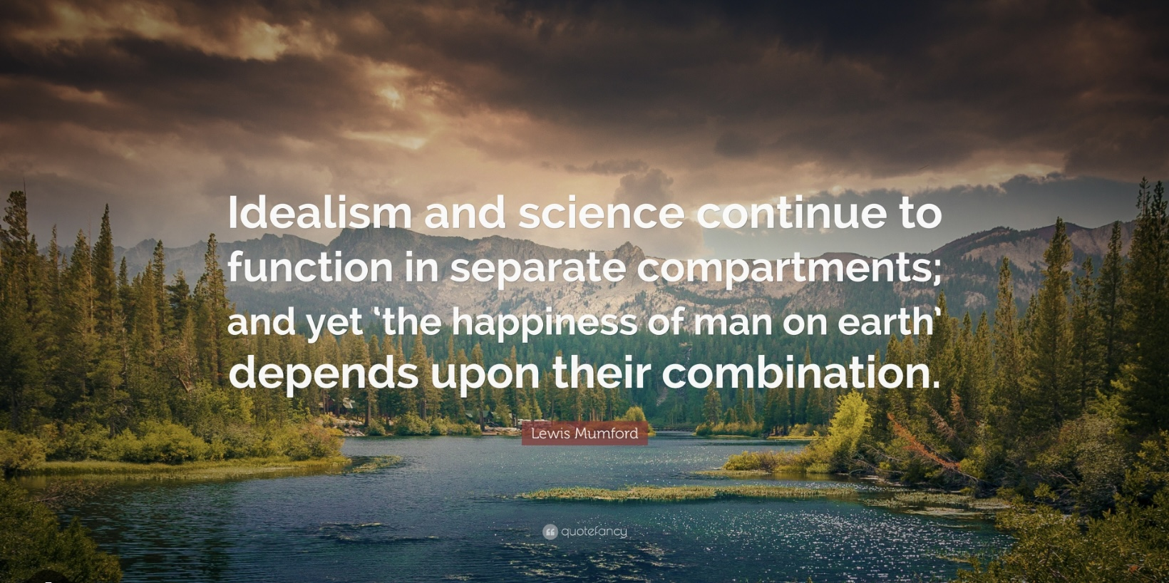
INTEGRAL SCIENTIFIC THEORIES

Slide 497
Many open-minded investigators see paranormal phenomena as manifestations of a realm not explainable under a physicalist paradigm. Rather than reject or dismiss these phenomena they question the physicalist paradigm.
Scientists like Rupert Sheldrake, Michael Levin, Donald Hoffman, and Giulio Tononi are proposing new scientific theories, backed by empirical and mathematical evidence, that transcend the physicalist paradigm and open the door for an integration of science and spirituality.
Rupert Sheldrake, a British biologist, is known for his morphic resonance theory, which suggests that natural systems inherit a collective memory from all previous entities of their kind. This idea challenges conventional views of biology and genetics, proposing a new way of understanding how organisms develop and evolve.
The morphic fields theory, often referred to as "morphic resonance," is a hypothesis that seeks to explain patterns of organization in nature. Sheldrake proposes that there are invisible fields, called morphic fields, that organize the structure and behavior of systems, from molecules to societies. These fields are thought to contain information that shapes the form and development of living organisms and systems.
Morphic Resonance is the central concept of Sheldrake's theory. Morphic resonance suggests that similar patterns and behaviors are influenced by past occurrences of those patterns and behaviors. In other words, once a particular form or behavior has occurred, it becomes easier for it to occur again, as it resonates with previous instances.

Slide 498
Sheldrake's theory challenges conventional views of genetic inheritance by suggesting that morphic fields, rather than just genes, play a crucial role in the development and inheritance of traits. He posits that organisms inherit not only genetic material but also influences from past members of their species through morphic resonance.
In Sheldrake's view, DNA codes for the “building materials” of organisms but not for the architectural plan and assembly process of these materials. Expecting DNA to account for the entire process of development is akin to expecting a pile of airplane parts to spontaneously assemble into a functioning airplane just by shaking the room. He suggests that additional organizing principles or fields, like his proposed "morphic fields," are necessary to guide the assembly and development of these components into coherent, functional structures.
Sheldrake uses this analogy of airplane parts to illustrate his view that DNA alone cannot account for the complex organization and development of living organisms. He argues that while DNA provides the instructions for producing proteins and other molecular components, the "building materials" of life, it does not explain how these components are assembled into the intricate structures and forms of organisms.
According to Sheldrake, the universe is not governed solely by fixed laws but also by habits that develop over time. Morphic fields and resonance contribute to the habitual nature of reality, where repeated patterns become more likely to occur.
Sheldrake's theory has implications for understanding biological development, behavior, and consciousness. It suggests that learning and memory might be influenced by morphic fields, potentially explaining phenomena like instinctual behavior and telepathy.

Slide 499
Morphic fields and morphic resonance are controversial and have been criticized for lacking empirical evidence and scientific rigor. To counter this criticism Sheldrake has designed experiments to empirically test the validity of his claims. Despite his positive findings, many scientists continue to view Sheldrake's ideas as speculative and not grounded in established scientific principles.
Sheldrake's theory has sparked interest and discussion in both scientific and philosophical circles, encouraging exploration of alternative explanations for complex biological and psychological phenomena.
Michael Levin is a prominent biologist known for his work in developmental biology and bioelectricity. His research focuses on understanding how cells communicate and organize themselves to create complex structures during development and regeneration.
Levin studies the role of bioelectric signals in cell communication and development. He proposes that electric fields and ion flows across cell membranes are crucial for guiding the formation of tissues and organs. These bioelectric signals serve as a kind of "blueprint" that cells use to determine their position and role in the body.
Levin's work suggests that bioelectric signals contribute to morphogenetic fields, which are patterns of information that guide the development and regeneration of tissues. These fields help coordinate the behavior of individual cells to achieve complex anatomical structures.
Levin's research explores how bioelectric signals can be manipulated to promote tissue regeneration and repair. By altering the bioelectric environment of cells, he has shown it is possible to induce regeneration in tissues that do not typically regenerate, such as limbs in mammals.

Slide 500
Levin is interested in the potential for bioelectricity to be used in synthetic biology and regenerative medicine. By understanding and controlling bioelectric signals, scientists could potentially create new biological structures or repair damaged ones, leading to advances in tissue engineering and regenerative therapies.
Levin views biological systems as information processing entities. He explores how bioelectric signals, along with genetic and biochemical signals, form a complex network that processes information to guide development and adaptation.
Levin's work has implications for regenerative medicine, cancer treatment, and understanding congenital defects. By harnessing bioelectric signals, it may be possible to develop new therapies for a range of medical conditions.
Michael Levin's research is at the forefront of exploring how bioelectric signals contribute to the fundamental processes of life, offering new insights into development, regeneration, and the potential for innovative medical applications.
His findings which are published in peer-reviewed journals contribute to a growing body of evidence supporting the importance of bioelectricity in biology and suggest a paradigm shift in understanding how complex biological structures are formed and maintained.

Slide 501
Both Levine and Sheldrake explore ideas that challenge conventional scientific paradigms, though they come from different backgrounds and focus on different subjects, there are many similarities in their work .
Sheldrake's concept of morphogenetic fields and Levin's research on bioelectrical fields both explore unconventional mechanisms of biological development and organization.
Both Sheldrake and Levin propose that fields play a crucial role in shaping biological form and function. Sheldrake's morphogenetic fields are hypothetical fields that guide the development of organisms, while Levin's bioelectrical fields focus on the role of electrical signals in cellular communication and pattern formation.
Both concepts suggest that there is an underlying informational structure that guides the development and organization of living systems. Sheldrake's fields are thought to contain information about the form and behavior of organisms, while Levin's bioelectrical fields involve the distribution of electrical signals that influence cell behavior and tissue patterning.
Both theories adopt a holistic view of biology, emphasizing the importance of understanding the organism as a whole rather than just a collection of parts. This contrasts with more reductionist approaches that focus solely on genetic or molecular explanations.
Both Levine and Sheldrake draw on a wide range of disciplines to support their ideas. Sheldrake's work spans biology, psychology, and parapsychology, while Levine integrates insights from bioengineering, computer science, and physics into his biological research.

Slide 502
While Sheldrake is more directly involved in exploring consciousness through his studies on telepathy and other psychic phenomena, Levine's work on bioelectricity and its potential role in cognition and perception touches on similar themes. Both are interested in how perception and consciousness might extend beyond traditional explanations.
Both Sheldrake and Levin challenge traditional scientific views by proposing mechanisms that are not yet fully understood or accepted by the mainstream scientific community. While Sheldrake's ideas are more speculative and metaphysically challenging of the physicalist worldview, Levin's work is grounded in experimental research but still pushes the boundaries of traditional developmental biology.
Both theories offer the potential to provide new insights into complex biological phenomena, such as regeneration, development, and evolution. They encourage exploration of how non-genetic factors might contribute to the emergence of form and function in living systems.
Donald Hoffman is a cognitive scientist known for his work on perception, consciousness, and the nature of reality. He is a professor in the Department of Cognitive Sciences at the University of California. Hoffman's research challenges conventional views about how we perceive the world and raises intriguing questions about the relationship between perception and reality.
Hoffman book "The Case Against Reality: Why Evolution Hid the Truth from Our Eyes," presents his theories to a broad audience.

Slide 503
Hoffman is best known for his "interface theory of perception," which suggests that our perceptions do not reflect reality as it is. Instead, they function more like a user interface, evolved to guide adaptive behavior rather than to reveal the true nature of the world.
According to this theory, what we perceive is shaped by evolutionary pressures to enhance survival and reproduction, rather than to provide an accurate depiction of objective reality.
Hoffman employs mathematical models and evolutionary game theory to support his ideas, arguing that natural selection does not favors organisms that perceive instead,. Natural selection favors instead, those that perceive an interface of that underlying reality.
Hoffman's exploration of the true nature of reality is deeply informed by scientific principles, particularly from cognitive science, evolutionary biology, and computational modeling. Hoffman uses evolutionary game theory to model how perception evolves.
He argues that natural selection shapes perceptual systems not to perceive reality accurately, but to maximize an organism's fitness. Through mathematical simulations, he demonstrates that perceptions that enhance survival and reproductive success are favored, even if they do not correspond to the true nature of reality
As a cognitive scientist, Hoffman draws on empirical research about how humans perceive the world. He examines how the brain processes sensory information and constructs a coherent experience of reality. This research supports his idea that perception is a constructed interface, rather than a direct window to objective reality.

Slide 504
Hoffman employs computational models to illustrate how perceptual systems might function as interfaces. These models simulate how organisms interact with their environments and how their perceptual systems evolve to prioritize useful information over accurate representation. This approach allows for a rigorous, testable framework to explore his theories.
Hoffman's work is characterized by an interdisciplinary approach, integrating insights from philosophy, psychology, biology, and computer science. This broad perspective allows him to explore the implications of his theories across different domains and to propose a scientifically grounded yet philosophically rich account of perception and reality.
Insights from neuroscience about how the brain processes information and generates conscious experience also inform Hoffman's work. He considers the neurological basis of perception and consciousness, exploring how these processes might align with his theory that our perceptions are shaped by evolutionary pressures.
Hoffman's work extends into the study of consciousness, where he explores the possibility that consciousness is fundamental to reality, rather than a byproduct of physical processes. He proposes that what we consider to be physical objects might be better understood as constructs of conscious agents.
Hoffman's concept of "conscious agents" is a central element of his theoretical framework, which proposes that consciousness is fundamental to reality. In Hoffman's model, conscious agents are the fundamental building blocks of reality. They are not derived from physical entities but are considered primary and irreducible.

Slide 505
A conscious agent is defined by its ability to have experiences and make decisions based on those experiences. Each agent possesses a "consciousness" that allows it to perceive, process information, and interact with other agents. Hoffman uses a mathematical framework to describe conscious agents, specifying their interactions and transformations. This formalism allows for precise modeling of how agents experience and influence each other.
Conscious agents have experiences, which are subjective and internal. Based on these experiences, they make decisions and take actions, influencing their environment and other agents. Conscious agents do not exist in isolation. They form complex networks through their interactions, with each agent influencing and being influenced by others. These interactions give rise to the phenomena and structures we observe in the world.
According to Hoffman, the physical world we perceive is an emergent phenomenon arising from the interactions of conscious agents. Our perceptions are akin to a user interface, simplifying the complex web of interactions into a manageable experience.
Hoffman's theory challenges the traditional view that consciousness arises from physical processes. Instead, it posits that consciousness is a fundamental aspect of reality, with physical phenomena emerging from the interactions of conscious agents.
This framework invites a reevaluation of how we understand reality, suggesting that what we perceive is not an objective truth’ but a construct shaped by the dynamics of conscious agents. By focusing on consciousness as primary, Hoffman's theory opens up new avenues for exploring the nature of reality, the mind-body problem, and the potential for consciousness beyond human experience.

Slide 506
Through these scientific approaches, Hoffman builds a compelling case for his interface theory of perception, challenging traditional assumptions about the relationship between perception and reality and inviting further investigation into the nature of consciousness and the limits of human knowledge.
Hoffman's ideas offer a compelling theoretical framework, and some empirical validation. They are supported by experimental findings in perception and cognitive science but remain controversial and have sparked considerable debate. They push the boundaries of how we think about consciousness, perception, and reality, encouraging new perspectives and discussions in both scientific and philosophical communities.
Hoffman's work has intriguing overlaps with Immanuel Kant's philosophical concepts of the phenomenal and the noumenal.
According to Kant, the phenomenal world is the world as we experience it through our senses and cognitive faculties. It is the reality that appears to us, shaped by the structures of our mind, such as space and time.
The noumenal world, in contrast, is the reality that exists independently of our perceptions and cognitive structures. It is the "thing-in-itself" that we cannot directly know or experience because our understanding is always filtered through the lens of our senses and mental constructs.
Hoffman's theory agrees with Kant suggesting that our perceptions do not provide a true representation of the noumenal world. Instead, they act as a user interface, evolved to aid survival rather than to reveal the objective nature of reality. This aligns with Kant's idea that our experiences are shaped by our cognitive faculties, rather than being direct encounters with the noumenal.

Slide 507
While Kant's framework is philosophical, Hoffman's approach is rooted in evolutionary biology and cognitive science. This evolutionary angle provides a scientific basis for the idea that our perceptions are not direct windows to the noumenal world.
Both Kant and Hoffman suggest that there is a fundamental distinction between the world as we perceive it and the world as it is in itself. This raises questions about the limits of human knowledge and the nature of reality. Hoffman's work, like Kant's, invites us to consider the possibility that our understanding of reality is inherently limited by the structures of our perception and cognition.
While Kant and Hoffman operate in different intellectual traditions, their ideas converge on the notion that human perception is not a straightforward reflection of an independent reality. Instead, both suggest that what we perceive is shaped by intrinsic constraints, whether they be cognitive ,as in Kant's philosophy, or evolutionary, as in Hoffman's theory.
Hoffman's ideas about conscious agents and their existence in fundamental reality also presents an intriguing framework that can be compared with Carl Jung's archetypes and the Christian concept of the spirit world.
Hoffman's theory posits that consciousness is fundamental to reality. He suggests that the physical world as we perceive it is not the ultimate reality but rather an interface created by conscious agents interacting with each other.

Slide 508
In Hoffman's framework, conscious agents are the basic building blocks of reality. These agents have experiences and make decisions, and their interactions give rise to the perceptions and phenomena we observe. This model implies that consciousness is not a byproduct of physical processes but a primary element of existence.
Jung proposed the concept of the collective unconscious, a part of the unconscious mind shared among all humans, containing universal experiences and memories. Within the collective unconscious, Jung identified archetypes as innate, universal symbols and themes that shape human experiences and behaviors. These archetypes manifest in myths, dreams, and cultural narratives, influencing individual and collective psychology.
While Jung's archetypes are psychological constructs rather than fundamental elements of reality, both archetypes and conscious agents emphasize the role of underlying structures in shaping experience. Hoffman's conscious agents could be seen as a metaphysical parallel to Jung's psychological archetypes, both serving as foundational elements that influence perception and behavior.
In Christianity, the spirit world is a dimension inhabited by spiritual beings such as angels, demons, and souls. This realm is considered to be as real as the physical world, though it is typically beyond human perception.
These beings are often seen as having consciousness and agency, influencing the material world and human lives according to divine will or spiritual laws. This spirit world has much in common with Jung’s archetypes and Hoffman’s conscious agents.

Slide 509
Hoffman's conscious agents could be compared to spiritual beings in that both are considered fundamental, non-physical entities with agency. While Hoffman's theory is not inherently religious, it suggests a reality where consciousness and agency exist beyond the physical, akin to the spiritual dimensions proposed in Christianity.
All three concepts, Hoffman's conscious agents, Jung's archetypes, and the Christian spirit world propose layers of reality beyond the immediately perceptible. They suggest that what we perceive is shaped by deeper, often unseen structures or entities.
Each framework implies a form of interconnectedness: conscious agents interact to form perceived reality, archetypes link individual psyches to a collective unconscious, and the spirit world connects the material and spiritual dimensions.
These ideas encourage exploration beyond the physicalist paradigm, inviting questions about the nature of consciousness, the structure of reality, and the potential for unseen influences in our lives.
While Hoffman's scientific approach differs from Jung's psychological theory and Christian theology, all three offer rich perspectives on the complexities of existence and the potential layers of reality beyond our immediate perception. While much of Hoffman's work is theoretical, he also considers empirical evidence from experiments in perception and cognition.

Slide 510
Giulio Tononi’s Integrated Information Theory (IIT) is a theoretical framework aimed at understanding the nature of consciousness. Tononi, a neuroscientist, proposes that consciousness is a fundamental aspect of the universe and can be understood in terms of information integration.
IIT posits that consciousness corresponds to the capacity of a system to integrate information. The more integrated the information, the higher the level of consciousness.
A central concept in IIT is the Φ value, which quantifies the degree of integrated information within a system. A higher Φ value indicates a higher level of consciousness.
According to IIT, consciousness is not a property of individual neurons or simple systems but emerges from "complexes" of elements that have high Φ values. These complexes are subsets of a system that maximize integrated information.
IIT suggests that consciousness is a single, unified experience. Only one complex can be conscious at a time within a system, and it excludes overlapping complexes.
IIT aims to explain the qualitative aspects of experience, or qualia, by proposing that the specific way information is integrated gives rise to the subjective quality of experience.
While IIT is a theoretical framework, it suggests that the physical substrate of consciousness is the arrangement and interaction of elements in a system that maximizes integrated information.

Slide 511
IIT is mathematically rigorous and provides a formal framework for understanding consciousness. IIT has been tested in some empirical studies, such as those involving neural correlates of consciousness and brain imaging. However, the theory is complex and faces challenges in empirical validation, particularly in measuring integrated information in practical settings.
IIT is still a developing theory and has sparked considerable debate and research in the fields of neuroscience, philosophy, and artificial intelligence. It offers a unique approach to understanding consciousness by focusing on the informational properties of systems rather than their specific biological or physical characteristics.
Bernardo Kastrup considers ITT the most promising explanation of consciousness so far proposed and believes it is totally compatible with his idealist worldview.
Sheldrake, Levin, Hoffman and Tononi are gifted researchers and thinkers pushing the boundaries of traditional science, offering innovative perspectives that challenge established physicalist paradigms and open new avenues for research and exploration.
While all these theories are backed by empirical and mathematical evidence, some like Levin's work, are more grounded in experimental evidence, while others, like Sheldrake's hypothesis, remain more speculative and controversial.

Slide 512

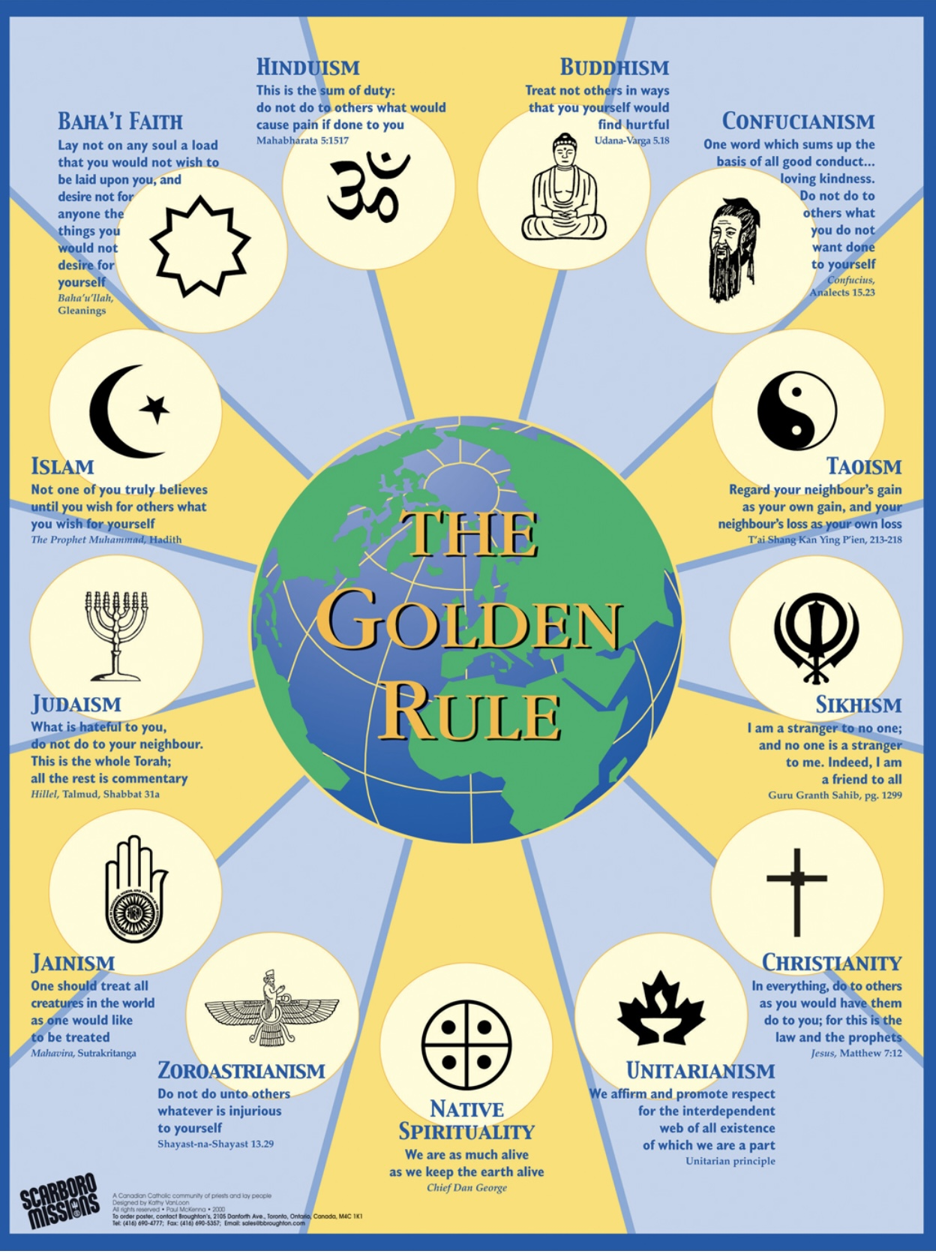
INTEGRAL SPIRITUALITY
A spiritual paradigm shift:

Slide 513
We previously explored how as a society transitions from a predominantly traditional to modern and post-modern stages of development, there is a decline in involvement with organized religions. This decline has been attributed to a combination of social, cultural, and individual factors.
Many Western societies have become more secular over time, with a greater separation between religion and public life. This shift led to a decline in religious influence on social and political institutions.
Higher levels of education and access to scientific knowledge led individuals to question traditional religious narratives and to seek explanations based on empirical evidence.
Exposure to a variety of cultures and belief systems encouraged people to explore different perspectives and question their own inherited beliefs. This diversity led to a more individualized approach to spirituality.
Western emphasis on individualism and personal autonomy led people to seek personal spiritual paths rather than adhering to organized religious doctrines.
As social norms evolved, particularly around issues like gender equality, LGBTQ+ rights, and social justice, some traditional religious teachings increasingly appeared outdated and in conflict with contemporary values.
Scandals and perceived hypocrisy within religious institutions led to disillusionment and a loss of trust, prompting individuals to distance themselves from organized religion.

Slide 514
The internet and digital media provided access to a wide range of information and perspectives, allowing people to explore and question religious beliefs more easily than in the past.
There was a growing emphasis on personal well-being, mindfulness, and mental health, which led people to seek spiritual fulfillment outside traditional religious frameworks.
While traditional religious participation declined, spirituality and the search for meaning remain important to many people taking new or different forms.
We also previously discussed how the "meaning crisis" or the perceived loss of meaning, purpose, and value in contemporary life, is in part, a consequence of the decline of traditional religious and cultural narratives in the face of scientific and technological advancements.
An integral stage idealist metaphysics, such as the one advocated by Bernardo Kastrup and other contemporary idealists, is a narrative that offers several ways to address the spiritual aspects of the crisis we find ourselves in.
Idealism by positing that consciousness is fundamental, suggests that the universe is inherently meaningful and purposeful. This view can re-enchant the world by imbuing it with intrinsic value and significance, countering the notion of a cold, indifferent physicalist universe.

Slide 515
By framing consciousness as the primary substance of reality, idealism provides a philosophical foundation that bridges the gap between scientific understanding and spiritual and existential concerns. This integration offers a more holistic worldview, where scientific discoveries are seen as insights into the workings of a conscious universe.
Idealism emphasizes the central role of consciousness, which elevates the importance of individual experience and introspection. This perspective can help individuals find personal meaning and purpose by recognizing their own consciousness as a fundamental aspect of reality.
Idealism implies a deep interconnectedness between all conscious beings, fostering a sense of unity and shared purpose. This encourages us to take a more compassionate and empathetic worldview, where meaning is derived from relationships and community.
By suggesting that reality is shaped by consciousness, idealism allows for the creation and appreciation of narratives and myths that resonate with human experience. These stories can provide frameworks for understanding life's challenges and opportunities, offering guidance and meaning.
Idealism can offer a deeper existential framework by positing that life is not just a random occurrence but part of a larger conscious reality. This perspective can provide comfort and a sense of belonging in the cosmos, addressing existential anxieties.

Slide 516
If consciousness is fundamental, ethical considerations become central to understanding reality. This can inspire a sense of moral responsibility and purpose, encouraging actions that align with the well-being of conscious entities.
The idea that a single consciousness underlies all living things is a perspective associated with idealist philosophical and spiritual traditions, such as pantheism, panentheism, and certain interpretations of non-duality. This viewpoint leads to a compelling moral framework centered around the Golden Rule: "Do unto others as you would have them do unto you.“
If all living beings are manifestations of a single consciousness, then the boundaries between self and others become less distinct. This interconnectedness suggests that harming another is, in a sense, harming oneself. The Golden Rule naturally follows as a guideline for behavior, promoting empathy and compassion.
The idea of a shared consciousness fosters a deeper understanding and empathy towards others. The Golden Rule encourages individuals to consider the feelings and perspectives of others, which aligns with the notion of a unified consciousness experiencing life through diverse forms.
If all beings share a common consciousness, there is a heightened sense of moral responsibility to treat others with kindness and respect. The Golden Rule serves as a simple yet profound ethical principle that can guide actions and decisions in a way that honors this shared existence.

Slide 517
The Golden Rule is a principle that in various forms across many cultures and religions, suggesting its universal applicability. If a single consciousness underlies all, then such universal principles gain even more significance as they resonate with the fundamental nature of reality.
While the Golden Rule is a powerful ethical guideline, its application can be complex. Different individuals may have different needs and desires, so understanding and context are crucial. The idea of a single consciousness can encourage deeper reflection on these complexities.
The notion of a single consciousness can provide a rich philosophical foundation for the Golden Rule, emphasizing empathy, interconnectedness, and moral responsibility.
The idea that a single consciousness underlies all living things also encourages work towards social justice.
When people view all living beings as interconnected, it fosters a sense of unity and empathy. This perspective can motivate individuals to work towards social justice, as the suffering or injustice experienced by one is seen as affecting the whole. It encourages people to act with compassion and solidarity.
If a single consciousness is believed to underlie all life, it implies that all beings have intrinsic value and deserve equal respect and consideration. This helps break down barriers of discrimination and prejudice, promoting equality and fairness in social systems.

Slide 518
Recognizing a shared consciousness leads to a sense of collective responsibility for the well-being of others. This can inspire individuals and communities to take action against social injustices, knowing that improving the conditions for others ultimately enhances the collective experience.
The idea of a single consciousness encourages us to look at social issues from a holistic perspective, understanding that problems are interconnected and require comprehensive solutions. It can lead to more integrated and sustainable approaches to social justice work.
Practices that arise from this belief, such as mindfulness and meditation, can cultivate awareness and presence. These practices can help individuals become more attuned to the needs of others and more effective in their social justice efforts.
Social justice plays a crucial role in creating a meaningful society by promoting fairness, equity, and respect for all individuals.
Social justice ensures that resources, opportunities, and privileges are distributed fairly, reducing disparities and leveling the playing field for everyone, regardless of their background.
By advocating for marginalized and underrepresented groups, social justice empowers individuals to have a voice and participate fully in society, fostering a sense of belonging and agency.

Slide 519
Social justice initiatives encourage understanding and acceptance among diverse groups, which strengthens community bonds and reduces conflict. By addressing systemic inequalities, social justice can lead to a more inclusive economy where everyone has the opportunity to contribute and thrive, ultimately benefiting society as a whole.
A focus on social justice encourages individuals and institutions to reflect on their values and practices, promoting ethical behavior and a commitment to the common good.
Addressing social injustices aligns with environmental sustainability goals, as both aim to create systems that are equitable and sustainable for future generations.
Diverse and inclusive societies are more innovative, as they bring together a wide range of perspectives and ideas, leading to creative solutions to complex problems. By embedding social justice into the fabric of society, we create environments where everyone can thrive, contribute, and find meaning in their lives.
By offering a worldview where consciousness and meaning are integral to the fabric of reality, idealist metaphysics can provide a philosophical basis for addressing the meaning crisis, helping individuals and societies find renewed purpose and direction and meaningful My, Our and The stories.

Slide 520

SYMBOLS AND TRUTHS

Slide 521
Many different terms have been used to describe a deeper, less tangible aspect of human experience that transcends the ordinary. The experiences described by these terms beckon us to explore that other realm.
Recall that the term Noumenal originates from Immanuel Kant's philosophy and refers to the realm of nature as it really is, independent of human perception. The noumenal world is contrasted with the "phenomenal" world, which is the world as we experience it through our senses. Kant considered the noumenal to be beyond human comprehension. Modern physics agrees with Kant.
The “paranormal” refers to phenomena that are beyond or outside the scope of normal scientific understanding. It includes events or experiences that cannot be explained by current scientific laws, such as ghosts, telepathy, or other supernatural occurrences. Physicalists say the paranormal does not exist; Idealists believe it may be a way of gaining insights into the hidden realm.
In contrast to the paranormal, the “Supernatural” refers to phenomena or entities that are beyond or outside the laws of nature and cannot be explained by scientific understanding. The supernatural includes miracles or magic. It encompasses anything that defies the ordinary natural.
The term “Mystical” describes experiences or states of consciousness that involve a direct, intimate union or communication with the divine or ultimate reality. Mystical experiences are often characterized by a sense of oneness, transcendence, and profound insight.

Slide 522
The “Transcendent” refers to that which goes beyond the ordinary limits of experience. In a spiritual or philosophical context, it describes aspects of reality that surpass human understanding or the material world, such as the divine or ultimate truths.
The term “Archetypal” is used in psychology, particularly in the work of Carl Jung, to refer to universal symbols or themes that recur across cultures and time periods. Archetypes are innate, collective symbols or patterns that shape human experiences and narratives.
“Myths” are traditional stories that explain natural phenomena, cultural practices, or beliefs. These stories typically involve gods, heroes, or supernatural beings and convey deep truths and moral lessons. Myths, such as those in the bible, are by some people problematically, taken literally rather than as metaphors.
The term “Divine” relates to anything that is of, from, or like God or a god. It refers to the qualities or attributes associated with a deity, such as omnipotence, omniscience, or benevolence. The divine is typically considered sacred and is associated with religious or spiritual significance.
“Ineffable” refers to an experience or concept that is so profound or complex that they cannot be adequately expressed through language.

Slide 523
The “Sacred” denotes something that is considered holy, divine, or worthy of reverence and respect. Sacred objects, places, or concepts are associated with religious or spiritual significance.
“Awe” is a profound emotional response that combines feelings of reverence, admiration, and fear or respect, often in reaction to something vast, powerful, or sublime. Awe can be triggered by natural phenomena, like a breathtaking landscape or a starry sky, extraordinary human achievements, or spiritual experiences. Awe often leads to a sense of being part of something much larger than oneself.
“Wonder” is a feeling of curiosity and amazement, often accompanied by a desire to understand or explore. It arises when encountering something new, unexpected, or inexplicable. Wonder can inspire a sense of fascination and drive the pursuit of knowledge or deeper insight. It is often associated with a childlike openness to the mysteries of the world.
“Gratitude” is the feeling of thankfulness and appreciation, often directed toward someone or something that has provided help, kindness, or a benefit. It involves recognizing and acknowledging the positive aspects of one's life and the contributions of others. Gratitude can enhance well-being and foster positive relationships by encouraging a focus on the good things in life.

Slide 524
“Reverence” is a deep and profound respect or admiration for someone or something. It involves a sense of honor, veneration, and awe, particularly toward things considered sacred, holy, or highly esteemed. Reverence can be directed toward deities, religious symbols, nature, individuals, or ideals that hold significant meaning or value. This emotion is characterized by a respectful acknowledgment of the worth or importance of its object, often accompanied by a sense of humility.
Each of these terms is a symbol, or metaphorical finger, pointing at an illusive deeper truth. Literalists take the finger as the truth, metaphoralists understand it points at something else that cannot be fully known.
,
The metaphor of a finger pointing at the moon is used in spiritual and philosophical teachings to illustrate the distinction between teachings or symbols and the deeper truths they represent. Originating from Zen Buddhism, this metaphor suggests that spiritual teachings, texts, or symbols are like a finger pointing toward the moon. The finger itself is not the moon; rather, it is a guide to help direct one's attention toward the moon.
The metaphor suggests that one should not become overly focused on definitions, teachings, rituals, or symbols themselves, as they are merely tools or pointers. Instead, the focus should be on the deeper understanding or experience that these tools are intended to convey or lead one toward. In other words, the ultimate truth or enlightenment is the "moon," and the teachings are just the "finger" pointing the way.
The terms defined above are just a few of the many symbolic fingers pointing at a realm that imbues our ordinary lives with extraordinary meaning.

Slide 525
Many of us live in the absolute physicalist certainty that science has definitively established that the fundamental building blocks of the universe are physical particles and forces. We live in this certainty because we are not aware of what Bertrand Russell pointed out at the beginning of the 20th century and physics has been saying since then: "Science does not aim at establishing what the nature of reality is, but merely at discovering how things behave.“
Far from establishing what the basic nature of the universe is, modern physics tells us that if we investigate nature at the smallest, most fundamental level our technology permits, nature shows us that it behaves in a way so far best modelled by the mathematics of the Standard Model of particle physics.
The Standard Model is formulated as a quantum field theory, using complex mathematical structures to describe particle interactions and symmetries. Quantum Field Theory (QFT) is a fundamental theoretical framework that combines classical field theory, quantum mechanics, and special relativity to describe how particles and fields interact.
In QFT, fields are the primary entities, not particles. Every type of particle is associated with a corresponding field that permeates space and time. For example, the electromagnetic field is associated with photons.
Particles are seen as excitations or "quanta" of their respective fields. When a field is excited, it manifests as a particle. This perspective allows particles to be created and destroyed, which is essential for describing interactions.

Slide 526
When we look at nature, we see mathematics which physics metaphorically calls “particles and forces.”
Physicalists, much like religious fundamentalists, then reify these metaphors or myths into literal concrete realities. On this fallacy stands physicalism the metaphysics of the modern stage of development.
The human brain evolved to survive in the macroworld where to our senses and cognition Kant’s Noumenal, quantum theory’s mathematical model, and Hoffman’s conscious agents appears as objects. From our phenomenal experience we then extrapolate and assume that very small objects constitute the basic essence of the universe.
Once we make this assumption, we are on a slippery slope to physicalism, scientism, anomalies, crisis of normal science, loss of meaning and the polycrisis we find ourselves in.
For now, perhaps because of our cognitive and sensory limitations forever, the true nature of the universe eludes us. There are however many “fingers” pointing to new “moons”, or possible fundamental realities that might, if we are open to them, not only revolutionize science, and society but also give us back a sense of meaning and purpose.

Slide 527
PART VII-GROWTH AND HEALING
Resources and resilience
Fragility
Resourcing systems
Individual growth and healing
Depth psychology
Internal family systems
Ignatian spirituality
Converging stories
As above so below
The dynamics of mind
Teilhard de Chardin
Healing Our and the stories

Slide 528

RESOURSES AND RESILIENCE

Slide 529
In systems theory, resources are broadly defined as inputs that are necessary for the maintenance of the equilibrium or homeostasis of that system.
In biological systems, like the human body for example, resources such as nutrients, water, and oxygen are essential for cellular processes that sustain life. These resources help regulate internal conditions, ensuring that variables like temperature, pH, and energy levels remain within a narrow range suitable for survival.
In ecological systems, resources such as sunlight, food, water, and habitat space are vital for maintaining population balance and biodiversity. The availability and distribution of these resources can influence species interactions and ecosystem stability.
In human-made systems like society with its political and economic subsystems resources like energy, materials, and information are necessary to maintain operational efficiency and stability. Proper management and allocation of these resources helps prevent disruptions and ensure the system can adapt to changes or external pressures.
Resources are fundamental to the stability and adaptability of both natural and artificial systems, enabling them to respond to internal and external changes while maintaining equilibrium.
Healthy, just and meaningful My, Our and The stories are resources that are essential for the healthy functioning of individuals, societies and the world.

Slide 530
Unhealthy, unjust and meaningless My, Our, and The stories are stressors that reduce the wellbeing of these systems.
Cumulative stressors that cannot be accommodated can become traumatic stressors that increase the vulnerability of systems until they totally breakdown.
Resilience refers to the ability of a system to adjust and recover from stressors. Resources increase the resilience of systems.
Among the many resources that increase personal resilience and promote healthier My stories include:
Strong relationships with family, friends, and a community that provide emotional encouragement and practical assistance during difficult periods.
Understanding and managing one's emotions helps individuals cope with stress and effectively face challenges.
The ability to find solutions and make decisions in the face of adversity enhances resilience.
Belief in one’s ability to influence outcomes and overcome obstacles fosters a proactive approach to challenges.
Maintaining good health and having access to healthcare services supports overall wellness and recovery from difficulties.

Slide 531
Having a meaningful direction can provide motivation and strength during tough times.
Among the many resources that promote societal or Our story resilience are:
Strong community bonds and shared values encourage collective action and support during crises.
Reliable transportation, communication, and utility systems are essential for societal function and recovery.
Transparent and accountable governance ensures efficient resource allocation and response to crises.
A diverse economy backed by strong financial systems enhances resilience to economic disruptions.
Access to education and information empowers individuals and communities to adapt and innovate.
Comprehensive healthcare services help maintain the health of the population and its capacity to withstand health crises.
Some of the many factors that contribute to a healthy spiritual perspective, or the story are:
Taking time to reflect on one’s beliefs, values, and experiences can foster a deeper understanding of oneself and one’s place in the world. Practices like meditation or journaling can be helpful.

Slide 532
Being open to exploring various spiritual traditions and philosophies can broaden one's perspective and encourage personal growth. This includes being willing to question and re-evaluate one's beliefs.
Engaging with a community of like-minded individuals can provide support and shared experiences, helping to reinforce and deepen spiritual beliefs.
Developing compassion for others and empathy towards different experiences is central to many spiritual traditions and can lead to a more profound sense of interconnectedness.
Finding purpose and meaning in life can significantly contribute to a healthy spiritual perspective. This may involve pursuing passions, helping others, or contributing to a cause larger than oneself.
Integrating spirituality with other aspects of life, such as work, relationships, and personal growth, can help maintain a balanced and well-rounded spiritual perspective.
Viewing spirituality as a lifelong journey of learning and growth can help sustain a vibrant and evolving spiritual life. This includes being open to new experiences and insights.
Practicing gratitude can enhance one's spiritual perspective by fostering a sense of abundance and appreciation for life’s experiences, both positive and challenging.

Slide 533
Each of these factors can contribute to a healthy, resilient, and evolving spiritual perspective, helping individuals navigate life’s complexities with greater peace and understanding.
These and many other factors can contribute to fostering healthy, and resilient, My, Our and The stories which can help us navigate life’s complexities with greater equanimity and perspective.

Slide 534

FRAGILITY

Slide 535
Systems, whether they are mechanical, biological, social, or organizational, are designed to operate within certain parameters. When a system is stressed beyond its capacity, it can lead to a variety of issues, including inefficiency, failure, or even collapse.
End-stage capitalism, is a feature of the modern stage of development and the major contributor to the polycrisis. It places profits above both the collective good and ecological sustainability. It is characterized by extreme wealth concentration, rampant exploitation of the commons, monopolies, social inequality and control of the means of communication, government and institutions by the very wealthy.
End-stage capitalism’s focus on maximizing short-term profits, is based on a reductionist view that ignores or oversimplifies complex social and environmental factors.
From a systems perspective, it’s clear that by prioritizing individual success and competition over collective well-being and cooperation, end-stage capitalism promotes a culture where personal gain is valued at the expense of the health and wellbeing of much of the world’s population and the sustainability of the economic, political, and eco systems
In its reductionistic focus on profits and the free-market end stage capitalism overlooks systemic impacts, such as environmental degradation and social inequality, treating them as externalities rather than integral parts of the its economic system.

Slide 536
By focusing on individual components, such as specific markets or sectors, rather than the interconnectedness of the entire system, end-stage capitalism contributes to fragmentation rather than cohesion. Its focus on short-term gains rather than long-term sustainability undermines the resilience and adaptability of Western civilization and of earth’s ecosystem.
The modern stage of development with its predominantly left hemisphere individualist, reductionistic worldview is incompatible with a right hemisphere holistic systems perspective.
Modern economics sees the individual extraction and accumulation of great wealth without constraints as ultimately desirable oblivious to the damage this does to nestled systems with which the economy co-exists.
There are compelling similarities between cancer and end-stage capitalism.
Cancer is a condition in which cells bypass the body's normal regulatory mechanisms. In a healthy organism, cells grow, divide, and die in a controlled fashion. This cell regulation is vital for the proper functioning of tissues and organs.
Cancer arises when cells start to proliferate and divide without control, disregarding the signals that typically govern cell behavior. Cancerous cells "break free" from the system's regulatory controls.
Just as cells in biological systems depend on regulatory frameworks to maintain equilibrium, other systems, such as the economy, also require effective oversight to operate efficiently. Without appropriate regulation, components within a system will expand unchecked, resulting in instability and potential collapse.

Slide 537
The occurrence of cancer represents a failure of feedback mechanisms that usually regulate cell proliferation. In the same vein, economic systems rely on feedback mechanisms like market indicators and regulatory oversight, which are essential for sustaining balance and avoiding crises.
Cancer impacts not only the rogue cells but the entire organism, underscoring the interconnectedness of systems, where issues in one area can have far-reaching effects. In economic contexts, lack of regulations in one sector can create ripple effects throughout the entire system, potentially leading to its collapse.
Cancer redirects resources away from healthy cells, akin to how monopolies or unchecked entities within an economy can amass resources and power hindering competition and innovation.
Early detection and intervention in cancer leads to significantly better outcomes. Likewise, in economic systems, recognizing and tackling problems promptly can help avert their escalation into more significant issues.
Effective cancer treatment often necessitates a holistic approach that considers the entire body rather than focusing solely on the tumor. Similarly, resolving economic challenges requires a comprehensive perspective that takes into account multiple factors and stakeholders.
By exploring the similarities between cancer and other systems, we can derive valuable insights into how to design and manage systems more effectively, preventing imbalances and ensuring long-term stability and health.

Slide 538
While some forms of capitalism have the potential to be more systems-focused, particularly when incorporating elements like corporate social responsibility and sustainable practices, end-stage capitalism reflects a more reductionist and individualistic mindset. To address its challenges, a shift towards systemic thinking that considers the broader social, environmental, and economic impacts is essential.
Erosion of resources affects individuals, societies and the whole planet. A reduction in personal resources affects an individual’s resilience increasing their susceptibility to stress, mental health challenges, and difficulties in recovering from setbacks.
The depletion of societal resources and resilience may result in social unrest, economic downturns, and diminished preparedness for disasters or crises.
A decrease in global resilience resources can lead to heightened conflict among groups, environmental deterioration, and an inability to effectively tackle global issues such as climate change and pandemics.
When systems are overstressed, they become less effective at performing their intended functions. Individual parts of the system might fail, leading to a breakdown of the entire system.
In extreme cases, the entire system may collapse. This can happen, for example, in ecosystems where the loss of a keystone species disrupts the balance, leading to widespread consequences.

Slide 539
Negative feedback loops can exacerbate the problem, where the system's response to stress further increases the stress, leading to a vicious cycle.
The global ecosystem functions as a bounded chaotic system, characterized by complex interactions and feedback loops among its various elements, such as climate, biodiversity, and human activities. These interactions can lead to unpredictable and emergent behaviors typical of chaotic systems. However, this ecosystem operates within defined limits, or "attractors," which delineate the conditions under which it typically thrives.
Chaos theory, which deals with complex and dynamic systems that are highly sensitive to initial conditions offers insights into how systems like the Earth's climate might behave under certain conditions.
An “attractor” is a term used in chaos theory to refer to a stable state or behavioral pattern that the system may adopt after experiencing a disturbance. An attractor refers to a set of states toward which a system tends to evolve. This could involve changes in climate, species distribution, and ecosystem functionality. The system continues to operate but under very different conditions.
In the context of climate change, an attractor could represent a stable climate state around which the Earth's climate regularly fluctuates. When changes in external conditions or internal dynamics occur, such as significant increases in atmospheric greenhouse gases, these stable patterns or attractors can shift and be replaced by new ones.

Slide 540
The earth’s climate has undergone numerous changes throughout its history but for the past 12000 years it has been relatively stable and conducive to the development of Human civilization.
This cluster of relatively stable patterns with some natural fluctuations in temperature and other climatic phenomena constitutes an attractor.
The burning of fossil fuels emits significant amounts of greenhouse gases into the atmosphere, disrupting the Earth's energy equilibrium and acting as a significant perturbation to the climate system.
As perturbations increase, they push the climate toward a tipping point, beyond which it transitions to a different attractor. The climate system’s inherent sensitivity to variables such as atmospheric composition, solar radiation, and ocean currents means small changes can lead to much larger, sometimes unexpected shifts.
This new attractor could represent a new stable climate state, which might include altered temperature distributions, precipitation patterns, and increased frequency of extreme weather events. The system may stabilize around this new attractor pattern, which could be quite different from historical climates, leading to long-term changes in ecosystems, sea levels, and socio-economic conditions.
One hypothesis is that we are heading towards a new attractor called “hot house earth”. In this scenario the melting polar ice and permafrost, combined with ocean circulation changes, could drive the climate system past a tipping point. This new “hot house” attractor would consist of a significantly warmer global climate with altered weather patterns and potentially challenging conditions for current ecosystems and human societies.

Slide 541
System collapse occurs when a system can no longer sustain its function or structure. This scenario is more severe than merely shifting to a new attractor and can lead to the breakdown of ecological, economic, or social systems. Collapse typically involves reductions in biodiversity, ecosystem services, and resilience. It may lead to irreversible transformations, such as species extinction or the loss of crucial habitats.
The future of the global ecosystem, whether it shifts to a new attractor or faces collapse, is shaped by the magnitude and speed of changes, as well as the system's resilience. Human actions, including mitigation and adaptation strategies, play a crucial role in determining these outcomes.
Understanding these dynamics is essential for developing policies and practices aimed at minimizing the risk of collapse and fostering sustainable transitions to new attractors.

Slide 542

RESOURSING SYSTEMS

Slide 543
To foster a system’s resilience it is crucial to maintain and enhance its resources. When resources are compromised, vulnerability increases and the capacity to manage and recover from challenges declines. Investing in system resilience-building strategies is essential.
Global resilience resources encompass collaborative initiatives among countries aimed at tackling worldwide challenges and bolstering defenses against global threats.
Safeguarding ecosystems and biodiversity is vital for the planet’s capacity to support life and adapt to environmental changes.
Technological advancements can offer solutions to global issues and improve adaptive capabilities.
Encouraging cross-cultural dialogue and understanding promotes peace and mitigates conflict.
Robust international institutions and frameworks facilitate coordinated responses to global emergencies.
Meaningful shared spiritual The stories can serve as powerful resources that enhance well-being and foster growth at individual, societal, and global levels. Such stories can provide the foundation for resilience and transformation, helping individuals and communities navigate challenges and emerge stronger. Spirituality and meaning are crucial resources that can foster resilience in individuals, societies, and the world.

Slide 544
At the individual level spirituality can offer comfort, hope, and resilience, helping individuals cope with life's challenges and uncertainties. It can lead to greater self-awareness and personal growth. Engaging with spiritual beliefs and practices can provide individuals with a sense of purpose and direction, enhancing life satisfaction and fulfillment.
Spirituality can be a catalyst for personal growth following trauma. It may help individuals find meaning in their experiences, leading to increased personal strength, appreciation for life, and improved relationships.
At the level of a society shared spiritual beliefs and practices can strengthen bonds within communities, fostering a sense of belonging and mutual support. Spirituality underpins ethical and moral systems, guiding behavior and promoting values like compassion, empathy, and justice.
Spiritual traditions play a key role in preserving cultural heritage and identity, contributing to societal stability and continuity. Spirituality can also help communities heal and rebuild after collective trauma, such as natural disasters or conflicts, by fostering unity and shared meaning.
At the global level, spirituality can promote a sense of interconnectedness and shared humanity, encouraging global cooperation and understanding. Spiritual principles can inspire efforts towards peace, reconciliation, and conflict resolution on a global scale.
Many spiritual traditions emphasize the sacredness of nature, which can inspire global movements towards environmental conservation and sustainability.

Slide 545
Globally, spirituality can contribute to healing and growth following large-scale traumas, such as wars or pandemics, by fostering a sense of global community and shared purpose.

Slide 546
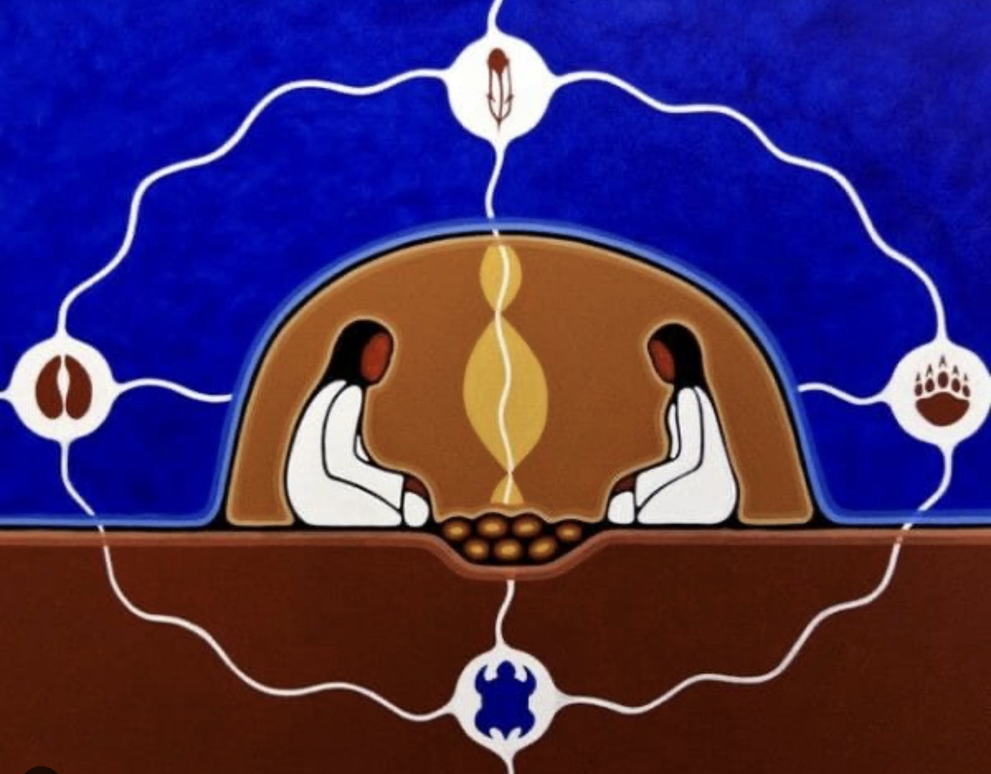
INDIVIDUAL GROWTH AND HEALING

Slide 547
Personality is a system that manifests as patterns of thinking, emotional reactions and behavior. The personality system helps individuals navigate their environment, form relationships, and achieve personal goals. Experiences and feedback from the environment can reinforce or alter personality.
Some people’s personalities are more resilience than others. Resilience in this context refers to the ability to adapt to stress, adversity, or change and bounce back from challenges. People with resilient personalities may have traits like optimism, adaptability, and strong emotional regulation. These individuals can more effectively manage stress and recover from setbacks.
People with less resilient personalities might struggle more with stress and adversity.
Different factors influence personality resilience. Some individuals may be genetically predisposed to traits that enhance or reduce resilience. Supportive or adverse early life experiences can shape resilience. For example, a nurturing environment can foster resilience, while chronic stress or trauma can undermine it. Attachment styles are important contributors to resilience.
Effective coping strategies, such as problem-solving skills, social support, and mindfulness, can enhance resilience.

Slide 548
Understanding personality as a system helps us recognize how different factors interact to influence an individual's resilience. It also highlights the potential for personal growth and change, as interventions can target specific components to enhance overall resilience.
Attachment theory holds that the bonds formed with primary caregivers in early childhood profoundly influence an individual’s personality and their emotional and relational patterns throughout life. When these early attachments are disrupted, they lead to attachment disorders, which typically manifest as difficulties in forming healthy relationships, managing emotions, and maintaining a stable sense of self.
Trauma and attachment disorders fragment an individual's identity, making it difficult to maintain a coherent sense of self. This profoundly impacts an individual's sense of purpose, worth, connection, direction and meaning disrupting the narratives they hold about themselves and their place in the world.
This fragmentation also leads to confusion about values, and goals, and instills a sense of helplessness and powerlessness, making it challenging to envision a future where the person has agency or influence. This can contribute to a narrative of futility and despair.
Trauma and attachment disorders often result in negative self-perceptions and internalized beliefs of inadequacy or unworthiness. These beliefs can dominate personal narratives, overshadowing any sense of value or meaning.

Slide 549
Attachment disorders impair one's ability to form secure and trusting relationships. This can lead to isolation and a lack of meaningful connections, further eroding a sense of purpose.
Healing from trauma and attachment disorders can lead to what is known as post-traumatic growth (PTG). Healing helps people find meaning and purpose in life and can lead to improved relationships, a healthier sense of self and of greater personal strength.
Post-traumatic growth refers to the positive psychological changes that some individuals experience as a result of struggling with highly challenging life circumstances or traumatic events. While much of the research on PTG has focused on adults, the concept is not limited to them. Children and adolescents can also experience post-traumatic growth, though the manifestations and processes might differ due to the child’s developmental stage and support systems.
The healing of attachment disorders presents unique challenges but individuals with these disorders can also experience post-traumatic growth and positive change.
The frequency of post-traumatic growth varies widely depending on several factors, including the nature of the trauma, personality variables, and the support systems available to the person. Research suggests that PTG is a relatively common phenomenon, with a substantial number of trauma survivors, sometimes over half, reporting some form of PTG. However, the extent and nature of this growth can differ significantly from person to person.

Slide 550
The specific areas of growth in PTG include improved relationships, increased personal strength, a greater appreciation for life, spiritual development, and the discovery of new possibilities.
People with trauma and attachment disorders often struggle with emotional regulation. Healing these issues can help individuals develop better coping mechanisms for stress and emotional challenges, leading to greater emotional stability and resilience.
Trauma and insecure attachments can affect self-esteem and identity formation. By addressing these issues, individuals can develop a stronger sense of self-worth and a clearer understanding of their identity, which is essential for a meaningful life.
Healing trauma and attachment wounds can free individuals from patterns of behavior that limit their potential allowing for psychosocial growth, exploration of new interests, and the pursuit of goals that align with their true values and desires.
Attachment issues and traumatic experiences may prompt individuals to reevaluate what is truly important to them. This reevaluation can lead to a clearer understanding of personal values and priorities.
Many people who experience PTG report a newfound appreciation for life which leads to a deeper sense of gratitude and a more meaningful engagement with everyday experiences.

Slide 551
PTG can result in stronger, more meaningful relationships. The realization of the importance of social connections and support can enhance the sense of meaning derived from relationships with family, friends, and community.
Healing from trauma and attachment issues can lead to a recognition of personal strength and resilience. This strength can empower individuals to pursue meaningful goals and challenges that they may have previously avoided.
For some, trauma and attachment issues prompts spiritual or existential exploration, leading to a deeper understanding of life's purpose and meaning. By resolving past traumas and building secure attachments, individuals may find it easier to explore and engage with questions of meaning, purpose, and connection to something greater than themselves.
Experiencing trauma can open individuals up to new possibilities and goals they might not have considered before. This can lead to a renewed sense of direction and purpose.
As individuals work through trauma and attachment issues, they often become more empathetic and compassionate, not only towards others but also towards themselves. This can enhance their ability to connect with others and contribute positively to their communities
PTG does not mean the absence of distress or difficulty. People can experience both growth and ongoing challenges simultaneously.

Slide 552
PTG is not guaranteed and varies from person to person. The process can be complex and requires time, support from family and friends, and often professional guidance. Establishing secure and supportive relationships is crucial for healing. These relationships can provide a foundation for trust and connection, allowing individuals to rewrite narratives of isolation and fear.
PTG is not a universal experience, and not everyone who experiences trauma will necessarily experience growth. The process of healing from trauma requires finding meaning in the suffering that occurred.
Finding meaning in suffering involves connecting with something larger than oneself. Engaging with community, social causes, or cultural traditions can help individuals find a sense of belonging and purpose.
Engaging in creative activities, such as writing, art, or music, can be a powerful way to explore and express personal narratives. Creative expression can facilitate healing by allowing individuals to externalize and reframe their stories.
For some, exploring existential or spiritual beliefs offers a framework for understanding their experiences and finding meaning. This might involve reconnecting with religious or philosophical traditions that provide a sense of purpose and connection to the universe.
Trauma therapy by integrating traumatic memories, challenging negative beliefs, and fostering self-compassion can help individuals process their traumatic experiences and develop healthier narratives.

Slide 553
Healing From trauma and attachment issues is a deeply personal journey that involves reclaiming one's narrative and reconnecting with sources of meaning and value. By fostering secure relationships, engaging with community and culture, and exploring existential questions, individuals can begin to construct narratives that support a sense of purpose and fulfillment.
Trauma and attachment issues contribute to unhealthy My stories. Developing healthy and meaningful My, Our, and The stories is a crucial part of individual healing and growing.
Approaches to healing trauma and attachment issues such as Jungian depth psychology, Internal Family System, and Ignatian Christian spirituality, draw on both psychology and spirituality. Although these three approaches come from different traditions and use different language they converge in significant and interesting ways.
Let’s take a closer look at these three models, asking what guidance they offer us on this personal journey of healing and how these three very different “fingers” are really pointing at the same “moon”.

Slide 554

HEALING MY STORIES

Slide 555
“Traditional psychology asks: what is wrong with you? Trauma informed psychology asks: what happened to you? Culturally informed psychology asks: what happened to your people? Liberation psychology asks: what continues to happen to you and to your people?...Trauma informed psychology suggests that something has happened in the past and that through good therapy we learn how to get over it by becoming more integrated and resilient so that we can get on with lives. Liberation psychology says that we’re all born into oppressive systems in which some of us fare better than others. We neglect to recognize these oppressive systems and that no one is free until everyone is free from their oppression.” Linda Thai
“Medicine is a social science, and politics is nothing else but medicine on a large scale”. Rudolf Virchow.

Slide 556
Mental health care’s goal is to help people heal and grow. This involves understanding how their issues developed, how they manifest, and what they require in order to heal. To be able to do this helpers must not only understand people’s “My stories” but also their “Our and The stories”.
A society’s economic and political system determines the way resources are distributed. Unfair resource distribution and inequality create insecurity and are by far the biggest source of stress for people all over the world.
This is because unfair resource distribution leads to housing, food, hierarchical, and ecological stressors, which lead to interpersonal and intersocietal conflicts.
The chronic stress associated with economic and other injustice also impairs the functioning of the Human prefrontal cortex, a part of the brain which helps individuals to “do the hard things when the hard thing is the right things to do”. Because of this impairment the poor, traumatized and marginalized who have chronic high stress, also have an exceedingly difficult time doing the hard things necessary to improve their situation.
Despite the popular myth of the self-made person, lifting yourself up by the bootstraps is nearly impossible.
This makes it statistically very likely that those who grew up with and live in chronically stressful circumstances will remain in those circumstances through their lives. There are exceptions but they are rare. Upward mobility requires social justice, services and supports all of which have been cut in order to give tax breaks to the wealthy. Upward mobility has been decreasing in Western societies, especially in the US, as inequality has increased.

Slide 557
The social factors and circumstances that a person faces are the most important variable determining their health. Social variables are more important than biology or the health care people receive.
These “social determinants of health” include early childhood conditions, family socioeconomic status, education, gender, race, employment conditions, housing conditions, disabilities, social inclusion and supports, safety, exposure to discrimination, levels of stress and many other factors.
Mental health care typically includes a range of interventions. Ideally, government sponsored public health plays the critical role in mental health care by focusing on prevention, early intervention, and the promotion of mental well-being across populations. Its goals include reducing the incidence of mental health disorders and mitigating their impact on individuals and communities.
Public health initiatives focus on primary prevention, which aims to prevent mental health issues before they occur. This includes promoting healthy lifestyles, providing education about mental health, and addressing social determinants such as poverty, violence, and discrimination.
By identifying and addressing mental health issues early, public health strategies can prevent conditions from worsening. This involves screenings, community-based services, and accessing resources that can offer support and treatment promptly.
Public health campaigns work to reduce the stigma surrounding mental illness and encourage people to seek help. These campaigns aim to increase awareness and understanding, making it easier for individuals to talk about their mental health.

Slide 558
Public health professionals contribute to the creation of policies that ensure mental health is included in broader health care planning and provision. This includes advocating for mental health parity in insurance coverage and ensuring resources are allocated to mental health services.
Public health research provides important data on the prevalence, causes, and treatment of mental health disorders. This information guides the development of effective prevention and intervention strategies.
Public health emphasizes the role of communities in promoting mental well-being. By involving local organizations and stakeholders, public health initiatives can tailor programs to meet the specific needs of diverse populations.
In essence, the intersection of public health and mental health care is about creating supportive environments where mental well-being is prioritized and resources are available to help individuals lead healthier, fulfilling lives.
Primary and specialized care both play essential roles in a comprehensive mental health care system, each contributing to the support and treatment of individuals with mental health needs.
Primary care providers, such as family doctors, often serve as the first point of contact for individuals experiencing mental health issues. They play a critical role in initial assessments and screenings.

Slide 559
Primary care practitioners are pivotal in identifying mental health conditions early, as they often have ongoing relationships with patients. This can lead to timely intervention and prevent issues from escalating.
Primary care settings provide an opportunity to address both physical and mental health needs cohesively, recognizing the interconnection between the two.
When more complex or severe mental health conditions are identified, primary care providers can refer patients to specialized mental health services for further evaluation and treatment. Primary care often manages common mental health conditions, such as depression and anxiety, through medication management and supportive counseling.
Specialized care involves mental health professionals such as psychiatrists, psychologists, clinical social workers, and psychiatric nurse practitioners, who have the training to handle more severe or complex mental health disorders.
Specialized providers conduct thorough assessments and diagnoses, which may involve a range of psychological tests and evaluations to understand a person's condition more deeply.
They offer specific treatments such as psychotherapy, advanced pharmacological management, and other specialized interventions . Specialized care often involves collaboration among a multidisciplinary team to deliver comprehensive treatment plans that address multiple facets of a patient’s mental health needs.
Mental health care typically includes a range of interventions.

Slide 560
Psychoeducation involves providing individuals and their families with information about mental health conditions, treatment options, and coping strategies. It aims to empower patients by enhancing understanding and engagement in their own treatment process
Psychotherapy, often referred to as talk therapy, has several key goals which are designed to help individuals improve their overall mental well-being and cope with life's challenges. These goals include symptom relief, understanding and insight, behavioral change, emotional regulation, improved relationships, and empowerment and autonomy.
Medications such as antidepressants, antipsychotics, mood stabilizers, and anxiolytics are commonly prescribed to manage symptoms of mental health disorders.
Community-based programs aim to reduce stigma, provide support, promote social inclusion, and improve access to services.
Social service providers address social determinants of health such as housing, employment, and education.
All mental health interventions should be informed by the social determinants of health model and consider the importance of the conditions in which people are born, grow, live, work, and age.

Slide 561
Today we’re becoming increasingly aware of the enormous impact that attachment issues and trauma have on people’s mental health. There are important principles involved in the treatment of these conditions that deserve brief mention.
Pierre Marie Felix Janet was a pioneering French psychologist, physician, philosopher and psychotherapist. Janet was one of the first psychologists to draw a clear connection between a person’s past trauma and symptoms presenting later in life.
The foundations underlying the treatment approaches to trauma spectrum disorders have not changed much in the last 100 years since Janet first described them. There are three phases to the active stage treatment of trauma spectrum dissociative disorders.
Phase 1 deals with the person’s safety and aims to stabilize them. It involves:
1) developing a personal roadmap for the healing process.
2) developing realistic and attainable goals and setting up a plan of action for achieving those goals in a practical timeframe.
3) establishing a sense of stability and safety in interpersonal relationships, one's own body, and all other areas of life

Slide 562
4) learning how to regulate emotions, and how to manage psychological and behavioral symptoms that may contribute to a sense of instability and overall personal suffering.
5) beginning to recognize and tap into resources and inner strength and…
6) developing crucial coping mechanisms and life skills, geared towards effectively managing painful experiences.
Phase 2 deals with the “remembrance and mourning” of the trauma. Once an individual has developed a strong and functional set of coping skills and feels reasonably safe and secure in their surroundings, it becomes possible to address buried memories.
Phase 3 involves reconnecting with the world of other people, nature, the universe a meaningful occupation and all other aspects of a meaningful, fulfilling and healthy life.
The three phases of trauma and attachment therapy are supported by the “four pillars” of recovery from trauma.
These 4 pillars are components of trauma work that are important in each of the three stages of trauma therapy. They are:

Slide 563
1. Psychoeducation which involves developing a model of the mind by which to understand ourselves.
2. Mindfulness which involves "seeing” ourselves including our body sensations, feelings, thoughts, and behaviors.
3. Physical movement, breathing, and meditation practices and…
4. Human connection and relational healing.
One issue that is of particular importance when we consider individual healing is whether mental health issues require individual or systemic solutions.
We can ask the same question for cardiovascular diseases, cancer, our deteriorating attention problems, and political polarization.
In his book, Stolen Focus, Johan Hari makes the point that society portrays all these as issues about which we make individual choices and are therefore personally responsible for changing.
He argues that the reality is that powerful corporations, lobbyist and social media are using sophisticated technologies to manipulate us in the service of profit. (Ex. food, tobacco industries)

Slide 564
“Cruel optimism” describes when a simple solution is proposed to a complex problem for example : go on a diet, stop smoking, or give up social media.
This simple solution ignores the deliberately engineered powerfully addictive aspects of these problems. When people inevitably don’t achieve results with these simplistic solutions, they are blamed for not trying hard enough. Ex. 95% of people who go on a diet and lose weight regain it within 1-2 years. Failure is then blamed on the person, not on how the food industry manipulates people.
Similarly mental health issues are complex, largely socially determined problems and although the individual approaches to improving them that the pharmaceutical and wellness industries promote can be somewhat helpful, such individual based approaches are forms of cruel optimism.
Authentic optimism considers the complexity of problems such as these and the need for both collective and personal approaches in solving them.
Having considered some of the complexities involved in healing “My stories” let now turn to three psychotherapeutic approaches that embody many of these principles as well as the values of the integral stage of development.

Slide 565
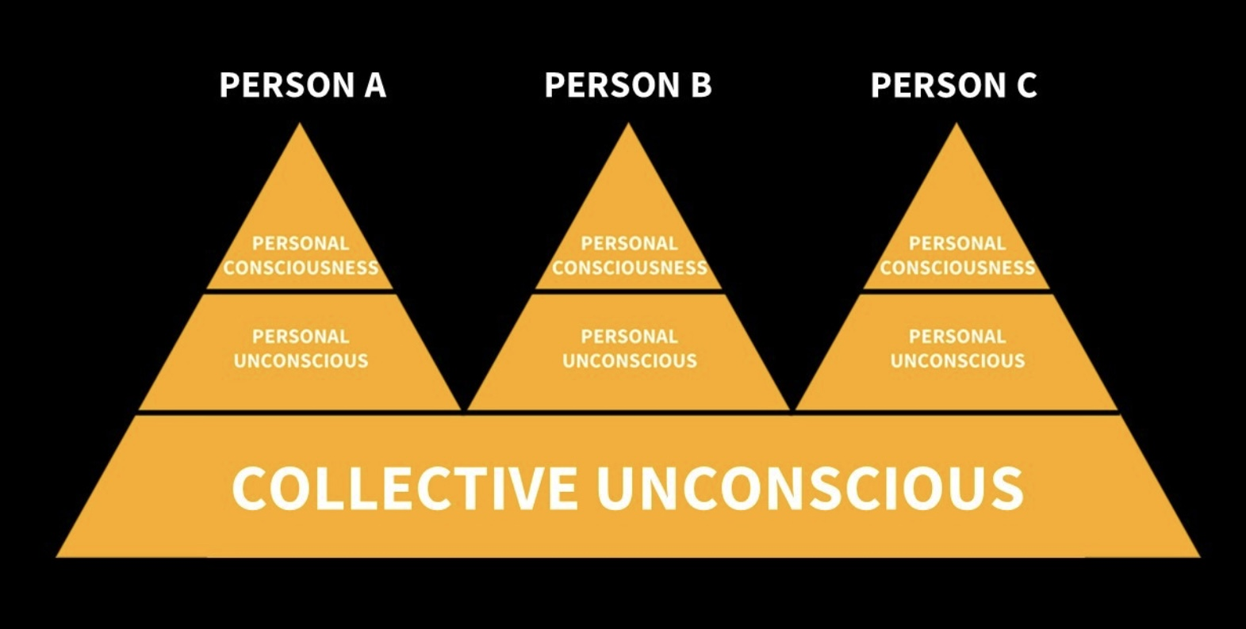
DEPTH PSYCHOLOGY

Slide 566
Carl Jung (1875-1961) was a Swiss psychiatrist and psychoanalyst who founded analytical or depth psychology an approach which explores the deeper layers of the human psyche. Jung's work has had a profound influence on psychology, psychotherapy, and fields like literature, art, and religious studies.
A few concepts form the foundation of Jungian psychology, which seeks to understand the complex interplay between the conscious and unconscious aspects of the human mind.
Like his mentor Freud, Jung saw the mind as consisting of several layers.
The conscious mind is the part of the mind that contains thoughts, feelings, and perceptions that we are currently aware of. It's our immediate awareness and contact with the outside world through our senses.
The Preconscious or subconscious mind acts as a kind of intermediary between the conscious and unconscious mind. It includes anything that is not presently in the conscious mind but can be easily brought into awareness with attention or effort. It contains memories and information that we can readily recall.
The unconscious mind is the largest and most influential part of the mind in Freud's model. It contains desires, fears, memories, and experiences that are not easily accessible to conscious awareness. Freud believed these unconscious elements exert significant influence over our behaviors and emotions, often manifesting in dreams, slips of the tongue, and other indirect ways.
Freud believed that understanding and bringing elements of the unconscious into conscious awareness could help resolve inner conflicts and alleviate psychological distress

Slide 567
Freud was a metaphysical physical but Jung was an idealist and deeply interested in spirituality. Jung diverged from Freud’s model of the mind by subdividing the unconscious into the personal unconscious which was essentially the same as in Freud’s model, and the collective unconscious.
Jung’s Collective Unconscious is a part of the unconscious mind shared by all humans, containing universal experiences and archetypes. The collective unconscious is distinct from the personal unconscious, which holds individual experiences and memories.
The collective unconscious is based on the idealist notion that individual consciousnesses are part of a larger, unified consciousness or mind.
Archetypes are innate, universal symbols and themes that emerge in dreams, myths, and art. Common archetypes include the Hero, the Shadow, the Anima/Animus, and the Wise Old Man/Woman.
The Shadow represents the unconscious part of the personality that contains repressed weaknesses, desires, and instincts. Integrating the shadow is essential for achieving self-awareness and personal growth.
Anima and Animus are the unconscious feminine side in men (anima) and the masculine side in women (animus). Balancing these aspects is important for psychological development and achieving wholeness.
Individuation is the process of integrating different parts of the personality to achieve self-realization and a harmonious self. Individuation a lifelong journey towards becoming one's true self.

Slide 568
The Self is the central archetype representing the totality of the psyche. It encompasses both the conscious and unconscious mind. Finding one’s true Self is the goal of individuation.
In Jung’s lifetime his psychology, particularly his concept of the collective unconscious, represented a significant paradigm shift in that it bridged the gap between psychology and spirituality. Unlike Freud, who focused primarily on the personal unconscious and individual experiences, Jung introduced the idea of a collective unconscious. This concept suggests that our unconscious is not just a repository of personal experiences but is also deeply connected to a broader, shared human experience.
By suggesting that the collective unconscious is a reservoir of shared symbols and experiences, Jung implied that there is a fundamental unity underlying human consciousness. Jung's ideas resonate with spiritual and philosophical traditions that propose the existence of a single, underlying consciousness, interconnectedness or spirit among all living things.
The connection that Jung established between psychology and spirituality opened new avenues for understanding human behavior, creativity, and the search for meaning. It allowed for a more holistic view of the human psyche, where psychological growth and spiritual development are intertwined.
Jung's work encouraged the exploration of myths, dreams, and symbols as pathways to understanding the deeper aspects of the human experience and our connection to the larger cosmos.
Jung had a profound interest in the relationship between instinct and the soul, and how these elements influence the pursuit of spirituality and the development of personality.

Slide 569
Jung saw instincts as fundamental, natural forces within the psyche that drive behavior and influence the unconscious mind. He believed that while instincts are rooted in our biological nature, they also have a spiritual dimension, as they connect us to the collective unconscious.
Jung viewed the pursuit of spirituality as a journey toward individuation, where individuals strive to integrate the conscious and unconscious parts of themselves. This process involves confronting and reconciling with one's shadow and embracing the archetypes that resonate with one's personal and spiritual growth. By doing so, individuals can achieve a more balanced and authentic personality.
The integration of instinct and spirituality leads to a more harmonious and complete personality. Jung believed that neglecting either aspect could result in an imbalanced psyche. For example, focusing solely on instinctual drives without spiritual reflection might lead to a life dominated by materialism and superficial desires. Conversely, ignoring instinctual needs in favor of purely spiritual pursuits might result in a disconnection from reality and practical life.
Jung emphasized the importance of recognizing and embracing the interplay between instinct and spirituality as a means of achieving psychological health and a deeper understanding of oneself. This balance allows individuals to live more fulfilling lives, where both their material and spiritual needs are acknowledged and integrated into their personal growth.

Slide 570
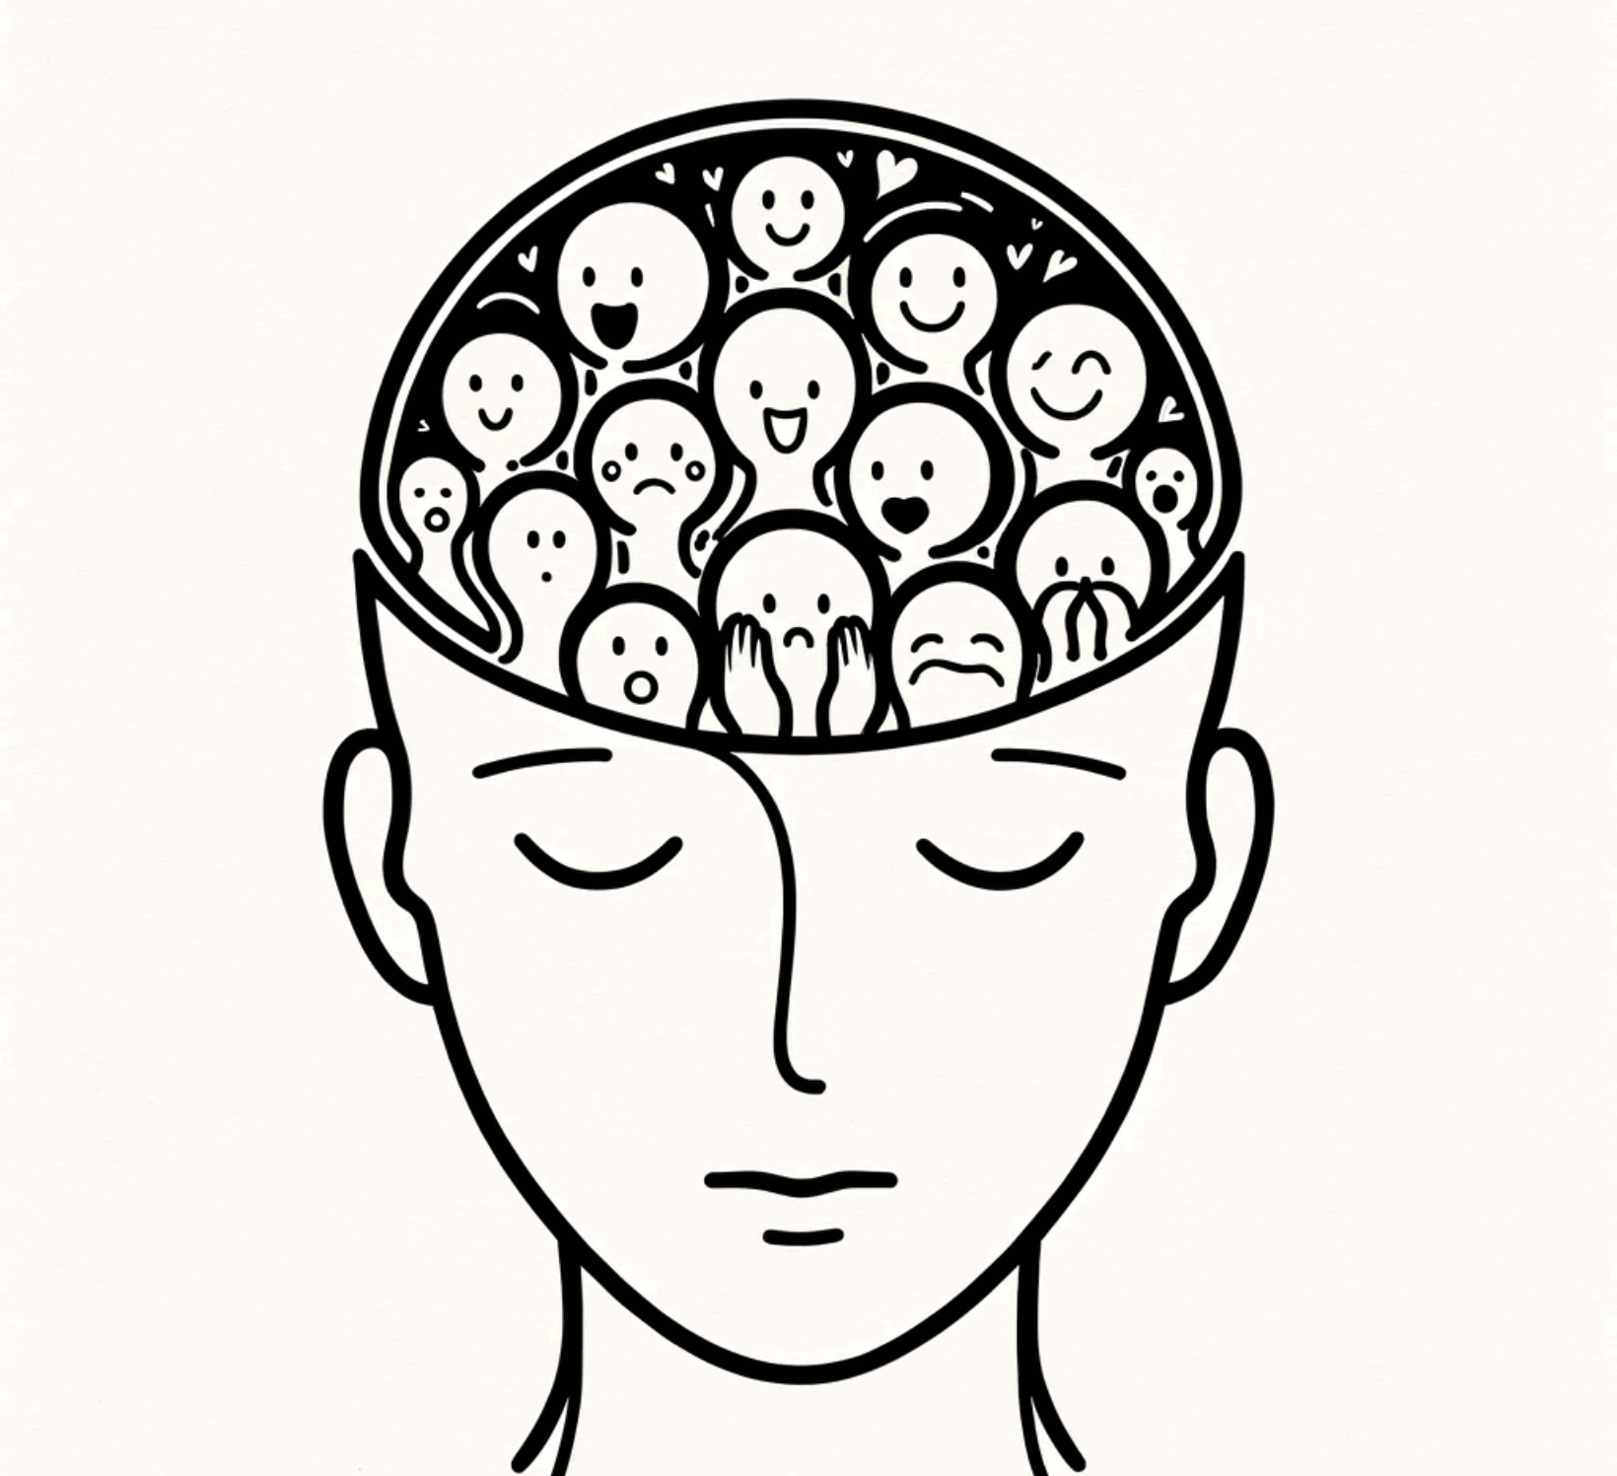
INTERNAL FAMILY SYSTEMS

Slide 571
Internal Family Systems (IFS) is a therapeutic approach developed in the 1980s by Dr. Richard C. Schwartz. IFS is based on the idea that, much like a family, the mind is made up of multiple "parts," each with its own perspectives, feelings, and roles. These parts are not seen as pathological but as natural components of the mind that can become unbalanced or extreme due to life experiences.
IFS identifies three main types of parts:
Exiles carry the burdens of past traumas, pain, or shame. They are hidden away because they are vulnerable and can overwhelm the individual with their intense emotions.
Managers try to keep the system of self organized and protect the individual from feeling the pain of the exiles. They often manifest as controlling, perfectionistic, or critical thoughts and behaviors.
Firefighters act impulsively to distract the individual from the pain of the exiles, often through behaviors like substance abuse, overeating, or other compulsive actions.
At the core of the IFS model is the concept of the "Self," which is the compassionate, wise, and centered aspect of a person.
The "Self” is characterized by qualities such as calmness, curiosity, compassion, confidence, creativity, courage, clarity, and connectedness, often referred to as the "8 Cs" of Self.
The Self is seen as a natural leader that can harmonize and heal the various "parts" or subpersonalities within an individual.

Slide 572
In Internal Family Systems therapy, "burdens" refer to the negative beliefs, emotions, or energies that parts carry, as a result of past experiences or trauma. These burdens can distort or weigh down the parts and affect their behavior, functioning and natural roles, leading to internal conflict and distress.
Several different types of burdens have been described:
Personal burdens originate from an individual's personal experiences, such as trauma, loss, or difficult relationships. They often manifest as extreme beliefs or emotions, like shame, guilt, or fear.
Legacy burdens are passed down through generations. They are not the result of an individual's direct experiences but are inherited from family, cultural, or societal influences. Legacy burdens can include beliefs, emotions, or patterns of behavior that originate from ancestors or cultural heritage. For example, a legacy burden might be a pervasive sense of shame or fear that has been transmitted through family stories, cultural narratives, or historical trauma.
In IFS therapy, identifying and addressing legacy burdens can help individuals release these inherited influences and live more freely.
Cultural burdens arise from societal norms, stereotypes, or cultural expectations. They can include pressures to conform to certain roles or behaviors based on gender, race, or socioeconomic status.
The burdens carried by exiles often include feelings of worthlessness, abandonment, or vulnerability. Exiles are pushed away or hidden to protect the individual from feeling these intense emotions.

Slide 573
The burdens carried by protectors might include beliefs that, to keep the system safe, they must be vigilant, controlling, or self-sacrificing.
Unattached burdens are not tied to any specific part within the individual's internal system. Instead, they are seen as external energies or influences that have attached themselves to the person, often as a result of traumatic or overwhelming experiences. Unattached burdens can manifest as intrusive thoughts, emotions, or sensations that don't seem to belong to any particular part.
In IFS, the goal is to help the individual recognize and release these different types of burdens, allowing parts to return to their natural, healthy states and function more harmoniously. This process involves accessing the Self, which can provide the compassion, clarity, and courage needed to facilitate healing and integration.
Integration consists of understanding and unburdening the exiles, and helping the managers and firefighters adopt healthier roles.
Schwartz has discussed the spiritual nature of the Self, suggesting that it is more than just a psychological construct. He describes it as having a transcendent quality, resonating with spiritual or mystical experiences. He has also noted that when people access their Self, they frequently report feelings of interconnectedness and a sense of being part of something larger than themselves.
This idea of the Self resembles the concept of a single consciousness or universal mind that connects all living things found in various spiritual and philosophical traditions.

Slide 574
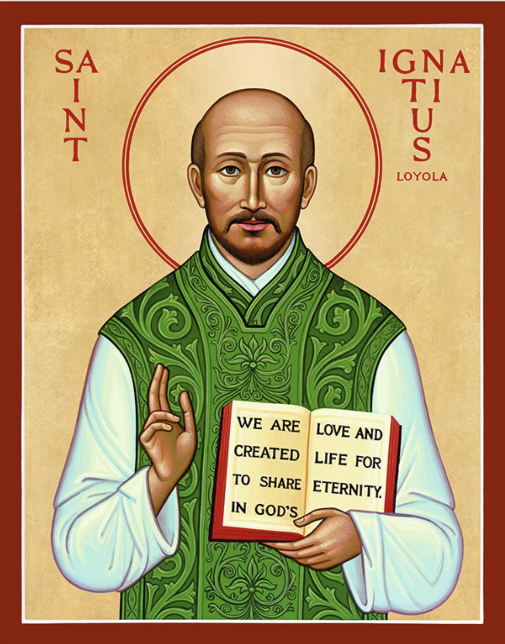
IGNATIAN SPIRITUALITY

Slide 575
Ignatius of Loyola was a Spanish priest and theologian who, in 1534, founded the Society of Jesus, commonly known as the Jesuits.
Born in 1491 in the Basque region of Spain, he initially pursued a military career but underwent a profound spiritual transformation after being injured in battle. Following his recovery, he devoted himself to religious life and education.
Ignatius is known for his spiritual writings, particularly the "Spiritual Exercises”.
The Spiritual Exercises are a set of meditations, prayers, and contemplative practices which are designed to deepen one's relationship with God, discern God's will, and foster spiritual growth and transformation. They are typically undertaken in a retreat setting over a period of 30 days, but they can also be adapted for shorter periods or daily life.
Participants engage in structured meditations on the life of Jesus Christ, contemplating his teachings, actions, and the mysteries of faith.
In the Ignatian Spiritual Exercises, the figure of Jesus plays a central and transformative role. The exercises are designed to help individuals deepen their relationship with Jesus, understand His life and teachings, and follow His example more closely.
A significant portion of the Spiritual Exercises involves meditating on the life of Jesus as depicted in the Gospels. Participants are encouraged to use their imagination to place themselves in the scenes of Jesus' life, experiencing His actions, words, and emotions firsthand. This imaginative prayer helps individuals connect with Jesus on a personal and emotional level.

Slide 576
The exercises aim to inspire participants to emulate Jesus' virtues and values, such as love, humility, compassion, and service. By contemplating His life, individuals are encouraged to reflect on how they can incorporate these qualities into their own lives.
Jesus serves as a model for discernment and making choices aligned with God's will. Participants are guided to seek God's guidance in their decisions, much like Jesus did throughout His ministry, and to align their lives with His teachings.
Reflecting on the Passion, death, and Resurrection of Jesus is a crucial part of the exercises. These meditations invite participants to experience the depth of Jesus' love and sacrifice, leading to a deeper understanding of the meaning of suffering, redemption, and hope.
Through prayer and reflection, individuals are encouraged to converse with Jesus as a friend and to seek His guidance and companionship in their spiritual journey.
Jesus is the focal point of the Ignatian Spiritual Exercises, serving as both a model and a companion for those seeking spiritual growth and transformation.
The exercises emphasize discernment of spirits, helping individuals distinguish between influences that lead them toward or away from God. Regular reflection on one's thoughts, actions, and motivations is encouraged to foster self-awareness and spiritual growth.
Participants are guided to develop indifference to worldly attachments, seeking freedom to follow God's will.

Slide 577
The Ignatian Spiritual Exercises offer a holistic approach that integrates spirituality and psychology to foster growth and healing.
From a spiritual perspective, the exercises help individuals discern God's will in their lives, deepen their faith, and cultivate virtues such as humility, gratitude, and love. They encourage a personal encounter with God and aim to transform one's life in accordance with Christian values.
Psychologically, the exercises promote self-awareness and emotional intelligence. They encourage introspection and reflection, helping individuals understand their motivations, desires, and fears. By fostering a deeper understanding of oneself, the exercises can lead to personal growth, improved decision-making, and a greater sense of peace and purpose.

Slide 578
CONVERGING HEALING STORIES

Slide 579
Although Jungian psychology, Internal family systems and Ignatian spirituality are very different traditions and use very different language, the psychological and spiritual models they describe are remarkably similar.
IFS parts, such as Managers, Firefighters, and Exiles are shaped by an individual's personal experiences. These parts can be thought of as existing Jung’s “personal unconscious”.
Parts carry burdens related to past traumas or emotional wounds. Jung's personal unconscious contains repressed memories and unresolved conflicts.
Legacy and unattached burdens are inherited from family, cultural, or societal influences and are not the result of an individual's direct experiences. Jung's collective unconscious contains archetypal patterns which are shared across humanity and passed down through generations. The Ignatian realm of spirits is composed of a panoply of spirits of various degrees of maturity that seek to influence our thoughts feelings and behaviors.
IFS burdens are negative beliefs, emotions, or energies that parts carry, often due to past trauma or experiences. These burdens can lead to parts being hidden or repressed, as the individual may not want to face the pain or discomfort associated with them.
The shadow represents the unconscious and repressed parts of the personality that an individual does not recognize or accept. These can include undesirable traits, instincts, or emotions that the conscious ego finds difficult to acknowledge.
Immature spirits are often difficult to recognize and often cloak themselves in shrouds of benevolence and good motives.

Slide 580
Internal Family Systems burdens, Jung's shadow, and immature spirits all describe aspects of the psyche that are hidden or repressed.
Burdens can distort the natural roles and functioning of parts, leading to behaviors that might seem extreme or maladaptive. Parts carrying burdens may act out in ways that protect the individual from perceived threats or pain.
The shadow can influence behavior in ways that are inconsistent with the individual's conscious self-image. When the shadow is not acknowledged, it can manifest in projections onto others or in unexpected emotional reactions.
Jung's psychology, IFS and Ignatian spirituality recognize the multiplicity within the human psyche. Jung introduced the concept of archetypes and the collective unconscious, which includes various universal symbols and motifs that manifest in individual psyches.
IFS conceptualizes the mind as made up of multiple "parts" or subpersonalities, each with its own perspective and role.
Ignatian spirituality sees the individual as being influenced by spirits that vary as to their degree of maturity.
In Jungian psychology, the process of individuation involves integrating different aspects of the self, including the shadow.
IFS focuses on creating harmony among the different parts of the self, often through internal dialogue and understanding, aiming to achieve a balanced and integrated self.
Ignatian spirituality involves discerning the various spirits influencing us and choosing to listen to the more mature ones.
Jung emphasized the Self as a central archetype representing the totality of the psyche and the guiding force in the process of individuation. In IFS, the Self is also a core concept, viewed as the compassionate and wise center of a person's internal system, capable of leading and healing the various parts. In Ignatian spirituality, in order to align their lives with the will of God individuals are directed to draw inspiration from the life of Jesus and imagine what He would do in the situation they are faced with.

Slide 581
Jung emphasized the Self as a central archetype representing the totality of the psyche and the guiding force in the process of individuation.
In IFS, the Self is also a core concept, viewed as the compassionate and wise center of a person's internal system, capable of leading and healing the various parts.
In Ignatian spirituality, in order to align their lives with the will of God individuals are directed to draw inspiration from the life of Jesus and imagine what He would do in the situation they are faced with.
All three approaches emphasize the importance of bringing unconscious elements into conscious awareness as a path to healing.
Jungian therapy seeks to make the unconscious conscious.
IFS encourages understanding and accepting all parts of the self, even those that are wounded or protective.
Ignatian spirituality has people become aware and be respectful of the immature spirits seeking to influence them and while recognizing the importance of these spirits in the world choosing not to act on their counsel.
Jungian psychology places a strong emphasis on the use of dreams, myths, and symbols as tools for understanding the psyche.
IFS is more focused on the internal dialogue among parts, it also utilizes imagery and visualization techniques to facilitate communication and healing within the internal system.
Ignatian spirituality uses active imagination in which the person becomes a participant in scenes from the Bible that involved Jesus.

Slide 582
All these approaches are not just about symptom relief but also about personal growth and transformation.
Jungian psychology aims for individuation, a process of becoming one's true self.
IFS seeks to create a harmonious internal system that allows for personal development and well-being.
Ignatian spirituality aims to align the person’s life with God’s will.
The goal in IFS is to help parts release their burdens and integrate into the Self, allowing for healing and balance. This involves acknowledging and understanding the burdens, with compassion and curiosity.
Integration of the shadow involves becoming aware of and accepting these repressed aspects of the self. Jung believed that acknowledging and integrating the shadow leads to greater self-awareness and personal growth.
Burdens are often rooted in unconscious memories or experiences that have not been fully processed or integrated.
The shadow is a key component of the unconscious, containing elements that are not readily accessible to the conscious mind.
All three approaches involve deep self-reflection and the cultivation of self-awareness. They encourage individuals to explore their inner thoughts, emotions, and motivations. Just as IFS helps individuals discern and integrate different parts of themselves, the Spiritual Exercises involve discerning spiritual influences and integrating one's life with a sense of divine purpose.

Slide 583
IFS focuses on healing and harmonizing the internal system by fostering self-compassion and understanding among the parts.
Jungian psychology on individuation and Ignatian spirituality on healing and redemption through faith, grace, and the transformative power of divine love. All these approaches aim to restore a sense of wholeness and peace within the individual.
Although Jung's analytical psychology, Internal Family Systems and Ignatian spirituality were developed in different contexts and times they share an idealist metaphysics which creates many points of convergence between them. All three models suggest that at a fundamental level individual human personalities are deeply influenced by conscious entities existing in a different collective realm.
In Kastrup’s idealist model individual personalities are “eddies” in a large “body of water” of universal mind. Each of these conscious “eddies” is temporarily (while that person is alive) a distinct system that is nested within the larger universal mind system. Although separate the eddy continually draws from and contributes to the larger body of water. When at death the physical aspects of the eddy cease to be, the “water”, or consciousness that was the eddy now becomes part of universal mind.
Jungian psychology, internal family systems and Ignatian spirituality integrate psychology and spirituality and offer what I believe are currently among the most valuable frameworks for exploring the complexity of the human psyche and fostering psychological and spiritual healing and growth. They are imminently compatible with Kastrup’s idealistic model.

Slide 584
Can these approaches tell us anything about how to heal unhealthy Our and The stories?

Slide 585
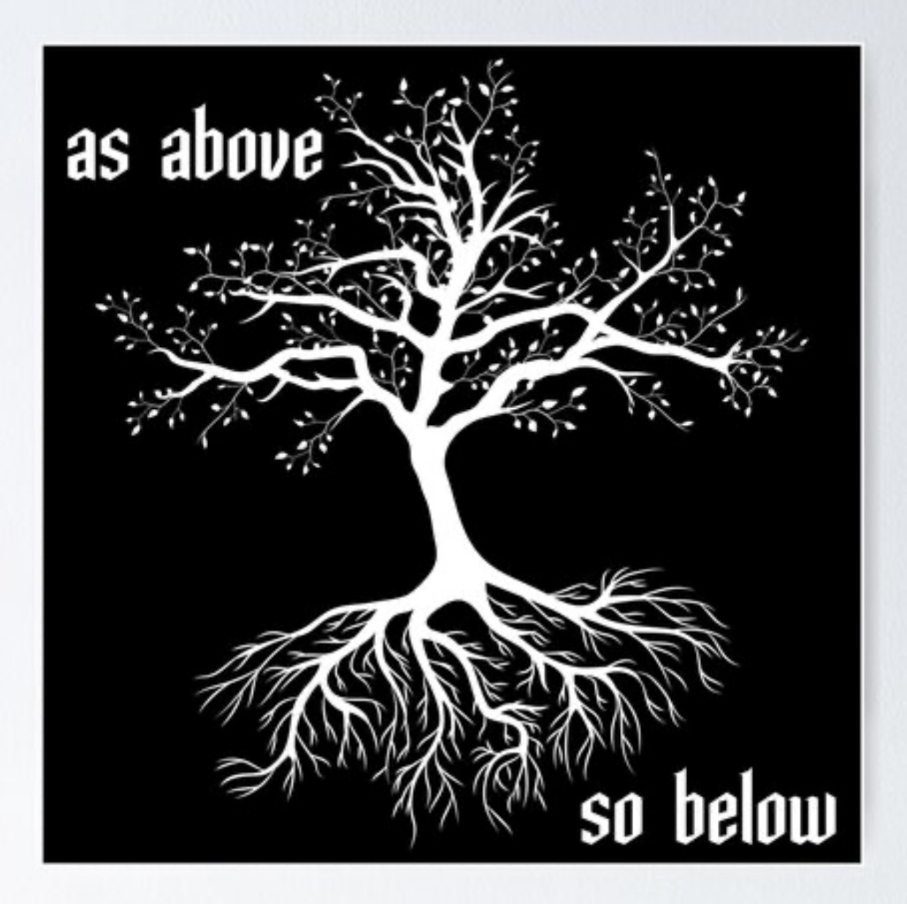

Slide 586
In nested systems, different levels are interconnected and interdependent and what happens at one level affects what happens at another level. Each level within a nested system relies on the others for stability and function. Changes or disruptions at one level have cascading effects on other levels. For example, in an ecosystem, a change in the population of a particular species, one level, can affect other species and the overall health of the ecosystem, another level.
Nested systems contain feedback loops, where changes at one level create responses at other levels, which in turn can influence the original level. These loops can be either reinforcing (positive feedback) or balancing (negative feedback), contributing to the system's dynamics.
The degree to which one level affects another can vary depending on the system. In some cases, changes at a smaller, more localized level can have significant impacts on the larger system, while in other cases, the influence might be more subtle or require a cumulative effect.
If we consider individuals, families, societies, global communities, and the whole cosmos interconnected nested systems, then resourcing, growth and healing at one level can have ripple effects on all other levels contributing to the overall health and well-being of the entire structure.
Personal growth and healing can have a direct impact on families and close relationships. When individuals work on their mental, emotional, or physical health, they often bring more positive energy, understanding, and resilience to their interactions with family members, which can improve family dynamics and relationships.

Slide 587
A healthy and supportive family environment can foster the well-being and development of its members, influencing their ability to contribute positively to society. Families that prioritize communication, empathy, and support can serve as foundational units that promote societal well-being.
Societal growth and healing, such as through social justice initiatives, educational improvements, or economic development, can enhance the quality of life for individuals and families. A society that values equity, education, and health creates an environment where individuals and families can thrive.
Positive changes at the global level, such as international cooperation on climate change, peacebuilding, or global health initiatives, can have widespread benefits for societies and individuals. Global efforts to address large-scale challenges can create a more stable and sustainable world for all.
The phrase "as above, so below" refers to an idea that originates from Hermeticism, a philosophical and spiritual tradition based on writings attributed to Hermes Trismegistus.
Hermes Trismegistus is not a historical person but rather a legendary figure often associated with the blending of Greek and Egyptian cultures and is believed to be a representation of the convergence of the Greek god Hermes and the Egyptian god Thoth. Both deities are associated with wisdom, writing, and communication. The name "Trismegistus" means "thrice-great," suggesting that he is the greatest of the great.

Slide 588
Hermes Trismegistus is a syncretic (combining different beliefs, practices and traditions) figure that emerged during the Hellenistic period, when Greek and Egyptian cultures were interacting intensely, particularly in Alexandria. He is considered the founder or source of the Hermetic tradition, a philosophical and spiritual system that emphasizes the pursuit of knowledge and mastery of divine wisdom. Hermeticism influenced Gnostic and alchemical practice.
Hermeticism has influenced a variety of religious, esoteric, and philosophical traditions, including early Christian Gnosticism, the Kabbalah, and the Renaissance revival of magic and alchemy.
The Hermetic texts emphasize the idea of a harmonious universe governed by a single divine principle, where all parts of existence are interconnected.
Hermes Trismegistus continues to be a significant figure in esoteric traditions, often invoked in discussions of mysticism, alchemy, and the search for hidden knowledge. His legacy is evident in the continued interest in Hermetic teachings and texts, which are studied by those interested in the occult, spirituality, and the synthesis of ancient wisdom.
“As above so below” suggests that there is a correspondence between different levels of reality or existence, such as that of the universe or the divine and the individual or the earthly.
Essentially, it implies that the patterns and truths found in the larger universe are reflected in the smaller, individual components, and vice versa.

Slide 589
“As above, so below" is related to an idealist metaphysics. Idealism posits that reality is fundamentally mental or spiritual. From this perspective, "as above, so below" can be interpreted as the idea that Universal mind, the "above“, shapes and reflects individual minds, the "below“.
The concept of "as above, so below" and the idea of nested systems are related in that both emphasize the interconnectedness and reflection of patterns across different levels or scales of reality.
A nested system is a system that exists within a larger system, much like Russian dolls, where each smaller system is part of a bigger one. In nature and various disciplines, nested systems can be seen in ecosystems, organizational structures, and even in the human body (cells within tissues, tissues within organs, etc.). Each level of the system can influence and reflect the characteristics of the other levels.
The principle of "As Above, So Below” suggests that there is a correspondence between the larger, more universal level and the smaller, individual level. Implying that patterns, structures, and truths found at one level are reflected at another.
Both nested systems and “as above, so below” emphasize the interconnectedness of different levels of reality. In nested systems, each level is interconnected and interdependent, much like how "as above, so below" suggests a reflection and connection between different scales of existence.

Slide 590
In nested systems, patterns or behaviors at one level can often be seen at other levels. Similarly, "as above, so below" posits that the same fundamental principles or patterns apply across different levels, whether they are spiritual, physical, or psychological.
Both concepts encourage a holistic view of reality. Understanding one level of a nested system can provide insights into other levels, just as recognizing the correspondence between the macrocosm and microcosm can lead to a deeper understanding of the whole.
The idea of "as above, so below“ is seen in Kastrup's idealism, Jung’s psychology, and Ignatian spirituality as each of these perspectives acknowledges the interconnectedness between individual experiences and a larger, more universal reality.
Bernardo Kastrup's idealist view suggests that individual minds are like eddies in a stream, with the stream itself representing a universal consciousness or mind. In this framework, "as above, so below" highlights the idea that individual consciousnesses (the "below") are manifestations or expressions of the universal consciousness (the "above").
The patterns, structures, and dynamics of the universal mind are echoed in the individual minds, suggesting a deep interconnectedness and shared essence.

Slide 591
Carl Jung's concept of the collective unconscious posits that there is a part of the unconscious mind shared among all humans, containing archetypes and universal symbols.
In this context "As above, so below" highlights how the individual psyche (the "below") is influenced by and reflects the collective unconscious (the "above"). The universal themes and symbols present in the collective unconscious manifest in individual dreams, thoughts, feelings and behaviors, illustrating a continuity between the personal and the collective.
Ignatian spirituality, with its emphasis on discernment and the influence of spiritual forces, suggests that individuals are influenced by a realm of spirits or divine presence. "As above, so below" can be seen here as the idea that the spiritual realm (the "above") has a direct impact on the individual's spiritual journey and decision-making processes (the "below").
The divine or spiritual influences are mirrored in the individual's actions and experiences, suggesting a flow of guidance and inspiration from the higher realm to the personal level.
In each of these views, "as above, so below" underscores the belief that individual experiences are not isolated but are deeply connected to and influenced by a larger, unseen, reality.

Slide 592
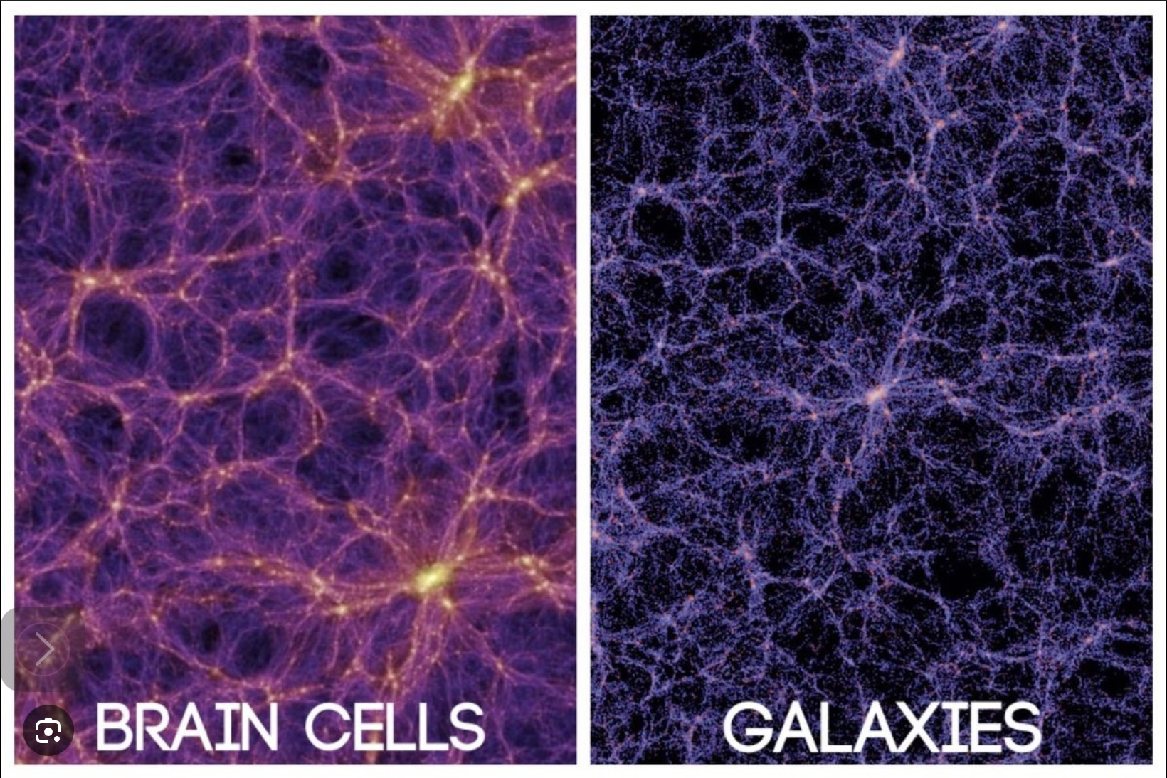

THE DYNAMICS OF UNIVERSAL AND INDIVIDUAL MIND

Slide 593
Sigmund Freud, the founder of psychoanalysis, introduced the concept of the "dynamics of the mind" to describe the complex interactions and forces at play within the human psyche.
Central to Freud’s theory is the conflict between the id, ego, and superego. Conflicts between the id and superego can lead to anxiety, which the ego attempts to manage through various defense mechanisms, such as repression, denial, and projection.
Freud emphasized the role of the unconscious mind in influencing behavior and thought. Much of the mind's dynamics occur outside of conscious awareness, with repressed desires and memories affecting conscious actions and emotions.
The themes of the unconscious and of different parts of the mind that are in conflict with each other are also present in Jung’s psychology, IFS, and Ignatian spirituality.
The ideas of “as above so below” and nested systems suggest that the dynamics we see in the individual mind may also be present in universal mind. Certain philosophical traditions support this notion.
The concept of yin and yang is a fundamental principle in Chinese philosophy and cosmology, representing the dual nature of reality. It is rooted in ancient Chinese thought and is central to various philosophical, medical, and spiritual traditions, including Taoism and Confucianism.
Yin and yang describe how seemingly opposite or contrary forces are actually complementary, interconnected, and interdependent in the natural world. They are not static or absolute but are relative to each other, constantly interacting and transforming.

Slide 594
Yin is often associated with qualities such as darkness, passivity, receptivity, femininity, cold, and softness. It represents the more inward, nurturing, and subtle aspects of existence.
Yang, on the other hand, is associated with light, activity, assertiveness, masculinity, heat, and hardness. It embodies the outward, active, and dynamic forces in the universe.
The yin-yang symbol, known as the Taijitu, visually represents the balance and harmony between these two forces. Each side contains a small circle of the opposite color, symbolizing that within yin there is yang, and within yang there is yin. This illustrates the idea that nothing is purely yin or purely yang, and each contains the seed of the other.
Yin and yang are in a constant state of flux, maintaining a dynamic equilibrium. Changes in one force will lead to changes in the other, and the balance between them is essential for harmony in the universe. This concept is applied to various aspects of life, including health, relationships, and nature.
Yin and yang offer a holistic way of understanding the world, emphasizing the interconnectedness and interdependence of all things. It teaches that balance and harmony arise from the dynamic interplay of opposing forces, and this balance is essential for the well-being of individuals and the universe as a whole.
Georg Wilhelm Friedrich Hegel (1770- 1831) is considered one of the most important figures in German idealism and Western philosophy. Hegel's work has had a profound influence on a wide range of fields, including philosophy, political theory, history, and theology.

Slide 595
Hegel is best known for his comprehensive philosophical system, which seeks to explain the development of reality, thought, and history. His work is characterized by a dialectical method, which involves the resolution of contradictions through a process of synthesis.
Hegel's dialectic is often summarized as a three-step process: thesis, antithesis, and synthesis. This method describes how conflicting ideas (thesis and antithesis) are reconciled to form a new, higher level of understanding (synthesis). This process is dynamic and ongoing, reflecting the evolution of ideas and reality.
This dialectical process is not linear but rather cyclical and ongoing. Each synthesis becomes a new thesis, which then encounters its own antithesis, leading to a further synthesis. Through this continuous process, ideas and historical developments evolve, leading to higher levels of understanding and complexity.
Hegel's philosophy is often referred to as "absolute idealism." He posited that reality is fundamentally mental or spiritual, and that the material world is a manifestation of an underlying absolute spirit or mind. This spirit evolves through history, achieving self-awareness and freedom.
Hegel viewed history as a rational process, guided by the unfolding of the World Spirit towards greater freedom and self-awareness. He believed that historical events and developments are not random but are part of a larger, purposeful process.

Slide 596
Yin and Yang and Hegel's dialectics are both conceptual frameworks that address the dynamics of change, balance, and the interaction of opposites in the universe. Although they originate from vastly different philosophical traditions, they share similarities in how they conceptualize the dynamics of existence.
Both systems emphasize the interaction and interdependence of opposites. In Yin and Yang, these opposites are complementary forces that define each other and maintain balance. In Hegel’s dialectics, it involves the opposition of thesis and antithesis leading to synthesis.
They both describe processes of transformation driven by the interaction of opposites. In Yin and Yang, change is a constant flow where one aspect transforms into another (e.g., day into night). In Hegel's dialectics, change is seen as a progression through contradictions toward higher states of understanding or being.
Yin and Yang represent a continuous balancing act between forces, suggesting harmony in the universe. Similarly, Hegelian dialectics suggests that through the resolution of contradictions (synthesis), a new equilibrium is reached, which then evolves into new contradictions.
Yin and Yang sees everything in the universe is interconnected and in constant flux. Balance arises from the harmonious interaction of Yin (passive, receptive) and Yang (active, creative) forces. The universe is understood as cyclical, where states of being and forms constantly transform into one another.

Slide 597
Hegel’s Dialectics see the universe as being characterized by a historical and logical process where each stage of development arises from the contradictions inherent in the preceding stage. Understanding or reality is advanced through synthesis, where conflicting ideas are reconciled to create a new understanding or state.
Both frameworks encourage a holistic view of reality by emphasizing the necessity of understanding opposing forces not as mutually exclusive, but as complementary aspects of a unified whole.
They propose that the universe is not static but is continually evolving through a dynamic interplay of forces or ideas. This reflects a belief in the perpetual motion and development of existence.

Slide 598
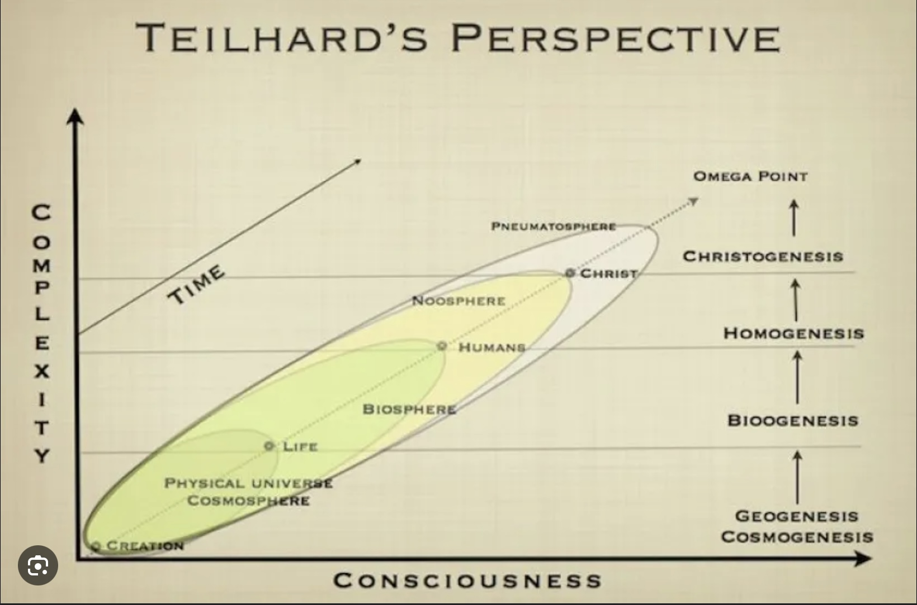
TEILHARD DE CHARDIN

Slide 599
Pierre Teilhard de Chardin, a French Jesuit priest, philosopher, and paleontologist, proposed a visionary perspective on evolution that combines science and spirituality. His concept of cycles of construction and destruction is integral to his broader idea of the universe evolving towards an Omega Point, a state of ultimate complexity and consciousness.
Teilhard de Chardin viewed the evolutionary process as involving cycles of construction (creation, growth, and complexity) and destruction (breakdown, simplification, and entropy). These cycles are not merely oppositional but are interdependent processes that drive the evolution of the universe.
Destruction, in this sense, clears the way for new forms of construction, allowing for greater complexity and higher levels of organization.
Teilhard emphasized the idea of complexification, where matter and life evolve towards increasing complexity. This process is marked by the emergence of new structures and forms of organization, from simple particles to complex organisms and, ultimately, to conscious beings.
As evolution progresses, Teilhard believed that diverse elements of the universe converge towards greater unity. This convergence is not just physical but also involves consciousness and spirit. The cycles of construction and destruction play a role in this convergence, as they facilitate the integration and synthesis of diverse elements.

Slide 600
The Omega Point is the culmination of the evolutionary process, a state of ultimate complexity, consciousness, and unity. It represents the final goal or destiny of the universe, where all elements are harmonized in a higher state of being. For Teilhard, the Omega Point is both a scientific and spiritual concept, embodying the divine and the ultimate purpose of evolution.
Teilhard saw human consciousness as a critical factor in the evolutionary process. Humans, through their capacity for reflection, creativity, and love, contribute to the movement towards the Omega Point. Human actions and decisions can influence the direction and pace of this evolutionary journey.
Teilhard's concept of the Omega Point has profound spiritual and philosophical implications. It suggests that the universe is not a random collection of events but a purposeful journey towards a state of ultimate unity and consciousness.
This vision offers a sense of hope and direction, proposing that all experiences, including challenges and destruction, contribute to a greater cosmic purpose.
Pierre Teilhard de Chardin ideas share some important similarities with Hegelian philosophy, particularly in terms of their views on the development and evolution of consciousness and the universe.
Both Teilhard de Chardin and Hegel viewed reality as a dynamic, evolving process. Teilhard integrated evolutionary theory with Christian theology, proposing that the universe is moving towards an ultimate point of convergence the "Omega Point." This is analogous to Hegel's idea of the unfolding of the World Spirit towards greater self-awareness and freedom.

Slide 601
Teilhard emphasized the unity of the spiritual and material worlds, suggesting that evolution is not just a physical process but also a spiritual one. This resonates with Hegel's notion of absolute idealism, where reality is fundamentally spiritual or mental in nature.
Both thinkers saw history and the cosmos as progressing towards a higher state of being. For Hegel, this was the realization of freedom and self-consciousness, while for Teilhard, it was the unification of humanity and the cosmos in Christ at the Omega Point.
Much like Hegel's dialectical method seeks to reconcile contradictions through synthesis, Teilhard's work involved synthesizing scientific and religious ideas.
There are also interesting parallels between Teilhard de Chardin's concept of evolution towards the Omega Point, Internal Family Systems therapy's goal of achieving a harmonious internal family, Carl Jung's process of individuation, and the journey of Ignatian spirituality. Each of these frameworks shares a common theme of integration and movement towards a more unified, harmonious state of being.
Teilhard envisioned the universe evolving towards a point of ultimate unity and consciousness, which he called the Omega Point. This represents the culmination of both physical and spiritual evolution, where all creation converges in Christ. It emphasizes a holistic integration of all aspects of existence into a higher, unified reality.

Slide 602
IFS views the mind as composed of multiple sub-personalities or "parts," each with its own perspectives and roles. The goal of IFS is to achieve internal harmony by integrating these parts, led by the "Self," which is seen as the core of a person’s identity. This process involves healing and reconciling conflicting parts to achieve a balanced, cohesive internal system.
Jung’s concept of individuation is the process of integrating various aspects of the self, including the conscious and unconscious, to achieve a more complete and authentic self. This journey involves reconciling the ego with the deeper aspects of the psyche, such as the shadow, anima/animus, and the Self, leading to personal wholeness and self-realization.
Ignatian spirituality emphasizes discernment and the integration of one's life with the divine will. It involves a journey towards greater spiritual freedom and alignment with God’s purpose. This spiritual journey aims at a deeper union with God and a more harmonious alignment of one's desires with divine love.
Integral theory sees the integral stage of development as the synthesis of the best aspects of all previous stages of development.
All these frameworks emphasize the integration of disparate elements (whether parts of the psyche, spiritual and material realities, or internal conflicts) into a more unified whole.
Each involves a transformative process, moving from a state of fragmentation or conflict towards greater harmony and realization of potential.

Slide 603
Whether it’s the Omega Point, the Self in IFS and in Jungian psychology, God in Ignatian spirituality, or the integral stage in integral theory, there is a central guiding force or goal that directs the journey towards integration.
While focusing on individual transformation, these processes also imply a broader collective or universal dimension, suggesting that personal growth contributes to a larger cosmic or communal evolution.
These diverse approaches share a vision of moving towards a state of greater unity, harmony, and fulfillment, whether in psychological, spiritual, or cosmic terms.
The dynamics of individual minds and universal mind as seen in the patterns of physics and cosmology seem to consist of cycles of construction (creation, growth, and complexity) and destruction (breakdown, simplification, and entropy) driving the evolution of the universe towards higher integral stages of complexity and organization.
Perhaps towards a culmination of the evolutionary process, a state of ultimate complexity, consciousness, and unity where all elements are harmonized in a higher state of being which Teilhard called the Omega Point.

Slide 604


SOCIETAL AND PLANETARY HEALING AND GROWTH

Slide 605
IFS, Jungian psychology and Ignatian spirituality are primarily ways to heal My stories but if the dynamics of individual and universal mind are similar then, could their principles also be applied to families, societies and to the whole world ?
Following the IFS model, for example, we might think of different social groups, ideologies, and cultural narratives as parts of a larger societal family system. Just as individuals have parts, societies have different groups, factions, and narratives that represent various interests, values, and historical experiences. Recognizing these parts involves identifying and acknowledging the diverse voices and perspectives within a society.
Much like a person’s IFS parts, each societal part has a role and function, rooted in historical, cultural, or economic contexts. Understanding these roles can help clarify why certain groups or narratives behave as they do.
Encouraging open and empathetic dialogue between societal parts can help reduce polarization and promote understanding. This involves creating safe spaces for different groups to express their concerns, fears, and hopes.
In IFS, the Self is the compassionate, curious leader that can harmonize internal parts. Societally, this might translate to fostering leadership and collective values that emphasize empathy, inclusivity, and shared humanity, guiding society toward integration and healing.

Slide 606
Societal parts often carry historical wounds and traumas. Healing these requires acknowledging past injustices, offering reparations or apologies where appropriate, and creating pathways for reconciliation and forgiveness.
Promoting integration requires encouraging collaboration and integration among societal parts, finding common goals and shared values. This might involve joint projects, community-building activities, and policies that promote equity and justice.
Listening to and empowering marginalized voices is critical as these parts often hold key insights into societal imbalances and potential paths to healing.
By applying these principles, societies can work towards greater harmony and integration, much like individuals do in IFS therapy. The goal is to create a more cohesive and resilient communities where diverse parts are acknowledged, valued, and aligned toward a common good.
Healing and growing at the societal and planetary levels that is informed by integral psychological perspectives involves addressing the deep-seated, shared elements of the human psyche that influence human thoughts, feelings and behaviors.
This process can be complex, as the collective unconscious consists of a multitude of shared parts, archetypes or spirits that transcend our individual conscious everyday experience.

Slide 607
Different traditions have suggested ways in which we might approach the healing of societies. Storytelling and cultural reflection can bring unconscious themes into consciousness. This can be done through literature, art, theater, and film, which explore and reinterpret archetypal narratives, allowing societies to confront and process collective fears and hopes.
Educational programs that promote awareness of psychological concepts, including the collective unconscious help individuals and communities recognize and address unconscious biases and behaviors.
In polarized societies facilitating open dialogue and reconciliation processes can help address collective traumas and integrate shadow aspects of the collective unconscious, leading to healing and transformation.
Communal rituals and ceremonies that acknowledge and honor shared experiences can serve as a means of connecting with the collective unconscious and fostering a sense of unity and healing.
Psychological and social interventions that address collective issues, such as prejudice, discrimination, and systemic injustice can help societies work through unconscious dynamics that perpetuate these problems.
Promoting values that align with collective healing involves visionary leaders that guide societies toward integrating positive aspects of the collective unconscious and fostering a more harmonious future.
Global collaboration and exchange of ideas to address shared challenges and tap into the collective wisdom of humanity can help societies learn from each other and integrate diverse perspectives.

Slide 608
We previously discussed post-traumatic growth in individuals. The concept of PTG can also be applied at the societal and global levels. Communities, societies and the global collective can experience growth and healing after collective trauma, such as that we’re experiencing as a result of the polycrisis.
For post-traumatic growth to occur at these levels, there needs to be a collective acknowledgment of the trauma and an understanding of its impact on communities and society. There also need to be channels for open dialogue and communication. This includes sharing stories, experiences, and emotions related to the trauma.
Until digital technologies such as Twitter/X and Facebook were coopted in the interests of the oligarchs, there was the potential that the internet and digital media might be used as tools for social healing, growth and progress as, for a time, they fostered movements that resisted oppression.
There are several historical examples of this.
The Arab Spring (2010-2012) was a series of anti-government protests and uprisings that spread across the Arab world. Social media platforms like Facebook, Twitter, and YouTube played crucial roles in organizing protests, sharing information, and broadcasting events to a global audience. In countries like Tunisia and Egypt, digital media helped mobilize citizens and document government crackdowns.

Slide 609
Iran's Green Movement (2009) followed the disputed presidential election in Iran. Protests erupted across the country with social media and digital communication tools being extensively used to organize demonstrations and share information, especially given the restrictions on traditional media. Twitter, in particular, became a vital platform for disseminating news and coordinating actions.
In 2019-20 in response to proposed extradition legislation, massive protests erupted in Hong Kong. Protesters used encrypted messaging apps like Telegram and social media platforms to organize and communicate. Digital media also helped bring international attention to the movement and document instances of police violence.
In the United States in 2020, the Black Lives Matter movement gained significant momentum after the killing of George Floyd. Social media platforms were used to organize protests, share information about systemic racism, and amplify voices of marginalized communities. The movement's digital presence helped it gain international support and awareness.
Following a military coup in Myanmar in 2021, widespread protests broke out across the country. Activists used social media to organize demonstrations, share news, and document human rights abuses. Despite internet shutdowns and censorship, digital media played a crucial role in sustaining the movement.
These examples illustrate how the internet and digital media empowered individuals and movements to resist oppression, amplify their voices, and connect with a global audience.

Slide 610
Unfortunately, digital media is increasingly being co-opted by wealthy interests, and this is affecting the media landscape: A small number of large corporations and wealthy individuals own significant portions of digital media platforms and news outlets. This concentration of ownership influences the types of content that are prioritized or suppressed, aligning them with the interests of those in control.
Many digital media platforms rely heavily on advertising revenue, which has led to content being shaped by the interests of advertisers. This reliance can discourage critical reporting on companies or industries that are major advertisers.
Algorithms used by social media platforms to curate content have prioritized sensational and polarizing content, which generates more engagement. This has amplified misinformation and divisive narratives.
Wealthy individuals and organizations fund and support the spread of misinformation to shape public opinion and political outcomes. Digital platforms are used to disseminate false or misleading information quickly and widely.
Some groups use astroturfing (creating the illusion of grassroots support) and automated bots to amplify certain messages or drown out dissenting voices. This has distorted public discourse and made it difficult to discern genuine public sentiment. There are instances where digital platforms suppressed content that criticized powerful interests.

Slide 611
The design of social media platforms, which encourages echo chambers and filter bubbles, has increased polarization by reinforcing existing beliefs and isolating users from differing viewpoints.
The collection and use of personal data by digital platforms has been leveraged to target individuals with tailored misinformation and propaganda, further influencing public opinion and behavior.
While these issues are complex and multifaceted, they highlight the need for greater transparency, accountability, and regulation of digital media. Efforts to promote media literacy, diversify media ownership, and develop ethical guidelines for algorithmic content curation are some ways to address these challenges and ensure that digital media can serve as a platform for diverse and critical voices.
Strong support systems, including mental health resources, community organizations, and governmental support, are crucial to help individuals and communities process trauma. Efforts to build resilience through education, community engagement, and empowerment can facilitate growth.
A shared vision for a better future in the form of meaningful, healthy Our and The stories can motivate collective action and foster positive changes in societal structures and norms. Effective leadership that is empathetic, transparent, and forward-thinking can guide societies through the healing process and towards growth.

Slide 612
Societies will need to adapt culturally and socially, embracing new values and practices that promote well-being and inclusivity. When these elements are present, much like individuals experiencing post-traumatic growth, societies have the potential to not only recover from trauma but also to emerge stronger, more cohesive, and more resilient.
We cannot begin to heal from the polycrisis without addressing its main cause. End-stage capitalism still seems desirable or at least inevitable to a large proportion of the world’s population. This economic maladaptive system is fuel for dysregulated greed which itself is an attempt to compensate for personal psychological issues, meaningless The stories and the trauma of the polycrisis.
This greed is a symptom of an illness that has spread to the whole planet. Other symptoms include the unsustainable extraction of resources from nature, the obscene accumulation of wealth by a tiny proportion of the population, the consumerism that affects most of us, the declining living standards, and the erosion of democracies. This illness is rapidly destroying the only home we know of that is hospitable and available to humans.
There are several alternatives to end-stage capitalism. These economic systems would help restore the health of societies and of the planet as they would move us towards a more ecologically sustainable and equitable future.
Each of these models comes with its own set of potential benefits and challenges, and it's likely that any transition away from end stage capitalism would involve a combination of these ideas rather than a single, monolithic system.

Slide 613
Democratic Socialism combines elements of socialism with democratic governance, aiming to reduce inequality through wealth redistribution, social welfare programs, and public ownership of key industries.
Participatory Economics, also known as “parecon” emphasizes participatory decision-making, equitable distribution of resources, and worker self-management.
Circular economy focuses on sustainability aiming to minimize waste and make the most of resources by creating closed-loop systems where products are reused, repaired, and recycled.
Post-capitalism encompasses various ideas, including the use of technology to automate labor and provide universal basic income, potentially leading to a society where traditional work is less central.
Degrowth advocates for a reduction in consumption and production, emphasizing living within ecological limits and prioritizing well-being over economic growth.
We have explored how we lost many of the traditional “Our stories” that once served to unite us as a society, and we are increasingly fragmented into groups with competing and irreconcilable narratives that are hostile towards each other. We have tried to understand some of the cultural, technological, economic, and political reasons why this happened.

Slide 614
To address the fragmentation of social narratives, it is essential to foster dialogue and understanding across different groups. Encouraging critical thinking and media literacy can help individuals navigate the complex media landscape and engage with diverse perspectives. Creating narratives that reflect the diversity of experiences and values within a society can help foster a sense of belonging and shared purpose.
Encouraging community involvement and civic engagement can help rebuild trust and create opportunities for people to come together around common goals. Providing platforms for open and respectful dialogue can help bridge divides and promote understanding between different groups.
Rebuilding trust in institutions requires transparency, accountability, and responsiveness to the needs and concerns of diverse communities. By addressing these challenges, societies can work towards creating new, cohesive narratives that unite people while respecting and celebrating diversity.
An integral stage society is characterized by a holistic and inclusive approach to local, national and global governance, emphasizing interconnectedness, collaboration, and the integration of diverse perspectives and values. Policies and decisions are made considering multiple perspectives and dimensions, including environmental, economic, social, and cultural factors.
Nations and organizations work together to address global challenges such as climate change, poverty, and inequality, recognizing that these issues transcend national borders.

Slide 615
An integral world order values and integrates diverse cultural, philosophical, and spiritual perspectives, fostering mutual respect and understanding.
Emphasis is placed on sustainable development and the responsible stewardship of natural resources to ensure the well-being of future generations.
There is a focus on peaceful conflict resolution and the promotion of dialogue and understanding to prevent and resolve disputes.
Organizations like the European Union (EU), the United Nations (UN), and the International Court of Justice (World Court) are steps toward such an integral world order, as they embody some of these principles.
The European Union promotes economic and political integration among its member states, fostering cooperation and reducing the likelihood of conflict. It emphasizes human rights, democracy, and the rule of law
The United Nations aims to maintain international peace and security, promote sustainable development, and uphold human rights. It serves as a platform for dialogue and cooperation among nations.
The International Court of Justice settles legal disputes between states and provides advisory opinions on international legal issues, promoting the rule of law at the global level.
These and many other organizations abide by several integral stage principles:

Slide 616
Recognizing that nations and peoples are interconnected and that global challenges require collaborative solutions.
Upholding the inherent dignity and rights of all individuals, regardless of nationality, ethnicity, or background.
Ensuring that international laws and agreements are respected, and that justice is accessible to all.
Committing to sustainable practices that protect the environment and promote long-term well-being.
Encouraging open communication and cooperation among diverse stakeholders to foster understanding and address common challenges.
While these organizations represent important steps toward an integral world order, achieving such a vision requires ongoing efforts to deepen integration, enhance inclusivity, and address emerging global challenges in a holistic and coordinated manner. The future of humanity depends on making this vision a reality.
For now, global organizations like the UN, the World Court, and the European Union face significant challenges when dealing with resistance from powerful nations. Powerful nations often prioritize their sovereignty and resist international directives or rulings that they perceive as infringing on their national interests or autonomy.
Some powerful countries choose to comply with international agreements and rulings only when it aligns with their interests, undermining the authority and effectiveness of these organizations.

Slide 617
In the UN Security Council, the five permanent members (China, France, Russia, the United Kingdom, and the United States) have veto power, which is used to block resolutions or actions that do not align with their interests, even if there is broad international support.
Powerful nations often contribute significant funding to international organizations, which can give them disproportionate influence over decision-making processes and priorities.
Tensions and rivalries between powerful nations impede consensus-building and cooperation within global organizations, leading to gridlock or ineffective responses to global issues.
The rise of nationalist and populist movements in some powerful countries led to skepticism and hostility toward international cooperation and multilateral institutions.
The World Court, for example, relies on the consent of states to its jurisdiction. Powerful nations often refuse to recognize its authority or comply with its rulings if they conflict with national interests.
Powerful nations such as the US under the Trump regime have chosen to withdraw from international agreements and organizations, and refuse to participate in certain initiatives, weakening the collective efforts to address global challenges.
The economic and military capabilities of powerful nations enables them to pursue unilateral actions or exert pressure on other countries and international bodies, often undermining multilateral efforts.

Slide 618
These challenges highlight the complexities of global governance and the need for ongoing dialogue, negotiation, and reform to ensure that international organizations can effectively address global issues and promote cooperation among nations.
In democratic countries regulatory agencies exist to protect the public, ensure justice, and promote equity by overseeing business practices and ensuring they align with established laws and ethical standards.
Regulatory bodies ensure that businesses adhere to safety standards and provide accurate information about their products and services. This helps protect consumers from dangerous products, misleading claims, and unfair practices.
To maintain a healthy economy, regulatory agencies enforce antitrust laws to prevent monopolistic practices and promote fair competition. This prevents businesses from engaging in practices that could unfairly eliminate competition and harm consumers.
Many agencies oversee environmental regulations to ensure that businesses do not exploit natural resources irresponsibly or cause environmental harm. This helps to protect ecosystems and public health.
Regulatory bodies monitor financial markets to prevent fraud, insider trading, and other unethical financial practices. This is crucial for maintaining investor confidence and the stability of financial systems.

Slide 619
Agencies enforce labor laws that protect workers' rights, including fair wages, safe working conditions, and non-discriminatory practices. This ensures equity and justice in the workplace.
Regulatory agencies establish health and safety regulations to protect the public from health hazards associated with business activities.
Regulations can ensure that all segments of society have access to essential services and opportunities, promoting greater equity and reducing disparities.
By policing business interests, regulatory agencies help maintain a balance between economic growth and the well-being of society, ensuring that business practices contribute positively to the community and economy. This oversight is crucial for building trust in markets and institutions, ultimately supporting a fair and just society.
Dismantling regulatory institutions can significantly impact environmental protection, consumer rights, and social justice.
Without regulatory oversight, businesses will prioritize profit over environmental responsibility, leading to increased pollution, resource depletion, and ecosystem destruction. The absence of enforced regulations results in more frequent environmental disasters, as companies do not adhere to safety and sustainability standards.

Slide 620
Consumers face greater exposure to unsafe, defective, or fraudulent products, as businesses are not held accountable for adhering to safety and quality standards. Misinformation and deceptive advertising will become more prevalent without regulations ensuring transparency and honesty in business practices.
Regulatory institutions play a role in addressing systemic inequalities by enforcing laws related to labor rights, housing, and access to services. Without them, marginalized communities will experience increased discrimination and reduced access to essential resources. Economic disparities will widen, as fair competition regulations will not be enforced, enabling monopolies or unfair practices that disadvantage smaller or minority-owned businesses.
The absence of regulatory oversight will lead to financial instability, as fraudulent activities and financial misconduct will go unchecked, undermining market integrity and investor confidence.
Removing regulations will compromise public health and safety standards, leading to more workplace injuries, health hazards, and unsafe products reaching the market.
Dismantling regulatory institutions as Trump and Musk are currently doing creates an environment where short-term economic gains overshadow long-term societal well-being, leading to increased risks and inequities across various sectors. Keeping these institutions intact is crucial for promoting a balanced and sustainable approach to economic and social development.

Slide 621
Democracy can succeed but only if it controls capitalism and if people become aware of the ways they are manipulated and conned by politicians and their wealthy masters. This involves understanding that money, power, and status do not equate with happiness.
When ordinary people become better informed and unite, they can resist the influence of the wealthy and powerful who try to impose their agendas on us. Only education and unity among the majority will help us preserve democratic values and foster a healthier Our story that will enable our My stories to flourish.

Slide 622
PART VIII-MY PERSONAL SPIRITUAL MYTH
Questions a myth must answer
The dialogue
Appendixes:
1. The evolution of the universe
2. The history of metaphysics
3. Bernardo Kastrup’s idealism
4. Donald Hoffman’s theory
5. Rupert Sheldrake’s theory
6. Michal Levin’s theory
7. Synchronicity and quantum theory
8. Teilhard de Chardin’s theory
9. Putting it all together
10.Evolutionary patterns
11. Ignatian spirituality
In conclusion

Slide 623
May I live graciously and joyfully nurturing the flame and being of service to the universe.

Slide 624
I BELIEVE IN…
Seeking to understand myself, society and the universe while remaining mindful that I do not have access to ultimate truths.
Embracing stories about myself, society, and the universe that are true, good, and beautiful.
Allowing these stories to guide my life.

Slide 625
The word "myth" can be understood in several different ways. Here I use “myth” as a story that metaphorically attempts to evoke the ineffable, that is those aspects of human experience and the universe that are beyond ordinary comprehension and expression. In this sense, myths serve as a bridge between the known and the unknown, using symbolic language and imagery to convey complex ideas, emotions, and truths that are difficult to express directly.
Myths are not just stories but are profound expressions of the human attempt to understand and communicate the mysteries of existence, such as the nature of the divine, the origins of the universe, and the essence of life and death. By embodying these ineffable concepts in narrative form, myths provide a way for people and cultures to explore and share their deepest insights and beliefs.
Myths are integral to cultural identity, helping to define the beliefs, values, and norms of a community. They create a shared narrative that binds people together, fostering a sense of belonging and continuity with the past.
Myths can also be personal. A personal myth is a grand narrative unique to each individual. My personal myth consists of meaningful My, Ours and The stories that are aligned and that serve as a “North star" guiding me in my quest to live a meaningful life.

Slide 626
My personal myth helps me be more resilient by providing me with a framework for interpreting challenges, setbacks, existential fears and uncertainties such as the fear of death and of the unknown. My personal myth motivates me to persevere through difficulties, as I try to see these experiences as part of a larger story.
My personal myth connects me to meaningful “Our and The” stories that are greater than My story. This connection helps give my life a sense of meaning and fulfillment.
My personal Myth serve as a bridge between the sacred and the mundane realms, helping me navigate the complexities of the spiritual and material worlds.
Just as people grow and change, so too do their personal myths. Myths are not static but evolve over time, reflecting new insights, experiences, and understandings. This adaptability allows individuals to remain true to their core while integrating new dimensions into their life story.
Bernardo Kastrup’s writes: "a religious myth can infuse ordinary aspects of life with enchantment and significance: accidents and coincidences become invested with hidden purposes; our actions in the world acquire the importance of a cosmic mission; our suffering becomes the carrier of critical insights; even objects and people around us acquire a numinous aura“.
Kastrup’s advises us to “adopt a personal meaningful religious myth that resonates deeply and passes intellectual scrutiny and then live life as if this myth were true, all the while knowing that its truth cannot be ascertained”.

Slide 627
Meaningful, aligned, and healthy “My”, “Ours”, and “The” stories are critical to our personal, cultural, and planetary wellbeing and survival. A personal myth serves as a compass that helps us navigate the complexities of life with intention and clarity. By searching for and embracing a personal religious myth, we can live more authentically and meaningfully, guided by stories that resonates deeply with our true selves.

Slide 628

THE QUESTIONS A PERSONAL MYTH MUST ANSWER

Slide 629
There are many important questions that a healthy personal religious myth or “The story" needs to address. In the dialogue that follows we will look at five of these questions.
1) what is the universe?
2) what is life?
3) what is consciousness?
4) does the universe have a purpose? And
5) what implications does a healthy personal religious myth have for mental health?
Trying to address these questions, I will convene, in spirit, an imaginary panel of prominent figures who have sought to formulate answers to them. Some of these thinkers lived long ago, some are still doing their work today.
I will act as a "medium" attempting to “channel” their thoughts as they engage with one another.
I’ve sought to be as faithful to their views as I possibly can.
As they enter the conversation, I will ask them to introduce themselves. Some will make lengthier contributions than others.
All these figures have been crucial in the evolution of my own “The story"

Slide 630
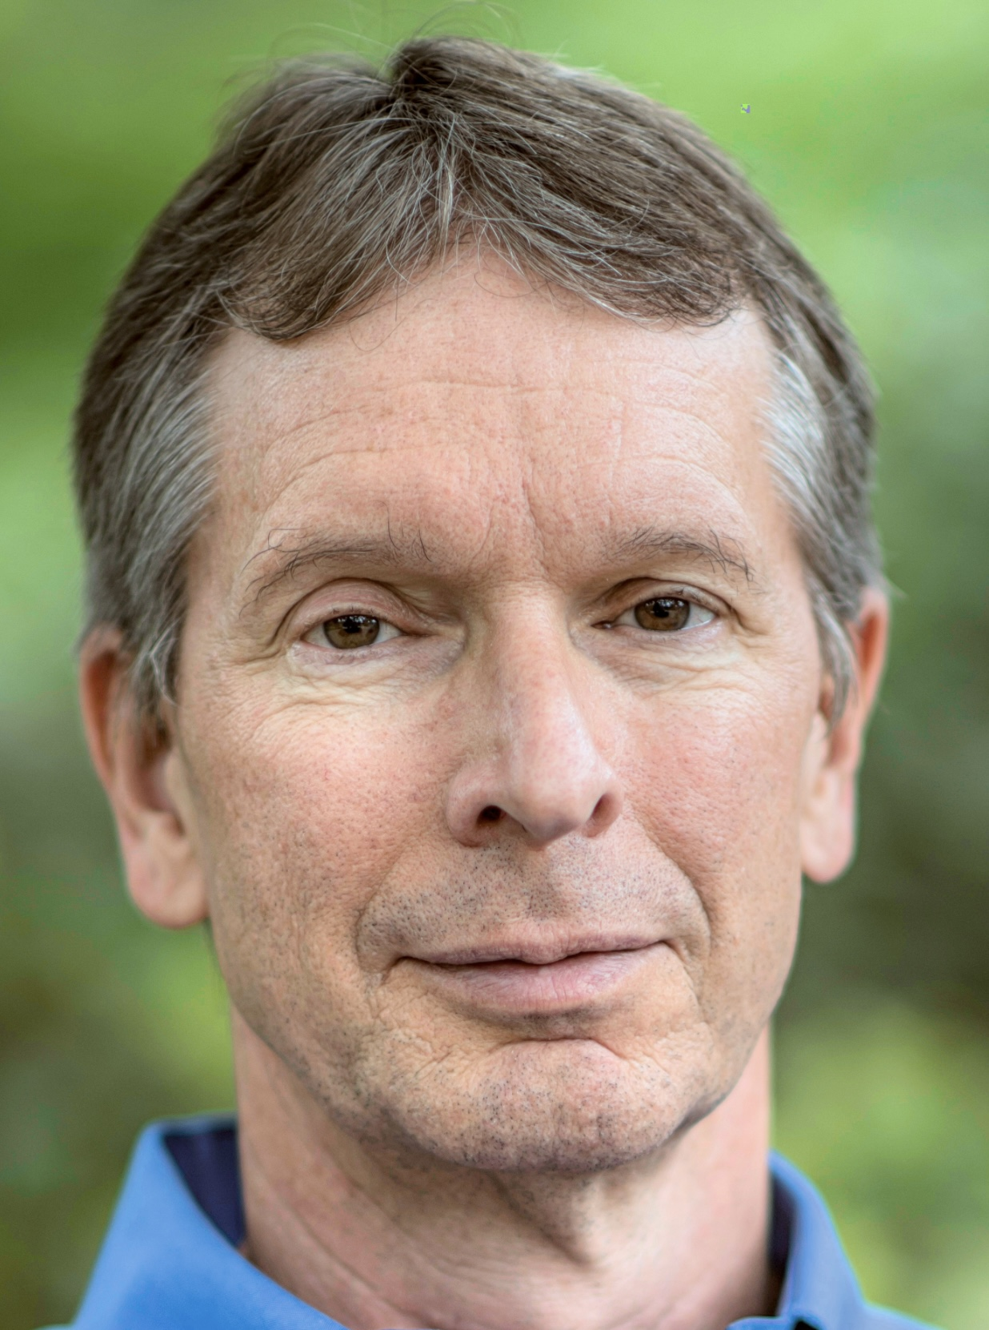
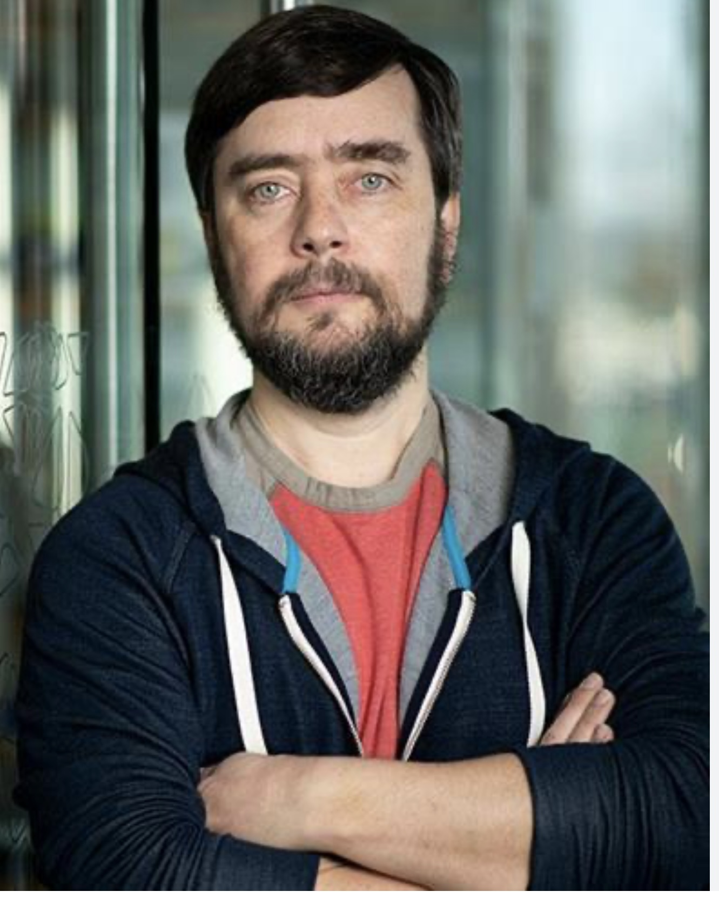
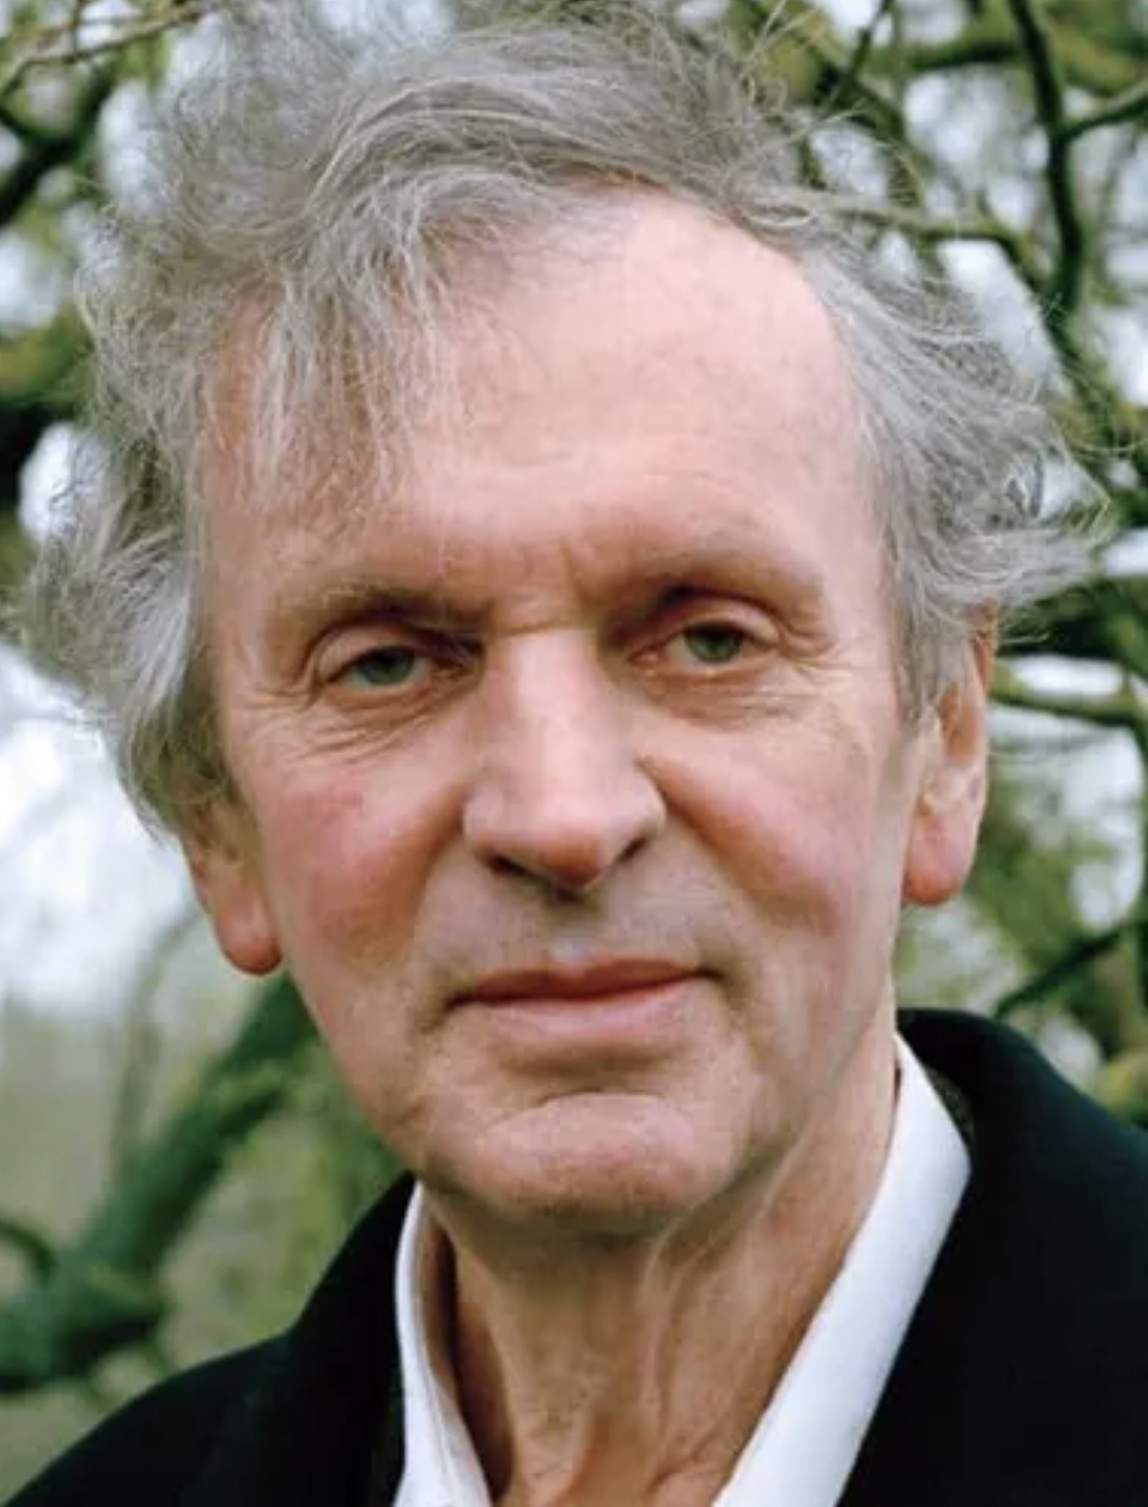

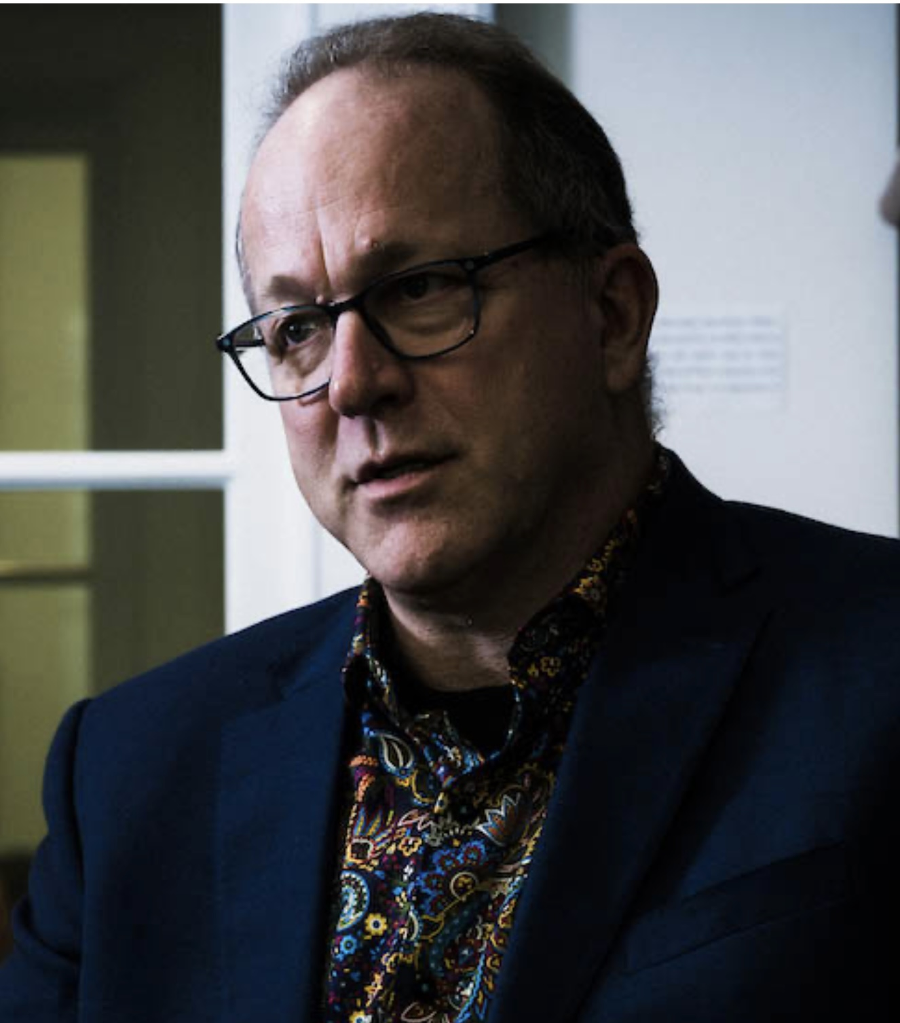
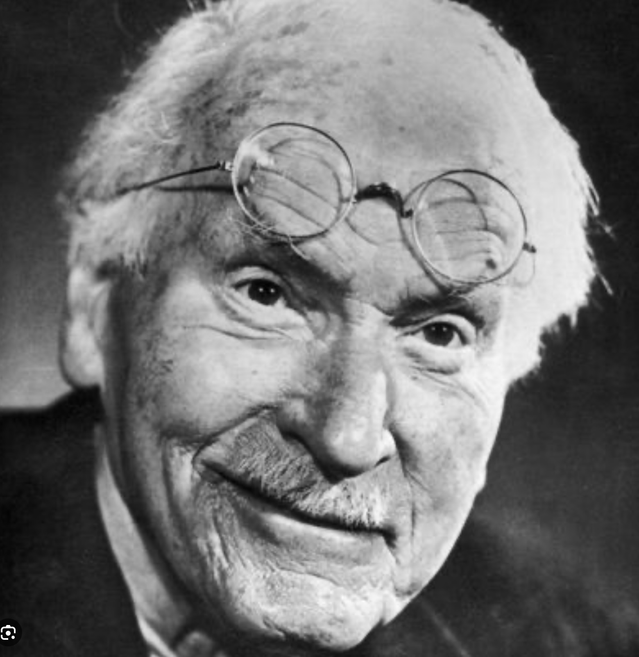
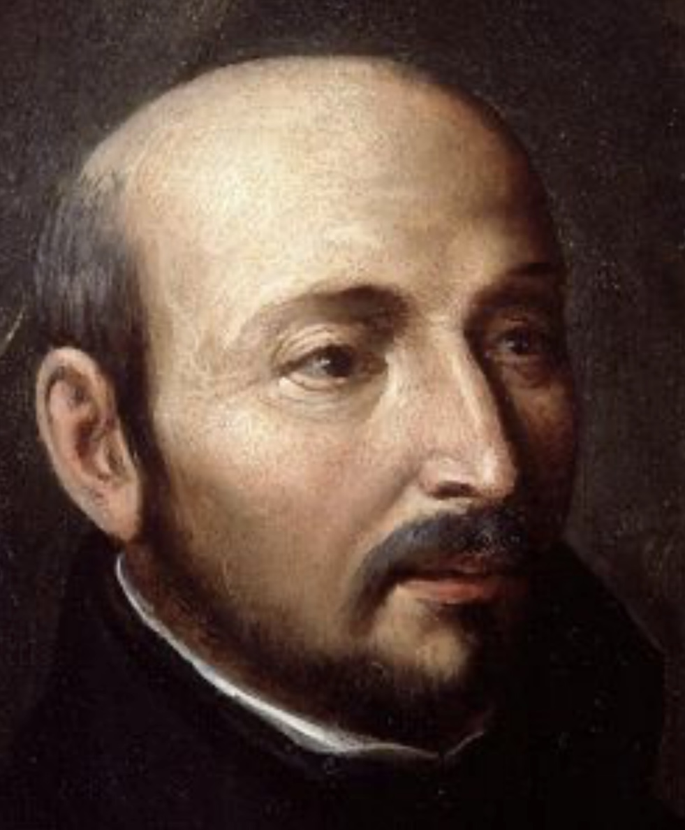
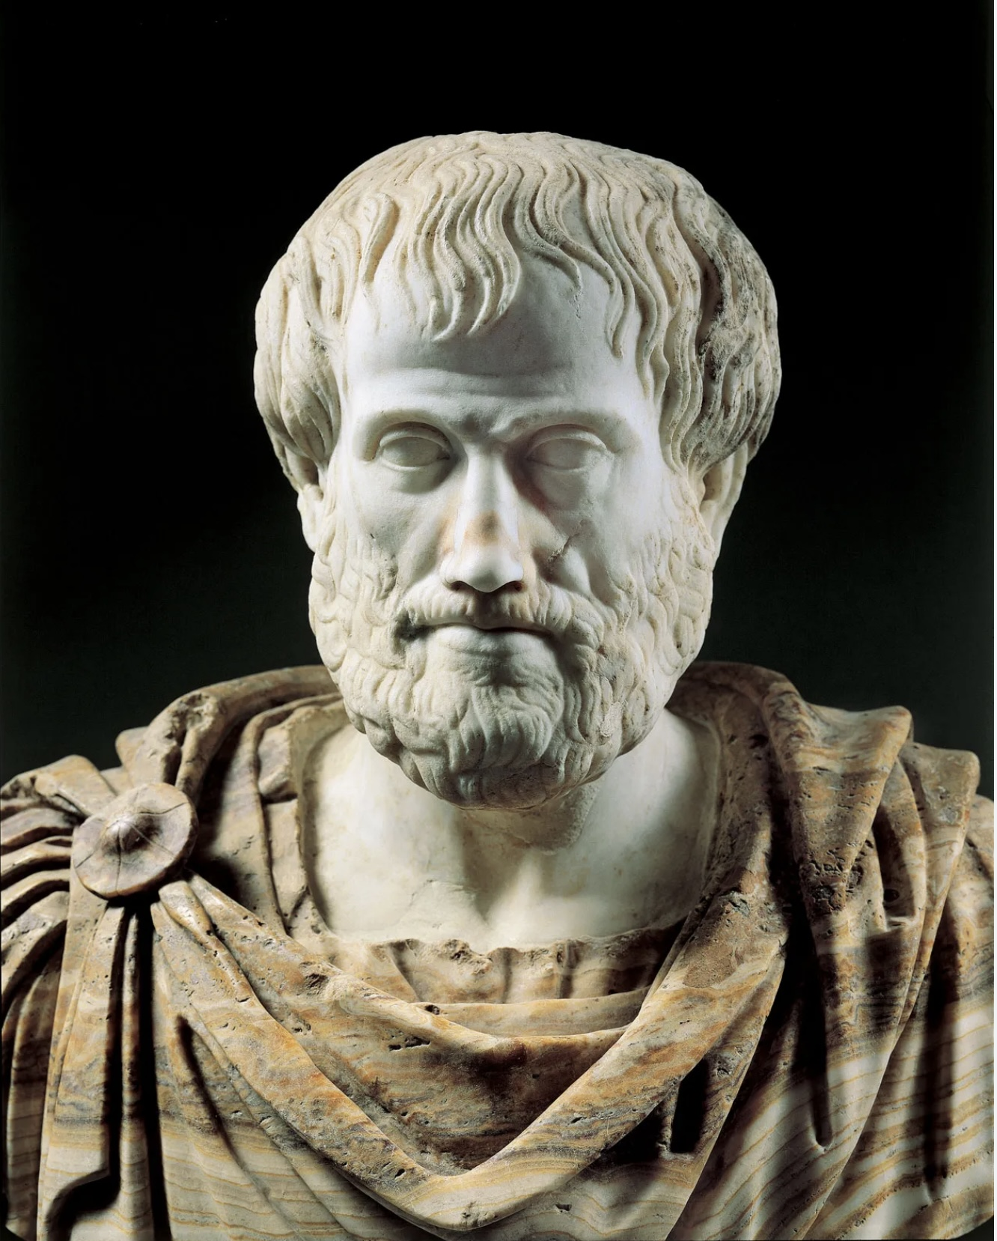
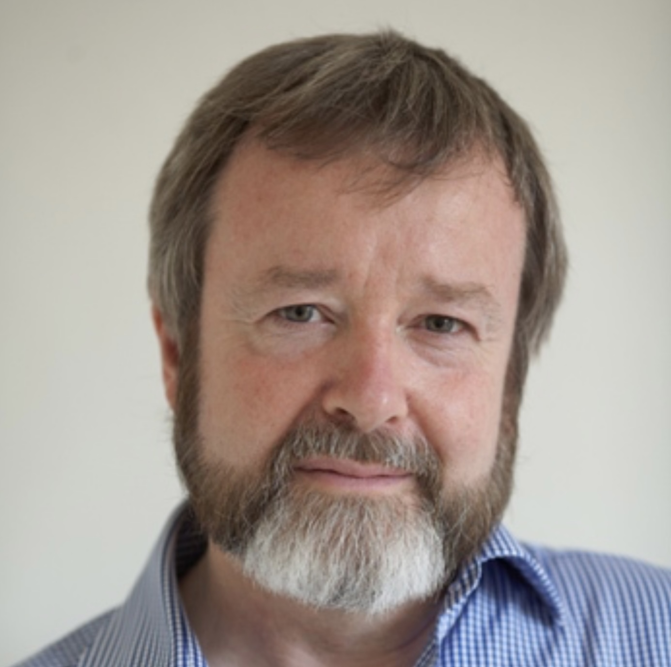
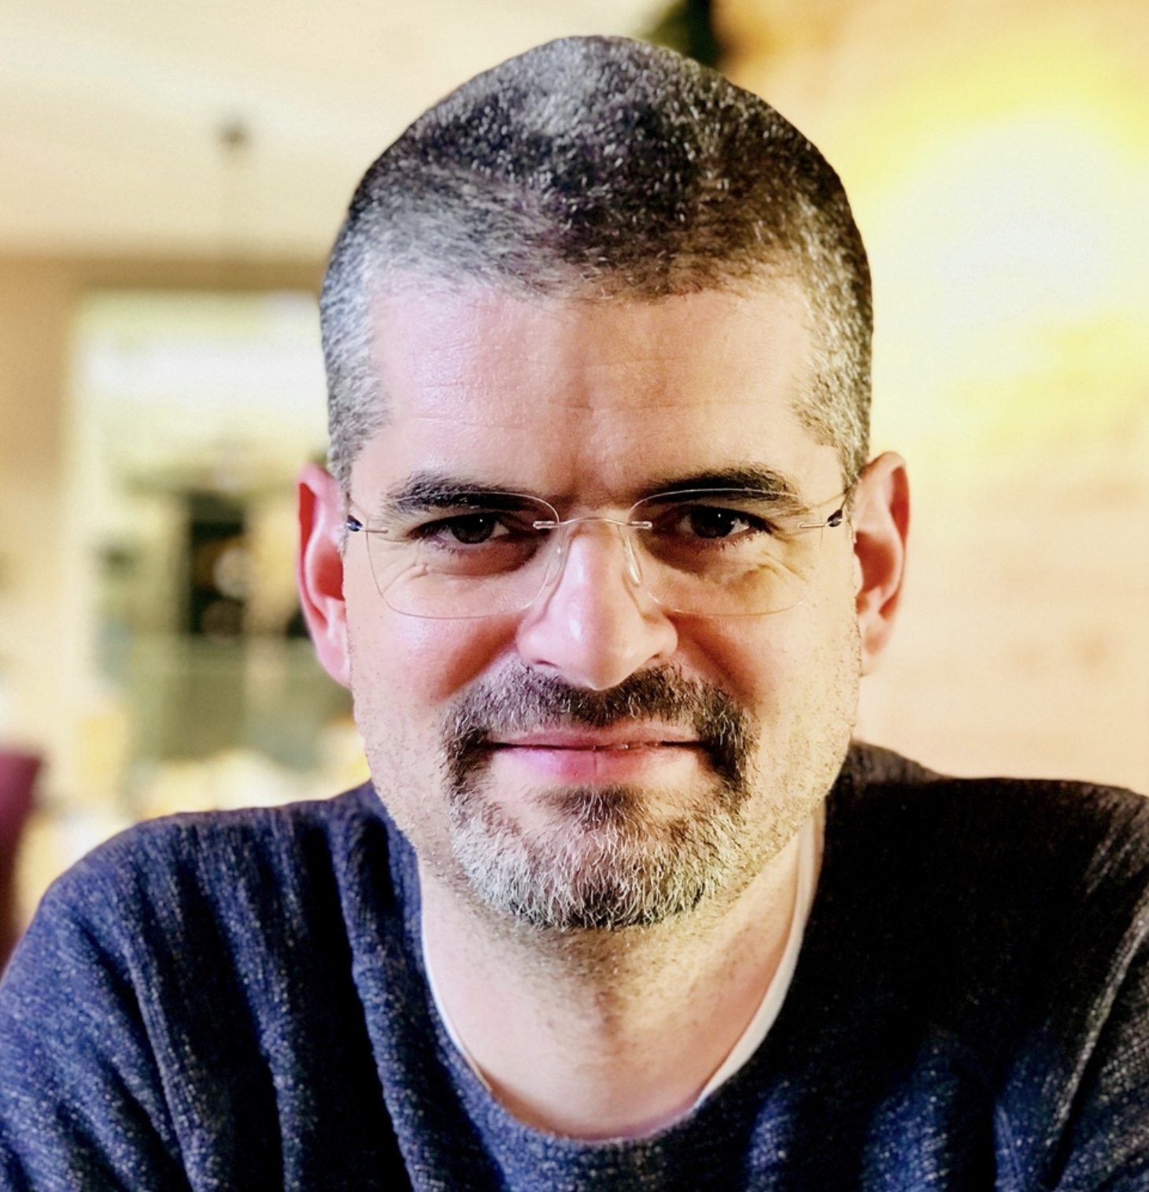
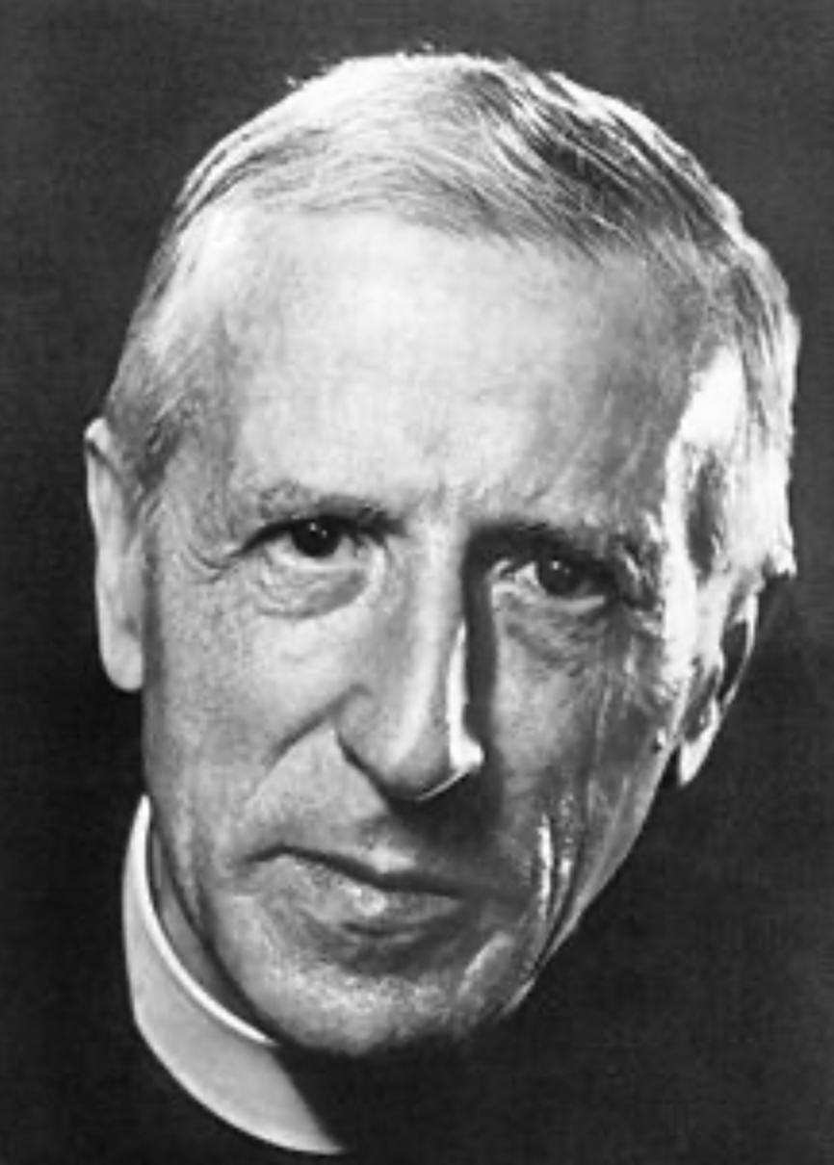
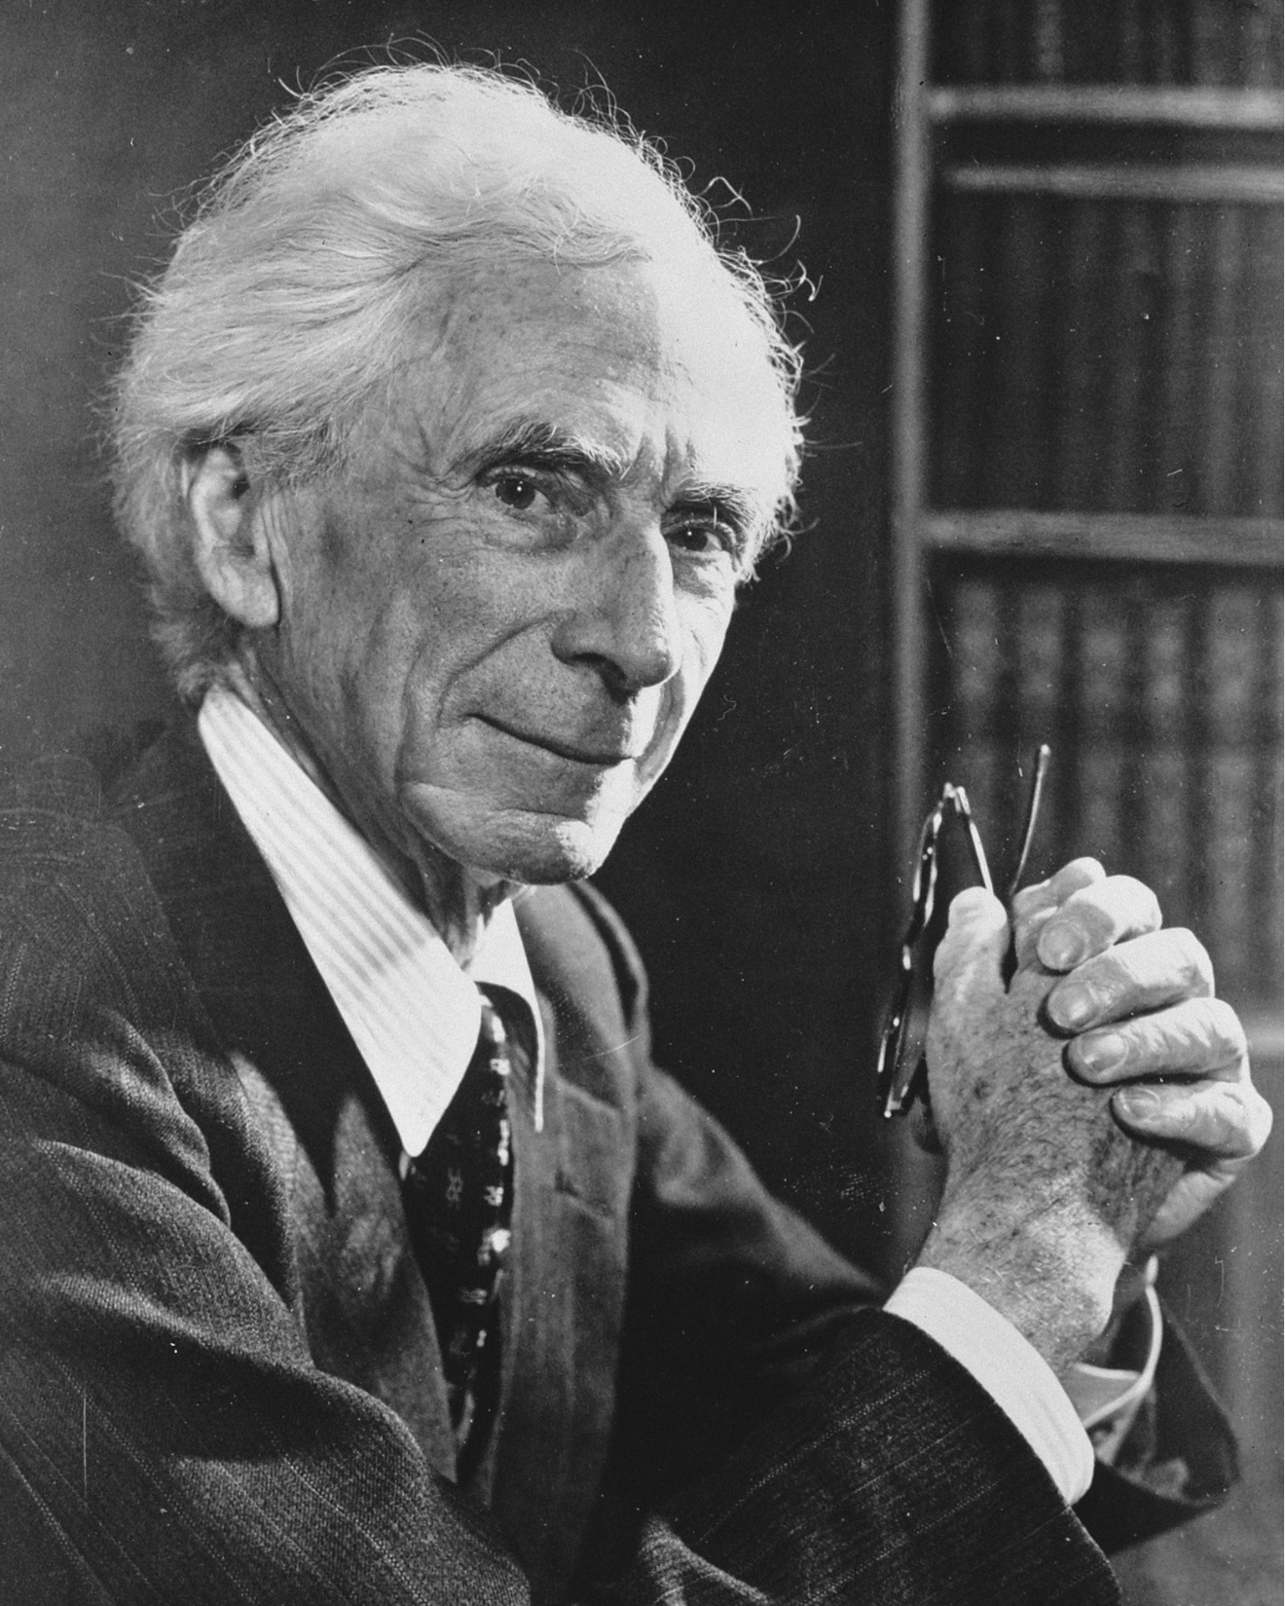
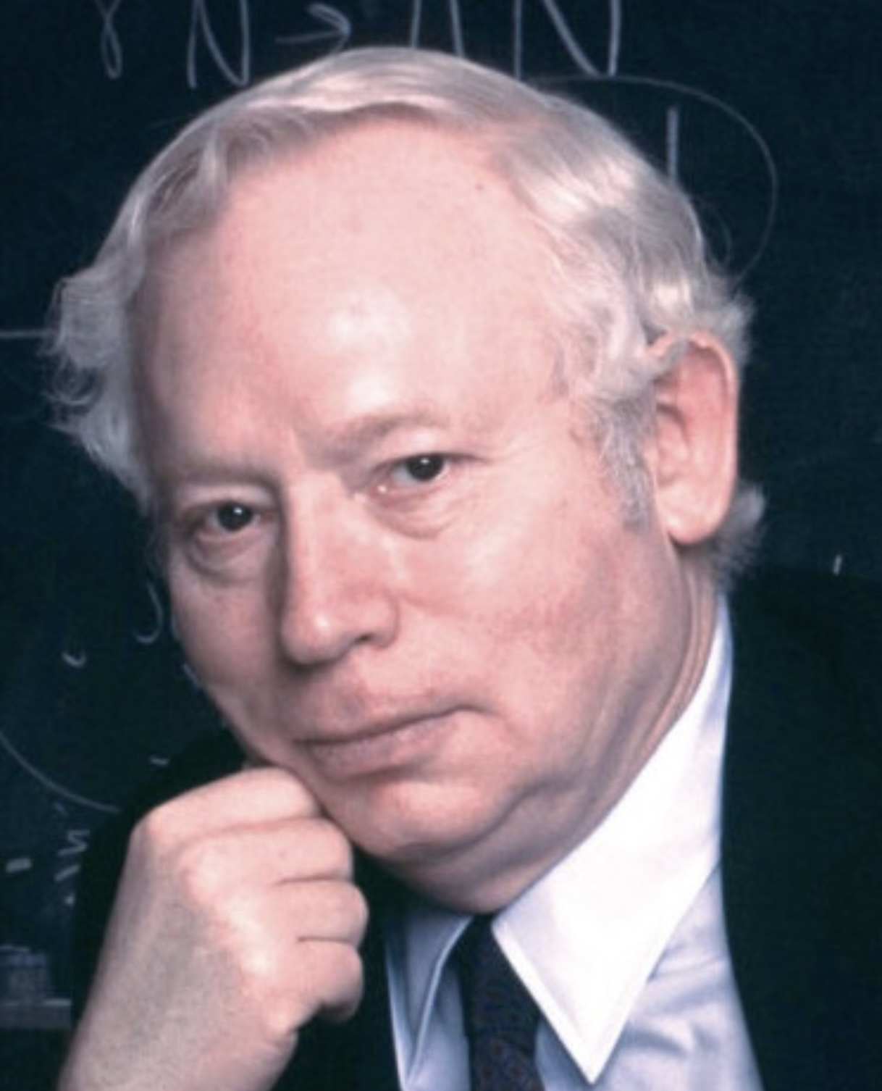
THE PANEL
Donald Hoffman
Michael Levin
Rupert Sheldrake
Ken Wilber
Jeffrey Kripal
C G Jung
Ignatius of Loyola
Aristotle
Ian MacGilchrist
Bernardo Kastrup
Bertrand Russell
Pierre Teilhard de Chardin
Steven Weinberg

Slide 631
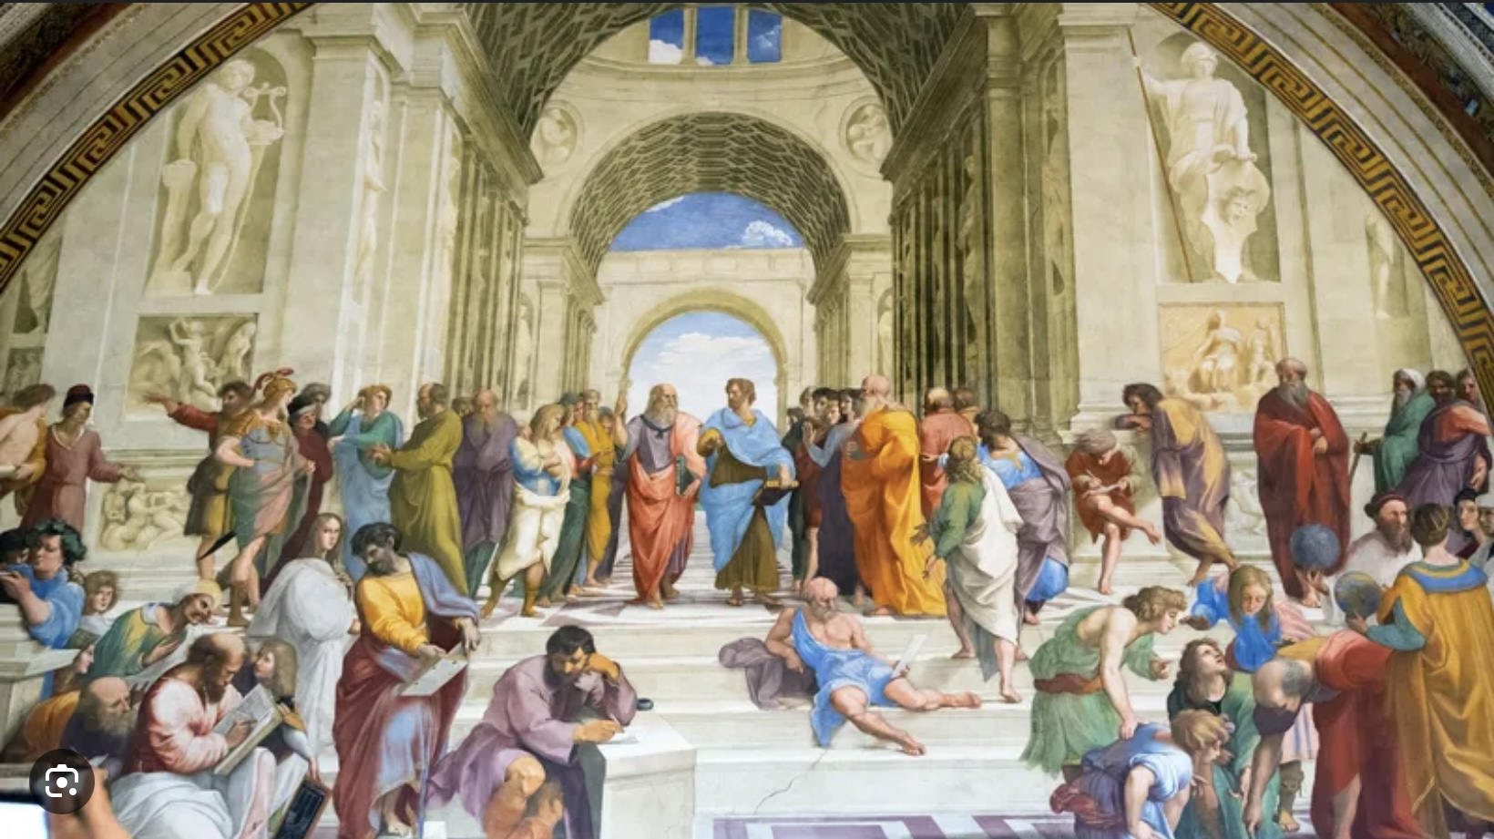
THE DIALOGUE

Slide 632
1) WHAT IS THE UNIVERSE?

Slide 633
Luis-Welcome everyone, I’m thrilled to be hosting this conversation between a panel of great intellectual and spiritual figures. We’ll be informal, with panel members making contributions at any time during the conversation. Panel members, when you speak for the first time, please introduce yourselves. As moderator I will be responsible for keeping us on track and on time.
Now let me remind you of our first question: what is all this, or what is the universe?
Bertrand Russell- Hello, I am honored to be in such illustrious company. I am Bertrand Russell. I existed on the earthly plane from 1872 to 1970. I was a British philosopher, mathematician, logician, historian, social critic, political activist, and public intellectual. I was also awarded a Nobel Prize in literature.
To begin I would like to make two brief comments: Luis, as the channeler of this imaginary panel, are you aware that I once wrote "A stupid man's report of what a clever man says is never accurate, because he unconsciously translates what he hears into something that he can understand." Are you not at risk of misrepresenting the ideas of some of history’s greatest thinkers? Also, this panel consists entirely of men. Are there no prominent women you could have invited?
Luis- Thank you, Lord Russell for those very incisive comments. While I will make every efforts to remain faithful to the views of the panel members, I know I will inevitably fail. I apologize in advance. As to your second point, again I apologize, in my defense, I would suggest that many of the panel members are here only in spirit and that spirit is neither male nor female.

Slide 634
Plato- Since I'm the oldest spirit on the panel I will start our discussion. I lived from 428 to 348 BCE. I was a Greek philosopher, a student of Socrates, and the teacher of Aristotle. I believed that ultimate reality lies not in the changing physical world but in an intelligible realm of forms, and I founded the Academy, the first long-lasting institution of higher learning in the Western world. It’s said that much of Western philosophy, theology, and science grew in dialogue with, or in reaction to my ideas.
Luis- Today you’re most famous for your allegory of the cave. Can you briefly explain to us what you were trying to say?
Plato- Imagine human beings living from childhood in a cavern, their legs and necks bound, able to see only the wall before them. Shadows pass, and these they take for reality. By this image I wished to say that most of us live among appearances, opinions, customs, and half-truths, mistaking them for what is. Education is not the pouring of knowledge into the mind, but the turning of the soul: a painful reorientation away from shadows toward the light that gives all things their being. When one ascends and beholds the sun, the Good itself, he sees not only more clearly, but differently. And when he returns to the cave, he is ridiculed, for those who have never left cannot imagine that their world is incomplete. Thus, the allegory is about awakening: about truth, responsibility, and the difficult task of loving the light enough to endure the journey toward it, and compassionate enough to return.
Luis-you're suggesting an earthly realm of shadows and another "higher" realm. What is that other realm like?
Plato- It is not another place, but another way of seeing. That realm is ordered, intelligible, and stable, where things are known not by their shifting appearances, but by what they are. There dwell the Forms: Beauty itself, Justice itself, Equality itself, unchanging measures by which all earthly things are judged and understood.
The highest of these is the Good, which illuminates all understanding, as the sun makes sight possible. To glimpse this realm is not to escape the world, but to finally understand it.

Slide 635
Luis- Does the Platonic realm exist or is it a metaphor?
Plato-Platonic space is a reality not grasped by the senses but by the intellect alone. It is real not as stone or water is real, but as truth is real: the invisible order that gives the visible its meaning. To call it a “space” is a concession to language; it is more rightly a domain of being, where what is most real is what never changes.
Luis- You believed in the traditional Greek Gods. What is the relation between this Platonic realm and the Greek gods.
Plato- The gods of our stories are images that speak to the soul; the Forms are truths that speak to the intellect. The gods participate in the higher order, they are noble insofar as they reflect Justice, Beauty, and above all the Good. Where myth instructs through image and drama, the Platonic realm instructs through reason. When myth points upward, it is a friend of philosophy; when it distorts the Good, it must be purified.
Luis- What does the allegory say about the creation of the Universe and its fundamental nature?
Plato-The allegory teaches that the universe is not created by a craftsman who molds matter from nothing but ordered by a principle of intelligibility. The source of reality is not a maker standing outside the world, but the Good, like the sun, which does not construct things by force, yet gives being, order, and knowability to all that is. The world we perceive is therefore not false, but derivative: it participates in intelligible forms rather than originating itself. Creation is not an event in time, but a continuous dependence of becoming upon being. If one must speak of a “creator,” it is not a divine artisan, but the Good itself, that by which things are, are ordered, and are worth knowing at all.
Luis- and what is the Good?
Plato- The Good is that by which all things are knowable and all being is sustained. It is not merely one thing among others, but the source of truth, beauty, and existence itself, as the sun is not sight, yet makes sight and growth possible. To know the Good is not to possess it, but to be rightly oriented by it.
Luis- and the Good is more “real” than the physical world Human beings seem to inhabit?
Plato- yes, more real, because it does not come to be or pass away. The physical world participates in reality; the Good grounds it. What changes borrows its being from what does not. Thus the Good is not less real for being unseen, but more real, for it is that by which all else is.

Slide 636
Luis- You believed that there were not just the “shadow like” realm we inhabit and the realm of Platonic forms but also an intermediary realm “anima mundi” or the Soul of the world. This realm was inhabited by Daemons. This sounds a lot like Hinduism subtle body or Christianity realm of the Spirits.
Plato- Ah, my friend, you have listened well between the lines of my dialogues. I never taught that reality is divided only into two realms, the shadow-world of becoming and the luminous realm of eternal Forms. Between them I placed a third, a living bridge: what later thinkers called the anima mundi, the World-Soul. This World-Soul is not abstract like the Forms, nor gross like bodies. It is a field of living intelligence, woven of number, harmony, and motion, through which the Forms are translated into time and matter. It is what allows Beauty to appear in a face, Justice in a city, and Goodness in a life. Within this intermediate realm dwell the daimones. They are neither gods nor mortals but messengers and mediators. They carry prayers upward and inspiration downward. They shape dreams, intuitions, callings, and the strange urgings of conscience. Through them, the eternal speaks to the temporal. You are right to hear echoes here of other wisdoms. The Hindu speaks of a subtle body and higher planes of being; the Christian of angels and spirits; the Neoplatonist of intelligences and souls. These are not contradictions, but many tongues pointing to the same middle realm, the realm where meaning, image, and purpose take form before entering the physical world. Thus, the cosmos is not a dead machine, but a great ensouled organism. Between the invisible and the visible there is always a living conversation, and the daimones are its voice. And the human soul, standing at the crossroads of these worlds, must learn to listen.
Luis- What is the human Soul and what crossroads does it exists at?

Slide 637
Plato- here we come to the very heart of my philosophy. I conceived the human soul as a being that stands at a three-way crossroads of reality. It is born into the body, it is shaped by the World-Soul, and it is oriented toward the eternal Forms. You are not merely in the cave, nor merely in heaven, you are the hinge between them.
In the Republic I described the soul as having three powers:
Appetite (epithymia). This binds you to the body, hunger, sex, fear, comfort, survival. It is tuned to the material world of change.
Spirit (thymos). This is your fire, courage, pride, shame, honor, anger, the urge to be seen. It resonates with the World-Soul and the daimonic realm. It is where symbols, ideals, and emotions move you.
Reason (logos) This is not merely calculation, but the power to recognize truth. It is kin to the Forms themselves, Beauty, Justice, Goodness. These are not parts in space but levels of attunement.
The human soul lives at the meeting point of:
The Sensible World | Bodies, time, decay | Sensation, desire, fear
The World-Soul | Living meanings, images, archetypes | Emotion, imagination, conscience, dreams
The Forms | Eternal intelligible truth | Insight, knowing, moral clarity

Slide 638
You feel this tension constantly: You desire pleasure. You feel called by meaning and You glimpse truth. These are three different gravitational pulls acting on one soul.
You experience inner conflict because you belong to all three worlds at once. Your body wants comfort. Your spirit wants significance. Your reason wants truth. This is why you feel torn, restless, and incomplete, not because you are broken, but because you are ontologically stretched between realms. The soul is not meant to collapse into one world, but to harmonize them. That harmony is what I called justice in the soul.
When the soul remembers its true origin, the realm of Forms, it begins to turn upward. This is not an escape from life, but a re-ordering of it: Desire becomes disciplined, emotion becomes ennobled, reason becomes luminous and the soul becomes what it always was meant to be: a living bridge between heaven and earth.

Slide 639
Luis- The material world seems very similar to the Hindu concept of the Gross body. Is the Good similar to the Hindu concept of the causal body? If so, is there in your philosophy a subtle body?
Plato- you speak in another mythic tongue, but the intuition is akin. The visible world may be likened to what Hinduism calls the gross body; the Good to that deepest principle which gives being and intelligibility in Hinduism the causal body. Between them, yes, there is a middle realm: the soul itself, especially the rational soul, which apprehends Forms and mediates between becoming and being. I did not name it “subtle body,” as the Hindu’s did, yet I taught that the soul is ordered in levels, and that only when it is properly harmonized can it turn toward the Good.
Luis- Thank you Plato. Let’s now turn to your student Aristotle. Aristotle, there a famous painting by Raphael called the school of Athens in which You and Plato are the central figures of the painting. Raphael tried to captures your philosophical differences from your teacher Plato by having you point downwards at the earth while Plato pointed upwards at the heavens. How does that illustrate the differences between yours and Plato’s philosophical approach?
Aristotle- I'm Aristotle. I lived from 384 to 322 BC. I was a Greek philosopher and polymath. I was a student of Plato who was a student of Socrates. I was a tutor to Alexander the Great. Raphael understood us well. Plato gestures upward to what is eternal and separate, the Forms apprehended by intellect alone. I point downward not to deny those principles, but to insist that they are discovered within the world we experience. Form is not elsewhere; it is immanent in things themselves. Where Plato begins with what must be true to make knowledge possible, I begin with what is, observed carefully, and ask what principles are at work within it. We sought the same truth, but by different paths.

Slide 640
To the question "what is all this, what is the universe?“ I believe the universe was created by an eternal, and immaterial being. This “prime mover” is not a personal deity with humanlike attributes, but rather a transcendent and perfect being that imparts motion and order to the cosmos through Its existence.
The Earth is spherical and at the center of the universe. The sun, moon, planets and all the fixed stars revolve around it. The earth is imperfect and changeable while everything we see in the sky above us is perfect and unchanging.
Matter is fundamentally one thing though it changes in form and quality. The four primary qualities of matter, fire, earth, water and air, are constituted of combinations of two pairs of opposites; hot – cold and wet – dry. The combination of these opposites determines how matter appears: fire=hot + dry, earth=dry + cold, water=cold + wet and air =wet + hot.
I also think that what humans perceive to be what is out in the world, for example trees, animals, and other objects is what those things are really like.
Luis-Thank you, Aristotle, for giving us such a concise summary of your views. Your views were adopted and incorporated by the Catholic Church into its theological teachings and were, until recently, part of Western culture’s dominant “The story".
The findings of the scientific revolution falsified many of your theories. Our view of “what this all is”, has changed. I can’t think of anyone better qualified to provide us with the current physicalist scientific views on the universe than Steven Weinberg.

Slide 641
Steven Weinberg-Thank you. I'm Stephen Weinberg an American theoretical physicist and cosmologist. I was born in 1933 and died in 2021. I made contributions to the understanding of the early universe, the formation of galaxies, and the nature of dark matter. I was awarded a Nobel Prize in physics in 1979.
I take a philosophically physicalist perspective believing that the fundamental constituents of the universe are physical matter and energy, and that all phenomena, including consciousness, can be explained in terms of these processes. I believe that the natural world is all that exists and that everything can be understood through the scientific method and the laws of nature. Philosophical physicalism excludes the existence of God, spirits or souls. This has been the dominant perspective in the natural sciences since the 19th century.
Current cosmological theory suggest that the universe originated 13.8 billion years ago in what we call the big bang. It has been expanding ever since, and the rate of expansion is accelerating due to dark energy. The universe is made of matter, and energy and of dark matter and energy. What preceded the big bang is still a topic of debate and speculation. Some theorists propose the big bang emerged from quantum fluctuations in a vacuum; others postulate a cyclical universe where big bangs happened repeatedly. Ultimately the cause of the Big Bang remains a mystery.
Philosophers call Aristotle's view that what we perceive is what is really out there, naïve realism. Although naïve realism appears to be common sense, philosophy and science have shown beyond any doubt that what humans perceive is not what is out there.
What then, is out there? Currently quantum field theory or QFT, gives us the best description of what is out there . QFT is a theoretical framework in physics that combines quantum mechanics with special relativity to describe the interactions of elementary particles as fields. QFT tells us particles are not discrete objects but rather excitations of underlying fields that permeate all of space.

Slide 642
According to QFT, particles such as electrons, photons, or quarks, are associated with a specific field. These fields can interact with each other by exchanging excitations, or energy. The “standard model” describes 17 elementary particles each with its corresponding quantum field. Particles are therefor not material objects but rather energy excitations of their respective quantum fields.
Luis- Thank you Dr. Weinberg. I appreciate your brevity. Below you will find several appendixes that go in greater detail into the topics our panel is discussing. Appendix 1 explores the evolution of our understanding of the universe.
Big bang cosmology has encountered some challenges. One particularly thorny problem is the issue of fine tuning. Fine-tuning refers to the fact that many of physical constants and initial conditions of the universe appear to be remarkably precisely finely tuned to allow for the existence of life as we know it. Many fundamental parameters in physics, such as the strength of the gravitational, electromagnetic, and nuclear forces, as well as the masses of elementary particles, seem to be finely balanced in such a way that even small changes to them would render the universe inhospitable to life.
Fine-tuning is often discussed together with the anthropic principle, which suggests that the universe must be compatible with the existence of observers, such as humans, because we are here to observe it.
Proponents of intelligent design argue that fine tuning strongly suggests that the universe is not simply the result of chance, as a physicalist cosmology would have it, but that there is design or purpose to it. Implying a designing intelligence.
To try to salvage their atheistic perspective, cosmologists have put forth the multiverse hypothesis. It postulates the existence of a very large, perhaps infinite, number of universes, each with its own set of physical laws, constants, and properties.

Slide 643
According to the multiverse theory, our universe is just one of many, it arose by chance and just happens to have the right parameters to permit life. The vast majority of universes in the multi-verse don’t have the right parameters for life to arise in them.
Critics of the multiverse theory respond pointing out that this theory 1) violates Occam's razor which is the principal in philosophy and science that suggests that when considering competing explanations or hypothesis the simplest one is usually the best, and 2) the theory is unprovable since from our universe we cannot observe other universes. This makes the multiverse theory not physics but metaphysics.
Bertrand Russell- to add to what Steven said, it’s important to remember that a science such as physics does not describe what the universe, matter and energy, are. Physics only describes mathematically, how things in the universe behave. How things behave is the purview of science, their essence or what they fundamentally are, that of metaphysics.
Bernardo Kastrup-I'm humbled to be in such distinguished company. I'm Bernardo Kastrup, I was born in 1974 in Rio de Janeiro and now live in The Netherlands. I have a PhD in computer engineering and worked at CERN, The European organization for nuclear research, helping to design their particle accelerator. I left that position to get another PhD in philosophy. I have written 12 books about philosophical idealism and regularly contribute to Scientific American magazine.
I am now the executive director of the Essentia foundation which aims at communicating, in an accurate yet accessible way, the latest analytical and scientific indications that metaphysical physicalism is fundamentally flawed.

Slide 644
Indeed, clear reasoning and the evidence at hand indicate that metaphysical idealism or non-dualism, the notion that nature is essentially mental, is the best explanatory model we currently have. This is known in specialist communities, but hasn't yet been openly communicated, in an accessible manner, to the culture at large. The Essentia foundation hopes to help close this communication gap.
Bertrand is right, Physics describes how nature behaves not what it is. Newtonian physics was a model that treated fundamental particles as if they were very small lumps of matter. Assuming that, helped Newton develop an accurate mathematical way of describing how macroscopic nature behaves.
Quantum theory, however, revealed that particles aren’t small bits of matter and that a model that treats them as energy excitation of one of 17 quantum fields helps describe nature’s behavior even better. The assumption that nature is made up of small lumps of matter has been refuted by modern science but persists in our culture.
Throughout the ages philosophers have tried to understand what the fundamental nature of the universe is. Our perception tells us that there are two types of things: mind or consciousness and matter or physical objects. From this a number of possibilities arise 1) mind is fundamental and matter arises from it. This is the view that I support and has been the dominant view across diverse cultures and time 2) matter is fundamental and mind arises from it. This is the view that pervades our culture, and that philosophically naïve scientists cling to despite the devastating evidence against it. I present that evidence in two of my books and summarize it on an essential foundation video entitled “Analytical idealism course”. 3) both mind and matter are fundamental which was the view put forth by Rene Descartes or 4) mind and matter are both aspects of some other fundamental thing. This is a philosophical position known as dual aspect monism.

Slide 645
Luis- For those who would like to explore these ideas in more detail I’ve also posted below two appendixes, the first outlines the history of metaphysics and traces the origins and development of both metaphysical idealism and physicalism. (appendix 2) The second summarizes some of Bernardo’s ideas. (Appendix 3)
Dr. Hoffman, I know you agree with most of what Bernardo said. Your work also probes the fundamental nature of reality. I wonder if you would care to share some of your ideas with us.
Donald Hoffman- Hello, I’m happy to be here. I’m Donald Hoffman. I was born in 1955, I’m a cognitive psychologist and professor of cognitive sciences at the University of California, Irvine. I’ve done research on visual perception, consciousness, and the nature of reality. My work challenges traditional views of perception and reality, proposing that our perceptions are not a direct representation of the world, as Aristotle and naïve realists suggest, but rather a user interface created by our brains to help us navigate and survive in the world.
My work on perception, consciousness, and the nature of reality is grounded in mathematics and physics and draws on evolutionary theory, Quantum mechanics, and Information theory. This work is in line with theories proposed by physicists such as John Archibald Wheeler and Max Tegmark. I have written three books including the 2019 “The case against reality: why evolution hid the truth from our eyes.”
“User interface theory”, has sparked much debate and discussion in the fields of psychology, philosophy, and cognitive science.
“User interface theory”, proposes that our perceptions of reality are not a direct representation of the world, but rather a simplified user interface that our brain constructs to help us navigate and survive in the world. Beyond this interface there may be a deeper, more fundamental reality that is not constrained by the limitations of our perceptions.

Slide 646
Our perceptions are shaped by natural selection to provide us with useful information rather than an accurate representation of reality. Perceptions are more like a desktop interface, or screen, on a computer, simplifying complex information to make it user friendly. The user interface makes it manageable for our brains to use the information being processed in the “computer” efficiently .
“User interface theory” also proposes that the fundamental constituents of reality are not physical objects or particles, but rather conscious agents and their interactions. Meaning that behind the user interface, fundamental reality is made up of conscious agents interacting with each other. These conscious agents may not be physical entities as we traditionally understand them, but rather fundamental elements of reality that give rise to our perceptions and experiences.
This means that the true nature of reality is beyond our perceptions and is fundamentally based on conscious experiences and interactions. Fundamental reality may operate based on principles and dynamics that are not bound by space-time or by the laws of physics, as we currently understand them. Fundamental reality may involve complex interactions and information processing that go beyond our sensory experiences and cognitive abilities.
While the details of what lies beyond the space-time user interface are not yet clear, the theory suggests that there may be a rich and intricate reality that underlies our everyday perceptions. The theory challenges conventional views of the universe and raises questions about the nature of consciousness, reality, and the relationship between the two.
Luis- You said that beyond the interface that is the world as we perceive it, there may be a deeper more fundamental reality that is not constrained by the limitations of our perceptions and that the fundamental constituents of reality are not physical objects or particles, but rather conscious agents and their interactions. What’s the nature of these conscious agents and how do they affect the material world foe example our minds?

Slide 647
Donald Hoffman -Think of conscious agents as the true players behind the scenes, simple systems defined by experiences, decisions, and actions. They are not little people in the head, and they are not made of particles. They are mathematical structures that interact with one another, exchanging experiences much like nodes in a network.
What we call the “physical world,” including brains and minds, is not fundamental, it’s a user interface our perceptions construct to help us survive, not to show us the truth. Your mind is not produced by the brain; rather, the brain is a symbol in the interface for deeper interactions among conscious agents. Consciousness doesn’t emerge from matter; matter emerges from consciousness.
Luis -It’s a realm that is difficult to imagine. Is there an overlap between it and Platonic spaces?
Donald Hoffman – Yes, there’s a deep resonance, though the languages differ. Plato’s Forms and what I call conscious-agent dynamics are both non-physical realities that ground the world we perceive. Platonic spaces gesture toward an abstract, timeless structure underlying appearances; my work suggests that structure is made of interacting conscious agents rather than static objects or laws. So, you can think of Platonic spaces as an early intuition of a reality beyond the perceptual interface, one we’re now trying to model mathematically in terms of consciousness itself.
Luis- These conscious agents are not conscious in the way human beings are, that is meta-conscious or aware that we are conscious?
Donald Hoffman- Exactly. Most conscious agents are not meta-conscious. In my framework, the fundamental agents have experiences and make choices, but they are not aware that they are conscious. Human self-reflection, consciousness turned back on itself, is a very special, higher-order construction. It’s like the difference between seeing and knowing that you are seeing. So meta-consciousness is not fundamental; it’s an emergent property of certain complex networks of conscious agents, one that evolution happened to discover in us.

Slide 648
2) WHAT IS LIFE?

Slide 649
Luis- Thank you Dr. Hoffman. Below, I've posted a brief summary of your groundbreaking work. (Appendix 4 ) For those who are intrigued by your ideas and would like to learn more about them, I suggest they read your book or watch your many YouTube videos .
The question we’ve asked in this section was "what is the universe?“. we could undoubtedly spend a lifetime pondering this question, but we have other questions we want to consider. Before moving on to the next section, I would like to try to capture, with two quotations, the spirit of what our panelists have so far proposed.
The first quotation is from Werner Eisenberg: "not only is the universe stranger than we think, it is stranger than we can think" and second is from Sir James Jeans. He wrote, echoing the sentiment of so many of the greatest scientists and philosophers who ever lived, “The universe begins to look more like a great thought than like a machine. Mind no longer appears to be an accidental intruder into the realm of matter… We ought rather to hail mind as the creator and governor of the realm of matter.“
On that note, let’s move on to our second question: “what is life?”
Let’s start by quoting a definition of "life" taken from a biology textbook: "biologists define life as a characteristic that distinguishes living organisms from non-living objects or inanimate matter. According to biology, life is typically characterized by the presence of certain key features, such as cellular organization, metabolism, growth, adaptation, response to stimuli, reproduction, and evolution. These characteristics collectively define what is considered to be alive and form the basis for the study of living organisms and their interactions with their environment.“

Slide 650
Michael Levin- I'm a biologist who first trained as a computer scientist, so I feel compelled to address the question of what life is. I'm Michael Levin, I was born in 1969. I research regenerative medicine, developmental biology, and bioelectricity. I’m the Vannear Bush Professor of biology and director of the Allen discovery Centre at Tufts University. My work explores the role of bioelectrical signals in controlling cell behavior, pattern formation, and regeneration in living organisms.
This may surprise some people, but biologists have a great deal of difficulty defining life. Some organisms such as viruses have some of the characteristics of life described in the quote you read, but not all. Are viruses living organisms? I prefer to define life as a dynamic process that involves the continuous interaction and communication between cells and tissues within an organism.
In my work I study the importance of bioelectrical signals in controlling cell behavior and pattern information during development and regeneration. Bioelectricity plays a crucial role in orchestrating complex biological processes and shaping the form and function of living organisms.
Biologists used to think at all the information necessary for the development of an organism was contained in its DNA. We now know that's not so, the DNA may code for the hardware, or the "bricks" that make up cells, but it is electrical fields that direct how that hardware is put together. This is a new and enormously exciting field about which we know next to nothing.

Slide 651
Rupert Sheldrake- My name is Rupert Sheldrake and I’m a British biologist and author. I developed the concept of “morphic resonance”. My work was inspired by several key figures 1) Charles Darwin 2) Carl Jung on whose concepts of the collective unconscious and archetypes I drew. 3) Henri Bergson, especially his ideas on creative evolution and the nature of consciousness. 4) Alfred North Whitehead and his ideas about the interconnectedness of all things and 5) Gregory Bateson work on systems theory, cybernetics, and the interconnectedness of mind and nature.
Morphic resonance, proposes that there is a field like collective memory that influences many processes.

Slide 652
Morphic fields, also known as morphogenetic fields, are fields that organize the structure and pattern of form in nature. These non-material fields are an evolving collective memory that influences the development and behavior of systems such as living organisms. I propose that morphic fields underlie the behavior of not only biological structures but also social systems. Morphic fields provide a framework for understanding how patterns and information are transmitted across space and time. My work challenges traditional notions of biological inheritance and evolution, proposing a more holistic and interconnected view of the natural world.
I have explored and empirically researched a variety of settings where morphic fields could potentially be at work:
1) Morphic fields could influence social behaviors and interactions in groups of animals. For example, the idea that flocks of birds or schools of fish are able to move and coordinate their actions in a synchronized manner could be attributed to a shared morphic field that guides their behavior.
2) Morphic fields may play a role in guiding the development of organisms. For instance, the process of embryonic development and the formation of specific body structures could be influenced by morphic fields that contain information about the desired form and function of the organism. This is where my work most overlaps with Michael’s.
3) Morphic fields could be involved in the transmission of learned behaviors and memories across generations. This idea suggests that patterns of behavior and knowledge could be passed down through a collective memory encoded in morphic fields.
4) Morphic fields could play a role in cultural evolution, influencing the transmission of ideas, beliefs, and practices within human societies. This concept implies that there is a shared field of information that shapes cultural norms and behaviors.

Slide 653
Across these various settings, I have explored how morphic fields could potentially explain patterns and phenomena in nature that are not easily accounted for by traditional scientific explanations.
While the existence and mechanisms of morphic fields remain controversial and subject to further investigation, they offer a unique perspective on the interconnectedness and organization of living systems.
I have had several conversations with Michael Levin, and I am a great admirer of his work. He’s told me that my work has also influenced him. While there are some differences in our concept of fields there are also some intriguing similarities.
The main difference is that Michael’s bioelectric fields can be entirely explained under current physics while morphic fields still cannot.
Some of the similarities between morphic, bioelectric and quantum fields are:
1) Both quantum and morphic fields are non-material entities that exist beyond the physical realm.
2) Bioelectric fields, morphic fields, and quantum fields are all thought to influence the behavior and organization of systems: a. Bioelectric and morphic fields play a role in guiding the formation and behavior of tissues, organs, and whole organisms and b. Quantum fields determine the properties and interactions of particles at the quantum level.
3) All three types of fields involve the transfer of information that guides the behavior and properties of systems. Bioelectric fields transmit electrical signals that regulate cellular processes, morphic fields contain a collective memory that influences patterns of form and behavior in living organisms, and quantum fields encode information about particle properties and interactions.
4) All three fields also represent a more holistic perspective on the nature of reality, suggesting that there are underlying fields that connect and influence diverse phenomena. They provide frameworks for understanding the interconnectedness of biological development, living systems, and quantum phenomena.

Slide 654
Luis- Rupert, I’ll ask you the same question I asked Donald: Your morphogenetic fields are a little easier to imagine than Donald’s conscious agents that are the fundamental constituents of reality. Is there an overlap between these two and between them and Platonic spaces?
Rupert Sheldrake- Yes, I think there is a strong family resemblance. Morphogenetic fields, like Platonic Forms, are not material things but organizing patterns that shape processes in time. They are more like habits or memories of nature than fixed laws. In that sense, Plato intuited something very real: formative principles that are not reducible to matter.
Where Donald speaks of conscious agents, I speak of fields with an intrinsic mental or experiential aspect. We differ in emphasis, but we are pointing toward a similar idea, that the universe is structured by non-material, non-local patterns, and that mind is woven into the fabric of nature rather than emerging accidentally from it.
Luis- Thank you Dr. Sheldrake. Appendix 5 below, summarizes some of your ideas. Quantum field theory offers us a mathematically extremely accurate model of fundamental reality representing elementary particles as energy excitations of quantum fields. Morphic resonance suggests that fields not only organize energy at the quantum level, but they also organize biology, social behavior, learning and memory, and cultural evolution. Is this more evidence that the universe seems more like mind than machine? How does a concept like morphic fields address the question of what life is?
Would anyone like to take a stab at that question?

Slide 655
Bernardo Kastrup- I think that from the big bang until the moment life first arose, universal mind was a single experiential consciousness whose mentation is becoming increasingly more complex. I’ve postulated that dissociation, as happens in structural dissociation theory and dissociative identity disorder, is a fundamental phenomenon in the universe. Life arose as a dissociation of a “part” mind from universal mind. Once that part mind dissociated it reproduced and evolved by Darwinian natural selection.
Picture an eddy or whirlpool in a stream. The eddy is both separate from, and a part of, the stream. Just as whirlpools in a stream form and dissipate, life or individual consciousnesses form, (dissociate) and dissipate (die) within universal consciousness. Individual consciousnesses arise as localized patterns of experience within universal consciousness but are ultimately always a part of that universal consciousness.
A dissociated mind perceives universal mind as separate from itself just as a dissociative identity disorder “alter” might perceive other alters as separate from itself even thought they both are parts of the same mind. Similarly, we humans see universal mind from across a dissociative boundary, and it looks like the universe and separate from us even thought we are apart of it. This concept emphasizes the interconnectedness of all consciousness and suggests that individual identities are temporary manifestations within a larger, unified consciousness.
Luis- Same question Bernardo, is there an overlap between your universal mind, Rupert’s morphogenetic fields, Donald’s conscious agents that are the fundamental constituents of reality, and Platonic spaces?

Slide 656
Bernardo Kastrup- Yes, there is a deep overlap, once we strip away differences in metaphor. Plato’s realm of Forms, Rupert’s morphogenetic fields, and Donald’s conscious agents are all attempts to point beyond a purely physical ontology. In my view, they can be understood as patterns of excitation within a single universal mind. What Donald treats as multiple agents and Rupert as formative fields, I see as dissociative processes, localized perspectives, within one underlying consciousness. So, Platonic spaces are not a separate realm, but the stable, law-like structures of mentation itself. Different languages, different emphases, but all gesturing toward the primacy of mind over matter.
Luis- Bernardo, You are saying that the universe, until life arose, was a single mind. We know minds operate following associative rather than causal logic. Simply explained causal logic asks what makes something happen. It’s about mechanisms, direction, and intervention: If I change X, will Y change because of it? Associative logic asks what goes together. It’s about patterns and correlations without claiming why: When X appears, Y tends to appear too. Quantum field theory has associative rather than causal features. Does this suggest that quantum field theory is describing part of the universal mind’s experience mathematically?
Bernardo Kastrup- That’s exactly what I believe, as did Carl Jung. This is how Jung explained synchronicities. Universal mind, as is characteristic of mind follows associative logic. Jung thought the human size scale universe only appears to follow Newtonian causal logic because the associative features of the quantum level when scaled up to the human size scale world, are subject to statistical averaging which makes them appear to operate through cause and effect.

Slide 657
Carl Jung- Thank you Bernardo. I think you’ve done a marvelous job of capturing the spirit of my work in your writings. My name is Carl Gustav Jung, and I am a Swiss psychiatrist, psychoanalyst, classicist, mythologist, and some say mystic. I lived from 1875 to 1961. I founded an approach called analytical or depth psychology. In the 21st century I’m known for my concepts of the collective unconscious, archetypes, synchronicity and the process of individuation.
I believe that there is an experiential uniting metaphysical ground underlying both psyche and physics. I think synchronicity is key to understanding this. Synchronicities can be understood as an ordering system by means of which things coincide without there being an apparent cause. In contrast to the cause-and-effect physical world, the human psyche works by association or based on similarities.
The meaningful coincidences of synchronicities are arranged as if they were the dream of a greater comprehensive consciousness.
Synchronicity underlies quantum phenomena and are the only real ordering principle in nature, meaning that events in nature unfold according to similarity-based associations and that the whole universe looks like a great consciousness operating on the principle of associative similarity.
Newtonian mechanics is a special case of quantum physics applicable at the level of the macroscopic world. Causality is a special case of synchronicity also applicable at the level of the macroscopic world. Therefor causality is to synchronicity as Newtonian mechanics is to quantum physics
Everything has an underlying archetypal structure. Numbers and mathematics for instance are archetypes of order. Archetypes can take possession of a person or manifest in the physical world.

Slide 658
Luis- Professor Jung, are you saying that archetypes are patterns existing in your experiential uniting metaphysical ground that are mind like, influence everything from matter to Humans and operate through associative logic?
Carl Jung- Yes, but with an important clarification. I would not say that archetypes are ideas floating about, nor metaphysical entities in the naïve sense. Rather, they are primordial patterns of experience, structures of the psyche that arise from a deep, psychoid ground where mind and matter are not yet fully separated. This ground is not conscious in the human sense, but it is ordered and meaningful. Archetypes express themselves simultaneously in psychic life and in the material world, which is why they appear in myths, dreams, symbols, and sometimes even in synchronistic events. They do not operate by linear causality, but by association, analogy, and resonance. Their logic is symbolic rather than rational. They shape how experience comes together for us, how emotions, images, instincts, and meanings constellate, long before reflective thought intervenes. In that sense, archetypes are not invented by humans; rather, humans participate in them.
Luis- I’m sure you saw this coming: Bernardo Kastrup sees Mind-at-Large as a universal field of consciousness. within which there are associating experiential states that cohere into semi-autonomous clusters. When such a cluster becomes sufficiently integrated and insulated by a dissociative boundary, it forms an alter. Individual human minds are examples of complex alters within Mind-at-Large. How do your archetypes and complexes map unto these ideas?

Slide 659
Carl Jung- What Kastrup calls Mind-at-Large, I approached empirically as the collective unconscious, a psychic field not created by the ego, but within which the ego arises. Archetypes are not images or ideas themselves, but form-giving patterns within this field, organizing principles that shape experience wherever consciousness differentiates.
Complexes are where these archetypal patterns become locally constellated around personal experience. When a complex acquires sufficient energy and autonomy, it behaves as a partial personality, much like what Kastrup describes as an alter, bounded by dissociation.
Thus, the mapping is close: Mind-at-Large ↔ Collective unconscious. Archetypes ↔ Deep organizing forms within that field. Complexes ↔ Semi-autonomous clusters of experience. Ego ↔ A particularly stable and narratively coherent complex
Where I differ is emphasis: I did not begin with metaphysics, but with phenomenology. Yet I would say Kastrup has given ontological language to what I observed psychologically.

Slide 660
Michael Levin- Bernardo and I have had several conversations about these concepts, and although philosophy is not my field of expertise, I’m very sympathetic to his and Carl’s ideas.
Since we’re talking about life, mind and consciousness, I think this may be a good time to bring up the concept of “cognitive lightcones”. A lightcone typically refers to the region a light source, such as a streetlamp, illuminates. Cognitive scientists borrow the term lightcone and use the term cognitive lightcone to denote the limits of an organism’s cognitive capabilities. A cognitive lightcone defines the complexity or size of the goals an organism can work towards or pursue. This “size” of goals consists of how far forward and back in time, and the physical distance from itself the organism considers in its calculations of how to successfully navigate its environment and survive.
I like William James’s definition of intelligence as the ability to get to the same goal by different means. To illustrate what he meant by this, consider how a magnet is attracted to an iron object. If you place an obstacle between the magnet and the iron object, the magnet won’t try to find an alternative way to reach the magnet. Now if you place an obstacle between a bacteria and its food, the bacteria will keep trying different ways of getting to the food. The bacteria has a cognitive lightcone or intelligence while the magnet does not.
The greater an organism’s problem-solving ability or cognitive lightcone is, the more we see it as intelligent.
Single celled organisms have small light cones or intelligences, complex organisms such as human beings a much larger one, groups of organisms such as an ant colony or a human society a yet larger collective lightcone/intelligence.

Slide 661
Biology tells us that over the course of evolution, single celled organisms evolved into cooperating, DNA sharing, multicellular organisms. As an organism’s complexity increased, individual cells learned to coordinate with other cells by means of ion channels, bioelectricity, hormones and eventually nervous systems. Single celled organisms evolved, organizing into the tissues, organs, and body systems of complex animals.
With evolution we see the merging or nesting of organisms with smaller lightcones to become organisms with larger lightcone or intelligence.
If single celled organisms have a small light cone, and complex organisms such as human beings a much larger one, complex organisms are compound intelligences consisting of a great number of smaller intelligences. The ant, for example, is made up of cells each of which has its own intelligence operating in the ant's physiological space. The ant as a whole organism has compound intelligence.
The compounding of intelligence does not however stop at the level of the individual ant. Ants function more like colonies than individual organisms. The ant colonies have all the features of a living organism; the goal to survive, homeostasis, self-organization, metabolism, growth, adaptation, and response to stimuli. Collective lightcones, such as an ant colony, are large and very intelligent beings capable of amazing feats that still defy human understanding such as predicting the weather more accurately than any human supercomputer.
Luis- In your framework life and cognitive lightcones or intelligence go together. Are cognitive lightcones related to consciousness?
Michael Levin- I haven’t really investigated the connection between intelligence and consciousness, so I don’t feel qualified to speak about it. I do like Stuart Hameroff’s definition of consciousness as awareness or having subjective first-person experience of the external or internal world.

Slide 662
Luis- Michael, in the last year you’ve started talking about “Platonic spaces”. Can you briefly tell us what they are for you, why they’re important in biology and why, while it seems you’ve been thinking about them for a while, you’ve only recently began mentioning them?
Michael Levin- That’s a great question, by Platonic space, I mean an abstract space of possibilities, a space of forms, goals, or solutions, that exists independently of any one material implementation. Development, cognition, and evolution all take place within such spaces. Bodies, brains, and societies are not just pushed around by physics; they are navigating possibility spaces.

Slide 663
A useful analogy is mathematics. Numbers aren’t made of atoms, but they’re still real in the sense that physical systems can instantiate them. In biology, we see something similar: cells and tissues don’t just obey local chemical rules, they behave as if they’re referencing a space of possible outcomes and selecting among them. Development, regeneration, and even cancer suppression make much more sense if we think of organisms as agents operating in these abstract spaces, rather than as passive machines pushed around by molecular forces.
Why is this important? Because it helps explain robustness, plasticity, and goal-directedness in living systems. If a salamander regenerates a limb, it’s not replaying a fixed molecular script, it’s correcting errors relative to a target morphology. That target isn’t written anywhere in DNA in a literal blueprint sense. Instead, it seems to exist as a point or region in a Platonic space of anatomical possibilities that the system can sense and move toward.
As for why I’ve only recently started talking about this explicitly: part of it is strategic and part of it is cultural. For a long time, I focused on developing experimental results and computational tools that force these questions to arise, without leading with philosophical language that might distract or polarize people. But as the data accumulated, especially around bioelectric control, basal cognition, and long-range anatomical memory, it became harder to avoid naming what these systems appear to be doing.
So, I’d say the ideas have been there implicitly for years, but only recently has the field, and the evidence, been ready for a more explicit discussion. My hope is that framing biology in terms of navigation through Platonic spaces opens new experimental questions, not metaphysical dead ends. The goal isn’t to replace molecular biology, but to give it a richer explanatory landscape, one that can accommodate meaning, memory, and intelligence at every scale of life.

Slide 664
Luis: How do Platonic spaces relate to Jung’s archetypes?
Levin: Relating this to Carl Jung actually helps clarify what I mean by Platonic spaces, because Jung was circling the same structure from the inside, while I’m approaching it from the outside. Let me try to line them up. Jung’s archetypes are often misunderstood as: inherited images, symbolic characters or mythic stories in the head. But Jung himself was clear that archetypes are not images. They are forms, patterns, organizing principles that generate images. That makes them very close to what I call Platonic spaces. An archetype, in my language, is best understood as a stable region in a space of psychological and relational possibilities toward which minds, cultures, and stories reliably converge. The Hero, the Shadow, the mother, the Self, these are not ideas people happen to invent. They are attractors in the space of human meaning-making.
Jung spoke of the collective unconscious, which made many scientists uncomfortable because it sounded mystical or Lamarckian. But reframe it like this: The collective unconscious is shared access to the same abstract spaces, not shared storage of content.
Just as different species independently evolve eyes, and different tissues independently regenerate limbs, different minds independently discover the same archetypal structures because they are navigating the same space of possibilities. No information transfer is required. No spooky inheritance. Just shared constraints.
If archetypes are real in this sense, if they are features of the space of possible minds, then meaning is not arbitrary. Your search for meaning is not you inventing something out of nothing.
It is you finding your way through a terrain that already has shape.

Slide 665
Jung intuited that terrain, Teilhard sensed its direction. Biology is now uncovering the machinery that lets matter move through it. Different vocabularies. Same deep grammar. And once you see that grammar, the old split between science and myth begins to look less like a discovery, and more like a historical misunderstanding we’re finally outgrowing.
Luis: I know you like to stay with the empirical but is it possible that this Platonic realm is not just mathematical but that within it are more complex structures that may influence not just physiological architecture but also human minds
Levin: Yes, it is possible. And more than that, it is becoming increasingly difficult to rule out, even if one insists on staying disciplined and empirical. Let me be precise, because this is where language easily outruns evidence.
First, what I’m confident about we already know, beyond reasonable doubt, that the Platonic realm involved in biology is not merely mathematical in the narrow sense. It is not just equations, symmetries, optimization functions. The spaces I’m talking about include semantic structure (better vs worse outcomes), normativity (correct vs incorrect forms), functional coherence (what counts as a viable solution). Those are not reducible to mathematics alone, even if mathematics can describe them. So, the Platonic realm is already richer than physics admits.
Here’s where things get interesting. We see the same kinds of structures appearing in biological morphogenesis, neural cognition, collective behavior, human symbolic systems and myth, narrative, and ethics
This reuse suggests we’re not dealing with separate, domain-specific hacks but with deep structures that operate across multiple scales and substrates. That is exactly what you’d expect if the Platonic realm contains high-level organizational patterns and different systems tap into them depending on their capacities

Slide 666
Here is the strongest version I would tentatively allow, framed cautiously: The Platonic realm may contain structured landscapes of meaning, not just abstract relations, and sufficiently complex systems may be able to couple to those landscapes. These structures would not be physical, not be personal minds and not be supernatural agents. But they would be real patterns that shape what kinds of minds are possible, bias cognition toward certain narratives, values, and symbols and act as attractors in psychological and cultural space. That sounds provocative but notice how little it actually adds beyond what we already observe.
This is where Jung becomes harder to dismiss than many scientists assume. If archetypes are not inherited images, not mystical contents but stable deep structures in the space of possible minds then it becomes plausible that: minds do not create meaning ex nihilo, they discover and negotiate pre-existing forms.
That discovery process would feel, subjectively, like encounter rather than invention. And importantly that subjective impression would be accurate, not illusory.
Luis: In Ignatian spirituality minds are influenced by spirits that are more or less mature and our task is discernment. In Kastrup’s eddies we are dissociated from universal mind by a dissociative boundary. Could complexes within universal mind be what the spirits that Ignatian spirituality points to using mythic rather than analytical philosophical language? How does Ignatian spirituality and Kastrup’s eddy metaphor fit with your platonic realm and the complex forms that might exist therein?
Levin: Yes, that is a coherent possibility, and more importantly, it is a structurally parsimonious one. What you’re proposing is not a collision of incompatible worldviews, but multiple vocabularies describing interaction with structured regions of a nonphysical space, some speaking mythically, some philosophically, some empirically. Let me try to align them without collapsing their differences.

Slide 667
Start with the shared problem they are all addressing. Each of these frameworks is grappling with the same empirical fact: Human minds are not unitary, transparent, or sovereign. We are influenced by patterns of thought, emotion, value, and intention that feel other-than-me, yet not external in the ordinary physical sense. Ignatian spirituality, Jungian psychology, Kastrup’s idealism, and my own work on collective intelligence all begin from this anomaly.
They diverge mainly in how literally they take the phenomenology. In Ignatian spirituality, “spirits” are not ghosts in spacetime and not necessarily supernatural beings in a naïve sense but sources of influence that move the mind toward or away from greater integration, truth, and love. Crucially, Ignatius emphasizes discernment, not obedience. That already tells you something important: these influences are not deterministic they do not override agency, they must be evaluated by their fruits
From my perspective, that maps very cleanly onto interaction with attractors in a nonphysical space.
Bernardo Kastrup gives us a powerful analytic bridge. In his model there is a universal mind individual minds are dissociated complexes (eddies) and mental contents can arise from within the larger field, not just from the local ego. If you take that seriously, then what Ignatius called “spirits” need not be independent agents angels or demons as entities. They could instead be dynamical complexes within universal mind, temporarily coherent patterns of intention, value, and narrative. In other words: not persons, but person-like influences. That distinction matters.
Here is where my own language becomes useful. The Platonic realm, as I use it, already contains abstract goal structures, value gradients, forms of coherence and attractors in semantic and moral space. If that realm is richer than mathematics alone, as biology increasingly suggests, then it may contain complex forms, not just simple relations. These would not be physical objects or conscious agents by default. But they could be stable patterns of meaning, recurrent solutions to the problem of being a mind and normative attractors that bias cognition and behavior

Slide 668
Such structures would feel like influences and crucially they would be encountered, not invented. This reframes Ignatian discernment in a way that makes it scientifically respectable. Discernment becomes: the skill of distinguishing which attractors lead toward greater integration, expanded agency, and coherence, versus those that lead toward constriction, fragmentation, and loss of future options. That is not theology. That is control theory applied to minds.
Some attractors are shallow, brittle, self-reinforcing but narrowing. Others are deep, stabilizing and capable of integrating more information without collapse.
Ignatius called these differences spirits. Jung called them complexes. Kastrup calls them mental processes within mind-at-large. I would call them regions of possibility space with different affordances.
Here is an important point scientists often miss Mythic language persists not because people were confused, but because it is well-suited to describing encounters with non-local, non-object-like structures.
When an influence is not inside the ego, is not externally observable, and has intention-like effects yet does not fully obey personal will the most honest human response is relational language. Calling such things “spirits” is not childish. It is phenomenologically accurate, even if ontologically underdetermined.
Here is the cleanest way I can say it: The Platonic realm may contain complex forms of meaning and value. Universal mind (if it exists) may instantiate these forms dynamically. Individual minds may partially couple to them through dissociated processes. And spiritual traditions developed discernment practices to tell the difference between attractors that expand life and those that diminish it. Different lenses. Same terrain. And if that is even approximately right, then discernment is not about obeying invisible authorities. It is about learning how to navigate a reality that is deeper than matter, richer than mechanism, and more demanding than comfort. That, to me, is a hypothesis worthy of both science and a serious search for meaning.

Slide 669
Luis: This is fascinating. I have one last observation: All these models also seem remarkably in keeping with internal family systems.
Levin: Yes, and this similarity is not superficial. It’s structural. In fact, Internal Family Systems (IFS) may be one of the clearest psychotechnologies humans have developed for interacting with exactly the kind of layered, non-unitary mind that biology, idealism, and spiritual traditions are all pointing toward. Let me say why that matters.
start with the shared empirical fact IFS, Ignatian spirituality, Jungian psychology, and my own work all begin from the same observation: A human mind is not a single agent. It is a collective, a community of semi-autonomous processes with different goals, fears, memories, and values. This is not metaphorical. It is operationally true. And once you accept that, a lot of things snap into focus.
In IFS parts are not pathologies they are adaptive sub-agents. Each has a goal (usually protection, survival, or connection), each operates with limited information. From my perspective, an IFS part looks very much like: a local controller navigating a restricted region of psychological possibility space.
Each part has its own value function, its own sense of danger and safety and its own temporal horizon. In other words, each part has a small cognitive light cone. That’s exactly what we see at lower biological scales.

Slide 670
IFS’s most radical move is the concept of Self: calm, curious, compassionate, capable of holding contradictions. This is not the ego. It is not a manager part. It is what appears when the system is sufficiently integrated. In my language, Self corresponds to a higher-scale agent capable of navigating a larger region of possibility space and coordinating lower-level subagents. This is not mystical. It’s how complex systems work. When coordination succeeds, a new level of agency becomes real.
How this fits the Platonic realm. Here’s the key alignment Platonic spaces contain forms of viable organization. Some of those forms correspond to ways of being a coherent mind. IFS parts are partial instantiations of those forms. The Self is closer to a global attractor for psychological coherence. Parts are not errors. They are locally optimal solutions in constrained regions of the space. Trauma narrows the space. Parts become extreme because their world becomes small. Healing, then, is not elimination. It is expansion of navigable space.
IFS clinicians know this well: parts feel like someone else. That phenomenology has often been dismissed as: imagination, dissociation, narrative convenience. But from a systems perspective, it makes perfect sense. When semi-autonomous agents: have memory, have goals, can veto actions and can surprise the executive system they are other, functionally speaking. Not supernatural. But not imaginary either.
Now the synthesis becomes clear. Ignatian “spirits” = value-laden attractors influencing the mind. Kastrup’s eddies = dissociated sub-processes in universal mind. IFS parts = dissociated sub-processes in individual mind Platonic forms = the structured space these processes are navigating.
The same pattern repeats across scale. What changes is vocabulary, metaphysics, and degree of personification. What stays constant is distributed agency.

Slide 671
IFS reframes discernment beautifully. Discernment becomes: noticing which part is speaking, understanding its fear and goal, evaluating whether its strategy still serves the whole, inviting a larger perspective online. That is indistinguishable, in functional terms, from: navigating among attractors in psychological possibility space with increasing scope, flexibility, and compassion.
When independent traditions, therapy, spirituality, philosophy, and biology, all converge on the same architecture, that is a strong signal. Not of proof. But of constraint. Reality may simply be this way agency is layered, unity is achieved, not given meaning emerges through coordination and wisdom is the skill of letting larger-scale controllers come online without erasing the smaller ones.
IFS did not invent this. Ignatius did not invent this. Jung did not invent this. They each discovered usable interfaces to the same deep structure. And that, to me, is exactly what we should expect if minds, like bodies, are navigating a Platonic terrain that is older, deeper, and more structured than any one discipline can see on its own.
Luis- Thank you so much Michael. Every time I think about your work, I’m reminded of Bernardo Kastrup’s comment that he doesn’t know why you haven’t won a Nobel prize yet.

Slide 672
3) WHAT IS CONSCIOUSNESS?

Slide 673
Luis- I noticed that we switched from asking “what is life?” to our next question “what is consciousness?”. Michael, I’ve included Appendix 6 below which goes into your ideas in greater depth.
Bernardo Kastrup- When does a human being first experience consciousness? Is it when the egg is fertilized? Is it three weeks after conception when the brain starts to form? Is it at viability? At birth? Is it later? Consciousness seems to change incrementally in human beings without there being a clear point at which it begins.
If universal mind is a stream, and life “eddies”, then consciousness existed even before life. A human being has always been part of universal mind but dissociated from it when life arose. As a fertilized egg that consciousness was associated with a very small “lightcone” which had the potential for growth and for becoming a mature human with a large lightcone.
It’s tempting to speculate that this same process of a consciousness full of potential for growth happened when 1) the universe arose in the big bang, 2) when life first arose in the universe by dissociating from universal mind and then evolved over eons into more complex forms and 3) when a fertilized egg begins its journey of development into a human being. These three processes appear to be very similar, all three began as “seeds” or “eggs” with great potential to develop into entities of great complexity.
In my view consciousness is the essential nature of the universe, there is nothing but consciousness. Consciousness, however, like the universe, life and the human mind evolves, changes form and becomes more complex.
I think one of the problems we run into when we discuss consciousness is that we confuse the psychological concept of “the conscious mind” with the philosophical one of “consciousness”.

Slide 674
The light visible to the human eye is only a tiny portion of the electromagnetic spectrum that ranges from Gamma rays to radio waves. Similarly, the psychological “conscious mind” or ego, the visible part of the iceberg, as defined by Freud, is only a sliver of whole spectrum of consciousness which ranges from the phenomenal experience of the early universe, to what it feels like to be a bacteria, a human being, or even organisms much more complex than us.
This view of consciousness is very compatible with the models of the great religious traditions from Hinduism to Christianity: 1) The existence of the “seeds” is made possible by the ground of all being, the causal body or God. 2) The “instructions” that guide the “seed” or “egg” as it unfolds are the morphic or quantum fields, the subtle body or spirit, and 3) the actual seed as it grows and transforms into its full potential is matter, the gross body, our bodies, or the physical world.
I have written a book about Carl Jung’s metaphysics, would it be possible, since he’s one of the members of this imaginary panel, to have him comment on this topic?
Luis- Bernardo, FYI , appendix 3 below lists different types of consciousness that you have referred to.

Slide 675
Carl Jung- I was raised in a Christian household but developed my own unique perspective on spirituality. I have a deep respect for the diversity of human experience and a belief in the transformative power of the unconscious mind in guiding individuals towards a deeper understanding of themselves and the world around them.
One of my key spiritual ideas was the concept of the "transcendent function," which suggests that the psyche has a natural tendency to move towards wholeness and integration. This process of individuation, or self-realization, can lead to a deeper connection with the divine or spiritual aspects of the self.
I was deeply influenced by Eastern philosophies and religions, including Hinduism, and incorporated many of its ideas into my work. While I did not specifically refer to the philosophical idealist Hinduism's concept of the causal, subtle, and gross bodies in my writings, there are many parallels between my ideas and these Hindu concepts.
I believe that the human psyche is made up of various layers, including the conscious mind, the personal unconscious, and the collective unconscious. Within these layers, there are two opposing forces: the instinctual drives of the unconscious and the spiritual aspirations of the conscious mind.
Instinctual drives, are rooted in our biological and evolutionary heritage. These instincts, such as the drive for survival and reproduction, are powerful forces that shape our behavior and motivations. Ignoring or repressing instincts can lead to psychological imbalances and neuroses.
Humans also have spiritual aspirations which include the search for meaning, purpose and to be of value. The human psyche has a natural inclination towards spiritual growth and self-realization and seeks wholeness through connection with something greater than oneself.

Slide 676
Humans experience a psychic tension between our instincts and spiritual aspirations which we need to balance. The process of individuation, or the integration of the conscious and unconscious aspects of the self, is a way to reconcile this tension and achieve a sense of inner harmony and fulfillment. Acknowledging and honoring both our instinctual nature and our spiritual aspirations is essential for achieving psychological health.
I think of “consciousness” as including 1) ordinary ego consciousness or the conscious mental processes clearly “visible” to us, as well as 2) the personal, and the 3) collective unconscious which are both obfuscated or difficult to “see”.
The personal unconscious is the part of the psyche that contains forgotten or repressed memories, as well as aspects of one's personality that are not fully conscious. The personal unconscious is unique to each individual and is shaped by personal experiences, traumas, and emotions.
The collective unconscious refers to the part of the unconscious mind that is shared by all human beings, it is inherited and common to all cultures. The collective unconscious, can be seen as analogous to the Hindu subtle body or Christianity’s realm of spirits. It consists of archetypes, universal symbols, images and universal patterns of human experience that shape our thoughts and behaviors.
Archetypes are therefor islands of consciousness or entities with their own experience. Archetypal consciousness is very different from ego consciousness. It is not integrated into but affects ego consciousness.
Archetypes, including the hero, the mother, the shadow, and the wise old man, influence our thoughts, feelings, and behaviors on a deep level, shaping our experiences and perceptions of the world. We need to explore and understand the collective unconscious to achieve greater self-awareness and personal growth.
If we are not aware of their influence and negotiate with them, we become their puppets, and our lives unfold entirely along archetypal lines.

Slide 677
Instincts and spirit are both modes of expression of archetypes. They are in tension and fuel psychic life.
Daemons exist in the same space as archetypes. Daemons are guiding or inspiring spirits, inner voices, or a higher self that influence an individual's thoughts, actions, and creative endeavors. Daemons pull us towards the full realization of our human potential.
Psyche is therefor an ecosystem of communicating conscious agencies of which ego consciousness is merely one of the participants. To achieve greater self-awareness and personal growth we need to explore and understand all these aspects of the collective unconscious.
The other key concept in my work synchronicity. We normally explain the physical world using causality: this and that has to precede this and that. But mechanistic causality isn't sufficient to account for how we relate to the physical world and how the physical world relates back to us. In addition to chains of cause and effect, the physical world also organizes itself according to archetypally determined relationships of meaning, just like dreams do.
Luis- My apologies for interrupting. You don’t have to go into detail now about the differences between causal and associative logic and the implications this has for the fundamental nature of reality because I’ve added appendix 7 below to attempt to explain all this. (we’ve also briefly talked about it earlier in the dialogue)
Carl Jung- Thank you. I will then just explain what synchronicity is and leave the details to you.

Slide 678
Synchronicities are meaningful coincidences that seem to defy causal logical explanation. They are events that are causally seemingly unrelated but occur in ways that are associative and feel meaningful and significant to the observer. Synchronicities are felt to some people to be signs from the universe or higher power, guiding them in some way. Others see them as random occurrences that our brains try to make sense of. I understand synchronicities as moments of connection between the psyche and the physical world.
Let me give you a few examples of synchronicities:
You are thinking about an old friend you haven't seen in years, and suddenly they call you out of the blue.
You keep seeing the same number or symbol repeatedly in different places, such as on license plates, clocks, or in random conversations. You have a dream about a specific event or person, and then that exact event or person shows up in your life the next day.
You are struggling with a decision, and a stranger gives you advice that directly addresses your dilemma without knowing anything about your situation.
You come across a book or a song that provides the exact insight or answer you were seeking at that moment.
One of the most famous examples of synchronicity is the one in which Freud and I were having a heated discussion about synchronicity and alchemy when, without explanation, a book on alchemy fell from a bookshelf and opened to a page that helped resolve our dispute. Synchronicities can take many forms and can be unique to each individual's experience.

Slide 679
I explored Synchronicity in my 25-year long correspondence with Physics Nobel Laureate Wolfgang Pauli. Pauli was subject to experiences of synchronicity that left a deep impression on him. These synchronistic events often involved uncanny connections between his inner thoughts, dreams, or intuitions and external events in the world around him. Pauli's encounters with synchronicity led him to explore the intersection of physics, psychology, and metaphysics, and to engage in deep philosophical reflections on the nature of reality, consciousness and prompted him to consider the deeper implications of quantum mechanics for our understanding of reality and the mind.
Pauli was famous for the strange phenomenon that happened around him. Clocks would often stop in his presence and electronic devices would malfunction or stop working. This led to the idea of the "Pauli effect," which suggested that his presence somehow disrupted electrical equipment. While there is no scientific explanation for this phenomenon, it has become a part of Pauli's legend and is often cited as an example of his mysterious and enigmatic nature.
Exploring synchronicities invites us to consider the possibility of a deeper, more mysterious dimension to existence that goes beyond our everyday perceptions and rational explanations.
Luis- Synchronicity remind me of Donald Hoffman’s work. At the level of the time space user interface causality applies but beyond the user interface, Donald’s soft and hardware or essential mental reality, associative logic applies.

Slide 680
Your thoughts on consciousness also align with Michael Levin’s and Bernardo Kastrup’s: everything is consciousness, human beings are dissociated eddy like lightcones with other smaller lightcone eddies nestled within us. Dissociated eddies perceive themselves as separate, yet they are part of the stream or universal mind. As the great mystic Meister Eckhart wrote “The eye with which I see God is the same eye with which God sees me”. Dr. Jung, Appendix 7 below, tries to explain the connection between synchronicities and quantum physics.
Professor, when you speak of Archetypes such as the hero, the mother, the shadow, and the wise old man as being islands of consciousness or entities with their own experience albeit a consciousness that is very different from ego consciousness, I am reminded of internal family system parts. When you describe the psychic tension between instincts and spiritual aspirations I am reminded of IFS’s conflicts between different part or between parts and the Self. And when you say that psyche has a natural tendency to move towards wholeness and integration I am reminded of IFS’s Self. What are your thoughts on this mapping?
Carl Jung- You are sensing a genuine resonance, not a superficial analogy. What you call parts in Internal Family Systems are very close to what I observed as complexes, semi-autonomous psychic realities with their own affect, intention, and limited consciousness. They are not merely metaphors; they behave as if they were personalities within the psyche, capable of dialogue, conflict, and even possession of the ego.
The archetypes, the Hero, the Mother, the Shadow, the Wise Old Man, are deeper still. They are not personal parts but universal patterns, shaping and informing these complexes much as a riverbed shapes the flow of water. If complexes are islands, archetypes are the tectonic forces beneath them.

Slide 681
Your observation about tension is particularly apt. The struggle between instinct and spirit, which I described as a fundamental psychic polarity, indeed mirrors the conflicts between parts, or between parts and what you call the Self. Here we are speaking the same language from different symbolic vocabularies.
And yes, the psyche does strive toward wholeness. What I named individuation, IFS describes as the emergence of Self-leadership: a centering principle that is neither ego nor instinct, but a regulating, reconciling presence. The Self, in my understanding, is both the goal and the guide of this process.
So, I would say this: IFS is not a contradiction of analytical psychology, but a modern, experiential articulation of truths long observed. It approaches the same inner reality with a therapeutic immediacy that my generation could only gesture toward symbolically.
When different disciplines arrive independently at the same psychic structure, we should take that not as coincidence, but as confirmation.

Slide 682
Luis- I’m wondering if anyone else would like to comment further on the question “what is consciousness?”
Jeffrey Kripal- I will. My name is Jeffrey Kripal; I was born in 1962. I'm a scholar of religion and culture known for my interdisciplinary approach to studying mystical and paranormal experiences. I am the J. Newton Rayzor Chair in Philosophy and Religious Thought at Rice University and the Associate Director of the Center for Theory and Research at the Esalen Institute. My work combines religious studies, psychology, cultural analysis, and the humanities to explore the ways in which individuals make meaning of extraordinary experiences that are often labeled as "paranormal" or "supernatural."
I have written numerous books and articles on topics such as mysticism, consciousness, the paranormal, and the intersection of science and religion. My work challenges traditional boundaries between academic disciplines and encourages a more open and inclusive approach to understanding the complexities of human spirituality and belief systems.
I think it’s important to recognize the role of the imagination, mystical experiences and altered states of consciousness, in shaping religious beliefs and experiences. I also believe we need a more open-minded and inclusive approach to studying and understanding religious phenomena.
I have written about a variety of contemporary religious experiences including 1) Near-death experiences 2) UFO encounters and the accompanying profound shifts in consciousness and beliefs about the nature of reality they have on experiencers, and 3) Mystical experiences such as feelings of oneness with the universe, encounters with divine beings, or profound insights into the nature of existence.

Slide 683
I believe that experiences that are labeled as "paranormal" or "supernatural" can be understood as manifestations of the human imagination and the ways in which individuals make sense of the world around them. These experiences should be taken seriously as part of the broader human experience and studying them can offer valuable insights into the nature of consciousness, belief systems, and the boundaries of what we consider to be "normal" reality.
Religious experiences are not limited to the past as recorded in the founding texts of the great religious traditions. Religious experiences continue to happen in the present day. Mystical experiences, encounters with the divine, and other forms of religious or spiritual phenomena are ongoing and can be found across different cultures and belief systems. I’m interested in exploring how these experiences are understood and interpreted in contemporary society.
Luis- Are synchronicities a type of mystical or religious experience?
Jeffrey Kripal- Yes, they are. I have addressed this topic in my work. Synchronicities can be understood within the context of religious and mystical traditions as moments of connection with a deeper reality or higher consciousness. They are a way in which the universe communicates with us, providing insights, guidance, and a sense of interconnectedness that transcends ordinary cause-and-effect relationships. They can be powerful and transformative experiences that open new ways of understanding the nature of reality, consciousness, and the human experience.

Slide 684
Although I’m agnostic about what underlies the phenomena I study, including synchronicity, I’m very sympathetic to the ideas of some of the other panelists. I think that Bernardo’s idealism, influenced by Jung’s work and in keeping with contemporary physics makes enormous sense.
I think that the boundaries between our personal “eddy” and universal mind are not hard boundaries, they are permeable. This permeability is the territory I study. I personally have opaque, thick, or impermeable boundaries, so I don’t have religious experiences. Some people’s boundaries are much thinner and permeable, and they have religious or mystical experiences such as the ones I study much more often. It’s interesting that trauma seems to make people’s boundaries more permeable.
One last point, it’s interesting that Jung thought that it was the body and the autonomic nervous system that was the most attuned and receptive to material from the collective unconscious. The genius that he was, he anticipated the work of trauma therapists such as Steven Porges that is exploding into our awareness today.
Luis- You’ve written that paranormal or supernatural phenomena exist at the boundary between the material world and the realm of the imaginal and suggested that’s why these phenomena often exhibit features of both the material world, such as physical effects and measurable data, and the realm of the imagination, such as symbolic meanings and subjective experiences.
Jeffrey Kripal- Yes UFOs for example have some features that are physical, for instance we can detect them with our instruments. They also other features that seem mindlike such appearing and disappearing and defying the laws of physics. Near-death experiences also seem to straddle the boundary between life as a dissociated eddy, and death as a return to universal mind. Individuals who have psychic gifts may also be able to more easily transcend their individual eddy.

Slide 685
4) DOES THE UNIVERSE HAVE A PURPOSE?

Slide 686
Luis- This is such an amazing discussion, and I hate to rush us, but we should move on to our next question: “where is the universe going, and does it have a purpose?” Is it randomly going nowhere as our philosophical physicalist friends claim, or does it have a purpose.
Pierre Teilhard de Chardin- My name is Pierre Teilhard de Chardin. I was a French Jesuit priest, paleontologist, theologian and philosopher. I lived from 1881 to 1955. I thought a lot about evolution both biological and that of the universe. I think the Universe does have a purpose. Addressing this I wrote, "no evolutionary future awaits anyone except in association with everyone else“.
I postulated three laws of evolution: 1) recurring patterns exist in the universe which, in the course of evolution, become more complex 2) love is the creative attractive energy that causes life to unify and become more complex 3) with life’s greater unification and complexity come more expanded forms of consciousness.
Along with biogeologist Vladimir Vernadsky I postulated the Noosphere as the next evolutionary step.
The noosphere is the sphere of human thought, encompassing all the collective mental and spiritual activity of humanity. The evolution of life on Earth has progressed from the geosphere (physical Earth) to the biosphere (living organisms) and is now moving towards the emergence of the noosphere, where human consciousness and interconnectedness play a central role.
The noosphere represents a higher level of consciousness and interconnectedness among individuals, where ideas, knowledge, and spiritual insights are shared and exchanged globally. It is often associated with the idea of a global mind or collective consciousness that transcends individual perspectives and unites humanity in a shared mental space.
The noosphere is but a step to where the universe is ultimately going, the Omega point, at which the entirety of the cosmos reaches a final unification of consciousness and intelligence which is God in her full potential.

Slide 687
The Omega Point is the culmination of the evolutionary process, towards which all of creation is moving. It is a state of ultimate unity and convergence, where all individual consciousnesses and energies merge into a higher, collective consciousness. At the Omega point human beings and the universe as a whole reach a state of maximum complexity, consciousness, and unity. It is the fulfillment of God's plan for creation, where all of existence is drawn towards a state of divine unity and wholeness. We are moving towards an Omega point.
Since evolution requires a unification of consciousness, I also think that individual and societal problems such as gross inequalities, exploitation, nationalism, isolation, marginalization, war, and conflicts of different kinds powerfully inhibit evolution.
Luis- Socrates’s “know thyself” underscores the importance of self-awareness in the pursuit of truth and meaning. God will only truly know herself and her full potential when she has reached the Omega point. As Carl Jung wrote: “Primal consciousness has a will to self-knowledge and in the minds of humans the universe becomes self-aware.” and he added “the ultimate goal of psychic life is to bring to the light of metacognitive consciousness every aspect of itself so it may know itself fully” I believe he was not only referring to individual human beings but also to universal consciousness. “knowing itself fully” is the omega point.
At the big bang, the universe had enormous potential but only phenomenal consciousness and no conscious awareness. At the omega point its full potential is realized and it fully knows itself metacognitively. This process is very similar to how life develops. At fertilization, the human egg has vestigial consciousness with a great potential to evolve. A fully realized human being has reached their full potential and fully knows themselves. Does that align with what you’re saying?

Slide 688
Pierre Teilhard de Chardin- Yes, very deeply, my friend, you are speaking from within the same current of thought. What you describe is precisely the law of complexity–consciousness that I sought to name. From the first flash of the cosmos, there is not merely matter in motion, but an inside to things, a rudimentary, phenomenal consciousness laden with promise. As complexity increases, consciousness deepens; and as consciousness deepens, reflection is born.
In the human person, the universe bends back upon itself and begins to know that it knows. This is not an accident of evolution but its direction. What Socrates named self-knowledge at the level of the person, I perceived as the same movement at the level of the cosmos.
The Omega Point is not imposed from without; it is the fulfillment of an interior drive already present at the Big Bang. Just as the fertilized egg contains not awareness but an immense potential for awareness, so the early universe carried within it the destiny of metacognition. At Omega, consciousness does not merely exist—it recognizes itself fully, unified, personal, and luminous.
Thus, individual self-realization and cosmic self-realization are not two stories but one story told at different scales. In becoming fully ourselves, we participate in the universe’s own awakening.
Luis- I apologize Father, for not exploring your ideas further, appendix 8 below summarizes them briefly.

Slide 689
5) WHAT IMPLICATIONS DOES A HEALTHY PERSONAL RELIGIOUS MYTH HAVE FOR MENTAL HEALTH?

Slide 690
Luis- We still have one last question to consider and that is “What implications does a healthy or unhealthy “The story” have for our mental health?”
I’ll state the obvious: Since “My stories” are embedded in “Our stories” which are embedded in “The stories”, it’s difficult for the core “My story” to be healthy when the outer layers “Our and The stories” aren’t.
On the one hand the traditional Christian “The story” was wedded to Aristotelian science which was overthrown in the scientific revolution. This institutional traditional Christian “The story” has, since then struggled to incorporate scientific advances.
On the other hand, the modern scientific philosophical materialist “The story” in not just wrong but also degenerate, if we define degenerate as something that has lost physical, mental or moral qualities considered normal and desirable. The modern “The story” lost meaning, value and purpose. These two “The stories” that are dominant in our culture are unhealthy. It is therefor not surprising that we feel lost and without meaning.
Saint Ignatius of Loyola- That speaks to me because as a young man I was quite lost until I found a healthy “The story” that saved me. My name is Ignatius of Loyola. I was born in 1491 and died in 1556. I was canonized in 1622. I was a Spanish Catholic priest and theologian who co-founded the religious order of the Society of Jesus, also known as the Jesuits. I am best known for my book "Spiritual Exercises," which outline a set of meditations, prayers, and mental exercises designed to help individuals deepen their relationship with God.
I was born into a noble family in the Basque region of Spain. As a young man, I was a soldier with a reputation for my love of adventure, military prowess, and courtly lifestyle which included gambling, and womanizing.
I was very ambitious and had a desire for glory. I sought honor and recognition through my military exploits. I served as a soldier in the Spanish army and participated in various battles and campaigns, including the Battle of Pamplona where I was injured.

Slide 691
My leg wound played a crucial role in my spiritual transformation. The incident happened in 1521, when I was defending the fortress of Pamplona against the French army.
During the battle, I was struck by a cannonball that severely injured my right leg and left me incapacitated. I was taken back to my family's castle at Loyola to recover from the wounds. My recovery was long and painful; I endured many surgical procedures without anesthesia and would likely in the 21st century have been diagnosed with a post-traumatic spectrum disorder.
During this ordeal I underwent a profound spiritual experience that changed the course of my life. Unable to pursue my military career, I began to read books on the lives of the saints and the teachings of Christ. I experienced intense spiritual insights and desires to follow in the footsteps of the saints and serve God wholeheartedly. I committed myself to a life of prayer, service, and devotion to God.
In the course of my spiritual awakening, I underwent a profound transformation, turning away from my former way of life and embracing a life of prayer, humility, and service. I dedicated myself to the pursuit of spiritual growth, discernment, and the founding of the Society of Jesus, a religious order focused on education, mission work, and service to the marginalized. Between 1522 and 1524 I wrote “The spiritual exercises” which have since become a cornerstone of Christian spirituality
The "Spiritual Exercises" is a manual for spiritual growth and discernment that outlines a series of meditations, prayers, and contemplative practices designed to help individuals deepen their relationship with God and discern God's will for their lives. It is considered one of the most influential works of Christian spirituality and has been used by countless individuals seeking to deepen their faith and develop a closer relationship with God.

Slide 692
The Spiritual Exercises are typically undertaken over a period of about 30 days, although they can also be adapted for shorter retreats or individual prayer sessions. They are structured around four main "weeks" or stages:
The First Week focuses on self-awareness, sin, and the need for repentance and conversion. It invites individuals to reflect on their lives, their relationship with God, and the ways in which they may be called to change and grow.
The Second Week centers on the life and teachings of Jesus Christ. Participants are invited to meditate on the life of Jesus, his ministry, his teachings, and his ultimate sacrifice on the cross. The goal is to deepen one's understanding of and relationship with Jesus.
The Third Week focuses on the passion and death of Jesus. Participants are invited to meditate on the suffering and sacrifice of Jesus, contemplating the depth of God's love and the invitation to respond with gratitude and devotion.
The Fourth Week centers on the resurrection and new life in Christ. Participants are invited to reflect on the joy of the resurrection, the hope of new life, and the call to live as disciples of Christ in the world.
Throughout the Spiritual Exercises, participants engage in various forms of prayer, meditation, and reflection, guided by a trained spiritual director or retreat leader. The goal of the Exercises is to help individuals deepen their relationship with God, discern God's will for their lives, and grow in spiritual freedom, love, and service to others.
My journey of spiritual growth and discernment eventually led to the founding of the Society of Jesus. I founded the Jesuits because I wanted to create a religious community dedicated to serving God, the Church, and humanity through education, mission work, and spiritual guidance.

Slide 693
I gathered a group of like-minded companions who shared my vision and commitment to serving God and in 1540, with the approval of pope Paul III , we formed the Society of Jesus. We took vows of poverty, chastity, and obedience, and dedicated ourselves to the greater glory of God and the service of others. We established schools, colleges, and universities, and become renowned for our educational excellence and commitment to forming well-rounded individuals who went on to make a positive impact on society.
Jesuit spirituality is a rich tradition of spiritual practices and principles. Central to Jesuit spirituality is the idea of finding God in all things and seeking to deepen one's relationship with God through prayer, reflection, and service to others. Some key aspects of Jesuit spirituality include:
1) The Spiritual Exercises are series of meditations, prayers, and contemplative practices based on my book to help individuals grow in their relationship with God and discern God's will for their lives.
2) Ignatian discernment is the practice of discerning God's presence and guidance in one's life through prayerful reflection and decision-making.
3) Contemplative prayer is the practice of engaging in prayer and reflection to deepen one's awareness of God's presence and to cultivate a sense of inner peace and connection with the divine.
4) Finding God in all things recognizes the presence of God in every aspect of life, from the mundane to the extraordinary, and seeking to respond to God's love with gratitude and compassion.
5) Service and social justice emphasizes the importance of working for the greater good and advocating for social justice, especially on behalf of the poor and marginalized.
Jesuit spirituality is characterized by a deep commitment to prayer, discernment, and action in the service of others, as well as a profound sense of gratitude and awe for the presence of God in the world.

Slide 694
Jesuits follow a set of principles and values that guide our mission and work. Some of the key principles guiding us include:
1) Service to others especially the marginalized and vulnerable in society.
2) Education as a means to promote social justice and personal development.
3) Discernment, which is a process of prayerful decision-making guided by the Holy Spirit, to determine the best course of action in any given situation.
4) Contemplation in action, seeks to integrate contemplative prayer and reflection into our daily lives, while we are also actively engaged in the world and working for social change.
5) Finding God in all things. God can be found in every aspect of life, and we strive to see the divine presence in all people and situations.
These principles reflect our commitment to faith, justice, and intellectual inquiry, as well as our mission to promote a more just and compassionate world.
Discernment of spirits is a key concept in Jesuit spirituality. It refers to the practice of discerning or distinguishing between the movements of the spirit of God and other spirits, such as the spirit of the world, the spirit of the enemy (Satan), and one's own personal desires and motivations.
I believe that God communicates with individuals through the movements of the spirit, guiding them towards greater love, faith, and service. There are, however, other spirits that can influence and deceive individuals, leading them away from God's will and towards selfishness, fear, and sin.
Discernment of spirits involves paying attention to one's inner thoughts, feelings, and desires, as well as external circumstances, to discern whether they are leading towards God or away from God. It requires prayerful reflection, self-awareness, and openness to the promptings of the Holy Spirit.

Slide 695
Luis- Thank you Father for that and for your contribution. You did indeed go from unhealthy to healthy My, Our, and The stories and it didn’t just improve your mental health, you’re convinced it saved your life. I love Ignatian spirituality and retreats. It is a spirituality that is based on a healthy Christian “The story” that also promotes healthy “Our” and “My stories”. What I find remarkable is how incredibly similar the Ignatian “The story” is to the “The story” some of our panelists have been sketching out for us.
Not only does Ignatian spirituality give us a healthy “The story” but it also seeks to create healthy “Our stories” through social justice and stewardship of the planet and “My stories” through the spiritual exercises and discernment.
The spiritual exercises and discernment are psychologically sophisticated strategies that are strikingly similar to the tools, skills and strategies necessary to heal from trauma and attachment issues. They are also simple and intuitive.
Coming back to the question “ How is “The story” relevant to mental health”, I would say that the Ignatian “The story” transformed not only St. Ignatius of Loyola’s life but has transformed the lives of countless other people.
An enormous amount of literature in the form of scholarly articles and academic books has been published describing the benefits of spirituality and religion in promoting health and healing. This literature has reported a wide range of benefits including greater marital stability and better relationships, less substance abuse, lower suicide rates, lower rates of anxiety and depression, better coping with losses, pain and life stressors, more positive self-esteem and confidence, enhanced feelings of belonging, improved capacity for problem-solving, and increase hope. People who have regular spiritual or religious practices live longer and heal faster from illness and surgery.

Slide 696
When we try to answer the question “what implications does a healthy personal religious myth have for mental health? We have to keep in mind that Human beings don’t just live events, we live the meaning we give to events. My, Our, and The stories are the lens through which we interpret suffering, joy, loss, illness, relationships, and death. These lenses has profound effects on both mental and physical health.
Stress, trauma, illness, and loss are inevitable. What varies is whether they feel random and meaningless or painful but intelligible. Healthy stories help answer “why is this happening?” “what does this mean about me?” and “How can I respond?”. Coherence is the sense of meaning that religious or spiritual faith gives people when they are in difficult circumstances beyond their control. Research shows that a sense of coherence, feeling that life is understandable and meaningful, is one of the strongest mediators between spirituality and health. When events fit into a larger story, the nervous system settles; when they don’t, the body remains in threat mode.
Stories shape emotions. Believing “This pain means I am broken” leads to shame, despair, and helplessness. Believing “This pain is asking something of me” leads to sadness, curiosity, compassion, agency. A coherent story doesn’t eliminate pain, but it prevents pain from becoming overwhelming or identity-defining, reducing anxiety, depression, and despair.

Slide 697
A coherent personal story answers “who am I?”, “what matters?” and “why do I belong?” This supports stable self-esteem, healthier relationships, reduced reliance on substances or compulsive behaviors and a stronger sense of being valued and connected. Without a story, people often borrow one from fear, shame, or cultural pressure.
Stories don’t just comfort us, they organize action. They shape how we respond to setbacks, how we treat our bodies, whether we seek help or withdraw and how we forgive ourselves and others. Spiritual or meaning-based stories often provide concrete coping strategies: acceptance, forgiveness, gratitude, prayer, meditation, service, or community connection, all associated with better health outcomes.
Healthy stories matter because they transform suffering from chaos into meaning, help regulate our nervous system, sustain hope, guide coping, and support both mental and physical health. As Viktor Frankl observed in Man’s Search for Meaning, when circumstances are beyond our control, the meaning we assign to them remains within our control, and that meaning can be life-preserving.
There’s only one person in our panel that hasn’t yet participated in this dialogue and that’s Ken Wilber. I have learned so much from integral theory. Ken, you are without peer at synthesizing various theories, and I’ve been inspired by you to do the same. I wonder if you’d be so kind as to close today’s proceedings by telling us a little about yourself, your work and what you have heard today.
Ken Wilber- Thank you. I’m Ken Wilber an American philosopher and writer best known for my work on integral theory. I was born in 1949. Integral theory seeks to integrate multiple perspectives and approaches to understanding human consciousness and development. I have written numerous books on topics such as psychology, spirituality, and philosophy.

Slide 698
In my career I’ve explored Integral theory which seeks to provide a comprehensive framework for understanding the world that includes insights from psychology, spirituality, science, and philosophy. I think that by integrating different perspectives, we can gain a more holistic understanding of reality.
I propose a model of human development that includes different levels of consciousness, from egocentric to world-centric to cosmocentric. Individuals can evolve and grow through these levels of consciousness.
I introduced the concept of quadrants, which represent different aspects of reality, individual and collective, subjective and objective. I argue that a complete understanding of any phenomenon requires considering it from the perspectives of all four quadrants.
I emphasize the importance of a holistic approach to personal development, which includes physical, emotional, mental, and spiritual practices. I believes that by engaging in an integral life practice, individuals can achieve greater levels of well-being and fulfillment.
Integral theory concerns not only individuals but also extends to the development of societies and cultures. Societies, like individuals, go through stages of development and evolution.
There are a number of ideas that can help us understand the development of societies include: I incorporate the Spiral Dynamics model, developed by Don Beck and Christopher Cowan, into integral theory. This model suggests that societies evolve through different stages of development, each characterized by a unique set of values, beliefs, and worldviews.
I view cultural evolution as a process of increasing complexity and integration. Societies move from more egocentric and ethnocentric stages to world-centric and even cosmocentric stages, where there is a greater emphasis on interconnectedness and unity.

Slide 699
I advocate for an integral approach to politics, which takes into account the perspectives and needs of all individuals and groups within a society. I believe that by integrating different political ideologies and values, we can create more inclusive and sustainable social systems. Integral theory holds that integrating diverse worldviews and values promotes greater harmony, progress, and well-being at both individual and collective levels.
Now, to summarize what our panelists have discussed. I appreciate that you’ve tried to bring an integral perspective to today’s dialogue. The notion of the “cosmic egg” which suggests that to help us make sense of the world humans rely on three levels of stories embedded within each other: My, Our and The stories. Having healthy My, Our and Me stories gives meaning, purpose and value to our lives.
We next proposed that the modern “The story” is degenerate and that we need a new healthy one.
We considered how, although we may be getting less ignorant, we may not be able to grasp ultimate reality, at least until we reach the omega point. We also reviewed different ways of knowing.
We said that a “The story” must address a few questions: 1) what is the universe? 2) what is life? 3) what is consciousness? 4) does the universe have a purpose? and 5) what implications does all this have for mental health?
We then engaged in this imaginary dialogue between members of a panel each of whom has made great contributions to answering our five questions.
Aristotle told us that the universe was created by a prime mover, earth was the center of the universe, and matter consisted of fire, earth, water and air.
Steven Weinberg then gave us the Big Bang picture of the universe and the quantum field theory understanding of matter.

Slide 700
Bertrand Russell reminded us that Steven Weinberg's description of matter does not tell us what matter fundamentally is, only how it behaves.
Bernardo Kastrup made a compelling argument against philosophical physicalism and for philosophical idealism, the view that mind or consciousness is the fundamental essence of the universe.
Donald Hoffman supported Bernardo's view with his mathematically based user interface theory.
Bernardo Kastrup started to address our second question "what is life?" suggesting that it is a "dissociated" alter of universal mind.
Rupert Sheldrake explained his view that the patterns and structures in nature are guided not by entities such as DNA but by morphic fields that in many ways resemble quantum fields. Sheldrake’s morphic fields also resemble the bioelectric fields guiding the development of organisms that Michael Levin is investigating.
Next, we considered the question "what is consciousness?". Bernardo Kastrup stated his belief that consciousness is all there is, though there are many forms of it including phenomenal and self-aware consciousness. He pointed out that as life becomes more complex, new forms of consciousness have and will continue to emerge.
Carl Jung described various forms of consciousness: the conscious, or ego consciousness and the unconscious, personal and collective. He shared with us his view that the collective unconscious consists of autonomous entities such as Archetypes and Daemons that exert an influence over our ego-consciousness.
Jeffrey Kripal then explained how Jung's model of the psyche and Kastrup’s idealist metaphysical model can help explain the paranormal or supernatural.
We then asked what is the purpose of the universe? or where is this all going? Pierre Teilhard de Chardin suggested that evolution is a process of association powered by the attractive force of love which causes everything to unify and become more complex bringing about more expanded forms of consciousness.

Slide 701
Michael Levin is showing, experimentally, that life is not just driven from the bottom up by molecules, but organized from the inside out by fields of meaning, memory, and intention. Cells and tissues exhibit genuine agency, navigating spaces of possible forms. This is a clear example of interiors, purpose, goals, proto-cognition, operating at every level of biological complexity. Levin is doing hard science that makes reductionism untenable, and biology is finally catching up to an integral view of mind and matter as inseparable aspects of the same evolving process.
Finally, we asked what all that we’ve been discussing today has to do with mental health and answered that having a healthy “The story” is critical for good mental health.
St. Ignatius of Loyola gave us a brief overview of his thinking and you, Luis, commented on how in line Jesuit spirituality is with our other panelists ideas.
Luis- Ken, there appears to be many similarities between the views of Plato, Ignatius of Loyola, Jung, Kastrup, Levin, Sheldrake and Schwartz’s IFS. Can you try to summarize those links?

Slide 702
ken Wilber- Thinkers tend to take old wine and pour it into new vessels. Schwartz’s ifs parts, Jung’s complexes, and Kastrup’s alters within mind-at-large are all modern names for what Plato meant by the daimonic middle realm, the world-soul that stands between raw matter and eternal truth. these thinkers have one ontology, or view of what exists, but they speak different dialects
Plato’s daimonic world: between the forms and the physical world lies a living field of meaning, inhabited by daimones. These are not “beings with wings” but patterns of mind and motivation that move the soul. The inspire, tempt, protect, compel, whisper and haunt your conscience. Your vocation, and your recurring inner voices arise here.
Jung’s archetypal psyche: Jung rediscovered this realm as the collective unconscious. Archetypes are daimones stripped of myth: the mother, the hero, the shadow, the trickster and the wise old one are not ideas you invent, they seize you, shape dreams, guide fate, and erupt in neurosis or creativity. this is exactly how daimones behaved in Plato’s cosmology.
IFS parts: ifs is a psychologically hygienic way of encountering the daimonic realm. Managers, firefighters, and exiles are localized daimonic intelligences living in the world-soul of our psyche they are semi-autonomous, emotionally charged, organized around meaning and protection and often frozen in time. They are not hallucinations, they are living substructures of consciousness.
Kastrup’s alters in mind-at-large: Kastrup finally makes explicit what Plato could only suggest mythically: reality itself is mental. The universe is a single field of consciousness. Our psyche is a dissociated island in this ocean. Our parts are sub-dissociations within that island. This is exactly what daimones are: structured regions of mind in the world-soul.

Slide 703
We are not merely an organism. We are a knot in the world-soul. Our brain is not a generator of consciousness, it is a filter that tunes us into bodily drives, archetypal forces and transcendent truth. Our IFS parts live in the middle realm: not matter not god but meaning-in-motion.
Trauma fragments the daimonic layer. Parts get frozen, polarized, and exiled. This is why Jung saw neurosis as a loss of soul; IFS sees it as unintegrated parts and Plato saw it as injustice in the soul.
Healing is not simply symptom removal. It is the restoration of harmony in the world-soul within us. IFS’s Self is our participation in Plato’s form of the good. Self and the Good are the luminous center that can listen without fear, love without possession and see without distortion. Self/Good is not produced by therapy, it is remembered.
Luis- Thank you so much Ken. In appendix 9, below, I have tried to outline, in an integral, speculative and associative fashion some of the implications of what we’ve covered in this dialogue.
In closing I just want to say what a privilege it was to have my Daemonic Muse, with AI’s help guide this dialogue even if she frequently woke me up at obscene hours wanting to be heard.

Slide 704
Welcome to Week 31
Searching for meaning circle
Don’t walk behind me; I may not lead. Don’t walk in front of me; I may not follow. Just walk beside me and be my friend. Albert Camus
You are not a drop in the ocean. You are the entire ocean in a drop. Rumi

Slide 706
PURPOSE IN LIFE SCALE INTERPRETATION
Total Score Range: The total score typically ranges from 12 to 60 (assuming a 1 to 5 scoring range per item).
Higher Scores: Higher scores are associated with positive outcomes, such as:
  Greater life satisfaction and overall well-being.
  Lower levels of depression and anxiety.
  A sense that one's life is goal-oriented and has clear direction.
Lower Scores: Lower scores may suggest:
  An absence of purpose, sometimes described as existential frustration or emptiness.
  Potential for higher levels of stress or psychological distress.
Note on Norms: While higher scores generally mean greater purpose, specific cutoff points for "high" versus "low" can depend on the population being studied. Researchers often compare individual scores to established norms for specific age groups or clinical populations.
For the exact scoring instructions and scale manual, you can refer to the Traumatic Stress Research Consortium website, where the scale is hosted.

Slide 707
PURPOSE AND HEALTH
• In people who already have heart disease, each one-point increase on a 6-point purpose-in-life scale was associated with a 27 % lower risk of having a heart attack over a two-year period.
• Among older adults, a one-point increase in purpose corresponded to a 22 % lower risk of stroke.
• Studies have linked stronger purpose in life with reduced incidence of Alzheimer’s disease by more than half and milder cognitive decline.
• In gene-expression studies, “hedonic” well-being (pleasure-oriented) was associated with higher expression of inflammatory genes and lower expression of genes involved in antiviral and antibody responses; whereas “eudaimonic” well-being (purpose/meaning oriented) showed the opposite, healthier patterns of gene expression.
• Purpose is also correlated with better engagement in preventive health behaviors (e.g. screenings, vaccinations).
• People with strong purpose may have greater telomerase activity (an enzyme important for chromosome maintenance) and thus possibly slower cellular aging.

Slide 708
Exploring meaning

Slide 709
I BELIEVE IN…
Seeking to understand myself, society and the universe while remaining mindful that I do not have access to ultimate truths.
Embracing stories about myself, society, and the universe that are true, good, and beautiful.
Allowing these stories to guide my life.

Slide 710
The Cosmic Egg of Meaning
Exploring My Story, Our Story, and The Story
Circle of Meaning Session

Slide 711
THREE LEVELS OF MEANING: MY, OURS AND THE STORIES

Slide 712
Introduction: The Cosmic Egg (Richard Rohr)
Meaning has three levels:
- My Story: Personal identity
- Our Story: Collective identity
- The Story: Transcendent or spiritual context
Today we'll reflect on all three, then explore how they intersect to shape our sense of meaning and purpose.

Slide 713
“ A healthy psyche lives within at least three levels of meaning… that is within three sets of stories: “my”, “ours”, and “The” story.” Richard Rohr
In our search for meaning or to make sense of our lives we turn to three interconnected stories. Like Russian dolls, these three stories are embedded or nestled within each other. The all-encompassing stories that envelop all others are “The stories” within which are “Our stories” which in turn contain “My stories”.
“The stories” describe the universe, all that exists and the origins of existence, the great patterns that are thought to always be true. “The stories” can save us from the smallness of “My stories” and the illusions of “Our stories”.
"Our stories" are the collective narratives shared by families, cultural or ethnic communities, and nations. In Western cultures, there are various unique subcultures, each with a different version of "Our story." These narratives enhance our understanding of identity.
“My stories” are our personal stories. They describe who each of us is and how we may or not feel and think we are significant. It guides us in our everyday life. Psychology and psychotherapy encourages the exploration of “My stories”.

Slide 714
Feeling that our lives is closely tied to our perception of having purpose and value. Having purpose is having an important reason for being alive, while feeling valued is believing and feeling that we are important, worthy or useful.
Feeling that we have purpose and value require that we have healthy connections with ourselves, others, nature, a meaningful occupation and the universe. If as children, we are well loved, we are shown, by the way we are seen by loving parental figures, that we have purpose and value. When we are loved as children, we are more likely to develop a healthy “My story”.
Our sense of meaning depends not only on having a healthy “My story” and sense of self, but also on being part of communities with healthy “Our stories” and “The stories”. All these stories then guide our lives.

Slide 715
1. My Story – Who am I?
• Who and what are the key people events or moments that have shaped who you are today?
• What personal beliefs, values, principles or experiences guide your life and give it meaning?
• When do you feel most fully yourself? Who is the most authentic you?

Slide 716
2. Our Story – Where do I belong?
• What groups or communities have most shaped your identity?what do they believe? How do they treat others?
• What collective stories, struggles, or rituals have made you feel connected or purposeful?
• How has your culture or family influenced what you see as meaningful?

Slide 717
3. The Story – Why are we here?
• What are the biggest questions you ask about existence, life, and the universe?
• Do you sense a larger story or force that holds your life within it?
• What spiritual, philosophical, or scientific story do you most resonate with?

Slide 718
Reflecting Across the Three Stories
• Which story makes you feel most valued, seen, or alive?
• Which gives you the clearest sense of purpose?
• Are your stories coherent—or are they in tension?
- If in harmony, what does that feel like?
- If in conflict, what might be trying to emerge?

Slide 719
Rewriting a Story
• If you could rewrite one of these stories to feel more true or meaningful,
which one would it be?
• What is one small way you might begin that rewriting?

Slide 720
1. MY STORY – WHO AM I?
Luis

Slide 721
1. My Story – Who am I?
Who and what are the key people events or moments that have shaped who you are today?
My grandfather, mentors David, Fred, Gert and my wife. Getting into med school, going into psychiatry.
What personal beliefs, values, principles or experiences guide your life and give it meaning?
I am nothing but IFS like parts (that exist in a non-material realm) being seen by Self (the hub of the wheel of awareness, a version of we call God). This life is not about me I’m here to do the universes bidding.
When do you feel most fully yourself? Who is the most authentic you?
When I’m in Self.
Is there a song, poem or quotation that captures your “my story”?
I am light by India.Arie

Slide 722

1. MY STORY – WHO AM I?
KATE

Slide 723
1. My Story – Who am I?
Who and what are the key people events or moments that have shaped who you are today?
What personal beliefs, values, principles or experiences guide your life and give it meaning?
When do you feel most fully yourself? Who is the most authentic you?
Is there a song, poem or quotation that captures your “my story”?

Slide 724
1. MY STORY – WHO AM I?
NOW YOU

Slide 725
1. My Story – Who am I?
Who and what are the key people events or moments that have shaped who you are today?
What personal beliefs, values, principles or experiences guide your life and give it meaning?
When do you feel most fully yourself? Who is the most authentic you?
Is there a song, poem or quotation that captures your “my story”?

Slide 726
2. OUR STORY – WHERE DO I BELONG?
Luis

Slide 727
2. Our Story – Where do I belong?
• What groups or communities have most shaped your identity?what do they believe? How do they treat others?
Thinkers that challenge the status quo and are open, humble, curious, have a sense of humour and integrate various fields. My patients who face so much pain with so much courage.
• What collective stories, struggles, or rituals have made you feel connected or purposeful?
The idealist perspective that I’ve described at length in exploring meaning. A social justice perspective
• How has your culture or family influenced what you see as meaningful?
I’m an outsider and have fostered my identity around embracing that and rejecting bad conventionality.
Is there a song, poem or quotation that captures your “our story”?

Slide 729
2. OUR STORY – WHERE DO I BELONG?
KATE

Slide 730
2. Our Story – Where do I belong?
• What groups or communities have most shaped your identity?what do they believe? How do they treat others?
• What collective stories, struggles, or rituals have made you feel connected or purposeful?
• How has your culture or family influenced what you see as meaningful?
Is there a song, poem or quotation that captures your “our story”?

Slide 731
2. OUR STORY – WHERE DO I BELONG?
NOW YOU

Slide 732
2. Our Story – Where do I belong?
What groups or communities have most shaped your identity?what do they believe? How do they treat others?
What collective stories, struggles, or rituals have made you feel connected or purposeful?
How has your culture or family influenced what you see as meaningful?
Is there a song, poem or quotation that captures your “our story”?

Slide 733
3. THE STORY – WHY ARE WE HERE?
Luis

Slide 734
3. The Story – Why are we here?
What are the biggest questions you ask about existence, life, and the universe?
Why is there anything rather than nothing
Do you sense a larger story or force that holds your life within it?
absolutely
What spiritual, philosophical, or scientific story do you most resonate with?
That of Bernardo Kastrup, Rupert Sheldrake, Michael Levin and like-minded scientists
Is there a song, poem or quotation that captures your “The story”?
“Find a personal religious myth that passes intellectual scrutiny and resonates deeply for you. Live your life as if it were true even thought you will never be able to ascertain that it is.” Bernardo Kastrup

Slide 735
3. THE STORY – WHY ARE WE HERE?
KATE

Slide 736
3. The Story – Why are we here?
What are the biggest questions you ask about existence, life, and the universe?
Do you sense a larger story or force that holds your life within it?
What spiritual, philosophical, or scientific story do you most resonate with?
Is there a song, poem or quotation that captures your “The story”?

Slide 737
3. THE STORY – WHY ARE WE HERE?
NOW YOU

Slide 738
3. The Story – Why are we here?
What are the biggest questions you ask about existence, life, and the universe?
Do you sense a larger story or force that holds your life within it?
What spiritual, philosophical, or scientific story do you most resonate with?
Is there a song, poem or quotation that captures your “The story”?

Slide 739
REFLECTING ACROSS THE THREE STORIES
Luis

Slide 740
Reflecting Across the Three Stories
Which story makes you feel most valued, seen, or alive?
Which gives you the clearest sense of purpose?
Are your stories coherent—or are they in tension?
- If in harmony, what does that feel like?
- If in conflict, what might be trying to emerge?
Please see my “exploring meaning” presentation below

Slide 741
REFLECTING ACROSS THE THREE STORIES
KATE

Slide 742
Reflecting Across the Three Stories
Which story makes you feel most valued, seen, or alive?
Which gives you the clearest sense of purpose?
Are your stories coherent—or are they in tension?
- If in harmony, what does that feel like?
- If in conflict, what might be trying to emerge?

Slide 743
REFLECTING ACROSS THE THREE STORIES
NOW YOU

Slide 744
Reflecting Across the Three Stories
Which story makes you feel most valued, seen, or alive?
Which gives you the clearest sense of purpose?
Are your stories coherent—or are they in tension?
- If in harmony, what does that feel like?
- If in conflict, what might be trying to emerge?

Slide 745
REWRITING A STORY
Luis

Slide 746
Rewriting a Story
If you could rewrite one of these stories to feel more true or meaningful, which one would it be?
The outline feels meaningful. I accept that truth is complex.
What is one small way you might begin that rewriting?
My model is open and it’s a pleasure to keep modifying it.

Slide 747
REWRITING A STORY
KATE

Slide 748
Rewriting a Story
If you could rewrite one of these stories to feel more true or meaningful,
which one would it be?
What is one small way you might begin that rewriting?

Slide 749
REWRITING A STORY
NOW YOU

Slide 750
Rewriting a Story
If you could rewrite one of these stories to feel more true or meaningful,
which one would it be?
What is one small way you might begin that rewriting?

Slide 751
Closing Blessing for the Circle of Meaning
As we draw this circle to a close,
may we carry forward not just words,
but the quiet transformations they stirred.
Let us give thanks
for each story offered in vulnerability,
for each silence that held space for the sacred,
for the courage it takes to speak from the soul
in a world so often rushed and guarded.
May the meanings glimpsed here
fragile, unfolding, unfinished
continue to ripple outward,
guiding us gently toward deeper presence in our days.
May we remember that meaning is not a thing to be found,
but a relationship to be lived:
in the way we listen,
the way we tend,
the way we love.
And as we part,
may we do so with fuller hearts,
a little more attuned
to the beauty and mystery of being alive together.
Go in peace,
go in wonder,
go in gratitude.
Amen.
Let it be so.

Slide 752

APPENDIXES

Slide 753

APPENDIX 1 -THE EVOLUTION OF THE UNIVERSE.

Slide 754


Slide 755

THE BEGINNING OF EVOLUTION
Evolution is the gradual development of something from a simpler to a more complex form. Evolution appears to be a fundamental property of the Universe. Evolution is creative.
Current cosmological theory holds that the universe spontaneously emerged from the “bottom up”, through natural laws governing elementary particles and fundamental fields.
The universe originated 13.8 billion years ago in what we call the big bang. It has been expanding ever since, and the rate of expansion is accelerating due to dark energy.
What preceded the big bang is still a topic of debate and speculation. Some theorists propose the big bang emerged from quantum fluctuations in a vacuum, others postulate a cyclical universe where big bangs happened repeatedly. Ultimately the cause of the Big Bang remains a mystery.
The universe is made of matter, and energy and of dark matter and energy.

Slide 756

Evolution 1.0 matter
Cosmology, physics, chemistry, geology, biology, and human history all describe the evolving complexity of the universe.
Several hypothesis have been offered attempting to explain why this evolution towards complexity is happening.
1) the universe is evolving according to the design of a creator. This explanation traditionally runs into the problem of why a creator would allow evil to exist.
2) there is no creator and the evolution we see around us was inherent in the fundamental parameters , such as the strength of the gravitational, electromagnetic, and nuclear forces, and the masses of elementary particles that have been present from the time of the big bang.
From these parameters first emerged elementary particles and fundamental forces, then hydrogen and helium, and much later pockets of great complexity, such as the earth, the human brain, cultures, and the global ecosystem.
This hypothesis does not explain why the fundamental laws of the universe are so finely tuned to permit evolution to occur. If the fundamental laws were randomly set, the chances that a universe that is so hospitable to the emergence of complexity and life would arise spontaneously, would be infinitesimally small.
To account for this immensely improbable fine-tuned universe, physicalist cosmologists have proposed the multiverse hypothesis which suggests that our universe is but one of an infinite number of universes most of which have different laws and are inhospitable to complexity and to life.
Notes:
Yes, the integral stage of growth has several "my", "ours", and "The" stories. In some ways these stories are like quantum theories probability waves that haven't yet collapsed into one story.
In the simple course we have already covered some "my", and "our" stories. Today we're going to put some "The" stories out there.

Slide 757

THE SIMPLEST SUBJECT Physics
Currently, the best mathematical models describing nature at its fundamental level are the standard model and quantum field theory (QFT).
A field is not a “thing” it is a process. A magnet, earth’s magnetism, sound or the “arm wave” of sports fans in a stadium are all associated with fields. Consider sports fans “arm wave”: the people in the stadium are the organizing field that “carries” the “arm wave” energy.
The standard model theory of particle physics describes three of the four known fundamental forces and classifies all known elementary particles that we commonly refer to as matter. It is self-consistent and has demonstrated huge successes in providing experimental predictions.
The standard model assumes QFT according to which “elementary particles” are not material objects, but rather energy events organized by the region of influence of fundamental fields . In other words, particles are energetic ripples in the quantum fields. These fields give particles properties; energy gives them actuality.
The standard model describes 17 elementary particles each having its own organizing quantum field. Grand unification theories seek to reduce these 17 fields to one field. Everything in nature is energy. Fields give shape to that energy. Quantum field theory says that “matter” is not a thing, but vibratory energy events organized by fields but in truth we don’t know what matter is, only that its behavior is very precisely described using a mathematical model that treats it as energy excitation states in quantum fields.
Energy is “promiscuous” in that it can be transformed into many different forms: run motors, be transformed from a photon to a tree…
"I think that I can safely say that nobody understands quantum mechanics“ Richard Feynman
Notes:
I can’t do justice to his views but will try my best…

Slide 758


There are alternatives to the standard physicalist cosmological model that the universe spontaneously emerged from through natural laws governing elementary particles and fundamental fields.
One that is more philosophically and scientifically consistent is based on the observation that the universe does not seem to behave so much like a great machine as like a great evolving thought.
Idealism stipulates that everything emerges, “top down”, from a creative primal unitary consciousness.
One question wisdom traditions have asked is why a primal unitary consciousness would create the multiplicity we see in the universe rather than just be?
Several answers have been proposed:
1) the universe is an emanation or creative overflow
2) God and the universe are necessary parts of each other
3) Part of divine nature is an impetus to movement or play
4) Primal consciousness has a will to self-knowledge and in the minds of humans the universe becomes self-aware.
The universe begins to look more like a great thought than like a machine. Mind no longer appears to be an accidental intruder into the realm of matter… we ought rather to hail mind as the creator and governor of the realm of matter. Sir James Jeans

Slide 759

APPENDIX 2-THE HISTORY OF METAPHYSICS PHYSICALISM AND IDEALISM

Slide 760
Many pre-historic and indigenous cultures were animistic, attributing souls or a spiritual essence to objects, places, and creatures.
After Mesopotamia and Egypt, the Hindu civilization that arose in India’s Indus valley around 3000 BCE, is the world’s oldest historical culture and religion.
Hindu religion devoted particular attention to the inner realm of experience or mind and consciousness.
Buddhism is a branch of Hinduism in the same way that Protestantism is an offshoot of Christianity.
While Hindus and Buddhists have been, for thousands of years, exploring the mind, Western science has only been focused on the outer, material realm for at most 500 years.
In the 19th and 20th centuries western reductionist materialism dismissed Hinduism’s, Buddhism’s and Christian insights into the mind as primitive unscientific fairy tales.
In the early 20th century, the fathers of the quantum and relativistic revolutions awed by the implications of their discoveries embraced the ancient wisdom traditions to make sense of their findings.
In the last 40 years, Western psychology’s mindfulness movement has also rediscovered and borrowed liberally from Hindu and Buddhist insights into the mind.
“Multiplicity is only apparent, in truth, there is only one mind...” Erwin Schrödinger
“I see a pattern, but my imagination cannot picture the maker of that pattern. I see a clock, but I cannot envisage the clockmaker. The human mind is unable to conceive of the four dimensions, so how can you conceive of a God, before whom a thousand years and a thousand dimensions are as one?" Albert Einstein
"All matter originates and exists only by virtue of a force… We must assume behind this force the existence of a conscious and intelligent mind. This mind is the matrix of all matter." Max Planck
"The first gulp from the glass of natural sciences will turn you into an atheist, but at the bottom of the glass God is waiting for you."
Werner Eisenberg
Notes:
The history of metaphysics refers to the evolution of human ideas about the basic nature of the universe.

Slide 761

The origins of idealism
Although Hinduism and Buddhism arrived at their metaphysical idealism through deep contemplation of consciousness, their intuitive insights are remarkably aligned with the empirical findings of modern physics. Hinduism’s idealist metaphysics holds that reality is composed of three “bodies”, realms, or domains of experience:
1) The causal realm, is the ground of all being, One Mind, or the universal creative consciousness that is the basic essence of everything. The causal realm makes existence possible. The closest that Hinduism says humans come to experiencing the phenomenal consciousness of the causal body is in deep dreamless sleep or in states of meditation in which the meditator experiences “nothingness” or pure objectless consciousness.
2) The subtle realm arises from the causal realm and is experienced as our interior mental world. In Western culture we call it the imagination, or the Soul. In idealist metaphysics the subtle realm is immortal and more “real” than the material world. We experience the subtle realm in its purest form during REM sleep when we dream, and our experience of the material world is “offline”.
3) The gross realm is the external material world around us. In idealist metaphysics it is impermanent and the least substantial of the three realms.
In Western culture’s philosophical physicalism, the gross realm or material world in the form of elementary particles and forces is the only realm that exists and is real, all else including mind arises from it.
Idealism, in contrast, holds that the fundamental nature of the universe is consciousness or mind and all else arises from it.
Hinduism
Causal body
Subtle body
Plato’s Cave
Neoplatonism
The sun
The puppeteers and their puppets
Christianity
God, Spirit, the father, the ground of being
Soul, the holy ghost
Gross body
The shadows
The body, the son
Notes:
Hinduism's greater focus on the inner compared to the outer realm informs its metaphysics in which consciousness is primary.

Slide 762


Not just Hinduism but nearly all ancient wisdom traditions were philosophically idealist.
For example, according to the east Asian Taoist wisdom tradition, Tao is the absolute principle underlying the universe, combining within itself the principles of yin and yang and signifying the way, or code of behavior, that is in harmony with the natural order.
THE TAO OF PHYSICS
“ A physicist is just an atom’s way of looking at itself… Everything we call real is made of things that cannot be regarded as real” Niels Bohr
Tao Te Ching

Slide 763

appendix 3 A SUMMARY OF BERNARDO KASTRUP’S IDEAlism

Slide 764


DISSOCIATION
Bernardo Kastrup has a PhD in computer engineering and another in analytical philosophy. He is a rigorous thinker who has a deep knowledge of modern physics. He is also open, humble, curious, and funny.
Kastrup’s book “ why materialism is baloney” offers a convincing refutation of philosophical physicalism. Kastrup makes a very strong case for idealism or the idea that mind or consciousness is fundamental.
Kastrup argues that dissociation is a fundamental property of the universe. In dissociative identity disorder, alters dissociate from the unified private consciousness of an individual. Similarly, life is the dissociation of individual consciousnesses from Universal consciousness.
Metaphorically, individual consciousnesses are like eddies or whirlpools within a body of water that is Universal consciousness. Life, like an eddy, is dissociated or both separate but also a part of universal consciousness or the body of water.
The physical universe is what Universal mind looks like to a dissociated individual alter, consciousness, or “eddy” looking at it from across a dissociative boundary. Universal mind is the universe experienced from the inside. Matter is mind looked at from the outside. This is Spinoza’s God that Einstein believed in.
The ripples or vibrations of all the “water” around the individual “eddies” are the collective unconscious mind or Soul that has evolved from the ground of all being/universal consciousness and contains all the unfolding excitation states of the One mind
Birth and death are transitions between the personal private consciousness that is co-extensive with our bodies and universal/Soul consciousness. (formation and disappearance of the eddy. At death we reawaken to the oneness of universal mind.)
Paranormal experiences are compatible with this view because the boundary between the eddy and the body of water or between our consciousness and the collective unconscious, mind/Soul is permeable, or translucent. In mystical/spiritual experiences, dreams, and the imagination we are “seeing or perceiving” that which is at the boundary of and beyond our individual “eddy”.

Slide 765
EVOLVING CONSCIOUSNESS
Kastrup sees consciousness as evolving from the phenomenal consciousness of the early universe to the human self-aware metaconsciousness, to future versions of consciousness such as Teilhard de Chardin’s Omega point. Kastrup’s descriptions of the various forms of consciousness are inspired by Hindu and Buddhist traditions and modern neuroscience.
Consciousness comes in a variety of forms and refers to what it feels like to be something. This includes any kind of experience be it perception, feelings, cognition, or self-awareness. Some of these forms of consciousness are more familiar to us than others. In order from the most to the least familiar:
1) Cognitive consciousness this is the experience of observing, thinking and reflecting on and about the world. This is the consciousness associated with the rational information center or cerebral cortex .
2)Self-aware consciousness or metacognition - is knowing that we are conscious, or the awareness that we are aware. Humans experience this type of consciousness when we are mindful of our sensations, feelings, thoughts and behaviors. This is the consciousness of the self-aware information center.
3) Emotional consciousness – in humans, this type of consciousness is sometimes subconscious or unconscious meaning we’re not easily aware of it. We share this type of consciousness with organisms that are mostly driven by instincts or feelings without any cognition or self-awareness. These organisms react to sensations following primarily hardwired or instinctual programs. They experience and react to the environment without thought or self-awareness. They do however display intelligence and learning, and it does feel like something to be these organisms. This is the consciousness of the emotional information center.

Slide 766
EVOLVING CONSCIOUSNESS
4) Dream consciousness – The state of consciousness we experience while dreaming. This type of consciousness is thought in the Eastern traditions and by Jungians to provide access to the Soul or subtle realm that is beyond the mundane world of the self.
5) Phenomenal consciousness – is the experience of what it feels like to be something. Phenomenal consciousness resembles the type of consciousness we experience in deep dreamless sleep. It is the consciousness of our somatic information center or embodied cognition. It is raw experience. Kastrup thinks this is the type of consciousness the universe initially experienced. In the human form it has become self-aware.
7) Universal consciousness or one mind – In the eastern traditions this is the “ground of all being” or the “sky” that makes “the weather” of all that exists possible. It is the unified quantum field upon which all the excitation states of the universe occur. All forms of consciousness are parts of and evolved from universal or one mind.
According to Kastrup the Universe is a field of unified consciousness upon which the private consciousnesses of living beings which is co-extensive with their bodies exists.
Frederico Faggin whose ideas are very similar to Kastrup says: “quantum information describes the interiority or experience of the universe.”

Slide 767




1)
2)
3)
In the body of water metaphor, the ground of being/One mind is 1) a perfectly placid body of water or unified quantum field without any excitations. The elementary particles and fundamental forces that came into being after the big bang were 2) relatively simple excitation states or single notes the universe played in the quantum field. Over time the universe evolved into 3) an agitated body of water, a symphony, or the complex pattern of excitations of the quantum/morphic fields. Life, in a 4) eddy like fashion dissociated from universal consciousness. Life then 5) observes the universe/One mind from across a dissociative boundary and feels separate from or outside of it even though it is a part of it. 6) After death, when our individual “eddy” ceases to exist, our individual self-aware private consciousness, now without a dissociative boundary, rejoins the evolving universal consciousness. The excitations of the “eddy” becomes one with the excitations of One mind.
4)
5)
6)

Slide 768

appendix 4-Donald HOFFMAN’S MULTIMODAL USER INTERFACE THEORY

Slide 769

Donald Hoffman is a professor at the University of California who has joint appointments with the departments of philosophy, logic and philosophy of science, and computer science.
Hoffman has proposed the “multimodal user interface theory” which holds that "perceptual experiences do not match or approximate properties of the objective world, but instead provide a simplified, species specific, user interface to that world.“
Hoffman uses a mathematical model to show that every conscious being has evolved, not to perceive the world as it actually is, but rather to perceive the world in a way that maximizes biological survival "fitness payoffs".
Hoffman uses a computer metaphor to explain multimodal user interface theory: Consider a computer’s user interface, the screen, which displays images, icons, letters and numbers. These symbols on the screen are representations generated by the computers soft and hardware. Now imagine if we had to interact directly with the underlying electronics and programing of the computer which is the fundamental nature of these symbols, we would be dealing with an overwhelming amount of data.
The symbols seen on the computer’s screen provide a functional user-friendly interface which allows the user not have to deal directly with the computer’s underlying electronics and programming. These symbols on the screen allow the user to use the computer efficiently.
Our sensory perception of the world, which we assume to be its real nature is really a representation of the world on a computer screen, not the what the world with its underlying “electronics and programming” is actually like .
MULTIMODAL USER INTERFACE THEORY

Slide 770


MULTIMODAL USER INTERFACE THEORY
Hoffman argues, that all ordinary objects we perceive in time and space are metaphoric icons that act as our user interface underlying which is the fundamental “electronics and programming” reality.
Space-time is a feature of the user interface not of the fundamental reality.
Just like Newtonian Physics is a special case of relativity and quantum physics, relativity and quantum physics are special cases of the fundamental reality that underlies the user interface.
Bernardo Kastrup agrees with Hoffman and offers a similar metaphor: Pilots can fly an airplane completely by instruments for instance at night or in a dense fog.
Our sensory perceptions are like an airplane’s instrument dashboard. They are a simplified representations of fundamental reality, not what that reality is actually like. When we look at the world, we see the dashboard not the fundamental reality of the world.
What we perceive of the world is not what the world is like but what our “instruments”, our senses and our cognition, reduces the world to.
Our 5 sensory perception “instruments”(sight, sound, taste…) evolved through natural Darwinian selection to favour our survival.
What then is the “electronics and programming” of the world we perceive?
Hoffman and Kastrup agree that fundamental reality is a type of consciousness.

Slide 771
APPENDIX 5- RUPERT SHELDRAKE’S MORPHIC RESONANCE

Slide 772

Energy flows through the universe and is constantly being converted into other forms of energy. For example, the energy of light can through photosynthesis be converted to chemicals that build trees
Energy takes different forms because it's organized by fields. Fields give energy form or structure. Fields are not energy; they are regions of influence that organize energy. This room is filled with fields. Particles are not tiny bits of matter, but energy bound within fields.
Just like elementary particles, all self-organizing structures such as, molecules, living beings, the ecosystem, stars, galaxies, and the universe may also be organized by the influence of yet unrecognized fields. Rupert Sheldrake, who believes this, calls them “morphic fields”.
Morphogenetic, the morphic fields of lifeforms, are consequently part of a nested hierarchy. Quantum field theory describes 17 fields. There may be innumerable other morphic fields that organize atoms, crystals, molecules, organelles, cells, tissues, organs, organisms, groups of organisms and social groups, species, ecosystems, the planet, stars, and galaxies.
Some fields that have been well-studied fields include the electromagnetic, gravitational, and earth’s magnetic fields.
Developmental biologists are now discovering that genetics and epigenetics are an insufficient explanation for the process of morphogenesis or the physical development of an organism from a single cell. Genetics and epigenetics may code for the proteins or “the brick and mortar” of the organism, but they do not offer a plan as to how to put those materials together. Groundbreaking research by Michael Levin and others is now showing that what gives organisms form, or its blueprint, are morphogenetic electric fields. Michael Levin and Rupert Sheldrake are doing for biology what quantum and relativity physicists did for physics in the early 20th century.
MORPHIC FIELDS

Slide 773
Sheldrake, who is considered a heretic by mainstream scientists, suggests that the laws of nature are more like habits than immutable laws that were fixed at the big bang. These habits, or memories, are governed by fields.
Every self organizing structure from atoms, molecules, living organisms, ecosystems, stars, to galaxies may have a collective memory/field from which every individual draws, and to which every individual also contributes.
Sheldrake suggests that morphic fields underlie and organize the activity of our minds and memory. He believes human memory is not “stored” in the brain but in morphic fields.
Humans are organized by all the morphic fields from the quantum, to the morphogenetic, somatic, emotional and rational fields.
Most of these fields are part of our unconscious and inaccessible to us. A few are conscious.
MORPHIC FIELDS
"Science does not aim at establishing immutable truths or eternal dogmas; its aim is to approach the truth by successive approximations, without claiming that at any stage final and complete accuracy has been achieved."
Bertrand Russell
"Not only is the universe stranger than we think, it is stranger than we can think.“
Werner Heisenberg

Slide 774

Morphic resonance is the resonance of vibratory patterns of activity with similar patterns across space and time. The morphic field of any organism is within and around that organism but also within and around similar organisms both past and present.
The seed of an oak tree, for example, can be thought of as the “receiver” of the collective memory of all oak trees. The fertilized human egg as a receiver for all the collective memories of humans. These collective human memories shape not just physical development but also psychological development. Our "receivers" for the field of human consciousness access the memories of the consciousnesses of the many species that were our ancestors.
The Vedic rishis of ancient India who lived around 1500 BCE proposed a doctrine they called the field theory of global consciousness which held that an all-encompassing field of pure consciousness exists as a universal Self called Atman or Brahman. Atman/Brahman bears considerable resemblance to the Christian God. The rishis also taught that each individual consciousness is a small constituent part of Atman/Brahman.
Individual human memory works through morphic resonance. Our brains are more like smart TVs than video and sound recorders. When we search and find a memory, we are receiving and retrieving it from the morphic field. Why do I receive and retrieve my memories and not yours? Because memory works through morphic resonance on the basis of similarity from past to present. I, in the present, am the most similar to who I was in the past and resonate with that past. Memory works through "morphic resonance" or the influence of like upon like.
MORPHIC FIELDS

Slide 775
APPENDIX 6-A SUMMARY OF MICHAEL LEVIN’S IDEAS and my speculations about them

Slide 776

A NEW Biology
As of 2025 the only life we’ve detected and are sure exists in the universe is right here on earth. On earth, life is everywhere even in deep sea hydrothermal vents where it thrives in temperatures of 120 degrees Celsius
Scientific estimates of the probability of life existing elsewhere in the universe range from unlikely to almost certain.
The big bang banged 13.8, earth formed 4.54, and oceans appeared 4.41 billion years ago. Life on earth is thought to have started approximately 4.28 billion years ago.
Features which distinguish life from inert matter including its capacity for homeostasis, organization, metabolism, growth, adaptation, response to stimuli, and reproduction.
Cognition is a broad term that encompasses processes such as learning, reasoning, comprehending, problem-solving, and judging. “Cognition” is commonly defined as the central nervous system associated manipulation of mental abstract representations of the world.
“Basal or primitive cognition” however, extends the concept of cognition by recognizing that cognitive processes do not require a nervous system. They also occur when organisms without a nervous system interact with the environment in which they are immersed.
All life, including single celled organisms, has basal cognition and is intelligent in the sense that William James defined intelligence: “the ability to get to the same end by different means” or to achieve the same goal in multiple ways.
If you place a barrier between a magnet and an iron bar, the magnet won’t try to go around it to get to the iron. If you place a barrier between an organism, even a unicellular one, and its food, it will try different ways to get to that food. That is what basal cognition or intelligence is.

Slide 777

WHAT IS COGNITIVE LIGHTCONE?
A source of light such as a streetlamp can illuminate a cone like area which is called a lightcone.
In biology a cognitive lightcone defines the complexity or size of the goals an organism can work towards or pursue.
This “size” of goals consists of how far forward and back in time, and the physical distance from itself the organism considers in its calculations of how to successfully navigate its environment and survive.
The size of an organisms cognitive lightcone is proportional to its “intelligence”.
Single celled organisms have a small light cone, complex organisms such as human beings a larger one, groups of organisms such as an ant colony or a human society a yet larger one.
Machines such as a thermostat can be designed to have a cognitive lightcone. Machines are however designed, not self-organized and while they do achieve homeostasis and respond to stimuli, they do not have other features of living organisms such as metabolism, growth, and adaptation.

Slide 778

Cognition in its multiple forms, including basal cognition, allows organisms to navigate their physical environment and the challenges it presents to their survival taking in consideration both 1) physical space and 2) time
1)Physical space The boundaries of the physical environment a single celled organism considers in its cognitive calculations of how to navigate its environment, are local and much smaller than the boundaries of the physical environment human beings considers in their calculations.
Intelligence and cognition operate in different physical space dimensions. Within our bodies, our cell’s organelles operate in our cell’s metabolic and transcriptional space. Our cells operate in our physiological space. Our rational brains operate in 3-dimensional space.
2) Time Cognitive or computational boundaries of organisms involve not only physical space but also the 4th dimension; time. In our cognitive calculations humans can look back and forward in time many years. A single celled organism typically only looks forward and back seconds to minutes.
COGNITIVE LIGHTCONES

Slide 779


How did single cell organisms with an individual lightcone evolve into cooperating, DNA sharing, multicellular organisms with a larger lightcone?
Single cells first evolved into multicellular “biofilms”. Cells in biofilms no longer act like individual cells each with their own lightcone, they have larger lightcones and goals.
In biofilms cells are coupled by gap junctions that are similar to neuronal synapses.
When cells are connected by gap junctions what happens to one cell happens to all the others it’s connected with, so that these connected cells no longer function as individual cells but as a tissue.
An organism’s individual cells coordinate with other cells in the organism using DNA, RNA, proteins, ion channels, bioelectricity, hormones, nervous systems, etc. and by taking advantage of the laws of physics and chemistry to do work.
DNA produces proteins including ion channels. This is the cell’s hardware or its bricks and mortar. DNA does not tell those materials how to assemble themselves. That seems to be the role of bioelectrical fields.
Ion channels in cells create electrical gradients or bioelectricity which directs morphogenesis and encodes memory.
Cells thereby organize into tissues, organs, body systems, and organisms.
Organisms also organize into greater wholes such as colonies, families, cultures, and ecosystems.
MERGING LIGHTCONES

Slide 780

NESTLED LIGHTCONES
By this logic complex multicellular organisms such as ants or human beings are compound intelligences because they consist of a great number of smaller intelligences. The ant, for example, is made up of cells each of which has its own intelligence operating in the ant's physiological space. The ant as a whole organism has intelligence.
Ants, however, function more like collectives of cells or a colony than as individual organisms. The ant colonies have all the features of a living organism; the goal to survive, homeostasis, self-organization, metabolism, growth, adaptation, and response to stimuli.
Ant colony lightcones are large, very intelligent and capable of amazing feats that still defy human understanding. (such as very accurately predicting the weather.)
Similarly, humans organize themselves in societies that have lightcones which are far larger than that of an individual human
Peter Wohlleben convincingly argues in his book “the hidden life of trees” that trees are intelligent and have a social life that unfolds at a slower pace than in animals making it difficult for us to recognize. They also have a consciousness although it too is quite different from that that occurs in animals
The earth’s ecosystem appears to be a colony of mutually interdependent colonies, it engages in problem solving whose goal is its existence and survival and has many of the features of living organism; homeostasis, self-organization, metabolism, growth, adaptation, and response to stimuli. Does it also have a cognitive lightcone or intelligence? (see concept of the noosphere.)
Can we also say that the whole universe has a cognitive lightcone whose goal is existence? If so, could it be that the “intelligent design” we see in the universe is not necessarily evidence of an intelligent designer so much as a feature of the universe itself? (see concept of the Omega point.)
PART SPECULATION

Slide 781

My speculation:
If life is a dissociated eddy or whirlpool within the body of water of universal mind, then single cells, which have embodied cognition, cognitive lightcones, and a very simple form of consciousness are eddies. Our cells, tissues, and organs are continuously, without our being conscious of it, carrying out essential sophisticated functions requiring enormous intelligence.
A dissociation metaphor that integrates cognitive lightcones suggests that we are eddies within whom there are many other eddies.
As we previously alluded to there are several tiers of eddies, cooperating cognitive lightcones or intelligences in an organism such as a person. Each of these tiers are hardware, matter, or a form of energy that is organized and given form or structure by morphic fields.
Organisms such as ants or humans are also part of greater lightcones such as groups, societies, hives and ecosystems. These larger lightcones are also organized by morphic fields.
Is the universe then the largest lightcone or intelligence organized by THE FIELD within which all smaller lightcones or fields exist?
Although our human individual dissociated consciousnesses bias us towards identifying with our individual eddy, there are many instances in which we are able to transcend that limited individual consciousness.
This happens as our consciousness expands or is altered: 1)When become more aware of our subconscious emotional mind as we’ve done in this course. 2)When we become more aware of our somatic mind through meditation and biofeedback. In the early 70’s the famous yogi Swami Rama was studied in controlled lab conditions and could, at will, change his heart rate from 70 to 300 beats per minute. He was also able to stop his heart for up to 17 seconds. 3)Alternative medicine has long held that people can influence and heal illnesses and diseases such as cancer with the power of intention. Prior to Levin’s work however there was no plausible explanation for this.
TIERS OF
LIGHTCONES

Slide 782

My speculation
Just as in altered states of consciousness we are able to connect with smaller lightcones within us, we may at times also connect with larger ones of which we are a part.
As gap junctions connect single cells so that they effectively become one multicellular organism, love connects individuals. A person who loves another functions as if connected by a gap junction and feels what happens to the other.
There’s other several ways of fostering connections with others and transcending our individuality:
1) in psychotherapy there is sometimes a merger or melding of minds so that the therapist knows the patient’s thoughts and feels their feelings
2) In crowds’ or groups such as at sporting events, raves, or traditional group ceremonies participants sometimes lose their sense of personal identity, synchronize with others and feel and act as a collective.
3) A person having a mystical experience may no longer identify with the self but feels connected to nature, others, or the whole universe.
4) In dreams and the imagination, the dreamer may be leaving the material world and traveling in an archetypal, soul, subtle realm, or the space beyond our individual eddy
5) Empaths, who are exceptionally sensitive to the emotions and frame of mind of others seem to be able to transcend their lightcone.
TIERS OF LIGHTCONES
To die, to sleep- To sleep- perchance to dream. Ay, there’s the rub. Hamlet

Slide 783

Modern medicine mostly targets A) the body’s hardware as in surgery, or B) the body’s physiological spaces such as with medications or genetic manipulations.
Biologists are finding that interventions originating at the levels of larger lightcones such as the conscious mind, can be effective at influencing more basic unconscious processes or lightcones. For example, Levin’s group is using bioelecticity to encourage cancerous cell to reestablish gap junctions with other cells in a tissue thereby converting them to normal tissue cells.
Levin believes that higher level processes such as C) the conditioning of the emotional brain, or D) the beliefs of the rational brain, can affect and regulate lower-level processes such as physiological systems, organs, or cells.
Given our cartesian dualist paradigm that body and mind are separate, it’s difficult to persuade people to accept that this may happen. Total belief is however essential for it to happen and there are no guarantees that it will because these are complex systems.
The advantage of an approach to medicine in which larger processes or lightcones affect smaller ones is that not much effort is required to effect such changes, and we don’t need to know the nature of the lower-level mechanism we’re influencing.
The placebo effect and psychotherapy provide practical evidence of this. Belief in the process is central in these cases.
The well-established use of hypnosis to heal skin conditions also provides a fascinating and very visible example of this process.
LIGHTCONES IN MEDICINE

Slide 784
APPENDIX 7- SYNCHRONICITY AND QUANTUM THEORY
The connection between synchronicity and quantum theory has, in the last while, received a lot of attention especially among New Age devotees. I think it’s important to attempt to summarize some of what we know about this subject.
Let’s start by reviewing what synchronicity is. Synchronicities are meaningful coincidences that seem to defy causal logical explanation. They are events that are causally seemingly unrelated and occur in ways that are associative and feel meaningful and significant to the observer.
Humans perceive the physical world as operating through cause and affect. Cause and effect is a relationship between events or things, where one event (the cause) leads to another event (the effect). It is a fundamental concept in philosophy, science, and everyday life. Understanding cause and effect helps us make sense of the world around us and predict outcomes based on certain actions or events.
Science heavily relies on cause-and-effect relationships to understand the natural world. Scientists use experiments and observations to establish causal relationships between variables. By identifying causes and effects, scientists can make predictions, test hypotheses, and develop theories to explain how the world works.
In classical mechanics, for example, the interactions between objects can be explained by Newton’s causal laws of motion, which describe how forces cause objects to accelerate or change their state of motion. Newton’s laws of motion are a classical example of cause-and-effect relationships. They are intuitive because they describe the human scale sized world accurately.
In the field of cosmology, causal interactions between matter and energy describe the evolution of the universe, and the formation of galaxies, stars, and planets.

Slide 785
Synchronicities are physical world events that defy cause and effect logic, following instead associative logic which makes them meaningful and significant to the observer. ( Jung in the dialogue gave us several examples of synchronicities.)
Associative logic is a type of connection, relationship or link between events, elements or entities that is based on common associations rather than causality. In associative logic two or more things are connected or linked together based on common characteristics, experiences, or interactions.
Dreams and thinking follow associative logic. In dreams, our thoughts, memories, and emotions can become intertwined in a non-linear and sometimes seemingly random manner. This can lead to the creation of dream scenarios that are connected through associative links rather than strict logical sequences. Similarly, in thinking and problem-solving processes, our minds often make connections between different ideas, concepts, or memories based on associative logic. Freudian free association is a classical example of associative logic.
Quantum mechanics is the most accurate description of the physical world yet discovered yet unlike Newtonian mechanics it does not point to a cause-and-effect physical world. Several quantum mechanics phenomena defy causality and therefor the notion that nature is fundamentally causal:
1) Superposition: Quantum particles can exist in multiple states simultaneously. This means that a particle can be in two or more states at the same time until it is measured, at which point it "collapses" into a single state.
2) Entanglement: Quantum entanglement is a phenomenon where two particles become connected in such a way that the state of one particle is instantly correlated with the state of the other, regardless of the distance between them. This instantaneous connection seems to violate the principle of locality and suggests a non-causal relationship between entangled particles.

Slide 786
3) Quantum tunneling: Quantum tunneling is a phenomenon where particles can pass through energy barriers that would be impossible according to classical physics. This behavior is non-causal because particles can seemingly "teleport" through barriers without any apparent cause.
4) Wave-particle duality: In quantum theory, particles exhibit both wave-like and particle-like behavior, depending on how they are observed. This duality challenges our classical notions of causality because particles can behave as waves and exist in multiple states simultaneously.
Interactions at the quantum level are described in terms of probabilistic wave functions rather than strict cause-and-effect relationships. Quantum mechanics, which governs the behavior of particles at the smallest scales, introduces a level of uncertainty and non-determinism that is not present in classical physics.
Interactions at the quantum level are not easily explained in terms of strict causal logic and challenge our traditional notions of causality operating in the physical world. This indeterminacy is what prompted Einstein to exclaim that quantum theory couldn’t be right because “God does not play dice with the universe” to which Niels Bohr replied, “who is Einstein to tell God what to do?”.
Interactions at the quantum level share similarities with the associative logic of the mind in terms of making connections between seemingly unrelated elements. In both cases, there is a sense of non-linear relationships and interconnectedness. This interconnectedness is reminiscent of how the mind can make associative connections between different ideas, memories, or concepts based on patterns and relationships.
Just as the mind can draw associations between disparate elements to generate new insights or creative ideas, particles in the quantum realm can exhibit emergent properties and behaviors that arise from their interconnected nature. This dynamic and non-linear aspect of quantum interactions can be likened to the associative logic of the mind, where connections are made based on similarities, patterns, or shared characteristics.

Slide 787
This is what Sir James Jeans, echoing the thoughts of many other prominent physicists of his and subsequent eras, was alluding to when he proclaimed, “The universe begins to look more like a great thought than a great machine.” But if the quantum world is indeterminate and probabilistic, why does the human size scale world seem causal and deterministic?
Quantum physics describes the behavior of single fundamental particles. When the behavior of single particles is scaled up to the macroscopic level the indeterminacy “washes out” due to statistical averaging which makes the quantum level associative indeterminacy appear at the human size scale level to follow cause and effect laws.

Slide 788

APPENDIX 8-THE ALPHA AND THE OMEGA
Pierre Teilhard de Chardin was a prominent French Jesuit priest, paleontologist, theologian and philosopher
de Chardin postulated three laws of evolution: 1) recurring patterns exist in the universe which in the course of evolution become more complex 2) there is a creative attractive energy, called love, that causes life to unify and become more complex. 3) with life’s greater unification and complexity comes more expanded forms of consciousness.
Along with biogeologist Vladimir Vernadsky he postulated the Noosphere, a planetary intelligent consciousness, as the next evolutionary step.
He thought Noospheres would then be drawn towards an Omega point at which the entirety of the cosmos reaches a final unification of consciousness and intelligence which is God in its full potential.
Since evolution requires a unification of consciousness, he thought that the societal problems of isolation and marginalization were huge inhibitors of evolution
He stated, "no evolutionary future awaits anyone except in association with everyone else“
De Chardin thought finds validation in the work of Michael Levin.
1881-1955
Jesus says, "I am the Alpha and the Omega" (Revelation 22:13) and "I am the beginning and the end" (Revelation 21:6 )This is generally interpreted as representing the comprehensiveness of God, implying that God includes everything from the beginning to the end of the universe.

Slide 789

Appendix 9- putting it all together

Slide 790

As we consider the spectrum of consciousness, we may wonder where within it, basal cognition, such as that seen in single celled organisms, falls.
This implies that some forms of consciousness are not associated with brains, which single celled organism do not have.
We may also wonder what the relationship between consciousness, and cells, bodies and brains is ?
Several possibilities have been proposed concerning the relationship between the brain and consciousness (which also hold for cells and bodies. Brains ( but also organisms with basal cognition) can either 1) emit, 2) transmit, or 3) permit consciousness
1) Emit- The mainstream reductionistic materialist view is that the brain “emits” produces, creates or generates consciousness. In this view, consciousness is an epiphenomenon or emergent property of the complex arrangement of neurons present in the brain. Although this is the most common view today, it has very serious philosophical flaws well discussed in Kastrup’s “why materialism is baloney”.
2) Transmit- In this view the brain transmits but does not originate the transmission of consciousness. The brain is more like a TV set than a hard-drive recorder. This is the position of Rupert Sheldrake who believes that the brain tunes in to memories that are stored in morphogenetic fields that are outside of brains.
CONSCIOUSNESS
AND THE BRAIN

Slide 791
CONSCIOUSNESS
AND THE BRAIN
3) Permits- The brain does not passively transmit consciousness as a TV transmits a broadcaster's signal but actively shapes, forms, and brings it into being. Some things are allowed to be transmitted but not others. This is similar to Aldous Huxley’s idea of the brain as a “reducing valve”
Possibilities 2) and 3) are compatible with a metaphysical idealist view.
There are several varieties of idealism including A) panpsychism and B) cosmopsychism.
A) Panpsychism or micropsychism argues that elementary subatomic particles also have fundamental experiential properties. It is a bottom-up theory.
B) Cosmopsychism is the view that the universe is conscious , and that the consciousness of animals and humans is derived not from the consciousness of fundamental particles but from the consciousness of the universe itself. It is a top-down theory.

Slide 792

EVOLUTION 3.0
TRANSHUMAN CONSCIOUSNESS
We have considered the evolution of matter and life, but we also need to consider a third domain of evolution: culture and technology. Just as we see increasing complexity evolving in matter and life, we see it in culture and technology.
Conventional theories argue that culture and technology is passed on through memes the way biology is passed on through genes.
Sheldrake has however offered evidence that culture may be passed on through morphic resonance (simultaneous discoveries, potato washing monkeys etc.)
As we go from matter to life to culture and technology evolution speeds up.
As organisms become more complex, evolving from unicellular to complex beings such as animals, we see the development of systems that help integrate the function of the different specialized cells. These include the endocrine, central, and autonomic nervous systems.
Similarly, as societies evolve from archaic to post integral, we see culture, institutions, and technologies acting as the integrating systems of societies.
Simpler social forms of organization include bands and tribes. The most complex social forms of organization that exist today are large nations with hundreds of millions of citizens and multinational organizations such as the European Union and the United Nations.
“Our” cultural stories guide how people and groups in societies interact with one another and the world. Ideas, institutions, and technologies that work well for simpler societies such as bands and tribes that are at a less complex stage of development, don’t work so well when societies become larger and more complex

Slide 793

Gap junctions, much like neuronal synapses, are channels between cells in a tissue that transform the cell’s individuality into collectivity as what happens to one cell connected to others by gap junctions happens to the others.
A cell that is part of a tissue or organ and loses its gap junction connection to other cells, rather than exist as a part of and in the service of the goals of that tissue or organ, reverts to the goals of an individual cell which is to obtain as many resources as possible for itself and reproduce. That is what cancer is.
Unregulated capitalism’s emphasis on individualist over collective goals, like cancerous cells is threatening our survival as a civilization through unregulated greed and unsustainable consumption and its effects on the environment.
Imagine life from the perspective of that uncoupled individualistic cancer cell. Unaware that it is part of a bigger whole it is likely to despair as it questions its life's meaning and purpose.
As we have increasingly come to think of ourselves as separate individuals without a bigger purpose, humans have lost meaning and come to share that imaginary cell’s nihilistic despair.
Consoling a grieving father Einstein wrote “A human being is part of the whole, called by us "universe", a part limited in time and space. He experiences himself, his thoughts and feelings as something separated from the rest, a kind of optical delusion of his consciousness. The striving to free oneself from this delusion is the one issue of true religion. Not to nourish the delusion but to try to overcome it is the way to reach the attainable measure of peace of mind.“
Love and empathy are the gap junctions that connects us to all parts of ourselves, others, meaningful work, nature, and the universe. As we foster these connections we come to Erikson’s stage of integrity. We transcend ourselves and feel part of a whole. Without such connections we end up in despair.
Love and mystical experiences dissolve our sense of separateness and help us intuit the larger consciousnesses that transcends us. We are self-aware cells that sense that there’s more to “all this” than meets our individual eye.
SOCIETY AND
GAP JUNCTIONS
“ It is no measure of health to be well adjusted to a profoundly sick society”
J. Krishnamurti

Slide 794

APPENDIX 10:EVOLUTIONARY PATTERNS

Slide 795
Hinduism
  Causal body ground of being
  Subtle body
  Gross body
Plato’s Cave
Neoplatonism
  The sun
  The puppeteers and their puppets
  The shadows
Before attempting to describe the patterns we see at different levels in evolution, let’s pause to summarize some of what we heard in dialogue.
According to Bernardo Kastrup’s idealistic model, life began as a dissociation of individual mind from One mind. At first these dissociated individual minds/consciousnesses were quite simple. Their lightcone consisted of embodied cognition and phenomenal consciousness.
As life evolved from single celled to complex organisms, multiple cooperating cognitive lightcones nestled within each other becoming bigger lightcones. Within humans, for example, there are multiple nestled intelligences all coordinating and serving a single purpose. Human cellular and somatic intelligences lie within our emotional, rational, and self-observing intelligences.
While we experience ourselves as the aggregate of these multiple intelligences, we are more aware or conscious of some of the larger cognitive lightcones and less aware or unconscious of the smaller ones that lie within us.
Although most modern people experience themselves as individual and separate, to conclude from that experience that we are indeed separate individual beings makes as much sense as if a leaf on a tree were to conclude it is an individual separate from the tree.
Christianity
  God, Spirit, the father
  Soul, the holy ghost
  The body, the son
Jung
God
Collective unconscious, archetypes, spirit and instincts
Personal unconscious
Personality

Slide 796
Just like there are smaller lightcones nestled within our “ individual self”, our individual selves are nestled within bigger transpersonal lightcones.
Hunter gatherers very likely identified less with the separate individual selves we identify with today, and more with a bigger lightcone that contained not only the individual, but also the group and the natural environment.
Many belief systems based on idealist metaphysics agree that there are three realms:
1) what is fundamental is the “ground of being”, a creative principle, God, or in the language of physics the quantum field at the big bang
2) the Platonic forms, Soul, Jungian archetypes or vibrations of the quantum field.
3) and when life dissociates from one mind, and it “looks” at the Platonic forms, Soul, Jungian archetypes or vibrations of the quantum field from across a dissociative boundary life sees an illusion or user interface which we call the material world or gross realm
Hoffman thinks that 1) and 2) are not in space time but are the “electronics and programing” underlying the icons on the 3) user interface.
Hinduism
  Causal body ground of being
  Subtle body
  Gross body
Plato’s Cave
Neoplatonism
  The sun
  The puppeteers and their puppets
  The shadows
Christianity
  God, Spirit, the father
  Soul, the holy ghost
  The body, the son
Jung
God
Collective unconscious, archetypes, spirit and instincts
Personal unconscious
Personality

Slide 797
EVOLUTIONARY PATTERNS
In Chinese cosmology, the universe creates itself out of a primary chaos which is organized by cycles of Yin and Yang and formed into objects and lives.
Yin is retractive, passive and receptive while Yang is active repelling and expansive; in principle, this dichotomy, in some form, is seen in all things.
The word “symbolic” originates in the Greek symbolon meaning “that which is thrown or cast together”. The word diabolic originates in the Greek diaboli meaning “that which is thrown or cast apart”. The word religion comes from the Latin religare meaning “to tie together”
Chinese cosmology and the origins of these words reflect a universal pattern; evolution is grounded in complementary cycles of habit/yin and creativity/yang. These cycles involve attractive and repulsive forces engaging in construction and creative destruction.
Ancient Chinese cosmology agrees with modern physics in the view that complexity in the universe emerges from the complementary of these two opposites; habit and creativity, which are almost perfectly balanced.
These cycles manifest at all size scales from that of elementary particles to social order to the universe.
HABIT/YIN | CREATIVITY/YANG
Attraction, contraction, absorption, passivity, survival, safety, prehension, finitude, left brain | Repulsion, expansion, penetration, activity, exploration, adventure, comprehension, transcendence, right brain
Strong nuclear force, gravity, dark matter | Electromagnetism, dark energy
Night, dark, death | Day, light, birth
Planet and star formation, earth, down | Super nova, heaven, up
Physical/psychosocial homeostasis | Physical/Psychosocial growth
Individualism | Collectivism
Conservative, reactionary | Liberal, progressive

Slide 798

EVOLUTIONARY PATTERNS
Bertrand Russell made it clear that science does not know what “matter” is, what it does is describe some of nature’s patterns mathematically.
What we call fundamental forces and elementary particles are mathematical models attempting to describe nature’s patterns and succeeding remarkably well.
Quantum field theory has firmly rejected the idea that matter is made up of tiny solid material objects. Speculating on what matter is, is however metaphysics, not science.

Slide 799

As we ascend levels of complexity from physics, to chemistry, biology, psychology, to the social sciences patterns become more difficult to describe mathematically. We resort to approaches such as chaos theory and statistics.
Humans are very complex, but we do follow patterns. Personality is one such pattern
One metaphysical model we proposed is that individual human beings are dissociated alters of Universal Mind.
This would mean that our patterns of personality and our consciousness exist not just in our individual “eddy” but also within the greater “stream” of universal Mind.
Structural dissociation theory and Internal family systems describe personality as being further dissociated into part selves, or sub eddies within the individual eddy.
EVOLUTIONARY PATTERNS

Slide 800

Jeffrey Kripal and Bernardo Kastrup
In Kastrup’s water eddy metaphor, when we die, our individual dissociated eddy ceases to be, and all the individual consciousness experiences that were associated with our eddy rejoin the evolving universal mind and contribute to it.
This evolving universal mind may be composed of evolving morphic fields which organize all that has existed, from the laws of physics, chemistry, life, archetypes, to the memories of living beings. All those excitations are part of a great cosmic vibratory “symphony”.
Jeffrey Kripal suggests that the boundaries between the individual “eddy” of any living being and the “stream” that is Universal Mind are porous, permeable or translucent. Supernatural phenomena, he proposes, involve crossings of the boundary between the “eddy” and the “water” surrounding it, and have features of both the physical world and of the world of the Soul/imagination. They are “in-between phenomena” having properties from each of the different worlds they straddle.
Some individuals experience boundary crossing phenomena more readily than others. In altered states of consciousness and mystical experiences the “permeability” of the boundary increases.

Slide 801

idealism and MIND
Beliefs that people can be influenced, possessed, inhabited, or controlled by benevolent or malevolent spirits or entities, remember past lives, be reincarnated, inspired by muses, or be gifted with extraordinary talents are present across all cultures and times.
Many of these phenomena have been extensively scientifically studied and validated but despite that, continue to be rejected by mainstream physicalist science. One of the main reasons for this is that physicalism holds the metaphysical belief that the brain creates the mind and consciousness, and paranormal experiences are illusions or delusions.
Bernardo Kastrup makes an extremely compelling argument explaining why physicalism is “self-contradictory and leads to absurd conclusions”.
Idealism allows for a whole realm that physicalism denies. Spirits, archetypes, Daemons, unattached burdens, conscious agents and other such entities can be conceived of as morphic resonances that exist in Universal mind.

Slide 802

IDEALISM AND MIND
From birth each person is influenced by and incorporates into their personality or “eddy” some of these entities, especially those that resonate with them as they also influenced their ancestors, parents, or meaningful others. The person is not only influenced by but also influences these entities.
A person’s IFS part selves are related to the entities that have the most influence over them.
Wise mind, on the other hand, is the observer perspective which lets us understand that it is spirits or entities that are influencing us. Without Wise mind we remain under the control of entities and have no free will.
Wise mind can be seen as the One mind or God quietly whispering in our ear and attempting to guide us.
Quoting Ian MacGilchrist: “ What fundamentally exists is a field of consciousness which is divine and draws us towards goodness, beauty, truth and a sense of the holy and sacred. It’s to experience this that we have developed our complexity as human beings.”

Slide 803
THE INTERNET AS A METAPHOR FOR UNIVERSAL MIND
INTERNET | UNIVERSAL MIND
Hardware, physical infrastructure, cabling, routers, switches, servers, computers, tablets, smartphones. | Causal body, God, Ground of being, Atman, Brahman, Hoffman’s fundamental reality, universal field, One Mind, Self
Software, computer-device operating systems, software running network equipment | Subtle body, Spirit, archetypes, internal family parts
User interface, screens, speakers | Subtle body/Gross body interface, Hoffman’s icons, somatic, emotional and rational cognition
Content, video, audio, text, images | Gross body, our perceptions, thoughts, feelings, sensations, our bodies
User, You are exposed to an immensity of online content which can elevate or debase you. Content can be soul destroying, a waste of time, a pastime, instructional, enlightening, sublime etc.. If you are discerning and use wise mind the internet can help you to grow and heal. | self, you are an eddy that dissociated from universal Mind. Through morphic resonance you come into the world influenced by spirits and archetypes that influenced people close to you. To heal and grow you must use wise mind to discern which spirits/internal family parts you listen to.

Slide 804

APPENDIX 11: IGNATIAN SPIRITUALITY

Slide 805
IGNATIAN SPIRITUALITY
The ideas we’ve outlined in our dialogue, far from being new ideas, have been expressed many times before, for example in the spiritual tradition of St. Ignatius of Loyola (1491-1556) the founder of the Jesuit order:
Discernment of spirits is a central concept in Jesuit/Ignatian spirituality. Discernment of spirits is the making of decisions in the presence of God following the structured approach set down in the spiritual exercises of St. Ignatius of Loyola.
Discernment of spirits is the interpretation of what Ignatius called the "motions of the Soul" and defined as interior movements consisting of thoughts, imaginings, emotions, inclinations, desires, feelings, repulsions, and attractions.(personality and part selves)
Discernment of spirits involves becoming sensitive to these movements, reflecting on them, and understanding where they come from and where they lead us.
The practice of discernment of spirits may take place outside of the context of decision-making. In fact, it typically takes place in the daily examen. The daily examen is a reflective prayer that consists of a review of the day where one tries to discover where God’s perspective could have been of help to us, and how we would have responded from God’s perspective. By our reflection we hope to discern whether our desires and choices are motivated by the Holy Spirit or a base or evil spirit. Coming to understand our motivations helps us to choose what is good rather than destructive, holy rather than evil.(wise mind remediation)
Leaving aside the religious dogmatism, Christian metaphysics as expressed in Ignatian spirituality is remarkably similar to the idealist metaphysics we’ve described in our dialogue.
The spiritual exercises and discernment are also psychologically sophisticated approaches to healing and growth that are strikingly similar to the tools, skills and strategies used in psychotherapy.

Slide 806
IN CONCLUSION
We are experiencing individual mental health crisis nestled within cultural meaning crisis, nestled within an ecological crisis, nestled within crisis of faith. Our personal, collective, and planetary survival depends on us being able to resolve these crisis.
A significant contributor to this of polycrisis is end-stage capitalism with its modern physicalist metaphysics which places wealth and property above Human beings and the ecosystem and treats us as if we only have bottom of Maslow’s hierarchy material needs.
Bowlby described what happens when children are treated as if they have nothing but material needs.
Surviving the polycrisis requires a bio-psycho-socio-moral-spiritual understanding of what we’re facing.
We need to clean up by dealing with our addiction to consuming.
We need to grow up by focusing less on the individual and ourselves and more on the collective and others.
We need to show up by living less in the future and past and more in the present.
We need to wake up by living less in our individual emotions and thoughts and by living more connected to others, nature, a meaningful occupation, and “the two mysteries that are yet one”.
Since ultimate reality eludes our grasp, none of this is literally true but rather it is a meaningful story that I can accept intellectually and that resonates deeply with me. At this point it is my personal religious myth, and I aspire and strive to live my life as if it were true. I urge you to find your own personal religious myth.

Slide 807

“Wisdom is the recovery of innocence at the fat end of experience; it is the ability to see again what most of us have forgotten how to see but now fortified by the ability to translate some of that vision into words however inadequate.” John Bentley Mays
“Wisdom tells me I am nothing. Love tells me I am everything. Between the two my life flows.” Nisargadatta Maharaj

Slide 808

"I can live with doubt and uncertainty. I think it's much more interesting to live not knowing than to have answers which might be wrong."
Richard Feynman

Slide 809


“The fate of humankind hinges on our moral development.”
Albert Einstein

Slide 810
AUTHORS CITED

Slide 811
Alexander, Eben
Aquinas, Thomas
Aurelius, Marcus
Bacon, Francis
Bohm, David
Bohr, Niels
Boyle, Robert
Bowlby, John
Bruno, Giordano
Camus, Albert
Collins, Francis
Copernicus, Nicholas
Crittenden, Patricia
DaVinci, Leonardo
de Chardin, Teilhard
Derrida, Jacques
Descartes, Rene
Dirac, Paul
Durkheim, Emile
Einstein, Albert
Epicurus
Erikson, Erik
Feynman, Richard
Foucault, Michel
Fowler, James
Frankl, Viktor
Radin, Dean
Ricardo, David
Rhine, J B
Rohr, Richard
Rorty, Richard
Rousseau, Jean-Jacques
Russell, Bertrand
Sartre, Jean-Paul
Schwartz, Richard
Sheldrake, Rupert
Smith, Adam
Smith, Huston
Snyder Timothy
Stevenson, Ian
Socrates,
Teilhard de Chardin, Pierre
Tononi, Giulio
Trump, Mary
Tart, Charles
Tucker, Jim
Vance, J.D.
Vesalius
Virchow, Rudolph
Freud, Sigmund
Friedman, Milton
Galilei, Galileo
Grayson, Bruce
Greenspan, Alan
Harari, Yuval
Harvey, William
Hassan, Steven
Hayek, Friedrich
Hegel ,Georg Wilhelm Friedrich
Hoffman, Donald
Hume, David
Huxley, Aldous
Isaacson, Walter
James, William
Janet, Pierre
Jung, Carl
Kant, Immanuel
Kastrup, Bernardo
Kepler, Johannes
Kohlberg, Lawrence
Kripal, Jeffrey
Kuhn, Thomas
Lee, Bandy X.
Lemaitre, George
Levin, Michal
Leibniz, Gottfried
Locke, John
Loyola, Ignatius of
Macgilchrist, Ian
Malthus, Thomas
Maslow, Abraham
Mendel, Gregor
Mill, John Stuart
Mitchell, Edgar
Moody, Raymond
Newton, Isaac
Nietzsche, Friedrich
Norris, Pippa
Pascal, Blaise
Penrose, Roger
Planck, Max
Plato
Piaget, Jean
Polkinghorne, John
Pythagoras

Slide 812
Voltaire
Weber, Max
Weinberg, Steven
Wheeler, John Archibald
Wilber, Ken
Wigner, Eugene
Wittgenstein, Ludwig
Wolff, Richard

Slide 813
BIBLIOGRAPHY

Slide 814
Alexander, Eben
- Alexander, E. (2012). Proof of Heaven: A Neurosurgeon’s Journey into the Afterlife. Simon & Schuster.
- Alexander, E. (2014). The Map of Heaven: How Science, Religion, and Ordinary People Are Proving the Afterlife. Simon & Schuster.
Aquinas, Thomas
- Aquinas, T. (1265–1274). Summa Theologica. [Various publications]
- Aquinas, T. (1261–1265). Summa contra Gentiles. [Various publications]
Aurelius, Marcus
- Aurelius, M. (c. 180). Meditations. [Various translations]
Bacon, Francis
- Bacon, F. (1620). Novum Organum.
- Bacon, F. (1605). *The Advancement of Learning*.
Bohm, David
- Bohm, D. (1951). Quantum Theory.
- Bohm, D. (1980). Wholeness and the Implicate Order.
Bohr, Niels
- Bohr, N. (1913). "On the Constitution of Atoms and Molecules." Philosophical Magazine.
- Bohr, N. (1928). "The Quantum Postulate and the Recent Development of Atomic Theory." Nature.
Boyle, Robert
- Boyle, R. (1661). The Sceptical Chymist.
- Boyle, R. (1666). The Origin of Forms and Qualities.
Bowlby, John
- Bowlby, J. (1969). Attachment and Loss: Vol. 1. Attachment.
- Bowlby, J. (1973). Attachment and Loss: Vol. 2. Separation: Anxiety and Anger.
Bruno, Giordano
- Bruno, G. (1584). On the Infinite Universe and Worlds.
- Bruno, G. (1585). The Ash Wednesday Supper.

Slide 815
Camus, Albert
- Camus, A. (1942). The Stranger.
- Camus, A. (1942). The Myth of Sisyphus.
Collins, Francis
- Collins, F. S. (2006). The Language of God: A Scientist Presents Evidence for Belief.
- Collins, F. S. (2010). The Language of Life: DNA and the Revolution in Personalized Medicine.
Copernicus, Nicholas
- Copernicus, N. (1543). De revolutionibus orbium coelestium (On the Revolutions of the Celestial Spheres).
Crittenden, Patricia
- Crittenden, P. M. (2008). Raising Parents: Attachment, Representation, and Treatment.
- Crittenden, P. M., & Landini, A. (2011). Assessing Adult Attachment: A Dynamic-Maturational Approach to Discourse Analysis.
da Vinci, Leonardo
- da Vinci, L. (c. 1500). Codex Leicester.
- da Vinci, L. Codex Arundel [Collection of writings, various dates].
de Chardin, Teilhard
- Teilhard de Chardin, P. (1955). The Phenomenon of Man.
- Teilhard de Chardin, P. (1964). The Divine Milieu.
Derrida, Jacques
- Derrida, J. (1967). Of Grammatology.
- Derrida, J. (1972). Margins of Philosophy.
Descartes, Rene
- Descartes, R. (1637). Discourse on the Method.
- Descartes, R. (1641). Meditations on First Philosophy.
Dirac, Paul
- Dirac, P. A. M. (1930). The Principles of Quantum Mechanics.
- Dirac, P. A. M. (1947). The Physical Principles of the Quantum Theory.

Slide 816
Durkheim, Emile
- Durkheim, E. (1895). The Rules of Sociological Method.
- Durkheim, E. (1897). Suicide: A Study in Sociology.
Einstein, Albert
- Einstein, A. (1905). "On the Electrodynamics of Moving Bodies." *Annalen der Physik*.
- Einstein, A. (1916). *Relativity: The Special and the General Theory*.
Epicurus
- Epicurus. (c. 307 BC). Letter to Menoeceus.
- Epicurus. (c. 300 BC). Principal Doctrines.
Erikson, Erik
- Erikson, E. H. (1950). Childhood and Society.
- Erikson, E. H. (1968). Identity and the Life Cycle.
Feynman, Richard
- Feynman, R. P. (1965). The Feynman Lectures on Physics.
- Feynman, R. P. (1985). Surely, You're Joking, Mr. Feynman!.
Foucault, Michel
- Foucault, M. (1966). The Order of Things: An Archaeology of the Human Sciences.
- Foucault, M. (1975). Discipline and Punish: The Birth of the Prison.
Fowler, James
- Fowler, J. W. (1981). Stages of Faith: The Psychology of Human Development and the Quest for Meaning.
- Fowler, J. W. (1984). Becoming Adult, Becoming Christian.
Frankl, Viktor
- Frankl, V. E. (1946). Man's Search for Meaning.
- Frankl, V. E. (1959). The Doctor and the Soul: From Psychotherapy to Logotherapy.
Freud, Sigmund
- Freud, S. (1900). The Interpretation of Dreams.
- Freud, S. (1923). The Ego and the Id.

Slide 817
Friedman, Milton
- Friedman, M. (1962). Capitalism and Freedom.
- Friedman, M., & Schwartz, A. J. (1963). A Monetary History of the United States, 1867–1960.
Galilei, Galileo
- Galileo, G. (1632). Dialogue Concerning the Two Chief World Systems.
- Galileo, G. (1638). Discourses and Mathematical Demonstrations Relating to Two New Sciences.
Grayson, Bruce
- Grayson, B. (2021). After: A Doctor Explores What Near-Death Experiences Reveal about Life and Beyond.
Greenspan, Alan
- Greenspan, A. (2007). The Age of Turbulence: Adventures in a New World.
- Greenspan, A. (1966). Gold and Economic Freedom.
Harari, Yuval
- Harari, Y. N. (2011). Sapiens: A Brief History of Humankind.
- Harari, Y. N. (2015). Homo Deus: A Brief History of Tomorrow.
Harvey, William
- Harvey, W. (1628). De Motu Cordis (On the Motion of the Heart and Blood in Animals).
Hassan, Steven
- Hassan, S. (1988). Combatting Cult Mind Control.
- Hassan, S. (2012). Freedom of Mind: Helping Loved Ones Leave Controlling People, Cults, and Beliefs.
Hayek, Friedrich
- Hayek, F. A. (1944). The Road to Serfdom.
- Hayek, F. A. (1960). The Constitution of Liberty.
Hegel, Georg Wilhelm Friedrich
- Hegel, G. W. F. (1807). Phenomenology of Spirit.
- Hegel, G. W. F. (1820). *Elements of the Philosophy of Right*.
Hoffman, Donald
- Hoffman, D. D. (1998). Visual Intelligence: How We Create What We See.
- Hoffman, D. D. (2019). The Case Against Reality: Why Evolution Hid the Truth from Our Eyes.

Slide 818
Hume, David
- Hume, D. (1748). An Enquiry Concerning Human Understanding.
- Hume, D. (1739). A Treatise of Human Nature.
Huxley, Aldous
- Huxley, A. (1932). Brave New World.
- Huxley, A. (1954). The Doors of Perception.
Isaacson, Walter
- Isaacson, W. (2007). Einstein: His Life and Universe.
- Isaacson, W. (2023). Elon Musk.
James, William
- James, W. (1890). The Principles of Psychology.
- James, W. (1902). *The Varieties of Religious Experience*.
Janet, Pierre
- Janet, P. (1889). L'automatisme psychologique.
- Janet, P. (1919). Les médications psychologiques.
Jung, Carl
- Jung, C. G. (1959). The Archetypes and the Collective Unconscious.
- Jung, C. G. (1961). Memories, Dreams, Reflections.
Kant, Immanuel
- Kant, I. (1781). Critique of Pure Reason.
- Kant, I. (1788). Critique of Practical Reason.
Kastrup, Bernardo
- Kastrup, B. (2014). Why Materialism Is Baloney: How True Skeptics Know There Is No Death and Fathom Answers to Life, the Universe, and Everything.
- Kastrup, B. (2019). The Idea of the World: A Multi-Disciplinary Argument for the Mental Nature of Reality.
Kepler, Johannes
- Kepler, J. (1609). Astronomia Nova (New Astronomy).
- Kepler, J. (1619). Harmonices Mundi(Harmony of the Worlds).

Slide 819
Kohlberg, Lawrence
- Kohlberg, L. (1981). Essays on Moral Development, Vol. 1: The Philosophy of Moral Development.
- Kohlberg, L. (1984). Essays on Moral Development, Vol. 2: The Psychology of Moral Development.
Kripal, Jeffrey
- Kripal, J. J. (2007). Esalen: America and the Religion of No Religion.
- Kripal, J. J. (2010). Authors of the Impossible: The Paranormal and the Sacred.
Kuhn, Thomas
- Kuhn, T. S. (1962). The Structure of Scientific Revolutions.
- Kuhn, T. S. (2000). The Road Since Structure: Philosophical Essays, 1970-1993, with an Autobiographical Interview.
Lee, Bandy X.
- Lee, B. X. (Ed.). (2017). The Dangerous Case of Donald Trump: 27 Psychiatrists and Mental Health Experts Assess a President.
Lemaitre, Georges
- Lemaître, G. (1927). "A Homogeneous Universe of Constant Mass and Increasing Radius Accounting for the Radial Velocity of Extragalactic Nebulae." Annales de la Société Scientifique de Bruxelles.
Levin, Michael
- Levin, M. (2025). Ahead of the curve: Hidden breakthroughs in the biosciences
Leibniz, Gottfried
- Leibniz, G. W. (1714). Monadology.
- Leibniz, G. W. (1710). Theodicy.
Locke, John
- Locke, J. (1689). An Essay Concerning Human Understanding.
- Locke, J. (1689). Two Treatises of Government.
Loyola, Ignatius of
- Loyola, I. (1522). The Spiritual Exercises.
Macgilchrist, Ian
- MacGilchrist, I. (2009). The Master and His Emissary: The Divided Brain and the Making of the Western World.
- MacGilchrist, I. (2021). The Matter with Things: Our Brains, Our Delusions, and the Unmaking of the World.

Slide 820
Malthus, Thomas
- Malthus, T. R. (1798). An Essay on the Principle of Population.
Maslow, Abraham
- Maslow, A. H. (1954). Motivation and Personality.
- Maslow, A. H. (1968). Toward a Psychology of Being.
Mendel, Gregor
- Mendel, G. (1866). "Experiments on Plant Hybridization." Naturforschender Verein Brünn.
Mill, John Stuart
- Mill, J. S. (1859). On Liberty.
- Mill, J. S. (1863). Utilitarianism.
Mitchell, Edgar
- Mitchell, E. C. (1996). The Way of the Explorer: An Apollo Astronaut's Journey Through the Material and Mystical Worlds.
Moody, Raymond
- Moody, R. A. (1975). Life After Life.
- Moody, R. A. (1977). Reflections on Life After Life.
Newton, Isaac
- Newton, I. (1687). Philosophiæ Naturalis Principia Mathematica.
- Newton, I. (1704). Opticks.
Nietzsche, Friedrich
- Nietzsche, F. (1883–1885). Thus Spoke Zarathustra.
- Nietzsche, F. (1886). Beyond Good and Evil.
Norris, Pippa
- Norris, P. (2011). Democratic Deficit: Critical Citizens Revisited.
- Norris, P. (2018). Cultural Backlash: Trump, Brexit, and Authoritarian Populism.
Pascal, Blaise
- Pascal, B. (1670). Pensées.
- Pascal, B. (1658). The Provincial Letters.

Slide 821
Penrose, Roger
- Penrose, R. (1989). The Emperor's New Mind: Concerning Computers, Minds, and the Laws of Physics.
- Penrose, R. (2010). Cycles of Time: An Extraordinary New View of the Universe.
Planck, Max
- Planck, M. (1901). "On the Law of Distribution of Energy in the Normal Spectrum." Annalen der Physik.
- Planck, M. (1932). Where is Science Going?.
Plato
- Plato. (c. 375 BC).The Republic.
- Plato. (c. 380 BC). Symposium.
Piaget, Jean
- Piaget, J. (1936). The Origins of Intelligence in Children.
- Piaget, J. (1928). Judgement and Reasoning in the Child.
Polkinghorne, John
- Polkinghorne, J. (1986). The Quantum World.
- Polkinghorne, J. (1998). Belief in God in an Age of Science.
Radin, Dean
- Radin, D. (1997). The Conscious Universe: The Scientific Truth of Psychic Phenomena.
- Radin, D. (2006). Entangled Minds: Extrasensory Experiences in a Quantum Reality.
Ricardo, David
- Ricardo, D. (1817). On the Principles of Political Economy and Taxation.
Rhine, J. B.
- Rhine, J. B. (1934). Extra-Sensory Perception.
- Rhine, J. B. (1957). The Reach of the Mind.

Slide 822
Rohr, Richard
- Rohr, R. (2011). Falling Upward: A Spirituality for the Two Halves of Life.
- Rohr, R. (2019). The Universal Christ: How a Forgotten Reality Can Change Everything We See, Hope For, and Believe.
Rorty, Richard
- Rorty, R. (1979). Philosophy and the Mirror of Nature.
- Rorty, R. (1989). Contingency, Irony, and Solidarity.
Rousseau, Jean-Jacques
- Rousseau, J.-J. (1762). The Social Contract.
- Rousseau, J.-J. (1762). Émile, or On Education.
Russell, Bertrand
- Russell, B. (1912). The Problems of Philosophy.
- Russell, B. (1945). A History of Western Philosophy.
Sartre, Jean-Paul
- Sartre, J.-P. (1943). Being and Nothingness*
- Sartre, J.-P. (1946). Existentialism is a Humanism
Schwartz, Richard
- Schwartz, R. C. (1995). Internal Family Systems Therapy.
- Schwartz, R. C., & Sweezy, M. (2020). Internal Family Systems Therapy, Second Edition.
Sheldrake, Rupert
- Sheldrake, R. (1981). A New Science of Life: The Hypothesis of Morphic Resonance.
- Sheldrake, R. (2012). Science Set Free: 10 Paths to New Discovery.
Smith, Adam
- Smith, A. (1776). An Inquiry into the Nature and Causes of the Wealth of Nations.
- Smith, A. (1759). The Theory of Moral Sentiments.
Smith, Huston
- Smith, H. (1958). The World's Religions: Our Great Wisdom Traditions.
- Smith, H. (1976). Forgotten Truth: The Common Vision of the World's Religions.

Slide 823
Snyder, Timothy
- Snyder, T. (2010). Bloodlands: Europe Between Hitler and Stalin.
- Snyder, T. (2017). *On Tyranny: Twenty Lessons from the Twentieth Century*.
Stevenson, Ian
- Stevenson, I. (1966). Twenty Cases Suggestive of Reincarnation.
- Stevenson, I. (1974). Cases of the Reincarnation Type, Vol. I: Ten Cases in India.
Tononi, Giulio
- Tononi, G. (2004). Consciousness and Integrated Information Theory.
- Tononi, G. (2008). PHI: A Voyage from the Brain to the Soul.
Trump, Mary
- Trump, M. L. (2020). Too Much and Never Enough: How My Family Created the World's Most Dangerous Man.
- Trump, M. L. (2021). The Reckoning: Our Nation's Trauma and Finding a Way to Heal.
Tart, Charles
- Tart, C. T. (1969). Altered States of Consciousness.
- Tart, C. T. (2009). The End of Materialism: How Evidence of the Paranormal Is Bringing Science and Spirit Together.
Tucker, Jim
- Tucker, J. B. (2005). *Life Before Life: A Scientific Investigation of Children's Memories of Previous Lives.
- Tucker, J. B. (2013). *Return to Life: Extraordinary Cases of Children Who Remember Past Lives.
Vance, J.D.
- Vance, J. D. (2016). Hillbilly Elegy: A Memoir of a Family and Culture in Crisis.
Vesalius, Andreas
- Vesalius, A. (1543). De humani corporis fabrica (On the Fabric of the Human Body).
Virchow, Rudolf
- Virchow, R. (1858). Cellular Pathology.
Voltaire
- Voltaire (1759). Candide, or Optimism.
- Voltaire (1764). Dictionnaire philosophique*(Philosophical Dictionary).

Slide 824
Weber, Max
- Weber, M. (1905). The Protestant Ethic and the Spirit of Capitalism.
- Weber, M. (1922). Economy and Society.
Weinberg, Steven
- Weinberg, S. (1977). The First Three Minutes: A Modern View of the Origin of the Universe.
- Weinberg, S. (1992). Dreams of a Final Theory.
Wheeler, John Archibald
- Wheeler, J. A. (1998). Geons, Black Holes, and Quantum Foam: A Life in Physic
Wilber, Ken
- Wilber, K. (2001). A Theory of Everything: An Integral Vision for Business, Politics, Science and Spirituality.
- Wilber, K. (1995). Sex, Ecology, Spirituality: The Spirit of Evolution.
Wigner, Eugene
- Wigner, E. P. (1967). Symmetries and Reflections: Scientific Essays.
- Wigner, E. P. (1983). The Collected Works of Eugene Paul Wigner.
Wittgenstein, Ludwig
- Wittgenstein, L. (1921). Tractatus Logico-Philosophicus.
- Wittgenstein, L. (1953). Philosophical Investigations.
Wolff, Richard
- Wolff, R. D. (2012). Democracy at Work: A Cure for Capitalism.
- Wolff, R. D. (2009). Capitalism Hits the Fan: The Global Economic Meltdown and What to Do About It

