Slide 1
“It’s easy to mistake the maps we use for the territory we seek to describe… Cognition actively brings forth a world; it doesn’t reflect it.”
Evan Thompson

Slide 2

Welcome to session 32 of Simple
Brief review of what we’ve covered, your feedback, next steps, brunch and Joan and Nicole’s surprize.

Slide 3

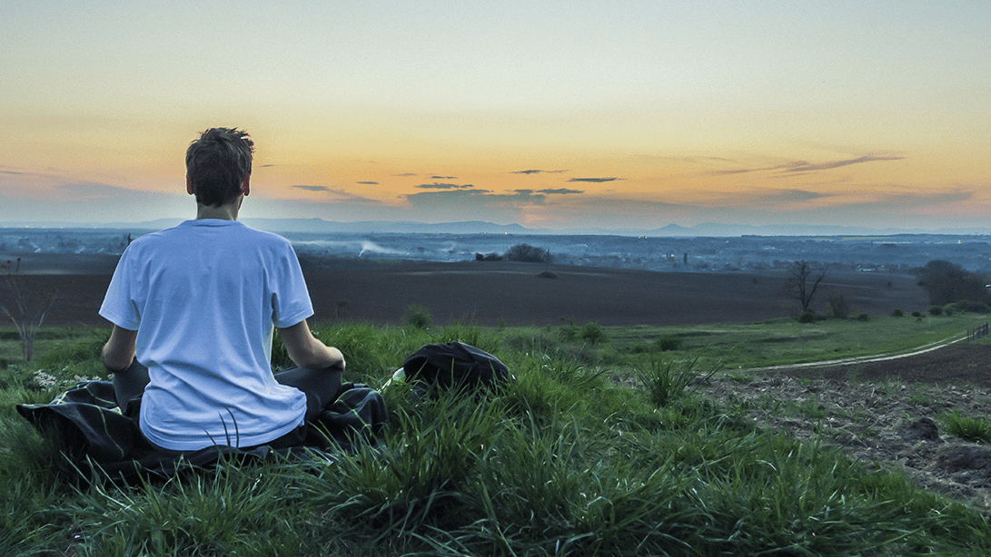
Warning about meditation
Feel free to skip it

Slide 4



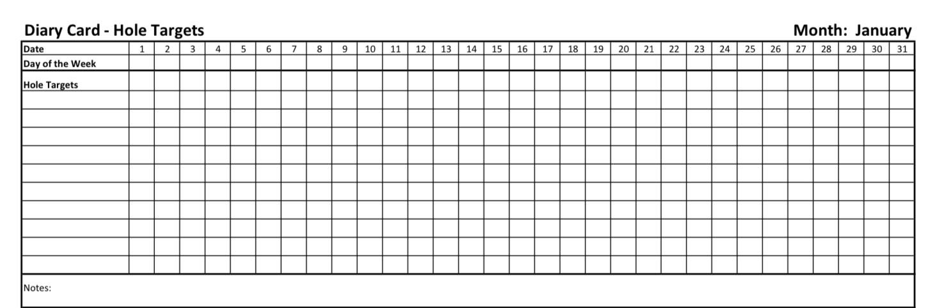
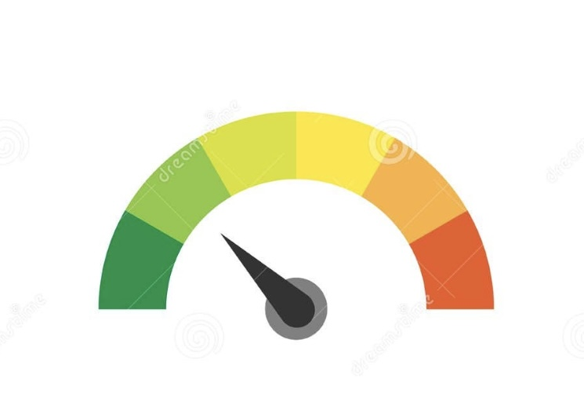
Check in regularly with your Personal dashboard
Spend a few moments checking in with yourself by asking:
1)What is the current risk that I’ll experience a state of crisis ?
Low b) Moderate c) high d) very high e) extreme
2) Am I in the window of tolerance?
a) Yes b) I’m a little outside c) very outside
3) Where is my energy tank right now?
Full b) ¾ c) ½ d) near empty
4) Have I been tracking my targets using the holes diary card ? how would I rate my targets right now?
5) How well am I focusing on what I’m doing. (for example, the course)
CRISIS RISK
WINDOW OF TOLERANCE
ENERGY RESERVES
RATING MY TARGETS
ATTENTION METER
% attention I’m paying
100
0

Slide 5
CONTINUING THE JOURNEY
Let us take a moment now
to settle into stillness.
Feel your breath—
noticing that it is still with you,
as it has been throughout this journey.
Let your eyes gently close,
or soften your gaze,
and bring to mind all those
who have traveled beside you
over these past thirty weeks.
Breathe in gratitude—
for every moment of courage,
every word shared in trust,
every silent knowing look,
every tear, every insight,
every breath that held pain or peace.
Let your heart acknowledge
the fullness of this shared experience—
the broken places that asked to be seen,
the younger selves that longed to be heard,
the strength that slowly unfurled in you,
and in those around you.
Though the simple course now draws to a close,
the path of healing does not end—
it winds on, inward and outward,
toward greater connection
with your own soul,
with those you love and struggle with,
with the living earth that holds us,
and with the great mysteries
that remain beyond our understanding,
but not beyond our reverence.
Set an intention now—
quietly in your heart—
to continue walking this path
with kindness toward yourself,
with patience for the process,
and with openness to what is yet to come.
You are not alone.
You never were.
The light you carry touches others
even when you cannot see it.
And the light of others—this community—
now lives within you.
When you’re ready,
return gently to this moment,
bringing with you
the memory of all that has been planted,
and the hope of all that is still to bloom.
May we continue on this sacred journey,
with grateful hearts
and steady steps.
Let it be so

Slide 6

What we will do today
Course highlights
Your Feedback
Next steps for you and for the course
Ask us anything
Brunch and Joan and Nicole’s surprise
Last word from co-leaders.

Slide 7
While today is officially the last session of the course, next week is an extra pilot session on sexuality and bonding. It will be in person and on zoom at the usual time and it will be informal and relaxed. (not recorded on YouTube)

Slide 8
COURSE HIGHLIGHTS

Slide 9
THE THEORY

Slide 10
it's simple
Structured
Integrative, integral, idealist
Mindful
Psychotherapy that is Learned
Easily
SIMPLE
Neurobiology
DBT
Psychodynamic attachment and trauma theory
Integral theory
Simple is a biopsychosociospiritual psychotherapy course/group that is geared towards anyone who experiences emotional dysregulation.
It strives to synthesize knowledge from a variety of disciplines into a single framework
Notes:
Thank you for your time I truly appreciate it. Over the next 30 minutes I’d like to share with you a project which I think, if taken to the next phase, could address some gaps in mental health care .
Simple is an acronym for… Integral is a nod to philosopher Ken Wilber whose work permeates the course while idealist refers to philosophical idealism which is becoming more accepted in academic philosophical circles particularly as articulated by philosophers such as Bernardo Kastrup. Mindful I don’t have to explain.

Slide 11
SIMPLE - Theory
WHAT WE COVERED IN THE SIMPLE COURSE
The content and structure of simple
The philosophical basis of Simple
Managing suicidal thoughts
The history of medicine and psychiatry
Psychodynamics
The evolution of the emotional brain
The evolution of the rational brain
Social determinants of health
Personality
Temperament and character
Attachment
The dynamic maturational model of attachment
Stress, distress, and post-traumatic stress disorder
Traumatic stress in children and adults
Structural dissociation theory
Spirituality and mental health
Internal family systems
Interpersonal conflicts and their repair
Meaning: “My", "Ours”, and “The” stories – What is this we call the Universe?

Slide 12
THERE’S A WHOLE IN MY SIDEWALK
I walk down the street.
There is a deep hole in the sidewalk.
I fall in.
I am lost… I am helpless.
It isn’t my fault.
It takes forever to find a way out.
I walk down the same Street.
There is a deep hole in the sidewalk.
I pretend I don’t see it.
I fall in again.
I can’t believe I am in the same place.
But it isn’t my fault.
It still takes me a long time to get out.
I walk down the same Street.
There is a deep hole in the sidewalk.
I see it is there.
I still fall in. It’s a habit.
My eyes are open.
I know where I am.
It is my fault. I get out immediately.
I walk down the same Street.
There is a deep hole in the sidewalk.
I walk around it.
I walk down another Street.

Slide 13
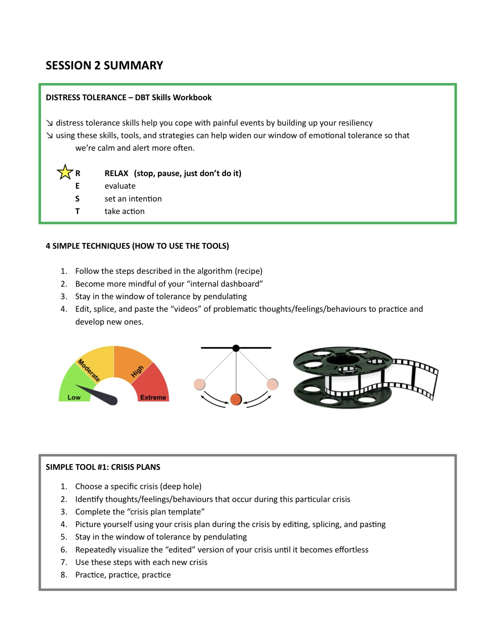

Slide 14
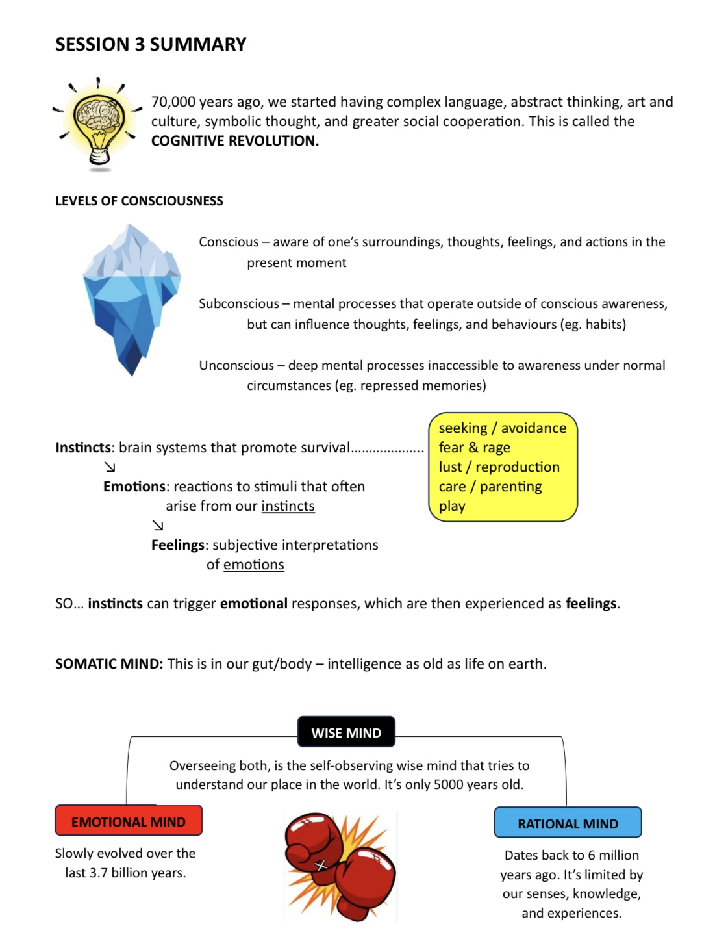
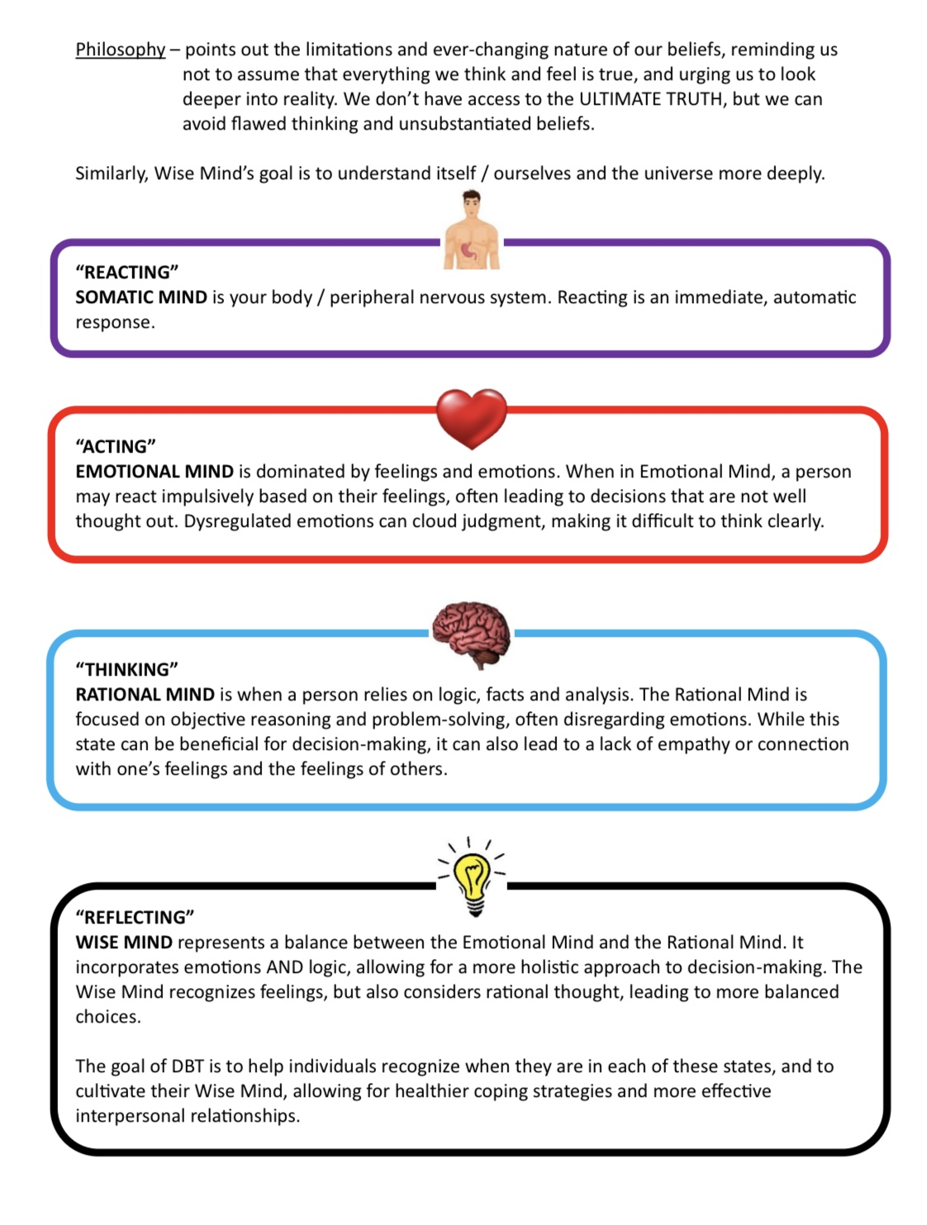
By Kate

Slide 15
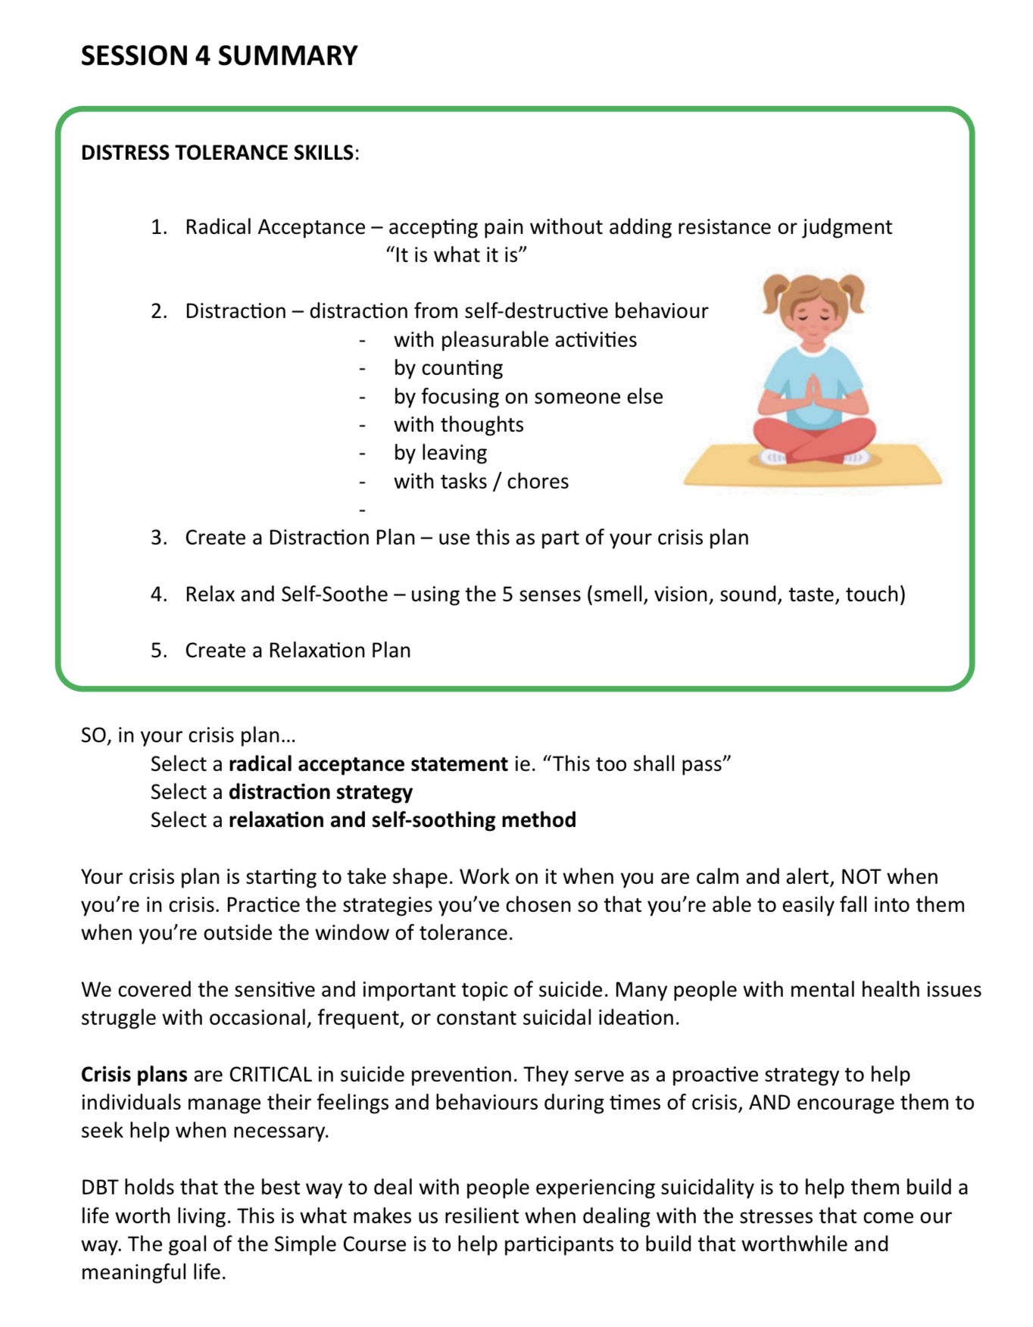

Slide 16
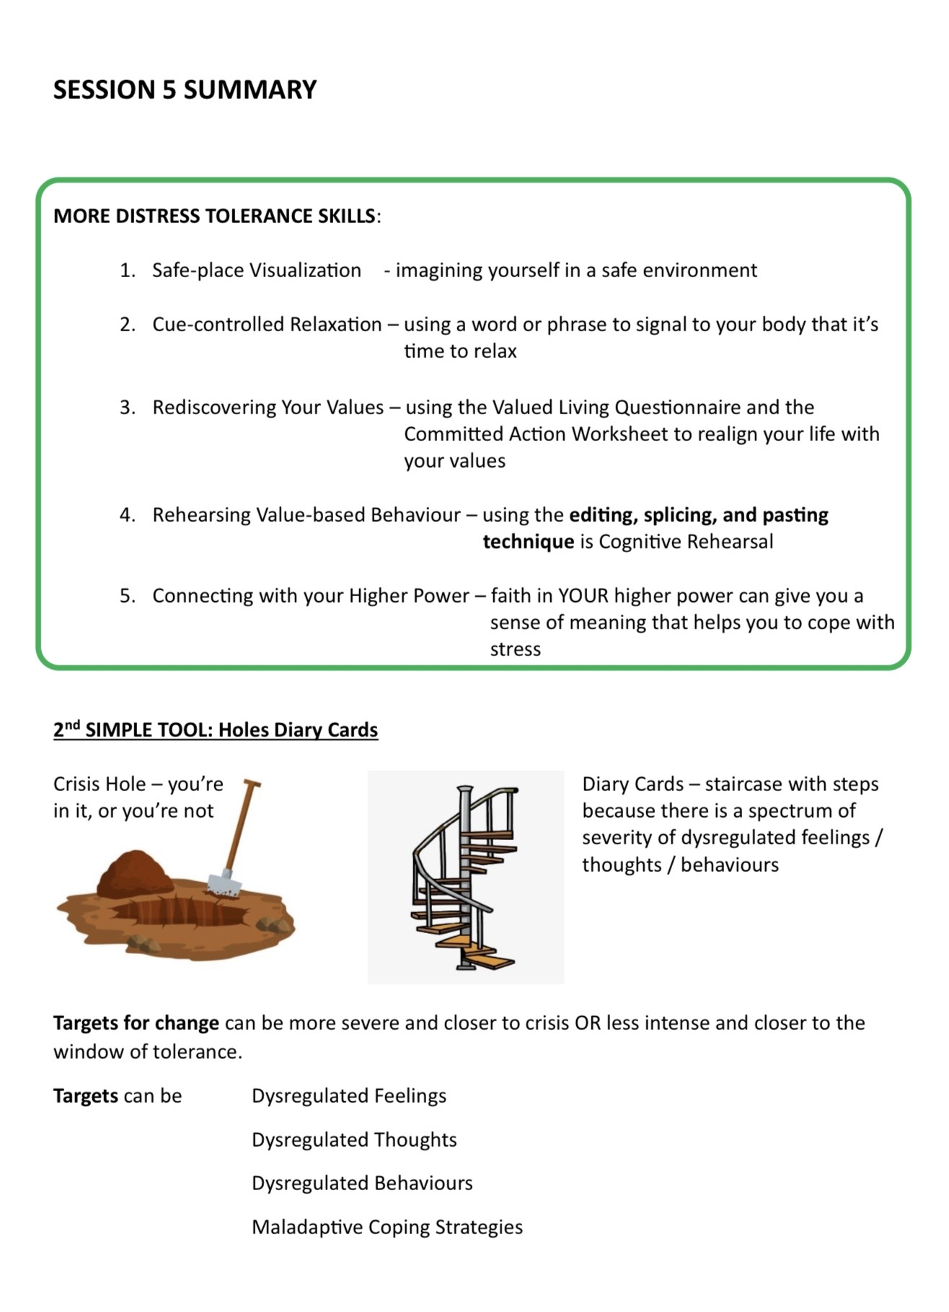
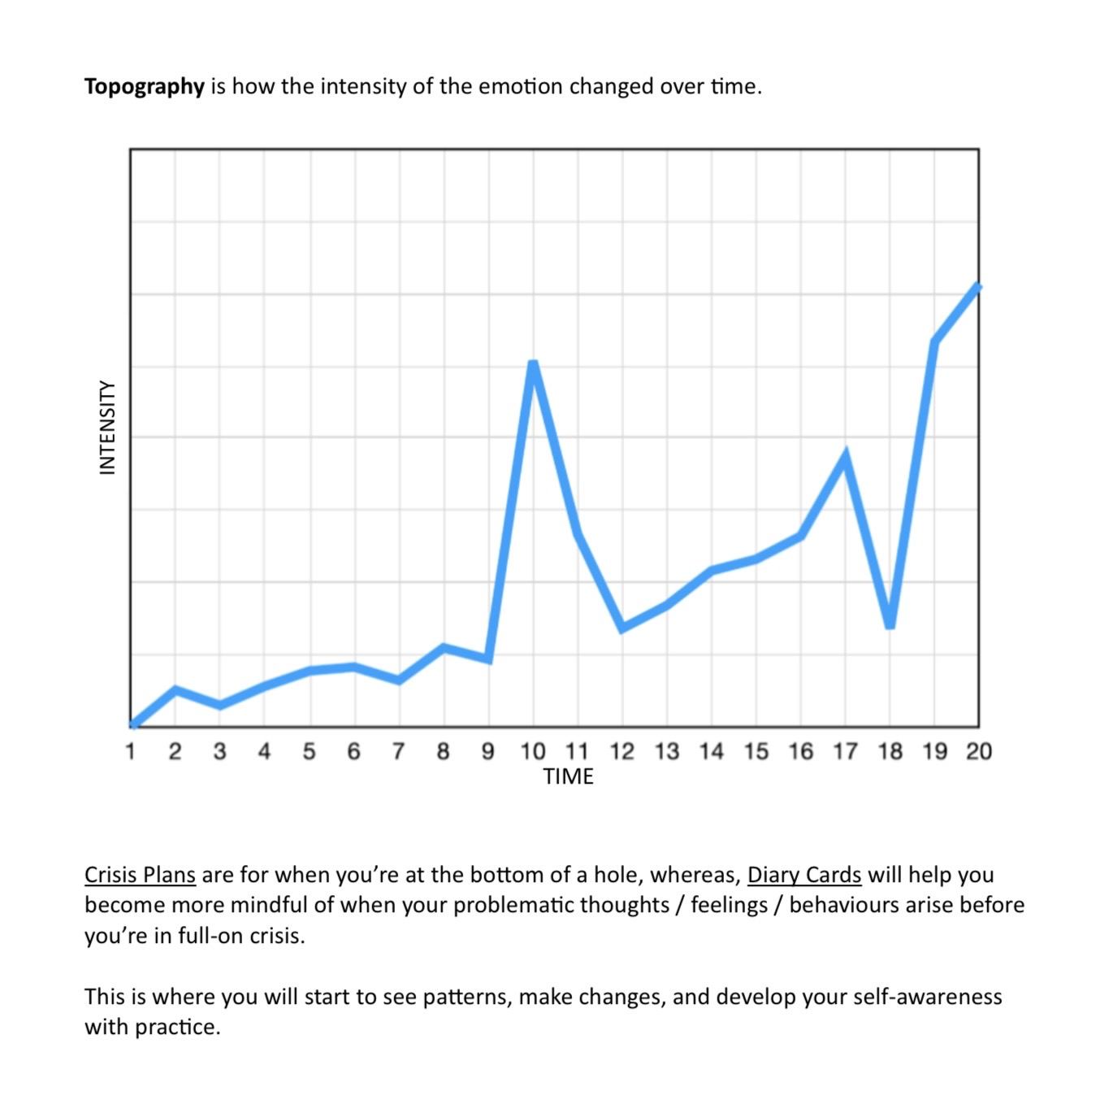

Slide 17
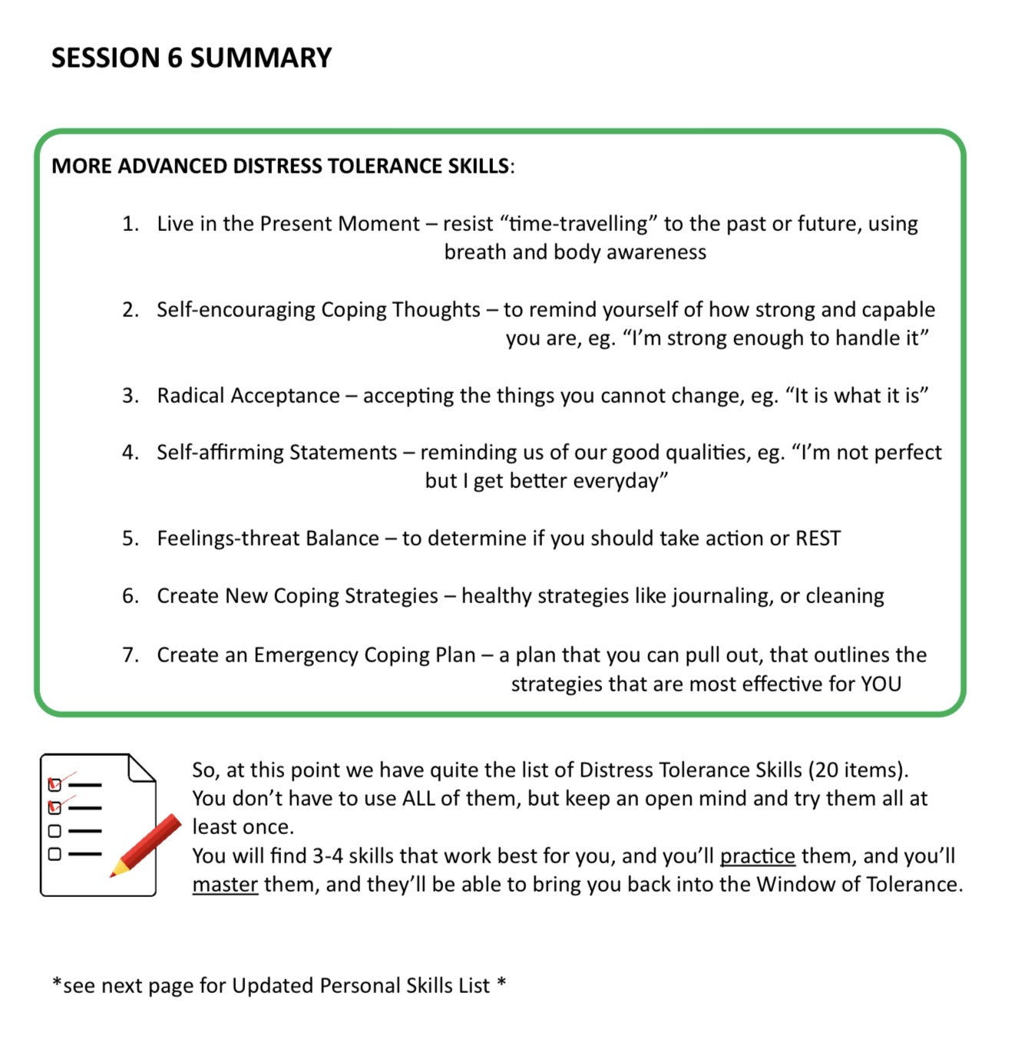
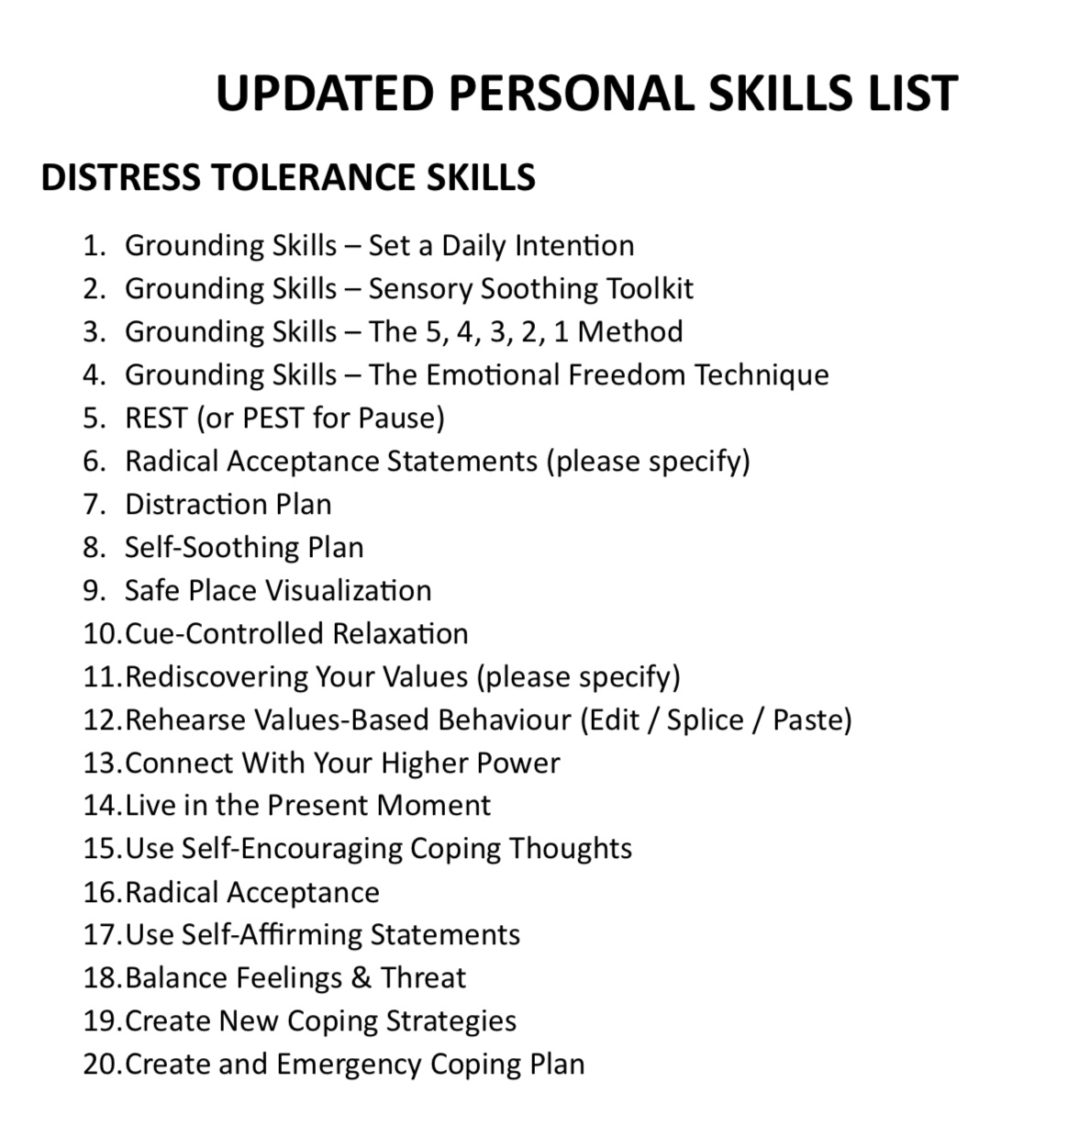

Slide 18
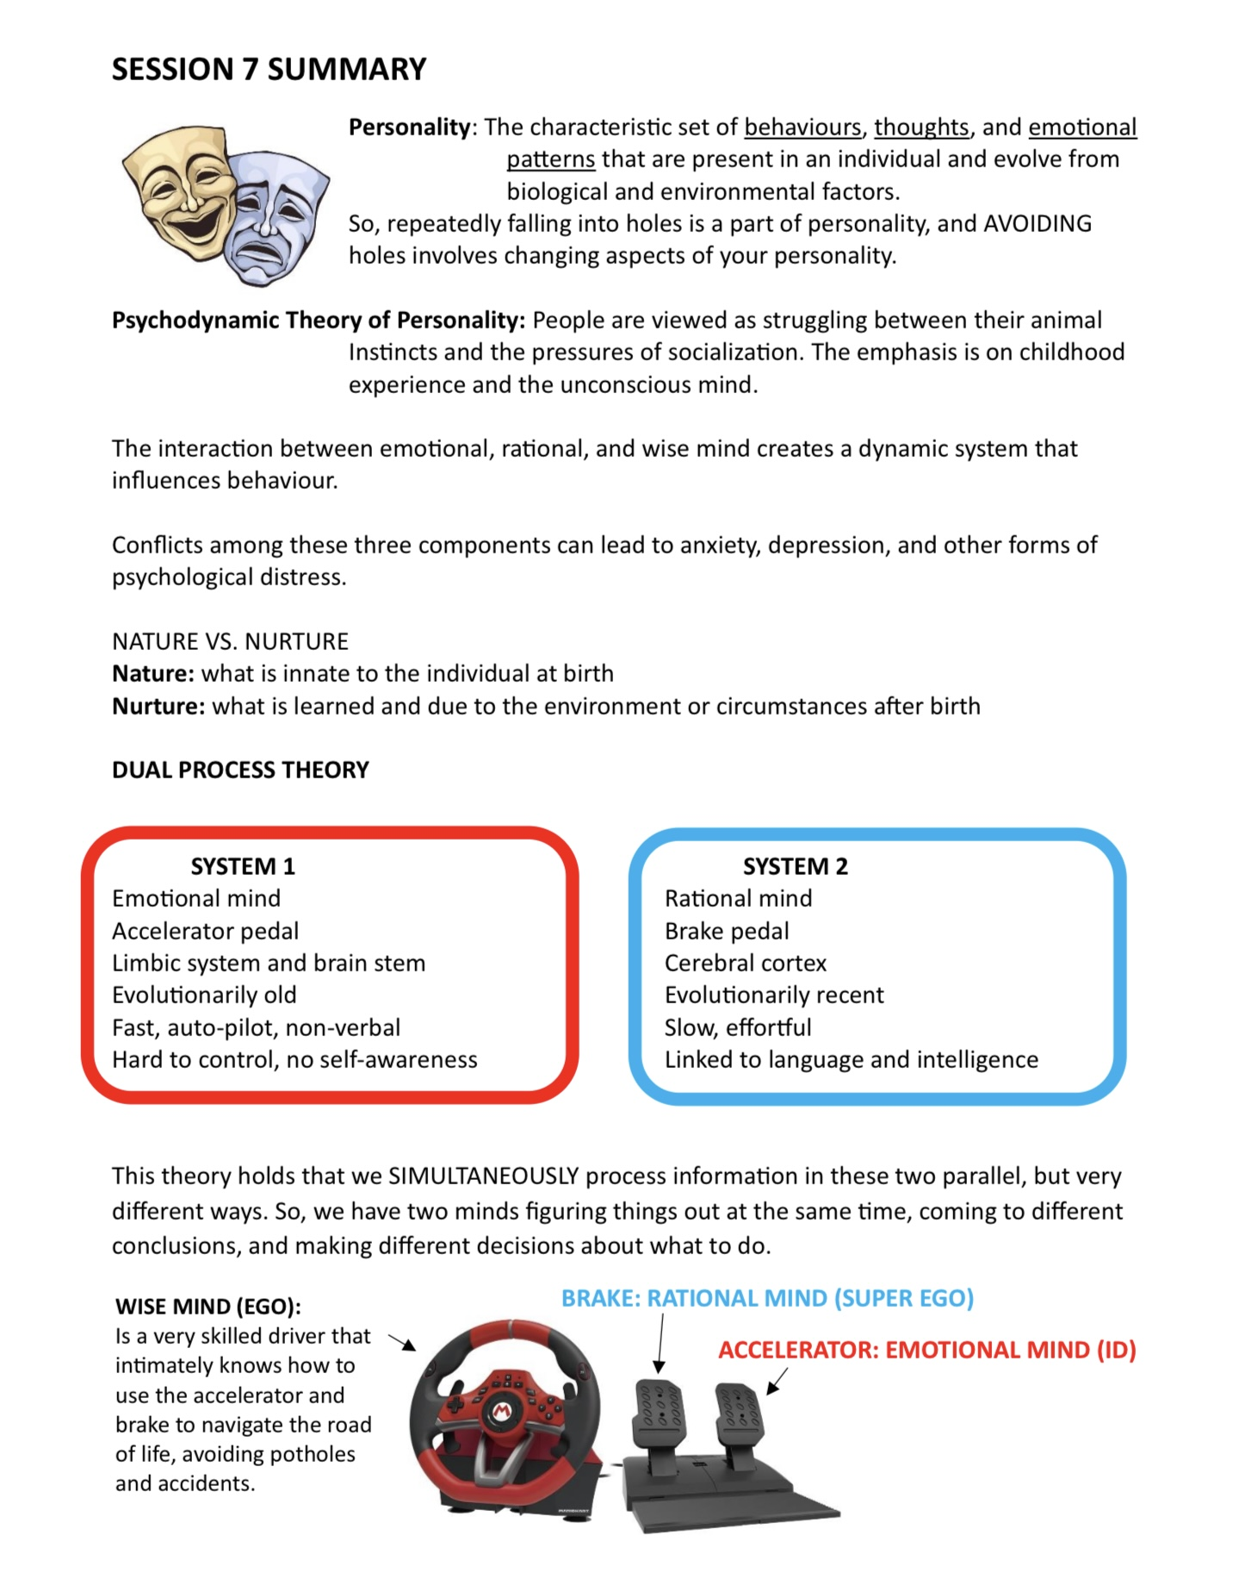
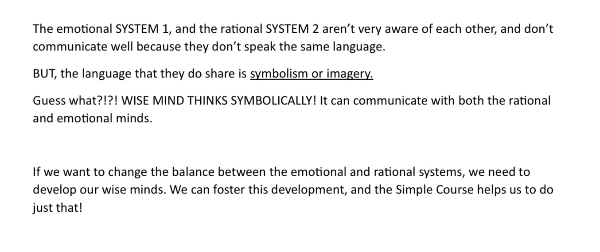

Slide 19
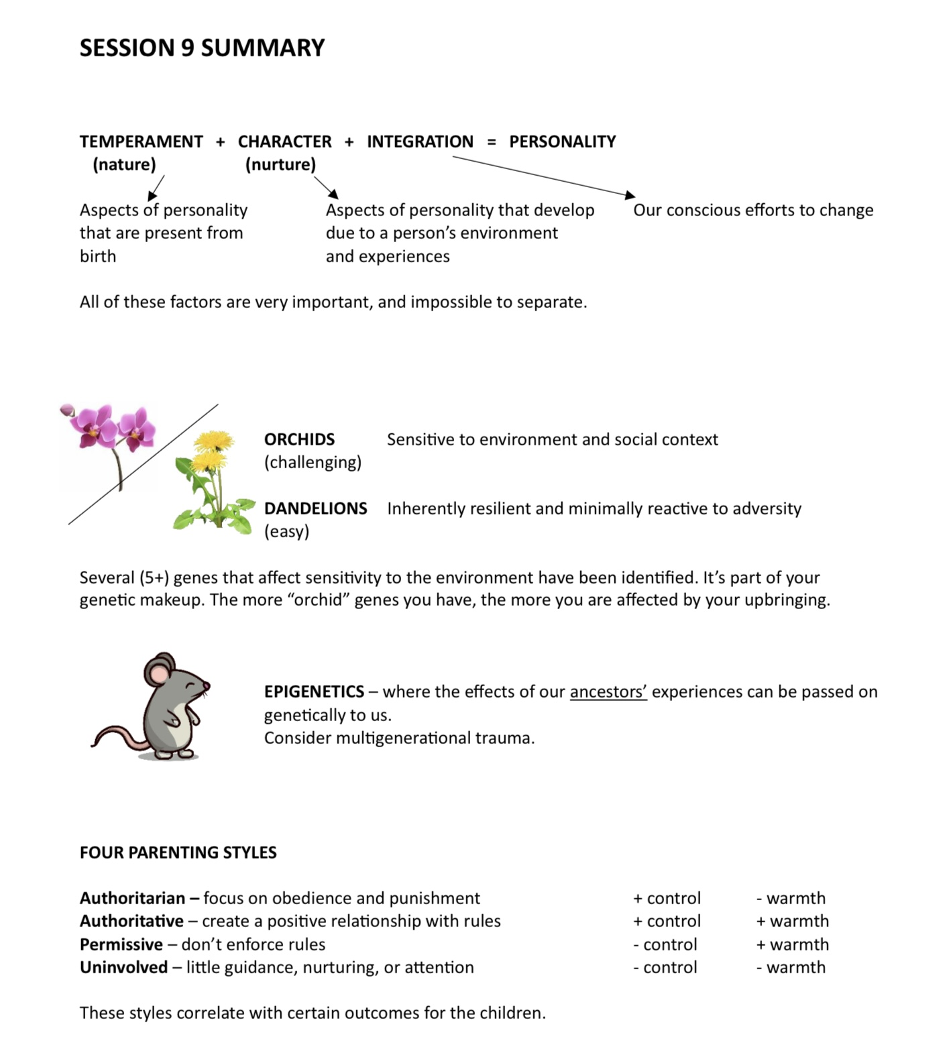
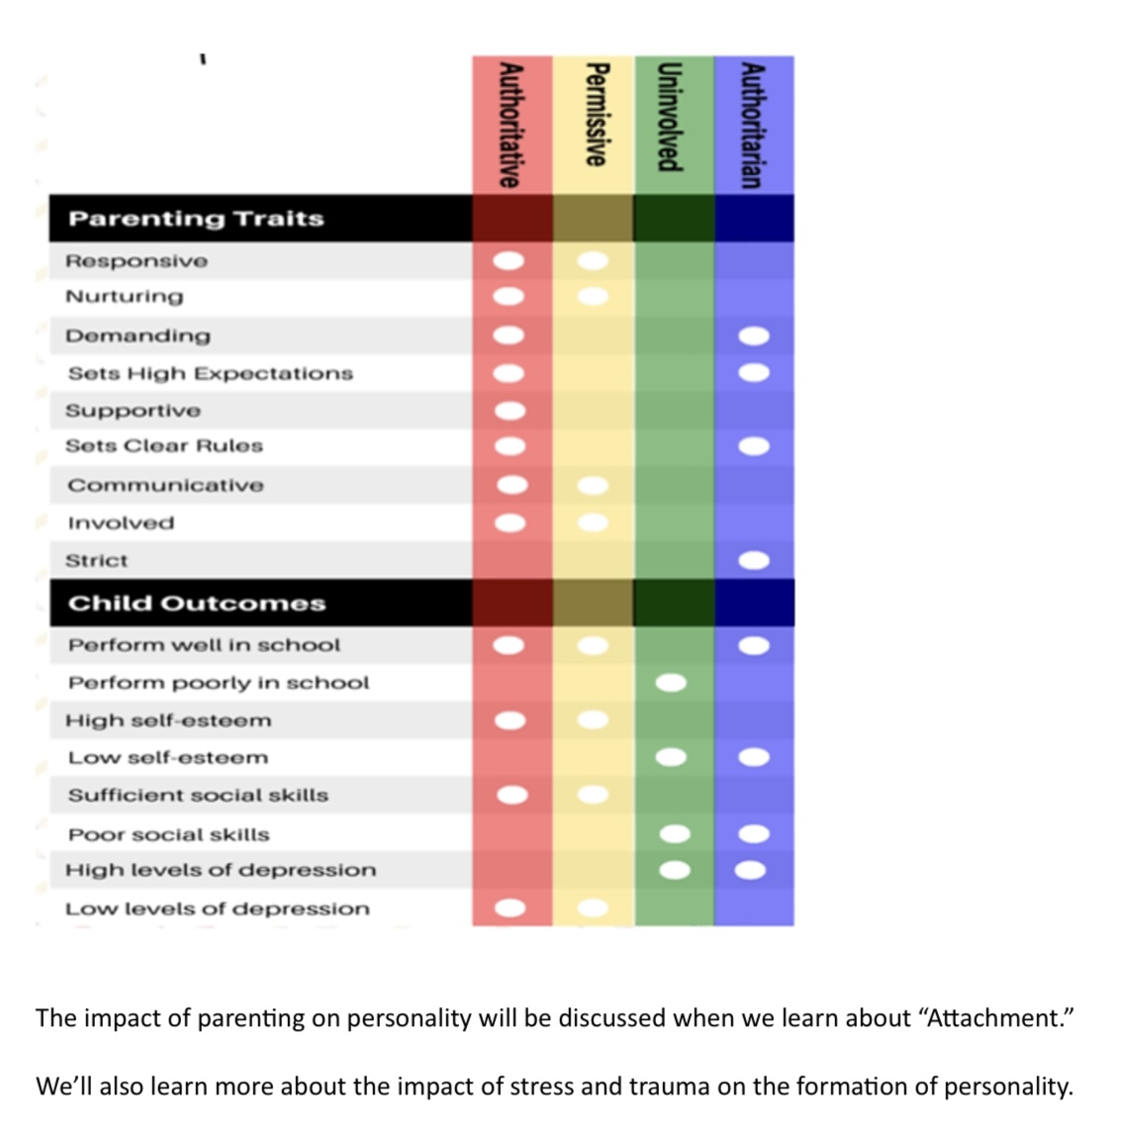

Slide 20
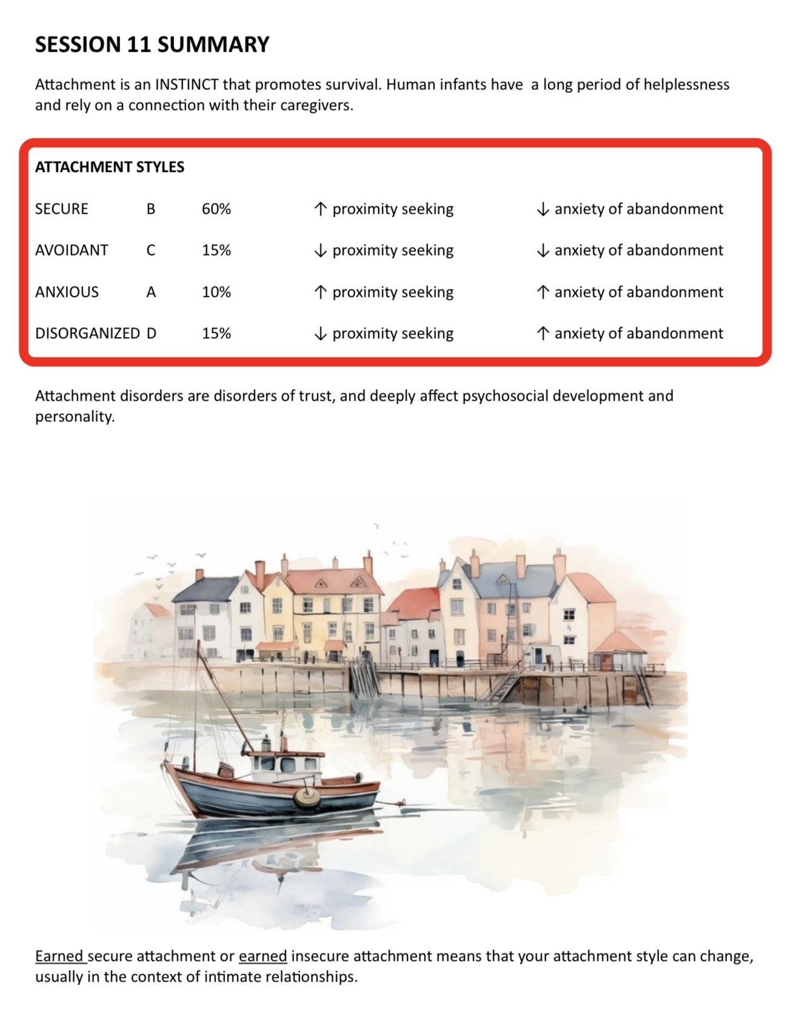
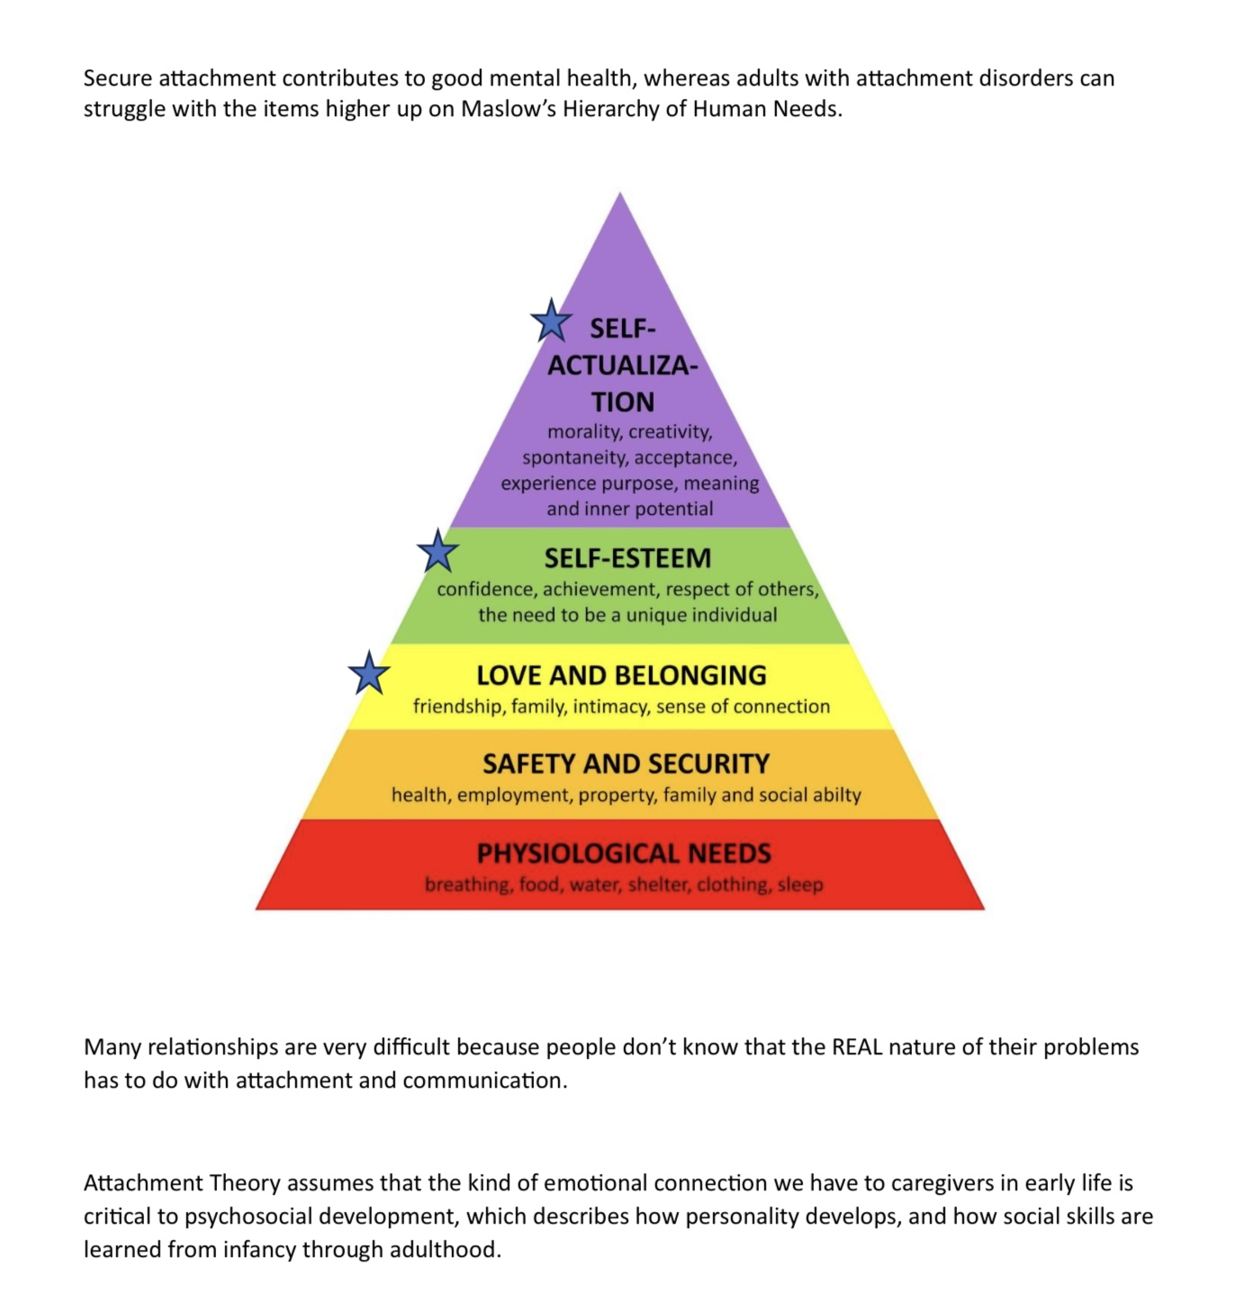

Slide 21
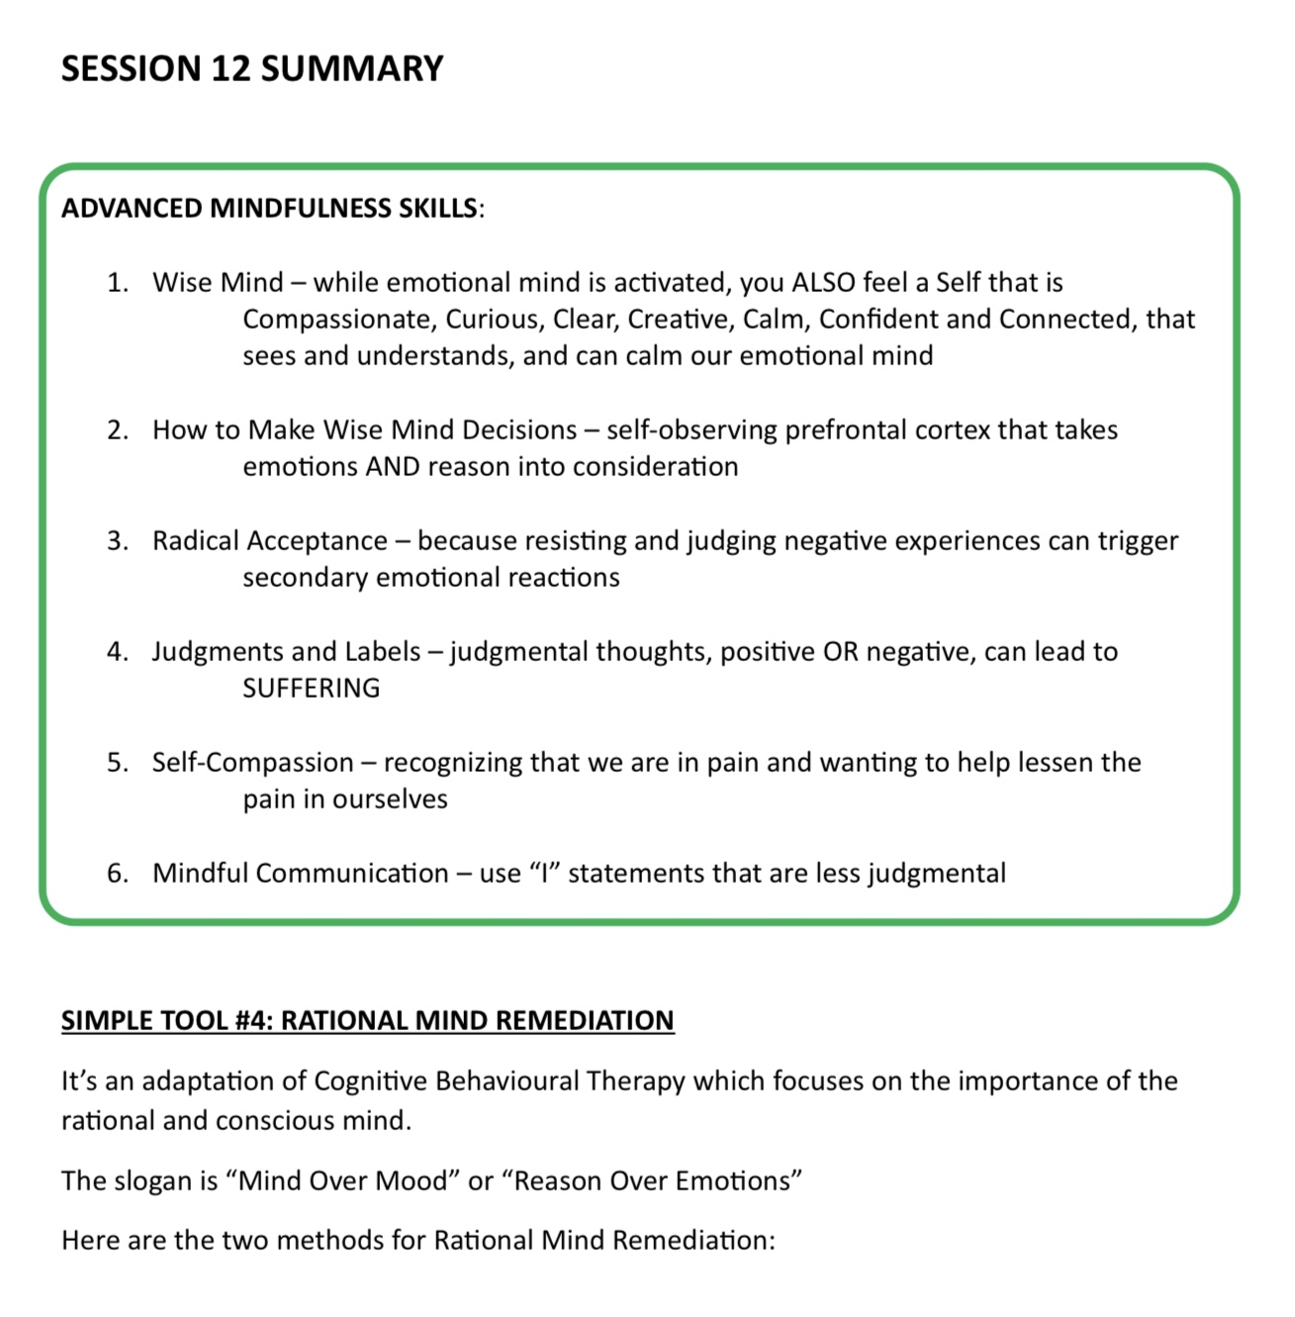
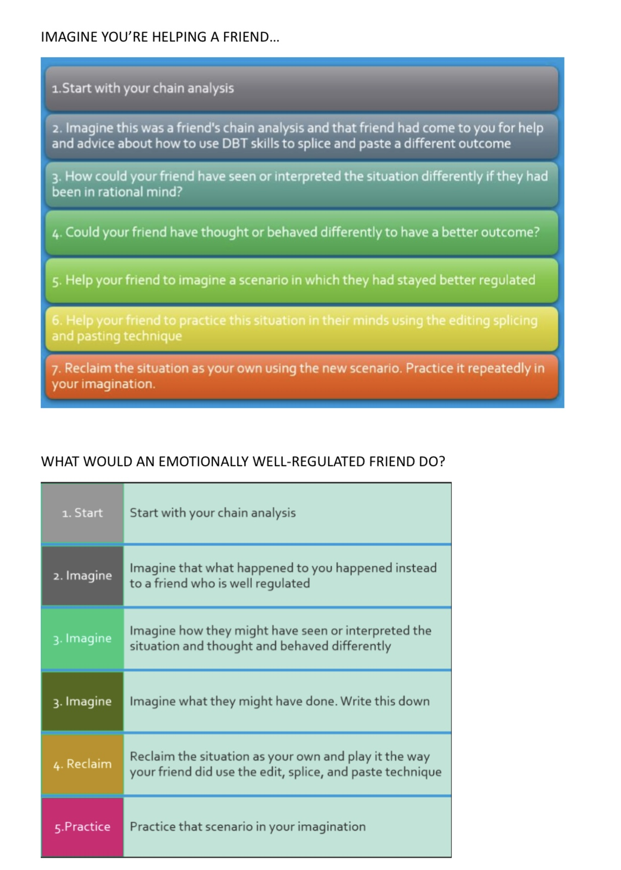

Slide 22
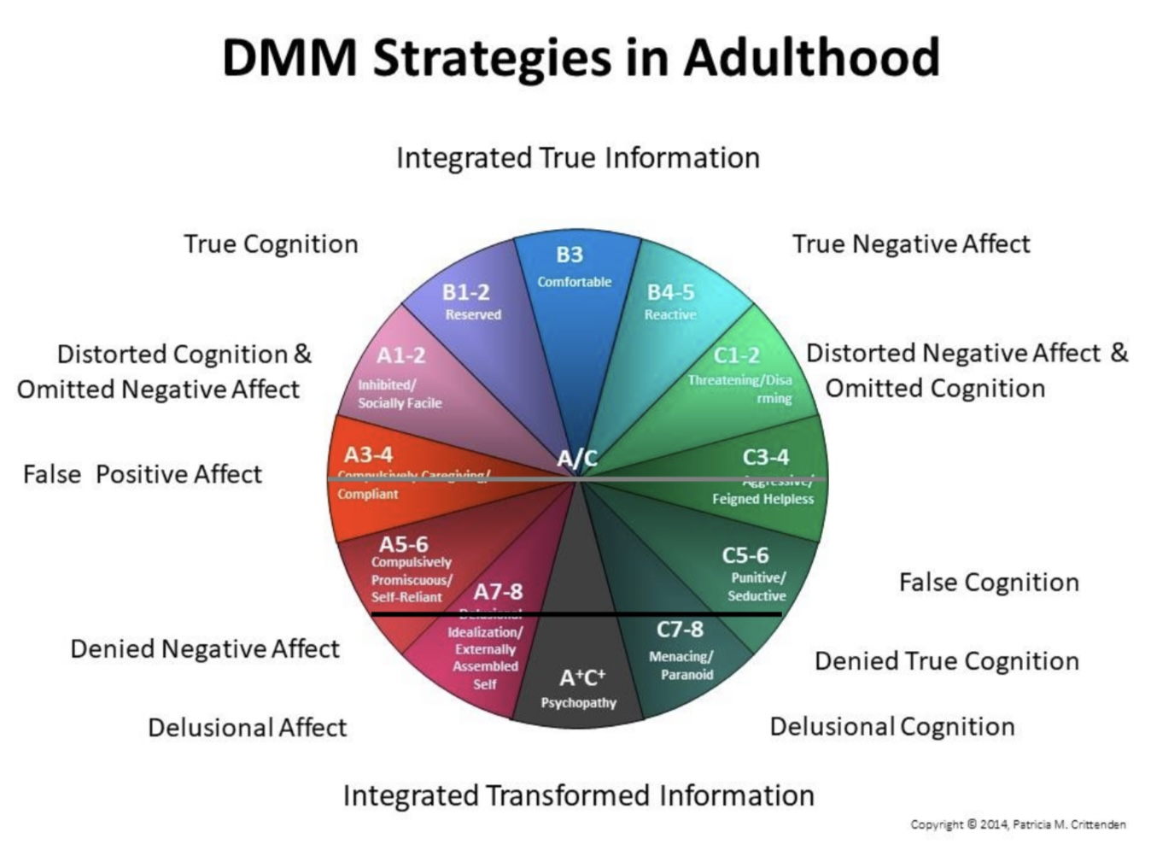
developmentally based psychopathology

Slide 23
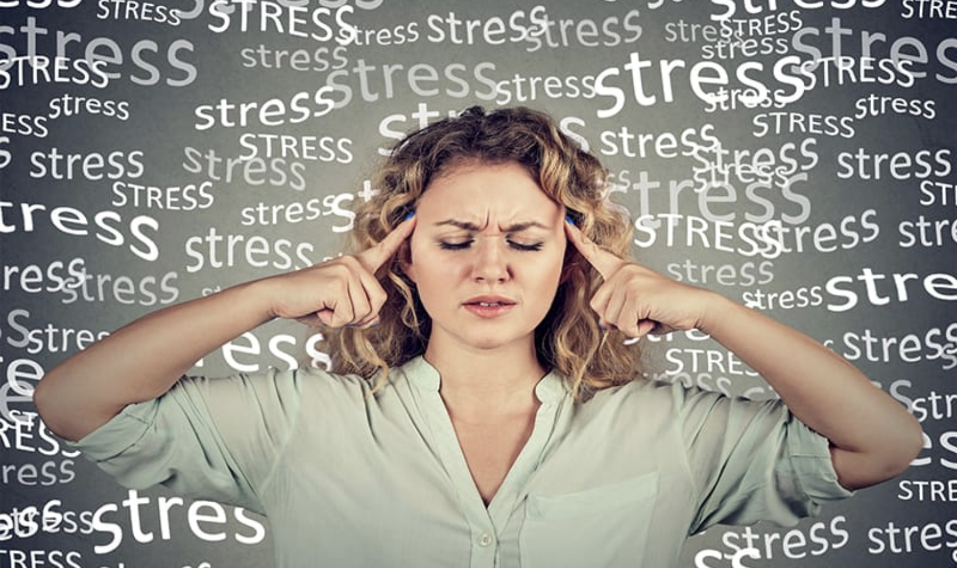

Slide 24
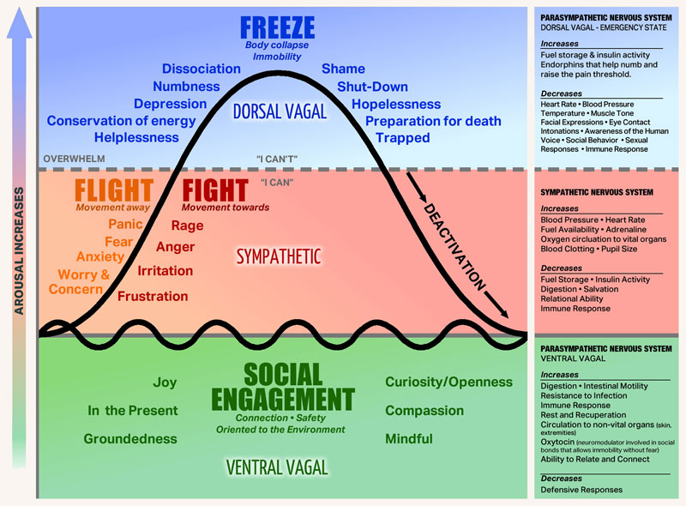
THE STRESS RESPONSE/AROUSAL CURVE

Slide 25
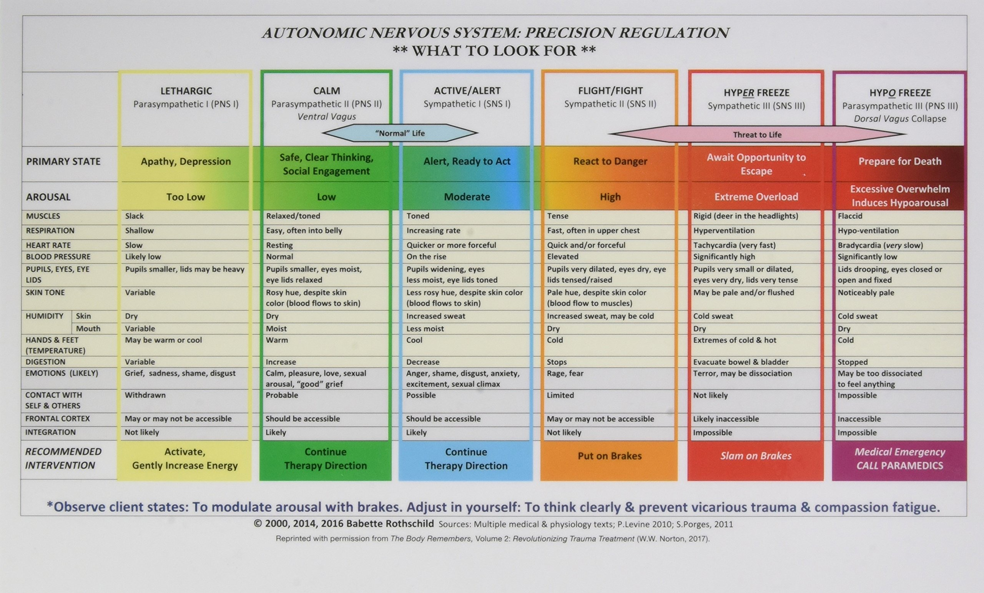

Slide 26
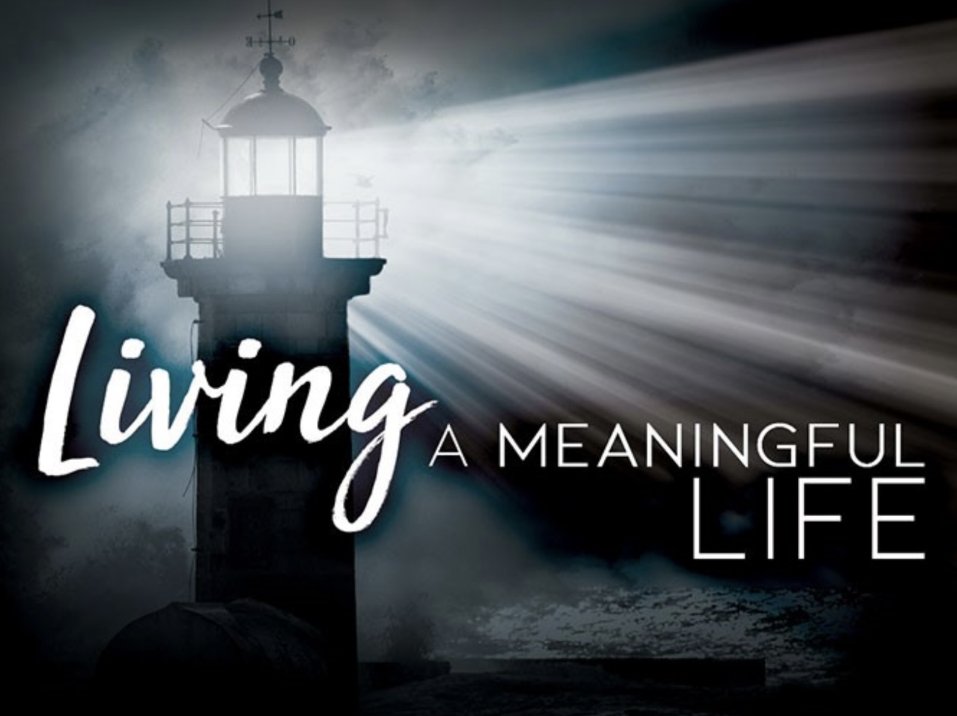
THE GOALS DIARY CARD PROCEDURE

Slide 27

THE trauma spectrum disorders

Slide 28
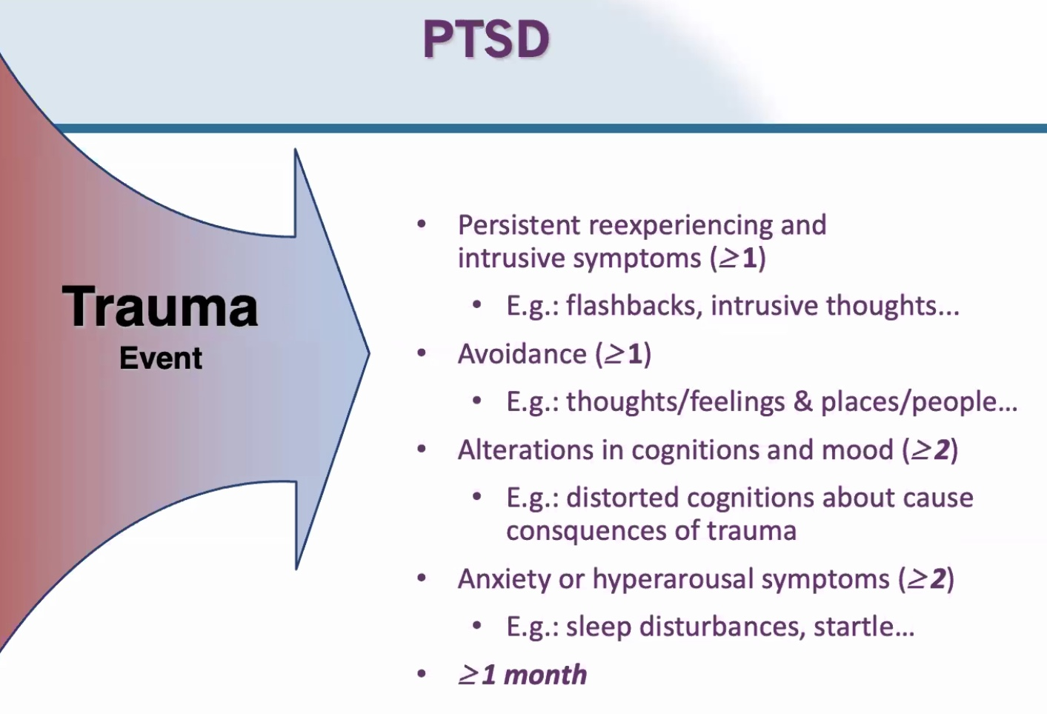
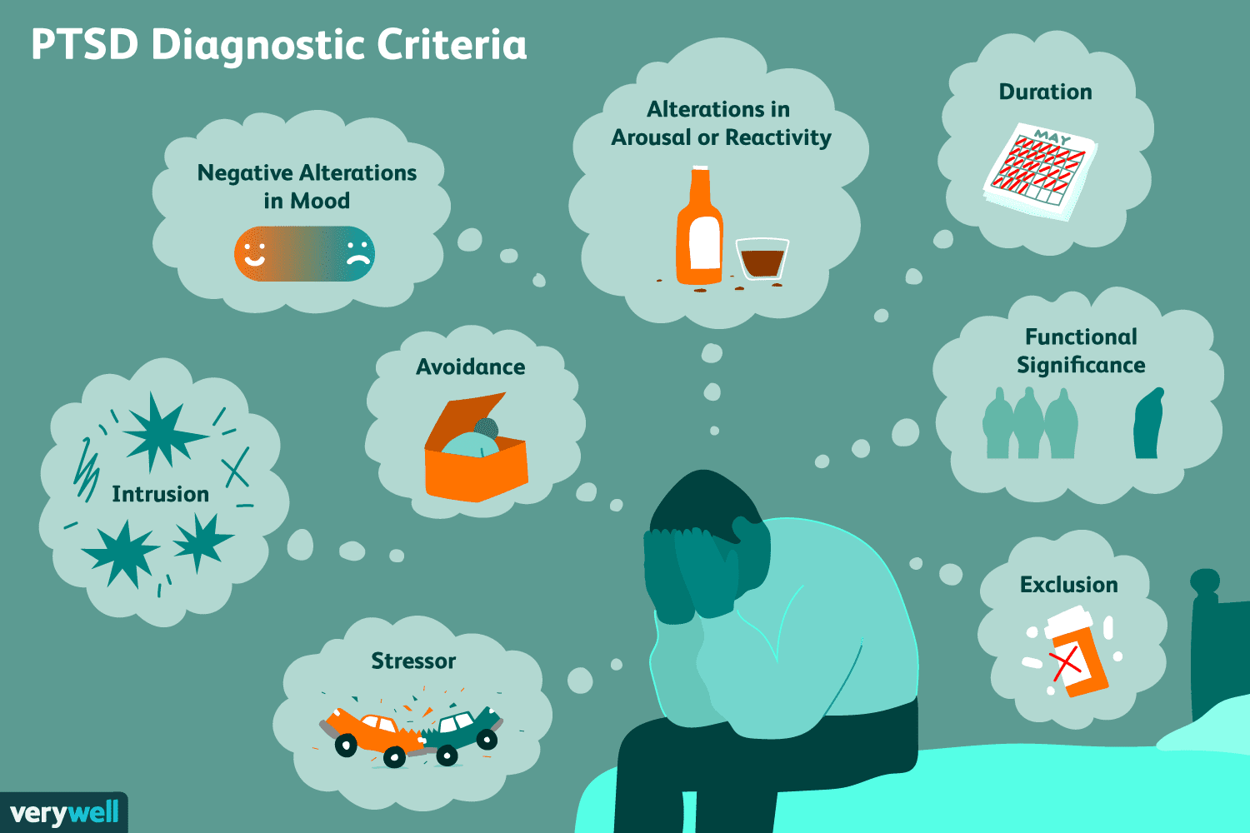
PTSD DIAGNOSTIC CRITERIA
2
5
7
3
6
4
8
1

Slide 29
Activation curves
Traumatic stress not resulting in PTSD
Inescapable traumatic stress resulting in PTSD
hyperfreeze
No escape
activated
calm
hypofreeze
Dissociated unprocessed traumatic complex
Requiring significant energy

Slide 30

DISSOCIATION and the treatment of the traumatic spectrum disorders

Slide 31

spirituality, religion, and health
The decisive question for man is whether or not, he is related to something infinite. Carl Jung
Spirits’ drive to serve something bigger than oneself is the opposite of instinct or the drive to act towards one’s own survival Bernardo Kastrup
Let me keep my mind on what matters, which is mostly standing still and learning to be astonished. Mary Oliver

Slide 32
internal family systems

Slide 33

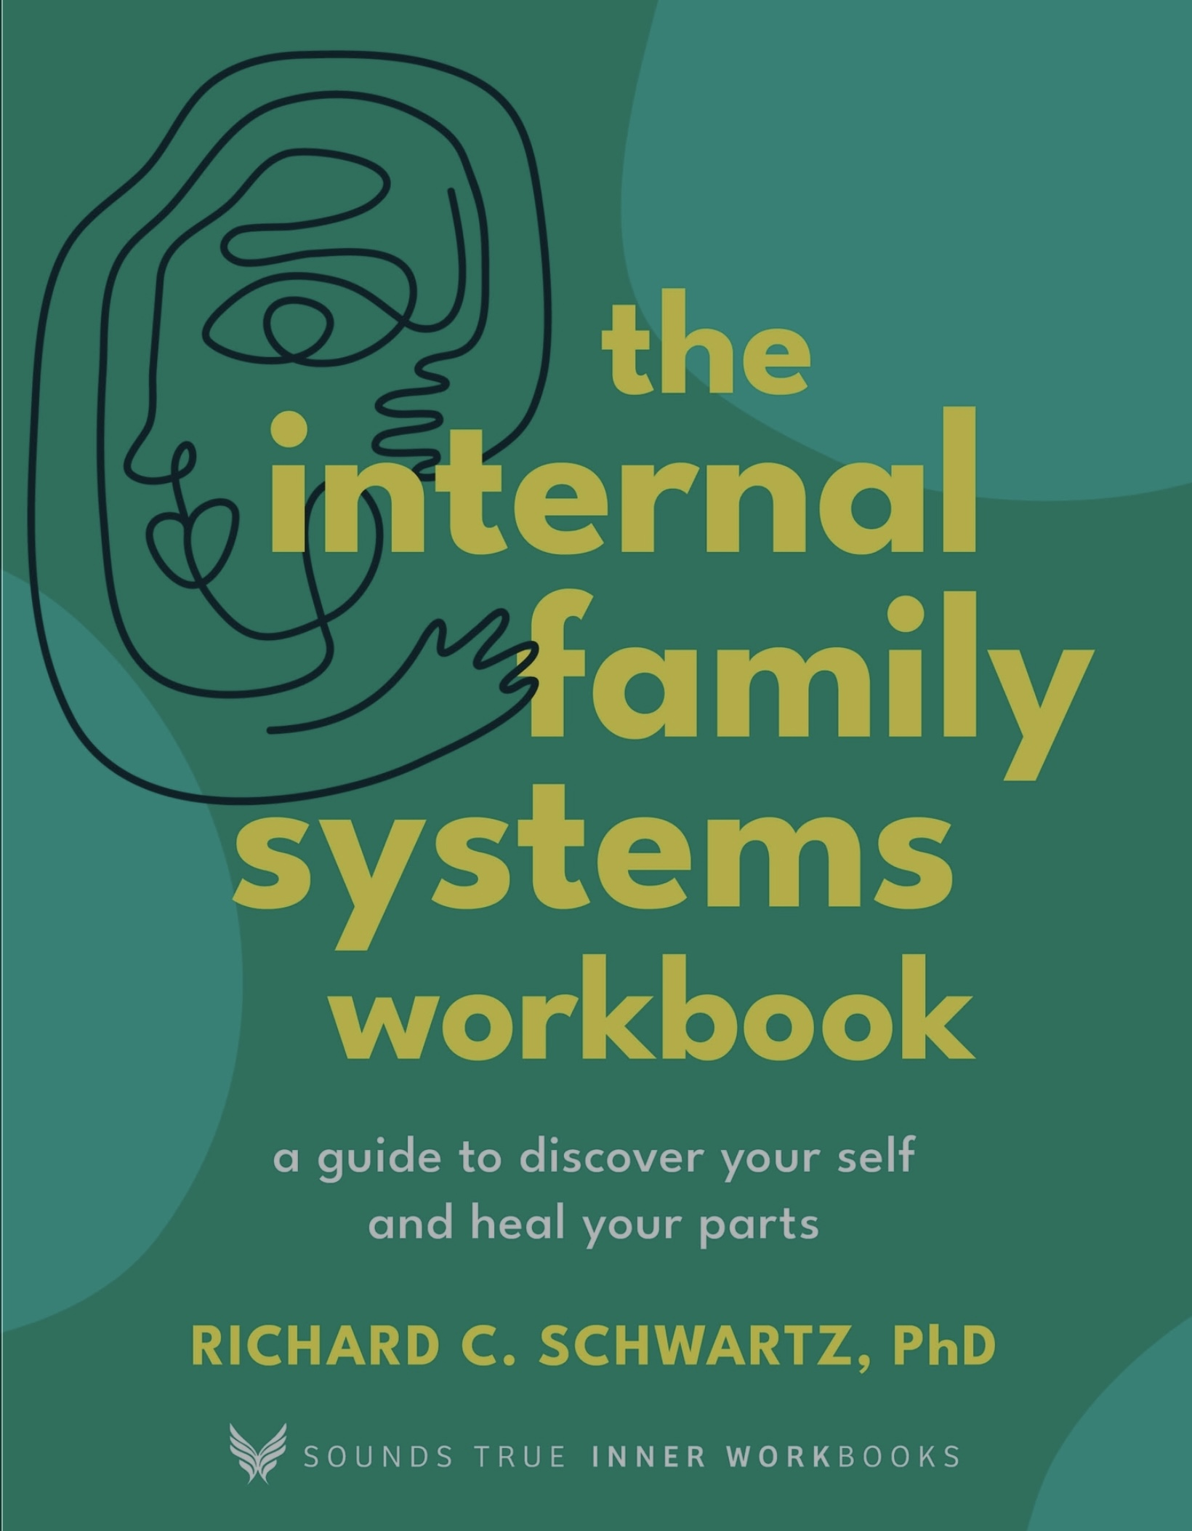

Slide 34

RELATIONSHIPS AND THEIR REPAIR
“A toxic relationship is one in which we can’t get to a point we’re ok with each other” Robert Waldinger

Slide 35

Searching for meaning circle
Don’t walk behind me; I may not lead. Don’t walk in front of me; I may not follow. Just walk beside me and be my friend. Albert Camus
You are not a drop in the ocean. You are the entire ocean in a drop. Rumi

Slide 36
THE TOOLS

Slide 37

6 simple tools
1 Crisis plans
2 Holes diary cards
3 Chain analysis
4 Rational mind remediation
5 Goals diary cards
6 Self-led remediation

Slide 38
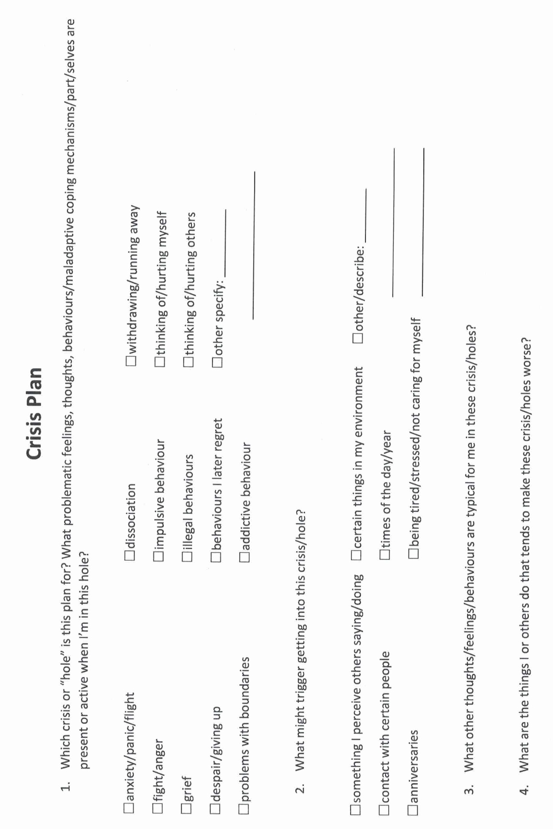

Slide 39
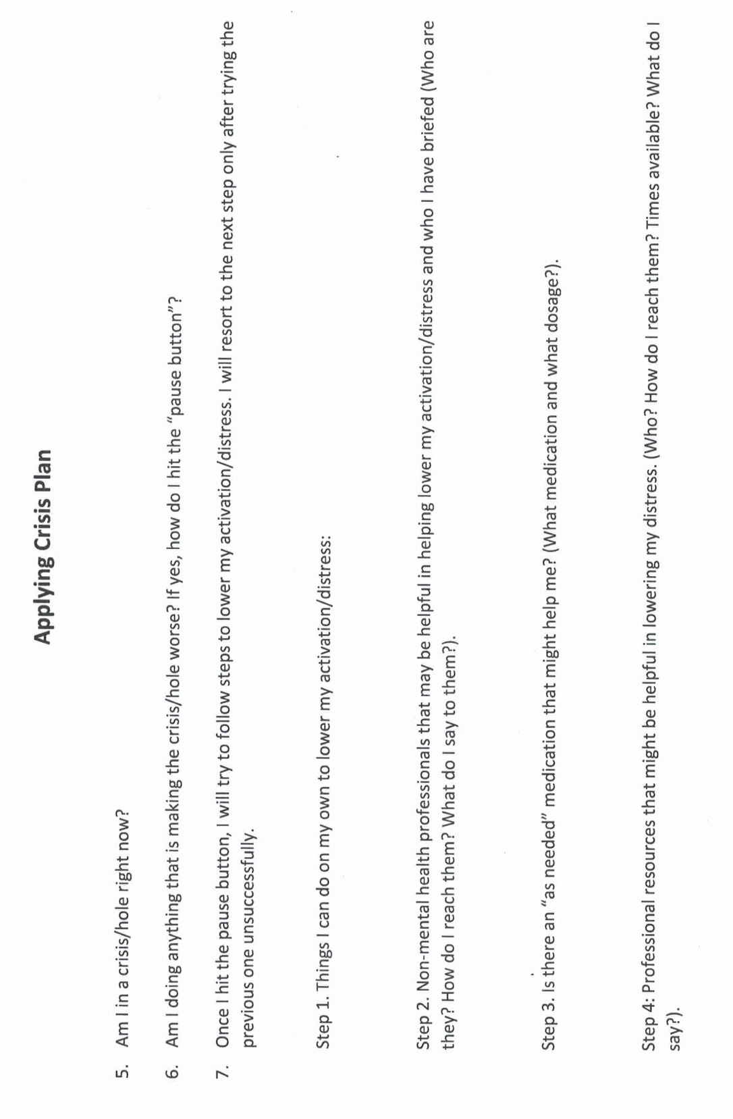

Slide 41
CHAIN ANALYSIS
Stay in window of tolerance by pendulating
1. what was the topography of your activation?
2. was there a trigger(s)?
3. what did you feel?
4. notice the sensations in your body without judging or trying to change them
5. what thoughts were associated with each feeling?
6. what behaviors or urges were associated with each feeling?
7. what was your energy balance before the activation? 0-10

Slide 42

1. How to do Rational mind remediation by imagining you’re helping a friend
Start with your chain analysis
Imagine this was a friend's chain analysis and that friend had come to you for help and advice about how to use DBT skills to splice and paste a different outcome
How could your friend have seen or interpreted the situation differently?
Could your friend have thought or behaved differently and to have a better outcome?
Help your friend to imagine a scenario in which they had stayed better regulated
Help your friend to practice this situation in their minds using the editing splicing and pasting technique
Reclaim the situation as your own using the new scenario. Practice it repeatedly in your imagination.

Slide 43

2. alternative rational mind remediation what would an emotionally well-regulated friend do ?
Start
Start with your chain analysis
Imagine
Imagine that what happened to you happened instead to a friend who is well regulated
Imagine
Imagine how they might have seen or interpreted the situation and thought and behaved differently
Imagine
Imagine what they might have done. Write this down
Reclaim
Reclaim the situation as your own and play it the way your friend did use the edit, splice, and paste technique
Practice
Practice that scenario in your imagination

Slide 44
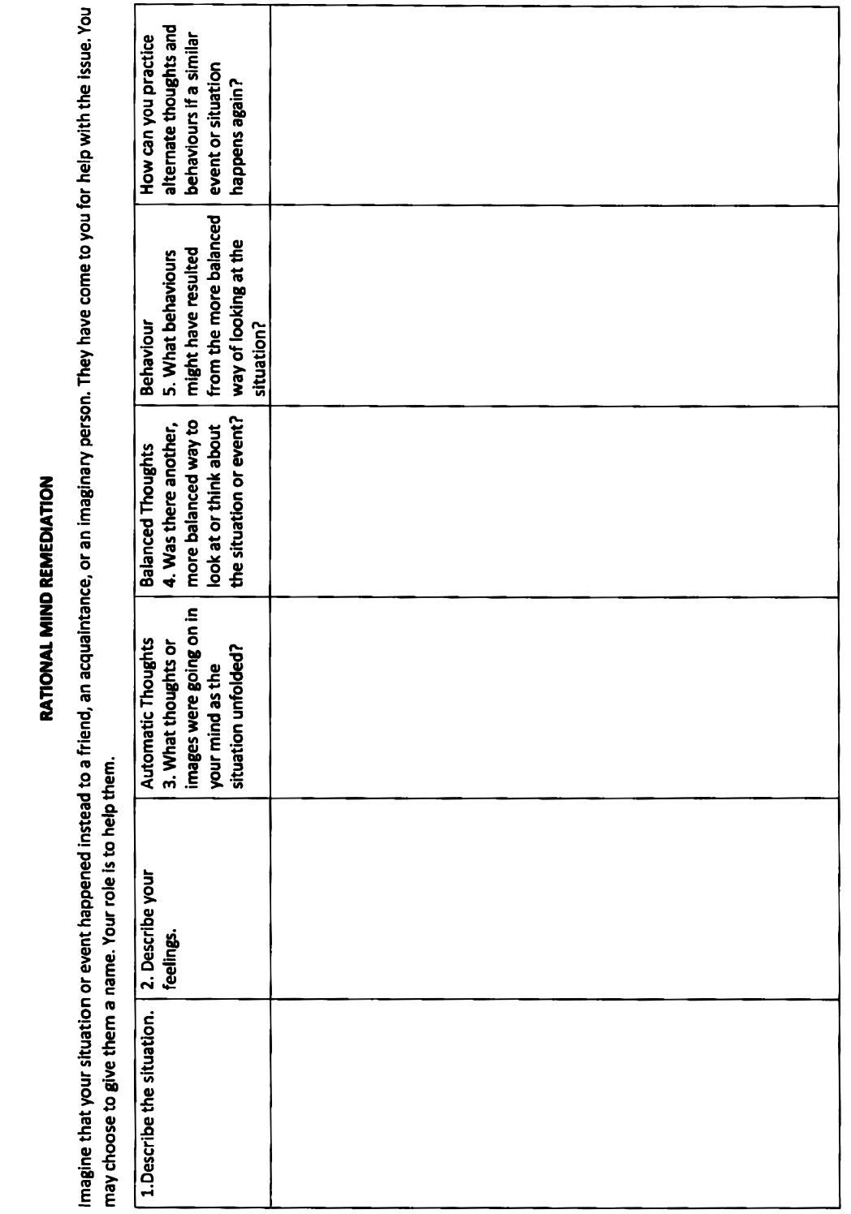

Slide 45
Goals diary card procedure algorithm
Step 1
1. Track your activities for a week using a blank week calendar.
This will give you a snapshot of your typical routine and allow you to assess its balance.
2. Rate yourself 0-10 on each of Maslow’s needs/ wellness domains (see slide below)
Step 2
3. Complete the wellness assessment tool. Choose 1-3 “proximal activities” for your goals.
4. Consider which of your Maslow’s needs are met and which of Erickson’s stages you have mastered.
Step 3
5. “Schedule” the activities you have chosen on a blank or other weekly schedule.
6. Use the goals diary card to track your progress with these activities
Step 4
7. If you have accomplished a goal, choose another from the wellness assessment tool and use it in your goal's diary card… repeat.

Slide 46

The 5 steps of SELF-LED remediation
1. Become acquainted with your internal family part selves. (which we will discuss next week)
2. Use these part selves as advanced targets in the holes diary cards.
3. Do a Wise mind chain analysis.
4. Foster your Wise mind.
5. Connect Wise mind with members of your inner family. Allow Wise mind to see, understand, and soothe your internal family. (Be an ideal parent)
This is a stage 2 tool that helps processed dissociated traumatic complexes
To use it, it’s very helpful to have practiced stage 1 skills/tools/strategies and be able to stay within reach of the therapeutic window

Slide 47
SUMMARY OF IFS CONFLICT EDIT SPLICE AND PASTE ALGORITHM
START
1. Choose the “Video Clip”. Pick a short, specific conflict moment. Where did connection break?
2. Watch the “Video” from a Calm Distance. Observe, don’t relive. Which parts appear? In what order?
3. Pause at the Moment You Lost Self. Identify the protector taking over. What did it fear?
4. Turn Toward the Protector. Offer curiosity, compassion, understanding. Thank it for trying to help. Ask what it needs.
5. Meet the Exile Beneath the Protector. Let the protector show you the vulnerable one. Soothe, comfort, witness.
6. Replay the Scene While Staying in Self. Run the same moment again internally. How would Self speak, act, or listen here?
7A. IF YOU’RE WORKING ALONE. Integrate internally. What did my parts learn? What will Self try next time?
7B. IF BOTH PARTNERS ARE WILLING. Take turns sharing Self-led narratives. Speak for parts, not from them. The partner listens without defending.
8. Update the System. Support protectors. Reinforce Self leadership. Integrate new pattern.
END — New Neural Template Installed. Self-led conflict blueprint strengthens.

Slide 48
THE SKILLS

Slide 49
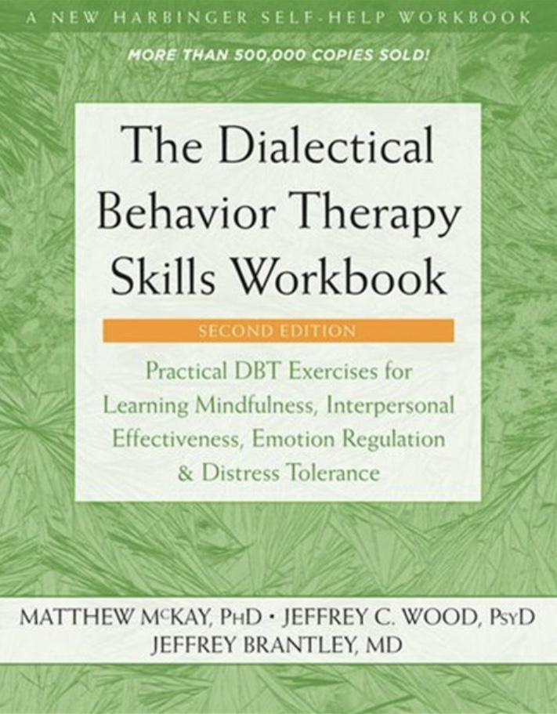
Dialectical Behavioral Therapy Skills
Four modules:
1 Distress tolerance – crisis plans
2 Mindfulness – crisis plans, diary cards, chain analysis, rational mind remediation, goals diary cards, wise mind remediation
3 Emotional regulation – all tools
4 Interpersonal effectiveness – all tools, interpersonal conflicts
The DBT skills are built in to the tools, techniques and strategies.

Slide 50


Slide 51
If there are no major objections, we will now use an AI scribe to transcribe and summarize the feedback you’ll give us. In Ontario, patient confidentiality is governed by the Personal Health Information Protection Act, or PHIPA. It sets the rules for how personal health information is collected, used, and shared, and ensures patients’ privacy is protected. The AI scribe we use is PHIPA compliant. People giving us feedback will not be individually identified; rather your comments will be incorporated into a summary which the co-leaders will use to modify future versions of the course so as to better suit future participants needs.

Slide 53
SIMPLE COURSE FEEDBACK
This feedback section is not about grading you or us. It’s about helping us understand what actually landed, what didn’t, and what might help the course serve future participants even better. We’re especially interested in concrete examples and honest reflections, both appreciative and critical.
We’ll go through a number of question and invite your feedback to each. So that everyone participates and we get through this section to the brunch and Nicole and Joan’s surprise we may do some gentle time management

Slide 54
SIMPLE COURSE FEEDBACK
A. What Helped Most:
What parts of the Simple Course were most helpful or meaningful for you? (e.g., specific topics, metaphors, exercises, group processes, or moments)
Was there a particular concept or practice that “clicked” for you? What made it click?
What, if anything, surprised you in a good way?

Slide 55
SIMPLE COURSE FEEDBACK
B. What Was Less Helpful or Hard to Engage With
What parts of the course felt less helpful, repetitive, confusing, or hard to engage with?
Were there topics that felt either too much, too little, or not well-timed?
Was anything missing that you expected, or didn’t expect, to matter as much as it did? (It’s okay if something that was helpful for others wasn’t helpful for you.)

Slide 56
SIMPLE COURSE FEEDBACK
C. Process & Pacing (How It Was Delivered)
How did the pacing of the course feel over 32 weeks? (Too fast, too slow, uneven, or just right)
How was the balance between teaching, discussion, exercises, and reflection?
How did the length of sessions and the overall structure work for you

Slide 57
SIMPLE COURSE FEEDBACK
D. Group Experience & Safety
What aspects of the group environment helped you feel safe, engaged, or understood?
Was there anything about the group process that made participation harder?
Did you feel you had enough space to reflect and speak, or too much pressure to do so?

Slide 58
SIMPLE COURSE FEEDBACK
E. Integration & Carry-Forward
What ideas, skills, or perspectives do you imagine continuing to use after the course?
Has the way you relate to yourself, others, or stress changed in any lasting way?
If someone asked you, six months from now, “What stayed with you from the course?”—what might you say?

Slide 59
SIMPLE COURSE FEEDBACK
F. Suggestions for Improvement
If we were to change or improve one or two things next year, what would you most want us to consider?
Are there topics you would expand, trim, move earlier/later, or present differently?
Is there something you wish we had done more—or less—of?
If possible, please focus on one or two concrete suggestions rather than many small ones.
We are genuinely interested in your feedback. Not everything can be changed, but everything is taken seriously. Thank you for helping shape what this course is becoming.
End of recording.

Slide 60
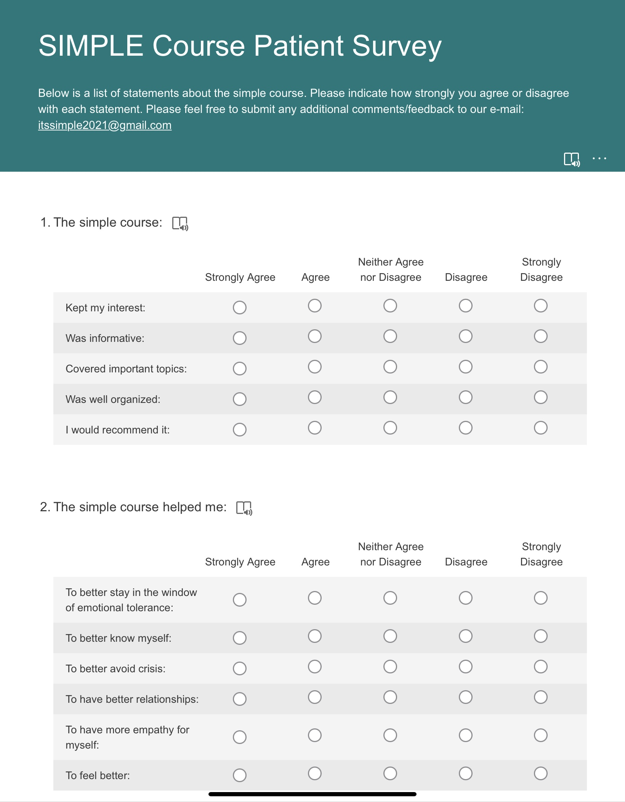
Simple course survey and end of year rating scales
As we approach the end of the course, we’re inviting you to think about your experience doing it.
In week 32 we’ll have brunch and ask you for feedback on the course.
In addition to that feed back we’d also be very grateful if you clicked on the following link and gave us your feedback online. https://forms.office.com/r/6qFT4dVTUS
Your suggestions and feedback are critical so that we can continue to adapt the course to participants needs
The survey asks the following questions:

Slide 61
Please also fill out the following brief survey
If you’re here in person, we will hand out a paper copy
If you’re on zoom, please go to https://forms.office.com/r/6qFT4dVTUS and fill it out there
We will share the results with you next week at the pilot session and will also email them to you

Slide 62
NEXT STEPS FOR YOU AND THE SIMPLE COURSE

Slide 63
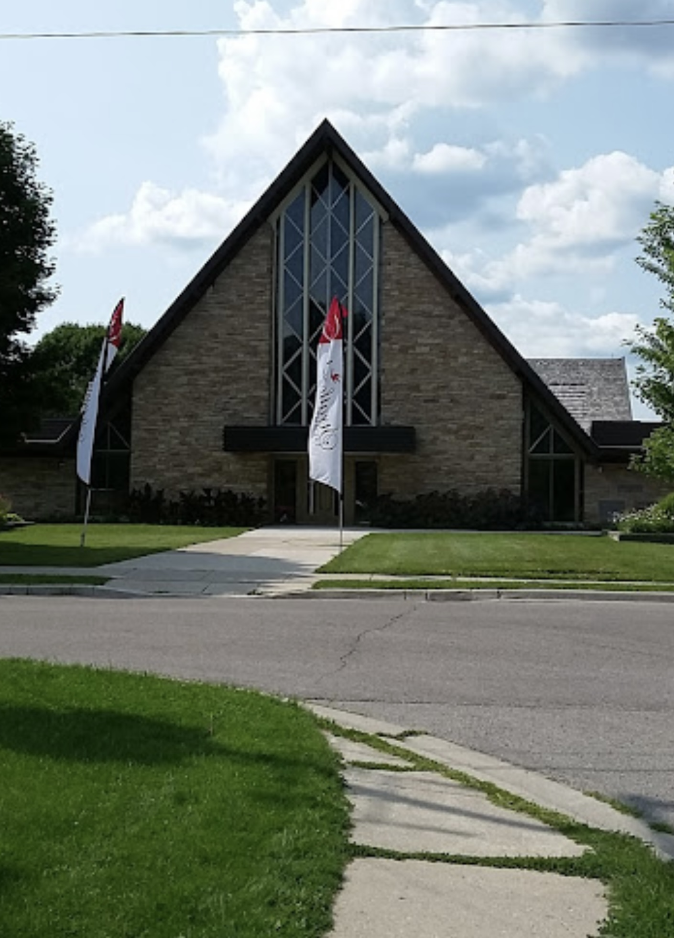
next steps for the simple course
The co-leaders meet over the summer to reflect on the past year and prepare for the next.
We’re planning to start the 2026-27 Simple course the first week of October.
If you would like to sign up for 2026-27 please send us your registration form ASAP
We’ll be calling everyone who is interested with more details.

Slide 64
NEXT STEPS FOR YOU
What is your intention when it comes to your continuing healing and growth?

Slide 65
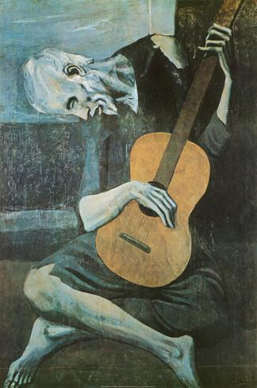
Thank you for giving us purpose
LAST WORDS FROM CO-LEADERS
“The meaning of your life is to find your gift and the purpose of your life is to give it away. “
Pablo Picasso
“Far and away the best prize that life has to offer is a chance to work hard at work worth doing”
Teddy Roosevelt

Slide 66
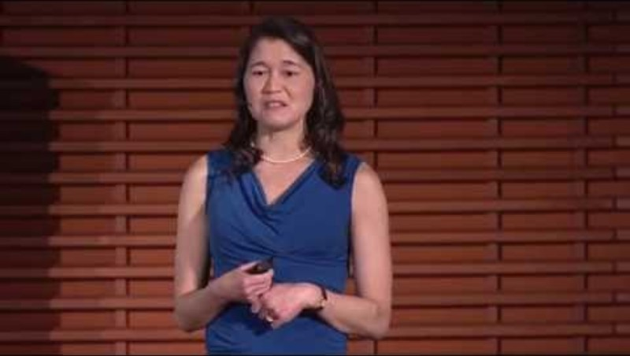

Slide 67
AS WE END ANOTHER YEAR
In 2022, 5,000 Canadians and 40,000 Americans were living with cystic fibrosis (CF)
Cystic fibrosis is an inherited disease caused by mutations in a gene called the cystic fibrosis transmembrane conductance regulator (CFTR)
The treatment of CF has been revolutionized in the past decade, dramatically improving life expectancy and quality of life for many patients, particularly due to CFTR modulator therapies. These drugs target the underlying genetic defect in the CFTR protein rather than just managing symptoms. The drug Trikafta which was approved in 2019 dramatically benefits about 90% of people with CF.
In the 1980s, the median survival for people with CF was under 20 years. Today, many patients are expected to live into their 40s, 50s, or beyond. However, access to these drugs remains very limited because of how expensive they are. Trikafta , has a list price of over $300,000 USD annually per patient in the United States . In Canada, the cost is approximately $360,000 CAD per year.
Breakthrough treatments, particularly in biotechnology and gene therapy often carry staggering price tags. This is commonly thought to be due to the high cost of research and development but much of that is publicly funded. The biggest cause of these high costs are patent protections that grant exclusive rights to companies for years, a profit-driven pharmaceutical industry incentivized to prioritize return on investment and weak government regulations on these industries.
This means that access to not only life-saving treatments, but other essential health care increasingly depends not on need, but on ability to pay.
It wasn’t always like this. When penicillin was discovered in 1928 by Alexander Fleming, he didn’t patent it. Penicillin was developed for widespread public use during wartime, it was seen as a common good, not a private commodity. Government investment drove production, and companies were incentivized not by profits alone but by social responsibility to serve the war effort.

Slide 68
Other examples of medical advances that prioritized public health not profits include:
The polio vaccine, developed by Jonas Salk, was famously declared the vaccine unpatentable. When asked who owned the patent, Salk replied, “The people… Could you patent the sun?”
The Human Genome Project (completed in 2003) was a publicly funded, international collaboration costing billions of taxpayer dollars. Results were made publicly available in real time. It created the foundation for many private biotech advances, but these companies then patented the downstream applications (e.g., genetic tests, gene therapies). Craig Venter’s attempt to privatize parts of the genome was fiercely resisted at the time.
Many early antiretroviral treatments for HIV were developed with public funding, often in collaboration with the NIH. Yet companies patented and priced them very high. The global backlash led to the formation of groups like Doctors Without Borders and The Global Fund, and eventually to the availability of generics in lower-income countries.
The mRNA platform used in Pfizer and Moderna COVID-19 vaccines was heavily based on decades of publicly funded research. NIH scientists co-developed key components. Moderna received nearly $2 billion in public funding yet still set high prices and refused to share IP with the world during the crisis.
Most basic research is done in universities and government labs that are publicly funded but the moment a potential application emerges, private industry steps in, patents it, and sells it back to the public often at astronomical prices.
This practice has been called the “socialization of risk, privatization of profit” model or socialism for the wealthy. The taxpayers pay for the expensive research which private companies then use to make products they sell at astronomical prices to health care users.
There is a deep irony here: some of our greatest medical discoveries were gifts offered freely by scientists and made possible by public investment. Yet we now live in a world where access to healing is mediated by wealth, and innovation and scientific advances are no longer an act of service, and a common good but a business model.

Slide 69
The trend of privileging private wealth over collective well-being is a defining feature of our time. It’s not just happening in medicine; it’s a structural shift shaping nearly every aspect of modern life. In Medicine, the body has become a marketplace. Life expectancy depends not on biology but on economic status. Healing is no longer a public duty; it’s a business opportunity.
This trend is happening not just in medicine. In education knowledge is increasingly becoming a product. Universities are defunded and tuitions are soaring ($500 vs. $30000). Student debt becomes a lifelong burden. Knowledge becomes a luxury, not a right. Education is marketed like a brand.
Housing has become an investment not a right. Real estate is now a global asset class for the ultra-wealthy. Homes sit empty as investment vehicles while people sleep in tents nearby. Renters are squeezed by hedge funds buying up entire neighborhoods. The basic human need for shelter becomes speculative capital. The logic of profit devours the logic of home.
The planet has become a commodity. Forests, water, and air are privatized or destroyed in the name of “growth.” Fossil fuel profits continue, even amid climate collapse. Green solutions are often monopolized offered only to those who can afford them. Nature itself is for sale, and the future of all life is collateral.
Attention has become an exploitable resource. Human focus is mined, gamified, and sold to advertisers. Social media platforms amplify outrage and misinformation because it’s profitable. The human psyche becomes an advertising surface, not a sacred interior.
All this leads to deepening inequality. We have created a two-tiered world: one of abundance for a few, precarity for the many. Wealth begets influence, and influence rewrites the rules. When basic needs depend on market forces, solidarity weakens. Citizens become consumers; neighbors become competitors. Democracy cannot thrive where power is bought. Ethics dissolve into what’s legal and what’s legal is often written by those who profit.
Climate collapse, pandemic response, AI governance each requires collective global action. But a world ruled by private interest cannot act with shared purpose.

Slide 70
These trends have exacted a profound cost on our collective well-being, mental health, and sense of meaning. Beneath the surface of economic growth and technological progress lies a spiritual erosion a quiet unraveling of our inner and communal lives.
When housing, healthcare, and education are precarious, even the privileged live in fear. For the less privileged, this becomes toxic stress, affecting the body, brain, and soul.
A society organized around individual success and market competition severs relational ties. We move more, work more, scroll more but belong less. Studies show that loneliness is as deadly as smoking. Young people report record levels of depression, anxiety, and suicidality.
Much distress is not disordered; it’s a natural response to an unnatural society. But we pathologize the individual rather than asking what the culture demands of them. We treat the soul’s cry for meaning as a biochemical glitch.
In commodified societies, shared spaces, parks, libraries, public institutions are underfunded or gone. There’s no place to gather, to feel part of something larger.
If you’re not a citizen with dignity and responsibility, but a consumer navigating markets, then your role is to choose, not to care. The question becomes: “What do I want?” not “What is worth giving my life to?”
When everything is for sale, nothing feels sacred. We lose shared stories that bind and orient us. Meaning becomes privatized, and many wander in existential drift. Work replaces vocation, and burnout replaces purpose. Status replaces connection, and envy replaces community. Spectacle replaces reality, and performance replaces authenticity.
This doesn’t just affect individuals it shapes the emotional climate of our entire culture as we become disillusioned with institutions, retreat into ideology and conspiracy and become increasingly tribal seeking belonging in reaction rather than in aspiration.
We have become disconnected from ourselves, others, meaningful work and the Sacred. Ian McGilchrist says we’ve become trapped in a left-hemisphere world: abstract, utilitarian, fragmented. We’ve lost the felt, embodied, relational depth that gives life its richness. As a result, people report feeling like observers of their own lives not participants in something alive and meaningful.

Slide 71
J. Krishnamurti wrote: “It is no measure of health to be well adjusted to a profoundly sick society.” In other words
when the social order itself is disordered, when it is built on injustice, alienation, and the suppression of truth, then to fit in, to be “normal,” may not be a sign of wellness. In fact, sensitivity to such a world may be a sign of inner truth, not illness.
This reframes our distress. Rather than asking, “What’s wrong with you?”, we begin to ask, “What happened to you?” and even, “What’s wrong with the world around you?” It shifts from blaming the individual to examining the context, trauma, economic insecurity, systemic oppression, cultural disconnection.
People often suffer not because they are broken, but because they feel too deeply in a culture that has gone numb. This reframe allows us to see distress as a truth-teller, not merely a disorder.
If suffering is not just personal but collective, solutions must be collective too, policy, justice, education, community, environment ,otherwise we’re treating symptoms while feeding the disease.
Recognizing that the issue lies not just with individuals but with society is liberating and urgent: It invites compassion, not blame. It breaks the spell of self-alienation and it calls us to imagine a world where human well-being, not just adjustment, is the goal.
Humans are meaning-makers. The desire for beauty, truth, love, and connection hasn’t been erased, it’s been exiled. When we recognize that our malaise is not personal failure but cultural misalignment, we can begin to imagine new ways of being: Reclaiming community through service, ritual, and shared creation. Restoring the sacred by honoring what cannot be priced. Healing not just individuals, but the systems and stories that shape them.

Slide 72
BRUNCH AND JOAN AND NICOLE’S SPECIAL

