Slide 1
Today we’re going to try something a little different. Throughout the course we've explored core emotional systems involved in seeking and exploration, threat and self-protection, attachment and caregiving and play. One thing that is important to understand is that these systems do not operate independently. They interact with one another in complex ways, shaping our thoughts, emotions, relationships, and behaviour.
There is, however, one important area of human experience that we have not explored directly: sexuality and intimate bonding. At first glance, sexuality may seem like just another instinct or drive. But the more closely we examine it, the more complex it becomes. Sexuality is not a single system. It is better understood as an ecology of interacting systems involving attachment, erotic desire, caregiving, belonging, novelty-seeking, self-protection, identity, and meaning-making.
This complexity helps explain why intimate relationships can be so rewarding and so difficult. Many of the "holes in the sidewalk" that people repeatedly fall into involve sexuality and bonding: loss of desire in long-term relationships, confusing love with sexual attraction, using sex to regulate loneliness or anxiety, struggles with jealousy, infidelity, shame, identity, or the tension between safety and aliveness.

Slide 2
This session is an attempt to understand those struggles through a different lens. Rather than asking who is right or wrong, normal or abnormal, healthy or unhealthy, we will explore how multiple biological, psychological, developmental, and cultural systems interact to shape our experience of intimacy and sexuality.
This is a pilot session. I am not presenting it as a finished product or as a definitive account of human sexuality. Rather, I am offering it as a framework for reflection and discussion. I am especially interested in your feedback: what resonated, what felt unclear, what seemed useful, what was missing, and whether you think this material belongs in future versions of the course.
As always, I invite you to approach today's topic with curiosity rather than certainty, compassion rather than judgment, and an openness to complexity.

Slide 3
Many people like to save the best for last.
To study this in a scientific way Joan and Nicole polled 100 people in the streets of Stratford by asking them if they like to save the best for last and if so, what do they save.
Of those that said yes, they made a list of the of the top responses.
Sex and chocolate were consistently among the top 3 responses.
Today we bring you both.
Our apologies to zoom participants who will have to abstain.

Slide 4
Welcome everyone to the final SIMPLE session.
This year we've explored attachment, trauma, stress, dissociation, meaning, spirituality, parts, protectors, exiles, Wise Mind, Self, and a remarkable number of ways human beings can accidentally make themselves miserable.
Today, however, we return to one of the deepest truths of all:
There is chocolate.
At the beginning of the course, we practiced mindfulness with a raisin.
The raisin was humble. Virtuous. Healthy.
The raisin tried its best.
But if we're honest, it always knew this day was coming. Take your truffle in your hand.
Before eating it, simply look at it.
Notice its shape, texture, colour.
Consider the extraordinary chain of events that brought it here.
Sunlight. Rain. Soil.
Cacao farmers.
Factory workers.
Truck drivers.
Store clerks.
And whatever mysterious force in the universe decided that fermented beans should eventually become chocolate truffles.
Pause and appreciate that.
Now bring the truffle closer.
Notice any anticipation.
Any excitement.
Any thoughts such as:
"I hope Joan doesn't talk for too long."
Notice that too.
As you hold the truffle, reflect on something we've learned this year:
The mind is rarely satisfied with the present moment.
A part of us is already planning the second truffle.

Slide 5
Another part is wondering if there are enough for everyone.
Another part is calculating calories.
Another part is saying,
"Life is short. Just eat the freaking truffle."
Just notice these parts with curiosity.
No need to exile them.
Now take a small bite.
Don't chew immediately.
Just notice.
Texture.
Taste.
Sweetness.
Bitterness.
The way something so small can create so much experience.
As you slowly chew, consider that many of life's greatest pleasures share something in common.
Chocolate.
Friendship.
Music.
Nature.
Love.
Sex.
They are difficult to enjoy while simultaneously analyzing them.
At some point we have to stop thinking about life
and actually taste it.
Take another bite.
Notice how quickly the mind adapts.
The first bite was amazing.
The second bite is merely excellent.
This is why there is a whole field called psychology.

Slide 6
As you finish your truffle, reflect on the deeper lesson.
Mindfulness was never really about raisins.
Or truffles.
Or breathing.
Or meditation.
It was about learning to arrive.
To actually be here for our lives.
To notice what is present.
To meet it with curiosity.
And perhaps even gratitude.
Take one final breath.
Notice the people around you.
Notice that for many months we have traveled together.
Learning.
Questioning.
Healing.
Growing.
And now, sharing chocolate.
Which may be the highest stage of spiritual development.
Thank you all for your willingness to participate in this pilot session, and throughout the course.
May you continue to notice.
May you continue to learn.
May you continue to heal.
And may your future contain both wisdom...
and good chocolate.
Amen.

Slide 7
We would appreciate it if you answered the following questions. We will come back o them at the end of the session in-person participants will be given a hard copy of the questions for those on zoom we suggest you take a picture of these screens.
Please answer the first three questions now by a show of hands.
How interested are you in learning about sexuality and intimate bonding as part of the SIMPLE course?
  1 Not interested
  2 Slightly interested
  3 Moderately interested
  4 Very interested
  5 Extremely interested
How comfortable do you feel discussing sexuality in an educational setting such as SIMPLE?
  1 Very uncomfortable
  5 Very comfortable
Which statement best reflects your current view?
  Sexuality is primarily biological.
  Sexuality is primarily psychological.
  Sexuality is primarily social/cultural.
  Sexuality is a combination of many factors.
  Unsure.

Slide 8
We will come back to the following questions after the session
Overall, how valuable was this session?
  1 Not valuable
  5 Extremely valuable
Did the session help you understand sexuality and bonding in a new way?
  1 Not at all
  5 Very much
Which concept was most helpful?
  Sexuality as an ecology of systems
  Attachment vs erotic systems
  Developmental influences
  Cultural and historical influences
  IFS perspective
  Other
Which concept was least clear or needs further development?
Did you feel the session was:
  Too simple
  About right
  Too complex

Slide 9
7.Did the session feel:
  Balanced and respectful
  Somewhat biased
  Strongly biased
8. Did you feel any important perspectives were missing? If so, which ones?
9. Would you recommend including this session in next year's SIMPLE course?
  Definitely not
  Probably not
  Unsure
  Probably yes
  Definitely yes
10. If this session were included next year, what would you change?
11. What is one idea from today's session that you are likely to remember a month from now?
.

Slide 10

SEXUALITY AND BONDING: FROM INSTINCT TO INSTITUTIONS TO IDENTITIES TO INTEGRATION
One can choose what to do, but not what to want.
Arthur Schopenhauer

Slide 11
PART I- INTRODUCTION
1. Sexuality and intimate bonding holes in the sidewalk
2. Why is it so difficult to talk about sexuality
3 The traditional story
PART II – THE MAP: How sexuality works
4. The core premiss
5. The biology of sexuality
6. The evolution of sexuality
7. the cultural evolution of norms
8. Sexuality as an ecology of bonding systems
PART III – MISALIGNMENT: Why things go wrong
9. Some definitions
10. Statistics
11. Sexuality identity categories: what they clarify and what they miss
12. How disruptions in psychosocial development affect sexuality
13. Our struggles with sexuality and bonding
14. Common modern sexuality and bonding “holes in the sidewalk”
PART IV – IFS understanding and healing
15. Healing bonding and sexuality issues (IFS)
PART V – INTEGRATION
16. A more humane frame
17. Closing reflection

Slide 12

PART I - INTRODUCTION

Slide 13
PART I- INTRODUCTION
1. Sexuality and intimate bonding holes in the sidewalk
2. Why is it so difficult to talk about sexuality
3. The traditional story

Slide 14
1. SEXUALITY AND INTIMATE BONDING “HOLES IN THE SIDEWALK”

Slide 15
SEXUALITY AND BONDING HOLES WE FALL INTO
We participate in a group like simple or go into therapy because we keep falling into the same painful holes.
Some of the most painful holes we fall into revolve around sexuality and intimate bonds:
Long term partners become “housemates” or friends after their erotic attraction has died.
Sex is used as a confirmation of “love”.
Partners are totally honest with one another, but the mystery is gone and boredom sets in.
Partners leave the relationship because the desire is gone but sometime after their desire returns and they want to reconcile.
People use sex to deal with loneliness, to feel safe or wanted.
People feel ashamed of their sexual fantasies and desires.
Etc.…
One of these holes may feel familiar to you.
In this session we offer a model to help us to better understand our sexuality and intimate bonds that may allow us to be more compassionate with ourselves and our partners.

Slide 16
2. WHY IS IT SO DIFFICULT TO TALK ABOUT SEXUALITY

Slide 17

WHY IS IT SO DIFFICULT TO TALK ABOUT SEXUALITY?
Sexuality is difficult to talk about because it’s a complex subject. It’s at once deeply personal, subject to moral judgements, and becoming increasingly politicized.
Sexuality touches on attachment or our need to be wanted and connected to others.
It is part of our identity or who we are and how we belong.
It is frequently linked to shame and power or what we hide, and how we control.
It also plays an important role in how meaningful we feel our lives are.
We’re currently living through rapid cultural changes around sexuality and identity which our instincts never evolved to handle.

Slide 18
IN TODAY’S SESSION, WE ENCOURAGE YOU TO BE CURIOUS RATHER THAN JUDGEMENTAL AND OPEN INSTEAD OF CERTAIN.

Slide 19
3 THE TRADITIONAL STORY

Slide 20

THE TRADITIONAL STORY ABOUT HUMAN SEXUALITY AND BONDING
Please note that we are not defending or attacking the traditional story just describing it.
In the traditional story about sexuality and bonding, humans are said to have evolved as naturally monogamous beings, with sexuality tightly linked to exclusive romantic attachments.
In this view:
Men evolved to seek sexual variety to spread genes as widely as possible.
Women evolved to seek commitment and resources, trading sexual access for protection, and parental investment.
Traditional marriage mirrors our evolutionary design for long-term, sexually exclusive pair-bonds which are our “natural” state.
Sex outside a monogamous relationship is a threat and infidelity is deviation, temptation, or moral failure.
Sexual identities other than heterosexual monogamy are problematic.

Slide 21
CHALLENGS TO THE TRADITIONAL STORY
The traditional narrative about sexuality and bonding justifies traditional marriage norms making them seem biologically determined. It also pathologizes much of Human sexual experience including most sexual identities other that “straight”, changes in desire in relationships, affairs, pornography use, framing these as moral failures.
This traditional story about sexuality and bonding has been widely challenged. Notably anthropologists Ryan and Jetha authors of “Sex at dawn” have offered a compelling alternative story. In this session we’ll start by exploring their claim that human sexuality evolved in hunter-gatherer societies that were organized around flexible bonding, shared childrearing, and non-exclusive sexual relationships. This made flexibility in bonding and sexuality biologically and genetically natural and strict lifelong heterosexual monogamy a poor fit for our evolutionary psychology.
We’ll then present a model that argues that sexuality and bonding involve several hardwired biological systems whose balance continuously changes over the short and long-terms. This model seeks to explain much of the distress associated with intimate sexual relationships as the result our attempts to force ancient instincts into traditional institutions.
Today many of us feel we are at war with our our sexuality . We battle our hungers, expectations, and disappointments. This, we’ll suggest may be because religion, politics, and science ignore and deny our biology and millions of years of evolved adaptations. The goal of this session is to give us a way to begin to understand and sooth these epic internal struggles.

Slide 22
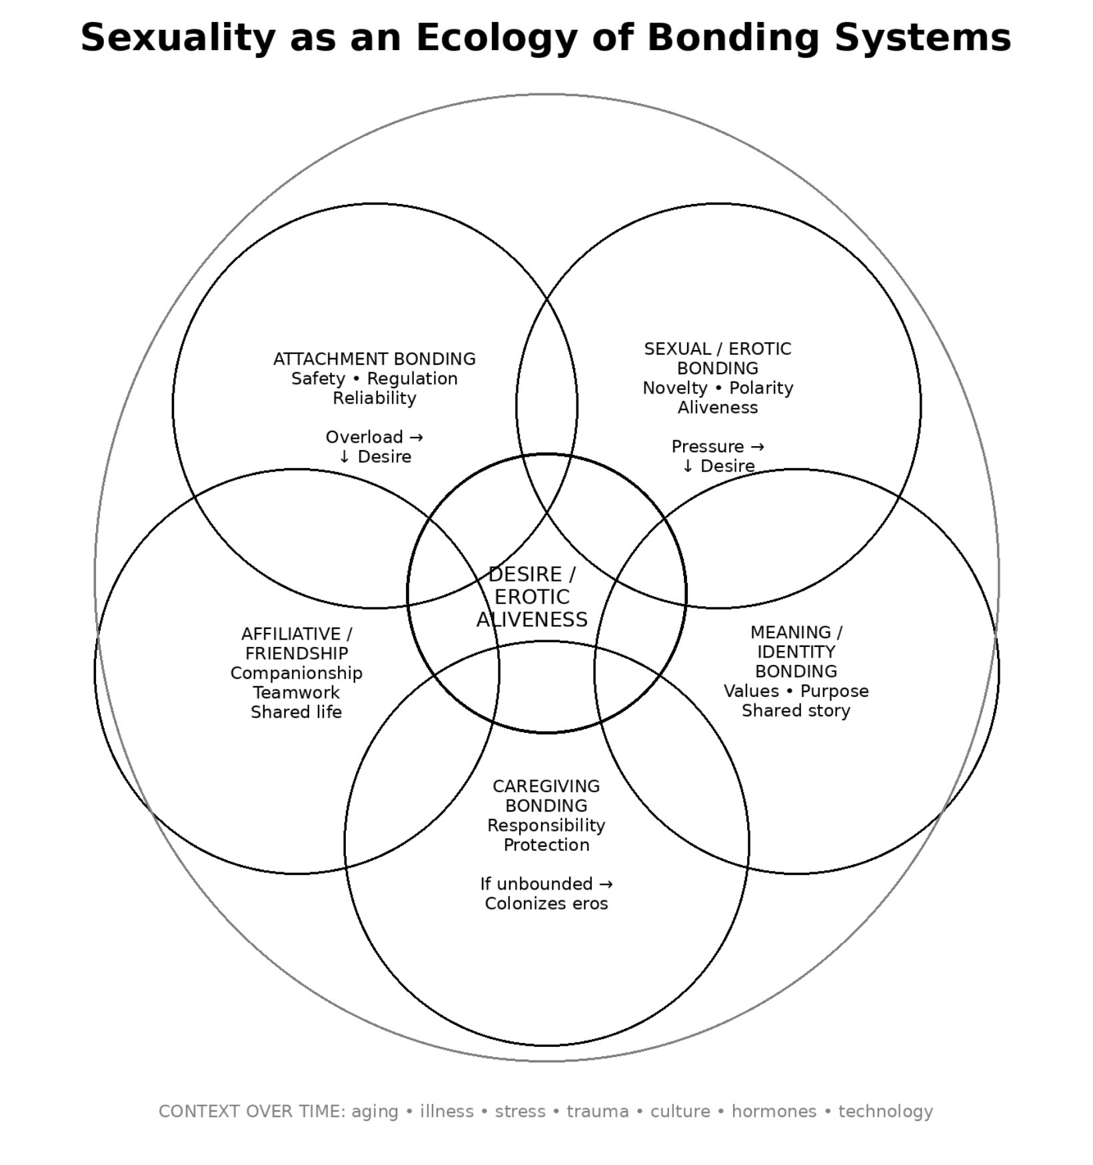
PART II – THE MAP: How sexuality works

Slide 23
PART II – THE MAP: How sexuality works
4. The core premiss
5. The biology of sexuality
6. The evolution of sexuality
7. the cultural evolution of norms
8. Sexuality as an ecology of bonding systems
9. How disruptions in psychosocial development affect sexuality

Slide 24
4. THE CORE PREMISS

Slide 25
THE CORE PREMISE OF THIS SESSION
What sexuality is: Sexuality is not a single drive, or instinct. It’s better understood as an ecology of bonding systems; multiple motivational and emotional systems that evolved for different purposes and are shaped over time by biology, development, culture, relationships, and context.
This ecology of bonding systems includes:
1. sexual desire,
2. attachment,
3. pair-bonding,
4. caregiving,
5. status and belonging,
6. novelty-seeking, and
7. meaning-making.

Slide 26
THE CORE PREMISE OF THIS SESSION
What these systems do: These systems can align, conflict, amplify, or inhibit one another, and their relative strength shifts across the lifespan and across situations.
Because of this, sexuality is dynamic rather than static, and relational rather than purely individual.
Why conflict is normal: Many of the tensions people experience around sexuality arise not from pathology, but from conflicts between these bonding systems, against a background of rapid cultural change.

Slide 27
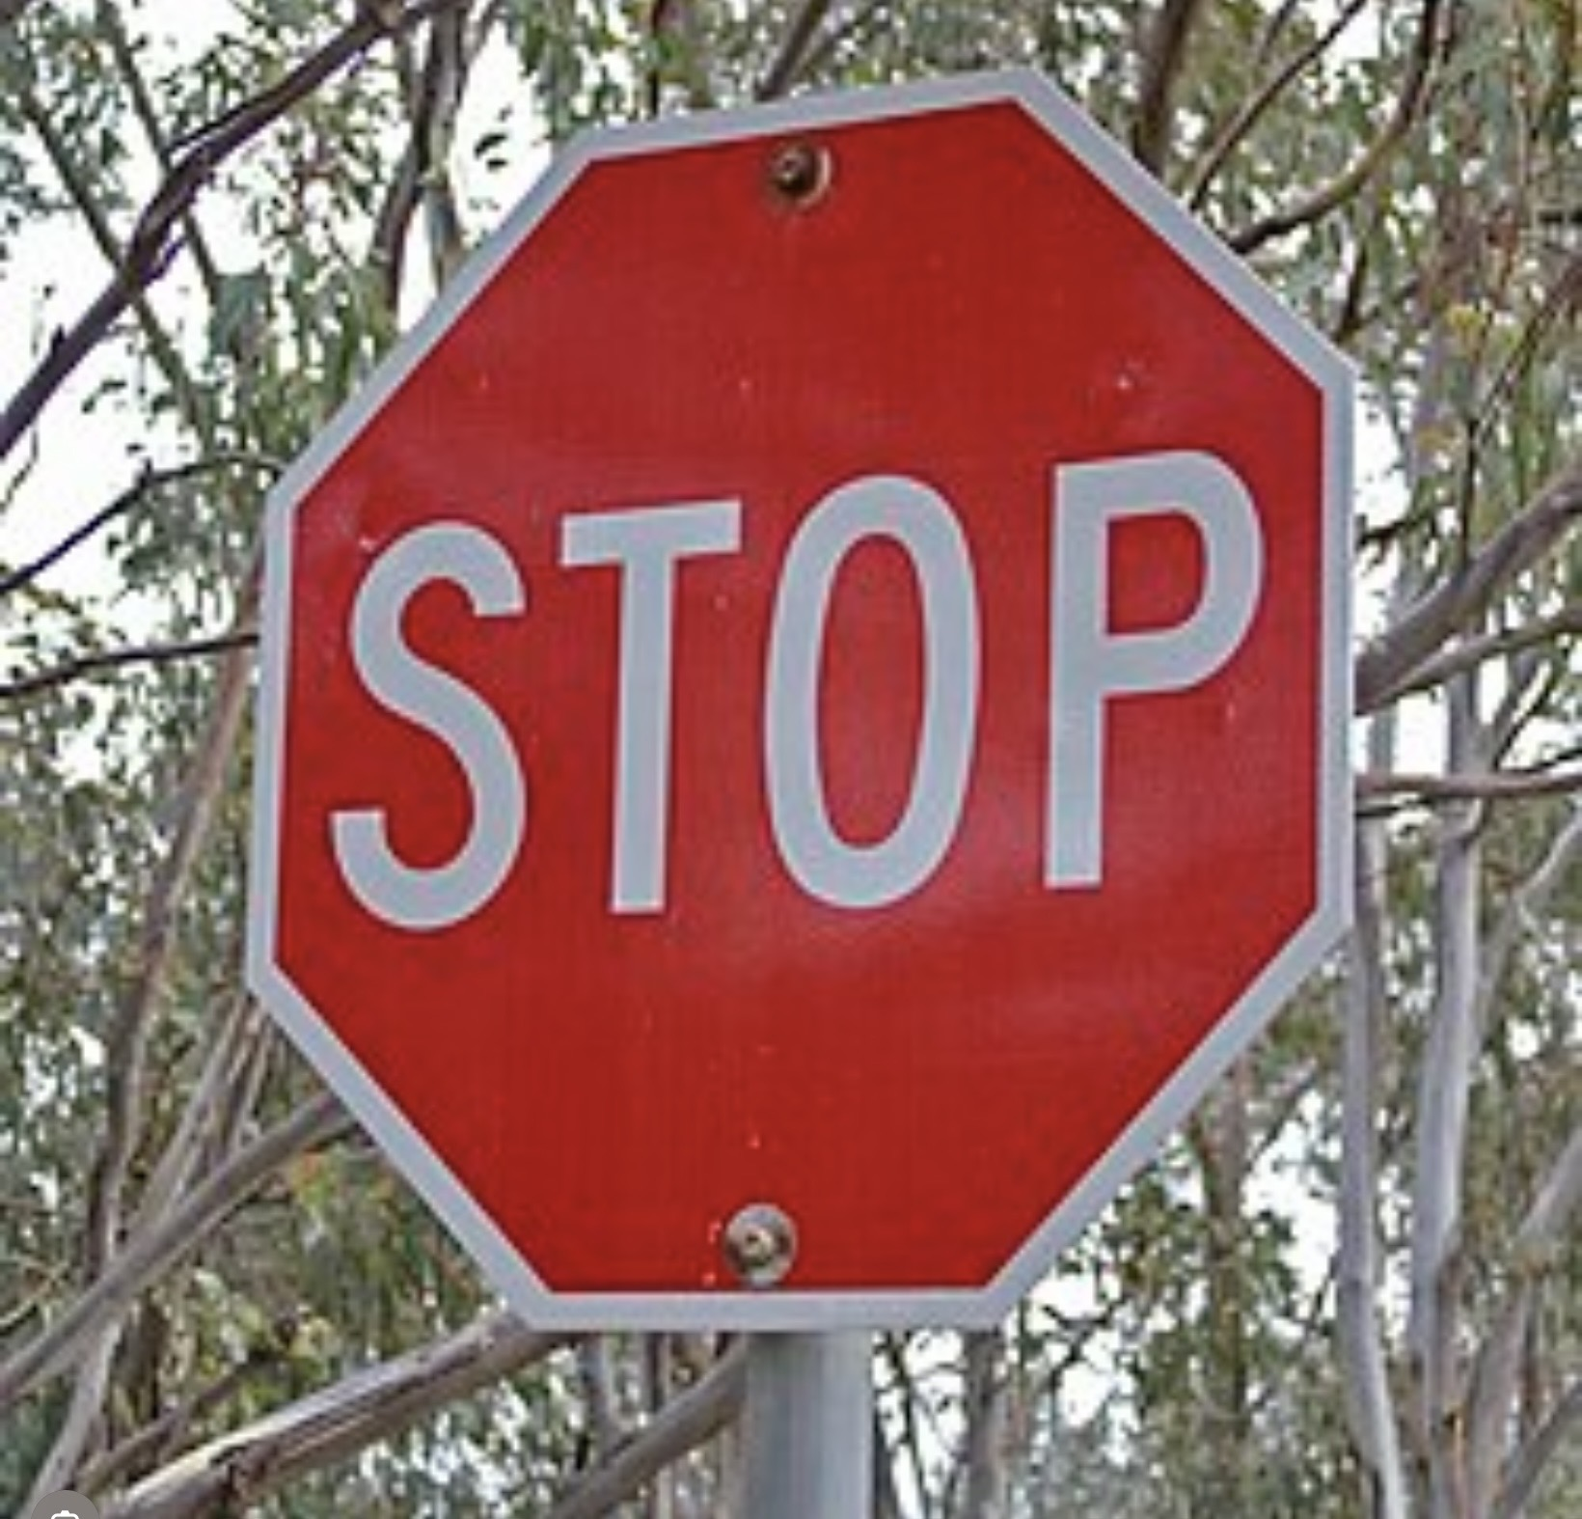
In this session we will not be ranking sexual identities or setting a hierarchy of what is more mature, healthier, or legitimate. Different patterns of sexuality and bonding can make sense in different lives, bodies, relationships, and cultures.
We will not pathologize difference: Variations in desire, attraction, identity, or relationship style are often a reflection of development, experience, temperament, and context and not evidence of illness or defect.
We will also not suggest that there is a “normal” standard but will instead recognize that human experience is diverse. Many people hold multiple, sometimes contradictory experiences of sexuality and bonding across time.
Our aim is not to collapse complexity into a single label or story, but to make room for it, to understand it with curiosity rather than judgment.
PLEASE NOTE WHAT WE WON’T BE DOING TODAY

Slide 28
5. THE BIOLOGY OF HUMAN SEXUALITY

Slide 29
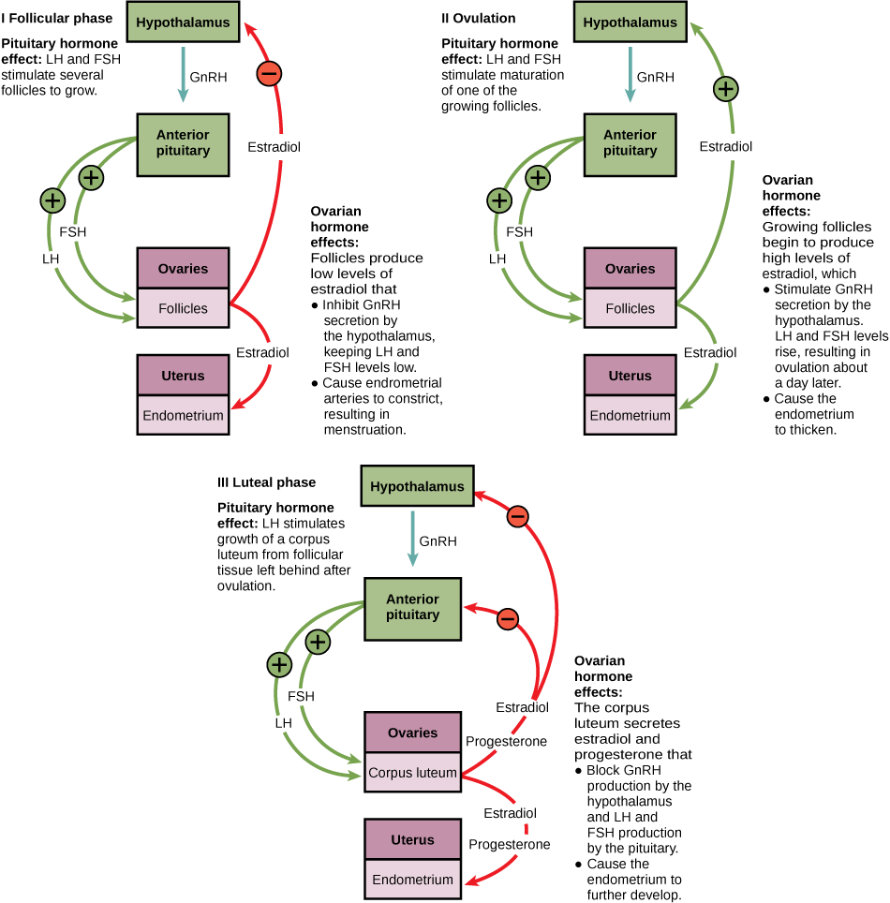
THE BIOLOGY OF HUMAN SEXUALITY
Human sexuality emerges from the interaction of three biological systems:
The reproductive system: Organs, gametes, and sex hormones (estrogen, progesterone, testosterone) that enable reproduction.
The endocrine system: Especially the hypothalamic–pituitary–gonadal (HPG) axis, which regulates sexual development, libido, fertility, and cyclical changes.
The nervous system including: The limbic system (desire, attachment, emotion). Dopaminergic reward pathways (motivation, pleasure). Autonomic nervous system (arousal, erection, lubrication, orgasm)
Sexuality is therefore not a single “drive,” but a distributed biological process.

Slide 30
SEXUALITY AND BONDING CHANGE OVER THE LIFESPAN:

Slide 31

INFANCY AND CHILDHOOD:
Sex hormones are present at low baseline levels.
Sexuality is not oriented toward reproduction, but toward sensory pleasure, body awareness and attachment and bonding
Early relational experiences quietly shape later sexual meaning.
Sexuality begins not as desire, but as aliveness in the body. Touch, warmth, pleasure, and comfort are woven into attachment.
As the child matures her cognitive and social worlds expand, sexuality recedes from the foreground. Erotic energy is sublimated into play, learning, and same-sex friendships. This is a time of rehearsal, boundaries, belonging, modesty, and curiosity are quietly practiced without full sexual expression.

Slide 32

Activation of the HPG axis triggers rapid rises in estrogen or testosterone, development of secondary sex characteristics and fertility
The reward system matures earlier than the frontal cortex, leading to heightened desire and novelty-seeking and increased emotional intensity
Sexuality becomes strongly linked to identity formation, peer comparison, self-consciousness and shame potential
Biology creates capacity and urgency, not wisdom.
With puberty, sexuality returns with force, now fused to self-definition. Desire asks: Who am I drawn to? What kind of body do I have? How am I seen?
Sexuality becomes a laboratory for identity, often intense, awkward, exhilarating, and vulnerable. Shame or pride at this stage leaves deep grooves.
PUBERTY AND ADOLESCENCE:

Slide 33
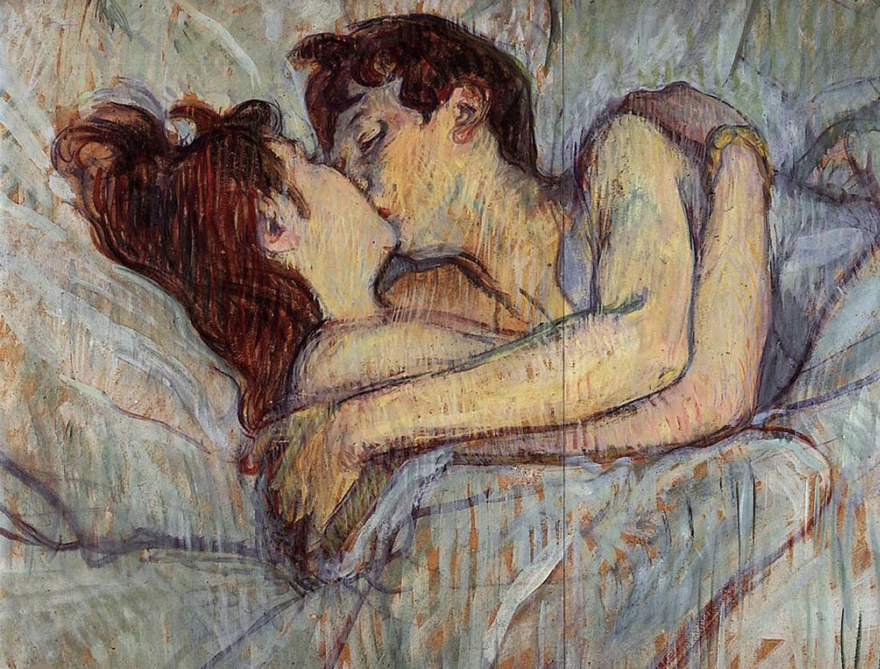
Hormone levels stabilize (with individual variation).
Sexuality becomes less about raw drive and more about context, relationship and meaning
Stress, sleep, illness, medications, trauma, and attachment patterns can modulate or override biological desire.
Testosterone (in all genders) tends to support libido while estrogen supports arousal and tissue health and oxytocin supports bonding.
Sexuality seeks mutual recognition. Desire is no longer only self-discovery but relational negotiation, how to want and be wanted without losing oneself.
Attachment patterns surface clearly. Sex becomes a language for bonding, reassurance, and emotional repair.
ADULTHOOD

Slide 34
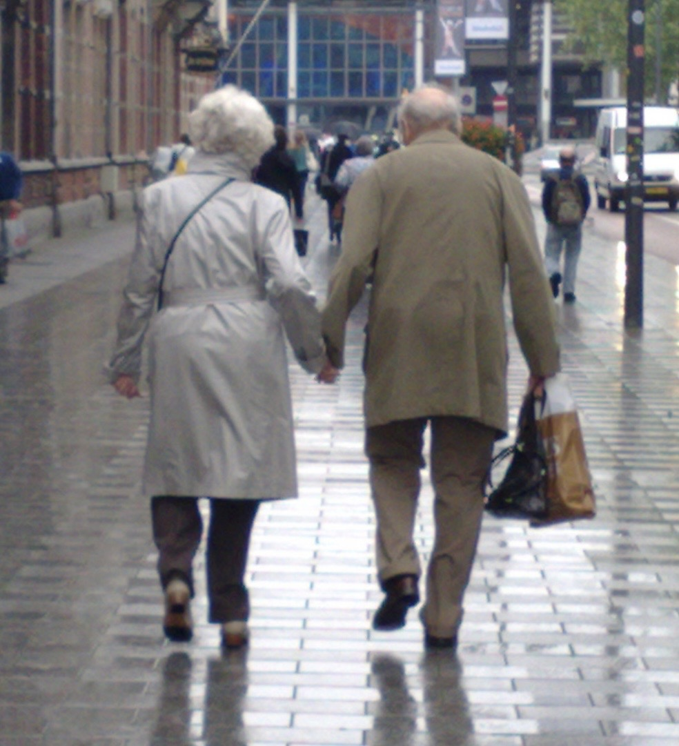
MID AND LATER LIFE
Gradual hormonal changes result in menopause with declining estrogen and progesterone in females and andropause with a gradual testosterone decline in males.
Capacity for pleasure and intimacy remains but sexuality often shifts from performance-focused to sensory, relational and meaning-based
The nervous system remains plastic; desire can be rekindled through safety, novelty, and emotional connection.
Erotic life is tested by time, loss, power, fatigue, and responsibility. For some, sexuality narrows; for others, it deepens. Desire becomes less about novelty and more about presence, truth, and creative vitality.
As performance recedes, embodiment remains. Sexuality becomes slower, symbolic, and profoundly relational. Touch, affection, shared history, and tenderness often eclipse urgency.

Slide 35
Stage | Sexuality Is Primarily…
Early childhood | Sensory, bodily, attachment-linked
Latency | Dormant, sublimated, relational learning
Adolescence | Identity-forming, exploratory, self-defining
Early adulthood | Intimacy-seeking, bonding, pair-focused
Midlife | Integrated with meaning, power, creativity
Later life | Companionate, embodied, symbolic, relational

Slide 36
Over the lifespan, sexuality matures from sensation to identity to intimacy and to meaning.
When development at one stage is disrupted, there are consequences for the persons future.
When it is integrated, sexuality becomes not merely something we do, but a way we are alive together.

Slide 37
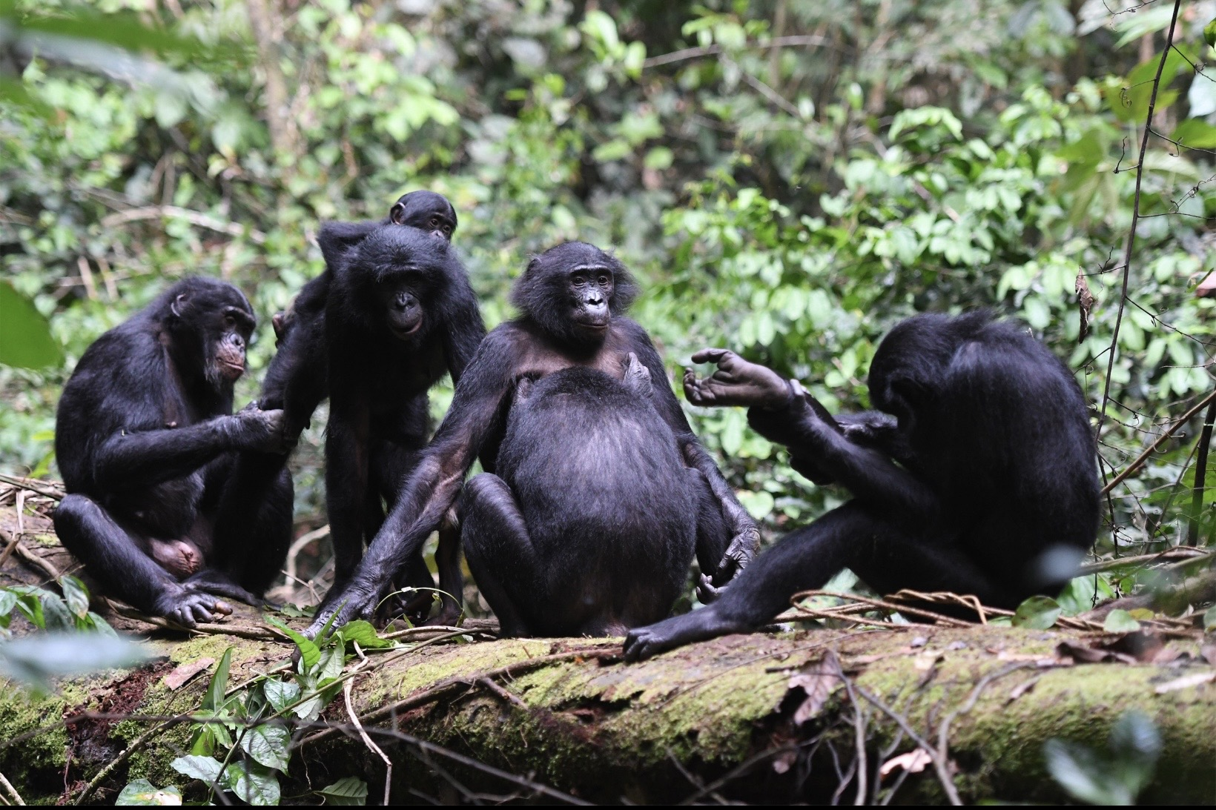
6. THE EVOLUTION OF SEXUALITY

Slide 38
ORIGINS OF SEXUAL REPRODUCTION
Early single-celled organisms reproduced asexually by dividing in two. This was efficient, but it produced genetically identical offspring, limiting variation and adaptability.
Sexual reproduction emerged when more complex single-celled organisms began exchanging genetic material. This introduced genetic diversity, allowing populations to adapt more effectively to changing environments.
With multicellular life, reproduction further specialized. Distinct sperm and egg cells evolved, bringing with them differentiation into sexes and sexual attraction.
In early animals, sexuality became linked to nervous systems, pleasure, and arousal. Pair bonding and social coordination emerged, and sex started to function as a motivator for proximity, cooperation, and connection.
In mammals, sexuality became deeply intertwined with attachment, parenting, and emotional regulation. Sexual bonds supported caregiving, long-term affiliation, and the survival of highly dependent offspring. Sex thus became a powerful organizer of relationship, care, and social structure.
Sexuality began as a biological strategy for genetic diversity, but in humans it expanded far beyond reproduction. It became woven into identity, meaning, culture, and morality.
Human sexuality is simultaneously biological, psychological, social, cultural, and spiritual, shaped as much by our personal (“my”), relational (“our”), and cultural or sacred (“The”) stories as by instinct alone.

Slide 39
HUMAN BONDING AND FLEXIBILITY
As we described earlier, the traditional narrative about Human sexuality assumes there is a single “natural” pattern we are meant to follow. In these accounts, lifelong monogamy is presented as the preferred or even biologically “natural” form of bonding, sexual exclusivity supports stable families, clear parentage, and social order, while deviations are framed as moral weakness or failures of self-control.
An alternative view, articulated in the book Sex at Dawn, challenges these assumptions. Drawing on anthropology, primatology, and evolutionary biology, this perspective argues that humans evolved not as strictly monogamous, but as a mixed mating strategy species. In other words, our biology reflects flexibility rather than a single fixed pattern as the traditional story argues.
Early human societies likely practiced serial pair-bonding, (the practice of engaging in a series of exclusive, committed romantic or sexual relationships sequentially) shared child-rearing, and relatively flexible sexual norms. While pair bonds mattered to our hunter gatherer ancestors, they were not necessarily exclusive for life, and they existed alongside broader communal networks of care and cooperation. Sexuality was embedded in social life rather than confined to a single lifelong partnership.
If this is how Humans lived for 95% of their time as a species, the tensions many people feel today, may represent a mismatch between our emotional biology and our modern cultural norms.

Slide 40
ATTACHMENT VS EROTIC SYSTEMS IN MODERN LIFE
The instinctual attachment and caregiving system’s purpose is safety and survival. It pushes us toward familiar others, long-term bonds, emotional regulation, and secure bases from which to explore the world. Attachment thrives on predictability, reliability, and trust.
The mating or erotic system, by contrast, evolved to support reproduction, genetic diversity, and vitality. It is energized by novelty, intensity, and aliveness. This system is less concerned with stability and more responsive to excitement, opportunity, and possibility.
These two systems are the cornerstones of sexuality and bonding.
In hunter gatherer societies, people lived in groups that typically ranged from 15 to 50 individuals. Childcare was communal, emotional support came from many other adults, and erotic energy did not have to be fully contained within one relationship. This reduced the pressure on any single bond to meet every emotional and existential need.
Modern life has radically changed this social ecology. We live predominantly in nuclear families which means that one other adult is expected to meet all our needs for attachment, eroticism, companionship, meaning, and identity for decades.

Slide 41
ATTACHMENT VS EROTIC SYSTEMS IN MODERN LIFE
Not only do we expect to be seen, understood, desired, supported, and fulfilled by one person but in addition, social media, dating apps, and movies make it easy to imagine that life might be happier or more exciting with someone else. When this sense of endless choice collides with stress, burnout, or major life transitions, relationships are more likely to fracture.
From an evolutionary perspective, it is not surprising that our erotic and attachment systems clash. The attachment system seeks safety and continuity, while the erotic system is easily stirred by novelty and intensity. Much contemporary distress around sexuality arises not because there’s anything wrong with us, but because ancient systems are being asked to operate in conditions they never evolved for.
Understanding this doesn’t tell us how we should live but it helps explain the complexity of our sexuality and how it is often conflicted.
Rather than choosing sides in the monogamy versus sexual flexibility debate, this view invites our curiosity asking us to be mindful of the systems that are active within us. If we understand what these systems are trying to do, then we may be able to relate to our inner conflicts more compassionately.

Slide 42
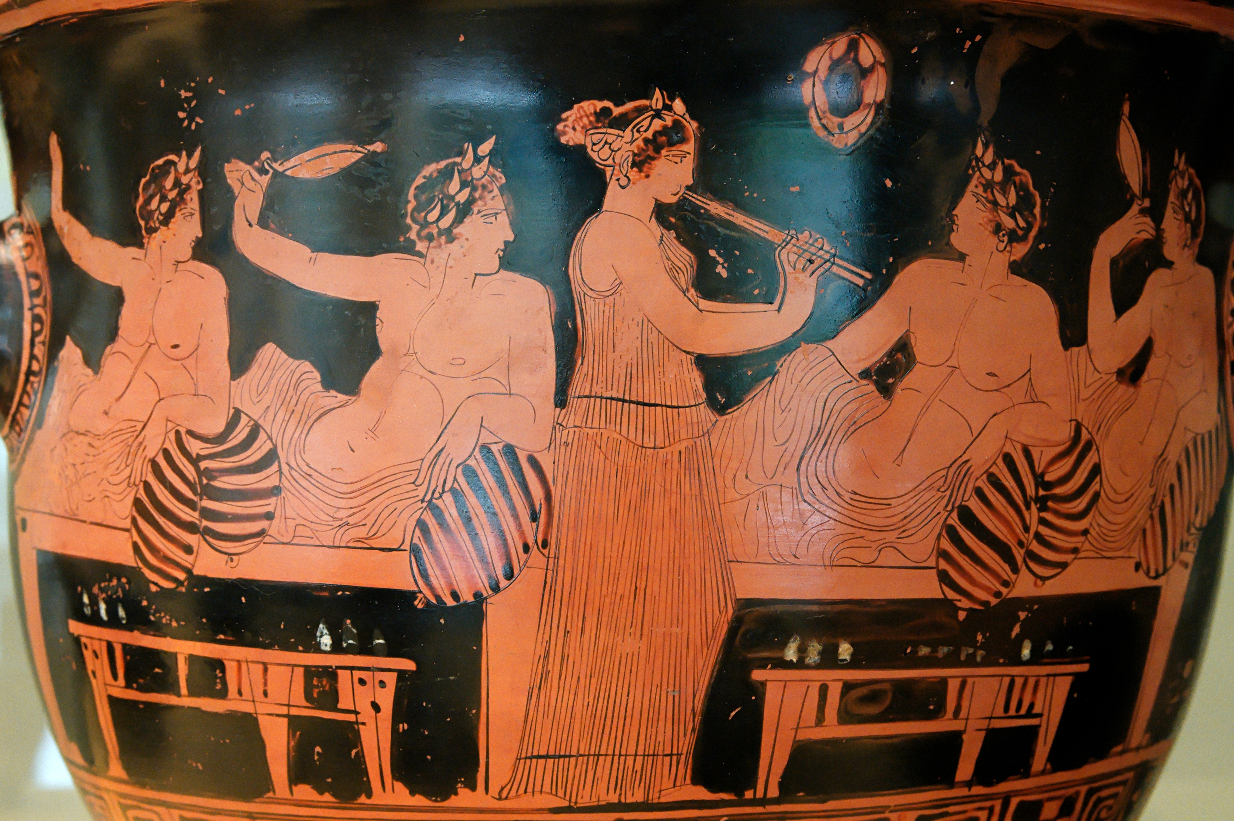
7. THE CULTURAL EVOLUTION OF NORMS

Slide 43
SHIFTING NORMS
For most of human history, difficulties with sex or close relationships were important to people but they weren’t nearly as important as they’ve become today. Human bonding didn’t evolve for the kind of social world most of us live in now.
With the agricultural revolution Humans transitioned from a nomadic hunter-gatherer lifestyle to a settled agricultural existence. Exclusive pair bonding became important mostly because agricultural societies invented private property.
Monogamous marriage became a way of managing “Private property” and passing it down the generations. The institution of monogamous marriage became central for organizing sex, child-rearing, inheritance, and social order.
The roles prescribed by traditional marriage, as we know it today, became fixed, and sexuality, especially women’s sexuality, was more tightly controlled to make sure families and property lines stayed intact.
In agricultural societies the couple became central, but it was still supported by strong communities, shared beliefs, and social obligations.
In modern times, the extended community was lost. The expectation of romantic love was added to marriages, turning the couple into not just a practical partnership but also an emotional ideal. Today, we often expect one intimate relationship to provide love, sex, friendship, emotional support, identity, personal growth, and a sense of meaning. At the same time, many of the families, communities, and shared traditions that used to help meet these needs have weakened or disappeared.

Slide 44
TRADITIONAL MARIAGE AS AN ECONOMIC INSTITUTION
Many authors have argued that traditional marriage (the monogamous union of 2 people) is fundamentally an economic institution rather than a purely natural arrangement.
The core idea, held by people like Engels, de Beauvoir, Firestone, Rubin, and Coontz, is that when, after the agricultural revolution, societies developed heritable private property, men needed to be certain they were their children’s father to pass wealth to their offspring. Traditional marriage’s enforced monogamy, along with women's economic dependency, was the mechanism that provided this certainty.
The nuclear family that emerged was not primarily about love or bonding, but about the orderly transmission of wealth down a male line.
This view has been criticized on several grounds:
1) anthropological evidence doesn't always fit tis neat developmental sequence
2) attachment research suggests some biological basis for pair-bonding, and
3) individual agency and love are real even if the structural conditions shape what choices people can actually make.

Slide 45
THE ARGUMENT SUMMARIZED
The
1
Heritable private property requires certainty of paternity
4
The nuclear family emerges as the unit that holds and transmits property
2
Certainty of paternity requires control of female sexuality
5
Women's economic dependency on husbands is structural, not accidental
3
This control is institutionalized as monogamous marriage
6
Therefore: family form follows economic logic, not purely natural bonding

Slide 46
ARGUMENTS AGAINST TRADITIONAL MARIAGE AS A PURELY ECONOMIC INSTITUTION
ANTHROPOLOGICAL COMPLEXITY
BIOLOGY IS NOT NOTHING
Not all pre-class or non-Western societies fit neatly into the "group marriage → monogamy" developmental sequence Engels assumed.
Attachment theory, pair-bonding research, and evolutionary psychology suggest some basis for durable two-person bonds independent of property systems.
AGENCY MATTERS
THE LOVE MARRIAGE PARADOX
People genuinely choose partners, love, and make families. The structural critique doesn't erase lived experience — but asks us to notice what conditions foreclose other choices.
Coontz notes that basing marriage on romantic love introduced both greater freedom and greater fragility. Divorce rates rose as economic coercion fell.

Slide 47
SHIFTING NORMS
There’s been a big shift in where our emotional and relational needs get met. This shift has happened much faster than our nervous systems, with its ancient instinctual attachment and sexual patterns can keep up with.
We commonly attribute tensions in relationships to flaws in our partners or in the relationship. It doesn’t occur to us that we are simply asking too much of a relationship.
Seen from this evolutionary ecology of systems perspective, many modern relationship struggles start to make more sense.
Conflicts, confusion, loss of desire, or repeated breakdowns don’t necessarily mean something is wrong with you, your partner or your relationship. These holes might instead reflect a mismatch between how humans evolved to bond and the social world we now live in. When too much pressure is placed on a system, it develops weak spots, blind spots, and “holes” that people fall into without meaning to.
The distress many of us experience in modern relationships isn’t a moral failure or a psychological defect but an “ecological” problem. To solve this problem, we can’t just go back to the past or give up modern freedoms. We must be mindful of how institutions have changed, and build relationships, communities, and therapeutic approaches that spread our emotional needs more realistically.

Slide 48
8. SEXUALITY AS AN ECOLOGY OF BONDING SYSTEMS

Slide 49
AN ECOLOGY OF BONDING SYSTEMS
In this section, we’ll elaborate on why it’s helpful to think about sexuality and bonding not as a single drive or fixed trait, but as an ecology of interacting systems.
Sexual desire doesn’t arise in isolation, and it isn’t something we simply “have” or “lose.” It emerges from the dynamic interaction of multiple biological systems, each with its own purpose, and conditions for activation. Desire is context-dependent, fluid over time, and deeply relational.
When we look at sexuality in this way, instead of asking “What’s wrong with my desire?” we ask, “Which of my biological systems are active right now, and which are being suppressed?”
Just as in a natural ecosystem, no single element explains the whole picture. Changes in stress, safety, novelty, trust, health, or life stage can rebalance the entire desire system. Changes in desire do not mean something is broken but that there’s a change in the balance of the system.

Slide 50
AN ECOLOGY OF BONDING SYSTEMS
The diagram on the left represents the core bonding systems that operate simultaneously within us.
They are the
1. attachment,
2. sexual or erotic,
3. caregiving,
4. affiliative or companionship, and
5. systems related to threat detection and self-protection.
Each of these systems “wants” something slightly different and each supports relationships in important ways.

Slide 51
WHAT EACH SYSTEM WANTS
1. The attachment system seeks safety, predictability, and emotional closeness. It allows us to feel secure enough to stay.
2. The erotic system seeks novelty, intensity, and embodied aliveness. It brings vitality, pleasure, and a sense of being desired.
3. The caregiving system wants to protect and nurture, often prioritizing another’s needs over one’s own. Caregiving sustains bonds through illness, stress, and vulnerability.
4. The affiliative system values companionship, shared meaning, and mutual support. Companionship creates friendship and shared life.
5. The self-protection system seeks safety and security. It detects threats and acts to prevent harm, maintain boundaries, and ensure survival.

Slide 52
AN ECOLOGY OF BONDING SYSTEMS
These systems can cooperate, but they can also compete. Healthy relationships usually draw on all of these, though not always in equal measure.
At the same time, each system can under certain conditions, suppress or distort sexual desire.
Ex. When attachment shifts into anxiety or fear of loss, desire may narrow or shut down.
When caregiving becomes dominant, especially in the context of a partner’s illness or dependency, partners may start to feel more like parent and child than lovers.
When safety becomes the overriding goal, novelty and risk, which fuel eroticism, often recede.

Slide 53
AN ECOLOGY OF BONDING SYSTEMS
Each of these systems evolved to solve a different survival problem, and none of them is inherently “good” or “bad.” Problems may arise however, when one system dominates at the expense of the others.
That the self is really an ecology of systems leads to uncomfortable unconscious psychic tensions: what makes us feel safest is often not what makes us feel most alive. Safety tends to reduce uncertainty, while erotic desire often thrives on difference, mystery, and a tolerable edge of risk.
From an evolutionary perspective, this makes sense, attachment stabilizes bonds, while desire pulls us toward exploration and reproduction. In modern relationships, however, we often expect one relationship to fully satisfy both.

Slide 54
AN ECOLOGY OF BONDING SYSTEMS
Many couples feel confusion or shame because of these tensions. They may love and trust their partner, yet feel their sexual desire fading, and interpret this as a personal or relational failure. In this model, it is neither. It is often the predictable result of an ecology that has become weighted toward safety, caregiving, and predictability, with less room for novelty and separateness.
This model does not tell us what relationships should look like. Instead, it offers a map to help us understand why desire fluctuates, why different people prioritize different systems, and why conflict around sexuality so often reflects deeper tensions between safety and aliveness rather than simple libido mismatches.
Understanding sexuality as an ecology of bonding systems, gives us a more self-compassionate and realistic framework. Rather than pathologizing ourselves or our partners, we can begin to ask better questions: Which systems are running the show right now? What does this relationship need more of, or less of, in this season of my life? And how can we work with our biology and history, rather than against them, as we navigate intimacy and meaning?

Slide 55
PART III – MISALIGNMENT: Why things go wrong

Slide 56
PART III – MISALIGNMENT: Why things go wrong
9. Statistics
10. Some definitions
11. Sexuality identity categories: what they clarify and what they miss
12. How disruptions in psychosocial development affect sexuality
13. Our struggles with sexuality and bonding
14. Common modern holes

Slide 57
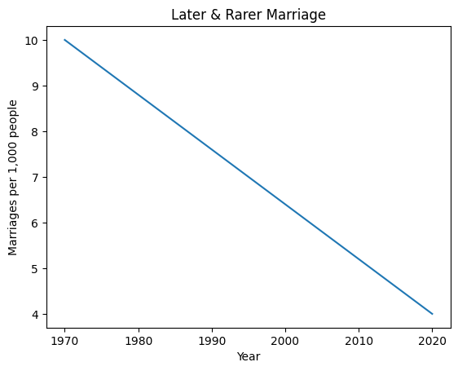
9. STATISTICS
These statistics don’t explain distress they set the background conditions for an explanation:
More people are marrying later, or not at all, than in any previous generation.
That leaves long stretches, in people’s lives, where attachment and sexuality are less structured, and more improvisational.

Slide 58
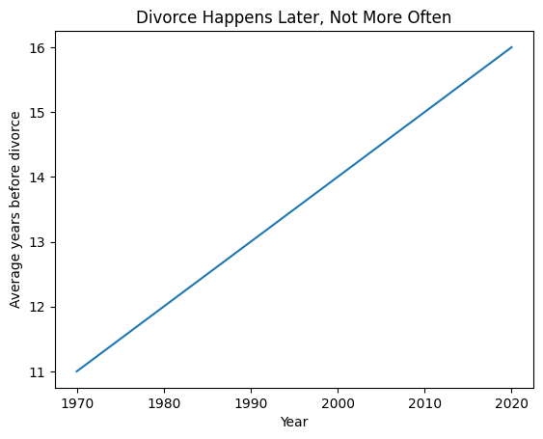
Divorce is happening later, and less frequently.
When divorce happens, it tends to occur after longer relationships in which partners have gone through multiple life transitions.

Slide 59
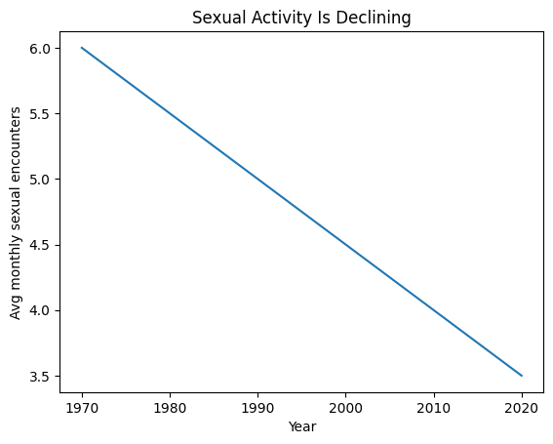
Despite a more sexualized culture sexual activity is declining across all age groups.
Younger adults, especially, are having less sex than previous cohorts.
Sex is being asked to do a lot more: reduce stress, define identity, provide reassurance, and be a source of novelty. As a result, it often suffers under all that weight.

Slide 60
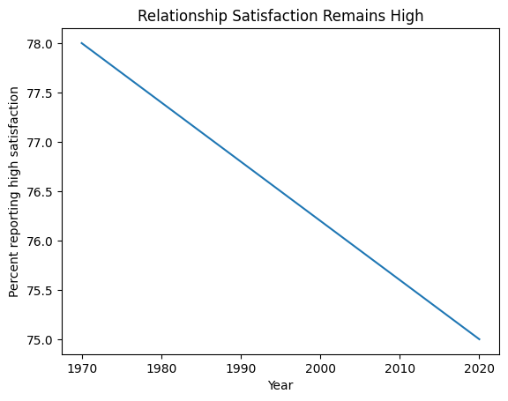
Despite all these changes, people in committed relationships report surprisingly high satisfaction.
If this is true, what does it suggest the problem is?
That’s the question we’re trying to answer in this session.

Slide 61
10. DEFINITIONS
Before we go further, we need to define some terms. Many of the tensions and confusions around sexuality arise because we use the same words to mean different things.
Sex: Refers to biological and reproductive characteristics such as chromosomes, hormones, internal and external anatomy. Sex is about bodies and reproduction, not identity or desire.
Gender: Refers to how a person experiences, understands, and expresses themselves in relation to cultural categories like masculine, feminine, both, or neither. This includes identity, social roles, and expression, and varies across cultures and time.
Cisgender (cis): When a person’s gender identity aligns with the sex assigned at birth.
Transgender (trans): When a person’s gender identity does not align with the sex assigned at birth.
Non-binary / gender diverse: Gender identity does not fit neatly into male/female categories.
Sexual orientation: Enduring patterns of romantic and/or sexual attraction to others.

Slide 62
Sexuality: Refers to the whole field of erotic life: desire, arousal, fantasy, behavior, relationship patterns, and the meanings we attach to them. Sexuality is shaped by biology, development, relationships, and culture and it changes over time.
Relationship structure: Describes how people organize intimacy and commitment, not orientation.
Consent: An ongoing, freely given agreement that requires awareness, choice, and safety.
Monogamous: Committed to one intimate partner at a time.
Consensually non-monogamous: Intimate relationships with more than one partner, with knowledge and consent.
Polyamorous: Multiple emotionally significant romantic relationships at the same time.
Bonding: Refers to the process by which connection with another person becomes emotionally regulating, significant, or organizing in our lives. Bonding answers the question: Who matters to us, and why?

Slide 63
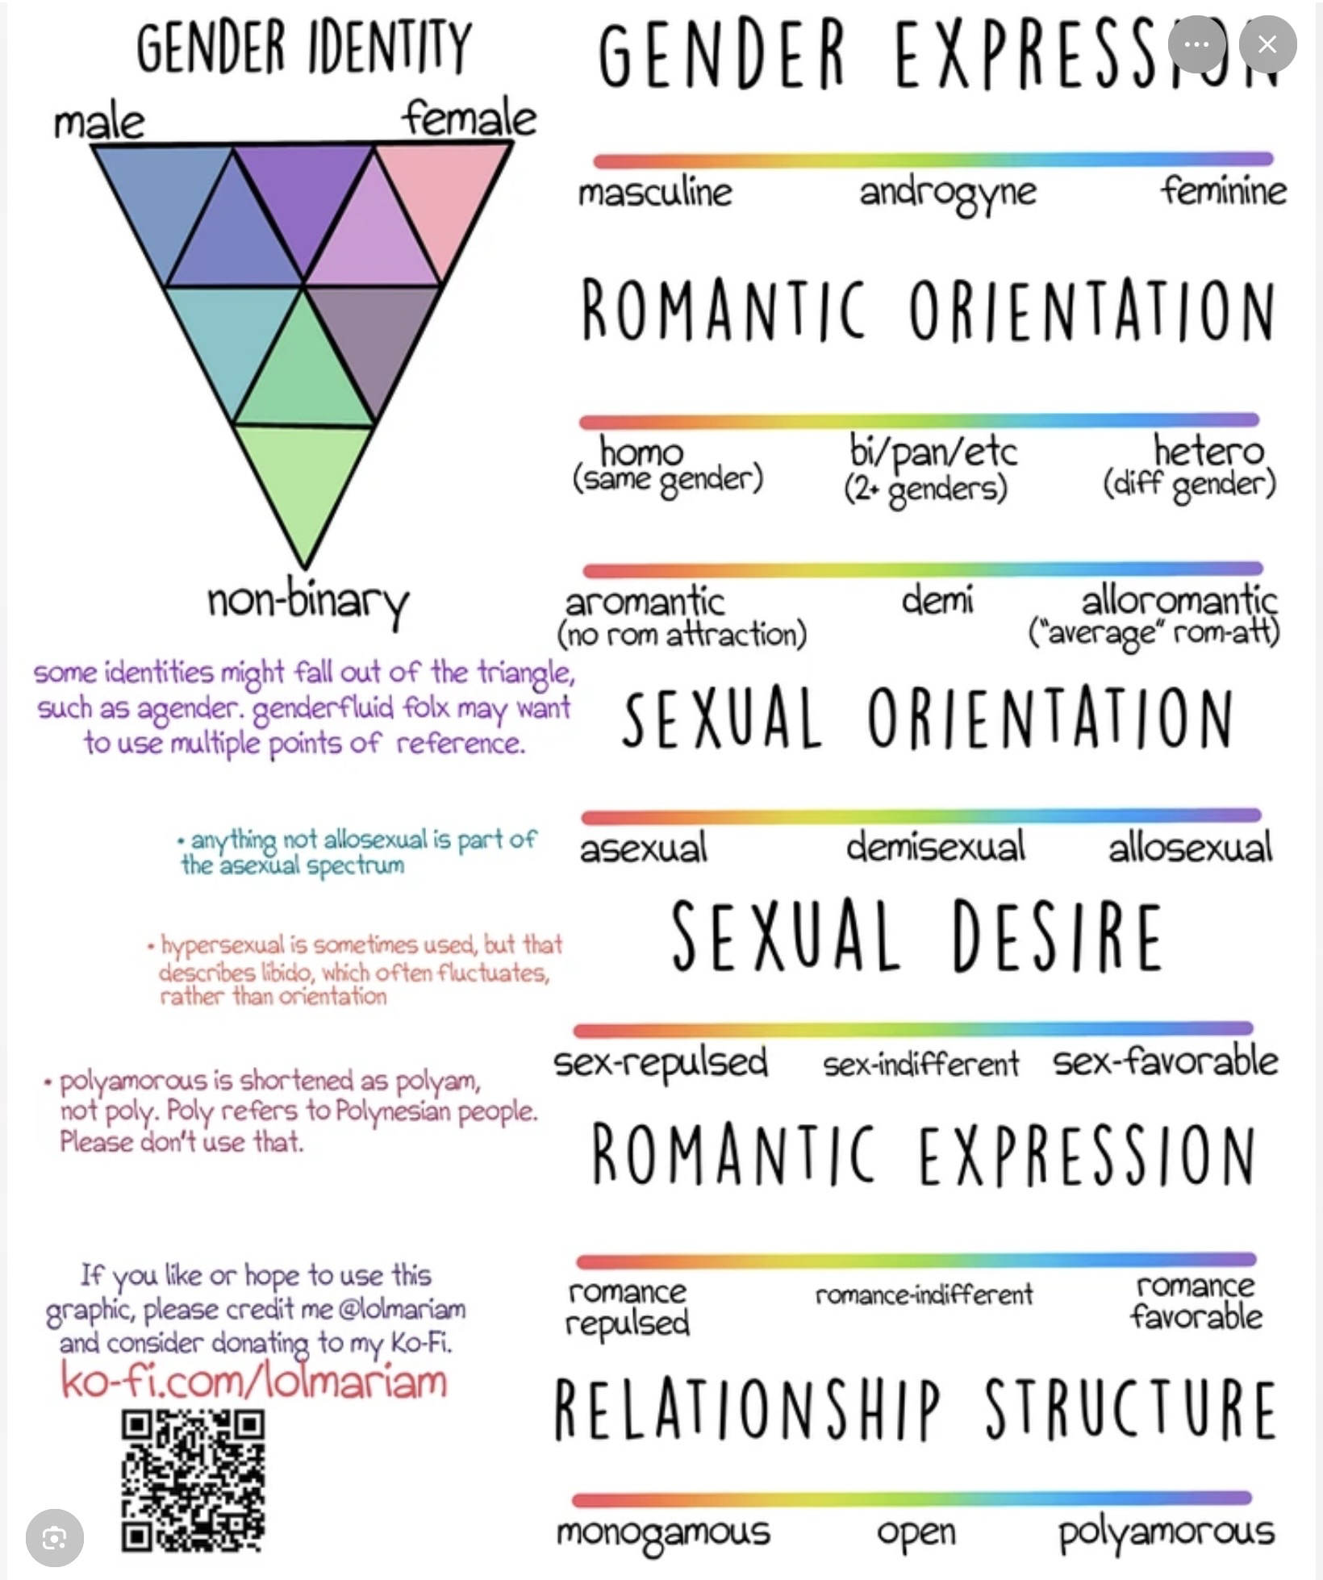
11. SEXUALITY IDENTITY CATEGORIES: WHAT THEY CLARIFY AND WHAT THEY MISS

Slide 64
SEXUAL IDENTITY: A SPECTRUM
Sexual identity refers to how a person thinks of themselves in terms of attraction and orientation
Heterosexual
(Straight)
Homosexual
(Gay/Lesbian)
Bisexual
Pansexual
Asexual
Attraction to
people of a
different gender
Attraction to
people of the
same gender
Attraction to
people of one's
own and other genders
Attraction regardless
of gender identity
or expression
Little or no sexual
attraction to
any gender

Slide 65
Additional Sexual Identity Categories
The language of identity continues to evolve — these terms reflect lived experiences
Demisexual
Queer
Questioning
Aromantic
Fluid
Sexual attraction only
after forming a deep
emotional bond
Umbrella term for
non-heterosexual or
non-cisgender identities
Actively exploring
one's sexual identity
or orientation
Little/no romantic
attraction (independent
of sexual attraction)
Sexual identity or
attraction that shifts
over time or context

Slide 66
KEY DISTINCTIONS TO REMEMBER
Sexual Orientation vs. Romantic Orientation
Identity vs. Behavior vs. Attraction
Sexual orientation (who you're sexually attracted to) can differ from romantic orientation (who you form romantic bonds with). A person can be asexual but biromantic, for example.
How someone identifies, who they are attracted to, and who they have sexual experiences with are three separate dimensions that don't always align.
Gender Identity vs. Sexual Identity
Labels Are Personal & Optional
Sexual identity describes attraction patterns. Gender identity (cisgender, transgender, non-binary, etc.) is a separate, distinct dimension of self.
People may choose not to use any label, or may use multiple labels. Identity language is self-defined and can change across a lifetime.

Slide 67
SEXUALITY IDENTITY CATEGORIES
When we talk about sexuality, we often rely on identity categories to help us make sense of ourselves and one another. Identity categories include labels for sexual orientation, relationship structures, gender identity and expression, and various erotic or kink-based scripts.
These categories have become an important part of how people explain who they are and how they seek connection.
At their best, categories and labels do real and important work:
They can reduce shame by helping people realize they are not alone or broken.
They provide language for experiences that were once unnamed or silenced.
They help people find community, especially in a world where many feel isolated in their differences.
Labels can also offer a sense of stability during times of confusion. When someone is trying to understand their desires, attractions, or relational patterns, a label can function like a handrail, something to hold onto while they find their footing.

Slide 68
SEXUALITY IDENTITY CATEGORIES
Categories and labels, however, also come with hidden traps:
One common risk is confusing states with traits, treating a pattern that may be situational, developmental, or relational as if it were fixed and permanent. What begins as a description of experience can quietly become a definition of the self.
Another risk is that labels can freeze what is actually a dynamic system. Sexuality, attraction, and bonding shift across time, relationships, stress levels, health, and life stage. When a label becomes rigid, it can stop people from noticing how their experience is evolving.
Labels can also mask deeper attachment and bonding dynamics. For example, intense attraction may be driven less by sexual orientation and more by familiarity, trauma, or unmet attachment needs.
When we focus only on identity categories, we may miss the underlying systems that are organizing desire and connection.
This doesn’t mean labels are wrong or should be discarded. It means they are maps, not mechanisms. A map helps us name where we are, but it doesn’t explain how the terrain was formed or what forces are shaping it.

Slide 69
When categories and labels are used flexibly, they support self-understanding. When they are used rigidly, they can limit curiosity and growth. Our goal here is to hold them lightly, alongside a deeper understanding of sexuality as an evolving ecology of bonding systems.
In this session, we’ll treat identity categories and labels as useful tools and starting points for inquiry rather than conclusions about who someone is or must remain.

Slide 70
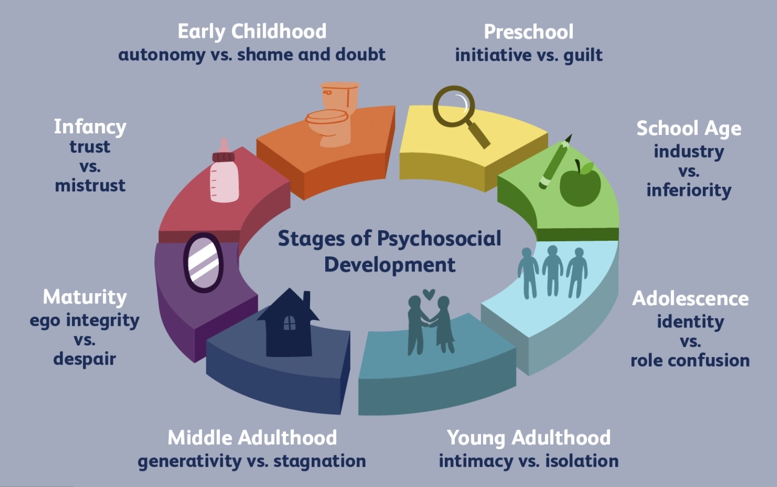
12. HOW DISRUPTIONS IN PSYCHOSOCIAL DEVELOPMENT AFFECT SEXUALITY
This section explains why sexuality often carries unfinished developmental work

Slide 71
PSYCHOSOCIAL DEVELOPMENT AND SEXUALITY
Sexuality doesn’t develop in isolation. It evolves alongside our psychosocial development as described in Erikson’s stages of safety, attachment, identity, intimacy, and meaning. When development is disrupted at any of the different stages of life, sexuality often carries the unfinished work forward.
When early childhood is marked by unsafe or inconsistent attachment, bodily aliveness may never feel reliably safe. Later in life, sexuality may be used to calm, numb, or ground overwhelming feelings, or avoided altogether because pleasure feels dangerous or shameful. People may report compulsive sexual behavior, dissociation during sex, or anxiety in their bodies. Sex can feel regulating rather than relational, and pleasure may feel overwhelming or unsafe.
When disruptions occur during the latency years, when children are learning boundaries, modesty, and social rhythm, sexuality may later feel poorly contained. Adults may struggle with boundaries, confuse affection with sexuality, or feel awkward and uncertain around erotic cues. Sexuality can feel either oddly absent or suddenly intrusive, reflecting incomplete learning about privacy and social containment.

Slide 72
PSYCHOSOCIAL DEVELOPMENT AND SEXUALITY
When adolescence is disrupted, through shame, pressure, or premature foreclosure of identity, sexuality can become fused with self-worth or identity. Desire may feel like proof of value, or sexuality may become something brittle and over-defining. People may say things like, “If I’m not desired, I don’t know who I am.” Sexual labels can carry intense pressure to stabilize the self rather than reflect lived experience.
When early adulthood is marked by unsafe or unreliable intimacy, sexuality often becomes an attachment strategy. Sex may be used to secure closeness, prevent abandonment, or maintain control, or it may be avoided to protect autonomy. People may alternate between intense sexual pursuit and emotional withdrawal, feeling torn between wanting closeness and panicking when it becomes real.

Slide 73
PSYCHOSOCIAL DEVELOPMENT AND SEXUALITY
In midlife, when sexuality must be integrated with power, loss, aging, and meaning, unresolved developmental issues may surface dramatically. Sexuality may erupt in novelty-seeking or acting out, or collapse under stress, resentment, or exhaustion. Affairs, sudden loss of desire, or identity confusion may appear, often accompanied by a sense that sex is the only place aliveness remains or that desire has disappeared entirely.
In later life, when aging, illness, or grief are difficult to integrate, sexuality may be prematurely mourned or anxiously clung to as proof of vitality. Some people resign themselves to the idea that their sexual life is “over,” while others feel desperate to confirm that they are still desirable. Sexuality may become tied to despair, denial, or shame around bodily change.

Slide 74
Sexuality that feels stuck, pressured, avoided, or overly tied to who someone thinks they are, points to developmental issues.
Healing isn’t about “fixing sex.” It’s about understanding when development got interrupted and giving the person what they didn’t get back then; safety, clear boundaries, identity, emotional closeness, or purpose.
As those needs are met, sexuality often becomes calmer, more alive, and more relational on its own

Slide 75
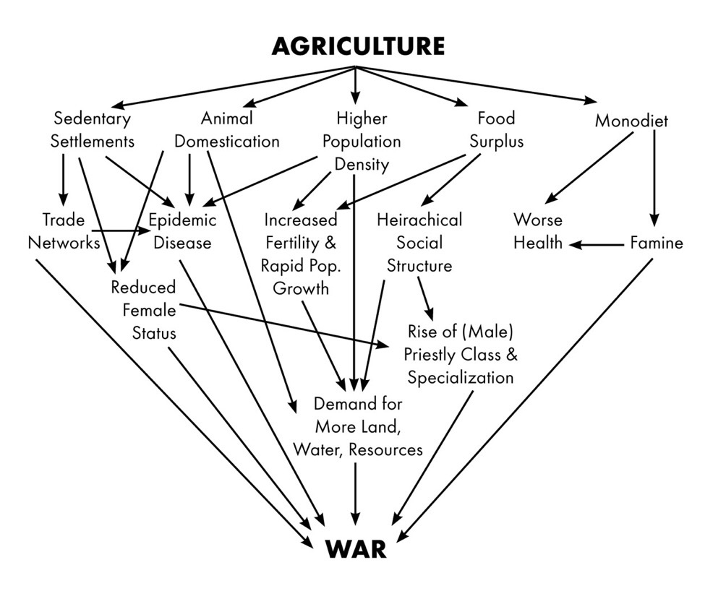
13. OUR STRUGGLES WITH SEXUALITY AND BONDING
What it looks like when one system runs the show too long

Slide 76
WAYS WE STRUGGLE WITH SEXUALITY AND BONDING
The struggles people have in sexual and intimate relationships usually follow common patterns. When we stop focusing on labels and instead look at how desire, closeness, meaning, and emotional regulation change over time, those patterns become easier to see. These patterns don’t mean that something is wrong with a person. They’re more about the tension between how our nervous systems evolved and how modern relationships now work.
When passion fades in a long-term relationship, people often assume love is gone. But more often, the relationship has become emotionally overloaded and centered on caregiving. When partners rely on each other for nearly everything; co-parenting, comfort, safety, companionship, and a sense of meaning, the relationship shifts into a “caretaking and security” mode. This mode is good for stability, but sexual desire usually needs a bit of distance, novelty, and unpredictability to stay alive.
When caregiving dominates, desire may fade, go quiet, or sometimes be directed towards other people. This is not betrayal, it means the relationship has shifted into a different mode.
Familiarity and loss of individuality also matter. Desire usually arises between two distinct people, not two people who feel merged or fused. When a relationship leaves little room for independence, mystery, or personal space, sexual tension often weakens. Emotional intimacy may deepen, but desire can flatten. This too is a sign that the balance between bonding and desire has changed.

Slide 77
WAYS WE STRUGGLE WITH SEXUALITY AND BONDING
Rising rates of infidelity and divorce are less about people becoming less moral and more about the pressures modern relationships are under.
People change over time, and partners don’t always grow in the same direction or at the same pace. A relationship that worked well in one stage of life can start to feel tight or mismatched in another. Without a way of understanding growth and change as normal, these shifts can feel like rejection or betrayal rather than a natural part of development.
Sex can also get pulled into roles it was never meant to play. It may be used to manage anxiety, soothe shame, prop up self-esteem, or provide a sense of identity or worth. When sex is asked to do this much emotional work, desire often becomes intense, fragile, or compulsive rather than playful and connected.
A common pattern in long-term relationships is that safety and desire drift apart. One partner becomes the source of comfort and security, while sexual energy moves into fantasy, pornography, emotional closeness with someone else, or physical affairs. This split is often unconscious and reflects an attempt to hold onto both safety and vitality when they no longer seem to exist together in the same relationship.

Slide 78
13. COMMON MODERN HOLES IN INTIMATE SEXUAL RELATIONSHIPS

Slide 79
Our struggles with sexuality and bonding cause us to fall into some common holes

Slide 80
COMMON SEXUALITY AND BONDING HOLES
Many relationship problems come from confusing different kinds of bonding. Some of our bonding involves feeling safe and reassured with someone, some liking the other person and enjoying time together, some is about taking care of each other and being responsible. All of these are important.
Erotic bonding is different. It’s about aliveness, attraction, and desire. It needs a bit of space, difference, and unpredictability to stay alive. When relationships become only about safety, caretaking, or companionship for too long, sexual desire often fades. When this happens, common patterns show up.
Some people chase closeness at all costs and ignore red flags in a developing relationship because being alone feels unbearable.
Others pull away from developing relationships as soon as things get serious to protect their independence.
Some go back and forth between wanting closeness and wanting distance.
Some idealize the early stage of a relationship and feel disappointed when real needs and limits appear.

Slide 81
COMMON SEXUALITY AND BONDING HOLES
Some leave when desire fades and return later when they miss the attachment.
Others get stuck in caretaker roles, rescuer dynamics, fantasy worlds, or fixed identities that once helped them cope but later hold them back.
What causes people to fall into any of these holes is the interaction between the various sexuality and bonding systems that we have already explored.
To heal and avoid these holes it is very helpful to understand those systems and how they interact but also how to help them co-exist in greater harmony.
Fortunately, internal family systems offers us a way of doing that.

Slide 82
PART IV – IFS understanding and healing

Slide 83
PART IV –IFS understanding and healing
15. Healing bonding and sexuality issues

Slide 84
15. HEALING BONDING AND SEXUALITY ISSUES - IFS

Slide 85
A NEW UNDERSTANDING OF ATTRACTION AND INTIMACY
Instead of starting with labels like sexual orientation or identity as a starting point for understanding what shapes our attraction and intimacy, this alternative approach starts with how desire and bonding actually manifest in real life.
It asks how conditions, such as safety, closeness, stress, history, and life stage, shape attraction and intimacy.
Labels describe what people call themselves. This alternative framework looks at what’s happening underneath the labels. It treats sexuality as something that shifts with time and context, rather than as a fixed trait.
In this approach we consider how our sexuality and bonding manifests or behaves under a number of conditions:
1. safety versus novelty,
2. closeness versus distance,
3. role of caregiving and
4. meaning attributed to sex and change over time.

Slide 86
A NEW UNDERSTANDING OF ATTRACTION AND INTIMACY
Safety versus novelty: one important pattern to consider is how our desire behaves under conditions of safety and novelty. Some people experience desire primarily when they feel secure and emotionally close; others feel it most strongly in contexts of excitement, distance, or unpredictability. Neither pattern is inherently pathological, but each tells us something about how attachment and erotic systems are interacting.
Closeness versus distance: another pattern is how our desire responds to conditions of closeness or distance. Does intimacy deepen desire, dampen it, or make it fluctuate? Does distance increase longing or produce relief? These patterns typically reflect attachment histories and regulation strategies more than sexual orientation per se.
Role of caregiving: to understand bonding and desire we also need to pay attention to the role of caregiving. For some people, caregiving enhances bonding; for others, it suppresses erotic energy. This becomes especially important in long-term relationships, illness, parenting, or unequal power dynamics, where caregiving and sexuality can come into tension.

Slide 87
A NEW UNDERSTANDING OF ATTRACTION AND INTIMACY
Meaning attributed to sex: equally important is the meaning attributed to sex. For some, sex is primarily about connection, for others, it’s about validation, regulation, play, transcendence, or identity. Understanding what sex means to us helps explains our patterns better than how often we desire it or with whom.
Change over time: this framework for understanding sexuality also tracks change over time. Desire and bonding shift with stress, trauma, medication, illness, aging, and life transitions. A pattern that feels like an “identity” at one stage of life may soften, intensify, or reorganize at another.
Variability: finally, this model normalizes variability. Desire is often cyclical, sexuality is deeply contextual, and identity, while meaningful, is usually provisional rather than final. From this perspective, fluctuation is not a failure of coherence but a feature of being human.
This label-bypassing approach to understanding our sexuality doesn’t ask us to abandon our labels and identities. It invites us to hold them lightly, while gaining a deeper understanding of the systems that actually organize desire, bonding, and relationship patterns.

Slide 88
In the appendix (starting with slide 92) you will find several self-reflection tools:
1) A self-assessment: understanding how your sexuality is organized
2) Self-reflection questionnaire a label-bypassing desire and bonding questionnaire
3) A parts mapping exercise for understanding relationship patterns
These may help you understand your sexuality and bonding from the perspective of this model.

Slide 89
AN INTERNAL FAMILY SYSTEMS PERSPECTIVE
Internal Family Systems invites us to look at sexuality in a way that is compatible with the ecology of systems perspective and this new understanding of attraction and intimacy. Instead of asking, “What kind of sexual person am I?” it asks, “Which parts of me are shaping my sexuality right now, and under what conditions?” From this view, sexuality isn’t a single trait or identity. It emerges from the interaction of several inner systems, each with its own needs and concerns.
Some parts, in the ecology or internal family, are focused on attachment. These parts care most about safety, closeness, reassurance, and continuity. When they are in the lead, sex may be about feeling connected, calming anxiety, maintaining the relationship, or expressing care. People may notice that desire increases with closeness or, just as commonly, that it fades once security is established. The message underneath is often, “I love my partner and want to stay connected, but erotic energy doesn’t easily coexist with feeling safe.”
Other parts are oriented toward eroticism and novelty. These parts seek aliveness, excitement, polarity, and exploration. They show up as fantasy, flirting, pursuit, play, or transgression. Desire may be strongest at a distance or in situations that feel new, uncertain, or slightly risky, and may fade in familiar or caretaking contexts. These parts are less about reassurance and more about vitality.

Slide 90
AN INTERNAL FAMILY SYSTEMS PERSPECTIVE
There are also parts whose main job is regulation. When distress, anxiety, shame, or emptiness rises, these parts step in to make the feeling stop. Sex, porn, hookups, or intensity can become quick ways to regulate the nervous system. From this perspective, what looks like “hypersexuality” is often an emergency strategy rather than excess desire. The underlying message is usually, “This helps me feel okay again.”
Other parts are focused on control, morality, and safety. These parts manage behavior by setting rules, suppressing impulses, or shutting sexuality down altogether. They may be protecting relationships, identities, or moral frameworks. Desire may still be present, but it is tightly monitored and constrained in the name of order, safety, or being a “good” person.
Traumatized parts also play a powerful role. These parts carry fear, shame, grief, disgust, or memories of violation. When they are close to the surface, sexuality may shut down, become painful, or involve dissociation. Sexual avoidance is often a form of protection for younger parts that were hurt, shamed, or overwhelmed. From an IFS perspective, sexual healing can’t happen unless these vulnerable parts feel safe.
Finally, there are parts concerned with meaning and identity. These parts try to make sense of desire by asking, “What does this say about me?” or “Who am I allowed to be?” They often gravitate toward labels or narratives that provide coherence and stability, especially when sexuality feels confusing or charged.

Slide 91
INTERNAL FAMILY SYSTEMS SEXUALITY
A helpful image may be to think of sexuality as a campfire.
Attachment parts want warmth and safety around the fire.
Erotic parts want sparks and movement.
Manager parts worry about control and consequences.
Firefighter parts throw fuel on the fire when things feel cold or painful.
Exiled parts sit nearby holding memories of being burned.
Problems tend to arise when any one part is forced to run the fire on its own. Balance comes when all parts are seen, understood, and allowed appropriate influence.

Slide 92
IFS HEALING SEXUALITY
From an internal family systems perspective, healing sexuality begins by normalizing inner diversity. Most people don’t have a single, unified sexuality. They have different parts with different needs, fears, and roles. Simply recognizing this often brings immediate relief, because it reduces shame and the pressure to “figure out who I really am.”
The next step is to gently get curious about how the sexual system is organized. We can ask questions like: Which parts want sex? Which parts resist it? Which parts use it to calm distress? Which parts fear it or try to control it? Mapping these patterns helps people understand their experience without judgment.
A key part of the work is learning to separate identity from parts. We are not our desire, our avoidance, or our fantasies. We are the Self in relationship with parts that carry those experiences. This makes it easier to tolerate ambiguity, avoid locking into rigid identities too quickly, and reduce compulsive behavior driven by unrecognized parts.
IFS also helps clarify the difference between attachment-based sex and erotic-based sex. One part may seek closeness, safety, and reassurance, while another seeks aliveness, novelty, or intensity. These parts aren’t in conflict by nature; they simply need different conditions. Problems often arise because neither has been consciously recognized or honored.

Slide 93
IFS HEALING SEXUALITY
When sex is being used to manage anxiety, emptiness, or distress, the focus shifts to regulation. Instead of trying to suppress or judge these behaviors, the work involves asking what the regulating part is protecting the person from in that moment. Understanding the protective role often softens the behavior.
If sexuality is marked by shutdown, pain, or aversion, the work usually goes beneath sex itself. Fear, shame, helplessness, or trauma are addressed first, allowing protective parts to relax. When that happens, desire often returns on its own rather than being forced.
Healing also frequently involves couple's work. Sexual difficulties usually arise between interacting systems, not because one person is broken. One partner’s erotic part may feel threatening to the other’s attachment part, and neither is wrong. Seeing this reduces blame and polarization and creates space for collaboration.
Overall, the IFS approach de-pathologizes much sexual suffering. It explains why desire shifts across contexts and life stages, integrates attachment, trauma, identity, and behavior, and avoids rushing into labels before understanding what’s actually happening. From this perspective, sexual distress usually reflects a nervous system and relational ecology under strain, not a defective libido or a disordered identity.

Slide 94
ACT V – INTEGRATION

Slide 95
PART V – INTEGRATION
16. A more humane frame
17. Closing reflection

Slide 96
16. INTEGRATION: A MORE HUMANE FRAMING OF SEXUALITY AND BONDING

Slide 97
A MORE HUMANE FRAMING
From the perspective of the ideas we’ve been exploring, what’s “wrong” with our sexuality and bonding is rarely the person and just as rarely the relationship. Most people are not broken, and most bonds did not fail because of a lack of effort or morals. What we are seeing instead are overburdened systems, nervous systems, attachment systems, and meaning systems, asked to do far more than they were shaped to carry on their own.
Humans evolved for multiple bonding in a community. Care, regulation, meaning, play, and belonging were distributed across many relationships, roles, and shared rituals. In modern life we’re missing that. We now ask a single partner to be lover, attachment figure, co-regulator, mirror of worth, source of meaning, and guarantor of belonging. That load would strain even the most secure bond.
When desire fades, when conflict escalates, or when people seek aliveness elsewhere, this framework invites us to see these moments not as betrayals but as signals of overload. The self system is sending us a message.
This reframing has powerful implications for self-understanding. Instead of asking, “What is wrong with me?” we can ask, “What has my system been carrying alone?”
That shift may ease shame and open curiosity. Patterns that feel like defects may begin to look like ingenious adaptations.

Slide 98
A MORE HUMANE FRAMING
This perspective may also increase our compassion. We may start to see our partners not as adversaries or disappointments but as fellow humans navigating the same challenging terrain we are.
Differences in desire, bonding, or identity become variations in how people manage these challenges, not moral failures or threats. From this perspective, the work is as much to strive towards understanding and equanimity as it is to build lives and relationships that better address our needs for care, meaning, and aliveness.

Slide 99
17. CLOSING REFLECTION

Slide 100
The central premise of this session is that sexuality is not a single instinct or drive. It is an ecology of interacting systems that evolved for different purposes.
These systems include attachment, erotic desire, caregiving, companionship, novelty-seeking, self-protection, identity, and meaning-making. They can support one another, but they can also come into conflict.
Many common struggles in intimate relationships arise not because people are broken or immoral, but because these systems are pulling in different directions. What makes us feel safest is often not what makes us feel most alive. What supports long-term attachment may not always support erotic desire.
Human sexuality is shaped not only by biology but also by development, culture, trauma, relationships, and life stage. As a result, desire and bonding naturally change across the lifespan.
The session suggests that many modern relationship difficulties reflect a mismatch between ancient bonding systems and contemporary expectations. We often ask one relationship to provide safety, companionship, meaning, identity, caregiving, and sustained erotic passion simultaneously.
Identity labels can be helpful, but they describe experiences rather than explain them. Beneath labels lie deeper systems that organize attraction, desire, and bonding.

Slide 101
From an Internal Family Systems perspective, sexuality can be understood as the expression of multiple parts, each with different goals and concerns. Healing involves understanding these parts and the systems they represent rather than pathologizing ourselves or others.
Ultimately, the session offers a more compassionate view of sexuality and bonding. Many of our struggles are not signs of personal failure but reflections of the complexity of being human.

Slide 102
CLOSING REFLECTION
As we end, it may be helpful to step back from all the ideas we explored and simply notice how your life is right now. Different bonding systems will dominate at different times in life. Sometimes attachment and safety; sometimes caregiving and responsibility; sometimes exploration, play, or erotic aliveness.
This is perfectly normal. The question is not which system should be central, but which one currently is and what that tells you about the demands your life is placing on you.
You might gently ask yourself where sexuality has been asked to do too much. Has it been carrying anxiety, shame, loneliness, validation, identity, or a sense of being alive?
It can also be grounding to remember moments when aliveness came more easily. Not just sexual aliveness, but moments of vitality, curiosity, connection, and presence. What conditions made those states possible? Was there more space, more play, more support, more separateness, or more meaning shared beyond a single relationship?
Finally, don’t expect immediate change, expect to listen to your part selves with greater kindness. Systems soften when they are understood.
As you think about sexuality and bonding don’t expect to find a final answer, rather understand how complex you are and to let that understanding become a form of self-care.
As you reflect, notice not just what you think, but what your body does.

Slide 103
Overall, how valuable was this session?
  1 Not valuable
  5 Extremely valuable
Did the session help you understand sexuality and bonding in a new way?
  1 Not at all
  5 Very much
Which concept was most helpful?
  Sexuality as an ecology of systems
  Attachment vs erotic systems
  Developmental influences
  Cultural and historical influences
  IFS perspective
  Other
Which concept was least clear or needs further development?
Did you feel the session was:
  Too simple
  About right
  Too complex

Slide 104
7.Did the session feel:
  Balanced and respectful
  Somewhat biased
  Strongly biased
8. Did you feel any important perspectives were missing? If so, which ones?
9. Would you recommend including this session in next year's SIMPLE course?
  Definitely not
  Probably not
  Unsure
  Probably yes
  Definitely yes
10. If this session were included next year, what would you change?
11. What is one idea from today's session that you are likely to remember a month from now?
.

Slide 105
APPENDIXES

Slide 106
A SELF-ASSESSMENT: UNDERSTANDING HOW YOUR SEXUALITY IS ORGANIZED
How to use this
For each statement, rate how true it feels most of the time on a scale from:
1 = Not at all true
2 = Slightly true
3 = Sometimes true
4 = Mostly true
5 = Very true
You may find that your answers vary across relationships or life stages, that variation matters.
1. Desire under safety vs. novelty
These questions explore whether your desire tends to arise more from emotional security or from excitement, distance, and unpredictability.
I feel more sexual desire when I feel emotionally safe and deeply connected to someone.
Feeling known, accepted, and secure increases my sexual interest.
Newness, risk, or unpredictability strongly intensify my desire.
I’m more likely to feel desire when there is some emotional or physical distance.
Too much familiarity or predictability dampens my sexual energy.
Reflection:
Does your desire lean more toward safety, novelty, or a shifting balance between the two?

Slide 107
A SELF-ASSESSMENT: UNDERSTANDING HOW YOUR SEXUALITY IS ORGANIZED
2. Desire in closeness vs. distance
These items look at how intimacy and separation affect your desire.
Emotional closeness usually deepens my sexual desire.
When someone wants closeness, I sometimes feel pressure that reduces desire.
Some distance or space makes me feel more interested or curious sexually.
After conflict or emotional intensity, my desire tends to drop.
Desire often returns after emotional repair or reconnection.
Reflection:
Does closeness tend to fuel, flatten, or complicate desire for you?
3. The role of caregiving
These questions explore how caregiving and responsibility interact with your erotic life.
Providing care or support makes me feel more bonded and attracted.
When I’m in a caregiving role, my sexual desire tends to decrease.
Feeling needed or relied upon is erotically activating for me.
Power imbalances (one person caring more, earning more, or struggling more) affect my desire.
Parenting, illness, or emotional caretaking has changed how I experience sexuality.
Reflection:
Does caregiving tend to enhance, suppress, or conflict with your erotic energy?

Slide 108
4. What sex means to you
Here the focus is not frequency or behavior, but function and meaning.
Sex is, for me, often about:
Emotional connection and closeness
Feeling wanted, valued, or reassured
Regulation (soothing anxiety, stress relief, grounding)
Play, pleasure, and curiosity
Transcendence, meaning, or spiritual connection
Identity or self-definition
(Rate each meaning separately.)
Reflection:
Which meanings feel central? Which feel heavy or pressurized?
5. Change over time
These items normalize fluctuation and developmental shifts.
My desire has changed noticeably across different life stages.
Stress, trauma, illness, or medication have affected my sexuality.
Patterns I once thought were “who I am” have softened or shifted.
I worry that changes in my desire mean something is wrong with me.
I can imagine my sexuality continuing to evolve in the future.
Reflection:
Where have you mistaken a phase or adaptation for a fixed identity?

Slide 109
6. Variability and flexibility
This section looks at how rigid or fluid your experience feels.
My desire comes in cycles rather than staying constant.
Context matters more than labels in understanding my sexuality.
I feel comfortable holding my sexual identity lightly.
I’ve felt pressure (internal or external) to define myself clearly.
Curiosity feels safer to me than certainty when it comes to sexuality.
Reflection:
How much room do you allow for uncertainty, change, and context?
Integrative Reflection
Reflect and journal on the following:
When has my sexuality felt most alive? What conditions were present?
When has it felt most burdened or pressured?
Which systems (attachment, caregiving, regulation, meaning) seem to dominate right now?
What would it mean to treat current difficulties as signals for rebalancing rather than identity failures?
This assessment is not about discovering what you are, but about understanding how your desire and bonding systems organize themselves under different conditions. Labels can still matter, but they work best when held in dialogue with the deeper patterns shaping intimacy over time

Slide 110
SELF-REFLECTION QUESTIONNAIRE
label-bypassing desire and bonding questionnaire
There are no right or wrong answers. Answer based on what is generally true for you, not what you think should be true.
Response format
For each statement, rate how true it is for you most of the time:
1 = Not at all true
2 = Slightly true
3 = Moderately true
4 = Mostly true
5 = Very true

Slide 111
I. DESIRE UNDER SAFETY VS. NOVELTY: Do you notice desire emerging more easily from safety, novelty, or a shifting balance between the two?
I feel most sexual desire when I feel emotionally safe and close to someone.
Emotional intimacy tends to increase my sexual interest.
Novelty, mystery, or unpredictability intensifies my desire.
Desire often increases when there is some distance or separation.
When things feel too stable or predictable, my desire tends to fade.
Stress or insecurity tends to shut down my sexual interest.

Slide 112
II. RESPONSE TO CLOSENESS AND DISTANCE: How does your system respond to more closeness versus more space?
Increased closeness usually deepens both my emotional and sexual desire.
Too much closeness can feel overwhelming or dampen my desire.
Time apart tends to increase longing or attraction for me.
Distance often brings relief rather than longing.
My desire fluctuates noticeably with changes in emotional proximity.
I feel most regulated when intimacy and autonomy are well balanced.

Slide 113
III. ATTACHMENT AND REGULATION PATTERNS: What seems to organize desire for you: connection, self-soothing, familiarity, or repair?
When I feel emotionally dysregulated, my sexual desire often changes.
Feeling seen and understood is a strong driver of my attraction.
Conflict tends to shut down my desire more than it activates it.
Sexuality sometimes functions as a way to soothe or regulate myself.
I notice familiar relationship patterns repeating across my life.
My desire is sensitive to rejection, criticism, or perceived withdrawal.

Slide 114
IV. CAREGIVING, POWER, AND EROTIC TENSION: How do caregiving and dependency interact with desire for you?
Providing care or support strengthens my sense of bonding.
Caregiving responsibilities tend to reduce my sexual interest.
I find it difficult to feel erotic desire toward someone I am caring for.
Being cared for increases my sense of closeness and attraction.
Unequal power or dependency affects my desire.
Illness, vulnerability, or responsibility shifts how my desire functions.

Slide 115
V. MEANING ATTRIBUTED TO SEX: What does sex mean in your system right now?
Sex is primarily about emotional connection for me.
Sex is a way to feel valued, desired, or affirmed.
Sex functions as play, exploration, or creativity in my life.
Sex helps regulate my mood or nervous system.
Sex has spiritual, transcendent, or meaning-making qualities for me.
Sexual desire is closely tied to my sense of identity or self-worth.

Slide 116
VI. CHANGE OVER TIME AND CONTEXT SENSITIVITY: Which patterns feel stable, and which feel context-dependent or time-limited?
My sexual desire has changed significantly over my life.
Stress strongly impacts my interest in intimacy or sex.
Trauma or loss has reshaped how desire shows up for me.
Medication, illness, or aging has altered my sexual patterns.
A pattern that once felt central to me feels less fixed now.
I expect my desire and bonding patterns to continue evolving.

Slide 117
VII. VARIABILITY AND SELF-COMPASSION: How comfortable are you with fluidity and complexity in yourself?
My desire is cyclical rather than constant.
I experience internal contradictions around intimacy and desire.
I can hold multiple truths about my sexuality at once.
Fluctuation in desire feels normal rather than alarming to me.
I feel less pressure to define myself in fixed sexual terms.
I can relate to my patterns with curiosity rather than judgment.
Optional Integration Questions (Open-Ended)
What patterns stood out most strongly for you?
Where do labels fit, and where do they fall short, in describing your experience?
Which domains feel most shaped by history, and which by current context?
What feels organized, and what feels in flux?

Slide 118
A PARTS MAPPING EXERCISE FOR UNDERSTANDING RELATIONSHIP PATTERNS
This exercise is not about diagnosing yourself or fixing anything. It’s about noticing which parts of you tend to take charge in relationships, especially under stress. Everyone has these parts. The goal is awareness, not self-criticism. Take your time. You don’t need to answer everything at once.
Step 1: Identify the part that has been “driving”:
Think about your most important relationship right now (or your most recent one). Ask yourself: When I feel pulled toward this person, what part of me is most active? When I feel distressed, distant, or reactive, what part takes over?
Common answers might sound like: “The part of me that needs reassurance”, “The part that wants freedom”, “The part that feels responsible for everything”, “The part that wants excitement or aliveness”, “The part that wants safety above all else”
Step 2: What is this part trying to protect?
Every part has a good reason for what it does. Ask gently: What does this part believe would happen if it didn’t do its job? What is it trying to prevent: abandonment, engulfment, loneliness, danger, worthlessness?
Complete the sentence: This part is trying to protect me from: ___________________

Slide 119
Step 3: Which system is dominating right now?
Different systems take turns organizing our relationships. None are bad, but problems arise when one runs everything. Notice which one feels strongest lately: Attachment system (closeness, reassurance, fear of loss). Autonomy system (space, independence, control). Caregiving system (responsibility, managing, rescuing). Erotic/aliveness system (desire, excitement, vitality). Threat system (hypervigilance, withdrawal, reactivity). Meaning system (identity, purpose, moral coherence) Circle or note the top one or two: The systems most in charge right now are: ___________________
Step 4: What has this system been asked to carry?
Now the key question, not “What’s wrong?” but “What’s overloaded?” Ask: Is this system carrying too much on its own? Is it being asked to meet needs that once came from other people, activities, or communities? For example: Attachment carrying all safety and belonging. Sexuality carrying aliveness, worth, and regulation. Caregiving carrying identity and purpose Finish this sentence: This system has been asked to carry: ___________________
Step 5: What happens to the other parts?
When one system dominates, others often go quiet or act out. Notice: Which parts feel muted, resentful, or stuck? Which needs are not getting airtime? Examples: Desire goes offline when caregiving dominates. Attachment panics when autonomy takes over. Curiosity disappears when threat is active Write: The parts that feel pushed aside are: ___________________

Slide 120
Step 6: Look back.
When Things Worked Better Think of a time when you felt more alive, balanced, or connected, either in this relationship or another season of life. Ask: What conditions were present then? What systems were sharing the load? You might notice: More space or separateness. More play or novelty. More support outside the relationship. Less pressure to be everything. Complete: In the past, what helped my system feel more balanced was: ___________________
Step 7: A gentle reframe
End by offering yourself a compassionate interpretation. Try this: “Nothing here means I am broken or incapable of love. It means certain parts of me have been working very hard under difficult conditions.” Or write your own version.

Slide 121
More definitions:
Biological male/man: an organism whose reproductive anatomy is organized around producing small gametes (sperm).
Biological female/woman: an organism whose reproductive anatomy is organized around producing large gametes (eggs/ova).
The categories biological male and female refer to biological sex and are distinct from gender identity, gender roles or expression and legal or social categories.
Heterosexual (straight): Primarily attracted to a different gender.
Homosexual (gay/lesbian): Primarily attracted to the same gender.
Bisexual: Attracted to more than one gender, often with variability over time.
Pansexual: Attraction that is not limited by gender categories.
Asexual (ace): Little or no sexual attraction; may still experience romantic or emotional attraction.
Eros: refers to the “life drive” not “sex acts, but desire, aliveness, longing, union, and the creative tension between self and other
Attraction: Refers to what draws us toward others, and it comes in different forms: sexual attraction, romantic attraction, aesthetic attraction, and attraction based on familiarity or attachment. These do not always align.
Libido: Psychic life energy that can express as sexuality, creativity, curiosity, or spiritual longing.

Slide 122
More definitions:
Desire: The felt sense of longing or attraction toward connection, pleasure, or meaning.
Arousal: A physiological state of bodily activation that may or may not involve desire.
Intimacy: Emotional, psychological, or physical closeness marked by vulnerability and mutual recognition.
Romantic: Desire for emotional intimacy, partnership, or bonding.
Aromantic: Little or no romantic attraction, regardless of sexual interest.
Two-Spirit: is a culturally specific Indigenous identity that integrates gender, sexuality, spirituality, and community role, it can’t be fully understood outside that cultural context.
Kink / erotic scripts: Describes preferred patterns of erotic play, fantasy, or power dynamics, not pathology.
Kink: Non-normative erotic interests that are consensual and intentional.
BDSM: Bondage/discipline, dominance/submission, sadism/masochism, often structured around consent and roles.
Types of bonding:
Attachment bonding: The drive for safety, security, and emotional regulation through close others, rooted in early caregiving relationships.
Sexual / erotic bonding: Bonding through sexual desire, arousal, and erotic connection, which may or may not include attachment or long-term commitment.

Slide 123
More definitions:
Affiliative / friendship bonding: Bonding through companionship, shared interests, mutual enjoyment, and trust, without erotic or caregiving components.
Caregiving bonding: Bonding organized around protecting, nurturing, or being responsible for another, common in parenting, illness, or asymmetrical relationships.
Meaning / identity bonding: Bonding through shared values, beliefs, narratives, or identities, including spiritual, ideological, or community-based connections.
Trauma bonding: We include trauma bonding here since it is frequently referred to. Unlike the other types of bonding however, trauma bonding is a pattern, not a system. It is a form of bonding that develops when attachment and caregiving systems are repeatedly activated in the context of threat, abuse, or intermittent reinforcement, leading people to feel intensely attached to those who harm or destabilize them.
These bonding systems can align, but they can also pull in different directions. Much of human confusion, conflict, and suffering around sexuality comes not from “being broken,” but from living at the intersection of systems that evolved for different purposes.

Slide 124
More statistics
Marriage is later and rarer but not more fragile
people are marrying much later than in the mid-20th century; median age at first marriage is now at historic highs across rich countries.
marriage rates have declined across most high-income nations, including Canada.
in Canada (2021), 56.9% of adults (15+) were in a couple: 44.3% married, 12.6% common-law
common-law unions have become a major bonding form, rising from 9.8% of census families (1991) to 22.7% (2021).
Fewer people marry, but those who do are older and more selective.
Divorce is less common, and happening later
divorce rates rose through much of the 20th century, peaked around 1980, and has generally declined since.
lifetime divorce risk has fallen marriages formed in the early 1970s: ~40–45% ended in divorce. Marriages formed in the late 1990s–early 2000s: ~30–35%
among divorcing couples, the average duration of marriage increased: 12.5 years (1980) → 15.3 years (2020)
Marriage is lasting longer before it ends.

Slide 125
More statistics
Common-law relationships are more flexible but less stable
common-law unions have higher turnover than marriages.
they may function as a testing ground, a long-term alternative, or a life-stage-specific arrangement
Commitment has diversified.
There’s less sexual behavior and fewer affairs
sex outside marriage has declined: (1991–1998) ~17%, (2010–2018) ~14%, (2021–2022) ~13%.
sexual inactivity among young adults has risen (1990) ~15% reporting no sex in prior year, ~23% today
sexual frequency and satisfaction tend to peak at ages 20–34, then gradually decline, but many older adults remain sexually active.
Overall, we are becoming less sexual.

Slide 126
More statistics
Relationship satisfaction remains high
overall, 63–75% of Canadians report high satisfaction with personal and family relationships.
by age: seniors (65+): ~72–79%, adults (25–64): ~61–72%, youth (15–24): ~54–76% (varies by year/measure)
satisfaction increases with family size: no children: ~71%, one child: ~75%, two children: ~78%, three or more: ~80%.
Despite cultural anxiety, most people report their close relationships are going well.
Sexual well-being is a common stress point
a substantial minority report sexual difficulties: ~40% of women and ~30% of men aged 40–59 report sex-related problems in some studies.
these difficulties can significantly affect bonding, self-esteem, and relationship satisfaction.
Sexual issues are common and normal and not a sign of relational failure.

Slide 127
More statistics
Monogamy still dominates but with more visible alternatives
attitudes toward exclusivity in Canada: 81% say romantic exclusivity is ideal, 70% say sexual exclusivity is ideal
among monogamy-oriented respondents: 90% favor romantic exclusivity, 79% favor sexual exclusivity
consensual non-monogamy: ~4% currently in open/poly relationships, ~20% report having been in one at some point, ~12% say an open relationship is their ideal
Alternatives exist and are growing, but monogamy remains the normative ideal.
LGBTQ2+ relationships: recognition and inclusion
about 4% of Canadians (15+) identify as lesbian, gay, or bisexual; ~0.24% identify as transgender or non-binary.
in 2021, ~1.5% of all couples were same-gender, transgender, or non-binary couples.
same-sex marriage has been legal since 2005, with steady growth in both marriage and cohabitation.
Canada shows very high social acceptance of homosexuality (~85% in global surveys).
Expanding recognition reflects broader cultural shifts.
Marriage is rarer and later, but not weaker; divorce is less common but occurs later; monogamy remains the norm; alternative bonding forms are more visible; and most people report high relationship satisfaction despite increased complexity.

Slide 128
Sexuality-Related Diagnoses in the DSM‑5‑TR
Sexual Dysfunctions (Disturbances in desire, arousal, orgasm, or pain; require distress and persistence)
Male: Erectile Disorder. Male Hypoactive Sexual Desire Disorder. Premature (Early) Ejaculation. Delayed Ejaculation
Female: Female Sexual Interest/Arousal Disorder. Female Orgasmic Disorder. Genito-Pelvic Pain/Penetration Disorder
These conditions are often multifactorial (medical, relational, developmental, attachment, medication-related).
Paraphilic Disorders (Atypical sexual interests only diagnosed if distress, impairment, or non-consent is involved)
Voyeuristic Disorder. Exhibitionistic Disorder. Frotteuristic Disorder. Sexual Masochism Disorder. Sexual Sadism Disorder. Pedophilic Disorder. Fetishistic Disorder. Transvestic Disorder
Gender Dysphoria. Gender Dysphoria in Adolescents and Adults. Gender Dysphoria in Children. Focus is on distress, not identity itself.

Slide 129
Sexuality-Related Diagnoses in the DSM‑5‑TR
Substance/Medication-Induced Sexual Dysfunction. Common with SSRIs, antipsychotics, opioids, alcohol, etc.
Other Specified / Unspecified Sexual Dysfunction. Used when symptoms are real but don’t fit neatly into categories.
What people actually present with in clinical practice:
1. Desire discrepancy: Mismatched libido between partners, often framed as “low desire,” but is relational, not individual. One of the most common reasons couples seek help.
2. Loss of desire in long-term relationships. Especially after caregiving, illness, parenting, chronic stress. Frequently attachment-dominant relationships suppress eroticism. Rarely a “disorder” usually a system under strain.
3. Sexual avoidance / sexual shutdown: Often trauma-related (developmental, relational, medical). May coexist with: PTSD, dissociation, shame-based schemas

Slide 130
Sexuality-Related Diagnoses in the DSM‑5‑TR
4. Compulsive or dysregulated sexual behavior: Porn overuse. Repetitive anonymous encounters. Sexuality used to regulate anxiety, shame, or emptiness. Not formally a DSM diagnosis (ICD-11 includes Compulsive Sexual Behaviour Disorder)
5. Sexuality–attachment conflicts: Desire present only outside attachment. Loss of arousal with emotional closeness. Splitting of sex and love. Common in individuals with avoidant or disorganized attachment histories.
6. Identity-related distress. Confusion about orientation, kink, monogamy vs non-monogamy. Distress often comes from moral conflict, shame, or social pressure, not sexuality itself
7. Infidelity-related distress: After affairs (emotional or sexual). Includes betrayal trauma, identity rupture, moral injury. Often misdiagnosed as depression or anxiety alone.
8. Sexual pain with no clear medical cause. Strong overlap with: Trauma, anxiety, hypervigilance, autonomic dysregulation
9. Sexual changes across the lifespan: Aging. Menopause. Illness. Disability. Medication effects. Frequently experienced as identity loss, not just sexual loss.

