Slide 1
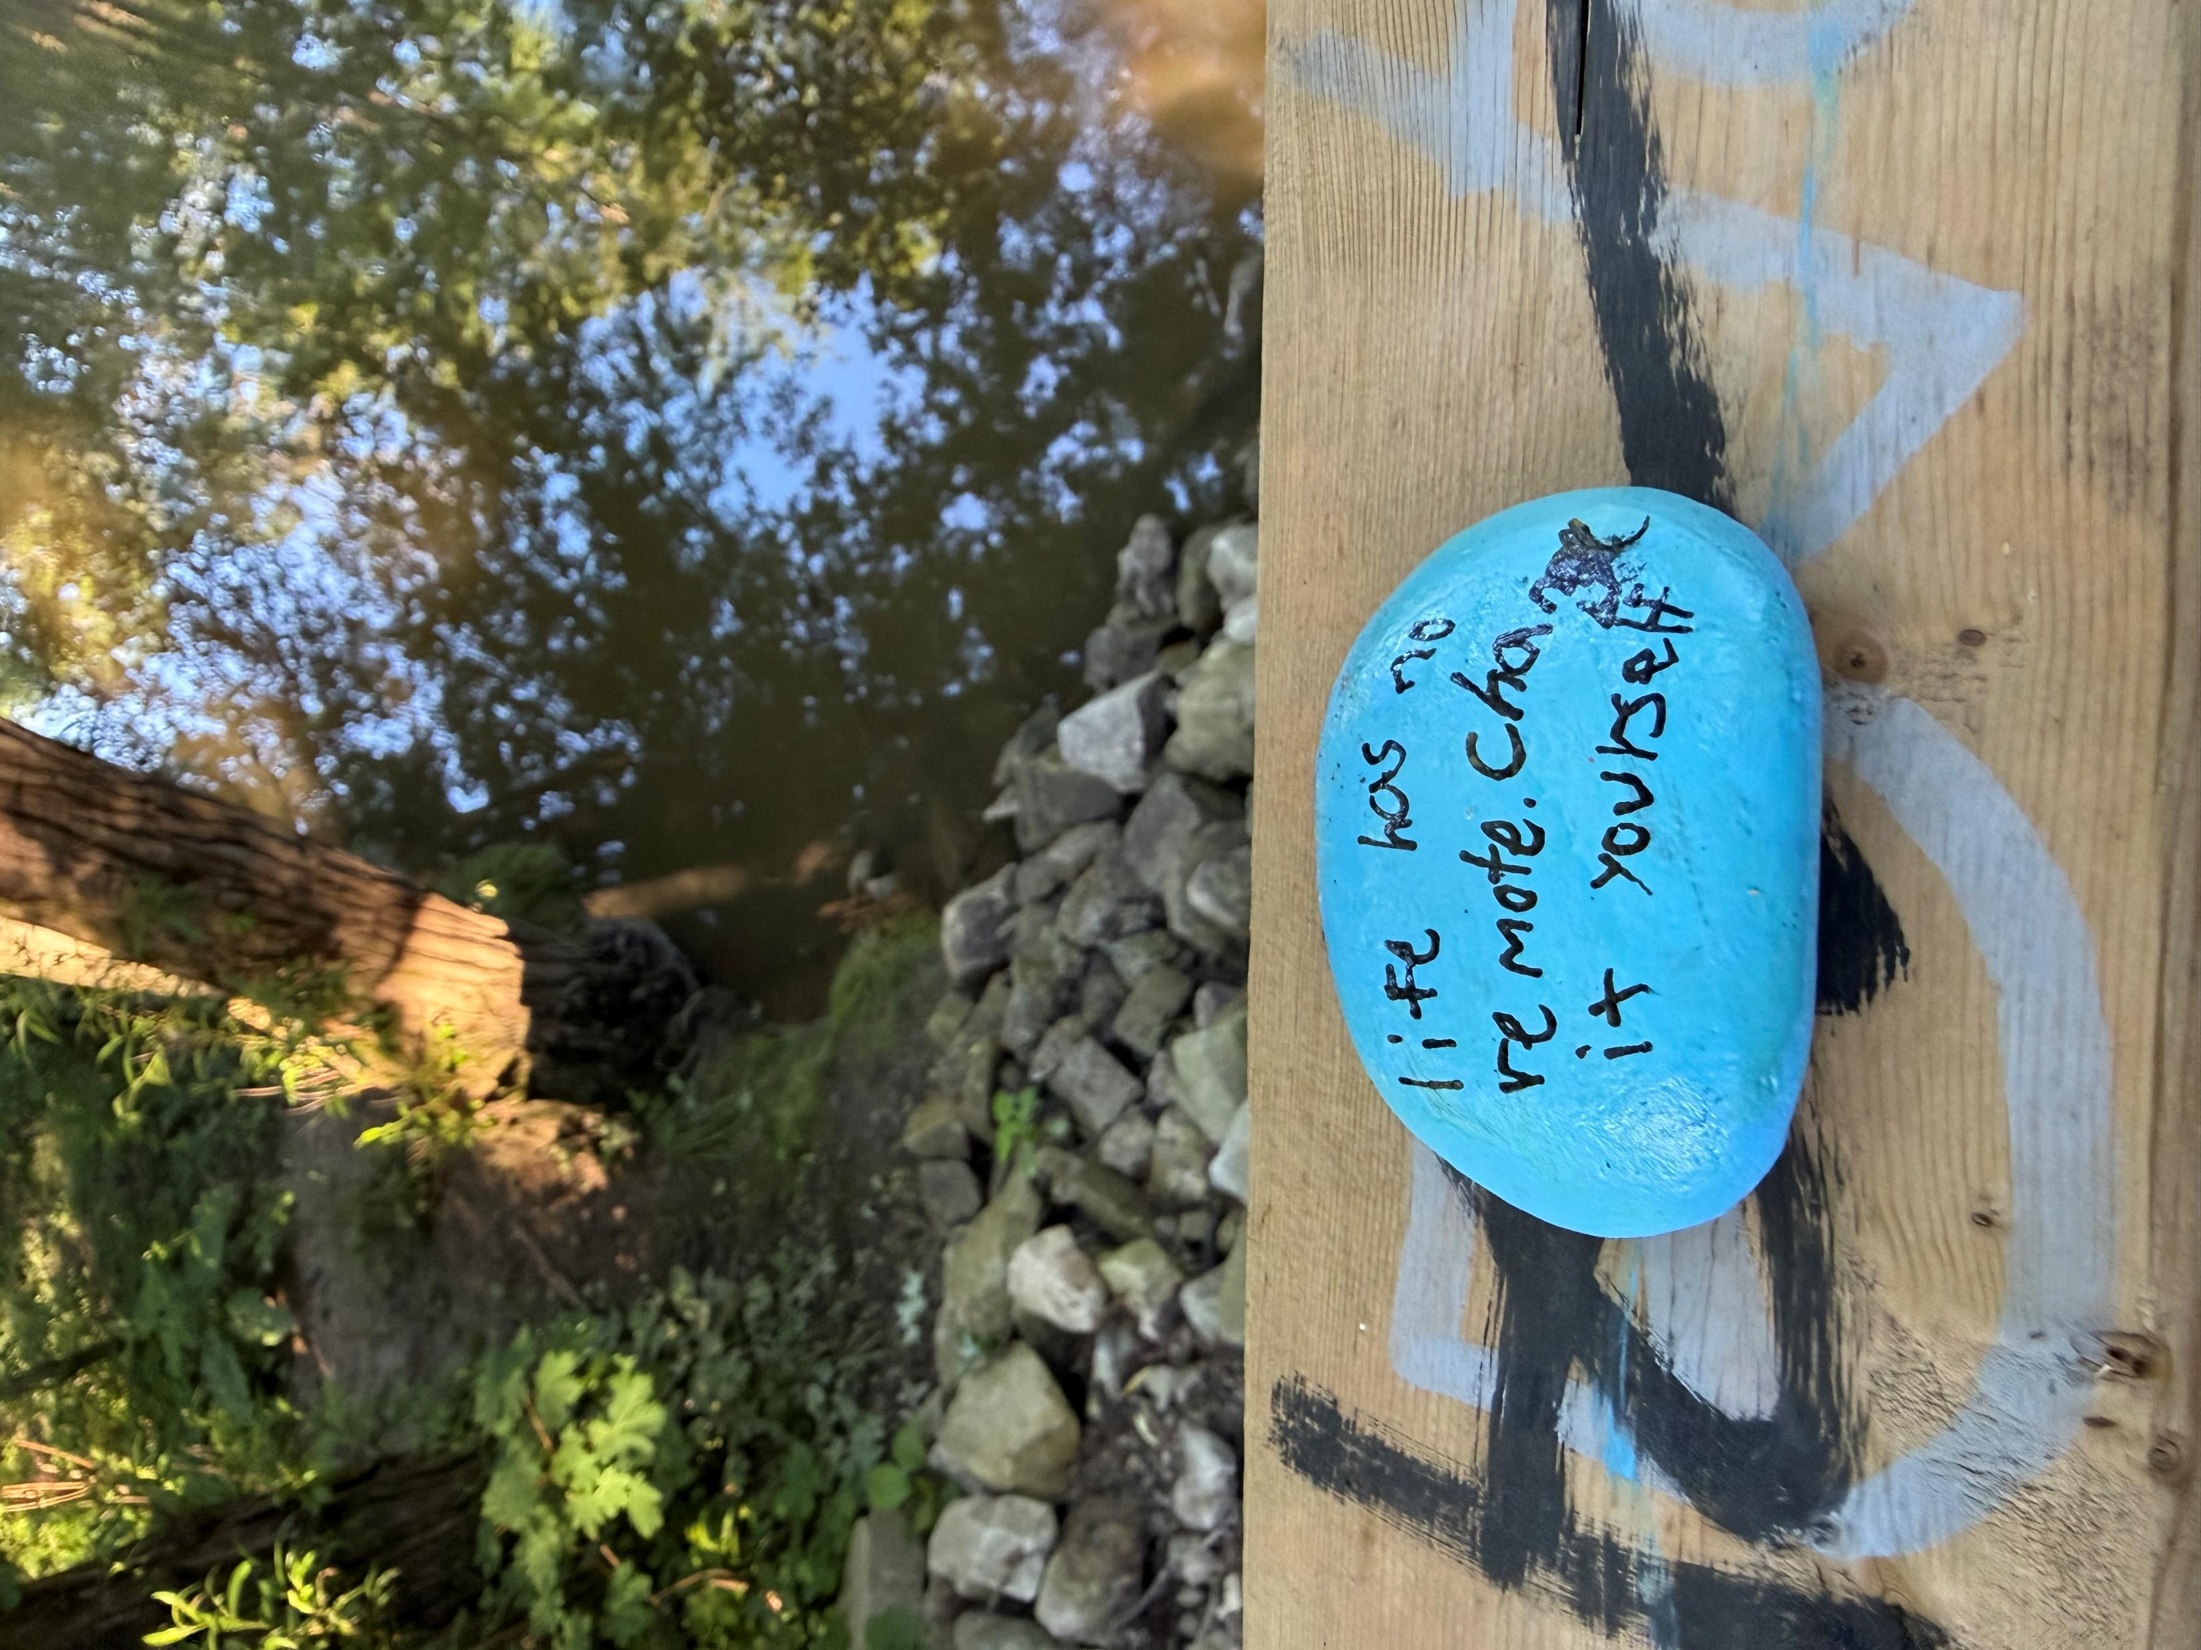
LIFE HAS NO REMOTE CHANGE IT YOURSELF

Slide 2
PLEASE START RECORDING

Slide 3

Welcome to simple week 2
Introducing 1) DBT distress tolerance skills, 2) the 4 simple strategies 3) the first tool: crisis plans.
Notes:
Hello, welcome to the third session of simple. The first two sessions were an orientation to course. Today we dive into the material. This session is divided into three parts. In the first we start our review of the DBT skills training workbook, then we will introduce the simple strategies and techniques, and finally will discuss the first simple tool; crisis plans.

Slide 4

Welcome back
SIMPLE COURSE · WEEK 2
Coping with, managing and tolerating distress and crisis
Today's big idea
Pain is a part of every life. With the right skills, tools and strategies, we can learn to stop adding more pain to the pain we already have.
Life can get better
Notes:
Welcome back. Today we begin working with the course material itself. The theme of today's session is coping with, managing and tolerating distress and crisis. The big idea to hold onto: pain is part of every life, but we often add to it with patterns of thinking, feeling and behaving that make things worse. The skills, tools and strategies in this course are designed to help us stop adding to our pain.

Slide 5





today's session
PART I
PART II
PART III
Distress tolerance
The 4 SIMPLE strategies
Our first tool: crisis plans
What DBT is and its four modules
Why tolerating distress matters
Our first skill: take a REST
Ways to use every tool more effectively
Introducing your personal dashboard
Why prepare before a crisis
Finding the “holes” we fall into
Ann's crisis plan
Break
DBT Skills Training Workbook, pp. 1–13
SIMPLE manual
SIMPLE manual
Notes:
Today's session has three parts. In Part I we start our review of the DBT Skills Training Workbook, pages 1 to 13, and learn our first distress tolerance skill, REST. In Part II we introduce the four SIMPLE strategies that help us use all of the tools more effectively, including the personal dashboard. We'll take a break, and then in Part III we introduce the first SIMPLE tool: crisis plans.

Slide 6




Questions to keep in mind today
Why do we sometimes add suffering on top of our pain?
What can I do in the very first moments of distress?
How can I tell when I'm heading toward a “hole”?
Why plan for a crisis before it happens?
We'll come back to these at the end of the session.
Notes:
As we go through today's material, keep these four questions in mind. Each part of the session answers one or more of them, and we'll return to them at the end to pull together the key points.

Slide 7

mindfulness practice
Creating a sensory soothing toolkit

Slide 8
CREATING YOUR SENSORY SOOTHING TOOLKIT
Let us begin by taking a comfortable position. You can close your eyes if that feels comfortable or simply soften your gaze.
Take a slow, gentle breath in… and let it out.
As we’ll learn in the course, our brains have ancient systems designed to protect us. When we are anxious, overwhelmed, ashamed, lonely, or distressed, our alarm system may be doing exactly what it was designed to do: trying to keep us safe.
At those moments, we often try to argue with ourselves, think our way out of our feelings, or force ourselves to be different. Sometimes that works.
But often the most helpful first step is much simpler: to communicate with the nervous system in the language it understands—the language of the body and the senses.
Today we are going to create a sensory soothing toolkit: a collection of small, accessible experiences that can help us return to the present moment and remind our bodies, “Right now, in this moment, I am safe enough.”
Imagine a small box, a bag, or even a corner of your home that belongs entirely to your wellbeing.
Let us explore what might go into it.
What could your eyes receive that brings a sense of peace or comfort?
Perhaps a photograph of someone you love… a picture of a meaningful place… a piece of art… a card with an inspiring quote… an image from nature… or simply a colour that feels calming.
Pause and notice what comes to mind.

Slide 9
CREATING YOUR SENSORY SOOTHING TOOLKIT
What could your ears receive?
Perhaps a playlist of music that settles your nervous system… the sound of rain… ocean waves… a favourite song… the voice of someone you love… or even a short recording of a compassionate message you have made for yourself.
Pause and notice.
What could your sense of smell receive?
A favourite tea… coffee beans… a candle… lavender… the smell of a forest after rain… a scarf carrying the scent of a loved one… a familiar smell that tells your body, you are home.
Pause.
What could your sense of touch receive?
A smooth stone from a meaningful walk… a soft blanket… a comfortable sweater… a pet’s fur… a stress ball… a warm mug held between your hands.
Notice how touch can communicate safety without a single word.
What could your sense of taste receive?
A piece of dark chocolate… a mint… a favourite tea… a small candy… a piece of fruit.
Something that invites you to slow down and really notice the experience.

Slide 10
CREATING YOUR SENSORY SOOTHING TOOLKIT
And finally, consider a sixth sense—not one in the paranormal sense, but the sense of meaning and connection.
What words could you include in your toolkit?
A note from someone you love.
A passage from a book.
A poem.
A prayer.
A reminder from your wise mind.
Perhaps a sentence such as:
This feeling is here, but it will pass.
I have survived difficult moments before.
May I offer myself the same kindness I would offer a friend.
Now take a moment and imagine opening your toolkit during a difficult day.
You are not trying to make your sadness disappear.
You are not trying to convince your anxiety that it is wrong.
You are simply saying to the frightened part of yourself:
“I see you. I am here with you. Let us take one small step toward comfort and safety together.”
Take one final breath.
Perhaps place a hand on your heart or another place that feels grounding.
Remember: a sensory soothing toolkit is not a luxury. It is a way of befriending your nervous system.
When you are ready, gently bring your awareness back to the room.

Slide 11
CREATING YOUR SENSORY SOOTHING TOOLKIT
Make your own sensory toolkit with Joan and Nicole next monday at the Homework/Boing group October 19 at noon.

Slide 12


Slide 13

Notes:
These general reminders are intended for participants doing the life course or those doing it on YouTube and then meeting in a group.

Slide 14
SIMPLE COURSE SCHEDULE 2026-27
Week 1- October 7
Week 2- October 14
Week 3- October 21
Week 4- October 28
Week 5- November 4
Week 6- November 11
Week 7- November 18
Week 8- November 25
Week 9- December 2
Week 10- December 9
Week 11- December 16
Week 12-December 23
December 30 no course
Week 13- January 6
Week 14- January 13
Week 15- January 20
Week 16- January 27
Week 17- February 3
Week 18- February 10
Week 19- February 17
Week 20- February 24
Week 21- March 3
Week 22- March 10
March 17 and 24 no course
Week 23- March 31
Week 24- April 7
Week 25- April 14
Week 26- April 21
Week 27- April 28
Week 28- May 5
Week 29- May 12
Week 30- May 19
Week 31- May 26
Week 32- June 2
Week 33- June 9
Homework and Boing group start next Monday October 19.
Homework group will run for 3 weeks on a trial basis from 12:00 to 12:30 pm. It will be done by Joan and Nicole. Boing will run Monday 12:30- 2:00 pm. Both will be held in person (444 Douro st. 2nd floor and on zoom.)

Slide 15
PRACTICE SESSIONS SCHEDULE
If your name is on the following schedule and shouldn't be, if it’s the wrong week, or if you volunteered and don’t see your name, please email us.
There are still 5 weeks open all for IFS work. Email us if you want to volunteer for one of those.

Slide 16
PRACTICE SESSIONS SCHEDULE
Date Preparation Subject Volunteer
1. Week 5 November 4 Crisis Plans Chris P.
2. Week 6 November 11 November 4 , 1:30 Holes diary cards Rona G.
3. Week 10 December 9 December 2, 1:30 Chain analysis Janet L.
4. Week 14 January 13 January 6, 1:30 Rational mind remediation Elaine S.
5. Week 18 February 10 February 3, 1:30 goals diary card Jeremy B.
6. Week 24 April 7 March 31, 1:30 IFS workbook 1
7. Week 25 April 14 April 7 IFS workbook 2 Leah S.
8.Week 26 April 21 April 14 IFS workbook 3
9. Week 27 April 28 April 21 IFS workbook 4
10. Week 28 May 5 April 28 IFS workbook 5
11.Week 29 May 12 May 5 1:30 PM Self-led remediation

Slide 17

TOOL PRACTICE- DEVELOPING A CRISIS PLAN
In 3 weeks, week 5 of the course, we will practice doing a crisis plan with Chris.
In 4 weeks, week 6 of the course we’ll practice the second tool holes diary cards with Rona.
We can also informally practice using the tools and skills in the boing group on Mondays.(starts October 19th 12:30-2:00 pm on zoom and at 444 Douro St. 2nd floor boardroom- just after the homework group which starts at noon.)

Slide 18

Homework from the past week
Read p. 1-13 of skills training workbook
Read Simple manual session 2
Submit any questions, comments, or feedback to itssimple2023@gmail.com

Slide 19
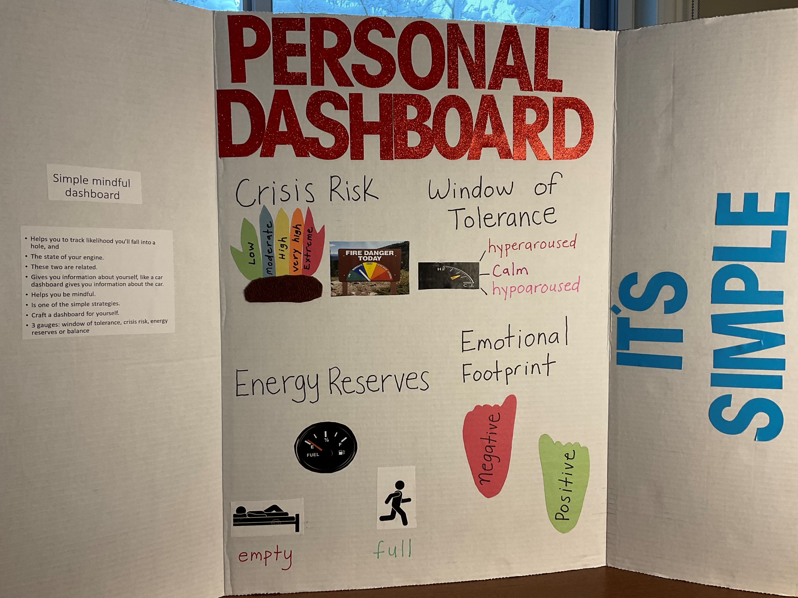
Homework for the coming week
Start tracking the skills you are learning using the DBT diary card or skills list.
At some point over the next week if you find yourself emotionally dysregulated try using the R relax in the acronym REST. Alternatively, practice “relax” using editing splicing and pasting a strategy we’ll talk about today.
Record your practice in your binder/notebook
Submit questions or comments to itssimple2023@gmail.com
Read Simple manual session 3
Decide on one “hole” you fall into and consider a crisis. Start working on a plan to deal with that crisis.
Try crafting your own personal dashboard. We will do this together in the first session of the boing group Monday October 19th in the board room of the Stratford family health team building and on Zoom.

Slide 20
HOMEWORK HABITS CHECKLIST
Circle or check what you will try this week.
1. Preparation habits
■ I schedule a specific time for homework.
■ I choose a consistent location with minimal distractions.
■ I gather what I need ahead of time (notebook, worksheet, pen).
2. Focus & pacing habits
■ I start with a tiny step (2–5 minutes).
■ I use a timer (10–15 minutes).
■ I remove distractions (phone away / Do Not Disturb).

Slide 21
HOMEWORK HABITS CHECKLIST
3. Tracking & organization habits
■ I keep materials in one place (binder / folder / notebook).
■ I write down insights right after doing the homework.
4. Self-compassion habits
■ I aim for progress, not perfection.
■ I notice resistance without judgment.
5. Accountability habits
■ I review my week: What worked? What didn’t?
■ I share honestly with my buddy — even when I didn’t do it.
Micro commitment:
This week I will focus on: ■ Time ■ Place ■ Tiny step ■ Timer ■ Other please specify:

Slide 22
ITS SIMPLE POLL QUESTIONS WEEK 1
Responses from in person participants:
1. I’m doing the simple course
For the first time 52%
b) I’ve done it before 48%
2. What best describes your current relationship to emotional deregulation?
a) It very significantly affects my life 63%
b) It somewhat affects my life 30%
c) I am not sure what it is 15%
3. How would you describe your emotional state at this moment? (multiple choice)
a) Calm and open 30%
b) Anxious 59%
c) Angry 4%
d) Numb 11%
e) Depressed 26%
f) Hopeful 19% Tired 4%
4. What is your biggest hope for this course? (multiple choice)
a) More stability in my life 85%
b) Better understanding of myself 70%
c) Better relationships 55%

Slide 23
5. What best describes your previous experience with mental health resources such as
therapy or groups?(single choice)
a) I’ve done courses or been in therapy before 78%
b) I’ve read about mental health or used self-help resources 19%
c) I’m new to all of this 15%
6. I plan to …(single choice)
a) Attend the Monday 12-2:00pm group in person 41%
b) Attend the Monday group on zoom 11%
c) Not attend the Monday group 19%
d) Attend the Monday group occasionally 22%

Slide 24
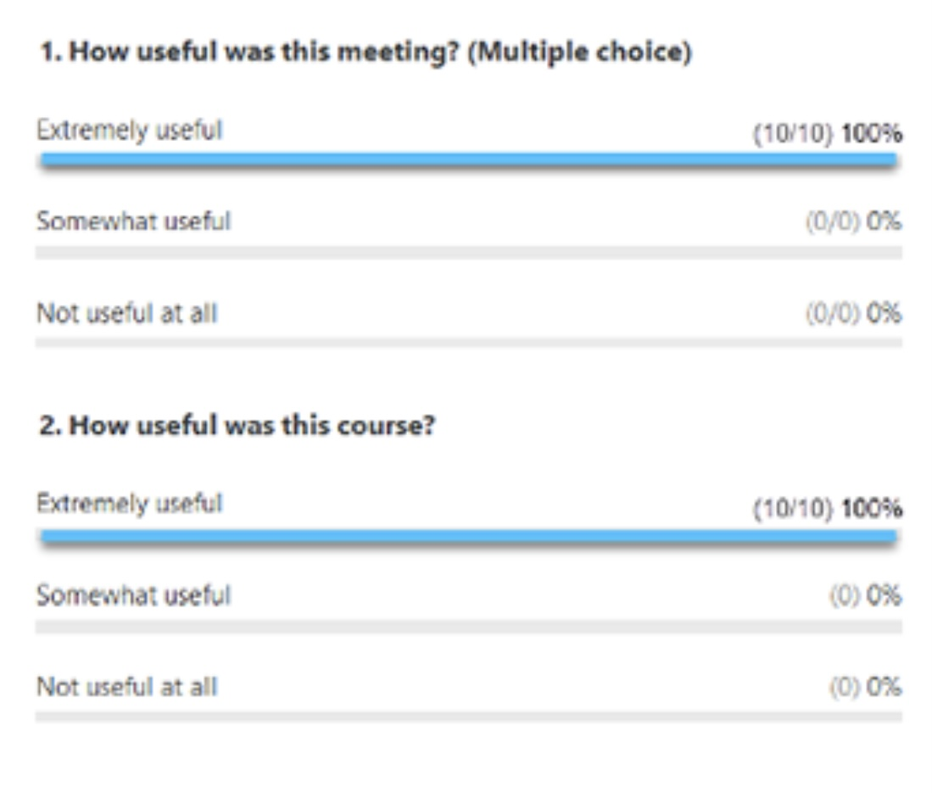
Week 2 POLL
Throughout the year we will be doing polls to better understand some of your thoughts, feelings and needs.
We’ll look at the answers of zoom participants immediately after we do the polls.
We’ll share the answers of in person participants at the beginning of the session the week after the poll.
Answers are anonymous
Week 2 poll…

Slide 25


WEEKLY ANNOUNCEMENTS
We did well last week but don’t forget if you’re on zoom, to keep signing in with your first name and the initial of your last name.
If you’re in person, please write your name legibly on the attendance sheet.
For next week’s mindfulness exercise, we’re going to need a raisin. If you’re on zoom, please have a raisin handy (or a small edible product-make a note now so you don’t forget.)
Next week Joan and Nicole will bring raisins for the in-person participants. (yes, Joan and Nicole, I volunteered you to bring the raisins)
The homework/boing group starts next week Monday October 19.(12 to 2:00 pm)
It will be both in-person and on zoom. The in-person session will be in the board room of the Stratford family health team at 444 Douro St. Stratford on the second floor.
For the first homework/boing group, Joan and Nicole will be guiding a craft group in which we’ll be creating a personal dashboard.
If you want to craft your own personal dashboard on zoom, you will need the following materials for the 19th
The personal dashboard is one of the self-soothing strategies we’ll be talking about today.

Slide 26
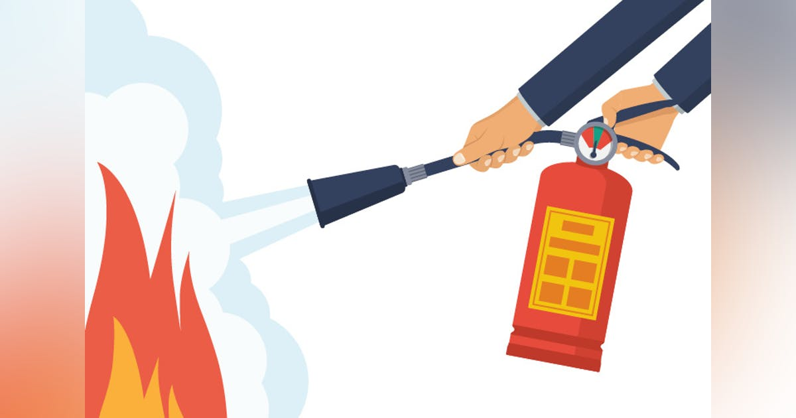
What we will do today
Part I We’ll review the Skills training workbook p. 1-13 – which covers 5 topics:
1. DBT an overview of the treatment, who the DBT skills training workbook book is for.
2. Basic distress tolerance skills, what are they?
3. About this chapter
4. How to use this chapter
5. Take a rest.
Part II We’ll introduce 4 Simple strategies that will help you use the tools more effectively. Covered in the Simple manual
Part III We’ll introduce the first tool: the crisis plan, also covered in the Simple manual session 2

Slide 27

E-mailed, questions, comments, feedback
HOUSEKEEPING

Slide 28
I'm wondering if it's common to have a situation where you are so outside of the window of tolerance that you literally can't do the coping skills, chain analysis, rational mind remediation etc.
Instead, you have to use other coping skills to try to calm and soothe yourself and get back to something resembling regulation.
So, putting the issue aside, not even trying to come up with solutions, just trying to get through the overwhelming emotions. Linda C.
Great question we’ll come back to it after we discuss the strategies and techniques, you’ll understand why.

Slide 29

IN THE NEWS
New discoveries in mental health & neuroscience
Karl Deisseroth MD PhD
Psychiatrist
Winner of the 2026 Nobel prize in physiology and medicine

Slide 30
Who he is: A Stanford scientist who is also a practicing psychiatrist. He still sees patients, and he says those encounters shape the questions he asks in the lab.
His big invention, optogenetics: He borrowed light-sensitive proteins from algae and found a way to place them in specific brain cells. Shining light on those cells could then switch them on or off. For the first time, scientists could test what a particular group of cells actually does, not just watch them light up on a scan.
Why it matters: It moved neuroscience from “these areas are associated with X” to “these cells cause X.” It’s now used in labs worldwide to study fear, motivation, memory, anxiety and depression.
The dissociation work: In a 2020 study, his team gave mice ketamine, which produces a dissociative state. They found a deep brain region that began firing in a slow, steady rhythm. When they recreated that rhythm with light, without any drug, the mice showed dissociation-like behaviour. A human patient whose seizures started near the matching region described feeling detached from themselves just before a seizure. So dissociation, which can feel vague or “all in your head,” turns out to have a measurable brain rhythm behind it.
Imagine the brain as a huge orchestra with billions of musicians. Before this work, we could only hear the whole orchestra playing. Deissroth found a way to tap individual musicians on the shoulder with a beam of light and ask them to play or stop, so we can hear what each one contributes. Using this, his team found that dissociation, that feeling of being detached or unreal, is linked to a particular rhythm in one part of the brain. For anyone who has felt that way, it’s a reminder that it’s a real brain state, not a personal failing.

Slide 31
Fun fact: Karl Deisseroth was the 4th psychiatrist ever to be awarded a Nobel Prize. The first two are somewhat infamous. In 1927, Julius Wagner-Jauregg won for treating neurosyphilis by deliberately infecting patients with malaria to induce high fevers. In 1949, Egas Moniz won for the lobotomy. Those treatments both proved to be disasters. Things improved in 2000, when Eric Kandel won for uncovering how memories are stored in nerve cells.

Slide 32
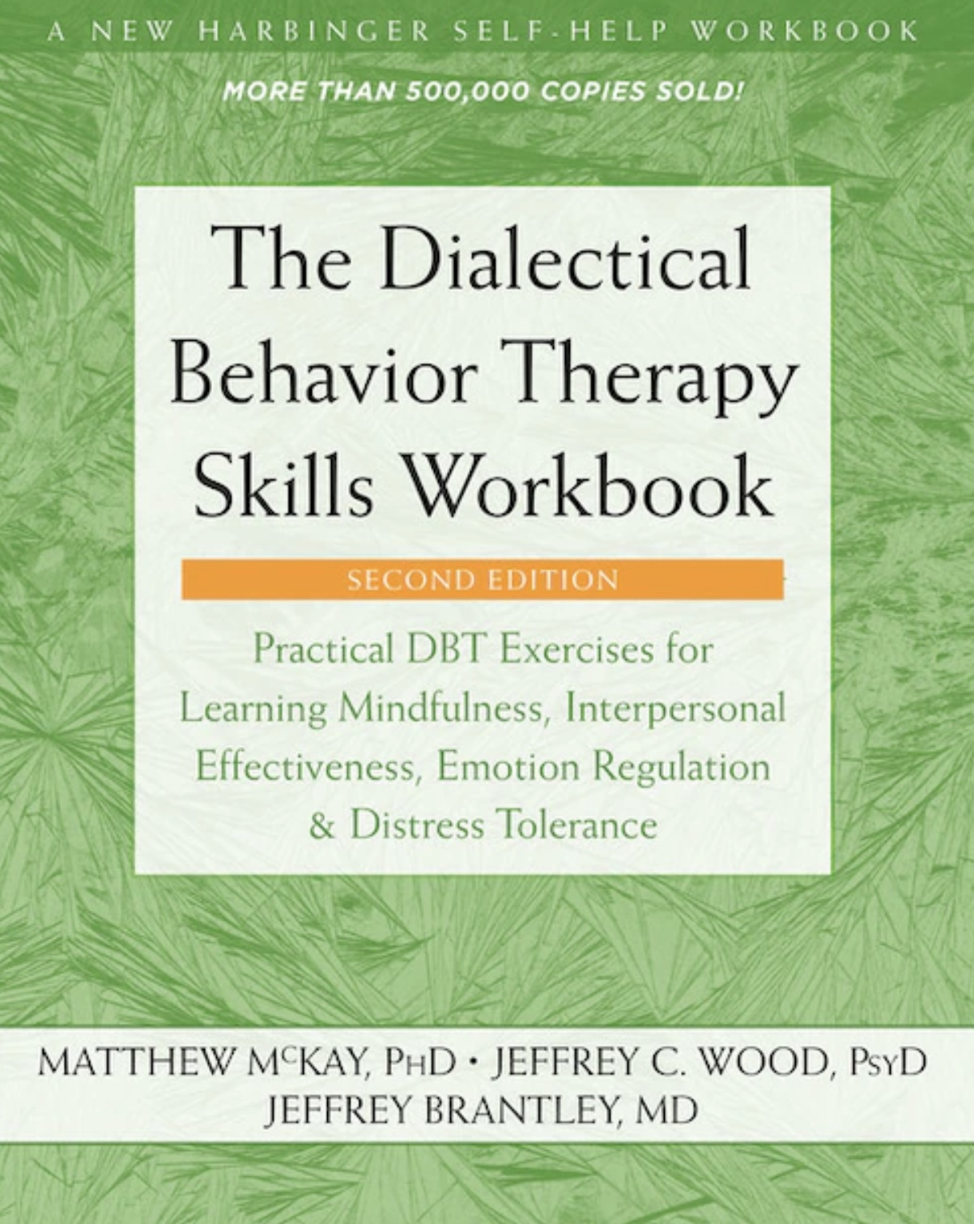


JOAN
NICOLE

Slide 33

Introducing the dbt workbook and the distress tolerance module

Slide 34
What we will do today
Part I We’ll review Skills training workbook p. 1-13 – which covers 5 topics:
1. DBT an overview of the treatment, Who the DBT skills training workbook book is for?
2. Basic distress tolerance skills, what are they?
3. About this chapter
4. How to use this chapter
5. Take a rest.

Slide 35

REVIEW OF DBT SKILLS TRAINING WORKBOOK PAGES 1-13
DISTRESS TOLERANCE part 1
Tolerating distress means coping with the physical and emotional pain and discomfort we sometimes experience in ways that over the long-term are likely to reduce, rather than increase, that pain.
This is also the goal of crisis plans which we’ll discuss later today.

Slide 36
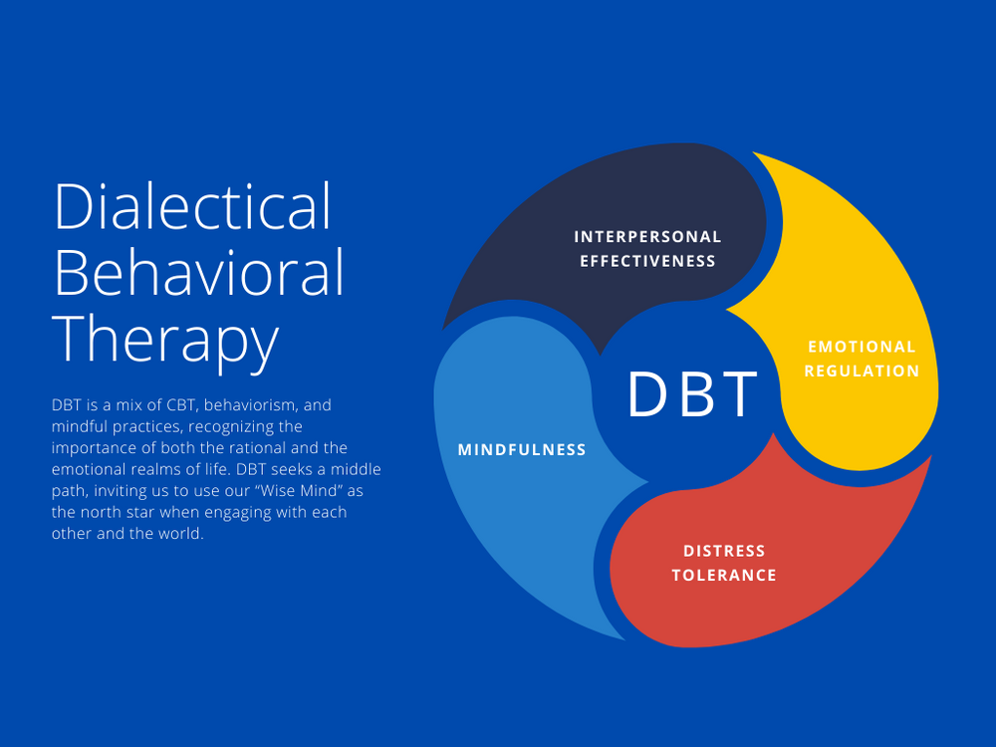
What is DBT?
Dialectical behavioral therapy- DBT was developed by Psychologist Marsha Linehan
Linehan was hospitalized for one year in a mental health institution and thought to have little chance of recovering from her issues.
In her autobiography “building a life worth living: a memoir” she writes that her psychiatrists diagnosed her as suffering from schizophrenia, she later self diagnosed as meeting the criteria for BPD.
One of goals of DBT is to help people cope with dysregulated and sometimes overwhelming emotions, that is to learn to better emotionally regulate
DBT Covers 4 skills Modules
  1.Distress Tolerance- we’ll start today.
  2. Mindfulness
  3. Emotion Regulation
  4. Interpersonal Effectiveness

Slide 37
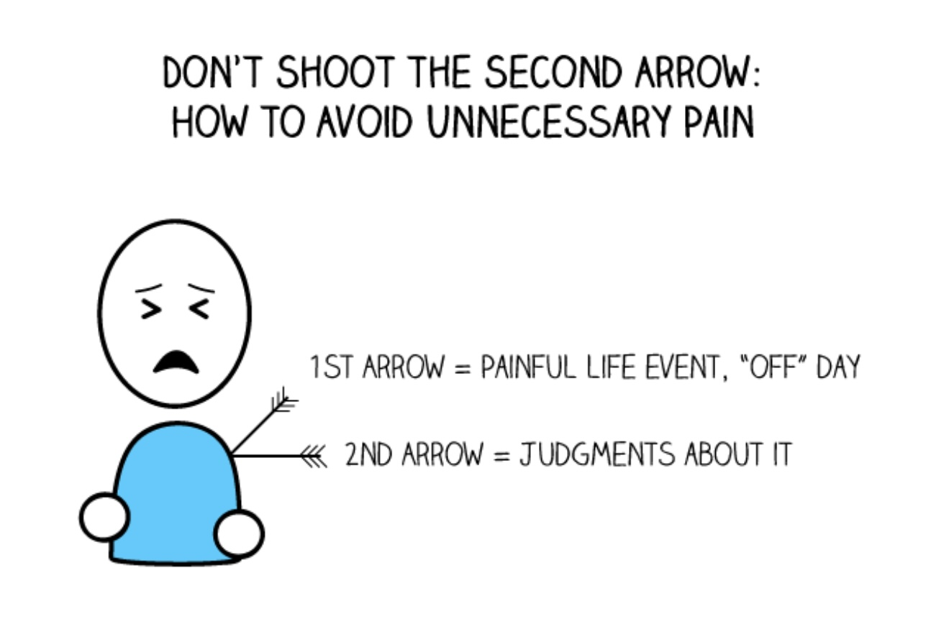
LIFE CAN GET BETTER
Linehan studied Buddhism and in 2011 was ordained as a Buddhist nun.
The first of the four “noble truths” of Buddhism says that “life involves dukkha” or pain.
When we’re in pain, we often have patterns of thinking, behaving and reacting emotionally that, over the long-term, add even more pain to the pain we’re already experiencing.
Buddhism also teaches us that “Pain is inevitable, but suffering is optional”. Buddhism uses the metaphor of being struck by two arrows: the first arrow that strikes us, the pain of life, is sometimes unavoidable, the second arrow, suffering, the avoidable one is the mental anguish we create by resisting and judging the first arrow.

Slide 38
LIFE CAN GET BETTER
Ex. 1st arrow- I lose an expensive pair of sunglasses 2nd arrow- how could I have done that I’m so stupid, I’m always doing stupid stuff.
With understanding, commitment and the right approach, we can change our patterns of reacting emotionally, thinking and behaving and reduce our suffering.
The skills, tools, and strategies we explore in this course are designed to help us do that.
Learning and using these approaches has helped many people live better lives.
Life can change for the better but only if you believe it can and work hard at it using effective approaches to bring this about.

Slide 39
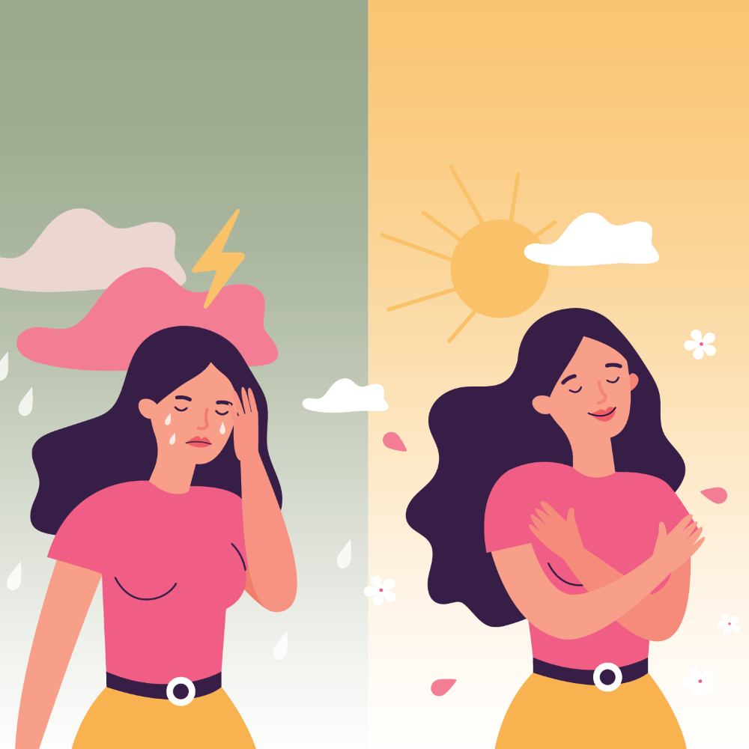
Distress Tolerance
Skills
“Distress tolerance skills help you cope better with painful events by building up your resiliency and giving you new ways to soften the effects of upsetting circumstance”
DBT skills workbook
In other words, using the skills, tools and strategies can help widen our window of emotional tolerance so that we’re calm and alert more often and anxious, angry, depressed, or dissociated less often.

Slide 40

crisis
What are crisis and why is it helpful to plan how to deal with them ?
Pain is an unavoidable part of life and when we’re in physical and/or emotional pain we may become distressed and overwhelmed.
Sometimes when we’re in pain and distressed, we add to the pain by concluding, often falsely, that these feelings will never end or get better. That conclusion adds more pain to our pain and we suffer.
When we’re in crisis, we often feel that our pain will never end and there’s nothing we can do to change it.
When we’re in crisis, we may also have a difficult time finding healthy coping strategies, and may, to try to stop the pain, resort to unhealthy or “maladaptive” ones that are familiar and that over the short term seem to provide some relief.
However, using maladaptive or unhealthy coping strategies, while temporarily helping us cope with our pain, usually only makes things worse in the long term. They are a “third arrow”
If we prepare and plan for a crisis and train ourselves to use healthy coping strategies, instead of using habitual maladaptive coping ones, we’re more likely to be hit with fewer arrows, or get out of our “holes in the sidewalk” faster and reduce our overall suffering.

Slide 41
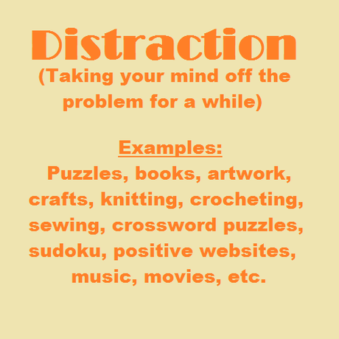
IS DISTRACTION HEALTHY OR
UNHEALTHY COPING ?
Over the coming weeks we’ll be learning many healthy coping skills. Distraction is one such skill that we'll look at in some detail.
Distraction can be a good way to cope with physical or psychological pain. Distraction temporarily helps us not focus on our pain.
Distraction may also give us the space and time we need to calm down and return to the window of tolerance before we act. Then when we’re calmer we are more likely to choose a healthier, rather than a maladaptive, way to deal with the situation we’re facing.
Distraction is not the same as avoidance. Avoidance is an unhealthy form of distraction.
The difference between distraction and avoidance is that with distraction we intend to eventually deal with the situation we’re facing in a healthier way when we are calmer and in the “window of emotional tolerance”.
When we avoid, we never deal with the underlying situation that created the pain.

Slide 42
THE FIRST DBT SKILL
Take a ”REST”
1.Relax
2.Evaluate
3. Set an intention
4. Take action

Slide 43
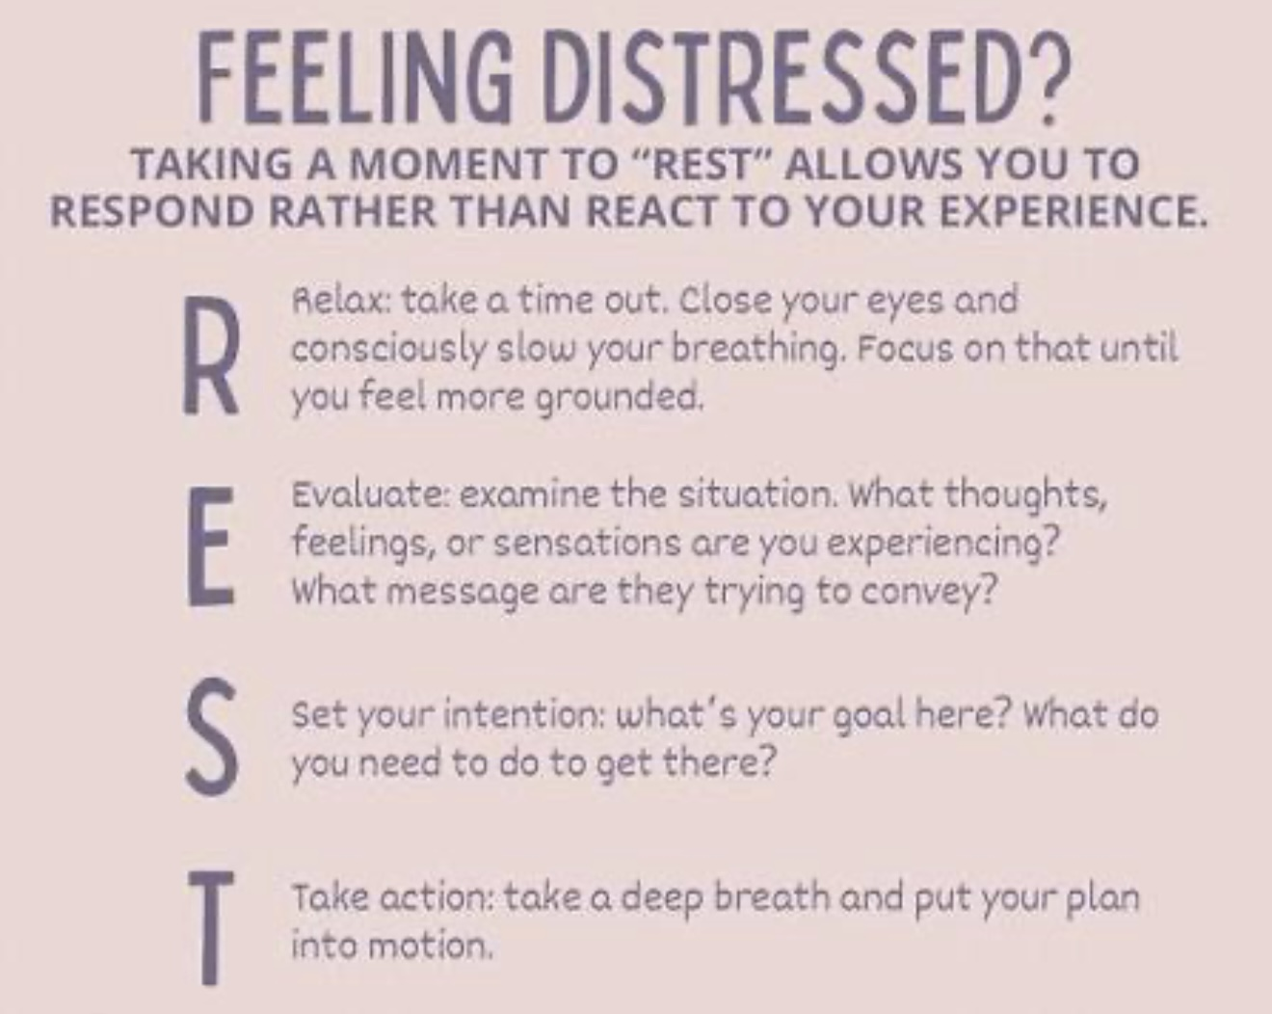
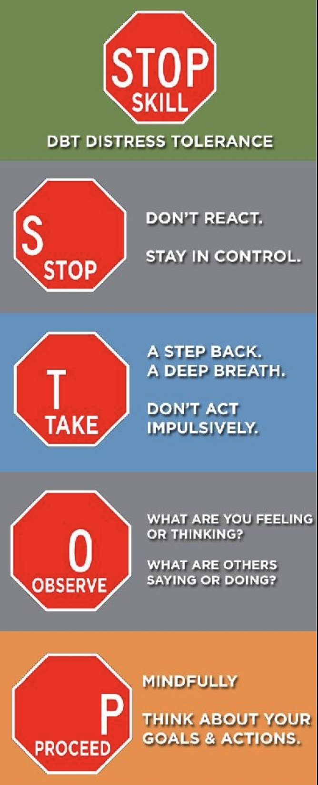

RELAX, STOP AND JUST DON’T DO IT
A crucial skill

Slide 44

1. REST- R IS FOR Relax
If you’re in crisis:
Stop what you’re impulsively doing, want to do or are about to do.
Take a breath. Count to 10, 50 or 100
Step away or back to allow yourself to have a different perspective
Don’t act impulsively
Remind yourself that this is an opportunity to behave differently than you have in the past which did not turn out well.

Slide 45

RELAX, STOP AND JUST DON’T DO IT
One of the key items in the grandmother’s operating manual is: “tell your grandchild to count to 10 before they do something stupid.”
This is the essence of RELAX, STOP AND JUST DON’T DO IT.
This is like a doorstop when impulses, feelings and urges to act want to take over and make you act in a way that in the long run is not in your or other people’s best interests .
This superpower to not act on your impulses, feelings or urges requires mindfulness. You can train yourself to do this by reminding yourself of it daily.
If you’re in a crisis and you’ve managed to RELAX, STOP AND JUST DON’T DO IT the next step is using your crisis plans.

Slide 46

2. REST- E IS FOR Evaluate
NB: for now, we will mostly focus on step 1. above: relax or take a step back.
As we get further into the course, we will learn the skills associated with the remainder of the acronym “EST”. This will involve:
1. Asking yourself what’s happening in the situation.
2. What are the facts?
3. Checking in with yourself. What are you feeling?
4. Observing others. Is anyone in danger?
We will learn to the EST skills in much greater detail when we explore the third simple tool: chain analysis. For now, don’t worry about the EST in REST.

Slide 47

3. REST- S is for Set an Intention
When we step away, back, or pause while experiencing dysregulated emotions we create the space to come up with a plan for what we’re going to do that will avoid making things worse.
Stepping back allows us to be less emotional and more rational and make better choices. We will learn to do this throughout the course.
We will learn to develop new ways of thinking, reacting emotionally and behaving when we explore the simple remediation tools (rational and wise mind remediation).
Our intention using these tools, will be to replace our maladaptive reactions with more adaptive ones (that we have reflected on).

Slide 48

4. REST-T IS FOR
Take Action
Taking action means putting our new more adaptive plan of how to deal with our situation into motion
We’ll do this deliberately and mindfully. At first, we will learn to do this by imagining the situation in our mind and using the editing, splicing and pasting technique that we will discuss shortly.
Again: At this point in the course, don’t expect to be able to use EST part of the REST skills.
You may simply want to focus on step 1 R for relax which is taking a time out and not doing what your emotional mind in crisis is telling you to do.
We’ll learn to do the EST steps as the course unfolds.

Slide 49
HOW TO USE the DBT SKILLS Workbook
You can use the dbt diary card (p.262-5) to track the skills you’re learning. We, however, recommend using the evolving skills list that we’ll provide to keep track of the skills that are particularly helpful to you
If you have time, try the exercises found in the workbook. If your time is limited, skip the exercises in the workbook and focus on the 6 tools and 4 strategies covered in the manual.

Slide 50
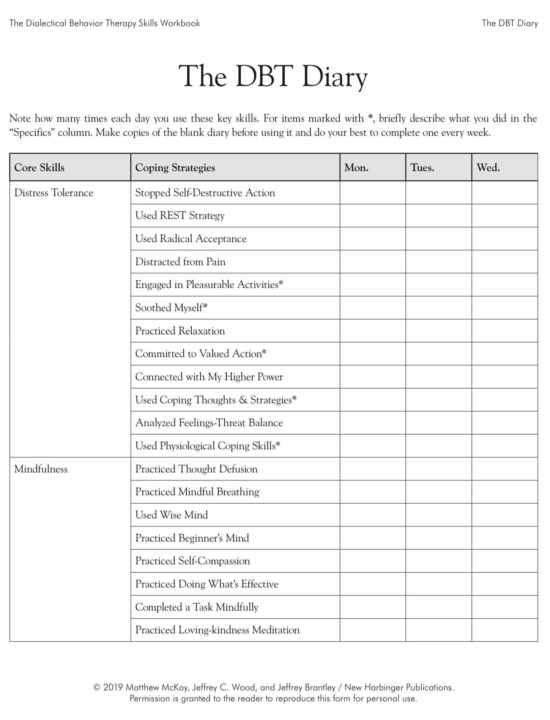
Today
X
Today
X

Slide 51
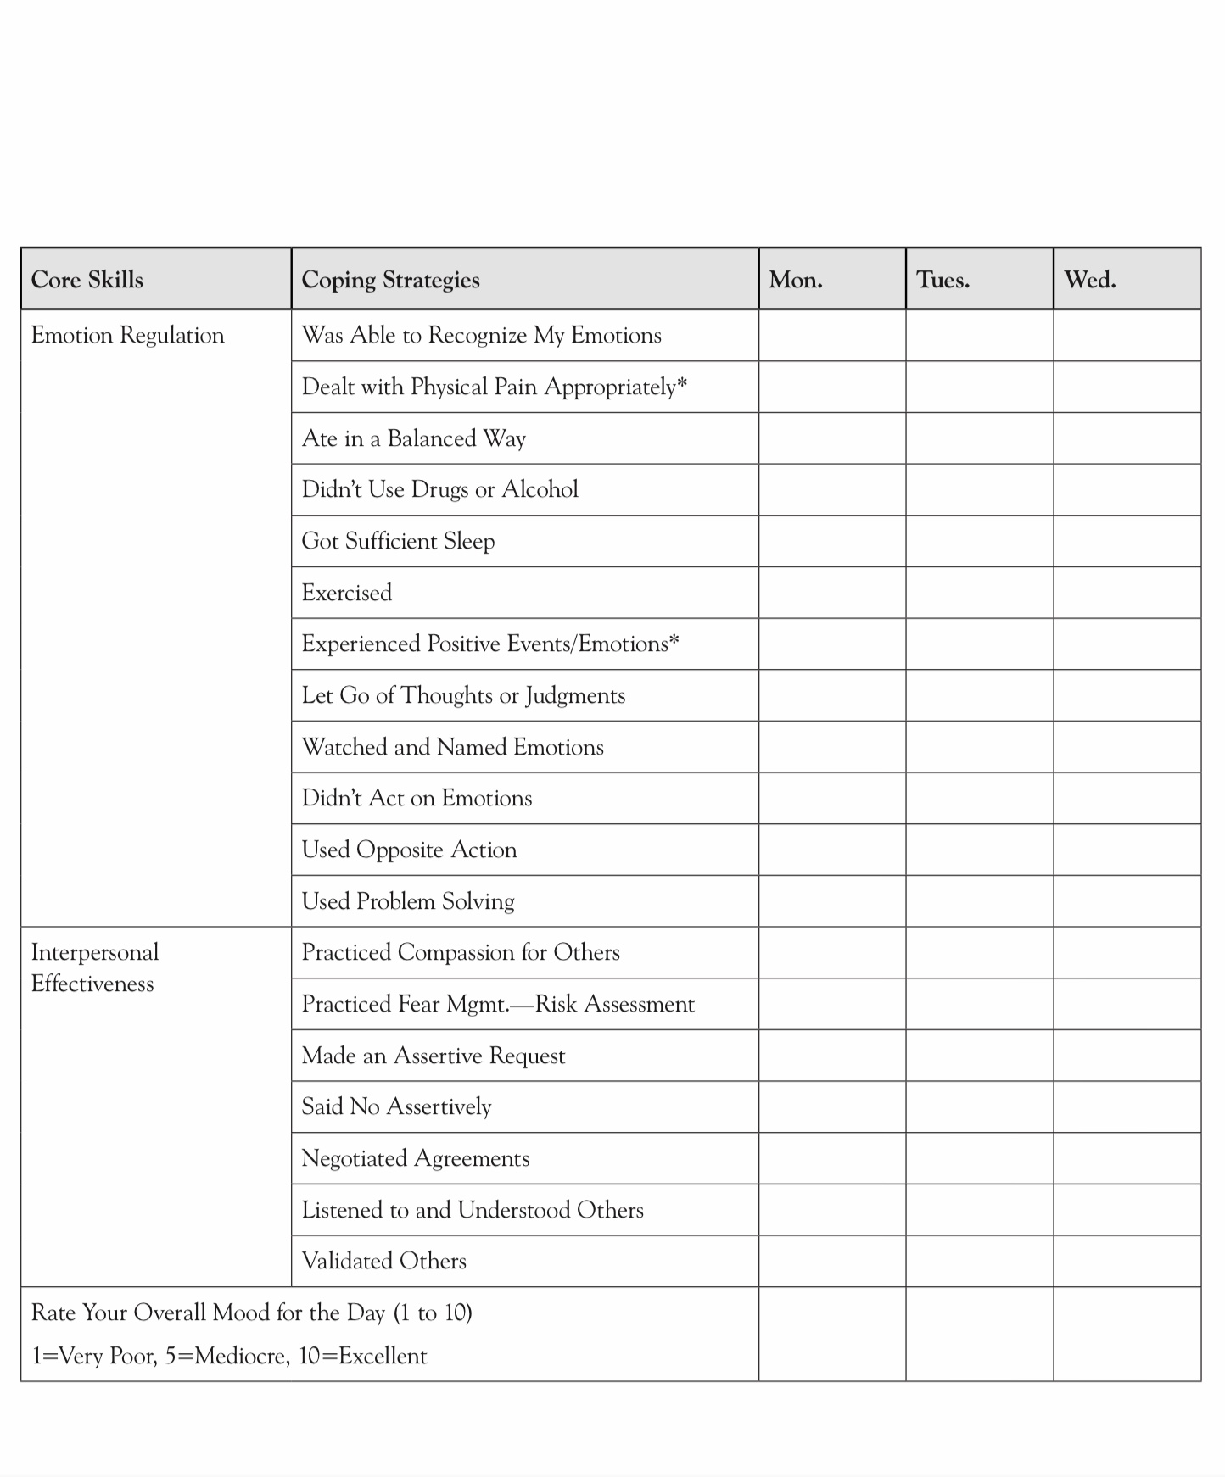

Slide 52
UPDATED PERSONAL SKILLS LIST
Distress tolerance skills
Grounding skills- Set a daily intention
“ - Sensory soothing toolkit
REST (or PEST) Pause

Slide 53

WARNING ABOUT DBT acronyms
An acronym is a memory aid in which the first letters of a word or a sentence are used to help us remember something else.
Today we consider REST. REST is an acronym for the first set of distress tolerance skills. REST stands for relax, evaluate, set an intention, and take action.
Different acronyms are used in different DBT skills manuals.
For example, REST, which is meant to help you remember the first distress tolerance skill, is used interchangeably with STOP (take a step back, observe, proceed mindfully.)
We also call STOP and REST “just don’t do it” after the Nike logo. Your feelings and thoughts may be urging you to do something, but you don’t act on them.
There’s other acronyms in the distress tolerance and the other DBT modules (TIPP, ACCEPTS, IMPROVE, etc.) Don’t worry too much about keeping all of these straight. We will cover them in the coming weeks.
The next two slides, which list acronyms commonly used in DBT, might help. Don’t worry too much about acronyms

Slide 54
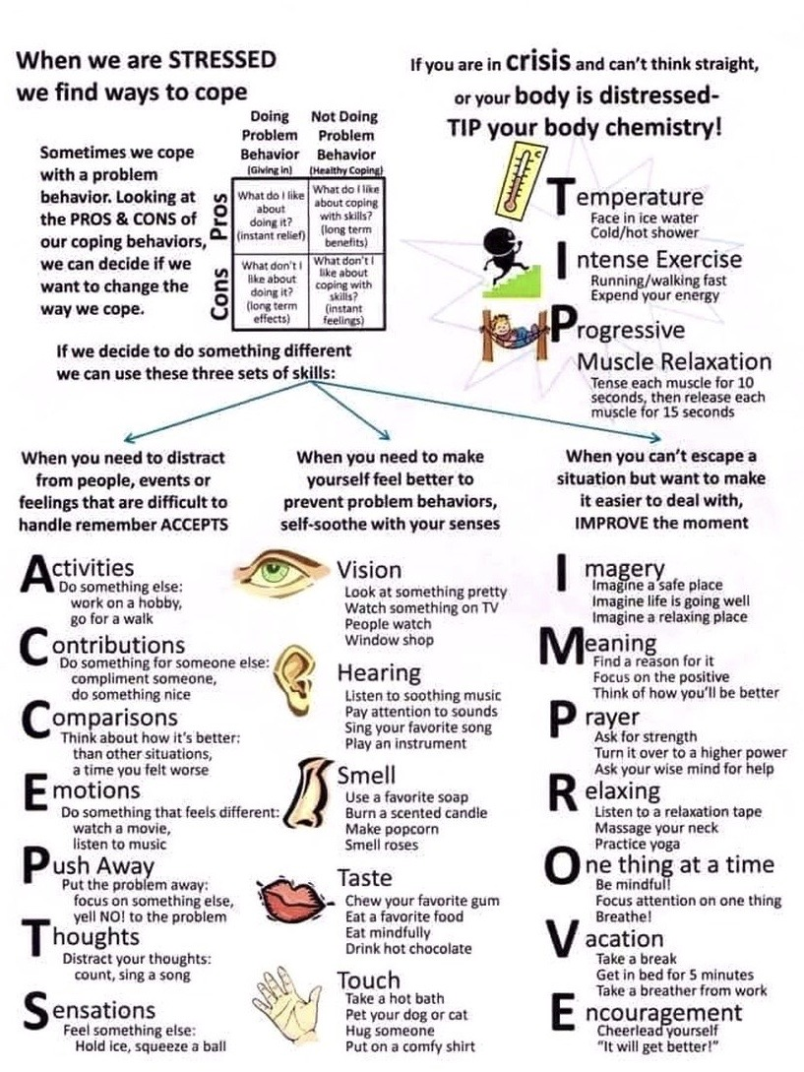
Notes:
These acronyms may be helpful in remembering the skills and the distress tolerance module.

Slide 55
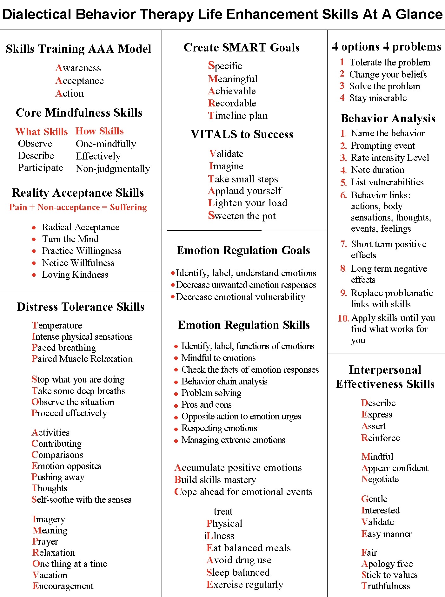
Notes:
These are some of the common acronyms used in all four modules.

Slide 56
What we will do today
Part II We’ll introduce 4 Simple strategies that will help you use the tools more effectively. Covered in the Simple manual

Slide 57

THE 4 SIMPLE STRATEGIES

Slide 58

skills, tools, TECHNIQUES AND STRATEGIES
In the course we learn skills, tools, techniques, and strategies to deal with dysregulated feelings, thoughts, and behaviors. They will help get us out of holes we may fall into or build a shelter for the storms.
Skills, tools, techniques, and strategies are necessary if we want to become proficient at any activity, be it being a carpenter, mechanic, pianist, hockey player, or a person living their daily life and coping with life’s challenges. Let’s start by defining these three terms.
Skill - The ability to do something well, expertise. The skills covered in the simple course can be found in the DBT skills training workbook.
Tool – Is a device or implement used to carry out a particular function. The six tools discussed in the simple course can be found in the simple manual. They are: 1. Crisis plans. 2. Diary cards. 3. Chain analysis. 4. Rational mind remediation. 5. The goals diary card. 6. Wise mind remediation.
Techniques and strategies – are ways of using the tolls effectively. In SIMPLE we use 4:

Slide 59

four techniques AND strategies FOR TOOL USE
When using the tools:
1. follow the steps described in the algorithms provided. This will help you adhere to good problem-solving practices.
2. be mindful of your internal personal “dashboard” or “instrument panel” by:
a) Monitoring your energy balance.
b) Being mindful of your crisis risk level.
c) Staying in the window of emotional tolerance
d) being aware of your state of activation
3. Stay in the window of tolerance by pendulating.
4. Use editing, splicing and pasting of the “videos” of problematic thoughts, feelings or behaviors to practice and develop new videos.
Notes:
The dashboard of the car gives the driver critical information about the state of the vehicle. This is extremely useful in avoiding trouble such as running out of gas. In simple we suggest people develop and imaginal dashboard with four instruments that helps them be mindful of their physiological states and stay out of trouble by for example filling their "gas tank" before they run out of gas.

Slide 60

four techniques AND strategies FOR TOOL USE
When using the tools:
1. follow the steps described in the algorithms and templates provided. This will help you adhere to good problem-solving practices.
An algorithm is a step-by-step set of instructions used to solve a problem, complete a task, or process data.
A template is a form used to carry out the steps outlined in the algorithm.
Notes:
The dashboard of the car gives the driver critical information about the state of the vehicle. This is extremely useful in avoiding trouble such as running out of gas. In simple we suggest people develop and imaginal dashboard with four instruments that helps them be mindful of their physiological states and stay out of trouble by for example filling their "gas tank" before they run out of gas.

Slide 61
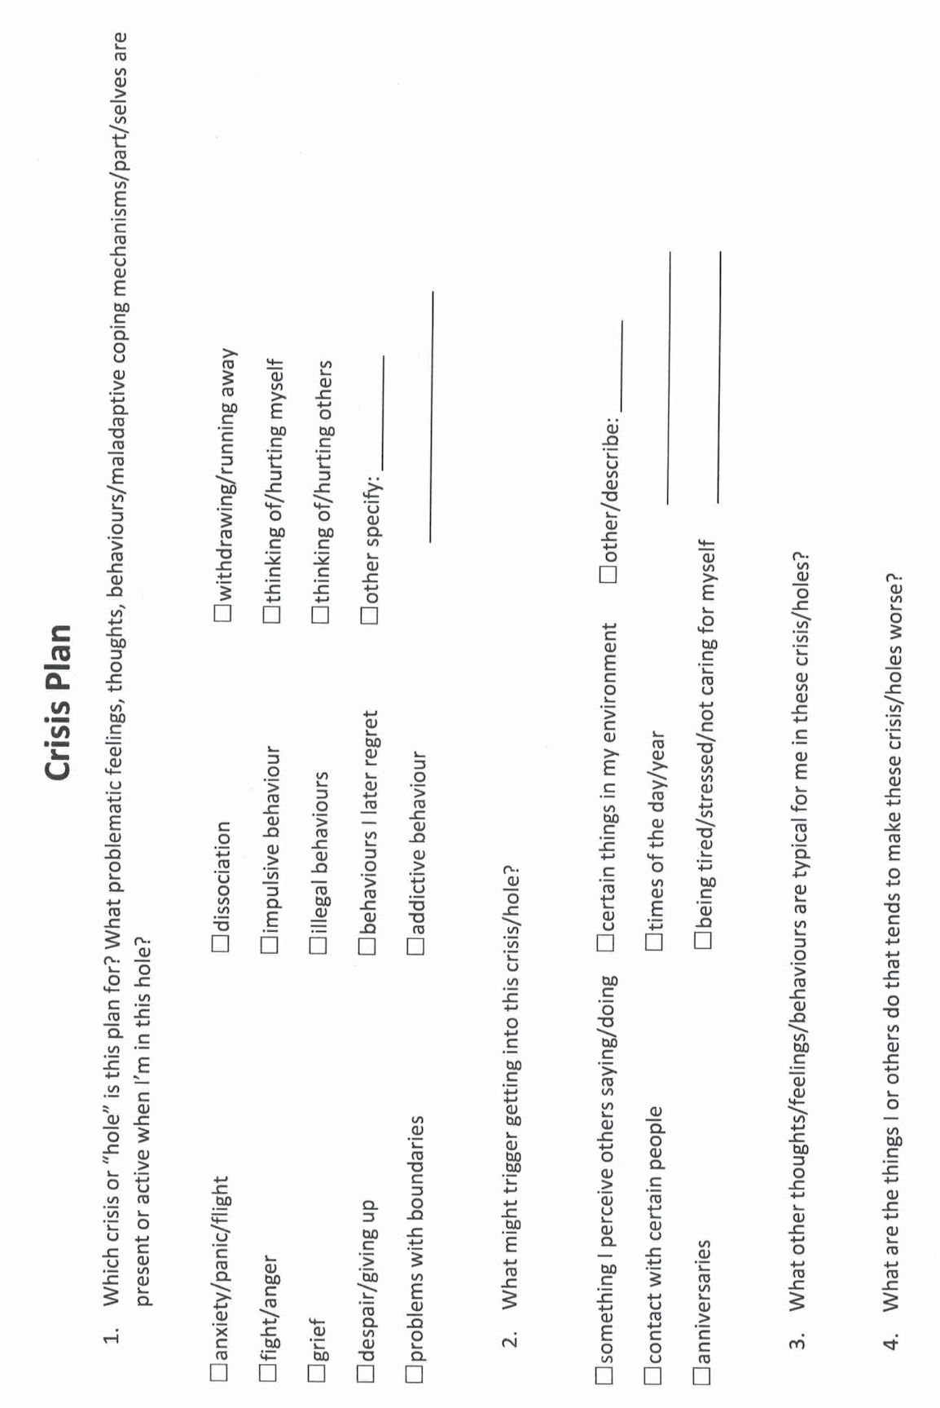
STEP 1. follow good Problem-solving strategies
For each of the 6 tools covered in the course, follow the steps recommended in the algorithms and templates provided to you. Avoid skipping any of the steps or improvising as you are likely to get lost and sidetracked. Ex:
Crisis plan algorithm
Crisis plan template
1. By following the crisis plan template you will develop specific plans to get out of or avoid the holes you have chosen to work on. The template prompts you to:
2. Understand the concept of holes or specific crisis for which the crisis plans are going to be used
3. Identify the specific holes that you want to work on.
4. Get to know the triggers, feelings, thoughts, and behaviors that are associated with those holes.
5. Recall, in your mind, a real crisis from the past in which you fell into the hole you are working on and use the "editing, splicing, and pasting" technique, along with your skills and tools, to imagine a different outcome that incorporates your crisis plan.
6. Stay in the window of tolerance while editing, splicing, and pasting by pendulating.
7. Repeatedly visualizing the new edited, spliced, and pasted version of the situation until you can visualize it without effort.
8. When a new crisis occurs work with it following these same steps.

Slide 62
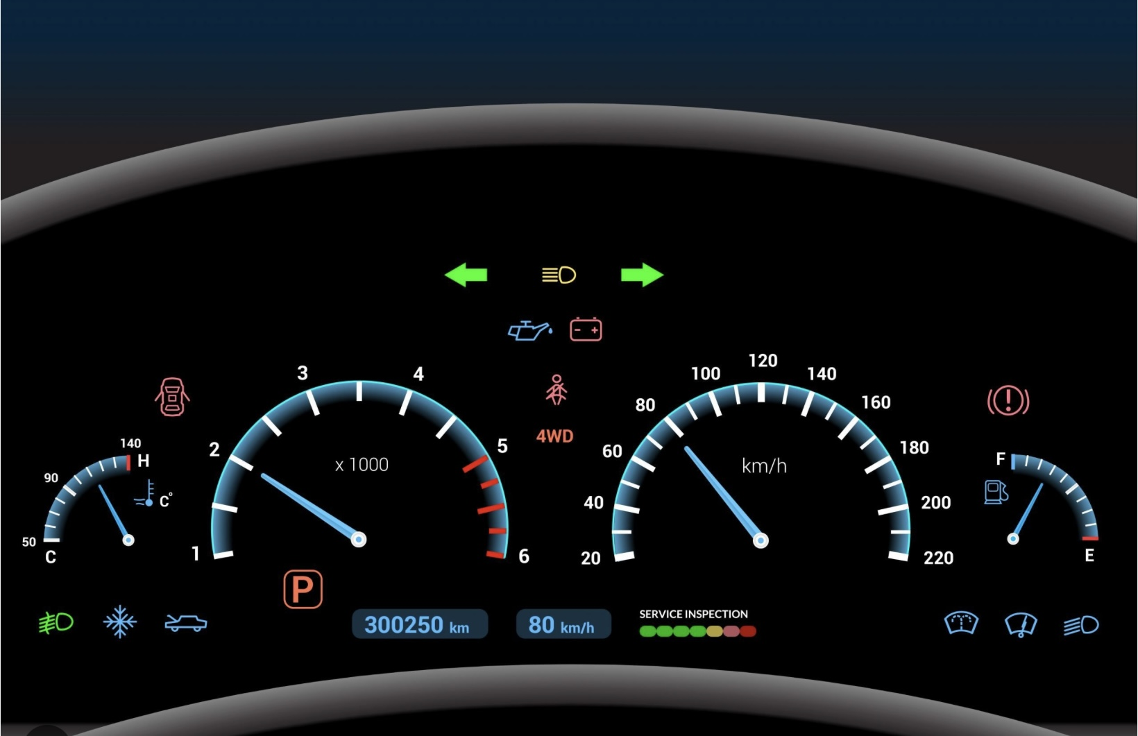
four techniques AND strategies FOR TOOL USE
When using the tools:
2. be mindful of your internal personal “dashboard” or “instrument panel” by:
a) Monitoring your energy balance.
b) Being mindful of your crisis risk level.
c) Staying in the window of emotional tolerance
d) being aware of your state of activation.
Your dashboard tells you whether you’re in the window of tolerance or relatively calm and alert. If you’re too far outside this window you may not have the bandwidth to use the skills tools and strategies.
Notes:
The dashboard of the car gives the driver critical information about the state of the vehicle. This is extremely useful in avoiding trouble such as running out of gas. In simple we suggest people develop and imaginal dashboard with four instruments that helps them be mindful of their physiological states and stay out of trouble by for example filling their "gas tank" before they run out of gas.

Slide 63
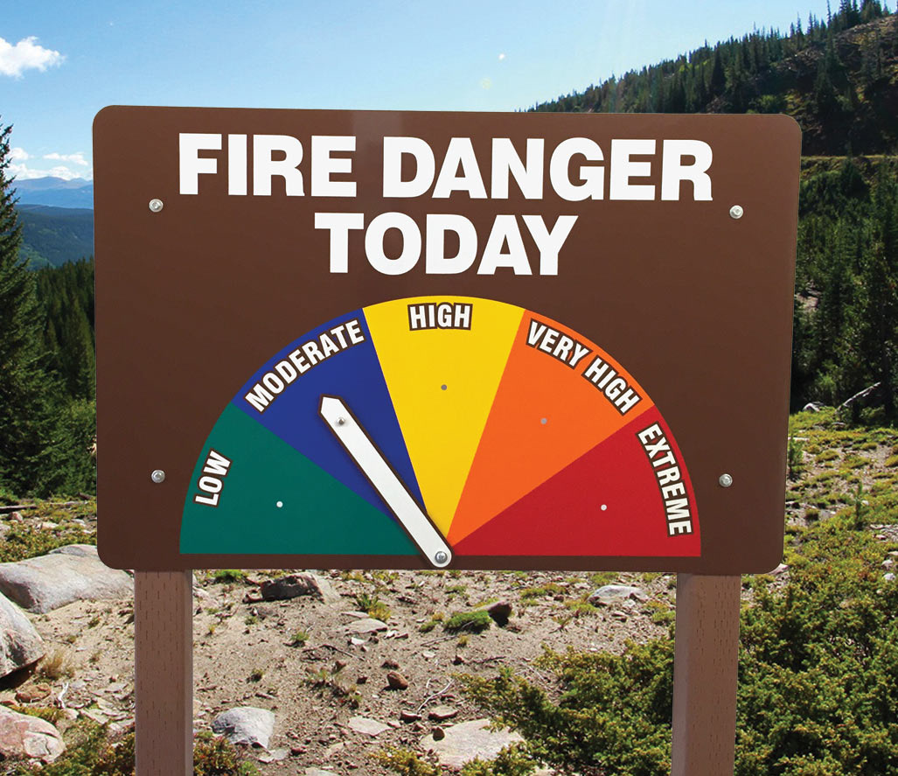

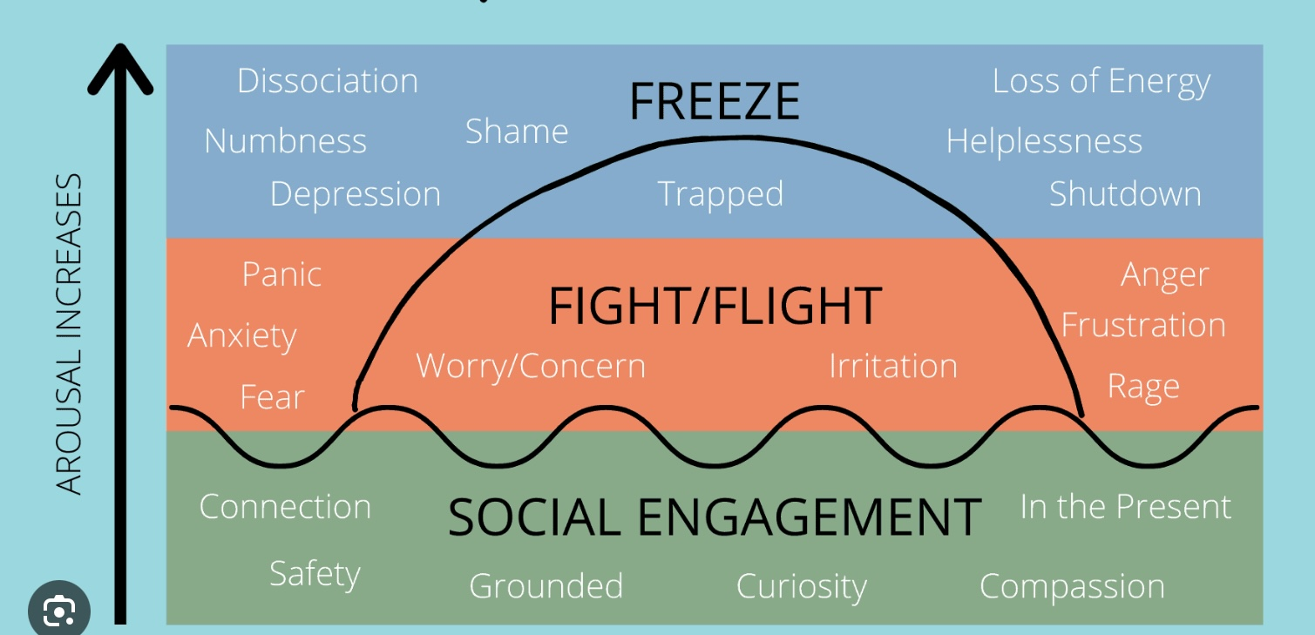

Check in regularly with your Personal dashboard
Spend a few moments checking in with yourself by asking:
1)What is the current risk that I’ll experience a state of crisis ?
Low b) Moderate c) high d) very high e) extreme
2) Am I in the window of tolerance?
a) Yes b) I’m a little outside c) very outside
3) What state of activation am I mostly in at the moment?
a) Calm b) Fight c) Flight d) Dissociated e) Depressed?
4) Where is my energy tank right now?
a) Full b) ¾ c) ½ d) near empty
CRISIS RISK
WINDOW OF TOLERANCE
STATE OF ACTIVATION
ENERGY RESERVES

Slide 64
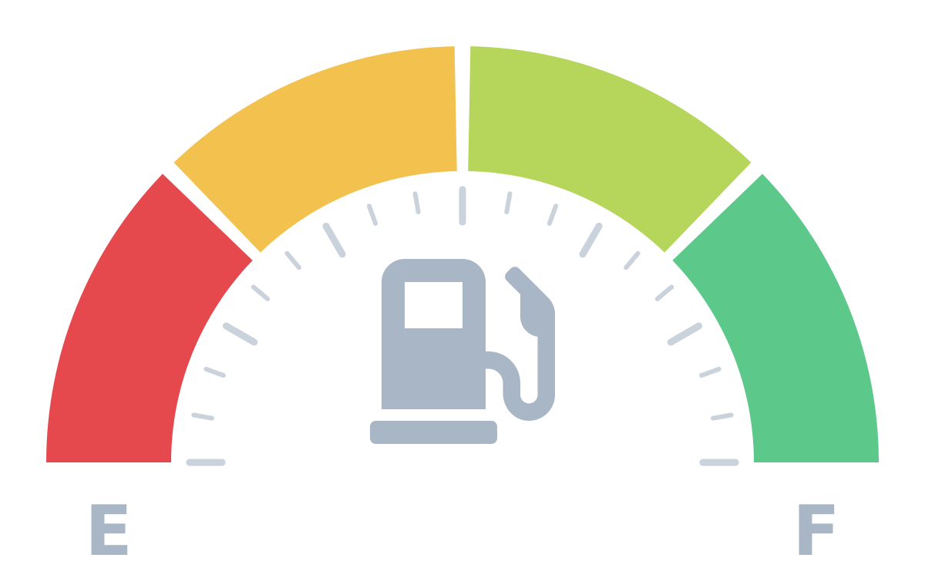
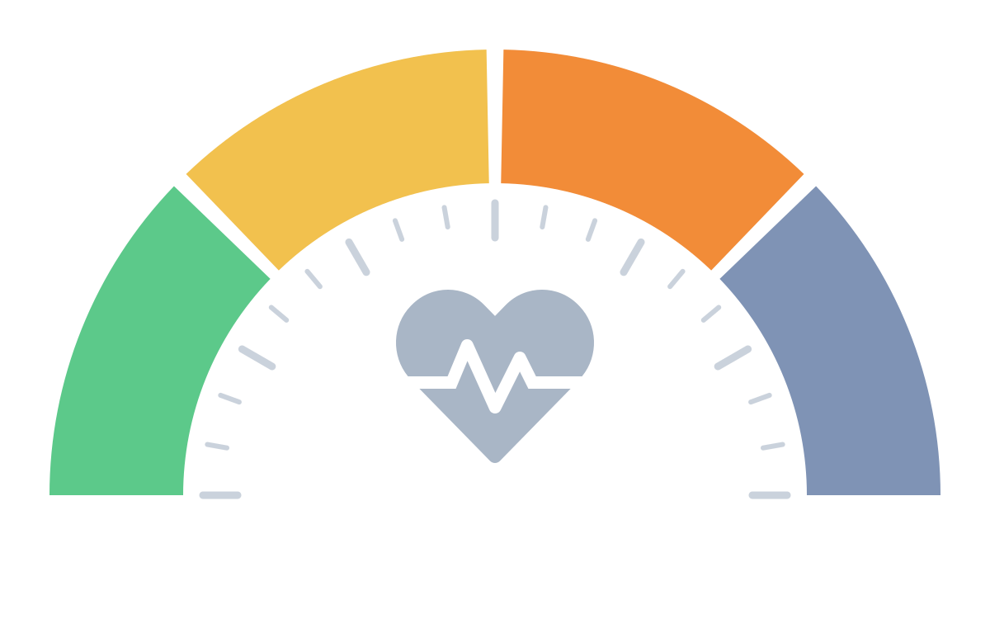
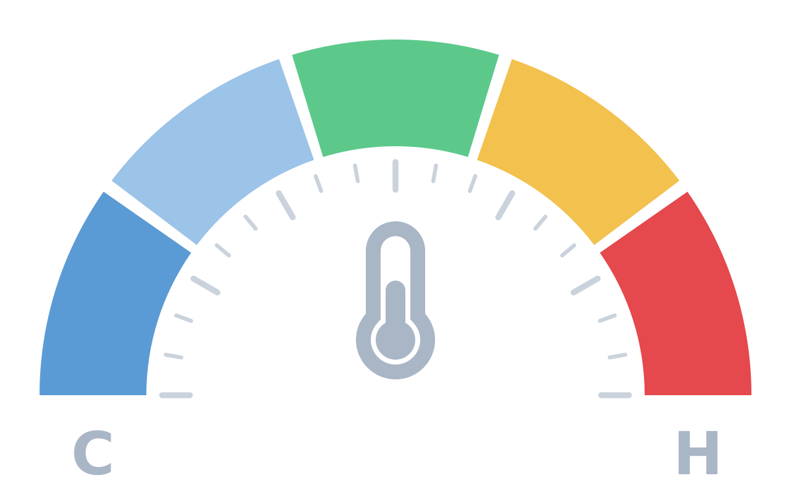
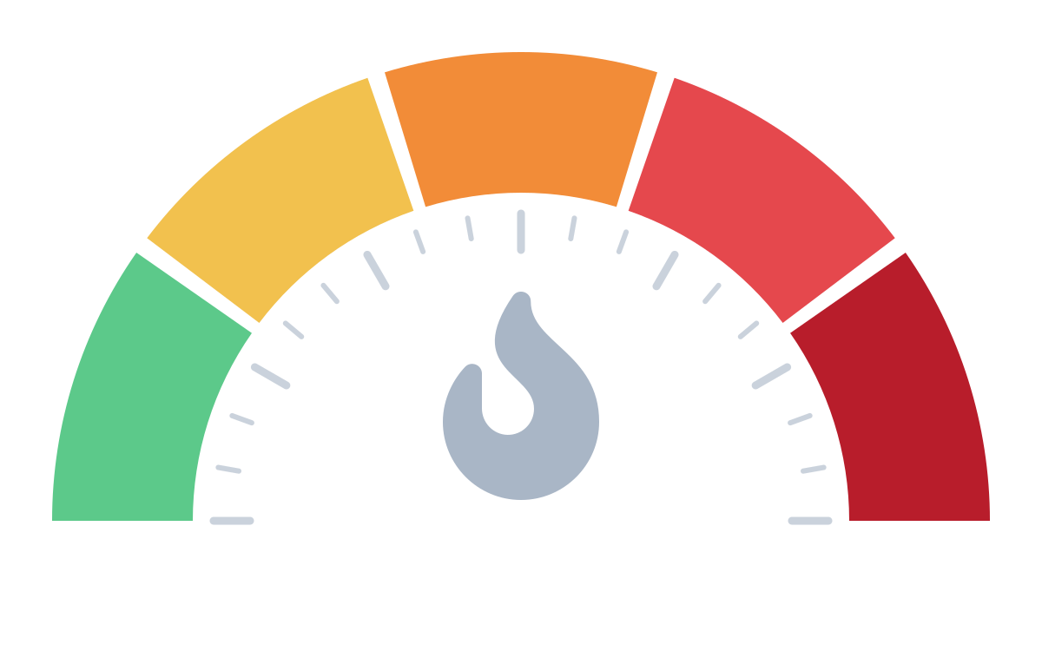
CHECK IN WITH YOUR PERSONAL DASHBOARD
Pause, take a breath, and read each gauge in turn. Just notice there are no wrong readings.
1
Energy reserves
2
State of activation
3
Window of tolerance
4
Crisis risk
How much fuel is in my tank right now?
Which state am I mostly in at the moment?
Am I inside my window, or above it (revved up) or below it (shut down)?
How likely is it that I’ll tip into a state of crisis?
Near empty
½
¾
Full
Calm
Flight
Fight
Freeze / shut down
numb, depressed, dissociated
Well below
A little below
Inside
A little above
Well above
Low
Moderate
High
Very high
Extreme
Then ask: Given these readings, what do I need right now?
Notes:
Facilitator script (about 2 minutes, slow pace):
Let's take a moment to check in with our dashboards. Settle into your seat, feet on the floor, and take one slow breath.
1. Energy: Notice your body. How much fuel is in the tank right now: near empty, half, three-quarters, or full?
2. Activation: Which state are you mostly in? Calm and connected; flight (worried, anxious, wanting to escape); fight (irritated, angry, braced); or freeze / shut down (numb, flat, far away).
3. Window of tolerance: Are you inside your window, where you can feel things and still think clearly? Or a little or well above it (revved up, overwhelmed), or below it (numb, shut down)?
4. Crisis risk: Putting it together, how likely is it that you'll tip into crisis today: low, moderate, high, very high, or extreme?
Then ask: Given these readings, what do I need right now? A skill to cool down or calm the body, something to re-energise, rest, connection, or reaching out for support.
Remember: there are no wrong readings. The point is noticing, not judging.

Slide 65
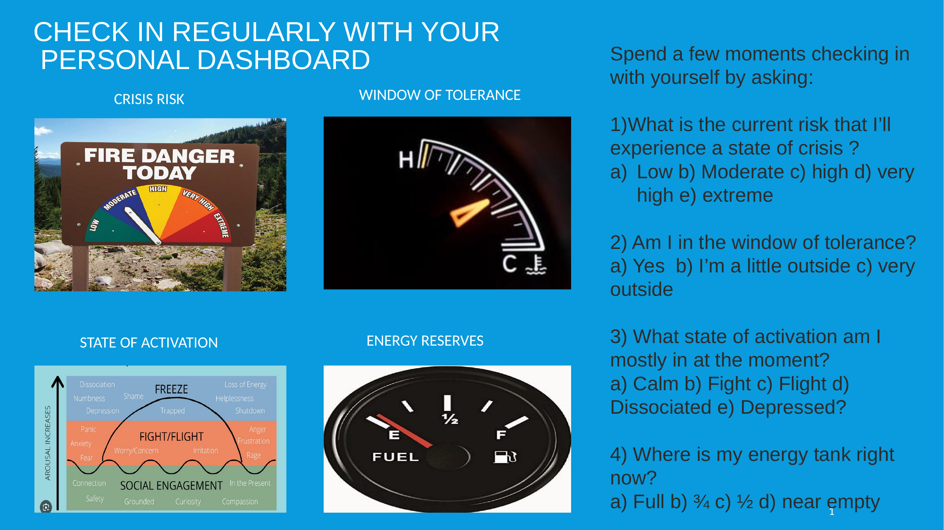
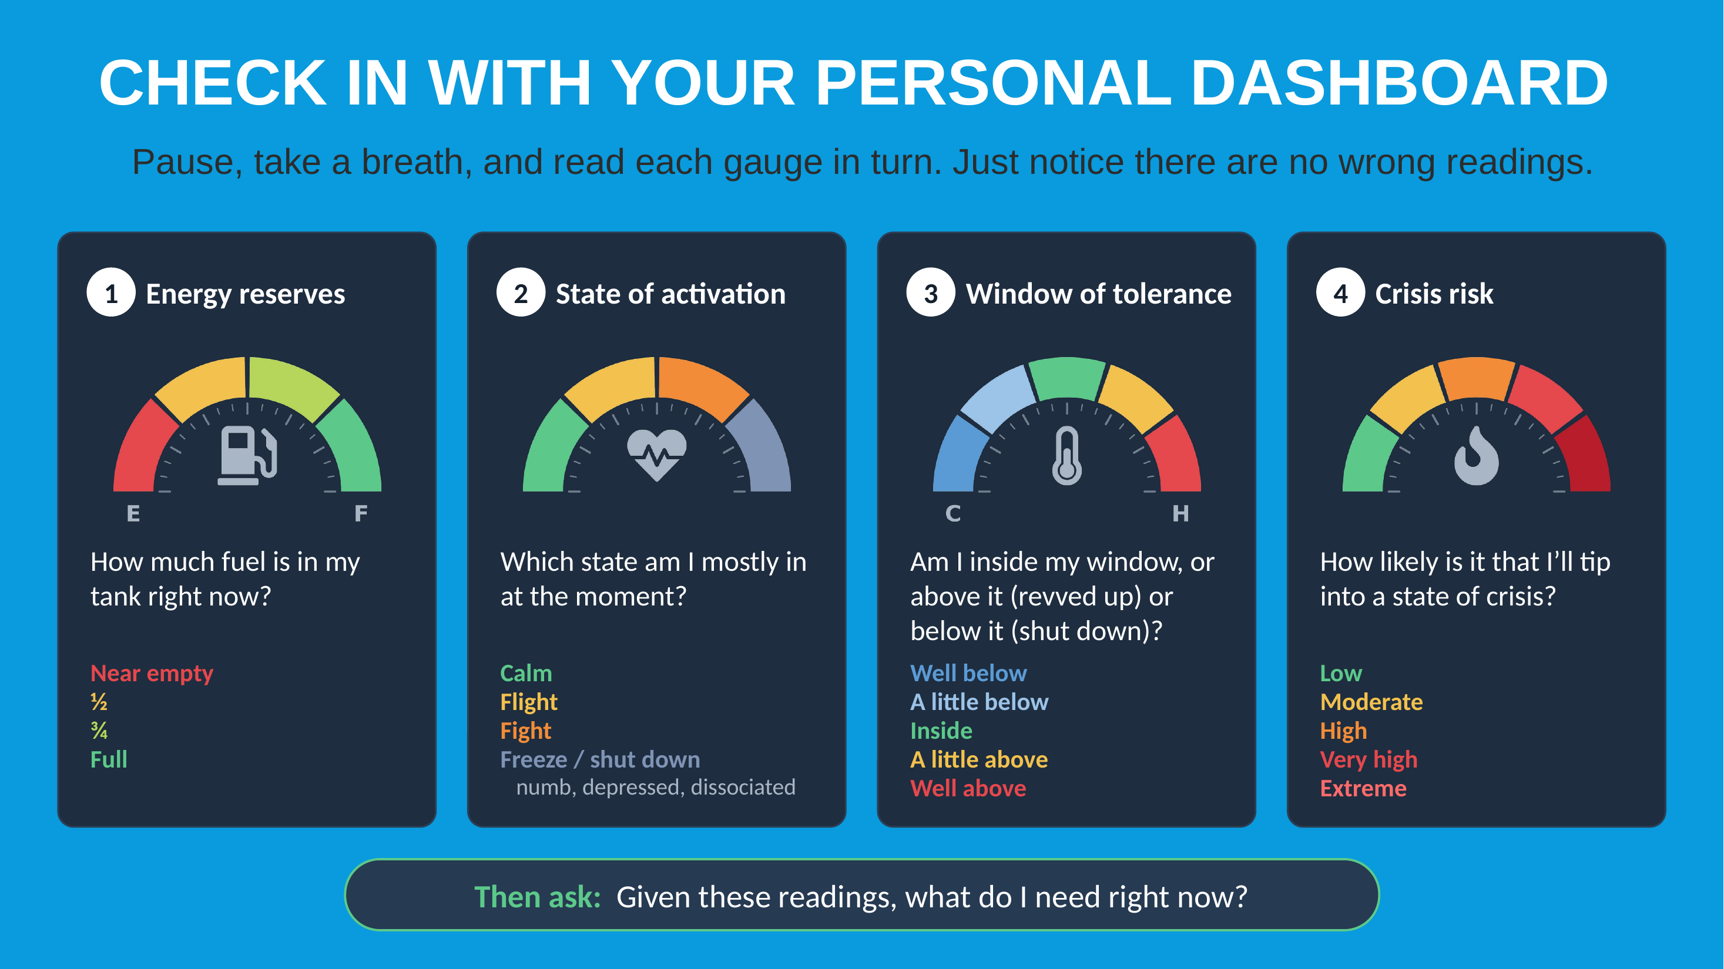
WHICH DASHBOARD SLIDE DO YOU PREFER?
Same check-in, two designs. Which one helps you read your gauges more easily?
Option A
A
Option B
B
Notes:
Show of hands: who prefers Option A (the original slide)? Who prefers Option B (the redesign)?
Follow-up prompts: What makes it easier to use? Is anything confusing or missing? Would you like elements of both?

Slide 66
STEP 2. SIMPLE MINDFUL DASHBOARD: SELF-AWARENESS STRATEGIES
The imaginary crisis risk, energy reserve, window of tolerance and state of activation “personal dashboard” or “instrument panel”, helps us to be mindful of the state of our body and mind and tells us if we’re are in a hole or at risk of falling into one.
Check in with these imaginary “instruments” which will give you critical information about yourself, just like a car’s dashboard gives you important information about the state of a car.
Much of the time, we are on automatic pilot and unaware of what is happening to our bodies and minds. Being on automatic pilot keeps us from trying to influence or manage what is going on with us.
Developing an imaginary personal dashboard is one of Simple’s mindfulness or self-awareness strategies. We will devote our first boing’s group to crafting a personal dashboard.
Until you’re able to automatically visualize a dashboard in your mind, it’s helpful to craft and use an actual one. This might also help other people around you be aware of your states.
The dashboard includes 4 gauges: 1. window of tolerance, 2. crisis risk 3. energy reserves or balance and 4. state of activation

Slide 67
THE PERSONAL DASHBOARD
A brief description of each the gauges in the personal dashboard:
1 the crisis risk gauge – provincial and national parks often prominently display forest fire risk signs. It may be helpful to think of our current risk of tipping into a crisis state in this way. This awareness can help us decide if you need to take precautions to prevent imminent crisis.
2 the state of activation gauge- we have a range of possible states of physiological activation. We most like to be calm or alert. We can however become hyperactivated into fight/flight or hypoactivated into dissociated/depressed states. What state are you in? This and the next gauge are related.
3. The window of tolerance gauge – this is like the oil temperature gauge in a car. Ideally, it's neither cold nor too hot but somewhere in the middle. Similarly, the optimal stage of activation for people is known as the window of tolerance in which we are calm or alert. When we are hypo activated or too cold, we are depressed or dissociated. When we are hyper activated or too hot, we are in fight or flight.
4. The energy reserve gauge – this is like the fuel gauge. It can be full when we're rested and have lots of energy, or it can be empty when we’re very tired.

Slide 68
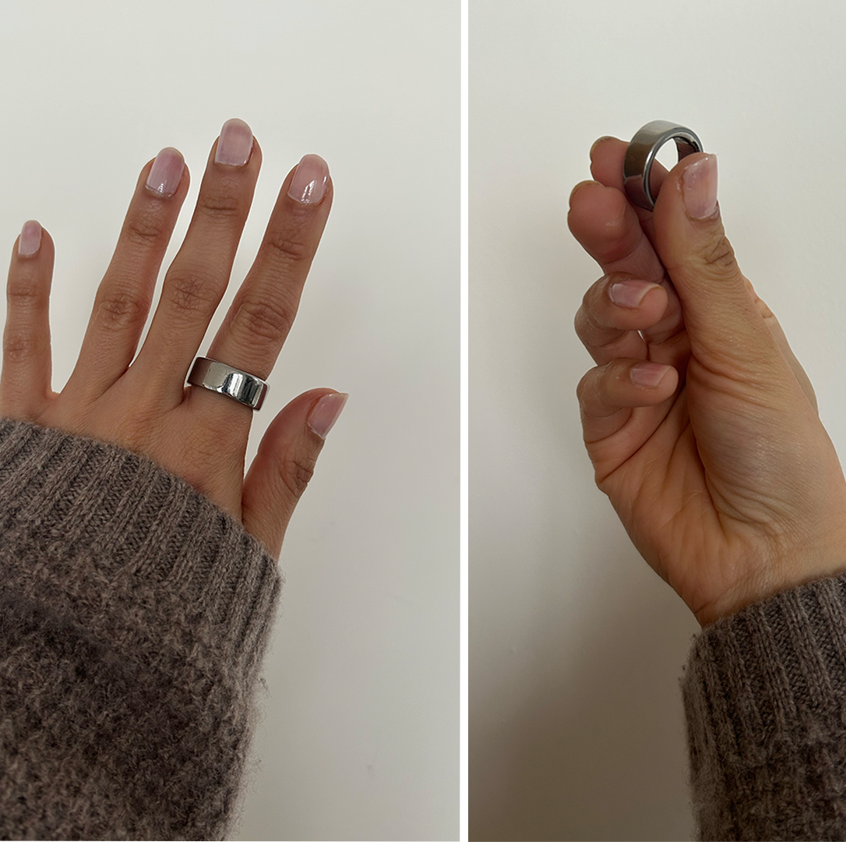
In the course we will encourage you to track not only your crisis risk, energy reserves, and state of activation but also, using the holes diary card, if you’re in a “hole”. Tracking is an excellent way of developing mindfulness.
Tracking these and other things like sleep, exercise, or stress has a lot of benefits, both for self-awareness and for long-term health.
When you track, you begin to notice connections: Ex: Poor sleep and higher stress the next day. More exercise leading to better mood or energy. Stress spikes tied to certain activities or times. This awareness helps you see patterns you might otherwise miss.
Seeing progress, like more steps walked, longer sleep, or steadier stress levels, can be motivating. It makes the invisible visible, which often encourages people to stick with healthy habits.
Tracking helps you catch small problems before they grow: Sleep getting shorter each week. Resting heart rate creeping up. Stress scores staying high for too long. This can prompt adjustments before health really suffers.
With data about yourself, you can make choices that actually fit your life: Adjusting bedtime routines. Knowing what type or amount of exercise helps. Recognizing which coping strategies lower stress.
Over time, the data becomes a kind of mirror. You see not only what happens but how you respond. For example: “When I meditate, my stress score drops the most,” or “If I skip workouts, my sleep worsens.”
TRACKING

Slide 69
It’s very helpful to have an actual dashboard close to you as a reminder to check in with it. In the first homework group we will talk about how to craft a dashboard and create a sensory soothing tool kit.

Slide 70
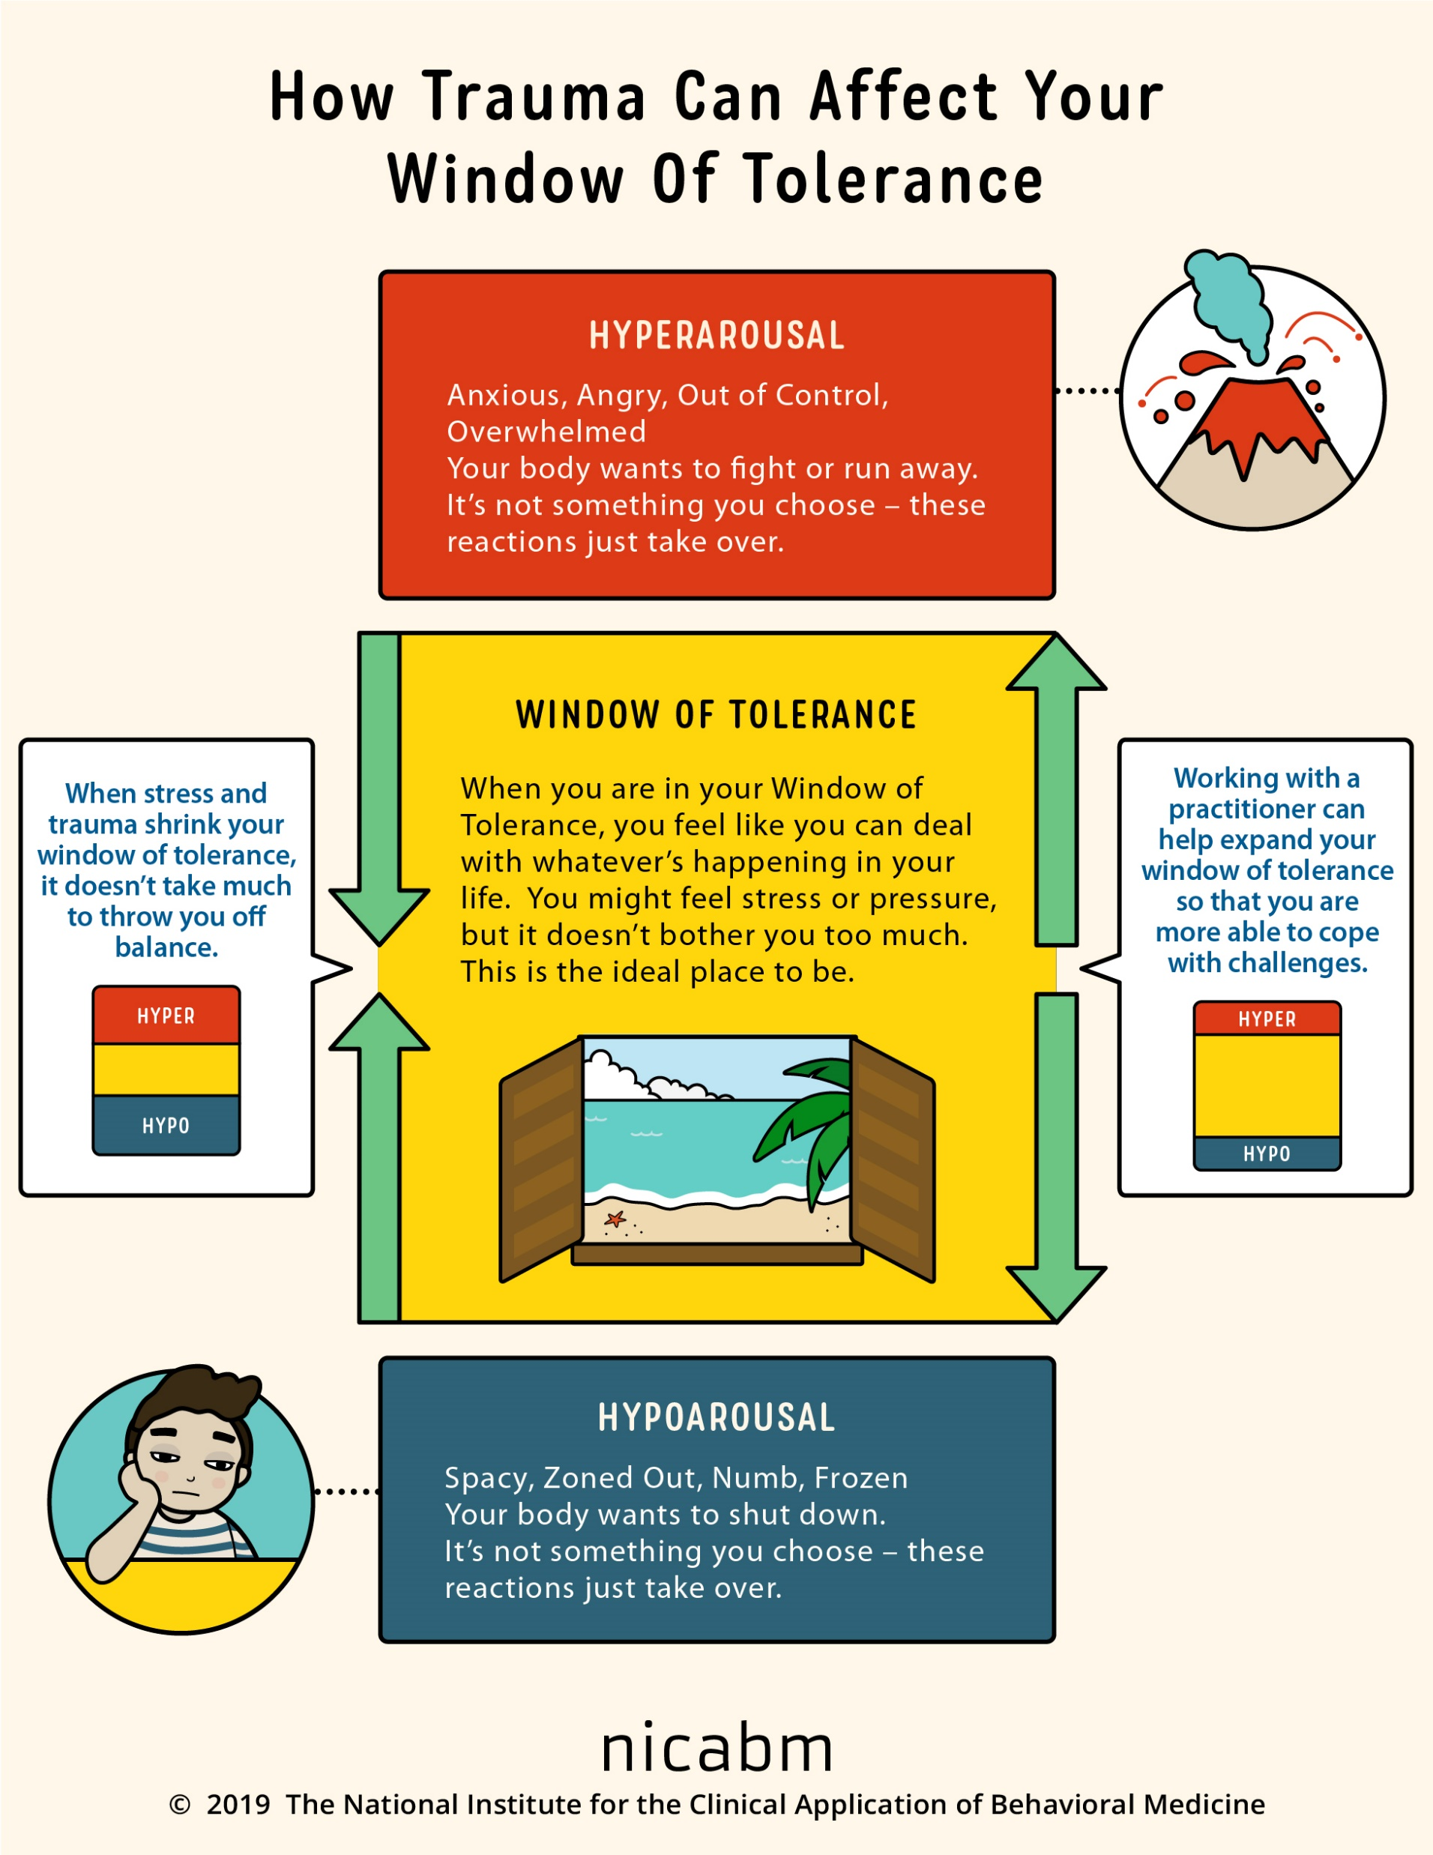
four techniques AND strategies FOR TOOL USE
When using the tools:
3. Stay in the window of tolerance by pendulating.
Notes:
The dashboard of the car gives the driver critical information about the state of the vehicle. This is extremely useful in avoiding trouble such as running out of gas. In simple we suggest people develop and imaginal dashboard with four instruments that helps them be mindful of their physiological states and stay out of trouble by for example filling their "gas tank" before they run out of gas.

Slide 71


STEP 3. Stay in your window of tolerance by pendulating
Pendulating means swinging from one thing or place to another.
When people have feelings, they also have thoughts and images that accompany those feelings.
One way of soothing ourselves, when we are experiencing intense negative feelings, and bringing ourselves back to the window of tolerable emotions, involves distraction or self-soothing: we learn to identify that we are emotional and learn to have alternative thoughts, a soothing inner dialogue, and/or calming and soothing images. When we are better regulated, we can then revisit the original thoughts and feelings we were having
To get good at pendulating we have to plan and practice it as we will further discuss when we talk about crisis plans. Many of the skills we’ll learn in the distress tolerance module can be used in pendulating.
I use pendulating to help me sleep better.
Distressing thoughts/feelings
Distracting/soothing
Images/thoughts/sensations

Slide 72

four techniques AND strategies FOR TOOL USE
When using the tools:
4. Use editing, splicing and pasting of the “videos” of problematic thoughts, feelings or behaviors to practice and develop new ones.
Notes:
The dashboard of the car gives the driver critical information about the state of the vehicle. This is extremely useful in avoiding trouble such as running out of gas. In simple we suggest people develop and imaginal dashboard with four instruments that helps them be mindful of their physiological states and stay out of trouble by for example filling their "gas tank" before they run out of gas.

Slide 73

STEP 4. Editing, splicing and pasting while pendulating to stay in window of tolerance
We all have memories or mental “videos” of times we’ve been dysregulated or fallen into holes.
When we are learning to get out of holes, these memories or videos are invaluable in helping us practice alternative ways of thinking, feeling, and behaving.
In Simple we’re going to learn to edit these old videos by splicing them and pasting in new more desirable and adaptive thoughts, feelings, and behaviors that get us out of our holes.
As we visualize these videos, we may get activated so we will need to know how to sooth ourselves by “pendulating”, then resuming our work on the videos.
+

Slide 74

TO EFFECTIVELY USE any of the 6 tools remember the 4 strategies and techniques
Stay organized and safe, and be effective when using the 6 tools by:
1. following the steps recommended in the Simple tool algorithms and templates to ensure good problem solving
2. Monitor your personal dashboard
3. Pendulate to stay in window of emotional tolerance.
4. To learn new patterns, work with old videos or memories of falling into holes. Edit, splice, and paste them with more adaptive or skillful feelings, thoughts and behaviors, and…
5. most importantly practice, practice, practice.

Slide 75
I'm wondering if it's common to have a situation where you are so outside of the window of tolerance that you literally can't do the coping skills, chain analysis, rational mind remediation etc.
Instead, you have to use other coping skills to try to calm and soothe yourself and get back to something resembling regulation.
So, putting the issue aside, not even trying to come up with solutions, just trying to get through the overwhelming emotions. Linda C.
Great question we’ll come back to it after we discuss the strategies and techniques, you’ll understand why.

Slide 76
What we will do today
Part III We’ll introduce crisis plans covered in the Simple manual session 2

Slide 77

introducing The 6 tools
Crisis plans
Holes diary cards
Holes analysis
Rational mind remediation
Goals diary cards
Self-led remediation
Notes:
In the third part of our session today we introduce the first tool; crisis plans.

Slide 78

Has there been a rise in the number of people experiencing crisis in recent years?

Slide 79
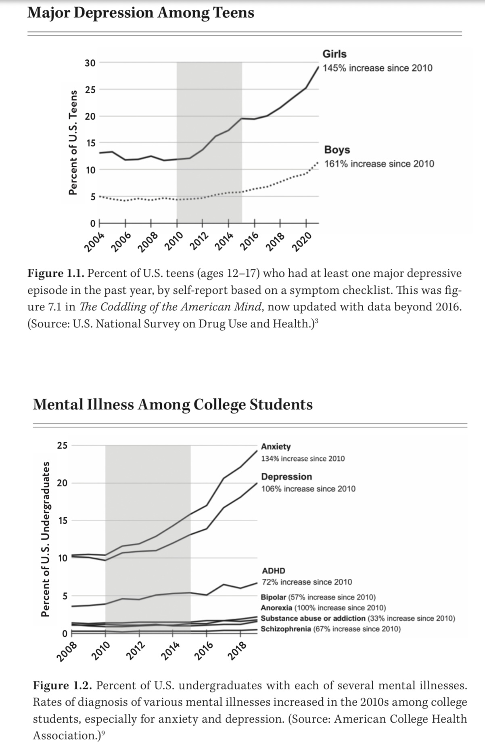
THE CRISIS LANDSCAPE
There’s strong evidence that people in many Western countries (as well as globally) are experiencing more mental health difficulties today than in previous decades. Many of the explanations of why this is happening tie into what’s being called the “polycrisis”, or overlapping economic, social, environmental, political, and technological crisis that reinforce one another. The layering of many crises intensifies psychological stress in ways that go beyond what a single problem would do.
Studies and health-data sources suggest that more people are reporting symptoms of depression and anxiety today than in past decades. Young people in particular are experiencing more distress, depressive symptoms, anxiety, and feeling overwhelmed.

Slide 80

THE CRISIS LANDSCAPE
Jonathan Haidt in his 2024 book The anxious generation, argues that children’s experience of growing up has been fundamentally transformed since about 2010 by two converging trends. There is a decline of “play-based childhoods”, kids having less unsupervised, risky, free play and a rise in more protective parenting; more structured environments; fewer opportunities for autonomy.
At the same time there’s been a rise of of “phone-based childhoods”, ubiquitous smartphones and social media creating new pressures, reshaping how children socialize, learn attention, and deal with stress. Together, these lead to what Haidt calls the “Great Rewiring” of childhood.
Haidt documents a notable sharp increase since early 2010s in adolescent anxiety, depression, self-harm, and suicide. These changes correlate in time with the widespread adoption of smartphones/social media.
He Identifies four harms in phone-centric childhoods.
1. Social deprivation; less in-person, unstructured interaction with friends.
2. Sleep deprivation; phones and screens intruding on sleep routines.
3. Attention fragmentation; constant digital distractions weakening sustained focus. And
4. Addiction or compulsive behavior ; tech platforms designed for engagement; children having difficulty moderating use.
He claims that we’re overprotecting children in the real world and under protecting them in the on-line world. More and more children and young adults are “failing to launch” in the transition from adolescence to adulthood with its associated responsibilities.

Slide 81
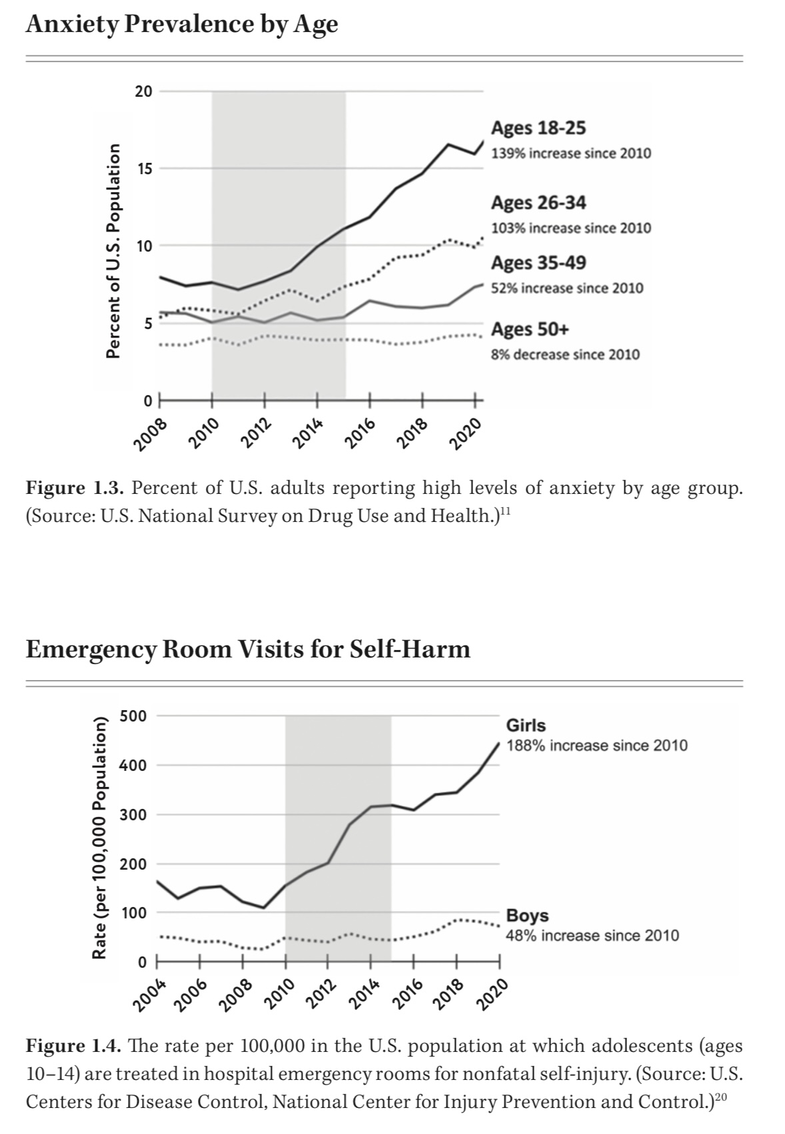
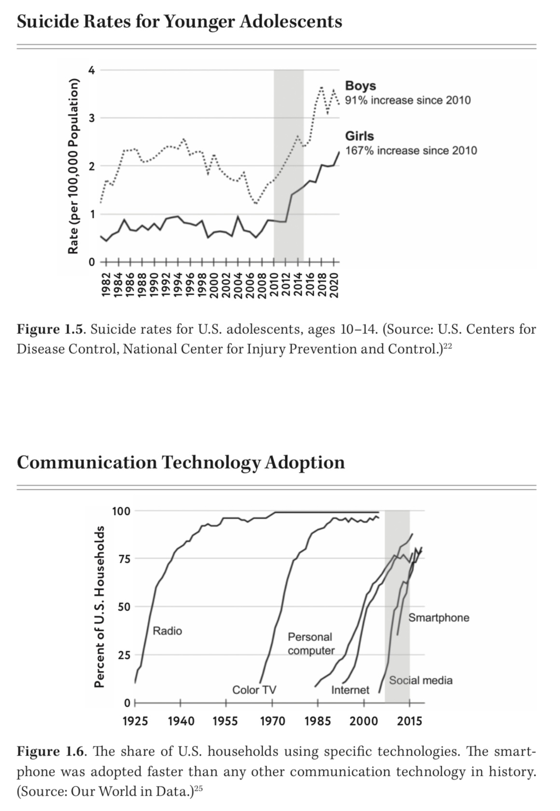
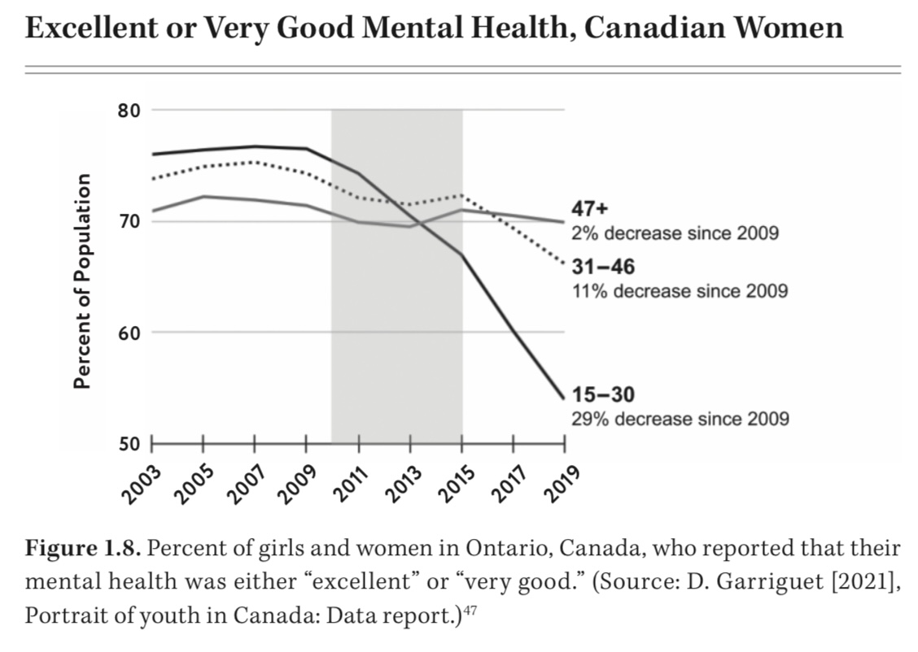
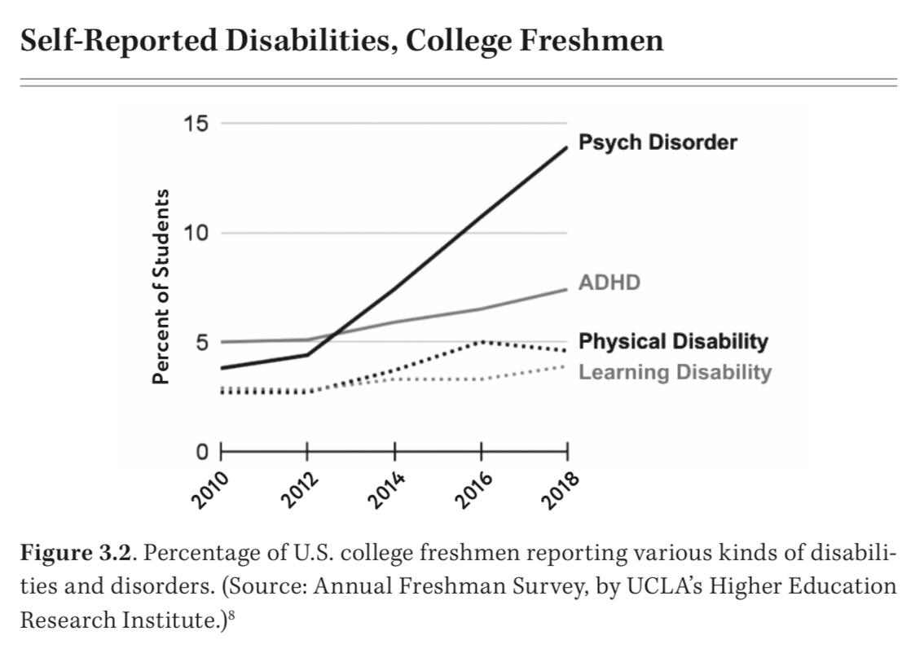

Slide 82
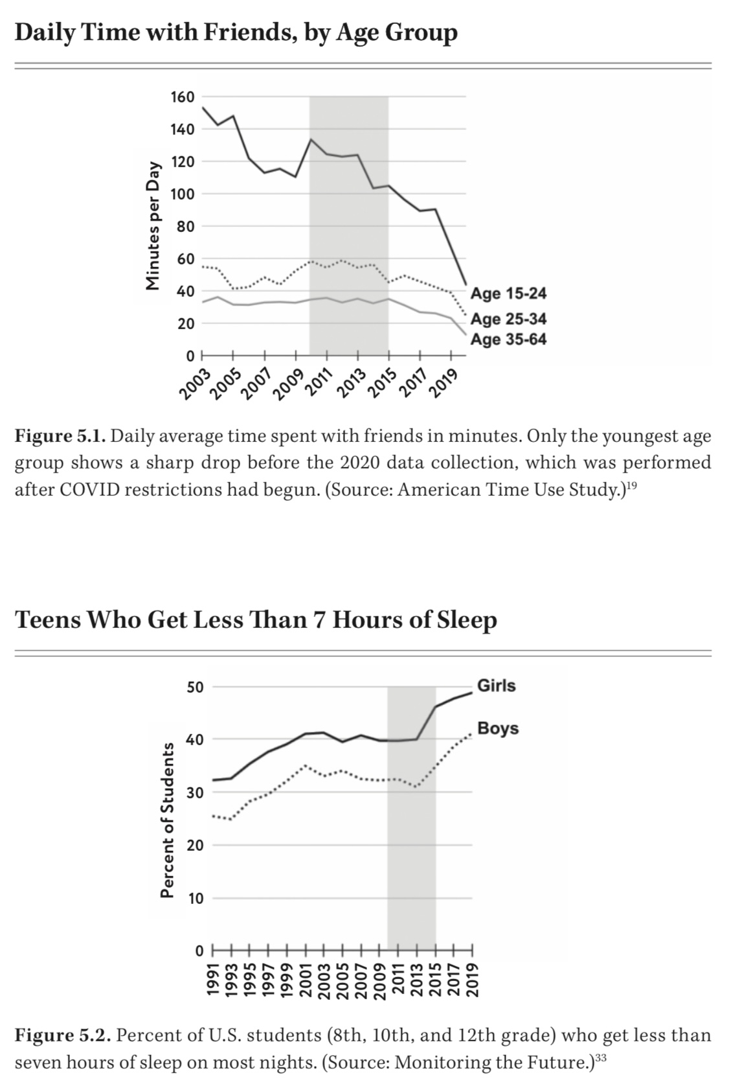
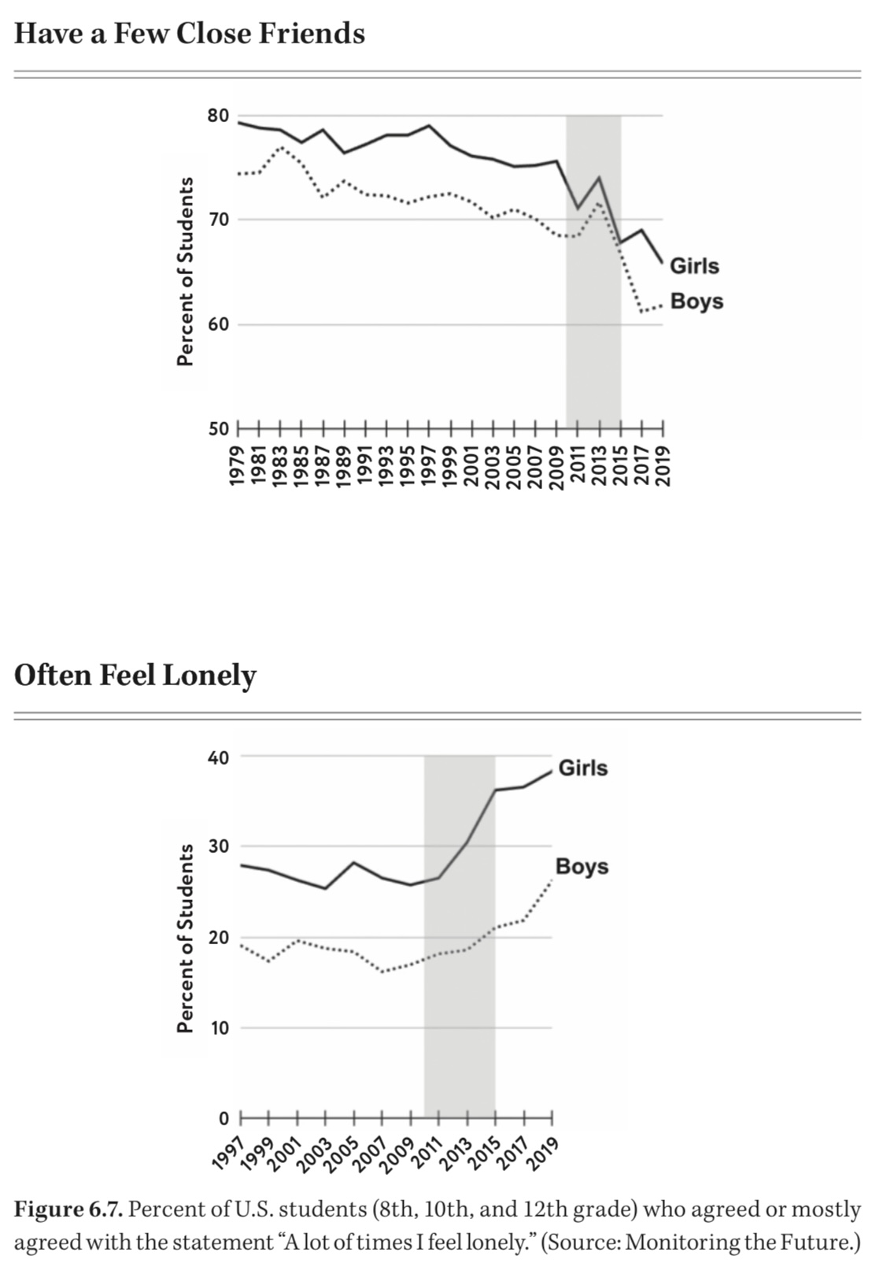
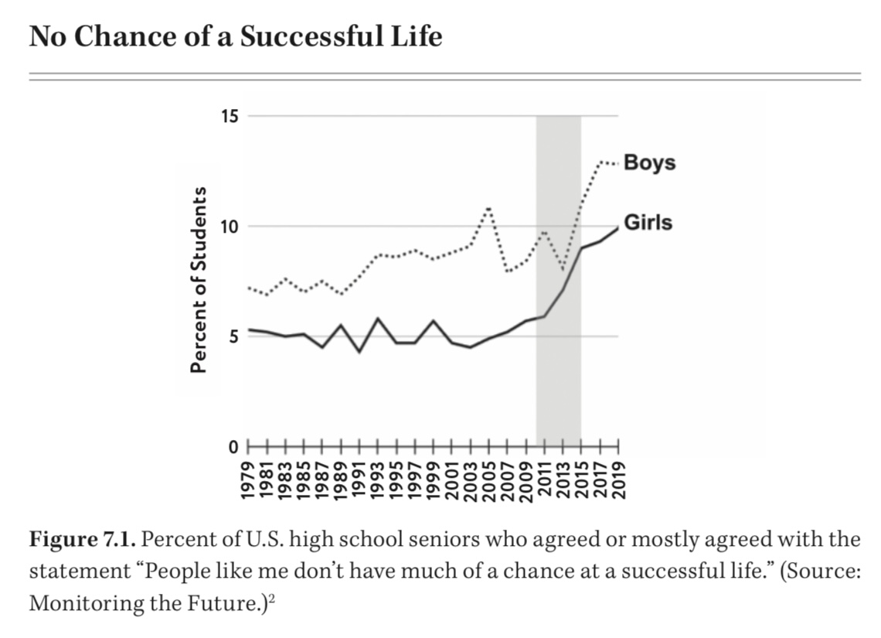
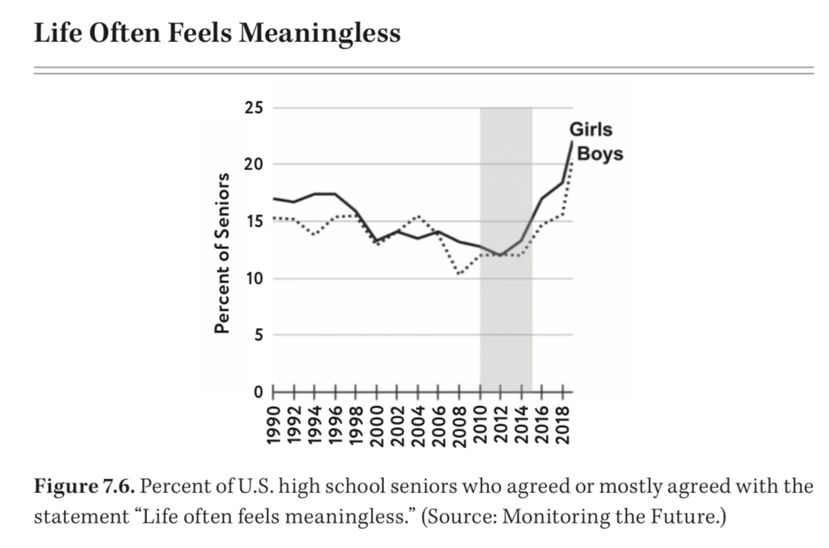

Slide 83
What is a crisis and what are crisis plans?

Slide 84
WHAT ARE CRISIS and crisis plans ?
A crisis is a time of perceived intense difficulty, trouble, or danger.
Crisis plans and distress tolerance skills are the first material introduced in DBT and the Simple course because crisis are critical events that absolutely need to be understood and managed before anything else. Crisis have the potential to be devastating, but when skillfully managed, they can help us learn to cope better in the future.
To develop crisis plans you will need the DBT distress tolerance skills. That is why the first simple tool, crisis plans, are introduced at the same time as are the DBT distress tolerance skills which we will discuss over the next few weeks
A personal crisis is a state of feeling which might be associated with an internal experience of confusion and anxiety to a degree that formally successful coping mechanisms fail us, and ineffective decisions and behaviors take their place. As a result, the person in crisis may feel confused, vulnerable, anxious, afraid, angry, guilty, hopeless or helpless.
Notes:
Many people don't take crisis plans, for example fire drills, or flight safety instruction seriously. They falsely assume that if an emergency happens, they will calmly figure out what to do. This is a common fallacy. In a real emergency people's rational brain frequently shuts off and their emotional brain takes over. In a real emergency many people panic and are unable to do simple things. Research has clearly shown that it's those people who take crisis plan seriously, and practice them repeatedly, that do the best in an emergency.

Slide 85

Preparing for future crisis they are likely to face is very important because it equips individuals with the skills, tools and strategies needed to manage overwhelming situations effectively.
Those who prepare for crisis do much better than those who haven’t because:
1. Knowing they have a plan can alleviate anxiety and fear associated with potential crises, allowing individuals to approach stressors with a clearer mindset.
2. Prepared individuals can respond more quickly and effectively to crises, as they have already thought through their options and know what steps to take.
3. As discussed in the previous slide, preparation often involves identifying and practicing coping strategies, which can enhance resilience and emotional regulation during difficult times.
4. Those who prepare often communicate their needs and plans to their support network; this makes it more likely for help to be available when needed.
PREPARING FOR A CRISIS

Slide 86

Personality is defined as the typical ways we tend to think, respond emotionally, and behave.
Crisis occur through a combination of external and internal factors.
Stressors are the external factors that typically trigger crisis. How the person responds to those stressors are the internal factors that are involved in crisis.
To develop new more adaptive ways of responding to stressors, we must become mindful of:
1) the nature of stressors and…
2) how we think, feel and behave when we face them. Then we must…
3) practice replacing the typical ways we feel, think and behave when we face these stressors, (our personality patterns), with more adaptive ways of thinking feeling and behaving.
4) to replace old with new patterns of responding to a crisis we must, in our imagination, repeatedly practice the new ways of feeling, thinking and behaving when we faced a stressor that we’ve experienced in the past, before attempting to do this in a new situation.
In other words, we must use the editing, splicing and pasting technique when developing and practicing crisis plans.
PERSONALITY AND CRISIS

Slide 87
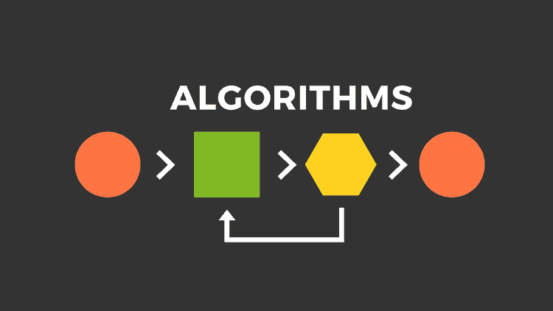
Crisis plan algorithm
Developing crisis plans and becoming skilled at using them involves 8 steps:
1. Understand the concept of holes you keep falling into. Choose a specific instance of a crisis for which you want to develop a crisis plan. (crisis are deep holes)
2. Identify some of the thoughts, feelings or behaviors that occur during the particular crisis you’ve chosen. (This is step 1 on the crisis plan template.)
3. Complete the remainder of the crisis plan template for that crisis
4. As vividly as possible imagine the particular crisis you are working with. Use the "editing, splicing, and pasting" technique, along with your skills and tools, to imagine a different outcome that incorporates your crisis plan.
5. Stay in the window of tolerance while editing, splicing, and pasting by pendulating.
6. Repeatedly visualize the new edited, spliced, and pasted version of the situation until you can visualize it without effort.
7. When a new crisis occurs work with it following these same steps.
8. practice, practice, practice.
the first Simple algorithm

Slide 88
Crisis plan algorithm
the first Simple algorithm
Developing crisis plans and becoming skilled at using them involves 8 steps:
Step 1. Understand the concept of holes you keep falling into. Choose a specific instance of a crisis for which you want to develop a crisis plan. (crisis are deep holes)

Slide 89
THERE’S A HOLE IN MY SIDEWALK
I walk down the street.
There is a deep hole in the sidewalk.
I fall in.
I am lost… I am helpless.
It isn’t my fault.
It takes forever to find a way out.
I walk down the same Street.
There is a deep hole in the sidewalk.
I pretend I don’t see it.
I fall in again.
I can’t believe I am in the same place.
But it isn’t my fault.
It still takes me a long time to get out.
I walk down the same Street.
There is a deep hole in the sidewalk.
I see it is there.
I still fall in. It’s a habit.
My eyes are open.
I know where I am.
It is my fault. I get out immediately.
I walk down the same Street.
There is a deep hole in the sidewalk.
I walk around it.
I walk down another Street.”
Portia Nelson

Slide 90
Crisis plan algorithm
Developing crisis plans and becoming skilled at using them involves 8 steps:
Step 2. Identify some of the thoughts, feelings or behaviors that occur during the particular crisis you’ve chosen. This is step 1 on the crisis plan template.
the first Simple algorithm

Slide 91
Step 2. of the algorithm Identifying the “holes” you want to work on
Identifying the holes you want to work on is the first item in the crisis plan template
Holes are any dysregulated, problematic, repetitive patterns of thoughts, feelings, or behaviors that you want to change.
Examples of holes include:
Any kind of substance abuse. Any other addiction such as gambling
Any destructive impulsive behavior
Engaging in repeated dysfunctional interpersonal interactions
Self blaming in a ruminative way or negative self talk
Being overly critical of others
Any dysregulated emotion such as anxiety, anger, or despair
Problems with boundaries, not being able to say no when appropriate. Being passive, aggressive or both.
Any frequently recurring behavior that you later regret
Withdrawing or running away
Thinking of, or actually hurting yourself
Suicidal thoughts
Etc.
It’s helpful to consider physical, emotional, thinking, and behavior holes separately although they go together:

Slide 92
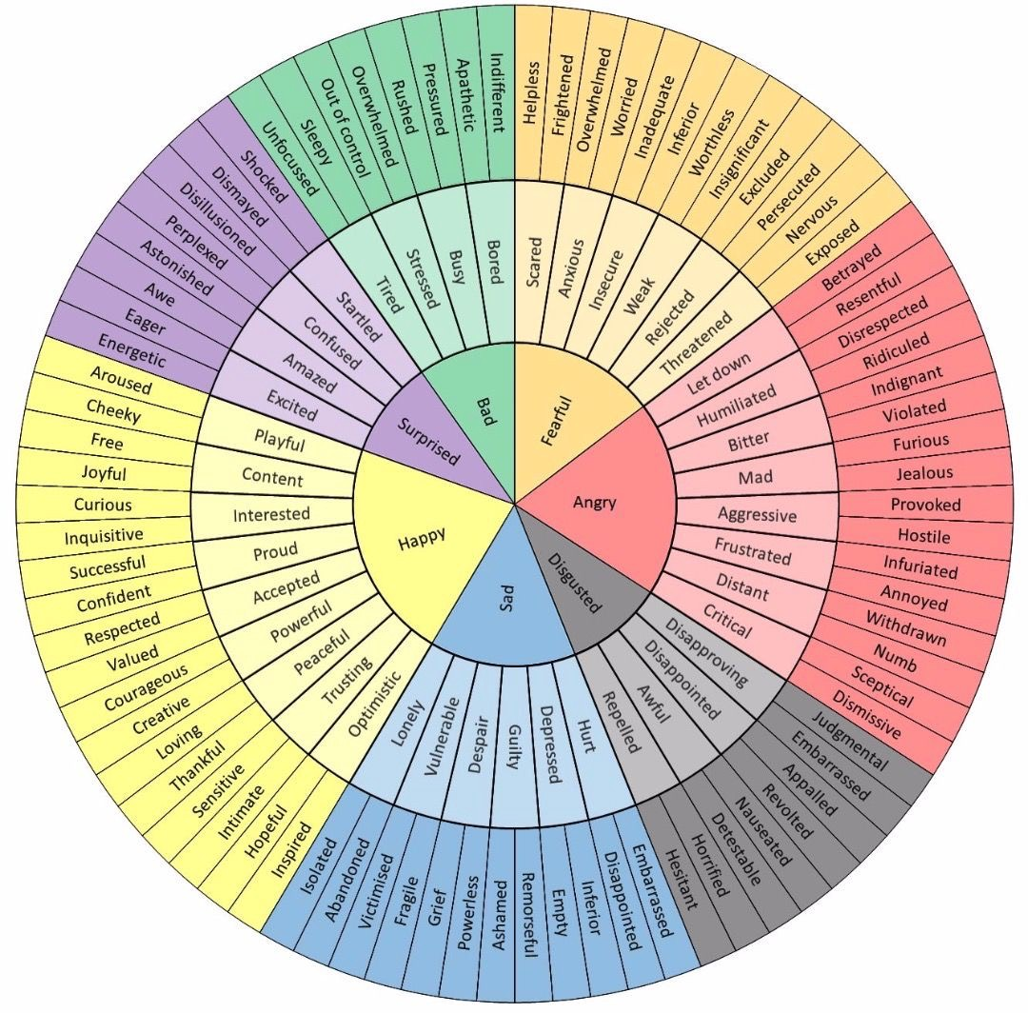
2.Feeling wheel: Finding your emotional holes
To find your “emotional holes” using the feeling wheel:
Think of a specific recent crisis you found yourself in and is a common type of crisis for you.
Try to identify one or more feelings you experienced during that crisis
For help identifying your feeling consider the innermost circle of the wheel.
Work from the center towards the periphery of the circle to further home in on your feelings.
These are your “emotional holes” or the feelings you tend to experience in a crisis

Slide 93
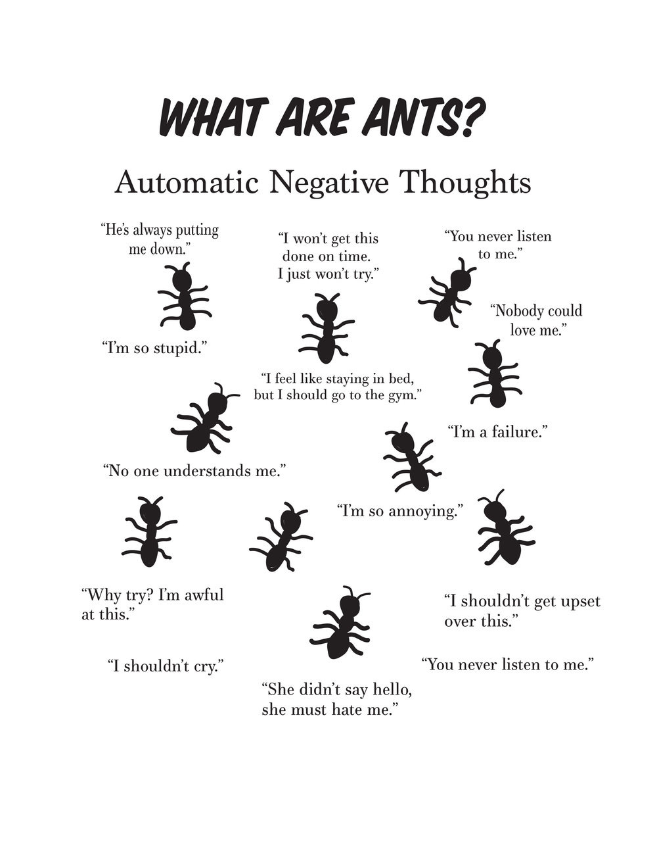
2. FINDING YOUR THINKING HOLES
To find your “thought holes”:
Think of a specific recent crisis you found yourself in and that is a common type of crisis for you.
Try to identify a few of the thoughts you had during the crisis .
Automatic negative thoughts are also referred to as ruminative thoughts because they repeat over and over again.
Thought holes or negative thoughts tend to fall into one of several categories

Slide 94
2. FINDING YOUR THINKING HOLES
Thought holes or negative thoughts tend to fall into one of several categories
Consider which category your thoughts belonged to:
thoughts of being
1) incompetent,
2) an impostor,
3) defective,
4) unworthy,
5) shameful,
6) guilty,
7) unsafe,
8) vulnerable, or
9) out of control.
You may have been so overwhelmed during your crisis that your thinking was disorganized, and you are unable to recall or identify any coherent thoughts

Slide 95
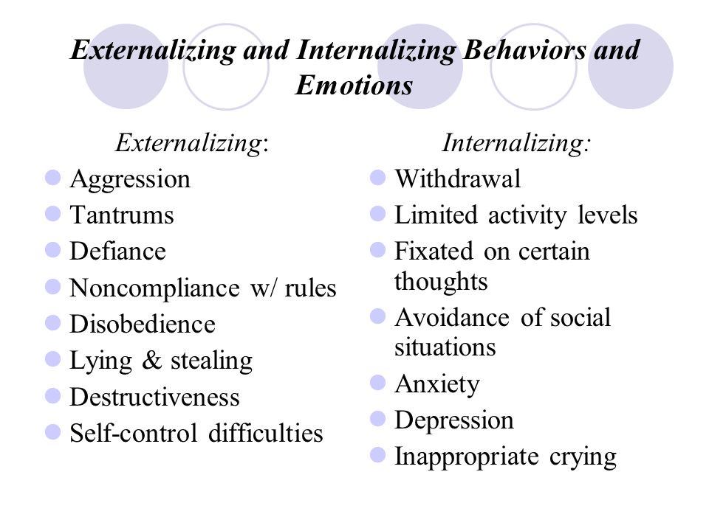
2. FINDING YOUR BEHAVIORAL HOLES
Externalizing and internalizing behaviors
To find your behavioral holes
Think of one or more behaviors you tend to engage in when you’re in the crisis you are working on.
Internalizing behaviors are inner directed while externalizing are directed outward to others or the environment.

Slide 96
Crisis plan algorithm
Developing crisis plans and becoming skilled at using them involves 8 steps:
Step 3. Complete the remainder of the crisis plan template for that crisis (items 2 to 7 on the template)
the first Simple algorithm

Slide 97
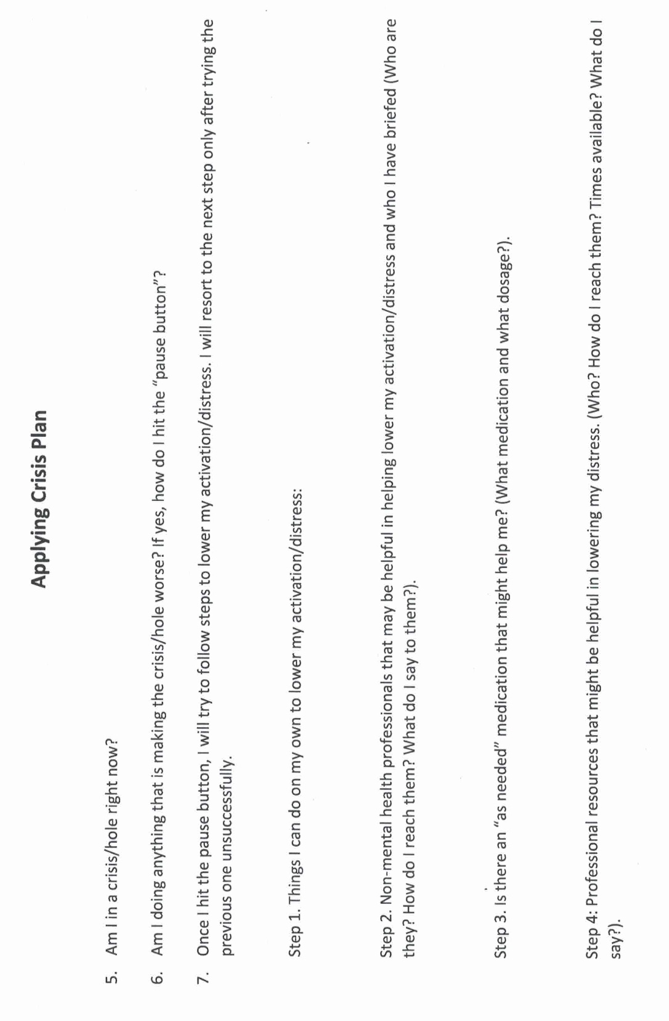
Crisis plan algorithm
Developing crisis plans and becoming skilled at using them involves 8 steps:
Step 3. Complete the remainder of the crisis plan template for that crisis
the first Simple algorithm

Slide 98
template
Notes:
A template is a structured form that helps you carry out the steps prescribed in the algorithm. There are many different crisis plans templates. This one is a compilation of some of the best features of other templates.

Slide 99
(template)

Slide 100
Crisis plan algorithm (continued)
Developing crisis plans and becoming skilled at using them involves 8 steps:
4. As vividly as possible imagine the particular crisis you are working with. Use the "editing, splicing, and pasting" technique, along with your skills and tools, to imagine a different outcome that incorporates your crisis plan.
5. Stay in the window of tolerance while editing, splicing, and pasting by pendulating.
6. Repeatedly visualize the new edited, spliced, and pasted version of the situation until you can visualize it without effort.
7. When a new crisis occurs work with it following these same steps.
8. practice, practice, practice.

Slide 101
In item 7 of the template steps 2 and 4 ask that people seek help from family, friends or from professionals. What are some of the challenges associated with doing that?

Slide 102

Help from others
The ideal and the reality
Trying to get help from family and friends can backfire. Some people can make the crisis worse.
Seek help only from those that are likely to be helpful
Prepare the person beforehand. Make sure they are willing to help and know what you need and what they should do
Many people do not have family or friends that might help when they’re in crisis
Getting help from professionals can be difficult especially if you don’t know the system or the person, you’re dealing with.
If you can, get to know the professional crisis resources that may be available to you.
We will talk more about this when in session 5 we discuss suicidal thoughts
Notes:
People be they family, friends, or mental health professionals who have a negative emotional footprint, have difficulty staying in the window of emotional tolerance and easily becomes dysregulated, or are judgmental rather than understanding may make a crisis worse rather than better.

Slide 103
Crisis plan algorithm
Developing crisis plans and becoming skilled at using them involves 8 steps:
1. Understand the concept of holes you keep falling into. Choose a specific instance of a crisis for which you want to develop a crisis plan. (crisis are deep holes)
2. Identify some of the thoughts, feelings or behaviors that occur during the particular crisis you’ve chosen. This is step 1 on the crisis plan template.
3. Complete the remainder of the crisis plan template for that crisis
4. As vividly as possible imagine the particular crisis you are working with. Use the "editing, splicing, and pasting" technique, along with your skills and tools, to imagine a different outcome that incorporates your crisis plan.
5. Stay in the window of tolerance while editing, splicing, and pasting by pendulating.
6. Repeatedly visualize the new edited, spliced, and pasted version of the situation until you can visualize it without effort.
7. When a new crisis occurs work with it following these same steps.
8. practice, practice, practice.
the first Simple algorithm

Slide 106
ANN’S CRISIS PLAN (p.69 of the manual)
Ann was raised by a perfectionistic and critical single mother, who spent long hours at work managing a restaurant. Ann told her therapist that she had felt sad and lonely for as long as she could remember. As a teenager and young adult, she had a few romantic relationships but had always ended up getting hurt and had long ago decided she was better off living alone with her three cats.
Ann, now in her late 50’ s, had for the last 25 years been a nurse in a family-run Mennonite nursing home. For the last 15 years she was the staff manager. Her job was the highlight of her otherwise quiet life, and she considered her patients her family.
Ann embraced the nursing home’s commitment to making the resident’s last years as meaningful as possible. She was rewarded with their great appreciation. Ann was like a daughter to the elderly couple, Ezra, and Ruth, who owned and ran the home. They did not think of the home as a business, but as a service to their residents and employees. With the support of this “family”, Ann managed her low-grade chronic depression and anxiety well, never missing a day of work.
When Ezra began to show signs of dementia, Ann was devastated. The owners of the home continued to run it for as long as they could, while looking for someone who would carry on their philosophy of care. Eventually, unable to wait any longer, they reluctantly sold to a company that ran nursing homes all over the province.
This transition was extremely difficult for Ann, and her anxiety and depression worsened. A new general manager, Jane, took over the home, and was tasked by the new owners, with introducing the company’s policies and procedures. As Ann was the nurse in charge, she was required to meet with Jane once a week, to report on the staff’s progress with the transition. Although Jane was always pleasant and polite, it was clear to Ann, that the nursing home would be run very differently, and that the financial bottom line had become an important consideration.

Slide 108
ANN’S CRISIS PLAN
Ann started seeing her psychiatrist more often during this trying time. They tweaked her medications, but that seemed to be of limited help. Ann did not feel she had many options, she could not see herself, in her 50’ s, finding another job, and could not afford to retire. If she went on disability, she would leave her beloved patients, and was afraid she would become more withdrawn and depressed.
She and her psychiatrist concluded that, although this was a stressful and challenging situation, Ann's dysregulated emotions contributed significantly to her symptoms. They decided that the current “acute hole”, within Ann’s longer-term chronic “valley”, was anticipating and meeting with Jane every week. They decided to work on a crisis plan.
In one of the sessions with her psychiatrist, Ann worked on a crisis prevention plan for the hole she fell into around the time of her weekly meetings with Jane. Working with the crisis plan template, Ann recognized the
1. unhelpful or problematic behavior was that, although she forced herself to attend these meetings, she wanted to run away from them, and after the meetings, she withdrew from her usual activities and ruminated.
She was 2. triggered by this work situation because she felt she had no control and felt pressured and devalued.
The 3. warning signs that she was in this hole, were that she would eat more, cry, ruminate, be unable to sleep, isolate herself, and avoid people.
Being alone 4. made it worse.
People may fall into holes at unpredictable times, in which case it is crucial to be aware of the warning signs and triggers so that they do not miss the fact that they are in a hole. Ann’s patterns were more predictable. Although she also ruminated during the remainder of the week, Ann felt most distressed from the day before, to the day after, her meetings with Jane. She felt some relief after the meetings when her worst fears had not materialized. Being aware of this time pattern was helpful in implementing the crisis plan.

Slide 109
ANN’S CRISIS PLAN
As Ann reviewed the distress tolerance module in the skills training workbook, she thought that 7. step 1 distraction, self soothing, and self-care would be good skills to use when she began to ruminate about work. She decided that the most helpful skills, to deal with the hole itself, would be radical acceptance, practiced relaxation, commitment to valued action, and using coping thoughts and strategies.(we will be discussing these over the next few weeks)
Ann had previously taken a cognitive behavioral therapy course and was familiar with thought records. It seemed to her that DBT’s “coping thoughts" were similar, if less structured than thought records. She was good at doing thought records and decided to structure her crisis plan around one.
Coping thoughts/thought records:
The situation was that the nursing home had new owners, and Ann had to meet weekly with Jane the manager. Her feelings around this were anxiety and sadness. Her automatic thoughts were "I won't be able to cope", "working at the nursing home won't be the same and will be awful", and "I will lose my job and income and I will be poor". The facts that supported her automatic thinking were: She did struggle to cope. The company that had taken over the nursing home did not care about her in the way Ezra and Ruth did. To this company nursing homes were a business and making money was important. If she did lose her job, she would be in financial distress. The facts that did not support her automatic thinking were: Ann was often told she was an excellent nurse and had coped with many difficult situations at work before. Jane had told her that she and her new employers valued her experience and familiarity with the residents, knew she was part of what made this nursing home special, wanted to keep that quality, and would work with her to do that, while at the same time introducing some changes.
Ann had done some research, and knew the company had a good reputation and ran their other nursing homes well. She also realized that poverty was a long way away and that she had many options before she got to that point. A balanced perspective, DBT’s coping thoughts, was: Although she was struggling, she had coped and adapted to many challenges before this. Although this was a change, the company had a good reputation and wanted to keep her, the staff, and the residents happy, and wanted to work with her

Slide 111
ANN’S CRISIS PLAN
Ann also realized that her fear of authority figures, and of people in general, had to do with the relationship she had with her mother as a child. Jane was not like her mother and so far, had been kind and respectful with her. Working through the thought record, Ann was reassured and slightly surprised by how much calmer and more confident she felt by the end of the session.
She also decided to…
“commit to valued action” by frequently reminding herself that succeeding at her job was not just about her, she owed it to Ezra and Ruth and to the residents. This was her purpose in life, she was good at it, and was proving to her mother that she was not worthless like she had always been made to feel. Succeeding in this new challenge would help her to heal from her traumatic childhood.
Ann had shared her struggles with Ruth and told her about the crisis plan.
7. step 2 Ruth suggested she come to their house weekly for supper, the day before meeting with Jane, and agreed to spend some time helping Ann refocus on her principles and goals.
Algorithm steps 6 and 8 Ann also resolved that she would devote 20 minutes every evening to visualizing herself in Wise mind, knowing her strengths and what was important: working with Jane so that the nursing home would continue to serve the residents, while maintaining high staff morale.
While doing the visualization, she would be mindful of her activation and breath, to ensure she remained in the window emotional of tolerance.
Ann is still working at the nursing home. She gained confidence from having managed the transition successfully and is given a lot of autonomy by Jane and the new company’s management.

Slide 112

MINDFULNESS reminder
Next week we’ll be mindfully eating a raisin.
Zoom participants please have some raisins available at the beginning of the class
Joan and Nicole will bring the raisins for those who come in-person.

Slide 113

KEY TAKEAWAYS
Carolynn Bart-Riedstra

Slide 114



Key takeaways: distress tolerance
The arrows that strike us
Distraction is not avoidance
1st arrow: Pain
Often part of life and sometimes unavoidable
Distraction buys time to calm down, and then we return to the problem. Avoidance never deals with it.
2nd arrow: Suffering
Judging and resisting the pain
3rd arrow: Unhealthy coping
Short-term relief that makes things worse over time
REST: for now, focus on R
Relax: stop, breathe, step back, and don't act on the urge. Just don't do it.
We can't always stop the first arrow, but we can learn to dodge the others.
Notes:
Three points from Part I. First, the arrows: pain is sometimes unavoidable, but suffering, our judging and resisting of the pain, is the second arrow, and unhealthy coping that brings short-term relief is a third. Second, distraction is a healthy skill when we use it to calm down and then return to the problem; avoidance means never dealing with it. Third, our first skill is REST. For now, focus on the R: relax, pause, step back, and don't act on the urge. We'll learn the EST steps as the course unfolds.

Slide 115




Key takeaways: the 4 SIMPLE strategies
1
2
3
4
Follow the steps
Check your dashboard
Pendulate
Edit, splice & paste
Use the algorithms and templates for each tool. Don't skip steps or improvise.
Crisis risk, window of tolerance, state of activation and energy reserves.
Swing to soothing thoughts and images, then return, to stay in your window of tolerance.
Replay old “videos” of falling into holes and paste in new, healthier responses.
And most importantly: practise, practise, practise.
Notes:
These four strategies apply to all six SIMPLE tools. Follow the steps in the algorithms and templates. Check in with your personal dashboard. Pendulate to stay in the window of tolerance. And use editing, splicing and pasting to rework old 'videos' of falling into holes. Most importantly, practise. Remember we'll craft personal dashboards together at the first Boing group.

Slide 116


Key takeaways: crisis plans
In a crisis, the rational mind often goes offline. People who plan and practise ahead of time cope best.
Before next week
Choose one “hole” and start a crisis plan for it
When dysregulated, practise the R in REST
Track the skills you're learning
Read SIMPLE manual session 3
Boing group starts Monday, October 19, 1–2:30 pm
A crisis plan starts by naming your hole: the feelings, thoughts and behaviours that show up.
Rehearse in your imagination first: replay a past crisis with a new ending, pendulating as needed.
Notes:
Three points about crisis plans. In a real crisis our rational brain often shuts off, which is why people who plan and practise ahead of time do best. A crisis plan starts by identifying the hole: the feelings, thoughts and behaviours that show up. And we rehearse in imagination first, editing, splicing and pasting a past crisis while pendulating to stay in the window of tolerance. Before next week: pick one hole and start a plan, practise relaxing when you notice you're dysregulated, and join us at the Boing group on Monday, October 19.

Slide 117
Homework for the coming week
Start tracking the skills you are learning using the DBT diary card or skills list.
At some point over the next week if you find yourself emotionally dysregulated try using the R relax in the acronym REST. Alternatively, practice “relax” using editing splicing and pasting a strategy we’ll talk about today.
Record your practice in your binder/notebook
Submit questions or comments to itssimple2023@gmail.com
Read Simple manual session 3
Decide on one “hole” you fall into and consider a crisis. Start working on a plan to deal with that crisis.
Try crafting your own personal dashboard. We will do this together in the first session of the boing group Monday October 19th in the board room of the Stratford family health team building and on Zoom.

Slide 118

See you next session

Slide 119

video
Session 3 of simple

Slide 120
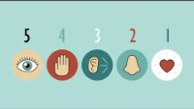
Notes:
In the sessions I provide links to videos that illustrate aspects of the material we are discussing in the course. Because of copyright laws I cannot post the video itself, instead you can view the video by pressing "Ctrl" on your computer as you click "click here for video"

Slide 121


Slide 122
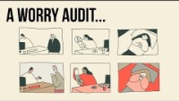

Slide 123


Slide 124


Slide 125


