Slide 1

Notes:
Having suicidal thoughts is an extreme form of distress. Crisis planning is about learning to deal with or tolerate distress. Because of its importance in mental health today we spend part of the session exploring suicidality.

Slide 2
PLEASE START RECORDING

Slide 3
Welcome to week 4 of simple
1. suicide AND SELF-HARM
2.distress tolerance SKILLS part II
Notes:
Having suicidal thoughts is an extreme form of distress. Crisis planning is about learning to deal with or tolerate distress. Because of its importance in mental health today we spend part of the session exploring suicidality.

Slide 4


WEEK 4 OF SIMPLE IN A NUTSHELL
Today we look at what happens when pain becomes so overwhelming that we fall into deep despair and begin to think life is unbearable.
From there how do we find our way back to hope?
PART A
PART B
Suicide and self-harm
Distress tolerance skills, part 2
Intervention and prevention
Radical acceptance, distraction, self-soothing
SIMPLE manual, session 4
DBT Skills Training Workbook, p. 14–32
Notes:
Welcome everyone to week 4. Today has two parts. In the first, we talk about suicide and self-harm: why they happen, how risk is understood, and what actually helps. Thoughts of suicide are an extreme form of distress, which is why this discussion belongs in our distress tolerance and crisis planning sessions. In the second part, Nicole and Joan take us through pages 14 to 32 of the DBT workbook: radical acceptance, distraction, and relaxing and self-soothing with the five senses. Along the way we will do our poll and take a break.

Slide 5
TODAY'S ROADMAP
PART A · SUICIDE AND SELF-HARM
PART B · DISTRESS TOLERANCE 2
When suffering overwhelms us — why crises happen, window of tolerance, emotional pain
Workbook p. 14–32
1
1
Radical acceptance
2
Definitions, myths and statistics
Suicides’ multiple cause — the biopsychosociospiritual model
2
Distraction (ACCEPTS and pleasurable activities)
3
4
Screening and assessment — acute vs. chronic risk, lethality
Your own distraction plan
3
5
Finding our way back to hope — crisis plans, intervention, prevention
4
Relax and self-soothe with the 5 senses
6
What DBT changed
5
Putting it together in your crisis plan
7
Building a life worth living — resilience, reasons for living, hope, meaning, connection
Notes:
Here is the map for today. Part A has seven sections, moving from understanding why suffering can become overwhelming, through what research tells us about causes and risk, to what actually helps and how we build lives worth living. Part B is practical: four distress tolerance skills from the workbook, and then putting them together into your crisis plan.

Slide 6





TAKE CARE OF YOURSELF
Topics in the course, such as today’s discussion of suicide and self-harm, may trigger feelings and thoughts. Research however shows that talking openly about suicide and mental health does not, in the long run make these problems worse, and if we look after ourselves, the benefits of these discussions greatly outweigh the risks.
Keep checking your dashboard
Pause when you need to
Use your skills
Reach out
Notice your energy, activation, window of tolerance and crisis risk as we go.
Take a break, turn off your camera, or step away. Come back when you are ready.
Grounding, the 5-4-3-2-1 method, your sensory soothing kit, REST, your crisis plan.
Talk with Betsy use your crisis plan.
If you are in crisis: call or text 9-8-8 (Suicide Crisis Helpline, 24/7) website 988.ca or go to your nearest emergency department. Call our local crisis line 1-888-829-7484
Notes:
Before we begin, a word about looking after ourselves. Some of you may have personal experience with suicidal thoughts or self-harm, or with losing someone. There is very good evidence that talking about suicide does not make it worse, but please keep monitoring your personal dashboard. If your crisis risk rises or you move outside your window of tolerance, pause and use your distress tolerance skills. Take a break whenever you need to. And if anyone is in crisis, 9-8-8 is available by phone or text, 24 hours a day.

Slide 7

Warning about meditation
Feel free to skip it

Slide 8
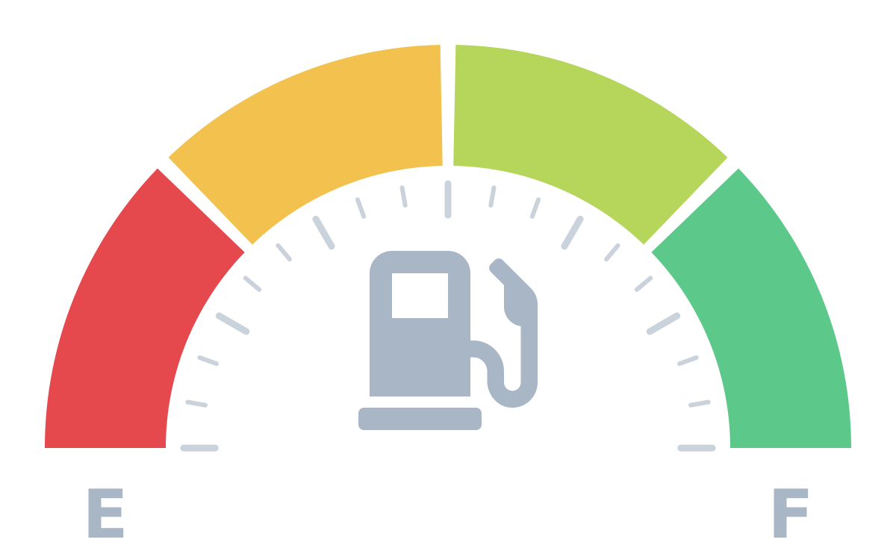
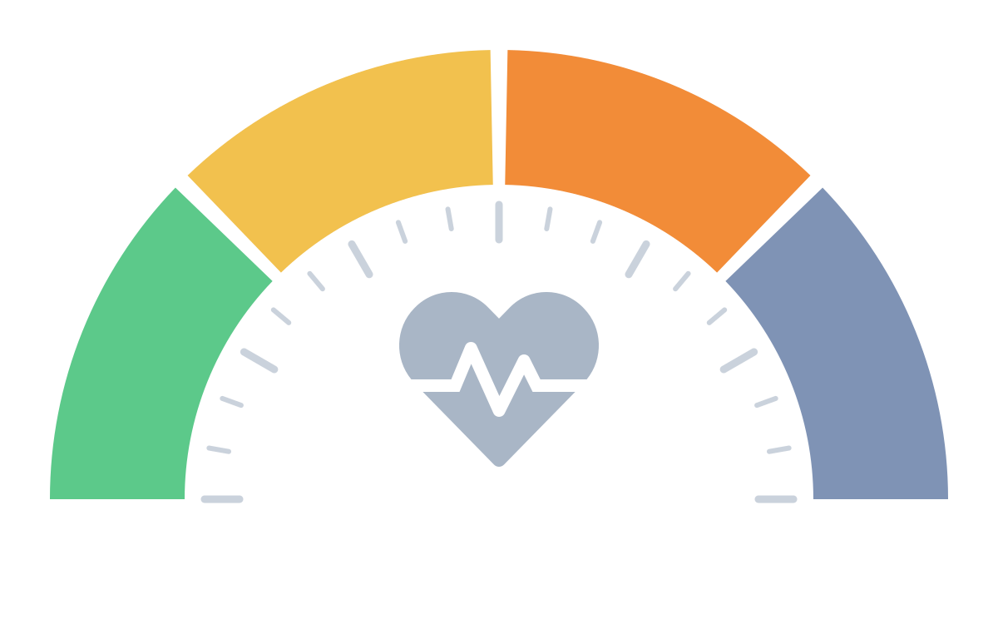
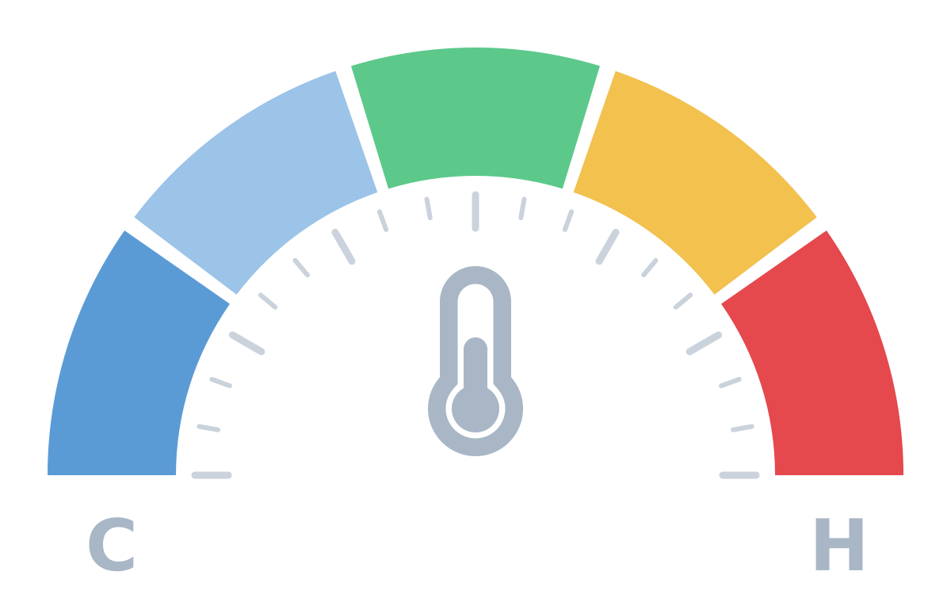
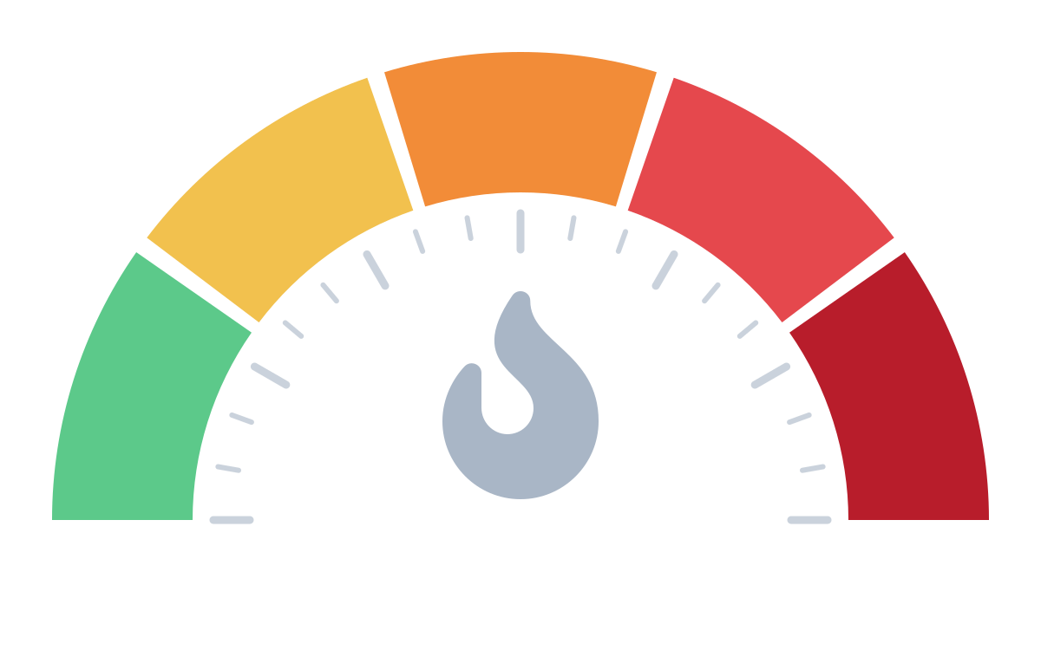
NOW CHECK IN WITH YOUR PERSONAL DASHBOARD
Pause, take a breath, and read each gauge in turn. Just notice there are no wrong readings.
1
Energy reserves
2
State of activation
3
Window of tolerance
4
Crisis risk
How much fuel is in my tank right now?
Which state am I mostly in at the moment?
Am I inside my window, or above it (revved up) or below it (shut down)?
How likely is it that I’ll tip into a state of crisis?
Near empty
½
¾
Full
Calm
Flight
Fight
Freeze / shut down
numb, depressed, dissociated
Well below
A little below
Inside
A little above
Well above
Low
Moderate
High
Very high
Extreme
Then ask: Given these readings, what do I need right now?
Notes:
Facilitator script (about 2 minutes, slow pace):
Let's take a moment to check in with our dashboards. Settle into your seat, feet on the floor, and take one slow breath.
1. Energy: Notice your body. How much fuel is in the tank right now: near empty, half, three-quarters, or full?
2. Activation: Which state are you mostly in? Calm and connected; flight (worried, anxious, wanting to escape); fight (irritated, angry, braced); or freeze / shut down (numb, flat, far away).
3. Window of tolerance: Are you inside your window, where you can feel things and still think clearly? Or a little or well above it (revved up, overwhelmed), or below it (numb, shut down)?
4. Crisis risk: Putting it together, how likely is it that you'll tip into crisis today: low, moderate, high, very high, or extreme?
Then ask: Given these readings, what do I need right now? A skill to cool down or calm the body, something to re-energise, rest, connection, or reaching out for support.
Remember: there are no wrong readings. The point is noticing, not judging.

Slide 9
Begin by finding a position that feels comfortable enough for the next few minutes.
You can close your eyes if that feels comfortable, or simply soften your gaze and look toward the floor.
There is nothing you need to accomplish during these few minutes.
Just notice that you are here.
Notice the chair supporting you.
Notice your feet touching the floor.
Perhaps gently press your feet into the floor for a moment and feel its solidity beneath you.
Take a slow breath in…
and allow the breath to leave in its own time.
And again…
breathing in…
and breathing out.
There is no need to breathe in any special way.
Simply notice that your body already knows how to breathe.
For the next few moments, bring your attention to the physical sensations of being here.
The feeling of your feet on the floor.
The weight of your body in the chair.
Perhaps the feeling of your hands resting in your lap.

Slide 10
Notice the sounds in the room.
Notice the temperature of the air against your skin.
You are here, in this room, at this moment.
And now notice what is happening inside.
You don’t have to search for anything.
Perhaps there is calm.
Perhaps there is tension.
Perhaps sadness, anxiety, curiosity, tiredness—or nothing very noticeable at all.
Whatever is here, see if you can simply notice it.
Without needing to change it.
You might quietly say to yourself:
This is what I am experiencing right now.
Sometimes our emotions become very intense.
And when that happens, the mind can tell us that we have to do something immediately.
Escape.
Make it stop.
Get away from what we are feeling.
But an emotion—even a very powerful emotion—is an experience occurring within us.
It is not the whole of us.

Slide 11
And it does not always require immediate action.
See if you can notice the small space between having a feeling and acting on that feeling.
Perhaps just one breath of space.
Breathing in…
and breathing out.
In that small space, there may be choices that we could not see a moment before.
We might wait.
We might ground ourselves.
We might reach out to another person.
We might allow the wave to rise and then begin to fall.
We don’t have to solve our lives in the middle of the wave.
For now, we can simply stay.
One breath.
And then another.
Now bring your attention back to your body.
Feel your feet against the floor.
Feel the chair beneath you.
Notice the room around you.

Slide 12
And perhaps remind yourself:
I can notice what I am feeling without immediately acting on it.
I can give myself time.
I can allow another possibility to emerge.
Take one more slow breath.
And when you’re ready, open your eyes or lift your gaze.
And return your attention to the room.
Today we’re going to talk about what happens when emotional pain becomes so intense that escape can seem like the only possibility—and about how we can help create enough space for other possibilities to become visible.

Slide 13


Slide 14
SIMPLE COURSE SCHEDULE 2026-27
Week 1- October 7
Week 2- October 14
Week 3- October 21
Week 4- October 28
Week 5- November 4
Week 6- November 11
Week 7- November 18
Week 8- November 25
Week 9- December 2
Week 10- December 9
Week 11- December 16
Week 12-December 23
December 30 no course
Week 13- January 6
Week 14- January 13
Week 15- January 20
Week 16- January 27
Week 17- February 3
Week 18- February 10
Week 19- February 17
Week 20- February 24
Week 21- March 3
Week 22- March 10
March 17 and 24 no course
Week 23- March 31
Week 24- April 7
Week 25- April 14
Week 26- April 21
Week 27- April 28
Week 28- May 5
Week 29- May 12
Week 30- May 19
Week 31- May 26
Week 32- June 2
Week 33- June 9

Slide 15
PRACTICE SESSIONS SCHEDULE
If your name is on the following schedule and shouldn't be, if it’s the wrong week, or if you volunteered and don’t see your name, please email us.
There are still 4 weeks open all for IFS work. Email us if you want to volunteer for one of those.

Slide 16
PRACTICE SESSIONS SCHEDULE
Date Preparation Subject Volunteer
1. Week 5 November 4 Crisis Plans Chris P.
2. Week 6 November 11 November 4 , 1:30 Holes diary cards Rona G.
3. Week 10 December 9 December 2, 1:30 Chain analysis Janet L.
4. Week 14 January 13 January 6, 1:30 Rational mind remediation Elaine S.
5. Week 18 February 10 February 3, 1:30 goals diary card Jeremy B.
6. Week 24 April 7 March 31, 1:30 IFS workbook 1
7. Week 25 April 14 April 7 IFS workbook 2 Leah S.
8.Week 26 April 21 April 14 IFS workbook 3
9. Week 27 April 28 April 21 IFS workbook 4
10. Week 28 May 5 April 28 IFS workbook 5
11.Week 29 May 12 May 5 1:30 PM Self-led remediation Jeremy B.

Slide 17

Homework from last week
Read Skills training workbook book p. 14-32
Read Simple manual session 5
Continue working on your crisis plans. Memorize them and practice them in your imagination.
Continue tracking skills you are learning using DBT diary card. Practice them.
Submit questions or comments to itssimple2023@gmail.com

Slide 18

Homework for the coming week
Submit questions or comments to itssimple2023@gmail.com
Read Simple manual session 5.
Read DBT Workbook p.33-46:
Create both a “distraction plan.” and “relaxation plan.” (pages 26 and 31 of the DBT workbook) . Both the distraction and relaxation plans can be a very useful part of your crisis plan.
Continue tracking and practicing the skills you are learning. Use the DBT diary card. Better yet use the skills list which we provide at each session.
Keep in mind that the skills we’ve covered so far are only a few of the many skills we’ll discuss so start thinking about your “preferred skills” or those you plan to use from among all that are presented. May put a next to your favorite skills
Continue working on your crisis plans. Practice it in your imagination. Use your distraction and relaxation plan in your crisis plan. Use the edit, splice and paste technique.

Slide 19

skills we will cover NEXT WEEK
For people using eBook or 1st edition of the DBT workbook
1. Safe-place Visualization
2. Cue-Controlled Relaxation
3. Rediscovering your values
4. Rehearsing value-based behavior
5. Connecting with your higher power

Slide 20
HOMEWORK HABITS CHECKLIST
Circle or check what you will try this week.
1. Preparation habits
■ I schedule a specific time for homework.
■ I choose a consistent location with minimal distractions.
■ I gather what I need ahead of time (notebook, worksheet, pen).
2. Focus & pacing habits
■ I start with a tiny step (2–5 minutes).
■ I use a timer (10–15 minutes).
■ I remove distractions (phone away / Do Not Disturb).

Slide 21
HOMEWORK HABITS CHECKLIST
3. Tracking & organization habits
■ I keep materials in one place (binder / folder / notebook).
■ I write down insights right after doing the homework.
4. Self-compassion habits
■ I aim for progress, not perfection.
■ I notice resistance without judgment.
5. Accountability habits
■ I review my week: What worked? What didn’t?
■ I share honestly with my buddy — even when I didn’t do it.
Micro commitment:
This week I will focus on: ■ Time ■ Place ■ Tiny step ■ Timer ■ Other please specify:

Slide 22

WEEKLY ANNOUNCEMENTS
Unfortunately, for health reasons Carolyn won’t be able to continue as a course co-leader.
We will therefor not be able to offer you the debrief at 12 pm.
We wish her a speedy return to health and thank for her contributions to the course

Slide 23
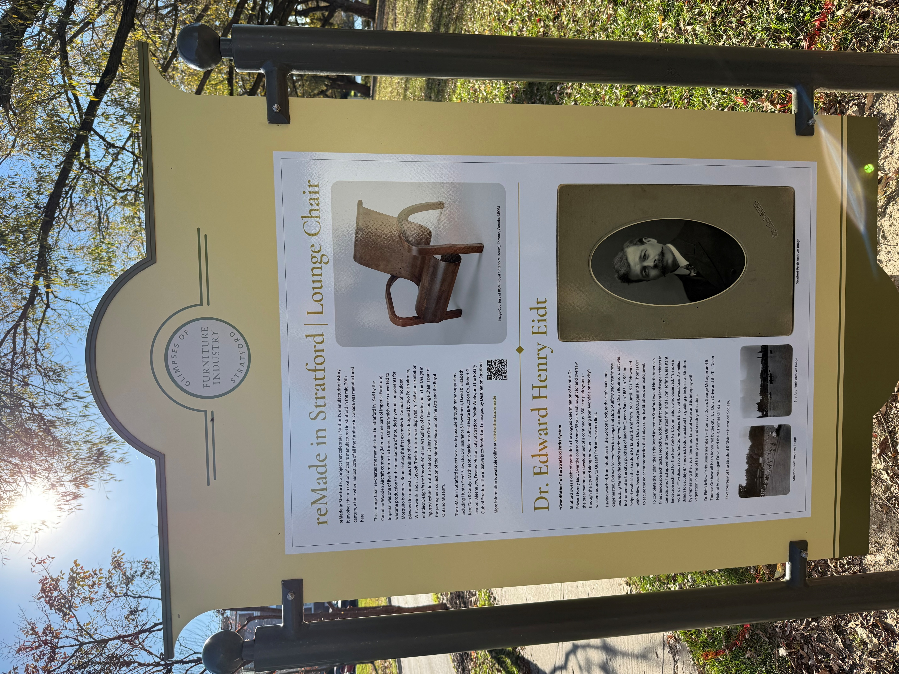
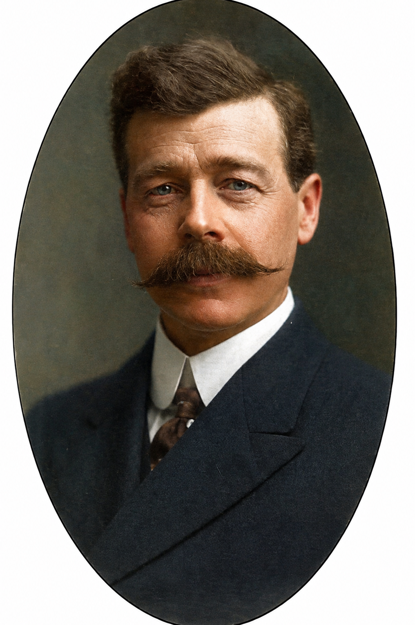
IN THE NEWS
Mental health & neuroscience in the news
A new plaque was put on the banks of the Avon celebrating Dr. Edward Henry Eidt

Slide 24
DR. EIDT AND THE AVON RIVER: HEALTH AS A PUBLIC GOOD
Around 1900, the Avon was a run-down mill stream, lined with private holdings (property). In 1899, the company that owned this land announced plans to drain the river and divide the riverbed into building lots, and a rail line.
Dr. Edward Eidt, a dentist who watched all this from his Ontario Street office, pushed a reluctant, tax-wary council to act. After the Parks Board formed in 1904, it bought private property along the river and the mill pond (now Lake Victoria) and tore down old buildings to create parkland, which today covers more than 850 acres.
Eidt took land out of private hands, put it under public ownership, paid for it with shared taxes, and opened it to everyone regardless of income. This collective ownership of a resource for the common good moved Stratford a small step in the direction of democratic socialism.
WHY THIS SEEMINGLY SMALL STEP MATTERS FOR HEALTH: THE SOCIAL DETERMINANTS
Equal access: A mill worker’s family and a factory owner’s family use the same riverbank for free.
Physical activity: Walking, skating, swimming, and play are part of daily life.
Mental health: Green space and water lower stress and improve mood.
Social connection: Shared space brings people together across class lines.
Environment: The river was protected instead of drained.
WHAT MIGHT HAVE HAPPENED
If the land had stayed private, the riverbed would likely have become housing lots and the banks a rail corridor. Lake Victoria, the swans, and the green space through the city centre would not exist. The Festival Theatre stands on land the Parks Board created, so Stratford’s main industry owes its existence to this decision. One dentist’s public-health instinct shaped the city for the next century.
PUBLIC AND PRIVATE
There is room for both the public and the private sectors. But private enterprise and markets respond to what people can pay. A foundational principle of democracy holds that everyone has basic rights including those who can’t pay. Basic human rights are more reliably protected when democratic governments are accountable for them. These rights include clean air and water, a healthy environment, safety, food, housing, education, health care, and rest and leisure.

Slide 25







The Four Estates: Who Does What?
Government draws the lines
Government
Public sector
Business
Private sector
Public or private?
Who should run it: water, transit, garbage pickup, recreation, housing?
Makes and enforces the rules, delivers public services, and collects taxes to pay for them.
Produces goods and services for profit. Creates most jobs and much of the wealth that gets taxed.
Regulate or not?
How many rules on private activity: zoning, short-term rentals, business licences?
Who pays?
Property tax, user fees, development charges, or other levels of government?
Civil society
Third sector
The press
Fourth estate
Charities, faith groups, unions, clubs and volunteers. Builds community, fills gaps, advocates.
Informs citizens and holds the other three to account by asking hard questions.
Candidates draw these lines differently. Ask them where they stand.
Who we vote into governments determines where these lines are drawn. What do we keep in the public sector? How do we pay for these costs? How do we regulate the private sector? Companies are entities whose fiduciary duty is to maximize profits, not benefit society at large. What would you support if you were living in Stratford in 1900?
Notes:
WHAT ARE THE FOUR ESTATES?
In old Europe, society was divided into three "estates": the clergy, the nobility and the commoners. When newspapers grew powerful, the press was nicknamed the "fourth estate" because it could check the power of the other three. Today we can think of four pillars of public life.
THE FOUR PILLARS
- Government (public sector): makes and enforces laws, provides services we share, and raises the money to pay for them.
- Business (private sector): produces most goods and services and most jobs; its profits, wages and property are a large part of what gets taxed.
- Civil society (third sector): charities, faith communities, unions, service clubs and volunteers. They build community, fill gaps that government and markets miss, and advocate for causes.
- The press (fourth estate): tells us what is happening and holds the other three accountable. When local news shrinks, there is less scrutiny of local decisions.
GOVERNMENT DRAWS THE LINES
Government is the one estate that decides where the boundaries sit between the others.
1. Public or private? Should a service be run by the city, contracted out to a company, or left to the market? Local examples: water, transit, garbage collection, arenas and pools, affordable housing.
- Some argue public delivery protects fairness, access and accountability.
- Others argue private delivery can be more efficient and keep taxes lower.
2. Regulate or not? How much should government set rules for private activity? Local examples: zoning and what can be built where, short-term rentals, business licensing, tree and noise bylaws.
- Some argue rules protect neighbours, safety and the environment.
- Others argue too many rules raise costs, slow housing and stifle small business.
3. Who pays? Municipalities rely mainly on property taxes, plus user fees (like transit fares or rec programs), development charges on new building, and transfers from the province and federal government.
- Some prefer broad taxes so everyone shares the cost.
- Others prefer "user pays" so those who use a service pay for it.
WHY IT MATTERS ON MONDAY
Ontario's municipal and school board election is Monday, October 26. Municipal candidates in Ontario don't run under party labels, so it helps to ask them directly where they would draw these lines.
DISCUSSION PROMPT
Pick one local service you care about. Should it be public or private, more or less regulated, and who should pay for it? What part of you is answering?

Slide 26
SUICIDE AND SELF-HARM
INTERVENTION AND PREVENTION
Last week we discussed the nature and evolution of our four minds: the somatic which reacts, emotional which acts, rational which thinks and self-observing which contemplates.
Today we’ll explore what happens when pain and suffering become so overwhelming that we temporarily lose access to our rational and contemplative minds and are highjacked by our emotional mind which understandably wants the pain and suffering to end. How do we find our way back to an integration of the four minds?

Slide 27
PART ONE
When suffering overwhelms us
Why crises happen
Review of the idea of the Window of tolerance.
Pain and suffering: emotional and physical
Why we think about suicide
Why we self-harm

Slide 28
“So many people are hanging on by the thinnest of threads. Treat people with kindness even when you don’t think they deserve it. You never know how much someone is struggling.”
— Nanea Hoffman

Slide 29

Every one of us has experienced moments when life felt overwhelming and unmanageable.
Sometimes suffering becomes so great that we begin to wonder whether we can keep going.
Today's session is about those moments...
Fortunately, most of those moments pass.
Notes:
That's a good point. Discussing suicidality could bring back personal experiences that people have had. It's very important in every every session but especially in this one that people keep monitoring their personal dashboard. If their crisis risk increases or they are very outside the window of tolerance, they should pause and use some distress tolerance skills. Although there is some risk of triggering people, this is an important discussion to have, and provided people are careful I think the benefits outweigh the risks.?

Slide 30
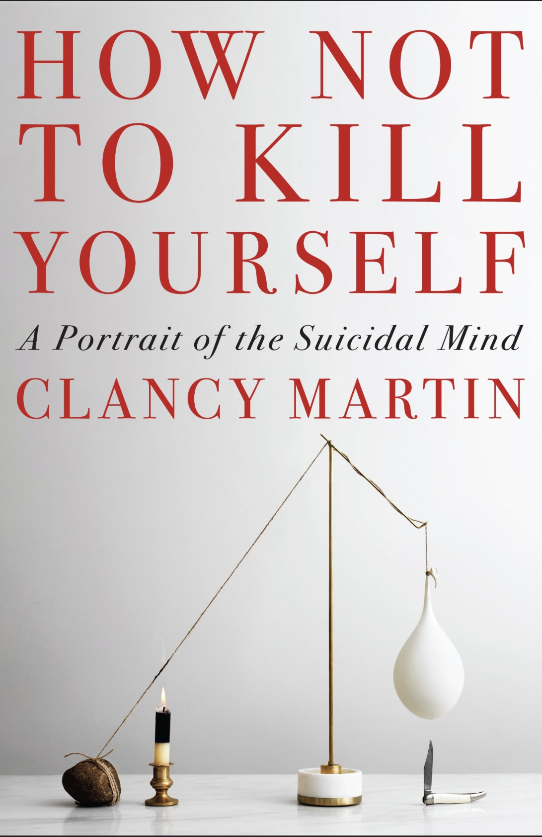
While some people participating in the SIMPLE course may never have had suicidal thoughts, it’s estimated that at least 12% of Canada’s population has seriously considered suicide at some point in their lives.
This % is much higher for people who experience mental health issues.
Suicidal ideation is a common and very important "hole" that many people, especially those with mental health issues, encounter.
Because it can be so consequential, we devote this session our distress tolerance and crisis planning modules to it.
Thoughts of suicide or self-harm, including feelings of despair and hopelessness, suicidal thoughts, and suicidal behaviors are, for anyone who experiences them, a critical “hole” for which crisis plans, and distress tolerance skills can be lifesaving. Having a crisis plan is a must for anyone who experiences these thoughts.
Although this discussion may trigger some people, it is an important one to have at this point in the course. There is very good evidence that talking about suicide or self-harm does not make it worse.
As we proceed today, pay attention to your personal internal dashboard and take care of yourself the best you know how. Take a break if you need to.
WHY TALK ABOUT SUICIDE

Slide 31
WHY CRISES HAPPEN
In this course we’ll be talking about the many "holes" that we may fall into as we make our way through life. Some are relatively small; others are much deeper. Most of the time we manage adversity, using the skills, relationships, and inner strengths we already possess. Sometimes life confronts us with challenges that overwhelm our coping resources.
A crisis occurs when the pain and suffering we are experiencing becomes greater than our ability, at that moment to cope with it. That pain and suffering can arise from many different sources: the loss of someone we love, the breakdown of a relationship, a traumatic experience, chronic physical illness, financial hardship, loneliness, shame, depression, anxiety, or simply the accumulation of too many stresses over too long a period of time.
Although the causes of crisis differ for each of us, the experience of being in crisis is quite similar: We begin to feel overwhelmed and become anxious or panic, angry or emotionally numb, withdraw from other people, turn to alcohol, drugs, or use other unhealthy ways of coping.
Some of us engage in self-harm, others begin to wonder whether life is worth living.

Slide 32
FROM BEING OVERWHELMED BY LIFE'S CHALLENGES TO A LIFE WORTH LIVING
Although crisis may on the surface, for each person, look very different, they usually arise when emotional pain and suffering exceeds our capacity to bear it.
The SIMPLE course begins with distress tolerance skills and crisis plans which aim to increase our capacity to bear emotional pain and learn to return to a calm/alert physiological state.
The goal of distress tolerance is not to eliminate pain, because none of us can avoid pain altogether. Distress tolerance can however help us survive the moments when life feels unbearable, keep us safe while the emotional storm passes, and give us enough “bandwidth” that we can begin tackling the problems that brought us to the crisis in the first place.

Slide 33
WHAT HAPPENS IN OUR BODIES AND MINDS WHEN PAIN OVERWHELMS OUR ABILITY TO COPE?
A BRIEF REVIEW

Slide 34
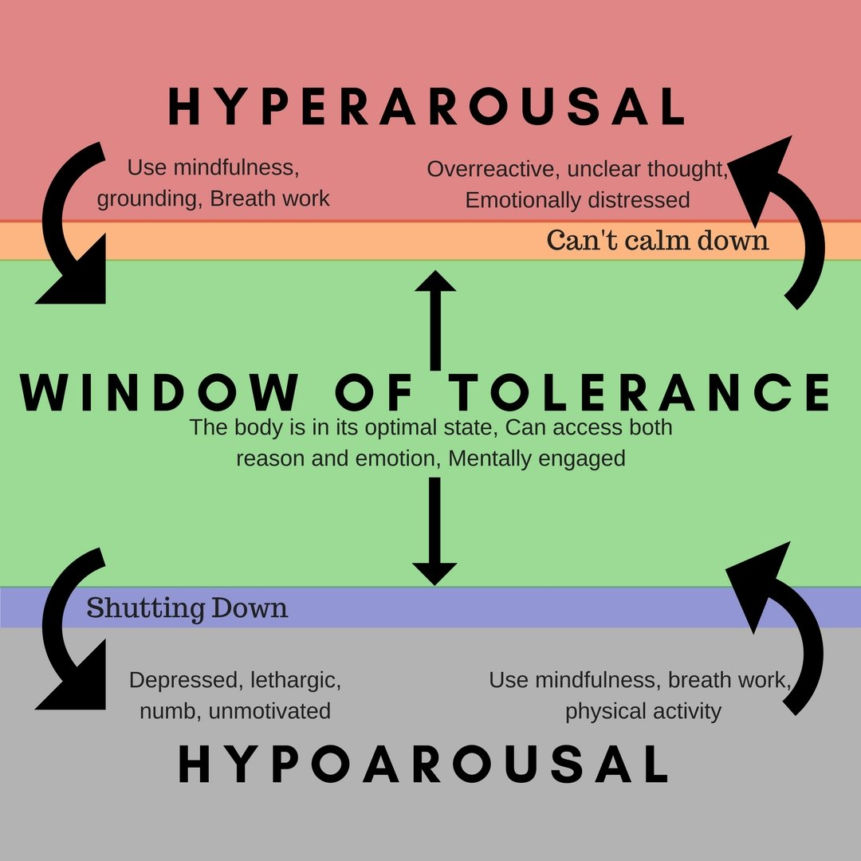
A BRIEF REVIEW OF THE WINDOW OF TOLERANCE
The Window of Tolerance is the range within which our nervous system functions most effectively. When we're within that window, we can think clearly, regulate our emotions, connect with others, and make good decisions. When we’re outside but close to the window of tolerance, life's challenges may still be difficult, but they remain manageable.
As stress increases, however, we begin to move toward the outer edges of that window. If the demands placed upon us continue to grow our coping resources become overwhelmed, we can no longer access our rational or self-observing minds.
As we move outside the window, some people experience hyperarousal. Their nervous system shifts into fight or flight. They may feel intensely anxious, panicked, angry, agitated, or emotionally overwhelmed. Thoughts race, emotions become difficult to regulate, and it becomes much harder to think clearly.
Others move into hypoarousal. Their nervous system begins to shut down. They may feel numb, empty, disconnected, exhausted, hopeless, or emotionally absent. They may withdraw from other people and lose the motivation to care for themselves or engage with life.

Slide 35
A BRIEF REVIEW OF THE WINDOW OF TOLERANCE
The further we move outside our Window of Tolerance, the less able we become to use our rational and self-observing minds. The skills we normally rely upon become increasingly difficult to access.
This is often the point at which people begin reaching for emergency and often maladaptive ways of coping. Some turn to alcohol or drugs. Some lash out in anger. Some dissociate. Some engage in self-harm. Others begin to experience thoughts that life is no longer worth living.
This is why distress tolerance and crisis plans are such an essential part of the SIMPLE course. Distress tolerance skills and crisis plans are not designed to solve life's problems immediately. Their purpose is to help us return safely to the Window of Tolerance, where our thinking becomes clearer, our emotions become more manageable, and we can once again begin to solve the problems that created the crisis in the first place.

Slide 36

Just as our bodies sometimes experience physical pain, our minds and hearts sometimes experience emotional pain. Emotional pain is a universal human experience. Every one of us will encounter it at different times in our lives.
As we already mentioned, emotional pain can arise from many different sources: grief after the loss of someone we love, rejection, loneliness, shame, trauma, depression, anxiety, disappointment, chronic stress, or the feeling that life has become overwhelming.
Sometimes it results from a single devastating event. More often, it develops gradually as many burdens accumulate over time until they become too heavy to carry.
Like physical pain, our capacity to feel emotional pain evolved for a good reason. It tells us that something in our lives needs attention. It signals that we have lost something important, that our needs are not being met, or that our current way of coping is no longer enough.
From this perspective pain is not an enemy but important message.
EMOTIONAL PAIN

Slide 37

EMOTIONAL PAIN
The problem is that when emotional pain becomes so intense, persistent, or overwhelming we might no longer be able to imagine it ending. At that point, our focus narrows. Instead of trying to solve our problems we shift to wanting the pain to end at whatever cost.
When we reach that point, we begin desperately searching for relief. We may withdraw, become angry, use alcohol or drugs, dissociate, self-harm or begin to think about suicide.
All of these are attempts to regulate unbearable emotional pain. Some are healthier than others, but all are attempts to cope.
It is important to remember that, in most cases, people who are experiencing suicidal ideation are not seeking death as much as they are seeking an end to unbearable emotional suffering.
The suicidologist Edwin Shneidman called this psychological pain so intense that the person can no longer imagine living with it “psychache”.
He argued that suicide is usually less about wanting to die than about wanting psychache to stop.
When we encounter someone experiencing suicidal thoughts we are meeting someone who is carrying unbearable pain.

Slide 38

WHY PEOPLE MIGHT THINK ABOUT SUICIDE
“Contemplating” suicide is often not due to one cause, but overlapping human experiences of pain, distress, loss, and disconnection including:
Unbearable emotional pain ("psychache") and hopelessness
Mental health conditions (depression, anxiety, bipolar, PTSD)
Relationship loss, rejection, or conflict
Histories of trauma, abuse, or bullying
Profound loneliness and social isolation
Financial, work, or academic stress
Chronic illness or ongoing physical pain
Substance use lowering control and intensifying distress
Feeling like a burden to others
Impulsivity during an acute crisis or sudden stressor

Slide 39
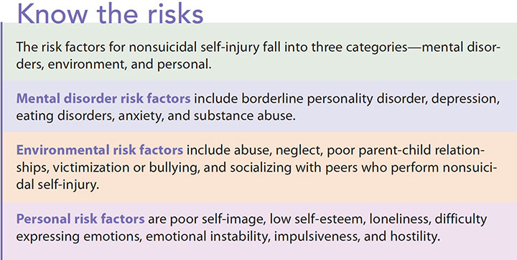
WHY PEOPLE
SELF-HARM
Self-harm like contemplating suicide is also often not about wanting to die, but about trying to cope with overwhelming inner experiences.
Self-harm may be used to:
Regulate intense emotions (release, relief, or to feel something when numb)
Gain a sense of control when life feels chaotic
Express inner pain that feels hard to put into words
Distract or ground from overwhelming thoughts or memories
Relieve tension through physical sensation
Punish oneself out of guilt, shame, or anger
Communicate distress or signal need for care
Feel real or embodied when dissociated or disconnected…

Slide 40
IN SUMMARY
WHEN SUFFERING EXCEEDS OUR CURRENT COPING CAPACITY...
We move outside our Window of Tolerance.
Emotional pain becomes difficult to bear.
People search for relief.
Some find healthy ways of coping.
Others turn to increasingly desperate strategies.
Our goal is not to judge those strategies but to help people find safer and more effective ones.

Slide 41
OUR JOURNEY FROM BEING OVERWHELMED BY LIFE'S CHALLENGES TO A LIFE WORTH LIVING:
THE WAY INTO CRISIS:
THE WAY OUT OF CRISIS:
LIFE'S CHALLENGES (stressors)
↓
OUR CURRENT COPING CAPACITY (resources)
↓
WHEN STRESSORS EXCEED OUR COPING CAPACITY
↓
CRISIS
↓
DISTRESS TOLERANCE SKILLS, TOOLS AND STRATEGIES
↓
INCREASED EMOTIONAL REGULATION (window of tolerance)
↓
BETTER PROBLEM SOLVING
↓
RECOVERY
↓
A LIFE WORTH LIVING

Slide 42
Suicide AND SELF-HARM
“The thought of suicide is a great consolation: by means of it one gets through many a dark night.”
— Friedrich Nietzsche

Slide 43
PART TWO
Understanding suicide
Some definitions
Suicide and self-harm
Myths about suicide
Some statistics

Slide 44
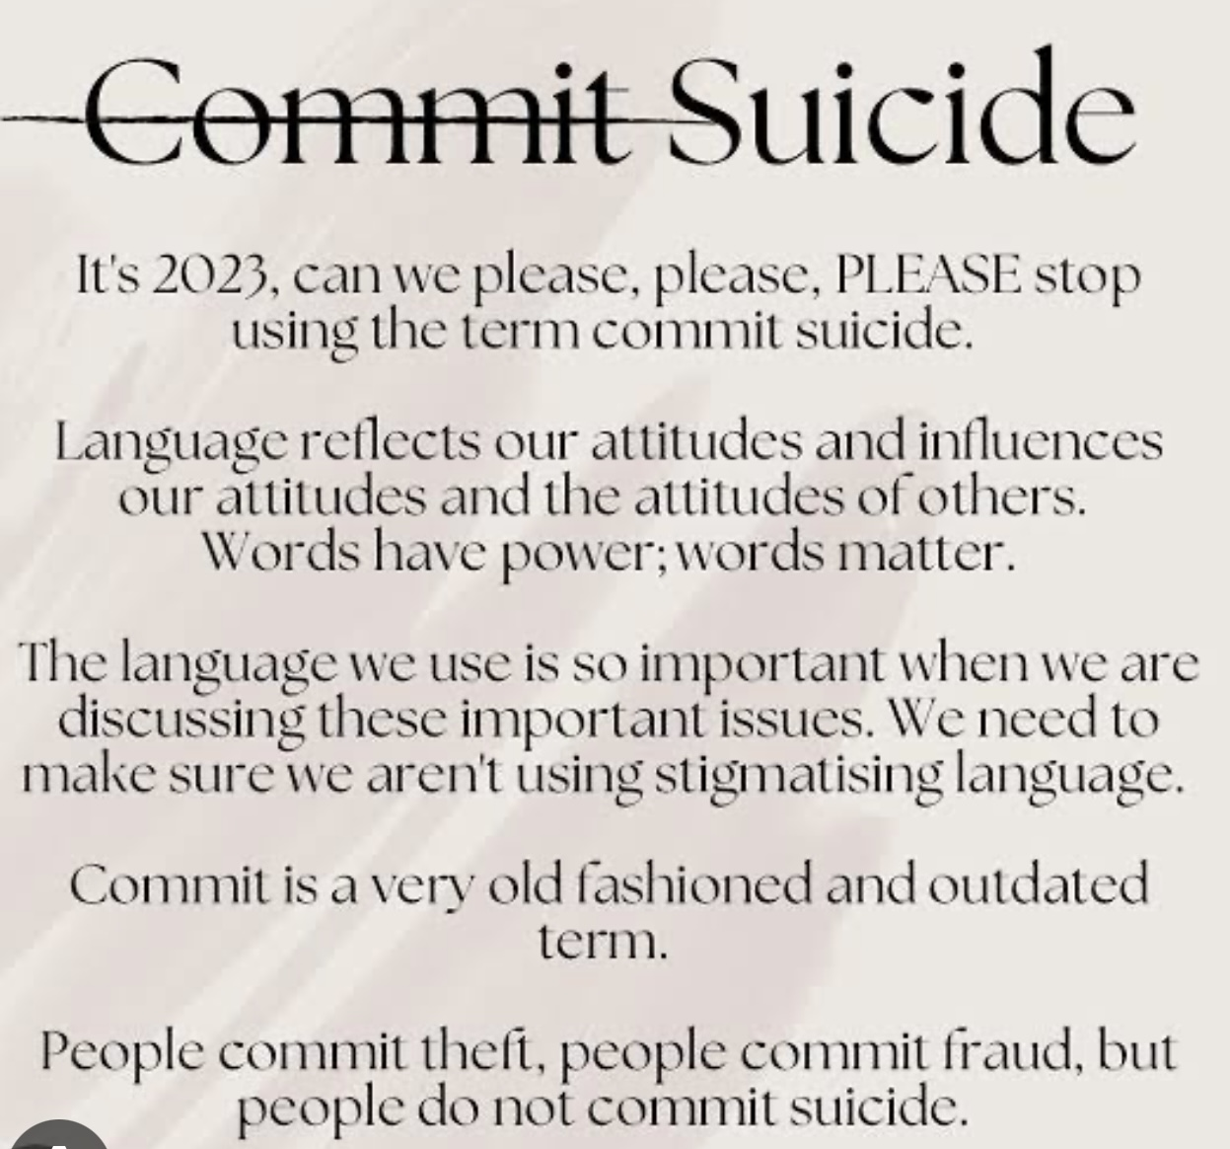
HOW WE USE WORDS IS IMPORTANT
When we talk about suicide, we use many different words and unfortunately some of them carry unnecessary judgment or stigma. The language we choose is important because it shapes the way we think about people who are suffering and having suicidal thoughts.
Today, mental health professionals generally avoid saying that someone "committed suicide" because the word “committed” has historical associations with crime and sin. Instead, we speak of someone who died by suicide. This reminds us that suicide is not a criminal act but a tragic outcome of overwhelming psychological pain.
It is also helpful to distinguish several related terms. Suicidal thoughts, or suicidal ideation, refer to thoughts that life is not worth living or thoughts about ending one's life. These thoughts exist on a spectrum, ranging from a passive wish not to wake up to detailed plans for suicide.
A suicide attempt refers to a self-injurious act carried out with at least some intent to die, whether or not death occurs. A suicide death occurs when that attempt is fatal.
Throughout the course, we strive to use language that is respectful, precise, and centred on understanding rather than judgment. Sometimes inadvertently we slip from that ideal, we apologize in advance and welcome you pointing it out to us.

Slide 45
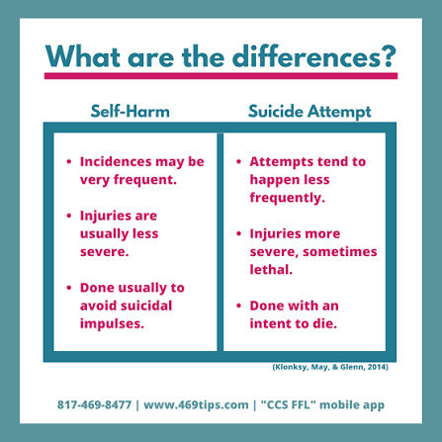
A common misunderstandings is that suicide and self-harm are closely related. Although they can occur together, they are typically driven by different motivations.
The defining feature of suicide is the intention to die. The defining feature of self-harm also known as non-suicidal self-injury is the intention to survive while reducing unbearable emotional pain.
People who self-harm often describe their behaviour as a way of regulating intolerable emotions. Physical pain can briefly interrupt emotional pain.
Some describe self-harm as releasing unbearable tension, escaping emotional numbness, or making invisible suffering visible.
Many people who self-harm are not trying to end their lives at all. They are trying to continue living. The behaviour may be maladaptive and dangerous, but its function is often to cope rather than to die.
That said, the suicide and self-harm should never be dismissed as unrelated. People who repeatedly self-harm have a significantly higher risk of future suicide attempts. For that reason, every episode of self-harm needs careful assessment, compassion, and support rather than judgment.
Understanding the difference between the two helps us to better respond. Rather than assuming we know someone's intentions, we need to be curious about the pain and motivations that lie underneath the behaviours.
SUICIDE VS.
SELF-HARM

Slide 46
A FEW COMMON MYTHS ABOUT SUICIDE
Much of what many of us believe about suicide simply isn't true. These myths can interfere with us understanding and helping people experiencing suicidal ideation.
One common myth is that talking about suicide puts the idea into someone's head. Research consistently shows the opposite. Asking directly, calmly, and compassionately about suicidal thoughts does not increase risk. Instead, many people experience profound relief when someone is willing to ask openly and without judgment.
Another myth is that people who talk about suicide never act on it. Many individuals who die by suicide have previously spoken about feeling hopeless, trapped, or wishing they were dead. Sometimes these statements are subtle. Sometimes they are quite direct. They should always be taken seriously.
Some people believe that suicide occurs without warning. While some suicides do happen impulsively, many are preceded by warning signs such as increasing hopelessness, withdrawal from others, giving away possessions, dramatic changes in mood, or feeling like a burden to those they love.
Another misconception is that people who are suicidal truly want to die. More accurately, most people want the pain to stop. They often feel trapped between unbearable suffering and an inability to imagine another way forward. If that suffering can be reduced and hope restored, many no longer wish to die.
Quite often suicidal crises are temporary, even when the problems that triggered them are not. With time, support, treatment, and the restoration of hope, people often recover and go on to live meaningful lives.

Slide 47
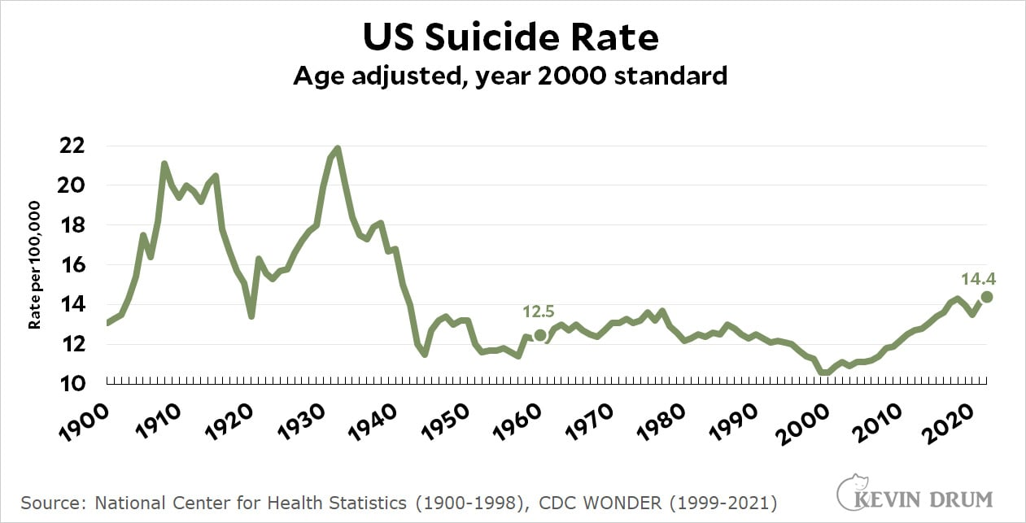
THE STATISTICS
Suicide is both more common and more preventable than most people realize.
Across the world, hundreds of thousands of people die by suicide every year, making it one of the leading causes of death, particularly among younger people. Yet for every death there are many more individuals who seriously consider suicide or survive an attempt.
Most importantly, suicidal thoughts are far more common than suicide deaths. Having these thoughts does not mean someone will act on them. It does mean they are suffering and deserve understanding, support, and effective treatment.

Slide 48

THE STATISTICS
One of the most encouraging findings from decades of research is that suicide is preventable. Many people who survive a suicide attempt later describe feeling grateful that they lived. Their circumstances changed. Their pain became manageable. They found treatment, connection, meaning, or hope that they could not imagine during the crisis itself.
Understanding suicide is about learning how people survive, recognizing suffering earlier, responding more effectively, and helping people remain alive long enough for hope to return.
Drew Barrymore started using alcohol when she was nine. Cannabis when she was 10. At only 13, she was admitted into detox. One year later, she attempted suicide for the first time. Three years later, she tried again. She now speaks openly about her recovery as a long process of understanding her pain and developing healthier boundaries.

Slide 49
PART THREE
Why does suicide happen?
A biopsychosociospiritual perspective.

Slide 50
Suicide never has just one cause. Like every problem we discuss in SIMPLE, it emerges from the interaction of biology, body, psychology, relationships, society and meaning.

Slide 51

SUICIDE NEVER HAS ONE CAUSE
When someone dies by suicide, our first instinct is usually to ask, Why? We look for a single explanation. Was it the depression? The relationship breakdown? The financial stress? Bullying? Addiction? A traumatic event?
But human beings are complex. Suicide is rarely due to a single cause. Instead, it results from the interaction of many different factors that gradually overwhelm a person's ability to cope.
The biopsychosociospiritual model gives us a richer way of understanding suicide by reminding us to consider the many biological, psychological, relational, social, and existential factors that may have contributed to bring a particular person to that place.

Slide 52
THE FOUR DETERMINANTS OF HEALTH
The biopsychosociospiritual perspective

Slide 53




Four domains DETERMINE OUR HEALTH
Health and illness come from four interacting domains rather than from any one cause. These domains constantly influence one another. For example, job loss (social domain) can lead to hopeless thinking (psychological domain), poor sleep and heavier drinking (biological domain), and a sense that life has lost its purpose (spiritual domain).
Problems can start in any domain and spread to the others, recovery can also begin in any domain. Strengthening one area often lifts the rest.
Biological
Psychological
Genes, sex, age, brain chemistry, physical illness and the effects of substances.
Thoughts, emotions, coping, personality, early trauma and health behaviours.
Social
Spiritual
Income, education, work, housing, relationships, discrimination, access to care.
Meaning, purpose, hope and values; connection to faith, community or something larger.
Notes:
Determinants are the conditions that make people healthy or ill. They interact: e.g., poverty (social) raises stress (psychological), which alters inflammation and sleep (biological), and can erode hope and meaning (spiritual).

Slide 54
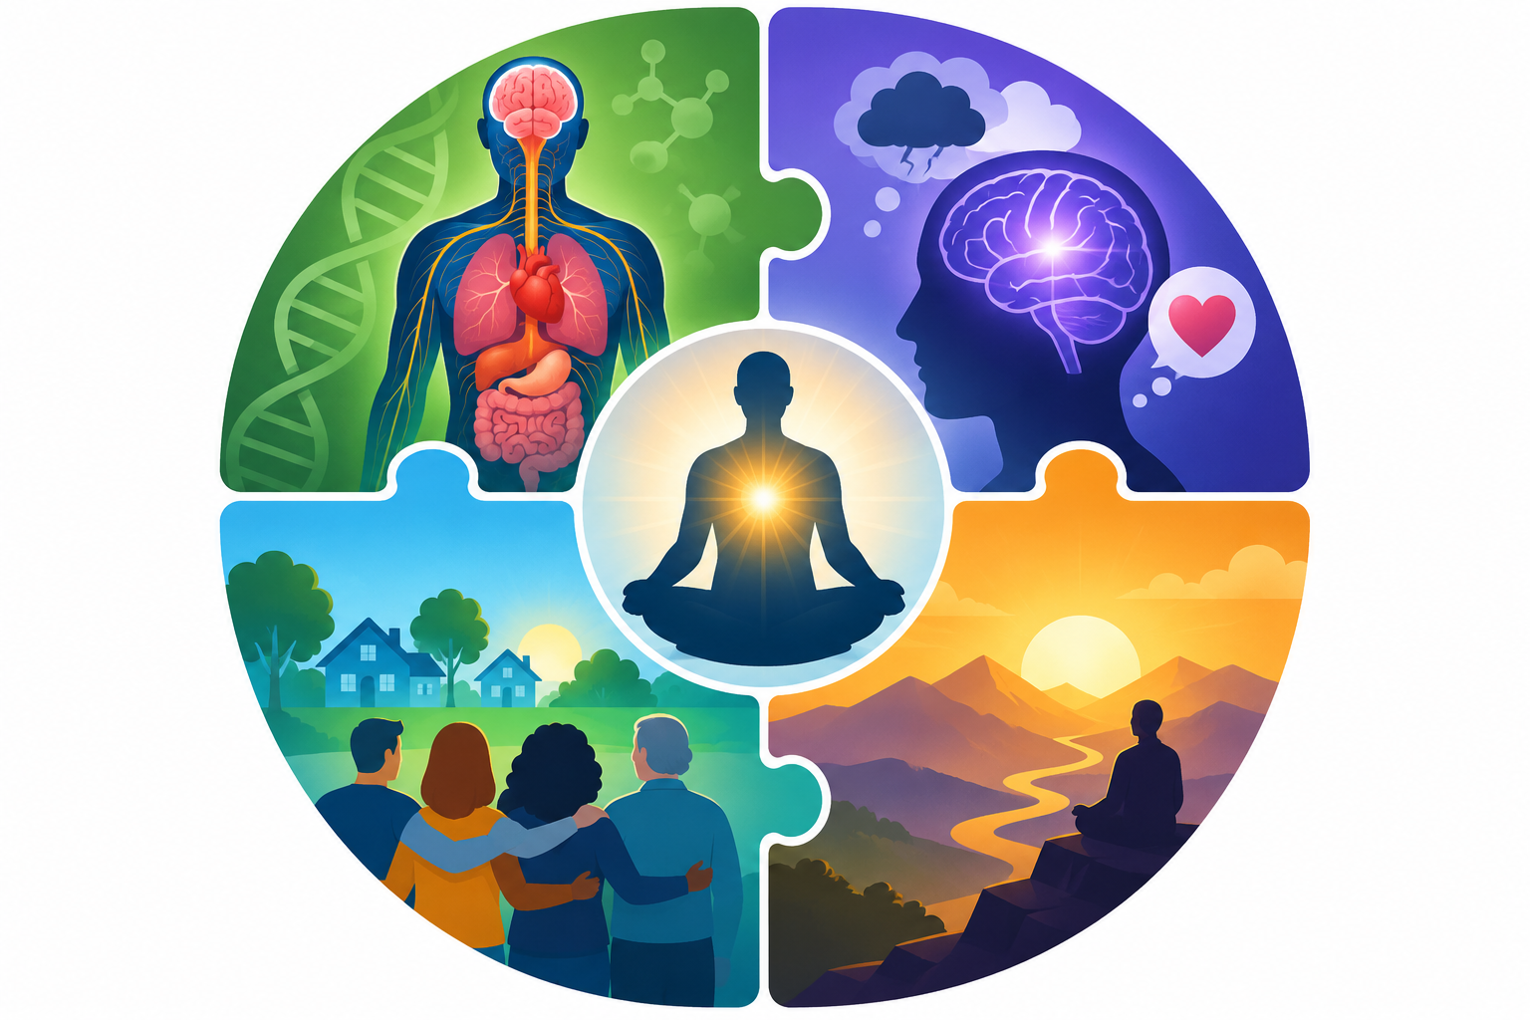
These 4 shape all health, including suicide
BIO-Family history and genetics load the dice; illness, pain and substances add risk.
PSYCHO-Childhood trauma and attachment issues sharply raise later risk of mental illness and suicide attempts.
SOCIO-Lower income and education bring are associated with higher rates of depression, addiction and suicide.
SPIRITUAL-Hope, purpose and belonging protect; hopelessness is a key warning sign.
Notes:
Social gradient: health and suicide risk track income, education and inclusion. ACEs strongly predict later depression, substance use and suicide attempts. Spiritual: VanderWeele 2016, Nurses' Health Study, 89,708 women 1996-2010; weekly or more attendance associated with about five-fold lower suicide rate. Observational; mainly white Christian nurses. Authors caution against "prescribing" attendance, but suggest it as meaningful social participation for those already religious.

Slide 55
How much does each contribute?
THE ROUGH CONTRIBUTIONS TO HEALTH OF EACH OF THE FOUR DOMAINS
Social
40–50%
Psychological / behavioural
20–30%
Biological
15–25%
Spiritual
Not measured separately
Shares overlap and vary by model; spiritual effects act mostly through social and psychological paths.
Notes:
Canadian figures (often attributed to PHAC / Senate Keon report): social & economic ~50%, health care ~25%, biology ~15%, physical environment ~10%. A 2024 McMaster/PHO review notes these are frequently cited but their sourcing is uncertain. US models differ: McGinnis 2002 gives behaviour ~40%, genetics ~30%, social ~15%, care ~10%; County Health Rankings: social-economic 40%, behaviours 30%, clinical care 20%, environment 10%. The four-domain split is my rough synthesis: behaviours sit in "psychological". No study isolates a spiritual percentage.

Slide 56
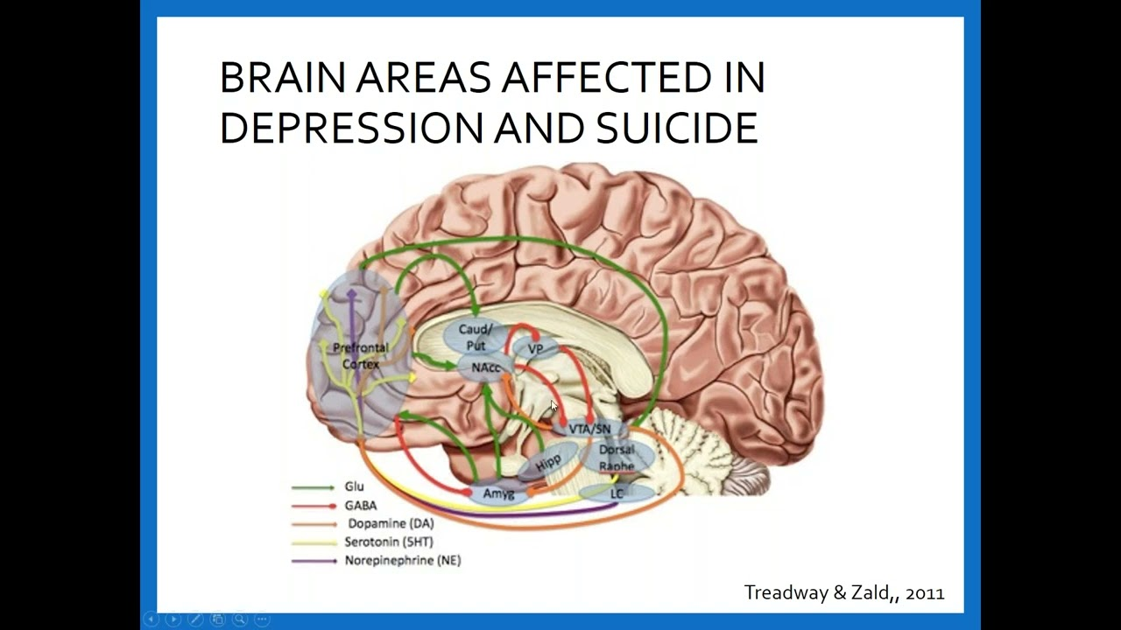
BIOLOGICAL FACTORS
Some people begin life with greater biological vulnerability than others. Our genes influence temperament, emotional sensitivity, impulsivity, and the way our brains respond to stress.
Mental illnesses such as depression, bipolar disorder, schizophrenia, anxiety disorders, PTSD, substance use disorders, and some personality disorders can all increase suicide risk.
That does not mean these conditions inevitably lead to suicide, but they can make emotional suffering much harder to bear.

Slide 57
THE BODY UNDER STRESS
Our minds do not suffer in isolation from our bodies. Chronic stress, trauma, sleep deprivation, physical illness, chronic pain, exhaustion, and prolonged activation of the stress response all reduce our capacity to tolerate emotional distress.
Suicide is unlikely if someone feels physically safe, emotionally regulated, and connected to others. It becomes more likely when the body has carried overwhelming stress for so long that simply continuing to survive begins to feel exhausting.

Slide 58

PSYCHOLOGICAL FACTORS
Our inner psychological landscape, or beliefs, memories, emotions and expectations we carry, shape the way we experience everything that happens to us.
Two people may face very similar circumstances yet respond very differently because they have different beliefs about themselves, other people, and the future.
One of the strongest psychological predictors of suicide is hopelessness. People begin to believe that nothing will ever change, that no one can help them, or that they themselves are beyond help.
Trauma often teaches people that the world is unsafe and unmanageable.
Inadequate parenting can leave them feeling fundamentally alone.

Slide 59

RELATIONSHIPS AND COMMUNITY
Human beings are fundamentally social creatures. We survive, develop and heal in connection with others.
It is therefore not surprising that disruptions in our relationships can profoundly affect our desire to keep living.
Relationship breakdown, loneliness, bereavement, abuse, conflict, unemployment, financial hardship, discrimination, and social isolation can all contribute to our overall health and to suicidal crises.
One of the strongest protective factors against suicide is the experience of belonging, knowing that someone genuinely cares, that someone would notice if we disappeared, and that our life matters to another human being.
We often start to feel hope when we no longer feel completely alone.

Slide 60

Our place in society defines us. (unhoused challenge) Our mental health is shaped not only by our personal history but also by the world around us.
Economic pressures, housing insecurity, unemployment, discrimination, social media, war, community disruption, and cultural expectations all influence how much stress people carry and how easy it is for them to seek help.
Some cultures encourage emotional openness, while others teach people to hide their suffering. Many societies place enormous value on independence, productivity, and success, making it difficult for people to admit vulnerability when they are struggling most.
Understanding suicide requires us to look not only at the individual but also at the social environment within which that individual is trying to survive.
SOCIETY AND CULTURE

Slide 61

MEANING, PURPOSE, AND THE HUMAN SPIRIT
The spiritual dimension is often overlooked in mental health care, but philosophers, spiritual traditions, and existential psychologists have always claimed it is at the centre of our health and wellbeing.
Life is about more than physical survival, we need meaning, purpose and a sense that we are valued to feel we’re living worthwhile lives.
Viktor Frankl, psychiatrist and Auschwitz survivor, observed that people can endure remarkable suffering if they are able to find meaning within it. When people lose hope, purpose, identity, or any sense that their lives matter, despair is not far off.
Whether our sense of meaning comes through faith, family, love, creativity, service, nature, or deeply held values, it gives us something that pain cannot take away.
Meaning does not eliminate pain, but it makes pain bearable by reminding us that even in the darkest moments there is still something worth living for.

Slide 62
BRINGING IT ALL TOGETHER
When we are struck by the many “slings and arrows of outrageous fortune” we may, like Hamlet ask if we want “to be or not to be”.
Our biology, psychology, relationships, society, and our sense of meaning all contribute to how much pain we can bear while maintaining hope.
Healing begins as we foster our personal resources and gradually work on reducing the pain we experience in different areas of our lives: we treat illness, regulate our nervous systems, develop healthier ways of thinking, strengthen relationships, improve social supports, and reconnect with meaning and purpose.
The biopsychosociospiritual model is a model of hope. If despair is the result of many different causes, healing is the result of taking many small steps towards rediscovering hope.

Slide 63
PART FOUR
Approaching people who are experiencing mental health issues
Screening
Assessment
Acute vs chronic risk
Lethality

Slide 64
What happens when someone with mental health issues seeks help?

Slide 65
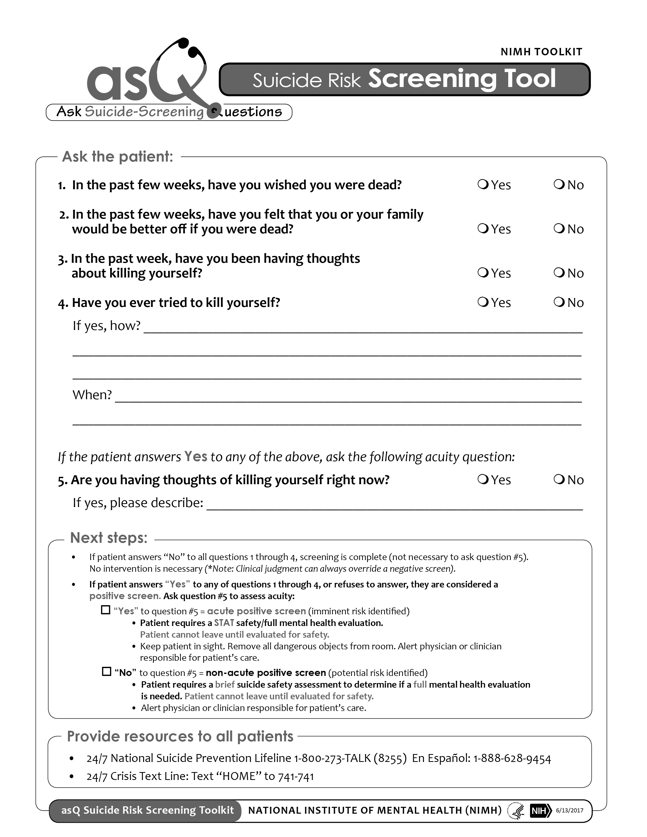
STEP1 SCREENING
When professionals meet someone experiencing mental health issues and seeking help, they must screen for suicidal thoughts in the same way that other physicians screen for other serious medical conditions.
Screening is a quick way of determining whether further assessment is needed.
Good screening begins with creating safety and trust. Rather than avoiding the subject, professionals are taught to ask open and respectful questions.
Do you feel your life is worth living?
Do you ever wish you could go to sleep and never wake up?
Do you wish you could simply go to sleep and not wake up? Or
Or do you have thoughts of ending your life?
Some professional's use screening tools such as ASK (see illustration)

Slide 66
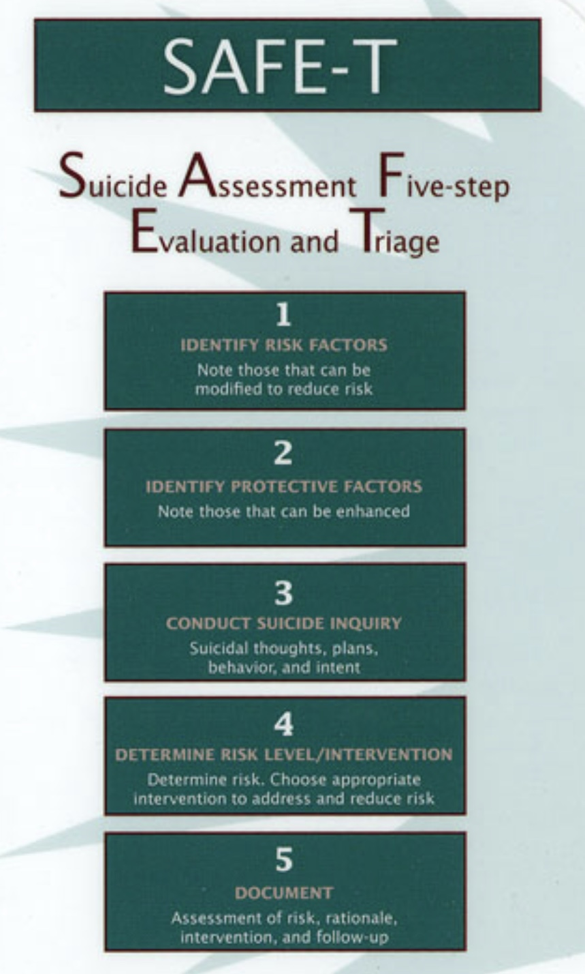
ASSESSMENT
If screening suggests that someone may be at risk, the next step is a more comprehensive assessment. Assessments are not just checking boxes on a form; they are an attempt to understand the person's story.
Professionals want to know not only whether suicidal thoughts are present, but what those thoughts mean. How often do they occur? How intense are they? Have they changed over time? Does the person simply wish the pain would end, or have they begun imagining specific ways of ending their life?
They also explore what has brought the person to this point. What stresses are they facing? What strengths have helped them survive until now? Who supports them? What gives their life meaning? What has stopped them from acting on these thoughts in the past?
Assessment involves understanding both risk and protective factors. It is an effort to appreciate the whole person rather than focusing only on the suicidal thoughts themselves.
Part of an assessments is also determining what the person needs to stay safe and begin moving back toward hope.

Slide 67
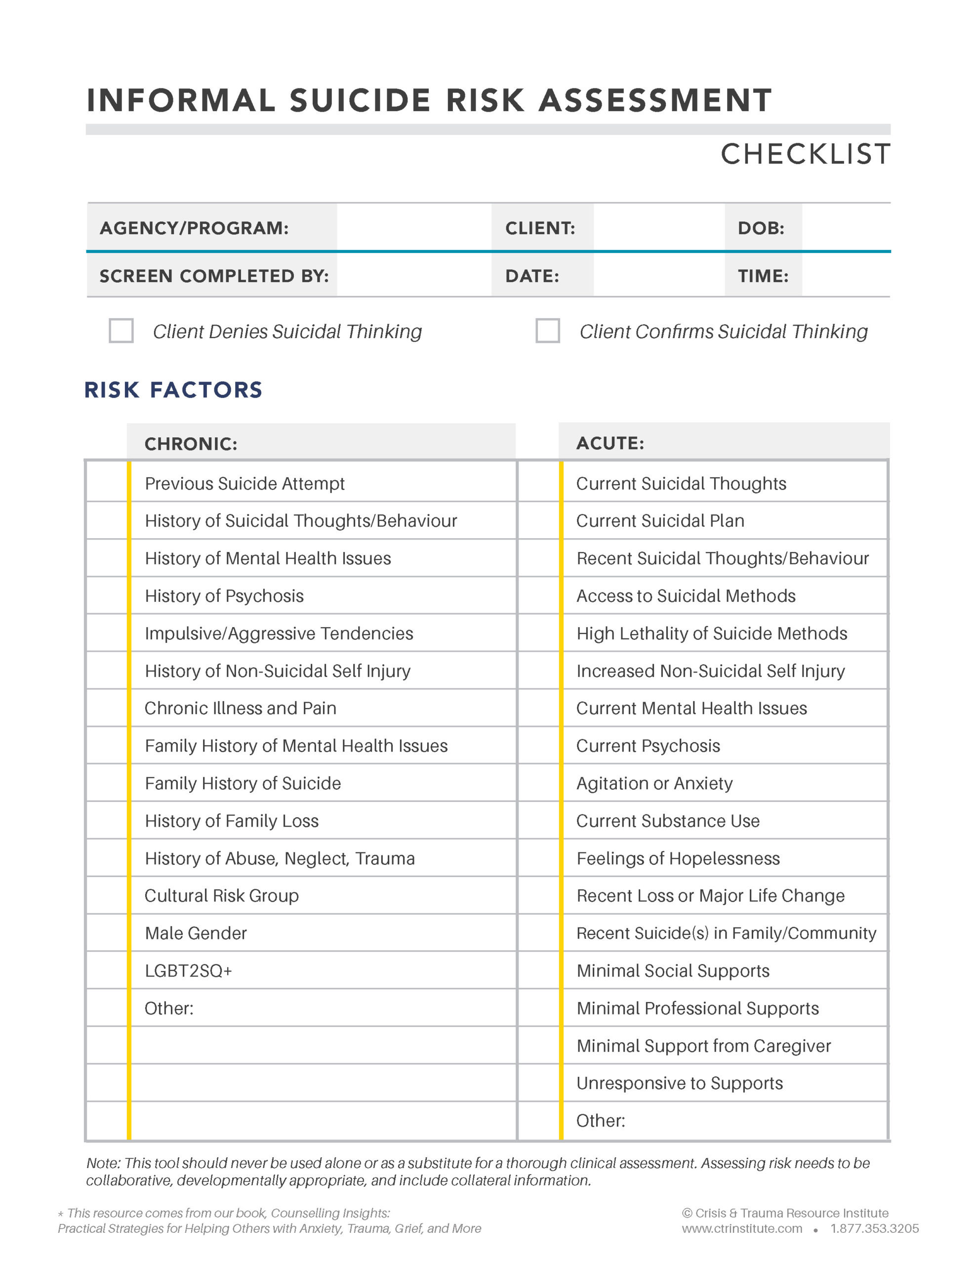
ACUTE RISK AND CHRONIC RISK
As part of an assessment, clinicians must distinguish between acute and chronic risk.
Some people live with suicidal thoughts for many months or even years. These thoughts may become part of the background of their lives, fluctuating in intensity but rarely disappearing completely. This is called chronic risk.
It requires ongoing treatment, support, and careful monitoring, but it does not necessarily mean that the person is in immediate danger.
Acute risk refers to a significant increase in danger over a relatively short period of time.
A person who has lived with chronic suicidal thoughts may suddenly experience a devastating loss, a relapse of depression, severe intoxication, overwhelming shame, or another crisis that dramatically increases the likelihood of acting on those thoughts.
When there is an acute risk clinicians do need to understand what has changed, why has the person lost hope, and if their ability to control their impulses has weakened. become weaker?”.
There are well established chronic or long-term risk and acute or short-term risk factors. (see checklist)

Slide 68
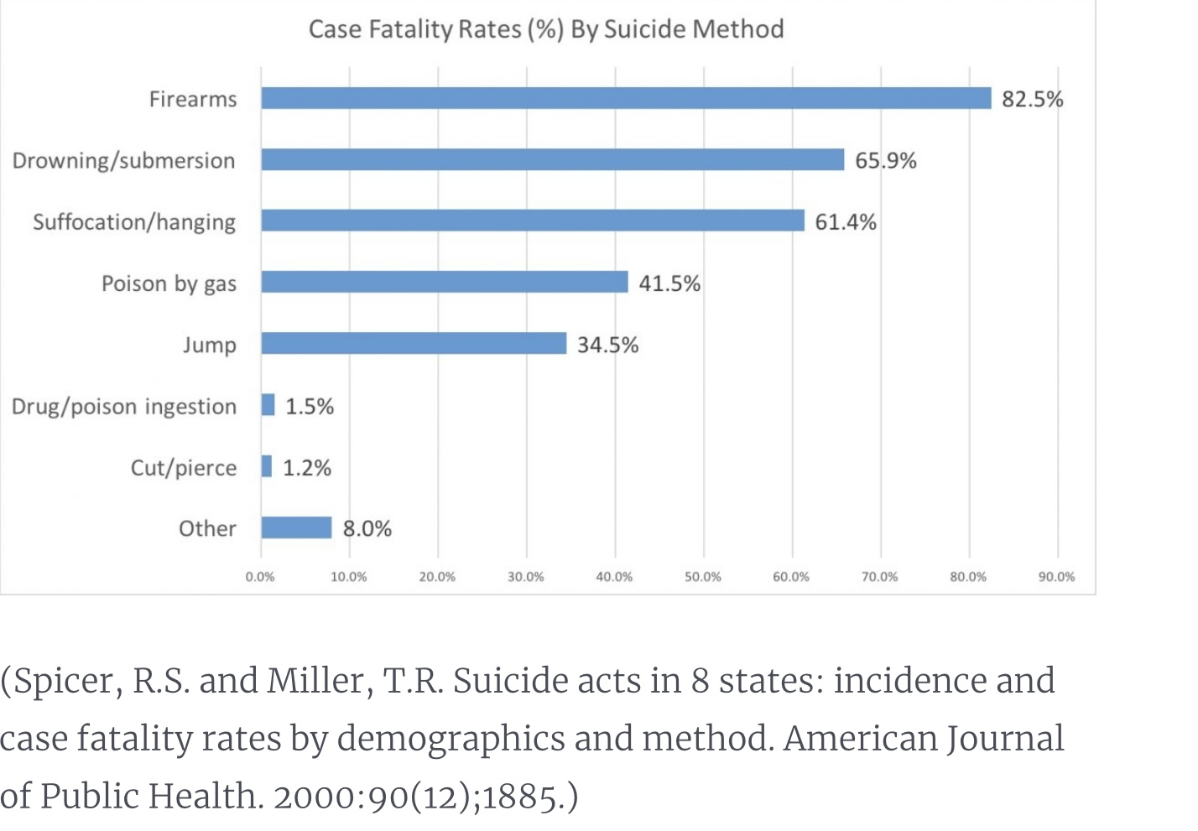
Not all suicidal crises carry the same degree of immediate danger. Part of every assessment involves understanding lethality—that is, how likely a particular act or plan would be to result in death.
Professionals consider many factors. Does the person have a specific plan? How detailed is it? Do they have access to the means they intend to use? Have they taken steps to prepare? Do they believe they are likely to die? Have they acted impulsively in the past?
At the same time, it is important to recognise that lethality is only one part of the picture. Someone may describe a highly lethal plan yet have little intention of acting on it, while another person may act impulsively with little planning at all.
Suicide assessments involve more than just determining if the person is suicidal. Clinicians gather many pieces of information and consider them together, always recognising that certainty is impossible. The goal is not to predict the future with perfect accuracy but to reduce risk as much as is reasonably possible given the resources available.
LETHALITY

Slide 69

Mental health professionals know that no assessment can predict the future with certainty. Instead, they need to try to understand the whole person asking how they arrived at this moment, what factors are increasing their suffering, what strengths remain available to them, and what can be done to reduce risk while increasing hope.
A good suicide assessment is a practical clinical application of the biopsychosociospiritual model as it considers the person's biology, their nervous system, their psychology, their relationships, their social circumstances, and their sense of meaning.
Professionals recognise that suicide risk rises when these dimensions become overwhelmed, and that recovery begins as each of these dimensions is gradually strengthened.
Suicide assessment is not about trying to determine who will live and who will die by suicide. It is about understanding suffering and responding to it with wisdom, compassion, and practical help.
BRINGING IT ALL TOGETHER

Slide 70
If the screening and assessment determine the person has suicidal thoughts what’s next?

Slide 71
PART FIVE
What has been shown to help people experiencing suicidal thoughts.
1. Crisis plans
2. Intervention
3. Prevention
4. Building resilience

Slide 72



THE FOUR CORNERSTONES
What has been shown to help
1. Crisis plans
2. Intervention
A written, personalised roadmap, made in advance, for getting safely through a suicidal crisis.
The immediate, compassionate response when someone is at risk, matched to their level of risk.
3. Prevention
4. Building resilience
Reducing risk long before a crisis, by strengthening mental health and reducing stigma.
Growing the capacity to recover from suffering without being overwhelmed by it.

Slide 73
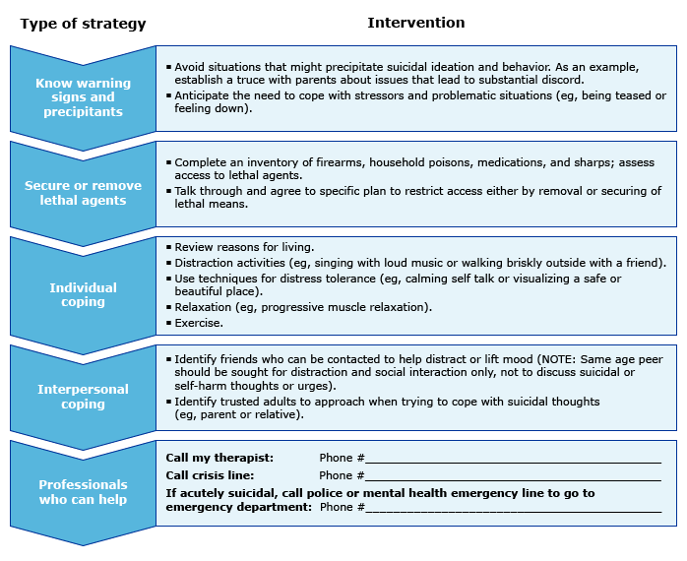
FIRST CORNERSTONE CRISIS PLANS
When someone is overwhelmed by suicidal thoughts, the goal is not to solve every problem in their life. It is to help them survive the crisis. Fortunately, crises are almost always temporary, even when they feel endless.
This is why it is imperative to develop crisis or safety plans before the next crisis arrives.
A good crisis plan is far more than a person’s promise not to harm themselves. It is a practical roadmap that can guide someone through moments when clear thinking becomes difficult.
Most plans include recognising personal warning signs, identifying coping strategies that have helped before, contacting supportive people, reaching professional services when necessary, and reducing access to highly lethal means.
During a crisis we borrow the rational thinking that our future emotionally distressed self may temporarily lose. A written plan allows our wiser mind to guide us when emotional pain has narrowed our perspective.

Slide 74
SECOND CORNERSTONE
INTERVENTION
When someone tells a professional, they are thinking about suicide, that professional’s first move is not to become an expert problem-solver but to be a calm, compassionate human being.
The evidence clearly shows that people are helped most when they feel heard rather than judged, understood rather than argued with, and accompanied rather than left alone.
Professional intervention depends upon the level of risk. Sometimes supportive outpatient treatment is sufficient. At other times urgent psychiatric assessment, crisis services, or hospitalization become necessary to provide safety while the crisis passes.
While doing all this, the client-caregiver therapeutic relationship remains one of the most powerful protective factors we possess.
Fostering a therapeutic relationship with people experiencing suicidal ideas is helped by several therapist qualities. (see over)
1. have a clear model for their intervention.
2. be transparent with clients.
3. Do psychoeducation.
4. address expectations.
5. be consistent.
6.collaborate with clients, be client centered
7. have healthy boundaries.

Slide 75
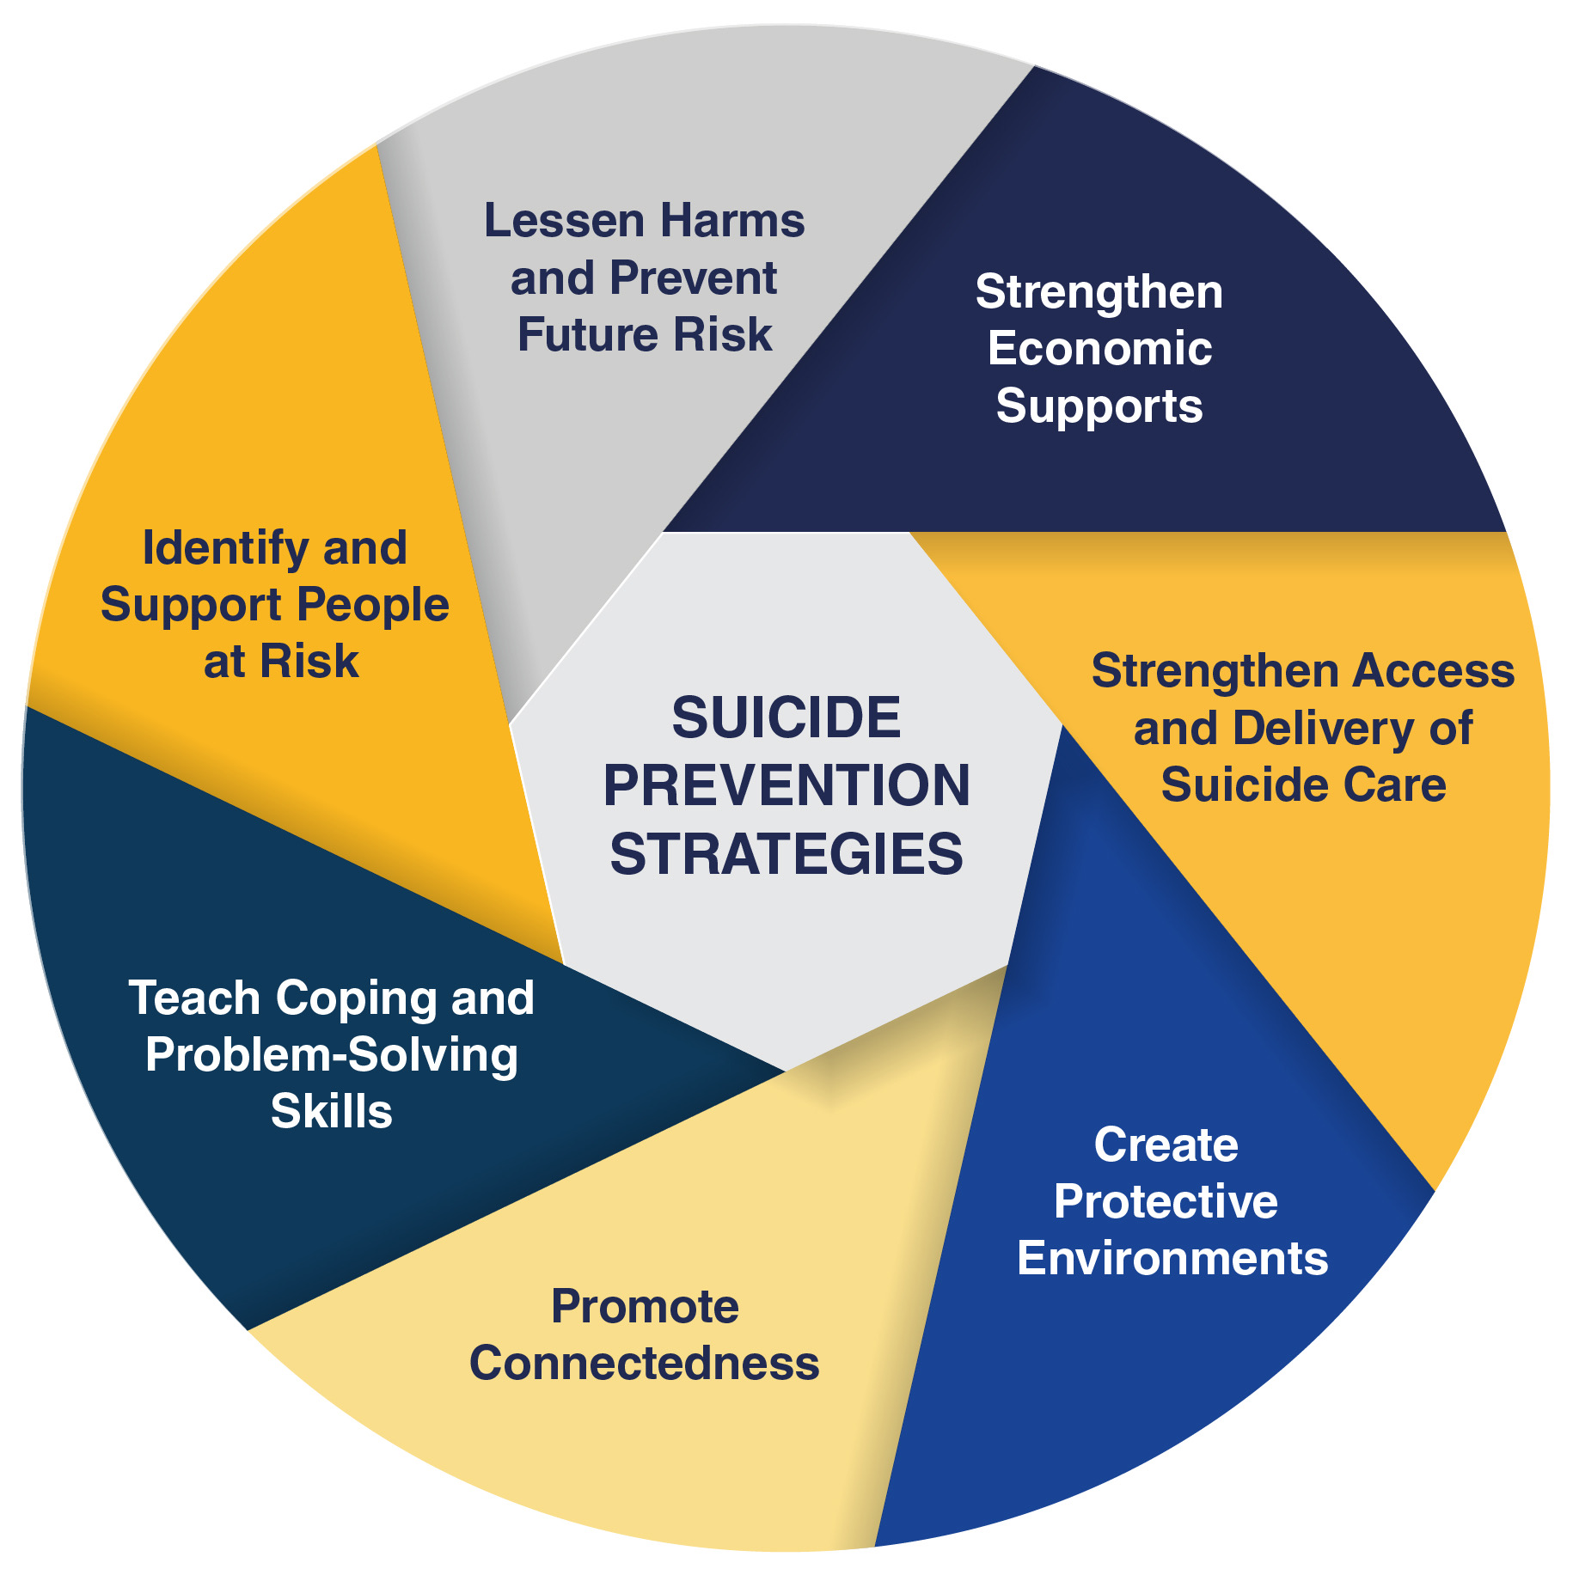
THIRD CORNERSTONE PREVENTION
Preventing suicide begins long before someone becomes suicidal.
Many of the factors that protect against suicide are the very same factors that promote mental health throughout life: secure relationships, effective treatment of psychiatric illness, healthy sleep, exercise, meaningful activity, reduced substance use, financial and social stability, and access to compassionate healthcare.
Prevention also means reducing stigma. The more openly we can speak about emotional suffering, the more likely people are to seek help before reaching a crisis. Communities, schools, workplaces and families all play an important role in creating environments where psychological pain can be recognised early and responded to with understanding rather than shame.
In many ways, suicide prevention is not simply about preventing death. It is about helping people build lives that feel worth living.
Suicide prevention strategies include…(see over)

Slide 76
FOURTH CORNESTONEBUILDING RESILIENCE
Building resilience involves helping people develop the capacity to bear and recover from pain without being permanently overwhelmed by it.
In this course we will explore many of the foundations of resilience: Understanding our emotions instead of fearing them, expanding our window of tolerance, learning emotion regulation and distress tolerance skills, healing trauma, developing secure relationships, finding meaning and purpose, cultivating self-compassion, caring for our bodies, our minds, our relationships, and our spirituality.
Resilience grows through countless small experiences of surviving difficulty rather than avoiding it. Each time we discover that painful emotions can be tolerated, understood, and eventually transformed, we become a little less frightened of future storms.
Resilience and hope are created through connection: one caring conversation, one supportive relationship, an effective treatment approach, an act of kindness, or one reason to stay alive for another day can be enough to begin changing the trajectory of our life.
Suicide prevention involves biology, psychology, relationships, community, and meaning. It starts with single small steps that the person does not have to take alone.

Slide 77
Part Six
What DBT brought to working with people experiencing suicidal ideation

Slide 78
WHAT DBT CHANGED
Prior to the introduction of DBT, mental health professionals approached suicide primarily by trying to stop someone from dying. While this is obviously important, it doesn’t go far enough. It focuses on preventing death rather than understanding why life has become so unbearable.
Dialectical Behaviour Therapy changed our way of thinking. DBT assumes that people who are experiencing suicidal thoughts are trying to escape emotional suffering that has become intolerable.
The problem is unbearable pain combined and too few effective ways of managing it.
DBT does not just focus on stopping suicidal behaviour. It holds that the way to address suicidal thoughts and behavior is through building a life that feels worth living.
Suicide prevention is not just the avoidance of someone’s death, it is about building hope, meaning, connection, and a future that the person wants to remain alive to experience.
DBT also recognised something that had often been overlooked. During an emotional crisis, our thinking changes dramatically. Intense emotion narrows attention, limits problem-solving, and convinces us that the way we feel now is the way we will feel forever. The suicidal mind mistakes temporary emotional states for permanent realities. This is why crises feel so urgent and why decisions made during those moments can become tragically irreversible.

Slide 79
WHAT DBT BROUGHT TO WORKING WITH PEOPLE EXPERIENCING SUICIDALIDEATION
DBT teaches practical skills that can be used precisely when emotions are at their most overwhelming.
Distress tolerance skills help people survive emotional storms without making them worse.
Emotion regulation skills reduce the intensity and frequency of emotional suffering over time. Mindfulness teaches people to observe thoughts and feelings without automatically acting upon them. Interpersonal effectiveness strengthens the relationships that so often become our greatest sources of protection.
One of DBT’s key contributions is its dialectical philosophy. Dialectics teaches us that two seemingly opposite things can both be true. We can completely accept ourselves as we are today, while also working toward meaningful change. We can acknowledge that life is deeply painful, while also believing that life is worth living. We can recognise the reality of despair without surrendering to it. Acceptance and change are not opposites. Together, they become the path toward healing.
As we will see throughout SIMPLE, these principles extend beyond suicide prevention. They apply to anxiety, depression, trauma, relationships, grief, addiction, and the ordinary challenges of being human.

Slide 80
What does DBT mean by “building a life worth living?”

Slide 81
Part Seven
Building a life worth living, the key goal of SIMPLE, involves fostering:
Resilience
Reasons for living
Hope
Meaning
Connection

Slide 82
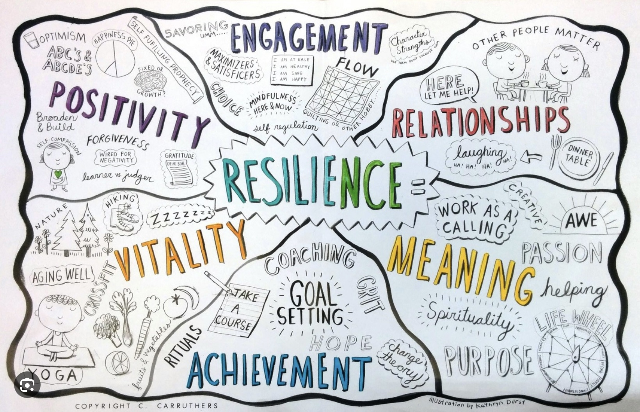
A LIFE WORTH LIVING: RESILIENCE
Resilience is the ability to bend without breaking, to recover after setbacks, and to continue moving toward what matters even when life remains imperfect.
Resilience is not something that you either have or you don’t. Developing resilience is a lifelong process of becoming increasingly able to meet life's challenges with contemplation and thinking rather than just reactivity and action.

Slide 83
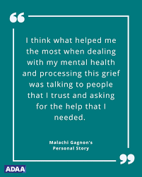
A LIFE WORTH LIVING: RECONECTING WITH OUR REASONS FOR LIVING
One of the most powerful therapeutic tasks is helping people reconnect with their reasons for living.
Our reasons for living are deeply personal. They may be children or grandchildren, partners, friendships, unfinished dreams, faith, creativity, responsibility, curiosity, love of nature, service to others, or simply the possibility that tomorrow might be different from today. What protects one person may mean very little to another.
Reasons for living are not arguments that someone else imposes upon us. They are discoveries that arise from within. Therapy often helps people uncover values that have been hidden beneath layers of fear, hopelessness, or emotional pain. As those values become clearer, life may gradually begin to regain direction and purpose.

Slide 84

A LIFE WORTH LIVING: HOPE
Hope is not just optimism or positive thinking.
Hope does not deny pain and suffering but refuses to believe that they are the whole story.
Many people who have survived suicidal crises later describe being astonished that they once believed their situation could never improve. Their circumstances changed, treatments began to work, relationships healed, grief softened, or they discovered strengths they never knew they possessed. The emotional certainty that life would never get better proved to be one more symptom of the crisis itself.
This is one of the reasons hope can sometimes be borrowed. When someone cannot yet believe that life is worth living, another person—a therapist, a friend, a family member, or a community—may temporarily hold that hope for them. Human beings often recover because someone else continued believing in them until they were able to believe in themselves again.

Slide 85
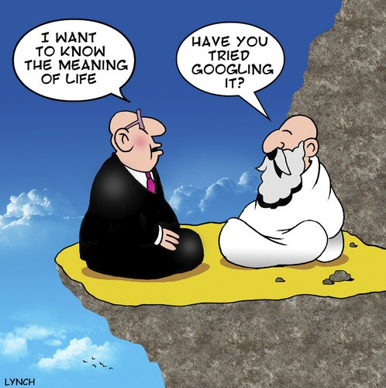
A LIFE WORTH LIVING: MEANING
We argue throughout SIMPLE, that human beings do not live by comfort alone. We live by meaning.
Meaning does not eliminate suffering, but it transforms our relationship with it. Meaning changes how we understand adversity.

Slide 86

A LIFE WORTH LIVING: CONNECTION
Decades of suicide research point to one conclusion: people survive because of connection.
Connection with another human being can interrupt the profound isolation that accompanies suicidal despair. Feeling seen, understood, accepted, and valued reminds us that we belong to something larger than our own suffering. Healthy relationships are emotional shelters during life's storms.
Connection is not limited to other people. We can become connected to our own Wise or Capital S self, to nature, to creativity, to community, to work that matters, to spiritual traditions, and to the larger story of which our individual lives form only one part.
Healing happens through relationships—with ourselves, with others, with our bodies, with the natural world, and with whatever gives our lives meaning and purpose.

Slide 87

We cannot eliminate life’s storms, but we can build a shelter sturdy enough to weather them so that we can enjoy the world when the sun returns.

Slide 88
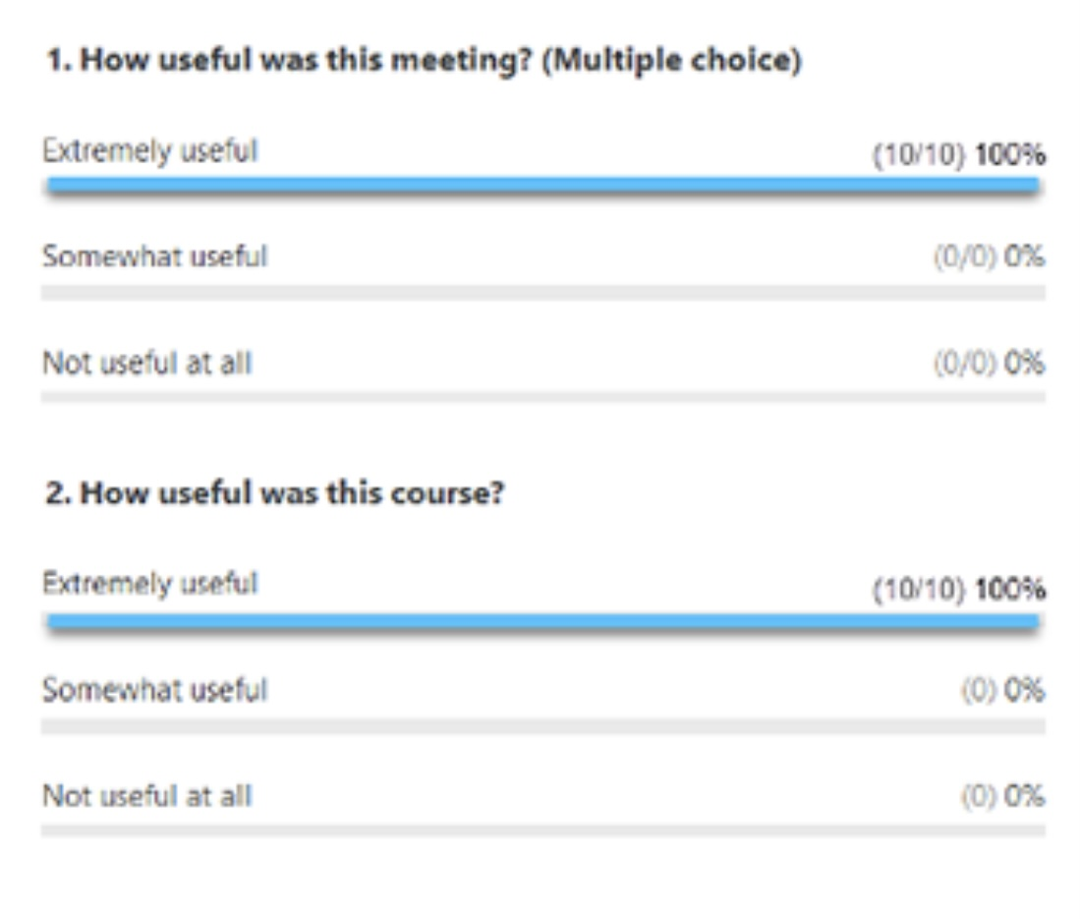
ZOOM POLL (optional)
Throughout the year we will be doing polls to better understand some of your thoughts, feelings and needs from the course.
We’ll look at the answers of zoom participants immediately after we do the polls.
We’ll share the answers of in person participants at the beginning of the session the week after the poll.
Answers are anonymous

Slide 89
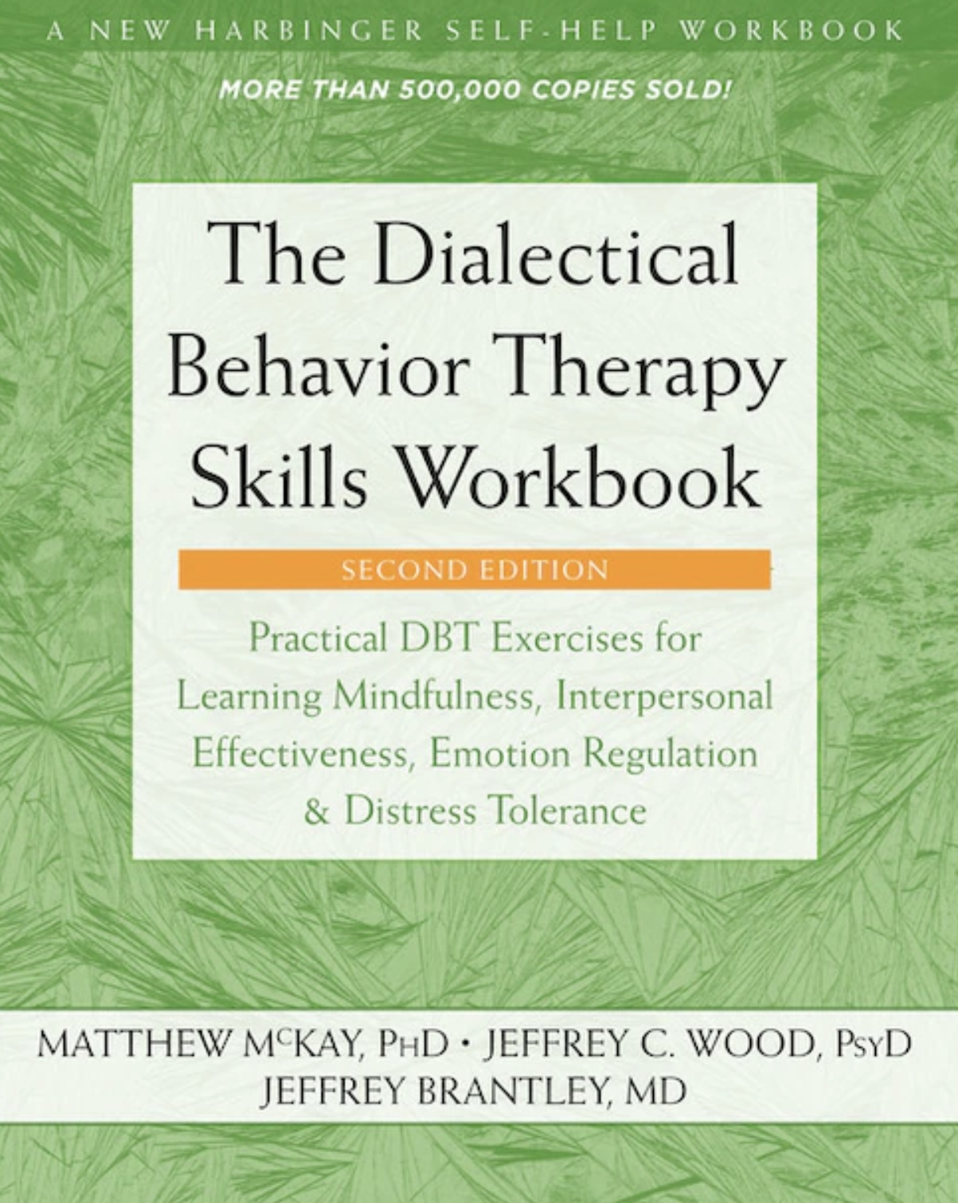


JOAN
NICOLE

Slide 90

Distress tolerance skills PART 2
DBT SKILLS TRAINING WORKBOOK p. 14-32

Slide 91
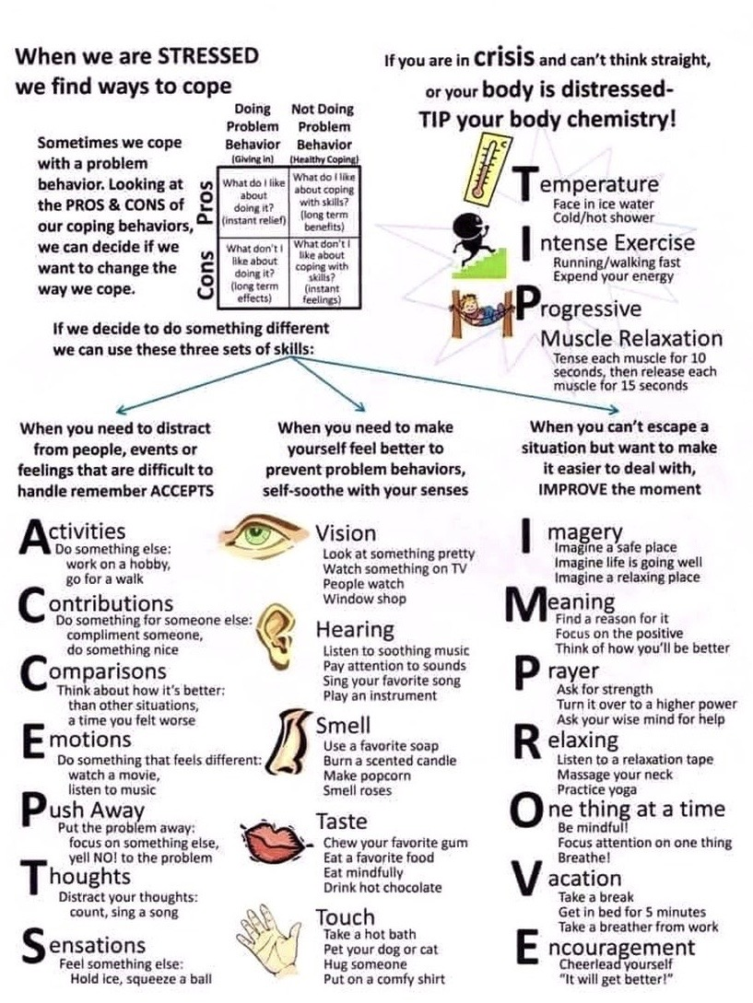
Skills training workbook p. 14-32, distress tolerance week 2
Today we’ll cover 3 subjects in the dbt workbook:
1. Calm mind ACCEPTS (distracts from emotional mind with Activities, Contributions, Comparisons, Emotions, Pushing away, Thoughts, and Sensations)
2. Sooth yourself with the 5 senses
3. Create distraction and self-soothing plans (choose skills to use in your crisis plan)

Slide 92
Skills training workbook p. 14-32, distress tolerance week 2
In 2 weeks, we’ll discuss:
Advanced distress tolerance skills-IMPROVE the moment (with imagery, meaning, prayer, relaxation, one thing at a time, vacation and encouragement)

Slide 93
Skills training workbook p. 14-32, distress tolerance week 2
In 4 weeks, we’ll go over:
Physiological hacks to calm yourself – TIP (Temperature, Intense exercise, Progressive muscle relaxation)

Slide 94
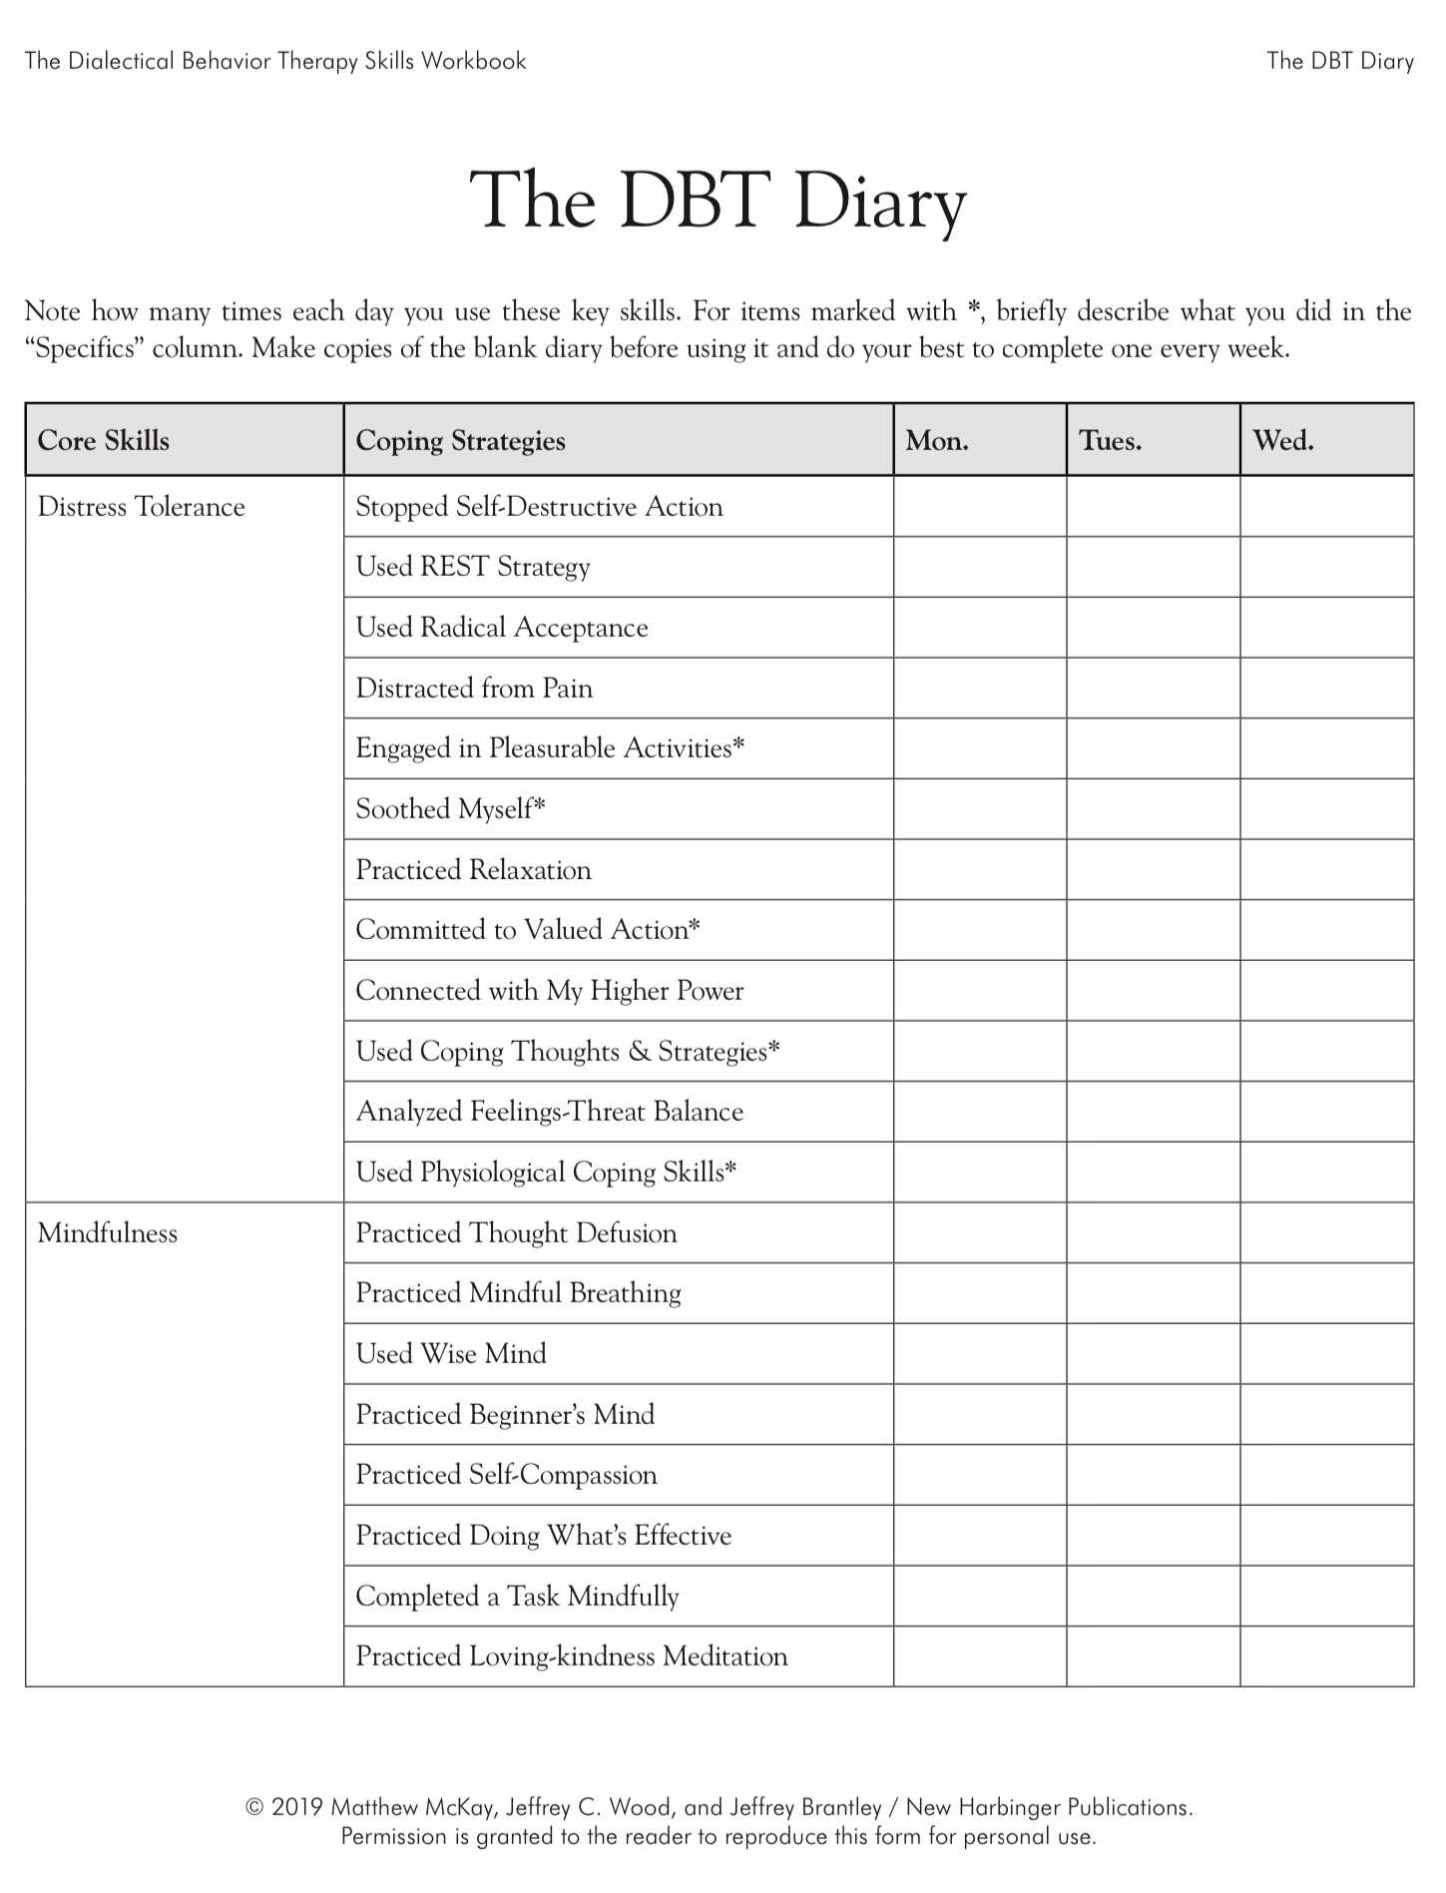
2 weeks ago
2 weeks ago
Today
Today
Today
Today
Today

Slide 95
KEEP A PERSONAL SKILLS LIST INSTEAD OF USING THE DBT DIARY CARD
Many people are confused by or don’t find the skills diary card helpful. People have for example mentioned that it doesn’t list skills you already know or that we talk about in the course but are not in the workbook such as for example the sensory soothing kit, the 5,4,3,2,1 method, or the emotional freedom technique.
Instead of using the skills diary card, consider keeping your own list of the skills you are learning or already know and write these down on a page in your binder.
You might even *(star) your favorite skills on this list.
You could include for example grounding skills such as the self-soothing toolkit, a breathing exercise, REST, and after today’s session radical acceptance statements, and your distraction and self-soothing plan.
Such a list might be more flexible, and more useful than sticking to the more rigid skills diary card provided in the workbook.
You can update this list as you learn new skills.
PERSONAL SKILLS LIST
Grounding skills- Set a daily intention
“ - Sensory soothing toolkit
“ -The 5,4,3,2,1 method
“ -The emotional freedom technique
REST (or PEST) Pause*
Radical acceptance statements
Distraction plan
Self-soothing plan
…

Slide 96
PERSONAL SKILLS LIST UP TO THE PRESENT
DISTRESS TOLERANCE SKILLS
Two weeks ago we covered:
Grounding skills- Set a daily intention
“ - Sensory soothing toolkit
“ -The 5,4,3,2,1 method
“ -The emotional freedom technique
REST (or PEST) Pause
Today we’ll cover
6. Radical acceptance statements (please specify)
7. Distraction plan “
8. Self-soothing plan “

Slide 97
Distress tolerance part2
1. Radical acceptance
2. Distraction
skills
4. Relax and Self Soothe skills
5. Create a relaxation Plan
3.Create a distraction plan

Slide 98
Distress tolerance 2
1. Radical acceptance
2. Distraction
4. Relax and Self Soothe
5. Create a relaxation Plan
3.Create a distraction plan

Slide 99
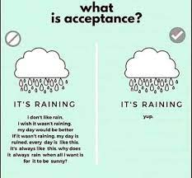
1. Radical Acceptance
Radical acceptance helps us better tolerate pain and distress by changing how we react to it.
When we are in physical or psychological pain, we often judge it and react with blame, anger, anxiety, and general non-acceptance of the pain. These judgements are a form of resistance to the pain. (the second arrow)
Resisting pain often makes it worse. Not only are we experiencing pain or distress but we’re also experiencing the resistance or rejection of it which is also painful. Pain and distress are made worse by this rejection and resistance.
Resistance and non-acceptance of pain may also keep us from doing what is under our control to deal effectively with the cause of the pain and distress.
Radical acceptance asks us to accept pain and distress without adding resistance, rejection or judgement.
Accepting the pain and distress does not mean that these are good things. Instead, it helps us focus on what we can do to alleviate these states rather than spending our energy futilely fighting, resisting and judging them .

Slide 100
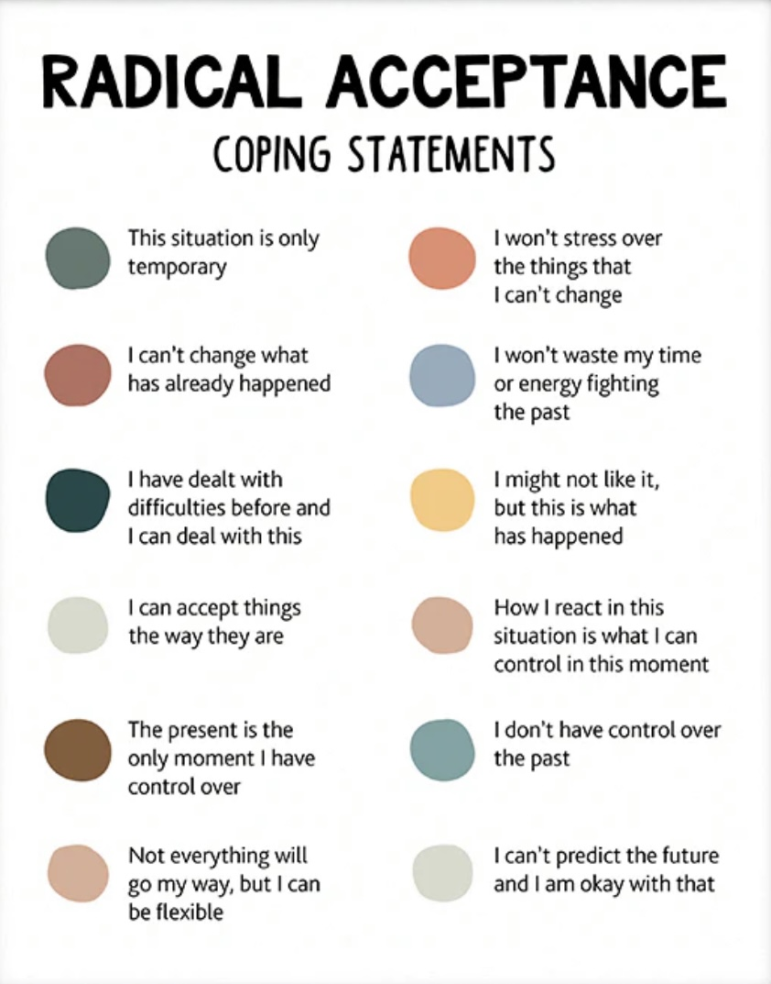
Radical acceptance coping statements
On the left are some examples of radical acceptance coping statements.
Choose one or more statements from this list for your own use. Add this to your list.
Or come up with your own statements
Think of them as your distress “mantra”
The key is to use these when you’re in pain or distress and find yourself resisting them.
Make radical acceptance coping statements part of your crisis plan.
Practice this for videos of past crisis using editing splicing and pasting

Slide 101

SMALL PRACTICES USING RADICAL acceptance
To get better at radically accepting pain and distress without judgement, rejection or resistance:
The key is to start with small things
For example, practice radical acceptance when 1. you’re caught in traffic, or 2. in a long line up at the grocery store, or 3. somebody is late to meet you or 4. talking to Rogers.
Can you think of other circumstances in which you might practice radical acceptance?
Decide ahead of time which radical acceptance “mantra” statements you will use.
Come up with your videos of when you experienced emotional pain. Use the editing splicing and pasting technique along with radical acceptance coping statements.
After practicing with small things try it with more serious things like watching the blue jays or maple leafs lose.

Slide 102
Distress tolerance 2
1. Radical acceptance
2. Distraction
4. Relax and Self Soothe
5. Create a relaxation Plan
3.Create a distraction plan

Slide 103

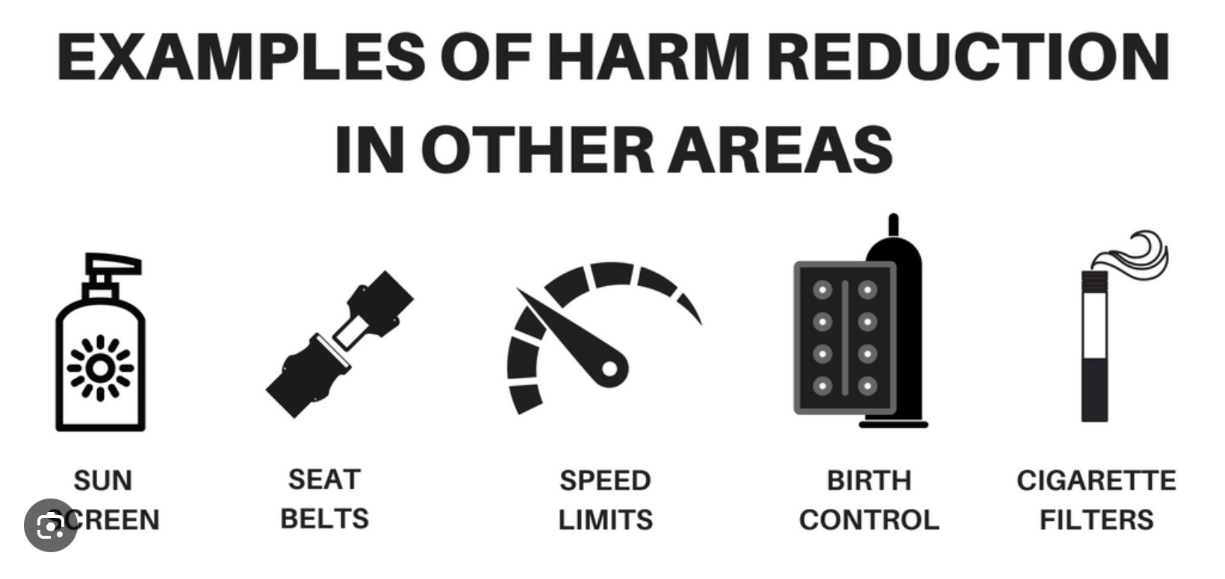
2. DISTRACT AND HARM REDUCE FROM SELF-DESTRUCTIVE BEHAVIORS
We sometimes use maladaptive or self-destructive strategies to try to sooth pain and distress but over the long term this makes them worse.
Maladaptive and self-destructive strategies can sooth us over the short term but cause more damage over the long term.
We can use distraction to try to not engage in maladaptive and self-destructive behaviors.
Watching TV can be a distraction if it’s deliberately used to self-sooth and you come back to deal with what dysregulated you in the first place or it can be avoidance if you use it reactively and excessively and never deal with what caused your dysregulation
We can also try harm reduction which is doing something that resembles the self-destructive strategy and therefor sooths us but is less harmful over the long run.
Ex. Hold an ice cube in your hand as long as you can. Snap a rubber band on your wrist , pop balloons with faces you’ve drawn.
You can now incorporate distraction and harm reduction into your crisis plan. Then edit, splice and paste it into our “videos” of a crisis.

Slide 104
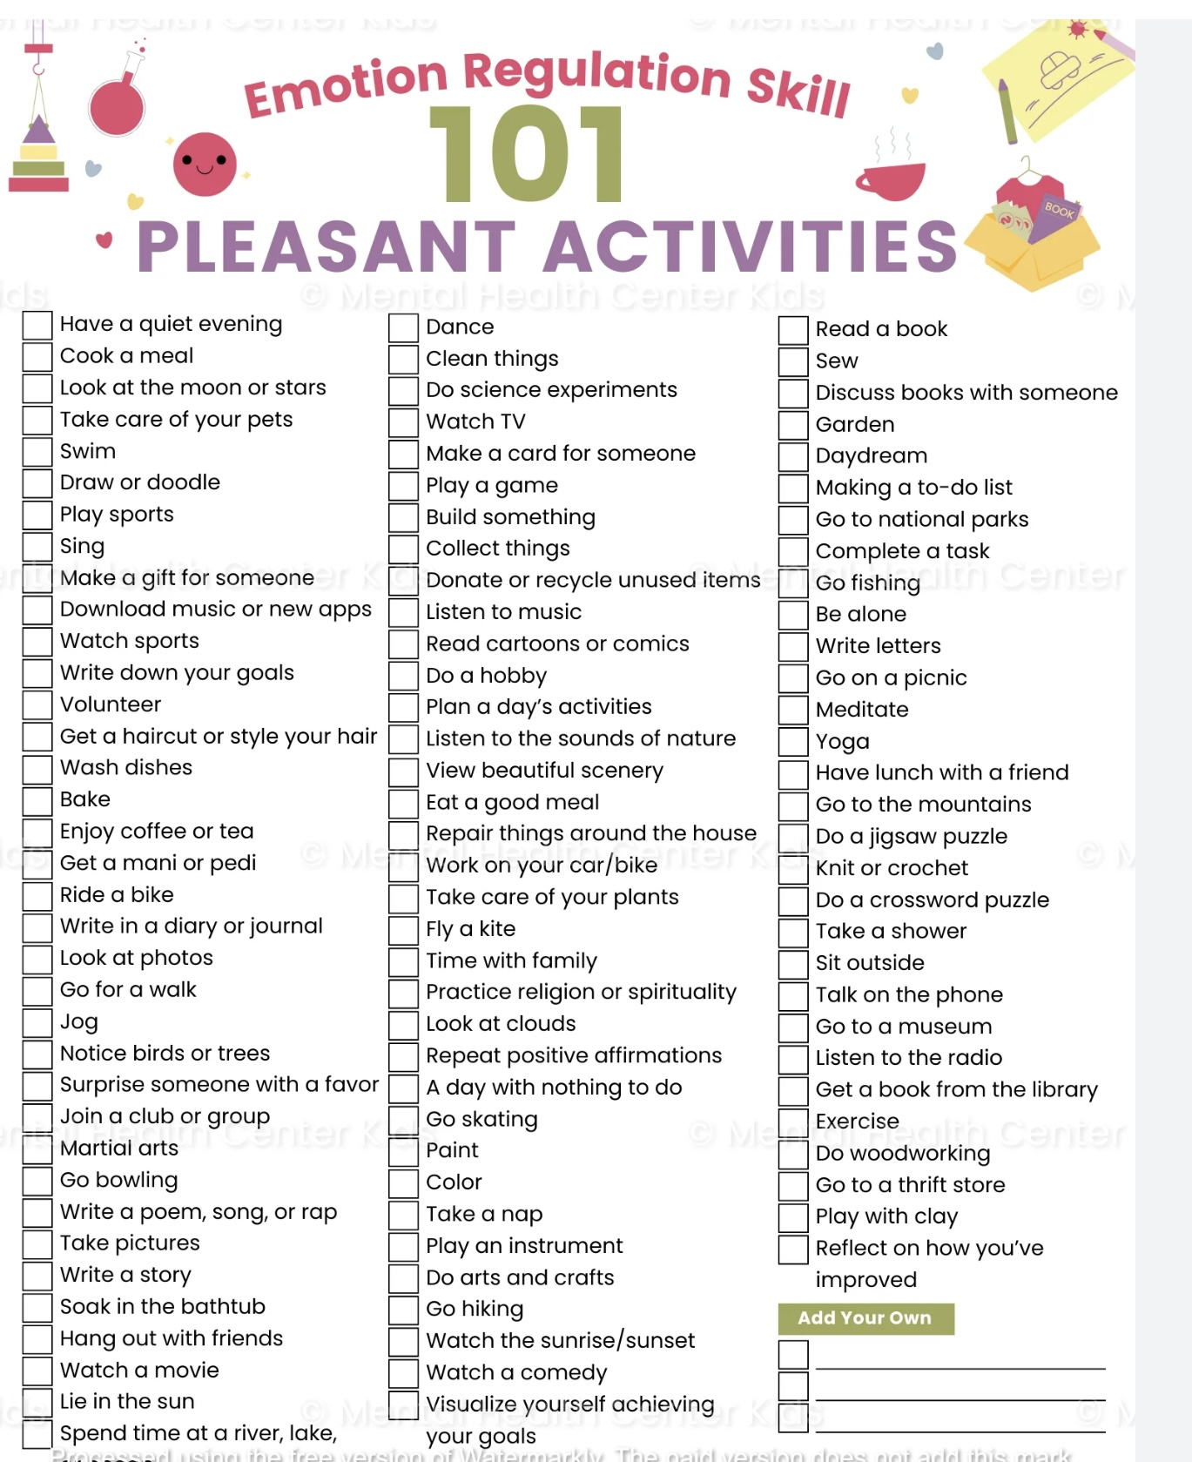
2. DISTRACT WITH PLEASURABLE ACTIVITIES
Review the list of pleasurable activities on pages 18-20 of the workbook
Check off the activities you are likely to use
Engage in these activities as often as you can, don’t wait until you’re in crisis. Come back to the check list when using the 5th tool, the goals diary card procedure
Sometimes doing something that makes you feel good is the best way to distract yourself from distressing and painful emotions
Remember to use these in your distraction plan

Slide 105

Other ways to distract yourself

Slide 106
2. Focus on someone else
Pay attention to someone else
Do something for someone else
Take your attention off yourself
Think of someone you care about
3. With thoughts
Distract your thoughts
Remember past pleasant events
Observe nature
Imagine your wildest fantasy coming true. What would it be?
4. By leaving
Distract yourself by leaving
Sometimes it’s helpful to just leave and create some distance between you and the problem
5. With tasks/Chores
Distract yourself with tasks/chores
Take care of yourself or your environment
1. By counting
Distract by counting breaths, subtracting numbers
OTHER WAYS OF DISTRACTING YOURSELF

Slide 107
Distress tolerance 2
1. Radical acceptance
2. Distraction
4. Relax and Self Soothe
5. Create a relaxation Plan
3.Create a distraction plan

Slide 108

3. Create your OWN Distraction plan and use it in your crisis plan

Slide 109
Distress tolerance 2
1. Radical acceptance
2. Distraction
4. Relax and Self Soothe
5. Create a relaxation Plan
3.Create a distraction plan

Slide 110




You've Met This Skill Before — On Purpose
RELAX AND SELF SOOTHE
In each of the 4 SIMPLE sessions, we’ve discussed the same practice: using the senses to come back to the present and calm your body.
Week 1
Week 2
1st BOING
TODAY
›
›
›
Grounding vs meditation — two kinds of mindfulness
5-senses mindfulness and 5-4-3-2-1 grounding
Building a sensory soothing toolkit
Self-soothing with the five senses
Grounding notice what is here
Anchors you in the present when you feel overwhelmed or far away.
Soothing offers something kind to anchor yourself to
Deliberately gives your body comfort when distress is high.
Self-soothing is a type of grounding the senses. Practice turns self-soothing into a habit you can reach for under stress and include in your crisis plan.
Notes:
Name the overlap directly so no one is left wondering 'haven't we done this?'. Yes, we have — deliberately. Week 1 introduced grounding as a gentler, often safer form of mindfulness, especially for people with trauma. Week 2 practised a five-senses exercise and linked it to 5-4-3-2-1. On Monday, BOING participants built a sensory soothing toolkit. Today's DBT section on self-soothing is the same family of skills. One useful distinction: grounding means noticing what is already around you, to come back to now; soothing means choosing to offer yourself something comforting. Both use the senses, and you will often do both together. Skills learned once are rarely available under stress; repetition is what makes them usable.

Slide 111
SELF-SOOTHING ALGORITHM: Six Steps how to use your sensory toolkit or relax using your senses
1
Notice and name
"I'm distressed." Rate it 0–10.
2
Pick one sense
The one that works best for you — check your toolkit.
3
Offer yourself something pleasant
Gently, as you would comfort a distressed child or part.
4
Give it your full attention
Describe it slowly, 1–3 min. Mind wanders? Return.
5
Let the body respond
Slow the breath, soften the shoulders, allow the calm in.
6
Re-rate and choose
Lower? Carry on. Still high? Try another sense.
Notes:
Walk through the steps using one sense as a live example (e.g. a warm mug of tea). Emphasise: one sense at a time, done slowly and fully, not a checklist. Step 1 and step 6 matter — rating before and after shows people it works and builds trust in the skill. Self-soothing is not avoidance: it lowers distress enough that wise mind can come back online. Invite participants to choose their 'go-to' sense this week and practise when calm (2–3 times) so it is available when distressed. Trauma note: if closing the eyes or focusing on the body increases distress, stay with outward grounding first.

Slide 112

4. Relax and Self Soothe
When we are in the window of emotional tolerance, that is calm or alert, we think more clearly and make better choices
Relaxation and self-soothing strategies can bring us back into the window of tolerance
We can relax and self-sooth using any of our 5 senses.
Use these in your sensory soothing kit.

Slide 113





SELF-SOOTHING ALGORITHM: Six Steps how to use your sensory toolkit or relax using your senses
Ideas for step 3
Sight a photo, nature, candlelight
Sound calming music, rain, a voice
3
Offer it something pleasant
Gently, as you would comfort a distressed child or part.
Smell lotion, coffee, lavender
Taste warm tea or a mint, slowly
Touch soft blanket, a pet, warm water
If turning inward feels unsafe, keep your eyes open and start with grounding: notice what is around you first.
Notes:
Walk through the steps using one sense as a live example (e.g. a warm mug of tea). Emphasise: one sense at a time, done slowly and fully, not a checklist. Step 1 and step 6 matter — rating before and after shows people it works and builds trust in the skill. Self-soothing is not avoidance: it lowers distress enough that wise mind can come back online. Invite participants to choose their 'go-to' sense this week and practise when calm (2–3 times) so it is available when distressed. Trauma note: if closing the eyes or focusing on the body increases distress, stay with outward grounding first.

Slide 114
MORE IDEAS FOR STEP 3 OF THE SELF-SOOTHING ALGORITHM AND FOR YOUR SENSORY TOOL KIT
3
Offer yourself something pleasant

Slide 115

SMELL
Light a candle, use incense
smell perfume, essential oils, or freshly baked bread/cookies
Go to a place with a comforting smell
Go to a forest or a farm

Slide 116

vision
Make a collage
Find a picture of or go to a place that’s visually soothing
Carry a photo of someone you admire or love

Slide 117

sound
Listen to…
music
Audio books/ podcast
Nature sounds
White noise machine
Guided meditations

Slide 118

Taste
Prepare and eat favorite meal
Or comfort food
Drink cold or hot drinks
Try gum, mints, candy
Chew on ice cubes
Prepare and drink fresh juicy fruit

Slide 119

touch
Use your self-soothing kit
Carry something soft and comforting in your pocket
Try a using prayer bead
Take warm or cold showers
Get a massage
Play with a pet
Wear comfortable clothes

Slide 120
Distress tolerance 2
1. Radical acceptance
2. Distraction
4. Relax and Self Soothe
5. Create a relaxation Plan
3.Create a distraction plan

Slide 121

PUTTING IT TOGETHER: select your:
1) radical acceptance statement
2) distraction strategy
3) relaxation and self soothing method and use these IN your crisis plan

Slide 122
Don’t forget to add radical acceptance statements and a distraction and self-soothing plan to your DBT diary card or personal skills list.
This is super important because if you don’t keep a list, you won’t remember the skills you’ve learned when you need them.
PERSONAL SKILLS LIST
Grounding skills- Set a daily intention
“ - Sensory soothing toolkit
“ -The 5,4,3,2,1 method
“ -The emotional freedom technique
REST (or PEST) Pause
Radical acceptance statements
Distraction plan
Self-soothing plan
…

Slide 123
PERSONAL SKILLS LIST UP TO THE PRESENT
DISTRESS TOLERANCE SKILLS
Grounding skills- Set a daily intention
“ - Sensory soothing toolkit
“ -The 5,4,3,2,1 method
“ -The emotional freedom technique
REST (or PEST) Pause
6. Radical acceptance statements (please specify)
7. Distraction plan “
8. Self-soothing plan “

Slide 124
KEY TAKEAWAYS: SUICIDE AND SELF-HARM
1
Crises happen when demands exceed our resources
2
Self-harm is usually about coping, not dying
3
Suicide never has one cause
We move outside our window of tolerance and lose access to Wise Mind.
It is often a way to manage overwhelming inner experiences. Our goal is to find safer strategies, not to judge.
Biology, the body, psychology, relationships, society and meaning all interact.
4
Healing works the same way in reverse
5
Asking directly helps
6
Crises are temporary
Many pathways lead to despair, so many pathways can lead back to hope.
Talking about suicide does not increase risk. It tells people they no longer carry it alone.
A written crisis plan lets our wiser mind guide us when pain narrows our view.
Notes:
Let us pull together the main ideas from the first part of today. Crises happen when life's demands exceed our coping capacity and we move outside our window of tolerance. Self-harm is usually an attempt to cope with overwhelming inner experience rather than a wish to die. Suicide is never the result of one cause, and the encouraging news is that healing follows the same principle in reverse. Asking someone directly about suicidal thoughts does not increase risk; it often brings relief. And because crises are almost always temporary, a written crisis plan made in advance lets our wiser mind guide us when emotional pain has narrowed our perspective.

Slide 125





KEY TAKEAWAYS: BUILDING A LIFE WORTH LIVING
DBT asks not only “How do we stop suicidal behaviour?” but “How do we help someone build a life that feels worth living?”
Resilience
Reasons for living
Hope
Meaning
Connection
Being wounded by life without being defined by those wounds.
Deeply personal, and discovered from within rather than imposed.
Not denying suffering, but refusing to believe it is the whole story. Hope can be borrowed.
“How might I respond in a way that reflects the person I wish to become?”
People survive through connection. Healing rarely happens in isolation.
“The goal is not to eliminate the storms. It is to help each of us build a shelter strong enough to live through them, and a life beautiful enough that we want to keep stepping outside when the sun returns.”
Notes:
The opposite of suicide is not simply survival; it is the gradual building of a life worth living. That rests on five things we explored: resilience, reasons for living, hope, meaning and connection. Remember that hope can be borrowed: when someone cannot yet believe life is worth living, another person can hold that hope for them until they can hold it themselves. The goal is not to eliminate the storms, but to build a shelter strong enough to live through them.

Slide 126
KEY TAKEAWAYS: DISTRESS TOLERANCE SKILLS
1
Radical acceptance
2
Distract
THIS WEEK
Choose one radical acceptance statement, one distraction strategy and one self-soothing method.
Add them to your crisis plan and personal skills list.
Rehearse them in your imagination with edit, splice and paste.
Keep checking your dashboard.
Accept pain without adding resistance or judgement (the second arrow). Start with small things like traffic or line-ups.
Use ACCEPTS and pleasurable activities (p. 18–20) to step away from emotional mind and self-destructive urges.
3
Relax and self-soothe
4
Make a plan in advance
Use smell, vision, sound, taste and touch to bring yourself back into your window of tolerance.
Write your distraction and self-soothing plans now, so they are ready when you need them.
In crisis? Call or text 9-8-8 or 1-888-829-7484
Notes:
From the workbook section today: radical acceptance means accepting pain without adding the second arrow of resistance and judgement. Distraction, using ACCEPTS and pleasurable activities, helps us step away from emotional mind and from self-destructive urges. Relaxing and self-soothing through the five senses brings us back into our window of tolerance. And the key is to make these plans in advance. This week, choose one of each, add them to your crisis plan and personal skills list, and rehearse them in your imagination using edit, splice and paste. If you do not keep a list, you will not remember these skills when you need them most.

Slide 127
2025-26 SLIDES

Slide 128
Suicide AND SELF-HARM
“The thought of suicide is a great consolation: by means of it one gets through many a dark night.”
— Friedrich Nietzsche
“So many people are hanging on by the thinnest of threads. Treat people with kindness you don’t think they deserve. You never know how much someone is struggling.”
— Nanea Hoffman
“Suicide doesn’t end the chances of life getting worse, it eliminates the possibility of it ever getting better.”
— Unknown
Myths and reality

Slide 129
ZOOM POLL
Please answer the following question
Answers are anonymous
In person participants please answer the page that was handed out.

Slide 130

Today we’re going to talk about suicide. Is there a risk some people might be triggered by this discussion?
Notes:
That's a good point. Discussing suicidality could bring back personal experiences that people have had. It's very important in every every session but especially in this one that people keep monitoring their personal dashboard. If their crisis risk increases or they are very outside the window of tolerance, they should pause and use some distress tolerance skills. Although there is some risk of triggering people, this is an important discussion to have, and provided people are careful I think the benefits outweigh the risks.?

Slide 131
WE NEED TO TALK ABOUT…
While some people attending the course may never have had suicidal thoughts, it’s estimated that at least 10% of Canada’s population will experience suicidal ideation at some point in their lives.( 5% will make an attempt and 4% a suicide plan)
Suicidal ideation is a common and very important "hole" that many people, especially those with mental health issues, encounter.
Because it can be so consequential, we devote part of this distress tolerance and crisis planning session to it.
Many people who struggle with mental health issues have either, occasional, frequent, or constant suicidal ideation.
Thoughts of suicide or self-harm, including feelings of despair and hopelessness, suicidal thoughts, and suicidal behaviors are, for anyone who experiences them, a critical “hole” for which crisis plans and distress tolerance skills can be lifesaving. Having a crisis plan is a must for anyone who experiences these thoughts.
Although this discussion may trigger some people, it is an important one to have at this point in the course. There is very good evidence that talking about suicide or self-harm does not make it worse (except for cases of “contagion” which we’ll discuss below)
As we proceed today, pay attention to your personal internal dashboard and take care of yourself the best you know how. Take a break if you need to.

Slide 132
Many different terms are used when talking about suicide and self-harm. These terms can be somewhat confusing. Could we define some of them?

Slide 133
frequently used terms
6. Suicide plan – how and the means by which the person intends to carry out suicide
7. Suicidal intent – refers to the main goal or objective of the suicidal behavior. Is it seeking relief? Sending a message? A cry for help? An expression of anger?
8. Suicide related communication – conveying suicidal ideation to others
9. Suicidal threats – an interpersonal communication that a reasonable person would interpret as communicating or suggesting that suicidal behavior might occur in the near future
10. Suicidal gesture – suicide-related behaviors that are carried out without suicidal intent. (is a term that can be misused to convey an intent to manipulate)
1. Suicidal behavior – any behavior resulting in an attempt or preparation for an attempt; this may include practicing or rehearsing for the attempt.
2. Suicide attempt – nonfatal self-directed potentially injurious behavior with any intent to die as a result of the behavior. A suicide attempt may or may not result in injury.
3. Non suicidal self injury (also known as self-harm) – deliberate self-directed destruction or alteration of body tissues without a conscious suicidal intent.
4. Postvension – interventions to address the care of bereaved survivors, caregivers, and healthcare providers. These are meant to destigmatize the tragedy of suicide and assist with the recovery process and serve as a secondary prevention effort to minimize the risk of subsequent suicides due to complicated grief, contagion, or unresolved trauma.
5. Suicide contagion – the phenomenon by which suicide and suicidal behavior is increased for some who are exposed to the suicide of others. This is especially common among younger people.
Notes:
This is a partial list of some of the commonly used terms in discussions about suicidality.

Slide 134
NON-SUICIDAL SELF-INJURY
Non-suicidal self-injury (NSSI) or non-suicidal self-harm (NSSH) can be defined in both a narrow and a broader sense, depending on context (clinical research vs. public health or psychosocial discussion).
Narrow Definition (Clinical / Research). In the DSM-5 and most clinical studies non-suicidal self-injury (NSSI) refers specifically to direct, deliberate, and self-inflicted damage to body tissue without suicidal intent and for purposes not socially sanctioned. Examples are cutting, burning, scratching, or hitting oneself. From this narrow definition are excluded behaviors such as substance misuse, disordered eating, or reckless driving. The emphasis is on direct tissue damage, absence of suicidal intent and a repetitive pattern.
This definition is used to distinguish NSSI from both suicidal behavior and broader self-destructive coping. strategies.
Broader Definition (Public Health / Psychosocial). In broader contexts, such as community mental-health research, or sociology, “self-harm” or “non-suicidal self-harm” may include any intentional act of self-injury or self-poisoning regardless of motive or degree of suicidal intent. Indirect forms of self-harm, such as binge drinking, starvation, or other risky behaviors, can be included under a “continuum of self-injury.” Under this broader definition the focus is on psychological distress, emotion regulation, and risk factors, rather than precise diagnostic boundaries.

Slide 135
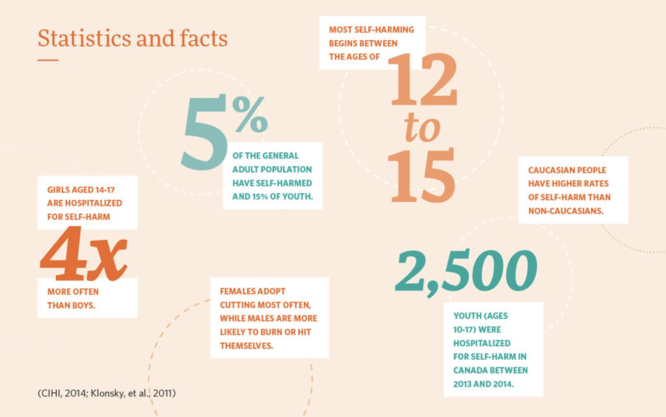
NON-SUICIDAL SELF-INJURY
Examples of non-suicidal self-injury (NSSI), that is, deliberate self-inflicted harm done without intent to die include:
1. Cutting or scratching: Using sharp objects (e.g., razor blades, knives, glass, safety pins) to make shallow cuts on arms, legs, or other body parts. Scratching the skin with fingernails or objects until it bleeds.
2. Burning: Pressing lit cigarettes, lighters, or heated metal against the skin. Pouring hot water or other hot substances on oneself.
3. Hitting or punching: Punching walls or hard objects. Hitting oneself (e.g., in the face or thighs). Banging one’s head against a wall or surface.
4. Interfering with wound healing: Picking at scabs or reopening old wounds to prolong healing or to feel pain again.
5. Hair-pulling: Pulling out hair from the scalp, eyelashes, eyebrows, or other body areas.
6. Severe skin-picking: Repeatedly picking at pimples, scabs, or healthy skin until it bleeds or scars.
7. Ingesting non-lethal or harmful substances: Swallowing small amounts of toxic or inedible materials (soap, chemicals, etc.) without suicidal intent. Taking medications in small overdoses, not to die but to feel pain or loss of control.
8. Extreme forms of physical restraint or deprivation: Starving oneself or excessive exercising (especially when primarily to punish oneself rather than for body image). Exposing oneself to extreme cold or heat intentionally.

Slide 136
Can you compare and contrast suicide and self-harm ?

Slide 137
SELF HARM VS. SUICIDE ATTEMPTS
It is important to distinguish self-harm from suicide attempts.
Self-harm is also referred to as “non-suicidal self-injury.”
Self-harm is defined as the deliberately hurting of the body such as by cutting, headbanging, hitting, or burning.
Self-harm is a harmful and maladaptive way of trying to cope with emotional pain such as sadness frustration or anger.
There are several important differences between self-harm and suicide attempts in terms of frequency, methods, severity, and purpose.
self-harm suicide attempts
Is very frequent and on the rise in the young happen less frequently
Often involve cutting burning and self hitting most frequent method is overdosing
is less life endangering are more life endangering sometimes fatal
Is often done to cope with painful emotions are done with an intent to die

Slide 138
WHY PEOPLE
SELF-HARM
Self-harm is often not about wanting to die, but about coping with overwhelming inner experiences.
Self-harm may be used to:
Regulate intense emotions (release, relief, or to feel something when numb)
Gain a sense of control when life feels chaotic
Express inner pain that feels hard to put into words
Distract or ground from overwhelming thoughts or memories
Relieve tension through physical sensation
Punish oneself out of guilt, shame, or anger
Communicate distress or signal need for care
Feel real or embodied when dissociated or disconnected…

Slide 139
WHY PEOPLE MIGHT CONSIDER SUICIDE
“Commit” is a word generally reserved for acts viewed as sinful or immoral. “Completed” is usually a good thing.
Instead of these words suicide awareness advocates encourage the use of words like contemplate, think of, died by, took her own life.
“Contemplating” suicide is often not due to one cause, but overlapping human experiences of pain, distress, loss, and disconnection including:
Unbearable emotional pain ("psych ache") and hopelessness
Mental health conditions (depression, anxiety, bipolar, PTSD)
Relationship loss, rejection, or conflict
Histories of trauma, abuse, or bullying
Profound loneliness and social isolation
Financial, work, or academic stress
Chronic illness or ongoing physical pain
Substance use lowering control and intensifying distress
Feeling like a burden to others
Impulsivity during an acute crisis or sudden stressor

Slide 140
How common are suicide and self-harm ?

Slide 141
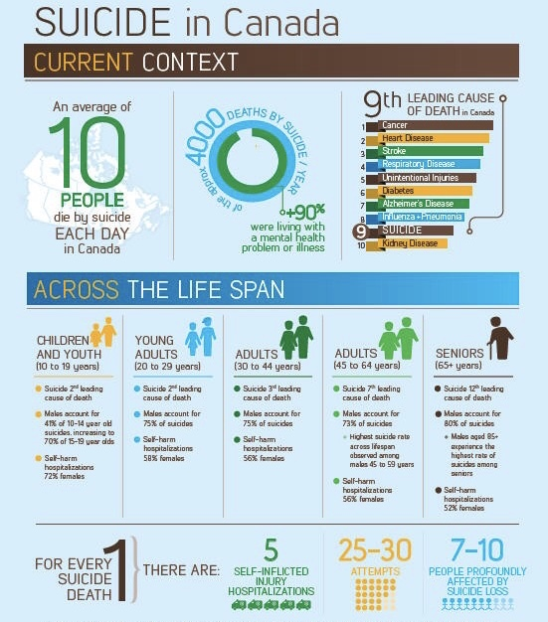
CANADIAN STATISTICS
In Canada there are approximately 120,000 suicide attempts every year, or 10-11 people per 100,000. (That’s over 300 suicide attempts in Canada every day of the year.)
In Canada approximately 4000 people die from suicide per year. That’s an average of more than 10 every day.
Every persons suicide profoundly affects an average of 10 people.
More than 90% of people who attempt, or die by suicide have diagnosable mental health issues.
More than 50% of people who die by suicide have never received any kind of mental health care
Males account for 75% of deaths by suicide
Females account for most suicide attempts and self-harm.
Overall, suicide is the 9th leading cause of death in Canada.
However:
For people aged 15 to 34 it is the 2nd leading cause of death.
Suicide rates among adolescents has gone up 40% in the last 10 years
Indigenous communities experience significantly higher rates of attempts and deaths by suicide. Suicide rates are higher in Northern and isolated communities

Slide 142

NON-SUICIDAL SELF-INJURY
Among adolescents, the lifetime prevalence of non-suicidal self-injury (NSSI) is estimated to be around 16 % (with girls typically higher than boys) in many studies.
A recent meta-analysis found an aggregate lifetime prevalence of NSSI in youth at 22 % and a past-12-month prevalence of 19.5 % .
In Canada, self-harm leads to about 20,000 hospitalizations annually.
Globally, there are an estimated 14 million incidents of self-harm per year.
These figures include non-suicidal self-harm (i.e. behaviors without intent to die) as well as deliberate self-harm / suicidal attempts in some studies, so definitions and numbers vary.
Rates tend to be higher during adolescence and young adulthood than in other life stages.
Females generally report higher rates of non-suicidal self-injury than males in community samples.
Many incidents of self-harm are not captured in available data (because people may not seek medical help or may treat wounds themselves), so these numbers likely underestimate the true prevalence.

Slide 143
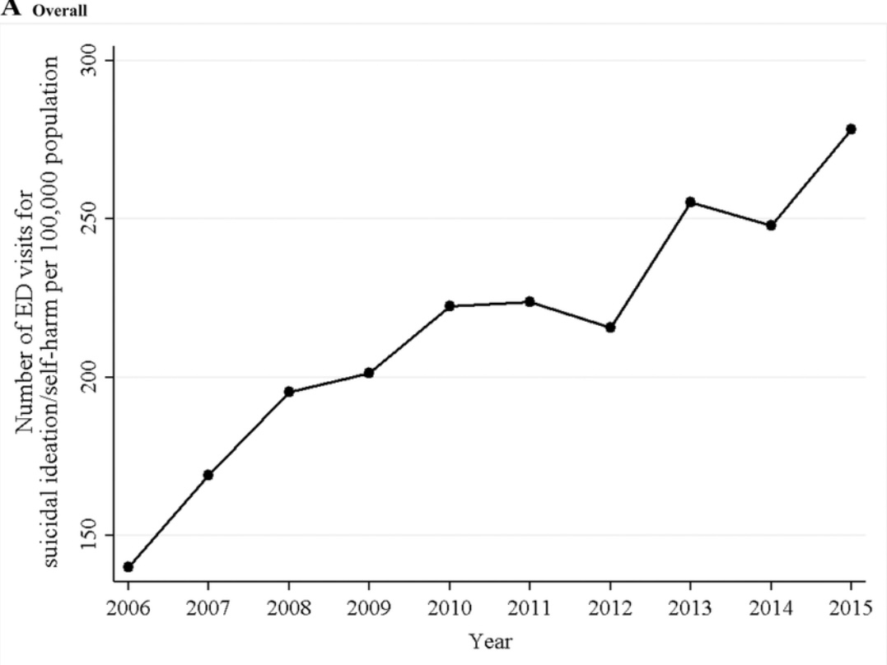

Slide 145
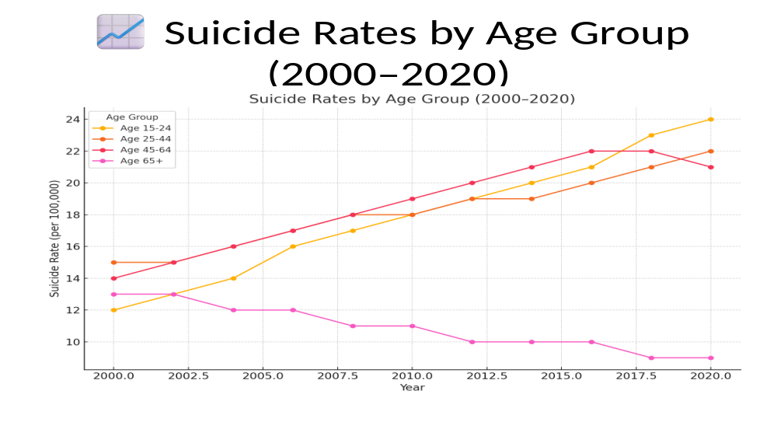

Slide 146
TRENDS
Although trends can vary by region, and demographic group, suicide rates in North America have overall increased over the last decade.
Several factors are thought to have contributed to this rise:
There has been an increase in mental health disorders such as depression and anxiety.
Despite growing awareness, access to mental health care can still be limited for many people.
Despite progress, there is still stigma surrounding mental health issues, which can prevent individuals from seeking help.
The opioid crisis and increased use of other substances have been linked to higher suicide rates. Substance abuse can exacerbate mental health issues and increase impulsivity.
Economic instability, unemployment, and financial stress can contribute to feelings of hopelessness and despair, leading to higher suicide rates.
Changes in social structures and increased social isolation, especially during events like the COVID-19 pandemic, have been associated with increased mental health challenges.
Easy access to means of suicide, such as firearms, can increase suicide rates. Efforts to restrict access have been shown to help reduce rates.

Slide 147


The sociological study of suicide begins with Émile Durkheim, one of the founding figures of sociology. His groundbreaking1897 work “Le Suicide” was the first major sociological study to treat suicide not just as an individual psychological phenomenon, but as a social fact, shaped by forces larger than any one person.
Durkheim’s core insight was that suicide is not simply an individual act driven by mental illness or personal despair, it is deeply influenced by the structure of society, particularly the degree of integration and social regulation a person experiences.
Durkheim identified four types of suicide, each arising from imbalances in these two social forces:
Egoistic Suicide- Occurs when social integration is too low. The person feels isolated, not meaningfully part of any group. It is common in societies with weak communal bonds. Example: A person with no family or religious ties who feels existentially adrift. “Egoism is the state where the individual ego asserts itself to excess in the face of the social ego and at its expense.”
Altruistic Suicide- Occurs when social integration is too high. The self is so absorbed into the group that one sacrifices themselves for it. Seen in highly collectivist cultures or military situations. Example: Kamikaze pilots, or suicide bombers. The individual “no longer perceives the limits of the self” and dissolves into the group identity.
THE SOCIOLOGY OF SUICIDE

Slide 148
Anomic Suicide- Occurs when social regulation is too low, especially during times of economic upheaval or rapid social change. Norms are disrupted; people feel unanchored. Example: Suicide rates rising after a financial crisis or divorce. Anomie is a state of “normlessness”, a disconnection from shared rules, expectations, and meaning.
Fatalistic Suicide - Occurs when social regulation is too high. Lives are overcontrolled and oppressive; there is no hope of change. Example: Suicides among prisoners or people in abusive institutions.
In his study of suicide, Durkheim shifted the lens from asking “What’s wrong with this person?” to “What does this person’s despair say about their relationship to society?”
It was a revolutionary move toward seeing mental health, despair, and even suicide as socially patterned phenomena, not just as private tragedies.
Durkheim’s theory remains relevant in modern research:
The suicide epidemic among men (especially middle-aged men) has been linked to egoistic or anomic factors.
Indigenous youth suicide involves disconnection (egoistic) and cultural suppression (fatalistic).
Workplace burnout or suicide in high-pressure professions overlaps with fatalistic and anomic types.
THE SOCIOLOGY OF SUICIDE

Slide 149
INEQUALITY AND SUICIDE RATES
There’s a well-documented and striking relationship between income inequality (measured by the Gini coefficient) and suicide rates, observed across many countries and over time.
Higher Gini coefficients (greater income inequality) are consistently associated with higher suicide rates, both across countries and within nations over time. “It’s not just poverty that predicts suicide, it’s inequality.” People’s sense of relative disadvantage, social exclusion, and lack of belonging appear more predictive than absolute economic hardship.
A 2021 World Psychiatry meta-analysis found that a 0.1 increase in a country’s Gini coefficient was associated with roughly a 5–8 % higher suicide rate, depending on age group.
OECD data show that countries with lower inequality (e.g. Norway, Denmark, Netherlands) tend to have lower suicide rates than similarly wealthy but more unequal nations (e.g. U.S., South Korea).
Within the U.S., counties with the highest inequality have suicide rates up to 30 % higher than those with the lowest inequality, even after adjusting for poverty and unemployment.
Different possible reasons have been offered for this. 1) Relative deprivation: When the gap between rich and poor widens, people experience more social comparison, shame, and feelings of failure.2) Erosion of social trust and cohesion: Inequality weakens community bonds, known protective factors against suicide.3) Reduced access to resources and mental-health supports for those at lower socioeconomic levels.4) Cultural emphasis on individual achievement in unequal societies can amplify despair in those who struggle economically.
The link is strongest for men, working-age adults, and younger people in highly individualistic societies.
In societies with strong social safety nets, inequality has a weaker effect, suggesting policy and culture can buffer the harm.
Rise in inequality seems to increase suicide risk, not only through material deprivation but by corroding the social fabric that gives people belonging, dignity, and hope

Slide 150
DEATHS OF DESPAIR
"Deaths of despair" is a term that has been used to describe deaths resulting from suicide, drug overdose, and alcohol-related conditions. The term was popularized by economists Anne Case and Angus Deaton, who highlighted the increasing rates of these deaths, particularly among middle-aged white Americans of lower socioeconomic status.
The term “despair” reflects the idea that these deaths are often linked to a sense of hopelessness , driven by factors such as economic hardship, social isolation, and lack of access to healthcare and mental health services.
The rise in deaths of despair has been attributed to several interconnected factors, including:
Declining job opportunities, particularly in industries like manufacturing and mining, which have led to economic instability and reduced social mobility for many individuals and families.
Changes in community structures, family dynamics, and social networks which have led to increased feelings of loneliness and isolation.
The opioid crisis, along with increased use of other drugs and alcohol, has contributed significantly to these types of deaths.
Shifts in cultural and societal norms may also play a role, influencing how individuals cope with stress and adversity.
Although the term was only recently popularized, historically many underprivileged communities, such as native North Americans, have also experienced deaths of despair.

Slide 151
Can you summarize the biological, physical, psychological, psychological, social and spiritual factors that have been linked to suicide?

Slide 152
BIOLOGICAL FACTORS IMPACTING SUICIDE
1. Neurotransmitter Imbalance-Low serotonin → Impulsivity, aggression, depression. Dopamine dysfunction → Anhedonia, hopelessness. Norepinephrine dysregulation → Emotional instability
2. Brain Structure & Function-Prefrontal cortex: ↓ impulse control, decision-making. Amygdala: ↑ emotional reactivity, fear
Anterior cingulate cortex: ↑ emotional pain, social rejection sensitivity
3. Genetic & Epigenetic Risk-Family history of suicide → inherited traits (e.g., impulsivity, mood disorders). Epigenetic changes from trauma or stress → altered brain chemistry
4. Hormonal & Stress Systems-HPA axis overactivation → chronic stress, cortisol imbalance. ↑ Risk in thyroid dysfunction, low testosterone, estrogen fluctuations
5. Physical Illness & Neurological Conditions-Chronic pain, traumatic brain injury (TBI). Epilepsy, stroke, Parkinson’s, multiple sclerosis. Terminal illness or cancer
Biological factors don’t cause suicide alone but lower the threshold, especially when combined with trauma, mental illness, or social stress.

Slide 153
PHYSICAL FACTORS IMPACTING SUICIDE
1. Chronic Pain-Linked to hopelessness, depression, and desire to escape suffering. Higher suicide risk with opioid dependence
2. Neurological Conditions-Traumatic brain injury (TBI), epilepsy, stroke, Parkinson’s, multiple sclerosis. Impact emotional regulation and cognitive function
3. Terminal and Life-Limiting Illnesses-Cancer, ALS, advanced heart/lung disease. Associated with loss of autonomy, existential distress
4. Disability and Functional Impairment-Loss of mobility, sensory deficits, or independence. Increased risk of isolation, depression, and suicidal ideation
5. Endocrine and Hormonal Disorders-Thyroid dysfunction, low testosterone, menopause. Can affect mood, energy, and mental health
6. Sleep Disorders-Chronic insomnia, sleep apnea. Strongly linked to depression and suicidality
Physical health conditions, especially when combined with pain, loss, or isolation, can significantly elevate suicide risk integrated care is essential.

Slide 154
PSYCHOLOGICAL FACTORS IMPACTING SUICIDE
1. Depression & Mood Disorders-Hopelessness, worthlessness, emotional pain. High suicide risk in major depressive episodes and bipolar disorder
2. Anxiety Disorders & PTSD-Severe anxiety and trauma-related flashbacks increase risk. Often co-occurs with depression and substance use
3. Personality Disorders-Especially borderline personality disorder (BPD). Emotional dysregulation, impulsivity, chronic emptiness
4. Substance Use Disorders-Lowered inhibition and increased impulsivity. Exacerbates depression and hopelessness
5. Cognitive Distortions-All-or-nothing thinking, catastrophizing, tunnel vision. Belief that things will never improve
6. History of Trauma or Abuse-Childhood adversity, neglect, or sexual abuse increase lifetime risk. Linked to shame, dissociation, and identity disturbance
Suicidality often stems from intense emotional pain + distorted thinking. Psychological support can restore hope, connection, and coping capacity.

Slide 155
SPIRITUAL FACTORS IMPACTING SUICIDE
Spiritual crisis or “dark night of the soul” -A person may feel that God is absent, that prayer is not answered, or that their spiritual life is void, leading to deep despair or alienation. This is often tied to psychological distress (e.g. depression) rather than purely spiritual causes.
Loss of religious belief / religious disaffiliation- For someone raised in a religious tradition, losing faith or feeling betrayed by traditions can produce existential emptiness, guilt, or crisis of meaning.
Spiritual guilt or shame- If a person believes that suicide is a sin (or that suicidal thoughts are sinful), they may suppress or hide distress, feel additional shame, or believe they have no “right” to seek help. This can inhibit them from talking openly about suicidal ideation or accessing mental health supports.
Fear of eternal consequences / damnation- In a strongly religious mindset, the person might fear spiritual punishment after death, yet feel trapped by suffering in life, leading to inner conflict, despair, or impulsive acts. The tension between doctrinal belief and lived suffering can become unbearable for some.
Spiritual isolation / loss of community- Religion often offers social support, shared rituals, and a sense of belonging. When people lose these connections, they may lose coping frameworks and support systems. The weakening of church-based social networks or disconnection from religious community may reduce protective buffers.
Cultural-religious expectation of “holding on”- In some religious or cultural narratives, persevering through suffering is valorized. Some may feel guilt or failure if they can’t “hold on,” deepening their distress. This can make people feel even more isolated or “weak” for having suicidal thoughts.
Meaninglessness / loss of purpose- When traditional religious narratives or spiritual meanings weaken, some people might struggle to find meaning, contributing to existential despair.
Spiritual or religious conflict -For example, internal conflict between personal desires / identity and religious teachings (e.g. sexuality, gender identity, moral struggles) can produce intense inner turmoil and guilt. Especially in places or communities where religious conservatism is strong, this tension may become acute.

Slide 156

RELIGIOUS/SPIRITUAL FACTORS IMPACTING SUICIDE
Sense of meaning & sacredness Protective
Community and belonging Protective
Positive coping & prayer Protective
Moral/religious prohibitions Protective
Spiritual struggle/guilt Risk-enhancing
Non-affirming religious environments Risk-enhancing

Slide 157
What is the mental health system’s approach to working with people experiencing suicidal thoughts?

Slide 158
WORKING WITH PEOPLE EXPERIENCING SUICIDAL THOUGHTS
1. Assessment: screening, evaluation, and triage, risk factors, lethality and chronicity
2. Interventions
3. Prevention
4. Building resiliency
5. DBT’s approach to suicidality
6. How to effectively seek professional help

Slide 159
WORKING WITH PEOPLE EXPERIENCING SUICIDAL THOUGHTS
1. Assessment: screening, evaluation, and triage, risk factors, lethality and chronicity
2. Interventions
3. Prevention
4. Building resiliency
5. DBT’s approach to suicidality
6. How to effectively seek professional help

Slide 160
SCREENING VS. EVALUATION
Suicide Screening is a brief, standardized process used to identify individuals who may be at risk for suicide. Its purpose is to flag potential risk quickly so that further evaluation can be done. It can be done by anyone in a healthcare, educational, or community setting, including non-specialists (e.g., nurses, teachers, crisis line workers, ER staff).
Tools used: PHQ-9 (especially item 9), Columbia-Suicide Severity Rating Scale (C-SSRS) screener version. Ask Suicide-Screening Questions (ASQ)
Screening doesn’t diagnose or determine actual level of risk and has high false positive/negative rates if used alone.
Suicide Evaluation (AKA Risk Assessment) is a comprehensive, clinical process to assess the severity, immediacy, and context of suicide risk. Its purpose is to determine the level of danger, understand underlying factors, and inform treatment and safety planning. It is conducted by trained mental health professionals (e.g., psychiatrists, psychologists, social workers). It includes: Assessment of current ideation (frequency, intensity, duration). Presence of a plan and means. Past attempts. Mental health history. Substance use. Protective factors (e.g., relationships, reasons for living). Risk factors (e.g., trauma, psychiatric illness, loss)
The goal is to classify risk (low, moderate, high, imminent) and guide next steps: hospitalization, safety/crisis plan, outpatient care, etc.

Slide 161
1. SCREENING AND ASSESSING PEOPLE WITH SUICIDAL IDEATION.
.
Notes:
A good assessment of suicidal individuals should consider several factors. Screening is something that happens before a more in-depth assessment. Screening determines whether that in-depth assessment needs to be done. The assessment itself is often divided into five steps

Slide 162
ACUTE VS CHRONIC RISK FACTORS
Risk factors are variables that are associated with an increased risk of a disease or negative health outcome
Suicide risk factors help professionals assess the likelihood that a person will die by suicide and are an important part of a suicide assessment.
There are chronic or longstanding and acute or short-term risk factors that predict death by suicide.
People with acute high risk (right hand column) are those who are most often admitted to hospital.
People with chronic high-risk factors (left hand column) are most often treated in outpatient settings and often not hospitalized.
Notes:
In epidemiology, a risk factor is a variable associated with an increased risk of a disease or negative health outcomes.

Slide 163
LETHALITY AND CHRONICITY
Suicide risk assessment involves assessing the lethality of a person’s chosen method for suicide and the duration of the suicidal ideation.
Lethality of method refers to the % of people who die in suicide attempts with different methods of suicide. For example, using firearms is much more lethal than ingesting harmful substances
Acuity/chronicity of suicidality refers to how long or frequently the person has thought of suicide.
Individuals who experience suicidal ideas can roughly be grouped into four categories.
1)Those with a highly lethal method and a chronic pattern of suicidal ideation
2)Those with highly lethal method in whom suicidal ideation is a new or acute phenomenon.
3)Those with low lethality and a chronic pattern
4)Those with low lethality in whom suicidal ideation is new
Treatment approaches vary depending on which of these categories people fall into.
Notes:
Another factor in assessing suicidal risk is considering lethality of the method.

Slide 164
THE SUICIDE RISK SPECTRUM
A careful assessment helps clinicians to determine each person’s suicide risk
Suicide risk, or the likelihood that a person will complete suicide, is a spectrum ranging from no risk to imminent risk of suicide completion.
Intent means the determination to do something.
Increasing degrees of risk are described as 1) suicidal thoughts without suicidal intent 2) suicidal thoughts with passive intent 3) suicidal thoughts with active intent and 4) suicidal thoughts with a specific plan.
There are suggested guidelines for working with each of these different degrees of risk
In real life, the fewer resources there are, the more mental health professionals develop a tolerance for suicide risk.
Compared to when I started in psychiatry in 1985, there much fewer resources today and an increased tolerance for suicide risk.
What does this say about our society?
Notes:
The risk of suicide of an individual is rated on a spectrum.

Slide 165
What approaches does mental health care use in working with people experiencing suicidal ideation ?

Slide 166
Approaches to WORKING WITH people EXPERIENCING Suicidal ideation
There are three types of approaches to working with people experiencing suicidal ideation:
1. Suicide interventions- describes the recommended immediate steps to take with someone who has active suicidal ideation.
2. Suicide prevention- is the collection of efforts to reduce the long-term risk of suicide of individuals, and in communities, and societies.
3. Building resiliency- involves helping vulnerable people develop ways of adapting in the face of adversity and distress.
The distress tolerance skills, and the crisis plan, are both intervention and prevention strategies
The overall goal of the Simple course is to help people build resilience

Slide 167
WORKING WITH PEOPLE EXPERIENCING SUICIDAL THOUGHTS
1. Assessment: screening, evaluation, and triage, risk factors, lethality and chronicity
2. Interventions
3. Prevention
4. Building resiliency
5. DBT’s approach to suicidality
6. How to effectively seek professional help

Slide 168
Suicide intervention refers to the collection of efforts to reduce the short-term or immediate risk of suicide in at-risk individuals.

Slide 169
CRISIS PLANS IN SUICIDE PREVENTION
Preparing individualized crisis plans is a critical intervention in suicide prevention. Crisis plans serve as a proactive strategy to help individuals manage their feelings and behaviors during times of crisis. Completing a crisis plan involves the active collaboration of the individual.
A crisis plan is tailored to the individual's specific needs and triggers. It includes personalized coping strategies and resources that can help them navigate difficult moments. Creating a crisis plan can empower individuals by giving them a sense of control over their situation. It encourages proactive thinking about how to manage crises.
The plan provides clear steps to take when experiencing suicidal thoughts or feelings.
Crisis plans involve identifying personal warning signs that indicate a crisis is approaching. Recognizing these signs can empower individuals to take action before reaching a critical point.
A crisis plan typically includes a list of supportive people in the individual's life who can be contacted during a crisis. Knowing who to reach out to can make a significant difference in times of distress.
Having a plan in place can reduce anxiety and uncertainty during a crisis. It provides a sense of control and preparedness, which can be comforting. Knowing there is a plan in place can help individuals feel less alone and more supported, which is vital in times of crisis.
Crisis plans also encourage individuals to seek professional help, whether through therapy or counseling. This can lead to ongoing support and resources for managing mental health.
By developing and utilizing a crisis plan, individuals can build resilience and coping skills over time, which can help them handle future challenges more effectively.

Slide 170
2. SUICIDE INTERVENTION AND PREVENTION: A CRISIS PLAN SPECIFICALLY FOR SUICIDAL IDEATION
A suicide intervention plan is a crisis plan adapted for a suicidal ideation “hole”. Notice the similarities between this template and simple’s crisis plan template
1.
2.
3.
4.
5.
Notes:
Suicide intervention is what is done in an acute situation when an individual has suicidal thoughts and is at risk of carrying them through. This five point crisis plan is general, the individual crisis plans that we work on in the simple course are personalized to each individual.

Slide 173
PSYCHOTHERAPEUTIC INTERVENTIONS PROVEN TO REDUCE SUICIDE RISK
Evidence-Based Therapies for Suicidality
Dialectical Behavior Therapy (DBT): Best evidence for reducing suicide attempts in BPD
Cognitive Behavioral Therapy (CBT): Helps reduce suicidal ideation and cognitive distortions
Collaborative Assessment and Management of Suicidality (CAMS): Targets suicidal drivers directly
Brief Cognitive Behavioral Therapy for Suicide Prevention (BCBT-SP): Proven effective in reducing post-attempt suicidality
Mentalization-Based Treatment (MBT): Enhances emotion regulation in personality disorders
Supportive Approaches with Emerging Evidence
Acceptance and Commitment Therapy (ACT): Promotes values-based living and diffusion from suicidal thoughts
Compassion-Focused Therapy (CFT): Reduces self-criticism and shame
Internal Family Systems (IFS): Addresses exiles and protectors linked to suicidality
Effective therapy focuses on emotion regulation, cognitive restructuring, connection, meaning, trauma processing and restoring a full life.
Therapeutic alliance with a professional is itself is a powerful protective factor.

Slide 174
INTERNAL FAMILY SYSTEMS AND SUICIDAL THOUGHTS
In Internal Family Systems (IFS), suicidal ideas are understood not as a sign of a “broken” or “disordered” self, but as the extreme distress of parts of the psyche that have lost hope or are trying to protect the system from unbearable pain. IFS brings a compassionate, non-pathologizing lens to these experiences:
1. Understanding Suicidal Parts- IFS assumes that every part has a positive intent, even those with destructive impulses. Suicidal parts are usually protectors. They may believe that ending life is the only way to:
• Escape unbearable suffering.
• Stop other parts (like exiles carrying trauma) from overwhelming the system.
• Regain control in a situation that feels hopeless or chaotic.
They are not “evil” or “crazy” parts, but desperate ones that have run out of strategies. Therapy begins by helping the client’s Self (the calm, compassionate center) get curious about these parts rather than fearing or fighting them.
2. Differentiating the Parts- IFS distinguishes among:
• The suicidal part (which holds the impulse or plan).
• Exiles (often younger parts burdened with pain, shame, or trauma that the suicidal part wants to stop feeling).
• Managers (parts that try to maintain control, function, and safety, often panicking when suicidal parts appear).
IFS helps the client separate from these parts enough to befriend and understand each one’s role.

Slide 175
INTERNAL FAMILY SYSTEMS AND SUICIDAL THOUGHTS
3. Creating Connection and Safety- IFS therapists don’t rush to eliminate suicidal thoughts. Instead, they:
• Help the person establish a Self-to-part relationship: “I see you, I understand how bad it feels, and I want to help you, not get rid of you.”
• Explore what the suicidal part fears would happen if it didn’t exist.
• Collaboratively build internal agreements (e.g., “I won’t act on this while we keep listening to you together.”)
• Ensure external safety through standard crisis planning, while keeping the inner work compassionate and curious.
4. Healing the Exiles- As trust develops, the suicidal protector often reveals the exiled parts it’s protecting those holding deep burdens of grief, shame, trauma, or worthlessness. When these exiles are witnessed and unburdened, the suicidal protector no longer needs to use such extreme strategies. It often transforms into a gentle guardian, using its fierce energy to protect life rather than end it.
5. The Therapist’s Stance- IFS therapists stay grounded in Self-energy, calm, curious, connected, and avoid polarization (e.g., “We have to stop you” vs. “We can’t stop you”). They balance safety (collaborating on external supports, emergency plans) with respect for the internal system’s wisdom and autonomy.
In short, IFS sees suicidal ideation not as an enemy, but as an invitation to listen more deeply to the parts of us that feel hopeless, burdened, or unseen and to bring the Self’s compassion to them

Slide 176
PHARMACOTHERAPY AND SUICIDALITY
Medications That May Reduce Suicide Risk
SSRIs/SNRIs: ↓ suicidal thoughts in adults; ↑ risk in youth (especially first 2–4 weeks)
Lithium: Strong protective effect in bipolar disorder; ↓ impulsivity and suicide attempts
Clozapine: Only FDA-approved drug for suicidality in schizophrenia
Ketamine/Esketamine: Rapid ↓ in suicidal ideation in severe depression (short-term)
Medications That May Increase Suicide Risk
Antidepressants (youth): SSRIs may ↑ suicidality early in treatment in people <25
Antiepileptics: Some (e.g., topiramate, levetiracetam) linked to ↑ suicide risk
Benzodiazepines: Long-term use may worsen depression or disinhibition
Stimulants: May help ADHD; misuse or rebound can increase risk
Medication effects on suicidality depend on age, diagnosis, and timing.
Close monitoring, especially during medication changes, is essential.

Slide 177
A suicidal person’s willing involvement in the suicide prevention process is of the utmost importance. Their insights into what works for them, what doesn’t, and their personal experiences is essential to the effectiveness of the crisis plan.
If the suicidal person is not cooperating with family, friends, and mental health professionals, preventing suicide can be extremely challenging if not impossible.
Some ways family friends and mental health professionals can enhance collaboration include:
Establishing a trusting relationship can encourage the individual to open up over time. Listening without judgment and showing empathy can help.
Encouraging them to seek professional help can be beneficial. Mental health professionals can provide guidance and support that may be more effective than informal support.
If there is an immediate risk of harm, it’s crucial to prioritize safety. This may involve family or friends contacting emergency services or a crisis hotline for guidance.
Change takes time, and it’s important to be patient. Sometimes, individuals may need time to come around to the idea of collaboration. Even if they are not ready to collaborate, offering consistent support and letting them know you are there for them can make a difference.
While crisis plans are vital in suicide prevention, and collaboration is crucial, there are ways to support suicidal individuals even if they are not initially cooperative.
SUICIDE AND THE THERAPEUTIC ALLIANCE

Slide 178
effective suicide intervention
1. have a clear model for their intervention.
2. be transparent with clients.
3. do psychoeducation.
4. address expectations.
5. be consistent.
6.collaborate with clients, be client centered
7. have healthy boundaries.
Effective suicide intervention and prevention requires that professionals be able to do a number of things with clients who experience suicidal thoughts:

Slide 179
WORKING WITH PEOPLE EXPERIENCING SUICIDAL THOUGHTS
1. Assessment: screening, evaluation, and triage, risk factors, lethality and chronicity
2. Interventions
3. Prevention
4. Building resiliency
5. DBT’s approach to suicidality
6. How to effectively seek professional help

Slide 180
Suicide prevention refers to the collection of efforts to reduce the long-term risk of suicide of individuals, and in communities, and societies.

Slide 181
2. SUICIDE PREVENTION
Suicide prevention strategies
1. Strengthen economic supports: strengthen household financial security, develop housing policies.
2. Strengthen access to and delivery of suicide care: make resources more easily accessible
3. Create protective environments: reduce access to lethal means among people at risk for suicide, develop policies to reduce alcohol use
4. Promote connectedness: engage individuals with community and peers.
5. Teach coping and problem-solving skills
6. Identify and support people at risk
7. Lessen harm and prevent future risk.
Notes:
In contrast to the acute suicide intervention, suicide prevention refers to…

Slide 182

SOCIOECONOMIC INTERVENTIONS THAT REDUCE SUICIDE RISK
1. Income Support & Poverty Reduction. Examples: Minimum wage increases, cash transfers, unemployment
insurance. Why it works: Reduces financial stress and despair.
2. Universal Health & Mental Health Care. Examples: Universal medical care expansion, community clinics, school-based services. Why it works: Improves access to care for those at risk
3. Employment & Education Programs. Examples: Job training, re-entry education, youth employment support. Why it works: Builds purpose, routine, and hope
4. Housing Stability. Examples: Subsidized housing, eviction prevention, Housing First. Why it works: Reduces stress and instability
5. Community Connection & Social Integration. Examples: Peer support, elder connection programs, cultural initiatives. Why it works: Counters isolation and strengthens belonging
6. Means Restriction. Examples: Gun control, safe storage laws, bridge barriers. Why it works: Prevents impulsive suicide attempts
7. Reducing Inequality. Examples: Progressive taxation, labor protections, anti-discrimination policies. Why it works: Promotes fairness, dignity, and societal cohesion

Slide 183
WORKING WITH PEOPLE EXPERIENCING SUICIDAL THOUGHTS
1. Assessment: screening, evaluation, and triage, risk factors, lethality and chronicity
2. Interventions
3. Prevention
4. Building resiliency
5. DBT’s approach to suicidality
6. How to effectively seek professional help

Slide 184
BUILDING RESILIENCY
DBT asserts that the best way to work with people experiencing suicidal thoughts is to help them build a life worth living
A life worth living includes among other things engagement with life, good relationships, a sense of meaning and achievement, vitality and positivity.(see slide)
The overall goal of the simple course is to help people build a life worth living. A life worth living makes us resilient when dealing with the inevitable stresses of life.

Slide 185
REASONS FOR LIVING
Even when experiencing suicidal thoughts, many people find powerful reasons to keep going including:
Love and responsibility for family, children, or friends
Moral, ethical, or spiritual beliefs about life
Fear of death or uncertainty about what comes after
Hope that circumstances or feelings may change
Commitments, goals, or unfinished responsibilities
Support from friends, therapy, or community
Enjoyment of activities, passions, or beauty in life
Concern about the impact on loved ones or others

Slide 186
WORKING WITH PEOPLE EXPERIENCING SUICIDAL THOUGHTS
1. Assessment: screening, evaluation, and triage, risk factors, lethality and chronicity
2. Interventions
3. Prevention
4. Building resiliency
5. DBT’s approach to suicidality
6. How to effectively seek professional help

Slide 187
Dialectical behavioral therapy was originally conceived as an approach to working with people experiencing self-harm and suicidal thoughts. How does DBT approach this work? And is it effective?

Slide 188
HIGHLIGHTS OF HOW DBT’s approaches working with SUICIDALITY
DBT introduced a number of novel suicide intervention and prevention strategies to support its overall aim of helping people to increase their resilience. These strategies include:
1) A patient centered approach or patient-professional partnership which contrasts with the medical model of the professional taking charge and making decisions for the personal who has suicidal ideas. The emphasis in DBT is on helping the person develop and implement a crisis plan rather than having the professional take control and be the person’s safety plan.
2) The avoidance of involuntary commitment which is seen as toxic to the therapeutic partnership.
3) The emphasis on building a life worth living as the best safeguard to suicide.
4) Placing the therapeutic emphasis on prevention, and intervention and not resorting to hospitalizations after an attempt because at that point the person has already chosen a solution to their distress.
5) Making continuing in therapy contingent on the success of that therapy as evidenced by a reduction in self-harm and suicidality. Improvement in these areas is a prerequisite for the yearly DBT therapeutic contracts to be renewed.
6) The use of a mutually pre-agreed yearly number of respite days in a safe professional environment. The patient chooses when to access these days but the total number cannot be exceeded.

Slide 189
DOES DBT REDUCE SELF-HARM AND SUICIDALITY?
EVALUATION OF SELF-HARM AND SUICIDE PREVENTION APPROACHES

Slide 190
Do you have any suggestions for how someone who has suicidal ideation might seek professional help (including presenting to the ER or contacting crisis)?

Slide 191
WORKING WITH PEOPLE EXPERIENCING SUICIDAL THOUGHTS
1. Assessment: screening, evaluation, and triage, risk factors, lethality and chronicity
2. Interventions
3. Prevention
4. Building resiliency
5. DBT’s approach to suicidality
6. How to effectively seek professional help

Slide 192
Resorting to professional help
To improve your chances of accessing appropriate and helpful professional resources, consider the following:
1. Get to know the crisis resources available in your area. It may be easier to get the help you need from someone you already know and trust.
2. Have a crisis plan ready. The last part of the crisis plan considers how to access professional help
3. When possible, share the crisis plan with the professionals you are seeking help from, if possible before the crisis, if not during the crisis.
4. Work out beforehand what help you need from professionals by specifying it in your crisis plan
5. Use assertiveness scripts to ask for specific forms of help (these scripts will be covered in the interpersonal effectiveness module)
6. Ask if the hospital or professional you work with uses hospitalization contracts ?
7. Use the edit, splice, and paste technique to work with a past crisis in which you accessed professional help to rehearse more effective approaches in case they are needed in the future.
Keep in mind that while all mental health professionals would ideally be understanding, sometimes we can also be judgemental.

Slide 193
PRACTICE USING SKILLS TOOLS AND STRATEGIES

Slide 194
Notes:
Ann's crisis plan
In one of the sessions with her psychiatrist, and worked on a crisis prevention plan for the whole she fell into around the time of her weekly meetings with Jane.
Working with the crisis plan template, and recognize the unhelpful behavior was that, although she forced herself to attend these meetings, she wanted to run away from them, and after the meetings, she withdrew from her usual activities and ruminated.
She was triggered by this work situation because she felt she had no control and felt pressured and devalued.
The warning signs that she was in this whole, word that she would eat more, cry, ruminate, be unable to sleep, isolate herself, and avoid people. Being alone made it worse.
People may fall into holes at unpredictable times, in which case it is crucial to be aware of the warning signs and triggers so that they do not miss the fact that they are in a whole. Ann's patterns were more predictable.
Although she also ruminated during the remainder of the week, and felt most distressed from the day before, to the day after, her meetings with Jane. She felt some relief after the meetings when her worst fears had not materialized. Being aware of this time pattern was helpful in implementing the crisis plan.
As and reviewed the distress tolerance module in the skills training workbook, she thought that distraction, self soothing, and self-care would be good skills to use when she began to ruminate about work.
She decided that the most helpful skills, deal with the whole itself, be radical acceptance, practice relaxation, commitment to valued action, and using coping thoughts and strategies.
And had previously taken a cognitive behavioural therapy course and was familiar with thought records. It seemed to her that DBT's "coping thoughts" were similar, if less structured than thought records. She was good at doing thought records and decided to structure her crisis plan around one.
The situation was that the nursing home had new owners, and and had to meet weekly with chain the manager.
Her feelings around this were anxiety and sadness.
Her automatic thoughts were "I won't be able to cope", "working at the nursing home won't be the same and will be awful", and "I will lose my job and income and I will be poor".
The fact that supported her automatic thinking were:
She did struggle to cope
The company that had taken over the nursing home did not care about her in the way Ezra and Ruth did.
To this company nursing homes were a business and making money was important.
If she did lose her job, should be financially in distress.

Slide 196
Ann’s crisis plan
ANN’S CRISIS PLAN Pages 69-73 of the simple manual
Notes:
We previously describe the steps involved in preparing a crisis plan. Today, using Ann as an example, we will illustrate how that is done. AndAnn, as all other clients presented in this manual, is not a real person, the composition of many real people.
Ann
Ann was raised by a perfectionistic and critical single mother, who spent long hours at work managing a restaurant. Ann told her therapist that she had felt sad and lonely for as long as she could remember. She had a few romantic relationships but it always ended up getting hurt and had long ago decided she is better off living alone with her three cats.
Ann, now in her late 50s, hat for the last 25 years been a nurse in a family-run Mennonite nursing home. For the last 15 years she was the staff manager. Her job was the highlight her for otherwise quiet life, and she considered her patients her family.
Ann embraced the nursing homes commitment to making the residence last year's as meaningful as possible. She was rewarded with her great appreciation. And was like a daughter to the elderly couple, Ezra, and Ruth, who owned and ran the home. They did not think of the home as a business, but as a service to the residents and employees.
With the support of this "family", and managed her low grade chronic depression anxiety well, never missing a day of work.
When Ezra began to show signs of dementia, and was devastated. The couple continued to run the home for as long as they could, while looking for a new owner who would carry on their philosophy of care. Eventually, unable to wait any longer, they reluctantly sold to a company that ran nursing homes all over the province.
This transition was extremely difficult for an, and her anxiety and depression worsened. A new general manager, Jane, took over the home, and was tasked by the new owners, with introducing the company's policies and procedures.
As and was a nurse in charge, she was required to meet with Jane once a week, to report on the staff's progress with the transition. Although Jane was always pleasant and polite, it was clear to and, that the nursing home would be run very differently, and that the financial bottom line had become an important consideration.
And started seeing her psychiatrist more often during this trying time. The tweak her medications, but that seemed to be of limited help. And not feel she had many options, she could not see herself, in her 50s, finding another job, and could not afford to retire. If she went on disability, she would leave her beloved patients, and was afraid she would become more withdrawn and depressed.
She and her psychiatrist concluded that, although this was a stressful and challenging situation, and's dysregulated emotions contributed significantly to her symptoms. They decided that the current acute whole, within and's longer-term chronic "valley", was anticipating and meeting with Jane every week. They decided to do a crisis plan.

Slide 197
CANADA AND ONTARIO’S NATIONAL SUICIDE PREVENTION STRATEGY

Slide 198
Canada has a national suicide prevention strategy. The Government of Canada launched the Federal Framework for Suicide Prevention in 2016, which outlines a coordinated and collaborative approach to preventing suicide in Canada. This framework aims to raise awareness, reduce stigma, promote mental health and wellness, and provide support for those at risk of suicide. Additionally, each province and territory in Canada also has its own suicide prevention initiatives and programs in place.
The framework is based on four key pillars:
Promoting mental health and wellness: This pillar focuses on promoting positive mental health and well-being for all Canadians, as well as reducing the stigma associated with mental illness and suicide.
Preventing suicide and self-harm: This pillar aims to prevent suicide and self-harm through early intervention, improved access to mental health services, and targeted interventions for at-risk populations.
Supporting those affected by suicide: This pillar focuses on providing support and resources for individuals and communities affected by suicide, including bereavement support and crisis intervention services.
Improving surveillance and data collection: This pillar aims to improve the collection and analysis of data on suicide and self-harm in Canada in order to better understand the factors contributing to suicide and to inform prevention efforts.
Some concrete initiatives of the Canadian Federal Framework for Suicide Prevention include:
1. Public awareness campaigns: The framework supports public awareness campaigns to reduce stigma around mental health and suicide, raise awareness about available resources, and promote help-seeking behaviors.
2. Training programs: The framework includes initiatives to train healthcare professionals, educators, and community members in suicide prevention strategies, risk assessment, and intervention techniques.
3. Crisis intervention services: The framework supports the development and expansion of crisis intervention services, such as helplines and crisis centers, to provide immediate support to individuals in crisis.

Slide 199
4. Research and data collection: The framework includes initiatives to support research on suicide prevention, improve data collection on suicide and self-harm, and use evidence-based practices to inform prevention efforts.
5. Support for at-risk populations: The framework includes targeted initiatives to support at-risk populations, such as Indigenous communities, LGBTQ+ individuals, youth, and veterans, who may face unique challenges related to mental health and suicide.
These initiatives are designed to work together to create a comprehensive and coordinated approach to suicide prevention in Canada, with the goal of reducing the number of suicides and suicide attempts and promoting mental health and well-being for all Canadians

Slide 200
Ontario also has an official suicide prevention strategy. The Ontario government released a comprehensive plan called the Ontario Suicide Prevention Strategy in 2019. This strategy aims to reduce the incidence of suicide in the province by focusing on prevention, intervention, and postvention efforts. The strategy includes initiatives such as increasing access to mental health services, promoting mental health awareness and education, enhancing training for healthcare professionals, and providing support for individuals at risk of suicide. Additionally, the Ontario Suicide Prevention Network works to coordinate and implement suicide prevention efforts across the province.
Some concrete initiatives of the Ontario Suicide Prevention Strategy include:
1. Increasing access to mental health services: The strategy aims to improve access to mental health services, including crisis intervention, counseling, and support services, for individuals at risk of suicide.
2. Promoting mental health awareness and education: The strategy includes initiatives to raise awareness about mental health and suicide prevention, reduce stigma, and promote help-seeking behaviors in the community.
3. Enhancing training for healthcare professionals: The strategy includes training programs for healthcare professionals to improve their skills in suicide risk assessment, intervention, and postvention.
4. Supporting high-risk populations: The strategy includes targeted initiatives to support high-risk populations, such as Indigenous communities, LGBTQ+ individuals, youth, and seniors, who may face unique challenges related to mental health and suicide.
5. Implementing postvention efforts: The strategy includes postvention efforts to provide support and resources for individuals and communities affected by suicide, including bereavement support and crisis intervention services.
These initiatives are part of a comprehensive and coordinated approach to suicide prevention in Ontario, with the goal of reducing the incidence of suicide and promoting mental health and well-being across the province.

Slide 201
See you next session

Slide 202
video
Week 4 of simple

Slide 203


Slide 204
The bridge between suicide and life why I don’t want to die anymore suicide; its time to talk about it
VIDEO LINKS
t

Slide 205


Slide 210
2024-25 Question
Can you show the grid you talked about last week when you mentioned the “theories of stupidity”.
You talked about how instincts are affected by the environment for example the care system is affected by the early care a child receives, this is described by attachment theory . Do instincts and how they are affected by the environment affect individuals only or do they also affect groups of people or societies?
Human interactions are influenced by a variety of instincts and innate behaviors. These instincts can shape how individuals perceive, communicate, an. This instinct drives behaviors like forming friendships, seeking companionship, and relate to one another.
Humans have an inherent need to form social bonds and connections building family units. It is rooted in the evolutionary advantages of cooperation and mutual support.
Most people have an instinctual capacity for empathy, allowing them to understand and share the feelings of others. This can lead to altruistic behaviors, where individuals act in the interest of others, sometimes at a personal cost.
Hierarchies and the pursuit of status are instinctual behaviors observed in many species, including humans. Individuals may instinctively seek to improve their social standing or align themselves with higher-status individuals or groups.
Humans have instincts related to territoriality and the maintenance of personal space. These instincts can influence how individuals react to physical proximity and territorial boundaries in social settings.
People often have an instinctual tendency to categorize others as belonging to an "in-group" (those who are similar or familiar) or an "out-group" (those who are different or unfamiliar). This can affect trust, cooperation, and conflict.
While these instincts can guide behavior, it's important to note that human interactions are also shaped by cultural, social, and individual factors. Education, personal experiences, and societal norms can modify or override instinctual behaviors, leading to a wide range of social dynamics.
Just like instincts can be affected by a person’s experience, social instincts can be affected by culture. For example, greed is a distortion of the seeking instinct and hunger for power over others a distortion of the pursuit of status.

