Slide 1
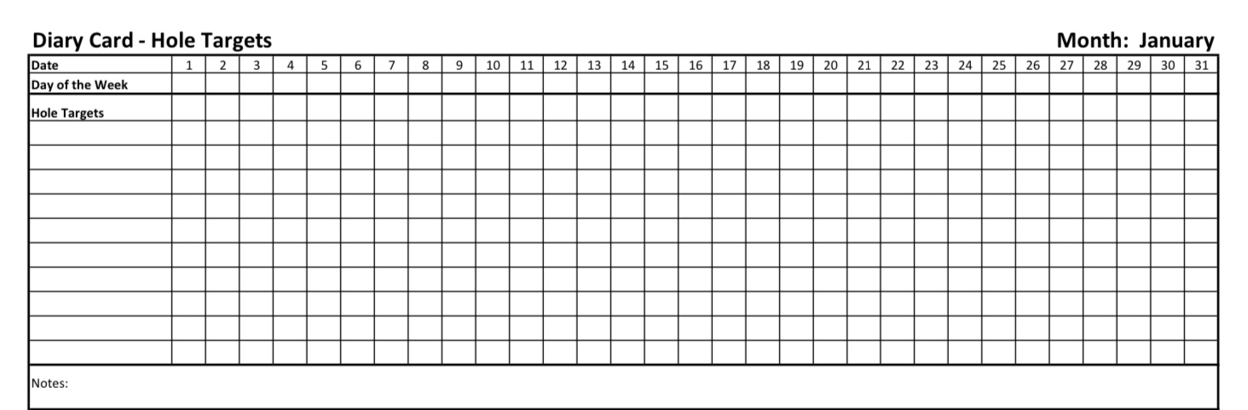

Slide 2
PLEASE START RECORDING

Slide 3
Welcome to simple week 5
Our first practice: Crisis plans
Introducing the second simple tool: holes (or targets) diary cards
Distress tolerance skills part III

Slide 4

Welcome to Session 5
SESSION 5 · INTRODUCTION
Over the last few weeks we’ve discussed our first tool, crisis plans. Today we put crisis plans into practice in an example working with Chris.
We then introduce the second SIMPLE tool, the holes or targets for change diary cards
In the last part of today’s session, we’ll discuss five more DBT skills that can help to bring ourselves back into the window of tolerance.
1
Practice
Preparing a crisis plan with Chris
Today’s theme
From climbing out of the hole… to noticing which step of the stairs we’re on.
2
The second SIMPLE tool
Holes or targets for change diary cards (SIMPLE manual, session 5)
Crisis plans help us at the bottom of a hole. Diary cards help us notice the slide before we get there.
3
Advanced distress tolerance
Skills training workbook, pp. 33–46
Notes:
Welcome everyone to session 5. Today has three parts. First, Chris has kindly volunteered to walk us through a crisis plan using the 8-step crisis plan algorithm we learned last week. Second, we introduce the second SIMPLE tool, holes diary cards, from session 5 of the SIMPLE manual. Third, we cover the advanced distress tolerance skills on pages 33 to 46 of the skills training workbook: safe-place visualization, cue-controlled relaxation, rediscovering your values, rehearsing values-based behavior, and connecting with your higher power.

Slide 5


Building on the first tool
WHERE WE ARE IN THE COURSE
The six SIMPLE tools build on each other in order, like a house: foundation first, then the frame, then the wiring and plumbing.
TOOL 1
TOOL 2
TOOL 3
TOOL 4
TOOL 5
TOOL 6
Crisis plans
Holes or targets for change diary cards
Holes or targets for change analysis
Rational mind remediation
Goals diary cards
Self-led remediation
Learned last week
TODAY
Coming later
Coming later
Coming later
Coming later
Crisis plans (tool 1)
Holes or targets for change diary cards (tool 2)
A quick but helpful fix for when we’re already at the bottom of a hole: all or nothing — either we’re in a crisis or we’re not. Today we practise the 8-step crisis plan algorithm and template with Chris.
For everyday awareness: a staircase with 10 steps, tracking how intense our problem feelings, thoughts, and behaviors are, day by day — before they become a crisis.
Notes:
Here is where we are in the course. Last week we learned the first tool, crisis plans. Today we add the second tool, holes diary cards. The order matters: the holes diary card is the foundation for every tool that follows. Crisis plans work with holes in an all-or-nothing way. Diary cards are more subtle: they treat our difficulties like a staircase with 10 steps, so we can see when we’re slipping before we reach the bottom.

Slide 6


Questions to KEEP in mind today
BEFORE WE BEGIN
Crisis plan
Diary card targets
As Chris works through the 8 steps of the algorithm, which step would be hardest for me, and which hole would I build my own plan around?
Which feeling, thought, or behavioral holes do I keep falling into?
Calming skills
Values and meaning
Where is my safe place? What cue word could I train my body to relax to?
What matters most to me, and how closely does the way I spend my time match it? What helps me feel connected to something bigger?
Have handy: your crisis plan algorithm and template, a blank holes or targets for change diary card and a pen.
Notes:
A few questions to keep in mind as we go. You don’t need to answer them now — just let them sit in the background. Please have your crisis plan template, a blank holes diary card, and your workbook handy, because later in the session we’ll take five minutes to choose your first diary card targets.

Slide 7

Warning about meditation
Feel free to skip it

Slide 8
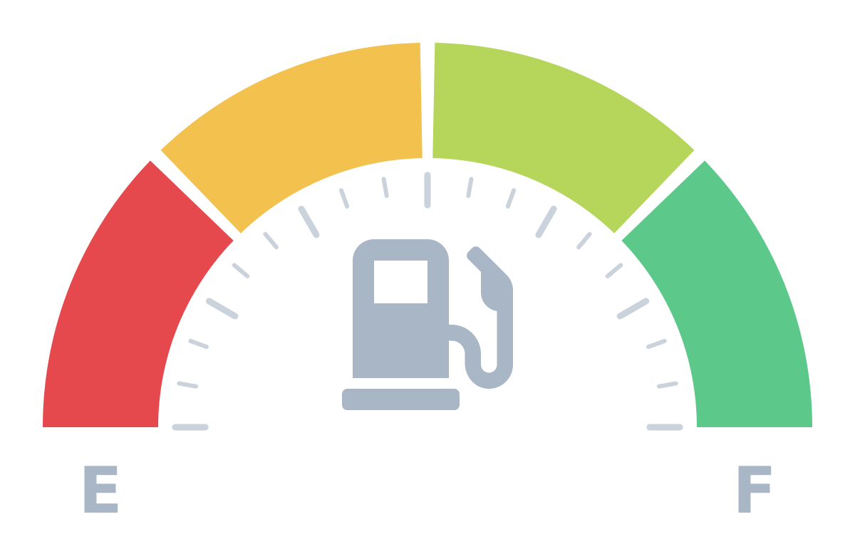
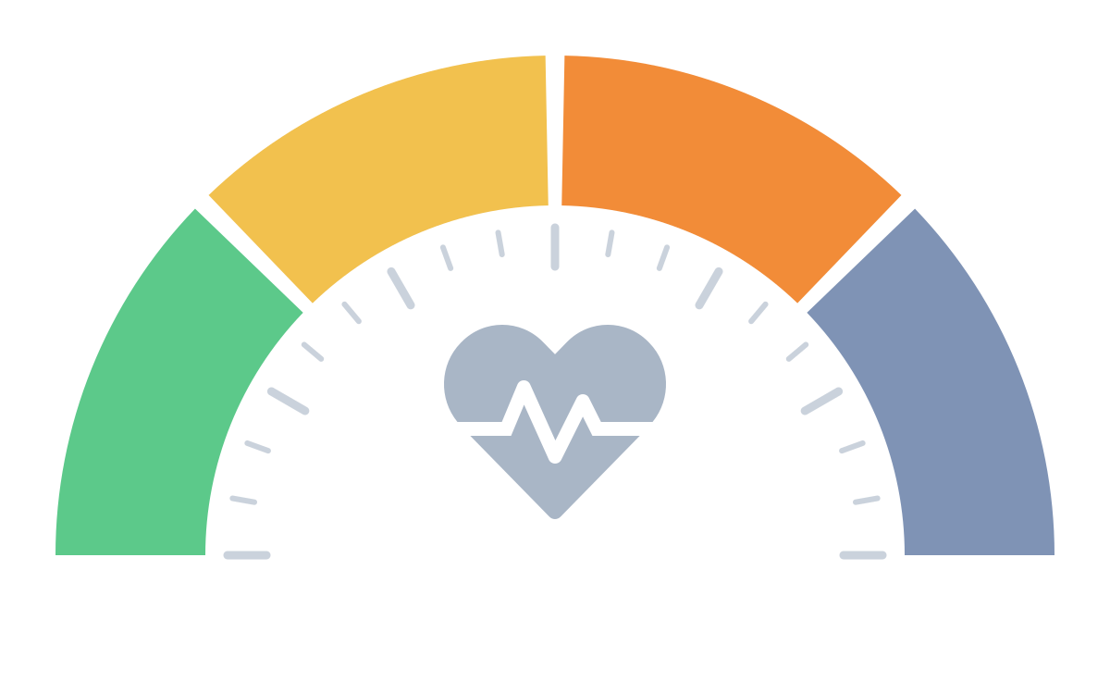
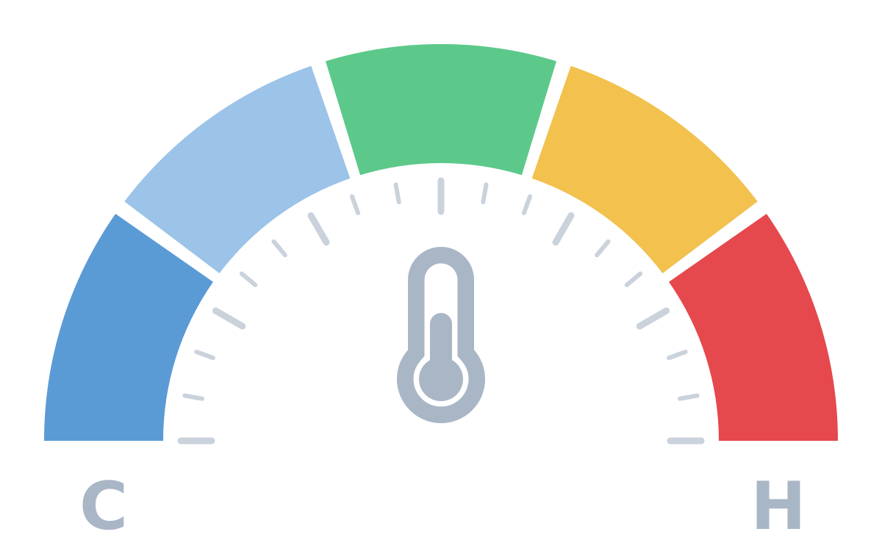
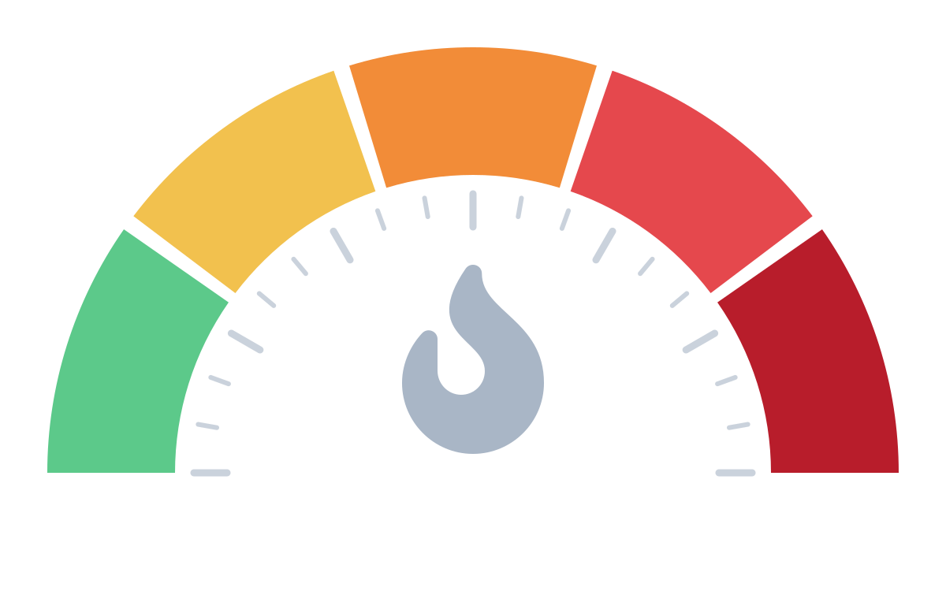
CHECK IN WITH YOUR PERSONAL DASHBOARD
Pause, take a breath, and read each gauge in turn. Just notice there are no wrong readings.
1
Energy reserves
2
State of activation
3
Window of tolerance
4
Crisis risk
How much fuel is in my tank right now?
Which state am I mostly in at the moment?
Am I inside my window, or above it (revved up) or below it (shut down)?
How likely is it that I’ll tip into a state of crisis?
Near empty
½
¾
Full
Calm
Flight
Fight
Freeze / shut down
numb, depressed, dissociated
Well below
A little below
Inside
A little above
Well above
Low
Moderate
High
Very high
Extreme
Then ask: Given these readings, what do I need right now?
Notes:
Facilitator script (about 2 minutes, slow pace):
Let's take a moment to check in with our dashboards. Settle into your seat, feet on the floor, and take one slow breath.
1. Energy: Notice your body. How much fuel is in the tank right now: near empty, half, three-quarters, or full?
2. Activation: Which state are you mostly in? Calm and connected; flight (worried, anxious, wanting to escape); fight (irritated, angry, braced); or freeze / shut down (numb, flat, far away).
3. Window of tolerance: Are you inside your window, where you can feel things and still think clearly? Or a little or well above it (revved up, overwhelmed), or below it (numb, shut down)?
4. Crisis risk: Putting it together, how likely is it that you'll tip into crisis today: low, moderate, high, very high, or extreme?
Then ask: Given these readings, what do I need right now? A skill to cool down or calm the body, something to re-energise, rest, connection, or reaching out for support.
Remember: there are no wrong readings. The point is noticing, not judging.

Slide 9
CUE CONTROLLED RELAXATION
To begin, sit in a comfortable chair with your feet flat on the floor and your hands resting comfortably, either on the arms of the chair or in your lap.
Close your eyes.
Take a slow, long breath in through your nose. Feel your belly expand like a balloon as you breathe in. Hold it for five seconds: 1, 2, 3, 4, 5. Then release it slowly through your mouth. Feel your belly collapse like a balloon losing its air. Again, take a slow, long breath in through your nose and feel your stomach expand. Hold it for five seconds: 1, 2, 3, 4, 5. Then exhale slowly through your mouth. One more time: take a slow, long breath in through your nose and feel your stomach expand. Hold it for five seconds: 1, 2, 3, 4, 5. Then exhale slowly through your mouth.
Now begin to take slow, long breaths without holding them, and continue to breathe smoothly for the rest of this exercise.
Now, with your eyes still closed, imagine that a white beam of light shines down from the sky like a bright laser and lands on the very top of your head.
Notice how warm and soothing the light makes you feel. This could be a light from God, the universe, or whatever power makes you feel comfortable.
As you continue to breathe smoothly, taking slow, long breaths, notice how the light makes you feel more and more relaxed as it continues to shine on the top of your head.
Now, slowly, the warm, white light begins to spread over the top of your head like soothing water. And as it does, the light begins to loosen any muscle tension that you’re feeling on the top of your head.
Slowly, the light begins to slide down your body, and as it moves across your forehead, all the muscle tension there is released.
Then the white light continues down past your ears, the back of your head, your eyes, nose, mouth, and chin, and it continues to release any tension you’re holding there.
Notice how pleasantly warm your forehead feels.

Slide 10
Now, slowly, imagine that the light begins to move down your neck and over your shoulders, releasing any muscle tension. Then the light slowly proceeds down both of your arms and the front and back of your torso.
Feel the muscles in your upper and lower back release. Notice the soothing sensation of the white light as it moves across your chest and stomach.
Feel the muscles in your arms release as the light moves down to your forearms and then across both sides of your hands to your fingertips.
Now notice the light moving down through your pelvis and buttocks and feel the tension being released.
Again, feel the light move like soothing water across your upper and lower legs until it spreads across both the upper and lower surfaces of your feet.
Feel all of the tension leaving the muscles of your body as the white light makes your body feel warm and relaxed.
Continue to notice how peaceful and calm you feel as you continue to take slow, long, smooth breaths.
Observe how your stomach continues to expand as you inhale, and feel it deflate as you exhale.
Now, as you continue breathing, silently think to yourself “breathe in” as you inhale, and then silently think the word relax as you exhale.
Slowly inhale and think: “breathe in.” Slowly exhale and think: “relax.” As you do, notice your entire body feeling relaxed at the same time.
Feel all the muscle tension in your body being released as you focus on the word relax.
Again, inhale and think: “breathe in.” Exhale and think: “relax.” Notice your entire body releasing any muscle tension.
Again, inhale…“ breathe in.” Exhale…“ relax.” Feel all the tension in your body releasing.
Continue breathing and thinking these words at your own pace for several minutes.
With each breath, notice how relaxed your entire body feels.
When your mind begins to wander, return your focus to the words “breathe in” and “relax.”

Slide 11
Practice the cue-controlled relaxation technique twice a day, and record how long it takes you to feel relaxed.
With daily practice, this technique should help you relax more quickly each time.
Again, remember that the ultimate goal of this technique is to train your entire body to relax simply when you think of your cue word, such as “relax.”
This will only come with regular practice. Initially, you might also have to think of the white-light imagery and engage in slow, deep breathing to help yourself relax. But with practice, this technique can help you relax in many distressing situations.
You can also combine this exercise with the previous safe-place visualization. Engaging in cue-controlled relaxation first will help you feel even more safe and calm in that visualization process.
If you closed your eyes, you can now open them and take a moment to return to the room. Look around, notice where you are.

Slide 12


Slide 13
SIMPLE COURSE SCHEDULE 2026-27
Week 1- October 7
Week 2- October 14
Week 3- October 21
Week 4- October 28
Week 5- November 4
Week 6- November 11
Week 7- November 18
Week 8- November 25
Week 9- December 2
Week 10- December 9
Week 11- December 16
Week 12-December 23
December 30 no course
Week 13- January 6
Week 14- January 13
Week 15- January 20
Week 16- January 27
Week 17- February 3
Week 18- February 10
Week 19- February 17
Week 20- February 24
Week 21- March 3
Week 22- March 10
March 17 and 24 no course
Week 23- March 31
Week 24- April 7
Week 25- April 14
Week 26- April 21
Week 27- April 28
Week 28- May 5
Week 29- May 12
Week 30- May 19
Week 31- May 26
Week 32- June 2
Week 33- June 9

Slide 14
PRACTICE SESSIONS SCHEDULE
If your name is on the following schedule and shouldn't be, if it’s the wrong week, or if you volunteered and don’t see your name, please email us.
There are still 3 weeks open all for IFS work. Email us if you want to volunteer for one of those.

Slide 15
PRACTICE SESSIONS SCHEDULE
Date Preparation Subject Volunteer
1. Week 5 November 4 TODAY Crisis Plans Chris P.
2. Week 6 November 11 TODAY November 4 , 1:30 Holes diary cards Rona G.
3. Week 10 December 9 December 2, 1:30 Chain analysis Janet L.
4. Week 14 January 13 January 6, 1:30 Rational mind remediation Elaine S.
5. Week 18 February 10 February 3, 1:30 goals diary card Jeremy B.
6. Week 24 April 7 March 31, 1:30 IFS workbook 1
7. Week 25 April 14 April 7 IFS workbook 2 Leah S.
8.Week 26 April 21 April 14 IFS workbook 3
9. Week 27 April 28 April 21 IFS workbook 4 Rona G
10. Week 28 May 5 April 28 IFS workbook 5
11.Week 29 May 12 May 5 1:30 PM Self-led remediation Jeremy B.

Slide 16

Homework from the past week
Continue tracking and practicing the skills you are learning. Use the DBT diary card or keep your own skills list.
Submit questions or comments to itssimple2023@gmail.com
Skills training workbook p. 33-46.
Simple manual session 5
Create your distraction plan. Create your relaxation plan. You can incorporate both into your crisis plan.
Continue working on your crisis plans. Memorize them and practice them in your imagination. Use your distraction and relaxation plans to complete your crisis plans.

Slide 17
Homework for the coming week
Submit
Submit questions or comments to itssimple2023@gmail.co
Read
Simple manual session 6
Start
Find your targets and start using your diary card.
Read
Skills training workbook p.47-68
Keep
Keep tracking and practicing all the skills you’re learning. Use the DBT diary card or your own skills list.

Slide 18

Skills training workbook p. 47-68
distress tolerance part 4 - advanced distress tolerance covers:
1. Live in the present moment
2. Use self encouraging coping thoughts.
3. Radical acceptance.
4. Self affirming statements
5. Feelings – threat balance
6. Create new coping strategies.
7. Create an emergency coping plan

Slide 19
HOMEWORK HABITS CHECKLIST
Circle or check what you will try this week.
1. Preparation habits
■ I schedule a specific time for homework.
■ I choose a consistent location with minimal distractions.
■ I gather what I need ahead of time (notebook, worksheet, pen).
2. Focus & pacing habits
■ I start with a tiny step (2–5 minutes).
■ I use a timer (10–15 minutes).
■ I remove distractions (phone away / Do Not Disturb).

Slide 20
HOMEWORK HABITS CHECKLIST
3. Tracking & organization habits
■ I keep materials in one place (binder / folder / notebook).
■ I write down insights right after doing the homework.
4. Self-compassion habits
■ I aim for progress, not perfection.
■ I notice resistance without judgment.
5. Accountability habits
■ I review my week: What worked? What didn’t?
■ I share honestly with my buddy — even when I didn’t do it.
Micro commitment:
This week I will focus on: ■ Time ■ Place ■ Tiny step ■ Timer ■ Other please specify:

Slide 21


Roger, the Avondale church custodian, asked us to kindly bring our indoor footwear and leave our outdoor shoes/boots under the bench at the entrance now that it’s about to get yucky.
WEEKLY ANNOUNCEMENTS

Slide 22

BOING/HOMEWORK GROUPS
This past Monday we had 3 participants for the 12-12:30 homework group and 5 for the boing group.
We had a very interesting group with great participation.
The optimal number of participants is in the range of 7 to 14 people. That adds even more to our conversation.
We encourage you to come Monday’s
Joan and Nicole will have at least one more homework group beyond that it depends on your interest.
Dr. Cleto plans to continue boing as long as there are at least 3 to 4 people coming

Slide 23
LAST WEEK’S IN PERSON POLL
1. I have suicidal thoughts (single choice)
a) Never 33%
b) Occasionally 50%
c) Often 9%
d) all the time 8%
2. I have attempted suicide
a) Never 58%
b) 1 or 2 times in my life 33%
c) More than 2 times 8%
3. I’ve self harmed without suicidal intent (includes cutting or scratching,
burning, hitting or punching objects or oneself, severe skin picking, taking
small overdoses, starving oneself or extreme exercise, intentionally
exposing self to extreme cold or heat etc. (single choice)
a) Never 42%
b) Occasionally 42%
c) Often 17%
d) Very often 0%
4. I have a good plan to deal with my suicidal and self harming thoughts
(single choice)
a) Yes 67%
b) No 33%
c) n/a 0%

Slide 24

IN THE NEWS
News items in mental health & neuroscience
“Why Americans Stopped Throwing Dinner Parties,” Derek Thompson, The Atlantic, October 2026
Curtesy of Rob

Slide 25




In the News: The Vanishing Dinner Party
Hosting friends or family at home at least monthly
Why it's happening
42%
→
12%
Harried lives
Intensive parenting
1975
2026
After a full workday, especially with two earners, planning a gathering feels like more work.
Evenings that once went to hosting adults now go to children.
A 70% drop in 50 years.
And we didn't just move it to restaurants: face-to-face socializing fell overall, and more people now eat out alone.
Fewer close friends
Home is too comfortable
Friendship networks are shrinking, most of all for people with less education.
Nearly 2 more hours a day at home than in 2003, mostly with screens.
Notes:
Source: Derek Thompson, 'Why Americans Stopped Throwing Dinner Parties,' The Atlantic, Oct 2026 (also on his Substack as 'You Are No Longer Invited to Dinner'). Data: Data For Progress replication of the DDB Needham Life Style surveys used in Putnam's Bowling Alone. Note: these are American figures; Canadian trends are likely similar but weren't measured here.

Slide 26


Why This Matters TO Us
For SIMPLE
The big idea
Technology hasn't made people unnecessary at work, but it has made them less necessary to our leisure.
Thompson calls this a coordination problem more than a personal failing. A screen asks nothing of us. A dinner party asks for matching schedules, cleaning, cooking, some awkwardness, and the risk the evening falls flat.
We regulate our emotions better in the company of others.
When connection takes effort and screens take none, isolation creeps in without anyone choosing it.
Lower the bar: a potluck, a coffee, a walk.
Ask yourself
When did you last have someone over, or visit someone's home? What got in the way?
What's the simplest version of "having people over" you could manage this month?
Notes:
Possible tie-in: the SIMPLE Christmas get-together as a low-pressure example of gathering.

Slide 27
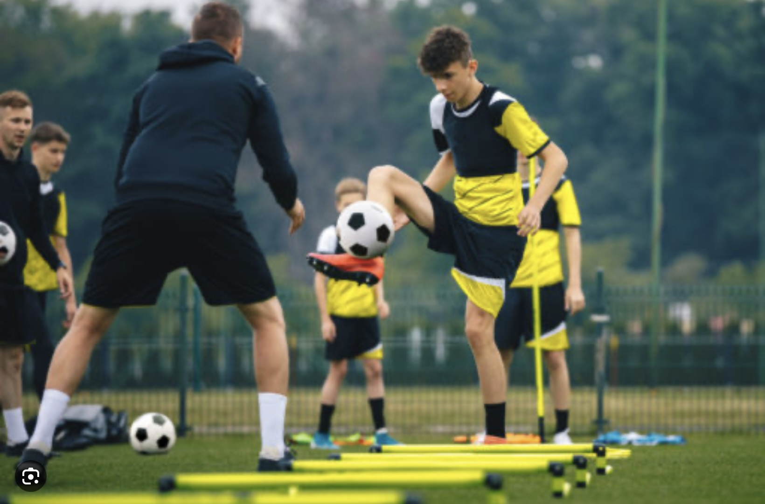
What we will do today
Practice preparing a crisis plan with Chris

Slide 28

four techniques AND strategies FOR TOOL USE
When using the tools:
1. follow the steps described in the algorithms provided. This will help you adhere to good problem-solving practices.
2. be mindful of your internal personal “dashboard” or “instrument panel” by:
a) Monitoring your energy balance.
b) Being mindful of your crisis risk level.
c) Staying in the window of emotional tolerance
d) being aware of your state of activation
3. Stay in the window of tolerance by pendulating.
4. Use editing, splicing and pasting of the “videos” of problematic thoughts, feelings or behaviors to practice and develop new videos.
Notes:
The dashboard of the car gives the driver critical information about the state of the vehicle. This is extremely useful in avoiding trouble such as running out of gas. In simple we suggest people develop and imaginal dashboard with four instruments that helps them be mindful of their physiological states and stay out of trouble by for example filling their "gas tank" before they run out of gas.

Slide 29
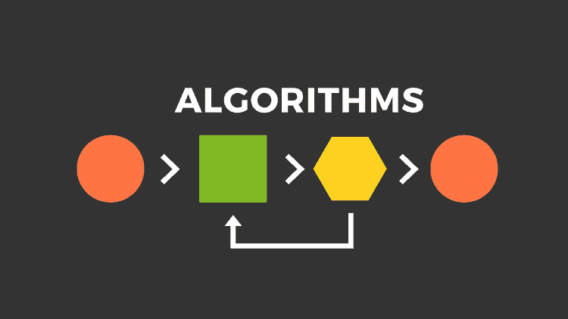
Crisis plan algorithm
8 STEPS
Developing your crisis plans and becoming skilled at using them involves 8 steps: This is the first Simple algorithm.
1. Understand the concept of holes you keep falling into or the specific crisis for which you are going to use the crisis plans
2. Identify some of the thoughts, feelings or behaviors that occur during the crisis that you want to work on. This is step 1 on the crisis plan template.
3. Complete the rest of your crisis plan template
4. Recall, in your mind, a real crisis from the past in which you fell into the hole you are working on and use the "editing, splicing, and pasting" technique, along with your skills and tools, to imagine a different outcome that incorporates your crisis plan.
5. Stay in the window of tolerance while editing, splicing, and pasting by pendulating.
6. Repeatedly visualize the new edited, spliced, and pasted version of the situation until you can visualize it without effort.
7. When a new crisis occurs work with it following these same steps.
8. practice, practice, practice.

Slide 30
four techniques AND strategies FOR TOOL USE
When using the tools:
1. follow the steps described in the algorithms provided. This will help you adhere to good problem-solving practices.
2. be mindful of your internal personal “dashboard” or “instrument panel” by:
a) Monitoring your energy balance.
b) Being mindful of your crisis risk level.
c) Staying in the window of emotional tolerance
d) being aware of your state of activation
3. Stay in the window of tolerance by pendulating.
4. Use editing, splicing and pasting of the “videos” of problematic thoughts, feelings or behaviors to practice and develop new videos.
Notes:
The dashboard of the car gives the driver critical information about the state of the vehicle. This is extremely useful in avoiding trouble such as running out of gas. In simple we suggest people develop and imaginal dashboard with four instruments that helps them be mindful of their physiological states and stay out of trouble by for example filling their "gas tank" before they run out of gas.

Slide 31
CHECK IN WITH YOUR PERSONAL DASHBOARD
Pause, take a breath, and read each gauge in turn. Just notice there are no wrong readings.
1
Energy reserves
2
State of activation
3
Window of tolerance
4
Crisis risk
How much fuel is in my tank right now?
Which state am I mostly in at the moment?
Am I inside my window, or above it (revved up) or below it (shut down)?
How likely is it that I’ll tip into a state of crisis?
Near empty
½
¾
Full
Calm
Flight
Fight
Freeze / shut down
numb, depressed, dissociated
Well below
A little below
Inside
A little above
Well above
Low
Moderate
High
Very high
Extreme
Then ask: Given these readings, what do I need right now?
Notes:
Facilitator script (about 2 minutes, slow pace):
Let's take a moment to check in with our dashboards. Settle into your seat, feet on the floor, and take one slow breath.
1. Energy: Notice your body. How much fuel is in the tank right now: near empty, half, three-quarters, or full?
2. Activation: Which state are you mostly in? Calm and connected; flight (worried, anxious, wanting to escape); fight (irritated, angry, braced); or freeze / shut down (numb, flat, far away).
3. Window of tolerance: Are you inside your window, where you can feel things and still think clearly? Or a little or well above it (revved up, overwhelmed), or below it (numb, shut down)?
4. Crisis risk: Putting it together, how likely is it that you'll tip into crisis today: low, moderate, high, very high, or extreme?
Then ask: Given these readings, what do I need right now? A skill to cool down or calm the body, something to re-energise, rest, connection, or reaching out for support.
Remember: there are no wrong readings. The point is noticing, not judging.

Slide 32
Crisis plan algorithm STEP 1
Developing your crisis plans and becoming skilled at using them involves 8 steps: This is the first Simple algorithm.
1. Understand the concept of holes you keep falling into or the specific crisis for which you are going to use the crisis plans.
Chris: My son has had some mental health struggles in the past which have caused me great anguish. He’s doing well now but I worry a lot. Recently he’s had some financial difficulties in part related to his mental health struggles. He decided he’d have to declare bankruptcy.
We recently had a phone conversation. I know he’s been procrastinating on the bankruptcy.
At one point in the conversation, I changed the subject and I asked if he needed help with the bankruptcy paperwork or if he should maybe hire a bookkeeper.
He became very angry and yelled at me. He said I was stressing him out and he’d do the paperwork when he was ready.
The conversation ended there.

Slide 33
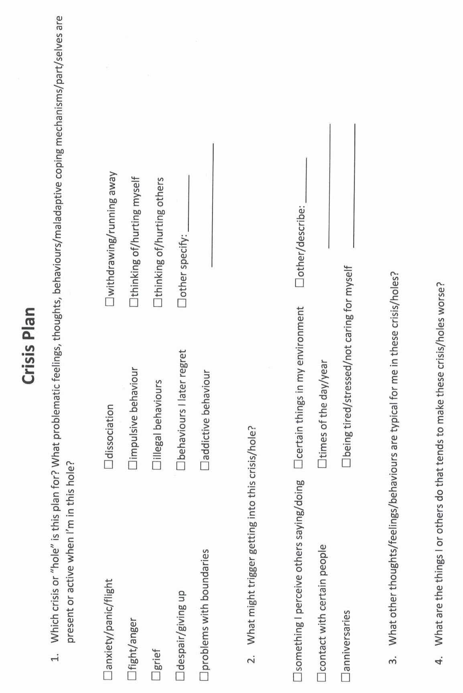
conversation with son
Notes:
Ann's crisis plan
In one of the sessions with her psychiatrist, and worked on a crisis prevention plan for the whole she fell into around the time of her weekly meetings with Jane.
Working with the crisis plan template, and recognize the unhelpful behavior was that, although she forced herself to attend these meetings, she wanted to run away from them, and after the meetings, she withdrew from her usual activities and ruminated.
She was triggered by this work situation because she felt she had no control and felt pressured and devalued.
The warning signs that she was in this whole, word that she would eat more, cry, ruminate, be unable to sleep, isolate herself, and avoid people. Being alone made it worse.
People may fall into holes at unpredictable times, in which case it is crucial to be aware of the warning signs and triggers so that they do not miss the fact that they are in a whole. Ann's patterns were more predictable.
Although she also ruminated during the remainder of the week, and felt most distressed from the day before, to the day after, her meetings with Jane. She felt some relief after the meetings when her worst fears had not materialized. Being aware of this time pattern was helpful in implementing the crisis plan.
As and reviewed the distress tolerance module in the skills training workbook, she thought that distraction, self soothing, and self-care would be good skills to use when she began to ruminate about work.
She decided that the most helpful skills, deal with the whole itself, be radical acceptance, practice relaxation, commitment to valued action, and using coping thoughts and strategies.
And had previously taken a cognitive behavioural therapy course and was familiar with thought records. It seemed to her that DBT's "coping thoughts" were similar, if less structured than thought records. She was good at doing thought records and decided to structure her crisis plan around one.
The situation was that the nursing home had new owners, and and had to meet weekly with chain the manager.
Her feelings around this were anxiety and sadness.
Her automatic thoughts were "I won't be able to cope", "working at the nursing home won't be the same and will be awful", and "I will lose my job and income and I will be poor".
The fact that supported her automatic thinking were:
She did struggle to cope
The company that had taken over the nursing home did not care about her in the way Ezra and Ruth did.
To this company nursing homes were a business and making money was important.
If she did lose her job, should be financially in distress.

Slide 34
Crisis plan algorithm STEP 2
Developing your crisis plans and becoming skilled at using them involves 8 steps: This is the first Simple algorithm.
2. Identify some of the thoughts, feelings or behaviors that occur during the crisis that you want to work on. This is step 1 on the crisis plan template.
Chris: I felt anxious and panicked
I recognize I may have some issues with boundaries
After the conversation I withdrew and stopped following my usual daily routine.

Slide 35
X
X
X
Notes:
Ann's crisis plan
In one of the sessions with her psychiatrist, and worked on a crisis prevention plan for the whole she fell into around the time of her weekly meetings with Jane.
Working with the crisis plan template, and recognize the unhelpful behavior was that, although she forced herself to attend these meetings, she wanted to run away from them, and after the meetings, she withdrew from her usual activities and ruminated.
She was triggered by this work situation because she felt she had no control and felt pressured and devalued.
The warning signs that she was in this whole, word that she would eat more, cry, ruminate, be unable to sleep, isolate herself, and avoid people. Being alone made it worse.
People may fall into holes at unpredictable times, in which case it is crucial to be aware of the warning signs and triggers so that they do not miss the fact that they are in a whole. Ann's patterns were more predictable.
Although she also ruminated during the remainder of the week, and felt most distressed from the day before, to the day after, her meetings with Jane. She felt some relief after the meetings when her worst fears had not materialized. Being aware of this time pattern was helpful in implementing the crisis plan.
As and reviewed the distress tolerance module in the skills training workbook, she thought that distraction, self soothing, and self-care would be good skills to use when she began to ruminate about work.
She decided that the most helpful skills, deal with the whole itself, be radical acceptance, practice relaxation, commitment to valued action, and using coping thoughts and strategies.
And had previously taken a cognitive behavioural therapy course and was familiar with thought records. It seemed to her that DBT's "coping thoughts" were similar, if less structured than thought records. She was good at doing thought records and decided to structure her crisis plan around one.
The situation was that the nursing home had new owners, and and had to meet weekly with chain the manager.
Her feelings around this were anxiety and sadness.
Her automatic thoughts were "I won't be able to cope", "working at the nursing home won't be the same and will be awful", and "I will lose my job and income and I will be poor".
The fact that supported her automatic thinking were:
She did struggle to cope
The company that had taken over the nursing home did not care about her in the way Ezra and Ruth did.
To this company nursing homes were a business and making money was important.
If she did lose her job, should be financially in distress.

Slide 36
Crisis plan algorithm STEP 3
Developing your crisis plans and becoming skilled at using them involves 8 steps: This is the first Simple algorithm.
3. Complete the rest of your crisis plan template

Slide 37
My perception that he might be being irresponsible and that this might be a sign he’s relapsing.
X
X
X
I isolate, sit by myself and ruminate, I get depressed
Imagining what might happen gets me into a downward spiral.
Notes:
Ann's crisis plan
In one of the sessions with her psychiatrist, and worked on a crisis prevention plan for the whole she fell into around the time of her weekly meetings with Jane.
Working with the crisis plan template, and recognize the unhelpful behavior was that, although she forced herself to attend these meetings, she wanted to run away from them, and after the meetings, she withdrew from her usual activities and ruminated.
She was triggered by this work situation because she felt she had no control and felt pressured and devalued.
The warning signs that she was in this whole, word that she would eat more, cry, ruminate, be unable to sleep, isolate herself, and avoid people. Being alone made it worse.
People may fall into holes at unpredictable times, in which case it is crucial to be aware of the warning signs and triggers so that they do not miss the fact that they are in a whole. Ann's patterns were more predictable.
Although she also ruminated during the remainder of the week, and felt most distressed from the day before, to the day after, her meetings with Jane. She felt some relief after the meetings when her worst fears had not materialized. Being aware of this time pattern was helpful in implementing the crisis plan.
As and reviewed the distress tolerance module in the skills training workbook, she thought that distraction, self soothing, and self-care would be good skills to use when she began to ruminate about work.
She decided that the most helpful skills, deal with the whole itself, be radical acceptance, practice relaxation, commitment to valued action, and using coping thoughts and strategies.
And had previously taken a cognitive behavioural therapy course and was familiar with thought records. It seemed to her that DBT's "coping thoughts" were similar, if less structured than thought records. She was good at doing thought records and decided to structure her crisis plan around one.
The situation was that the nursing home had new owners, and and had to meet weekly with chain the manager.
Her feelings around this were anxiety and sadness.
Her automatic thoughts were "I won't be able to cope", "working at the nursing home won't be the same and will be awful", and "I will lose my job and income and I will be poor".
The fact that supported her automatic thinking were:
She did struggle to cope
The company that had taken over the nursing home did not care about her in the way Ezra and Ruth did.
To this company nursing homes were a business and making money was important.
If she did lose her job, should be financially in distress.

Slide 38
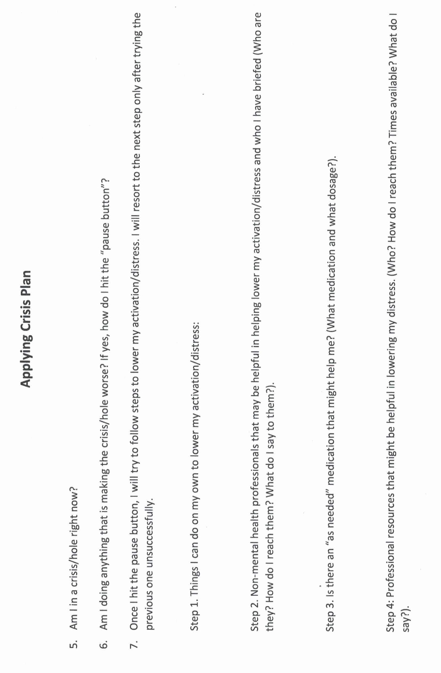
Not now but I can prepare for one when it happens
No, but I need to prepare.
We haven’t covered this yet, but I did the course before
And found the physiological distress tolerance cold water skill quite helpful. Once I do that, I ground myself with the 5,4,3,2,1 skill naming 5 things I see 4 I can feel 3 I can hear etc. repeating this if necessary and then do the higher power by reading one of my favorite passages from the bible. Sometimes I need to repeat these steps several times.
I sometimes use a prayer line.
I have a couple of PRN meds I can use as a last resort.
If nothing else is working I call my psychiatrist

Slide 39
Crisis plan algorithm STEP 4
Developing your crisis plans and becoming skilled at using them involves 8 steps: This is the first Simple algorithm.
4. Recall, in your mind, a real crisis from the past in which you fell into the hole you are working on and use the "editing, splicing, and pasting" technique, along with your skills and tools, to imagine a different outcome that incorporates your crisis plan.
Chris: I used the episode I mentioned above. I picture myself using the skills instead of ruminating.

Slide 40
Not now but I can prepare for one when it happens
No but I need to prepare.
We haven’t covered this yet, but I did the course before
And found the physiological distress tolerance cold water skill quite helpful. Once I do that, I ground myself with the 5,4,3,2,1 skill naming 5 things I see 4 I can feel 3 I can hear etc. repeating this if necessary and then do the higher power by reading one of my favorite passages from the bible. Sometimes I need to repeat these steps several times.
I sometimes use a prayer line.
I have a couple of PRN meds I can use as a last resort.
On occasion I’ve called my psychiatrist

Slide 41
Crisis plan algorithm STEP 5
Developing your crisis plans and becoming skilled at using them involves 8 steps: This is the first Simple algorithm.
5. Stay in the window of tolerance while editing, splicing, and pasting by pendulating.
Chris: I pay attention to my personal dashboard and if it’s getting dysregulated, I’ll do my 5,4,3,2,1 grounding exercises until I’m back in the window of tolerance.

Slide 42
Crisis plan algorithm STEP 6
Developing your crisis plans and becoming skilled at using them involves 8 steps: This is the first Simple algorithm.
6. Repeatedly visualize the new edited, spliced, and pasted version of the situation until you can visualize it without effort.
Chris: I try to do this visualization once a day, it only takes 5 minutes and it’s very helpful in preventing future crisis.

Slide 43
Crisis plan algorithm
STEP 7
Developing your crisis plans and becoming skilled at using them involves 8 steps: This is the first Simple algorithm.
7. When a new crisis occurs work with it following these same steps.
Chris: I realize the next crisis will be different but in many ways it will also be similar. I will have something new to work with.

Slide 44
Crisis plan algorithm STEP 8
Developing your crisis plans and becoming skilled at using them involves 8 steps: This is the first Simple algorithm.
8. practice, practice, practice.
Chris: My crisis take so much out of me and can snowball and last for quite a while. Doing crisis plans is a bit of an effort but the more I do them the fewer crisis I’ll have so the payback for the effort I’m putting into it is enormous.
Sometimes when things are OK, I’m tempted to neglect doing this, but I’ve tried to deal with this by creating a habit of checking in with my mental health just like I brush my teeth and pray every day.

Slide 45
QUESTIONS/COMMENTS
Notice how what Chris is doing is taking automatic emotional and somatic mind driven thoughts feelings and behaviors and reflecting and thinking about them in order to change them. Eventually, with lots of practice, these new thoughts feelings and behaviors may become automatic.

Slide 46
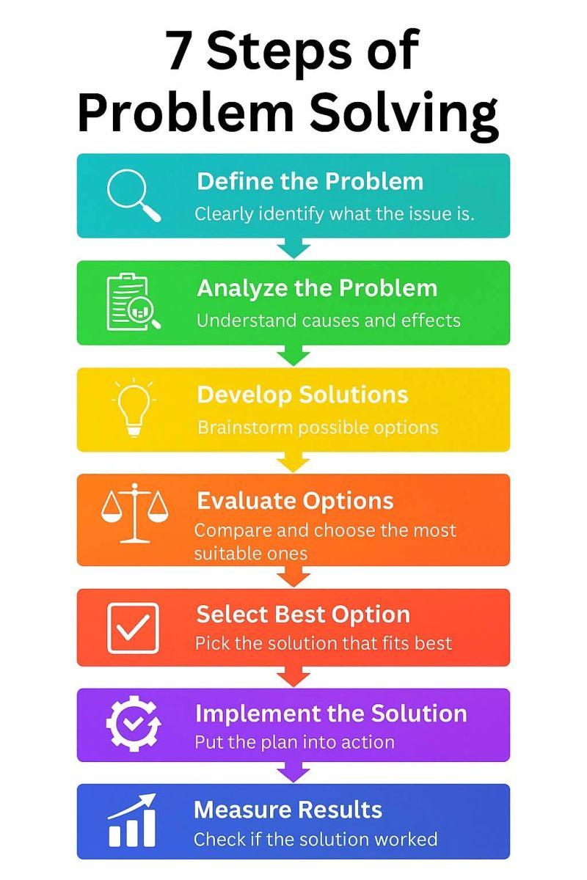
PROBLEM SOLVING WITH THE 6 SIMPLE TOOLS
Crisis plans follow the steps of good problem solving.
Crisis plans are a “beginner” form of mental health problem solving. They can nevertheless be very helpful.
Tools 2 to 5 also follow the steps of good problem solving. Tools 2-5 are a deeper or “intermediate” form of mental health problem solving. They can be even more helpful than crisis plans but they are more complex.
Today we introduce the second Simple tool: holes or targets for change diary cards. This tool focuses on step 1 of good problem solving: defining the problem.
We already defined some problems when we found our crisis plans holes so today will sound familiar to you.
The 6th Simple tool Self-led remediation does the deepest mental health issues problem solving and we will need to understand internal family systems before we can use that tool.
The 6th tool is an “advanced” mental health problem solving tool which can be enormously helpful as it helps us not only to emotionally regulate better but also to process our trauma.

Slide 47
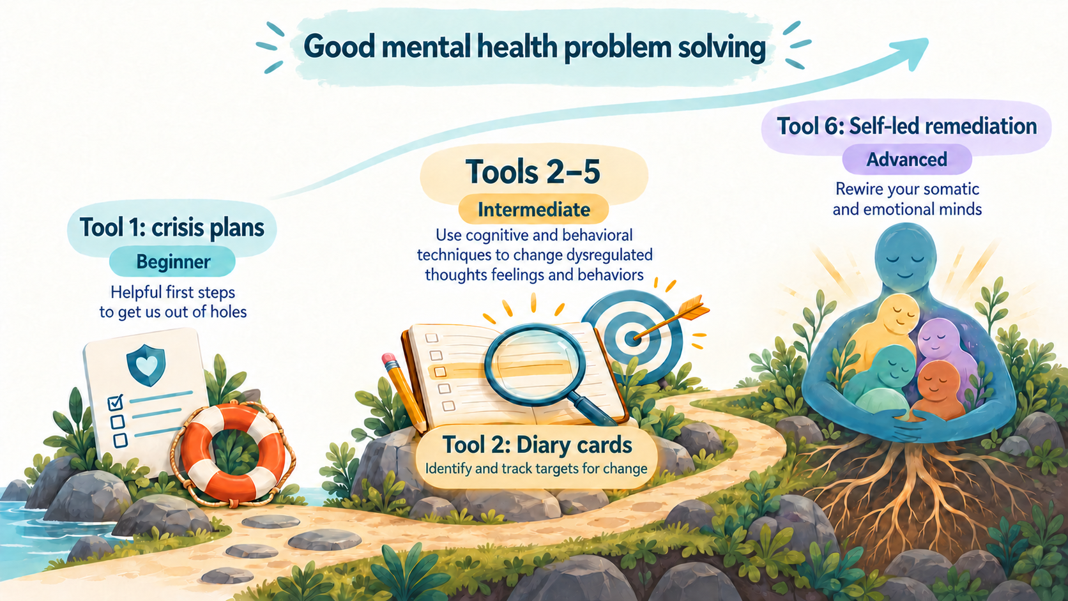

Slide 48

The 6 tools:
Crisis plans
Holes or targets for change diary cards
Holes analysis
Rational mind remediation
Goals diary cards
Self-led remediation

Slide 49
THE HOLES OR TARGETS FOR CHANGE DIARY CARD TEMPLATE
Targets for change
Squares for rating targets
Days of the month

Slide 50
M T W T F S S
struggling.
4 3 6 2 3 10 9
sad.
5 4 7 1 2 8 7
withdrawing
9 8 6 6 5 10 10

Slide 51

The WHAT, How, and why, of “holes” diary cards
1. crisis plans holes vs. diary card targets
2. topography
3. finding your targets for change
4. why do a holes diary card
5. making diary cards a habit

Slide 52

Are holes diary card targets and crisis plan holes the same thing ?

Slide 53
The WHAT, How, and why, of “holes” diary cards
1. crisis plans holes and diary card targets
2. topography
3. finding your targets for change
4. why do a holes diary card
5. making diary cards a habit

Slide 54


1. Crisis plan holes and diary card targets
crisis hole
Both crisis plans and holes diary cards are ways of identifying and working with the “holes in the sidewalk” or dysregulated thoughts feelings or behaviors. They are the same but with some slight differences.
The crisis plan’s holes in the sidewalk metaphor has an all or nothing quality, either we're in a crisis and at the bottom of the hole or we’re not in a hole at all.
Holes diary card targets are more subtle recognizing that there are many degrees of severity or intensity of dysregulated feelings, thoughts, and behaviors. In that way, targets are better represented by the image of a spiral staircase.
Because of this, the metaphor we use for crisis is that of a “hole”, while the one we use for diary cards is of “stairs” with steps.
diary cards steps
Notes:
You are already familiar with the concept of falling into "holes". When we are in crisis we fall into a "hole". The crisis plans are ways of getting out of these holes faster and eventually avoiding them. What holes were to crisis plans, targets are to diary cards. Targets are short for targets for change. Targets are quite like holes.

Slide 55
1. Crisis plan holes and diary card targets
crisis hole
In our holes diary cards, we arbitrarily choose a stairwell that has 10 steps, each step representing a different intensity of the dysregulated feelings, thoughts, or behaviors. We call these dysregulated thoughts, feelings, or behaviors targets for change. (or just “targets”)- this shortened version can create some confusion.
10 is the bottom step of the stairs, 1 is the top step closest to the sidewalk. 10 is the most intense, 1 the least. When you are lower in the staircase, you’re more likely to be in crisis and outside the window of tolerance.
If you prefer, instead of using a numerical 1-10 scale you can use colors ex. Yellow, orange, red, black, which may make it easier to visualize the intensity of the targets.
diary cards steps
Notes:
You are already familiar with the concept of falling into "holes". When we are in crisis we fall into a "hole". The crisis plans are ways of getting out of these holes faster and eventually avoiding them. What holes were to crisis plans, targets are to diary cards. Targets are short for targets for change. Targets are quite like holes.

Slide 56
The WHAT, How, and why, of “holes” diary cards
1. crisis plans holes and diary card targets
2. topography
3. finding your targets for change
4. why do a holes diary card
5. making diary cards a habit

Slide 57
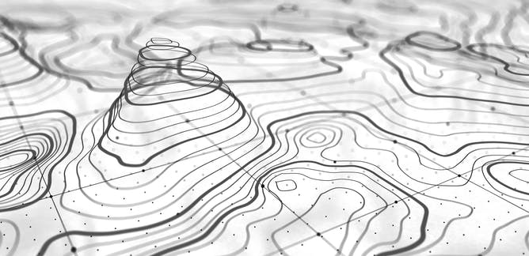
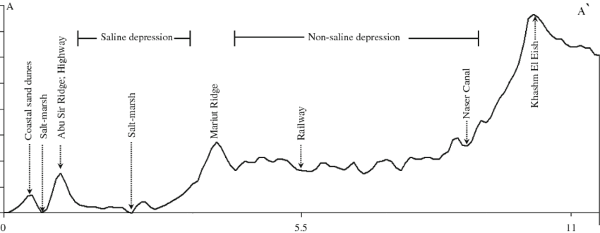
2. In geography “Topography” refers to the arrangement of the physical features, especially the elevation of a certain terrain. In simple we use the word topography to describe how the intensity of a person’s target emotions, thoughts or behaviors fluctuate over a period of time, in other words the topography tracks our journey up and down the stairwell over time.
The “topography” of our target dysregulated feelings, thoughts, or behaviors, can be depicted as a graph in which the horizontal axis is time while the vertical is the variation in intensity of our feelings, thoughts, and behaviors.
These variations can occur faster or slower, over the course of minutes, weeks or even months and years.

Slide 58
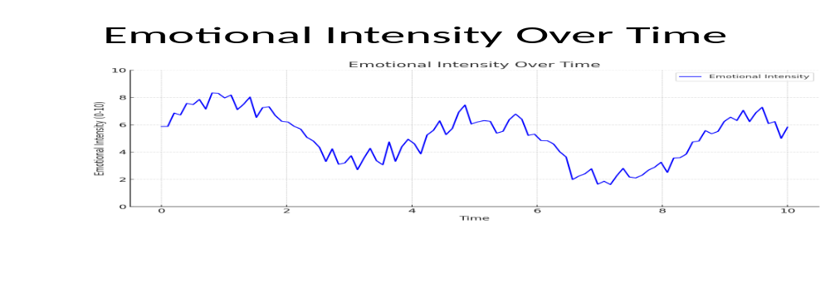
TOPOGRAPHY
This graph shows how the intensity of someone’s emotions may fluctuate over a period of time

Slide 59
The WHAT, How, and why, of “holes” diary cards
1. crisis plans holes and diary card targets
2. topography
3. finding your targets for change
4. why do a holes diary card
5. making diary cards a habit

Slide 60


Diary card targets
= crisis plan holes
3. FINDING YOUR TARGETS FOR CHANGE
To repeat: diary cards targets for change are the same as crisis plan holes. The slight difference is that crisis plan holes are all or nothing, you’re either in a crisis or you’re not, diary card targets vary in intensity from mild to severe.
Both crisis plan holes, and diary card targets are dysregulated physical states, emotions, thoughts, behaviors, or maladaptive coping strategies, that recur in our life, and that we have decided are problematic and want to change.
Examples of holes diary card targets include substance abuse, gambling, or any other addiction, engaging in dysfunctional social interactions, self-blaming, and rumination, excessive irritability or anger towards others.

Slide 61
3. FINDING YOUR TARGETS FOR CHANGE
Item 1 of the crisis plan template suggests some targets for change you may decide apply to you and you may want to use in your diary card: anxiety, anger, despair, problems with boundaries, impulsive behaviors, behaviors a person later regrets, withdrawing/running away, and thinking of/actually hurting self/others.

Slide 62
All these are potential targets
Notes:
A template is a structured form that helps you carry out the steps prescribed in the algorithm. There are many different crisis plans templates. This one is a compilation of some of the best features of other templates.

Slide 63
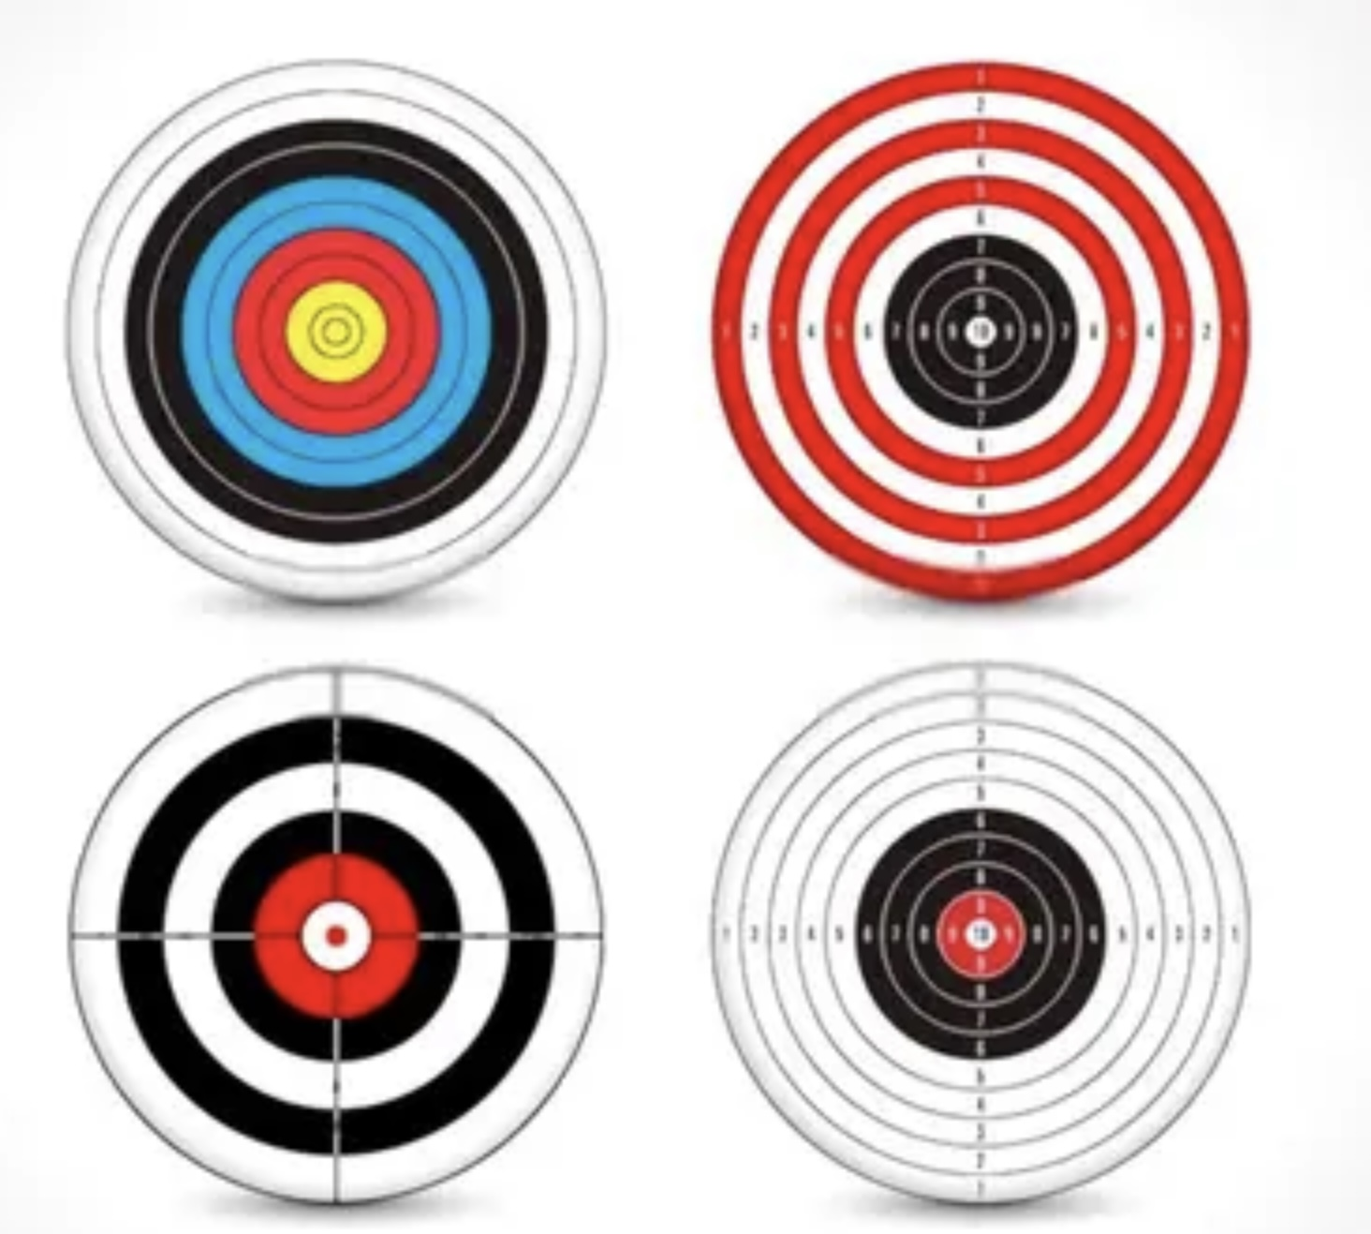
3 TYPES OF DIARY CARD TARGETS
There are beginner, intermediate, and advanced diary card targets. All the examples we have gave above are intermediate targets.
If you have trouble finding an intermediate target, use a “beginner target” in your diary card instead.
Beginner targets are more generic and catch-all than intermediate ones. They are easier to use than the more specific intermediate targets. Beginner targets include struggling, feeling bad, being upset, losing it, getting into trouble, or falling into a hole. Start with one of these.
We won’t discuss advanced targets until later in the course when we explore internal family systems part selves. If you don’t know what IFS is, don’t worry, we’ll get to it.

Slide 64
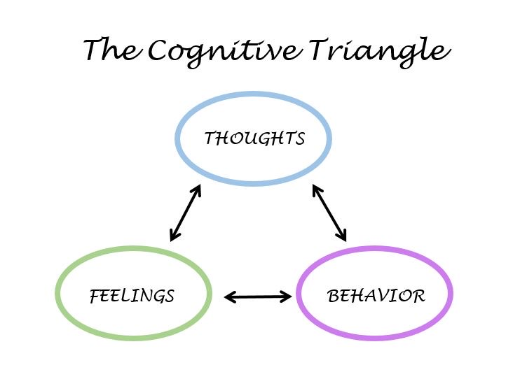
Diary card Targets
Diary card targets can be:
1. Feelings: to help you identify your feelings consult the wheel of feelings (see below) which we also used in trying to identify crisis plan holes.
2. Thoughts: consider ANTS or automatic negative thoughts (below)
3. Behaviors: consult externalizing vs. internalizing behaviors (below}
4. Maladaptive coping strategies: are defined as coping strategies that in the short term decrease your distress but increase it over the long term. Ex. Substance use, self-harm, unhealthy eating.

Slide 65
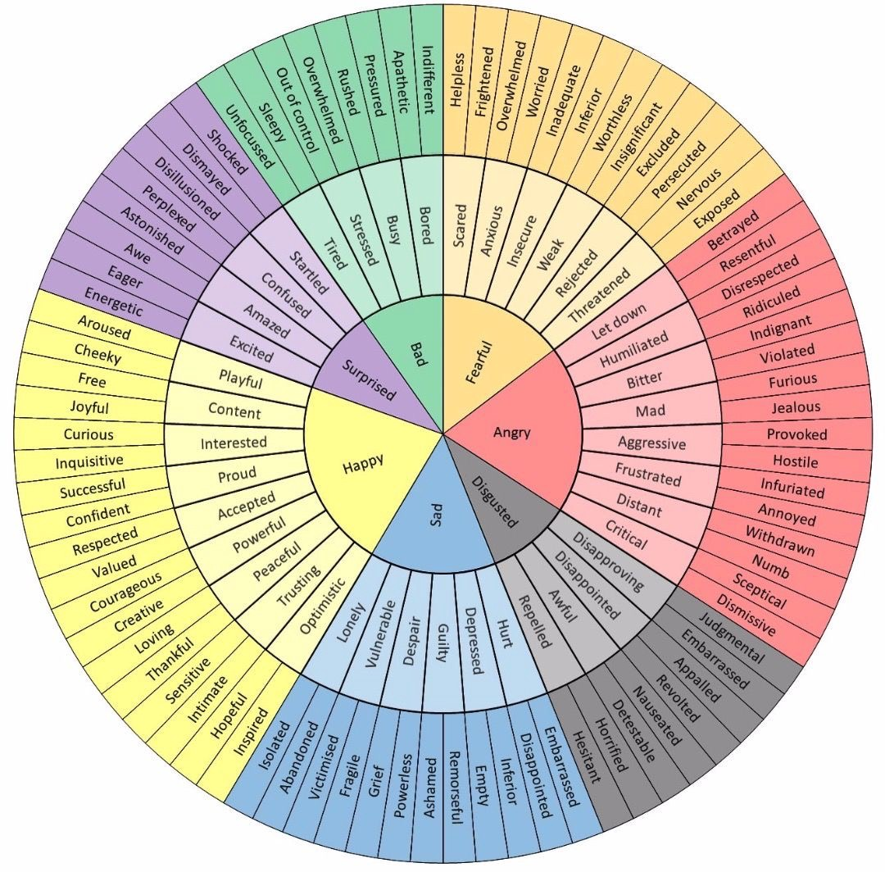
Which feelings from the wheel of feelings do you experience frequently and not necessarily when circumstances entirely merit it?
Notes:
The wheel of feelings, the list of cognitive errors and automatic negative thoughts, and that of internalizing and externalizing behaviours helped you find your holes. They can also help you find your targets which may be the same as your holes or different from them.

Slide 66
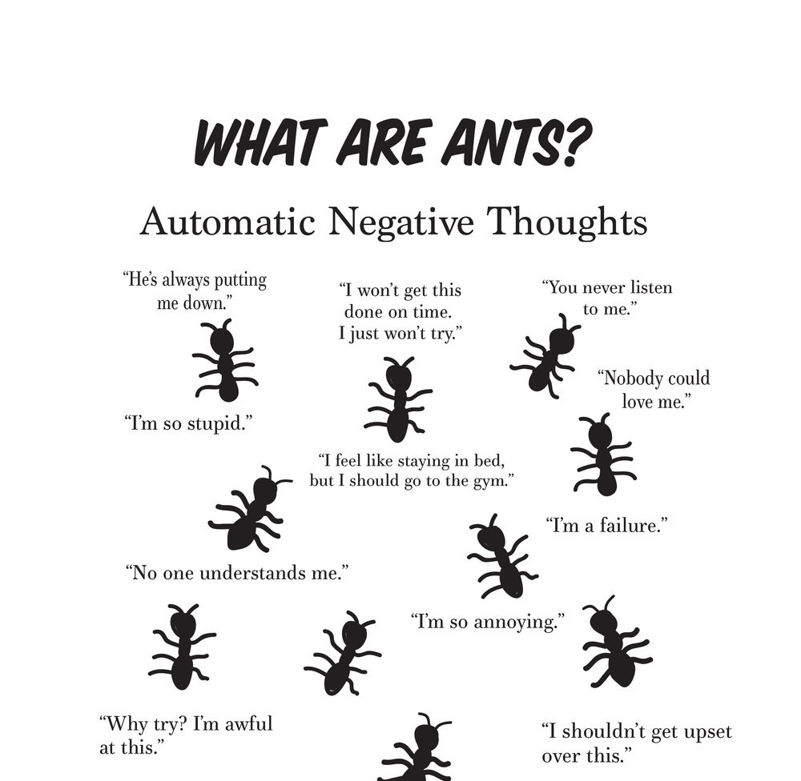
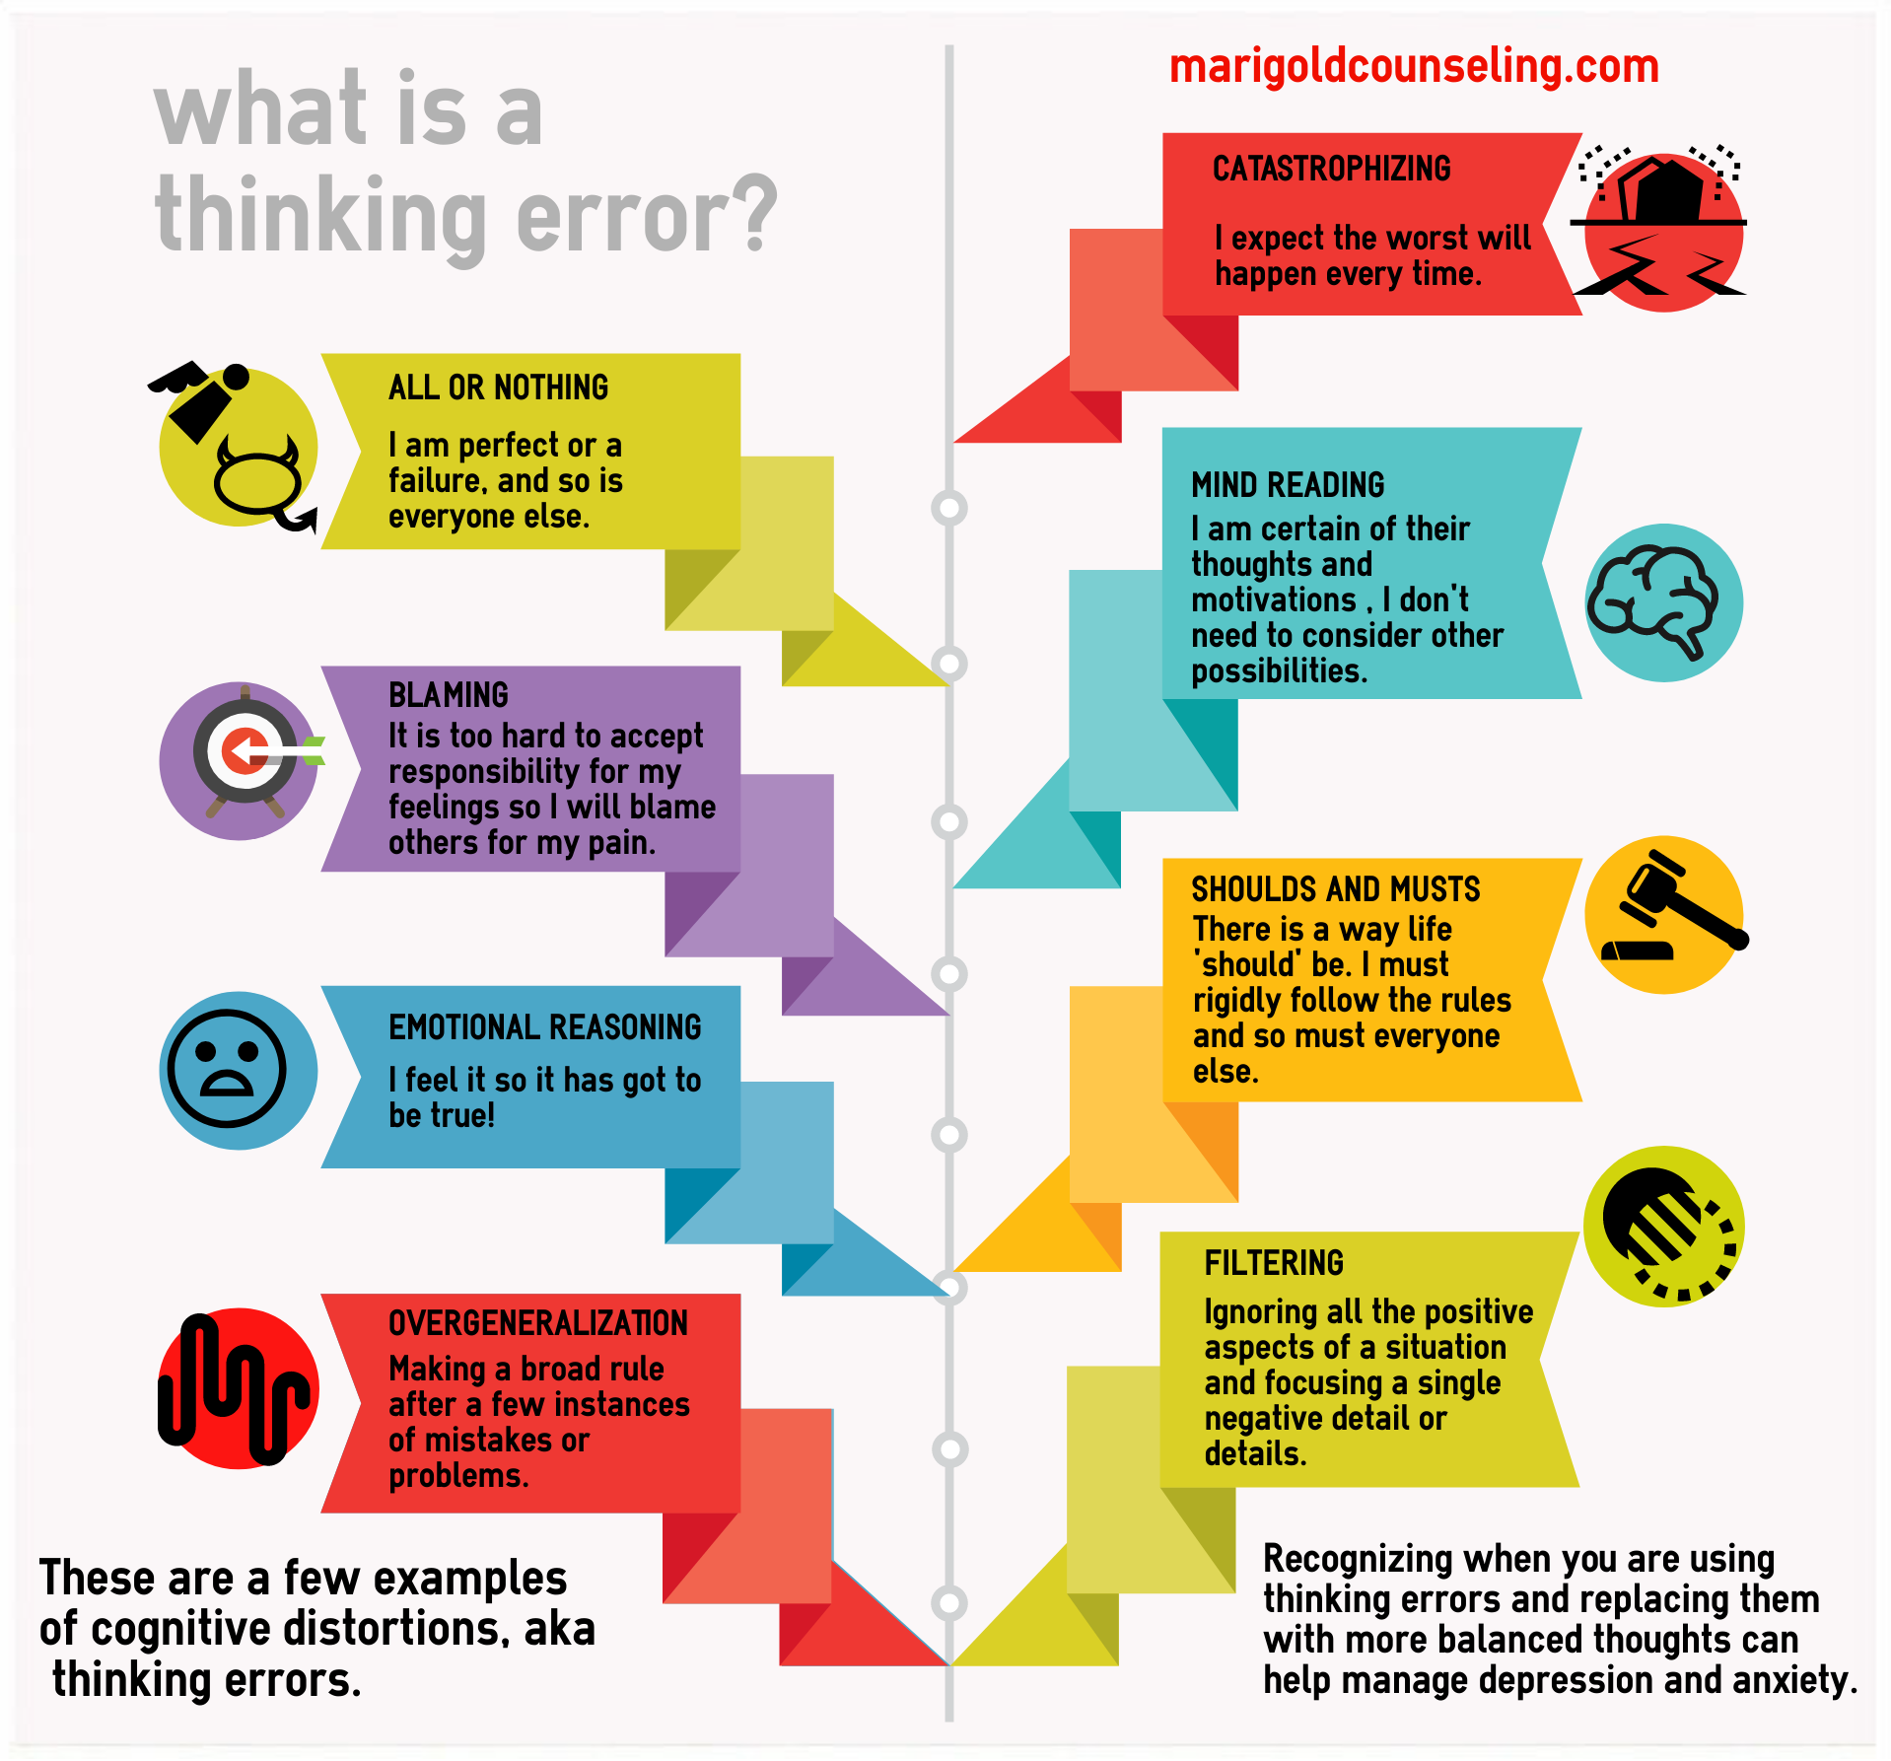
Which thoughts from among the ANTS (below) do you frequently have and not necessarily when circumstances entirely merit it?

Slide 67
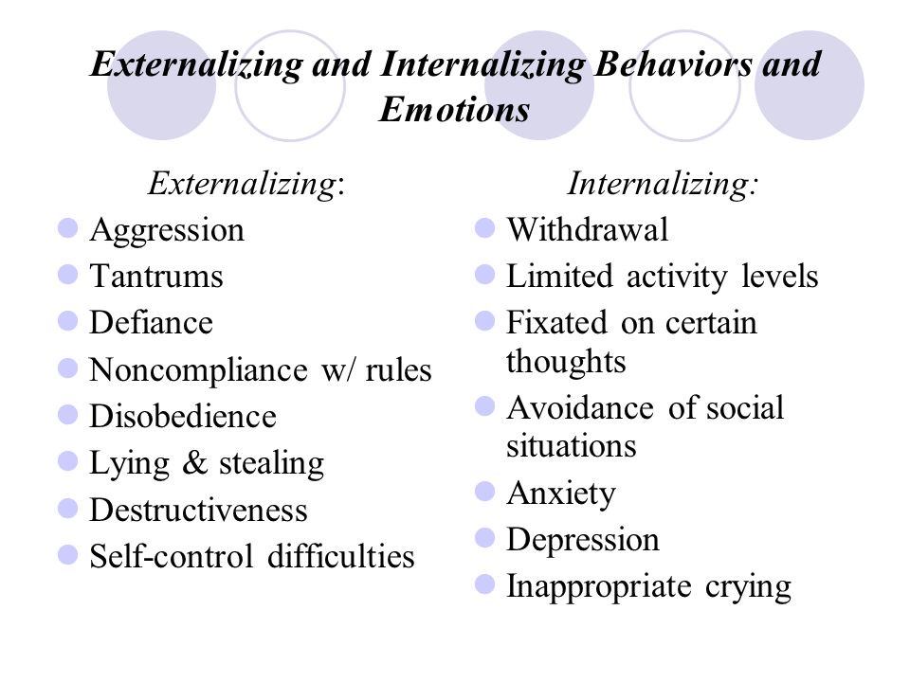
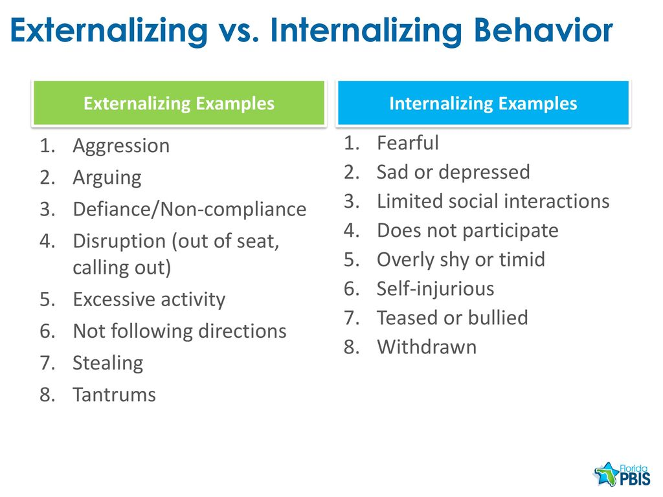
Which behaviors from the lists below do you frequently have and not necessarily when circumstances entirely merit it?

Slide 68

HOW TO FIND YOUR intermediate targets
1. Think about a time when you have been in a hole or crisis, outside the window of tolerance, “lost it”, “struggled”, “felt bad”, “got into trouble”, or were “very upset”. (in other words, start with a beginner targets)
2. When this happened, what were your dominant feelings, thoughts, or behaviors? (use the wheel of feelings, thinking errors and ANTS, and the internalizing and externalizing behaviors slides to help you)
3. From these choose from 1 to 3 feelings, thoughts, or behaviors that a)you experience frequently, b)are problematic for you, and c)you want to change.
4. These are your intermediate targets.
Intermediate targets change over time so go through this same process occasionally especially if your life circumstances are changing.

Slide 69
Intermediate targets checklist
HOLES DIARY CARDS · FINDING YOUR TARGETS
Tick those you experience often, that are problematic, and you want to change. Then choose 1–3 for your diary card.
Feelings
Use the wheel of feelings
Thoughts
Use thinking errors and ANTS
Behaviors
Internalizing, externalizing, and coping
Anxiety or worry
Ruminating
Withdrawing or isolating
Fear or panic
All-or-nothing thinking
Avoiding people or situations
Sadness or despair
Catastrophizing
Dropping my daily routine
Anger or irritability
Self-blame or self-criticism
Procrastinating
Shame
Mind reading
Angry outbursts or yelling
Guilt
Predicting the worst
Problems with boundaries
Loneliness
Emotional reasoning
Impulsive actions or spending
Feeling overwhelmed
“Always” or “never” thinking
Behaviors I later regret
Hopelessness
“Should” statements
Unhealthy eating
Feeling hurt or rejected
Discounting the positive
Alcohol, drugs, or gambling
Emptiness or numbness
Blaming others
Hurting myself (or urges to)
Other: ____________________
Other: ____________________
Other: ____________________
Notes:
This checklist offers common intermediate targets to help you find the ones for your holes diary card. Intermediate targets are the same kinds of things as crisis plan holes: feelings, thoughts, behaviors, or maladaptive coping strategies that recur and that you want to change. Tick the ones that you experience often, even when circumstances don’t fully merit it, that are problematic for you, and that you want to change. Then choose one to three. If nothing here fits, use the ‘Other’ line, or start with a beginner target such as struggling, feeling bad, being upset, losing it, getting into trouble, or falling into a hole. Your targets will change over time, so come back to this list now and then, especially when your life circumstances change.

Slide 70
Let’s take 5 minutes now to find between one and three targets for your holes diary card.
Remember if you can’t come up with an intermediate target start with a beginner one such as struggling, feeling bad, being upset, losing it, getting into trouble, or falling into a hole.
Write the target down on your holes diary card.
The co-leaders will go around the room answering your questions if you have any.
We’ll use the break question period to prioritize questions about targets and holes diary cards.
Next Monday in boing we’ll discuss targets and holes diary cards.
Please commit to keeping a holes diary card for the next week (and for the duration of the course) it’s difficult to use any of the other tools and skills if you’re not doing a holes diary card.
Holes diary cards usually take 1-2 minutes a day to complete but are an essential component of changing the things you want to change in your life.

Slide 71
DR. CLETO’S INTERMEDIATE TARGETS
Irritation with perceived negativity
YouTube misuse
Mindless eating

Slide 72
The WHAT, How, and why, of “holes” diary cards
1. crisis plans holes and diary card targets
2. topography
3. finding your targets for change
4. why do a holes diary card
5. making diary cards a habit

Slide 73
4. Why do holes diary cards?
To change the behaviors, thoughts, or feelings that you have chosen as your targets: 1) you must identify what they are, then 2) you must keep focusing, being aware, or being mindful of them.
Diary cards promote mindfulness by keeping you focused on and thinking about the behaviors, thoughts, or feelings that are problematic and that you want to change. Doing this you are setting an intention to change.
While crisis plans are a good tool to use when you’re at the bottom of a hole, diary cards will help you to become more mindful of when your problematic thoughts, feelings, or behaviors arise and you’re not in a full crisis.
Diary cards are the foundation you need to use any of the other simple tools. To use a metaphor, building a house requires that you follow a certain order starting with the foundation, then the frame, wiring and plumbing…
Don’t confuse the “holes diary card” with the “dbt skills diary card” or the “goals diary card” which is tool # 5.
There are different versions of holes diary cards. For example, some people who don’t want to leave a paper trail use electronic ones.

Slide 74
The WHAT, How, and why, of “holes” diary cards
1. crisis plans holes and diary card targets
2. topography
3. finding your targets for change
4. why do a holes diary card
5. making diary cards a habit

Slide 75
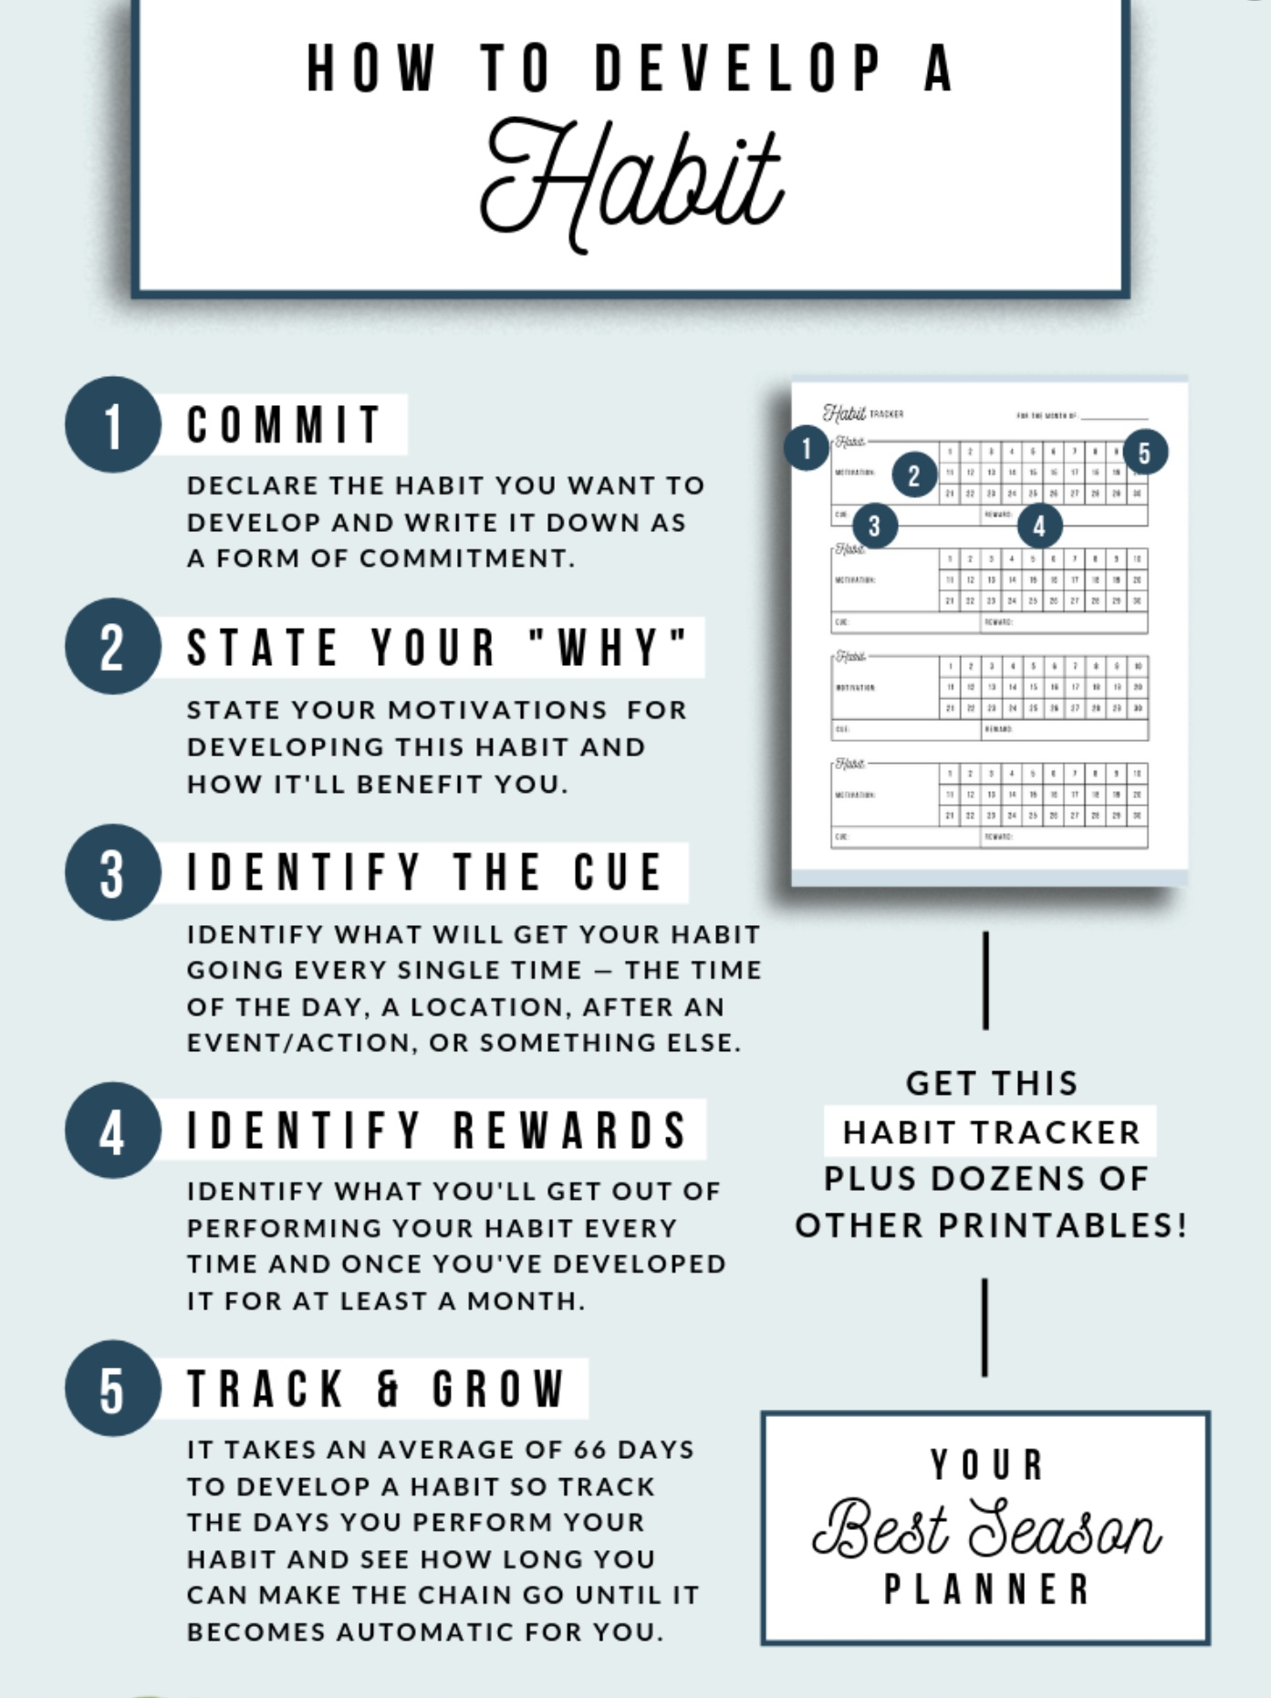

5. Making diary cards a habit
Notes:
Using diary cards regularly can be a challenge as might be developing any healthy habit. There are proven ways that help develop habits. The book tiny habits by BJ Fogg tackles this subject.

Slide 76
HOMEWORK HABITS CHECKLIST
Circle or check what you will try this week.
1. Preparation habits
■ I schedule a specific time for homework.
■ I choose a consistent location with minimal distractions.
■ I gather what I need ahead of time (notebook, worksheet, pen).
2. Focus & pacing habits
■ I start with a tiny step (2–5 minutes).
■ I use a timer (10–15 minutes).
■ I remove distractions (phone away / Do Not Disturb).

Slide 77
HOMEWORK HABITS CHECKLIST
3. Tracking & organization habits
■ I keep materials in one place (binder / folder / notebook).
■ I write down insights right after doing the homework.
4. Self-compassion habits
■ I aim for progress, not perfection.
■ I notice resistance without judgment.
5. Accountability habits
■ I review my week: What worked? What didn’t?
■ I share honestly with my buddy — even when I didn’t do it.
Micro commitment:
This week I will focus on: ■ Time ■ Place ■ Tiny step ■ Timer ■ Other please specify:

Slide 78
ANN’S INTERMEDIARY TARGETS
We met Ann in week 2 as she worked on a crisis plan. She was the nurse working at a family run nursing home that had been sold to new owners. Ann was trying to adjust to a stressful and challenging situation without becoming overwhelmed by her lifelong symptoms of anxiety and depression. Ann was particularly anxious about her weekly meetings with her supervisor Jane. She had prepared, and in her imagination practiced, a crisis plan to help her with these feelings and thoughts. Ann found this helpful. She liked using the “personal dashboard” because it helped her to pay attention to her feelings before they became overwhelming. She was also becoming more aware of the importance her energy balance and the importance of staying in the window of emotional tolerance. When she noticed that she was becoming activated, she reviewed the coping thoughts that she had chosen to use. She also though of her values; being of service to the residents.
Ann now wanted to find intermediate targets for her diary card. She recalled that they are the same as the holes used in the crisis plan: feelings, thoughts, or behaviors occurring when she was struggling to cope.
Using the wheel of feelings, Ann recognized that when she was emotionally activated, she often felt fear and sadness. Other emotions from the wheel that she related to were scared, anxious, worried, vulnerable, and fragile.
Ann realized her negative thoughts tended to fall into the categories of all or nothing, emotional reasoning, and catastrophizing.
Her behaviors were all internalizing; withdrawal, fixating on certain thoughts, and avoiding social situations.
Looking at this list, Ann thought she would use “ruminating on negative thoughts” and “withdrawing” as her intermediate targets. Being artistic, Ann decided she would use a pallet of colors, ranging from canary yellow to crimson red, to rate her targets.

Slide 79
ANN’S INTERMEDIARY TARGETS
M T W T F S S
ruminating
withdrawal.

Slide 80
Addendum: When Others Cross Our Boundaries
A special target for our Holes / Targets for Change diary cards
The course keeps evolving. This small piece links diary cards with the assertiveness skills we cover later. We introduce it now and will come back to it in the Interpersonal Effectiveness module.
Notes:
The SIMPLE Course is always evolving. Every so often we realize something is missing that deserves to be included. The challenge is to make the course more helpful without making it overwhelming. This piece involves both our holes / targets for change diary cards and the assertiveness (interpersonal) skills we cover later in the course. We decided to present it here and come back to it in the assertiveness module.

Slide 81
Sometimes we don't even name it
In recent one-on-one conversations about boundaries, three people described a partner who was:
1
2
3
Manipulative
Gaslighting
Disrespectful
Steering or pressuring us in indirect ways
Making us doubt our own memory or perception
Speaking to us with a demeaning tone
For a long time, none of them realized the partner was doing something wrong. They were upset by it — but they didn't call it.
Notes:
Recently we were talking with people we meet one-on-one about boundaries. With one person it was about how her partner is manipulative; with another, how the partner gaslights her; with a third, how the partner talks to her disrespectfully. What is interesting is that for a long time these people didn't even realize their partners were doing something wrong. Being on the receiving end, they were upset by the partner's behaviour, but they did not call it.

Slide 82
A personal example: sarcasm
1
2
3
4
Learned at home
Habit shows up
She called it
He saw it
Dr. Cleto grew up in a family that communicated with biting sarcasm
On best behaviour at first, then the old pattern crept in with his wife
From the very beginning, she consistently named the sarcasm
“What's wrong with her?” became “The problem is my style”
Why it mattered: had she not consistently called it out, the pattern he learned in his family could have become the way he spoke to his wife — damaging the relationship.
Notes:
Dr. Cleto was also thinking about his relationship with his wife. He grew up in a family that used biting sarcasm to communicate with each other. When he first met his wife he was, of course, on his best behaviour, but slowly the communication habit he had learned started to show up with her. What is remarkable is that from the very beginning his wife, who has good boundaries, consistently called him on his sarcasm. At first he wondered what was wrong with her, before realizing that the problem was his communication style. If she had not consistently called him out, the communication pattern he learned in his family might have become the one he used with his wife, and that would have been damaging for the relationship.

Slide 83
Holding it in vs. speaking up consistently
Holding it in until it bursts
Consistently assertive
Can lead to passive aggressive style of communicating:
Years of putting up with disrespect
Pent-up feelings: the dam breaks
Dramatic blow-up, relationship rupture
Partner changes, at least for now
Old habits may return, and the blow-up too
Name the behaviour each time it happens
Feelings don't pile up, so responses stay calm
The message is steady, not dramatic
Change is more likely to last
Standing up for herself was long overdue. The problem was waiting so long — not speaking up.
Notes:
One of the people we spoke with said she had put up with her partner's disrespectful behaviour and tone for many years before she exploded. She called him out in a dramatic way that led to a relationship rupture. This was long overdue: she was finally standing up for herself. The problem, as we will see in the interpersonal effectiveness module, was that she had pent-up feelings for so long that when she finally called him on it, it was as if the dam broke. He certainly heard her this time, and his behaviour changed, at least temporarily. If they reconcile, they may eventually go back to old habits, and she may have to express herself dramatically again. The alternative is for her to be more consistently assertive.

Slide 84
Adding it to your HOLES diary card
HOLES / TARGETS FOR CHANGE
1
Make it a special target
Trouble with boundaries
Pay consistent attention to it, and expand it with sub-items
Gaslighting
List others' behaviours
2
Disrespect
The things others do that upset us: gaslighting, disrespect, tone, sarcasm, etc.
Tone
3
Respond assertively
Sarcasm
Seeing them on the card reminds us to speak up each time, not years later
Other: ________
Notes:
This brings us back to diary cards. Our cards mostly list holes or targets for change in our own thoughts, feelings and behaviours. Some people already include 'trouble with boundaries' as a target. What we are suggesting is that this is a special target we should consistently pay attention to and expand. Under it we can list other people's behaviours that upset us: gaslighting, disrespect, tone, sarcasm, and so on. Our goal in listing these behaviours is to respond assertively to them, and including them on our diary cards reminds us to do that. So we propose adding a sub-item to our holes / targets for change diary cards that specifically addresses when others consistently violate our boundaries. The goal is to be more consistently assertive in dealing with these boundary violations.

Slide 85
ADDENDUM · WHEN OTHERS CROSS OUR BOUNDARIES
Boundary crossings checklist
Tick the ones that happen to you often, that are hard for you to handle, and that you want to respond to differently. Then choose 1–3 for your diary card.
Words & tone
Pressure & control
Space, privacy & body
Disrespect or put-downs
Gaslighting (“that never happened”)
Unwanted touch or standing too close
Sarcasm or mocking “jokes”
Ignoring my “no” or pushing me
Going through my phone or things
A harsh, cold or condescending tone
Silent treatment or stonewalling
Sharing my private information
Yelling, swearing or name-calling
Threats or intimidation
Gossiping or talking behind my back
Interrupting or talking over me
Controlling my money, time or friends
Showing up or calling uninvited
Criticizing or judging me
Lying or breaking agreements
Expecting me to always be available
Dismissing or minimizing my feelings
Unwanted advice or trying to “fix” me
Taking or borrowing without asking
Guilt-tripping or shaming me
Expecting me to solve their problems
Taking my help for granted
Blaming me for their feelings
Turning others against me
Pushing, grabbing or any physical harm
Other: ____________________
Other: ____________________
Other: ____________________
On your diary card, note when it happened, how you felt, and what you did. We will practise how to respond in the Interpersonal Effectiveness module.
Notes:
How to use this checklist:
- These are common ways other people can cross our boundaries. Participants tick the ones that happen often, are hard to handle, and that they want to respond to differently, then choose 1–3 for the diary card.
- On the diary card, track the situation (who, when), the feeling it brought up, and what they did (gave in, exploded, withdrew, or held the boundary).
- Brief definitions:
• Gaslighting: someone denies or twists what you saw, heard or felt until you doubt your own memory or judgment.
• Stonewalling / silent treatment: shutting down, refusing to talk, or withholding warmth as a way to punish or control.
• Guilt-tripping: using guilt to get you to do what they want.
• Turning others against me: bringing a third person in to take sides, or speaking badly about you to others.
• Sarcasm and tone: the words may sound fine, but the delivery carries contempt or a put-down.
- We are only naming these now. Assertiveness skills for responding to them come later, in the Interpersonal Effectiveness module.
- Safety: threats, intimidation, or any physical harm are more than a diary card target. If this is happening, bring it to a co-leader privately and add it to your crisis plan.

Slide 86
M T W T F S S
struggling.
4 3 6 2 3 10 9
sad.
5 4 7 1 2 8 7
withdrawing
9 8 6 6 5 10 10
Trouble with boundaries:
Gaslighting
Disrespect
Tone
sarcasm

Slide 87
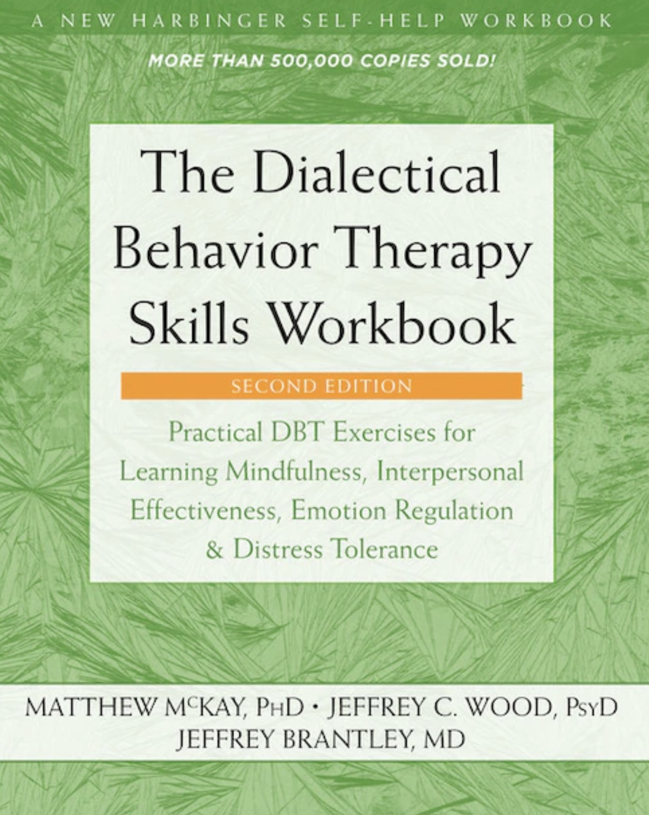


What we will do today
Skills training workbook p. 33-46 “advanced distress tolerance skills” which include;
1. safe place visualization,
2 .cue-controlled relaxation,
3. rediscover your values,
4. values-based behavior,
5. higher power.
JOAN
NICOLE

Slide 88

Distress tolerance part 3
Advanced distress tolerance
Skills training workbook Pages 33-46

Slide 89
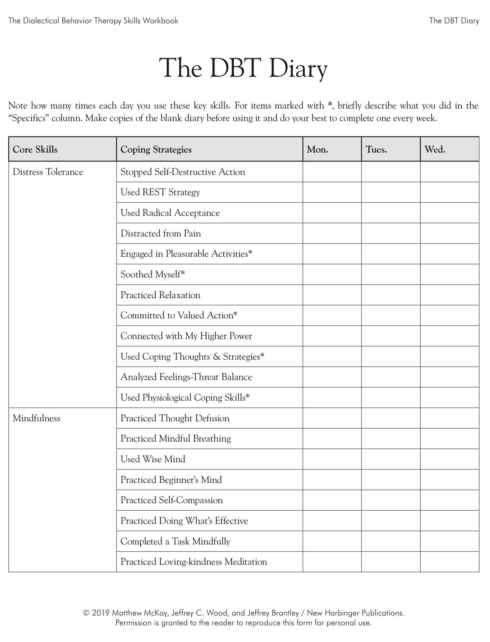
Today
X
Today
X
Today
X

Slide 90
PERSONAL SKILLS LIST UP TO THE PRESENT
Grounding skills- Set a daily intention
“ - Sensory soothing toolkit
“ -The 5,4,3,2,1 method
“ -The emotional freedom technique
REST (or PEST) Pause
Radical acceptance statements (please specify)
Distraction plan “
Self-soothing plan “

Slide 91

skills we will cover today
1. Safe-place Visualization
2. Cue-Controlled Relaxation
3. Rediscovering your values
4. Rehearsing value-based behavior
5. Connecting with your higher power

Slide 92
Subjects and skills we will cover today
1. Safe-place Visualization

Slide 93


1. Safe-Place visualization
Visualizing a safe place reduces distress and helps us return to the window of tolerance
When we imagine a safe, relaxing place, our body responds by relaxing.
The body can’t tell the difference between being in a real safe, relaxing place and imagining we are in one.
Do your safe-place visualization in a quiet place where there are no distractions
Follow the instructions on page 33 of the skills training manual. Record the text on your phone and listen to it. You can also find guided safe place visualizations on YouTube.
Try the safe-place visualization recorded on this slide.

Slide 94
Subjects and skills we will cover today
2. Cue-Controlled Relaxation

Slide 95

2. Cue-controlled relaxation
We did a cue controlled relaxation for our mindfulness exercise today.
A ”cue” is a word or phrase that through practice and repletion we learn to associate with a physical state of relaxation. We used the word relax but you can choose a different word.
Cue controlled relaxation involves repeating a word or phrase while at the same time deliberately relaxing our muscles
Try it by following the instructions on page 35 of the workbook. Record them on your phone and listen to them.
This technique takes time and repeated practice to master but can be very effective
Eventually just thinking or saying the cue word will automatically trigger relaxation
To get good at cue-controlled relaxation we need to practice it twice a day for at least 2 weeks
Use the practice recorded here.

Slide 96
Subjects and skills we will cover today
3. Rediscovering your values

Slide 97
3. Rediscovering your values
To rediscover your values, do the “Valued Living Questionnaire” on page 38 of the workbook
Start by rating the importance that each of the listed values holds for you
Then decide how much time and effort you want to invest in fostering these values
Are there discrepancies between your values and what you spend most of your time doing? If there are, how might you adjust your time/energy to better align with your values?
Use the “Committed Action Worksheet” on page 40 to create intentions and a plan to realign your life with your values
”Values” are ethics, principles, ideals, standards, or morals
Thinking of our values can help us tolerate distress
Sometimes we forget why we are doing something difficult and lose sight of our goals

Slide 98
VALUED LIVING QUESTIONNAIRE (Wilson, 2002)
Life Component: Less Important-> Moderately Important-> Extremely Important
Family (other than romantic relationships or parenting) 0 1 2 3 4 5 6 7 8 9 10
Romantic relationships (marriage, life partners, dating, and so on) 0 1 2 3 4 5 6 7 8 9 10
Parenting 0 1 2 3 4 5 6 7 8 9 10
Friends and social life 0 1 2 3 4 5 6 7 8 9 10
Work 0 1 2 3 4 5 6 7 8 9 10
Education and training 0 1 2 3 4 5 6 7 8 9 10
Recreation, interests, hobbies, music, and art 0 1 2 3 4 5 6 7 8 9 10
Spirituality and religion 0 1 2 3 4 5 6 7 8 9 10
Citizenship and community life 0 1 2 3 4 5 6 7 8 9 10
Self-care (exercise, diet, relaxation, and so on) 0 1 2 3 4 5 6 7 8 9 10

Slide 99
Committed Action Worksheet
(Adapted from Olerud & Wilson, 2002)
A component of my life that I value is…
My intention for this component is
The committed actions that I’m willing to take include the following (be sure to note when you’ll begin these actions):
2. A component of my life that I value is
My intention for this component is
The committed actions that I’m willing to take include the following (be sure to note when you’ll begin these actions):
3. A component of my life that I value is
My intention for this component is
The committed actions that I’m willing to take include the following (be sure to note when you’ll begin these actions):

Slide 100
Subjects and skills we will cover today
4. Rehearsing value-based behavior

Slide 101
4. Rehearsing values-based behavior
cognitive rehearsal involves:
1. Identifying the situation in which what we did, and our values don’t align
2. Identifying what we might have done had we acted in accordance with our values
4. Imagining ourselves in the situation and noting any barriers and challenges to doing what is in accordance with our values
5. Visualizing ourselves doing our values-based behavior
6. Imagining people responding well
7. Repeating the visualization
When trying to align our lives with our values we will face many challenges
We may for example have negative thoughts such as “I can’t do this”
Identifying potential challenges and imagining how to overcome challenges can be helpful
This is called “cognitive rehearsal”
The editing, splicing and pasting technique is a type of cognitive rehearsal that we’ll use all the time.

Slide 102
Subjects and skills we will cover today
5. Connecting with your higher power

Slide 103

5. CONNECTING WITH YOUR Higher power
Connecting with a higher power, whatever you understand this to be, can help you feel grounded, empowered, calm, and safe
It can connect you to something bigger than yourself or the “big picture”
Faith in a higher power gives many people a sense of meaning that helps them cope with distress
A higher power need not be traditionally religious concept like God.
A higher power can include Nature, The universe, or The goodness of others
We will return to a discussion of spirituality towards the end of the course

Slide 104

To help you Connect to your higher power
You might try to ask yourself the following questions:
What are some of my beliefs about a higher power that give me strength/comfort?
Why are these beliefs important to me?
How do these beliefs make me feel?
How do these beliefs make me feel about others?
How do these beliefs make me feel about life in general?
How do I honor these beliefs in my daily life?
What else would I be willing to do in order to strengthen my beliefs?
What can I do to remind myself of my beliefs on a regular basis?
How can I remind myself of my beliefs when I feel distressed?

Slide 105
UPDATED PERSONAL SKILLS LIST
Grounding skills- Set a daily intention
“ - Sensory soothing toolkit
“ -The 5,4,3,2,1 method
“ -The emotional freedom technique
REST (or PEST) Pause
Radical acceptance statements (please specify)
Distraction plan “
Self-soothing plan
Safe place visualization
Cue controlled relaxation
Rediscovering your values (please specify)
Rehearse values-based behavior or edit/splice/paste
Connect with your higher power “

Slide 106
Crisis plans: practice makes them work
KEY TAKEAWAYS · 1 OF 3
The 8-step crisis plan algorithm
What Chris’s plan showed us
1
Understand the hole you keep falling into
Prepare when you’re calm. You don’t need to be in a crisis to build a plan — you can get ready for the next one.
Know your triggers and warning signs. Noticing the pull to isolate and ruminate is the cue to act.
Layer your skills. Calm the body first, then ground, then connect — repeating steps as needed, with professional help as a last resort.
Make it a habit. A few minutes of daily visualization pays back enormously — like brushing your teeth.
2
Identify the thoughts, feelings, behaviors to work on
3
Complete the rest of the crisis plan template
4
Recall a real past crisis and edit, splice, and paste
5
Stay in the window of tolerance by pendulating
6
Visualize the new version until it’s effortless
7
Use the same steps when a new crisis comes
8
Practice, practice, practice
Notes:
Let’s pull together what we learned from Chris’s crisis plan. On the left are the 8 steps of the crisis plan algorithm, our first SIMPLE algorithm. On the right are the lessons from Chris’s plan: we can prepare for a crisis before it happens; we need to know our triggers and warning signs, like the urge to isolate and ruminate; skills work best layered, for example a physiological skill like cold water, then grounding with 5-4-3-2-1, then connecting with a higher power, with PRN medication or calling the psychiatrist as a last resort; and the more we practise, the fewer crises we have.

Slide 107


Holes diary cards: from holes to stairs
KEY TAKEAWAYS · 2 OF 3
1
1 = top step, least intense
A hole has degrees
2
Crisis plans are all or nothing. Diary cards rate the intensity of our targets for change from 1 to 10 (or with colors), so we notice the slide down the stairs early.
3
4
5
Start with 1–3 targets
6
Use the wheel of feelings, ANTS, and internalizing/externalizing behaviors. Can’t find one? A beginner target like “struggling” or “feeling bad” is fine.
7
8
9
The foundation for every tool
10
Diary cards keep us mindful of what we want to change. 1–2 minutes a day; tracking the topography over time shows our patterns.
10 = bottom step, most intense
Notes:
Key takeaways on the second SIMPLE tool. A crisis plan hole is all or nothing; a holes diary card treats it as a staircase with 10 steps, 1 at the top near the sidewalk and 10 at the bottom, the most intense. Diary card targets are the same kinds of things as crisis plan holes: feelings, thoughts, behaviors, or maladaptive coping strategies that recur and that we want to change. Choose one to three. If an intermediate target is hard to find, start with a beginner target. Keeping the card takes one to two minutes a day, and it is the foundation for all the tools still to come. Tracking it over time shows us our topography — how we move up and down the stairs.

Slide 108

Five new skills for YOUR personal skills list
KEY TAKEAWAYS · 3 OF 3
1
Safe-place visualization
The body can’t tell an imagined safe place from a real one, so it relaxes.
p. 33
This week
Fill in your holes diary card every day
Practise cue-controlled relaxation twice a day
Try the safe-place visualization
Complete the Valued Living Questionnaire
Add today’s skills to your personal skills list
Bring your targets and questions to BOING on Monday
2
Cue-controlled relaxation
Pair a cue word with relaxed muscles. Practise twice a day for at least 2 weeks.
p. 35
3
Rediscovering your values
Valued Living Questionnaire and Committed Action Worksheet: does your time match what matters?
pp. 38–40
4
Rehearsing values-based behavior
Cognitive rehearsal: imagine the barriers, then see yourself acting on your values.
5
Connecting with your higher power
Whatever you understand it to be — God, nature, the universe, the goodness of others.
Notes:
Finally, the five advanced distress tolerance skills from pages 33 to 46 of the workbook. Each one is a way back into the window of tolerance. Safe-place visualization works because the body responds to an imagined safe place as if it were real. Cue-controlled relaxation takes practice — twice a day for at least two weeks — but eventually just thinking the cue word triggers relaxation. Rediscovering values uses the Valued Living Questionnaire and the Committed Action Worksheet. Rehearsing values-based behavior is a type of cognitive rehearsal, like editing, splicing, and pasting. And connecting with a higher power can be whatever that means to you; we’ll return to spirituality later in the course. For this week: keep your holes diary card every day, practise the new skills, update your personal skills list, and bring your targets and questions to BOING on Monday.

Slide 109
2025-26 SLIDES

Slide 110

E-mailed questions, comments, feedback
Housekeeping
Could you be clearer about fawning?

Slide 111
Fawning” is not one of the classic physiological threat responses (fight, flight, freeze, faint), but it’s closely related and often considered a socially mediated survival strategy that arises in the same neurobiological context. Fawning refers to a trauma or stress response characterized by appeasing, placating, or people-pleasing behavior as a way to maintain safety, avoid conflict, or prevent rejection. It’s a learned adaptive response, especially in relationships where asserting oneself led to punishment or withdrawal of love.
While “fawn” isn’t a distinct autonomic state, it emerges from the same system that regulates fight, flight, and freeze. Fawning is a socially-oriented stress response, your body is activated (like in fight/flight), but the energy is redirected toward connection-seeking behaviors rather than confrontation or withdrawal.
Fawning and bullying are often linked, though they occupy opposite ends of the social stress spectrum. Understanding that link helps illuminate how both behaviors arise from the same underlying drive: to manage threat and preserve belonging.
Both fawning and bullying are responses to perceived threat or insecurity within a social hierarchy. Fawning is a submission strategy: The person has learned (often early in life) that safety or love depends on compliance, pleasing, or self-erasure. When faced with power, conflict, or rejection, they appease to stay safe or accepted. Bullying is a dominance strategy: The person has learned (often also early) that controlling or intimidating others restores a sense of safety or power when they themselves feel threatened, humiliated, or powerless.
Both are adaptive strategies to regulate fear and maintain control, just through opposite routes: Fawn: “If I keep you
happy, I’ll be safe.” Bully: “If I make you afraid, I’ll be safe.”

Slide 112
In many relationships or systems (schools, families, workplaces): Fawning individuals often become targets of bullying because their boundaries are weak and their compliance reduces social resistance. Bullies sometimes seek fawning
individuals to reaffirm their control and avoid mutual vulnerability. Both roles can alternate, a person may fawn toward
those above them (e.g., a boss or parent) and bully those below (e.g., a sibling or coworker) as the same pattern
cascades down the hierarchy.
Both responses tend to emerge from relational trauma or chronic insecurity: A child who had to appease a volatile
caregiver develops fawning as a nervous-system shortcut to safety. A child who felt powerless or humiliated may
develop bullying as a preemptive defense against being hurt again. Both represent adaptations to unsafe attachment
systems, one through submission, the other through domination.
Recovery from either end of this spectrum involves 1) recognizing the underlying fear (of rejection, loss, or
powerlessness) 2) reconnecting to the body to notice arousal before automatic behaviors take over building boundaries and assertive communication and 3) cultivating mutuality through relationships based on equality rather than submission or control.

Slide 113

video
Session 7 of simple

Slide 114


Slide 115
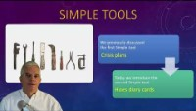

Slide 116
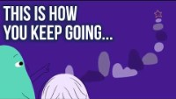

Slide 117
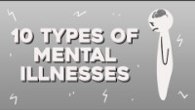

Slide 118
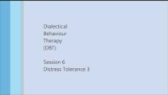

Slide 119
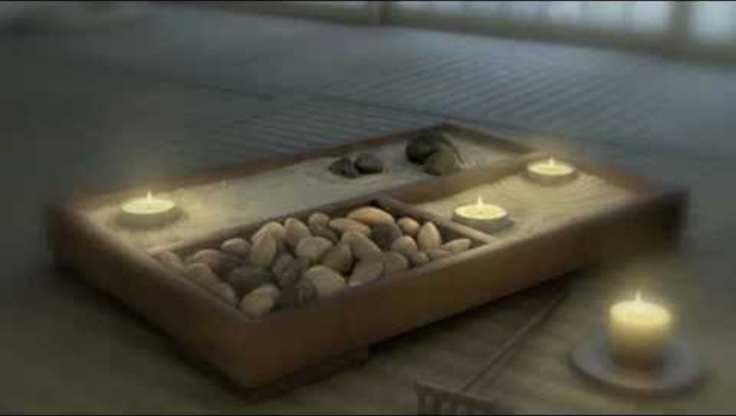

Slide 120


Slide 121


Slide 122


Slide 123

See you next session

